Slide 2
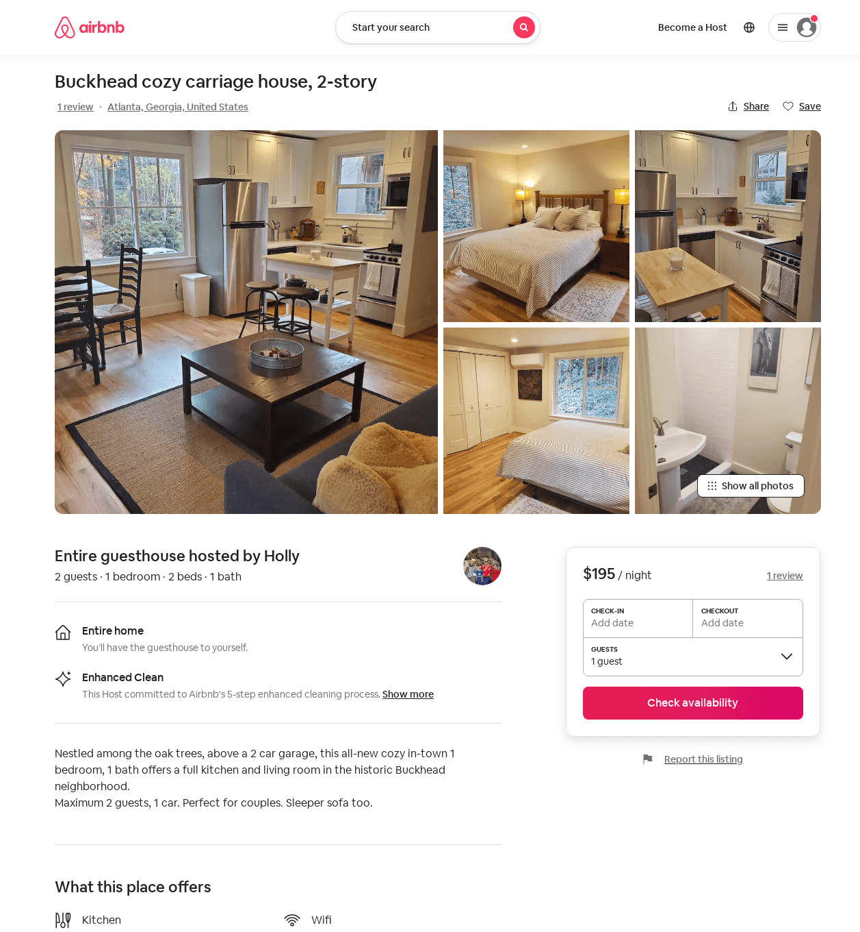
Listing 53671773
1
2
$170 - $195
5.0
2
Holly
183892062
1
https://www.airbnb.com/rooms/53671773
Aug 2022

Slide 3
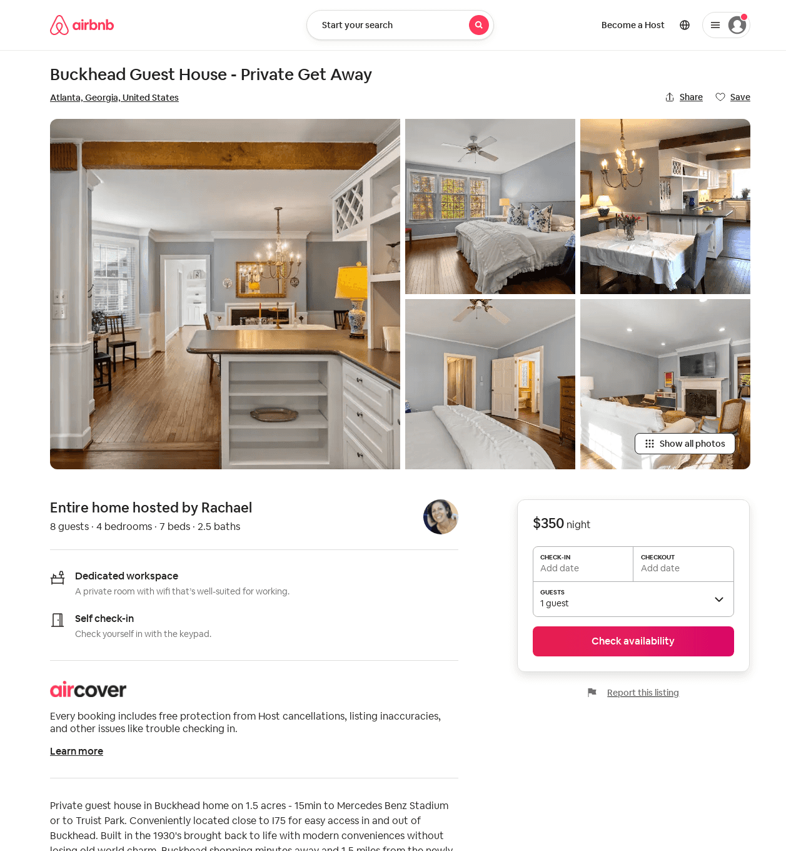
Listing 30412989
4
8
4.67
3
Rachael
8119185
1
https://www.airbnb.com/rooms/30412989
Aug 2022

