Slide 2
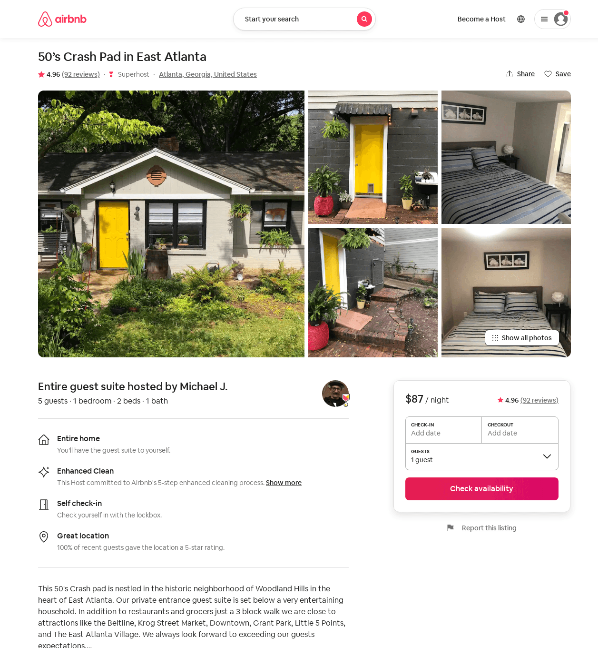
Listing 34562371
1
4
$64 - $87
4.94
1
Michael J.
27217115
1
https://www.airbnb.com/rooms/34562371
Aug 2022

Slide 3
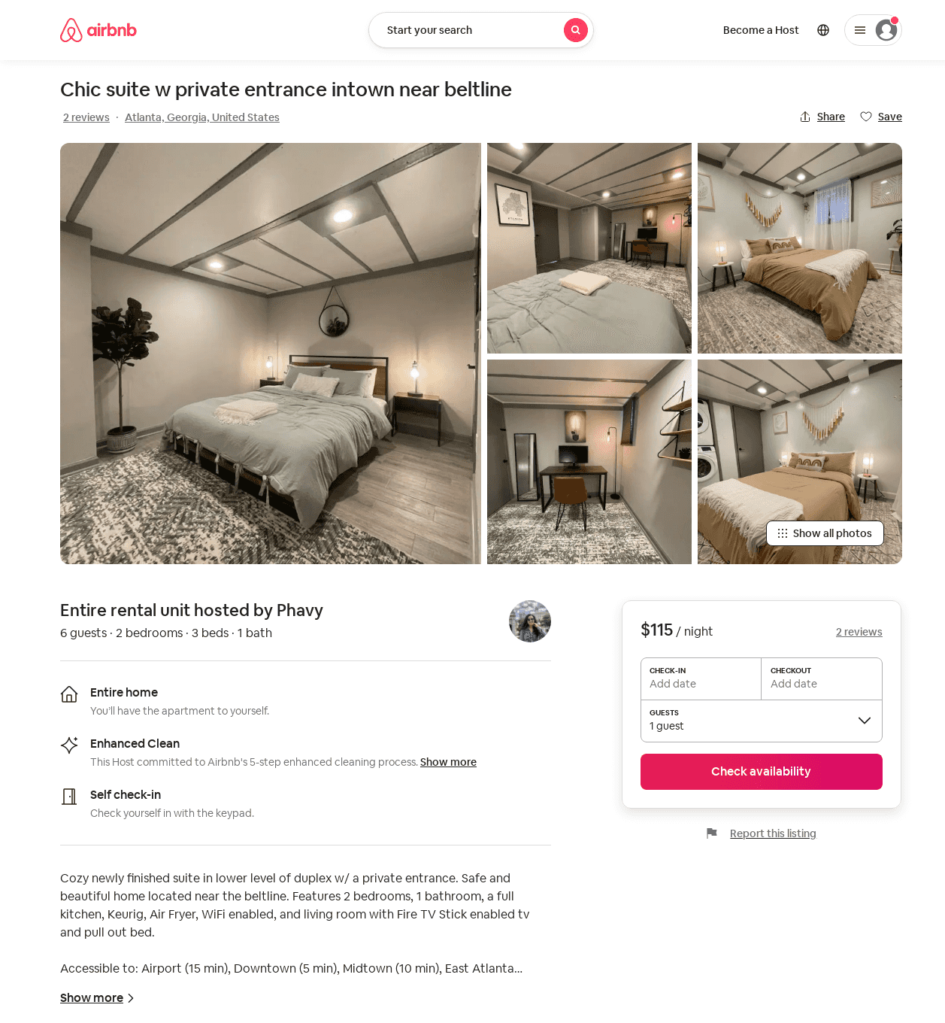
Listing 51799648
2
6
$95 - $125
4.76
1
Phavy
41642815
1
https://www.airbnb.com/rooms/51799648
Aug 2022

