Slide 2
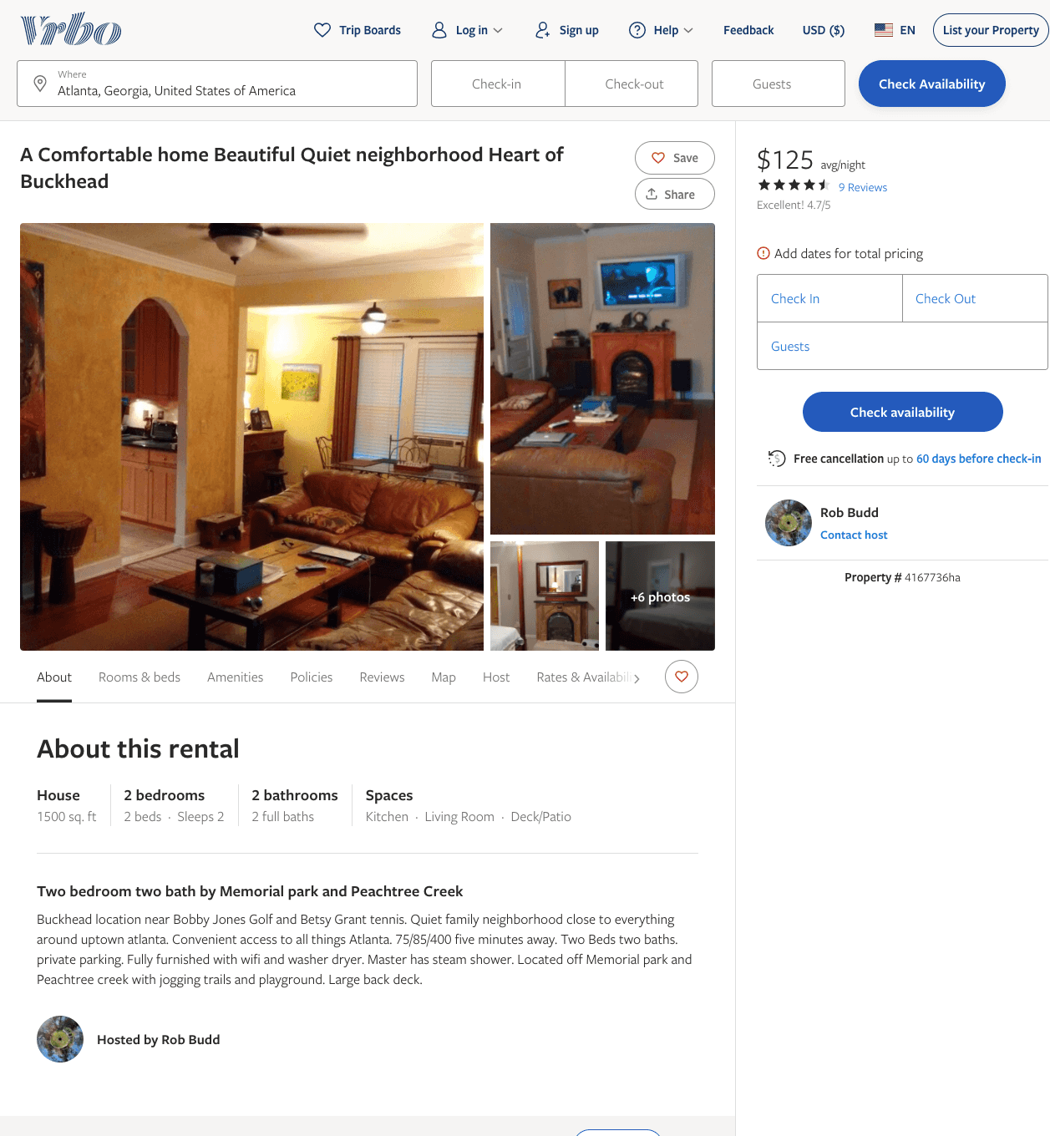
Listing 4167736
2
2
$125 - $145
4.7
5
Rob Budd
https://www.vrbo.com/4167736ha
Aug 2022

