Slide 2
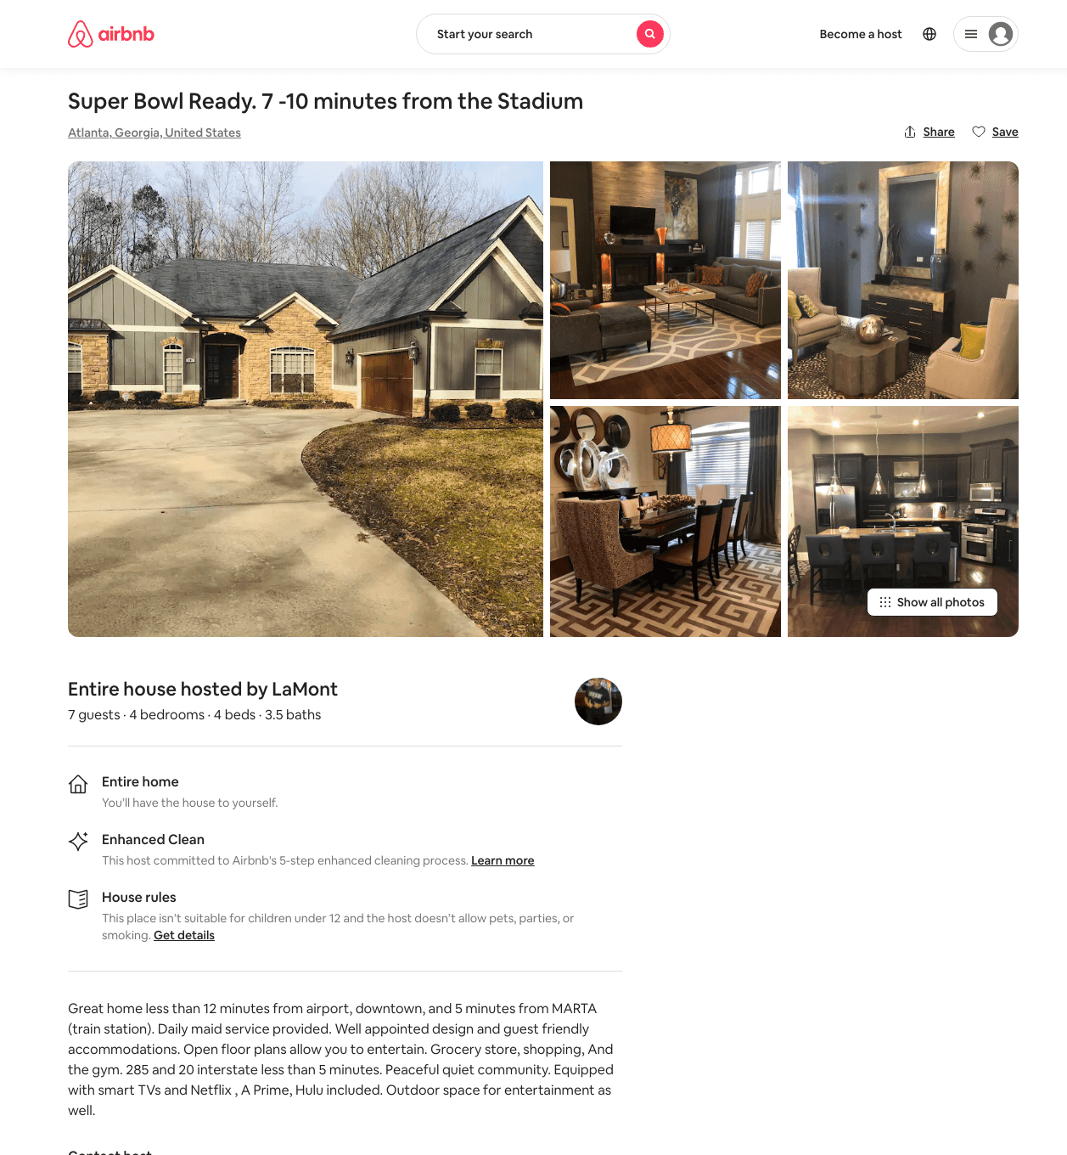
Listing 31460765
4
7
$464
4
LaMont
19986082
1
https://www.airbnb.com/rooms/31460765
Aug 2022

Slide 3
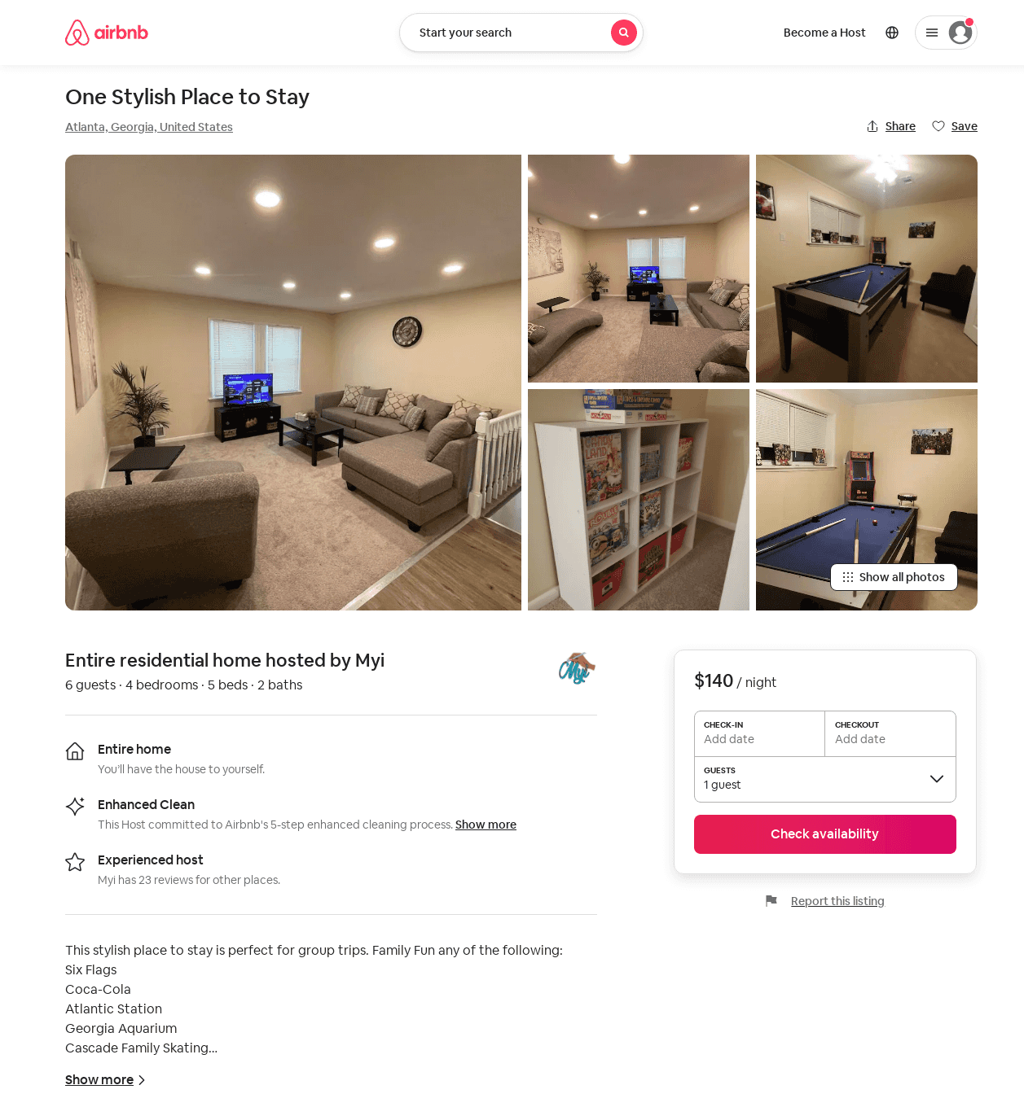
Listing 53097741
4
6
$140 - $271
4.71
2
Myi
119953602
2
https://www.airbnb.com/rooms/53097741
Jun 2022

