Slide 2
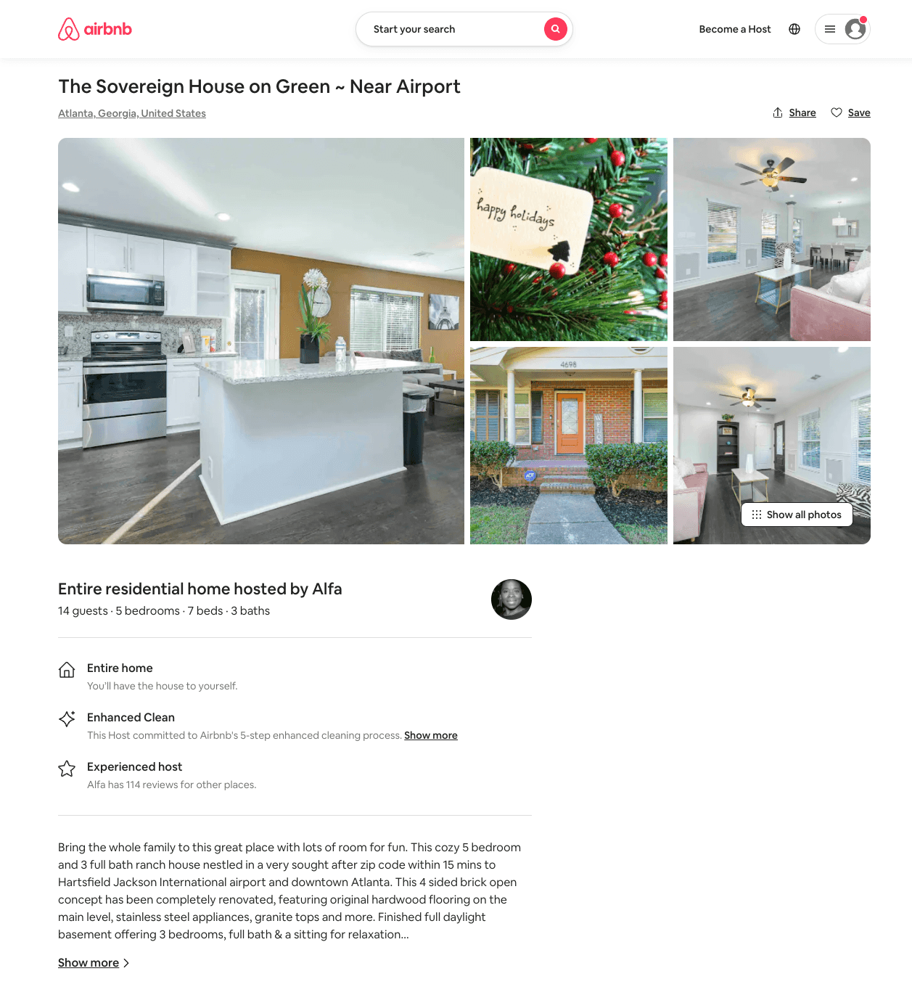
Listing 53926550
5
14
$238 - $394
4.73
3
Alfa
382470716
1
https://www.airbnb.com/rooms/53926550
Aug 2022

Slide 3
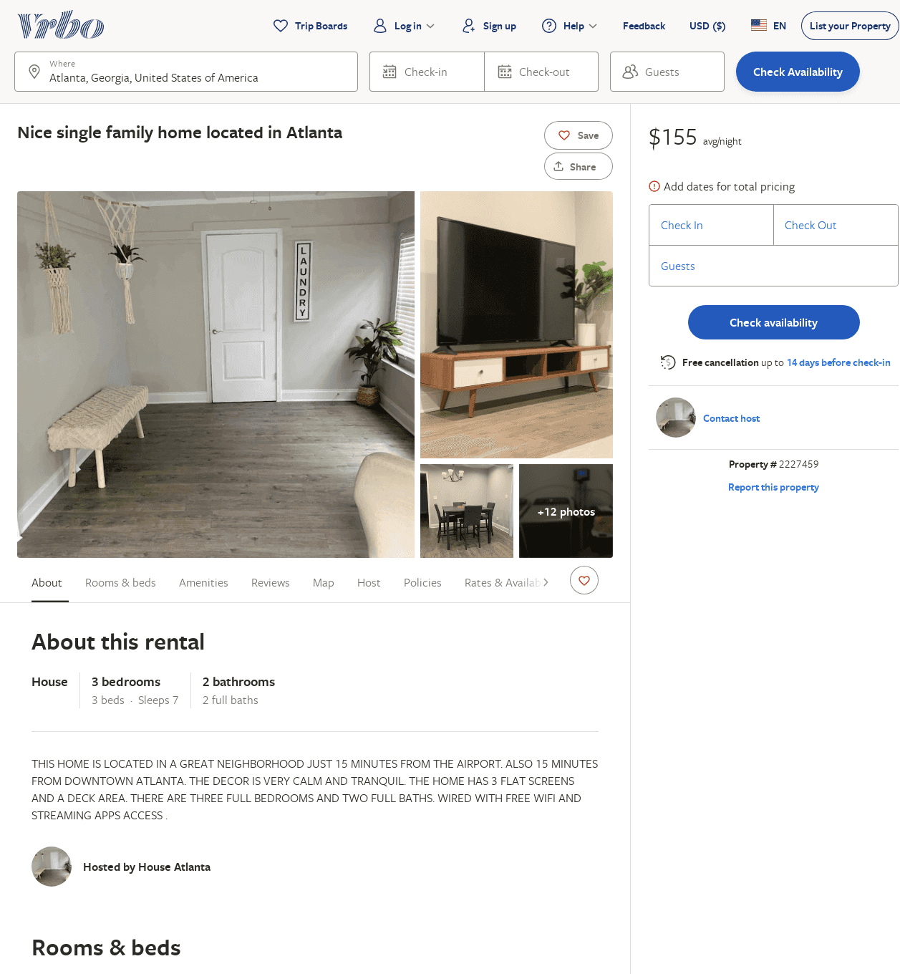
Listing 2227459
3
7
$155
2
https://www.vrbo.com/2227459
Aug 2022

