Slide 2
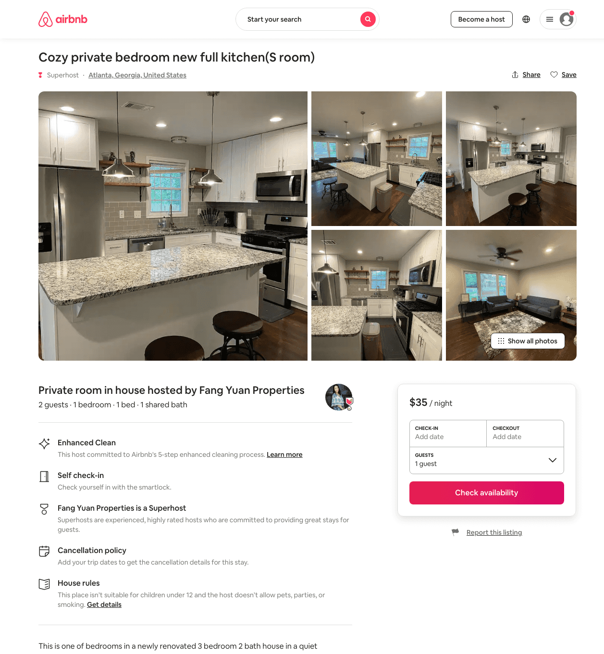
Listing 49115148
1
2
$35 - $62
4.68
1
Fang Yuan Properties
126122495
21
https://www.airbnb.com/rooms/49115148
Jul 2022

Slide 3
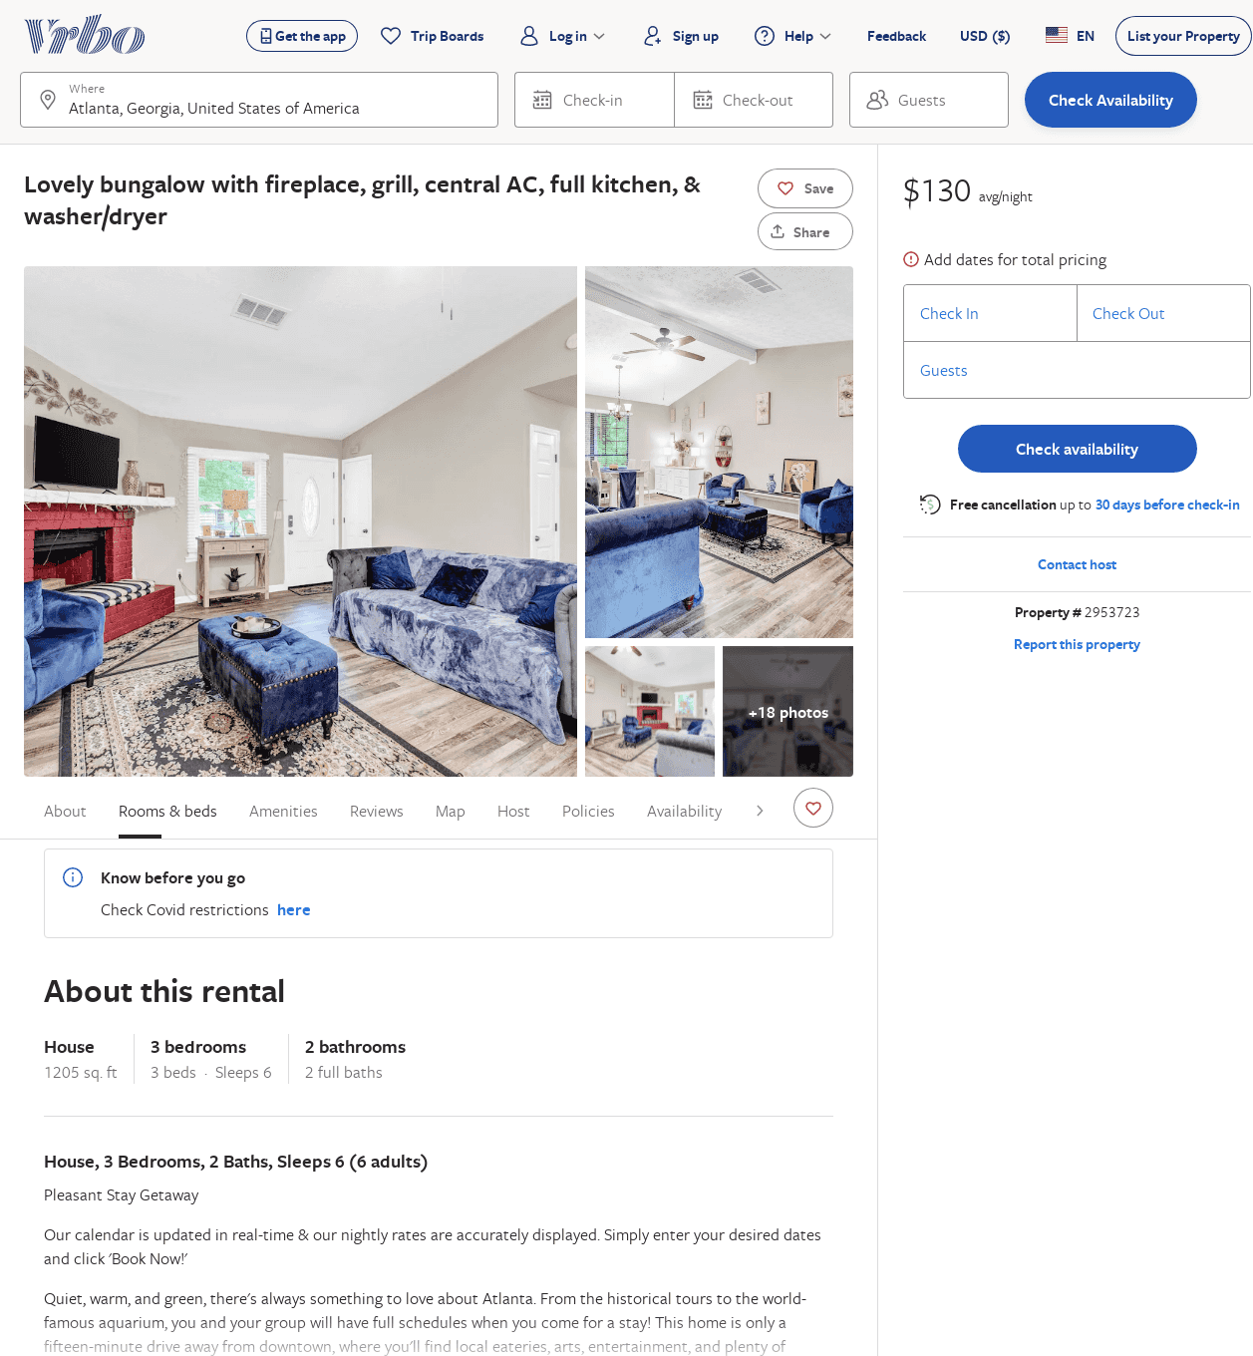
Listing 2953723
3
6
$109
3
Vacasa of Georgia
https://www.vrbo.com/2953723
Aug 2022

