Slide 2
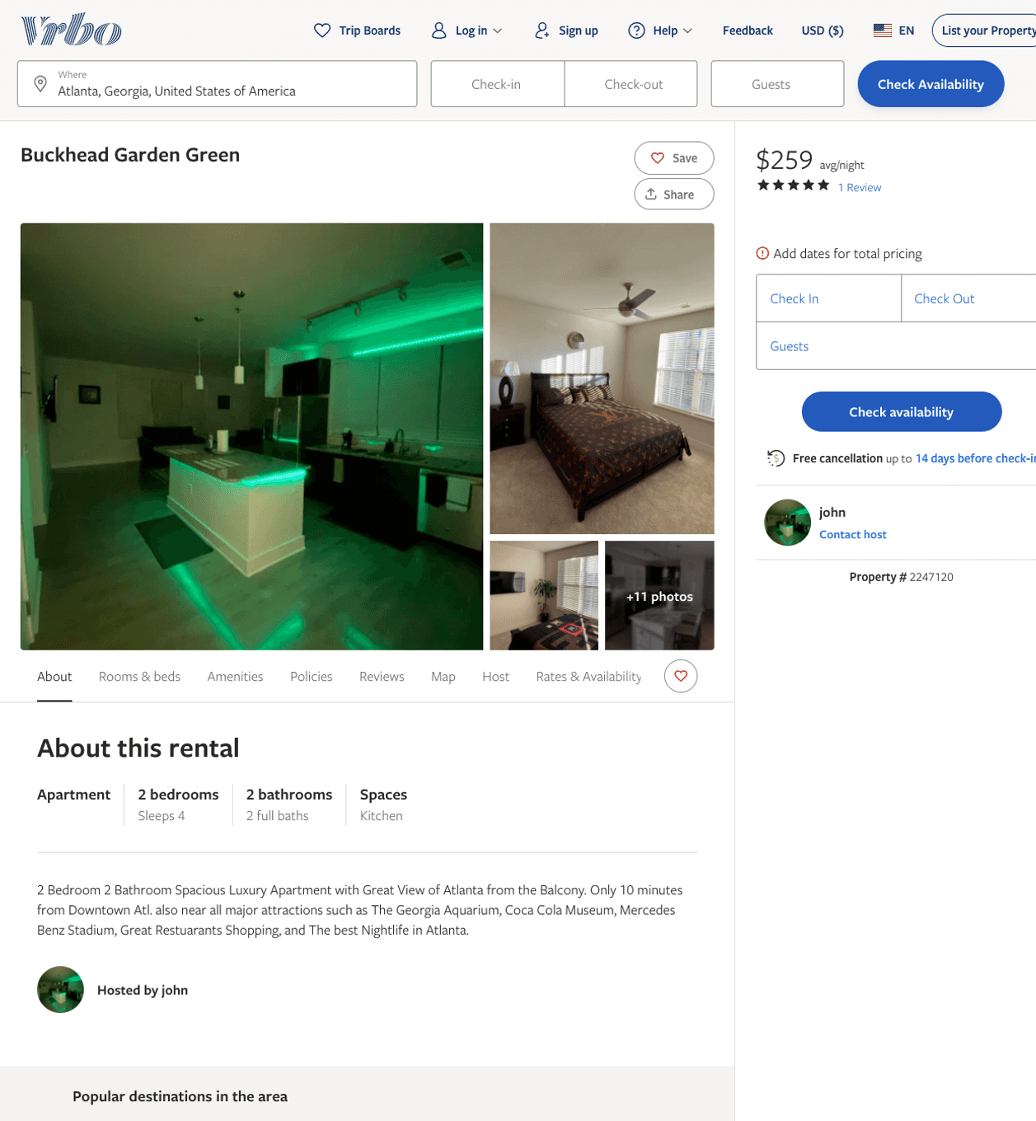
Listing 2247120
2
4
$239 - $259
5
2
john
https://www.vrbo.com/2247120
Aug 2022

Slide 3
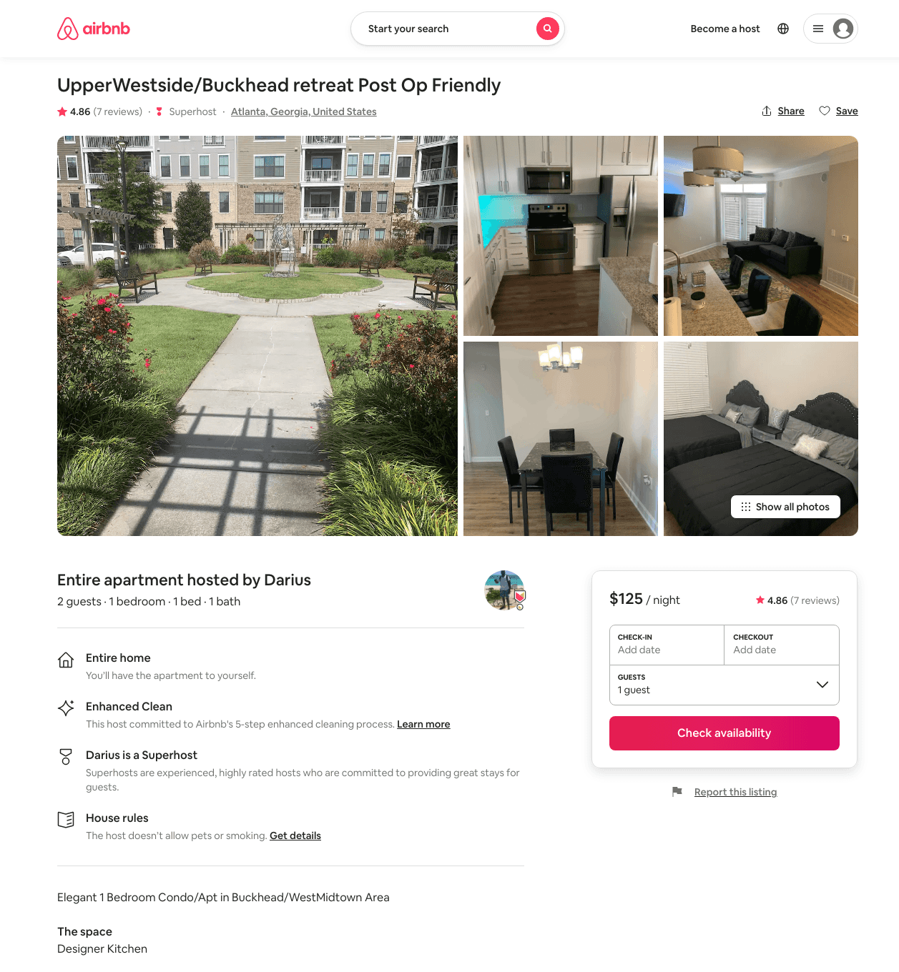
Listing 45770893
1
4
$100 - $153
4.81
1
Malcolm
267342926
1
https://www.airbnb.com/rooms/45770893
Aug 2022

Slide 4
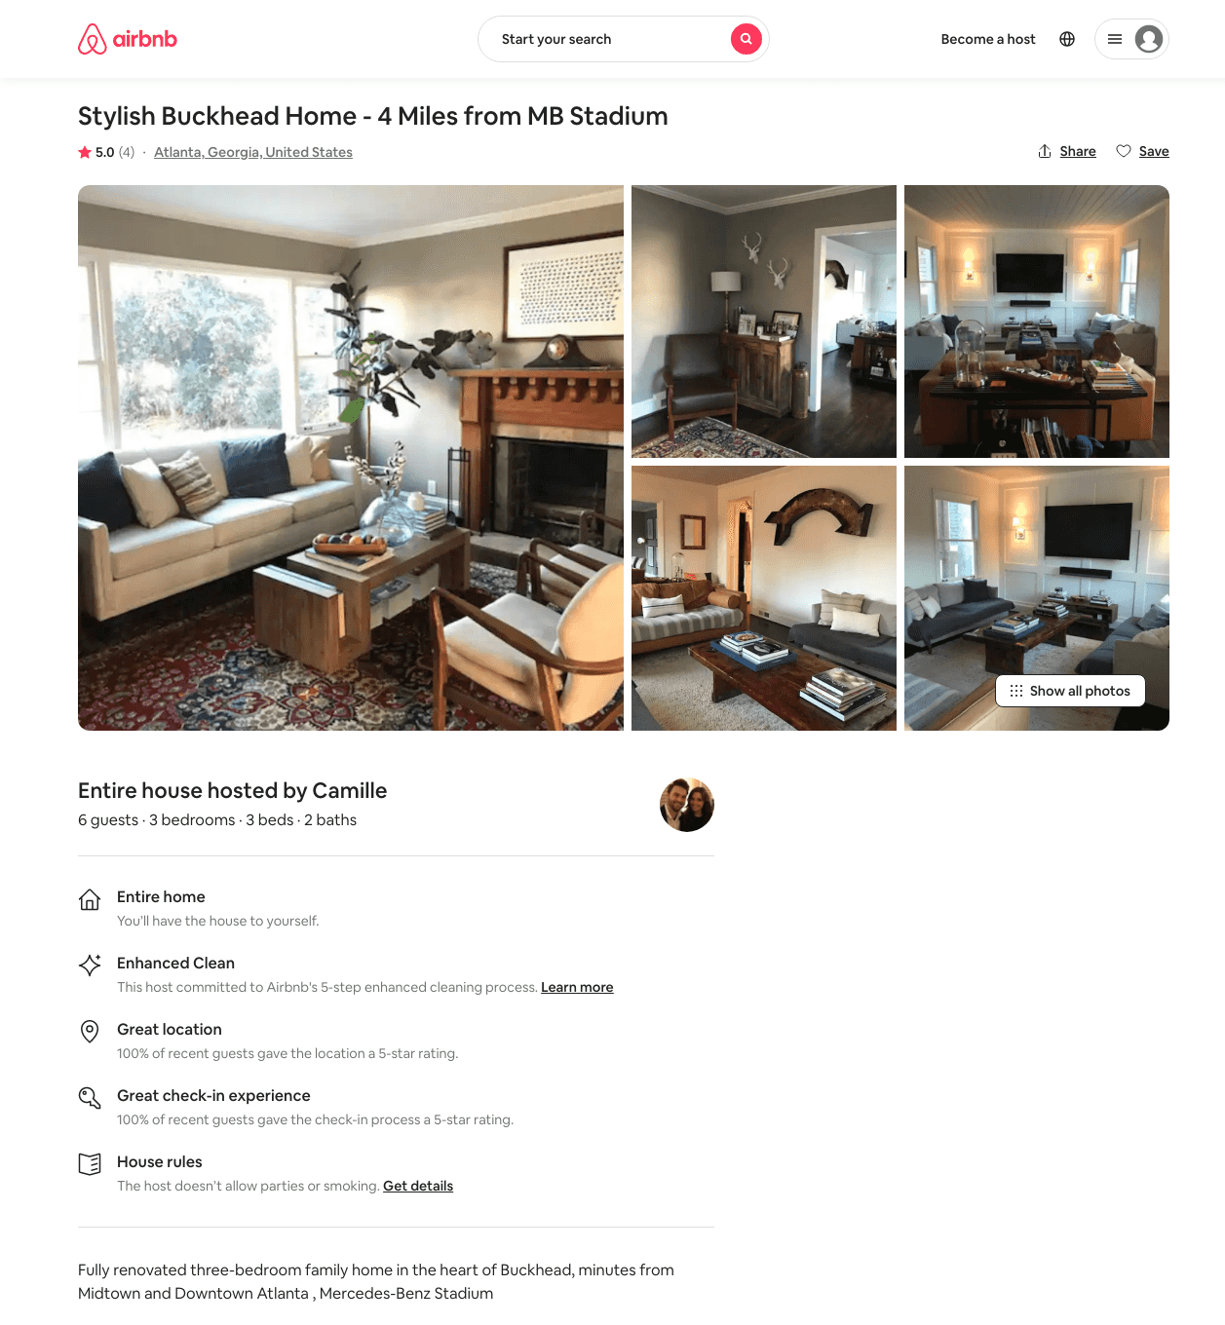
Listing 13596326
3
6
$450 - $550
5.0
3
Camille
78590250
1
https://www.airbnb.com/rooms/13596326
Aug 2022

Slide 5
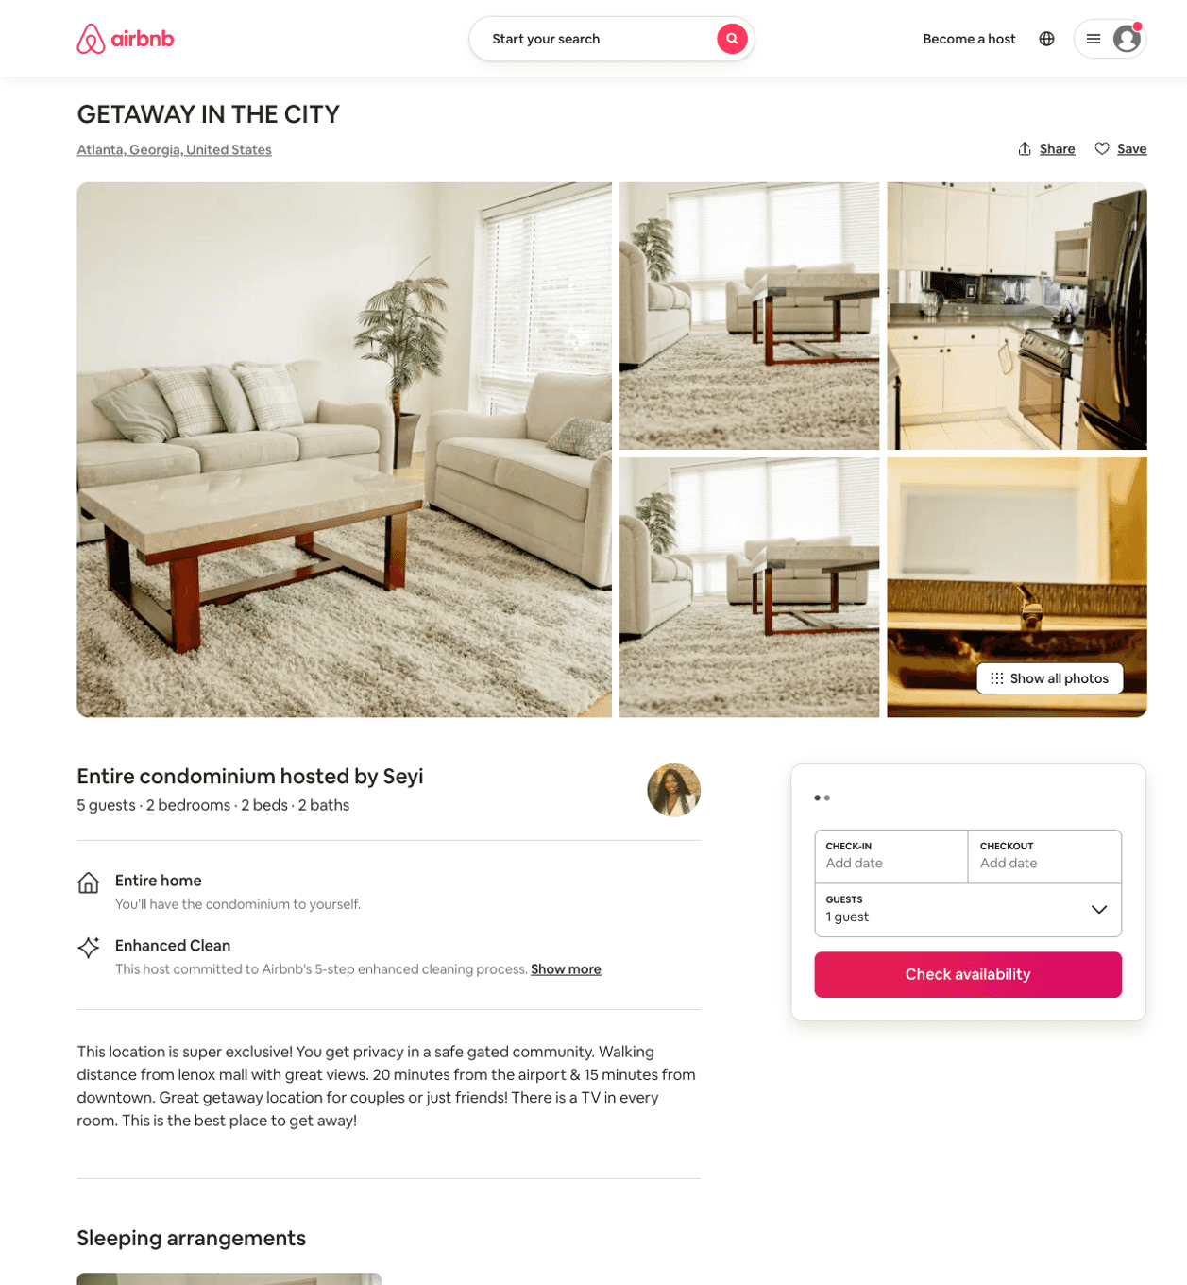
Listing 48427272
2
5
$200 - $300
30
Seyi
233915277
4
https://www.airbnb.com/rooms/48427272
Aug 2022

Slide 6
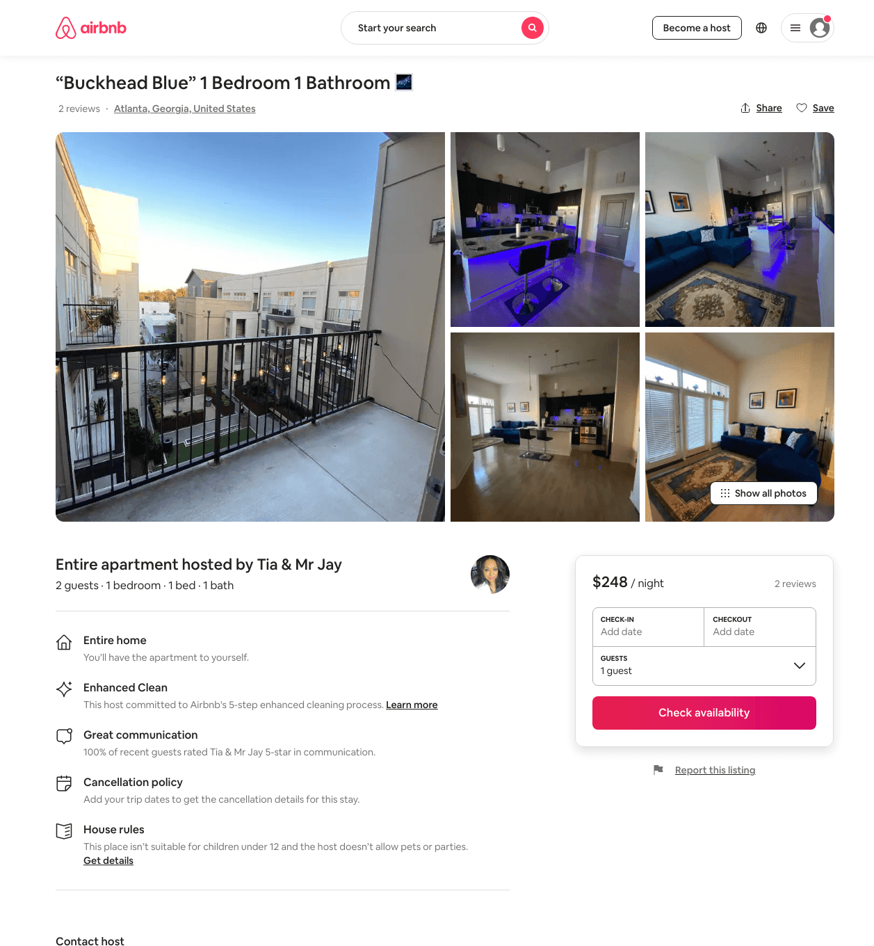
Listing 48544990
1
2
$221 - $310
2
Tia & Mr Jay
273325497
3
https://www.airbnb.com/rooms/48544990
Aug 2022

Slide 7
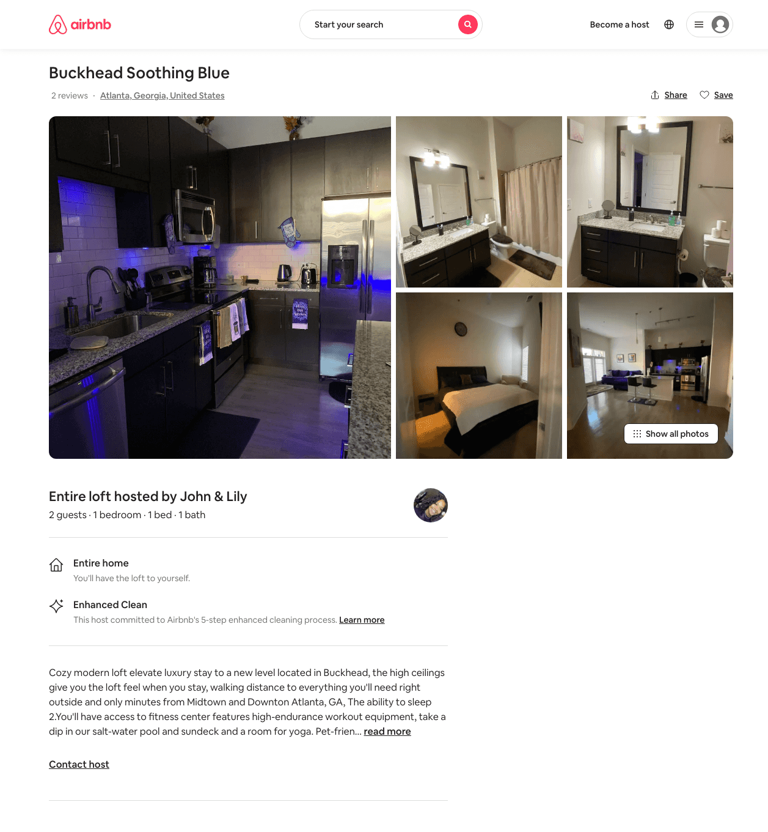
Listing 45741888
1
2
$156 - $199
4.86
2
John & Lily
370816058
4
https://www.airbnb.com/rooms/45741888
Jun 2022

Slide 8
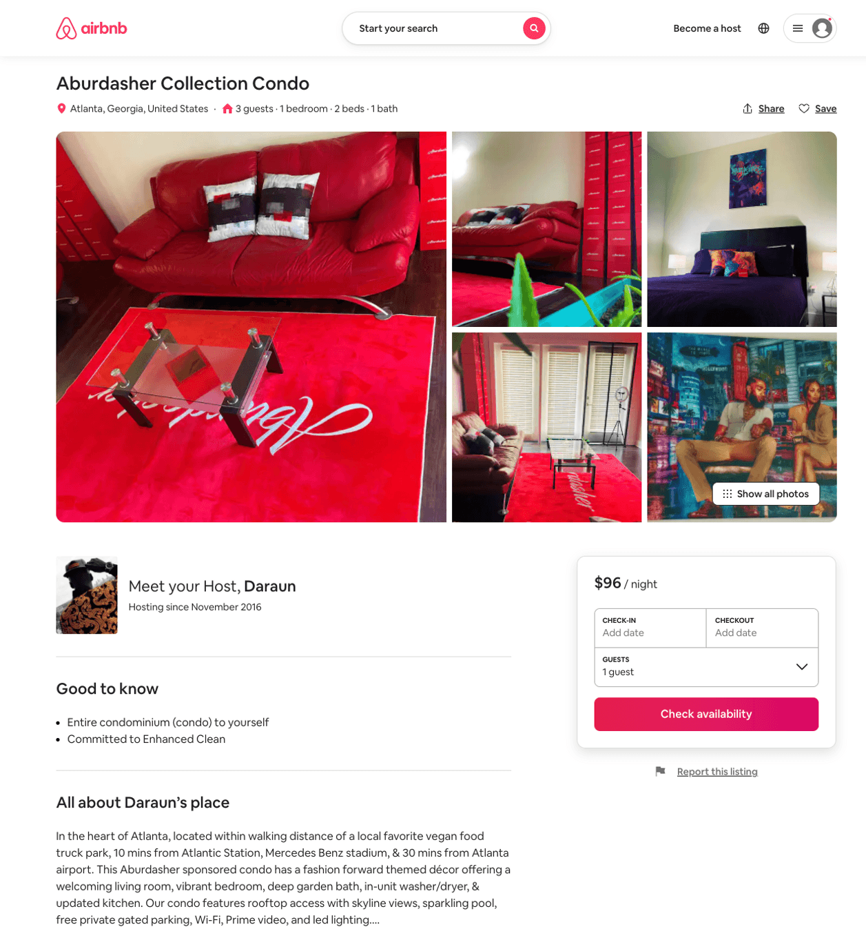
Listing 50002340
1
2
$96 - $140
4.94
1
Daraun
104711627
1
https://www.airbnb.com/rooms/50002340
Aug 2022

Slide 9
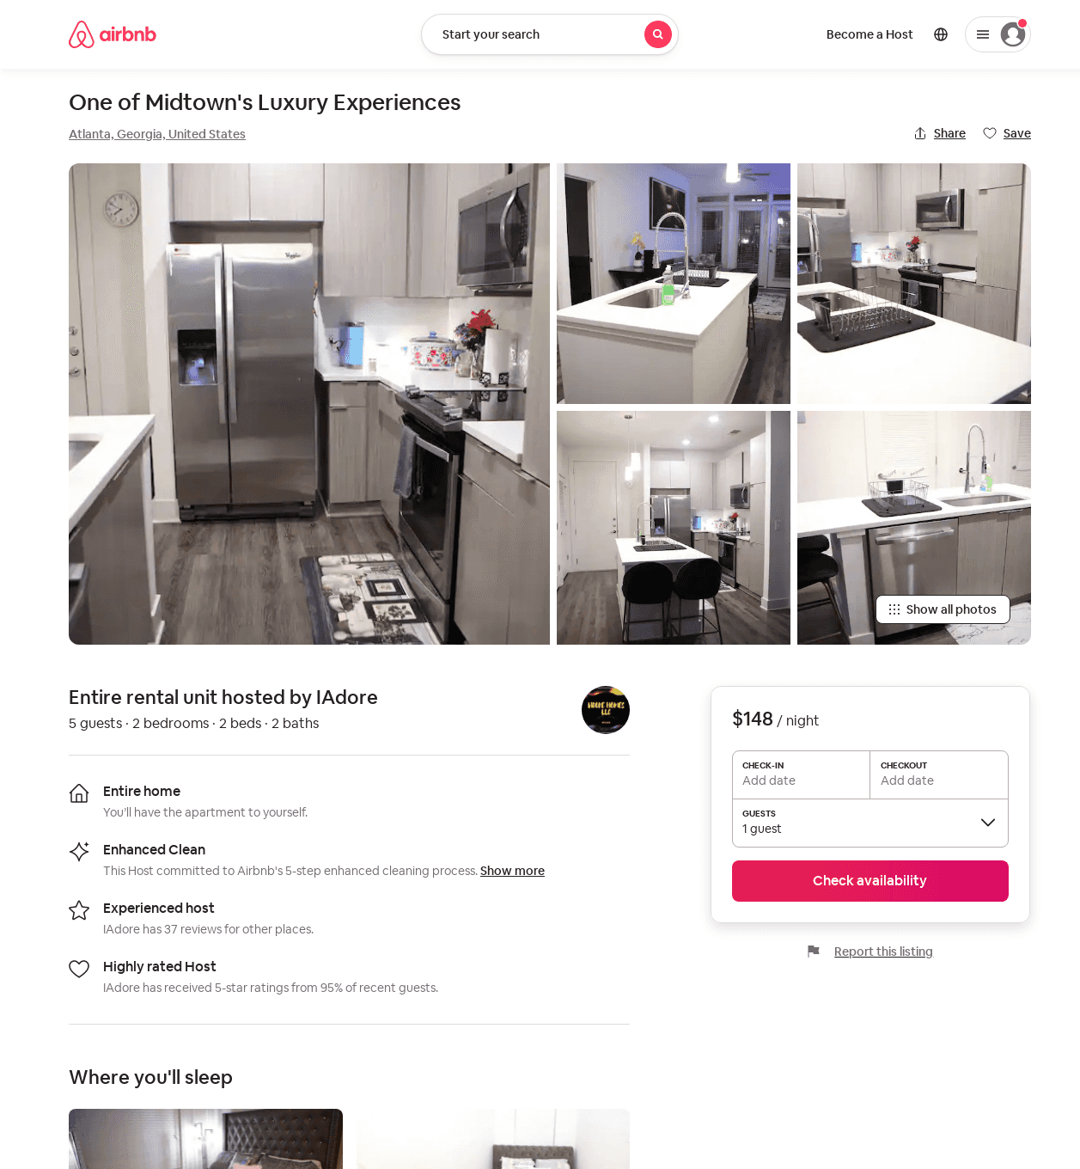
Listing 53198723
2
5
$120 - $166
4.71
3
IAdore
4635538
1
https://www.airbnb.com/rooms/53198723
Aug 2022

Slide 10
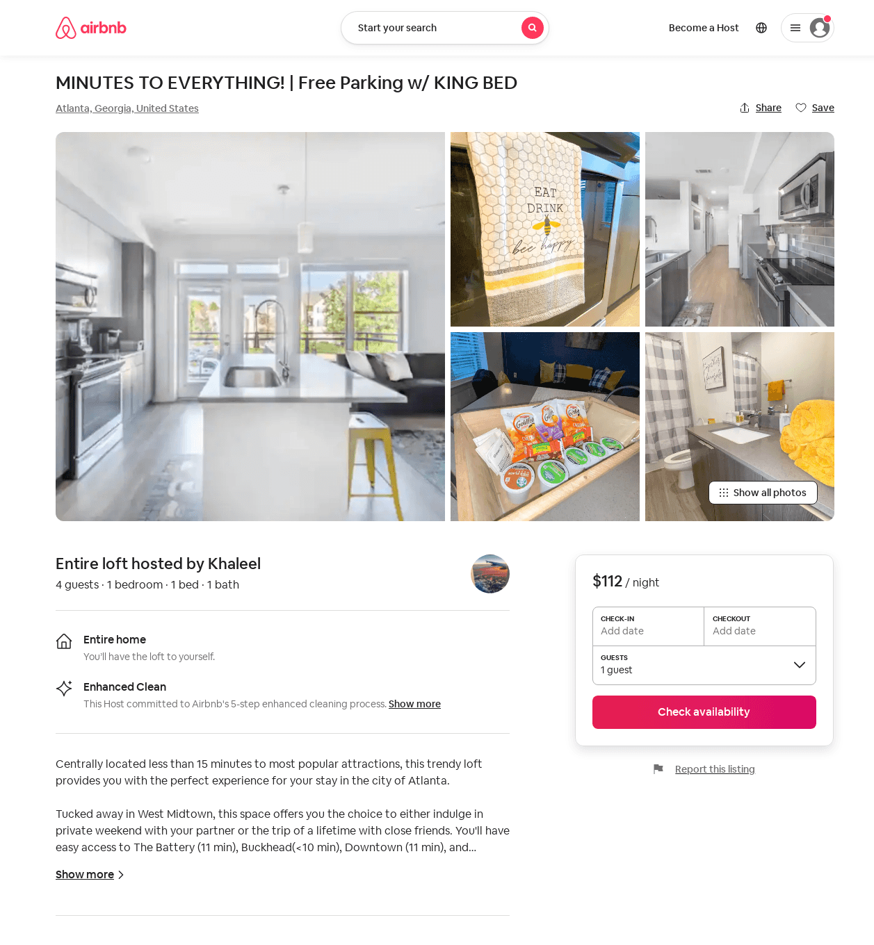
Listing 53034545
1
3
$78 - $170
5.0
7
Tish
429451407
1
https://www.airbnb.com/rooms/53034545
Jul 2022

Slide 11
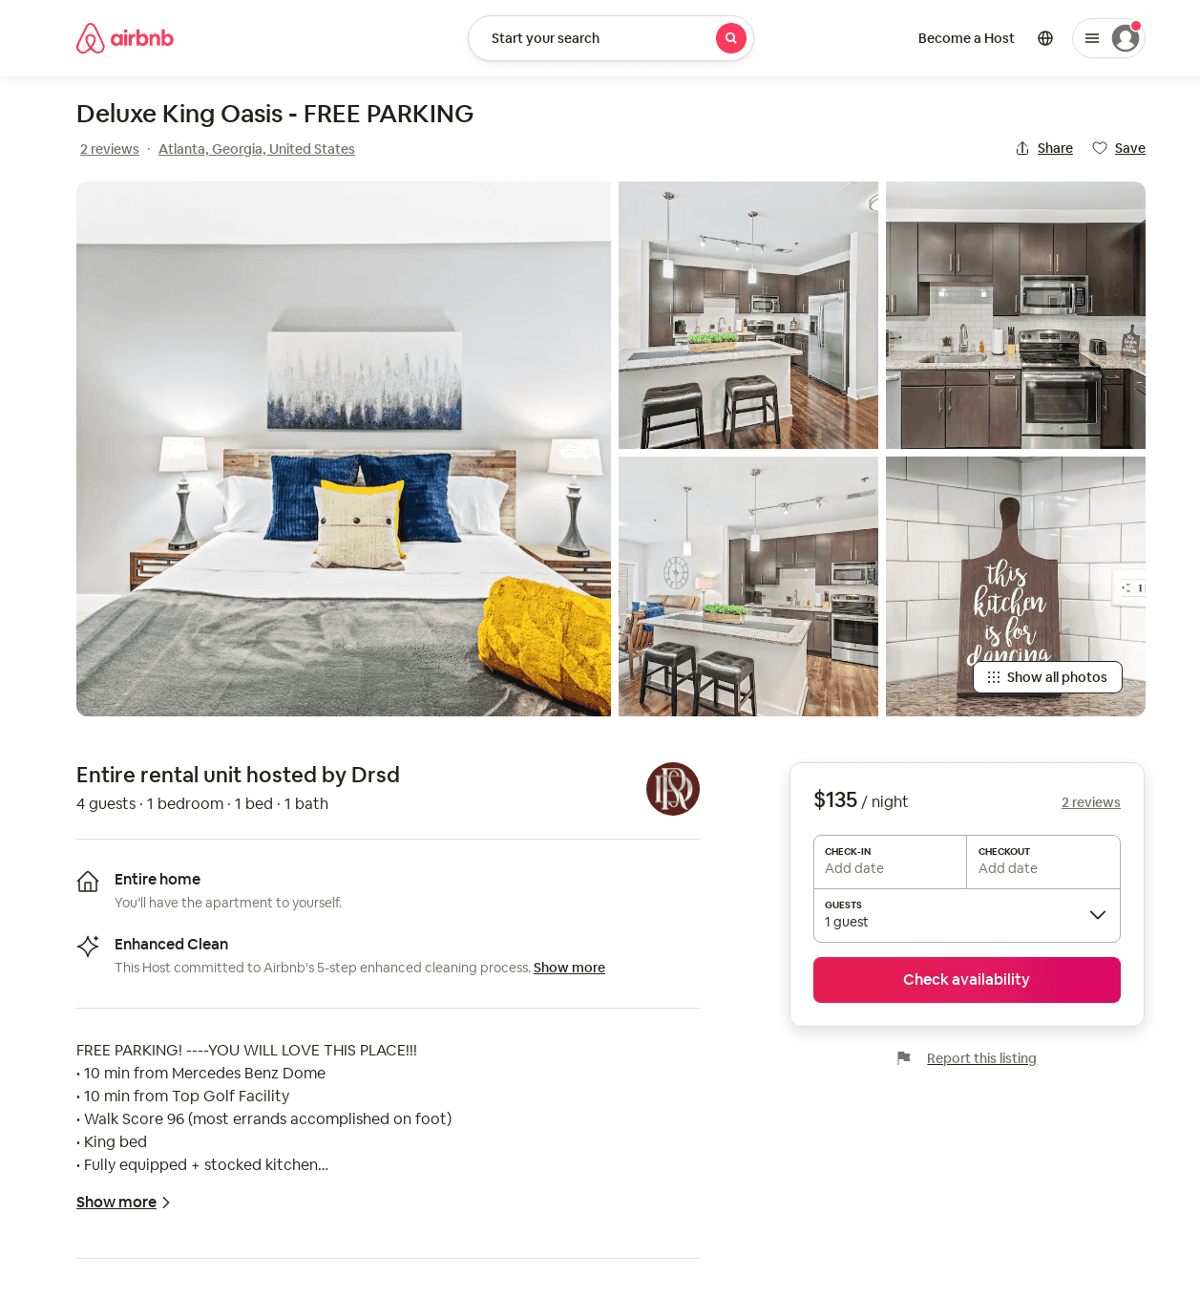
Listing 52638237
1
4
$102 - $150
4.88
1
Drsd
426106887
1
https://www.airbnb.com/rooms/52638237
Aug 2022

Slide 12
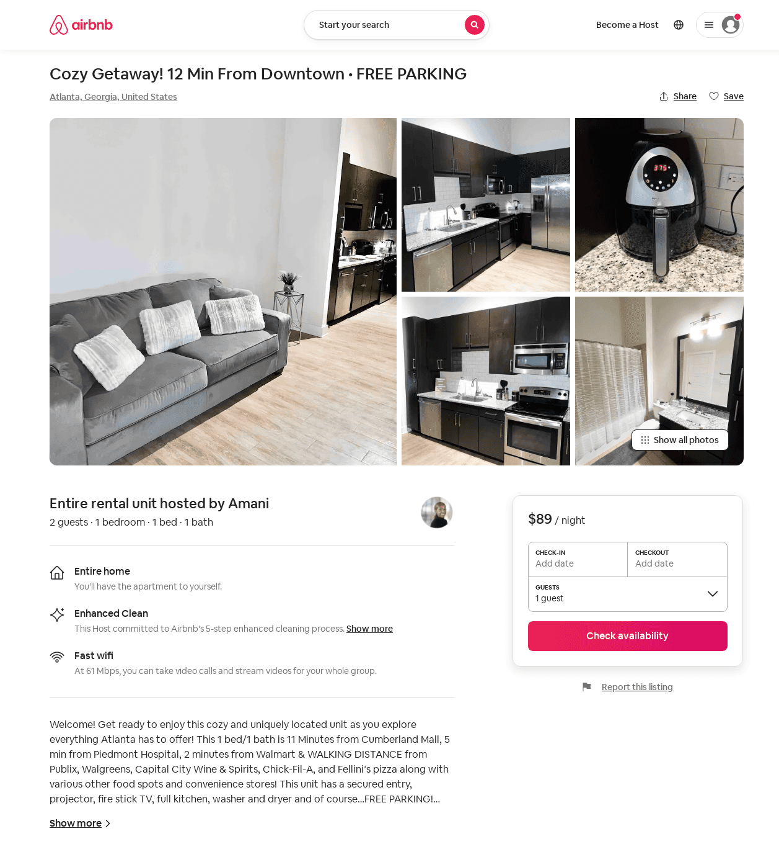
Listing 53867045
1
2
$89 - $99
4.60
2
Amani
435907670
1
https://www.airbnb.com/rooms/53867045
Aug 2022

Slide 13
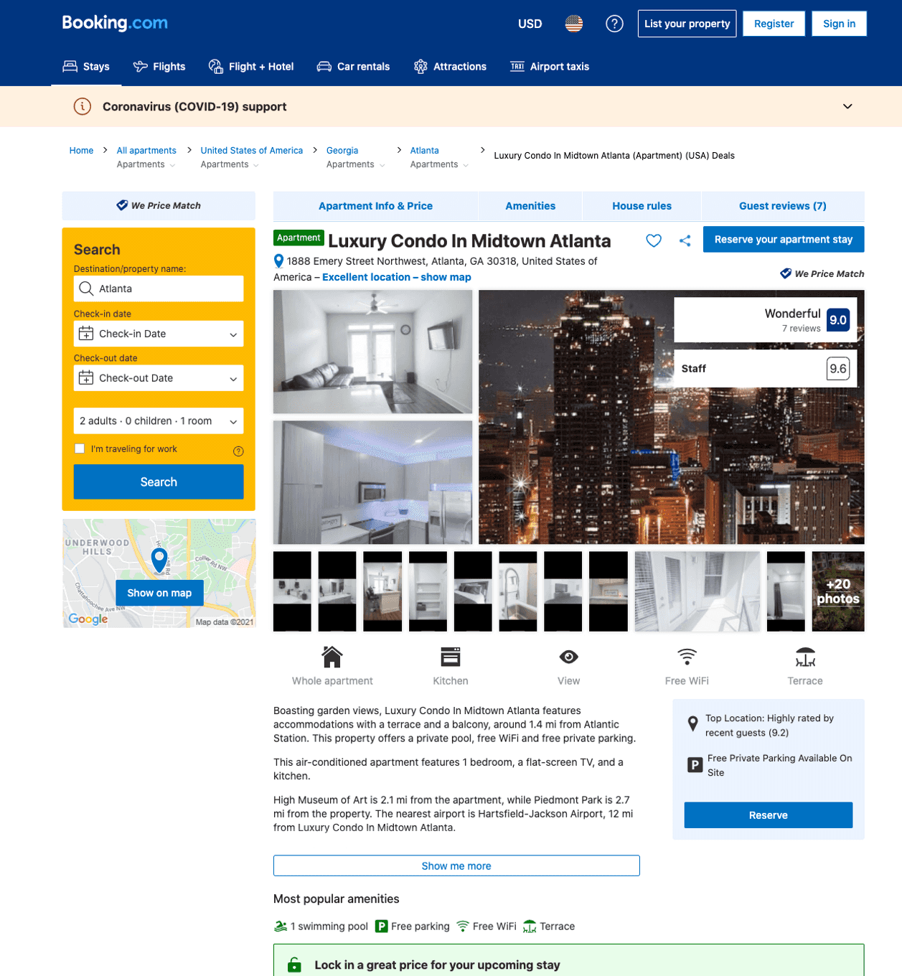
Listing luxury-condo-in-midtown-atlanta
1888 EMERY ST NW
undefined
1
9.4
https://www.booking.com/hotel/us/luxury-condo-in-midtown-atlanta.html
Sep 2022

Slide 14
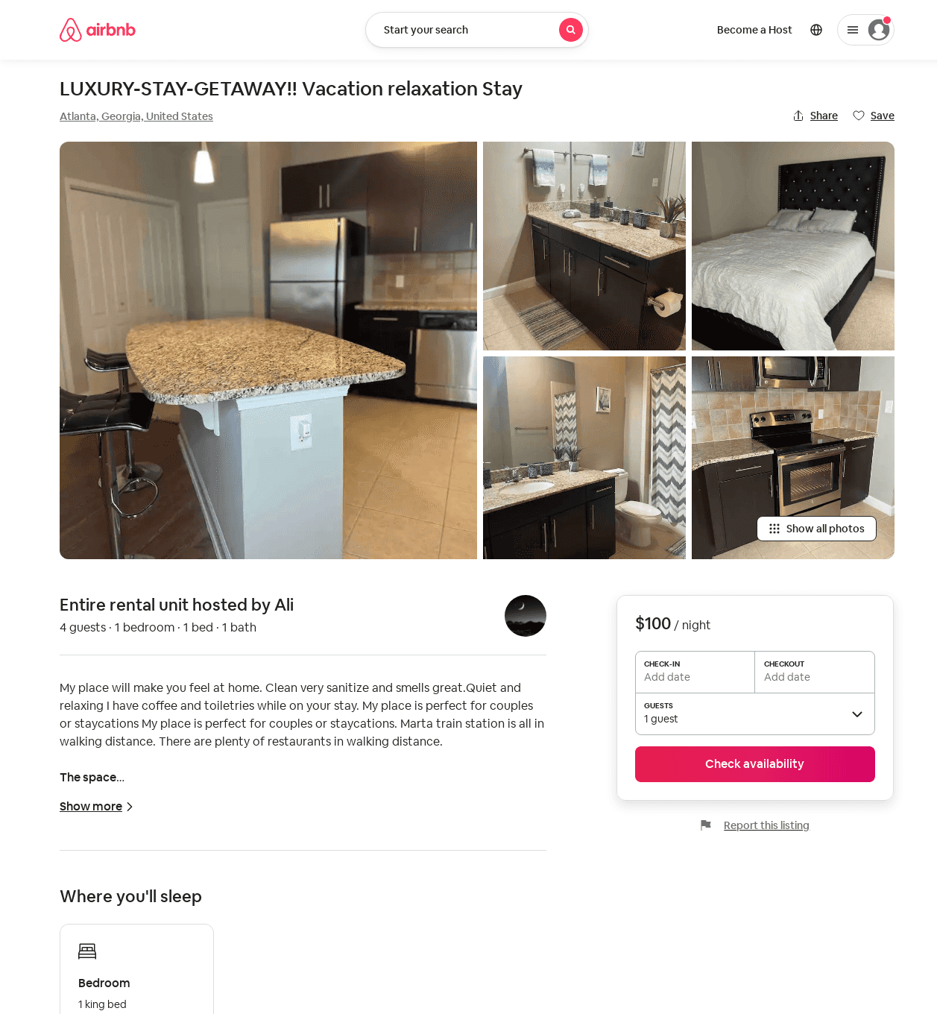
Listing 51886762
1
4
$86 - $111
4.27
1
Ali
283519469
1
https://www.airbnb.com/rooms/51886762
Aug 2022

Slide 15
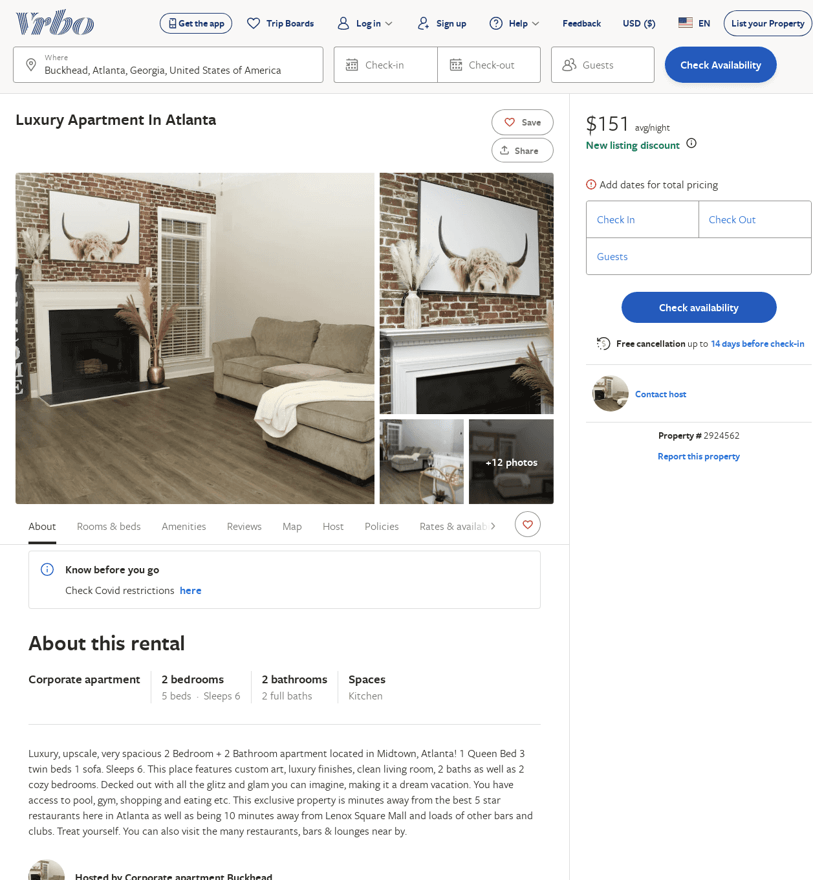
Listing 2924562
2
6
$144
3
https://www.vrbo.com/2924562
Aug 2022

Slide 16
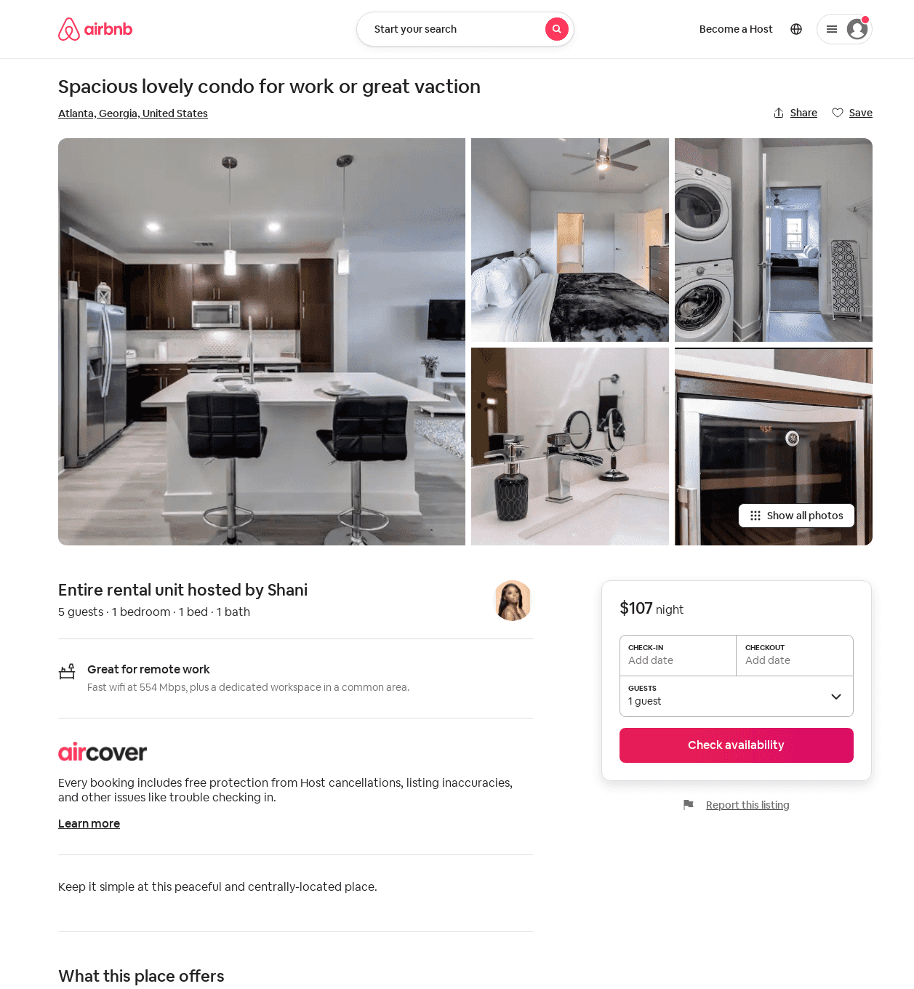
Listing 52146869
1
5
1
Shani
364134358
1
https://www.airbnb.com/rooms/52146869
Aug 2022

