Slide 2
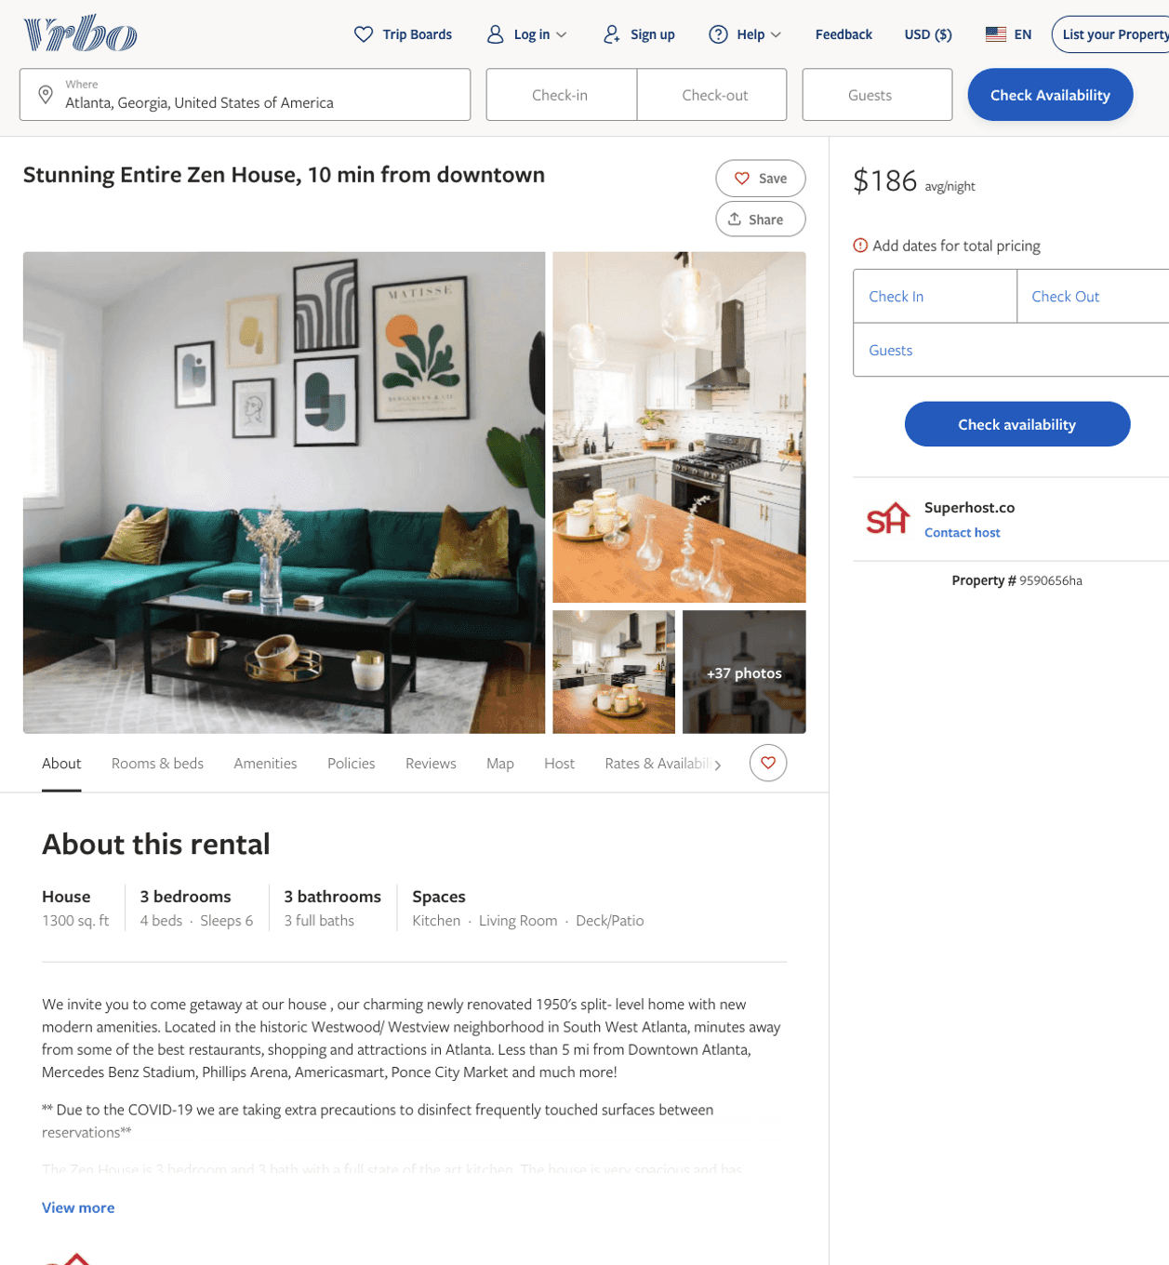
Listing 9590656
3
6
$150 - $230
2
Operations Manager
https://www.vrbo.com/9590656ha
Aug 2022

Slide 3
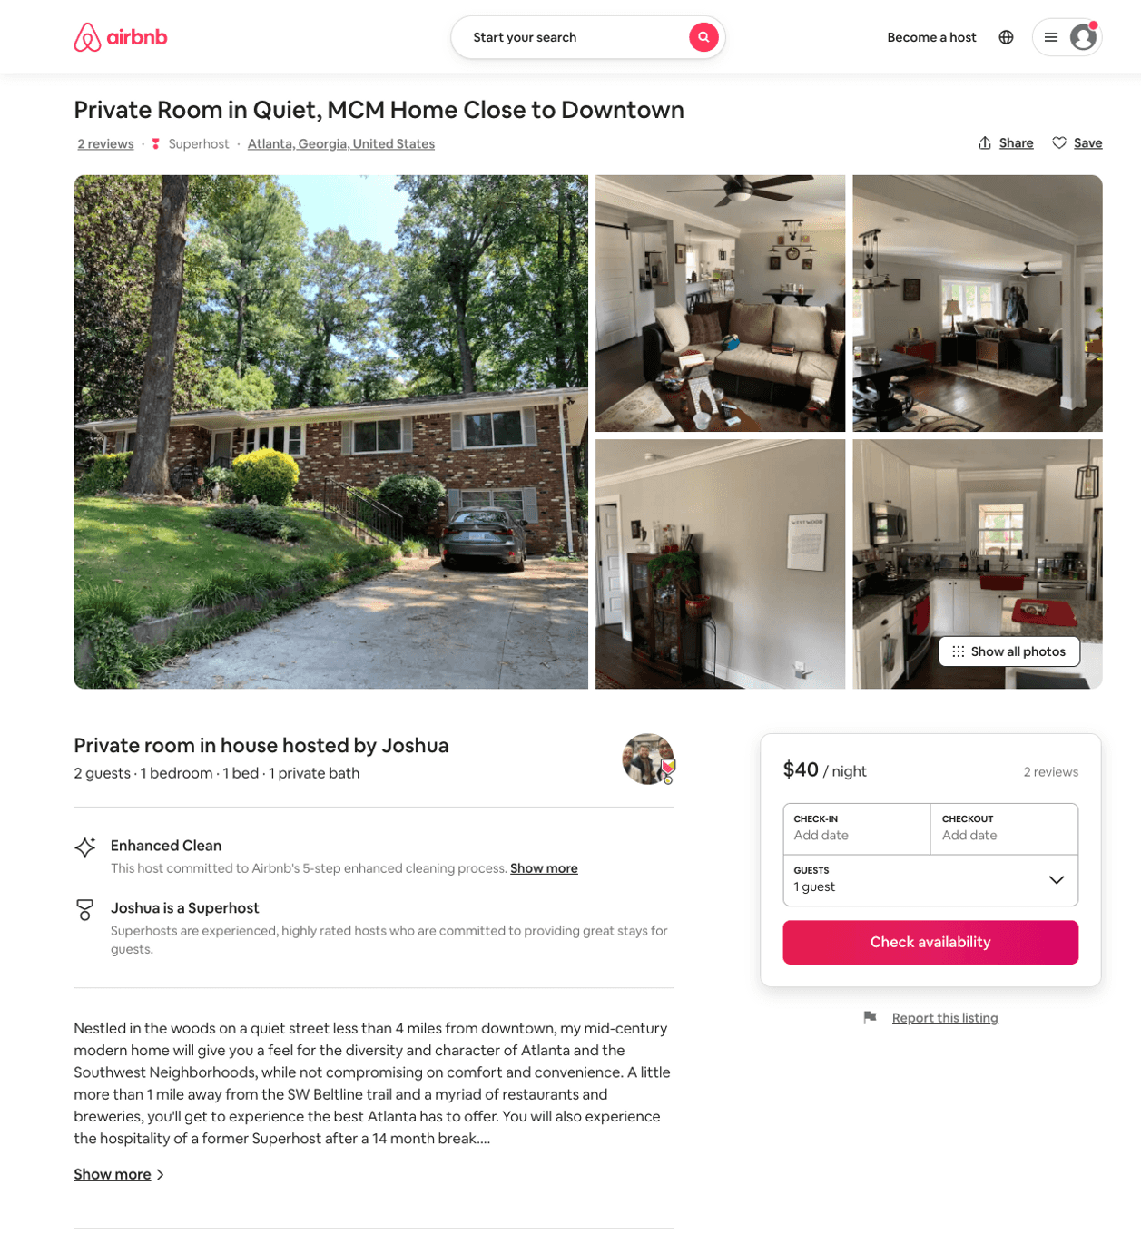
Listing 37889129
1
2
$40
1
Joshua
60512417
1
https://www.airbnb.com/rooms/37889129
Aug 2022

Slide 4
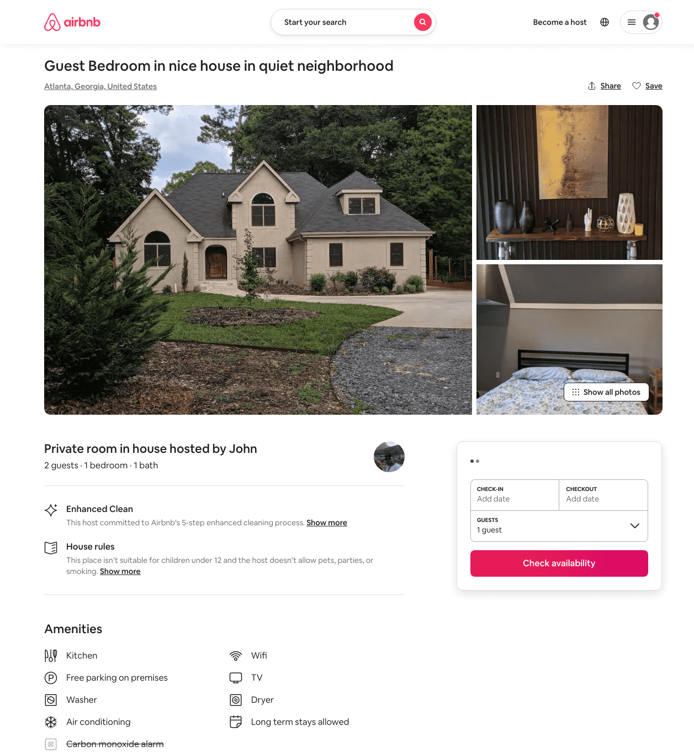
Listing 49833210
1
2
$40 - $50
3
John
180212799
3
https://www.airbnb.com/rooms/49833210
Jun 2022

Slide 5
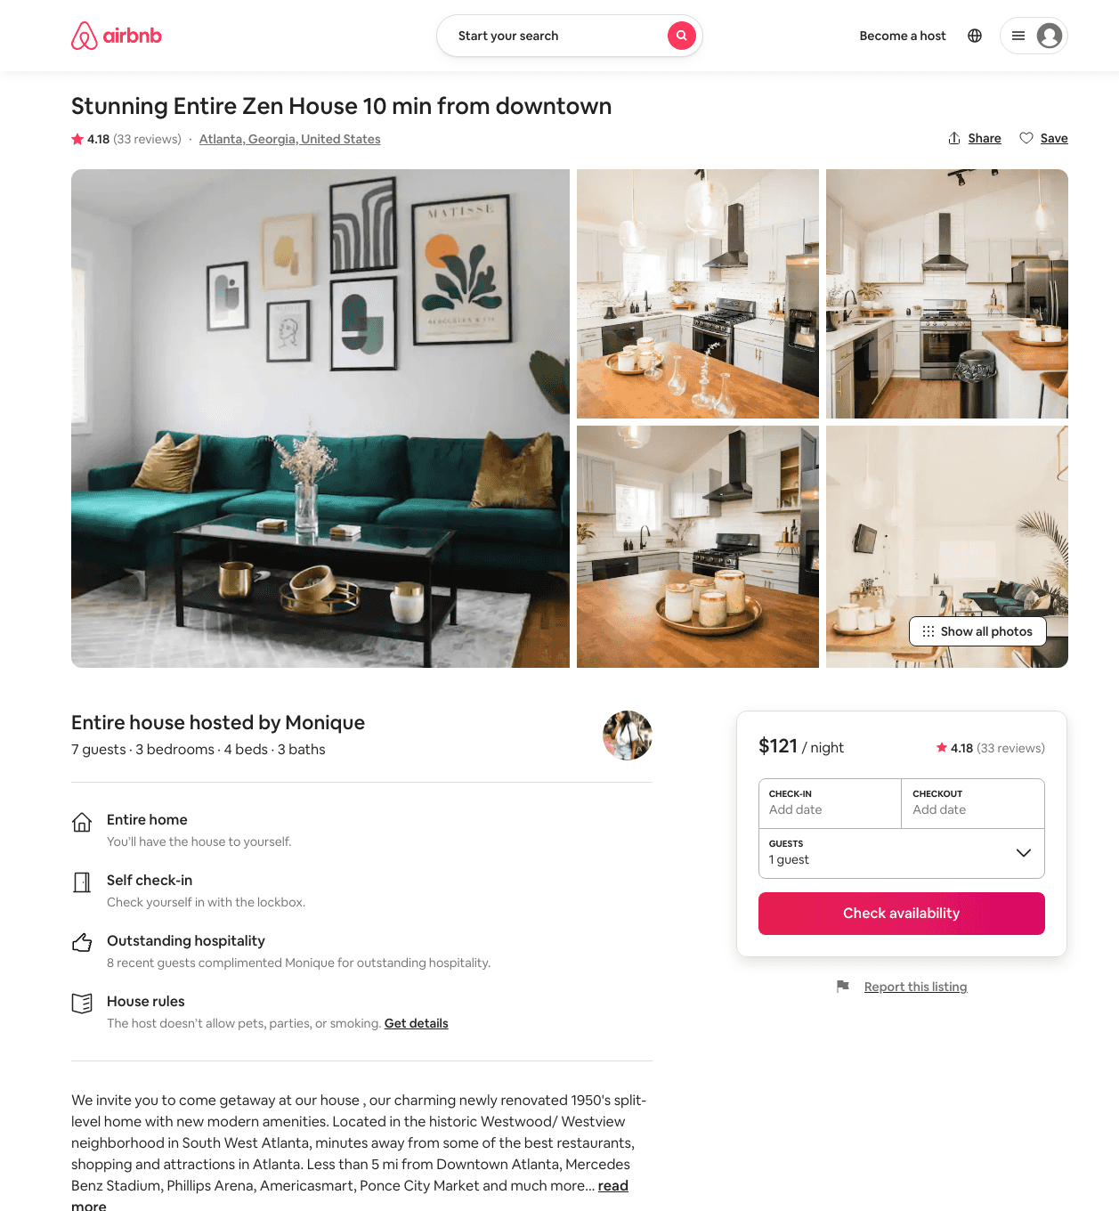
Listing 42124400
3
6
$111 - $247
4.33
1
Monique
46660863
3
https://www.airbnb.com/rooms/42124400
Jul 2022

Slide 6
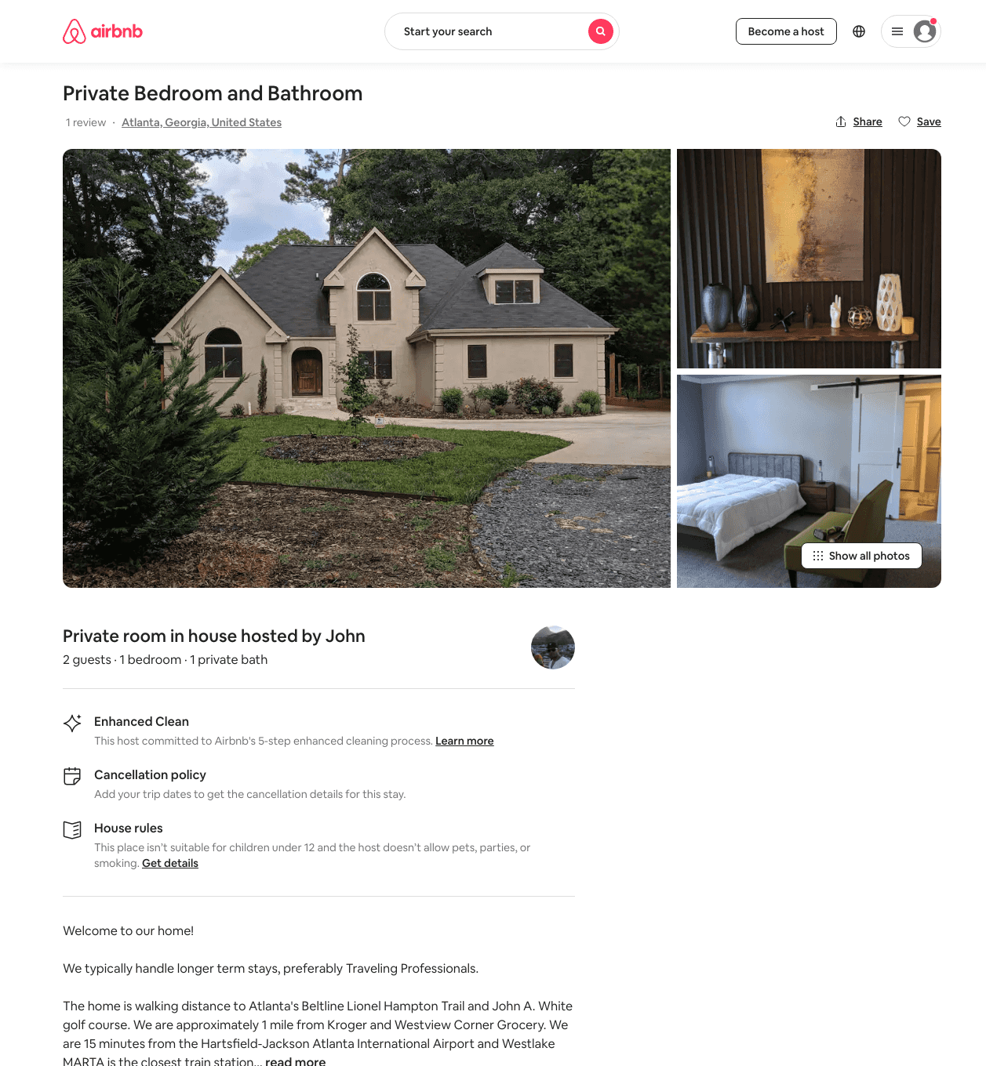
Listing 44323773
1
2
$50 - $65
4
John
180212799
3
https://www.airbnb.com/rooms/44323773
Jun 2022

Slide 7
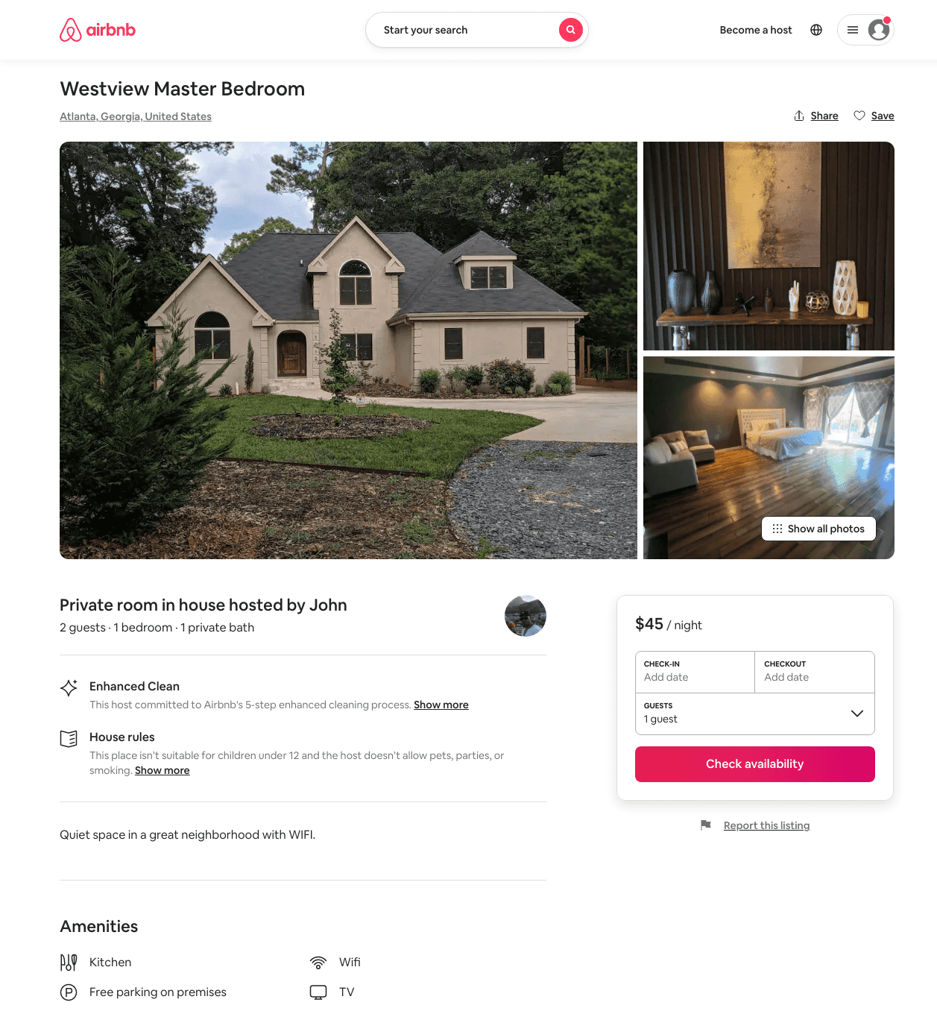
Listing 49461976
1
2
$45 - $70
5
John
180212799
3
https://www.airbnb.com/rooms/49461976
Jun 2022

Slide 8
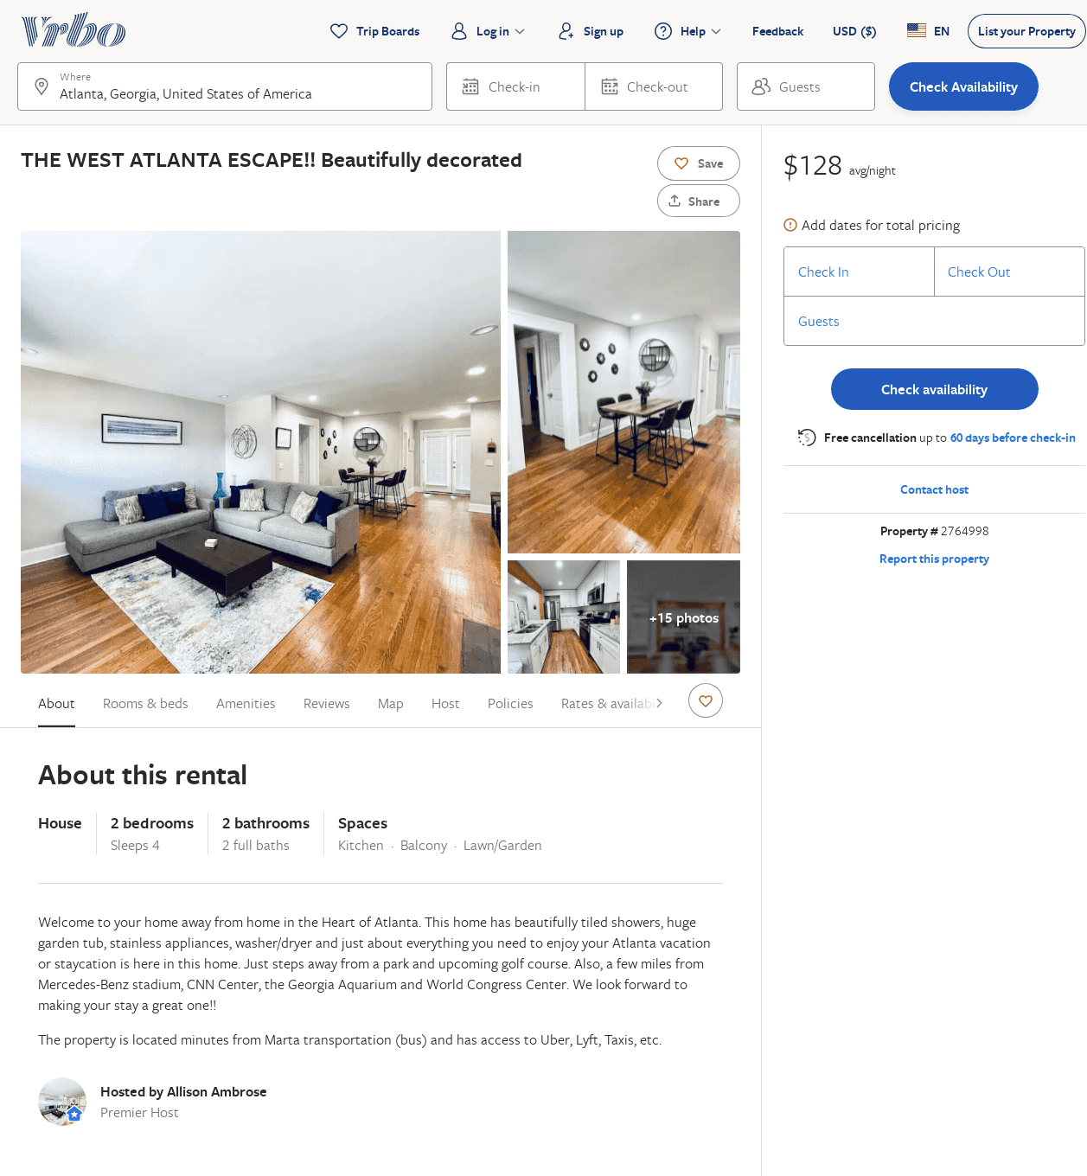
Listing 2764998
2
4
$128
5
2
Allison Ambrose
https://www.vrbo.com/2764998
Aug 2022

