Slide 2
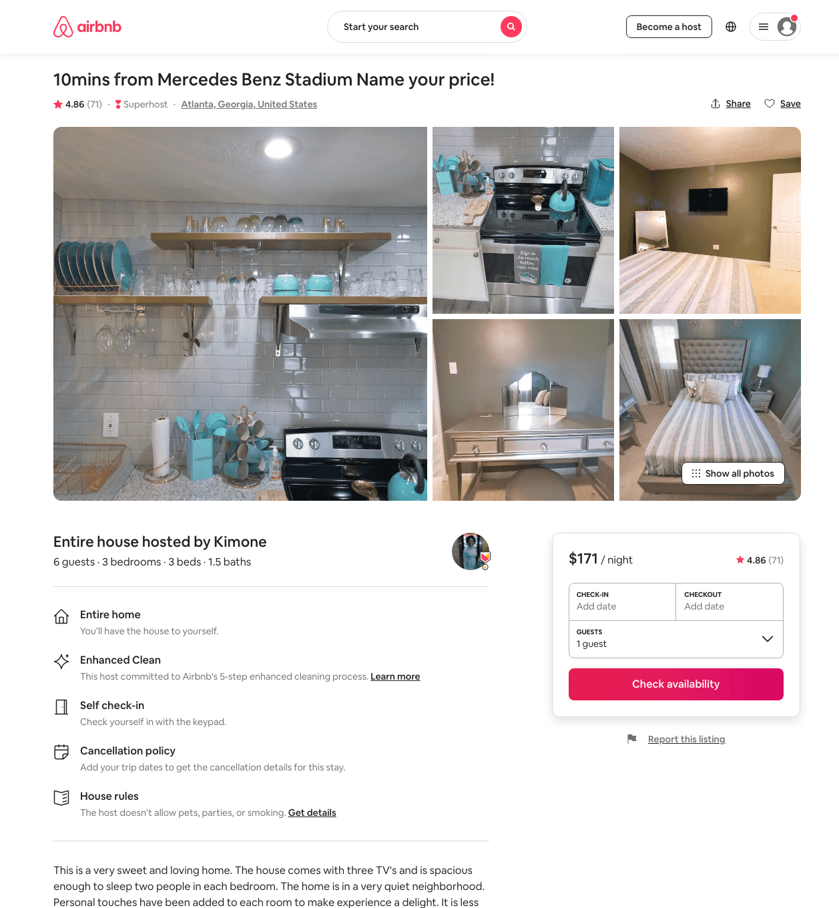
Listing 34819324
3
8
$154 - $263
4.83
1
Kimone
226109197
2
https://www.airbnb.com/rooms/34819324
Aug 2022

Slide 3
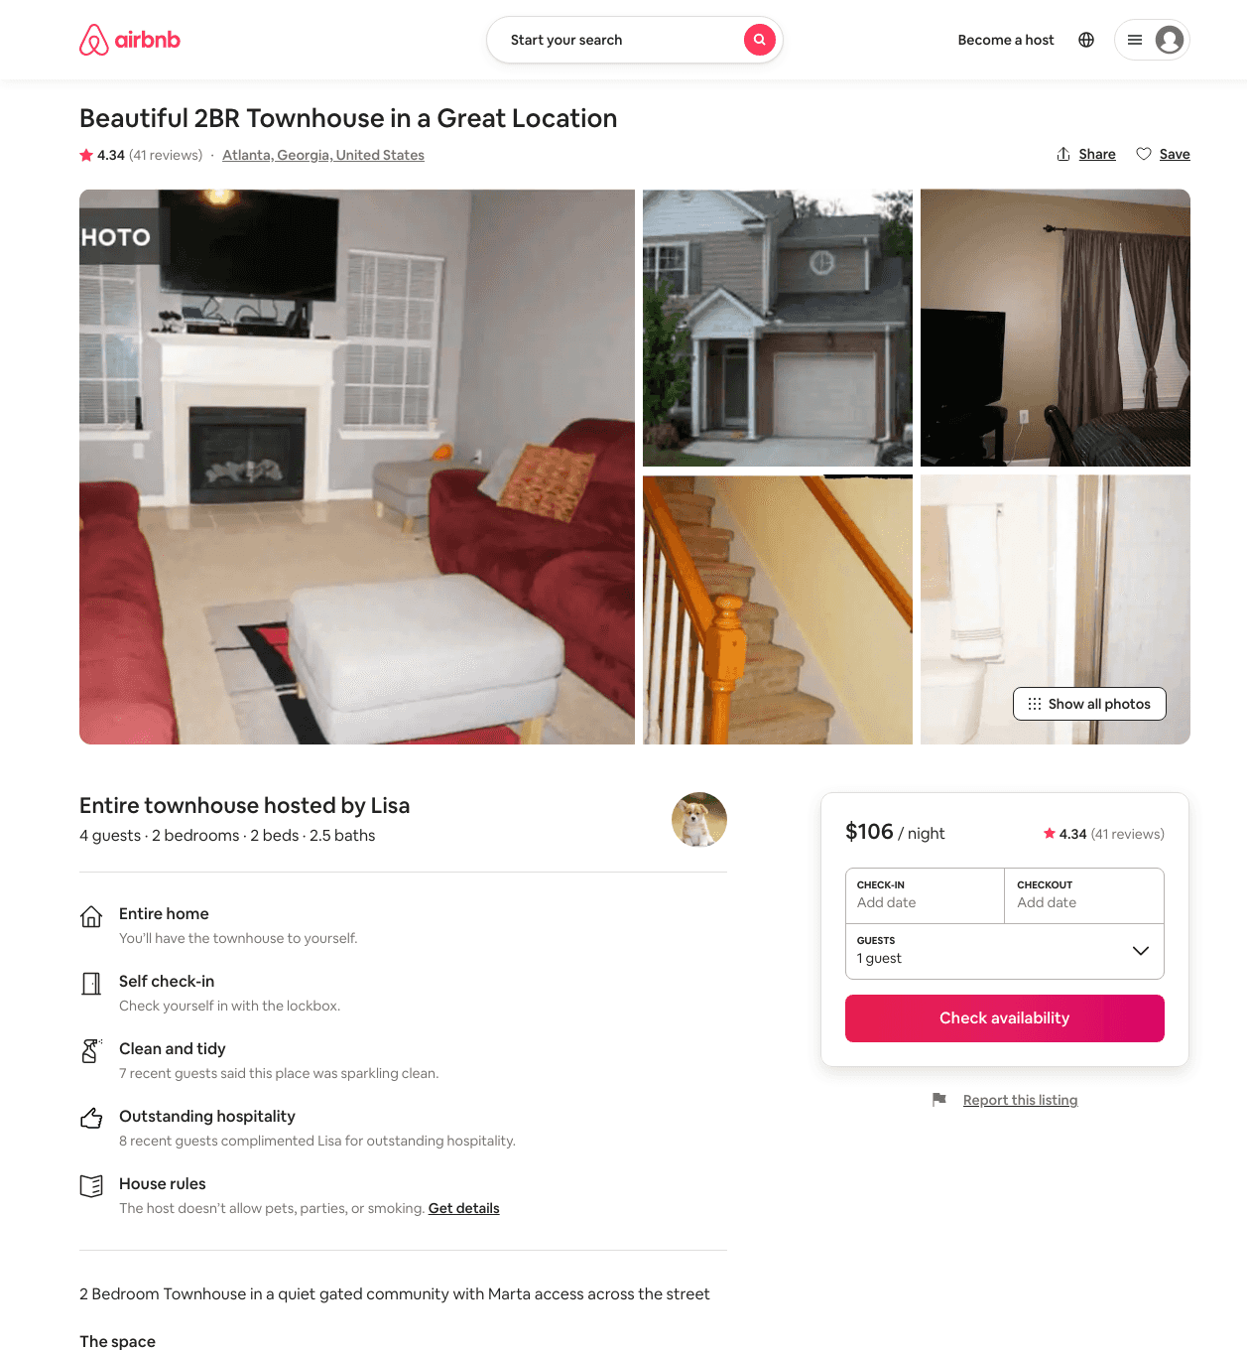
Listing 22165389
2
4
$93 - $116
4.40
2
Lisa
161899928
1
https://www.airbnb.com/rooms/22165389
Aug 2022

Slide 4
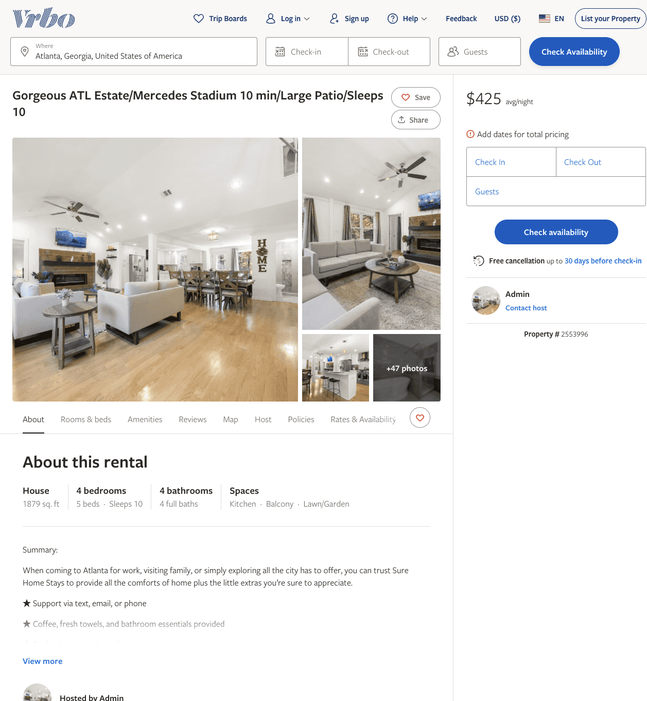
Listing 2553996
4
10
$274 - $485
2
Admin
https://www.vrbo.com/2553996
Aug 2022

Slide 5
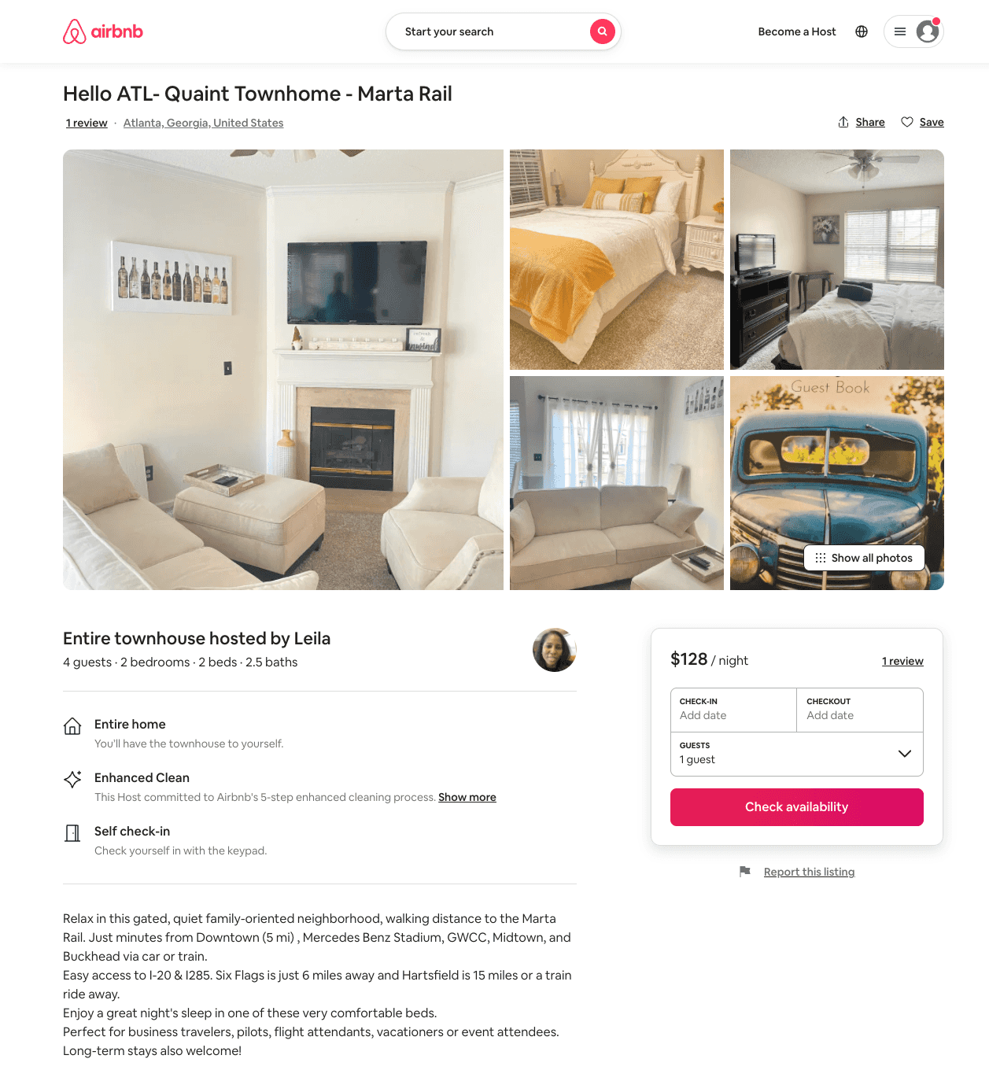
Listing 53323606
2
4
$102 - $128
5.0
30
Leila
238805243
1
https://www.airbnb.com/rooms/53323606
Aug 2022

