Slide 2
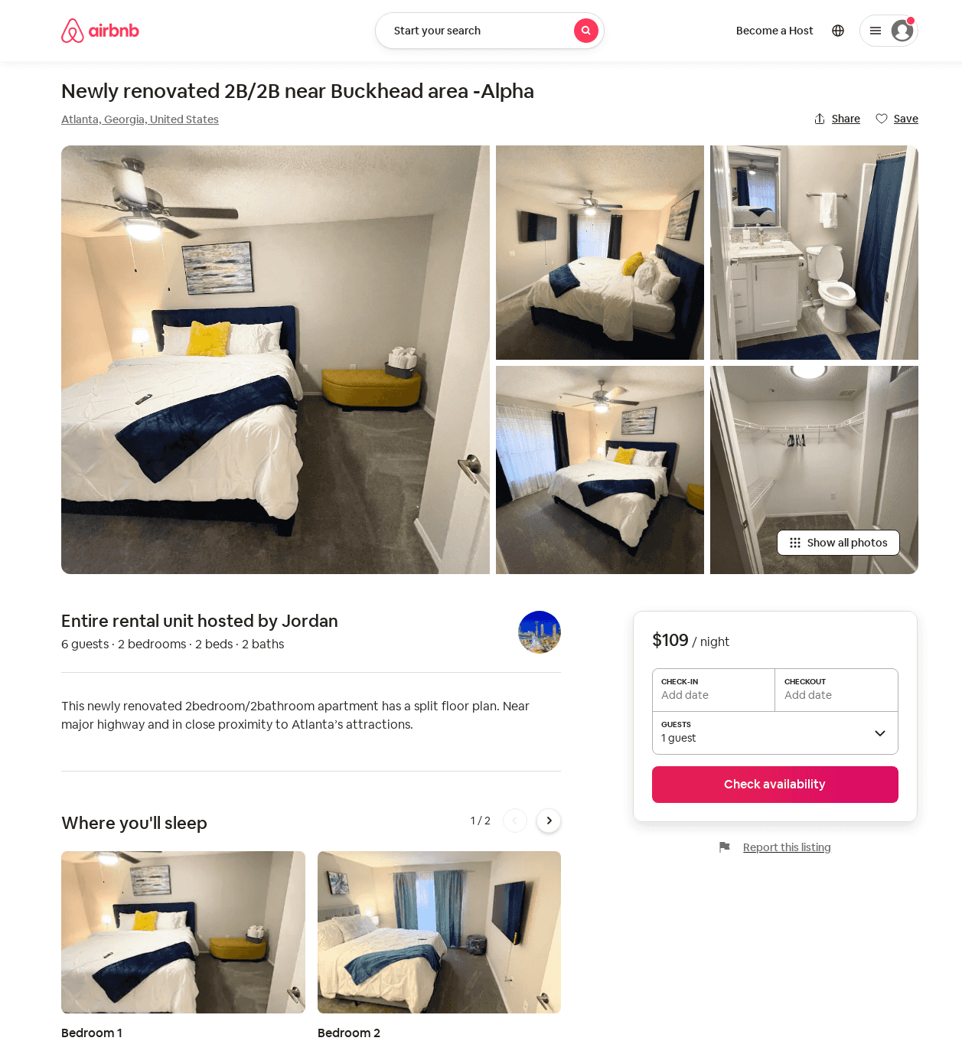
Listing 52828332
2
6
$109 - $160
4.91
1
Anthony
92449056
1
https://www.airbnb.com/rooms/52828332
Jun 2022

