Slide 2
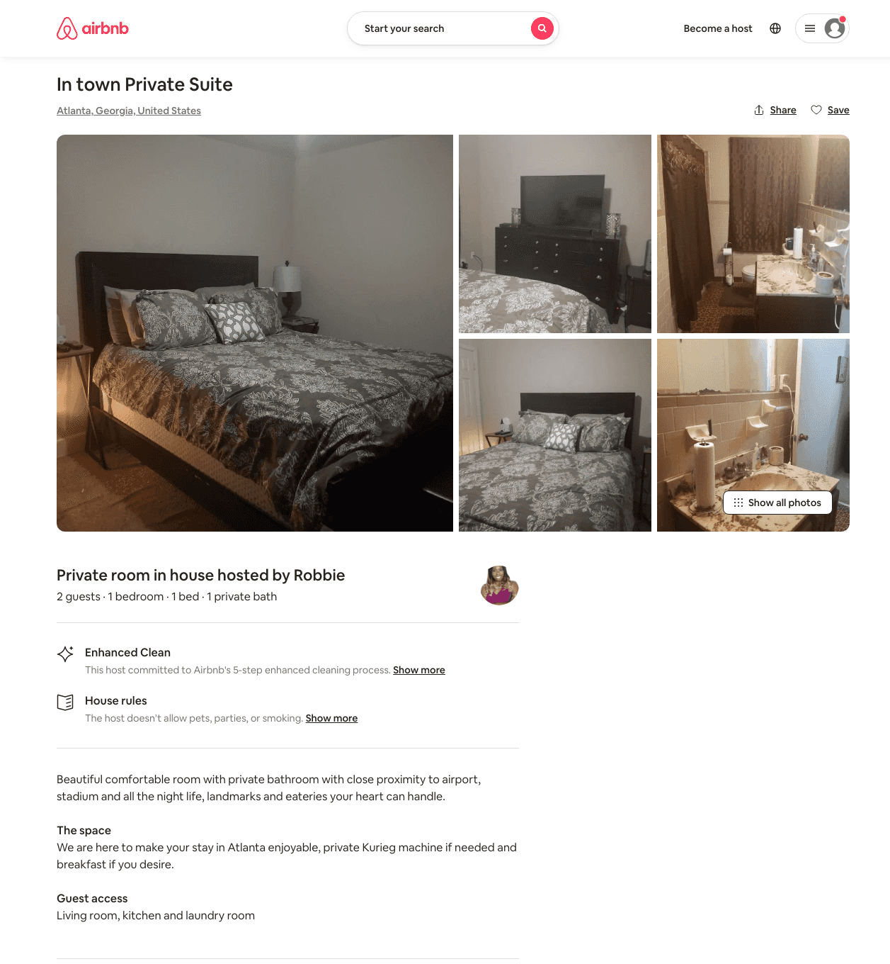
Listing 32020830
1
2
$75
1
Robbie
90688294
1
https://www.airbnb.com/rooms/32020830
Aug 2022

Slide 3
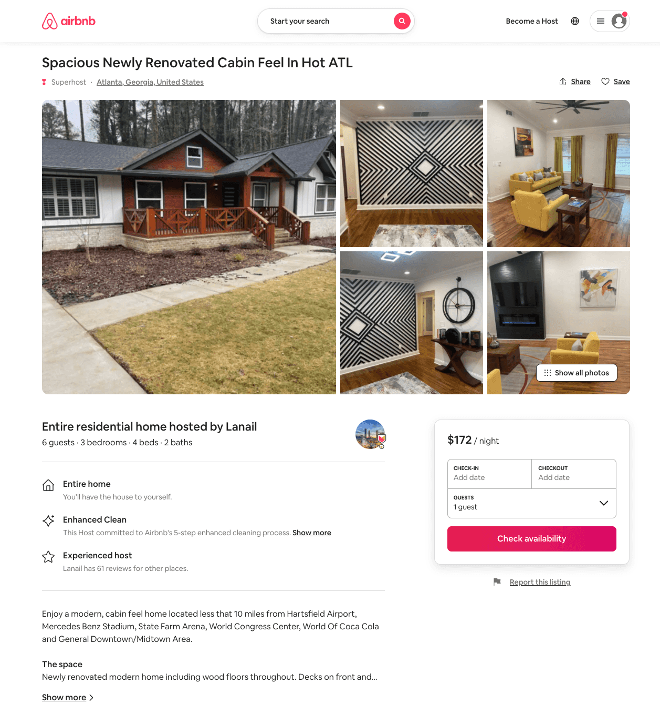
Listing 54157887
3
6
$172 - $185
4.95
3
Lanail
291095177
1
https://www.airbnb.com/rooms/54157887
Aug 2022

