Slide 2
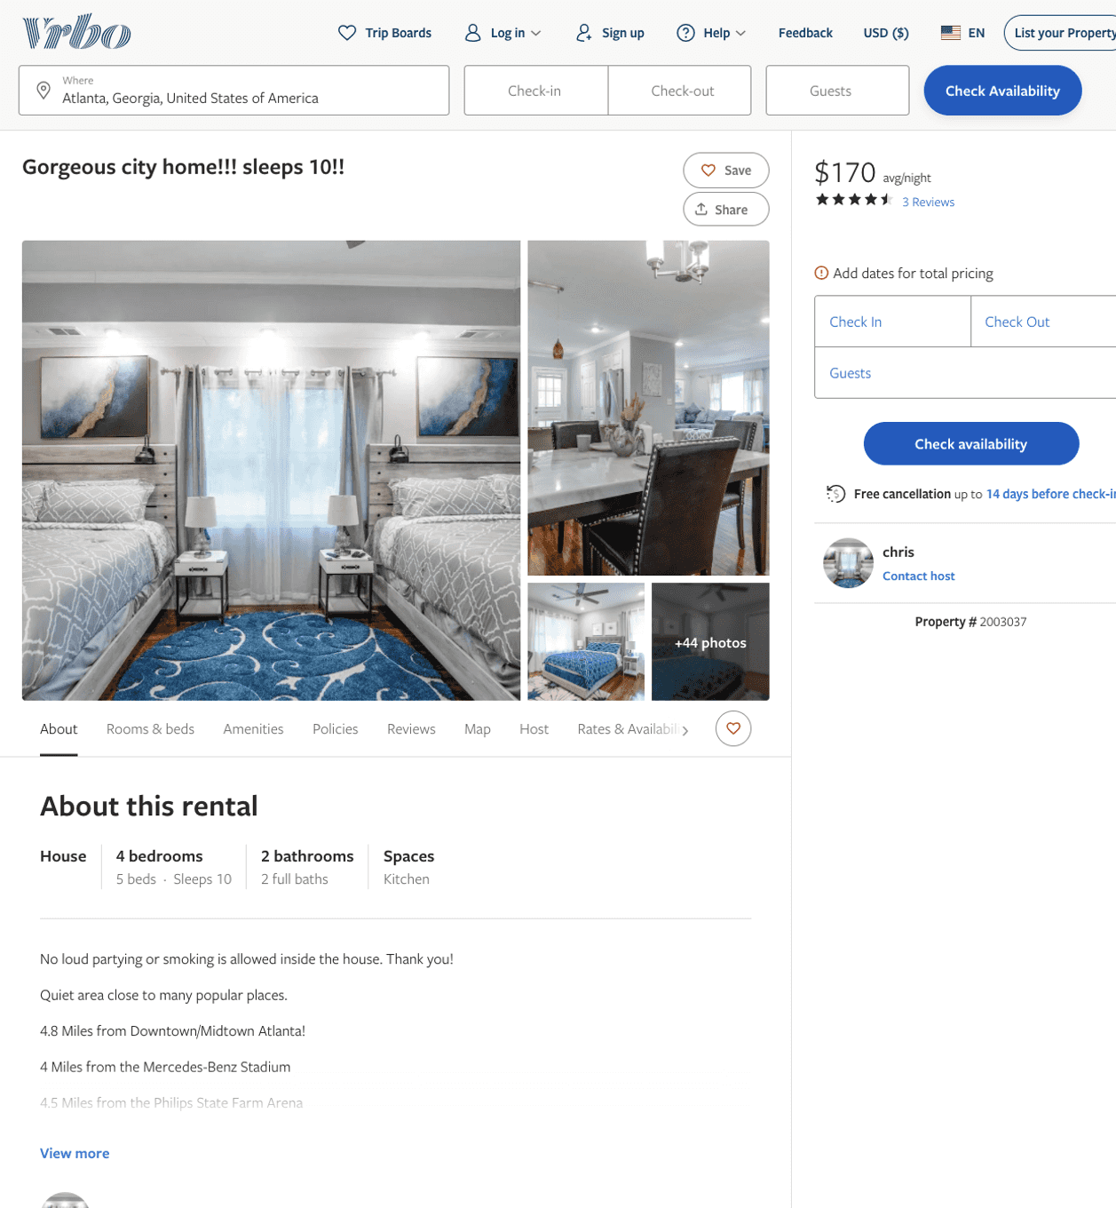
Listing 2003037
4
10
$170 - $207
4.4
2
chris
https://www.vrbo.com/2003037
Aug 2022

Slide 3
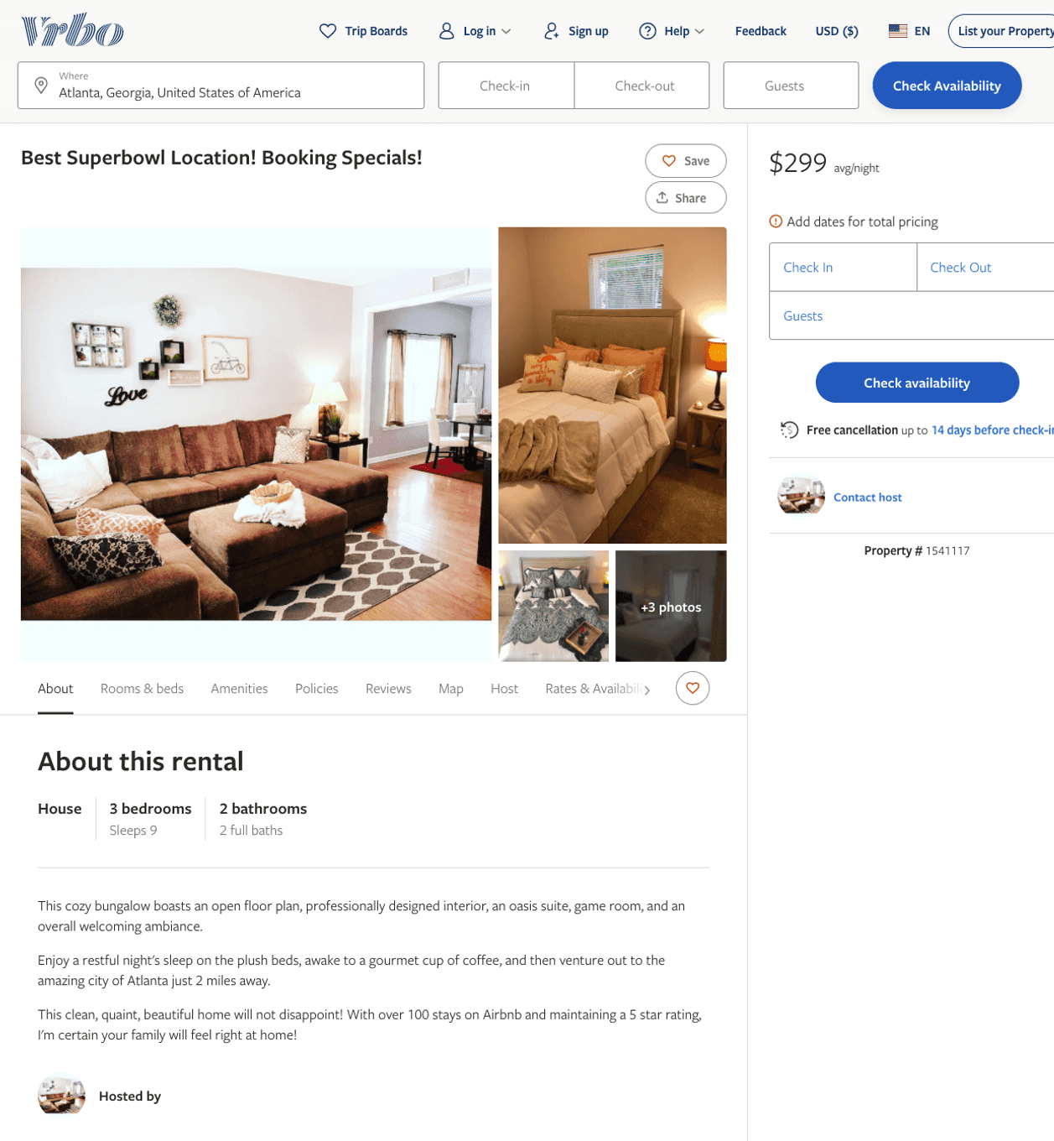
Listing 1541117
3
9
$299
2
Manika Gamble
https://www.vrbo.com/1541117
Aug 2022

Slide 4
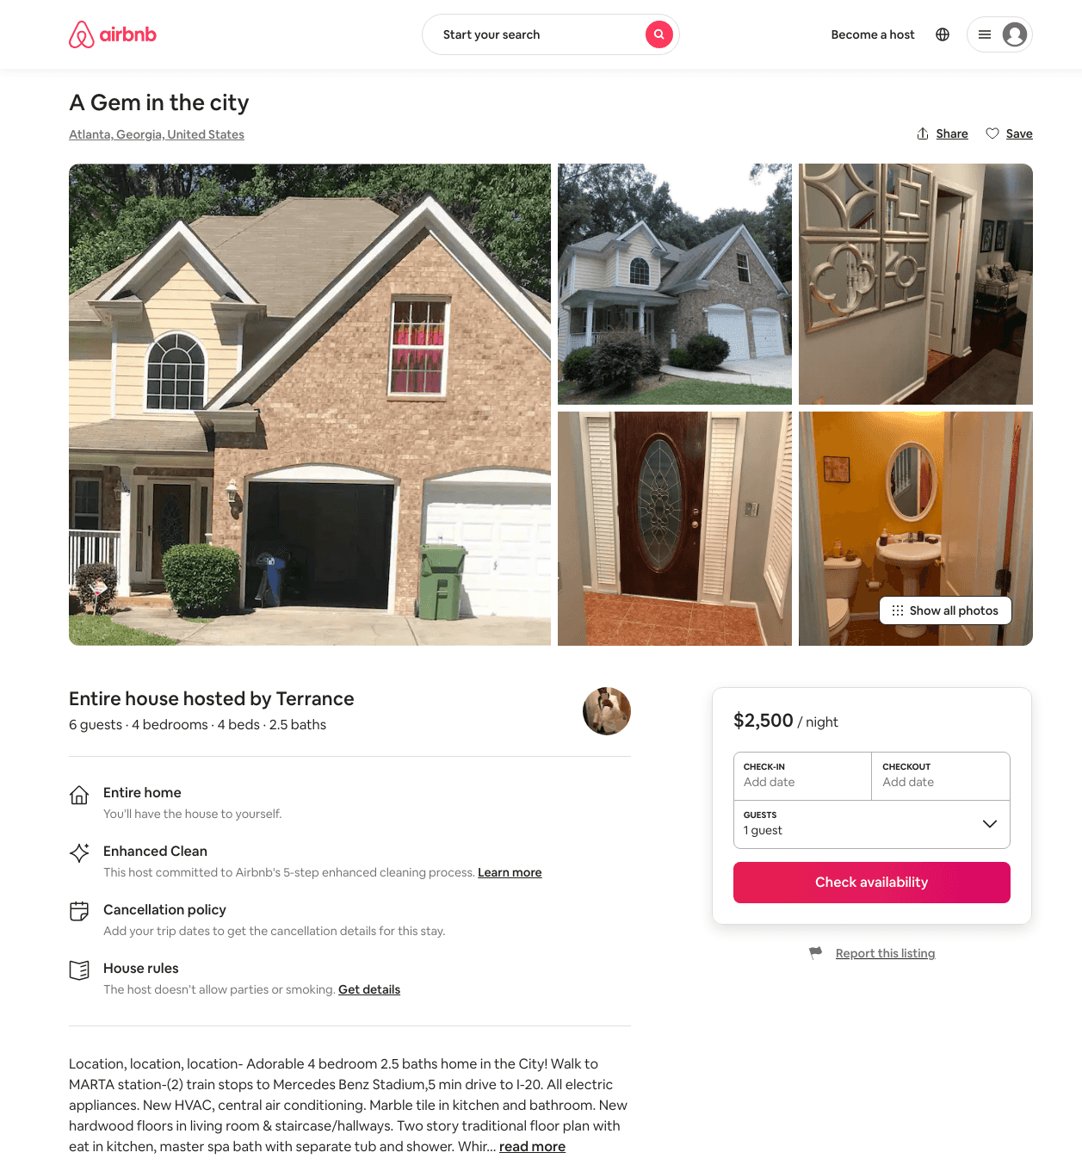
Listing 31598093
4
6
$2500
1
Terrance
231008233
1
https://www.airbnb.com/rooms/31598093
Aug 2022

Slide 5
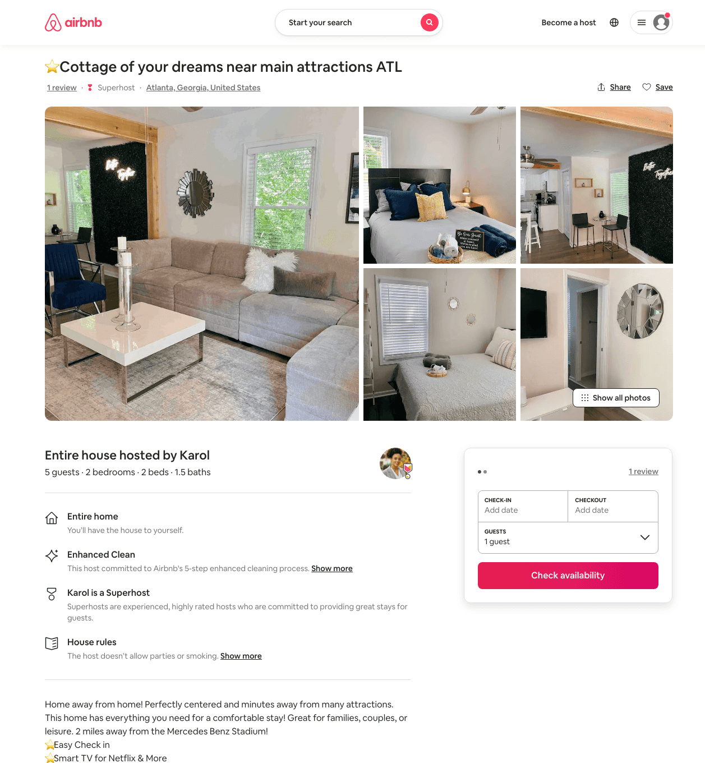
Listing 49531796
2
6
$96 - $195
4.86
1
Karol
64976928
4
https://www.airbnb.com/rooms/49531796
Aug 2022

Slide 6
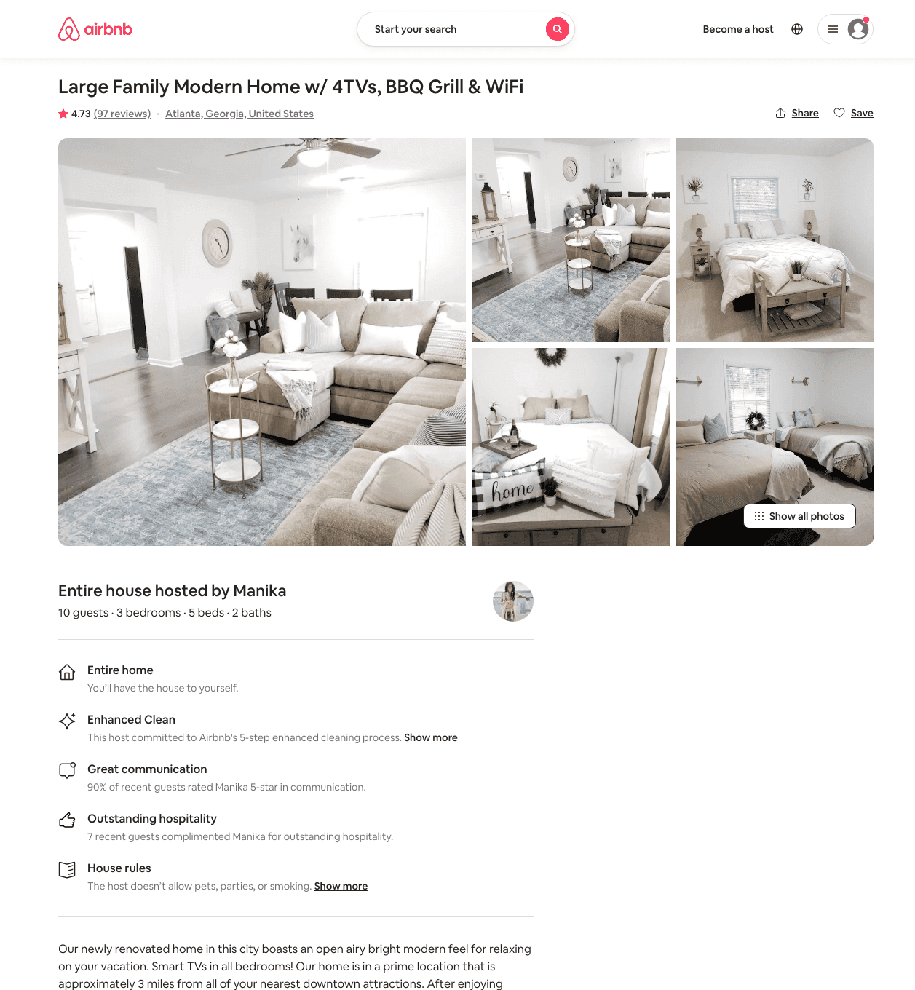
Listing 33290388
3
10
$122 - $278
4.54
2
Manika
49819100
11
https://www.airbnb.com/rooms/33290388
Aug 2022

Slide 7
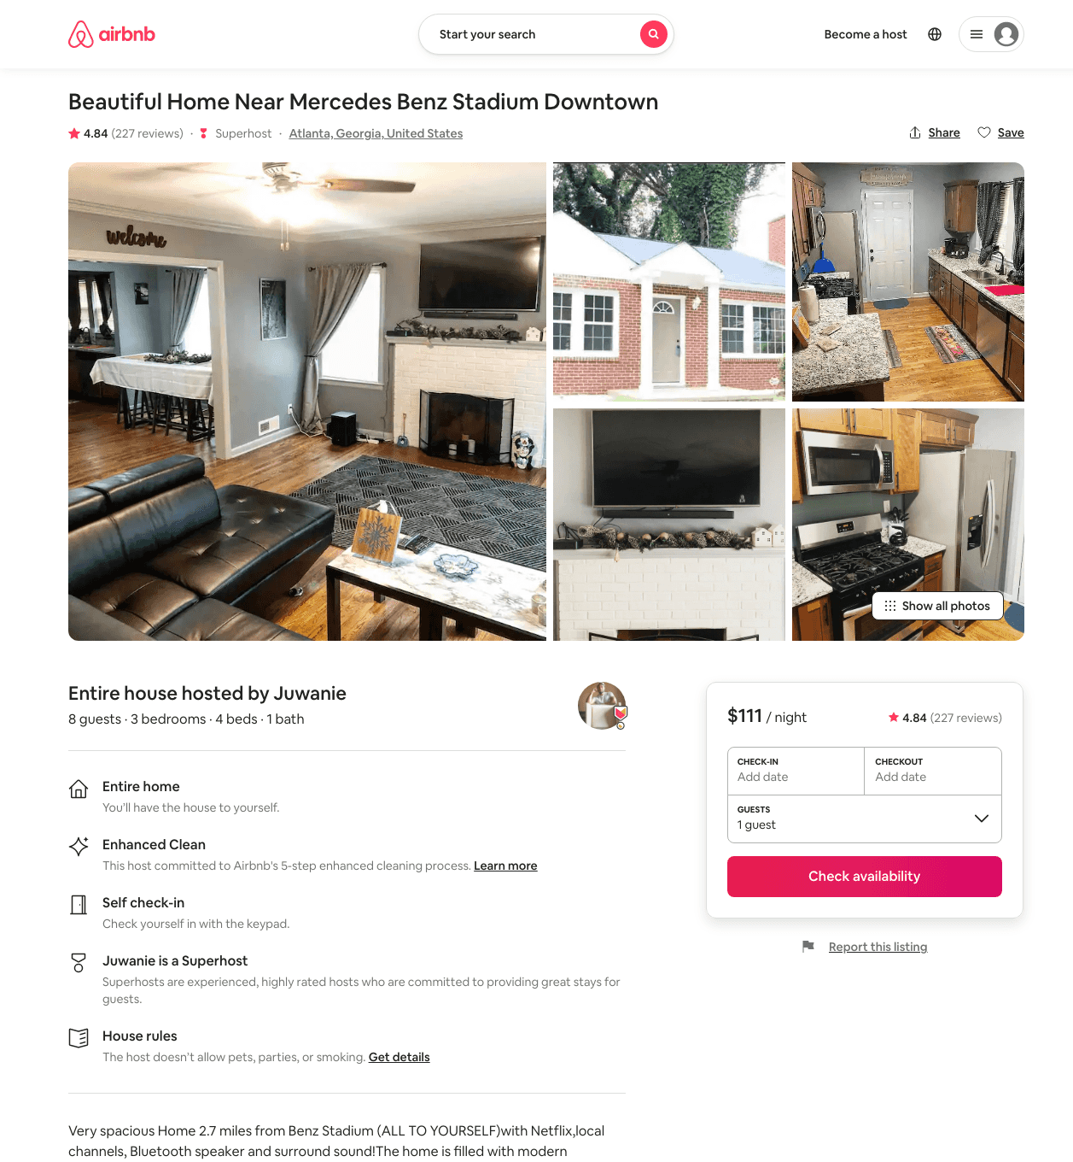
Listing 29739635
3
8
$111 - $150
4.74
1
Juwanie
70310350
3
https://www.airbnb.com/rooms/29739635
Aug 2022

Slide 8
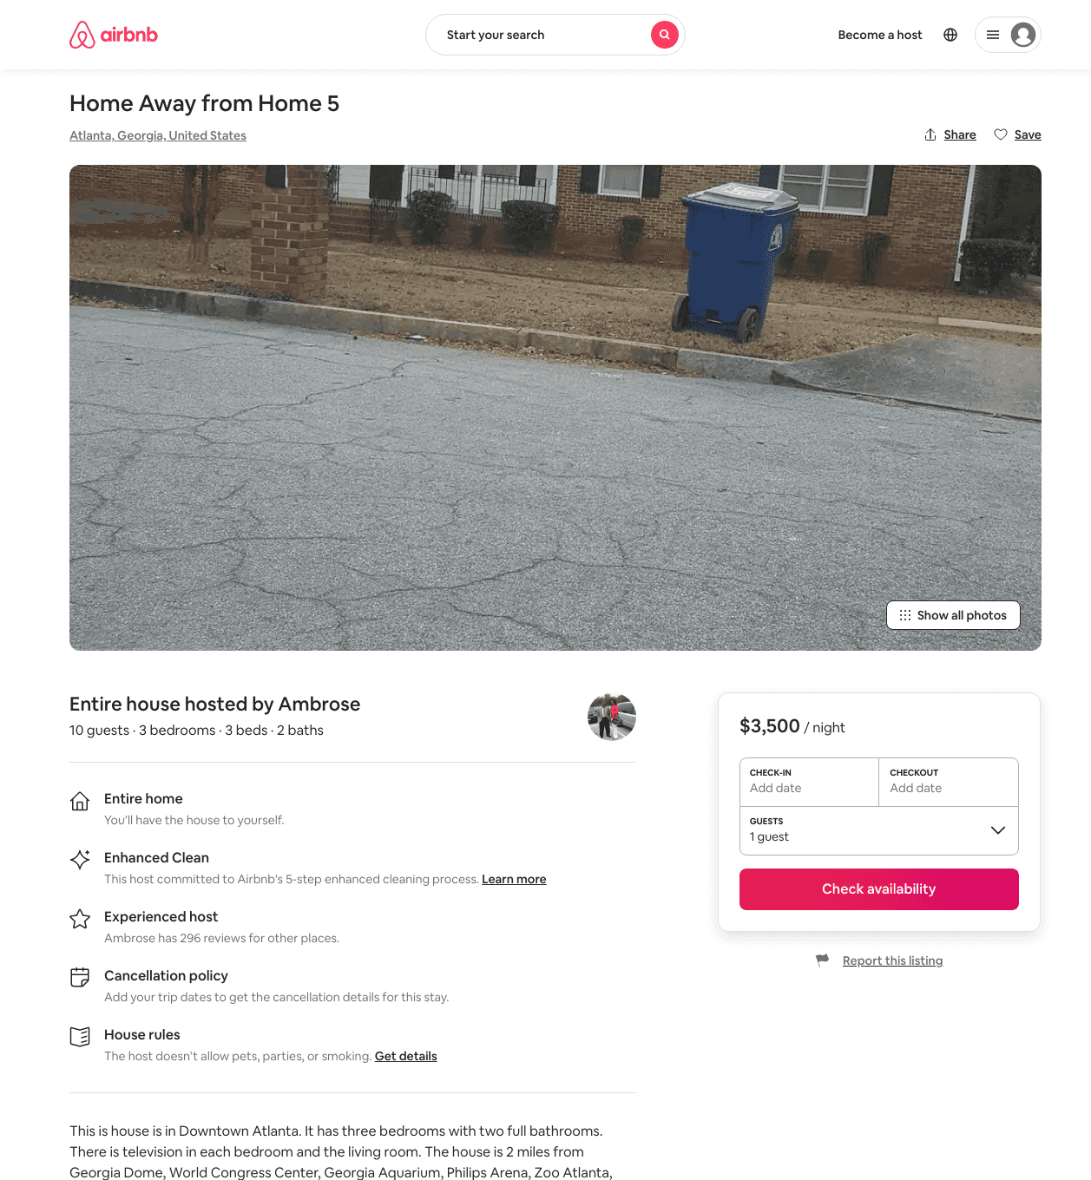
Listing 31652554
3
10
$3500
3
Ambrose
2492202
3
https://www.airbnb.com/rooms/31652554
Aug 2022

Slide 9
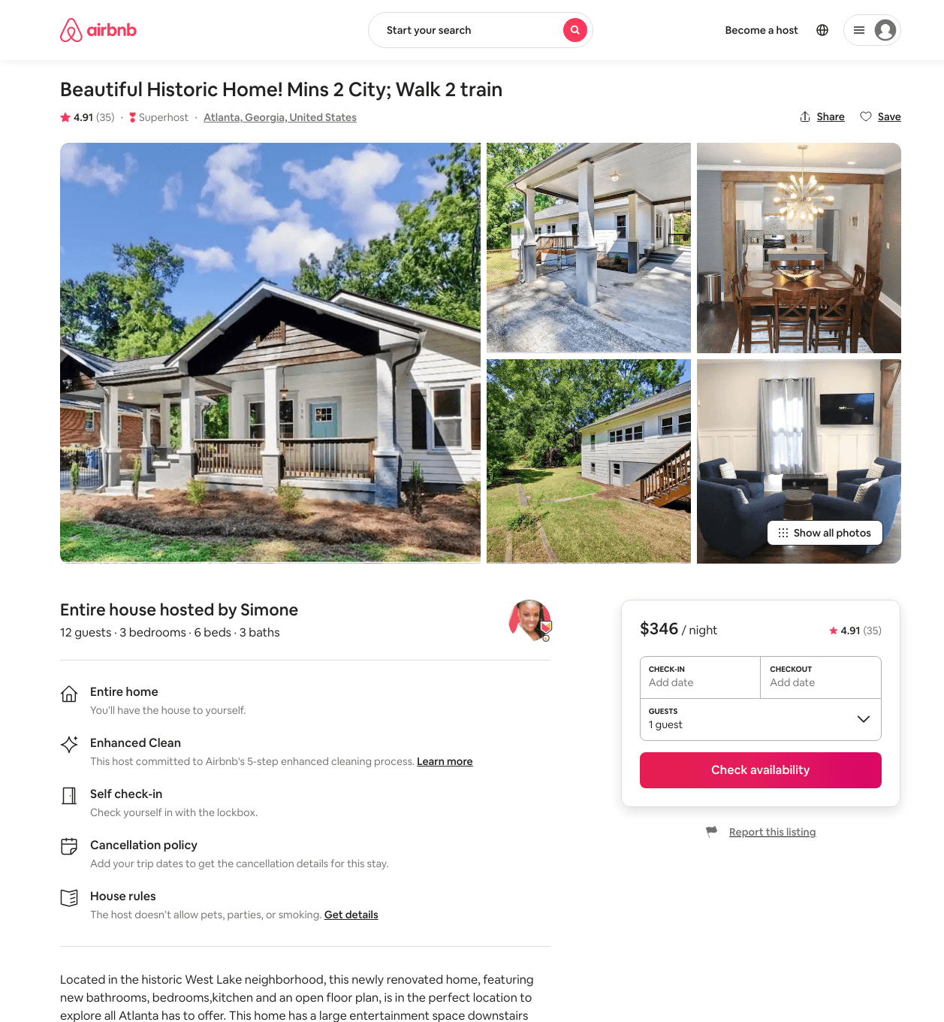
Listing 39923816
3
12
$222 - $415
4.92
2
Simone
132654896
1
https://www.airbnb.com/rooms/39923816
Aug 2022

Slide 10
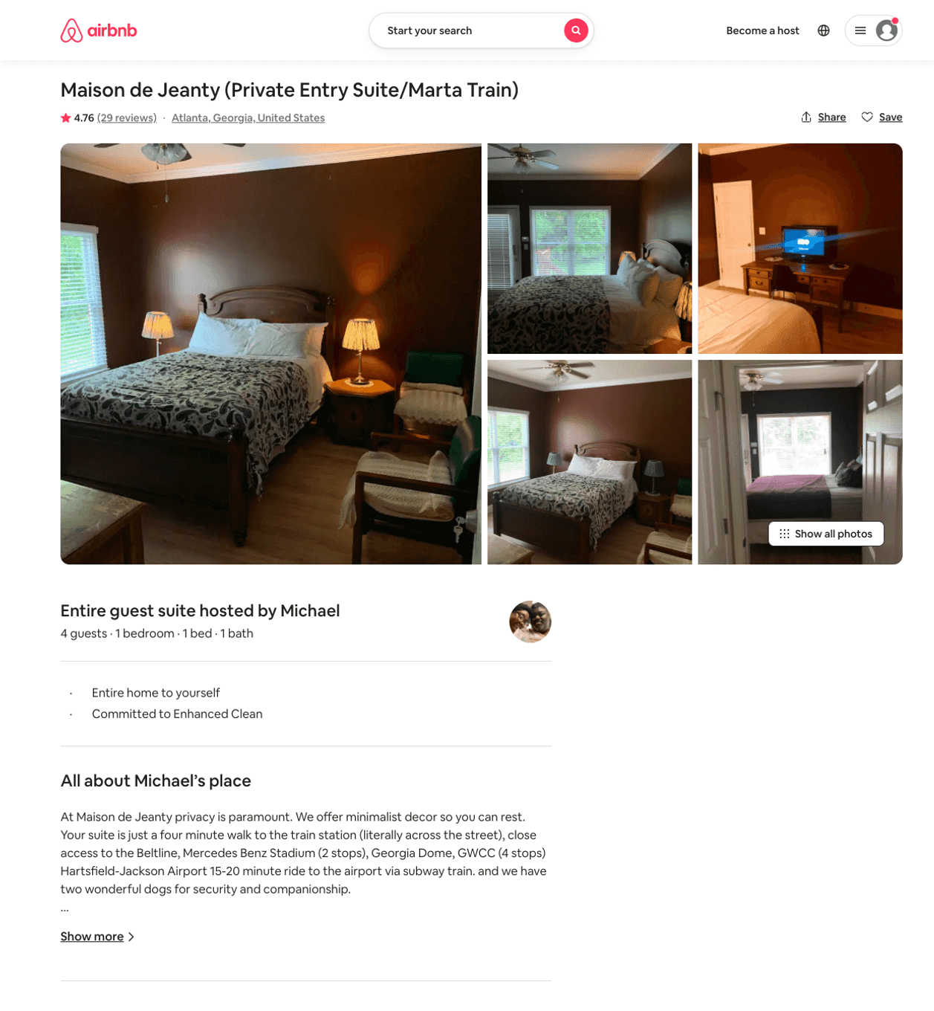
Listing 38725523
1
2
$42 - $79
4.41
1
Michael
297292970
1
https://www.airbnb.com/rooms/38725523
Jun 2022

Slide 11
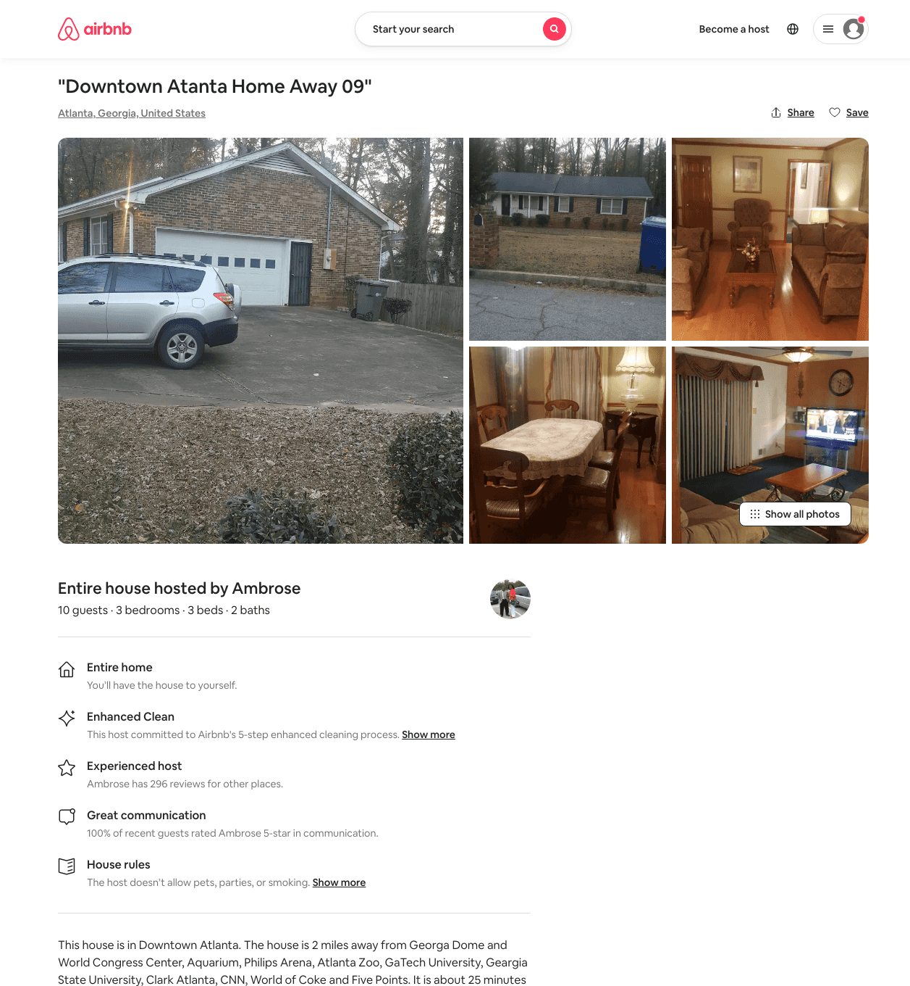
Listing 31620129
3
10
$800
5
Ambrose
2492202
3
https://www.airbnb.com/rooms/31620129
Aug 2022

Slide 12
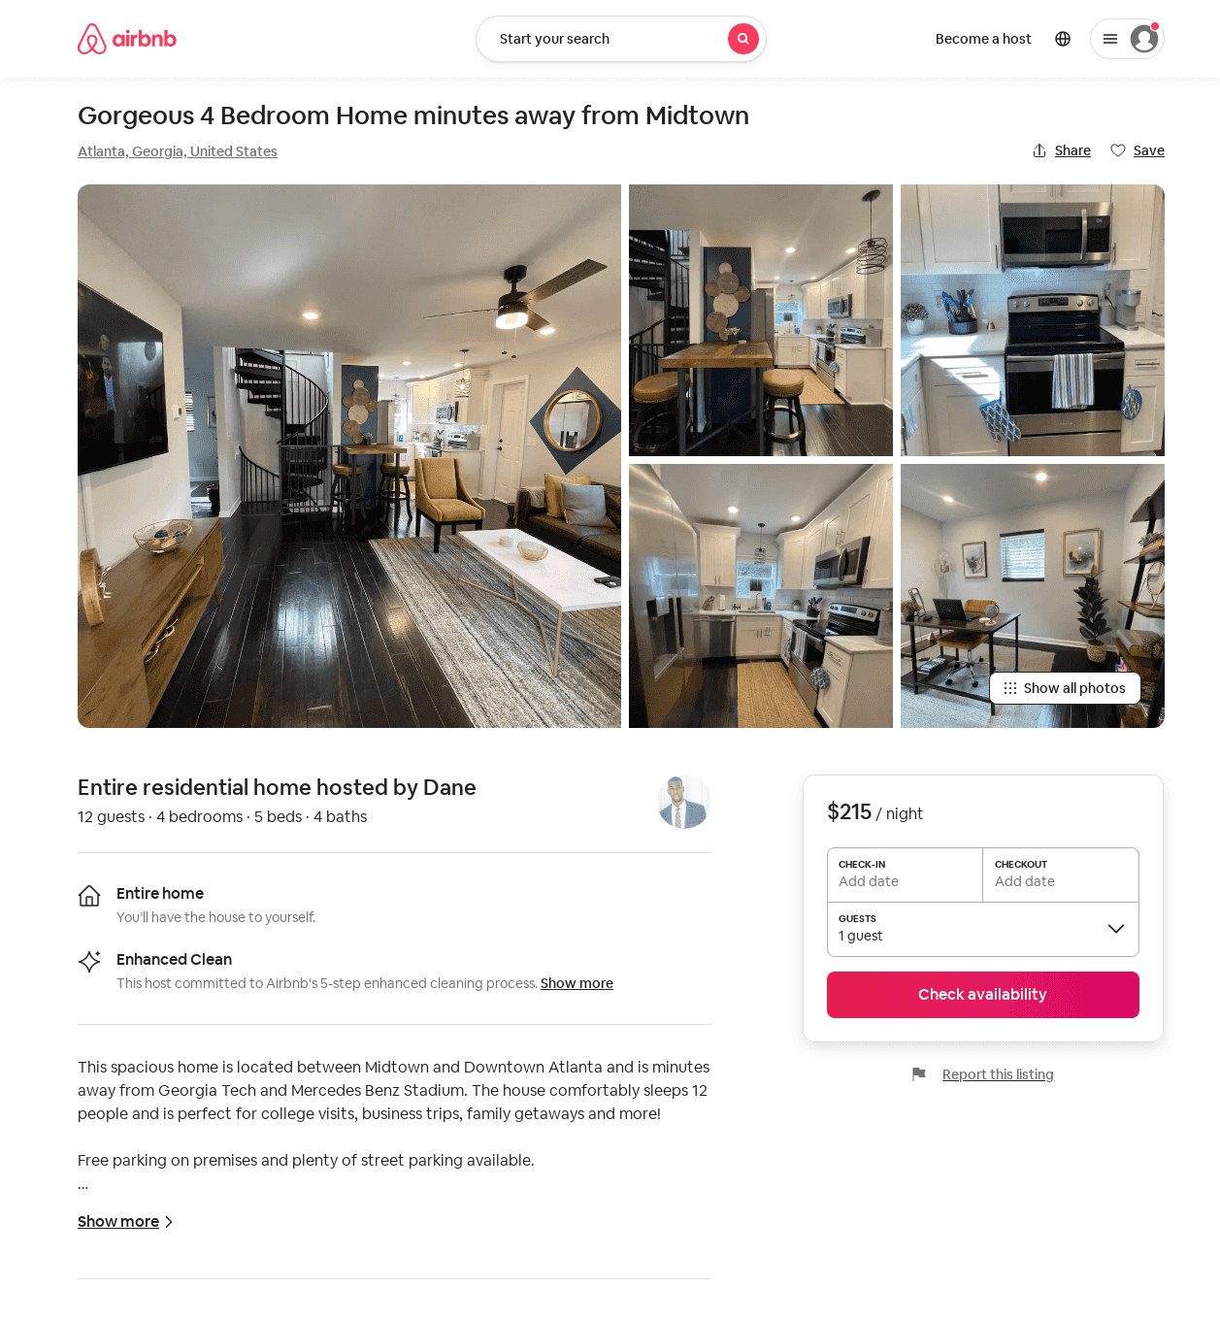
Listing 52406180
4
12
$162 - $279
4.88
2
Dane
36739421
1
https://www.airbnb.com/rooms/52406180
Jun 2022

Slide 13
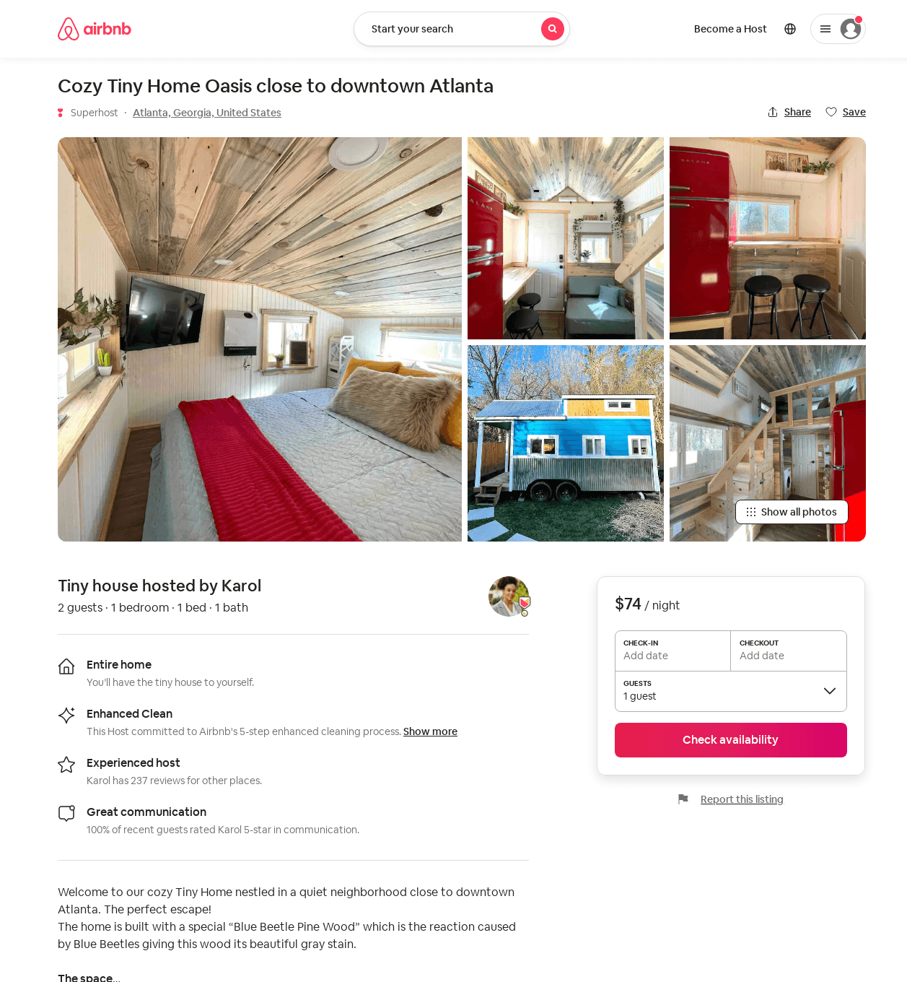
Listing 53955840
1
2
$68 - $82
4.87
1
Karol
64976928
4
https://www.airbnb.com/rooms/53955840
Aug 2022

Slide 14
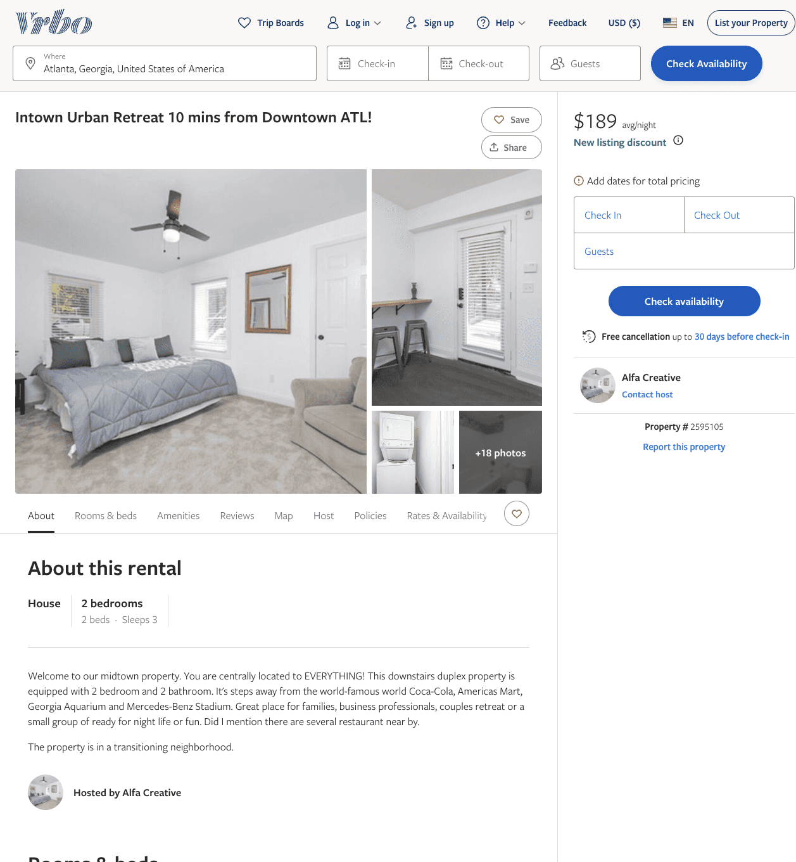
Listing 2595105
2
3
$189
3
Alfa Creative
https://www.vrbo.com/2595105
Aug 2022

Slide 15
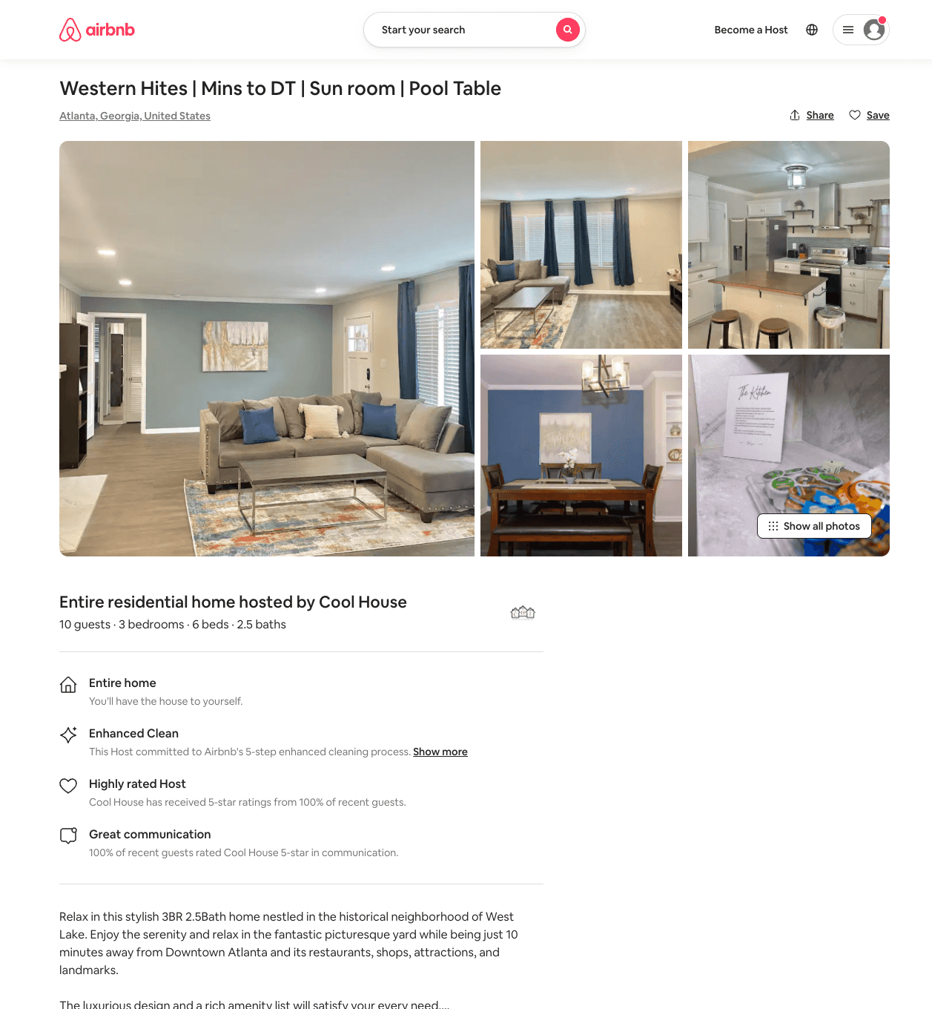
Listing 54054972
3
10
$166 - $400
4.88
1
Cool House
64585444
1
https://www.airbnb.com/rooms/54054972
Jul 2022

Slide 16
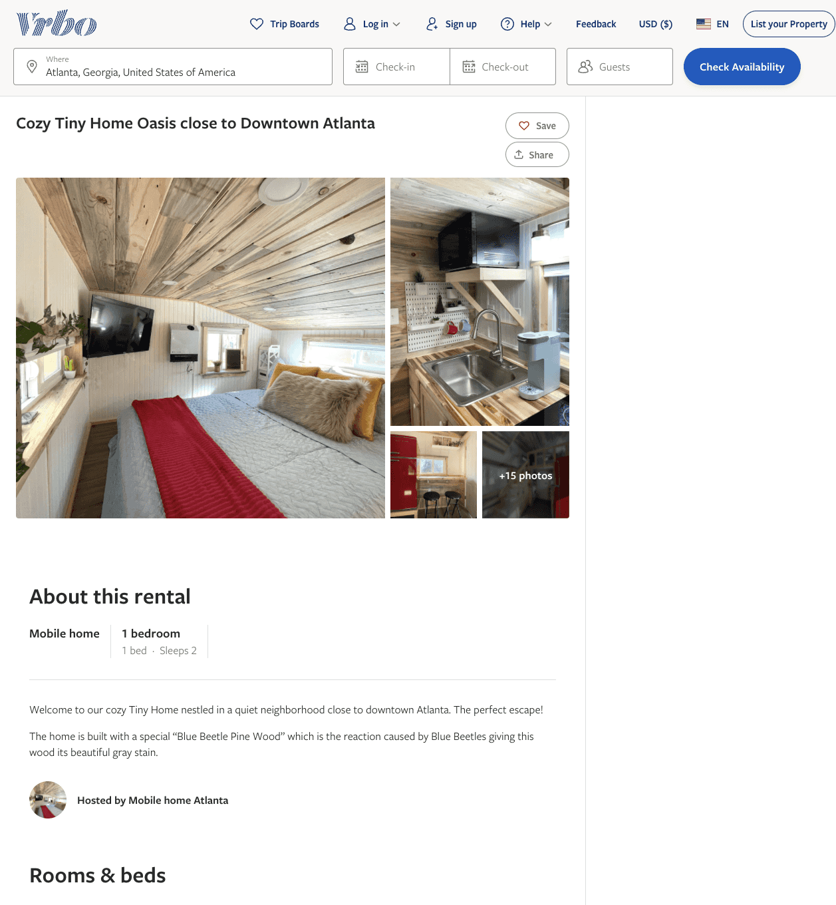
Listing 2605237
1
2
$120 - $79
2
Karol Jimenez
https://www.vrbo.com/2605237
Aug 2022

Slide 17
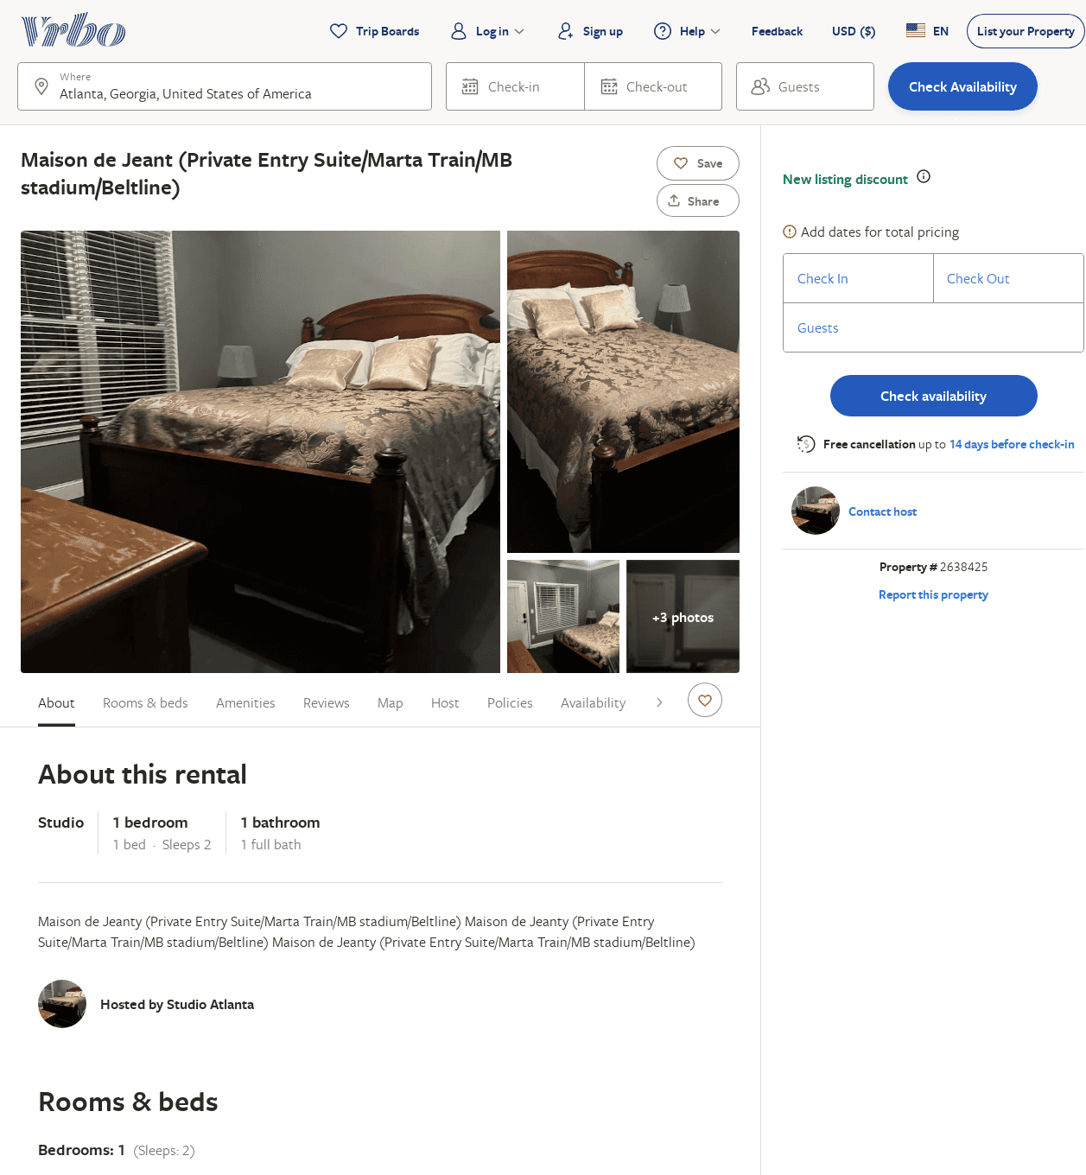
Listing 2638425
1
2
$49
5
1
https://www.vrbo.com/2638425
Aug 2022

Slide 18
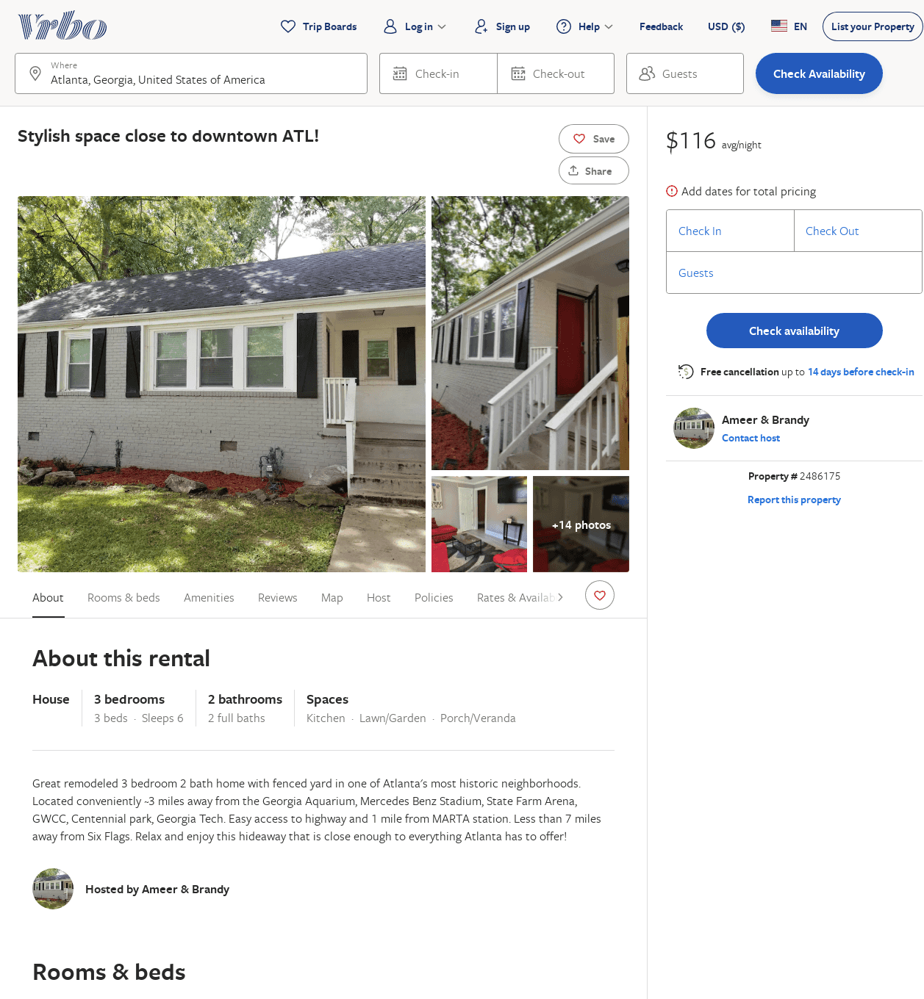
Listing 2486175
3
6
$116
2
Ameer & Brandy
https://www.vrbo.com/2486175
Aug 2022

Slide 19
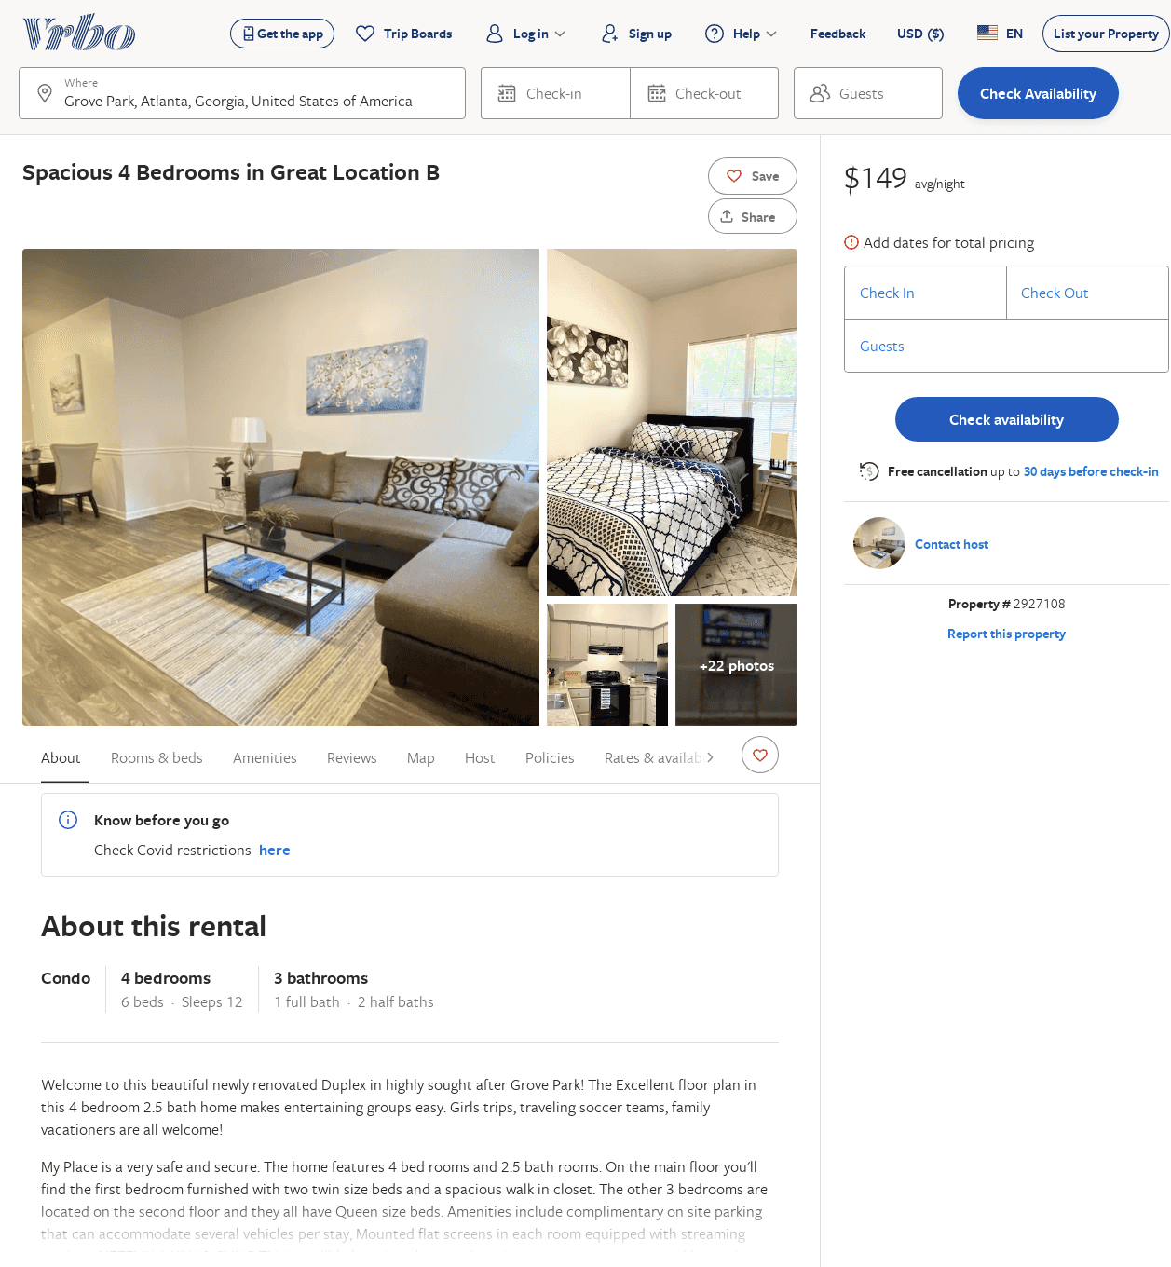
Listing 2927108
4
12
$149
2
https://www.vrbo.com/2927108
Aug 2022

