Slide 2
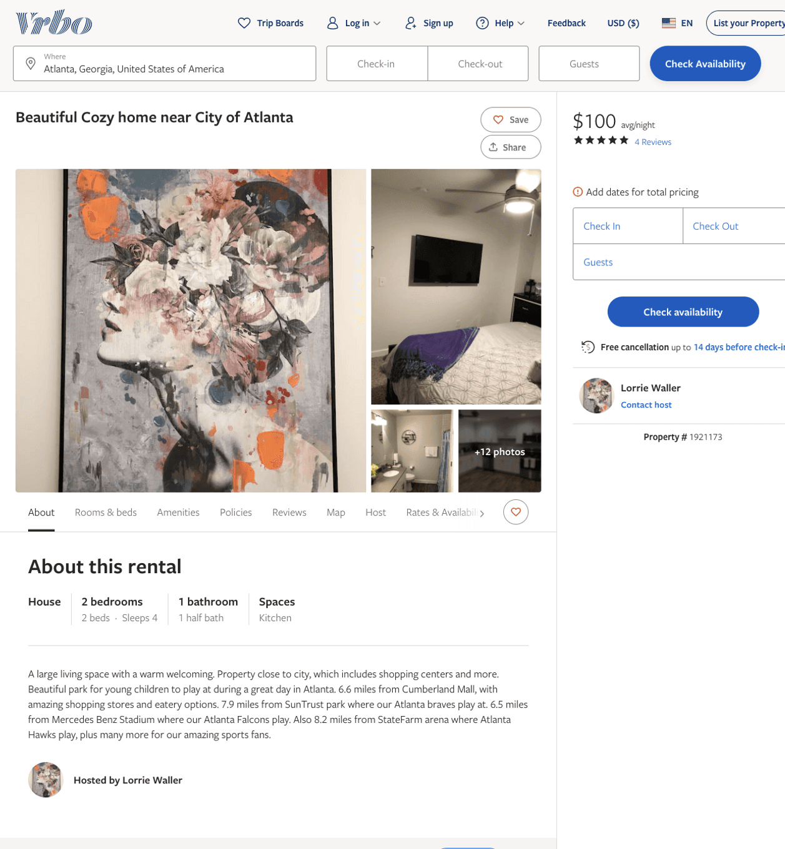
Listing 1921173
2
4
$100 - $99
4.888889
2
Lorrie Waller
https://www.vrbo.com/1921173
Aug 2022

