Slide 2
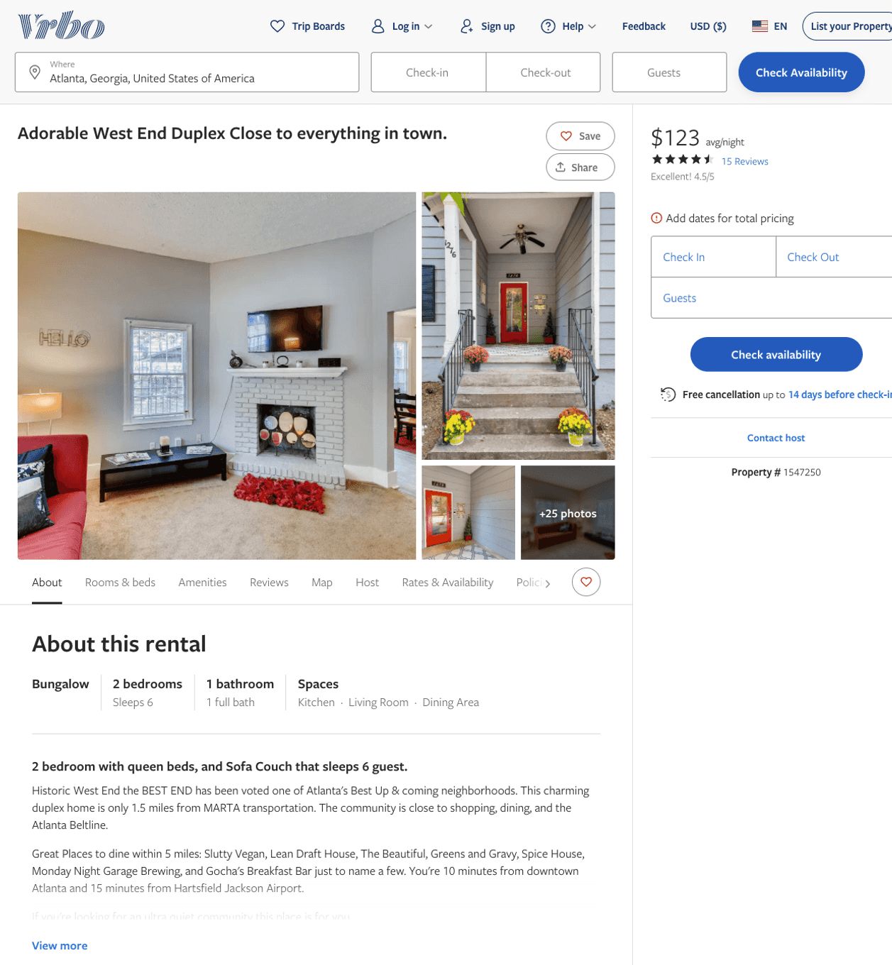
Listing 1547250
2
6
$110 - $95
4.529412
2
https://www.vrbo.com/1547250
Aug 2022

Slide 3
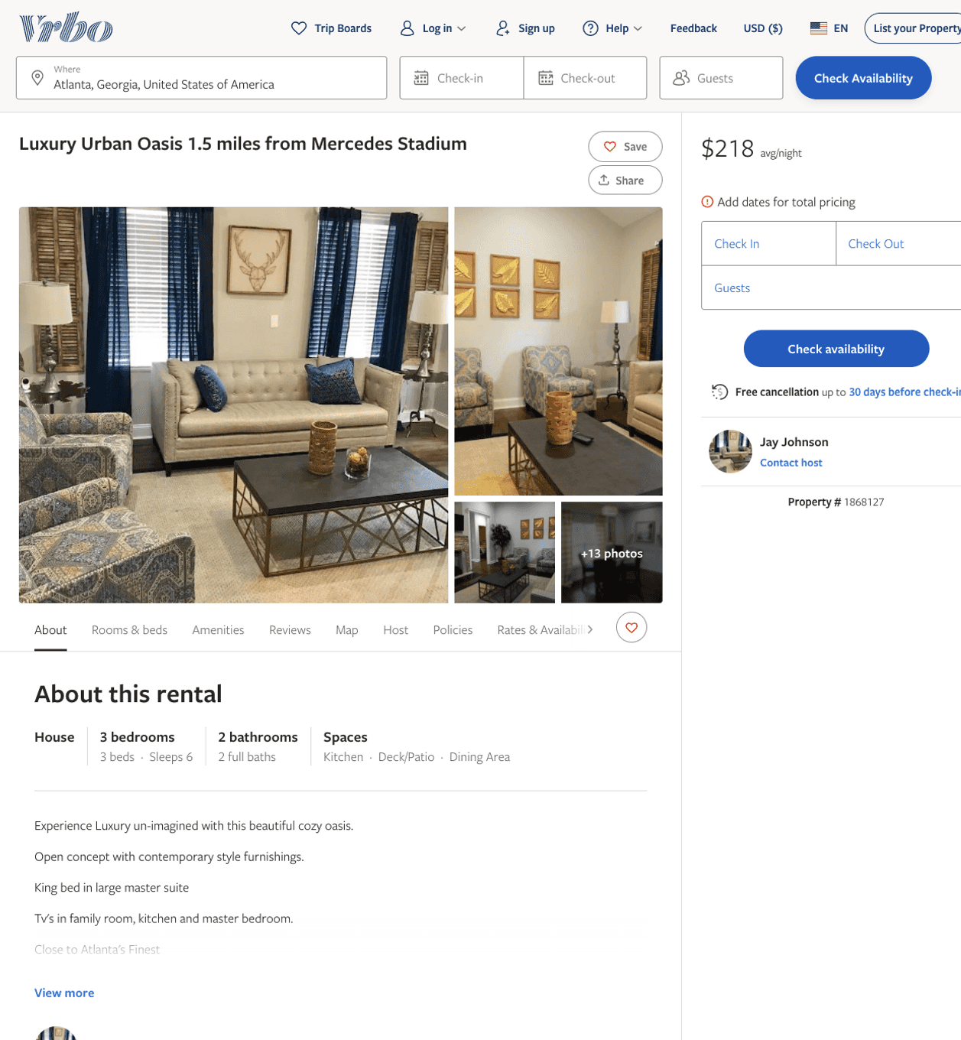
Listing 1868127
3
6
$218 - $239
2
Jay Johnson
https://www.vrbo.com/1868127
Aug 2022

Slide 4
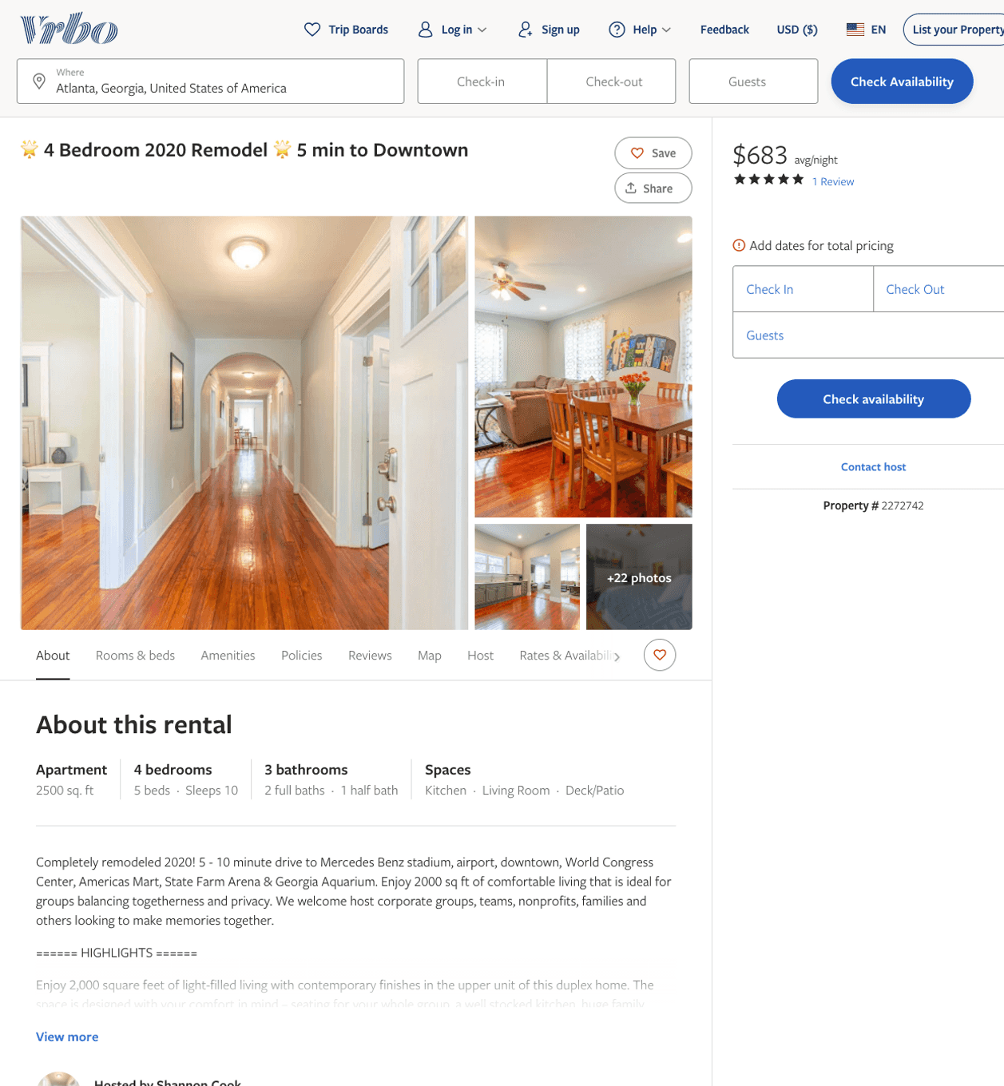
Listing 2272742
6
10
$444 - $720
4.75
1
Shannon Cook
https://www.vrbo.com/2272742
Aug 2022

Slide 5
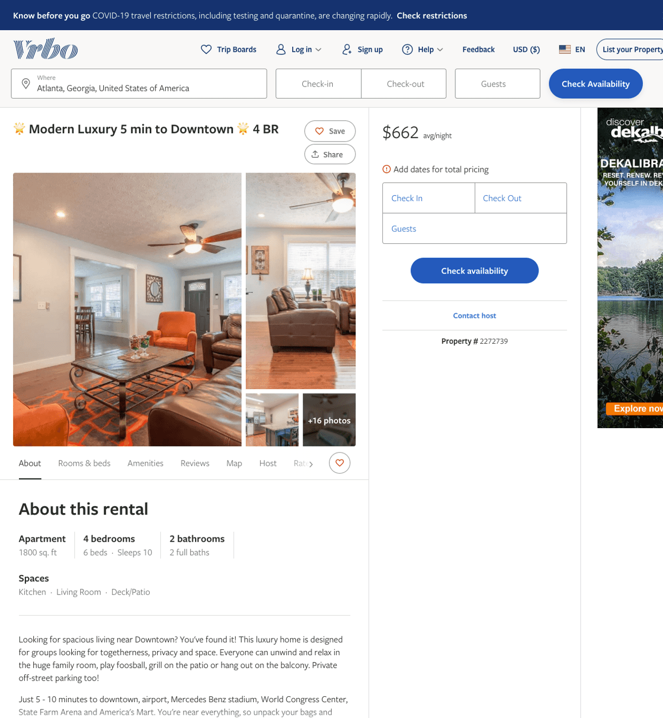
Listing 2272739
4
10
$420 - $730
4.5
1
Shannon Cook
https://www.vrbo.com/2272739
Aug 2022

Slide 6
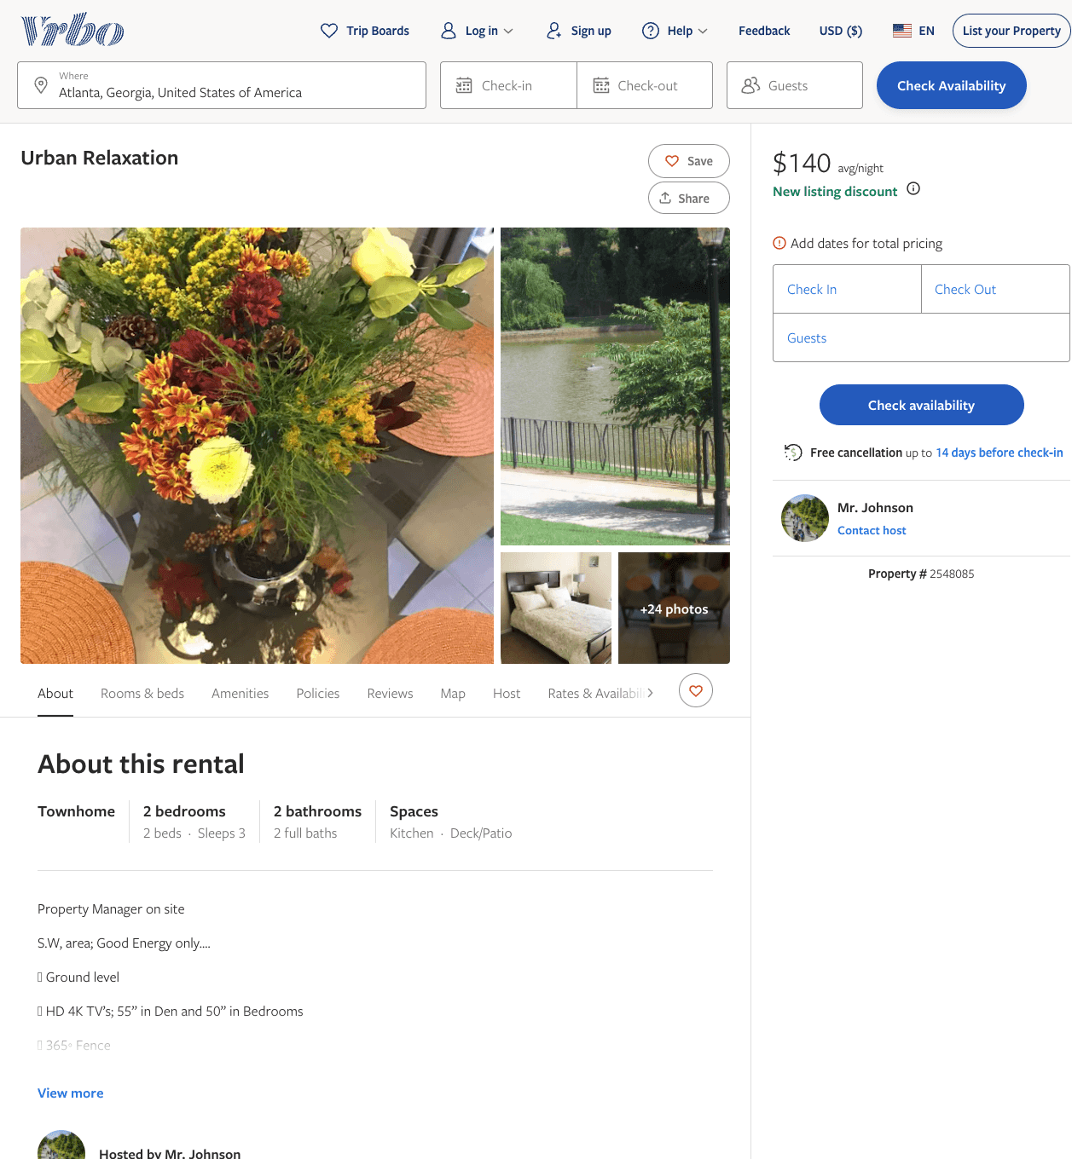
Listing 2548085
2
3
$140
5
2
Mr. Johnson
https://www.vrbo.com/2548085
Aug 2022

Slide 7
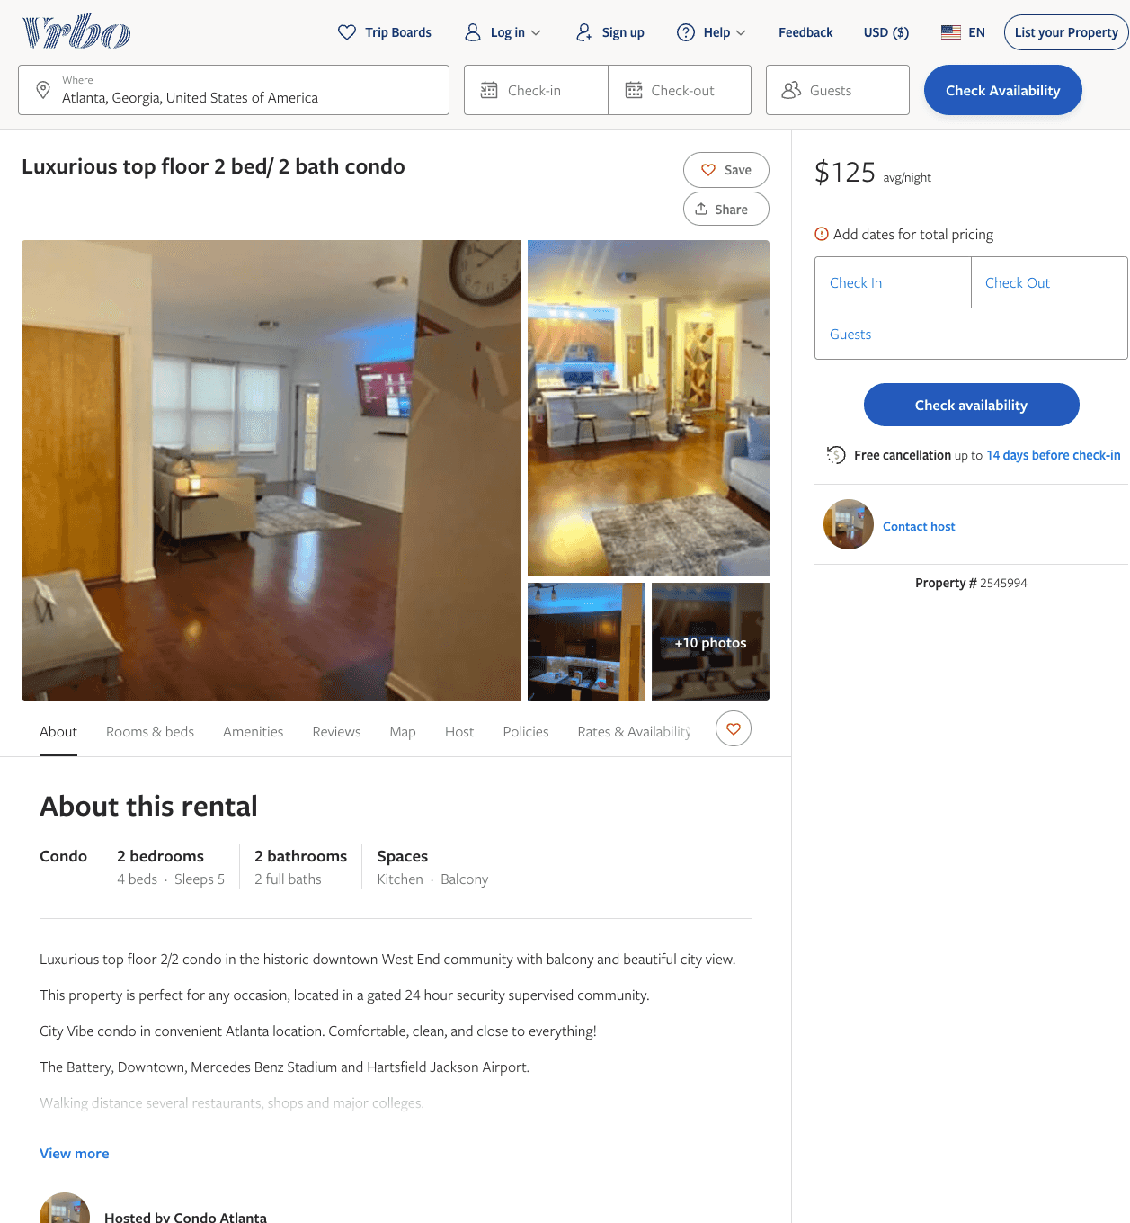
Listing 2545994
2
5
$125 - $132
2
Deniece
https://www.vrbo.com/2545994
Aug 2022

Slide 8
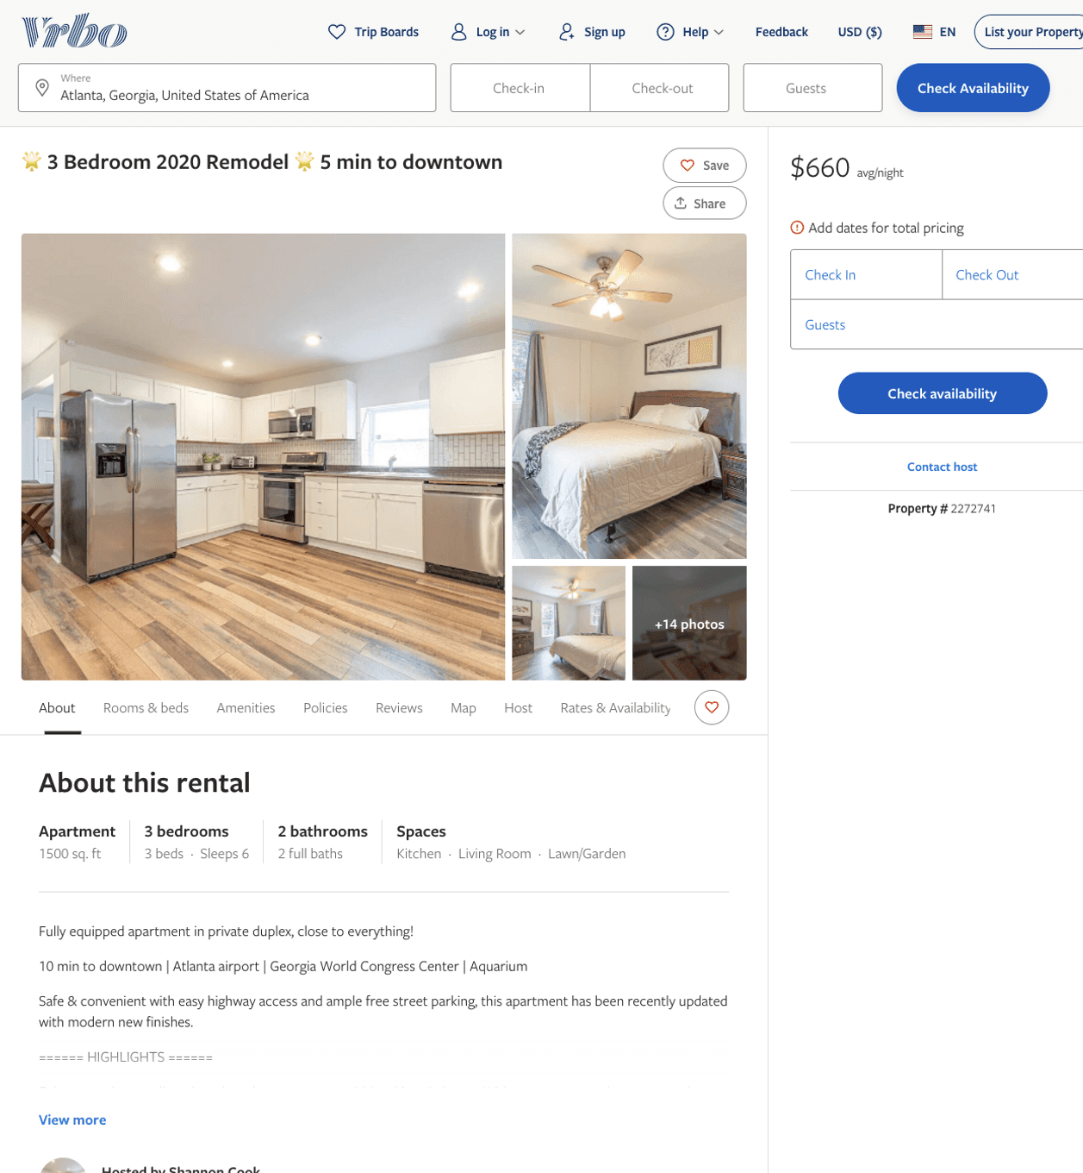
Listing 2272741
3
6
$428 - $705
1
Shannon Cook
https://www.vrbo.com/2272741
Aug 2022

Slide 9
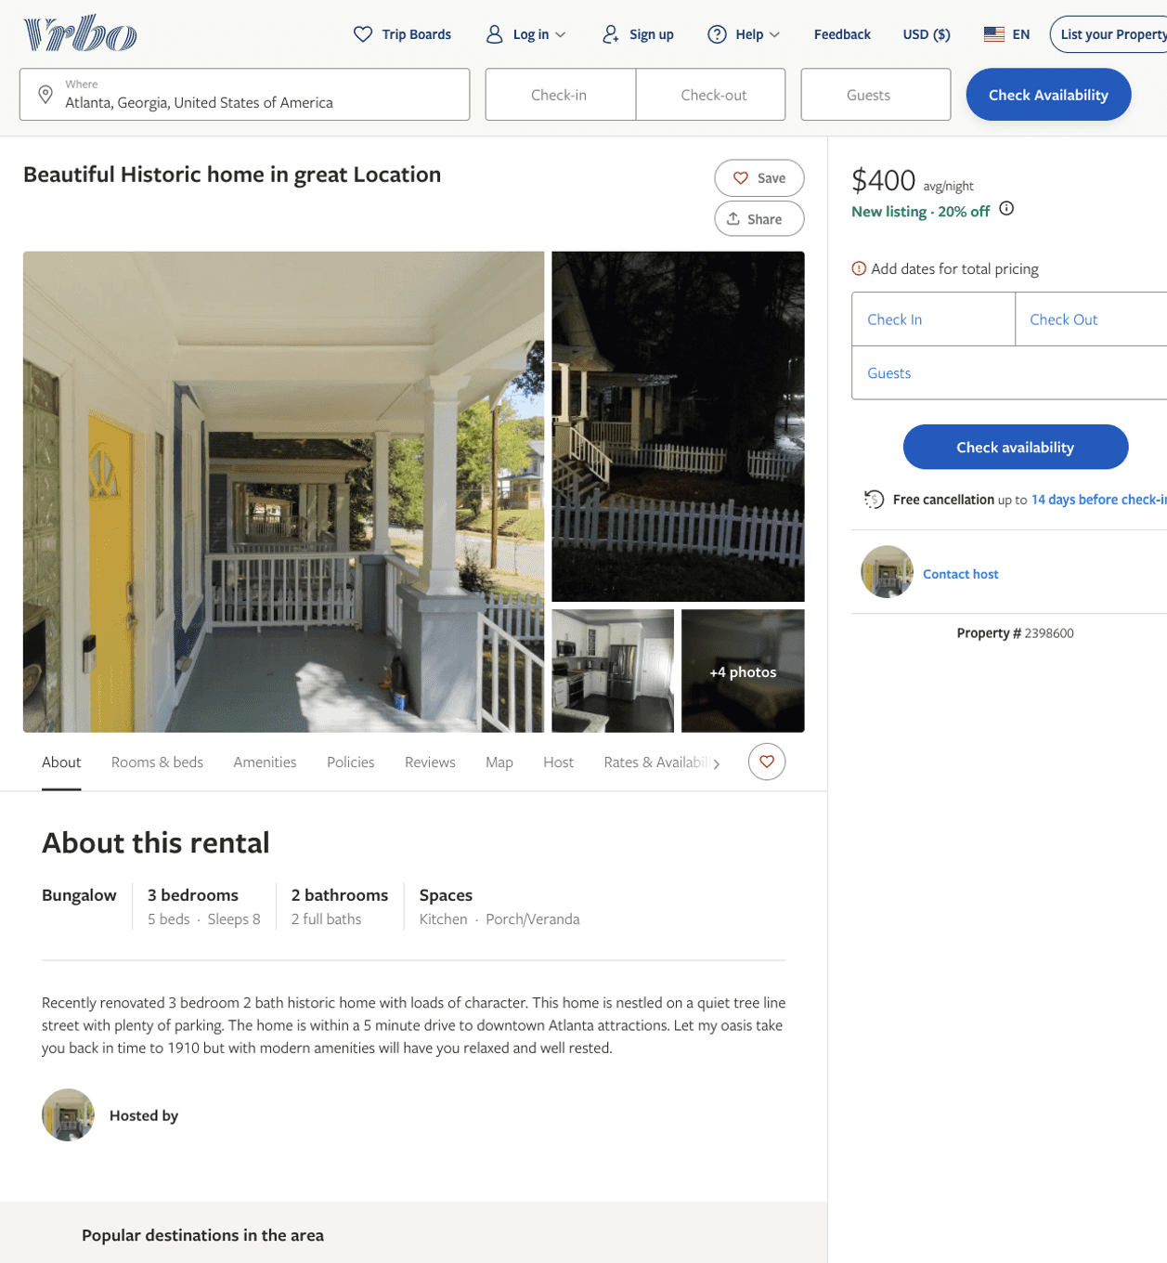
Listing 2398600
3
8
$400
2
https://www.vrbo.com/2398600
Aug 2022

Slide 10
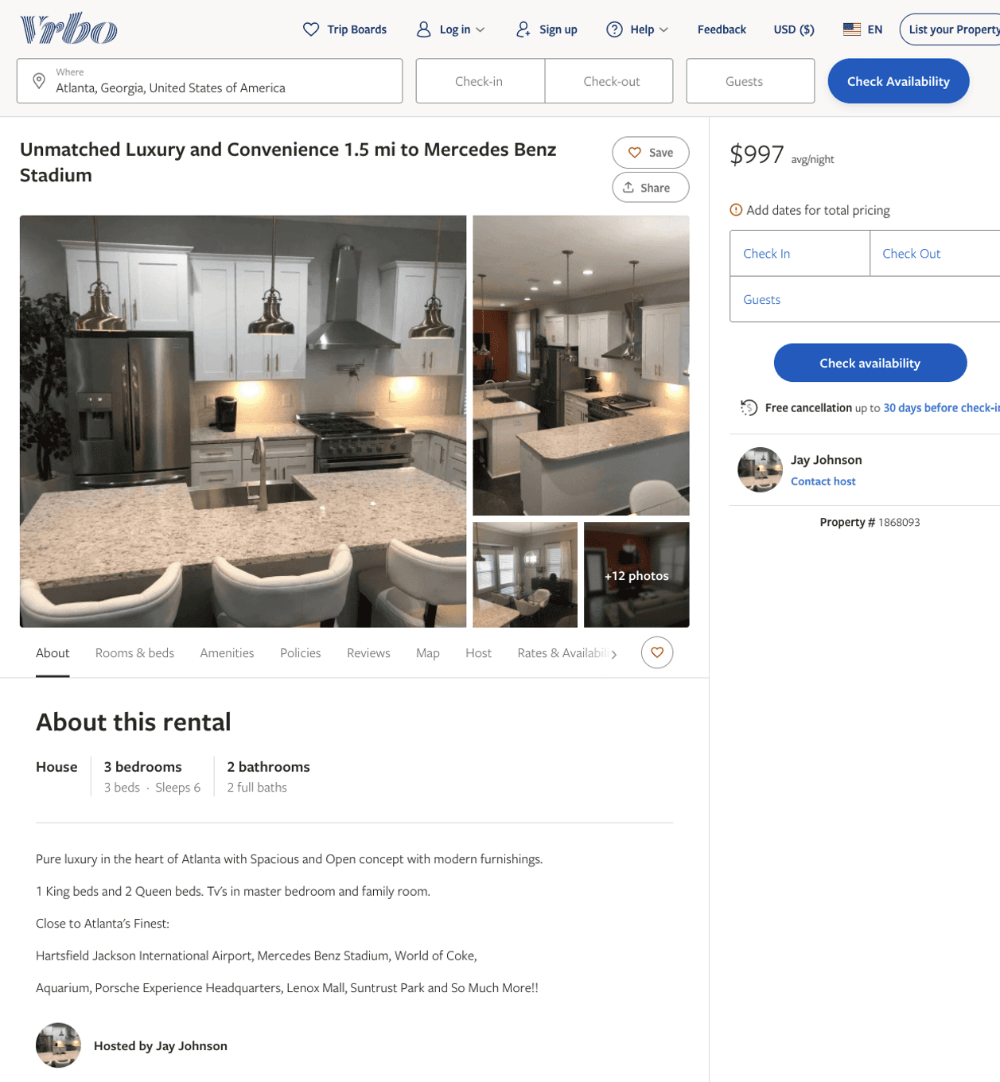
Listing 1868093
3
6
$997
2
Jay Johnson
https://www.vrbo.com/1868093
Aug 2022

Slide 11
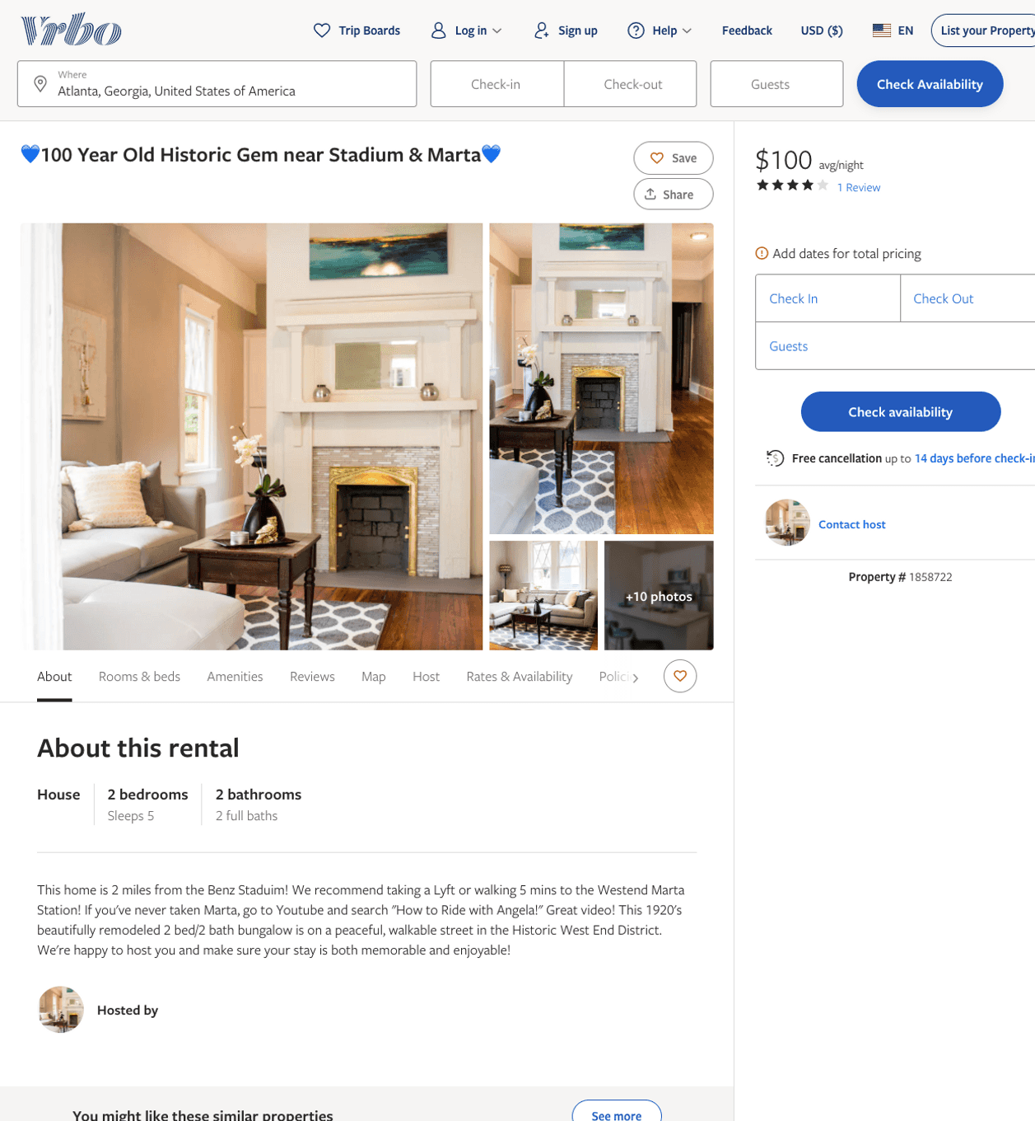
Listing 1858722
2
5
$100
4.3333335
5
https://www.vrbo.com/1858722
Aug 2022

Slide 12
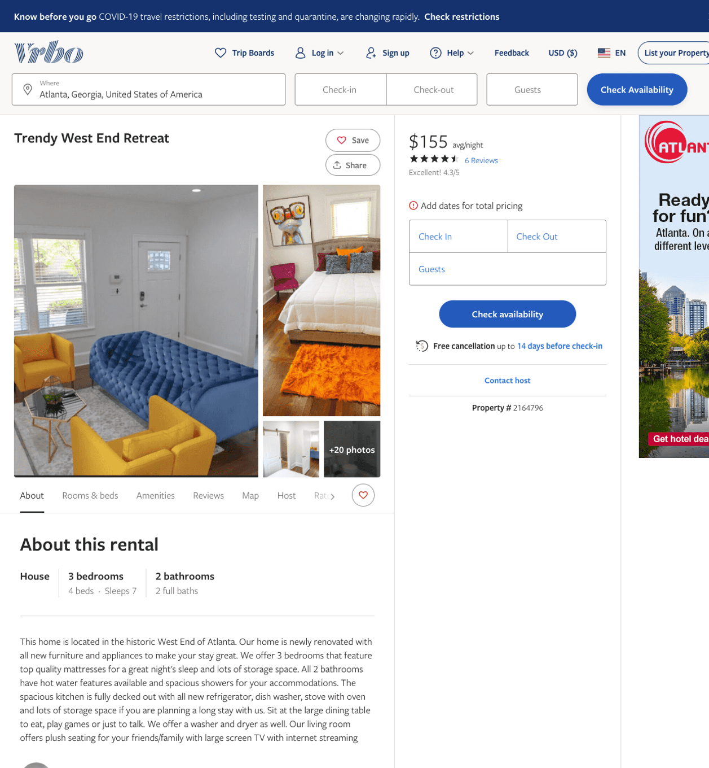
Listing 2164796
3
7
$155 - $207
4.428571
2
https://www.vrbo.com/2164796
Aug 2022

Slide 13
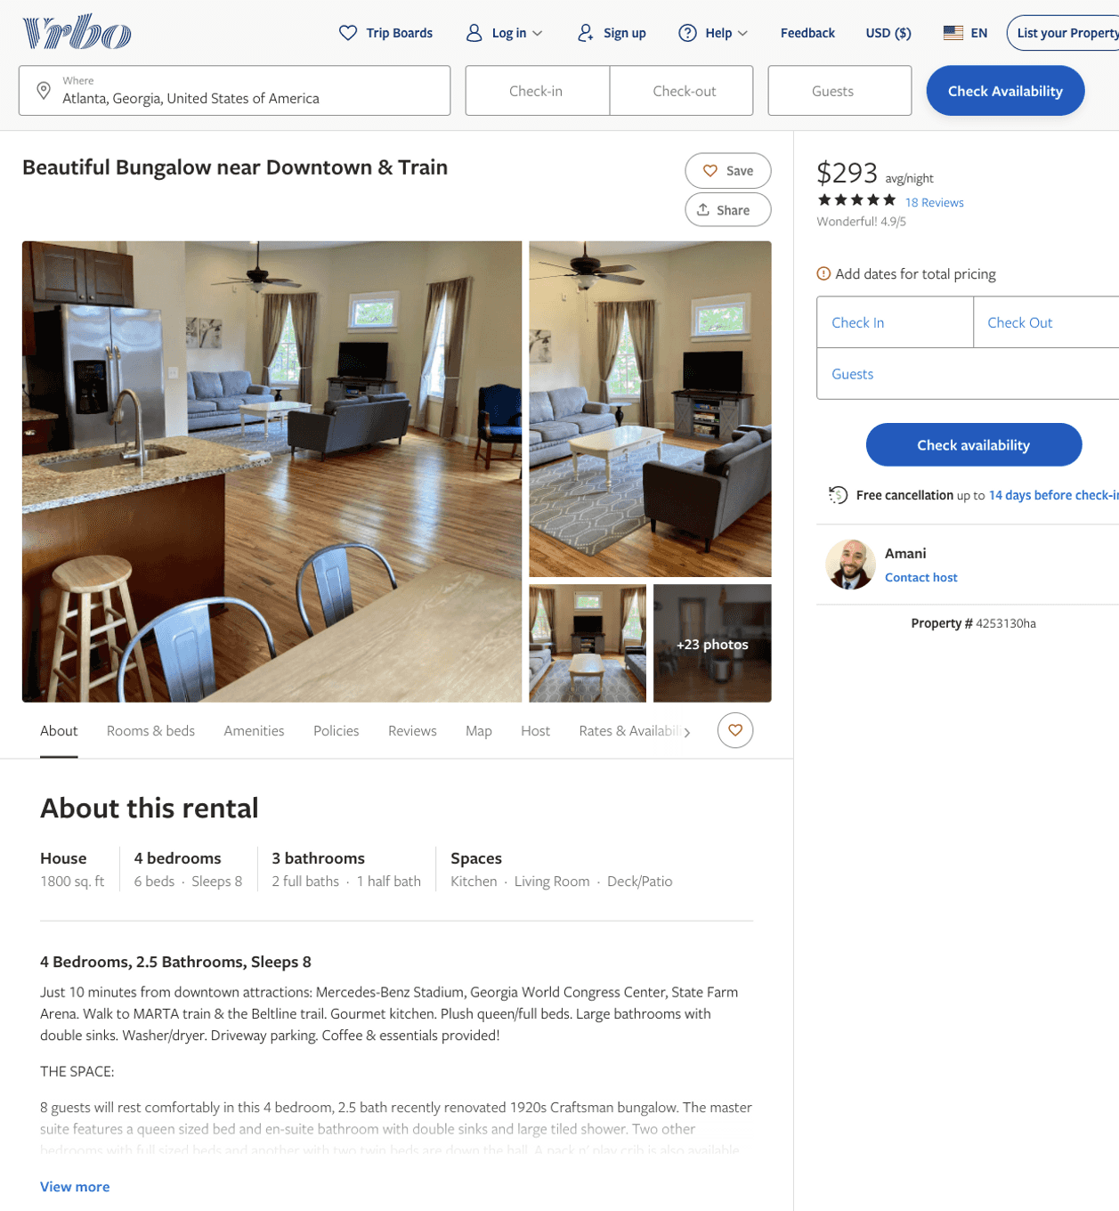
Listing 4253130
4
8
$254 - $306
4.904762
3
Amani
https://www.vrbo.com/4253130ha
Aug 2022

Slide 14
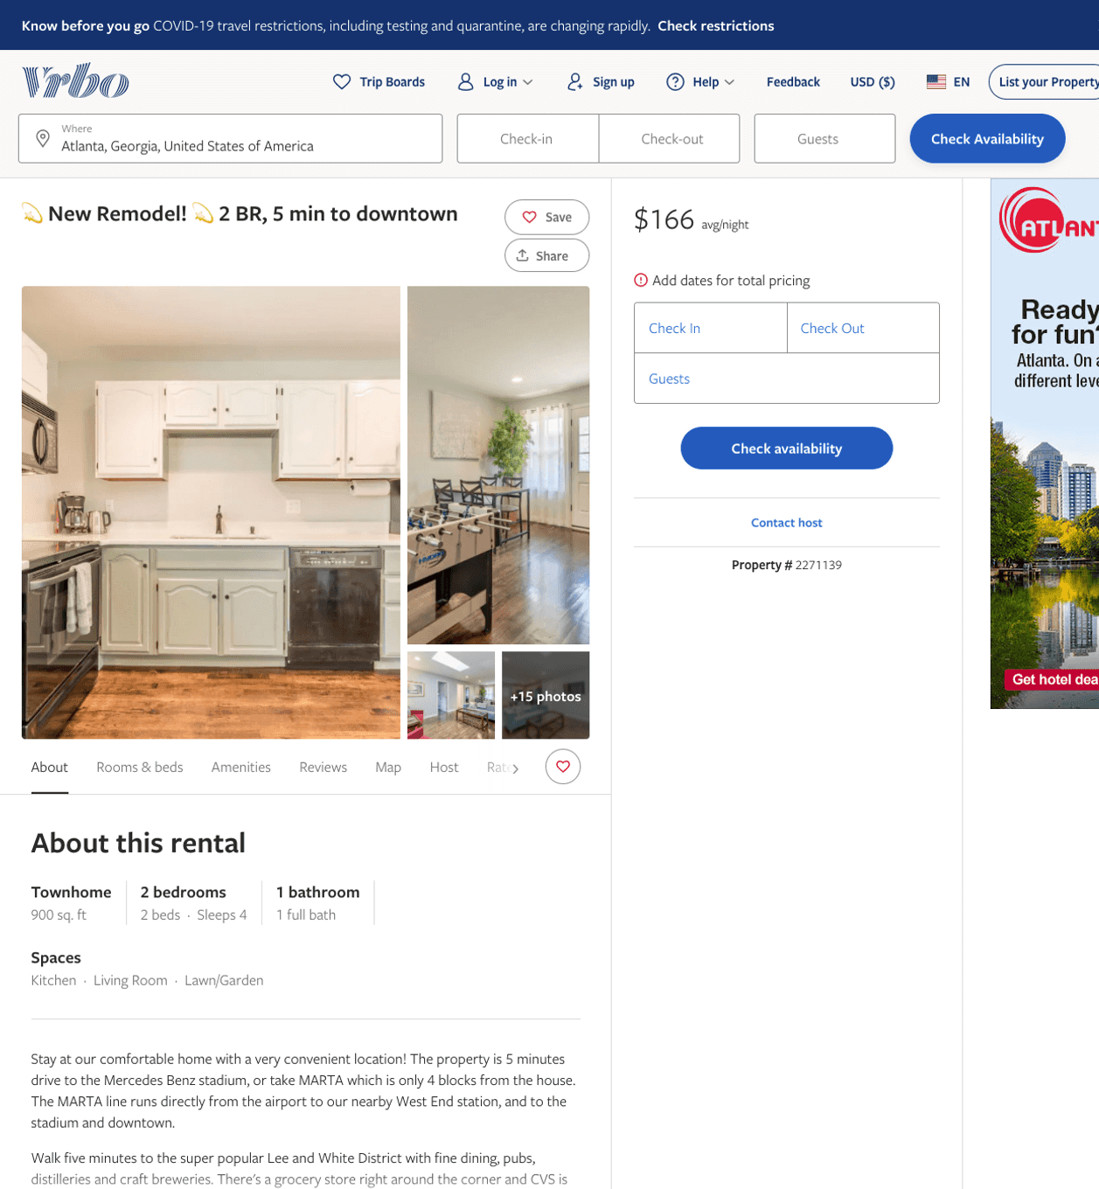
Listing 2271139
2
4
$116 - $168
4.875
1
Shannon Cook
https://www.vrbo.com/2271139
Aug 2022

Slide 15
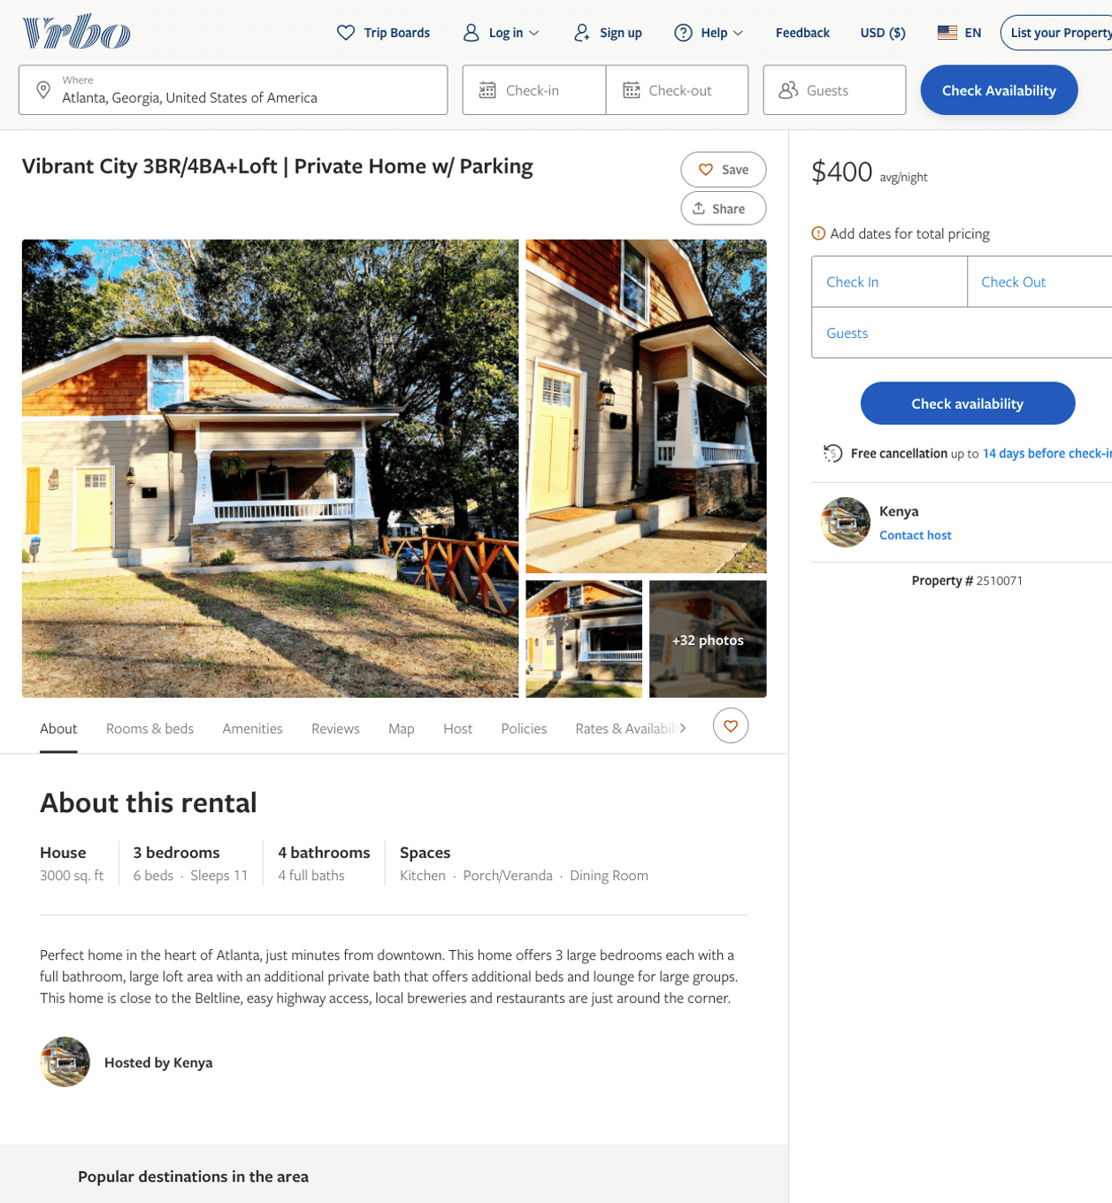
Listing 2510071
3
11
$225 - $400
4.25
2
Kenya
https://www.vrbo.com/2510071
Aug 2022

Slide 16
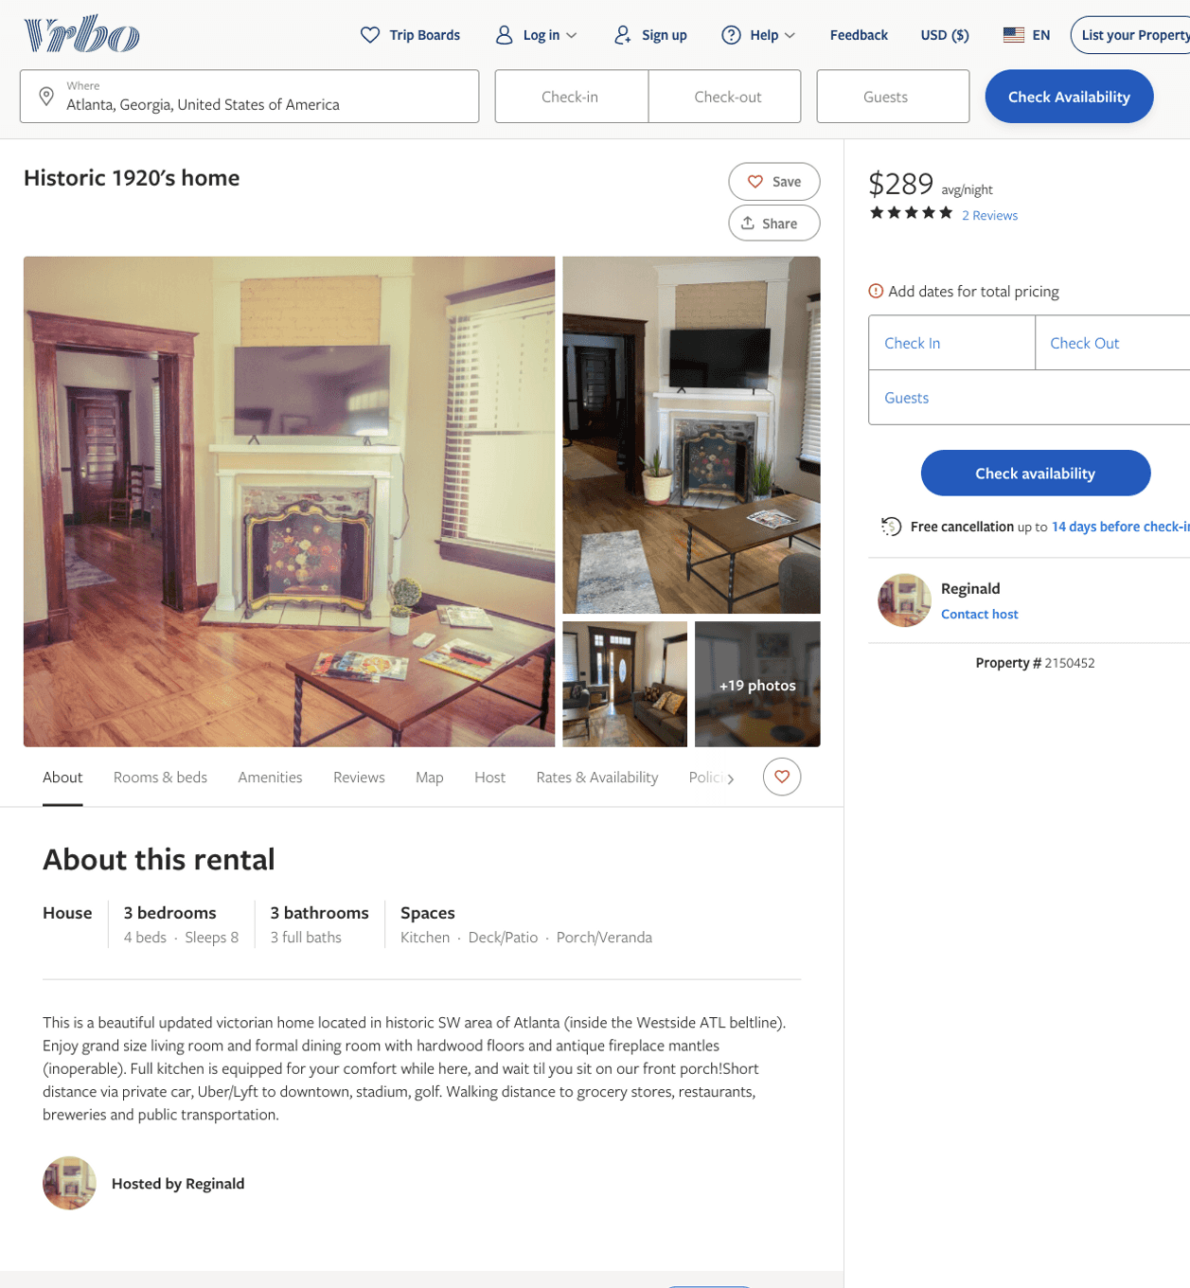
Listing 2150452
3
8
$242 - $305
4.6666665
3
Reginald
https://www.vrbo.com/2150452
Aug 2022

Slide 17
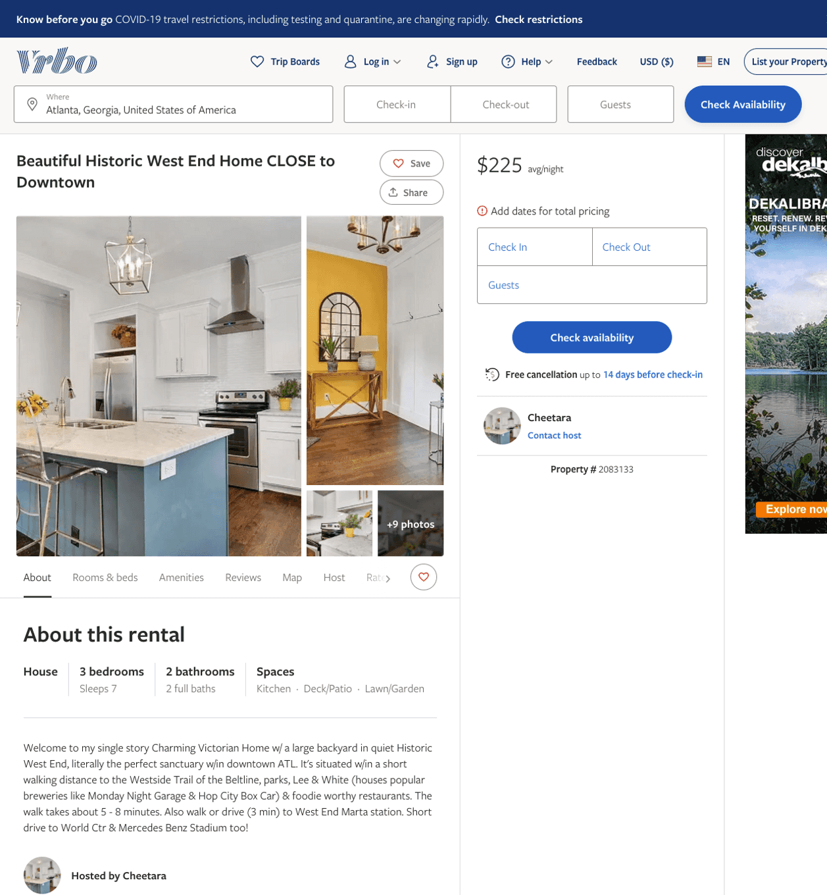
Listing 2083133
3
7
$225 - $285
2
Cheetara
https://www.vrbo.com/2083133
Aug 2022

Slide 18
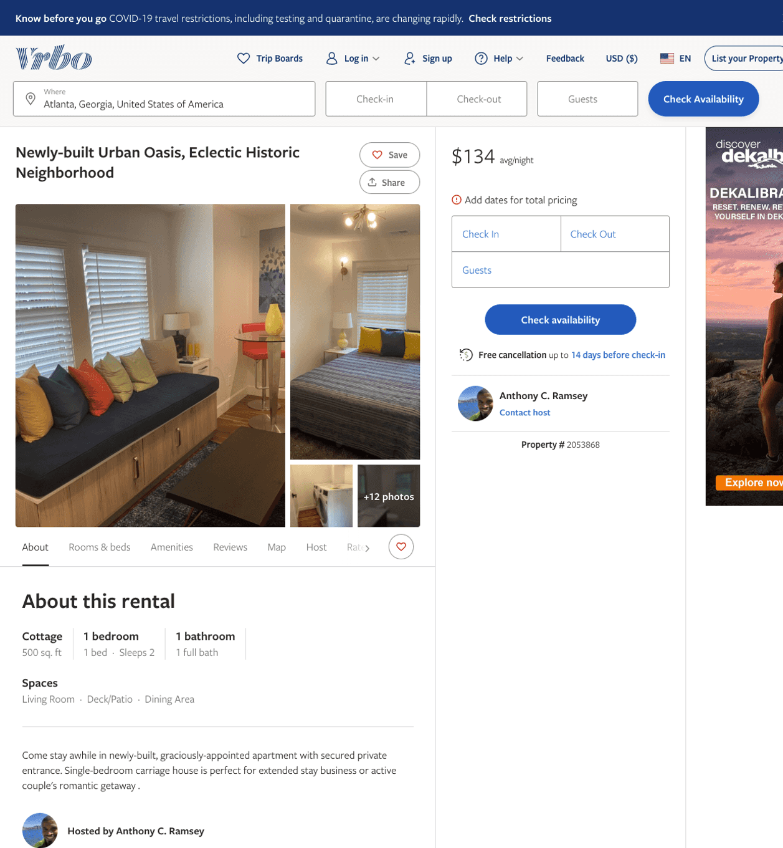
Listing 2053868
1
2
$128 - $134
3
Anthony C. Ramsey
https://www.vrbo.com/2053868
Aug 2022

Slide 19
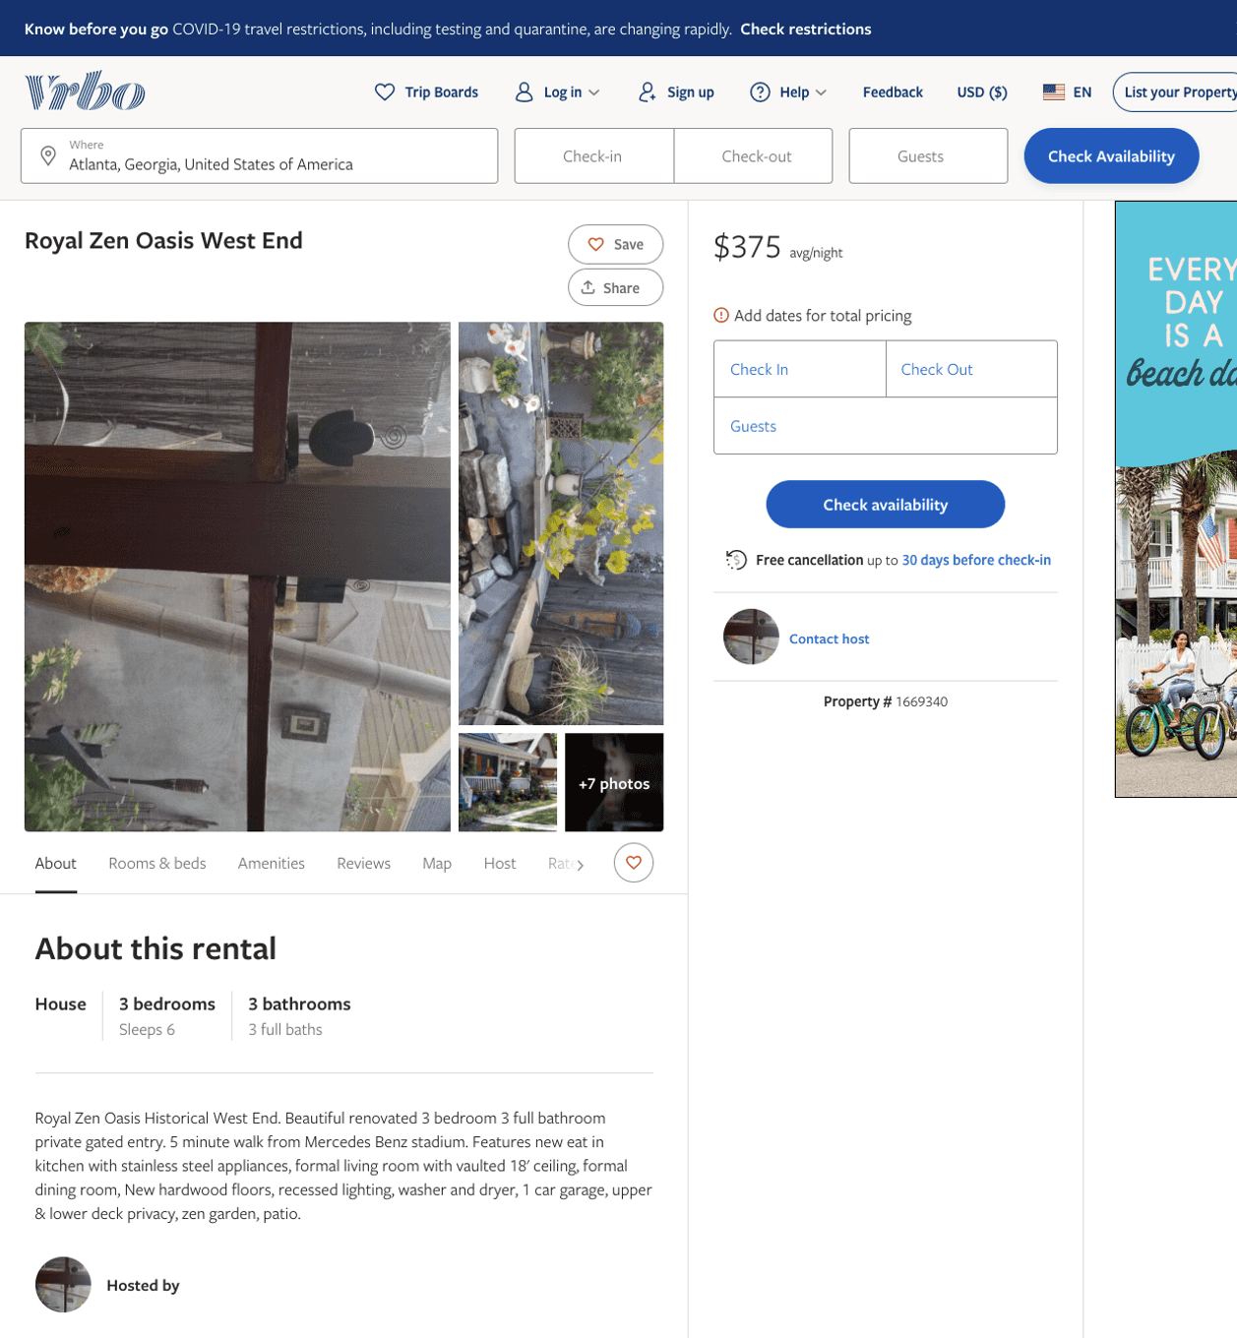
Listing 1669340
3
6
$375
2
https://www.vrbo.com/1669340
Aug 2022

Slide 20
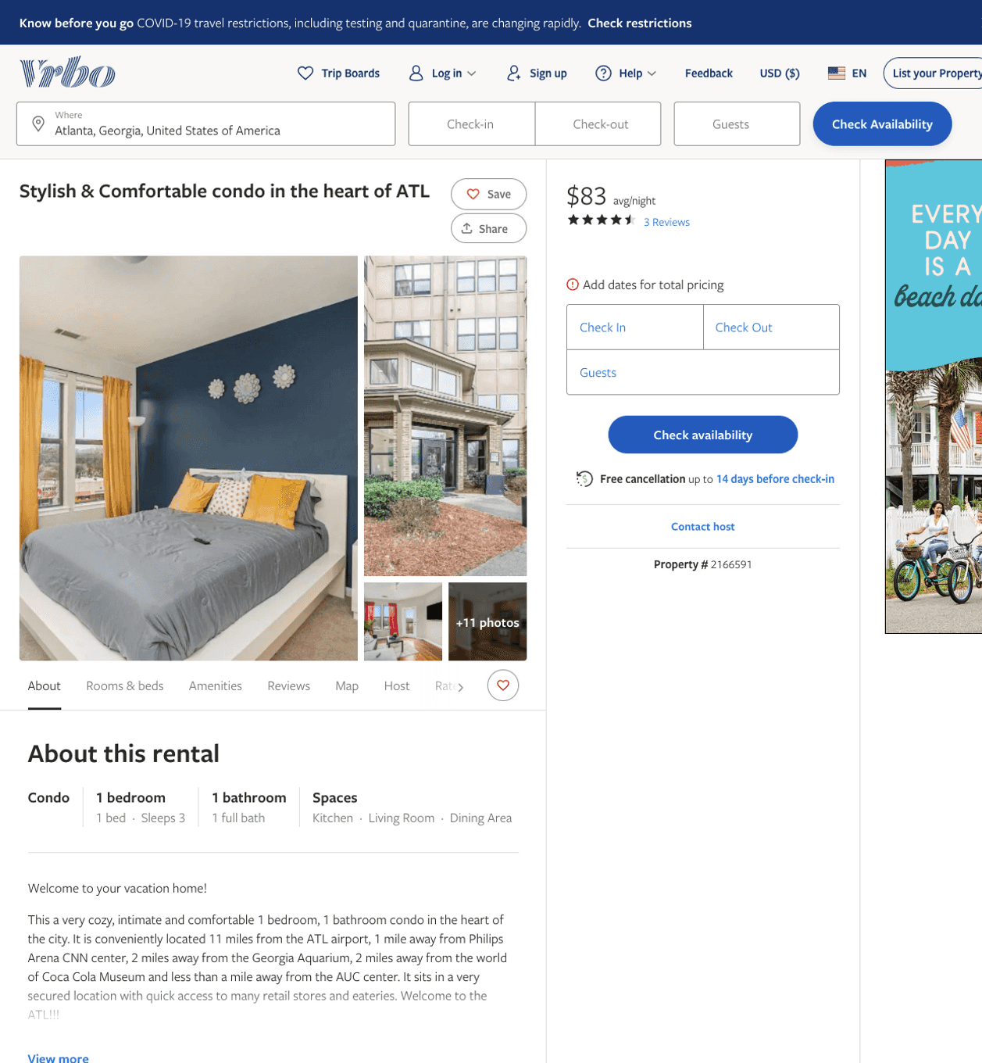
Listing 2166591
1
3
$78 - $96
4.571429
2
Trallonie
https://www.vrbo.com/2166591
Aug 2022

Slide 21
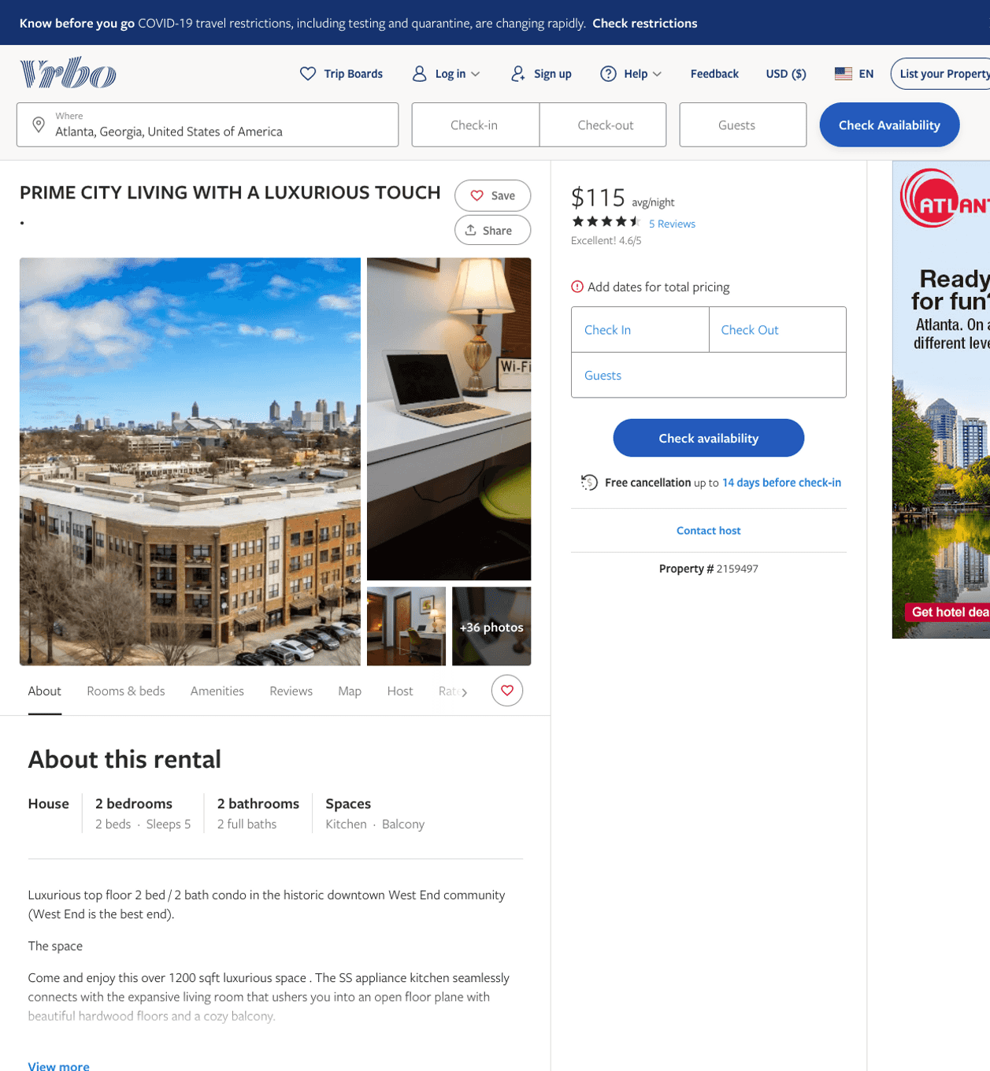
Listing 2159497
2
5
$115 - $149
4.3333335
1
stephanie
https://www.vrbo.com/2159497
Aug 2022

Slide 22
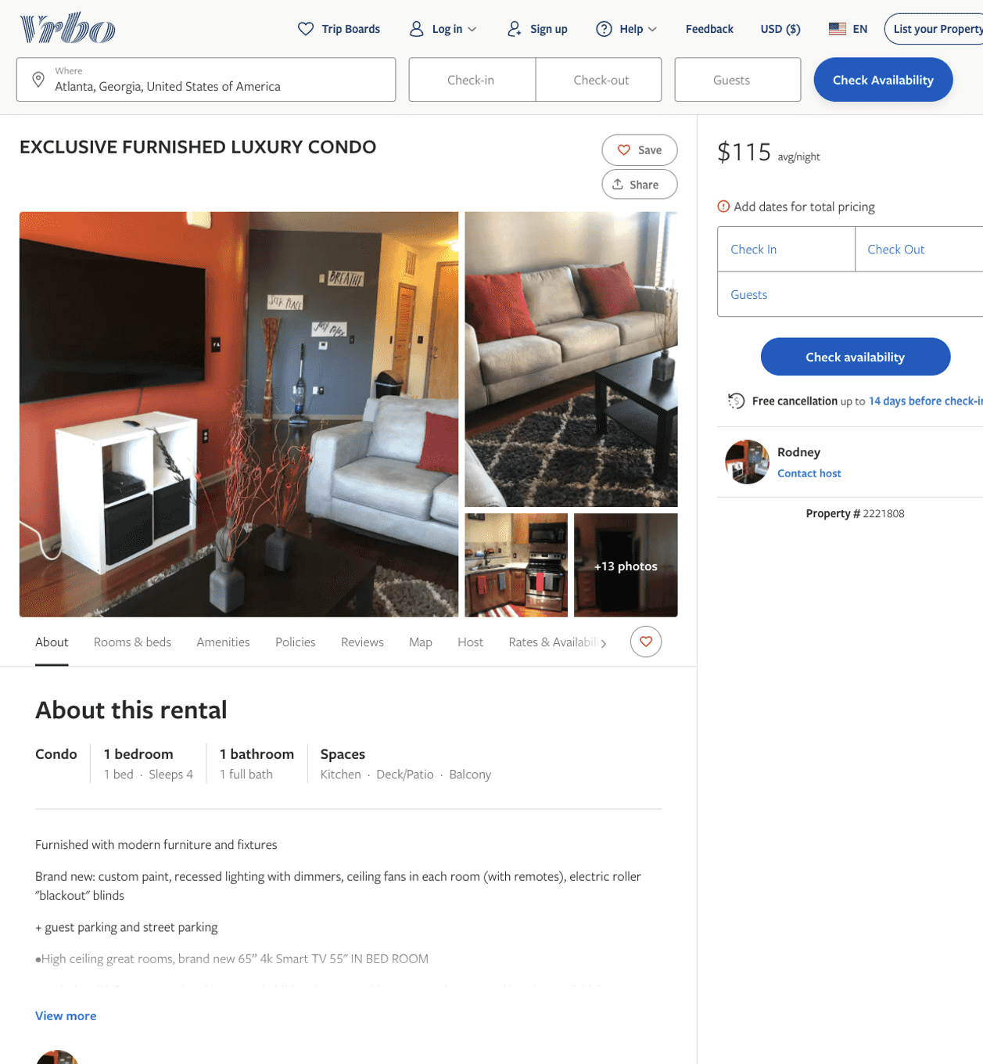
Listing 2221808
1
2
$115
3
Rodney
https://www.vrbo.com/2221808
Aug 2022

Slide 23
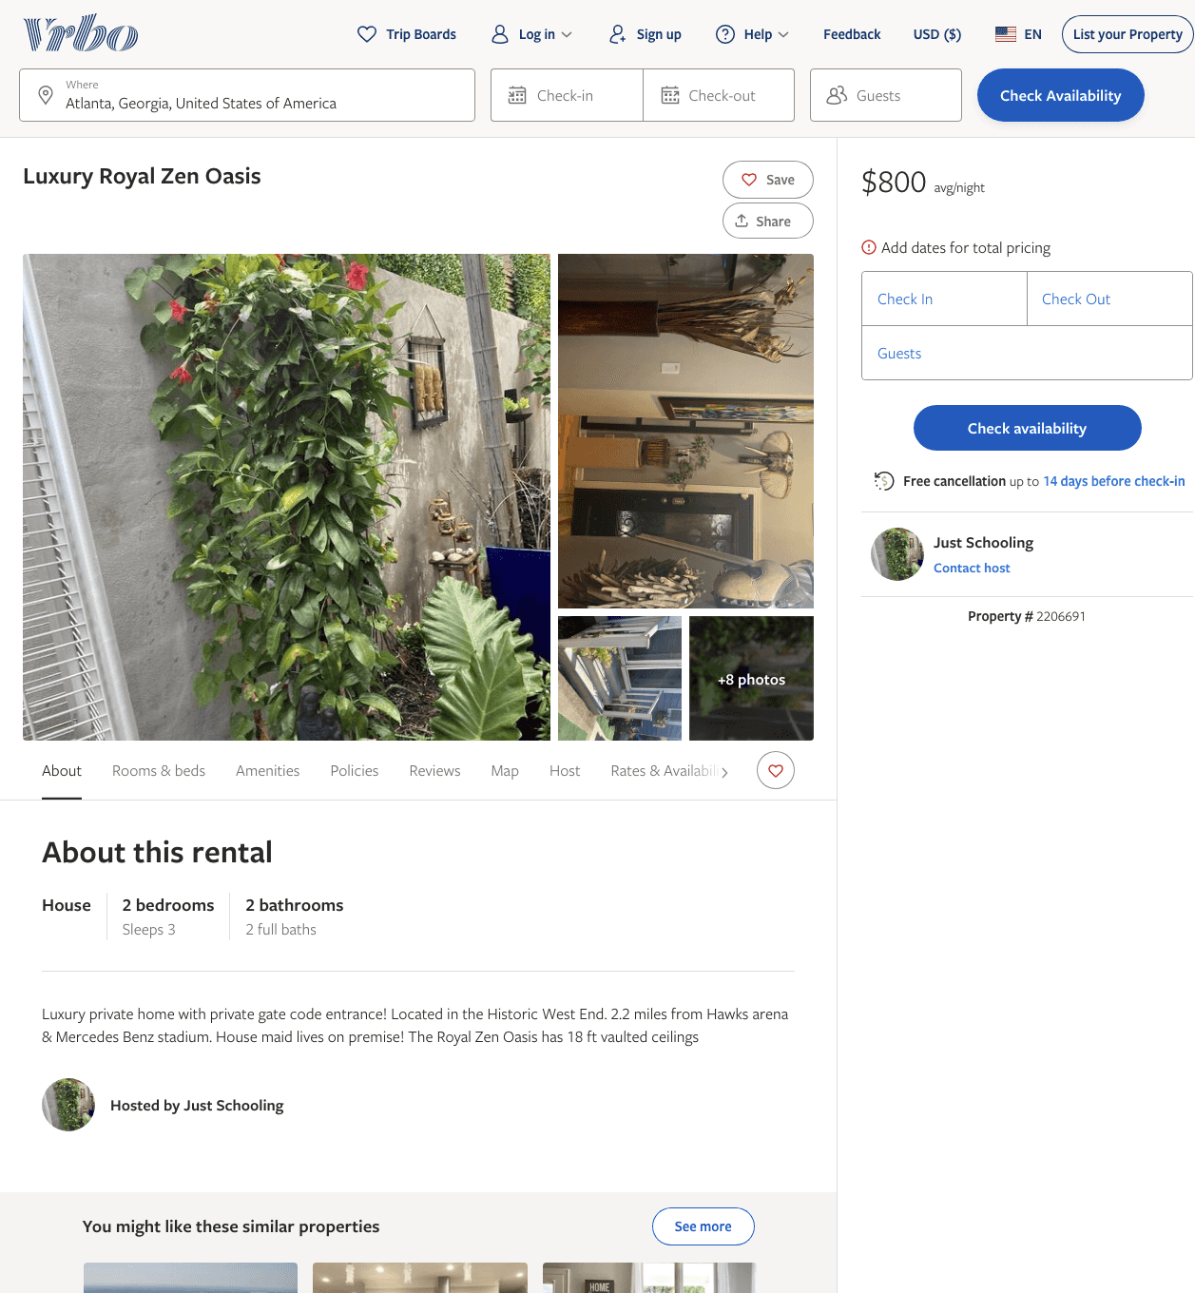
Listing 2206691
2
3
$800
1
Just Schooling
https://www.vrbo.com/2206691
Aug 2022

Slide 24
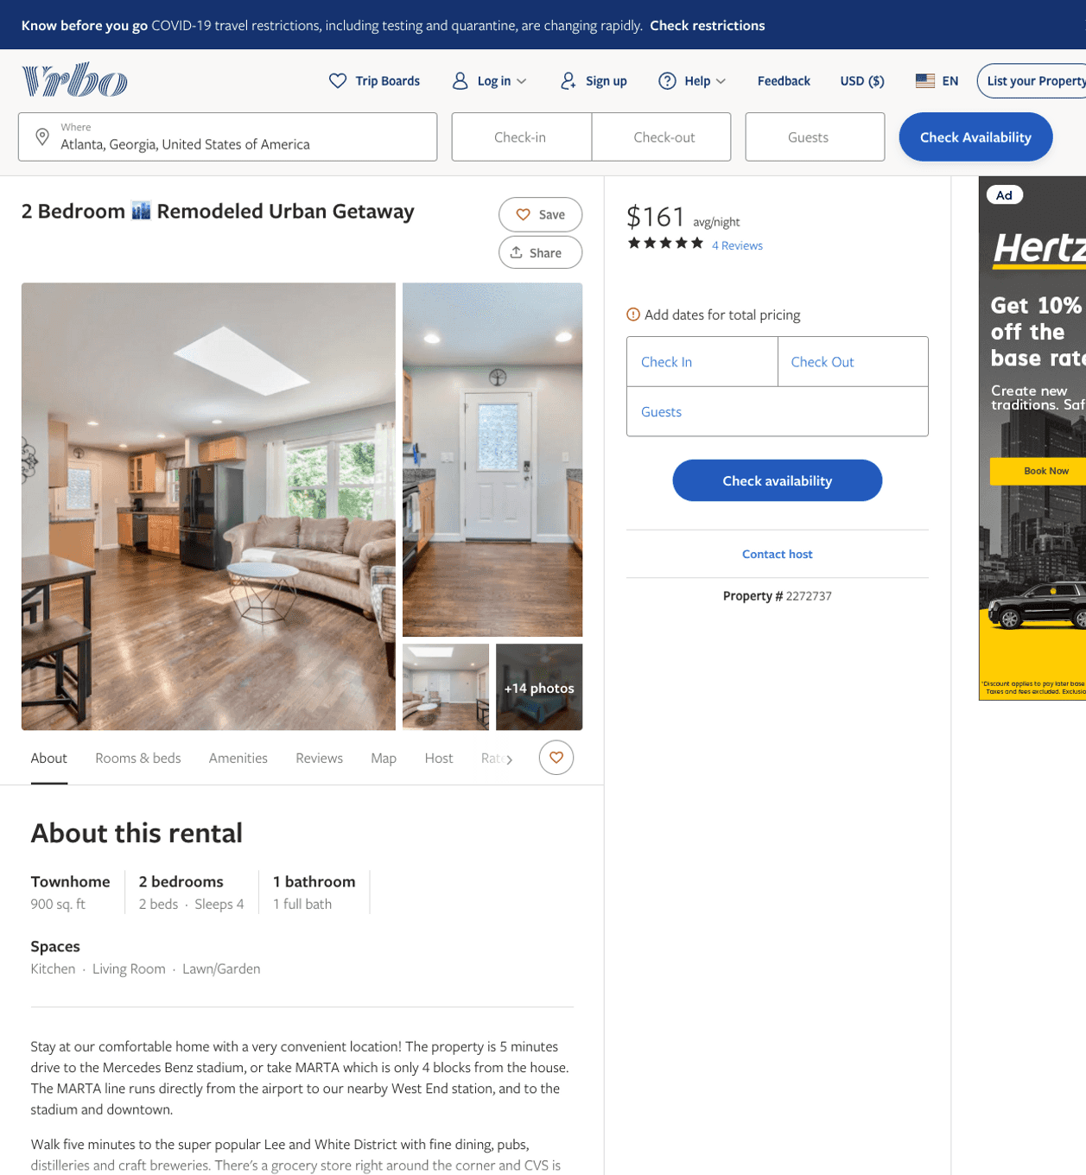
Listing 2272737
2
4
$126 - $158
4.65
1
Shannon Cook
https://www.vrbo.com/2272737
Aug 2022

Slide 25
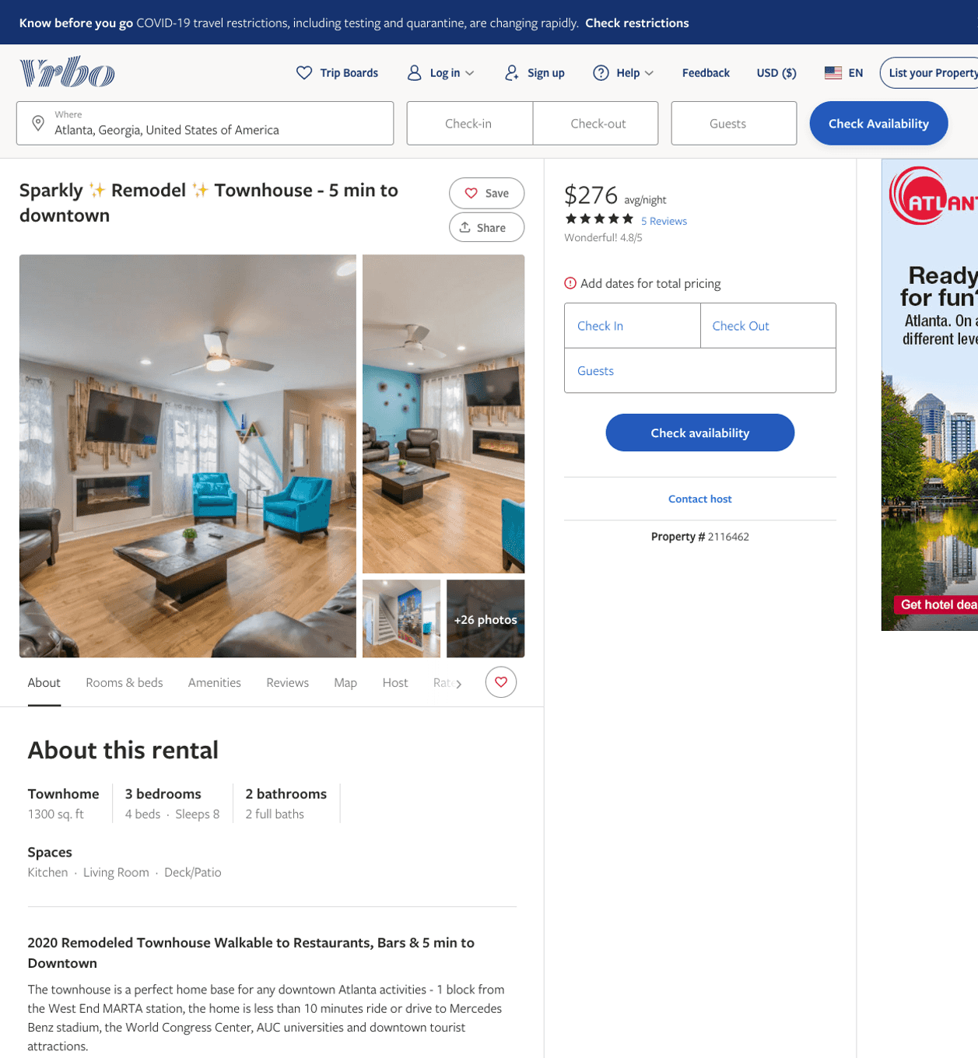
Listing 2116462
3
8
$228 - $368
4.65
1
Shannon Cook
https://www.vrbo.com/2116462
Aug 2022

Slide 26
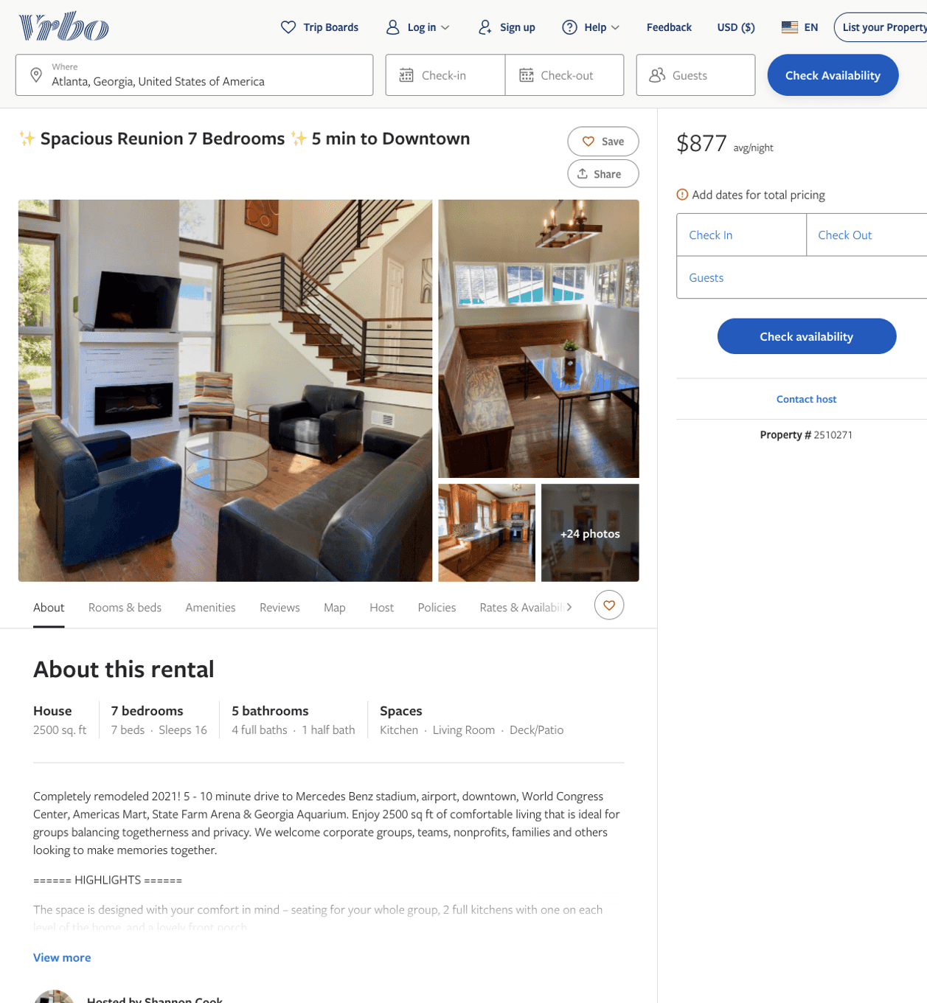
Listing 2510271
7
16
$735 - $877
5
1
Shannon Cook
https://www.vrbo.com/2510271
Aug 2022

Slide 27
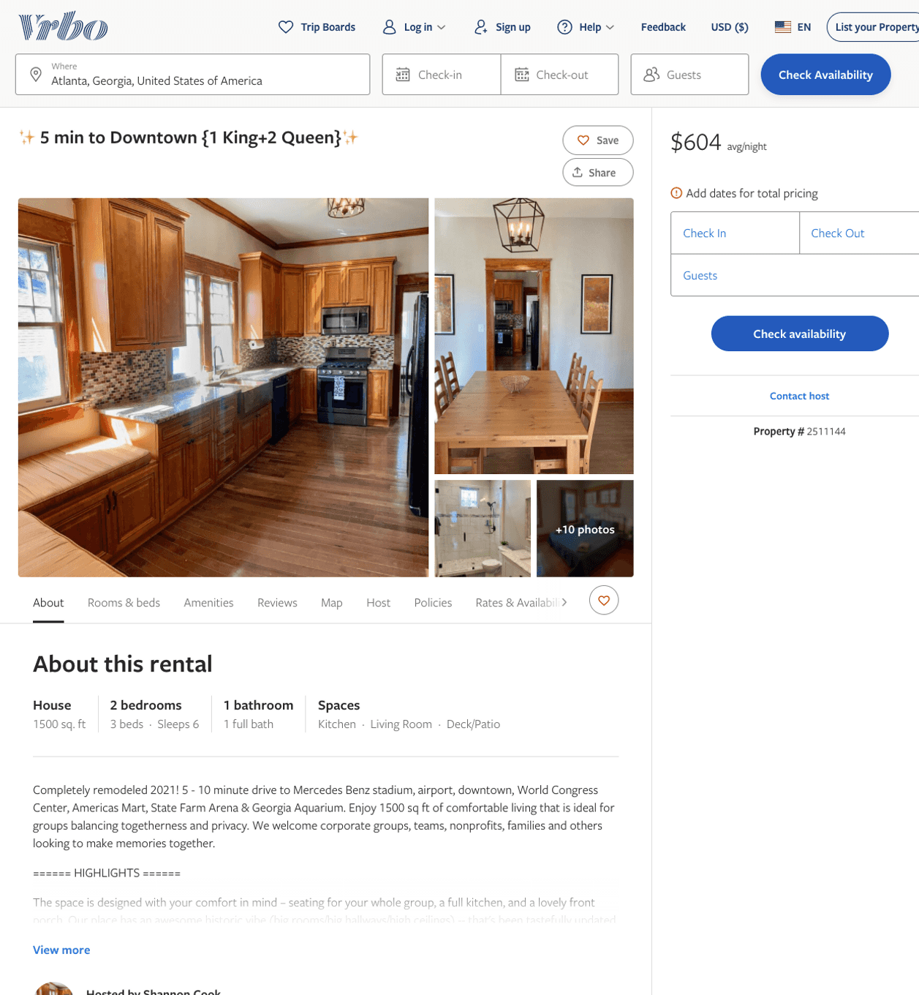
Listing 2511144
2
6
$315 - $604
4.3333335
1
Shannon Cook
https://www.vrbo.com/2511144
Aug 2022

Slide 28
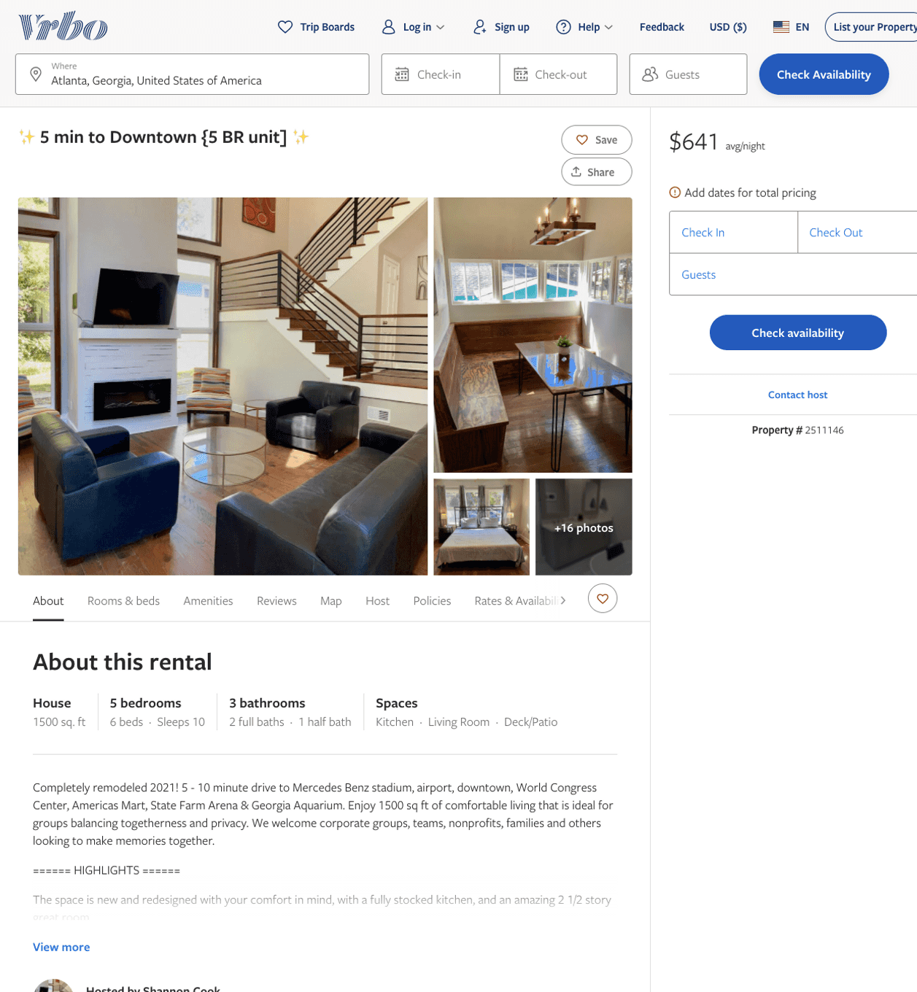
Listing 2511146
5
10
$459 - $750
5
1
Shannon Cook
https://www.vrbo.com/2511146
Aug 2022

Slide 29
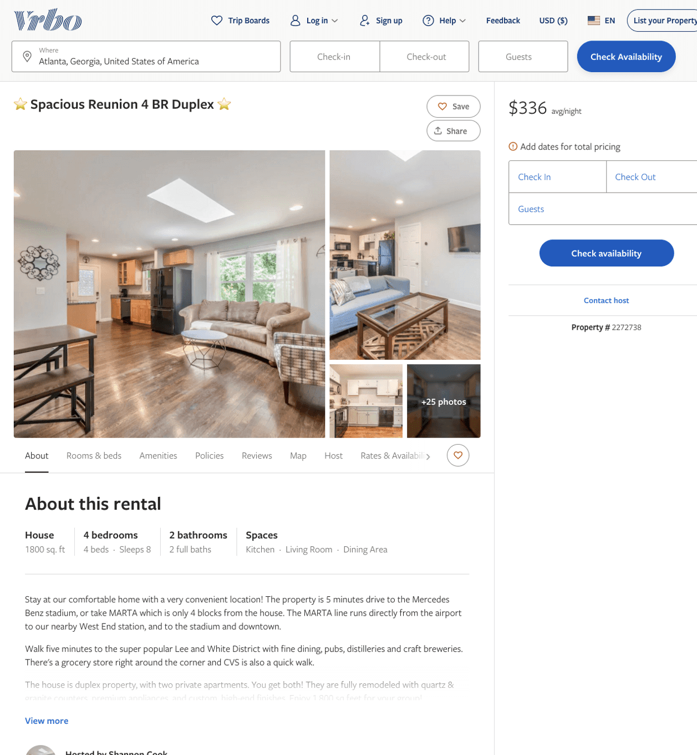
Listing 2272738
4
8
$266 - $343
1
Shannon Cook
https://www.vrbo.com/2272738
Aug 2022

Slide 30
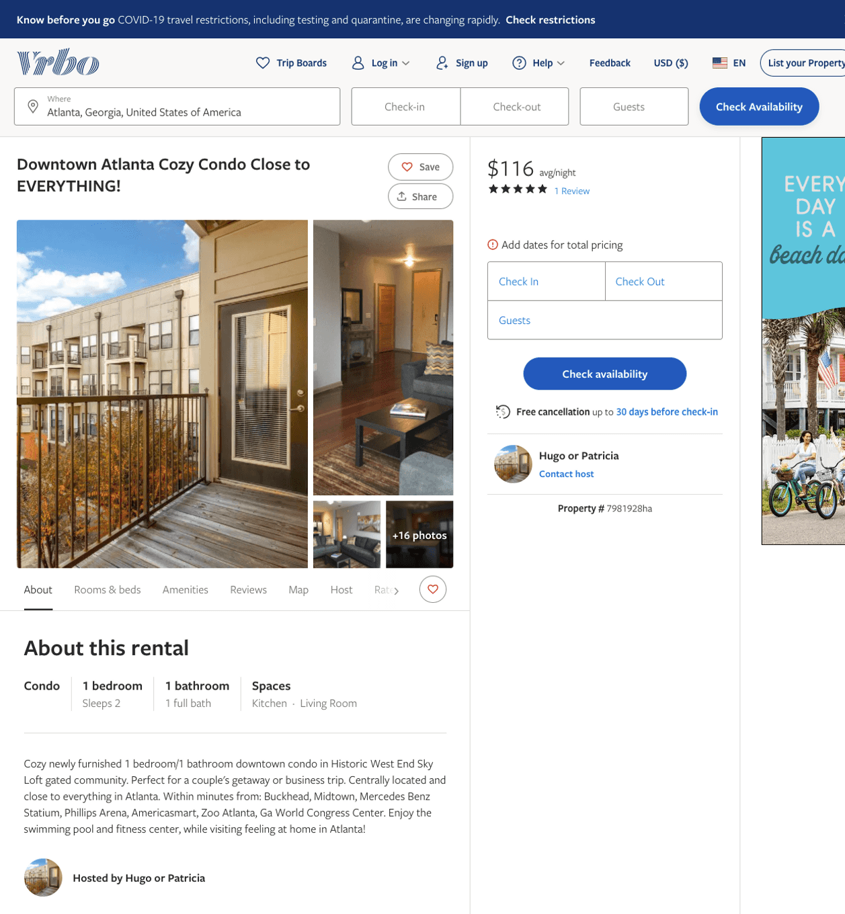
Listing 7981928
1
2
$117 - $120
5
5
Hugo or Patricia
https://www.vrbo.com/7981928ha
Aug 2022

Slide 31
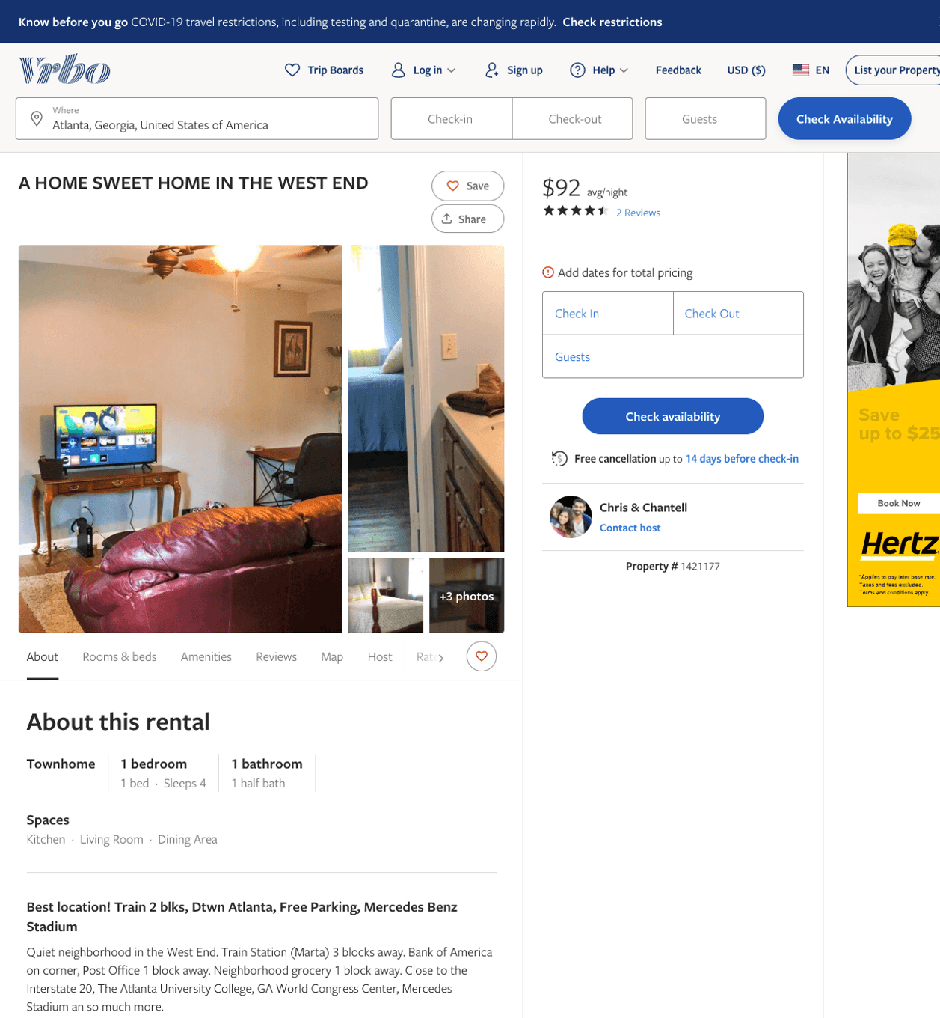
Listing 1421177
1
4
$92
4.5
2
Chris & Chantell
https://www.vrbo.com/1421177
Aug 2022

Slide 32
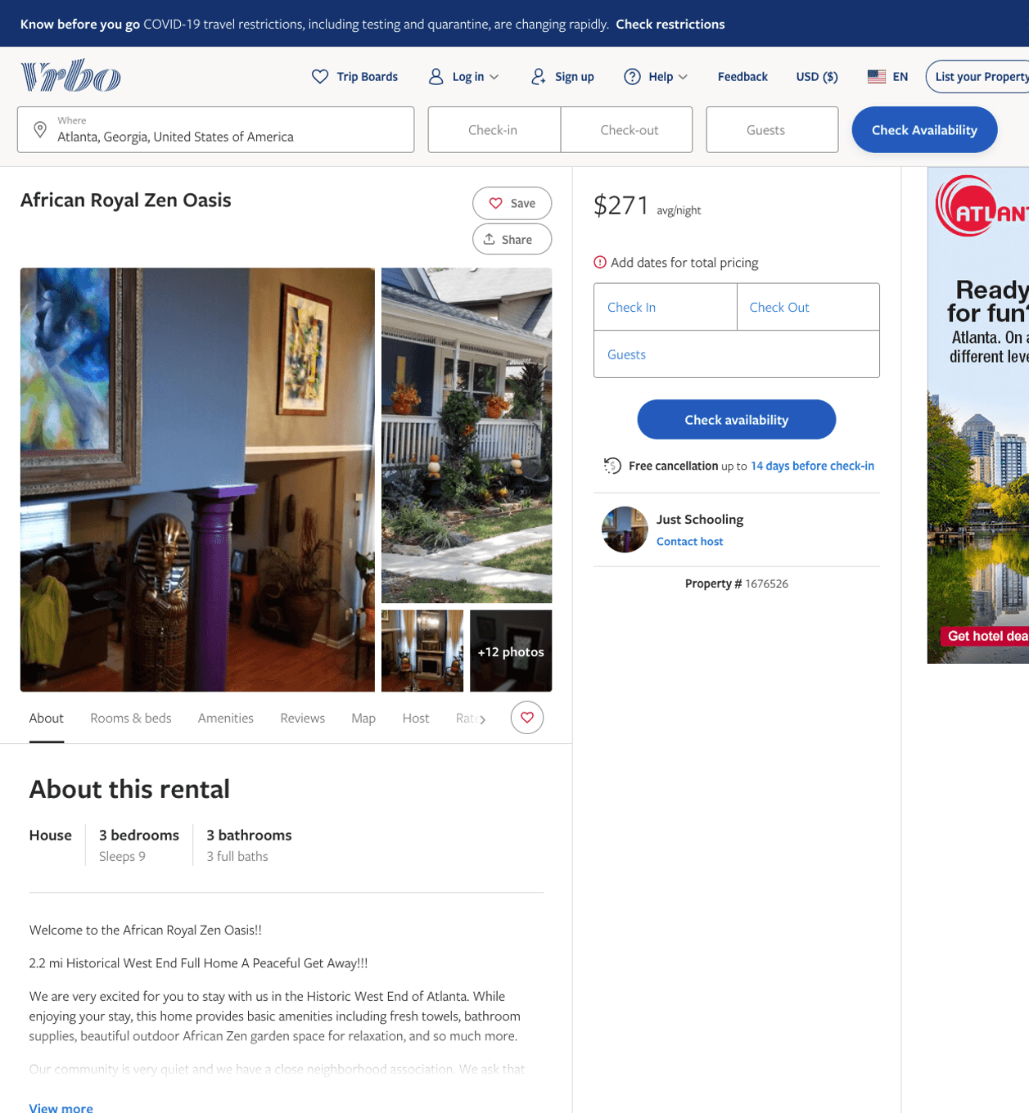
Listing 1676526
3
9
$271
1
Just Schooling
https://www.vrbo.com/1676526
Aug 2022

Slide 33
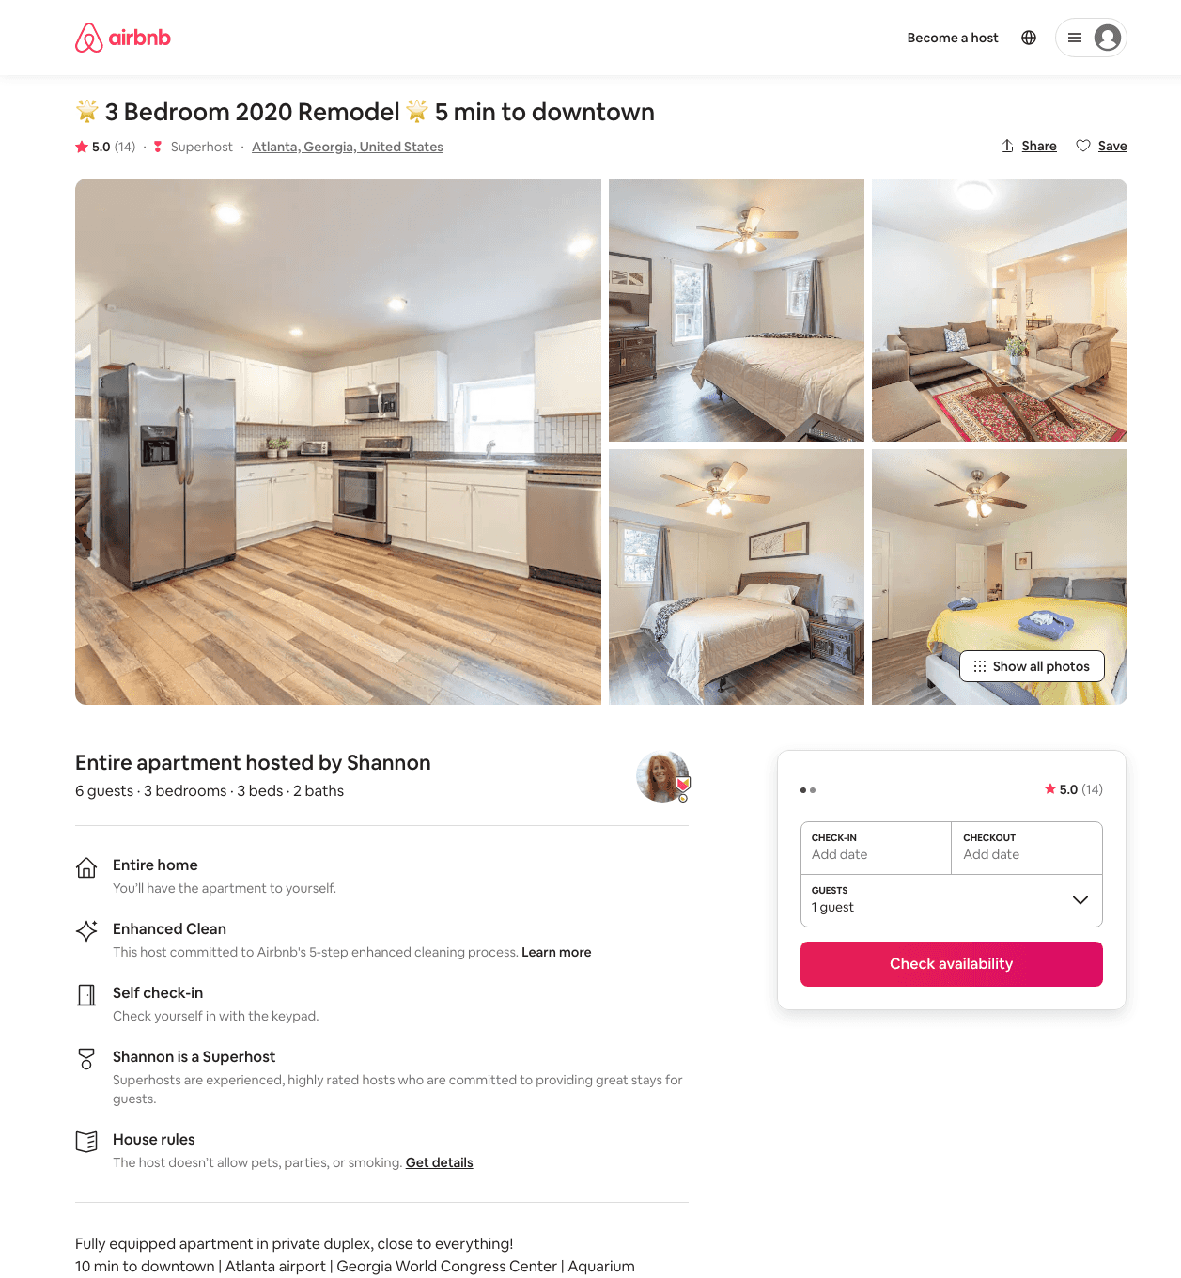
Listing 42071913
3
6
$176 - $729
4.77
2
Shannon
5111463
14
https://www.airbnb.com/rooms/42071913
Aug 2022

Slide 34
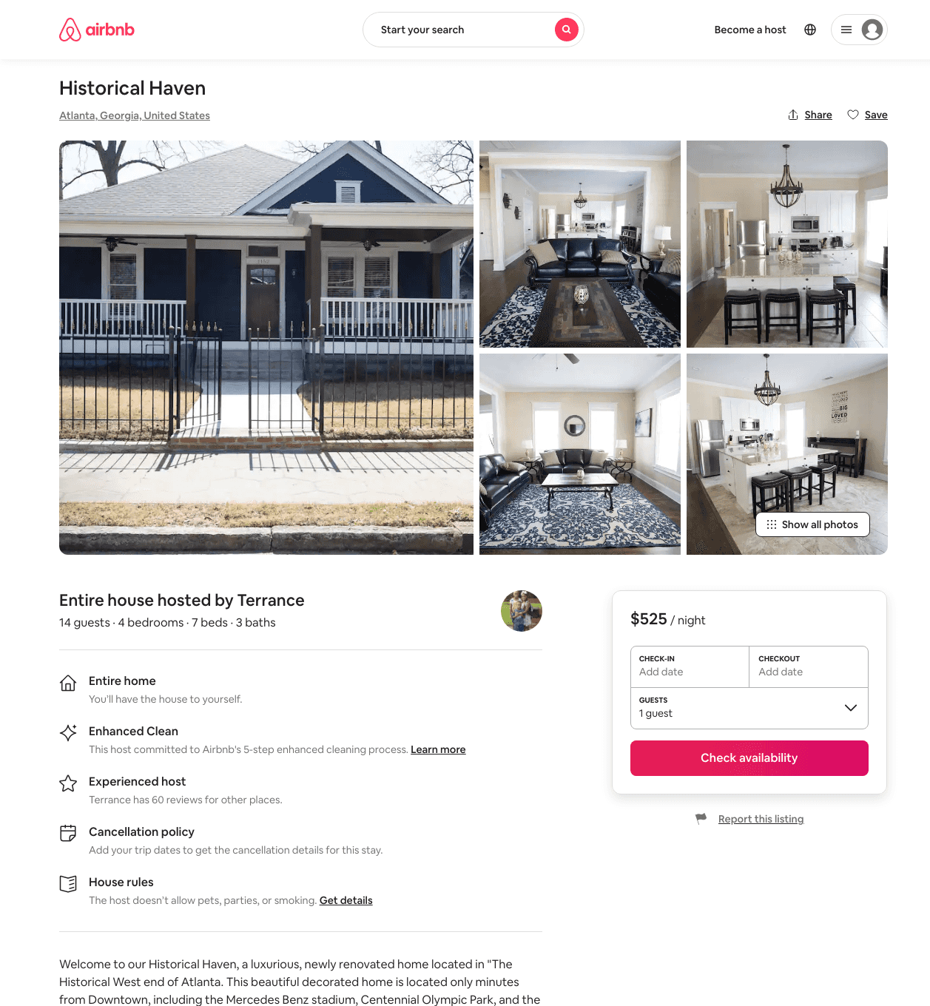
Listing 48544030
4
12
$475 - $575
4.50
3
Terrance
143708849
2
https://www.airbnb.com/rooms/48544030
Aug 2022

Slide 35
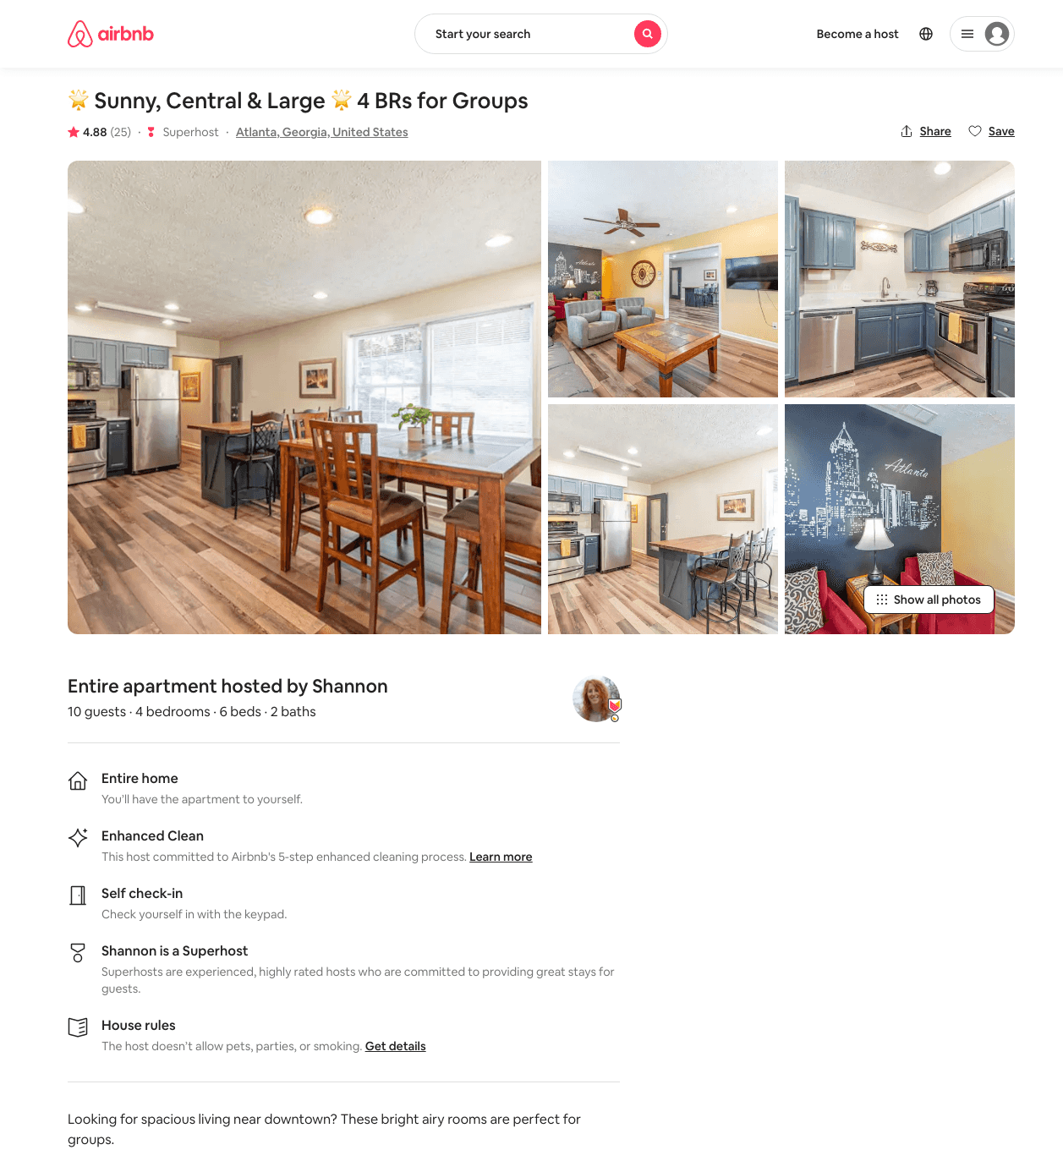
Listing 29659400
4
10
$197 - $851
4.91
2
Shannon
5111463
14
https://www.airbnb.com/rooms/29659400
Aug 2022

Slide 36
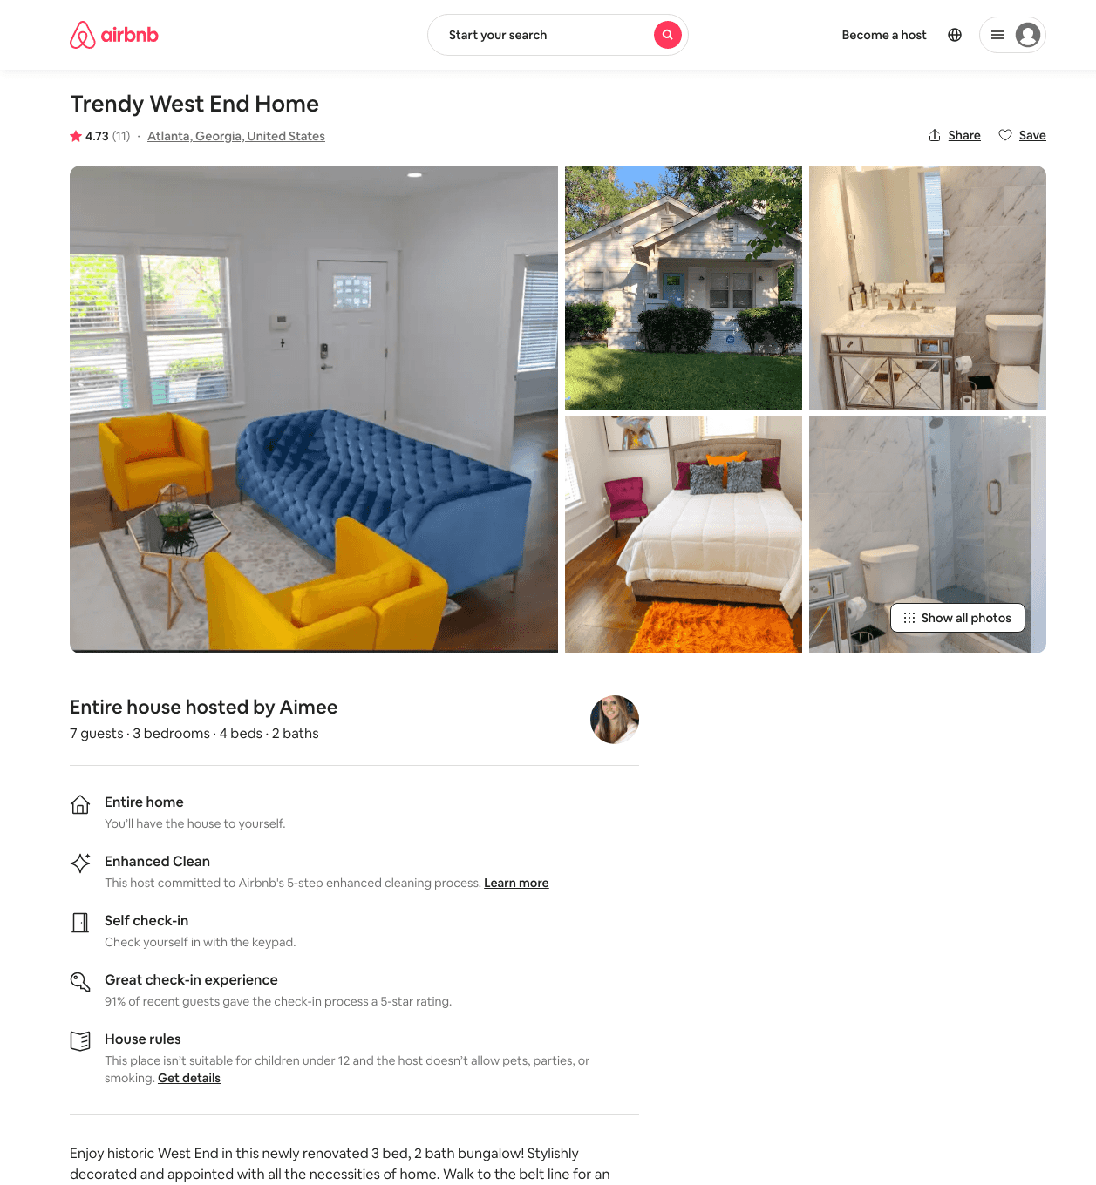
Listing 46490736
3
7
$135 - $404
4.82
2
Daniela
223721490
2
https://www.airbnb.com/rooms/46490736
Aug 2022

Slide 37
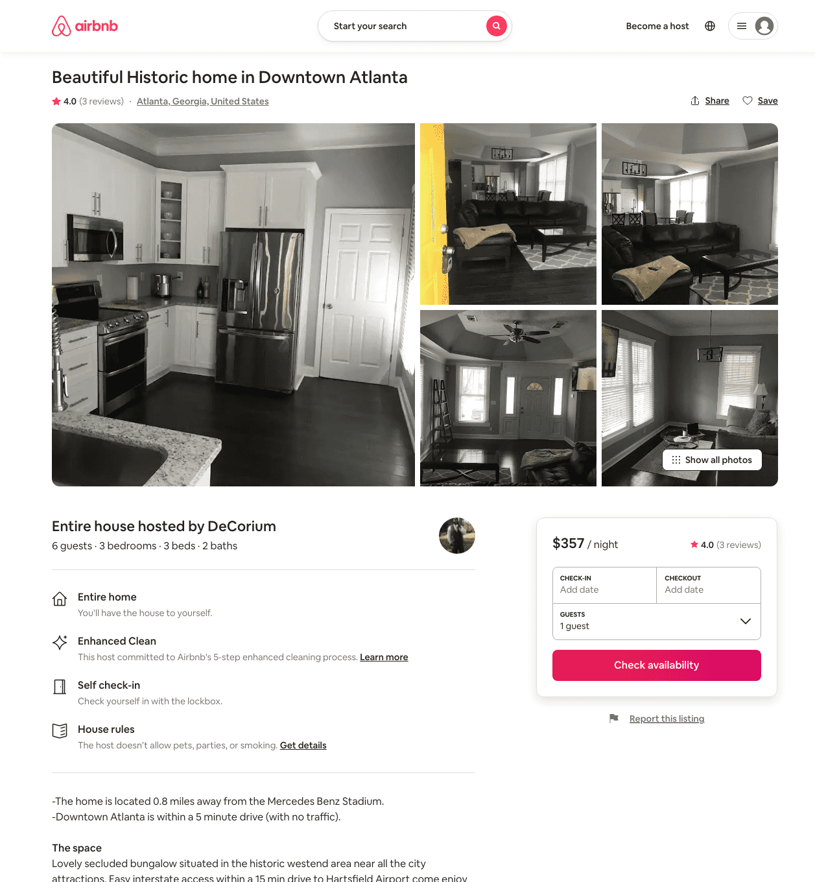
Listing 31672066
3
6
$300 - $395
4.50
2
DeCorium
4992628
1
https://www.airbnb.com/rooms/31672066
Aug 2022

Slide 38
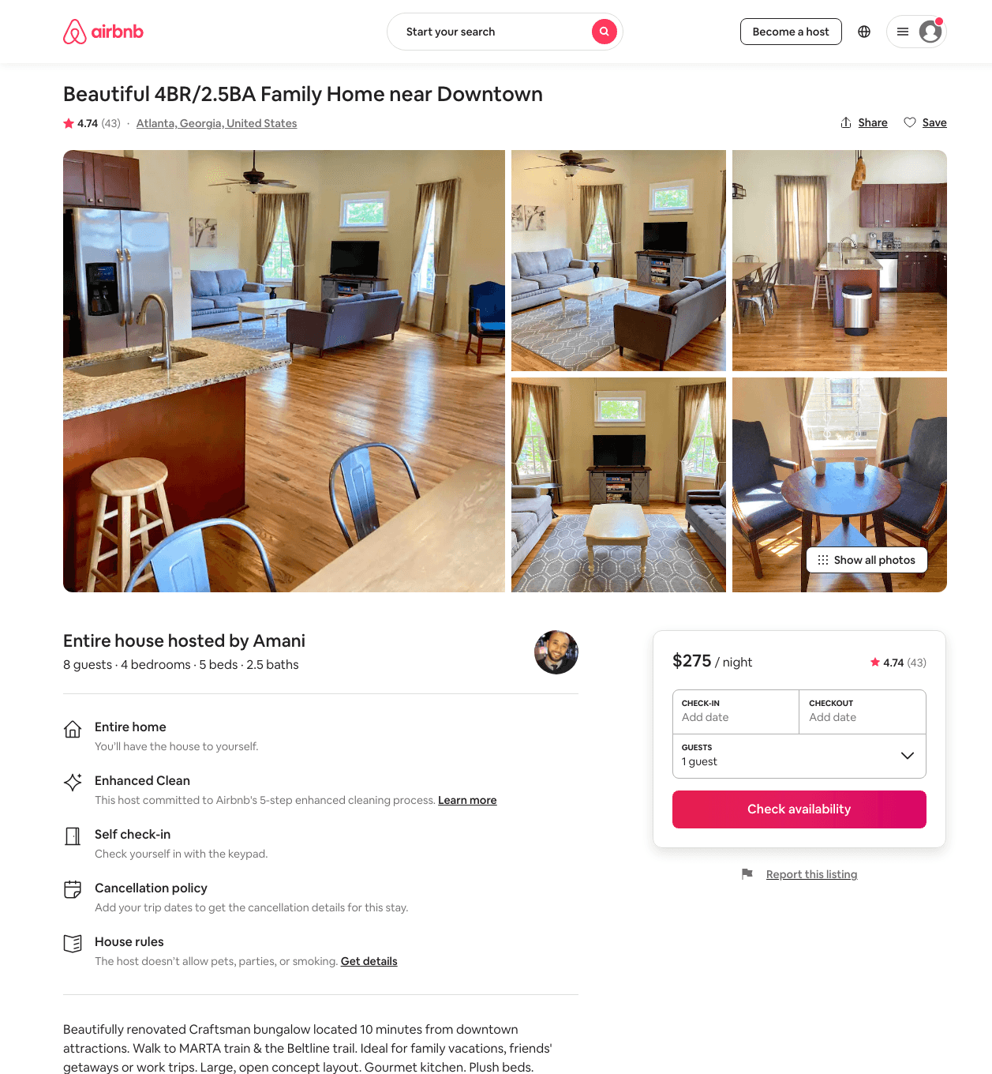
Listing 13808612
4
9
$211 - $432
4.79
3
Amani
43426856
1
https://www.airbnb.com/rooms/13808612
Jun 2022

Slide 39
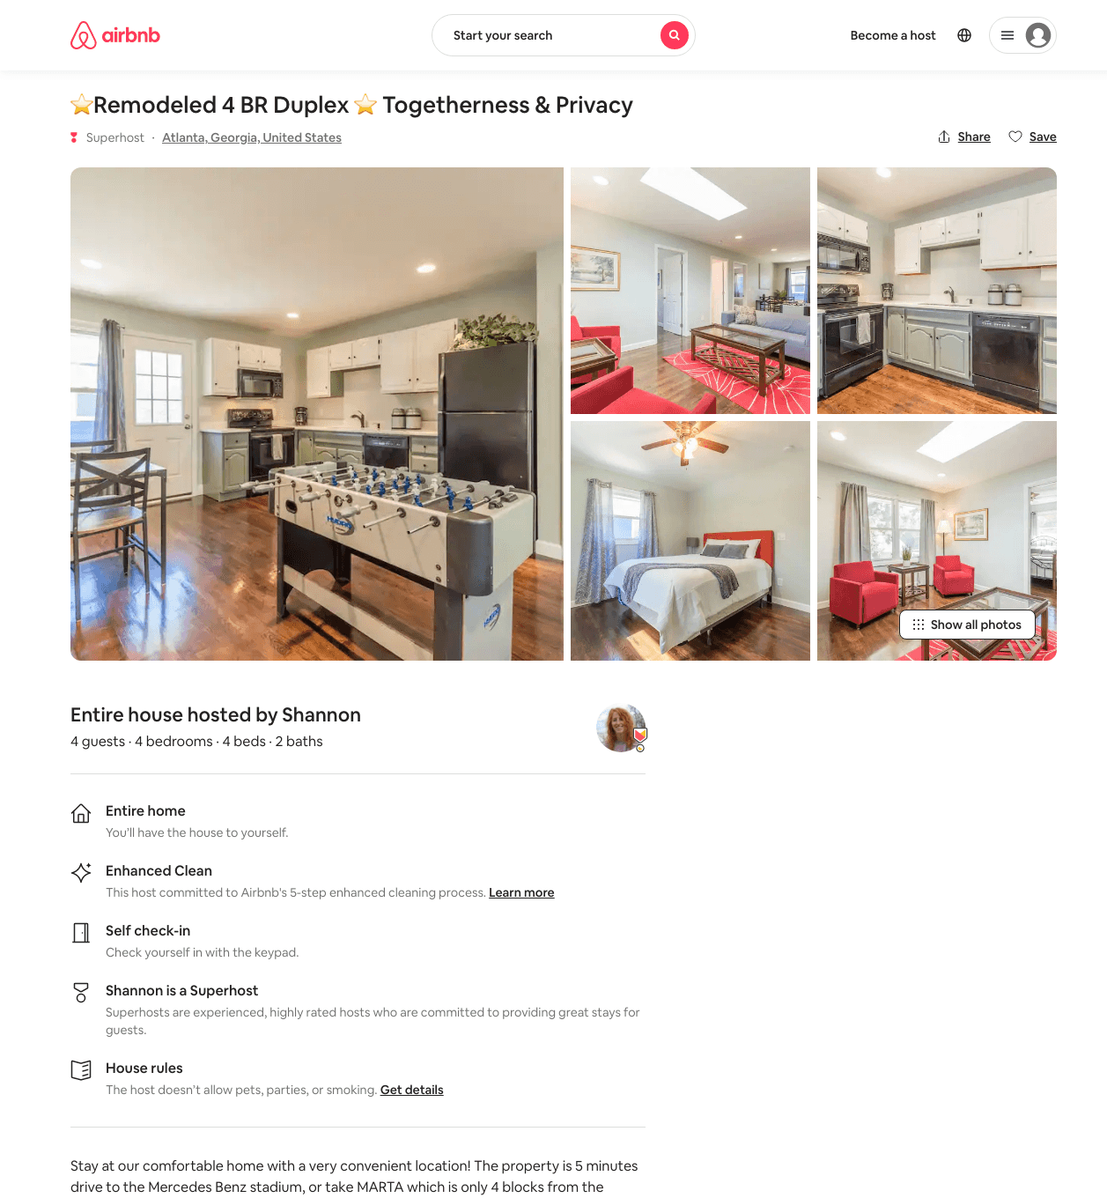
Listing 49128086
4
8
$191 - $317
5.0
2
Shannon
5111463
14
https://www.airbnb.com/rooms/49128086
Aug 2022

Slide 40
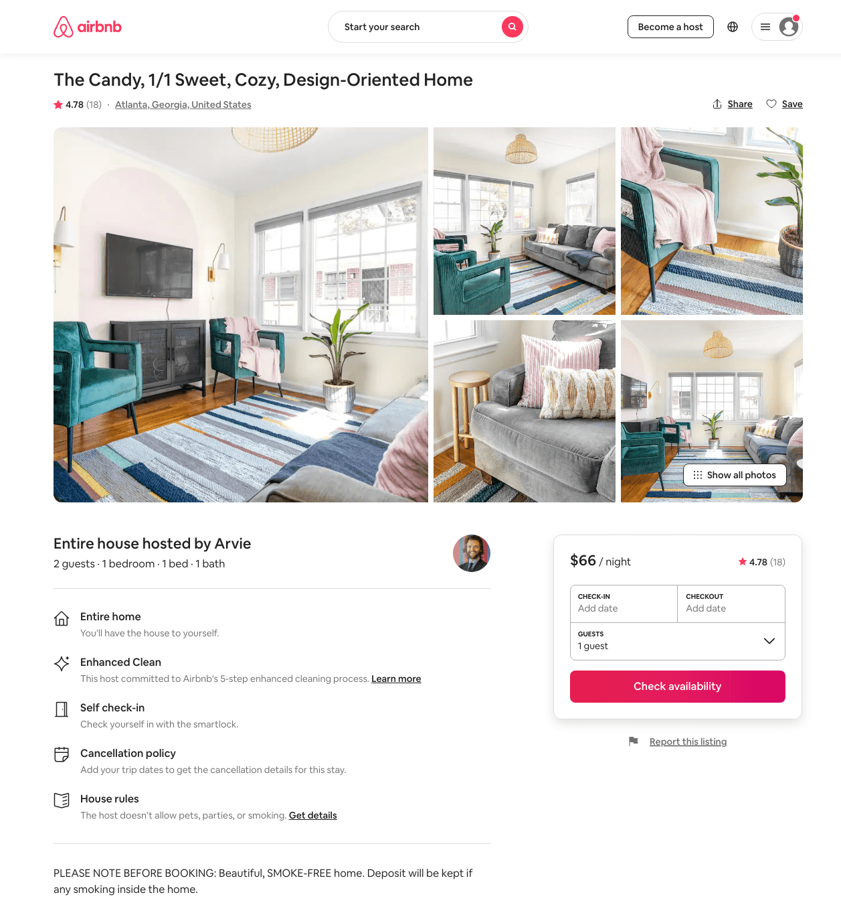
Listing 46983600
1
2
$65 - $96
4.81
1
Honey Homes
235928659
3
https://www.airbnb.com/rooms/46983600
Aug 2022

Slide 41
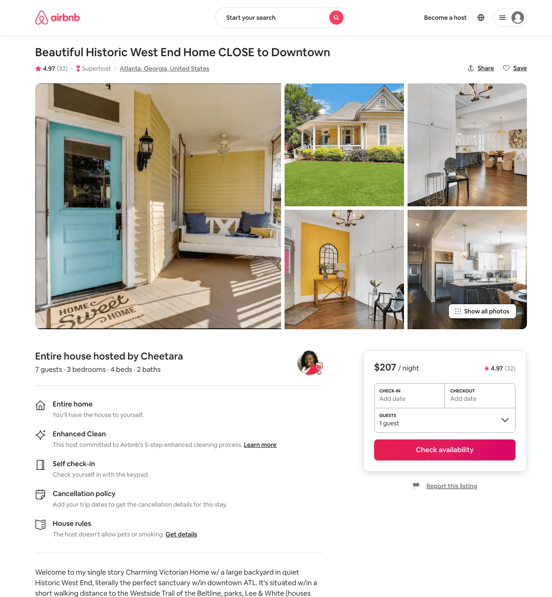
Listing 45525428
3
7
$147 - $308
4.94
1
Cheetara
93048951
1
https://www.airbnb.com/rooms/45525428
Aug 2022

Slide 42
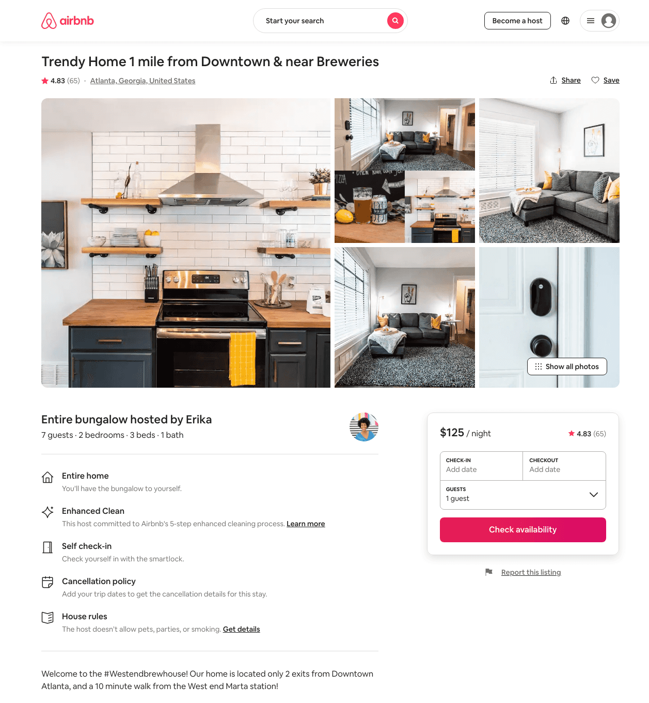
Listing 33168694
2
7
$86 - $237
4.80
1
Courtney
179626170
2
https://www.airbnb.com/rooms/33168694
Aug 2022

Slide 43
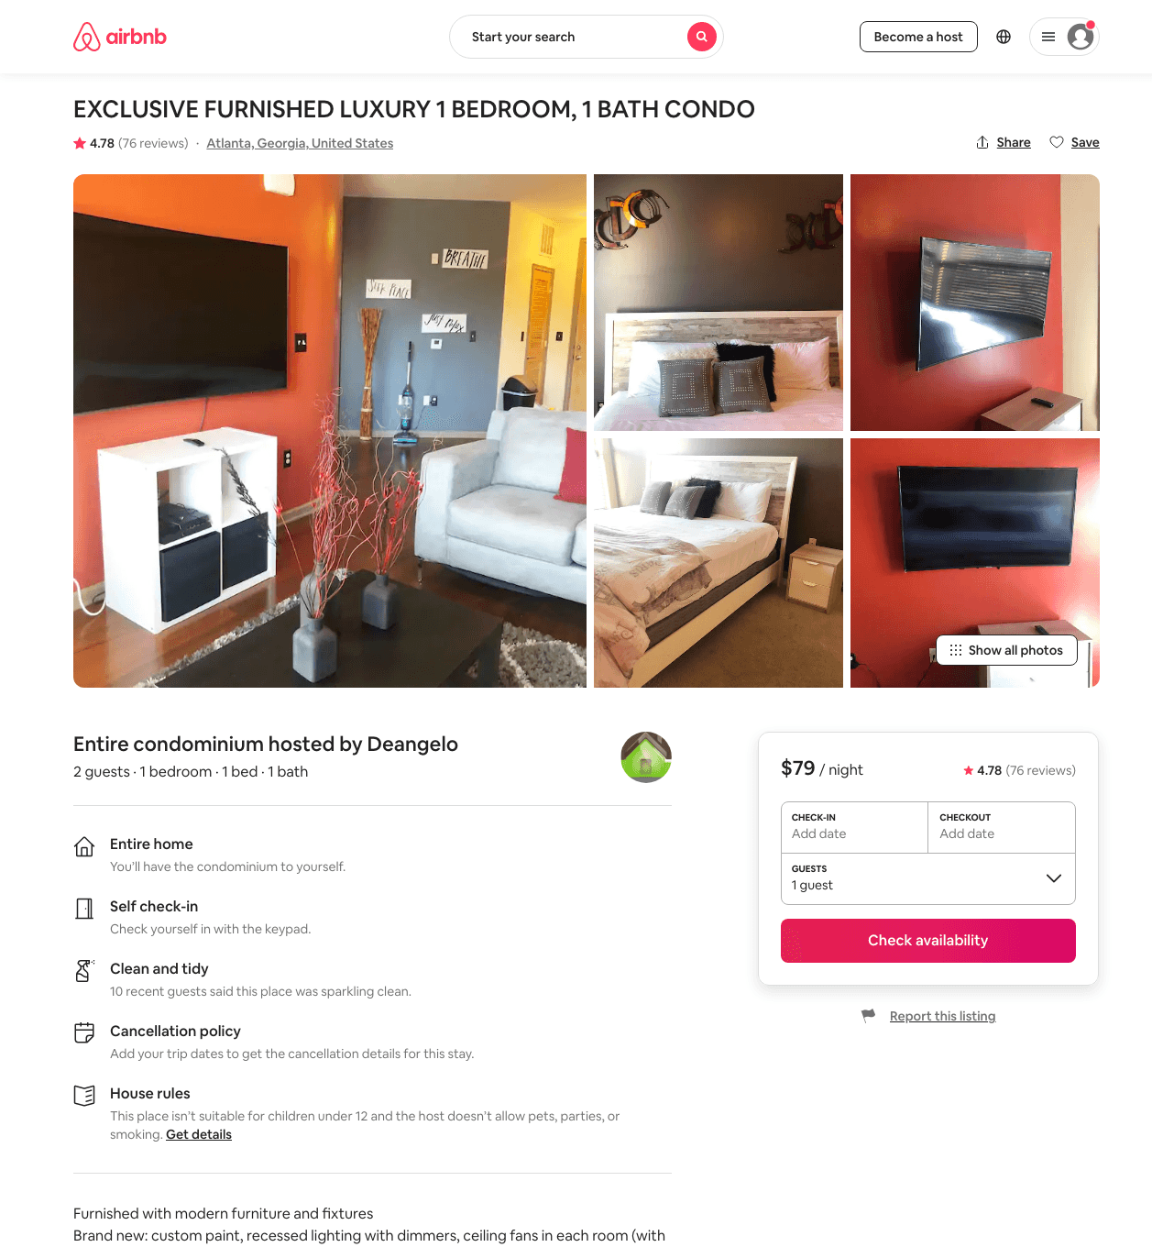
Listing 31585257
1
2
$75 - $119
4.74
1
Deangelo
147460585
1
https://www.airbnb.com/rooms/31585257
Aug 2022

Slide 44
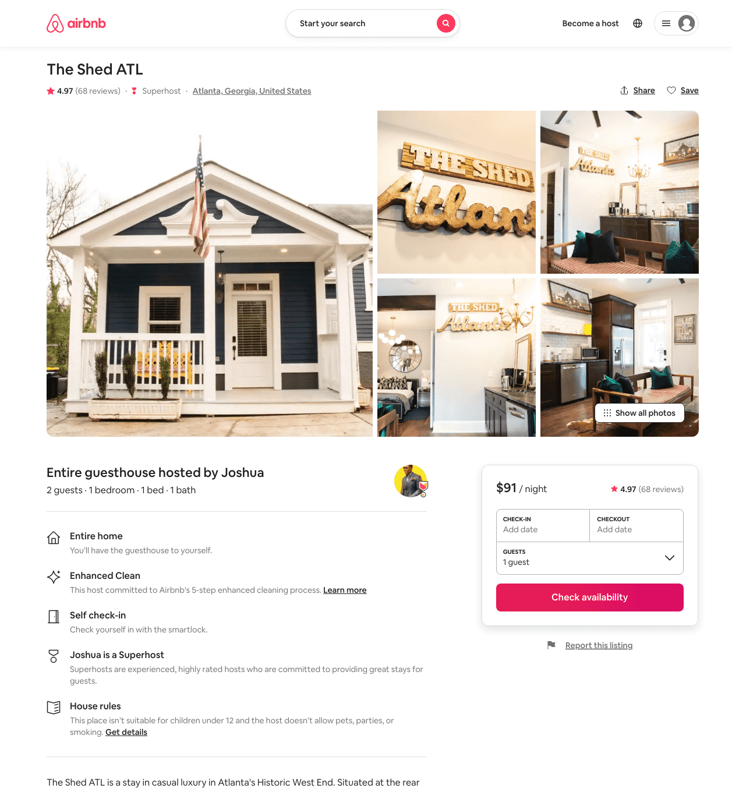
Listing 32757871
1
2
$84 - $106
4.98
2
Joshua
10573954
1
https://www.airbnb.com/rooms/32757871
Aug 2022

Slide 45
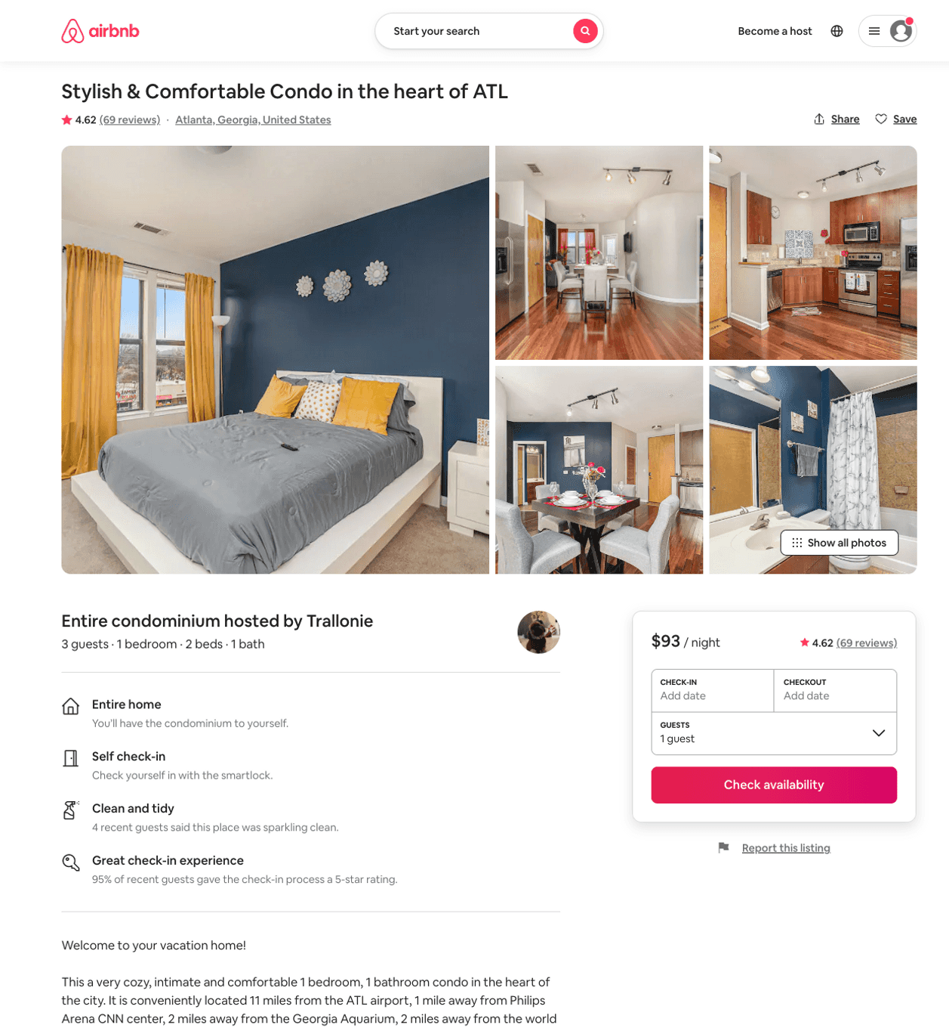
Listing 42388227
1
2
$63 - $122
4.61
2
Trallonie Estates
125420607
1
https://www.airbnb.com/rooms/42388227
Aug 2022

Slide 46
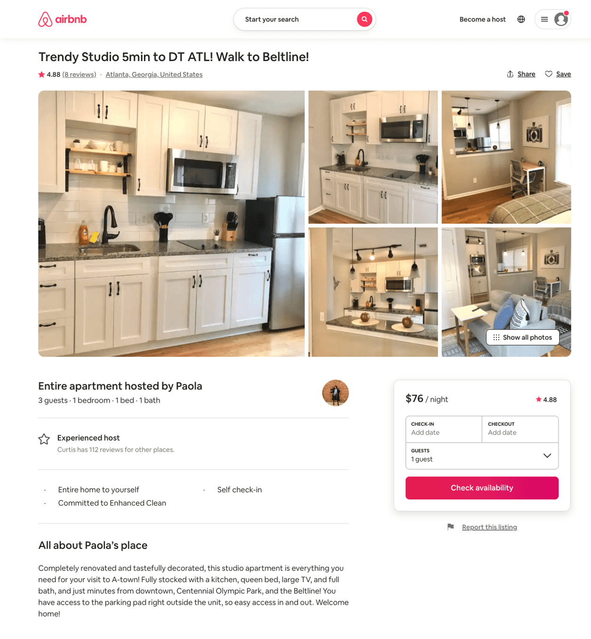
Listing 47961161
1
3
$65 - $77
4.67
2
Paola
190790952
3
https://www.airbnb.com/rooms/47961161
Aug 2022

Slide 47
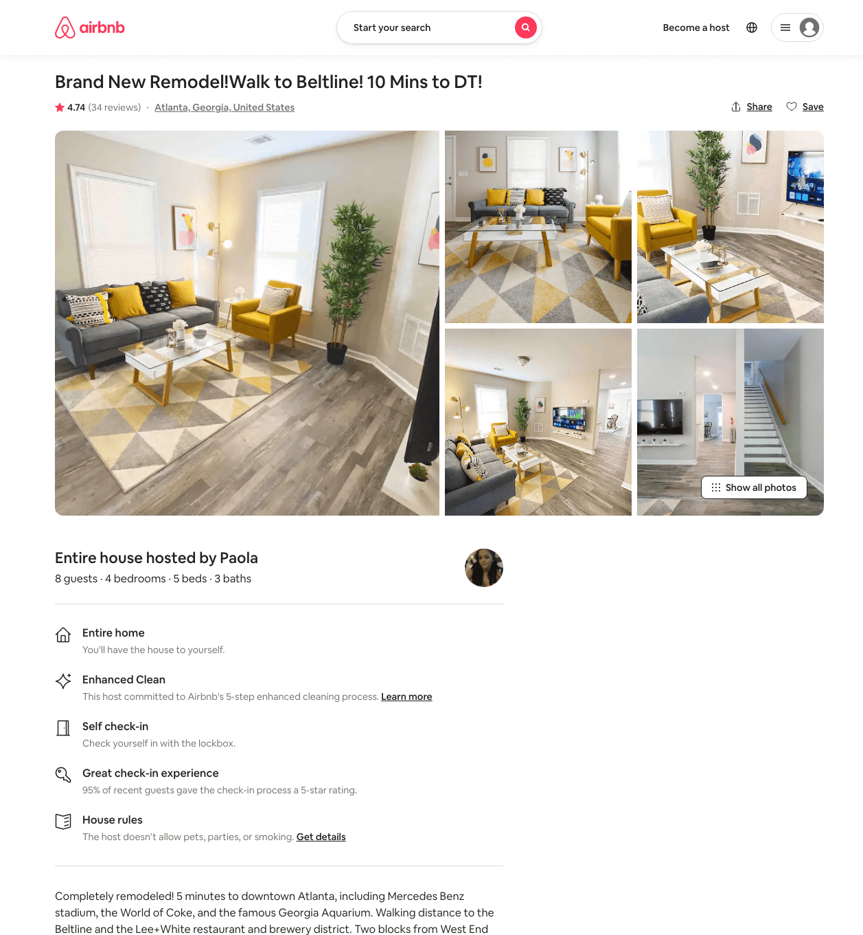
Listing 45126813
4
8
$137 - $211
4.74
2
Paola
190790952
3
https://www.airbnb.com/rooms/45126813
Aug 2022

Slide 48
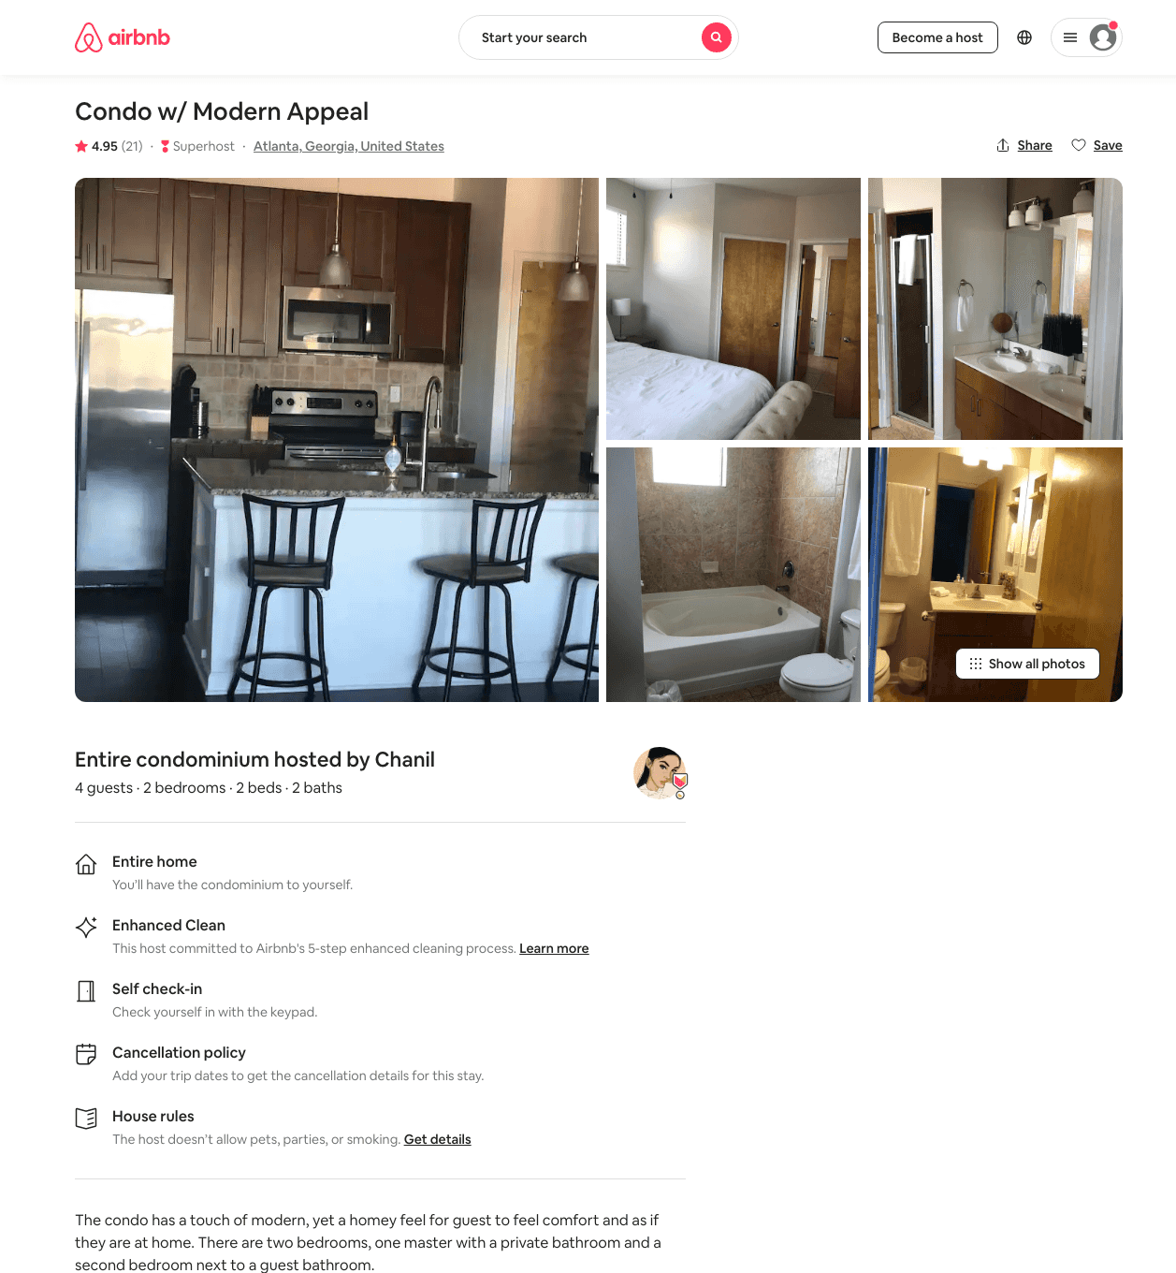
Listing 41007199
2
4
$176 - $219
4.87
2
Chanil
319964913
1
https://www.airbnb.com/rooms/41007199
Jun 2022

Slide 49
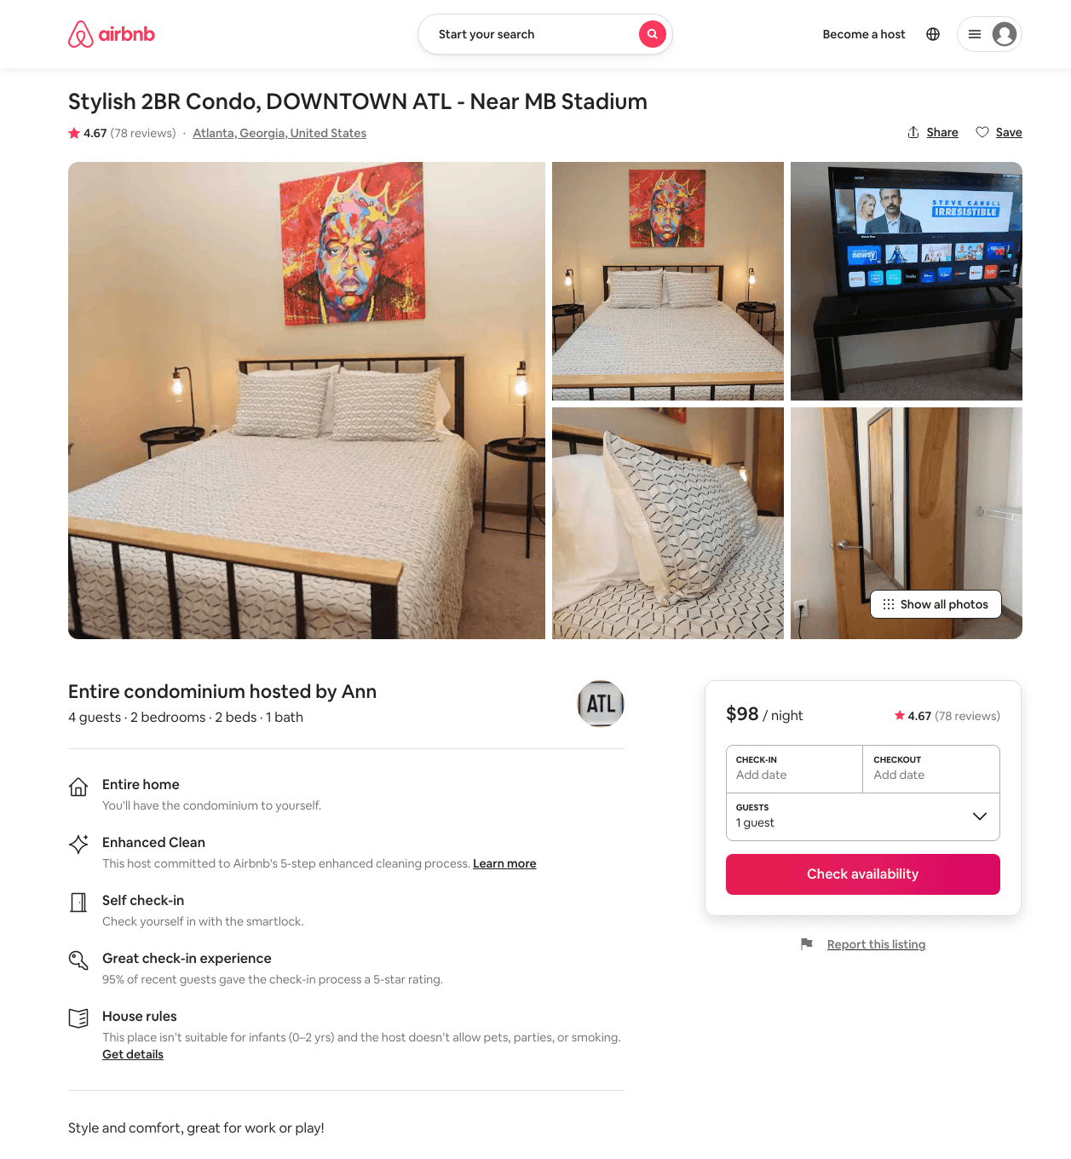
Listing 39036603
2
4
$62 - $116
4.62
1
Ann
69191072
1
https://www.airbnb.com/rooms/39036603
Aug 2022

Slide 50
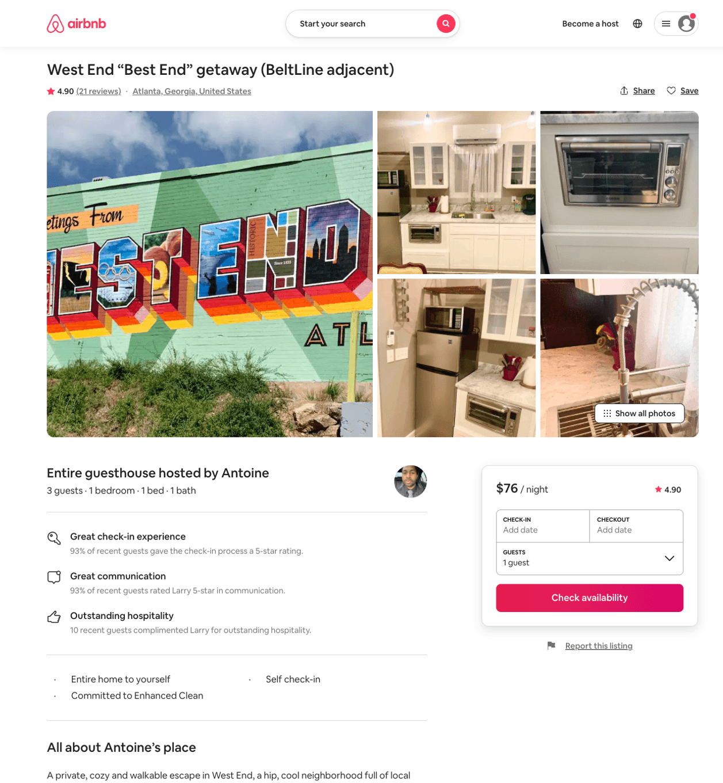
Listing 41766650
1
2
$75 - $84
4.93
2
Antoine
60812498
1
https://www.airbnb.com/rooms/41766650
Aug 2022

Slide 51
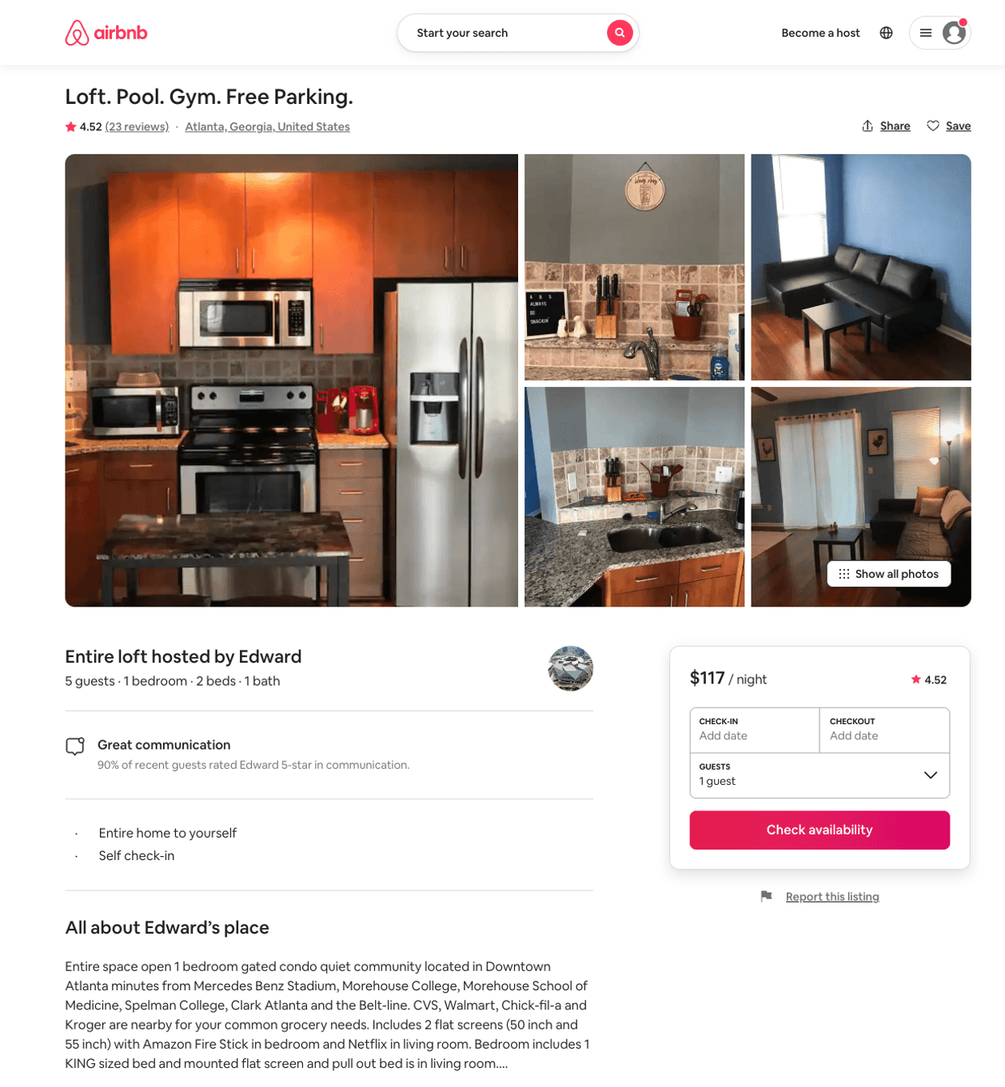
Listing 45098081
1
5
$36 - $123
4.69
1
Edward
118695908
8
https://www.airbnb.com/rooms/45098081
Aug 2022

Slide 52
Listing 14466981
1
2
$29 - $31
4.66
2
Rick
42301069
34
https://www.airbnb.com/rooms/14466981
Aug 2022

Slide 53
Listing 16062842
1
2
$29 - $30
4.38
2
Rick
42301069
34
https://www.airbnb.com/rooms/16062842
Aug 2022

Slide 54
Listing 39424437
5
14
$399 - $615
4.89
2
Steven
302826285
1
https://www.airbnb.com/rooms/39424437
Aug 2022

Slide 55
Listing 30731794
2
4
$498
2
Dominique
230016089
2
https://www.airbnb.com/rooms/30731794
Jul 2022

Slide 56
Listing 44337214
1
2
$109 - $150
4.92
3
Anthony
357679392
2
https://www.airbnb.com/rooms/44337214
Aug 2022

Slide 57
Listing 47119990
2
5
$54 - $170
4.56
1
Stephanie
380724467
3
https://www.airbnb.com/rooms/47119990
Aug 2022

Slide 58
Listing 40924179
1
1
$33 - $49
4.75
3
Andersen
169296999
3
https://www.airbnb.com/rooms/40924179
Aug 2022

Slide 59
Listing 9148695
1
2
$45 - $67
4.85
1
Chris & Mallerie
13200756
10
https://www.airbnb.com/rooms/9148695
Aug 2022

Slide 60
Listing 22095704
1
3
$75 - $105
4.82
2
Paul
643399
3
https://www.airbnb.com/rooms/22095704
Aug 2022

Slide 61
Listing 31460758
1
3
$78 - $107
4.76
2
Paul
643399
3
https://www.airbnb.com/rooms/31460758
Aug 2022

Slide 62
Listing 41046064
2
6
$87 - $211
4.79
1
Courtney
179626170
2
https://www.airbnb.com/rooms/41046064
Aug 2022

Slide 63
Listing 31498155
2
4
$99 - $174
4.90
2
Shannon
5111463
14
https://www.airbnb.com/rooms/31498155
Aug 2022

Slide 64
Listing 28937371
2
5
$125 - $136
4.78
14
Jeannell
79118134
1
https://www.airbnb.com/rooms/28937371
Aug 2022

Slide 65
Listing 31718202
2
4
$128 - $178
4.88
2
Dee
18117084
1
https://www.airbnb.com/rooms/31718202
Jun 2022

Slide 66
Listing 29657025
8
16
$519 - $859
4.76
2
Shannon
5111463
14
https://www.airbnb.com/rooms/29657025
Aug 2022

Slide 67
Listing 31759948
2
4
$600
2
Jock
137337012
1
https://www.airbnb.com/rooms/31759948
Aug 2022

Slide 68
Listing 33405824
6
12
$226 - $419
4.76
3
Talia
1851902
6
https://www.airbnb.com/rooms/33405824
Aug 2022

Slide 69
Listing 29657471
4
10
$191 - $851
4.88
2
Shannon
5111463
14
https://www.airbnb.com/rooms/29657471
Aug 2022

Slide 70
Listing 49198676
3
6
$119 - $217
4.95
1
Betty
14485911
1
https://www.airbnb.com/rooms/49198676
Aug 2022

Slide 71
Listing 48961021
2
6
$126 - $174
4.77
2
Kareem
357754550
1
https://www.airbnb.com/rooms/48961021
Aug 2022

Slide 72
Listing 20185862
1
2
$64 - $160
4.82
1
Andrea
143717562
6
https://www.airbnb.com/rooms/20185862
Aug 2022

Slide 73
Listing 31127057
1
2
$40 - $55
4.68
2
Whitney
2812029
2
https://www.airbnb.com/rooms/31127057
Jun 2022

Slide 74
Listing 46176060
1
2
$89 - $115
4.86
2
Beulah
69488268
2
https://www.airbnb.com/rooms/46176060
Aug 2022

Slide 75
Listing 31304128
3
8
$107 - $156
4.83
1
Jamaal & Saida
233947519
1
https://www.airbnb.com/rooms/31304128
Aug 2022

Slide 76
Listing 10499147
1
2
$45 - $61
4.76
1
Chris & Mallerie
13200756
10
https://www.airbnb.com/rooms/10499147
Aug 2022

Slide 77
Listing 34724858
1
2
$35 - $60
4.77
2
Charity
110467402
3
https://www.airbnb.com/rooms/34724858
Aug 2022

Slide 78
Listing 47768662
1
2
$89 - $98
4.90
2
Beulah
69488268
2
https://www.airbnb.com/rooms/47768662
Aug 2022

Slide 79
Listing 50229206
1
3
$67 - $109
4.95
2
Chris & Mallerie
13200756
10
https://www.airbnb.com/rooms/50229206
Jun 2022

Slide 80
Listing 16424550
1
3
$74 - $121
4.90
2
Toye
10417853
1
https://www.airbnb.com/rooms/16424550
Jul 2022

Slide 81
Listing 39673252
1
3
$92 - $108
4.86
4
Fa
236500297
1
https://www.airbnb.com/rooms/39673252
Aug 2022

Slide 82
Listing 48369941
Studio
3
$57 - $149
4.76
1
Robert
63823041
2
https://www.airbnb.com/rooms/48369941
Aug 2022

Slide 83
Listing 31713182
2
4
$70 - $88
4.69
2
Honey Homes
235928659
3
https://www.airbnb.com/rooms/31713182
Aug 2022

Slide 84
Listing 26518620
2
4
$66 - $102
4.75
2
Jerime
25160716
3
https://www.airbnb.com/rooms/26518620
Aug 2022

Slide 85
Listing 29571904
1
2
$60 - $79
4.73
2
Paul
643399
3
https://www.airbnb.com/rooms/29571904
Aug 2022

Slide 86
Listing 47979727
3
3
$145 - $165
4.80
2
Mr. J
386786604
1
https://www.airbnb.com/rooms/47979727
Aug 2022

Slide 87
Listing 47537263
2
7
$105 - $215
4.60
2
Venesha
140479211
5
https://www.airbnb.com/rooms/47537263
Aug 2022

Slide 88
Listing 25160561
3
6
$175 - $201
4.97
3
Helene & Eric
42230053
10
https://www.airbnb.com/rooms/25160561
Aug 2022

Slide 89
Listing 50660466
4
8
$171 - $500
4.83
2
Shea
409347053
2
https://www.airbnb.com/rooms/50660466
Aug 2022

Slide 90
Listing 49075150
3
6
$169 - $187
4.96
31
Helene & Eric
42230053
10
https://www.airbnb.com/rooms/49075150
Aug 2022

Slide 91
Listing 9151226
1
2
$45 - $67
4.75
1
Chris & Mallerie
13200756
10
https://www.airbnb.com/rooms/9151226
Aug 2022

Slide 92
Listing 40867630
1
2
$46 - $72
4.85
3
Evelyn
223722394
1
https://www.airbnb.com/rooms/40867630
Jun 2022

Slide 93
Listing 46097802
3
8
$166 - $332
4.94
2
Shannon
5111463
14
https://www.airbnb.com/rooms/46097802
Aug 2022

Slide 94
Listing 43495947
9
16
$531 - $923
4.92
2
Shannon
5111463
14
https://www.airbnb.com/rooms/43495947
Aug 2022

Slide 95
Listing 32043794
2
6
$92 - $145
4.74
2
Anne
86304502
1
https://www.airbnb.com/rooms/32043794
Aug 2022

Slide 96
Listing 43494955
6
10
$231 - $790
4.83
2
Shannon
5111463
14
https://www.airbnb.com/rooms/43494955
Aug 2022

Slide 97
Listing 29275913
3
8
$125 - $500
4.92
3
Trey
110527495
1
https://www.airbnb.com/rooms/29275913
Jun 2022

Slide 98
Listing 43310075
2
4
$94 - $123
4.64
4
Suggs
84702541
1
https://www.airbnb.com/rooms/43310075
Aug 2022

Slide 99
Listing 38108239
2
4
$72 - $225
4.75
2
Shannon
5111463
14
https://www.airbnb.com/rooms/38108239
Aug 2022

Slide 100
Listing 31807114
3
8
$135 - $1236
4.47
2
Wendell
237287077
2
https://www.airbnb.com/rooms/31807114
Aug 2022

Slide 101
Listing 5090568
1
3
$300
4.92
1
Karen
21487210
1
https://www.airbnb.com/rooms/5090568
Aug 2022

Slide 102
Listing 43878198
1
4
$76 - $103
4.52
2
Ashley
83509899
1
https://www.airbnb.com/rooms/43878198
Aug 2022

Slide 103
Listing 39025317
2
6
$97 - $121
4.80
3
Xi
25972040
2
https://www.airbnb.com/rooms/39025317
Aug 2022

Slide 104
Listing 13751861
1
4
$105 - $106
4.88
1
Kenneth
2664919
1
https://www.airbnb.com/rooms/13751861
Aug 2022

Slide 105
Listing 8148131
3
6
$2000
4.96
3
Nana
43019772
2
https://www.airbnb.com/rooms/8148131
Aug 2022

Slide 106
Listing 31101887
3
6
$2500
3
Nana
43019772
2
https://www.airbnb.com/rooms/31101887
Aug 2022

Slide 107
Listing 27491622
1
3
$60 - $99
4.94
2
Whitney
2812029
2
https://www.airbnb.com/rooms/27491622
Aug 2022

Slide 108
Listing 51281642
3
6
$119 - $209
3.88
3
Amanda
99707946
2
https://www.airbnb.com/rooms/51281642
Aug 2022

Slide 109
Listing 51388404
3
6
$104 - $119
4.73
2
Paola
190790952
3
https://www.airbnb.com/rooms/51388404
Aug 2022

Slide 110
Listing 51568028
1
3
$55 - $96
4.0
1
Edward
118695908
8
https://www.airbnb.com/rooms/51568028
Jul 2022

Slide 111
Listing 48431240
4
10
$221 - $2000
5.0
3
Xi
25972040
2
https://www.airbnb.com/rooms/48431240
Jun 2022

Slide 112
Listing 52026956
1
2
$51 - $92
4.93
2
Queen Sheba
4382721
1
https://www.airbnb.com/rooms/52026956
Jun 2022

Slide 113
Listing 32018122
3
5
$118 - $162
4.78
2
Talia
1851902
6
https://www.airbnb.com/rooms/32018122
Aug 2022

Slide 114
Listing 52469197
2
6
$79 - $130
4.60
1
Denise
424708814
4
https://www.airbnb.com/rooms/52469197
Jul 2022

Slide 115
Listing 22336880
2
8
$87 - $119
4.54
2
Jamie
28685522
4
https://www.airbnb.com/rooms/22336880
Aug 2022

Slide 116
Listing 52893852
5
10
$245 - $732
4.88
2
Shannon
5111463
14
https://www.airbnb.com/rooms/52893852
Aug 2022

Slide 117
Listing 52893851
2
6
$126 - $516
4.60
2
Shannon
5111463
14
https://www.airbnb.com/rooms/52893851
Aug 2022

Slide 118
Listing 51605953
3
11
$225 - $321
4.54
2
Chic
418064048
1
https://www.airbnb.com/rooms/51605953
Jun 2022

Slide 119
Listing 52882783
7
16
$477 - $779
4.60
2
Shannon
5111463
14
https://www.airbnb.com/rooms/52882783
Aug 2022

Slide 120
Listing 25545587
2
6
$130 - $350
4.72
2
A.M.G.
79597408
1
https://www.airbnb.com/rooms/25545587
Aug 2022

Slide 121
Listing 51598269
1
2
$123 - $134
14
Atlanta
174095187
2
https://www.airbnb.com/rooms/51598269
Aug 2022

Slide 122
Listing 53196515
1
2
$40 - $60
4.80
2
Dr. Paula
387535127
2
https://www.airbnb.com/rooms/53196515
Aug 2022

Slide 123
Listing 53297261
1
3
$73 - $140
4.81
2
Luciane
385364693
1
https://www.airbnb.com/rooms/53297261
Aug 2022

Slide 124
Listing 52058632
2
5
$89 - $103
4.67
2
Signature
421449458
1
https://www.airbnb.com/rooms/52058632
Aug 2022

Slide 125
Listing 53380628
4
4
$373 - $469
5
Brandon
225293803
1
https://www.airbnb.com/rooms/53380628
Aug 2022

Slide 126
Listing 53291144
2
6
$56 - $101
4.24
1
Atlanta
431436029
2
https://www.airbnb.com/rooms/53291144
Jul 2022

Slide 127
Listing 52675744
1
2
$100 - $150
4.67
2
Venesha
140479211
5
https://www.airbnb.com/rooms/52675744
Aug 2022

Slide 128
Listing 10857781
3
6
$675
2
Sarah
8082592
1
https://www.airbnb.com/rooms/10857781
Jul 2022

Slide 129
Listing 53574276
4
12
$271 - $379
4.71
2
Walter
45164925
1
https://www.airbnb.com/rooms/53574276
Aug 2022

Slide 130
Listing 53688804
1
2
$36 - $40
4.61
1
Adrianne
21186242
2
https://www.airbnb.com/rooms/53688804
Aug 2022

Slide 131
Listing 53688686
1
2
$36 - $60
4.80
1
Adrianne
21186242
2
https://www.airbnb.com/rooms/53688686
Aug 2022

Slide 132
Listing 53759095
2
4
$102 - $214
4.76
2
Venesha
140479211
5
https://www.airbnb.com/rooms/53759095
Aug 2022

Slide 133
Listing 2177830
1
4
$120 - $124
1
https://www.vrbo.com/2177830
Aug 2022

Slide 134
Listing 46155411
1
2
$51 - $98
4.89
2
Charles
1599944
1
https://www.airbnb.com/rooms/46155411
Aug 2022

Slide 135
Listing historic-west-end-atlanta-treasure
undefined
6
9
https://www.booking.com/hotel/us/historic-west-end-atlanta-treasure.html
Sep 2022

Slide 136
Listing 49130899
1
2
$96
4
Marcellus
255567129
1
https://www.airbnb.com/rooms/49130899
Aug 2022

Slide 137
Listing 53990795
5
14
$457 - $491
4.63
2
Venesha
140479211
5
https://www.airbnb.com/rooms/53990795
Aug 2022

Slide 138
Listing 53146133
4
10
$160 - $173
4.73
3
Atlanta
61366
7
https://www.airbnb.com/rooms/53146133
Aug 2022

Slide 139
Listing 52557296
5
16
$639 - $799
1
Blanket Homes
151556720
3
https://www.airbnb.com/rooms/52557296
Aug 2022

Slide 140
Listing 2651534
4
10
$248
4
1
https://www.vrbo.com/2651534
Aug 2022

Slide 141
Listing 52825888
2
2
$68
5.0
2
Dr. Paula
387535127
2
https://www.airbnb.com/rooms/52825888
Jun 2022

Slide 142
Listing 2635831
2
2
$65
60
https://www.vrbo.com/2635831
Aug 2022

Slide 143
Listing 2711105
3
6
$121
3
Lucas D Ramirez
https://www.vrbo.com/2711105
Aug 2022

Slide 144
Listing 2632370
5
13
$567
2
Venesha
https://www.vrbo.com/2632370
Aug 2022

Slide 145
Listing 2734585
1
2
$89
2
https://www.vrbo.com/2734585
Aug 2022

Slide 146
Listing 2781626
1
4
$125
5
1
https://www.vrbo.com/2781626
Aug 2022

Slide 147
Listing 2791341
3
6
$189
1
Gigi
https://www.vrbo.com/2791341
Aug 2022

Slide 148
Listing 31402871
1
2
$55 - $65
4.88
2
Elliott
21399845
1
https://www.airbnb.com/rooms/31402871
Aug 2022

Slide 149
Listing 54060003
1
2
$91
4.29
2
Edward
118695908
8
https://www.airbnb.com/rooms/54060003
Aug 2022

Slide 150
Listing 20755547
1
4
$89
4.70
1
Nichole
10175317
1
https://www.airbnb.com/rooms/20755547
Aug 2022

Slide 151
Listing 2812494
4
8
$600
1
https://www.vrbo.com/2812494
Aug 2022

Slide 152
Listing 2838121
0
16
$324
3
Cav
https://www.vrbo.com/2838121
Aug 2022

Slide 153
Listing 2836453
4
8
$390
2
Key Properties and Investments
https://www.vrbo.com/2836453
Aug 2022

Slide 154
Listing 31694927
3
6
$110
4
Michele
32228966
1
https://www.airbnb.com/rooms/31694927
Jun 2022

Slide 155
Listing 2875645
3
6
$199
1
Jay Davis
https://www.vrbo.com/2875645
Aug 2022

Slide 156
Listing 45875645
3
6
1
Blanket Homes
151556720
3
https://www.airbnb.com/rooms/45875645
Aug 2022

Slide 157
Listing 2898928
2
6
$229
1
Sean Santiago
https://www.vrbo.com/2898928
Aug 2022

