Slide 2
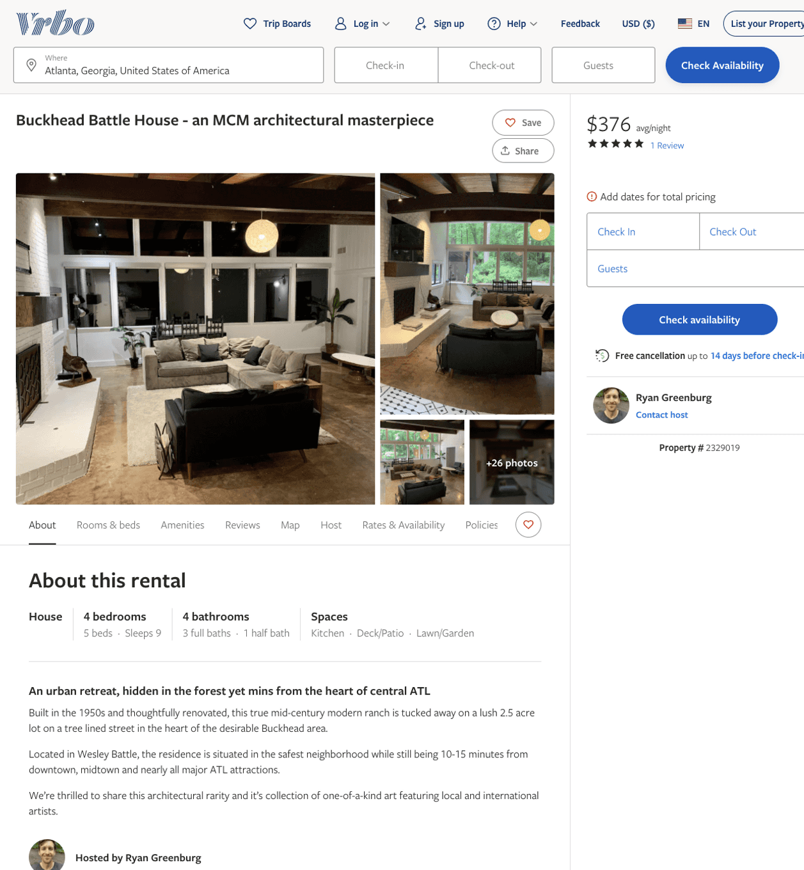
Listing 2329019
4
9
$376 - $554
4.4545455
2
Ryan Greenburg
https://www.vrbo.com/2329019
Aug 2022

Slide 3
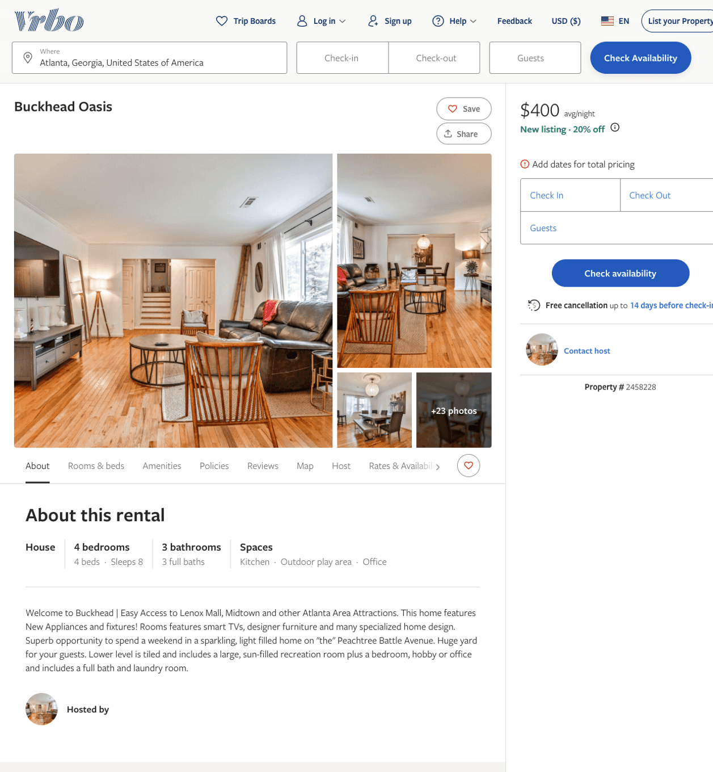
Listing 2458228
4
8
$340 - $400
5
3
Desmond L Hollingsworth
https://www.vrbo.com/2458228
Aug 2022

Slide 4
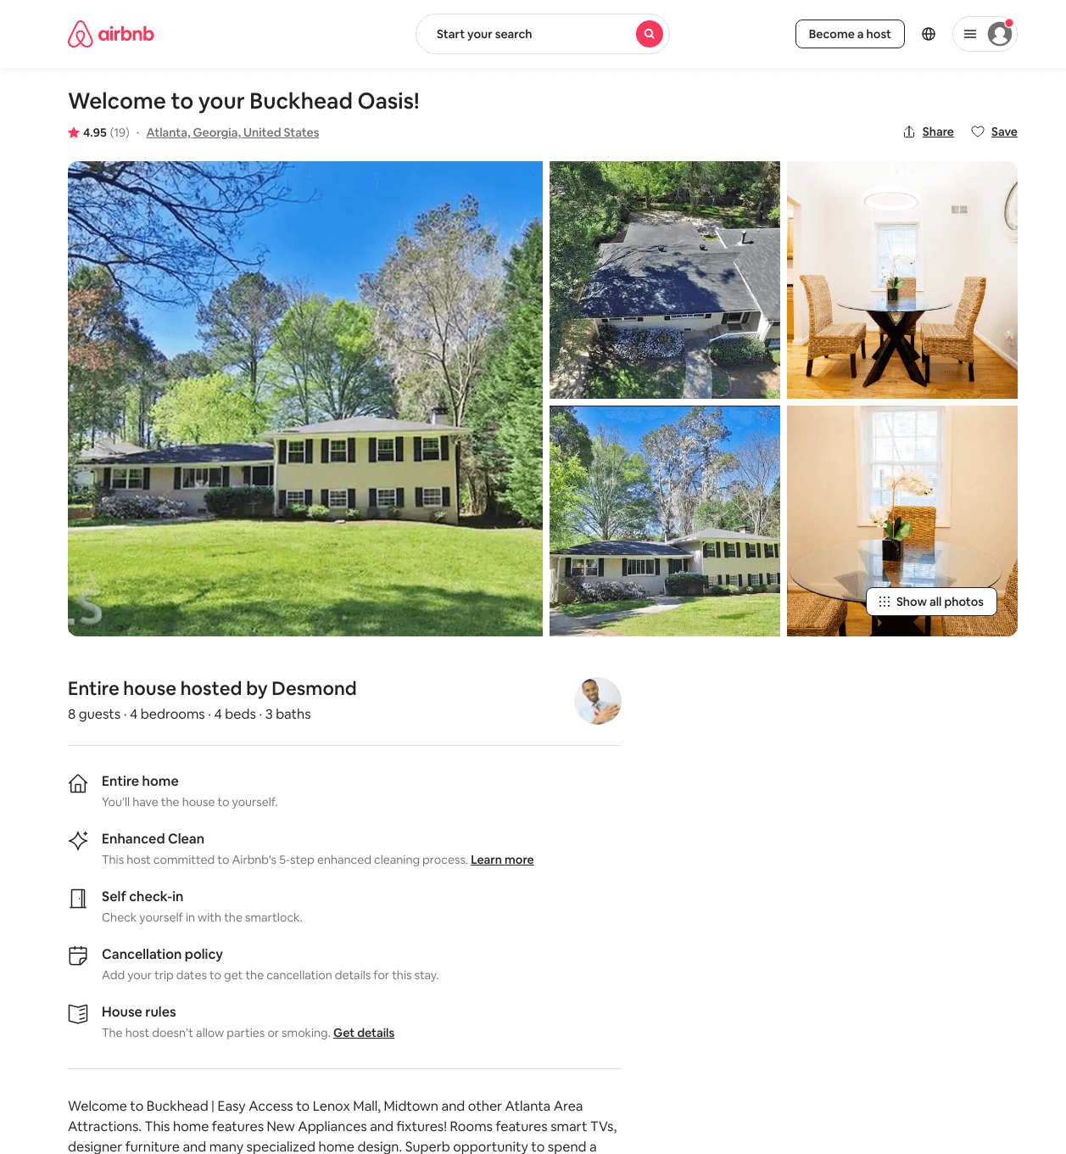
Listing 46048980
4
8
$225 - $500
4.86
2
Desmond
151562639
2
https://www.airbnb.com/rooms/46048980
Aug 2022

Slide 5
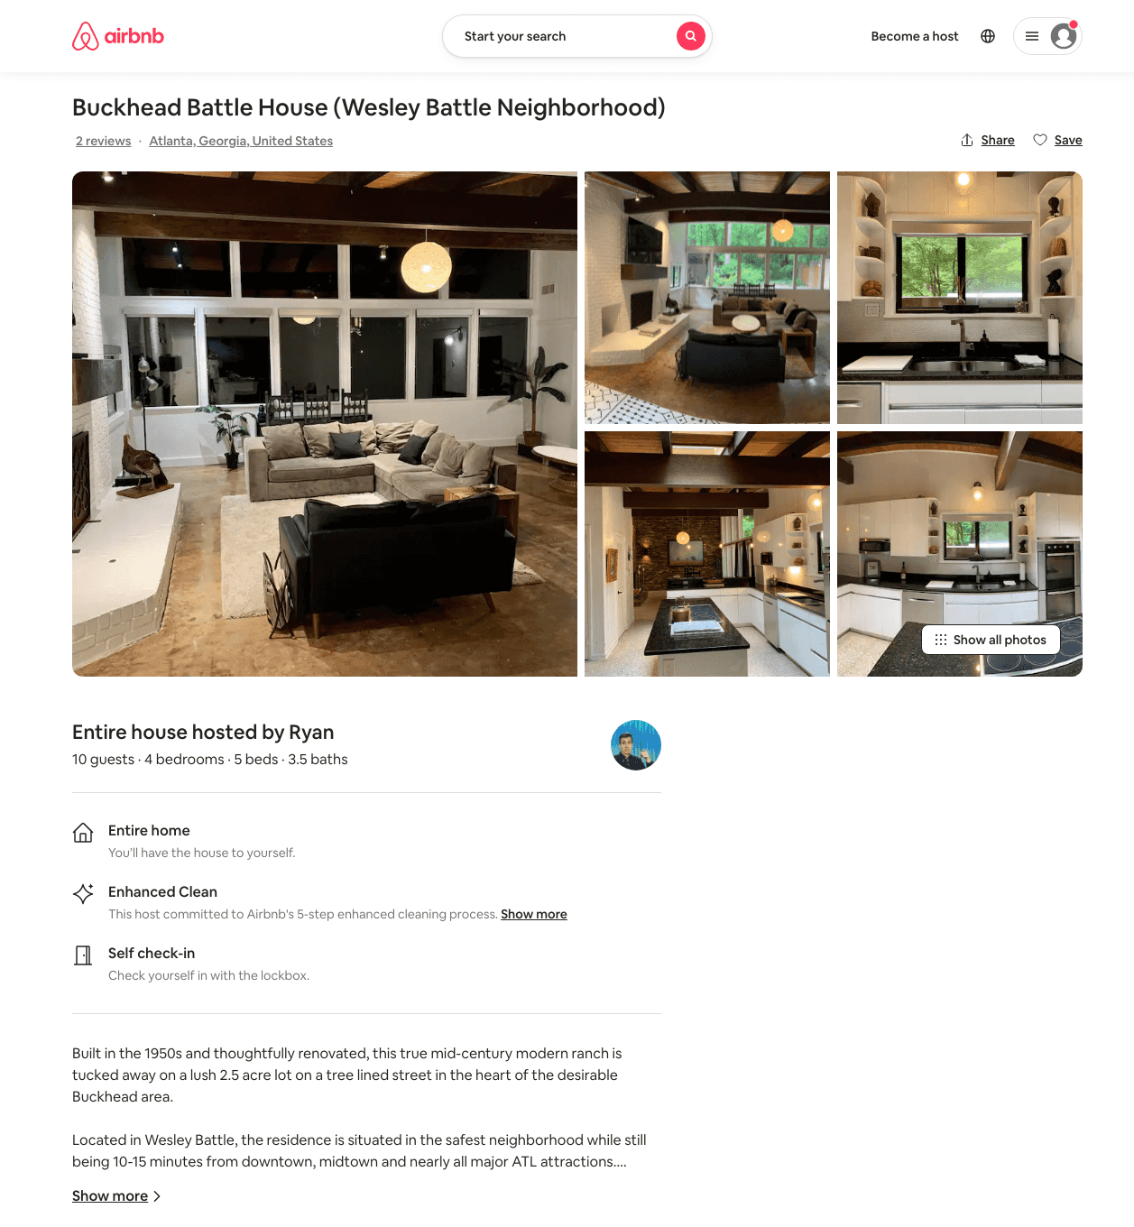
Listing 50054544
4
8
$382 - $650
4.85
2
Ryan
21340271
1
https://www.airbnb.com/rooms/50054544
Aug 2022

