Slide 2
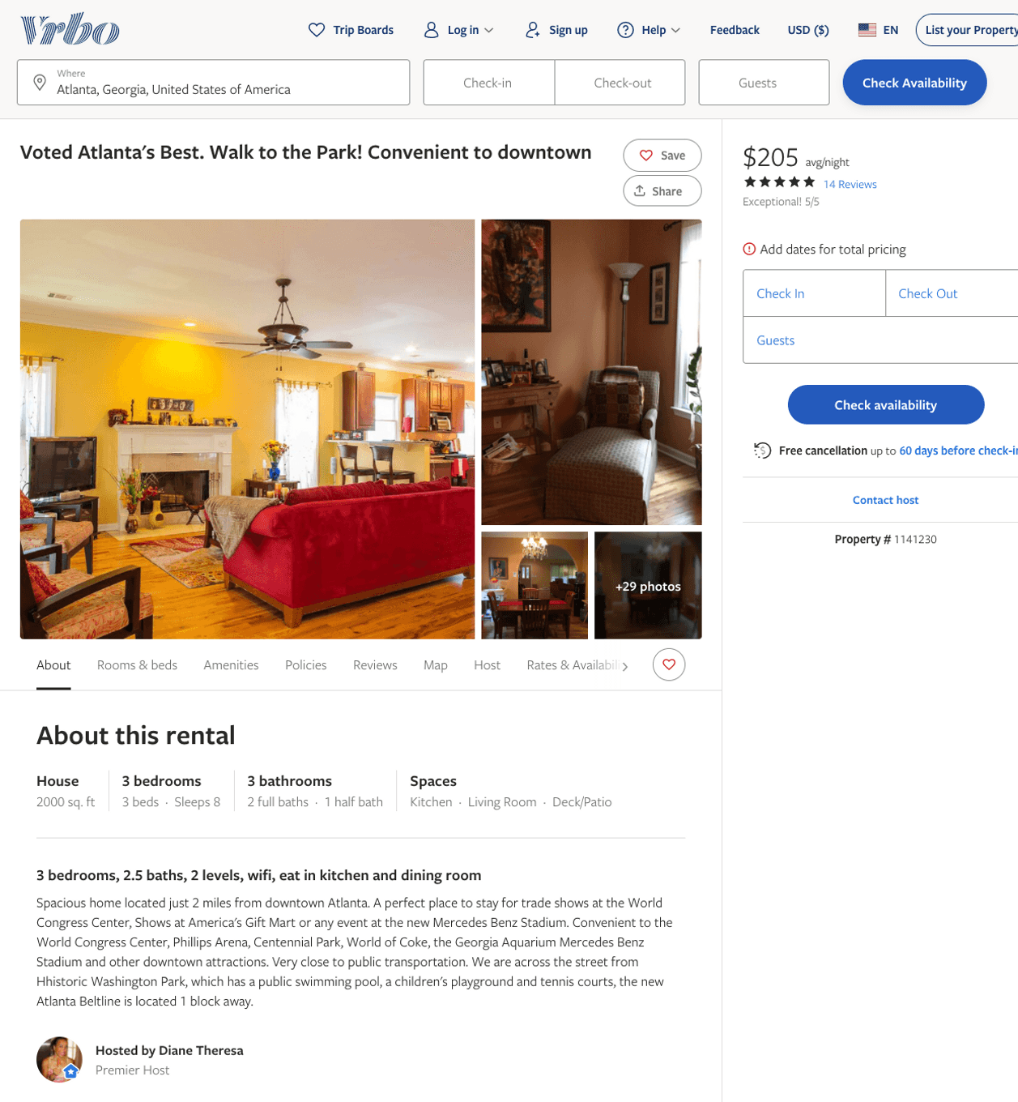
Listing 1141230
3
8
$142 - $205
5
2
Diane Theresa
https://www.vrbo.com/1141230
Aug 2022

Slide 3
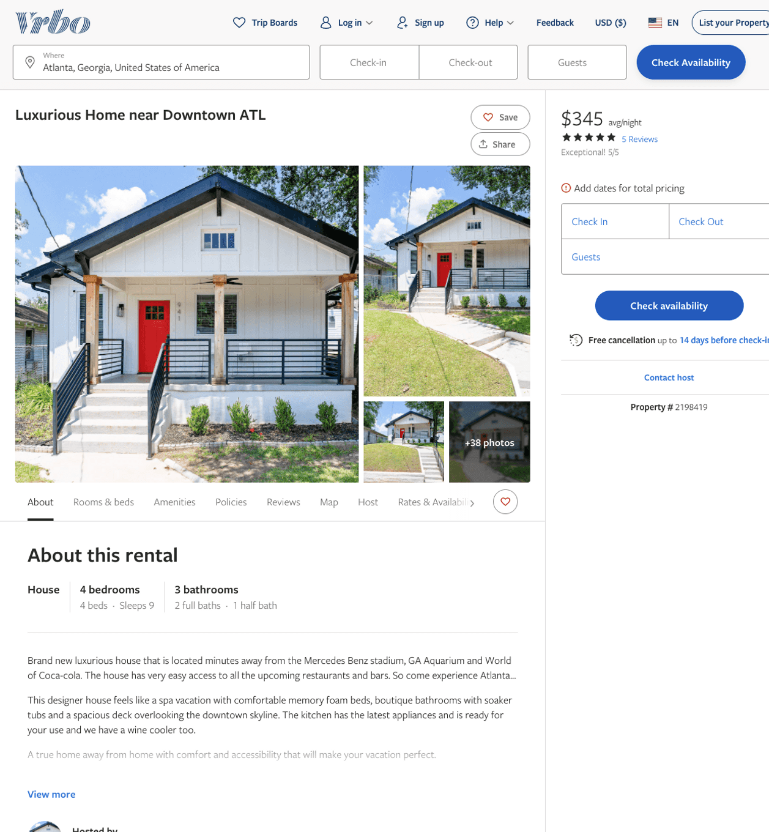
Listing 2198419
4
9
$301 - $345
4.75
1
https://www.vrbo.com/2198419
Aug 2022

Slide 4
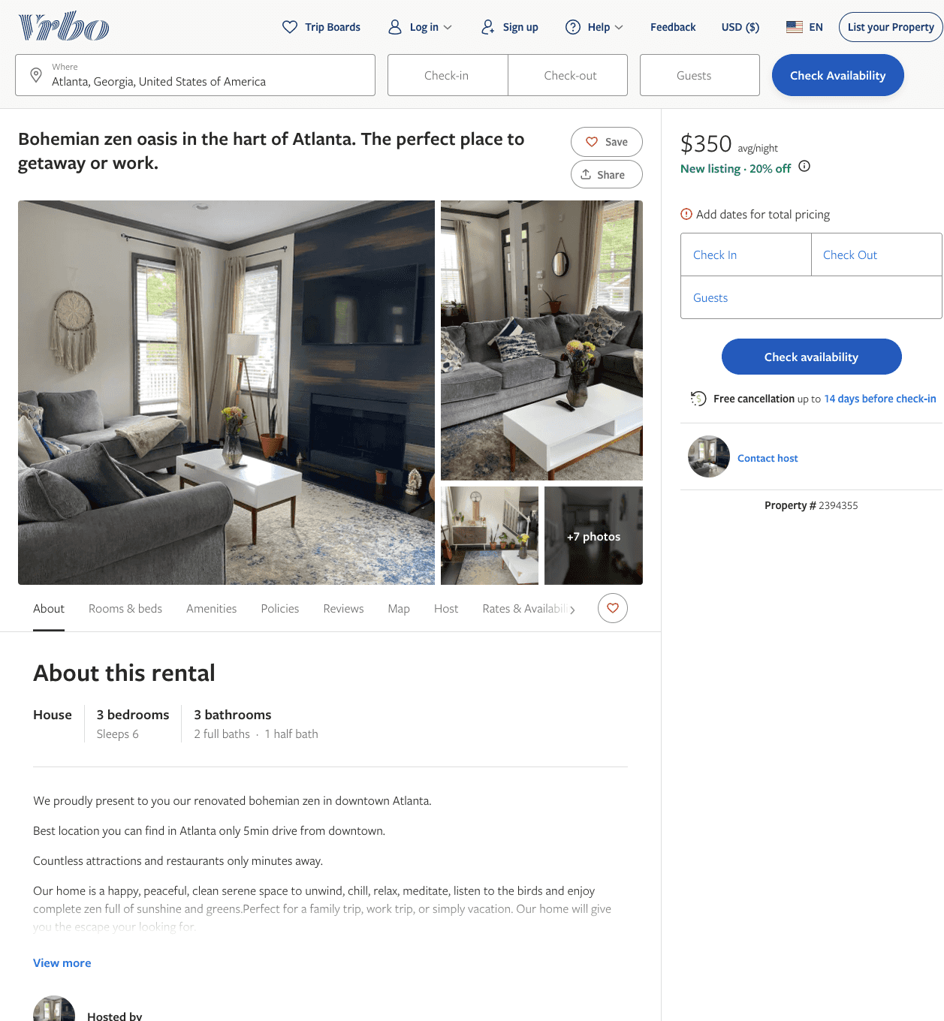
Listing 2394355
3
6
$307 - $350
3
https://www.vrbo.com/2394355
Aug 2022

Slide 5
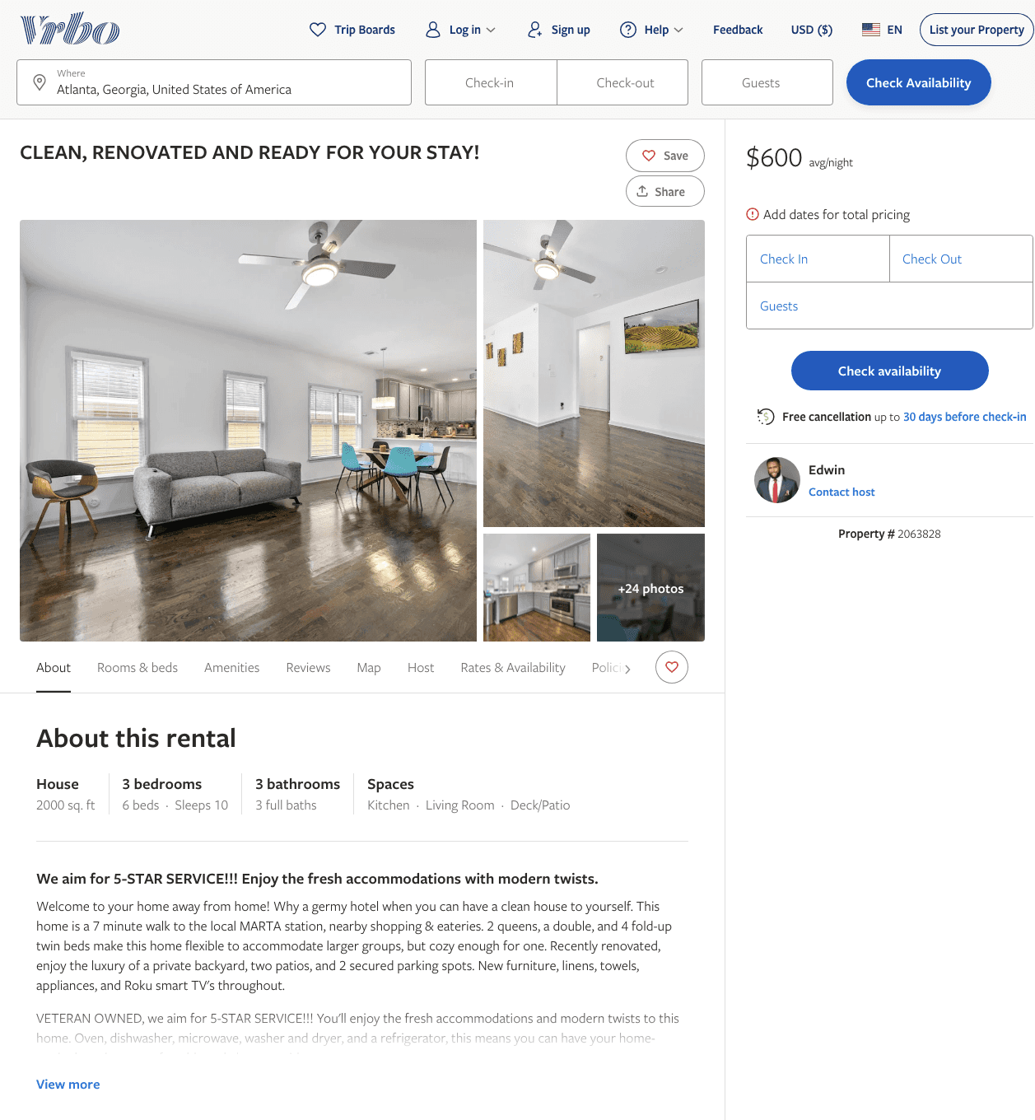
Listing 2063828
3
10
$600
3
Edwin
https://www.vrbo.com/2063828
Aug 2022

Slide 6
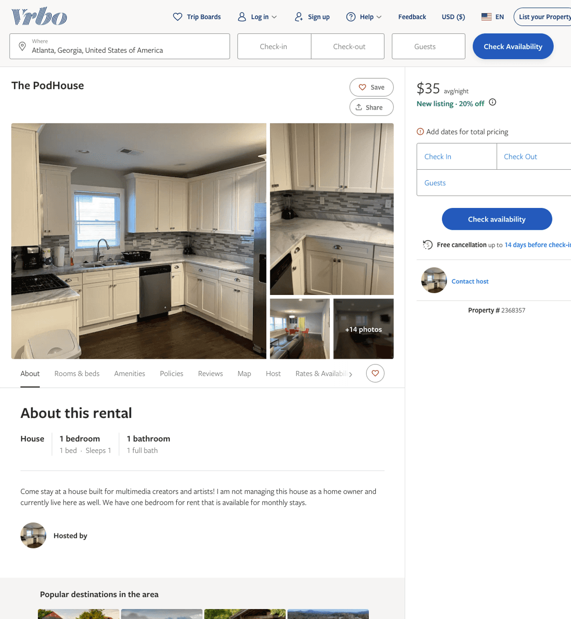
Listing 2368357
1
1
$35
2
Robb
https://www.vrbo.com/2368357
Aug 2022

Slide 7
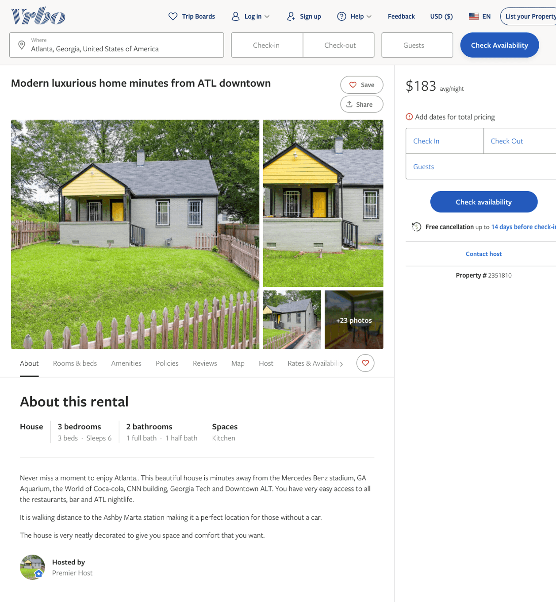
Listing 2351810
3
6
$160 - $203
1
https://www.vrbo.com/2351810
Aug 2022

Slide 8
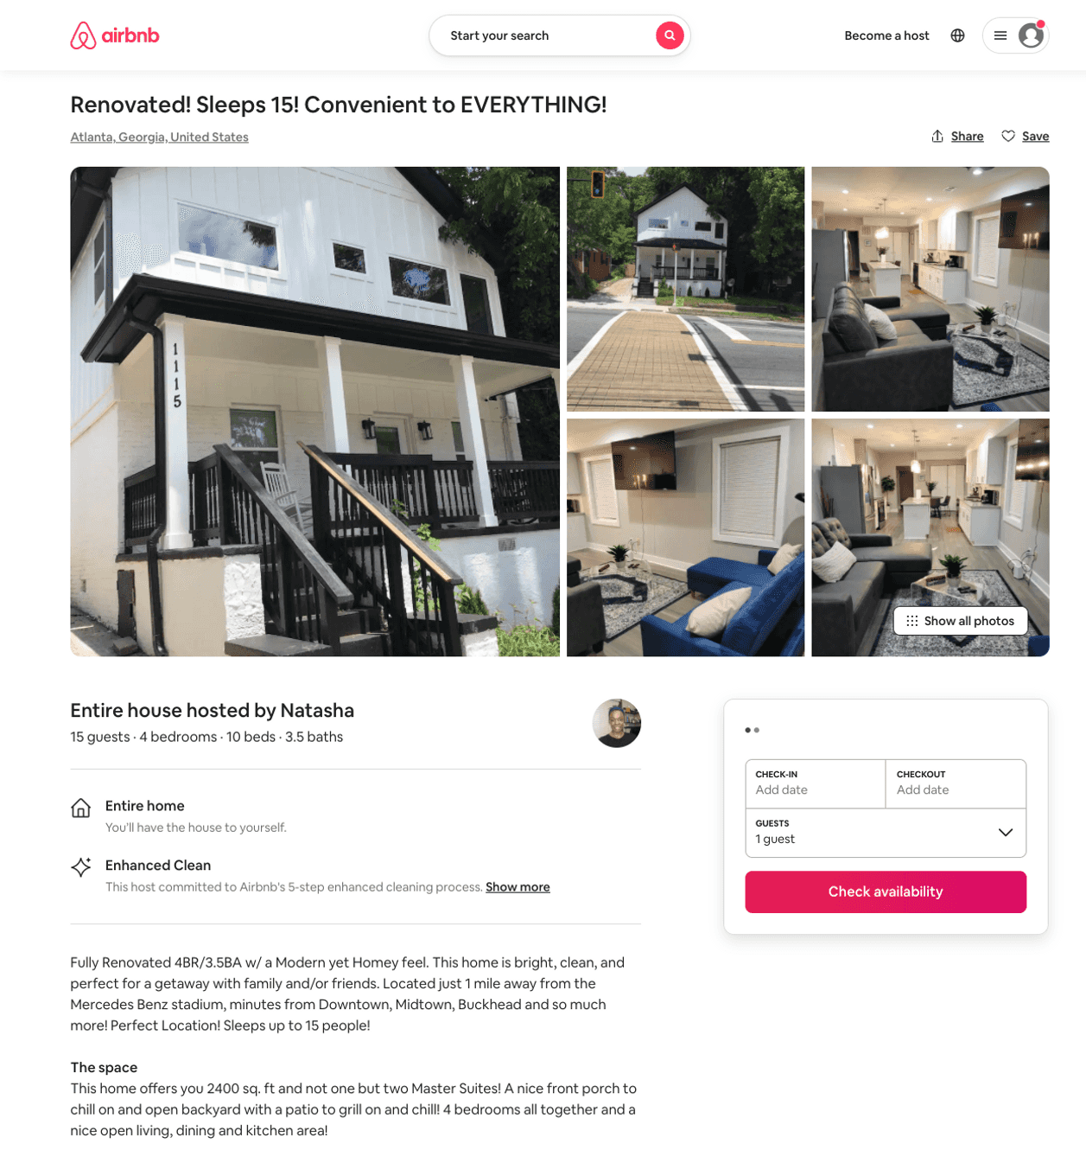
Listing 50378643
4
16
$350 - $556
4.93
2
Natasha
406952797
2
https://www.airbnb.com/rooms/50378643
Aug 2022

Slide 9
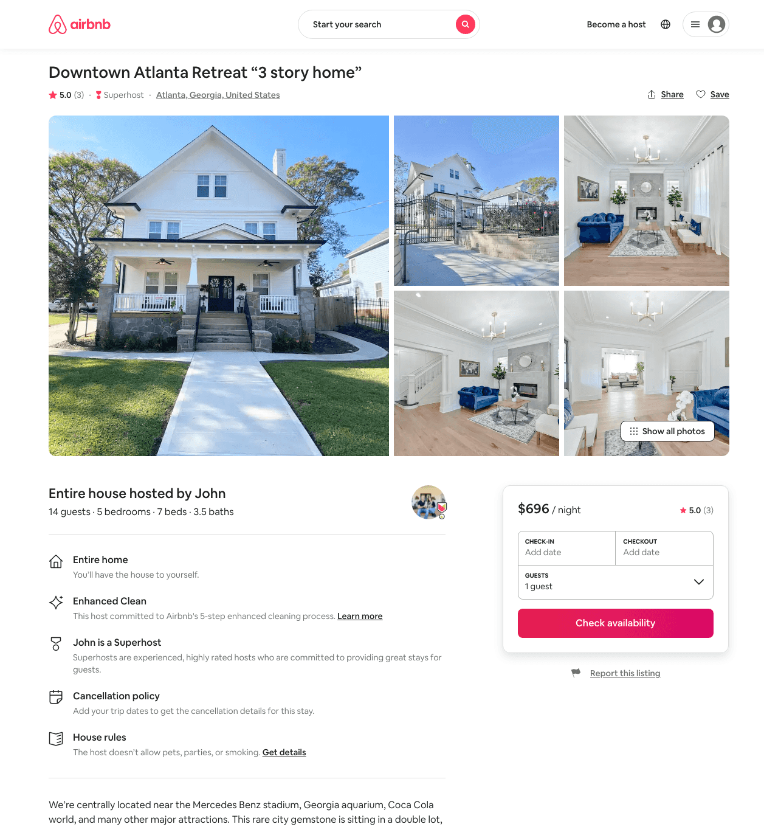
Listing 46359276
5
14
$578 - $781
5.0
2
John
195805984
2
https://www.airbnb.com/rooms/46359276
Aug 2022

Slide 10
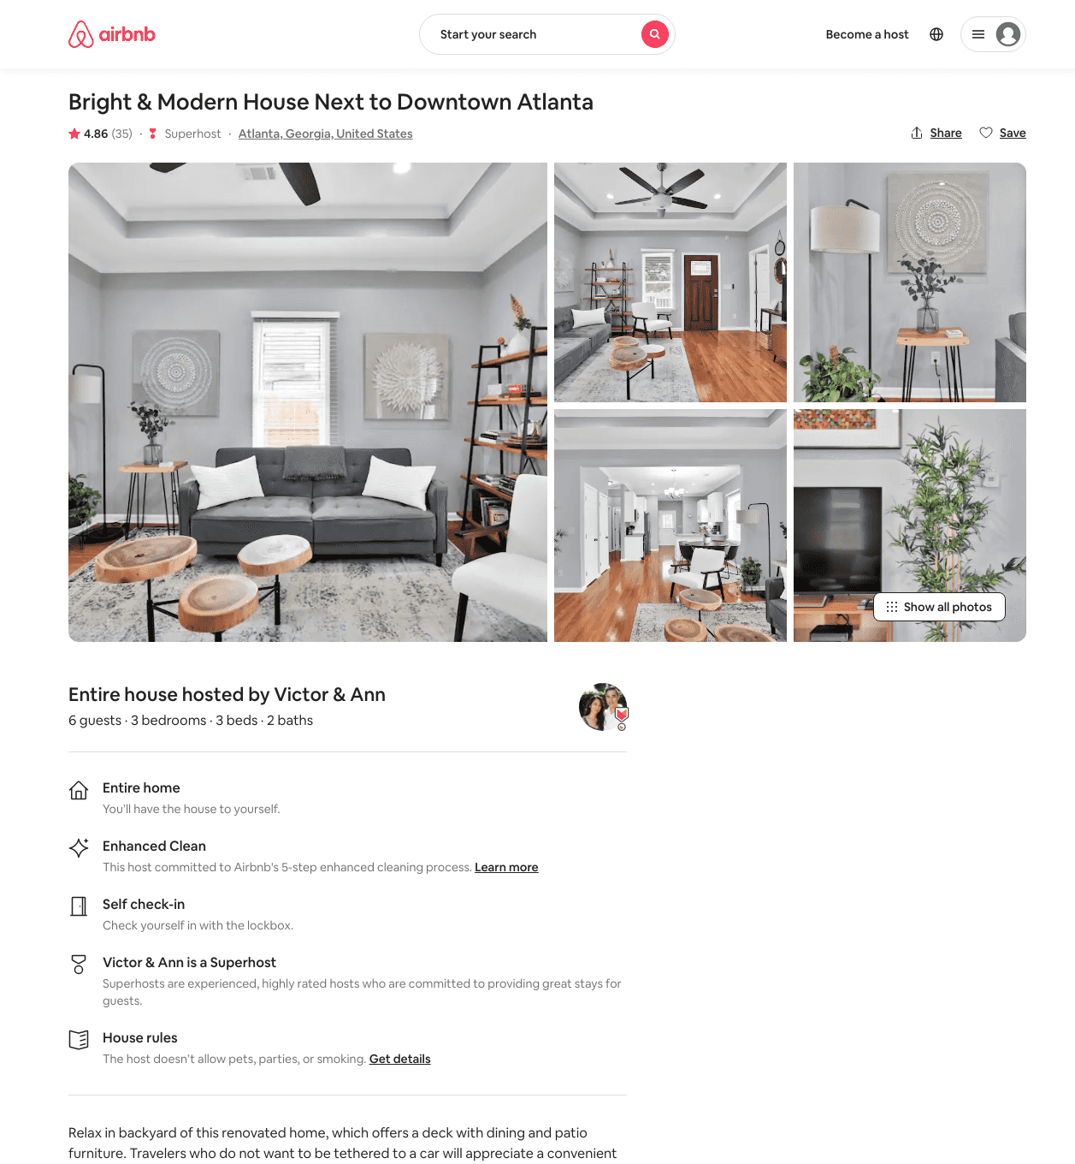
Listing 36064124
3
6
$215 - $255
4.77
2
Victor & Ann
16793482
2
https://www.airbnb.com/rooms/36064124
Jun 2022

Slide 11
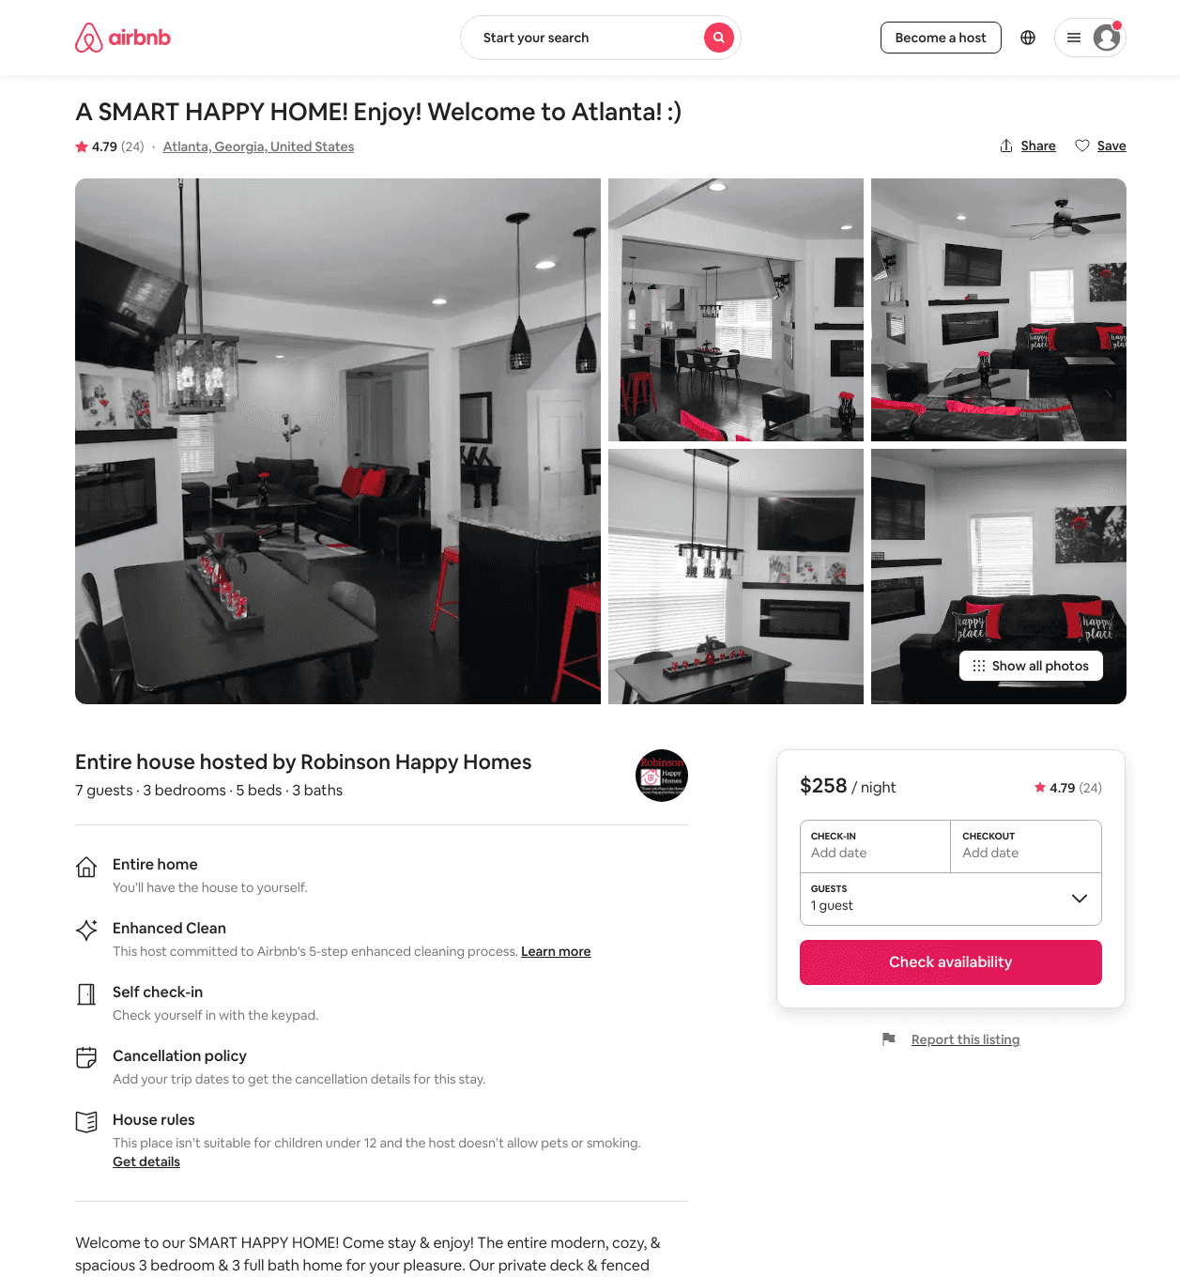
Listing 44651179
3
7
$165 - $318
4.83
1
Robinson Happy Homes
153167092
1
https://www.airbnb.com/rooms/44651179
Aug 2022

Slide 12
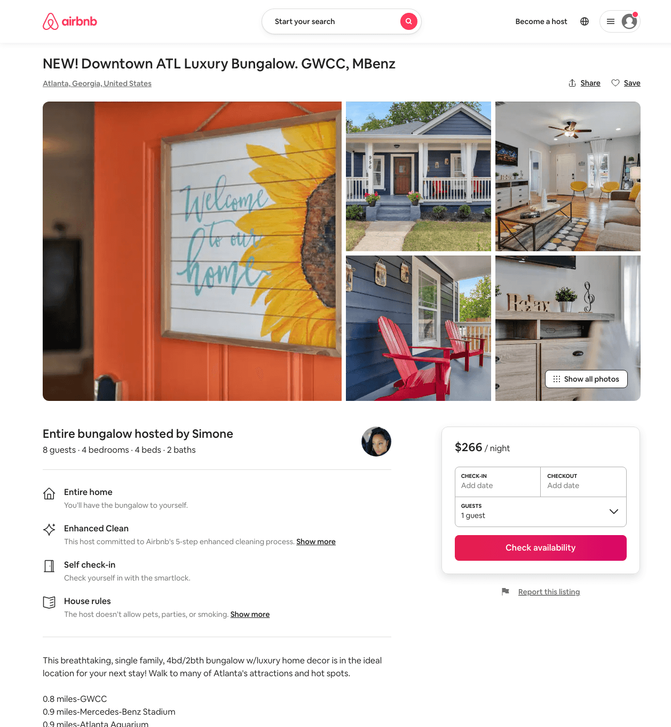
Listing 49912658
4
10
$194 - $324
5.0
1
SDL Financial
43926026
2
https://www.airbnb.com/rooms/49912658
Aug 2022

Slide 13
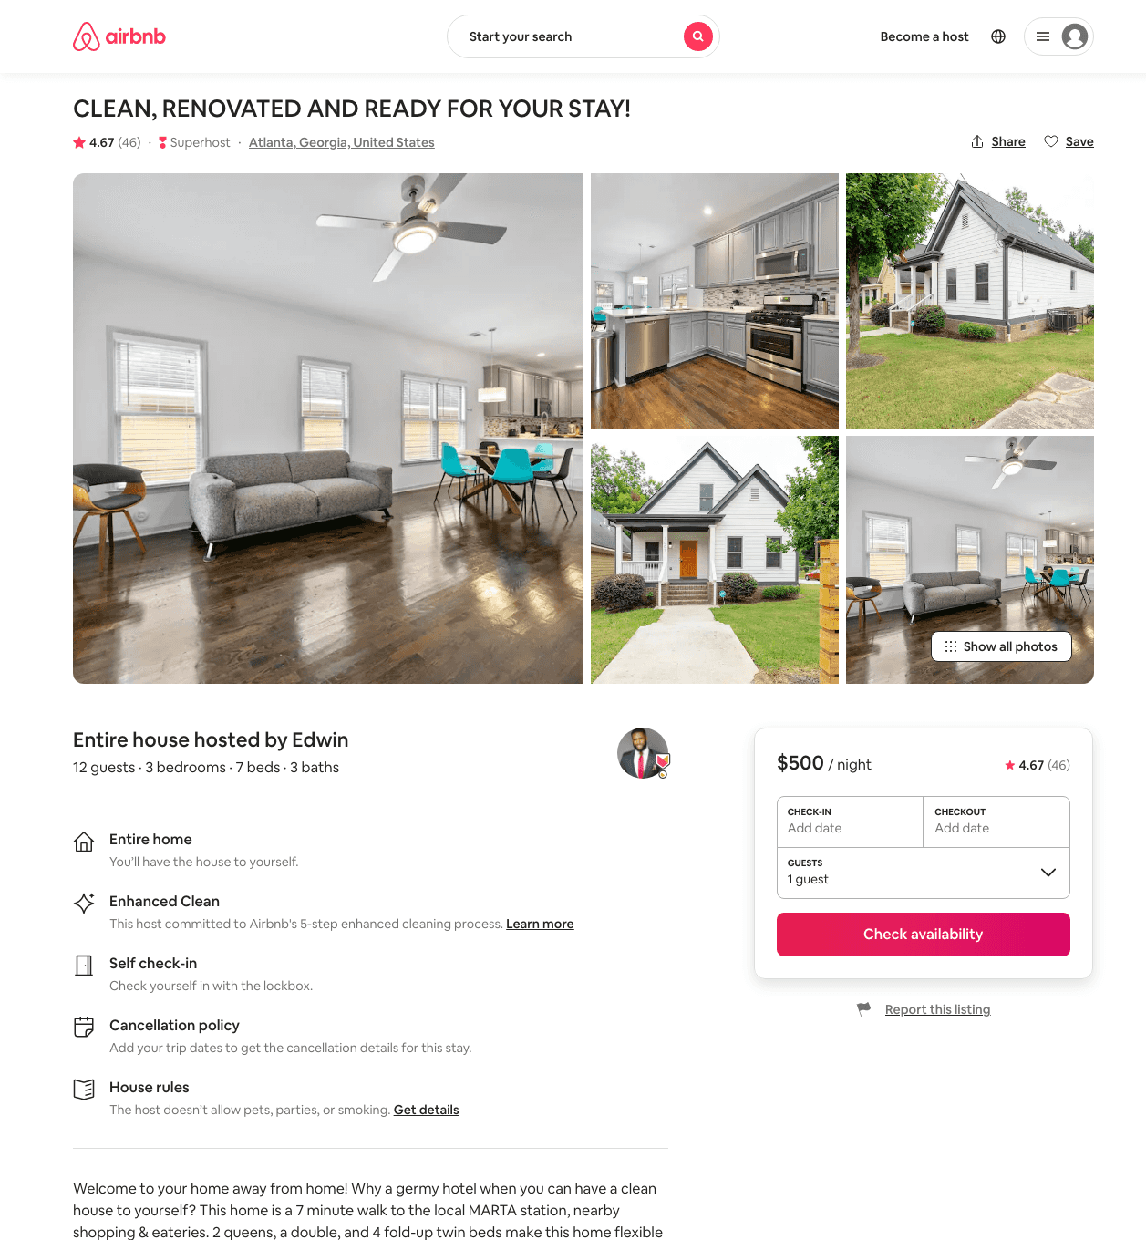
Listing 31499314
3
11
$300 - $499
4.76
2
Edwin
236005559
1
https://www.airbnb.com/rooms/31499314
Aug 2022

Slide 14
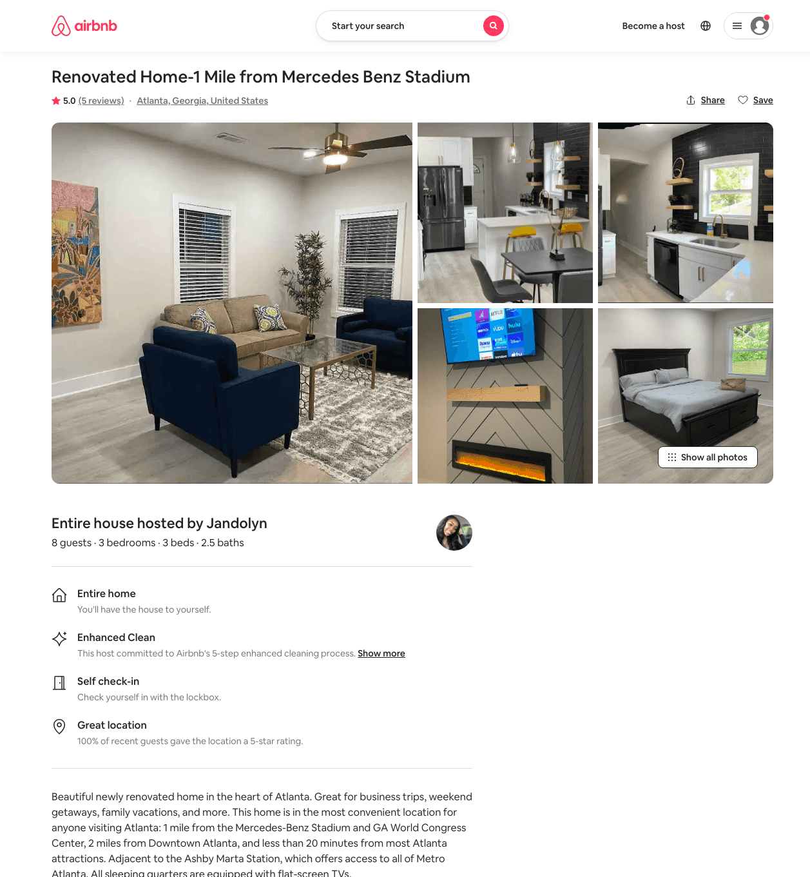
Listing 50074189
3
8
$119 - $236
4.90
1
Jandolyn
202571804
1
https://www.airbnb.com/rooms/50074189
Aug 2022

Slide 15
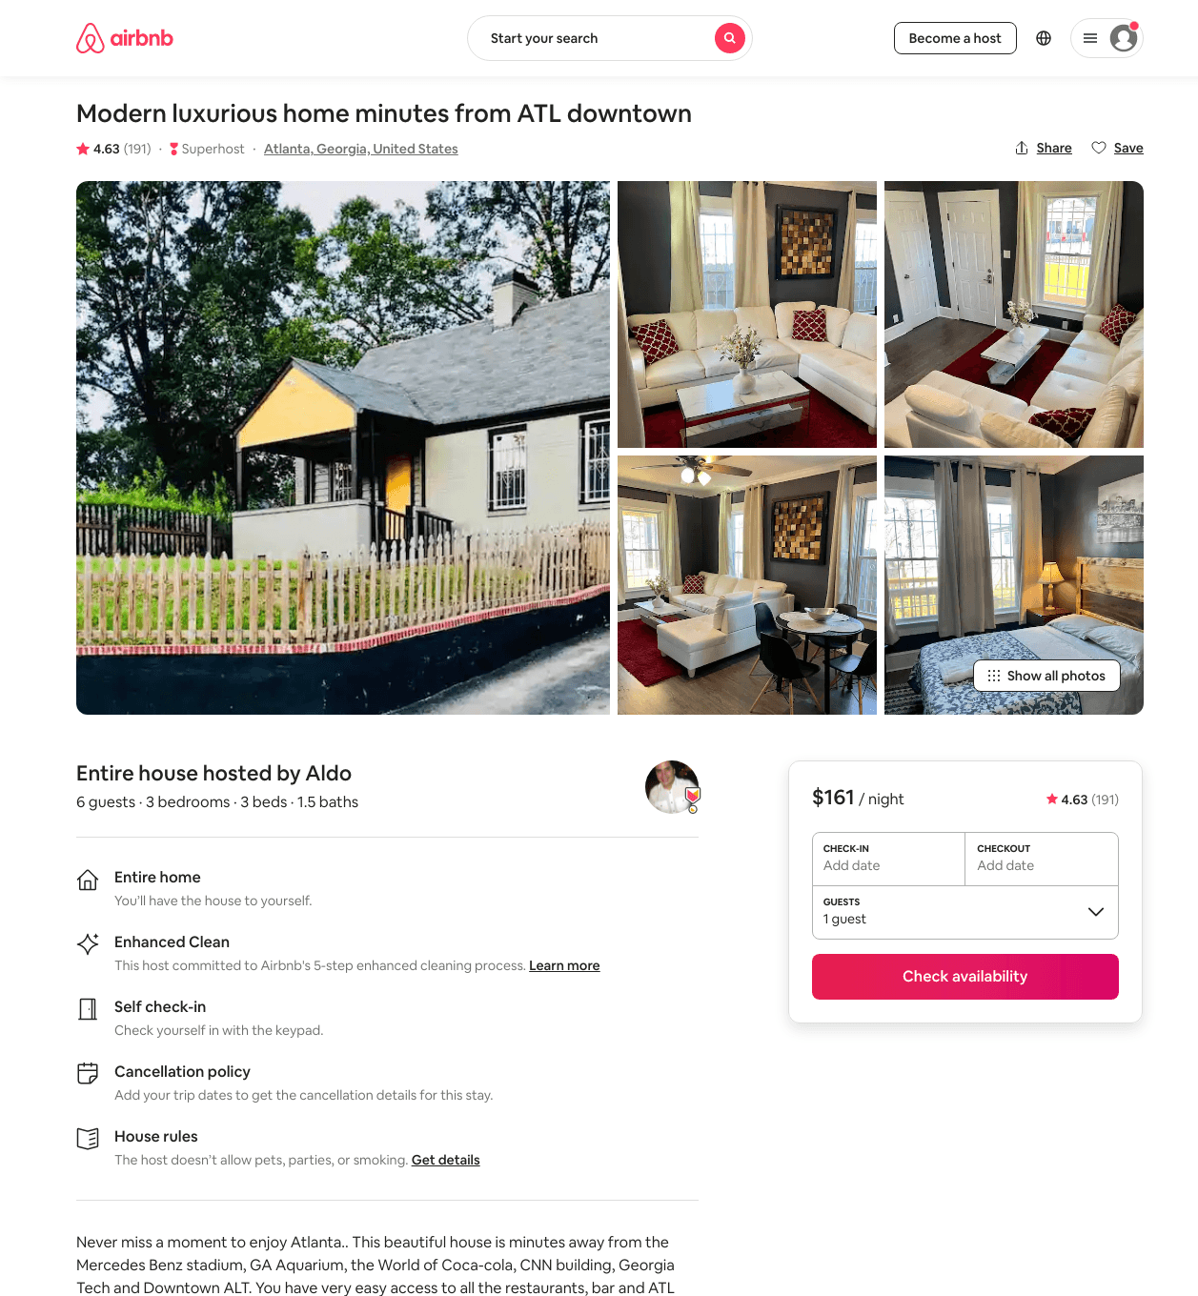
Listing 32964146
3
6
$93 - $191
4.62
1
Aldo
370956
6
https://www.airbnb.com/rooms/32964146
Aug 2022

Slide 16
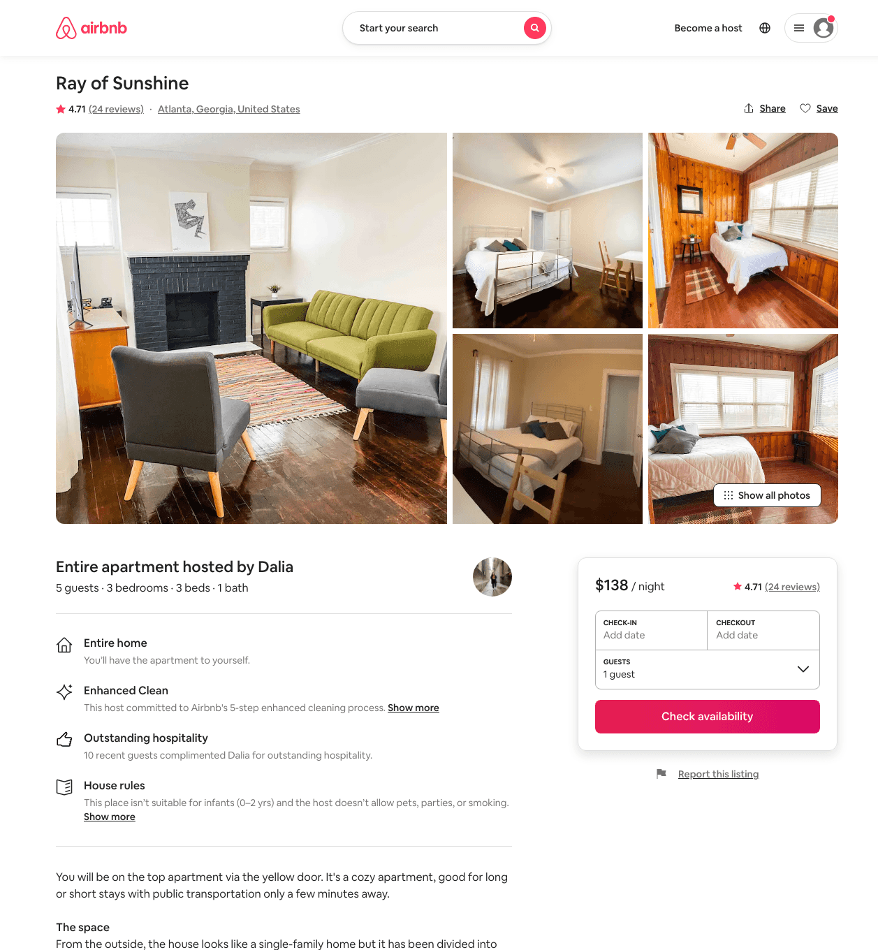
Listing 29543293
3
5
$95 - $141
4.65
3
Dalia
56752175
2
https://www.airbnb.com/rooms/29543293
Aug 2022

Slide 17
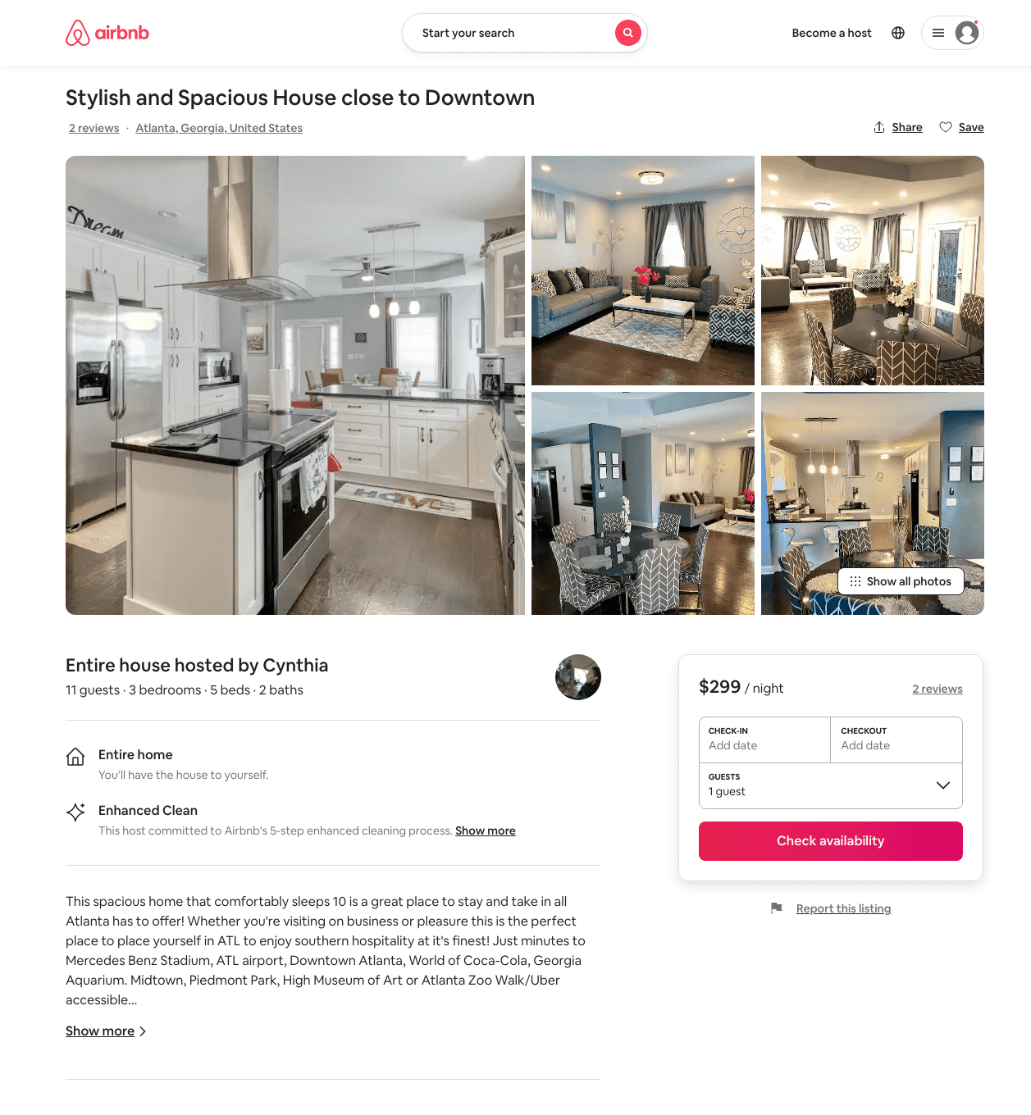
Listing 49347275
3
6
$147 - $309
4.79
32
Cynthia
53362437
2
https://www.airbnb.com/rooms/49347275
Aug 2022

Slide 18
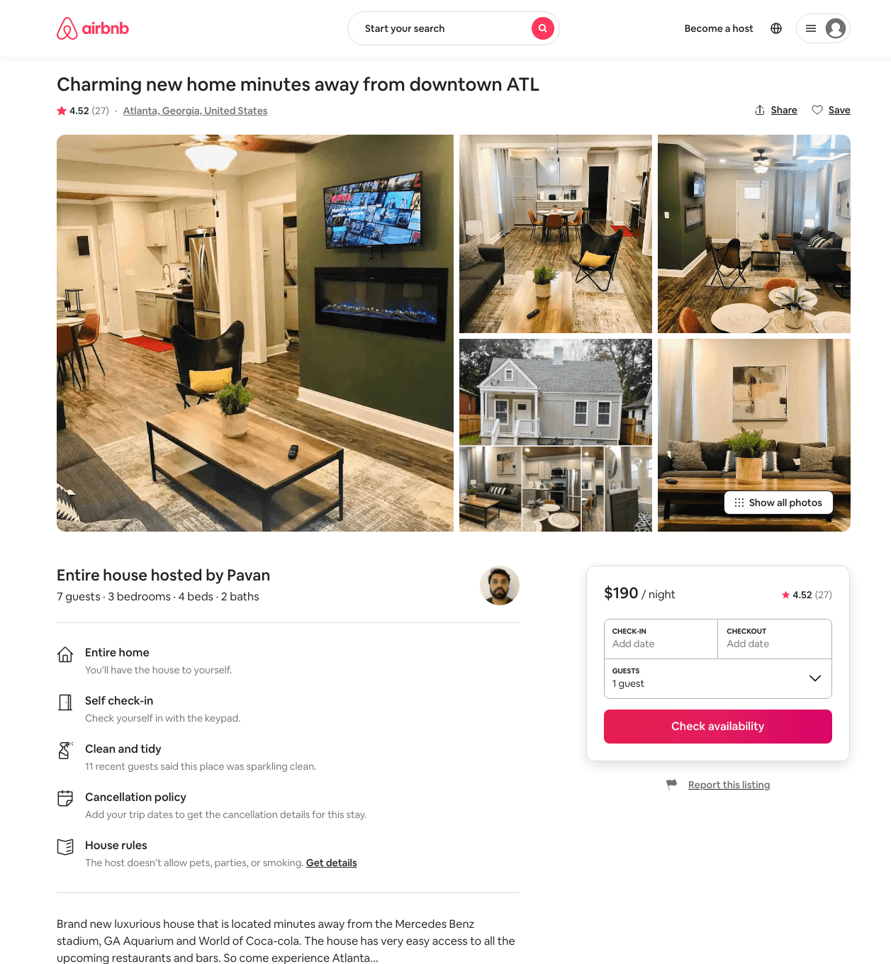
Listing 46063373
3
9
$121 - $195
4.54
1
Aldo
370956
6
https://www.airbnb.com/rooms/46063373
Aug 2022

Slide 19
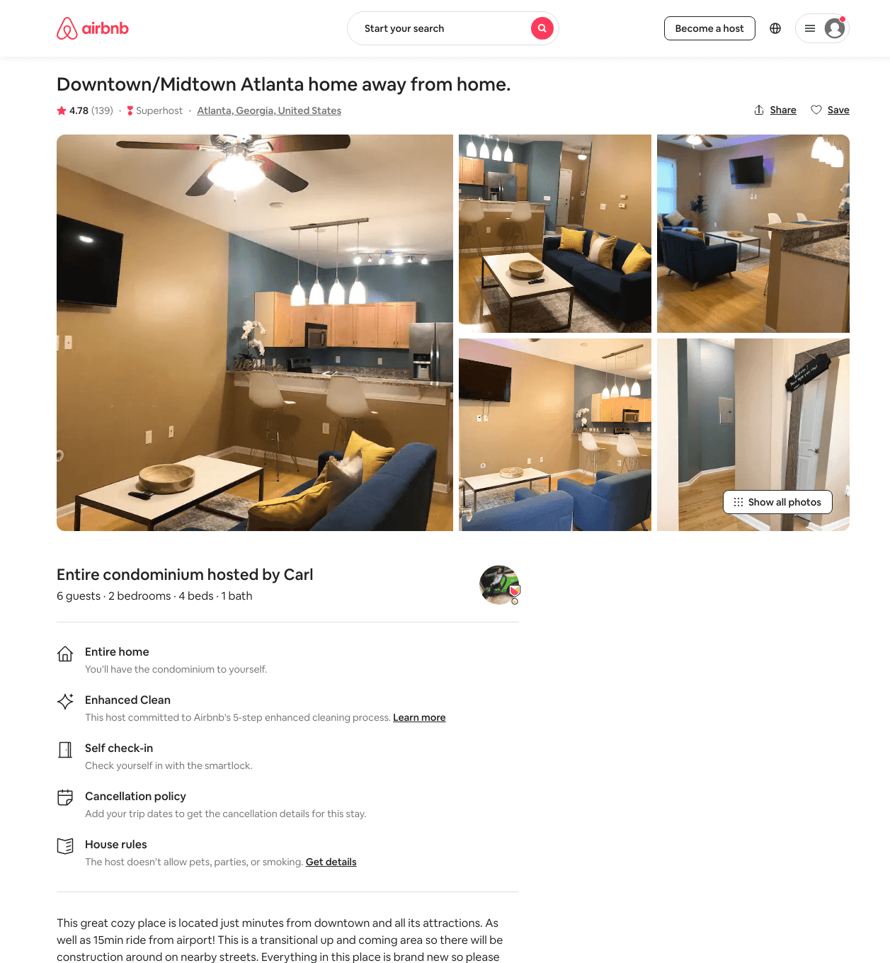
Listing 37755741
2
6
$74 - $174
4.60
1
Carl
84816252
1
https://www.airbnb.com/rooms/37755741
Aug 2022

Slide 20
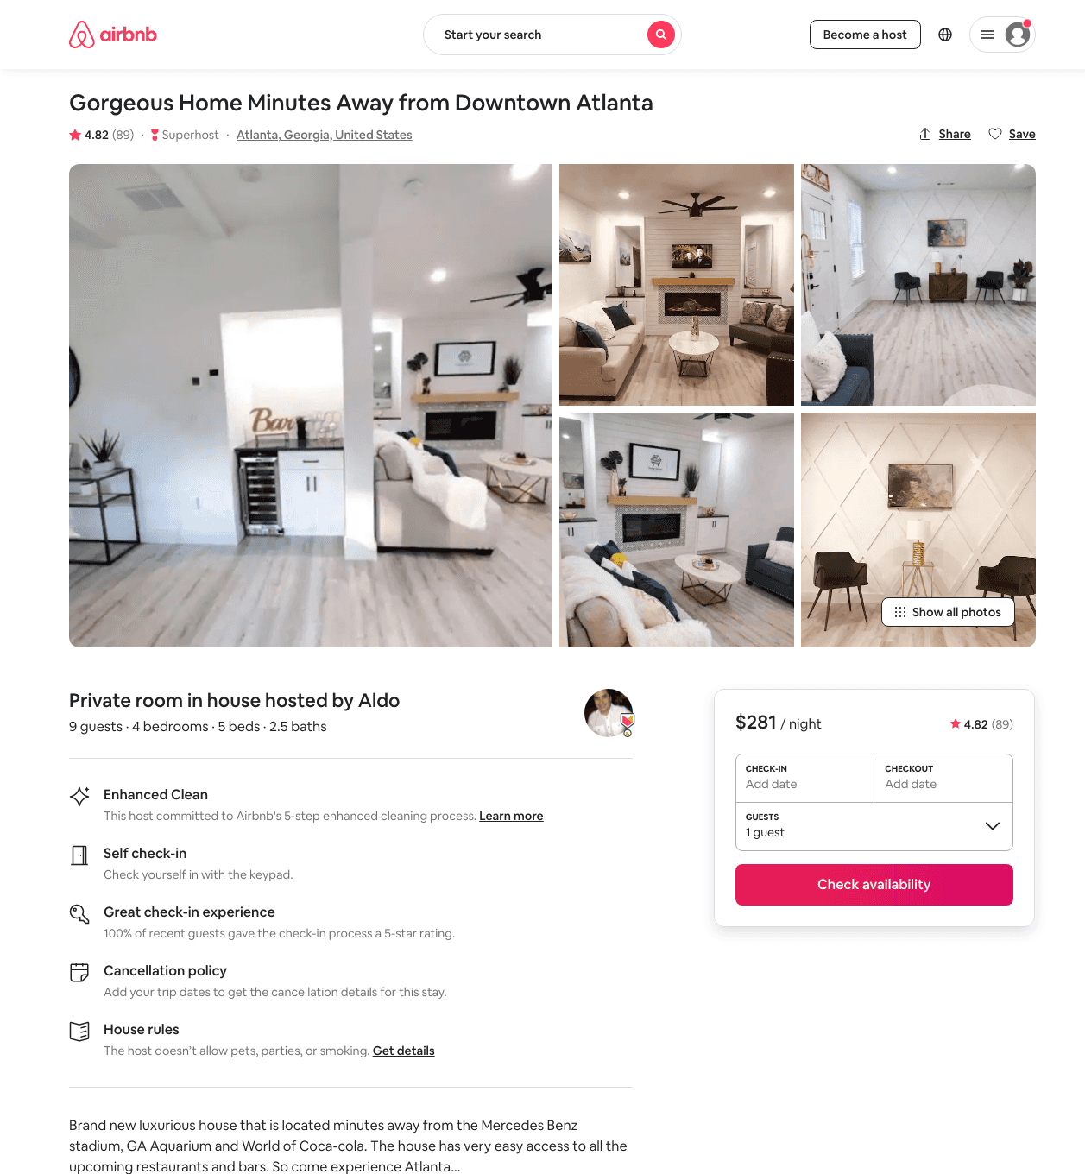
Listing 44681827
4
11
$178 - $325
4.75
1
Aldo
370956
6
https://www.airbnb.com/rooms/44681827
Aug 2022

Slide 21
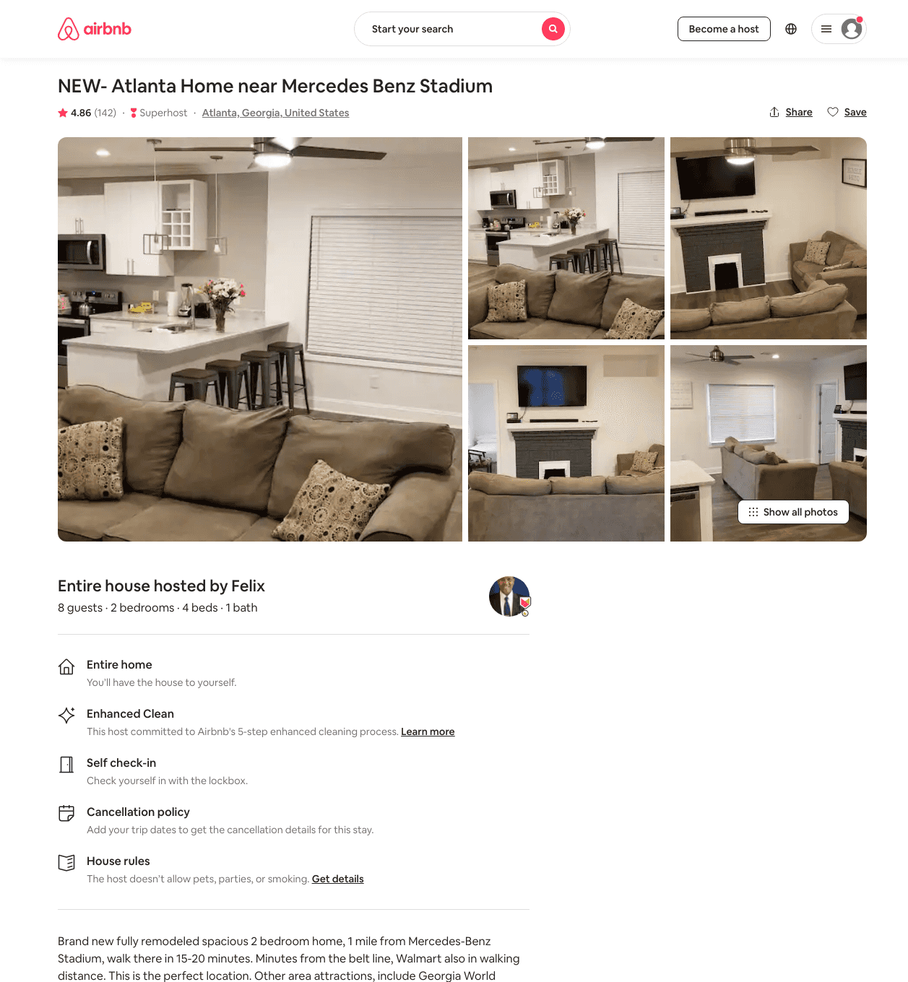
Listing 31863567
2
8
$88 - $107
4.85
2
Felix
194573934
1
https://www.airbnb.com/rooms/31863567
Aug 2022

Slide 22
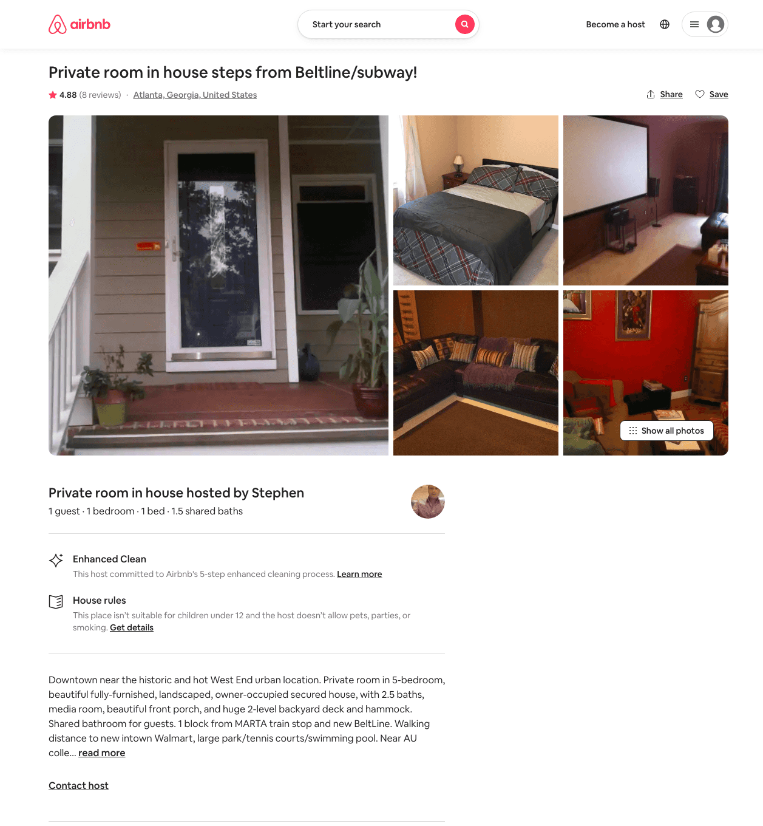
Listing 1424100
1
1
$41
4.90
2
Stephen
7663789
1
https://www.airbnb.com/rooms/1424100
Jun 2022

Slide 23
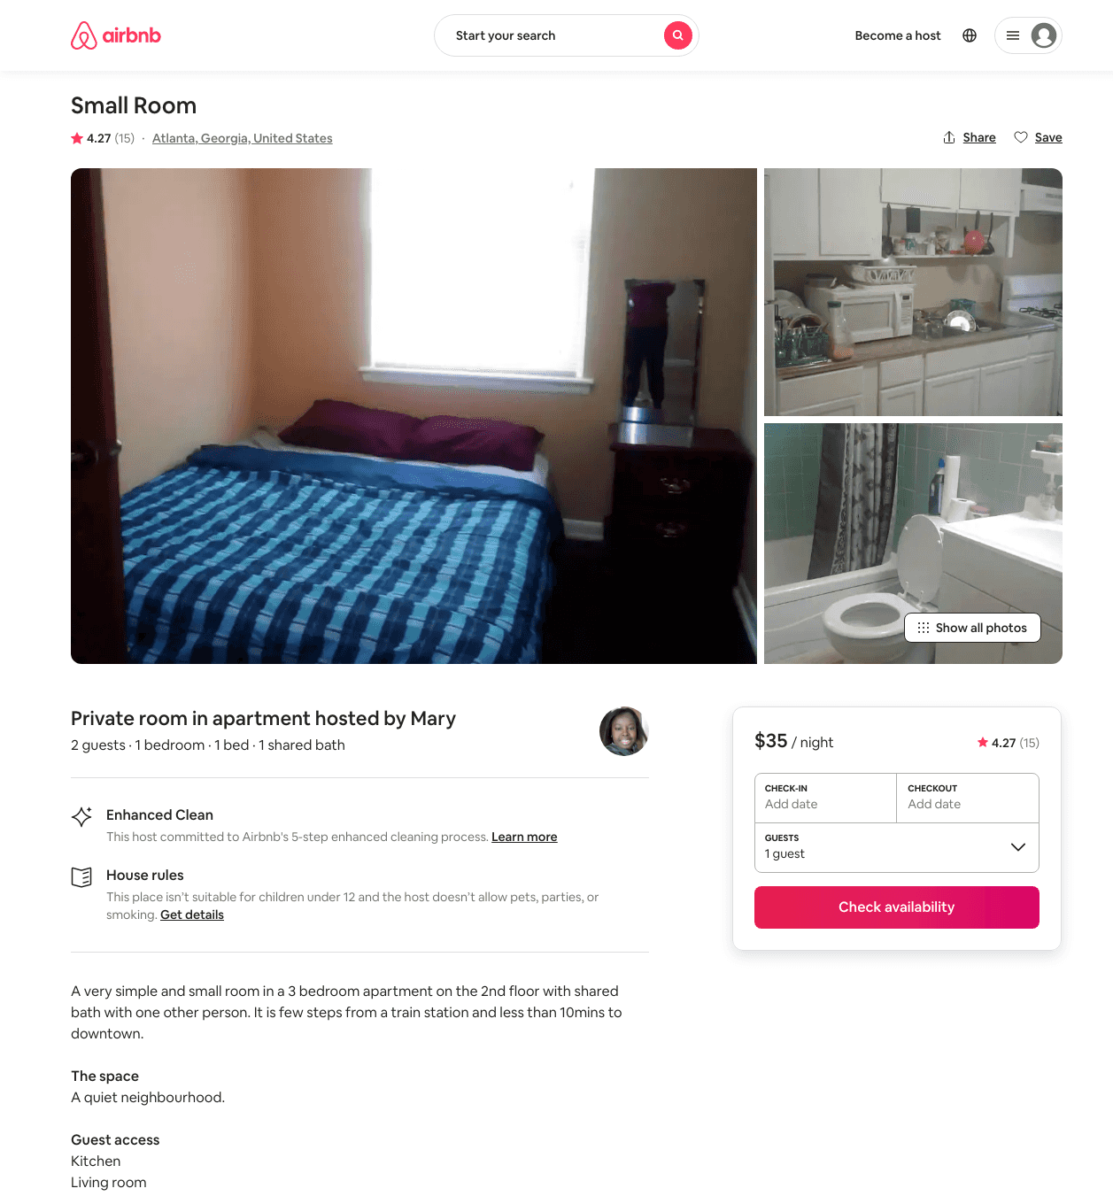
Listing 20423952
1
1
$35
4.27
3
Mary
122653938
2
https://www.airbnb.com/rooms/20423952
Aug 2022

Slide 24
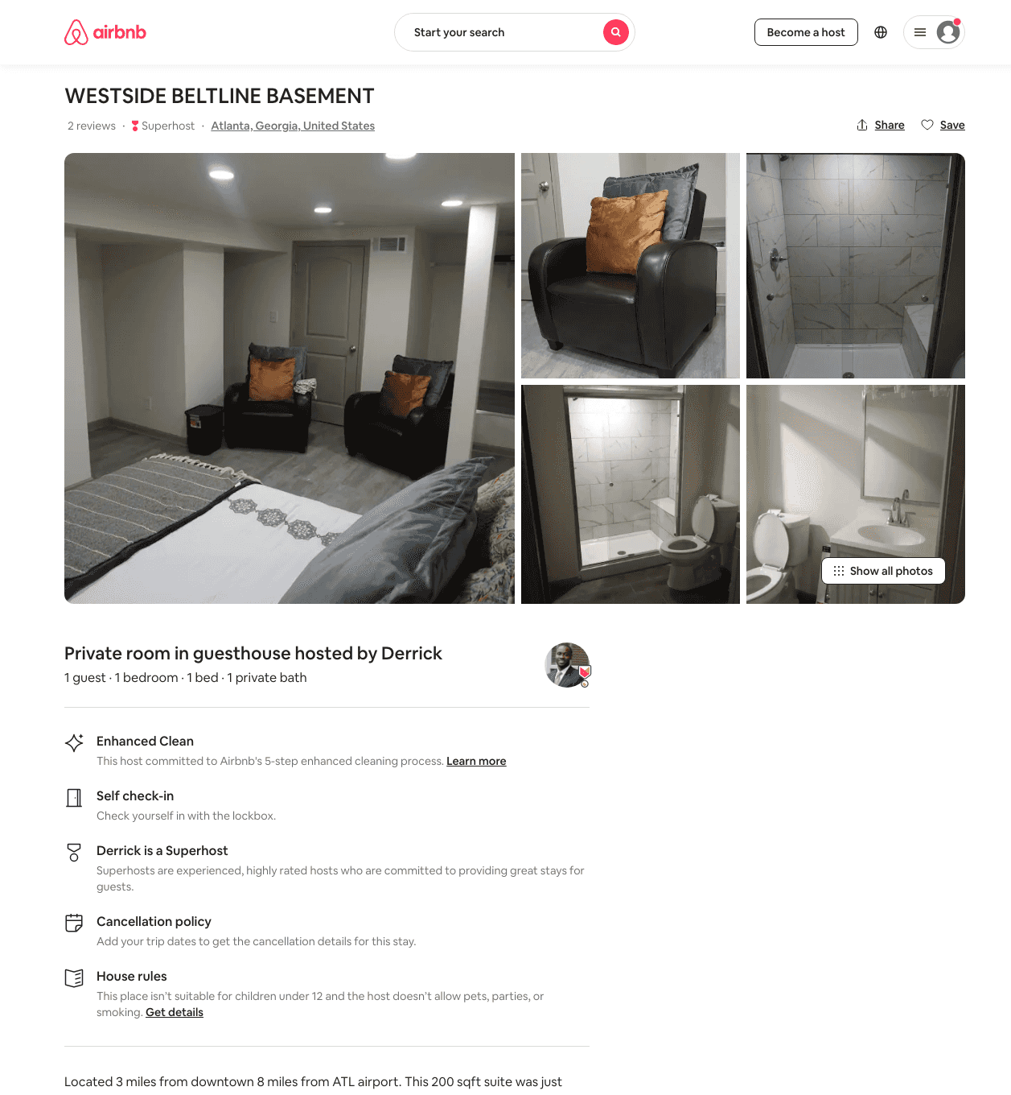
Listing 35492049
1
1
$42 - $79
4.80
3
Derrick
257889
5
https://www.airbnb.com/rooms/35492049
Aug 2022

Slide 25
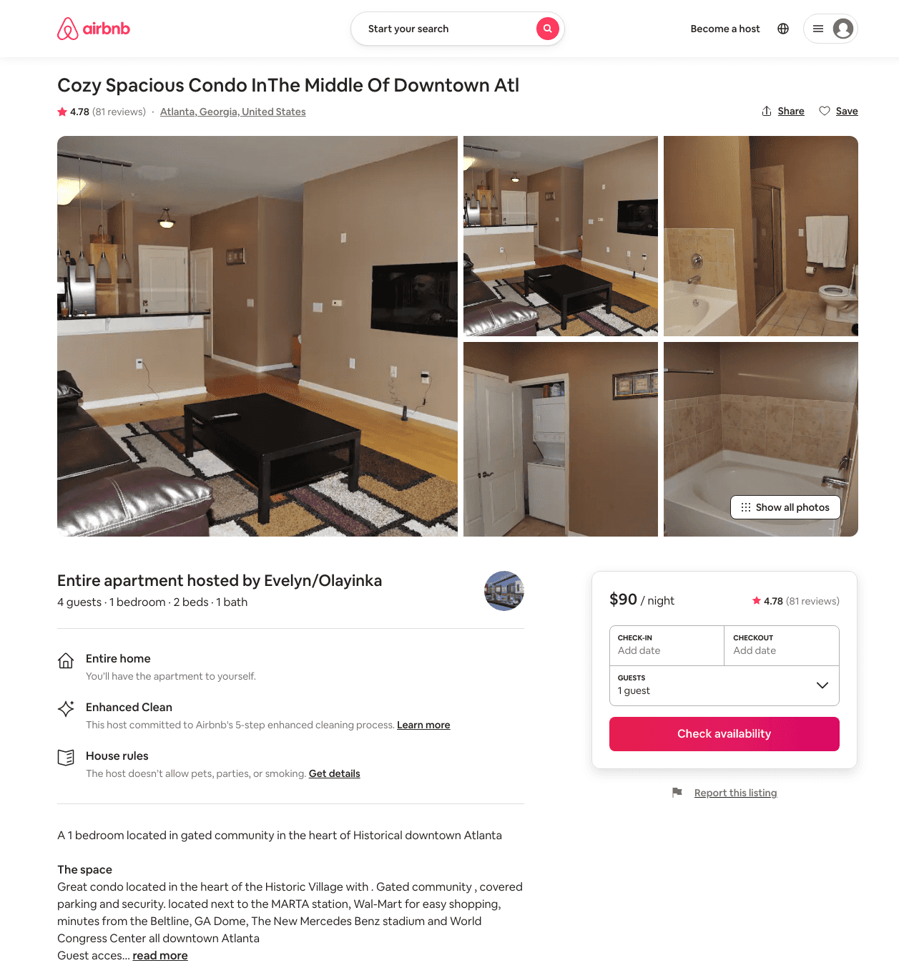
Listing 19018521
1
4
$90 - $99
4.74
3
Evelyn/Olayinka
44991875
2
https://www.airbnb.com/rooms/19018521
Jun 2022

Slide 26
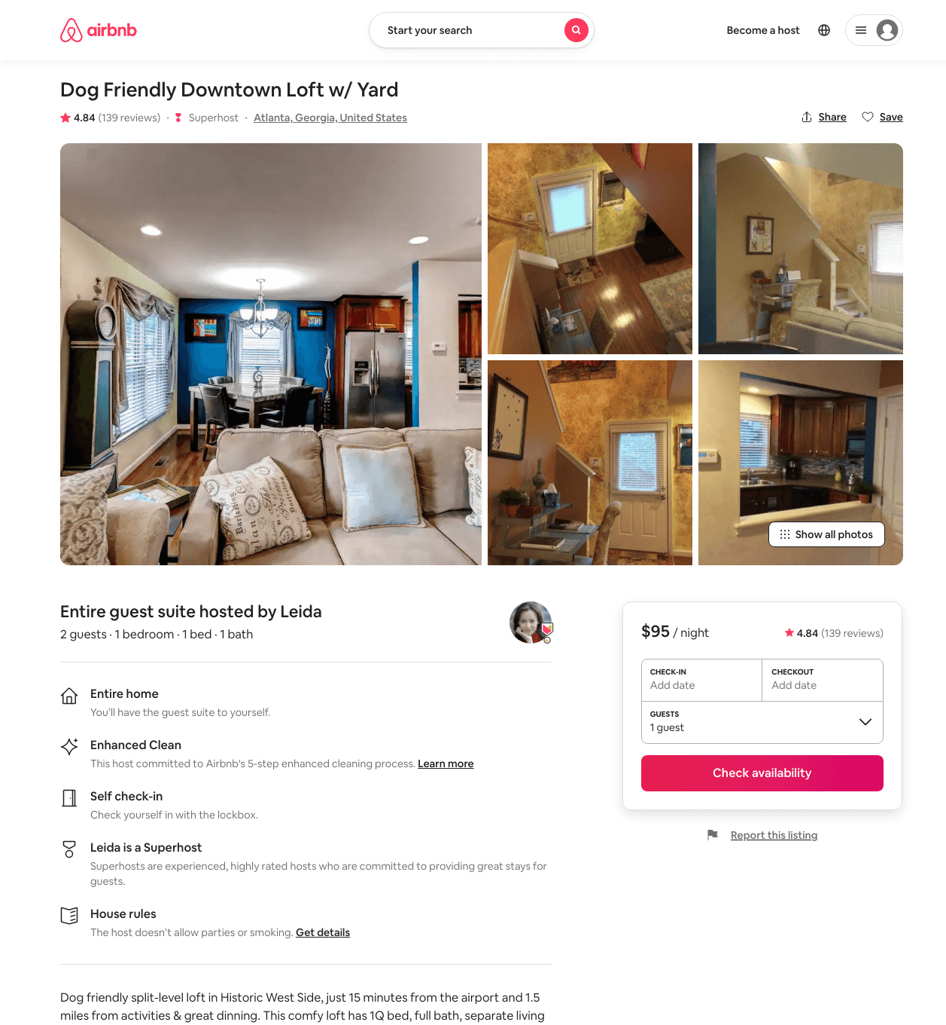
Listing 1843749
1
2
$95
4.86
1
Leida
9633146
1
https://www.airbnb.com/rooms/1843749
Aug 2022

Slide 27
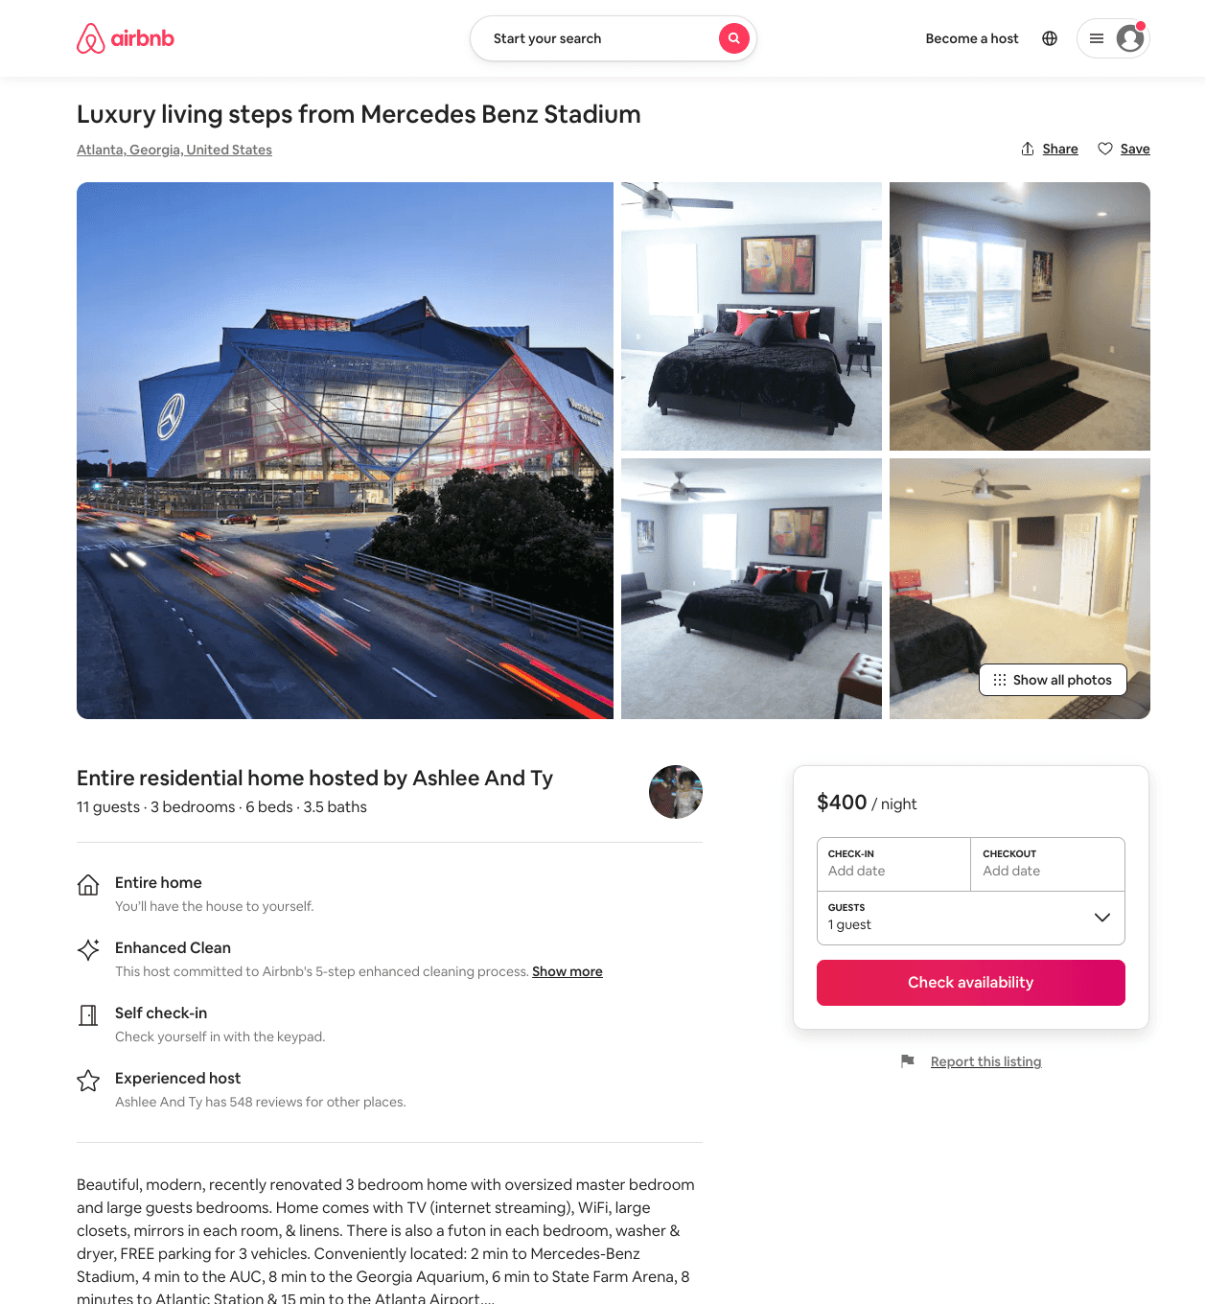
Listing 51065553
3
11
$218 - $464
4.50
2
Ashlee And Ty
33398144
5
https://www.airbnb.com/rooms/51065553
Aug 2022

Slide 28
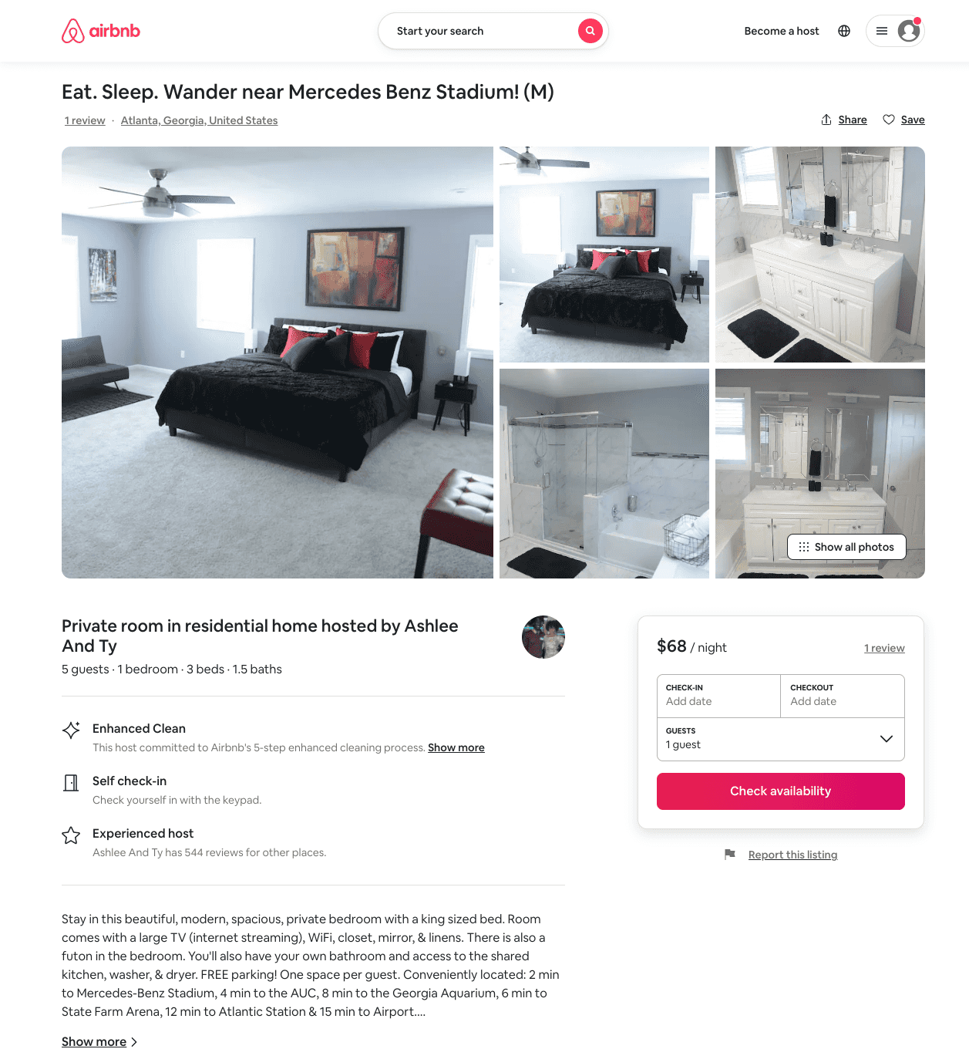
Listing 50443685
1
5
$50 - $85
4.75
2
Ashlee And Ty
33398144
5
https://www.airbnb.com/rooms/50443685
Aug 2022

Slide 29
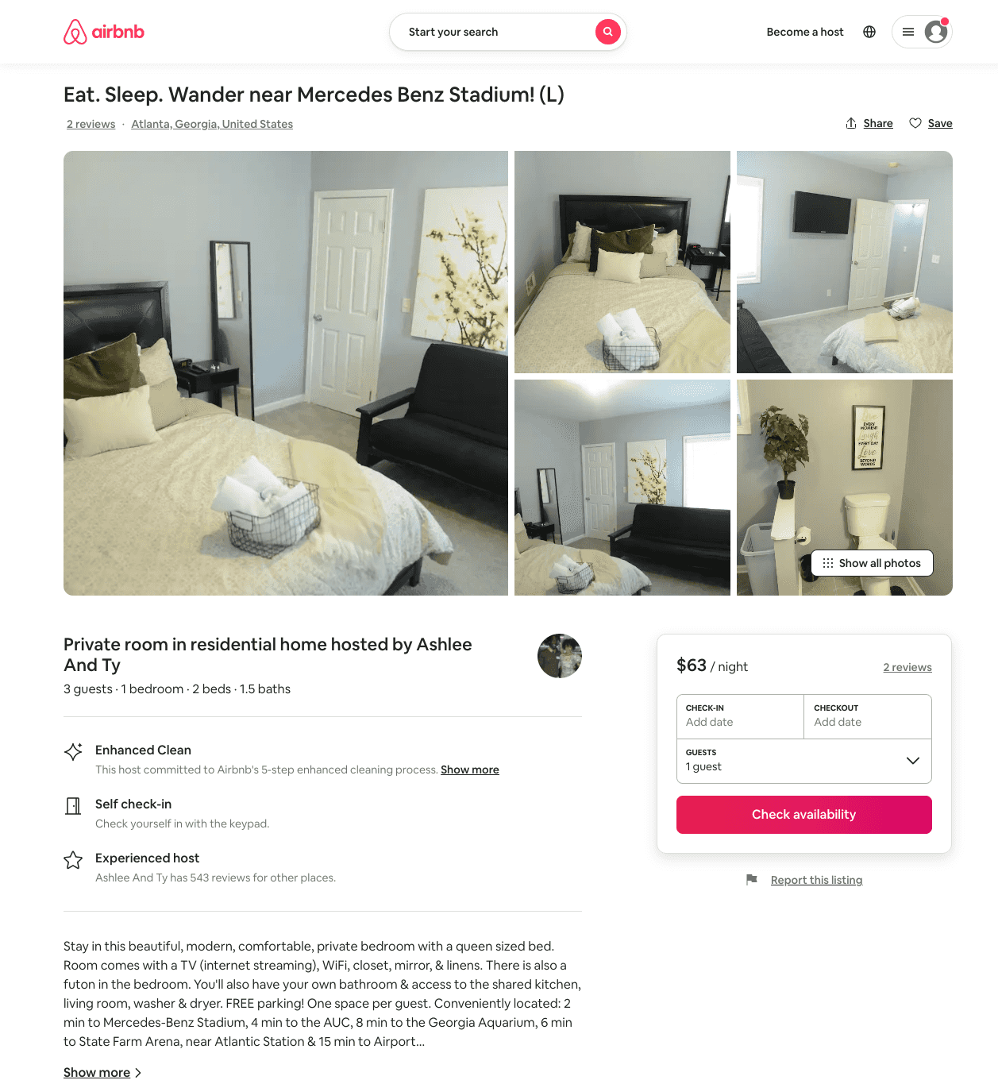
Listing 51064717
1
3
$44 - $67
4.74
1
Ashlee And Ty
33398144
5
https://www.airbnb.com/rooms/51064717
Aug 2022

Slide 30
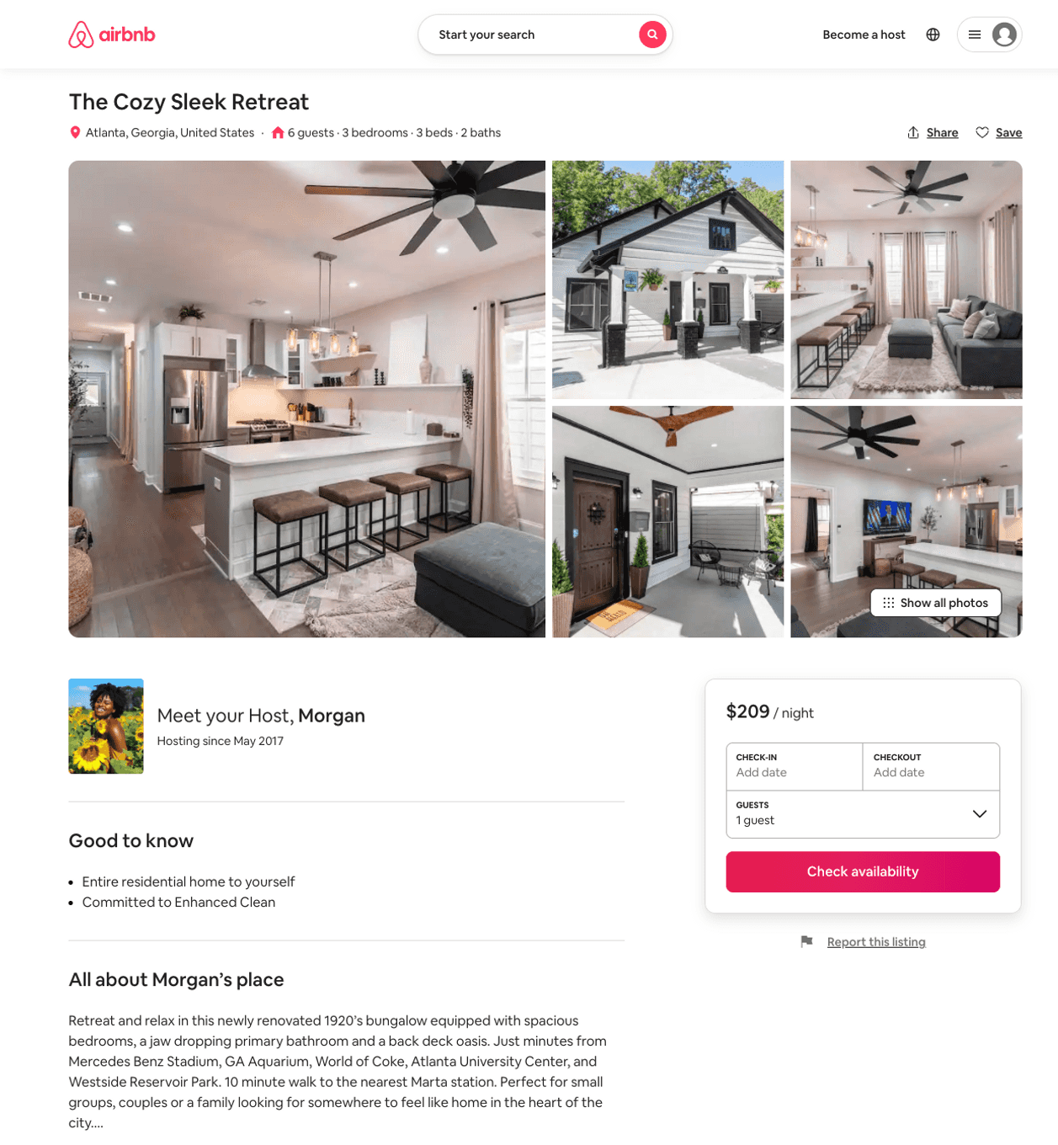
Listing 51772280
3
6
$211 - $314
5.0
3
Morgan
130394775
1
https://www.airbnb.com/rooms/51772280
Aug 2022

Slide 31
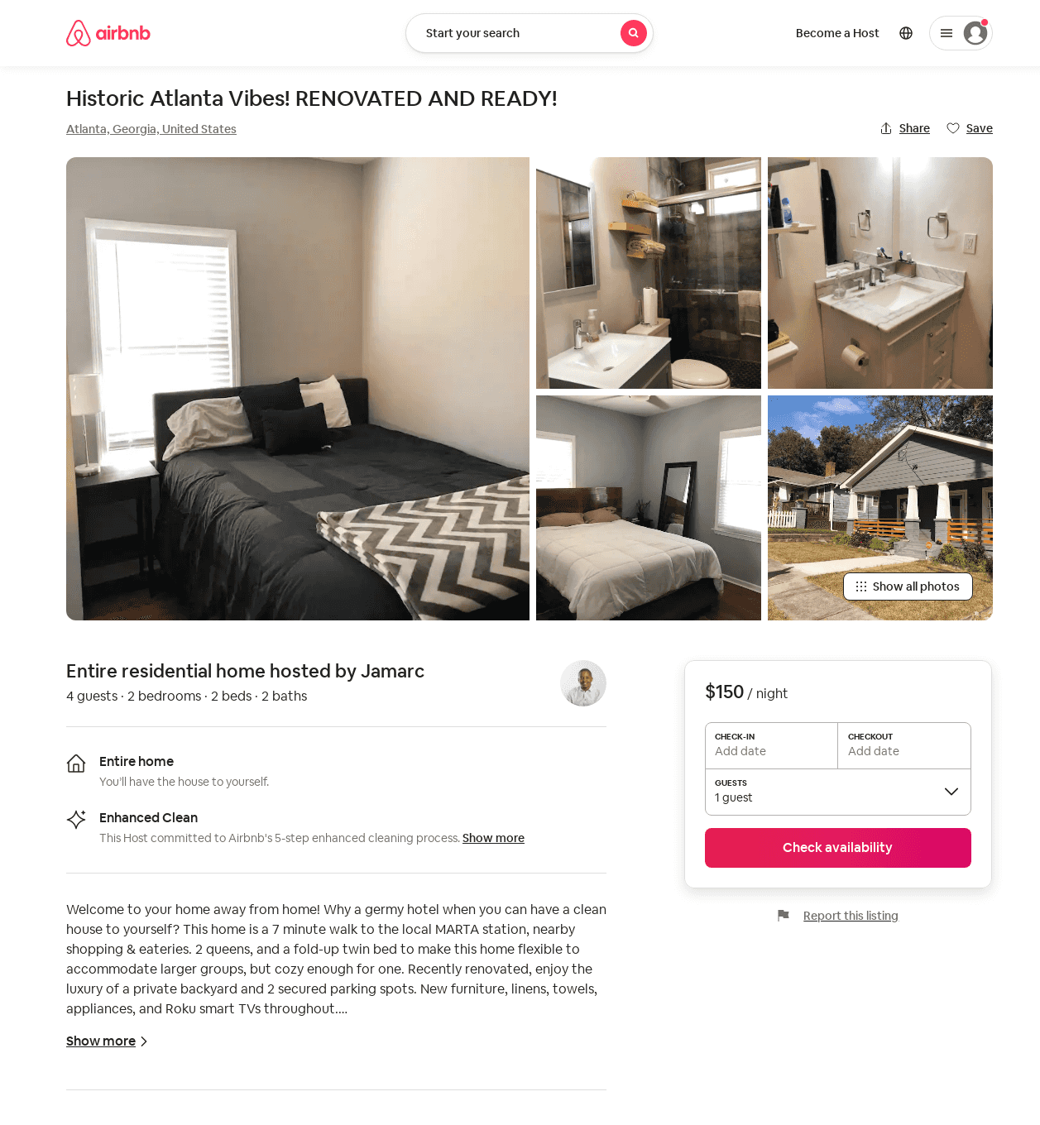
Listing 49675890
2
4
$150
3
Jamarc
48854858
1
https://www.airbnb.com/rooms/49675890
Jun 2022

Slide 32
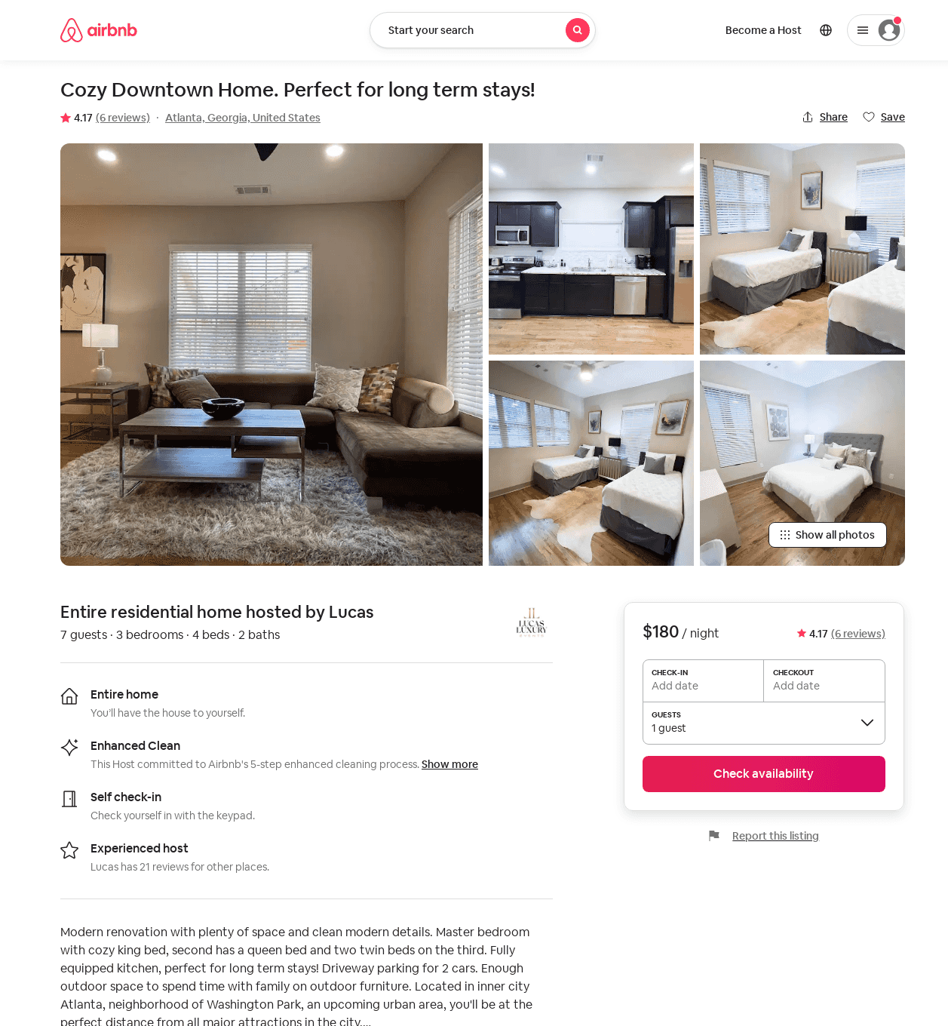
Listing 51518448
3
6
$94 - $180
4.53
1
Lucas
399949953
6
https://www.airbnb.com/rooms/51518448
Aug 2022

Slide 33
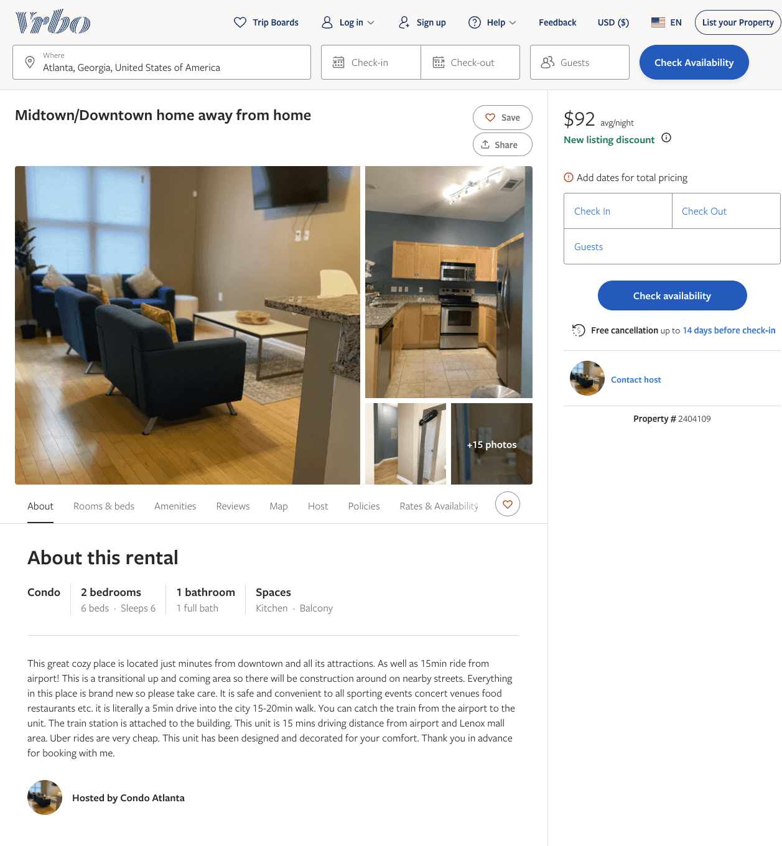
Listing 2404109
2
6
$121 - $92
4.25
1
https://www.vrbo.com/2404109
Aug 2022

Slide 34
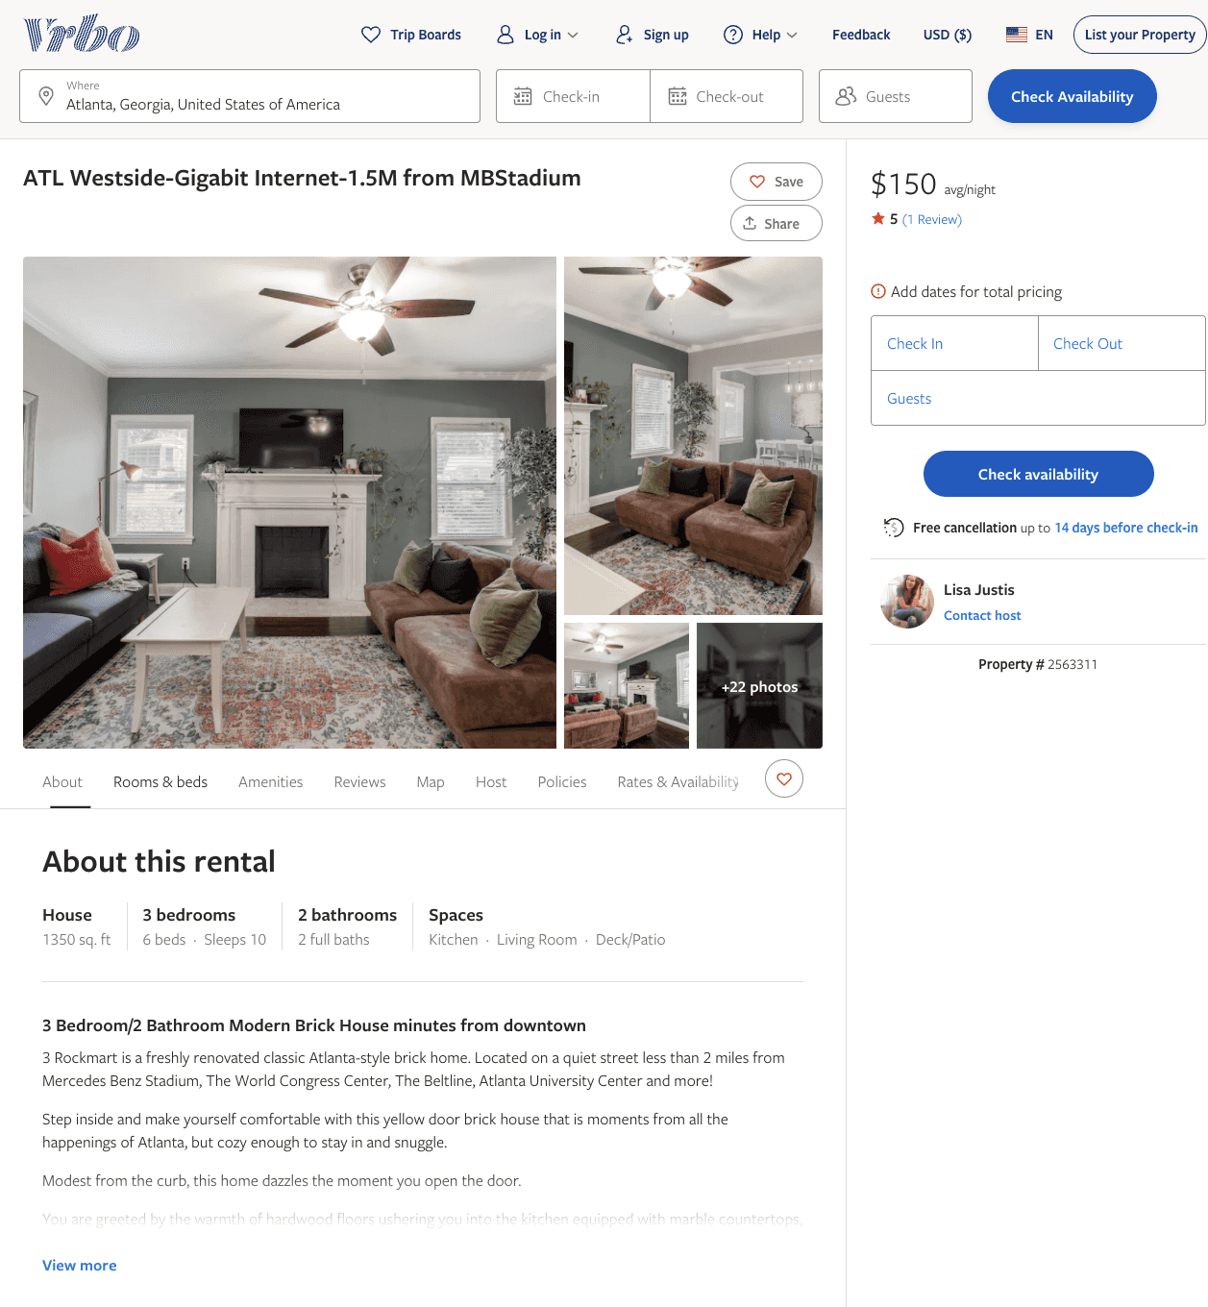
Listing 2563311
3
10
$150 - $205
4.909091
2
Lisa Justis
https://www.vrbo.com/2563311
Aug 2022

Slide 35
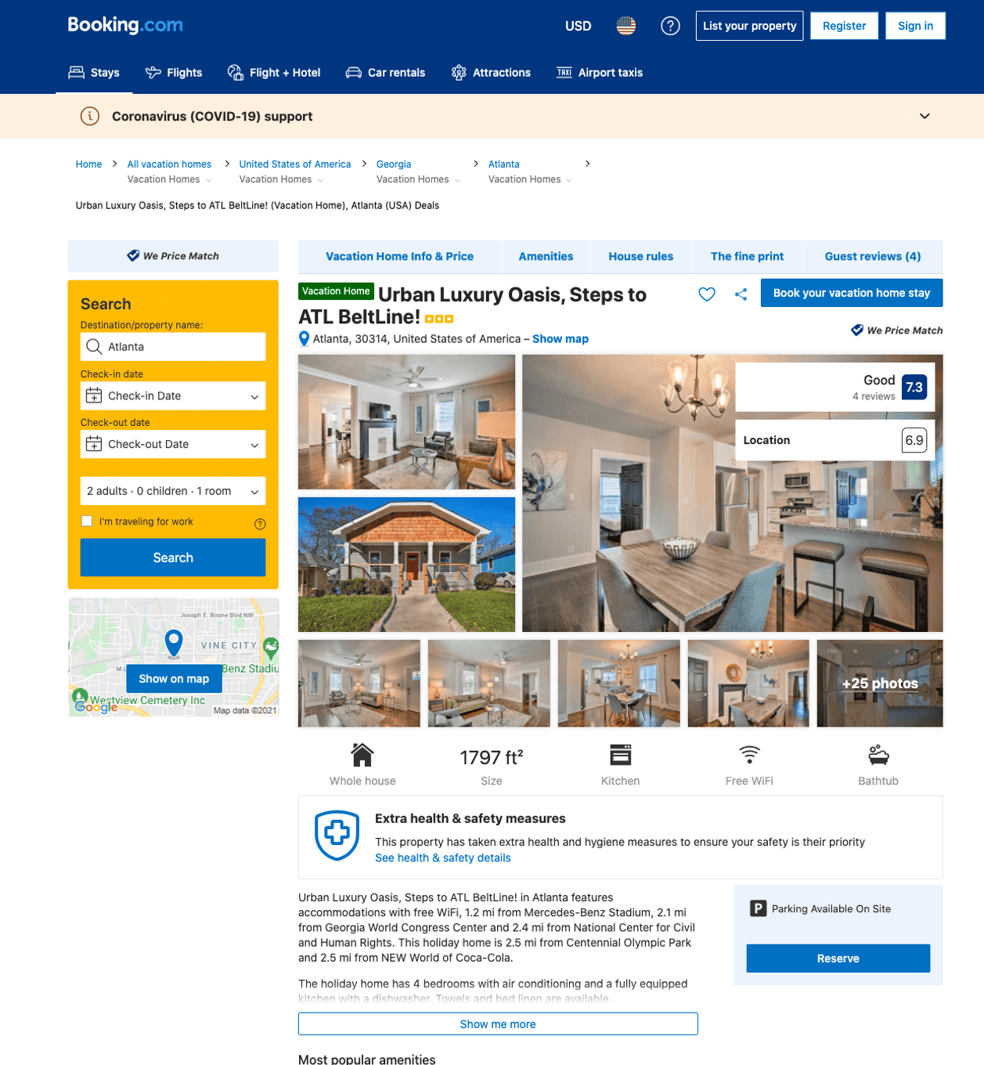
Listing urban-luxury-oasis-steps-to-atl-beltline
undefined
8
6.7
https://www.booking.com/hotel/us/urban-luxury-oasis-steps-to-atl-beltline.html
Sep 2022

Slide 36
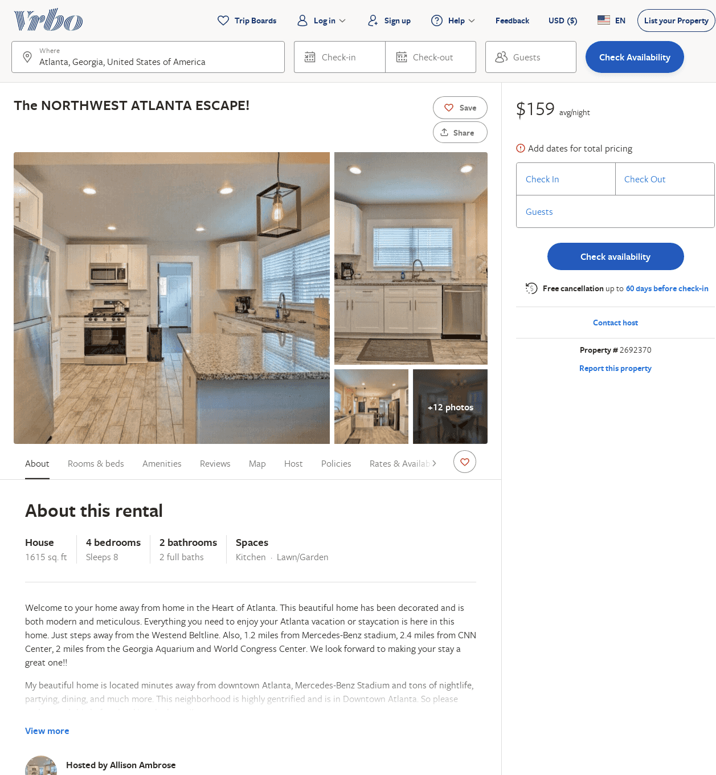
Listing 2692370
4
8
$193
5
2
Allison Ambrose
https://www.vrbo.com/2692370
Aug 2022

Slide 37
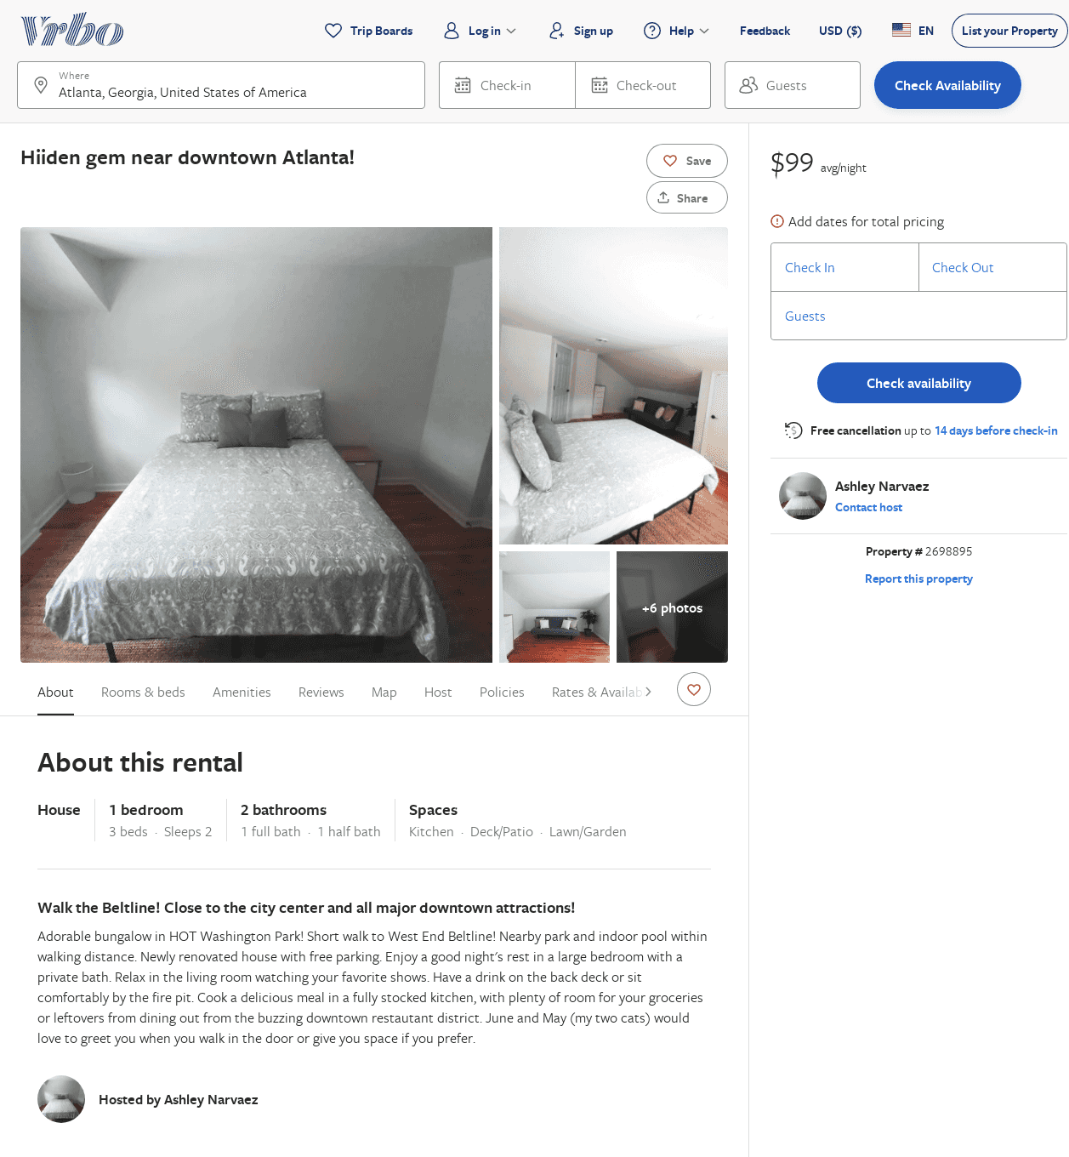
Listing 2698895
1
2
$99
1
Ashley Narvaez
https://www.vrbo.com/2698895
Aug 2022

Slide 38
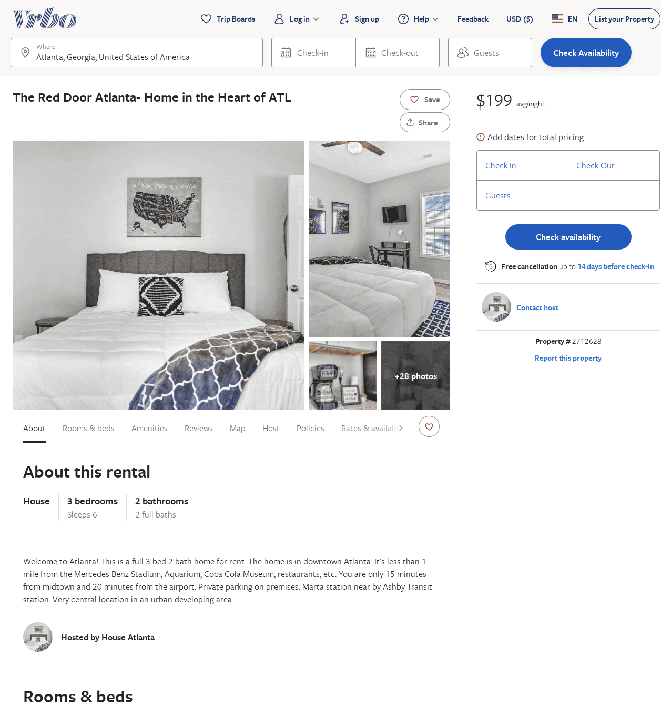
Listing 2712628
3
6
$150
2
Alex
https://www.vrbo.com/2712628
Aug 2022

Slide 39
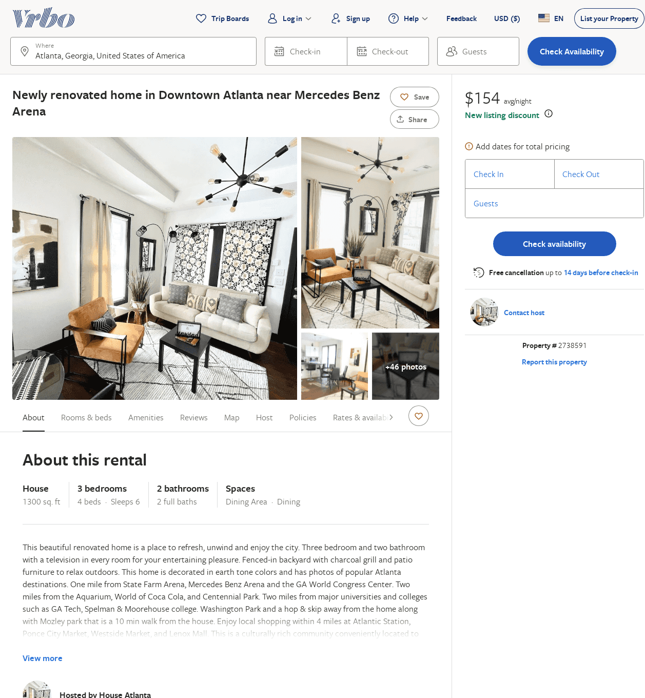
Listing 2738591
3
6
$177
4
2
https://www.vrbo.com/2738591
Aug 2022

Slide 40
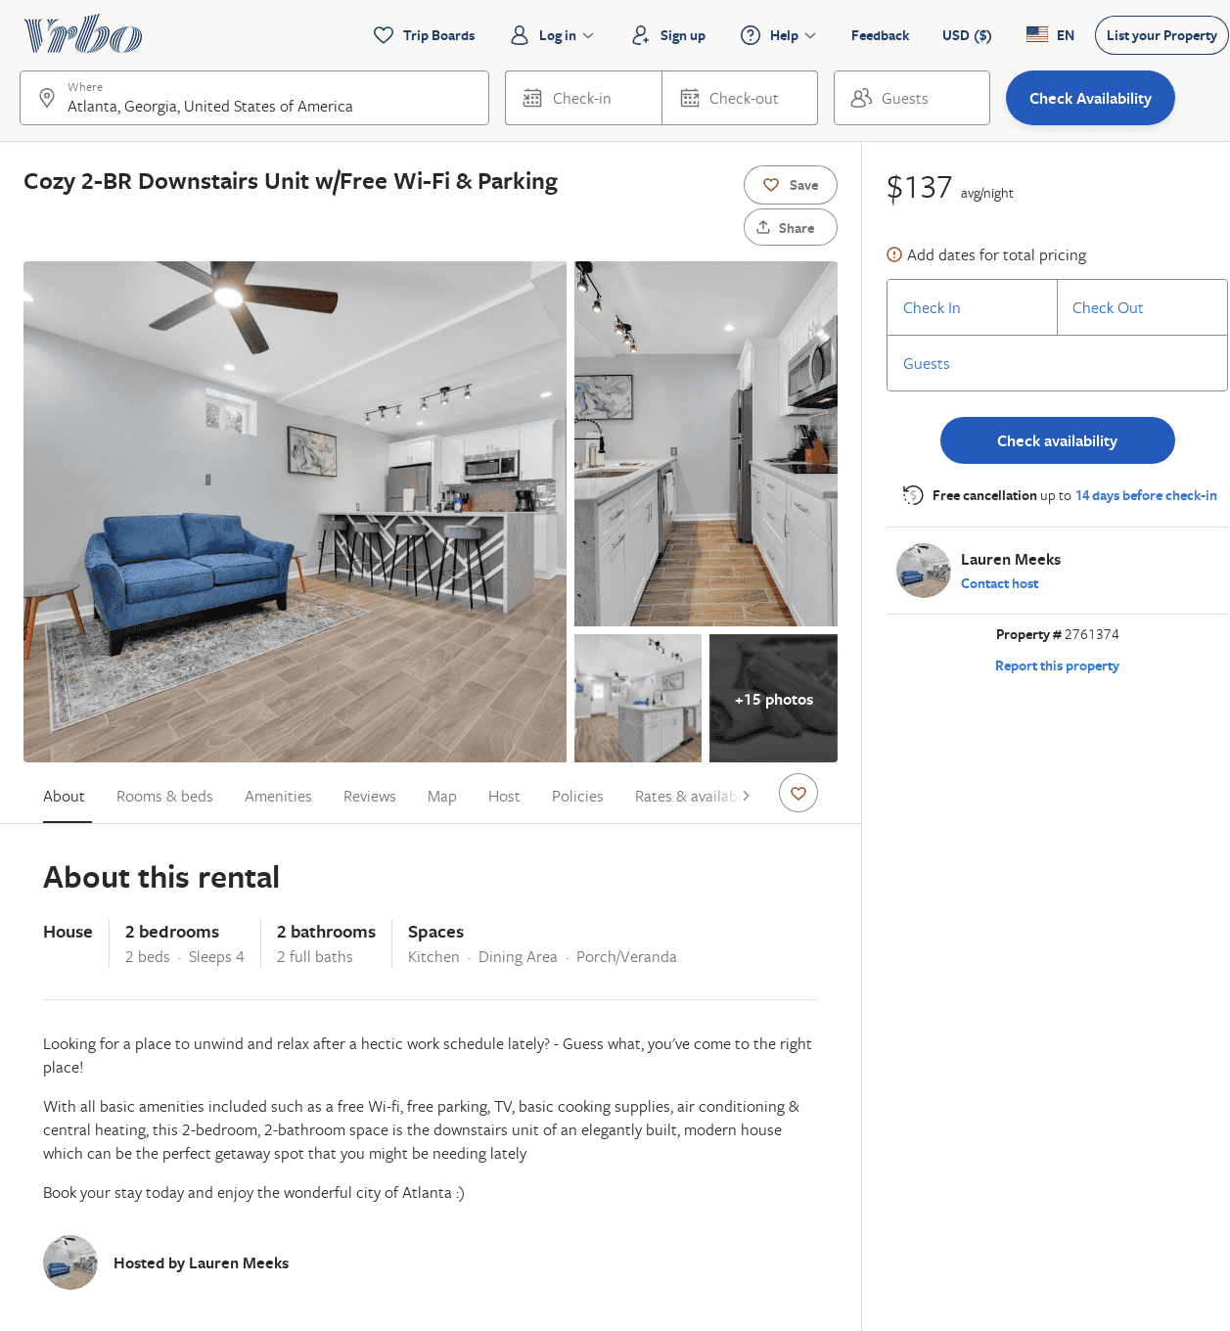
Listing 2761374
2
4
$139
2
Lauren Meeks
https://www.vrbo.com/2761374
Aug 2022

Slide 41
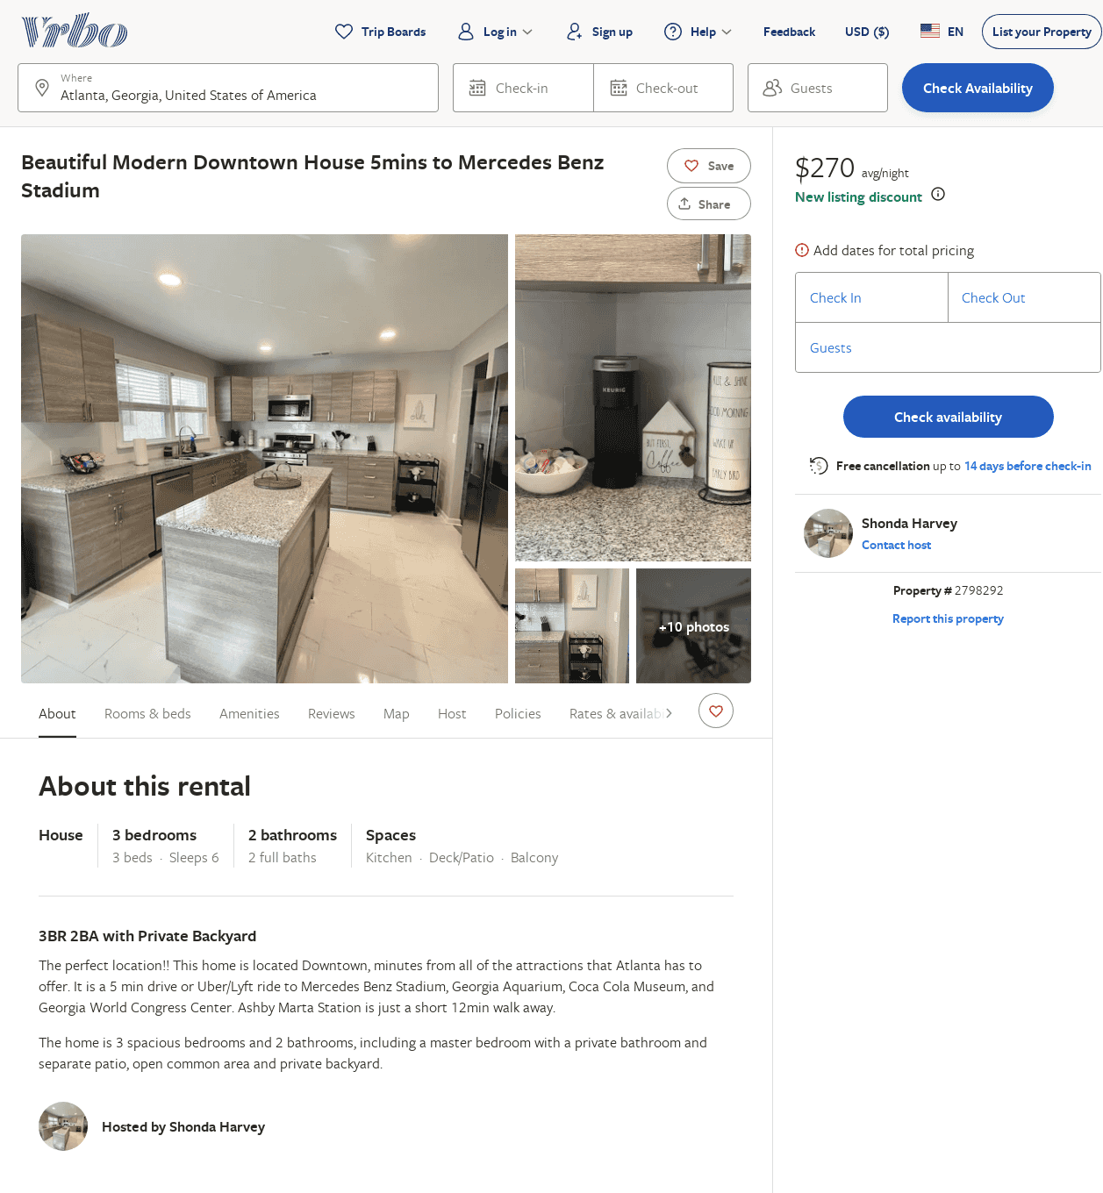
Listing 2798292
3
6
$220
4
2
Shonda Harvey
https://www.vrbo.com/2798292
Aug 2022

Slide 42
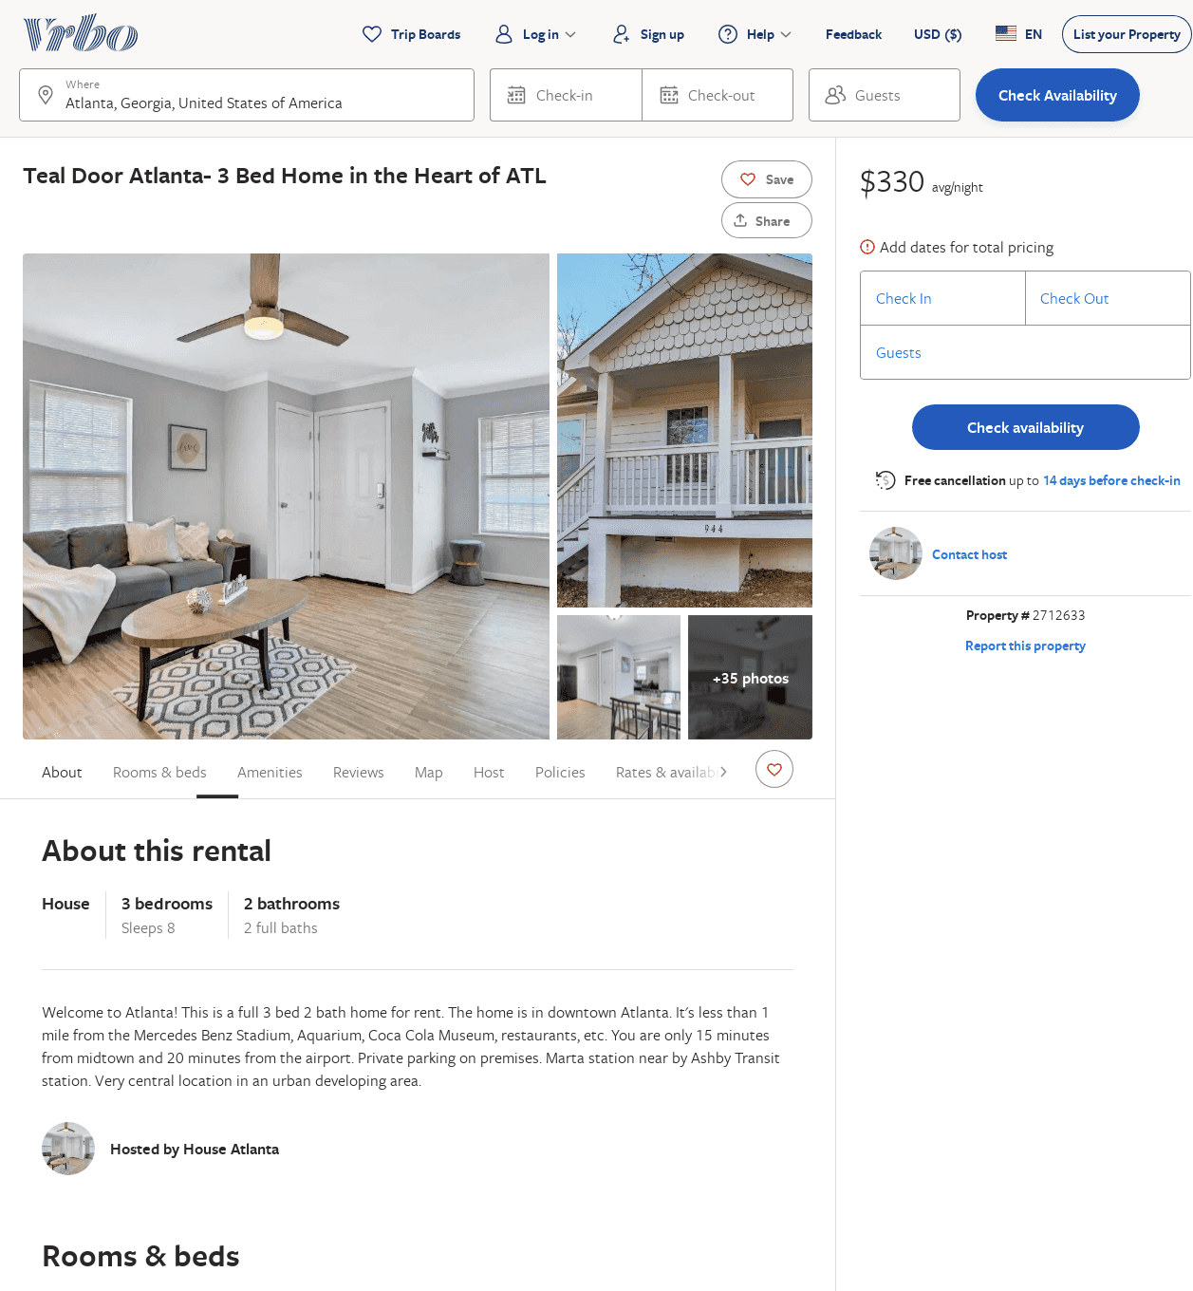
Listing 2712633
3
8
$182
2
https://www.vrbo.com/2712633
Aug 2022

Slide 43
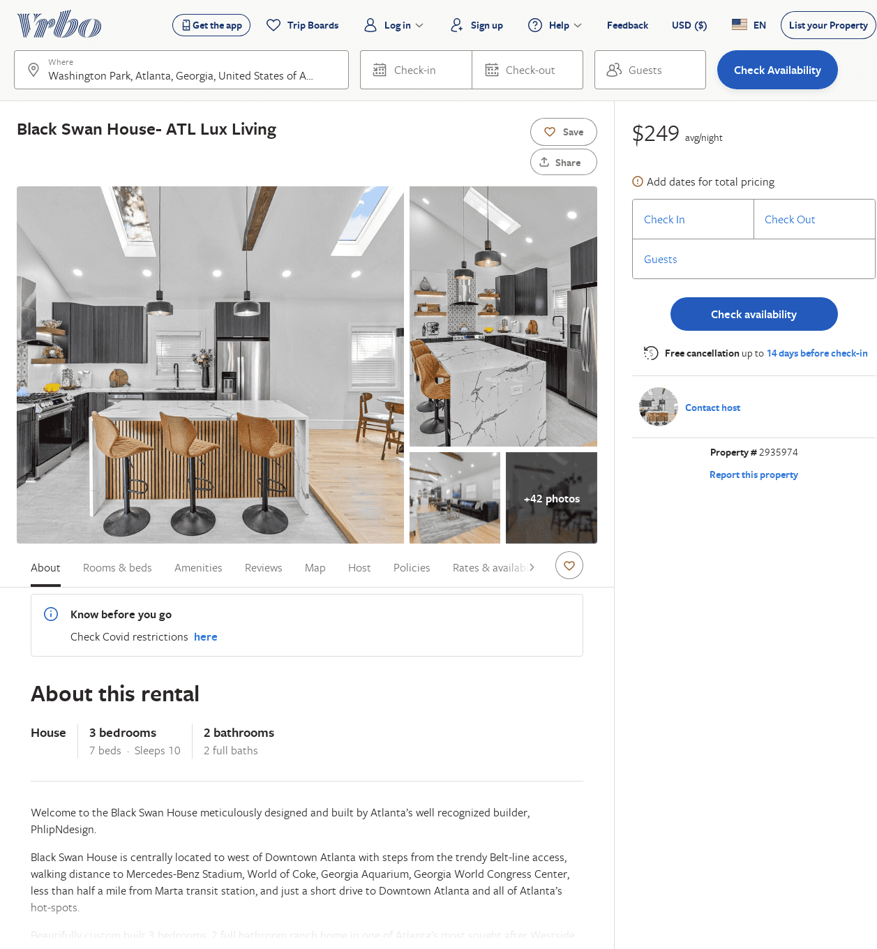
Listing 2935974
3
10
$286
2
https://www.vrbo.com/2935974
Aug 2022

Slide 44
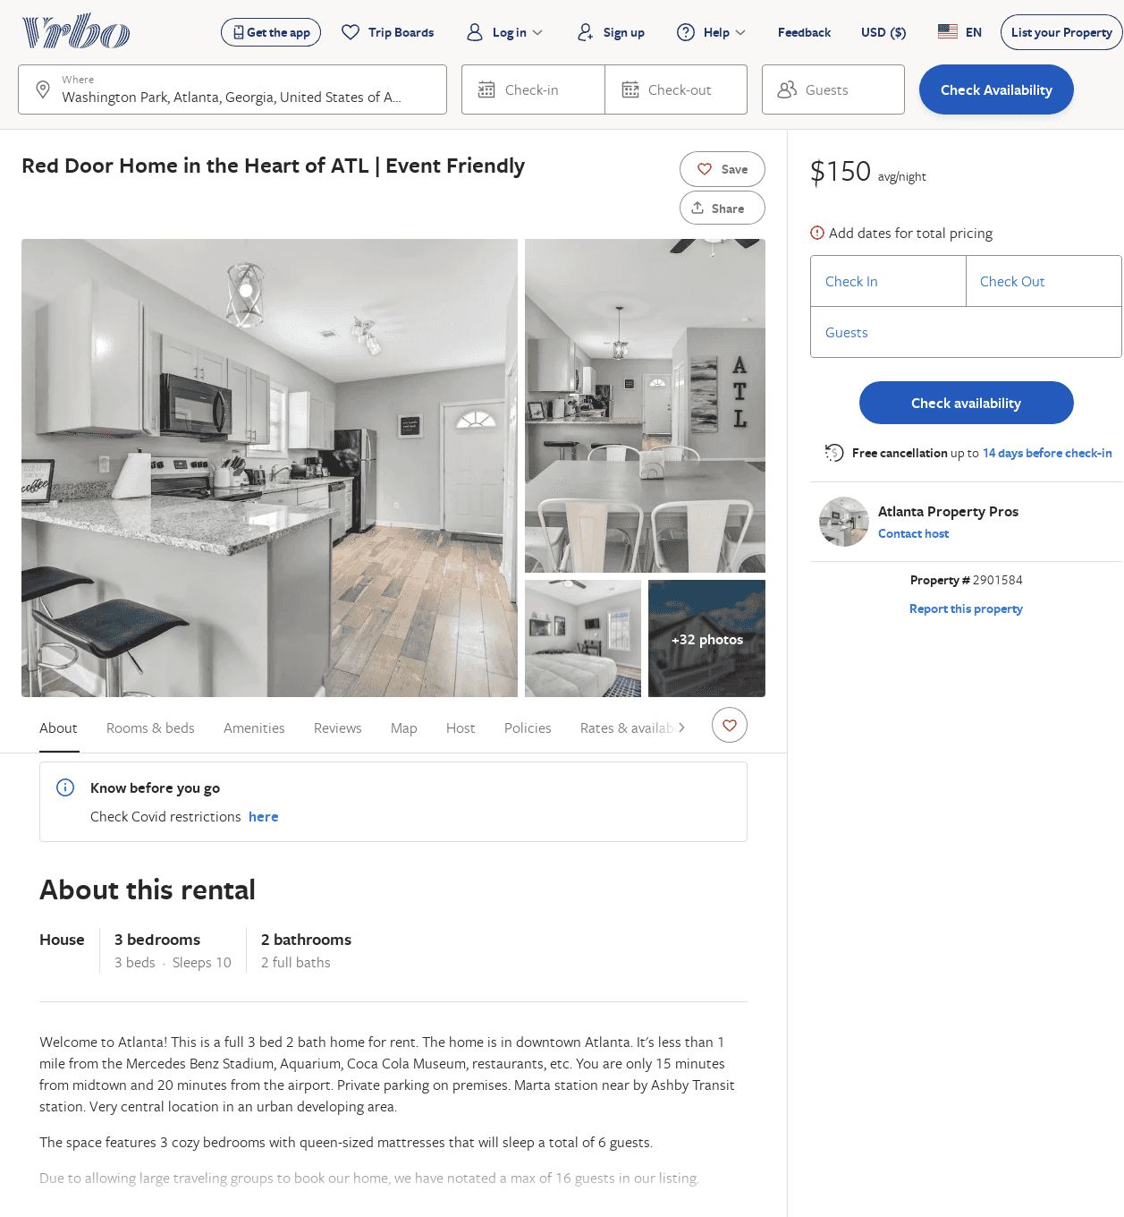
Listing 2901584
3
10
$150
1
Atlanta Property Pros
https://www.vrbo.com/2901584
Aug 2022

Slide 45
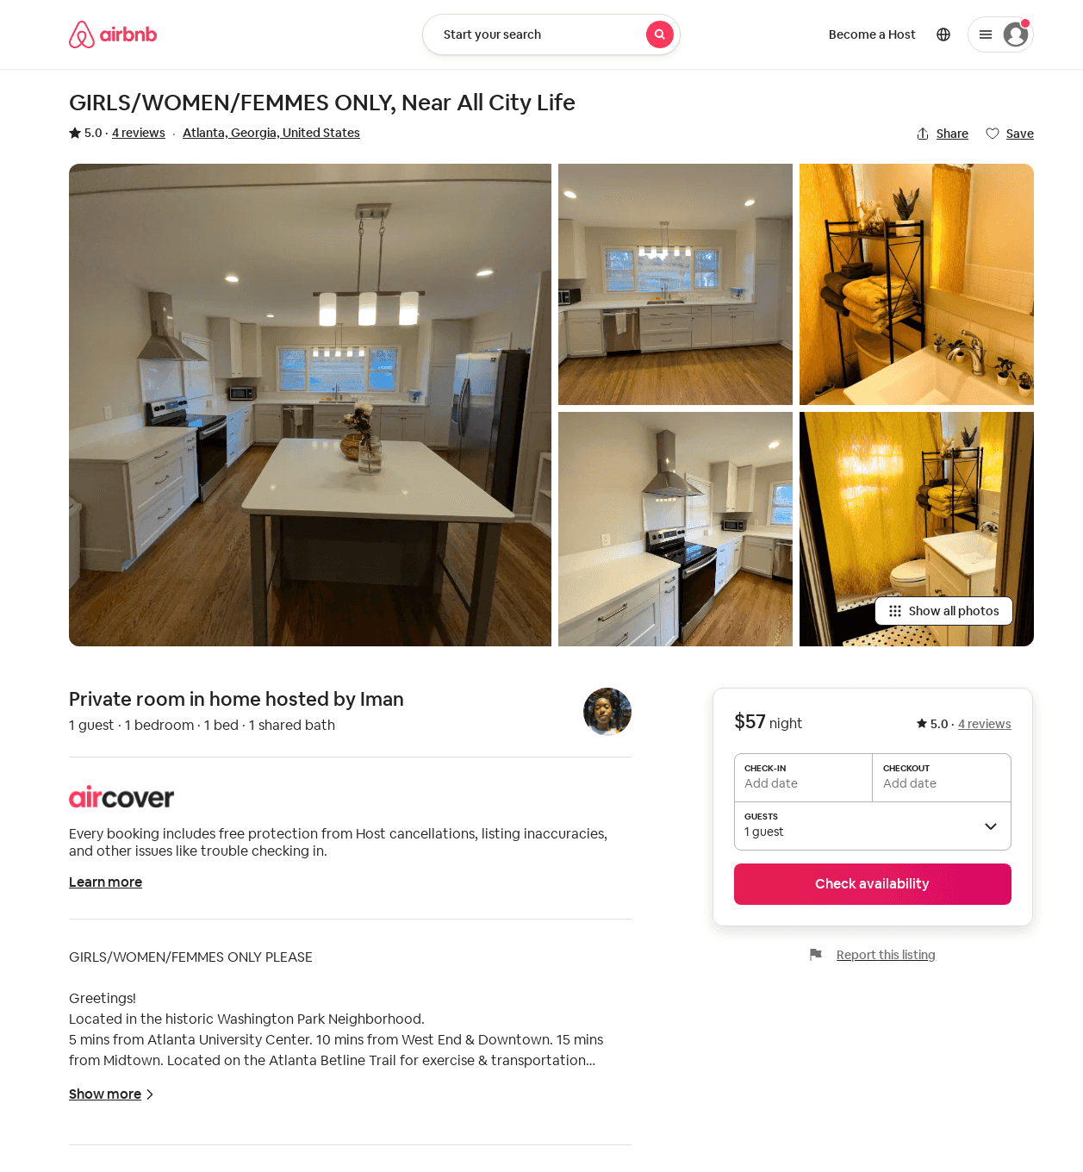
Listing 45216230
1
1
5.0
1
Iman
278016990
1
https://www.airbnb.com/rooms/45216230
Aug 2022

