Slide 2
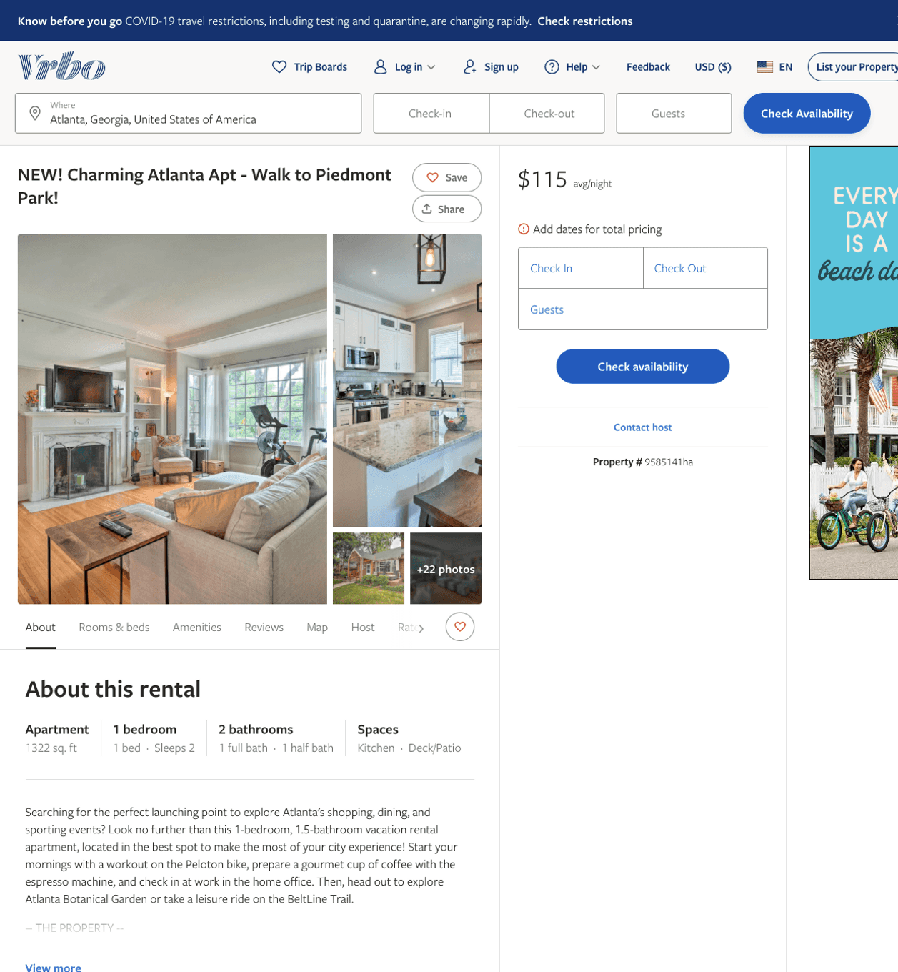
Listing 9585141
1
2
$101 - $99
4
3
Evolve
https://www.vrbo.com/9585141ha
Aug 2022

Slide 3
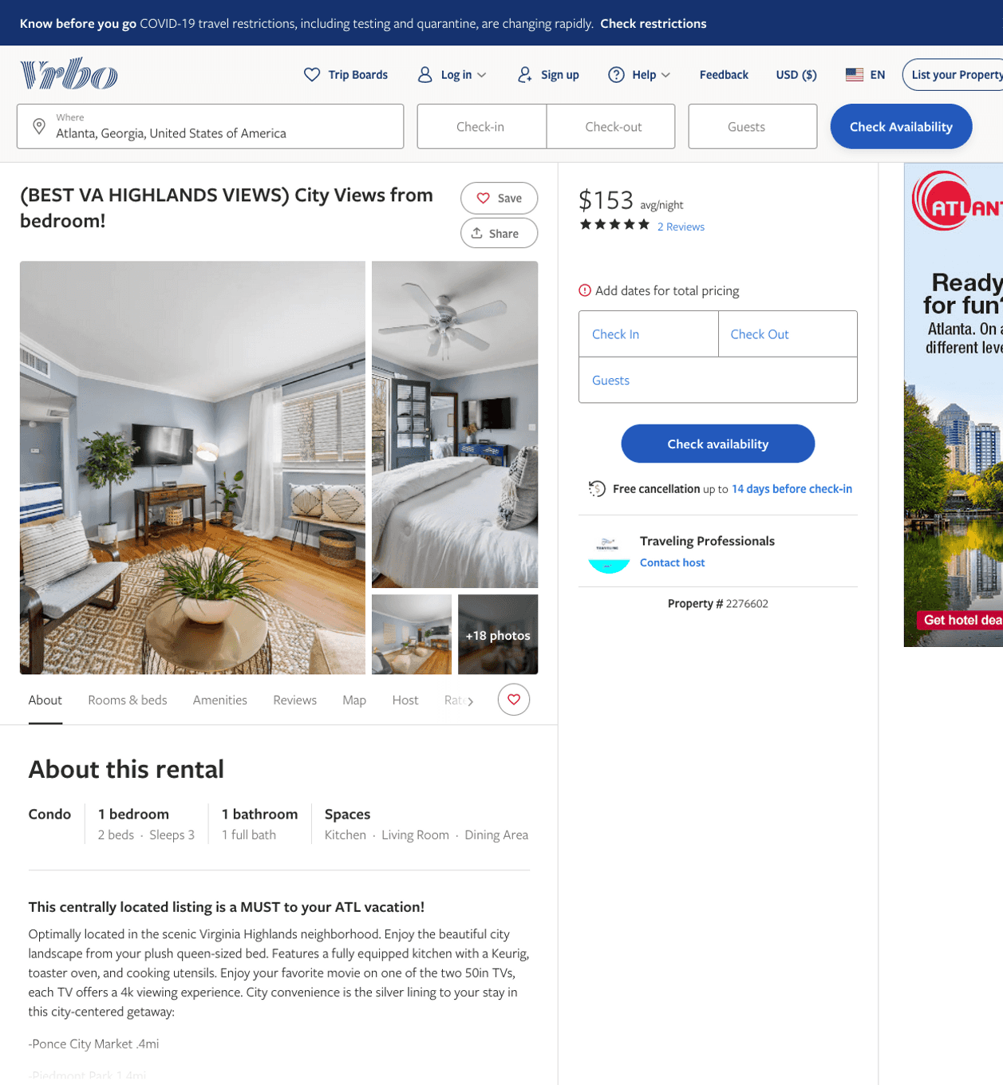
Listing 2276602
1
3
$133 - $169
4.6153846
2
Traveling Professionals
https://www.vrbo.com/2276602
Aug 2022

Slide 4
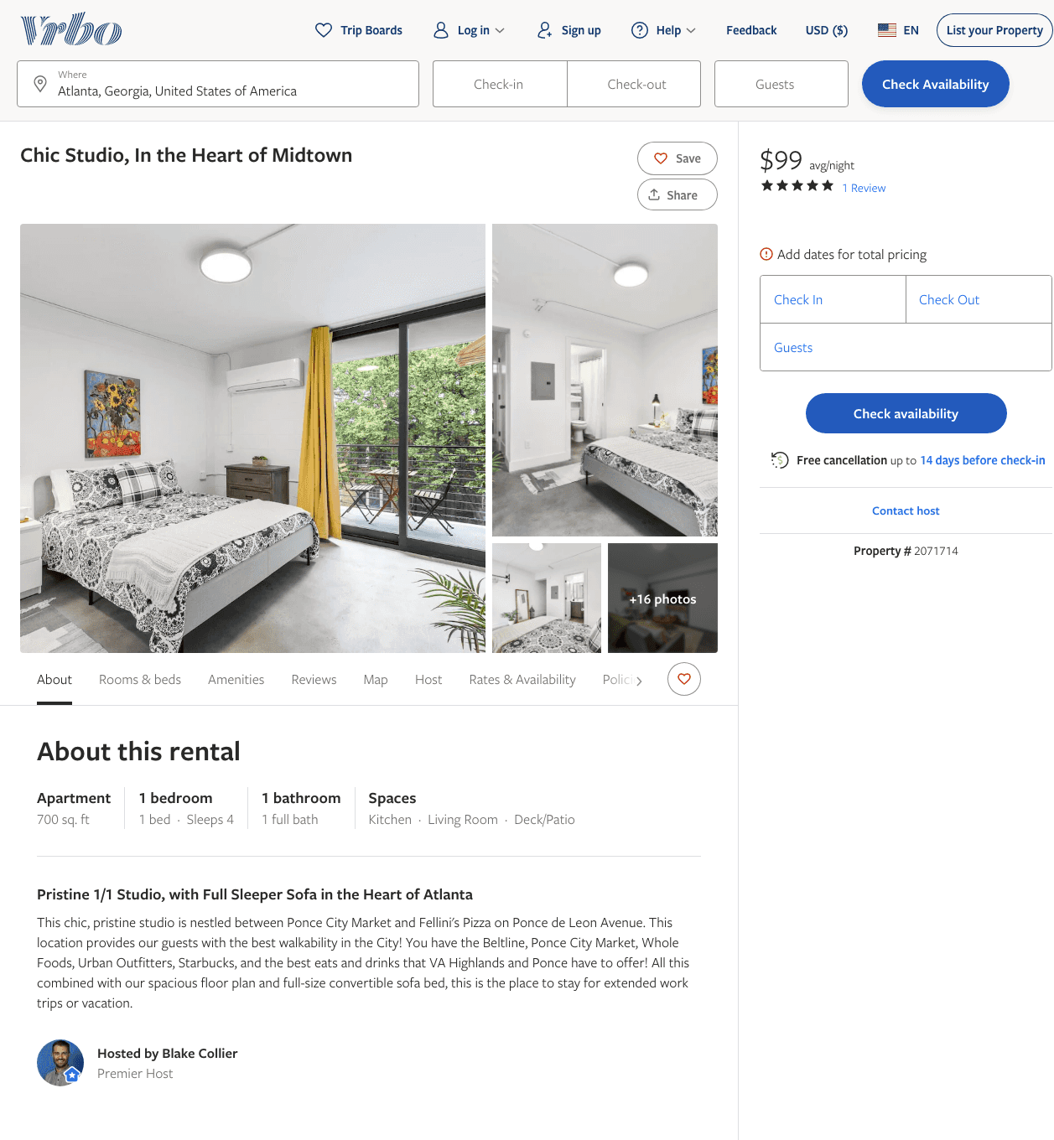
Listing 2071714
1
3
$100 - $99
3.75
2
Blake Collier
https://www.vrbo.com/2071714
Aug 2022

Slide 5
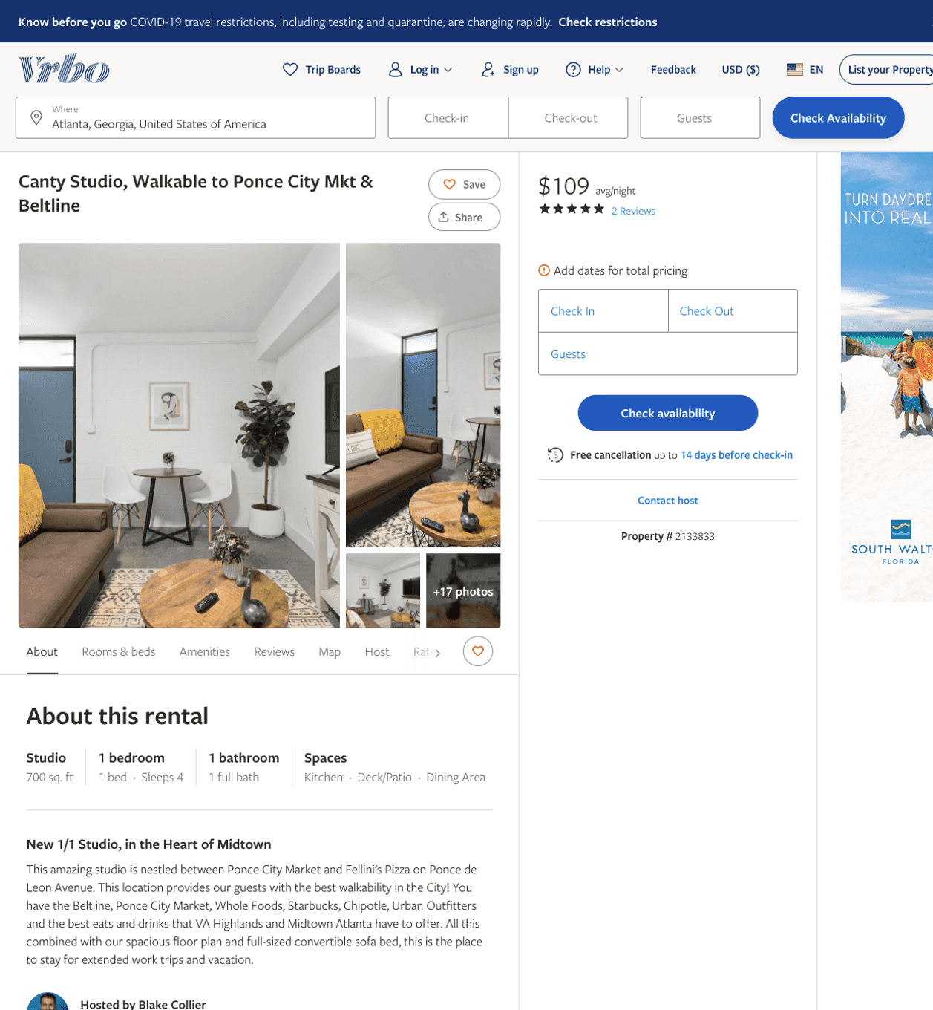
Listing 2133833
1
3
$100 - $99
5
2
Blake Collier
https://www.vrbo.com/2133833
Aug 2022

Slide 6
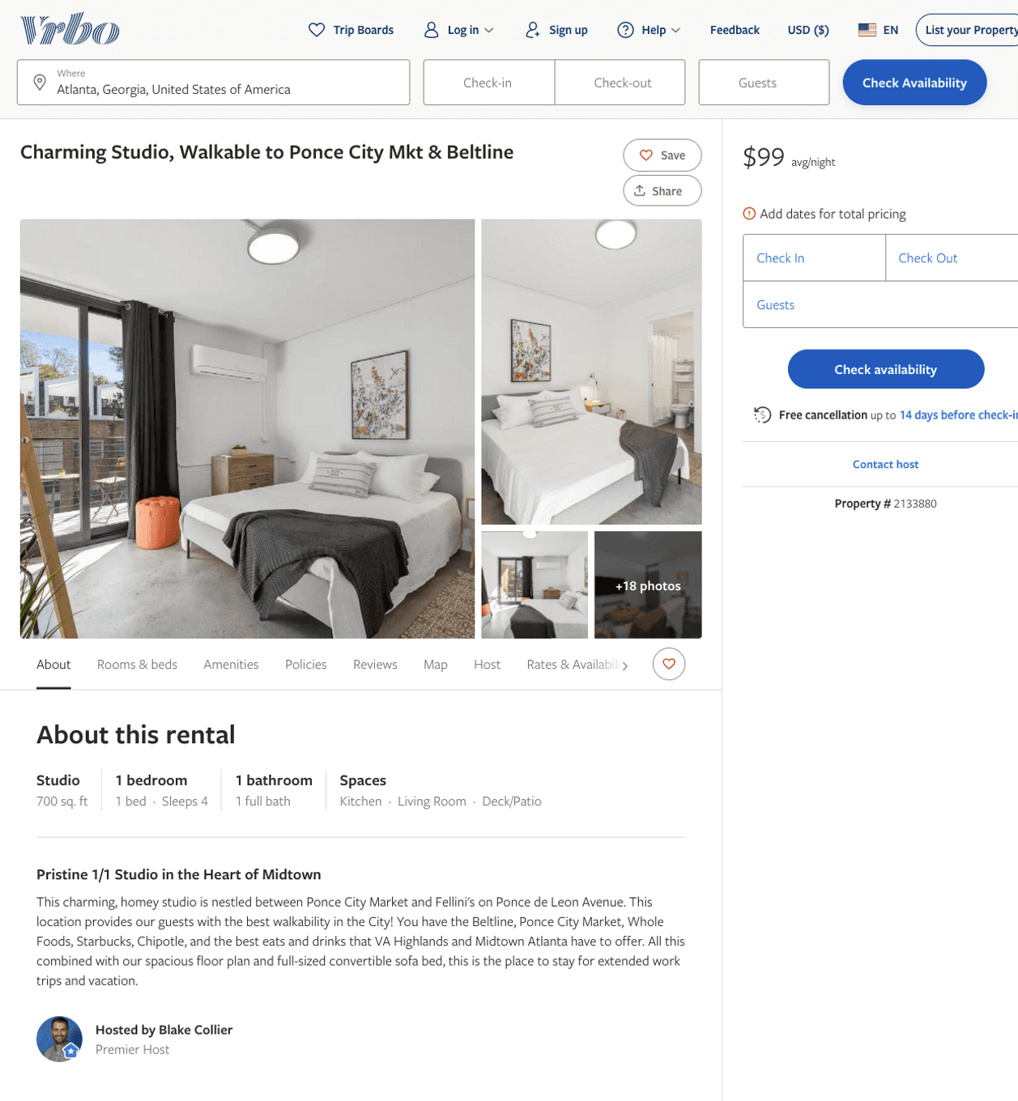
Listing 2133880
1
3
$100 - $99
3
2
Blake Collier
https://www.vrbo.com/2133880
Aug 2022

Slide 7
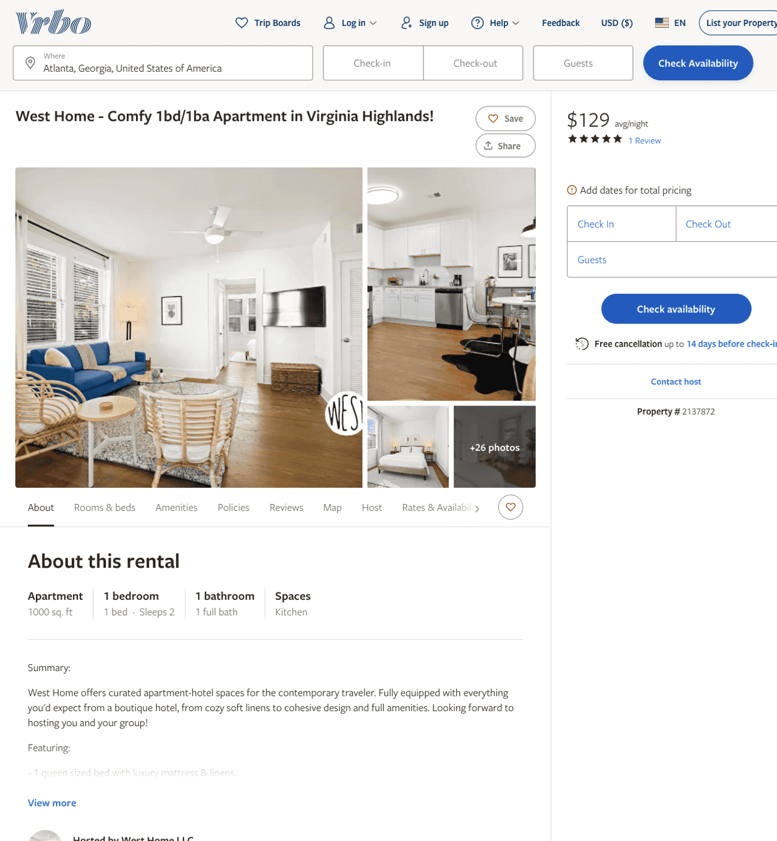
Listing 2137872
1
2
$105 - $172
5
2
West Home LLC
https://www.vrbo.com/2137872
Aug 2022

Slide 8
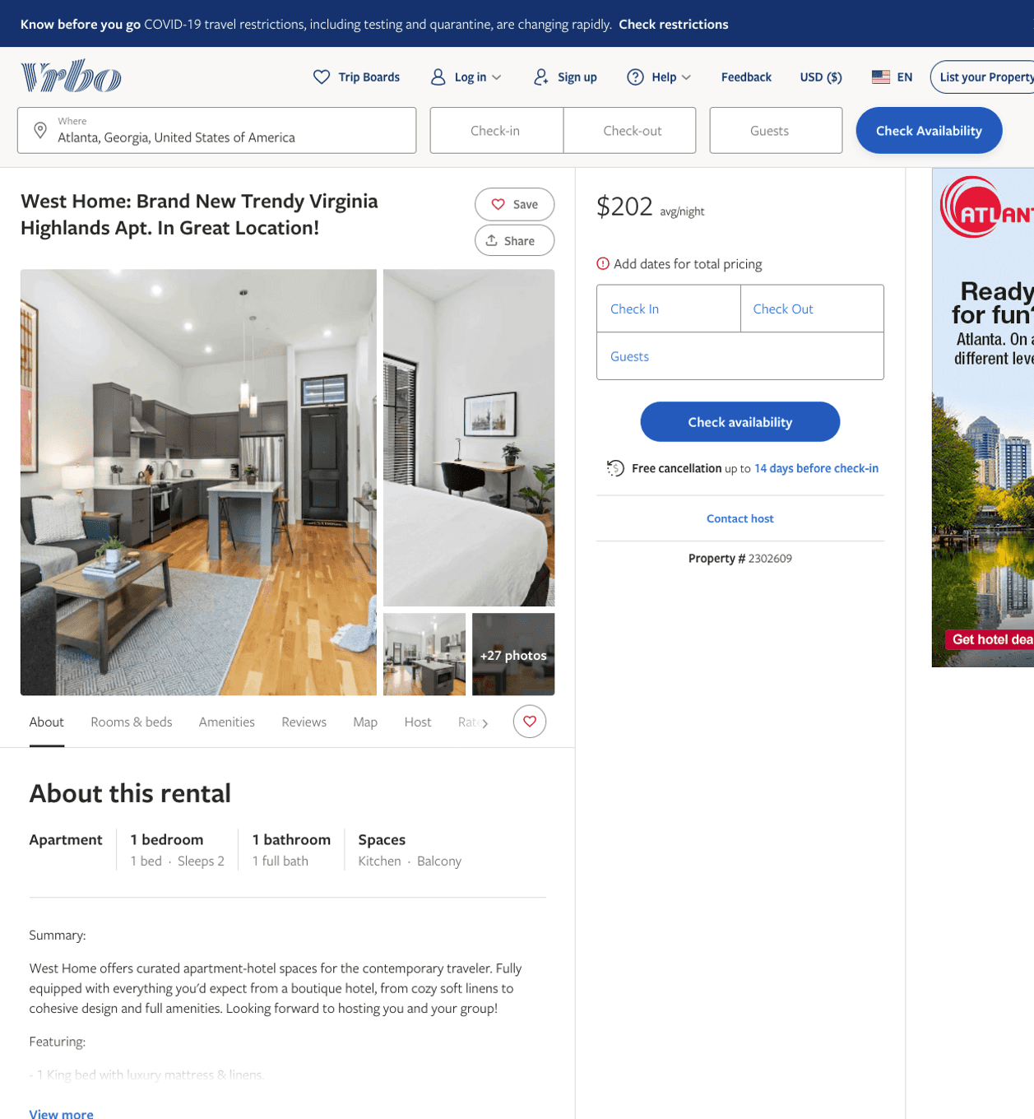
Listing 2302609
1
2
$185 - $221
2
West Home LLC
https://www.vrbo.com/2302609
Aug 2022

Slide 9
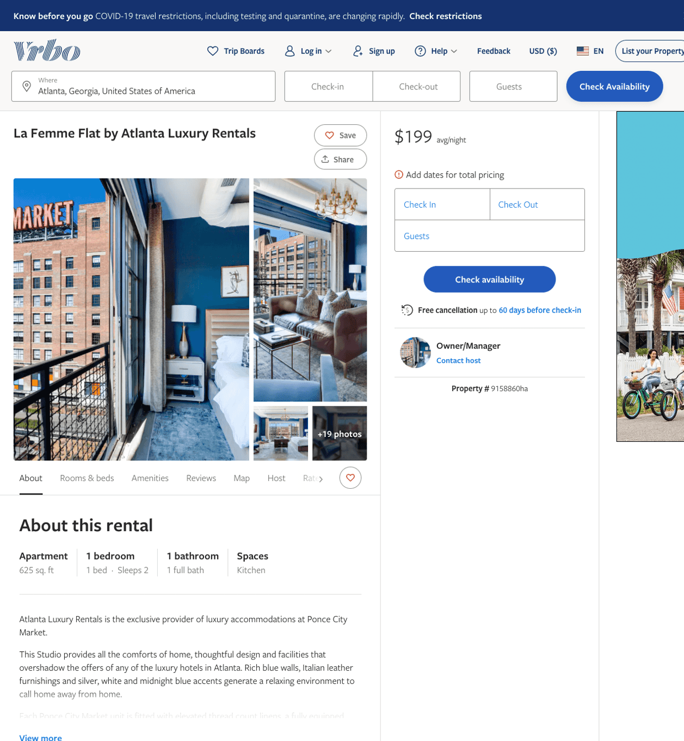
Listing 9158860
1
2
$180 - $259
2
Owner/Manager
https://www.vrbo.com/9158860ha
Aug 2022

Slide 10
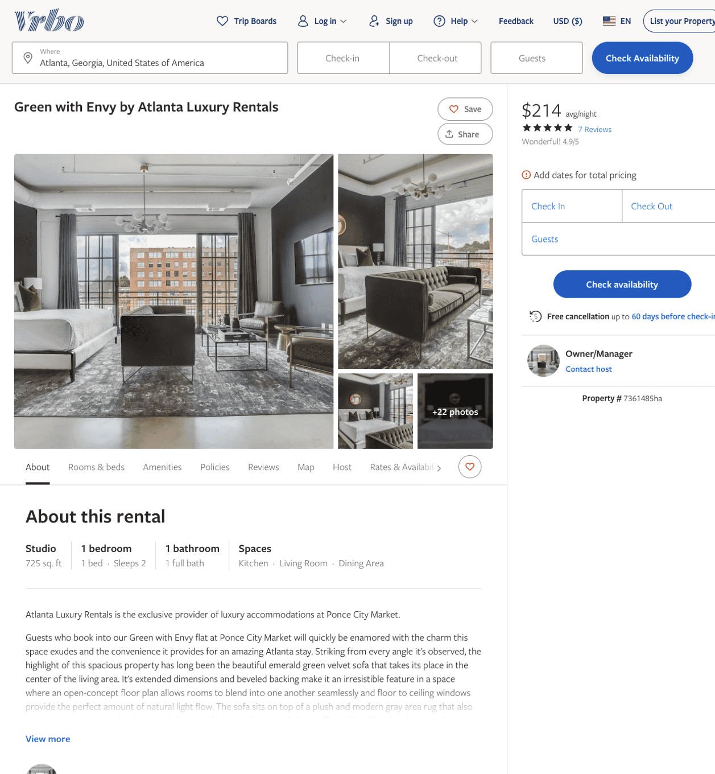
Listing 7361485
1
2
$199 - $268
4.909091
2
Owner/Manager
https://www.vrbo.com/7361485ha
Aug 2022

Slide 11
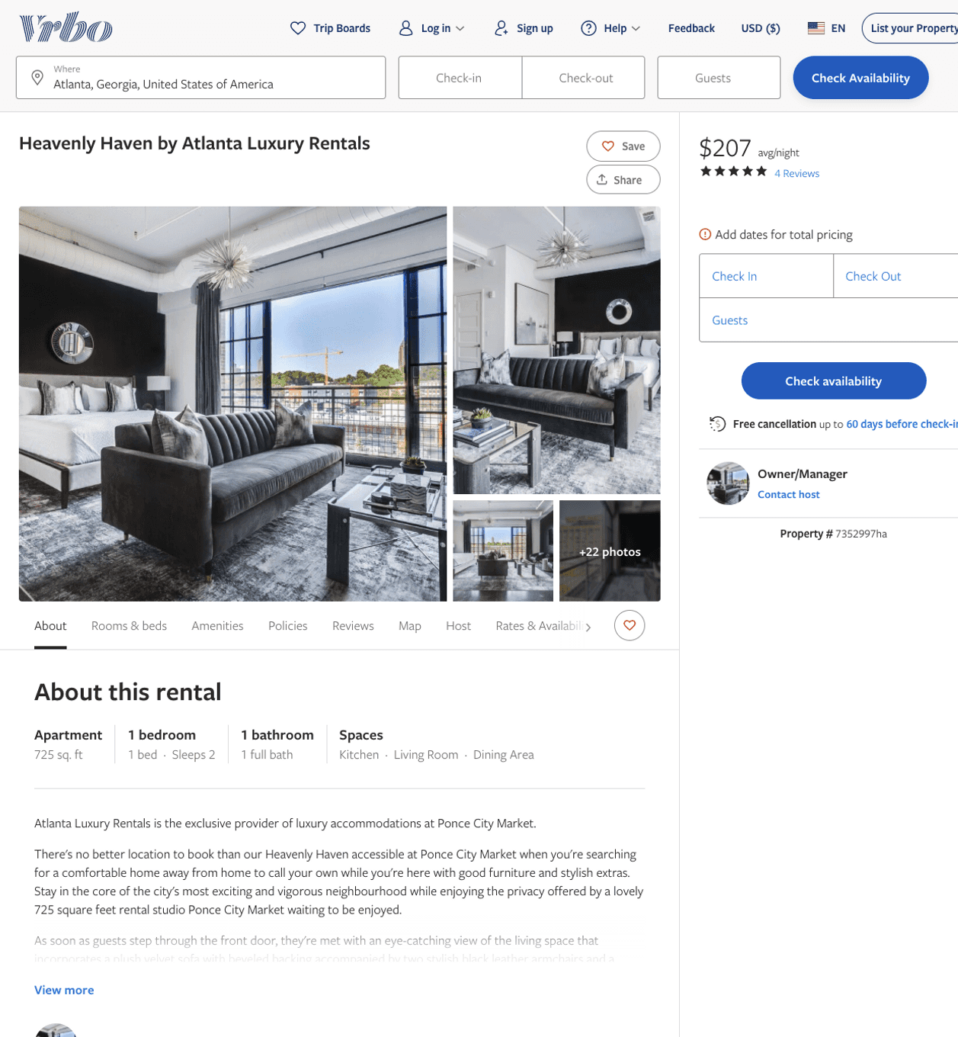
Listing 7352997
1
2
$188 - $256
4.75
2
Owner/Manager
https://www.vrbo.com/7352997ha
Aug 2022

Slide 12
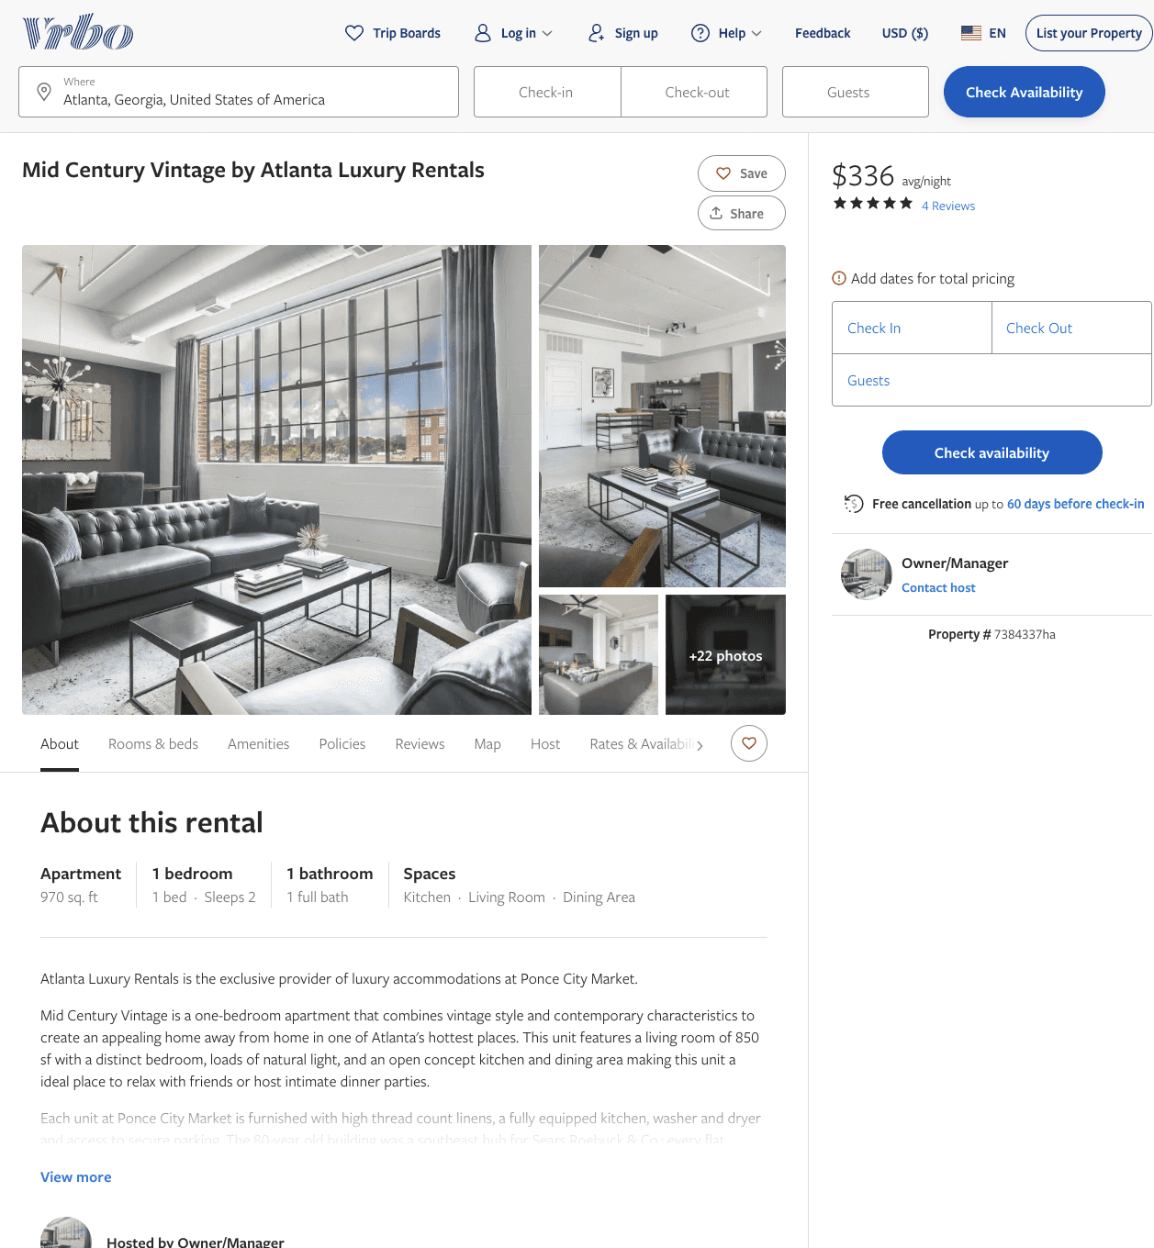
Listing 7384337
1
2
$252 - $333
5
30
Owner/Manager
https://www.vrbo.com/7384337ha
Aug 2022

Slide 13
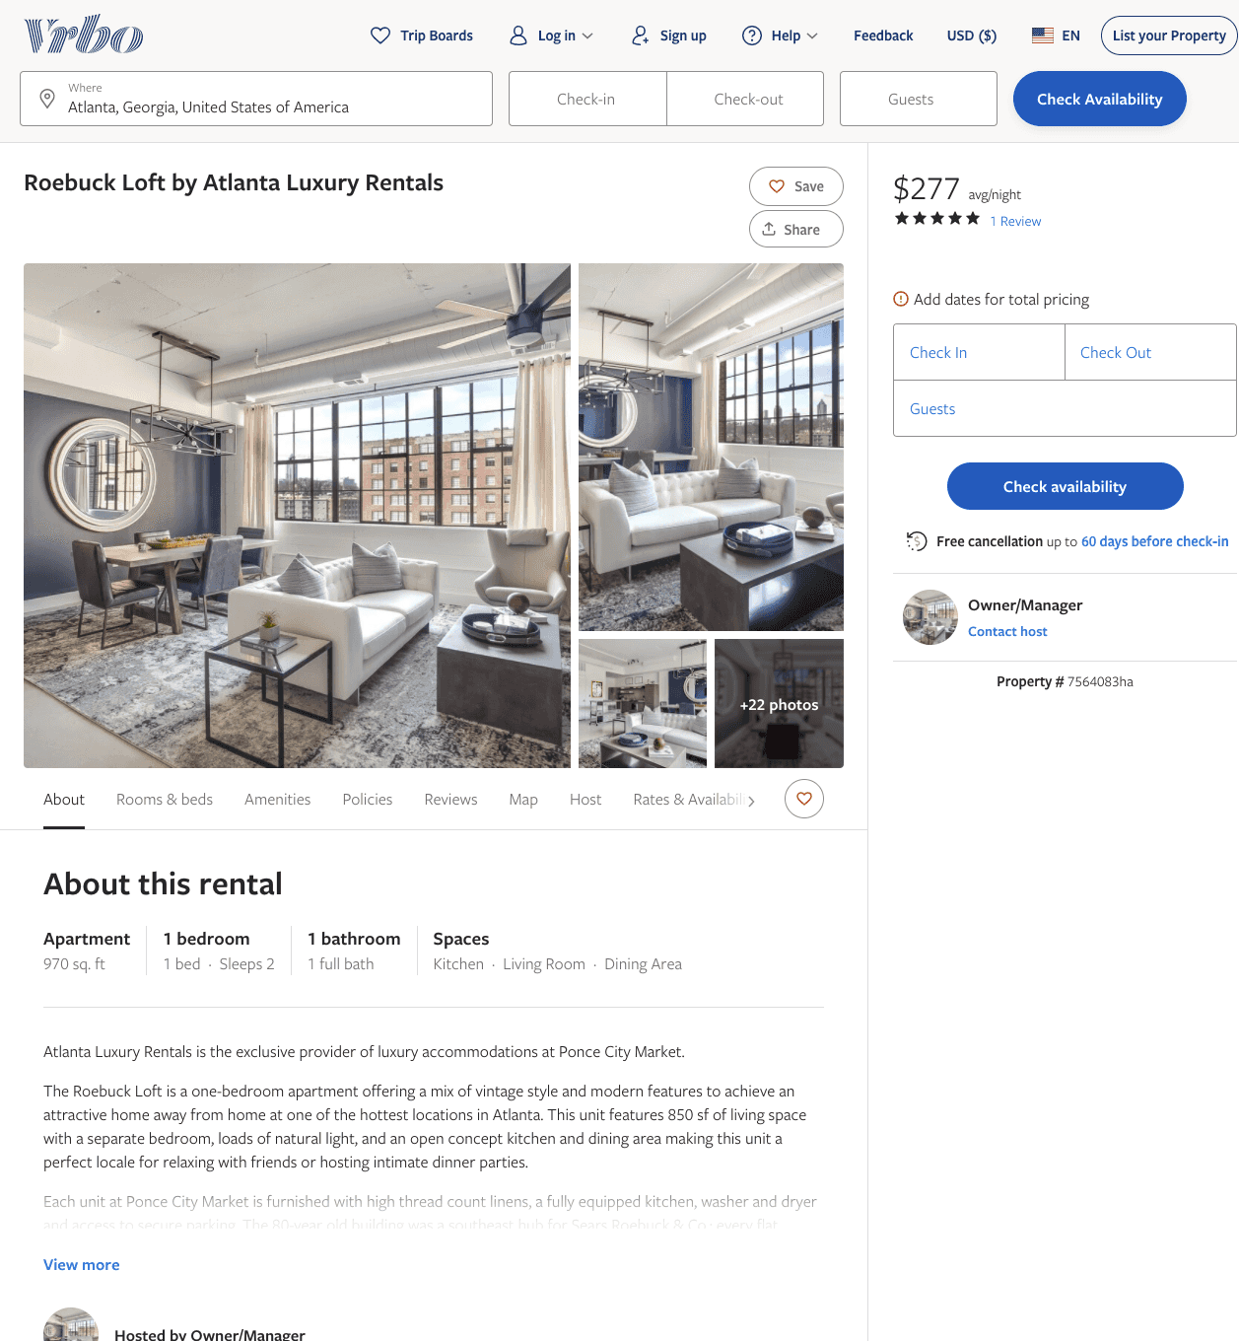
Listing 7564083
1
2
$235 - $367
5
2
Owner/Manager
https://www.vrbo.com/7564083ha
Aug 2022

Slide 14
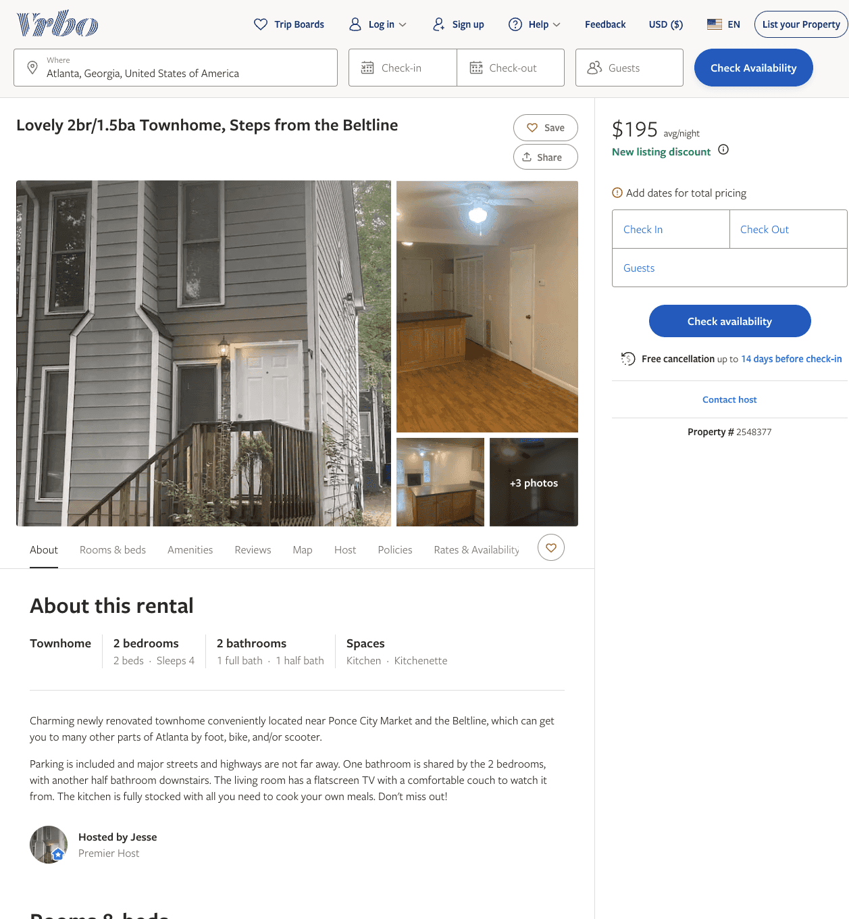
Listing 2548377
2
4
$133 - $195
5
4
Jesse
https://www.vrbo.com/2548377
Aug 2022

Slide 15
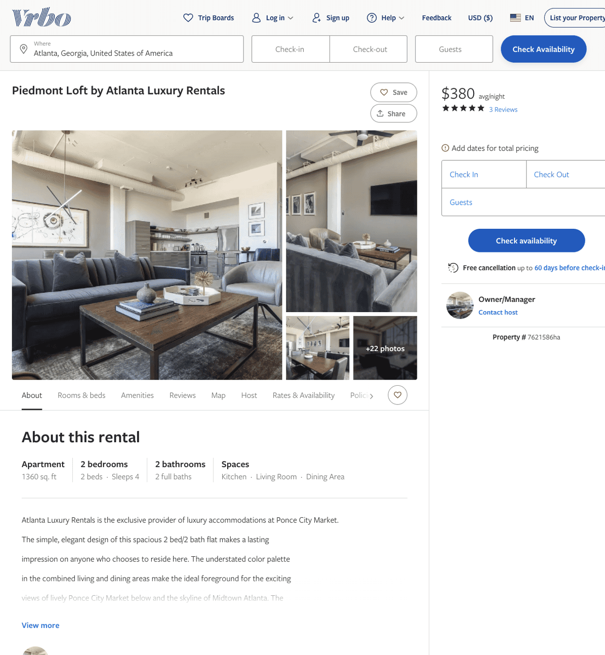
Listing 7621586
2
4
$290 - $417
5
2
Owner/Manager
https://www.vrbo.com/7621586ha
Aug 2022

Slide 16
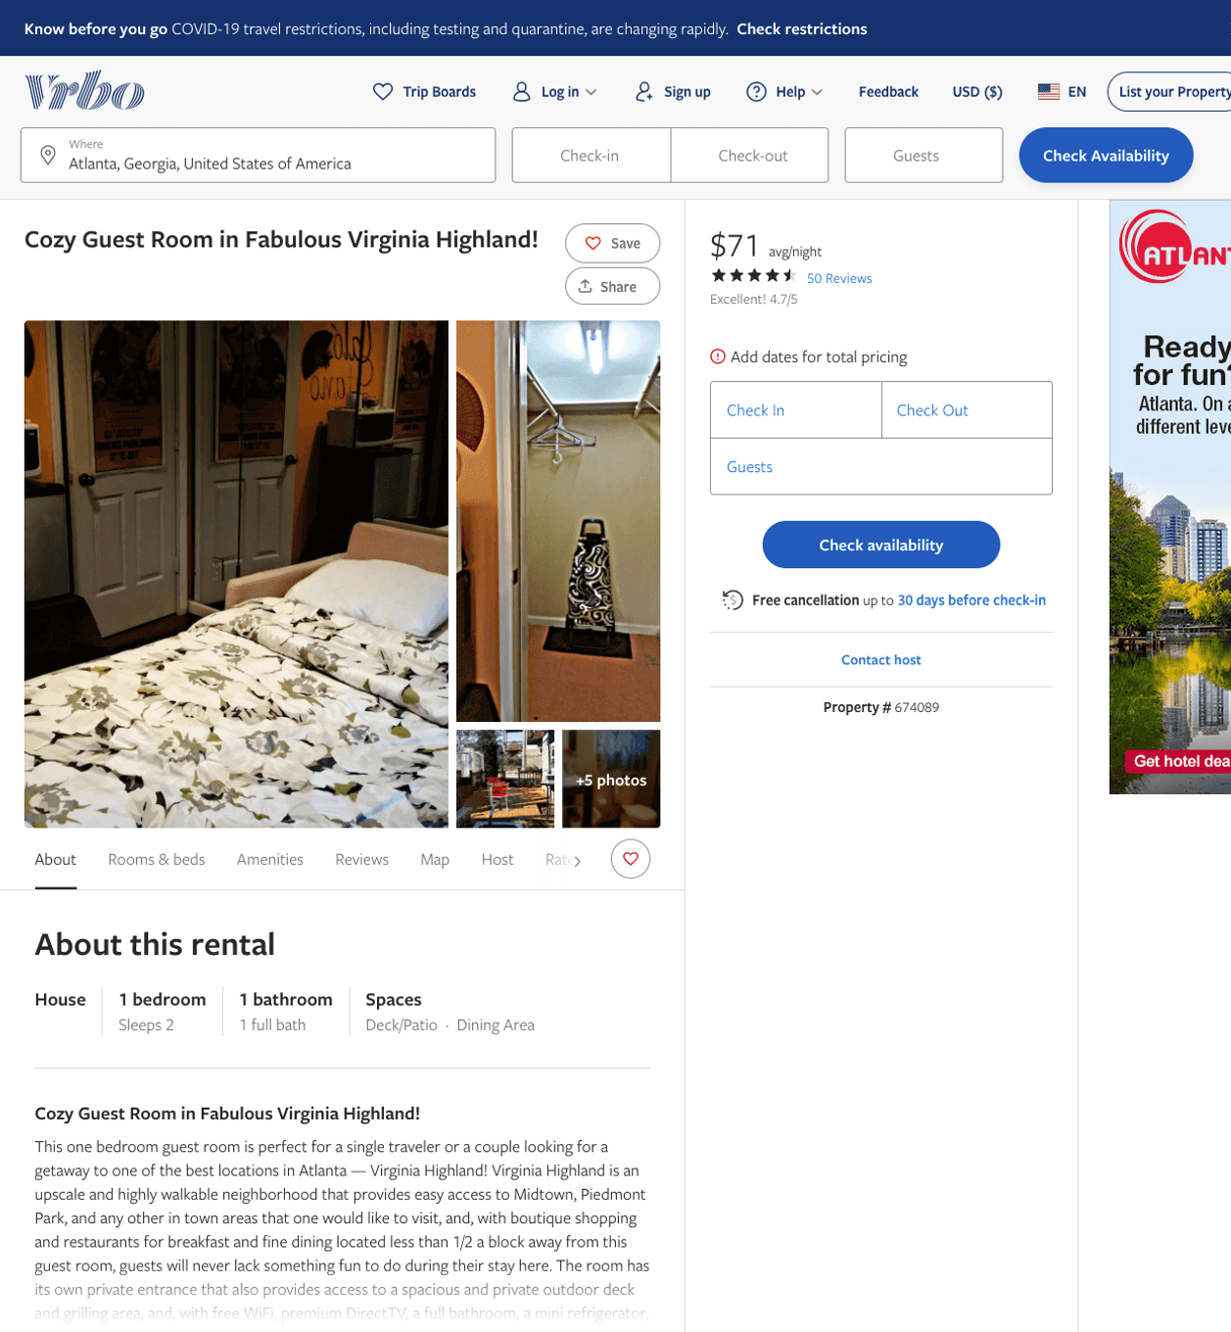
Listing 674089
1
2
$71 - $79
4.75
2
Owner/Manager
https://www.vrbo.com/674089
Aug 2022

Slide 17
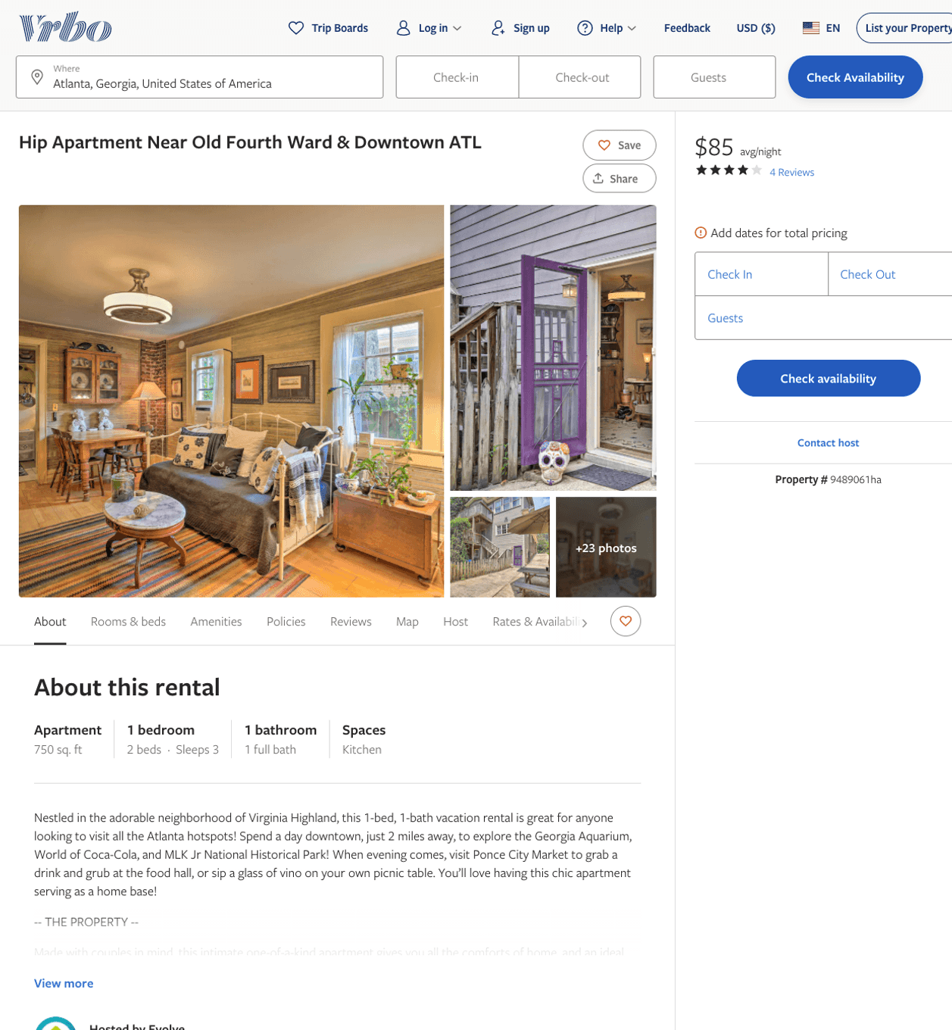
Listing 9489061
1
3
$101 - $86
3.75
2
Evolve
https://www.vrbo.com/9489061ha
Aug 2022

Slide 18
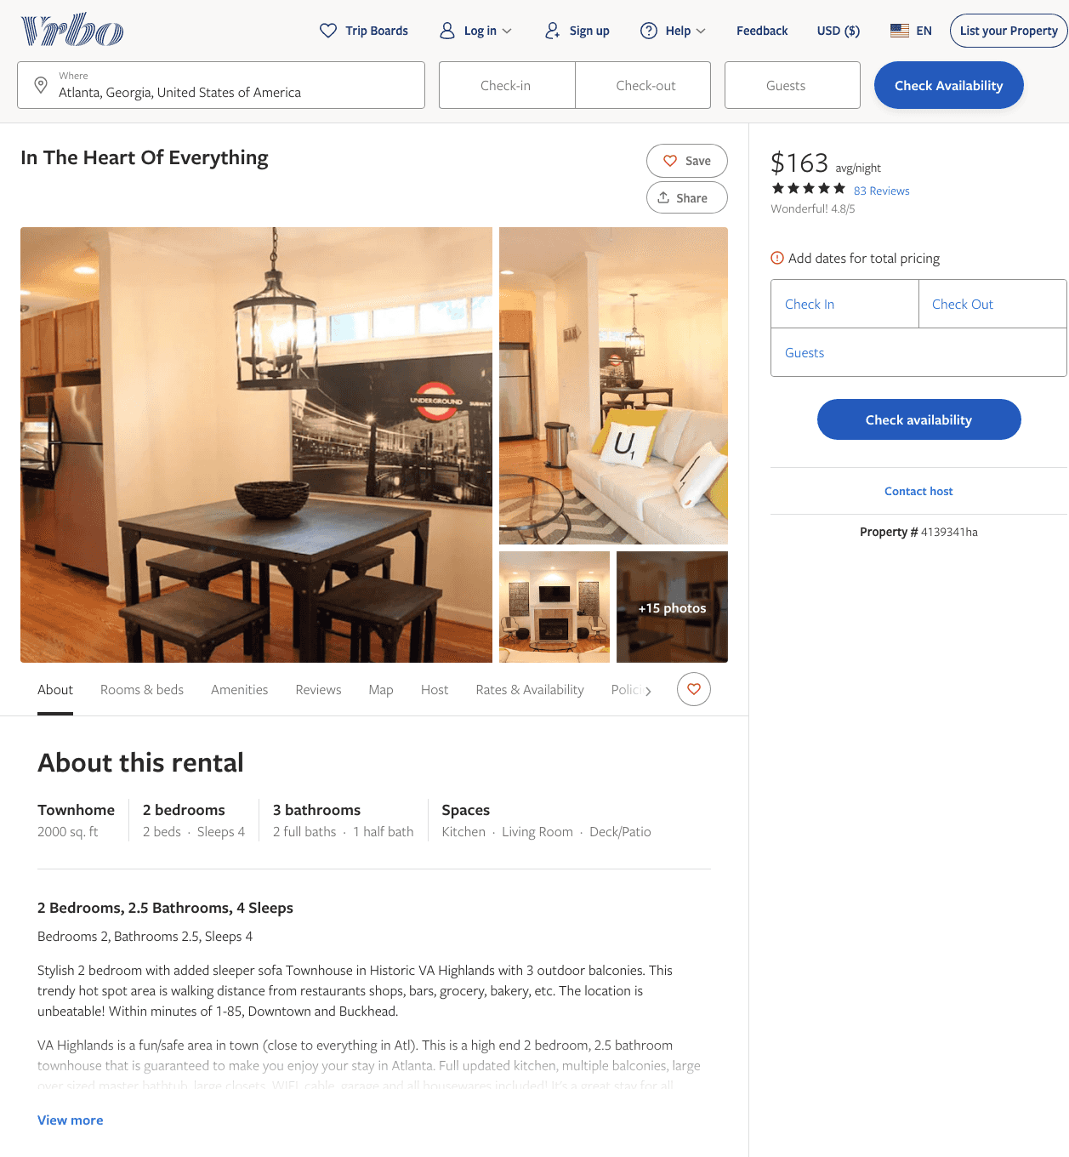
Listing 4139341
2
4
$163 - $189
4.7708335
2
Elizabeth Fletcher
https://www.vrbo.com/4139341ha
Aug 2022

Slide 19
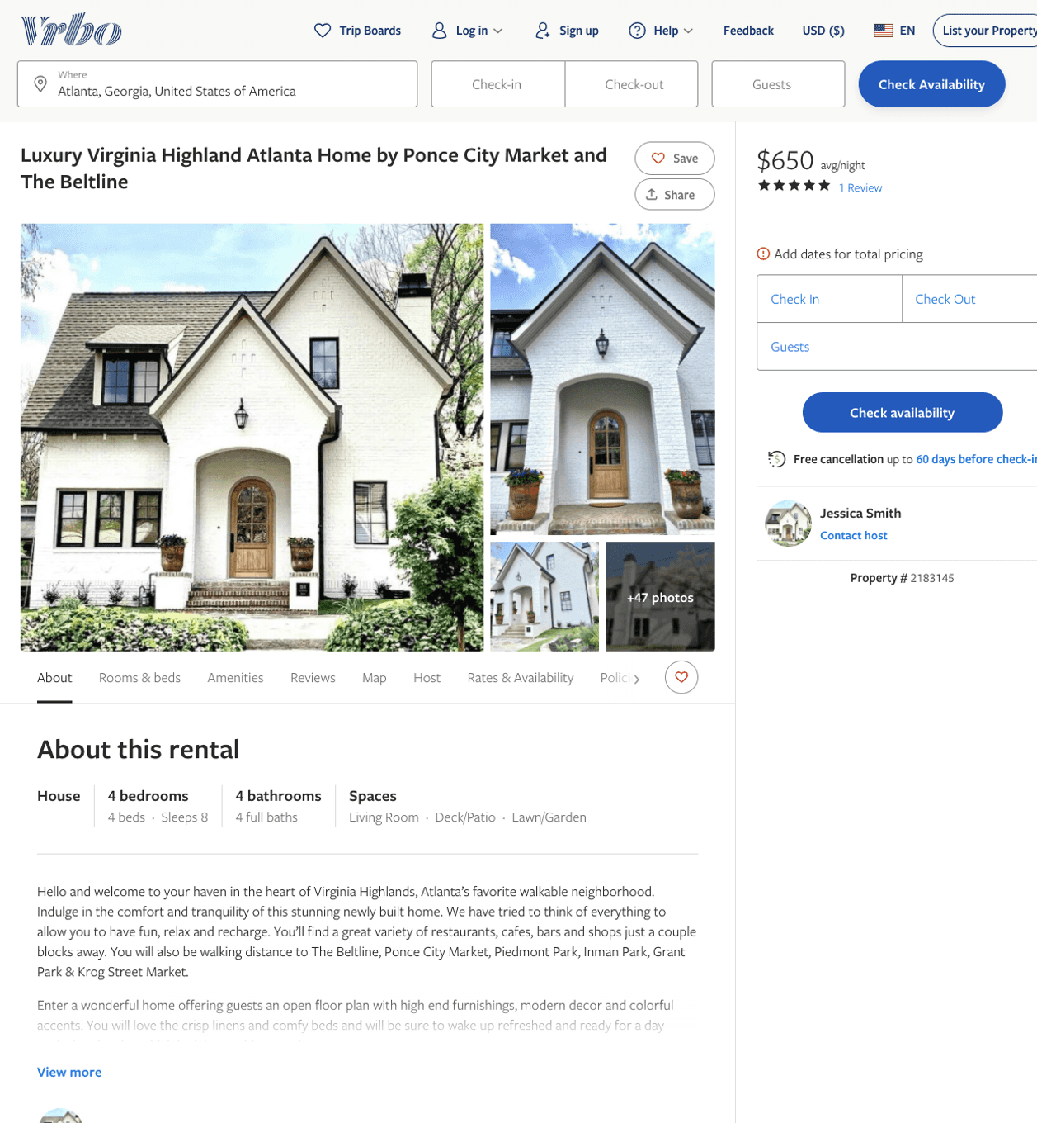
Listing 2183145
4
8
$625 - $700
5
4
Jessica Smith
https://www.vrbo.com/2183145
Aug 2022

Slide 20
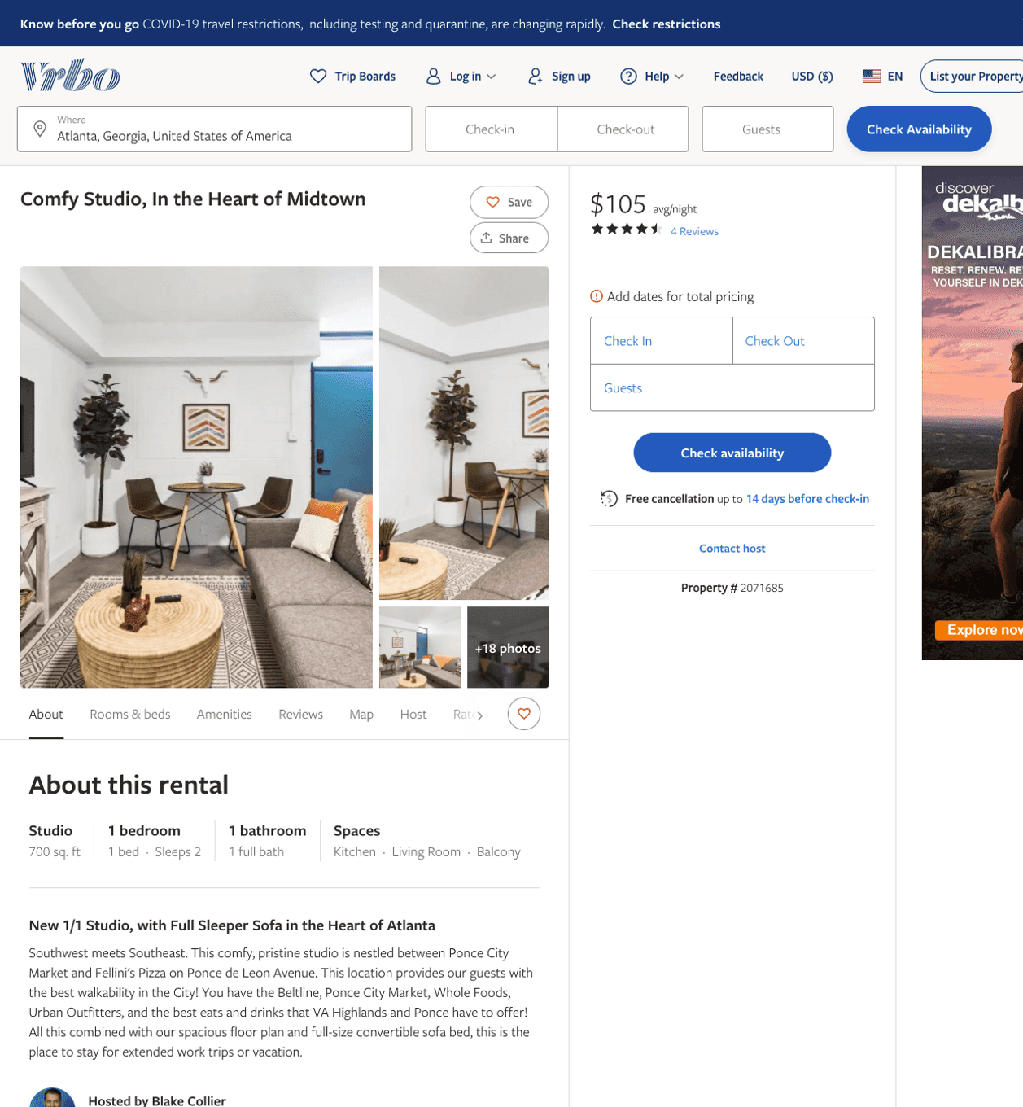
Listing 2071685
1
3
$100 - $99
4.625
2
Blake Collier
https://www.vrbo.com/2071685
Aug 2022

Slide 21
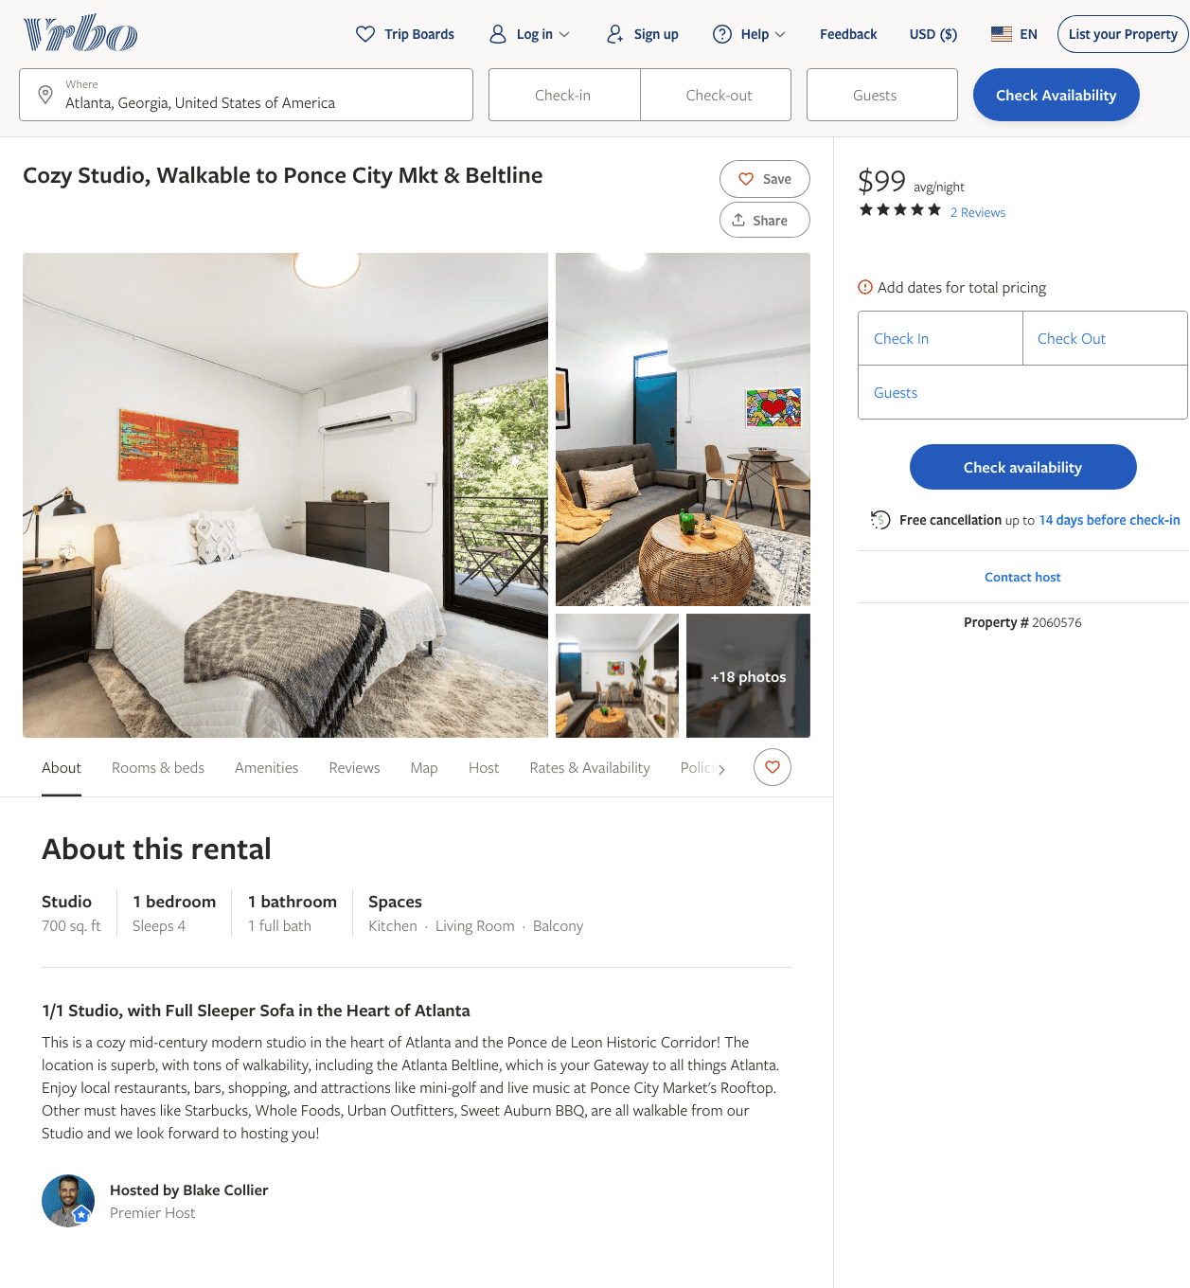
Listing 2060576
1
3
$100 - $99
5
2
Blake Collier
https://www.vrbo.com/2060576
Aug 2022

Slide 22
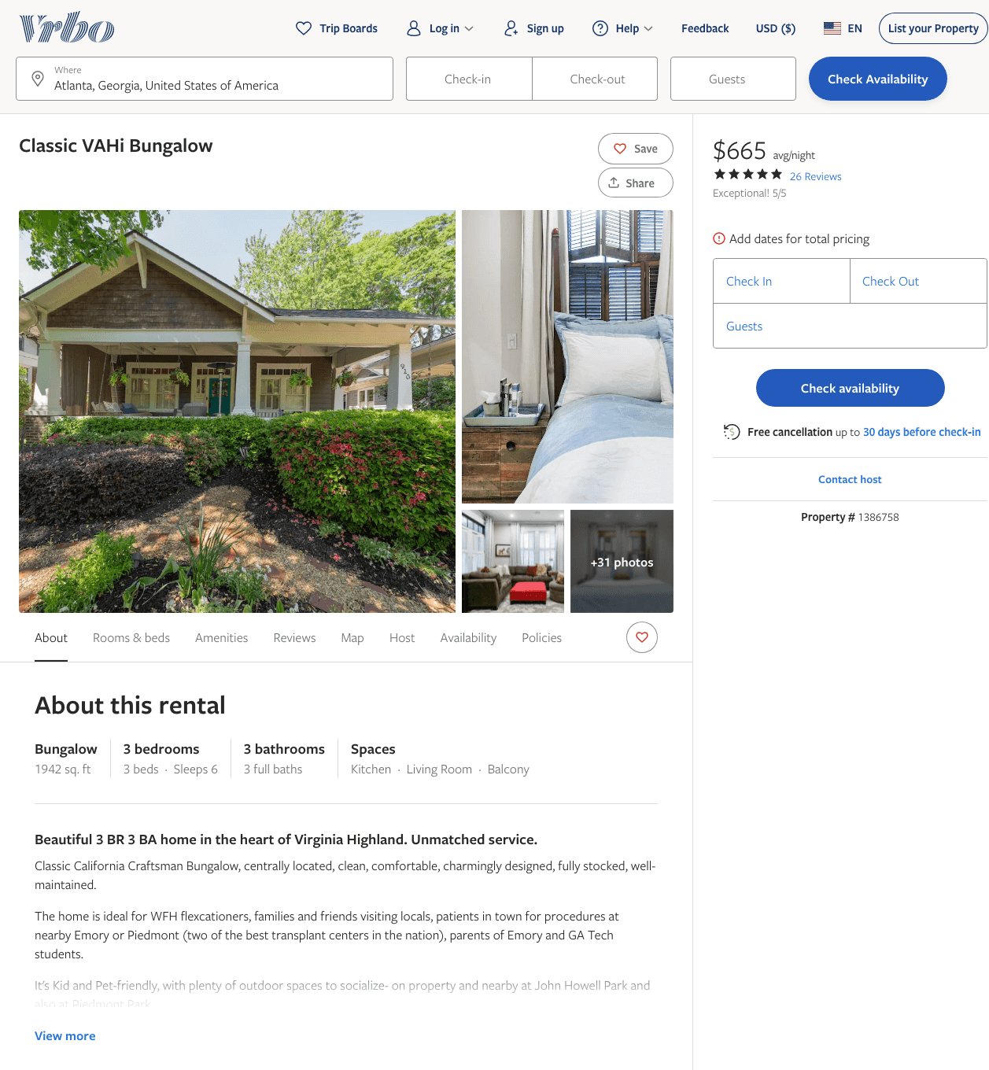
Listing 1386758
3
6
$614 - $715
5
2
Carmen
https://www.vrbo.com/1386758
Aug 2022

Slide 23
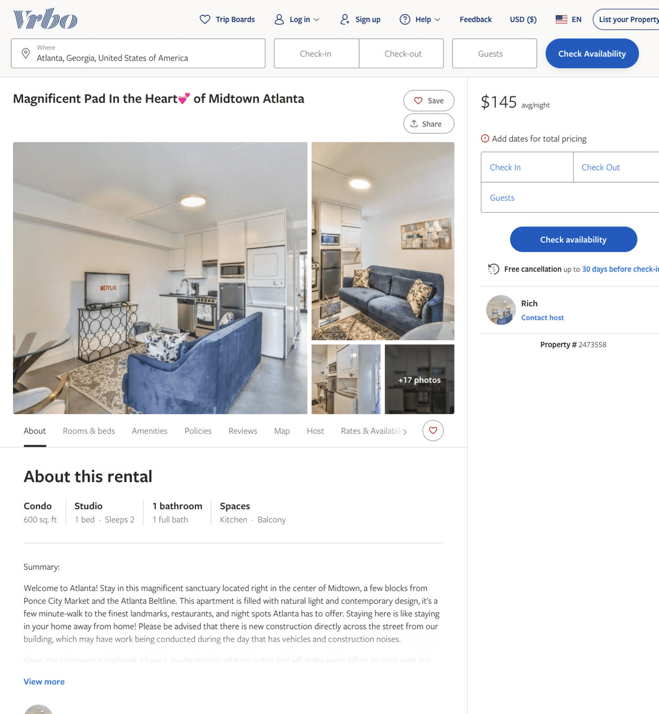
Listing 2473558
0
2
$104 - $172
5
2
Rich
https://www.vrbo.com/2473558
Aug 2022

Slide 24
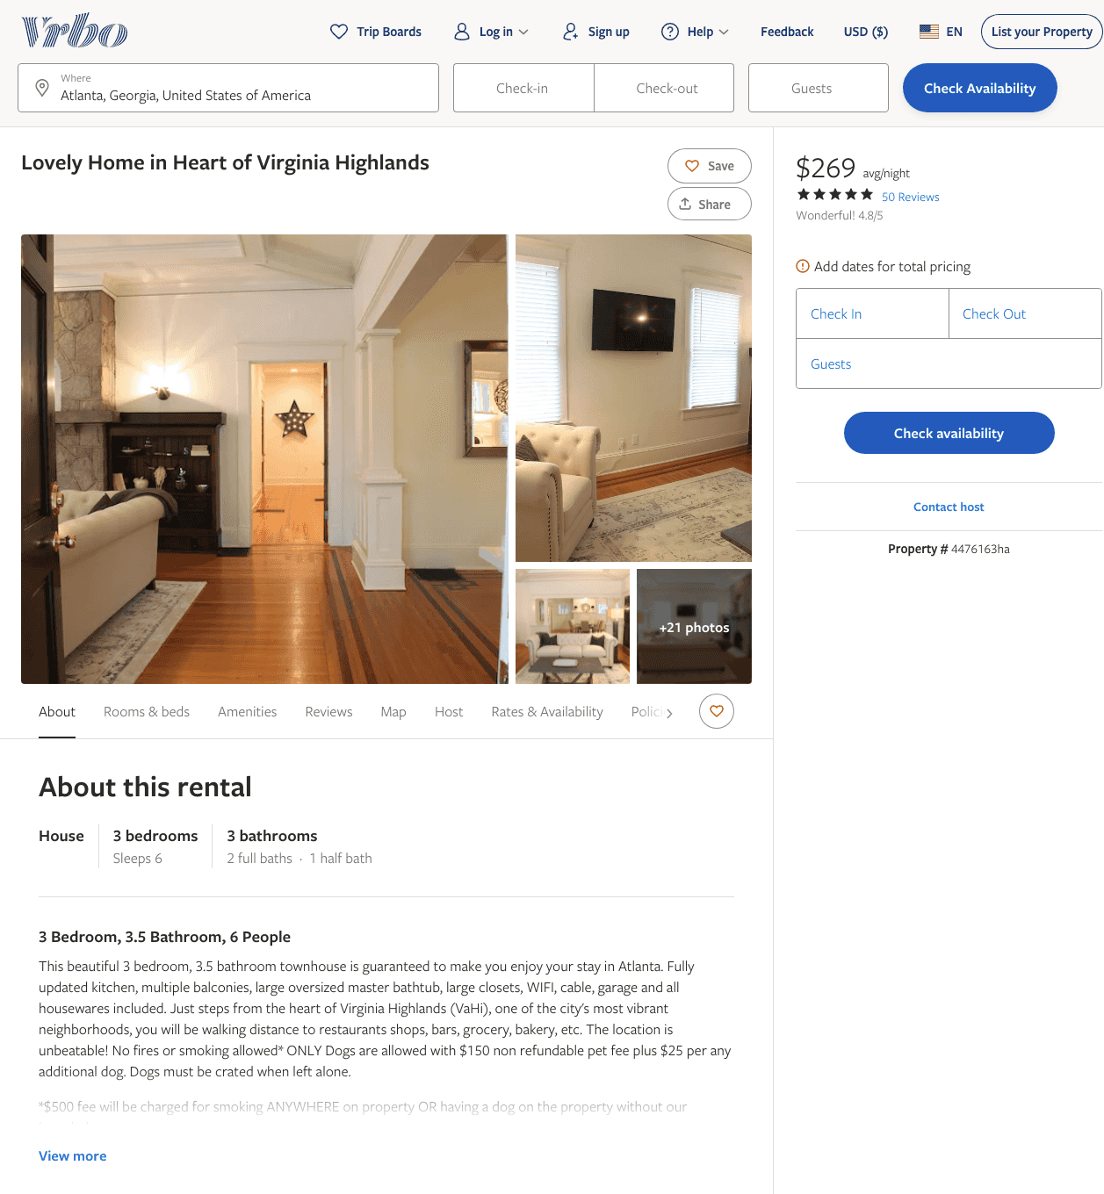
Listing 4476163
3
6
$269 - $303
4.754386
2
Elizabeth Fletcher
https://www.vrbo.com/4476163ha
Aug 2022

Slide 25
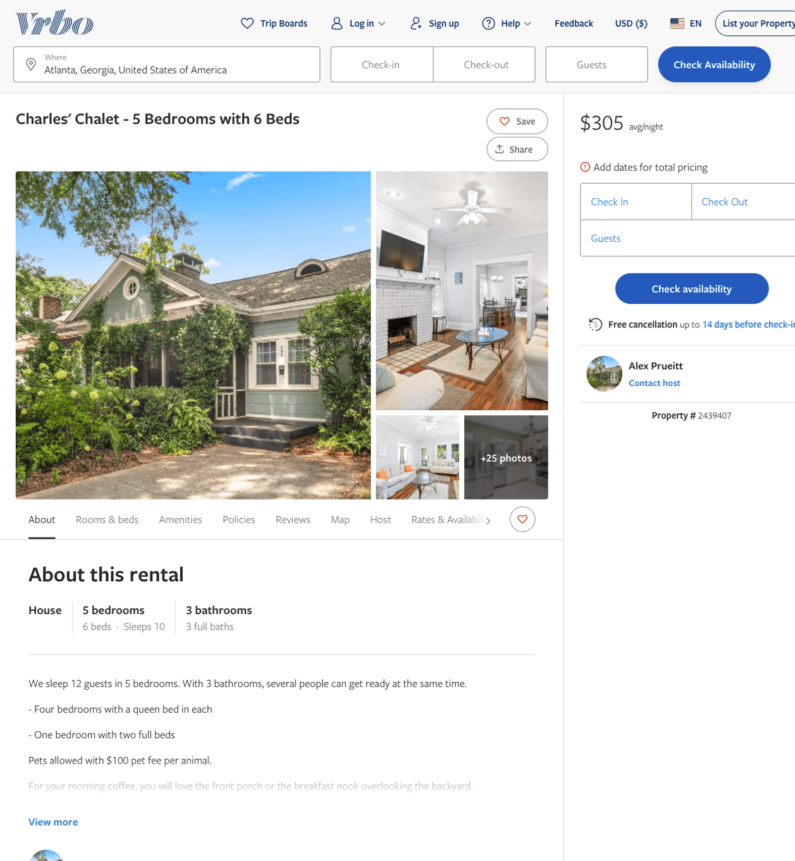
Listing 2439407
896 ST CHARLES AVE NE
5
10
$301 - $450
4.6363635
4
Alex Prueitt
https://www.vrbo.com/2439407
Aug 2022

Slide 26
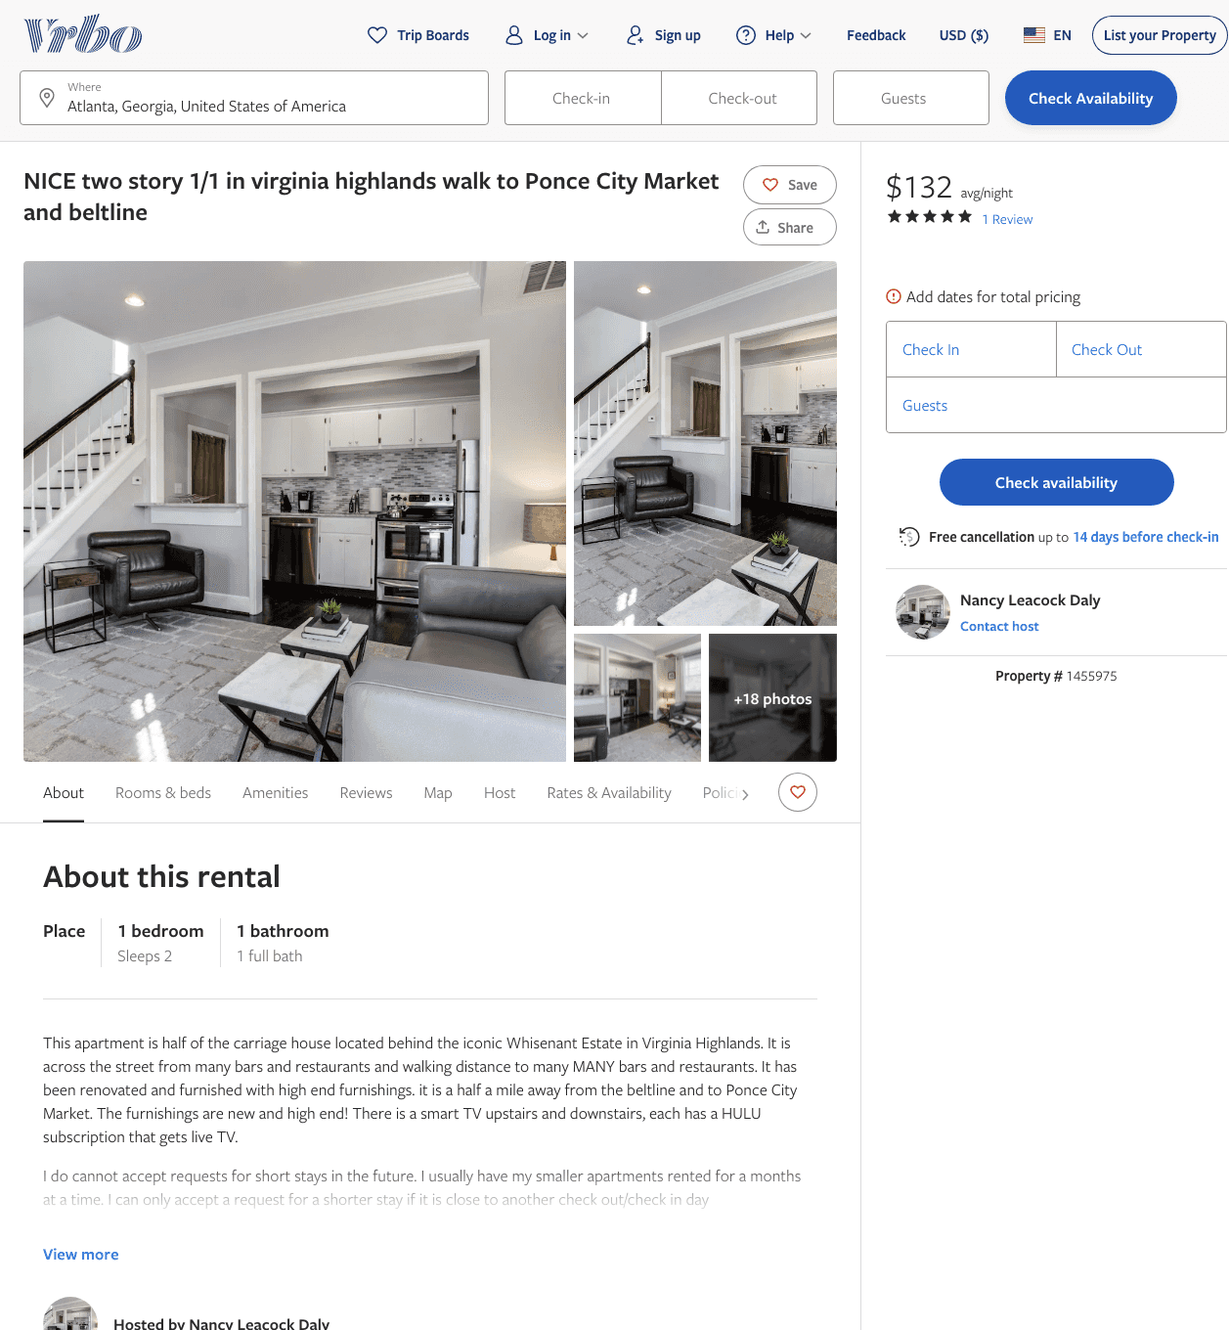
Listing 1455975
1
2
$132
5
6
Nancy Leacock Daly
https://www.vrbo.com/1455975
Aug 2022

Slide 27
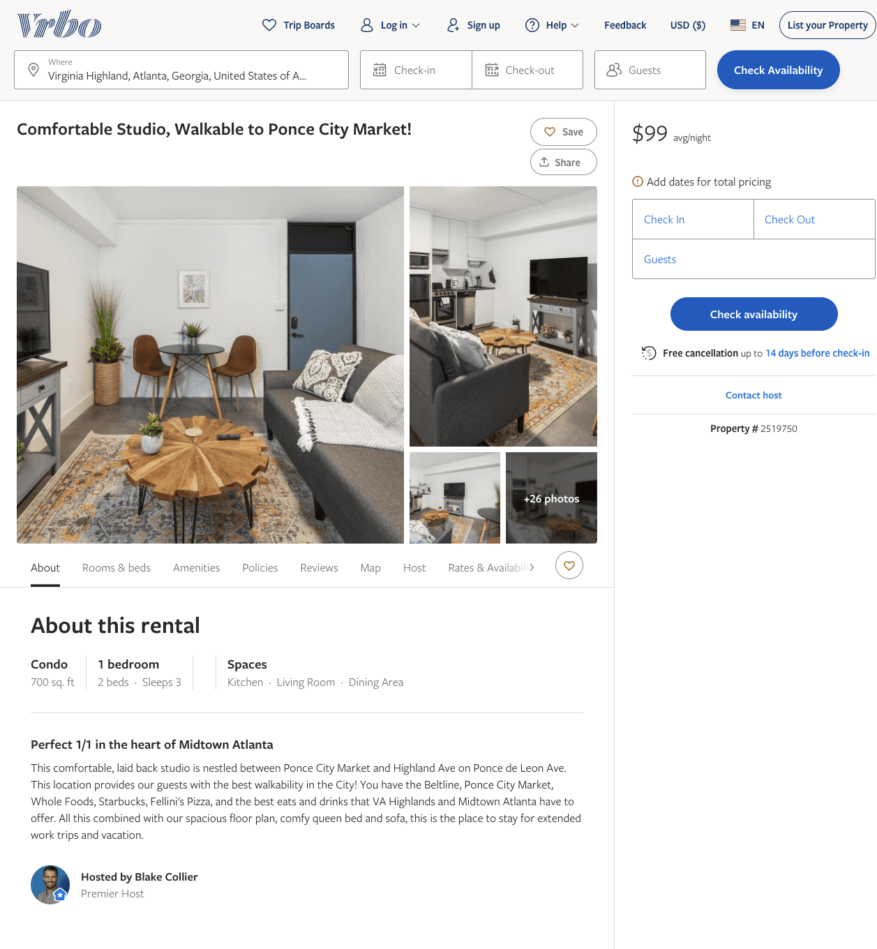
Listing 2519750
1
3
$100 - $99
5
2
Blake Collier
https://www.vrbo.com/2519750
Aug 2022

Slide 28
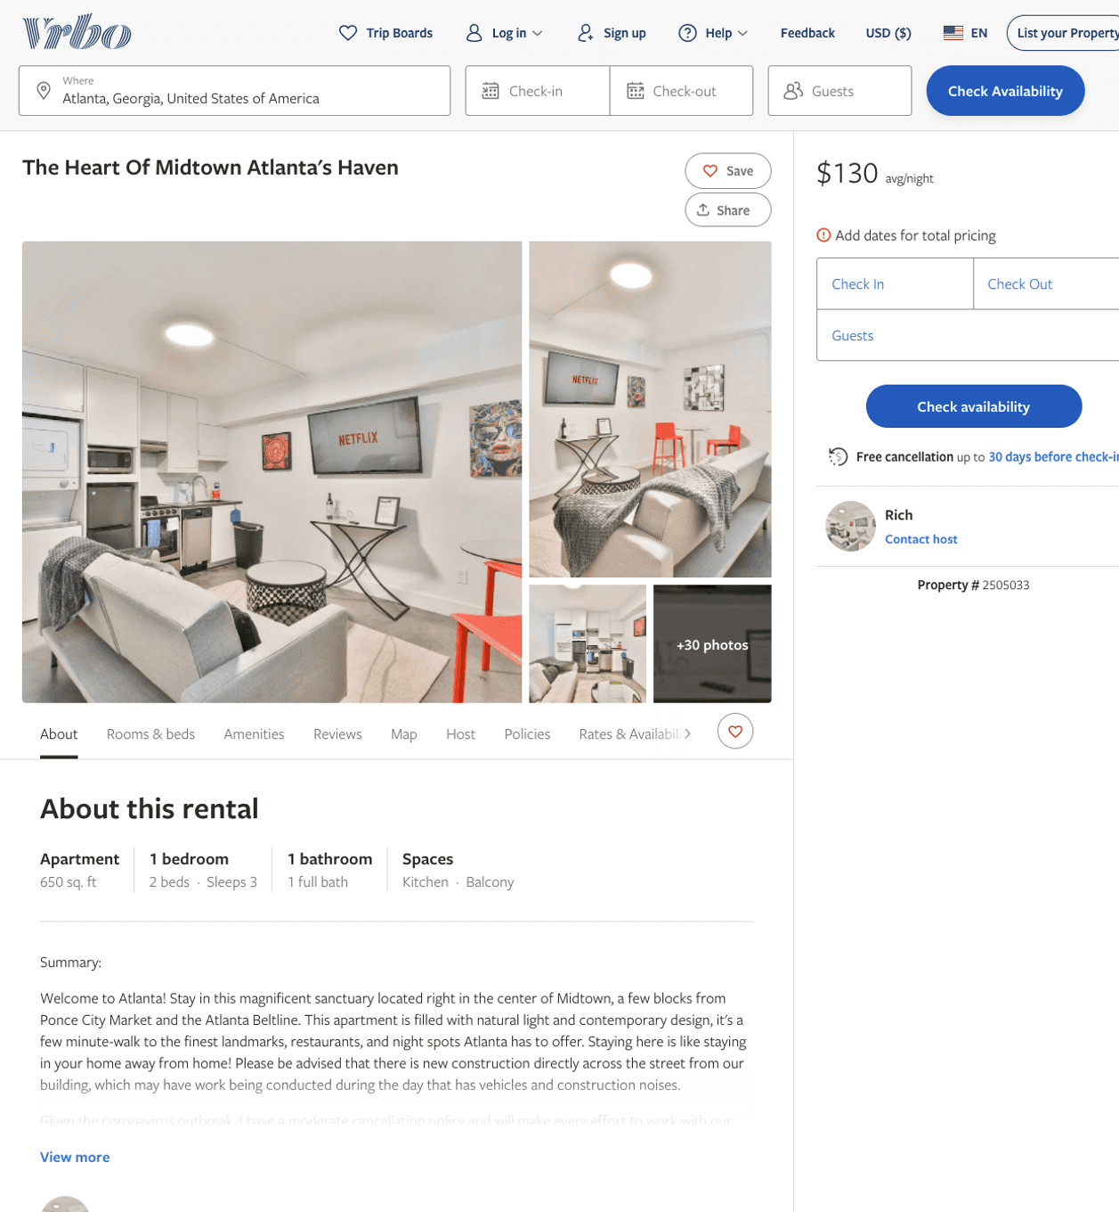
Listing 2505033
1
3
$100 - $97
2
Rich
https://www.vrbo.com/2505033
Aug 2022

Slide 29
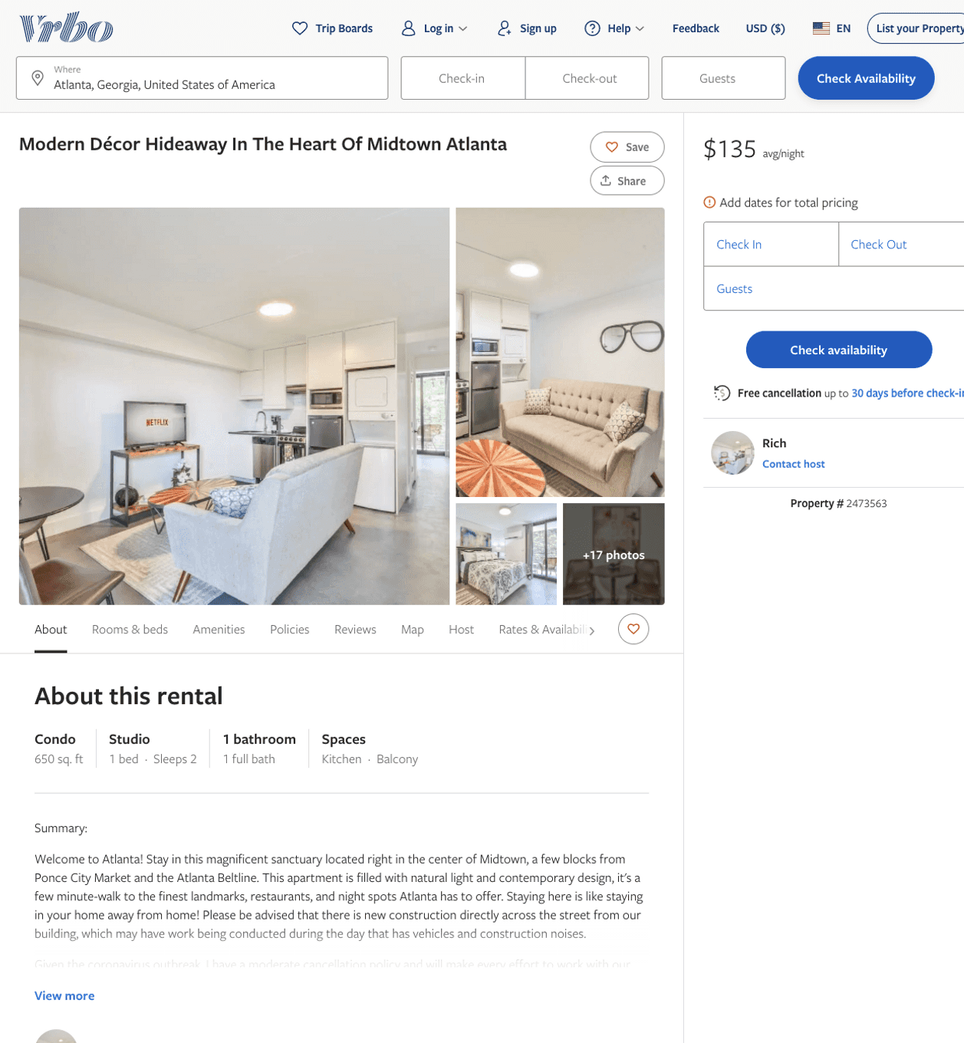
Listing 2473563
0
2
$119 - $95
5
2
Rich
https://www.vrbo.com/2473563
Aug 2022

Slide 30
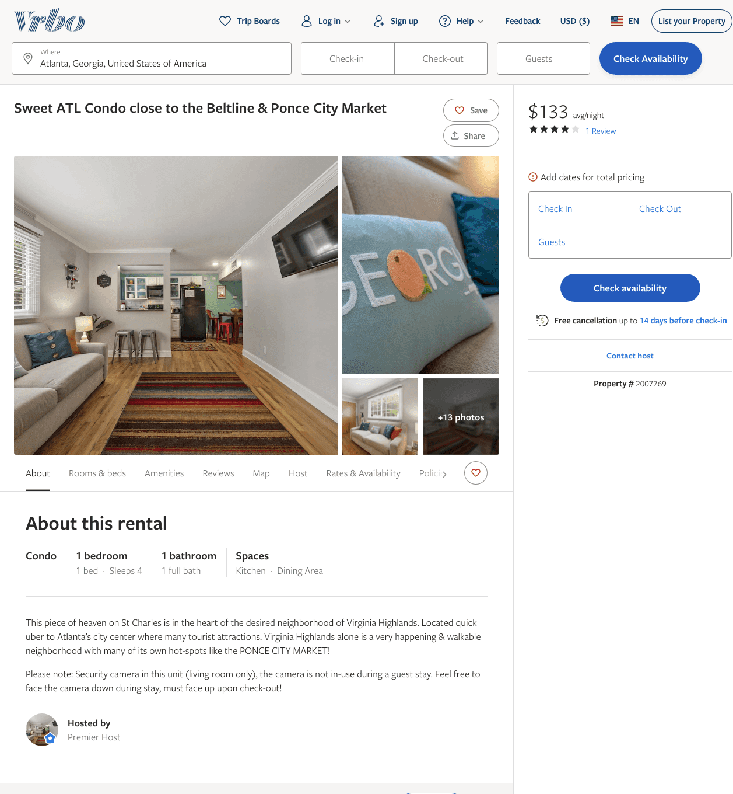
Listing 2007769
1
4
$133 - $151
4
2
https://www.vrbo.com/2007769
Aug 2022

Slide 31
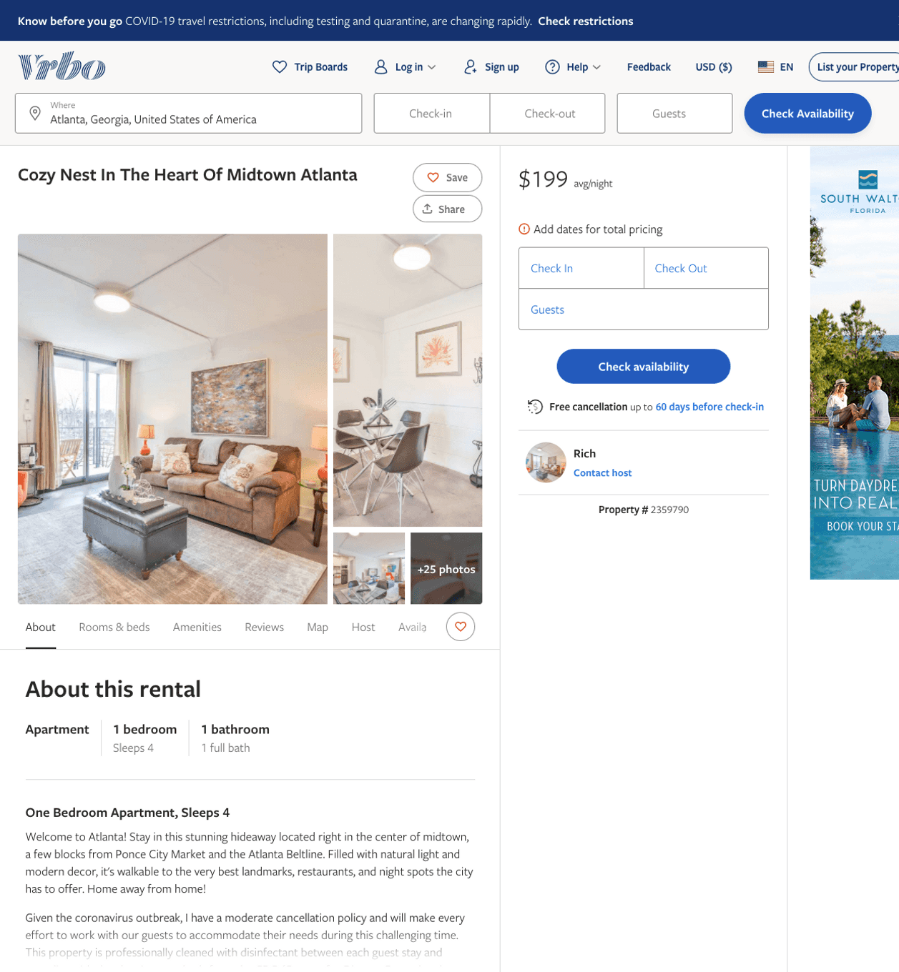
Listing 2359790
1
4
$135 - $213
2
Rich
https://www.vrbo.com/2359790
Aug 2022

Slide 32
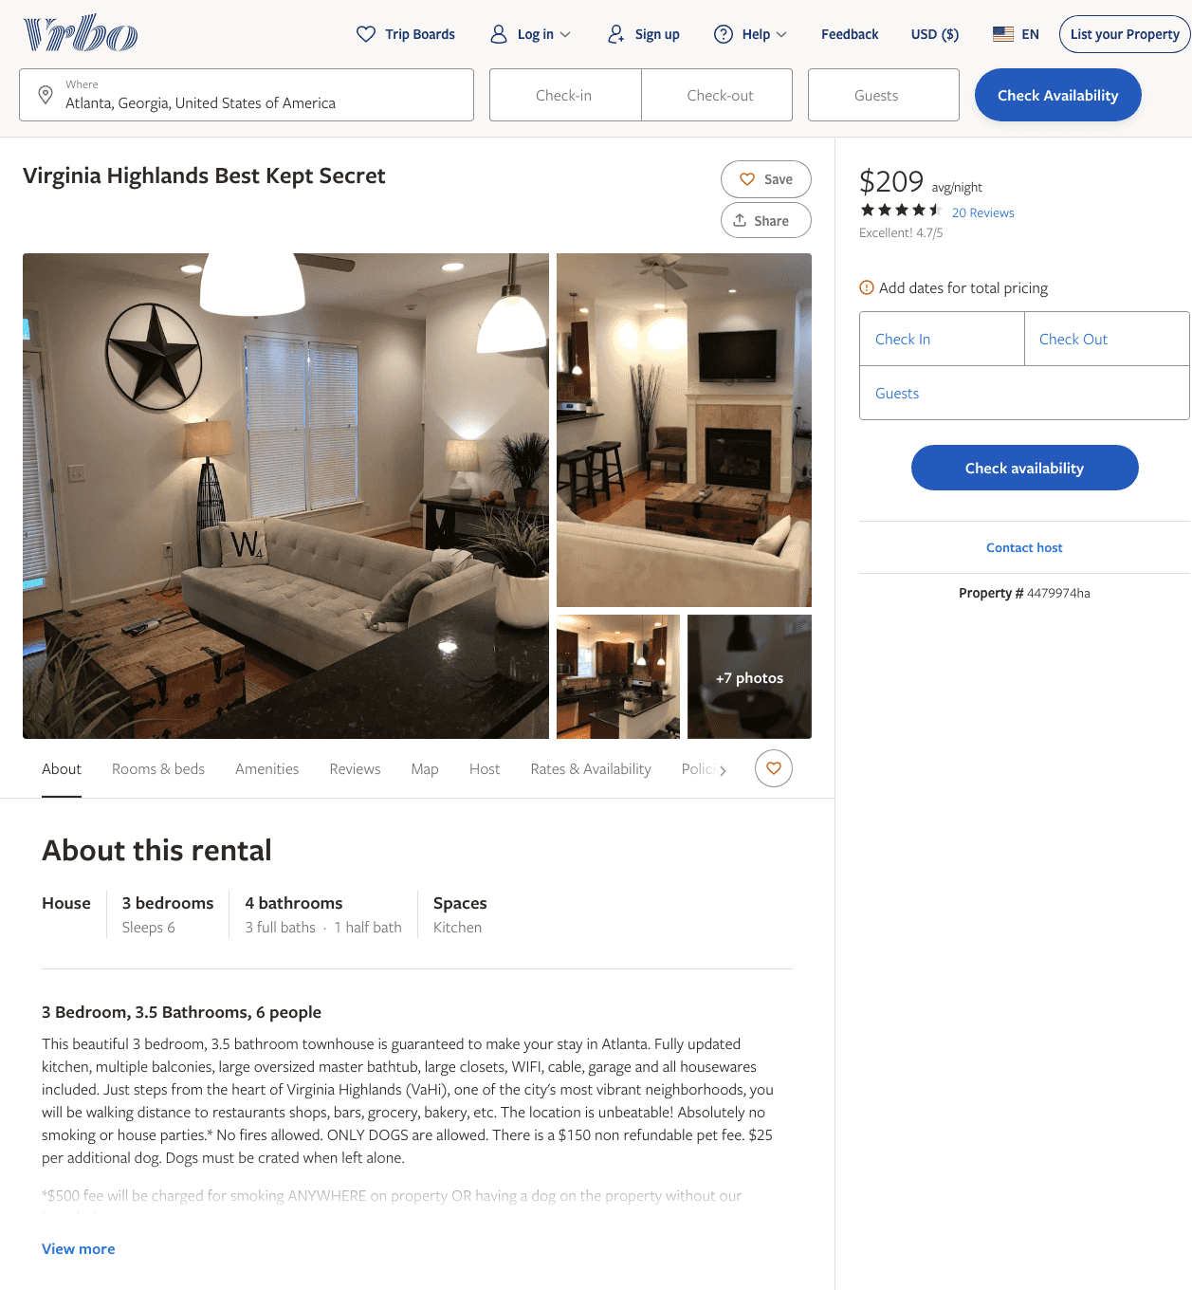
Listing 4479974
3
6
$209 - $226
4.6666665
2
Elizabeth Fletcher
https://www.vrbo.com/4479974ha
Aug 2022

Slide 33
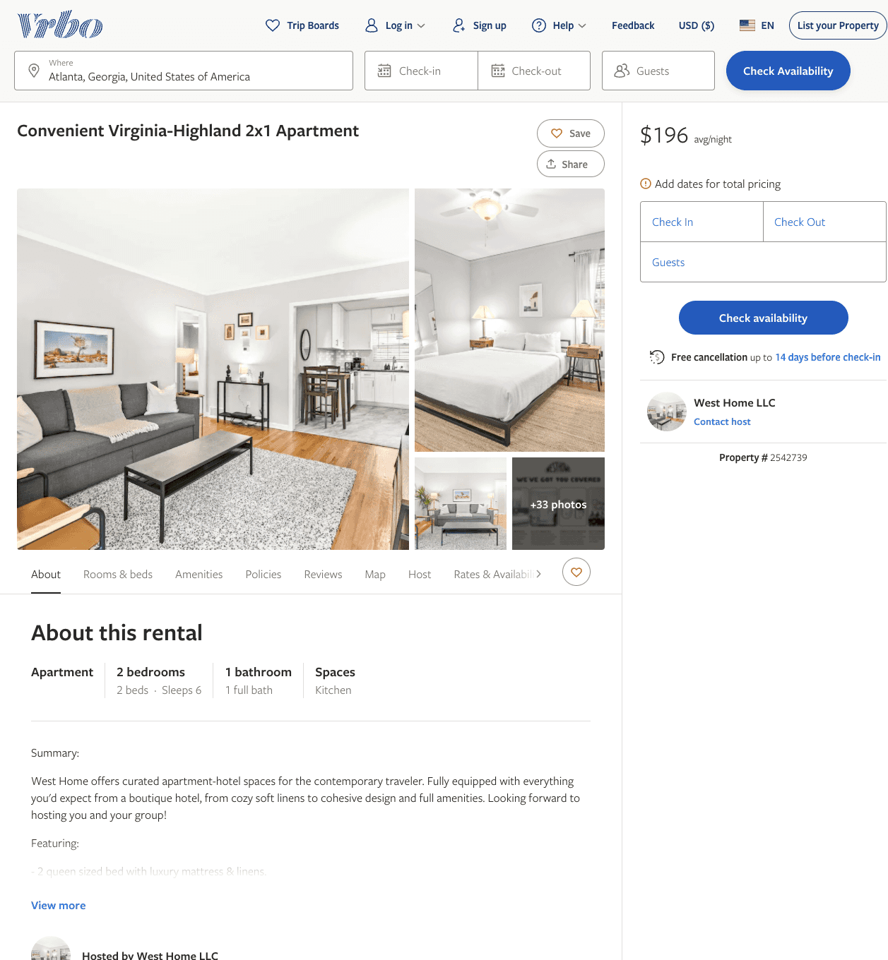
Listing 2542739
2
6
$168 - $220
5
1
West Home LLC
https://www.vrbo.com/2542739
Aug 2022

Slide 34
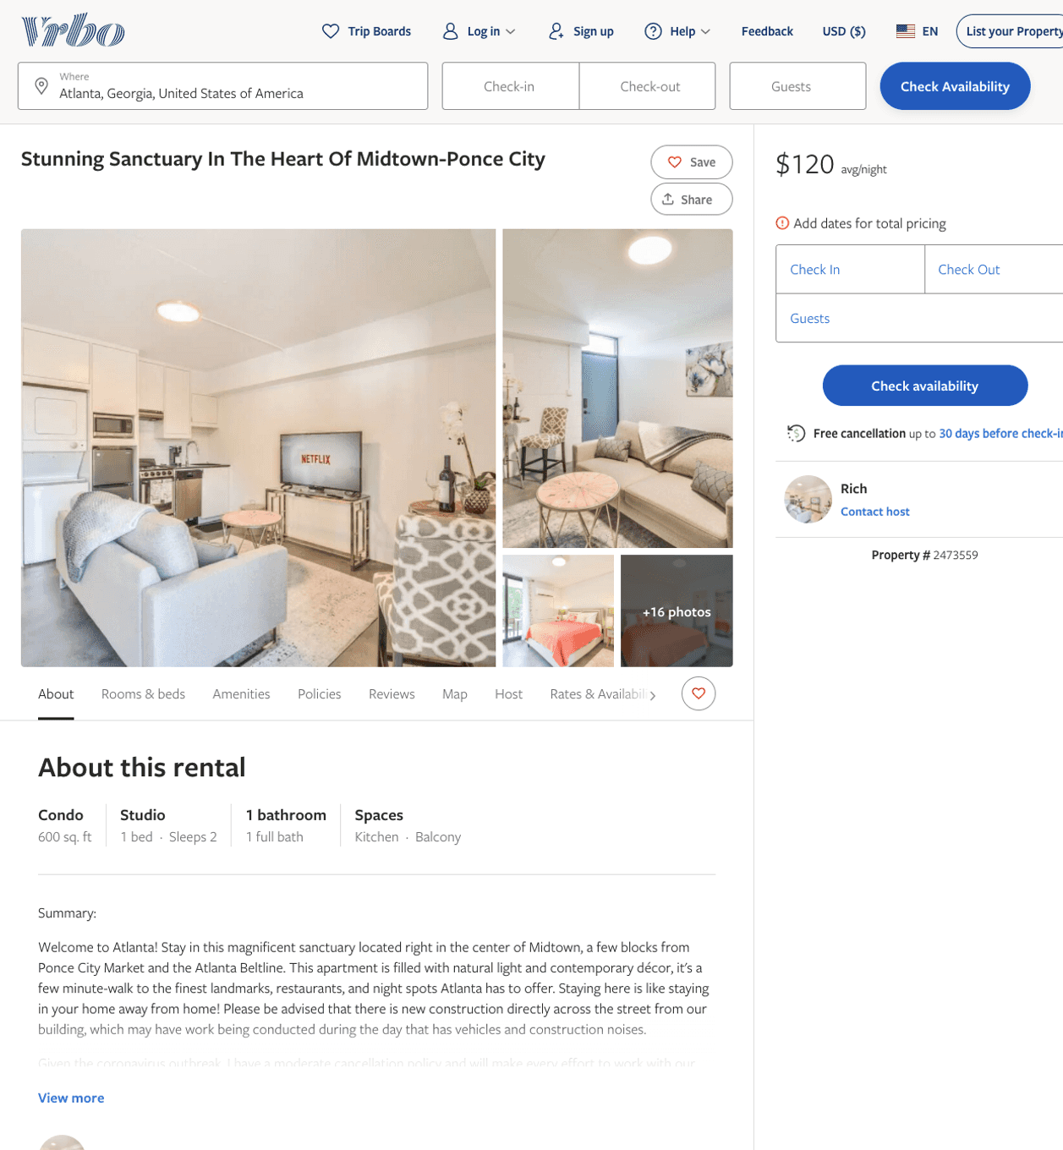
Listing 2473559
0
2
$118 - $96
2
Rich
https://www.vrbo.com/2473559
Aug 2022

Slide 35
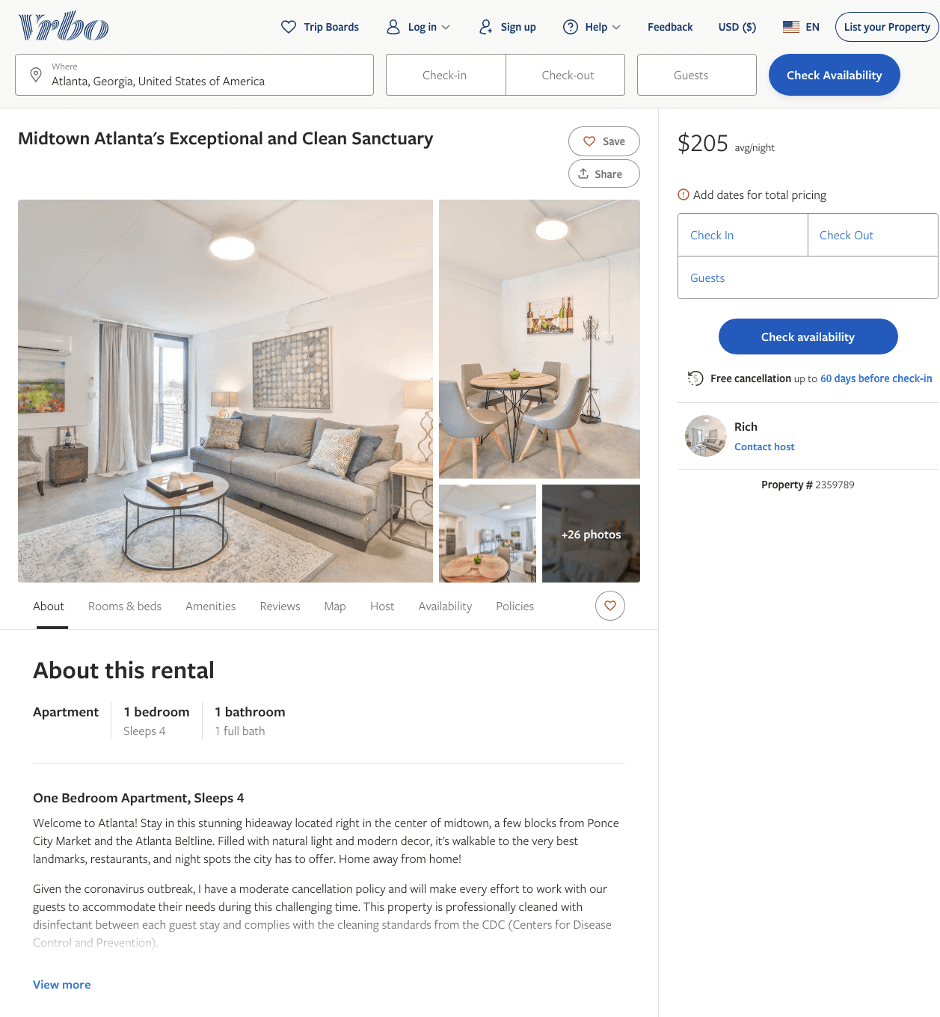
Listing 2359789
1
4
$170 - $214
2
Rich
https://www.vrbo.com/2359789
Aug 2022

Slide 36
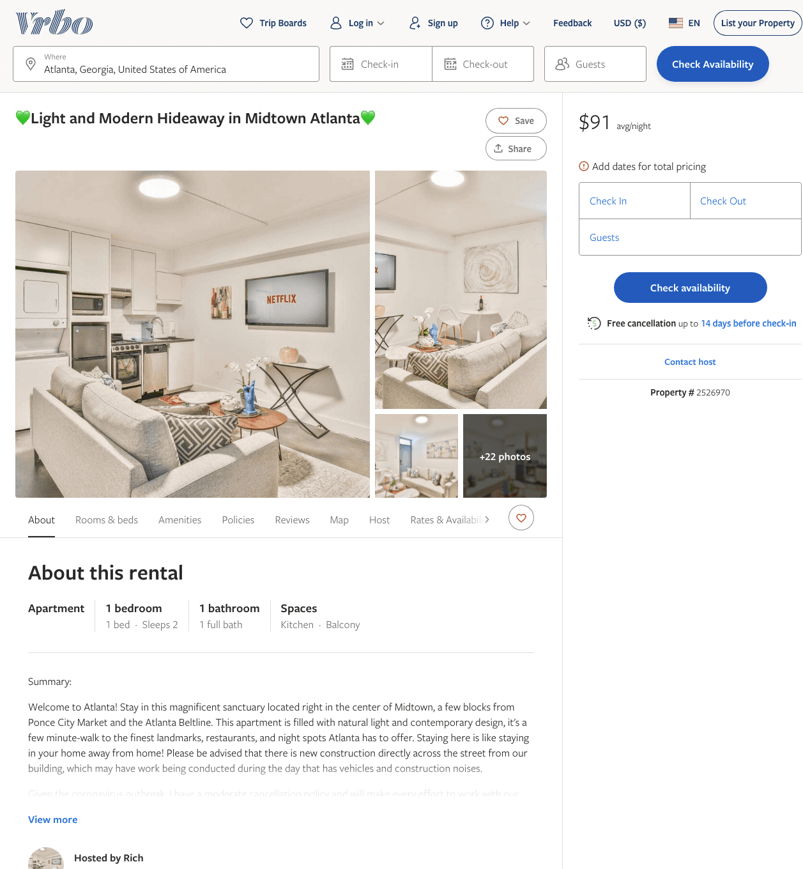
Listing 2526970
1
2
$102 - $94
2
Rich
https://www.vrbo.com/2526970
Aug 2022

Slide 37
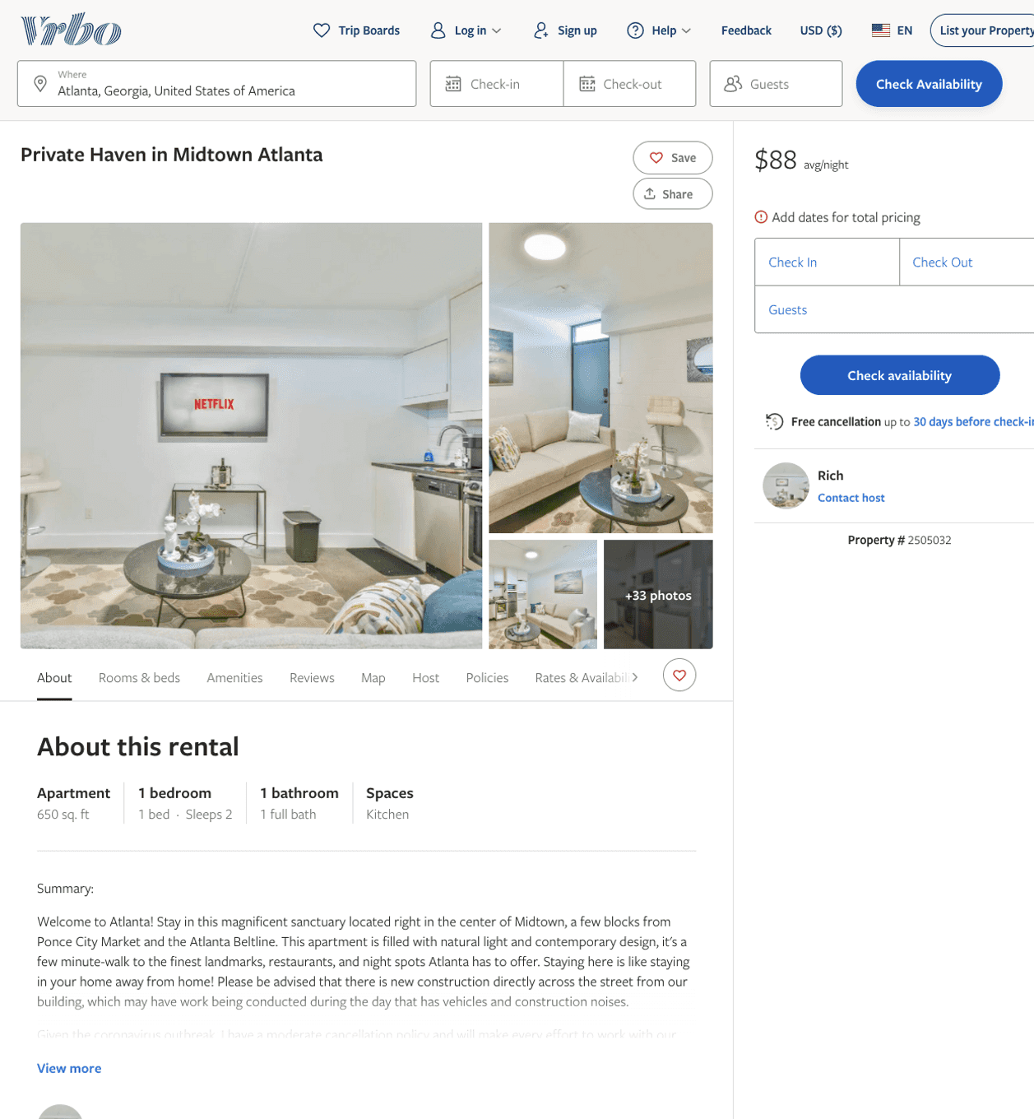
Listing 2505032
1
2
$137 - $90
2
Rich
https://www.vrbo.com/2505032
Aug 2022

Slide 38
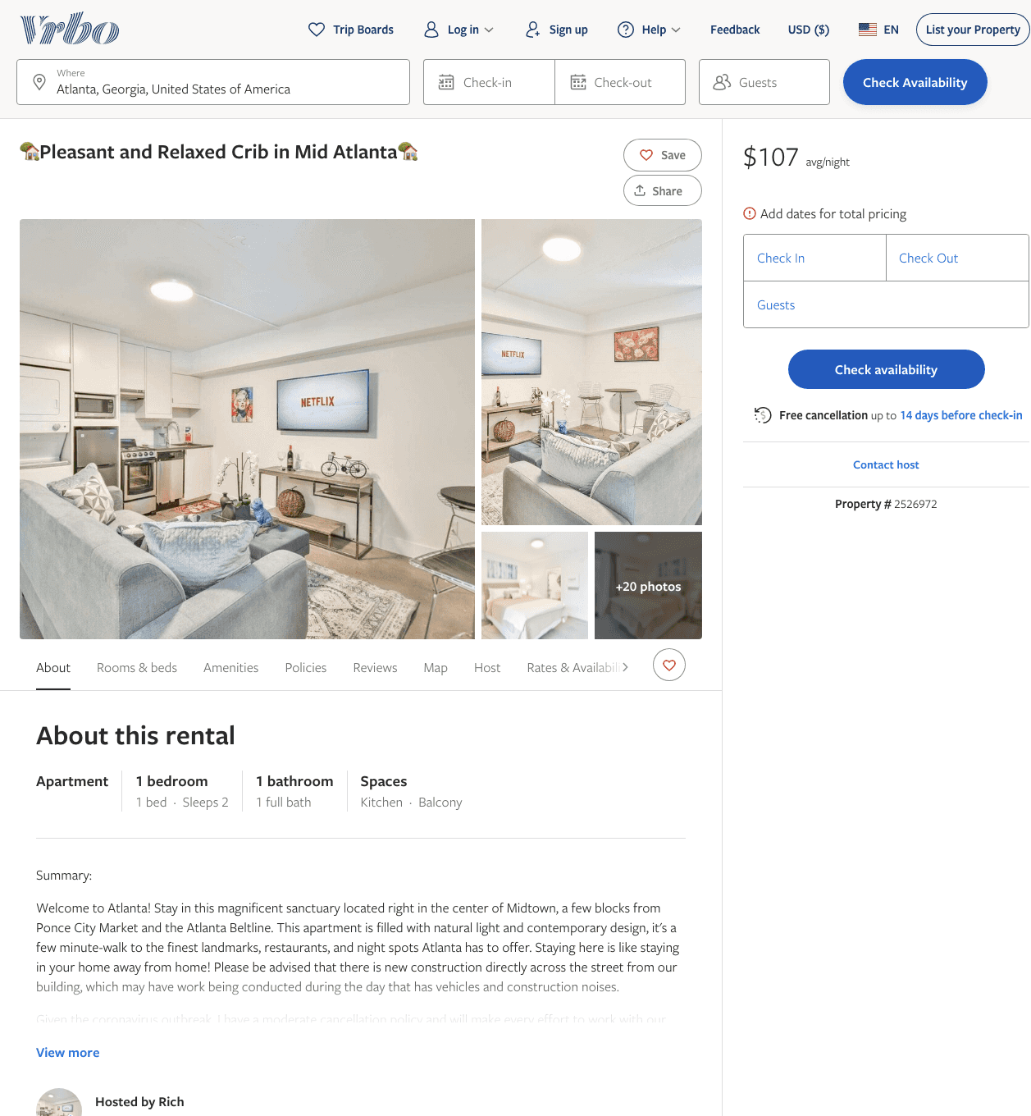
Listing 2526972
1
2
$100 - $99
2
Rich
https://www.vrbo.com/2526972
Aug 2022

Slide 39
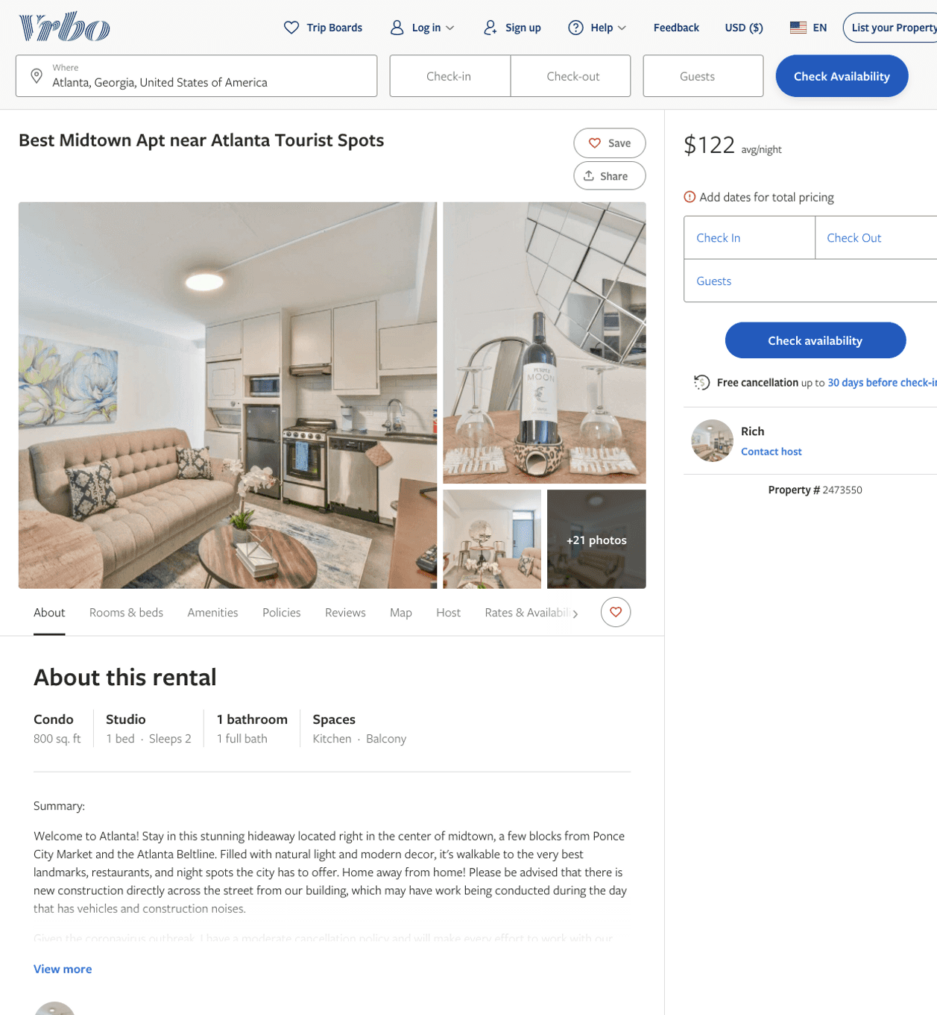
Listing 2473550
0
2
$111 - $159
2
Rich
https://www.vrbo.com/2473550
Aug 2022

Slide 40
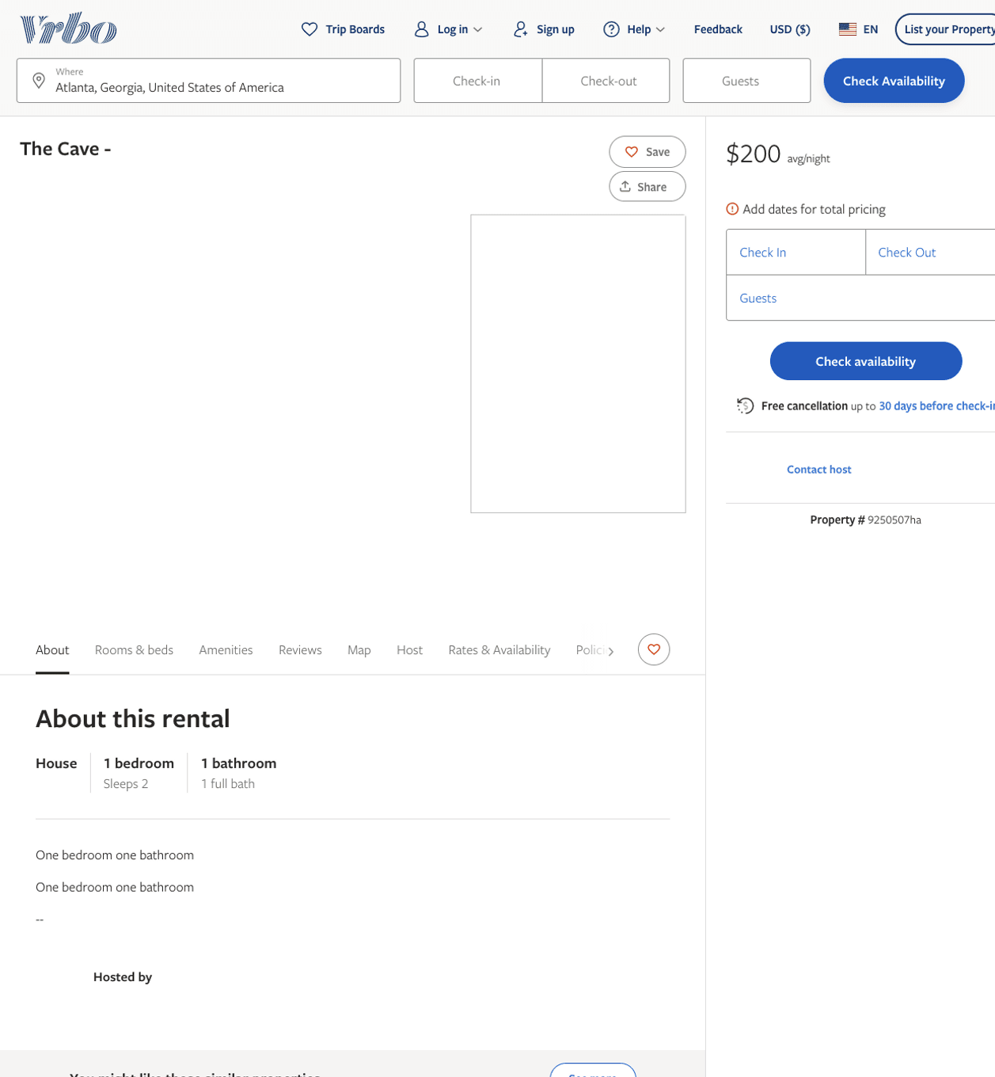
Listing 9250507
1
2
$200
1
https://www.vrbo.com/9250507ha
Aug 2022

Slide 41
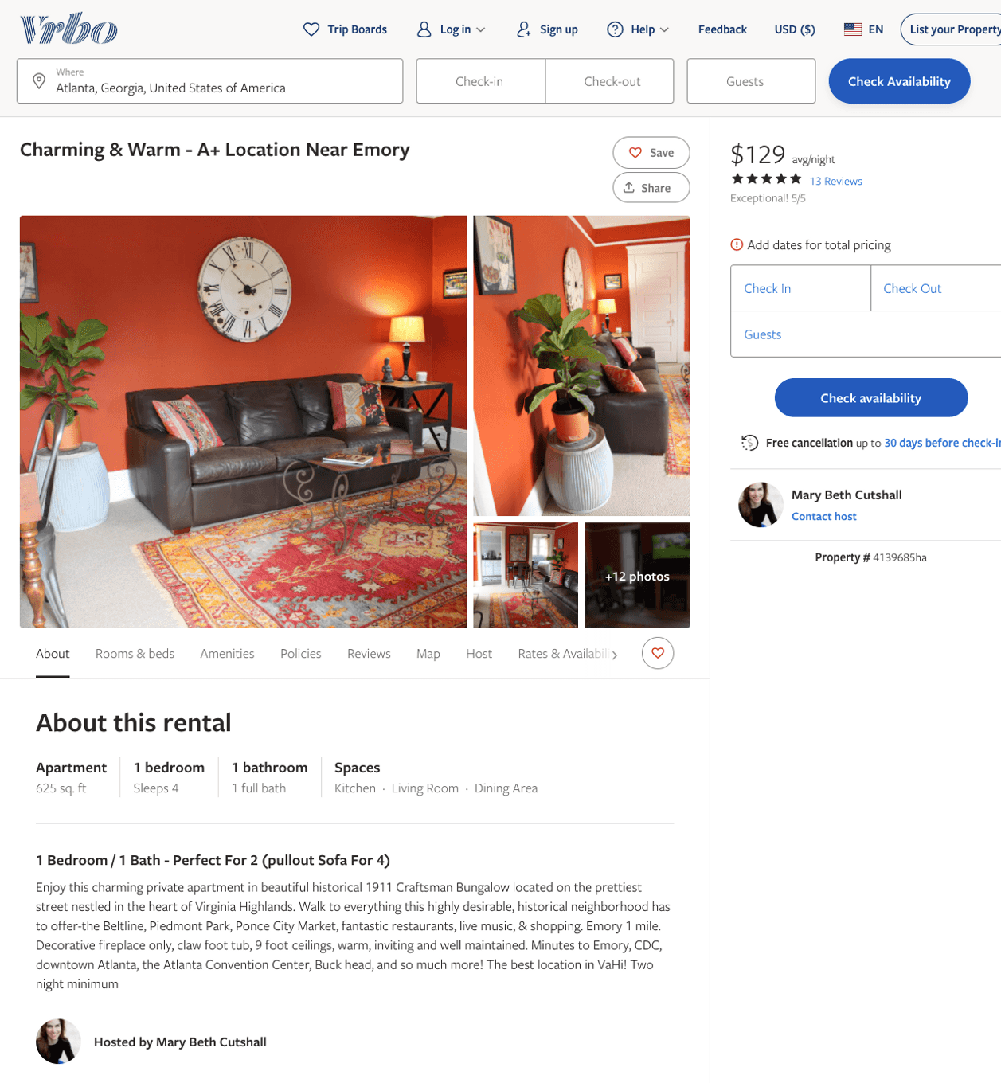
Listing 4139685
1
4
$129
5
1
Mary Beth Cutshall
https://www.vrbo.com/4139685ha
Aug 2022

Slide 42
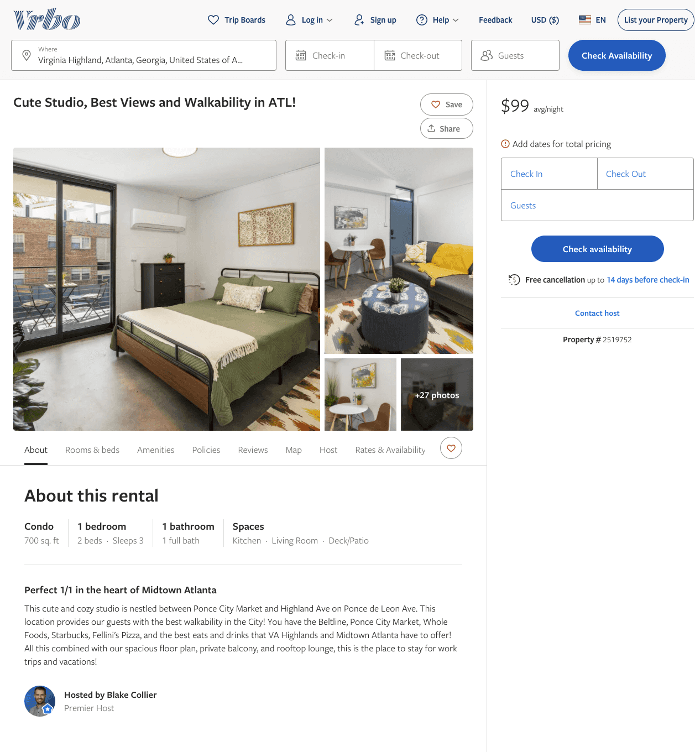
Listing 2519752
1
3
$101 - $99
2
Blake Collier
https://www.vrbo.com/2519752
Aug 2022

Slide 43
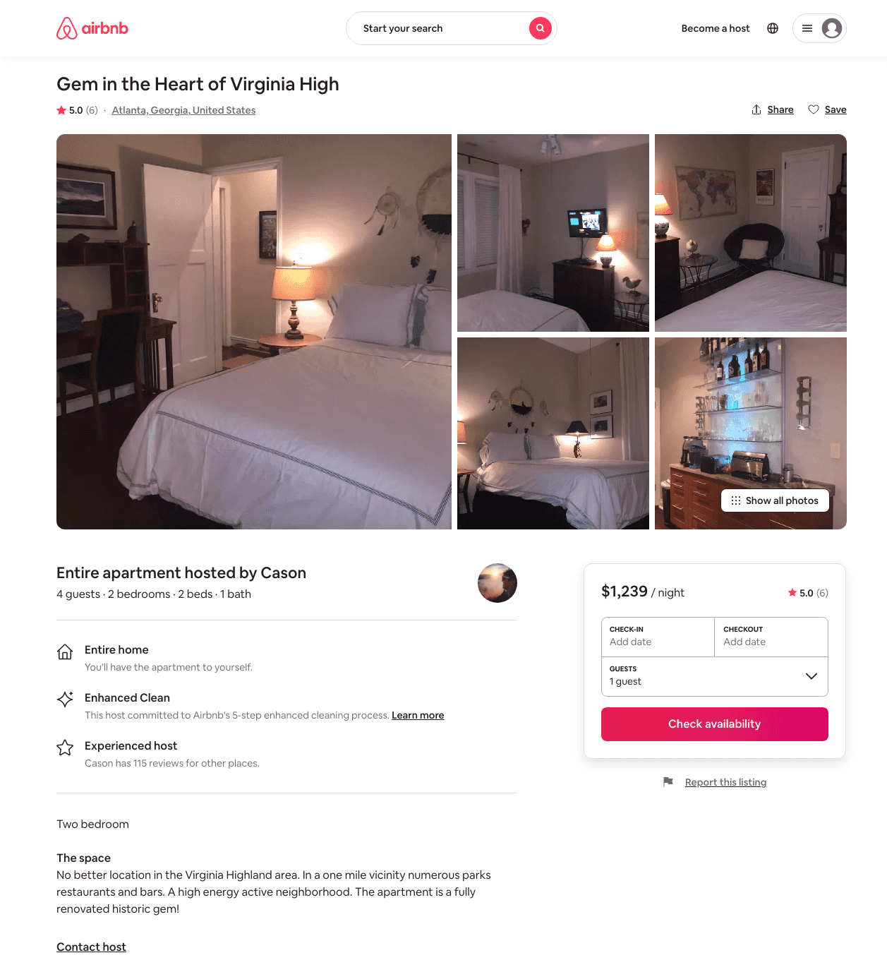
Listing 5860234
2
4
$1239
5.0
3
Cason
30383210
1
https://www.airbnb.com/rooms/5860234
Aug 2022

Slide 44
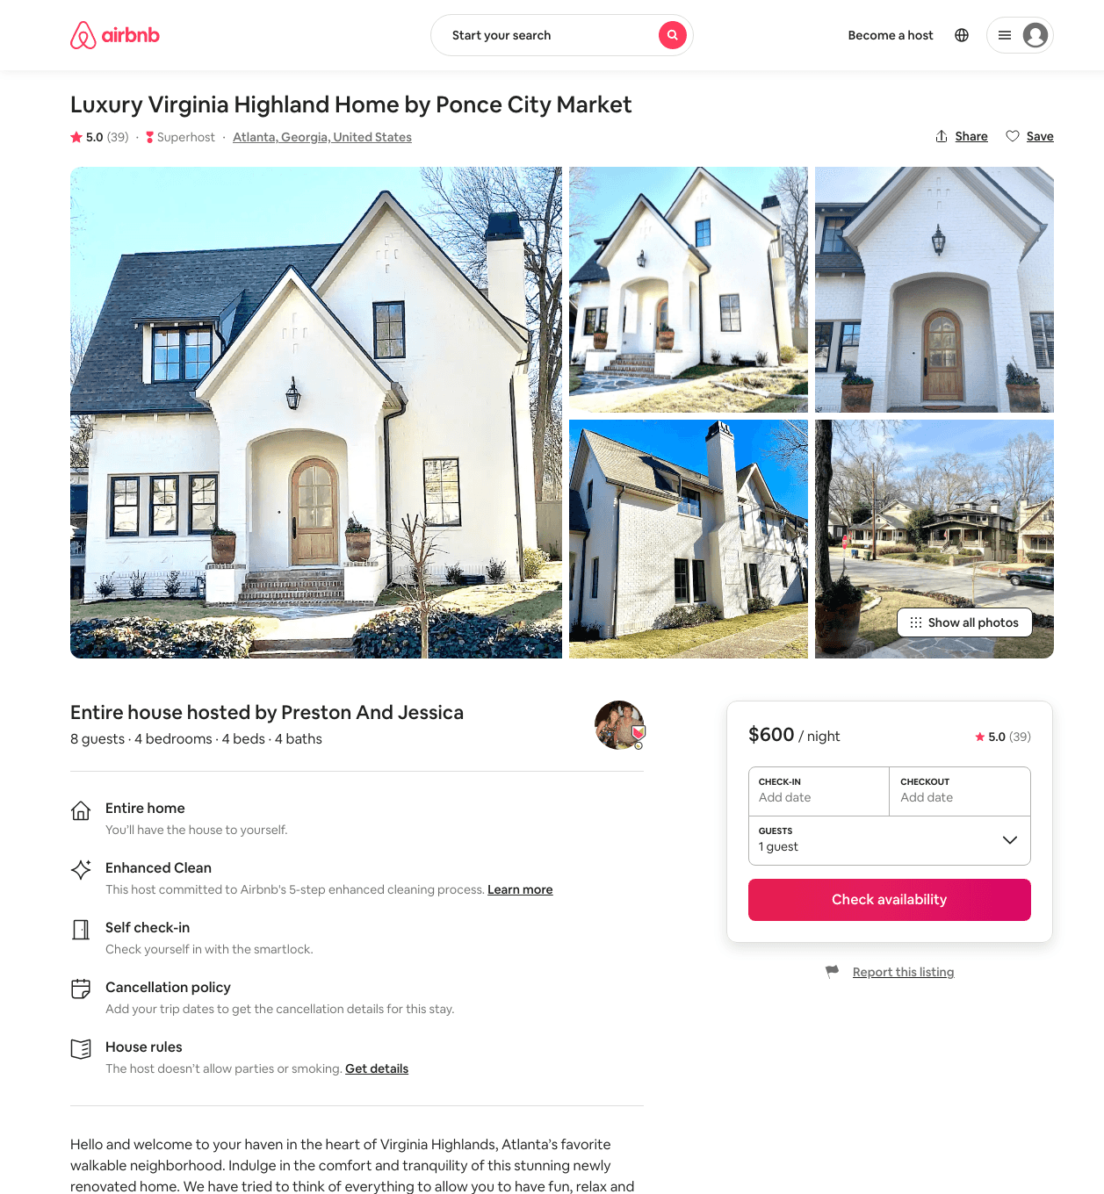
Listing 25292475
4
8
$547 - $700
4.99
2
Preston And Jessica
50890697
1
https://www.airbnb.com/rooms/25292475
Aug 2022

Slide 45
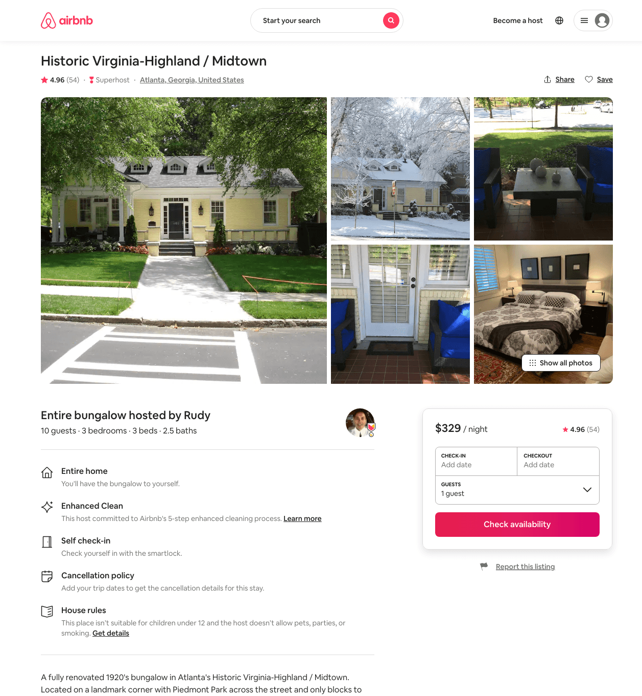
Listing 10834987
3
6
$329 - $856
4.94
3
Rudy
42162896
1
https://www.airbnb.com/rooms/10834987
Jul 2022

Slide 46
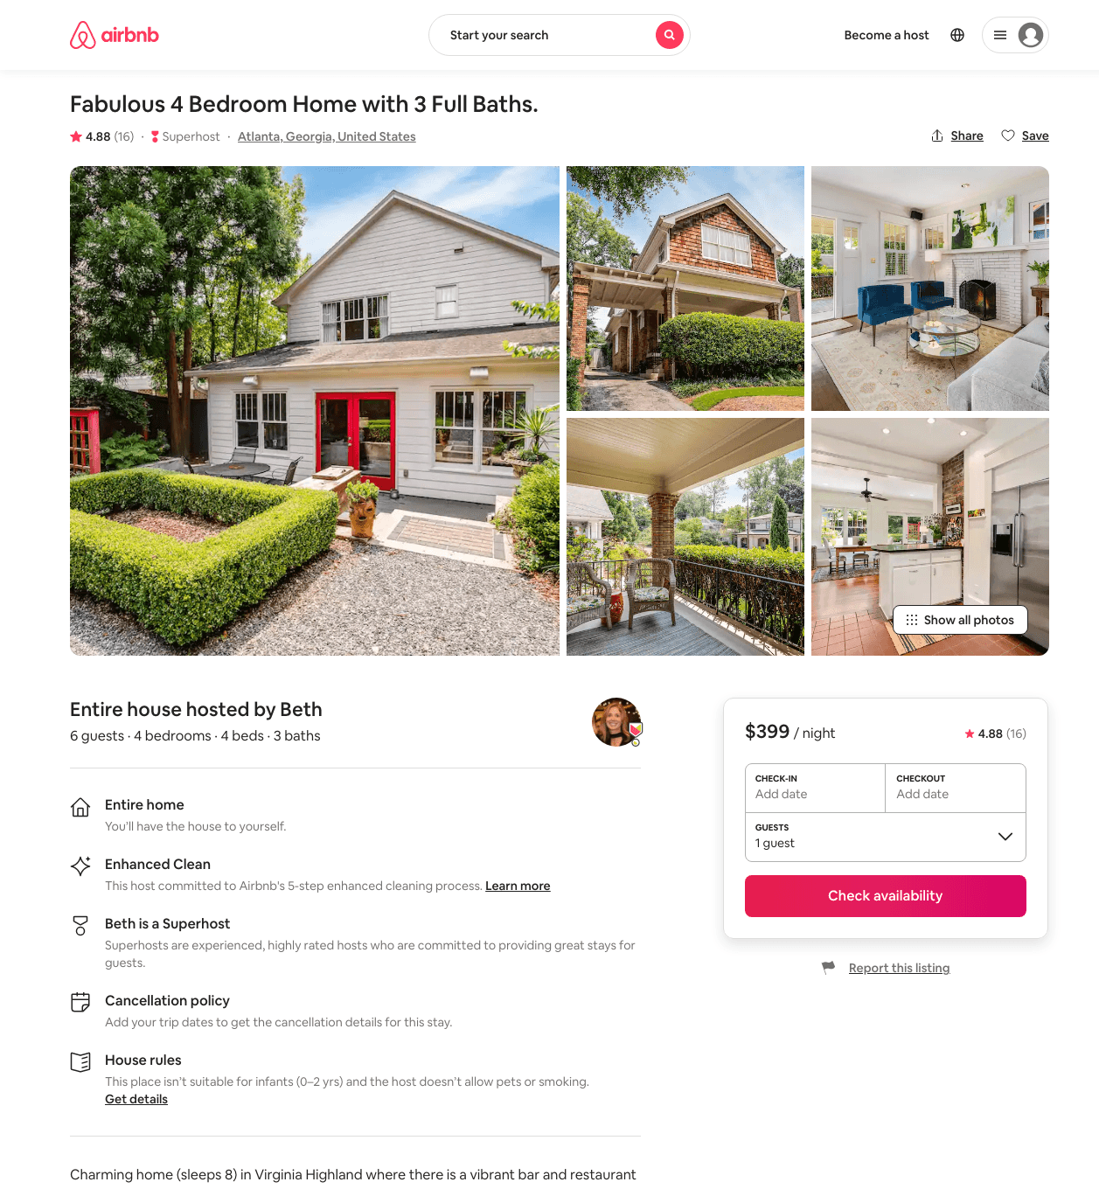
Listing 27750650
4
6
$399 - $472
4.90
2
Beth
209514675
1
https://www.airbnb.com/rooms/27750650
Aug 2022

Slide 47
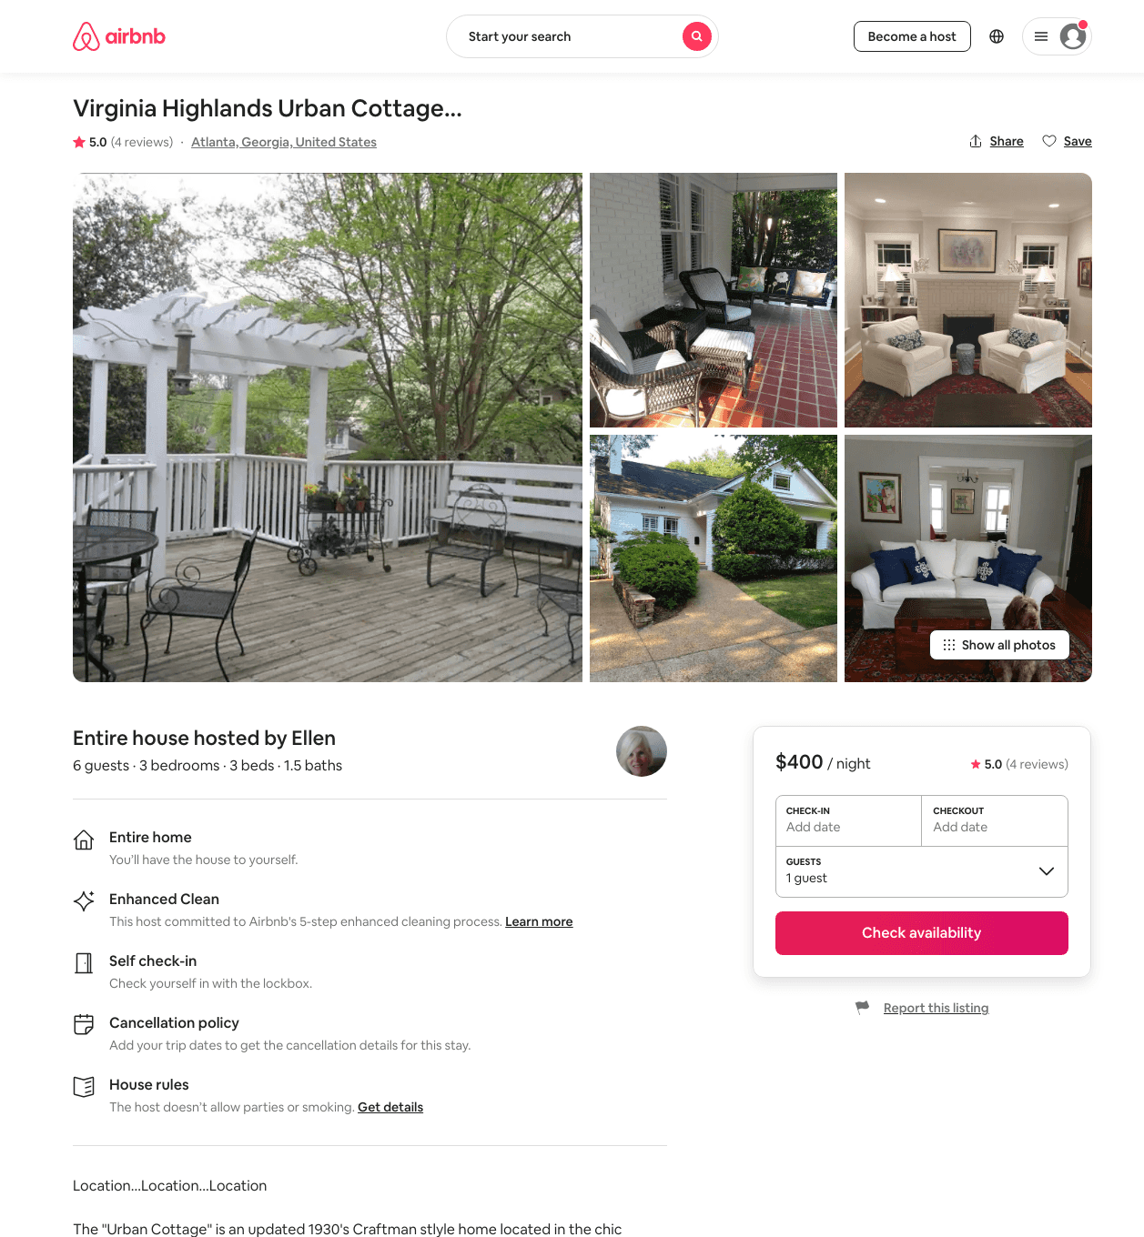
Listing 20686711
3
6
$400
4.89
2
Ellen
15190828
1
https://www.airbnb.com/rooms/20686711
Aug 2022

Slide 48
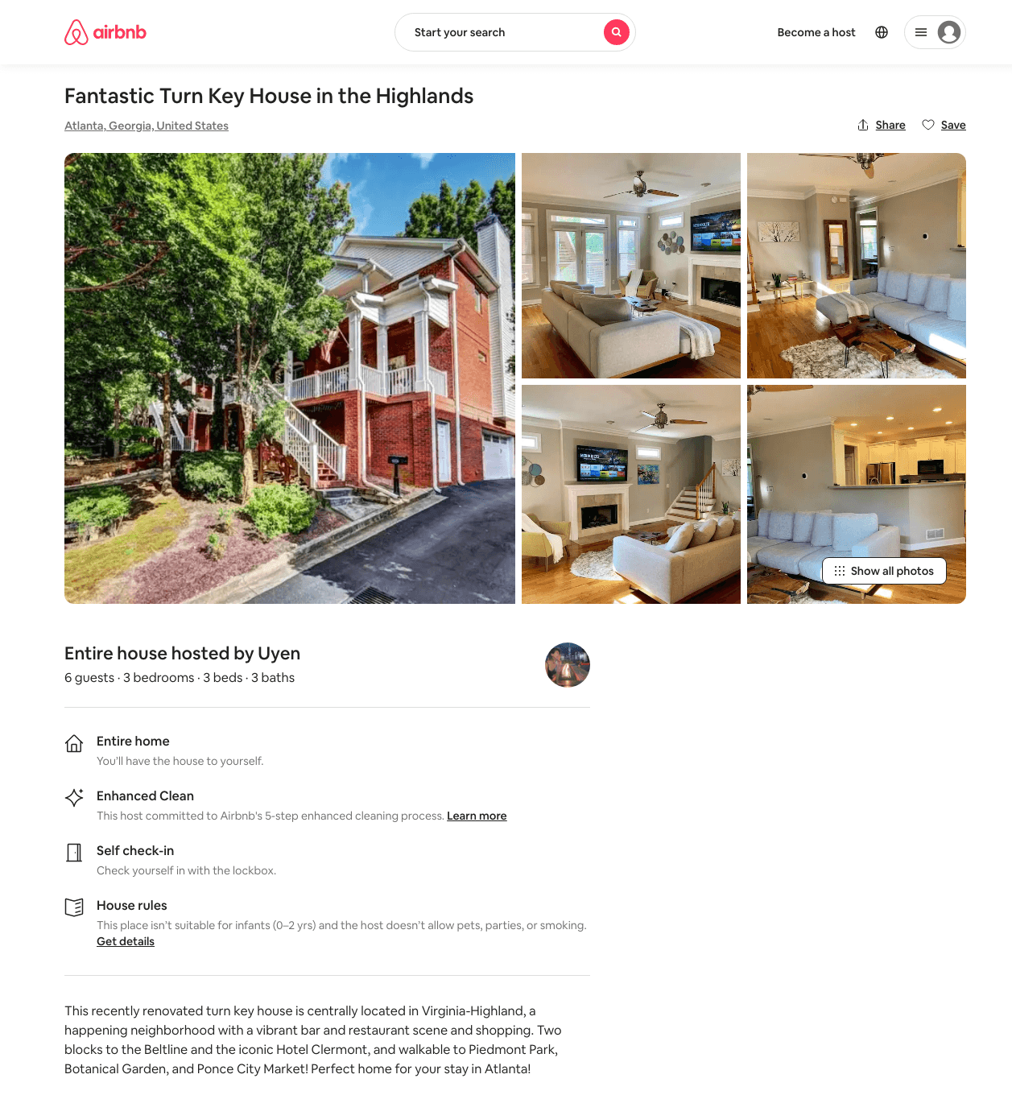
Listing 49042373
3
6
$228 - $293
4.89
3
Uyen
15607706
1
https://www.airbnb.com/rooms/49042373
Aug 2022

Slide 49
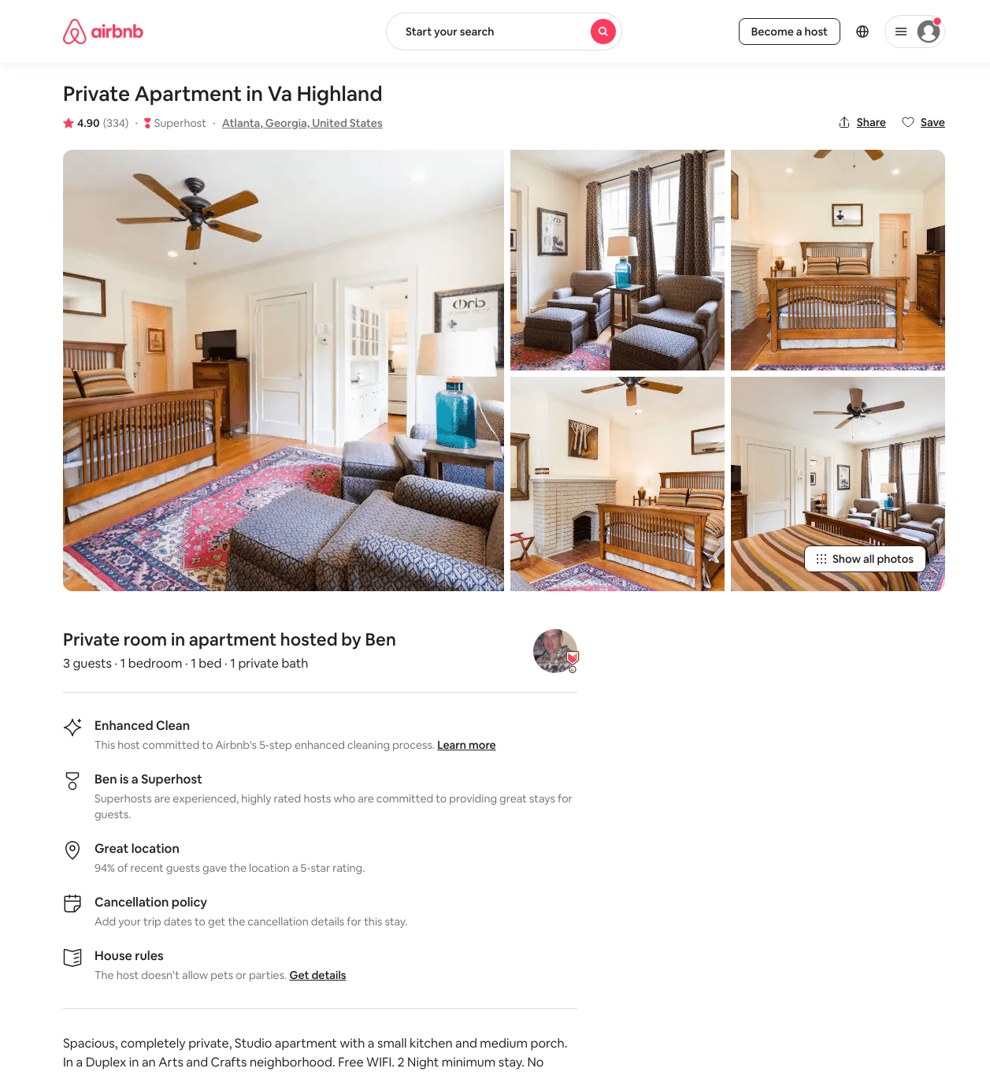
Listing 1178091
1
3
$89 - $99
4.91
2
Ben
5364527
2
https://www.airbnb.com/rooms/1178091
Aug 2022

Slide 50
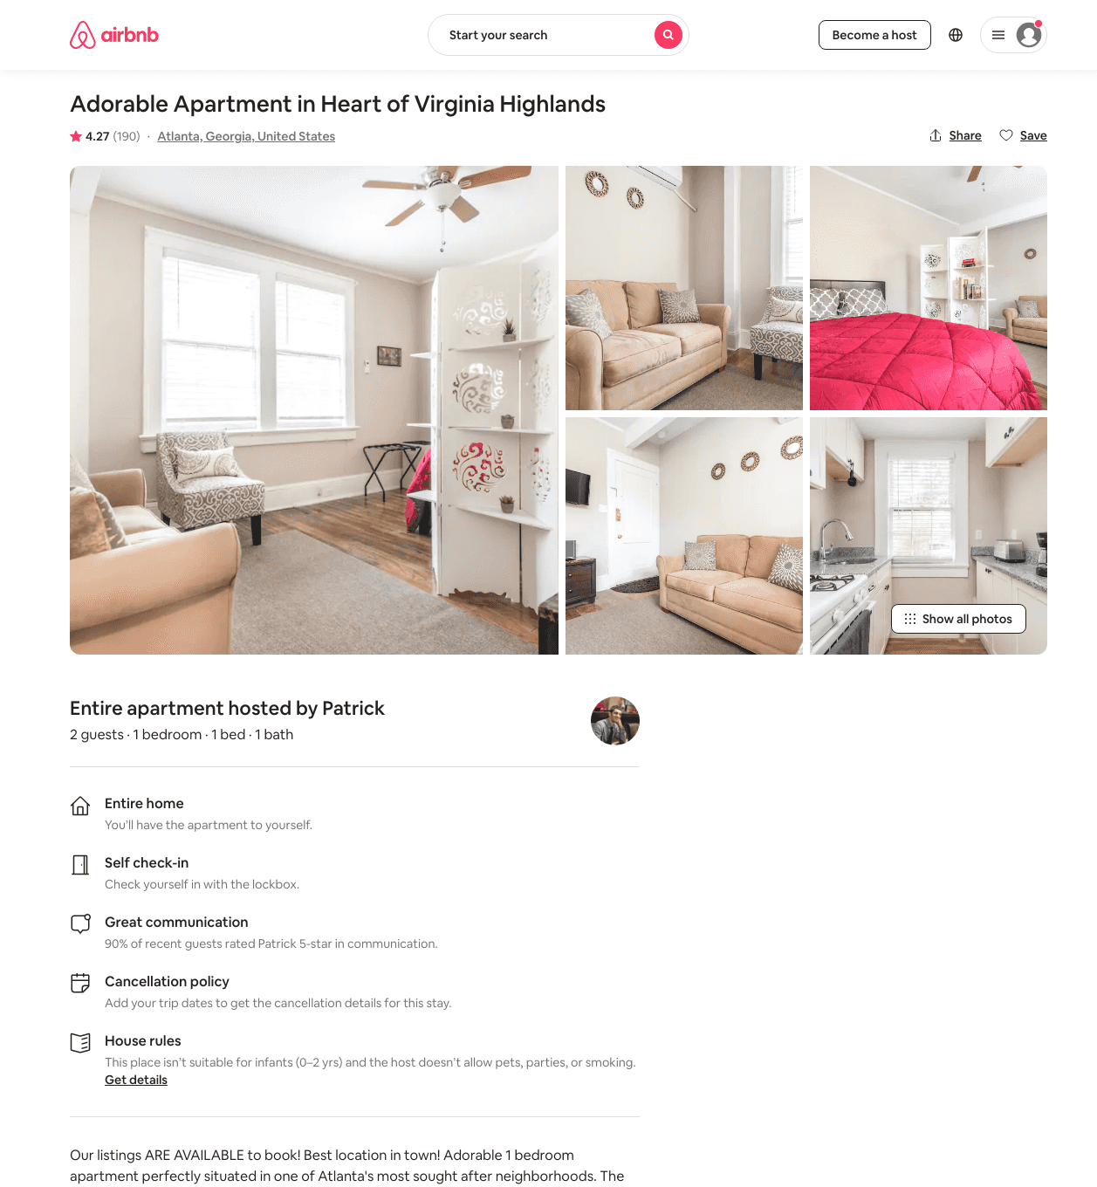
Listing 29570335
1
2
$52 - $82
4.31
1
Patrick
53850261
20
https://www.airbnb.com/rooms/29570335
Aug 2022

Slide 51
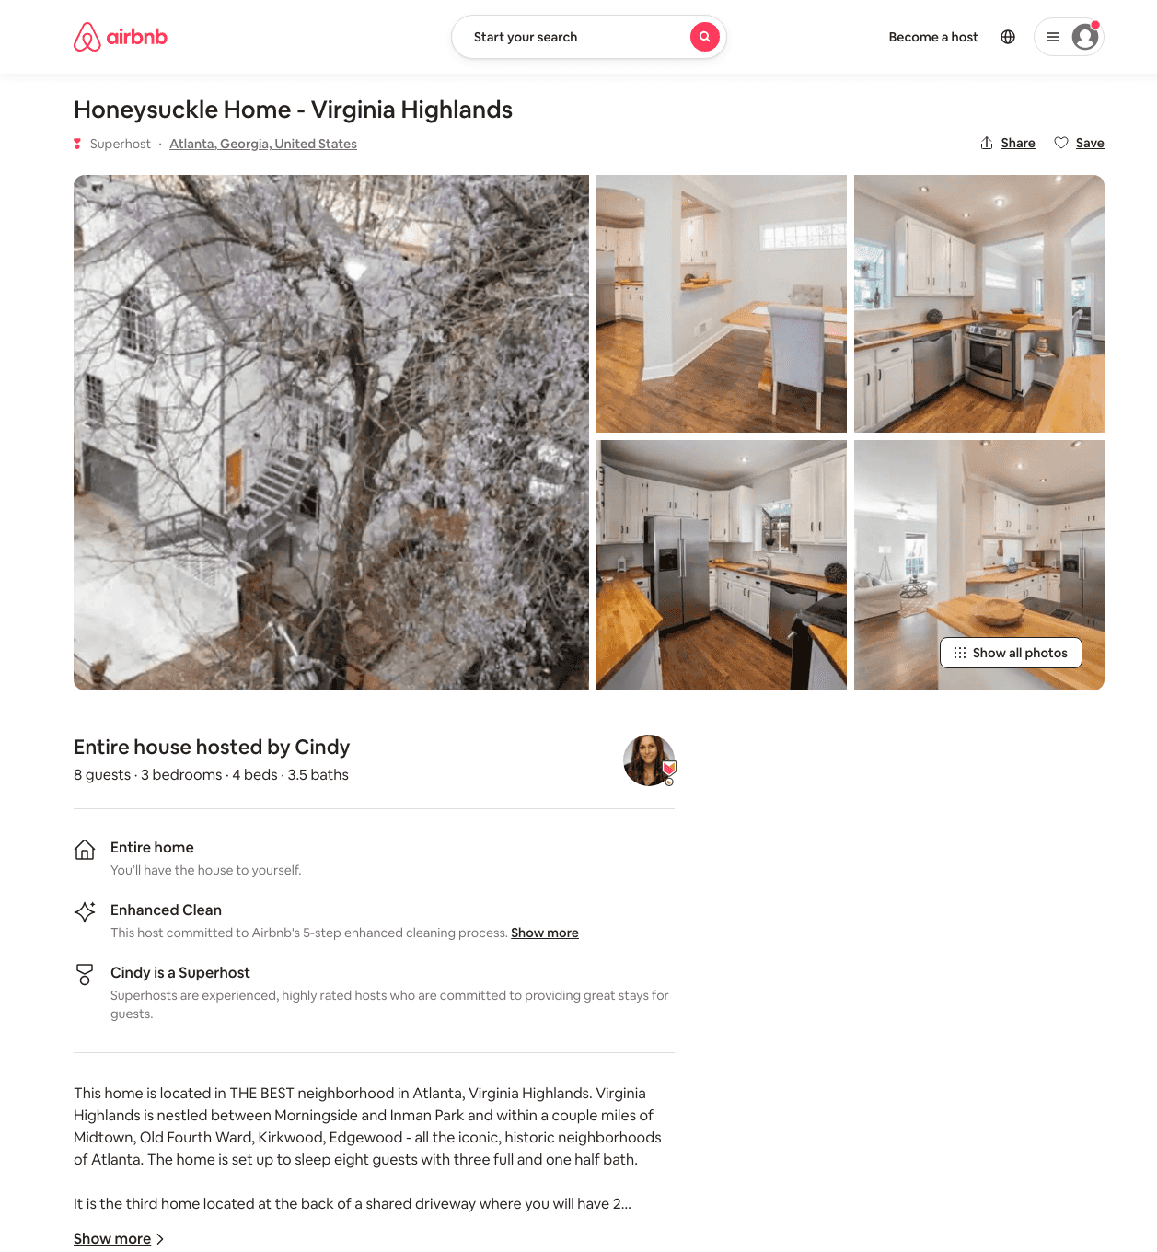
Listing 50115519
3
8
$191 - $300
4.87
2
Cindy
65974419
3
https://www.airbnb.com/rooms/50115519
Aug 2022

Slide 52
Listing 31803195
2
4
$200 - $226
5.0
2
Meghan
47918437
2
https://www.airbnb.com/rooms/31803195
Aug 2022

Slide 53
Listing 27575491
Studio
2
$52 - $84
4.39
1
Patrick
53850261
20
https://www.airbnb.com/rooms/27575491
Jul 2022

Slide 54
Listing 23861237
1
2
$85 - $117
4.99
2
Dale
179262747
1
https://www.airbnb.com/rooms/23861237
Aug 2022

Slide 55
Listing 46690327
1
2
$52 - $79
4.07
1
Patrick
53850261
20
https://www.airbnb.com/rooms/46690327
Aug 2022

Slide 56
Listing 45844840
1
4
$81 - $96
4.74
1
Danielle
16298672
1
https://www.airbnb.com/rooms/45844840
Aug 2022

Slide 57
Listing 980072
1
2
$79 - $84
4.91
2
Ben
5364527
2
https://www.airbnb.com/rooms/980072
Aug 2022

Slide 58
Listing 28690172
2
4
$68 - $104
4.40
1
Patrick
53850261
20
https://www.airbnb.com/rooms/28690172
Jun 2022

Slide 59
Listing 50343781
1
2
$81 - $105
5.0
1
Cary & Tina
19808428
3
https://www.airbnb.com/rooms/50343781
Aug 2022

Slide 60
Listing 45597473
1
3
$75 - $102
4.84
2
Blake
81660490
10
https://www.airbnb.com/rooms/45597473
Aug 2022

Slide 61
Listing 44432669
1
2
$78 - $173
4.54
1
Christina
53990514
2
https://www.airbnb.com/rooms/44432669
Jul 2022

Slide 62
Listing 40474297
1
2
$62 - $84
4.93
1
Cary & Tina
19808428
3
https://www.airbnb.com/rooms/40474297
Aug 2022

Slide 63
Listing 45504969
1
3
$72 - $98
4.82
2
Blake
81660490
10
https://www.airbnb.com/rooms/45504969
Aug 2022

Slide 64
Listing 49739008
1
2
$103 - $128
5.0
21
Hayley
249428077
3
https://www.airbnb.com/rooms/49739008
Aug 2022

Slide 65
Listing 31586419
1
2
$98 - $115
4.98
2
Jeff
22233372
1
https://www.airbnb.com/rooms/31586419
Aug 2022

Slide 66
Listing 43956720
2
6
$91 - $175
4.72
1
Tiffany
341757553
1
https://www.airbnb.com/rooms/43956720
Aug 2022

Slide 67
Listing 49636199
1
2
$127 - $218
4.46
2
West Home
228384155
45
https://www.airbnb.com/rooms/49636199
Aug 2022

Slide 68
Listing 2081565
1
2
$120 - $150
4.88
6
Nancy
2773373
9
https://www.airbnb.com/rooms/2081565
Aug 2022

Slide 69
Listing 50540340
1
2
$101 - $140
4.58
3
Evolve
121682456
51
https://www.airbnb.com/rooms/50540340
Aug 2022

Slide 70
Listing 21695064
1
4
$111 - $166
4.53
3
Golden Properties
52677672
1
https://www.airbnb.com/rooms/21695064
Aug 2022

Slide 71
Listing 7205195
1
3
$108 - $154
4.95
2
Mary Beth
19897956
1
https://www.airbnb.com/rooms/7205195
Aug 2022

Slide 72
Listing 23748773
1
3
$90 - $165
4.78
1
Andre
97838655
26
https://www.airbnb.com/rooms/23748773
Aug 2022

Slide 73
Listing 21713398
1
3
$93 - $166
4.92
1
Andre
97838655
26
https://www.airbnb.com/rooms/21713398
Aug 2022

Slide 74
Listing 14403601
2
$86 - $125
4.99
2
Suzanne
31901127
1
https://www.airbnb.com/rooms/14403601
Aug 2022

Slide 75
Listing 23703538
1
3
$93 - $169
4.86
1
Andre
97838655
26
https://www.airbnb.com/rooms/23703538
Aug 2022

Slide 76
Listing 23651043
1
3
$91 - $165
4.84
1
Andre
97838655
26
https://www.airbnb.com/rooms/23651043
Aug 2022

Slide 77
Listing 22176556
1
3
$92 - $166
4.84
1
Andre
97838655
26
https://www.airbnb.com/rooms/22176556
Aug 2022

Slide 78
Listing 23881052
1
3
$92 - $166
4.78
1
Andre
97838655
26
https://www.airbnb.com/rooms/23881052
Aug 2022

Slide 79
Listing 46024226
1
2
$79 - $146
4.69
2
Rich
31356024
22
https://www.airbnb.com/rooms/46024226
Aug 2022

Slide 80
Listing 5652417
1
3
$89 - $102
4.83
1
Natan
22698917
1
https://www.airbnb.com/rooms/5652417
Aug 2022

Slide 81
Listing 50198012
2
4
$71 - $166
4.65
1
Jazalyn & Chanele
196631374
2
https://www.airbnb.com/rooms/50198012
Jun 2022

Slide 82
Listing 9997505
2
4
$182 - $307
4.90
2
Shelly
41197539
1
https://www.airbnb.com/rooms/9997505
Aug 2022

Slide 83
Listing 12598295
1
2
$113 - $160
4.74
6
Nancy
2773373
9
https://www.airbnb.com/rooms/12598295
Aug 2022

Slide 84
Listing 2811122
1
2
$116 - $170
4.85
6
Nancy
2773373
9
https://www.airbnb.com/rooms/2811122
Aug 2022

Slide 85
Listing 48867296
1
2
$102 - $177
4.71
2
Safiya
394172555
1
https://www.airbnb.com/rooms/48867296
Aug 2022

Slide 86
Listing 31648849
Studio
2
$89 - $151
4.98
2
Elika
19805046
1
https://www.airbnb.com/rooms/31648849
Aug 2022

Slide 87
Listing 13466635
Studio
3
$45 - $47
4.55
60
WE ARE Ron & Annemarie
76829527
1
https://www.airbnb.com/rooms/13466635
Jul 2022

Slide 88
Listing 2722730
3
6
$525 - $645
4.64
2
Andrew
9894175
2
https://www.airbnb.com/rooms/2722730
Aug 2022

Slide 89
Listing 46046442
3
4
$220 - $250
4.98
2
Beth
49733941
1
https://www.airbnb.com/rooms/46046442
Aug 2022

Slide 90
Listing 33151934
3
5
$171 - $202
4.99
4
Hayley
249428077
3
https://www.airbnb.com/rooms/33151934
Aug 2022

Slide 91
Listing 22492666
1
2
$139 - $149
5.0
2
Greg And Tina
138547577
1
https://www.airbnb.com/rooms/22492666
Aug 2022

Slide 92
Listing 47534127
1
4
$93 - $166
4.79
2
Rich
31356024
22
https://www.airbnb.com/rooms/47534127
Aug 2022

Slide 93
Listing 46430182
1
2
$105 - $180
4.56
2
West Home
228384155
45
https://www.airbnb.com/rooms/46430182
Aug 2022

Slide 94
Listing 23197160
1
3
$92 - $163
4.87
1
Andre
97838655
26
https://www.airbnb.com/rooms/23197160
Aug 2022

Slide 95
Listing 49396274
1
2
$110 - $121
4.96
2
Jenny
14924373
1
https://www.airbnb.com/rooms/49396274
Aug 2022

Slide 96
Listing 22187042
1
3
$92 - $158
4.82
1
Andre
97838655
26
https://www.airbnb.com/rooms/22187042
Aug 2022

Slide 97
Listing 29364869
1
2
$43 - $84
4.40
1
Patrick
53850261
20
https://www.airbnb.com/rooms/29364869
Aug 2022

Slide 98
Listing 33706129
1
2
$49 - $74
4.22
1
Patrick
53850261
20
https://www.airbnb.com/rooms/33706129
Aug 2022

Slide 99
Listing 45954647
1
3
$75 - $102
4.79
2
Blake
81660490
10
https://www.airbnb.com/rooms/45954647
Aug 2022

Slide 100
Listing 38024721
1
2
$93 - $99
4.89
7
Linda
288505497
1
https://www.airbnb.com/rooms/38024721
Aug 2022

Slide 101
Listing 10334681
1
2
$90 - $134
4.96
2
Andrew & Laura
53183604
1
https://www.airbnb.com/rooms/10334681
Aug 2022

Slide 102
Listing 42475146
1
2
$59 - $94
4.99
1
K D
89397933
1
https://www.airbnb.com/rooms/42475146
Aug 2022

Slide 103
Listing 2037684
4
10
$421 - $807
4.93
3
Nancy
2773373
9
https://www.airbnb.com/rooms/2037684
Aug 2022

Slide 104
Listing 22208124
3
6
$493 - $850
5.0
2
Carmen
37551782
1
https://www.airbnb.com/rooms/22208124
Aug 2022

Slide 105
Listing 31959606
1
2
$48 - $77
4.35
1
Patrick
53850261
20
https://www.airbnb.com/rooms/31959606
Aug 2022

Slide 106
Listing 45956940
1
3
$75 - $99
4.86
2
Blake
81660490
10
https://www.airbnb.com/rooms/45956940
Aug 2022

Slide 107
Listing 22937062
1
3
$92 - $165
4.86
1
Andre
97838655
26
https://www.airbnb.com/rooms/22937062
Aug 2022

Slide 108
Listing 31837981
1
2
$90 - $97
4.92
3
Pete
44970848
1
https://www.airbnb.com/rooms/31837981
Aug 2022

Slide 109
Listing 17479691
3
6
$209 - $229
4.65
2
Elizabeth
36163257
4
https://www.airbnb.com/rooms/17479691
Aug 2022

Slide 110
Listing 49896201
2
6
$178 - $248
5.0
2
Minty
3976298
79
https://www.airbnb.com/rooms/49896201
Aug 2022

Slide 111
Listing 24633040
1
2
$30 - $75
4.89
14
Al
69553712
2
https://www.airbnb.com/rooms/24633040
Jul 2022

Slide 112
Listing 37533515
1
2
$156 - $289
4.92
1
Atlanta Luxury Rentals
115328988
54
https://www.airbnb.com/rooms/37533515
Aug 2022

Slide 113
Listing 9211042
1
2
$145
4.99
5
Concelia
47904213
1
https://www.airbnb.com/rooms/9211042
Jun 2022

Slide 114
Listing 48609939
1
3
$113 - $164
4.33
2
Minty
3976298
79
https://www.airbnb.com/rooms/48609939
Jul 2022

Slide 115
Listing 22018923
1
3
$92 - $166
4.86
1
Andre
97838655
26
https://www.airbnb.com/rooms/22018923
Aug 2022

Slide 116
Listing 35906011
1
2
$104 - $110
5.0
3
Steve
229436571
1
https://www.airbnb.com/rooms/35906011
Aug 2022

Slide 117
Listing 31010470
2
4
$330
5.0
3
James
15864363
1
https://www.airbnb.com/rooms/31010470
Aug 2022

Slide 118
Listing 17479756
3
6
$289 - $319
4.81
2
Elizabeth
36163257
4
https://www.airbnb.com/rooms/17479756
Jun 2022

Slide 119
Listing 50671516
896 ST CHARLES AVE NE
5
12
$214 - $686
5.0
2
Alex And Christina
20605441
40
https://www.airbnb.com/rooms/50671516
Aug 2022

Slide 120
Listing 45409549
3
6
$299
3
Alex
10774884
1
https://www.airbnb.com/rooms/45409549
Aug 2022

Slide 121
Listing 45074567
1
4
$89
4.93
1
Steve
76165775
1
https://www.airbnb.com/rooms/45074567
Aug 2022

Slide 122
Listing 21378160
Studio
2
$89 - $104
4.94
1
Ann & Cameron
13060412
2
https://www.airbnb.com/rooms/21378160
Aug 2022

Slide 123
Listing 48484901
1
2
$111 - $130
5.0
31
Jenn
99252075
22
https://www.airbnb.com/rooms/48484901
Aug 2022

Slide 124
Listing 30401448
2
4
$143 - $304
4.97
2
Kasey
32071854
1
https://www.airbnb.com/rooms/30401448
Jun 2022

Slide 125
Listing 19840447
1
2
$150 - $164
4.94
2
David
140246079
1
https://www.airbnb.com/rooms/19840447
Jun 2022

Slide 126
Listing 16379742
1
4
$150
4.89
2
Andrew
9894175
2
https://www.airbnb.com/rooms/16379742
Aug 2022

Slide 127
Listing 15313454
1
3
$59 - $65
4.89
30
Gene
22587680
1
https://www.airbnb.com/rooms/15313454
Aug 2022

Slide 128
Listing 51342610
1
4
$87 - $115
1
Russell
18676358
5
https://www.airbnb.com/rooms/51342610
Aug 2022

Slide 129
Listing 31932029
1
4
$105 - $152
4.67
1
Melissa
35657559
1
https://www.airbnb.com/rooms/31932029
Jun 2022

Slide 130
Listing 39392291
2
4
$80 - $111
4.83
1
Jamera
64978663
1
https://www.airbnb.com/rooms/39392291
Aug 2022

Slide 131
Listing 44755094
1
2
$126 - $128
5.0
90
Jenn
99252075
22
https://www.airbnb.com/rooms/44755094
Aug 2022

Slide 132
Listing 51615142
1
3
$62 - $121
4.73
2
Rich
31356024
22
https://www.airbnb.com/rooms/51615142
Aug 2022

Slide 133
Listing 50730774
1
2
$55 - $68
4.92
3
Kam
318311499
2
https://www.airbnb.com/rooms/50730774
Aug 2022

Slide 134
Listing 46656673
1
2
$32 - $77
4.40
1
Patrick
53850261
20
https://www.airbnb.com/rooms/46656673
Aug 2022

Slide 135
Listing 21799463
Studio
2
$80 - $105
4.90
1
Ann & Cameron
13060412
2
https://www.airbnb.com/rooms/21799463
Aug 2022

Slide 136
Listing 51744937
1
2
$102 - $143
5.0
6
Peter
418844786
1
https://www.airbnb.com/rooms/51744937
Aug 2022

Slide 137
Listing 52056432
1
2
$124 - $198
4.67
2
West Home
228384155
45
https://www.airbnb.com/rooms/52056432
Aug 2022

Slide 138
Listing 30857461
2
4
$395 - $426
4.86
5
Jeff
17391385
1
https://www.airbnb.com/rooms/30857461
Aug 2022

Slide 139
Listing 41825281
2
5
$92 - $202
4.66
1
Blitz Girlz
238758764
6
https://www.airbnb.com/rooms/41825281
Jun 2022

Slide 140
Listing 29573964
1
2
$52 - $78
4.20
1
Patrick
53850261
20
https://www.airbnb.com/rooms/29573964
Aug 2022

Slide 141
Listing 44958169
1
3
$77 - $95
4.20
2
Evolve
121682456
51
https://www.airbnb.com/rooms/44958169
Aug 2022

Slide 142
Listing 39467425
1
2
$111 - $135
4.89
28
Jenn
99252075
22
https://www.airbnb.com/rooms/39467425
Aug 2022

Slide 143
Listing 52277939
1
2
$102 - $140
4.88
1
Jared
5089781
1
https://www.airbnb.com/rooms/52277939
Jun 2022

Slide 144
Listing 52569619
2
4
$266 - $384
1
Atlanta Luxury Rentals
115328988
54
https://www.airbnb.com/rooms/52569619
Aug 2022

Slide 145
Listing 52564705
2
4
$112 - $150
4.65
1
Zakeus
327469235
6
https://www.airbnb.com/rooms/52564705
Jun 2022

Slide 146
Listing 18944349
Studio
2
$655 - $2999
4.55
1
Prakash
54760819
1
https://www.airbnb.com/rooms/18944349
Aug 2022

Slide 147
Listing 50218893
1
2
$53 - $108
4.98
1
Sasha
52333321
1
https://www.airbnb.com/rooms/50218893
Aug 2022

Slide 148
Listing 23578625
4
8
$375
4.95
1
Philip
170067116
1
https://www.airbnb.com/rooms/23578625
Aug 2022

Slide 149
Listing 52923429
1
2
$73 - $101
4.71
2
Rich
31356024
22
https://www.airbnb.com/rooms/52923429
Aug 2022

Slide 150
Listing 52937104
1
3
$72 - $94
4.78
2
Blake
81660490
10
https://www.airbnb.com/rooms/52937104
Aug 2022

Slide 151
Listing 9227483
3
8
$127 - $377
4.75
1
https://www.vrbo.com/9227483ha
Aug 2022

Slide 152
Listing 2244743
2
5
$149 - $162
4
1
Michael Badgett
https://www.vrbo.com/2244743
Aug 2022

Slide 153
Listing 2276366
2
5
$167 - $168
5
1
Michael Badgett
https://www.vrbo.com/2276366
Aug 2022

Slide 154
Listing 2210641
1
3
$149 - $159
1
Michael Badgett
https://www.vrbo.com/2210641
Aug 2022

Slide 155
Listing 53416720
1
2
$73 - $99
4.29
2
Rich
31356024
22
https://www.airbnb.com/rooms/53416720
Aug 2022

Slide 156
Listing 53416817
1
2
$79 - $101
4.67
2
Rich
31356024
22
https://www.airbnb.com/rooms/53416817
Aug 2022

Slide 157
Listing 53381001
2
4
$129 - $195
5.0
3
Jesse
12599124
2
https://www.airbnb.com/rooms/53381001
Aug 2022

Slide 158
Listing 53416367
1
2
$79 - $121
5.0
2
Rich
31356024
22
https://www.airbnb.com/rooms/53416367
Aug 2022

Slide 159
Listing 53699837
1
3
$75 - $98
4.84
2
Blake
81660490
10
https://www.airbnb.com/rooms/53699837
Aug 2022

Slide 160
Listing 46657625
2
4
$82 - $98
2.94
1
Patrick
53850261
20
https://www.airbnb.com/rooms/46657625
Aug 2022

Slide 161
Listing 53719289
896 ST CHARLES AVE NE
3
6
$192 - $497
4.75
2
Alex And Christina
20605441
40
https://www.airbnb.com/rooms/53719289
Aug 2022

Slide 162
Listing 53891210
1
2
$84 - $108
4.67
2
Rich
31356024
22
https://www.airbnb.com/rooms/53891210
Aug 2022

Slide 163
Listing 2577088
0
3
$101 - $99
2
Blake Collier
https://www.vrbo.com/2577088
Aug 2022

Slide 164
Listing 2568869
3
6
$287 - $300
5
3
uyen vo
https://www.vrbo.com/2568869
Aug 2022

Slide 165
Listing 2579828
0
2
$102 - $88
2
Rich
https://www.vrbo.com/2579828
Aug 2022

Slide 166
Listing 2579827
0
2
$120 - $138
2
Rich
https://www.vrbo.com/2579827
Aug 2022

Slide 167
Listing 2579825
1
2
$102 - $99
2
Rich
https://www.vrbo.com/2579825
Aug 2022

Slide 168
Listing 2579829
0
2
$170 - $86
5
2
Rich
https://www.vrbo.com/2579829
Aug 2022

Slide 169
Listing 54052928
1
3
$92 - $146
4.97
1
Mindy
168965866
3
https://www.airbnb.com/rooms/54052928
Jul 2022

Slide 170
Listing stylish-onebedroom-in-popular-virginia-highland
999 GREENWOOD AVE NE
undefined
1
8.5
https://www.booking.com/hotel/us/stylish-onebedroom-in-popular-virginia-highland.html
Sep 2022

Slide 171
Listing 2596799
1
2
$103 - $149
5
2
Rich
https://www.vrbo.com/2596799
Aug 2022

Slide 172
Listing 40514509
1
2
$61 - $84
4.92
1
Cary & Tina
19808428
3
https://www.airbnb.com/rooms/40514509
Aug 2022

Slide 173
Listing 46689366
1
2
$51 - $67
3.62
1
Patrick
53850261
20
https://www.airbnb.com/rooms/46689366
Aug 2022

Slide 174
Listing 54385365
1
3
$63 - $87
4.47
2
Blake
81660490
10
https://www.airbnb.com/rooms/54385365
Aug 2022

Slide 175
Listing 15205660
Studio
2
$90 - $126
4.95
3
Jim
27340052
1
https://www.airbnb.com/rooms/15205660
Aug 2022

Slide 176
Listing 2671058
0
3
$106
4.6666665
2
Blake Collier
https://www.vrbo.com/2671058
Aug 2022

Slide 177
Listing 2671303
0
3
$106
3
2
Blake Collier
https://www.vrbo.com/2671303
Aug 2022

Slide 178
Listing 2671336
1
3
$101
5
2
Blake Collier
https://www.vrbo.com/2671336
Aug 2022

Slide 179
Listing 2671097
0
3
$107
2
Blake Collier
https://www.vrbo.com/2671097
Aug 2022

Slide 180
Listing 52810930
4
8
$270 - $380
5.0
2
Harriet
2992443
1
https://www.airbnb.com/rooms/52810930
Aug 2022

Slide 181
Listing 43526656
1
2
$140
5.0
28
Jenn
99252075
22
https://www.airbnb.com/rooms/43526656
Aug 2022

Slide 182
Listing 2729968
1
4
$770
2
LEO and MARIE
https://www.vrbo.com/2729968
Aug 2022

Slide 183
Listing 52842070
1
2
$125
14
Judy
116113917
1
https://www.airbnb.com/rooms/52842070
Aug 2022

Slide 184
Listing 49316658
2
3
$162 - $189
18
Hayley
249428077
3
https://www.airbnb.com/rooms/49316658
Aug 2022

Slide 185
Listing 20863539
1
4
$107 - $150
5.0
2
Michael
145564672
1
https://www.airbnb.com/rooms/20863539
Aug 2022

Slide 186
Listing 2763014
1
2
$132
5
1
Cornelia Fretwell
https://www.vrbo.com/2763014
Aug 2022

Slide 187
Listing 2758887
2
6
$201
1
West Home LLC
https://www.vrbo.com/2758887
Aug 2022

Slide 188
Listing 2757429
2
6
$199
1
West Home LLC
https://www.vrbo.com/2757429
Aug 2022

Slide 189
Listing 23344116
1
3
4.96
2
Stacey
154390609
1
https://www.airbnb.com/rooms/23344116
Aug 2022

Slide 190
Listing 2931548
1
2
$91
1
Shonda
https://www.vrbo.com/2931548
Aug 2022

Slide 191
Listing 2937812
1
2
$114
1
Cornelia Fretwell
https://www.vrbo.com/2937812
Aug 2022

Slide 192
Listing 20187048
5
10
30
Andrew
62790862
1
https://www.airbnb.com/rooms/20187048
Aug 2022

Slide 193
Listing 22159821
2
4
4.82
2
Nicole
8284535
1
https://www.airbnb.com/rooms/22159821
Aug 2022

Slide 194
Listing 2942995
3
8
$339
2
Hattie & Nick
https://www.vrbo.com/2942995
Aug 2022

Slide 195
Listing 46787655
Studio
2
4.17
1
Patrick
53850261
20
https://www.airbnb.com/rooms/46787655
Aug 2022

Slide 196
Listing 2962103
2
6
$248
2
Minty Living
https://www.vrbo.com/2962103
Aug 2022

