Slide 2
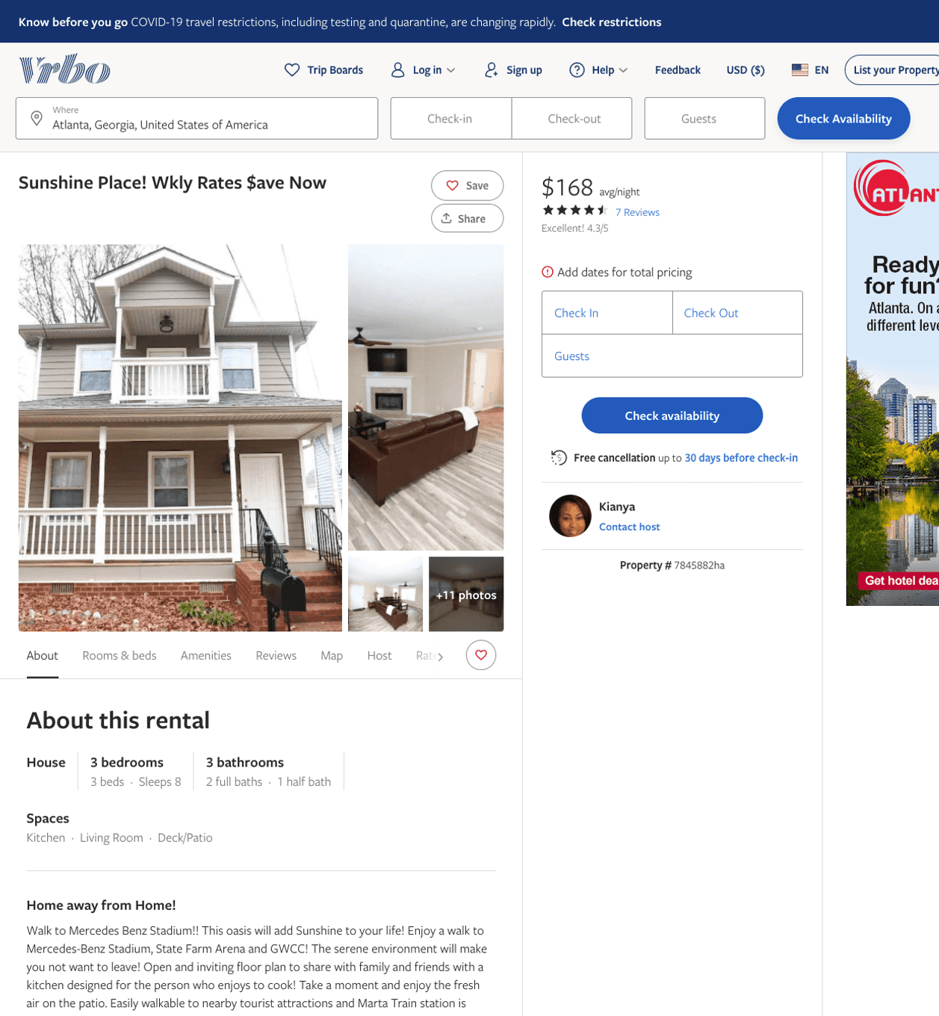
Listing 7845882
3
8
$137 - $168
4.3333335
2
Kianya
https://www.vrbo.com/7845882ha
Aug 2022

Slide 3
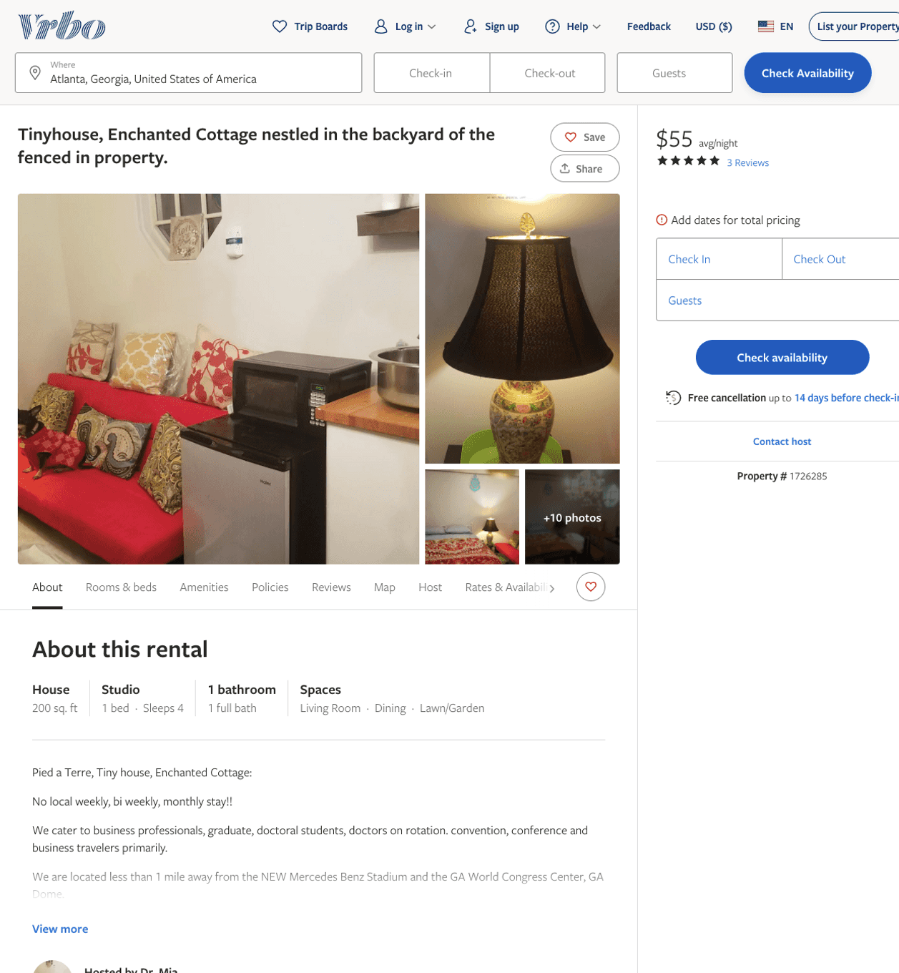
Listing 1726285
0
4
$48 - $57
5
3
Dr. Mia
https://www.vrbo.com/1726285
Aug 2022

Slide 4
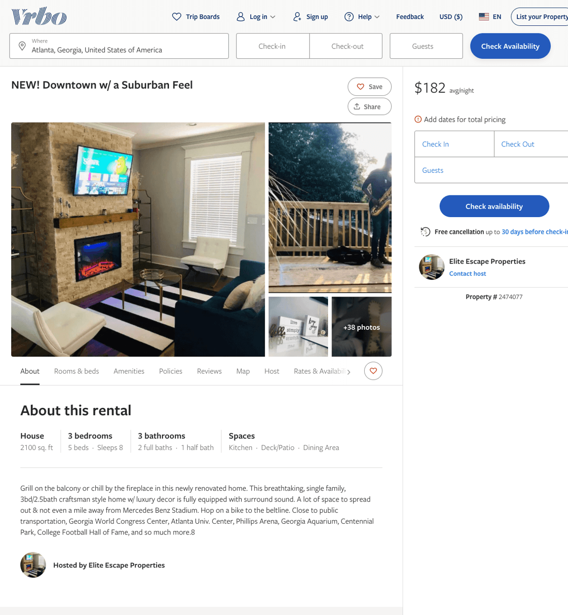
Listing 2474077
3
8
$149 - $194
4.5
1
Elite Escape Properties
https://www.vrbo.com/2474077
Aug 2022

Slide 5
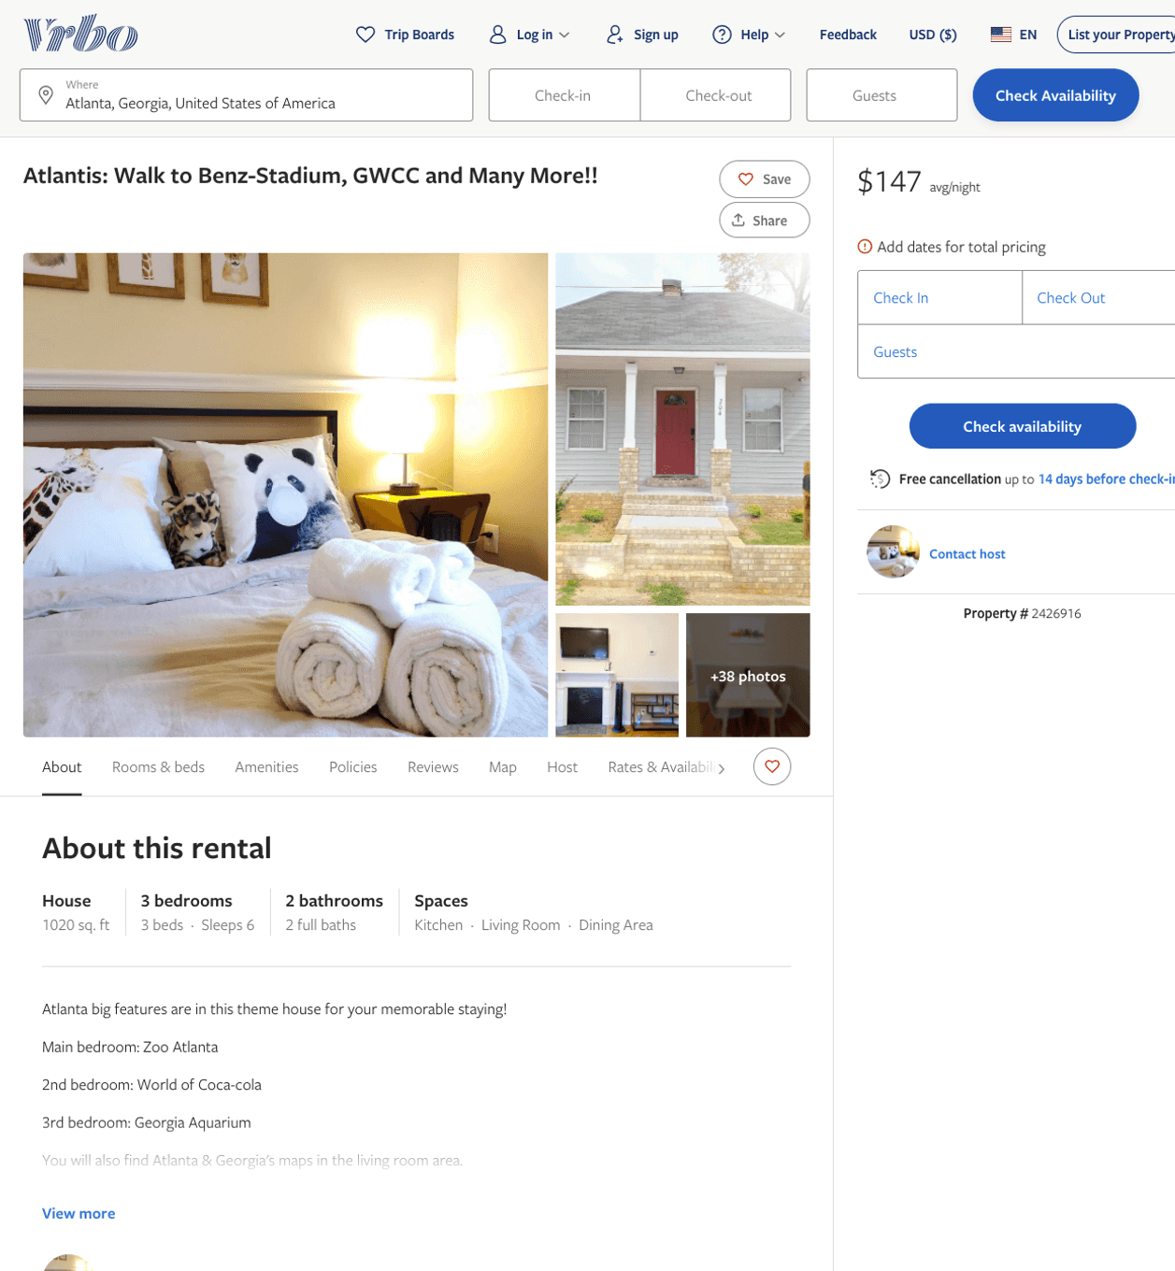
Listing 2426916
3
6
$142 - $228
4
3
https://www.vrbo.com/2426916
Aug 2022

Slide 6
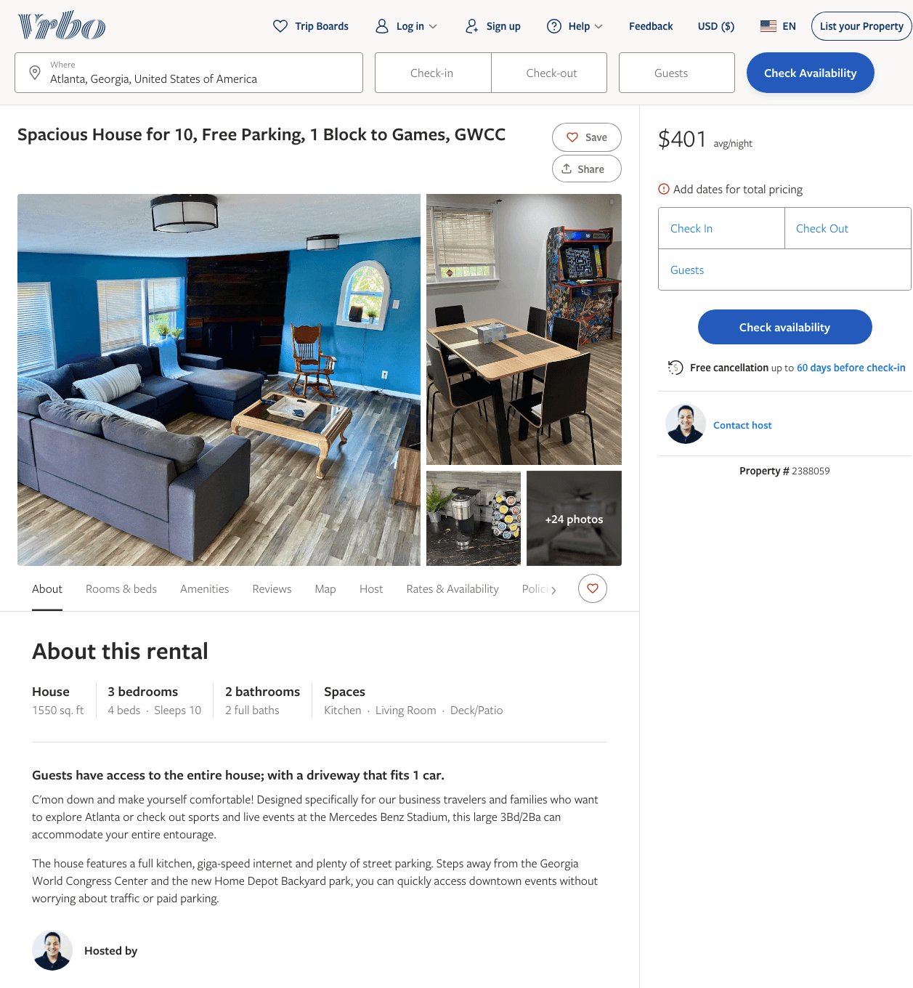
Listing 2388059
3
10
$232 - $403
5
1
Wei Yang
https://www.vrbo.com/2388059
Aug 2022

Slide 7
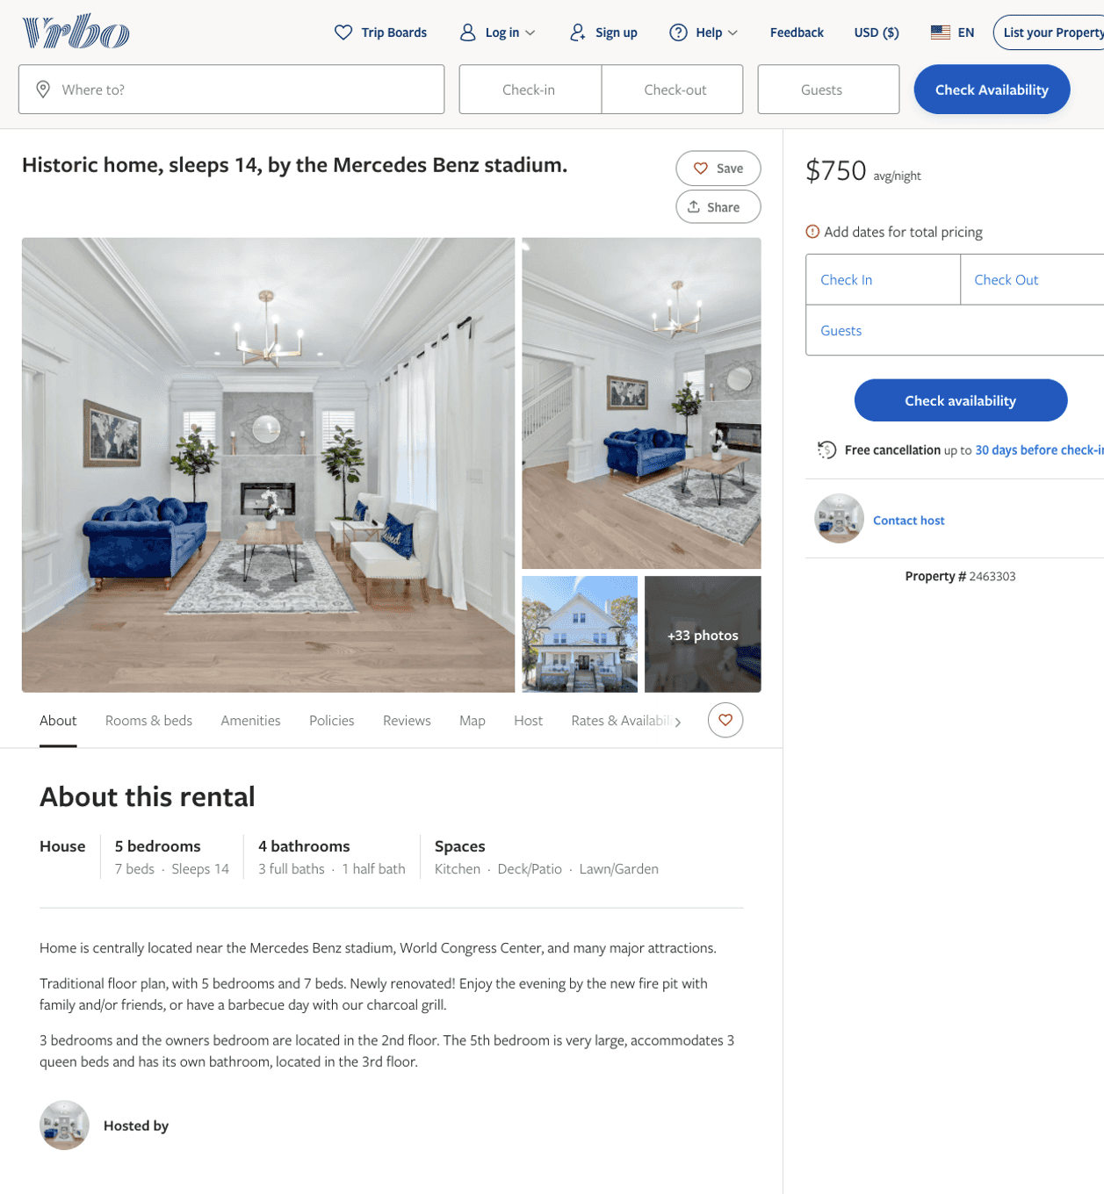
Listing 2463303
5
14
$700 - $750
4.8
3
https://www.vrbo.com/2463303
Aug 2022

Slide 8
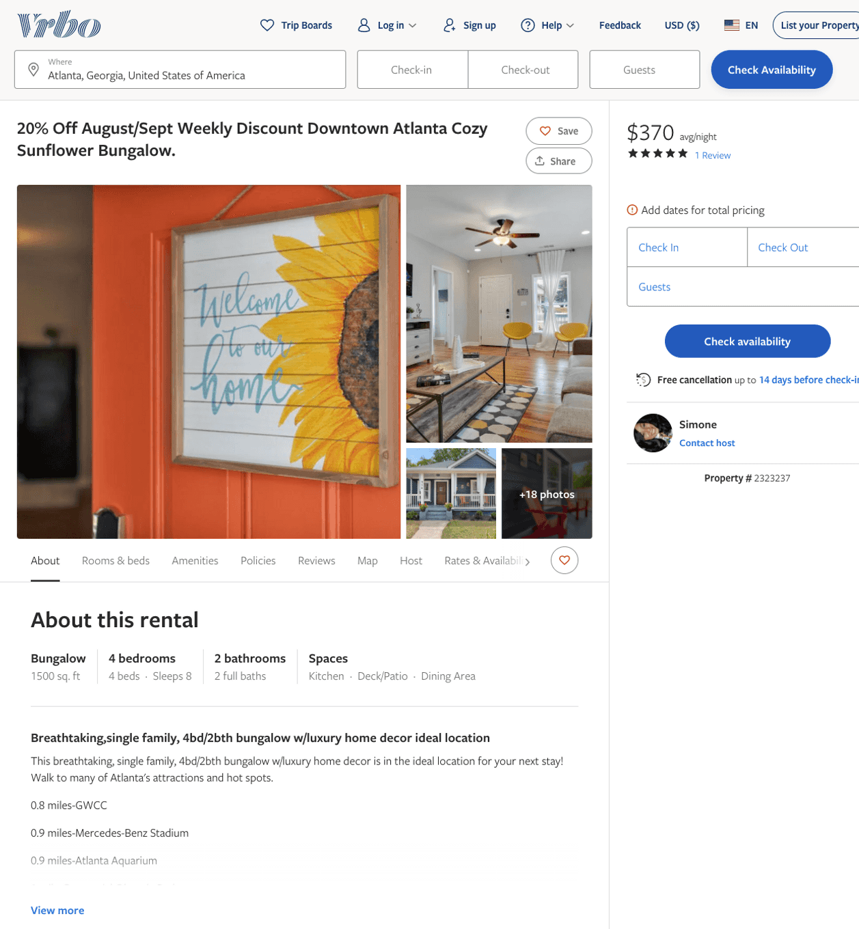
Listing 2323237
4
10
$267 - $345
4.8333335
2
Simone
https://www.vrbo.com/2323237
Aug 2022

Slide 9
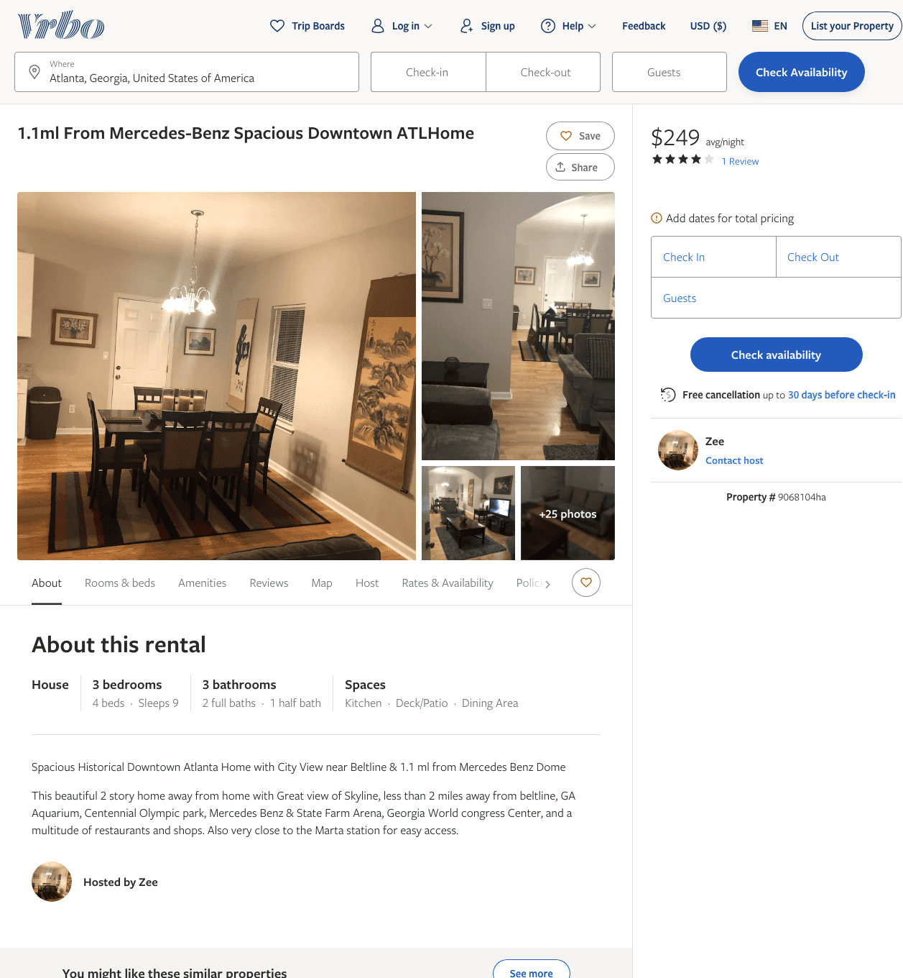
Listing 9068104
3
9
$220 - $260
4.6666665
2
Zee
https://www.vrbo.com/9068104ha
Aug 2022

Slide 10
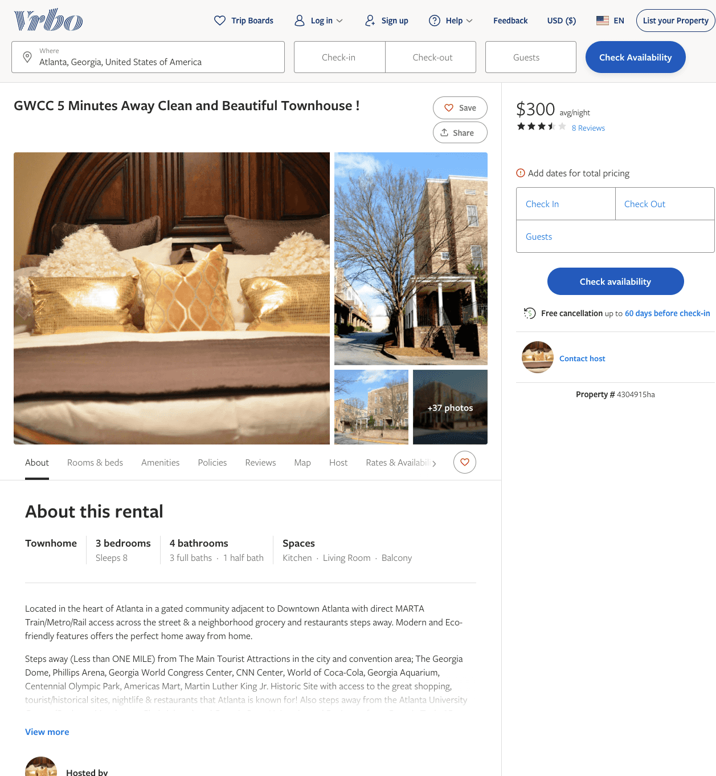
Listing 4304915
3
8
$300
3.625
2
https://www.vrbo.com/4304915ha
Aug 2022

Slide 11
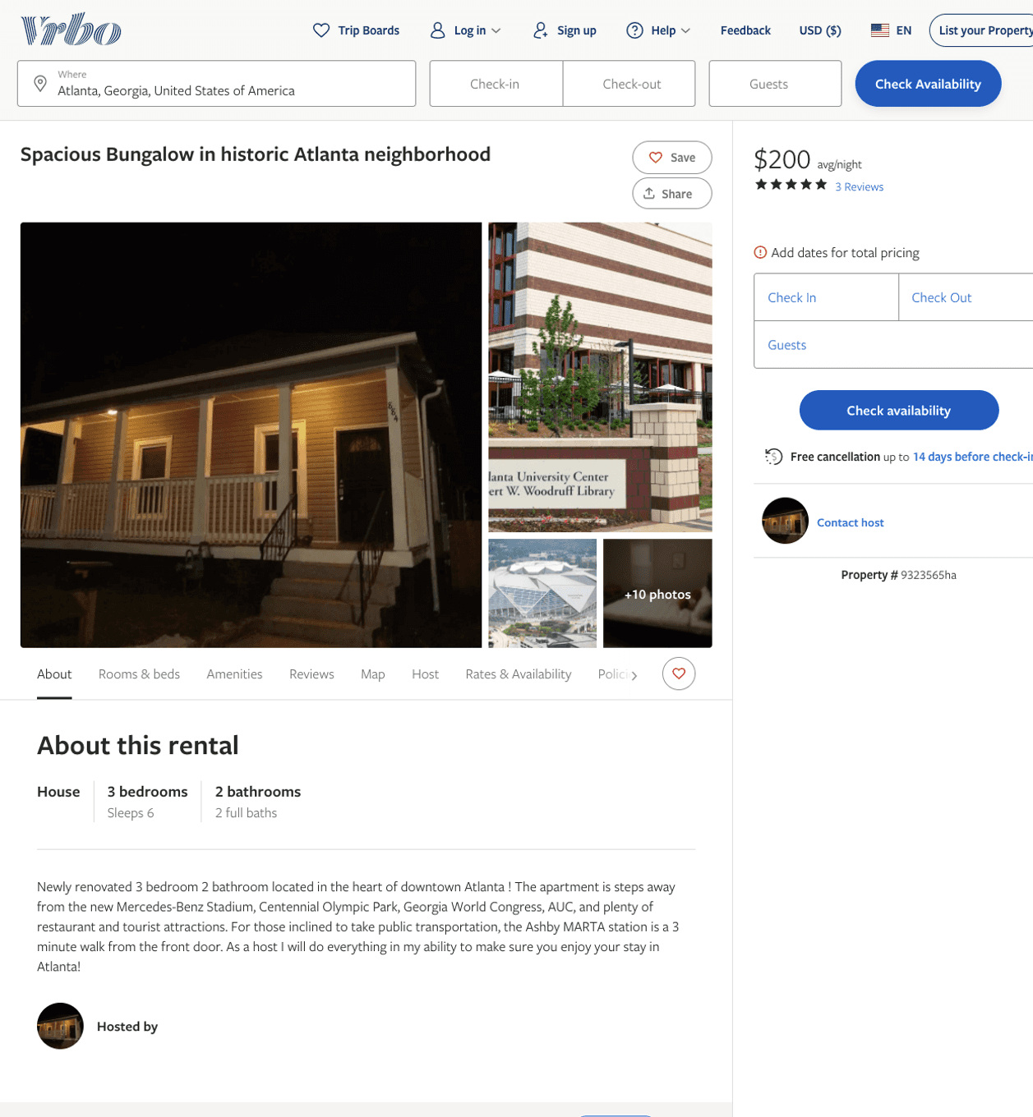
Listing 9323565
3
10
$130 - $200
4.75
2
https://www.vrbo.com/9323565ha
Aug 2022

Slide 12
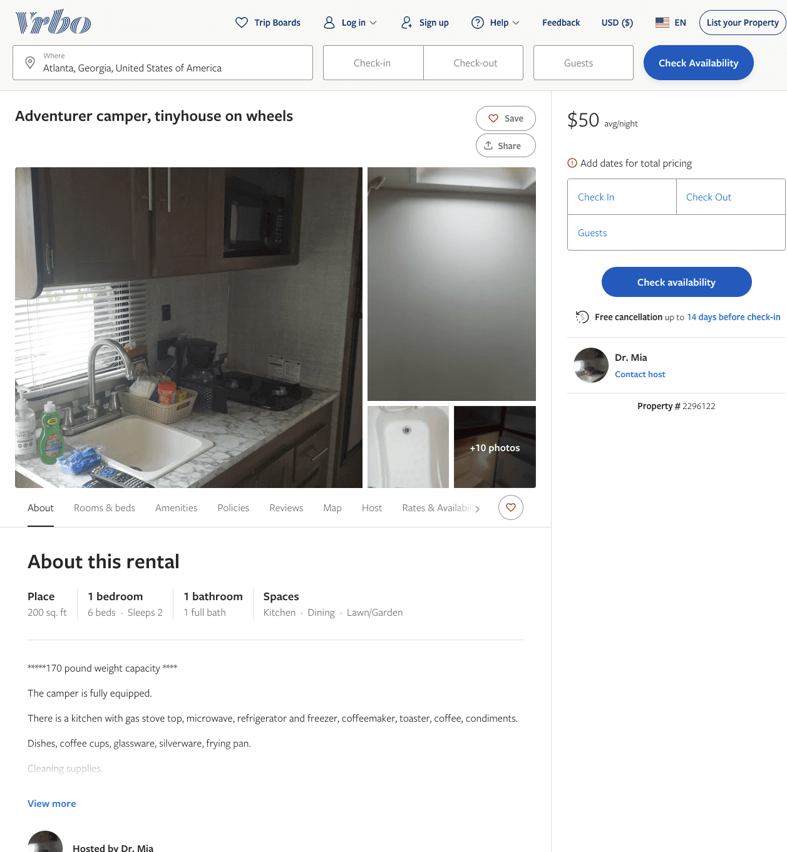
Listing 2296122
1
2
$39 - $50
3
Dr. Mia
https://www.vrbo.com/2296122
Aug 2022

Slide 13
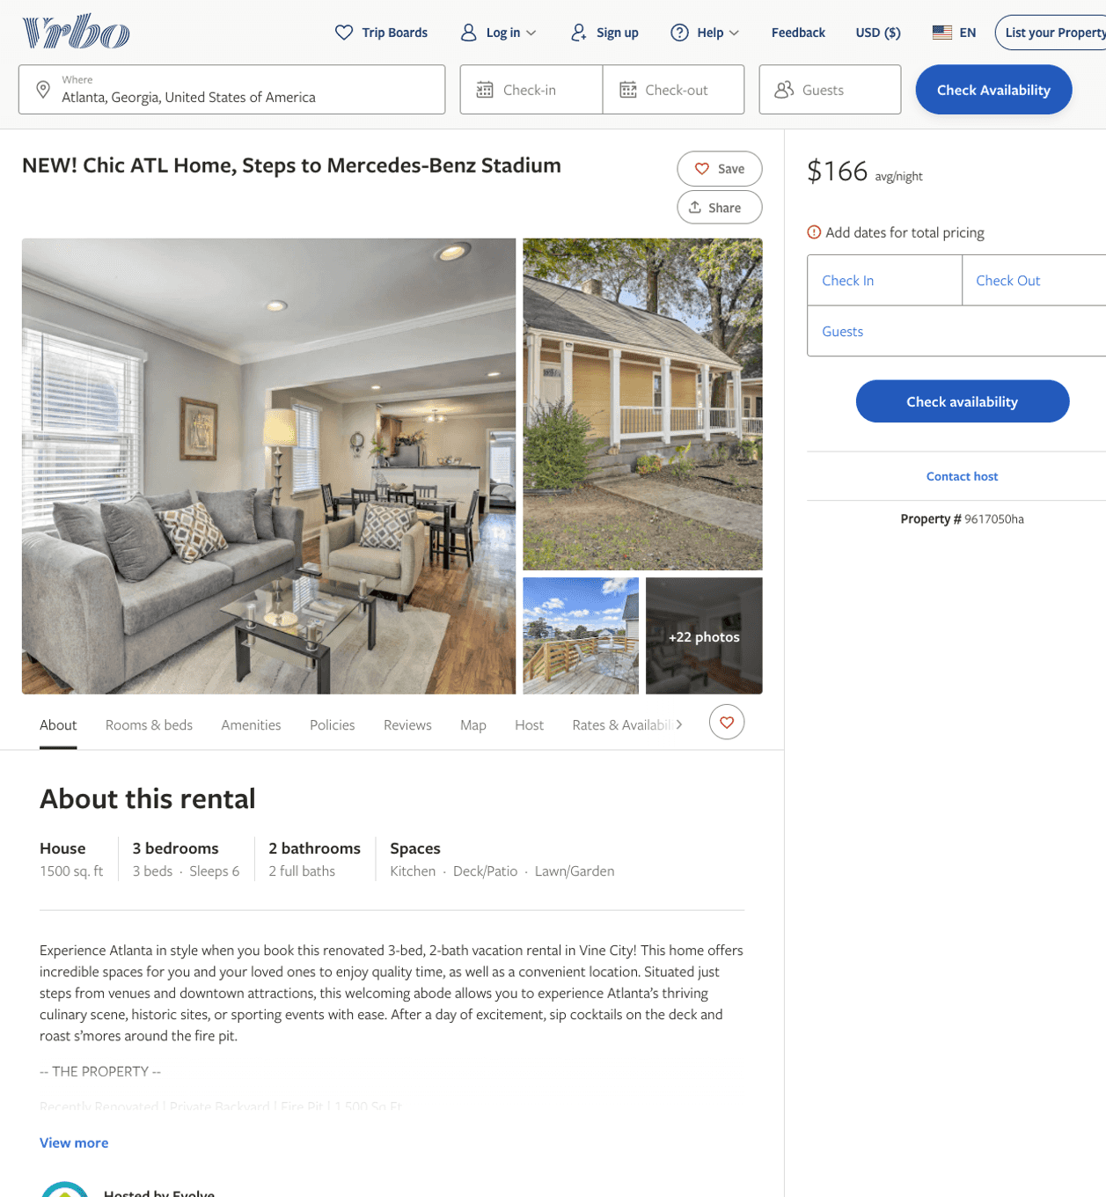
Listing 9617050
3
6
$168 - $231
5
2
Evolve
https://www.vrbo.com/9617050ha
Aug 2022

Slide 14
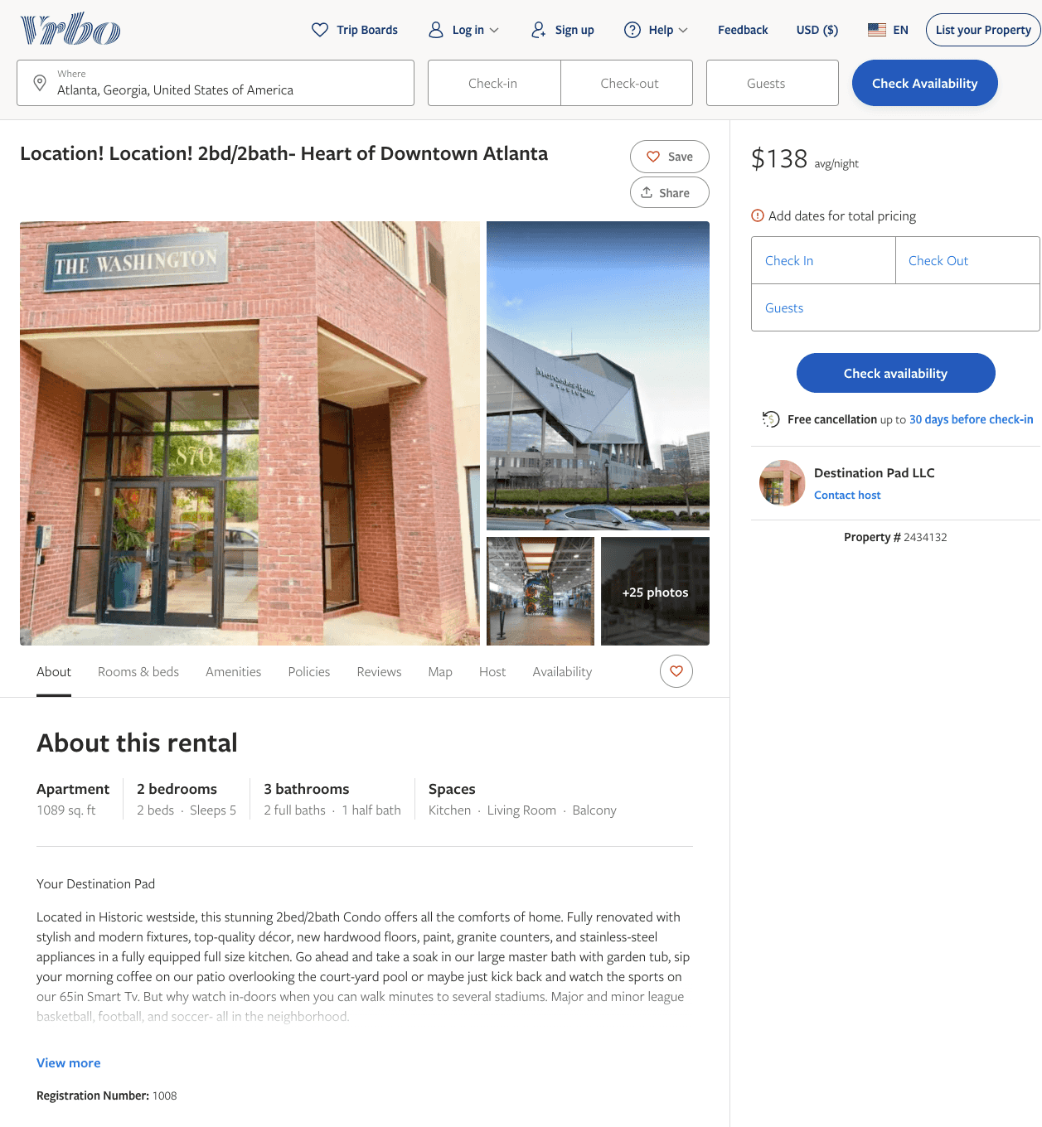
Listing 2434132
2
5
$128 - $165
2
Destination Pad LLC
https://www.vrbo.com/2434132
Aug 2022

Slide 15
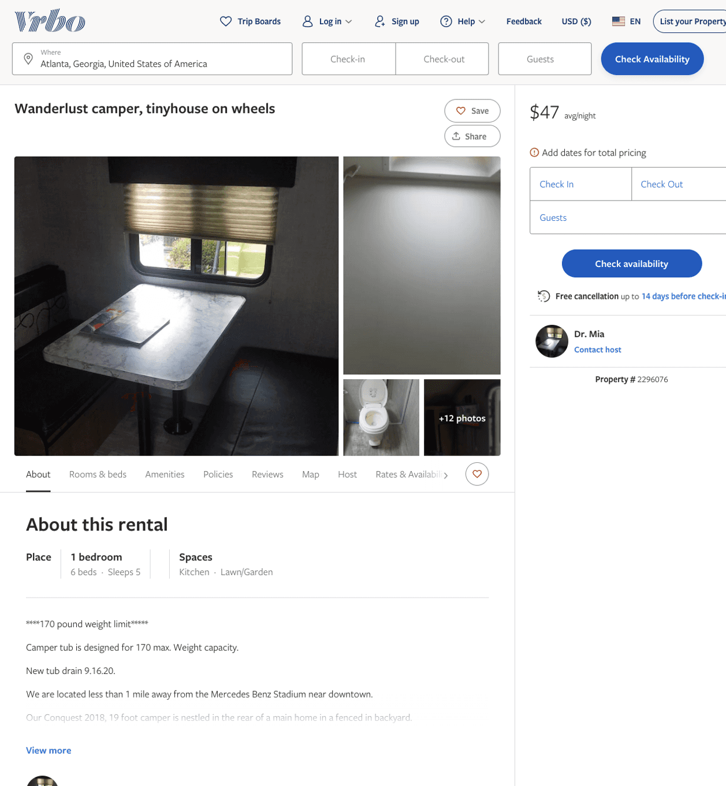
Listing 2296076
1
5
$47 - $50
3
Dr. Mia
https://www.vrbo.com/2296076
Aug 2022

Slide 16
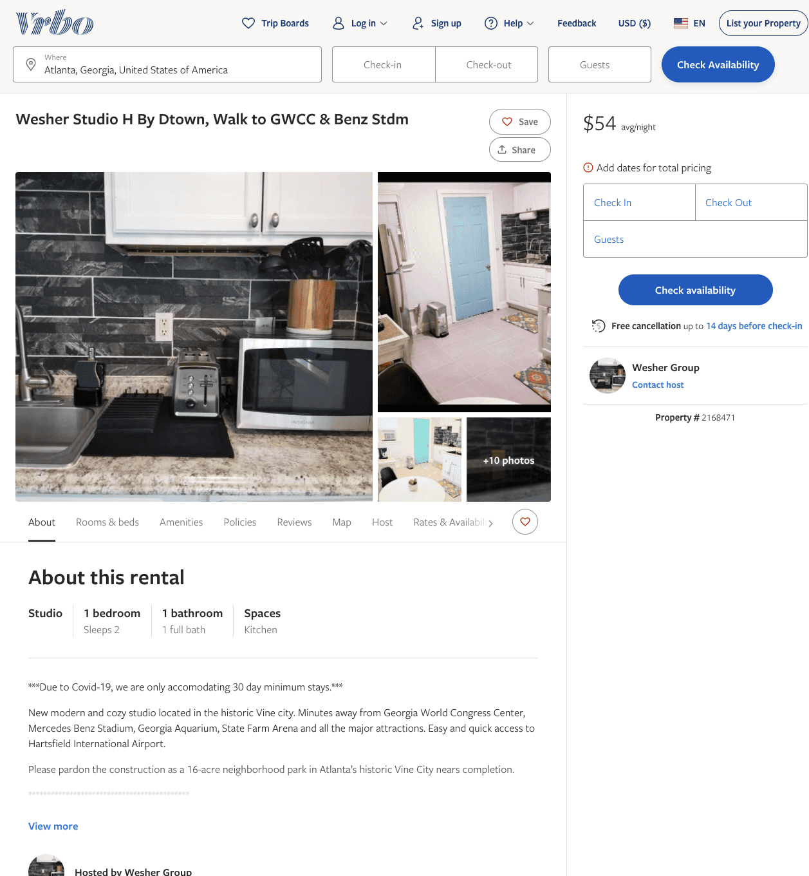
Listing 2168471
1
2
$54
30
Wesher Group
https://www.vrbo.com/2168471
Aug 2022

Slide 17
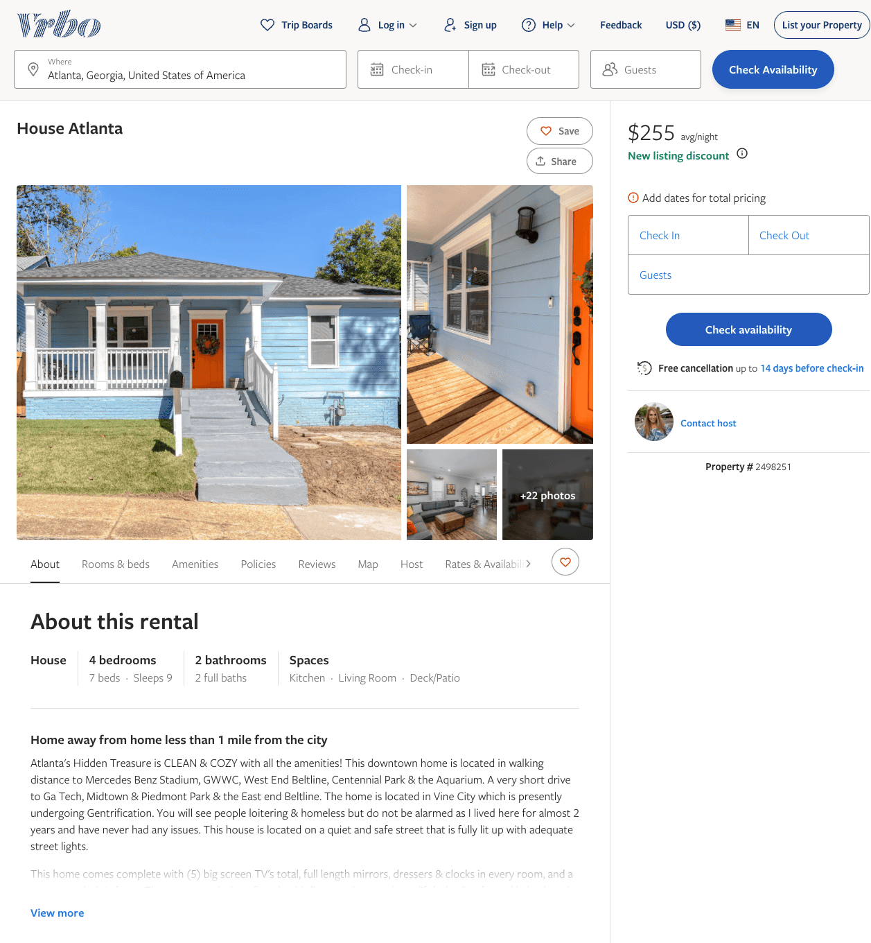
Listing 2498251
4
8
$249 - $298
3.6666667
90
https://www.vrbo.com/2498251
Aug 2022

Slide 18
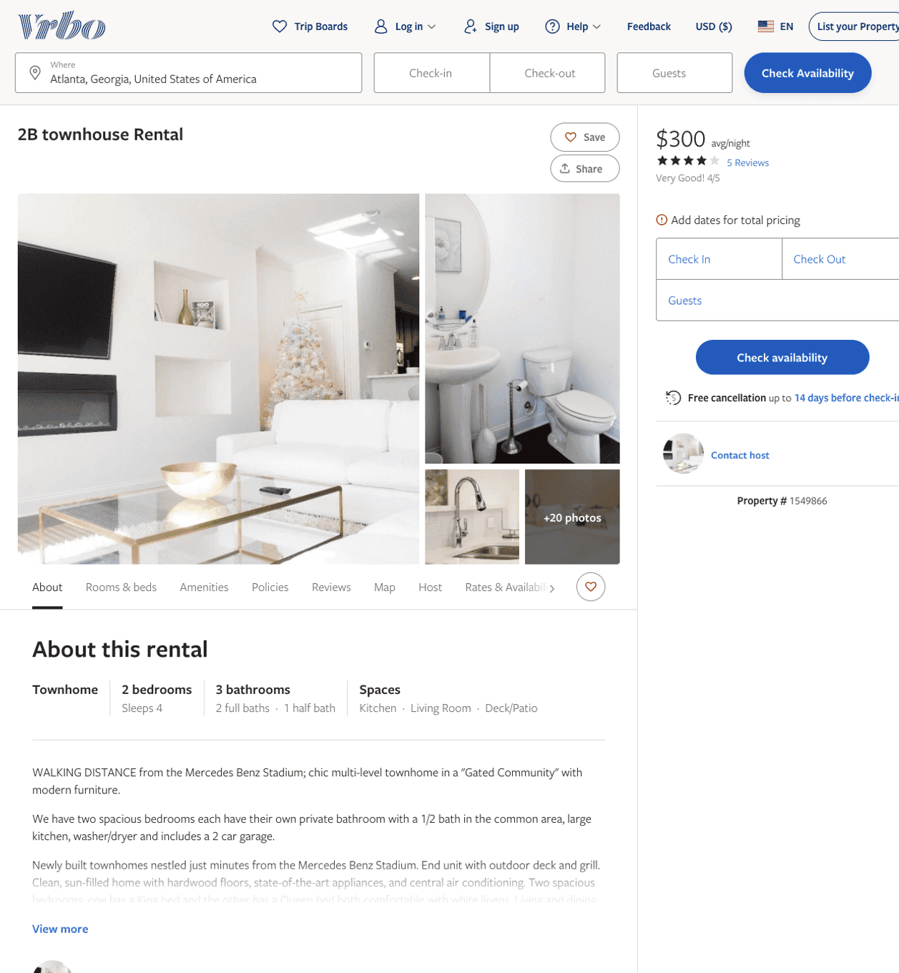
Listing 1549866
2
4
$300
4
1
https://www.vrbo.com/1549866
Aug 2022

Slide 19
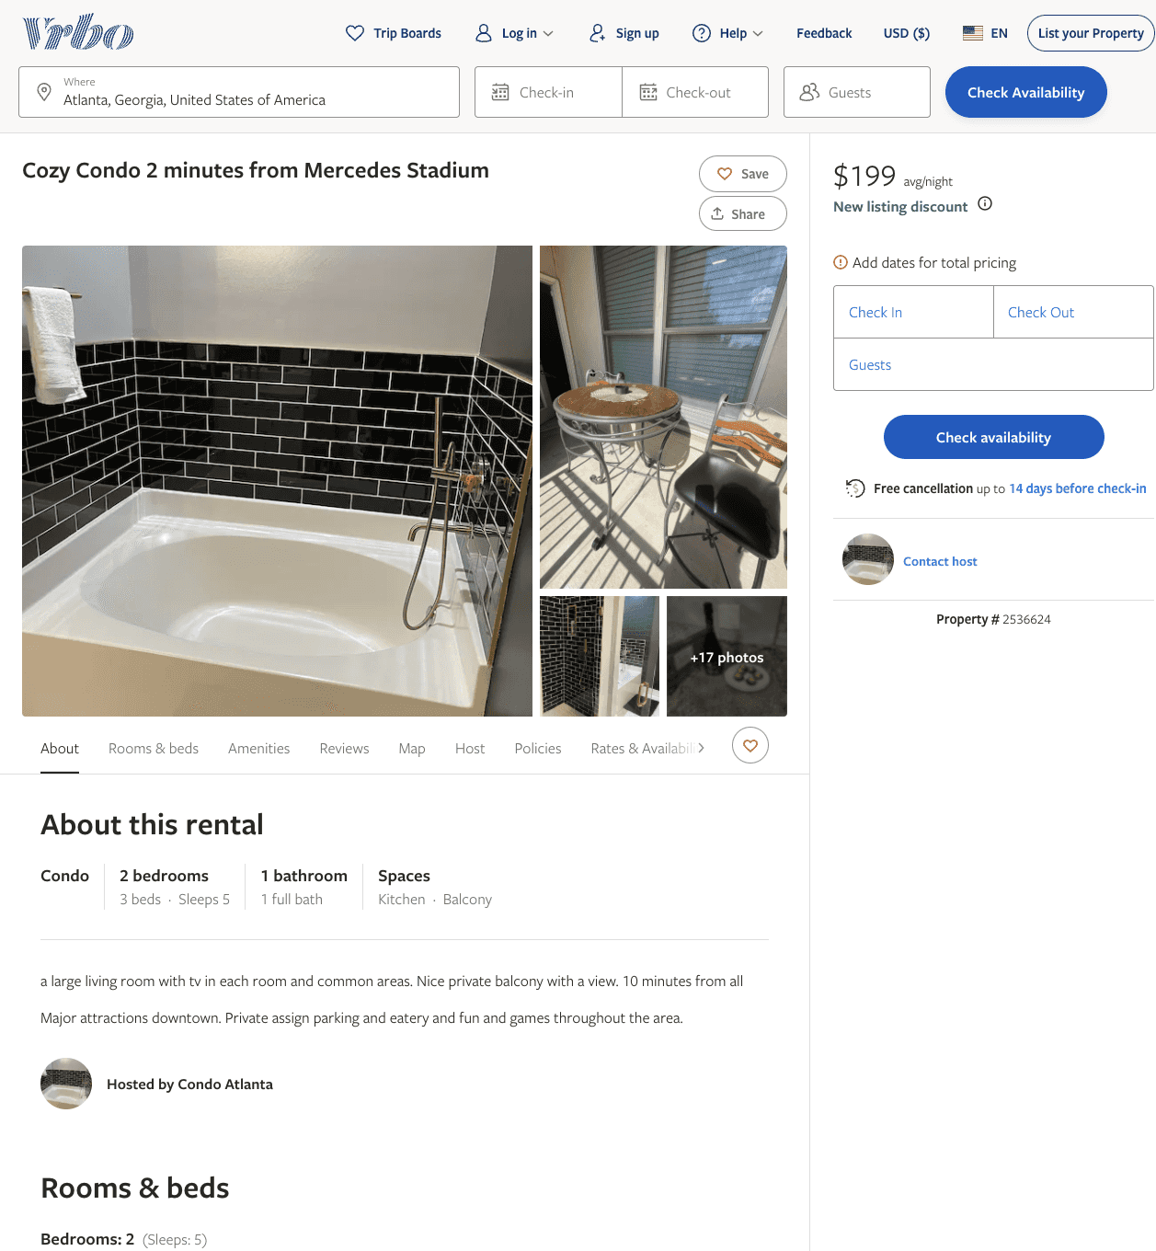
Listing 2536624
2
5
$199
5
3
https://www.vrbo.com/2536624
Aug 2022

Slide 20
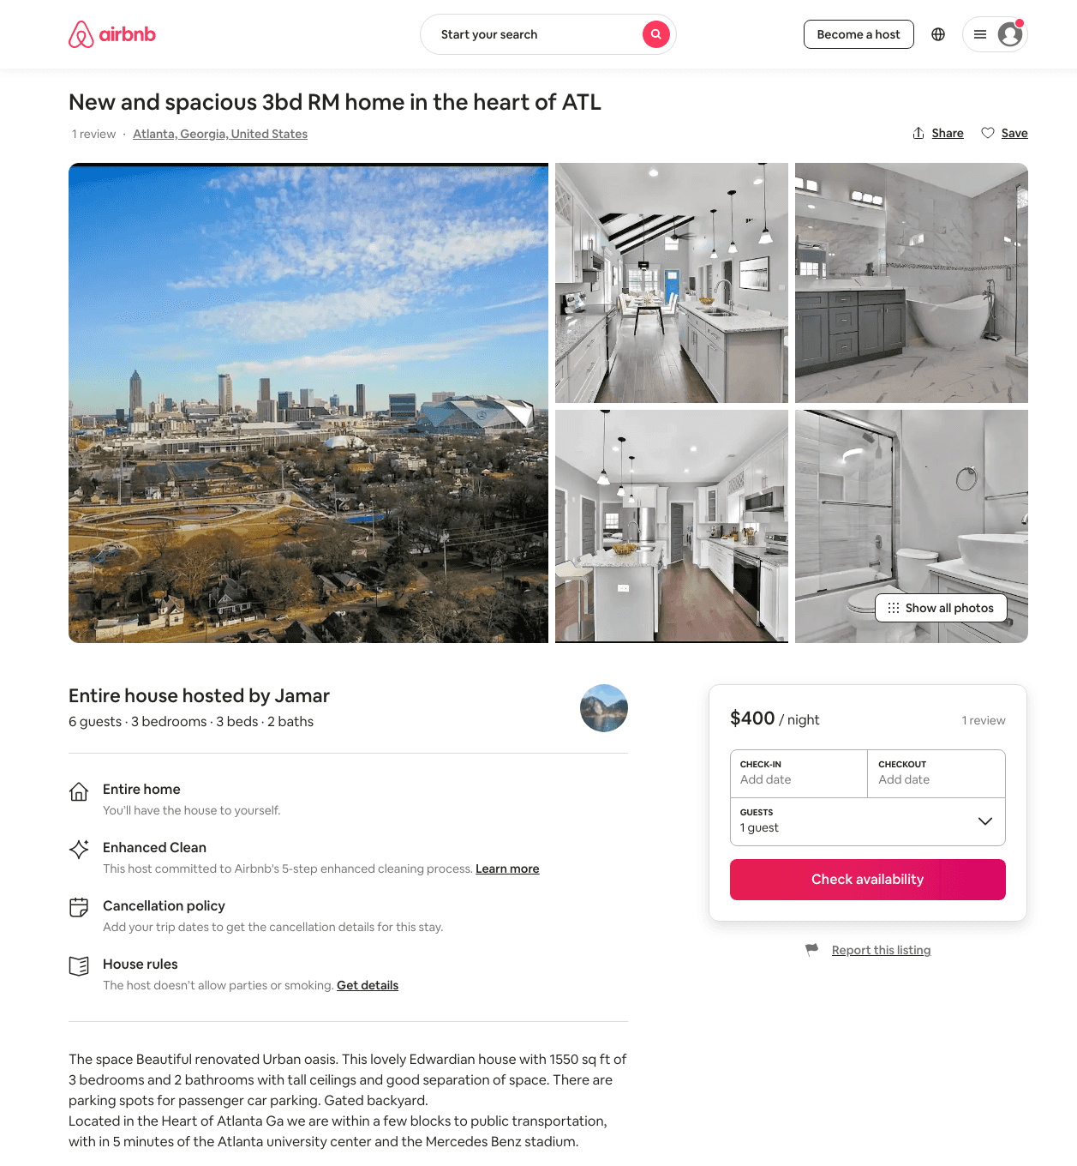
Listing 48848044
3
6
$310 - $650
4.84
2
Jamar
53542585
1
https://www.airbnb.com/rooms/48848044
Aug 2022

Slide 21
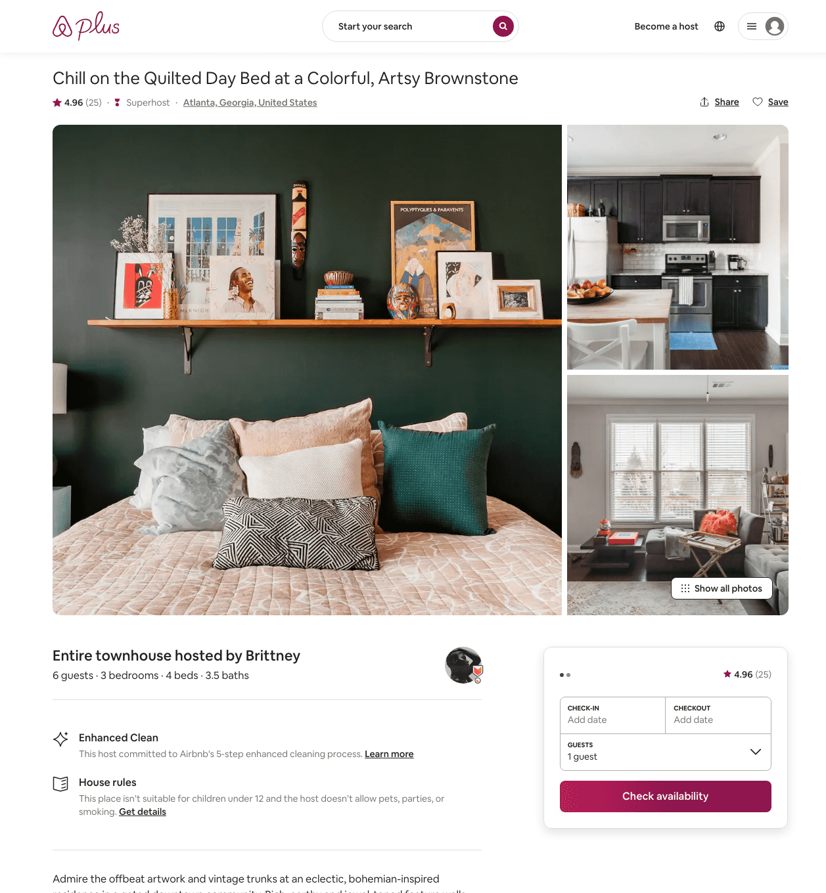
Listing 30785539
3
6
$204 - $431
4.97
2
Brittney
24728783
1
https://www.airbnb.com/rooms/30785539
Aug 2022

Slide 22
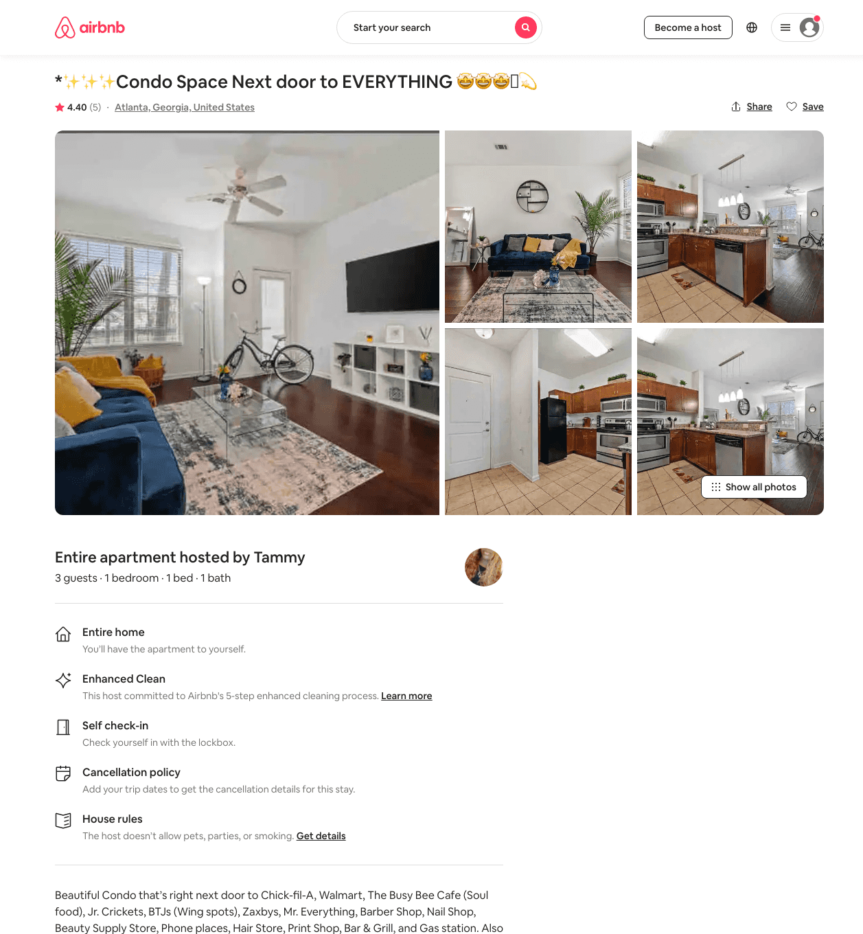
Listing 44069723
1
4
$70 - $93
4.40
1
Tammy
79721999
1
https://www.airbnb.com/rooms/44069723
Aug 2022

Slide 23
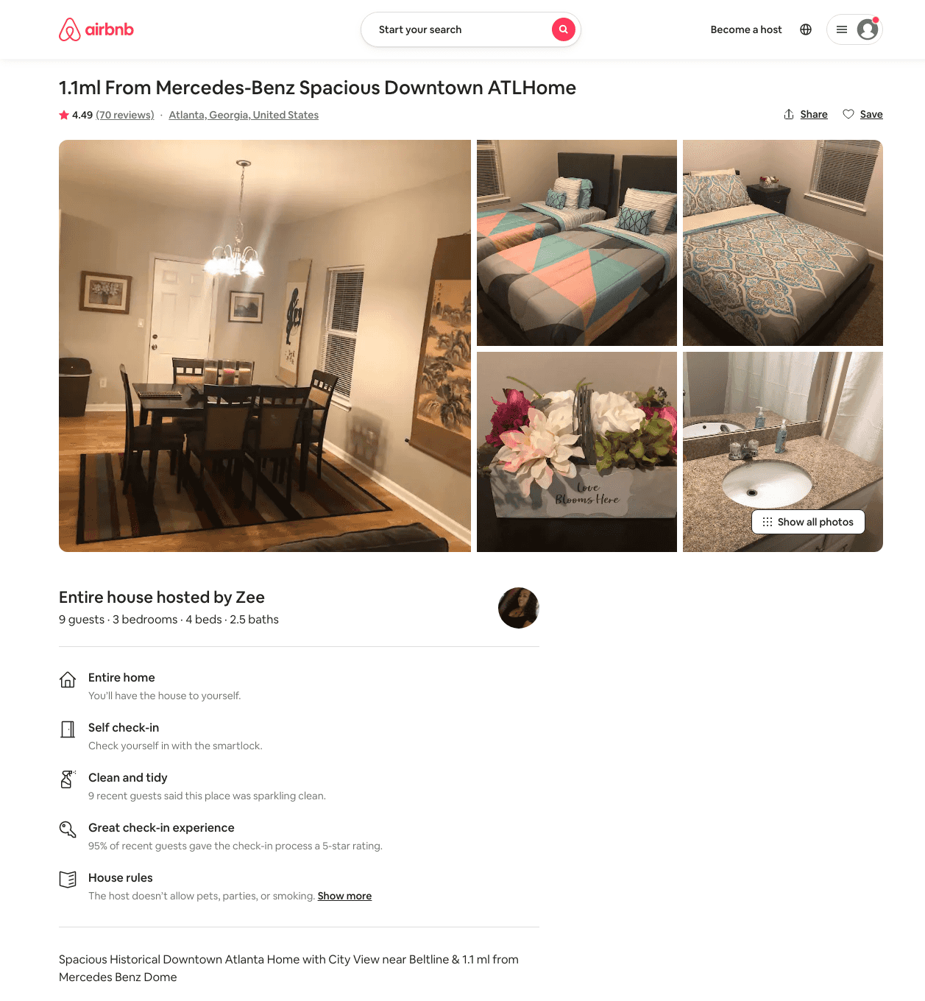
Listing 33853254
3
10
$175 - $243
4.45
2
Zee
166193492
1
https://www.airbnb.com/rooms/33853254
Jun 2022

Slide 24
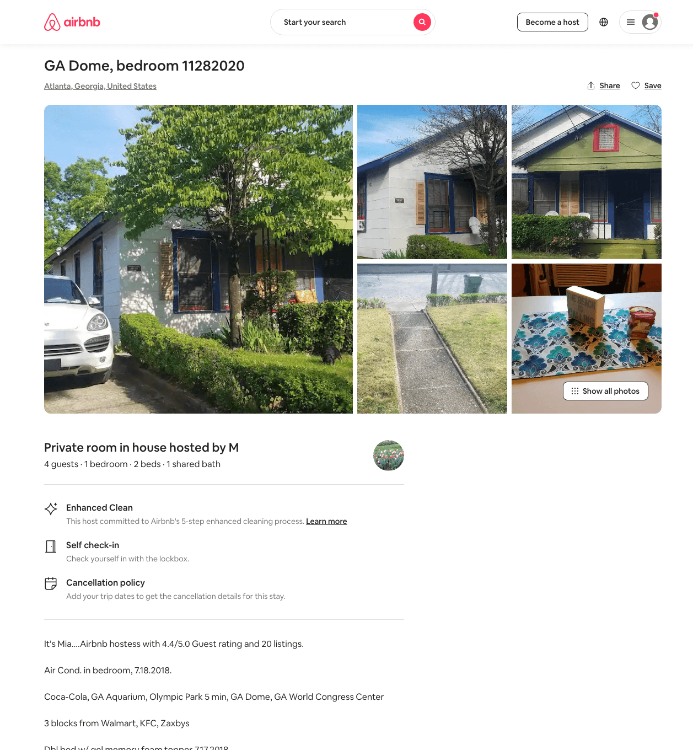
Listing 46695148
1
4
$30 - $35
5
M
28245434
13
https://www.airbnb.com/rooms/46695148
Aug 2022

Slide 25
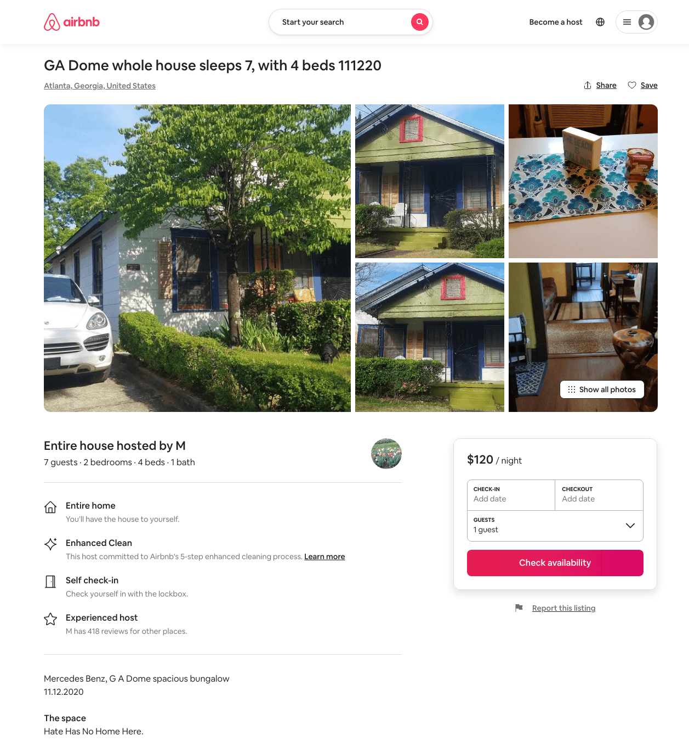
Listing 46394443
2
7
$120 - $121
5
M
28245434
13
https://www.airbnb.com/rooms/46394443
Aug 2022

Slide 26
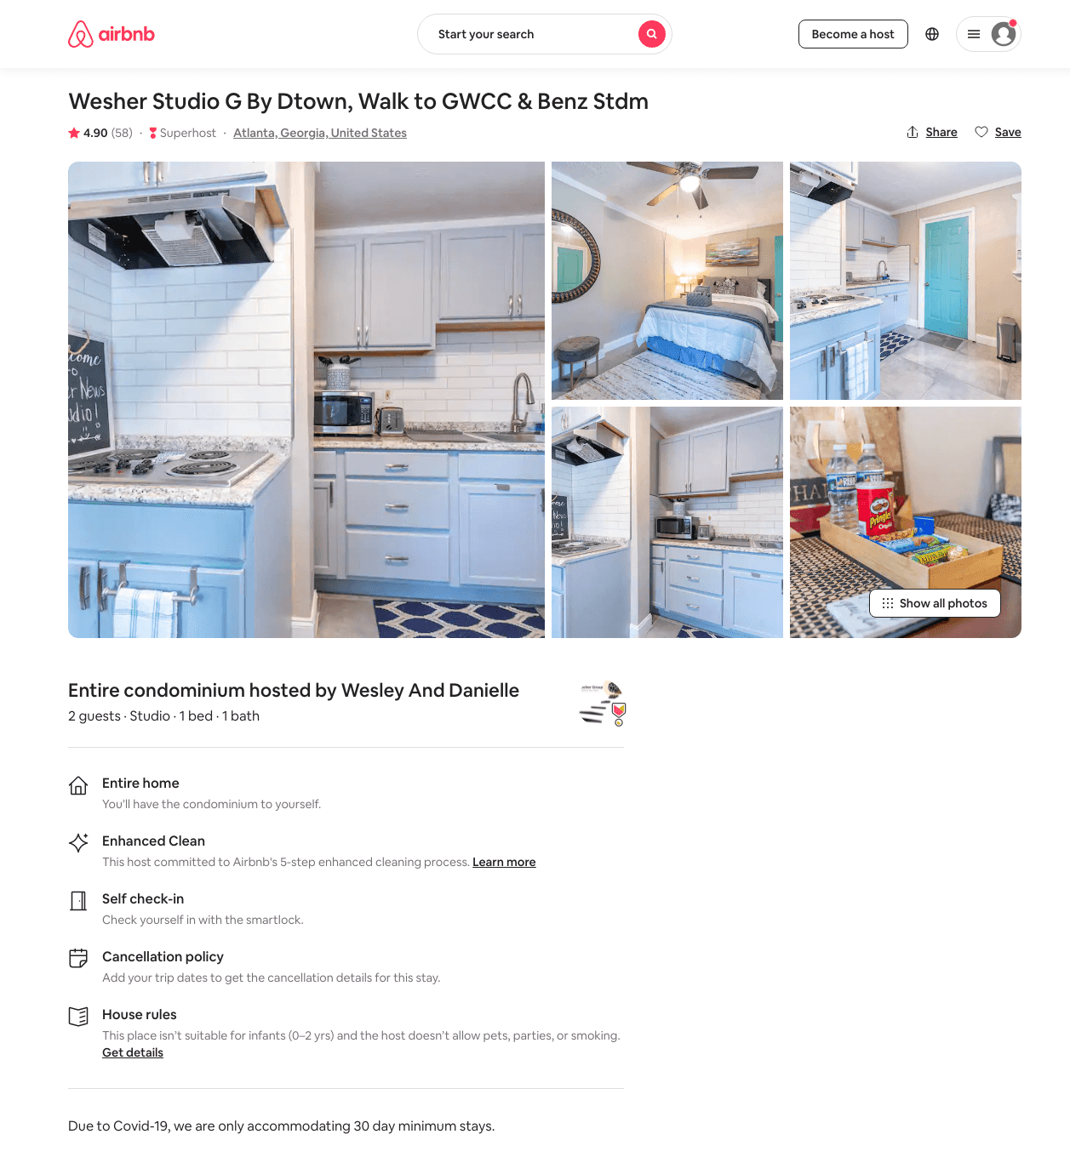
Listing 34673200
Studio
2
$51 - $75
4.87
30
Wesley And Danielle
261558628
3
https://www.airbnb.com/rooms/34673200
Aug 2022

Slide 27
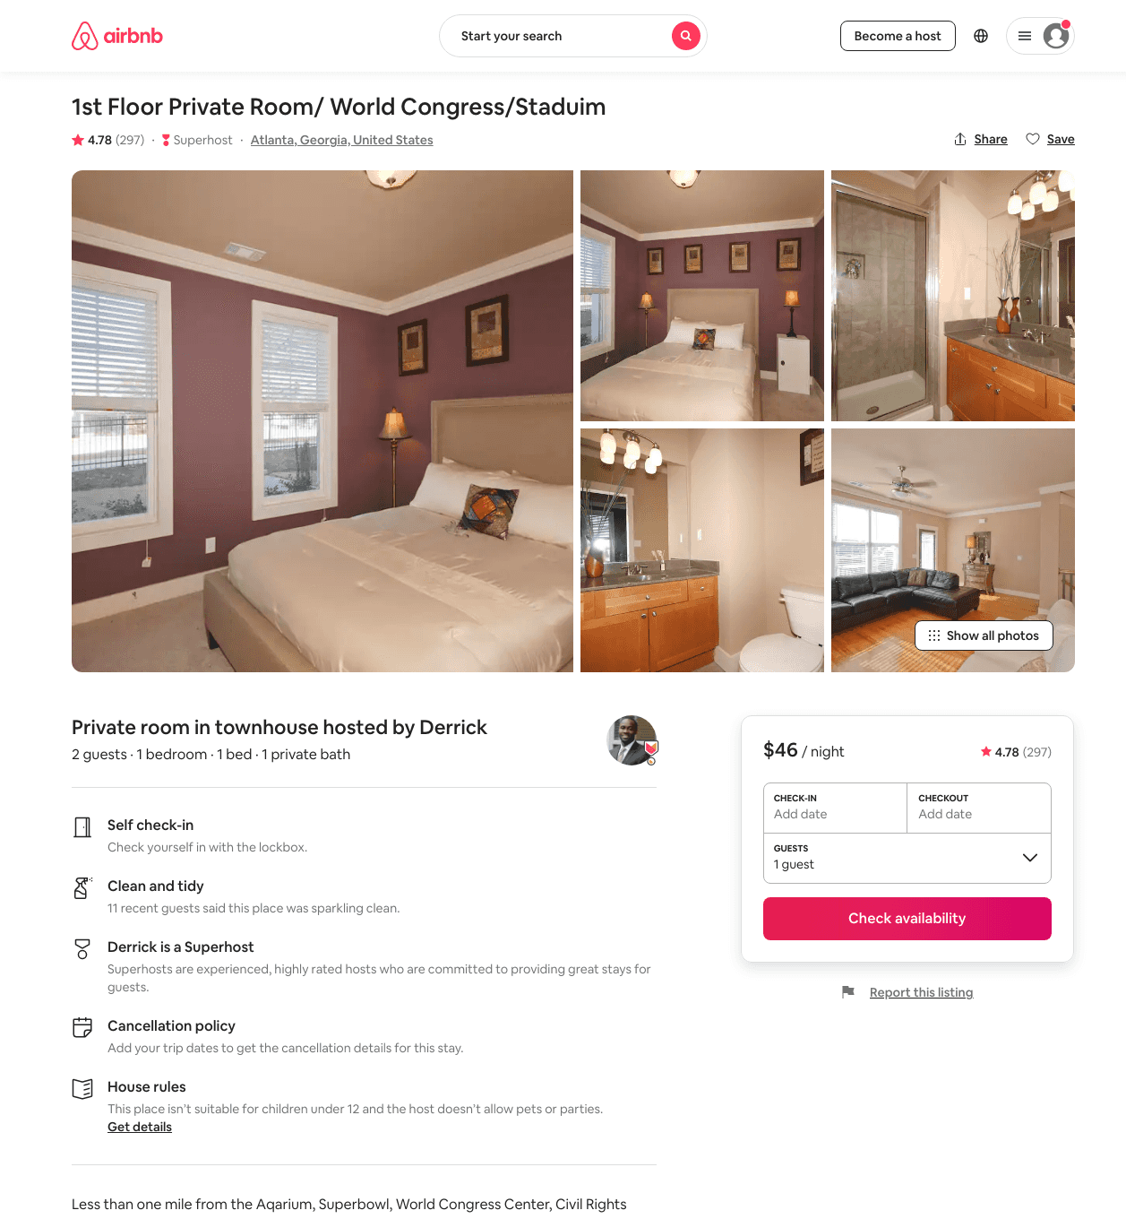
Listing 54823
1
1
$46 - $77
4.79
3
Derrick
257889
5
https://www.airbnb.com/rooms/54823
Aug 2022

Slide 28
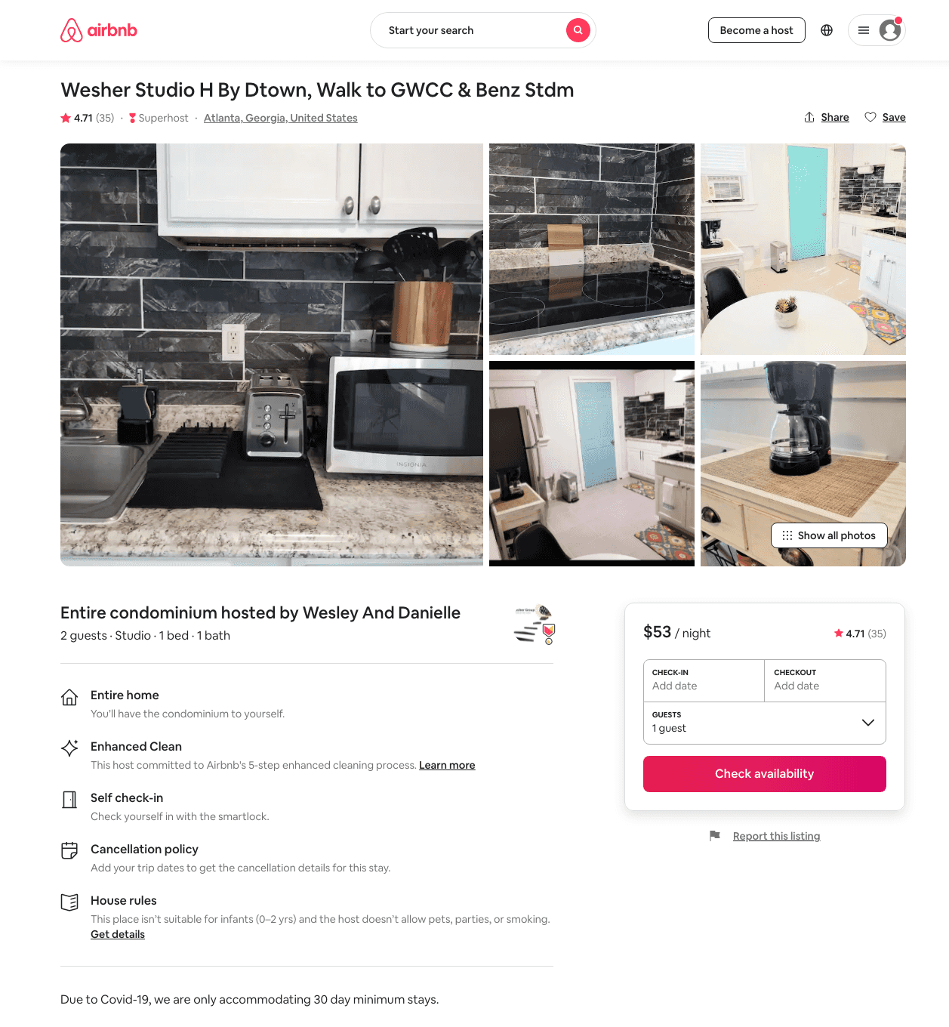
Listing 38190039
Studio
2
$51 - $76
4.74
30
Wesley And Danielle
261558628
3
https://www.airbnb.com/rooms/38190039
Aug 2022

Slide 29
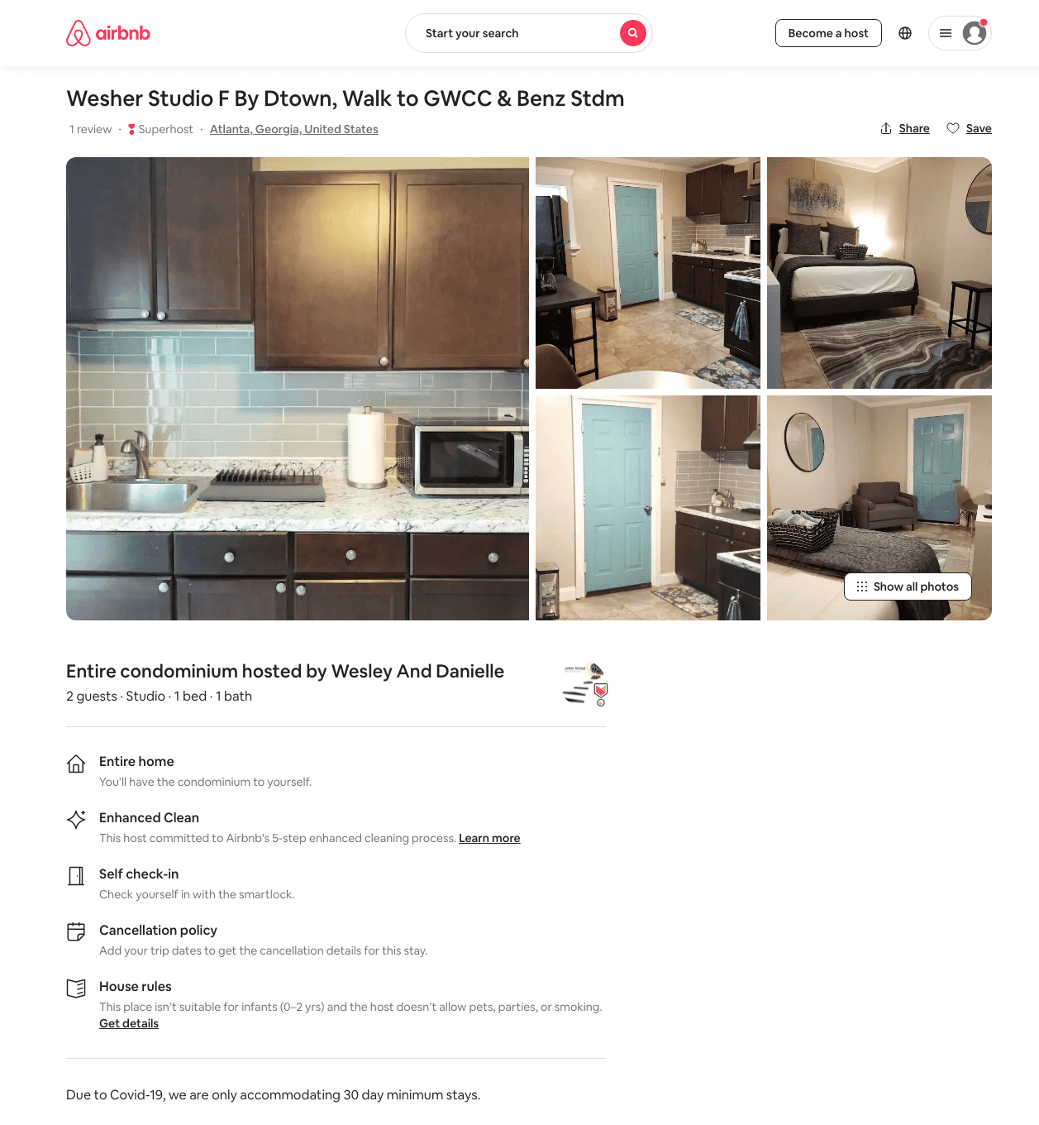
Listing 45933477
Studio
2
$50 - $63
5.0
30
Wesley And Danielle
261558628
3
https://www.airbnb.com/rooms/45933477
Aug 2022

Slide 30
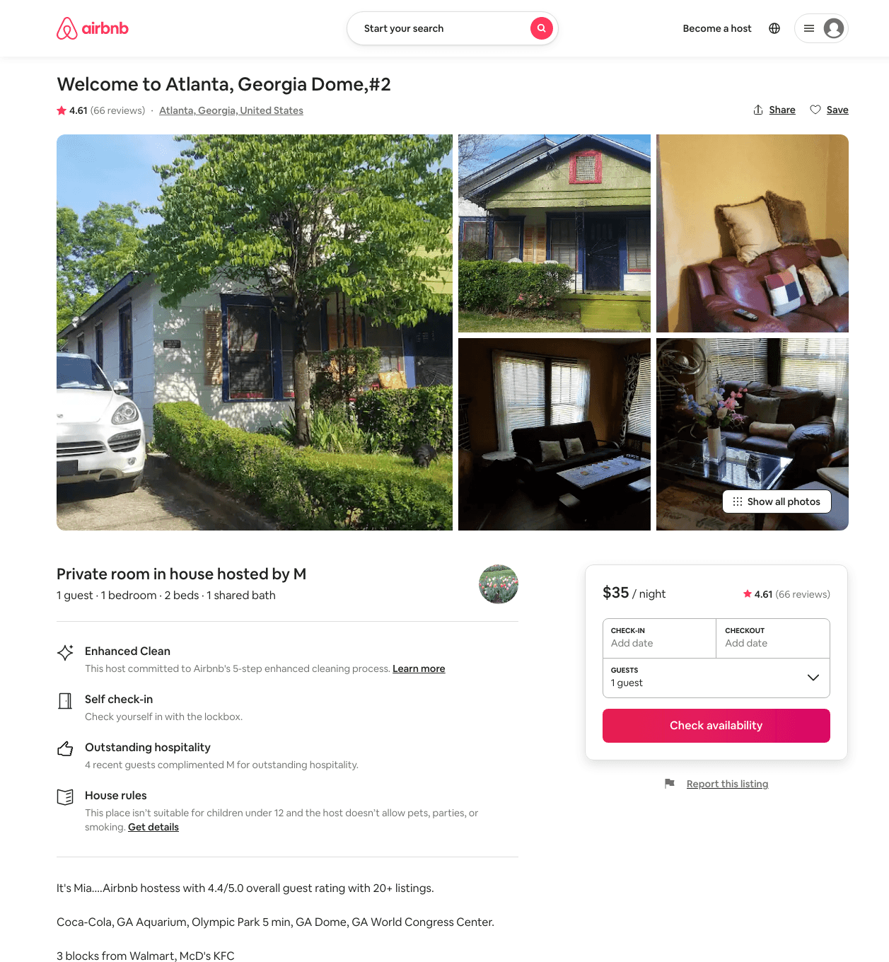
Listing 5445607
1
1
$35
4.61
5
M
28245434
13
https://www.airbnb.com/rooms/5445607
Aug 2022

Slide 31
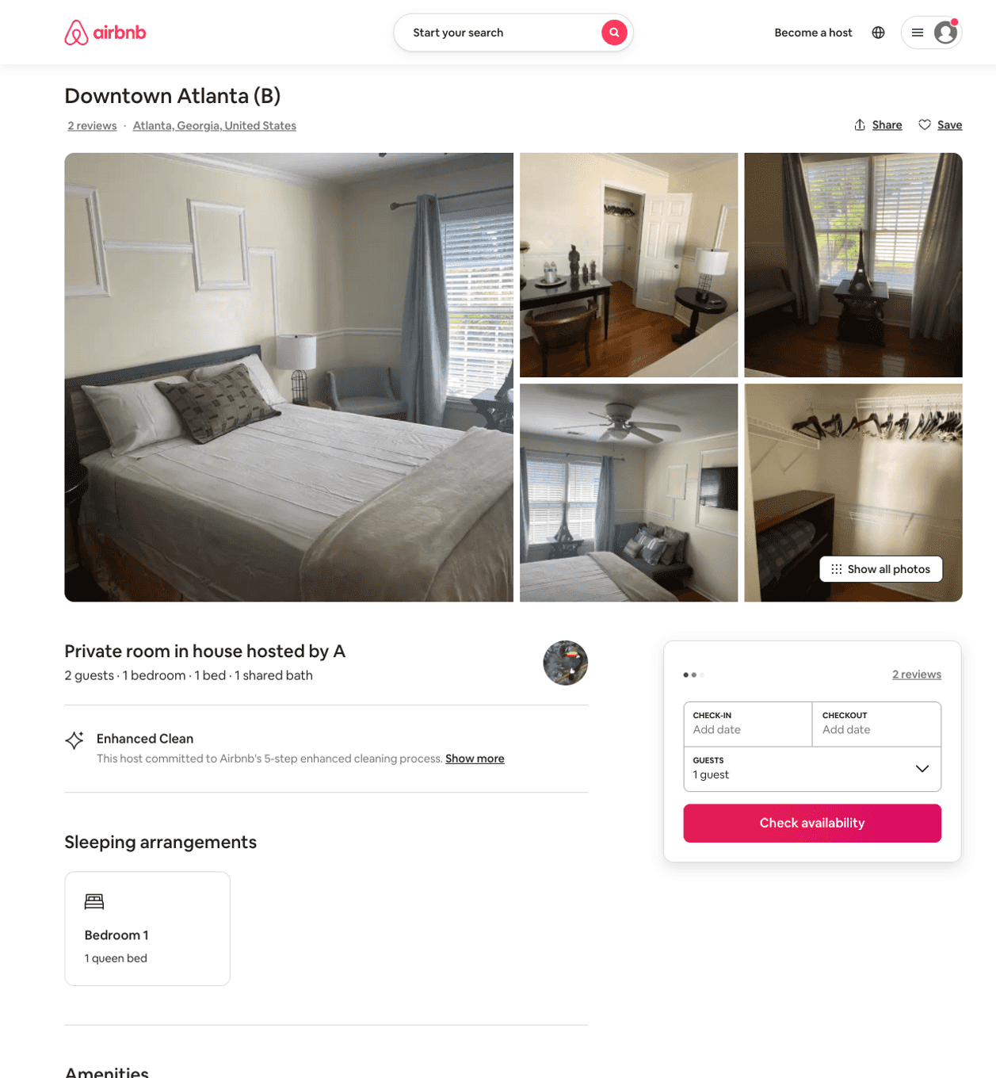
Listing 37158137
1
2
$49 - $52
4.93
2
A
75184336
2
https://www.airbnb.com/rooms/37158137
Aug 2022

Slide 32
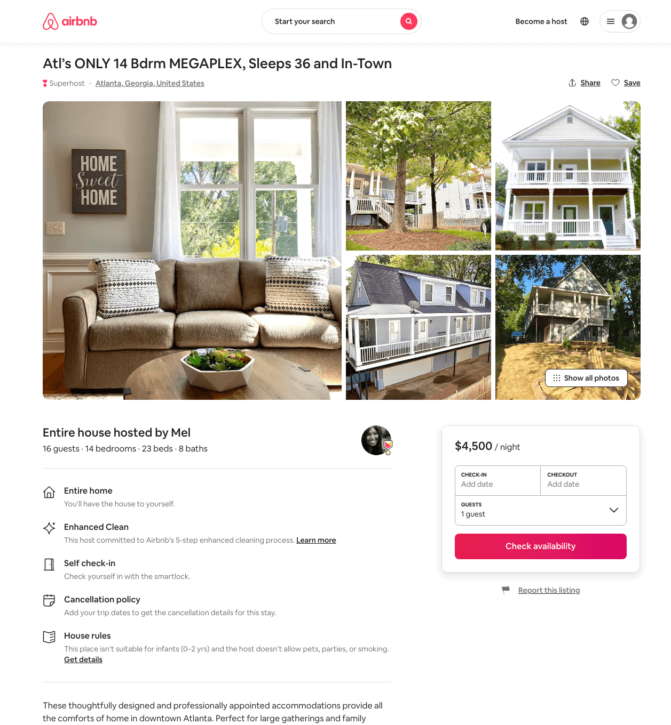
Listing 39813195
14
16
$4500
1
Mel
8032275
4
https://www.airbnb.com/rooms/39813195
Aug 2022

Slide 33
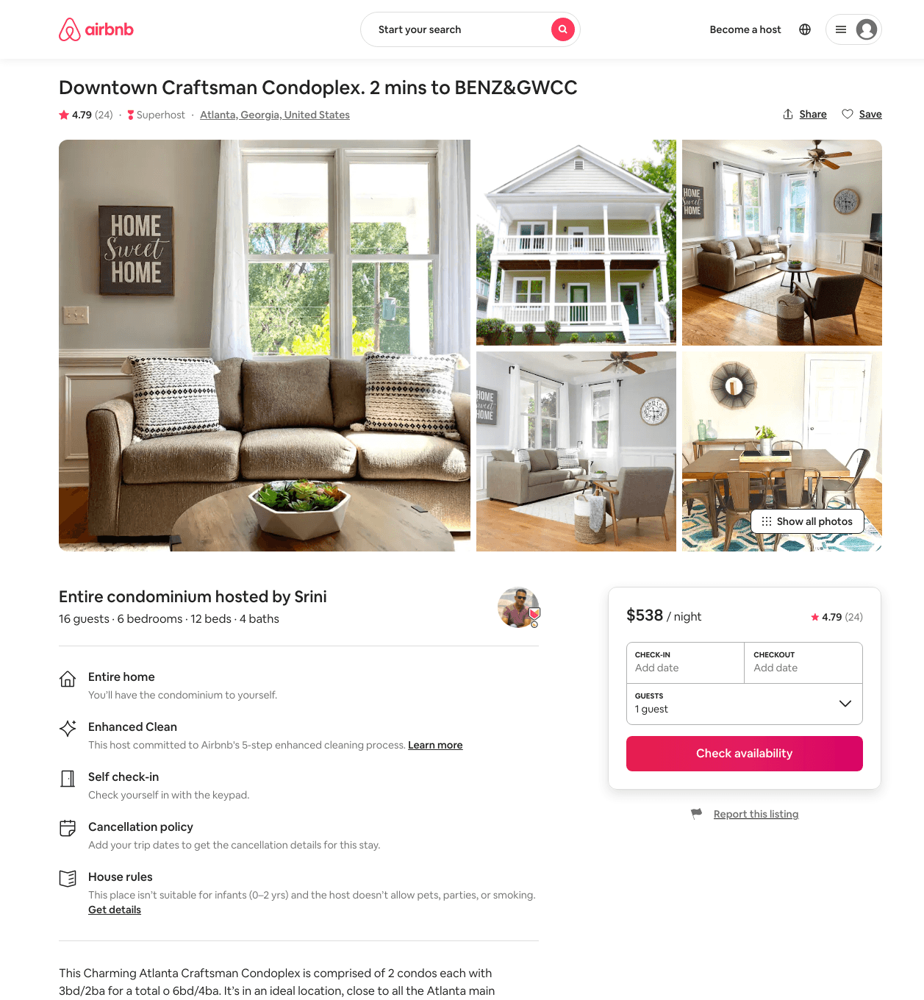
Listing 39447808
6
16
$499 - $581
4.87
2
Srini
302527004
3
https://www.airbnb.com/rooms/39447808
Aug 2022

Slide 34
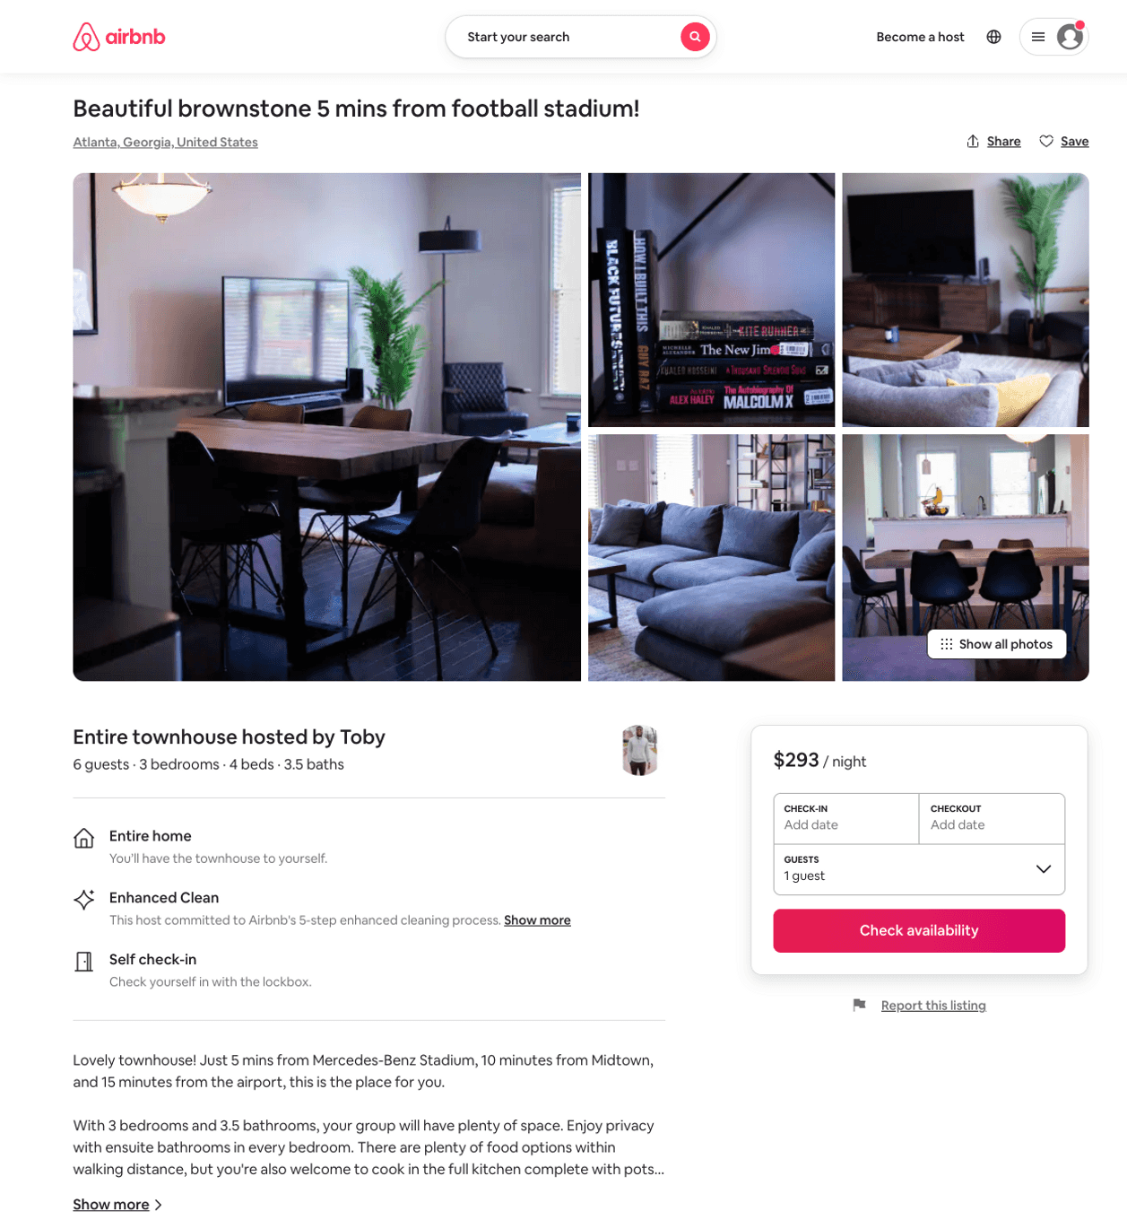
Listing 49070266
3
6
$129 - $329
4.91
2
Toby
57156237
1
https://www.airbnb.com/rooms/49070266
Aug 2022

Slide 35
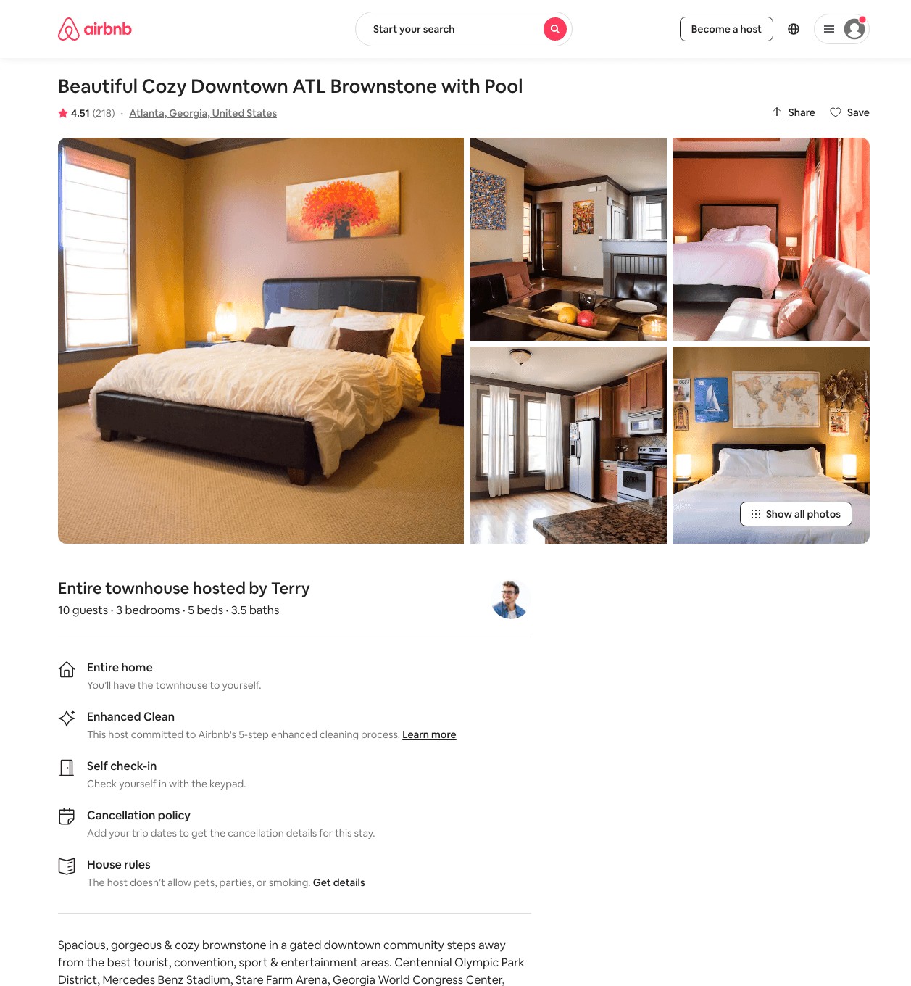
Listing 805454
3
10
$183 - $261
4.47
2
Terry
1408981
1
https://www.airbnb.com/rooms/805454
Aug 2022

Slide 36
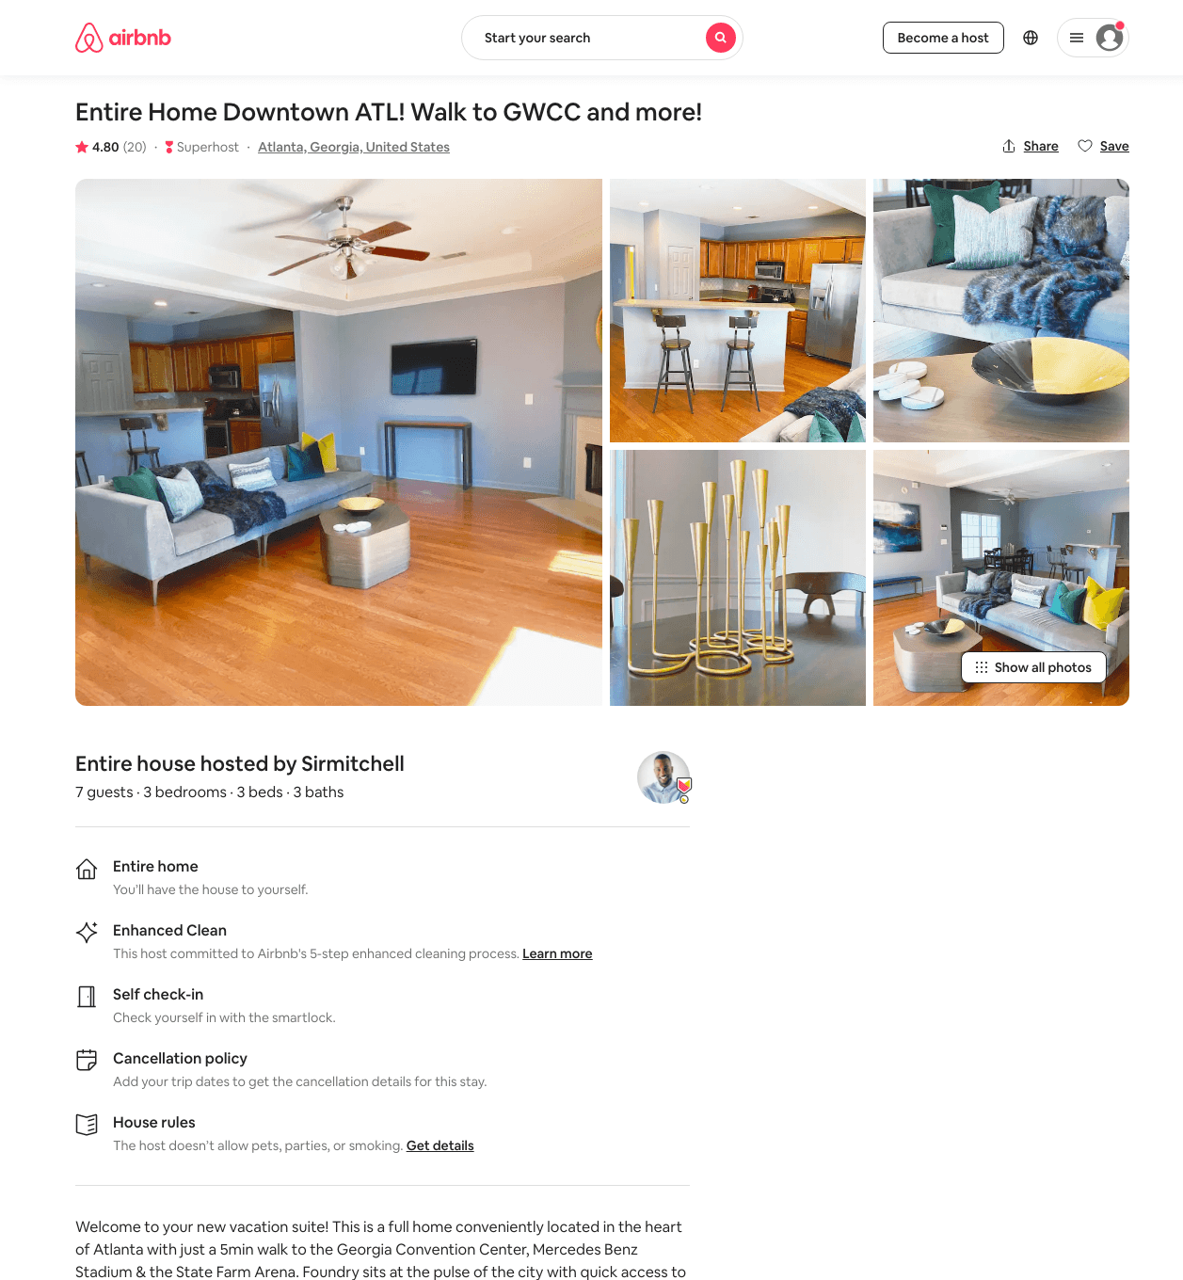
Listing 39773076
4
8
$143 - $286
4.82
3
Sirmitchell
98610696
1
https://www.airbnb.com/rooms/39773076
Aug 2022

Slide 37
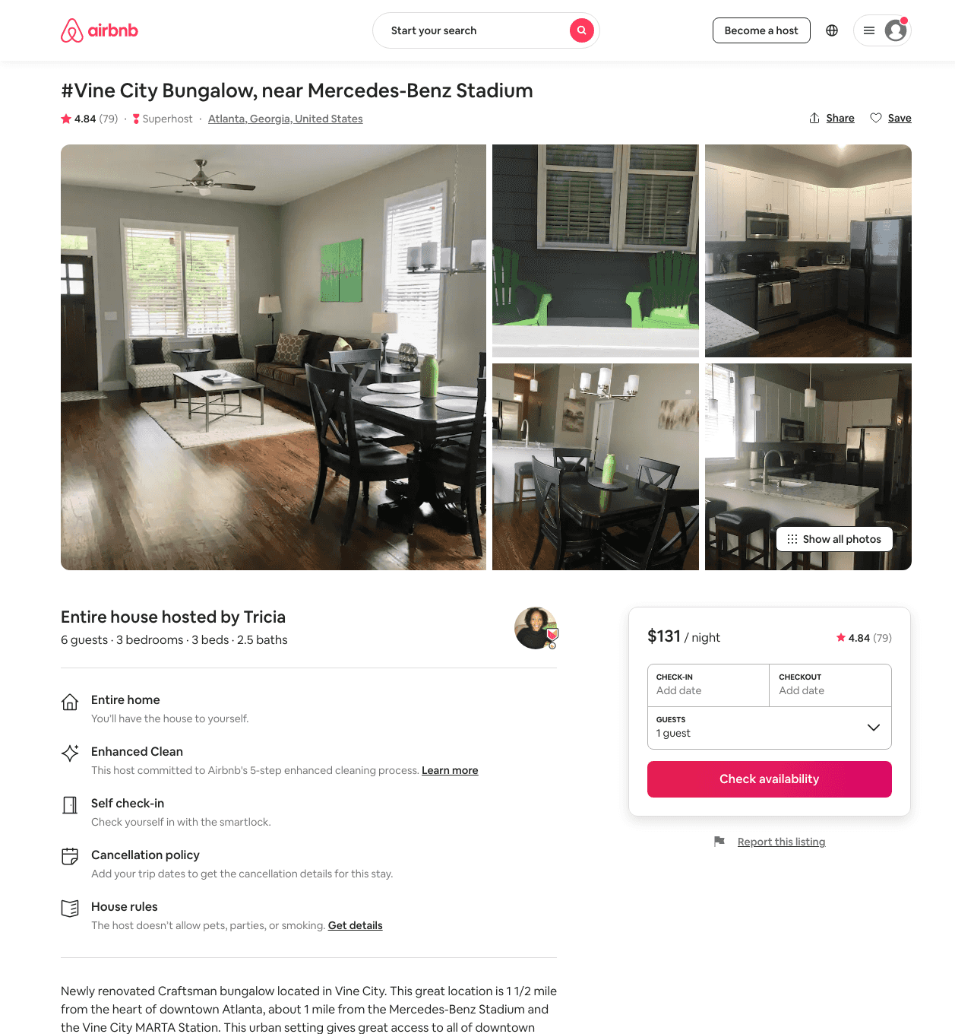
Listing 31281208
3
5
$131 - $183
4.85
2
Tricia
57874970
1
https://www.airbnb.com/rooms/31281208
Jun 2022

Slide 38
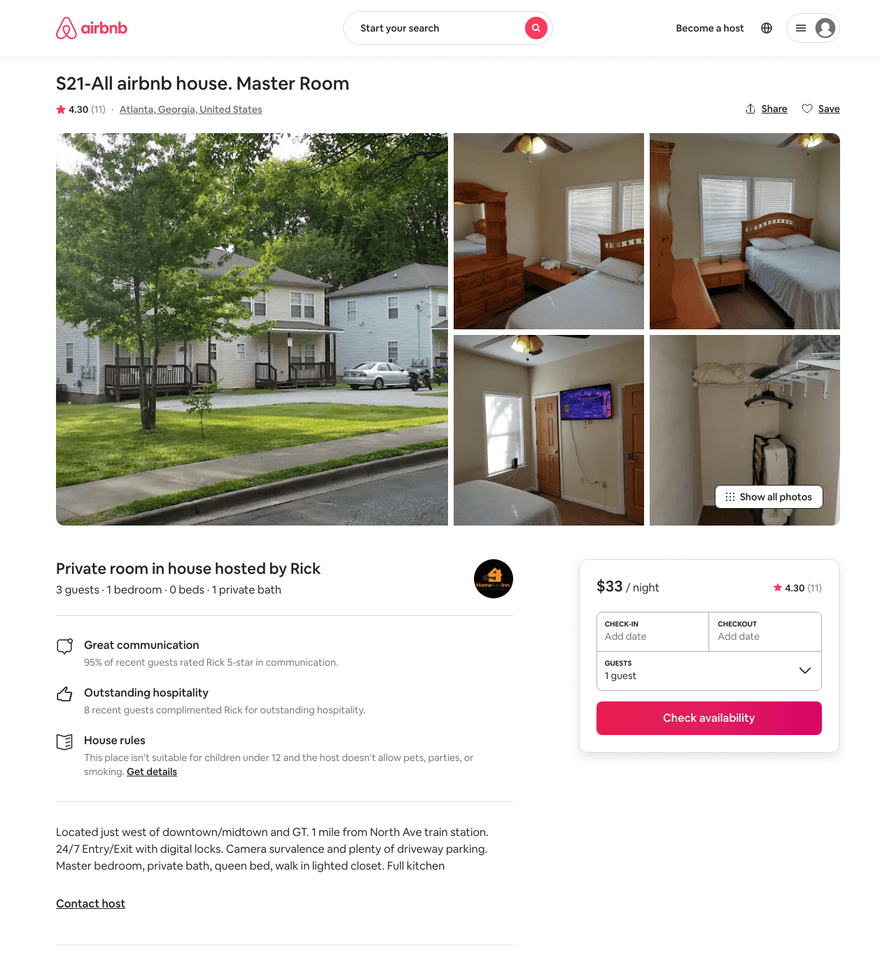
Listing 17701959
1
3
$33 - $34
4.16
2
Rick
42301069
34
https://www.airbnb.com/rooms/17701959
Aug 2022

Slide 39
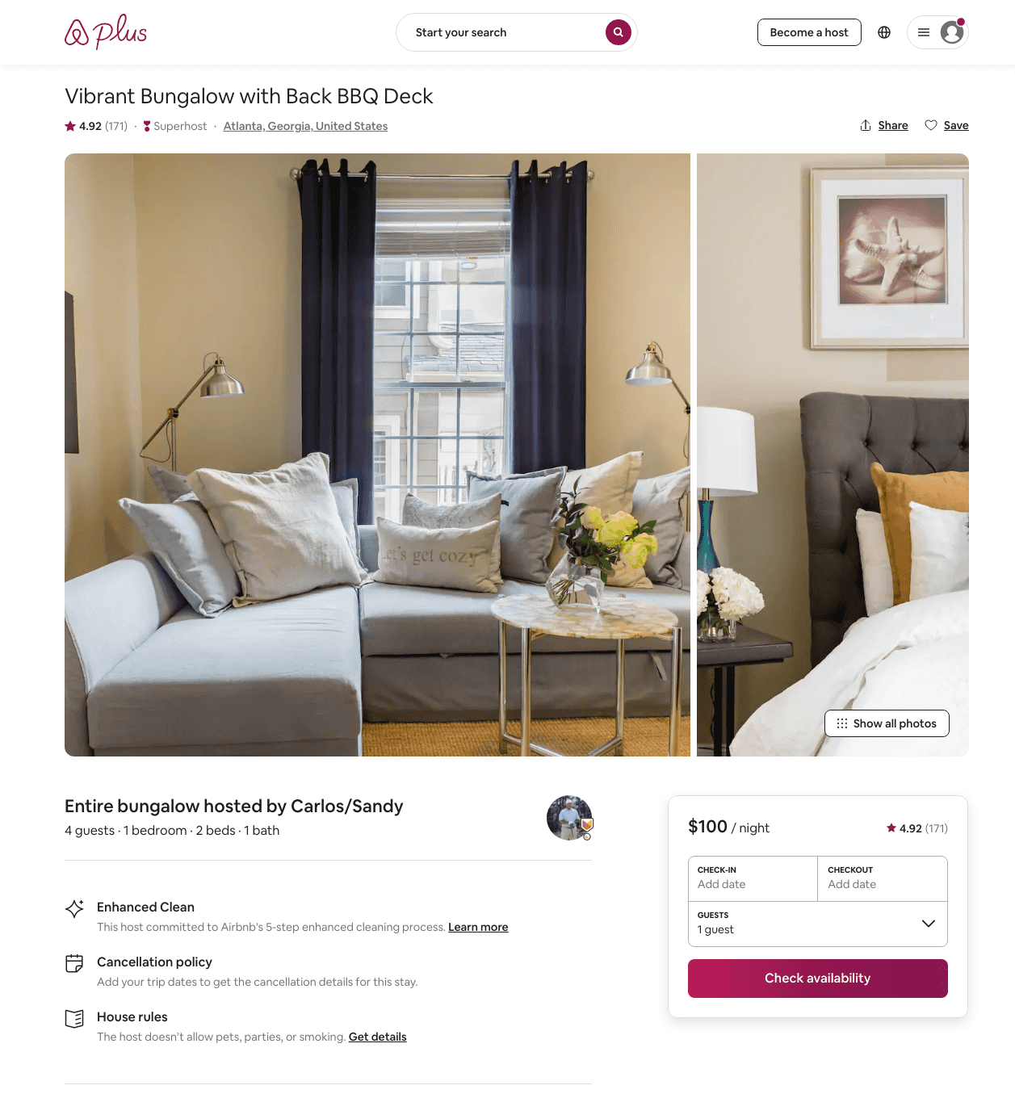
Listing 24430185
1
4
$101 - $150
4.92
2
Carlos/Sandy
184485946
1
https://www.airbnb.com/rooms/24430185
Aug 2022

Slide 40
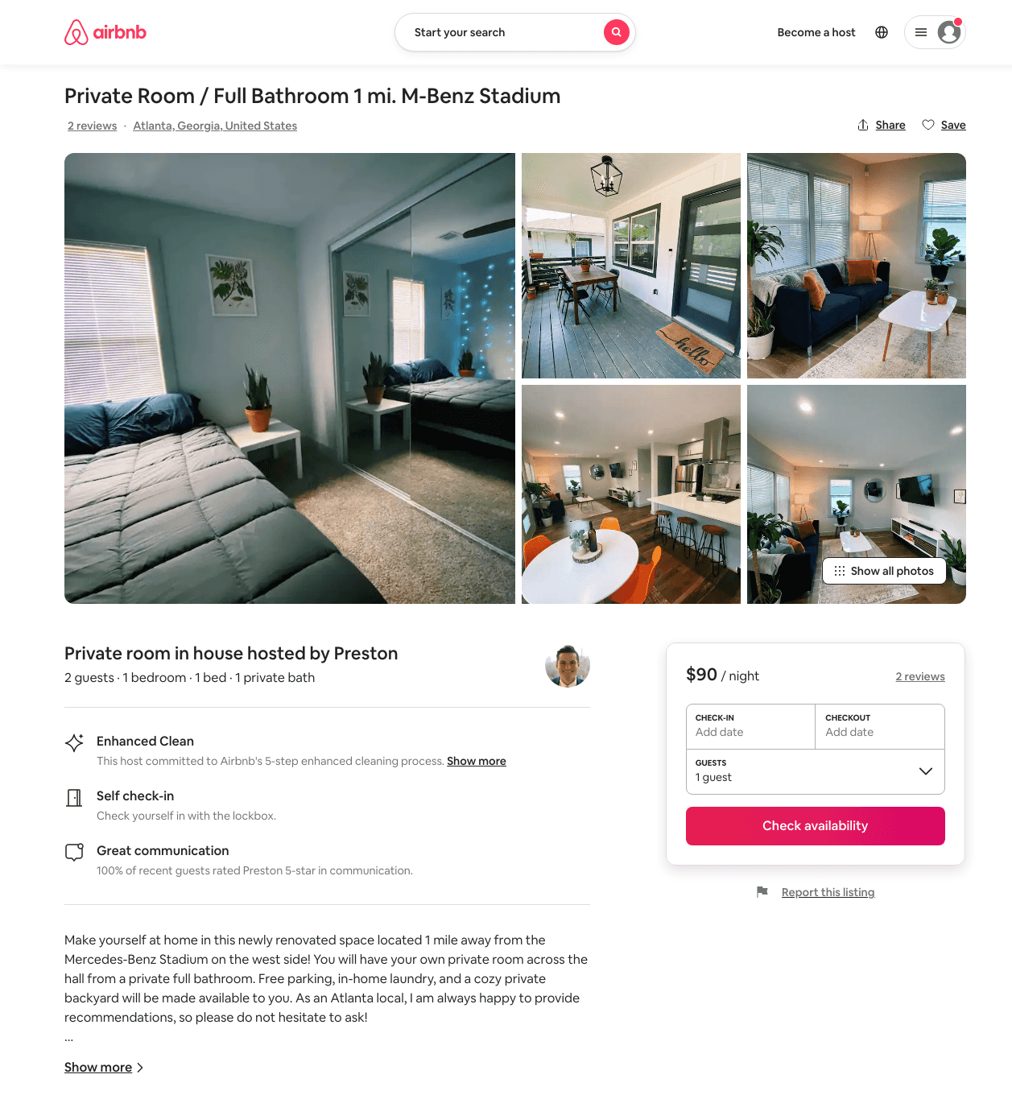
Listing 49875001
1
2
$61 - $94
4.96
1
Preston
61100897
2
https://www.airbnb.com/rooms/49875001
Aug 2022

Slide 41
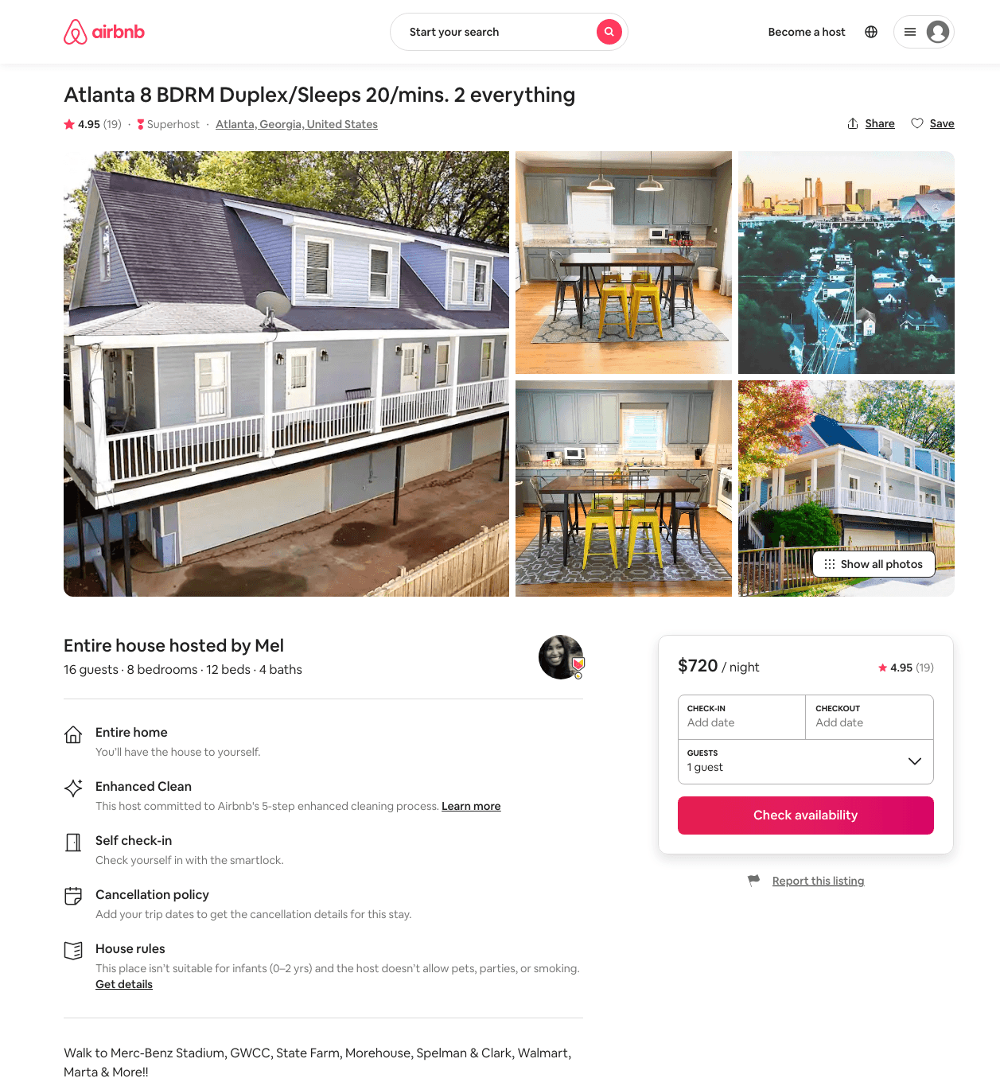
Listing 30065584
8
16
$720 - $839
4.84
2
Mel
8032275
4
https://www.airbnb.com/rooms/30065584
Aug 2022

Slide 42
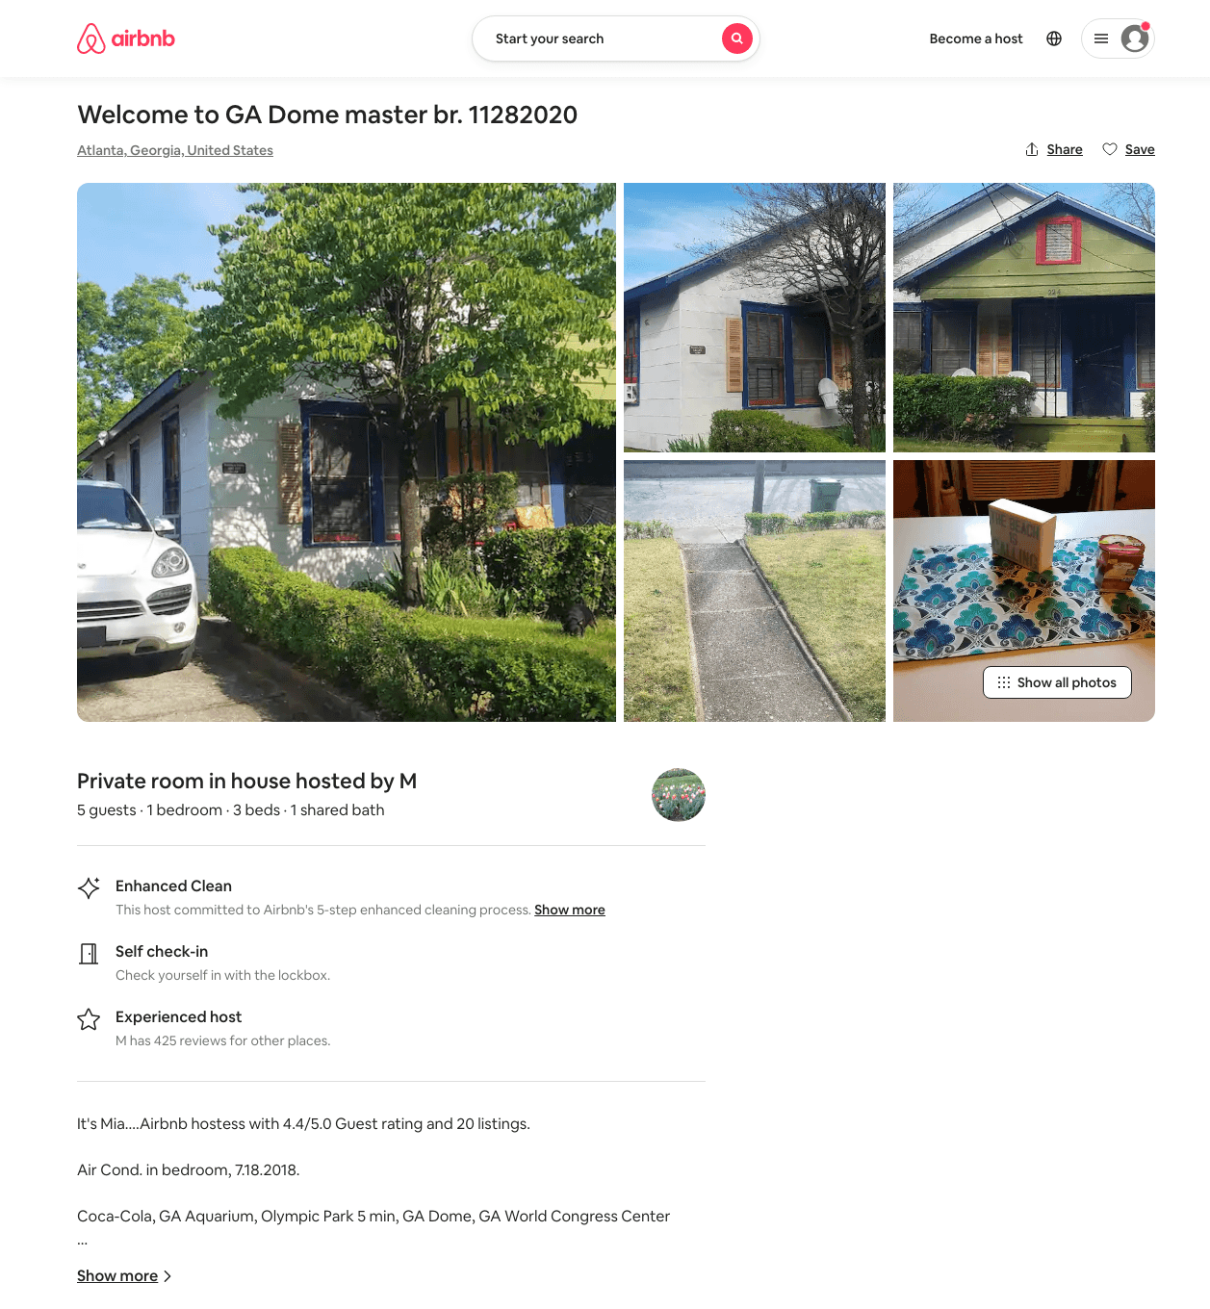
Listing 46694320
1
5
$35
5
M
28245434
13
https://www.airbnb.com/rooms/46694320
Jul 2022

Slide 43
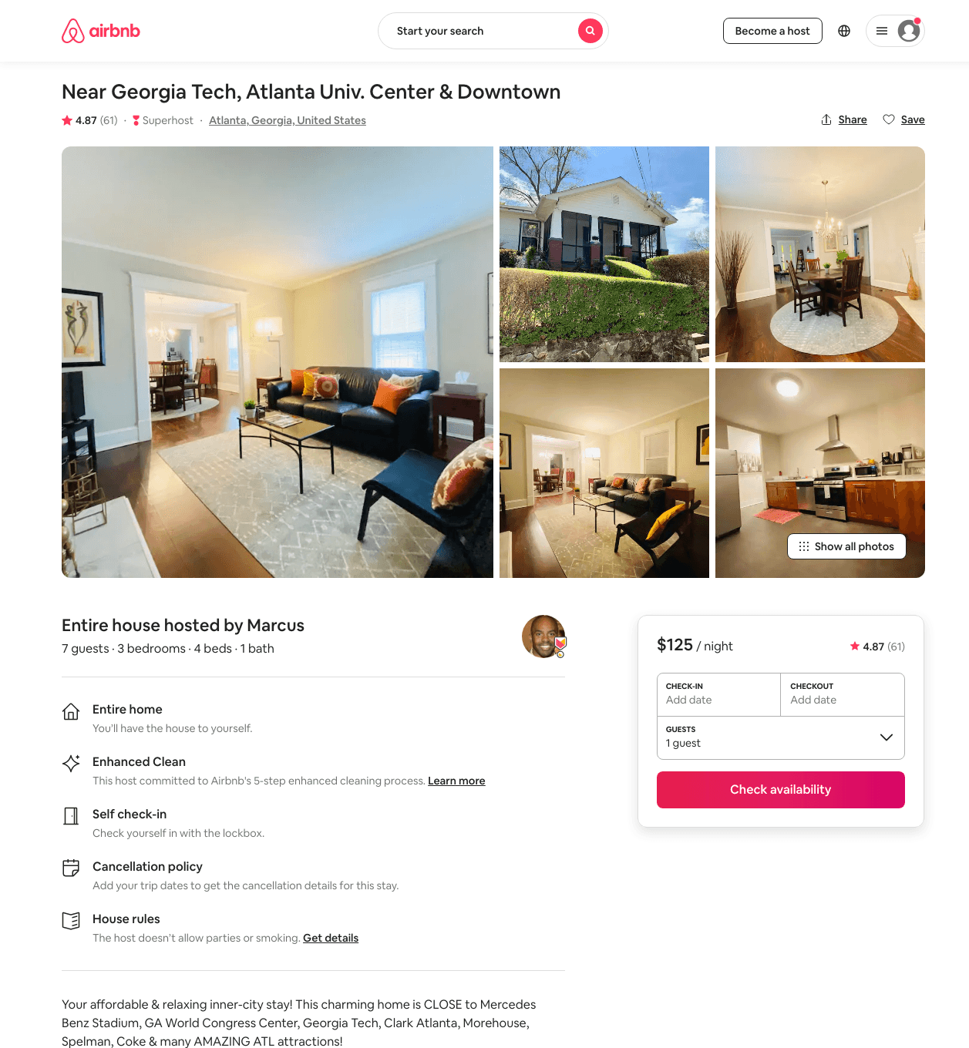
Listing 31859081
3
7
$127 - $234
4.82
2
Marcus
65468504
1
https://www.airbnb.com/rooms/31859081
Jun 2022

Slide 44
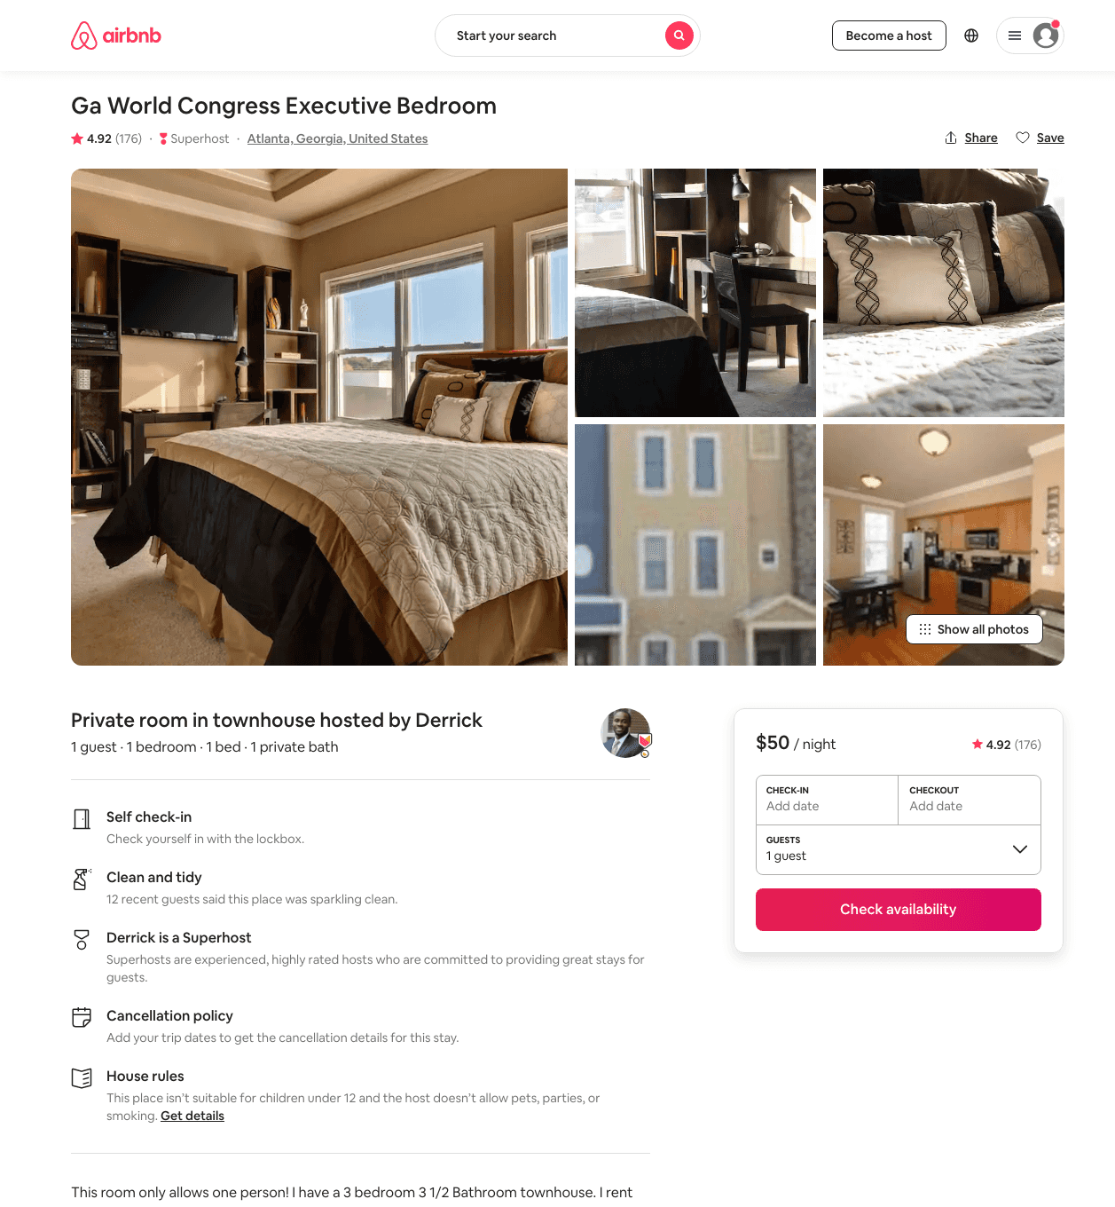
Listing 3949396
1
1
$49 - $86
4.91
3
Derrick
257889
5
https://www.airbnb.com/rooms/3949396
Aug 2022

Slide 45
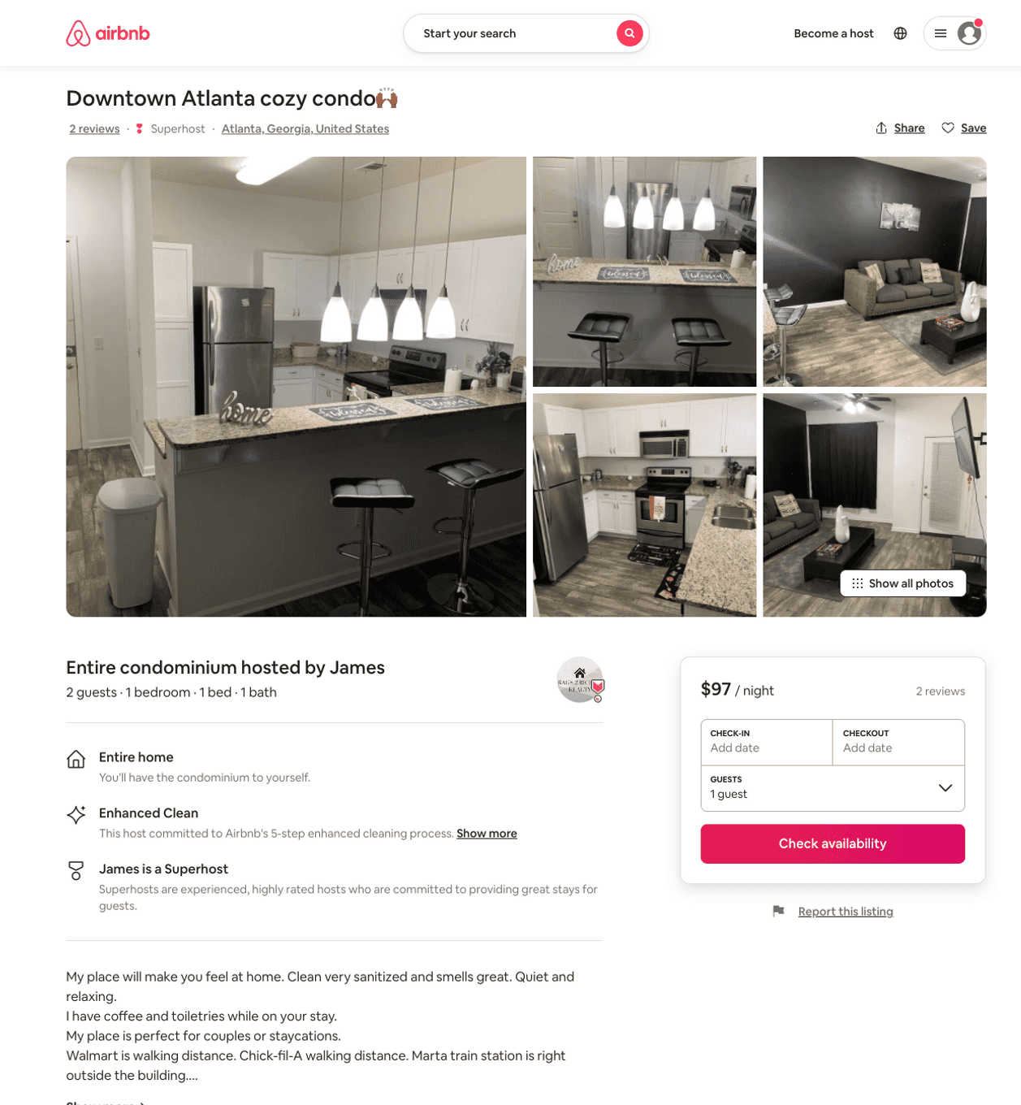
Listing 50799648
1
2
$56 - $101
4.32
1
James
156719496
1
https://www.airbnb.com/rooms/50799648
Aug 2022

Slide 46
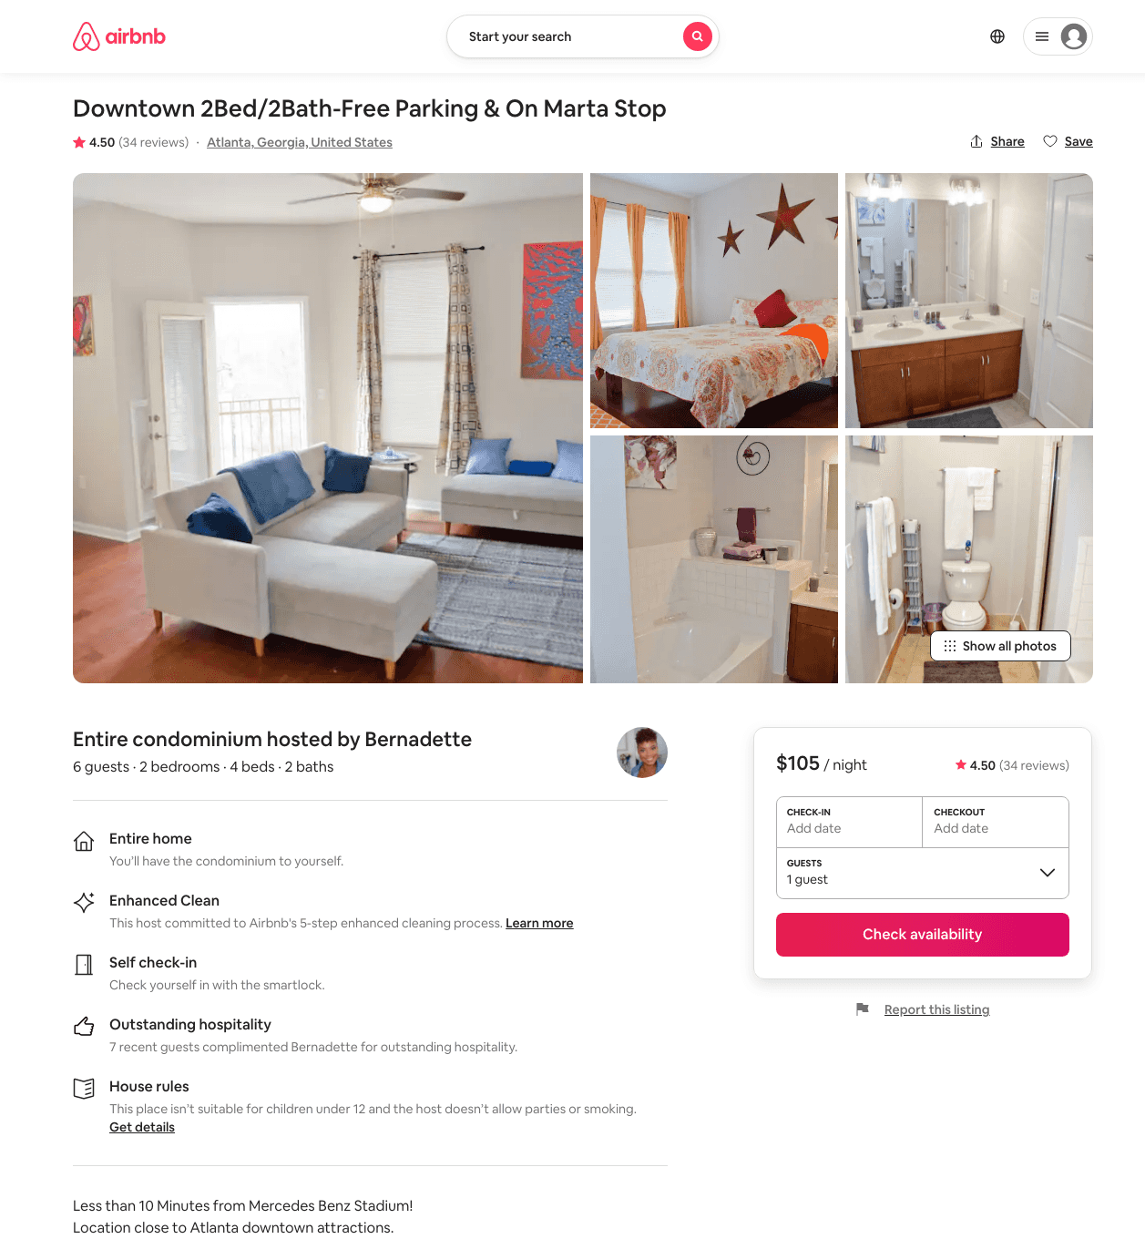
Listing 11790627
2
6
$81 - $118
4.54
2
Bernadette
47266451
2
https://www.airbnb.com/rooms/11790627
Aug 2022

Slide 47
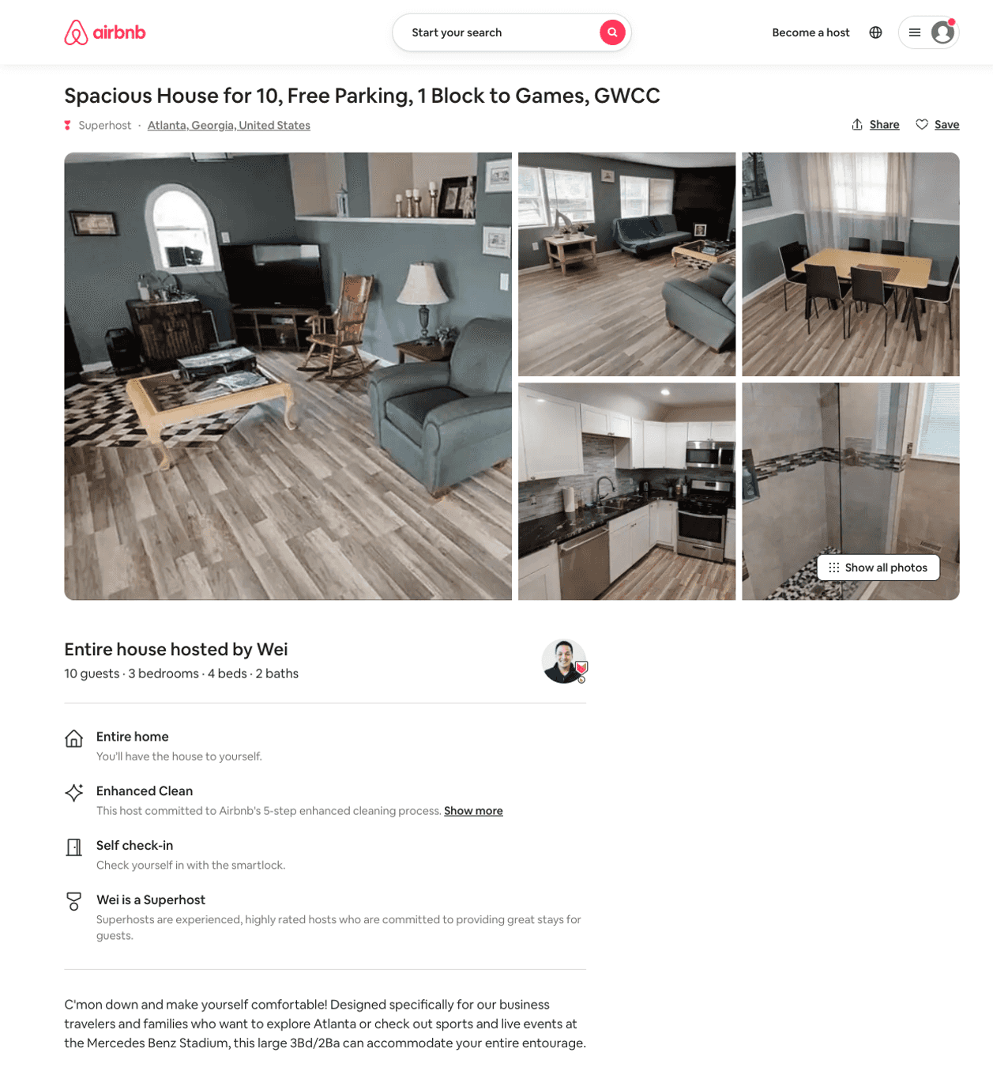
Listing 50770939
3
10
$163 - $380
4.83
2
Wei
6280569
3
https://www.airbnb.com/rooms/50770939
Aug 2022

Slide 48
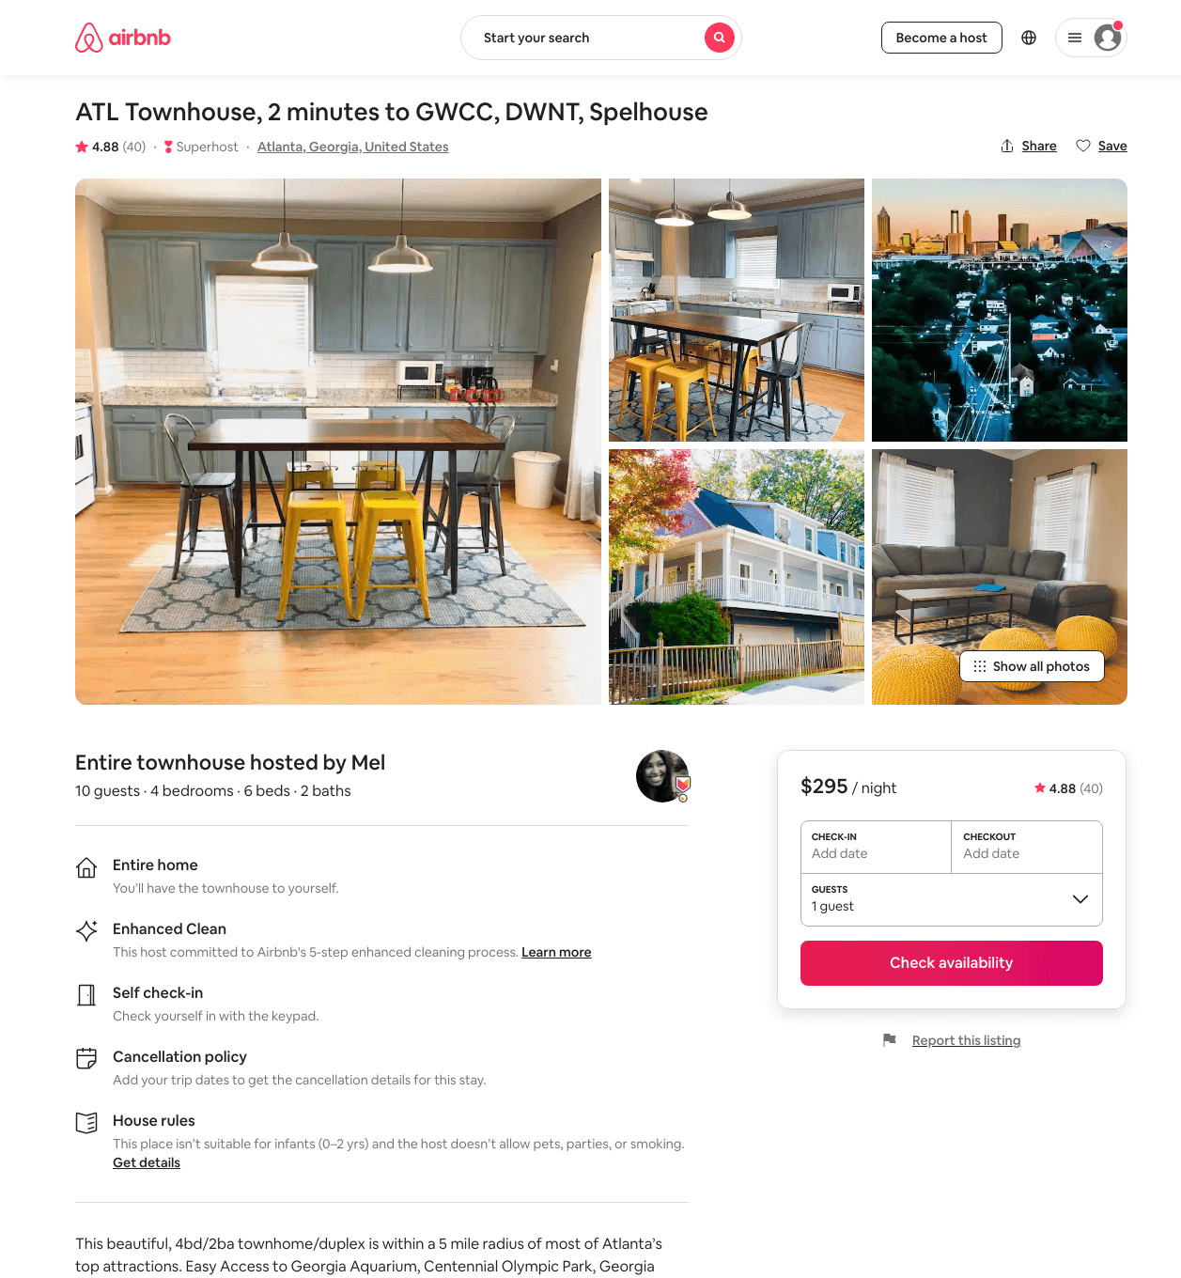
Listing 30268325
4
10
$268 - $329
4.90
2
Mel
8032275
4
https://www.airbnb.com/rooms/30268325
Aug 2022

Slide 49
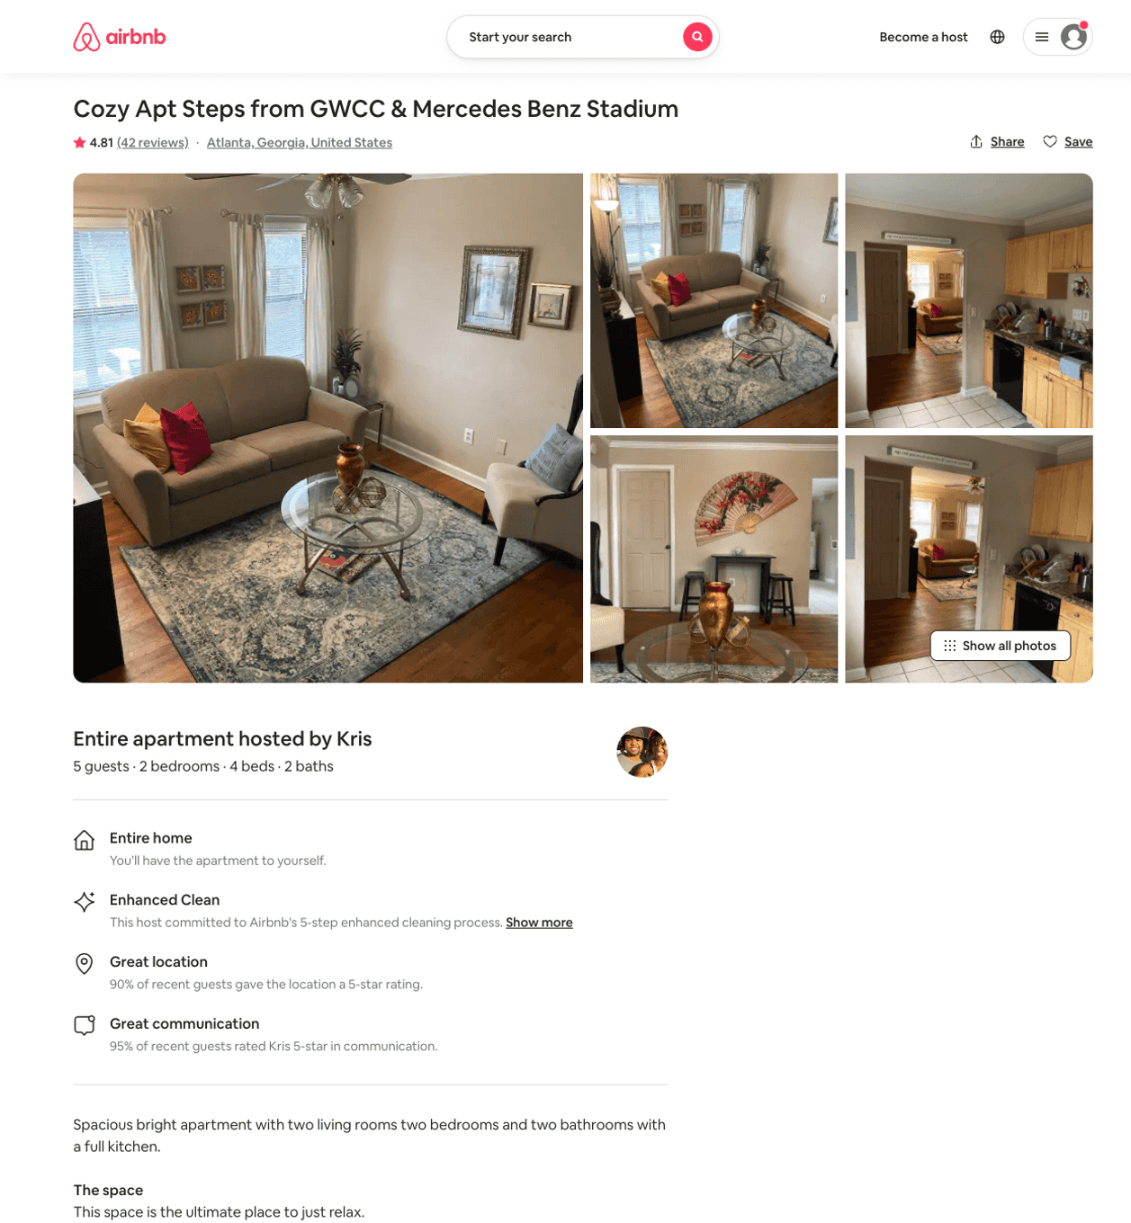
Listing 39107814
2
5
$85 - $94
4.71
3
Kris
8179855
1
https://www.airbnb.com/rooms/39107814
Aug 2022

Slide 50
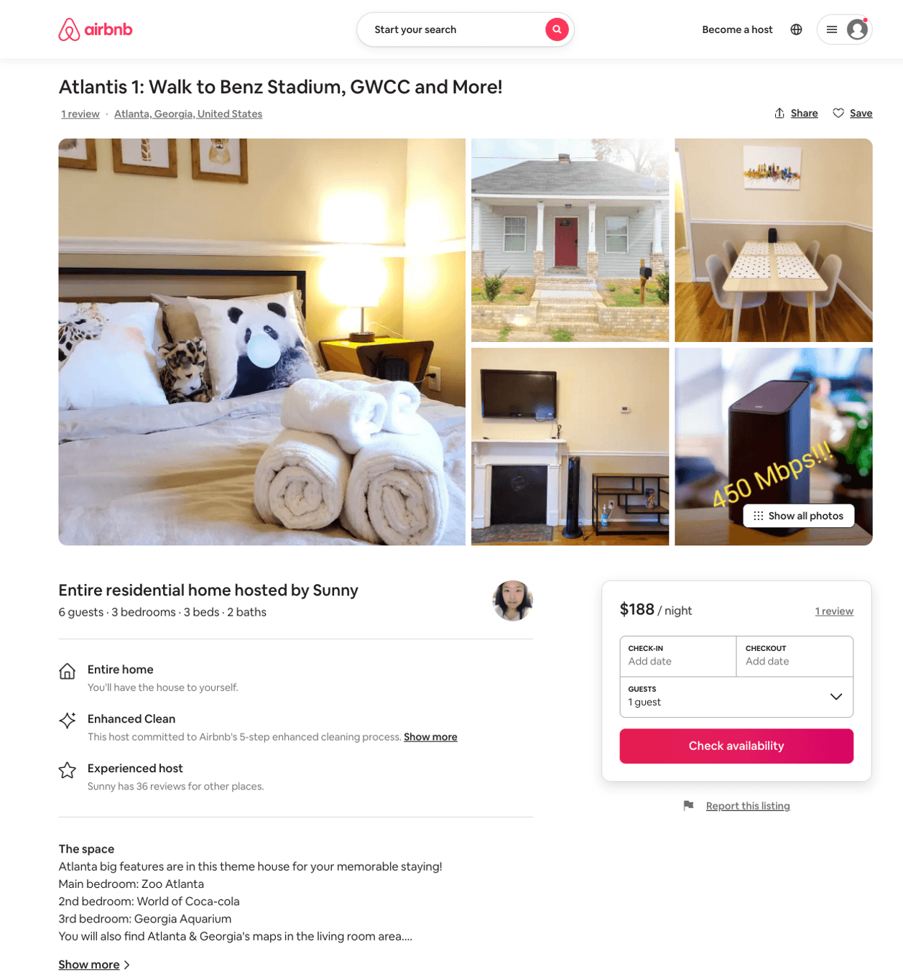
Listing 50467373
3
6
$130 - $208
4.71
2
Sunny
23579940
3
https://www.airbnb.com/rooms/50467373
Aug 2022

Slide 51
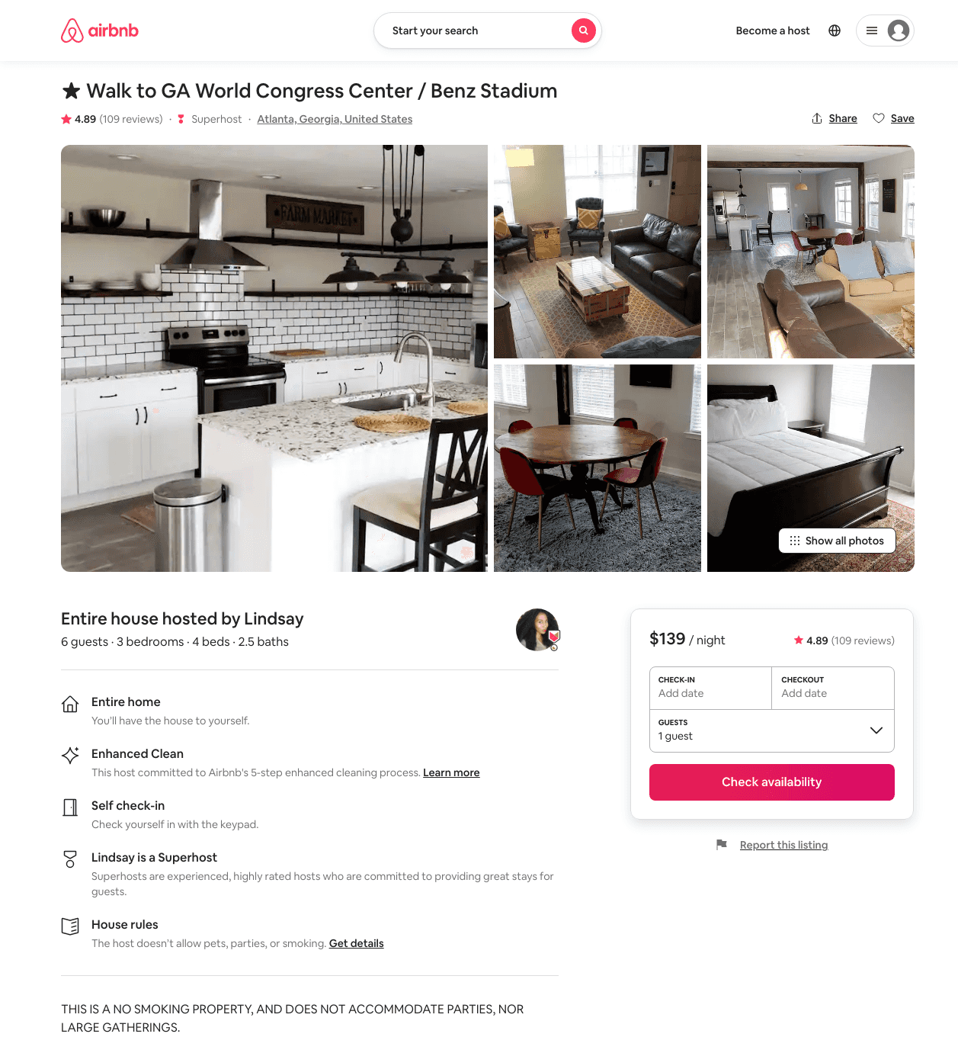
Listing 30659362
3
6
$114 - $225
4.88
2
Jesica
75276698
1
https://www.airbnb.com/rooms/30659362
Aug 2022

Slide 52
Listing 24358506
2
6
$350 - $750
4.63
1
Marcia
43035356
1
https://www.airbnb.com/rooms/24358506
Aug 2022

Slide 53
Listing 51395007
6
14
$176 - $370
4.87
1
Bryant
250716419
22
https://www.airbnb.com/rooms/51395007
Aug 2022

Slide 54
Listing 31704091
3
8
$107 - $384
4.72
2
Kianya
57131363
5
https://www.airbnb.com/rooms/31704091
Aug 2022

Slide 55
Listing 51712946
2
4
$108 - $162
4.57
2
Zacario
421165889
1
https://www.airbnb.com/rooms/51712946
Aug 2022

Slide 56
Listing 50900574
4
8
$159 - $485
4.44
2
Matt
150430543
4
https://www.airbnb.com/rooms/50900574
Aug 2022

Slide 57
Listing 27675135
2
6
$379
4.37
2
Nicole
55566707
2
https://www.airbnb.com/rooms/27675135
Jul 2022

Slide 58
Listing 31332311
2
5
$400
4.88
2
Nicole
55566707
2
https://www.airbnb.com/rooms/31332311
Jul 2022

Slide 59
Listing 31894713
3
6
$325
5.0
3
Jennifer
27923389
1
https://www.airbnb.com/rooms/31894713
Aug 2022

Slide 60
Listing 42086897
2
5
$175
4.89
2
Mason
294442716
1
https://www.airbnb.com/rooms/42086897
Jun 2022

Slide 61
Listing 47729696
2
2
$110 - $175
5.0
3
Michael
384544255
1
https://www.airbnb.com/rooms/47729696
Aug 2022

Slide 62
Listing 52586629
3
8
$161 - $259
4.43
3
Mayu
216565735
11
https://www.airbnb.com/rooms/52586629
Aug 2022

Slide 63
Listing 52680926
3
9
$138 - $277
4.59
3
Mayu
216565735
11
https://www.airbnb.com/rooms/52680926
Aug 2022

Slide 64
Listing 52633675
1
2
$49 - $52
4.94
4
C.
426065783
1
https://www.airbnb.com/rooms/52633675
Aug 2022

Slide 65
Listing 52790275
3
6
$163 - $212
4.33
2
Evolve
121682456
51
https://www.airbnb.com/rooms/52790275
Aug 2022

Slide 66
Listing 52518100
2
5
$150 - $204
5.0
2
Lucinda
234314706
4
https://www.airbnb.com/rooms/52518100
Aug 2022

Slide 67
Listing 52844036
2
4
$90 - $129
4.92
2
Walter
69381537
1
https://www.airbnb.com/rooms/52844036
Aug 2022

Slide 68
Listing 39780720
1
4
$75 - $81
4.94
2
Heather
140210789
1
https://www.airbnb.com/rooms/39780720
Aug 2022

Slide 69
Listing 53217897
4
8
$298
4.97
2
Arturo
326356295
1
https://www.airbnb.com/rooms/53217897
Aug 2022

Slide 70
Listing 53112403
2
6
$121
4.60
1
Anniece
349645019
1
https://www.airbnb.com/rooms/53112403
Aug 2022

Slide 71
Listing 53662811
3
10
$286 - $352
28
Mayu
216565735
11
https://www.airbnb.com/rooms/53662811
Aug 2022

Slide 72
Listing 53641466
3
10
$145 - $155
4.50
2
Bryant
250716419
22
https://www.airbnb.com/rooms/53641466
Aug 2022

Slide 73
Listing 8163298
1
2
$42 - $49
4.79
3
Lisa
570732
1
https://www.airbnb.com/rooms/8163298
Jul 2022

Slide 74
Listing 53973690
3
6
$208 - $254
4.62
2
George
419190394
2
https://www.airbnb.com/rooms/53973690
Jun 2022

Slide 75
Listing 54029936
3
6
$200 - $250
4.64
2
George
419190394
2
https://www.airbnb.com/rooms/54029936
Jun 2022

Slide 76
Listing 2625514
3
6
$233
4
2
George Ngwang
https://www.vrbo.com/2625514
Aug 2022

Slide 77
Listing 2626978
3
6
$115
5
31
George Ngwang
https://www.vrbo.com/2626978
Aug 2022

Slide 78
Listing 2635445
3
10
$283
1
Angela
https://www.vrbo.com/2635445
Aug 2022

Slide 79
Listing 54358349
4
9
$252
5.0
3
Kelly
66967737
1
https://www.airbnb.com/rooms/54358349
Aug 2022

Slide 80
Listing dp-location-location-stunning-2bd-47-2bath-heart-of-downtown-atlanta
undefined
5
8.8
https://www.booking.com/hotel/us/dp-location-location-stunning-2bd-47-2bath-heart-of-downtown-atlanta.html
Sep 2022

Slide 81
Listing 2638024
1
4
$141
5
2
Host
https://www.vrbo.com/2638024
Aug 2022

Slide 82
Listing 2583150
3
10
$206
1
1
https://www.vrbo.com/2583150
Aug 2022

Slide 83
Listing 2684420
2
28
$114
2
Paula Johnson
https://www.vrbo.com/2684420
Aug 2022

Slide 84
Listing 2696553
2
4
$101
2
https://www.vrbo.com/2696553
Aug 2022

Slide 85
Listing 47861456
2
5
$125 - $165
4.88
2
Wilma-Ann
212549212
2
https://www.airbnb.com/rooms/47861456
Aug 2022

Slide 86
Listing 2789815
0
6
$200
5
2
https://www.vrbo.com/2789815
Aug 2022

Slide 87
Listing 2791858
3
7
$219
4.5
1
Maria McNiece
https://www.vrbo.com/2791858
Aug 2022

Slide 88
Listing 2842401
2
4
$150
5
2
https://www.vrbo.com/2842401
Aug 2022

Slide 89
Listing 19139538
1
2
$70
1
Carlita
106089188
1
https://www.airbnb.com/rooms/19139538
Aug 2022

Slide 90
Listing 31862082
3
6
5
Kitanya
88226862
1
https://www.airbnb.com/rooms/31862082
Aug 2022

Slide 91
Listing 639786778825893800
4
9
4.83
3
Matt
150430543
4
https://www.airbnb.com/rooms/639786778825893800
Aug 2022

Slide 92
Listing 43527705
1
4
5.0
3
John
87508166
3
https://www.airbnb.com/rooms/43527705
Aug 2022

Slide 93
Listing 53142798
2
5
2
EasyLiving
100725352
1
https://www.airbnb.com/rooms/53142798
Aug 2022

Slide 94
Listing 2943477
4
9
$268
2
Matt Harrison
https://www.vrbo.com/2943477
Aug 2022

Slide 95
Listing 2955324
3
6
$135
2
https://www.vrbo.com/2955324
Aug 2022

