Slide 2
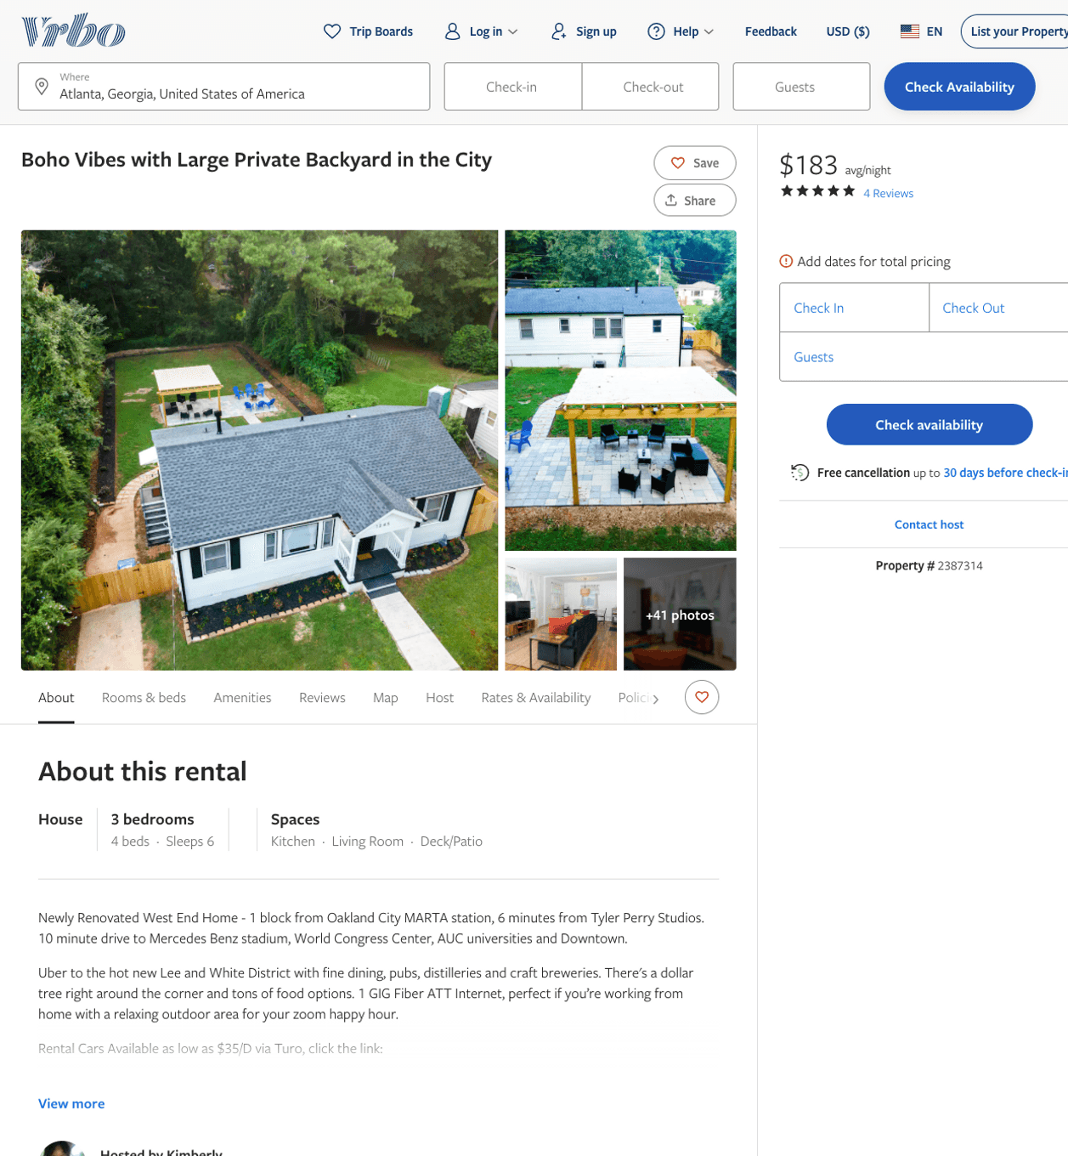
Listing 2387314
3
6
$156 - $194
4.6666665
2
Kimberly
https://www.vrbo.com/2387314
Aug 2022

Slide 3
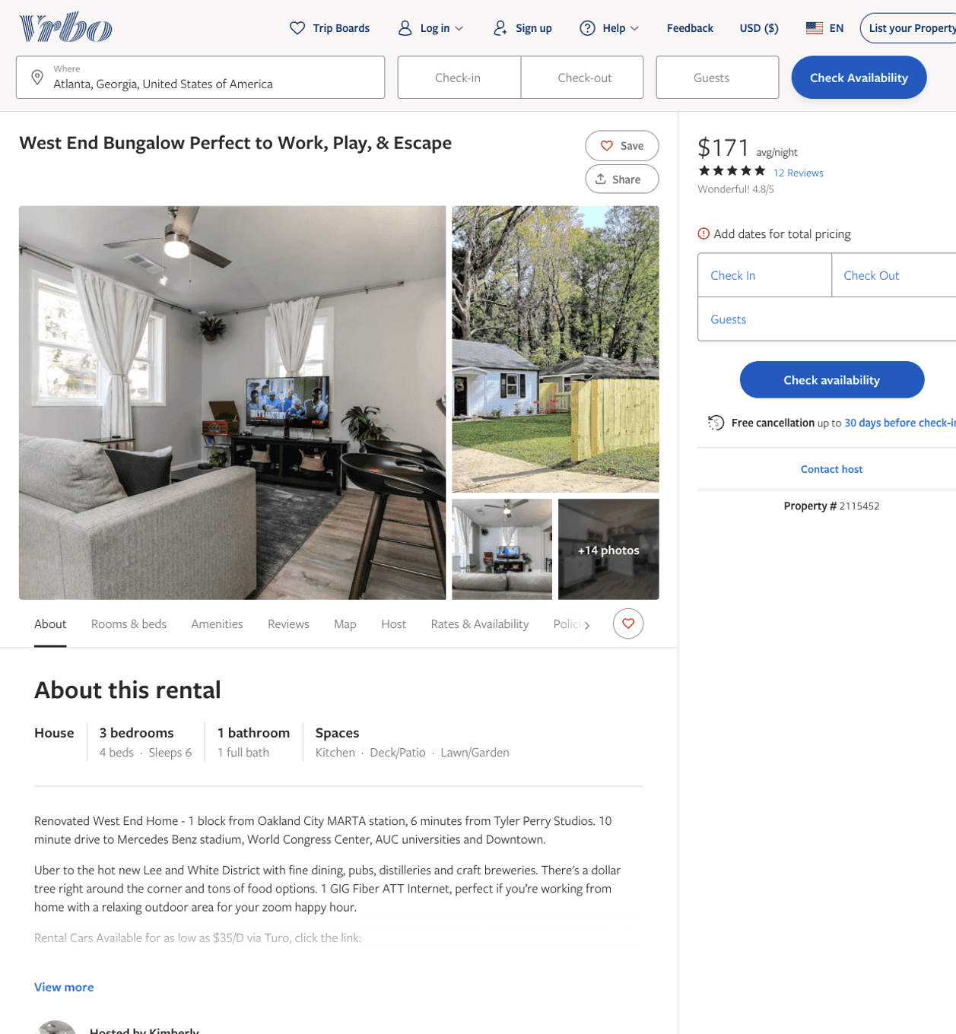
Listing 2115452
3
6
$149 - $182
2
Kimberly
https://www.vrbo.com/2115452
Aug 2022

Slide 4
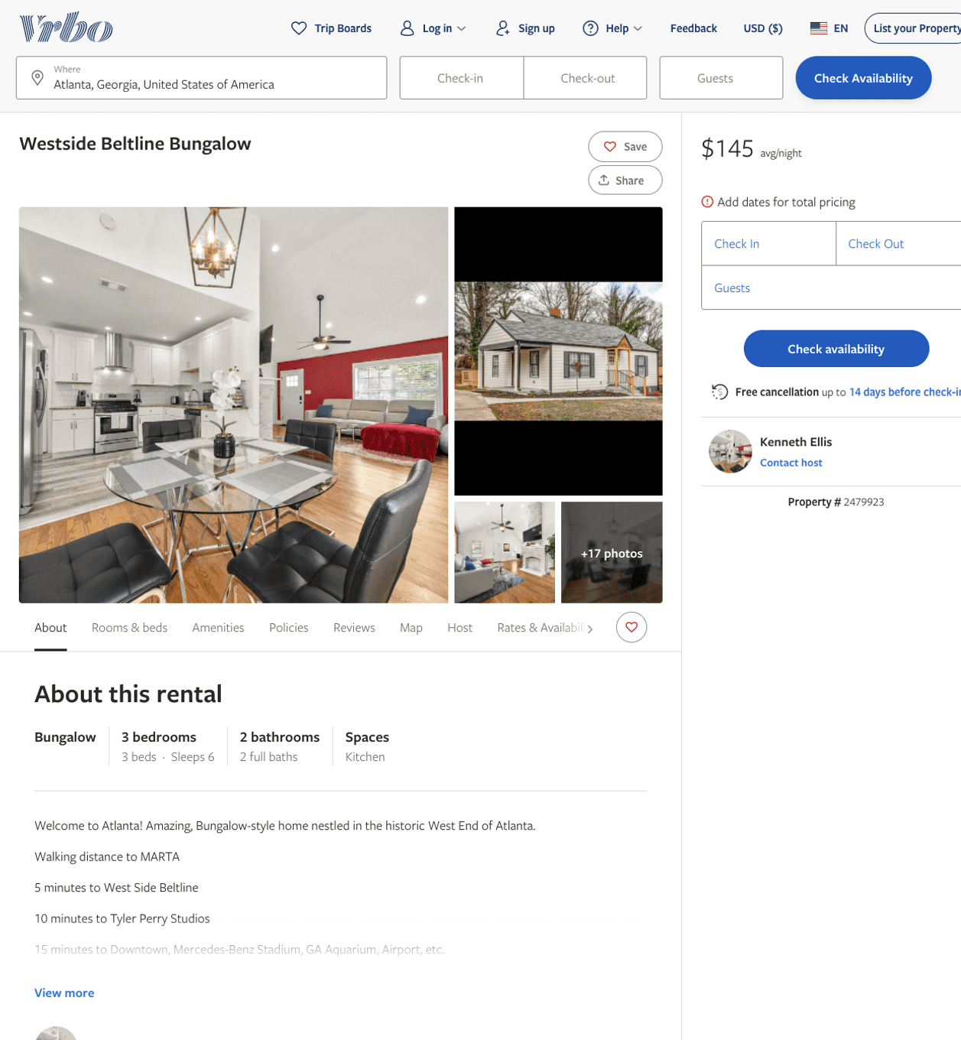
Listing 2479923
3
6
$123 - $149
4.5
1
Kenneth Ellis
https://www.vrbo.com/2479923
Aug 2022

Slide 5
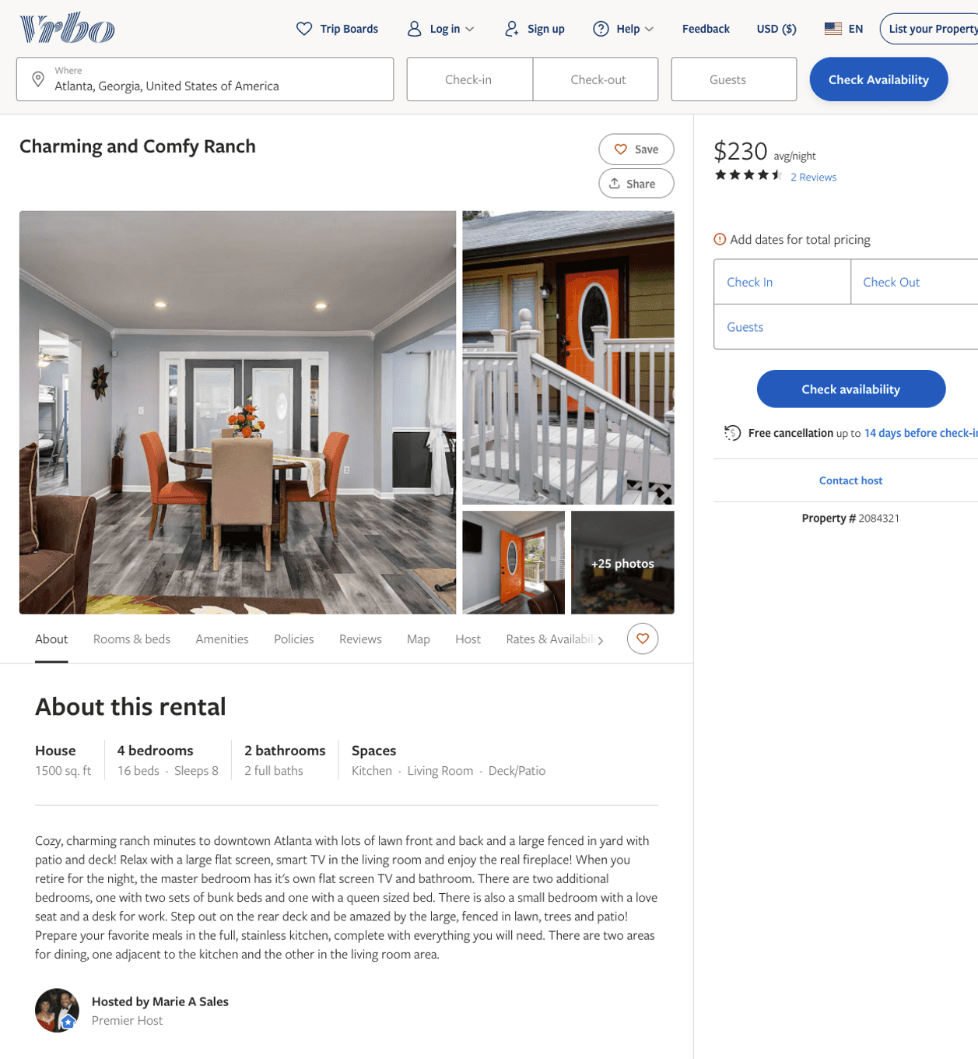
Listing 2084321
3
8
$174 - $240
4.6
3
Marie A Sales
https://www.vrbo.com/2084321
Aug 2022

Slide 6
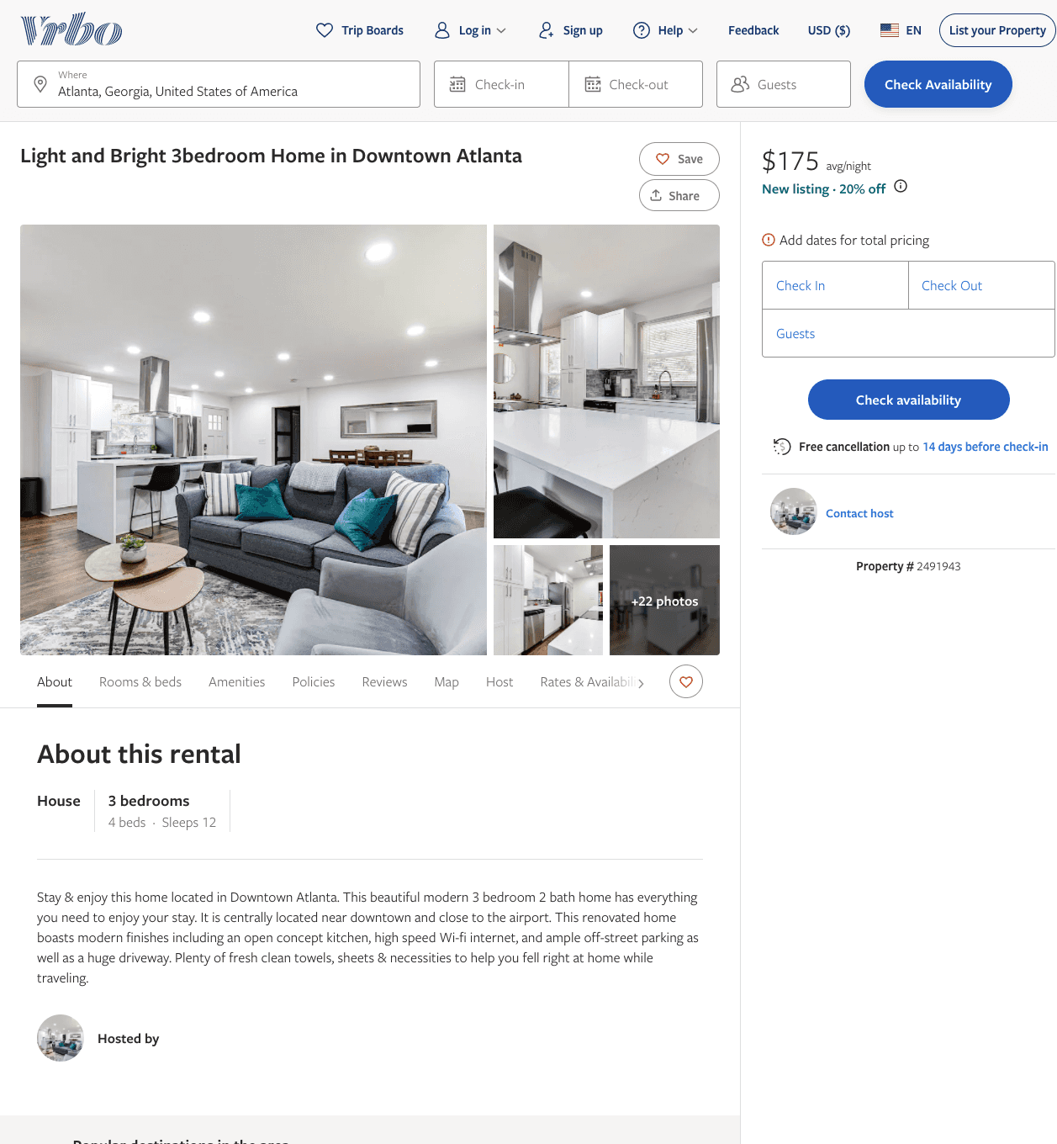
Listing 2491943
3
12
$140 - $175
2
Desire Pirkle
https://www.vrbo.com/2491943
Aug 2022

Slide 7
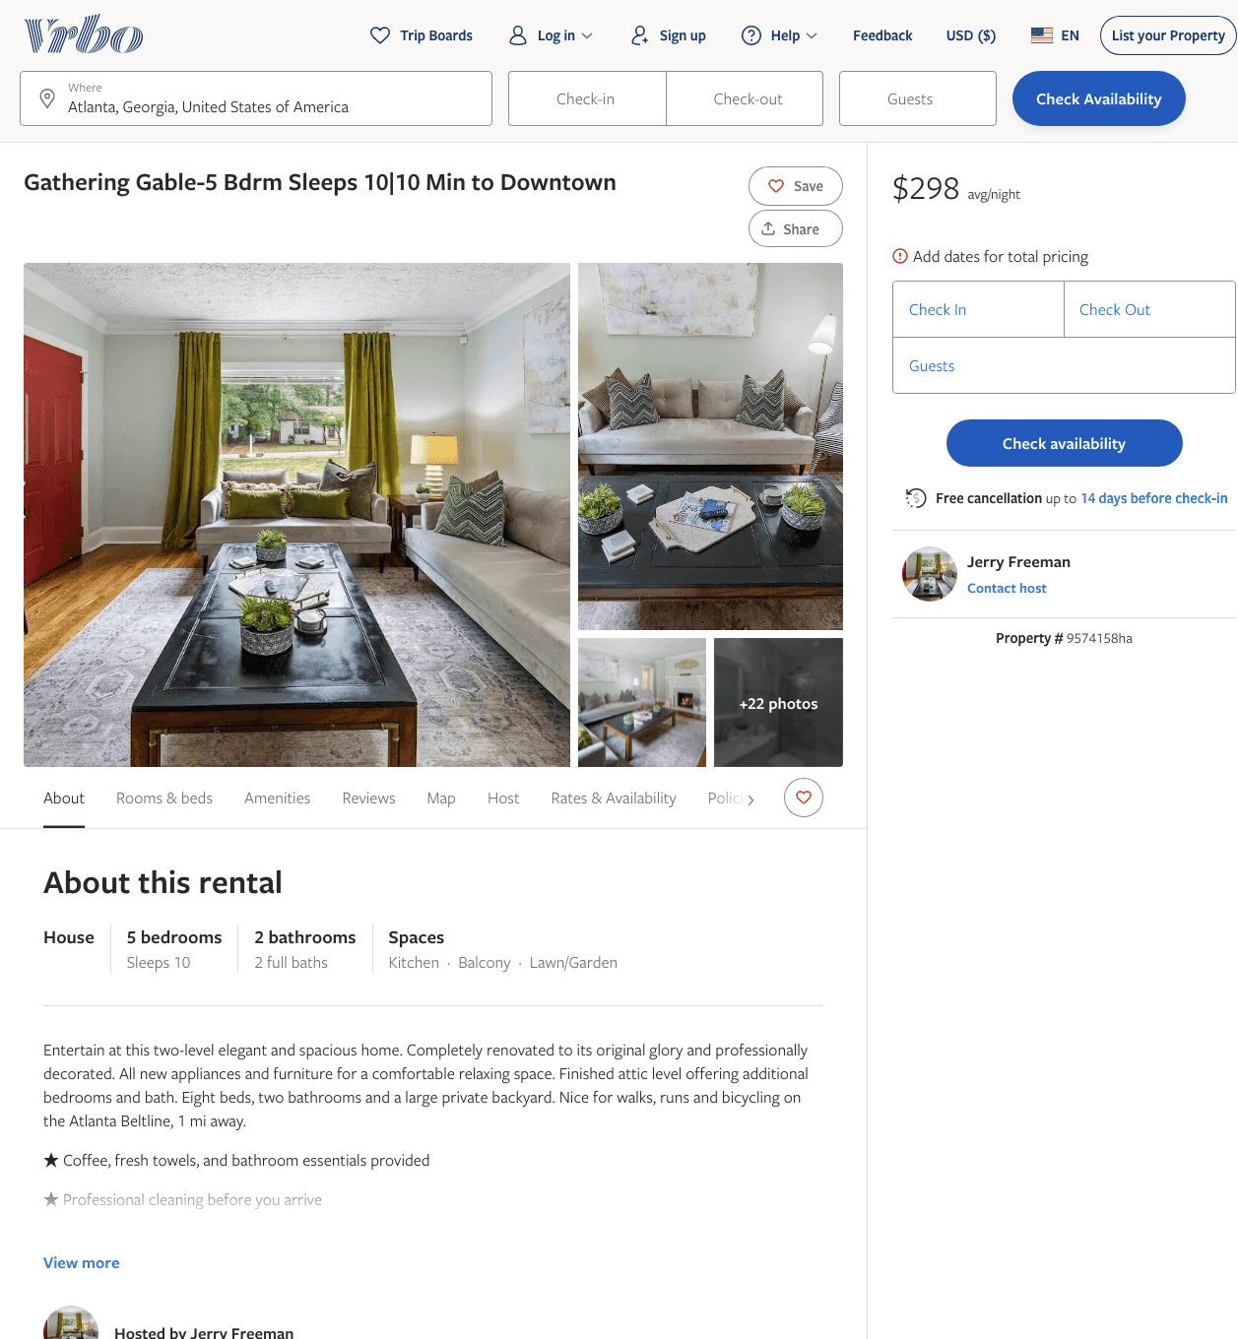
Listing 9574158
5
10
$277 - $346
2
Emily
https://www.vrbo.com/9574158ha
Aug 2022

Slide 8
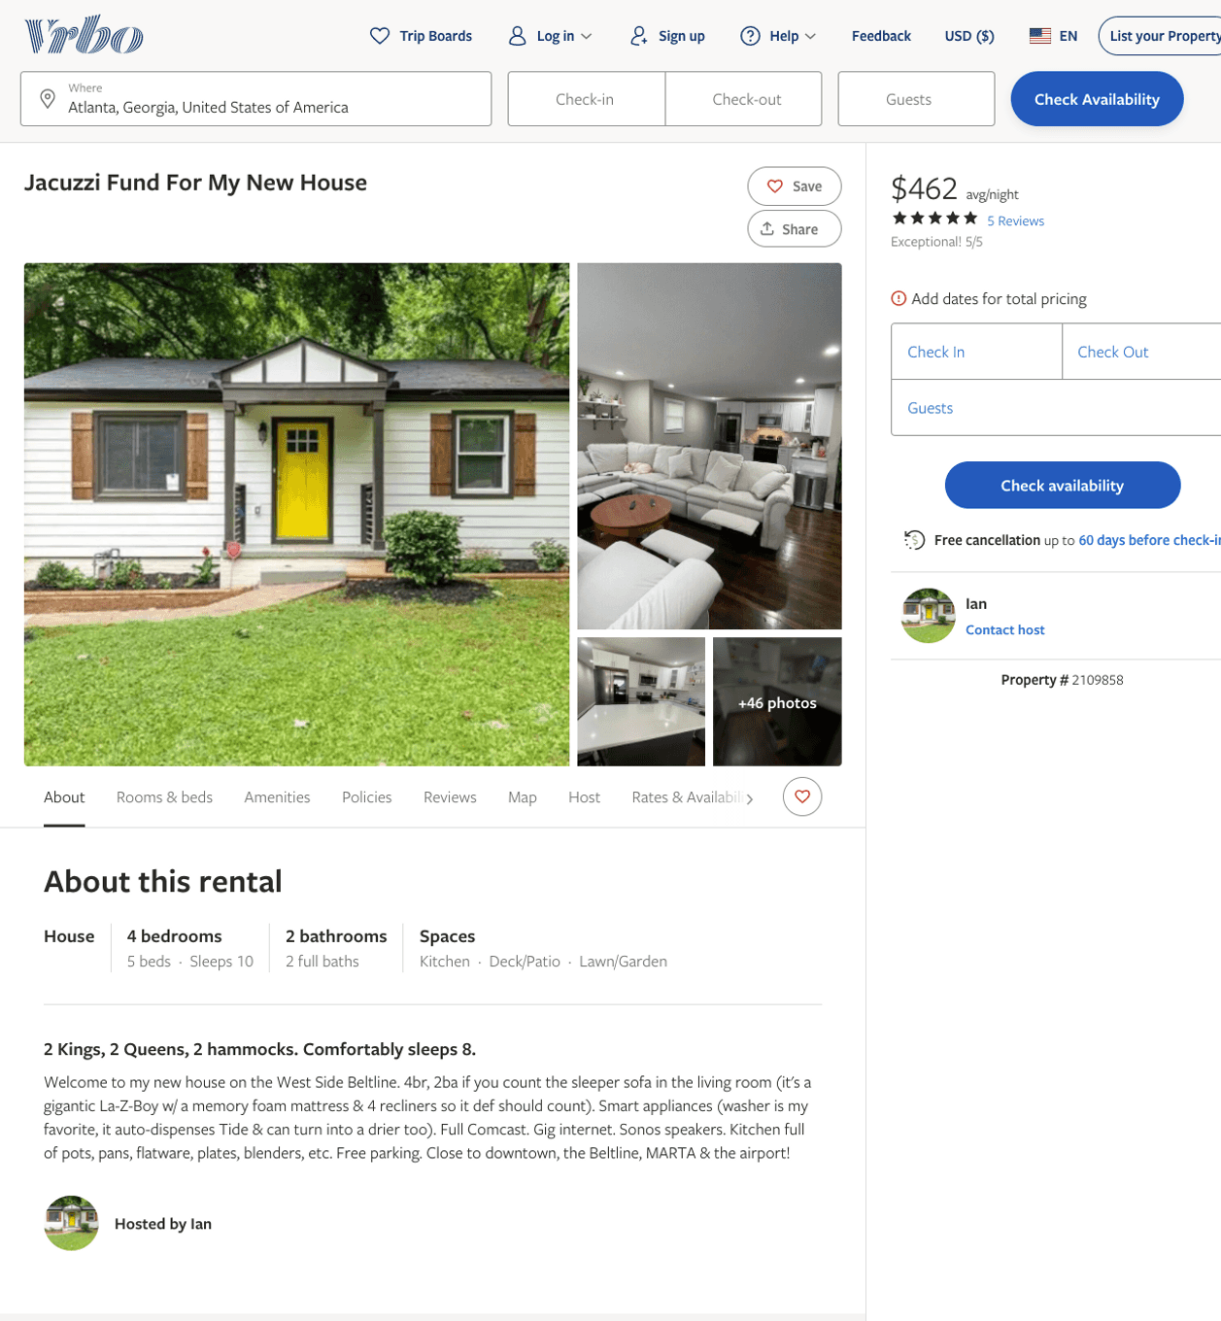
Listing 2109858
4
10
$206 - $472
4.428571
2
Ian
https://www.vrbo.com/2109858
Aug 2022

Slide 9
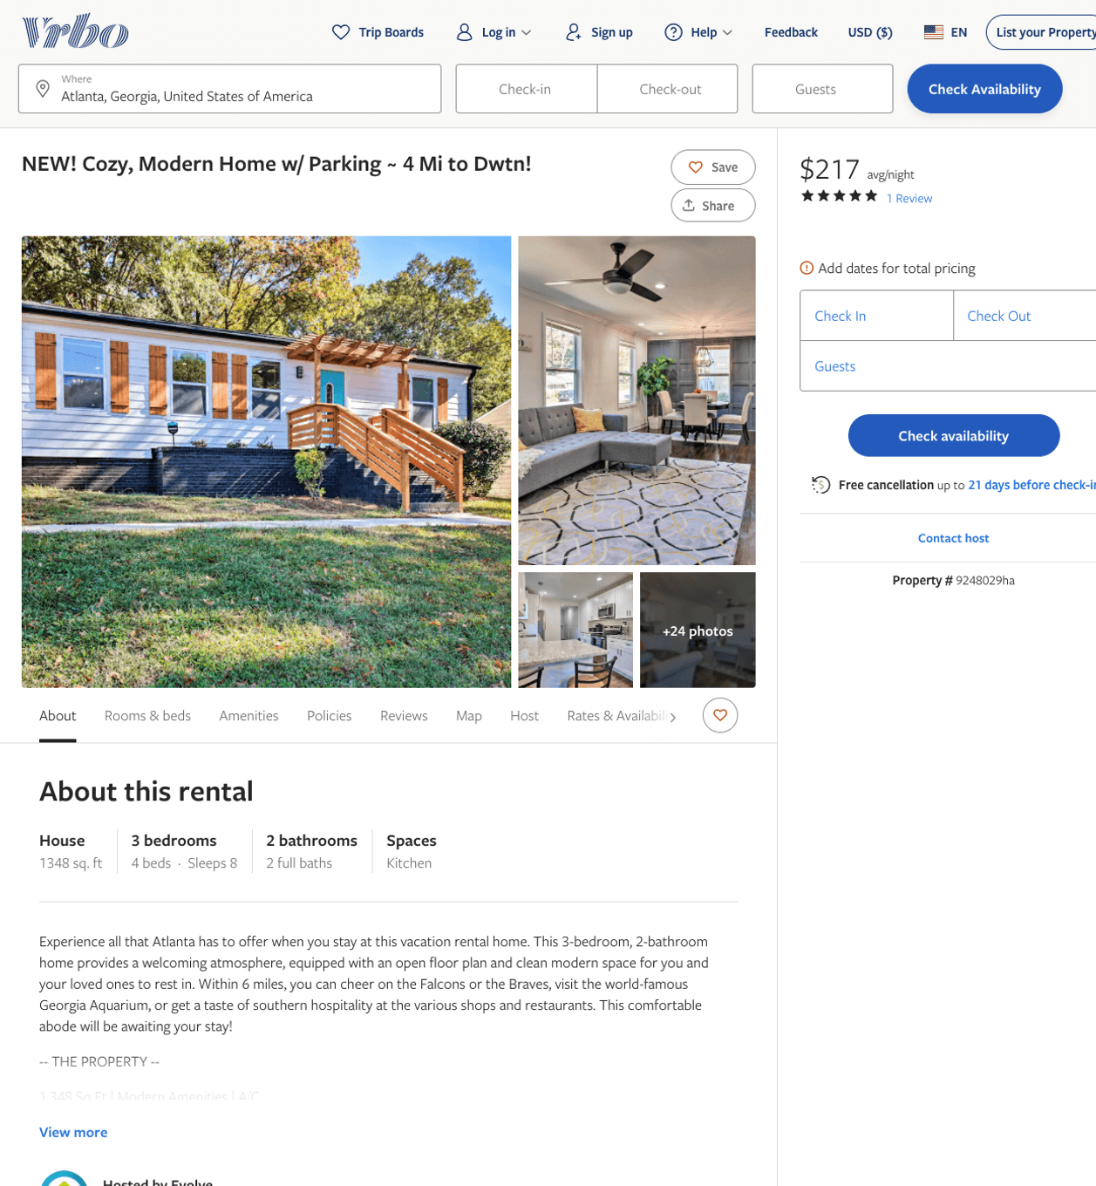
Listing 9248029
3
8
$151 - $218
5
2
Evolve
https://www.vrbo.com/9248029ha
Aug 2022

Slide 10
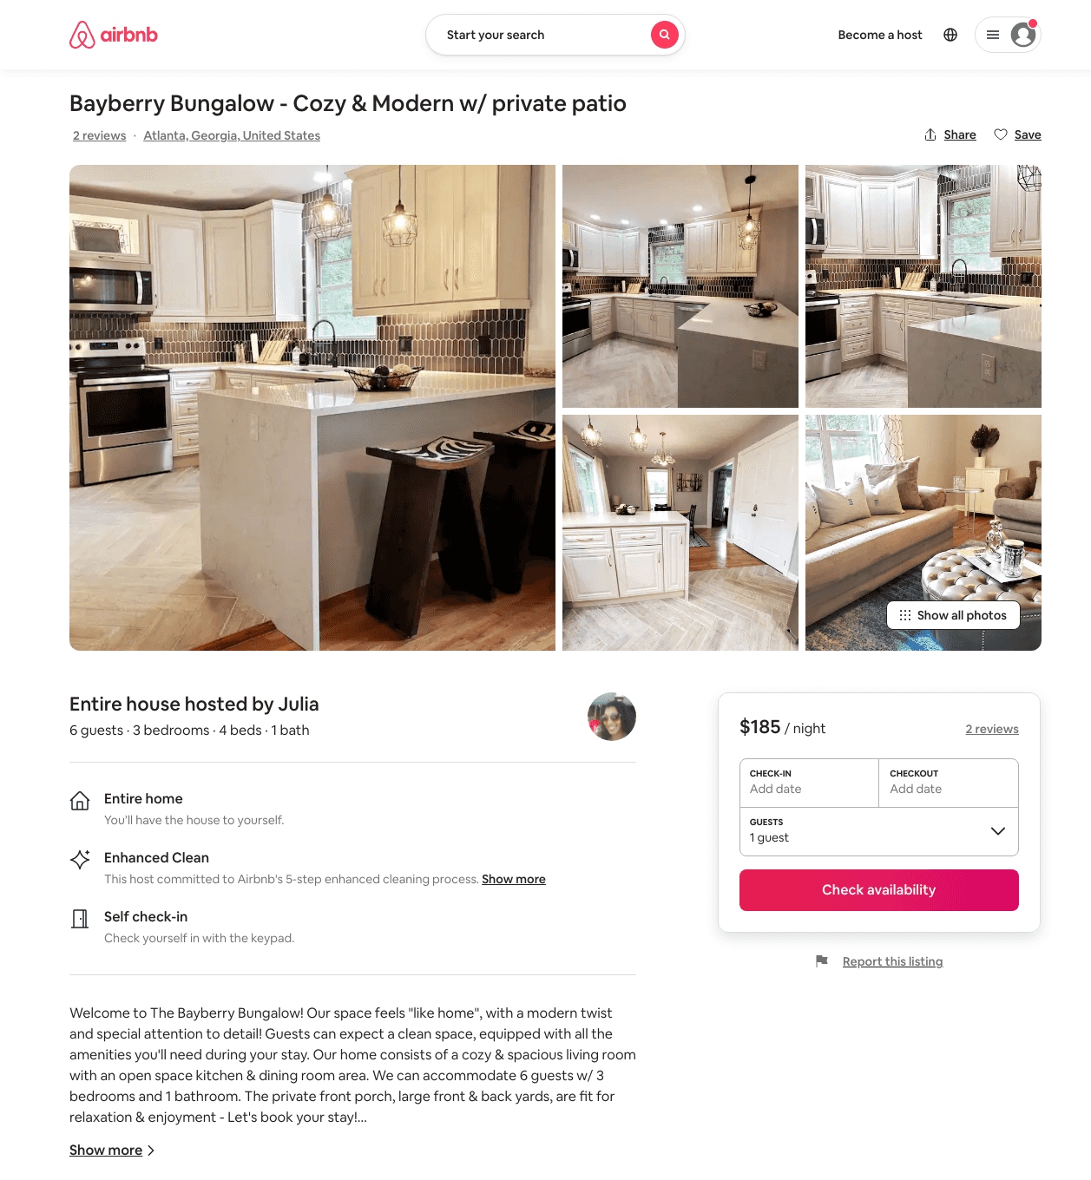
Listing 50028240
3
6
$161 - $222
4.76
3
Julia
340096900
1
https://www.airbnb.com/rooms/50028240
Aug 2022

Slide 11
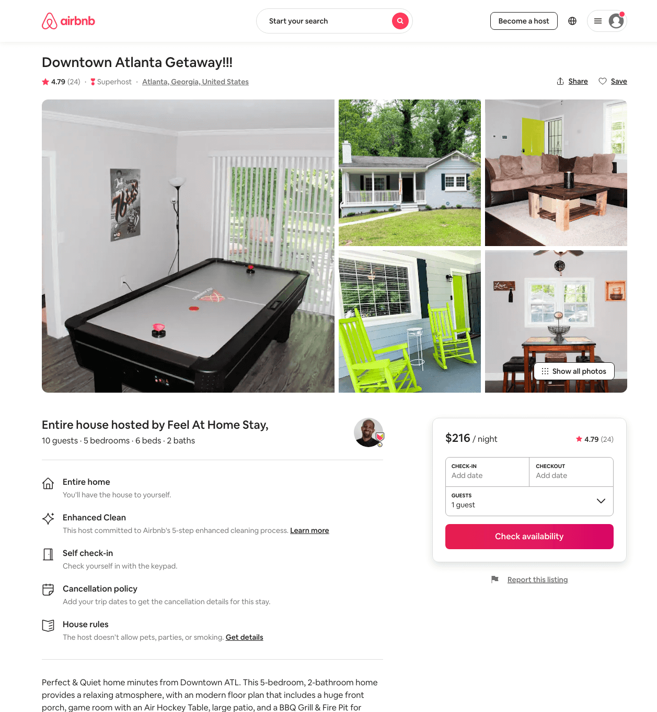
Listing 43239562
5
10
$232 - $295
4.67
2
Feel At Home Stay,
51240848
1
https://www.airbnb.com/rooms/43239562
Aug 2022

Slide 12
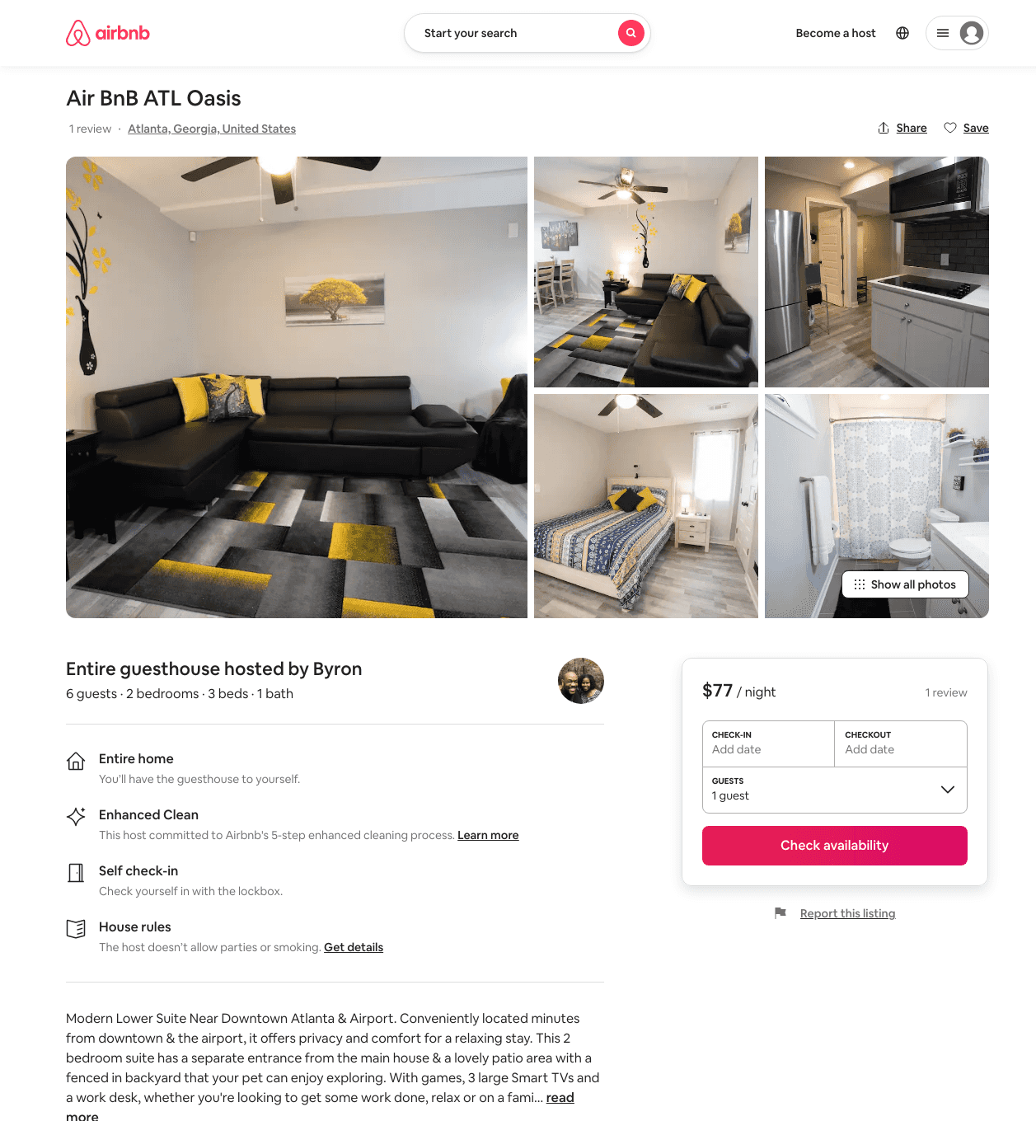
Listing 37603717
2
6
$67 - $119
4.89
1
Byron & DanYelle
40725274
1
https://www.airbnb.com/rooms/37603717
Aug 2022

Slide 13
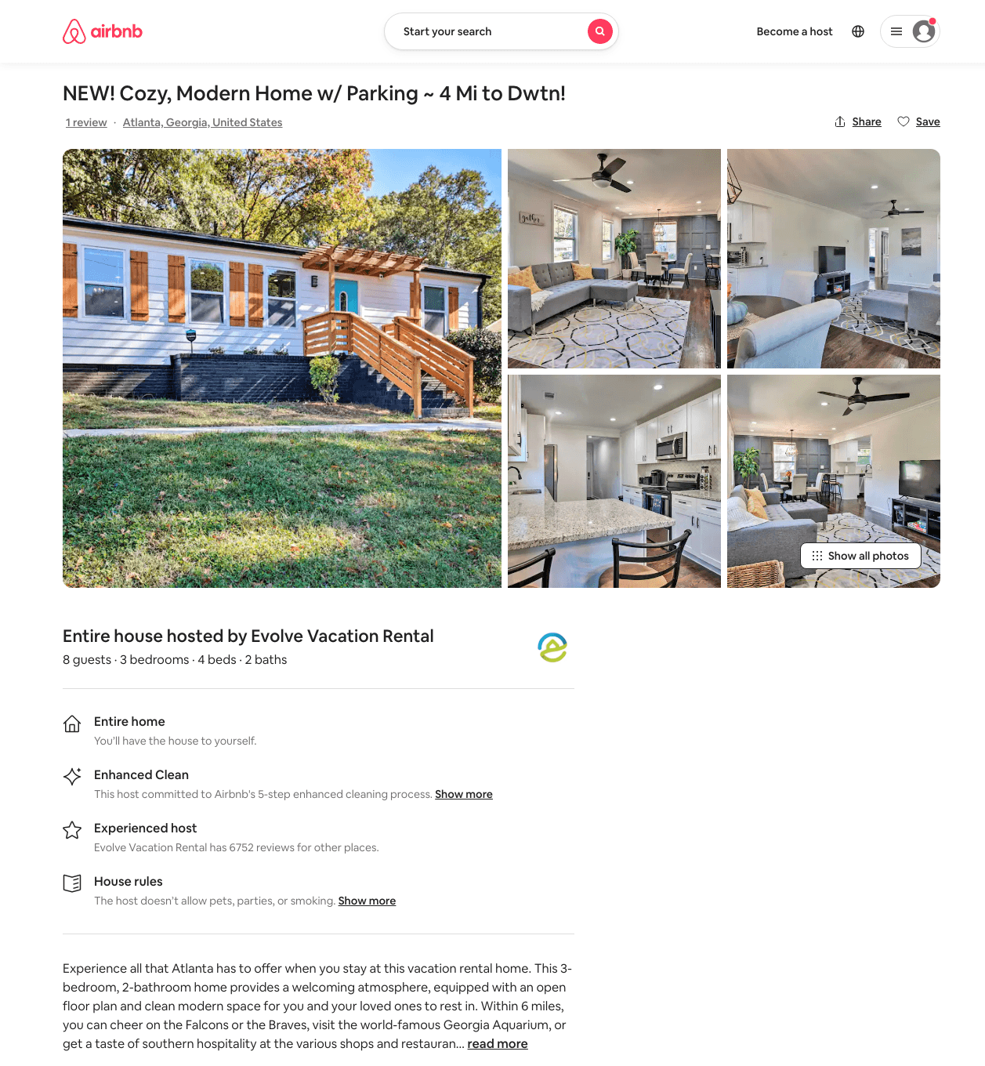
Listing 40104545
3
8
$163 - $205
2
Evolve
121682456
51
https://www.airbnb.com/rooms/40104545
Aug 2022

Slide 14
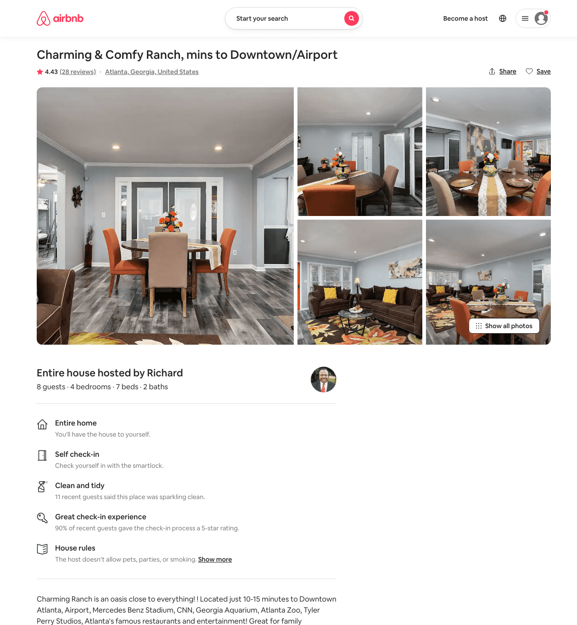
Listing 44665655
3
8
$172 - $241
4.43
2
Richard
361639795
1
https://www.airbnb.com/rooms/44665655
Jun 2022

Slide 15
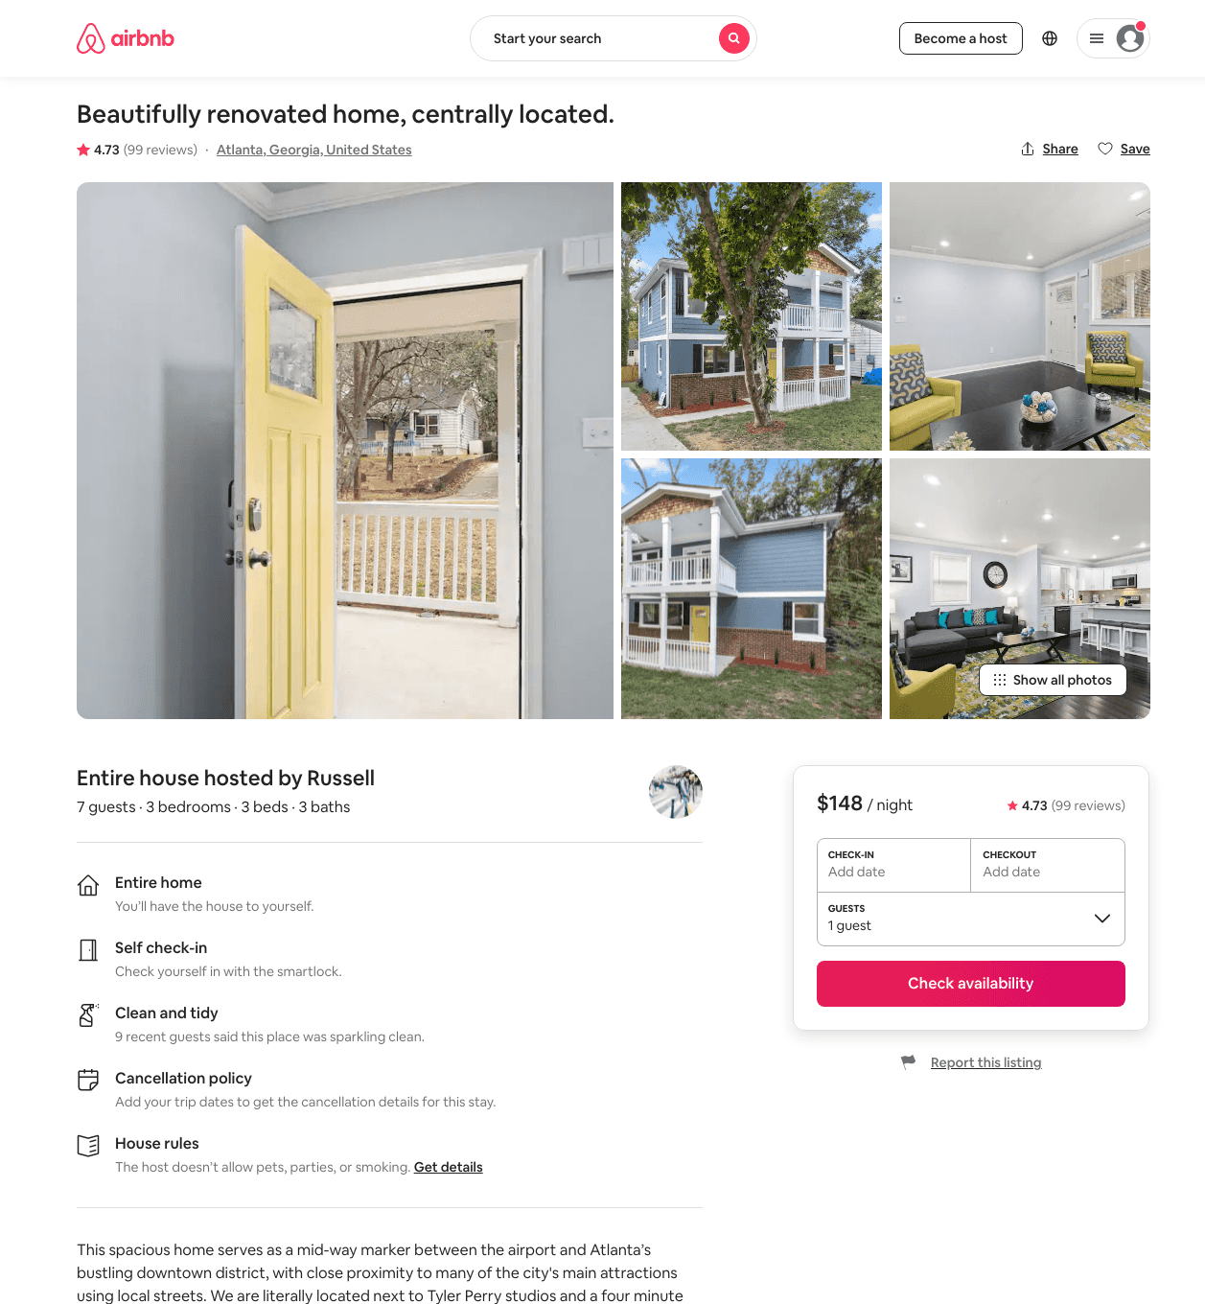
Listing 40867280
3
6
$132 - $188
4.56
3
Russell
5860689
2
https://www.airbnb.com/rooms/40867280
Jul 2022

Slide 16
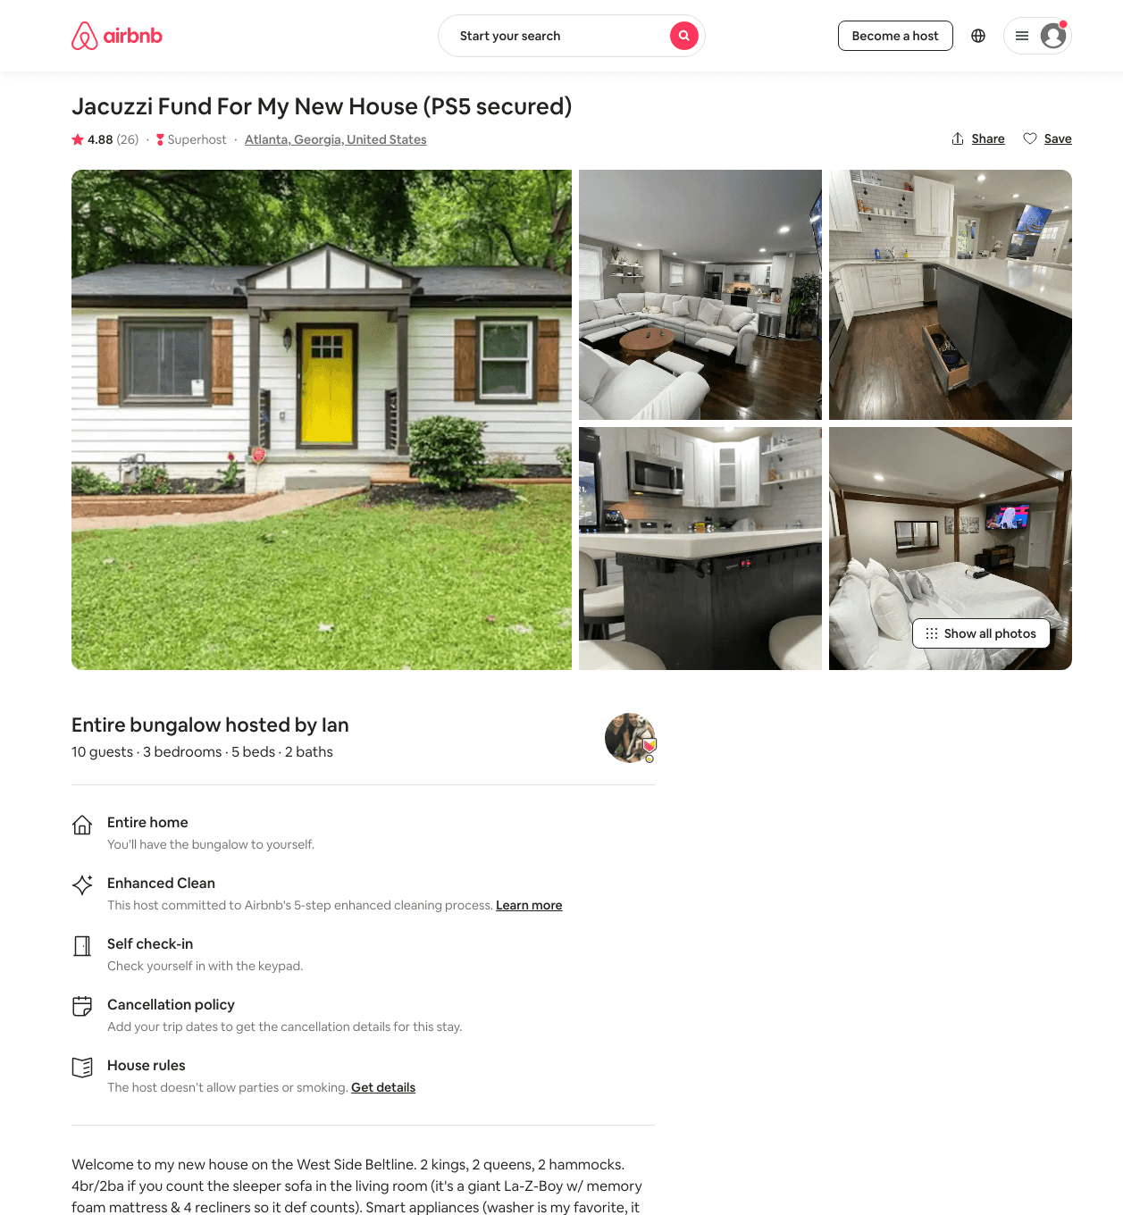
Listing 45259291
4
10
$175 - $656
4.83
2
Ian
4982522
1
https://www.airbnb.com/rooms/45259291
Aug 2022

Slide 17
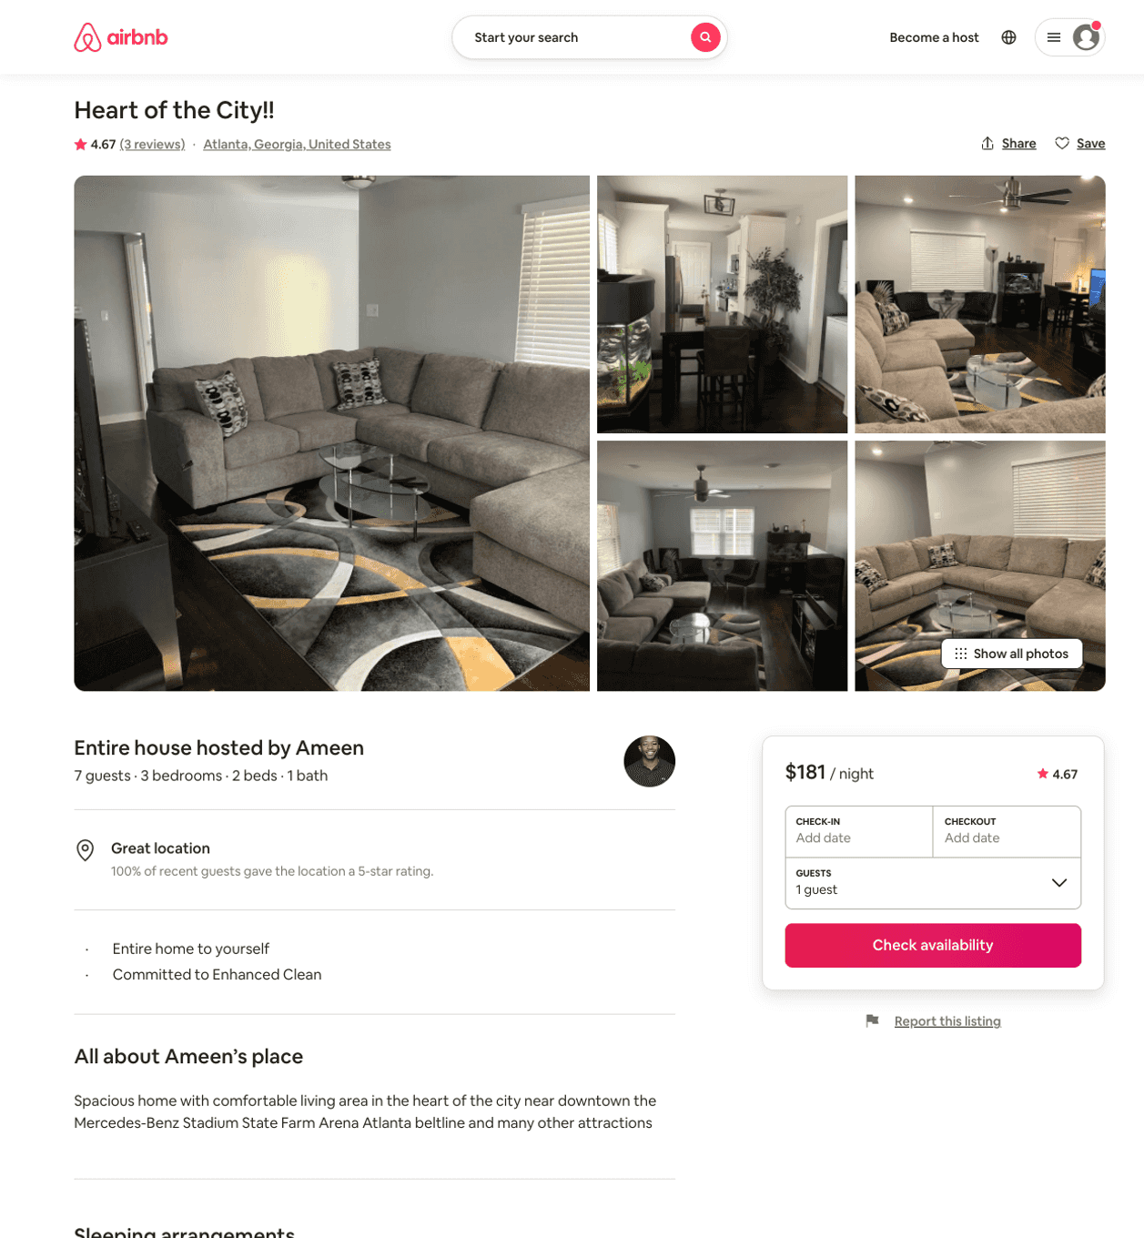
Listing 46282957
3
7
$181
4.75
3
Ameen
97280268
1
https://www.airbnb.com/rooms/46282957
Aug 2022

Slide 18
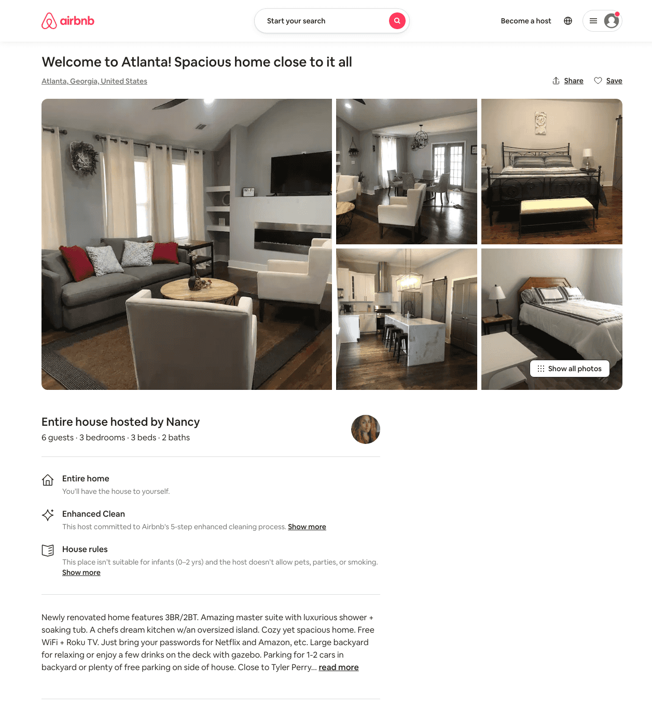
Listing 49421816
3
6
$125 - $236
4.86
3
Nancy
57898976
1
https://www.airbnb.com/rooms/49421816
Aug 2022

Slide 19
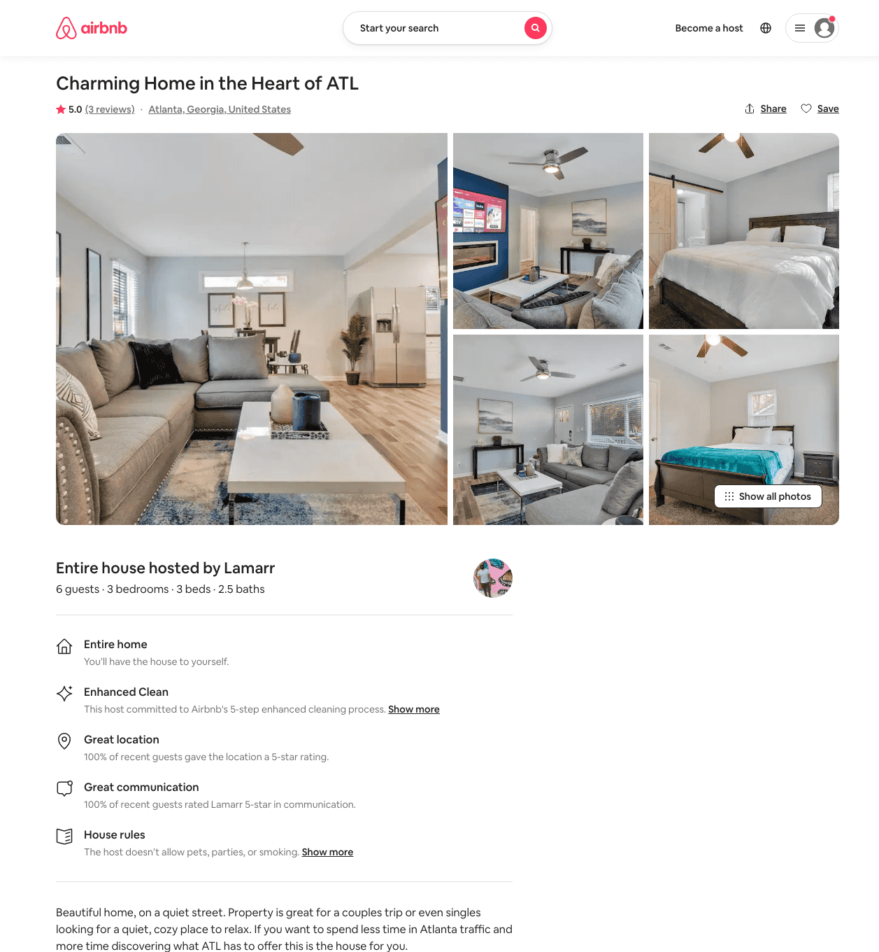
Listing 49370074
3
6
$142 - $219
4.98
2
Lamarr
33053289
1
https://www.airbnb.com/rooms/49370074
Aug 2022

Slide 20
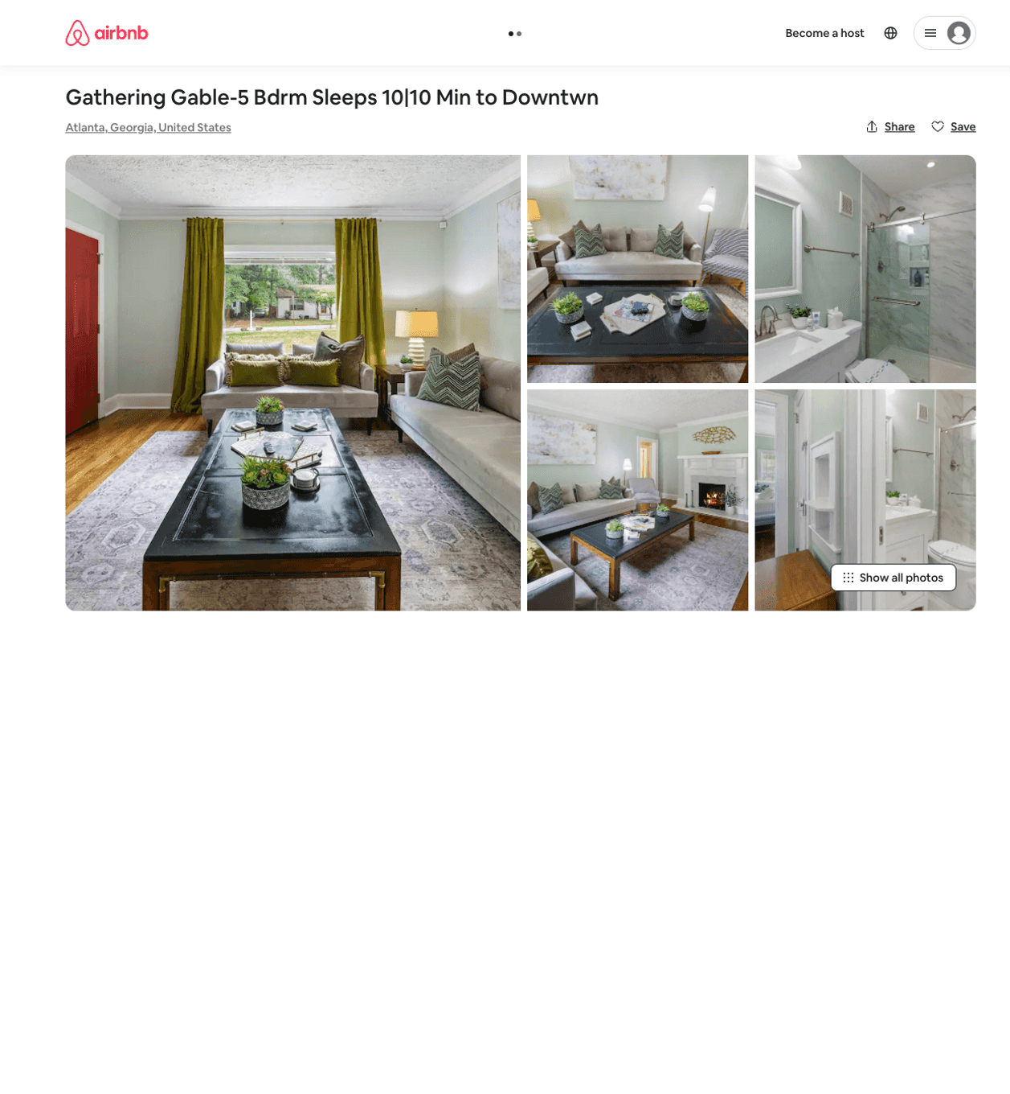
Listing 50441445
5
10
$192 - $383
4.50
1
PMI Atlanta
218820950
14
https://www.airbnb.com/rooms/50441445
Aug 2022

Slide 21
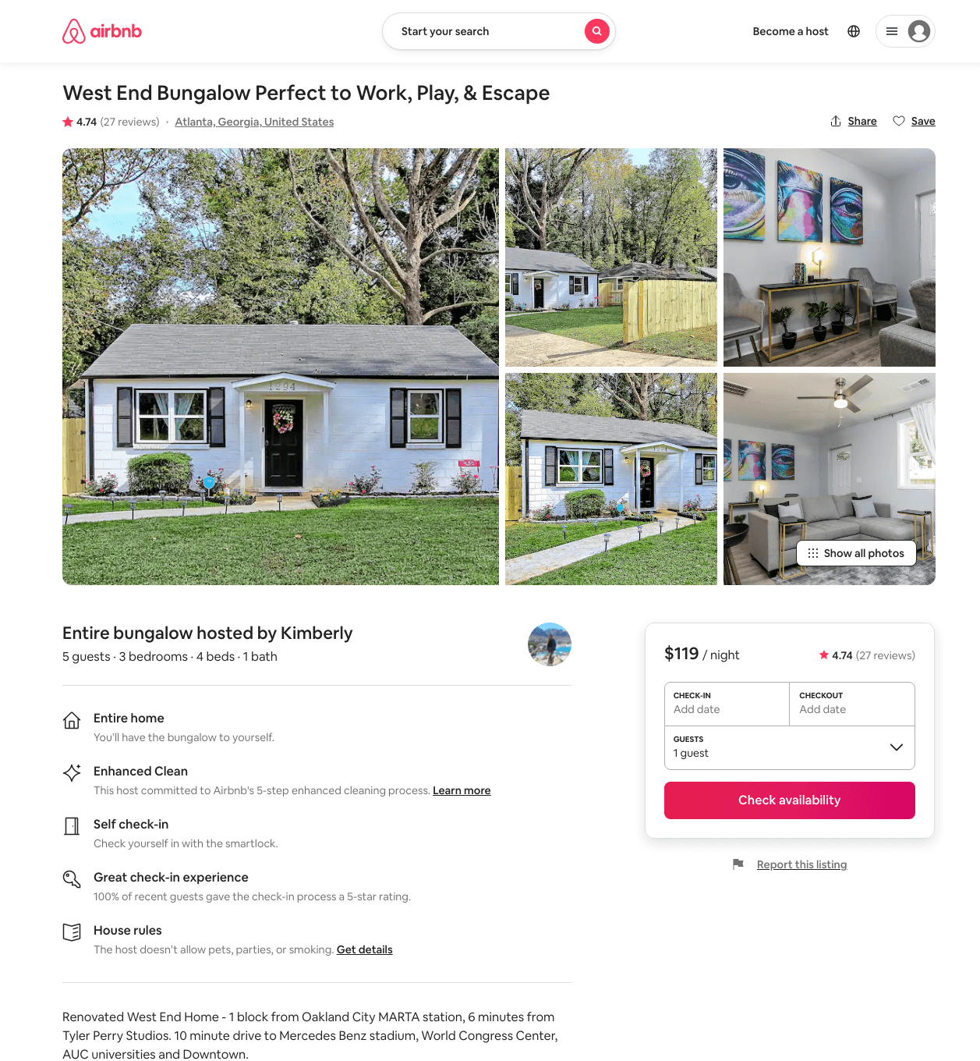
Listing 46176353
3
6
$119 - $174
4.64
2
Kimberly
194117587
2
https://www.airbnb.com/rooms/46176353
Aug 2022

Slide 22
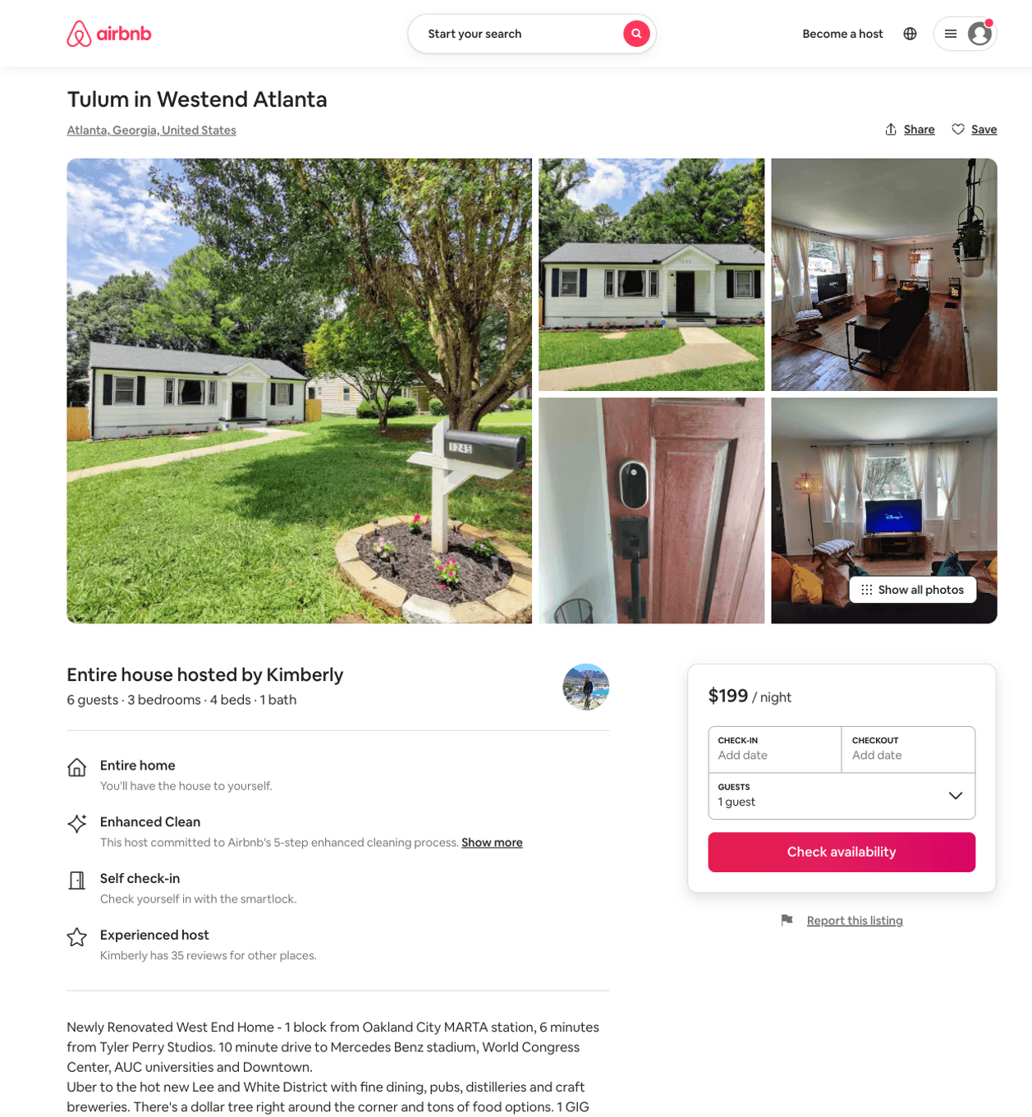
Listing 50697013
3
6
$112 - $219
4.50
2
Kimberly
194117587
2
https://www.airbnb.com/rooms/50697013
Aug 2022

Slide 23
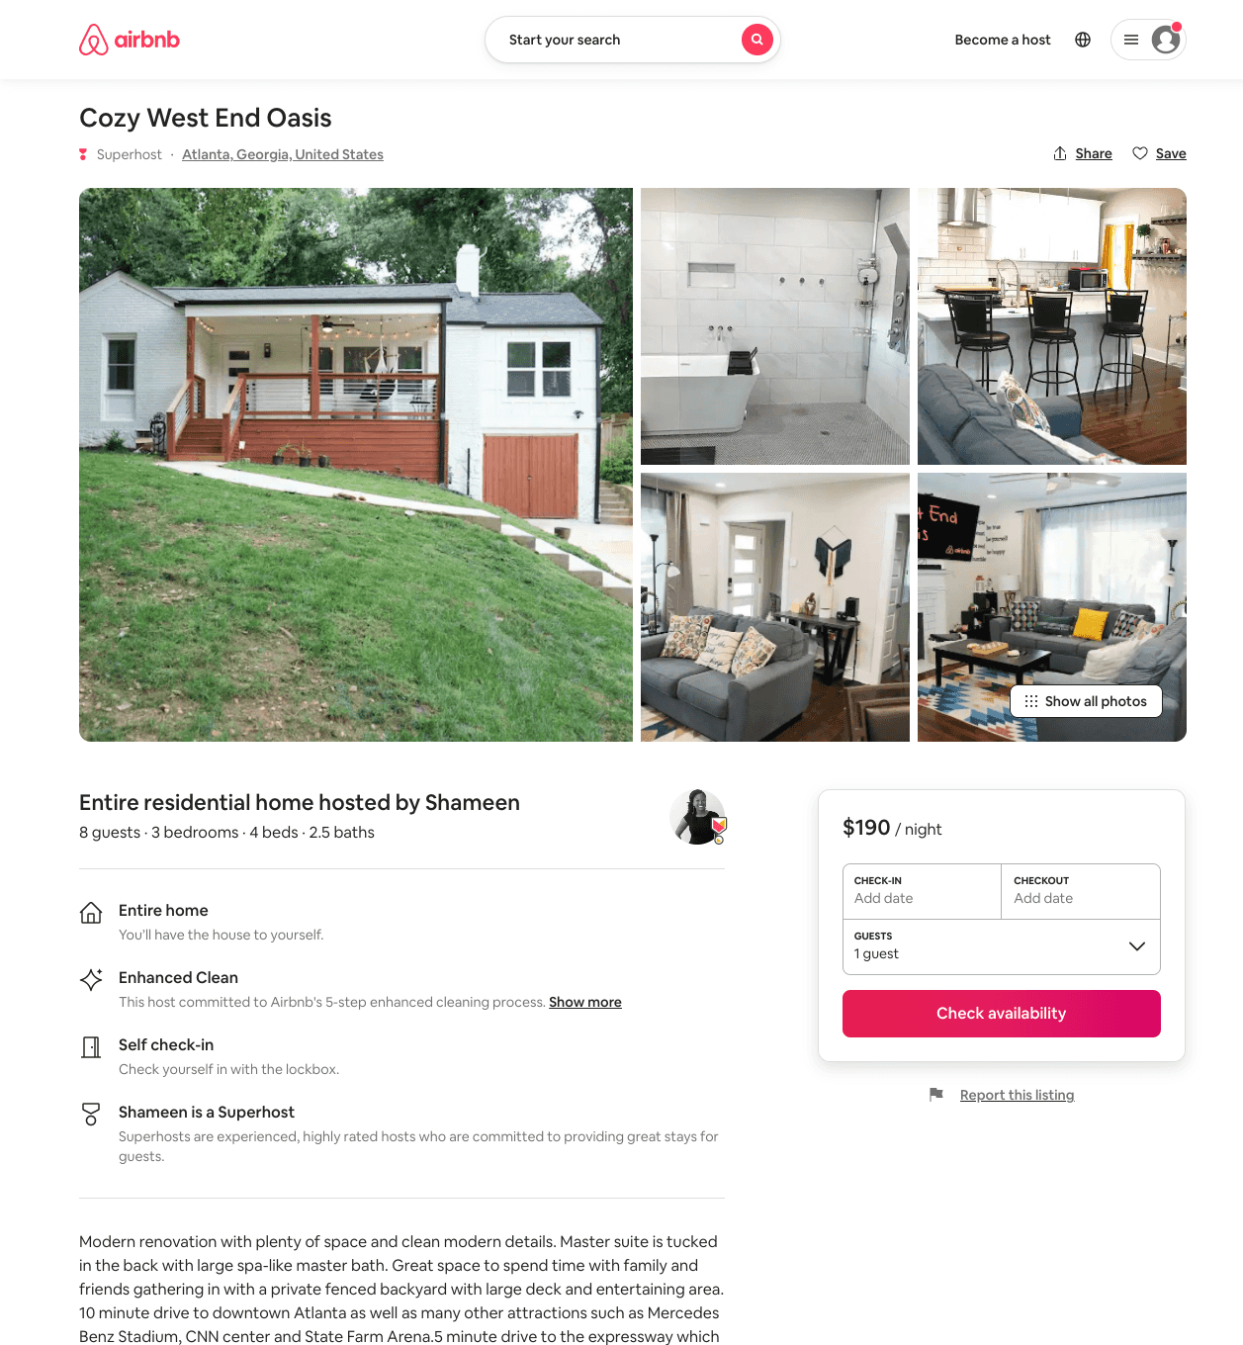
Listing 50673444
3
8
$112 - $243
4.95
1
Shameen
54609747
1
https://www.airbnb.com/rooms/50673444
Aug 2022

Slide 24
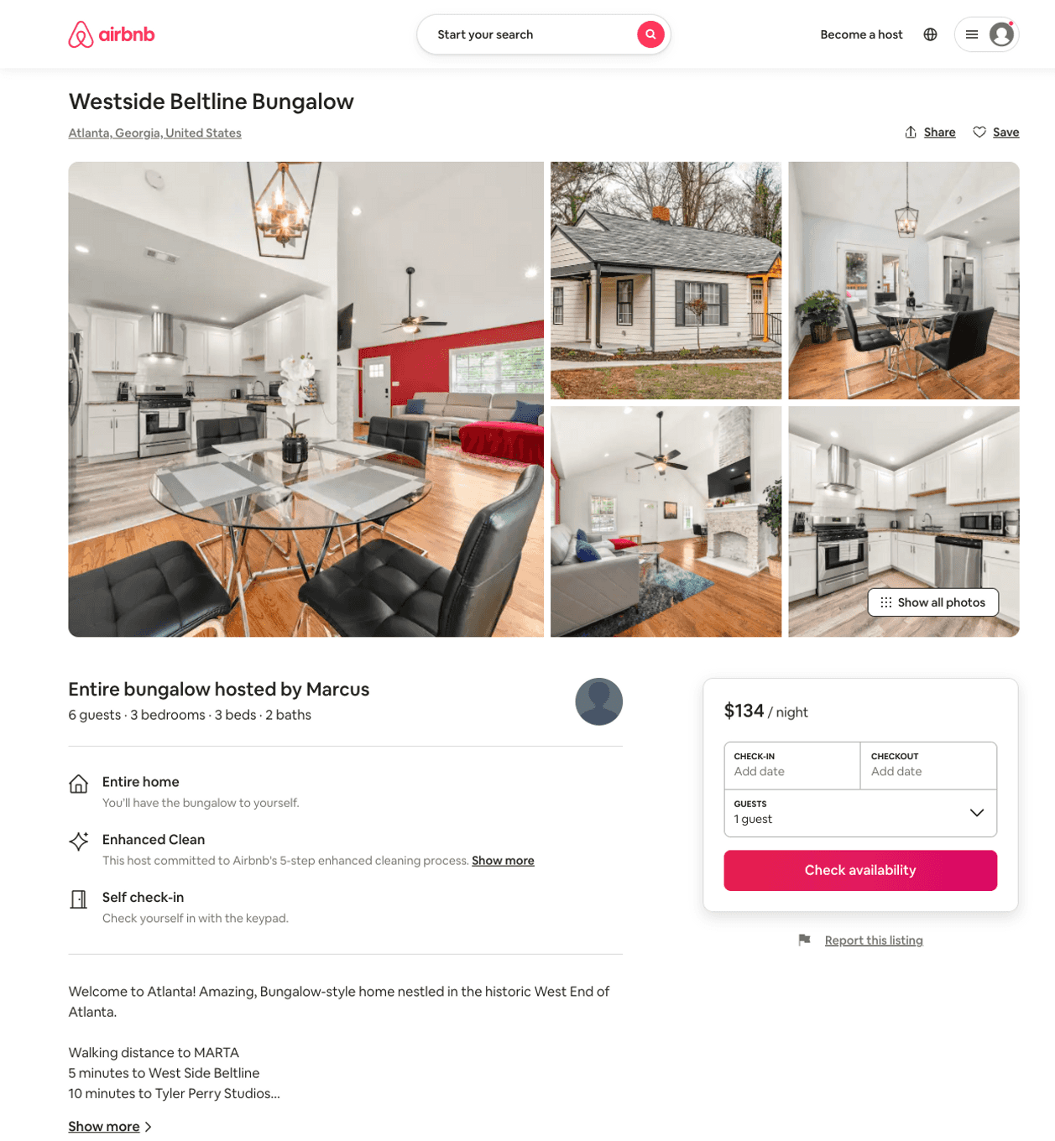
Listing 51726607
3
6
$91 - $176
4.52
3
Marcus
377625803
1
https://www.airbnb.com/rooms/51726607
Aug 2022

Slide 25
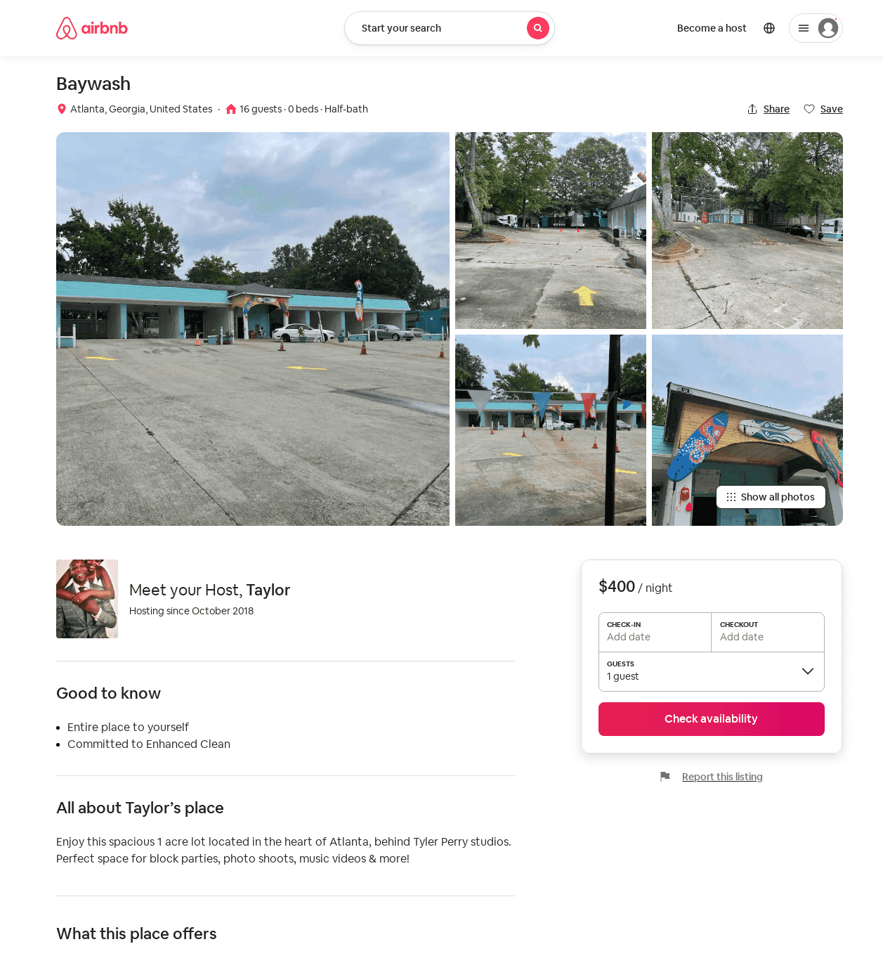
Listing 52113321
16
$400 - $500
1
Taylor
220795792
1
https://www.airbnb.com/rooms/52113321
Aug 2022

Slide 26
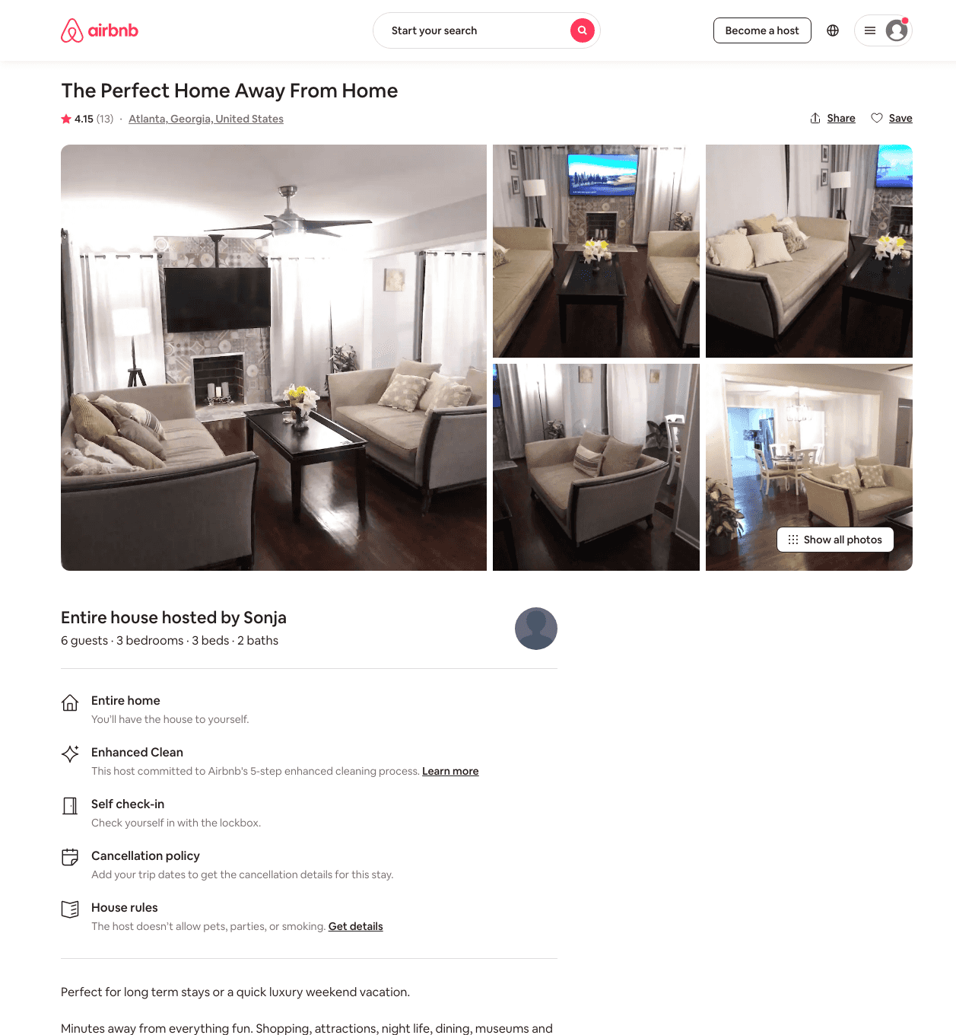
Listing 46647350
3
6
$100 - $168
4.29
4
Sonja
374998547
1
https://www.airbnb.com/rooms/46647350
Aug 2022

Slide 27
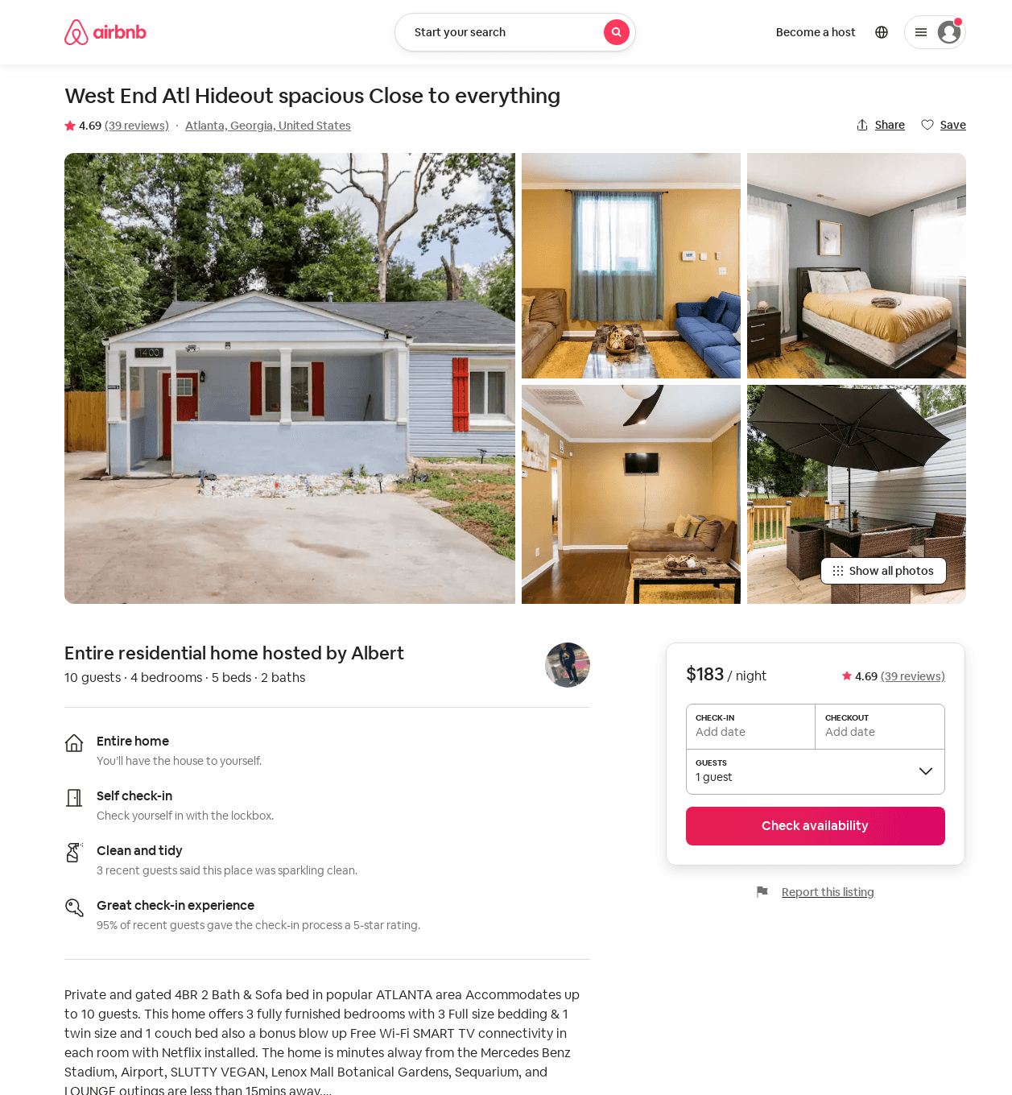
Listing 46091568
4
7
$134 - $250
4.81
3
Albert
359317657
2
https://www.airbnb.com/rooms/46091568
Aug 2022

Slide 28
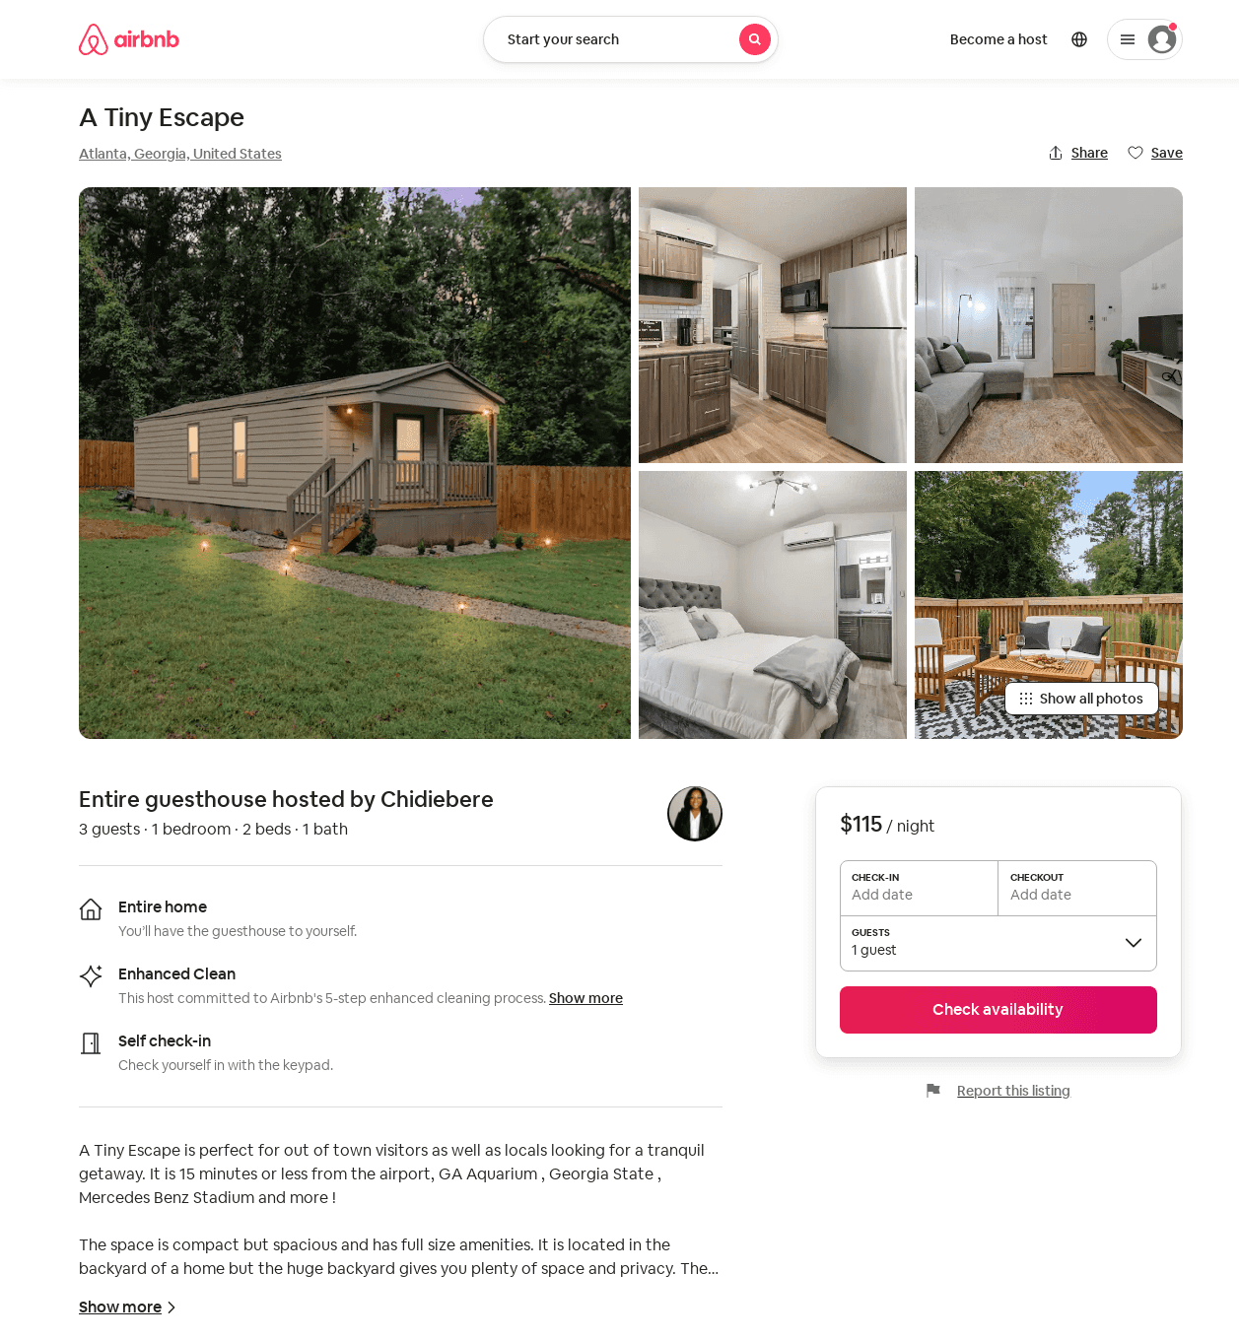
Listing 52261618
1
3
$89 - $131
4.76
2
Chidiebere
423025137
2
https://www.airbnb.com/rooms/52261618
Aug 2022

Slide 29
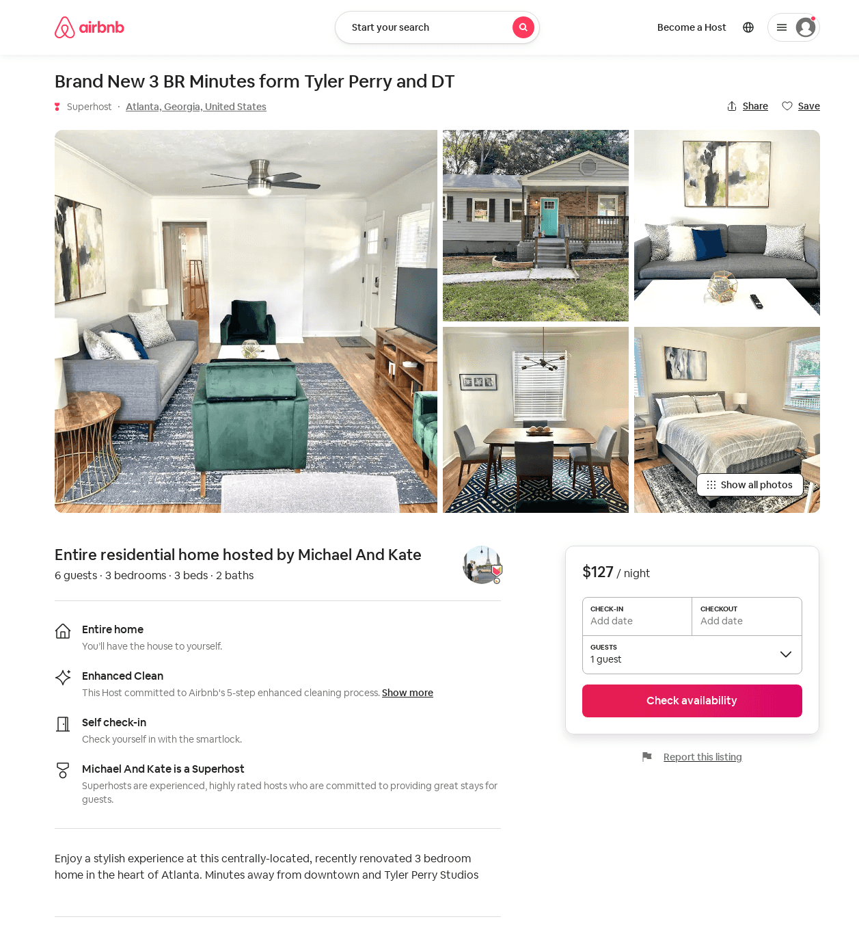
Listing 52242424
3
6
$114 - $202
4.92
1
Andrea
200839986
1
https://www.airbnb.com/rooms/52242424
Aug 2022

Slide 30
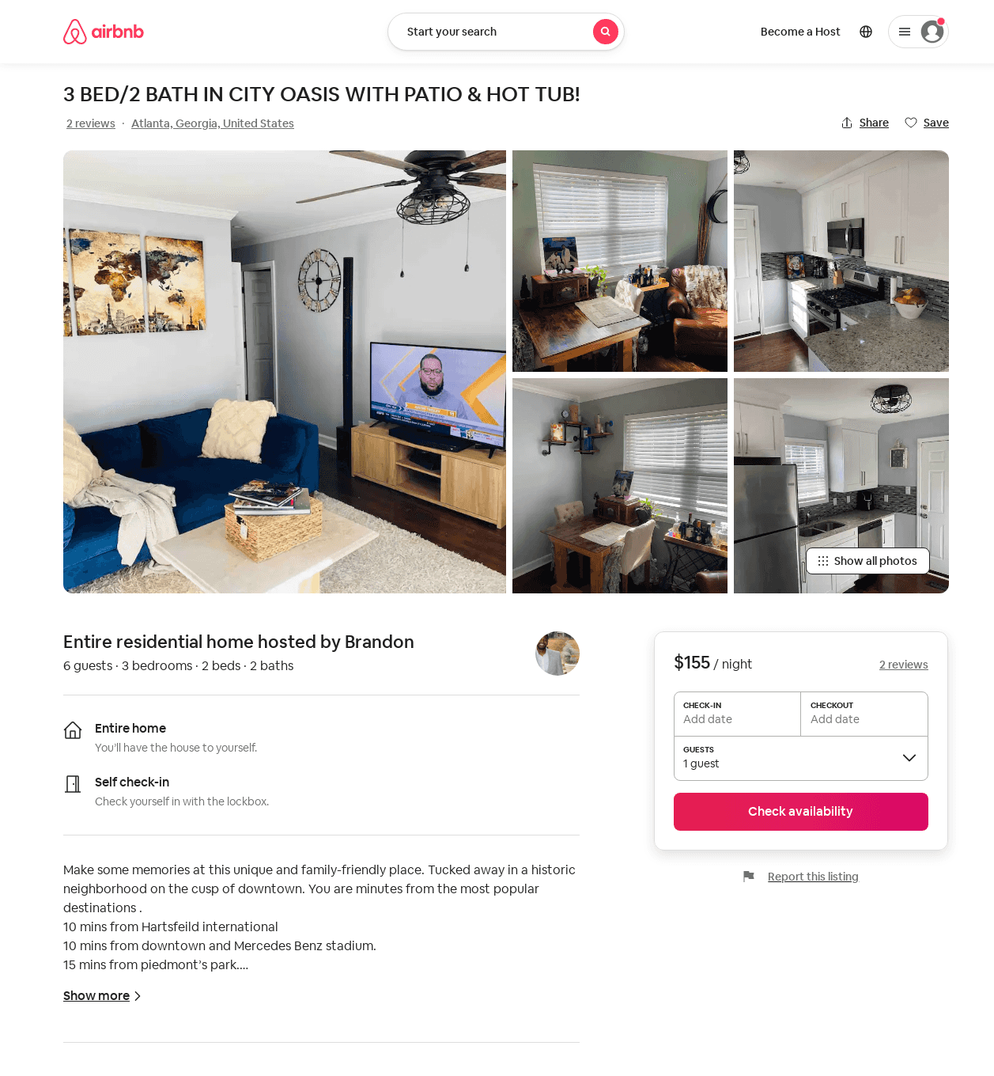
Listing 52486398
3
5
$148 - $191
4.59
2
Brandon
118075569
1
https://www.airbnb.com/rooms/52486398
Aug 2022

Slide 31
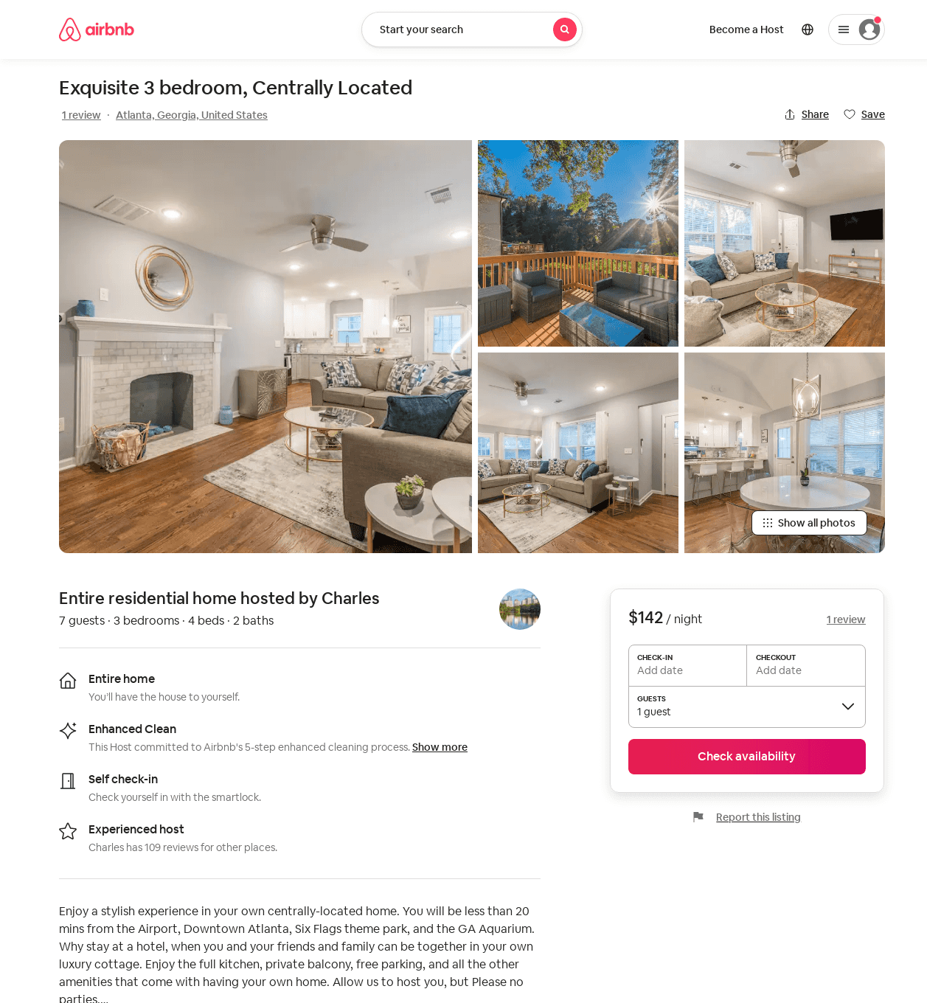
Listing 52734164
3
9
$119 - $186
4.71
1
Charles
33452003
2
https://www.airbnb.com/rooms/52734164
Aug 2022

Slide 32
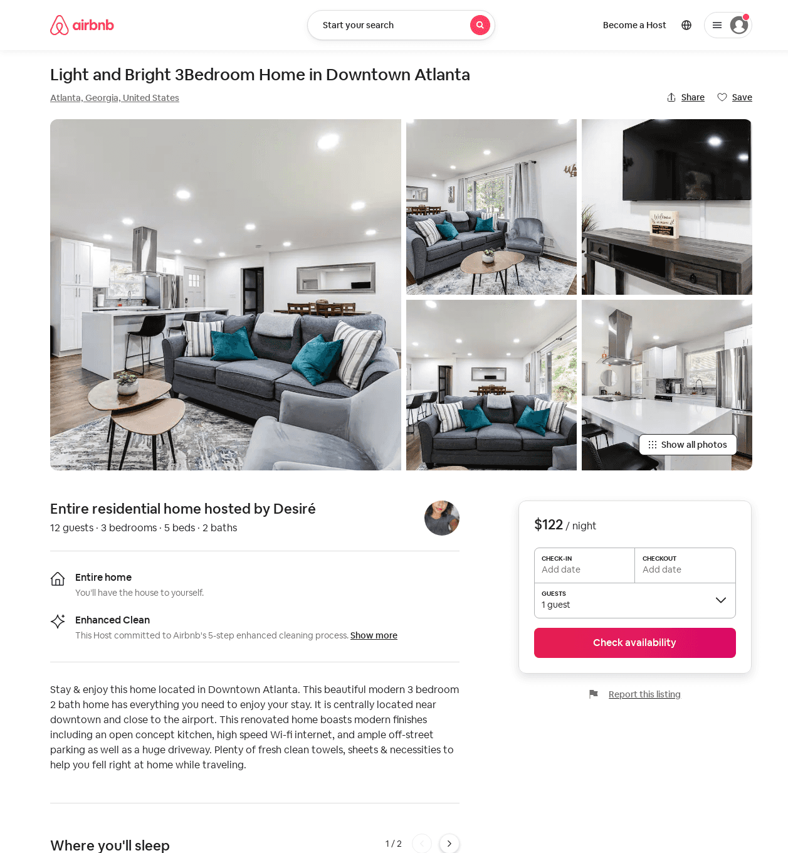
Listing 52567700
3
12
$88 - $170
4.78
2
Desiré
65764026
3
https://www.airbnb.com/rooms/52567700
Aug 2022

Slide 33
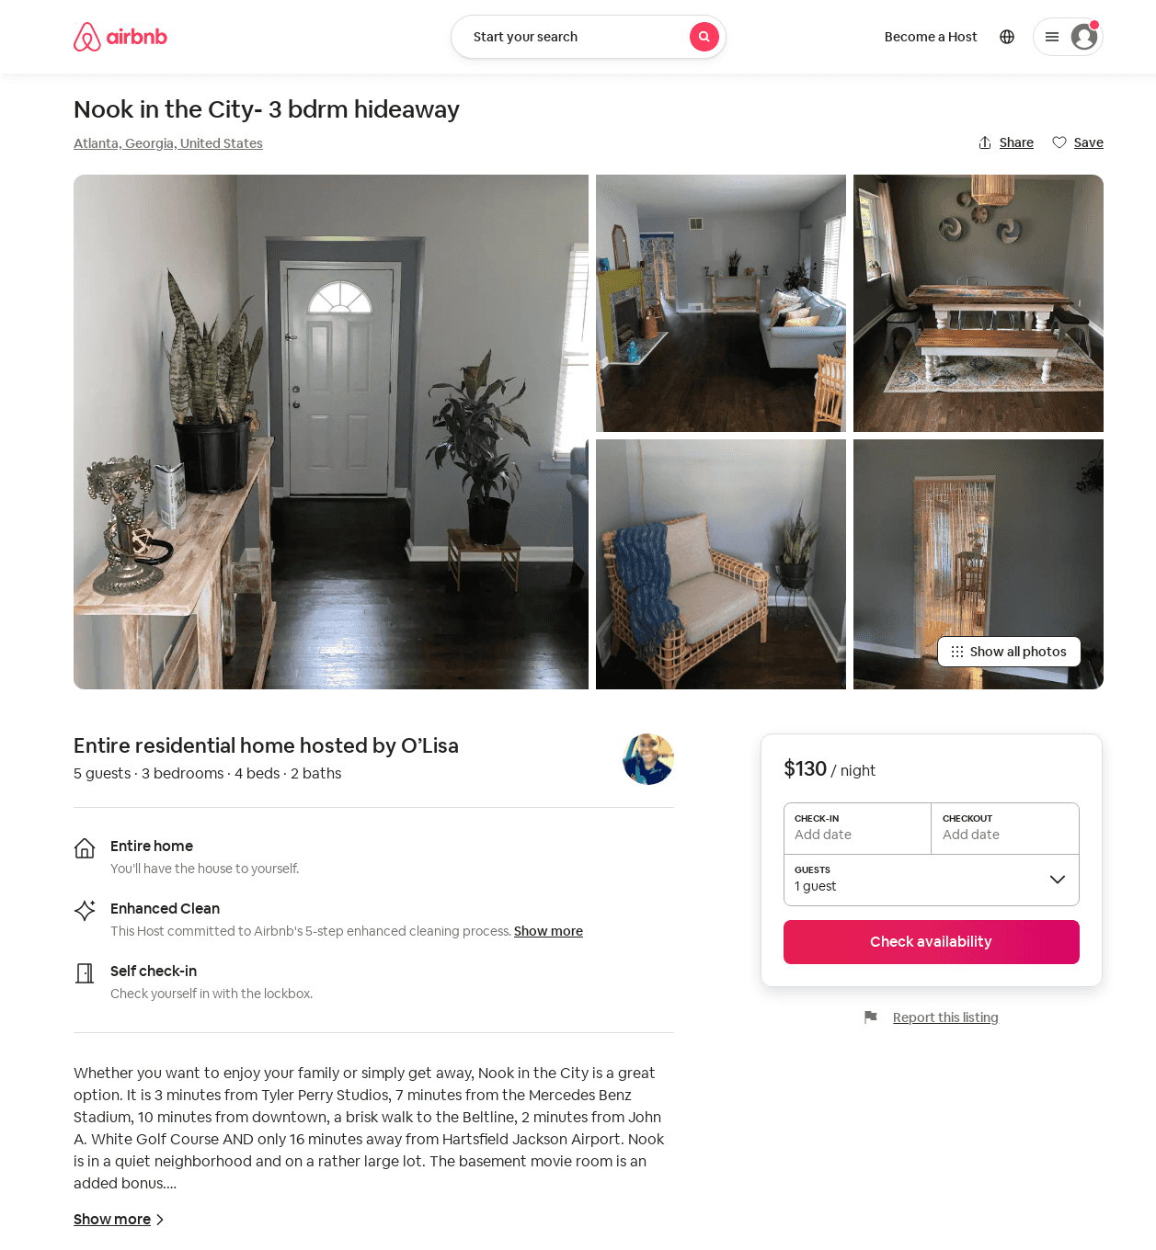
Listing 50478229
3
5
$102 - $173
4.63
2
OLisa
288319577
1
https://www.airbnb.com/rooms/50478229
Aug 2022

Slide 34
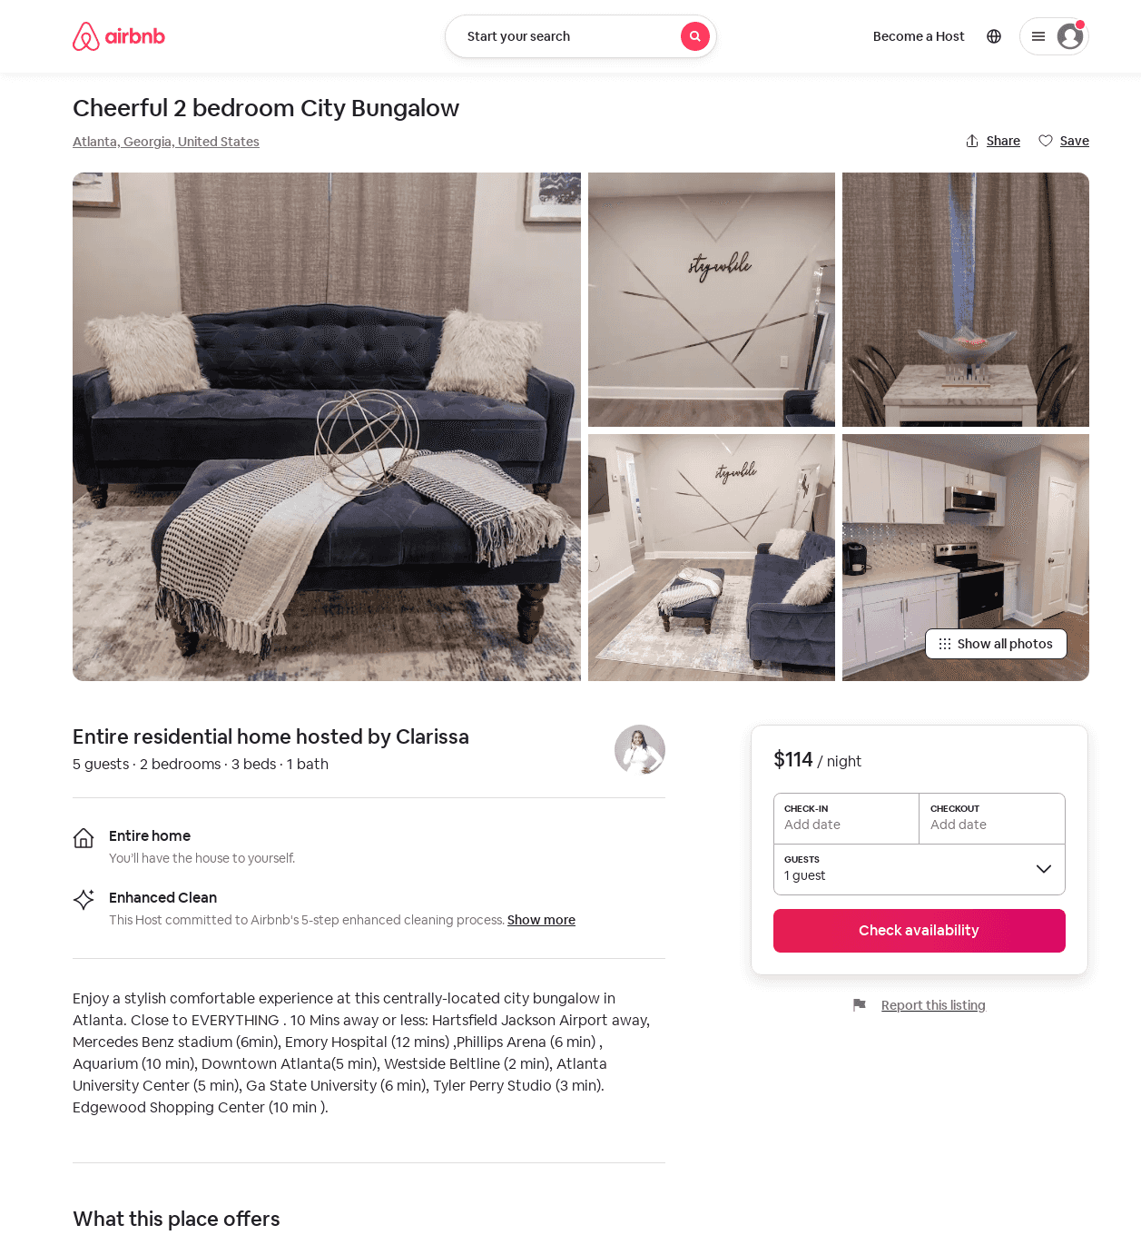
Listing 53676320
2
4
$90 - $118
4.58
2
Clarissa
43389923
1
https://www.airbnb.com/rooms/53676320
Aug 2022

Slide 35
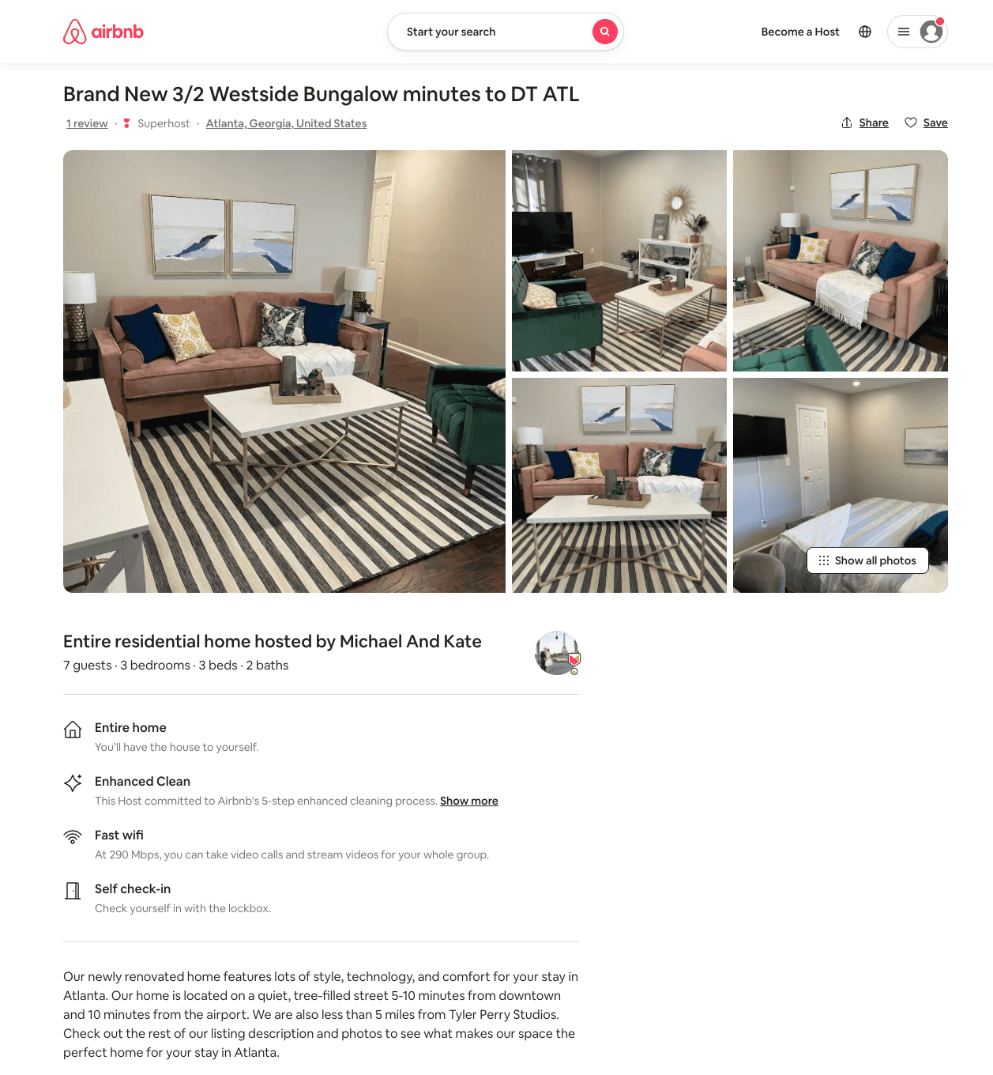
Listing 53953993
3
7
$114 - $132
4.65
2
Riaz
371221711
3
https://www.airbnb.com/rooms/53953993
Aug 2022

Slide 36
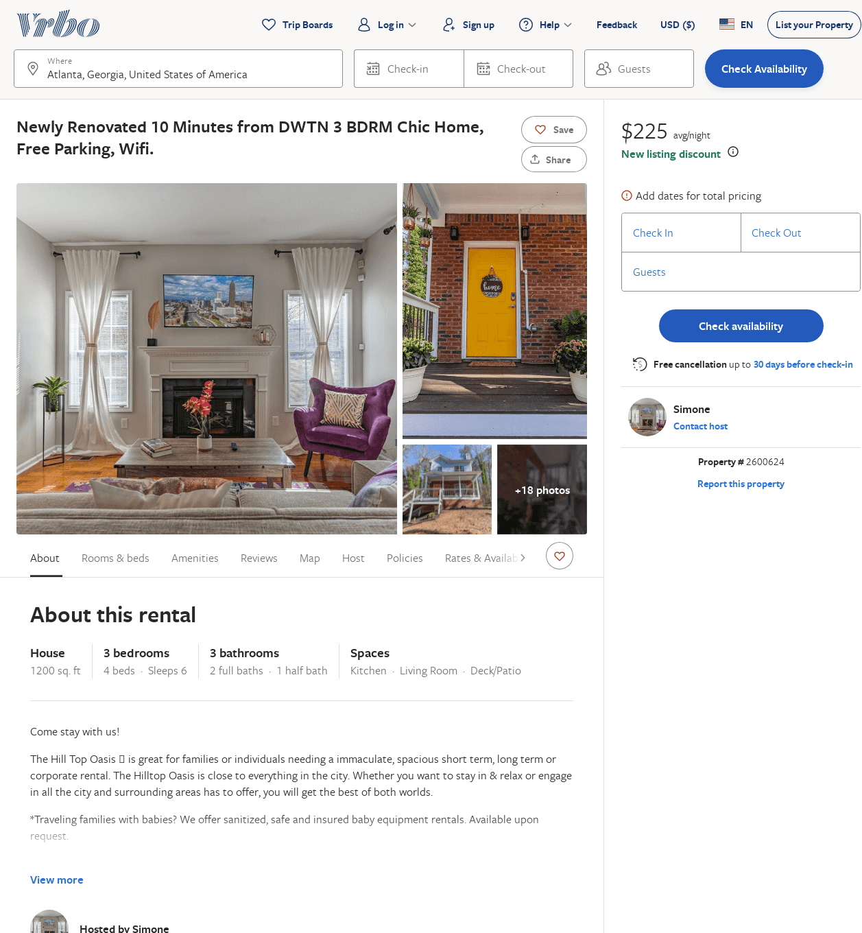
Listing 2600624
3
8
$282
5
2
Simone
https://www.vrbo.com/2600624
Aug 2022

Slide 37
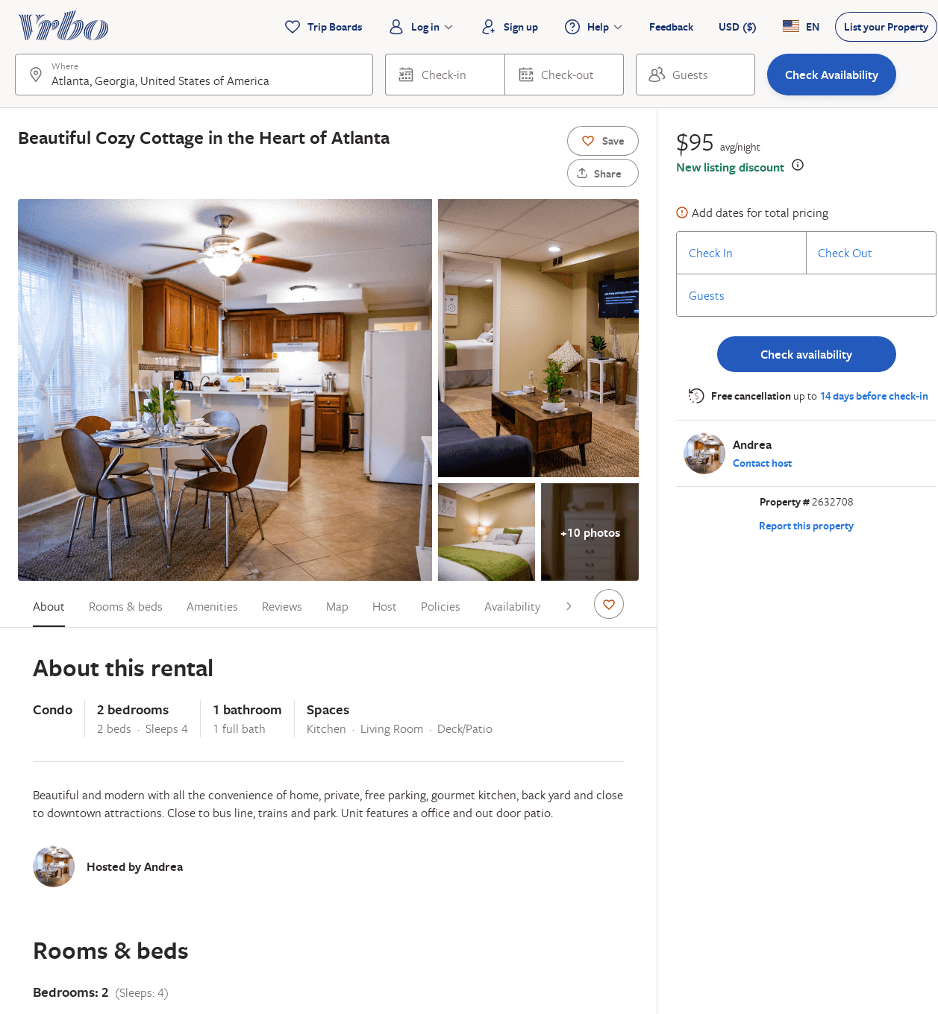
Listing 2632708
2
4
$102
4
3
Andrea
https://www.vrbo.com/2632708
Aug 2022

Slide 38
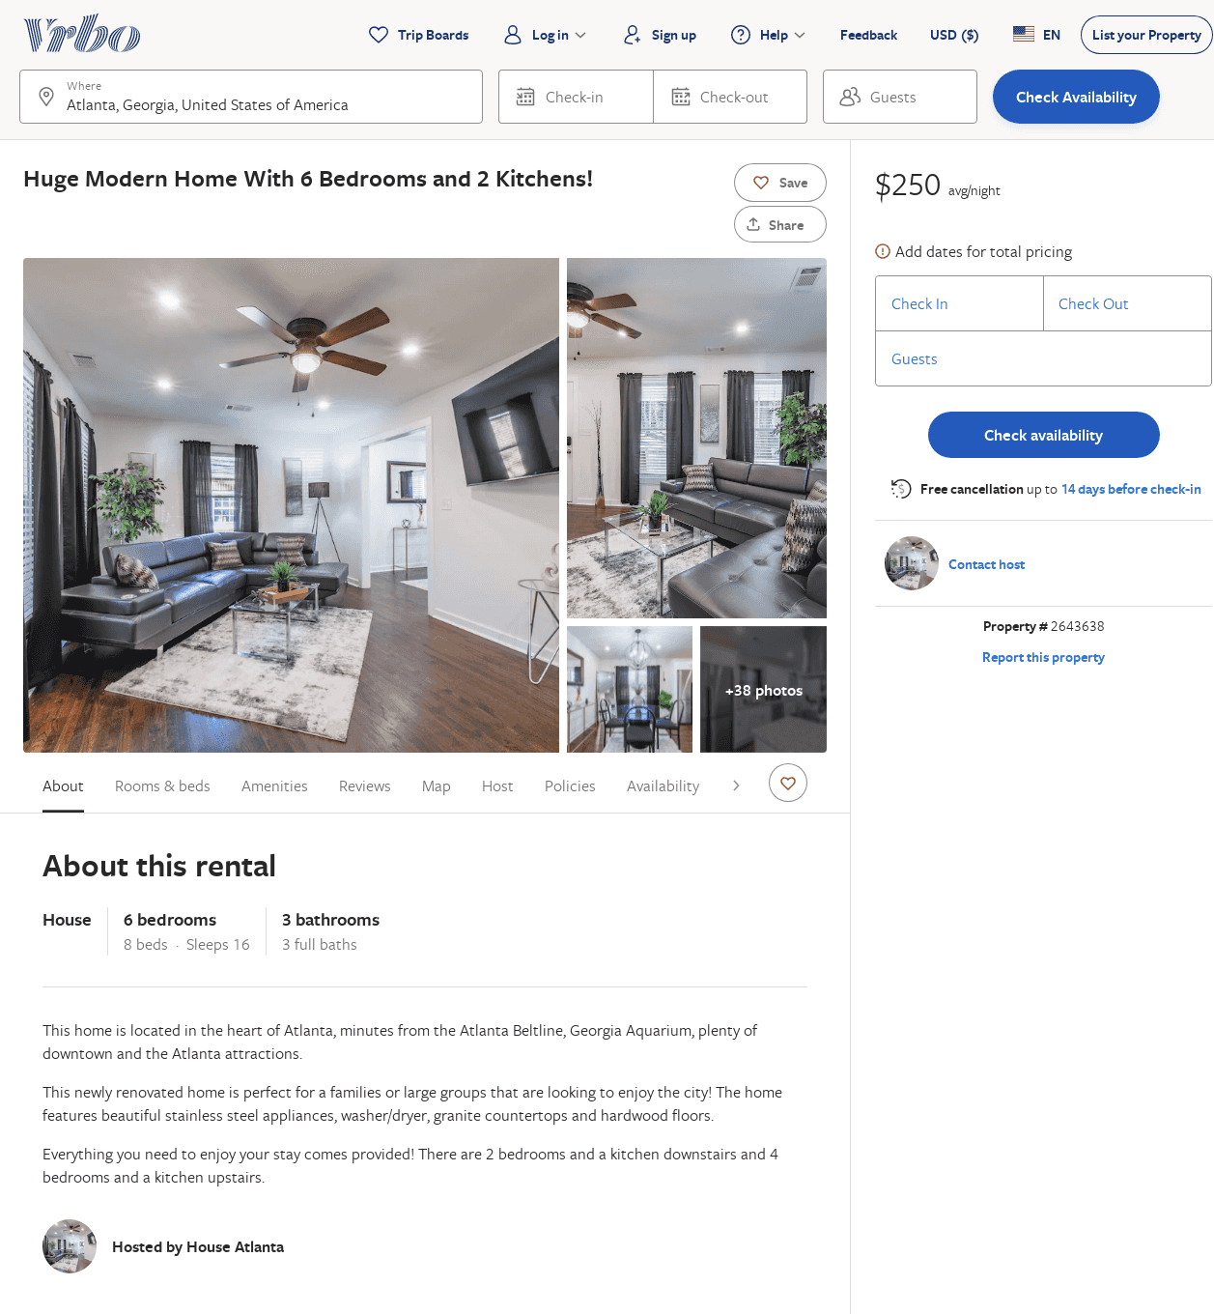
Listing 2643638
6
16
$250
1.75
3
https://www.vrbo.com/2643638
Aug 2022

Slide 39
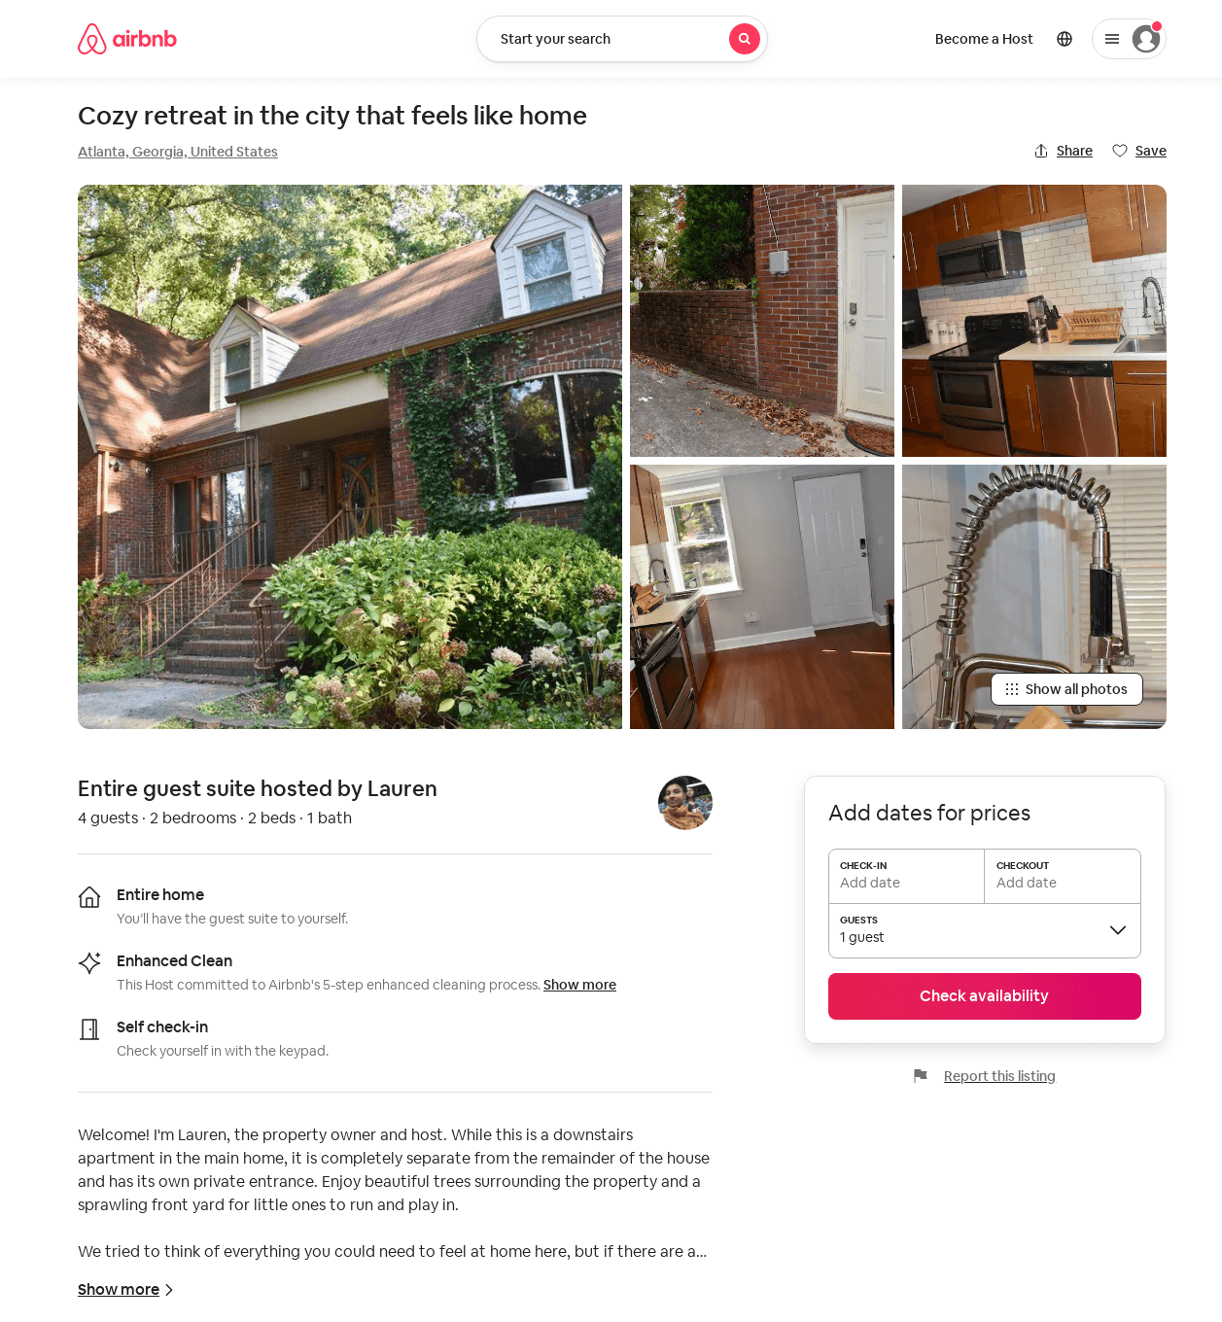
Listing 53435872
2
1
$85
31
Lauren
60915812
1
https://www.airbnb.com/rooms/53435872
Aug 2022

Slide 40
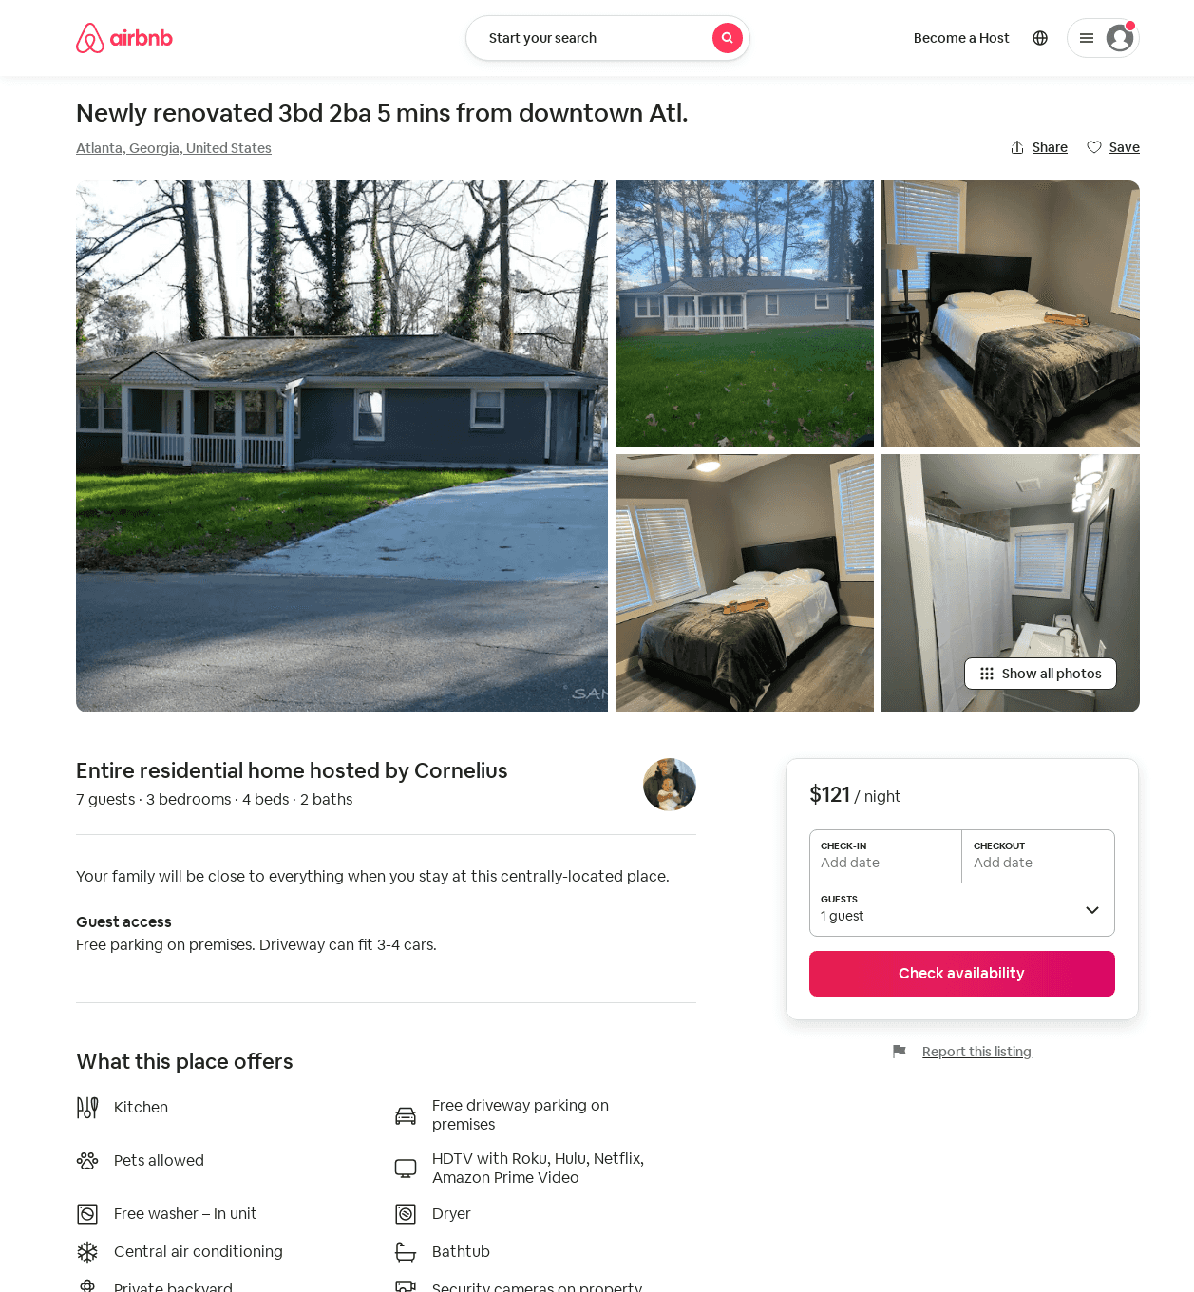
Listing 51656108
3
7
$121 - $163
4.83
2
Cornelius
418481631
1
https://www.airbnb.com/rooms/51656108
Aug 2022

Slide 41
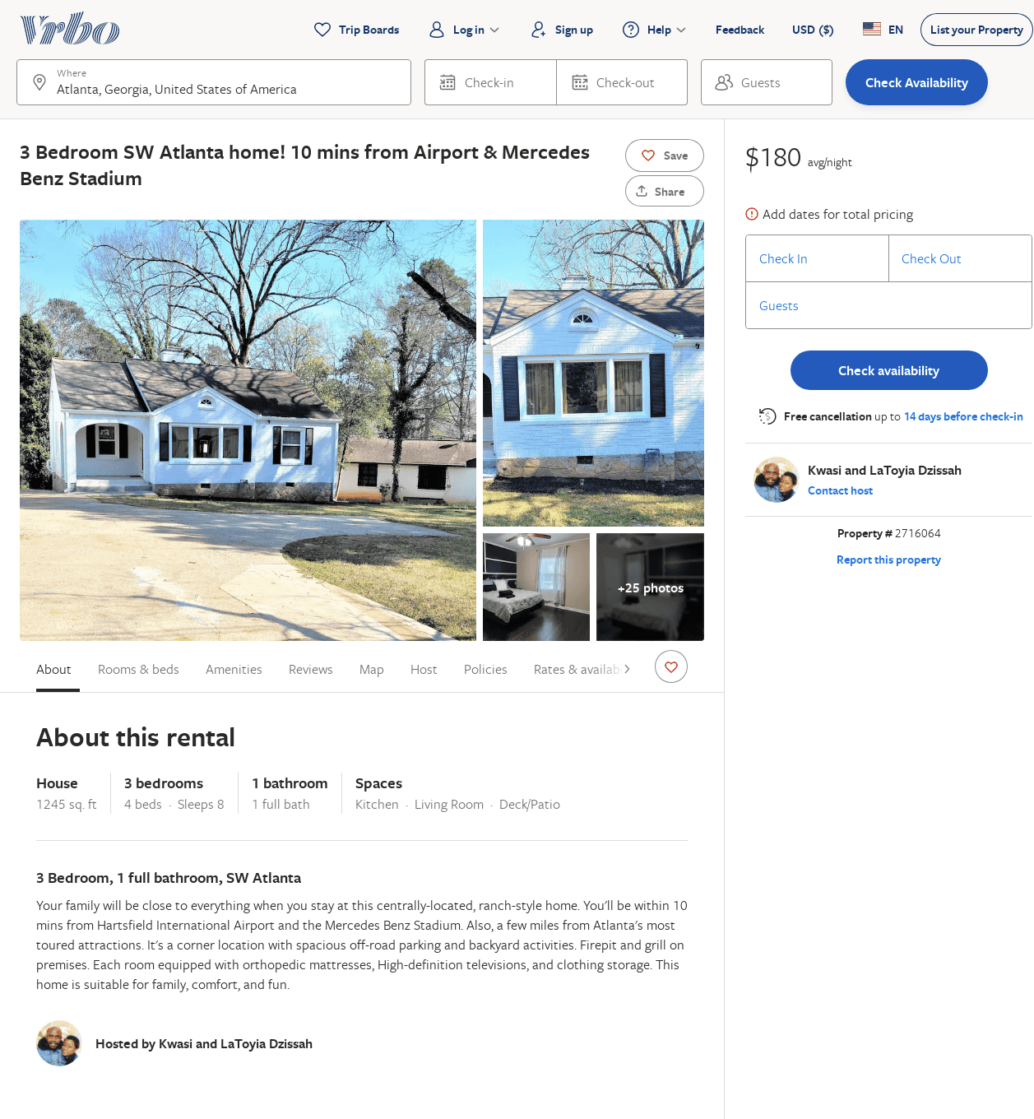
Listing 2716064
3
8
$196
2
Kwasi and LaToyia Dzissah
https://www.vrbo.com/2716064
Aug 2022

Slide 42
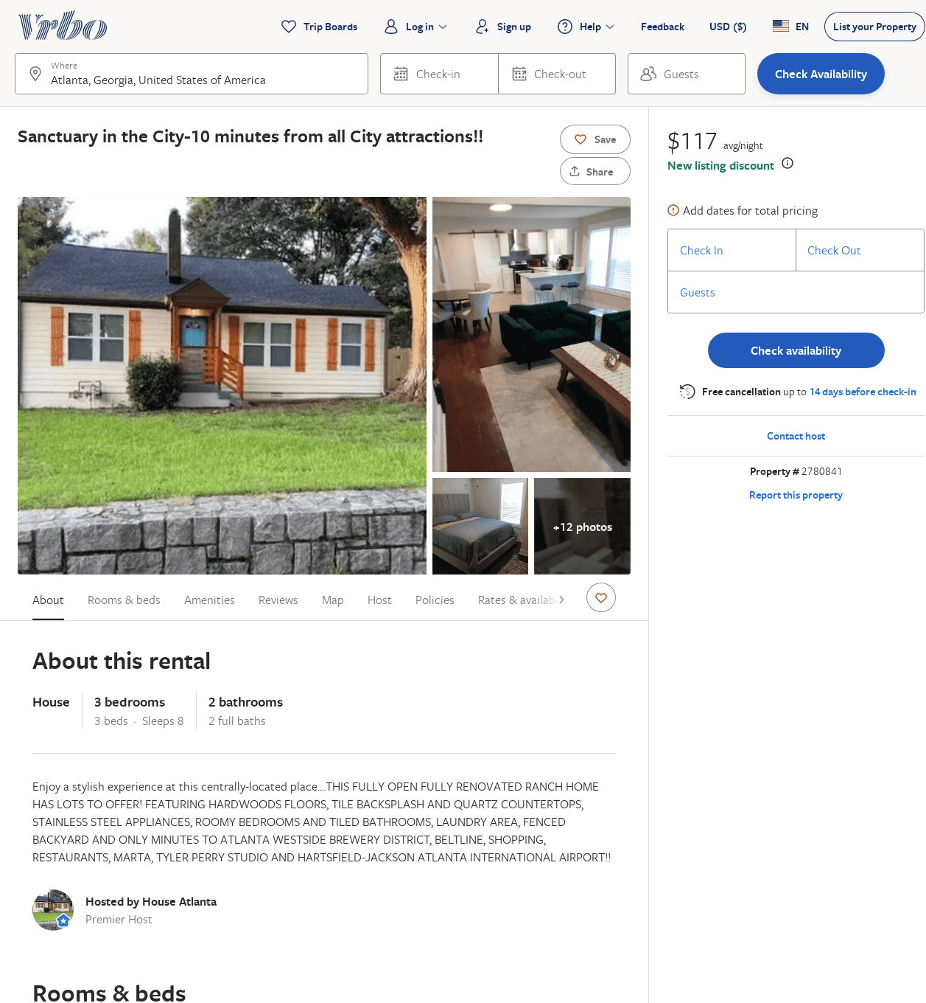
Listing 2780841
3
8
$117
4.6666665
2
https://www.vrbo.com/2780841
Aug 2022

Slide 43
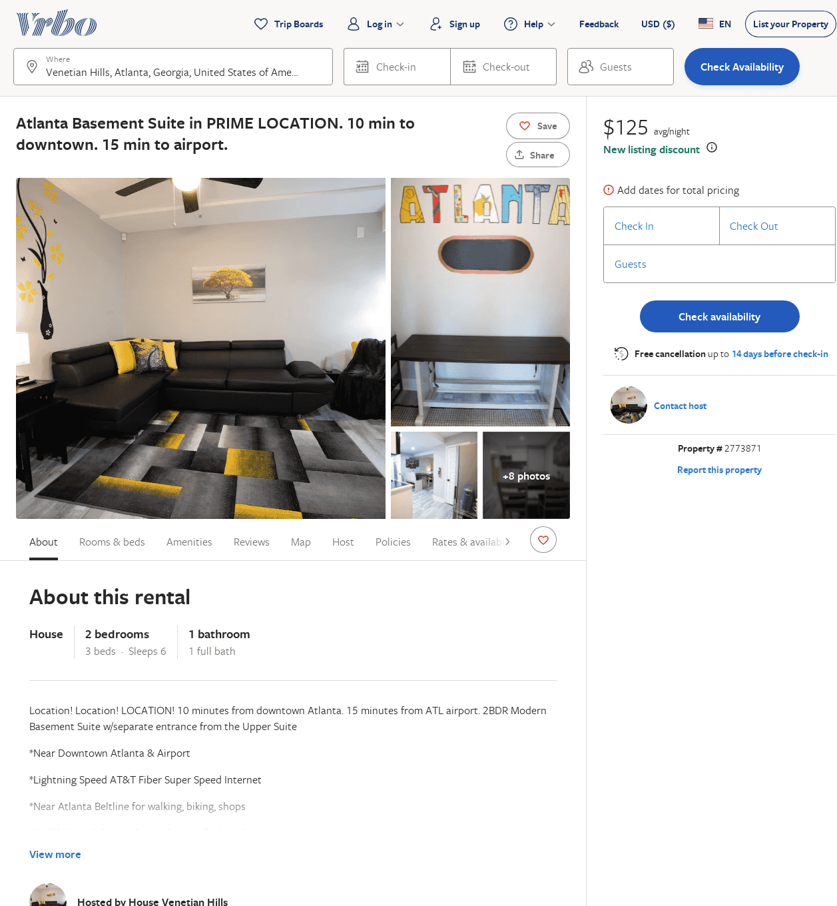
Listing 2773871
2
6
$125
1
https://www.vrbo.com/2773871
Aug 2022

Slide 44
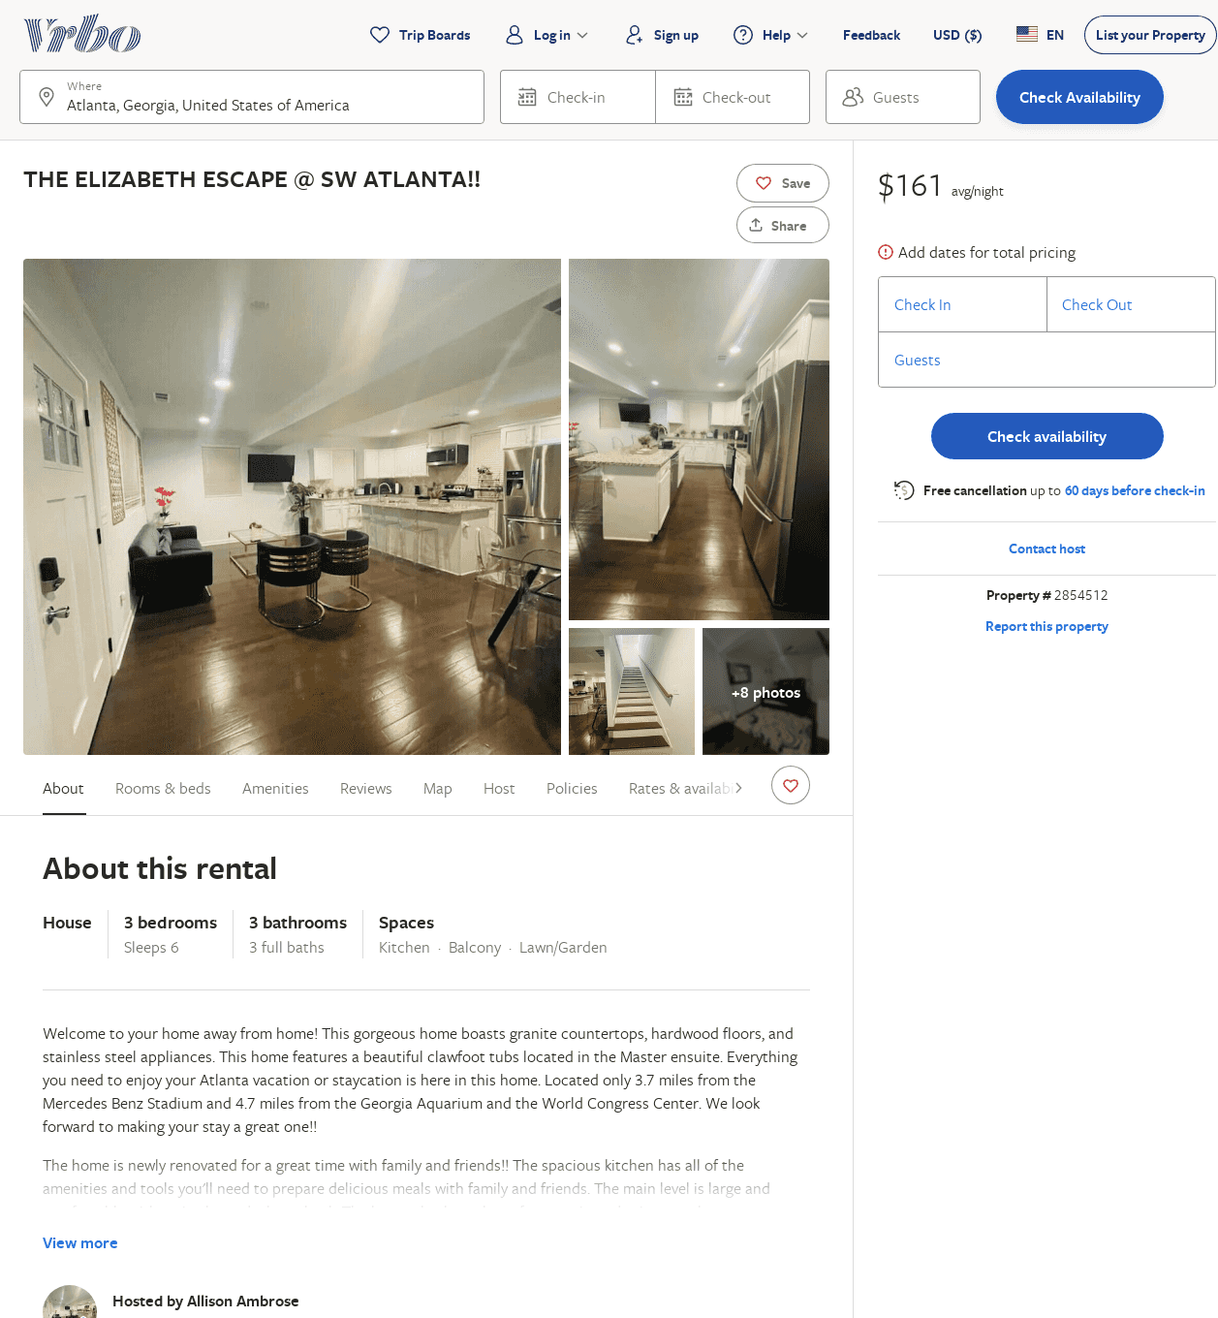
Listing 2854512
3
6
$161
2
Allison Ambrose
https://www.vrbo.com/2854512
Aug 2022

Slide 45
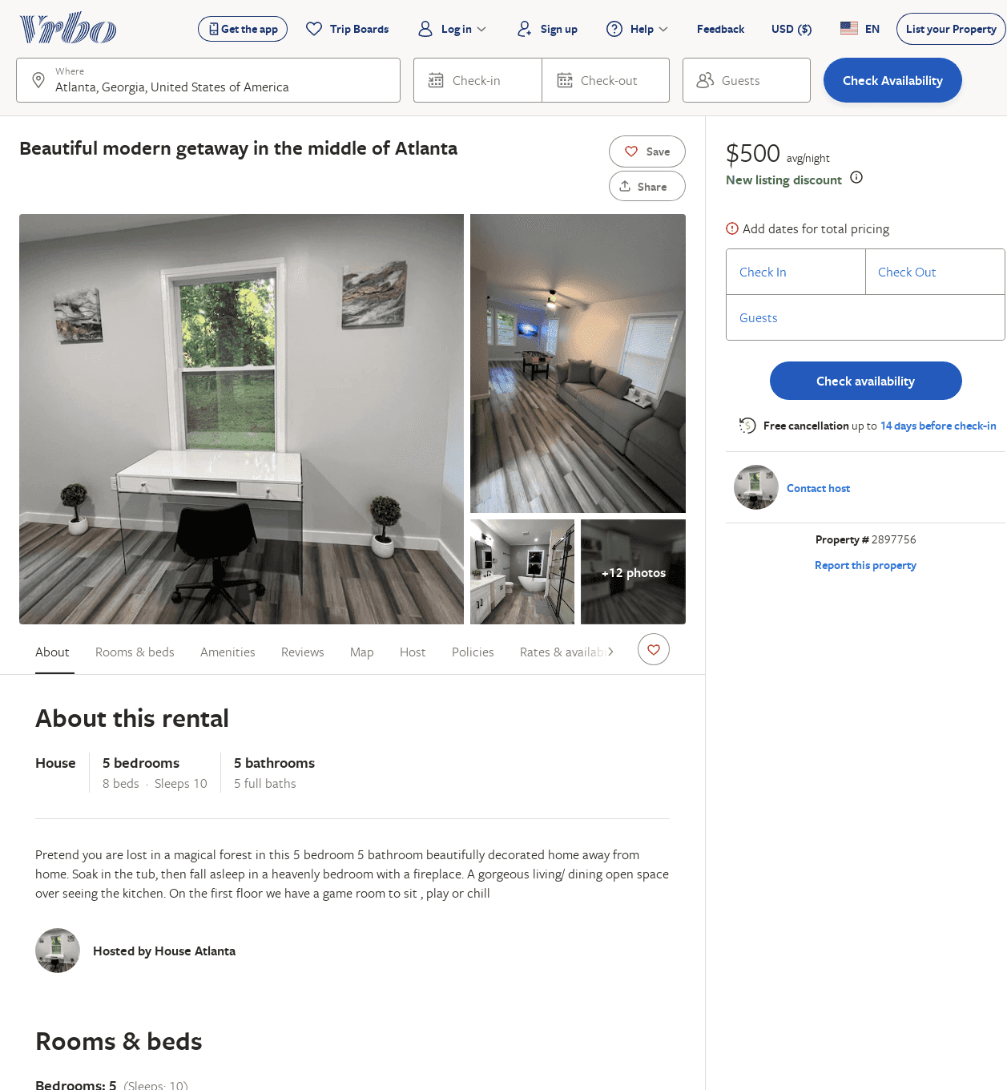
Listing 2897756
5
10
$380
2
https://www.vrbo.com/2897756
Aug 2022

Slide 46
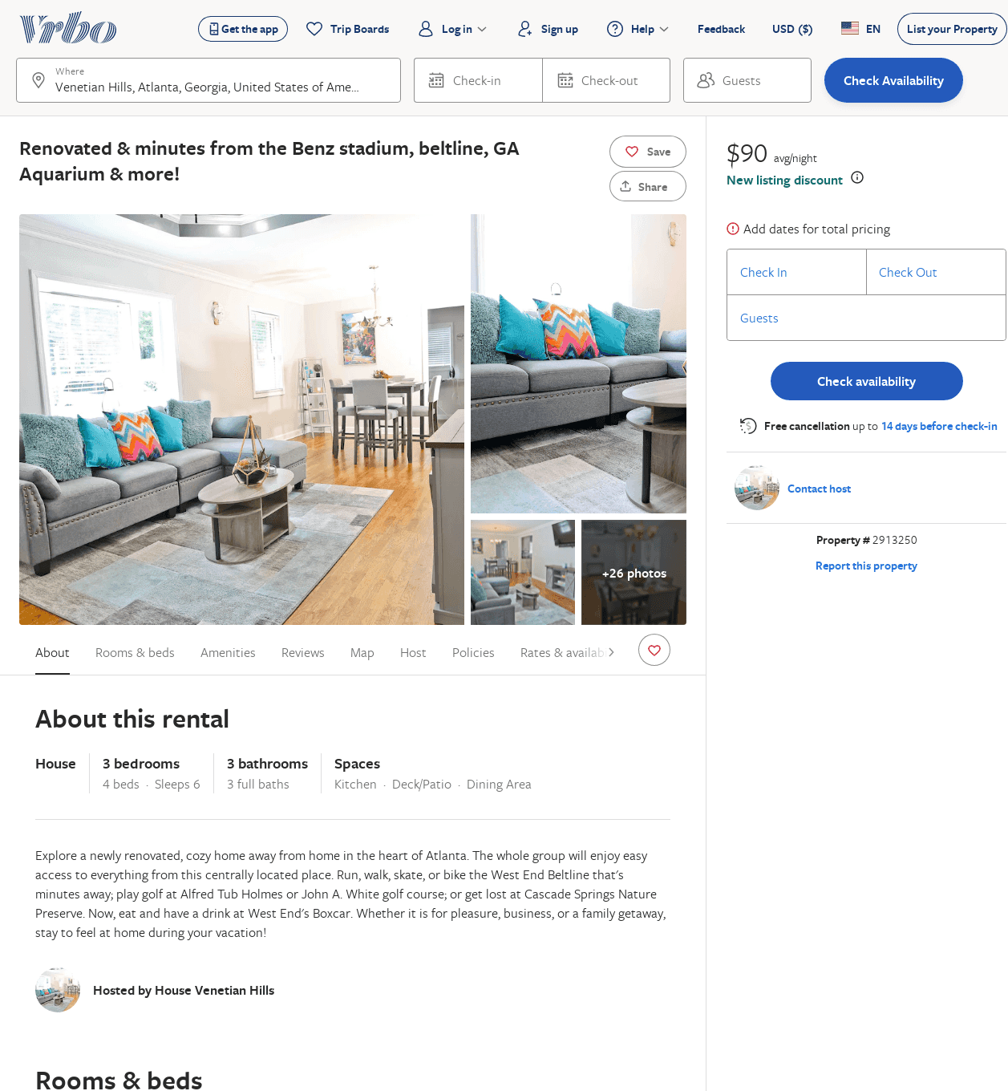
Listing 2913250
3
4
$100
5
2
C-Resilient Properties LLC
https://www.vrbo.com/2913250
Aug 2022

Slide 47
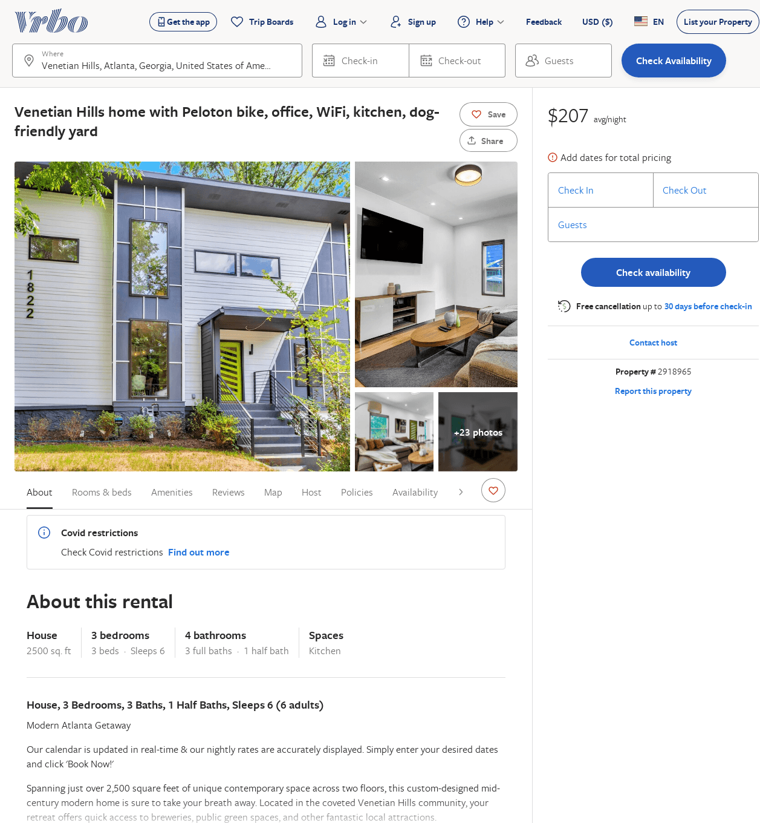
Listing 2918965
3
6
$157
2
Vacasa of Georgia
https://www.vrbo.com/2918965
Aug 2022

Slide 48
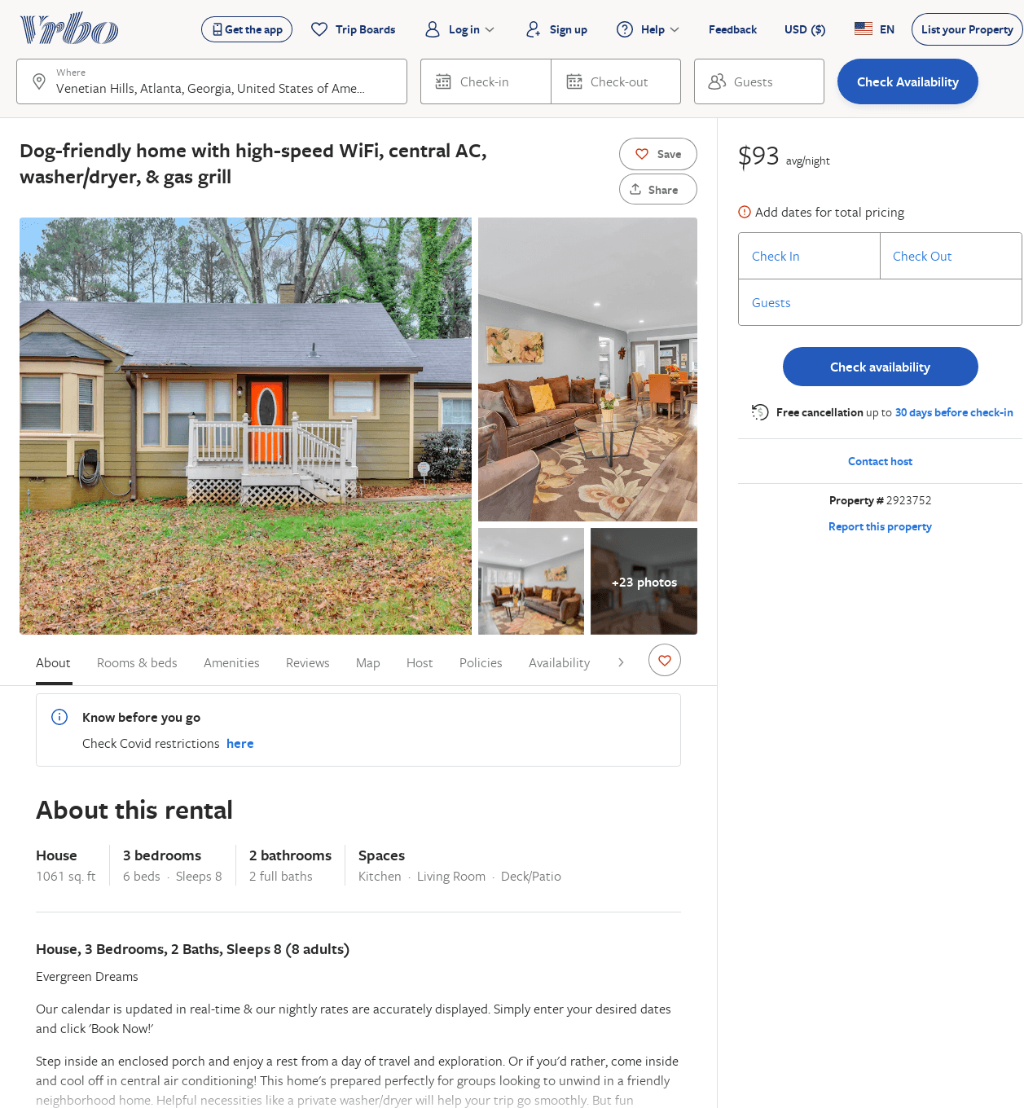
Listing 2923752
3
8
$172
2
Vacasa of Georgia
https://www.vrbo.com/2923752
Aug 2022

Slide 49
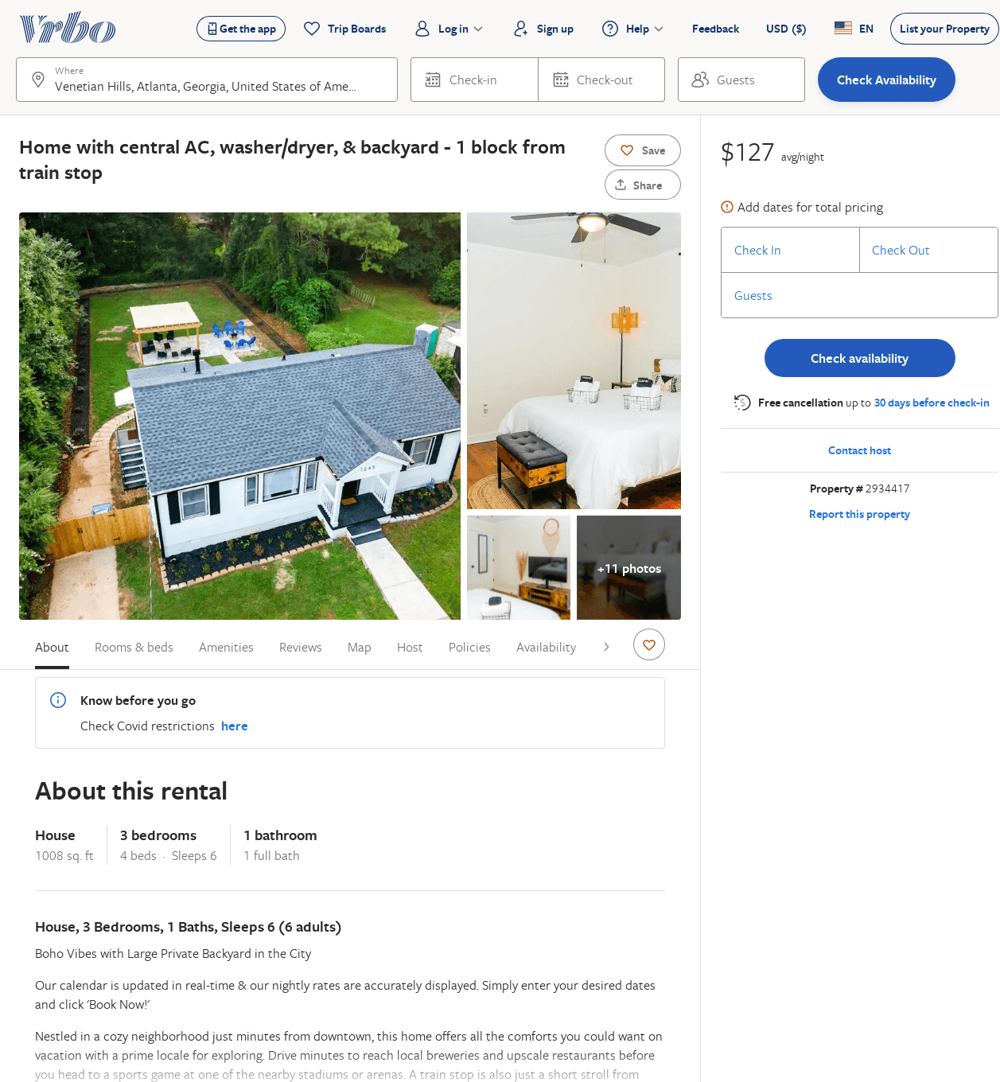
Listing 2934417
3
6
$106
2
Vacasa of Georgia
https://www.vrbo.com/2934417
Aug 2022

Slide 50
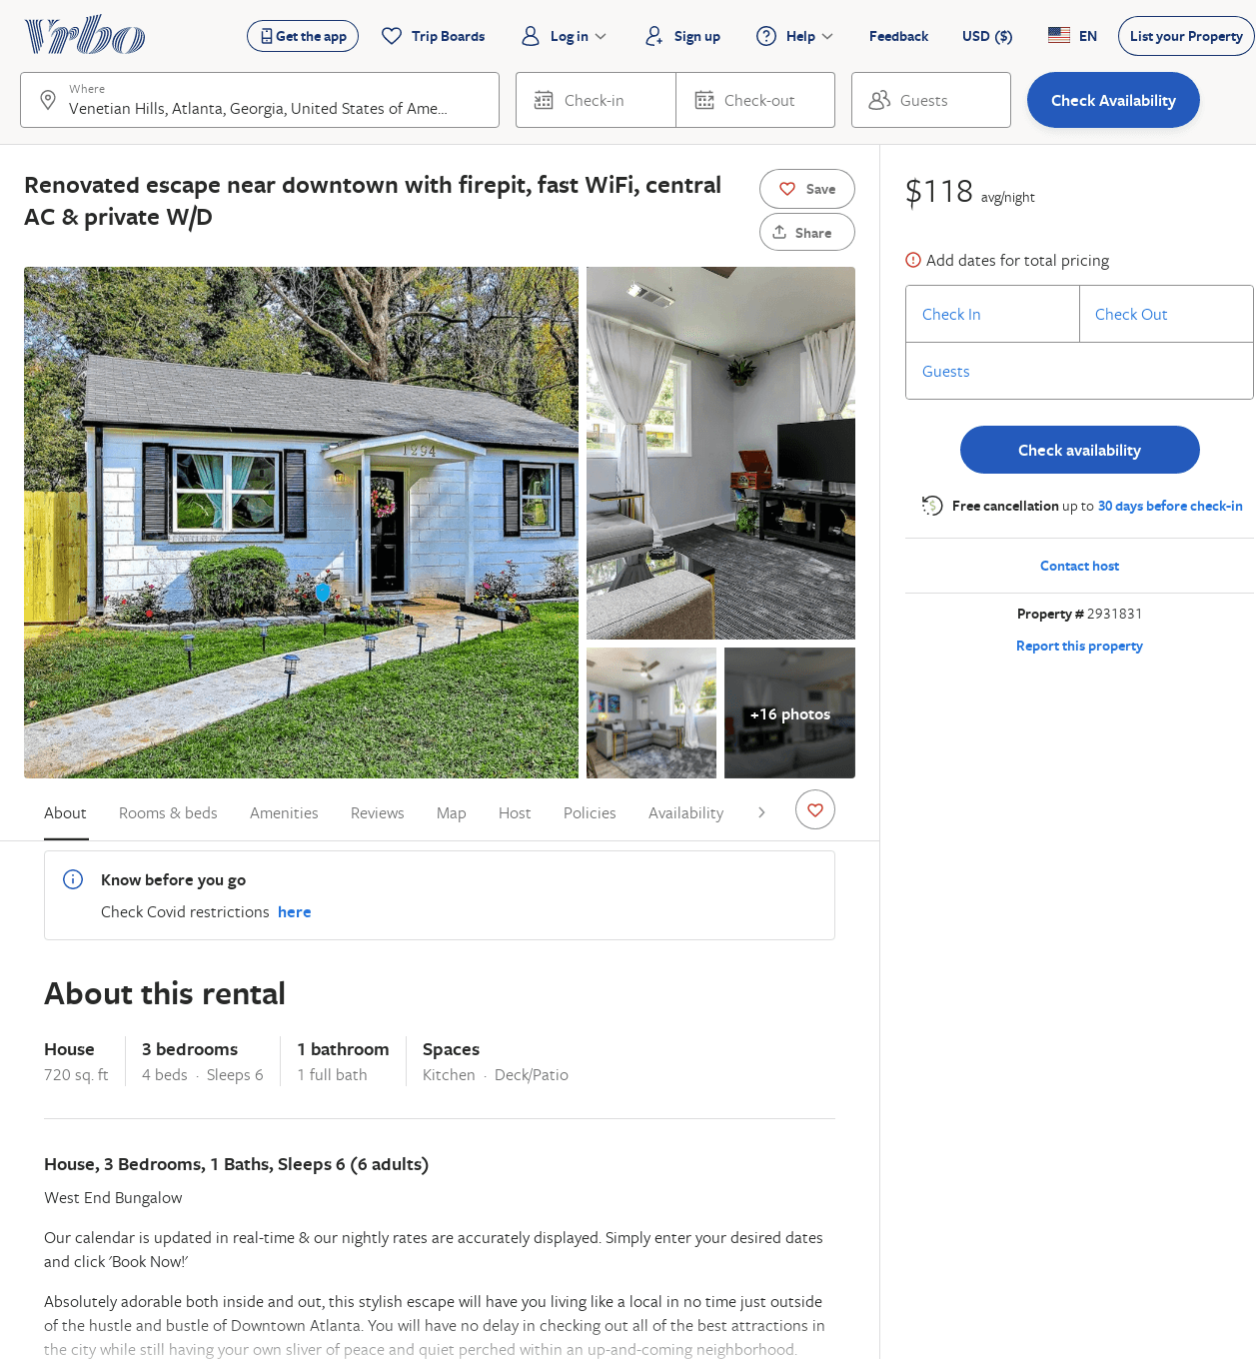
Listing 2931831
3
6
$92
4.6363635
2
Vacasa of Georgia
https://www.vrbo.com/2931831
Aug 2022

