Slide 2
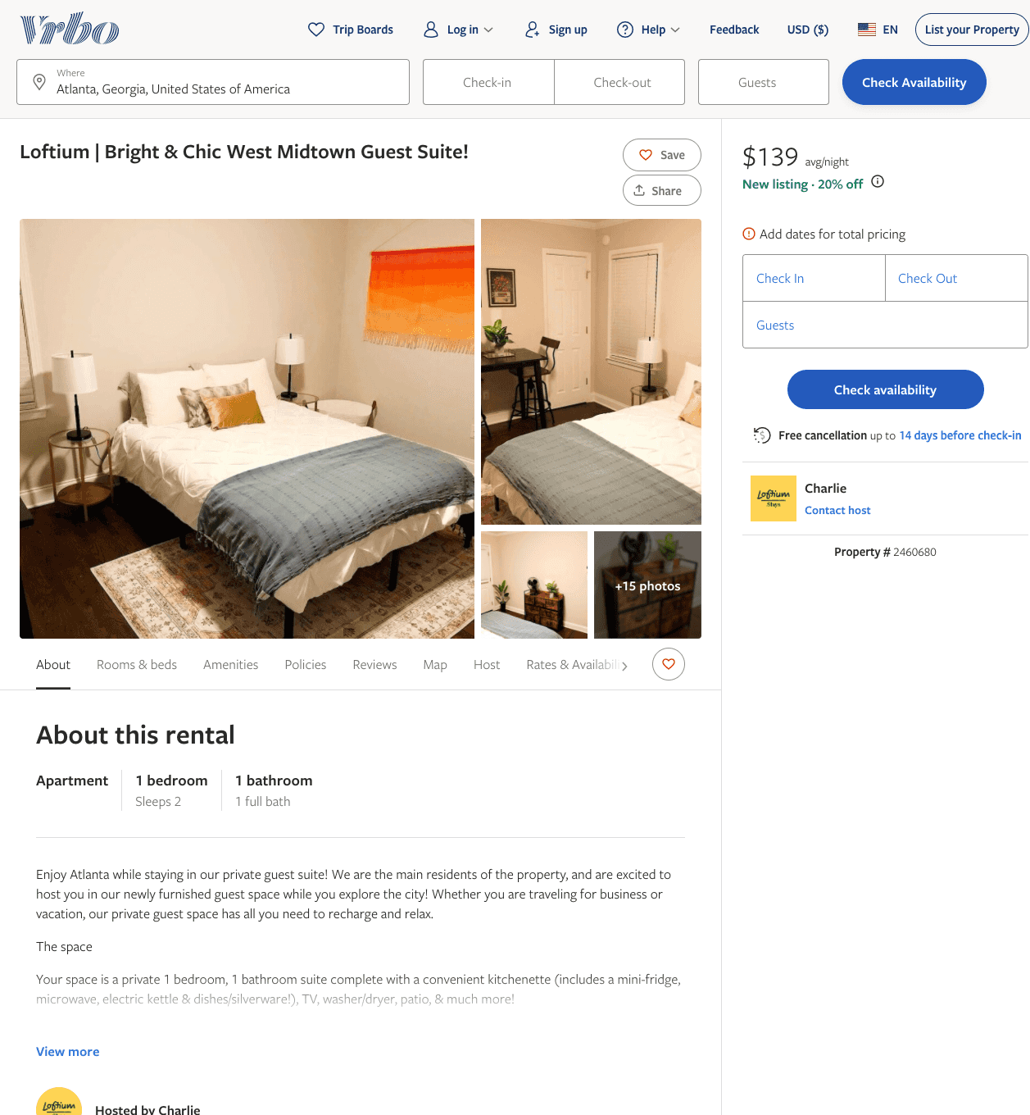
Listing 2460680
1
2
$102 - $60
4.75
3
Charlie
https://www.vrbo.com/2460680
Aug 2022

Slide 3
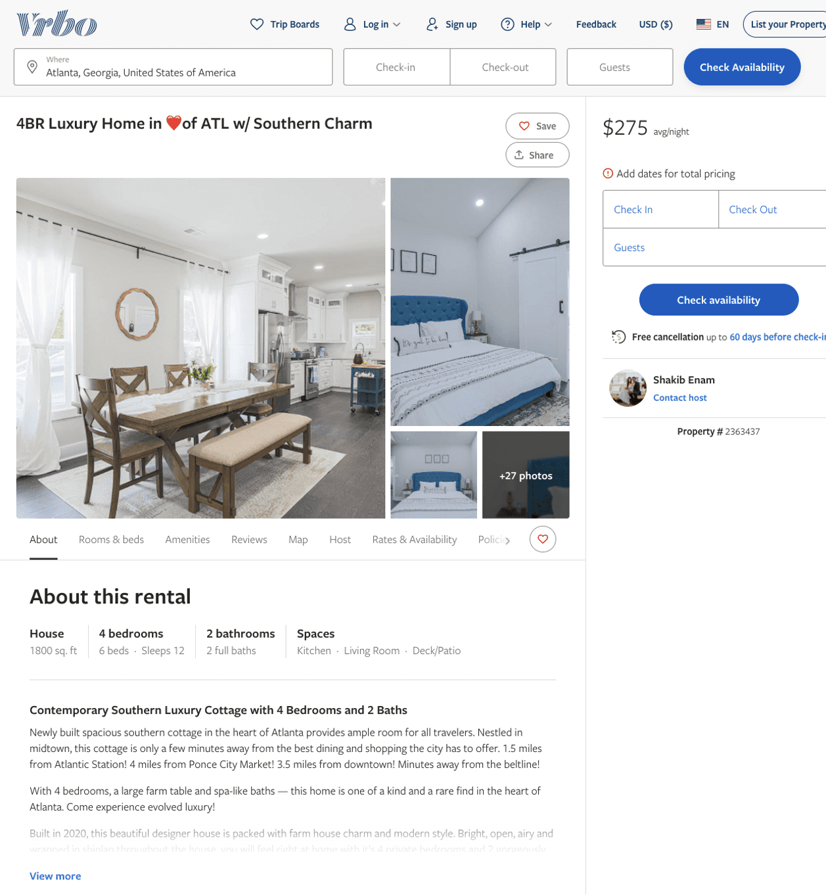
Listing 2363437
4
12
$314 - $431
3.6666667
3
Shakib Enam
https://www.vrbo.com/2363437
Aug 2022

Slide 4
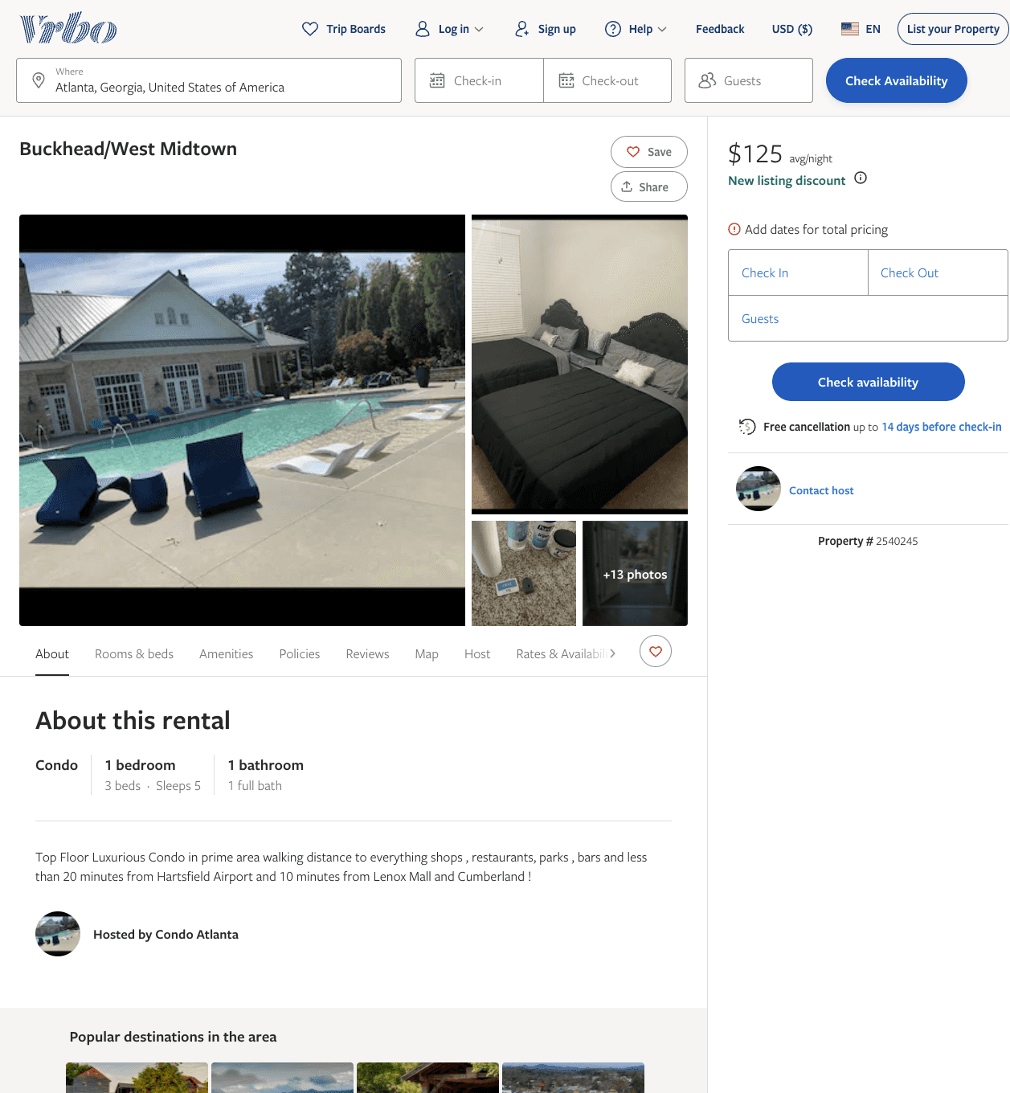
Listing 2540245
1
5
$125 - $153
2
https://www.vrbo.com/2540245
Aug 2022

Slide 5
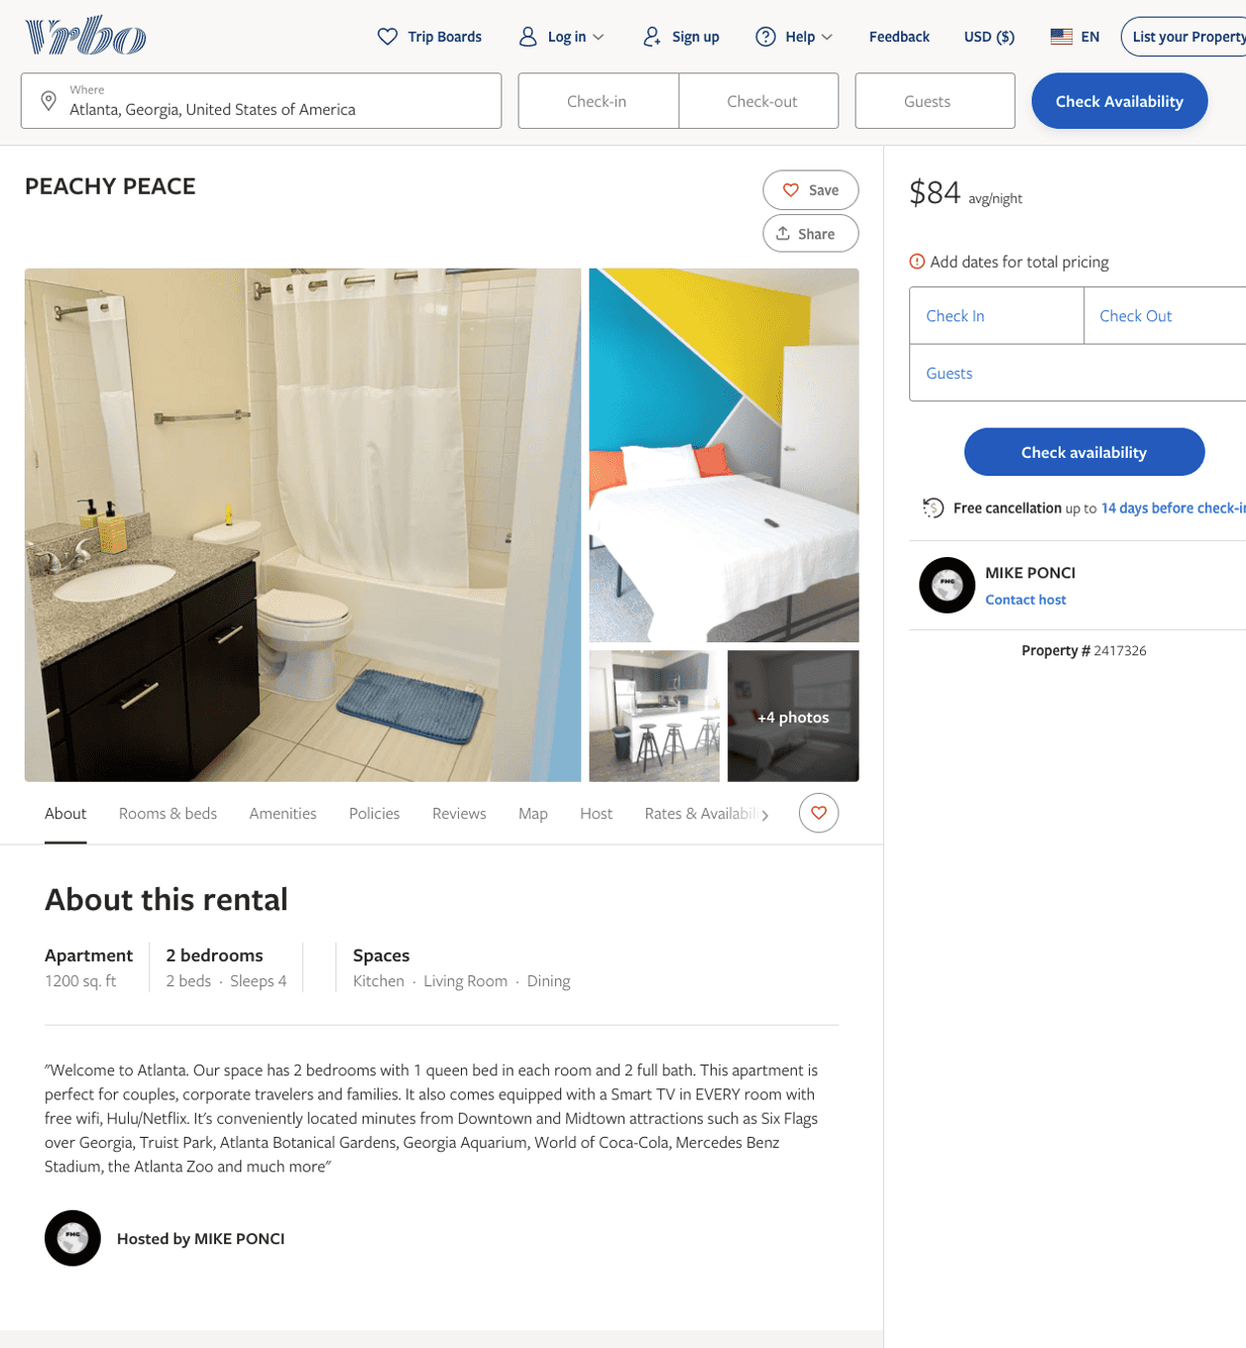
Listing 2417326
2
4
$102 - $84
1
MIKE PONCI
https://www.vrbo.com/2417326
Aug 2022

Slide 6
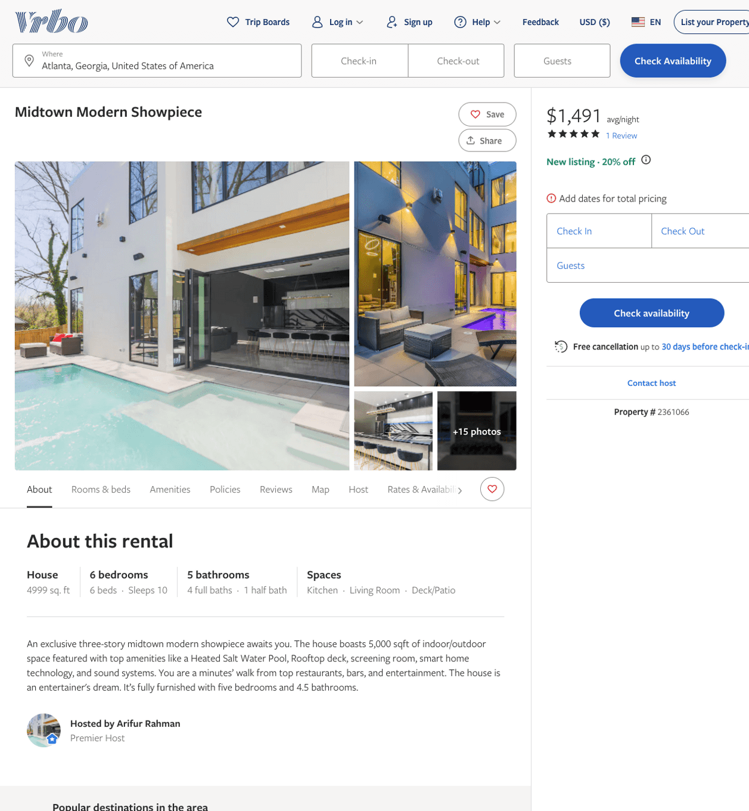
Listing 2361066
6
10
$1,016 - $967
5
2
Arifur Rahman
https://www.vrbo.com/2361066
Aug 2022

Slide 7
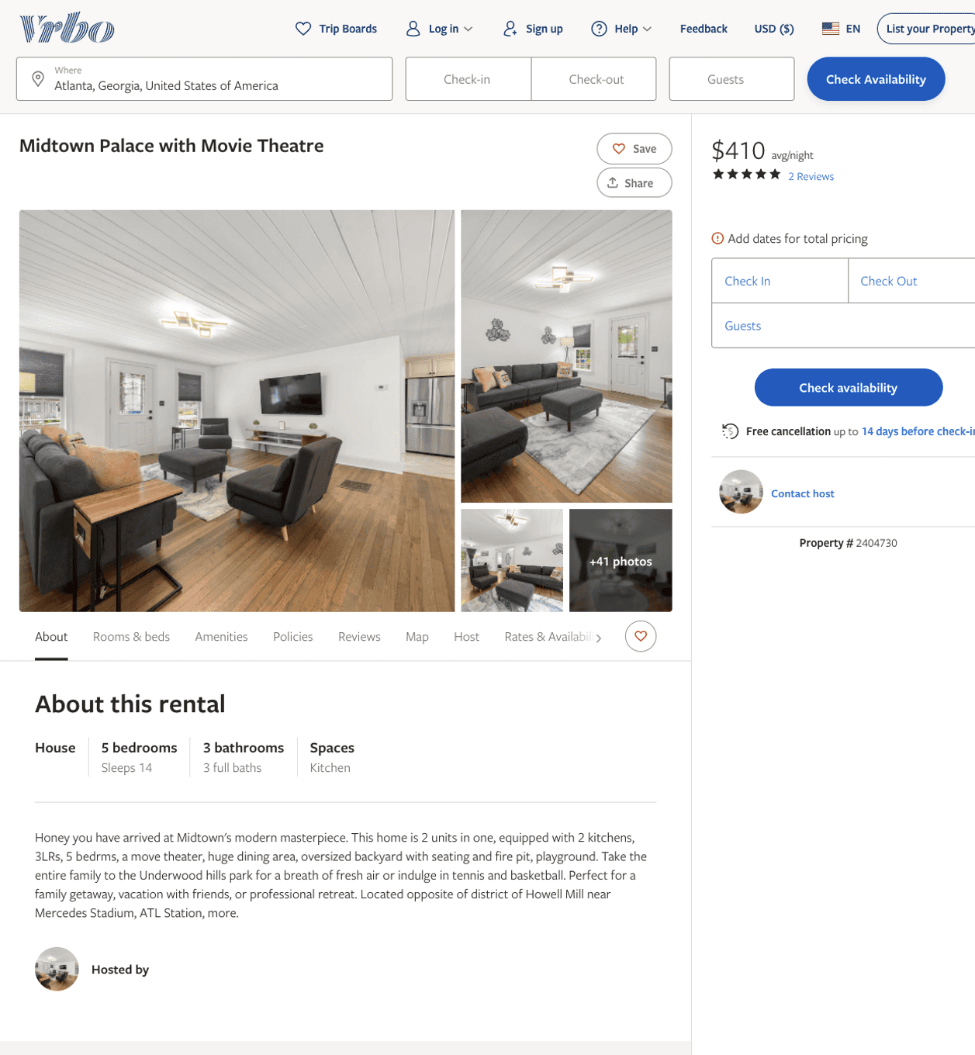
Listing 2404730
5
14
$410 - $512
3.5
2
https://www.vrbo.com/2404730
Aug 2022

Slide 8
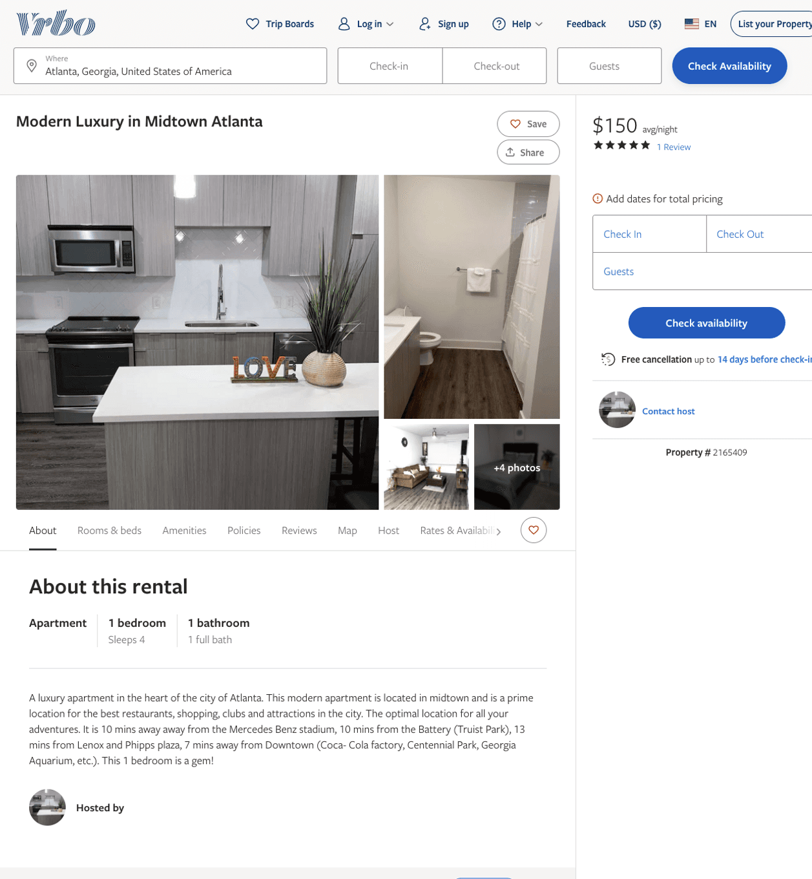
Listing 2165409
1
4
$150
5
2
https://www.vrbo.com/2165409
Aug 2022

Slide 9
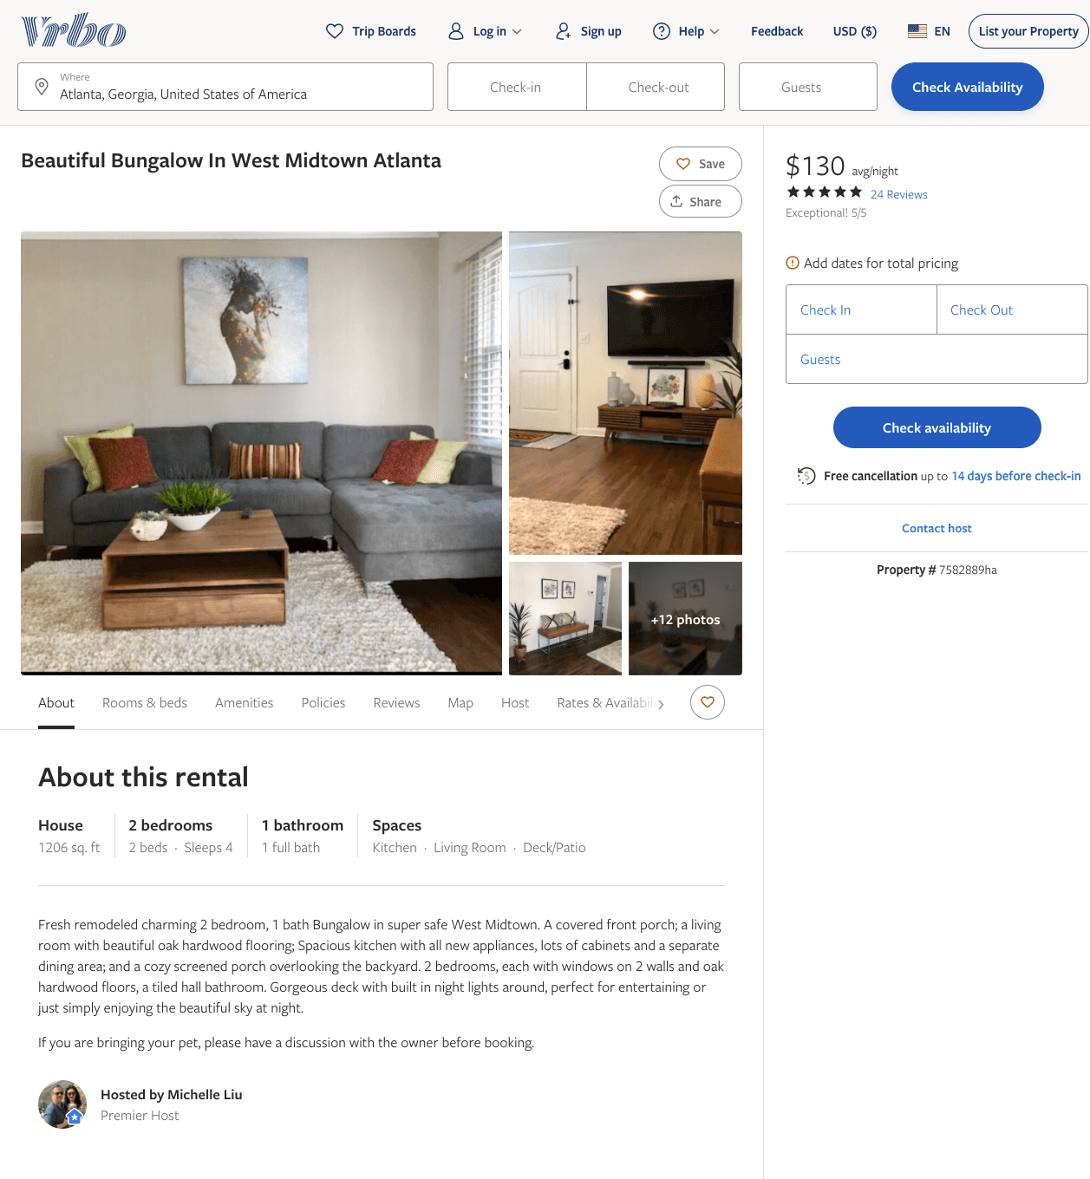
Listing 7582889
2
4
$120 - $130
4.939394
3
Michelle Liu
https://www.vrbo.com/7582889ha
Aug 2022

Slide 10
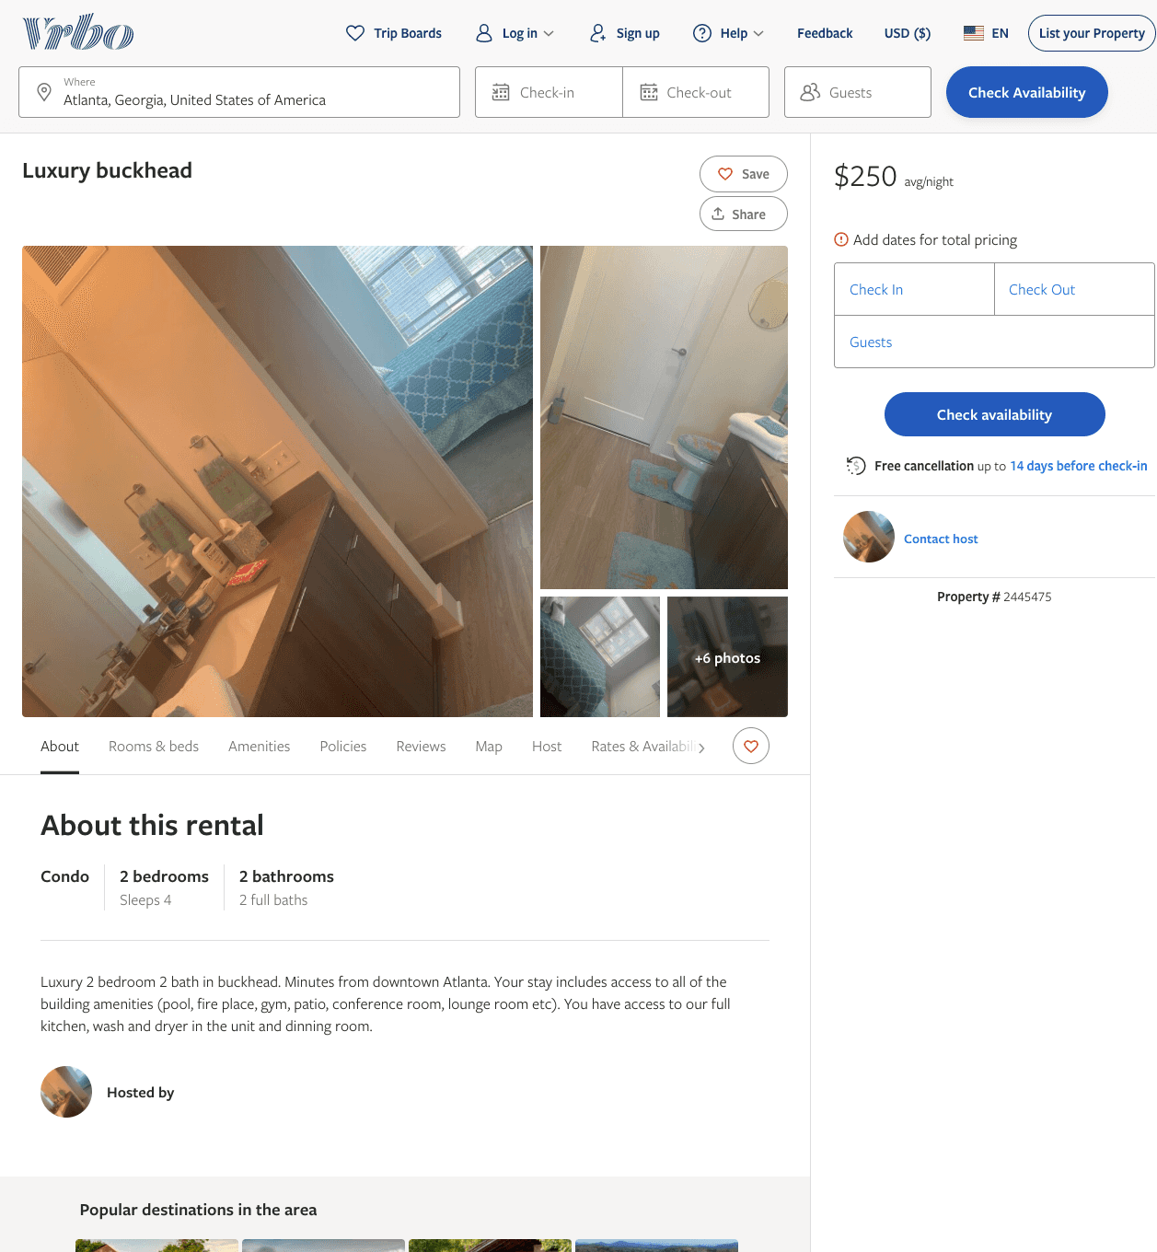
Listing 2445475
2
4
$250
1
https://www.vrbo.com/2445475
Aug 2022

Slide 11
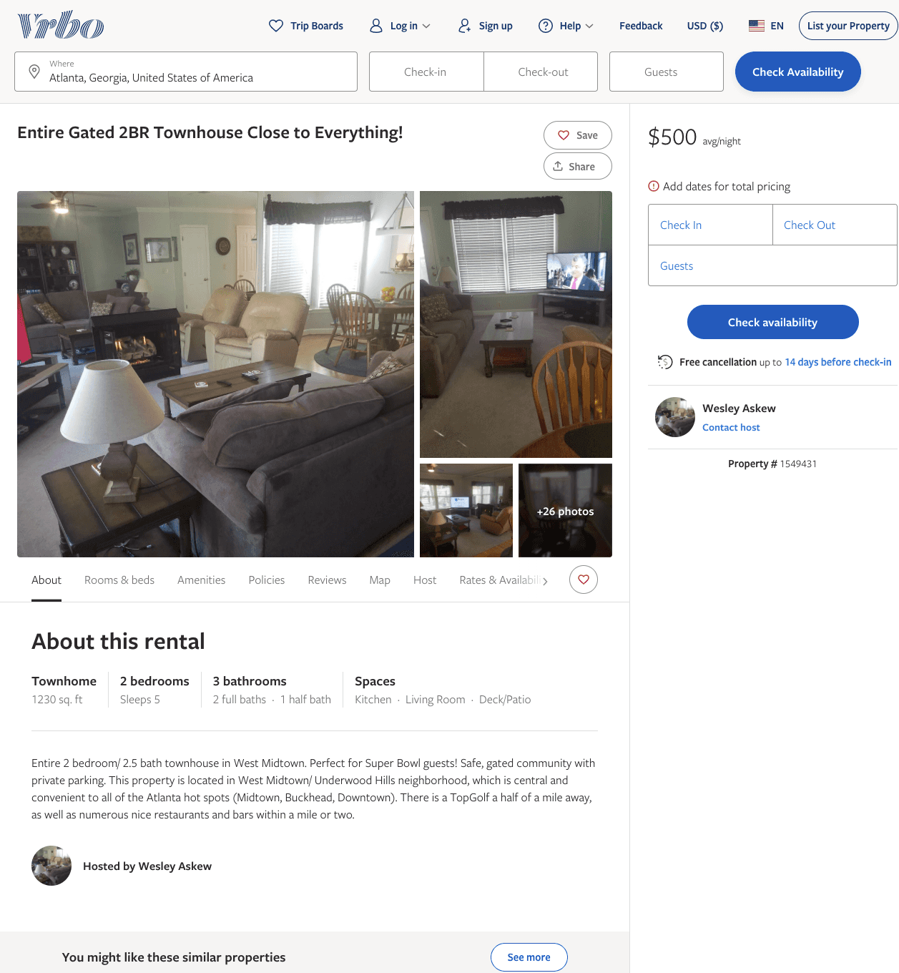
Listing 1549431
2
5
$500
1
Wesley Askew
https://www.vrbo.com/1549431
Aug 2022

Slide 12
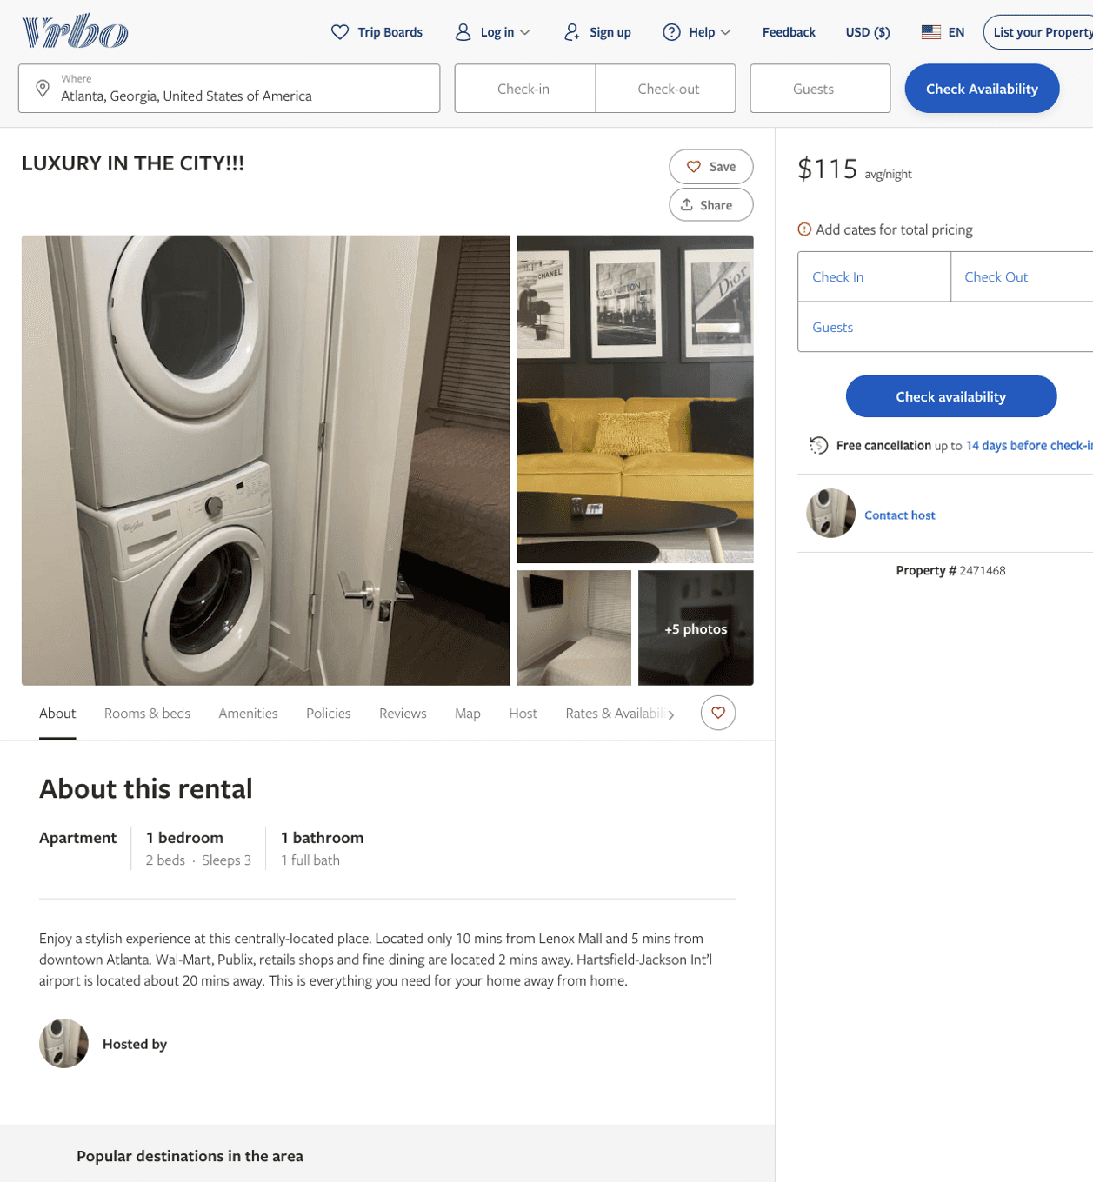
Listing 2471468
1
3
$115
2
https://www.vrbo.com/2471468
Aug 2022

Slide 13
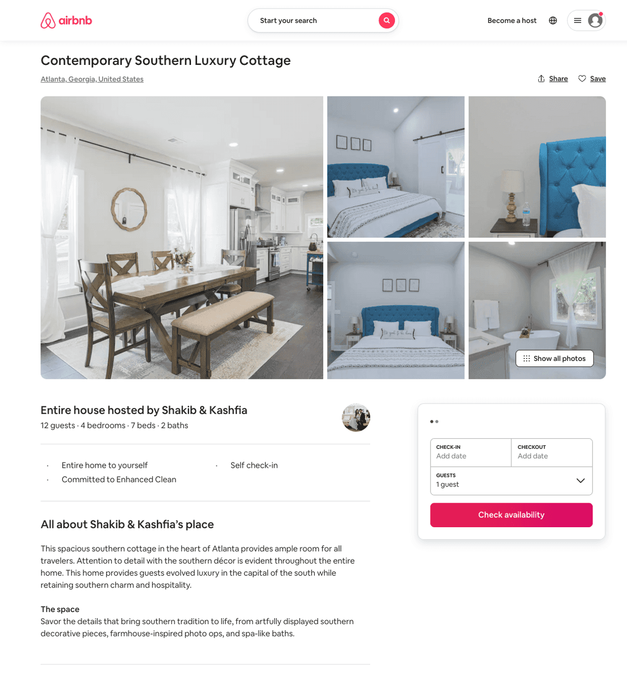
Listing 50350360
4
12
$261 - $495
5.0
2
Shakib & Kashfia
17215882
1
https://www.airbnb.com/rooms/50350360
Aug 2022

Slide 14
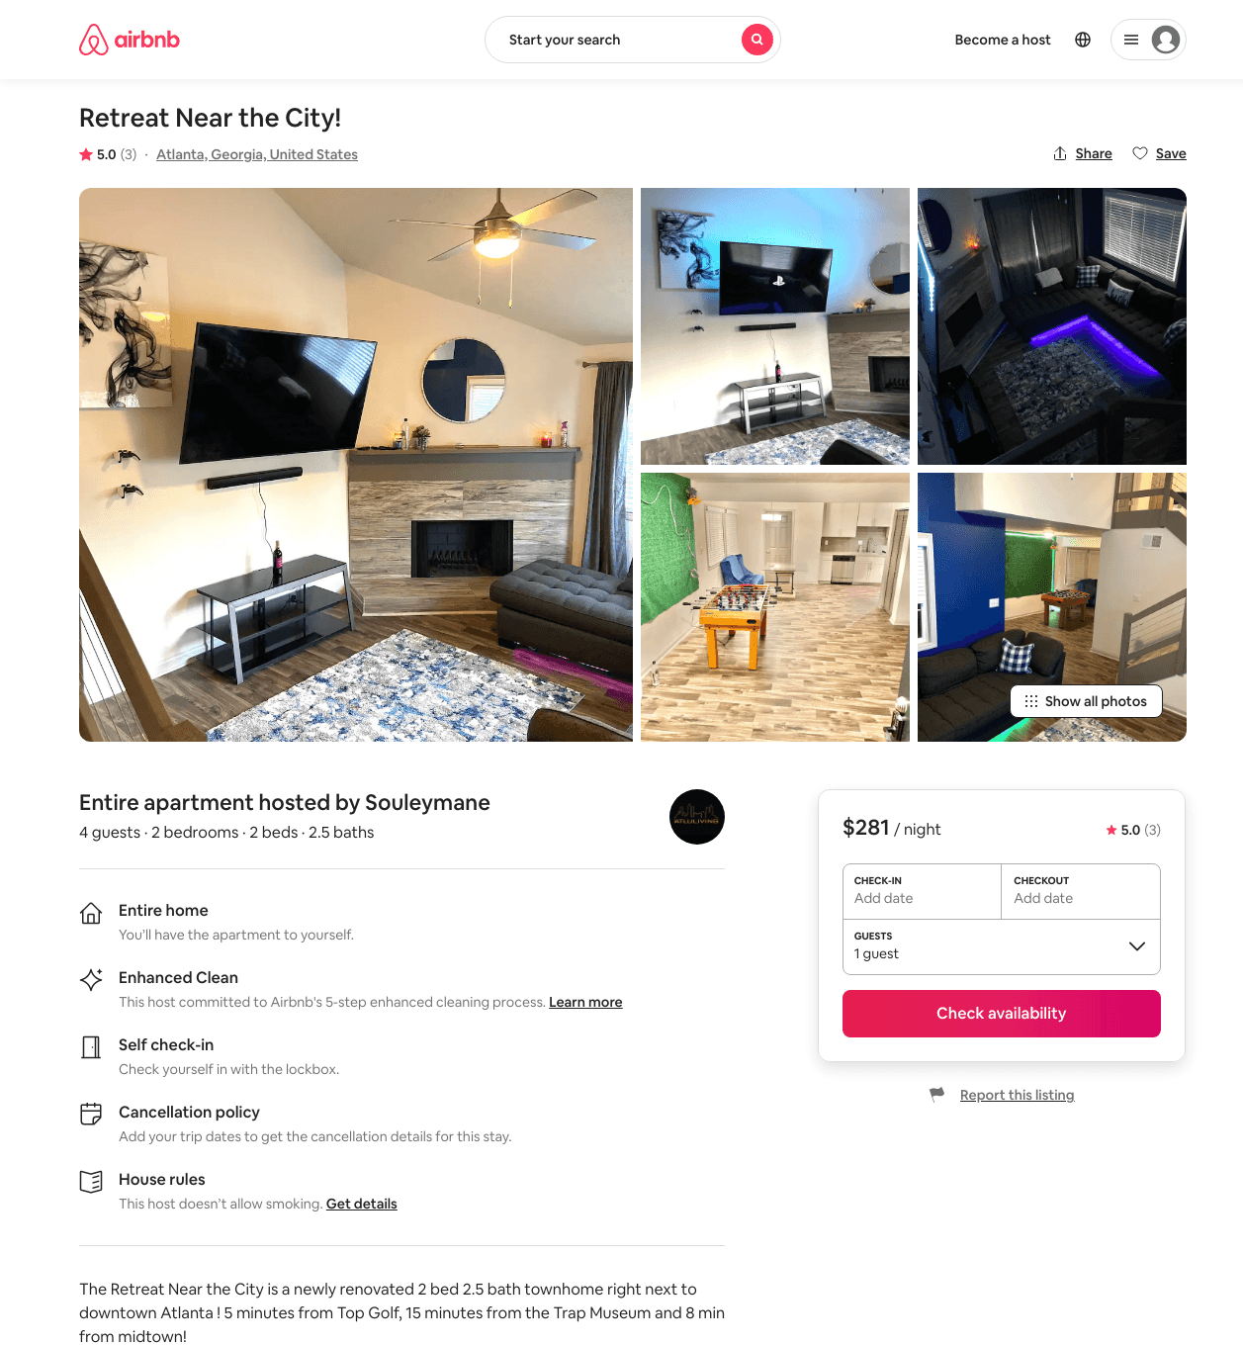
Listing 41967417
2
4
$154 - $380
4.71
2
Souleymane
112483241
3
https://www.airbnb.com/rooms/41967417
Jul 2022

Slide 15
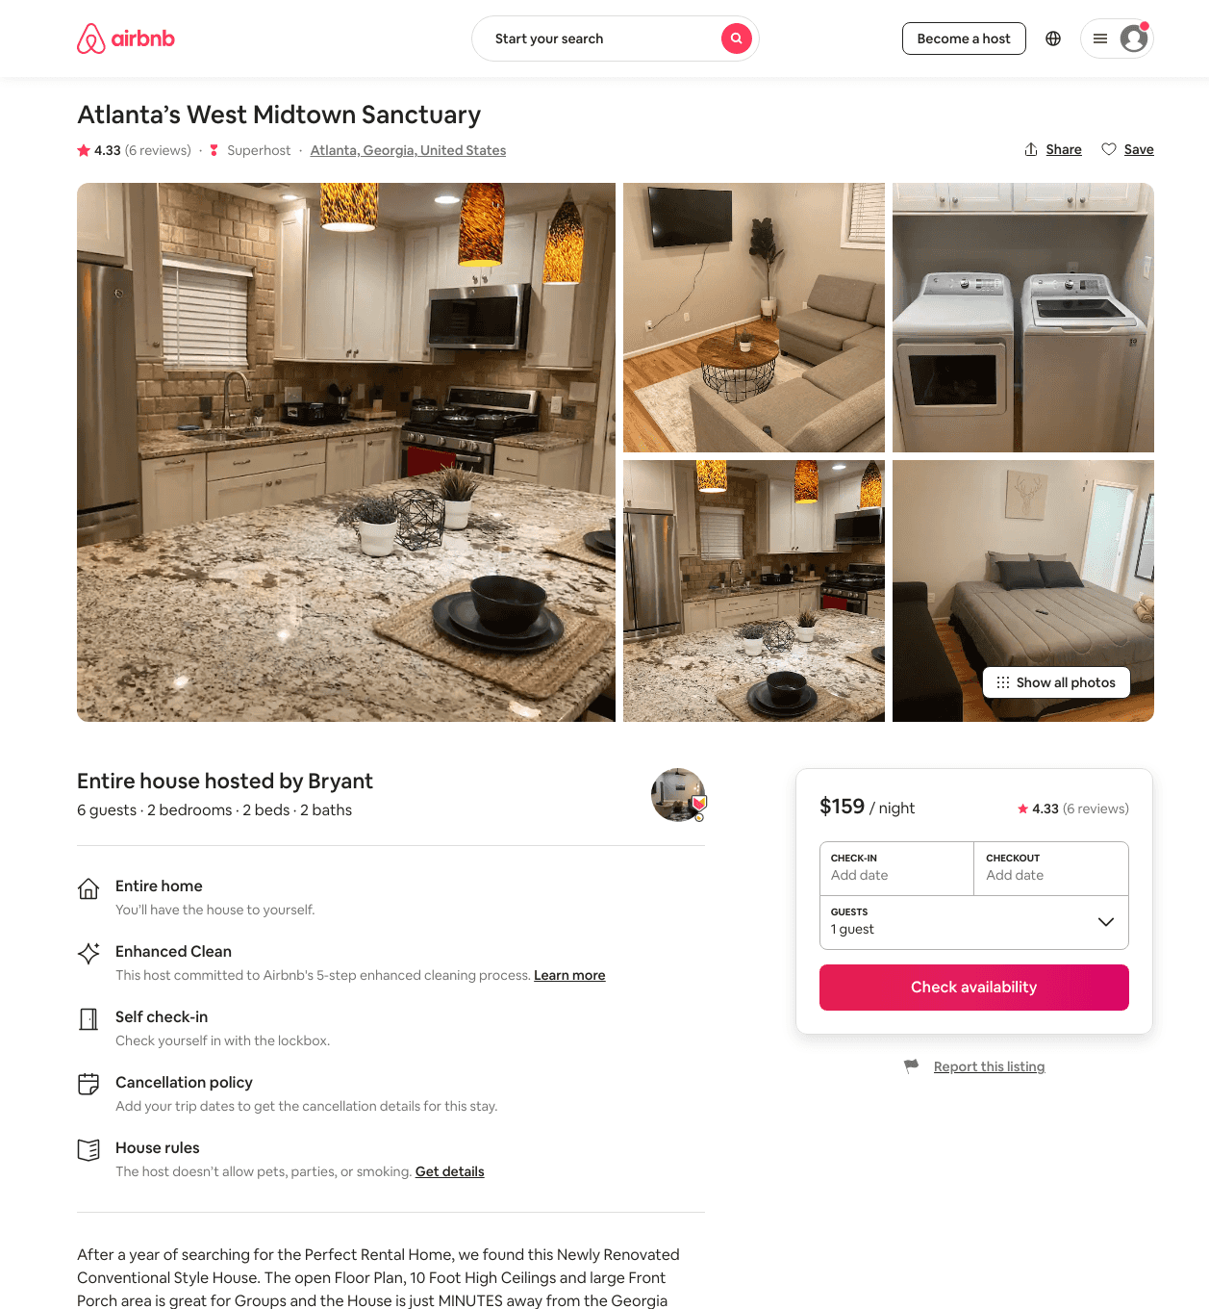
Listing 48150146
2
7
$92 - $231
4.77
1
Bryant
250716419
22
https://www.airbnb.com/rooms/48150146
Aug 2022

Slide 16
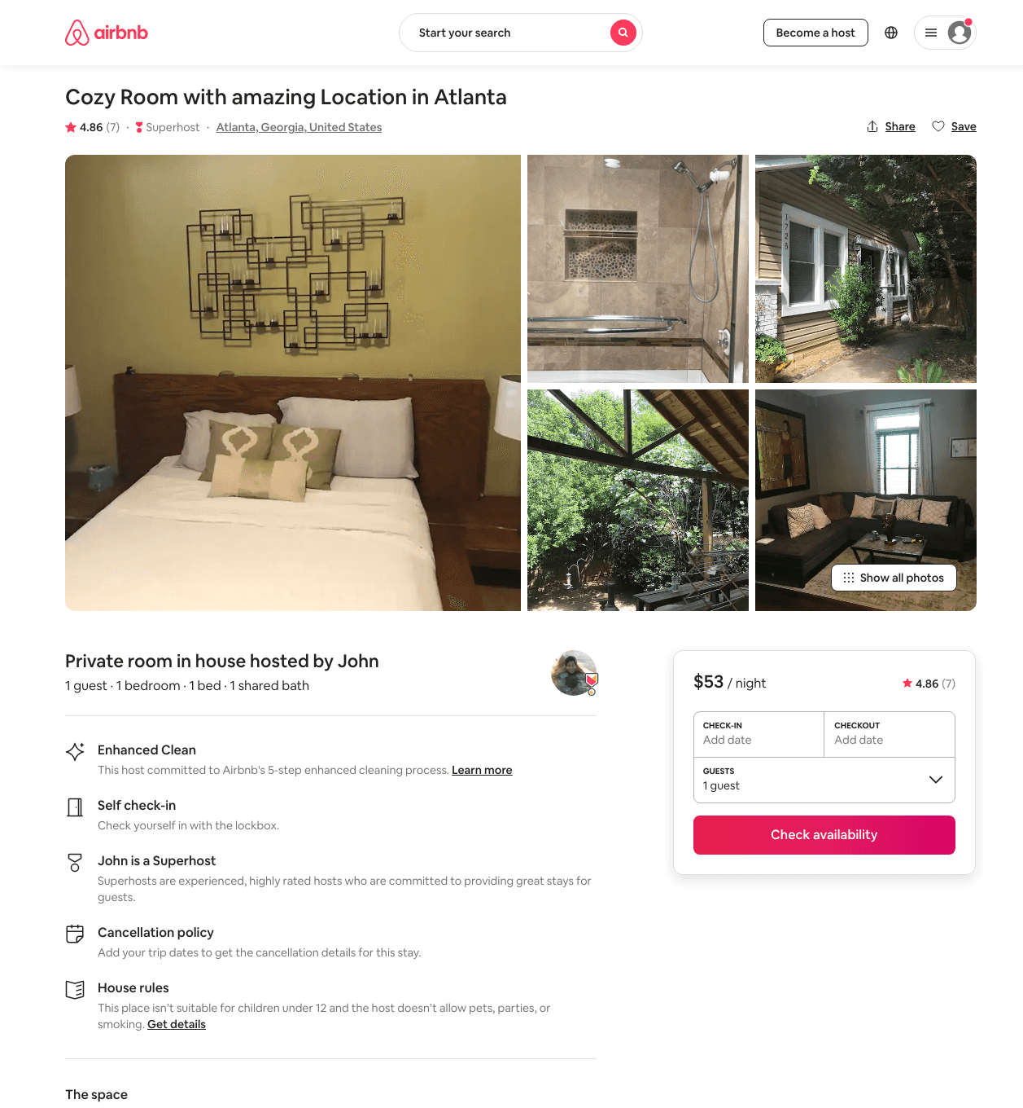
Listing 44498507
1
1
$53 - $54
4.87
2
John
69088362
2
https://www.airbnb.com/rooms/44498507
Aug 2022

Slide 17
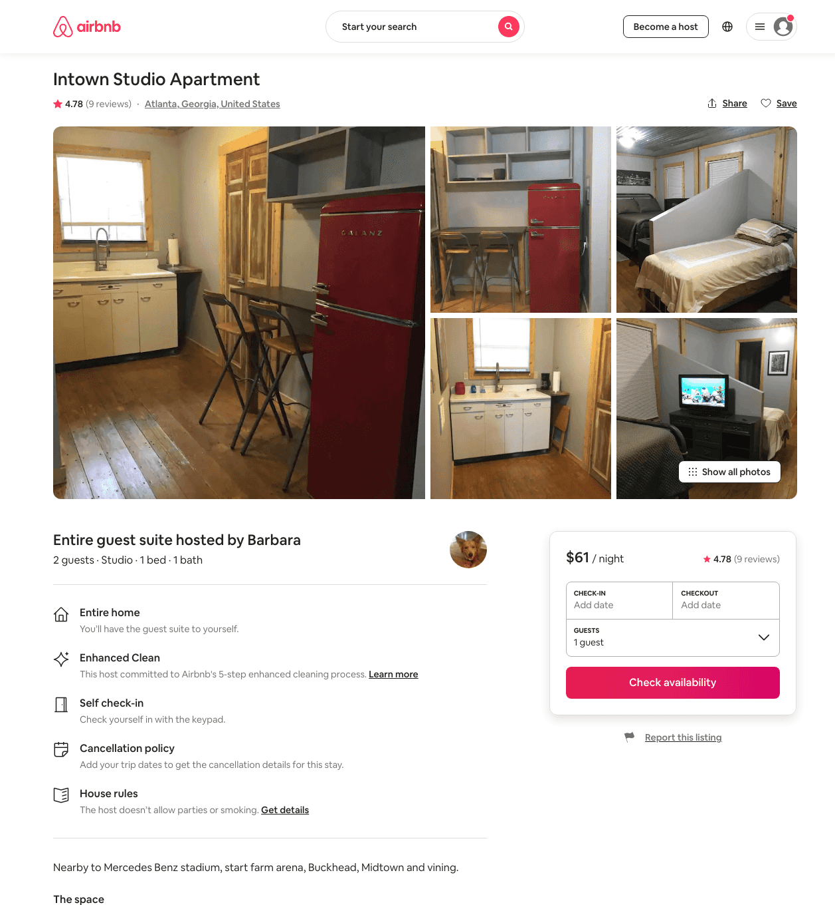
Listing 38279726
Studio
2
$60 - $63
4.79
30
Barbara
227345788
1
https://www.airbnb.com/rooms/38279726
Aug 2022

Slide 18
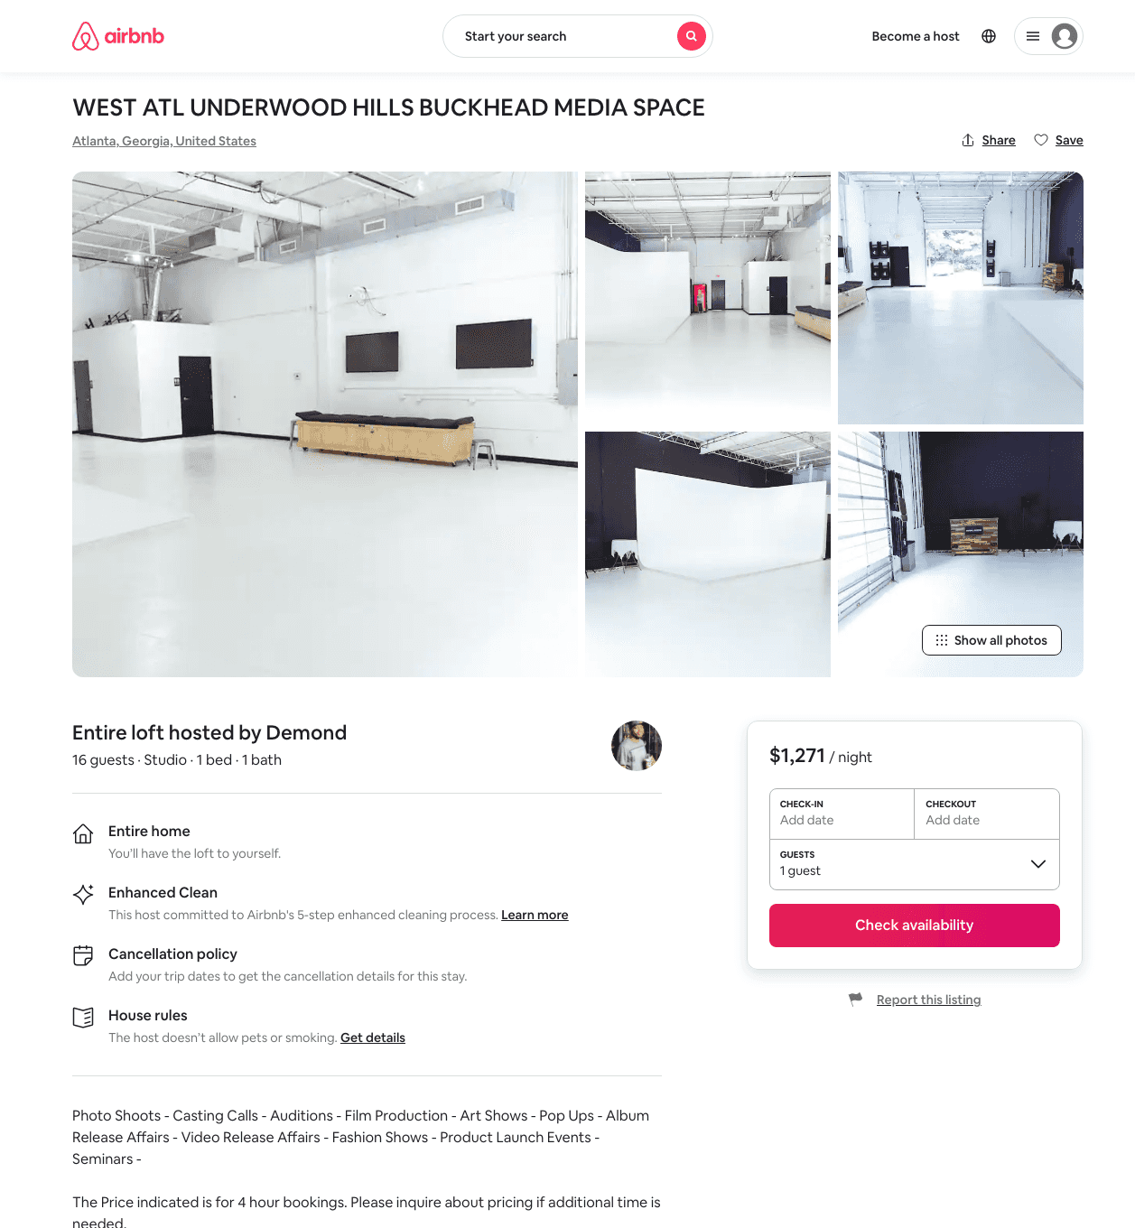
Listing 34036162
Studio
16
$1271 - $1929
1
Demond
247659355
1
https://www.airbnb.com/rooms/34036162
Aug 2022

Slide 19
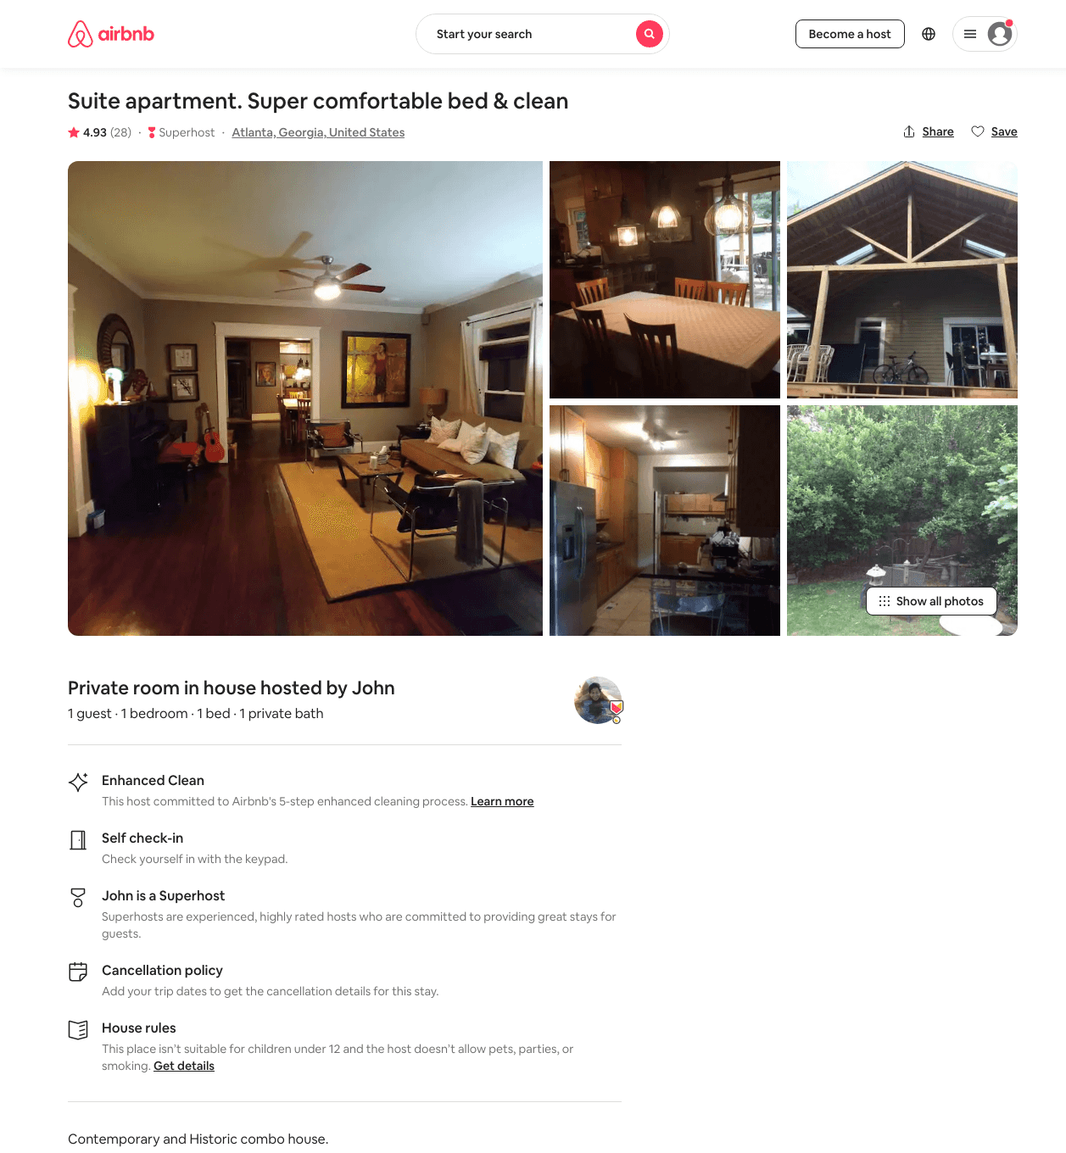
Listing 19435274
1
1
$60 - $82
4.95
2
John
69088362
2
https://www.airbnb.com/rooms/19435274
Aug 2022

Slide 20
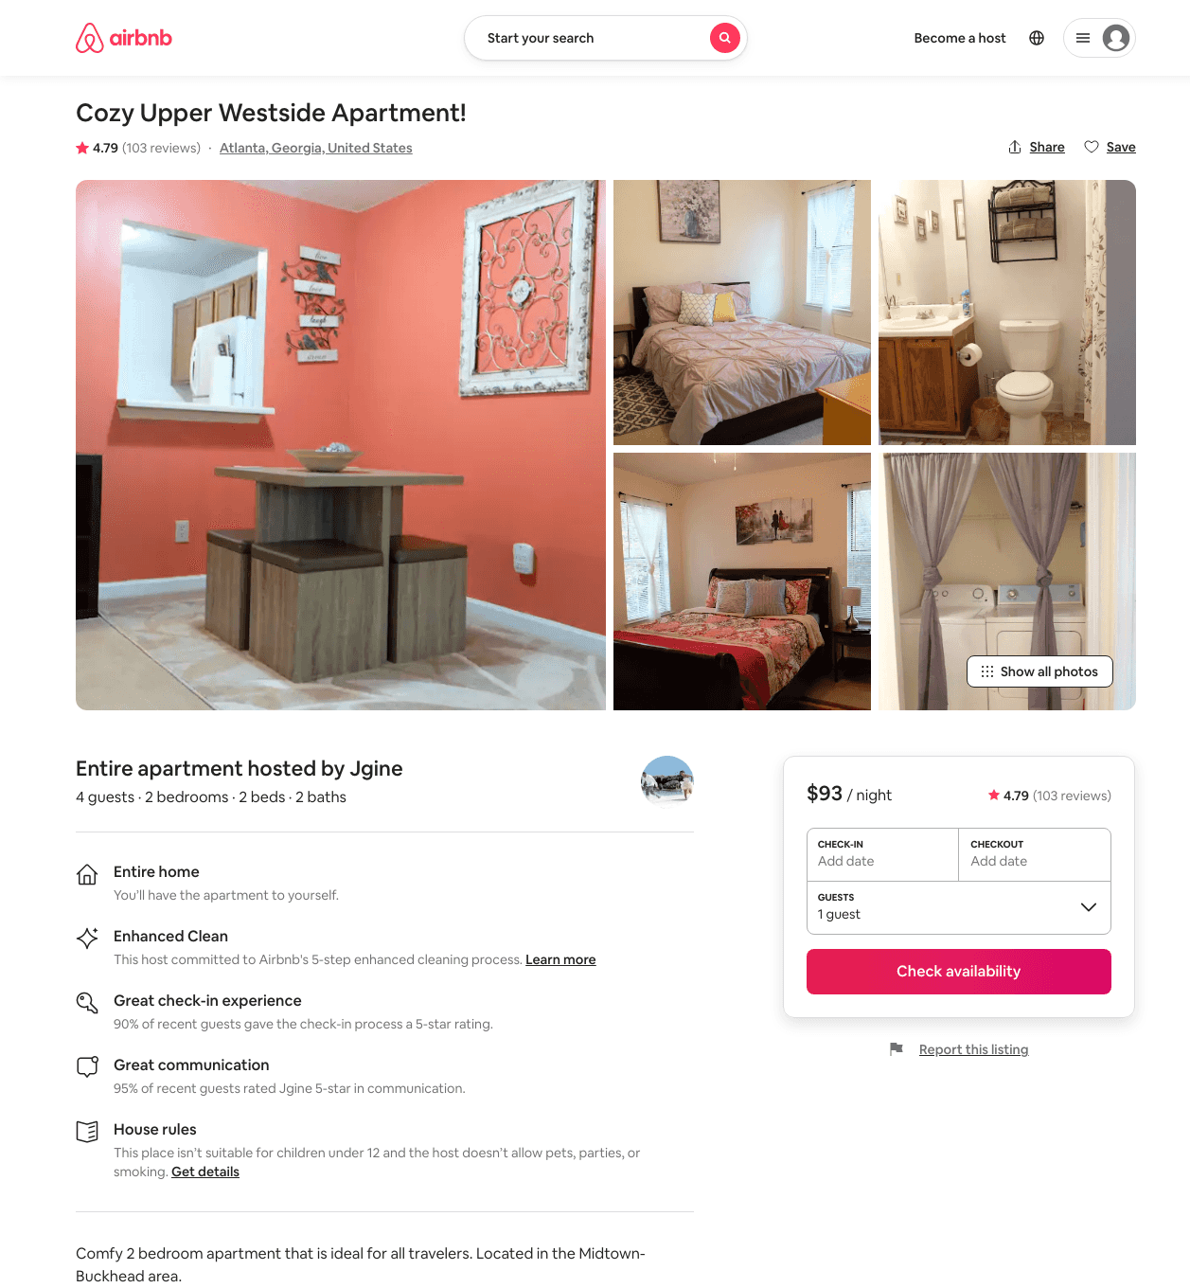
Listing 23726962
2
4
$86 - $102
4.77
2
Jgine
134170270
2
https://www.airbnb.com/rooms/23726962
Jun 2022

Slide 21
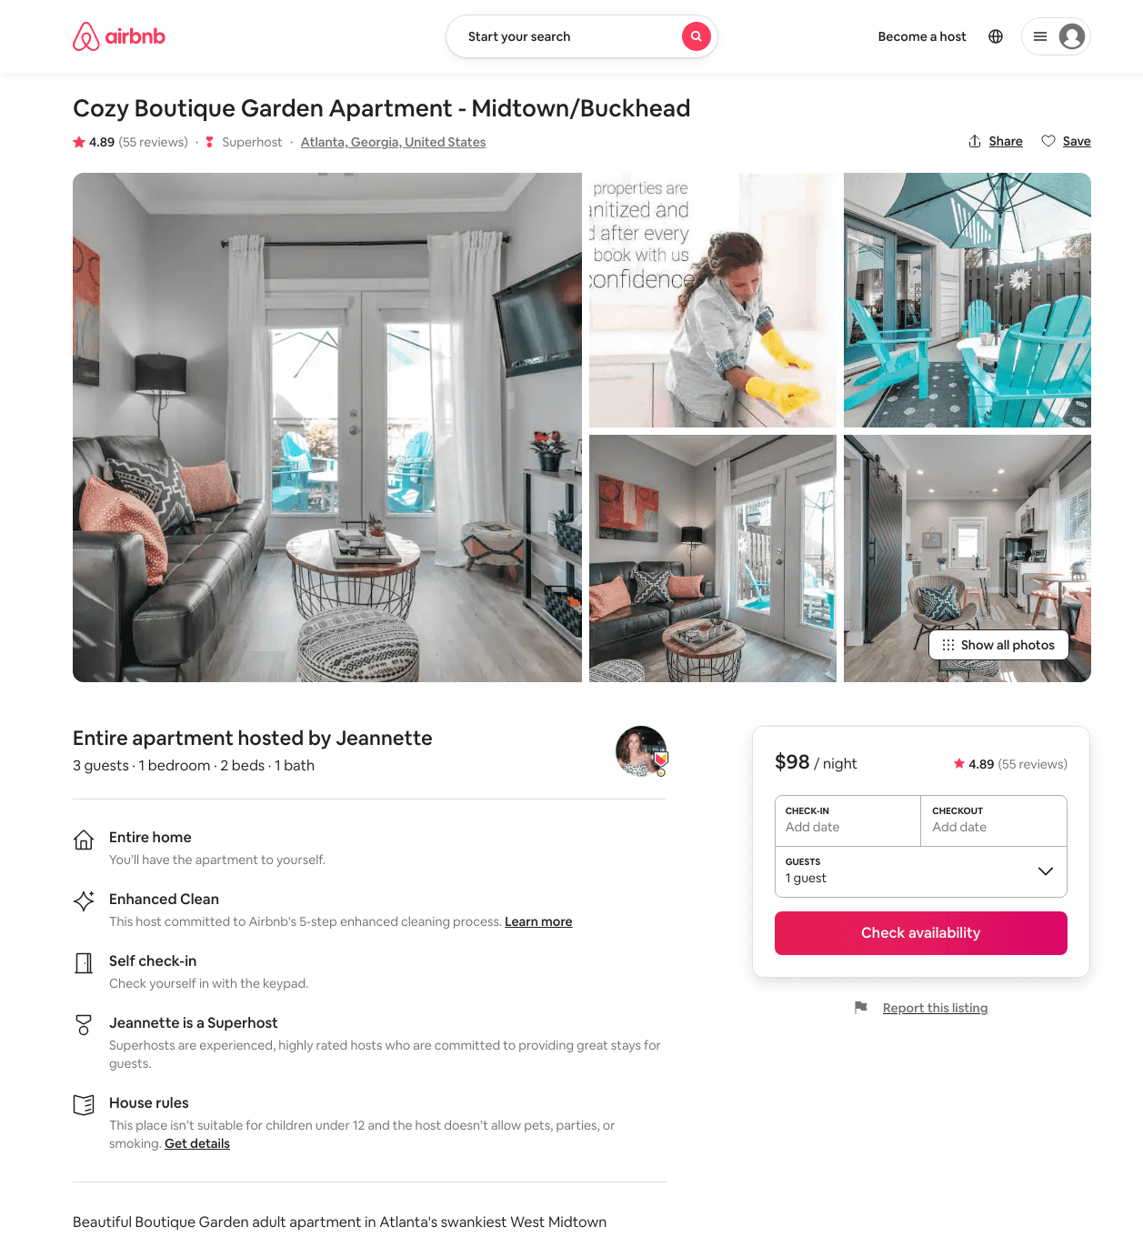
Listing 35464045
1
3
$84 - $106
4.89
2
Jeannette
14898078
1
https://www.airbnb.com/rooms/35464045
Aug 2022

Slide 22
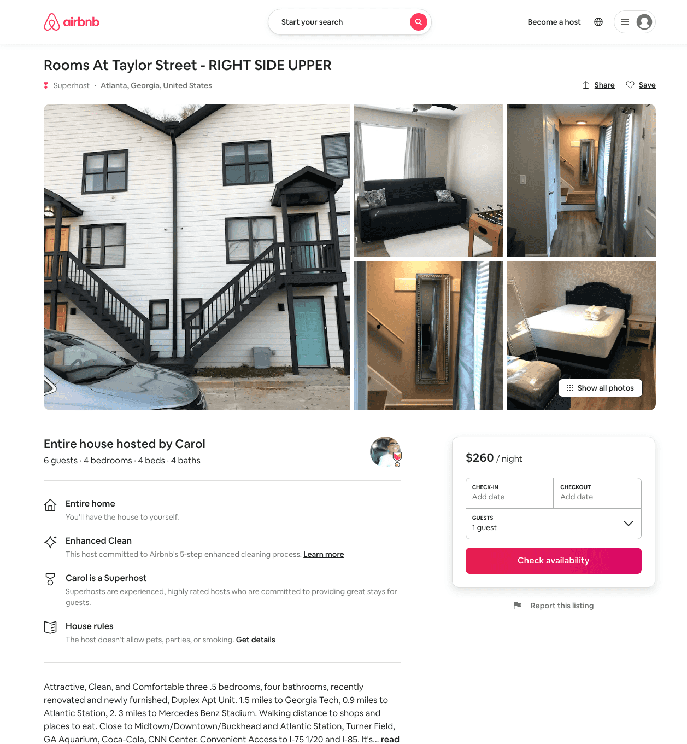
Listing 34339258
4
6
$260 - $332
5.0
2
Carol
14301034
6
https://www.airbnb.com/rooms/34339258
Aug 2022

Slide 23
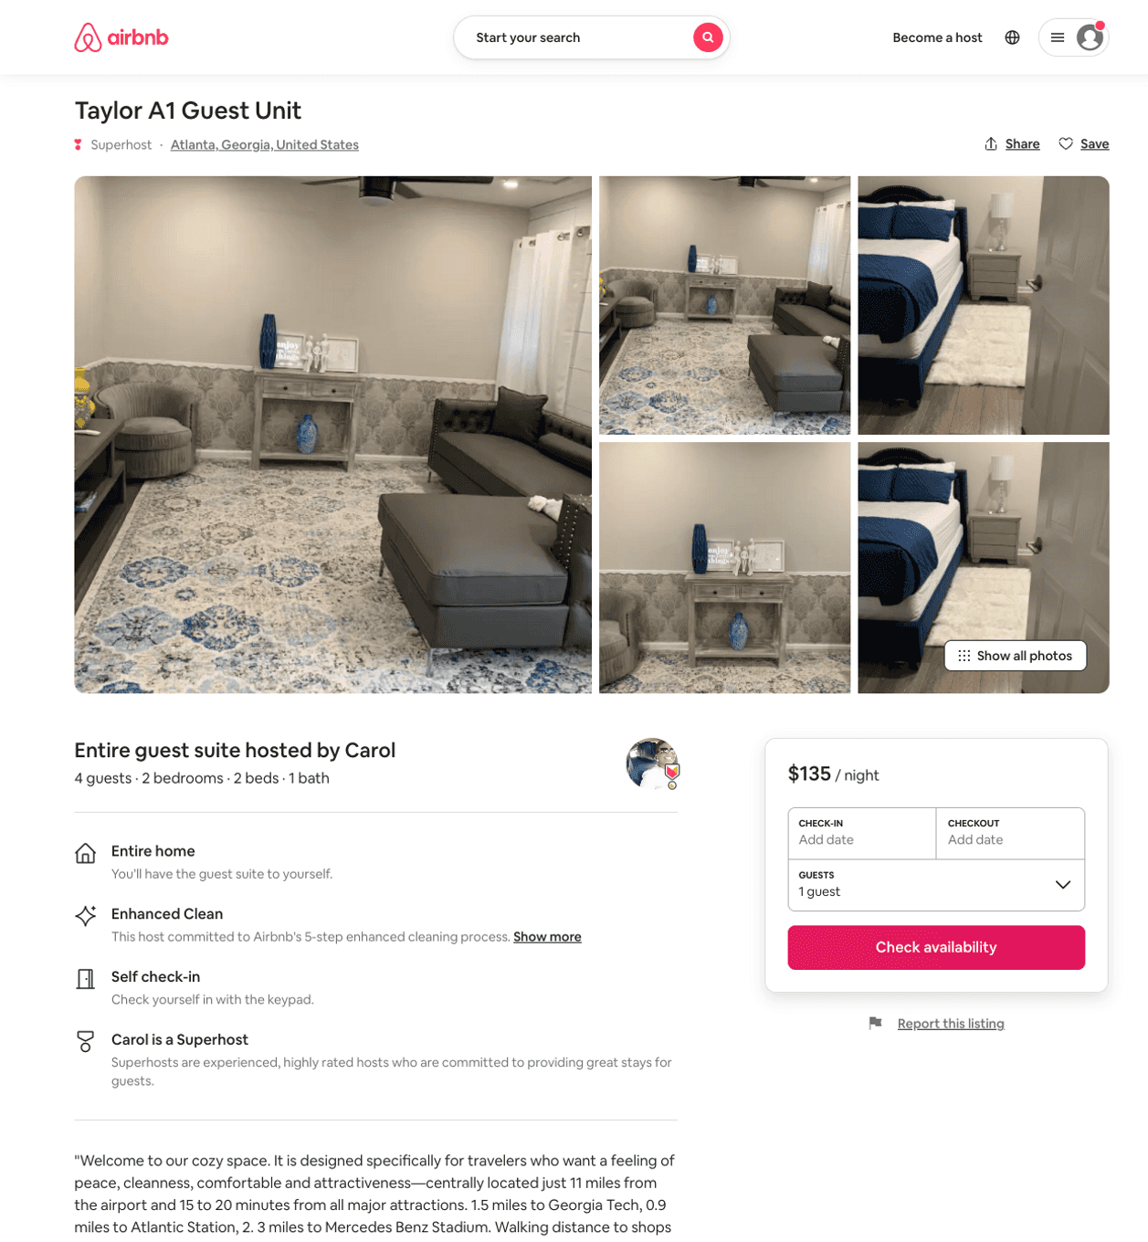
Listing 50879057
2
4
$129 - $143
4.96
2
Carol
14301034
6
https://www.airbnb.com/rooms/50879057
Aug 2022

Slide 24
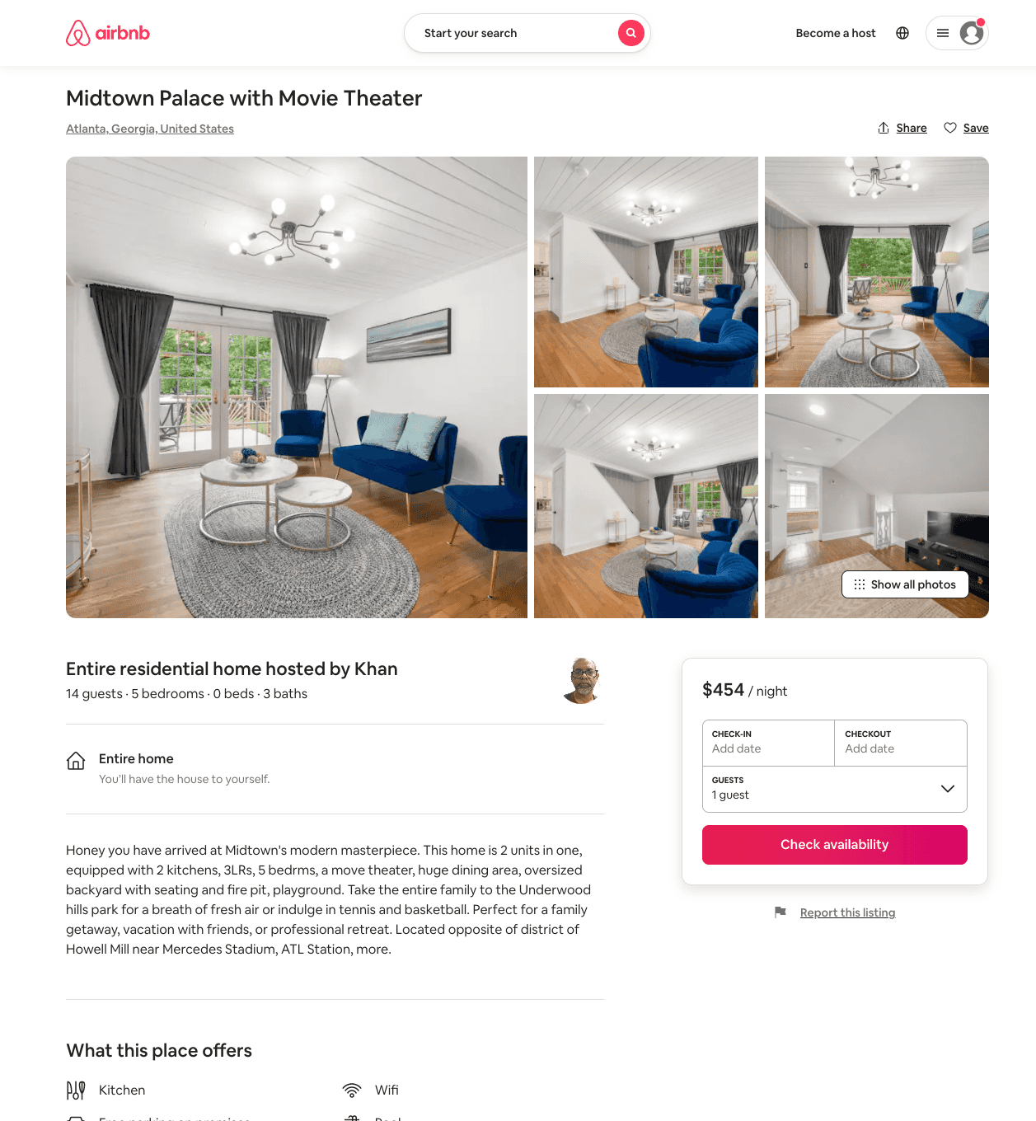
Listing 51270118
5
14
$338 - $483
4.29
1
Khan
415156412
1
https://www.airbnb.com/rooms/51270118
Aug 2022

Slide 25
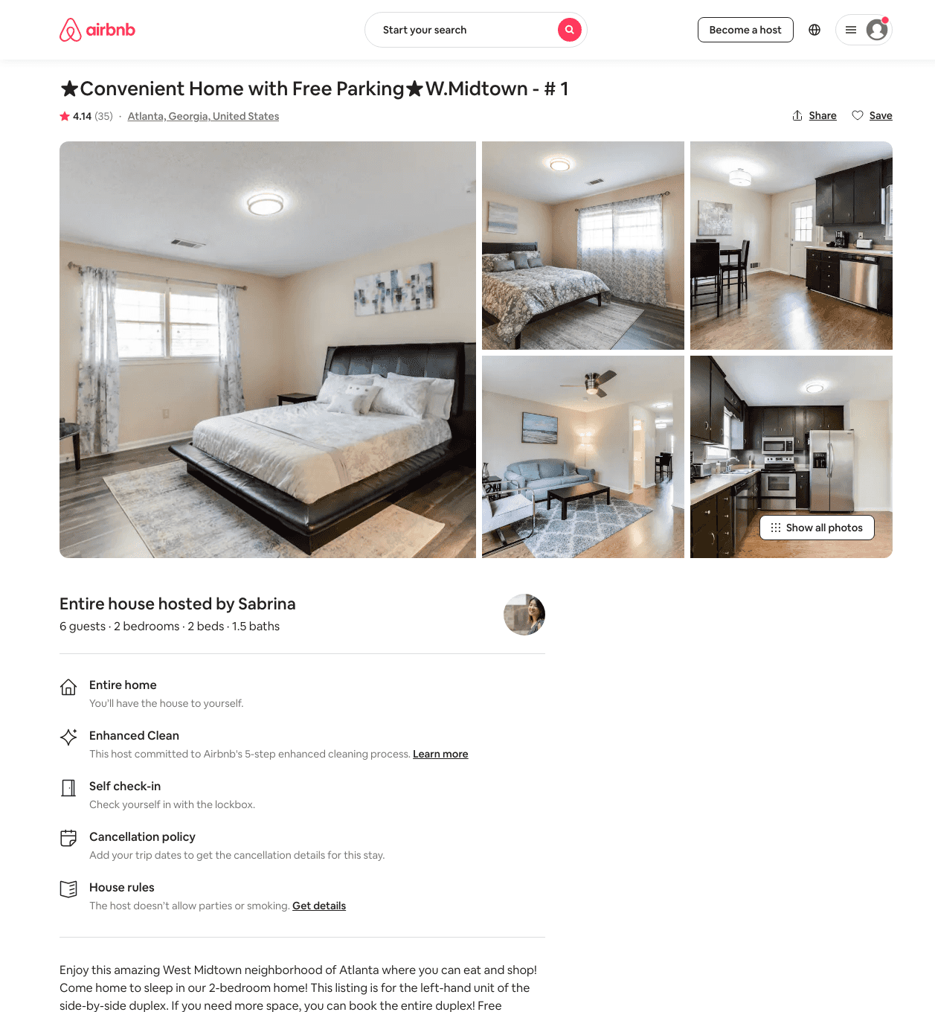
Listing 30320973
2
6
$102 - $169
4.26
2
Sabrina
14521910
3
https://www.airbnb.com/rooms/30320973
Aug 2022

Slide 26
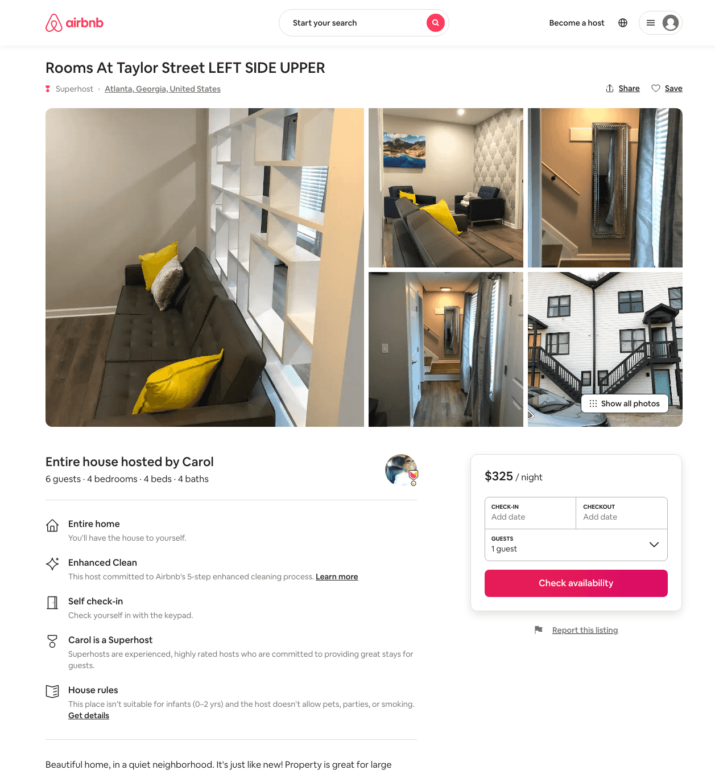
Listing 48965547
4
6
$291 - $332
5.0
2
Carol
14301034
6
https://www.airbnb.com/rooms/48965547
Aug 2022

Slide 27
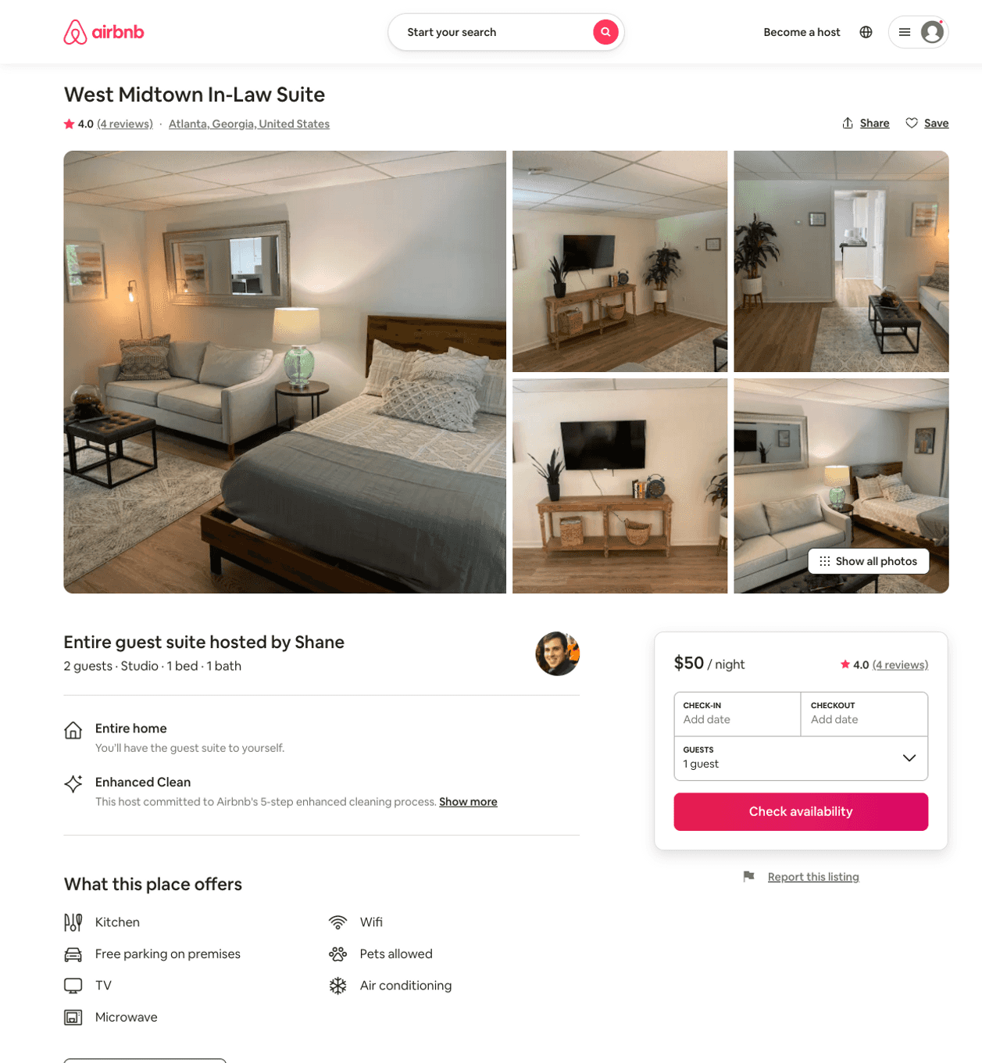
Listing 48542975
Studio
2
$50 - $109
4.60
2
Shane
45679155
1
https://www.airbnb.com/rooms/48542975
Aug 2022

Slide 28
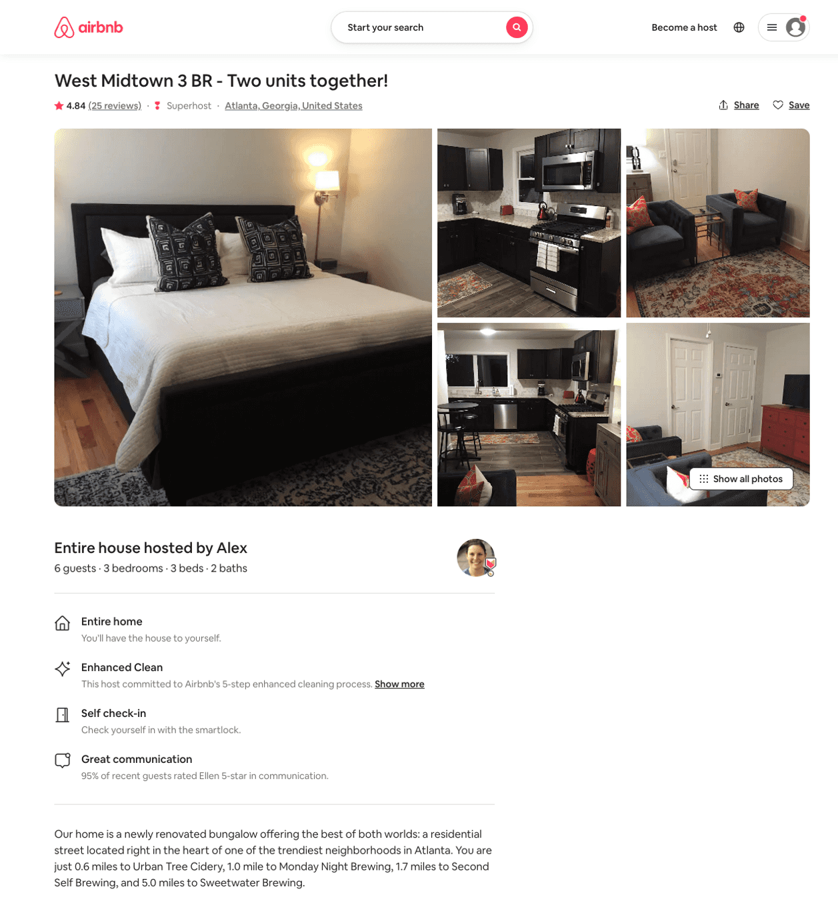
Listing 22496747
3
6
$229 - $500
4.85
3
Alex And Christina
20605441
40
https://www.airbnb.com/rooms/22496747
Jun 2022

Slide 29
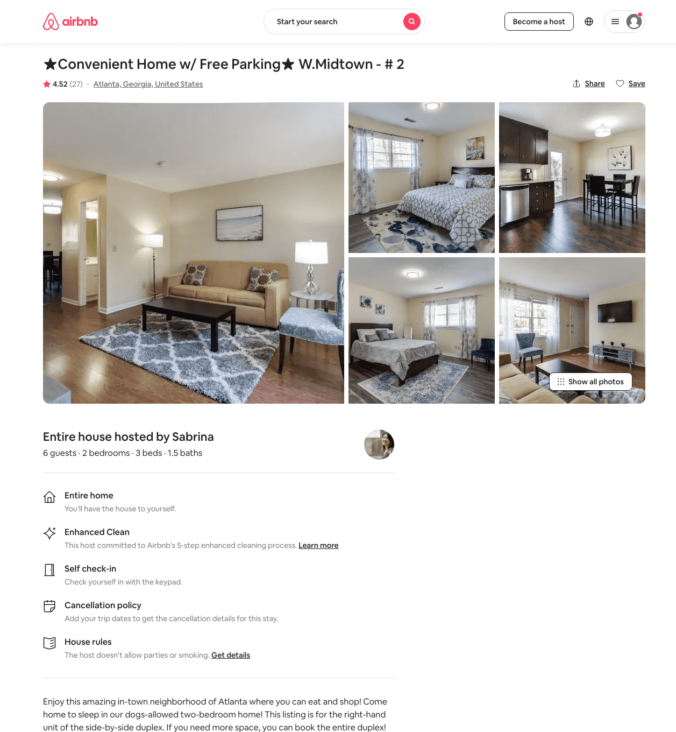
Listing 30321115
2
6
$116 - $157
4.53
2
Sabrina
14521910
3
https://www.airbnb.com/rooms/30321115
Aug 2022

Slide 30
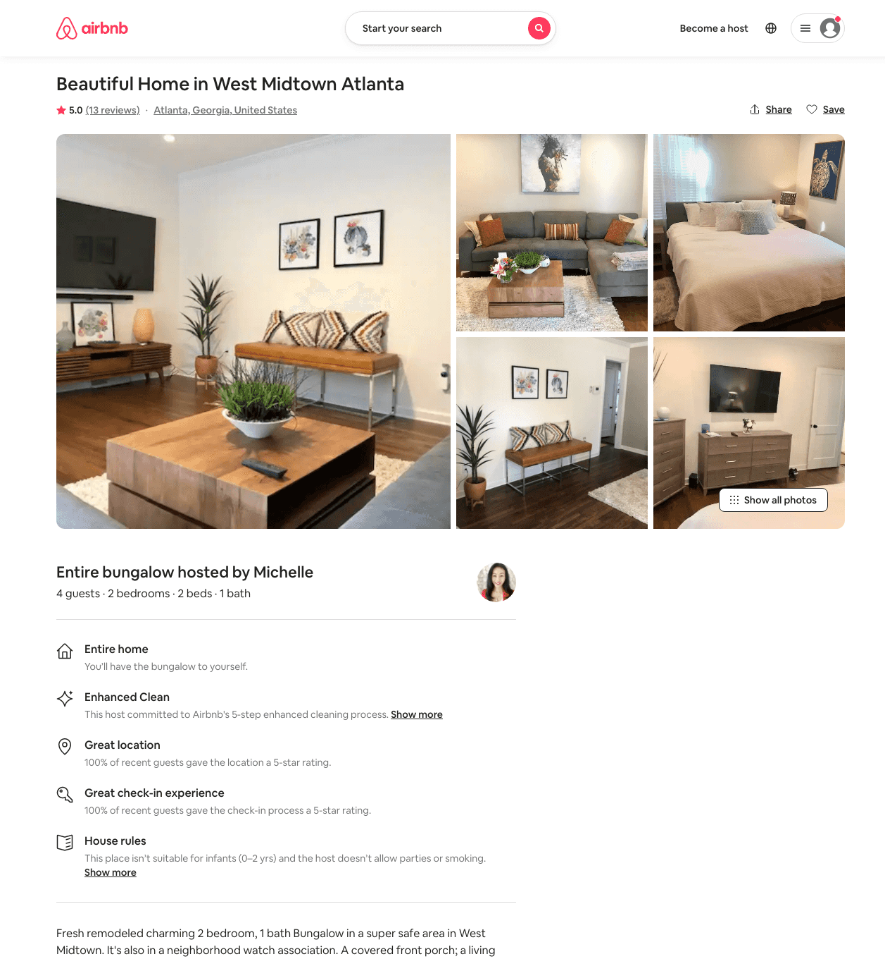
Listing 31962724
2
4
$130 - $131
5.0
3
Michelle
73314208
1
https://www.airbnb.com/rooms/31962724
Aug 2022

Slide 31
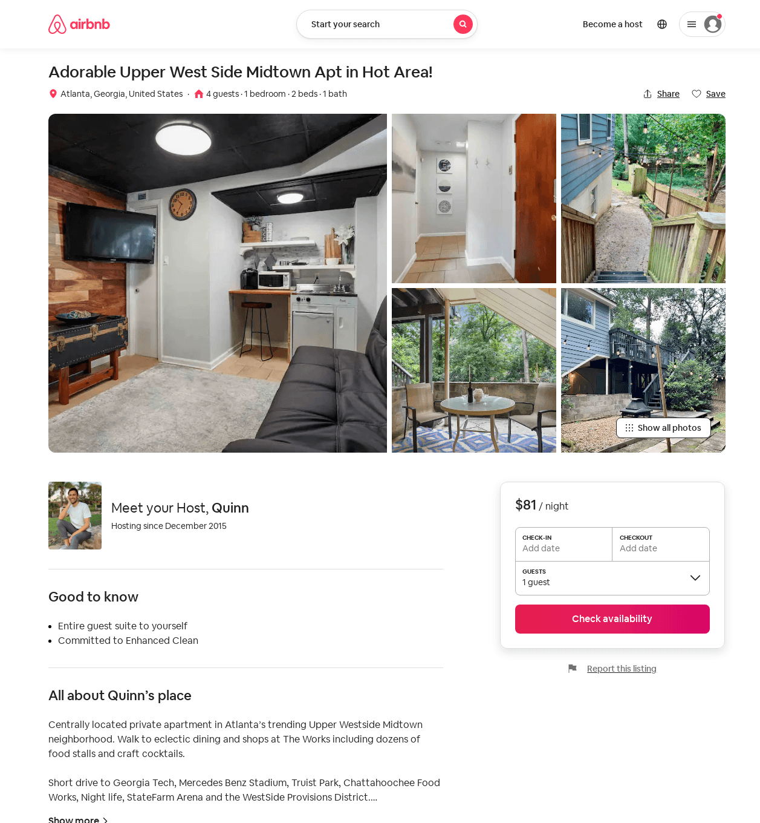
Listing 51966924
1
4
$62 - $97
4.95
1
Quinn
50902021
1
https://www.airbnb.com/rooms/51966924
Aug 2022

Slide 32
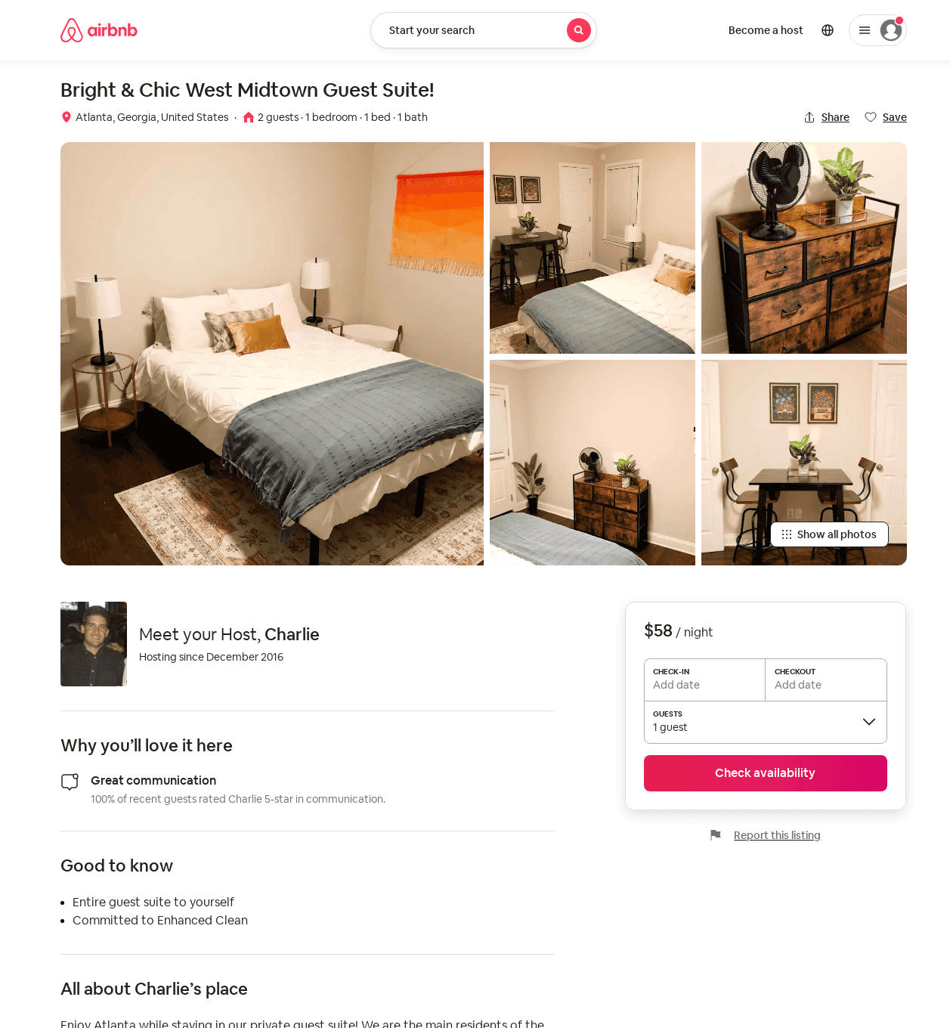
Listing 52010279
1
2
$49 - $77
4.90
1
Charlie
106649190
1
https://www.airbnb.com/rooms/52010279
Aug 2022

Slide 33
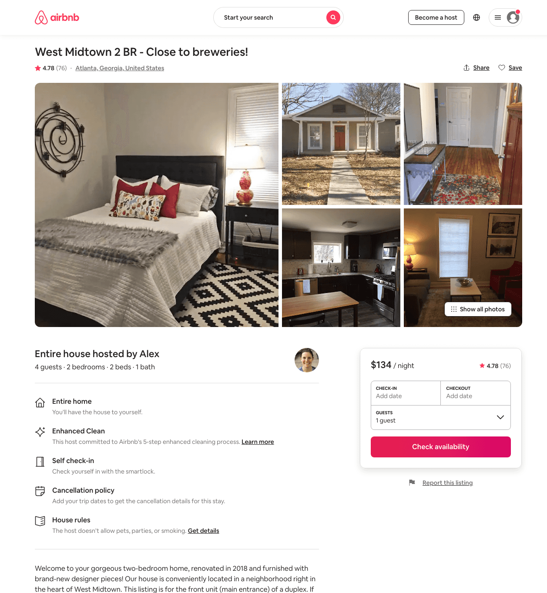
Listing 22496418
2
4
$80 - $151
4.76
3
Alex And Christina
20605441
40
https://www.airbnb.com/rooms/22496418
Aug 2022

Slide 34
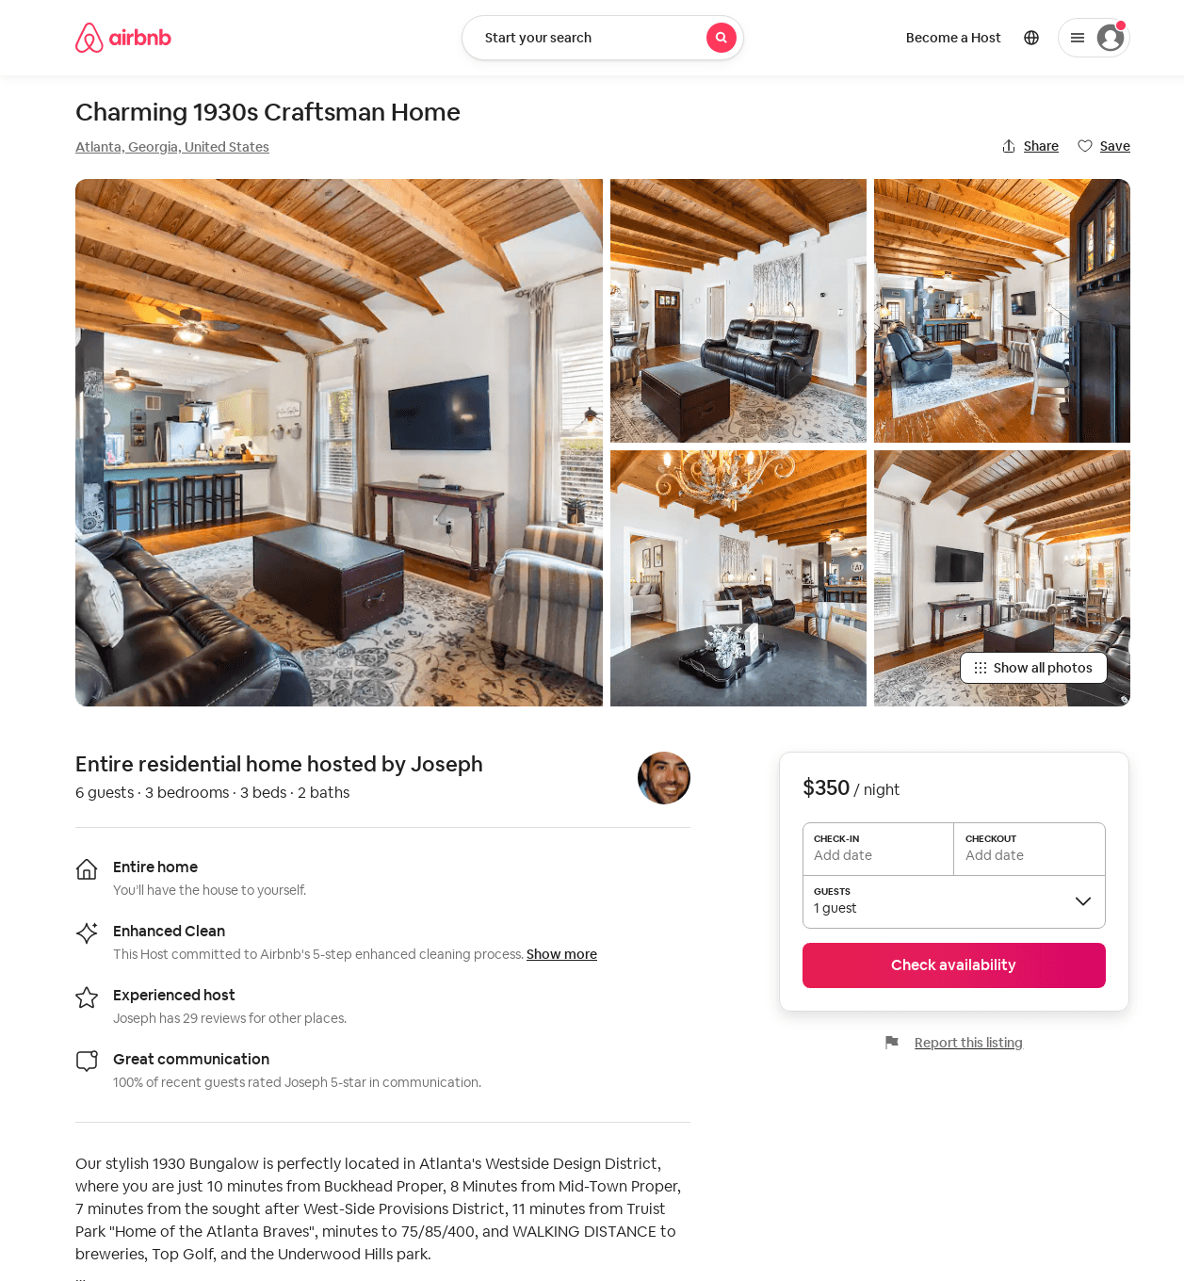
Listing 52124044
3
6
$350
4.75
2
Joseph
228129344
2
https://www.airbnb.com/rooms/52124044
Aug 2022

Slide 35
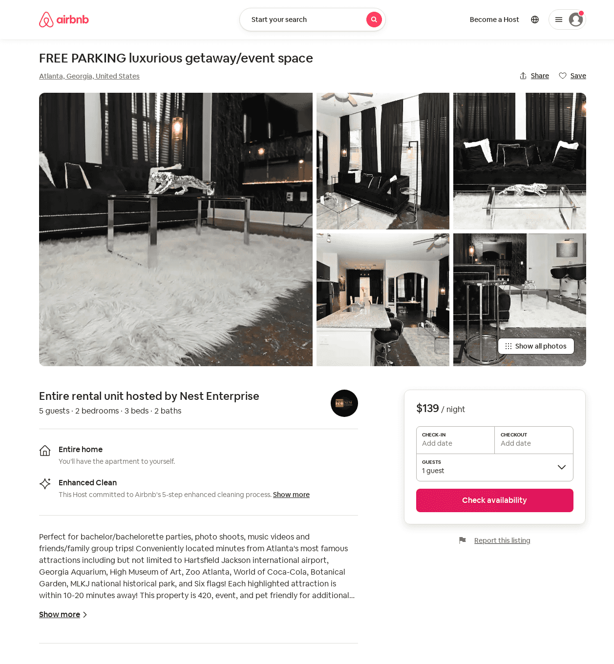
Listing 53868439
2
5
$139 - $213
5.0
28
Nest Enterprise
263930959
3
https://www.airbnb.com/rooms/53868439
Aug 2022

Slide 36
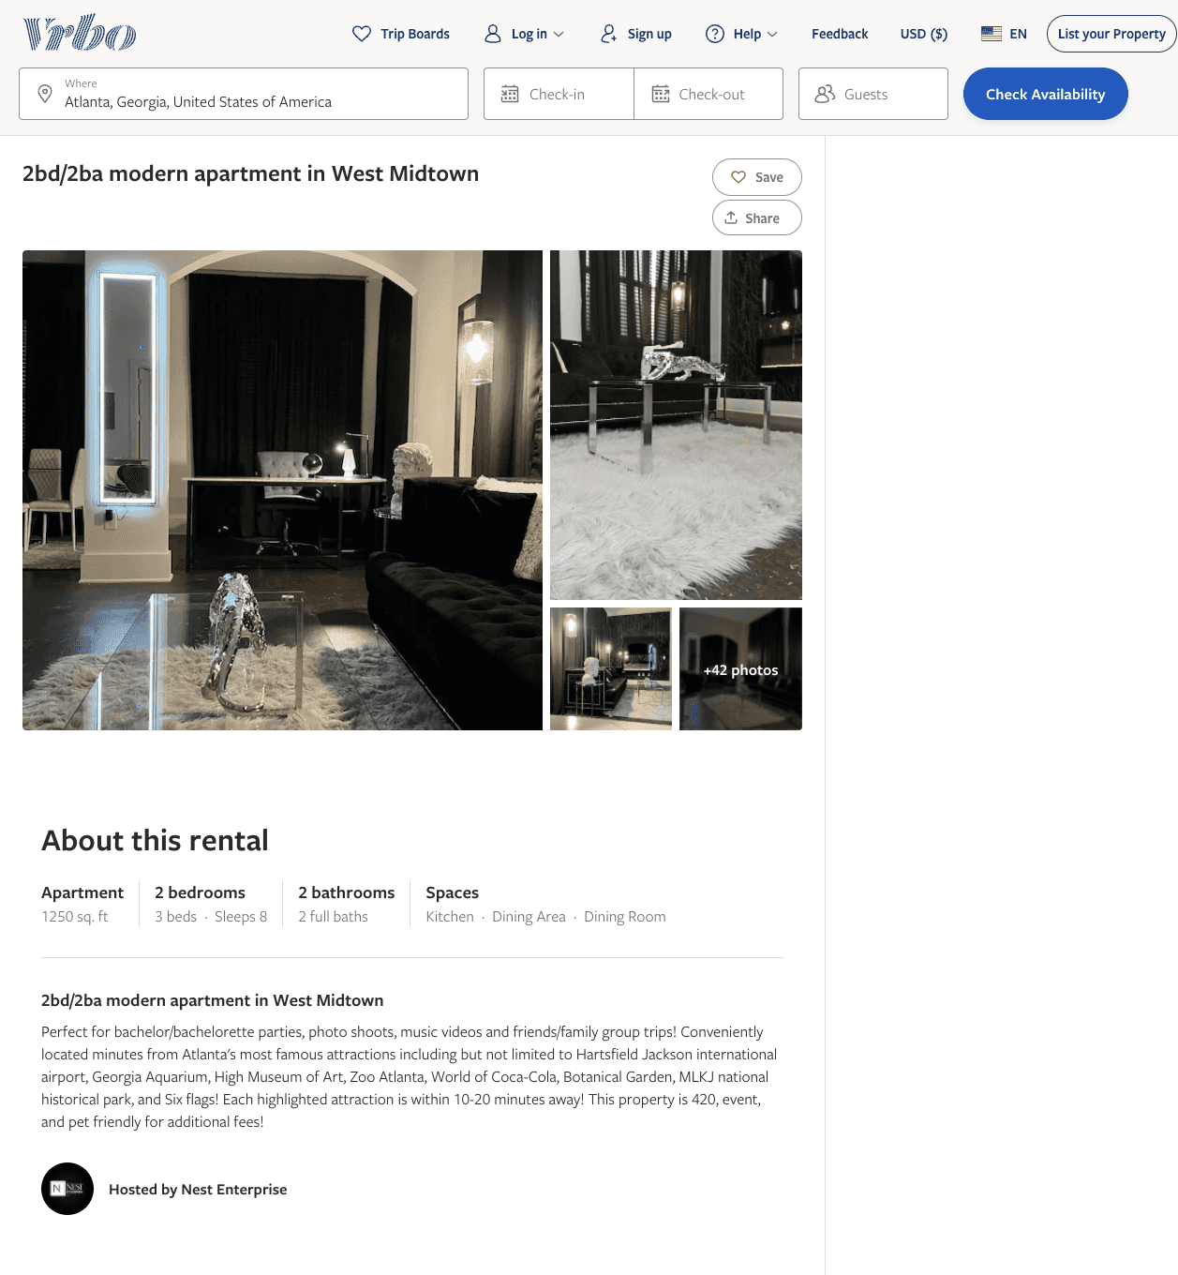
Listing 2602578
2
8
$166 - $186
2
Nest Enterprise
https://www.vrbo.com/2602578
Aug 2022

Slide 37
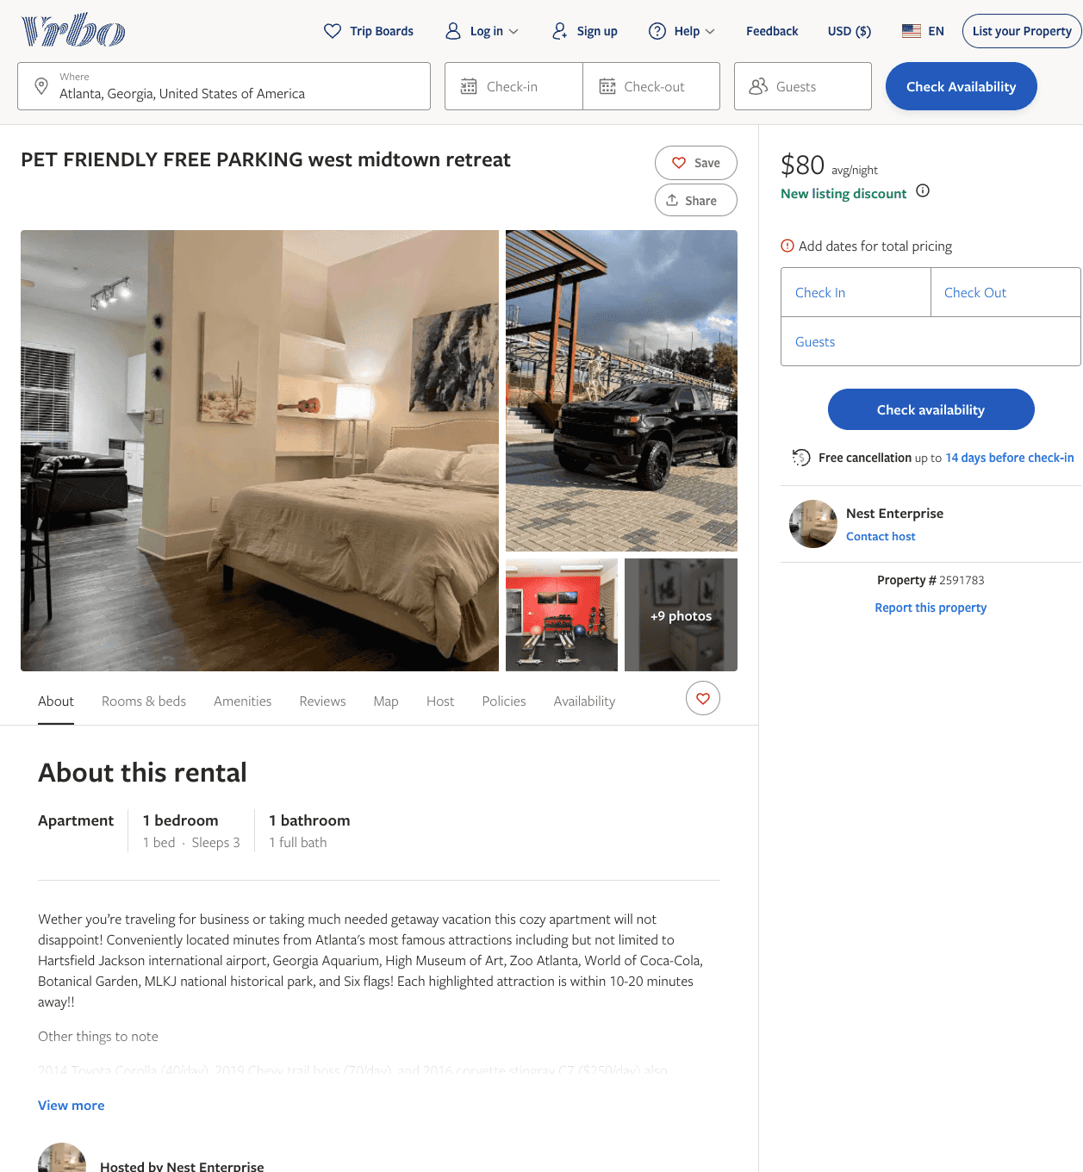
Listing 2591783
1
3
$136 - $94
4
Nest Enterprise
https://www.vrbo.com/2591783
Aug 2022

Slide 38
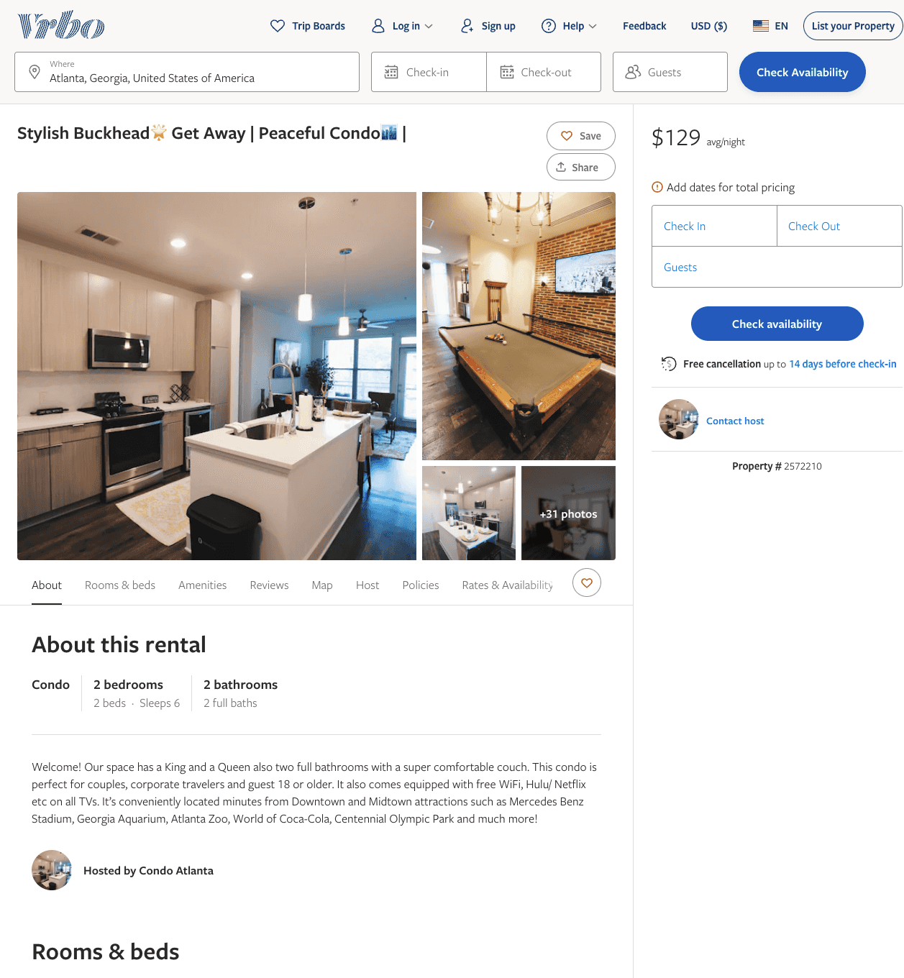
Listing 2572210
2
6
$102 - $129
1.6153846
3
https://www.vrbo.com/2572210
Aug 2022

Slide 39
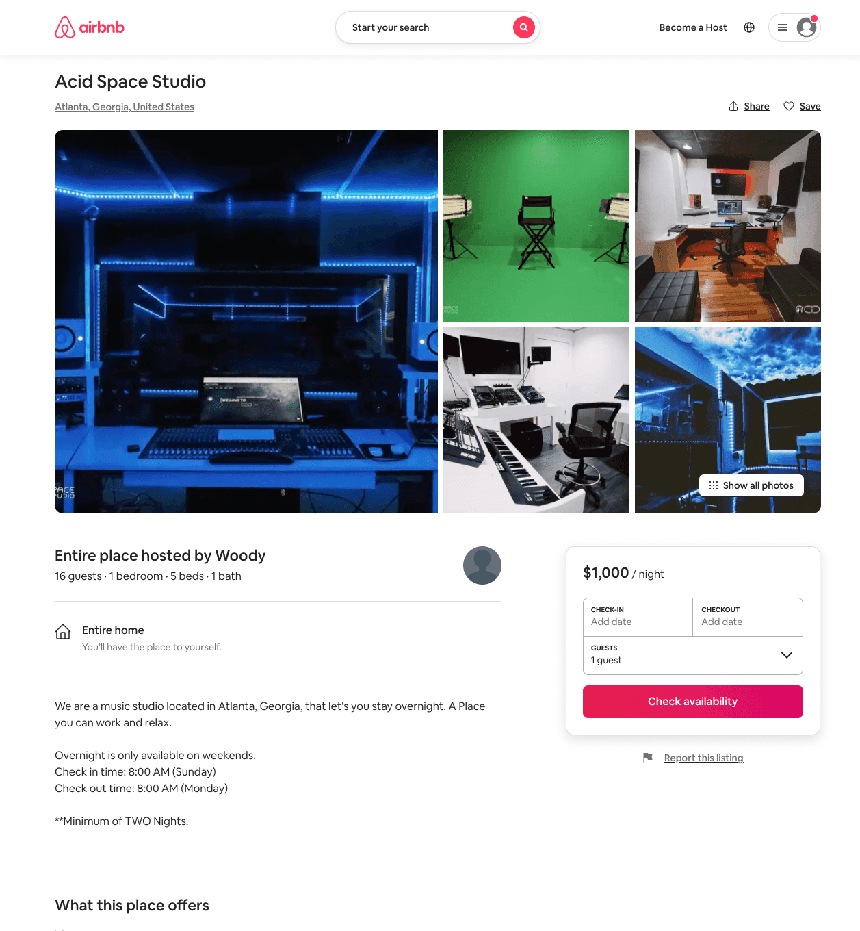
Listing 54301553
1
16
$1000
2
Woody
440429287
1
https://www.airbnb.com/rooms/54301553
Aug 2022

Slide 40
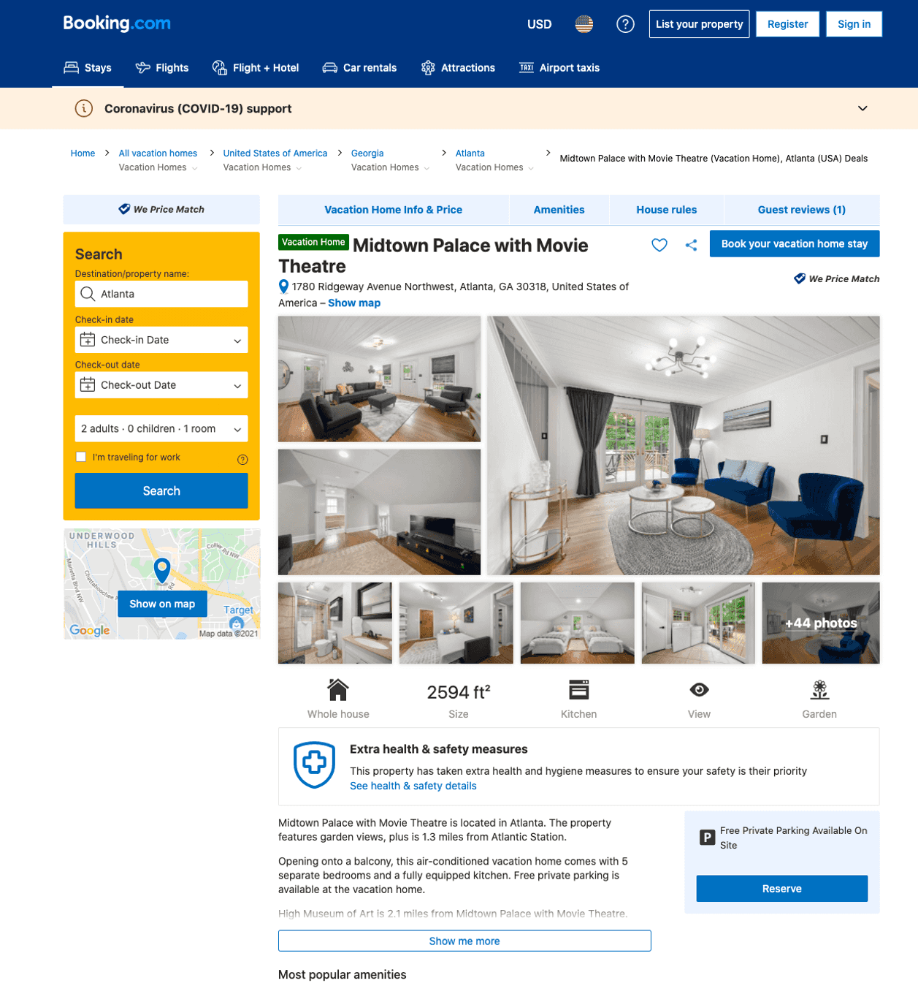
Listing midtown-palace-with-movie-theatre
undefined
14
9.3
https://www.booking.com/hotel/us/midtown-palace-with-movie-theatre.html
Sep 2022

Slide 41
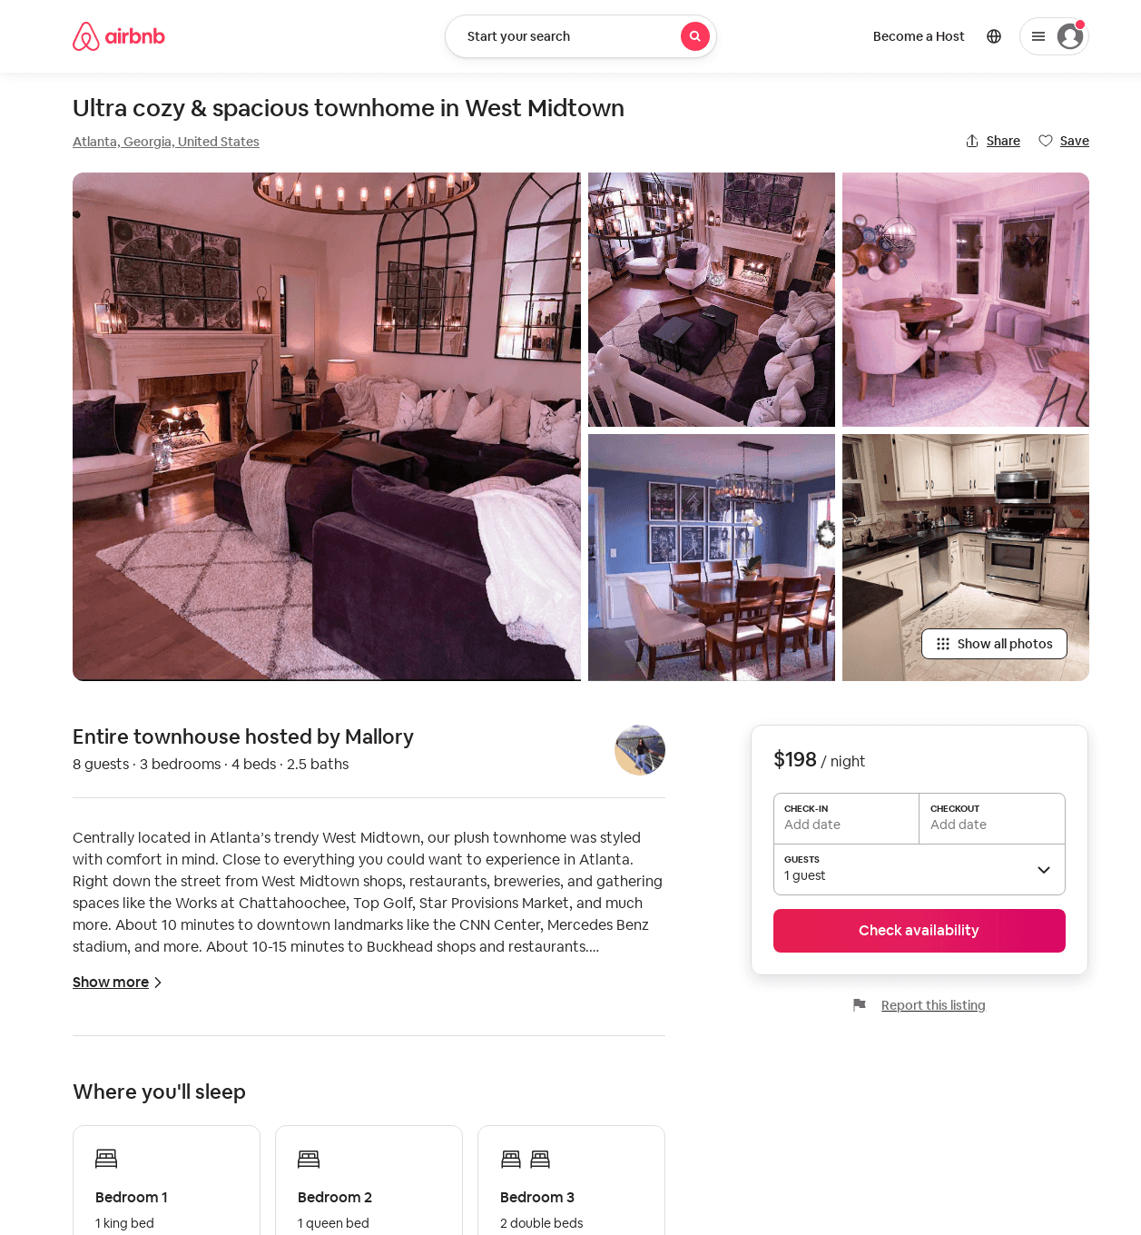
Listing 31720552
3
8
$198 - $265
4.93
3
Mallory
66915324
1
https://www.airbnb.com/rooms/31720552
Aug 2022

Slide 42
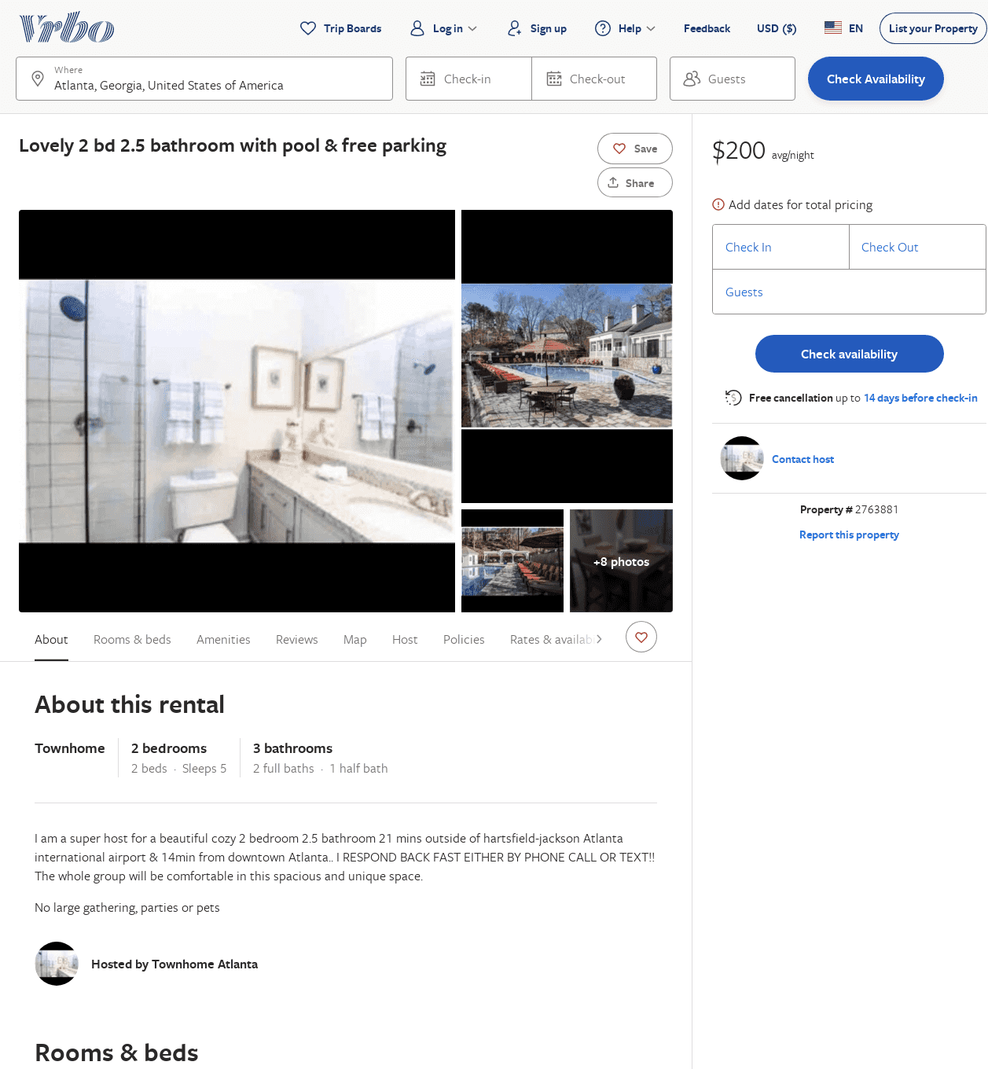
Listing 2763881
2
5
$200
60
https://www.vrbo.com/2763881
Aug 2022

Slide 43
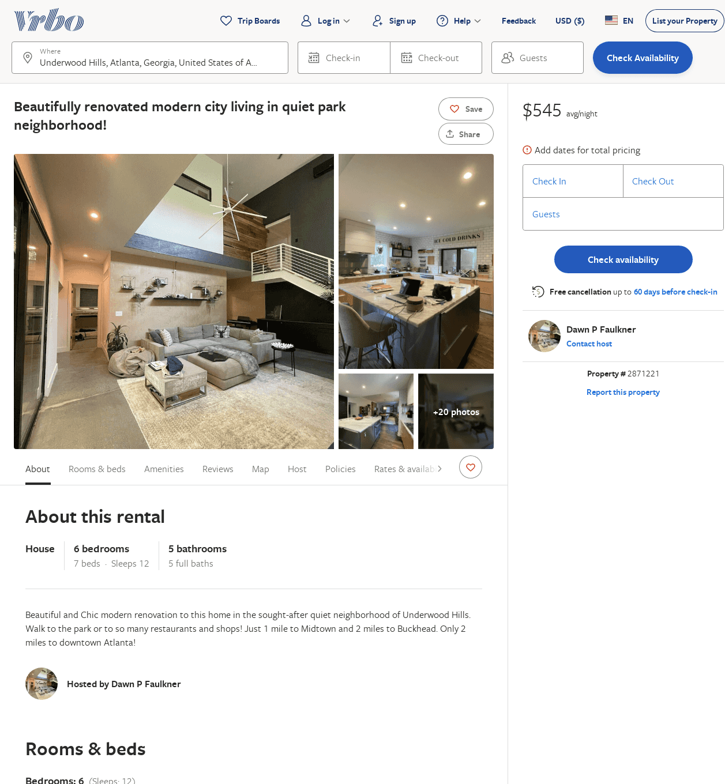
Listing 2871221
6
12
$458
5
2
Dawn P Faulkner
https://www.vrbo.com/2871221
Aug 2022

Slide 44
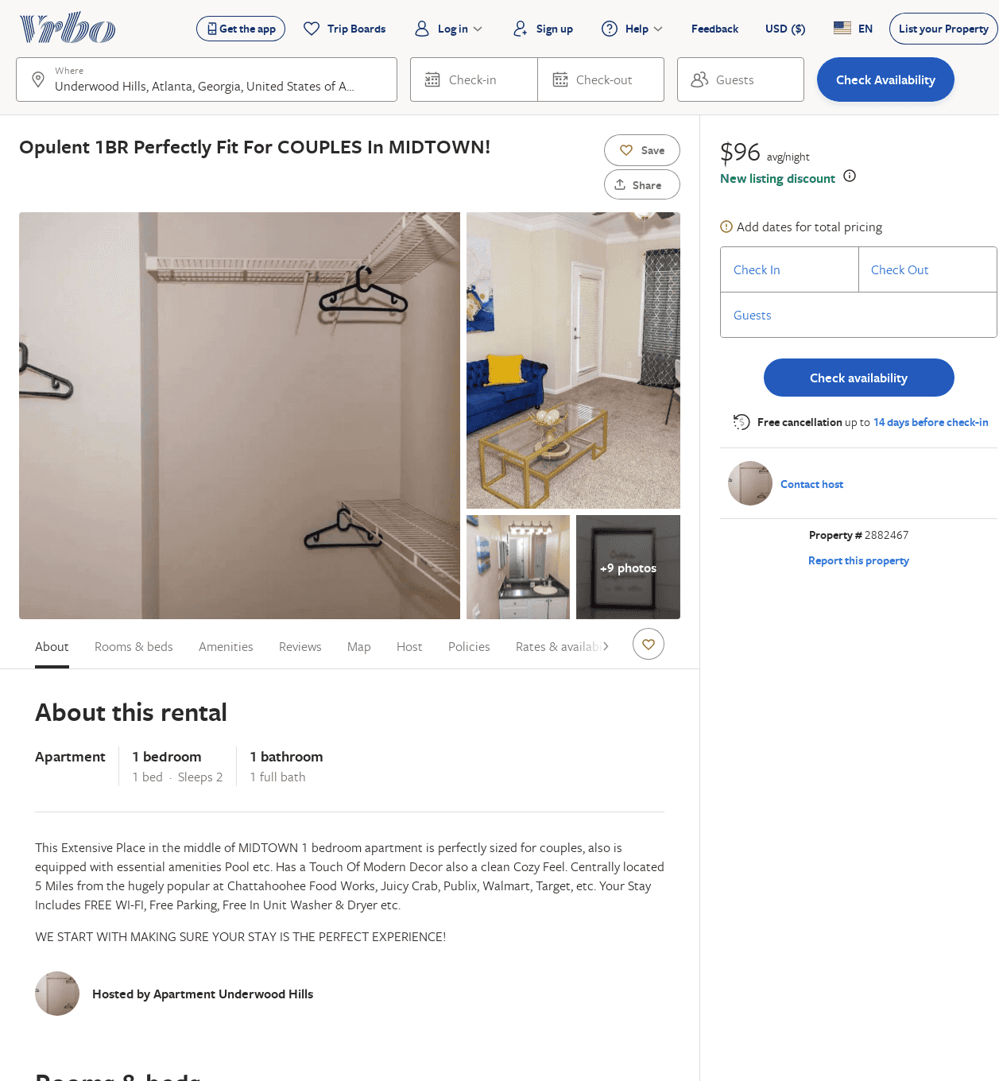
Listing 2882467
1
2
$97
1
https://www.vrbo.com/2882467
Aug 2022

Slide 45
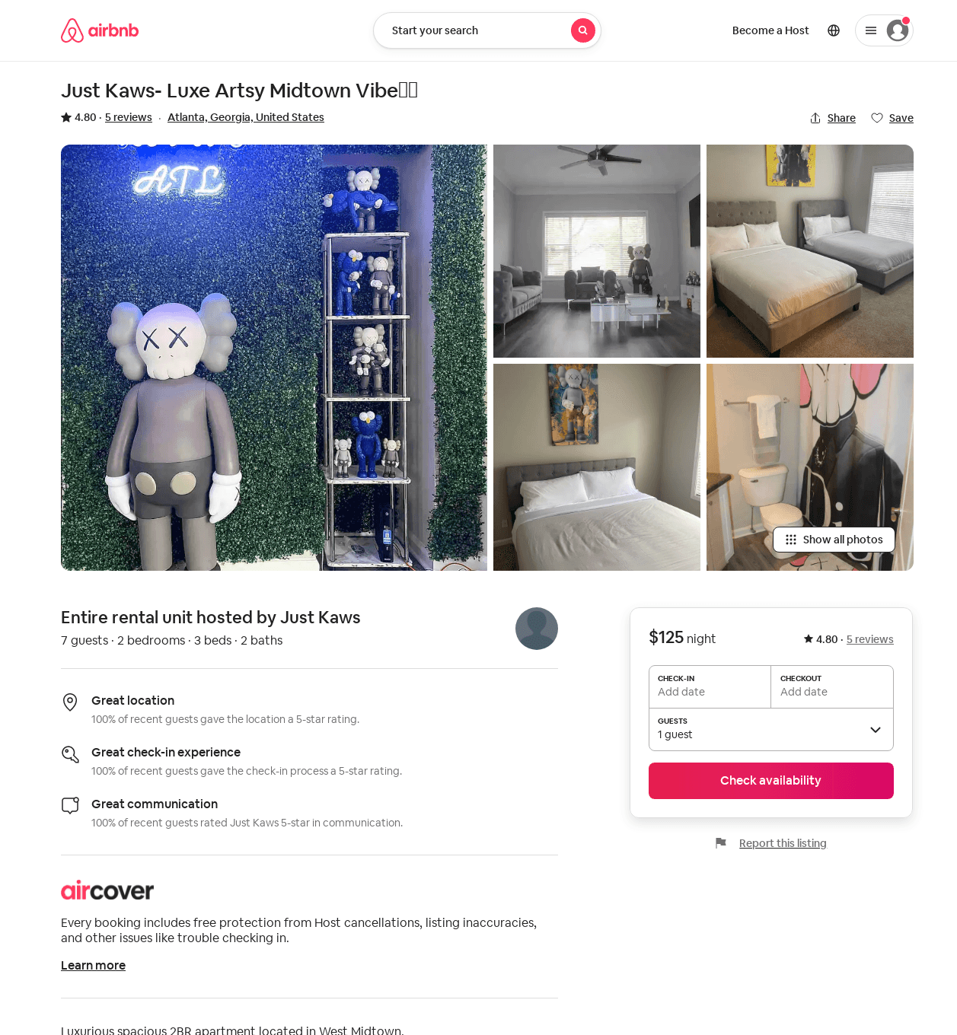
Listing 52120965
2
7
4.92
2
Just Kaws
292739527
1
https://www.airbnb.com/rooms/52120965
Aug 2022

Slide 46
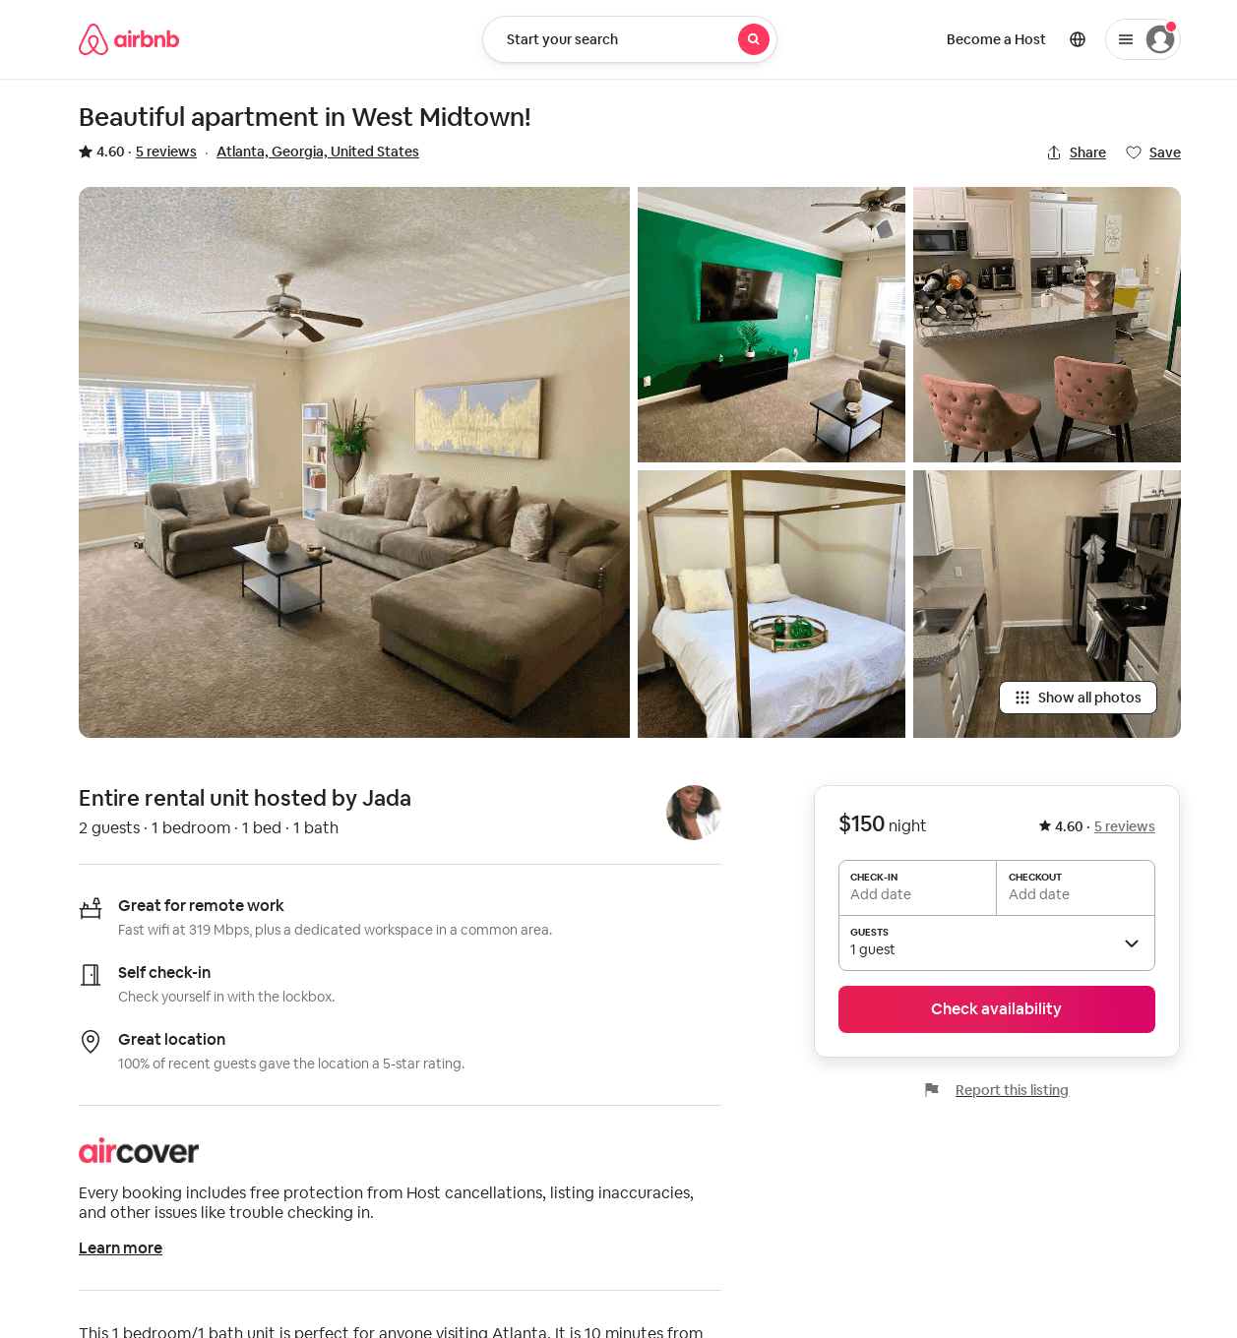
Listing 49642562
1
2
4.71
2
Jada
77744222
1
https://www.airbnb.com/rooms/49642562
Aug 2022

