Slide 2
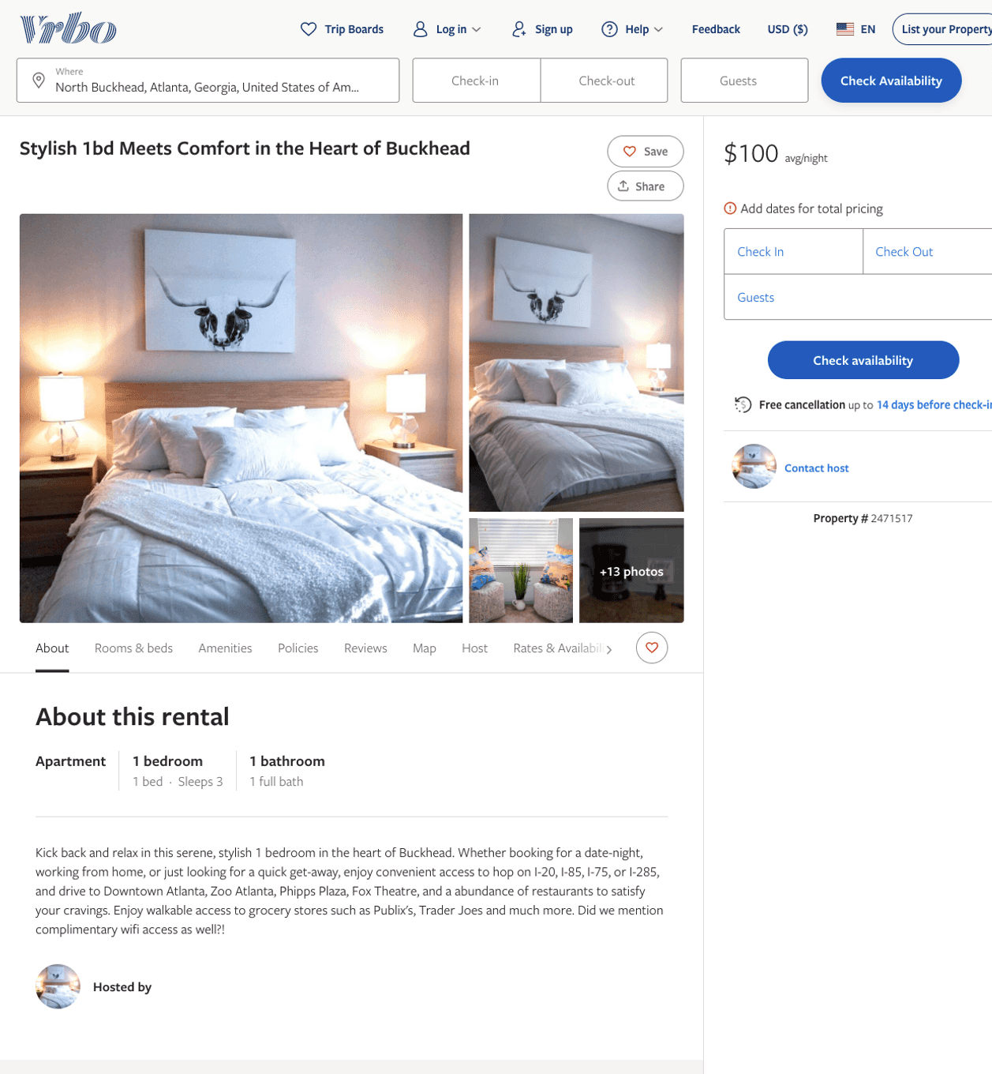
Listing 2471517
1
3
$100 - $99
2
Victoria
https://www.vrbo.com/2471517
Aug 2022

Slide 3
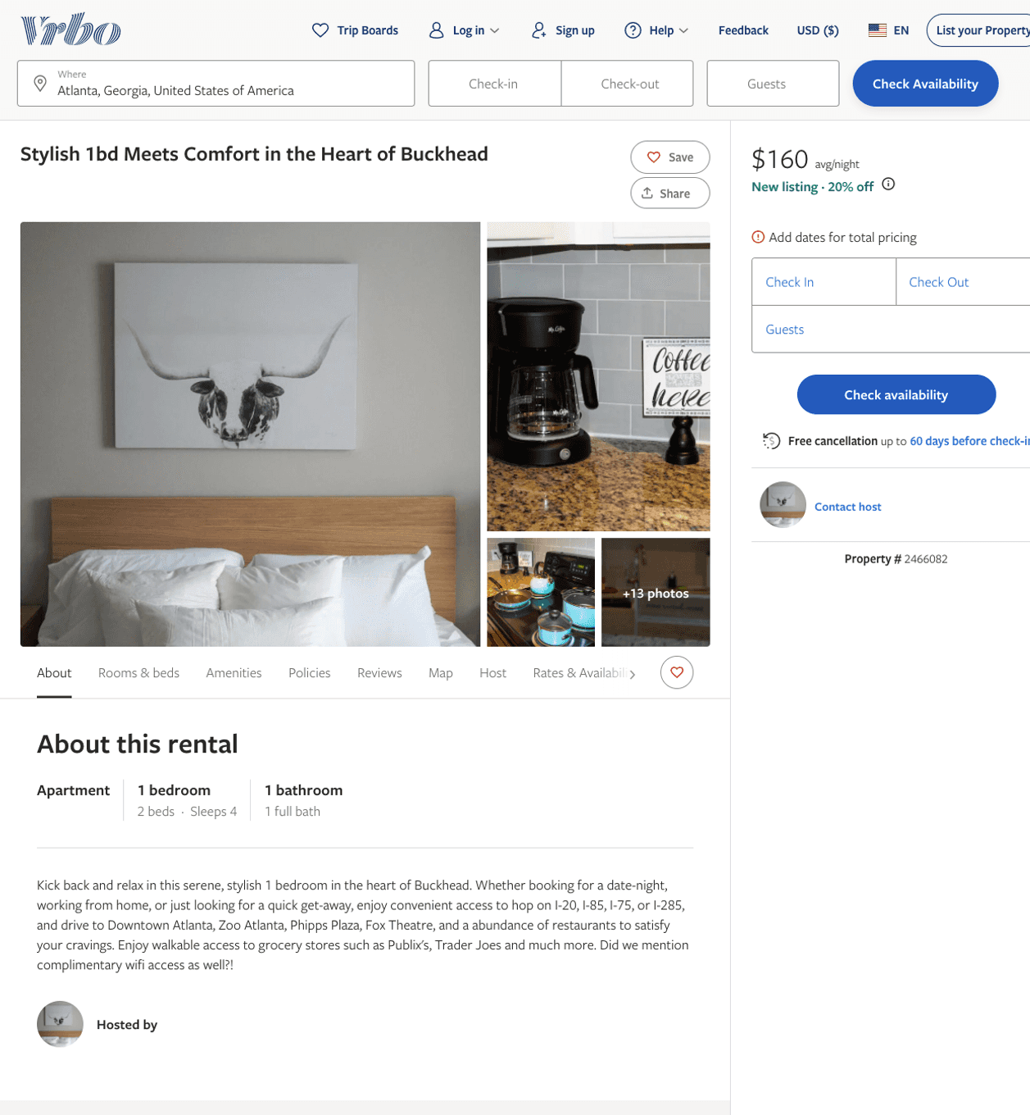
Listing 2466082
1
4
$100 - $99
4.6666665
2
Victoria
https://www.vrbo.com/2466082
Aug 2022

Slide 4
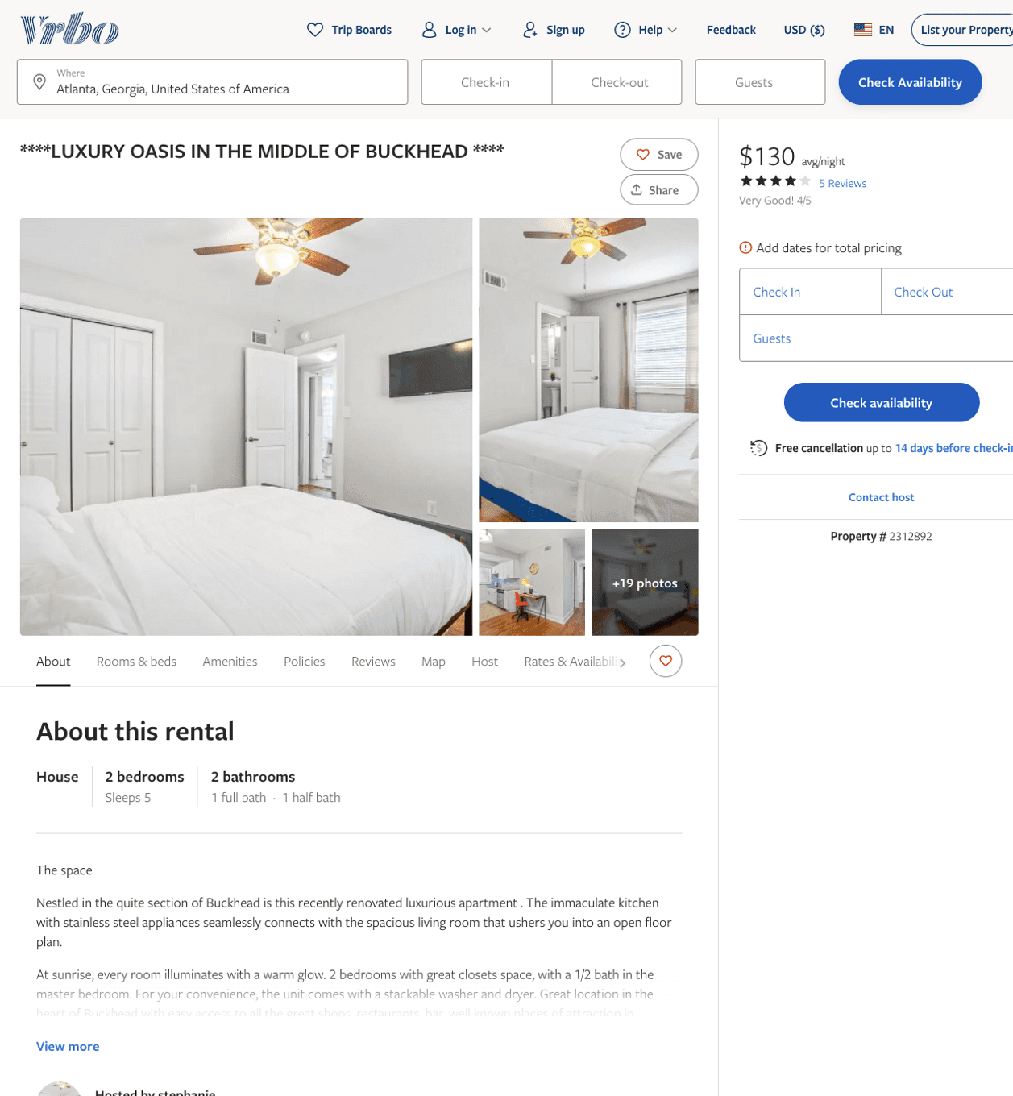
Listing 2312892
2
5
$130
4.1666665
1
stephanie
https://www.vrbo.com/2312892
Aug 2022

Slide 5
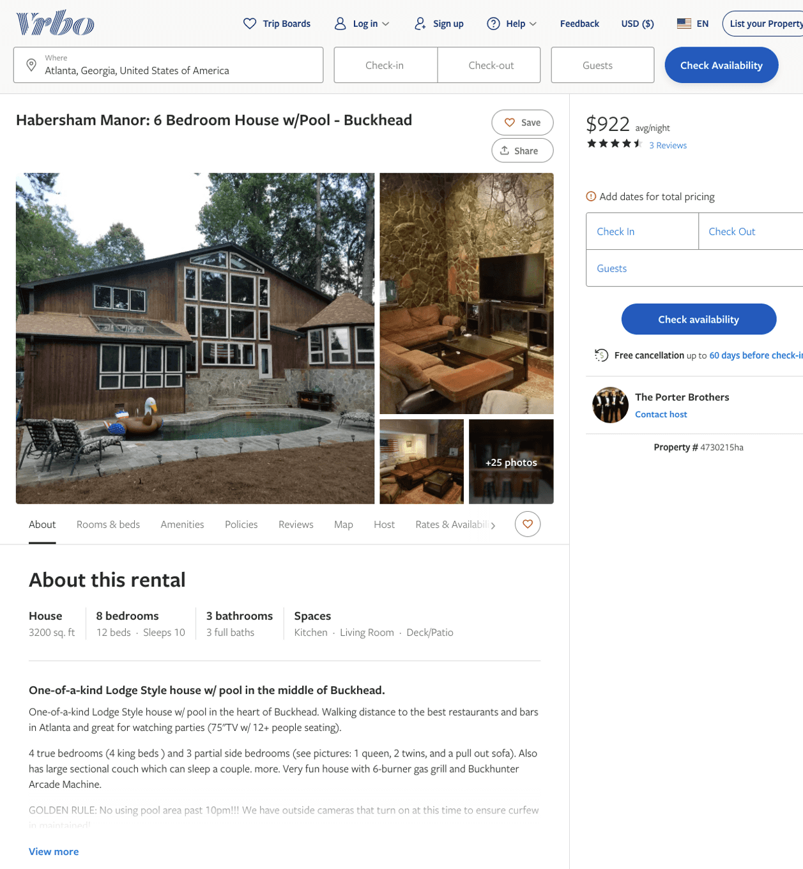
Listing 4730215
8
10
$849 - $930
4.6666665
3
The Porter Brothers
https://www.vrbo.com/4730215ha
Aug 2022

Slide 6
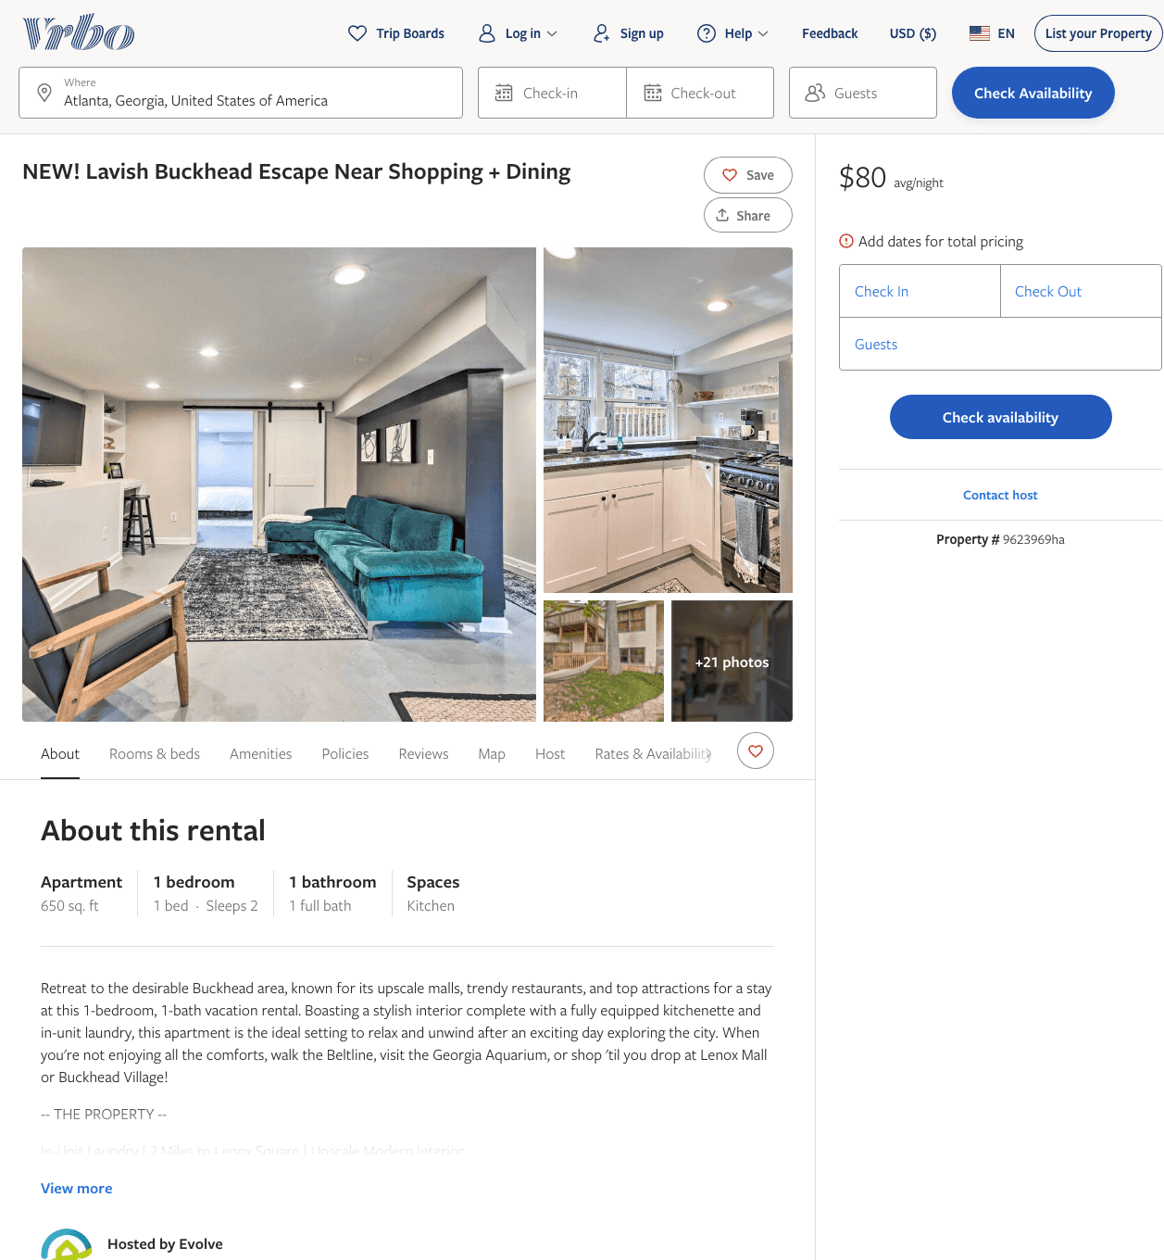
Listing 9623969
1
2
$107 - $97
6
Evolve
https://www.vrbo.com/9623969ha
Aug 2022

Slide 7
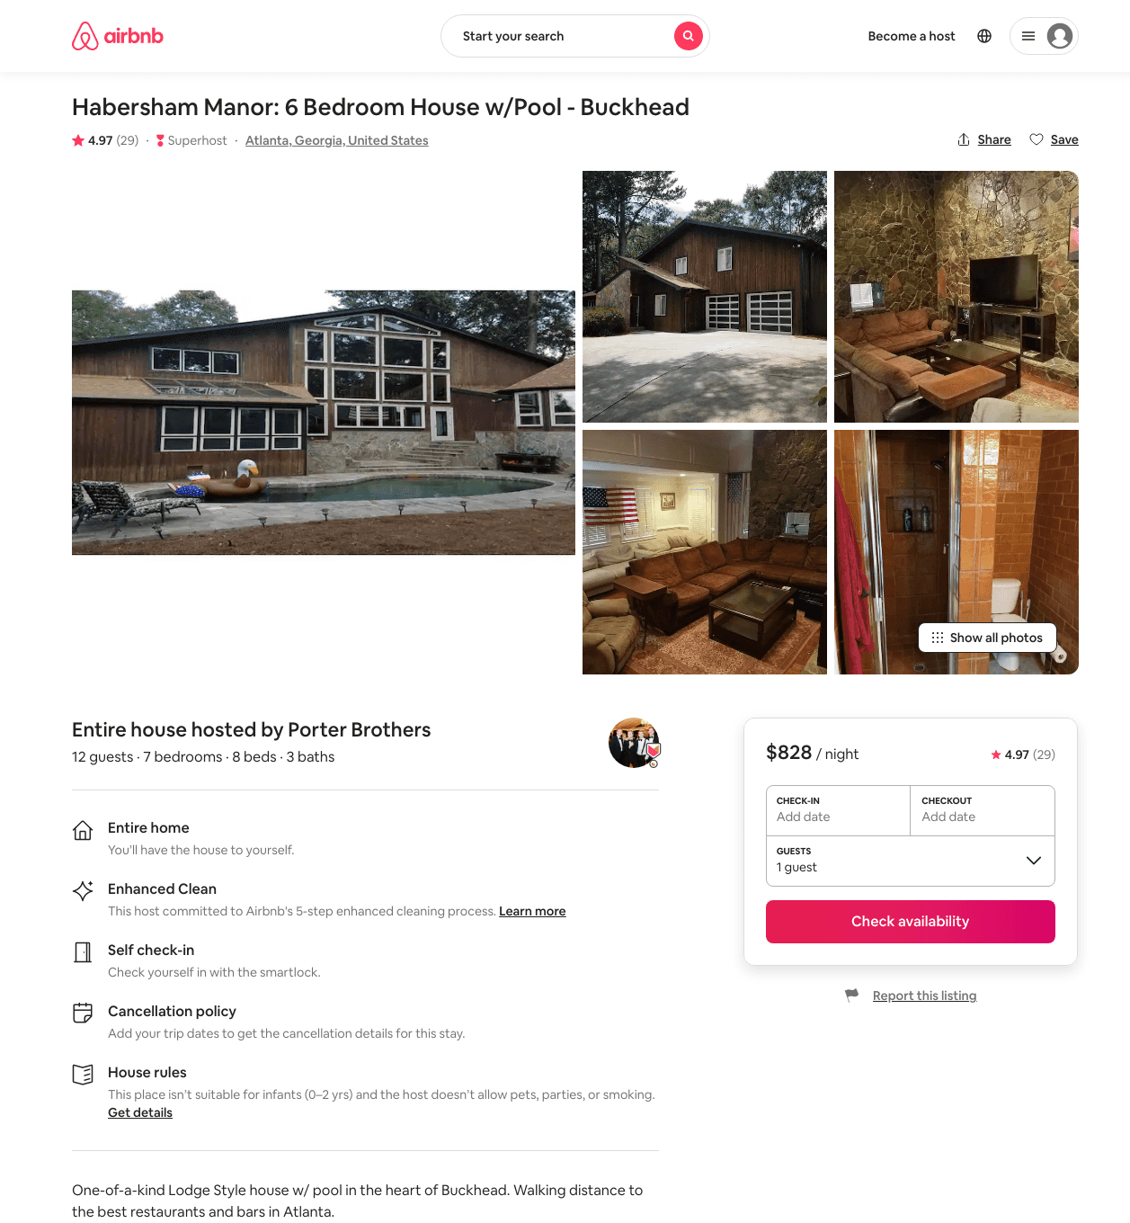
Listing 20409799
7
12
$828 - $999
4.98
2
Porter Brothers
15198746
1
https://www.airbnb.com/rooms/20409799
Aug 2022

Slide 8
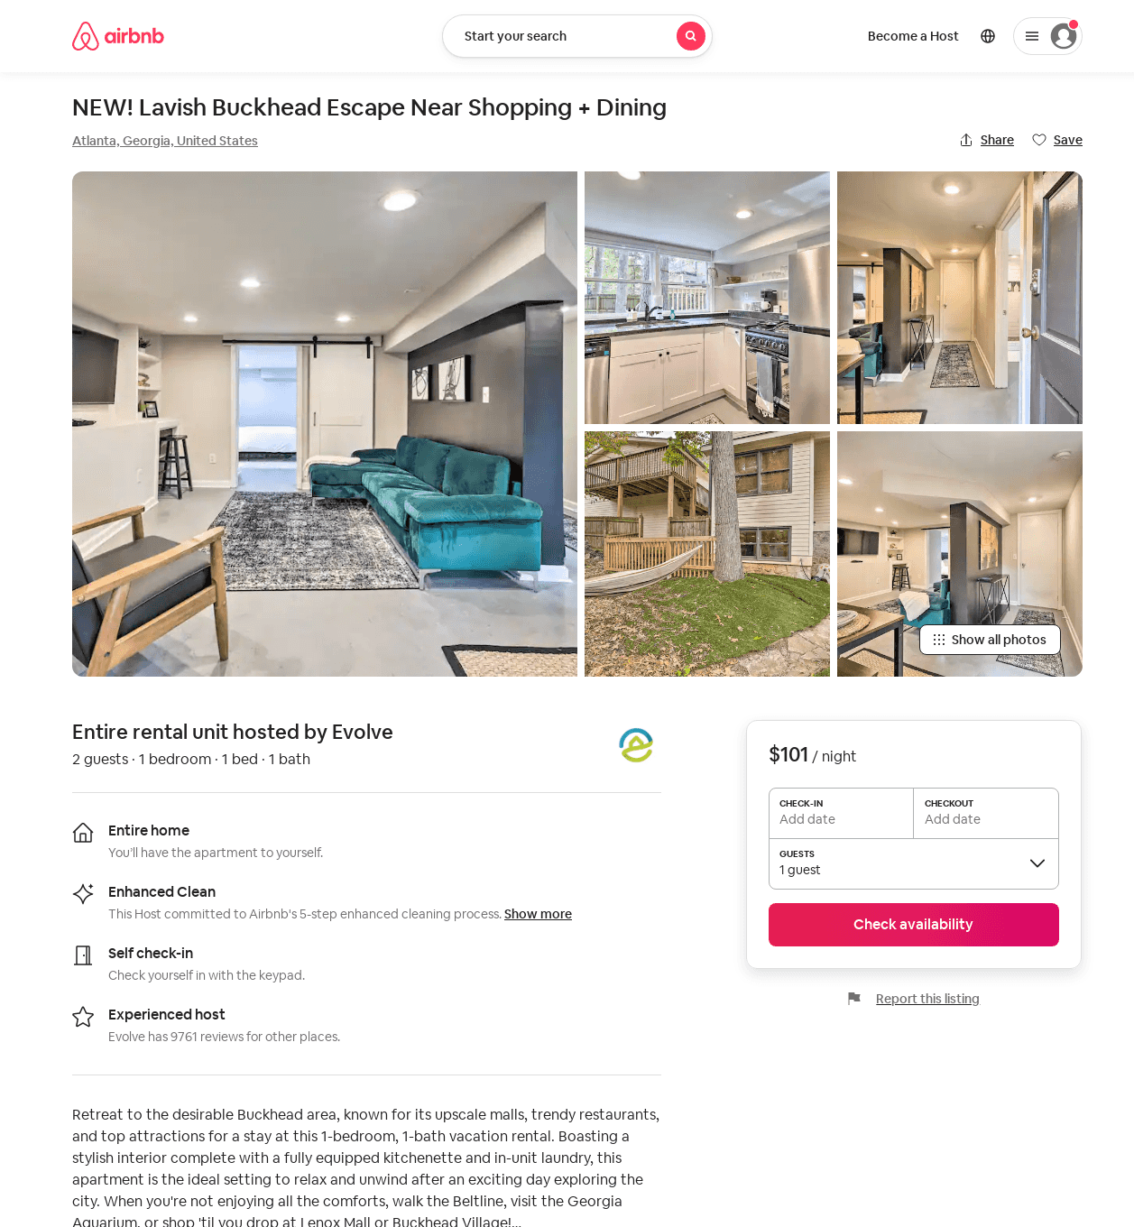
Listing 53144041
1
2
$91 - $106
30
Evolve
121682456
51
https://www.airbnb.com/rooms/53144041
Aug 2022

Slide 9
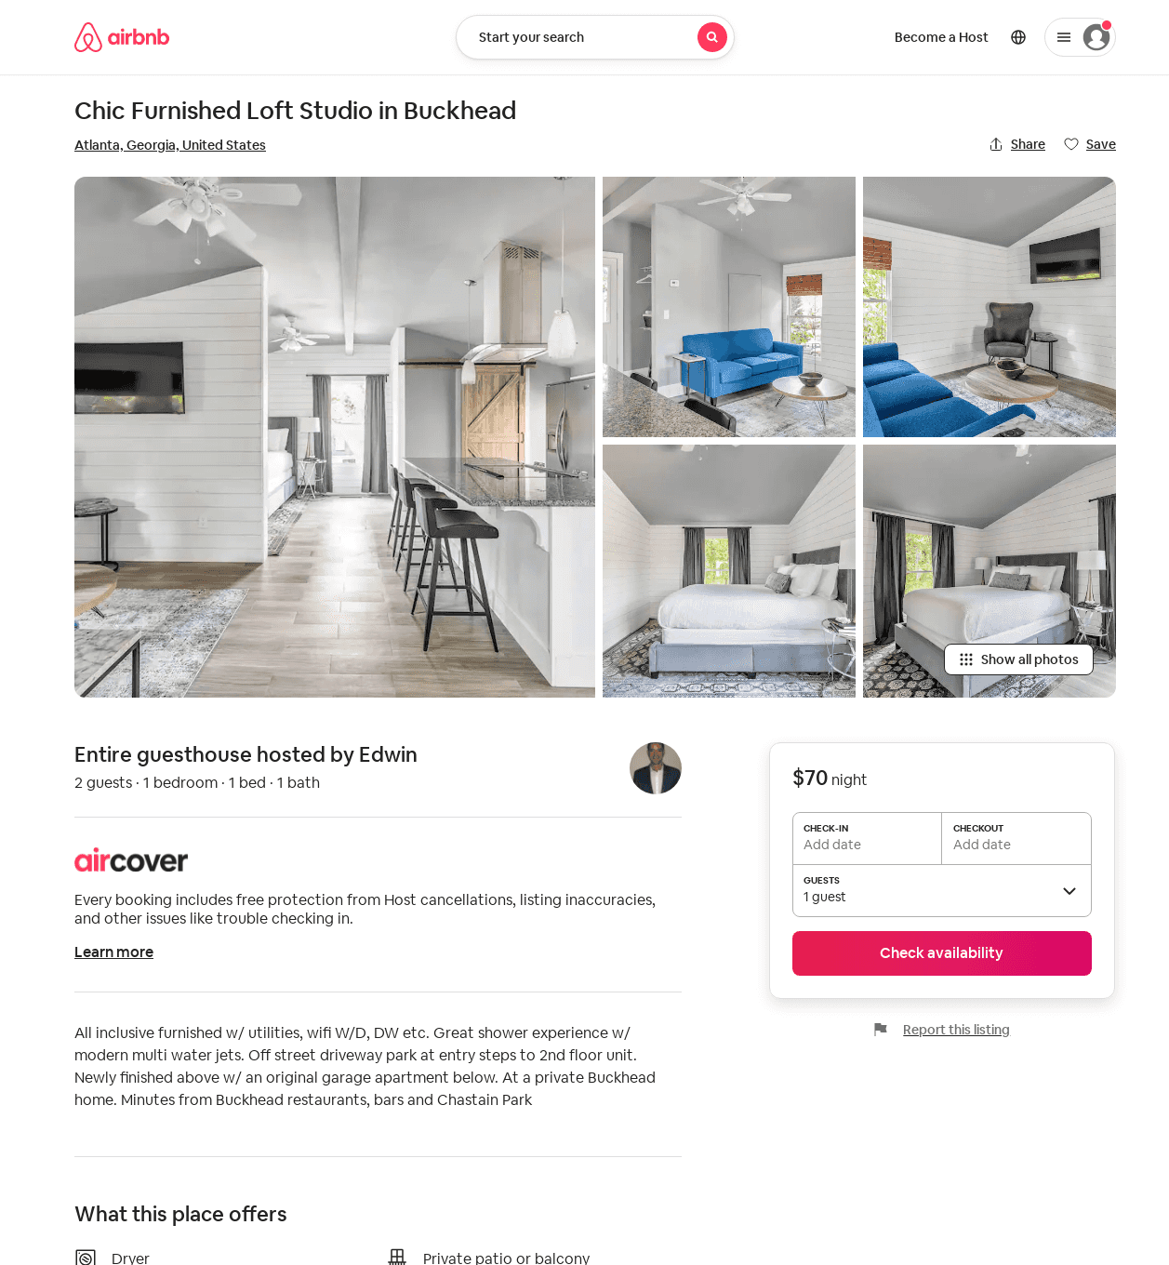
Listing 12381316
1
2
$70 - $87
30
Edwin
66919883
1
https://www.airbnb.com/rooms/12381316
Aug 2022

Slide 10
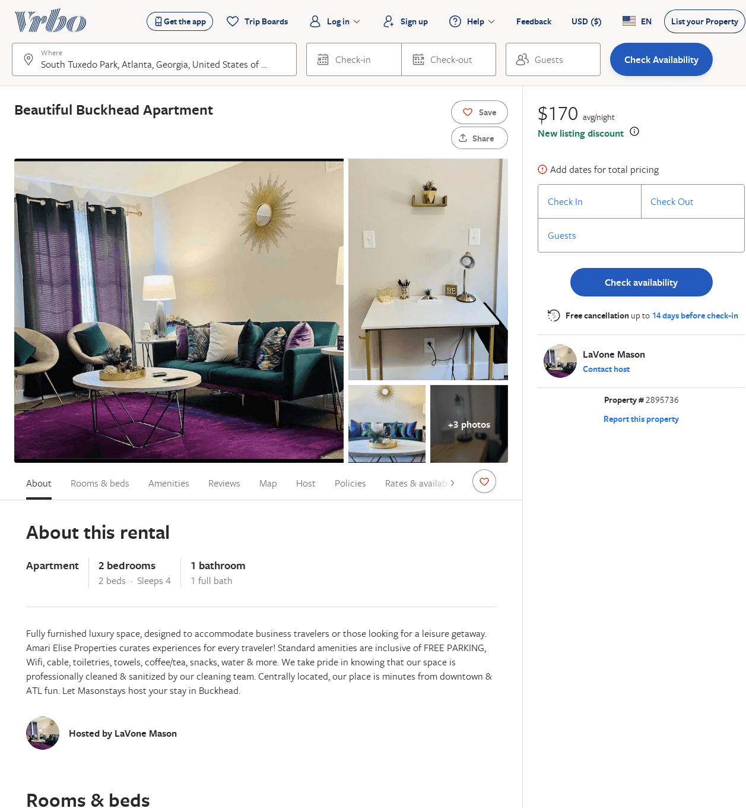
Listing 2895736
2
4
$170
3
LaVone Mason
https://www.vrbo.com/2895736
Aug 2022

