Slide 2
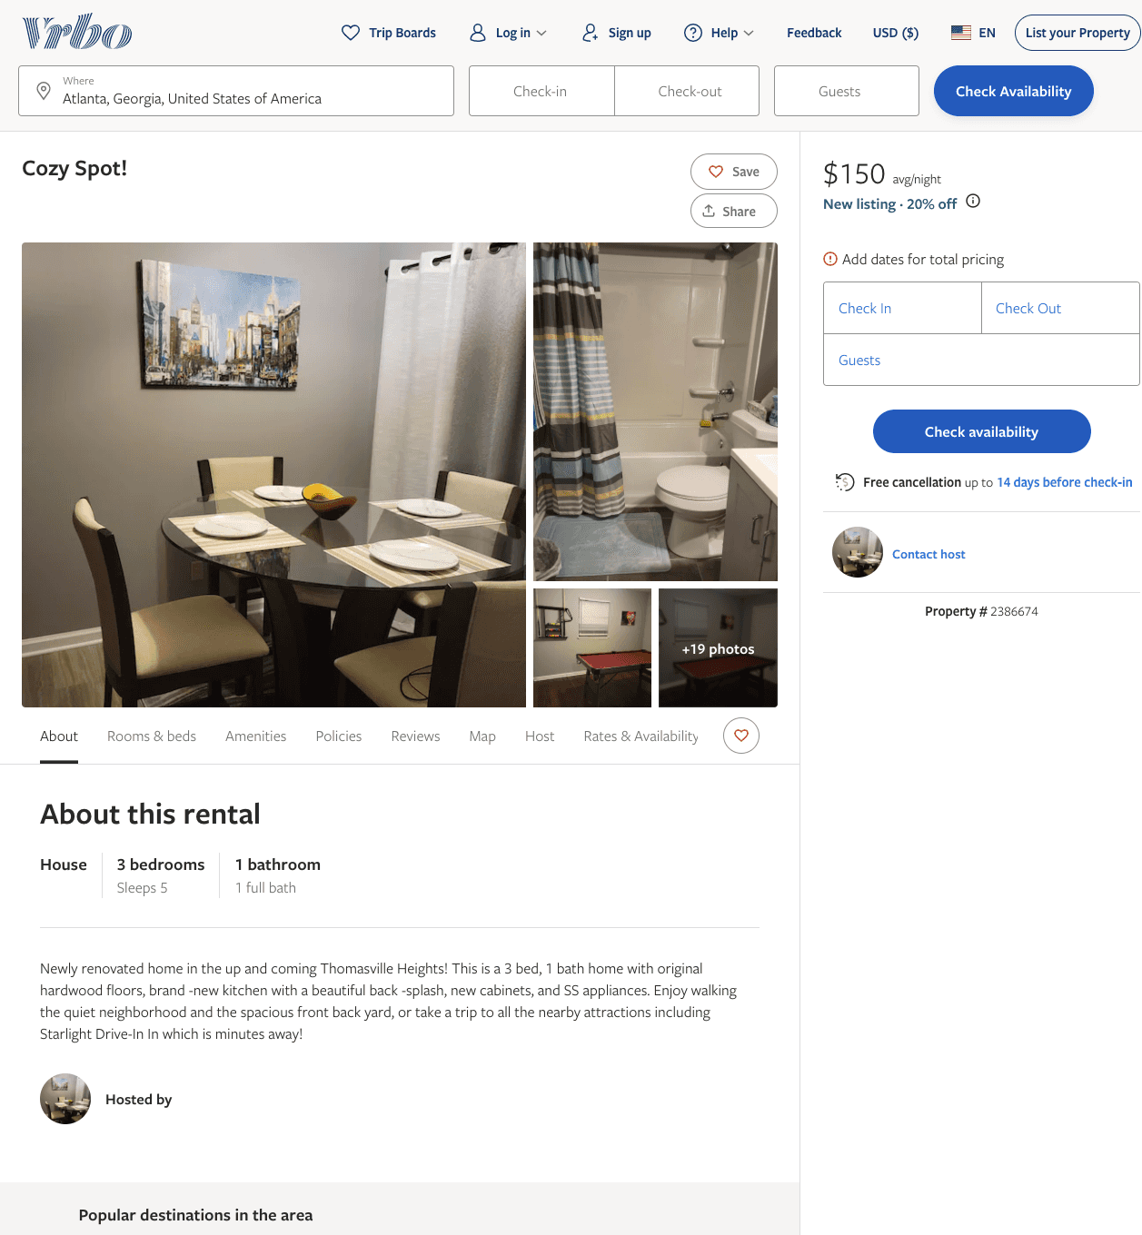
Listing 2386674
3
4
$120 - $150
4.96
2
Lakeisha Holloway
https://www.vrbo.com/2386674
Aug 2022

Slide 3
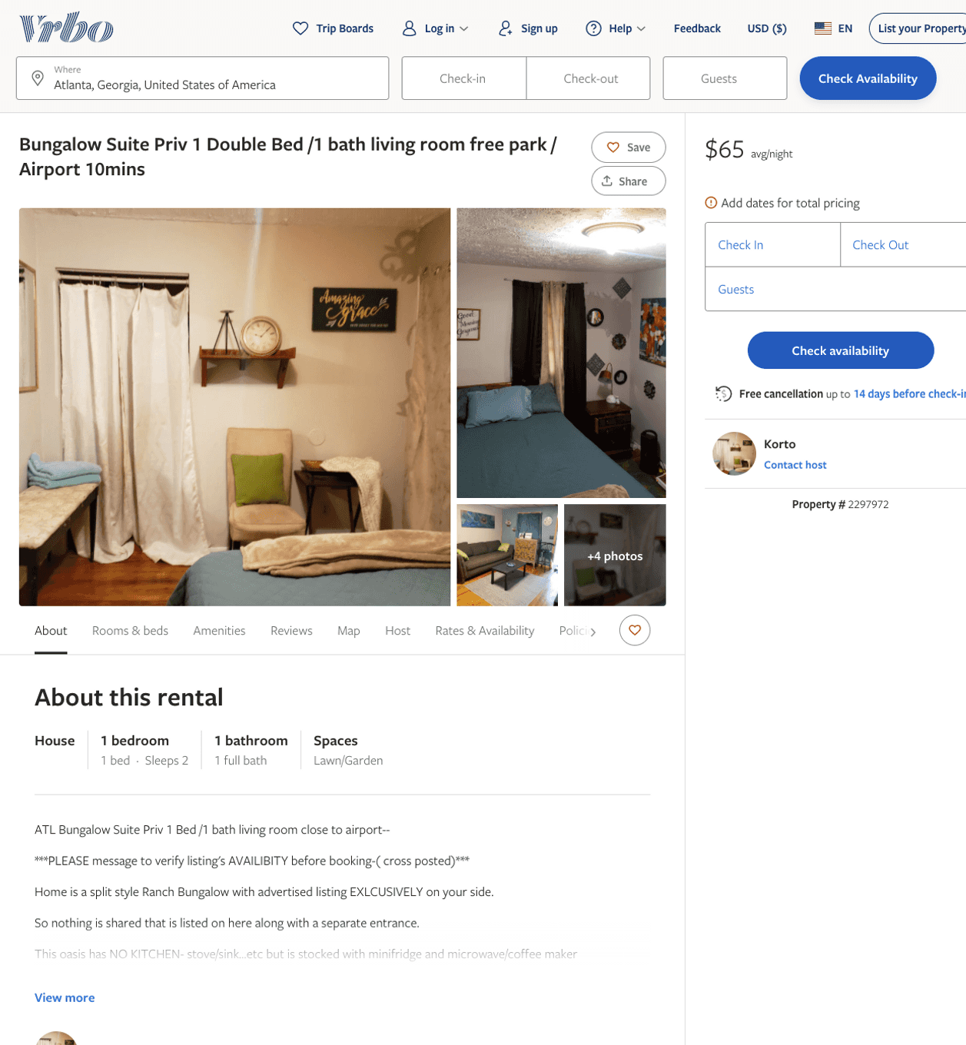
Listing 2297972
1
2
$65
5
3
Korto
https://www.vrbo.com/2297972
Aug 2022

Slide 4
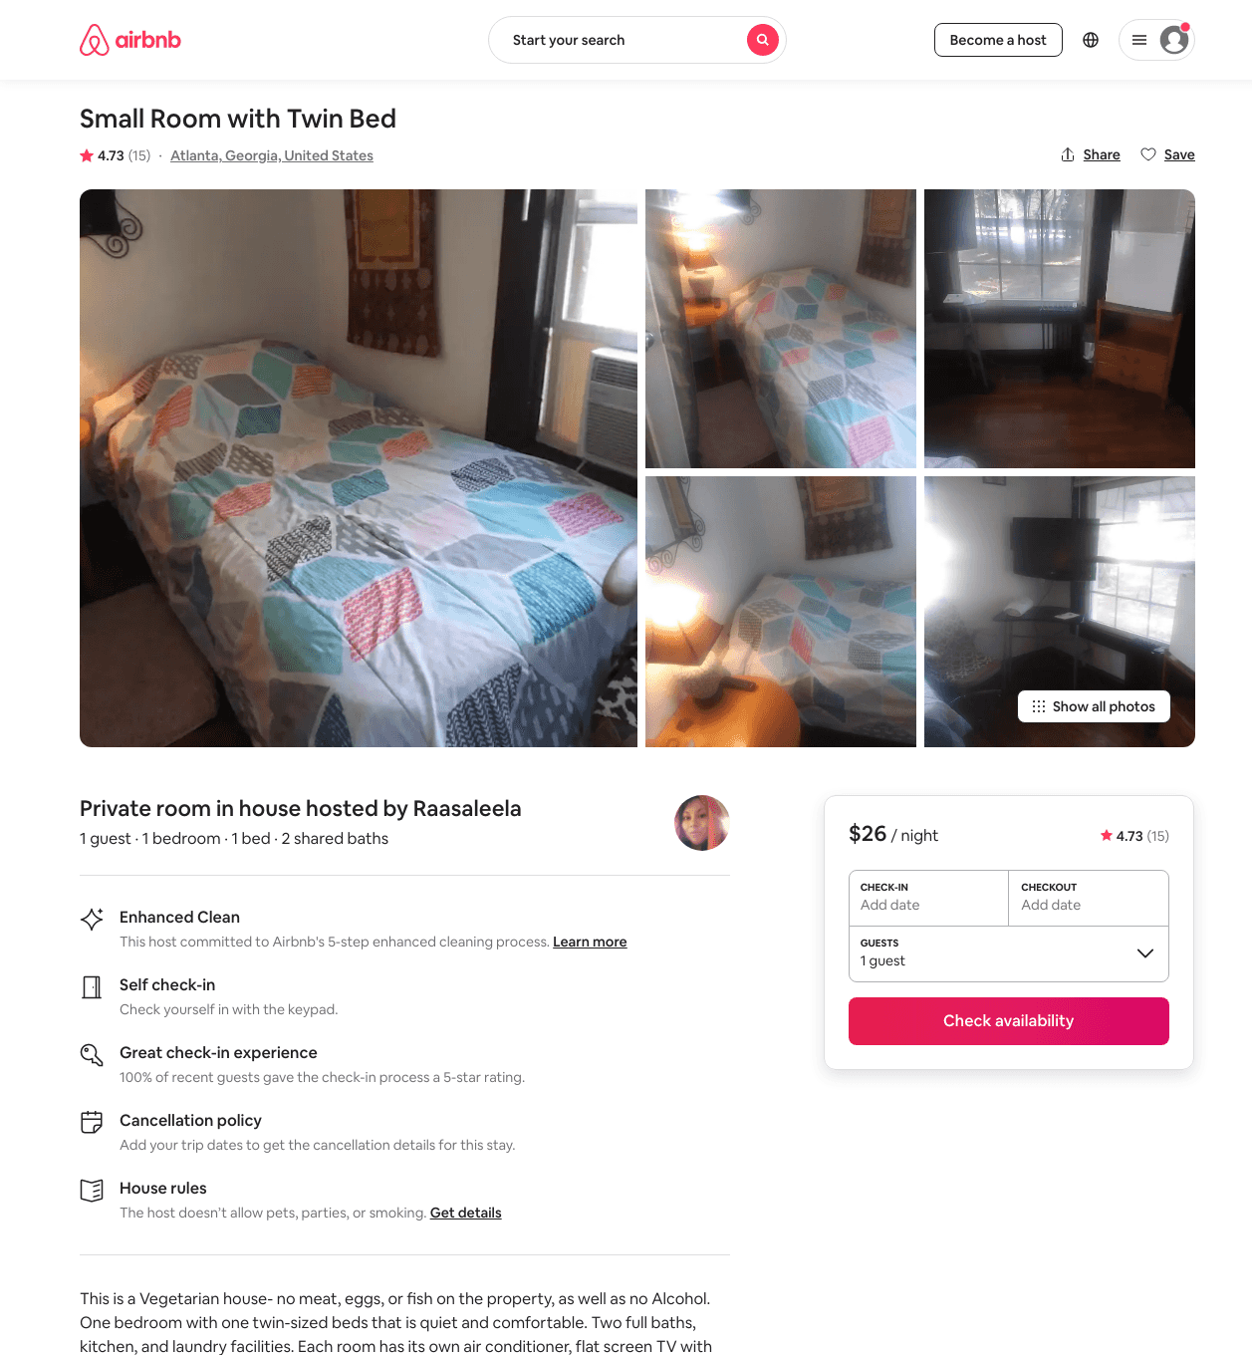
Listing 44137195
1
1
$12 - $32
4.46
2
Stuart
24010389
8
https://www.airbnb.com/rooms/44137195
Aug 2022

Slide 5
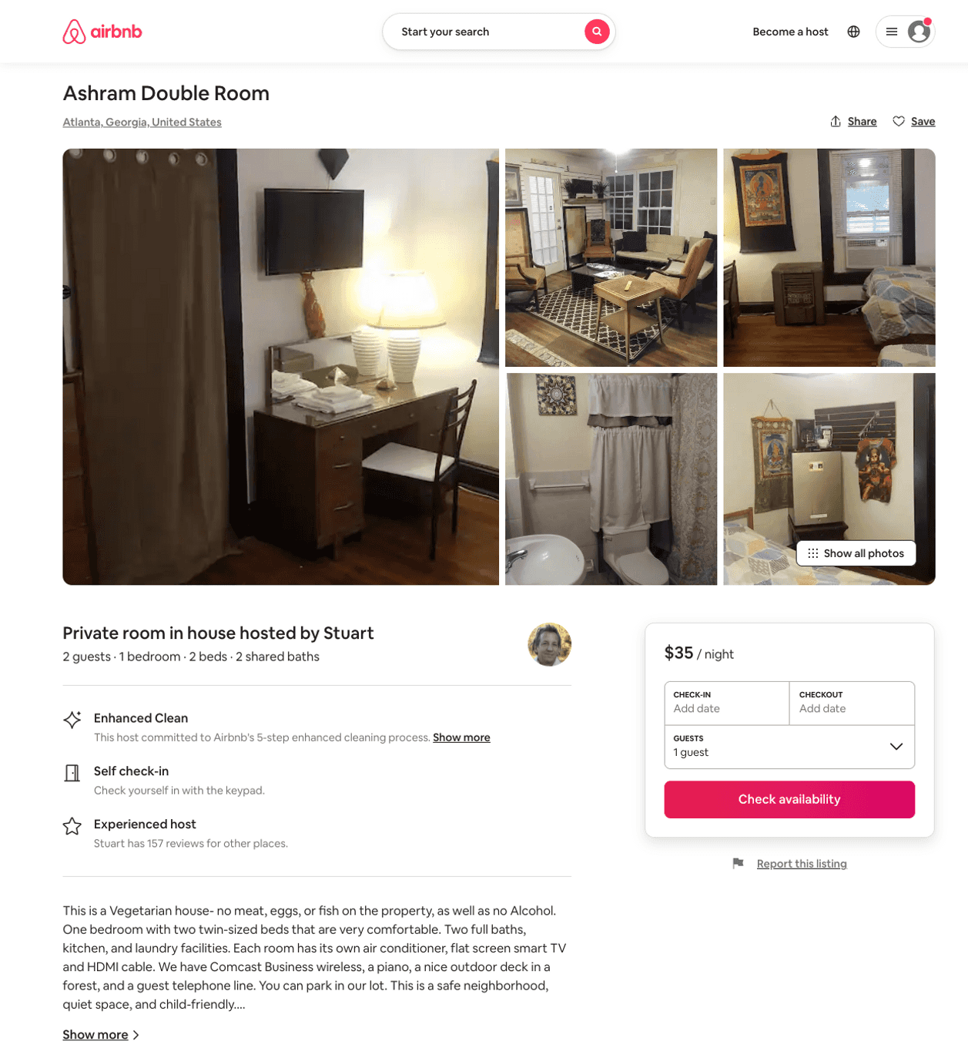
Listing 50704314
1
2
$20 - $35
5.0
2
Stuart
24010389
8
https://www.airbnb.com/rooms/50704314
Aug 2022

Slide 6
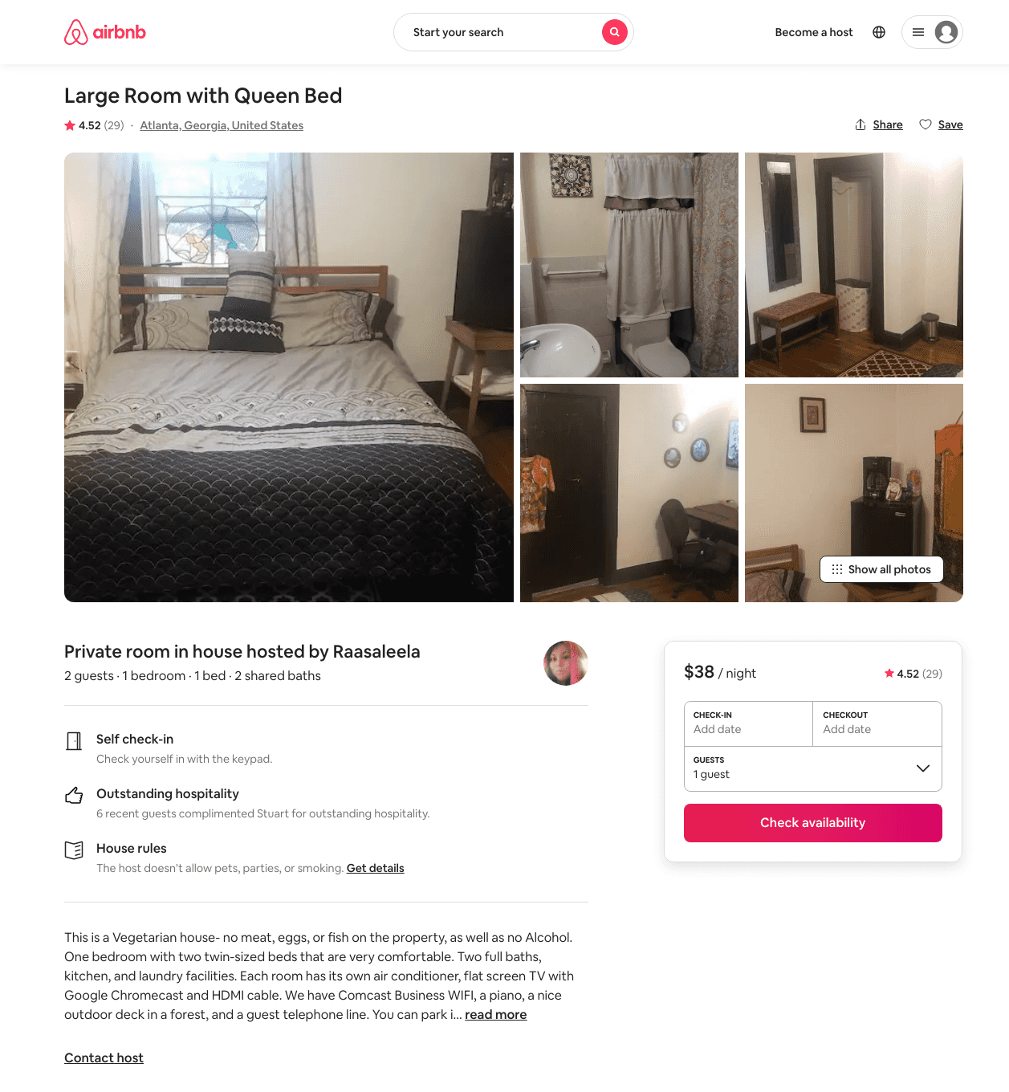
Listing 5410990
1
2
$15 - $38
4.49
2
Stuart
24010389
8
https://www.airbnb.com/rooms/5410990
Aug 2022

Slide 7
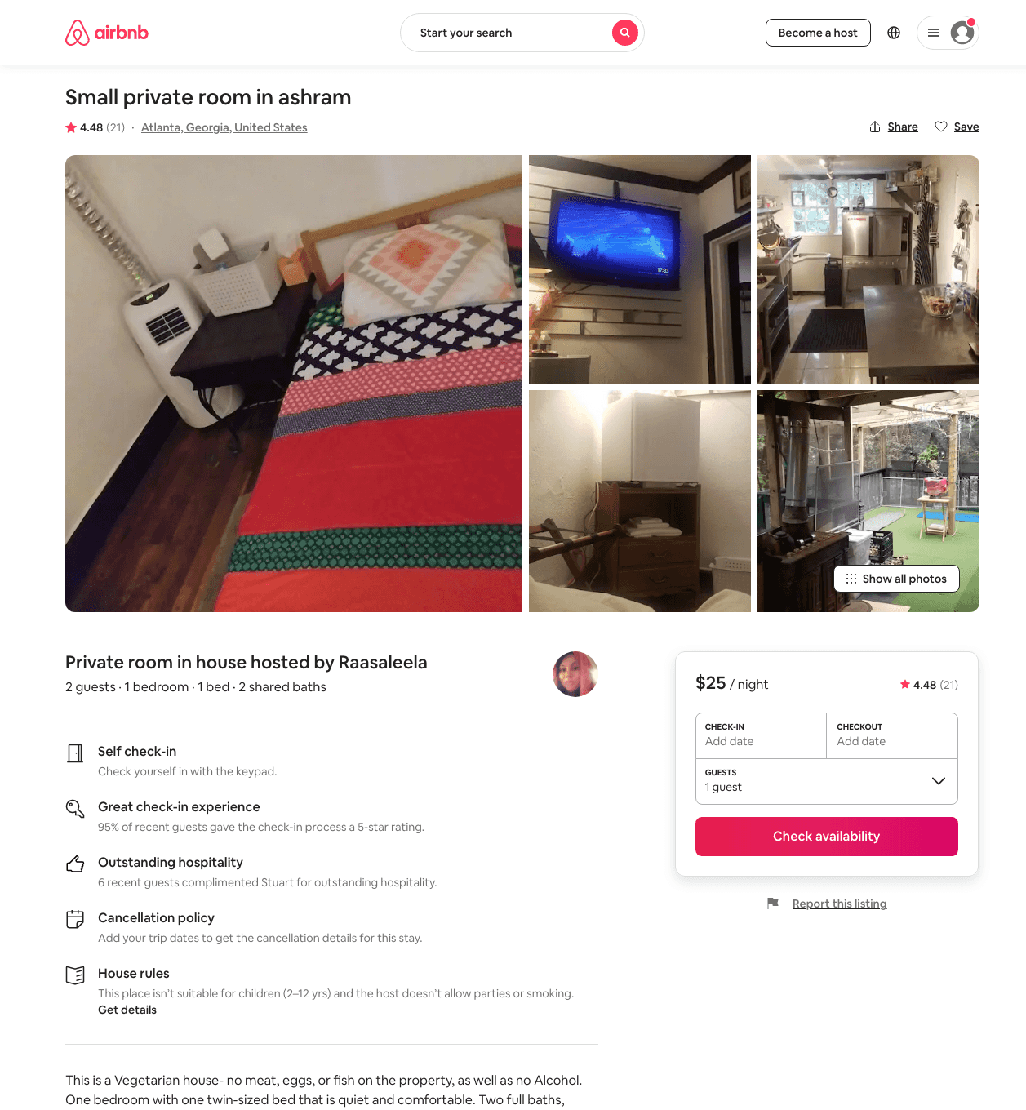
Listing 44137588
1
2
$17 - $29
4.41
2
Stuart
24010389
8
https://www.airbnb.com/rooms/44137588
Aug 2022

Slide 8
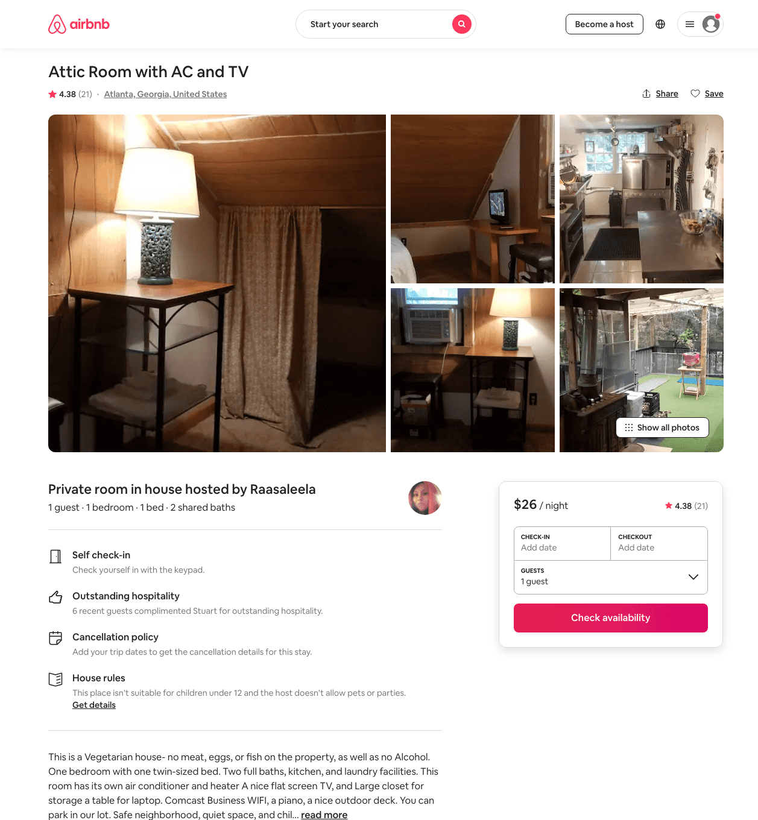
Listing 44182383
1
1
$16 - $34
4.45
2
Stuart
24010389
8
https://www.airbnb.com/rooms/44182383
Aug 2022

Slide 9
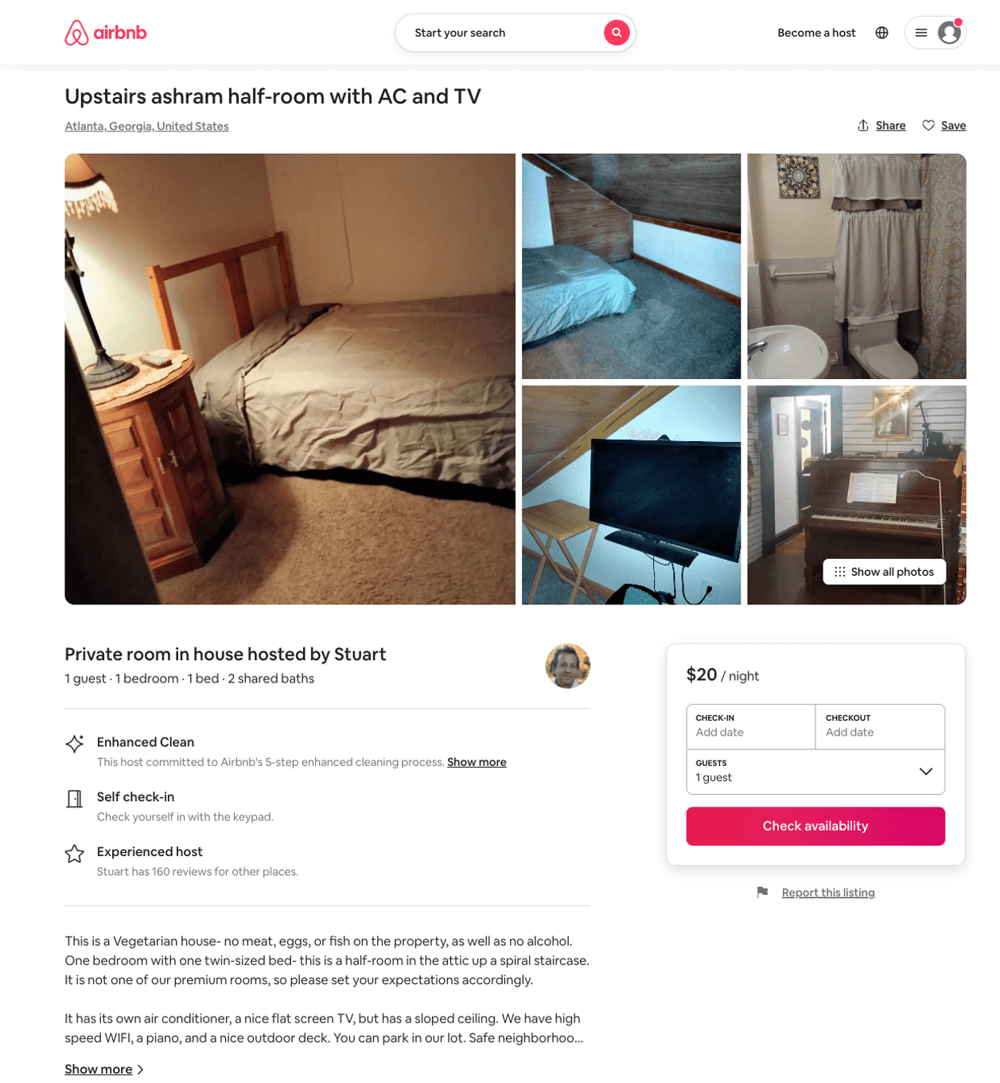
Listing 50851773
1
1
$13 - $25
4.46
2
Stuart
24010389
8
https://www.airbnb.com/rooms/50851773
Aug 2022

Slide 10
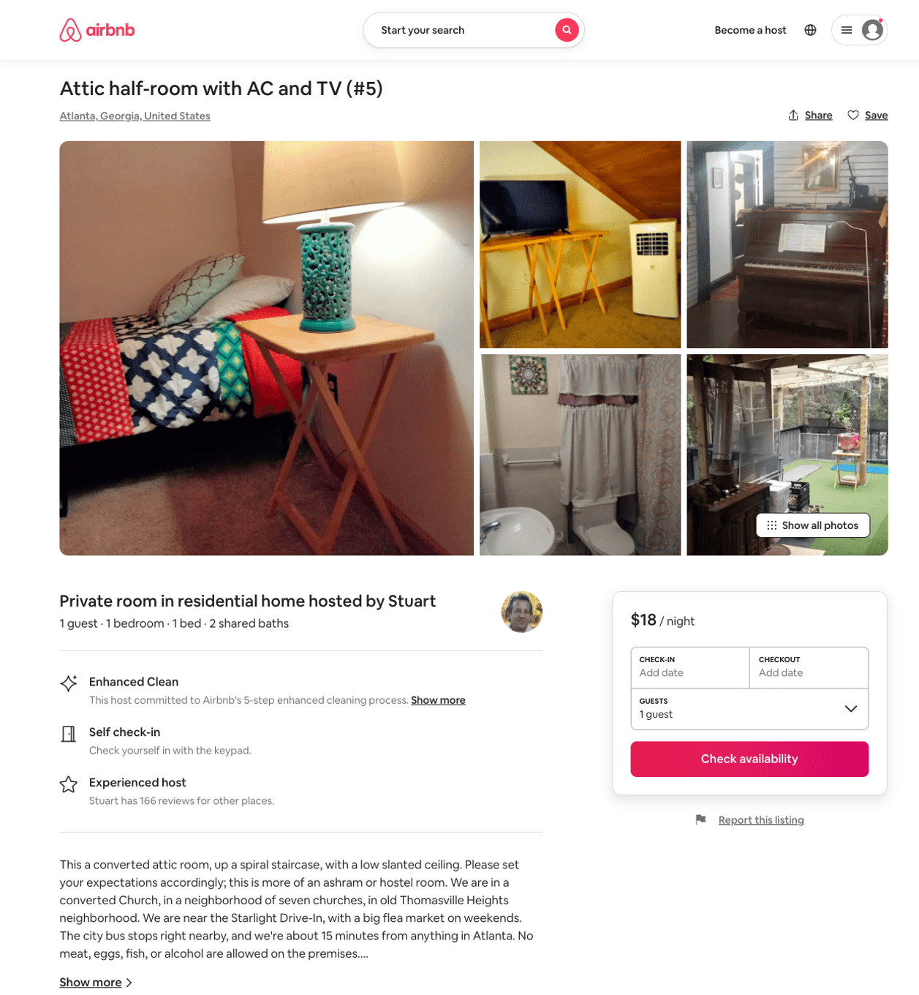
Listing 51366578
1
1
$18 - $25
4.13
2
Stuart
24010389
8
https://www.airbnb.com/rooms/51366578
Jul 2022

Slide 11
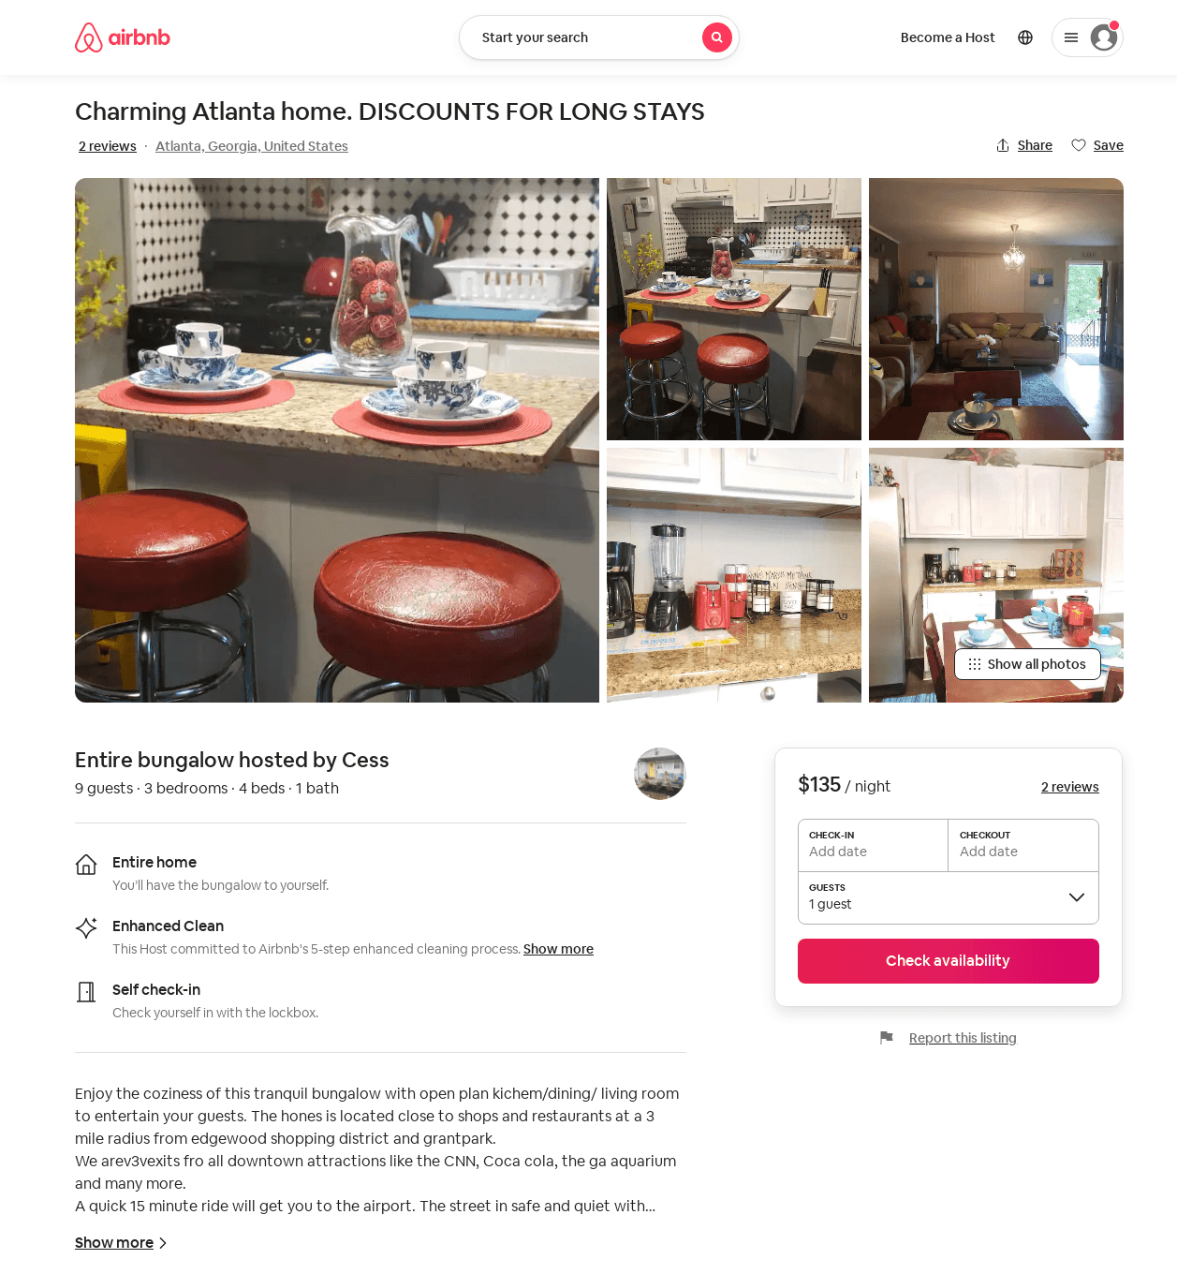
Listing 50894098
3
7
$135 - $139
4.50
2
Cess
403476497
2
https://www.airbnb.com/rooms/50894098
Aug 2022

Slide 12
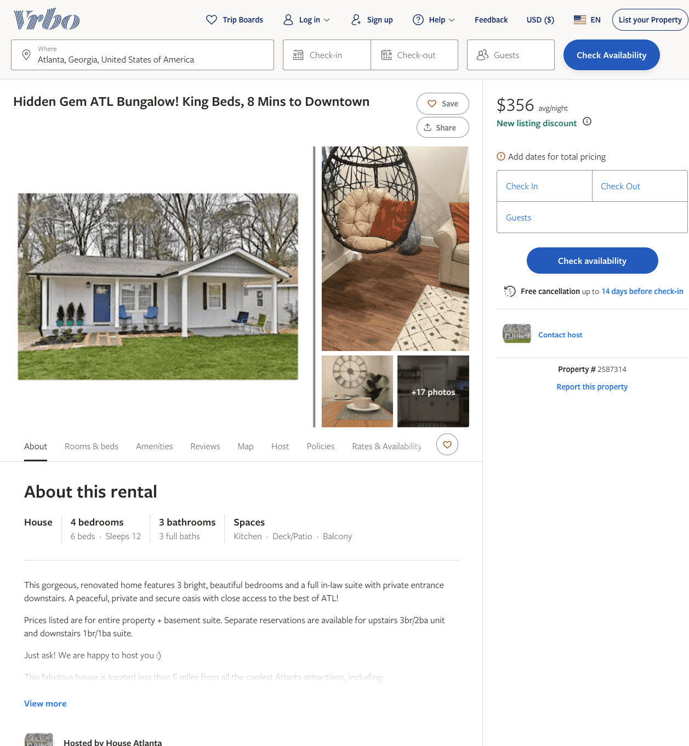
Listing 2587314
3
12
$310 - $356
5
1
Smith & Maddox
https://www.vrbo.com/2587314
Aug 2022

Slide 13
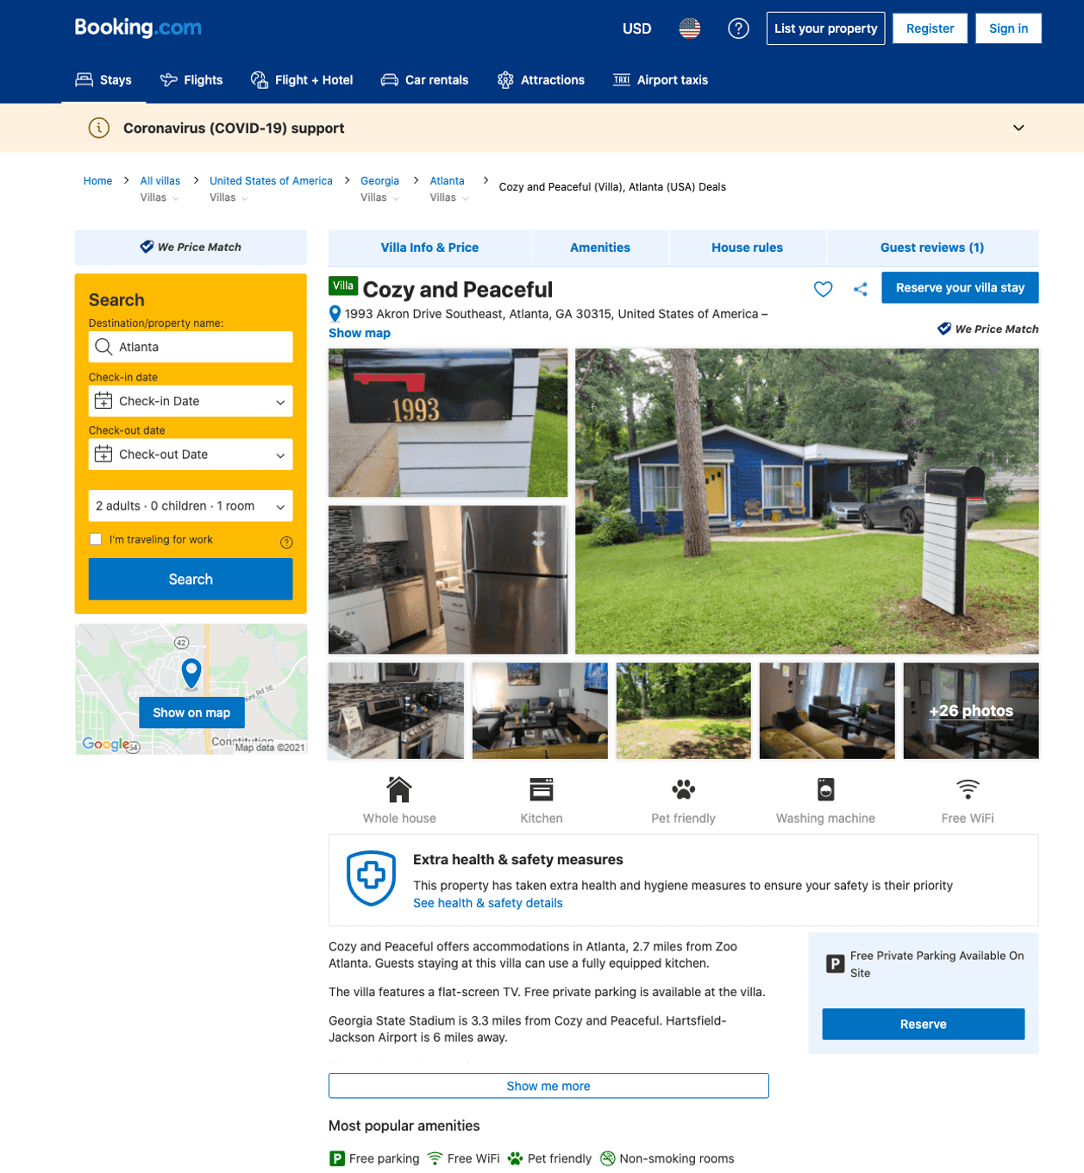
Listing cozy-and-peaceful
1993 AKRON DR SE
undefined
1
9.6
https://www.booking.com/hotel/us/cozy-and-peaceful.html
Sep 2022

Slide 14
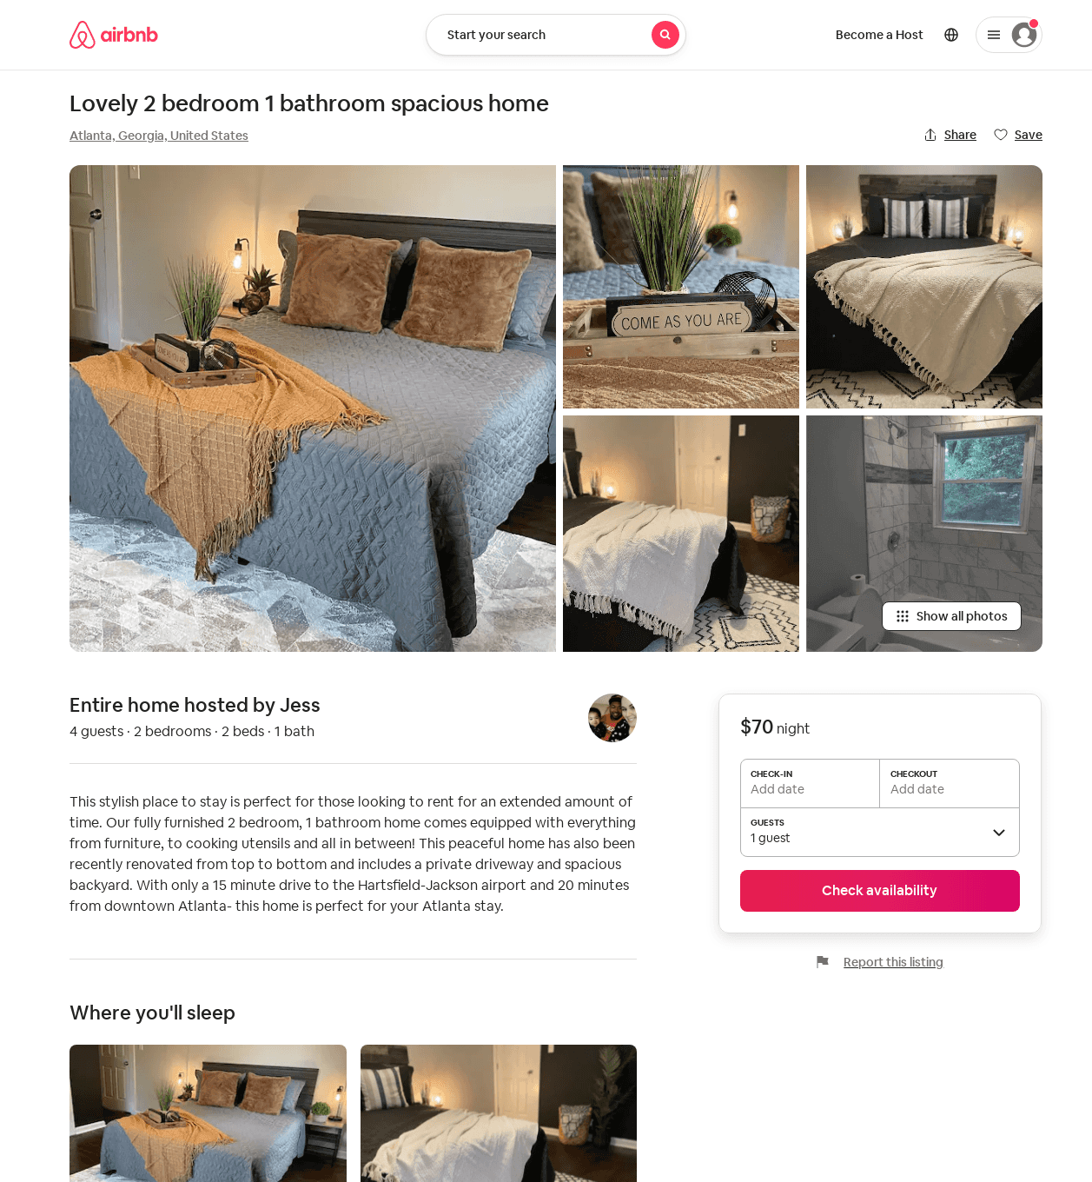
Listing 52363646
2
5
$70 - $113
5.0
2
Jessenia
148253010
1
https://www.airbnb.com/rooms/52363646
Aug 2022

Slide 15
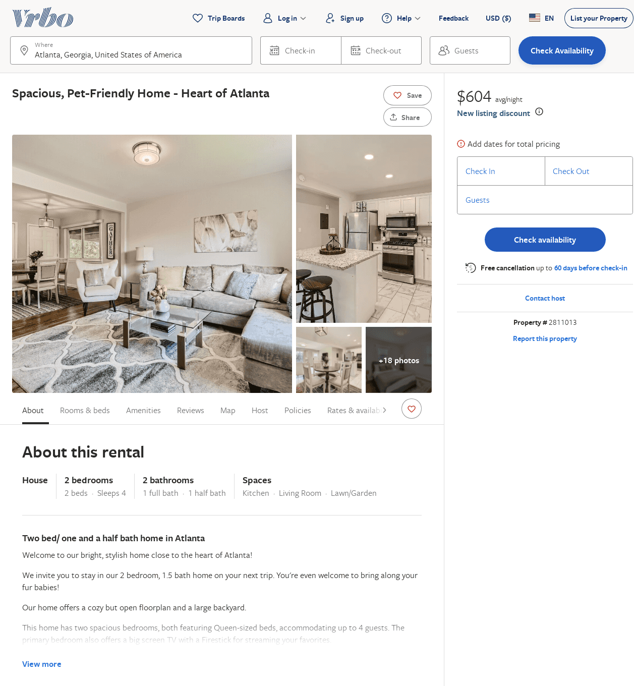
Listing 2811013
2
4
$167
1
Maria McNiece
https://www.vrbo.com/2811013
Aug 2022

Slide 16
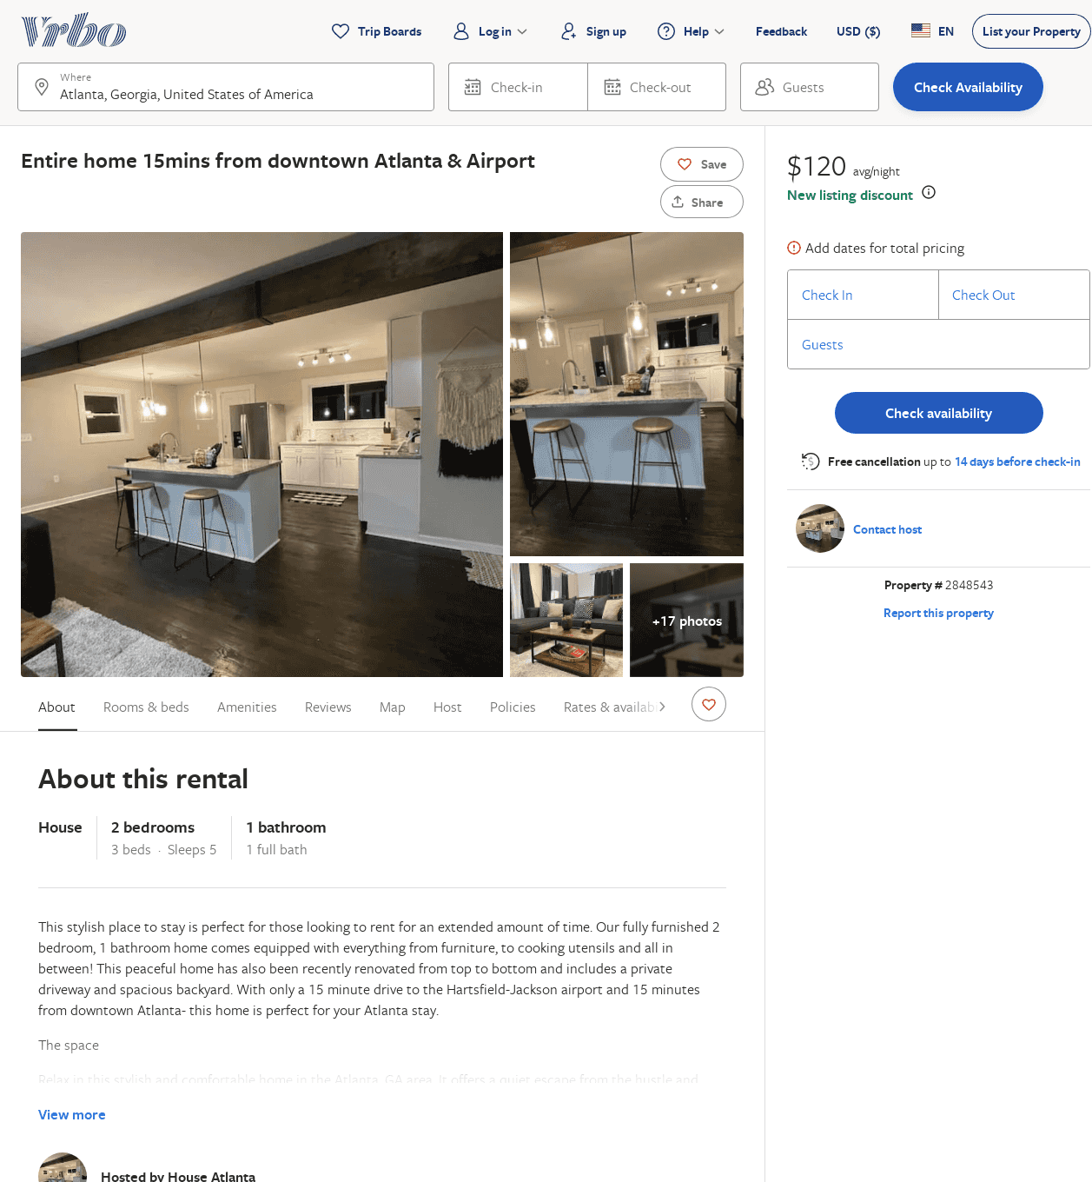
Listing 2848543
2
5
$120
2
https://www.vrbo.com/2848543
Aug 2022

