Slide 2
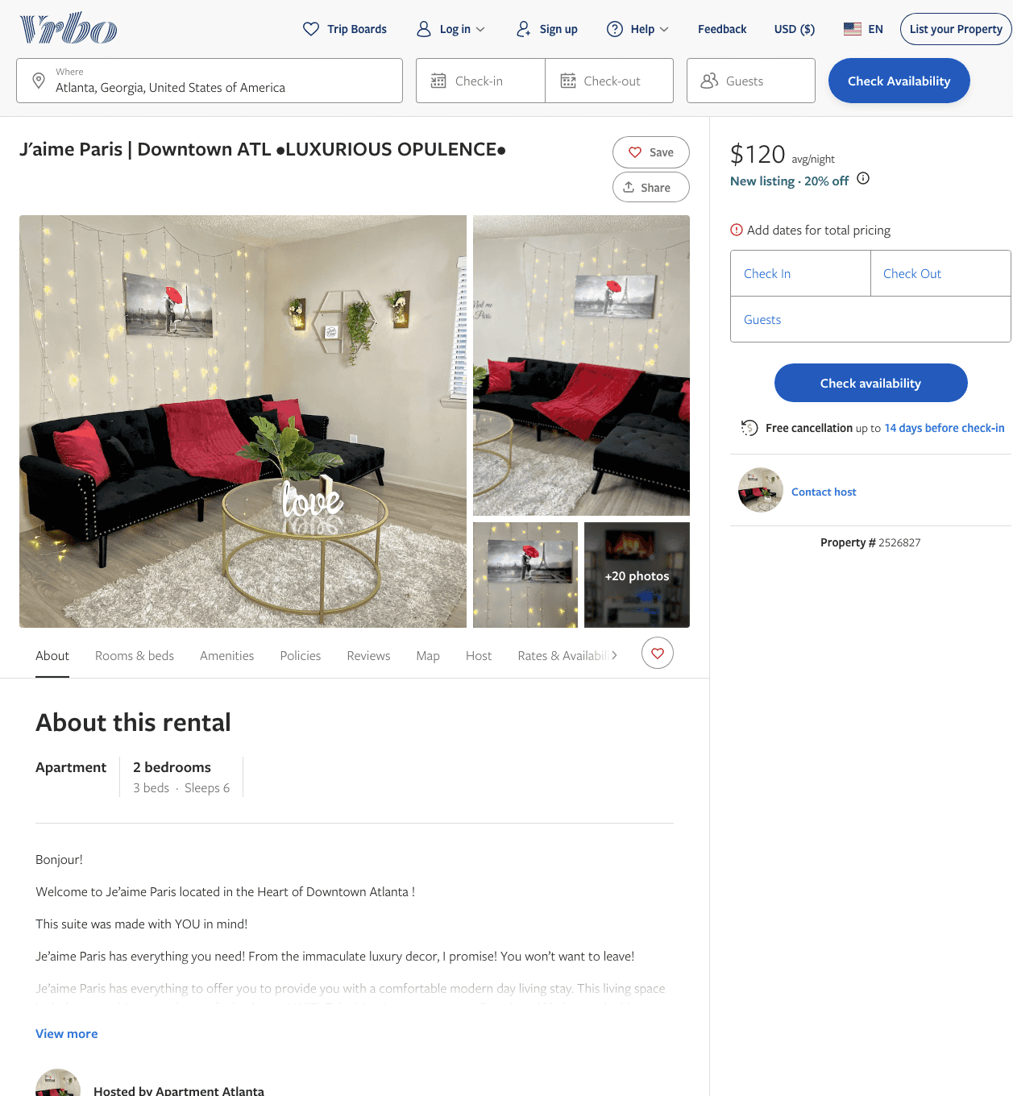
Listing 2526827
2
6
$120 - $88
2
https://www.vrbo.com/2526827
Aug 2022

Slide 3
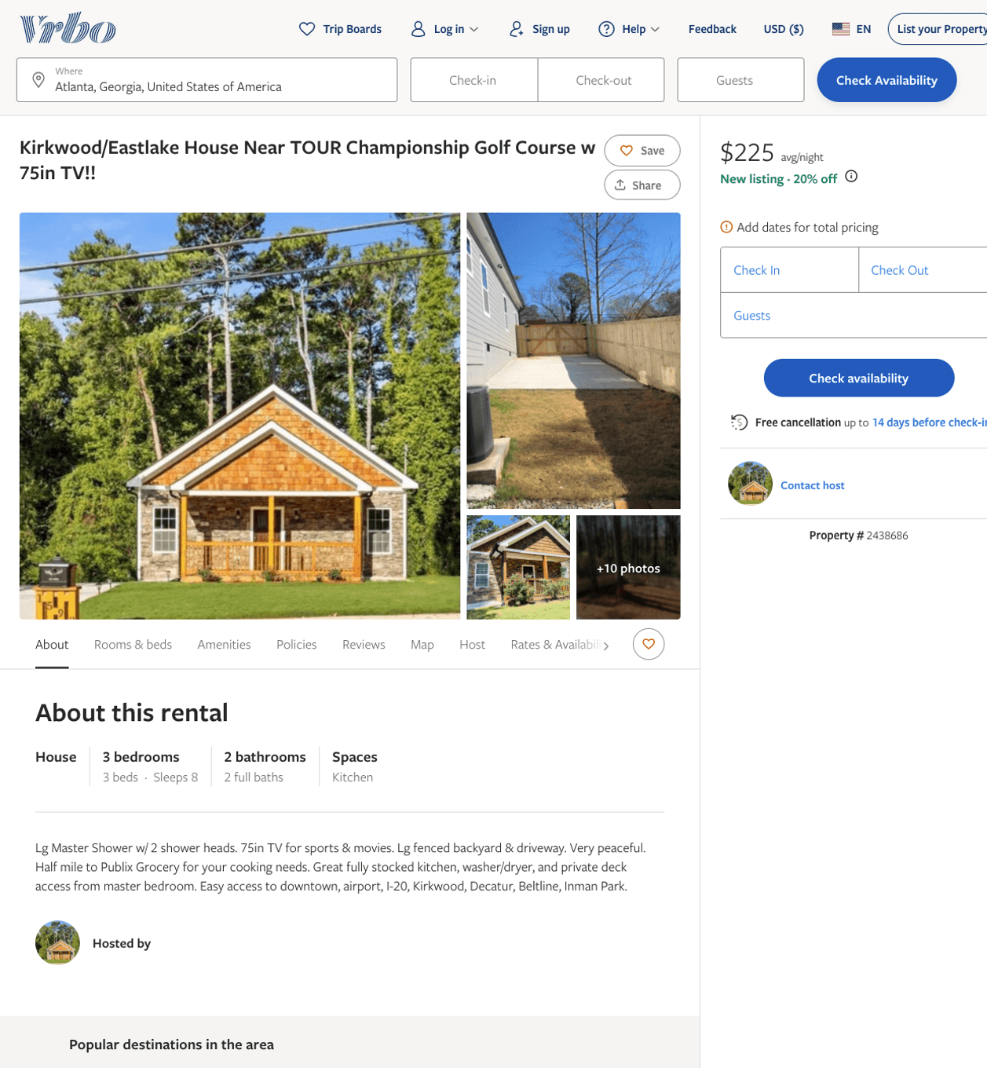
Listing 2438686
3
7
$225
5
2
Ross and Jean
https://www.vrbo.com/2438686
Aug 2022

Slide 4
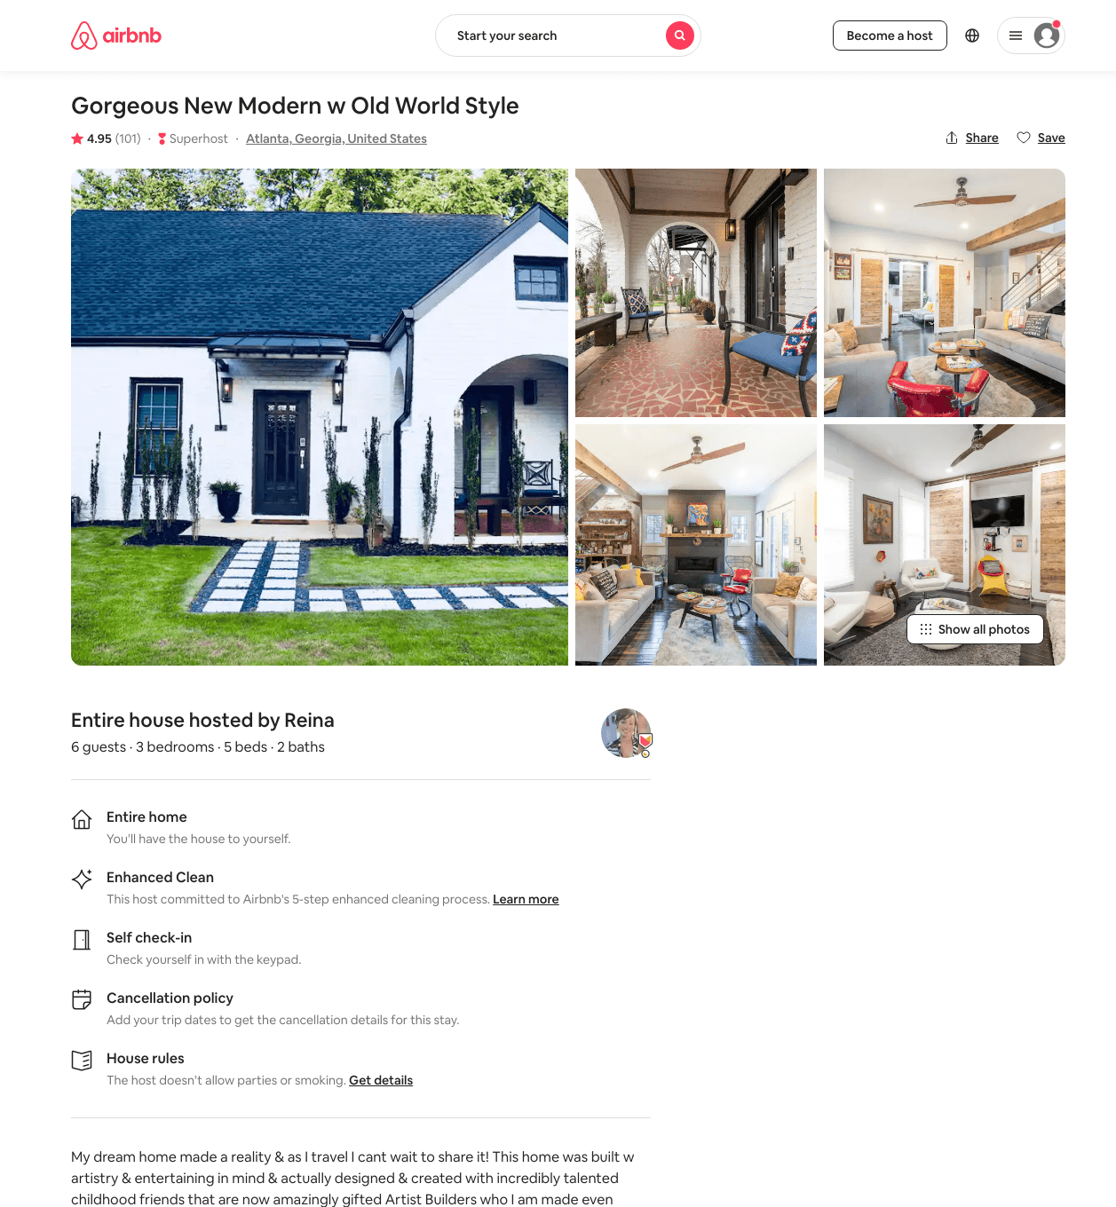
Listing 22346167
3
6
$228 - $393
4.94
2
Reina
19636176
3
https://www.airbnb.com/rooms/22346167
Aug 2022

Slide 5
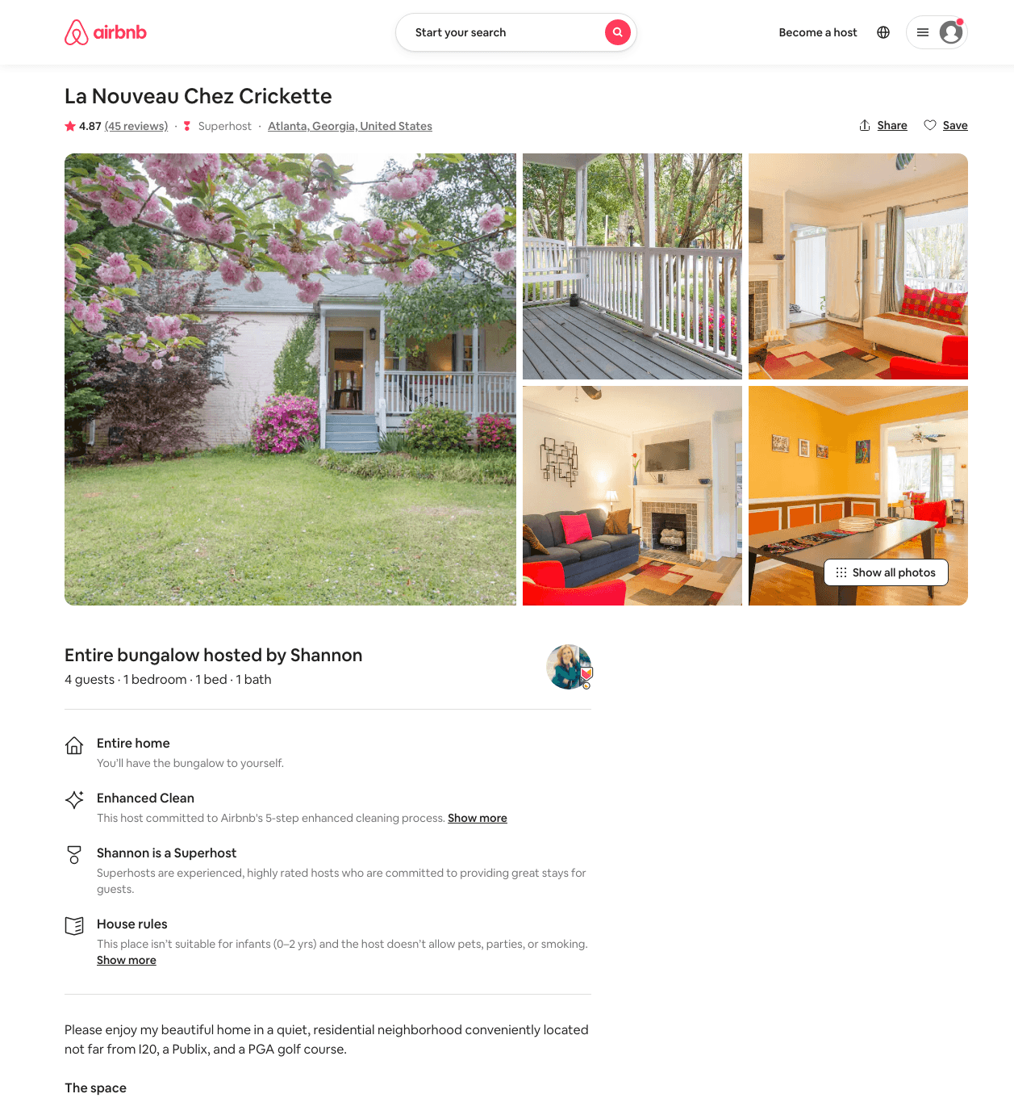
Listing 12104853
1
4
$91 - $99
4.90
2
Shannon
1352517
1
https://www.airbnb.com/rooms/12104853
Aug 2022

Slide 6
Listing 6151702
1
1
$85
4.98
7
Elle
31883770
1
https://www.airbnb.com/rooms/6151702
Aug 2022

