Slide 2
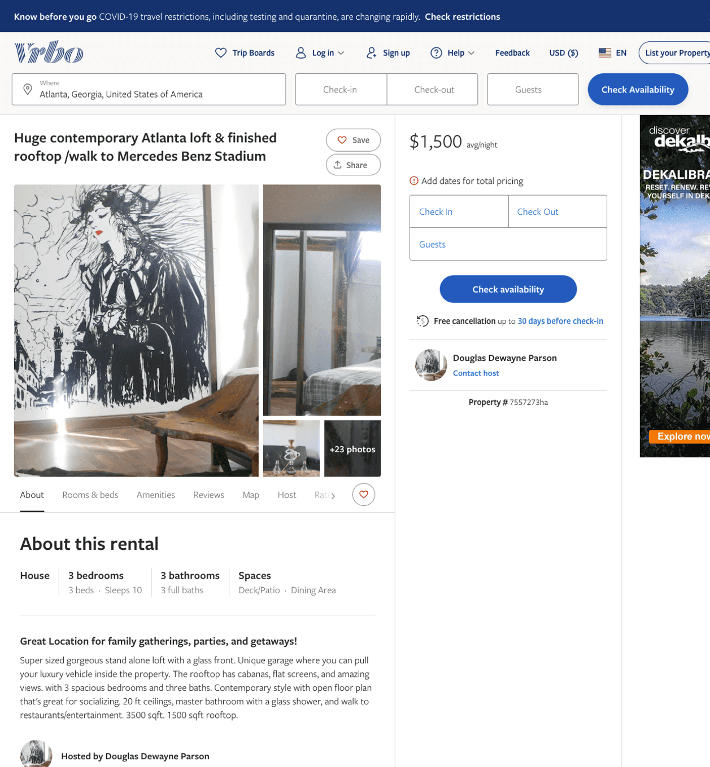
Listing 7557273
3
10
$1,500
3
Douglas Dewayne Parson
https://www.vrbo.com/7557273ha
Aug 2022

Slide 3
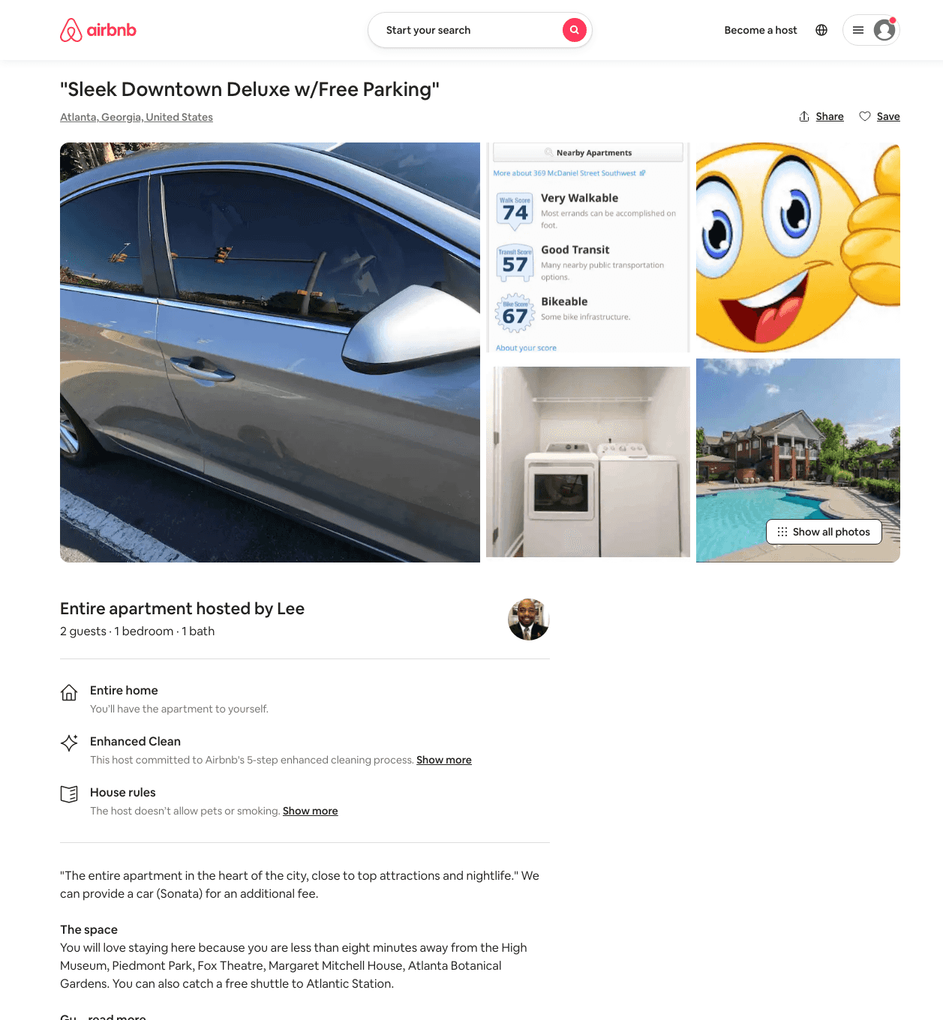
Listing 49539742
1
2
$70 - $88
4.53
2
Lee
314593943
1
https://www.airbnb.com/rooms/49539742
Aug 2022

Slide 4
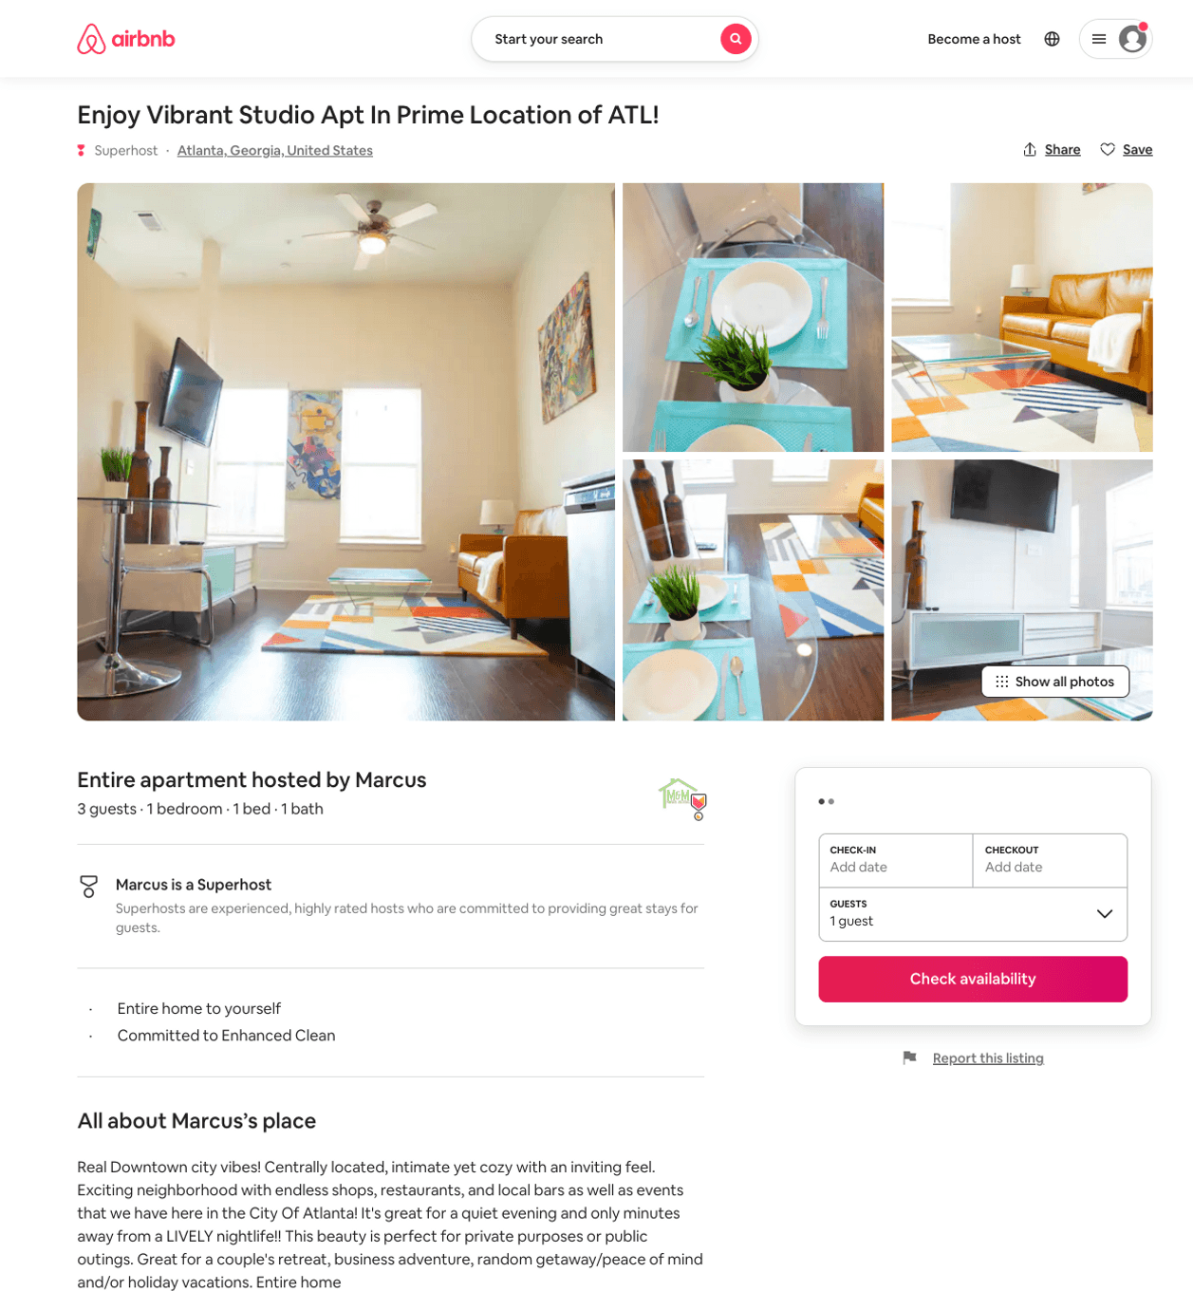
Listing 50503529
1
3
$72 - $167
4.86
1
Marcus
117627828
2
https://www.airbnb.com/rooms/50503529
Jun 2022

Slide 5
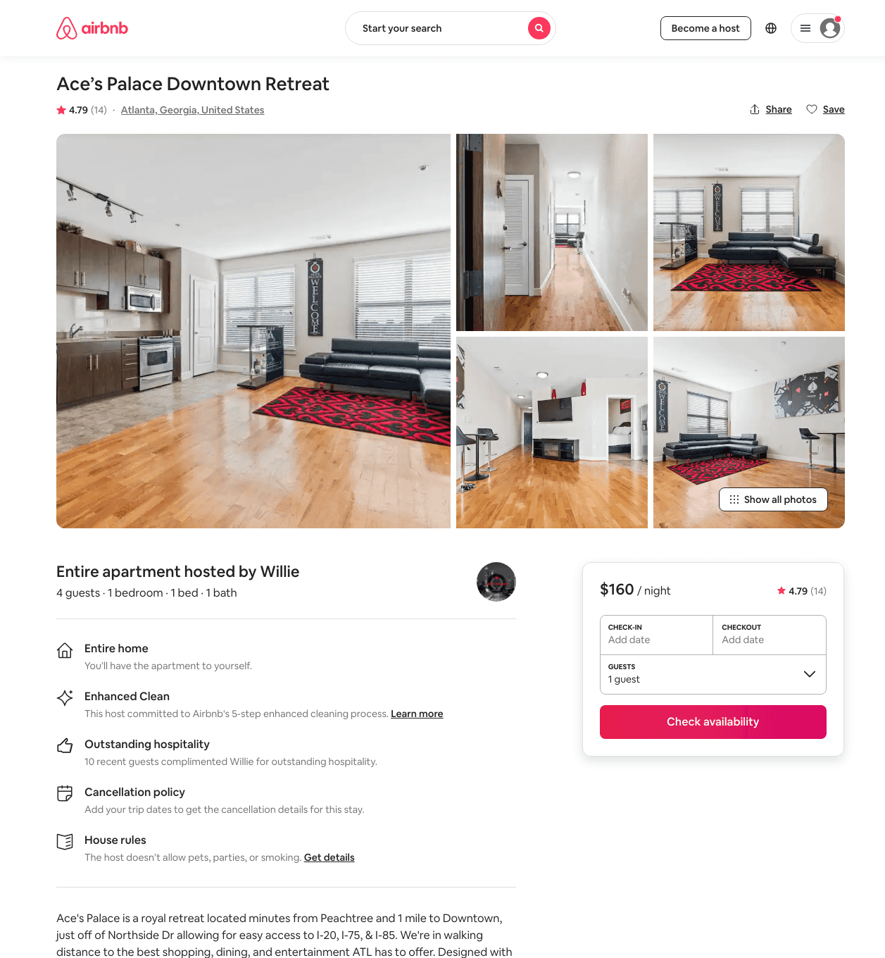
Listing 45676196
1
4
$95 - $229
4.73
3
Willie
370056475
1
https://www.airbnb.com/rooms/45676196
Aug 2022

Slide 6
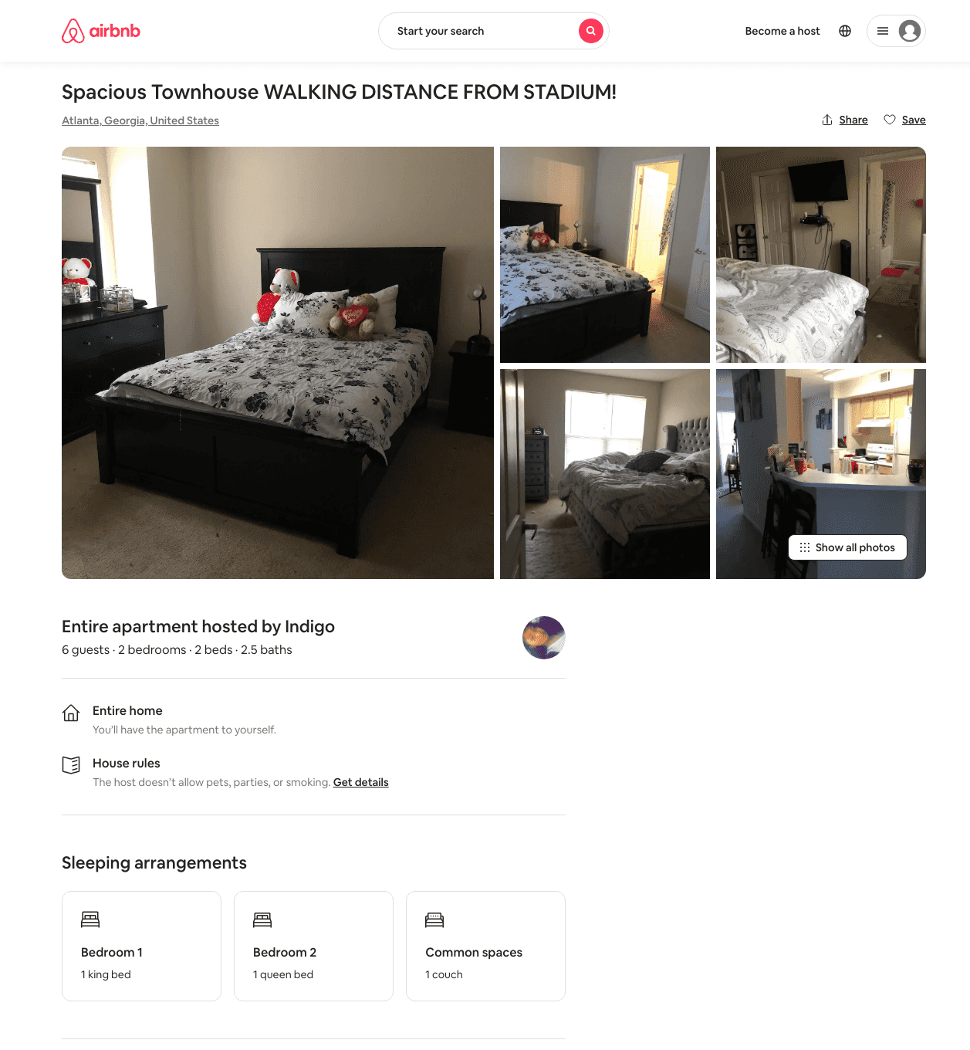
Listing 29803572
2
6
$450
1
Indigo
52545121
1
https://www.airbnb.com/rooms/29803572
Aug 2022

Slide 7
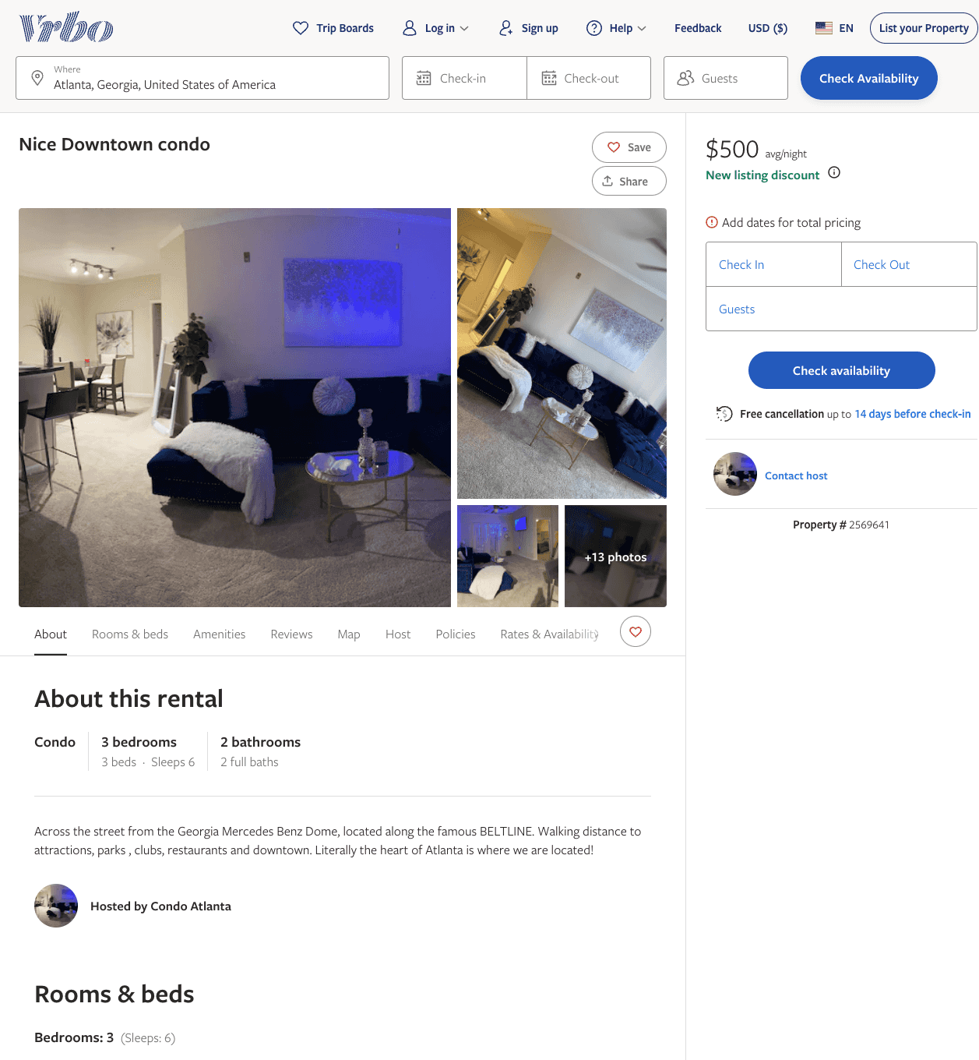
Listing 2569641
3
6
$350 - $529
1
1
https://www.vrbo.com/2569641
Aug 2022

Slide 8
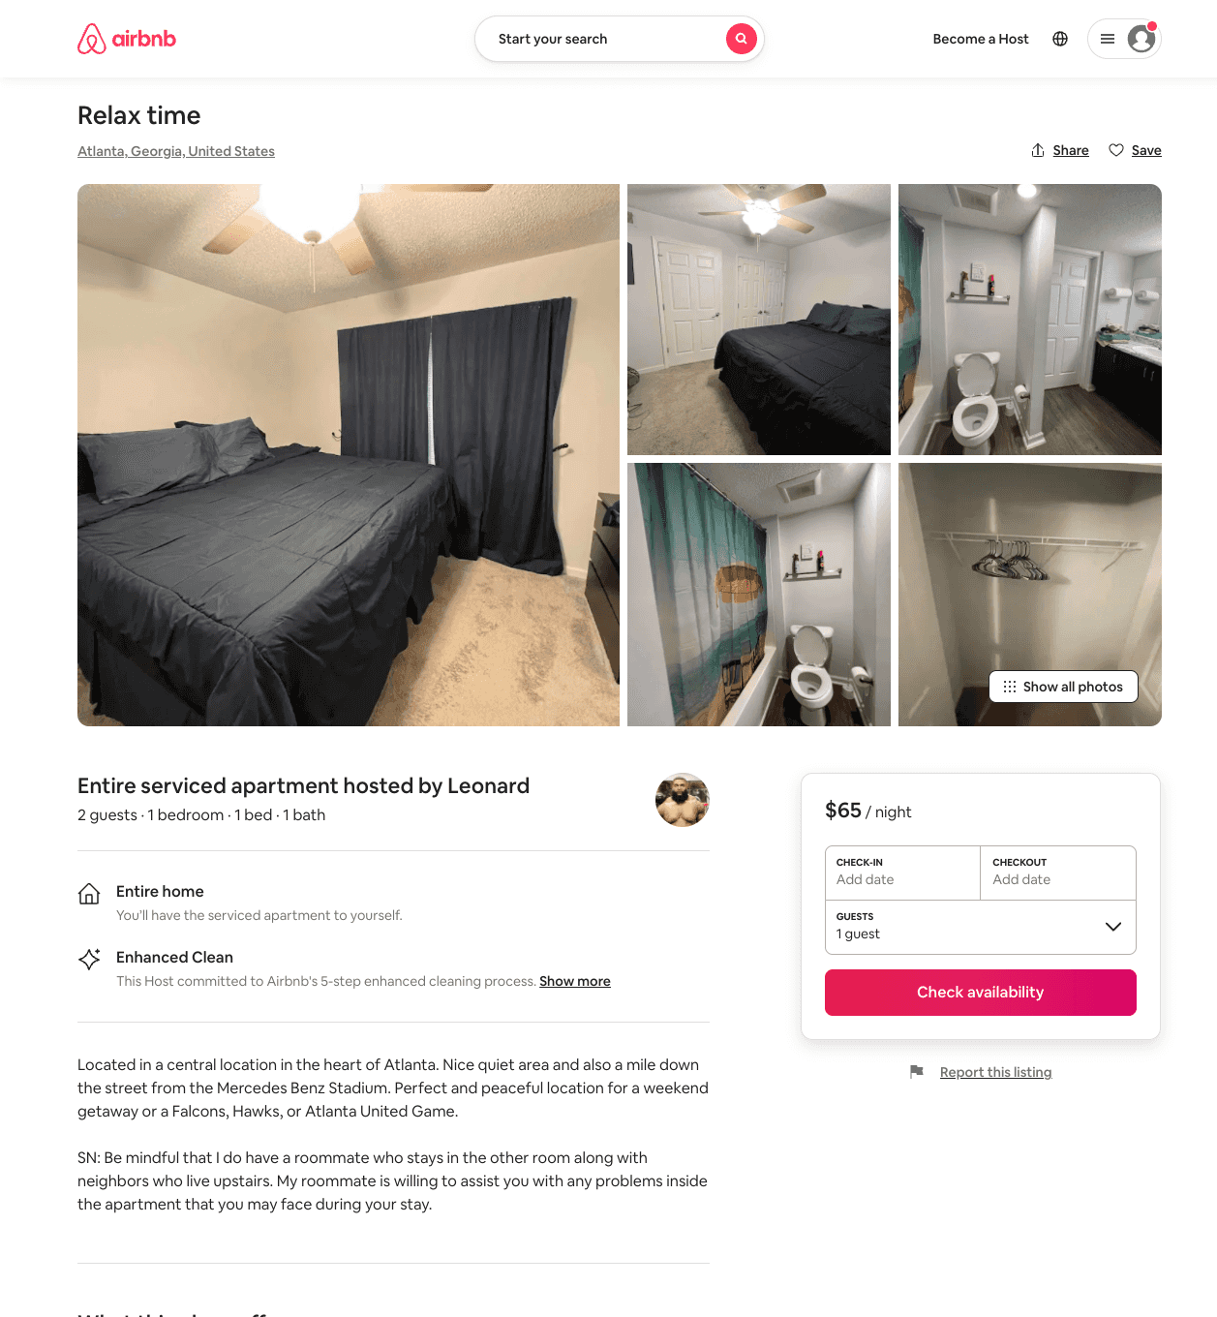
Listing 54141343
1
2
$44 - $65
5.0
1
Leonard
283251399
1
https://www.airbnb.com/rooms/54141343
Jun 2022

Slide 9
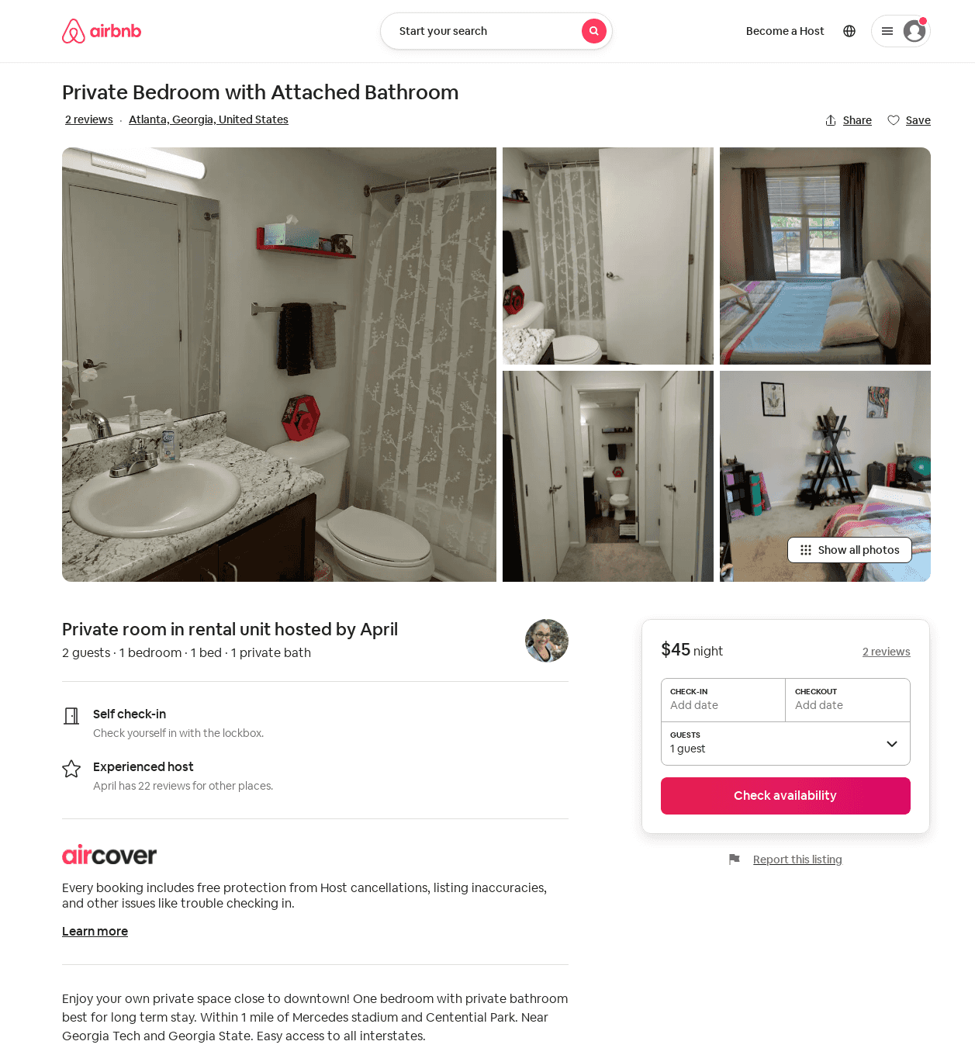
Listing 40861590
1
2
$45
5.0
1
April
68738105
1
https://www.airbnb.com/rooms/40861590
Aug 2022

Slide 10
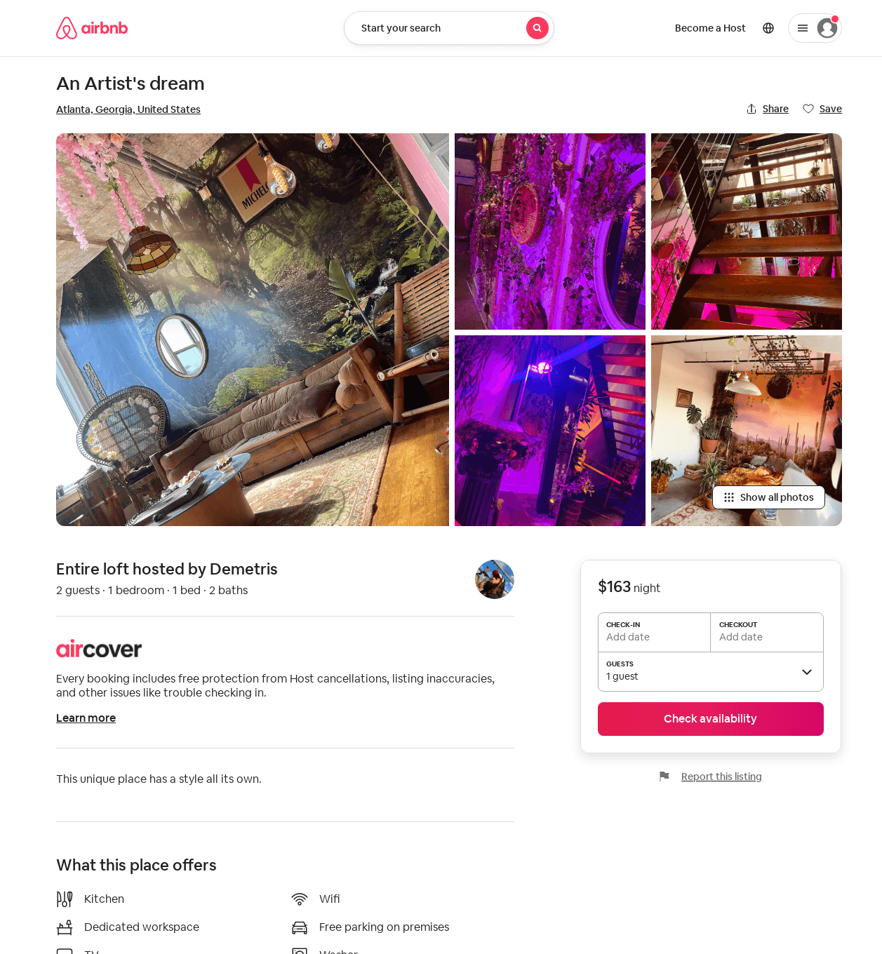
Listing 42714069
2
2
$154 - $163
1
Demetris
252112704
1
https://www.airbnb.com/rooms/42714069
Jul 2022

