Slide 2
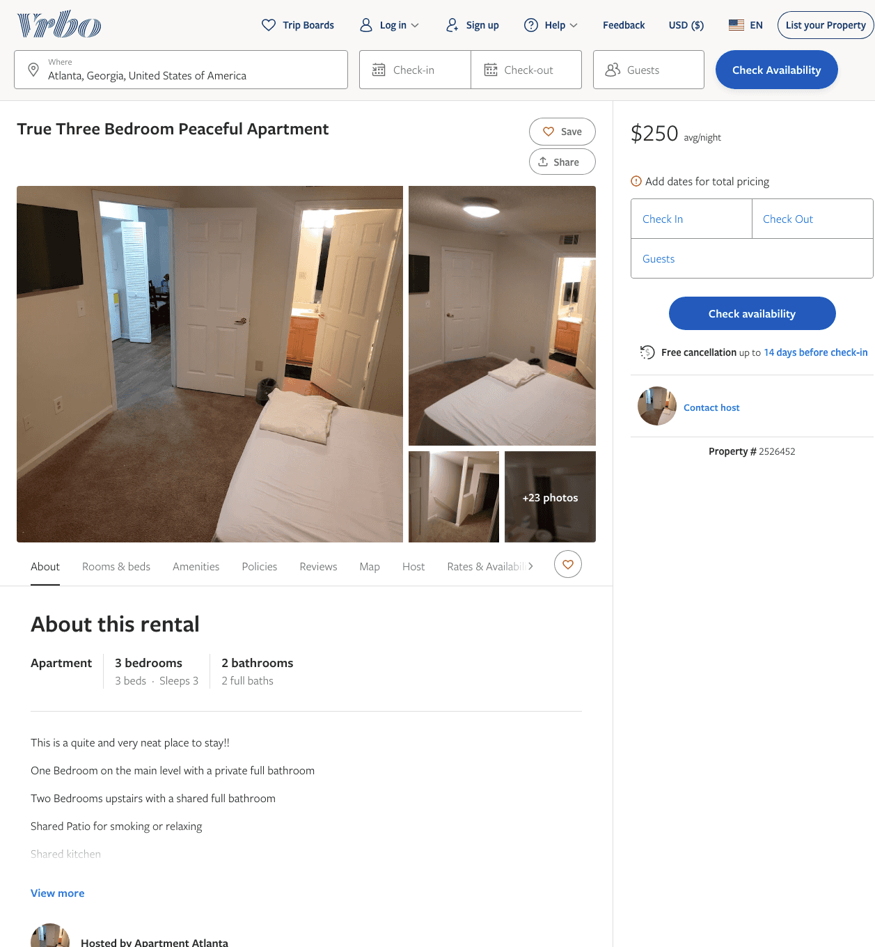
Listing 2526452
3
3
$250
2
https://www.vrbo.com/2526452
Aug 2022

Slide 3
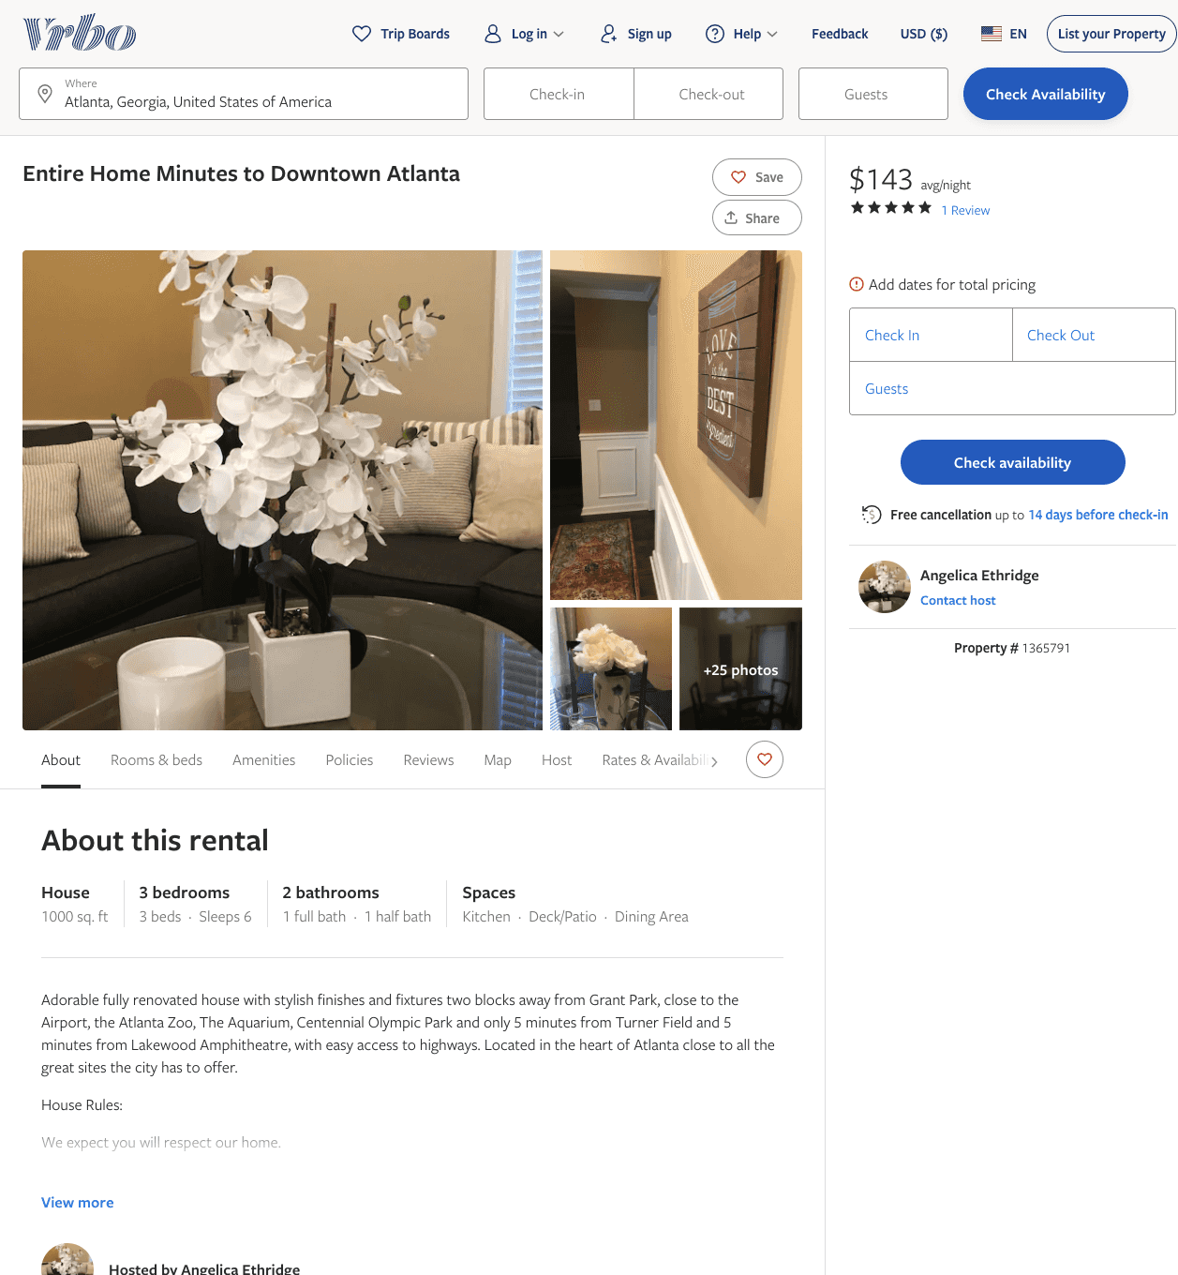
Listing 1365791
3
6
$135 - $150
4.3333335
3
Angelica Ethridge
https://www.vrbo.com/1365791
Aug 2022

Slide 4
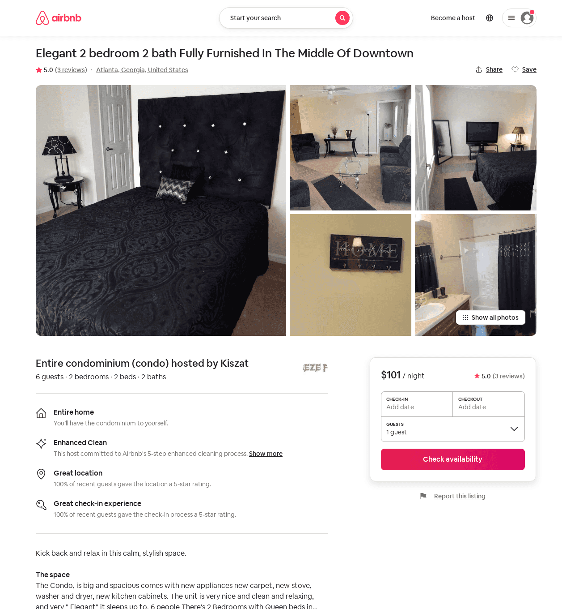
Listing 51999492
2
6
$81 - $115
4.77
2
Kiszat
418331884
1
https://www.airbnb.com/rooms/51999492
Aug 2022

Slide 5
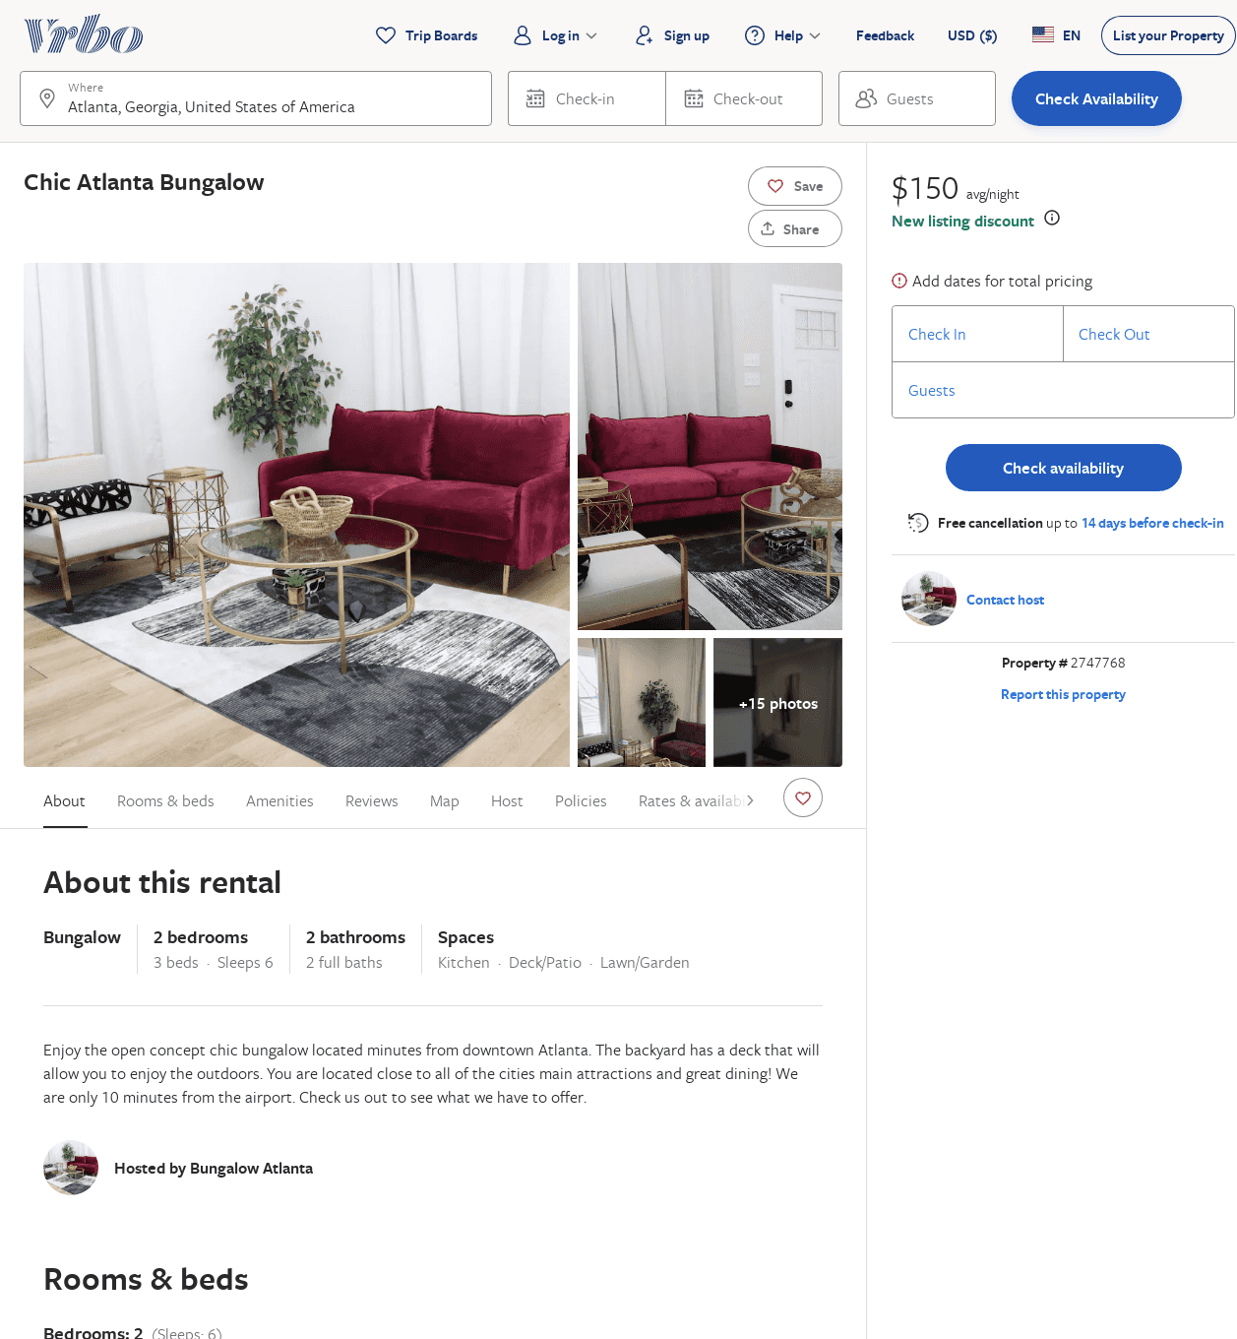
Listing 2747768
2
6
$143
5
3
https://www.vrbo.com/2747768
Aug 2022

