Slide 2
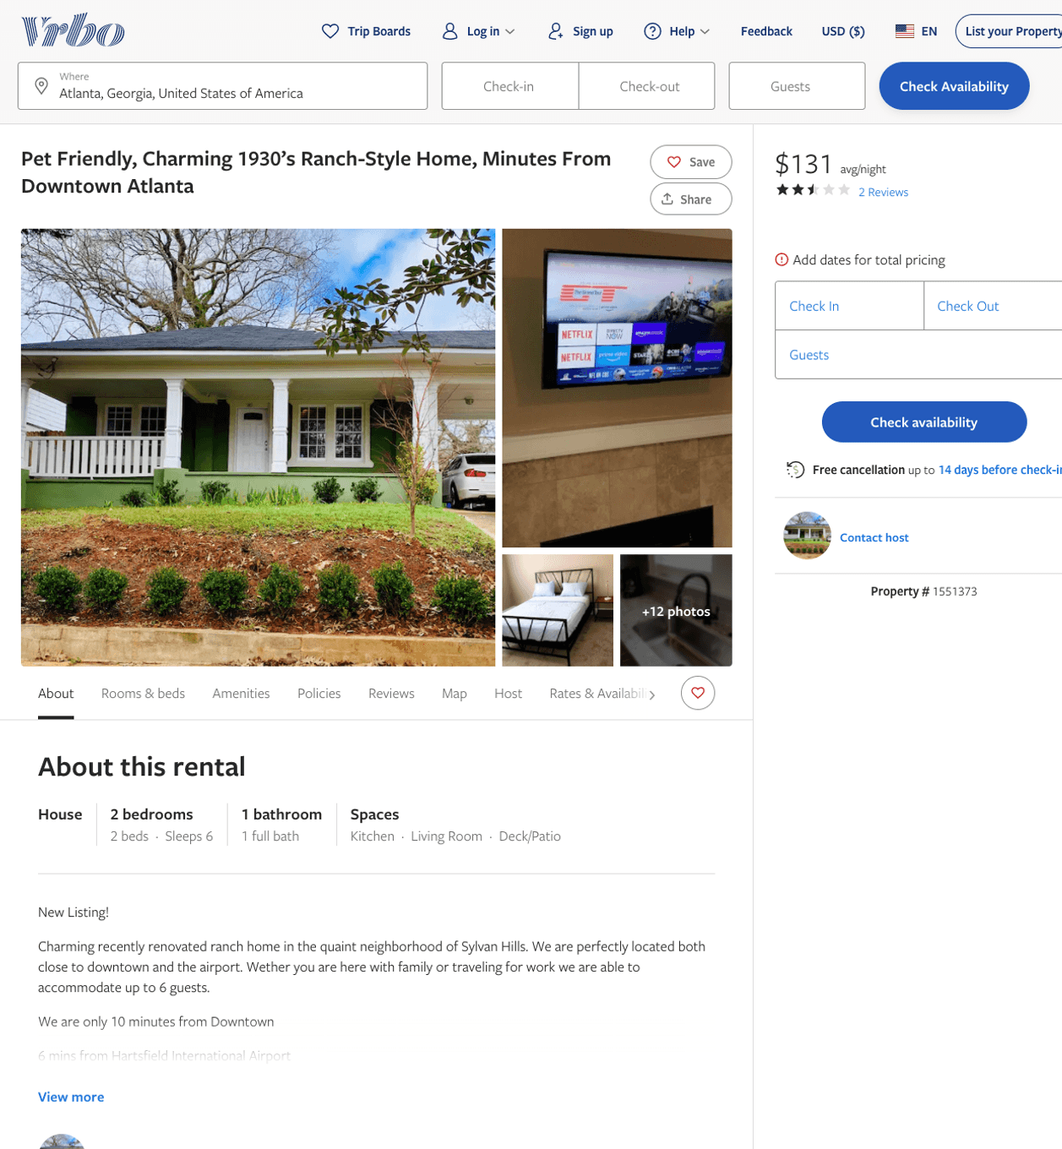
Listing 1551373
2
6
$119 - $135
3.3333333
1
https://www.vrbo.com/1551373
Aug 2022

Slide 3
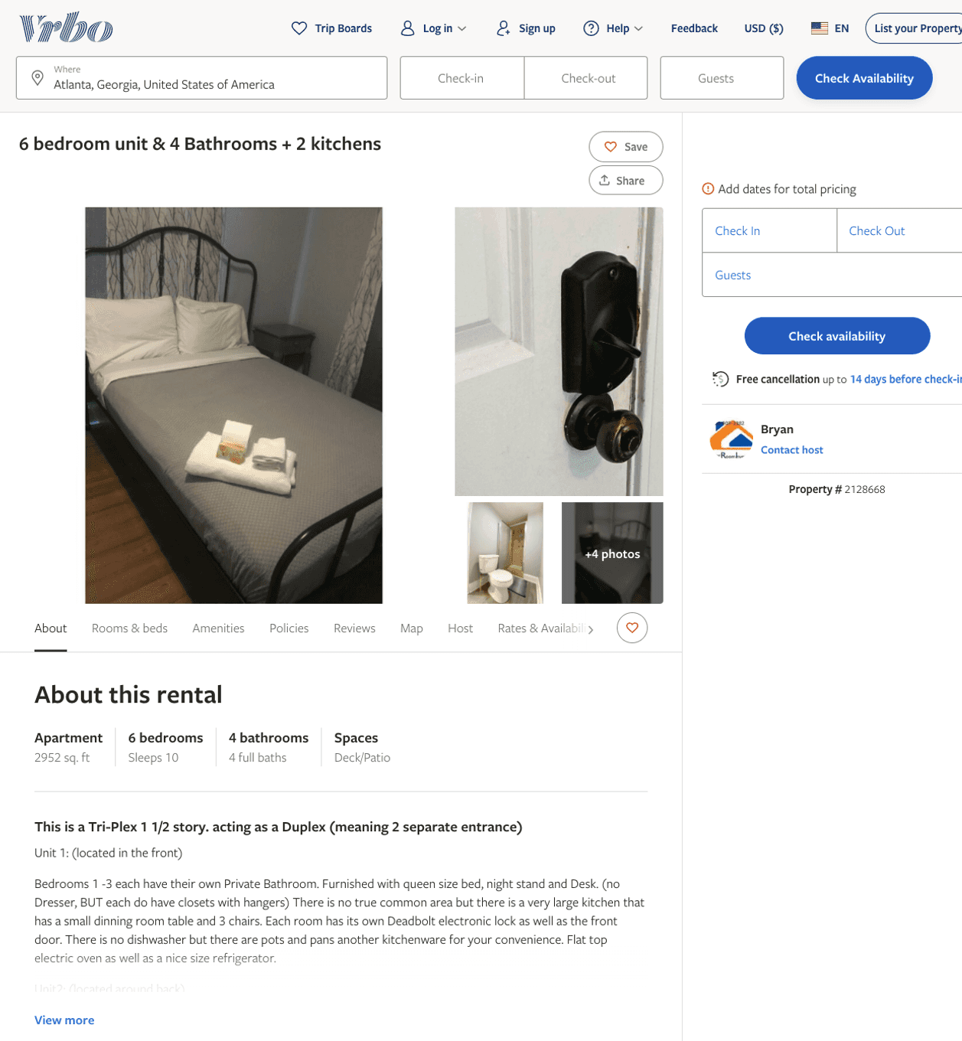
Listing 2128668
6
10
$180 - $184
7
Bryan
https://www.vrbo.com/2128668
Aug 2022

Slide 4
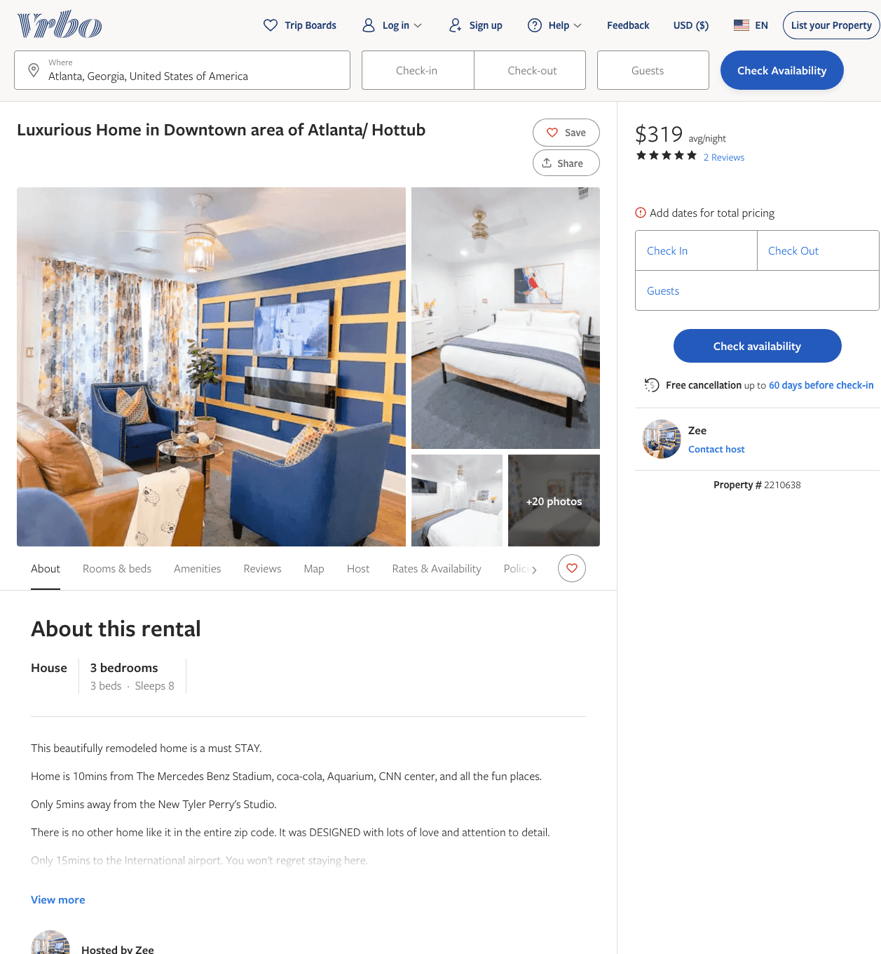
Listing 2210638
3
8
$264 - $488
5
1
Zee
https://www.vrbo.com/2210638
Aug 2022

Slide 5
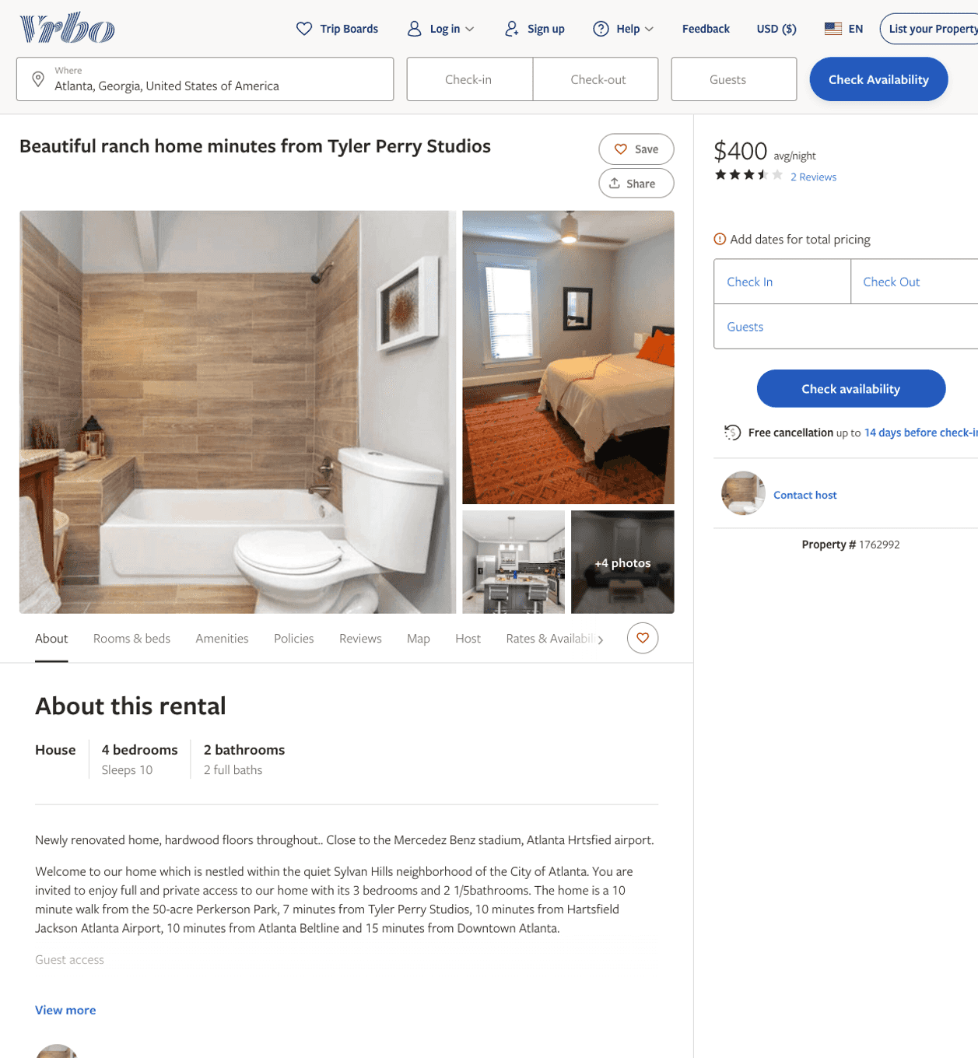
Listing 1762992
4
10
$400
3.5
15
https://www.vrbo.com/1762992
Aug 2022

Slide 6
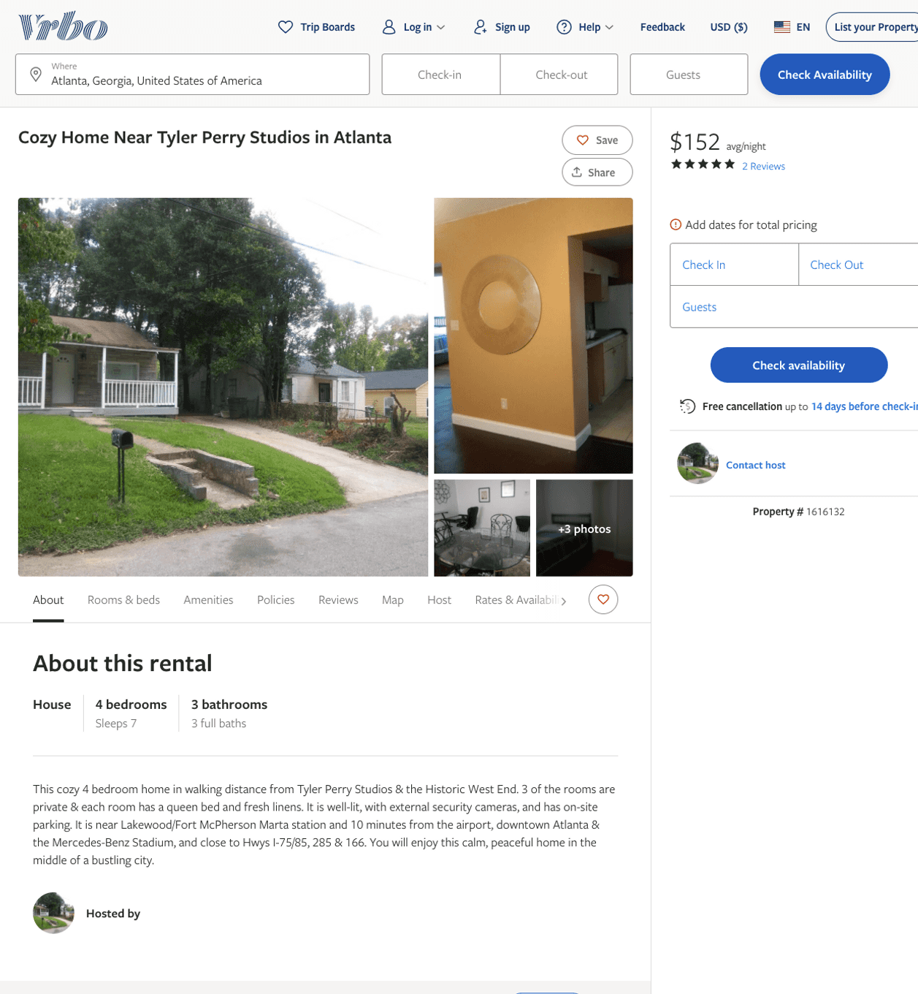
Listing 1616132
4
7
$152
5
2
https://www.vrbo.com/1616132
Aug 2022

Slide 7
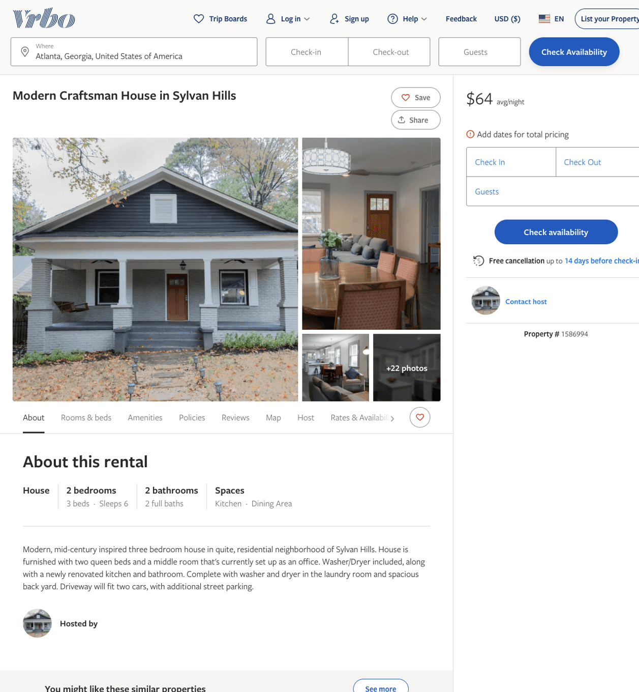
Listing 1586994
2
6
$64
90
https://www.vrbo.com/1586994
Aug 2022

Slide 8
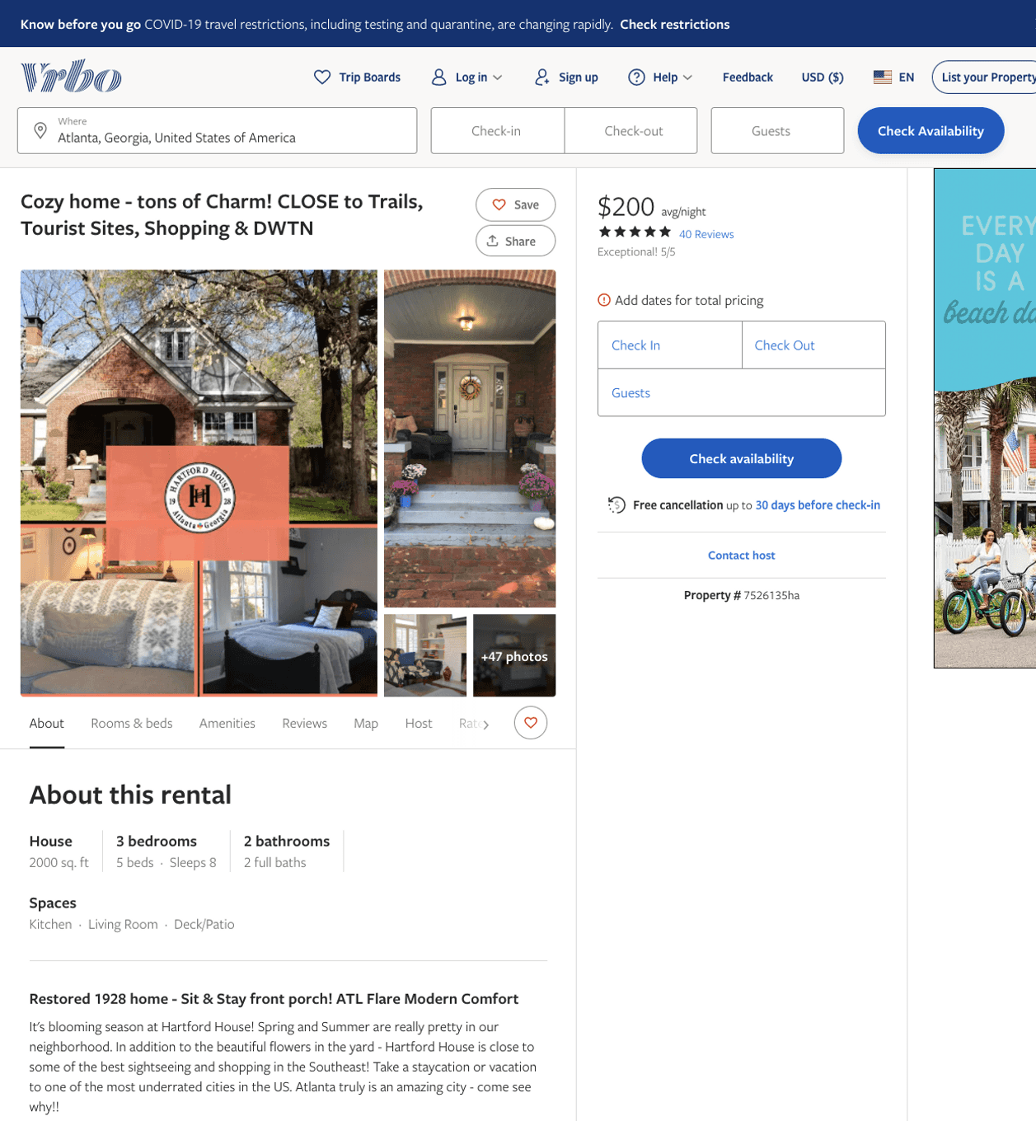
Listing 7526135
3
8
$195 - $206
4.939394
2
Laura Robinson
https://www.vrbo.com/7526135ha
Aug 2022

Slide 9
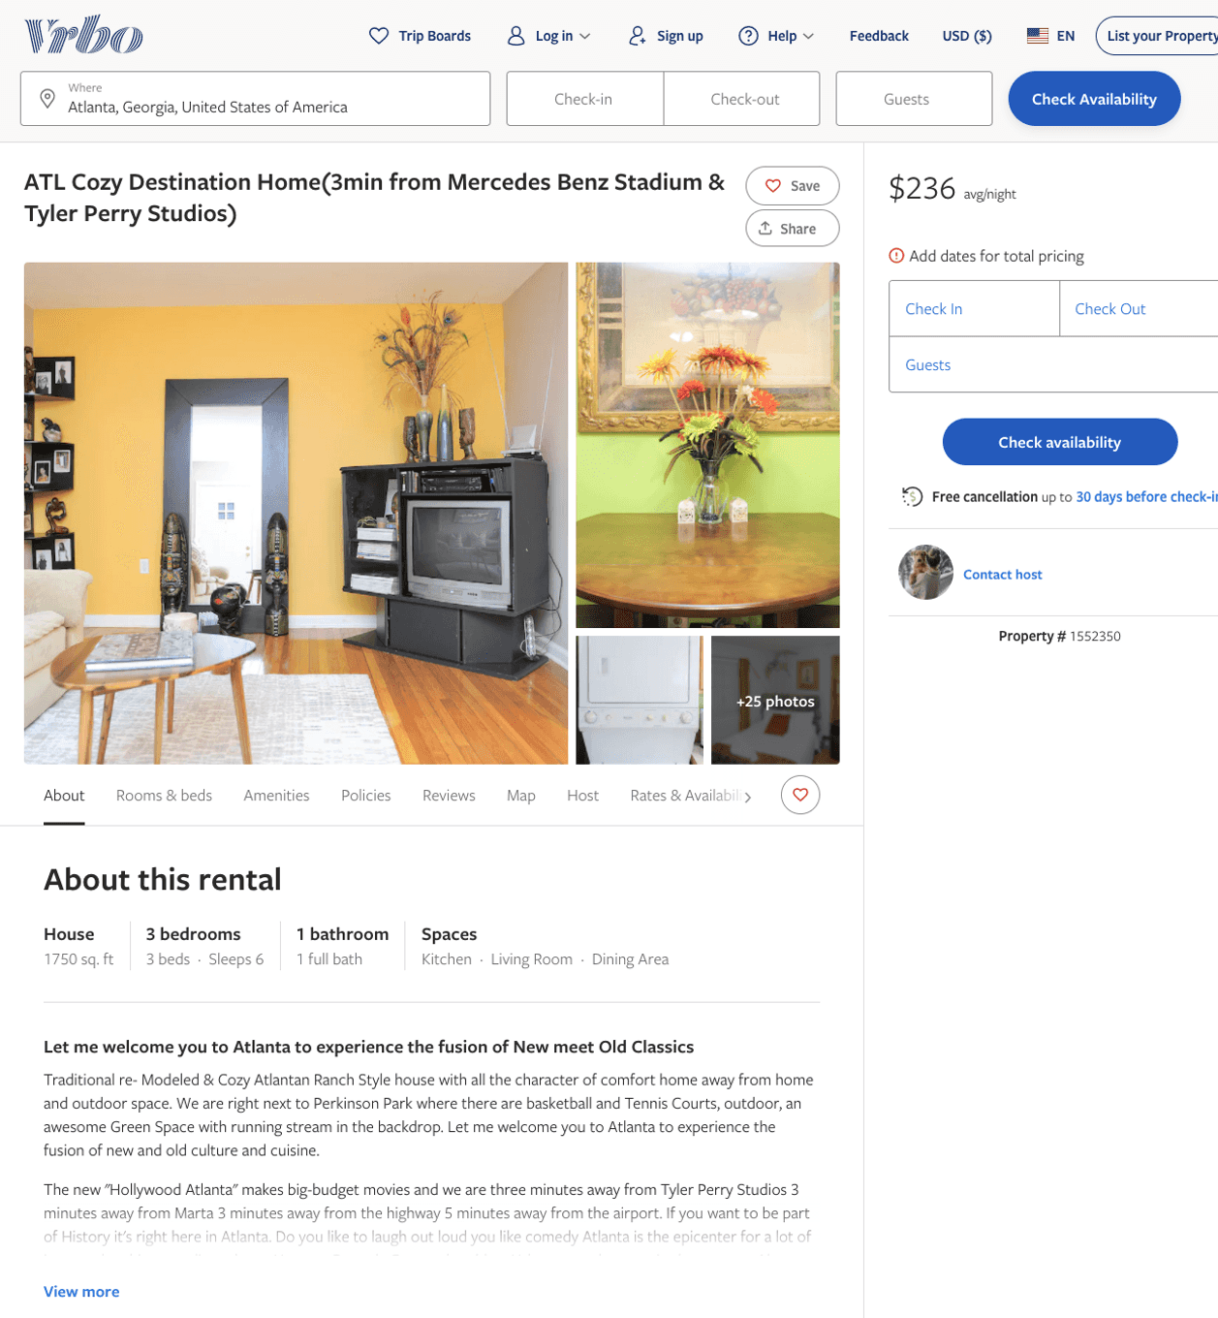
Listing 1552350
3
6
$236 - $299
4
https://www.vrbo.com/1552350
Aug 2022

Slide 10
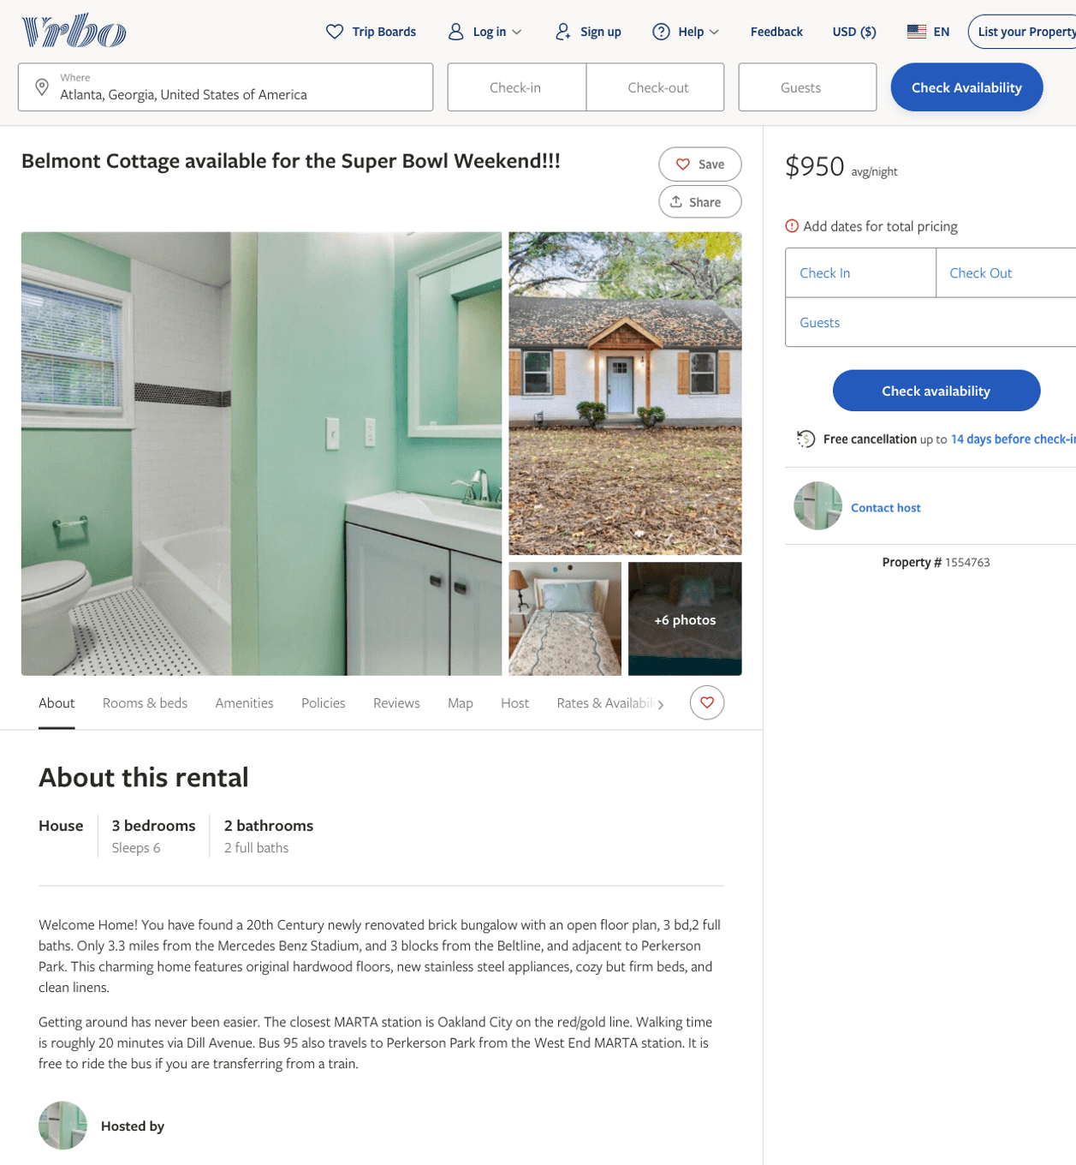
Listing 1554763
3
6
$950
3
https://www.vrbo.com/1554763
Aug 2022

Slide 11
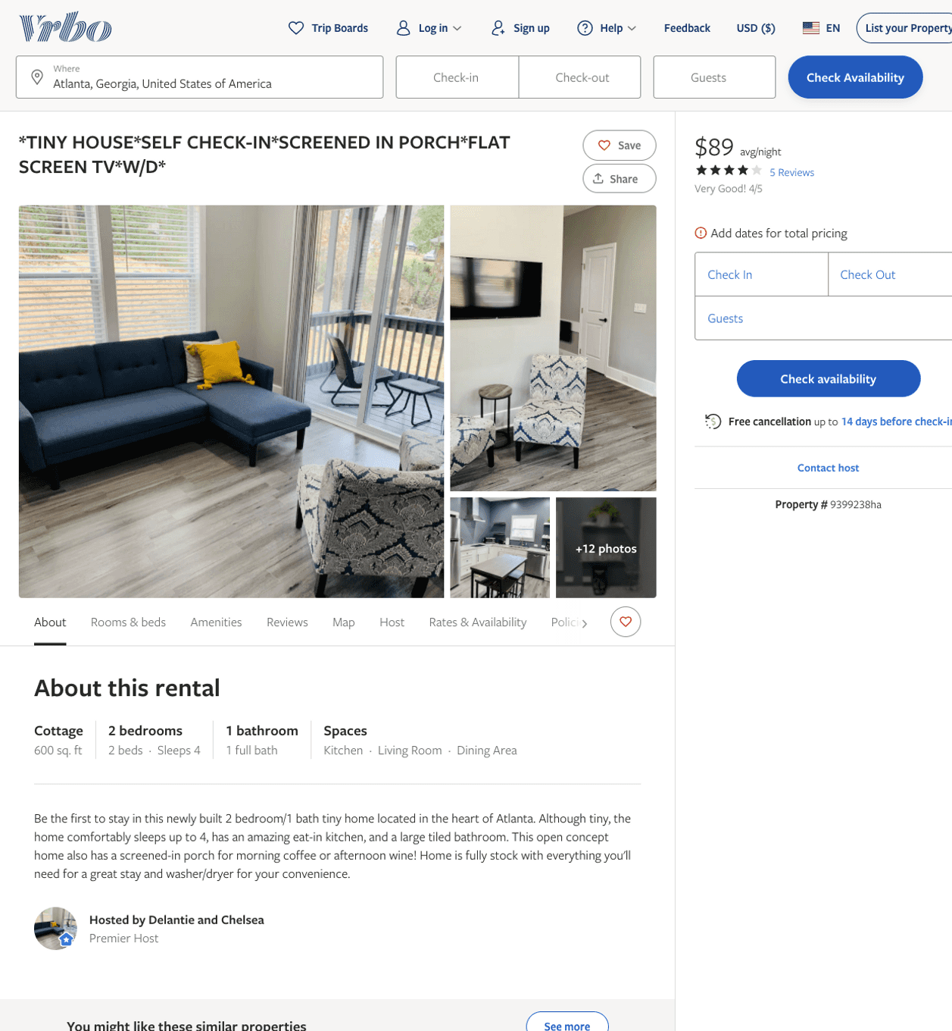
Listing 9399238
2
4
$70 - $94
4.3333335
1
Delantie and Chelsea
https://www.vrbo.com/9399238ha
Aug 2022

Slide 12
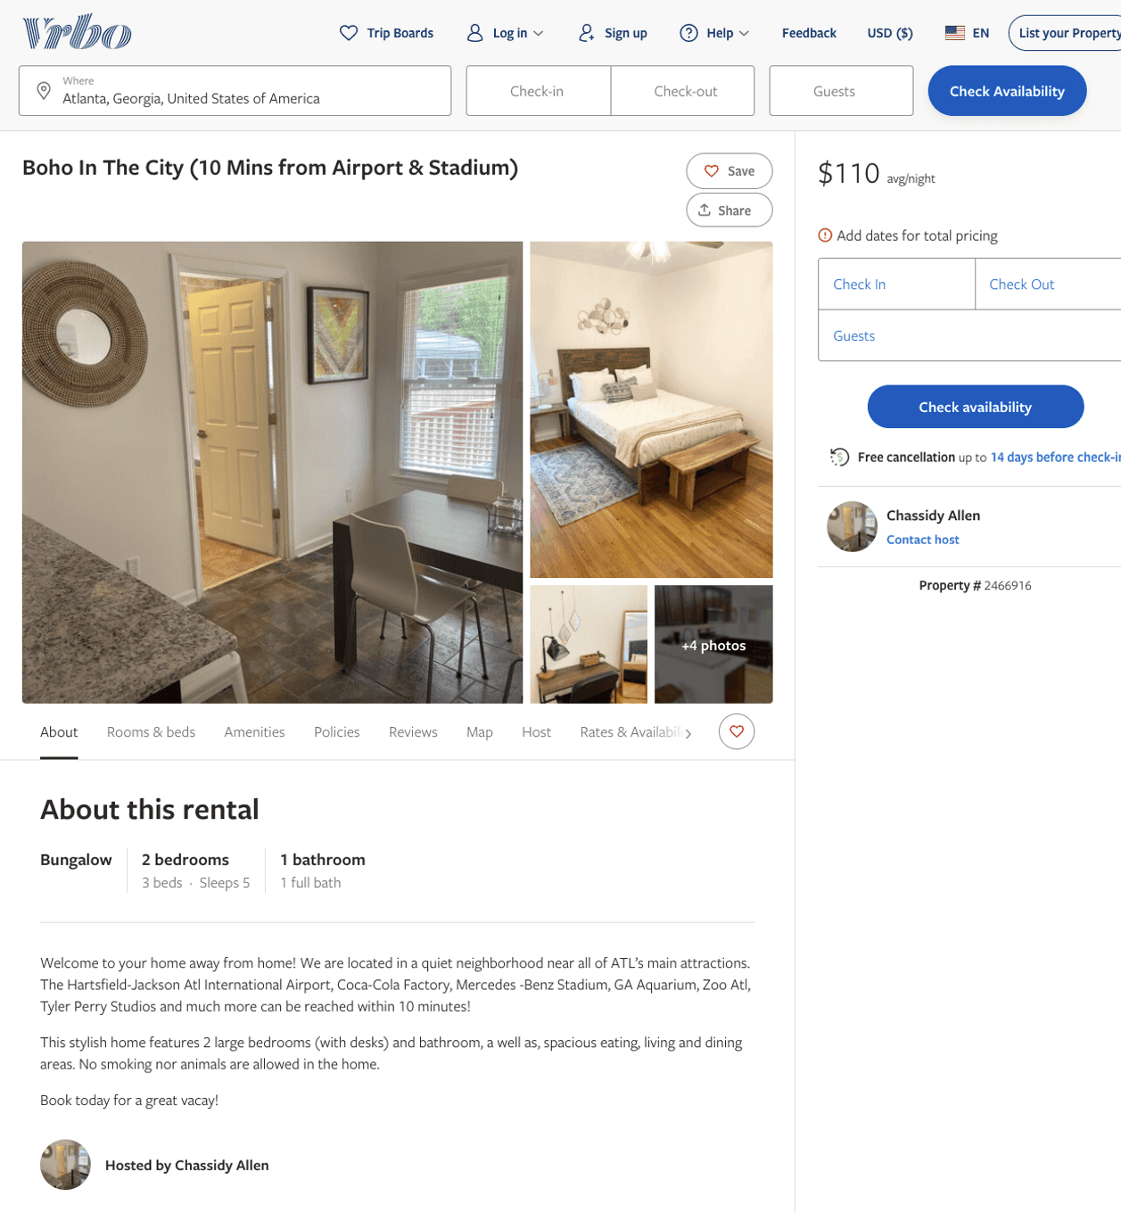
Listing 2466916
2
5
$100 - $117
5
1
Chassidy Allen
https://www.vrbo.com/2466916
Aug 2022

Slide 13
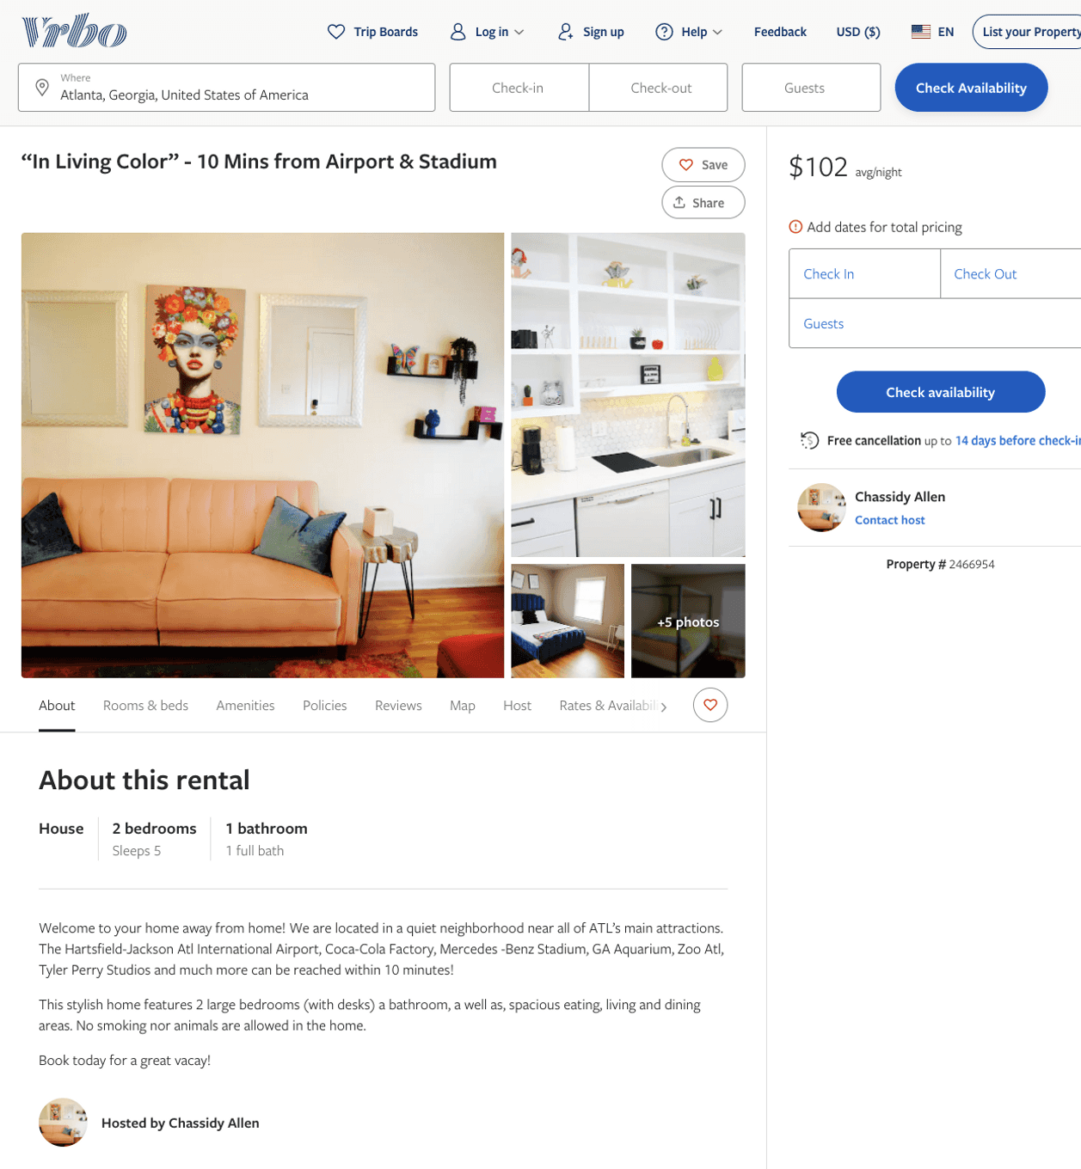
Listing 2466954
2
5
$102 - $110
1
Chassidy Allen
https://www.vrbo.com/2466954
Aug 2022

Slide 14
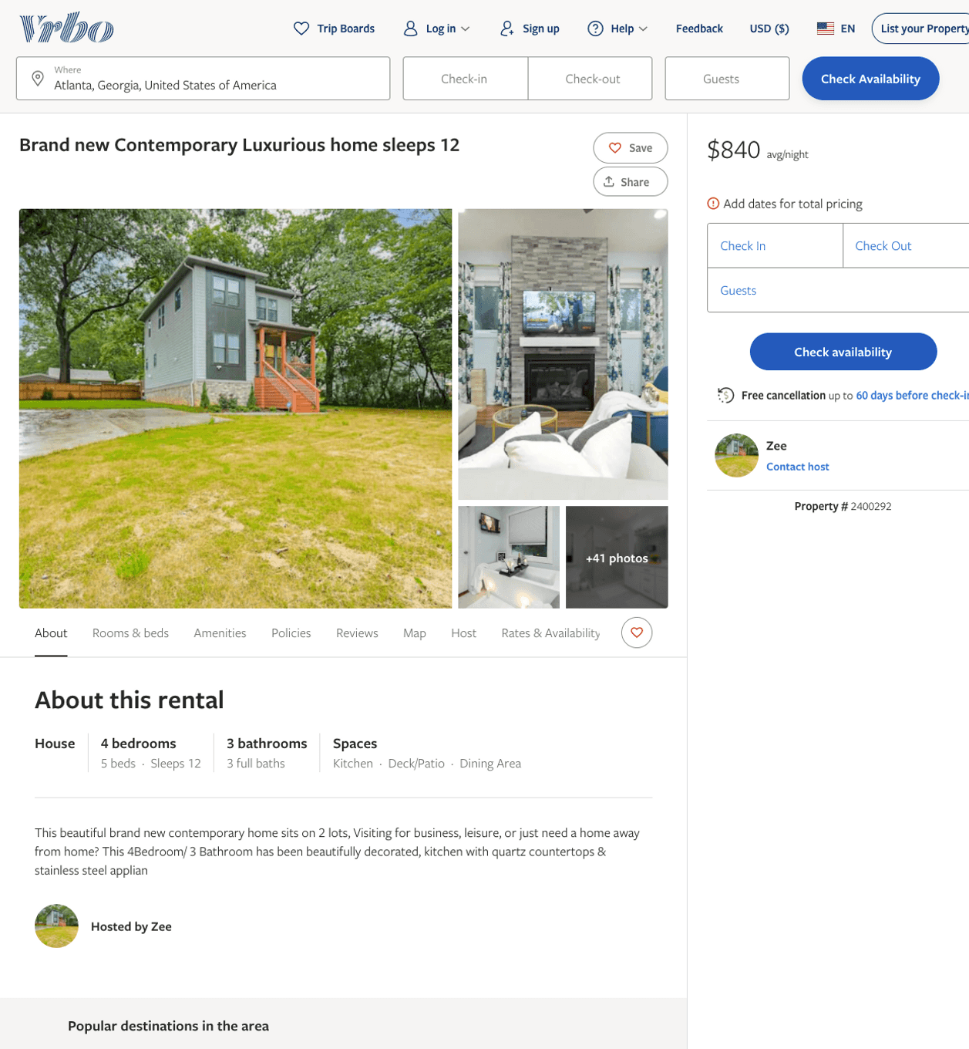
Listing 2400292
4
12
$477 - $928
3
Zee
https://www.vrbo.com/2400292
Aug 2022

Slide 15
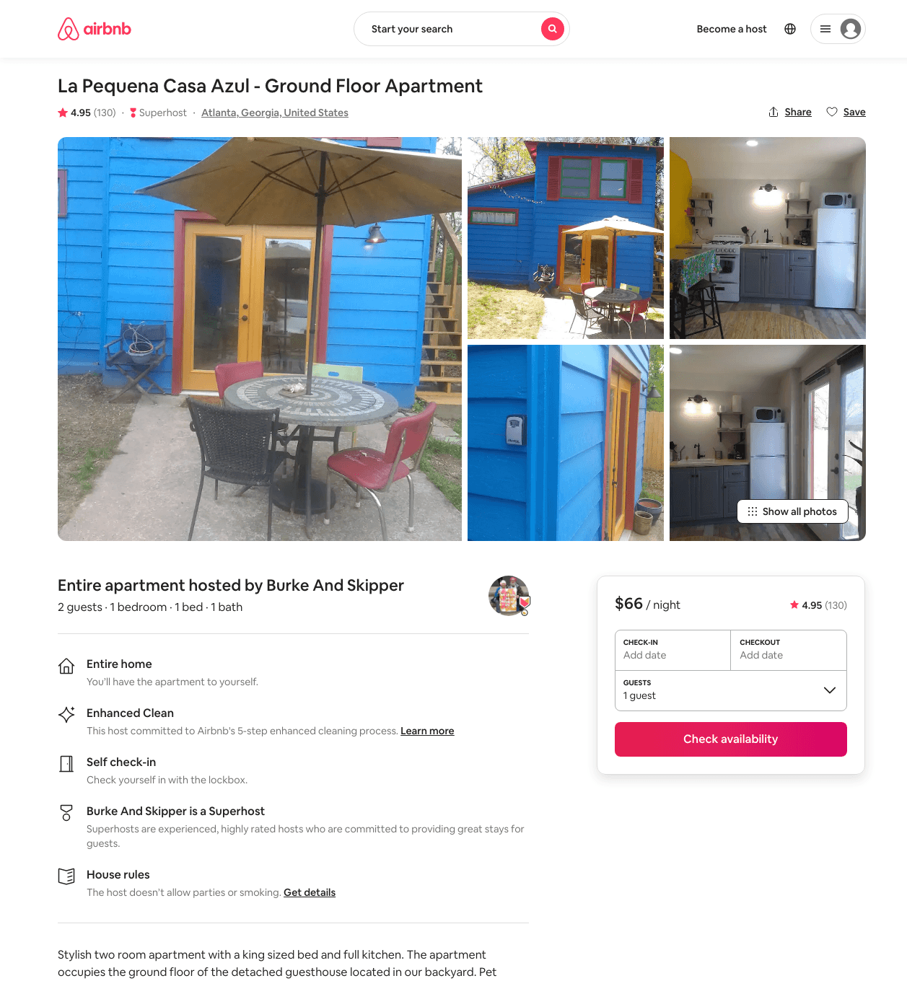
Listing 32847117
1
2
$49 - $73
4.94
2
Burke And Skipper
15098226
2
https://www.airbnb.com/rooms/32847117
Aug 2022

Slide 16
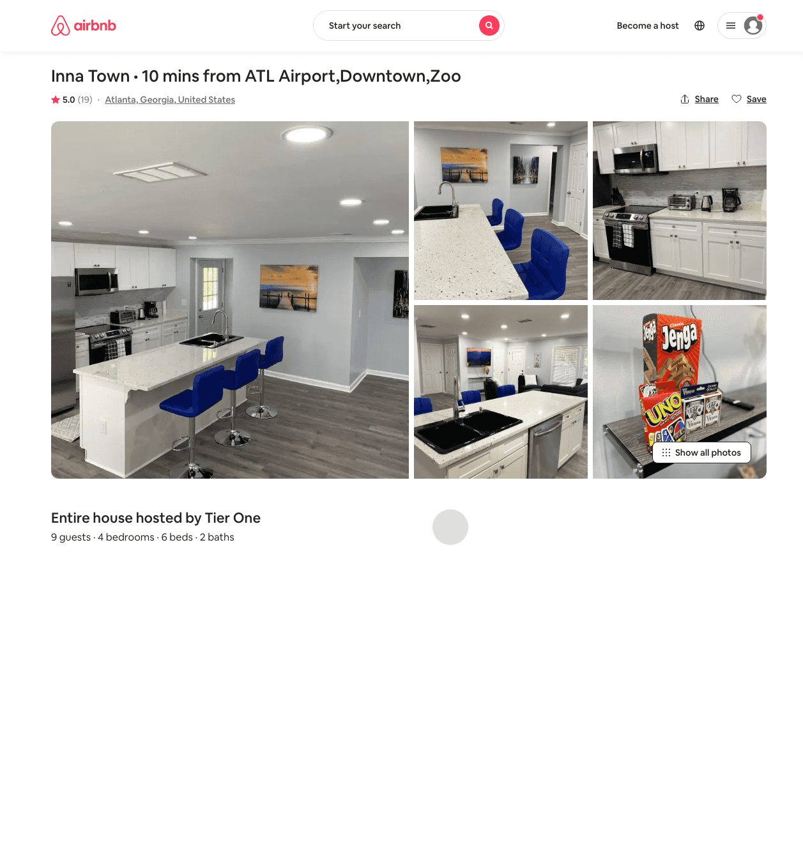
Listing 46724099
4
9
$163 - $267
4.83
2
Tier One
377628673
2
https://www.airbnb.com/rooms/46724099
Aug 2022

Slide 17
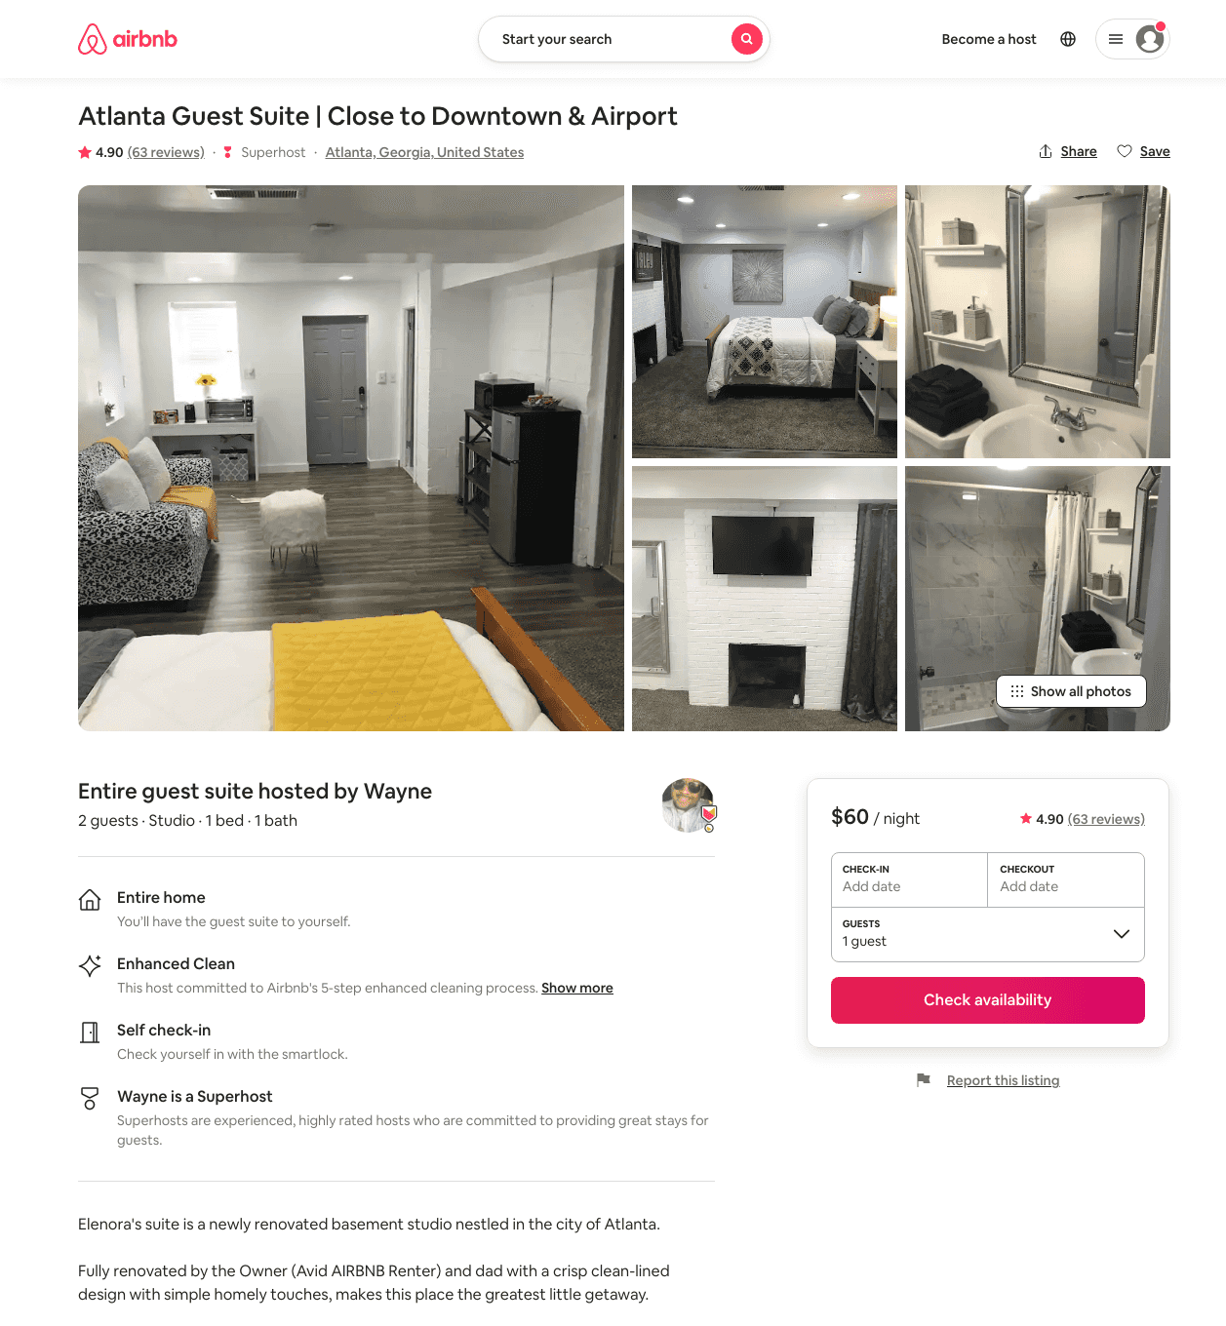
Listing 27755268
Studio
2
$44 - $94
4.91
2
Wayne
22852833
2
https://www.airbnb.com/rooms/27755268
Aug 2022

Slide 18
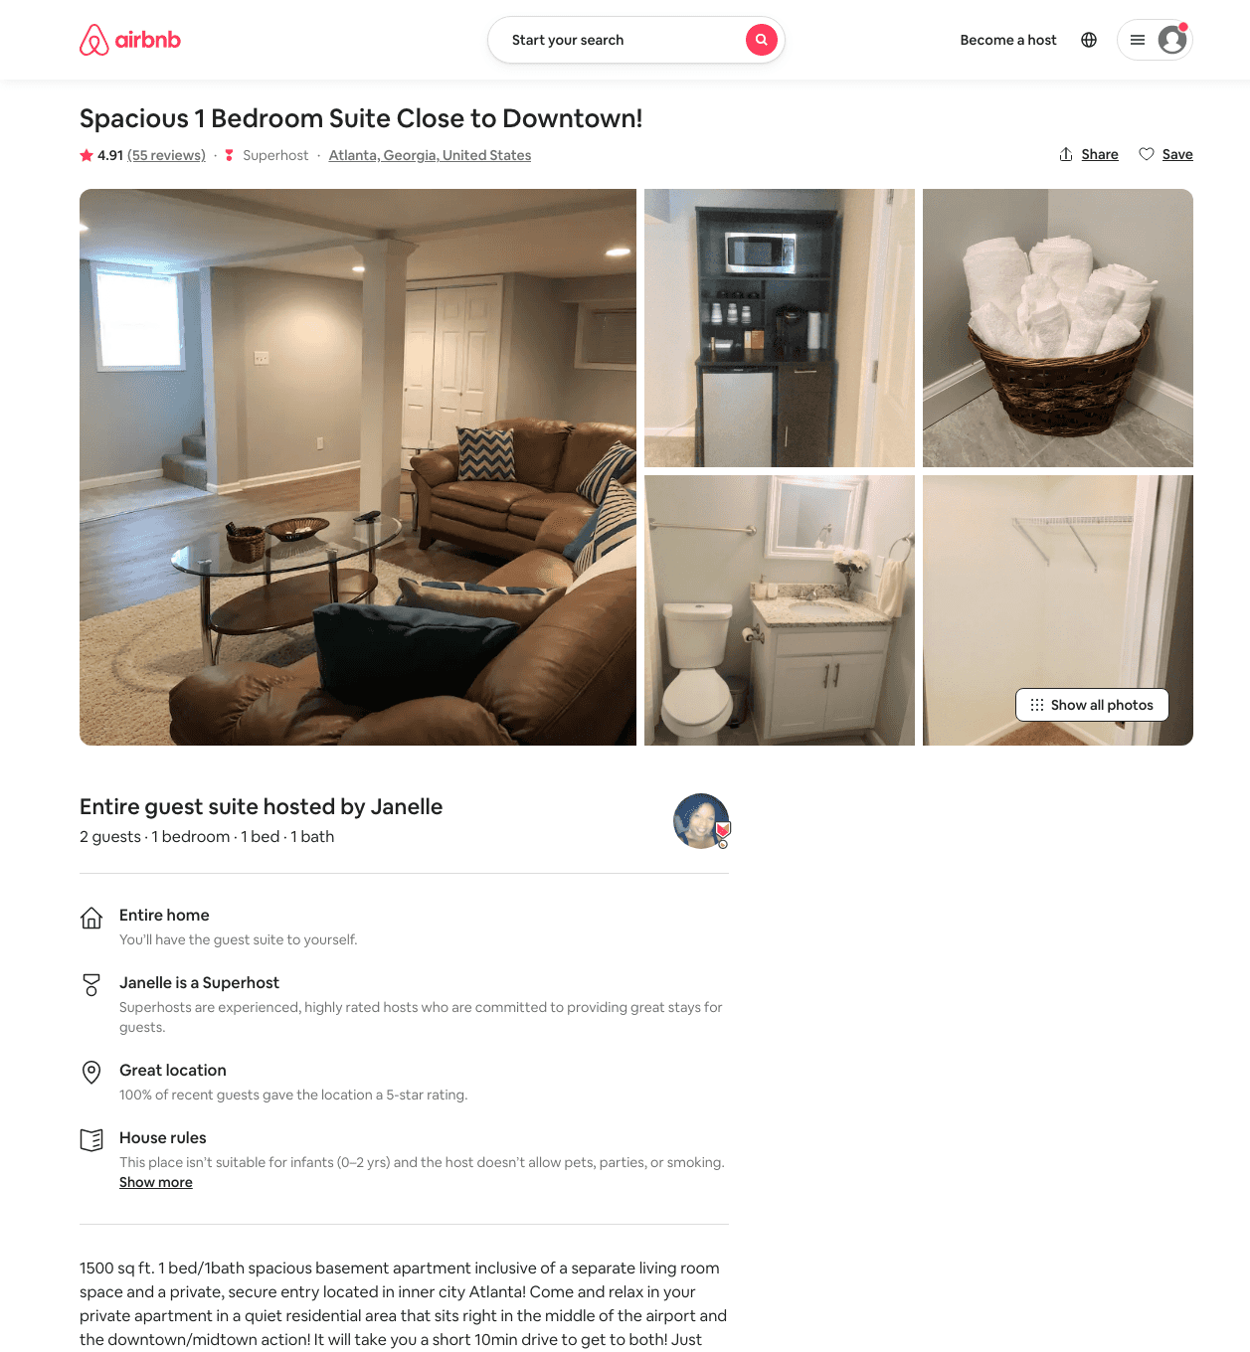
Listing 27061397
1
2
$70 - $94
4.90
2
Janelle
14203142
1
https://www.airbnb.com/rooms/27061397
Aug 2022

Slide 19
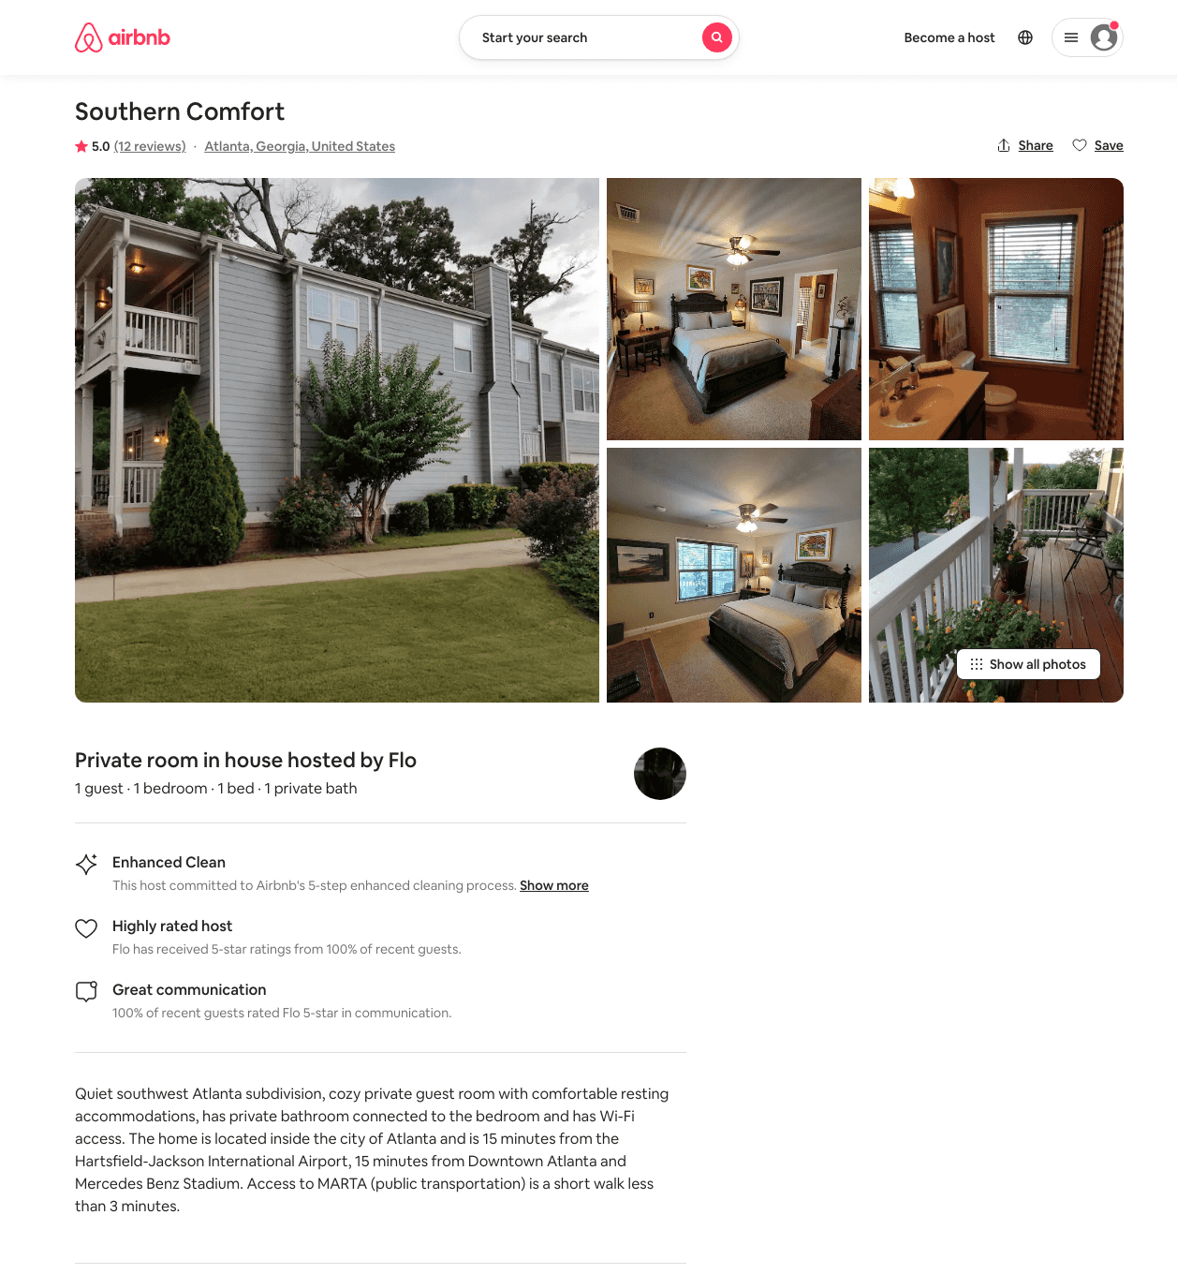
Listing 33341096
1
1
$30 - $31
4.88
21
Flo
251153763
1
https://www.airbnb.com/rooms/33341096
Aug 2022

Slide 20
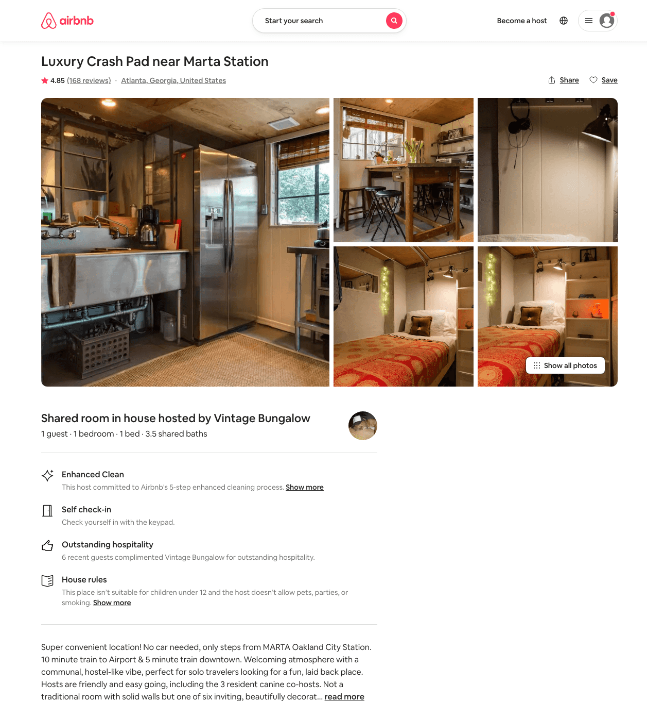
Listing 6118408
1
1
$32
4.82
3
Vintage Bungalow
2510032
14
https://www.airbnb.com/rooms/6118408
Aug 2022

Slide 21
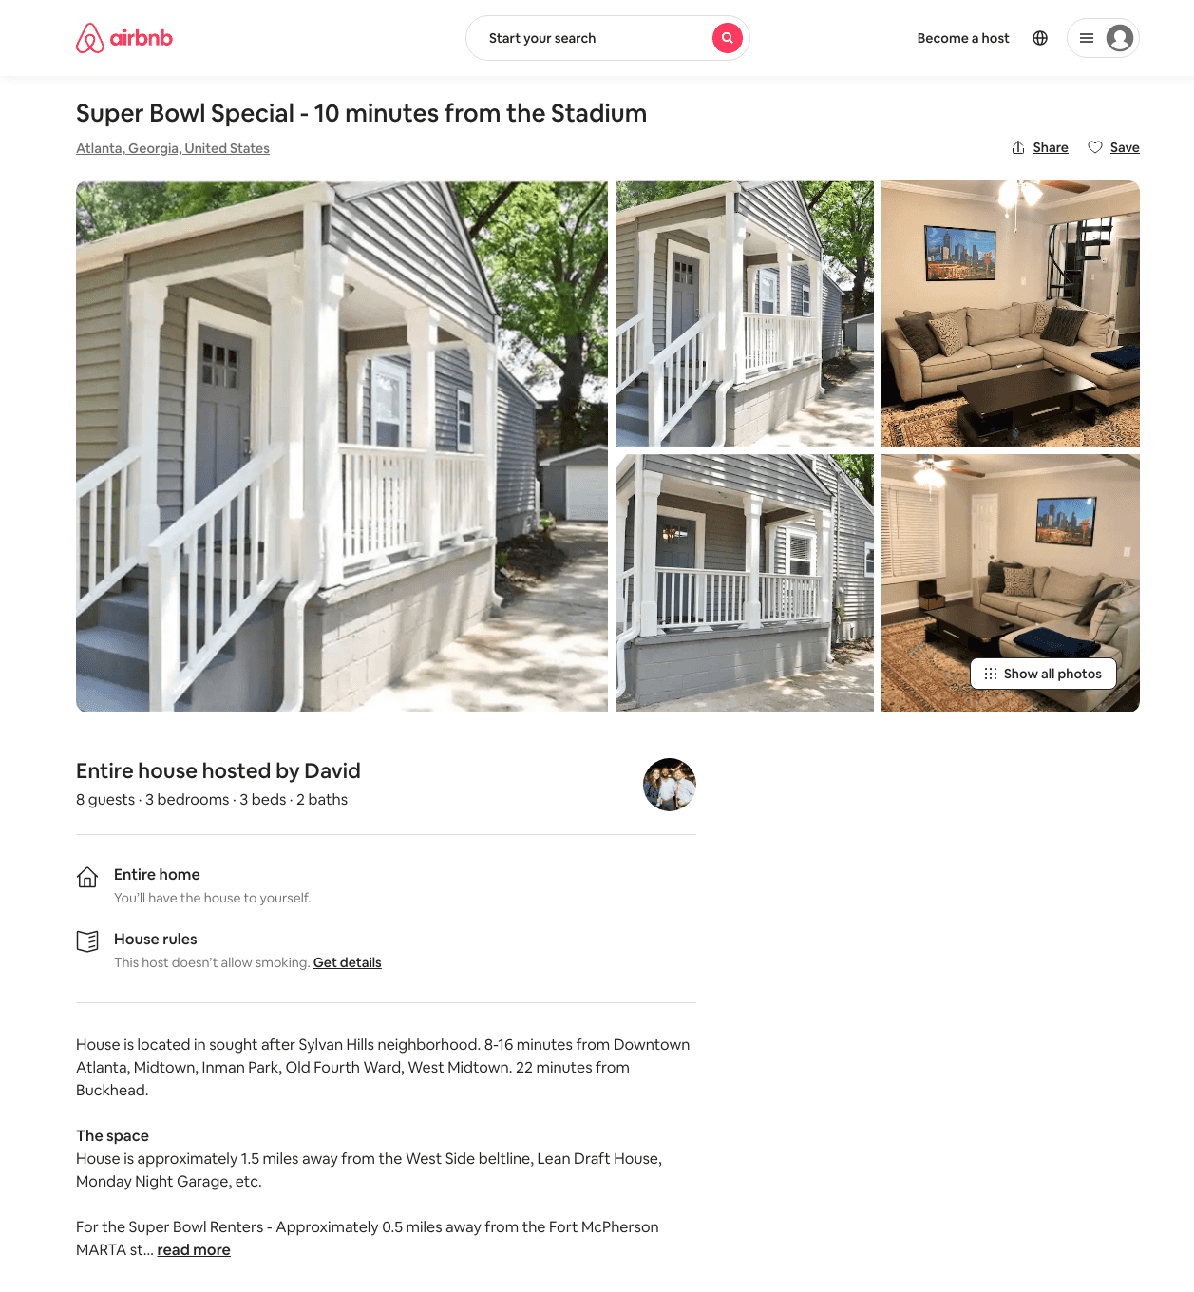
Listing 22422064
3
8
$475
3
David
117904635
1
https://www.airbnb.com/rooms/22422064
Aug 2022

Slide 22
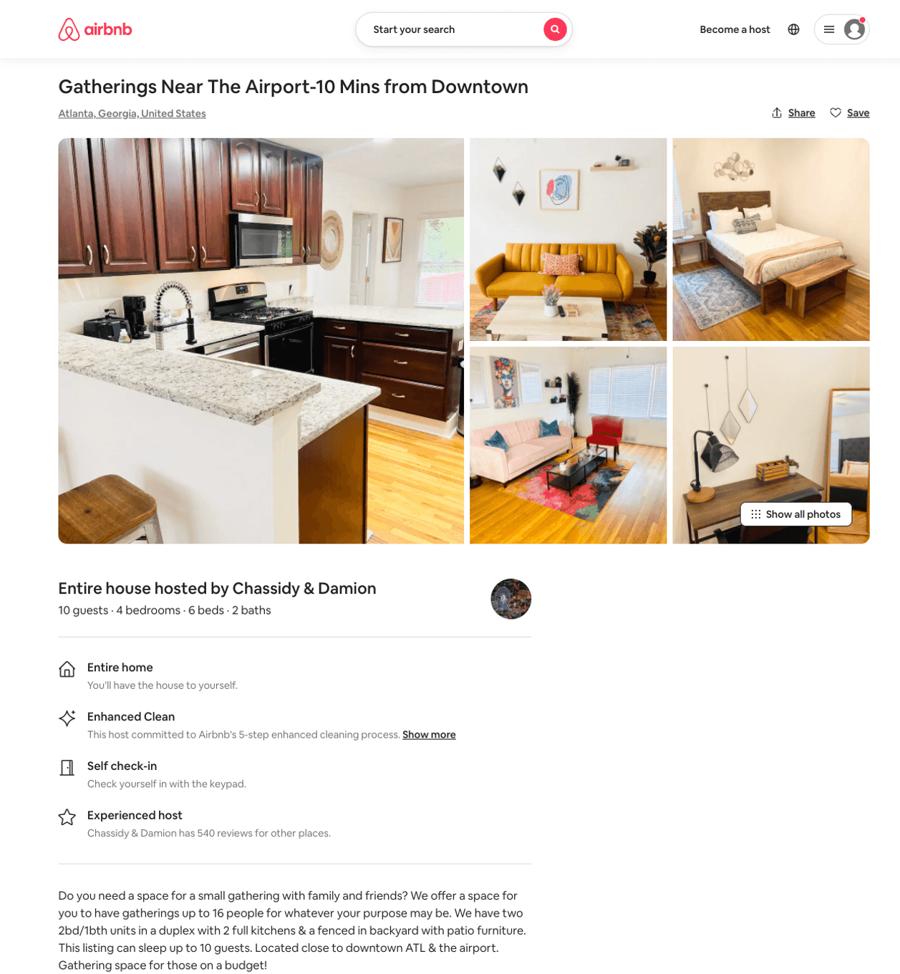
Listing 50691108
4
16
$400 - $450
4.89
1
Chassidy & Damion
105747515
6
https://www.airbnb.com/rooms/50691108
Aug 2022

Slide 23
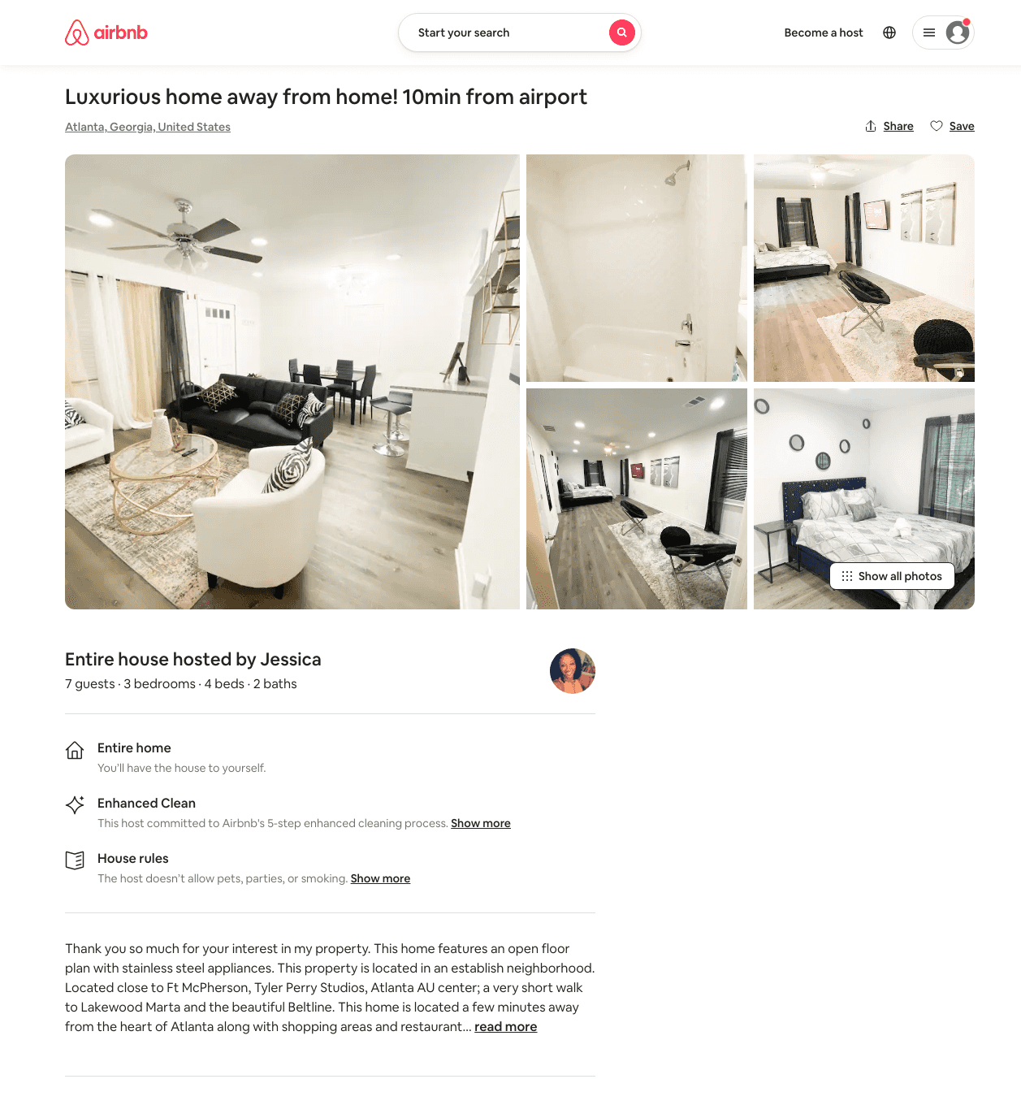
Listing 48044216
3
7
$134 - $239
4.82
2
Jessica
87050919
1
https://www.airbnb.com/rooms/48044216
Aug 2022

Slide 24
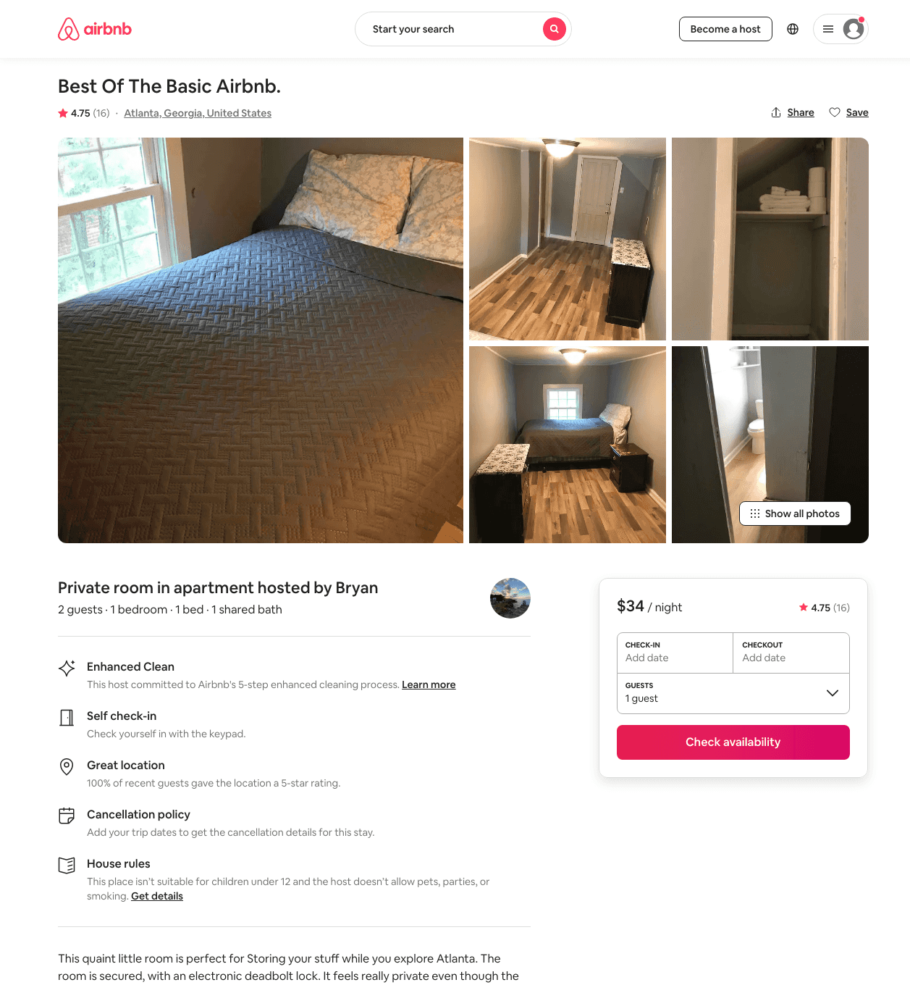
Listing 32103505
1
1
$29 - $49
4.79
2
Bryan
15032548
8
https://www.airbnb.com/rooms/32103505
Aug 2022

Slide 25
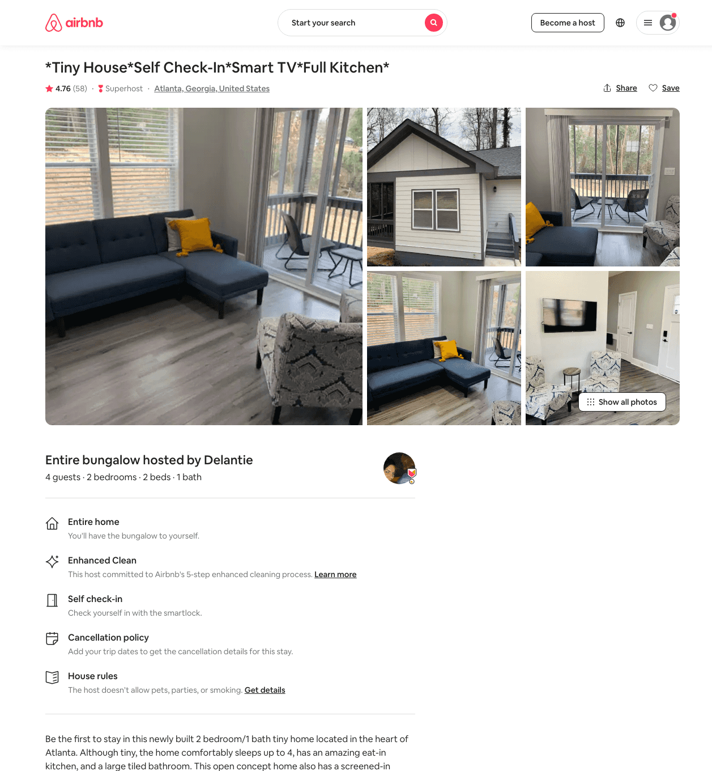
Listing 41857195
2
4
$67 - $79
4.77
2
Delantie
285867086
2
https://www.airbnb.com/rooms/41857195
Aug 2022

Slide 26
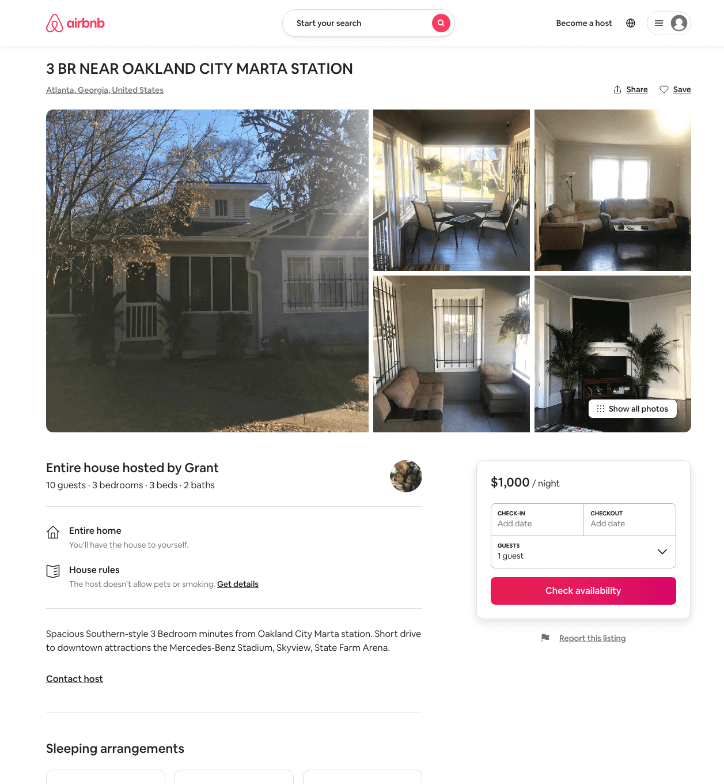
Listing 31365199
3
10
$1000
1
Grant
162170469
1
https://www.airbnb.com/rooms/31365199
Aug 2022

Slide 27
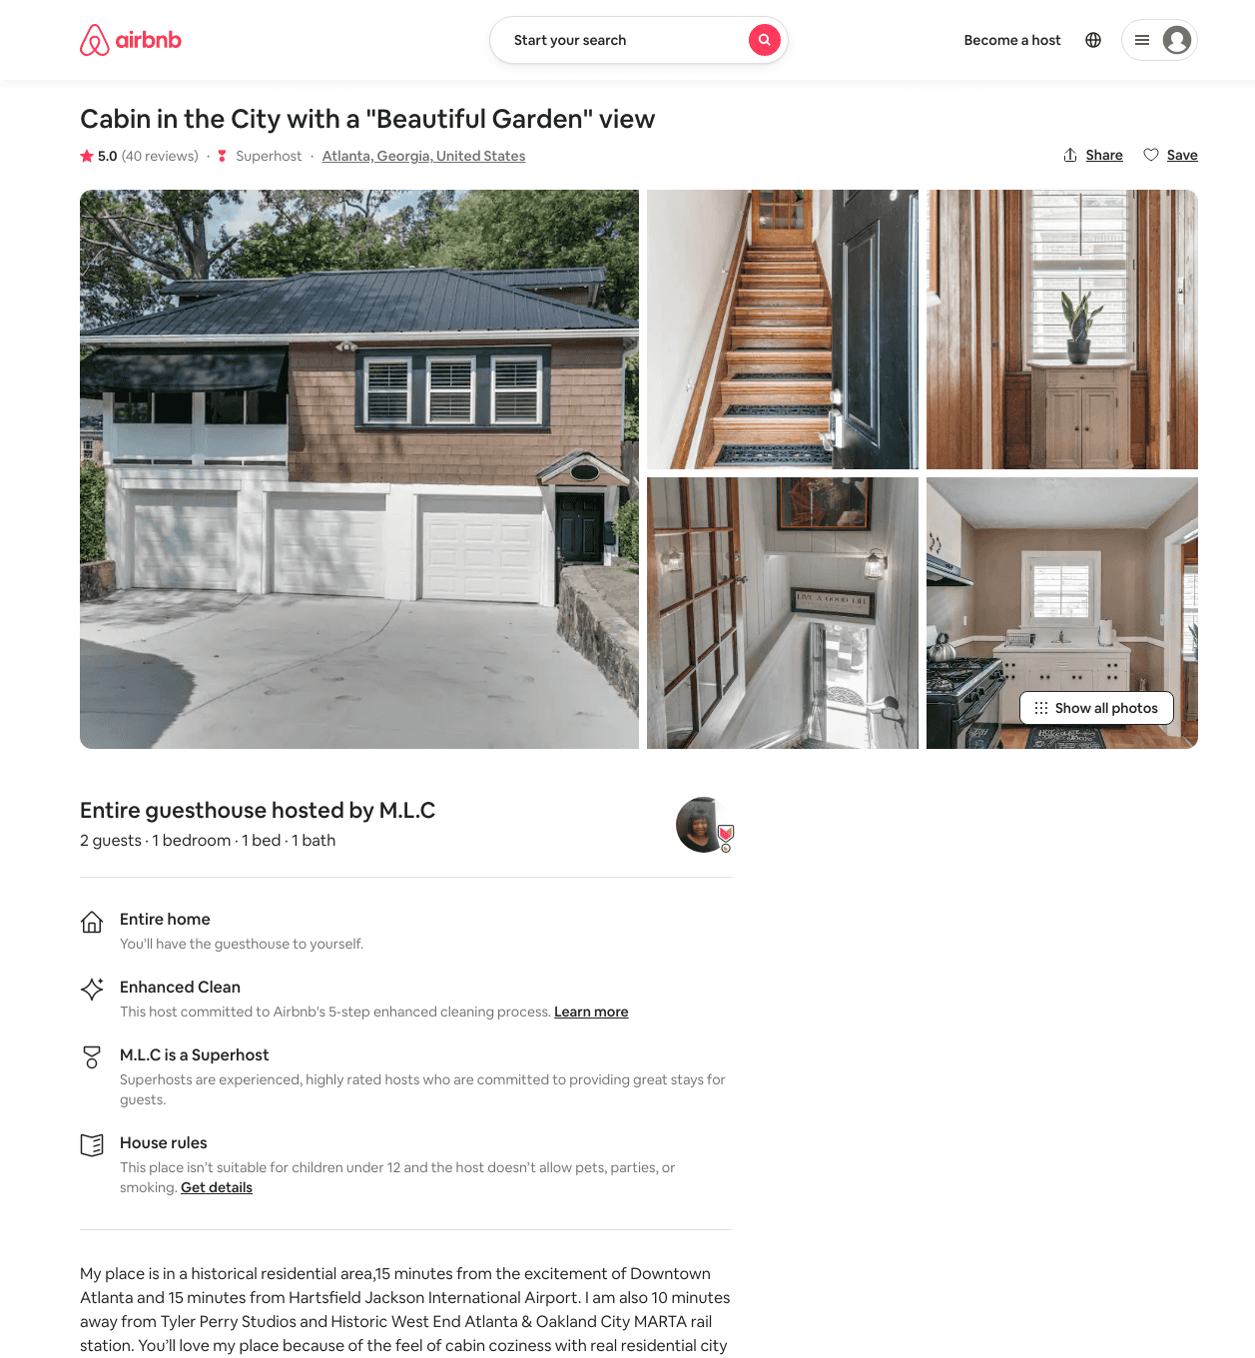
Listing 14339055
1
2
$109
5.0
2
M.L.C
85341088
1
https://www.airbnb.com/rooms/14339055
Jul 2022

Slide 28
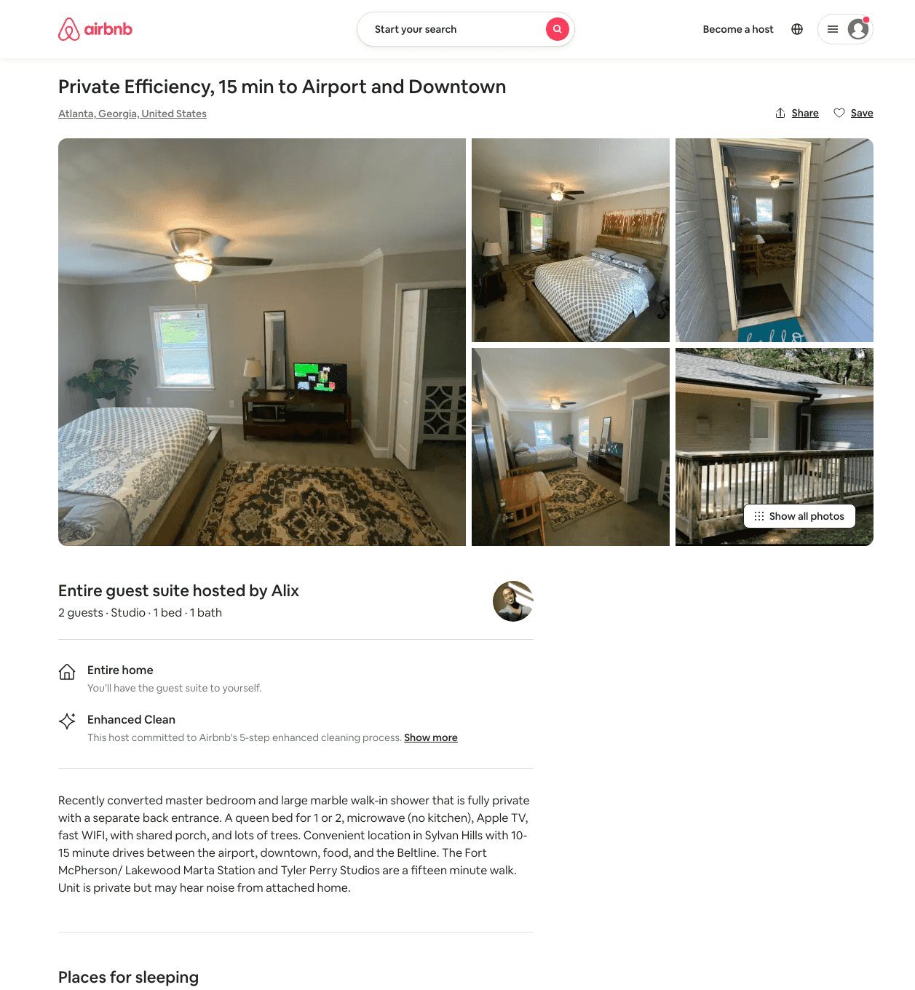
Listing 50033641
Studio
2
$40 - $68
4.91
3
Alix
14285483
1
https://www.airbnb.com/rooms/50033641
Aug 2022

Slide 29
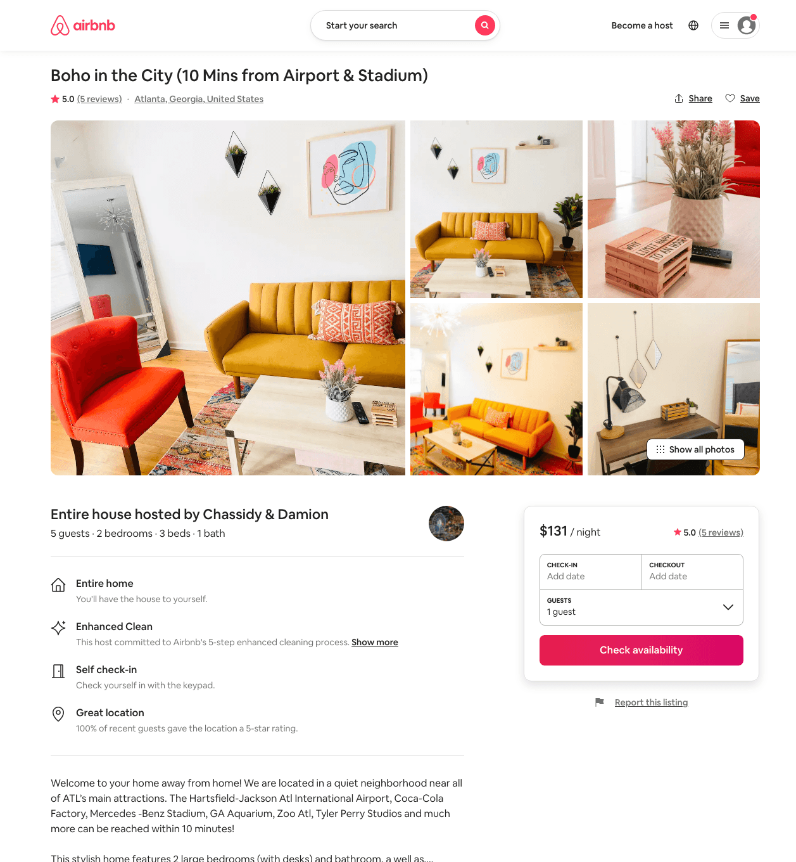
Listing 50086840
2
5
$92 - $151
4.80
1
Chassidy & Damion
105747515
6
https://www.airbnb.com/rooms/50086840
Aug 2022

Slide 30
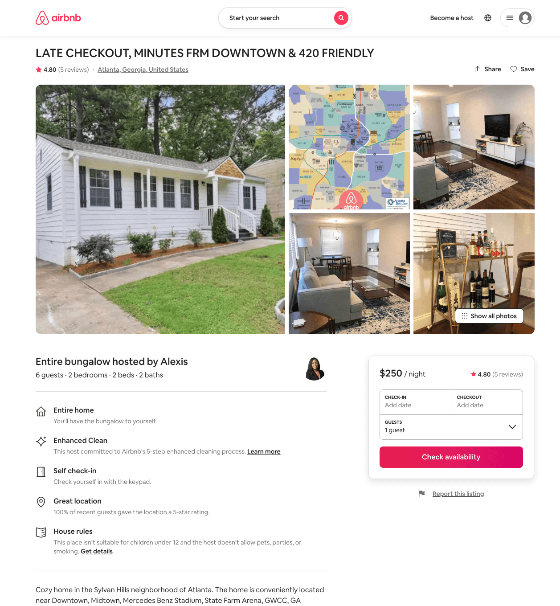
Listing 47403615
2
6
$250
4.83
2
Alexis
53617938
1
https://www.airbnb.com/rooms/47403615
Aug 2022

Slide 31
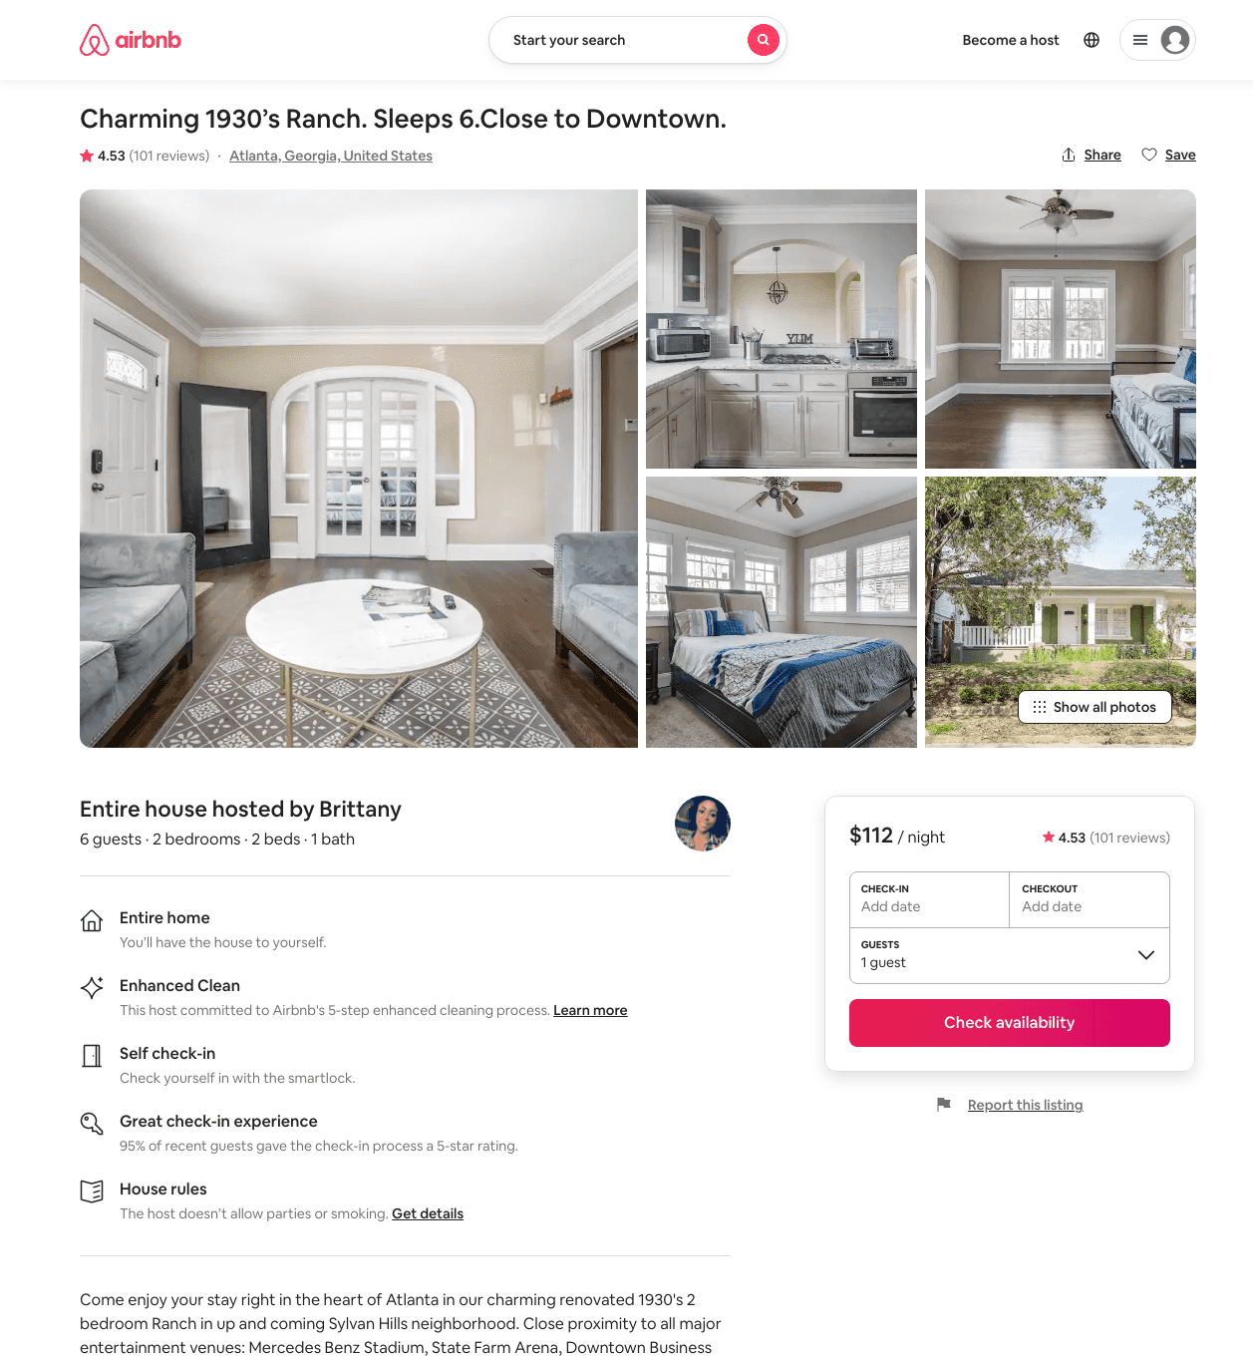
Listing 26952588
2
6
$94 - $130
4.53
2
Brittany
98511328
1
https://www.airbnb.com/rooms/26952588
Aug 2022

Slide 32
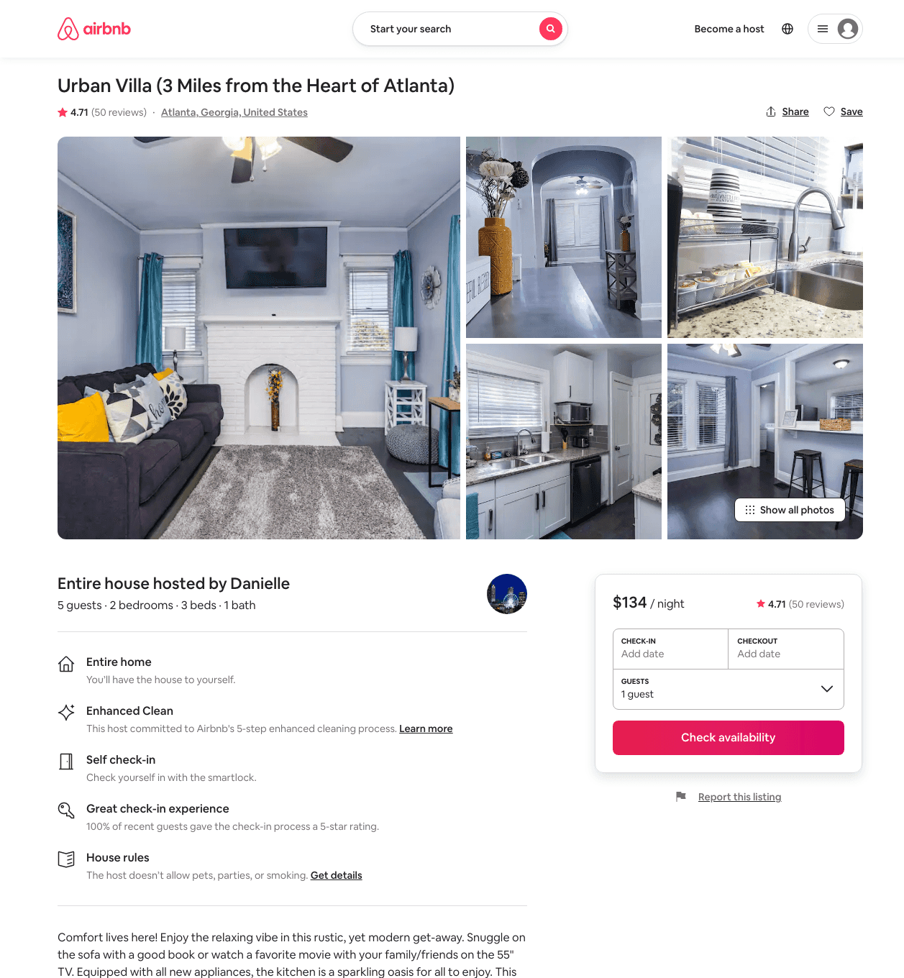
Listing 38411060
2
5
$132 - $262
4.76
2
Myles
121784535
1
https://www.airbnb.com/rooms/38411060
Aug 2022

Slide 33
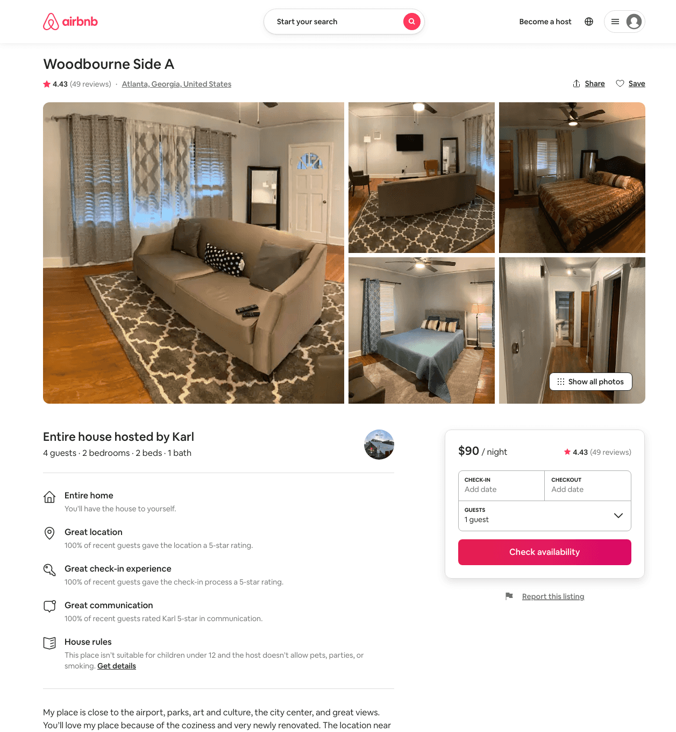
Listing 31833690
2
4
$90 - $99
4.44
2
Karl
97623920
2
https://www.airbnb.com/rooms/31833690
Aug 2022

Slide 34
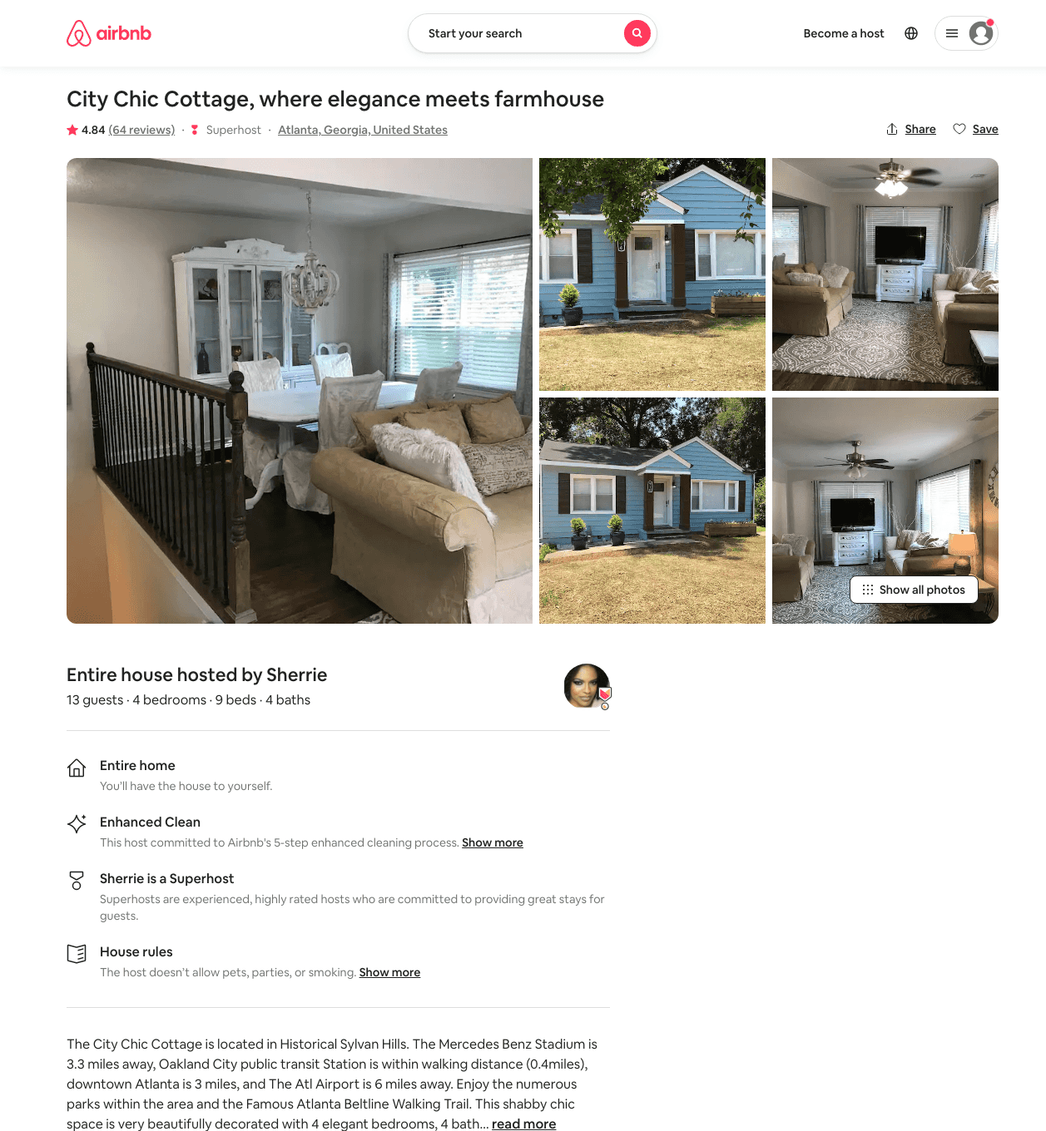
Listing 31804873
4
13
$239 - $287
4.84
2
Sherrie
168449345
1
https://www.airbnb.com/rooms/31804873
Jun 2022

Slide 35
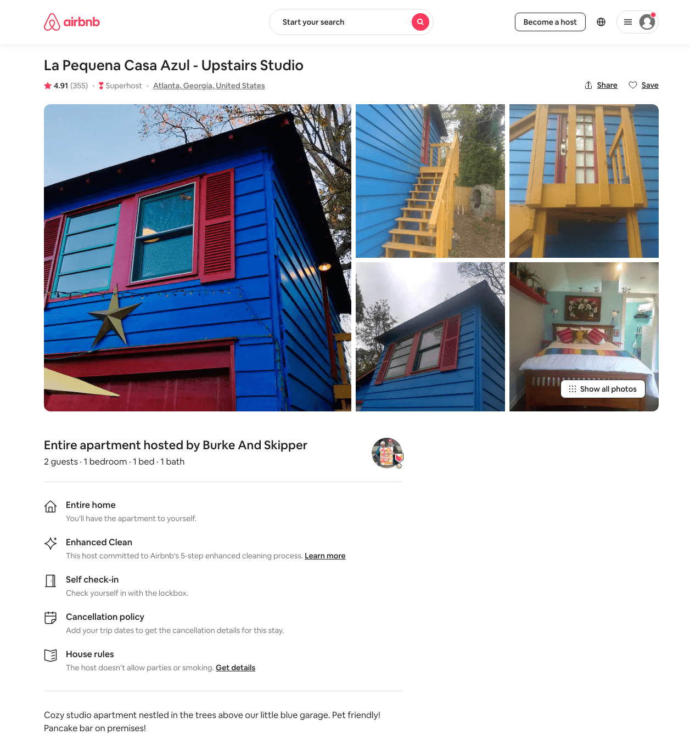
Listing 22225959
1
2
$42 - $53
4.92
2
Burke And Skipper
15098226
2
https://www.airbnb.com/rooms/22225959
Aug 2022

Slide 36
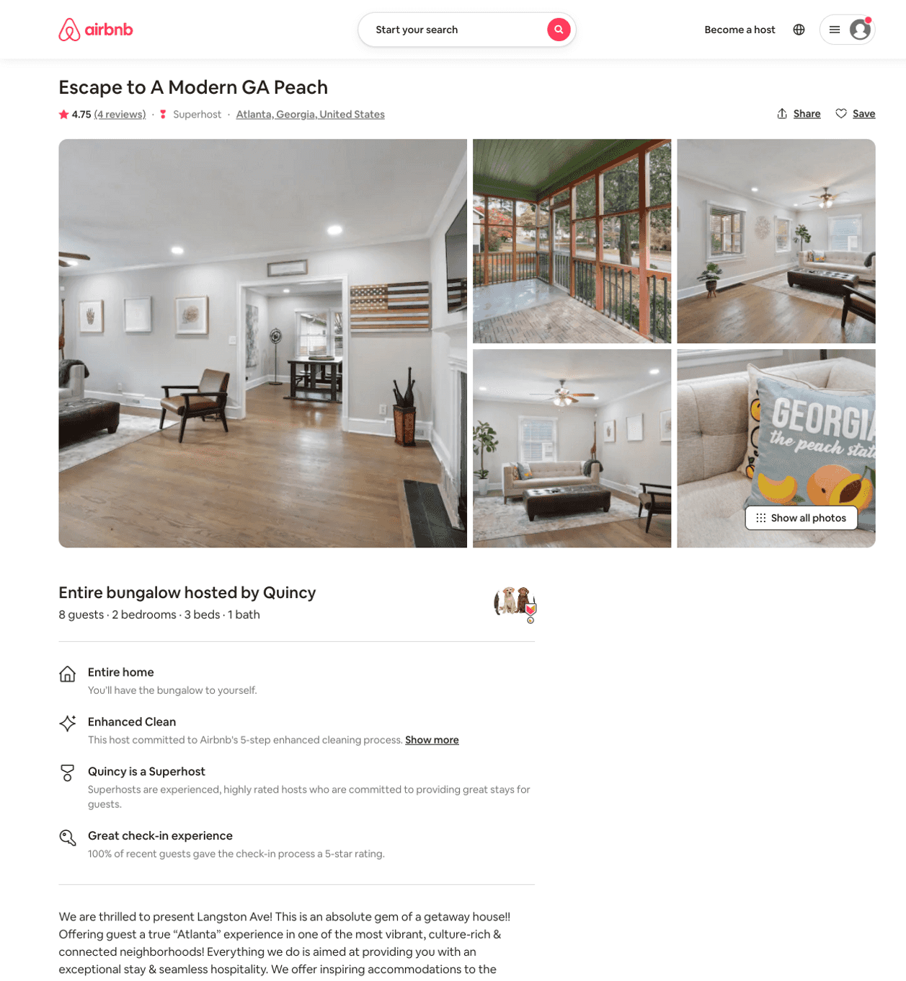
Listing 46396867
2
8
$96
4.73
4
Quincy
27147063
3
https://www.airbnb.com/rooms/46396867
Aug 2022

Slide 37
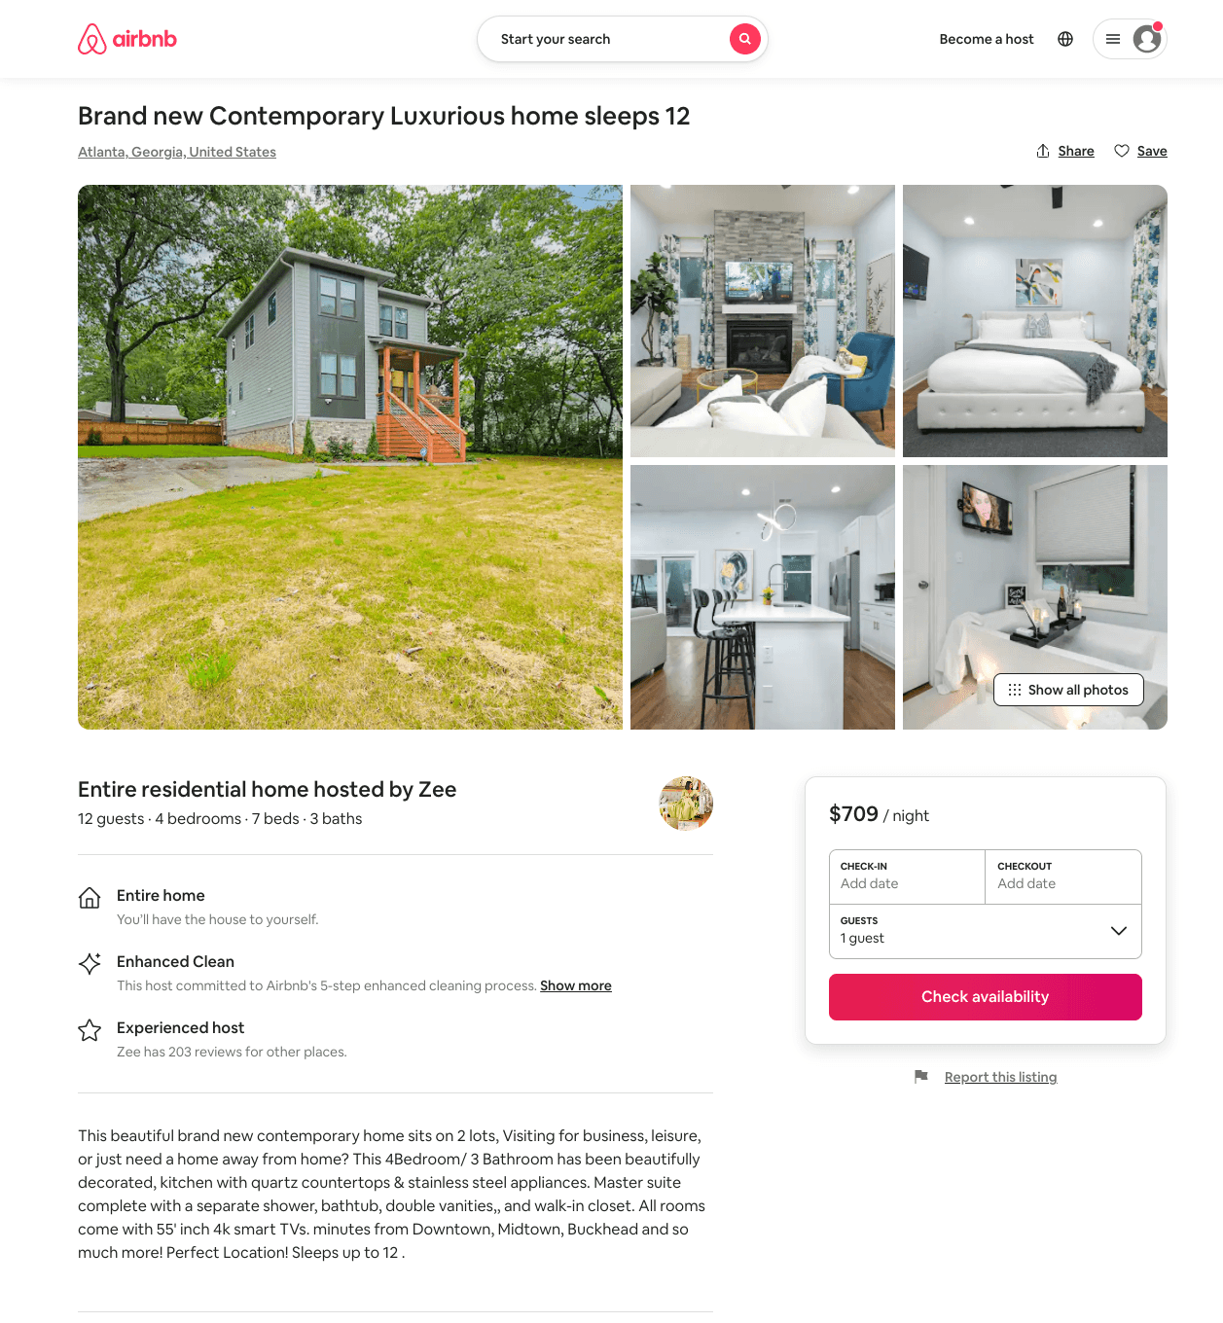
Listing 51199664
4
12
$491 - $1962
4.80
2
Zee
278629740
3
https://www.airbnb.com/rooms/51199664
Aug 2022

Slide 38
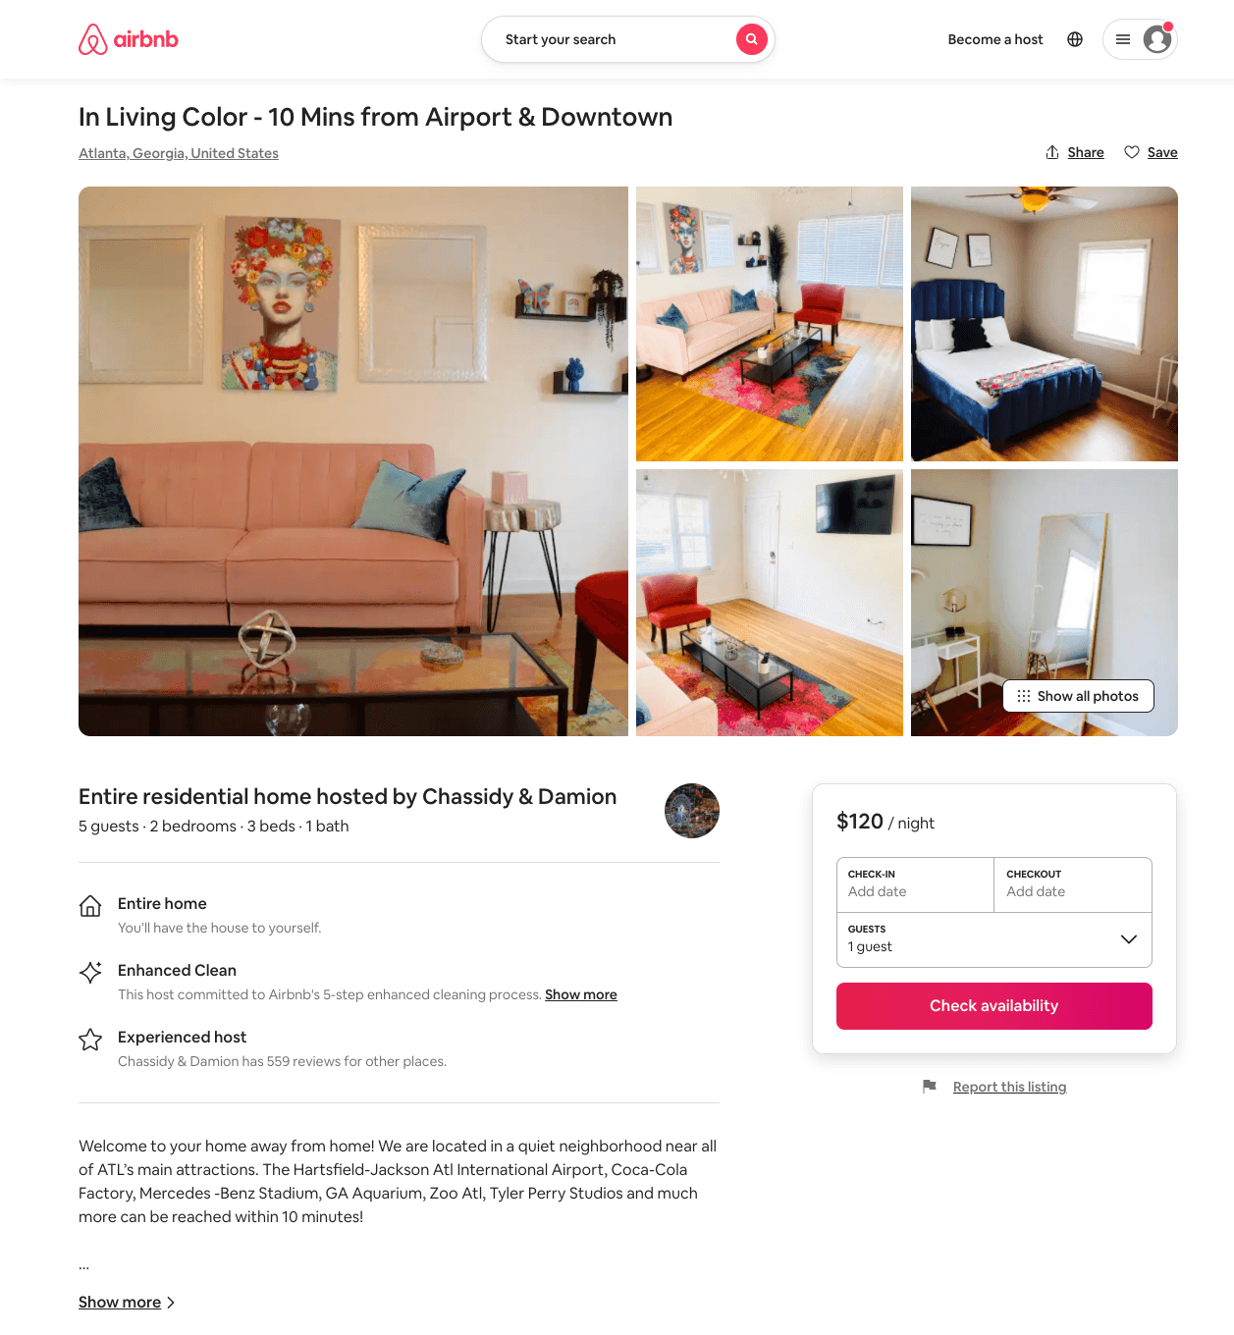
Listing 51225316
2
5
$99 - $135
4.67
1
Chassidy & Damion
105747515
6
https://www.airbnb.com/rooms/51225316
Aug 2022

Slide 39
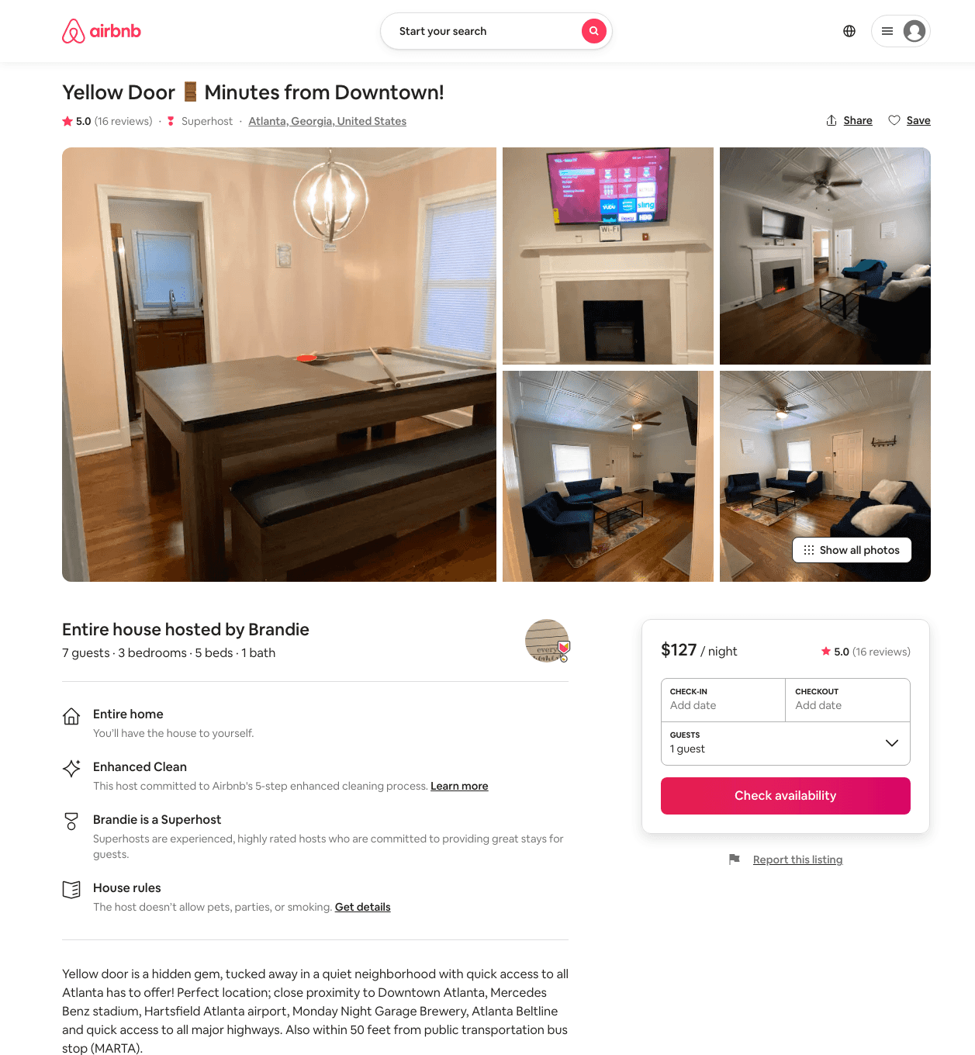
Listing 39702315
3
7
$127
5.0
2
Brandie
271672983
1
https://www.airbnb.com/rooms/39702315
Aug 2022

Slide 40
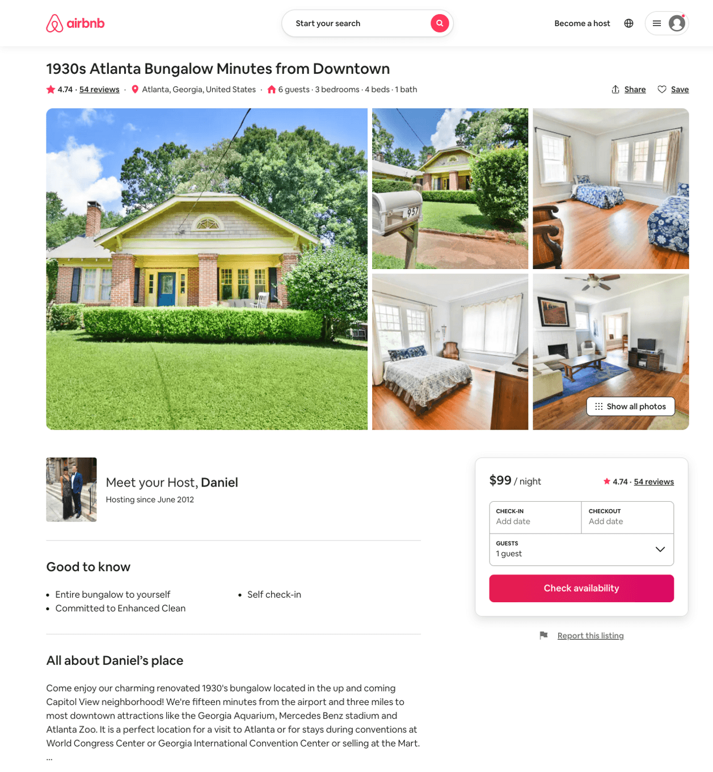
Listing 35005468
3
6
$99
4.74
100
Daniel
2620310
1
https://www.airbnb.com/rooms/35005468
Aug 2022

Slide 41
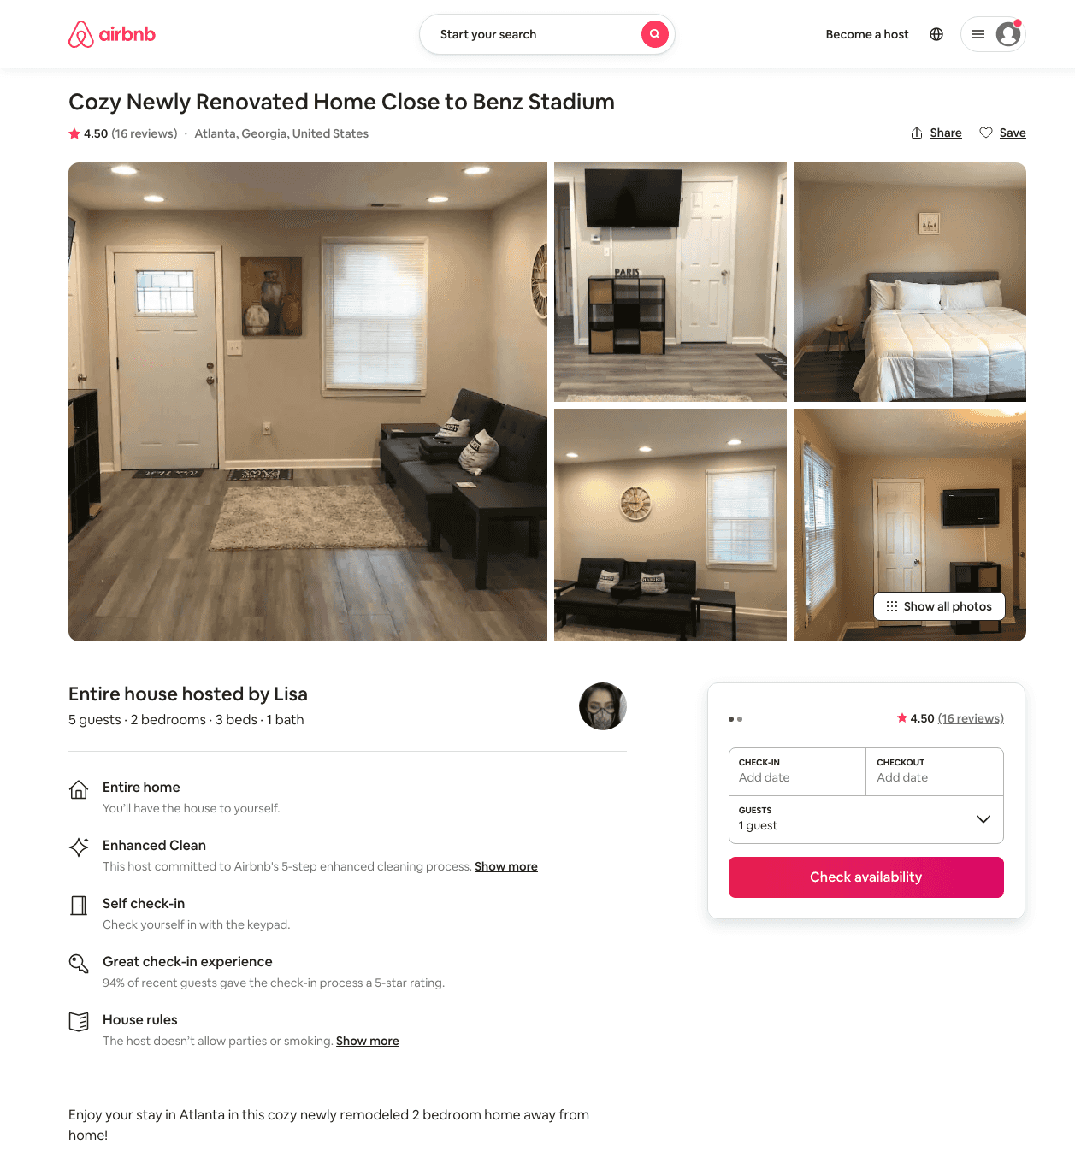
Listing 43397062
2
6
$97 - $121
4.42
3
Jon
338137546
1
https://www.airbnb.com/rooms/43397062
Aug 2022

Slide 42
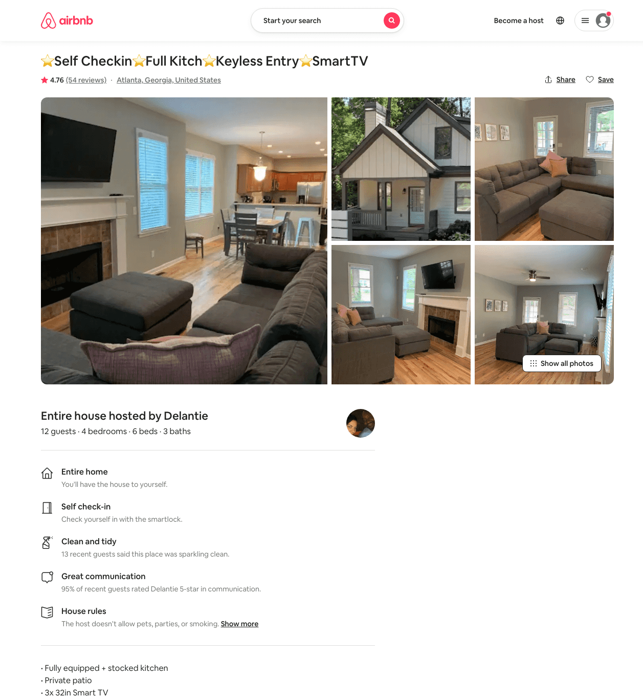
Listing 38066836
4
12
$173 - $201
4.78
2
Delantie
285867086
2
https://www.airbnb.com/rooms/38066836
Jun 2022

Slide 43
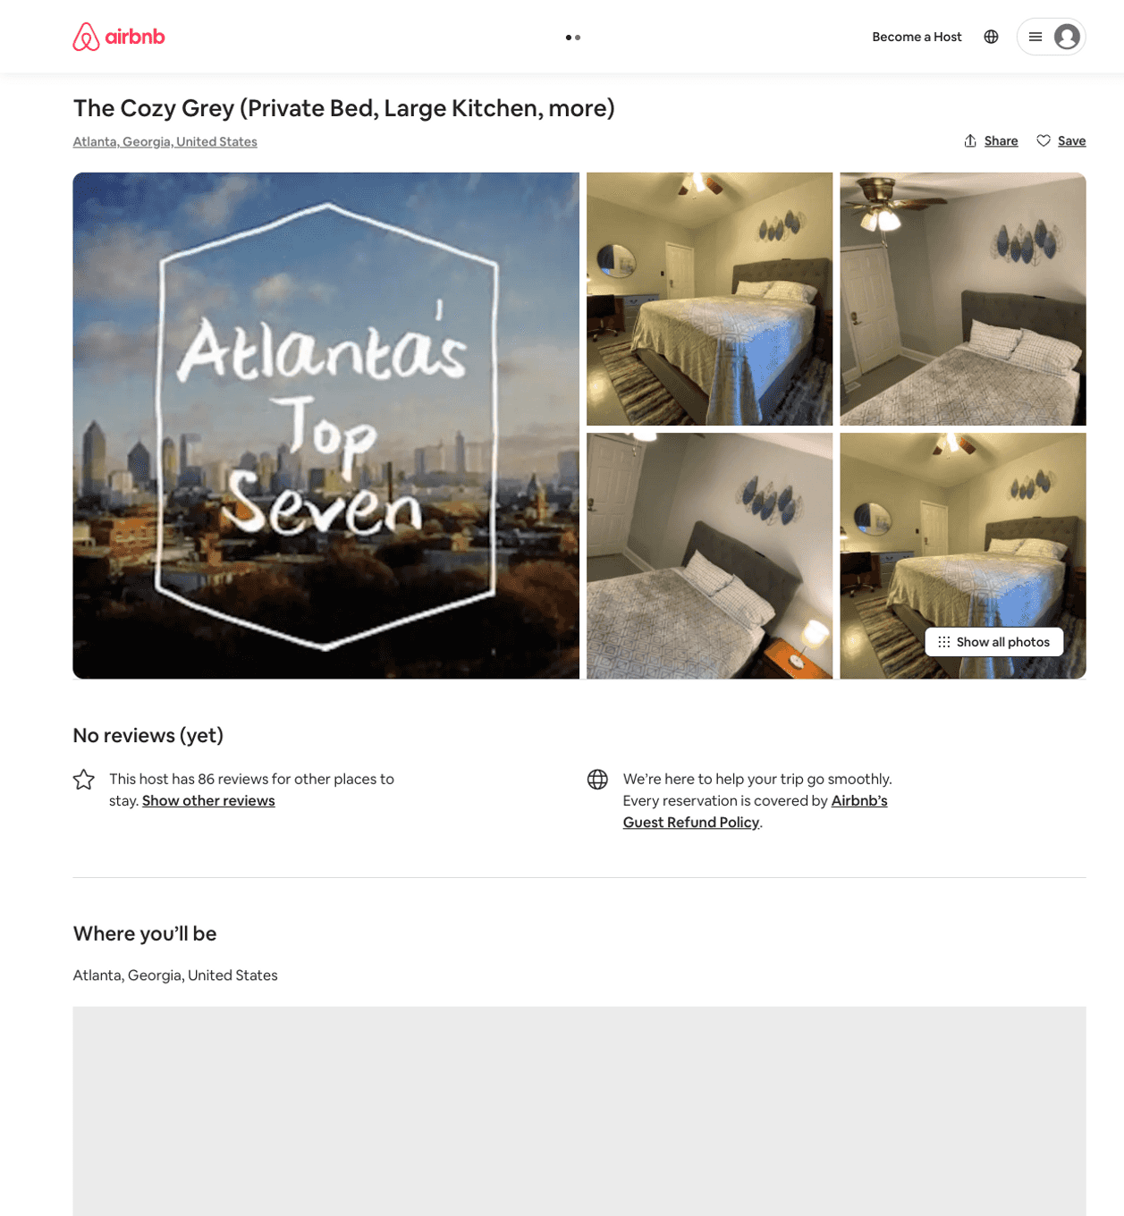
Listing 50484203
1
1
$31 - $47
4.67
2
Bryan
15032548
8
https://www.airbnb.com/rooms/50484203
Jul 2022

Slide 44
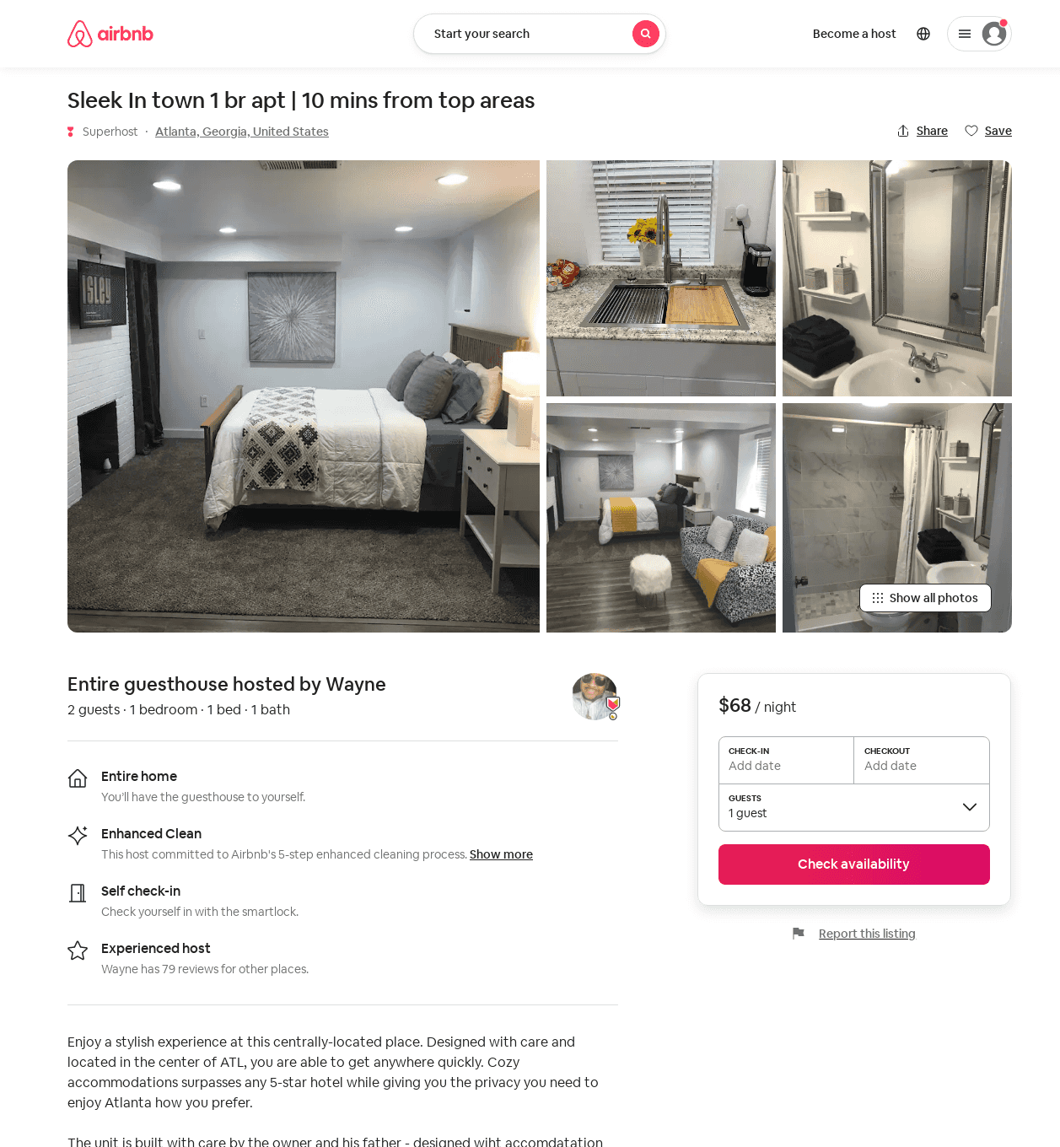
Listing 52457331
1
2
$40 - $82
4.90
2
Wayne
22852833
2
https://www.airbnb.com/rooms/52457331
Aug 2022

Slide 45
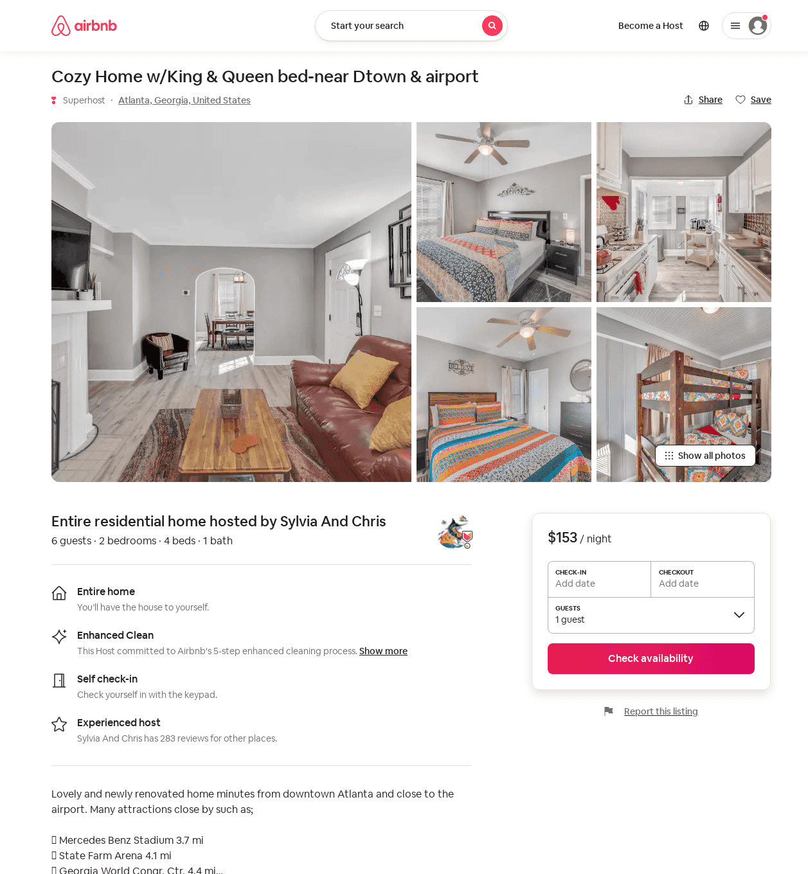
Listing 52519089
2
6
$131 - $162
4.43
2
Sylvia And Chris
143997218
4
https://www.airbnb.com/rooms/52519089
Jun 2022

Slide 46
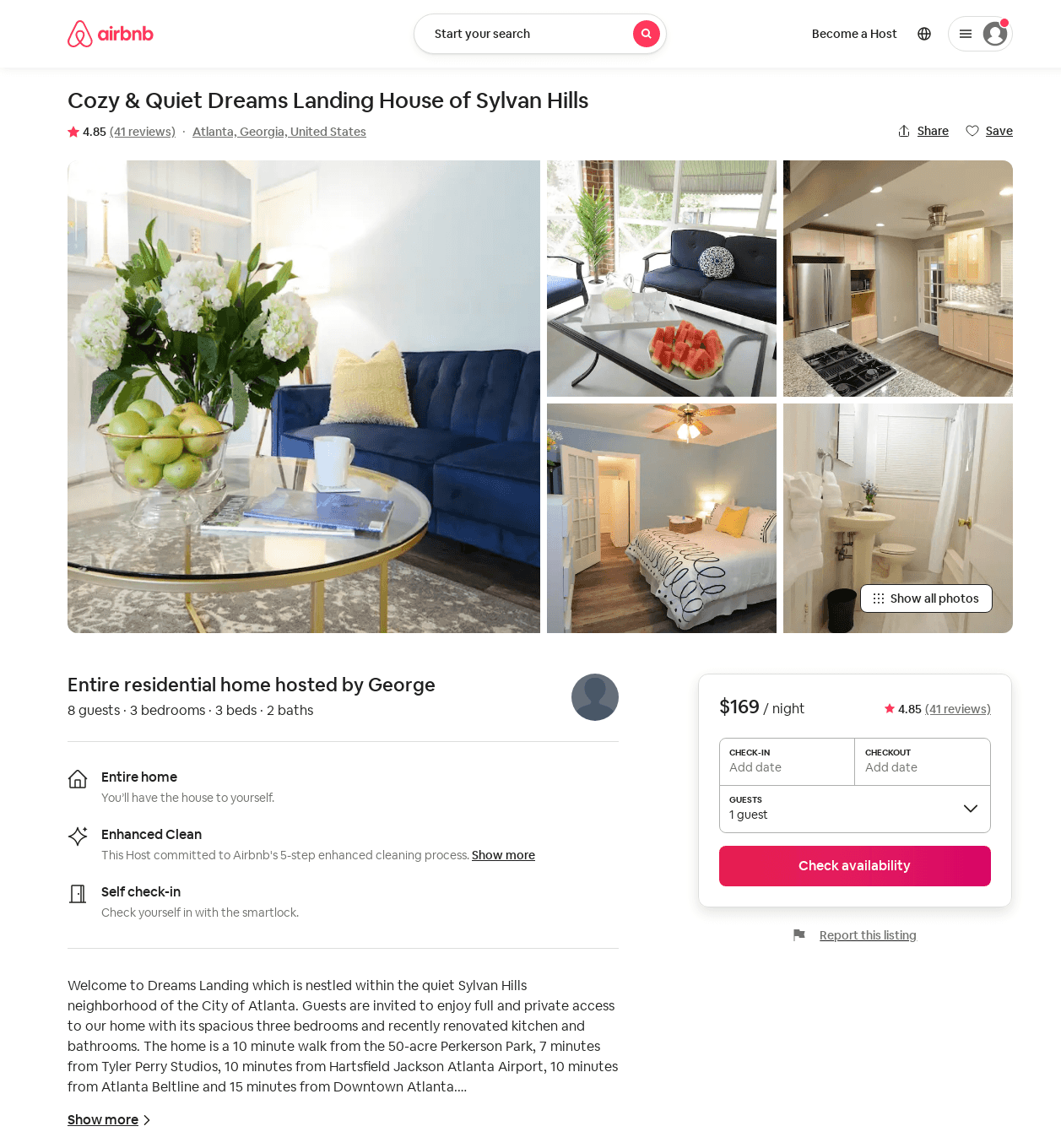
Listing 33421260
3
6
$169
4.86
30
Loren
246018435
1
https://www.airbnb.com/rooms/33421260
Aug 2022

Slide 47
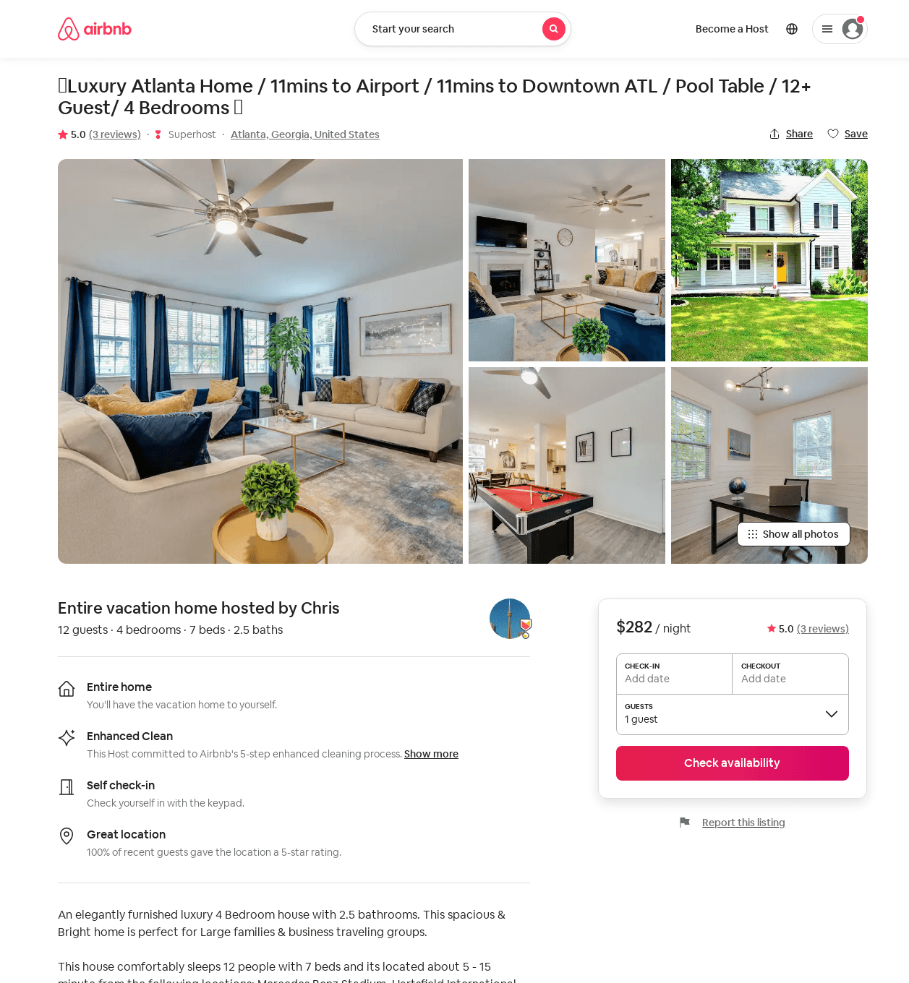
Listing 52723355
4
12
$211 - $429
4.85
2
Chris
362861580
1
https://www.airbnb.com/rooms/52723355
Aug 2022

Slide 48
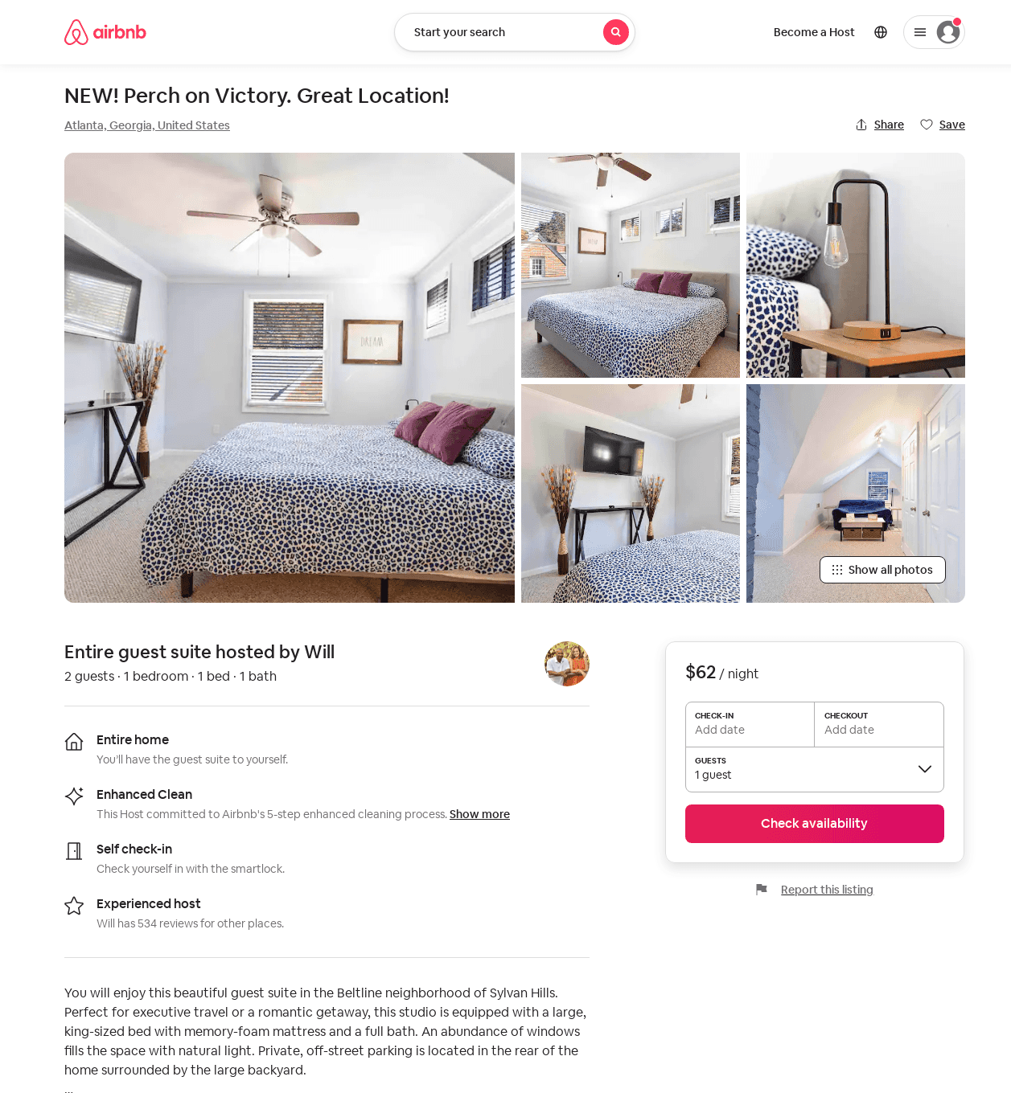
Listing 53546480
1
2
$50 - $62
4.63
2
Will
257608788
11
https://www.airbnb.com/rooms/53546480
Jul 2022

Slide 49
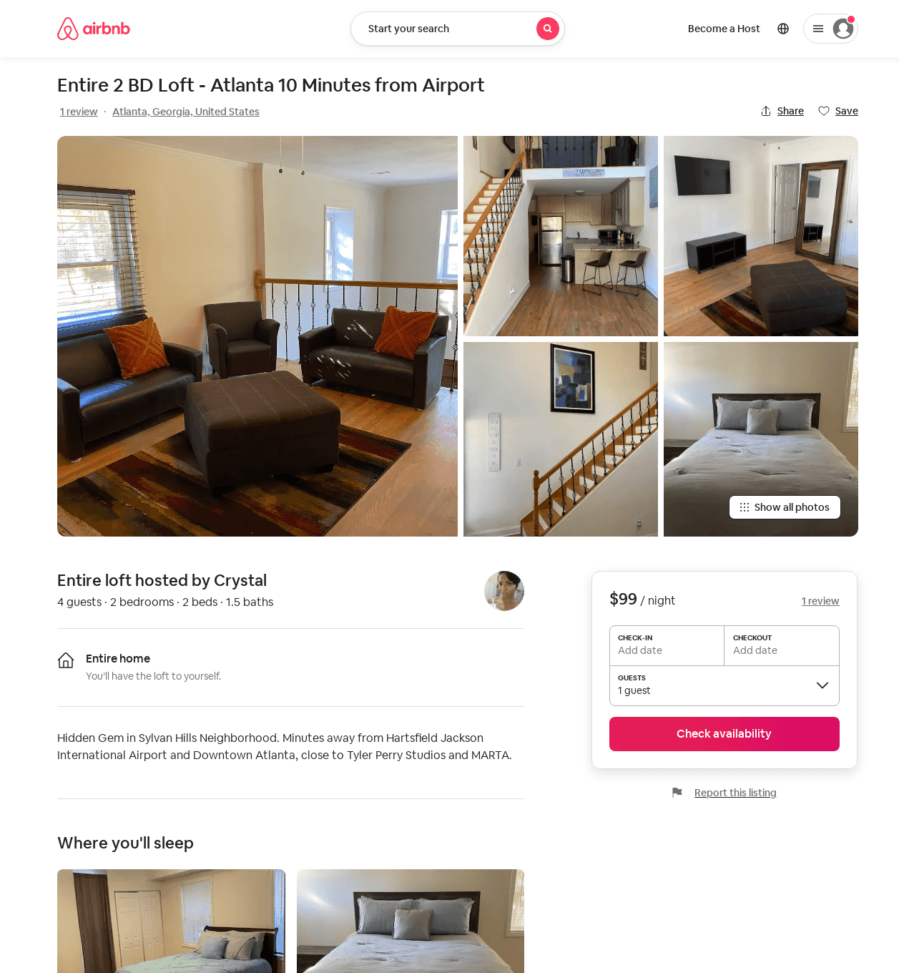
Listing 53106158
2
4
$85 - $96
4.45
1
Crystal
12305199
1
https://www.airbnb.com/rooms/53106158
Aug 2022

Slide 50
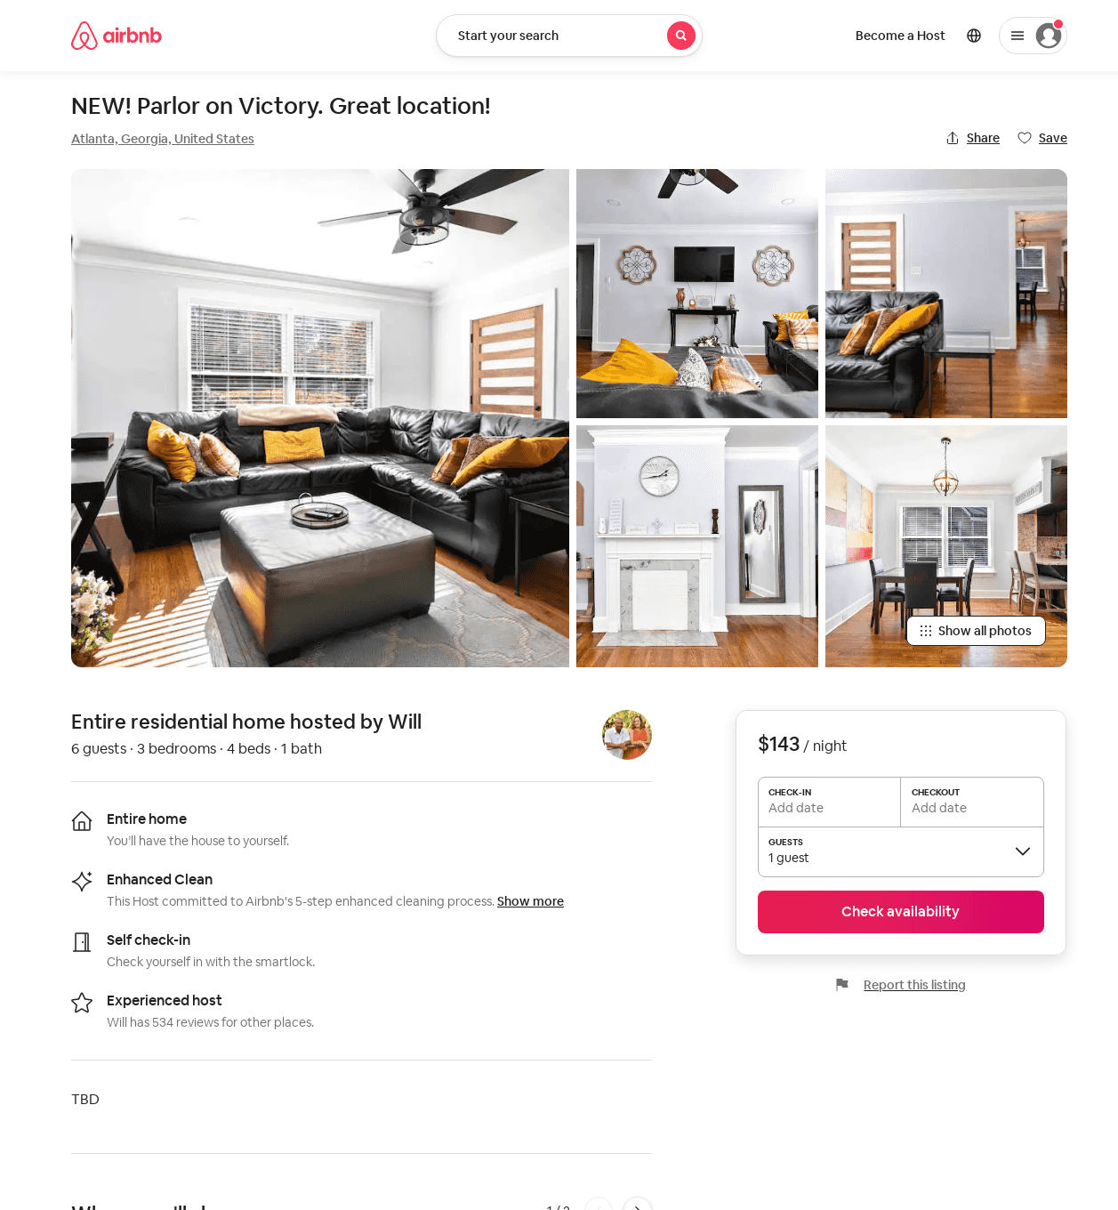
Listing 53547026
3
6
$126 - $143
2
Will
257608788
11
https://www.airbnb.com/rooms/53547026
Jun 2022

Slide 51
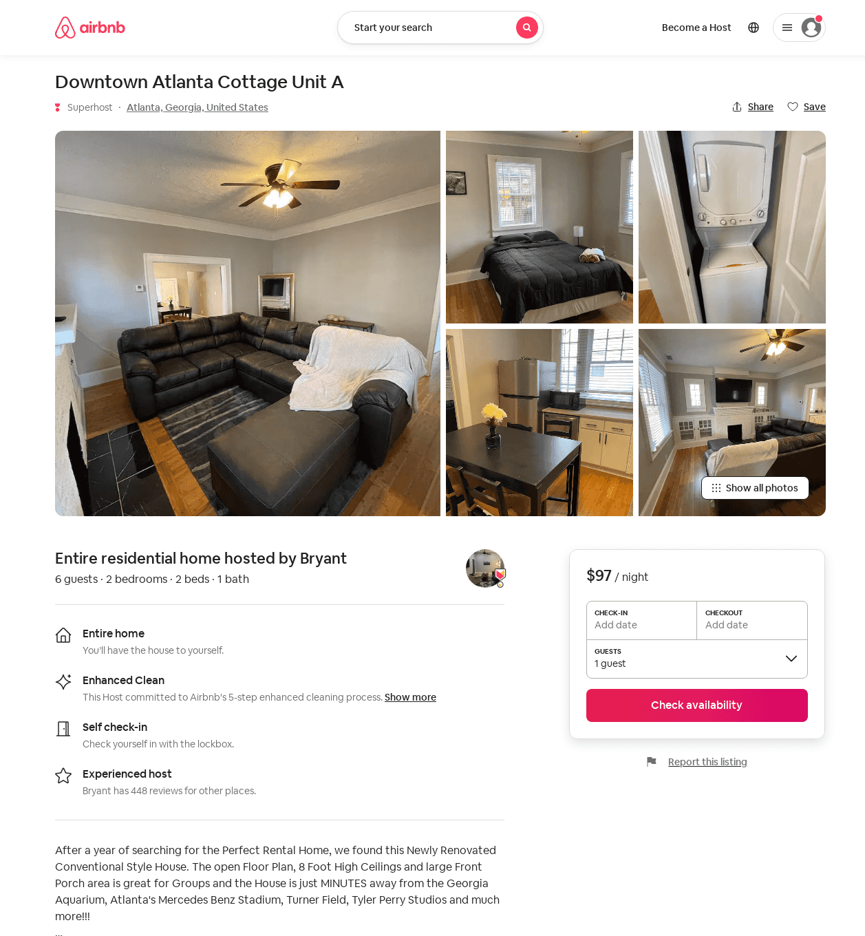
Listing 53575720
2
6
$91 - $123
4.80
2
Bryant
250716419
22
https://www.airbnb.com/rooms/53575720
Jul 2022

Slide 52
Listing 53481692
1
1
$63
1
Dex
400318456
1
https://www.airbnb.com/rooms/53481692
Jul 2022

Slide 53
Listing 53575852
2
4
$90 - $92
3.63
2
Bryant
250716419
22
https://www.airbnb.com/rooms/53575852
Aug 2022

Slide 54
Listing 2619342
1
2
$118
2
Lakienya Frett
https://www.vrbo.com/2619342
Aug 2022

Slide 55
Listing 54296648
Studio
2
$75 - $100
4.88
2
Lakienya
44959282
2
https://www.airbnb.com/rooms/54296648
Aug 2022

Slide 56
Listing 53906576
3
6
$109
5.0
2
John And Kellie
436682814
1
https://www.airbnb.com/rooms/53906576
Aug 2022

Slide 57
Listing 2712758
1
4
$145
2
https://www.vrbo.com/2712758
Aug 2022

Slide 58
Listing 39088235
1
1
$36
4.60
4
Bryan
15032548
8
https://www.airbnb.com/rooms/39088235
Aug 2022

Slide 59
Listing 2731796
3
10
$147
5
1
Kunle Akande
https://www.vrbo.com/2731796
Aug 2022

Slide 60
Listing 2791700
3
6
$137
2
Fahruk Akinleye
https://www.vrbo.com/2791700
Aug 2022

Slide 61
Listing 2836452
3
6
$143
2
Key Properties and Investments
https://www.vrbo.com/2836452
Aug 2022

Slide 62
Listing 2889678
4
12
$229
2
Vacasa of Georgia
https://www.vrbo.com/2889678
Aug 2022

Slide 63
Listing 2918340
3
10
$316
2
https://www.vrbo.com/2918340
Aug 2022

Slide 64
Listing 2930891
1
4
$135
2
https://www.vrbo.com/2930891
Aug 2022

Slide 65
Listing 16119811
3
3
4.57
2
Jean-Patrick
105120454
1
https://www.airbnb.com/rooms/16119811
Aug 2022

Slide 66
Listing 44491805
3
5
3
Bryan
15032548
8
https://www.airbnb.com/rooms/44491805
Aug 2022

Slide 67
Listing 2956400
3
6
$119
2
Vacasa of Georgia
https://www.vrbo.com/2956400
Aug 2022

