Slide 2
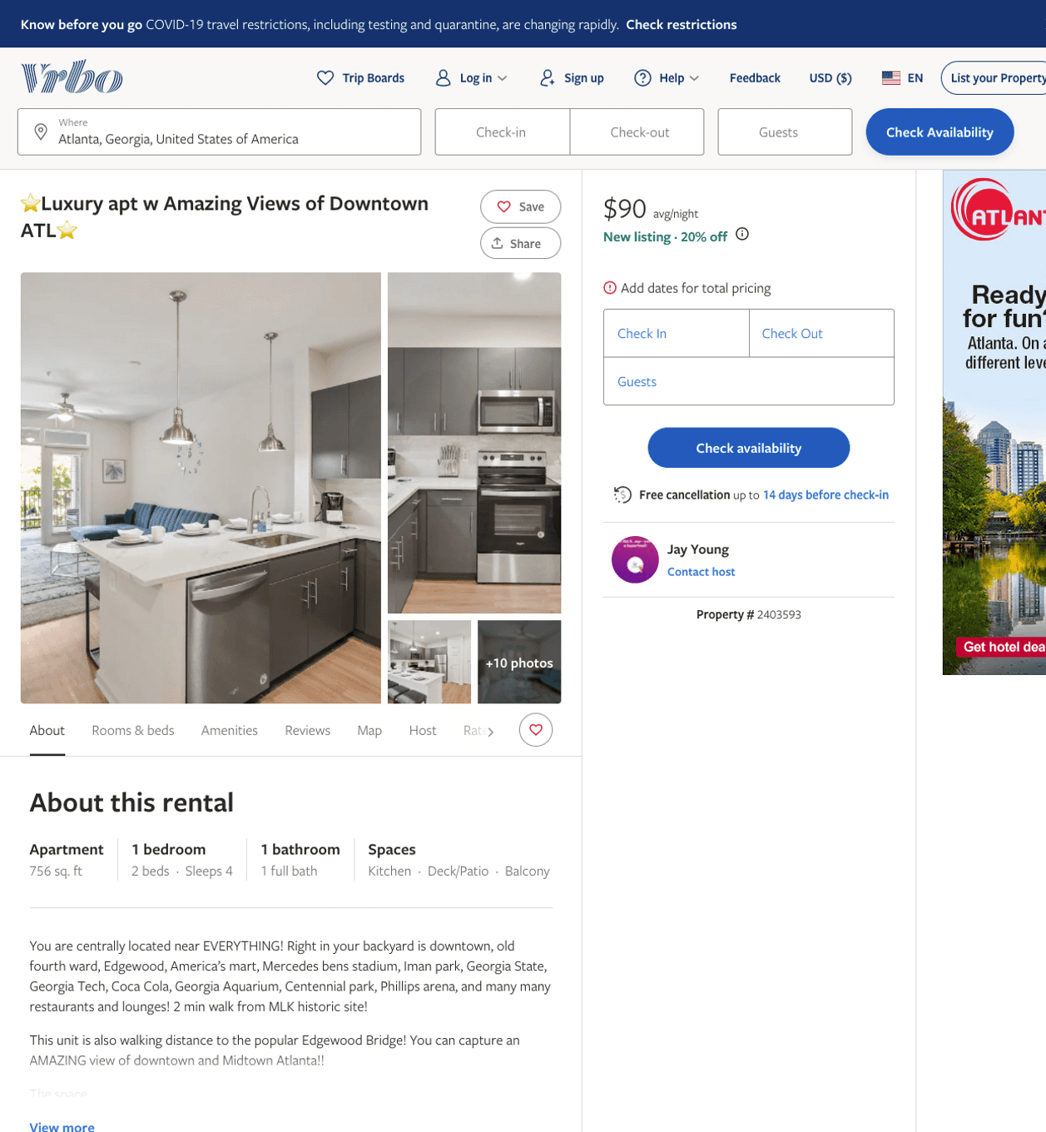
Listing 2403593
1
4
$100 - $99
3.857143
1
Jay Young
https://www.vrbo.com/2403593
Aug 2022

Slide 3
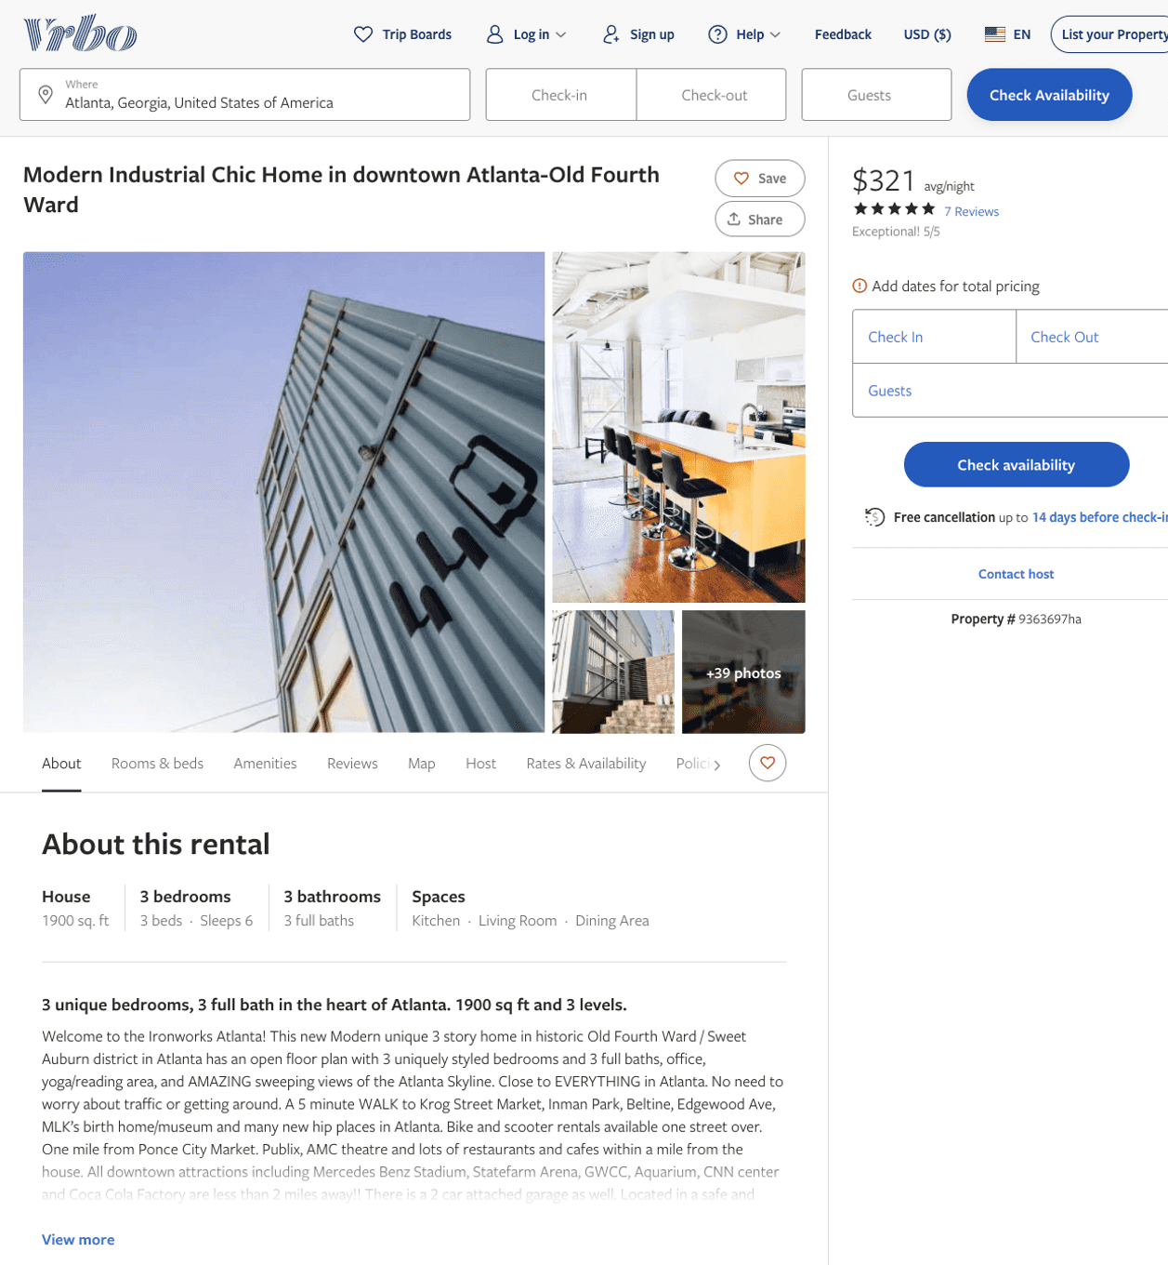
Listing 9363697
3
6
$286 - $350
4.9166665
3
Naila Aladin
https://www.vrbo.com/9363697ha
Aug 2022

Slide 4
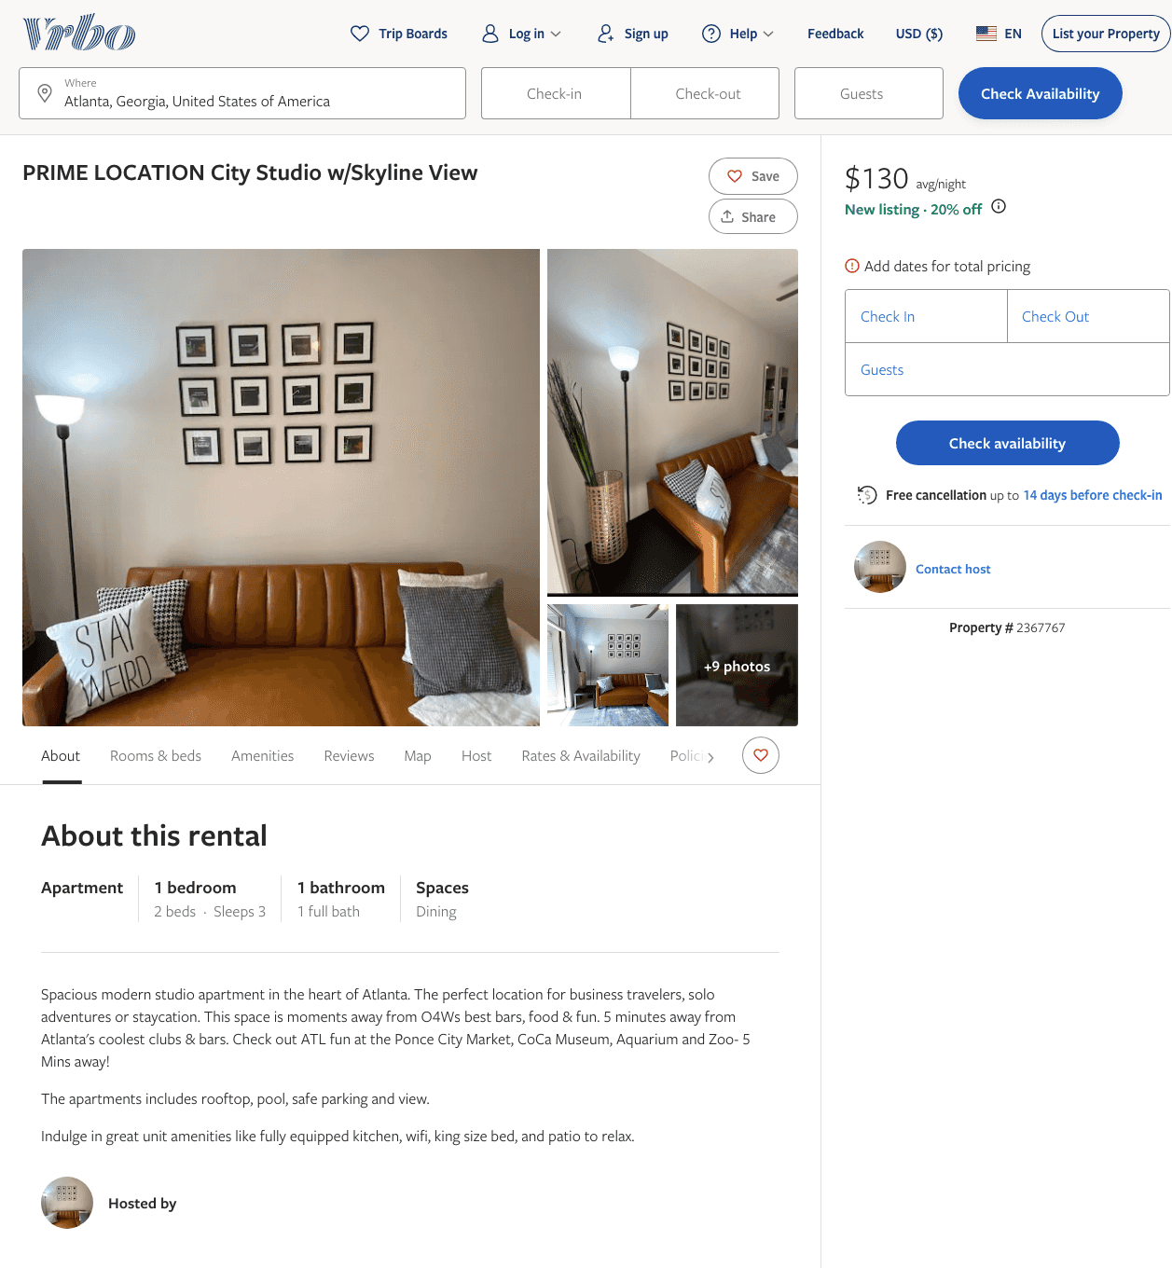
Listing 2367767
1
3
$102 - $93
4
1
https://www.vrbo.com/2367767
Aug 2022

Slide 5
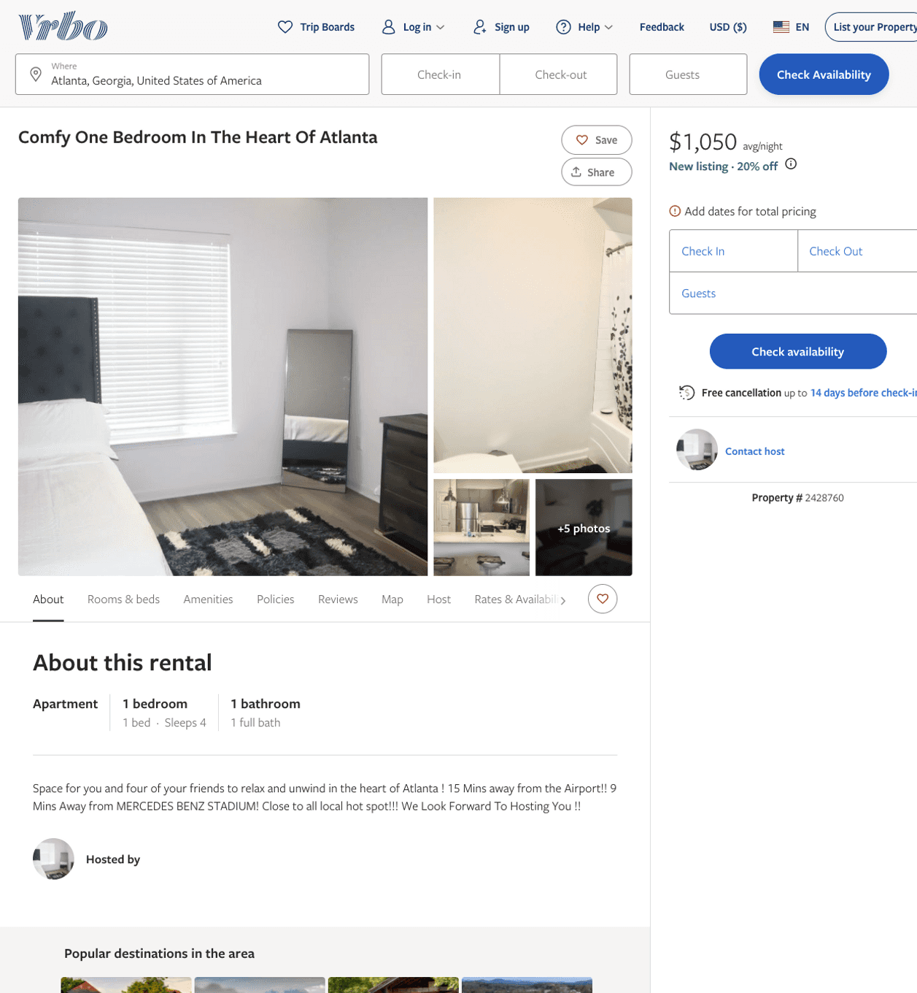
Listing 2428760
1
4
$1,050 - $85
5
2
https://www.vrbo.com/2428760
Aug 2022

Slide 6
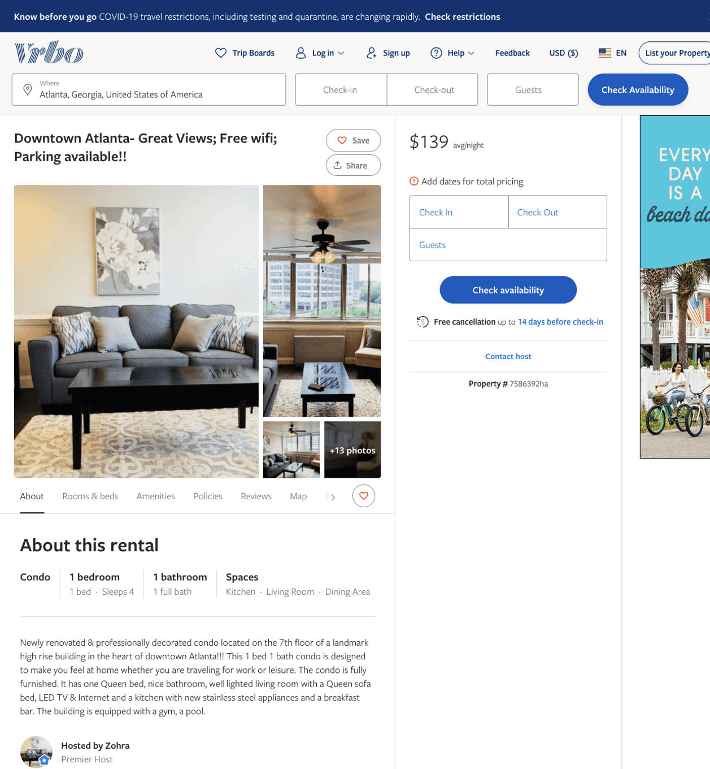
Listing 7586392
1
4
$139
28
Zohra
https://www.vrbo.com/7586392ha
Aug 2022

Slide 7
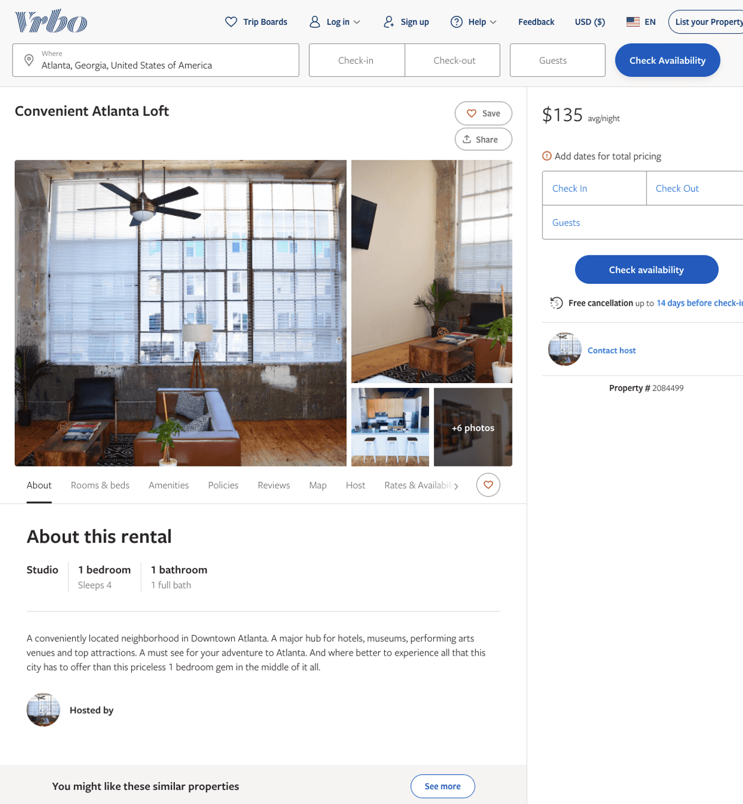
Listing 2084499
1
4
$135
2
https://www.vrbo.com/2084499
Aug 2022

Slide 8
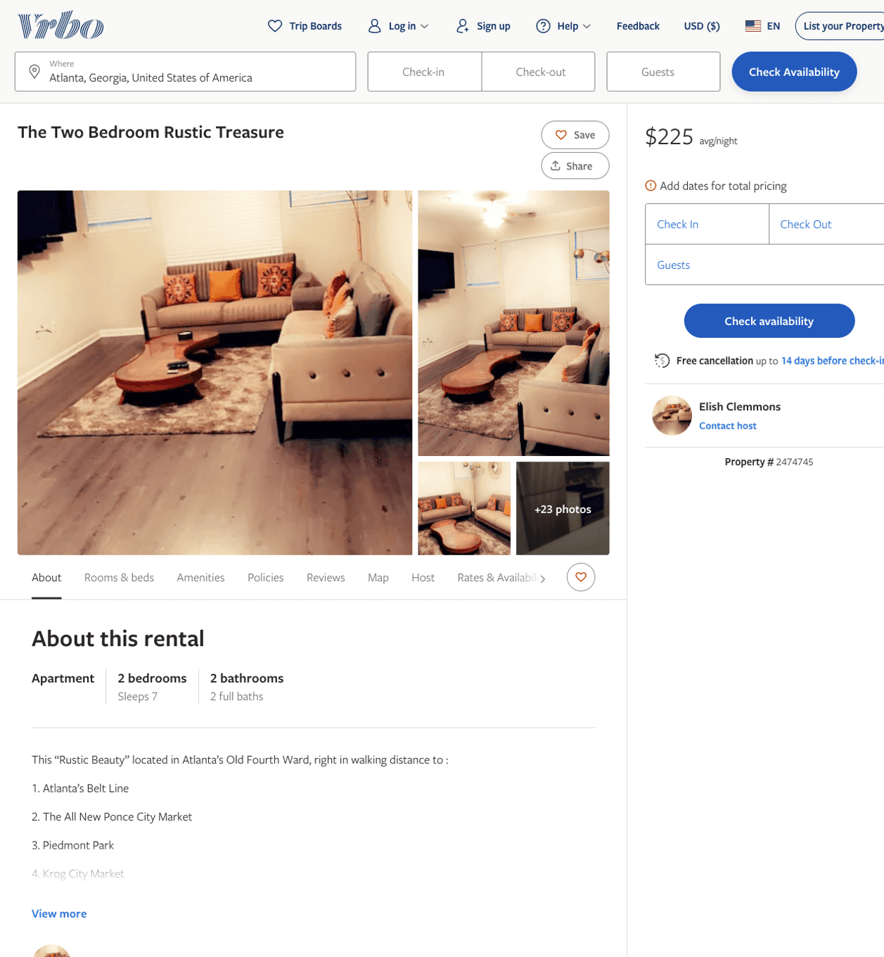
Listing 2474745
2
7
$225
2
Elish Clemmons
https://www.vrbo.com/2474745
Aug 2022

Slide 9
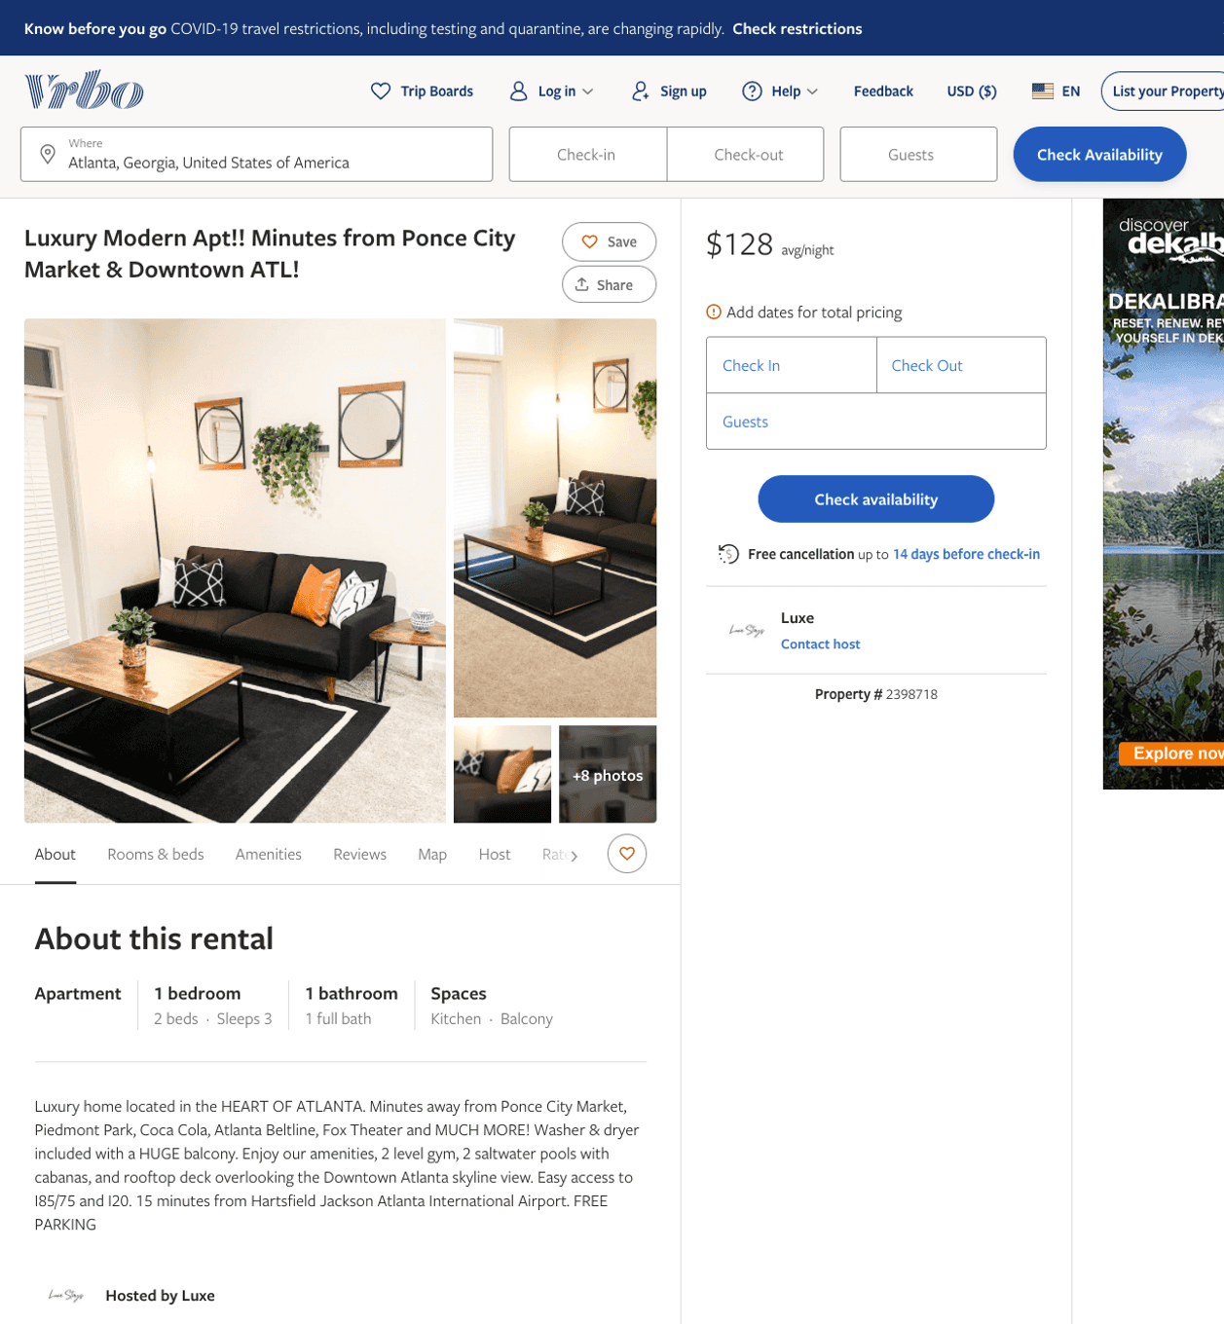
Listing 2398718
1
3
$100 - $120
4.75
2
Luxe
https://www.vrbo.com/2398718
Aug 2022

Slide 10
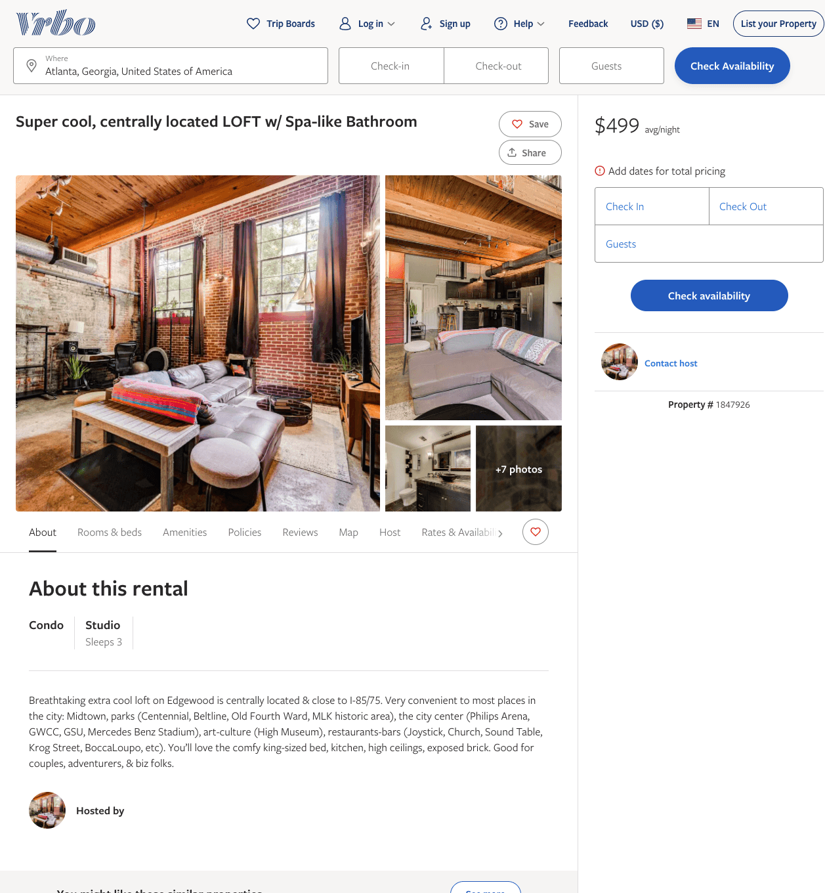
Listing 1847926
1
3
$499
1
https://www.vrbo.com/1847926
Aug 2022

Slide 11
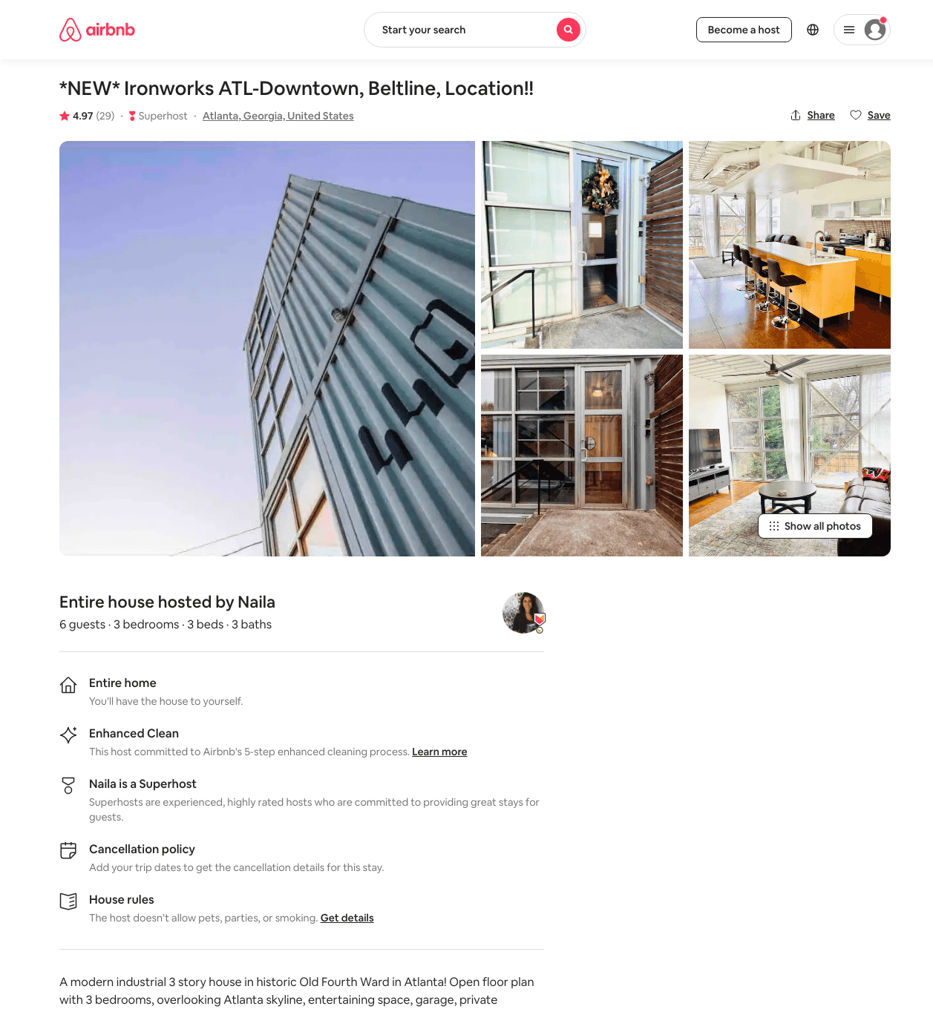
Listing 41400728
3
6
$255 - $354
4.90
3
Naila
236977791
2
https://www.airbnb.com/rooms/41400728
Aug 2022

Slide 12
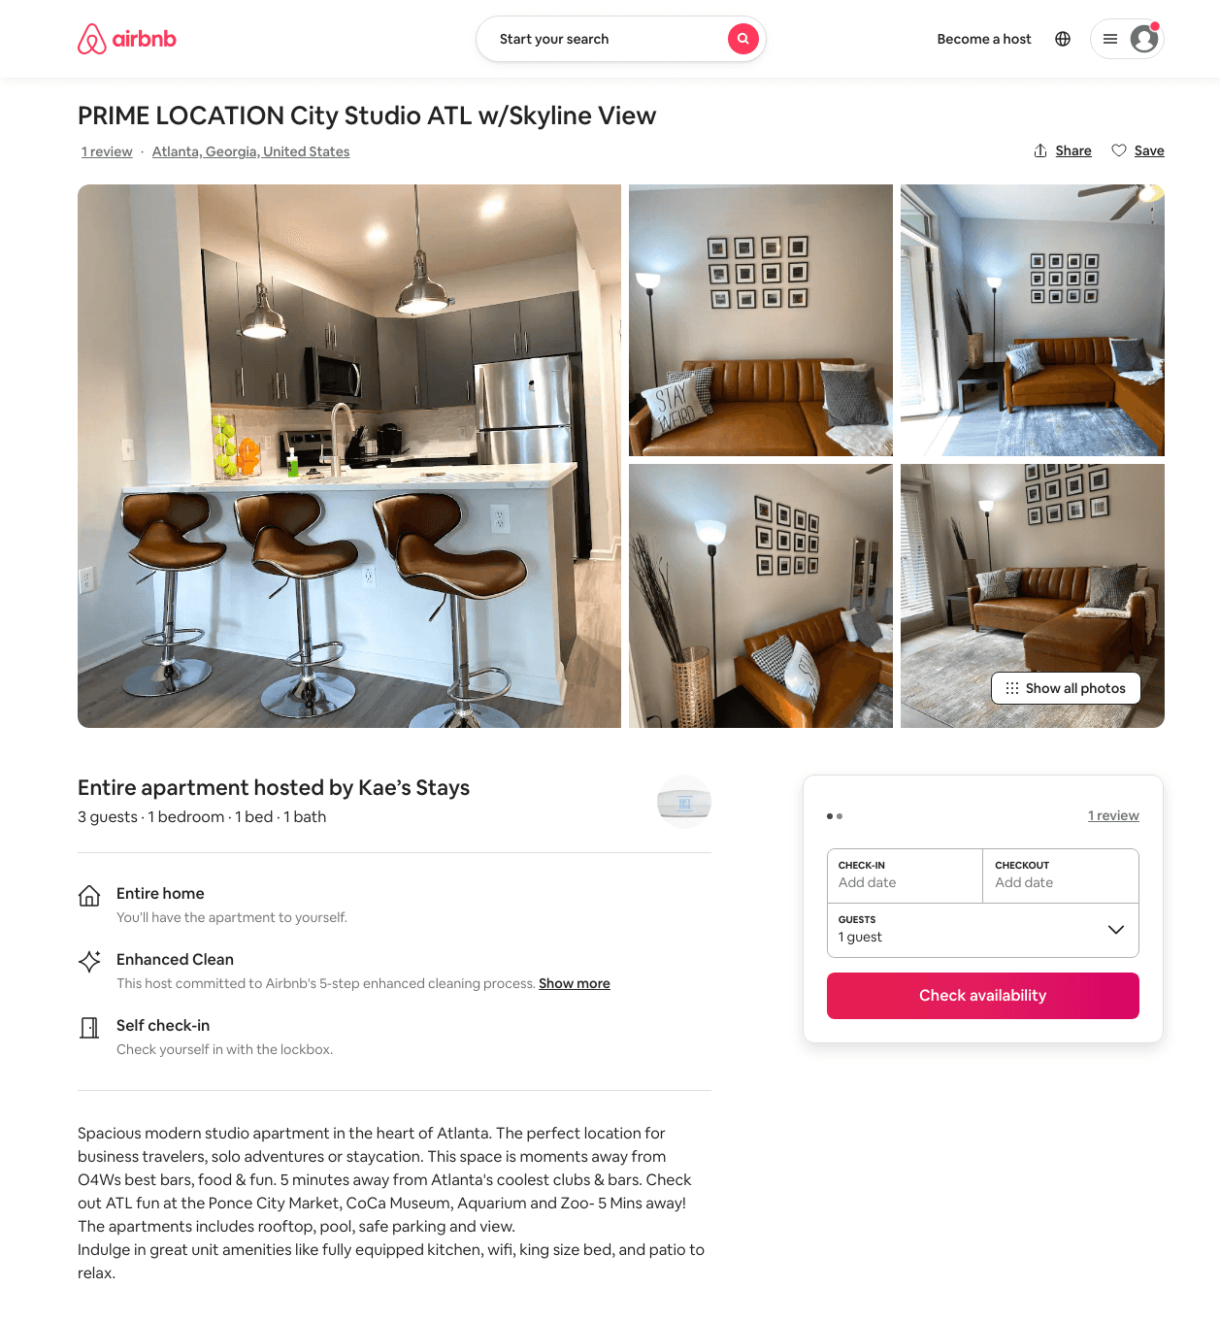
Listing 50073390
1
3
$64 - $172
4.66
1
Kae’s Stays
50220097
2
https://www.airbnb.com/rooms/50073390
Aug 2022

Slide 13
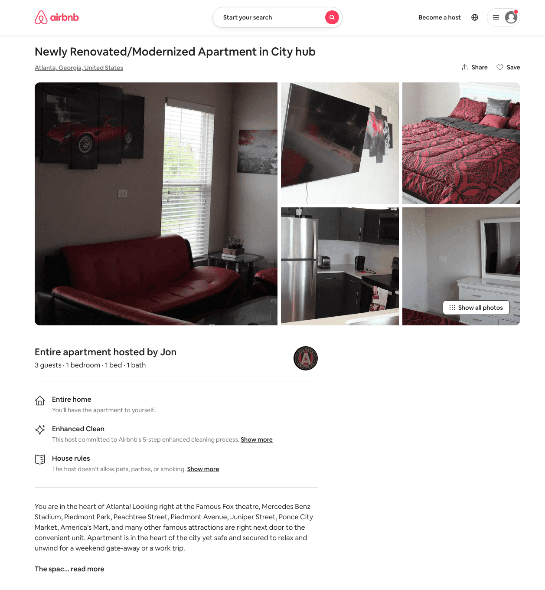
Listing 32049753
1
3
$121
5.0
1
Jon
171055422
1
https://www.airbnb.com/rooms/32049753
Aug 2022

Slide 14
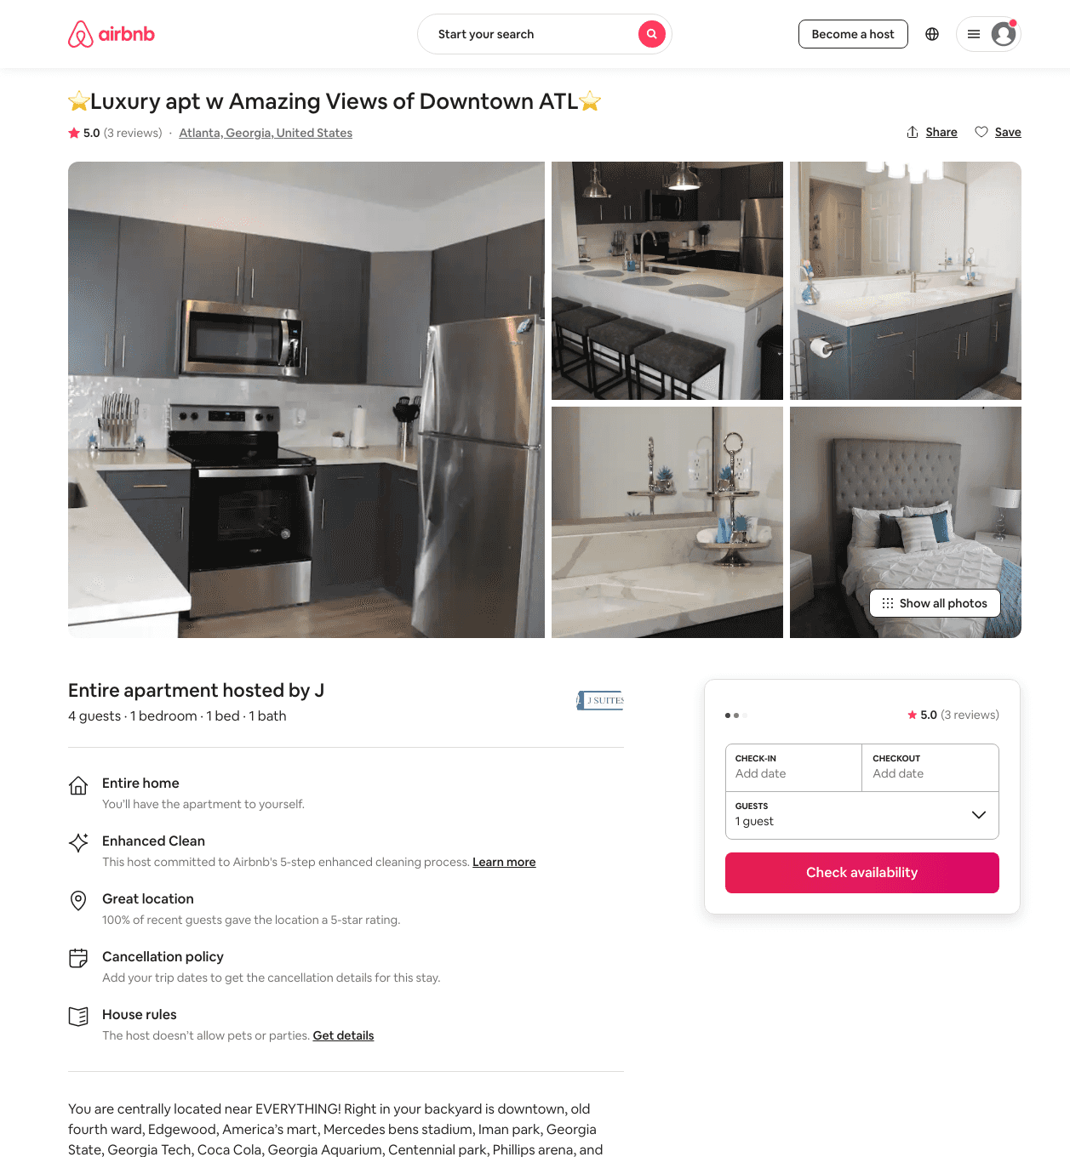
Listing 48992201
1
4
$93 - $150
4.78
1
Jay
159600096
1
https://www.airbnb.com/rooms/48992201
Aug 2022

Slide 15
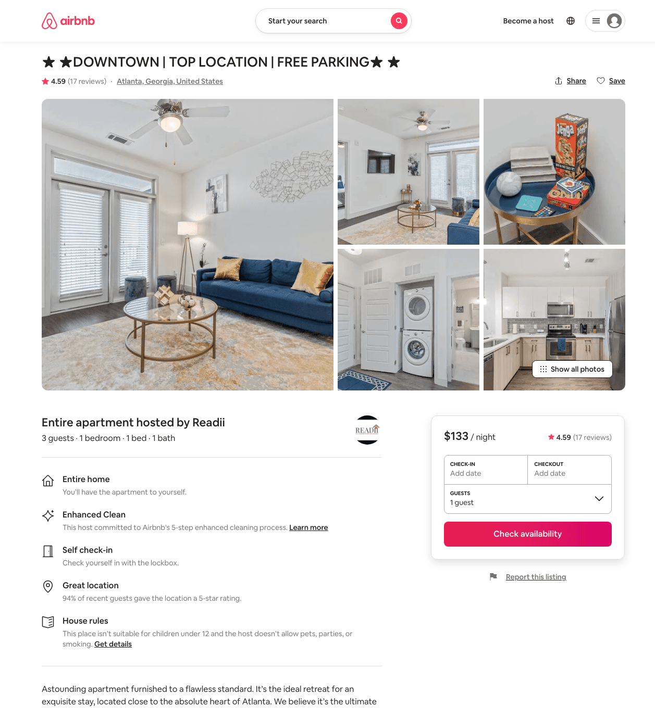
Listing 45000731
1
3
$120 - $148
4.68
30
Readii
196156024
1
https://www.airbnb.com/rooms/45000731
Aug 2022

Slide 16
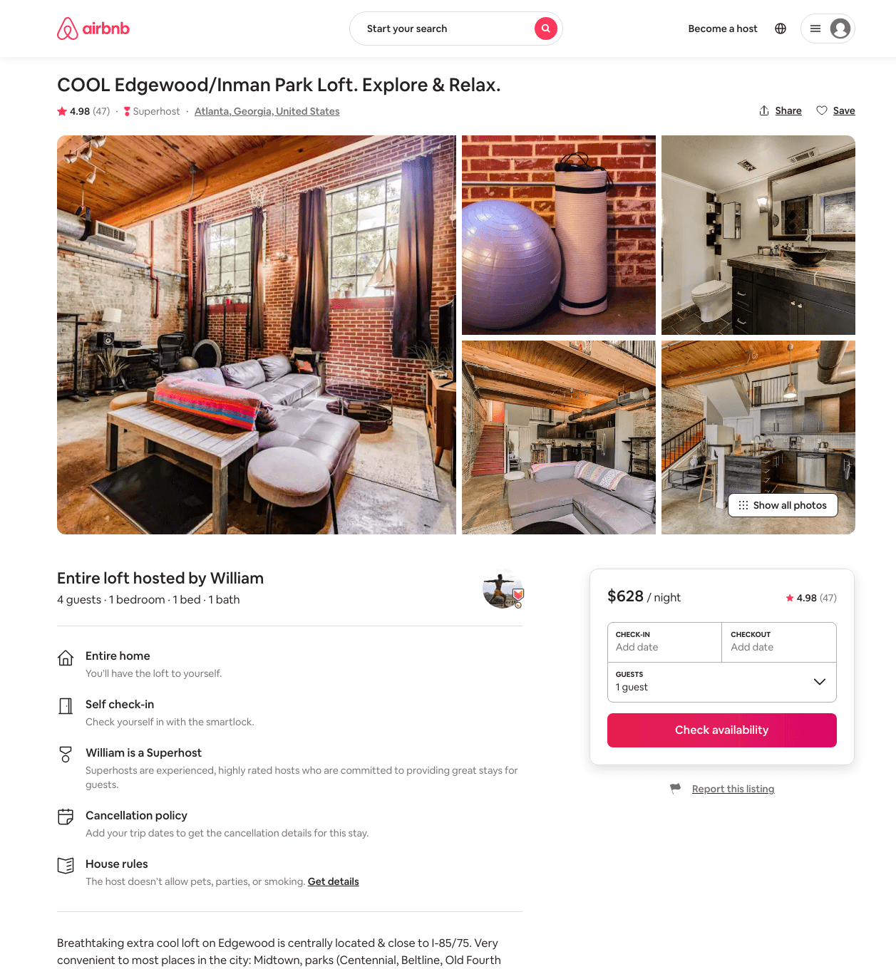
Listing 13346479
1
4
$628
4.98
3
William
35822541
2
https://www.airbnb.com/rooms/13346479
Aug 2022

Slide 17
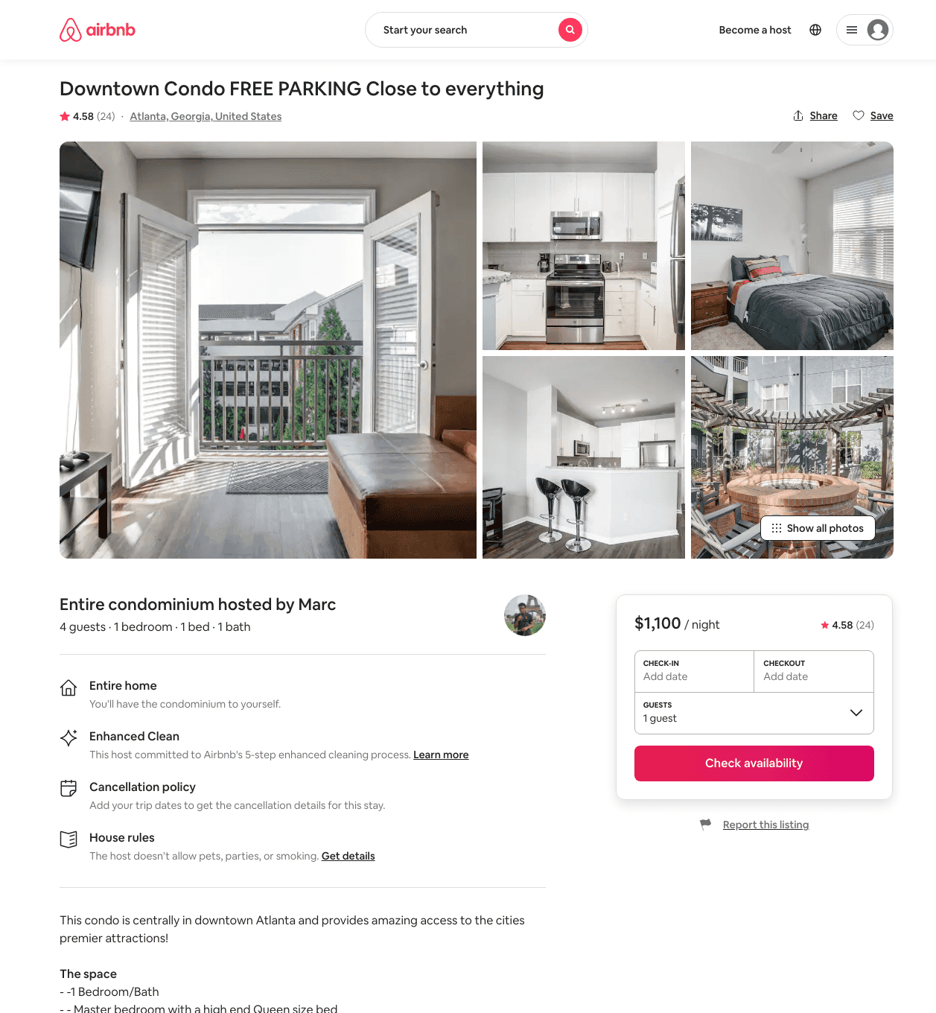
Listing 39531166
1
4
$1100
4.58
1
Marc
282589763
1
https://www.airbnb.com/rooms/39531166
Aug 2022

Slide 18
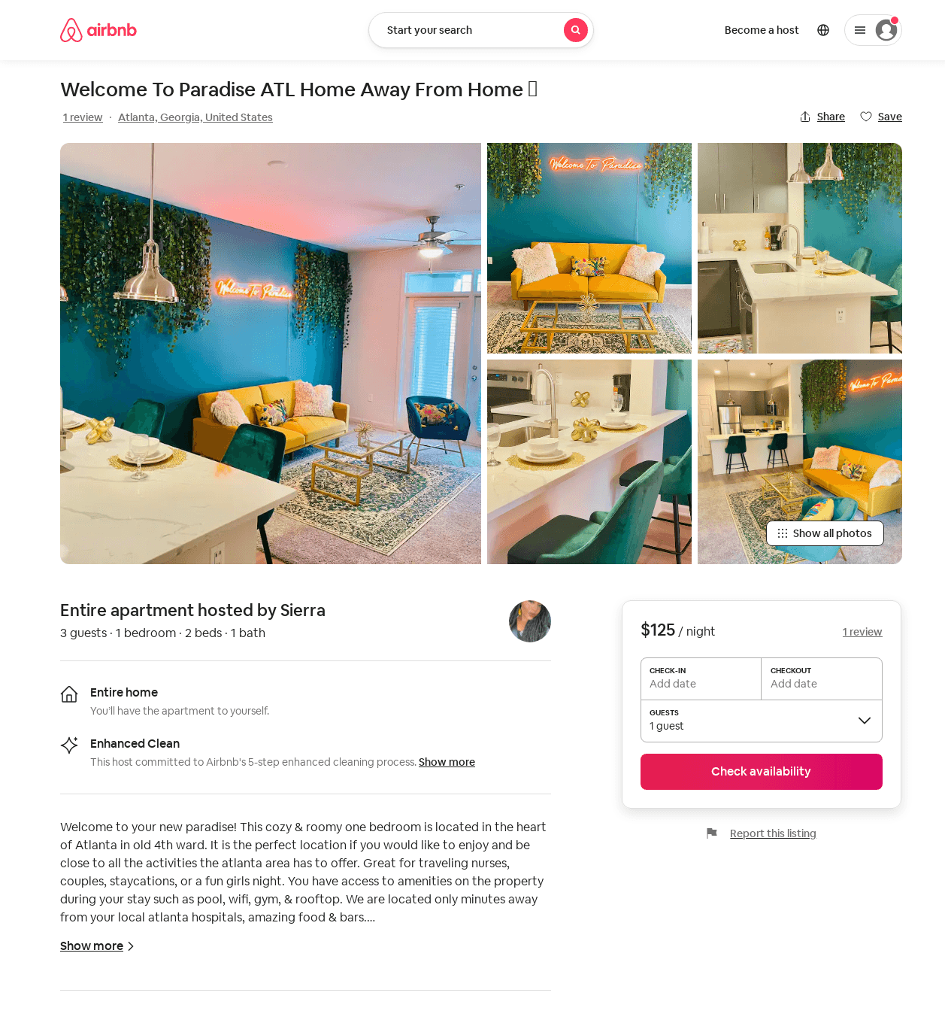
Listing 50311800
1
3
$99 - $157
4.81
1
Sierra
104147676
2
https://www.airbnb.com/rooms/50311800
Aug 2022

Slide 19
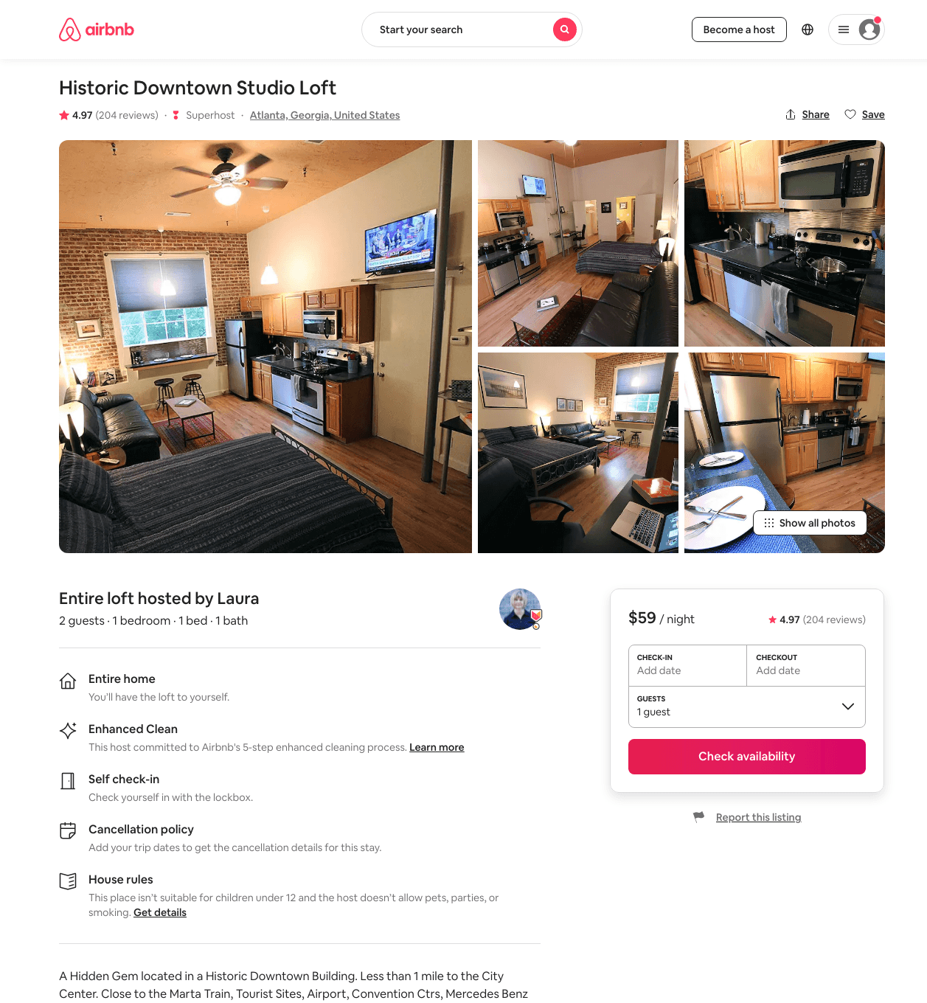
Listing 13312345
1
2
$59 - $87
4.97
3
Laura
30721929
2
https://www.airbnb.com/rooms/13312345
Aug 2022

Slide 20
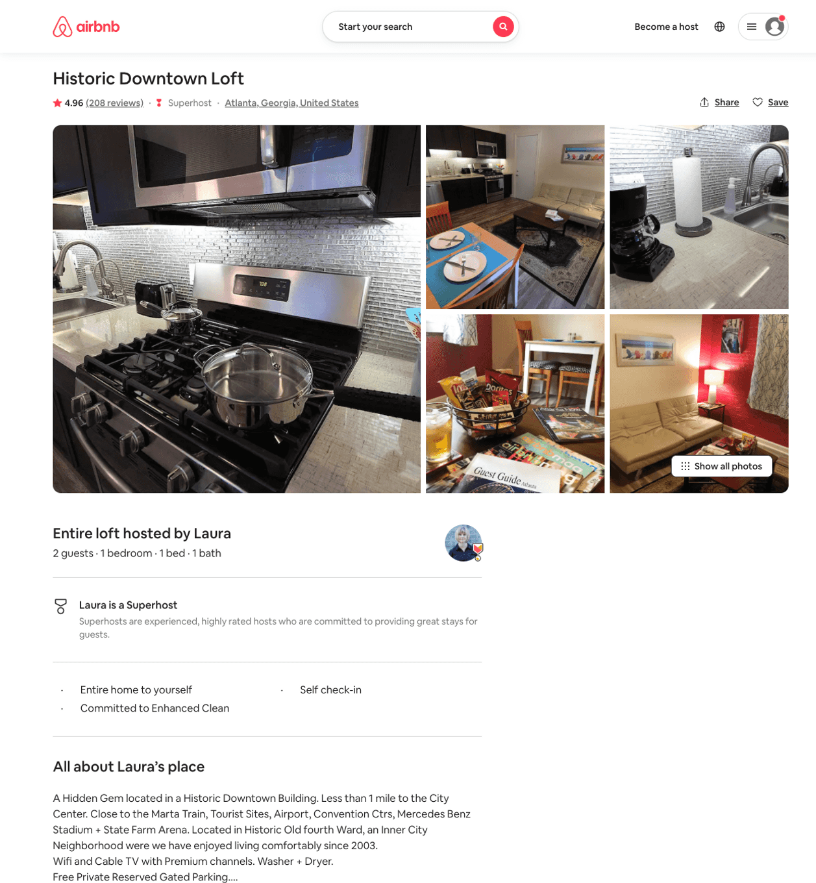
Listing 13452373
1
2
$80 - $89
4.95
3
Laura
30721929
2
https://www.airbnb.com/rooms/13452373
Aug 2022

Slide 21
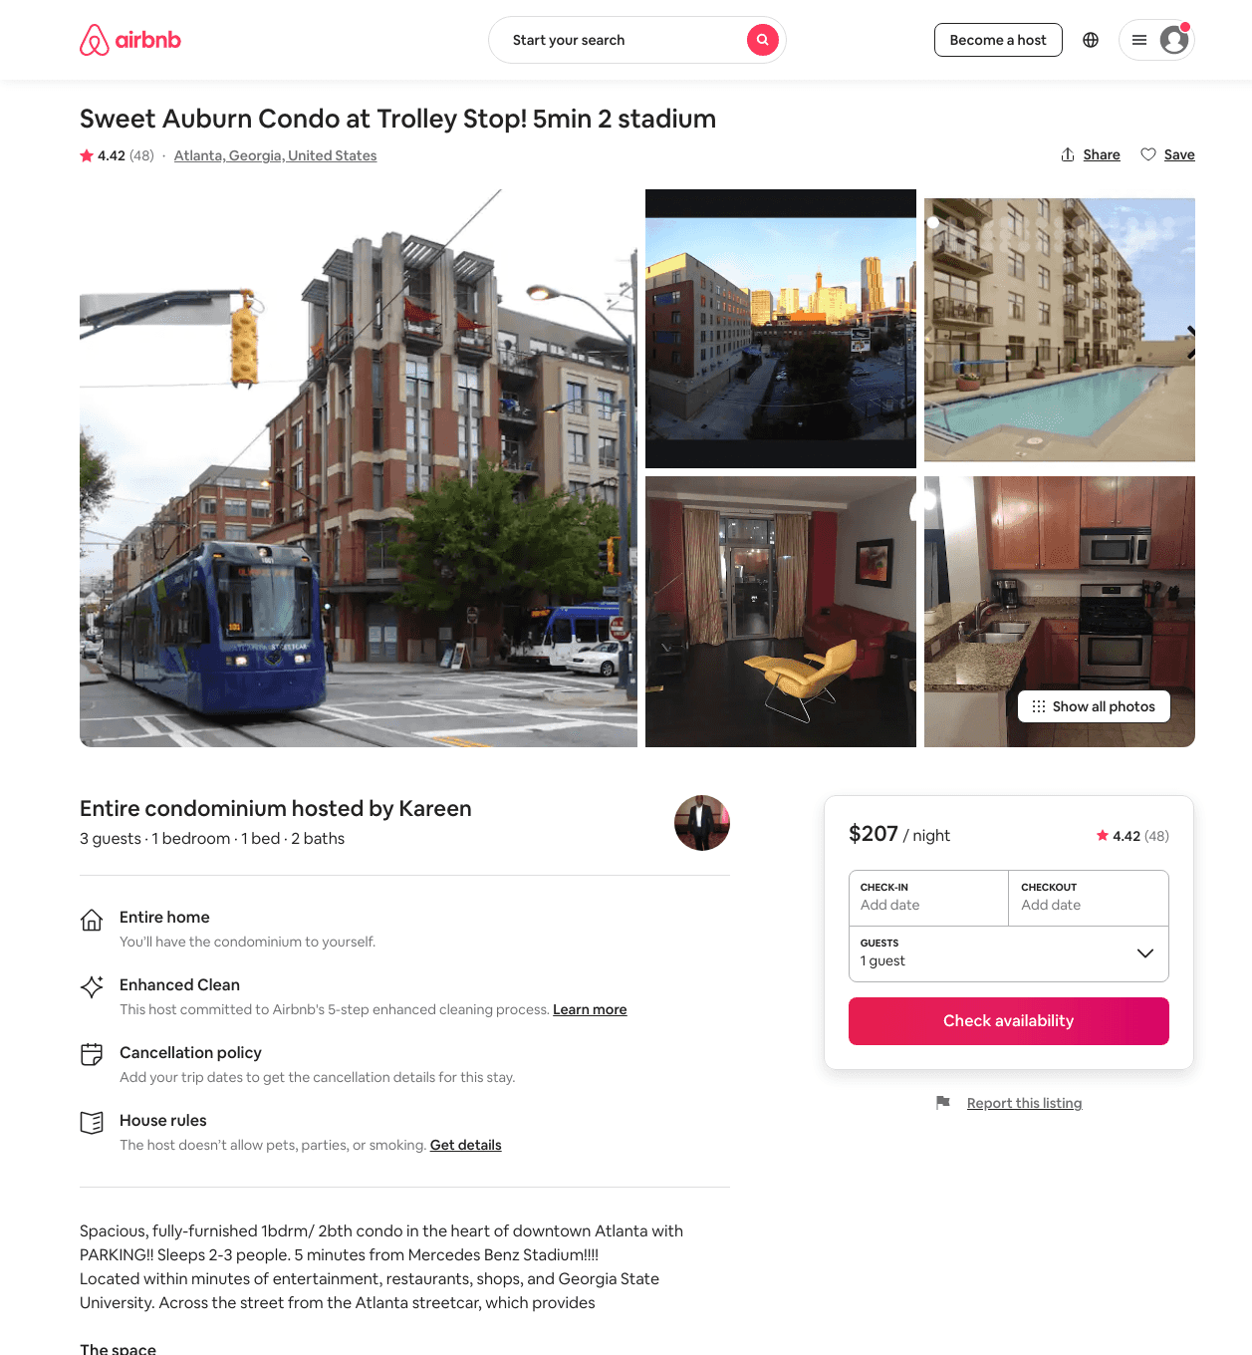
Listing 7971746
1
3
$207 - $350
4.43
2
Kareen
42065581
1
https://www.airbnb.com/rooms/7971746
Aug 2022

Slide 22
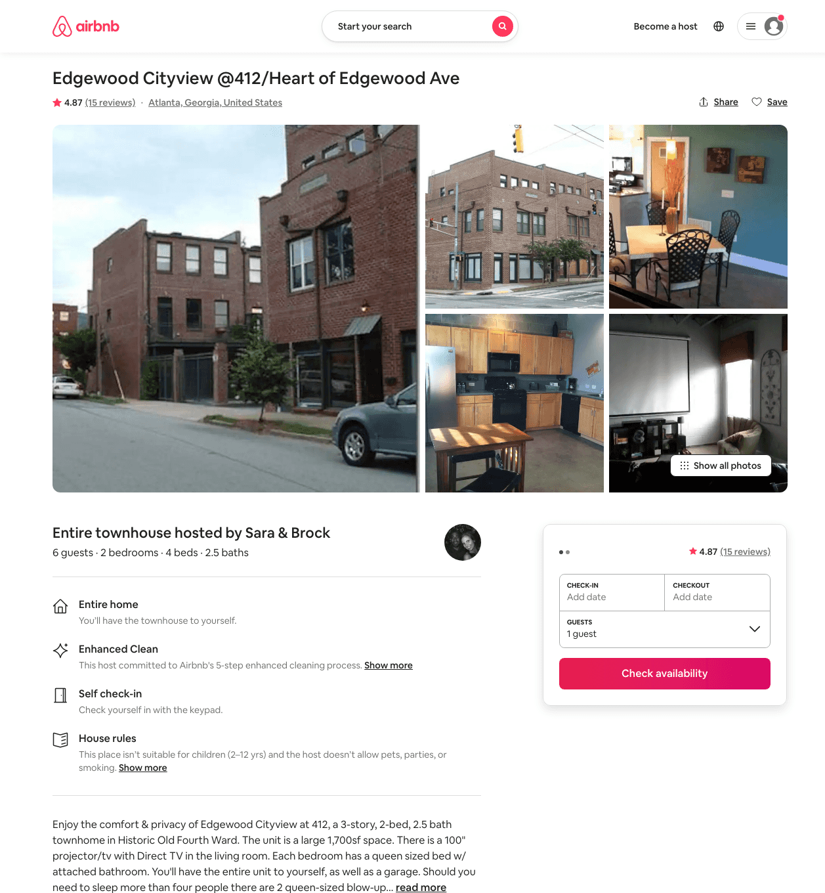
Listing 14368597
2
6
$214
4.87
2
Sara & Brock
88141545
1
https://www.airbnb.com/rooms/14368597
Jun 2022

Slide 23
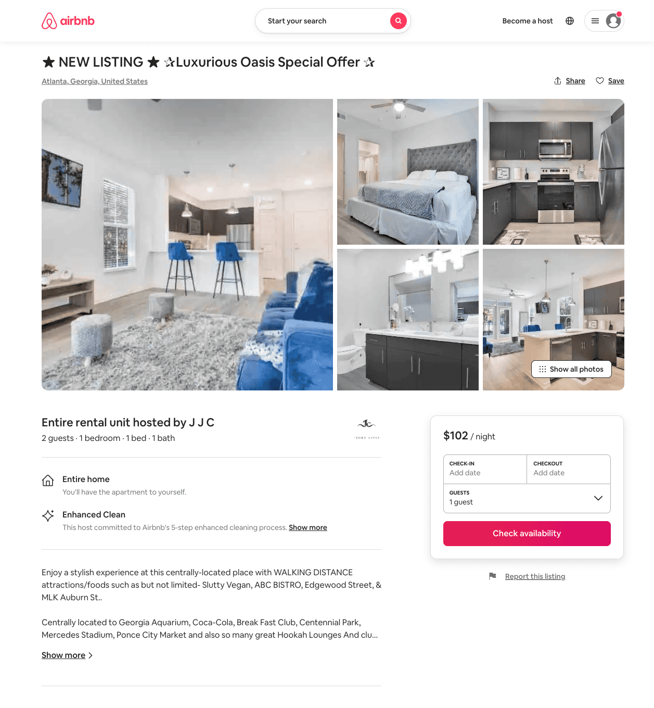
Listing 51048216
1
2
$79 - $137
4.53
2
Surety
375219116
2
https://www.airbnb.com/rooms/51048216
Aug 2022

Slide 24
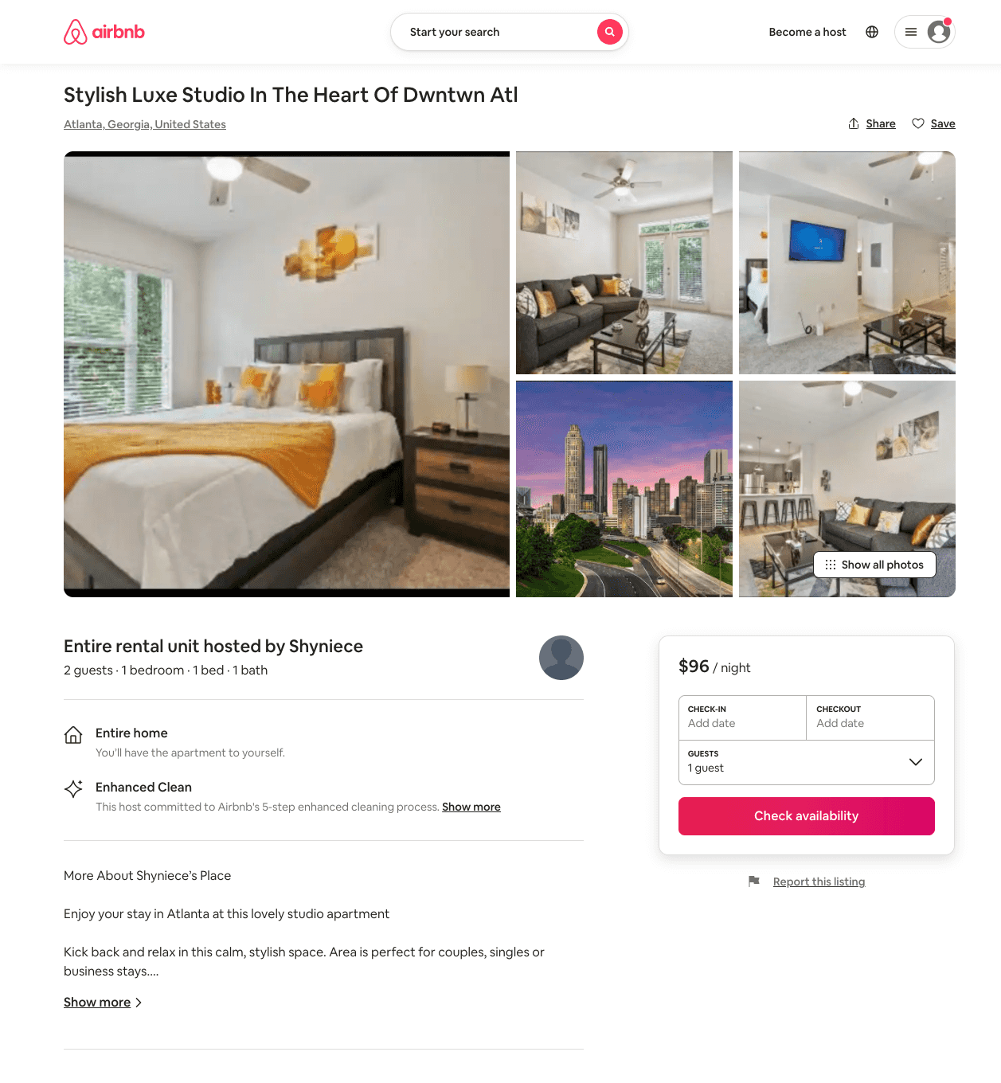
Listing 51016748
1
2
$84 - $117
4.69
1
Stylish Luxury
387016455
1
https://www.airbnb.com/rooms/51016748
Aug 2022

Slide 25
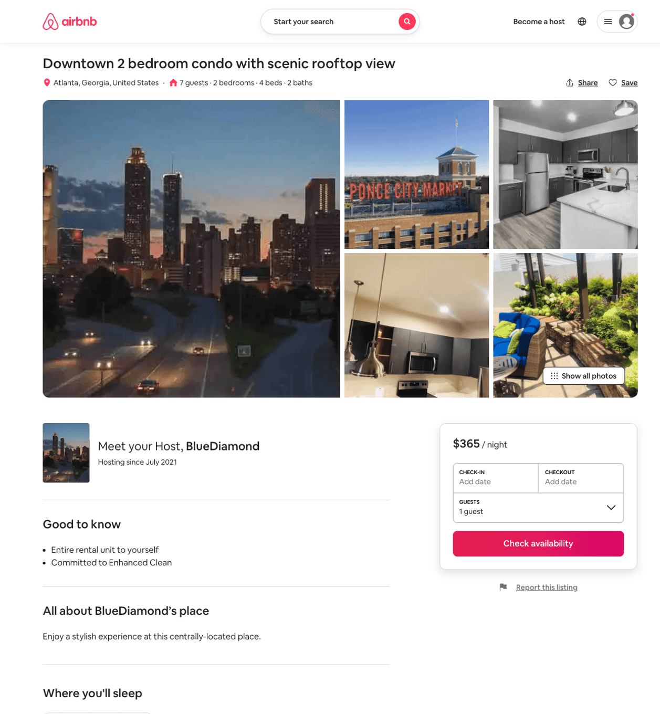
Listing 51312218
2
6
$220 - $365
4.67
2
BlueDiamond
415568098
1
https://www.airbnb.com/rooms/51312218
Aug 2022

Slide 26
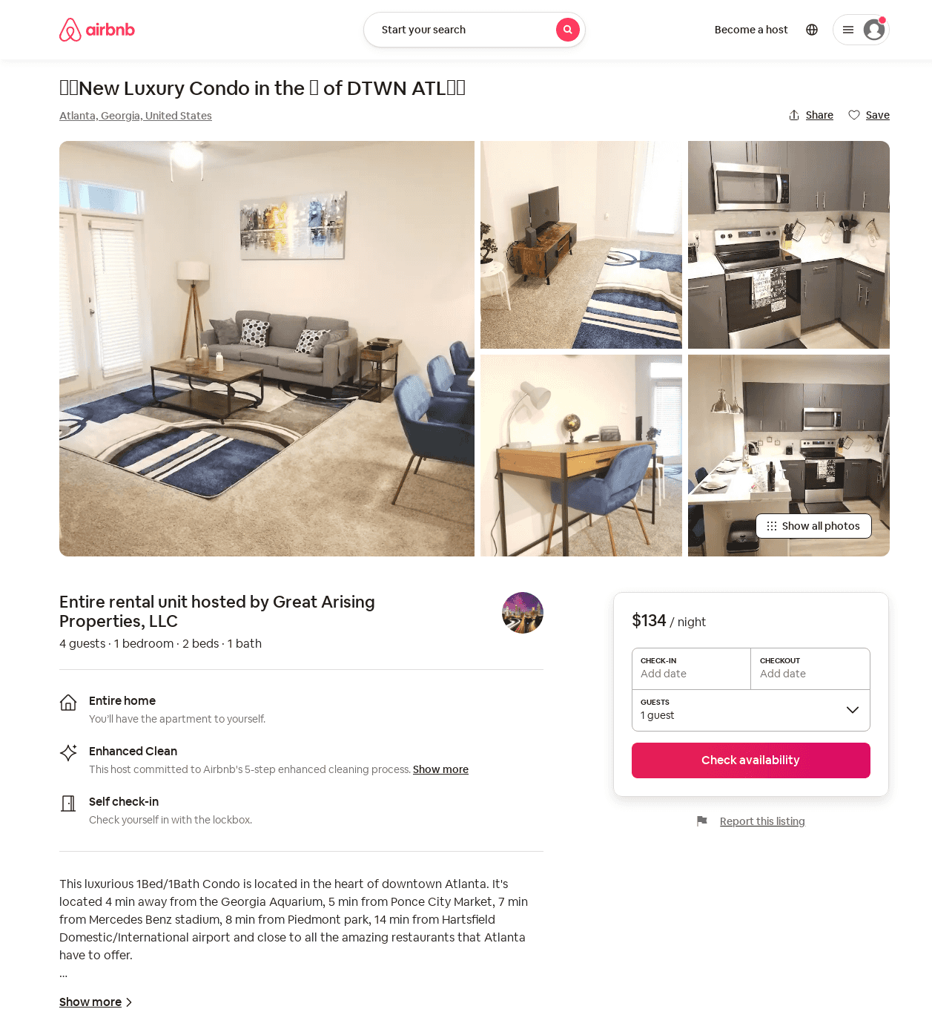
Listing 51862372
1
4
$89 - $134
4.77
1
Great Arising Properties, LLC
235988403
1
https://www.airbnb.com/rooms/51862372
Aug 2022

Slide 27
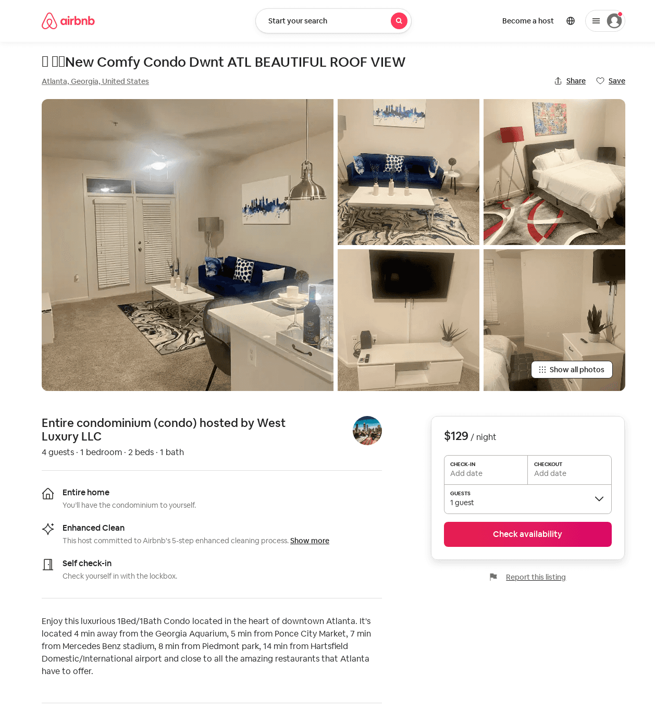
Listing 52352410
1
4
$92 - $150
4.78
2
West Luxury LLC
182518663
1
https://www.airbnb.com/rooms/52352410
Aug 2022

Slide 28
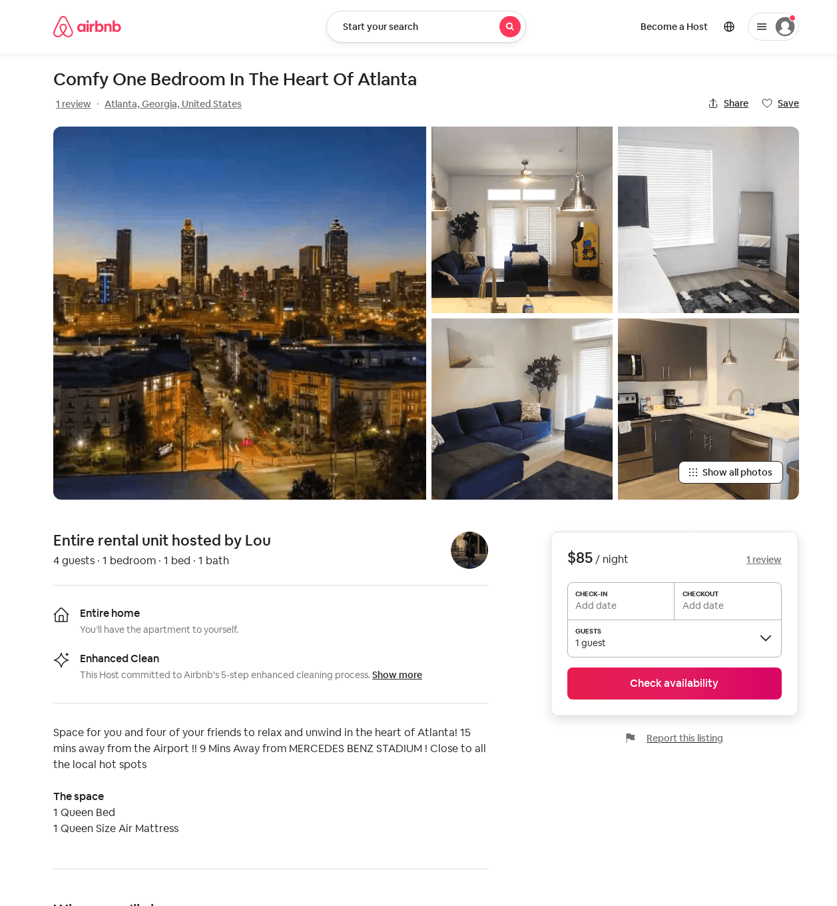
Listing 51350095
1
4
$85 - $89
4.78
1
Lou
245212978
1
https://www.airbnb.com/rooms/51350095
Aug 2022

Slide 29
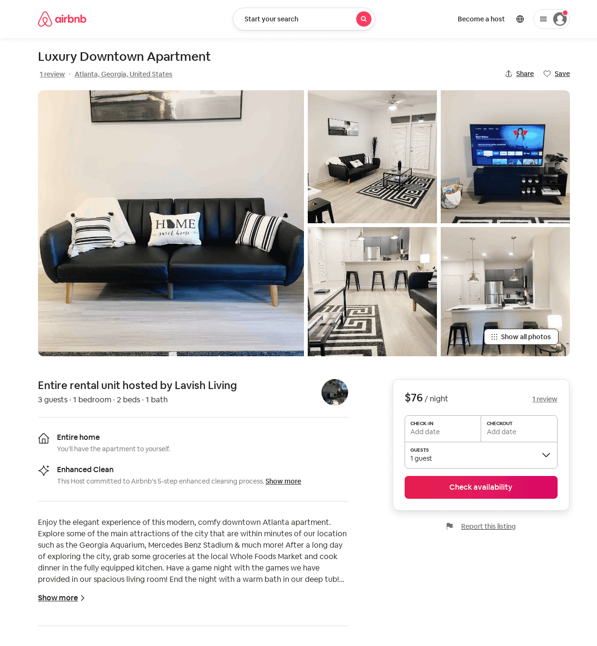
Listing 52719946
1
3
$76 - $391
4.86
1
Lavish Living
198492013
1
https://www.airbnb.com/rooms/52719946
Aug 2022

Slide 30
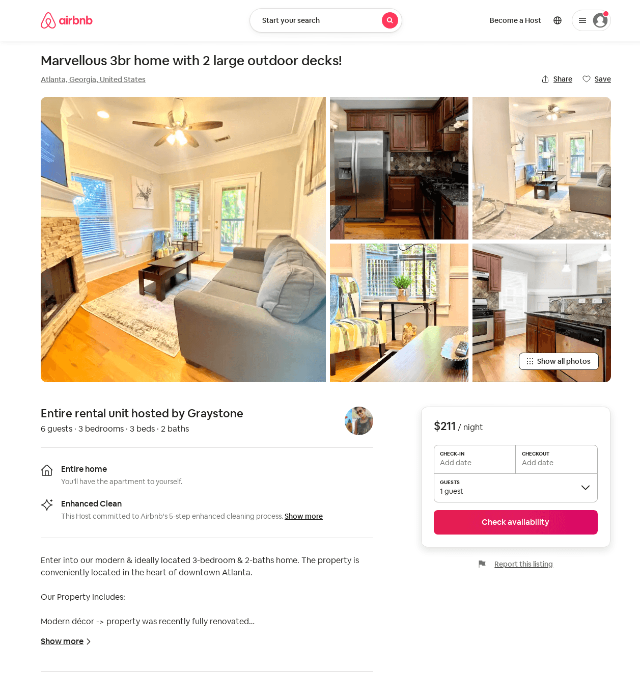
Listing 52446059
3
6
$172 - $264
4.90
3
Graystone Properties
424504497
1
https://www.airbnb.com/rooms/52446059
Aug 2022

Slide 31
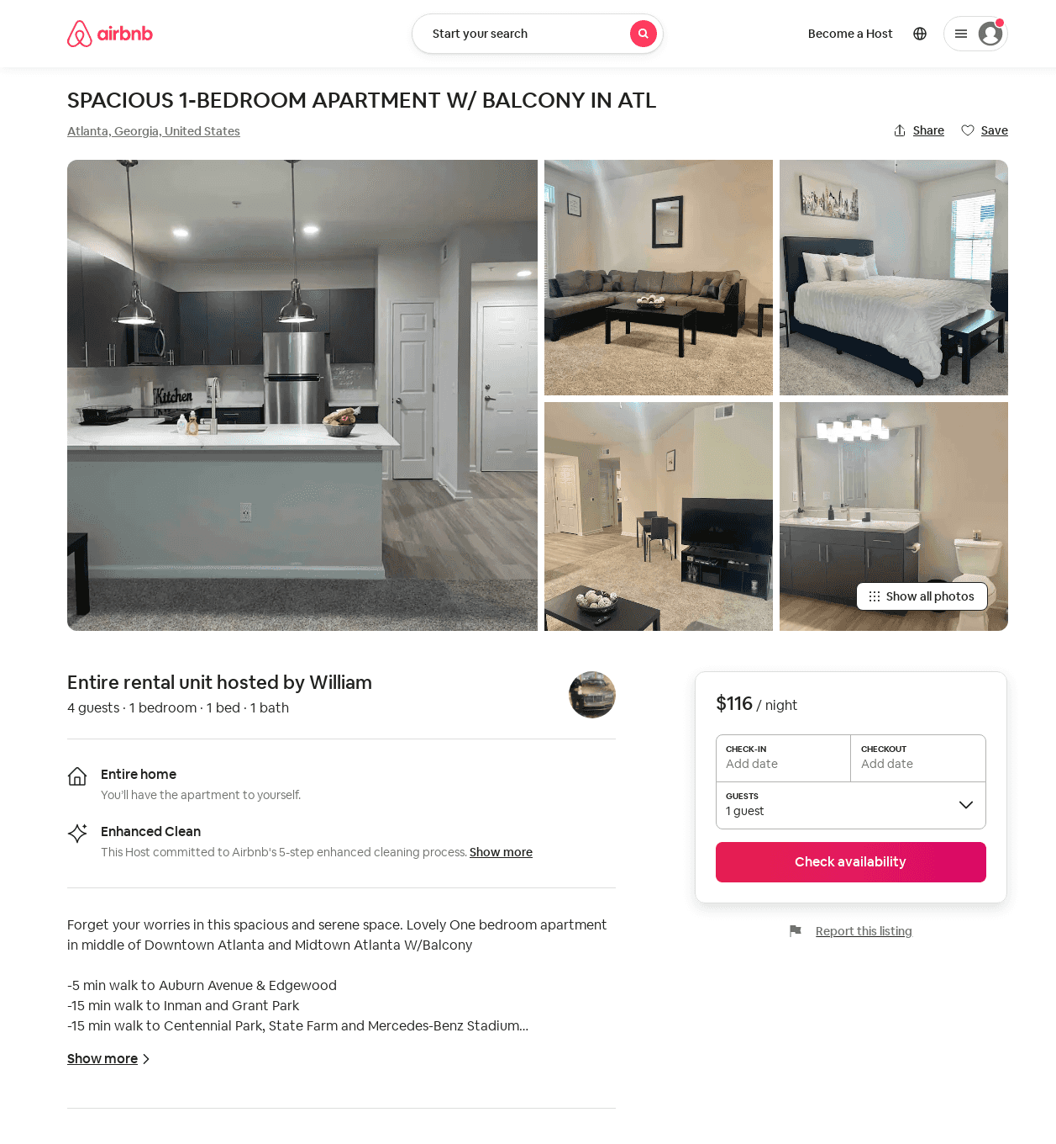
Listing 52147554
1
4
$86 - $116
4.78
1
Rich
349101316
1
https://www.airbnb.com/rooms/52147554
Aug 2022

Slide 32
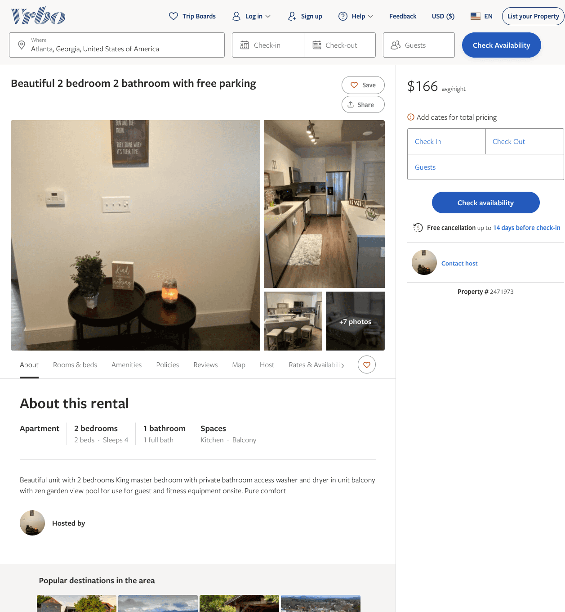
Listing 2471973
2
4
$166 - $169
2
https://www.vrbo.com/2471973
Aug 2022

Slide 33
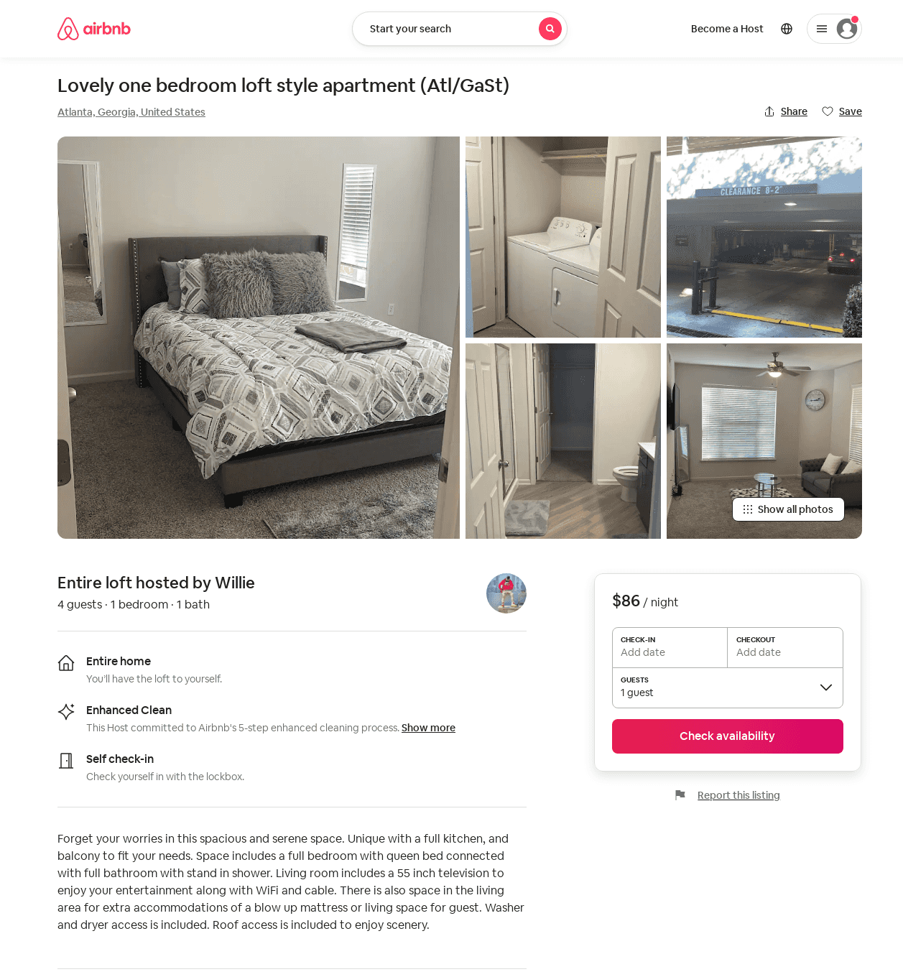
Listing 53299897
1
4
$69 - $127
4.65
1
Willie
431518422
1
https://www.airbnb.com/rooms/53299897
Aug 2022

Slide 34
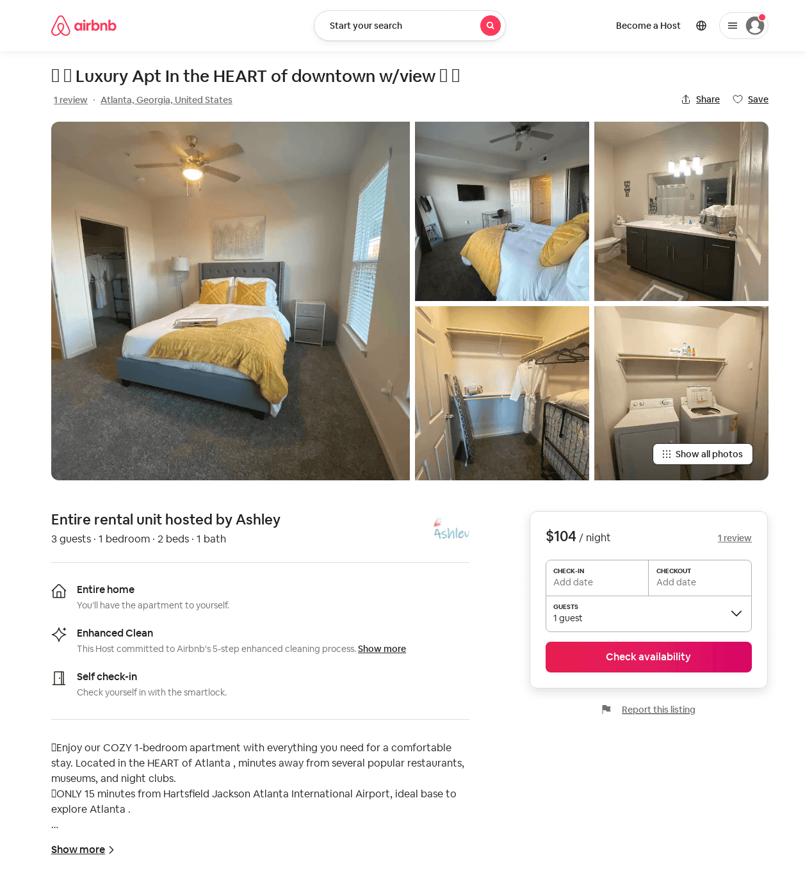
Listing 52753164
1
3
$92 - $121
4.93
3
Ashley
207774216
2
https://www.airbnb.com/rooms/52753164
Jul 2022

Slide 35
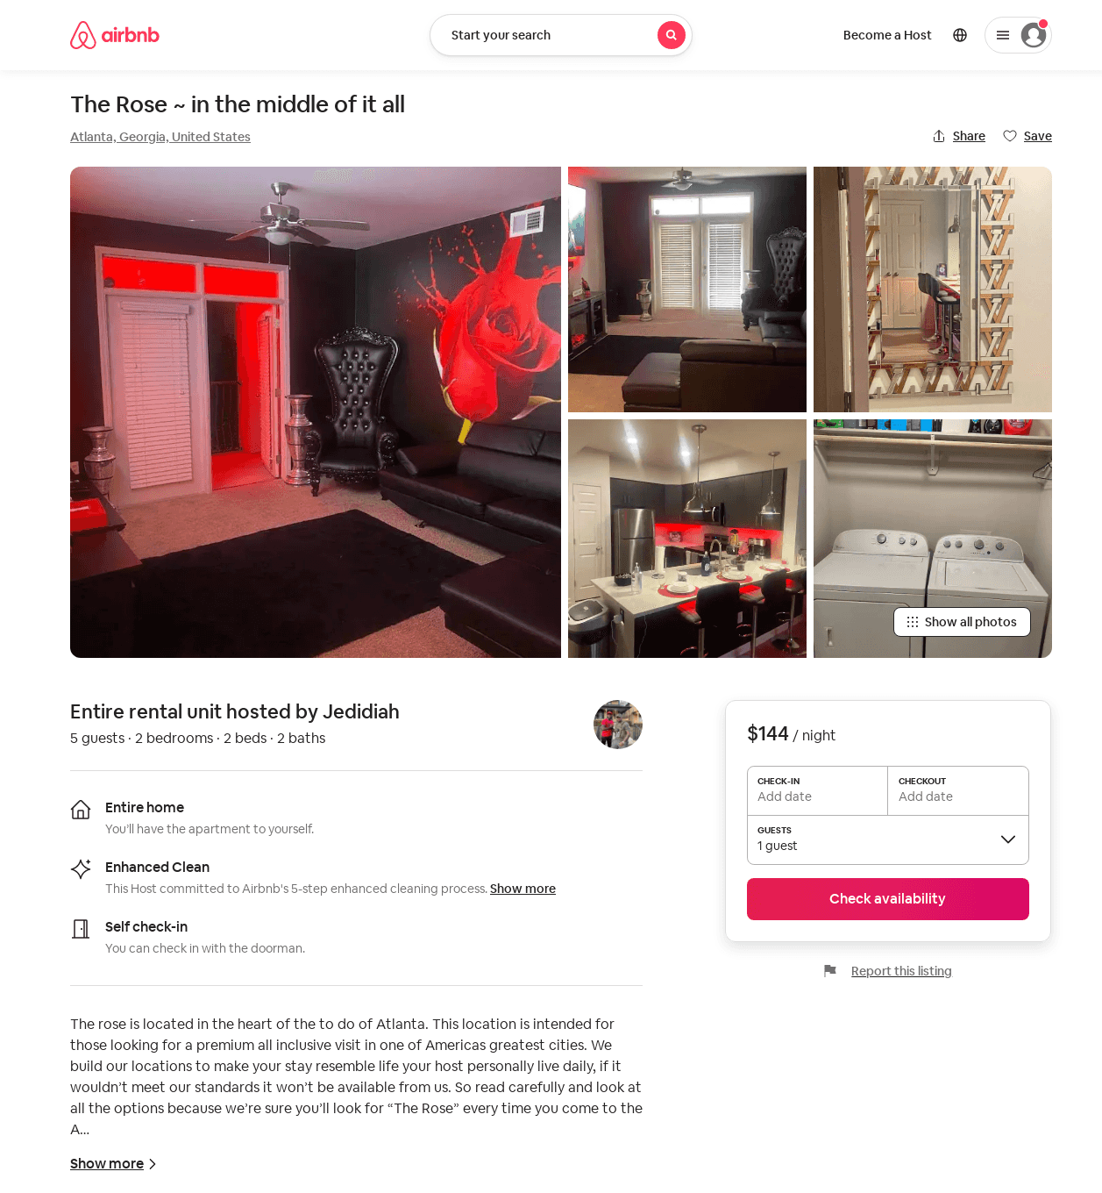
Listing 49713055
2
5
$107 - $221
1
Jedidiah
106406768
2
https://www.airbnb.com/rooms/49713055
Jun 2022

Slide 36
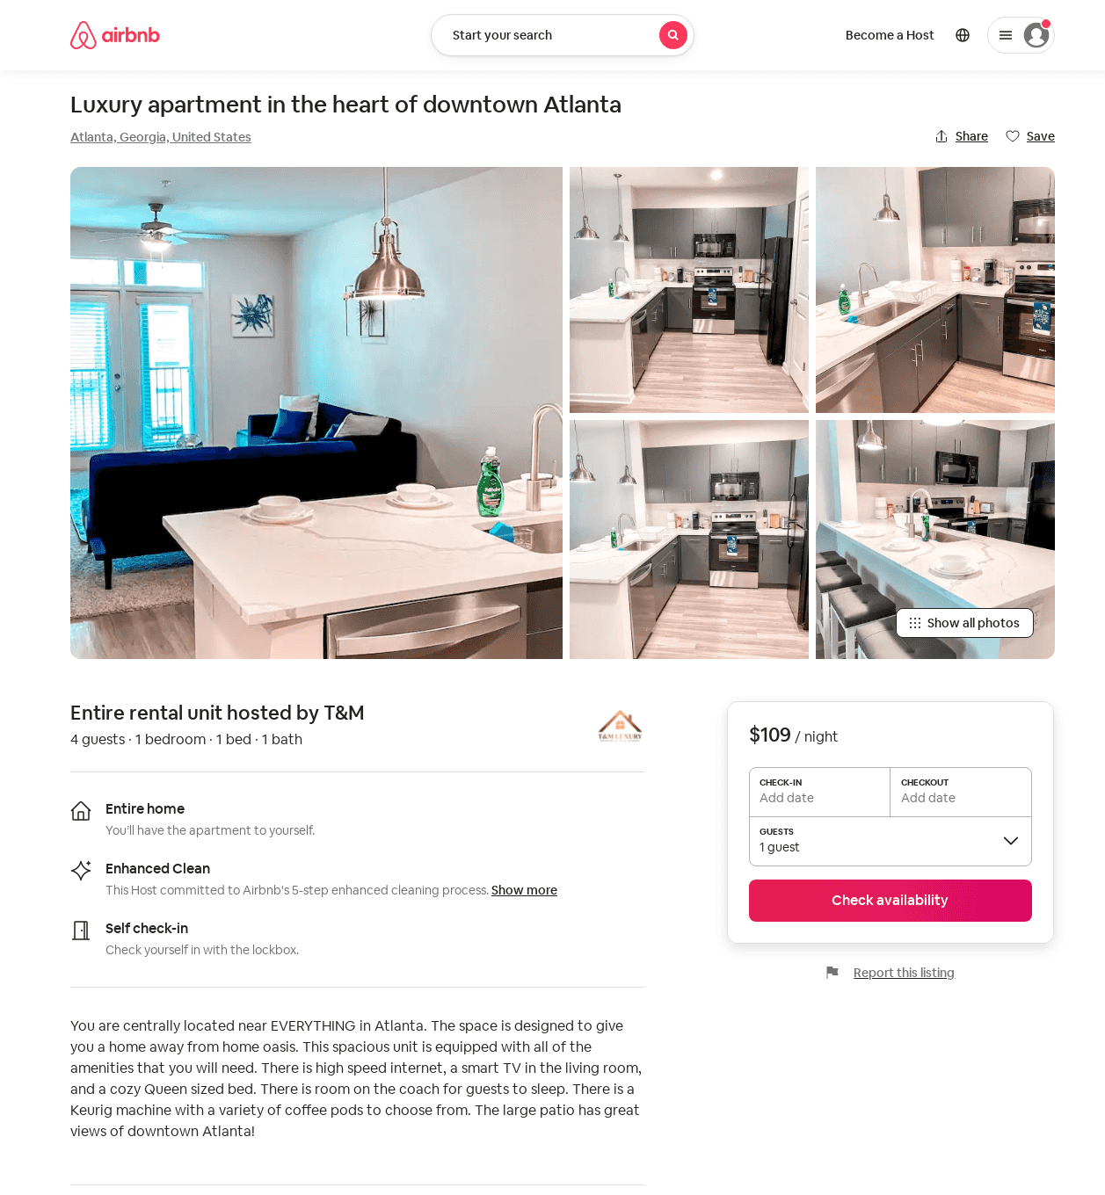
Listing 52443074
1
4
$81 - $134
4.84
1
T&M
424474823
1
https://www.airbnb.com/rooms/52443074
Aug 2022

Slide 37
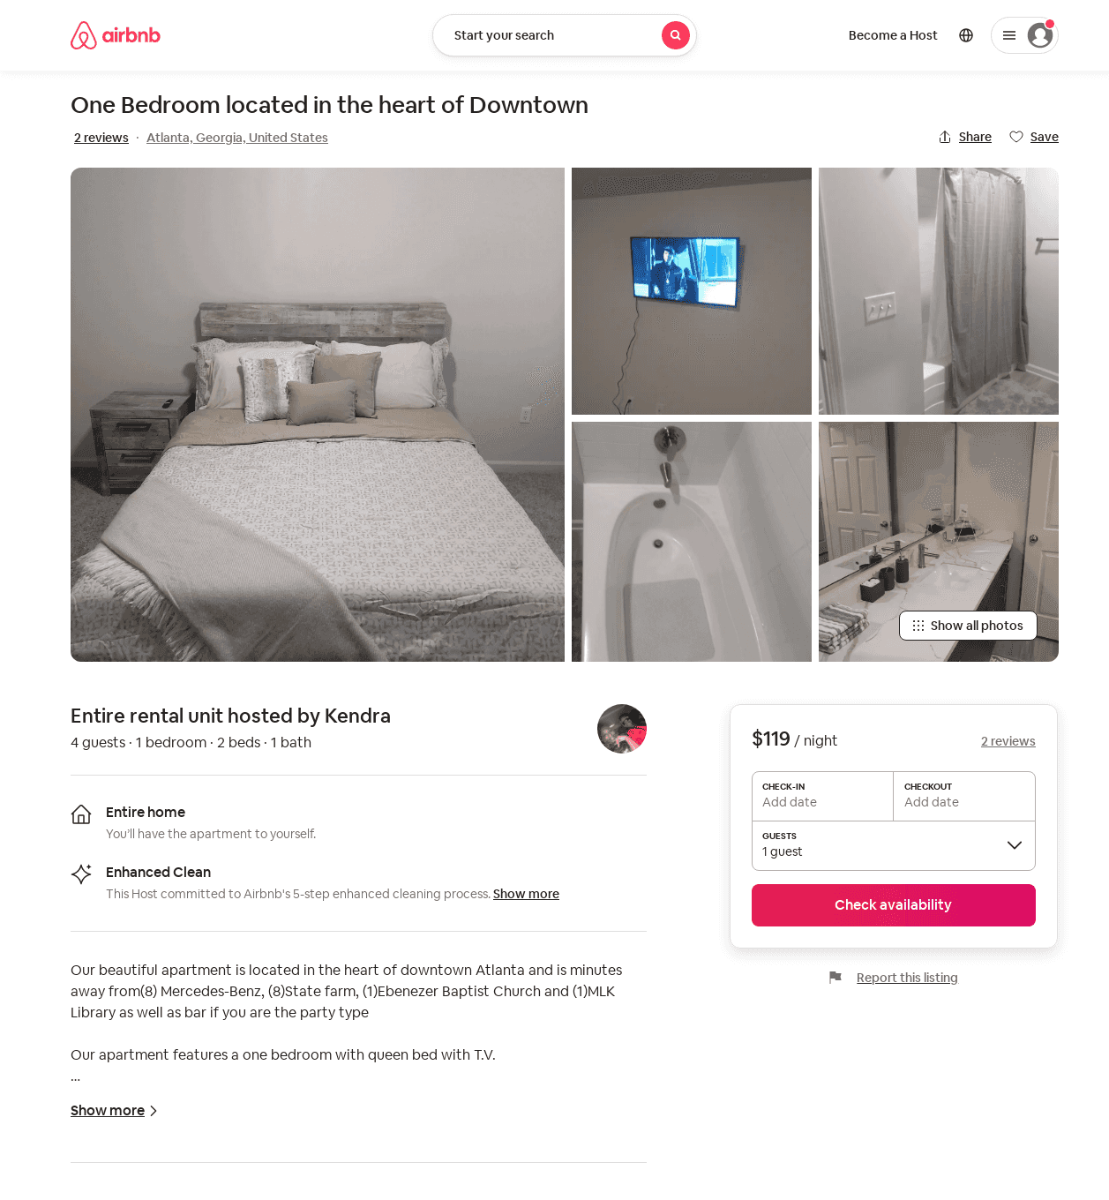
Listing 53461744
1
4
$110 - $130
5.0
3
Kendra
121356680
1
https://www.airbnb.com/rooms/53461744
Jun 2022

Slide 38
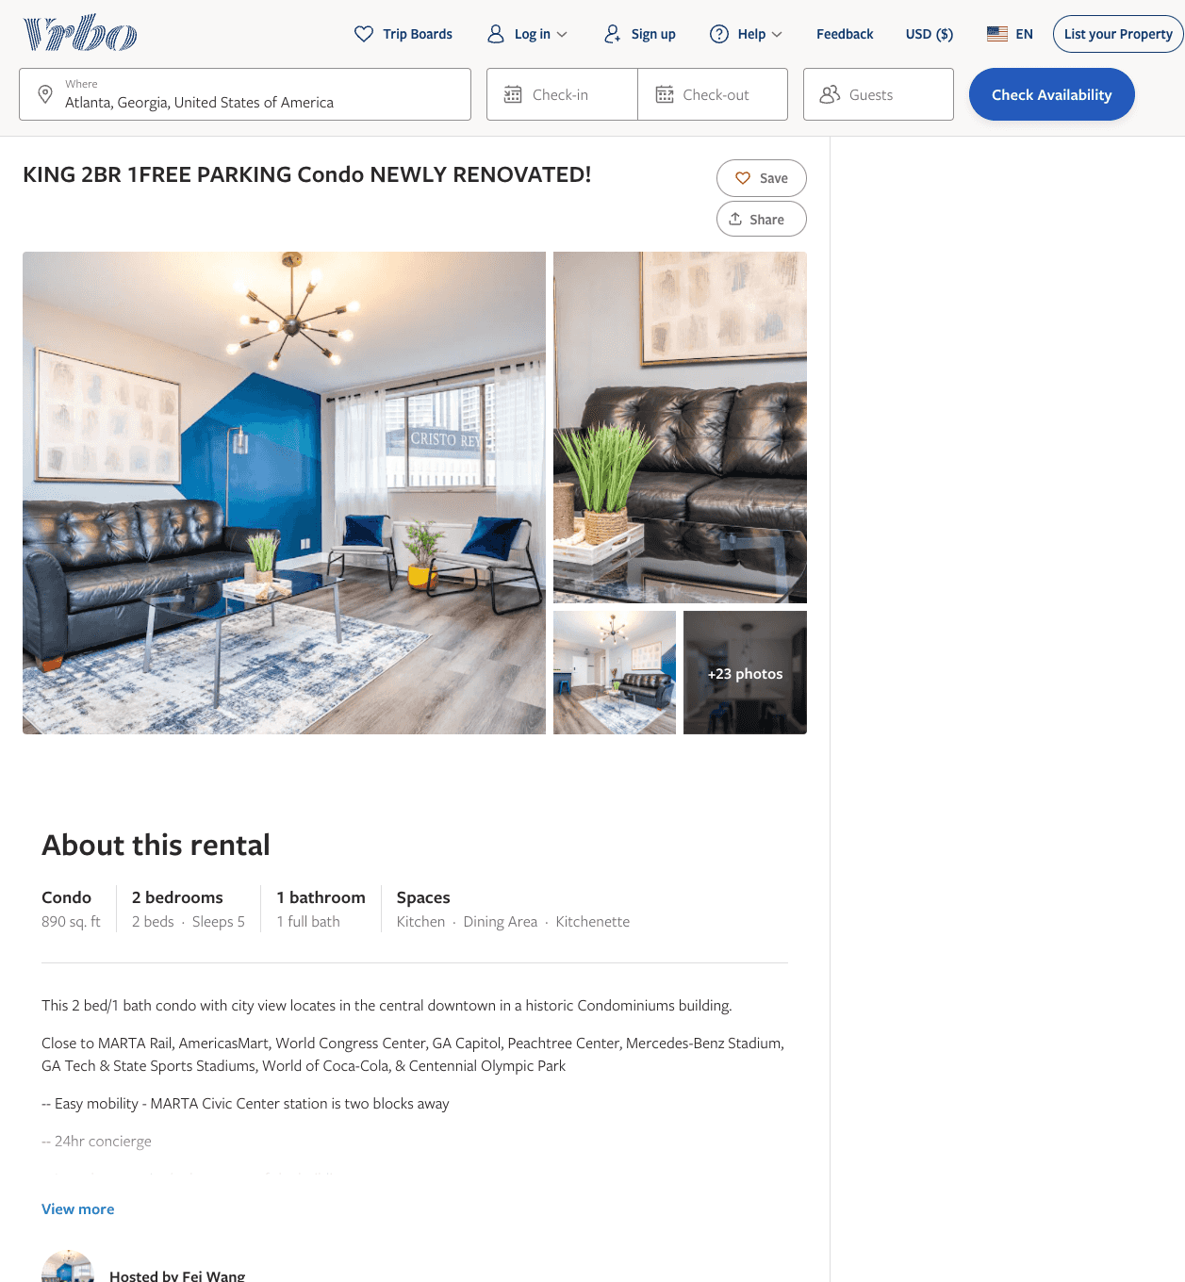
Listing 2598573
2
5
$148 - $177
3.5
1
Fei Wang
https://www.vrbo.com/2598573
Aug 2022

Slide 39
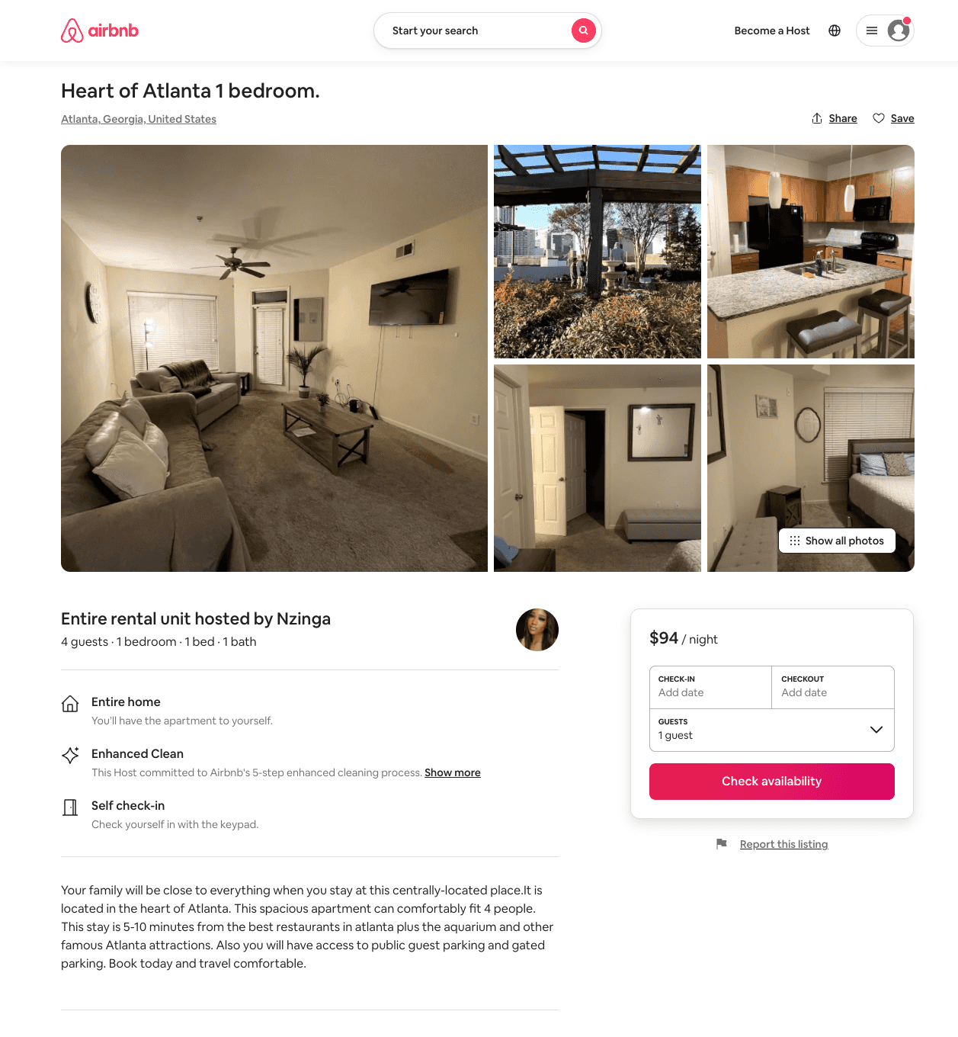
Listing 52108952
1
4
$94
1
Nzinga
306926236
1
https://www.airbnb.com/rooms/52108952
Jul 2022

Slide 40
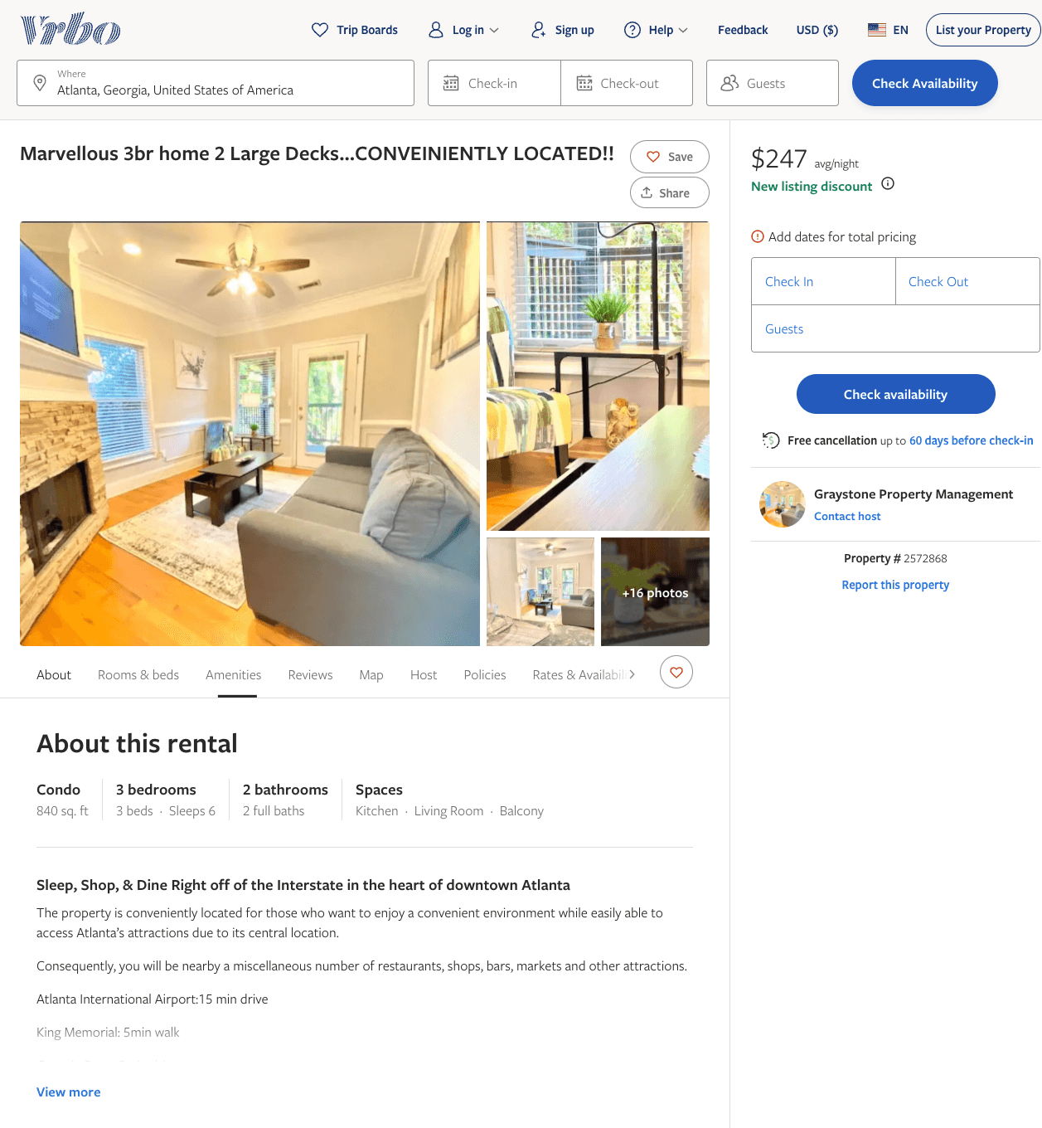
Listing 2572868
3
6
$259
4.5
1
Graystone Property Management
https://www.vrbo.com/2572868
Aug 2022

Slide 41
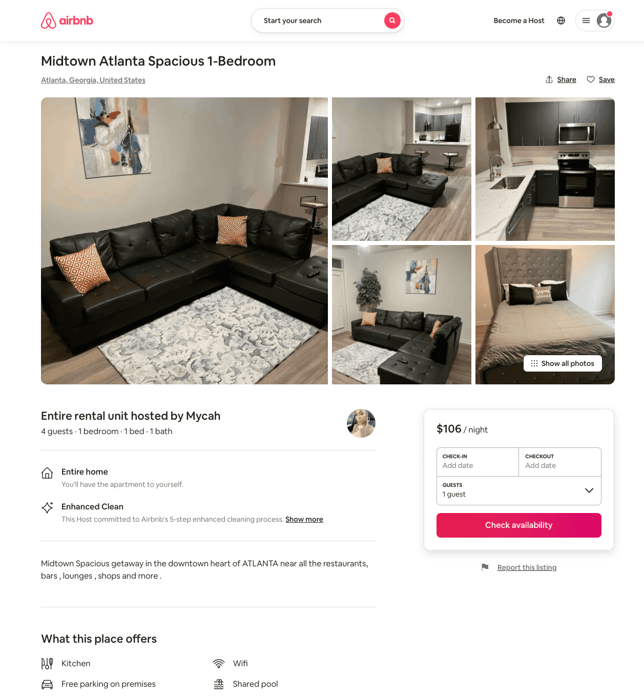
Listing 54164499
1
4
$106
3
Mycah
168185412
2
https://www.airbnb.com/rooms/54164499
Aug 2022

Slide 42
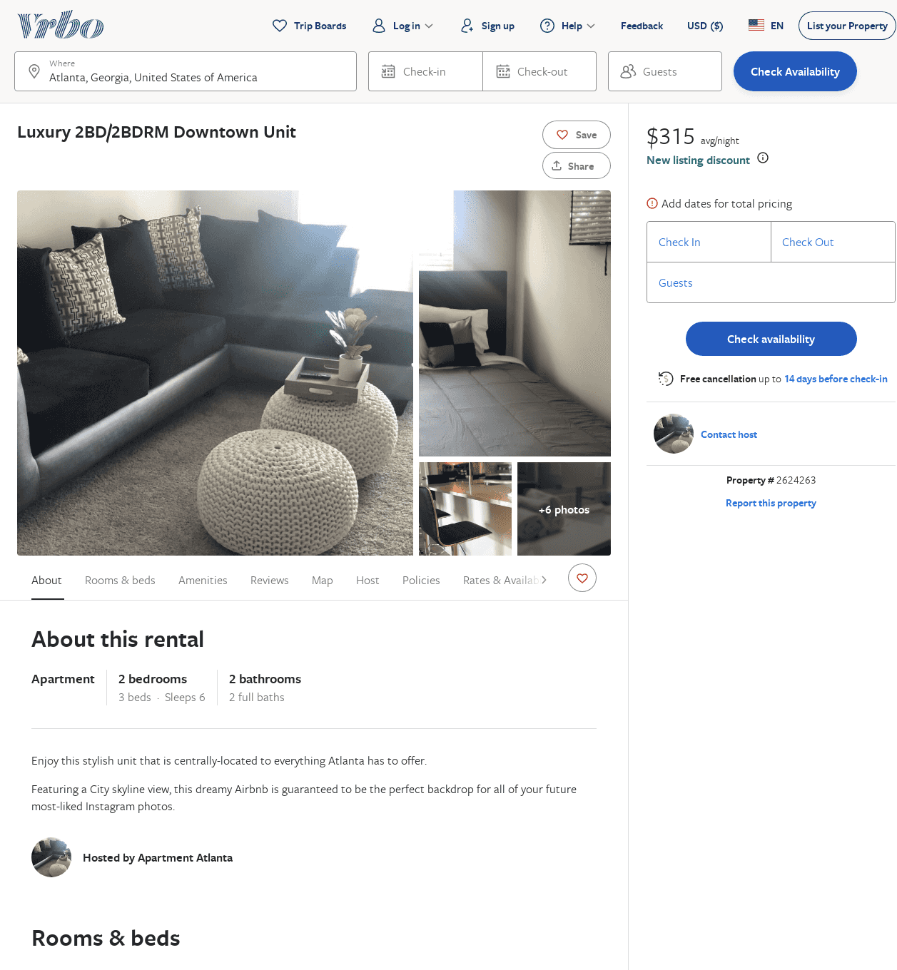
Listing 2624263
2
6
$315
2
https://www.vrbo.com/2624263
Aug 2022

Slide 43
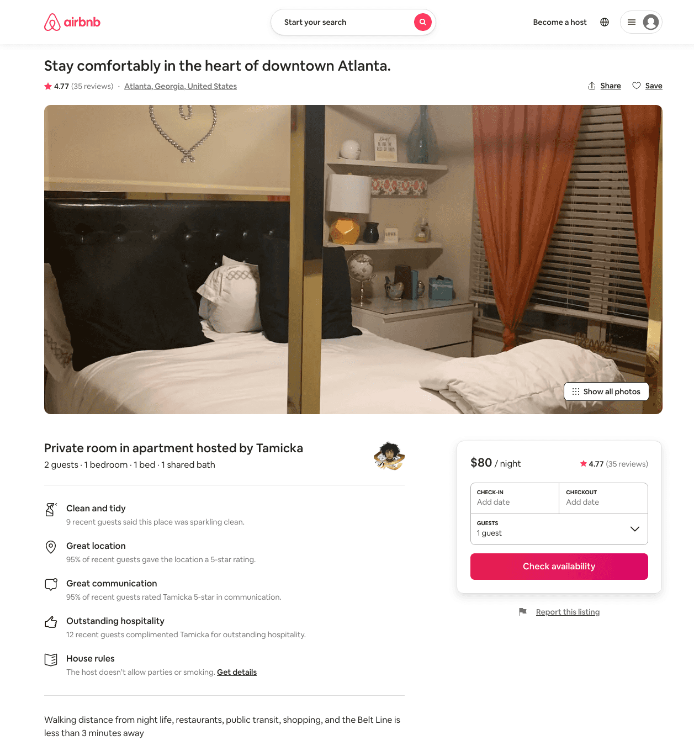
Listing 38964075
1
2
$80 - $100
4.74
1
The 25th Dynasty
57612258
1
https://www.airbnb.com/rooms/38964075
Aug 2022

Slide 44
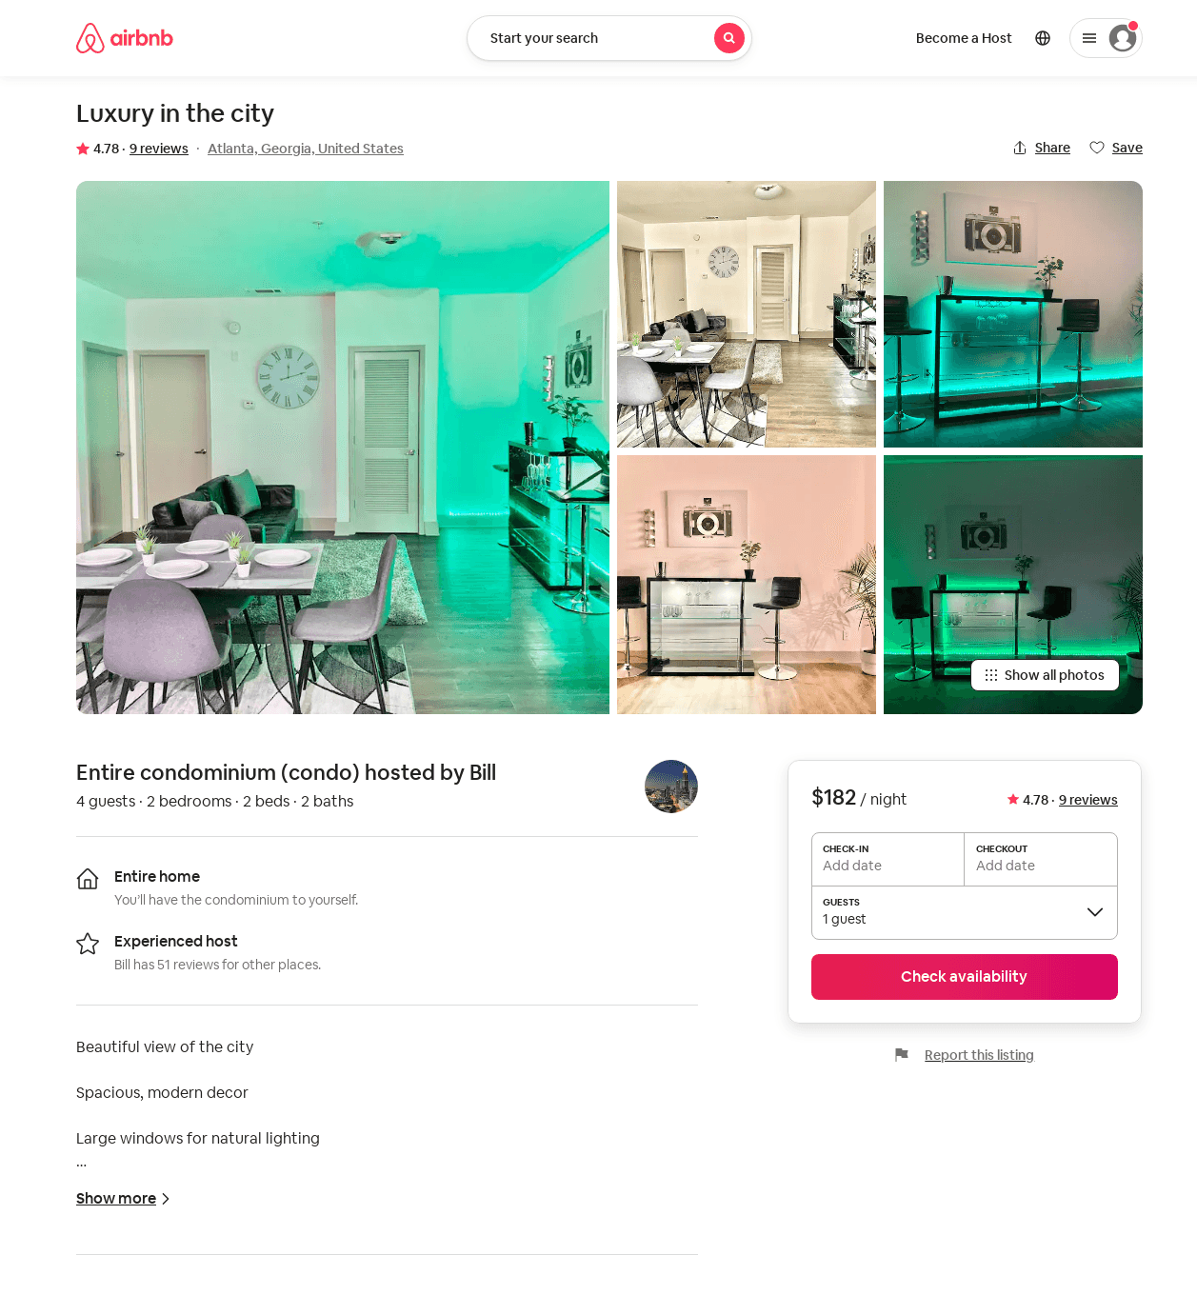
Listing 46021931
2
4
$161 - $183
4.80
1
Bill
122871783
2
https://www.airbnb.com/rooms/46021931
Aug 2022

Slide 45
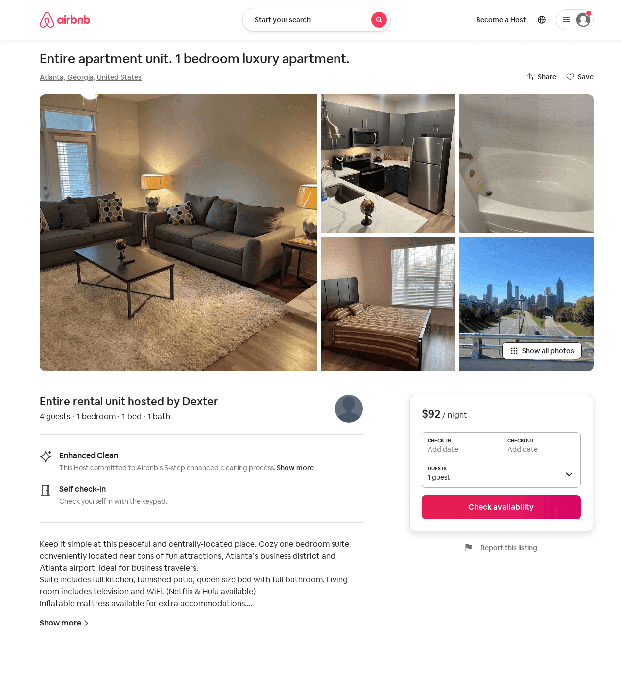
Listing 53877903
1
4
$64 - $103
4.50
1
Dexter
436416639
1
https://www.airbnb.com/rooms/53877903
Aug 2022

Slide 46
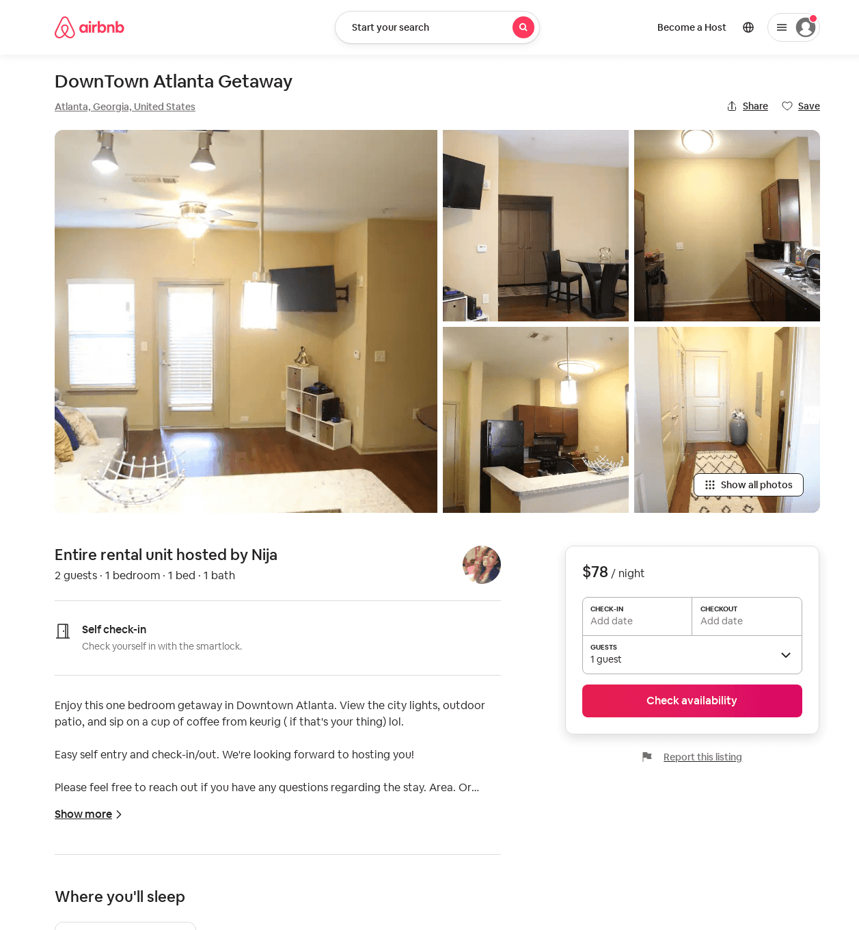
Listing 24115596
1
2
$71 - $100
4.84
2
Nija
141593294
1
https://www.airbnb.com/rooms/24115596
Aug 2022

Slide 47
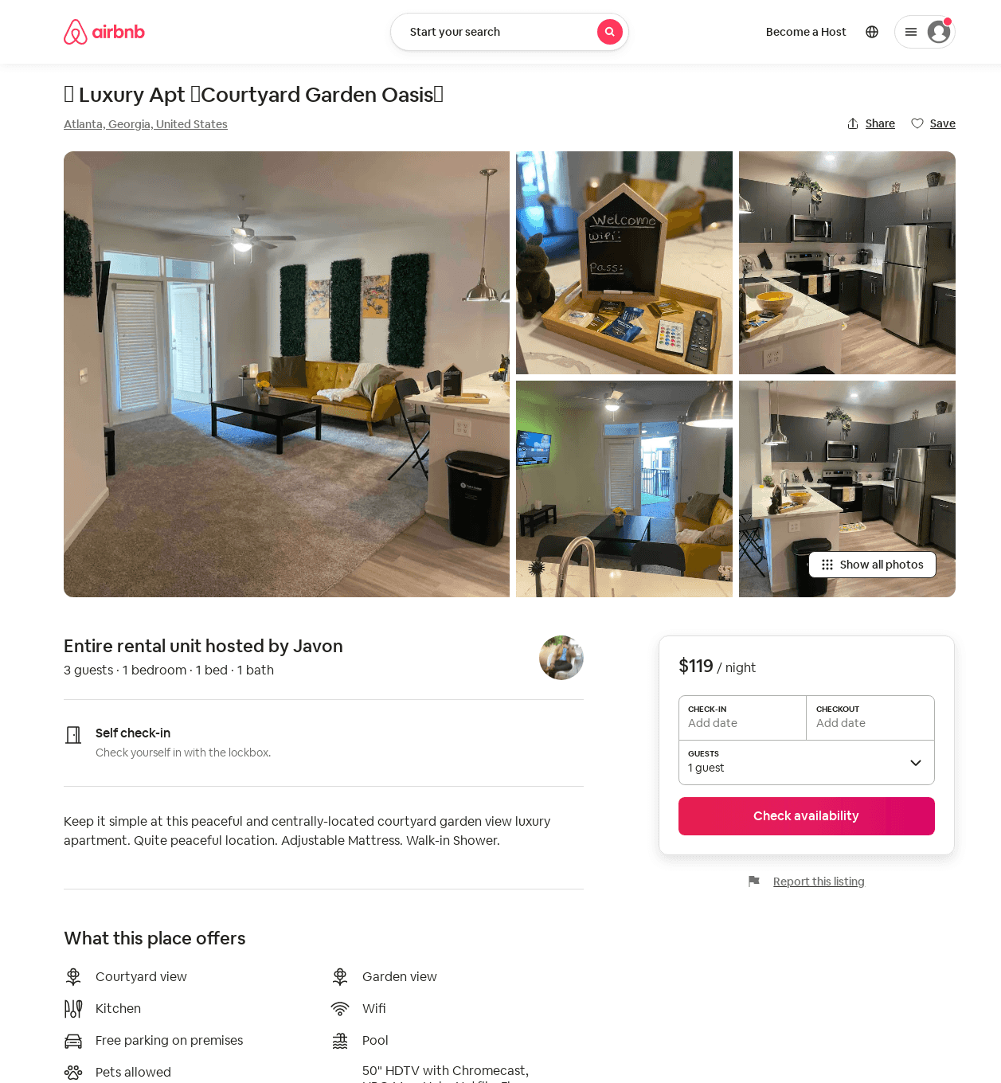
Listing 53479934
1
3
$81 - $119
4.90
3
Javon And Jalia
303329240
1
https://www.airbnb.com/rooms/53479934
Aug 2022

Slide 48
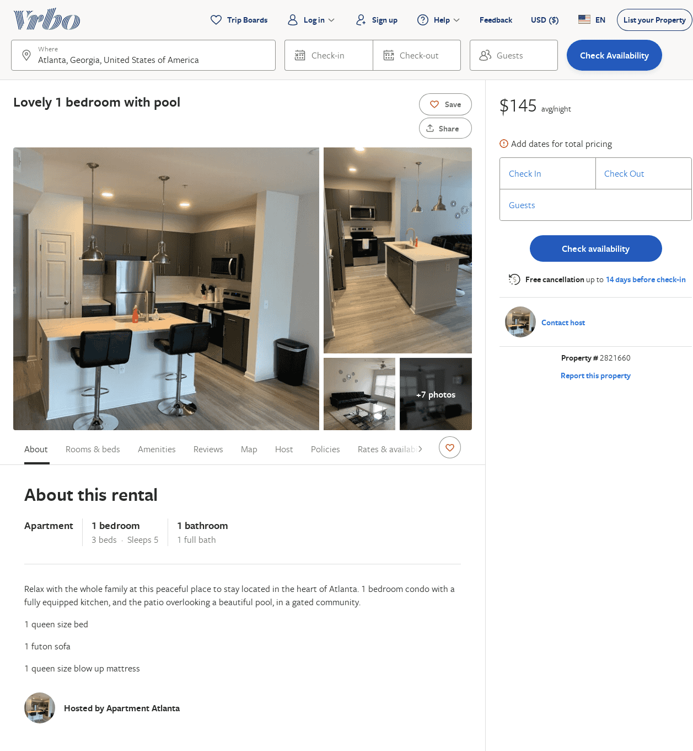
Listing 2821660
1
5
$145
2
Azhanee Scott
https://www.vrbo.com/2821660
Aug 2022

Slide 49
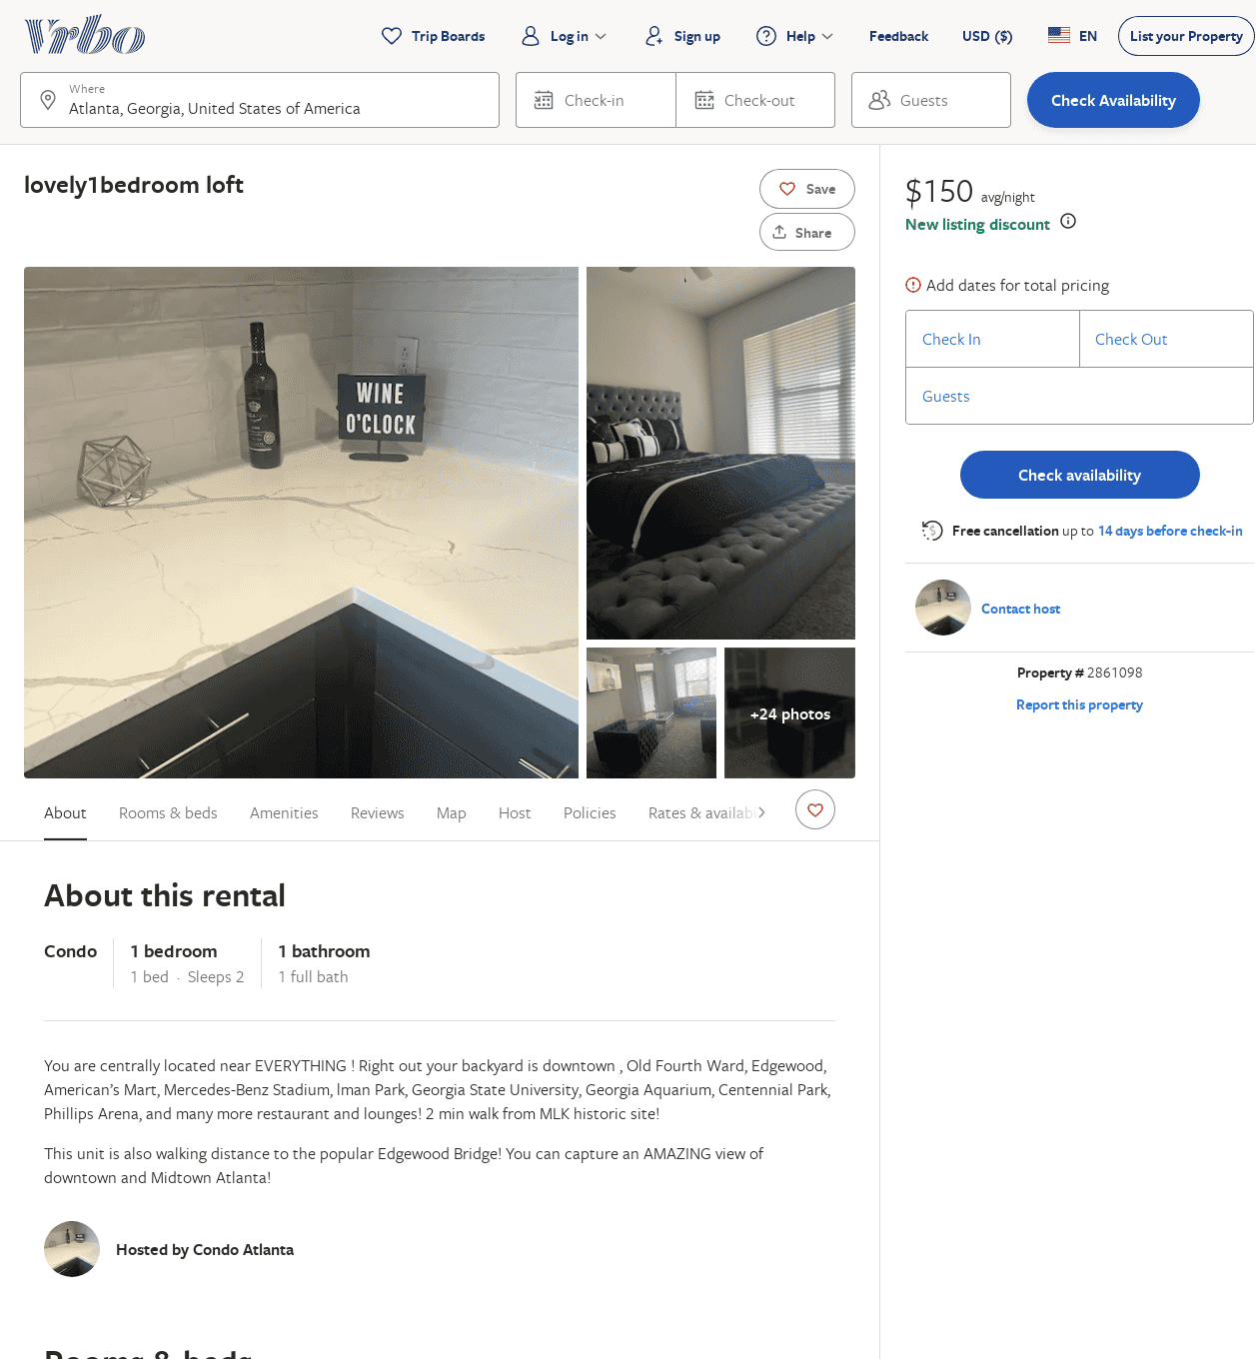
Listing 2861098
1
2
$80
4
2
https://www.vrbo.com/2861098
Aug 2022

Slide 50
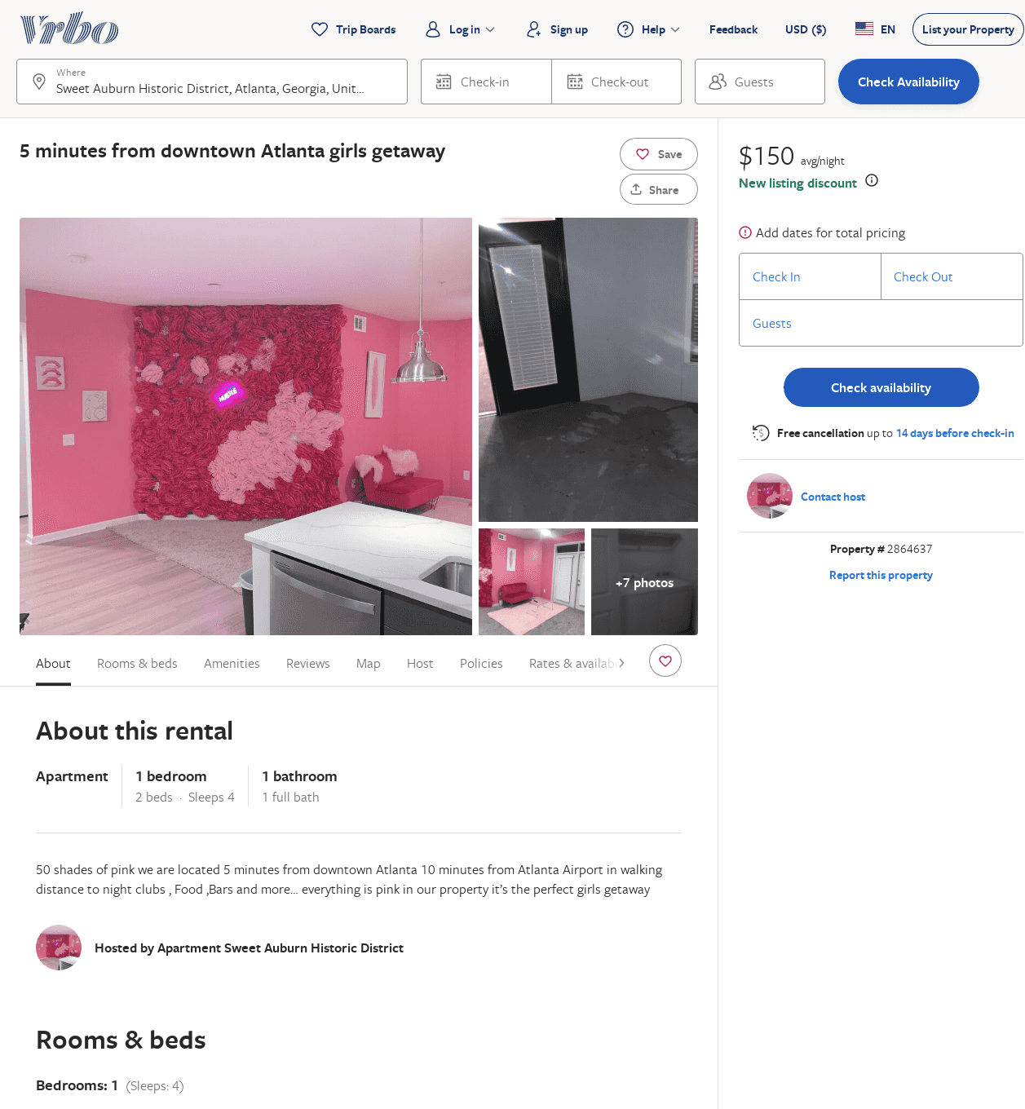
Listing 2864637
1
4
$150
3
https://www.vrbo.com/2864637
Aug 2022

Slide 51
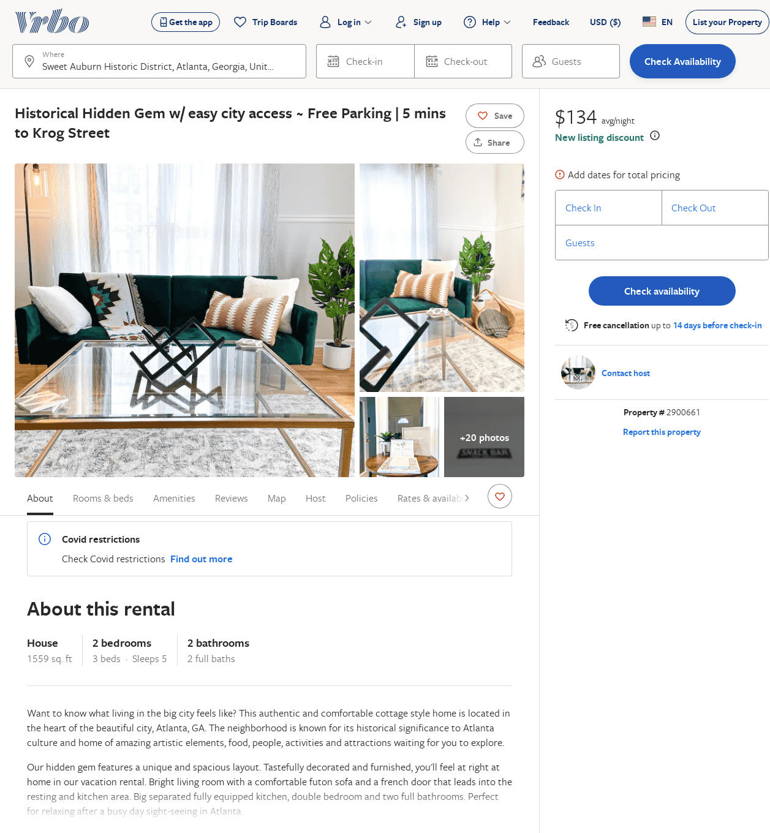
Listing 2900661
2
5
$115
1
https://www.vrbo.com/2900661
Aug 2022

