Slide 2
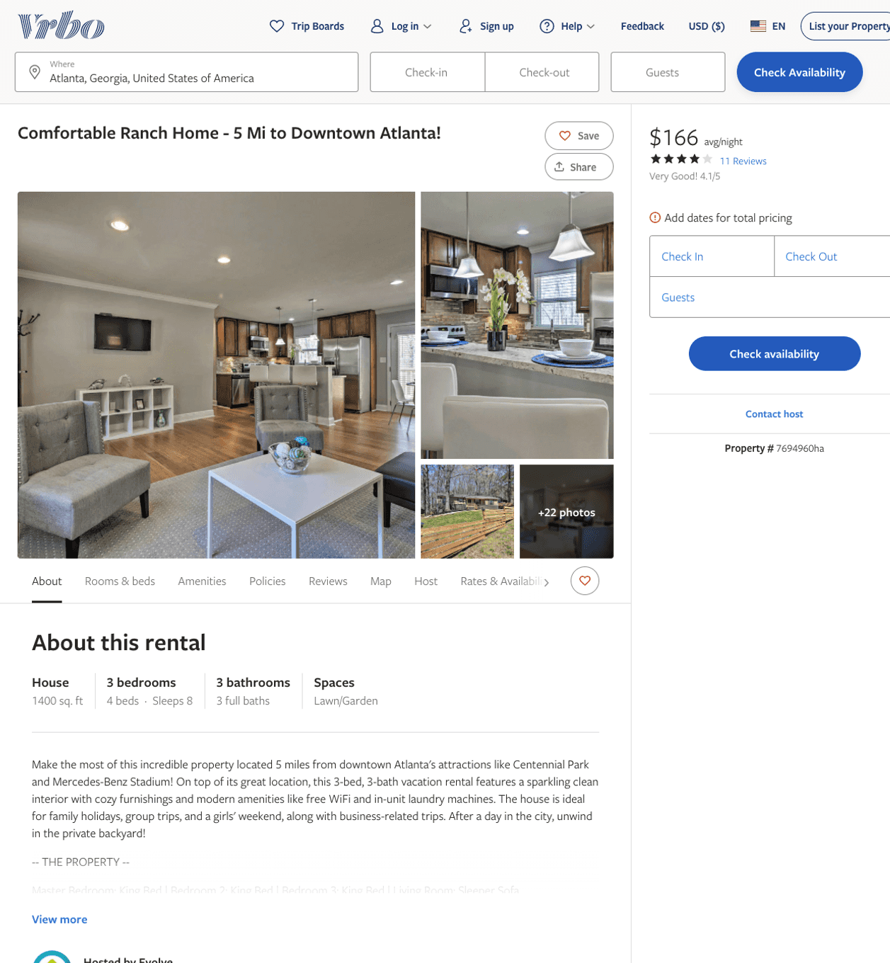
Listing 7694960
3
8
$130 - $235
4.0625
2
Evolve
https://www.vrbo.com/7694960ha
Aug 2022

Slide 3
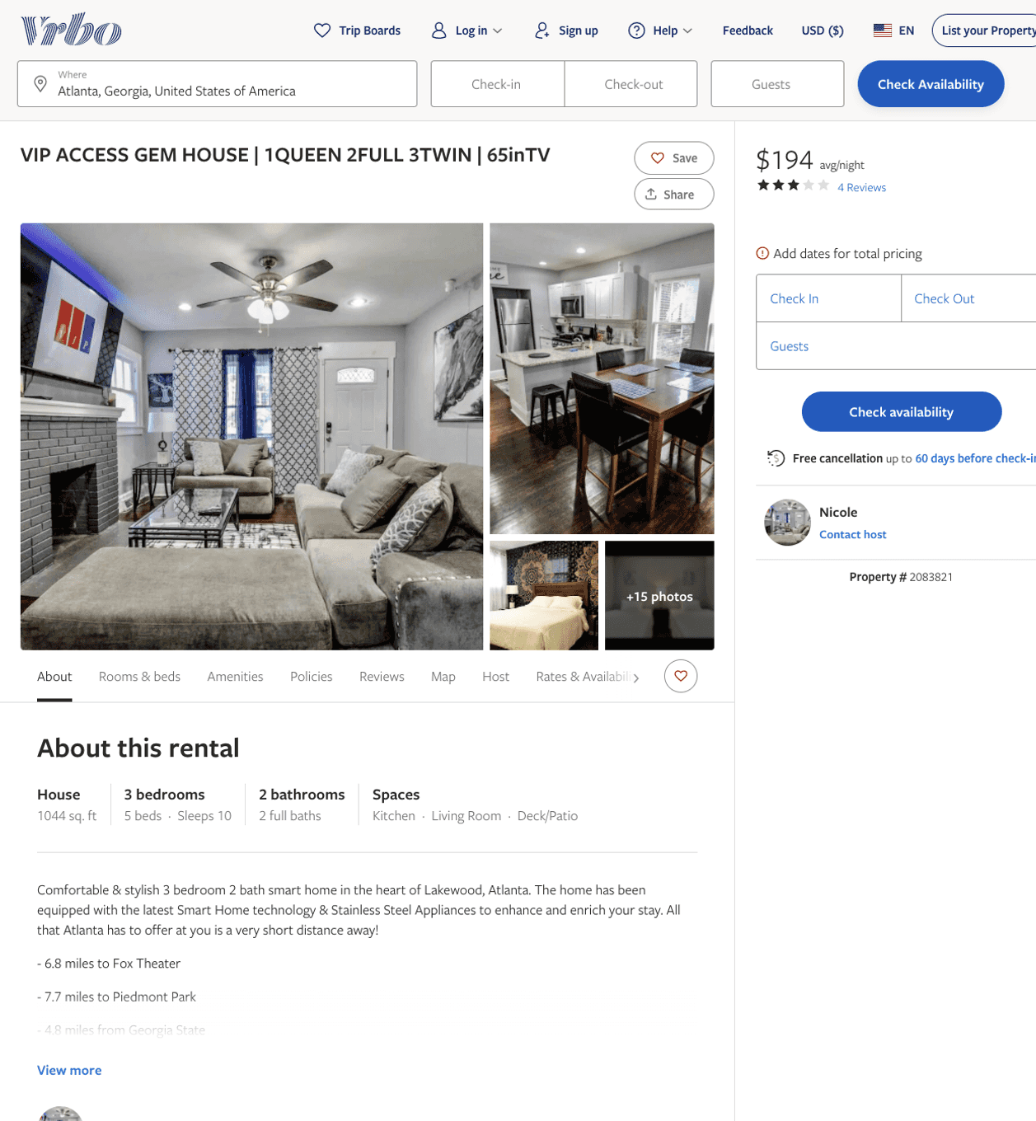
Listing 2083821
3
10
$189 - $261
3
1
Nicole
https://www.vrbo.com/2083821
Aug 2022

Slide 4
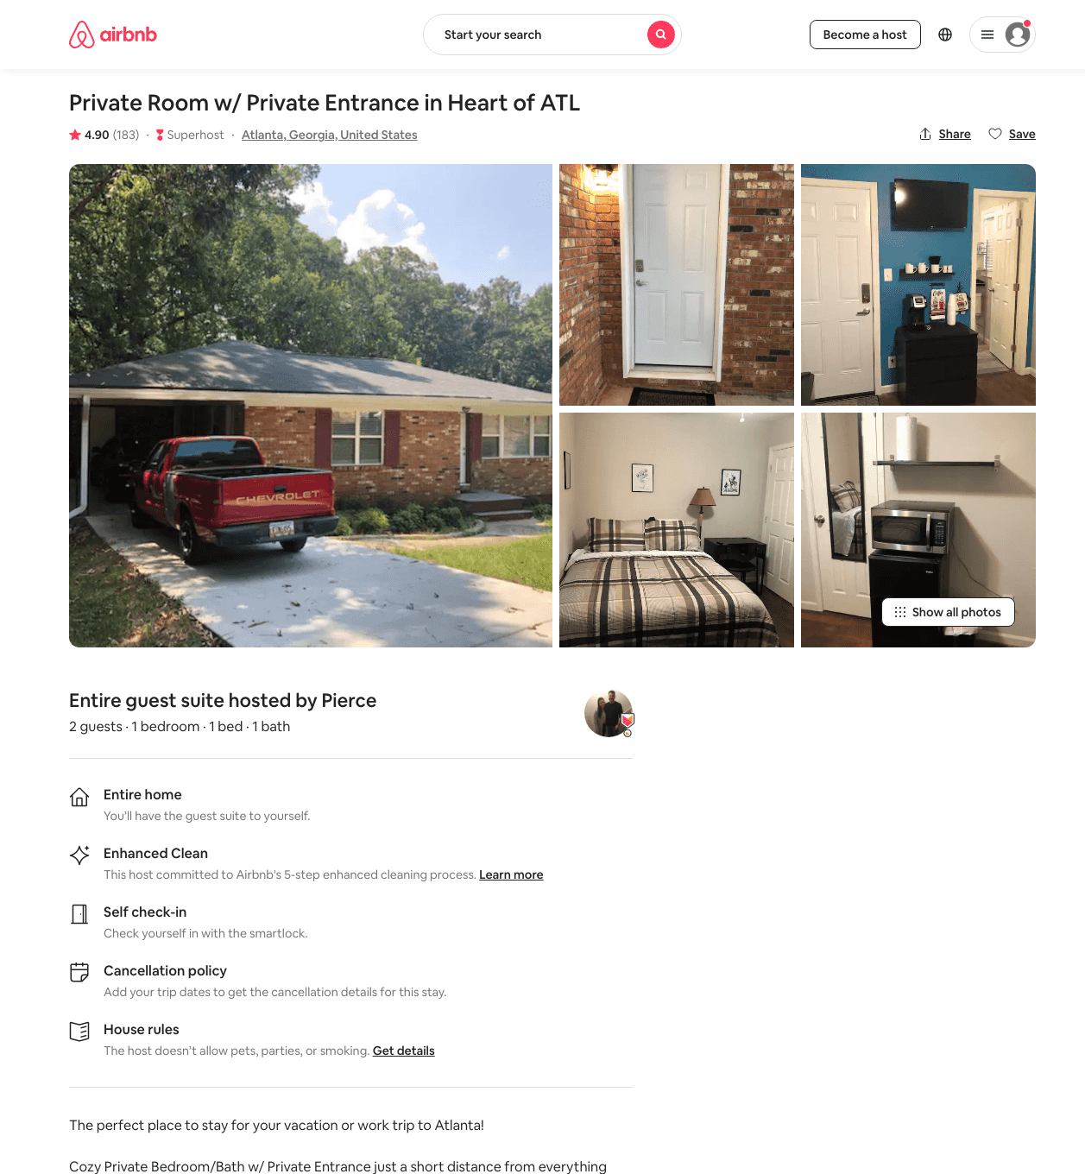
Listing 38512681
1
2
$46 - $69
4.91
1
Pierce
152536851
1
https://www.airbnb.com/rooms/38512681
Aug 2022

Slide 5
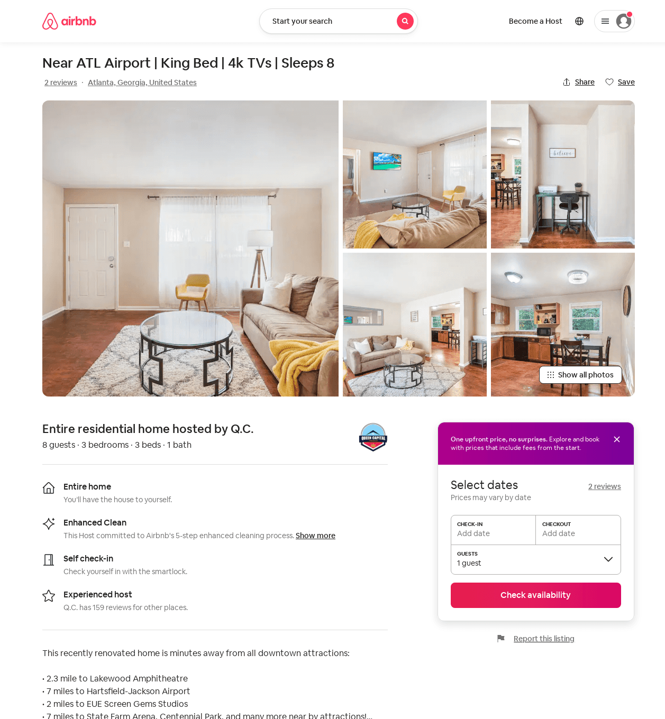
Listing 51667146
3
8
$98 - $140
4.0
2
Q.C.
278815354
5
https://www.airbnb.com/rooms/51667146
Aug 2022

