Slide 2
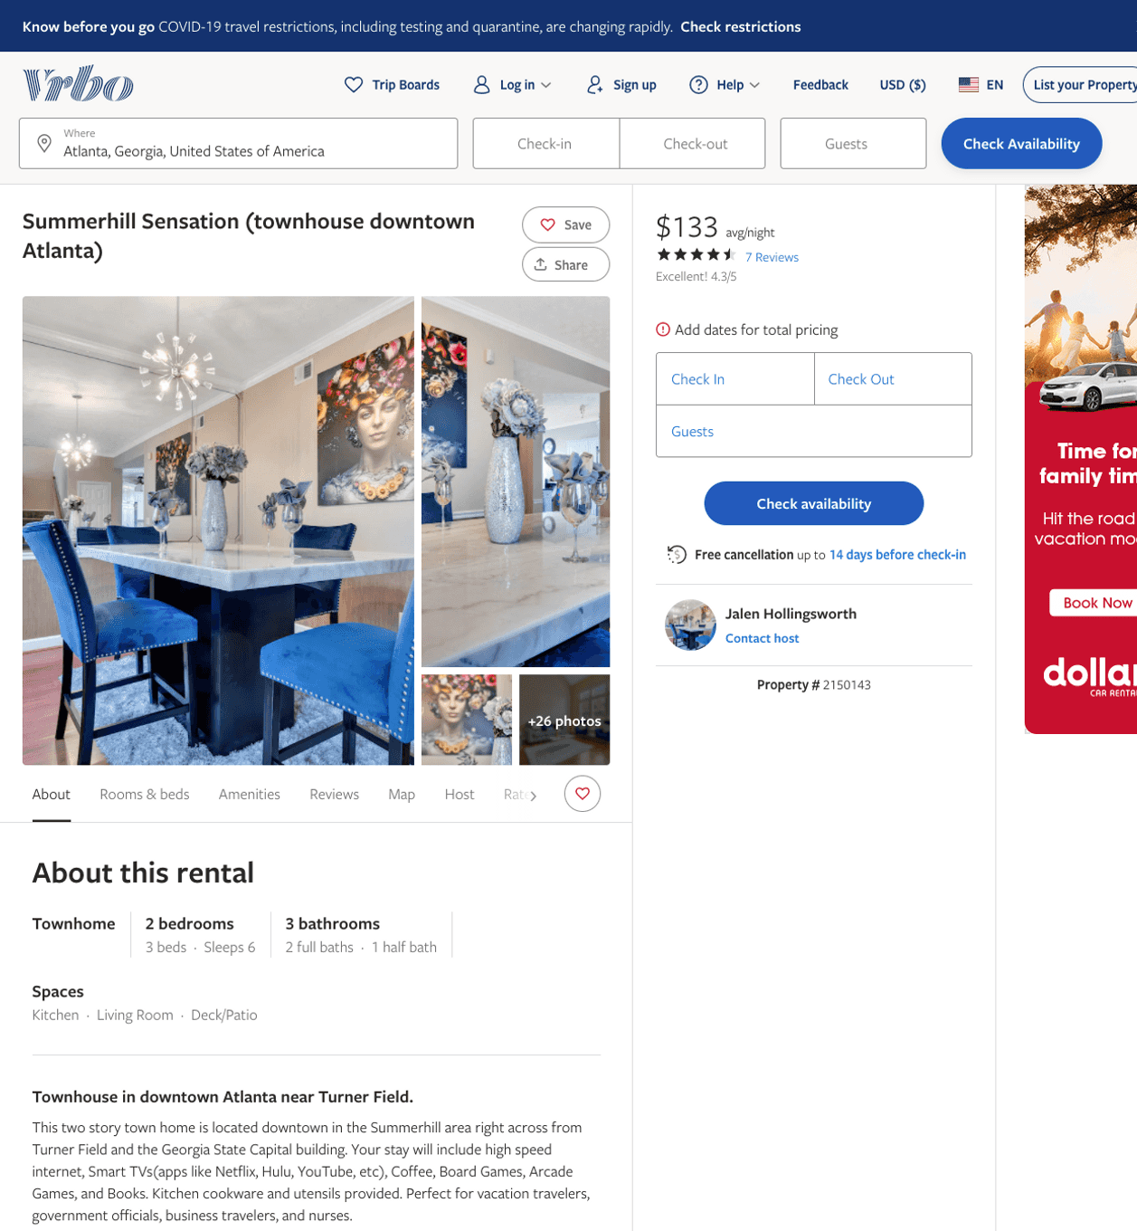
Listing 2150143
2
6
$112 - $161
4.5142856
1
Jalen Hollingsworth
https://www.vrbo.com/2150143
Aug 2022

Slide 3
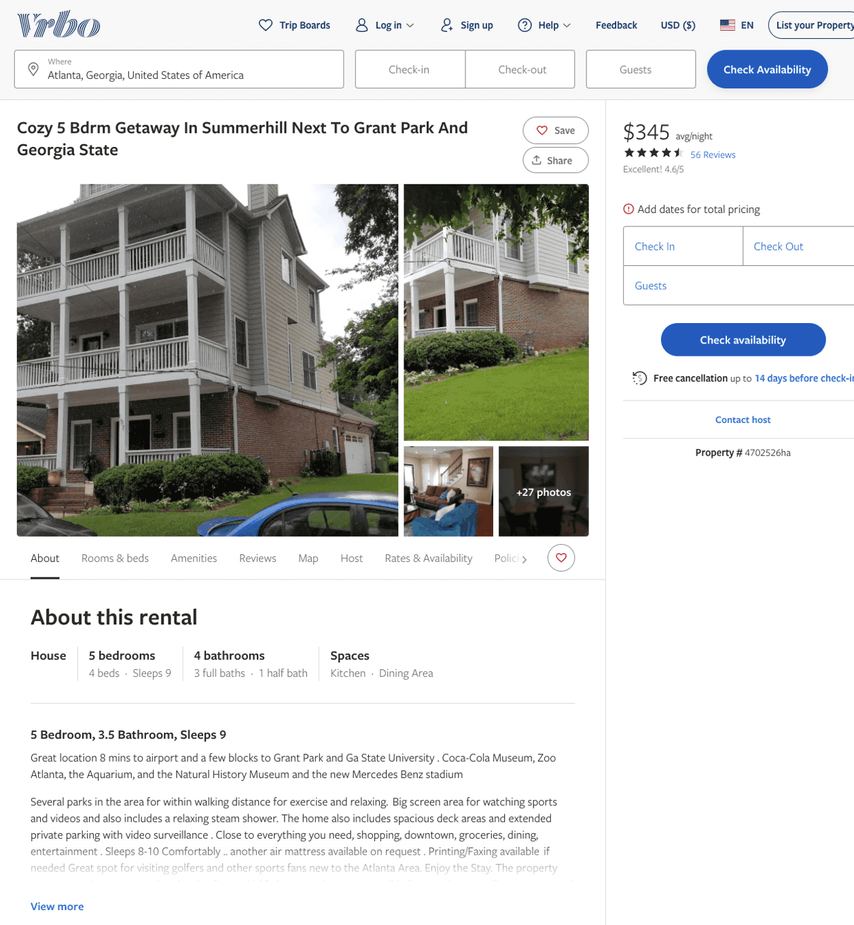
Listing 4702526
5
9
$310 - $383
4.6666665
1
owner/property manager
https://www.vrbo.com/4702526ha
Aug 2022

Slide 4
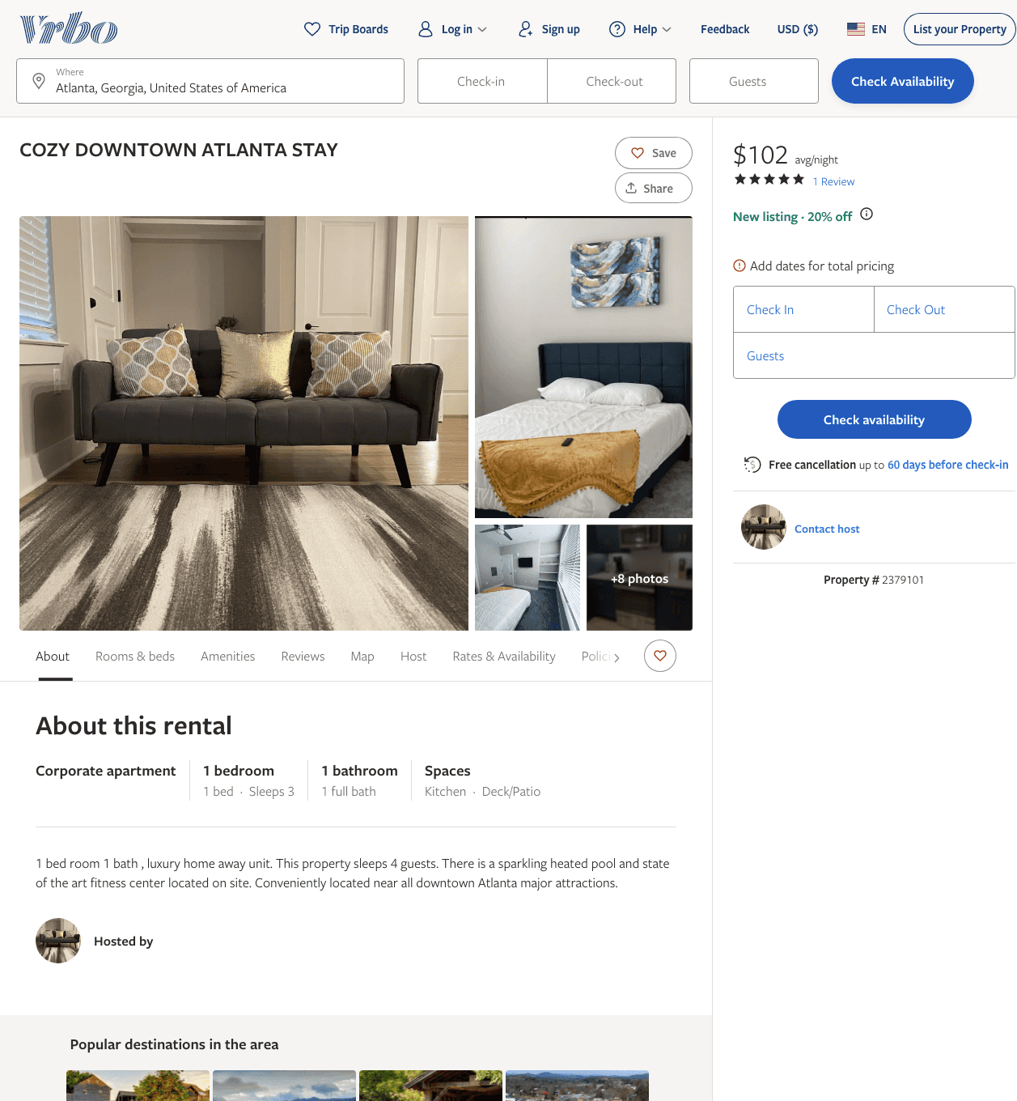
Listing 2379101
1
3
$102 - $99
4.5
2
https://www.vrbo.com/2379101
Aug 2022

Slide 5
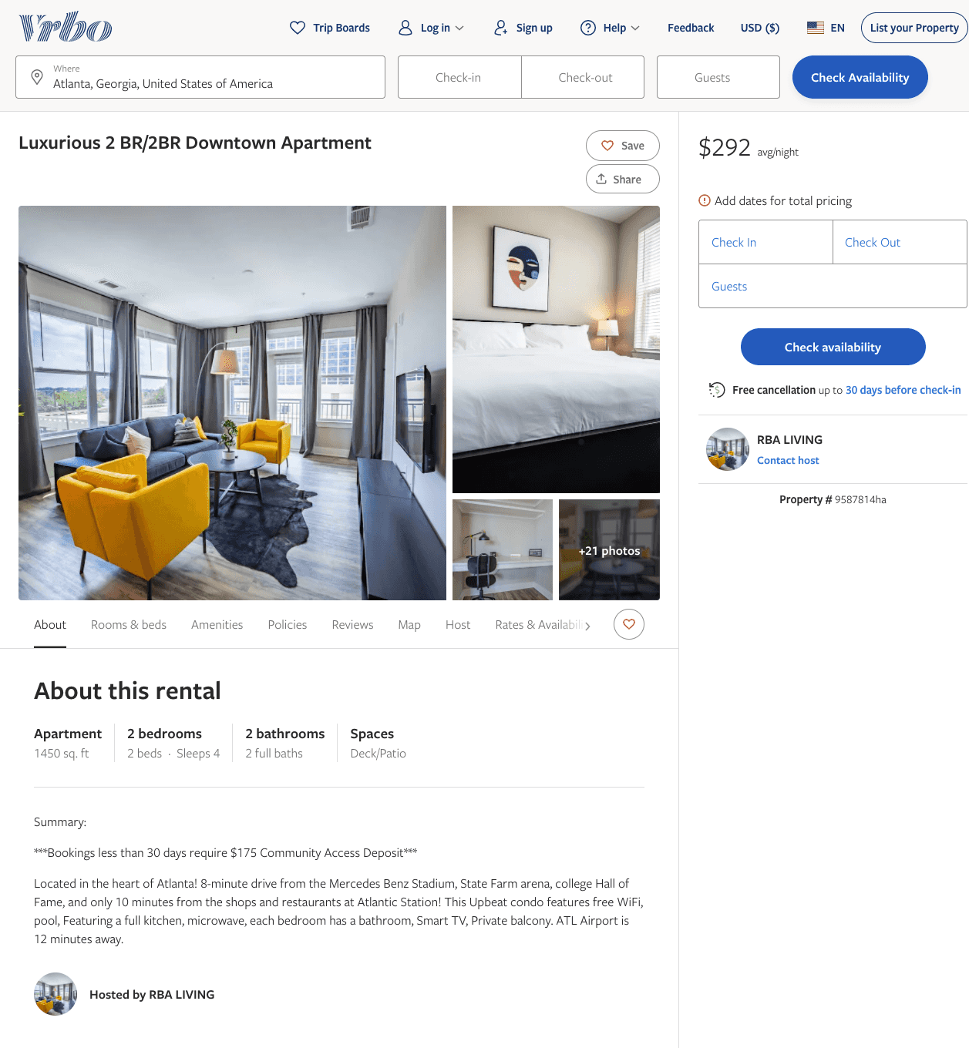
Listing 9587814
2
4
$184 - $292
2
RBA LIVING
https://www.vrbo.com/9587814ha
Aug 2022

Slide 6
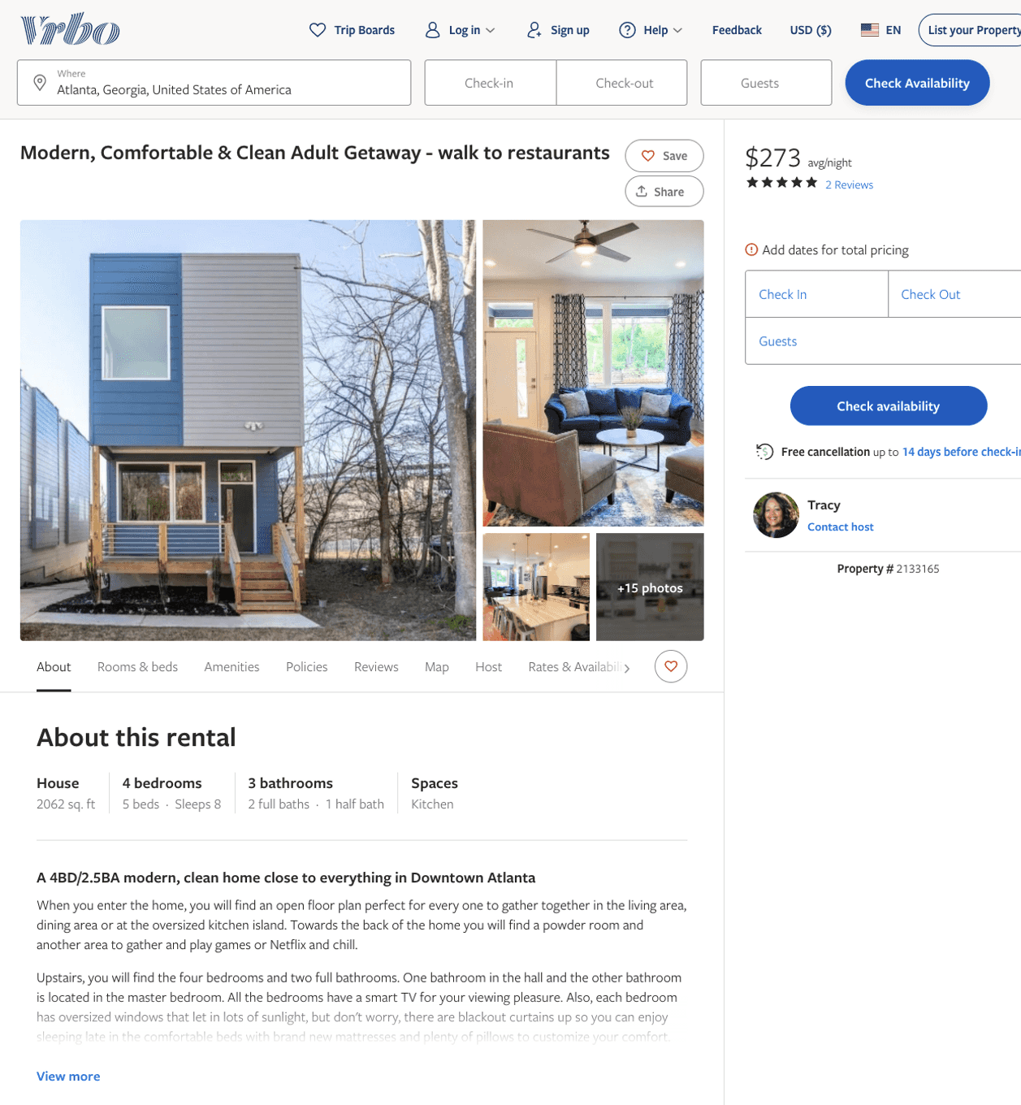
Listing 2133165
4
8
$273 - $373
5
3
Tracy
https://www.vrbo.com/2133165
Aug 2022

Slide 7
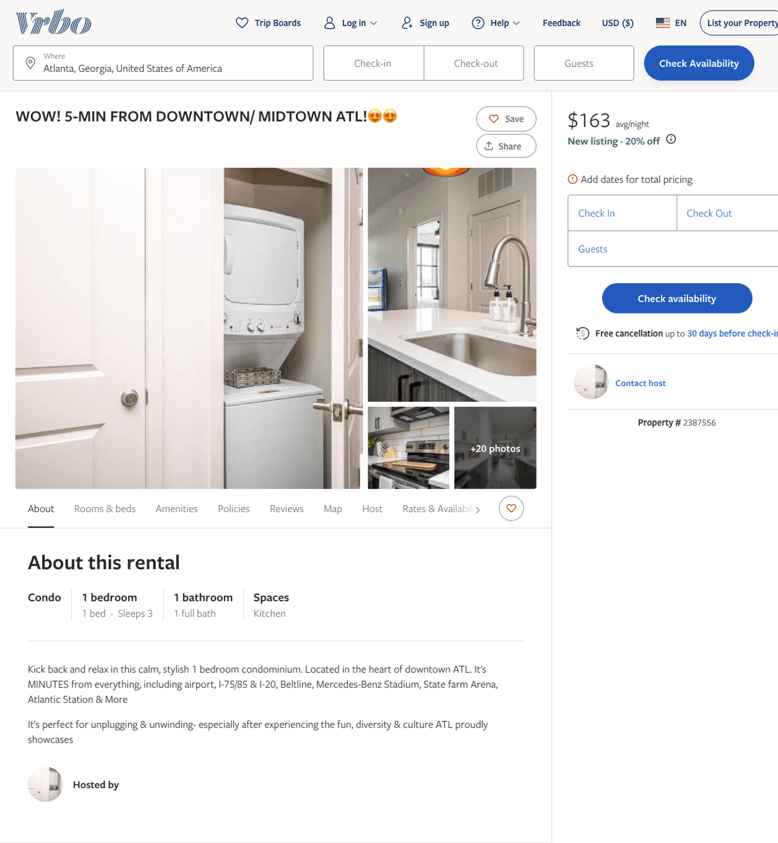
Listing 2387556
1
3
$136 - $171
5
2
https://www.vrbo.com/2387556
Aug 2022

Slide 8
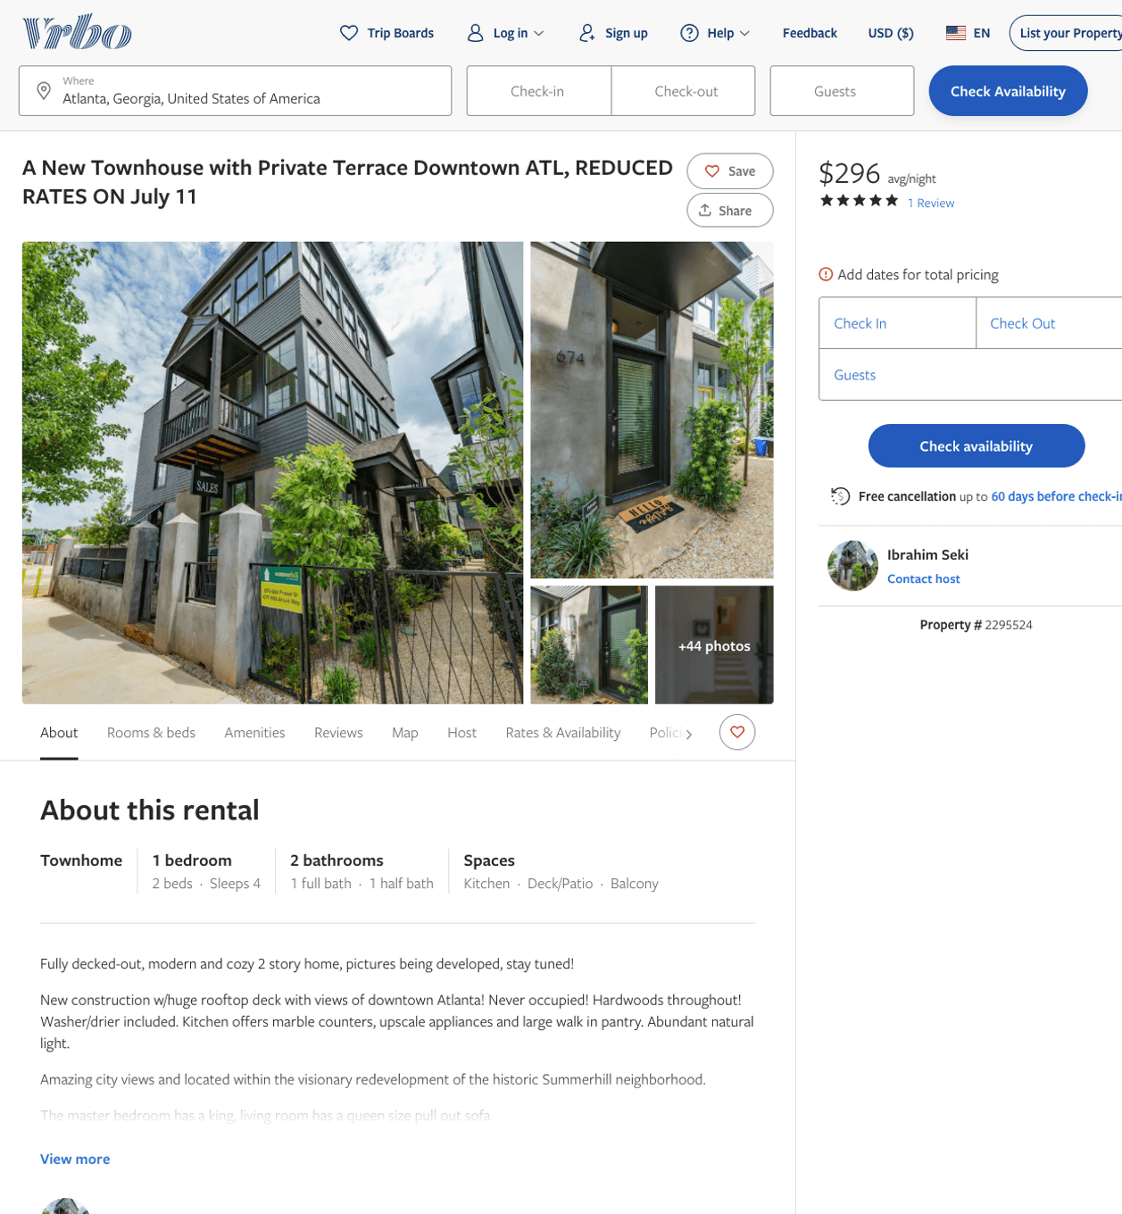
Listing 2295524
1
4
$142 - $330
5
2
Ibrahim Seki
https://www.vrbo.com/2295524
Aug 2022

Slide 9
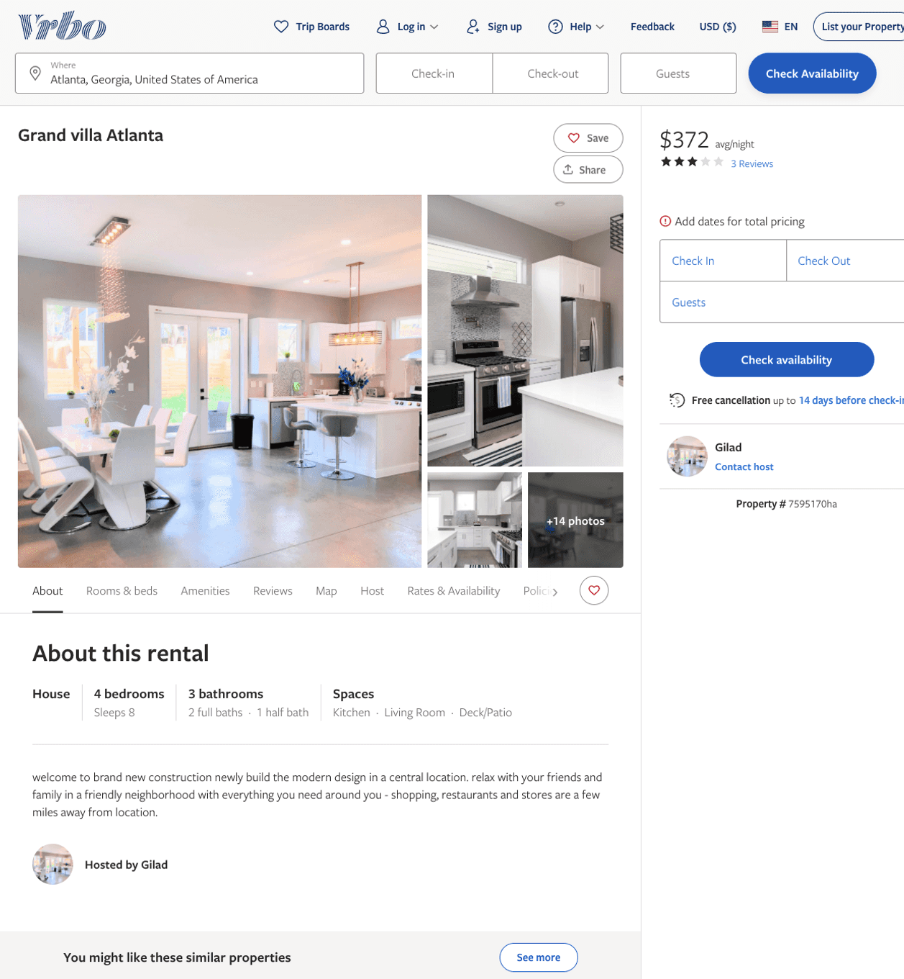
Listing 7595170
4
8
$349 - $376
3
3
Gilad
https://www.vrbo.com/7595170ha
Aug 2022

Slide 10
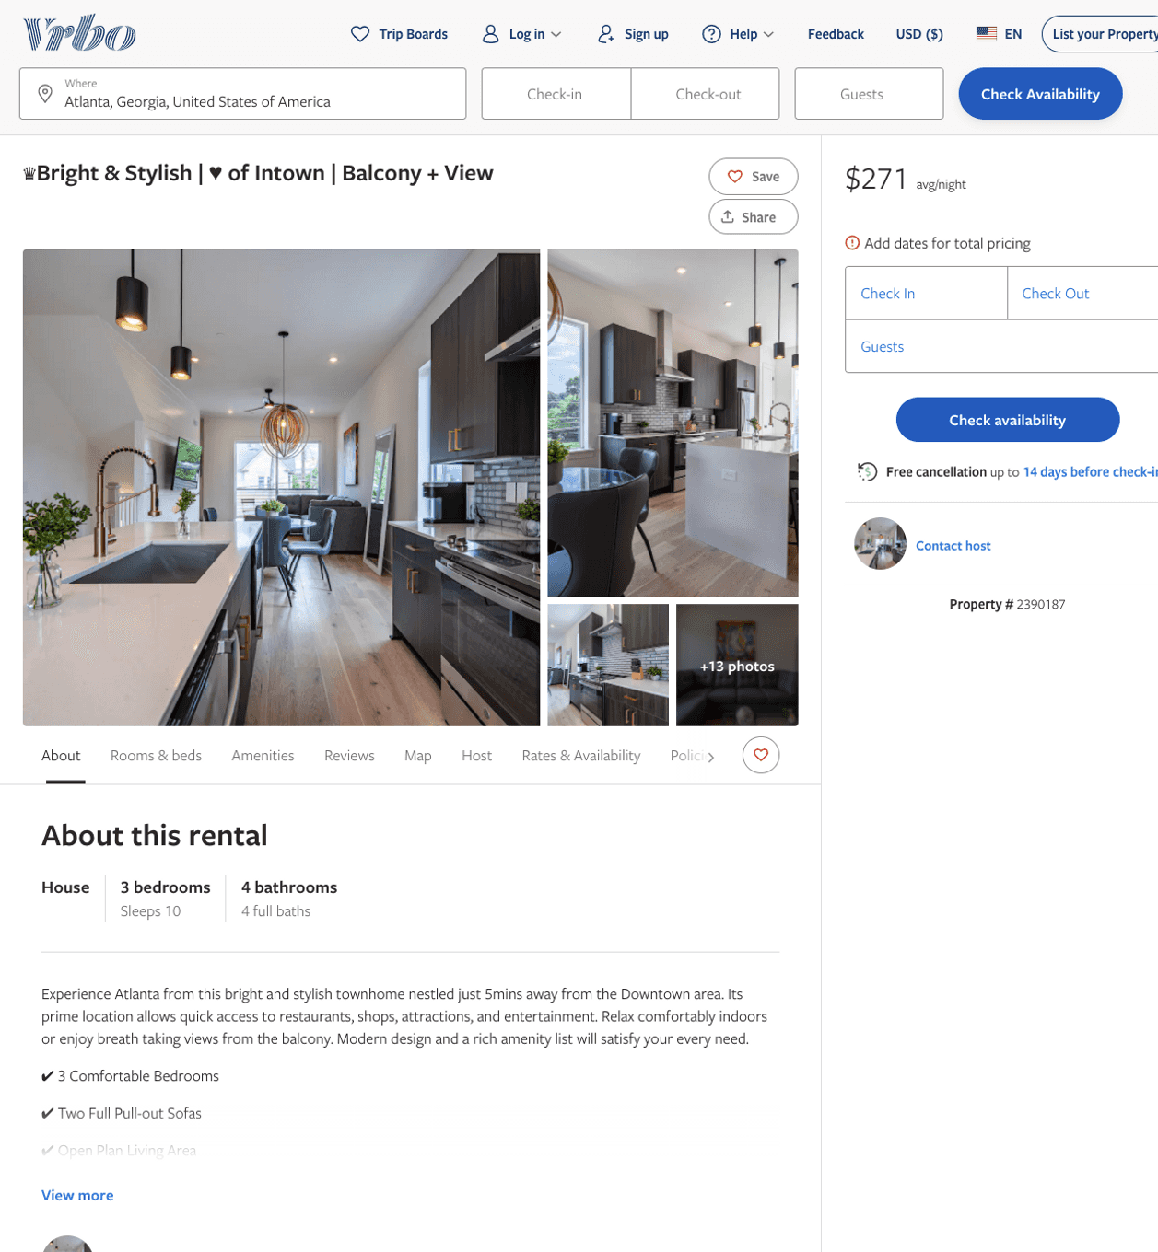
Listing 2390187
3
10
$271 - $539
4.75
1
William Tanzie
https://www.vrbo.com/2390187
Aug 2022

Slide 11
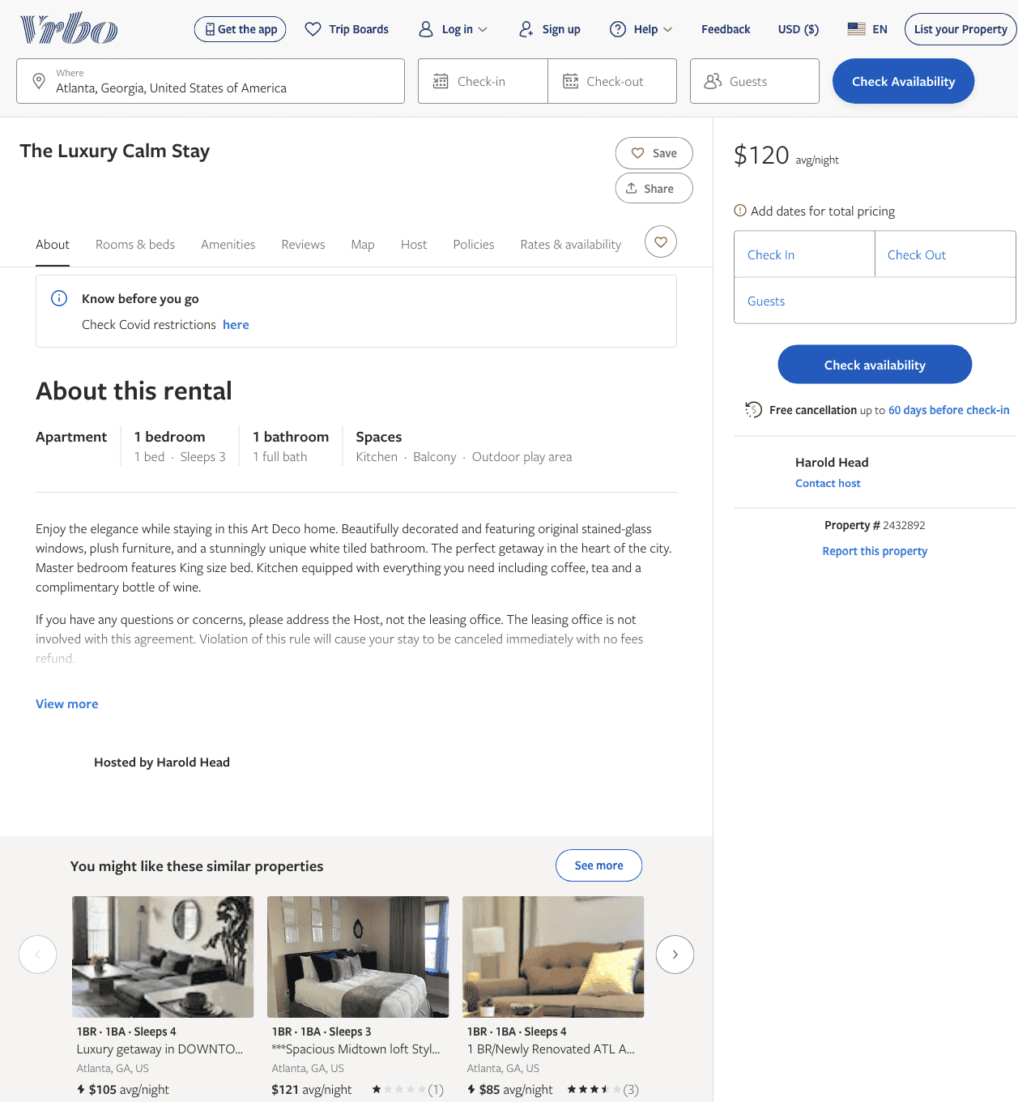
Listing 2432892
1
3
$120
3
Harold Head
https://www.vrbo.com/2432892
Aug 2022

Slide 12
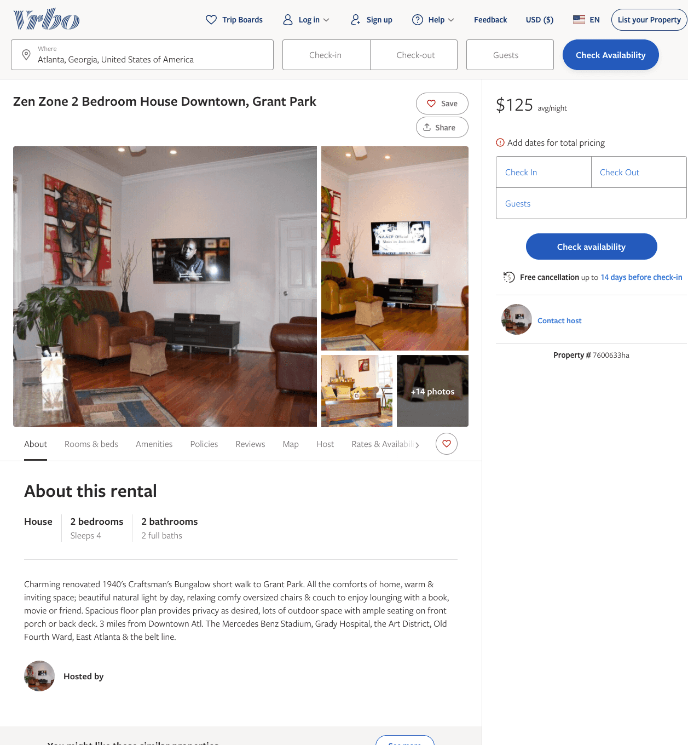
Listing 7600633
2
4
$125
3
https://www.vrbo.com/7600633ha
Aug 2022

Slide 13
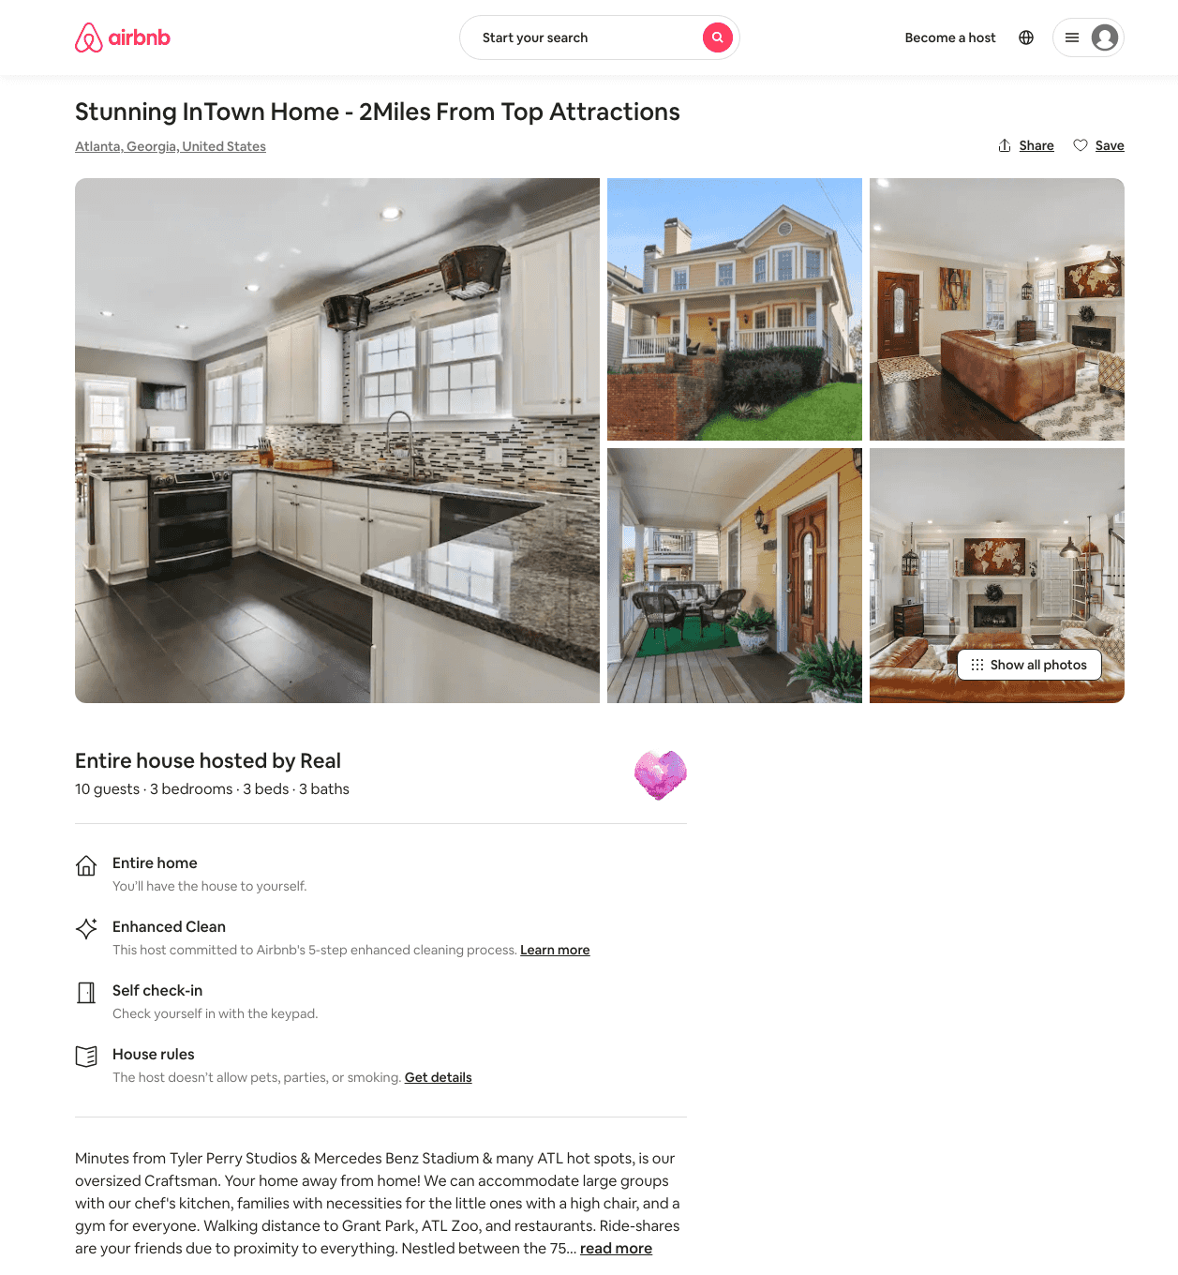
Listing 46276769
3
10
$300 - $350
4.89
7
Real
9598326
1
https://www.airbnb.com/rooms/46276769
Aug 2022

Slide 14
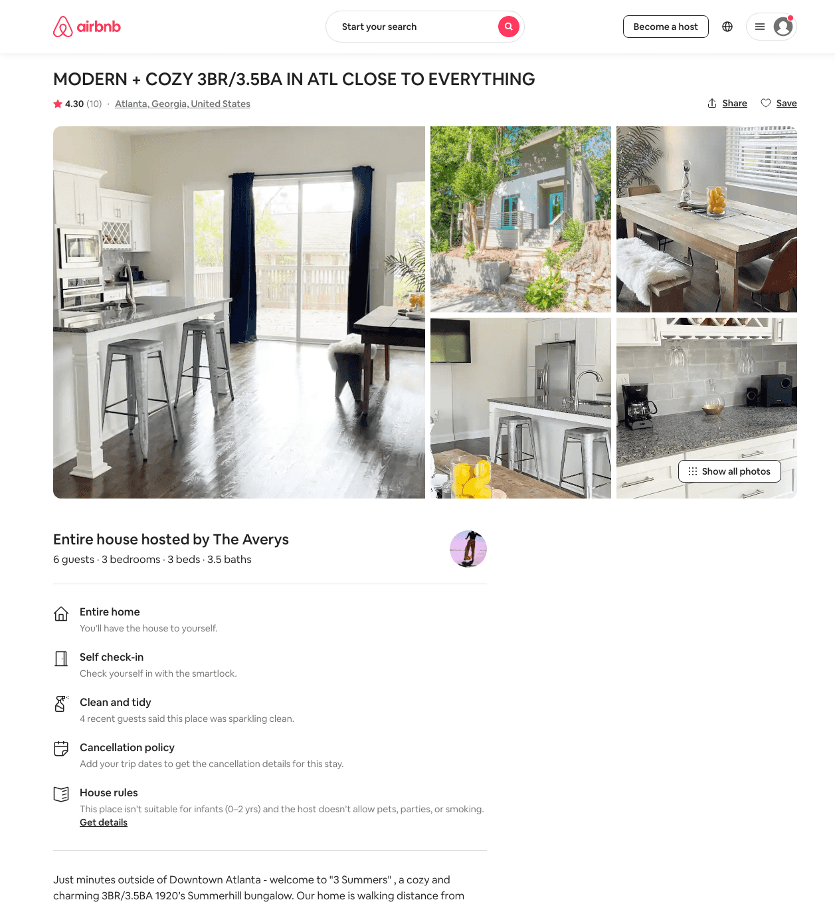
Listing 45953823
3
6
$216 - $313
4.50
2
The Averys
372538025
1
https://www.airbnb.com/rooms/45953823
Jun 2022

Slide 15
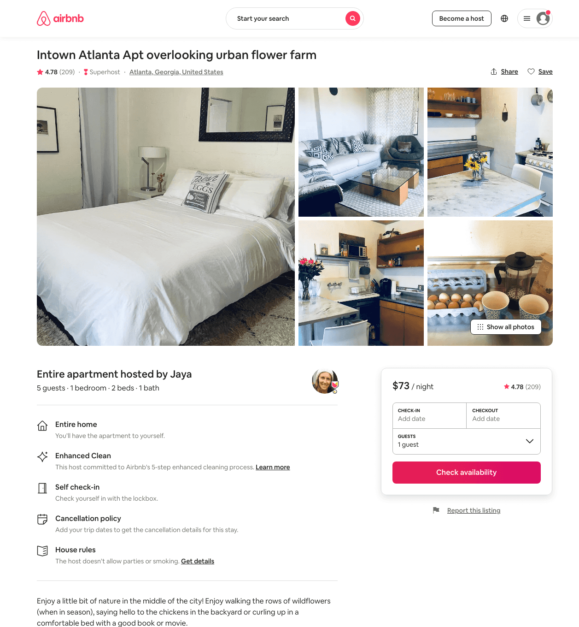
Listing 24849425
1
4
$59 - $83
4.75
1
Jaya
4241392
5
https://www.airbnb.com/rooms/24849425
Aug 2022

Slide 16
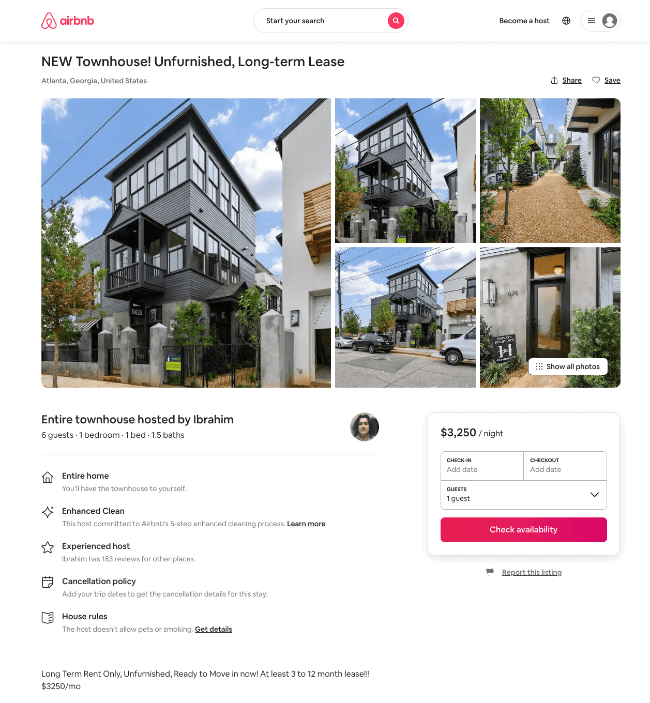
Listing 47056299
1
4
$126 - $3250
4.65
3
Ibrahim
244732315
1
https://www.airbnb.com/rooms/47056299
Aug 2022

Slide 17
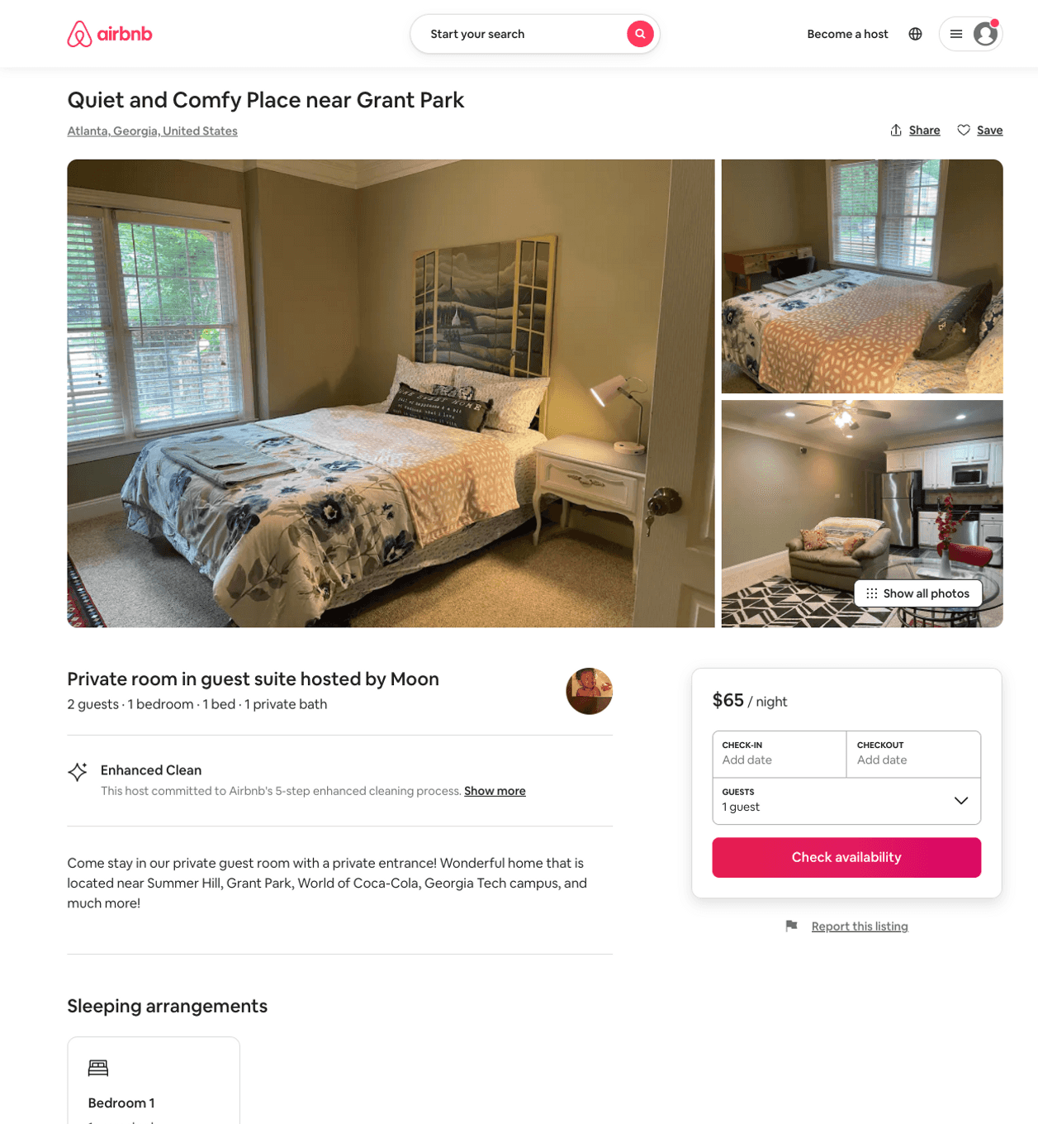
Listing 50401578
1
2
$49 - $75
4.97
1
Jackie
407129820
2
https://www.airbnb.com/rooms/50401578
Aug 2022

Slide 18
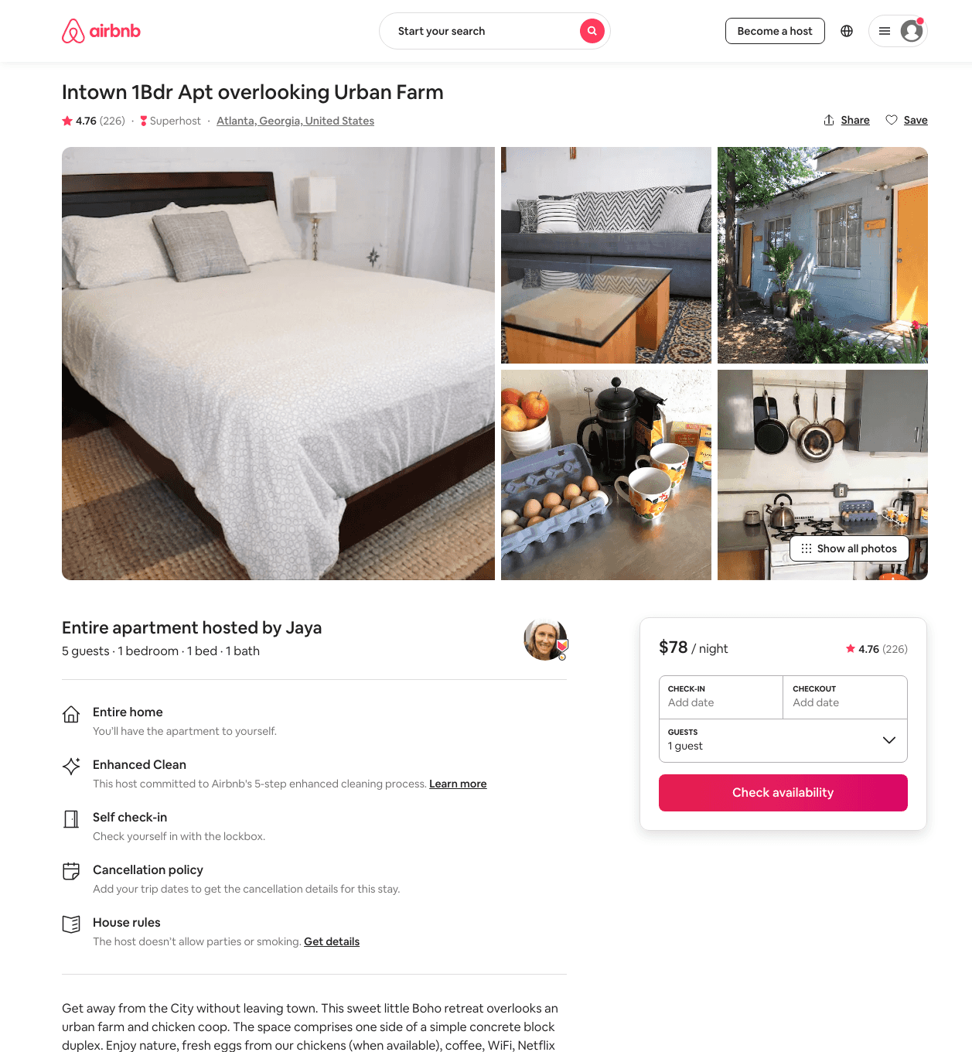
Listing 24115629
1
4
$64 - $85
4.80
1
Jaya
4241392
5
https://www.airbnb.com/rooms/24115629
Aug 2022

Slide 19
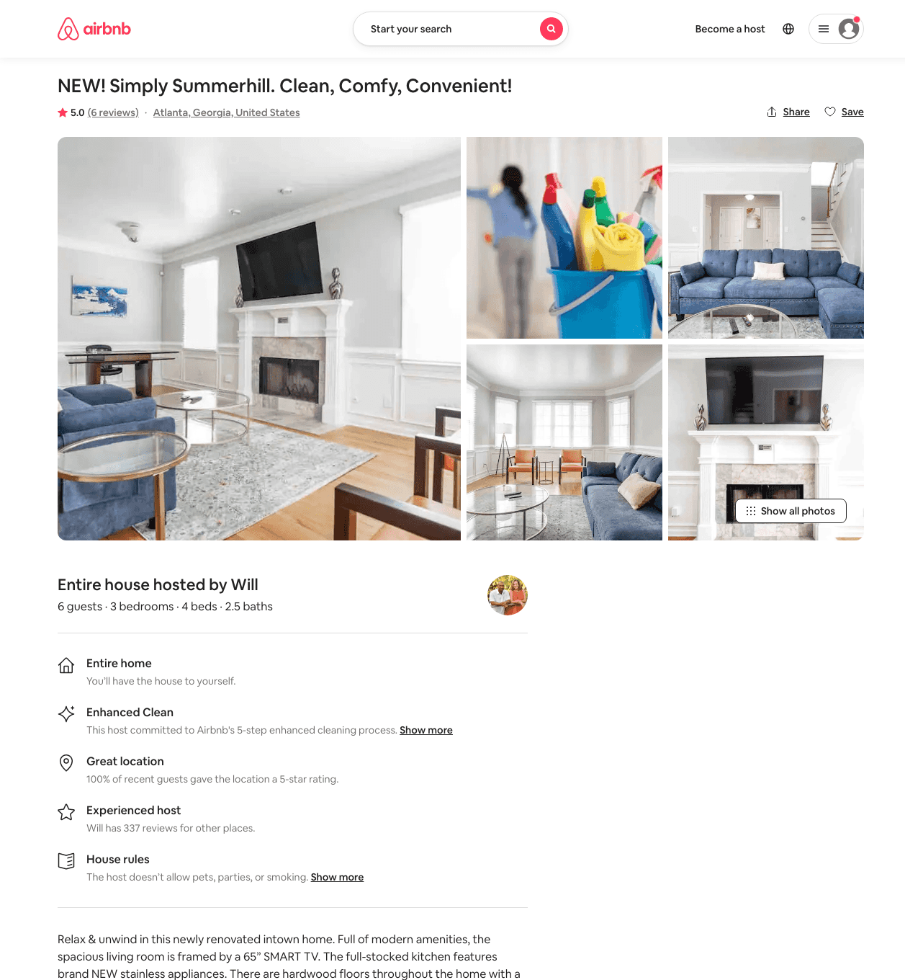
Listing 47971361
3
6
$129 - $239
4.64
2
Will
257608788
11
https://www.airbnb.com/rooms/47971361
Aug 2022

Slide 20
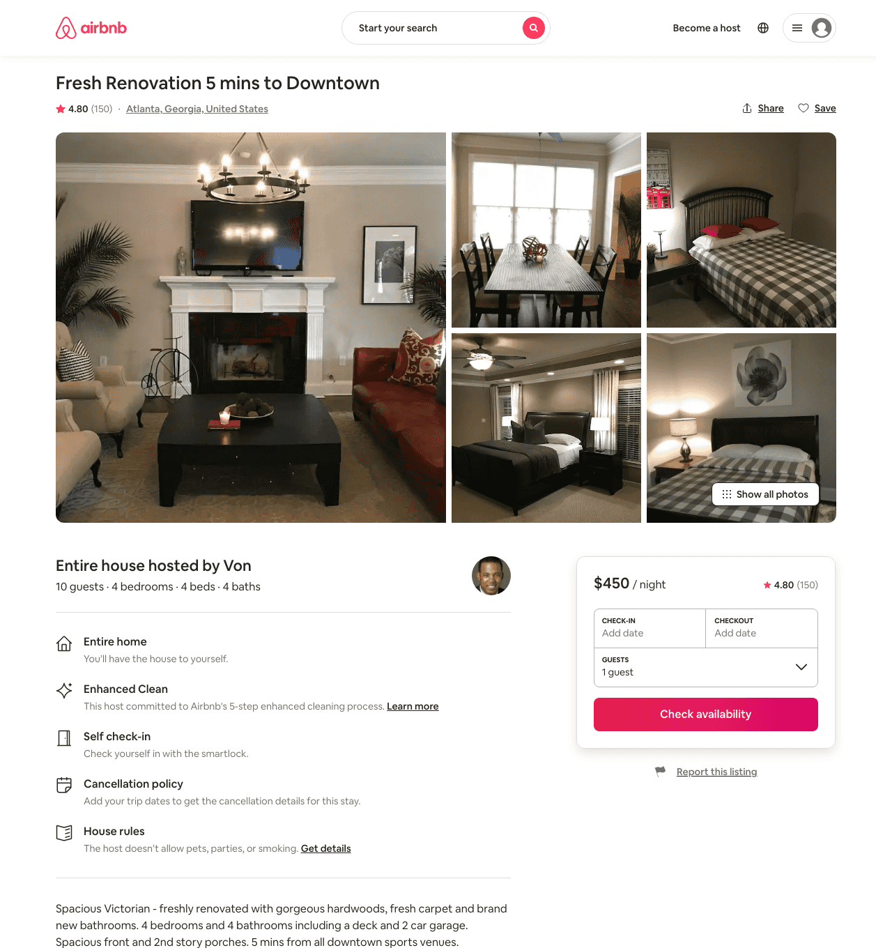
Listing 16530614
4
10
$350 - $450
4.77
1
Von
61464363
1
https://www.airbnb.com/rooms/16530614
Aug 2022

Slide 21
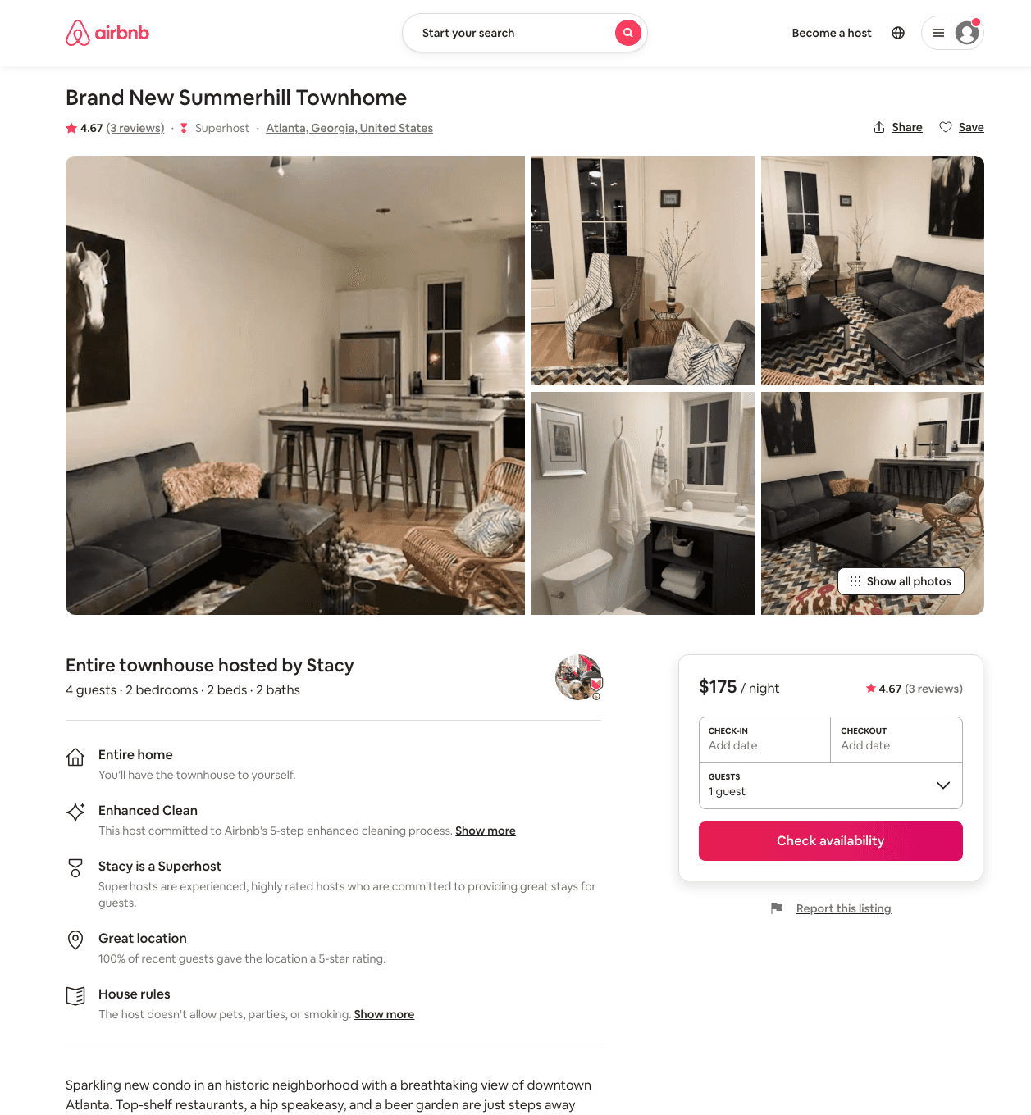
Listing 46742101
2
4
$159 - $200
4.95
1
Stacy
117133929
2
https://www.airbnb.com/rooms/46742101
Aug 2022

Slide 22
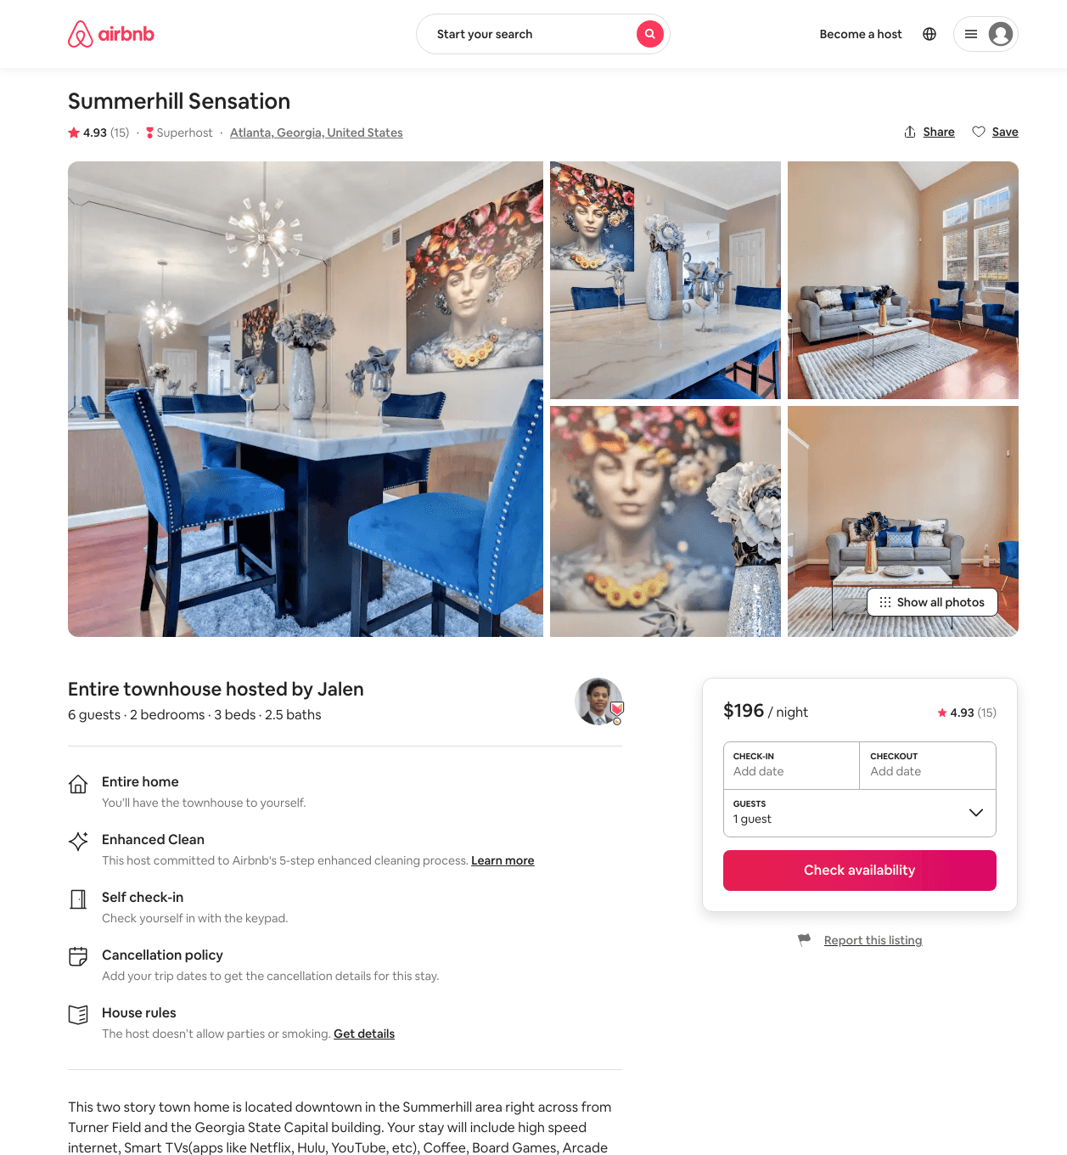
Listing 46980513
2
6
$128 - $204
4.83
1
Jalen
326079135
7
https://www.airbnb.com/rooms/46980513
Aug 2022

Slide 23
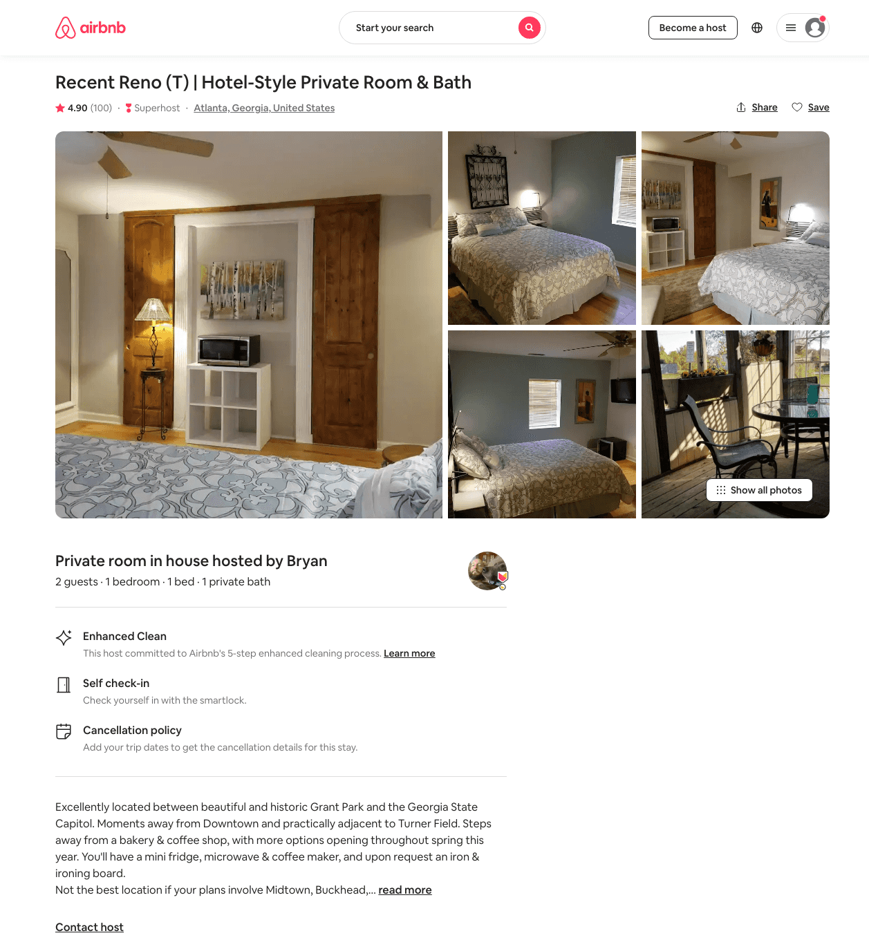
Listing 32735620
1
2
$49 - $88
4.88
2
Bryan
75327045
2
https://www.airbnb.com/rooms/32735620
Aug 2022

Slide 24
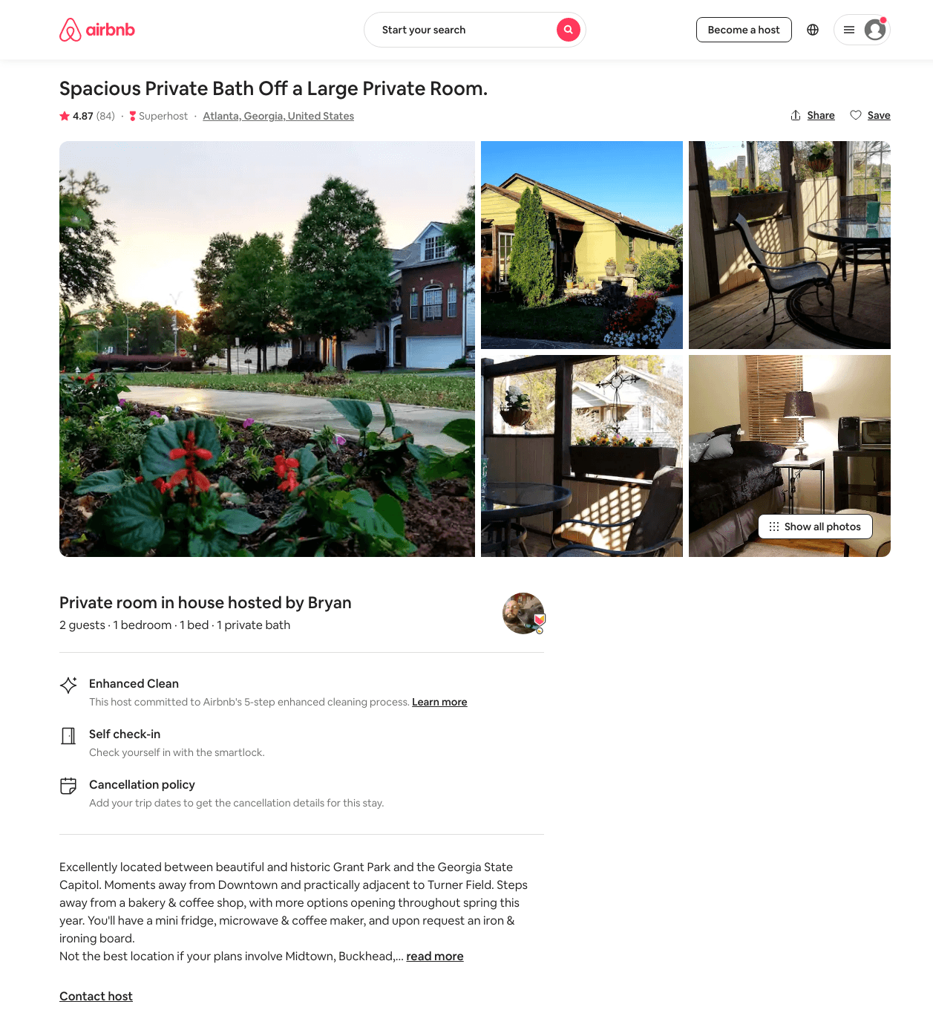
Listing 32251969
1
2
$49 - $55
4.90
2
Bryan
75327045
2
https://www.airbnb.com/rooms/32251969
Jun 2022

Slide 25
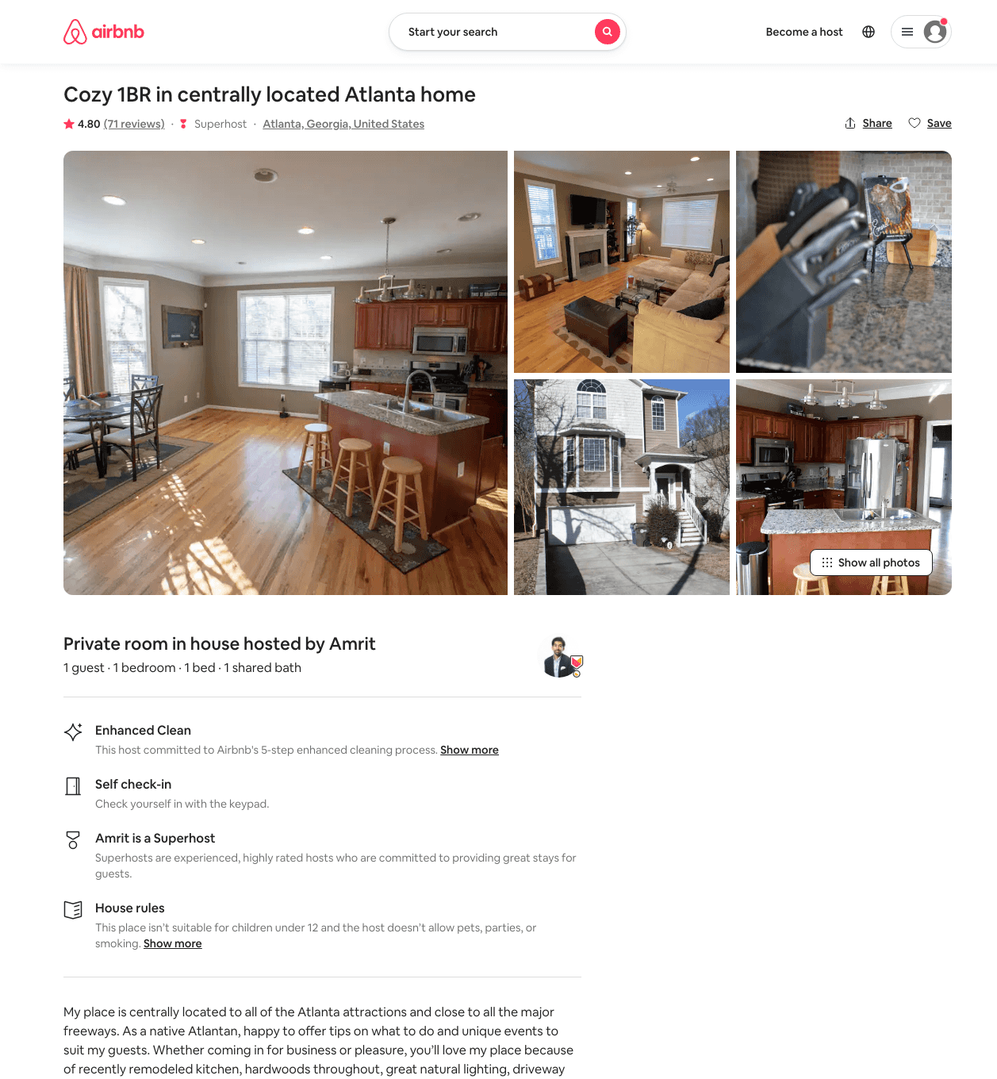
Listing 16393474
1
1
$50 - $63
4.78
3
Amrit
3564094
2
https://www.airbnb.com/rooms/16393474
Jun 2022

Slide 26
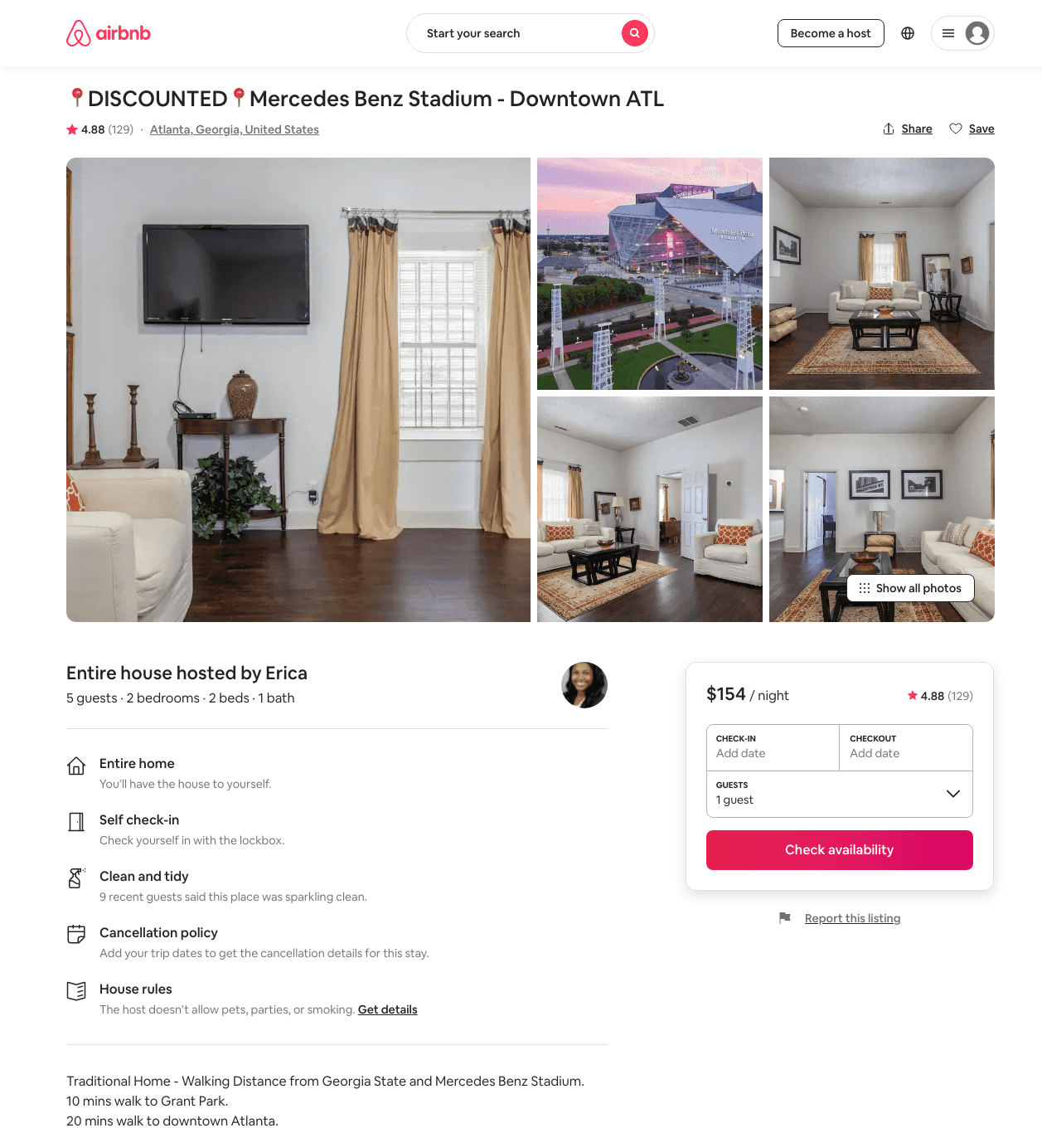
Listing 30801777
2
5
$85 - $155
4.81
1
Erica
230439724
2
https://www.airbnb.com/rooms/30801777
Jun 2022

Slide 27
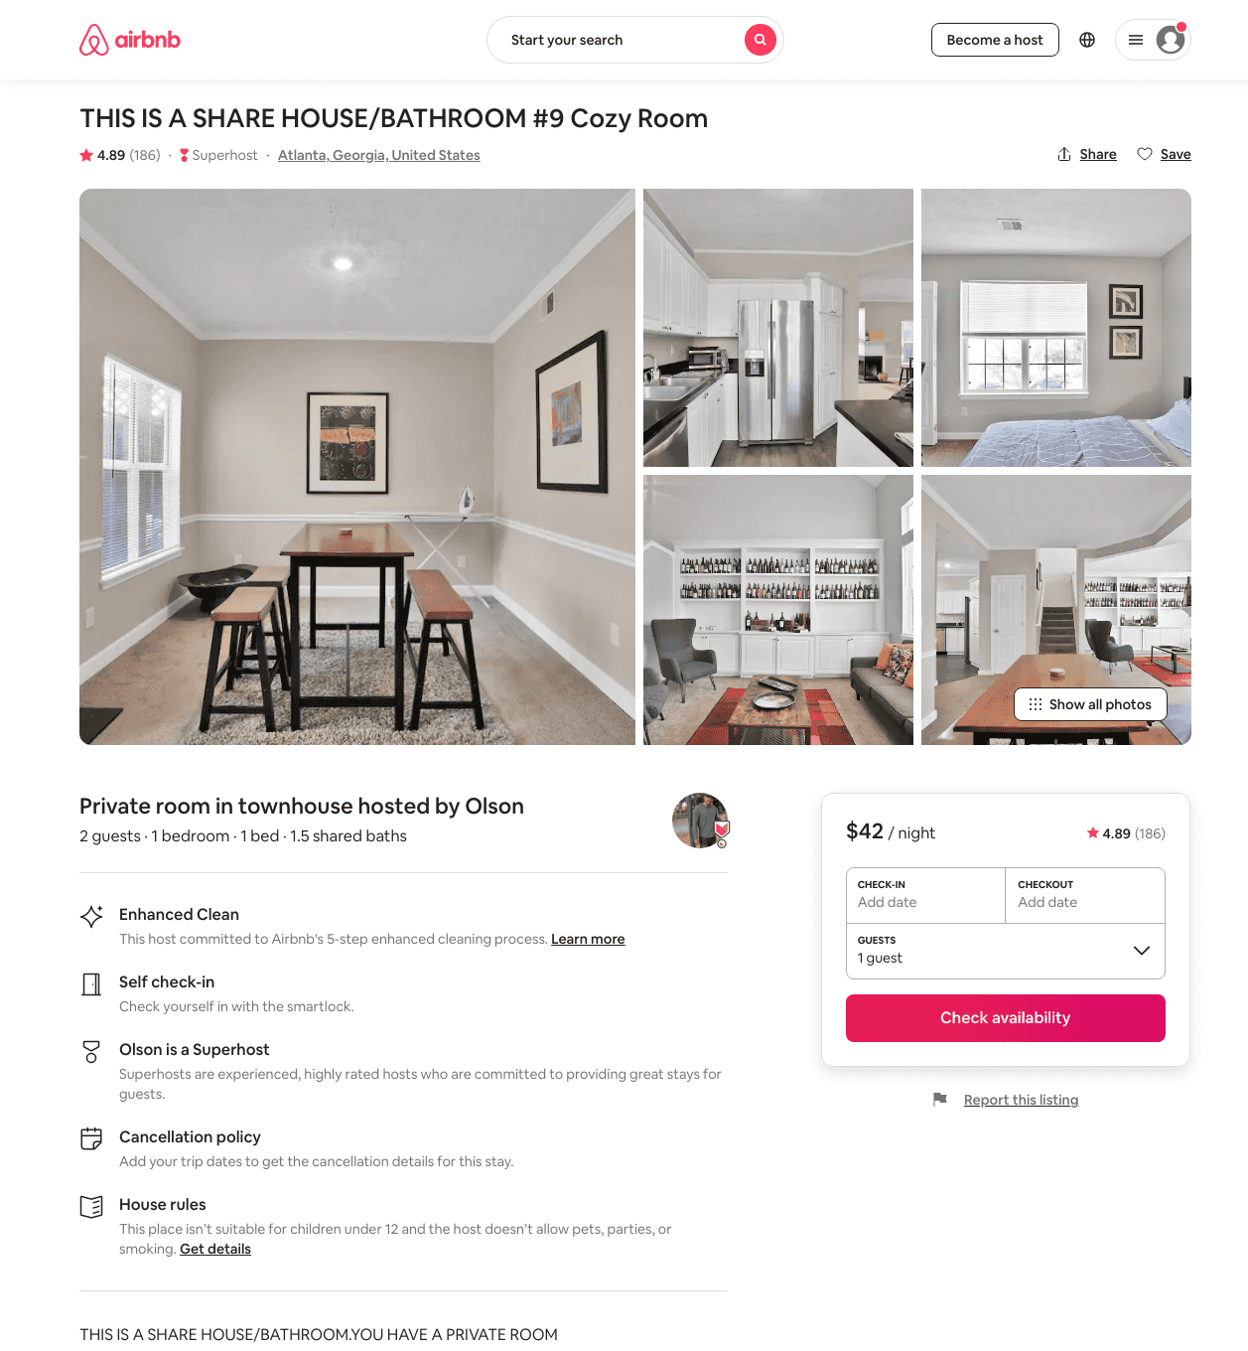
Listing 29016157
1
2
$42 - $47
4.87
2
Olson
190637327
3
https://www.airbnb.com/rooms/29016157
Aug 2022

Slide 28
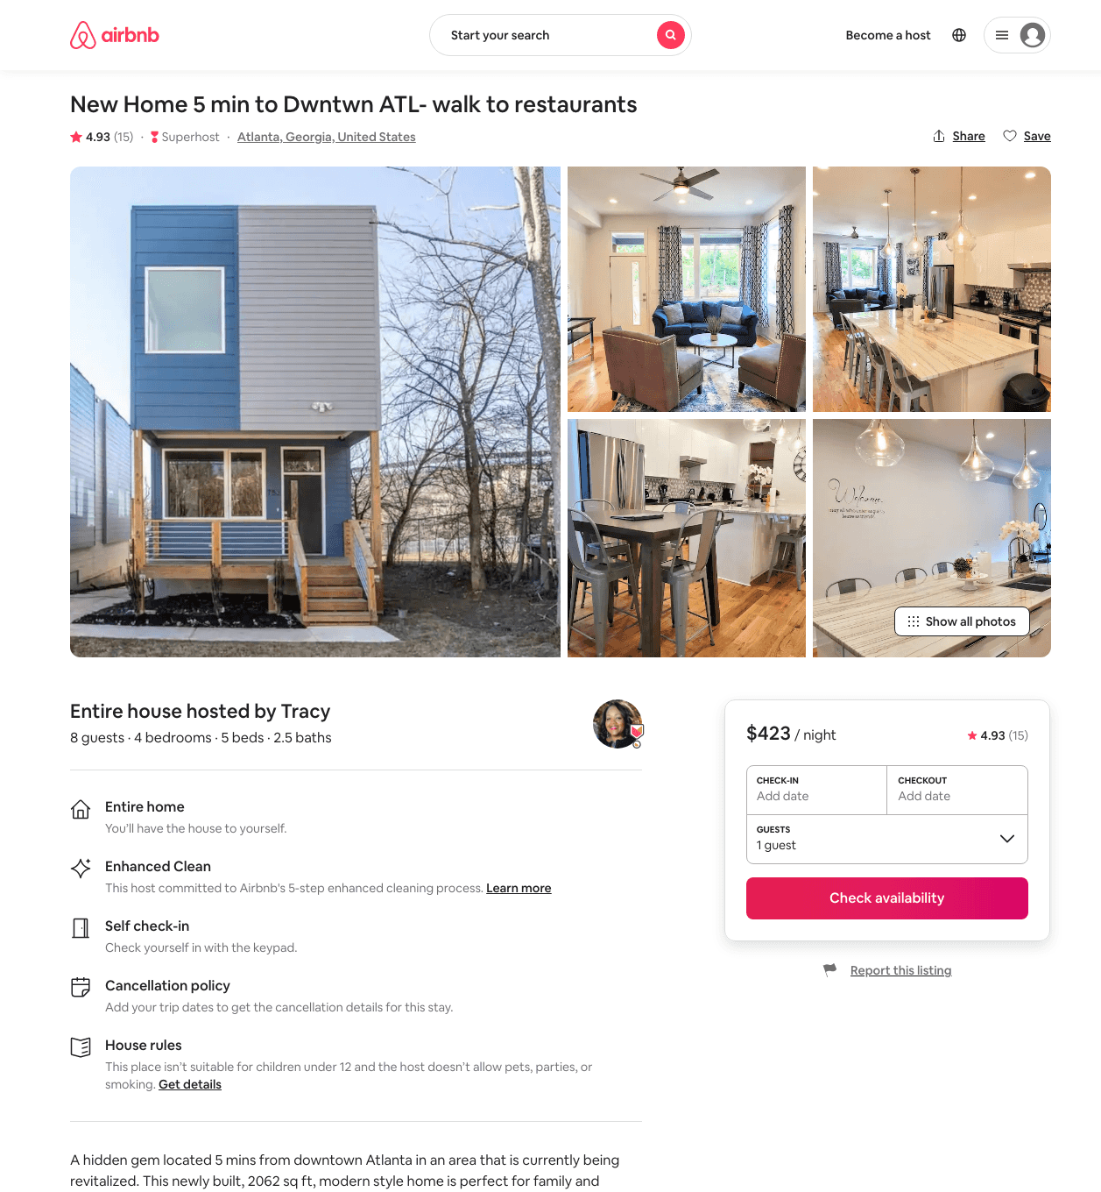
Listing 45399289
4
8
$257 - $401
4.92
3
Tracy
306622027
1
https://www.airbnb.com/rooms/45399289
Aug 2022

Slide 29
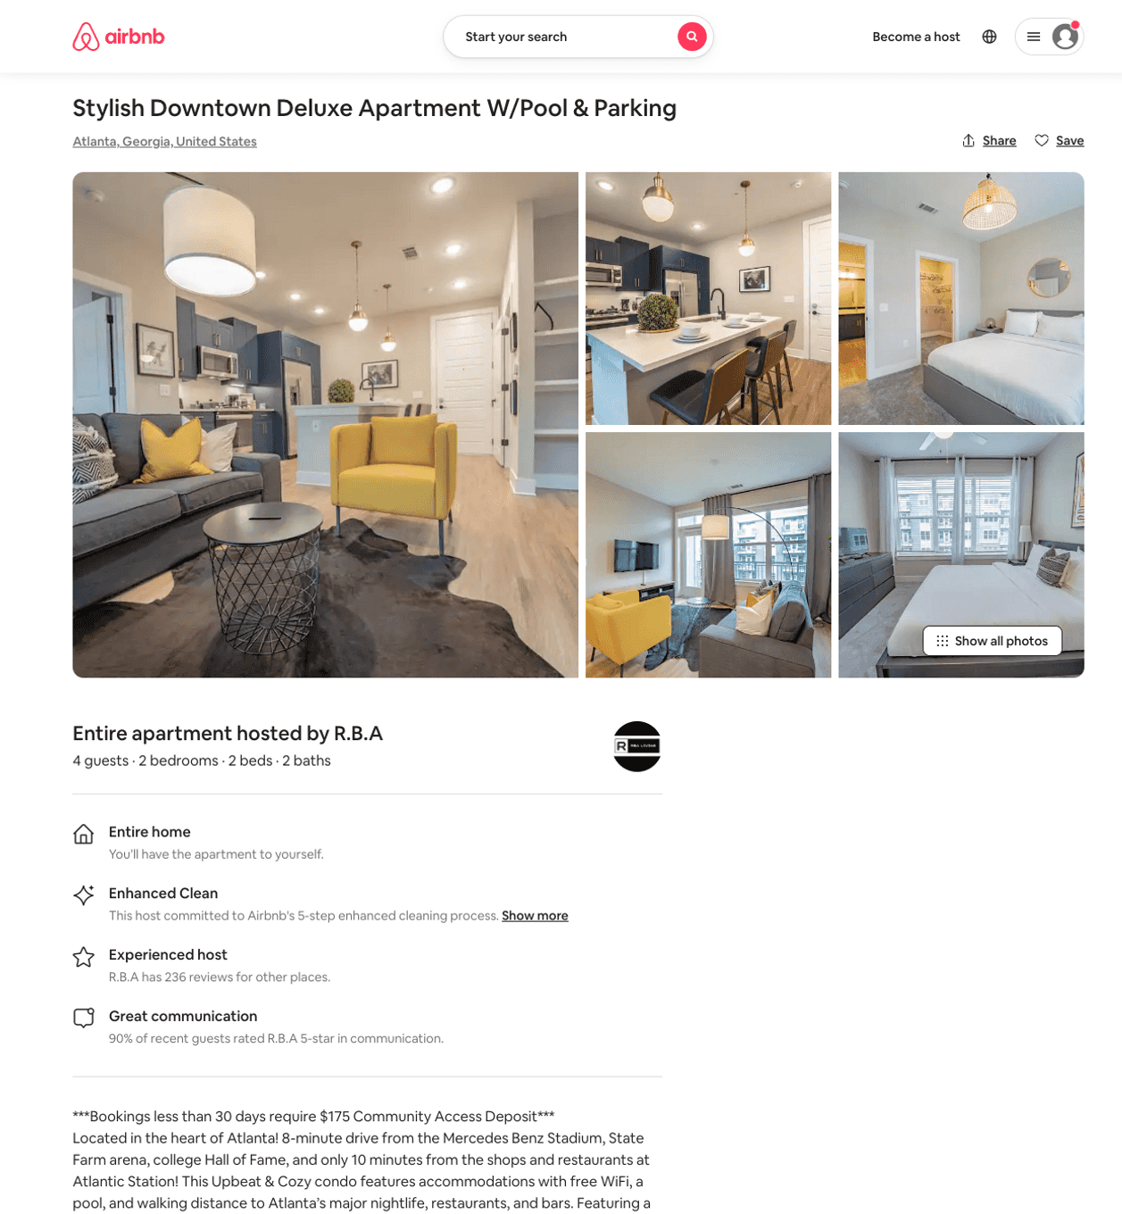
Listing 50280109
2
4
$133 - $229
4.54
3
R.B.A
26534449
17
https://www.airbnb.com/rooms/50280109
Aug 2022

Slide 30
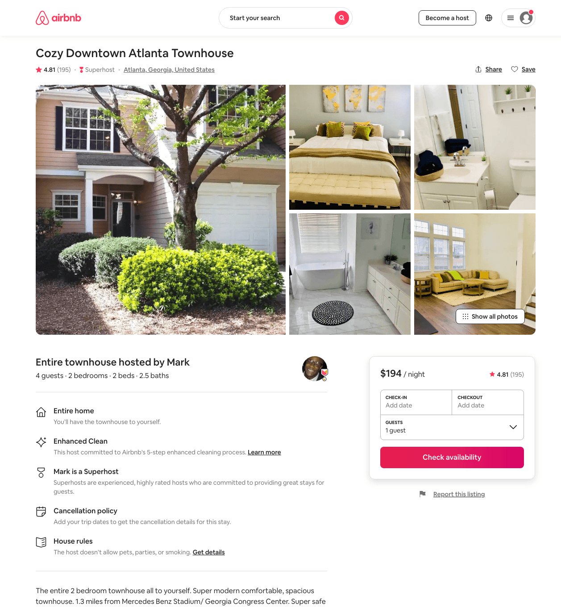
Listing 17573238
2
4
$194 - $214
4.81
2
Mark
27172465
2
https://www.airbnb.com/rooms/17573238
Jul 2022

Slide 31
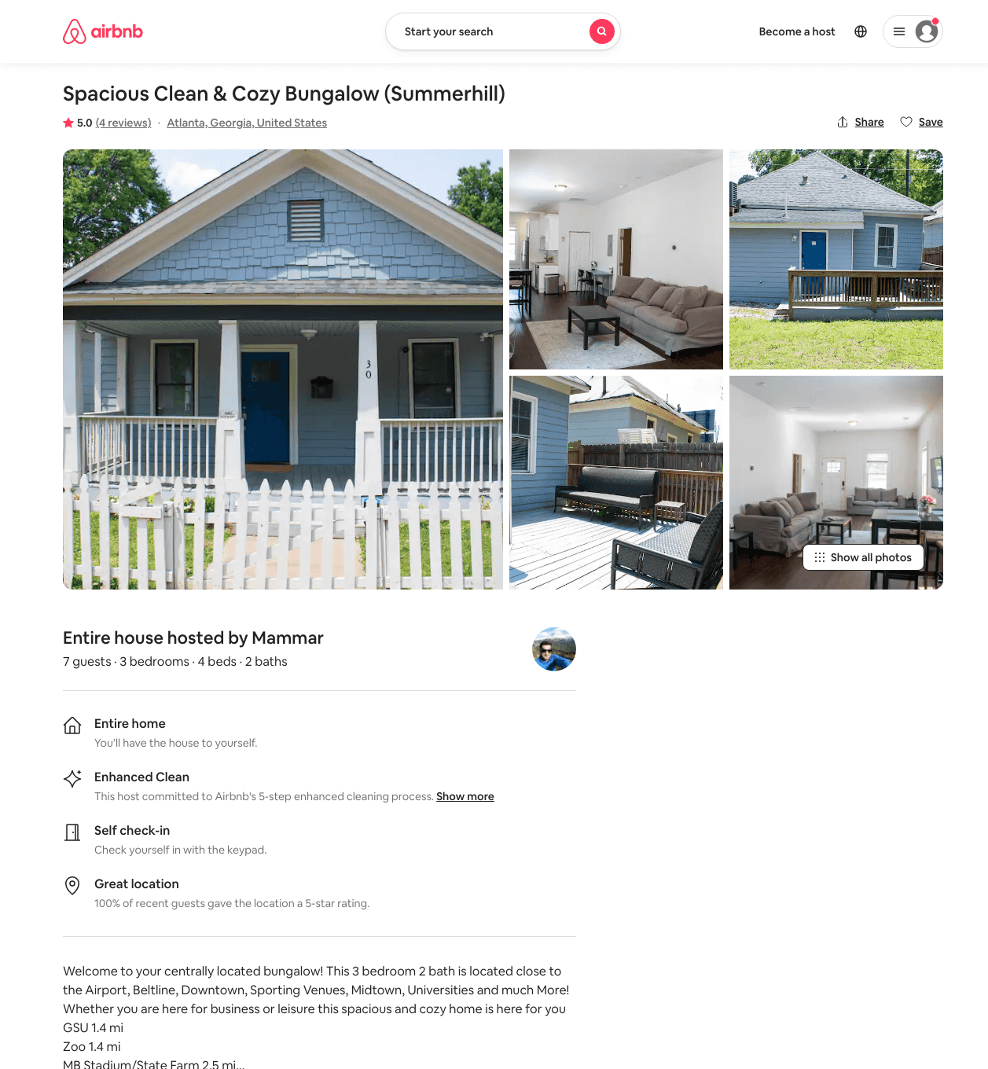
Listing 49548738
3
7
$115 - $166
4.48
1
Mammar
164054797
1
https://www.airbnb.com/rooms/49548738
Jul 2022

Slide 32
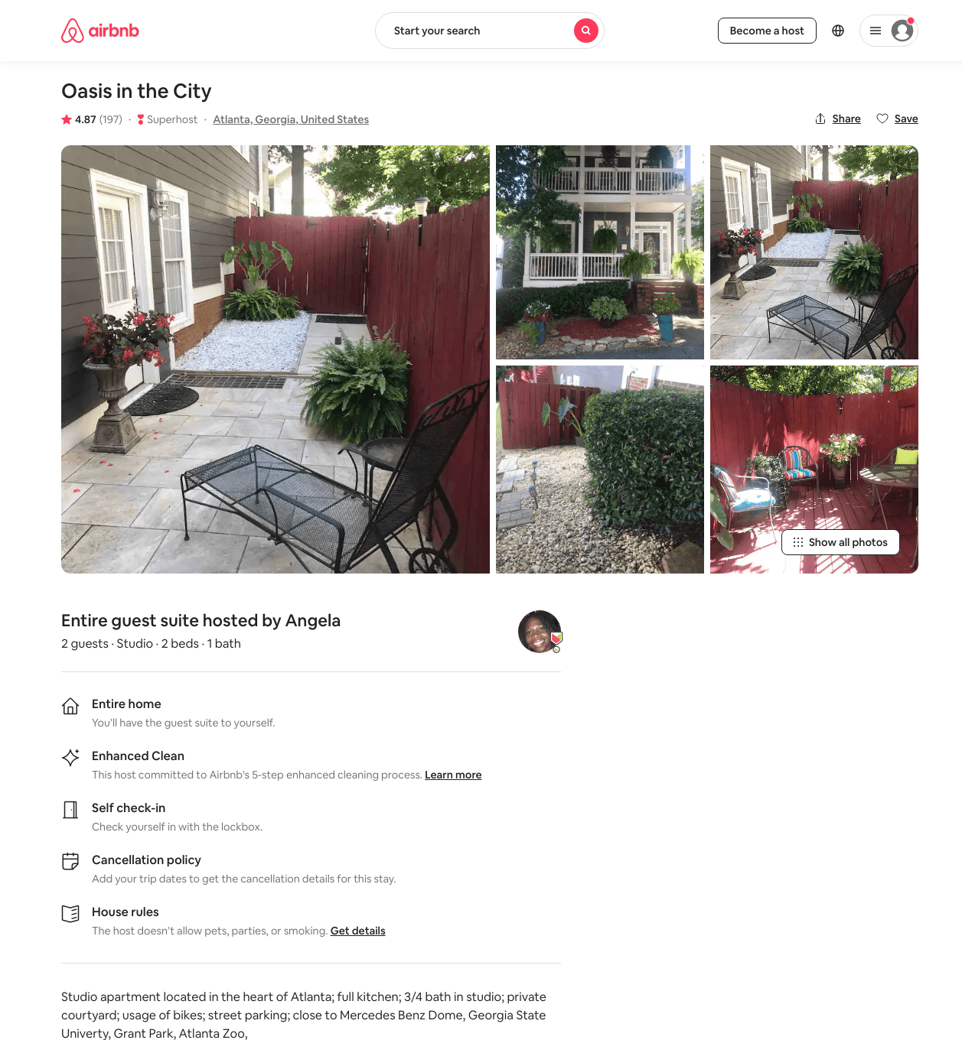
Listing 24737295
Studio
2
$70 - $81
4.84
2
Angela
187016973
1
https://www.airbnb.com/rooms/24737295
Aug 2022

Slide 33
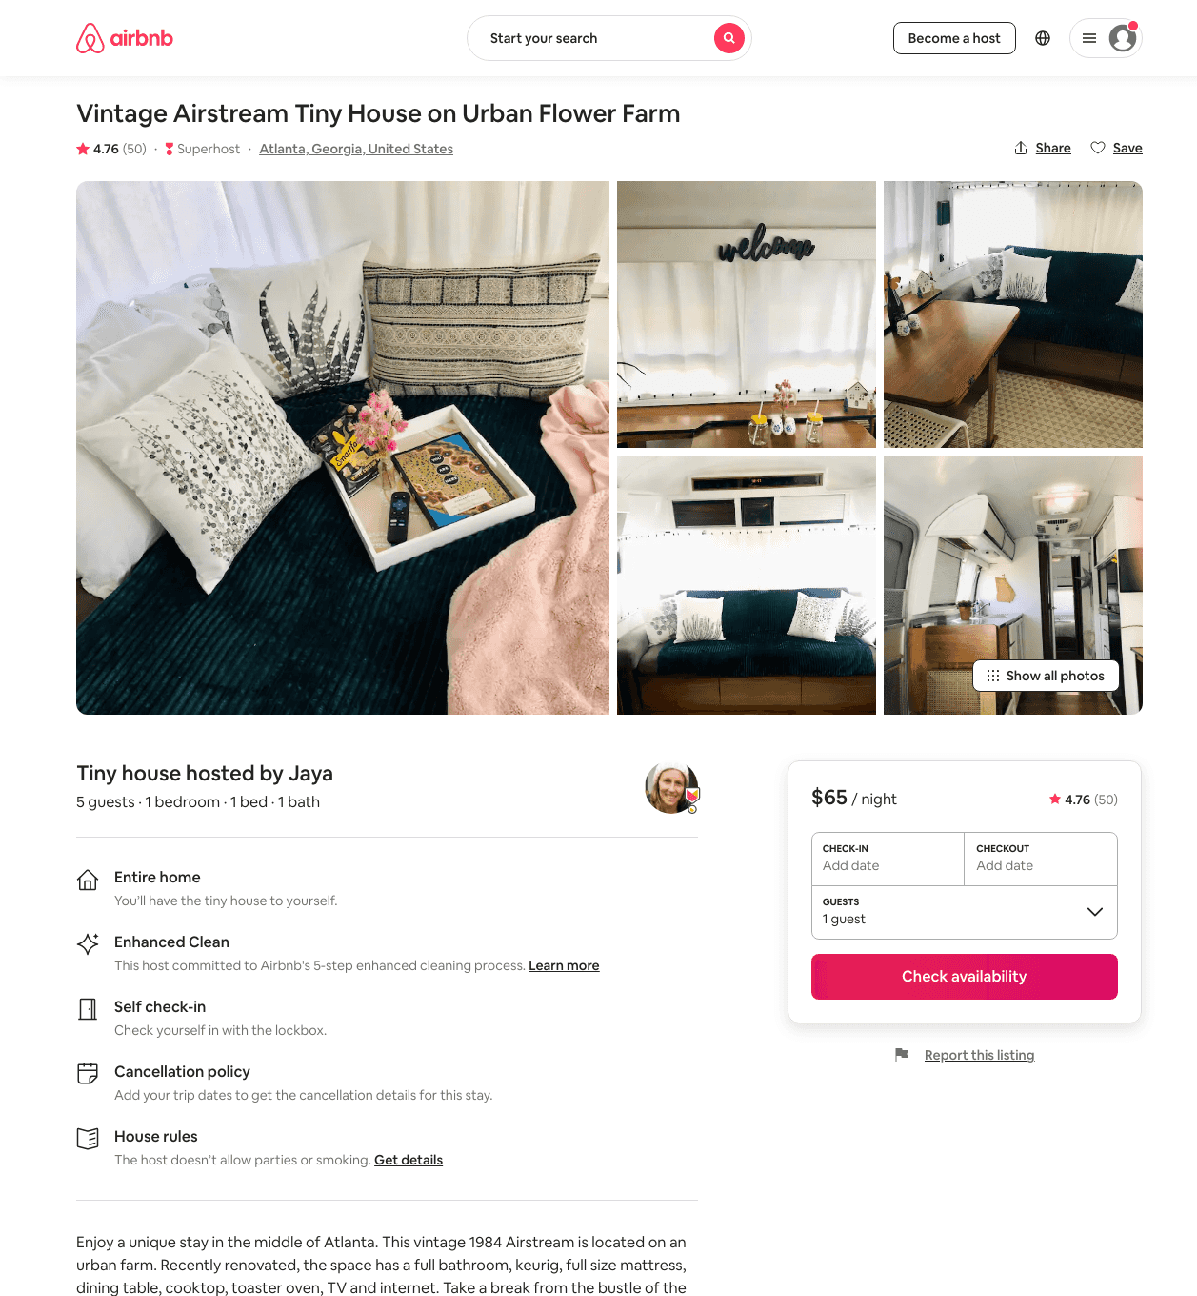
Listing 42120184
1
4
$53 - $73
4.78
1
Jaya
4241392
5
https://www.airbnb.com/rooms/42120184
Aug 2022

Slide 34
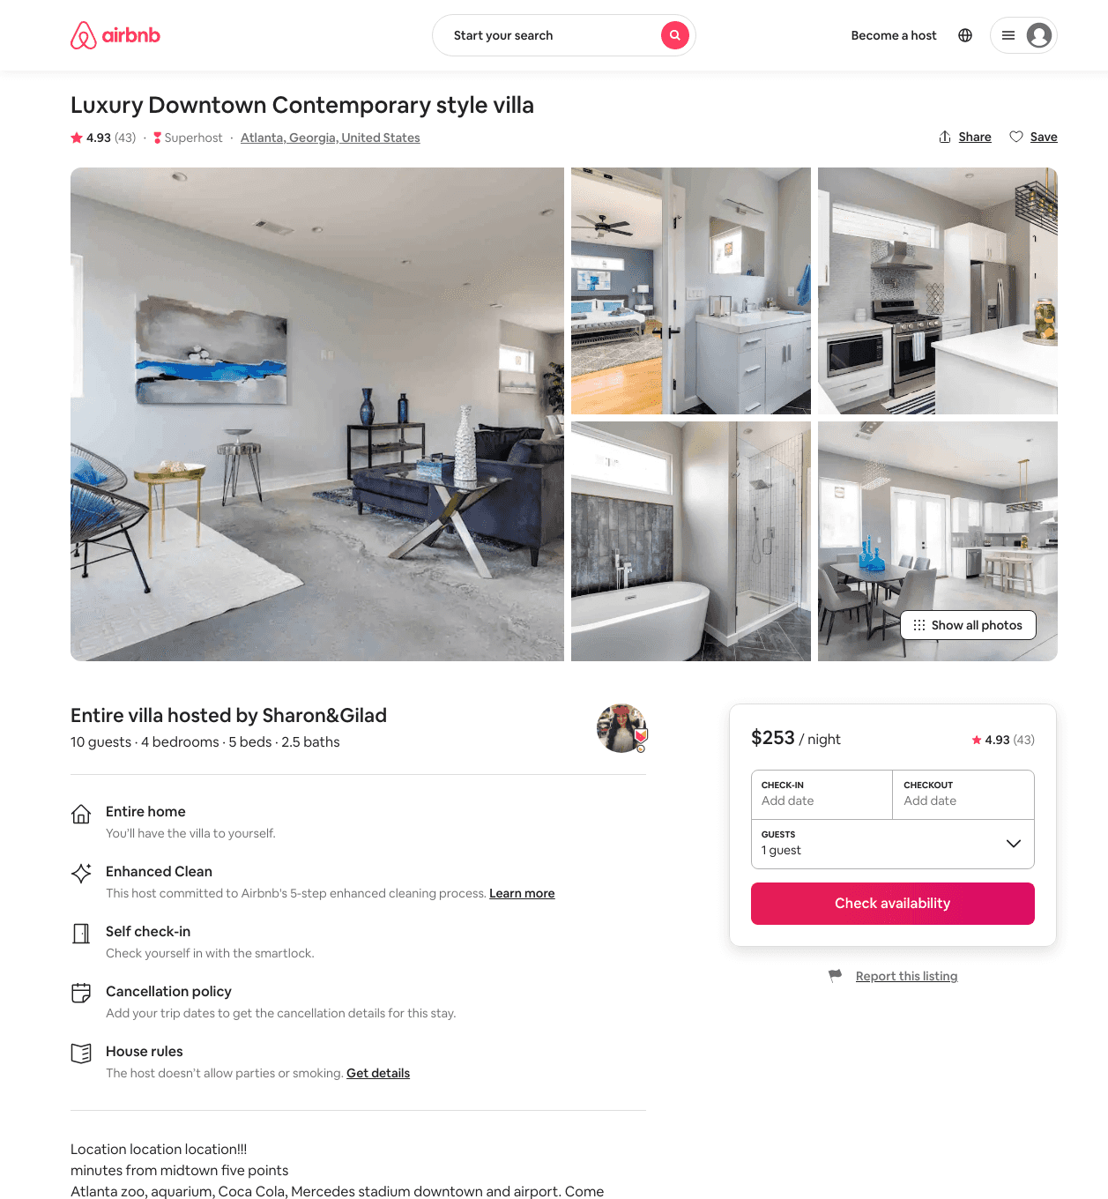
Listing 31906346
4
8
$178 - $368
4.87
3
Sharon&Gilad
6262132
1
https://www.airbnb.com/rooms/31906346
Aug 2022

Slide 35
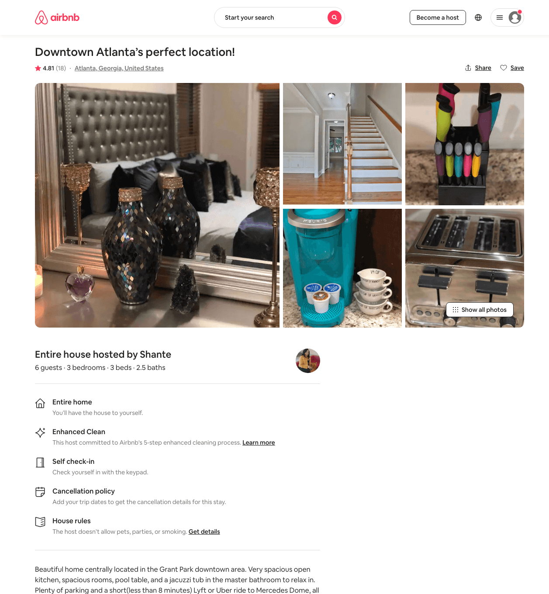
Listing 27635515
3
6
$300 - $500
4.71
1
Shante
103614244
1
https://www.airbnb.com/rooms/27635515
Jul 2022

Slide 36
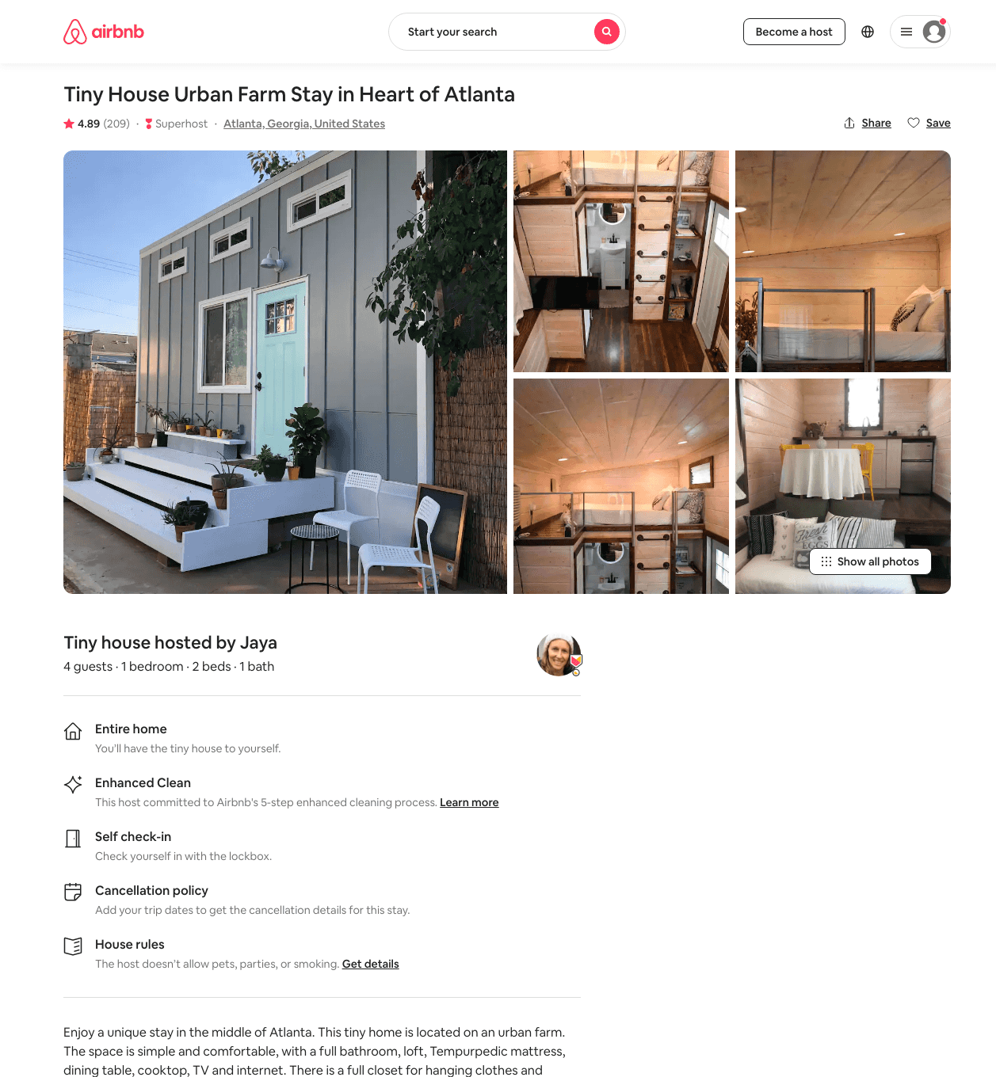
Listing 37881595
1
4
$67 - $99
4.88
1
Jaya
4241392
5
https://www.airbnb.com/rooms/37881595
Aug 2022

Slide 37
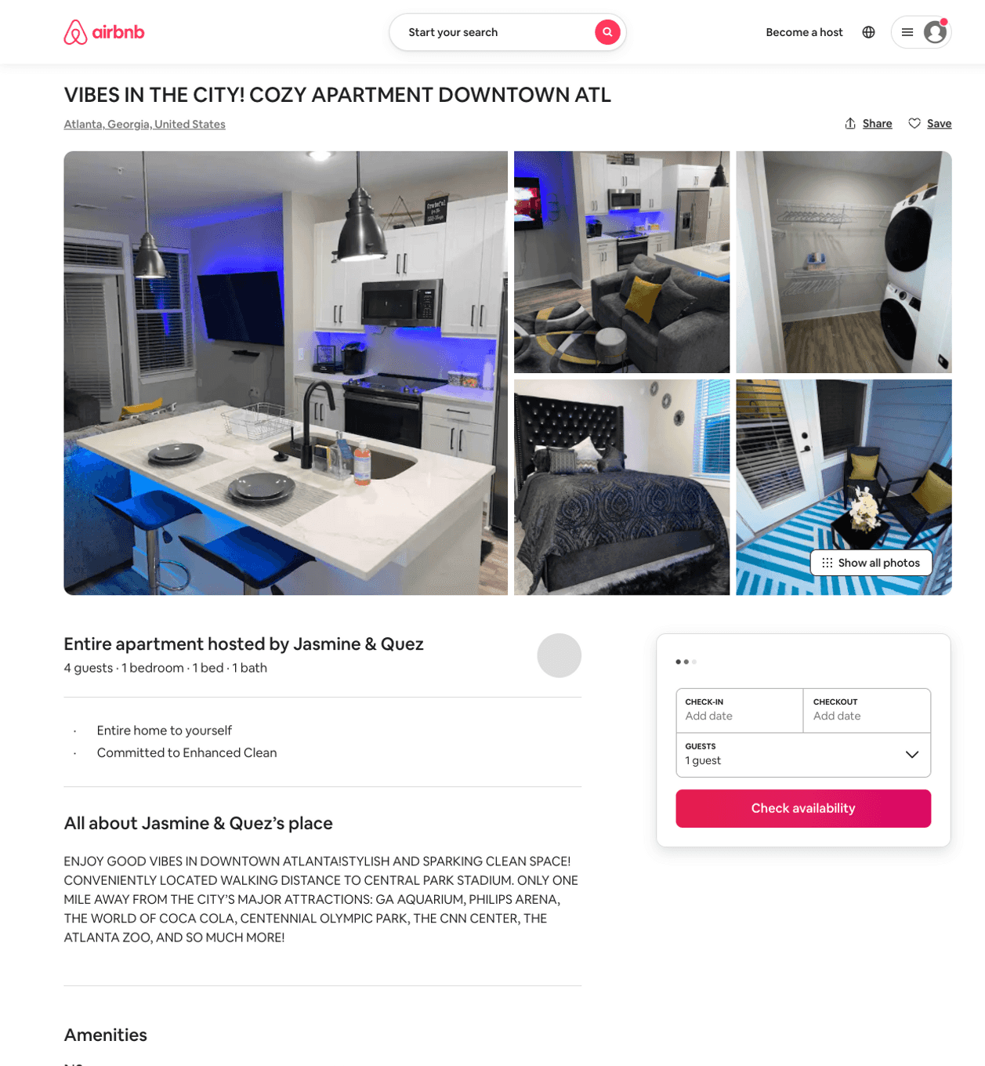
Listing 50776973
1
2
$86 - $155
4.57
2
ATL Rentals
104394606
2
https://www.airbnb.com/rooms/50776973
Aug 2022

Slide 38
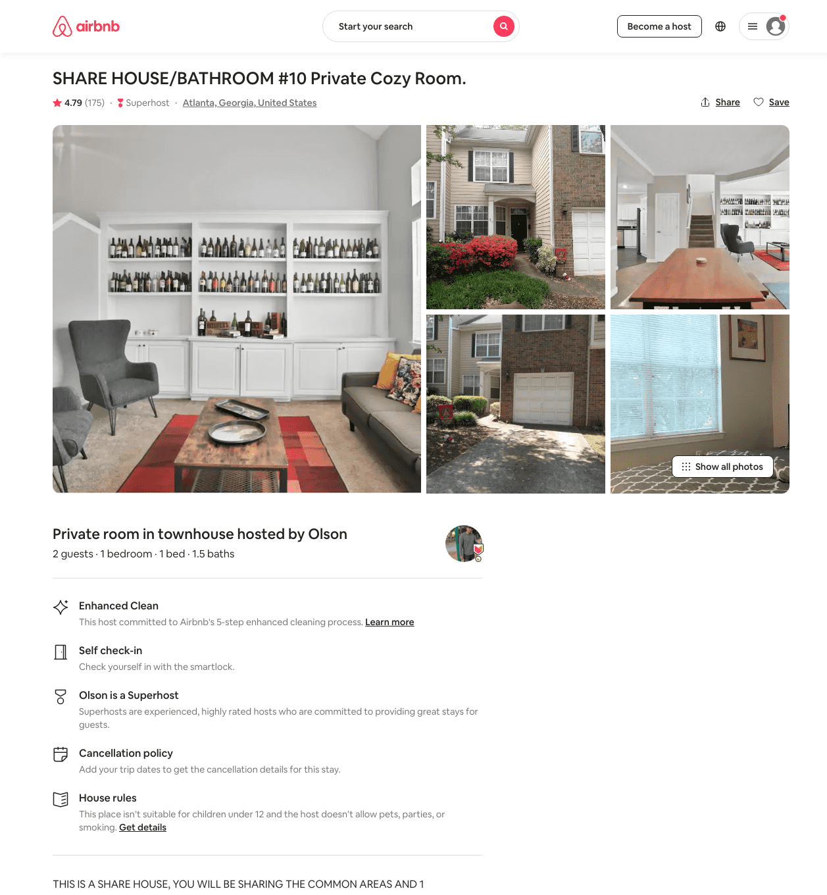
Listing 29131543
1
2
$42 - $51
4.82
2
Olson
190637327
3
https://www.airbnb.com/rooms/29131543
Aug 2022

Slide 39
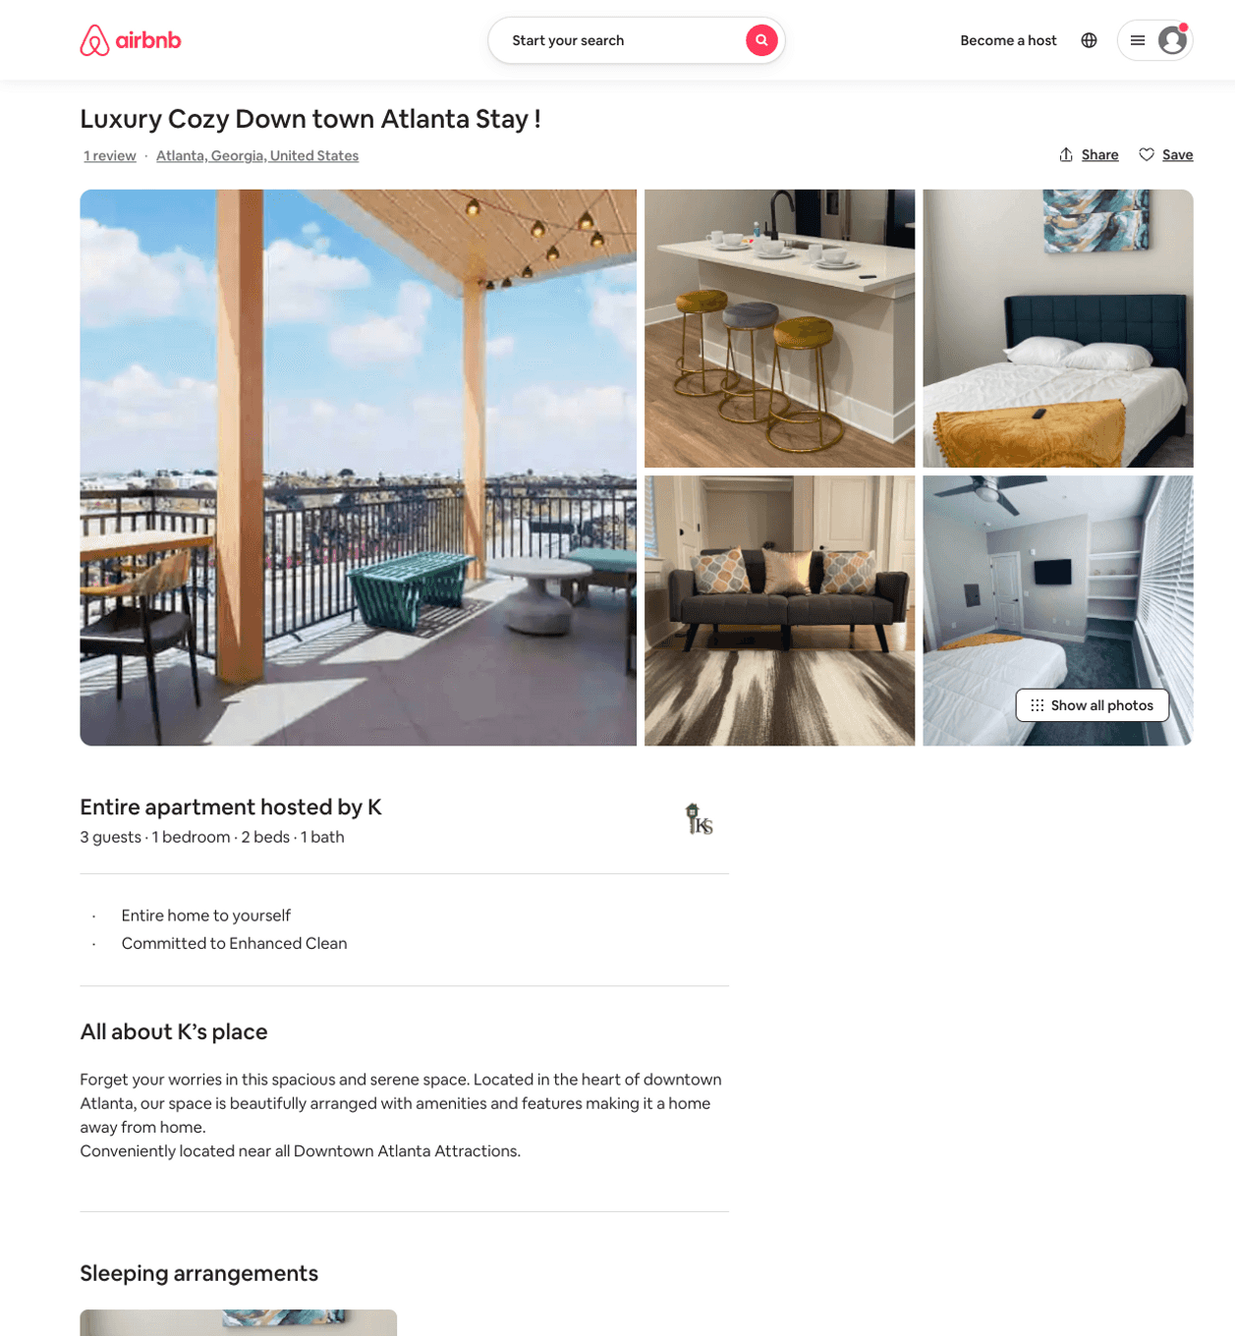
Listing 50657614
1
3
$80 - $101
4.89
1
K
369915460
3
https://www.airbnb.com/rooms/50657614
Aug 2022

Slide 40
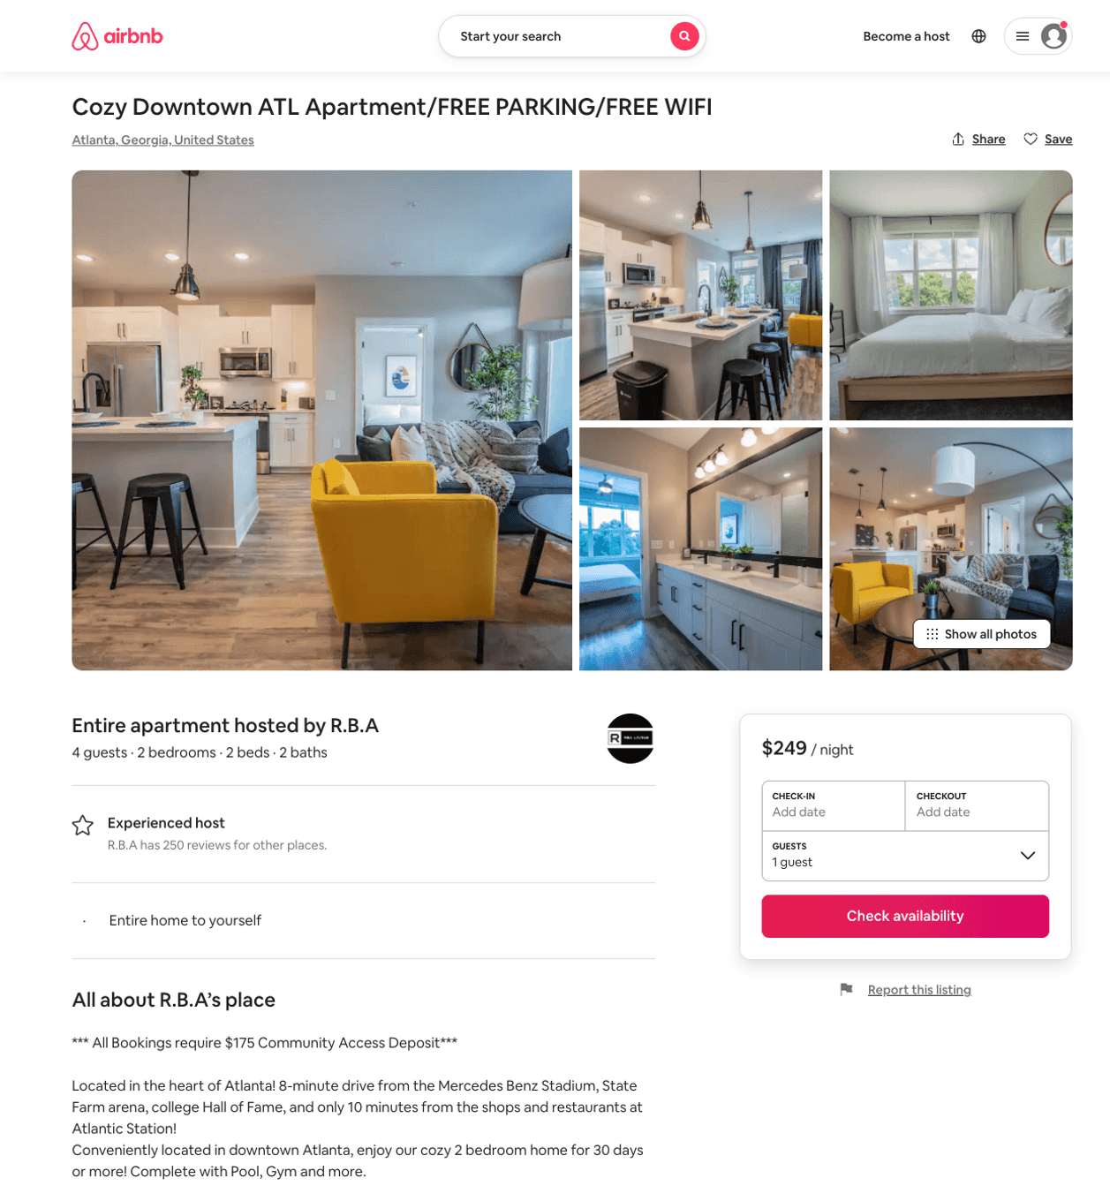
Listing 50870998
2
4
$135 - $307
4.65
3
R.B.A
26534449
17
https://www.airbnb.com/rooms/50870998
Aug 2022

Slide 41
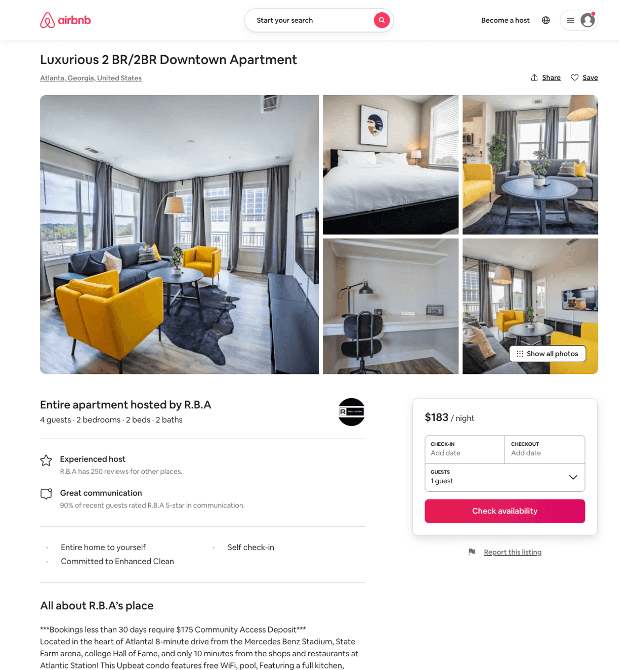
Listing 50518837
2
4
$139 - $599
4.74
3
R.B.A
26534449
17
https://www.airbnb.com/rooms/50518837
Aug 2022

Slide 42
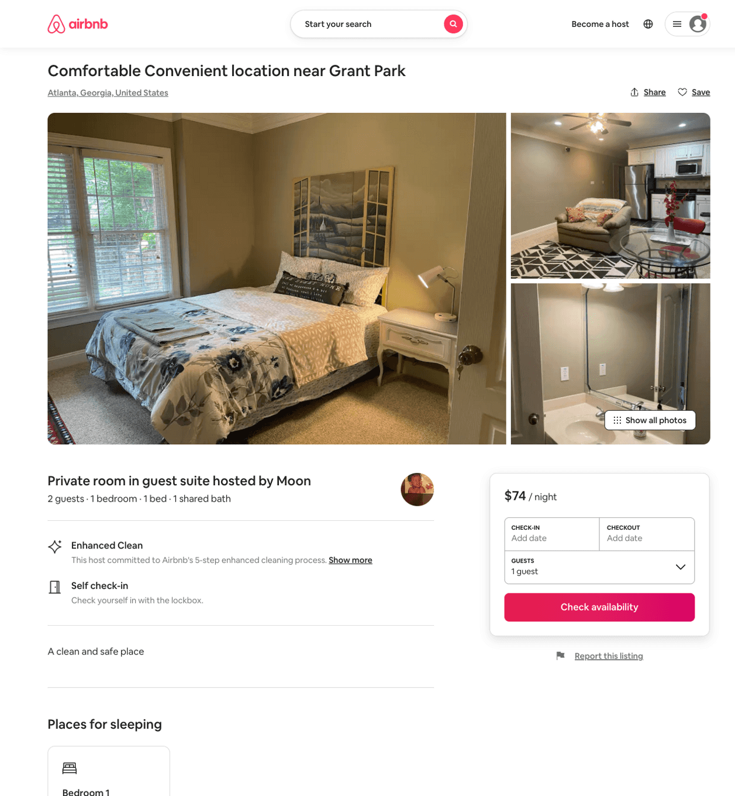
Listing 50399039
1
2
$54 - $77
5.0
1
Jackie
407129820
2
https://www.airbnb.com/rooms/50399039
Aug 2022

Slide 43
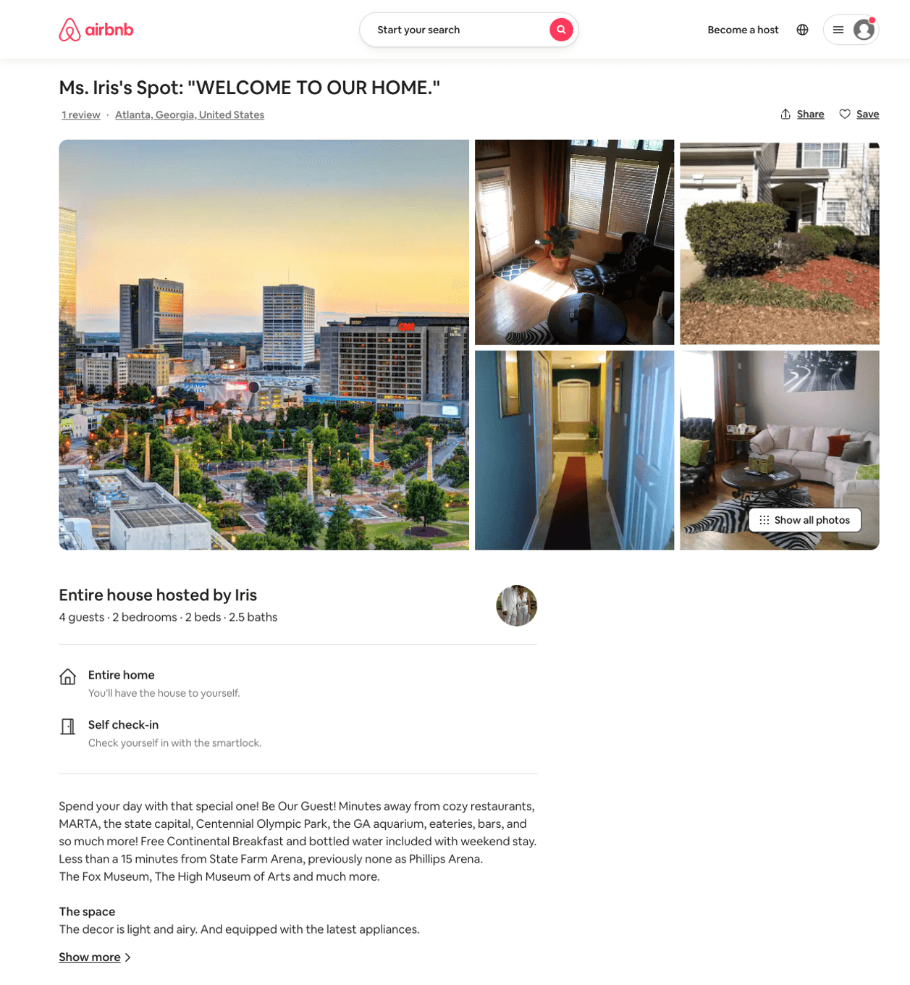
Listing 30527627
2
4
$550
1
Iris
228429738
1
https://www.airbnb.com/rooms/30527627
Aug 2022

Slide 44
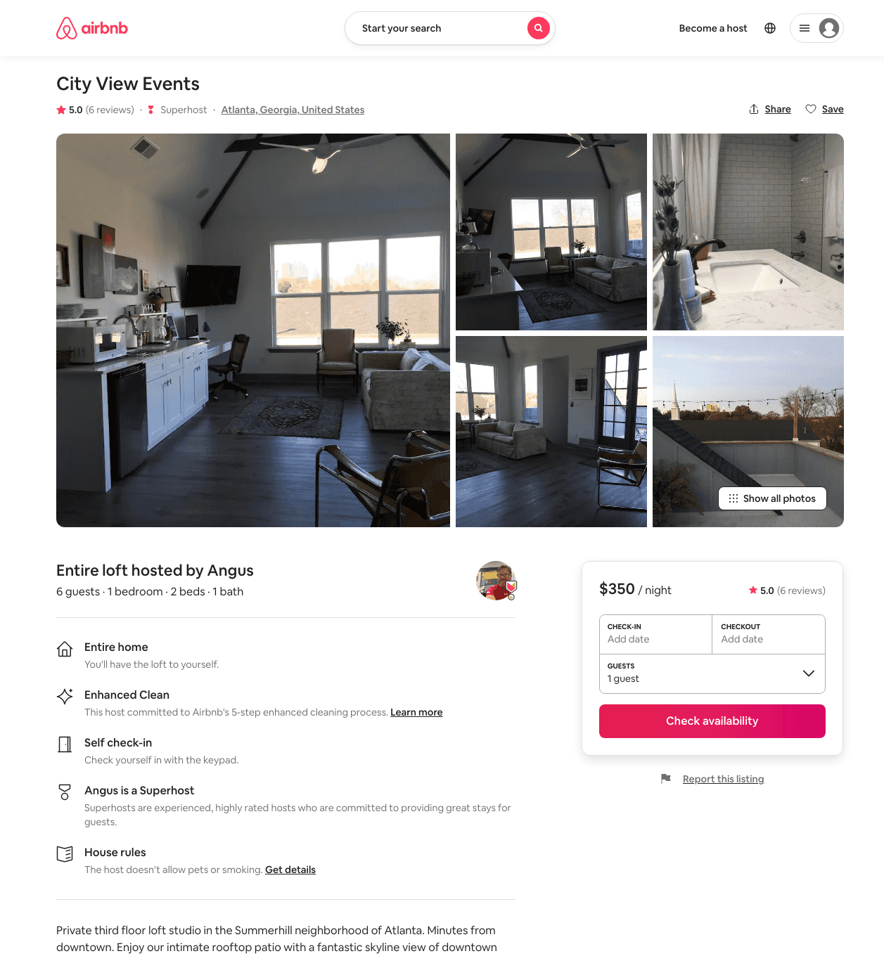
Listing 33242555
1
6
$350 - $407
5.0
1
Angus
6618963
2
https://www.airbnb.com/rooms/33242555
Aug 2022

Slide 45
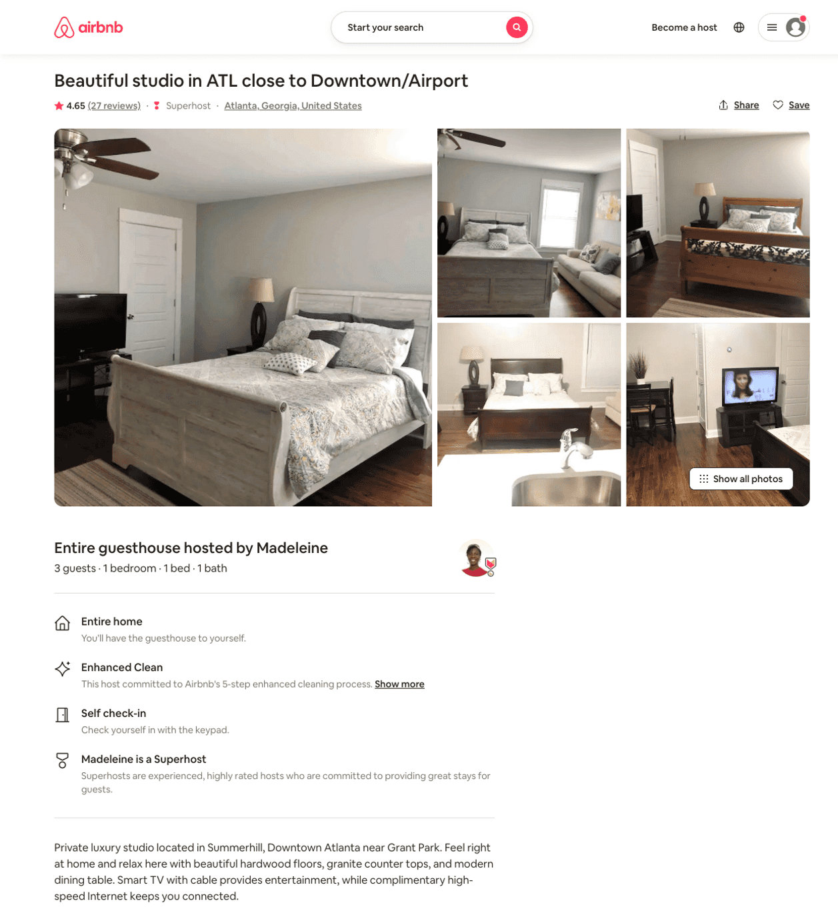
Listing 31764457
1
2
$68 - $116
4.74
1
Madeleine
238153217
1
https://www.airbnb.com/rooms/31764457
Aug 2022

Slide 46
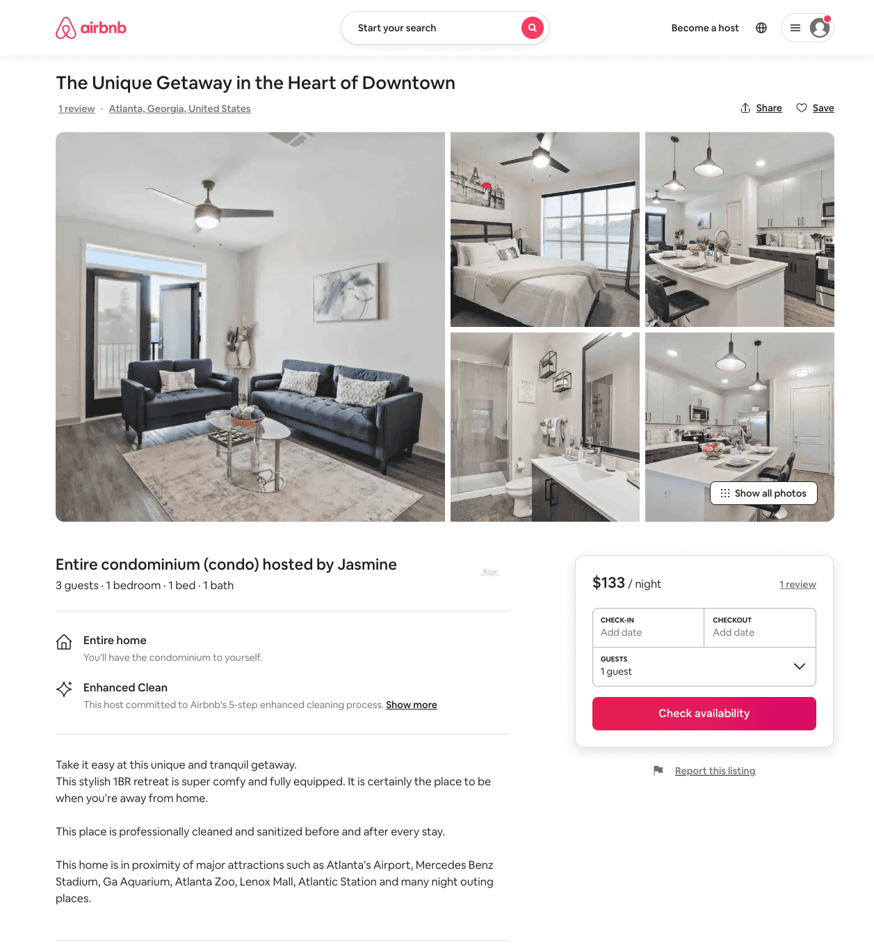
Listing 50934497
1
3
$95 - $150
5.0
1
Jasmine
250659649
1
https://www.airbnb.com/rooms/50934497
Aug 2022

Slide 47
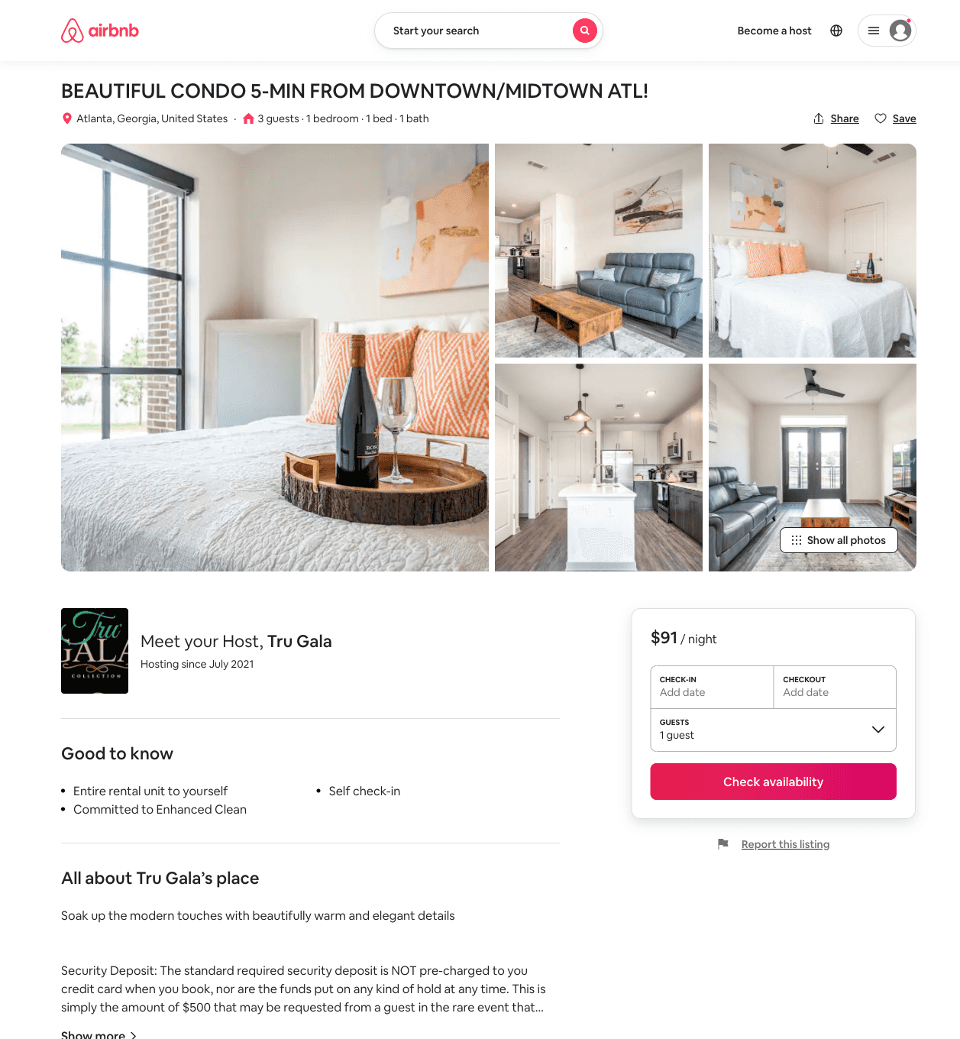
Listing 50849241
1
3
$91 - $183
4.80
2
Tru Gala
411085733
1
https://www.airbnb.com/rooms/50849241
Aug 2022

Slide 48
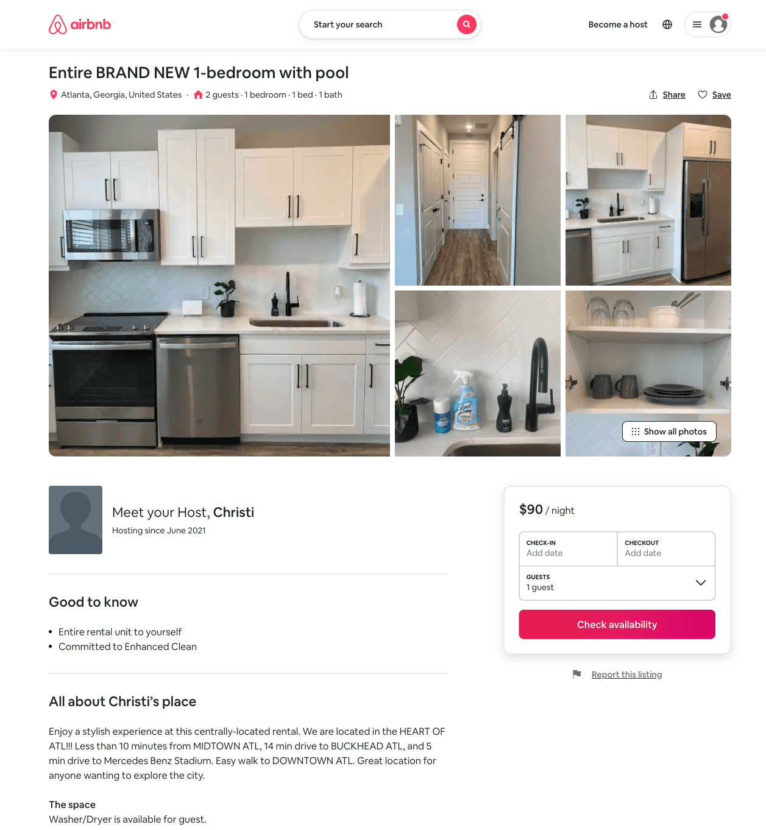
Listing 50617009
1
2
$90 - $125
4.78
1
Christi
408955536
1
https://www.airbnb.com/rooms/50617009
Aug 2022

Slide 49
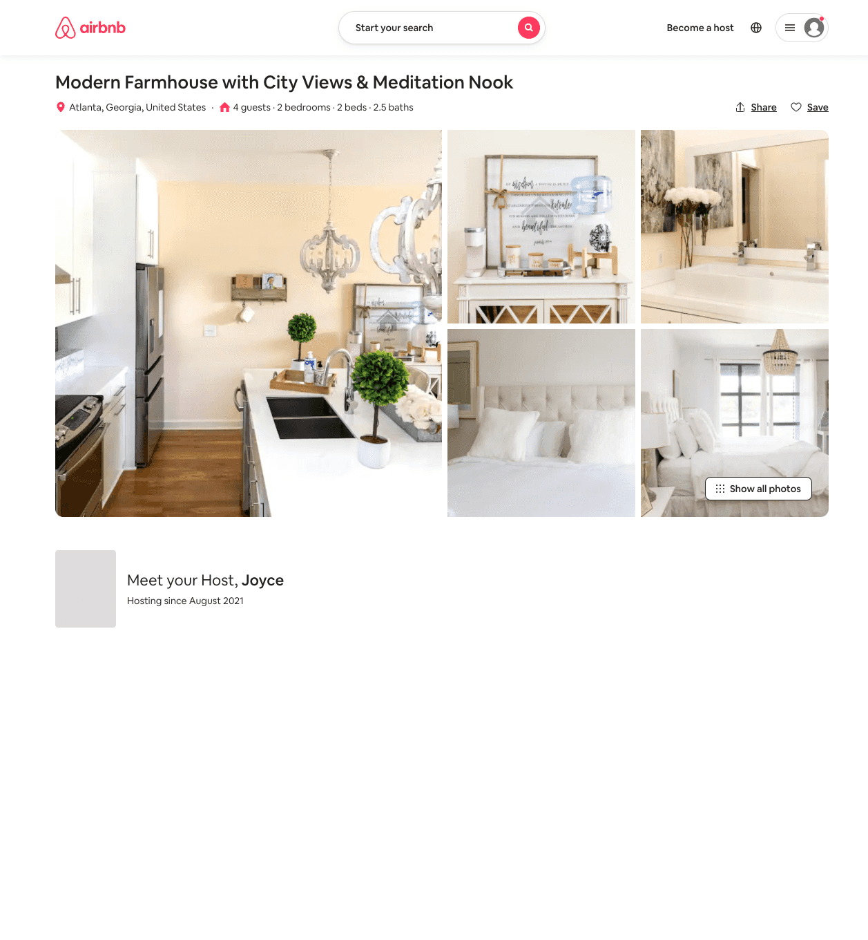
Listing 51616983
2
4
$164 - $275
4.50
2
Joyce
418144752
1
https://www.airbnb.com/rooms/51616983
Jul 2022

Slide 50
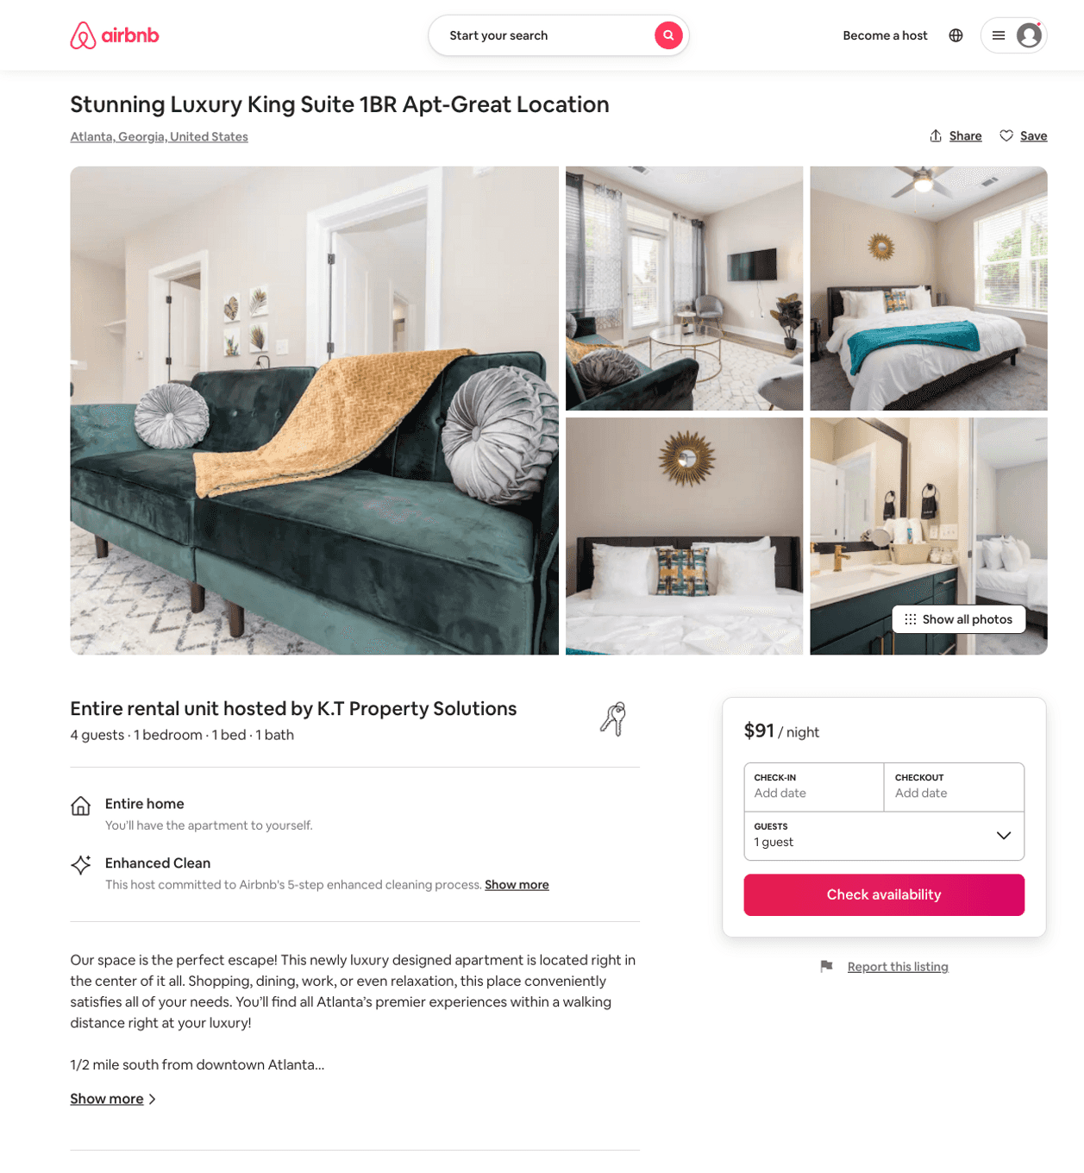
Listing 51582689
1
4
$65 - $124
4.87
1
K.T Property Solutions
386779343
1
https://www.airbnb.com/rooms/51582689
Aug 2022

Slide 51
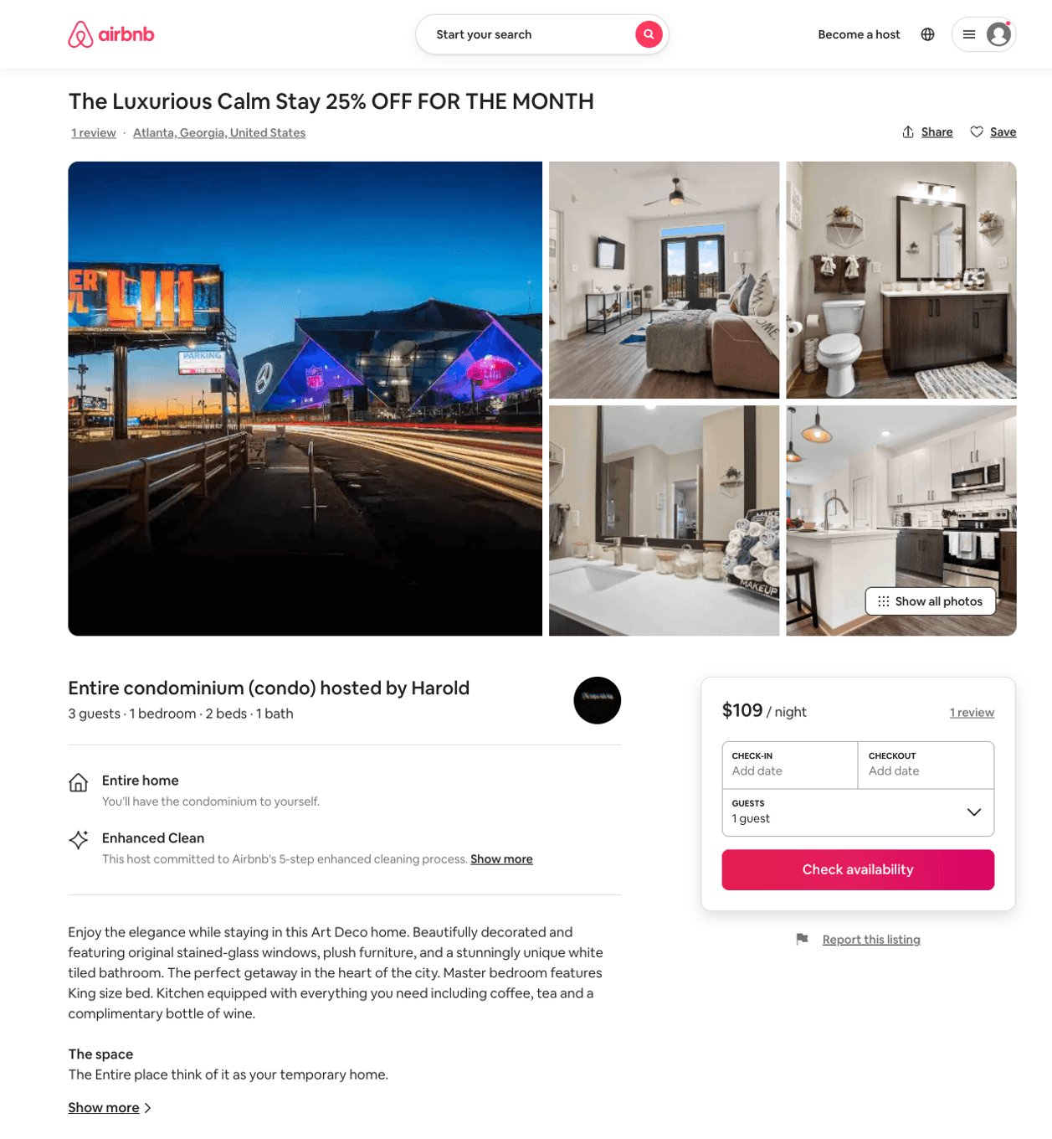
Listing 51025182
1
3
$75 - $135
4.75
1
Harold
153642283
1
https://www.airbnb.com/rooms/51025182
Jul 2022

Slide 52
Listing 51708704
3
6
$94 - $253
4.76
2
Lynette
226424456
1
https://www.airbnb.com/rooms/51708704
Aug 2022

Slide 53
Listing 6676789
1
2
$42 - $48
4.80
2
Olson
10731138
1
https://www.airbnb.com/rooms/6676789
Aug 2022

Slide 54
Listing 44250753
3
6
$164
30
Didem
130464324
8
https://www.airbnb.com/rooms/44250753
Aug 2022

Slide 55
Listing 51652216
4
12
$234 - $370
4.91
2
Arthur
20905604
3
https://www.airbnb.com/rooms/51652216
Aug 2022

Slide 56
Listing 52182630
2
8
$179 - $282
2
Elizabeth
193842768
4
https://www.airbnb.com/rooms/52182630
Jun 2022

Slide 57
Listing 52454399
2
6
$121 - $299
4.40
1
The Stylish
29505942
2
https://www.airbnb.com/rooms/52454399
Aug 2022

Slide 58
Listing 52383507
1
2
$44 - $55
4.70
2
Stephen
142648442
1
https://www.airbnb.com/rooms/52383507
Aug 2022

Slide 59
Listing 44526442
3
6
$149
30
Didem
130464324
8
https://www.airbnb.com/rooms/44526442
Aug 2022

Slide 60
Listing 52670252
2
5
$125 - $189
4.94
1
Talia
1851902
6
https://www.airbnb.com/rooms/52670252
Aug 2022

Slide 61
Listing 52906706
2
5
$134 - $153
4.67
2
Tray
428326727
1
https://www.airbnb.com/rooms/52906706
Aug 2022

Slide 62
Listing 52971589
2
5
$107 - $138
4.78
2
Matt
41470346
1
https://www.airbnb.com/rooms/52971589
Aug 2022

Slide 63
Listing 7606972
1
2
$108 - $121
5
1
Madeleine Kamga
https://www.vrbo.com/7606972ha
Aug 2022

Slide 64
Listing 2475493
2
6
$235
2
https://www.vrbo.com/2475493
Aug 2022

Slide 65
Listing 2464314
1
3
$64 - $80
5
1
https://www.vrbo.com/2464314
Aug 2022

Slide 66
Listing 2305701
1
4
$110 - $123
1
Robert Buchanan
https://www.vrbo.com/2305701
Aug 2022

Slide 67
Listing 51110086
4
10
$367 - $599
3
Royal
22098841
4
https://www.airbnb.com/rooms/51110086
Aug 2022

Slide 68
Listing 53250392
1
2
$67 - $136
4.57
1
Kay
410973133
2
https://www.airbnb.com/rooms/53250392
Aug 2022

Slide 69
Listing 53328024
1
4
$94 - $154
5.0
1
Adam
381560027
2
https://www.airbnb.com/rooms/53328024
Jun 2022

Slide 70
Listing 53134112
4
8
$299 - $556
4.67
2
Mia
143194222
1
https://www.airbnb.com/rooms/53134112
Aug 2022

Slide 71
Listing 53595407
1
3
$110 - $379
3
Devonte
389162122
1
https://www.airbnb.com/rooms/53595407
Aug 2022

Slide 72
Listing 53741265
4
8
$347 - $504
4.88
2
Ikenna
435257815
1
https://www.airbnb.com/rooms/53741265
Aug 2022

Slide 73
Listing 53631196
1
4
$89 - $135
4.93
1
Paisley
434303230
1
https://www.airbnb.com/rooms/53631196
Aug 2022

Slide 74
Listing 53630119
2
5
$87 - $132
4.85
1
Cherelle
434292126
1
https://www.airbnb.com/rooms/53630119
Aug 2022

Slide 75
Listing 53750867
1
3
$94 - $149
4.77
1
KK Properties
435337214
1
https://www.airbnb.com/rooms/53750867
Aug 2022

Slide 76
Listing 2558174
4
10
$453 - $500
5
3
Mia Levy
https://www.vrbo.com/2558174
Aug 2022

Slide 77
Listing 2583058
1
3
$143 - $150
5
2
https://www.vrbo.com/2583058
Aug 2022

Slide 78
Listing 2589441
2
5
$114
5
2
Cherelle
https://www.vrbo.com/2589441
Aug 2022

Slide 79
Listing 52151258
1
2
$105
2
Zann
165656076
3
https://www.airbnb.com/rooms/52151258
Jul 2022

Slide 80
Listing 2586241
2
6
$171 - $200
5
1
Serenity Deluxe-ATL
https://www.vrbo.com/2586241
Aug 2022

Slide 81
Listing 54148709
2
6
$110 - $217
4.50
2
Plushy
181205324
5
https://www.airbnb.com/rooms/54148709
Aug 2022

Slide 82
Listing 2620640
1
4
$105
1
2
https://www.vrbo.com/2620640
Aug 2022

Slide 83
Listing 54309177
4
12
$714 - $997
5.0
2
Skyline Luxe
359339730
1
https://www.airbnb.com/rooms/54309177
Aug 2022

Slide 84
Listing 52529993
1
2
$90 - $104
4.69
2
Tawana
207726223
1
https://www.airbnb.com/rooms/52529993
Aug 2022

Slide 85
Listing 2625719
2
5
$166
4.75
1
PHP Properties LLC
https://www.vrbo.com/2625719
Aug 2022

Slide 86
Listing 54310131
1
3
$74 - $125
4.68
2
Urban Legacy
440528139
1
https://www.airbnb.com/rooms/54310131
Aug 2022

Slide 87
Listing 54312843
1
3
$80 - $221
4.83
1
Knight Group
440556917
1
https://www.airbnb.com/rooms/54312843
Aug 2022

Slide 88
Listing 54379307
1
4
$75 - $103
1
Oludayo
434951317
1
https://www.airbnb.com/rooms/54379307
Aug 2022

Slide 89
Listing 53708146
2
5
$124 - $211
5.0
1
Php Properties
37103842
1
https://www.airbnb.com/rooms/53708146
Aug 2022

Slide 90
Listing 29131621
1
2
$46 - $60
4.86
2
Olson
190637327
3
https://www.airbnb.com/rooms/29131621
Aug 2022

Slide 91
Listing 2651422
2
4
$182
5
2
https://www.vrbo.com/2651422
Aug 2022

Slide 92
Listing 2712468
3
7
$137
3.6666667
2
Plushy Host
https://www.vrbo.com/2712468
Aug 2022

Slide 93
Listing 53487606
4
6
$210 - $218
4.81
2
Soley
432372841
1
https://www.airbnb.com/rooms/53487606
Aug 2022

Slide 94
Listing 2732712
4
8
$349
2
https://www.vrbo.com/2732712
Aug 2022

Slide 95
Listing 2769818
3
6
$263
1
Shannon Cook
https://www.vrbo.com/2769818
Aug 2022

Slide 96
Listing 2749464
1
5
$160
1
Tia
https://www.vrbo.com/2749464
Aug 2022

Slide 97
Listing 2809236
1
2
$130
2
2
https://www.vrbo.com/2809236
Aug 2022

Slide 98
Listing 2812164
3
7
$278
5
2
Posh Noire
https://www.vrbo.com/2812164
Aug 2022

Slide 99
Listing 2833853
2
7
$266
1
Posh Noire
https://www.vrbo.com/2833853
Aug 2022

Slide 100
Listing 41528805
1
2
$73
1
Dominique
169112374
1
https://www.airbnb.com/rooms/41528805
Jun 2022

Slide 101
Listing 2913115
3
6
$185
2
Plushy Host
https://www.vrbo.com/2913115
Aug 2022

Slide 102
Listing 2932902
2
2
$128
1
https://www.vrbo.com/2932902
Aug 2022

