Slide 2
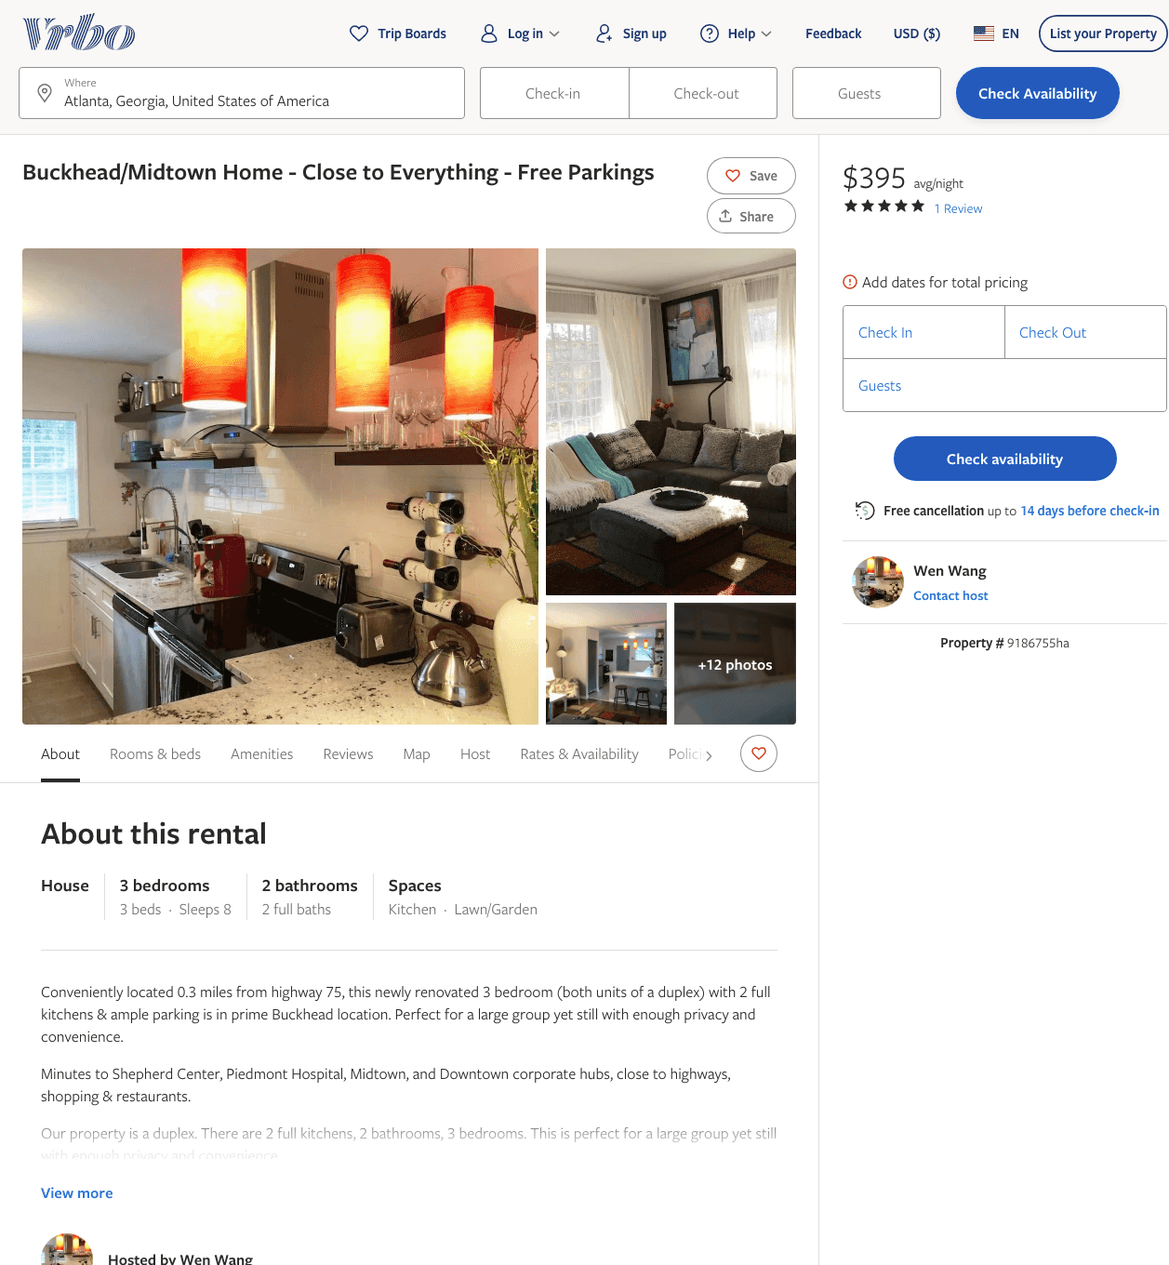
Listing 9186755
3
8
$395 - $399
4.5
3
Wen
https://www.vrbo.com/9186755ha
Aug 2022

Slide 3
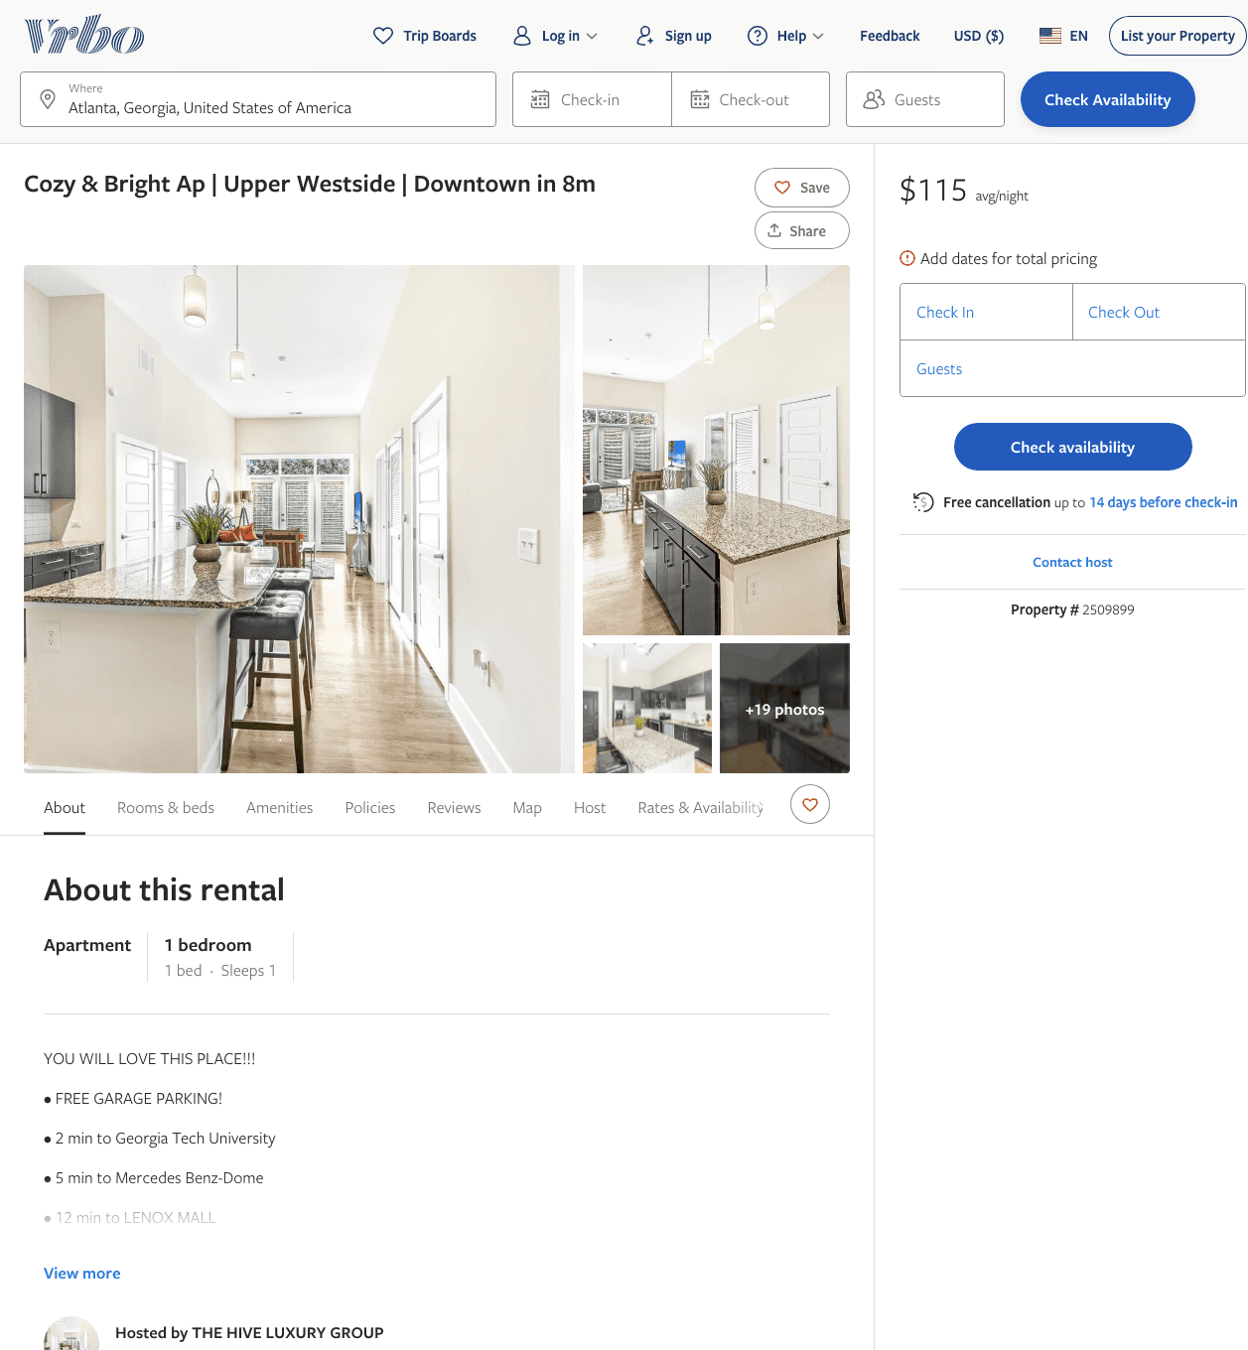
Listing 2509899
1
1
$106 - $124
1
THE HIVE LUXURY GROUP
https://www.vrbo.com/2509899
Aug 2022

Slide 4
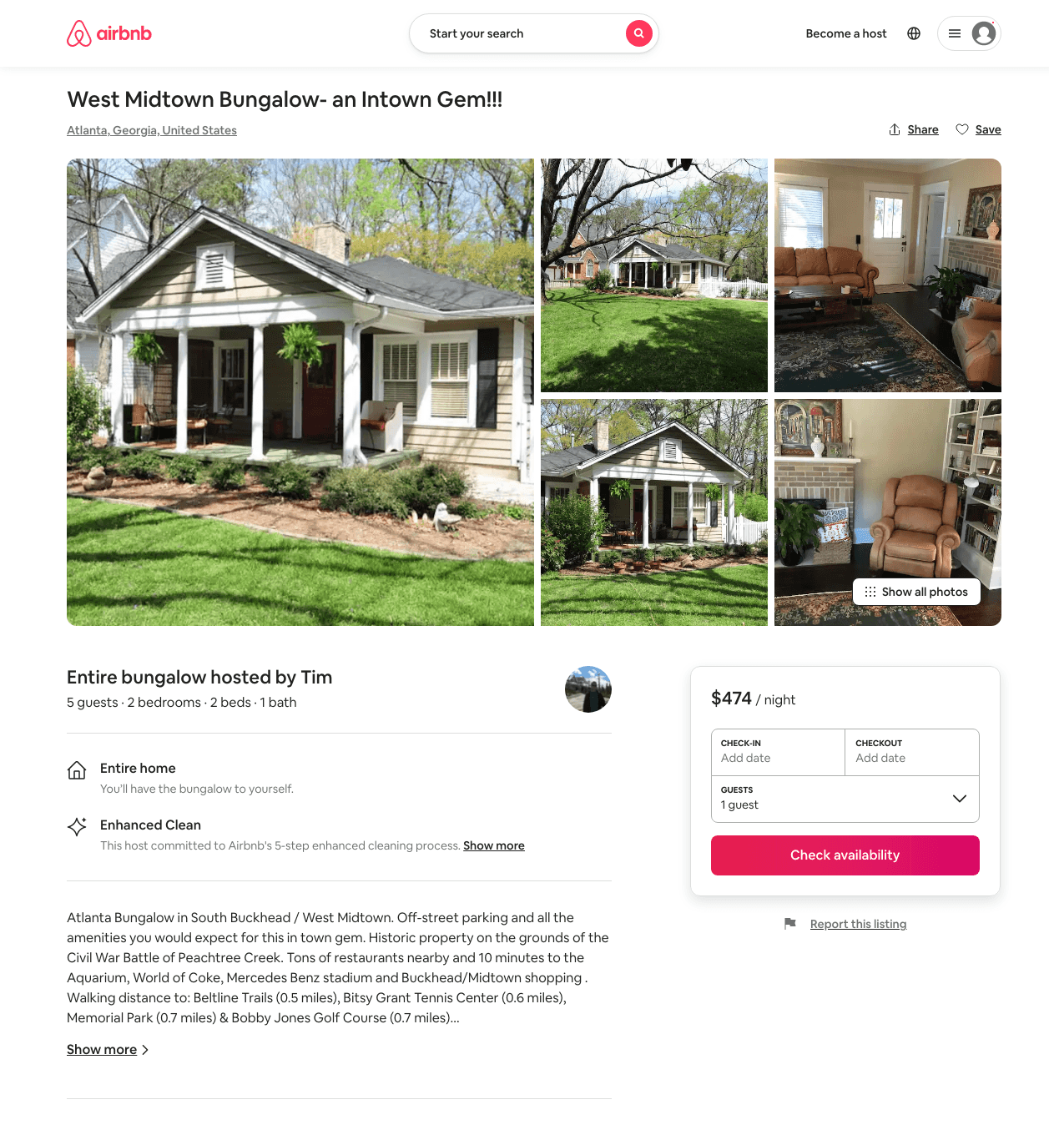
Listing 31705258
2
5
$474
5
Tim
11706645
1
https://www.airbnb.com/rooms/31705258
Aug 2022

Slide 5
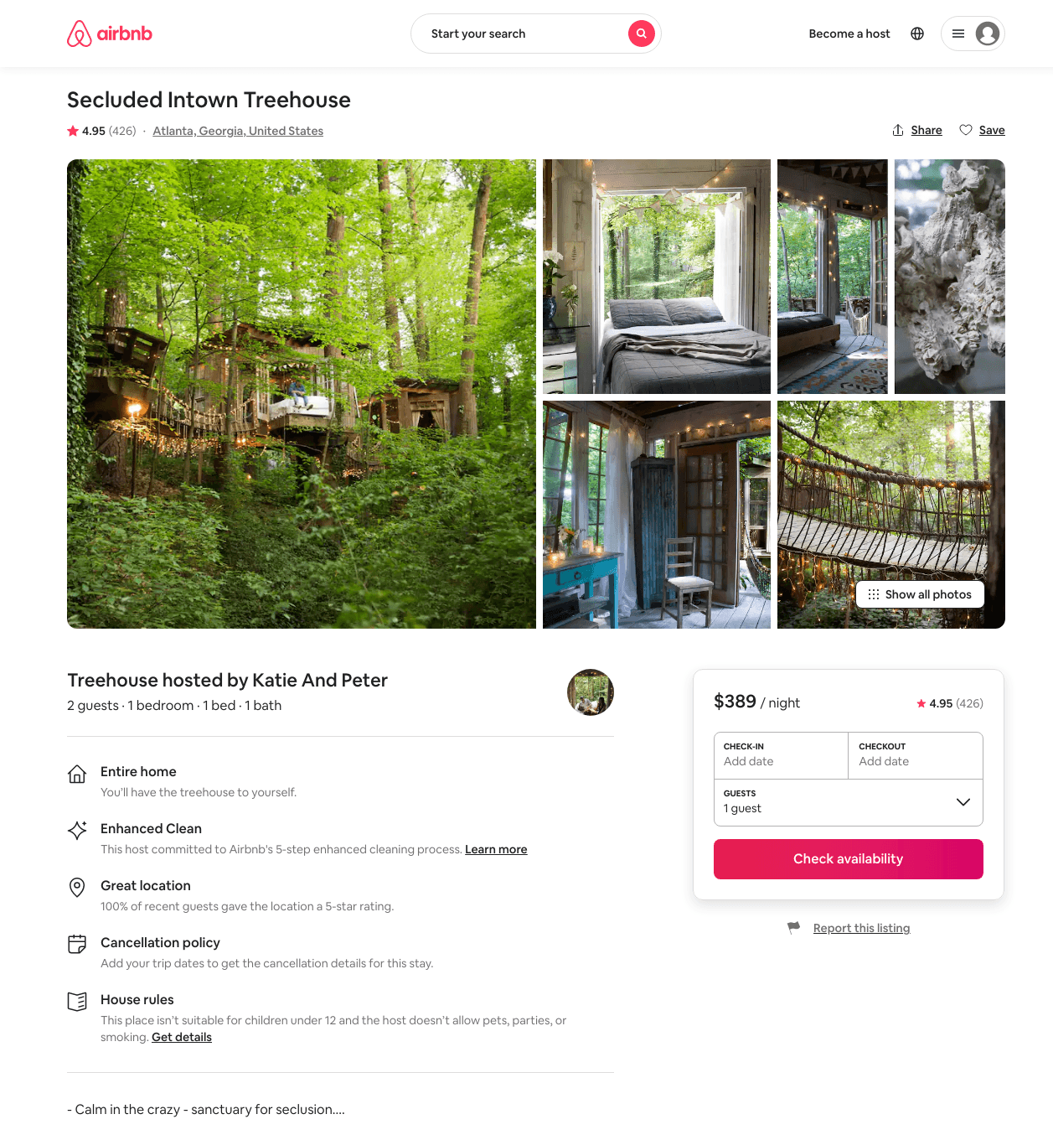
Listing 1415908
709 WILSON RD NW
1
2
$385 - $389
4.95
2
Katie And Peter
7629389
1
https://www.airbnb.com/rooms/1415908
Aug 2022

Slide 6
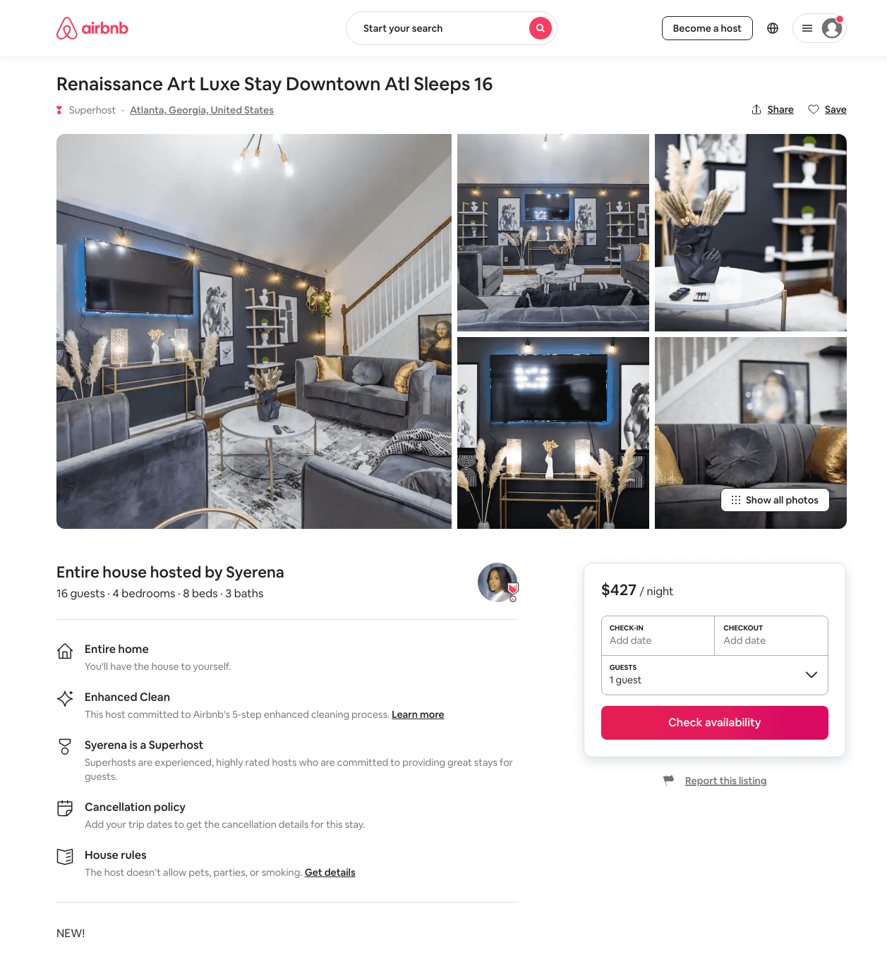
Listing 48225756
4
16
$167 - $441
3.67
2
Syerena
185063162
4
https://www.airbnb.com/rooms/48225756
Aug 2022

Slide 7
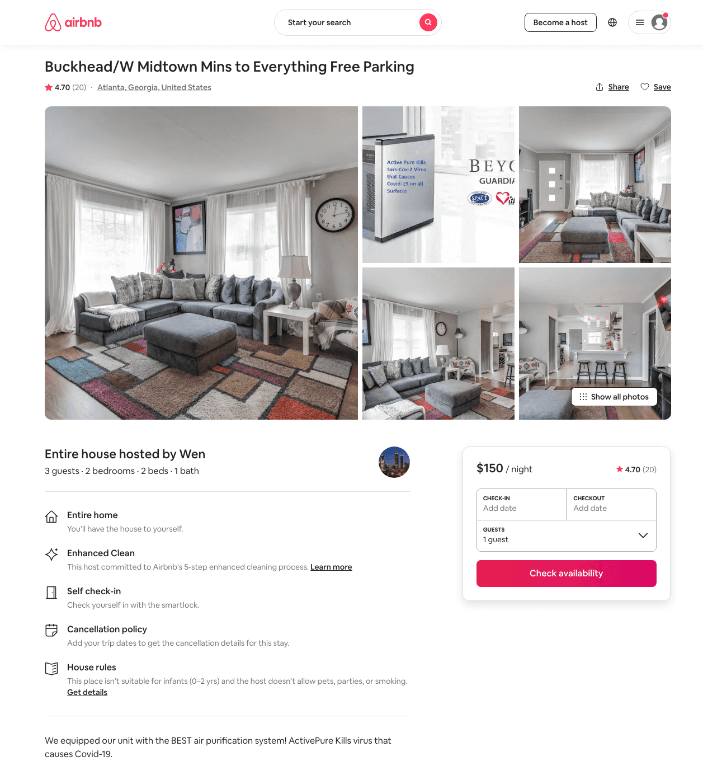
Listing 38075761
2
3
$102 - $155
4.68
2
Wen
51753341
4
https://www.airbnb.com/rooms/38075761
Aug 2022

Slide 8
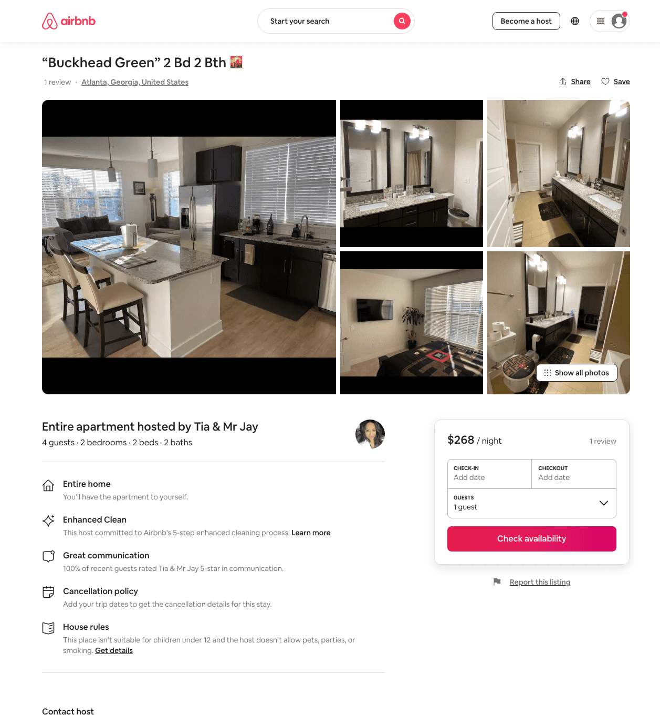
Listing 48546500
2
4
$249 - $350
2
Tia & Mr Jay
273325497
3
https://www.airbnb.com/rooms/48546500
Aug 2022

Slide 9
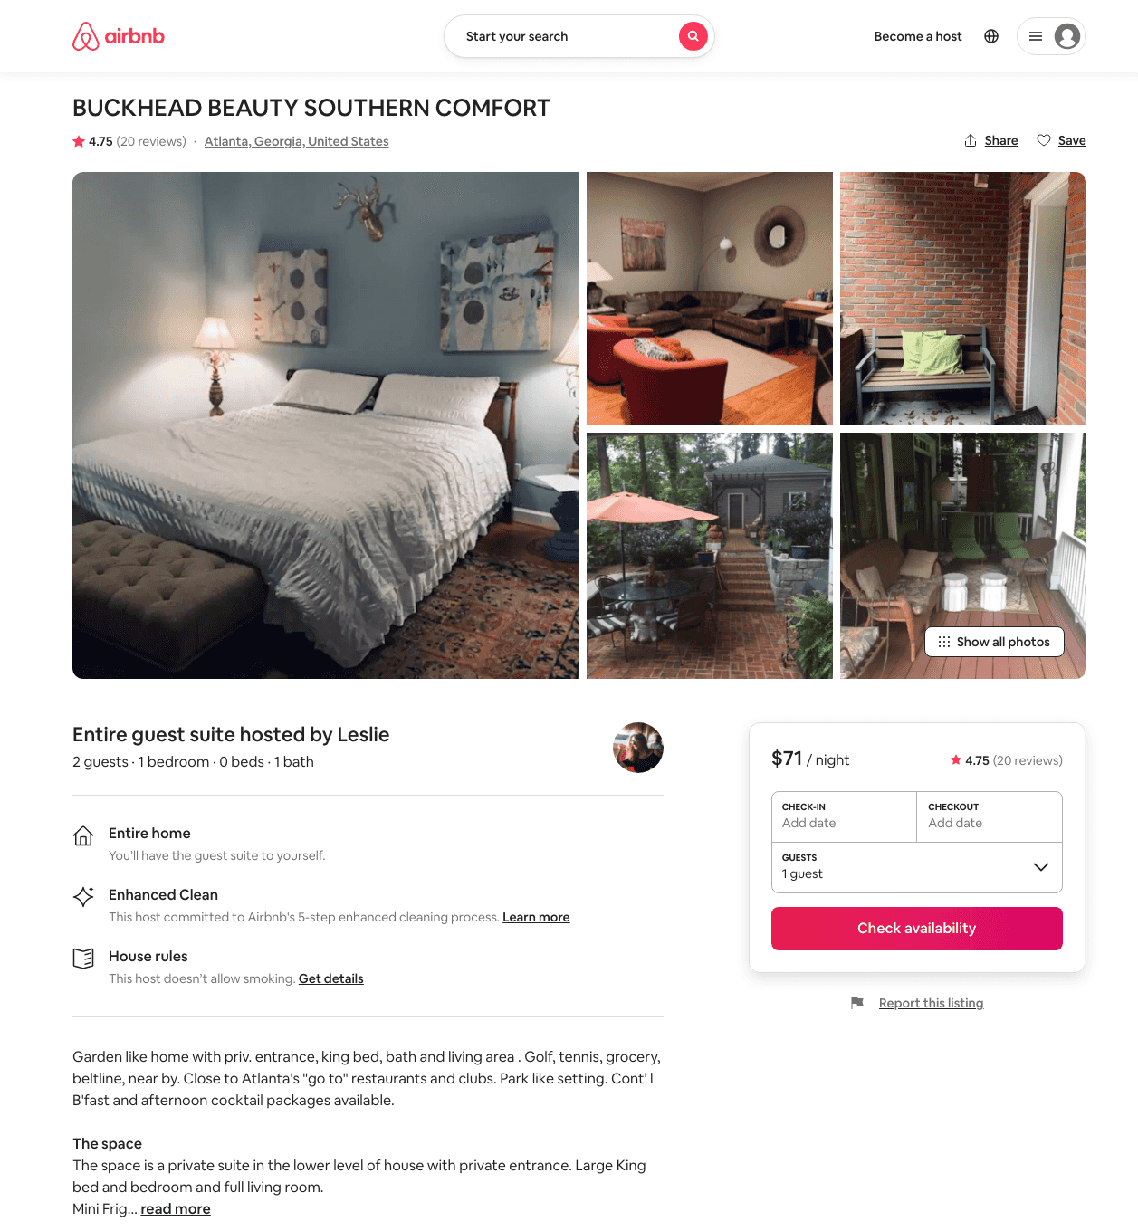
Listing 8698981
1
2
$71
4.75
2
Leslie
45602516
1
https://www.airbnb.com/rooms/8698981
Aug 2022

Slide 10
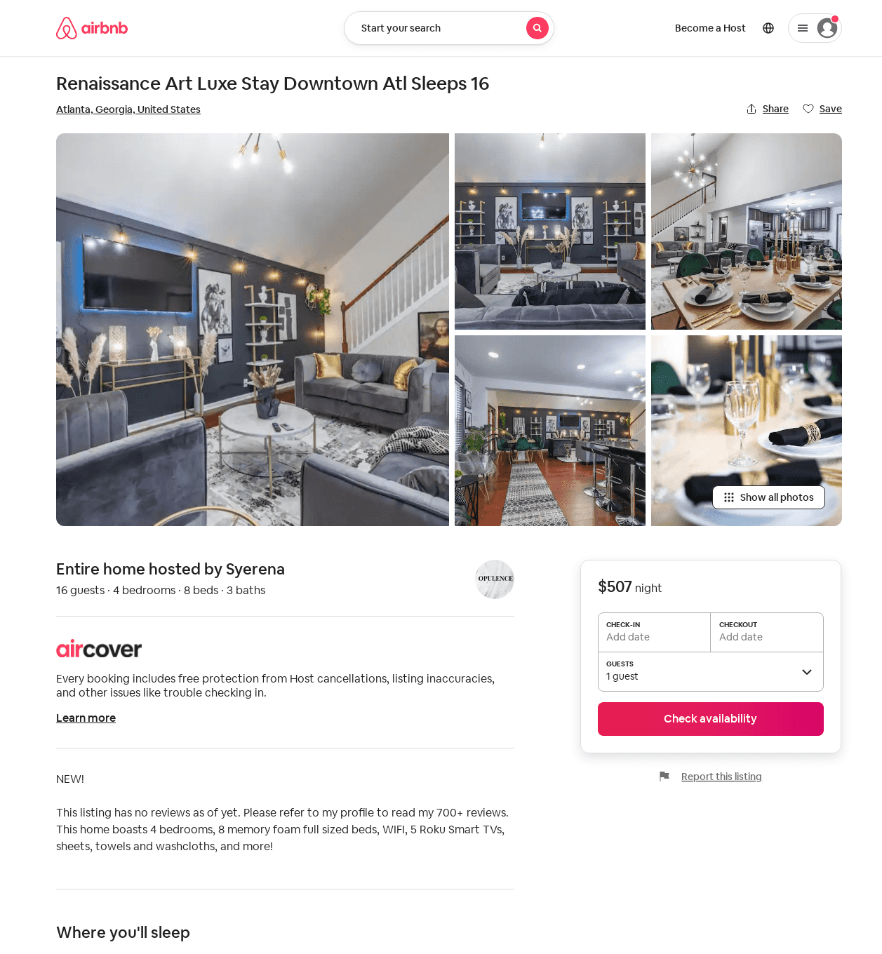
Listing 53559615
4
16
$568
2
Syerena
432856172
1
https://www.airbnb.com/rooms/53559615
Jul 2022

