Slide 2
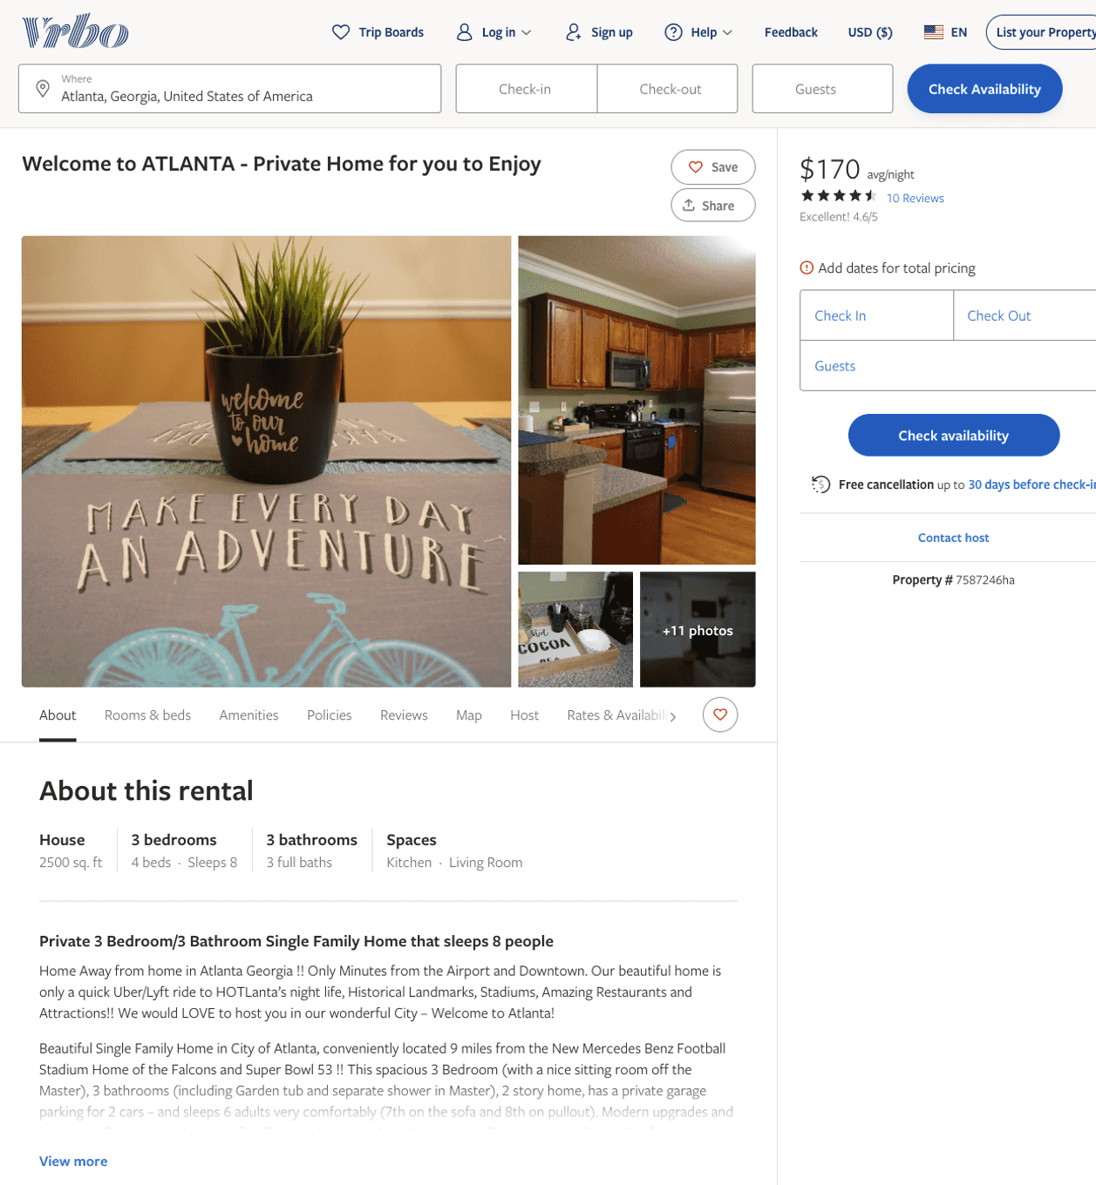
Listing 7587246
3
8
$166 - $190
4.3636365
2
https://www.vrbo.com/7587246ha
Aug 2022

Slide 3
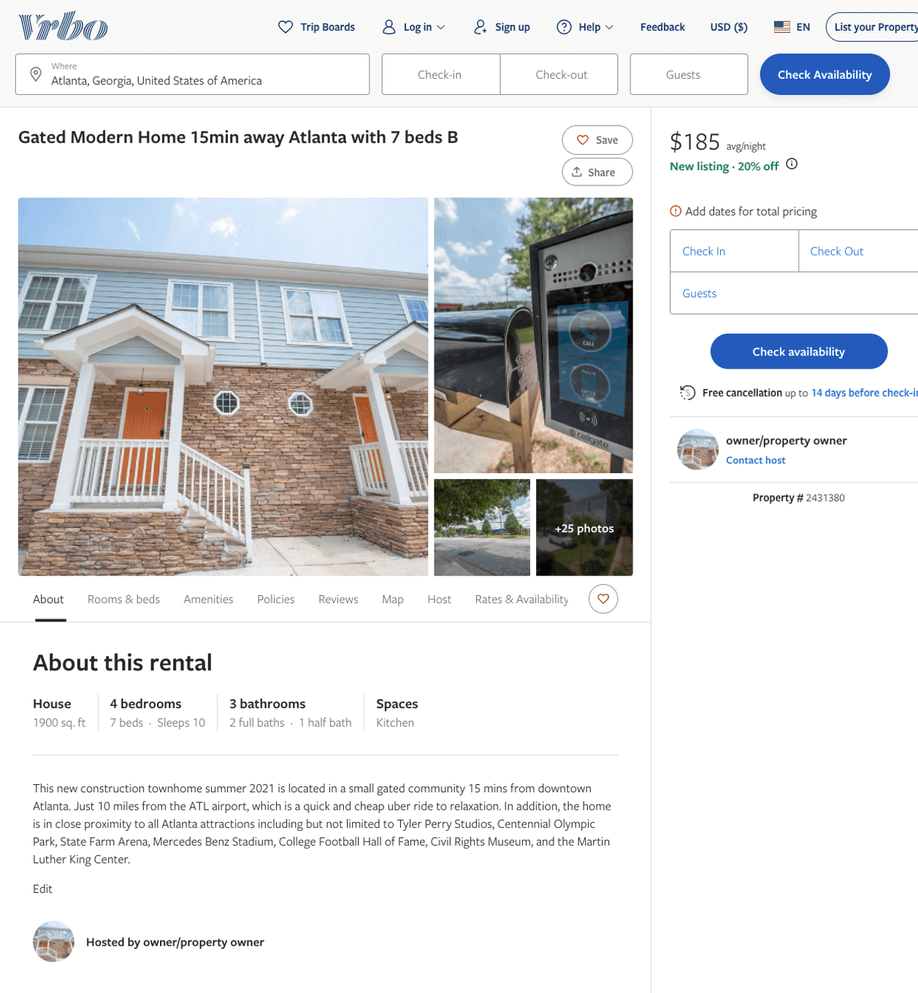
Listing 2431380
4
10
$114 - $79
5
2
owner/property owner
https://www.vrbo.com/2431380
Aug 2022

Slide 4
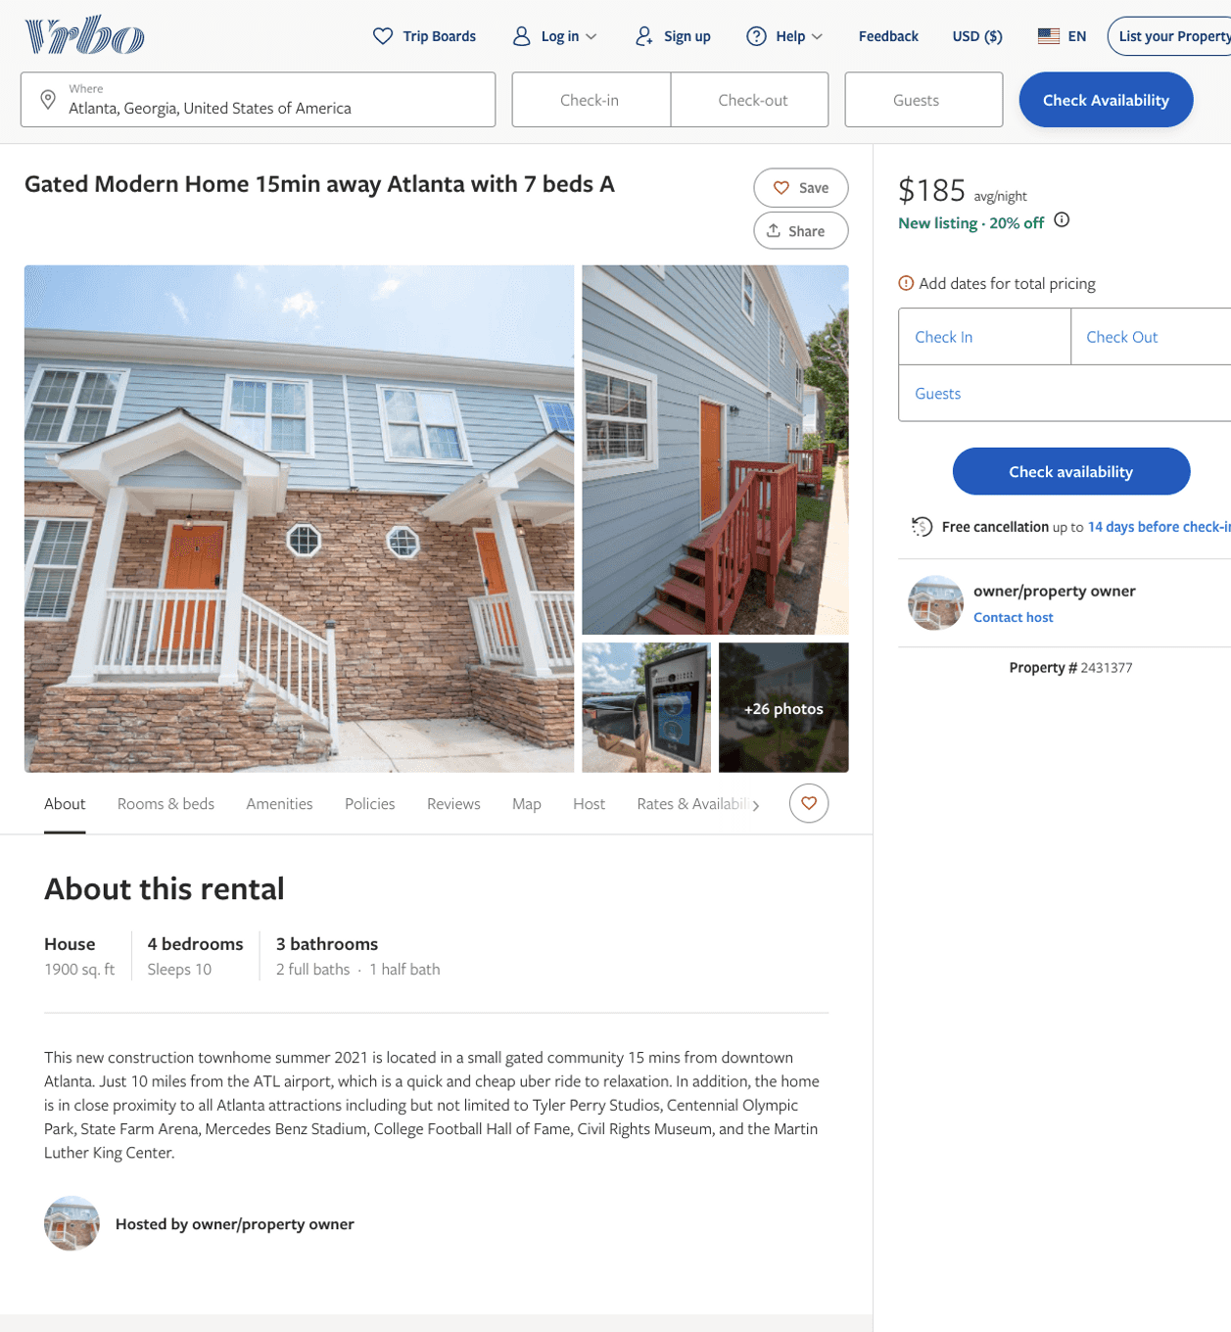
Listing 2431377
4
10
$119 - $185
5
2
owner/property owner
https://www.vrbo.com/2431377
Aug 2022

Slide 5
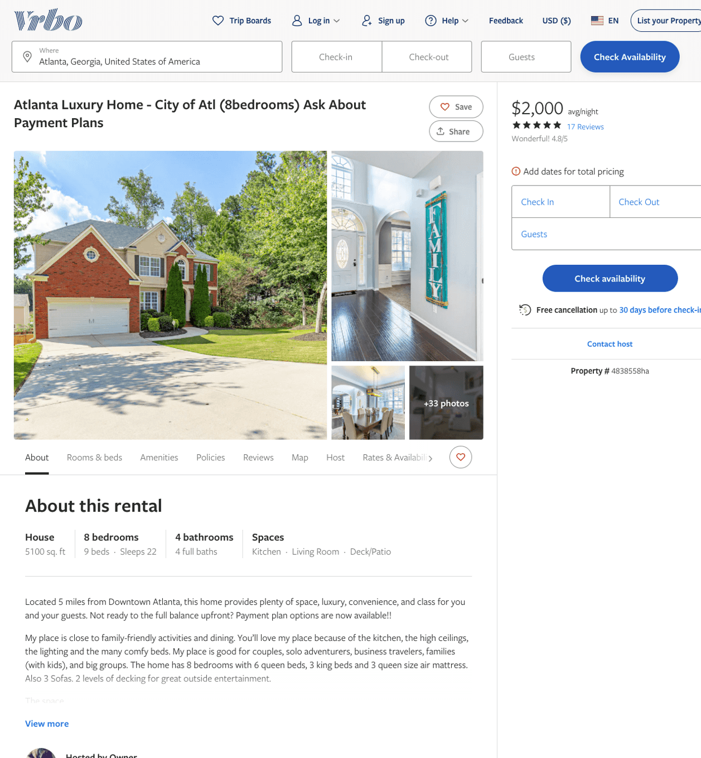
Listing 4838558
8
16
$1,299 - $2,000
4.8235292
3
Owner
https://www.vrbo.com/4838558ha
Aug 2022

Slide 6
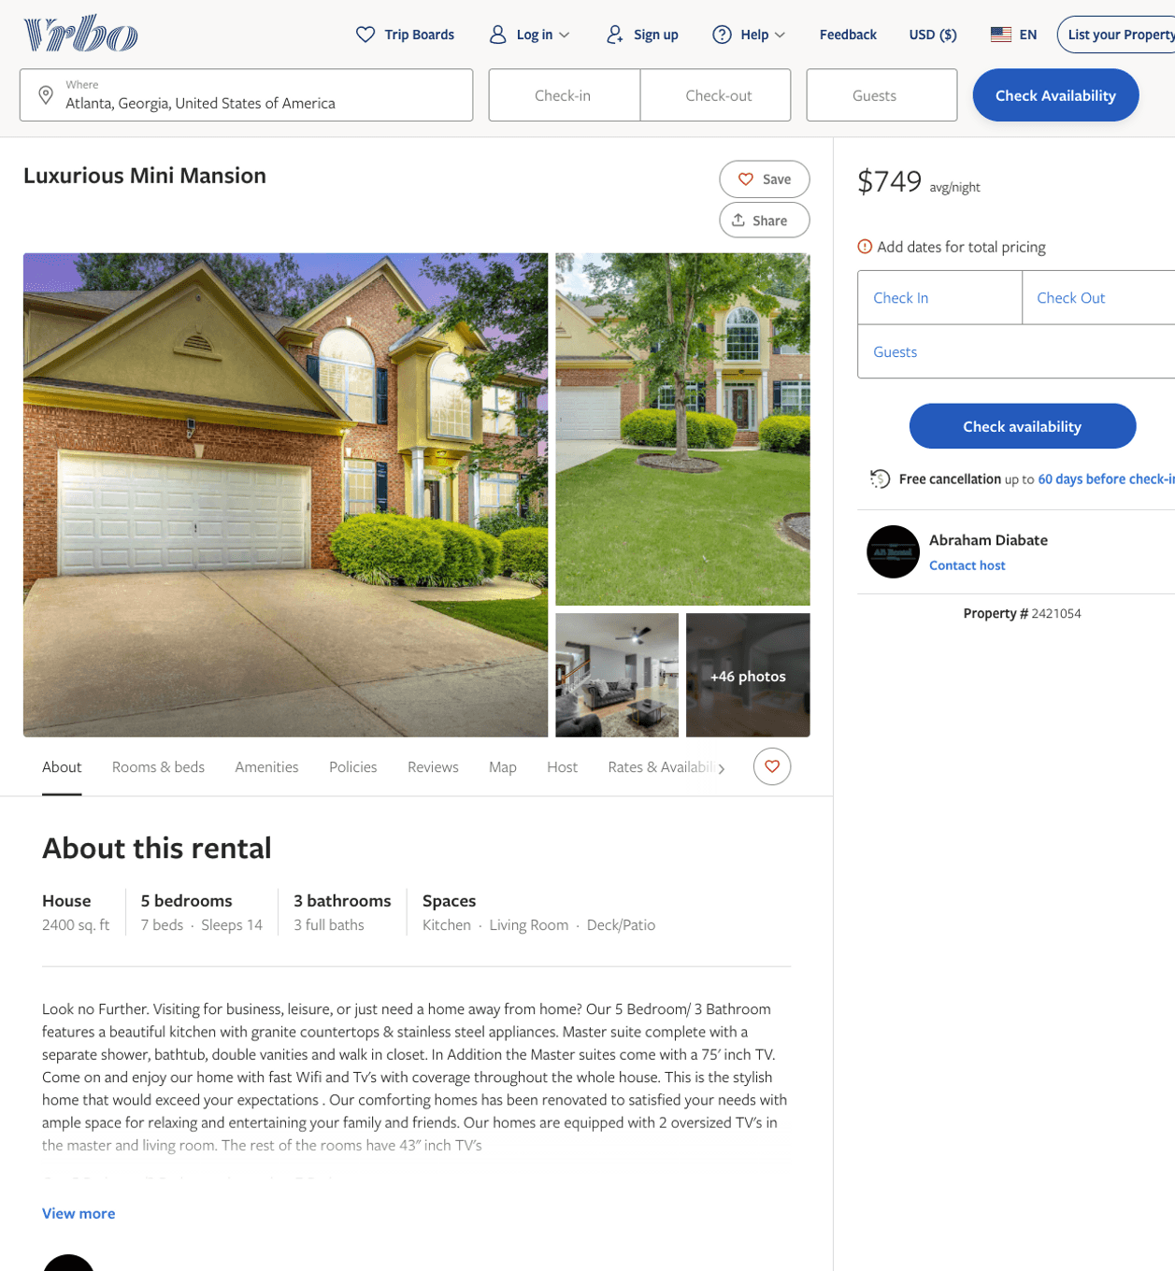
Listing 2421054
5
14
$749
3
Abraham Diabate
https://www.vrbo.com/2421054
Aug 2022

Slide 7
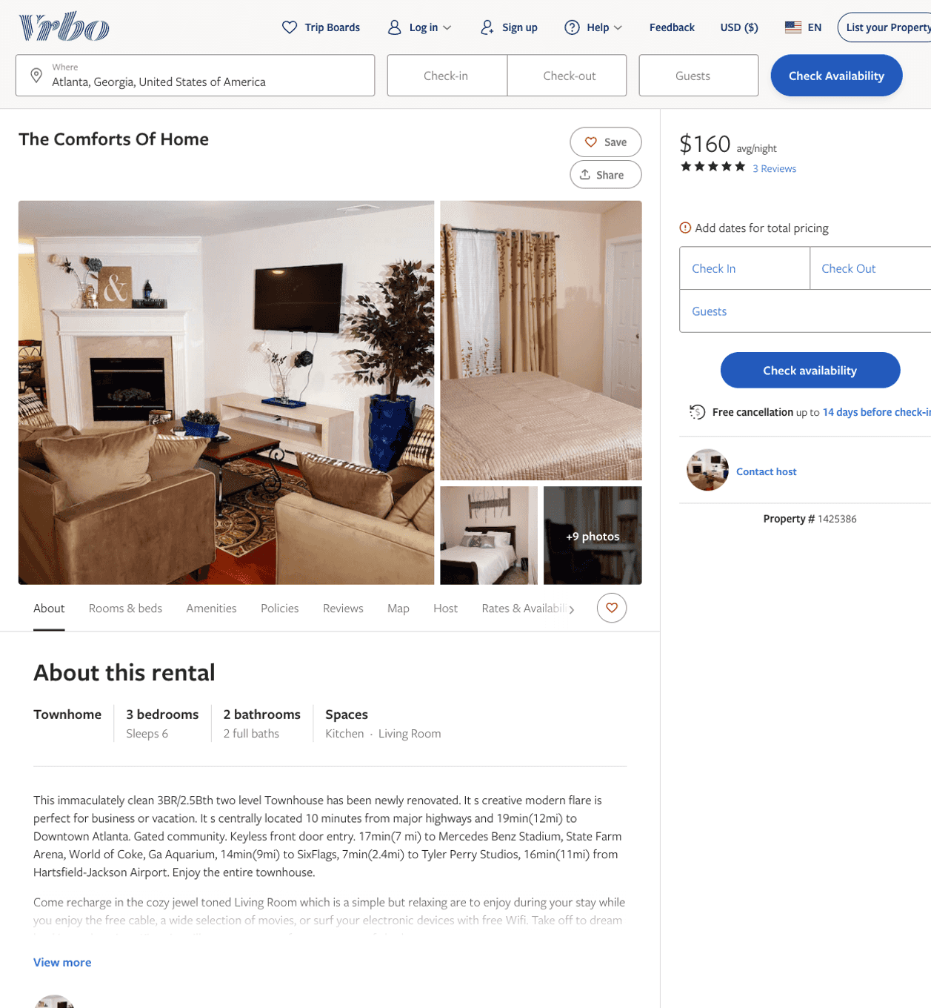
Listing 1425386
3
6
$136 - $160
5
2
https://www.vrbo.com/1425386
Aug 2022

Slide 8
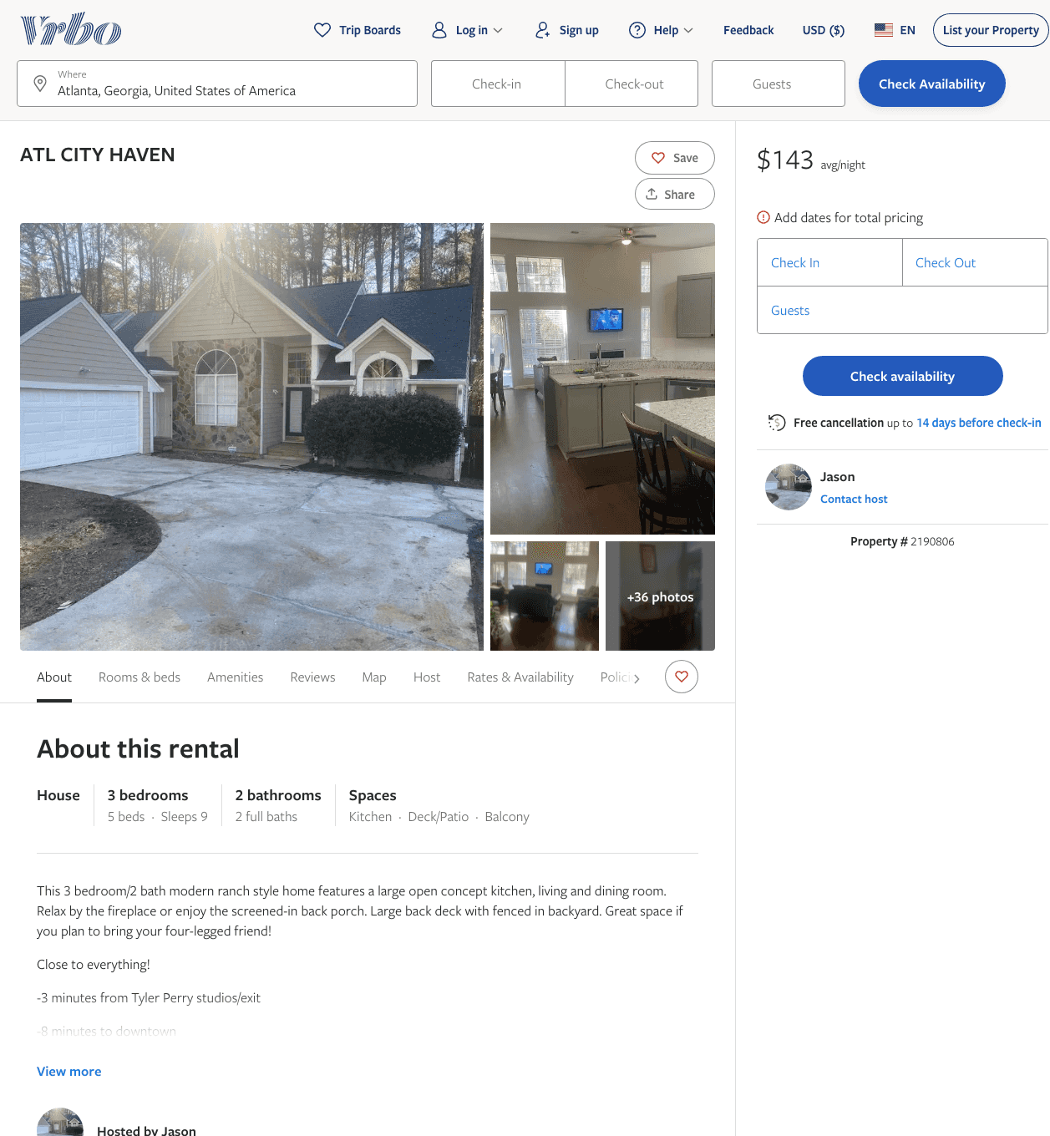
Listing 2190806
3
9
$135 - $144
4
Jason
https://www.vrbo.com/2190806
Aug 2022

Slide 9
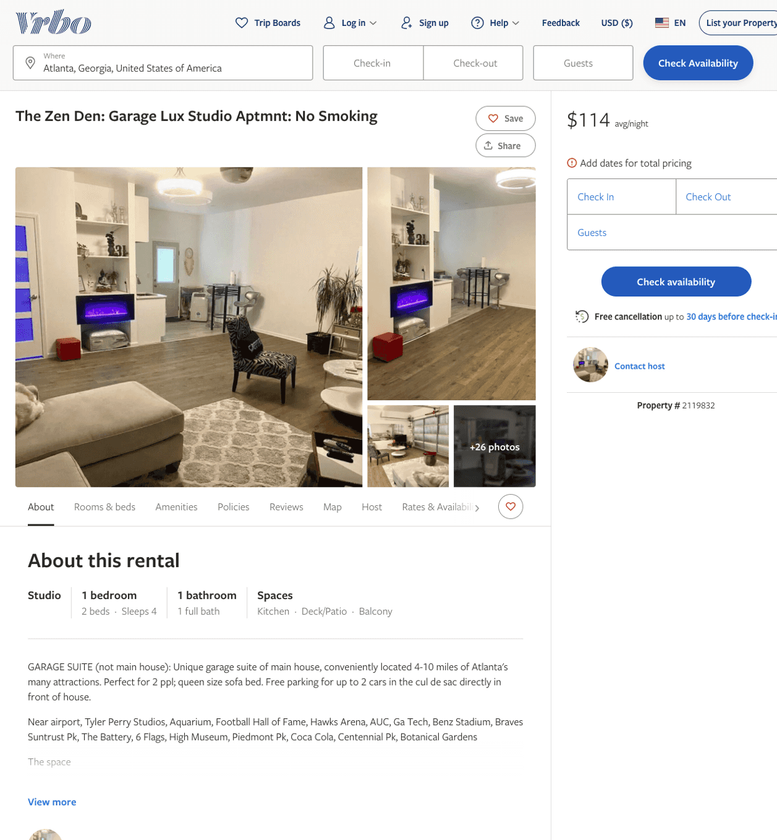
Listing 2119832
1
4
$114
2
https://www.vrbo.com/2119832
Aug 2022

Slide 10
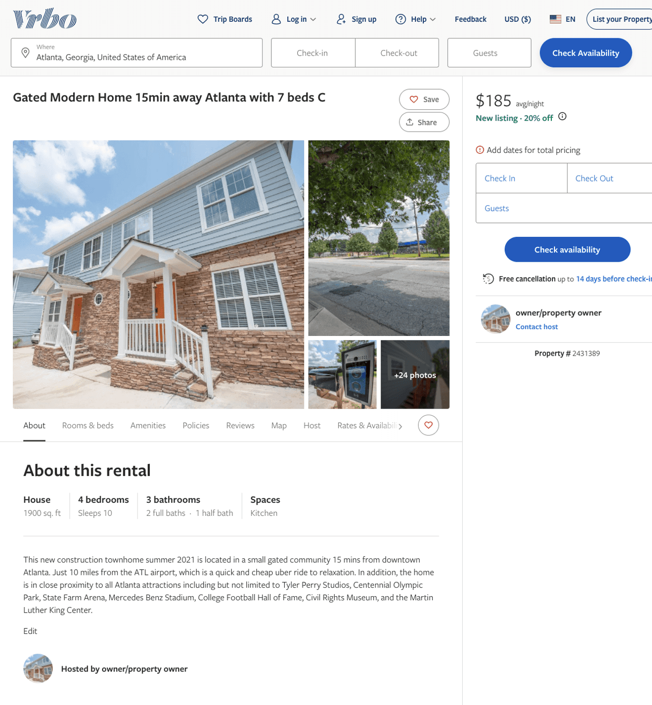
Listing 2431389
4
10
$139 - $74
3
2
owner/property owner
https://www.vrbo.com/2431389
Aug 2022

Slide 11
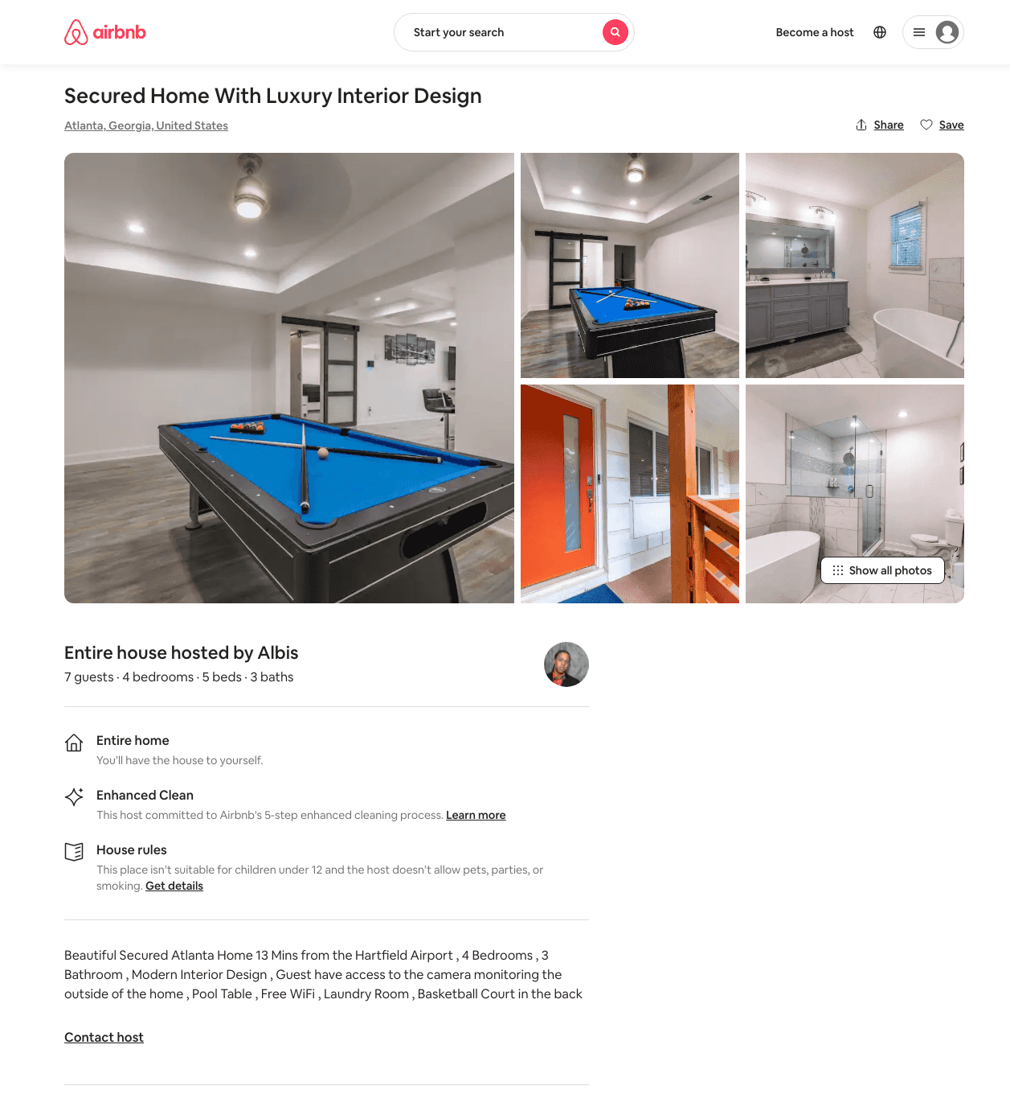
Listing 49064996
4
7
$350 - $883
4.90
2
Albis
121122237
1
https://www.airbnb.com/rooms/49064996
Aug 2022

Slide 12
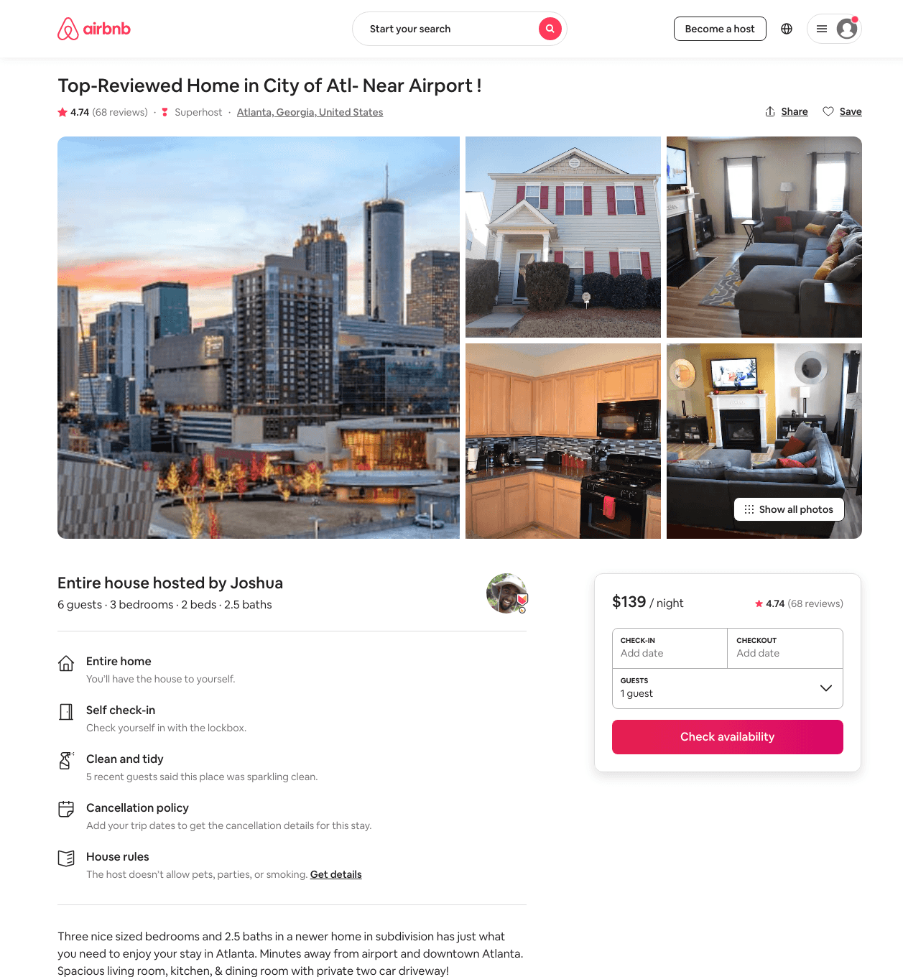
Listing 8305131
3
6
$139 - $214
4.77
2
Joshua
40210806
3
https://www.airbnb.com/rooms/8305131
Aug 2022

Slide 13
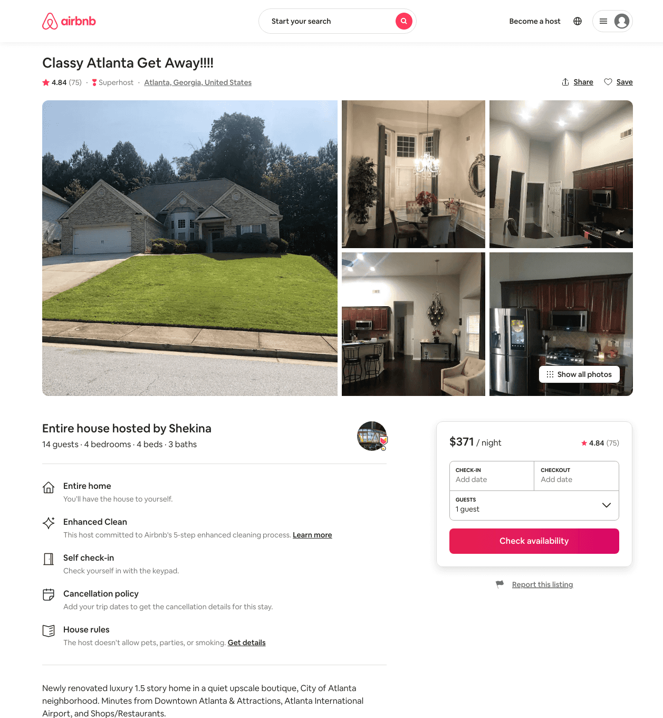
Listing 31458014
4
10
$371 - $550
4.87
2
Shekina
200506716
1
https://www.airbnb.com/rooms/31458014
Aug 2022

Slide 14
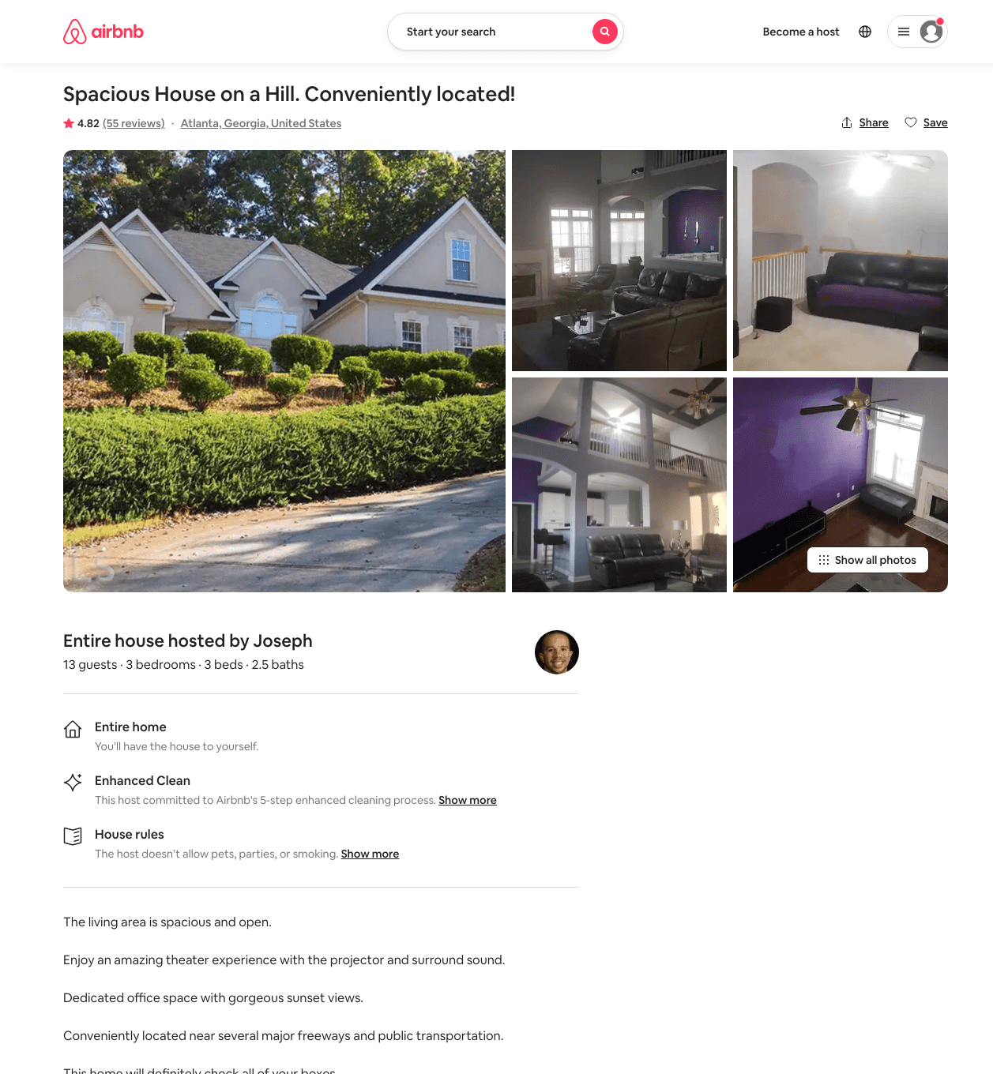
Listing 28983625
3
10
$229 - $338
4.81
2
Joseph
218458848
1
https://www.airbnb.com/rooms/28983625
Aug 2022

Slide 15
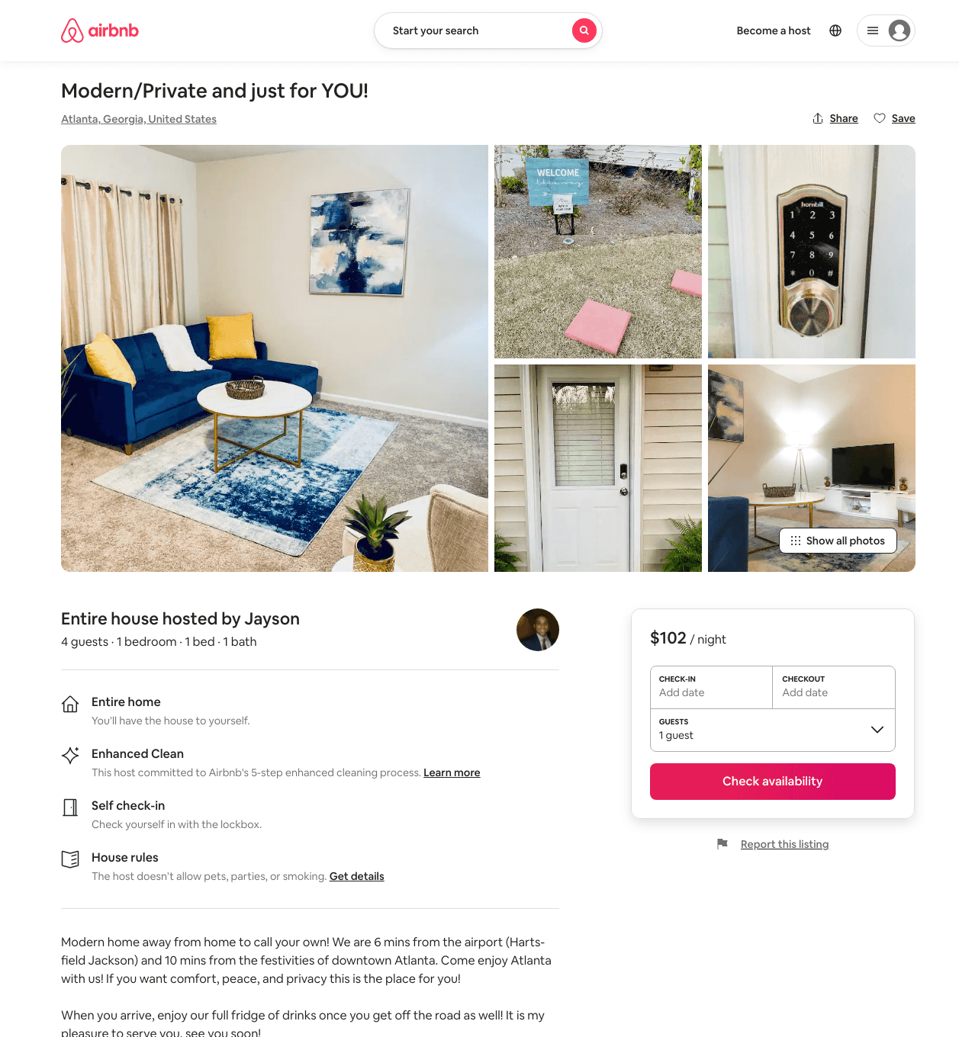
Listing 49014703
1
4
$61 - $108
4.77
2
Jayson
98318857
1
https://www.airbnb.com/rooms/49014703
Aug 2022

Slide 16
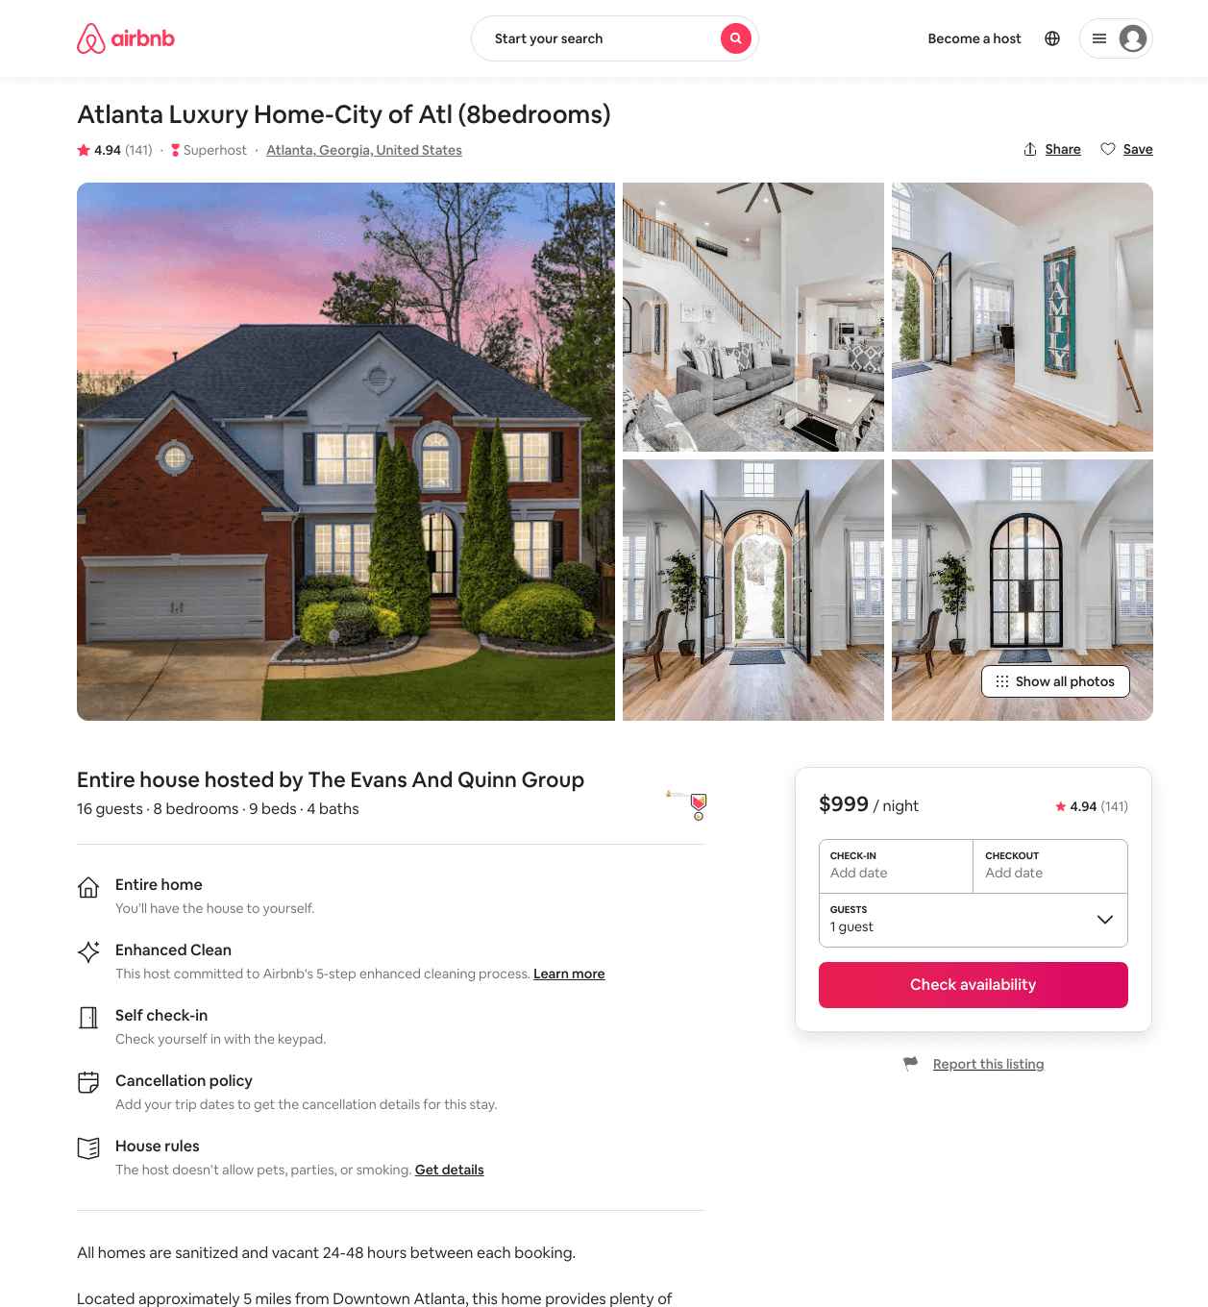
Listing 15008208
8
16
$772 - $1599
4.94
3
The Evans And Quinn Group
1442634
3
https://www.airbnb.com/rooms/15008208
Aug 2022

Slide 17
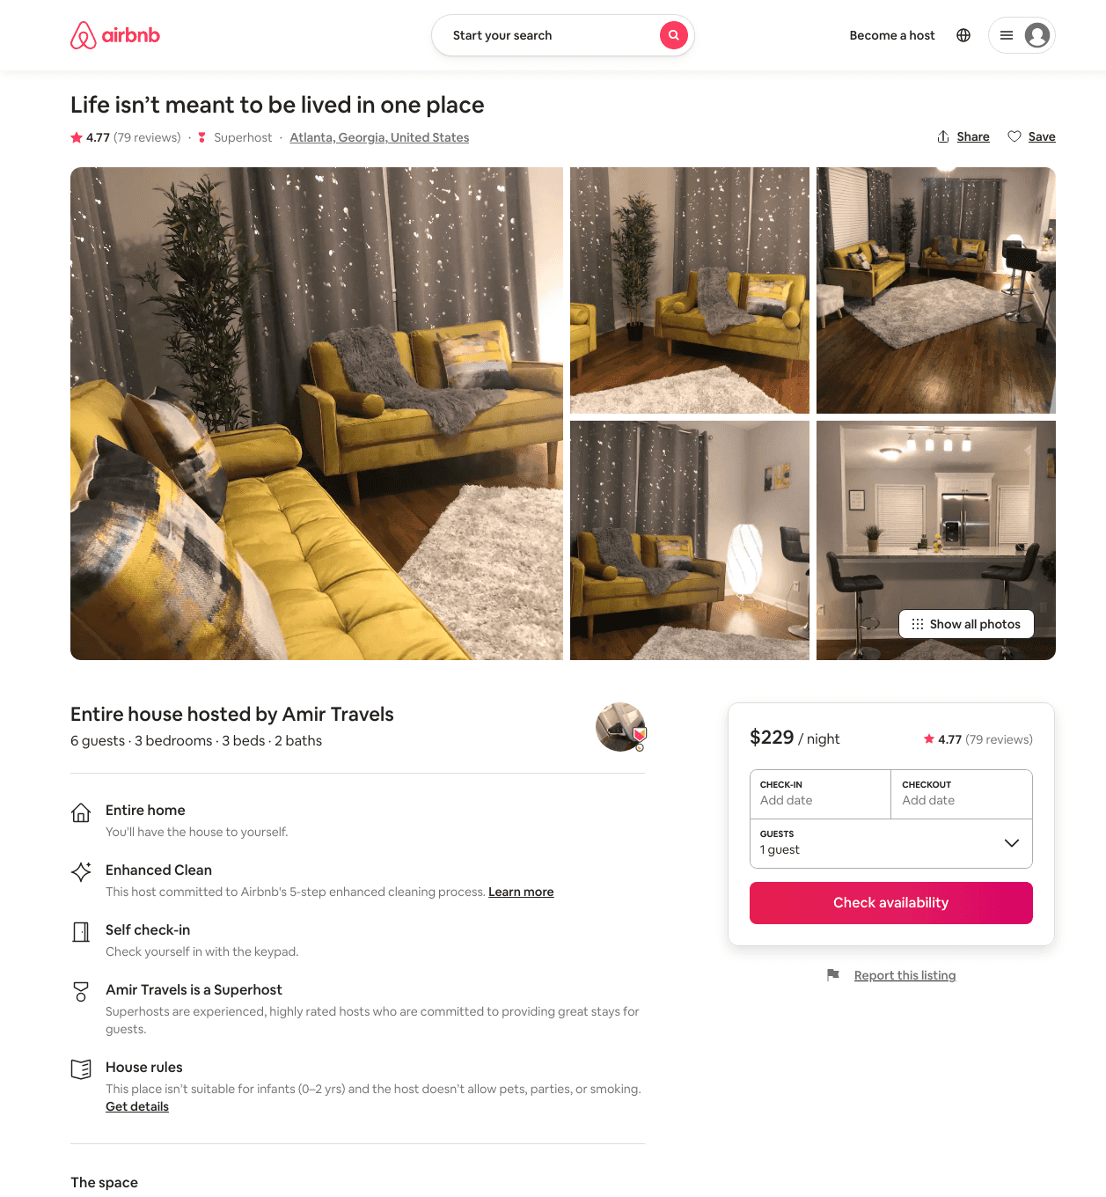
Listing 37375351
3
6
$153 - $329
4.72
2
Amir Travels
108906749
1
https://www.airbnb.com/rooms/37375351
Aug 2022

Slide 18
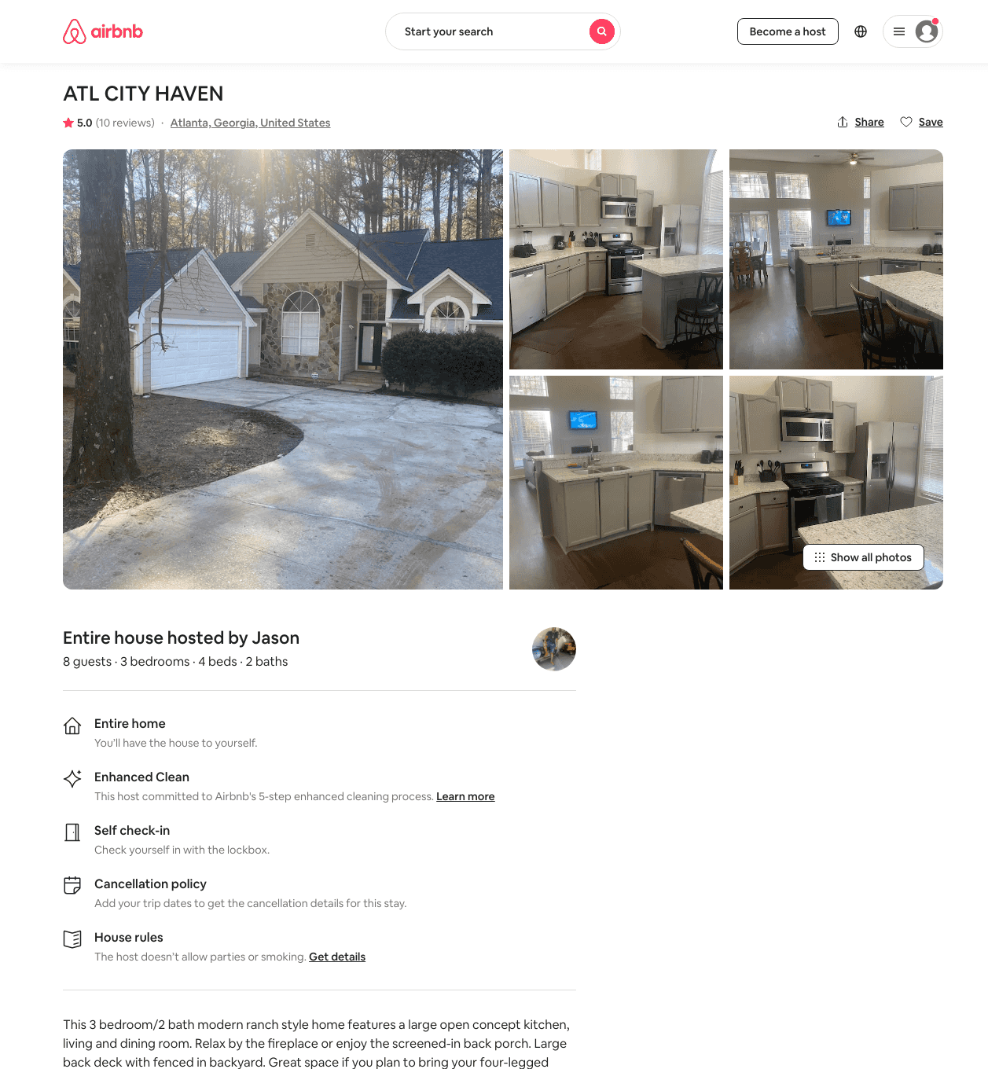
Listing 47868004
3
9
$123 - $155
4.71
2
Jason
47351539
2
https://www.airbnb.com/rooms/47868004
Aug 2022

Slide 19
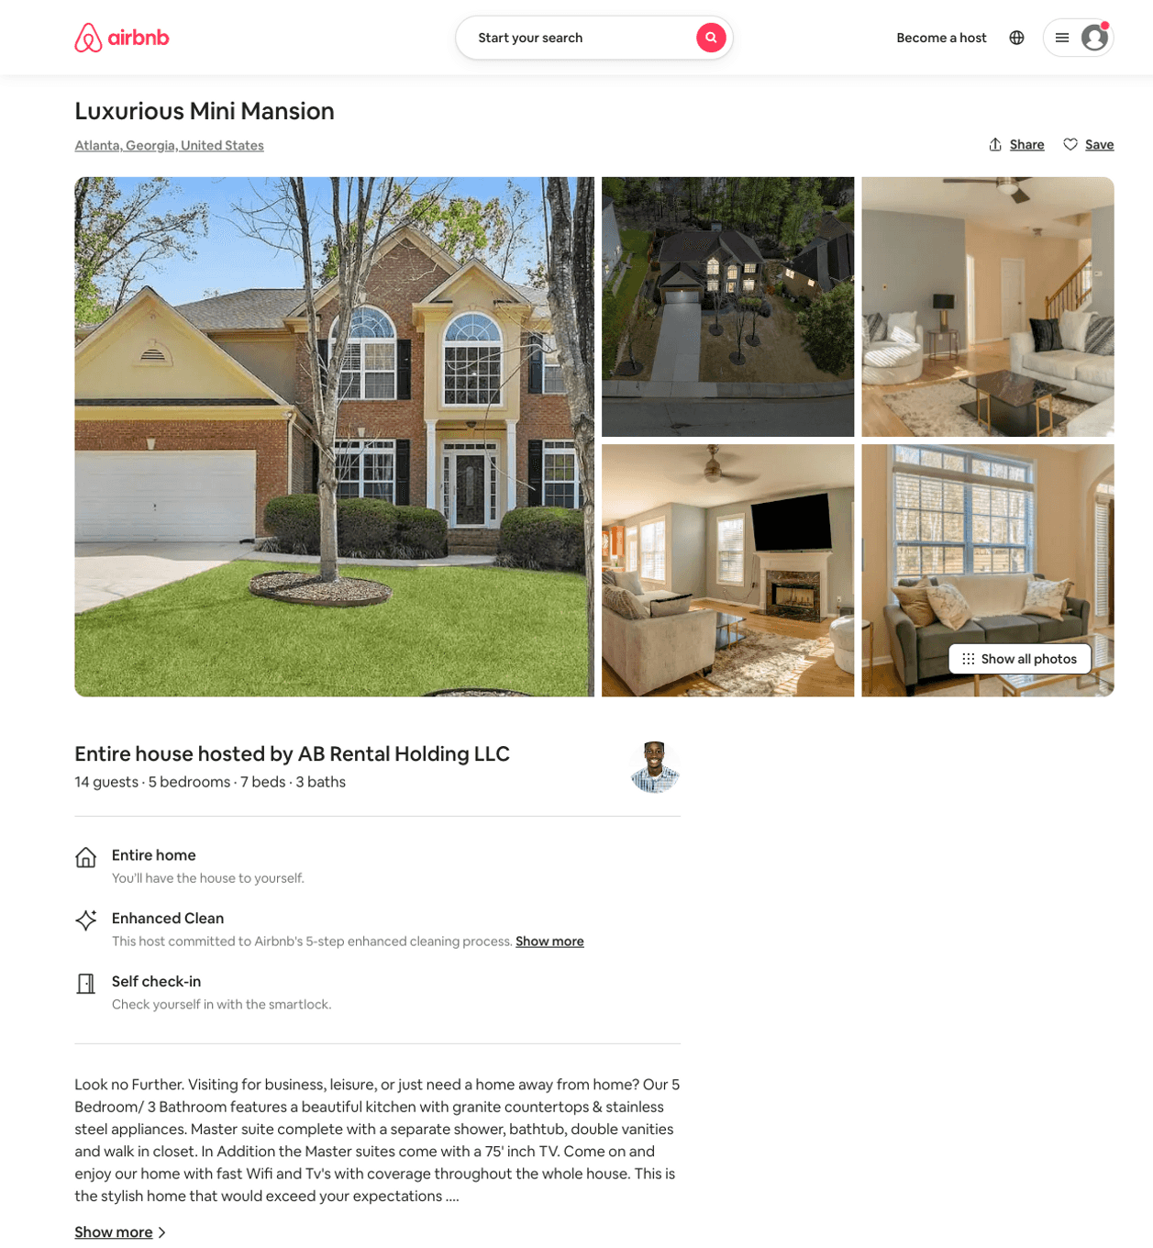
Listing 50992317
7
16
$549 - $871
5.0
3
AB Rental Holding LLC
412471037
1
https://www.airbnb.com/rooms/50992317
Aug 2022

Slide 20
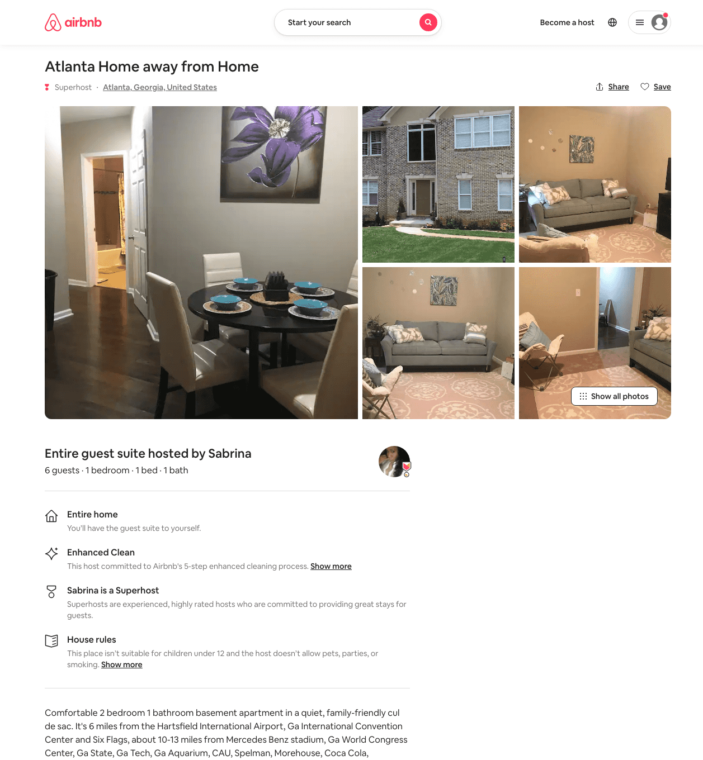
Listing 11929939
1
6
$299 - $328
2
Sabrina
58117421
3
https://www.airbnb.com/rooms/11929939
Aug 2022

Slide 21
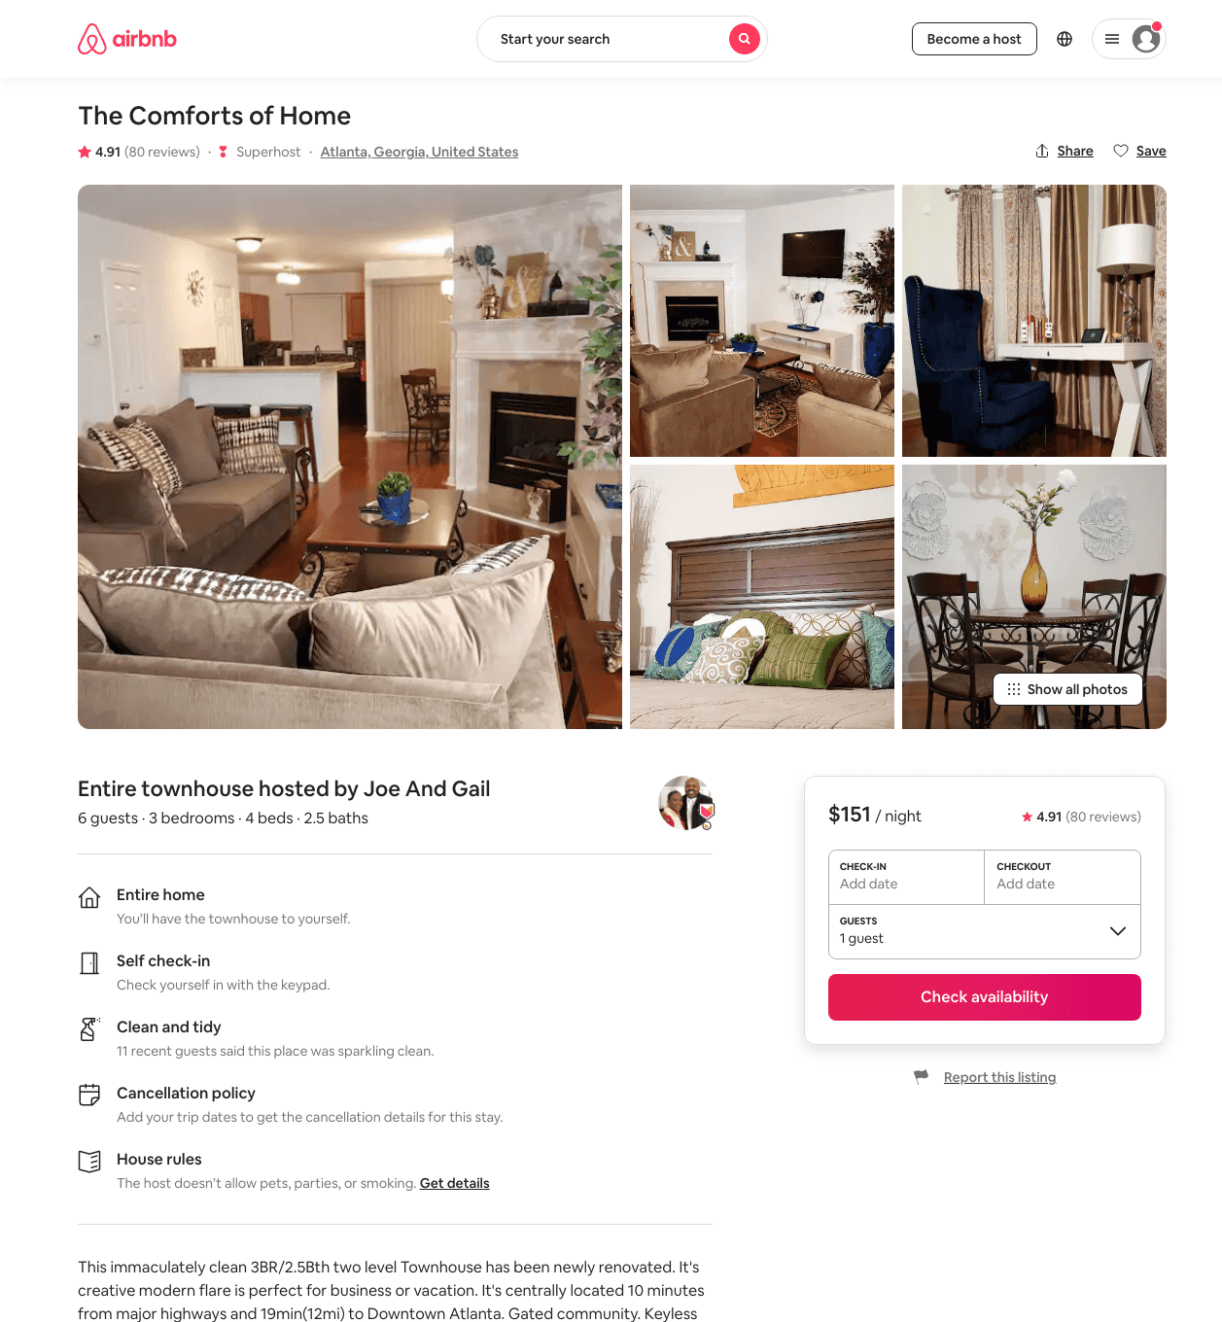
Listing 29419689
3
6
$135 - $161
4.90
2
Joe And Gail
52116971
1
https://www.airbnb.com/rooms/29419689
Jun 2022

Slide 22
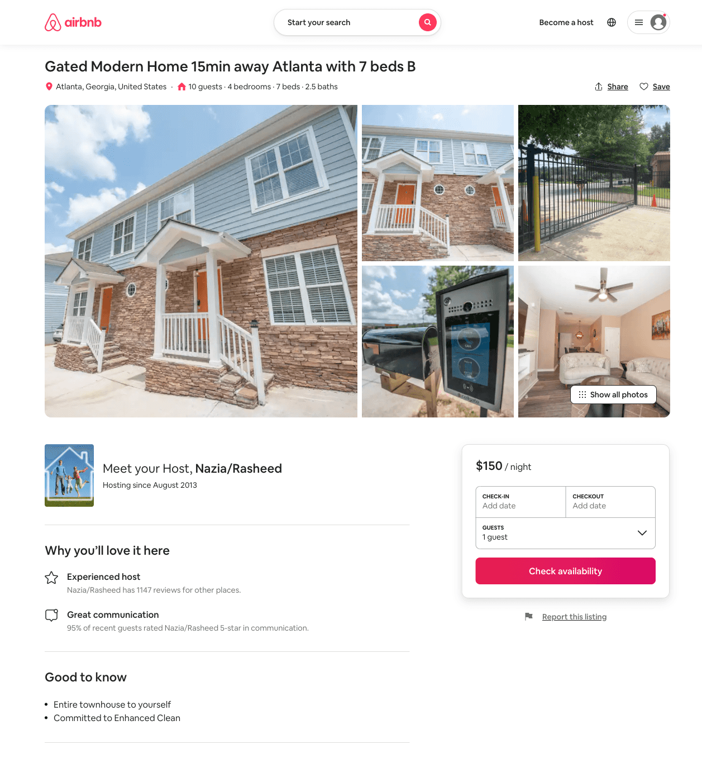
Listing 51618351
4
10
$124 - $190
4.77
4
Nazia/Rasheed
8544925
8
https://www.airbnb.com/rooms/51618351
Aug 2022

Slide 23
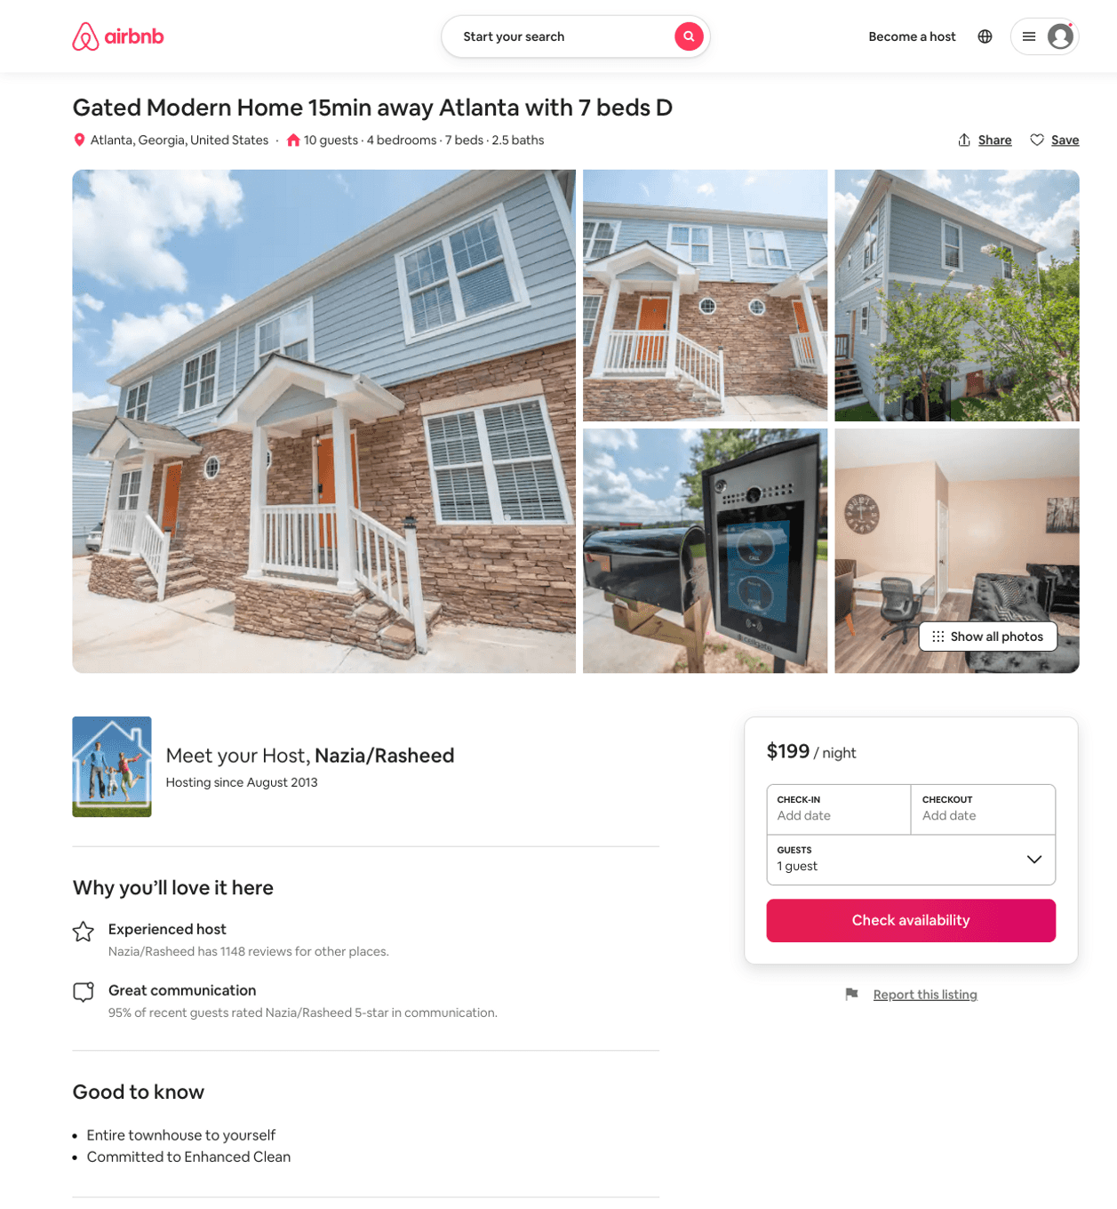
Listing 51656425
4
10
$120 - $230
4.78
4
Nazia/Rasheed
8544925
8
https://www.airbnb.com/rooms/51656425
Aug 2022

Slide 24
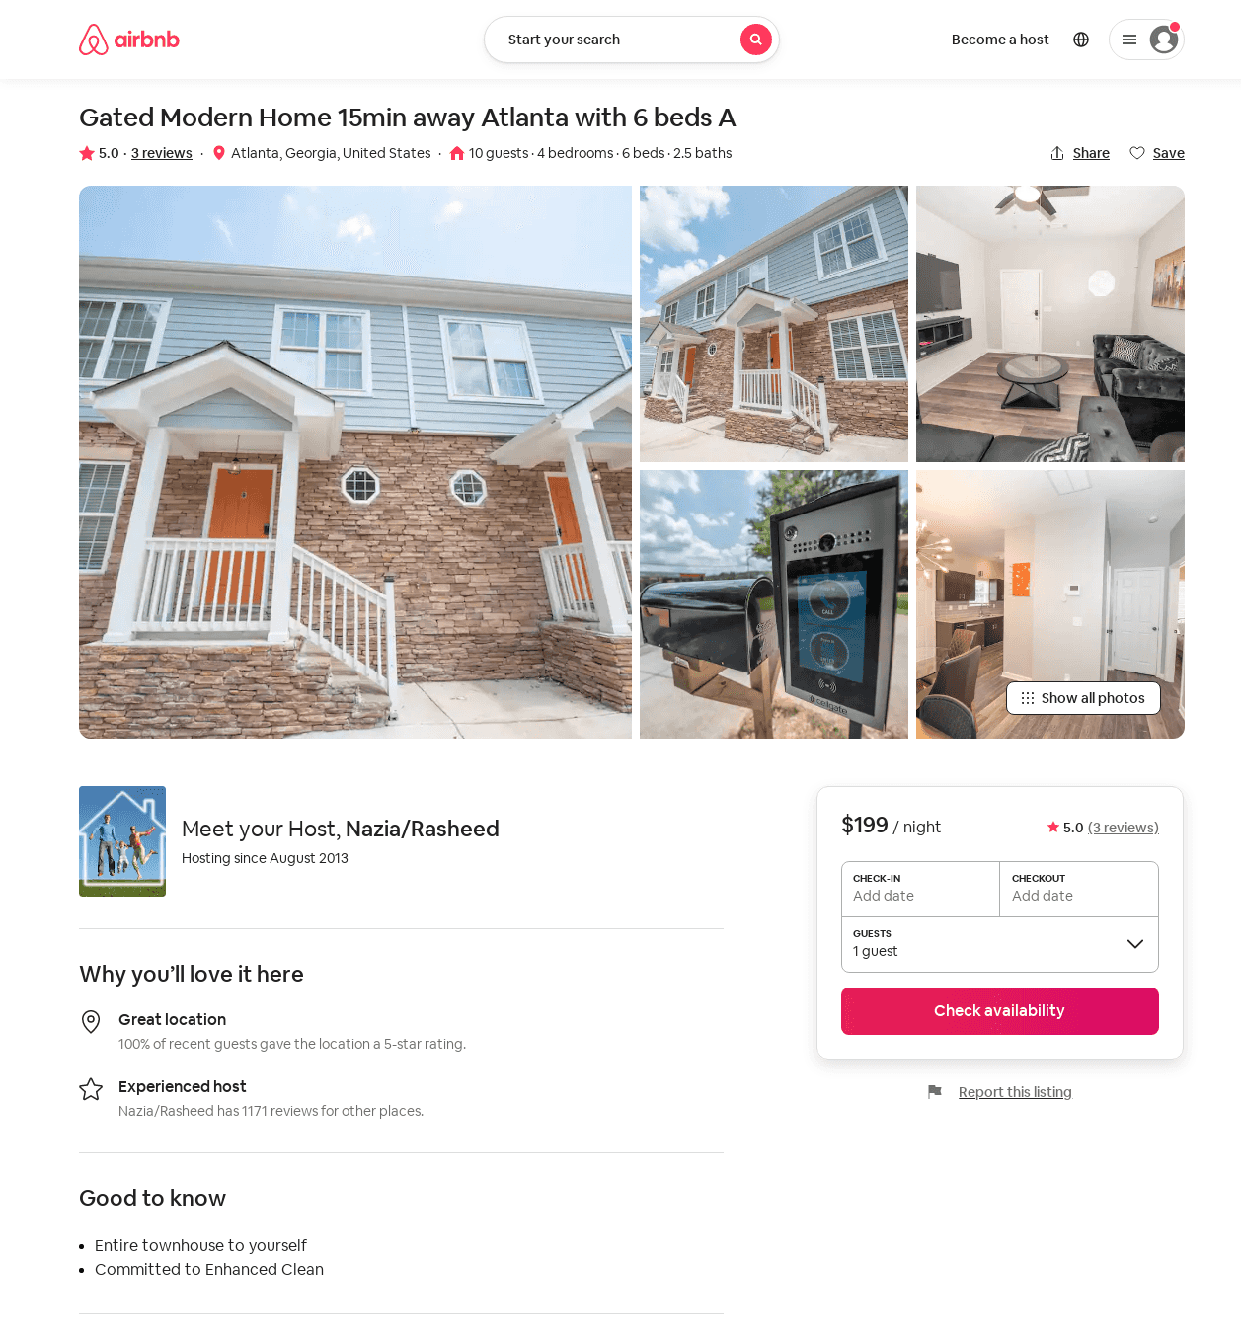
Listing 51613394
4
10
$117 - $199
4.60
4
Nazia/Rasheed
8544925
8
https://www.airbnb.com/rooms/51613394
Aug 2022

Slide 25
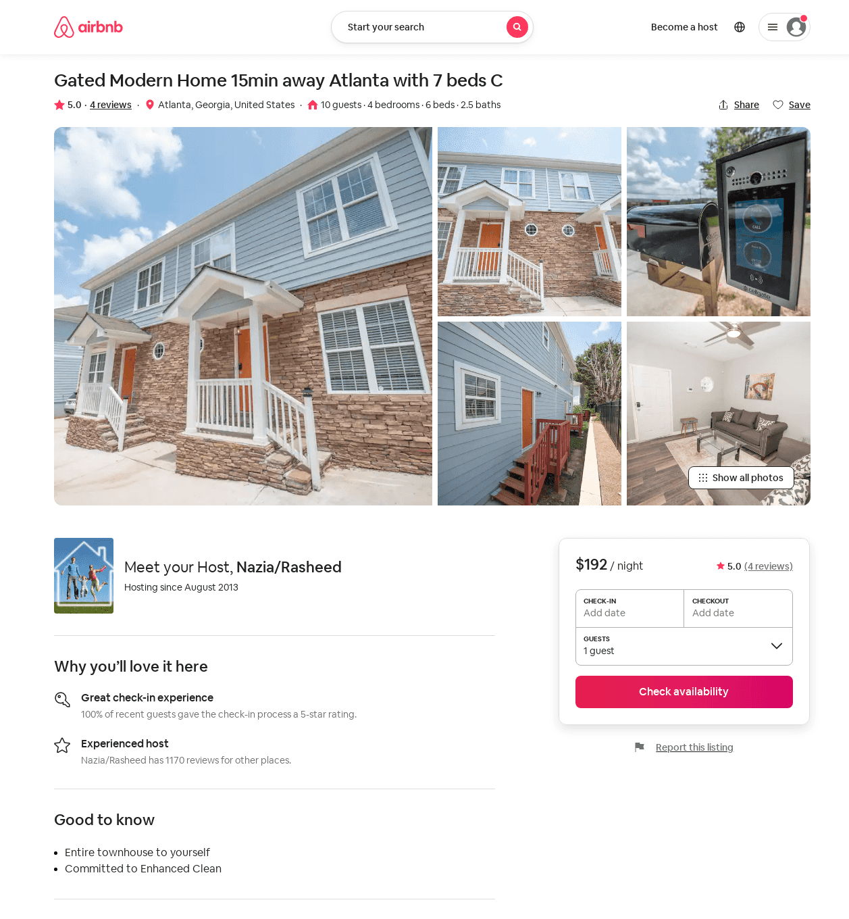
Listing 51656263
4
10
$112 - $265
4.77
4
Nazia/Rasheed
8544925
8
https://www.airbnb.com/rooms/51656263
Aug 2022

Slide 26
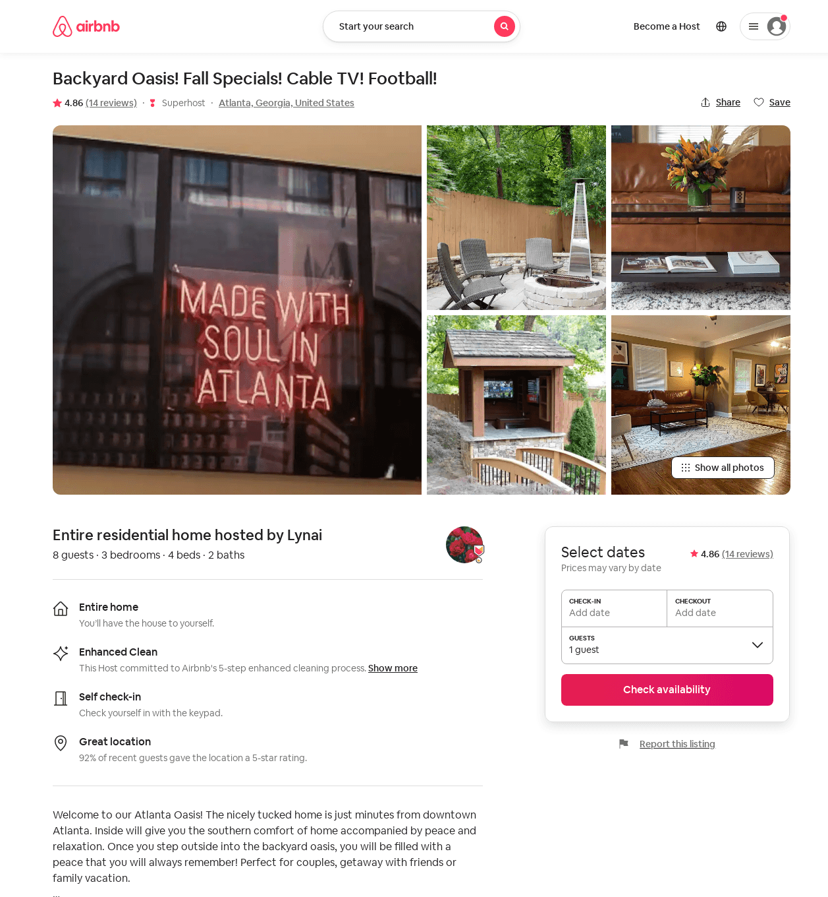
Listing 48786989
3
8
$116 - $177
4.89
2
Lynai
4797949
1
https://www.airbnb.com/rooms/48786989
Aug 2022

Slide 27
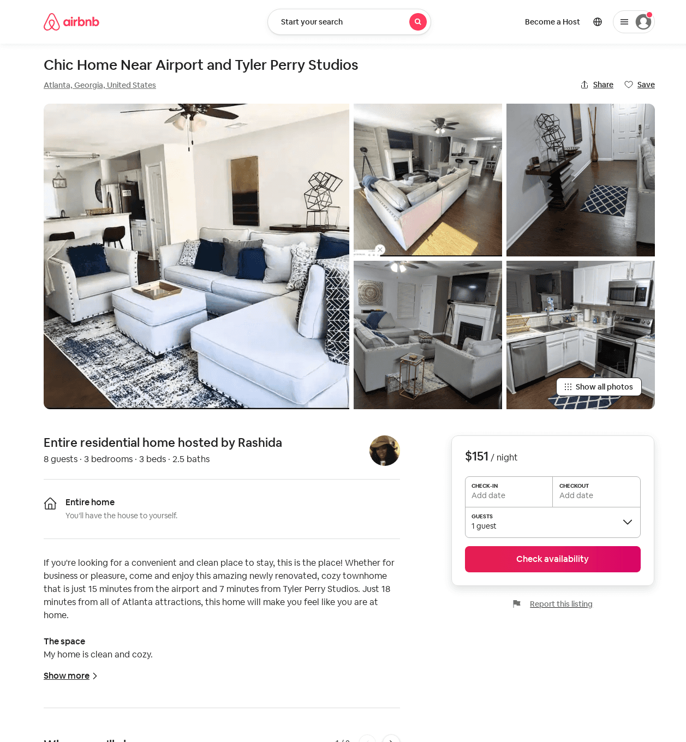
Listing 52658516
3
6
$116 - $189
4.67
2
Rashida
88784791
1
https://www.airbnb.com/rooms/52658516
Jun 2022

Slide 28
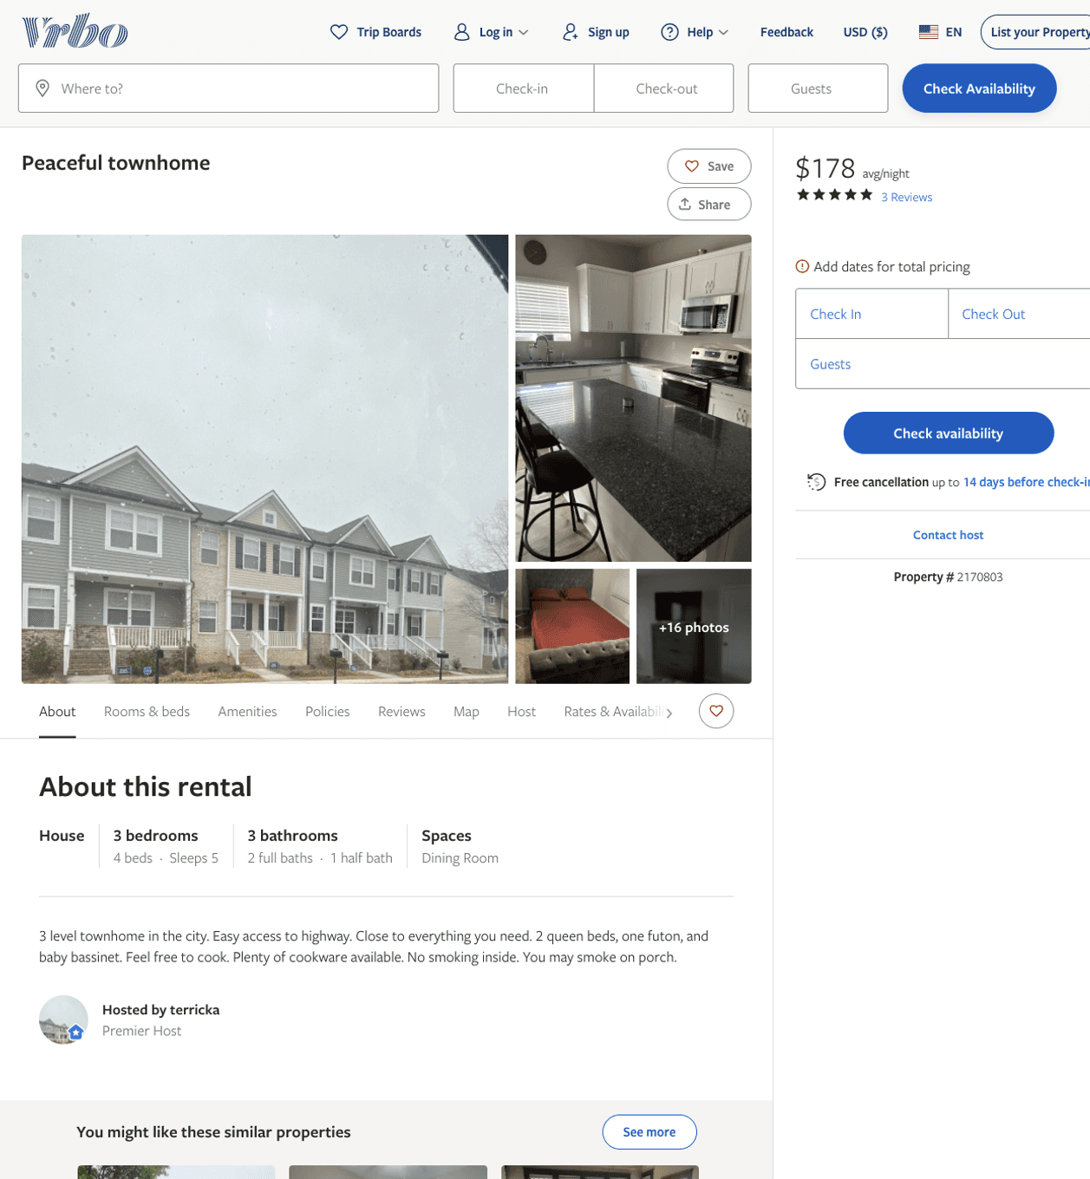
Listing 2170803
3
5
$178 - $180
5
1
terricka
https://www.vrbo.com/2170803
Aug 2022

Slide 29
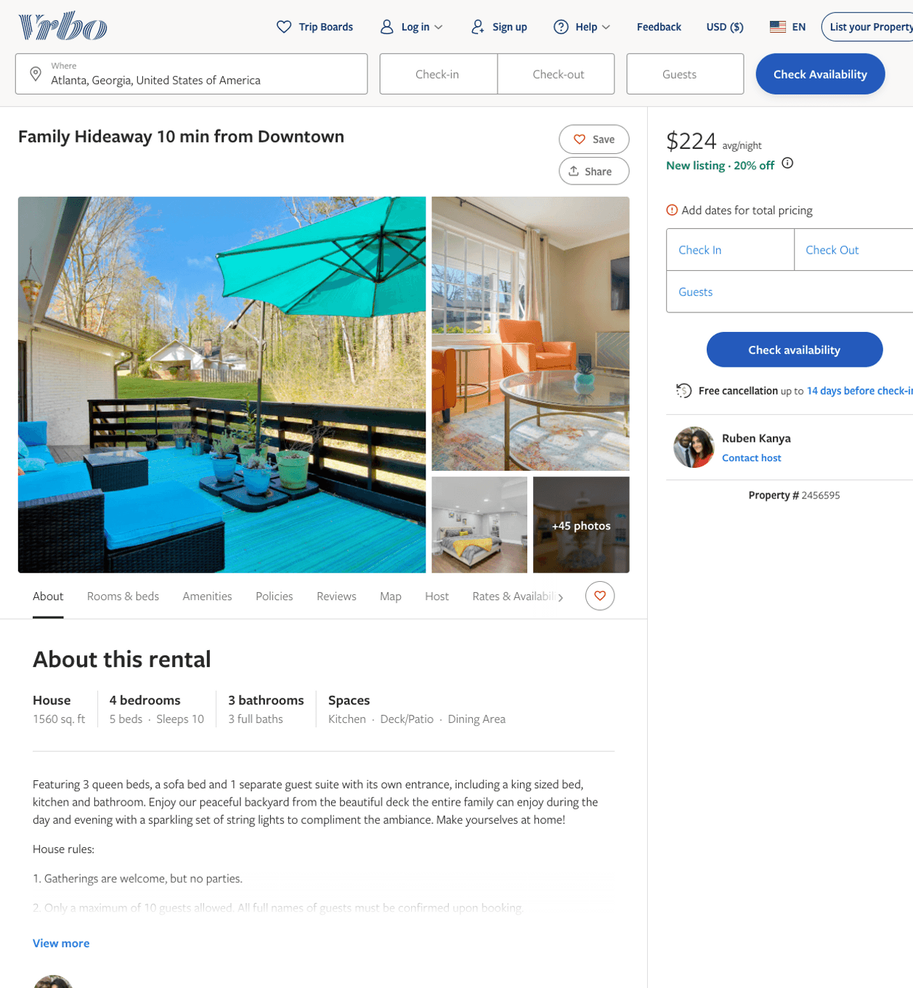
Listing 2456595
4
10
$154 - $245
5
1
Ruben Kanya
https://www.vrbo.com/2456595
Aug 2022

Slide 30
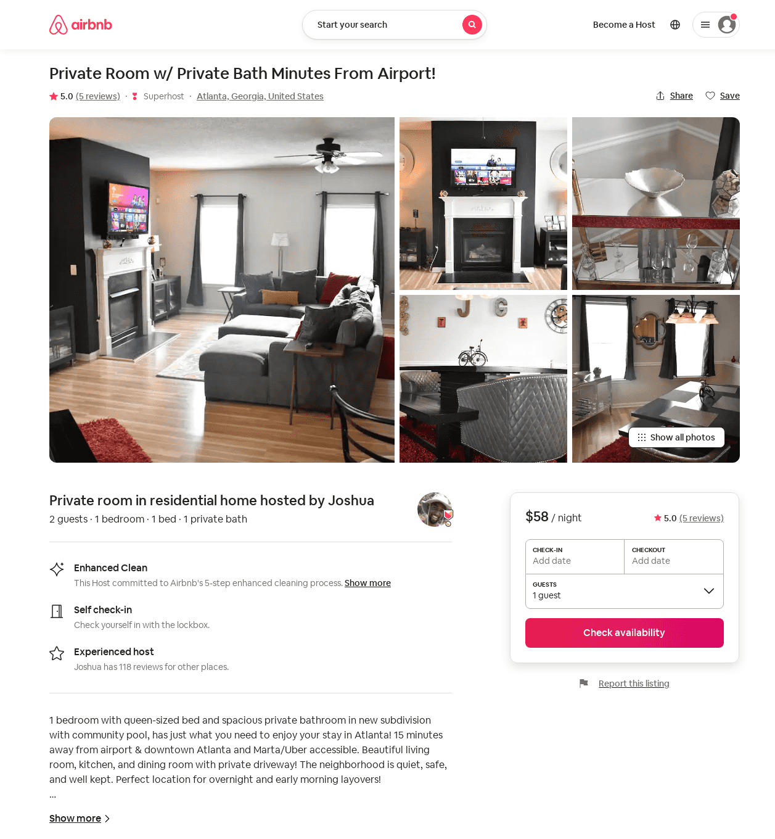
Listing 8865045
1
2
$40 - $59
4.92
2
Joshua
40210806
3
https://www.airbnb.com/rooms/8865045
Jun 2022

Slide 31
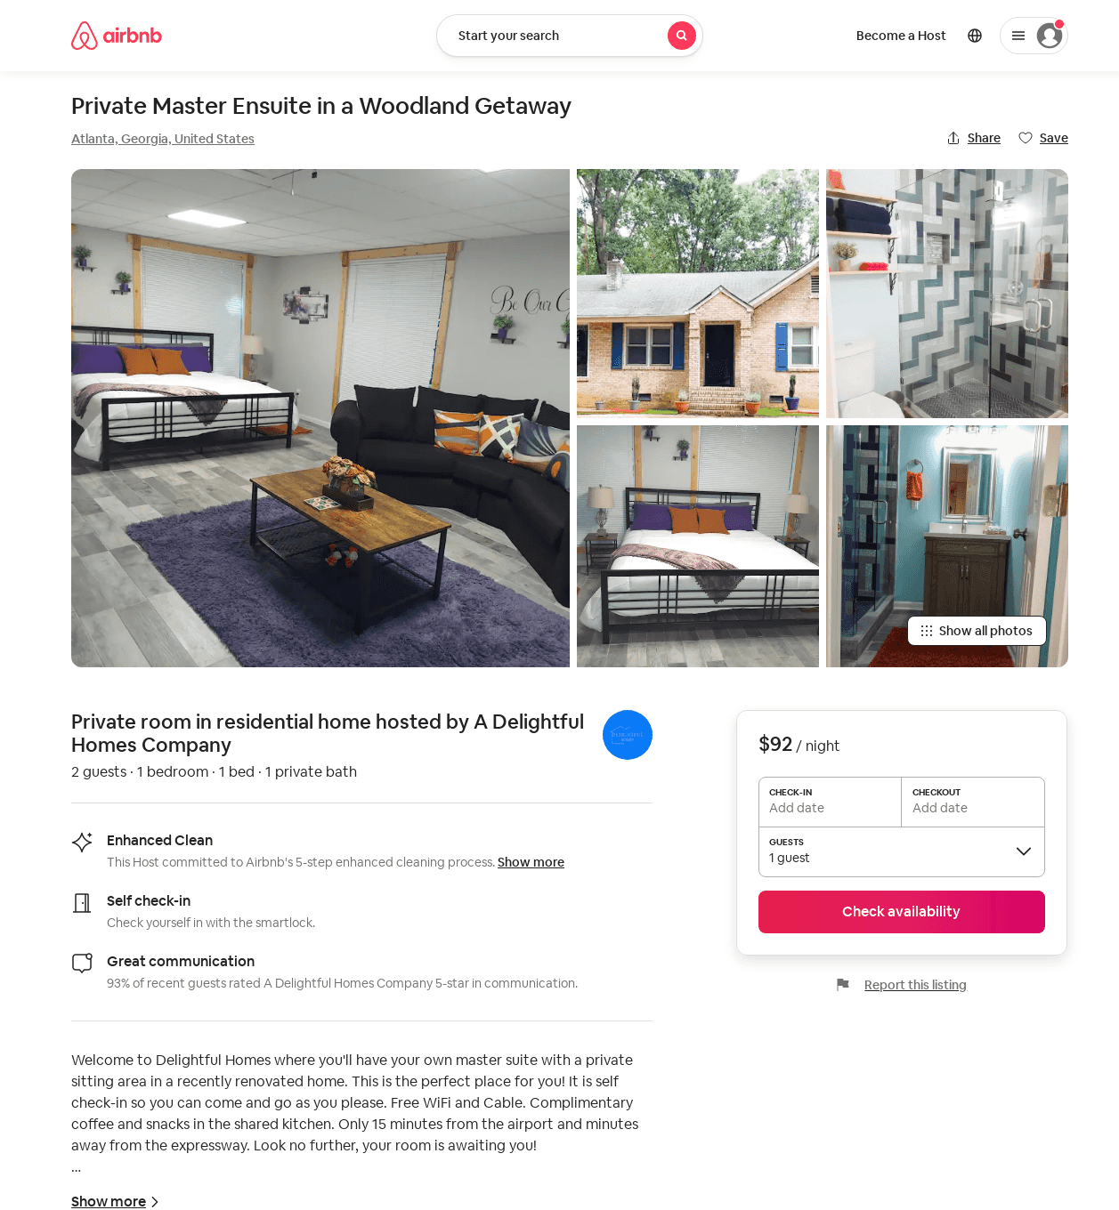
Listing 53180866
1
2
$92
2
A Delightful Homes
399534643
2
https://www.airbnb.com/rooms/53180866
Aug 2022

Slide 32
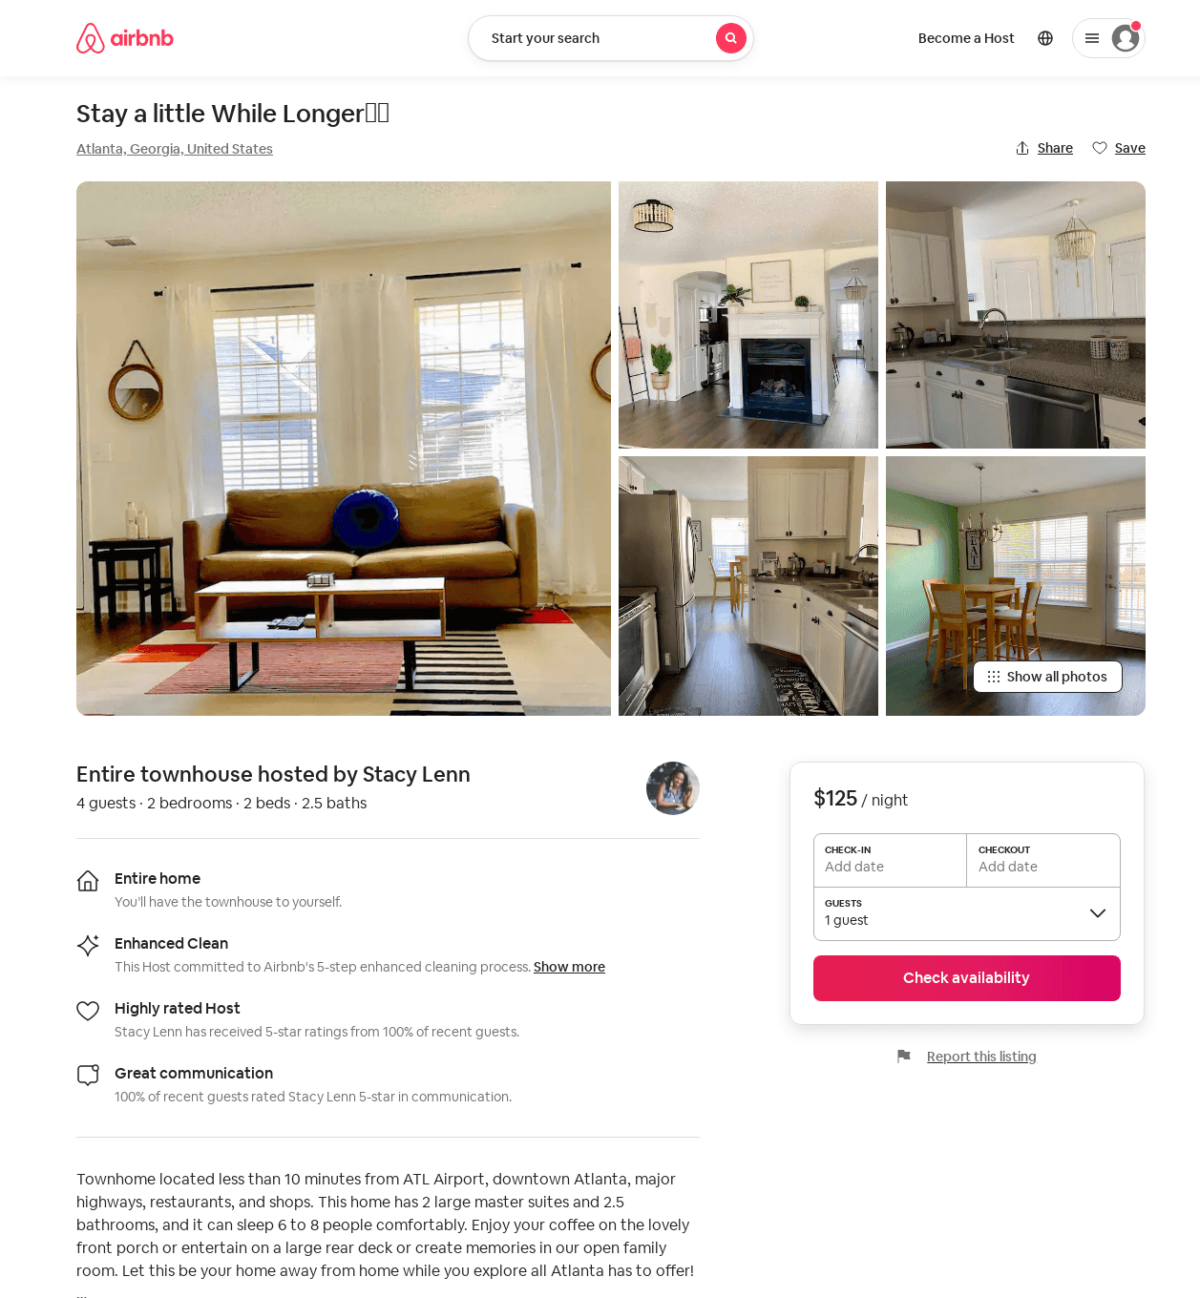
Listing 49007482
2
4
$85 - $153
5.0
2
Stacy Lenn
96292291
1
https://www.airbnb.com/rooms/49007482
Jun 2022

Slide 33
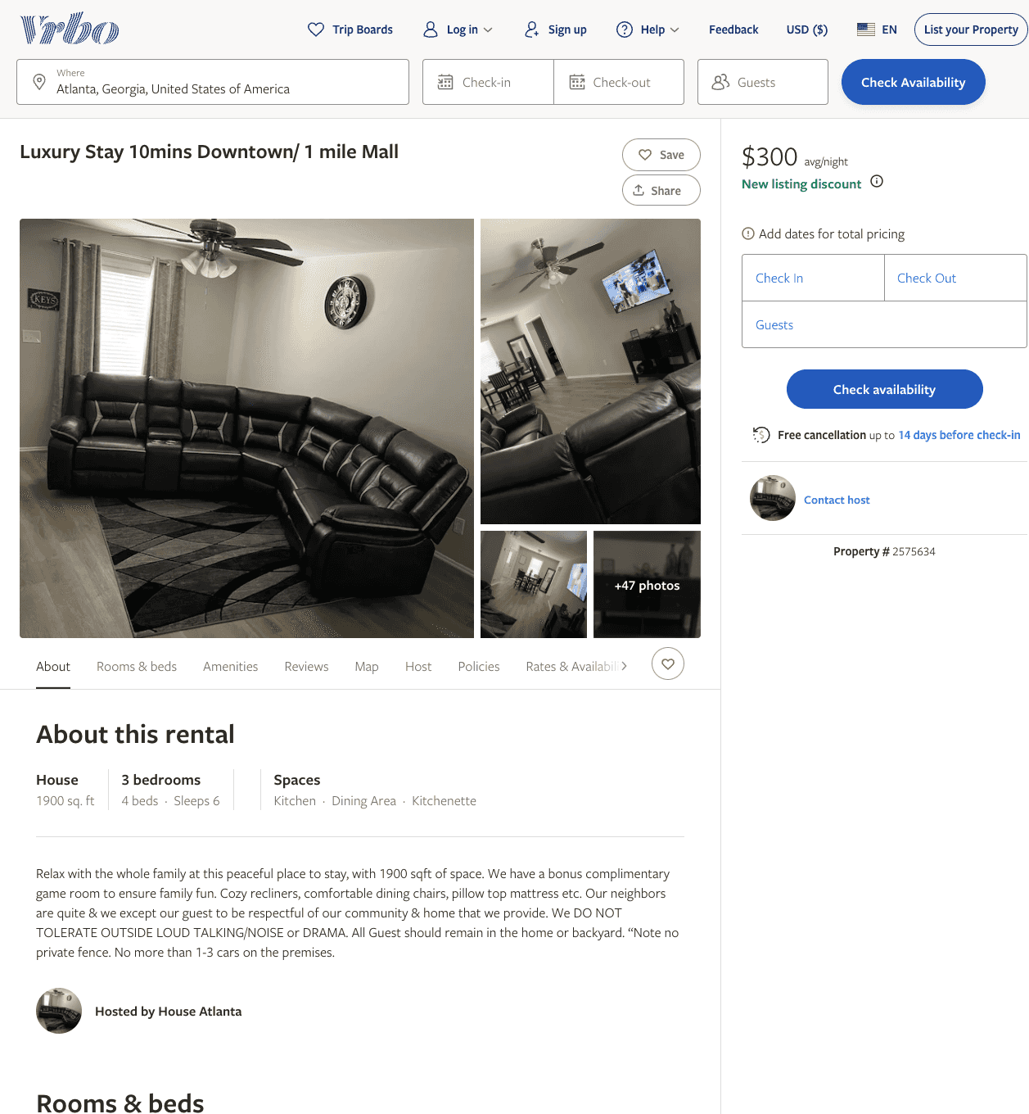
Listing 2575634
3
6
$300
5
1
https://www.vrbo.com/2575634
Aug 2022

Slide 34
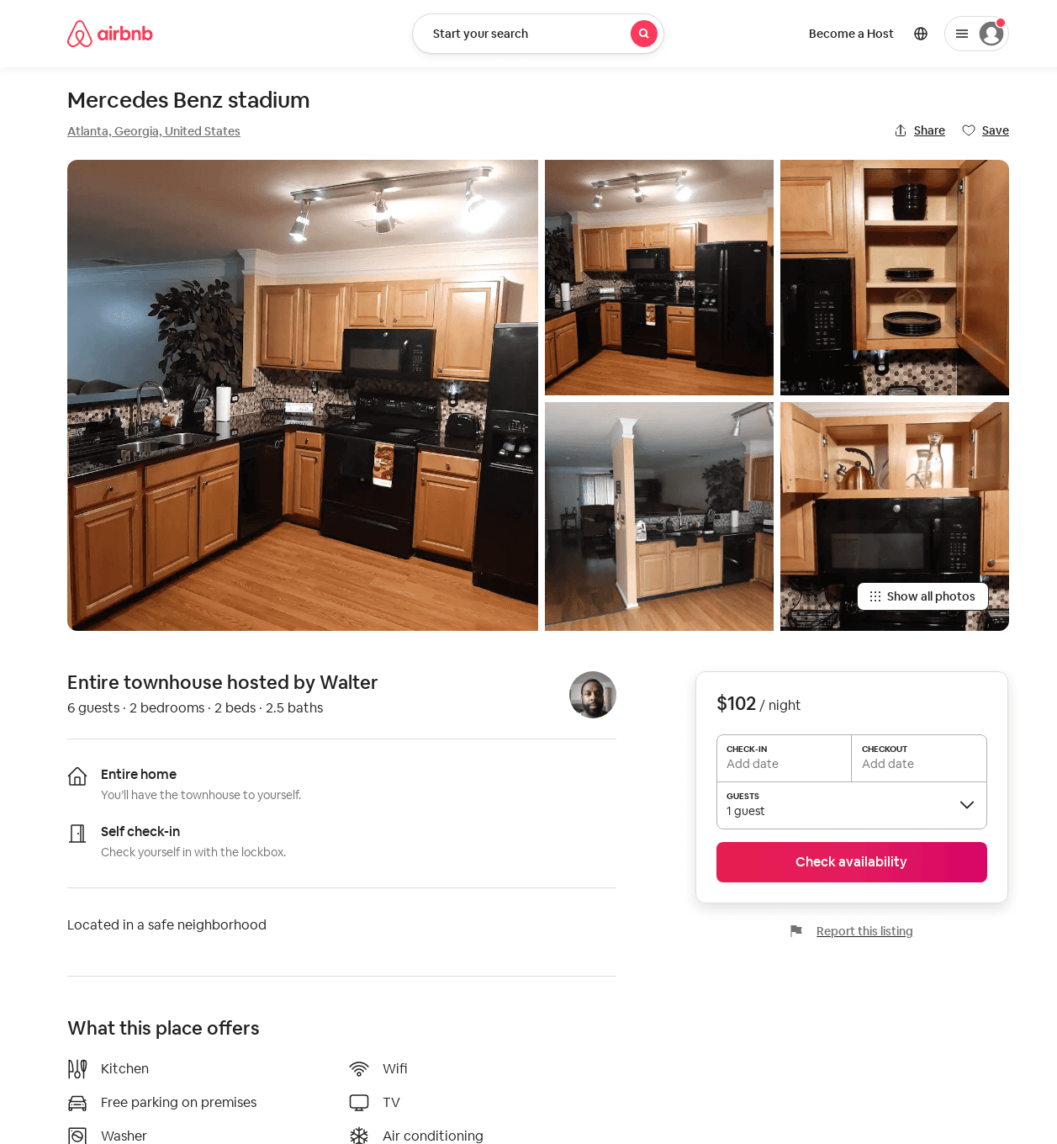
Listing 36698869
2
4
$102 - $148
5.0
2
Walter
167648280
1
https://www.airbnb.com/rooms/36698869
Jun 2022

Slide 35
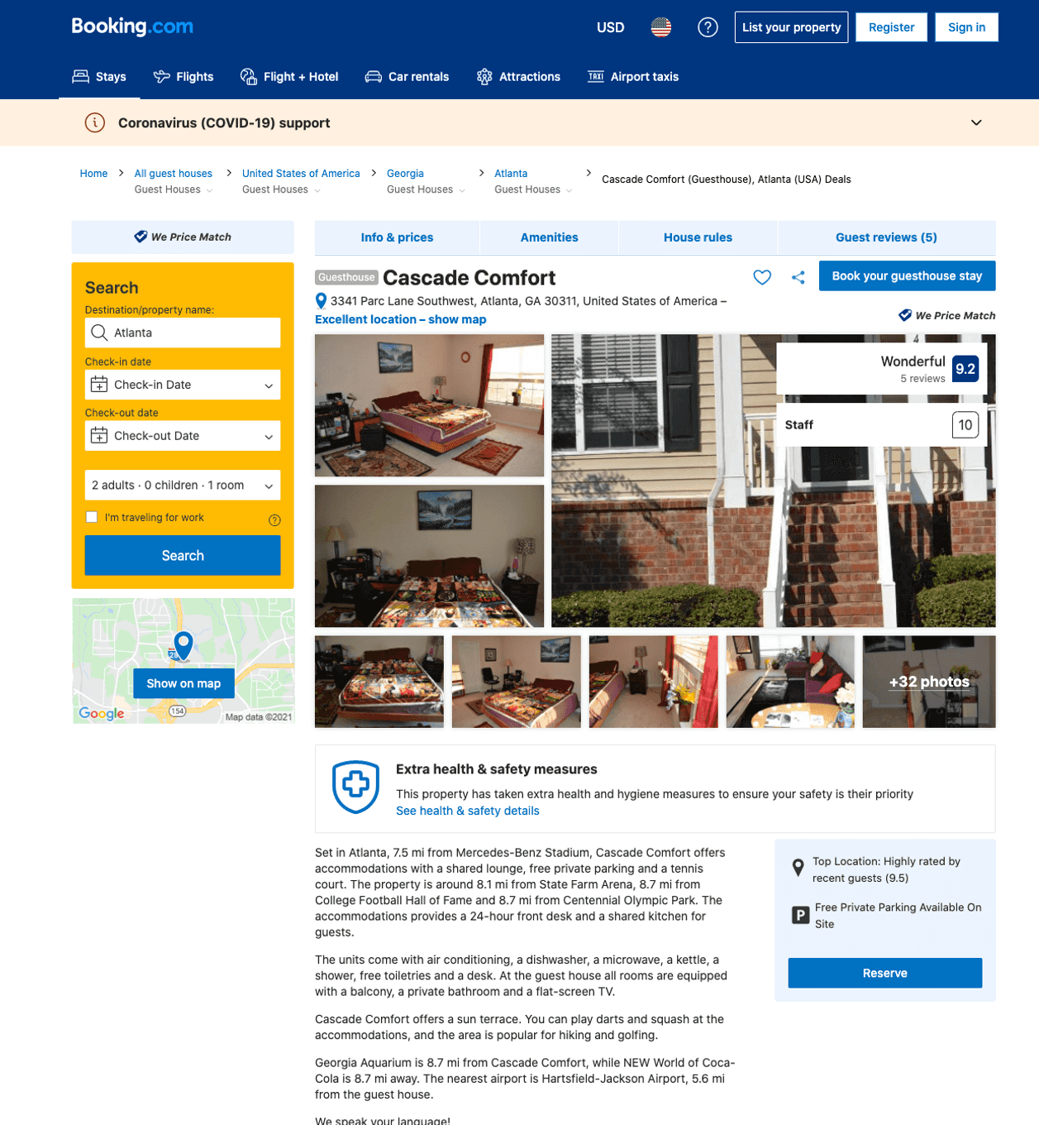
Listing cascade-comfort-atlanta1
undefined
1
7.9
https://www.booking.com/hotel/us/cascade-comfort-atlanta1.html
Sep 2022

Slide 36
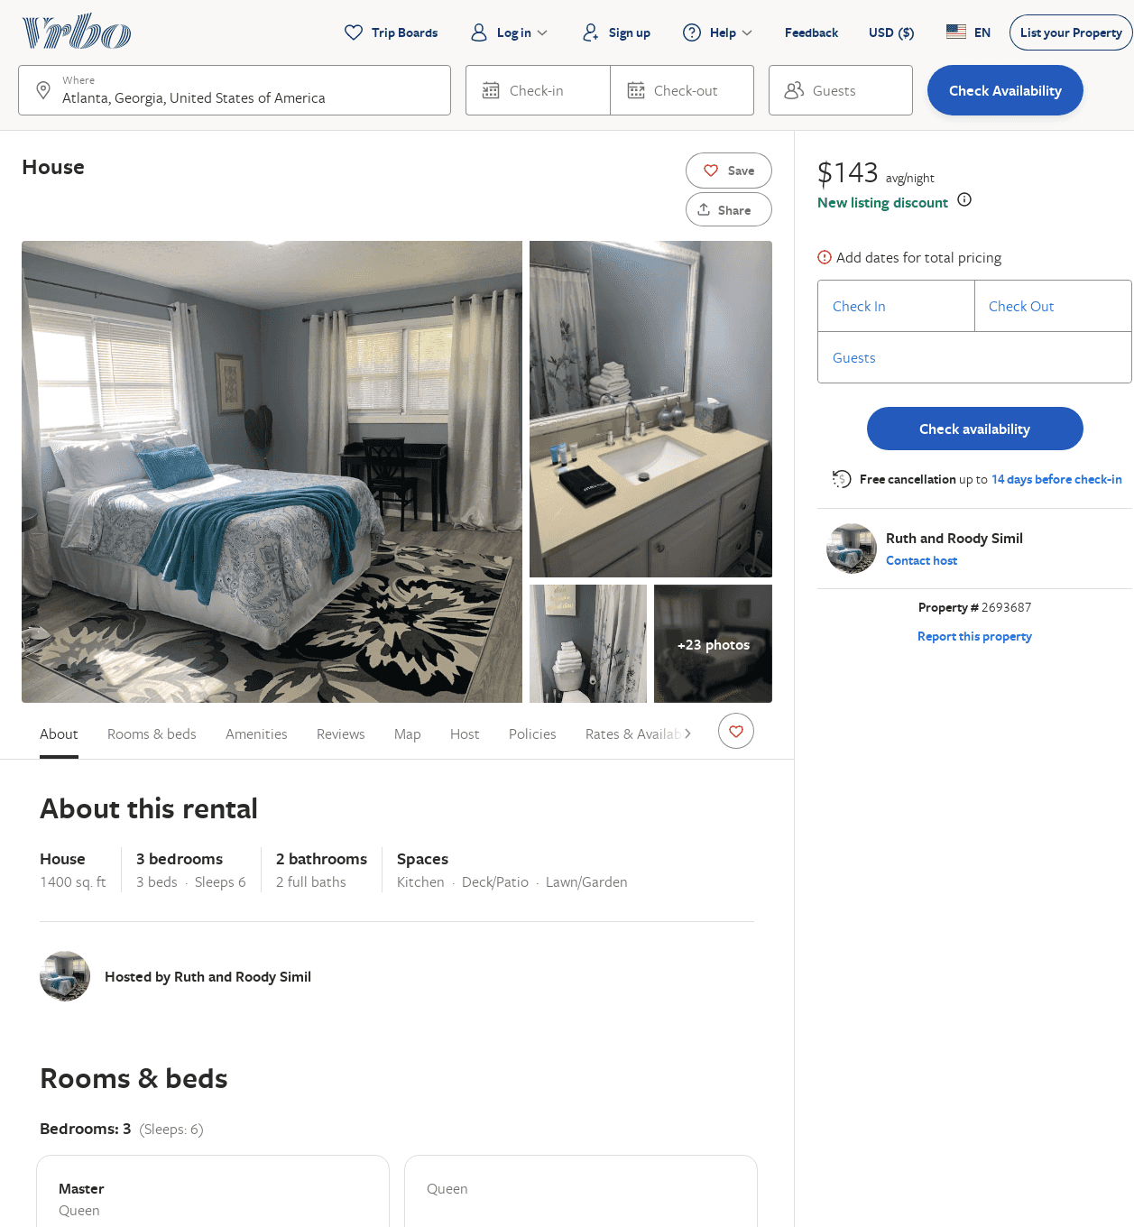
Listing 2693687
3
6
$125
5
2
Ruth and Roody Simil
https://www.vrbo.com/2693687
Aug 2022

Slide 37
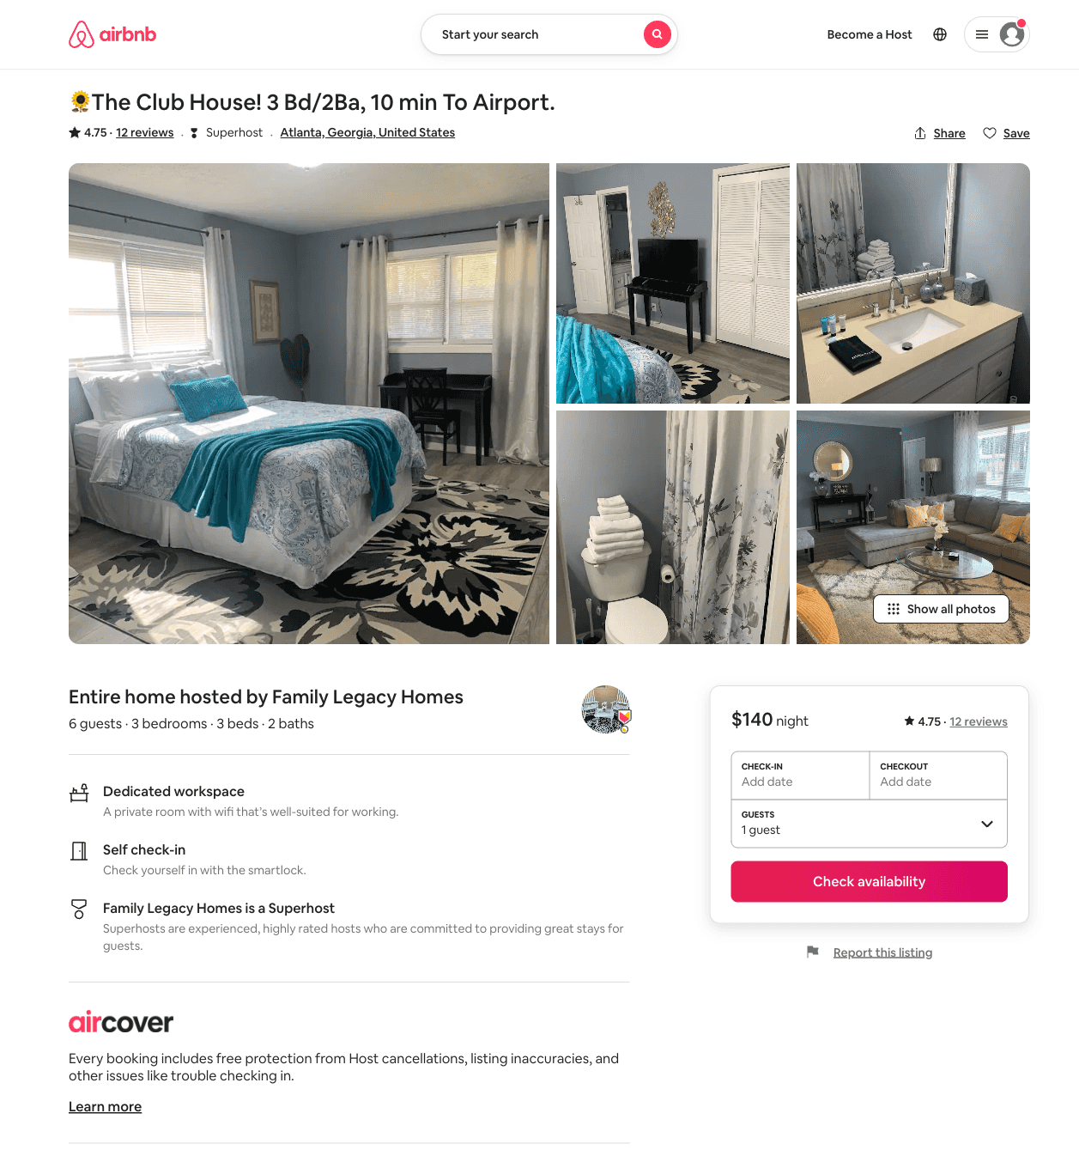
Listing 50423314
3
6
$101 - $157
4.75
2
Family Legacy Homes
301301897
1
https://www.airbnb.com/rooms/50423314
Aug 2022

Slide 38
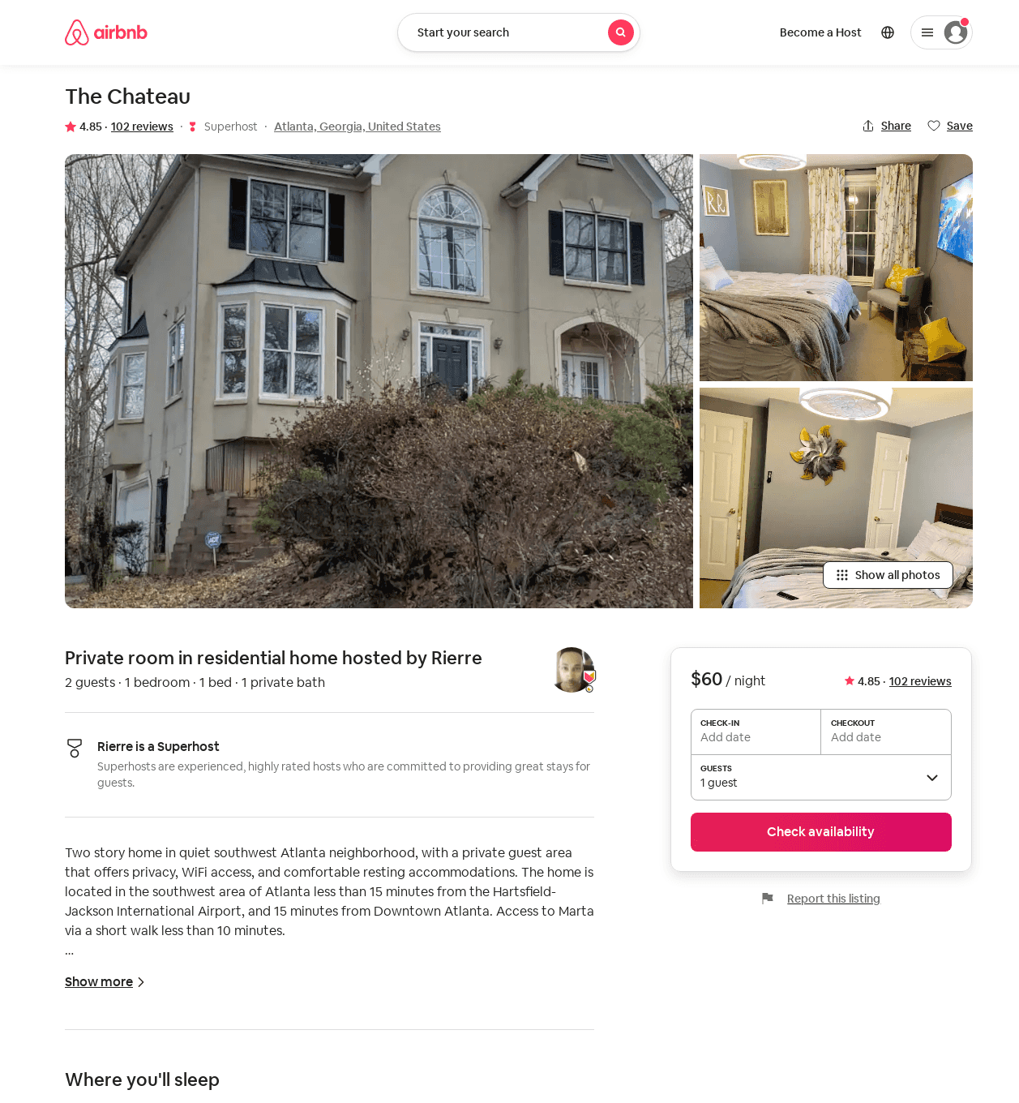
Listing 32181525
1
2
$56 - $77
4.86
1
Rierre
213642369
1
https://www.airbnb.com/rooms/32181525
Aug 2022

Slide 39
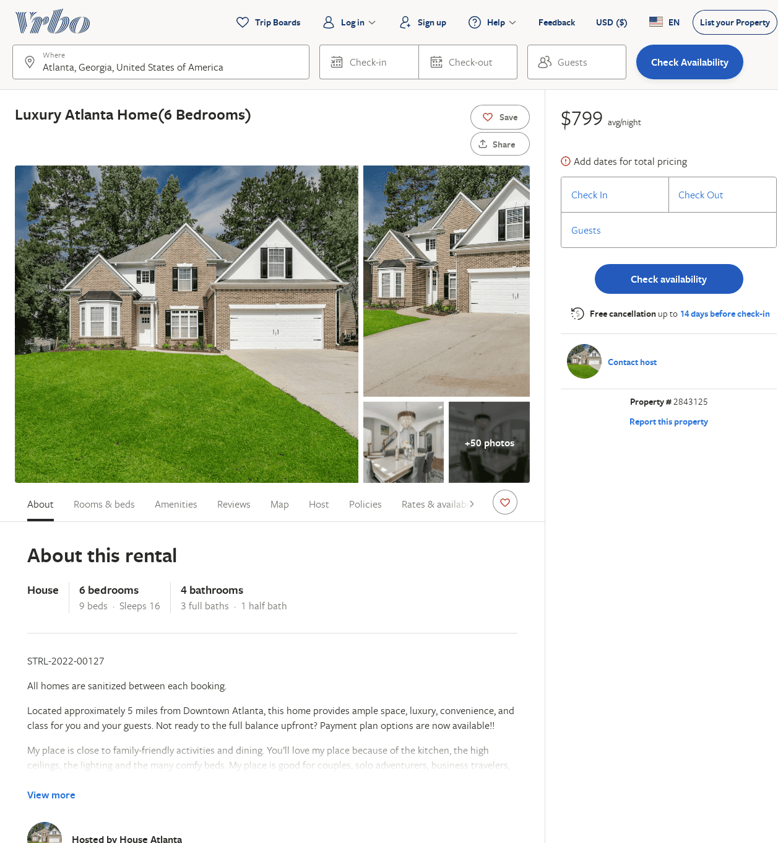
Listing 2843125
6
16
$799
3
https://www.vrbo.com/2843125
Aug 2022

Slide 40
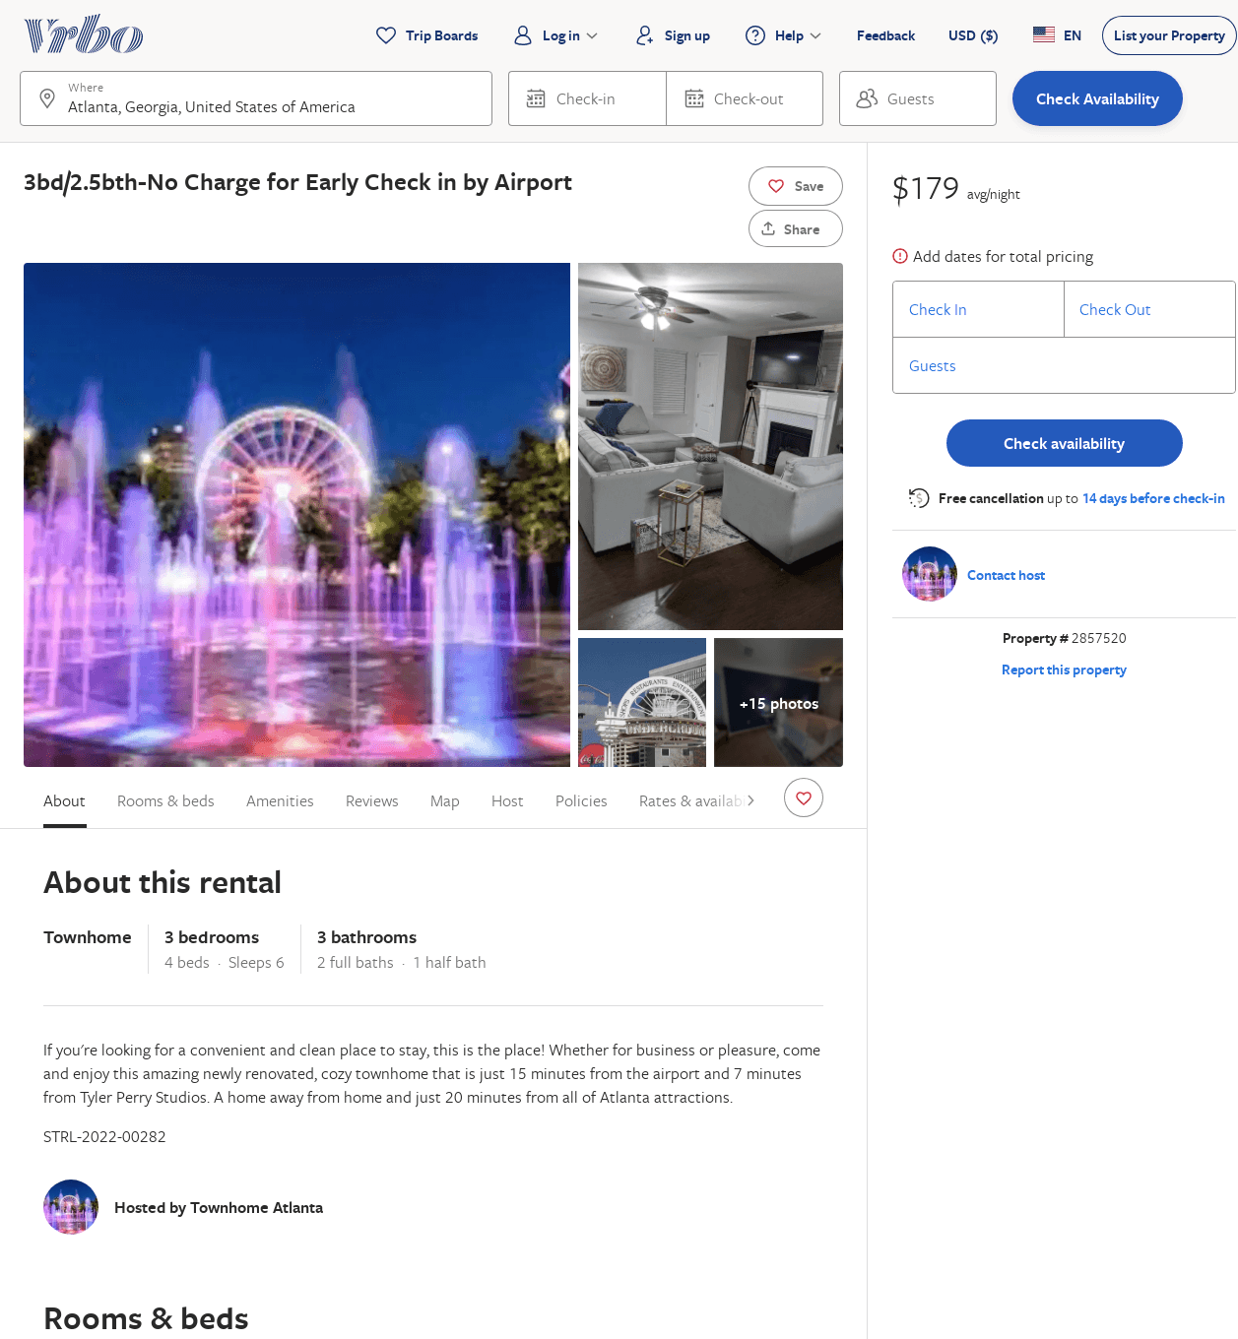
Listing 2857520
3
6
$179
2
Rashida Wilson
https://www.vrbo.com/2857520
Aug 2022

