Slide 2
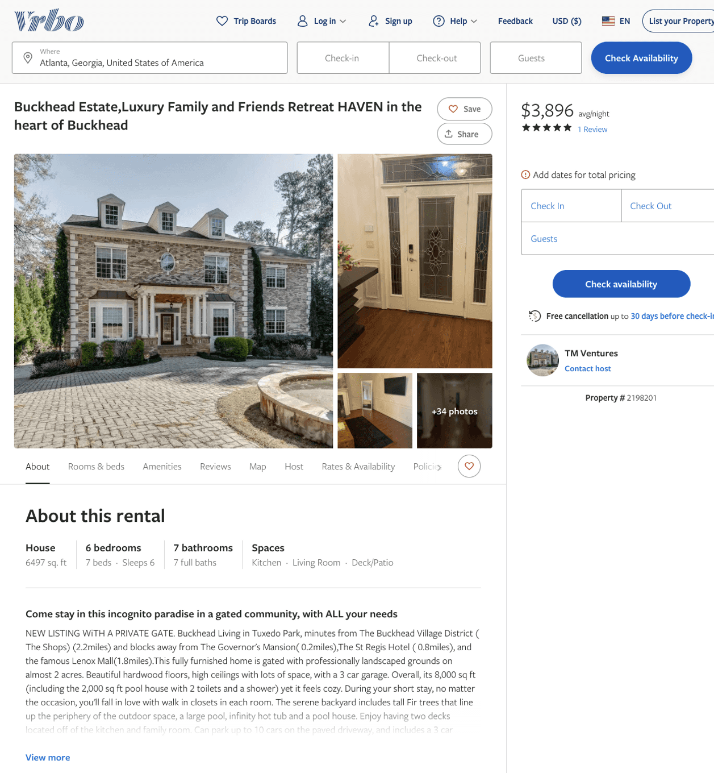
Listing 2198201
6
6
$2,550 - $3,886
5
2
TM Ventures
https://www.vrbo.com/2198201
Aug 2022

Slide 3
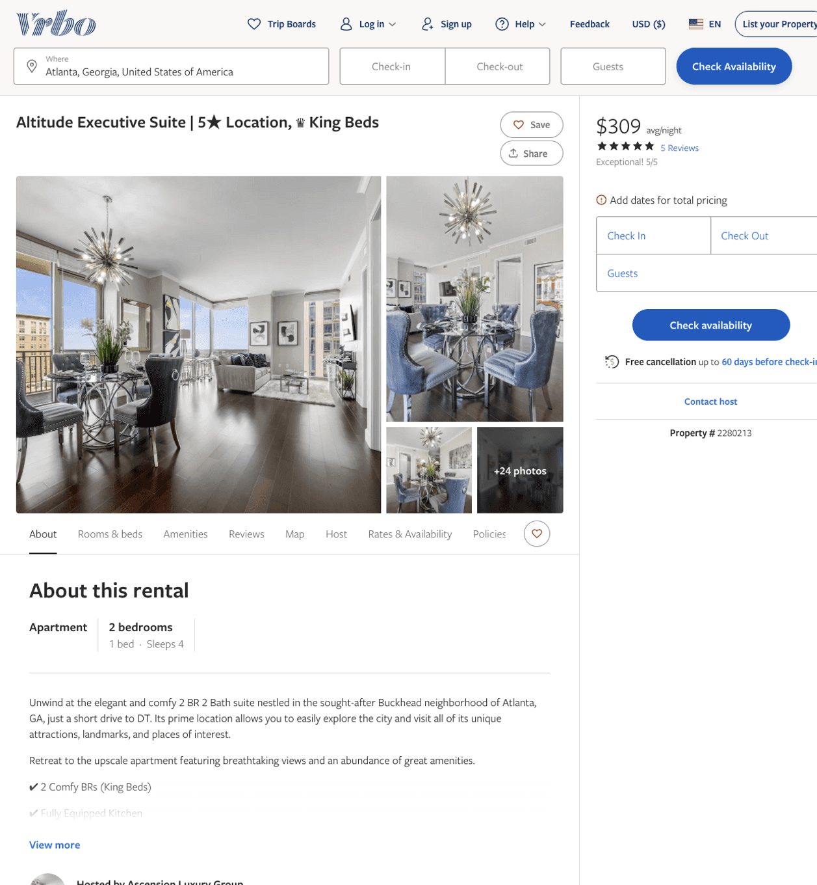
Listing 2280213
2
4
$309 - $337
5
7
Ascension Luxury Group
https://www.vrbo.com/2280213
Aug 2022

Slide 4
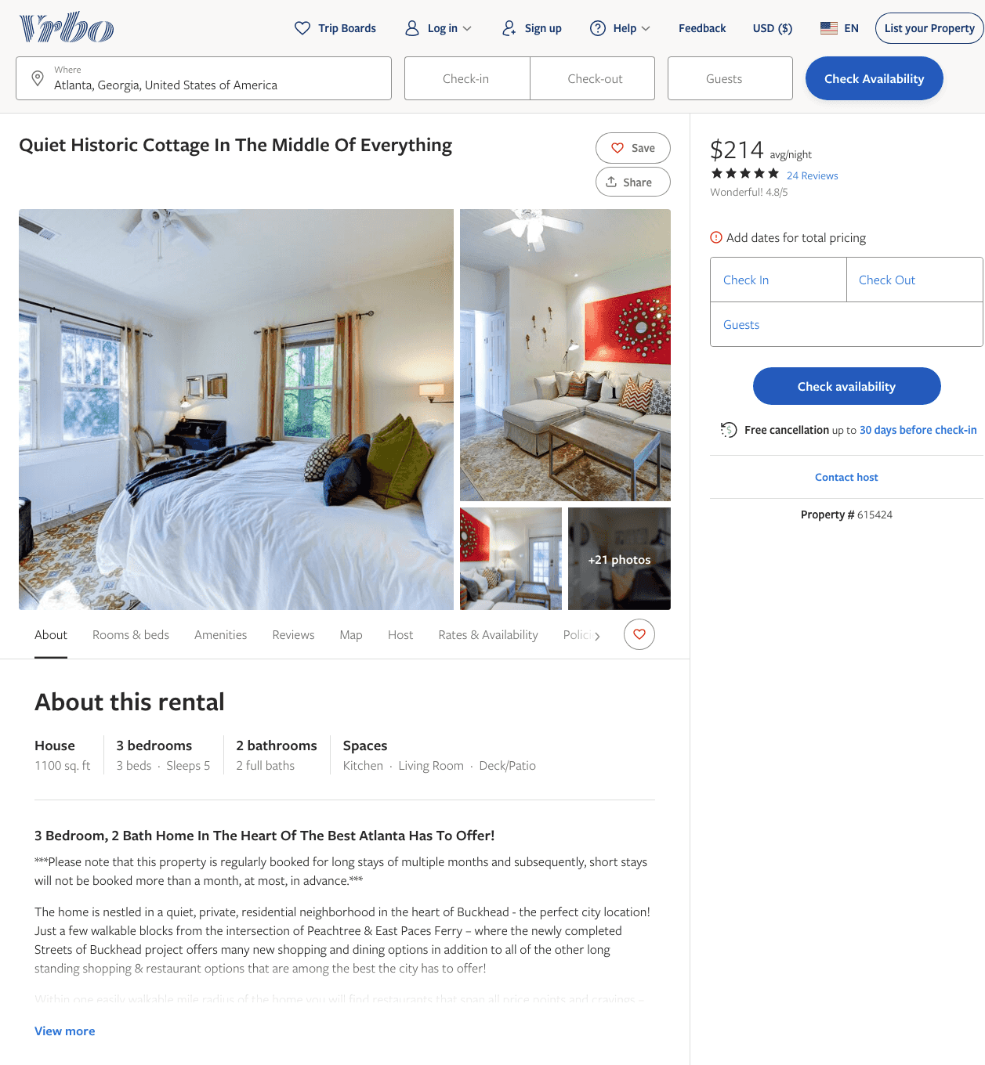
Listing 615424
3
5
$214 - $225
4.827586
4
owner/property manager
https://www.vrbo.com/615424
Aug 2022

Slide 5
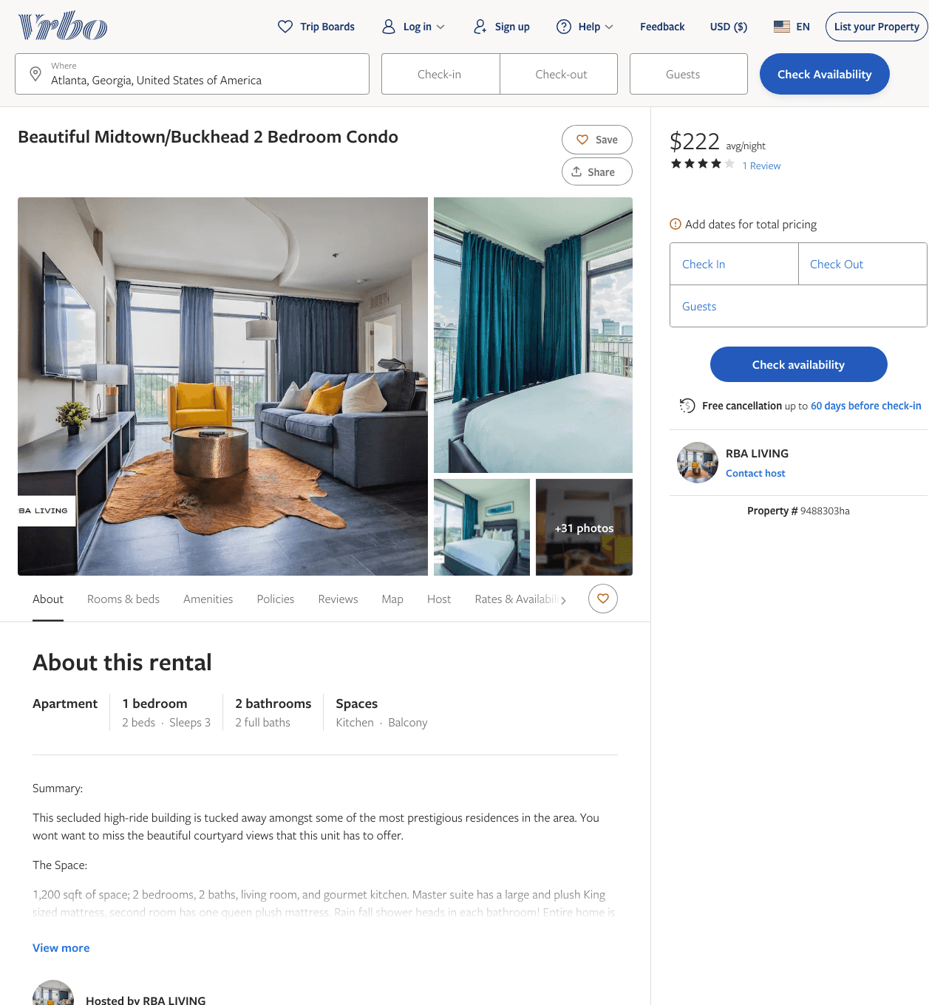
Listing 9488303
2
5
$222 - $258
4
2
RBA LIVING
https://www.vrbo.com/9488303ha
Aug 2022

Slide 6
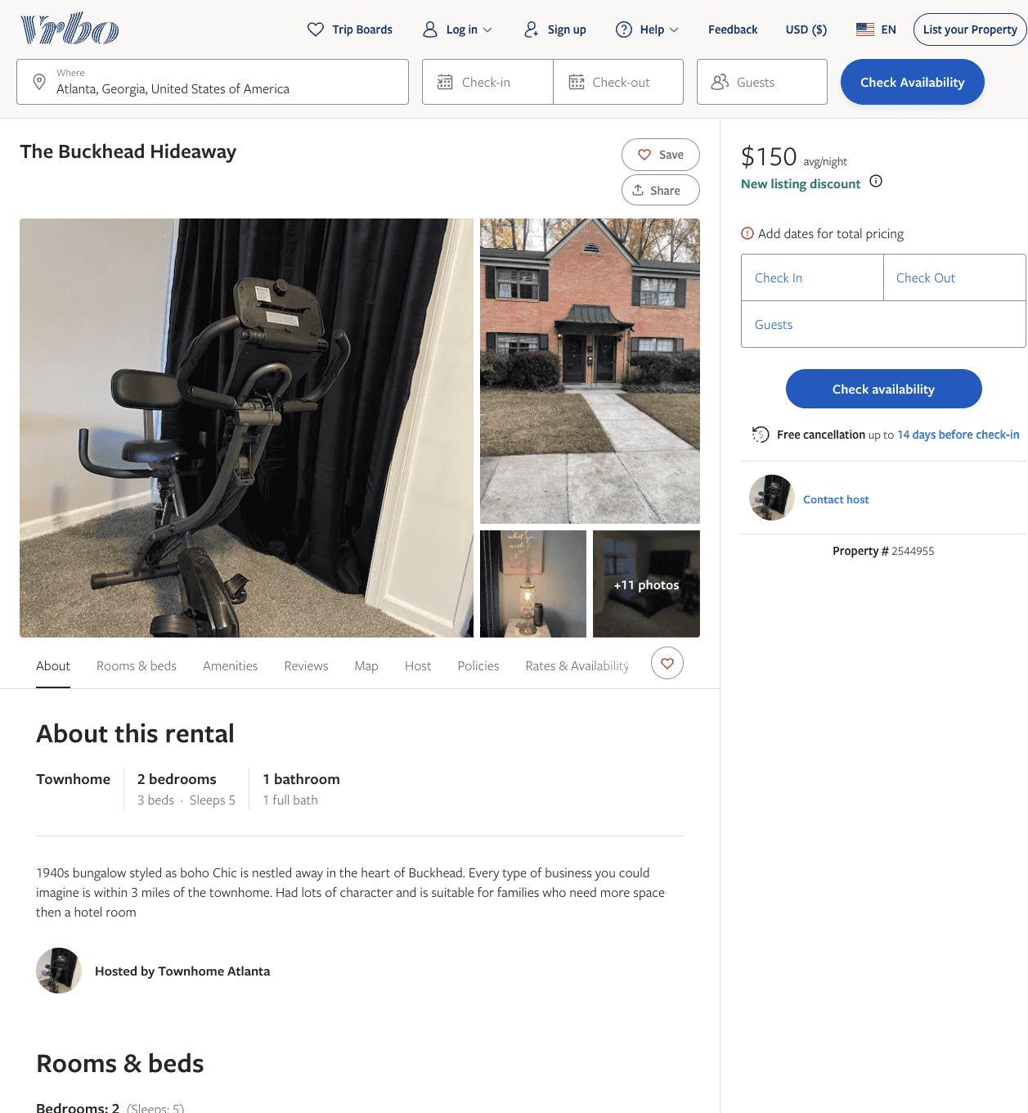
Listing 2544955
2
5
$150
2
https://www.vrbo.com/2544955
Aug 2022

Slide 7
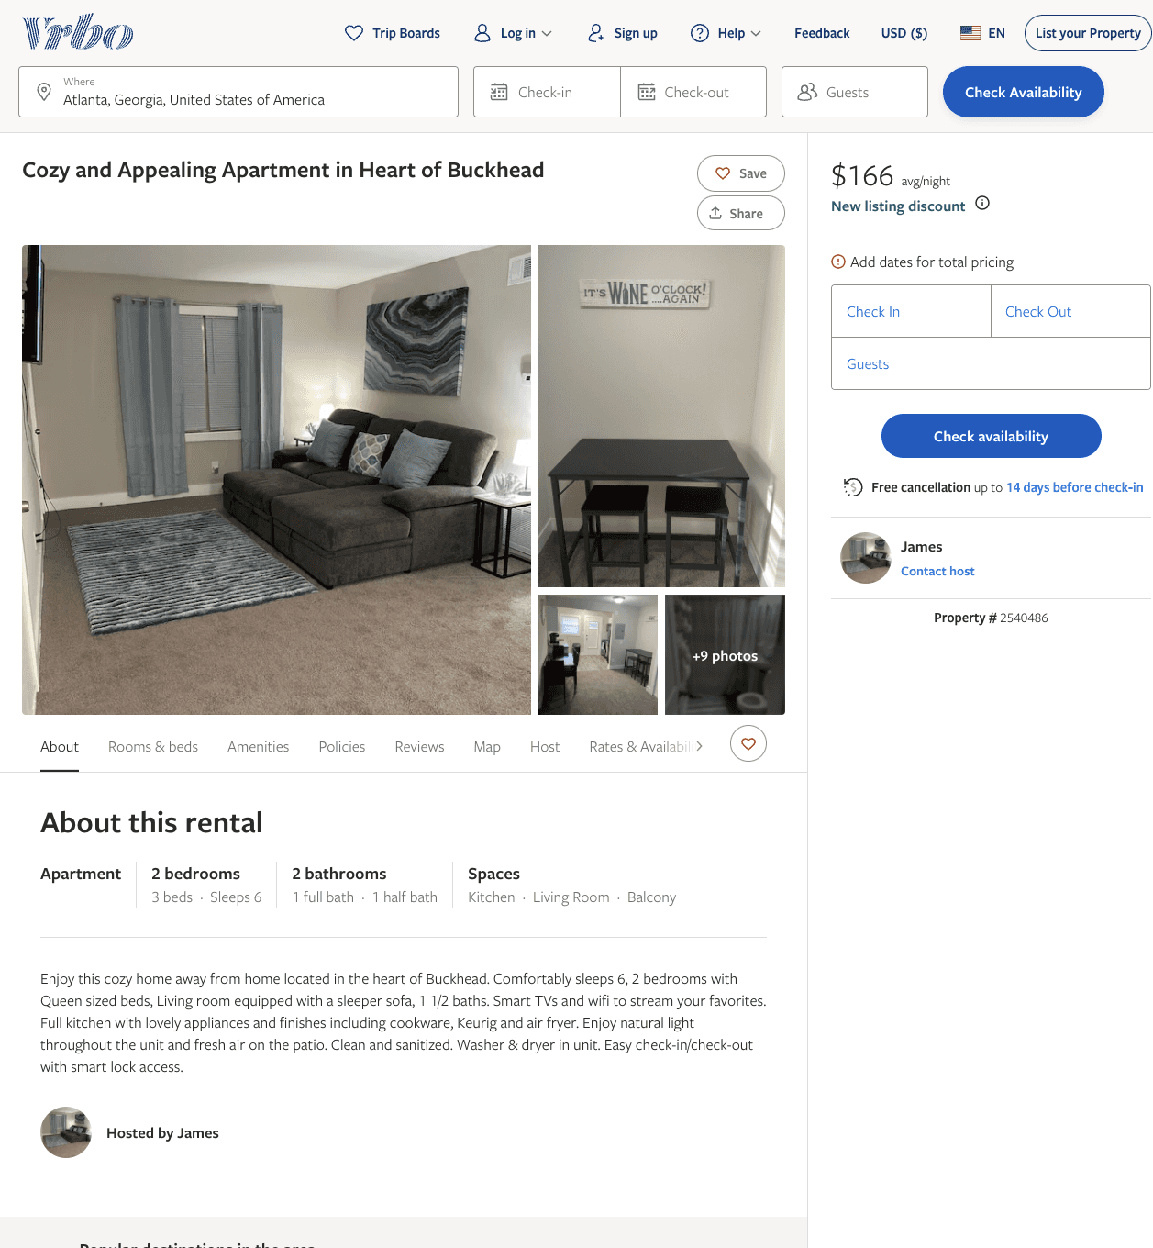
Listing 2540486
2
6
$160 - $190
3
2
James
https://www.vrbo.com/2540486
Aug 2022

Slide 8
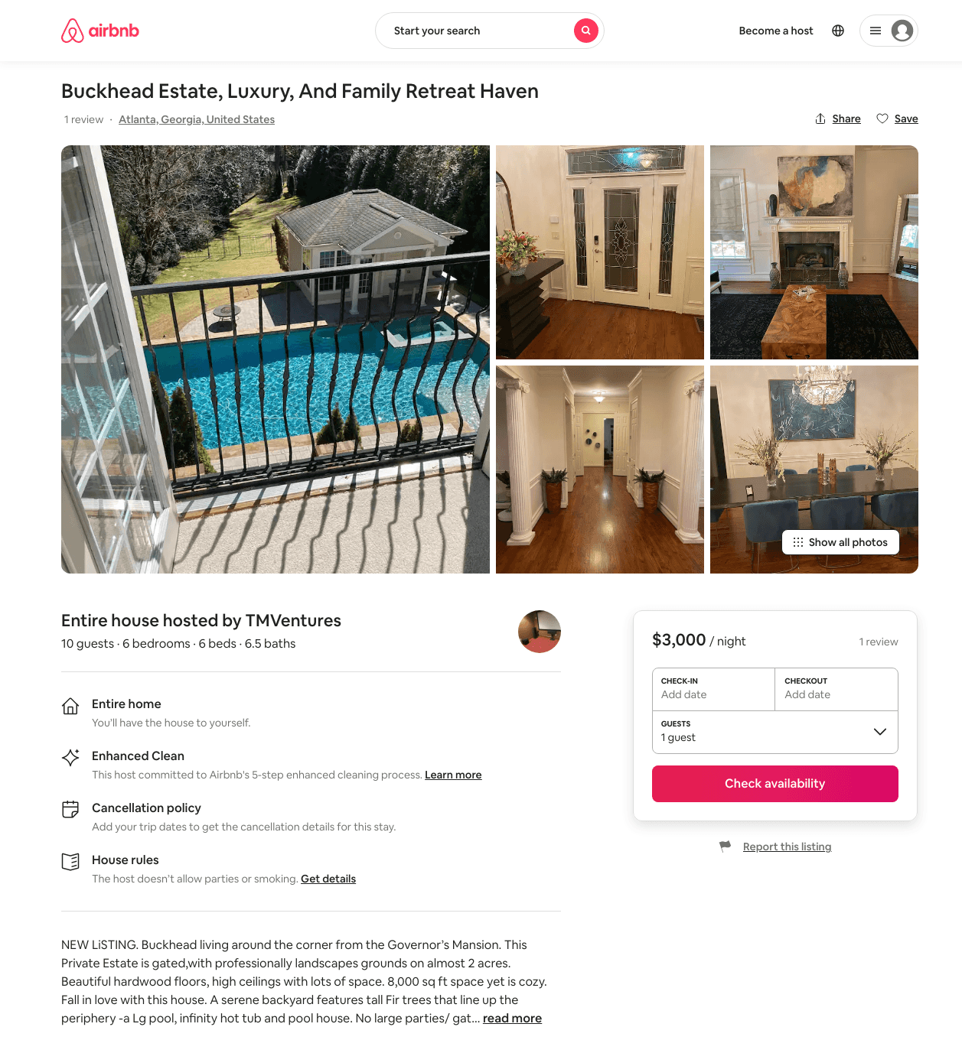
Listing 47852343
6
10
$1425 - $5000
4.0
2
TMVentures
352066257
2
https://www.airbnb.com/rooms/47852343
Aug 2022

Slide 9
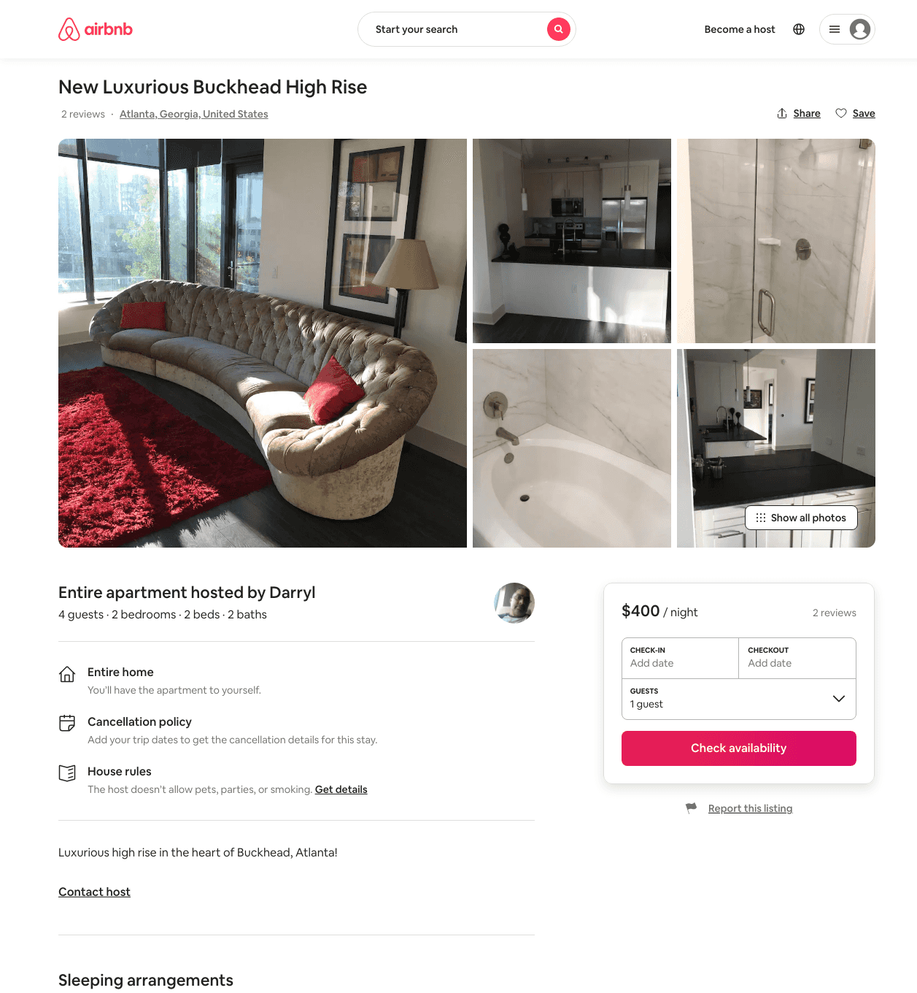
Listing 31742730
2
4
$400
2
Darryl
230816795
1
https://www.airbnb.com/rooms/31742730
Aug 2022

Slide 10
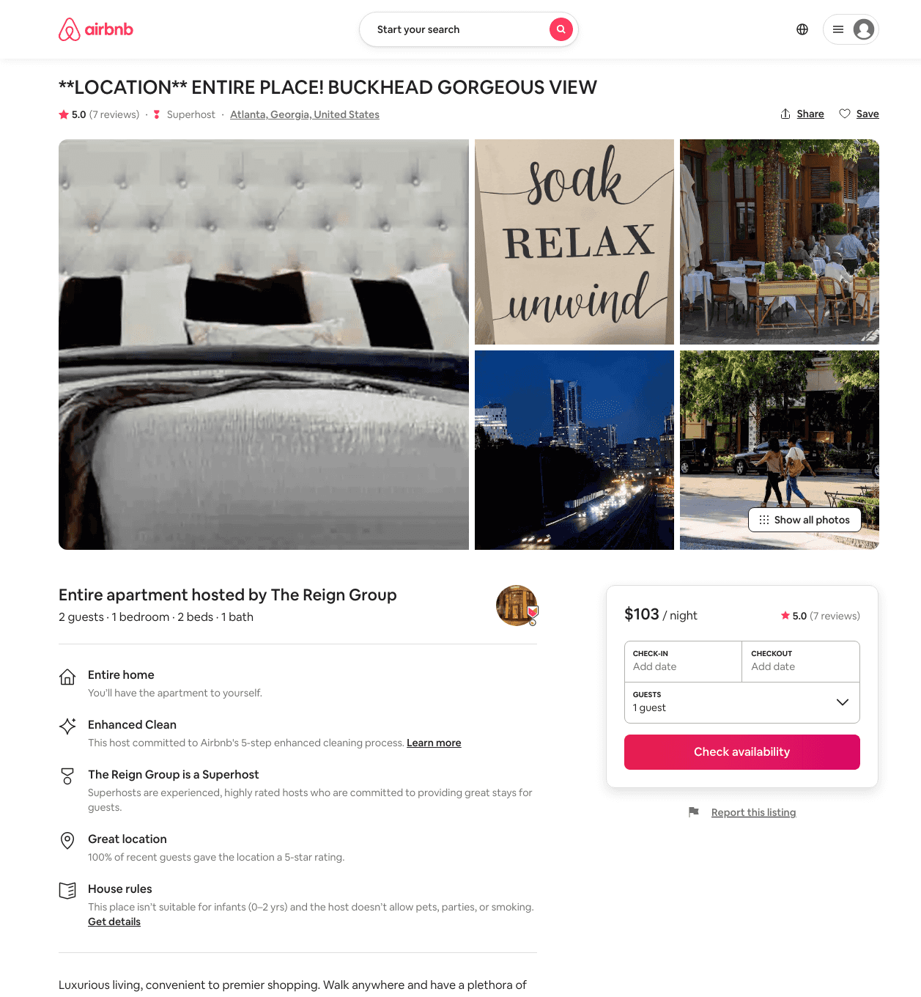
Listing 45869279
1
2
$85 - $106
5.0
2
The Reign Group
298247955
2
https://www.airbnb.com/rooms/45869279
Aug 2022

Slide 11
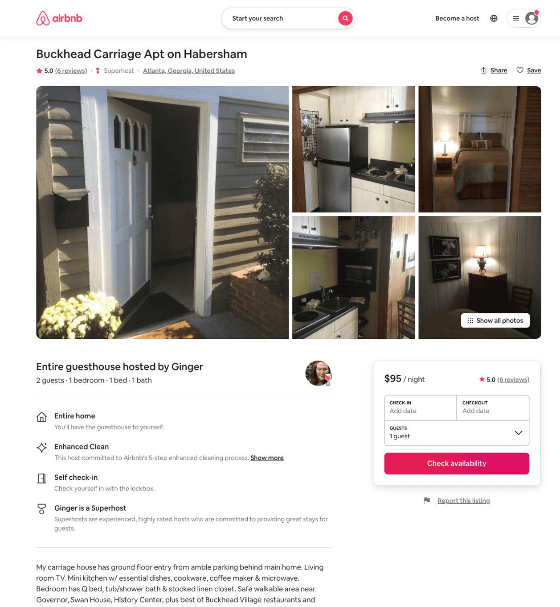
Listing 12622714
1
2
$85 - $95
4.92
30
Ginger
58580792
4
https://www.airbnb.com/rooms/12622714
Aug 2022

Slide 12
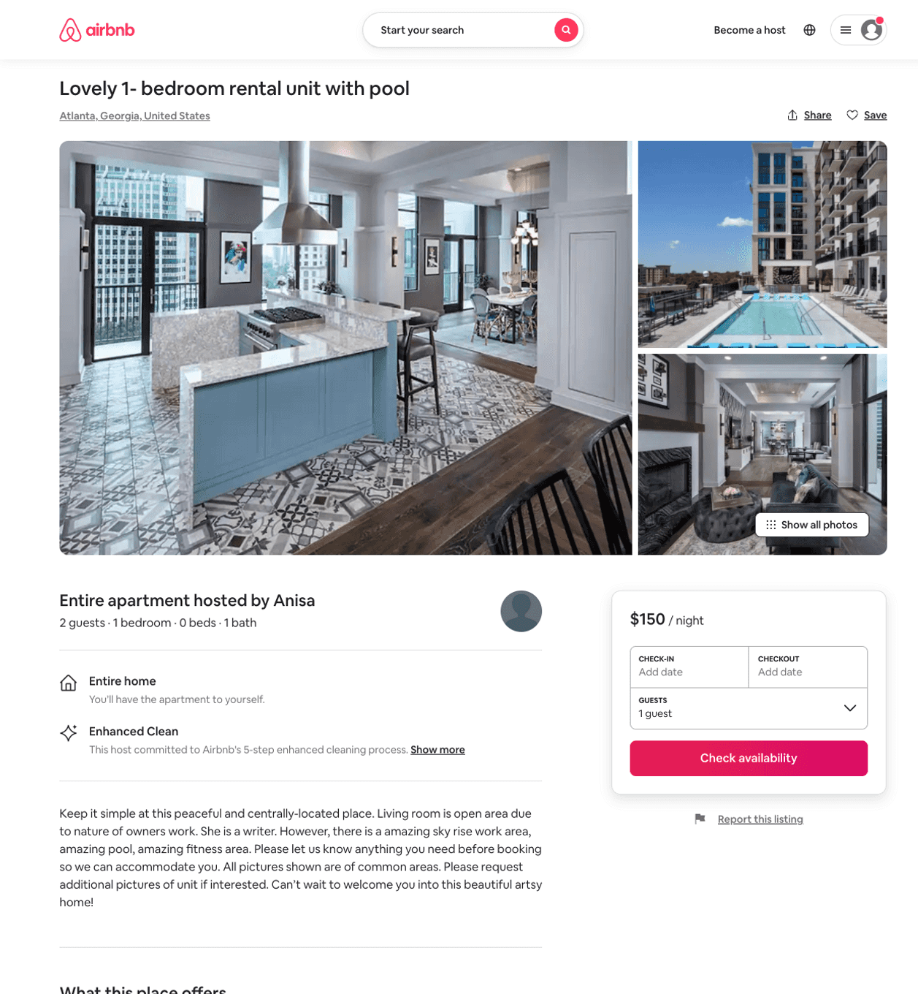
Listing 50795667
1
2
$93 - $150
1
Anisa
391194532
1
https://www.airbnb.com/rooms/50795667
Jun 2022

Slide 13
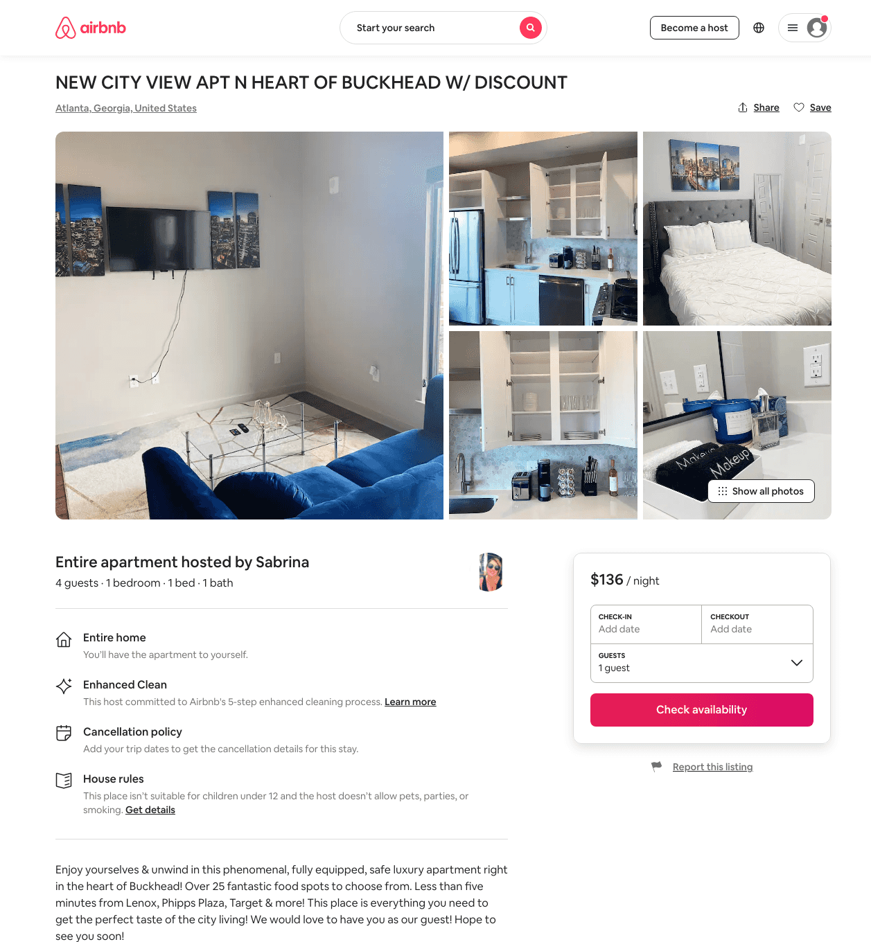
Listing 49129173
2
6
$90 - $200
4.88
1
Sandra
250975192
2
https://www.airbnb.com/rooms/49129173
Jun 2022

Slide 14
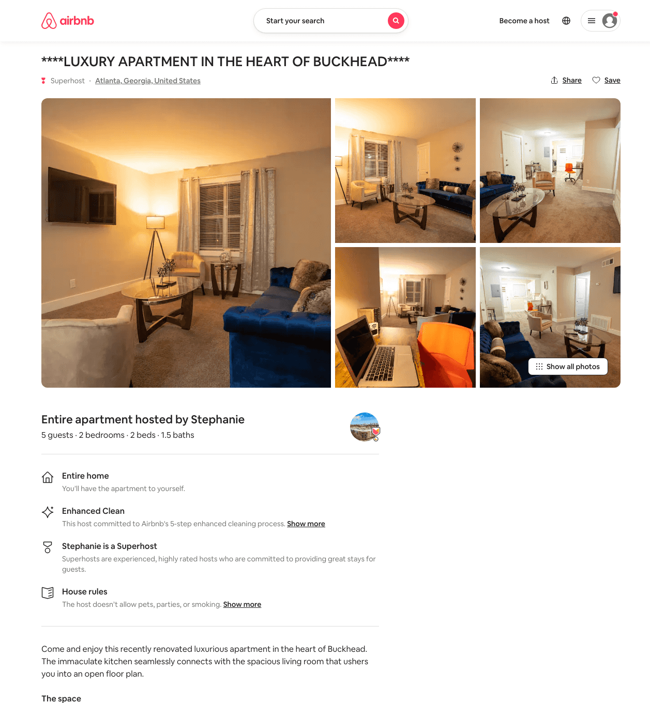
Listing 49216824
2
5
$80 - $100
4.42
1
Stephanie
380724467
3
https://www.airbnb.com/rooms/49216824
Aug 2022

Slide 15
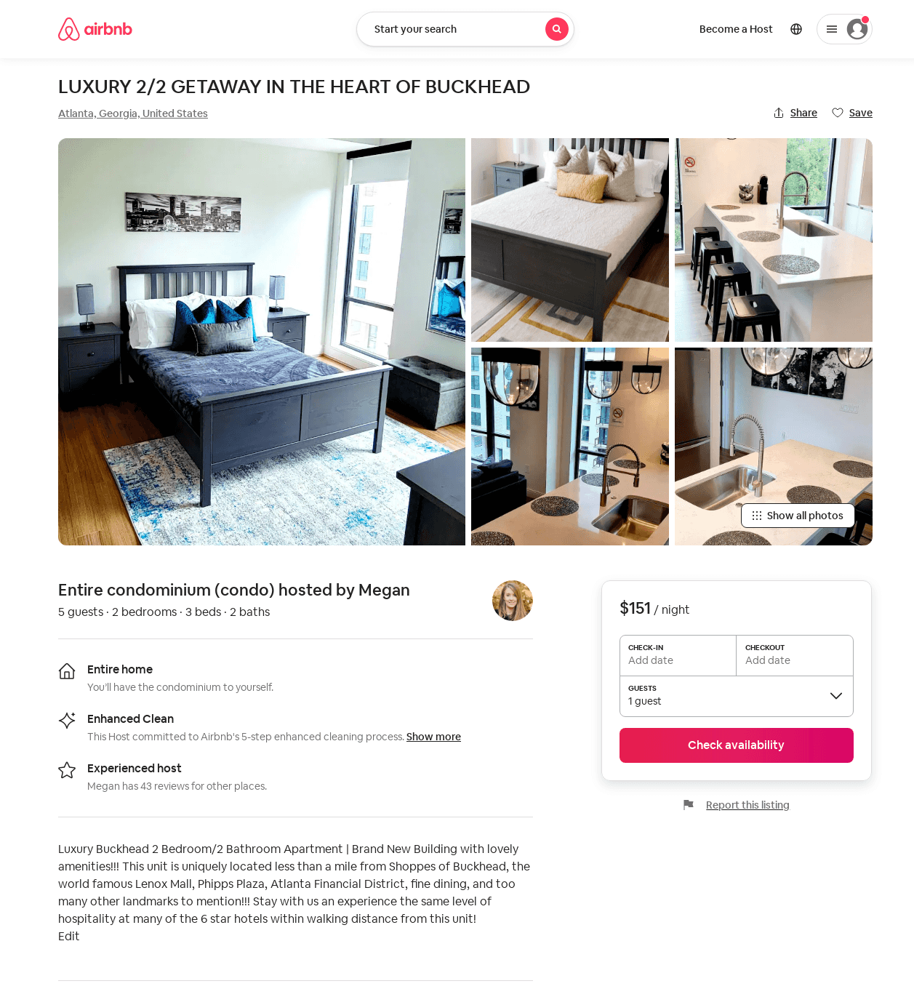
Listing 52532462
2
5
$115 - $190
4.81
2
Megan
291656289
2
https://www.airbnb.com/rooms/52532462
Jun 2022

Slide 16
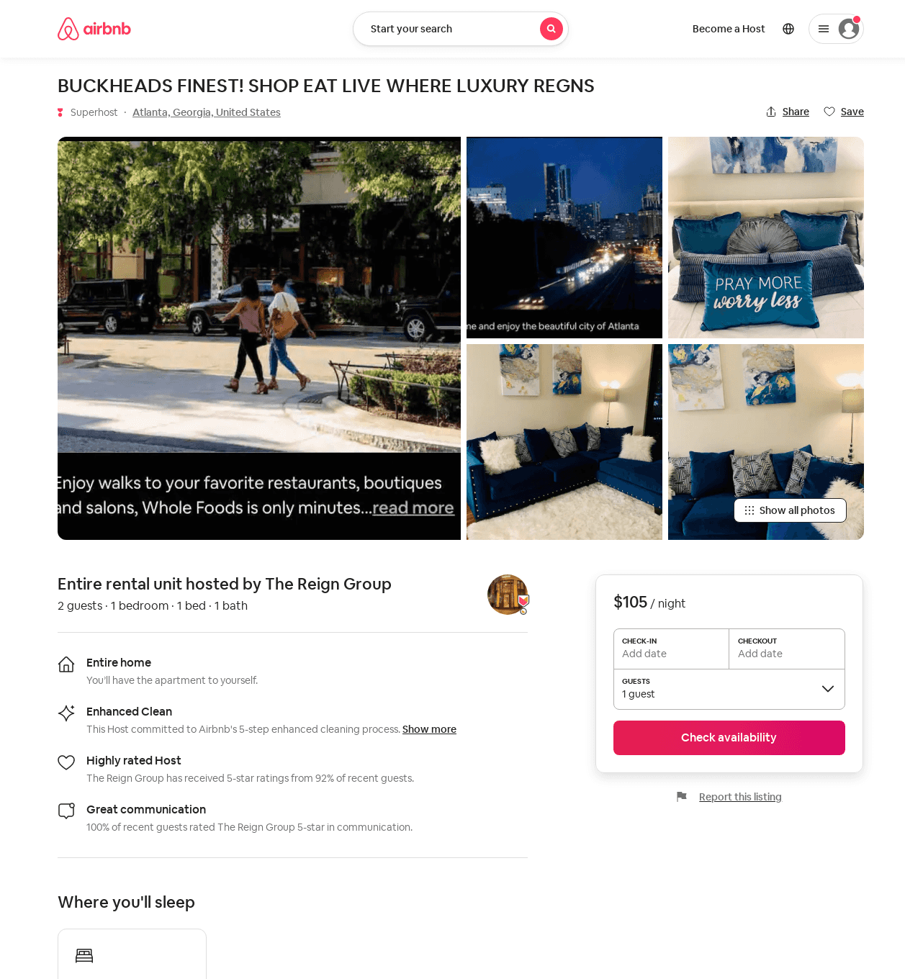
Listing 46770326
1
2
$105
1
The Reign Group
298247955
2
https://www.airbnb.com/rooms/46770326
Aug 2022

Slide 17
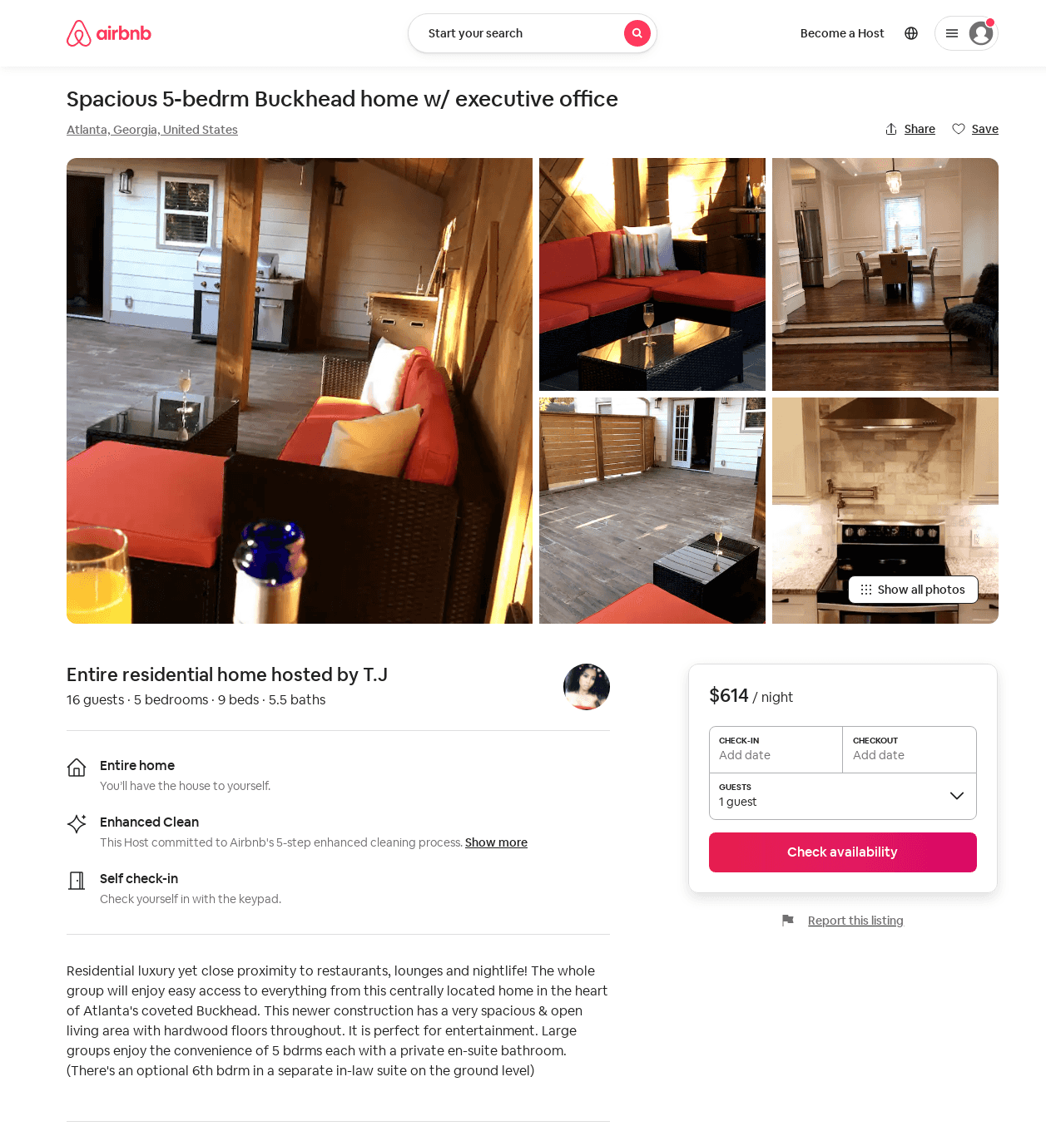
Listing 53076762
5
16
$535 - $628
1
T.J
56506344
1
https://www.airbnb.com/rooms/53076762
Aug 2022

Slide 18
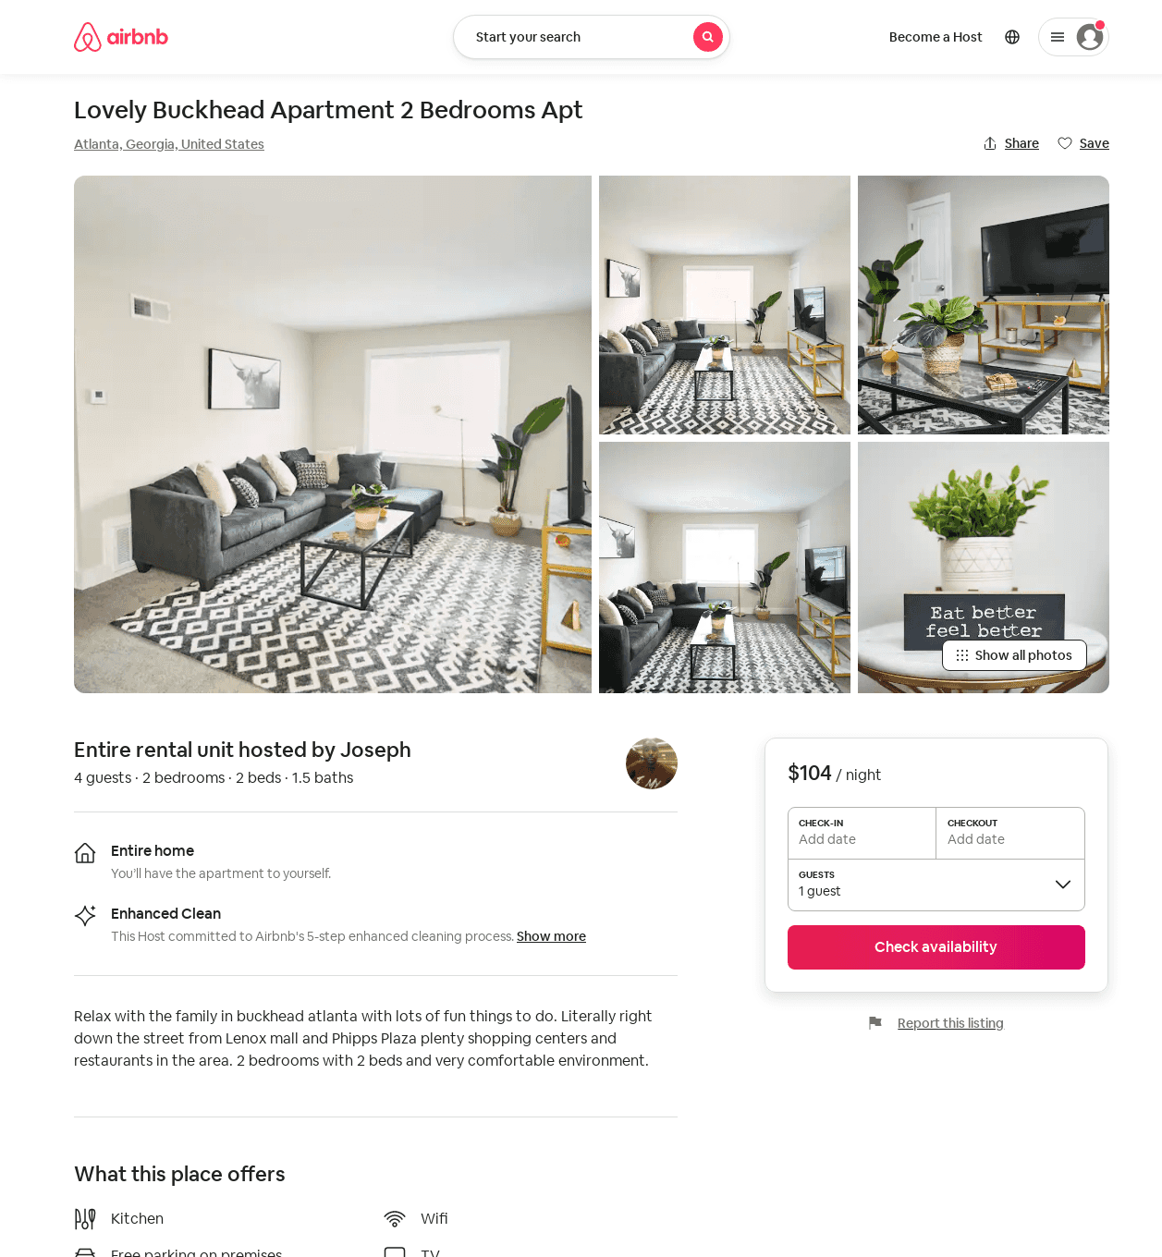
Listing 52031255
2
4
$104 - $114
2
Joseph
103032005
1
https://www.airbnb.com/rooms/52031255
Aug 2022

Slide 19
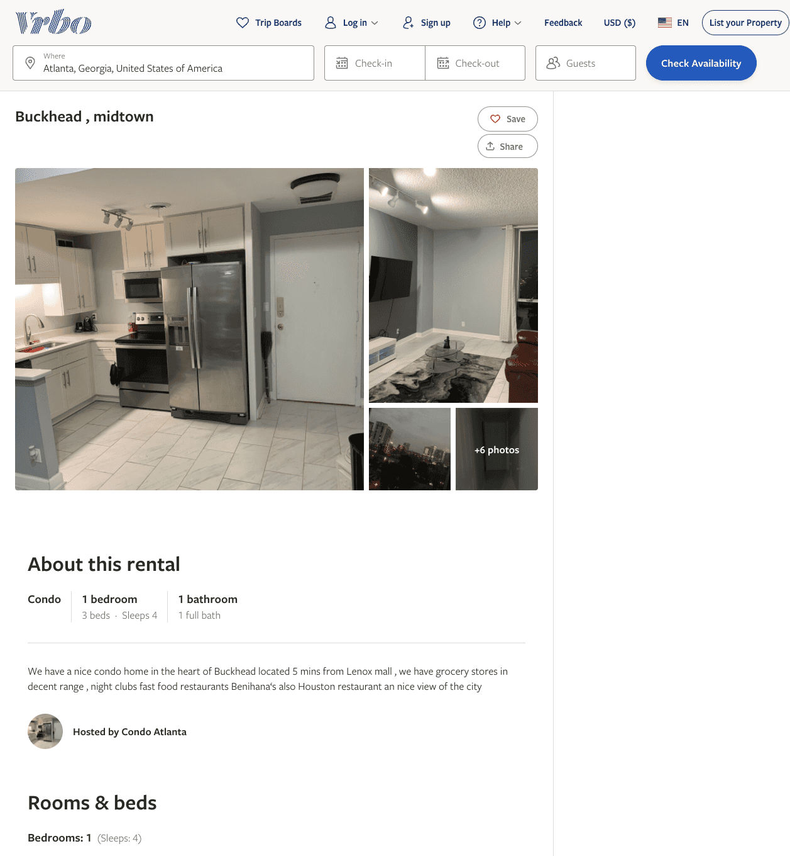
Listing 2602784
1
4
$150
2
https://www.vrbo.com/2602784
Aug 2022

Slide 20
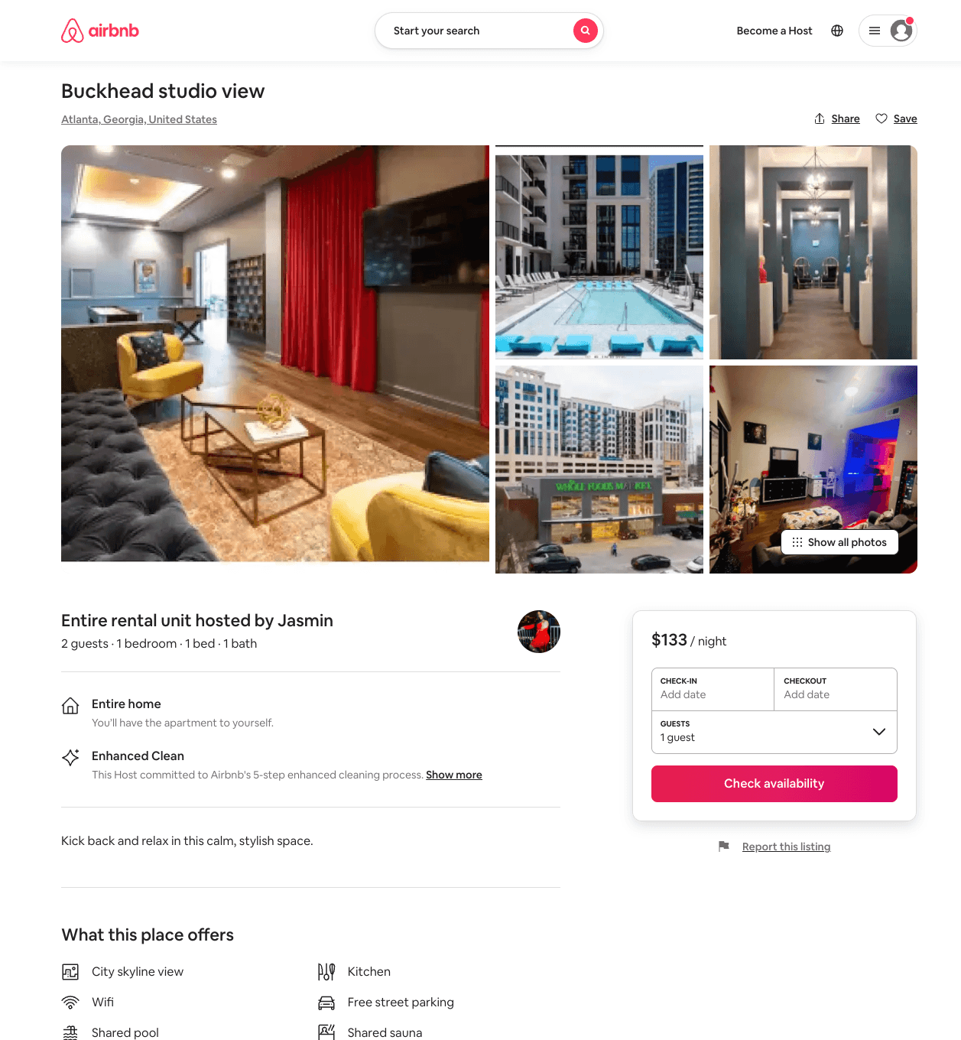
Listing 54167794
1
2
$133 - $200
4.71
1
Jasmin
408222465
2
https://www.airbnb.com/rooms/54167794
Aug 2022

Slide 21
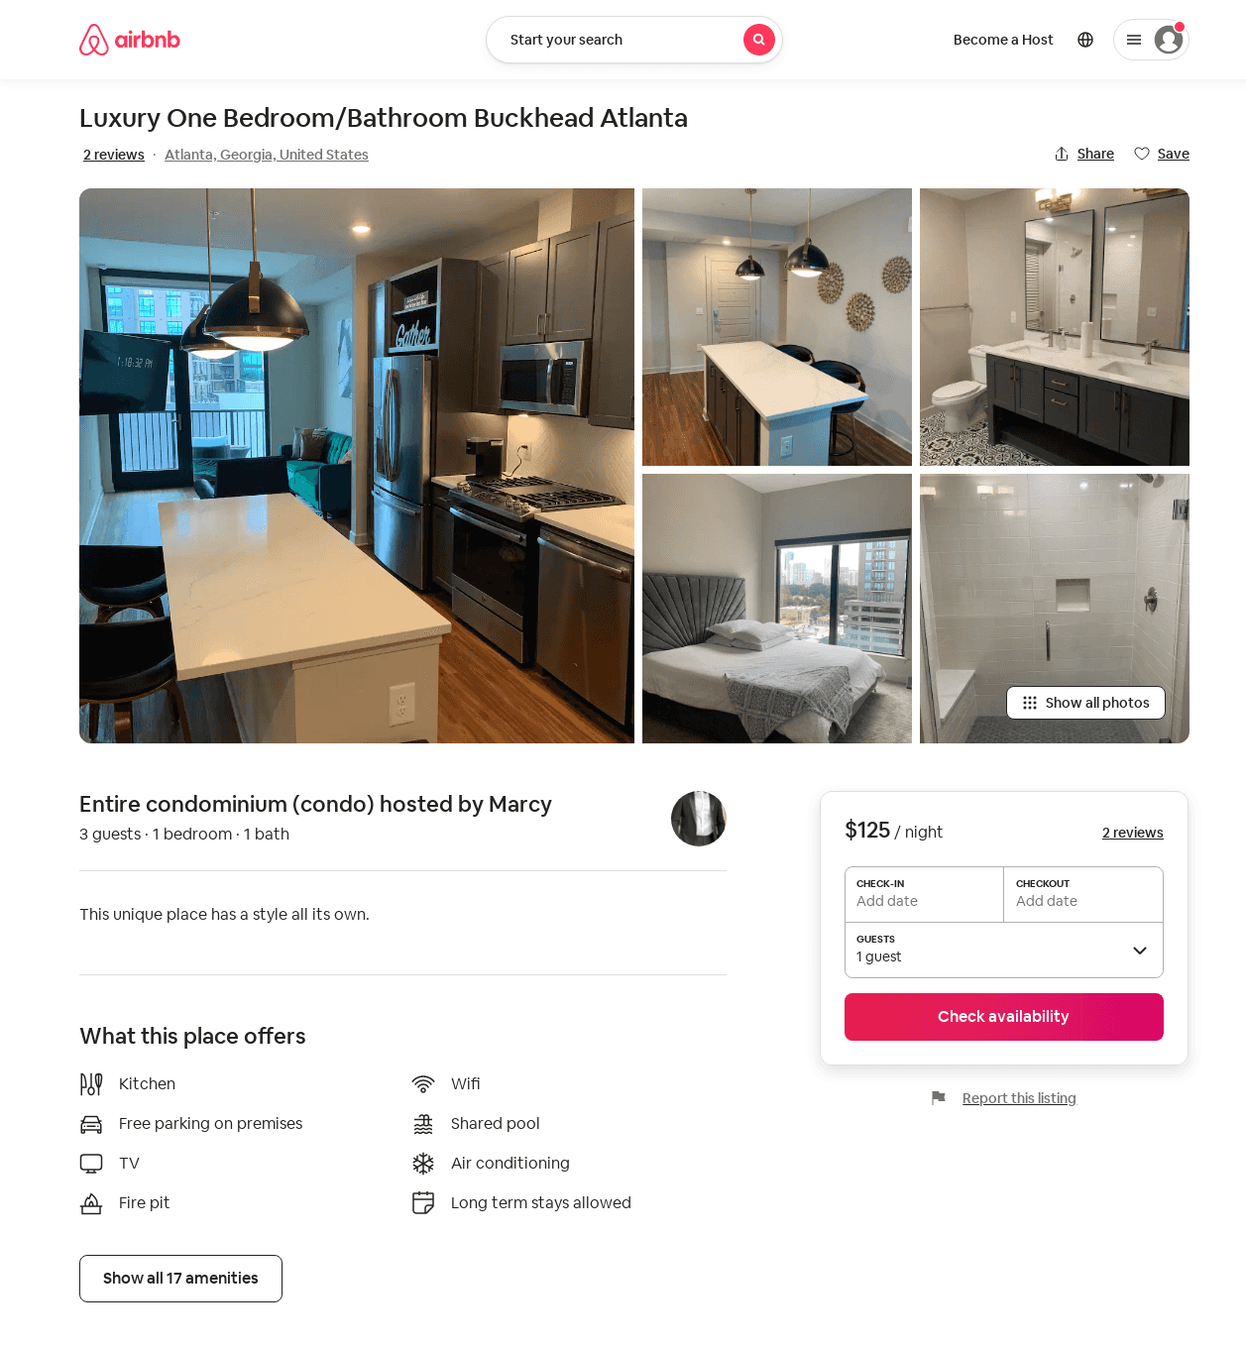
Listing 51062428
1
3
$125 - $175
4.86
2
Marcy
413146989
1
https://www.airbnb.com/rooms/51062428
Jun 2022

Slide 22
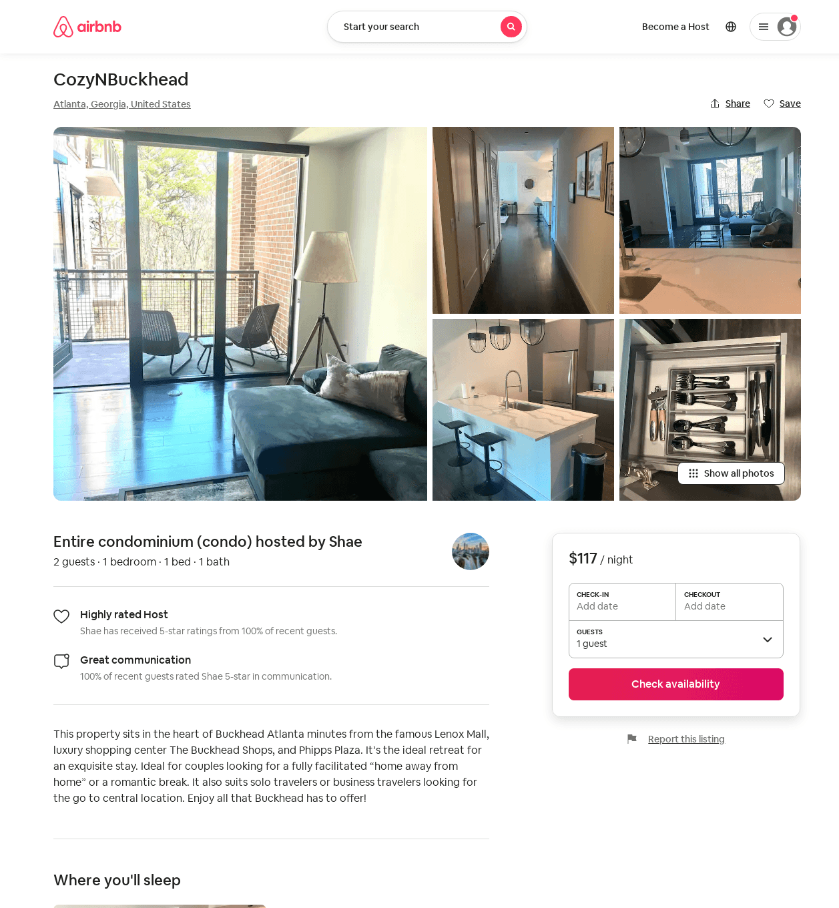
Listing 53593269
1
2
$117 - $137
4.69
1
Shae
434011626
1
https://www.airbnb.com/rooms/53593269
Aug 2022

Slide 23
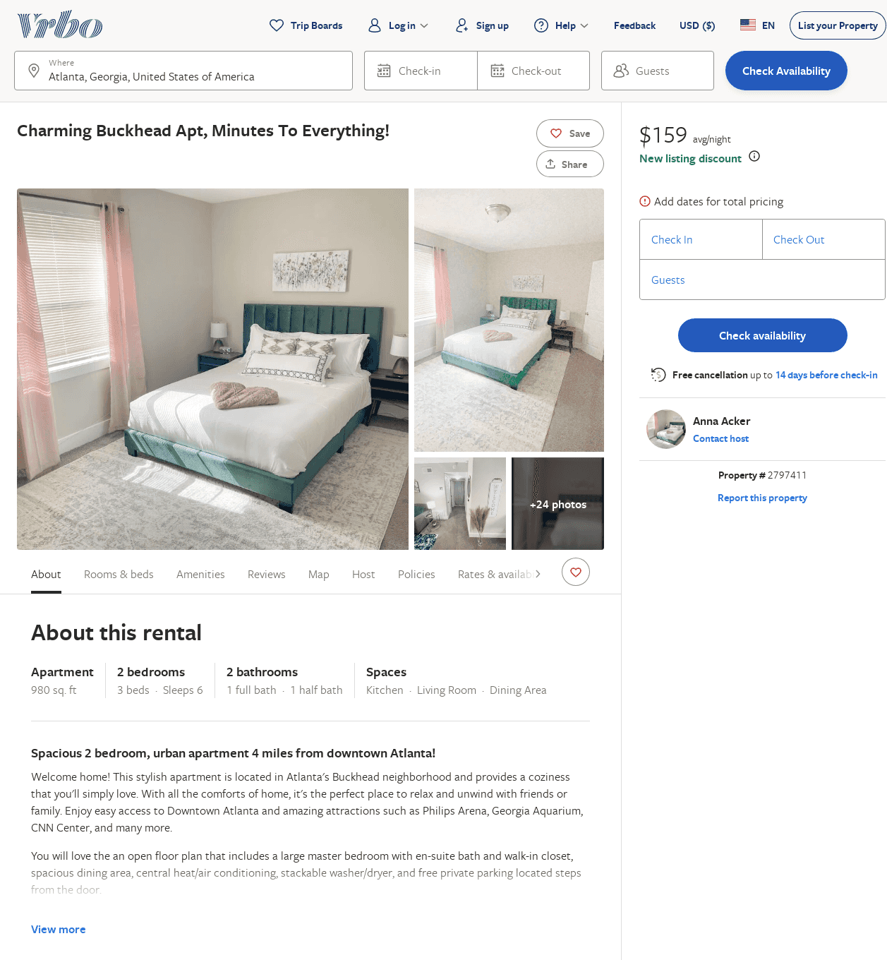
Listing 2797411
2
6
$141
5
2
Anna Acker
https://www.vrbo.com/2797411
Aug 2022

Slide 24
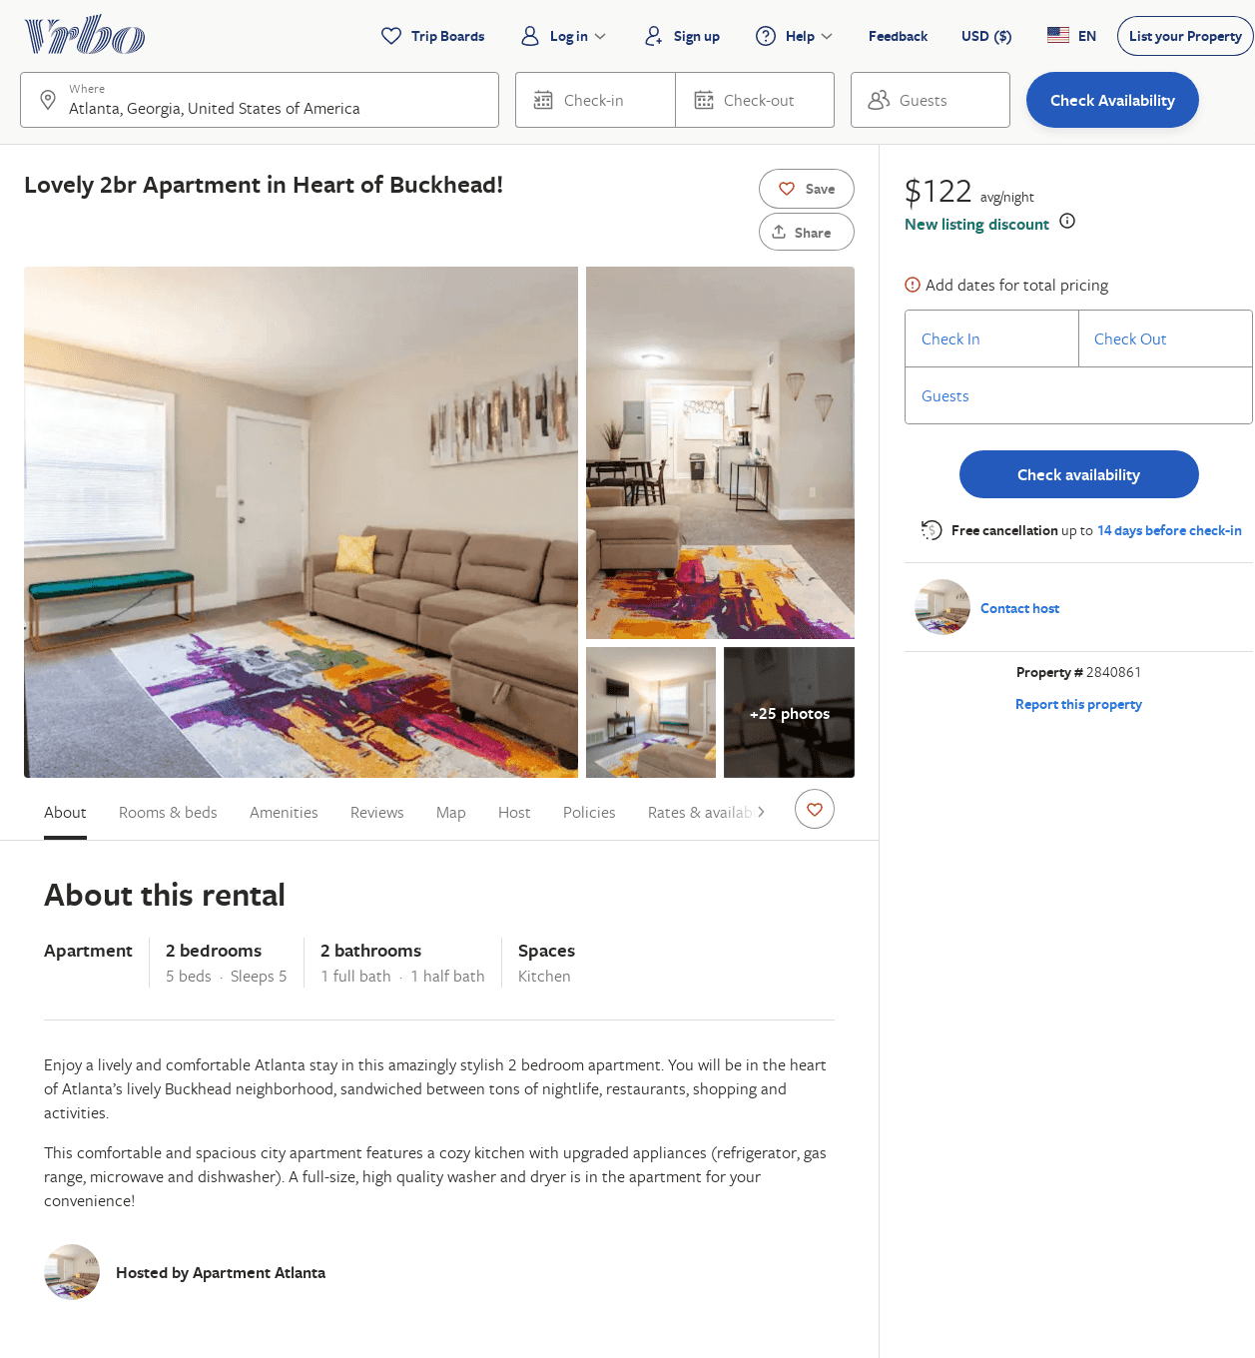
Listing 2840861
2
5
$143
4.5
2
https://www.vrbo.com/2840861
Aug 2022

Slide 25
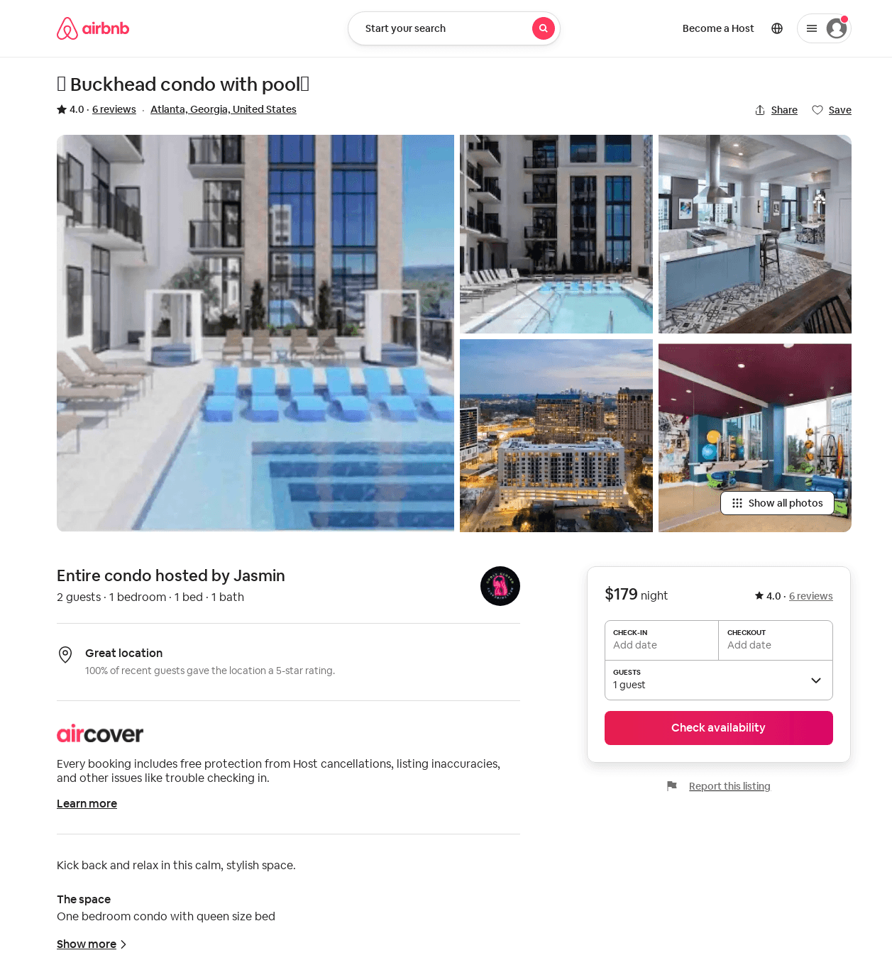
Listing 53383167
1
2
$179
4.0
1
Jasmin
408222465
2
https://www.airbnb.com/rooms/53383167
Jun 2022

Slide 26
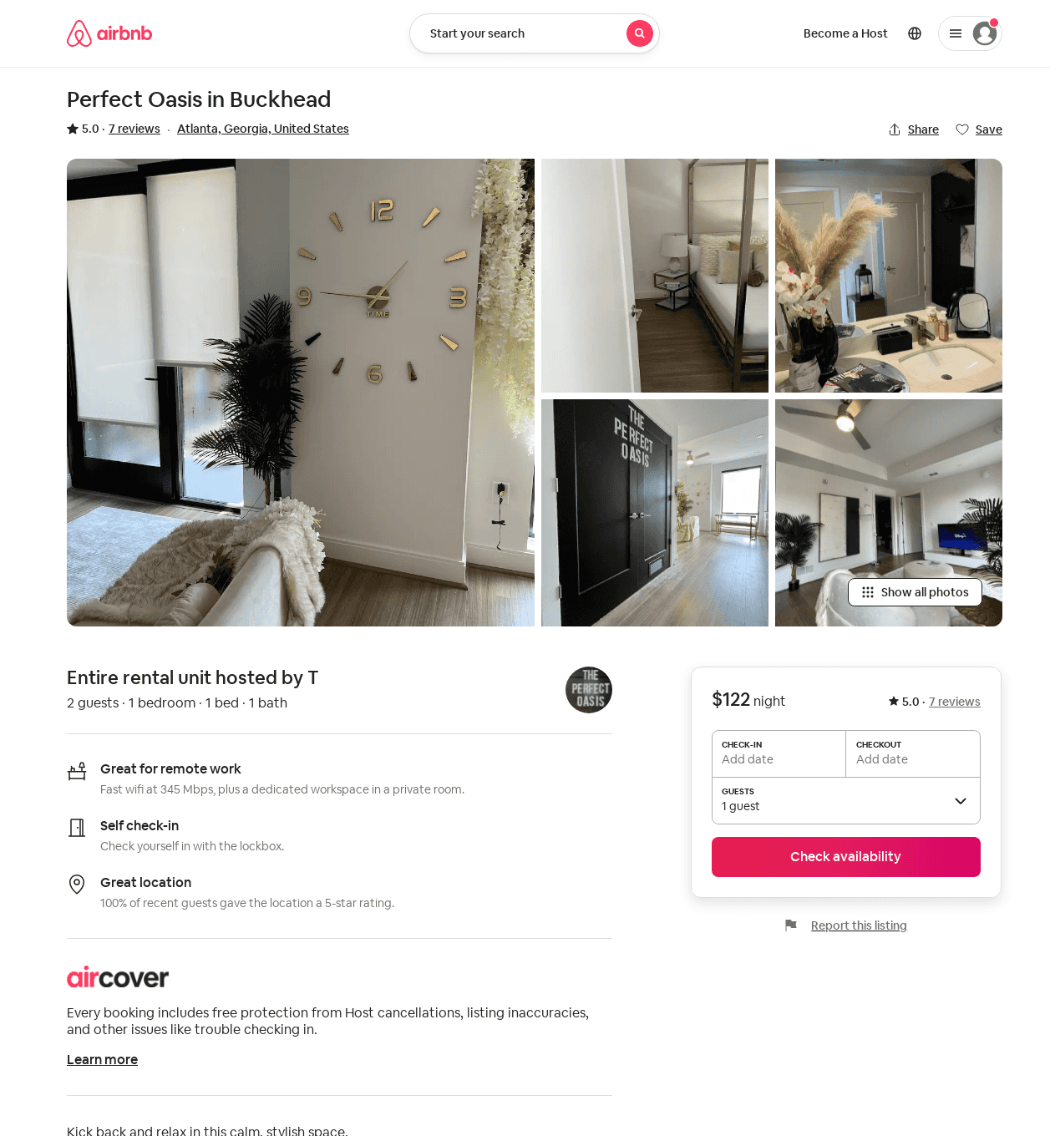
Listing 53421842
1
2
5.0
1
T
417655960
1
https://www.airbnb.com/rooms/53421842
Aug 2022

Slide 27
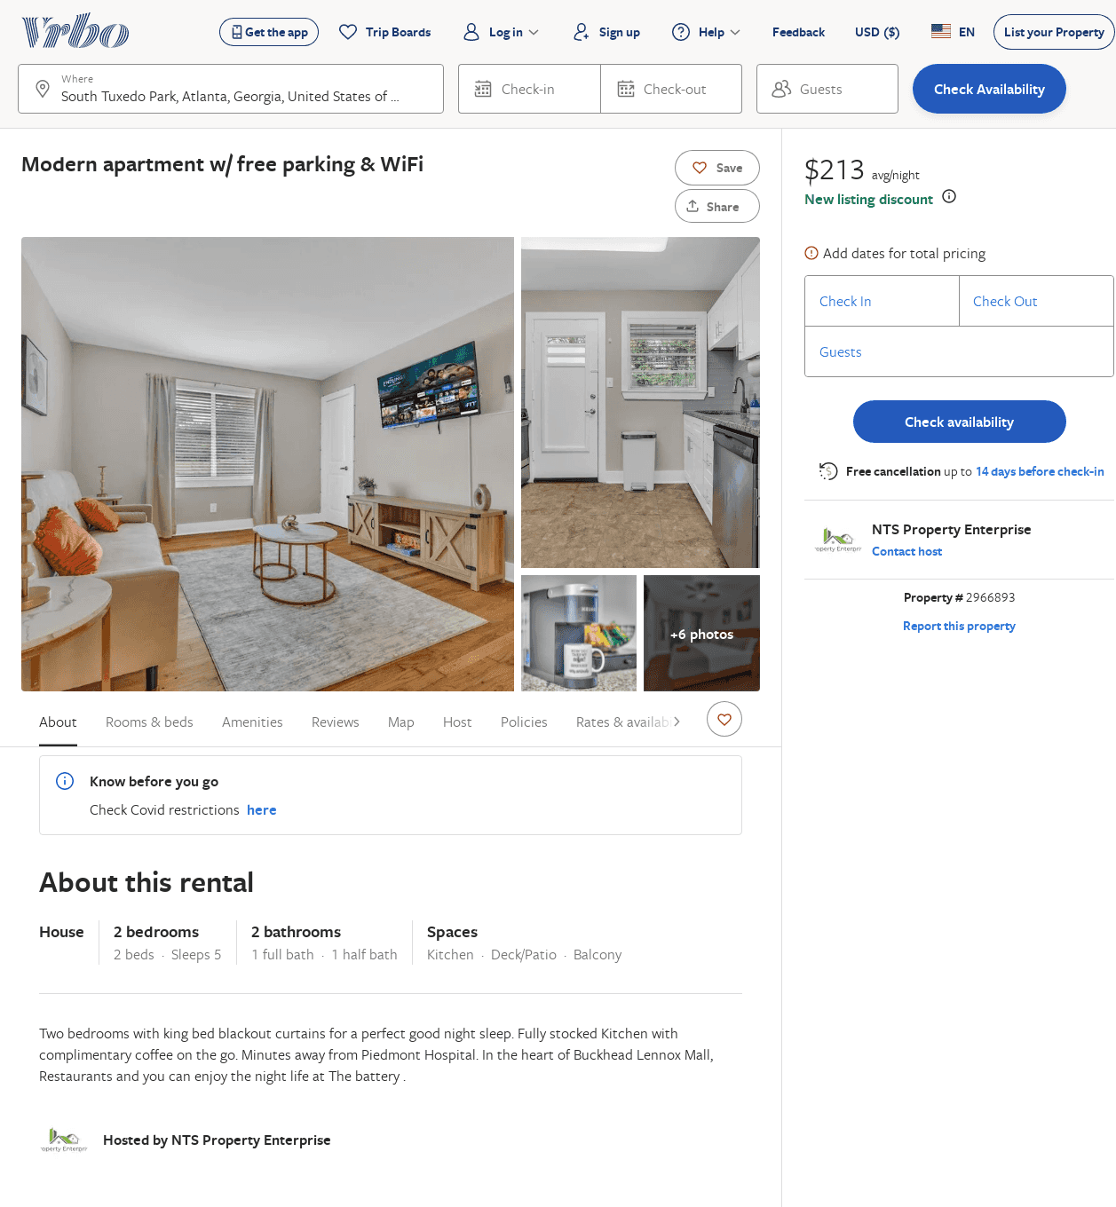
Listing 2966893
2
5
$213
2
NTS Property Enterprise
https://www.vrbo.com/2966893
Aug 2022

