Slide 2
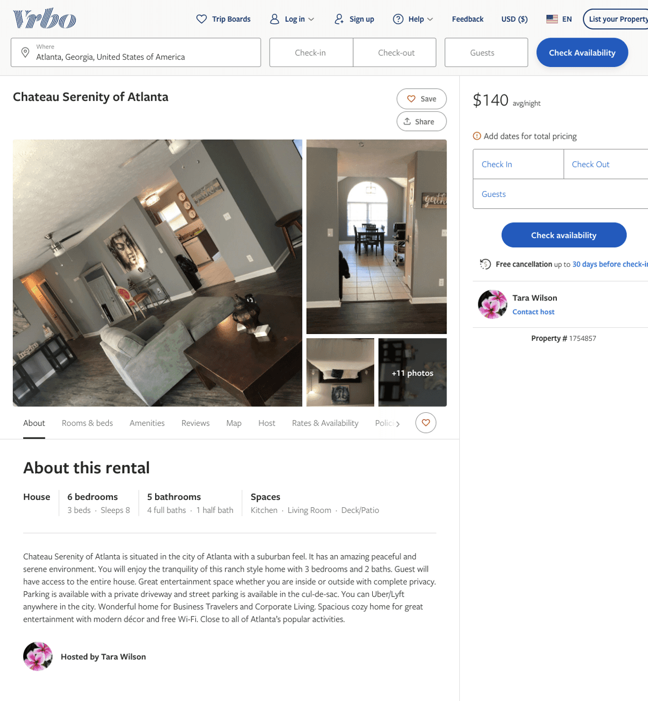
Listing 1754857
3
8
$133 - $140
2
Tara Wilson
https://www.vrbo.com/1754857
Aug 2022

Slide 3
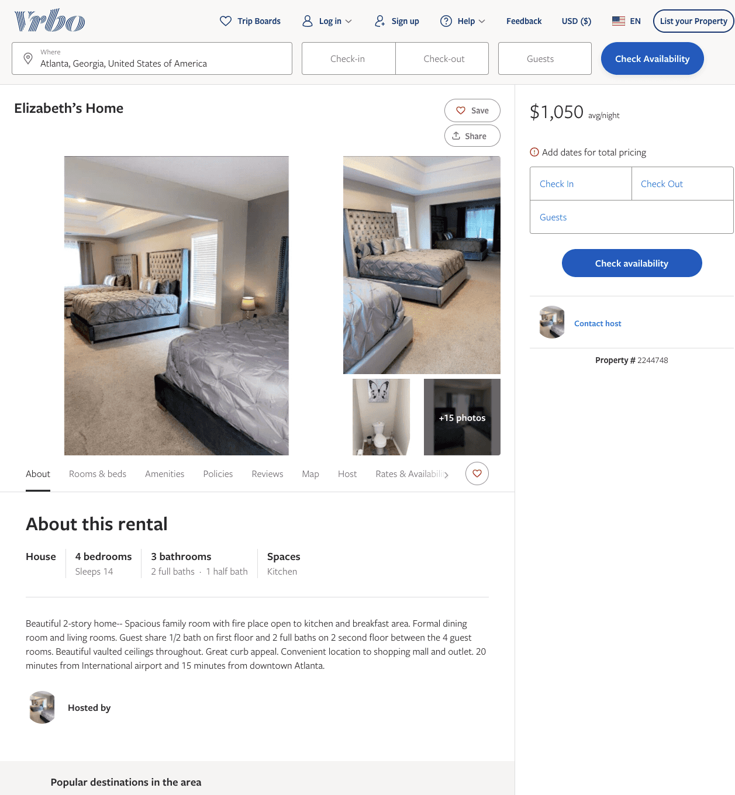
Listing 2244748
4
14
$1,050
1
https://www.vrbo.com/2244748
Aug 2022

Slide 4
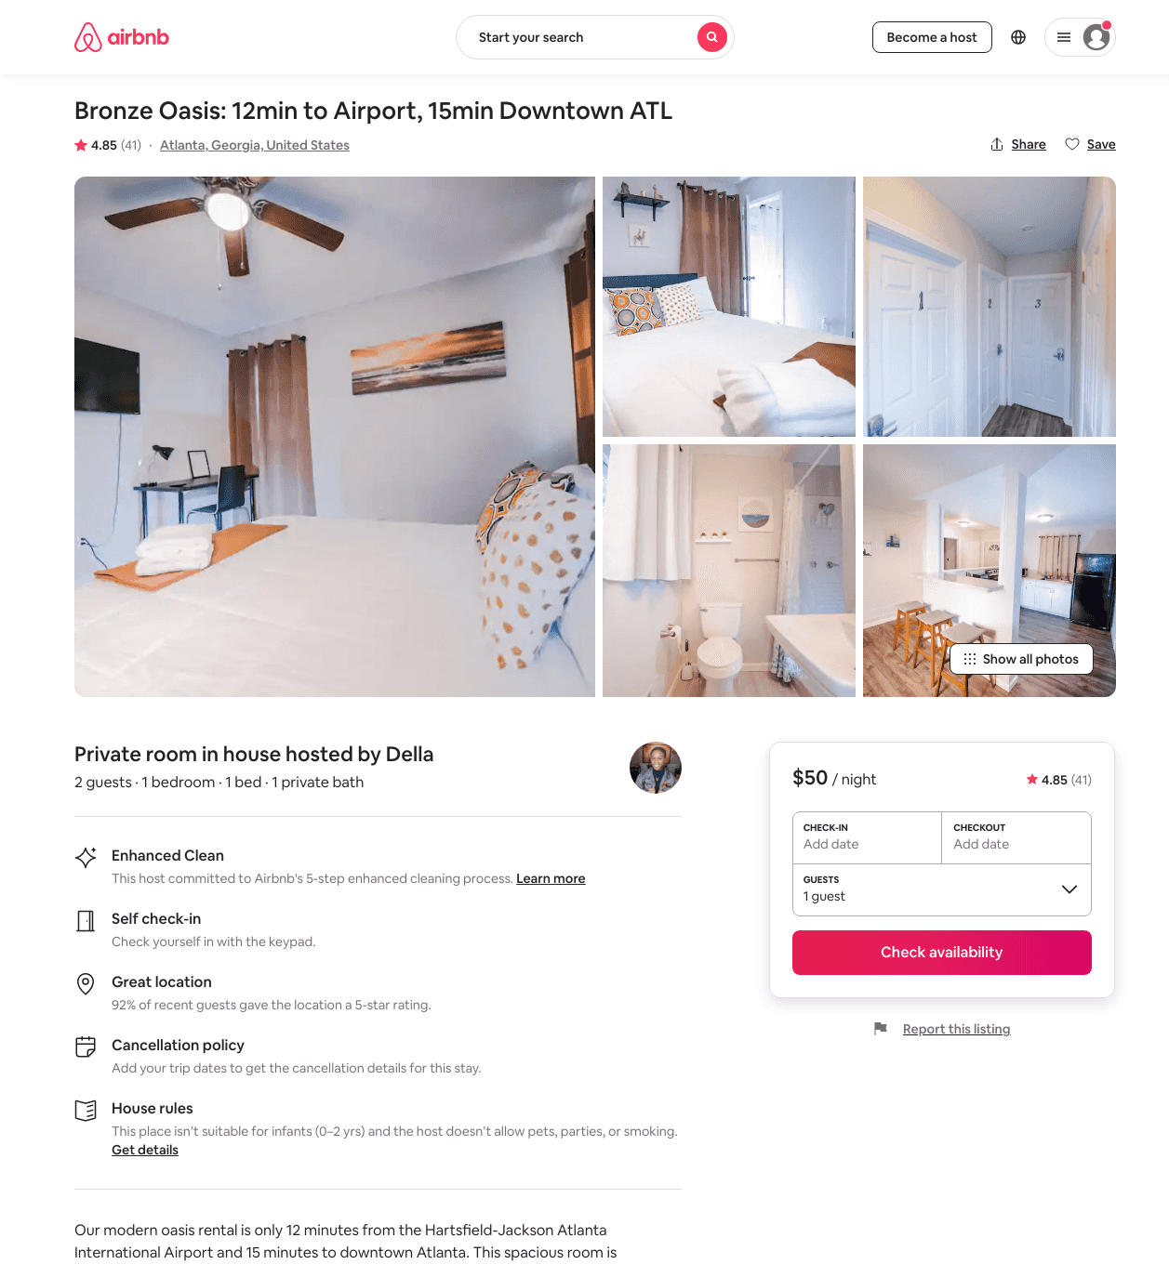
Listing 33657484
1
2
$49 - $61
4.87
4
Della
389503864
6
https://www.airbnb.com/rooms/33657484
Jul 2022

Slide 5
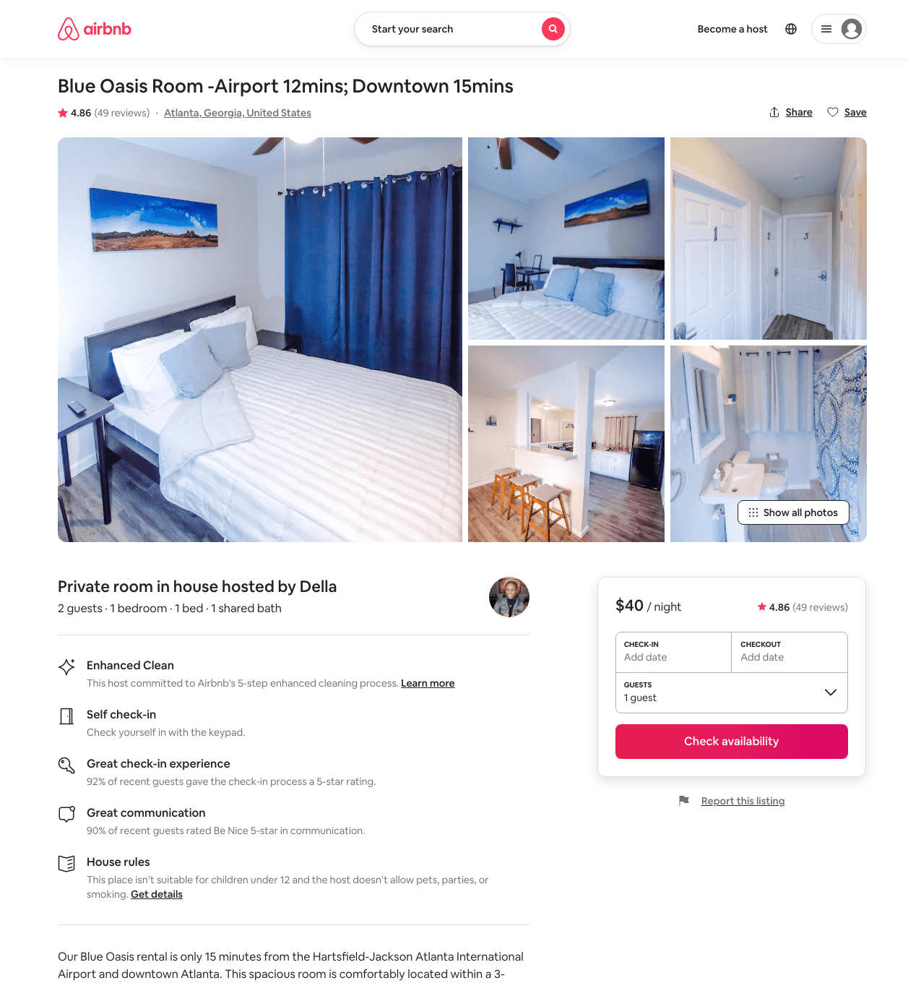
Listing 33659011
1
2
$40 - $63
4.78
4
Della
389503864
6
https://www.airbnb.com/rooms/33659011
Aug 2022

Slide 6
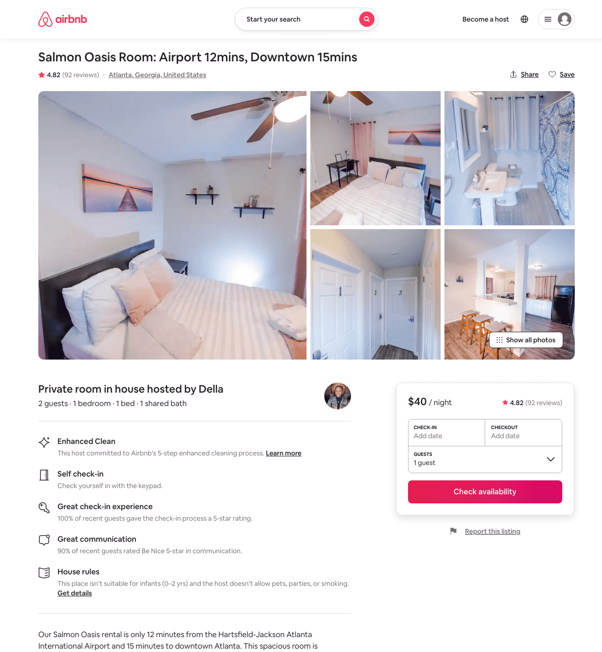
Listing 33659240
1
2
$40 - $56
4.79
4
Della
389503864
6
https://www.airbnb.com/rooms/33659240
Aug 2022

Slide 7
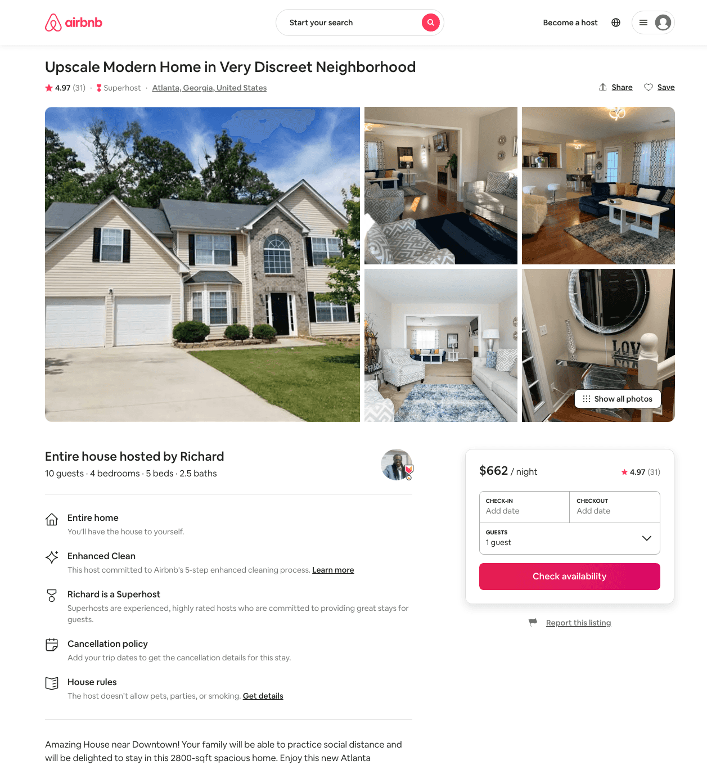
Listing 22027831
4
10
$532 - $685
4.98
2
Richard
147801224
1
https://www.airbnb.com/rooms/22027831
Aug 2022

Slide 8
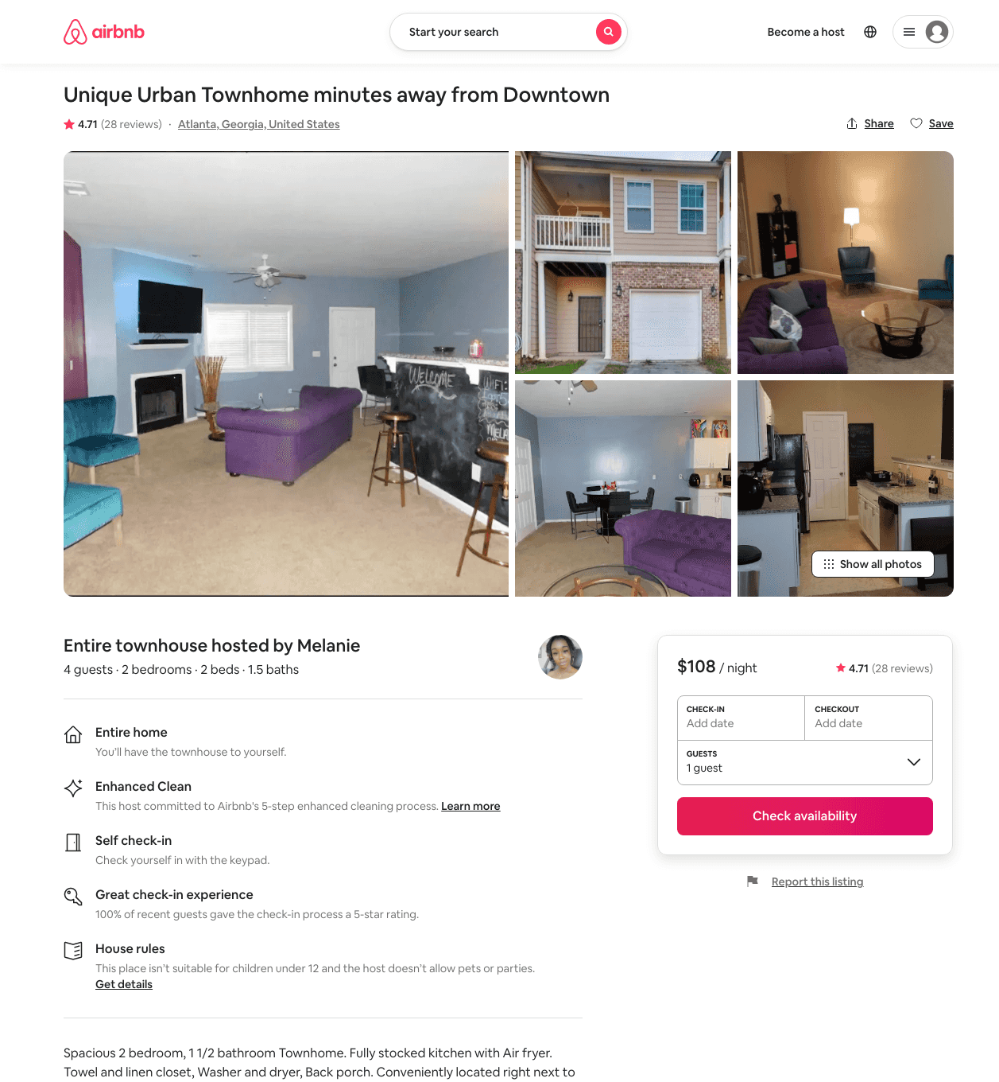
Listing 40391869
2
4
$88 - $225
4.72
2
Melanie
84011069
1
https://www.airbnb.com/rooms/40391869
Aug 2022

Slide 9
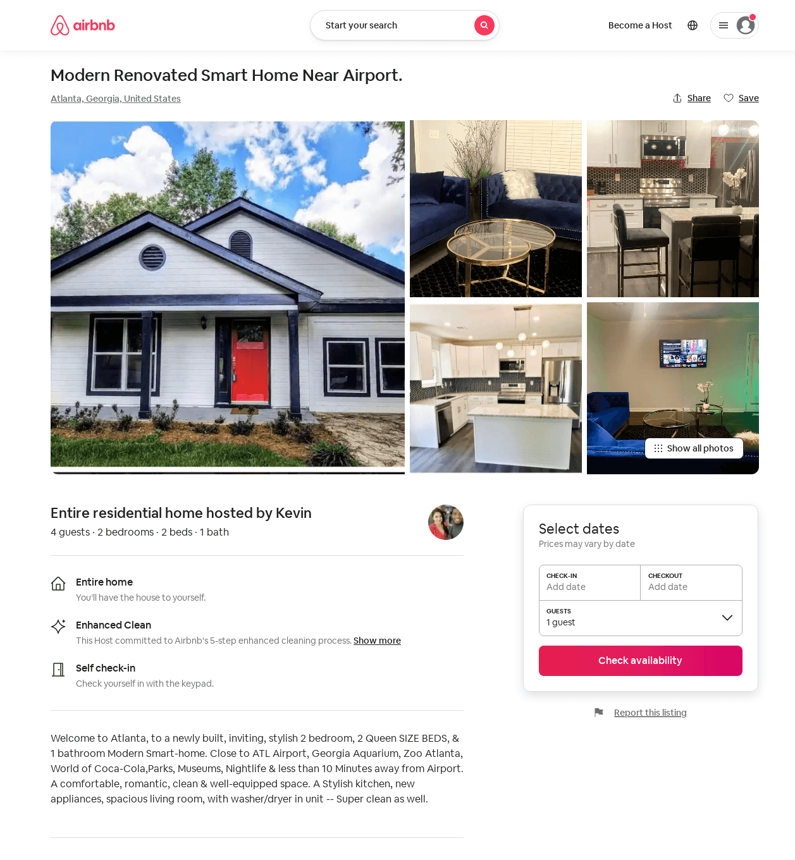
Listing 52518193
2
4
$10 - $194
4.97
3
Kevin
166085830
1
https://www.airbnb.com/rooms/52518193
Aug 2022

Slide 10
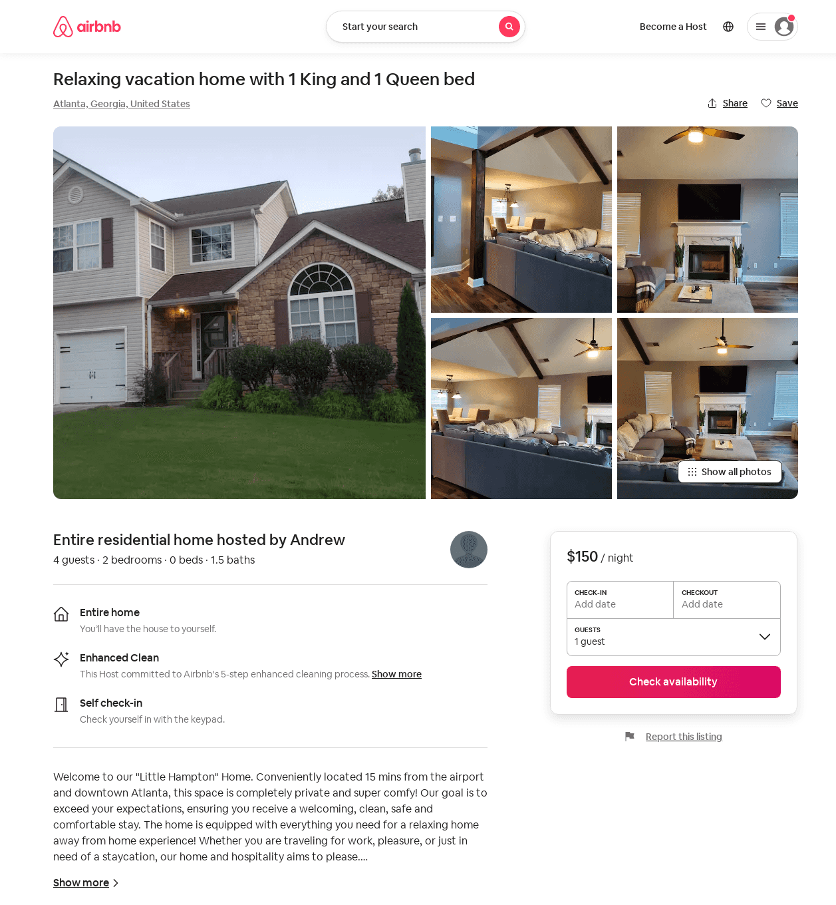
Listing 52795290
2
4
$150 - $195
4.86
2
Andrew
427415412
1
https://www.airbnb.com/rooms/52795290
Aug 2022

Slide 11
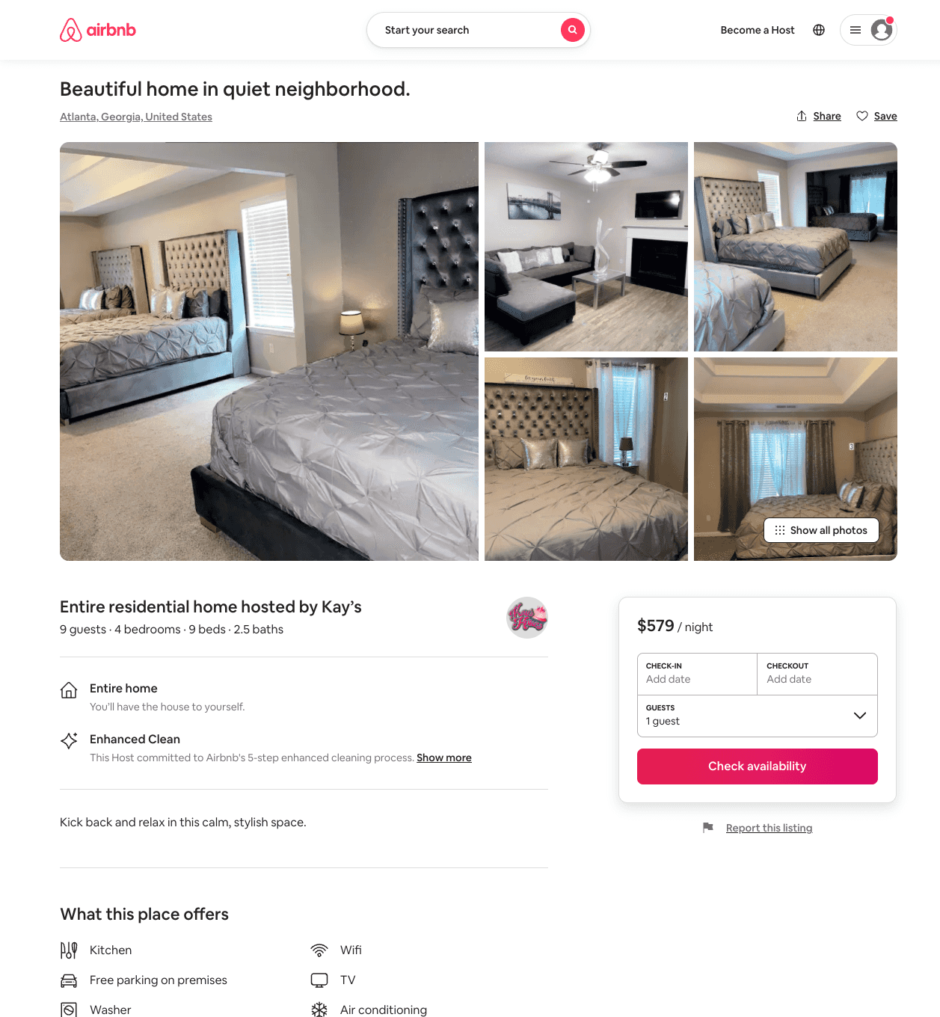
Listing 52985406
4
8
$579 - $865
1
Kay’s
422367194
2
https://www.airbnb.com/rooms/52985406
Aug 2022

Slide 12
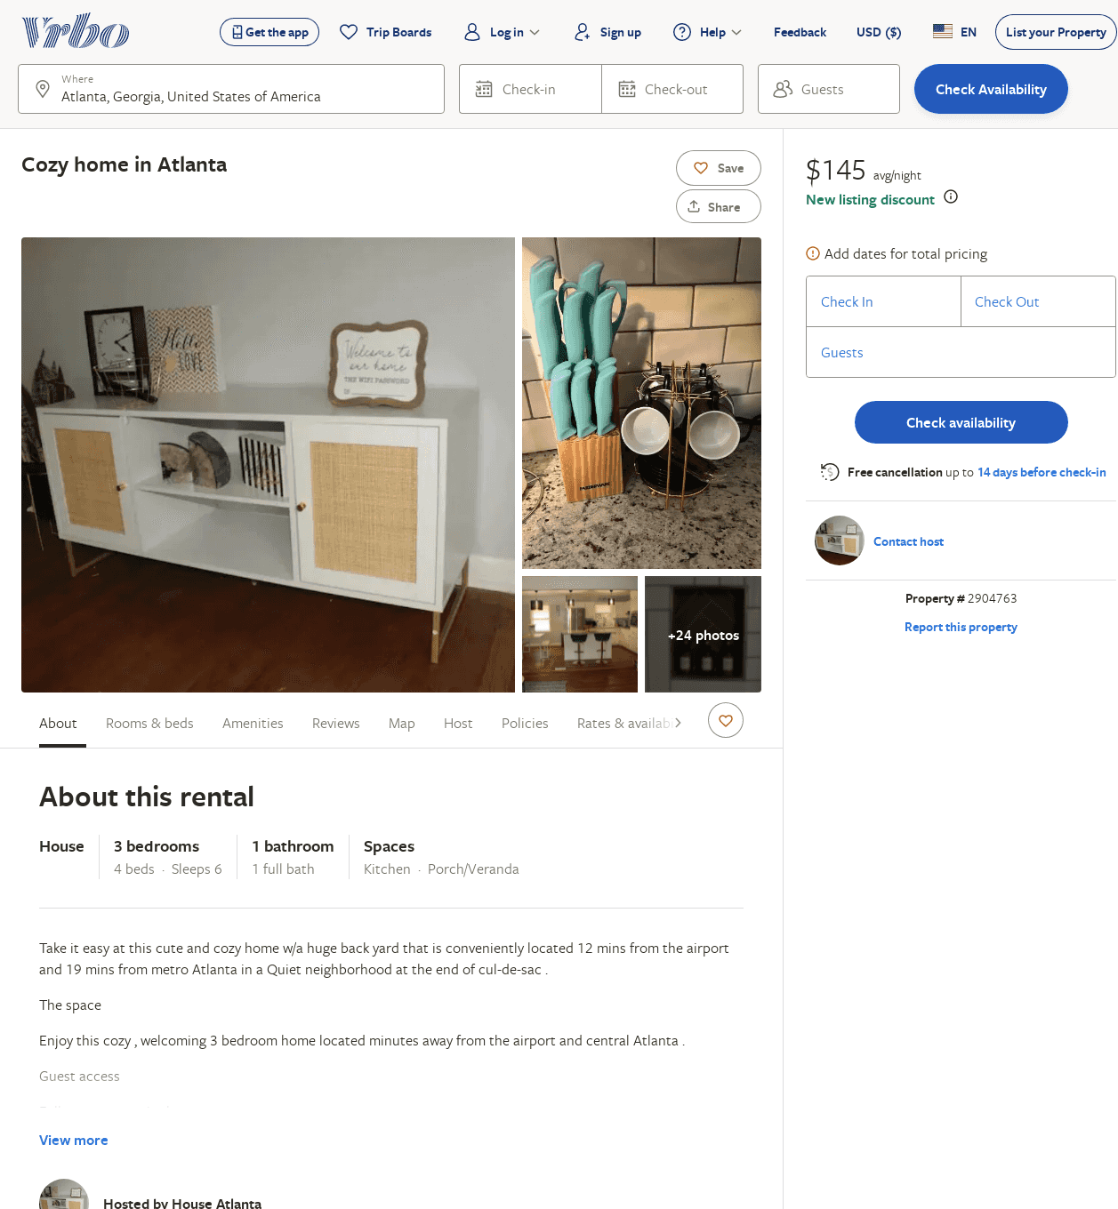
Listing 2904763
3
6
$145
1
https://www.vrbo.com/2904763
Aug 2022

Slide 13
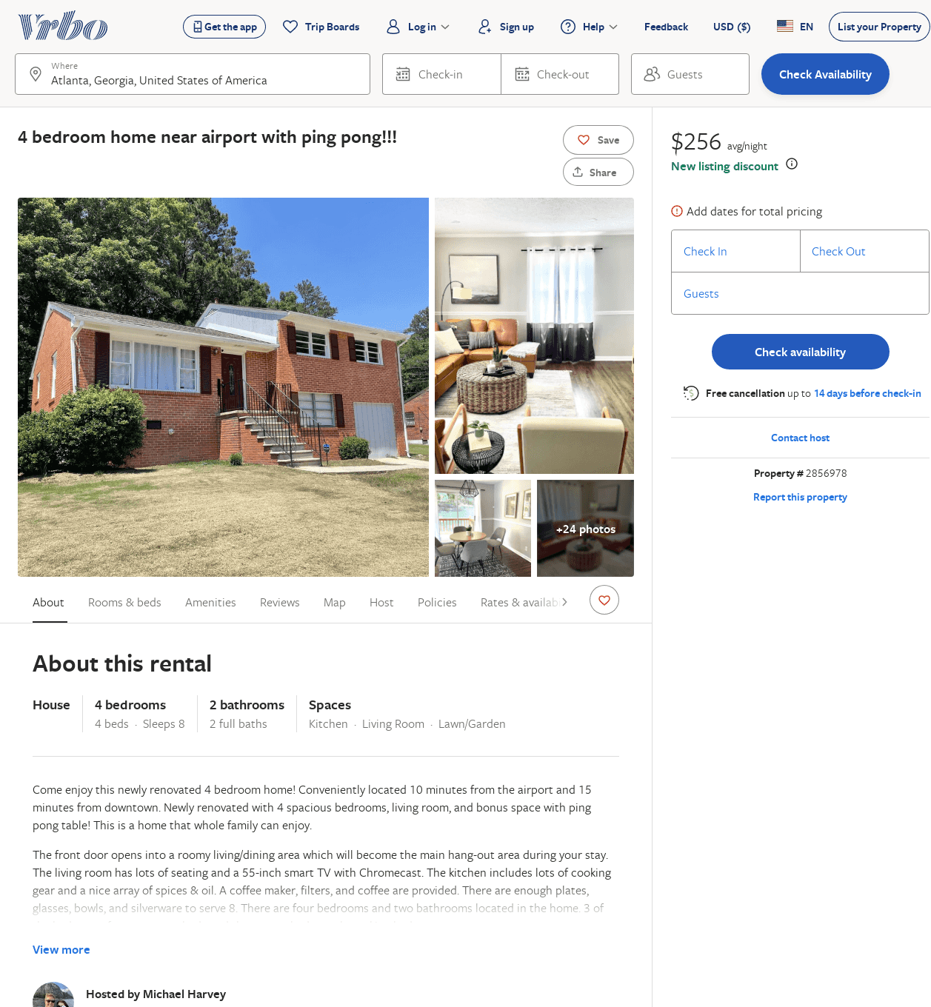
Listing 2856978
4
8
$169
2
Michael Harvey
https://www.vrbo.com/2856978
Aug 2022

Slide 14
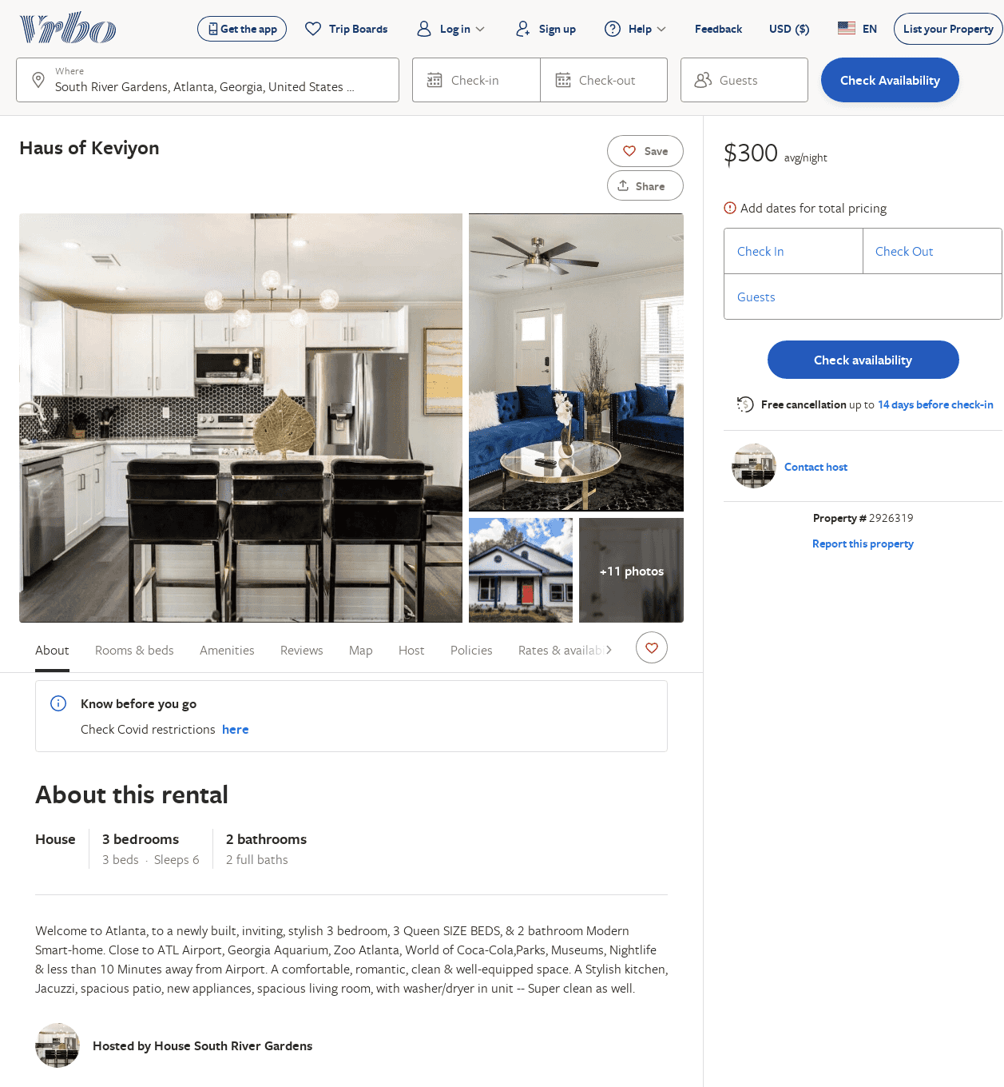
Listing 2926319
3
6
$300
3
https://www.vrbo.com/2926319
Aug 2022

Slide 15
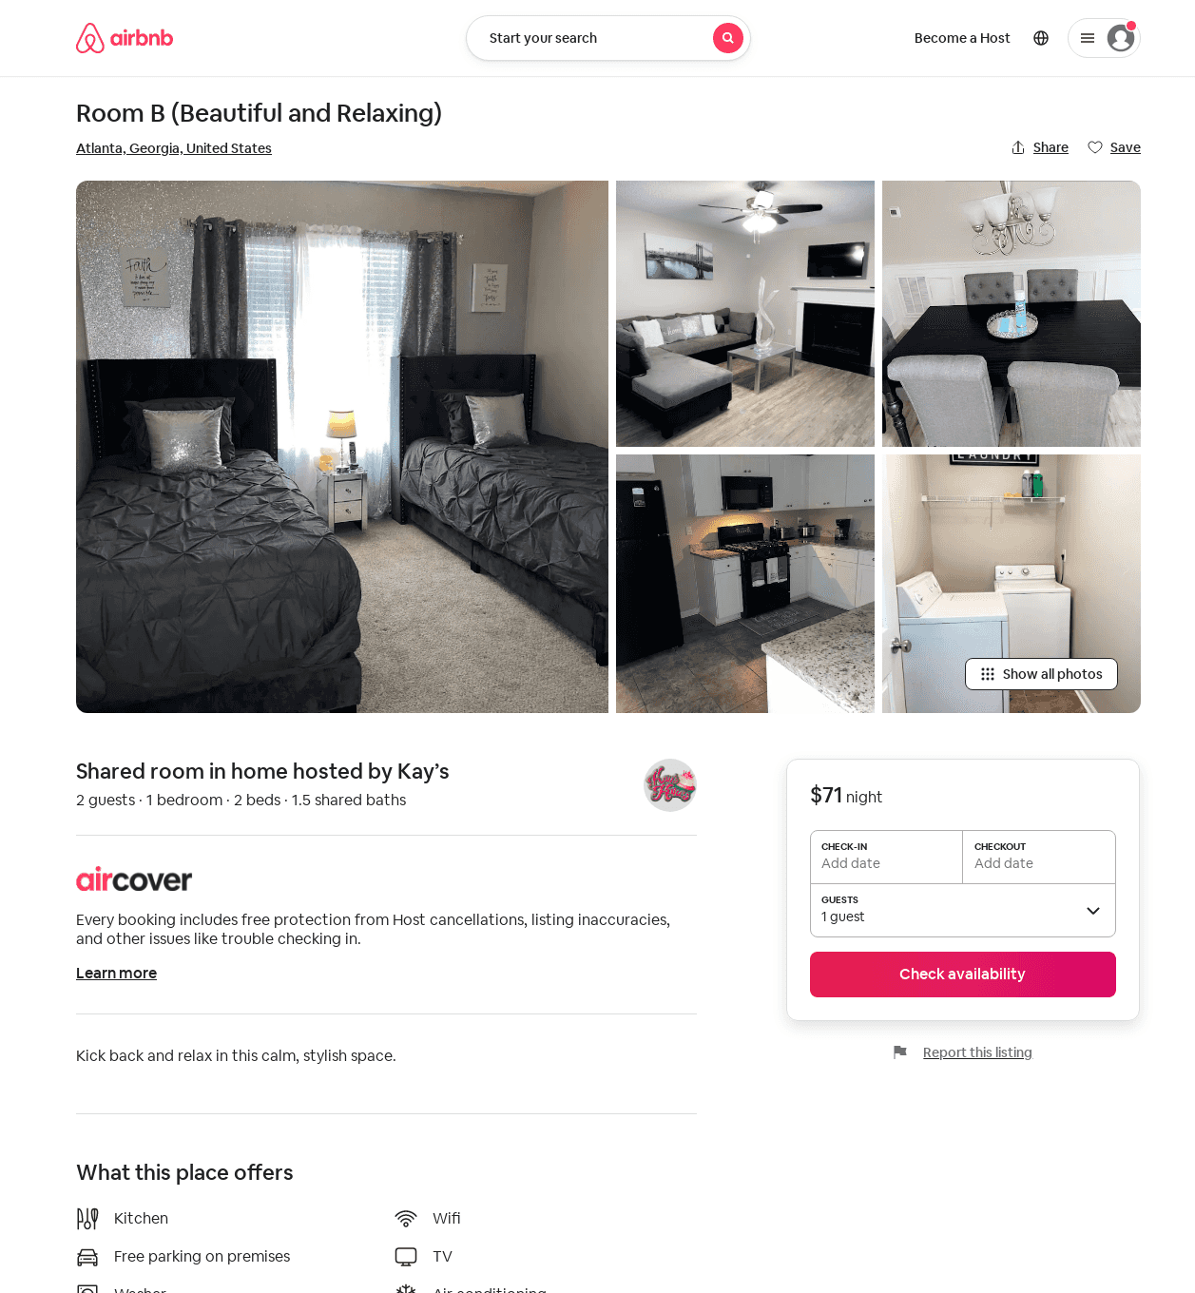
Listing 53210826
1
2
1
Kay’s
422367194
2
https://www.airbnb.com/rooms/53210826
Aug 2022

