Slide 2
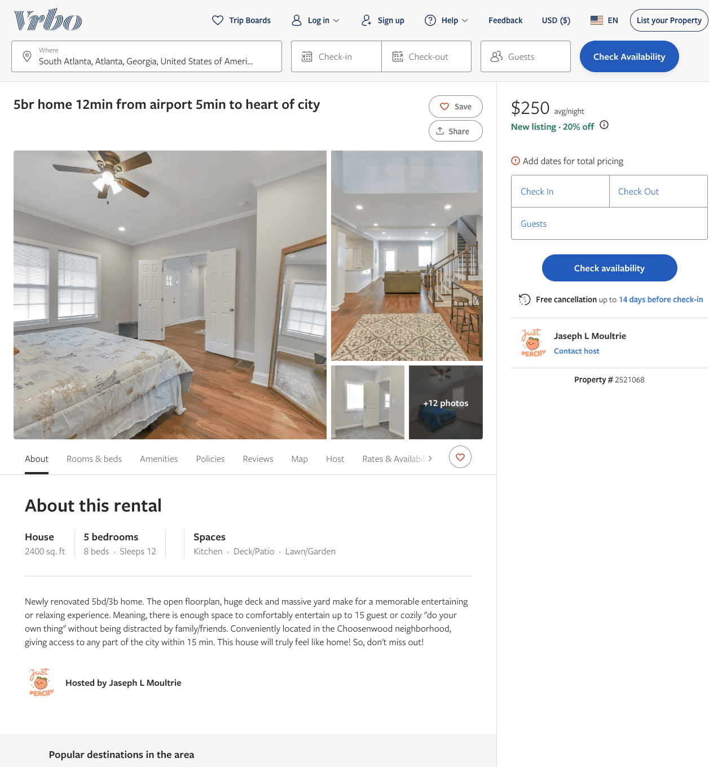
Listing 2521068
5
11
$250 - $295
4.9333334
2
Peach State Homes
https://www.vrbo.com/2521068
Aug 2022

Slide 3
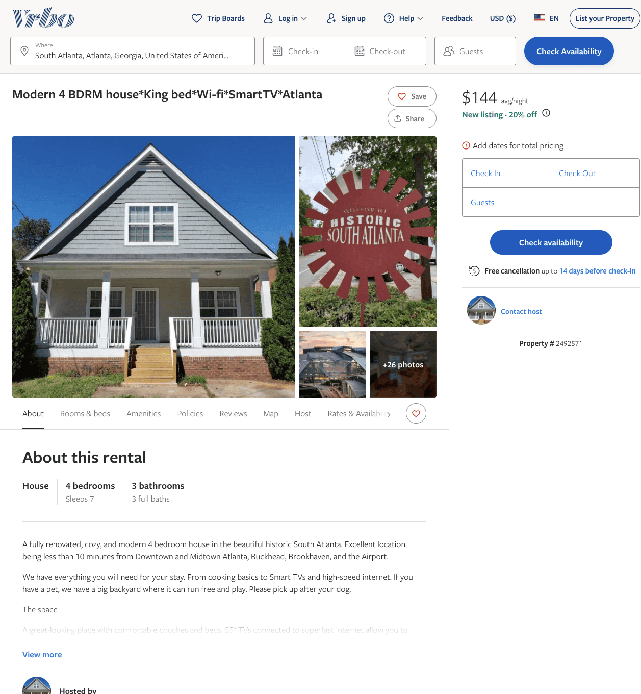
Listing 2492571
4
7
$144 - $211
3.5555556
1
Luiz
https://www.vrbo.com/2492571
Aug 2022

Slide 4
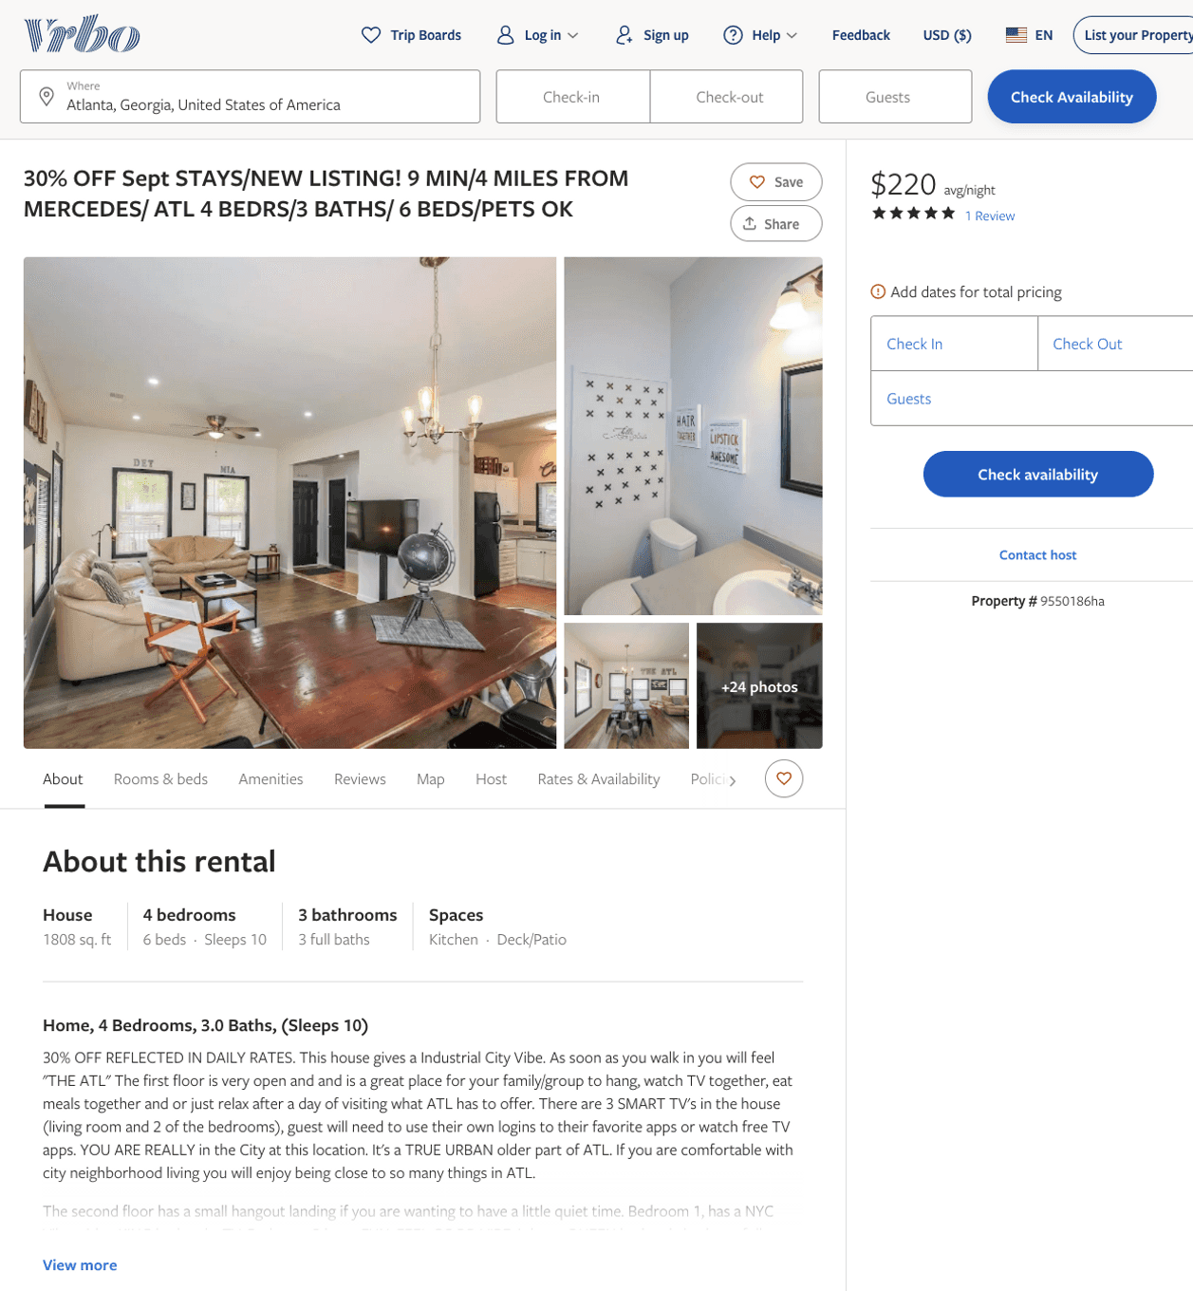
Listing 9550186
4
11
$118 - $283
4.5833335
1
https://www.vrbo.com/9550186ha
Aug 2022

Slide 5
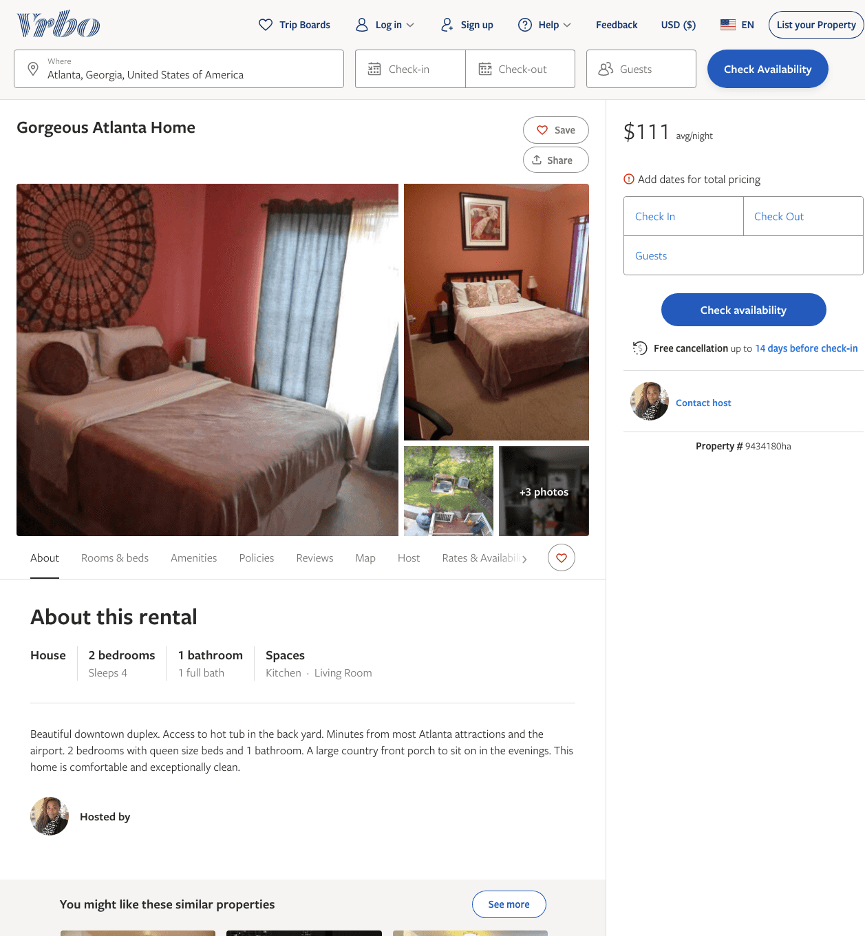
Listing 9434180
2
4
$111 - $73
30
https://www.vrbo.com/9434180ha
Aug 2022

Slide 6
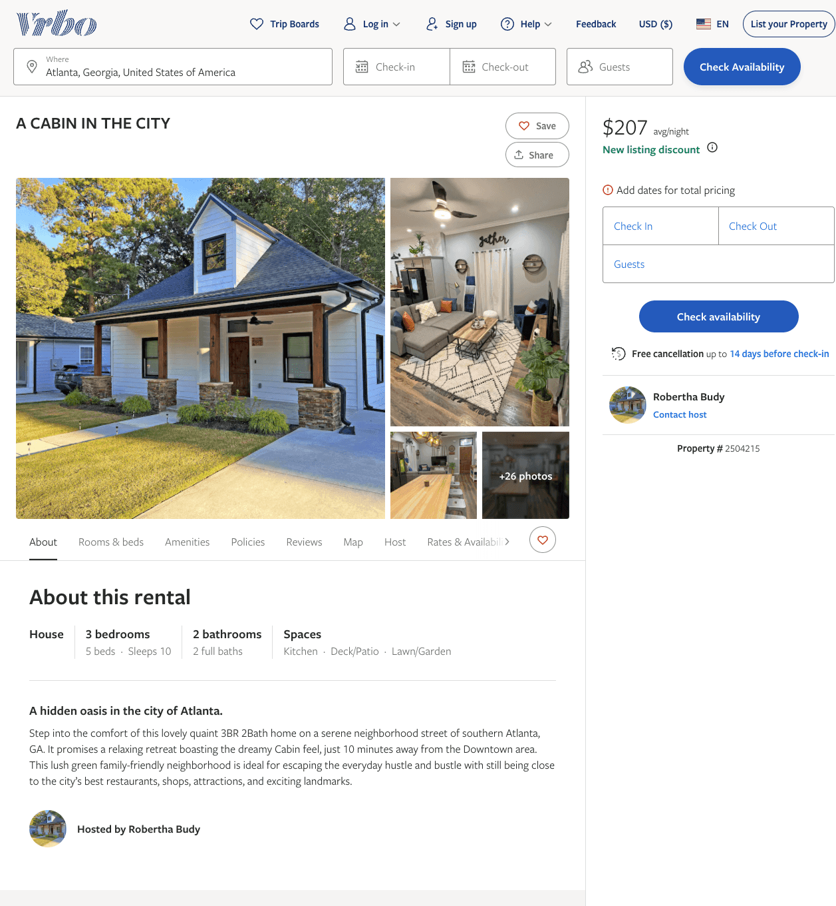
Listing 2504215
3
10
$207 - $354
5
2
Robertha Budy
https://www.vrbo.com/2504215
Aug 2022

Slide 7
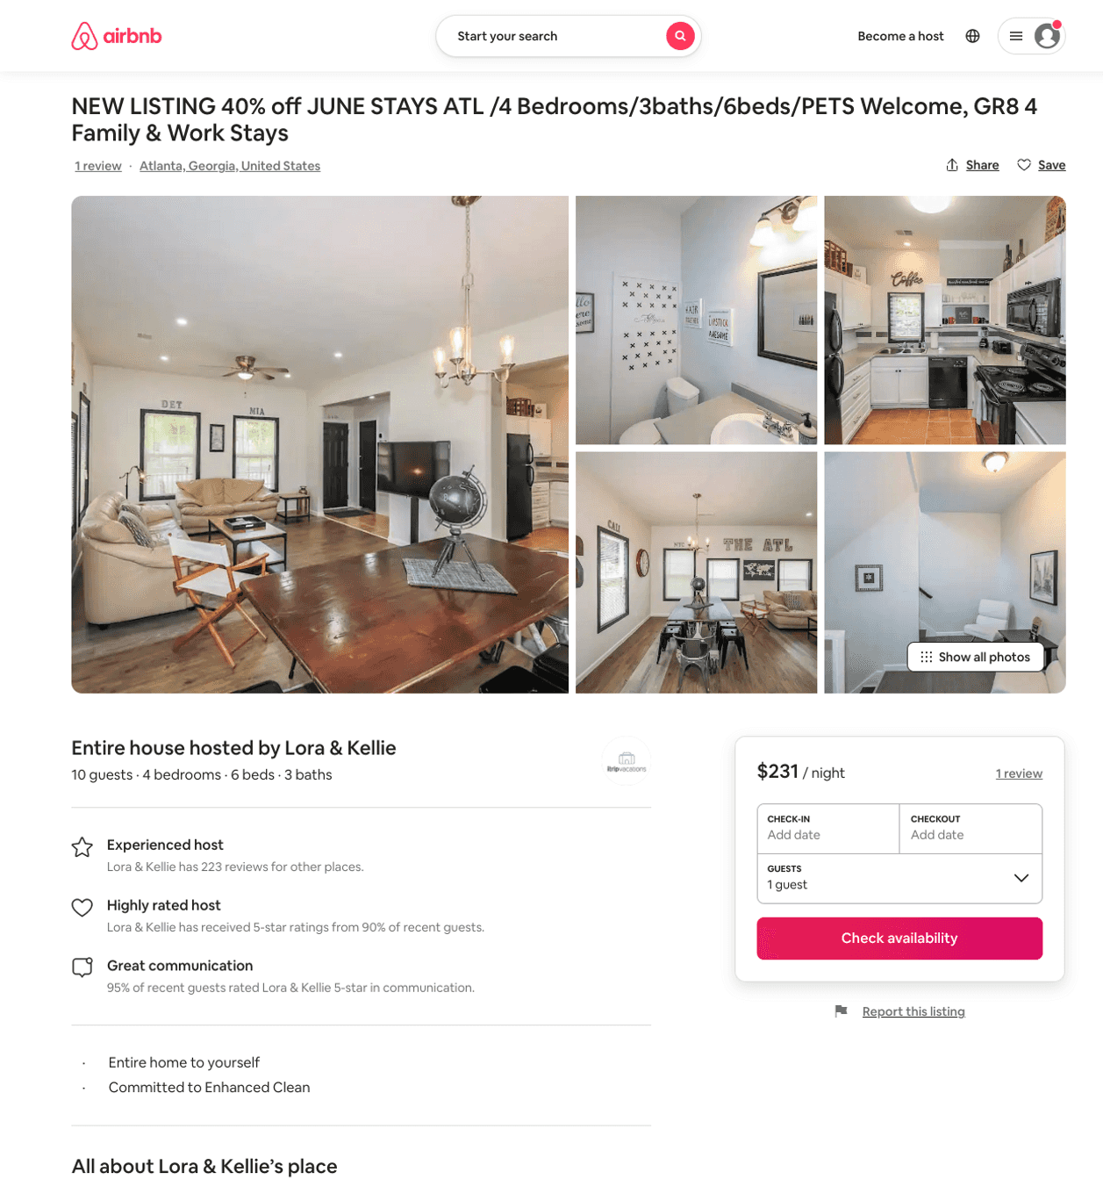
Listing 49997031
4
8
$176 - $489
4.75
2
Blitz Girlz
305467402
16
https://www.airbnb.com/rooms/49997031
Jun 2022

Slide 8
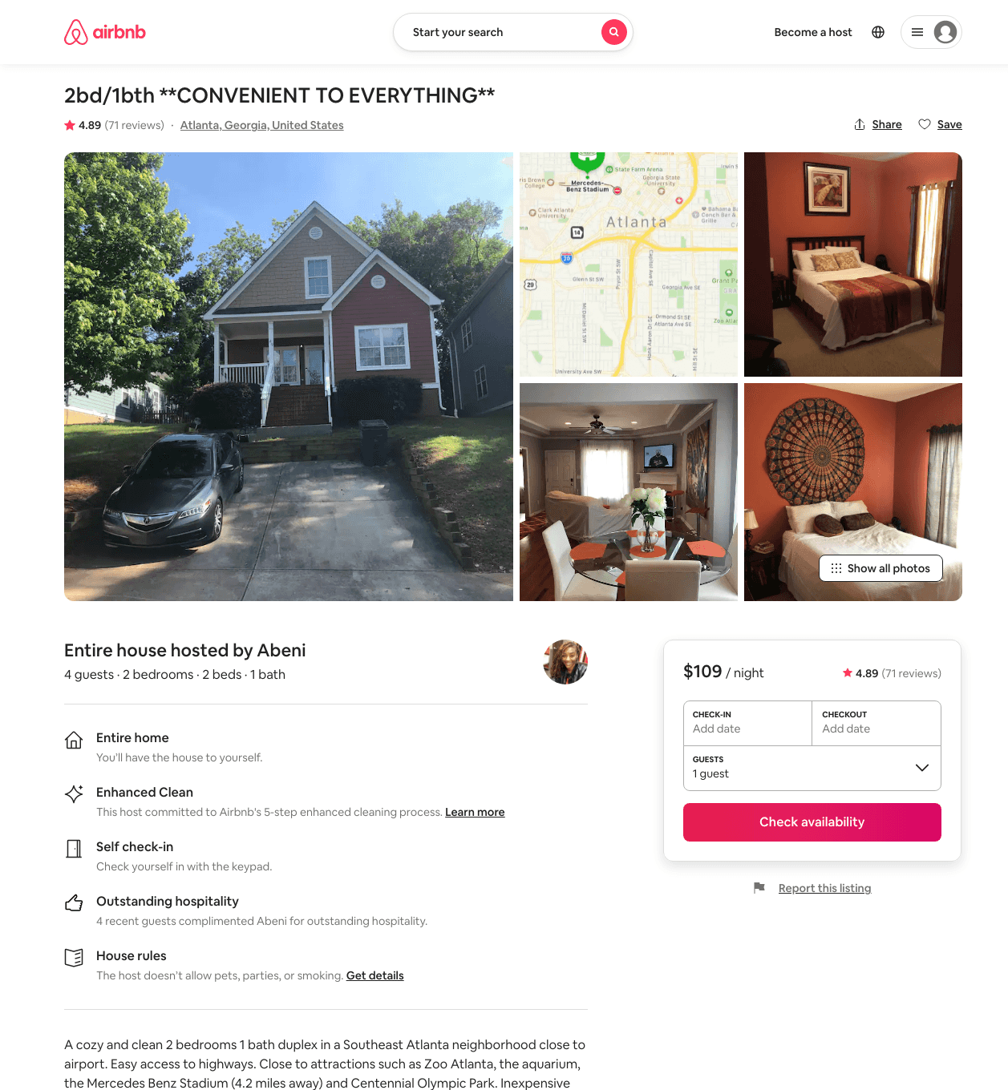
Listing 15494030
2
3
$79 - $110
4.88
21
Abeni
22629881
2
https://www.airbnb.com/rooms/15494030
Aug 2022

Slide 9
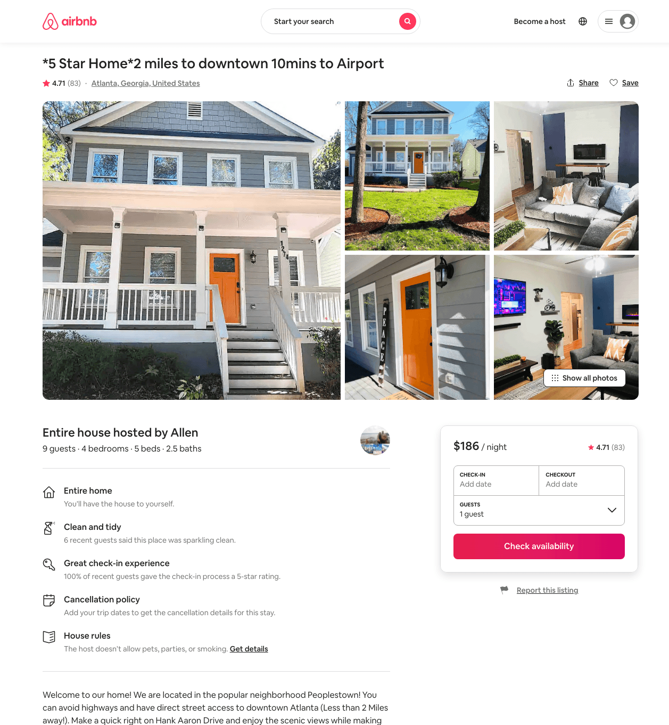
Listing 39419022
4
9
$175 - $229
4.65
2
Allen
120399001
1
https://www.airbnb.com/rooms/39419022
Aug 2022

Slide 10
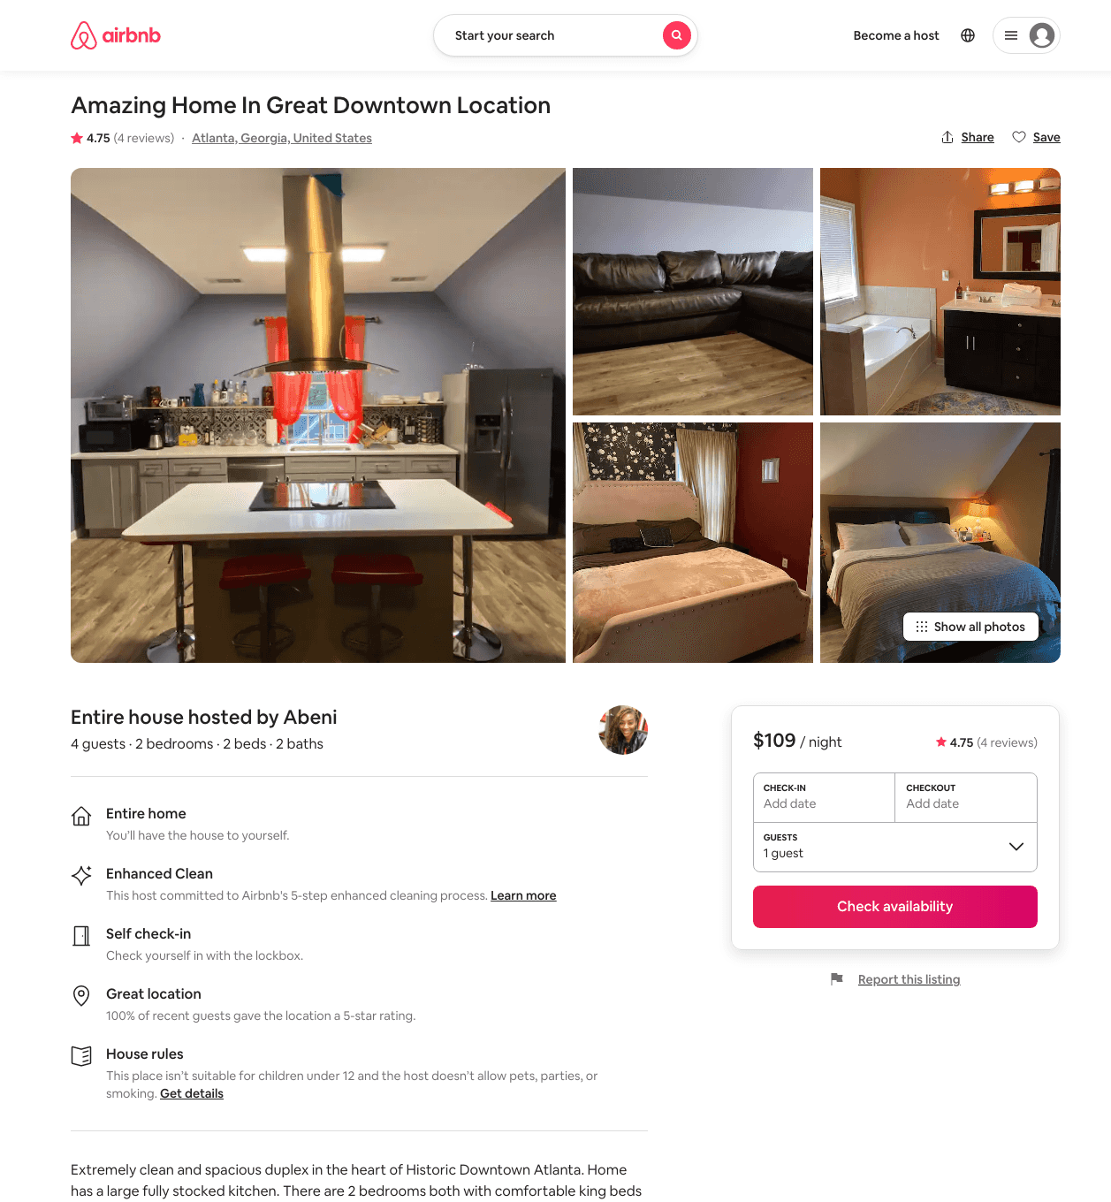
Listing 44380588
2
4
$79 - $122
4.86
28
Abeni
22629881
2
https://www.airbnb.com/rooms/44380588
Aug 2022

Slide 11
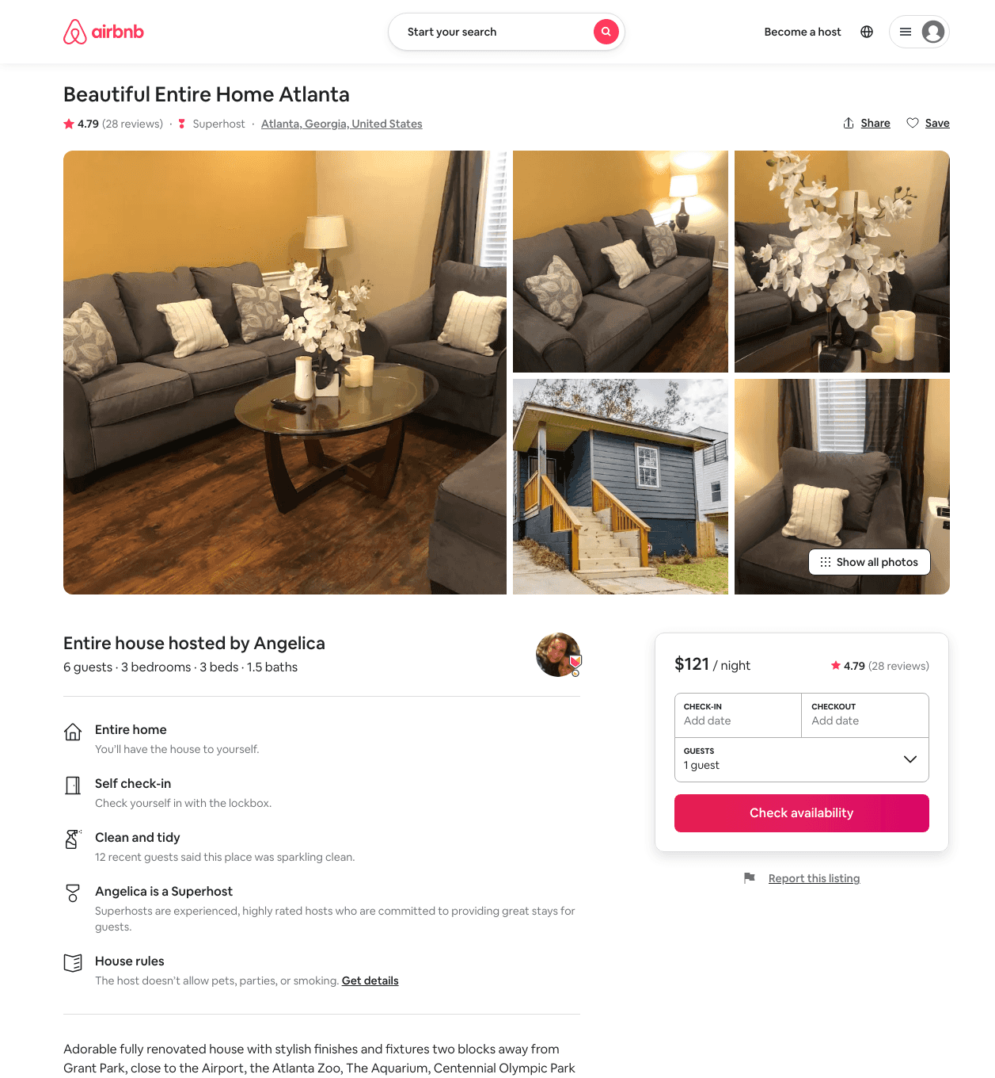
Listing 25965055
3
6
$110 - $139
4.72
3
Angelica
106948374
2
https://www.airbnb.com/rooms/25965055
Aug 2022

Slide 12
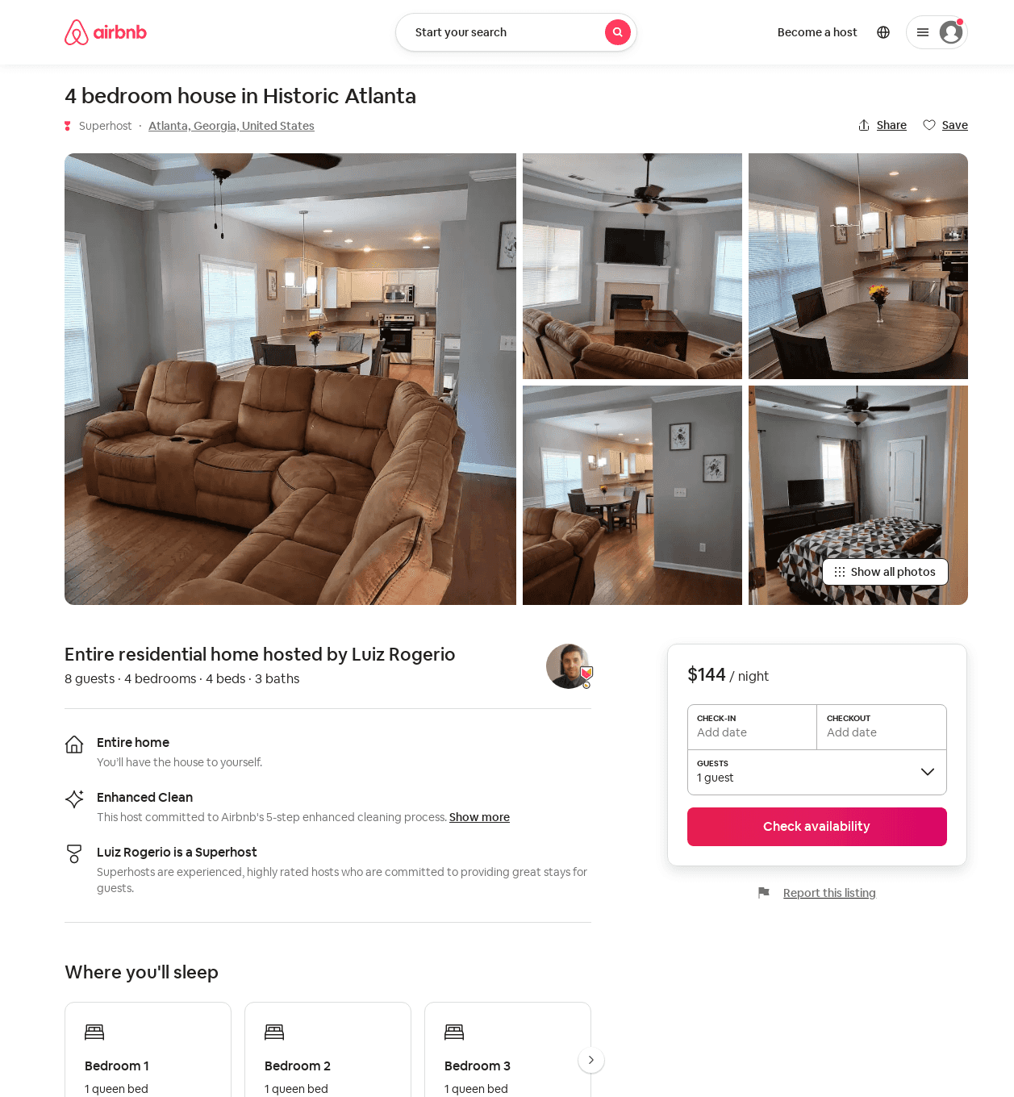
Listing 52225204
4
8
$124 - $476
4.59
2
Luiz Rogerio
149700196
2
https://www.airbnb.com/rooms/52225204
Aug 2022

Slide 13
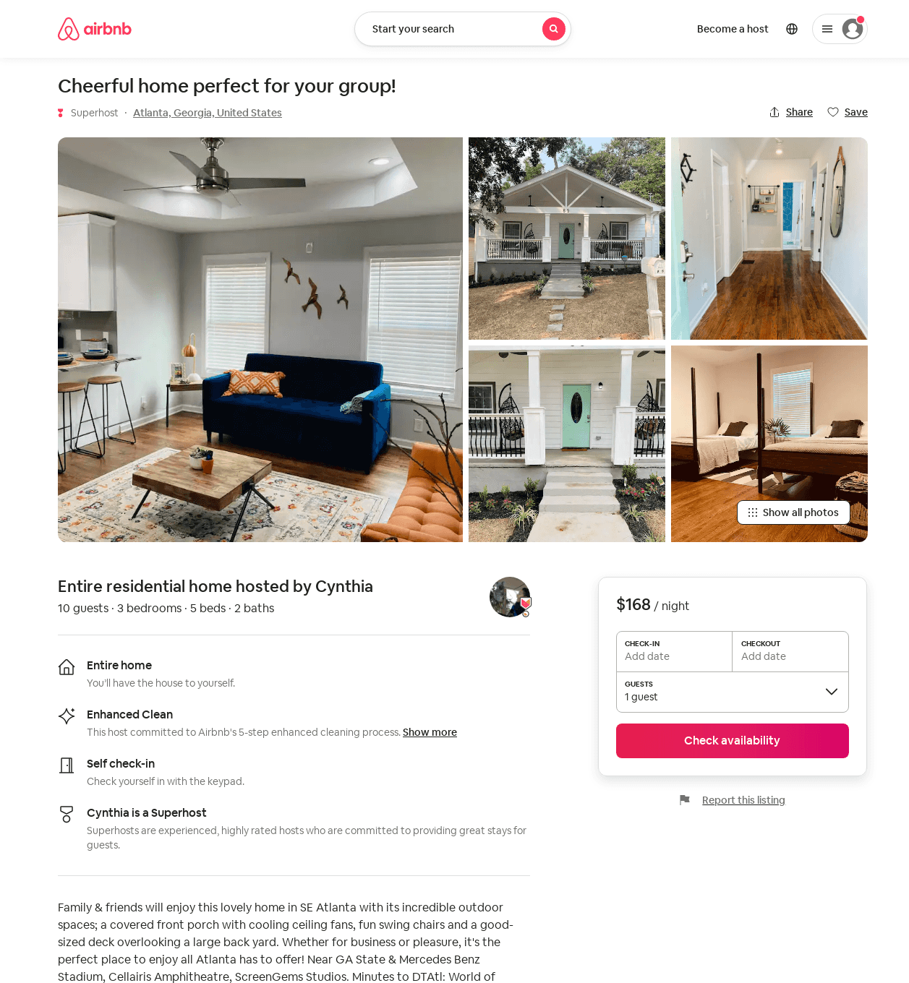
Listing 52132478
3
5
$96 - $195
4.77
32
Cynthia
53362437
2
https://www.airbnb.com/rooms/52132478
Aug 2022

Slide 14
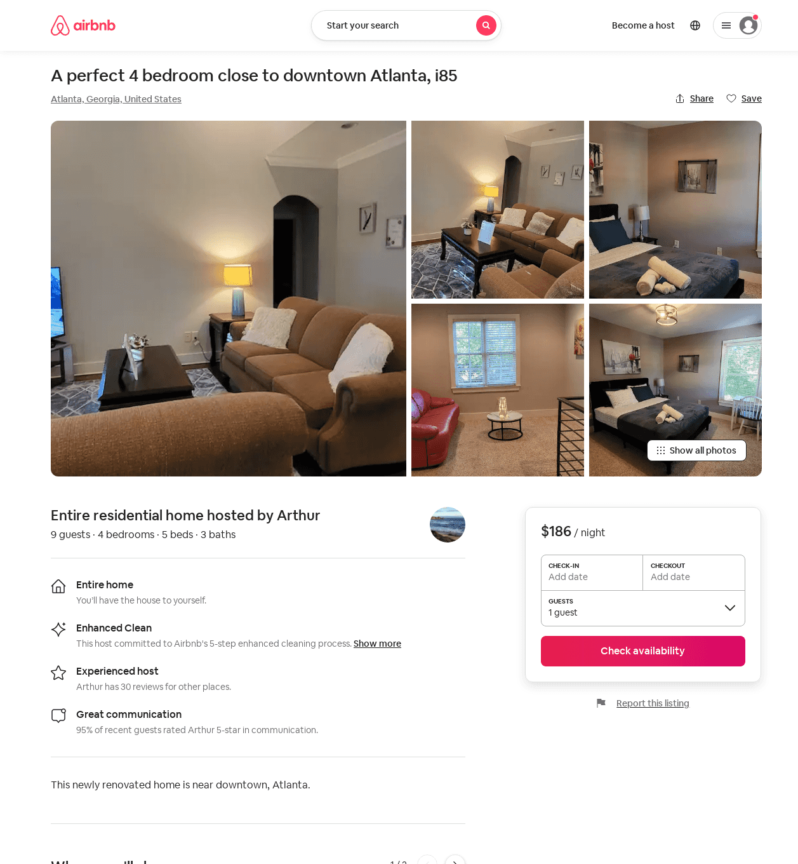
Listing 52433056
4
9
$179 - $251
4.91
3
Anna
292767528
16
https://www.airbnb.com/rooms/52433056
Jun 2022

Slide 15
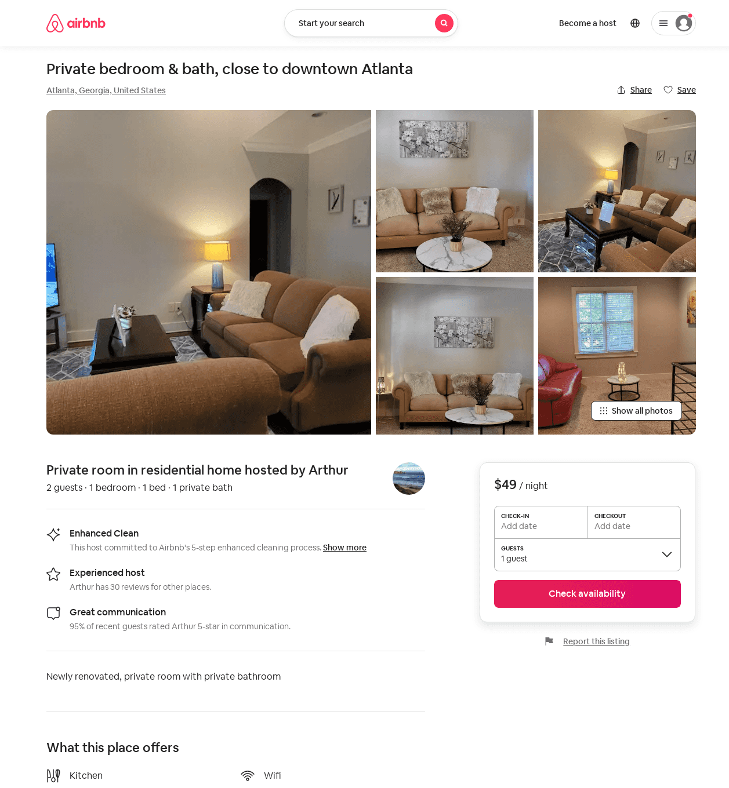
Listing 52433737
1
2
$48 - $56
4.88
1
Anna
292767528
16
https://www.airbnb.com/rooms/52433737
Aug 2022

Slide 16
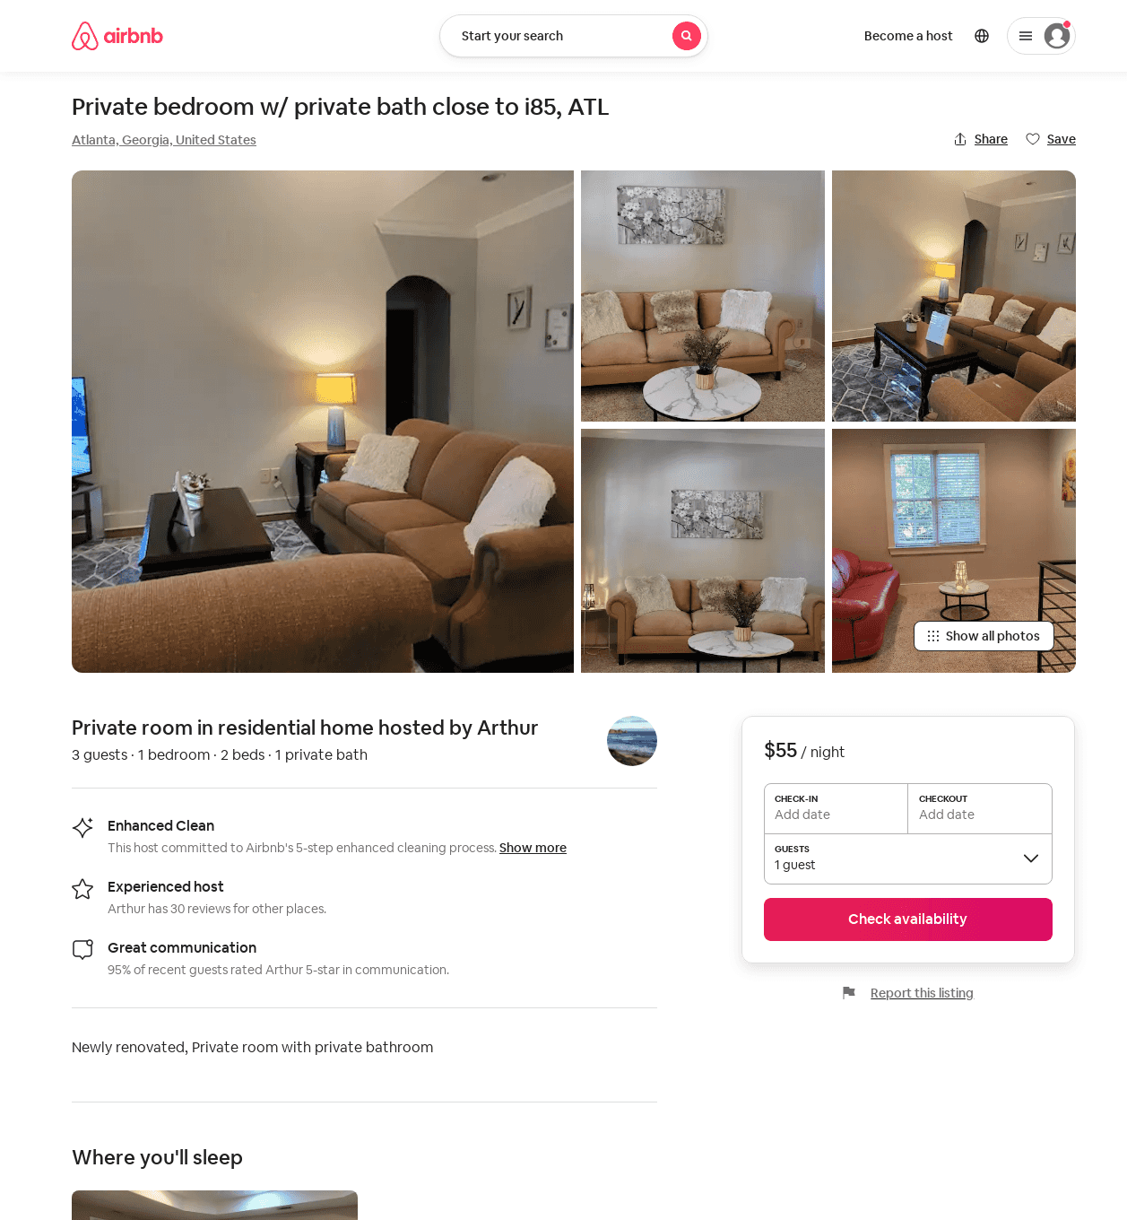
Listing 52433553
1
3
$48 - $66
4.77
1
Anna
292767528
16
https://www.airbnb.com/rooms/52433553
Aug 2022

Slide 17
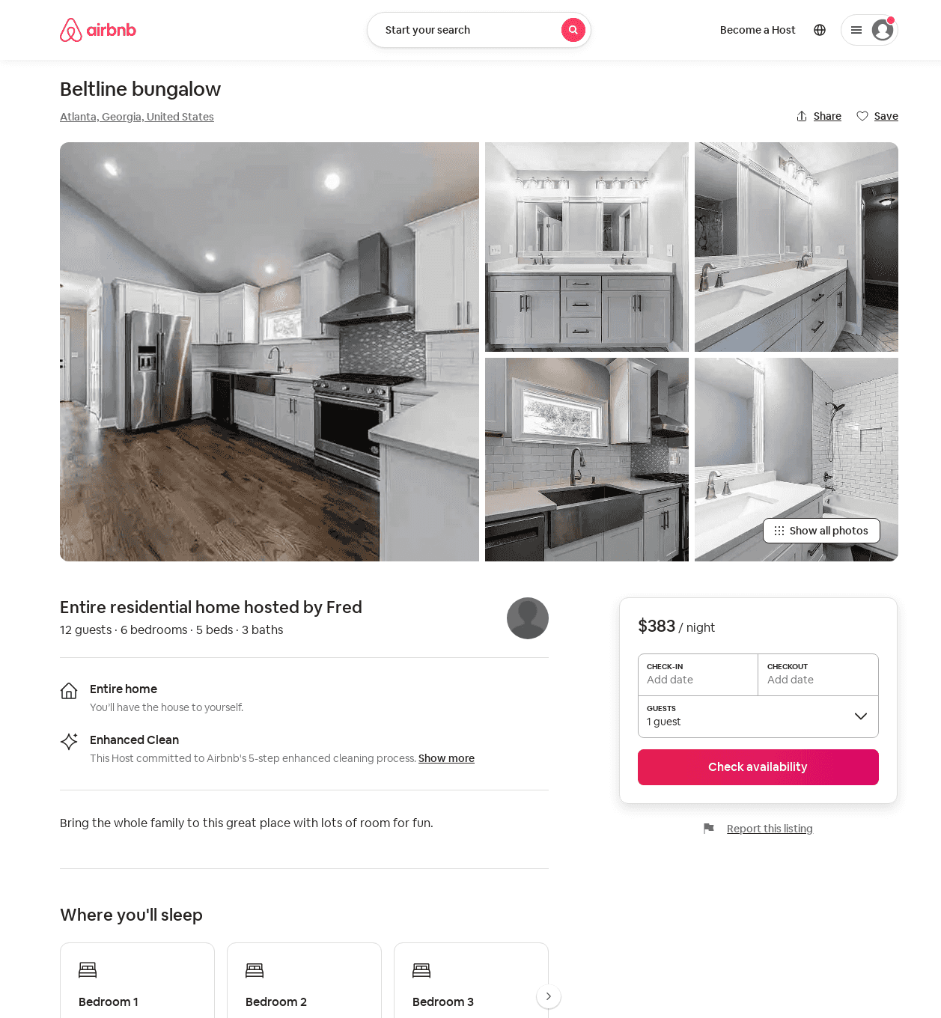
Listing 52807615
6
12
$270 - $512
5.0
2
Fred
427518613
1
https://www.airbnb.com/rooms/52807615
Aug 2022

Slide 18
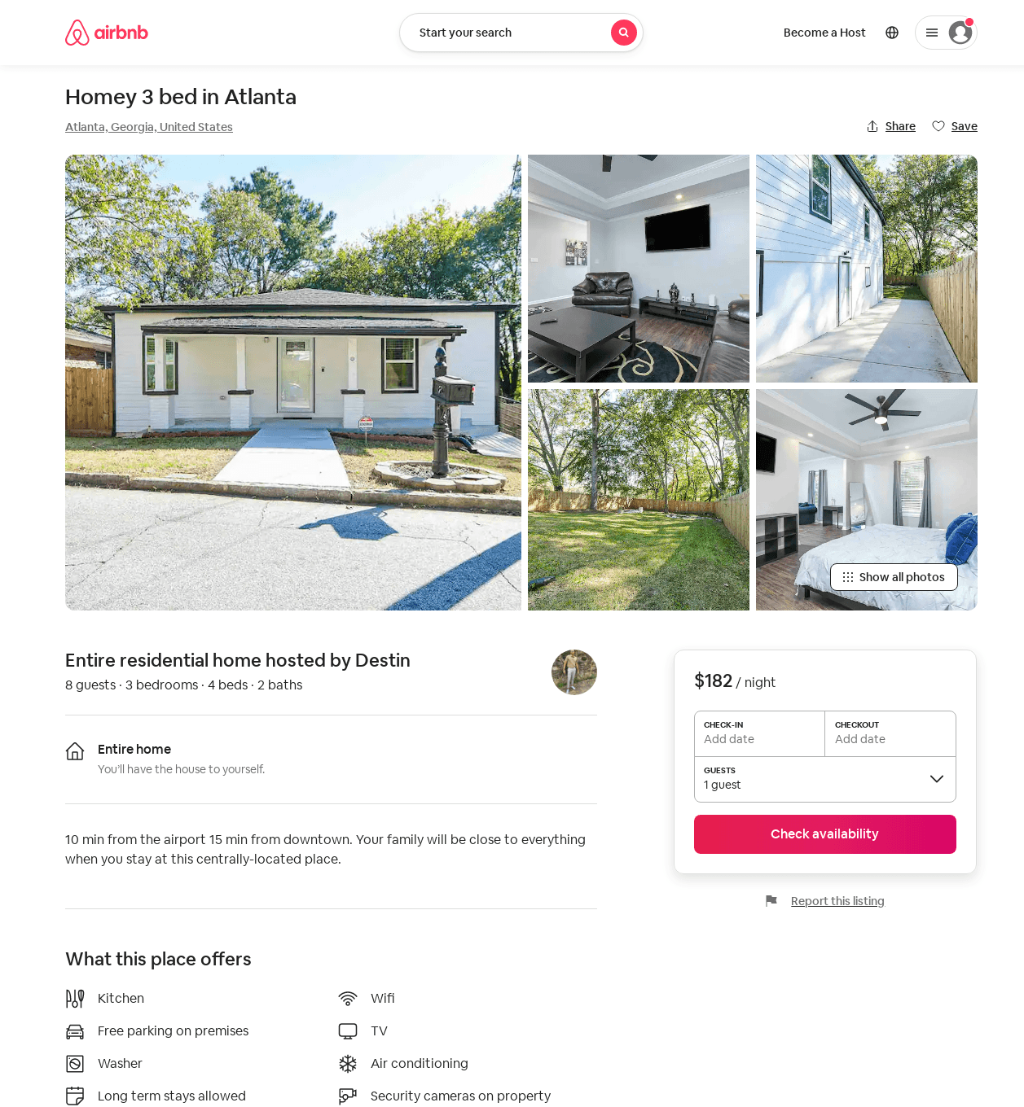
Listing 51844929
3
8
$164 - $200
4.68
2
Destin
84885746
1
https://www.airbnb.com/rooms/51844929
Aug 2022

Slide 19
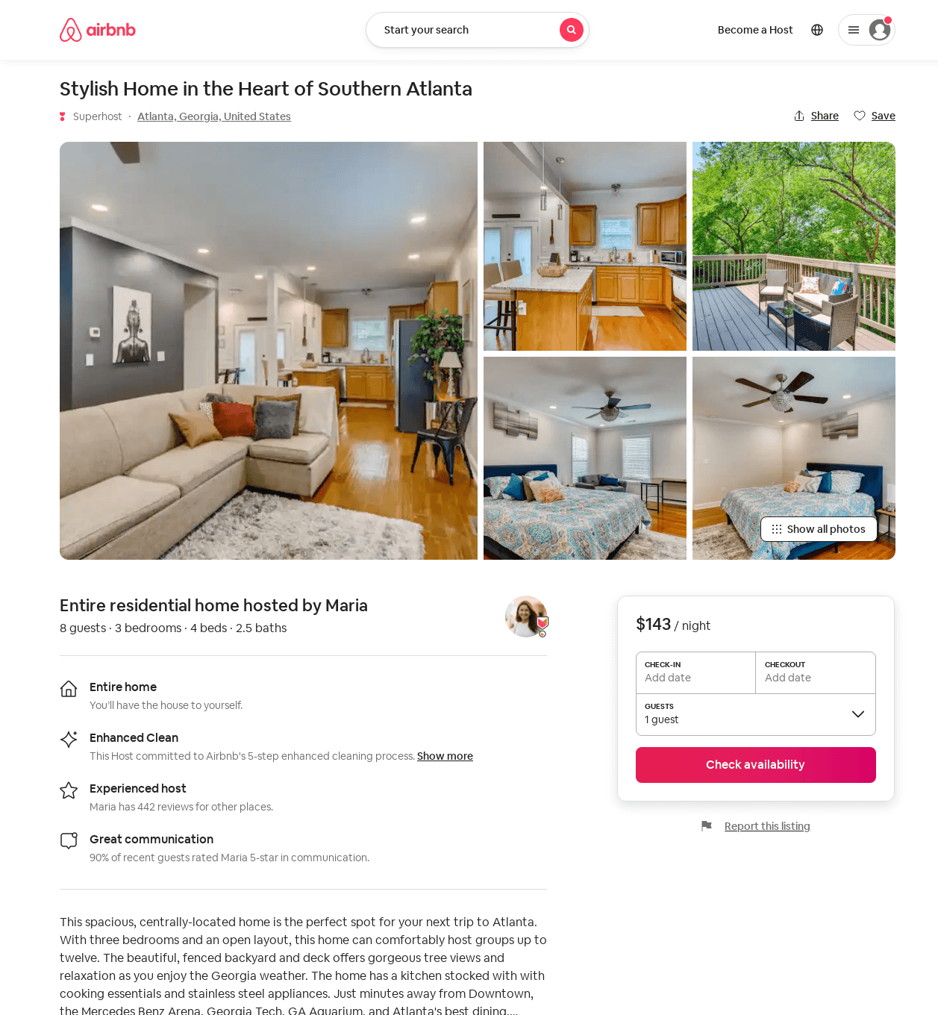
Listing 53541182
3
8
$111 - $220
4.46
1
Maria
230939573
13
https://www.airbnb.com/rooms/53541182
Jul 2022

Slide 20
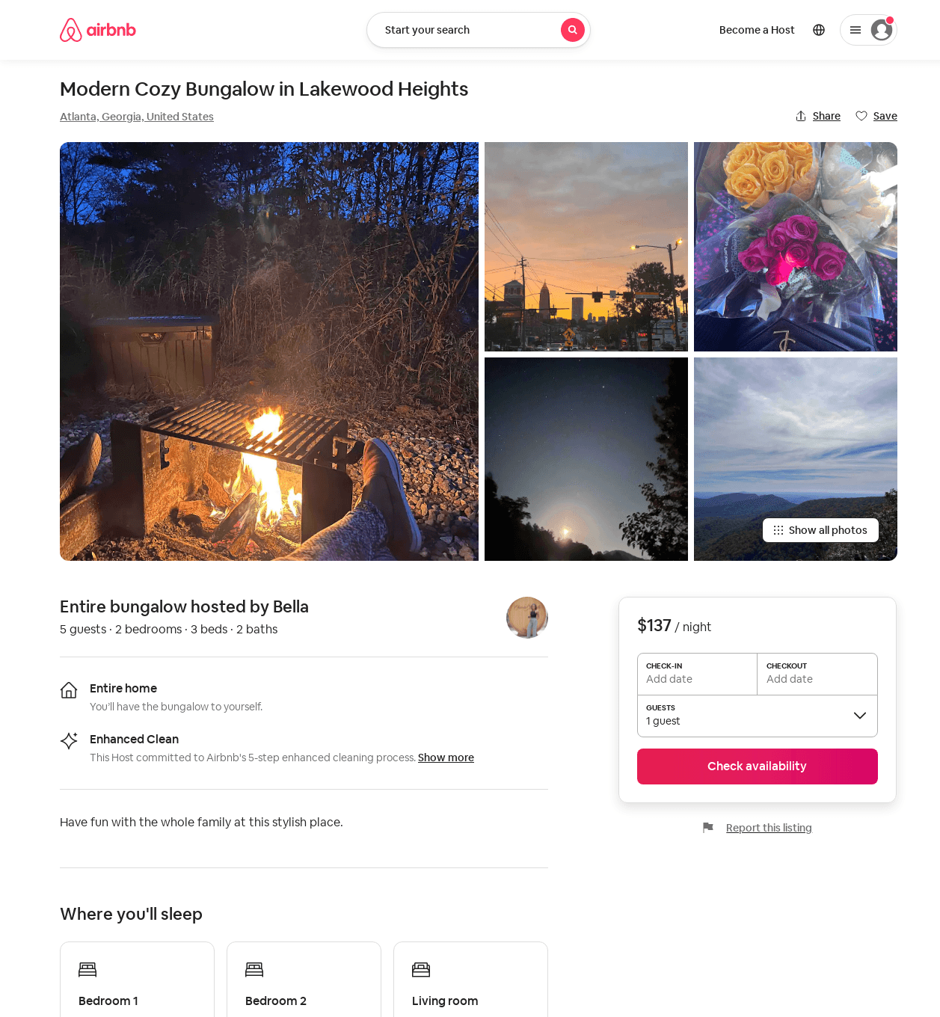
Listing 53216090
2
5
$79 - $137
4.64
2
Bella
38929910
1
https://www.airbnb.com/rooms/53216090
Aug 2022

Slide 21
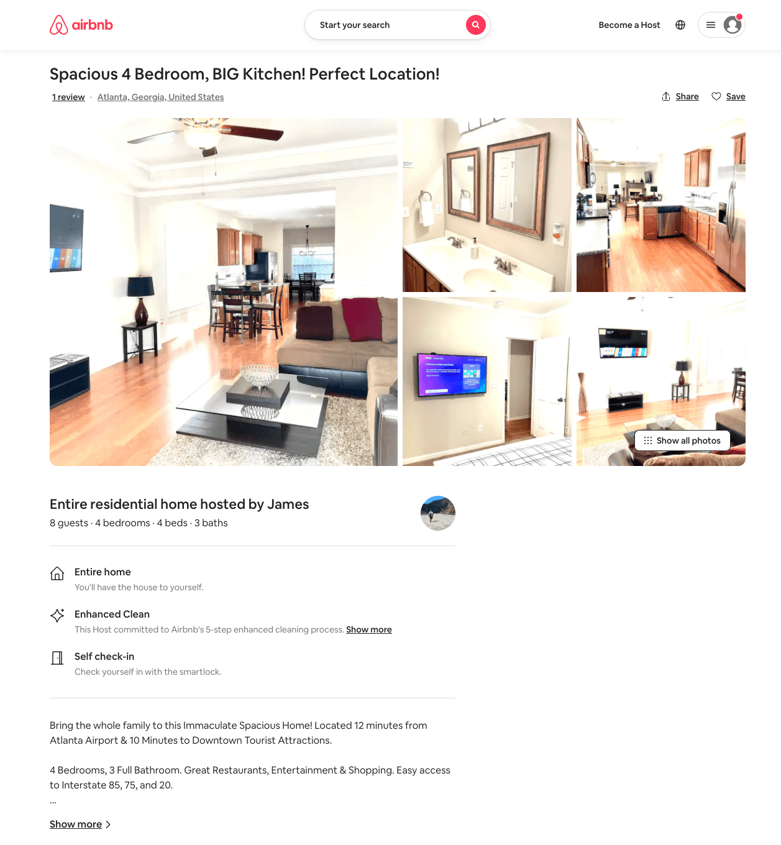
Listing 53941814
5
10
$173 - $305
4.94
3
James
9834071
1
https://www.airbnb.com/rooms/53941814
Aug 2022

Slide 22
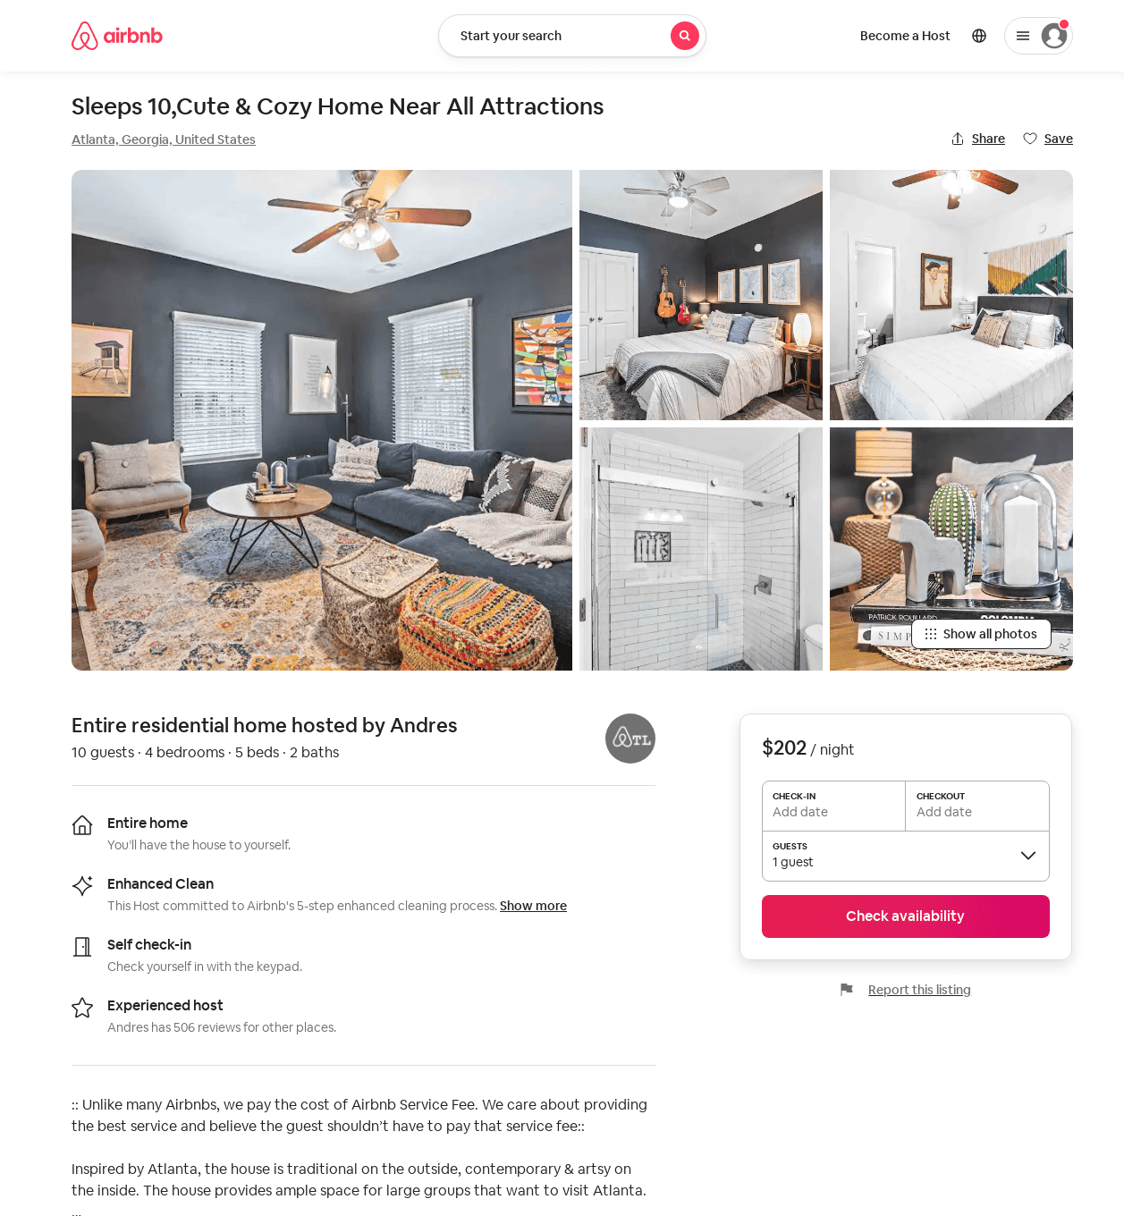
Listing 54385416
4
10
$161 - $423
4.57
1
Andres
14695069
8
https://www.airbnb.com/rooms/54385416
Jun 2022

Slide 23
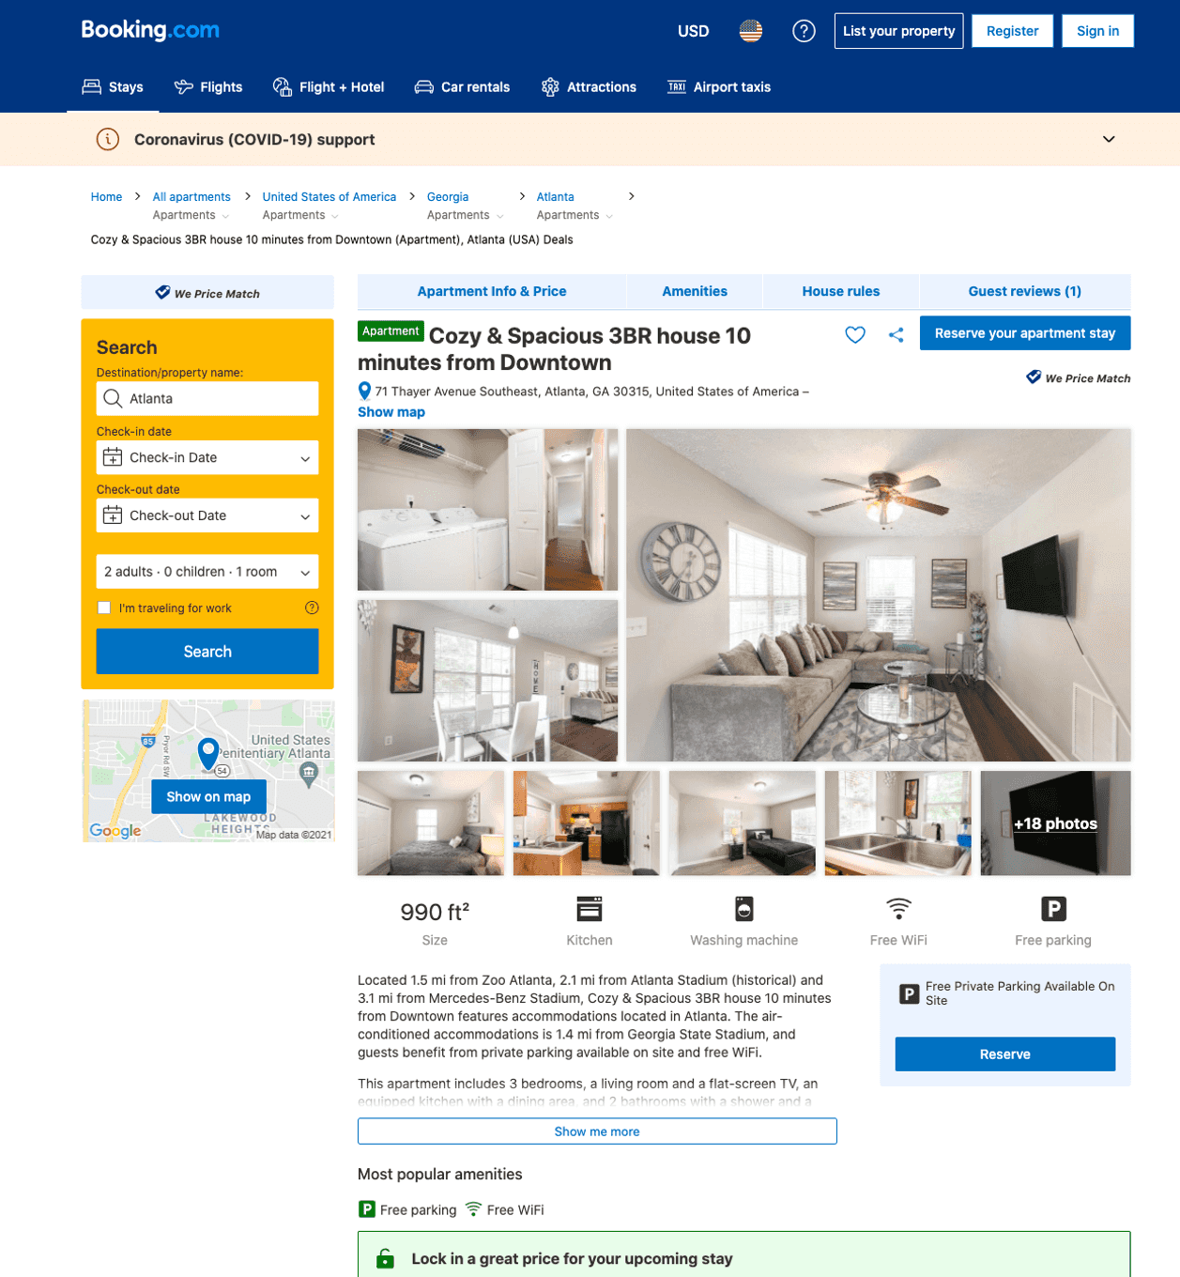
Listing cozy-spacious-3br-house-10-minutes-from-downtown
undefined
6
6.8
https://www.booking.com/hotel/us/cozy-spacious-3br-house-10-minutes-from-downtown.html
Sep 2022

Slide 24
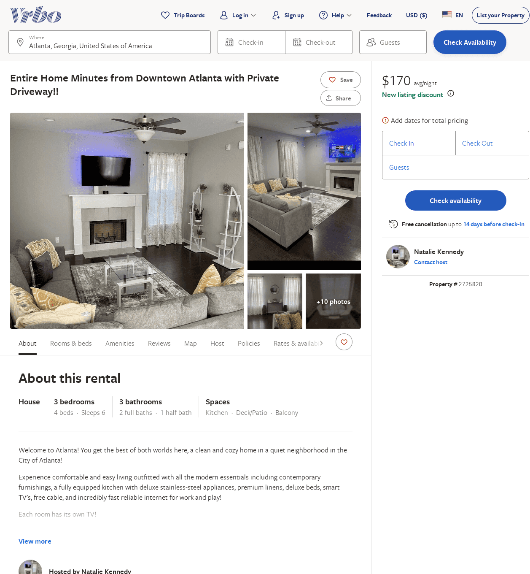
Listing 2725820
3
6
$280
5
3
Natalie Kennedy
https://www.vrbo.com/2725820
Aug 2022

