Slide 2
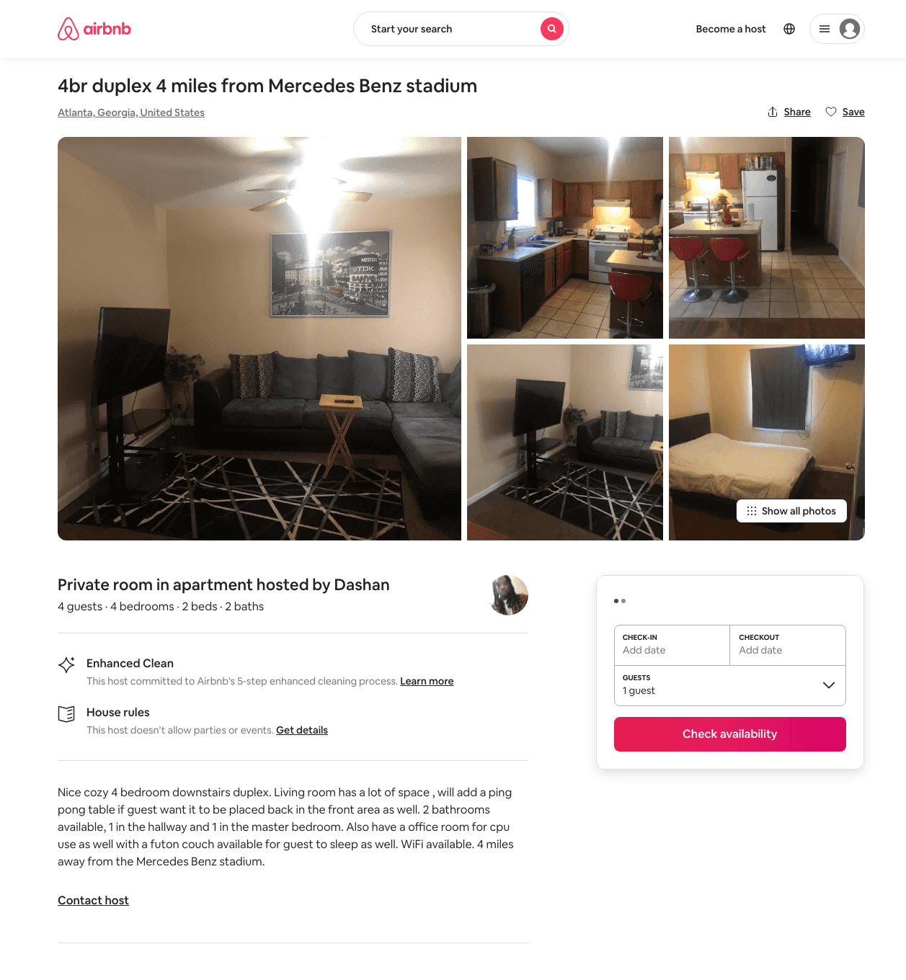
Listing 32008499
4
4
$500
1
Dashan
239122656
1
https://www.airbnb.com/rooms/32008499
Aug 2022

