Slide 2
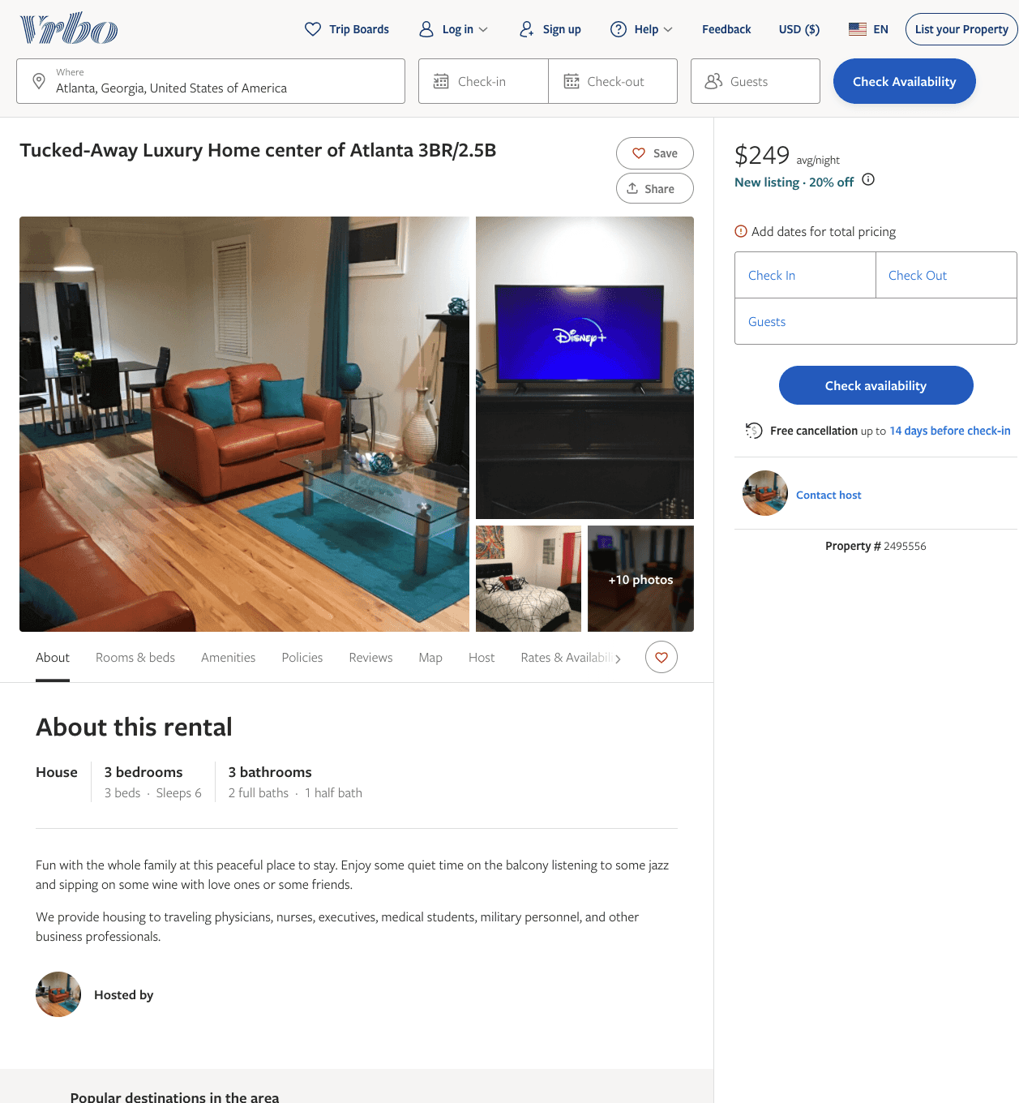
Listing 2495556
3
6
$249 - $268
1
JB
https://www.vrbo.com/2495556
Aug 2022

Slide 3
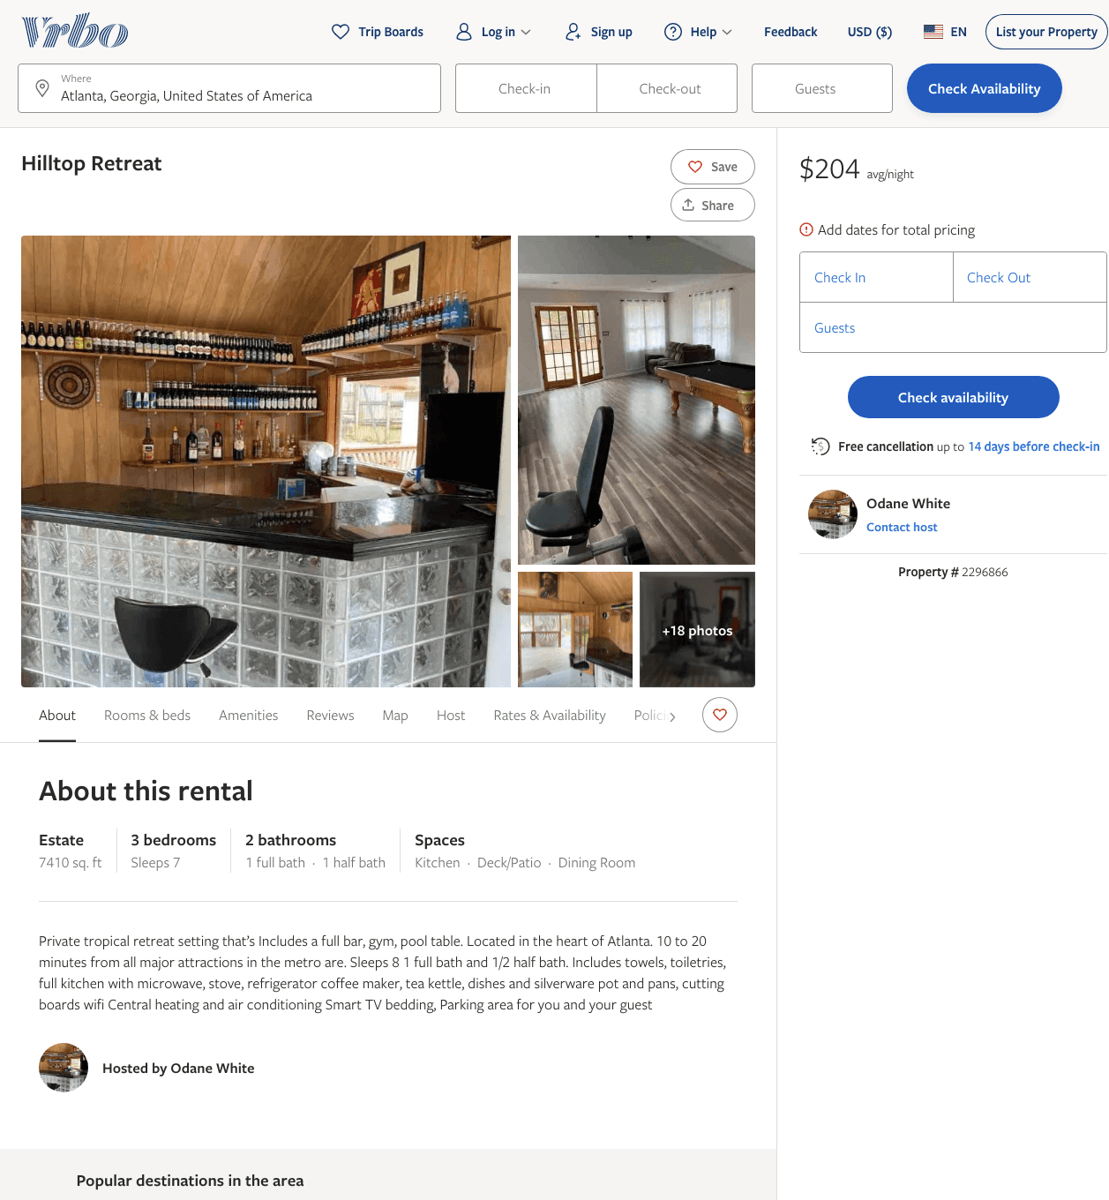
Listing 2296866
3
7
$178 - $337
5
1
Odane White
https://www.vrbo.com/2296866
Aug 2022

Slide 4
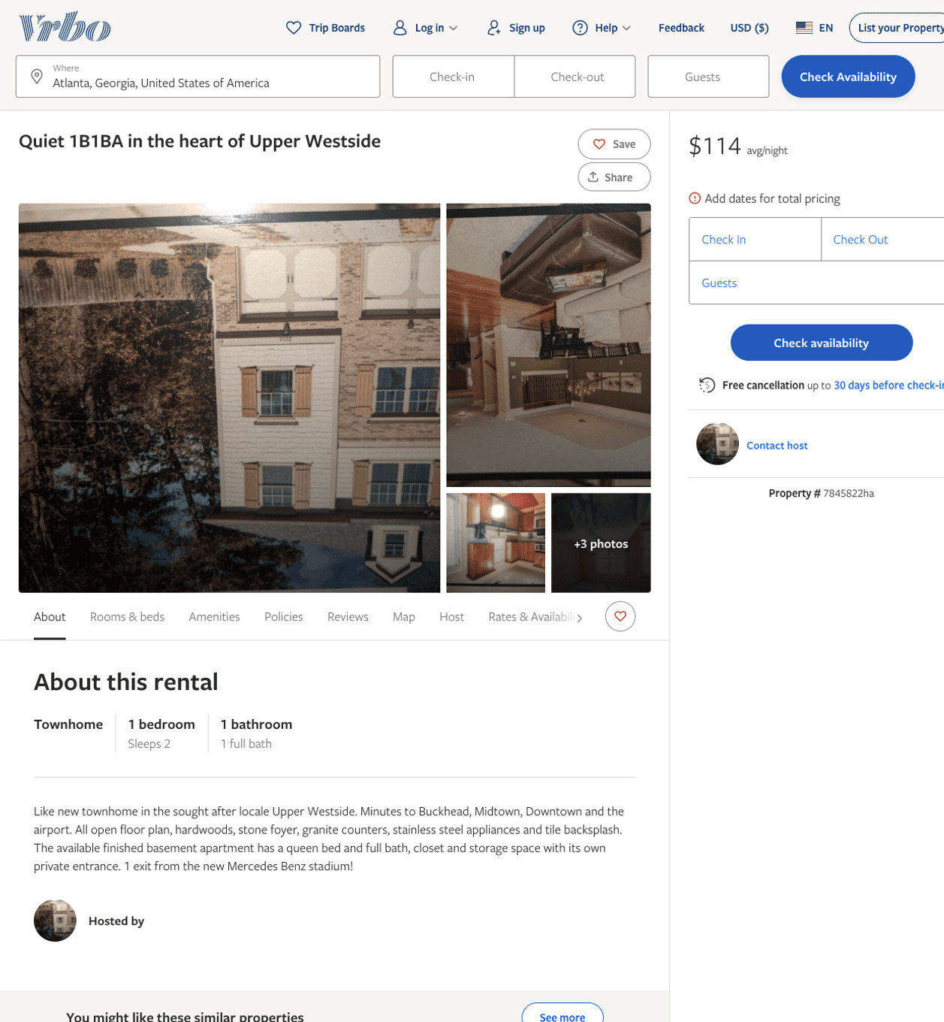
Listing 7845822
1
2
$114
1
https://www.vrbo.com/7845822ha
Aug 2022

Slide 5
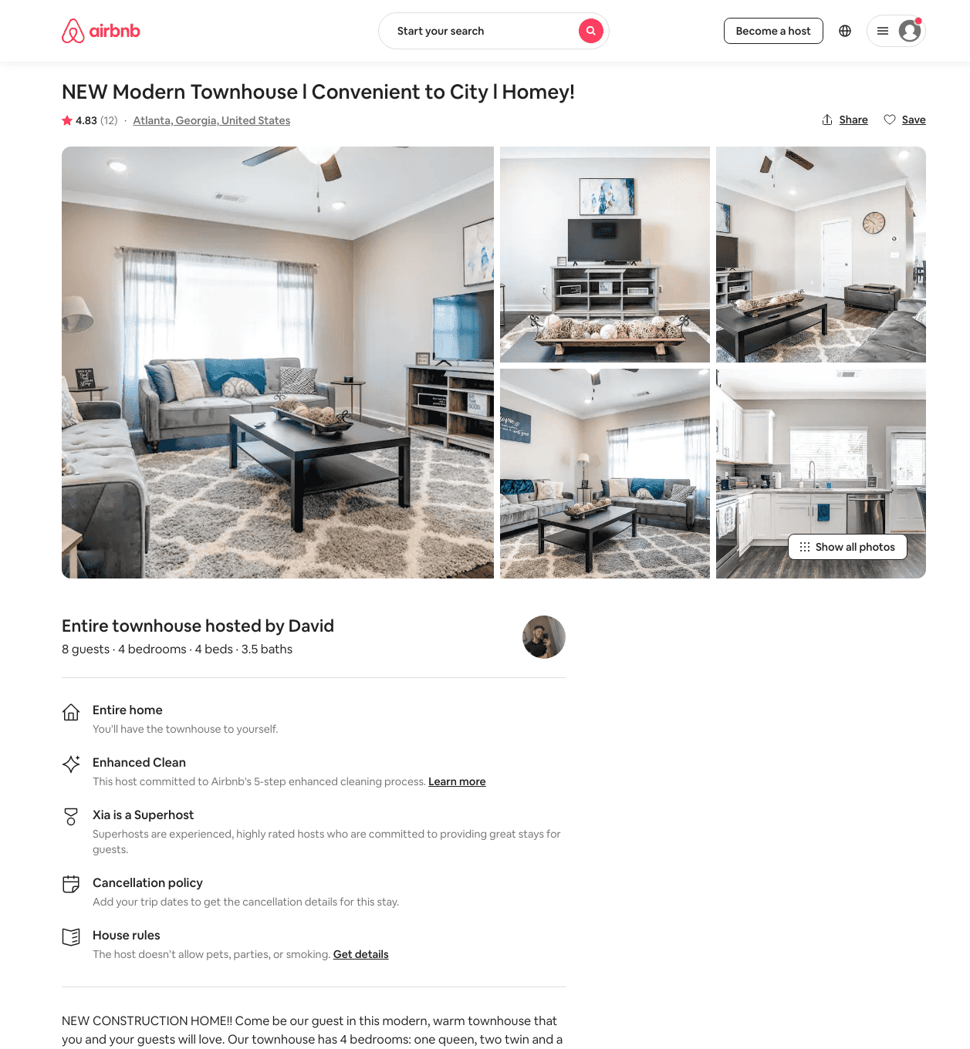
Listing 46963019
4
10
$135 - $285
4.38
2
Hammock Retreats
375318628
10
https://www.airbnb.com/rooms/46963019
Jun 2022

Slide 6
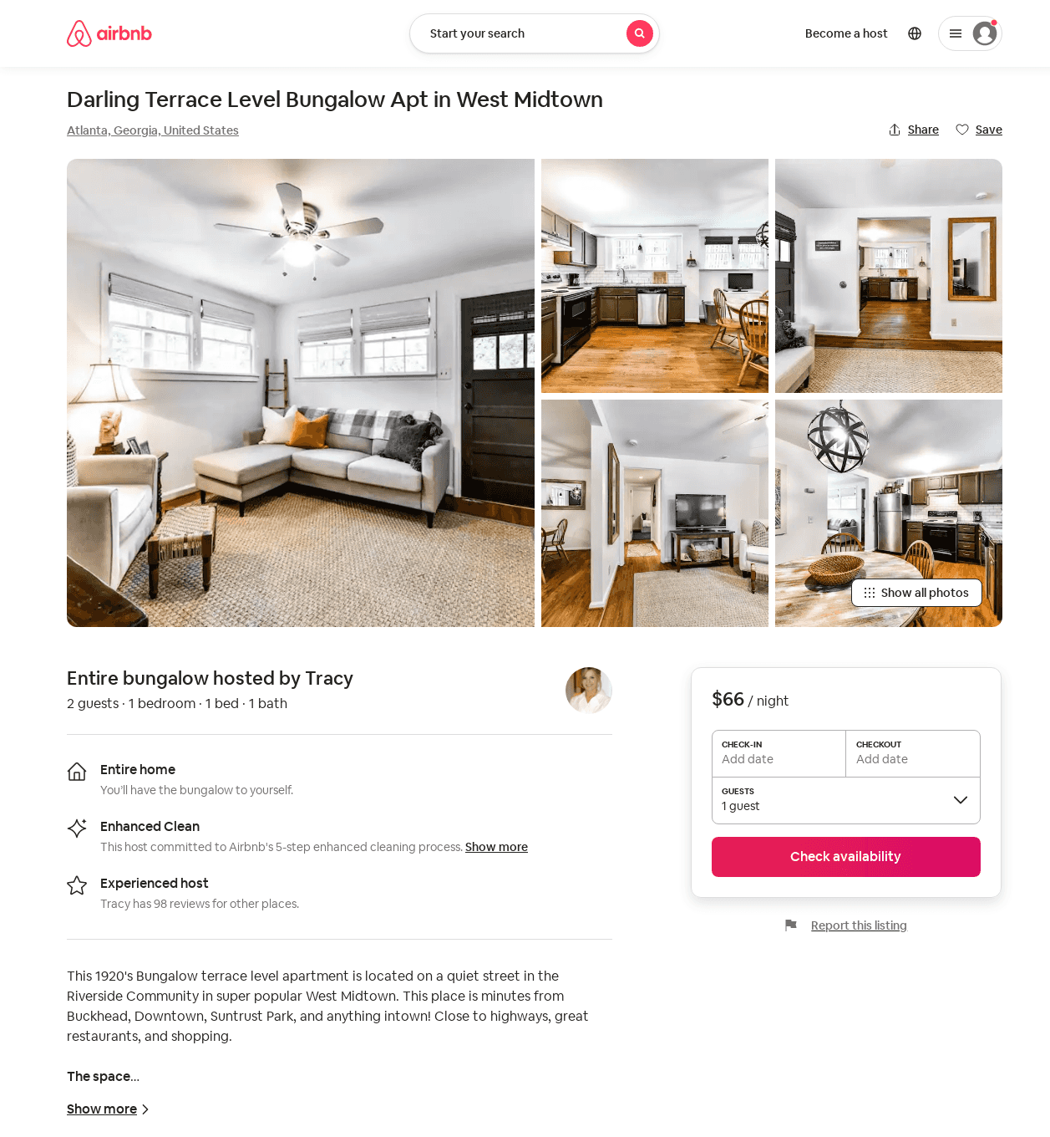
Listing 25873385
1
2
$66
7
Tracy
61248960
1
https://www.airbnb.com/rooms/25873385
Aug 2022

Slide 7
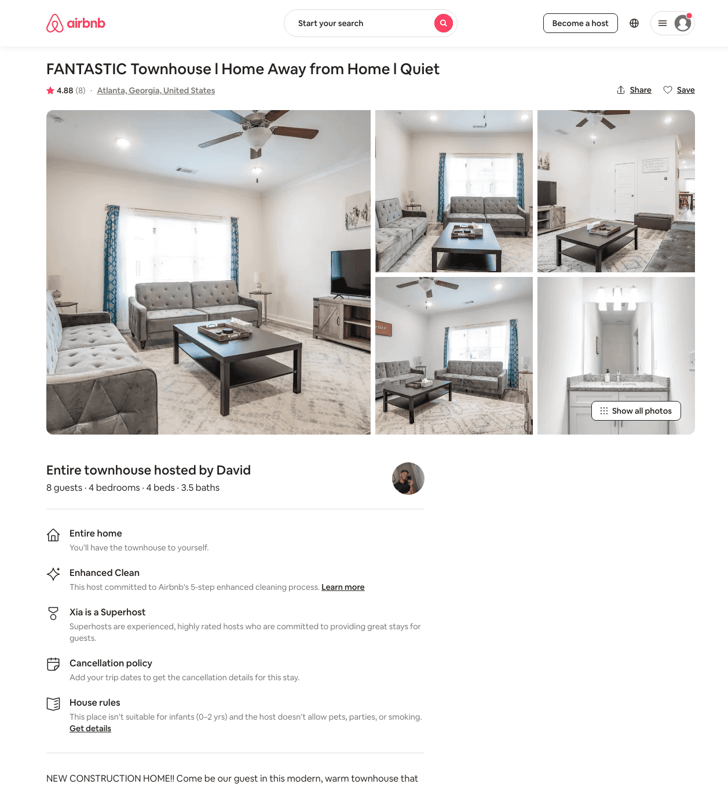
Listing 47234603
4
11
$135 - $230
4.37
2
Hammock Retreats
375318628
10
https://www.airbnb.com/rooms/47234603
Jun 2022

Slide 8
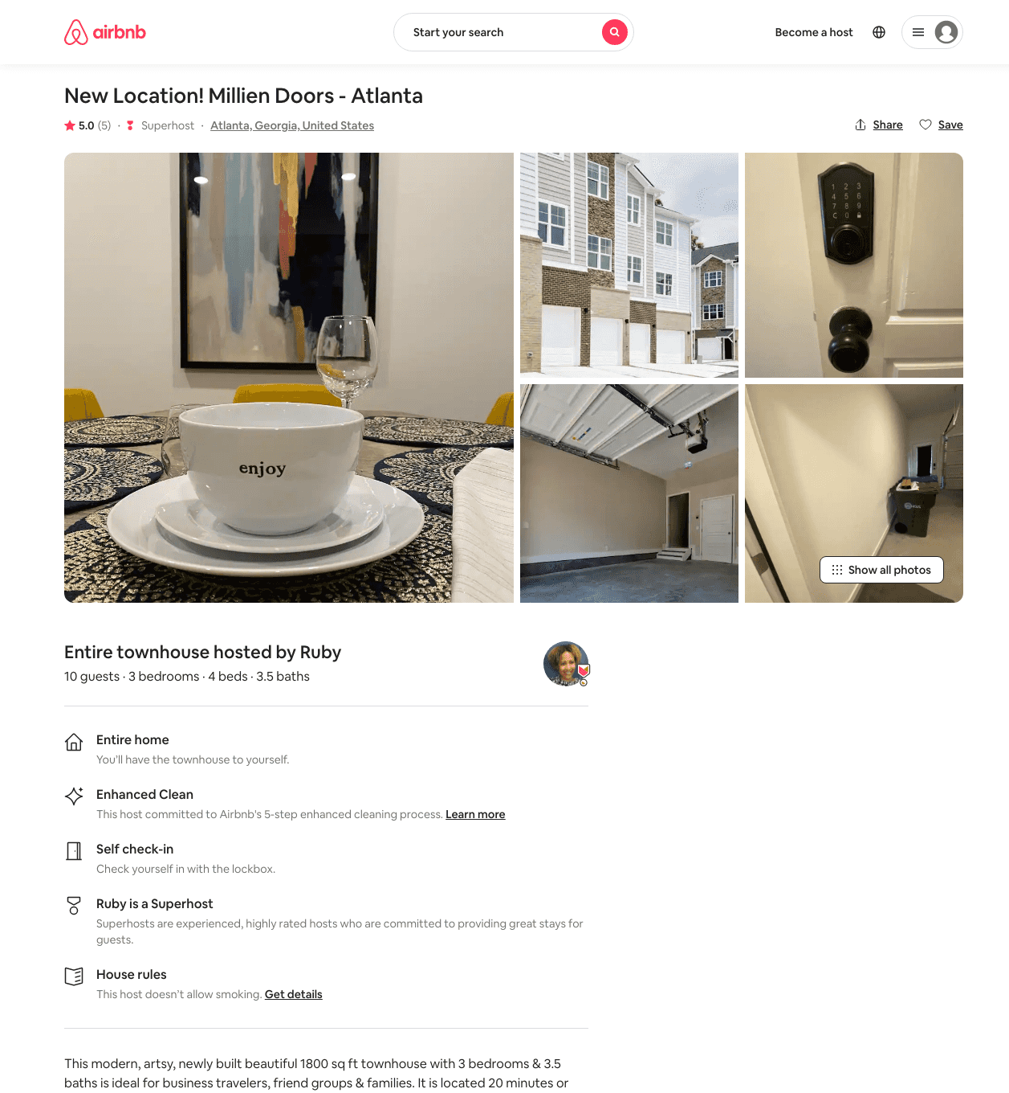
Listing 45153004
3
7
$202 - $482
5.0
1
Ruby
11998560
1
https://www.airbnb.com/rooms/45153004
Aug 2022

Slide 9
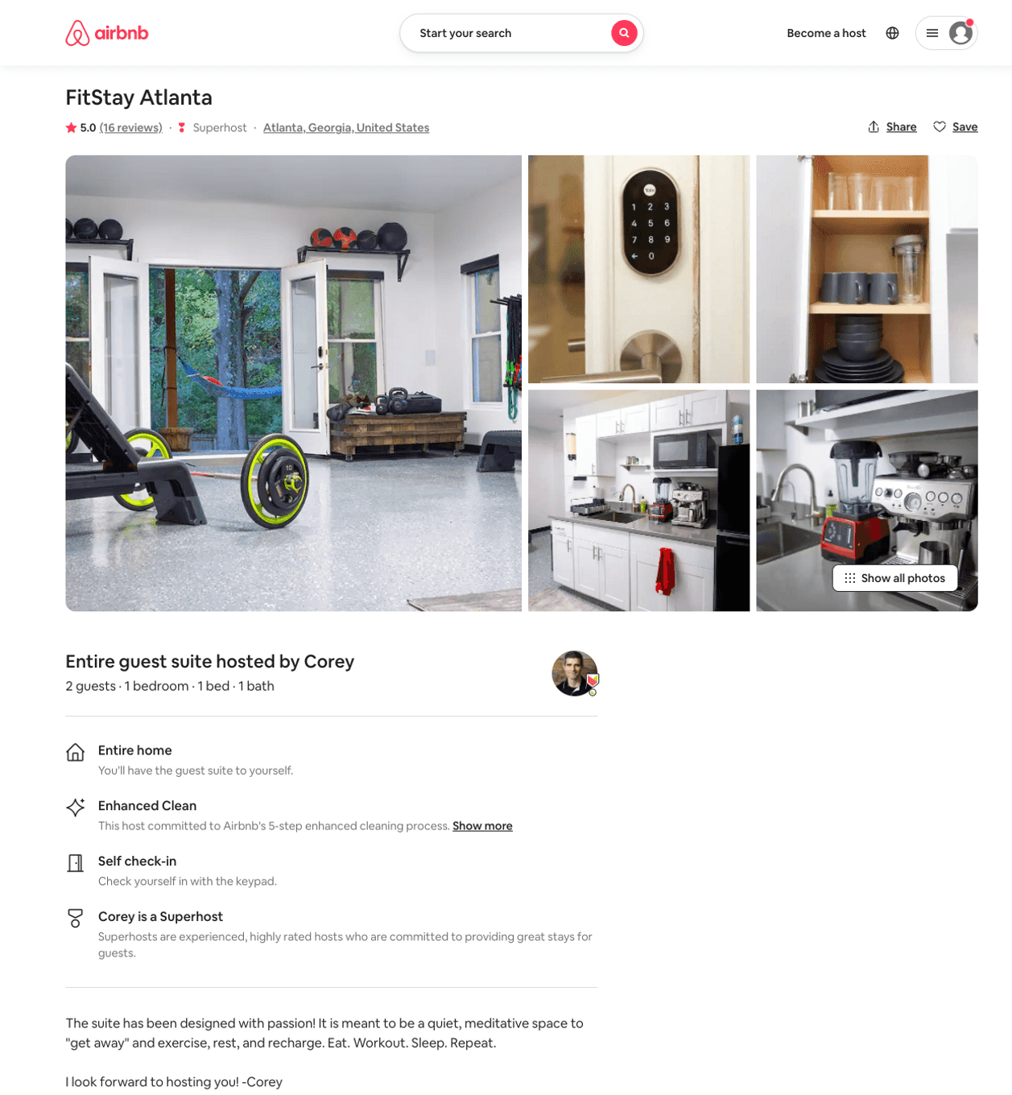
Listing 45926595
1
2
$95 - $295
5.0
2
Corey
44157136
1
https://www.airbnb.com/rooms/45926595
Aug 2022

Slide 10
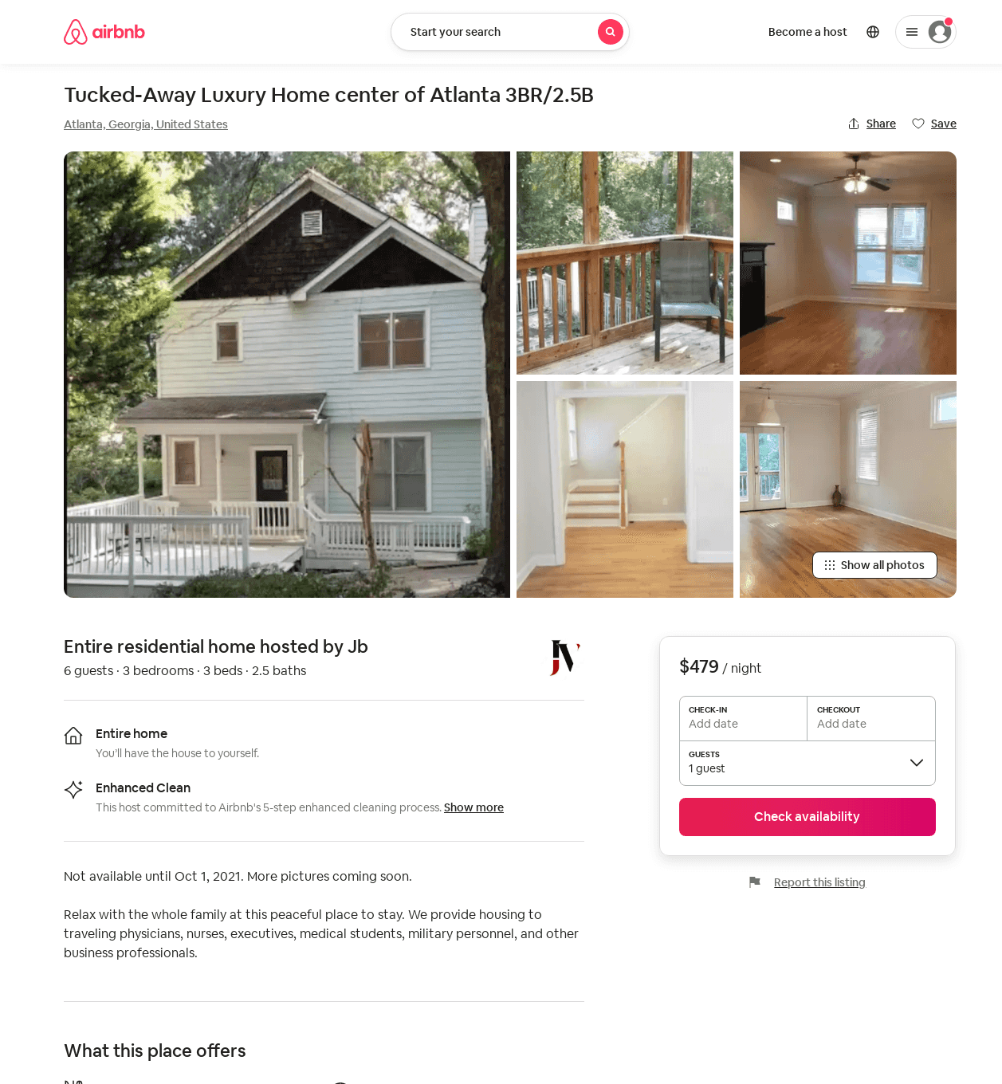
Listing 52454693
3
6
$149 - $479
4.50
30
Jb
408452226
2
https://www.airbnb.com/rooms/52454693
Aug 2022

Slide 11
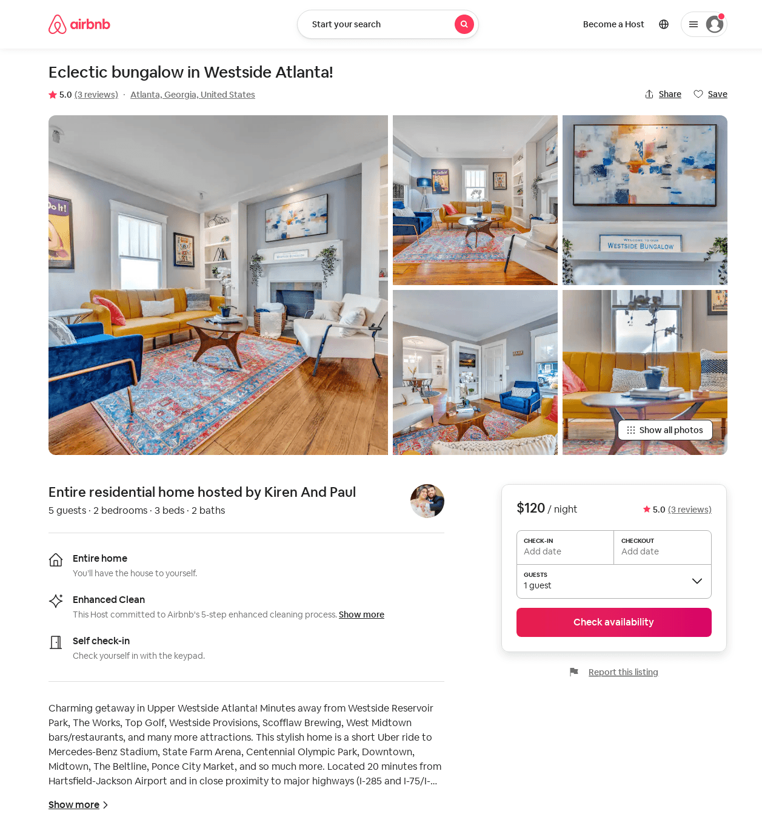
Listing 51716023
2
5
$110 - $155
4.93
2
Kiren And Paul
99552252
1
https://www.airbnb.com/rooms/51716023
Aug 2022

Slide 12
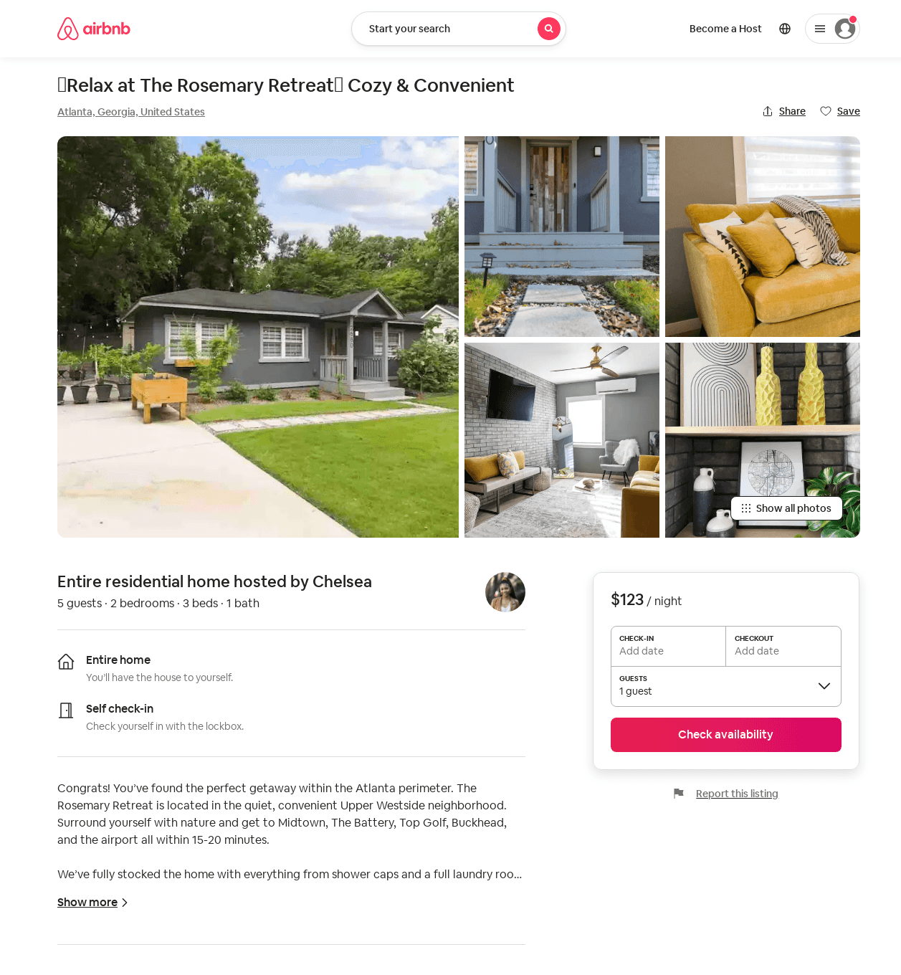
Listing 52786096
2
5
$96 - $162
4.92
2
Chelsea
421979922
1
https://www.airbnb.com/rooms/52786096
Aug 2022

Slide 13
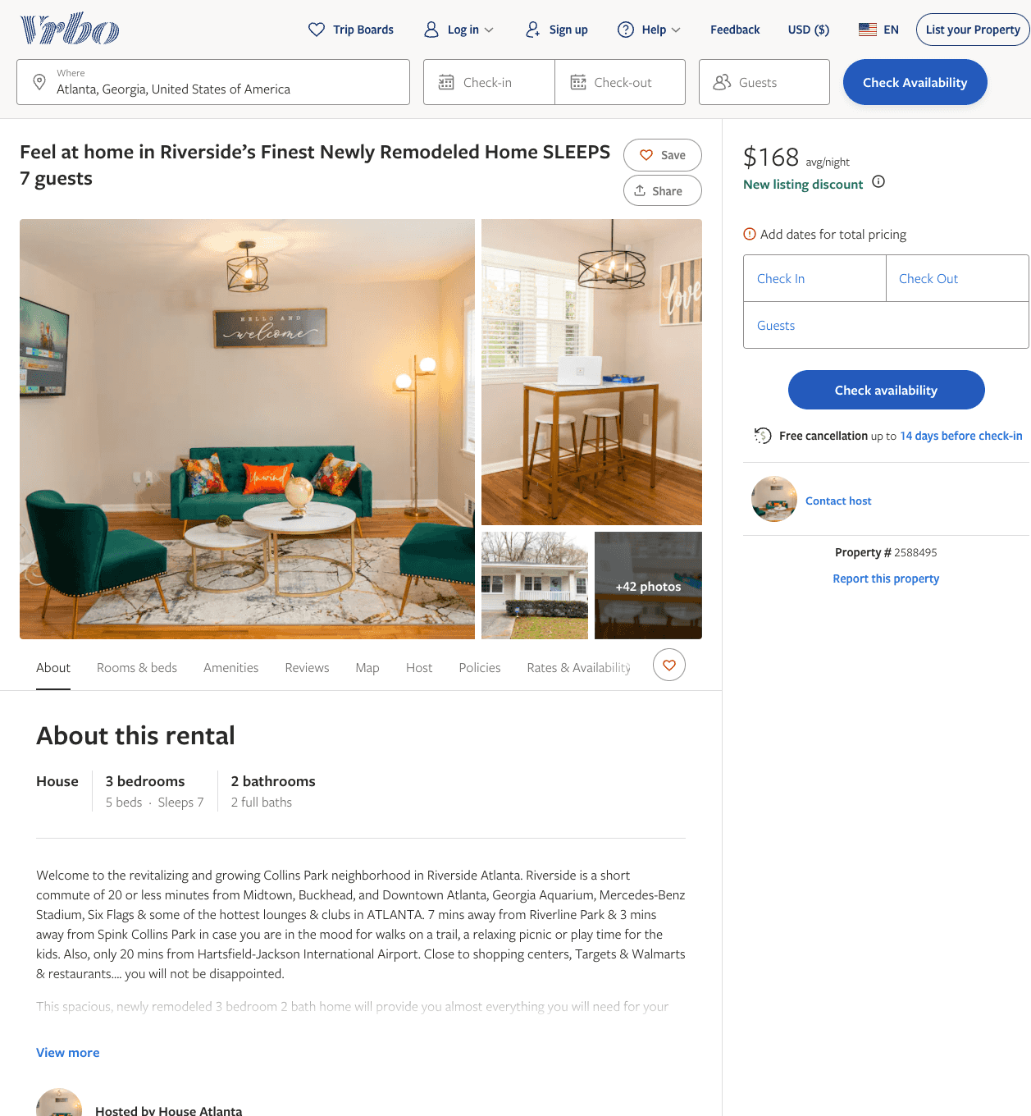
Listing 2588495
3
7
$168 - $221
4.6666665
2
Merissa Alexander
https://www.vrbo.com/2588495
Aug 2022

Slide 14
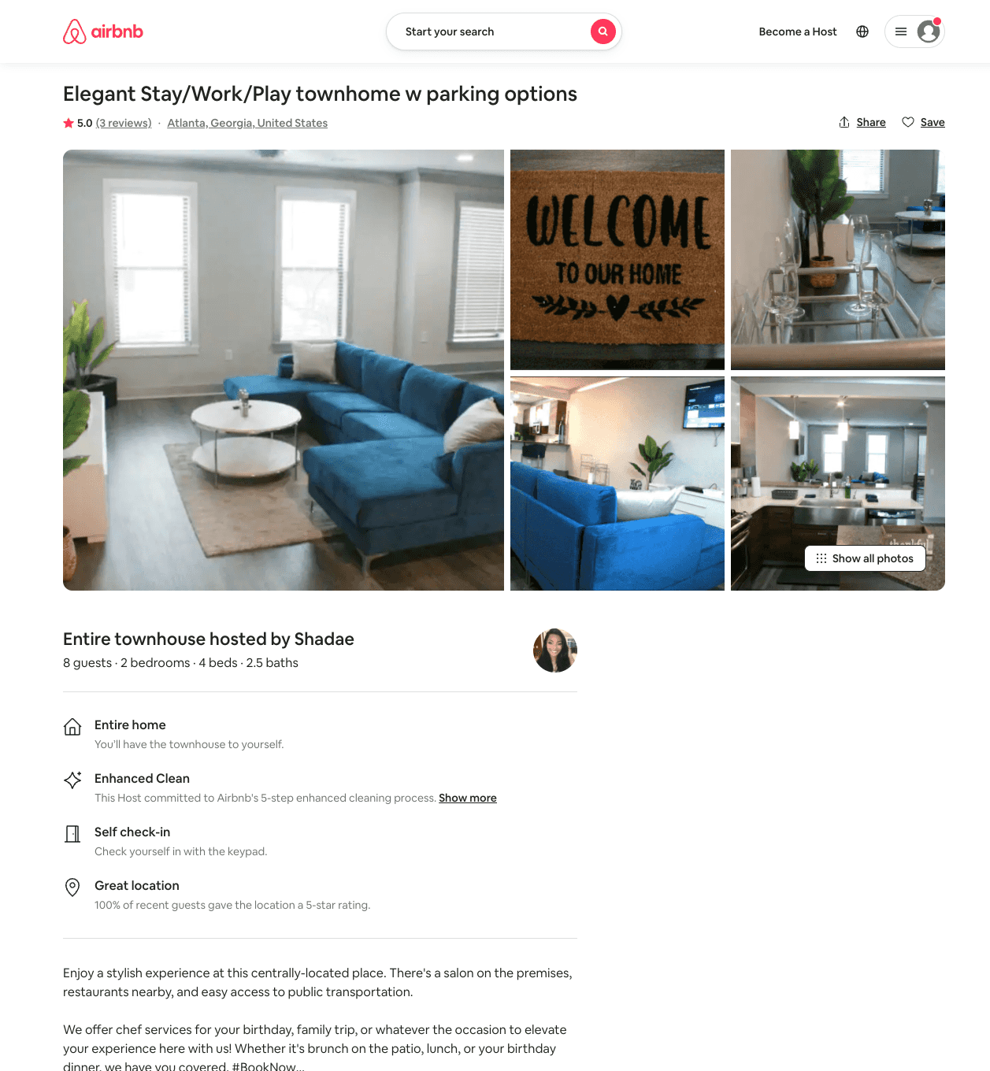
Listing 53953837
2
6
$106 - $180
4.63
2
Shadae
437061548
1
https://www.airbnb.com/rooms/53953837
Aug 2022

Slide 15
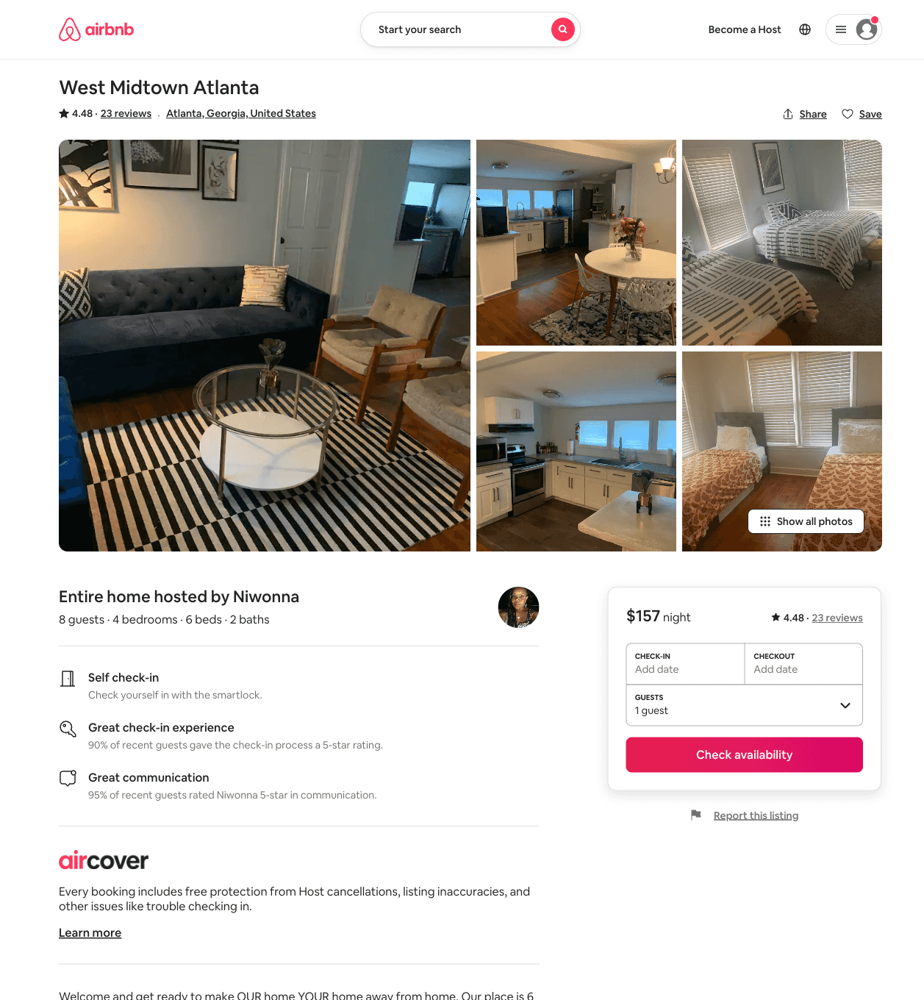
Listing 51234620
4
8
$141 - $166
4.62
2
Niwonna
184078459
1
https://www.airbnb.com/rooms/51234620
Aug 2022

Slide 16
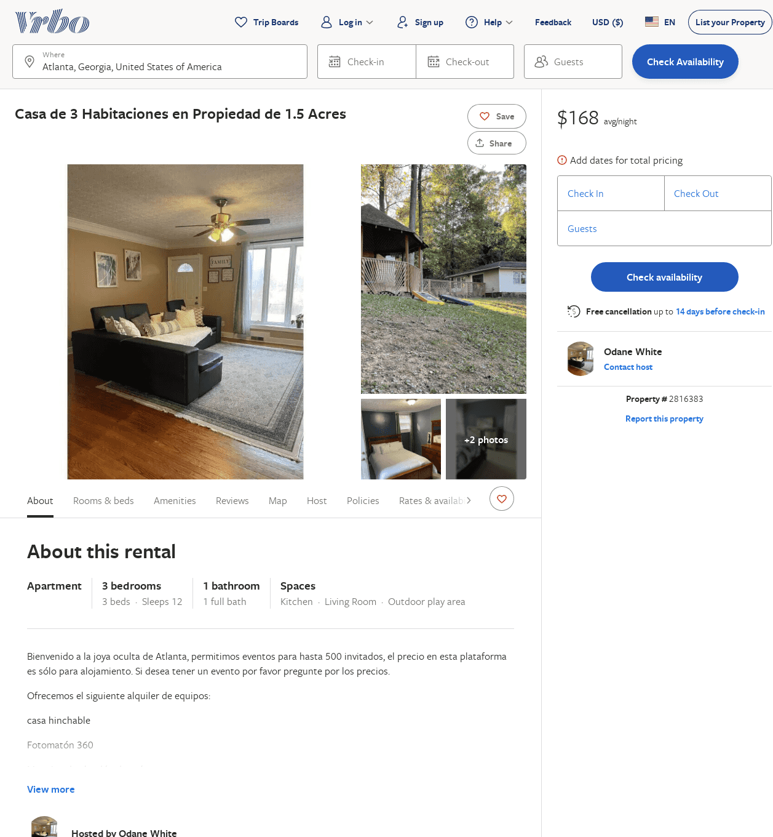
Listing 2816383
3
12
$190
1
Odane White
https://www.vrbo.com/2816383
Aug 2022

Slide 17
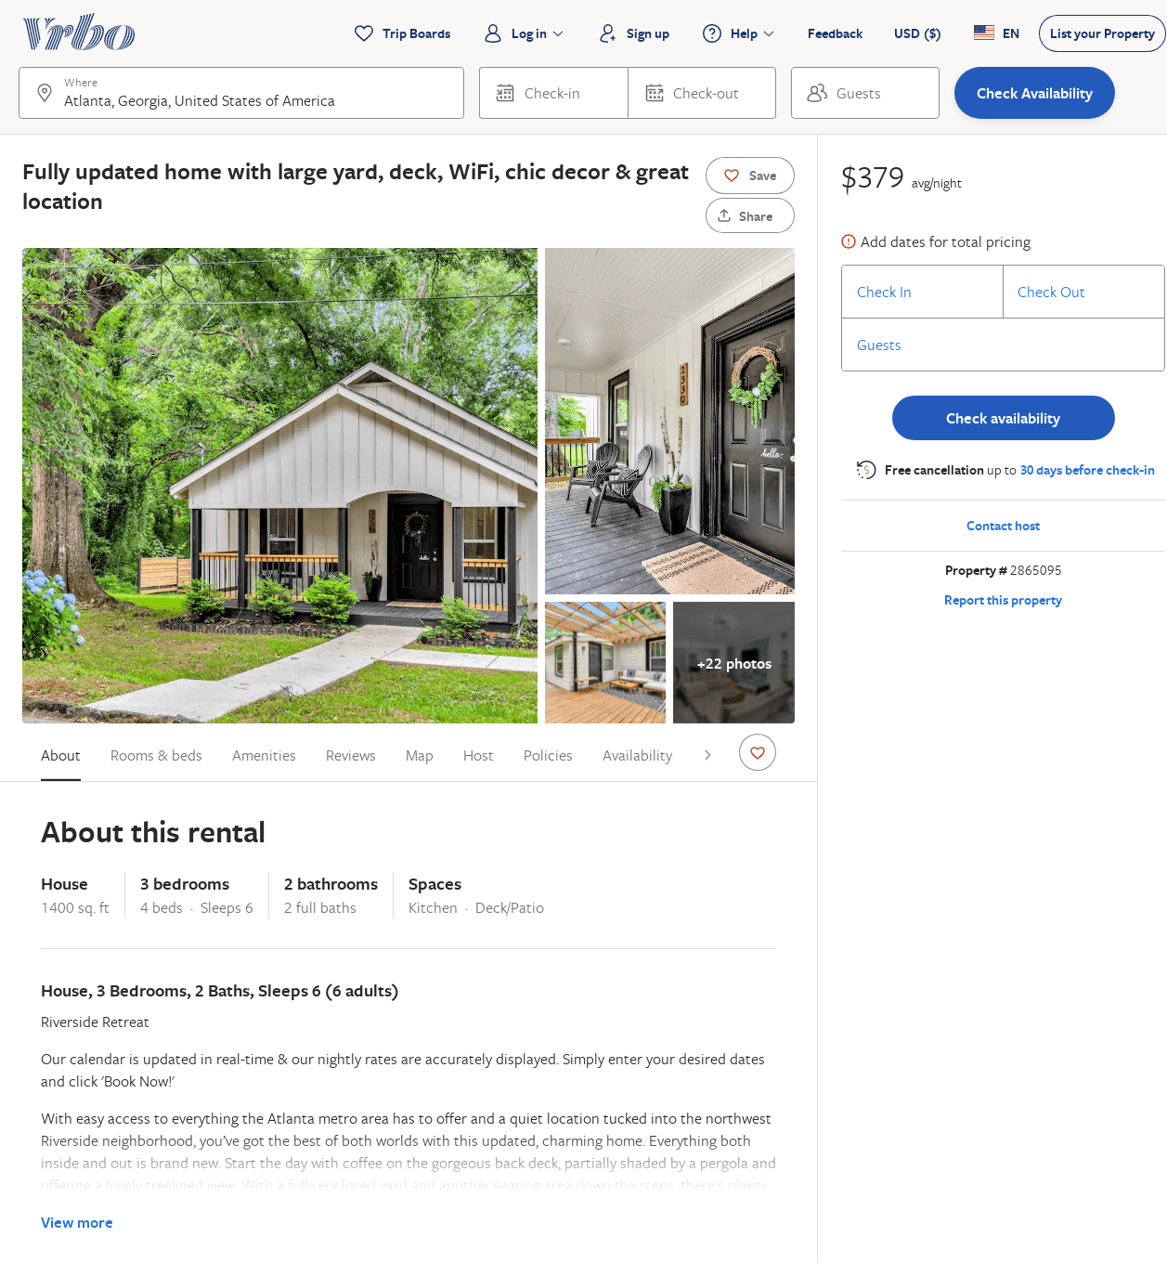
Listing 2865095
3
6
$378
2
Vacasa of Georgia
https://www.vrbo.com/2865095
Aug 2022

