Slide 2
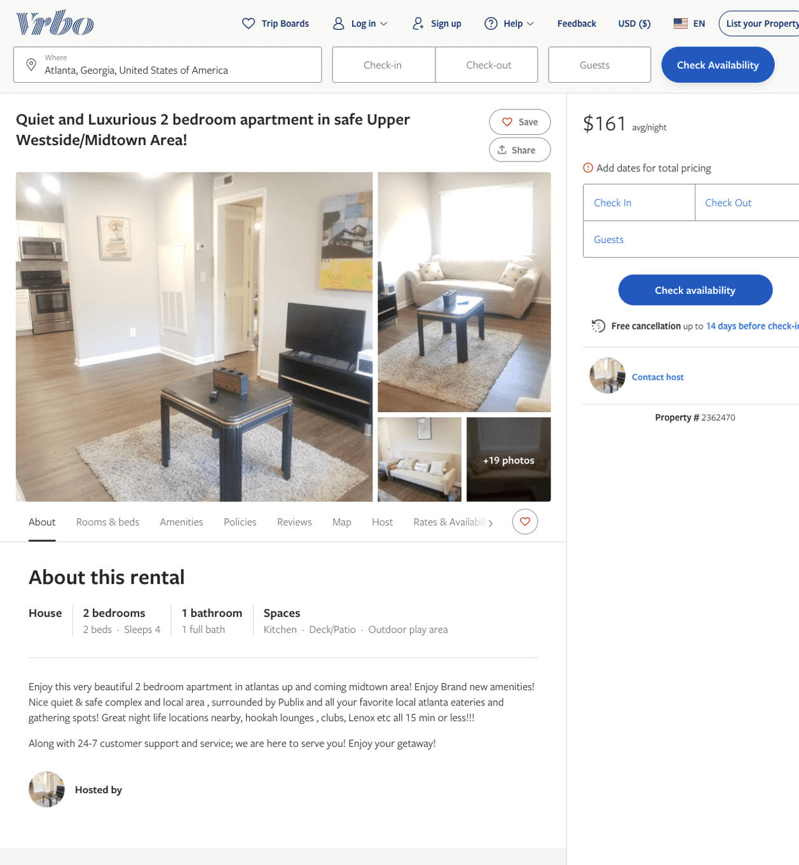
Listing 2362470
2
4
$157 - $169
5
2
Ron Bravo
https://www.vrbo.com/2362470
Aug 2022

Slide 3
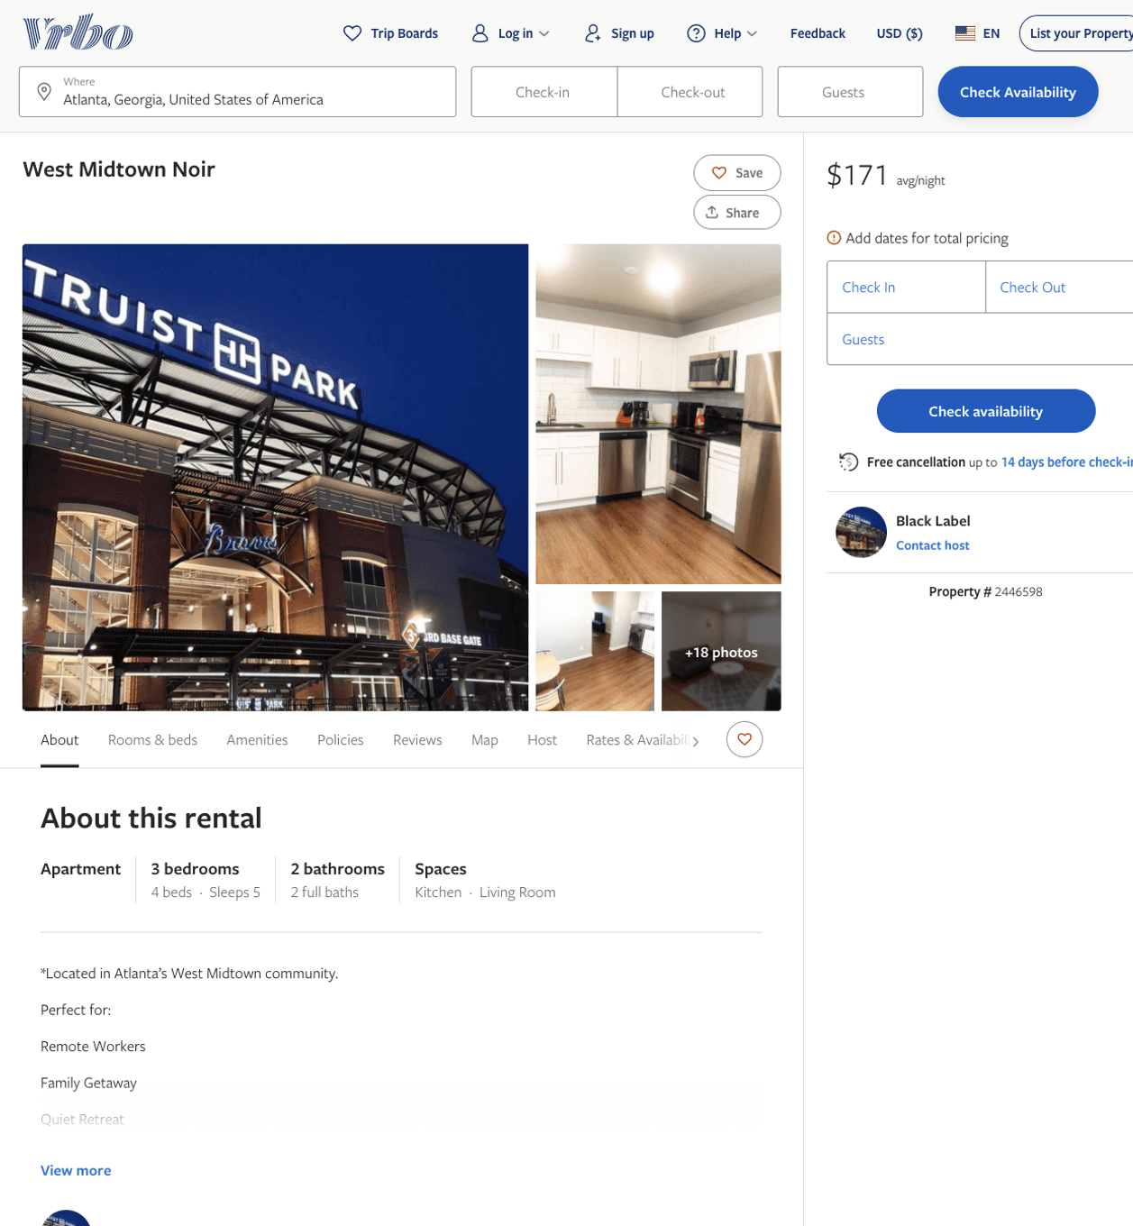
Listing 2446598
3
6
$147 - $199
2
Black Label
https://www.vrbo.com/2446598
Aug 2022

