Slide 2
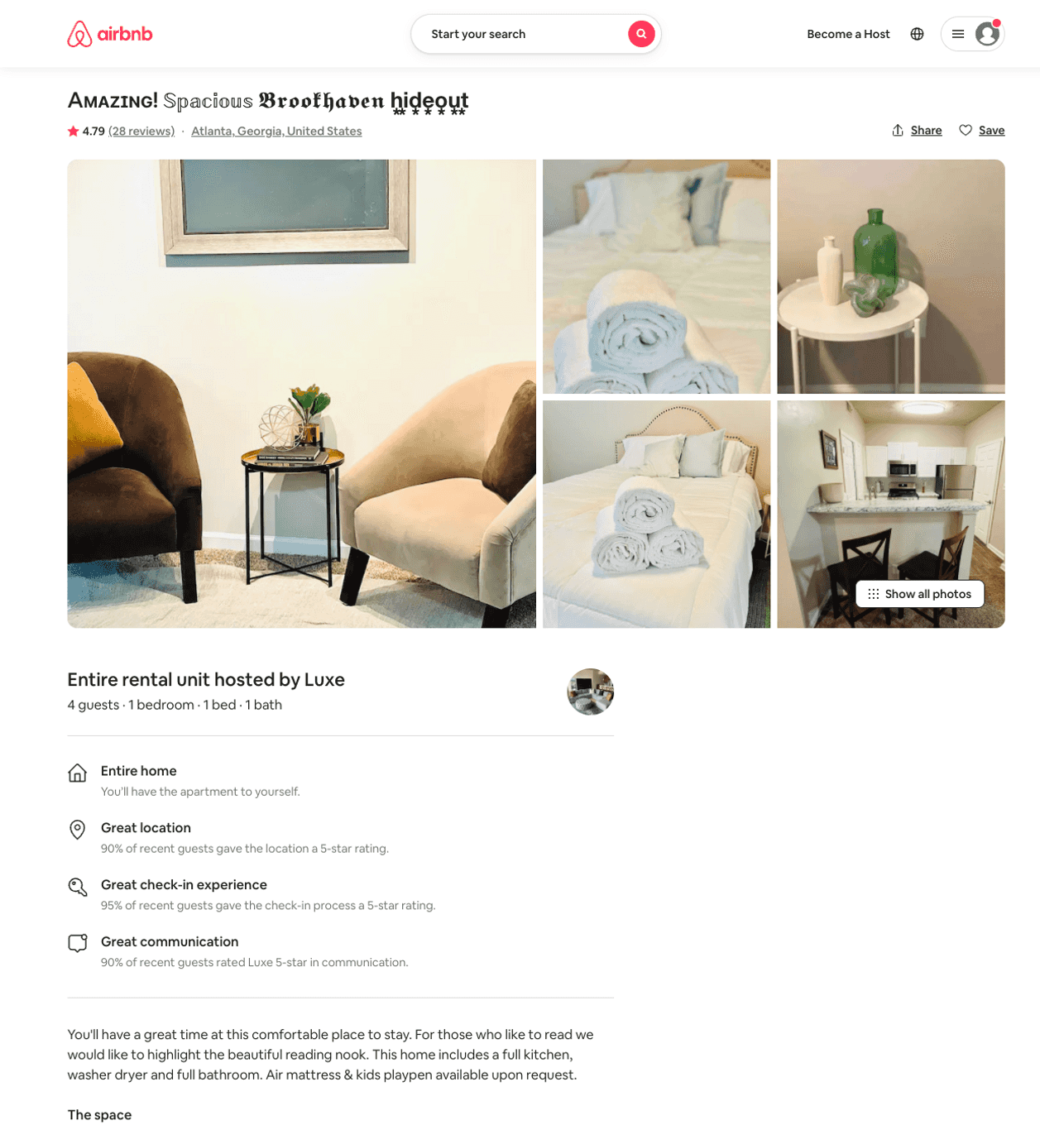
Listing 50610725
1
4
$66 - $163
4.81
1
Luxe
402203952
3
https://www.airbnb.com/rooms/50610725
Aug 2022

Slide 3
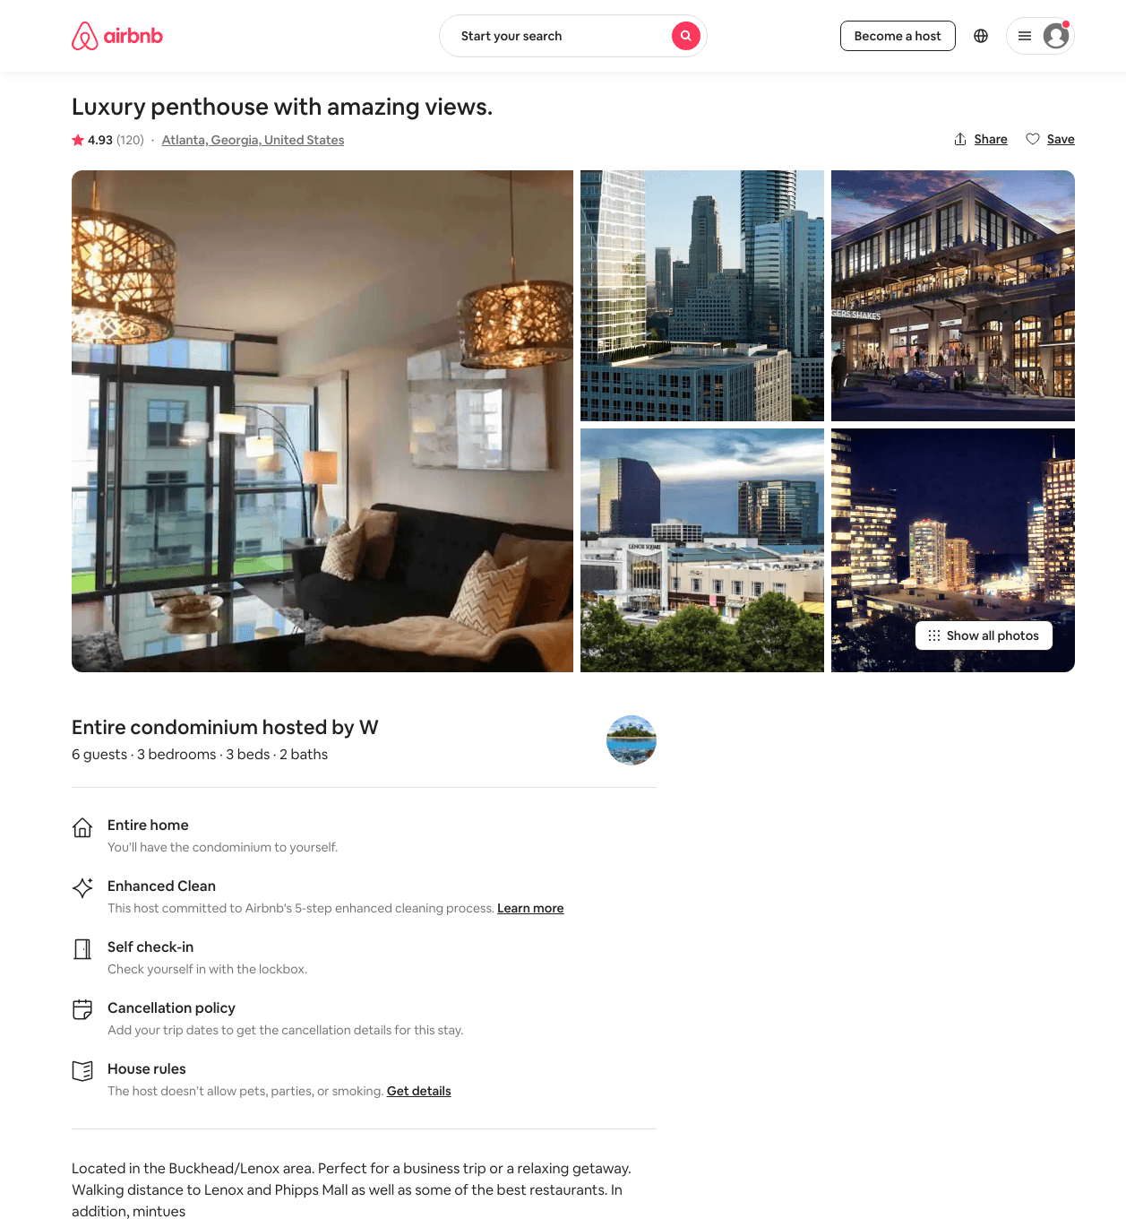
Listing 15875453
3
6
$292 - $456
4.91
2
W
102932620
1
https://www.airbnb.com/rooms/15875453
Aug 2022

Slide 4
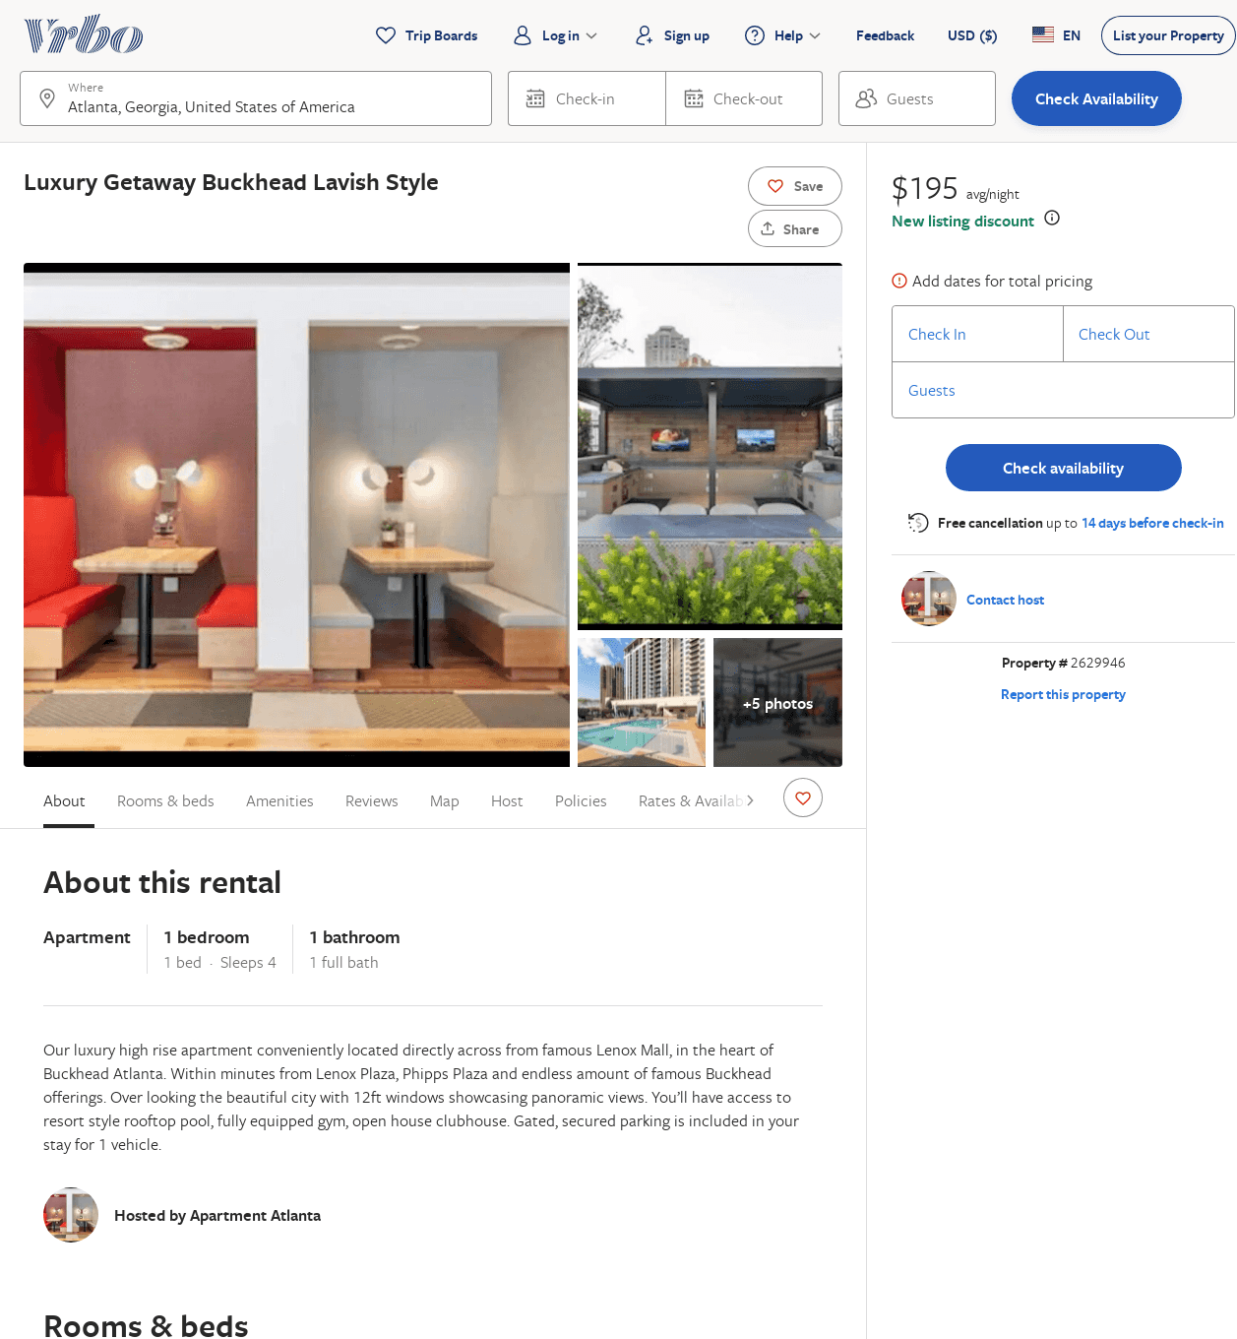
Listing 2629946
1
4
$207
2
https://www.vrbo.com/2629946
Aug 2022

Slide 5
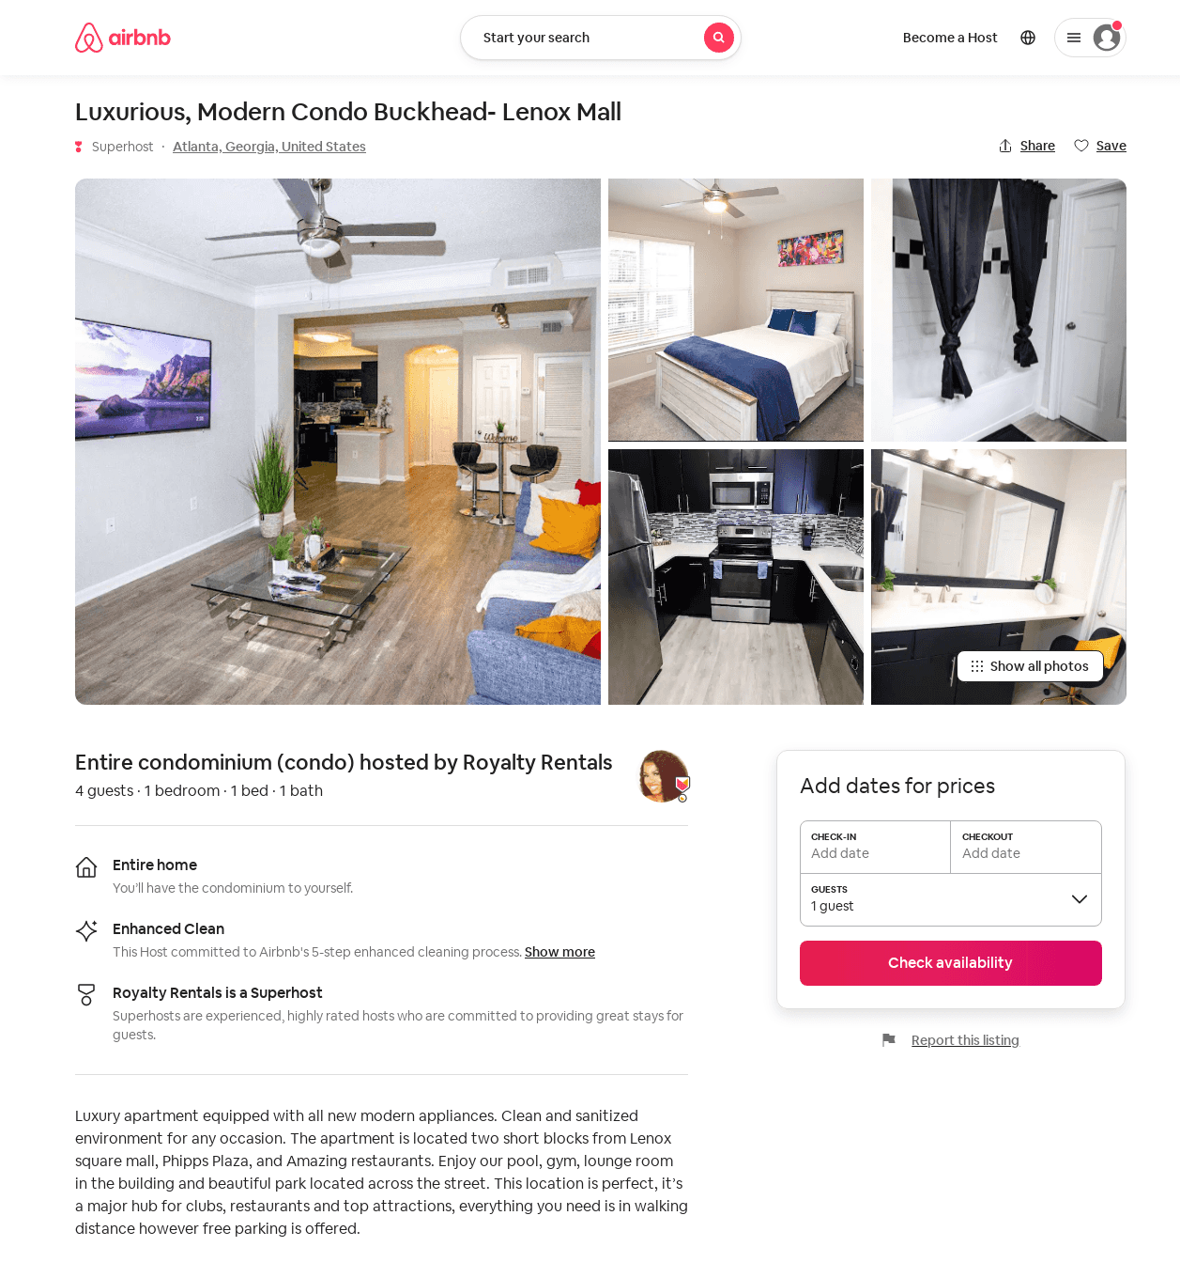
Listing 47308808
1
4
$90 - $92
2
Royalty Rentals
318212179
2
https://www.airbnb.com/rooms/47308808
Aug 2022

Slide 6
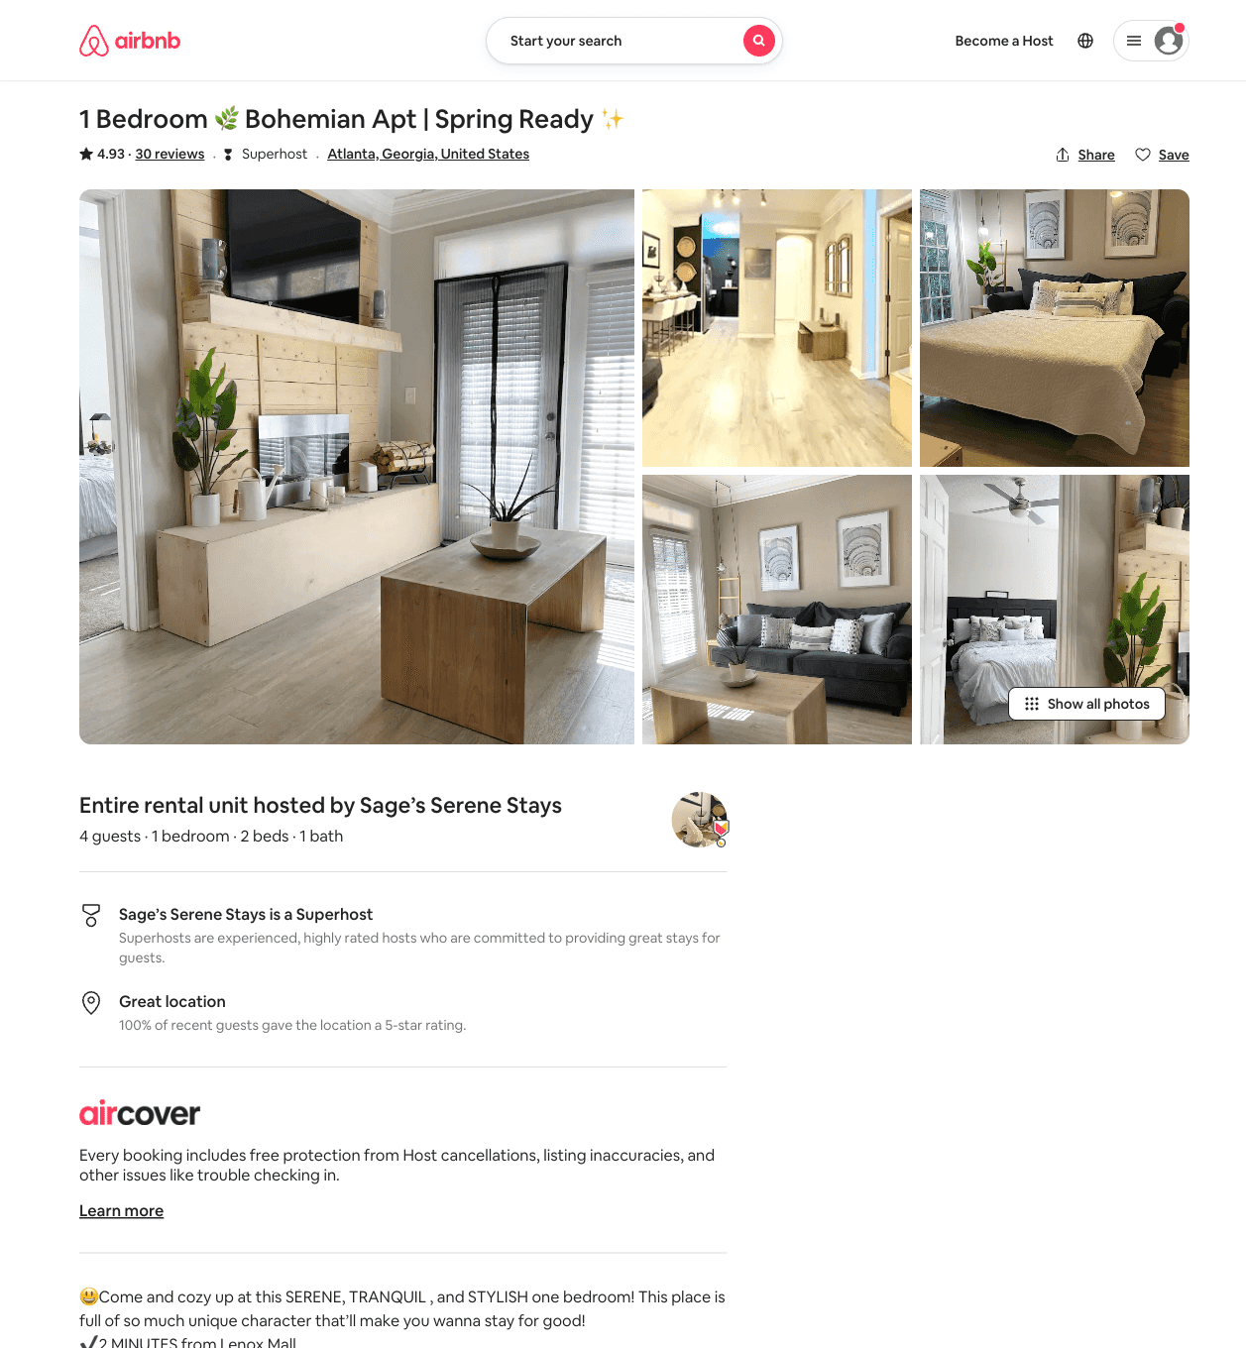
Listing 54047663
1
4
$85 - $114
4.93
1
Sage’s Serene Stays
438002095
1
https://www.airbnb.com/rooms/54047663
Aug 2022

Slide 7
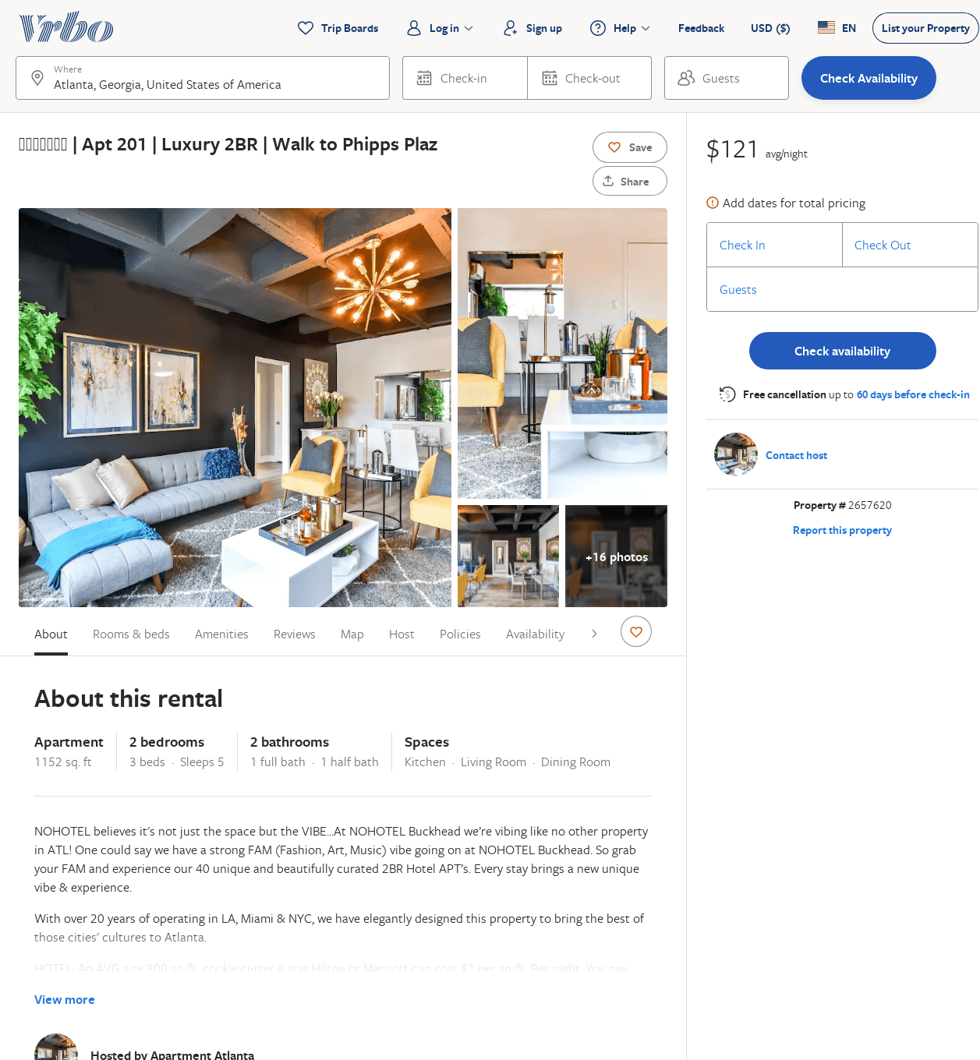
Listing 2657620
2
5
$146
1
https://www.vrbo.com/2657620
Aug 2022

Slide 8
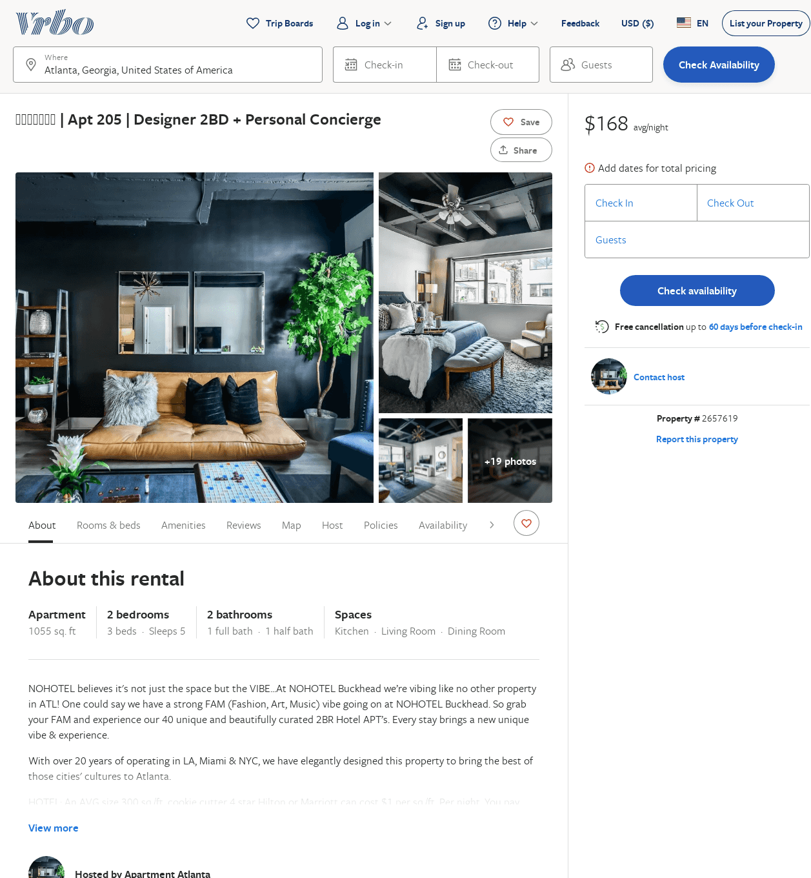
Listing 2657619
2
5
$164
1
https://www.vrbo.com/2657619
Aug 2022

Slide 9
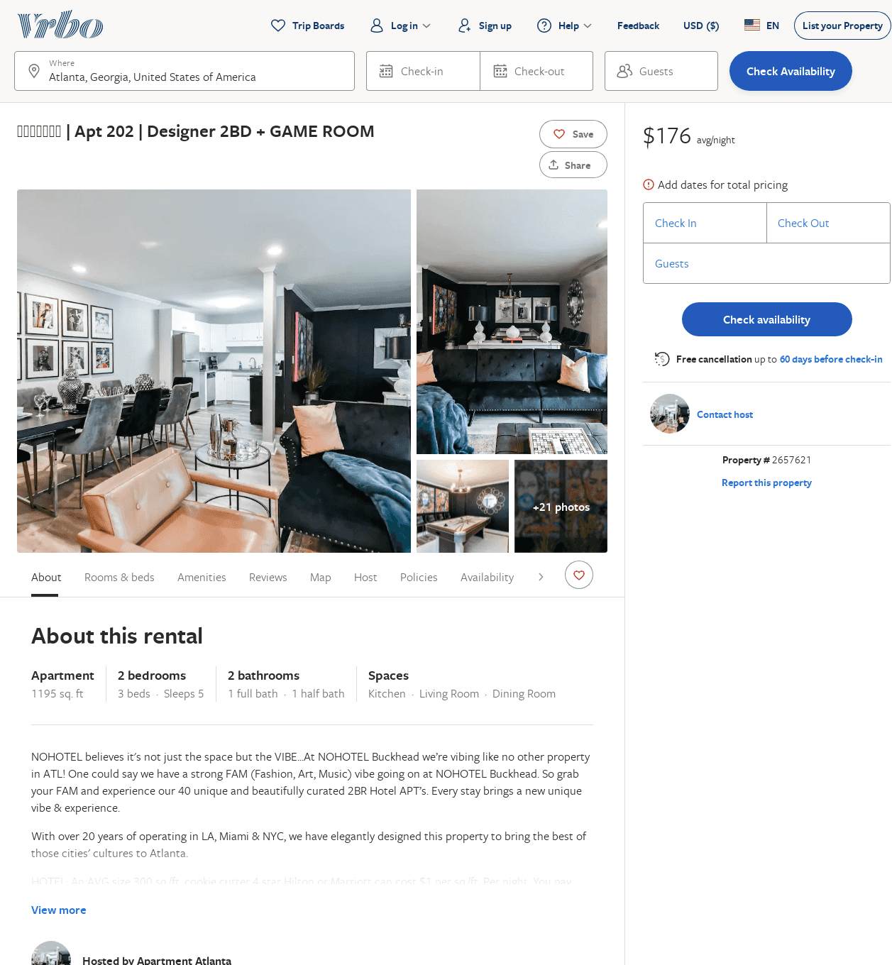
Listing 2657621
2
5
$235
1
https://www.vrbo.com/2657621
Aug 2022

Slide 10
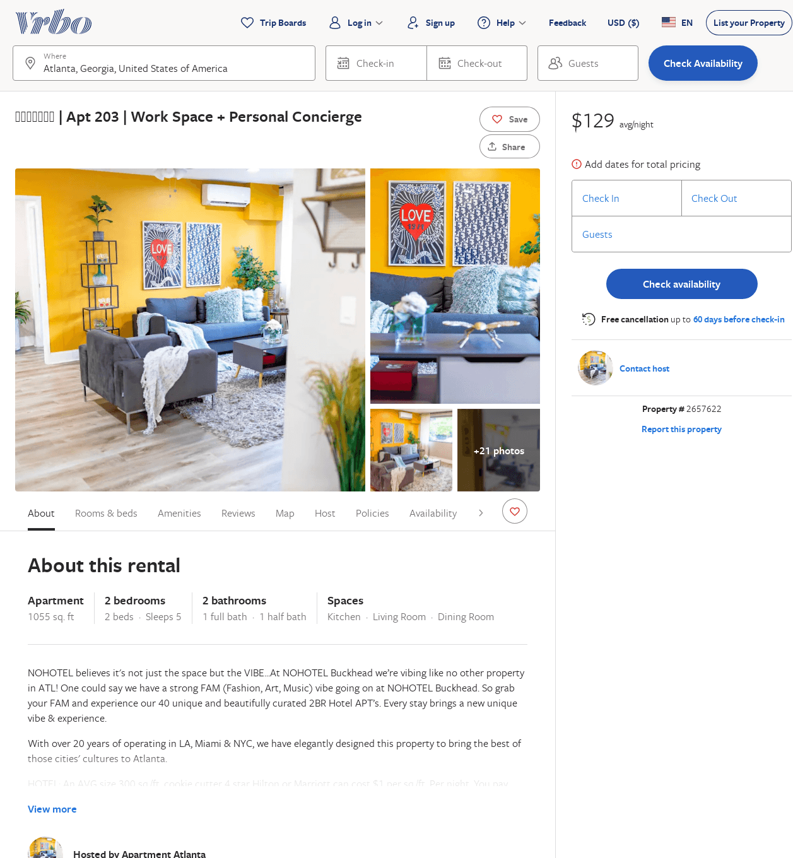
Listing 2657622
2
5
$170
1
https://www.vrbo.com/2657622
Aug 2022

Slide 11
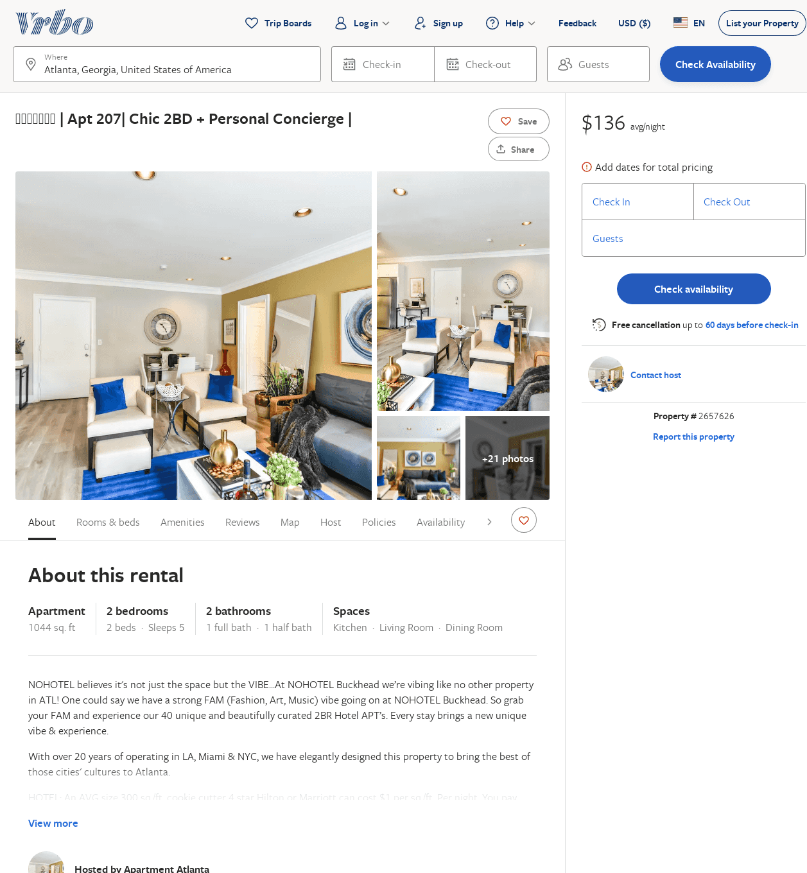
Listing 2657626
2
5
$151
1
https://www.vrbo.com/2657626
Aug 2022

Slide 12
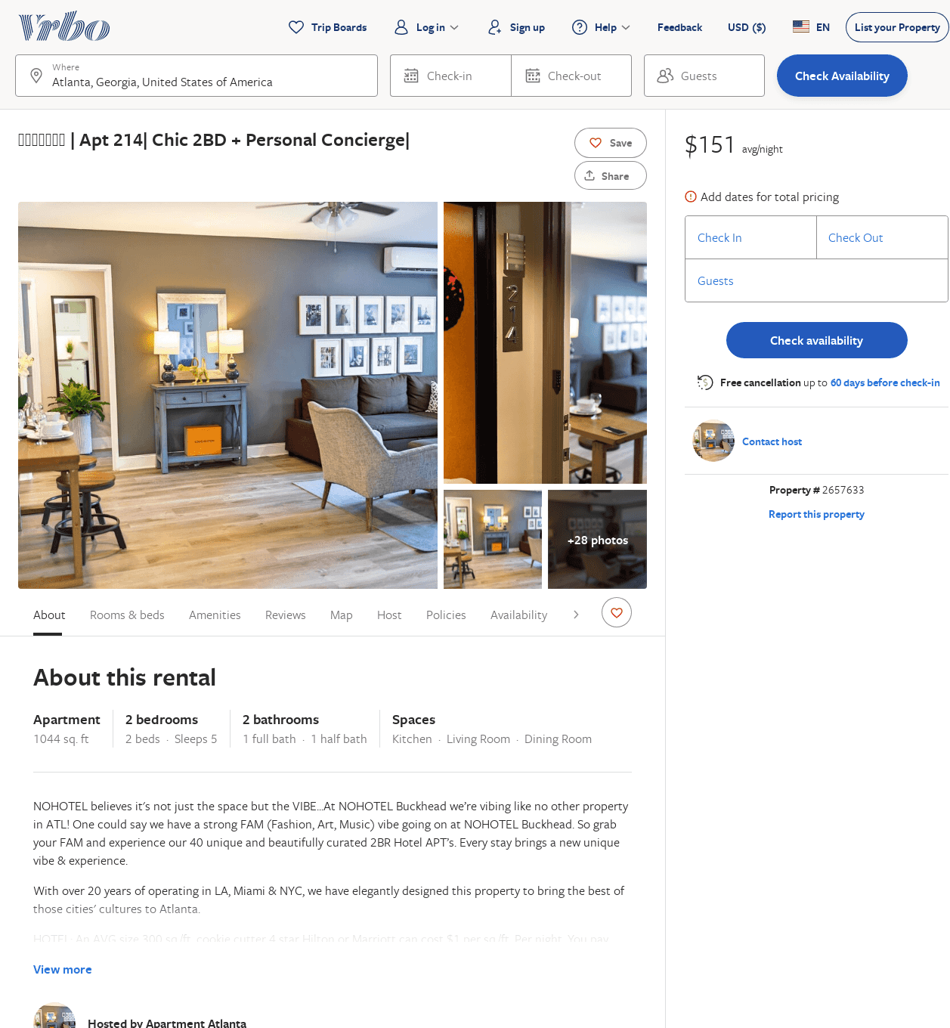
Listing 2657633
2
5
$159
1
https://www.vrbo.com/2657633
Aug 2022

Slide 13
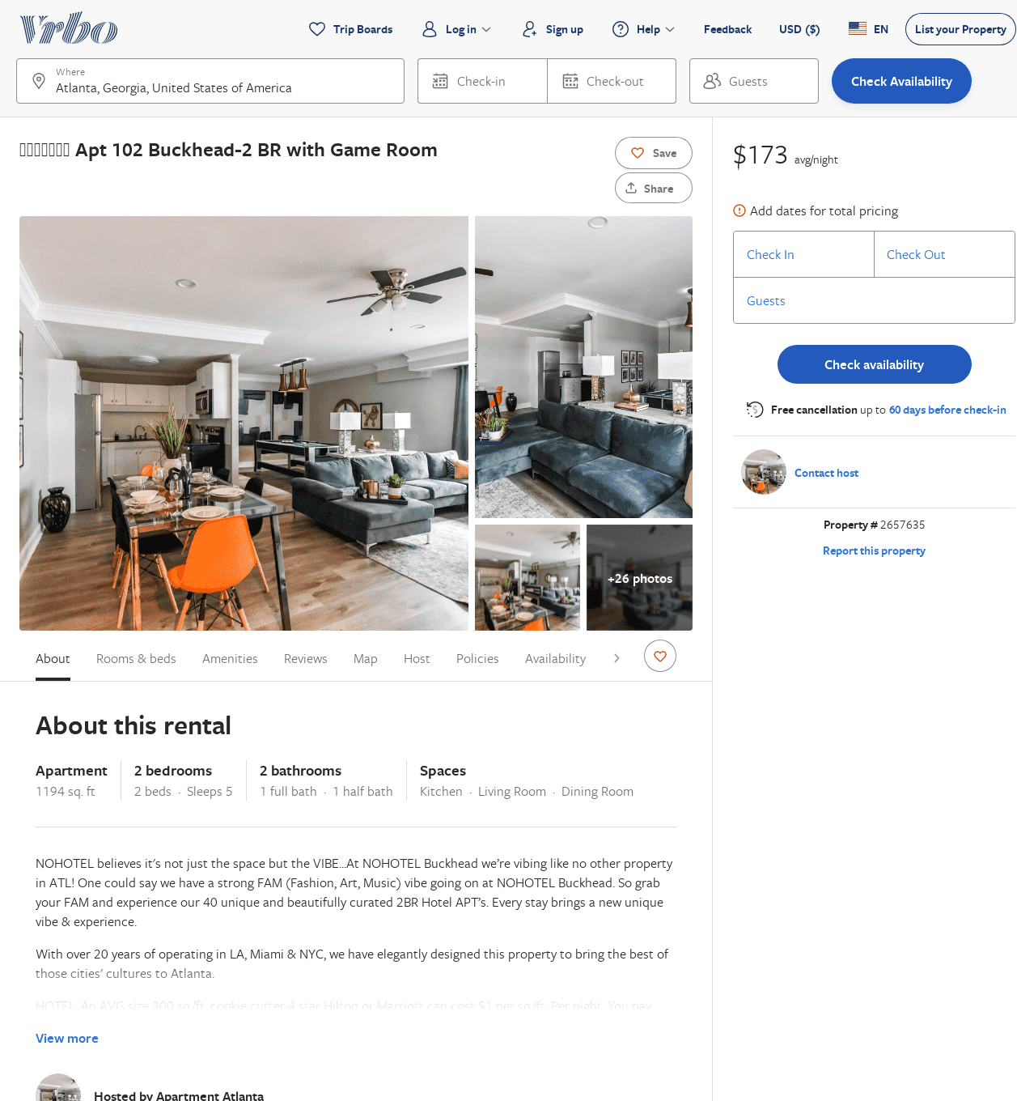
Listing 2657635
2
5
$199
1
https://www.vrbo.com/2657635
Aug 2022

Slide 14
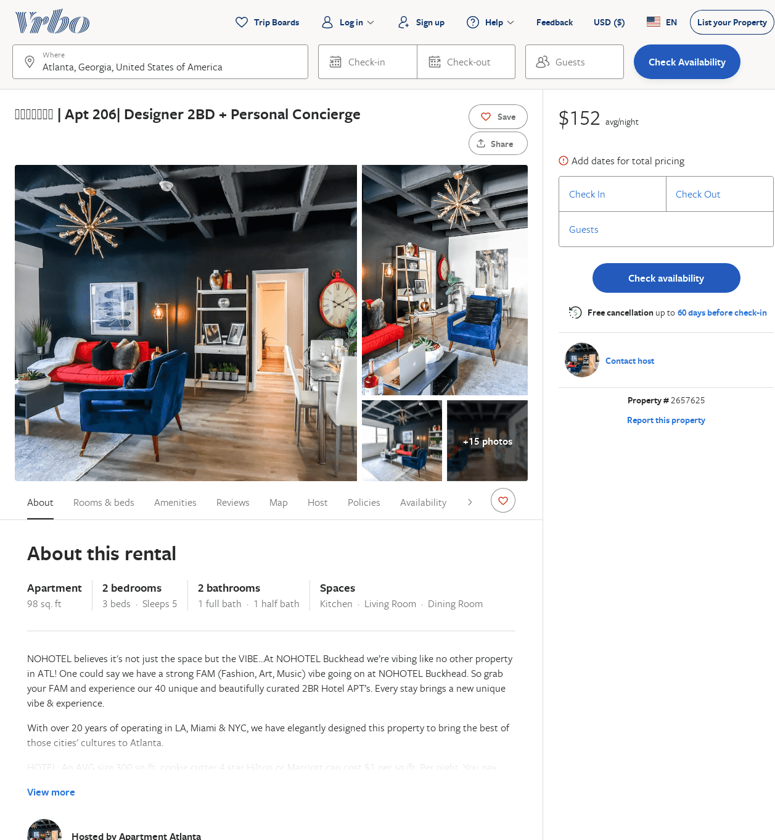
Listing 2657625
2
5
$163
1
https://www.vrbo.com/2657625
Aug 2022

Slide 15
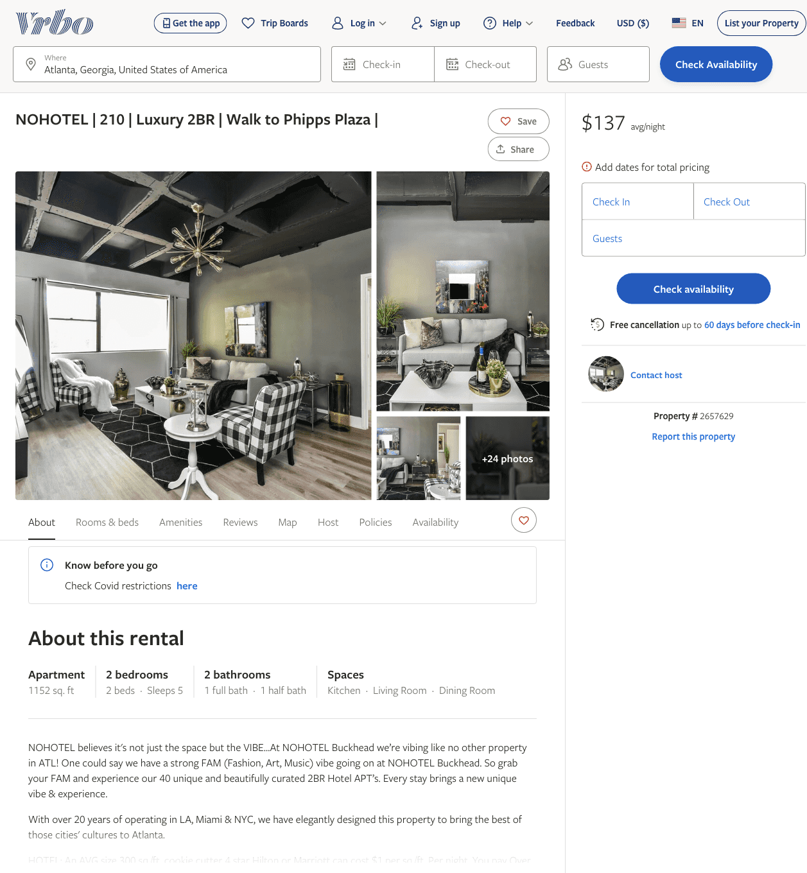
Listing 2657629
2
5
$137
1
https://www.vrbo.com/2657629
Aug 2022

Slide 16
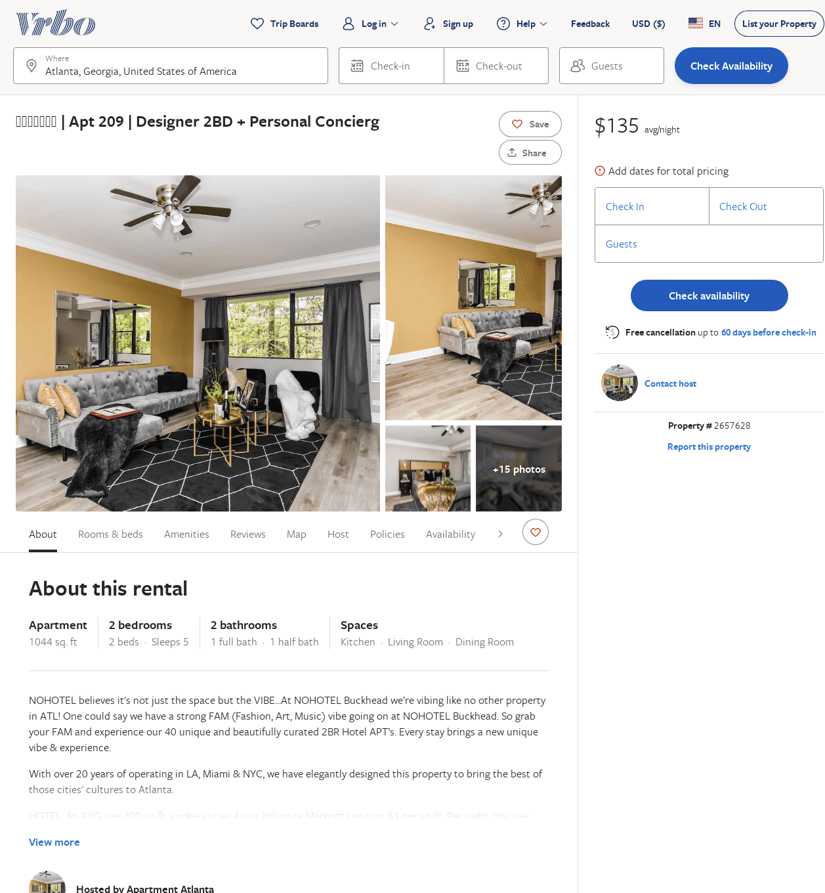
Listing 2657628
2
5
$161
1
https://www.vrbo.com/2657628
Aug 2022

Slide 17
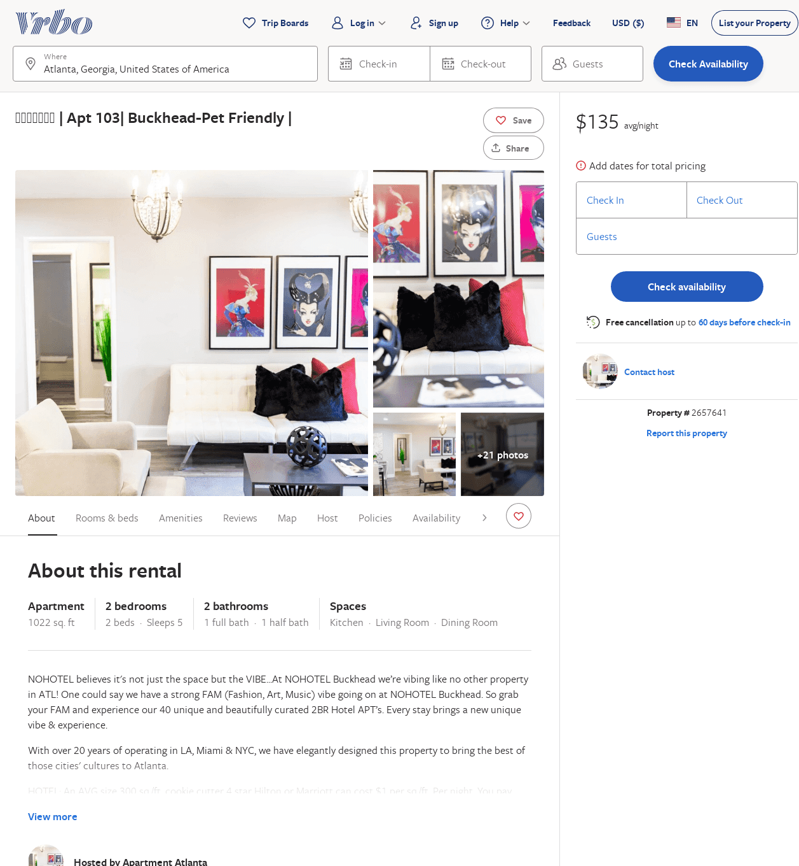
Listing 2657641
2
5
$161
1
https://www.vrbo.com/2657641
Aug 2022

Slide 18
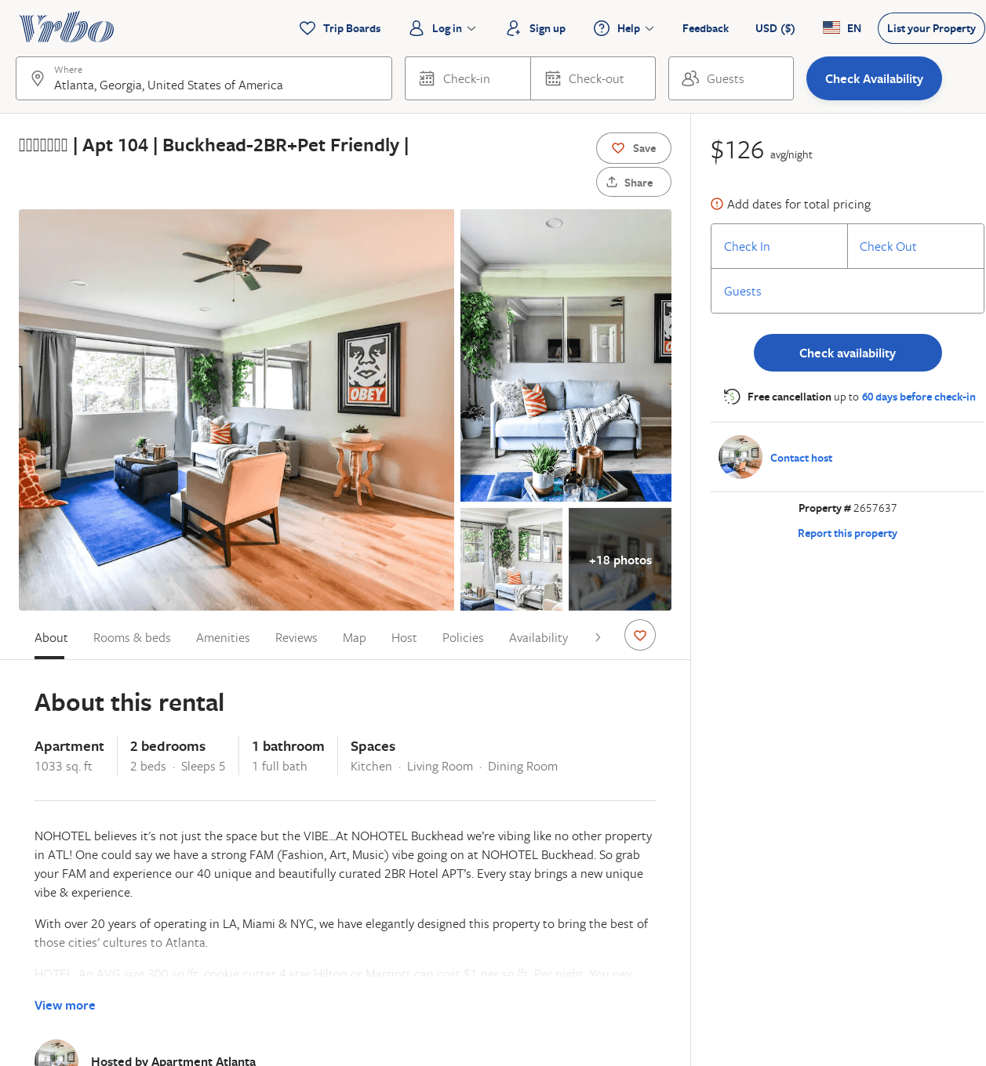
Listing 2657637
2
5
$150
1
https://www.vrbo.com/2657637
Aug 2022

Slide 19
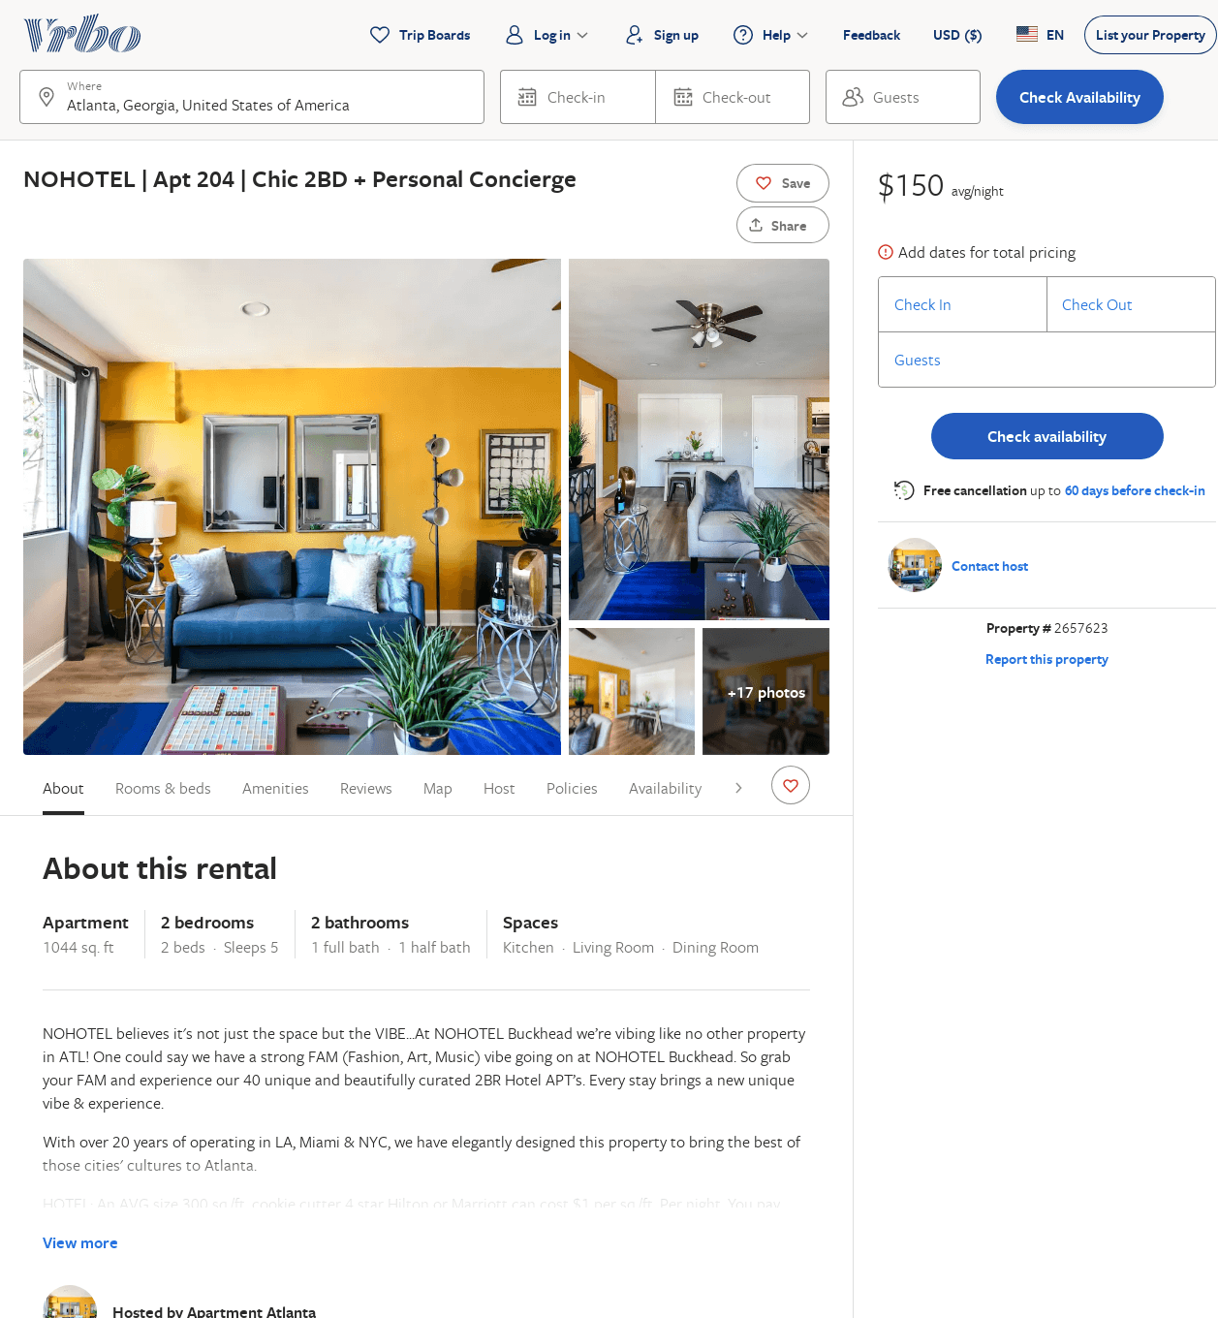
Listing 2657623
2
5
$161
1
https://www.vrbo.com/2657623
Aug 2022

Slide 20
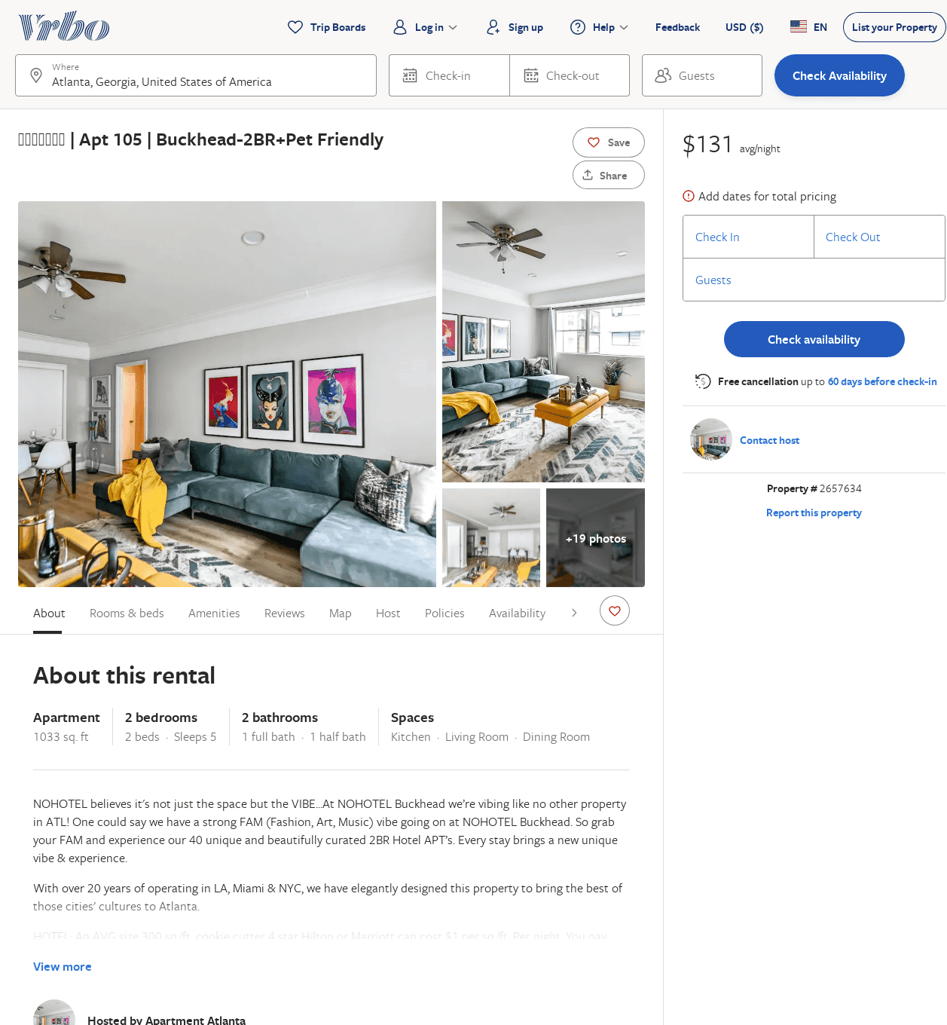
Listing 2657634
2
5
$150
1
https://www.vrbo.com/2657634
Aug 2022

Slide 21
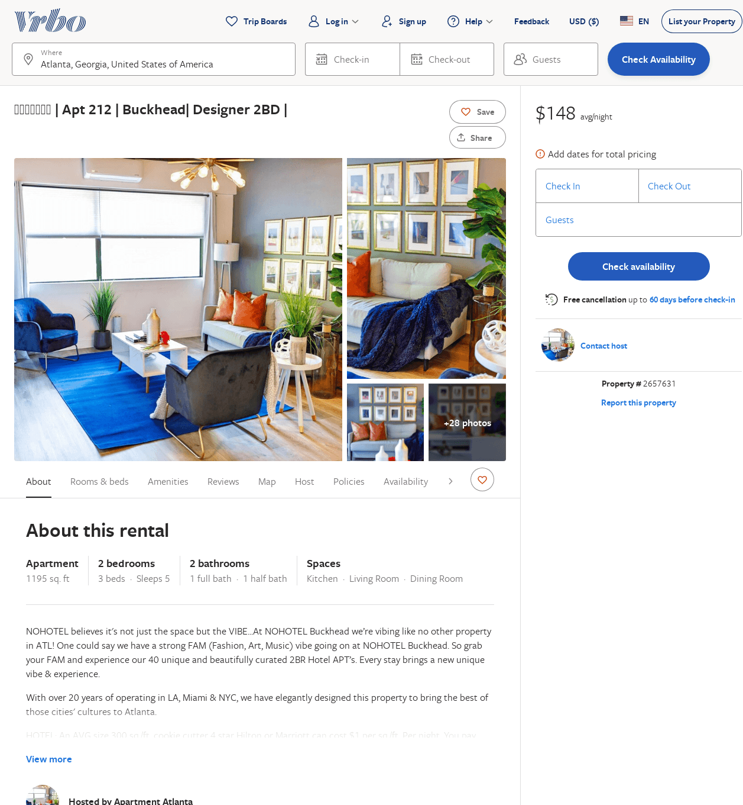
Listing 2657631
2
5
$159
1
https://www.vrbo.com/2657631
Aug 2022

Slide 22
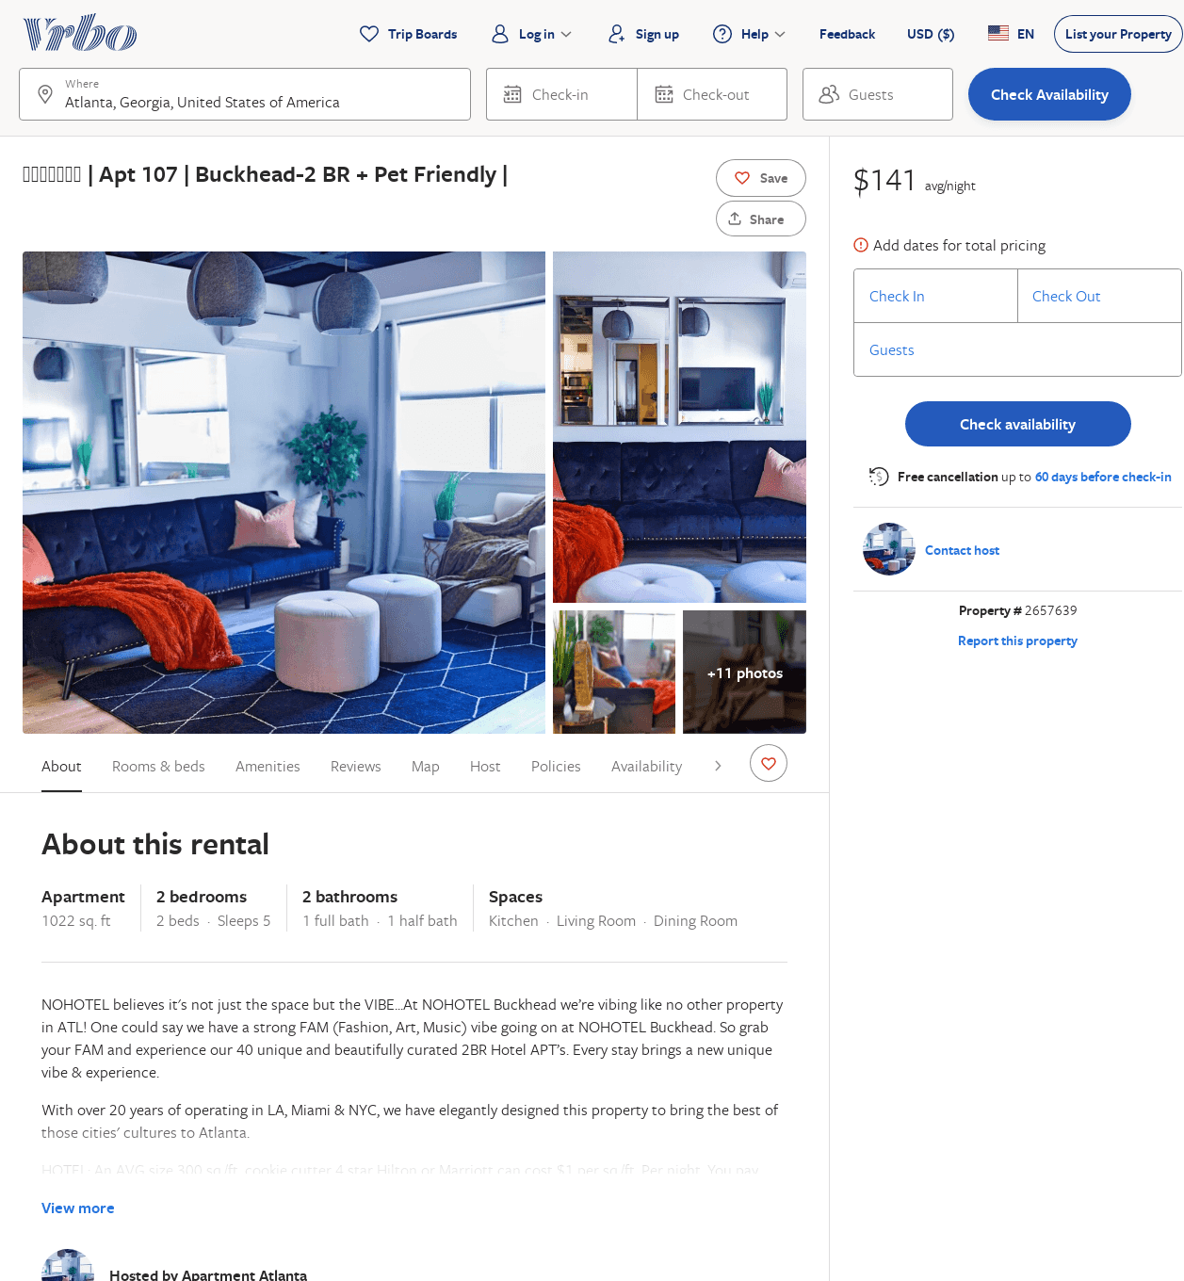
Listing 2657639
2
5
$150
1
https://www.vrbo.com/2657639
Aug 2022

Slide 23
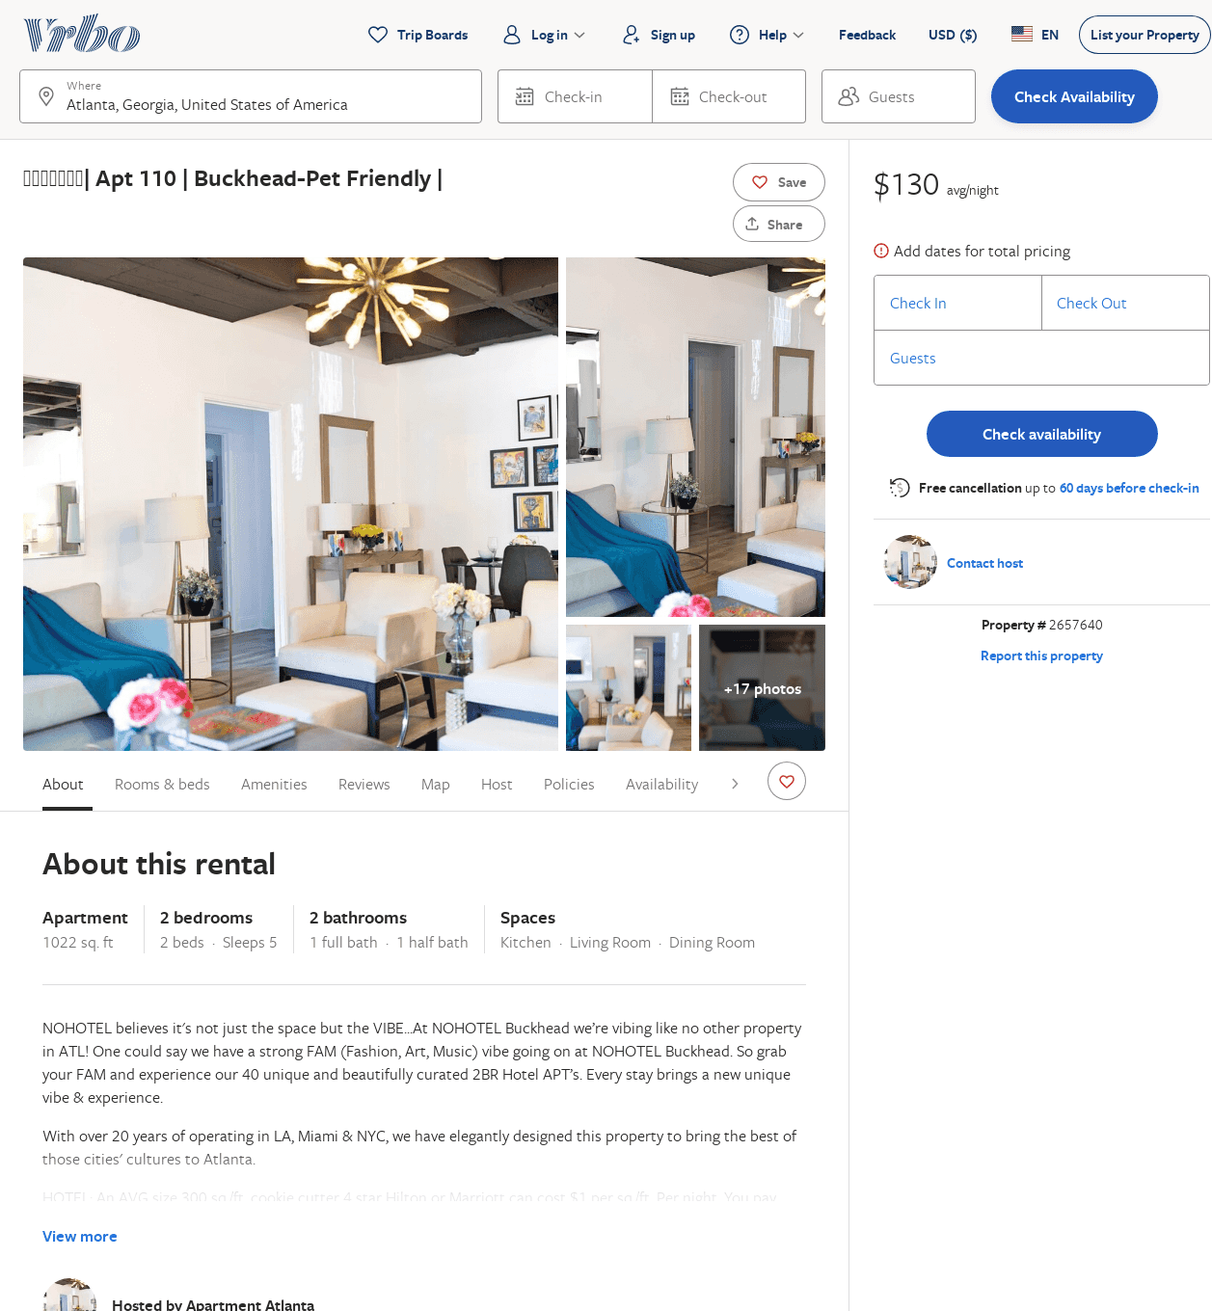
Listing 2657640
2
5
$151
1
https://www.vrbo.com/2657640
Aug 2022

Slide 24
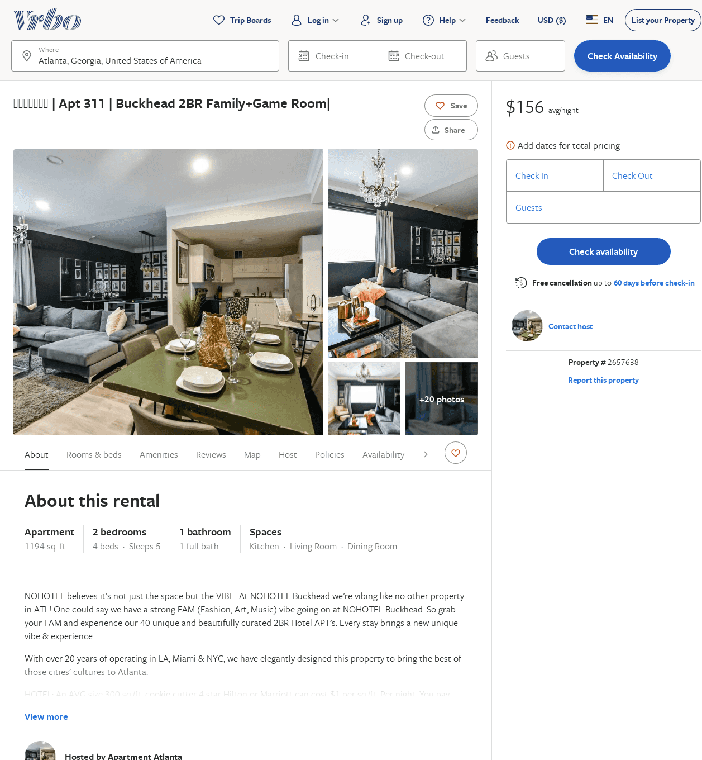
Listing 2657638
2
5
$172
1
https://www.vrbo.com/2657638
Aug 2022

Slide 25
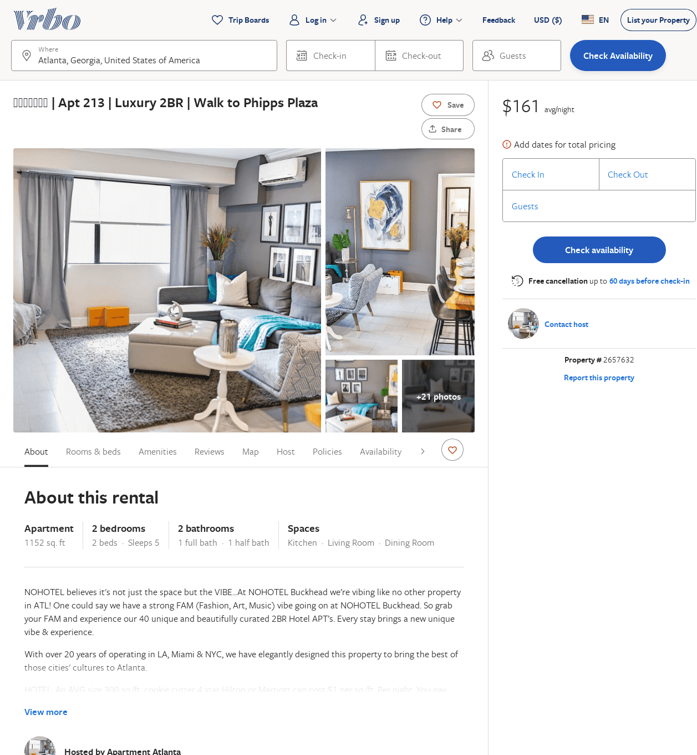
Listing 2657632
2
5
$177
1
https://www.vrbo.com/2657632
Aug 2022

Slide 26
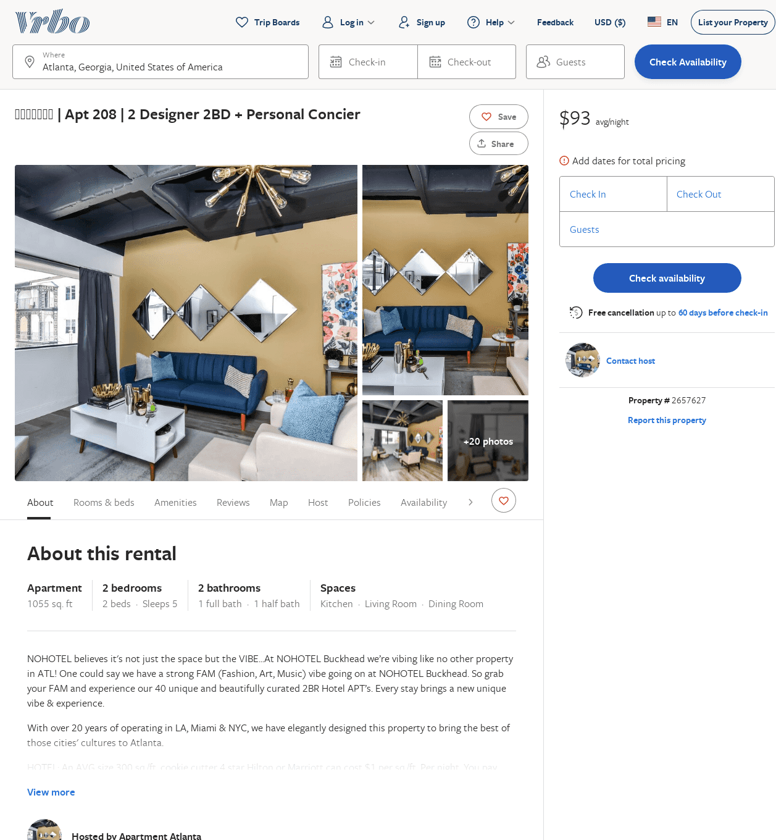
Listing 2657627
2
5
$161
1
https://www.vrbo.com/2657627
Aug 2022

Slide 27
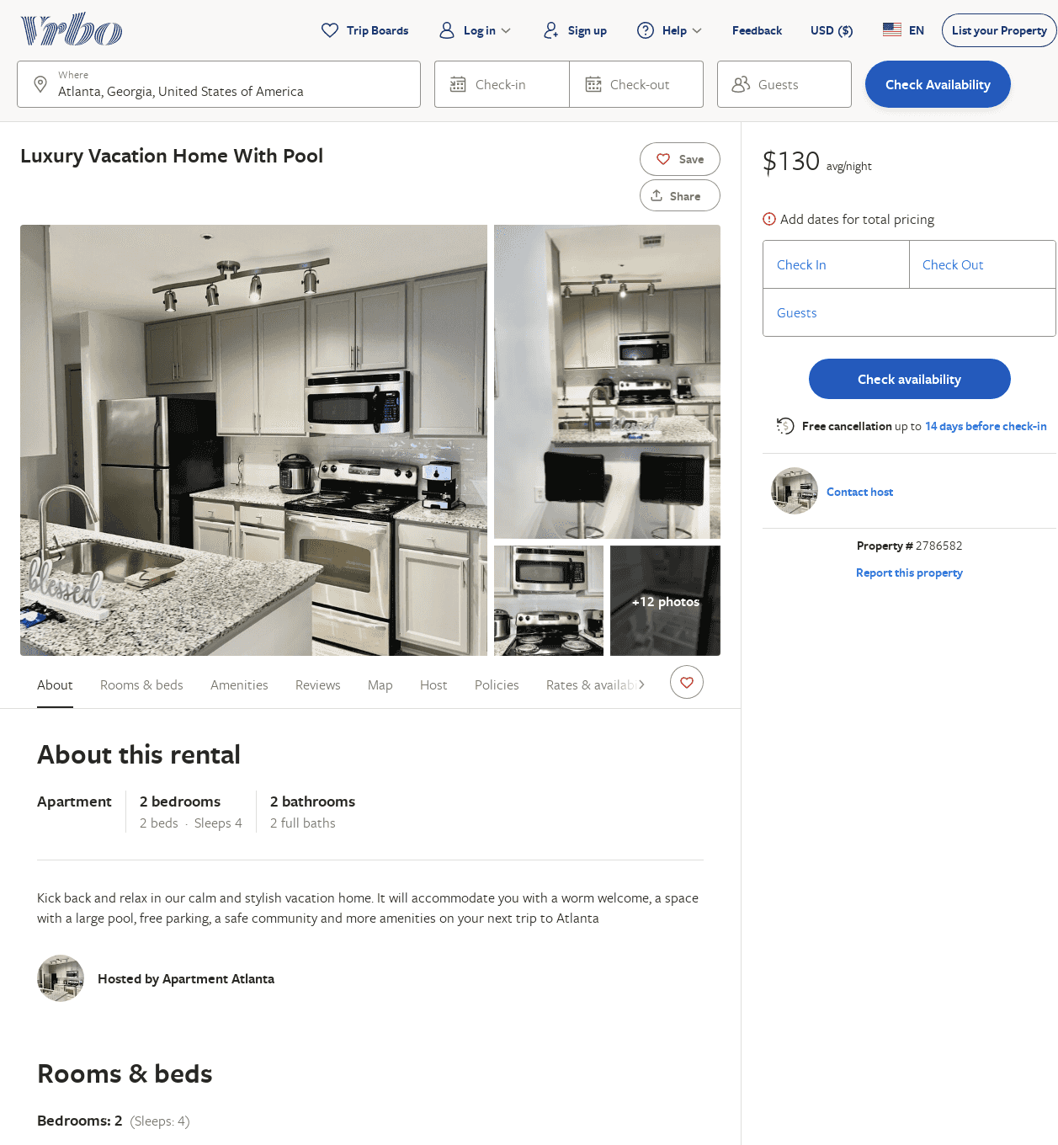
Listing 2786582
2
4
$160
2
https://www.vrbo.com/2786582
Aug 2022

Slide 28
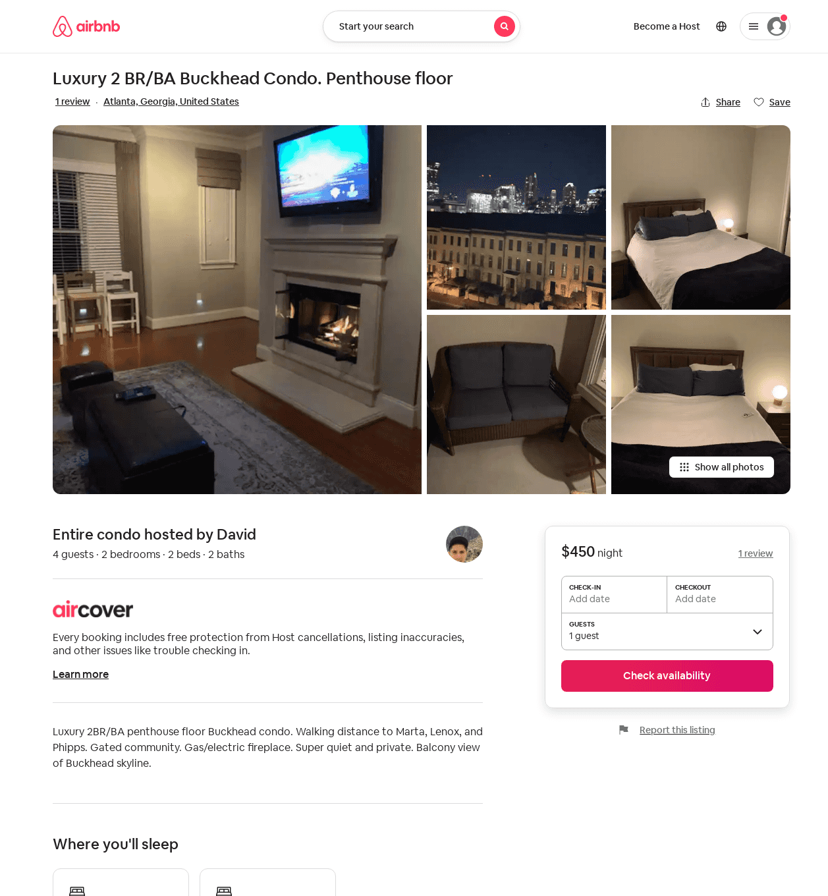
Listing 31362900
2
4
1
David
27111076
1
https://www.airbnb.com/rooms/31362900
Aug 2022

