Slide 2
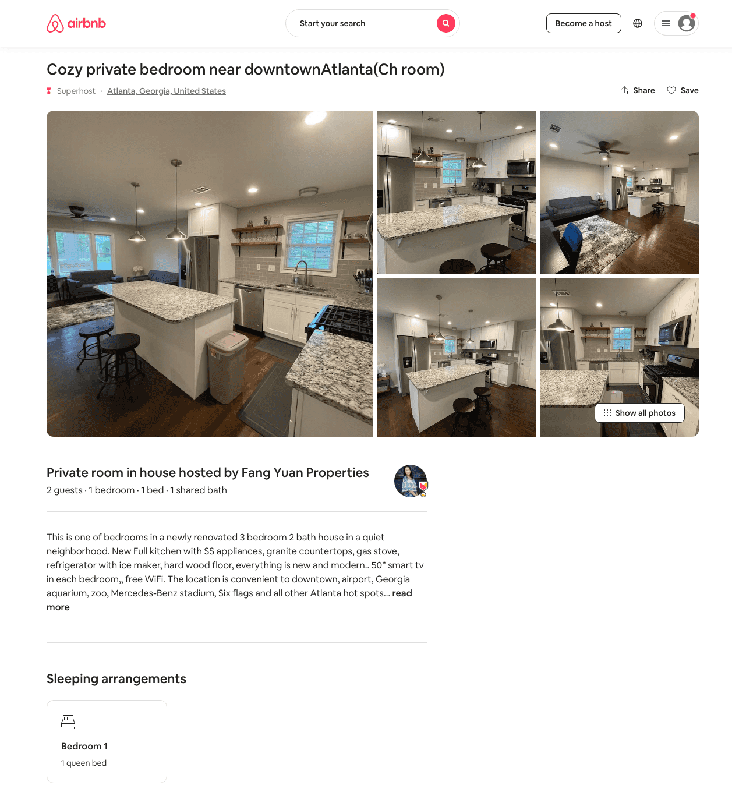
Listing 49115062
1
2
$35 - $57
4.74
1
Fang Yuan Properties
126122495
21
https://www.airbnb.com/rooms/49115062
Jul 2022

