Slide 2
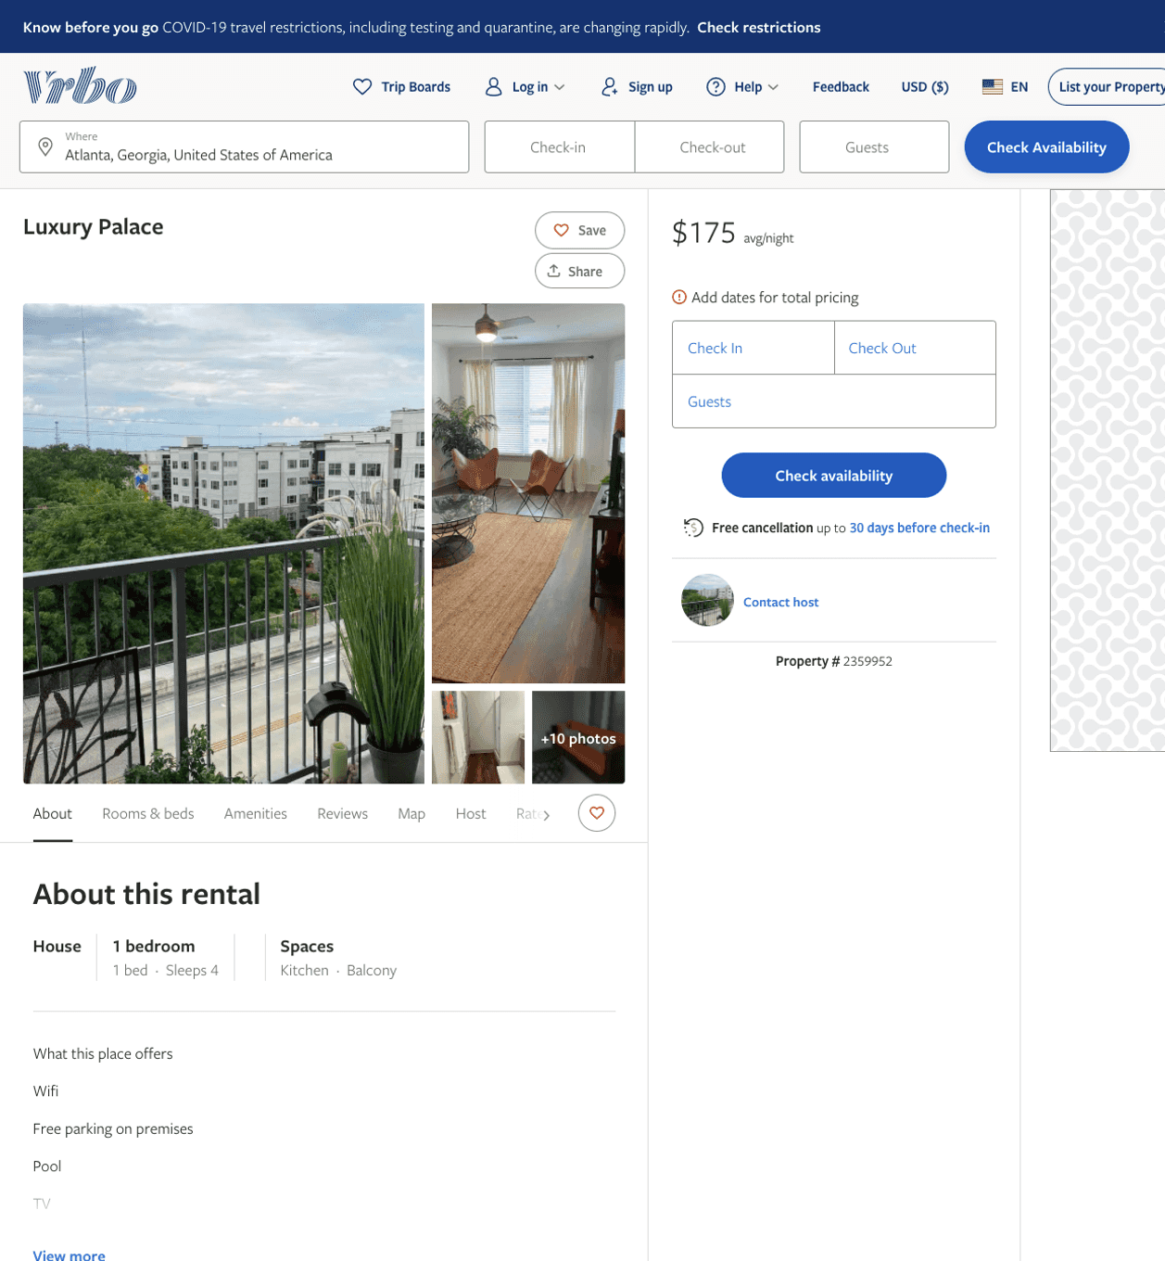
Listing 2359952
1
4
$175
4
2
https://www.vrbo.com/2359952
Aug 2022

Slide 3
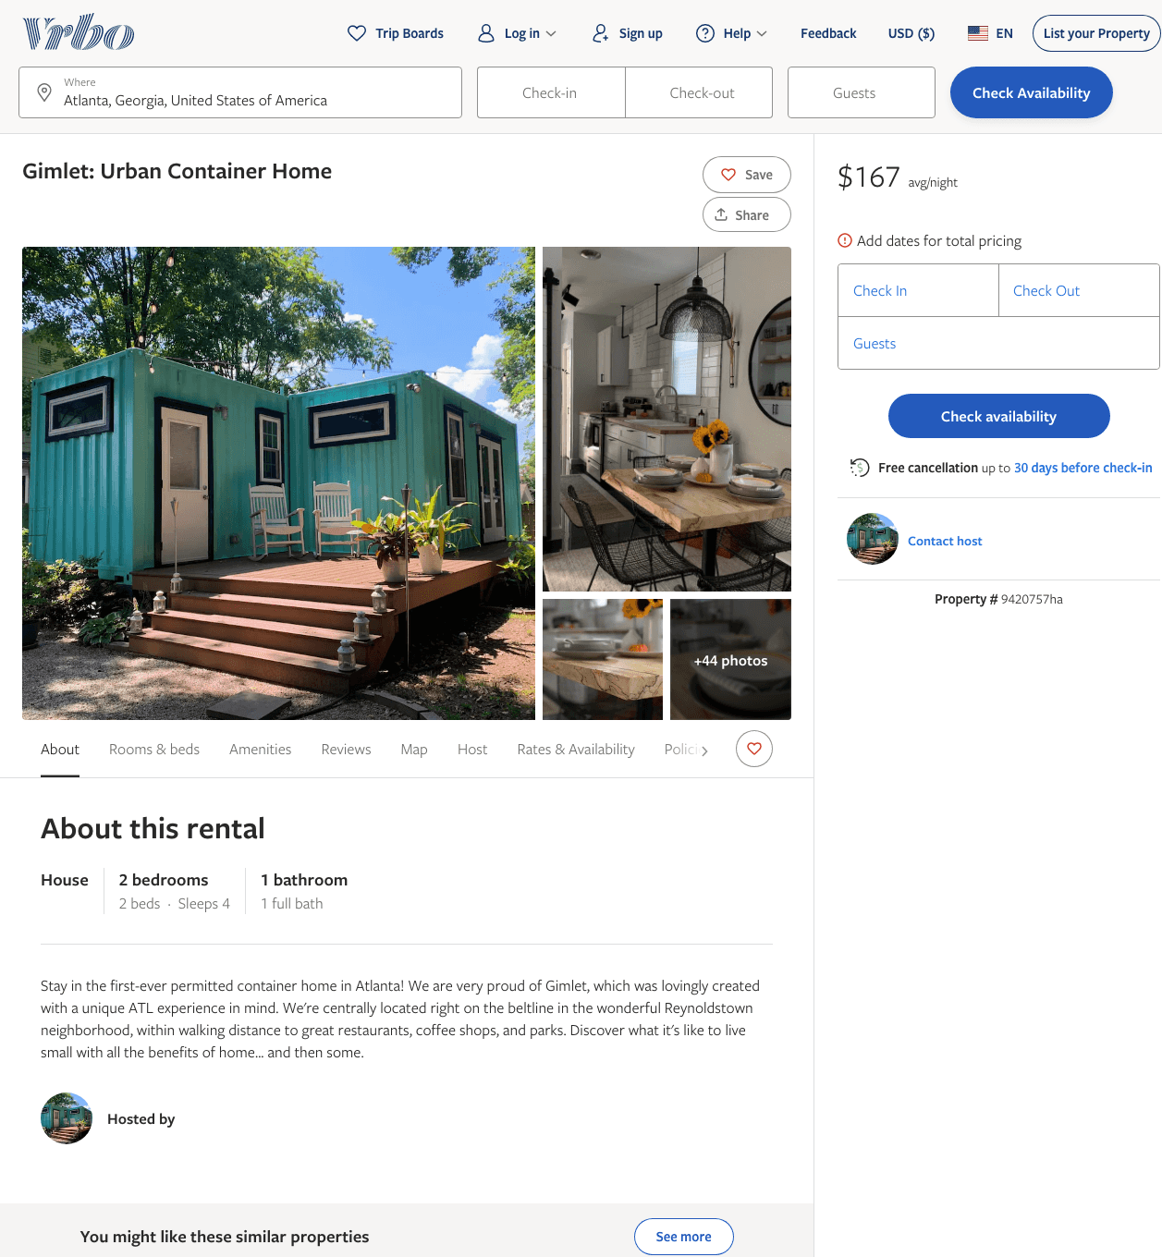
Listing 9420757
2
4
$167 - $174
5
3
https://www.vrbo.com/9420757ha
Aug 2022

Slide 4
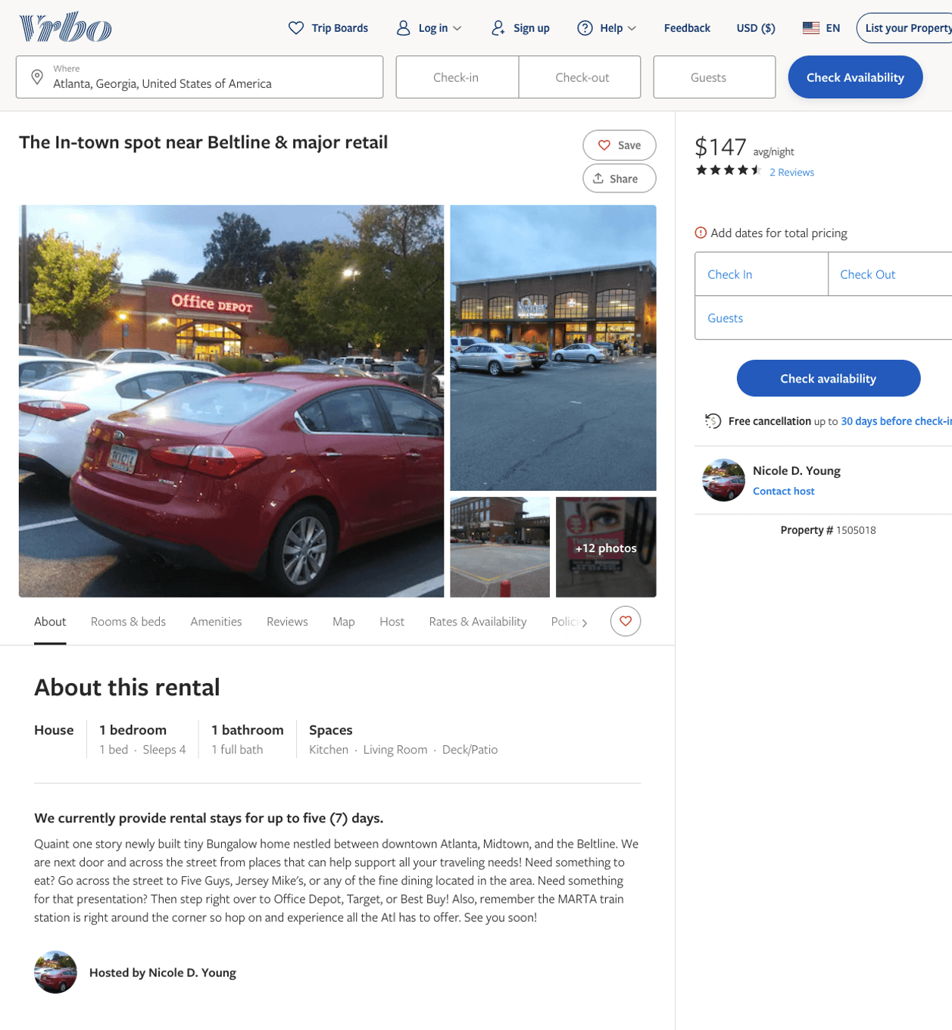
Listing 1505018
1
4
$119 - $147
4.6666665
1
Nicole D. Young
https://www.vrbo.com/1505018
Aug 2022

Slide 5
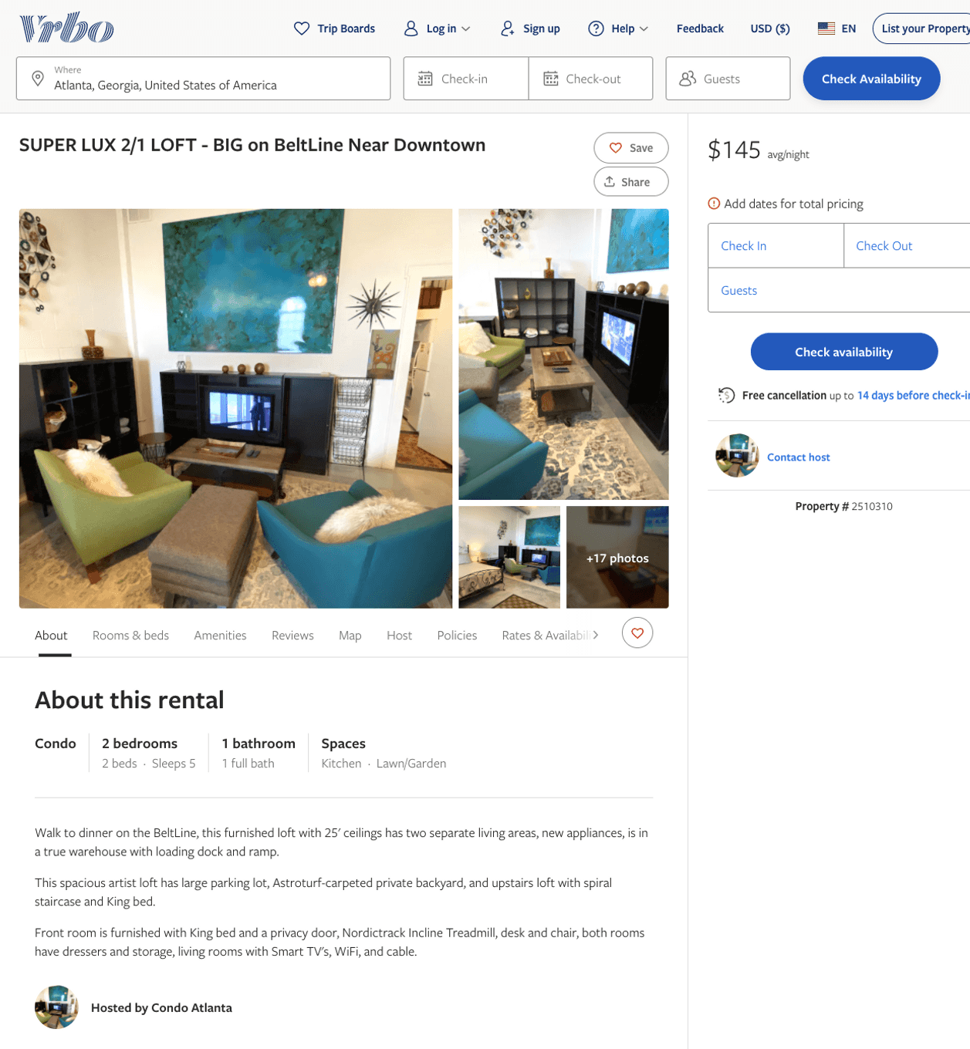
Listing 2510310
2
5
$122 - $99
30
https://www.vrbo.com/2510310
Aug 2022

Slide 6
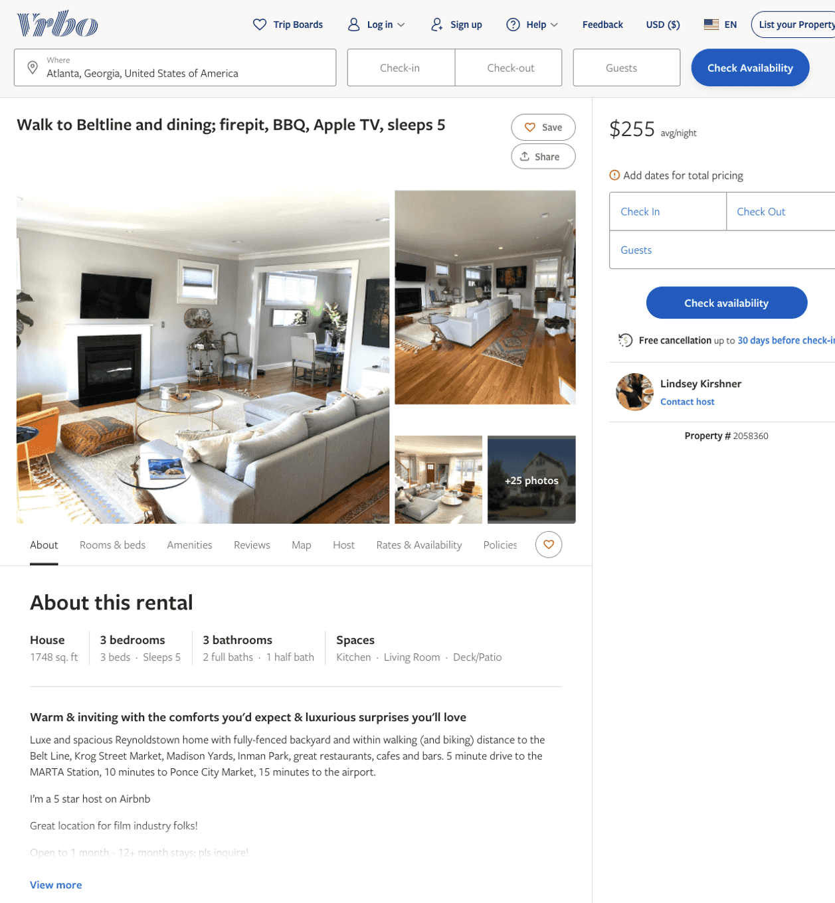
Listing 2058360
3
5
$216 - $275
14
Lindsey Kirshner
https://www.vrbo.com/2058360
Aug 2022

Slide 7
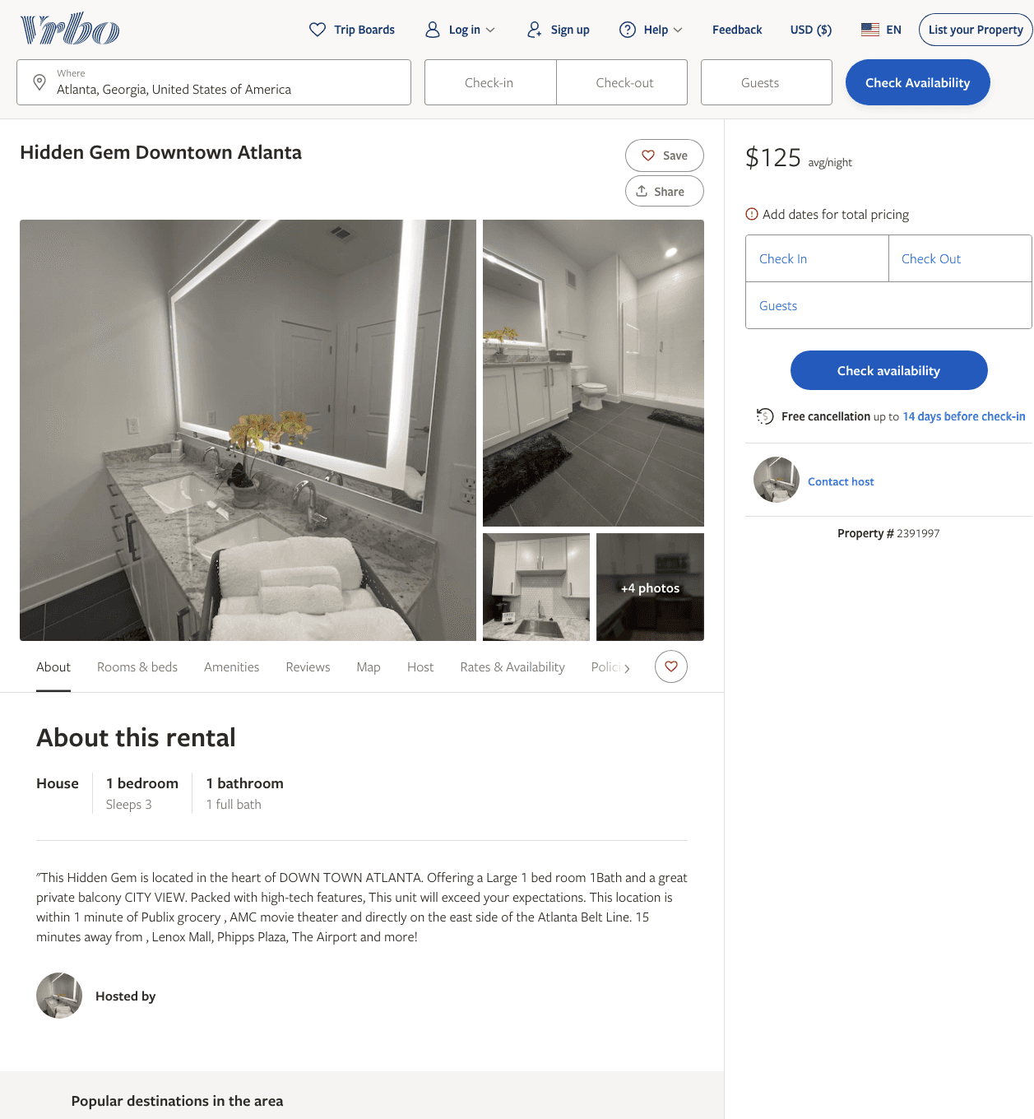
Listing 2391997
1
3
$103 - $99
2
https://www.vrbo.com/2391997
Aug 2022

Slide 8
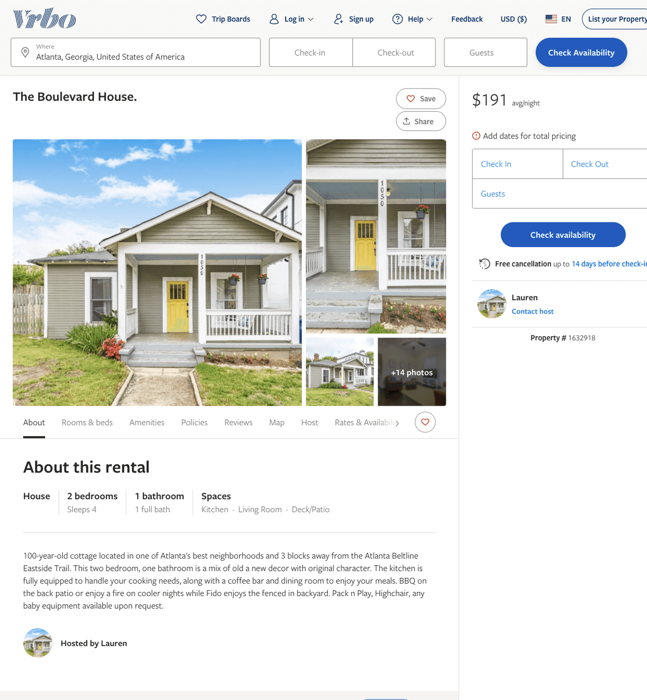
Listing 1632918
2
4
$191
2
Lauren
https://www.vrbo.com/1632918
Aug 2022

Slide 9
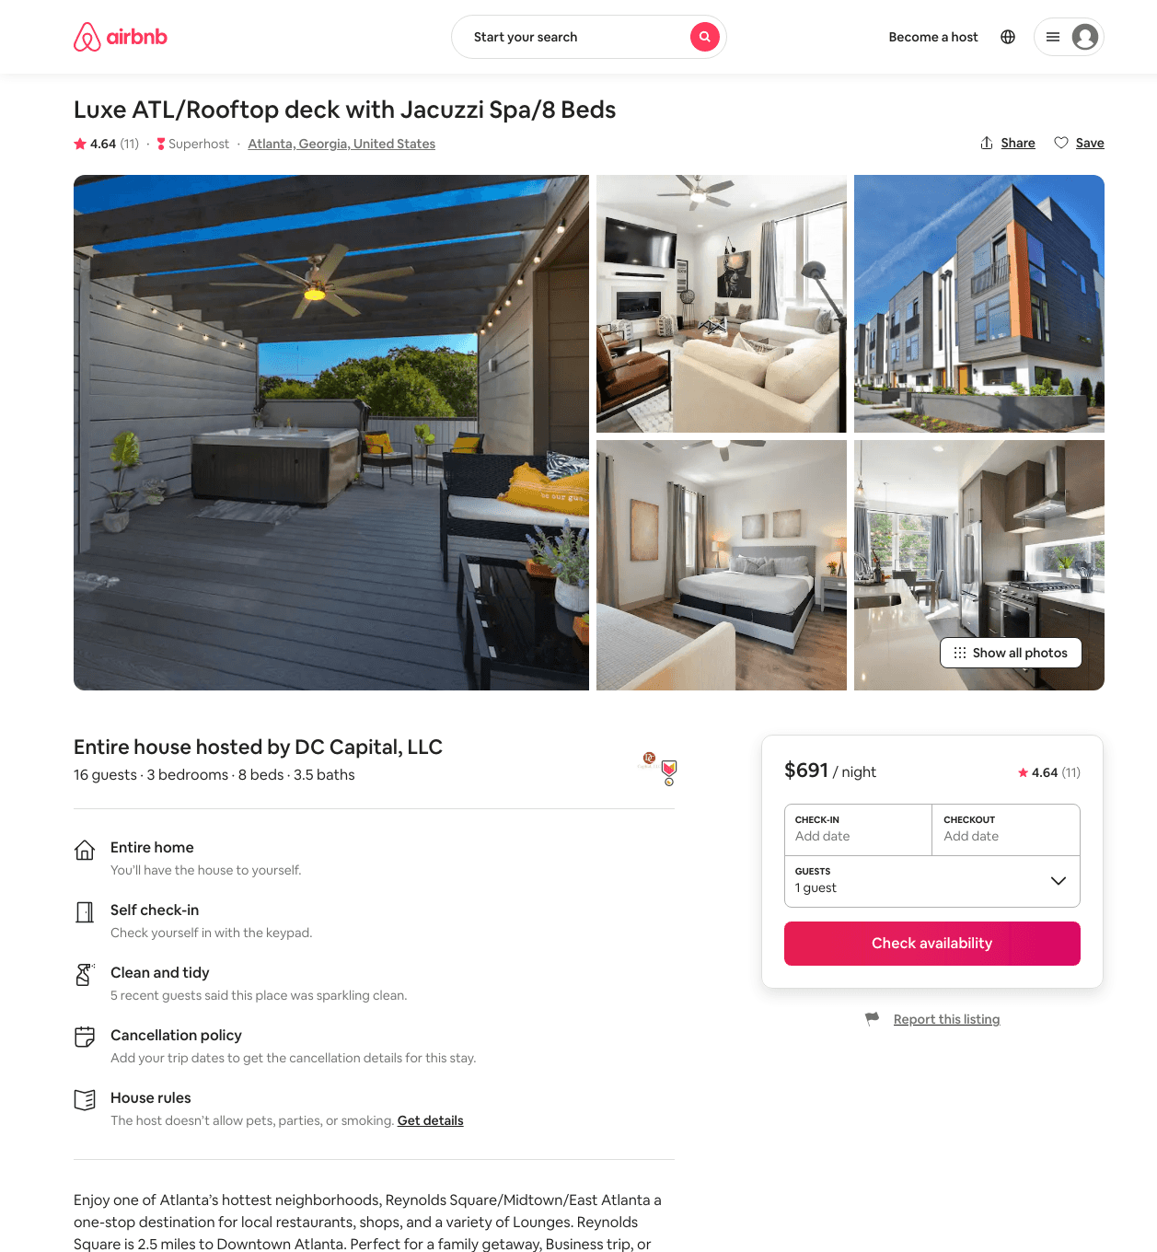
Listing 45494978
3
14
$342 - $769
4.72
3
DC Capital
104850762
1
https://www.airbnb.com/rooms/45494978
Aug 2022

Slide 10
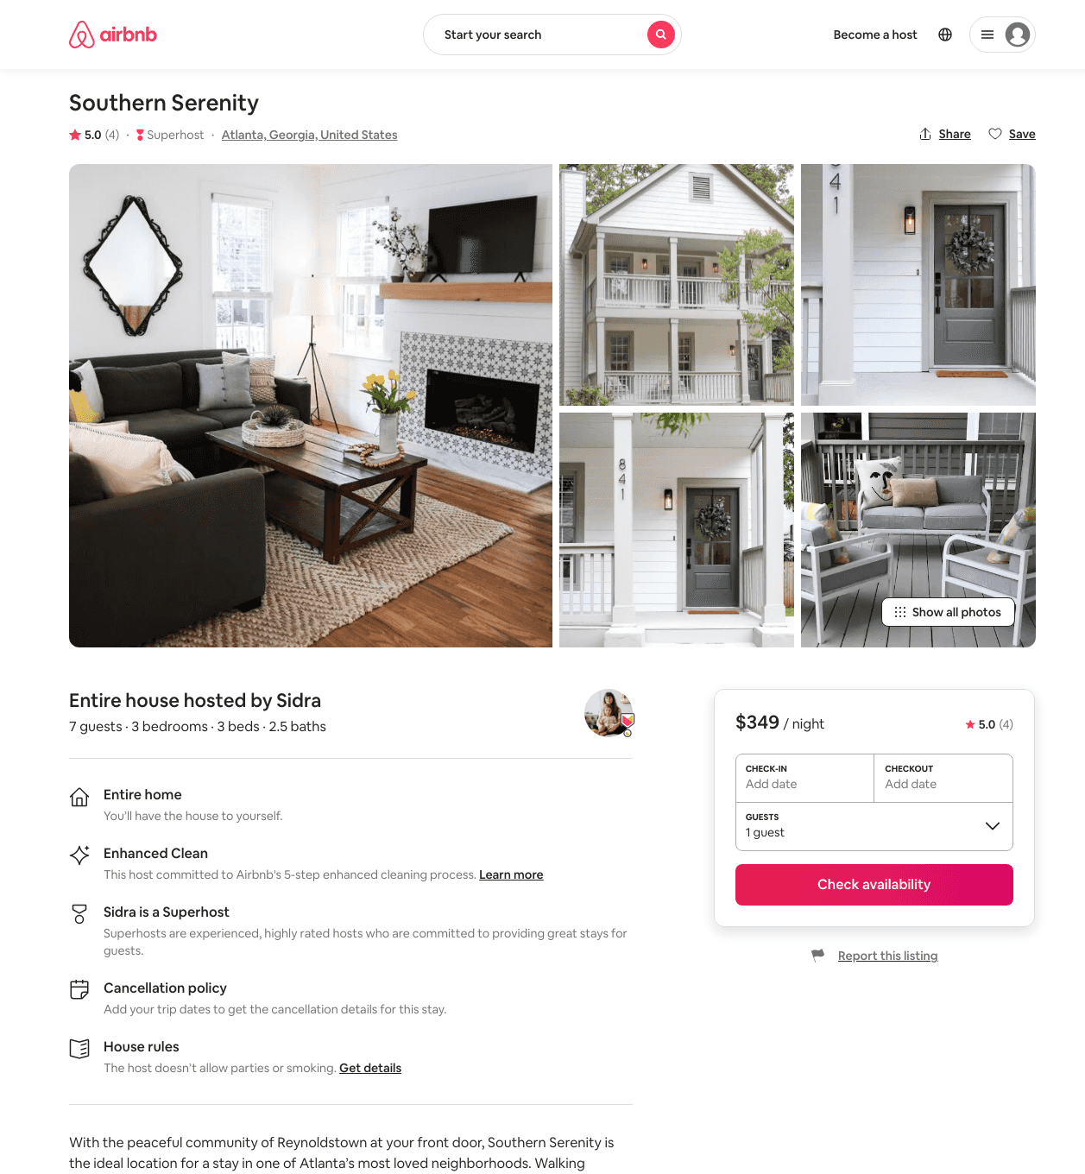
Listing 46351731
3
7
$292 - $542
4.88
2
Minty
3976298
79
https://www.airbnb.com/rooms/46351731
Aug 2022

Slide 11
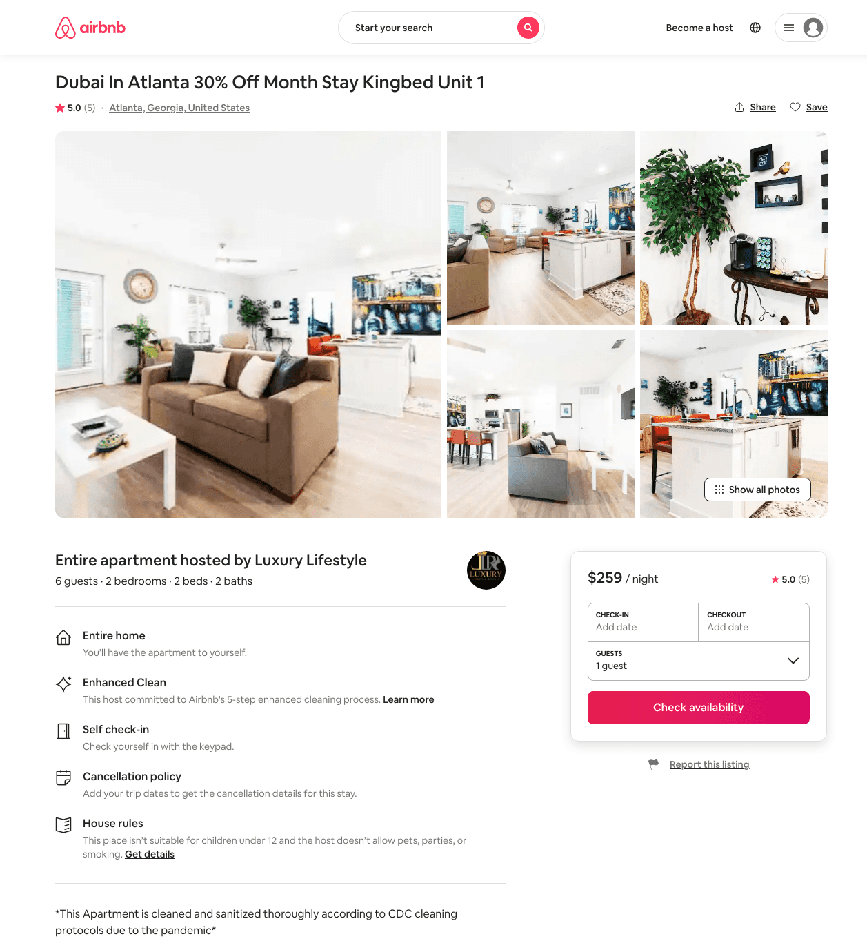
Listing 48352997
2
6
$107 - $3500
4.0
1
Luxury Lifestyle
105453470
6
https://www.airbnb.com/rooms/48352997
Jun 2022

Slide 12
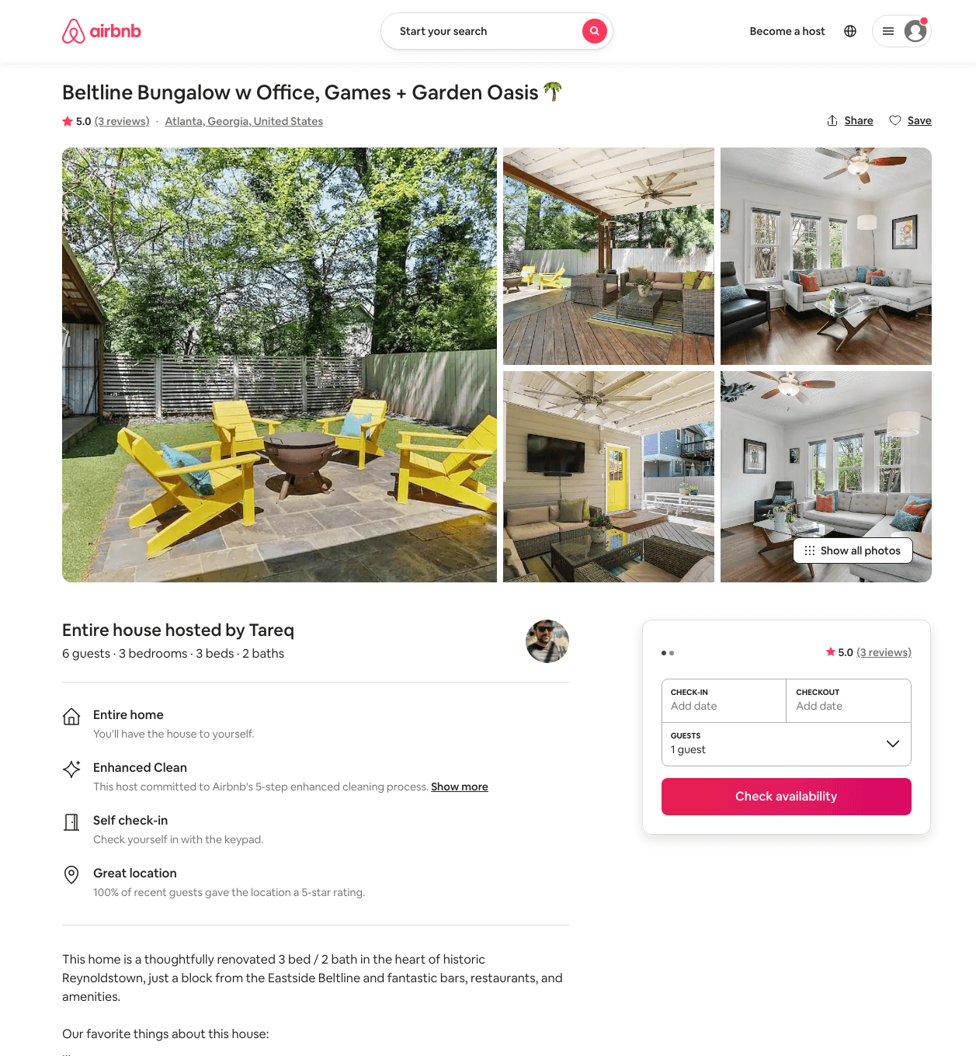
Listing 49887710
3
7
$225 - $585
5.0
2
Tareq
35443332
2
https://www.airbnb.com/rooms/49887710
Aug 2022

Slide 13
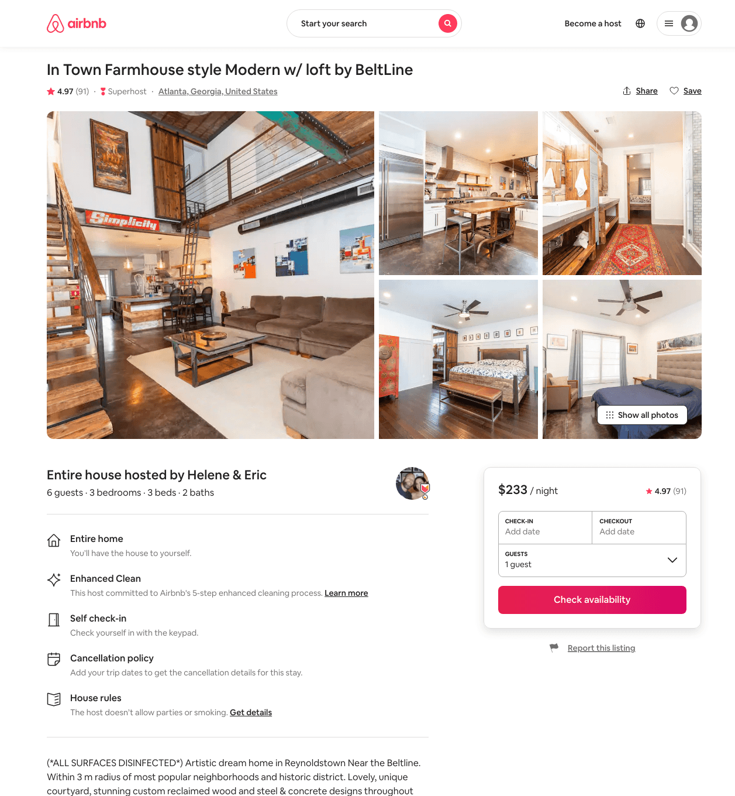
Listing 20600762
3
6
$224 - $249
4.97
3
Helene & Eric
42230053
10
https://www.airbnb.com/rooms/20600762
Aug 2022

Slide 14
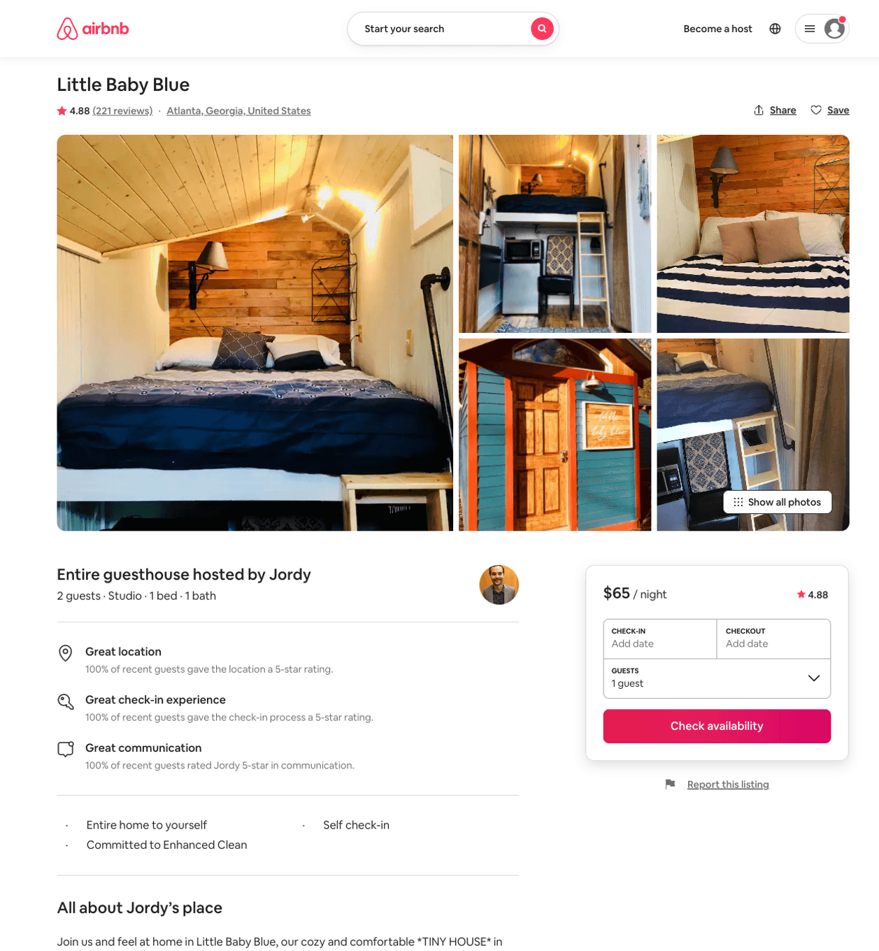
Listing 22909418
Studio
2
$52 - $67
4.88
1
Jordy
34127586
1
https://www.airbnb.com/rooms/22909418
Aug 2022

Slide 15
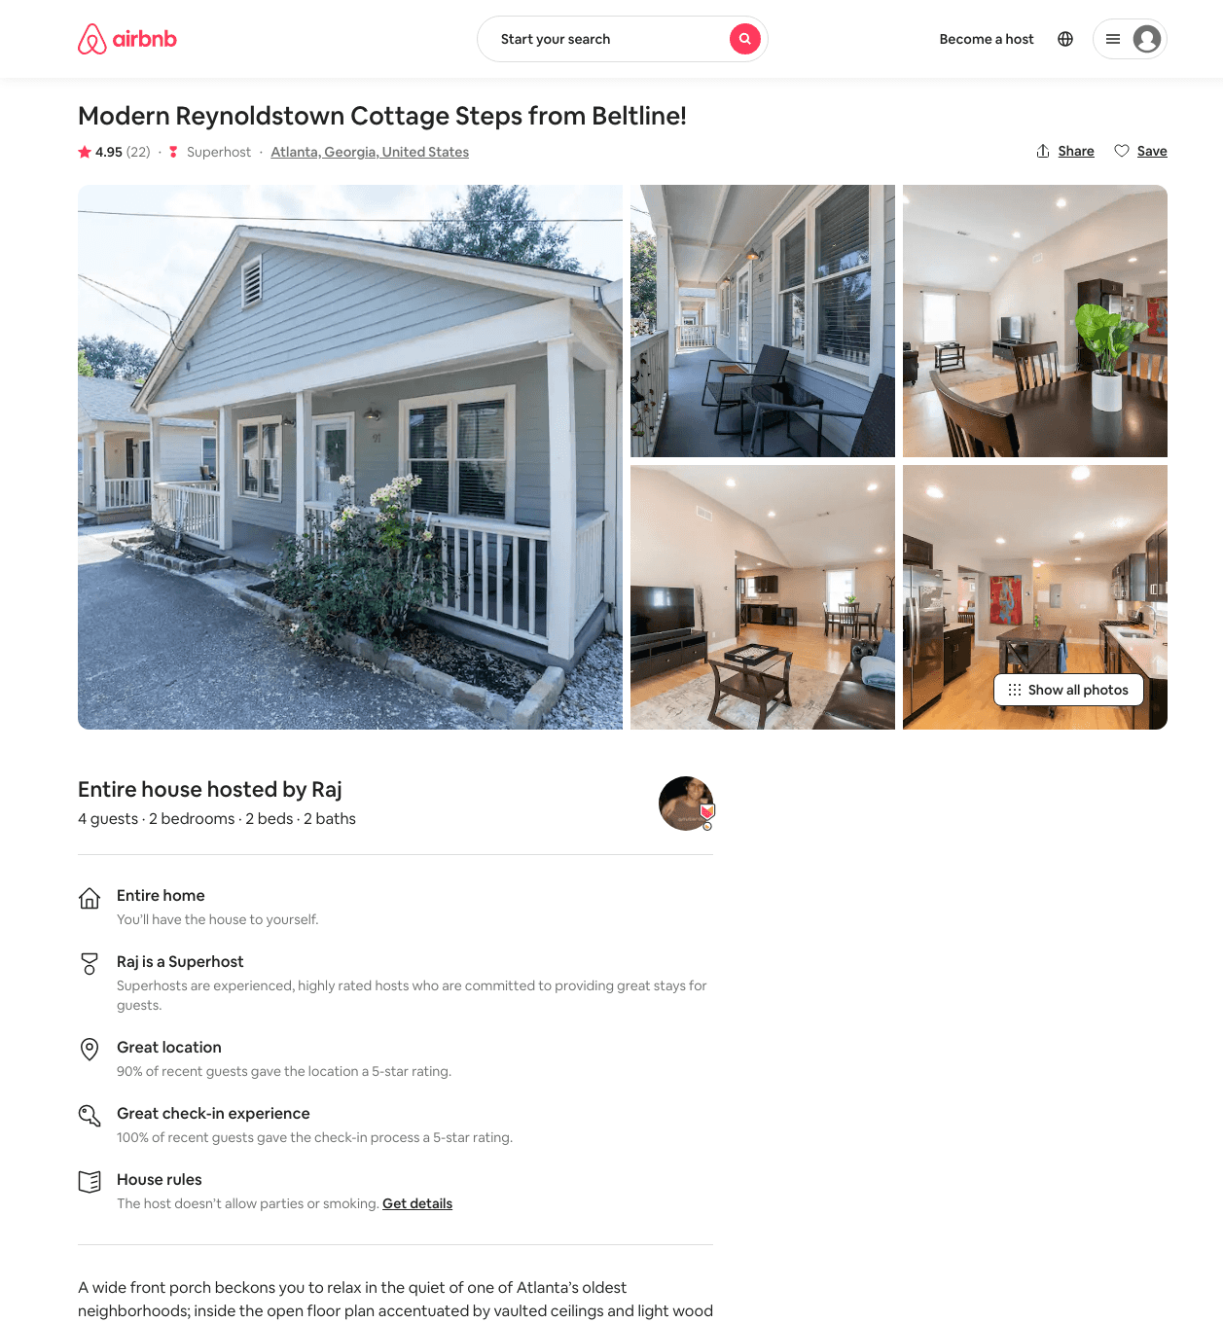
Listing 39025804
2
4
$195 - $250
4.95
4
Raj
48250653
1
https://www.airbnb.com/rooms/39025804
Aug 2022

Slide 16
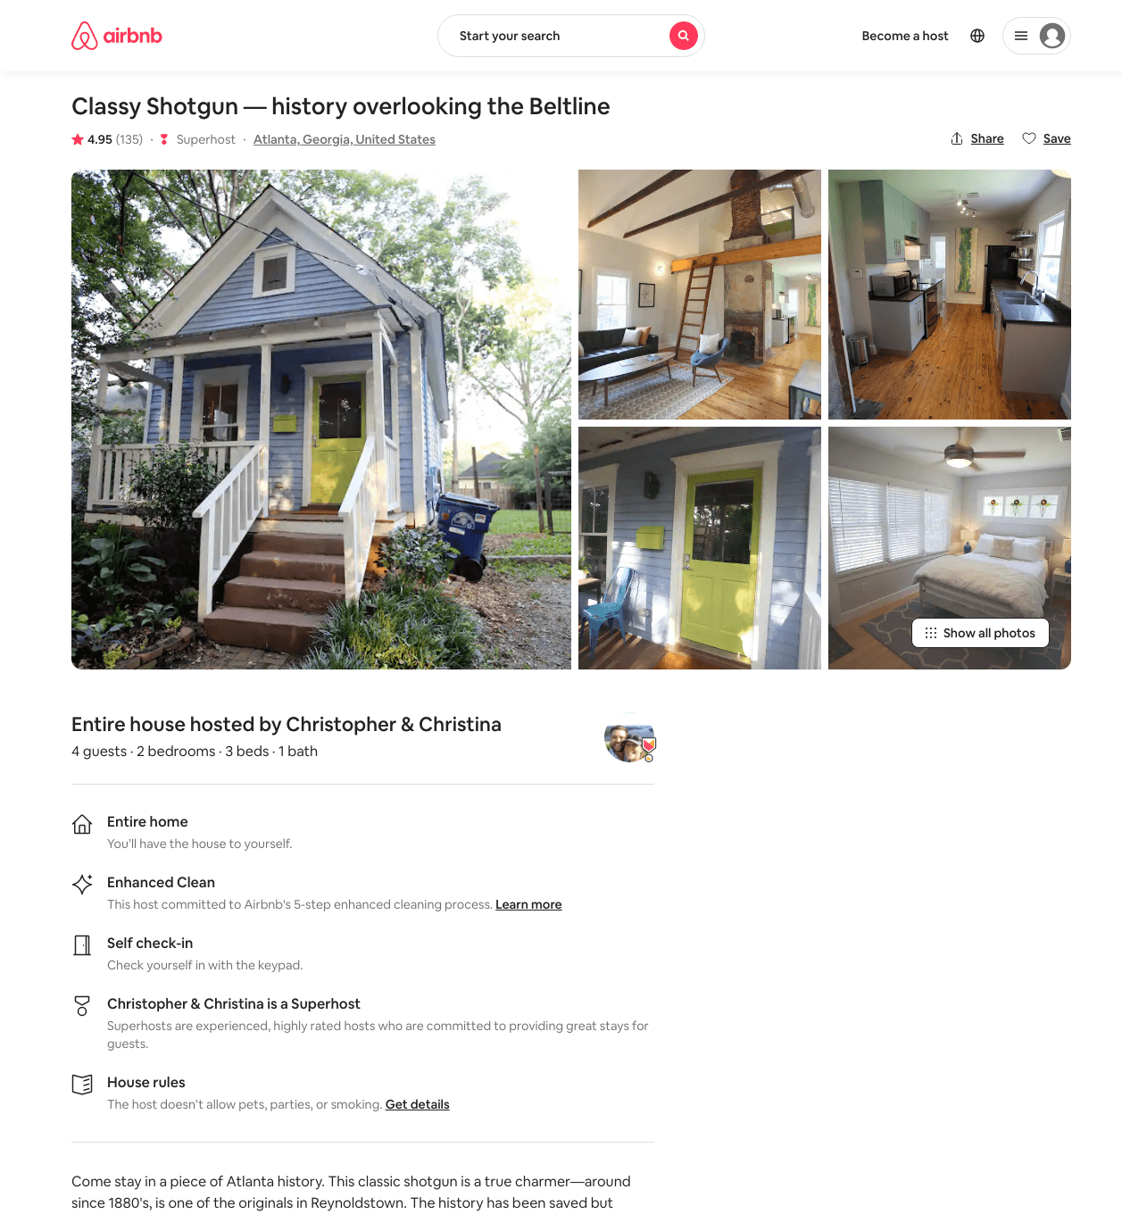
Listing 13100275
2
4
$191 - $326
4.94
2
Christopher & Christina
72779309
2
https://www.airbnb.com/rooms/13100275
Aug 2022

Slide 17
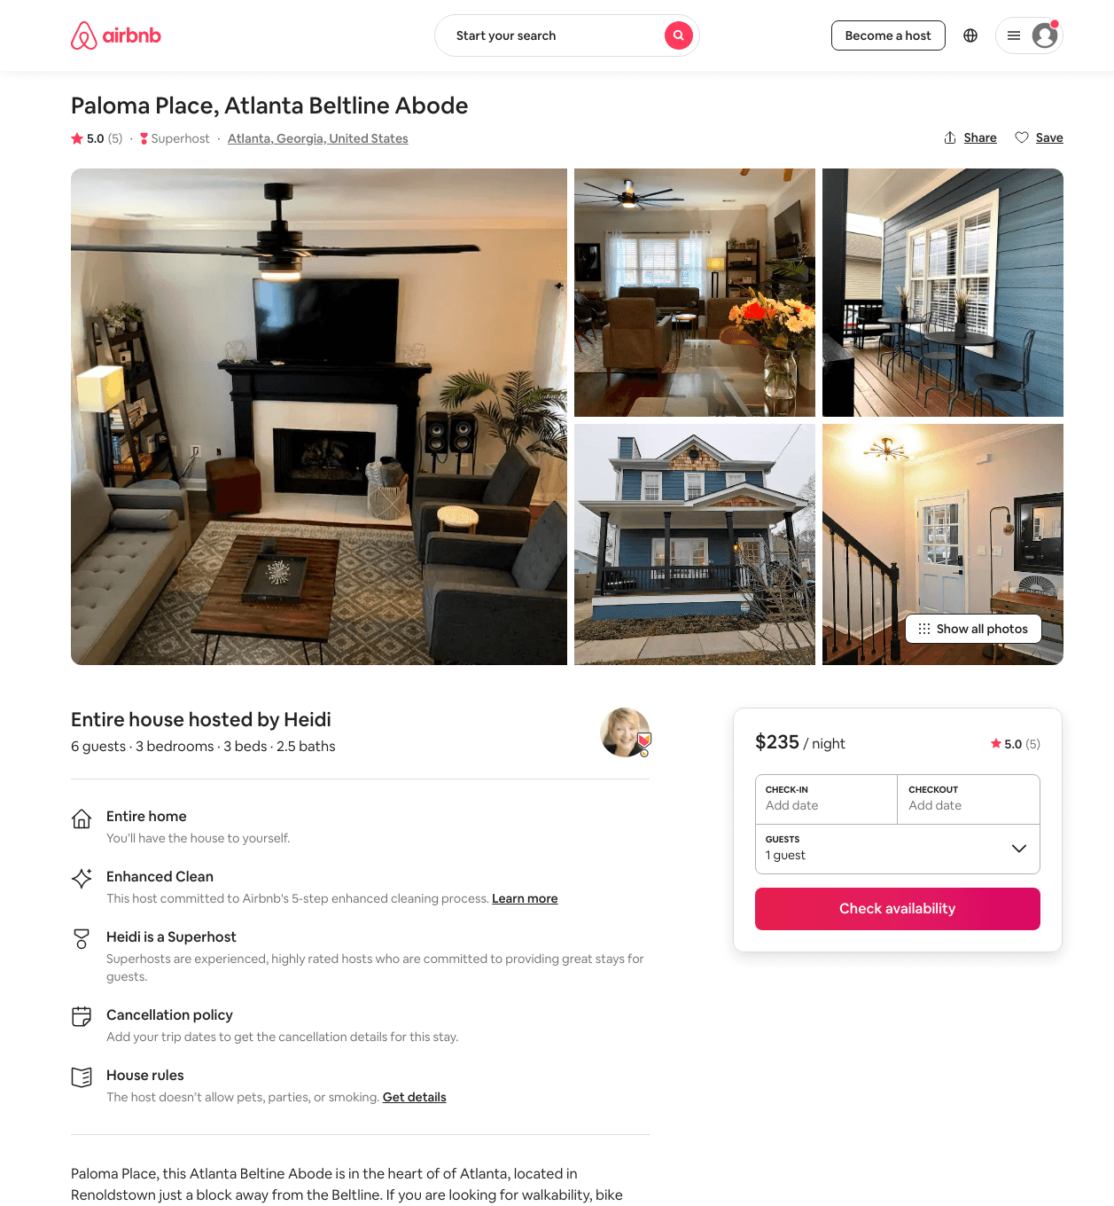
Listing 48167408
3
6
$125 - $236
4.93
2
Heidi
91582024
6
https://www.airbnb.com/rooms/48167408
Aug 2022

Slide 18
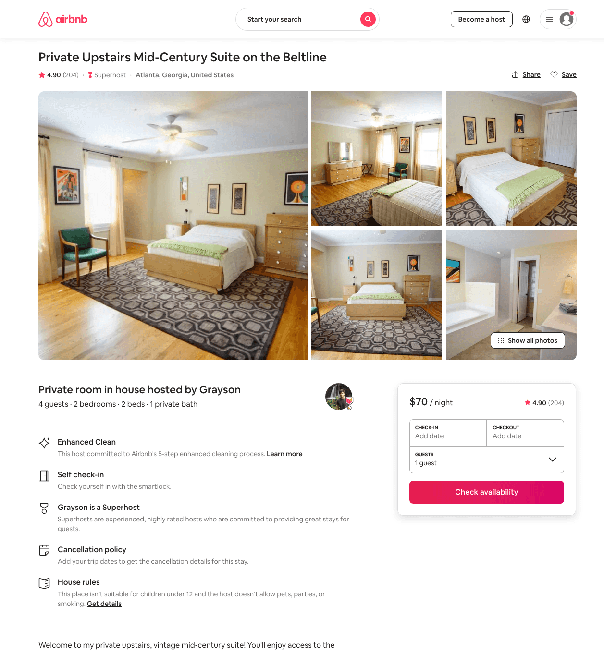
Listing 21311439
2
4
$66 - $82
4.91
1
Grayson
73345114
2
https://www.airbnb.com/rooms/21311439
Aug 2022

Slide 19
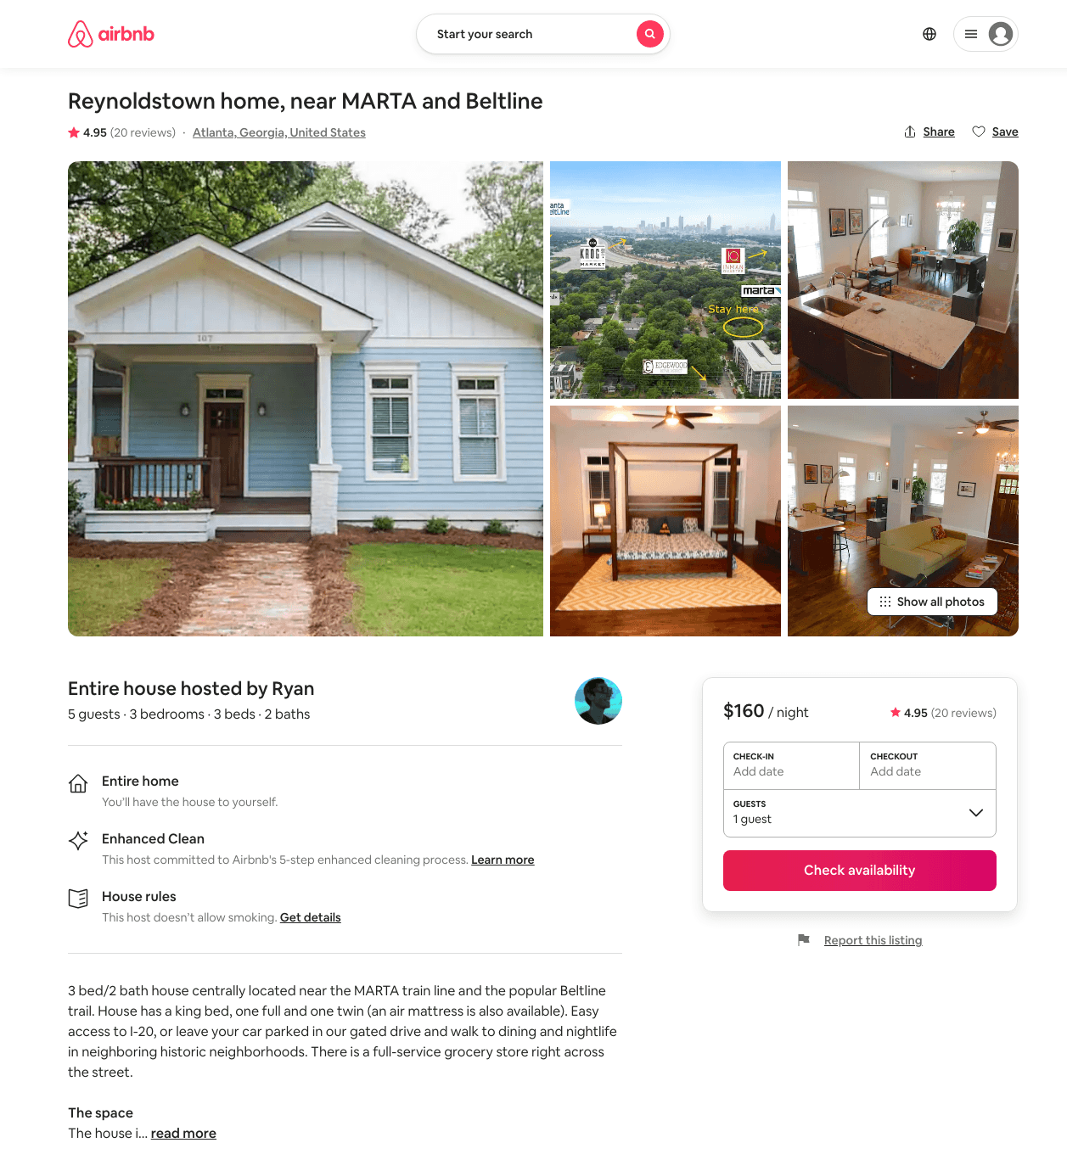
Listing 5359560
3
5
$151 - $300
4.88
4
Ryan
9110858
1
https://www.airbnb.com/rooms/5359560
Jul 2022

Slide 20
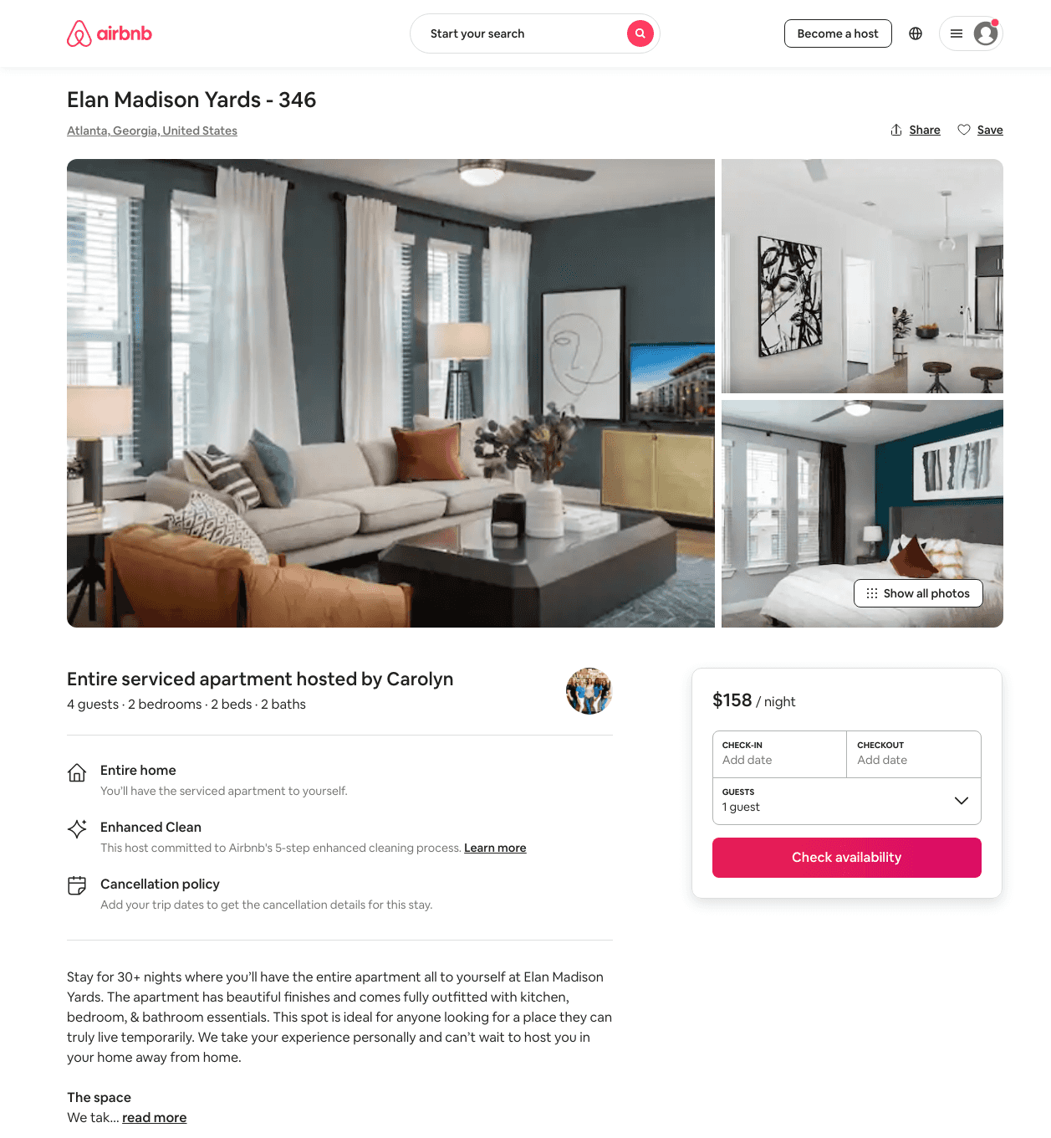
Listing 45237489
2
4
$76 - $158
30
Casey
359231771
601
https://www.airbnb.com/rooms/45237489
Aug 2022

Slide 21
Listing 45237430
2
4
$157
30
Casey
359231771
601
https://www.airbnb.com/rooms/45237430
Aug 2022

Slide 22
Listing 45237507
2
4
$166
30
Casey
359231771
601
https://www.airbnb.com/rooms/45237507
Aug 2022

Slide 23
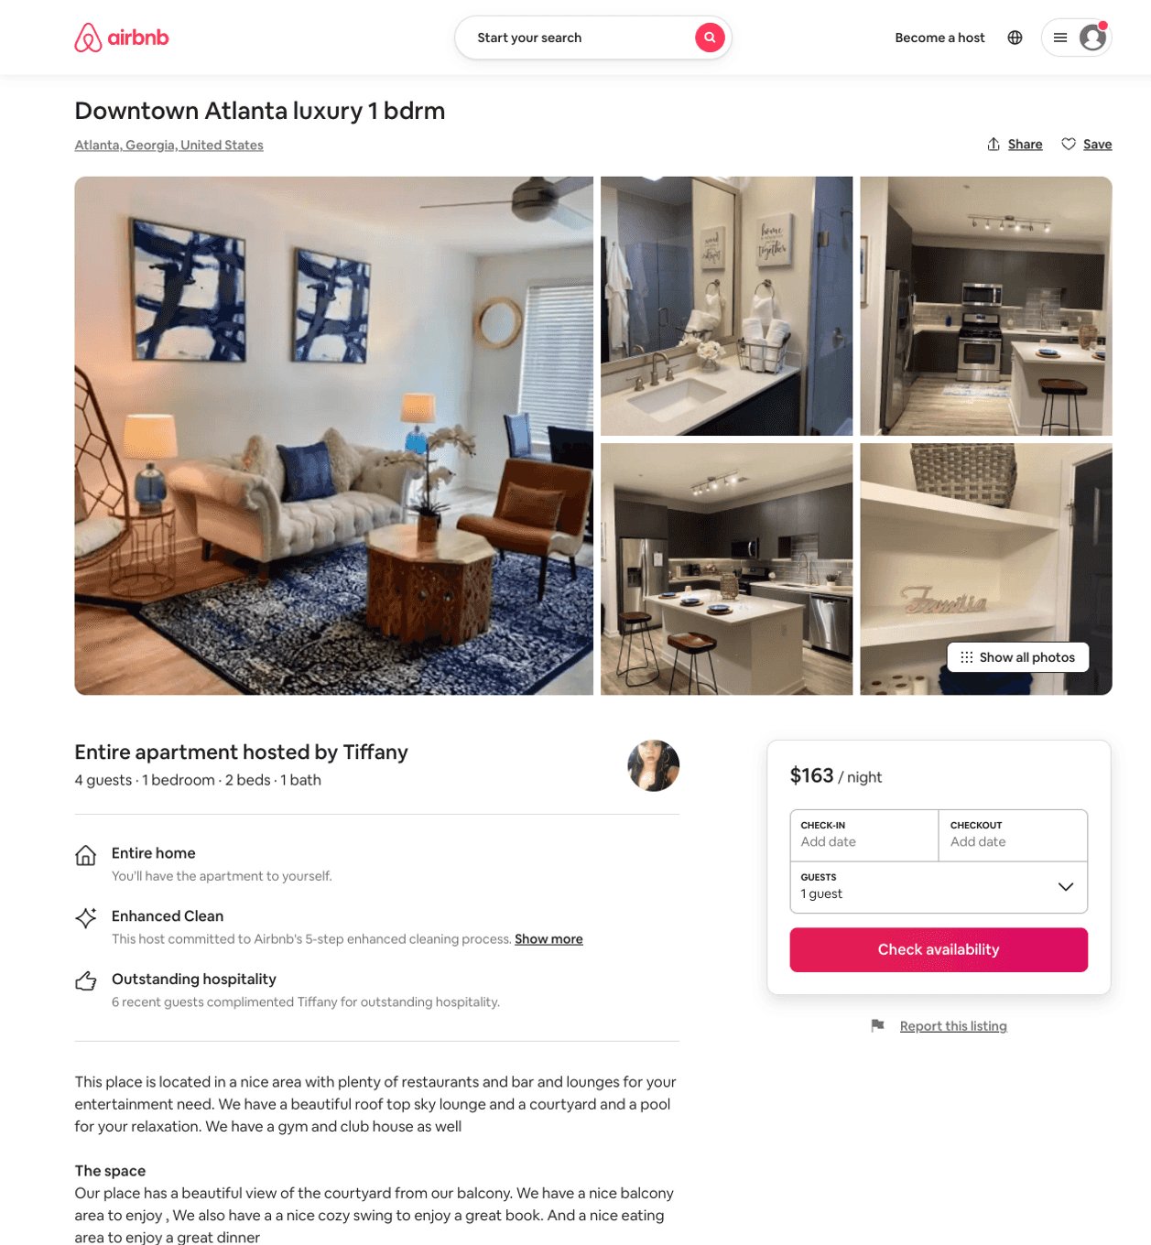
Listing 50403518
1
4
$86 - $189
4.46
1
Tiffany
324147987
3
https://www.airbnb.com/rooms/50403518
Aug 2022

Slide 24
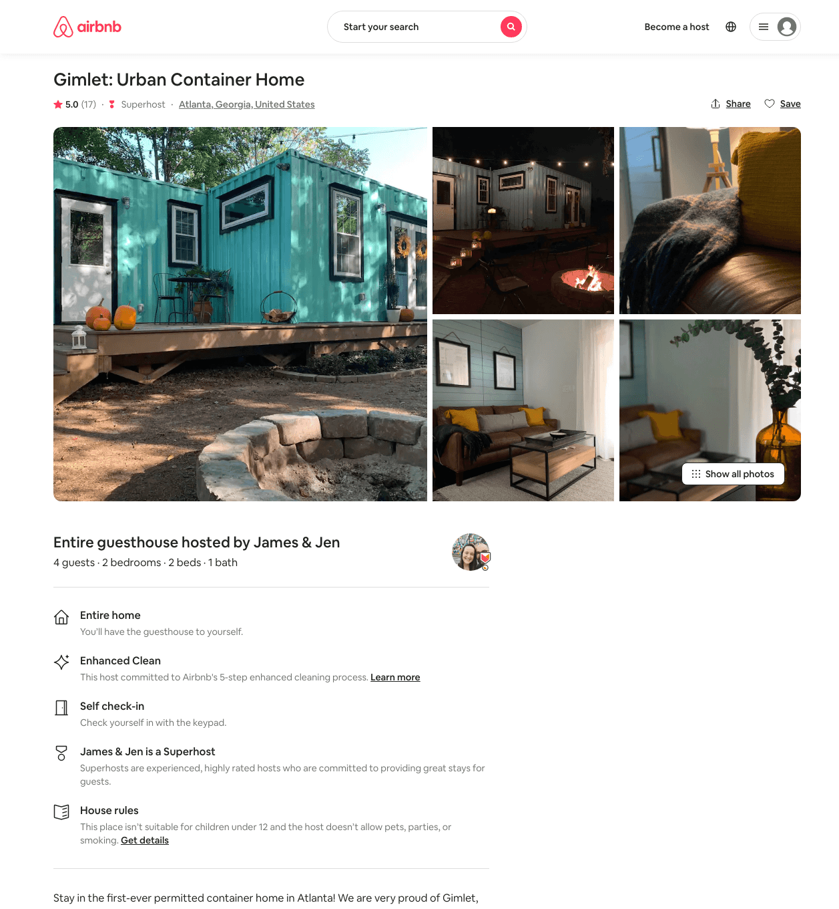
Listing 38672673
2
4
$154 - $180
5.0
2
James & Jen
2052005
1
https://www.airbnb.com/rooms/38672673
Aug 2022

Slide 25
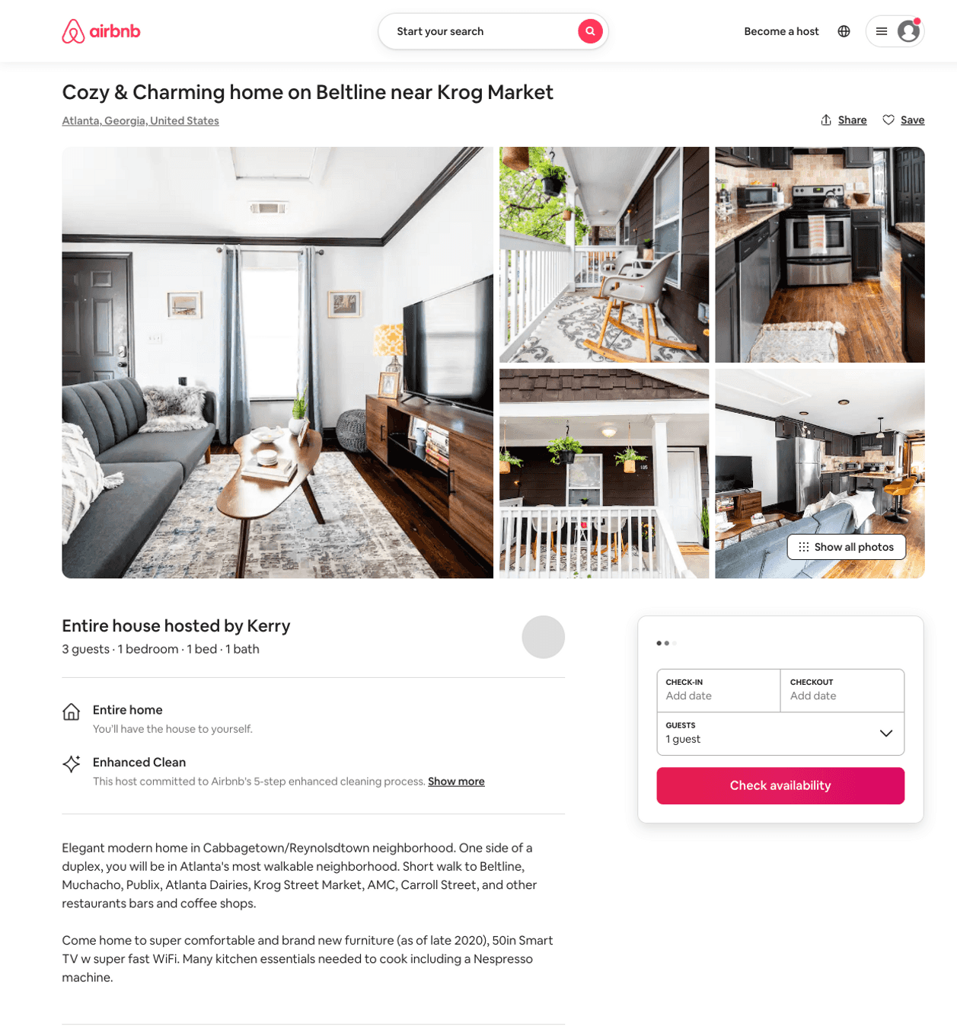
Listing 50436604
1
2
$125 - $244
4.89
2
Kerry
76441090
2
https://www.airbnb.com/rooms/50436604
Aug 2022

Slide 26
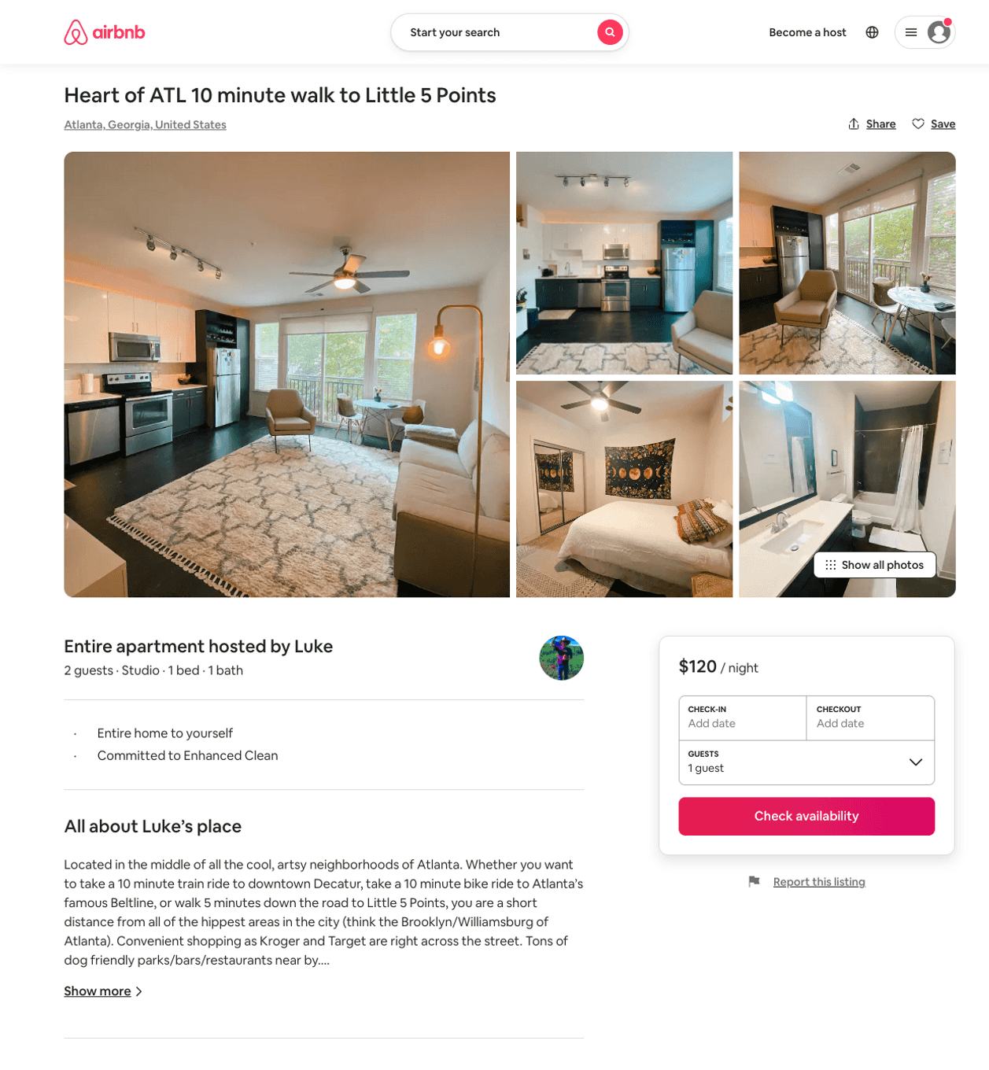
Listing 50194766
Studio
2
$89 - $143
5.0
3
Luke
18598384
1
https://www.airbnb.com/rooms/50194766
Aug 2022

Slide 27
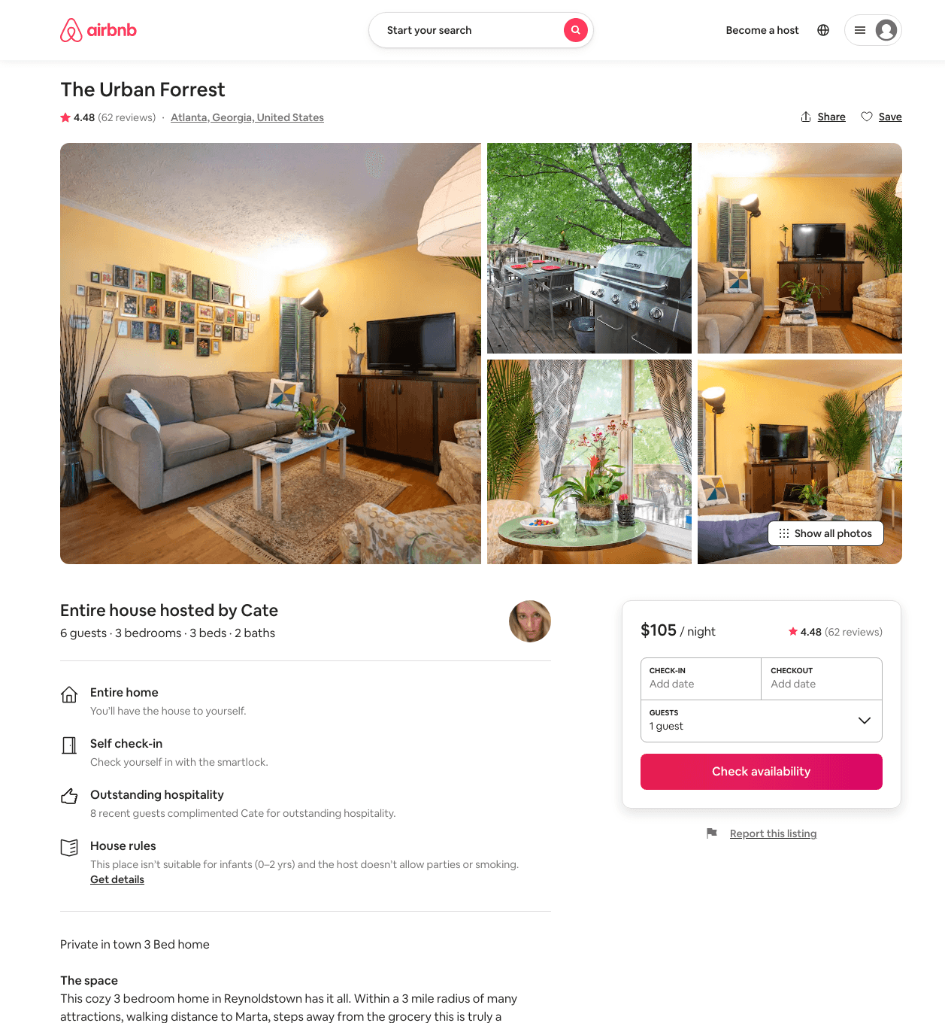
Listing 39628513
3
6
$104 - $130
4.63
2
Cate
304504871
1
https://www.airbnb.com/rooms/39628513
Aug 2022

Slide 28
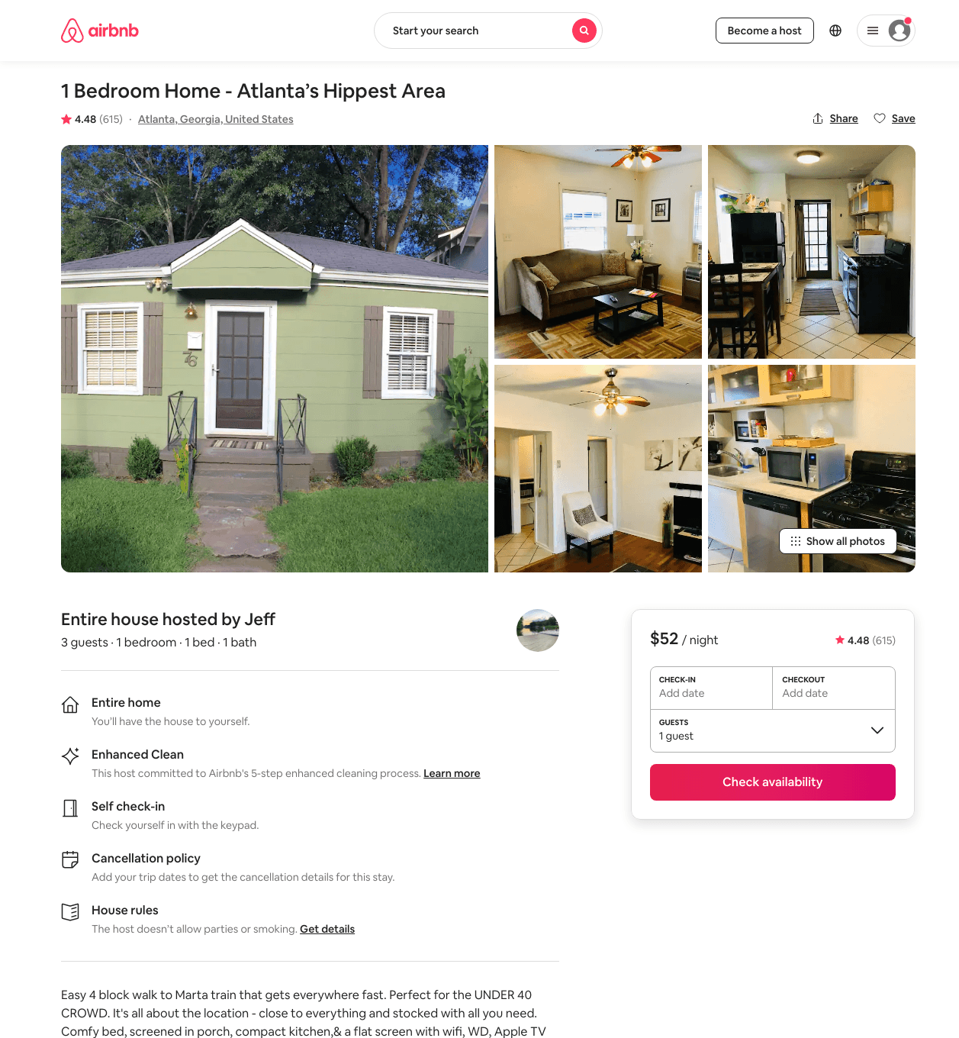
Listing 836943
1
3
$46 - $76
4.47
1
Jeff
3238980
1
https://www.airbnb.com/rooms/836943
Aug 2022

Slide 29
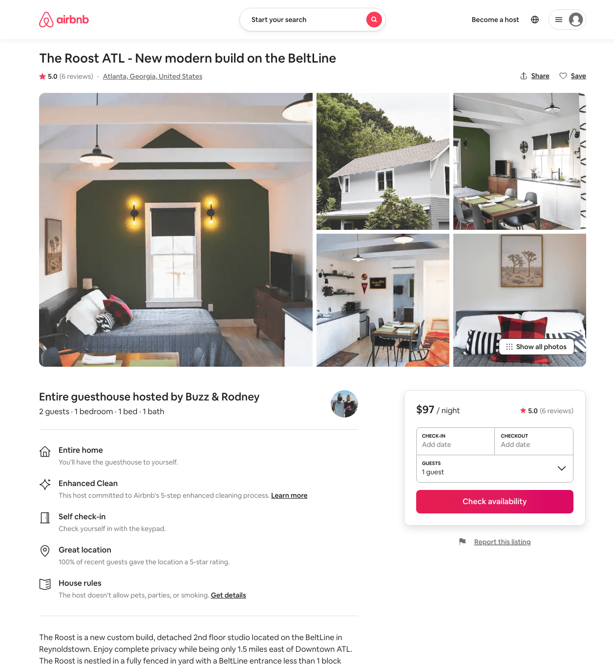
Listing 41396860
1
2
$97 - $114
5.0
2
Buzz & Rodney
325395157
1
https://www.airbnb.com/rooms/41396860
Aug 2022

Slide 30
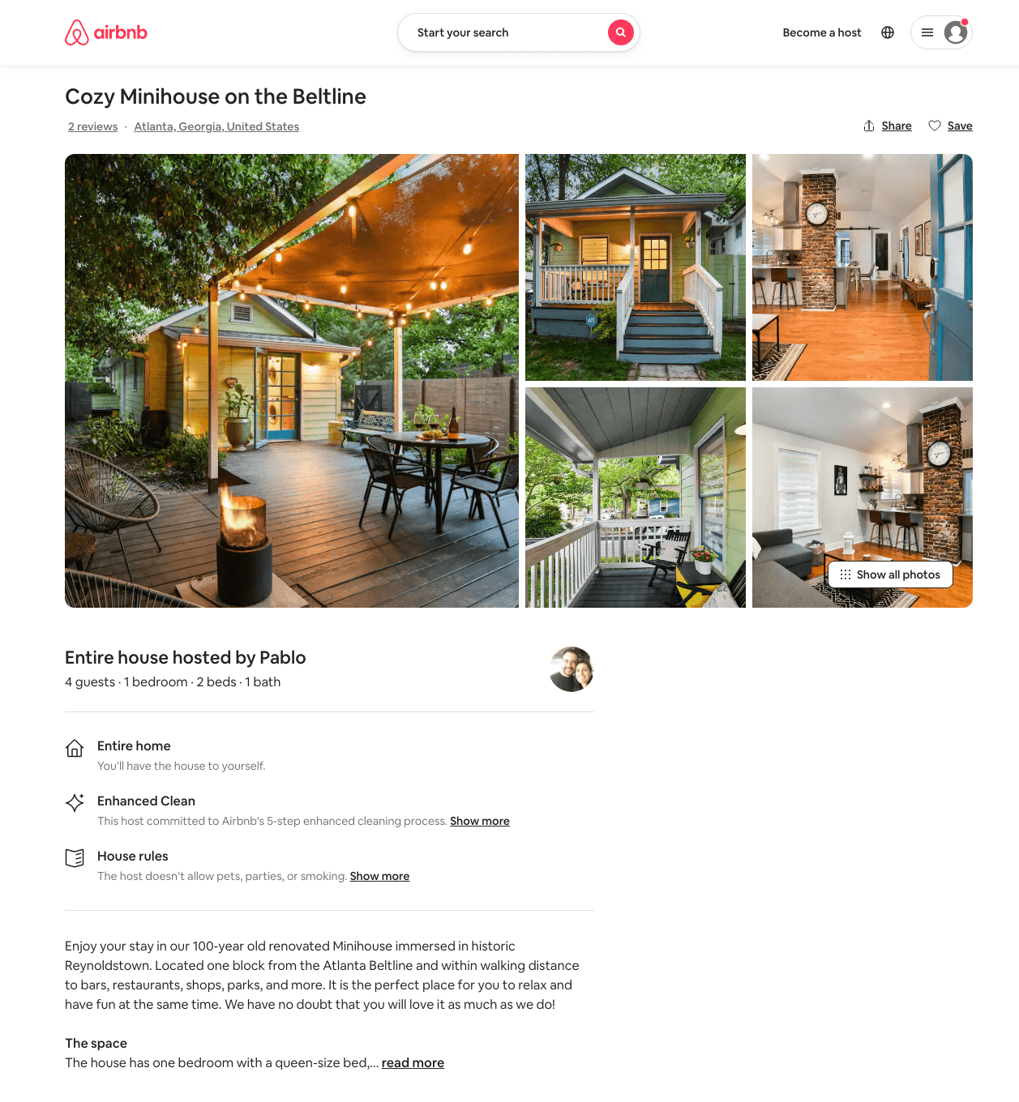
Listing 49077892
1
4
$150 - $191
4.99
2
Pablo And Priscila
5670683
1
https://www.airbnb.com/rooms/49077892
Aug 2022

Slide 31
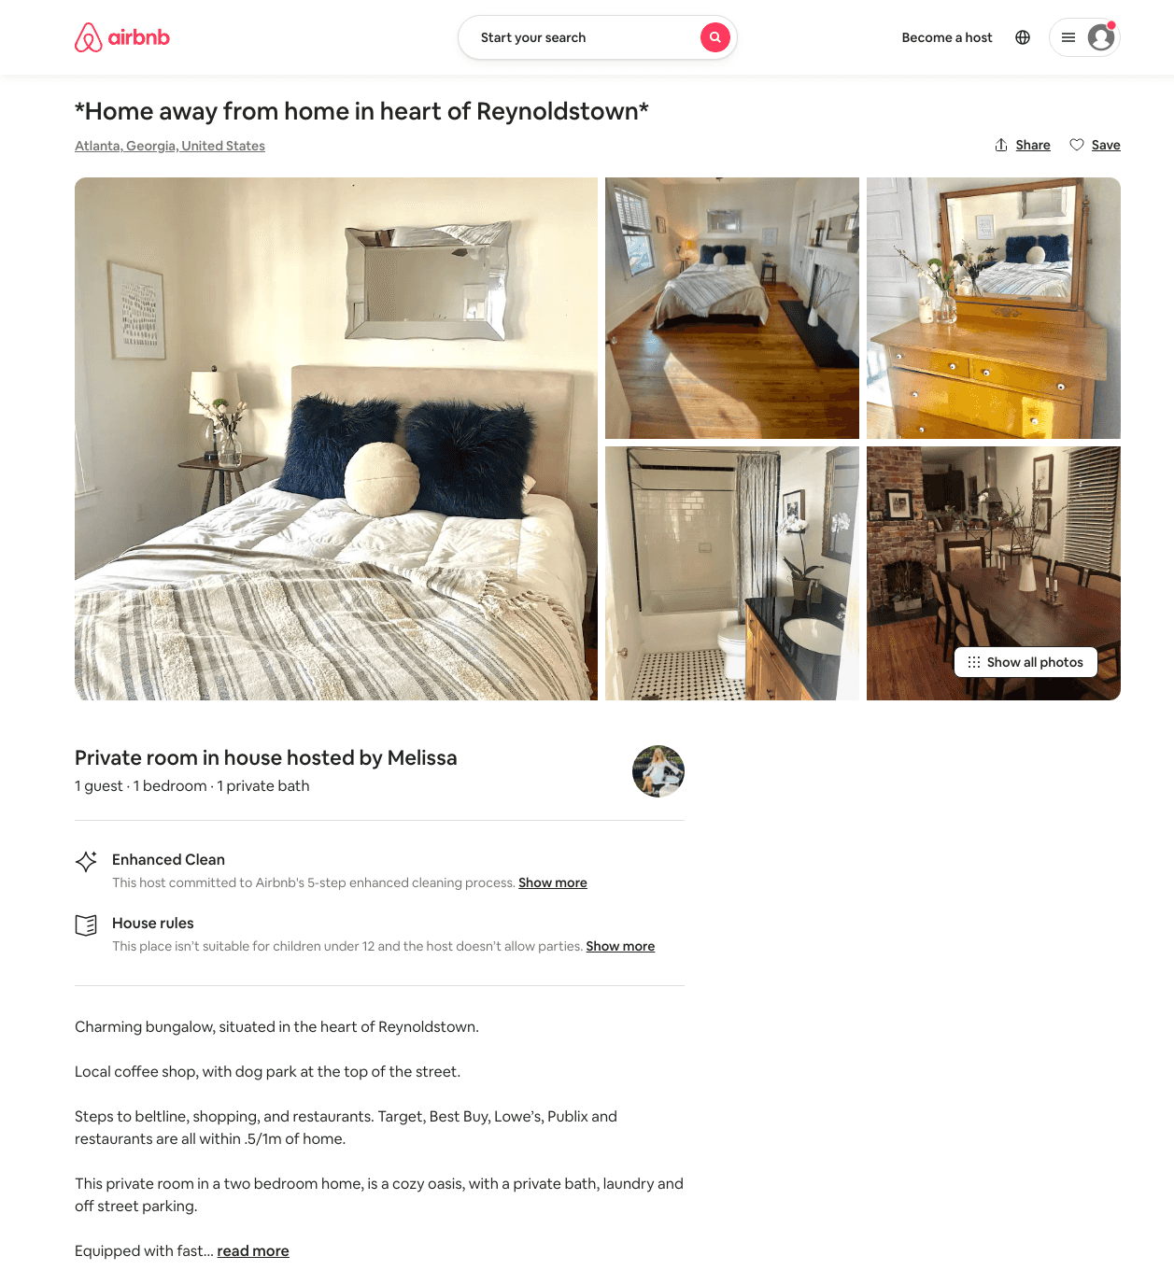
Listing 49349393
1
1
$32 - $40
10
Melissa
247433702
1
https://www.airbnb.com/rooms/49349393
Aug 2022

Slide 32
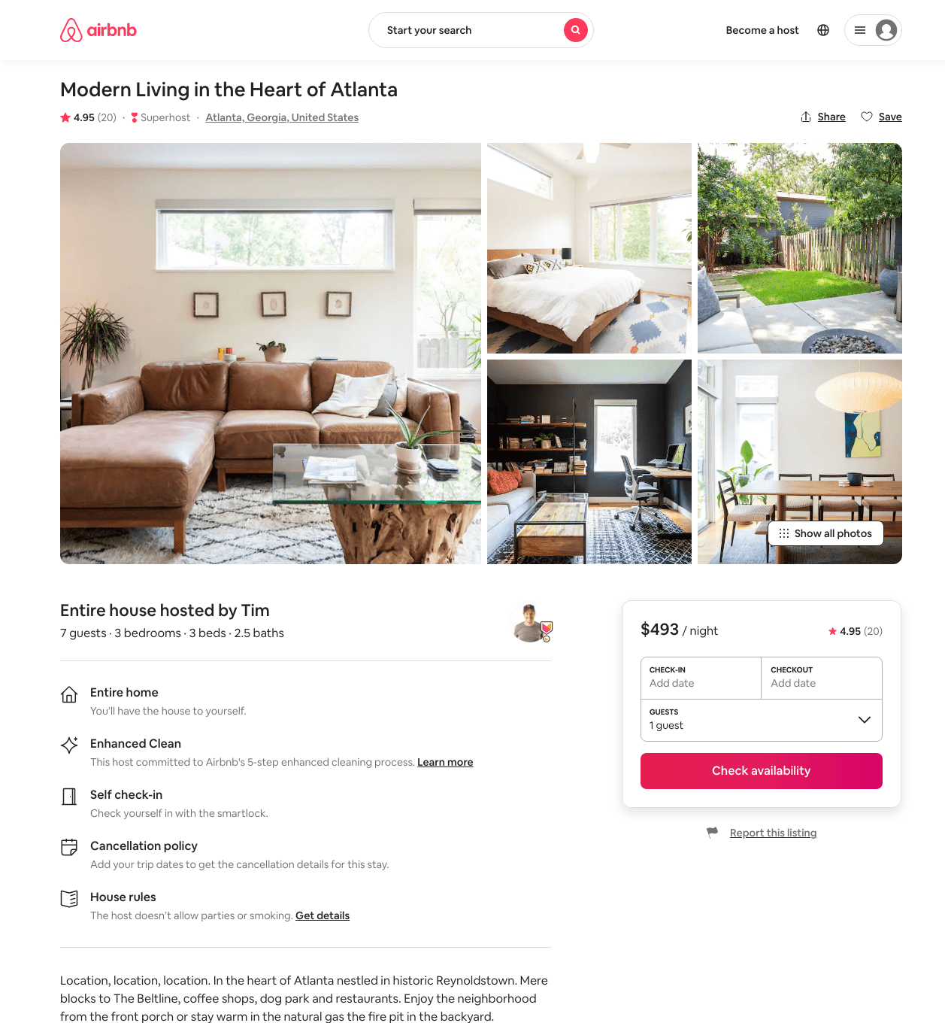
Listing 44908968
3
7
$274 - $493
4.89
1
Tim
13205009
1
https://www.airbnb.com/rooms/44908968
Aug 2022

Slide 33
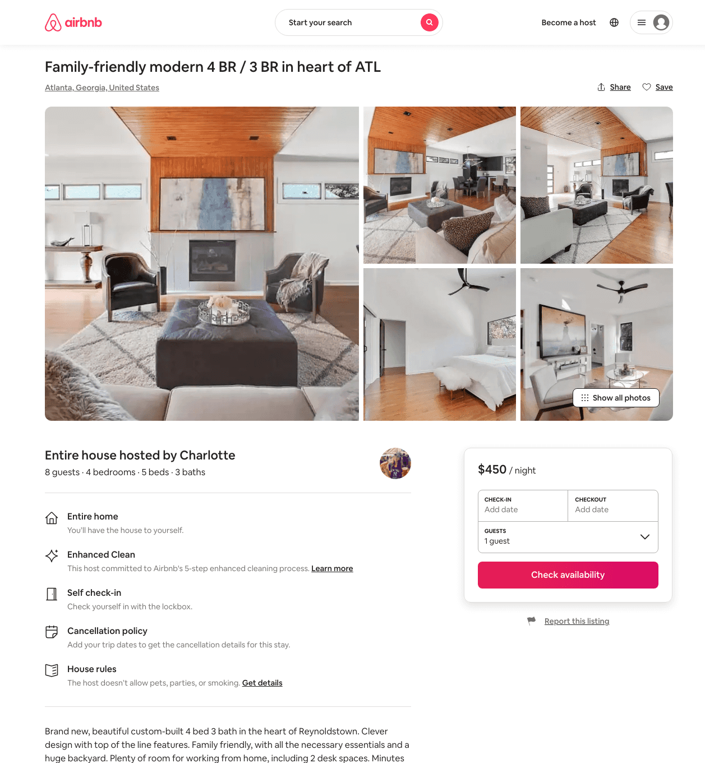
Listing 48122776
4
8
$356 - $600
4.92
3
Charlotte
70786342
1
https://www.airbnb.com/rooms/48122776
Aug 2022

Slide 34
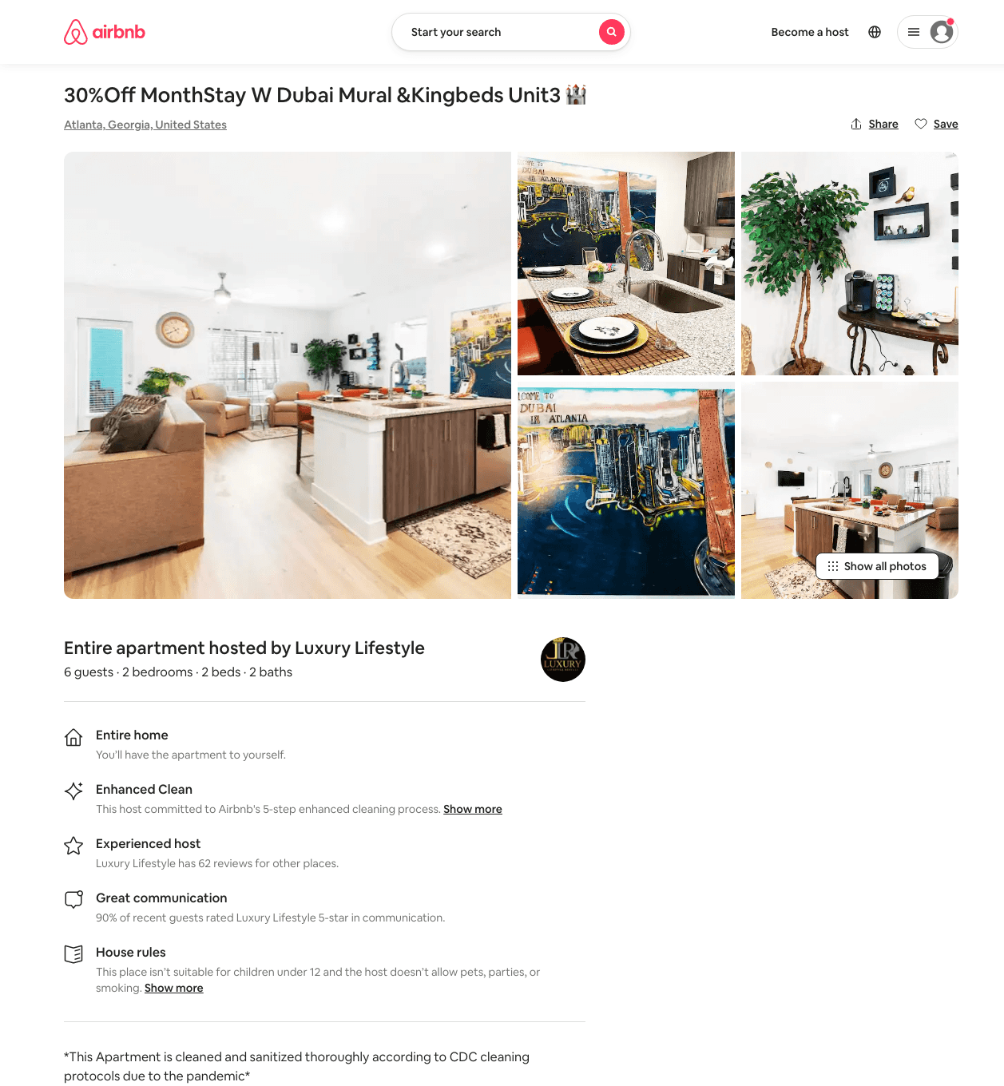
Listing 49276724
2
7
$211 - $3321
3.67
1
Luxury Lifestyle
105453470
6
https://www.airbnb.com/rooms/49276724
Aug 2022

Slide 35
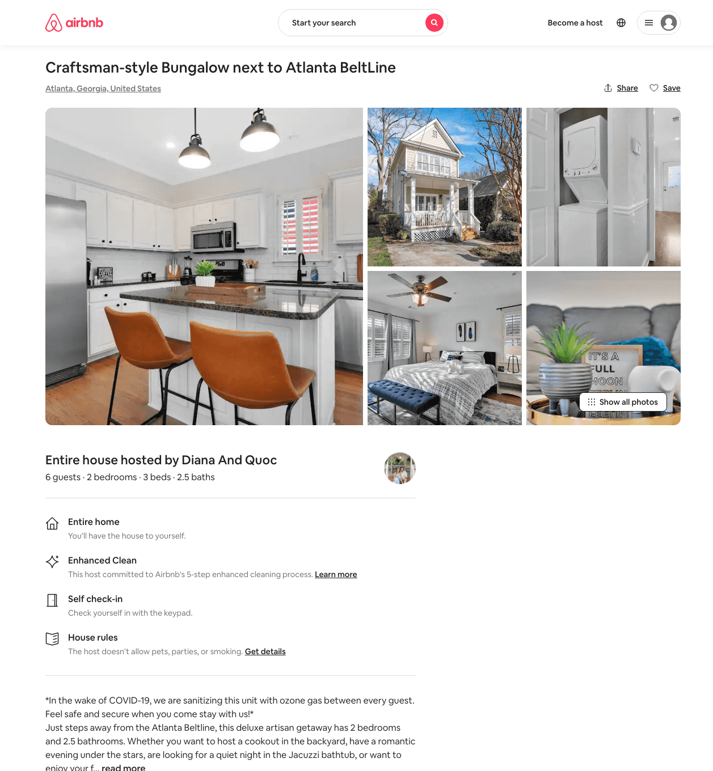
Listing 48934065
2
6
$150 - $441
4.76
2
Alex And Christina
20605441
40
https://www.airbnb.com/rooms/48934065
Aug 2022

Slide 36
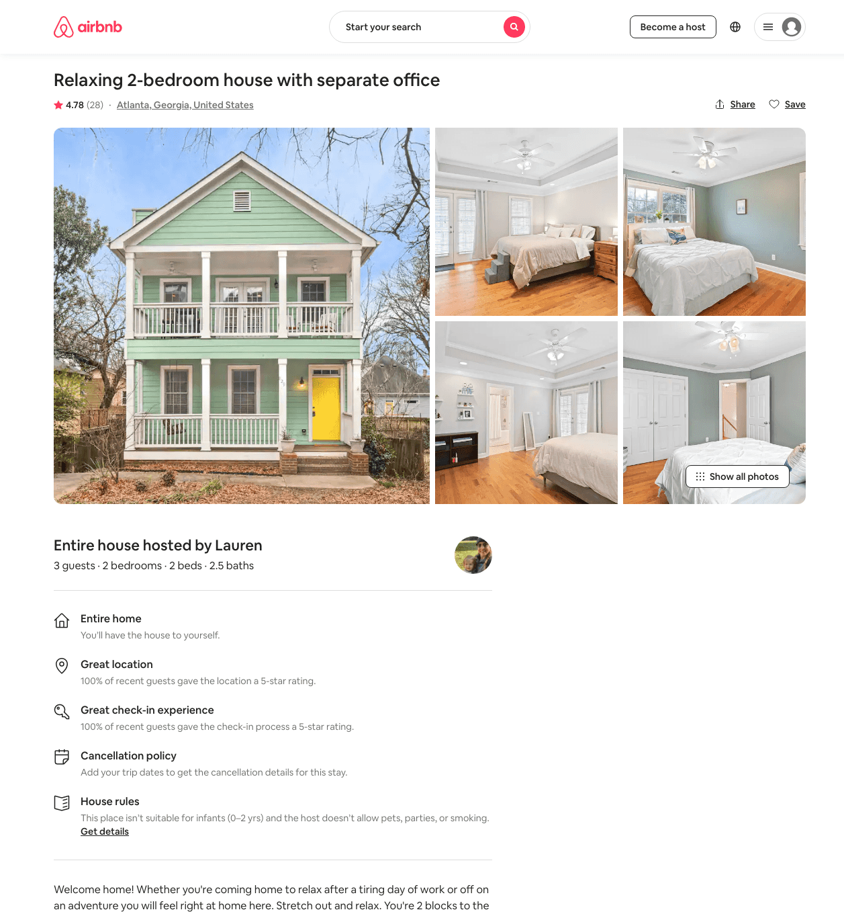
Listing 12203200
2
4
$136 - $249
4.85
2
Lauren
5066563
1
https://www.airbnb.com/rooms/12203200
Aug 2022

Slide 37
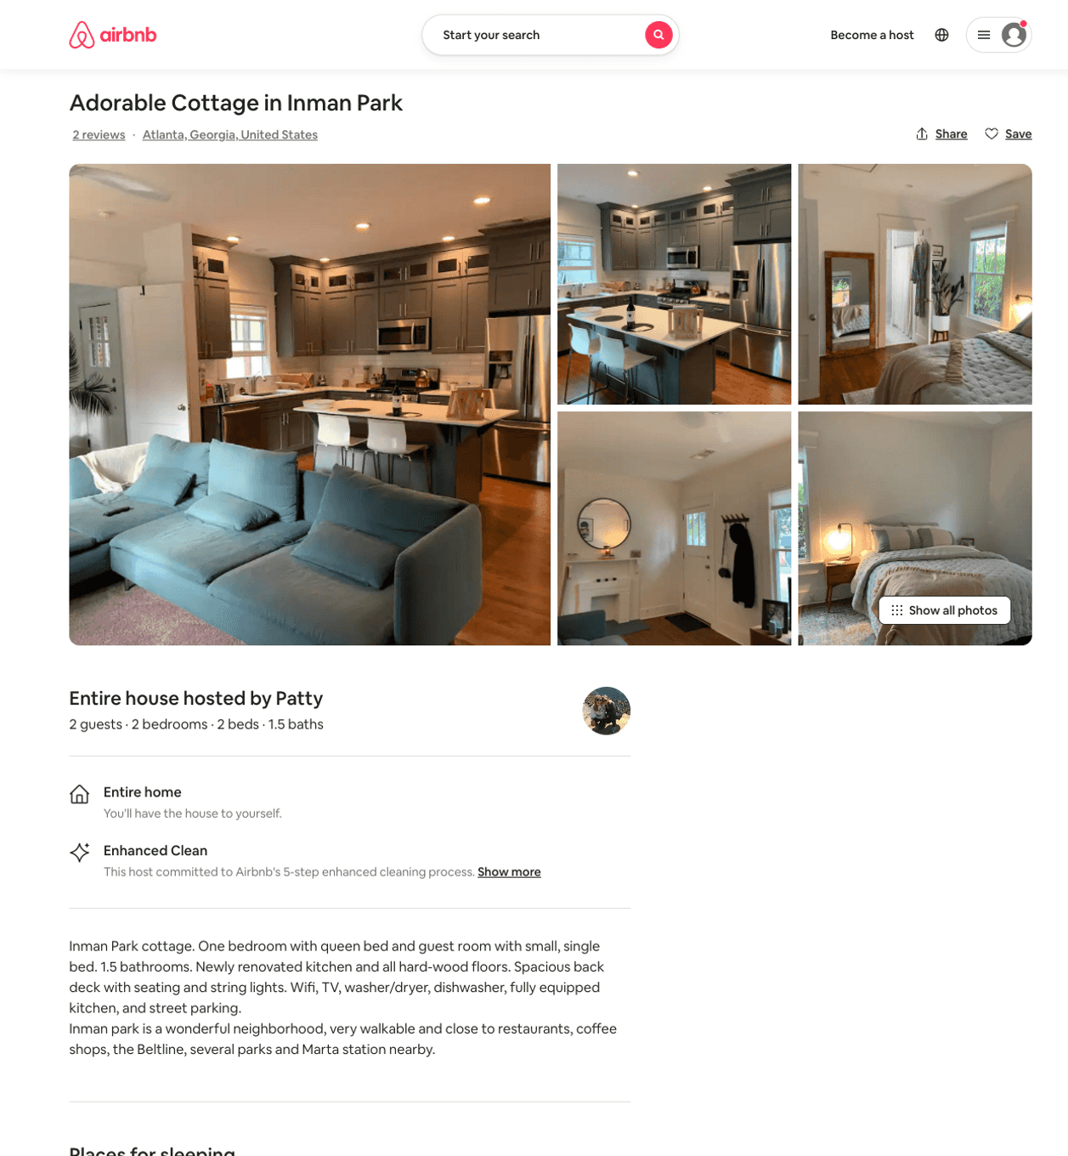
Listing 43981940
2
2
$155 - $157
4.50
5
Patty
12083726
1
https://www.airbnb.com/rooms/43981940
Jun 2022

Slide 38
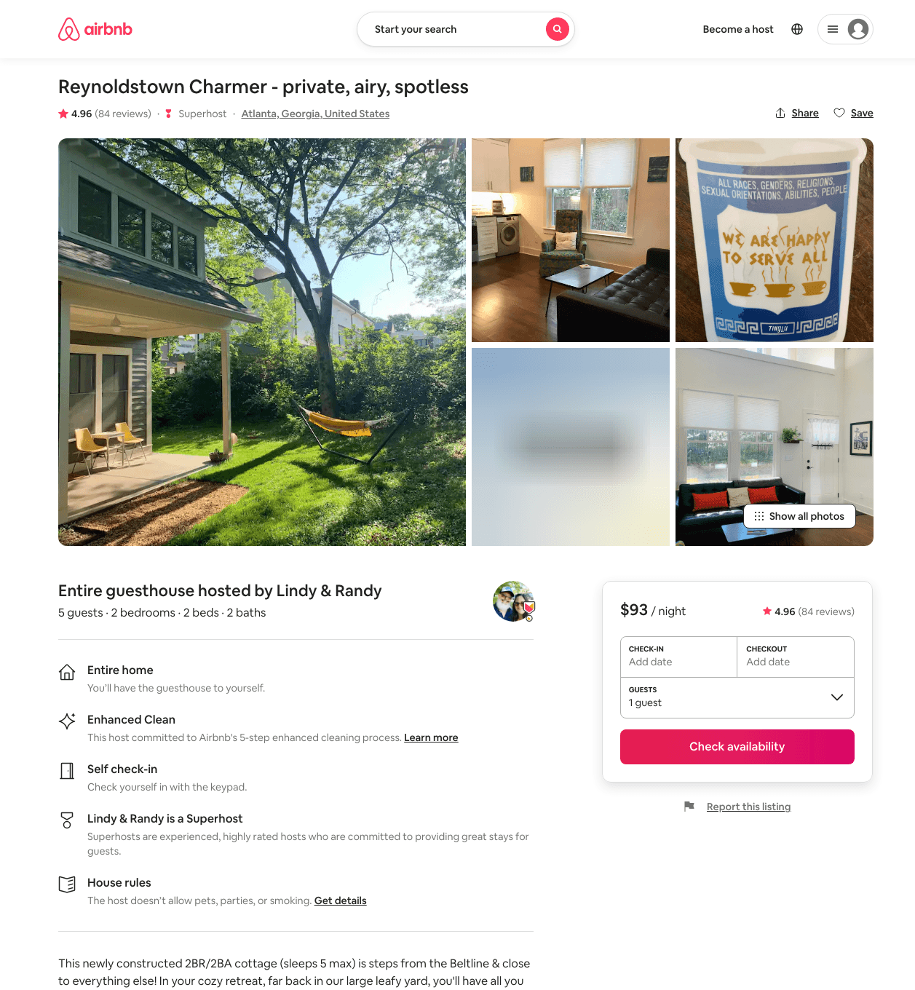
Listing 27058021
2
4
$84 - $113
4.97
2
Lindy
17200226
1
https://www.airbnb.com/rooms/27058021
Aug 2022

Slide 39
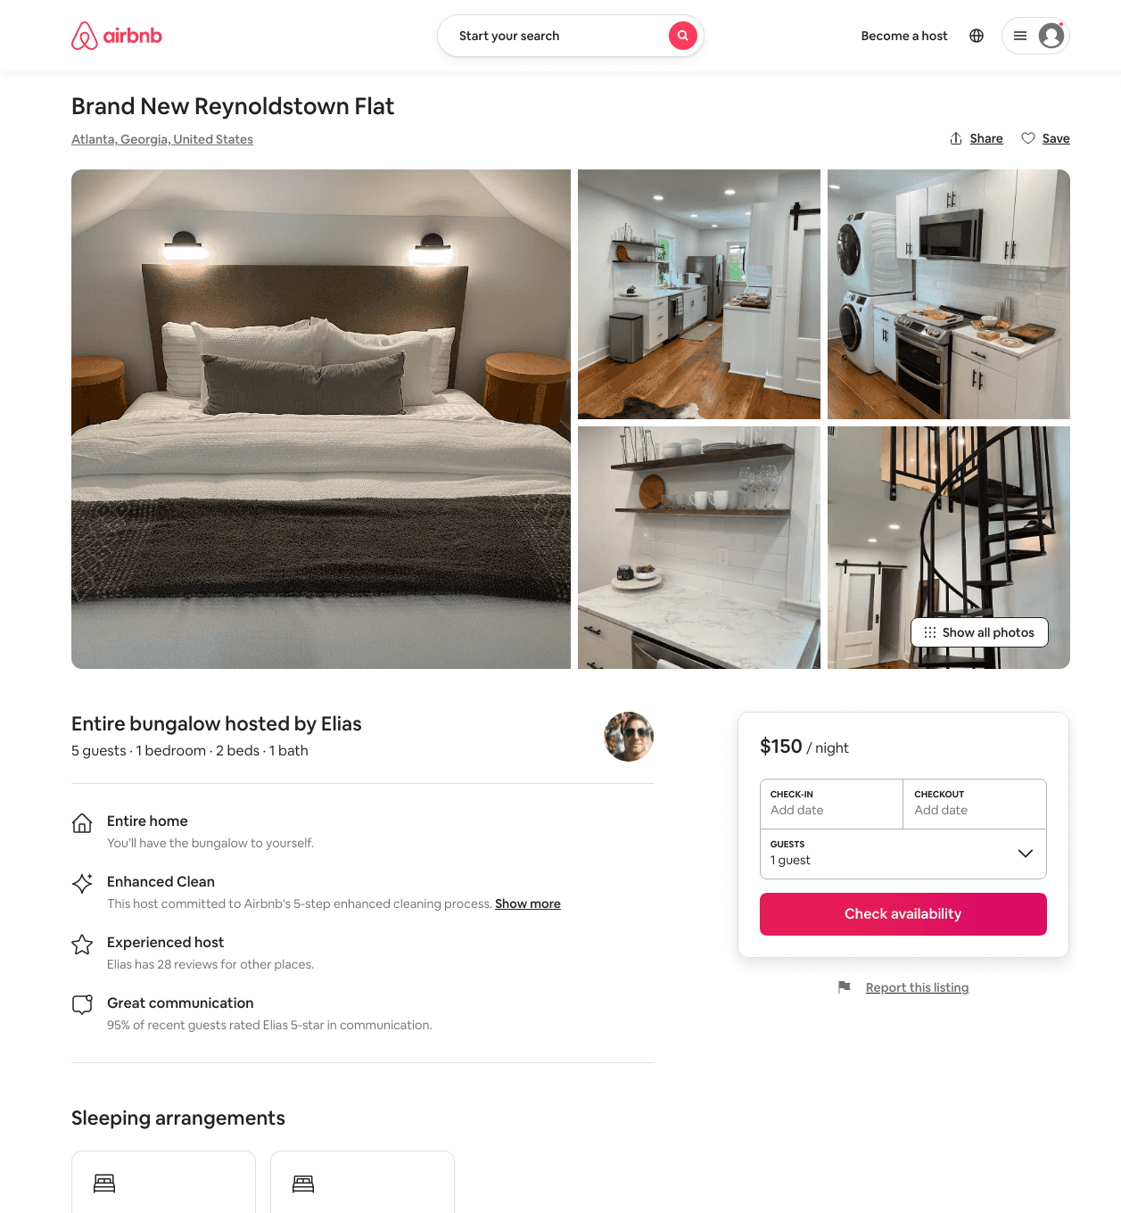
Listing 49833772
1
4
$98 - $176
4.91
1
Elissa
54529641
1
https://www.airbnb.com/rooms/49833772
Aug 2022

Slide 40
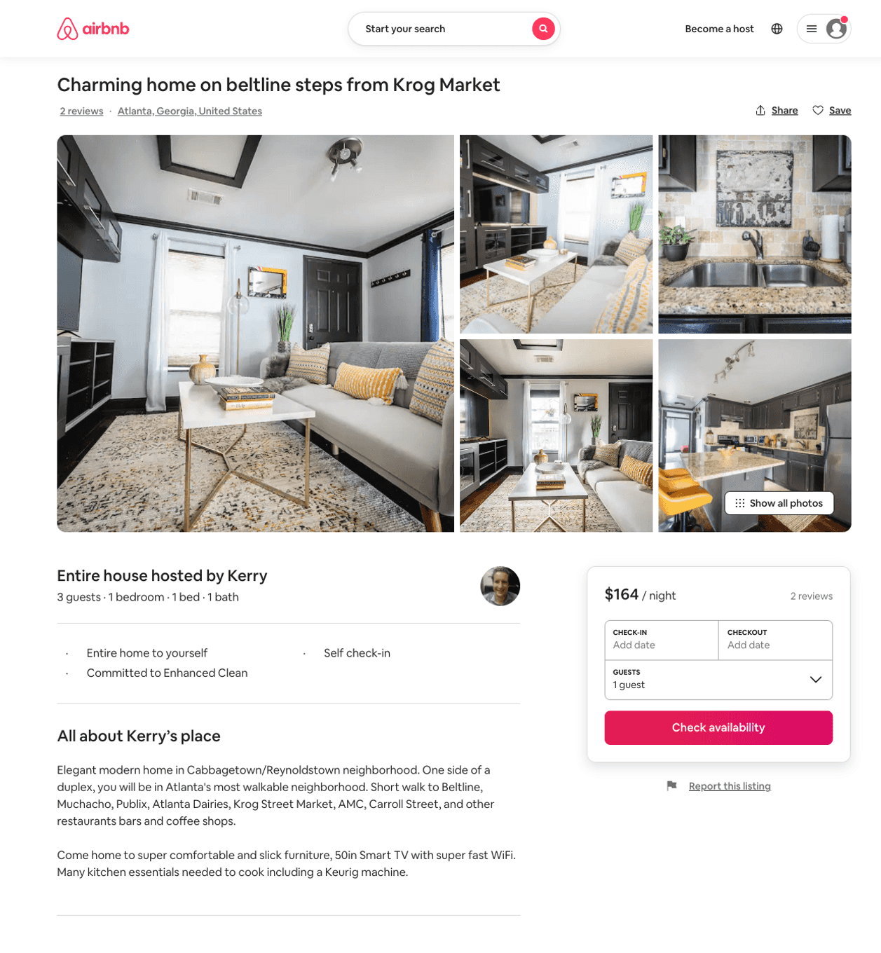
Listing 50525619
1
2
$134 - $263
4.87
2
Kerry
76441090
2
https://www.airbnb.com/rooms/50525619
Aug 2022

Slide 41
Listing 45237553
2
4
$169
30
Casey
359231771
601
https://www.airbnb.com/rooms/45237553
Aug 2022

Slide 42
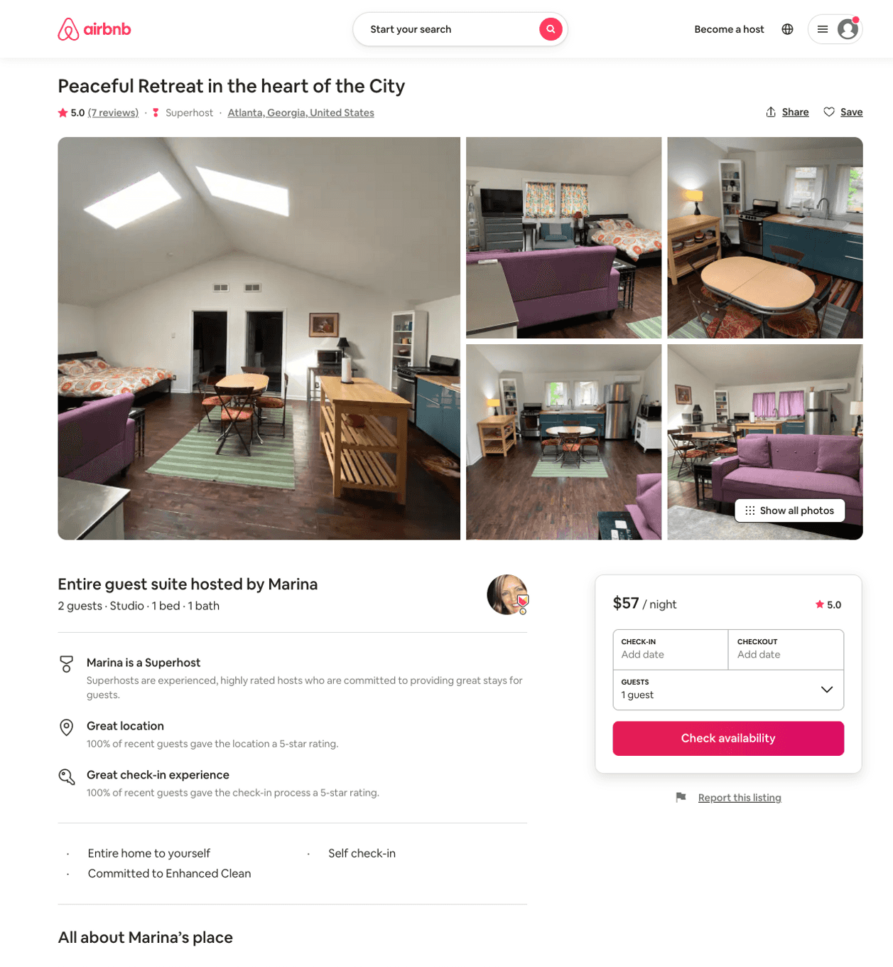
Listing 42529016
Studio
2
$57 - $69
5.0
4
Marina
29192274
2
https://www.airbnb.com/rooms/42529016
Jul 2022

Slide 43
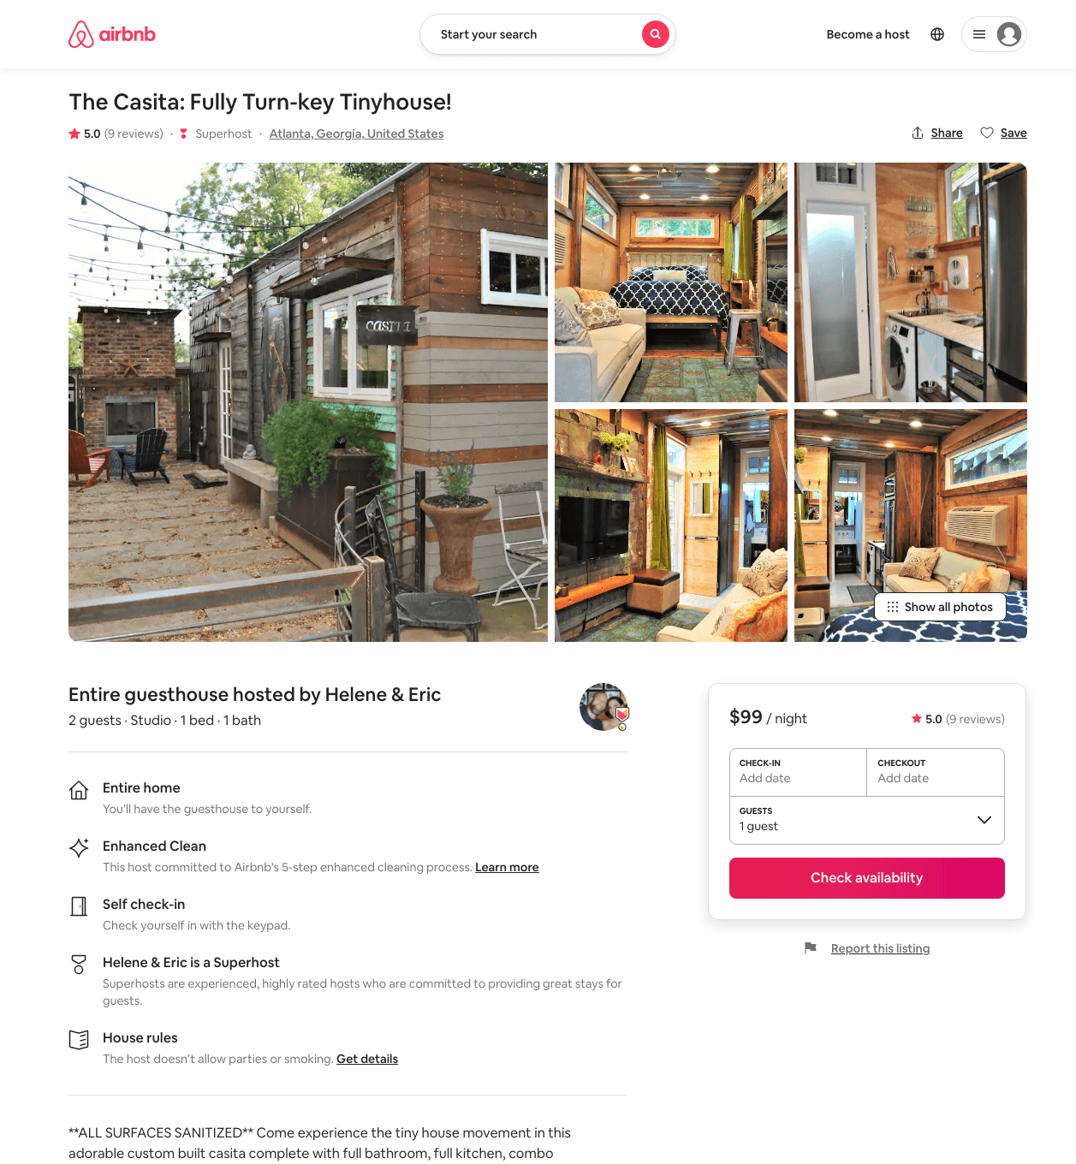
Listing 37147281
Studio
2
$99 - $102
5.0
31
Helene & Eric
42230053
10
https://www.airbnb.com/rooms/37147281
Aug 2022

Slide 44
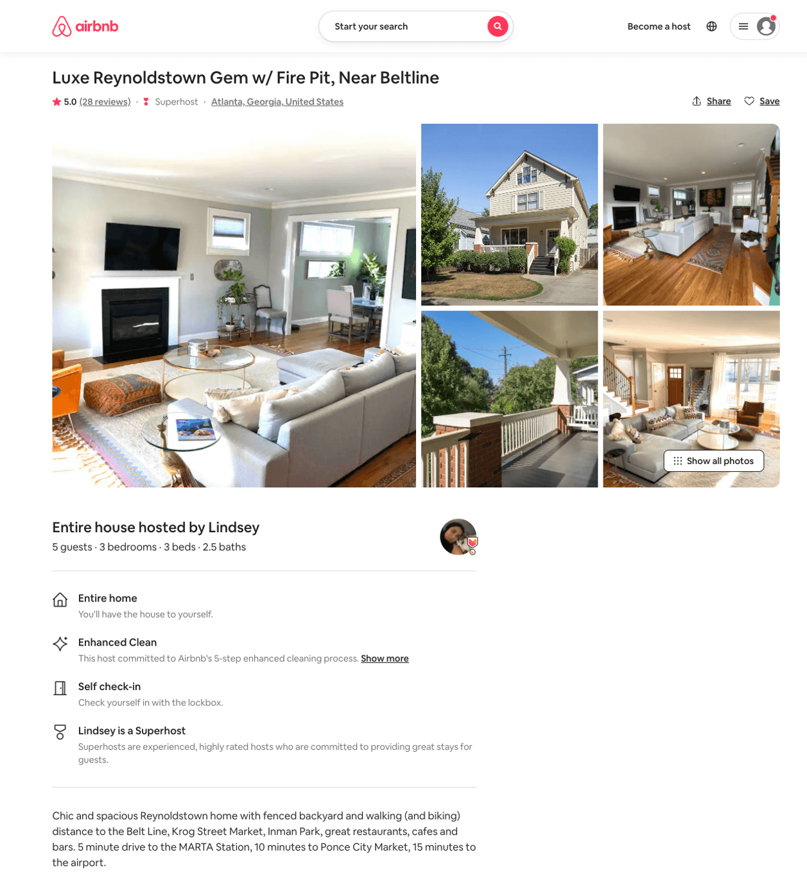
Listing 28279232
3
5
$245 - $315
5.0
7
Lindsey
13573886
2
https://www.airbnb.com/rooms/28279232
Aug 2022

Slide 45
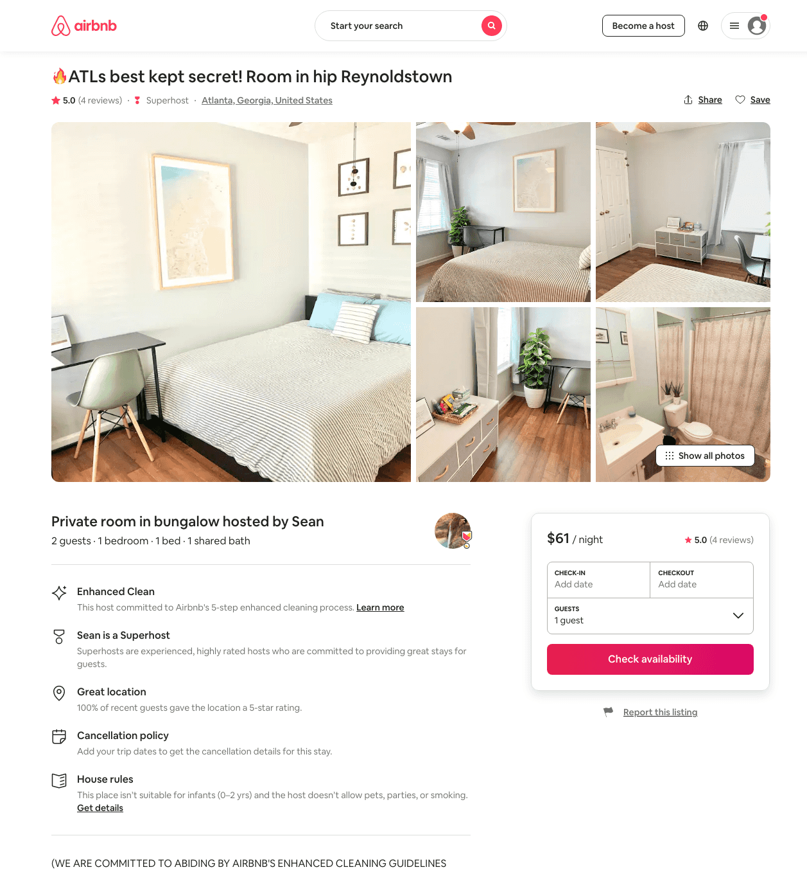
Listing 36833487
1
4
$47 - $74
4.94
3
Sean
287791
2
https://www.airbnb.com/rooms/36833487
Aug 2022

Slide 46
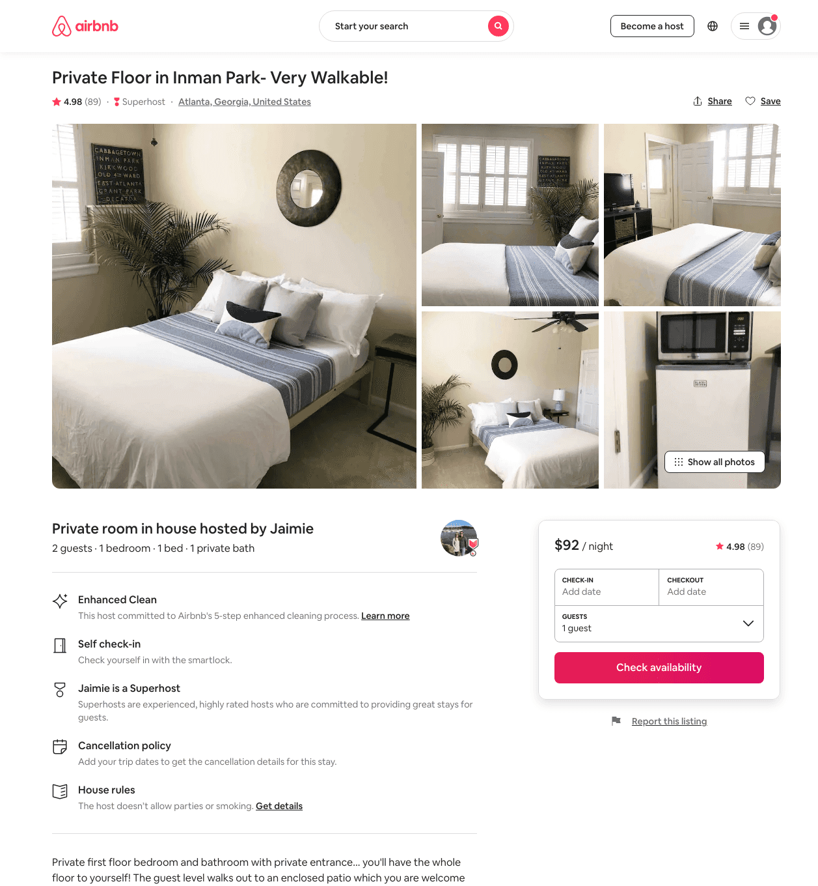
Listing 31351364
1
2
$92 - $113
4.98
2
Jaimie
45614846
1
https://www.airbnb.com/rooms/31351364
Aug 2022

Slide 47
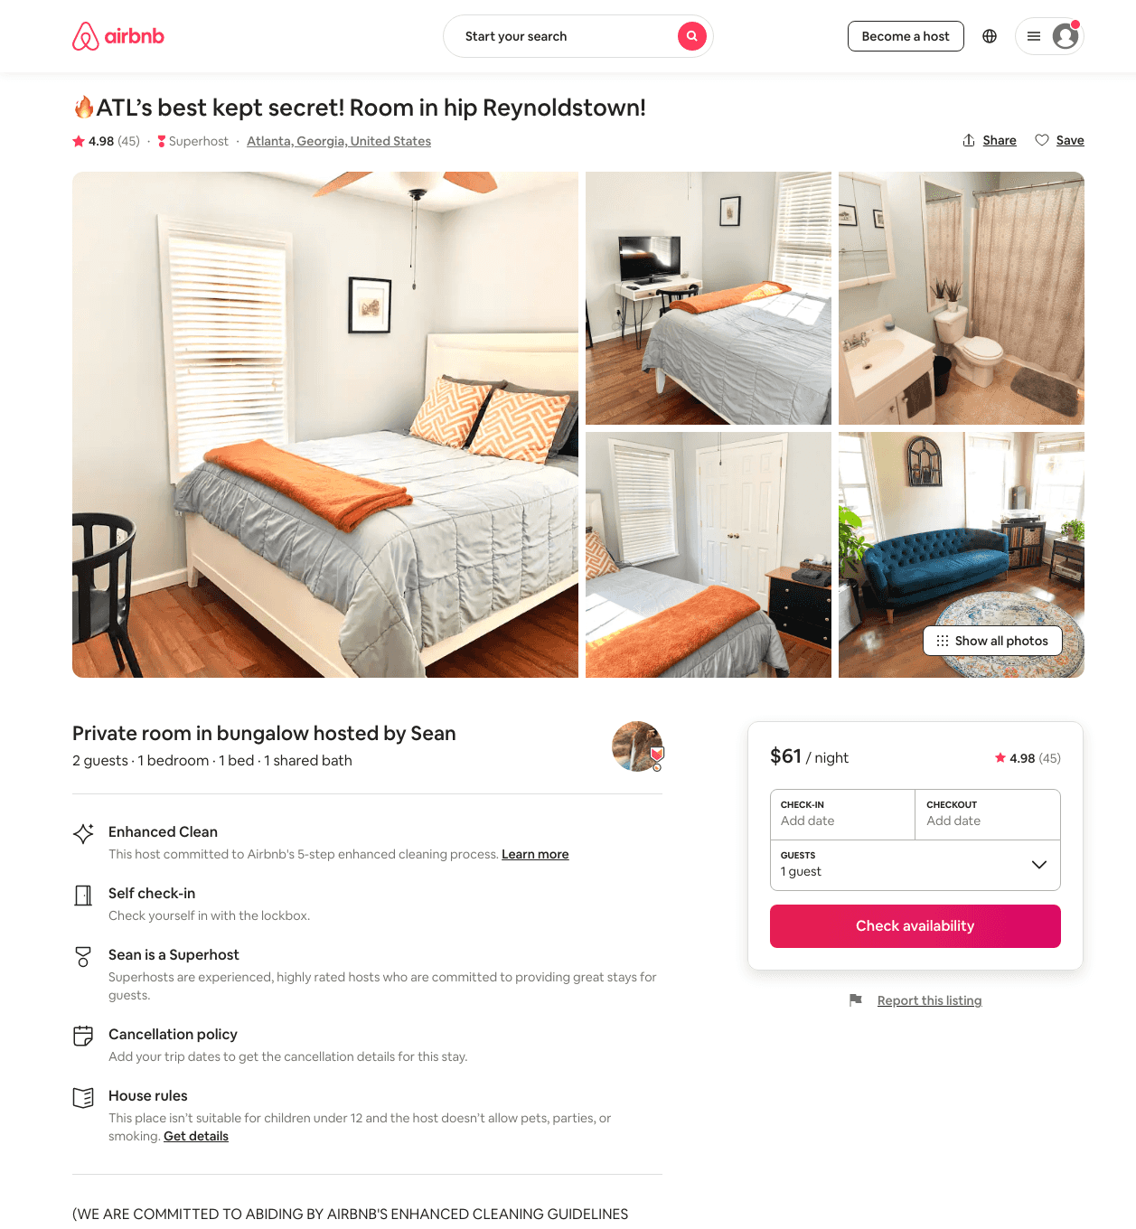
Listing 34616875
1
2
$46 - $63
4.99
3
Sean
287791
2
https://www.airbnb.com/rooms/34616875
Aug 2022

Slide 48
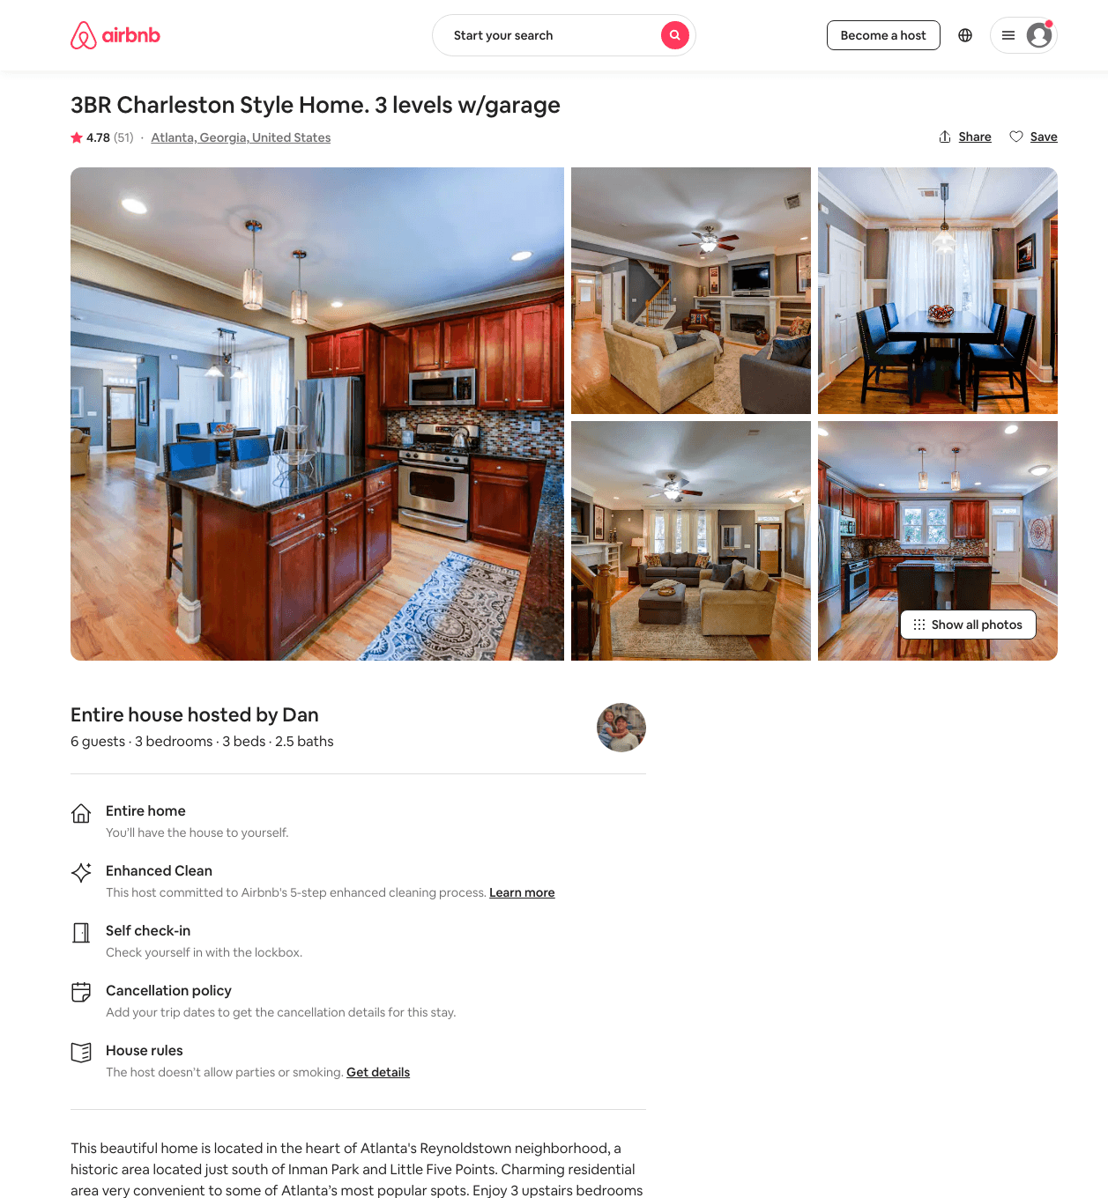
Listing 15972887
3
6
$208 - $236
4.77
30
Dan
47272985
2
https://www.airbnb.com/rooms/15972887
Jun 2022

Slide 49
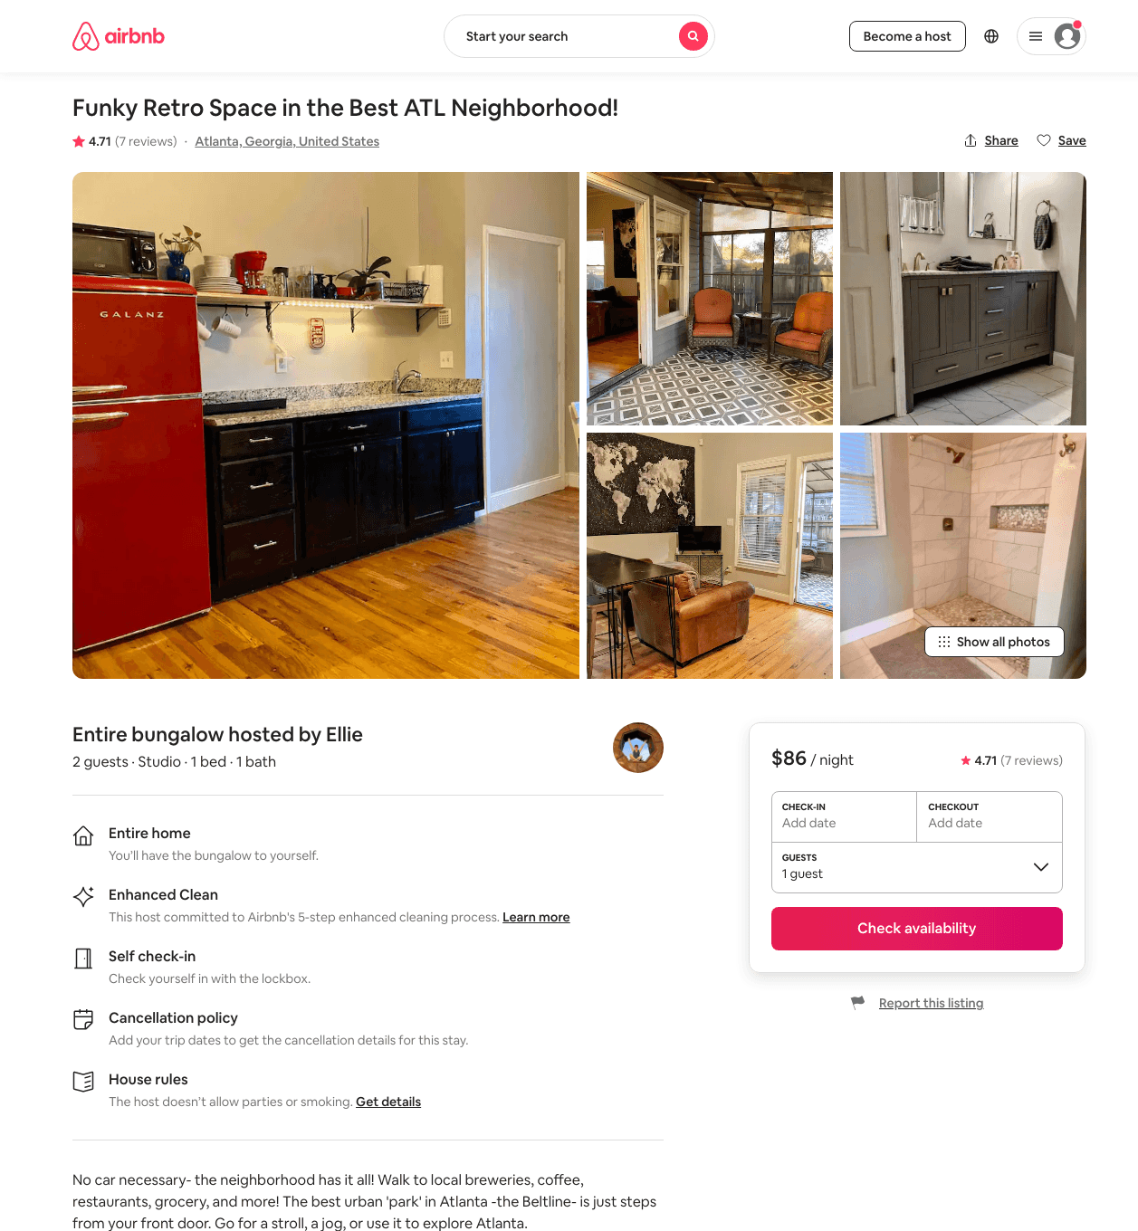
Listing 46531936
Studio
2
$85 - $92
4.86
2
Ellie
23604924
1
https://www.airbnb.com/rooms/46531936
Aug 2022

Slide 50
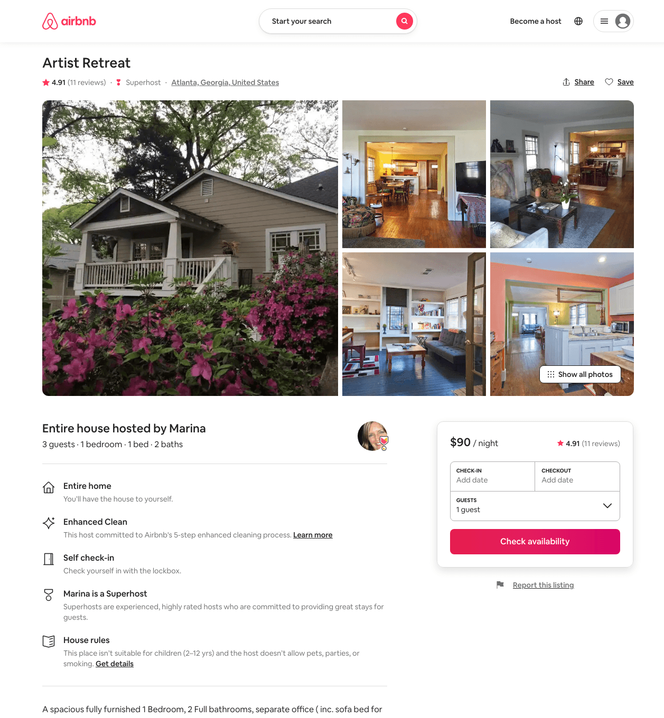
Listing 30548484
1
3
$90 - $110
4.96
5
Marina
29192274
2
https://www.airbnb.com/rooms/30548484
Jul 2022

Slide 51
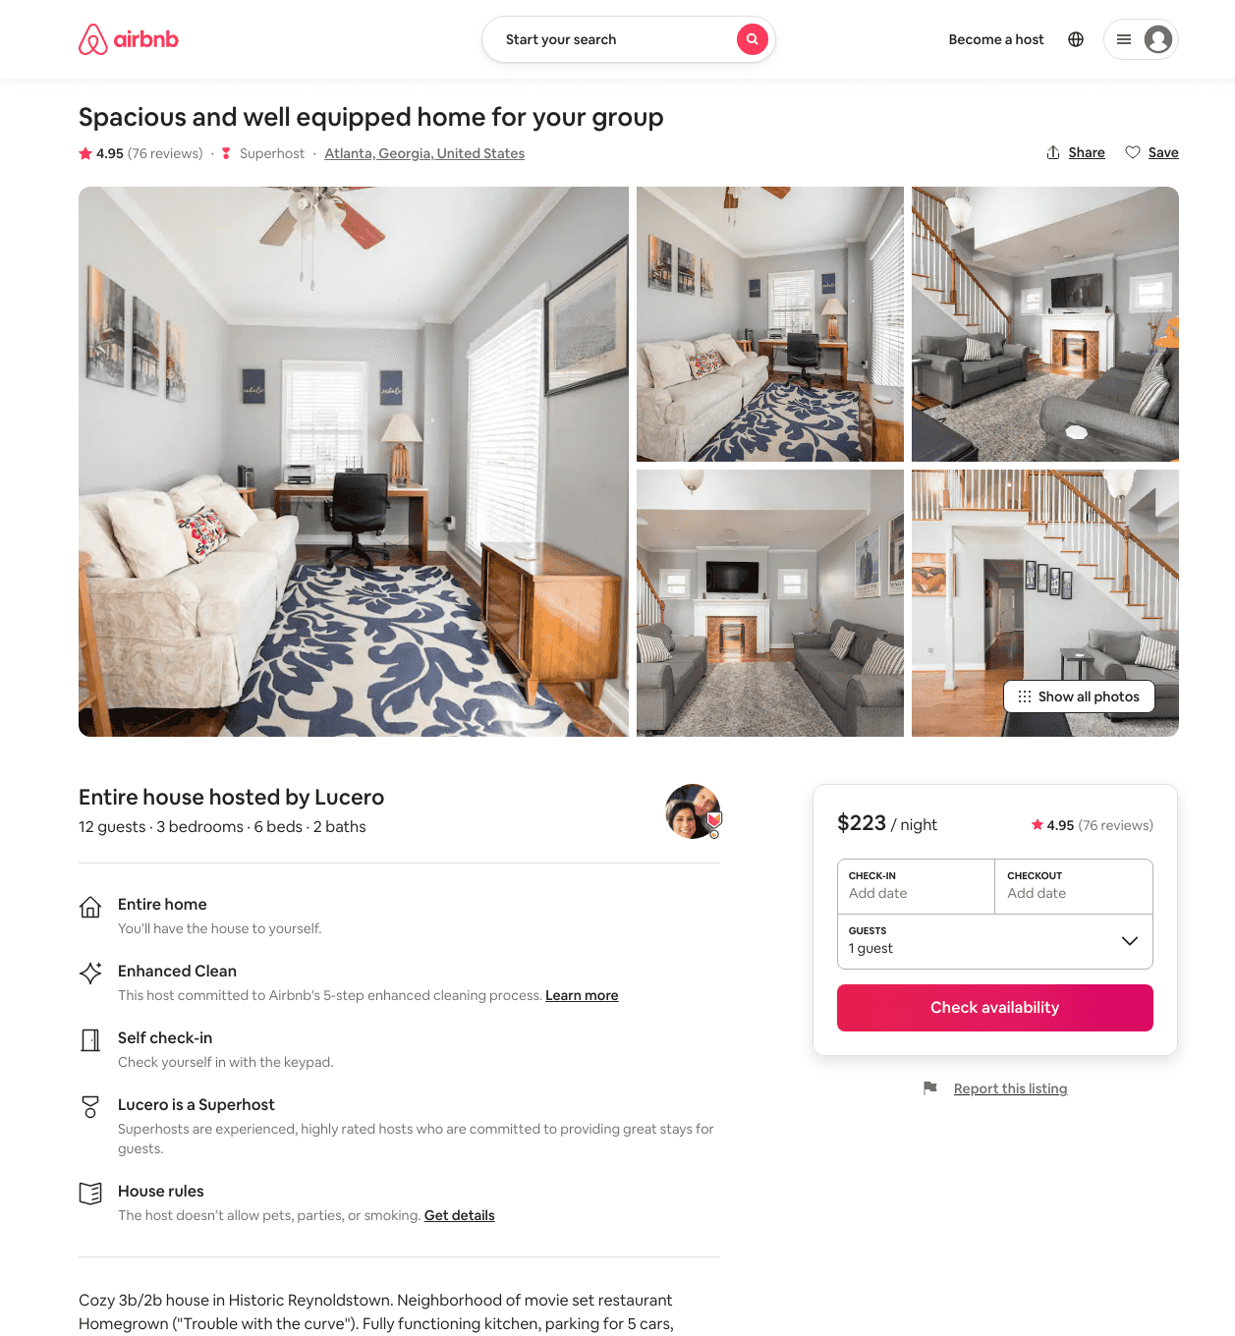
Listing 20603065
3
12
$174 - $229
4.95
2
Lucero
147235307
1
https://www.airbnb.com/rooms/20603065
Aug 2022

Slide 52
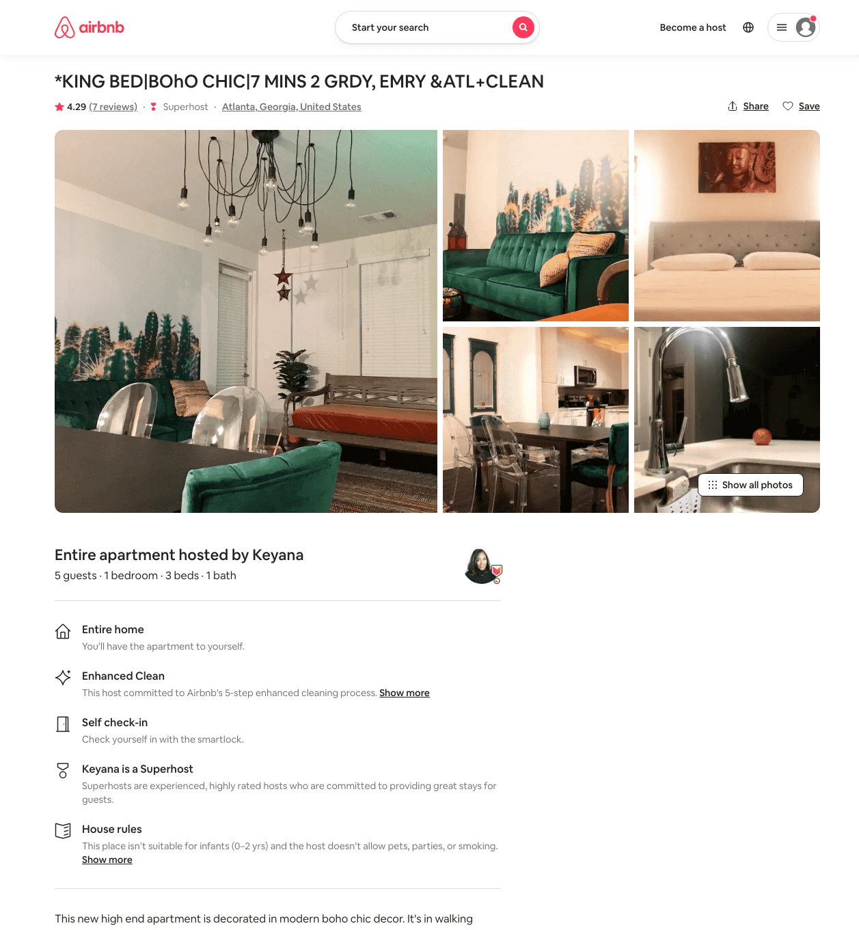
Listing 42415716
1
5
$169 - $207
4.29
1
Keyana
311528019
2
https://www.airbnb.com/rooms/42415716
Aug 2022

Slide 53
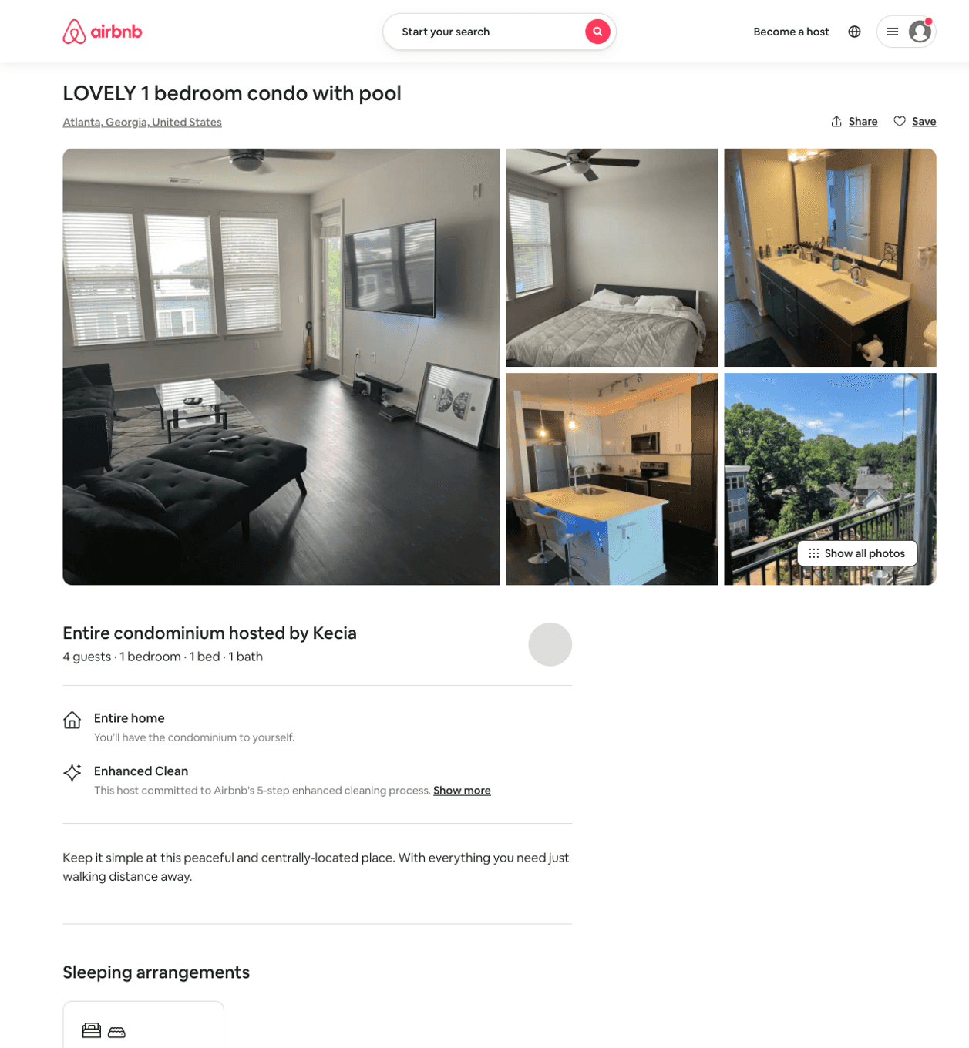
Listing 50324320
2
4
$84 - $141
4.62
2
Kecia
406382305
2
https://www.airbnb.com/rooms/50324320
Aug 2022

Slide 54
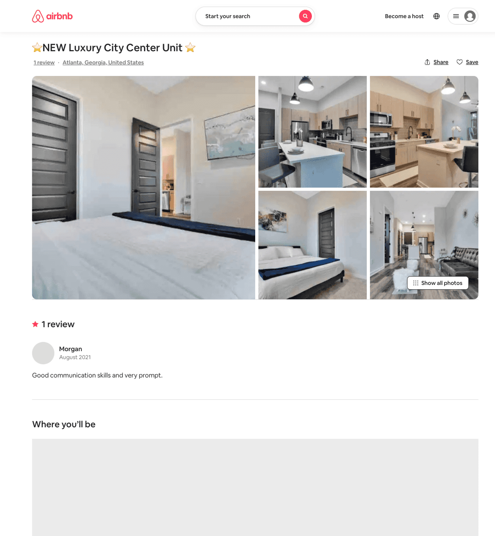
Listing 51326349
1
3
$83 - $112
4.74
2
Ac
415683461
1
https://www.airbnb.com/rooms/51326349
Aug 2022

Slide 55
Listing 51500187
2
5
$141 - $165
4.88
2
Minty
3976298
79
https://www.airbnb.com/rooms/51500187
Aug 2022

Slide 56
Listing 31570867
3
5
$243 - $586
4.97
2
Tammy
111197272
2
https://www.airbnb.com/rooms/31570867
Aug 2022

Slide 57
Listing 51688386
2
5
$133 - $164
4.88
2
Minty
3976298
79
https://www.airbnb.com/rooms/51688386
Aug 2022

Slide 58
Listing 51823951
1
2
$79 - $126
4.60
2
Modern Light
417539962
1
https://www.airbnb.com/rooms/51823951
Aug 2022

Slide 59
Listing 45816852
1
3
$198
5.0
1
Two W
302222159
7
https://www.airbnb.com/rooms/45816852
Jul 2022

Slide 60
Listing 51963956
2
4
$184 - $378
2
James
231303288
1
https://www.airbnb.com/rooms/51963956
Aug 2022

Slide 61
Listing 51784465
1
3
$130 - $153
5.0
2
Cory
51421469
1
https://www.airbnb.com/rooms/51784465
Jun 2022

Slide 62
Listing 52266138
2
4
$103 - $157
4.95
1
Thomas
423059064
1
https://www.airbnb.com/rooms/52266138
Aug 2022

Slide 63
Listing 52423552
1
2
$40 - $88
4.98
1
Saged
424321398
1
https://www.airbnb.com/rooms/52423552
Aug 2022

Slide 64
Listing 51227975
2
8
$149 - $210
4.42
2
Modish
129468080
1
https://www.airbnb.com/rooms/51227975
Aug 2022

Slide 65
Listing 50771529
2
6
$280 - $399
5.0
2
Kimberly
1389150
1
https://www.airbnb.com/rooms/50771529
Aug 2022

Slide 66
Listing 51804299
1
4
$92 - $150
4.94
2
Top Tier Rentals
419683378
1
https://www.airbnb.com/rooms/51804299
Aug 2022

Slide 67
Listing 52508988
1
2
$117 - $169
5.0
1
Tina
114892734
1
https://www.airbnb.com/rooms/52508988
Aug 2022

Slide 68
Listing 52885798
1
3
$110 - $126
4.82
3
Vickie
423569761
1
https://www.airbnb.com/rooms/52885798
Aug 2022

Slide 69
Listing 53110365
2
4
$149 - $680
4.61
1
Dawan
41851234
2
https://www.airbnb.com/rooms/53110365
Aug 2022

Slide 70
Listing 52392008
1
3
$100 - $121
4.80
3
Banton
406566757
1
https://www.airbnb.com/rooms/52392008
Jul 2022

Slide 71
Listing 53542674
1
4
$94 - $152
4.86
1
Lavish
367950800
4
https://www.airbnb.com/rooms/53542674
Aug 2022

Slide 72
Listing 53493041
4
8
$329 - $419
5.0
30
Kristen
105514806
2
https://www.airbnb.com/rooms/53493041
Aug 2022

Slide 73
Listing 53043713
2
5
$136 - $206
28
Alex And Christina
20605441
40
https://www.airbnb.com/rooms/53043713
Aug 2022

Slide 74
Listing 53809465
1
3
$130 - $203
4
Pasha Luxury
11490196
7
https://www.airbnb.com/rooms/53809465
Aug 2022

Slide 75
Listing 2570915
1
4
$130 - $140
5
1
CJ
https://www.vrbo.com/2570915
Aug 2022

Slide 76
Listing 2573638
2
4
$180 - $250
1
https://www.vrbo.com/2573638
Aug 2022

Slide 77
Listing 2570481
1
2
$125 - $137
5
3
Banton
https://www.vrbo.com/2570481
Aug 2022

Slide 78
Listing 2577423
1
2
$225 - $265
5
Kristen Leslie Zalatan
https://www.vrbo.com/2577423
Aug 2022

Slide 79
Listing 2529373
2
6
$126 - $250
2
Lauren Meeks
https://www.vrbo.com/2529373
Aug 2022

Slide 80
Listing the-in-town-spot
148 HOLIDAY AVE NE
undefined
1
9
https://www.booking.com/hotel/us/the-in-town-spot.html
Sep 2022

Slide 81
Listing 53097731
1
2
$183
30
Kristen
105514806
2
https://www.airbnb.com/rooms/53097731
Jun 2022

Slide 82
Listing 2613045
2
5
$166
5
1
Thomas Dixon
https://www.vrbo.com/2613045
Aug 2022

Slide 83
Listing 2644741
3
12
$188
5
2
Curt Morse
https://www.vrbo.com/2644741
Aug 2022

Slide 84
Listing 52968536
1
3
$105 - $108
4.75
2
Alexandria
152243578
1
https://www.airbnb.com/rooms/52968536
Jun 2022

Slide 85
Listing 1884815
1
4
$93
4
https://www.vrbo.com/1884815
Aug 2022

Slide 86
Listing 31711987
4
10
$350 - $399
5.0
4
Stephanie
206505019
1
https://www.airbnb.com/rooms/31711987
Aug 2022

Slide 87
Listing 2761849
4
10
$339
1
2
https://www.vrbo.com/2761849
Aug 2022

Slide 88
Listing 2808379
2
6
$198
4
2
https://www.vrbo.com/2808379
Aug 2022

Slide 89
Listing 2876263
3
6
$300
14
Alex Prueitt
https://www.vrbo.com/2876263
Aug 2022

Slide 90
Listing 2526260
1
4
$135
3
Trenisha
https://www.vrbo.com/2526260
Aug 2022

Slide 91
Listing 22258170
3
6
5.0
3
Grayson
73345114
2
https://www.airbnb.com/rooms/22258170
Aug 2022

Slide 92
Listing 2967030
1
2
$131
2
Minty Living
https://www.vrbo.com/2967030
Aug 2022

Slide 93
Listing 2962128
1
2
$183
2
Minty Living
https://www.vrbo.com/2962128
Aug 2022

Slide 94
Listing 2962077
2
5
$208
2
Minty Living
https://www.vrbo.com/2962077
Aug 2022

Slide 95
Listing 2962115
3
7
$563
2
Minty Living
https://www.vrbo.com/2962115
Aug 2022

