Slide 2
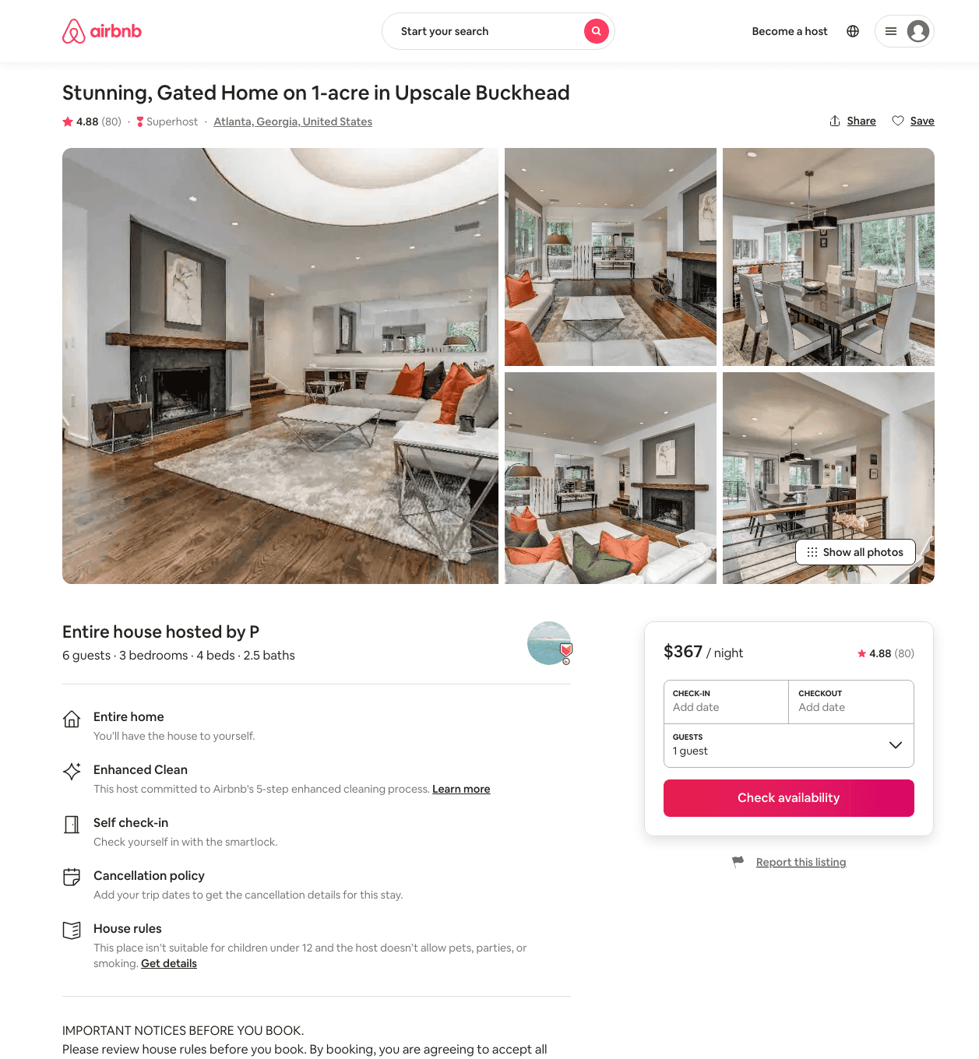
Listing 31714560
3
6
$340 - $616
4.85
2
P
237879281
1
https://www.airbnb.com/rooms/31714560
Aug 2022

Slide 3
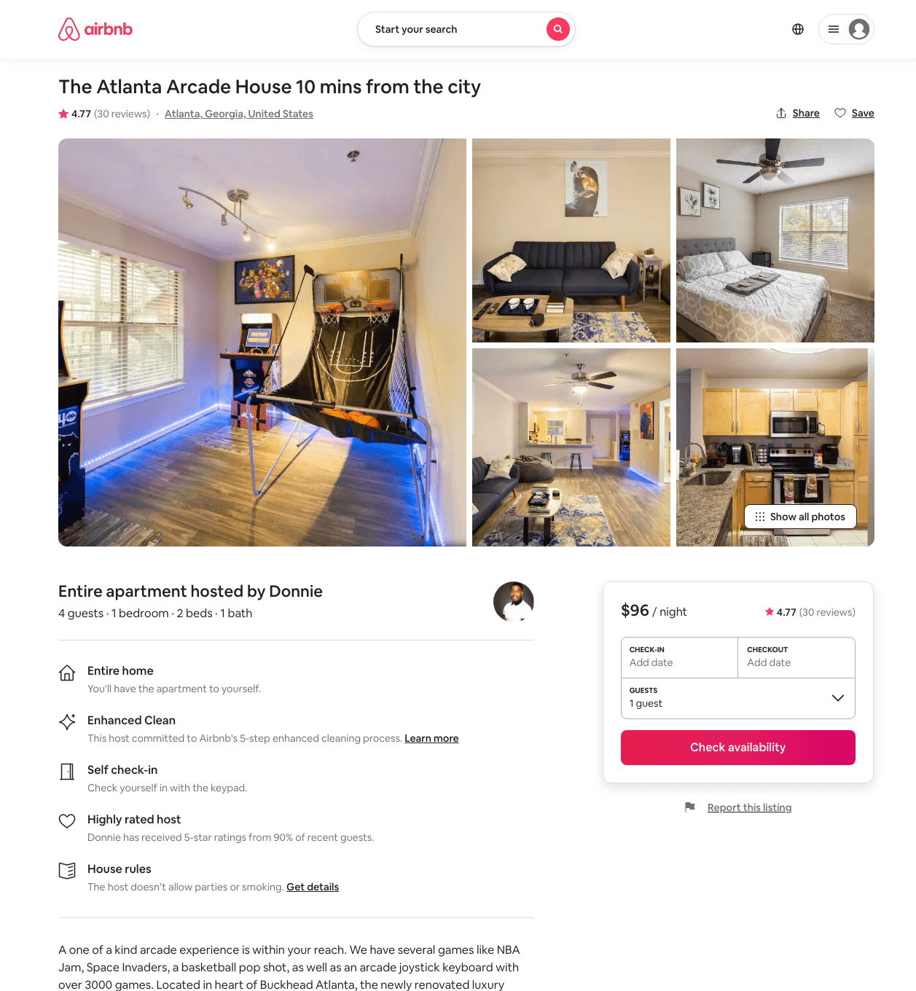
Listing 45364532
1
4
$79 - $120
4.66
1
Donnie
354521570
7
https://www.airbnb.com/rooms/45364532
Aug 2022

Slide 4
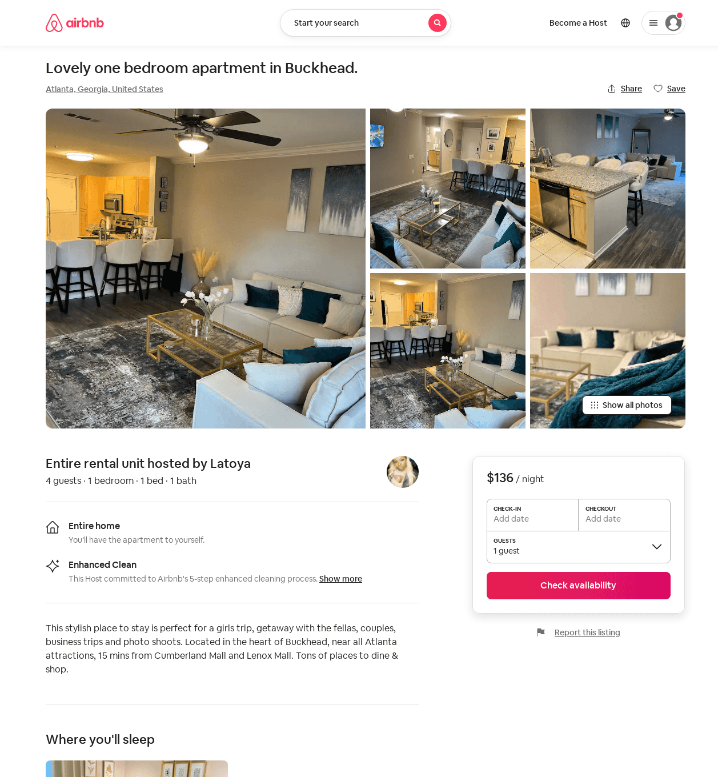
Listing 53438166
1
4
$111 - $136
4.86
2
Latoya
348148038
1
https://www.airbnb.com/rooms/53438166
Aug 2022

