Slide 2
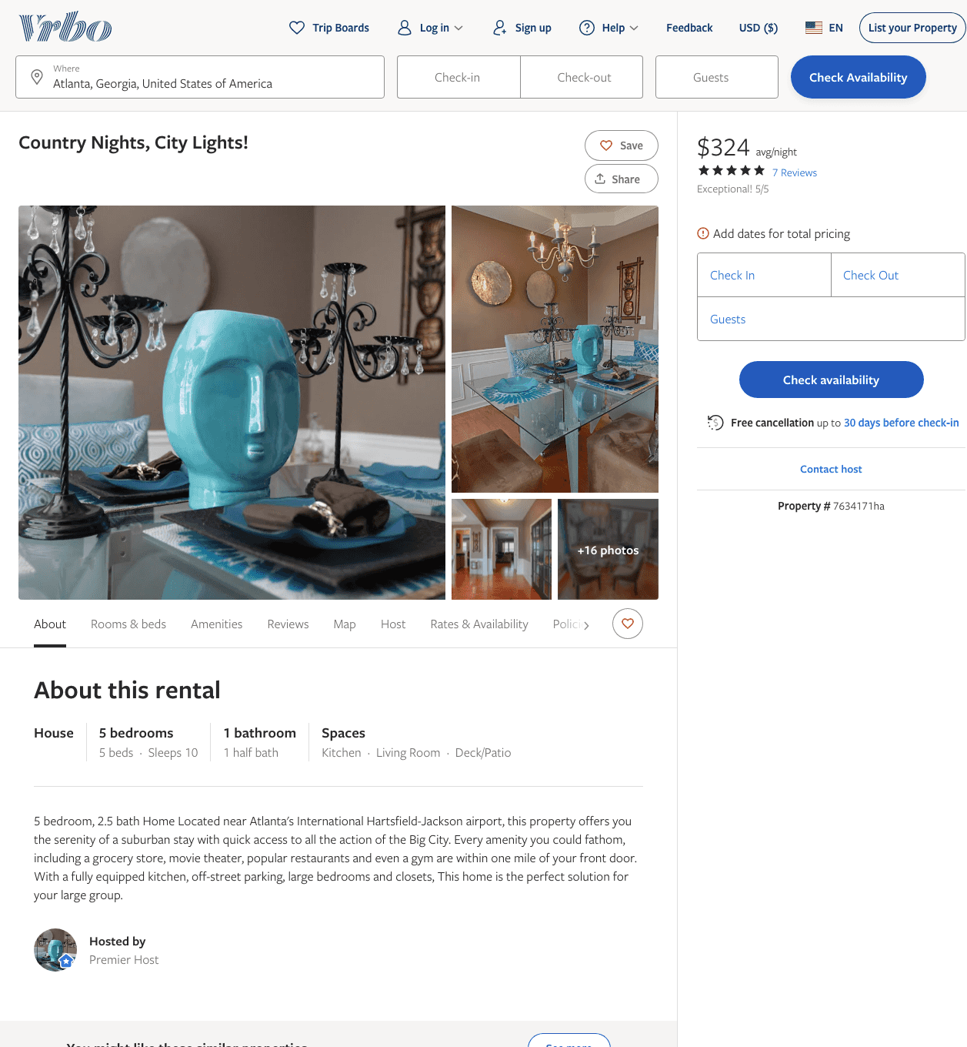
Listing 7634171
5
10
$299 - $324
5
3
https://www.vrbo.com/7634171ha
Aug 2022

Slide 3
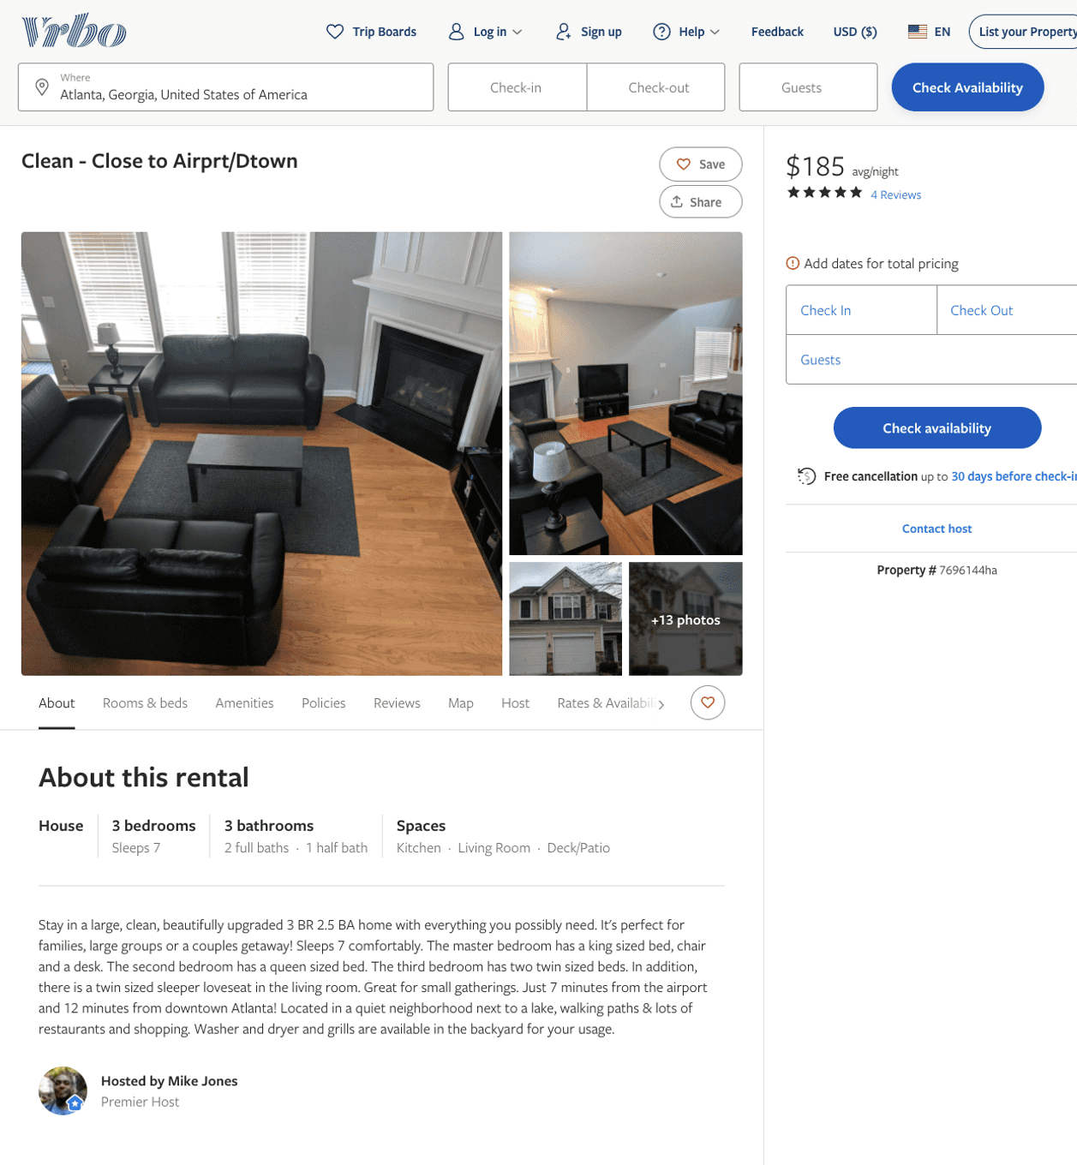
Listing 7696144
3
7
$145 - $204
4.857143
3
Mike Jones
https://www.vrbo.com/7696144ha
Aug 2022

Slide 4
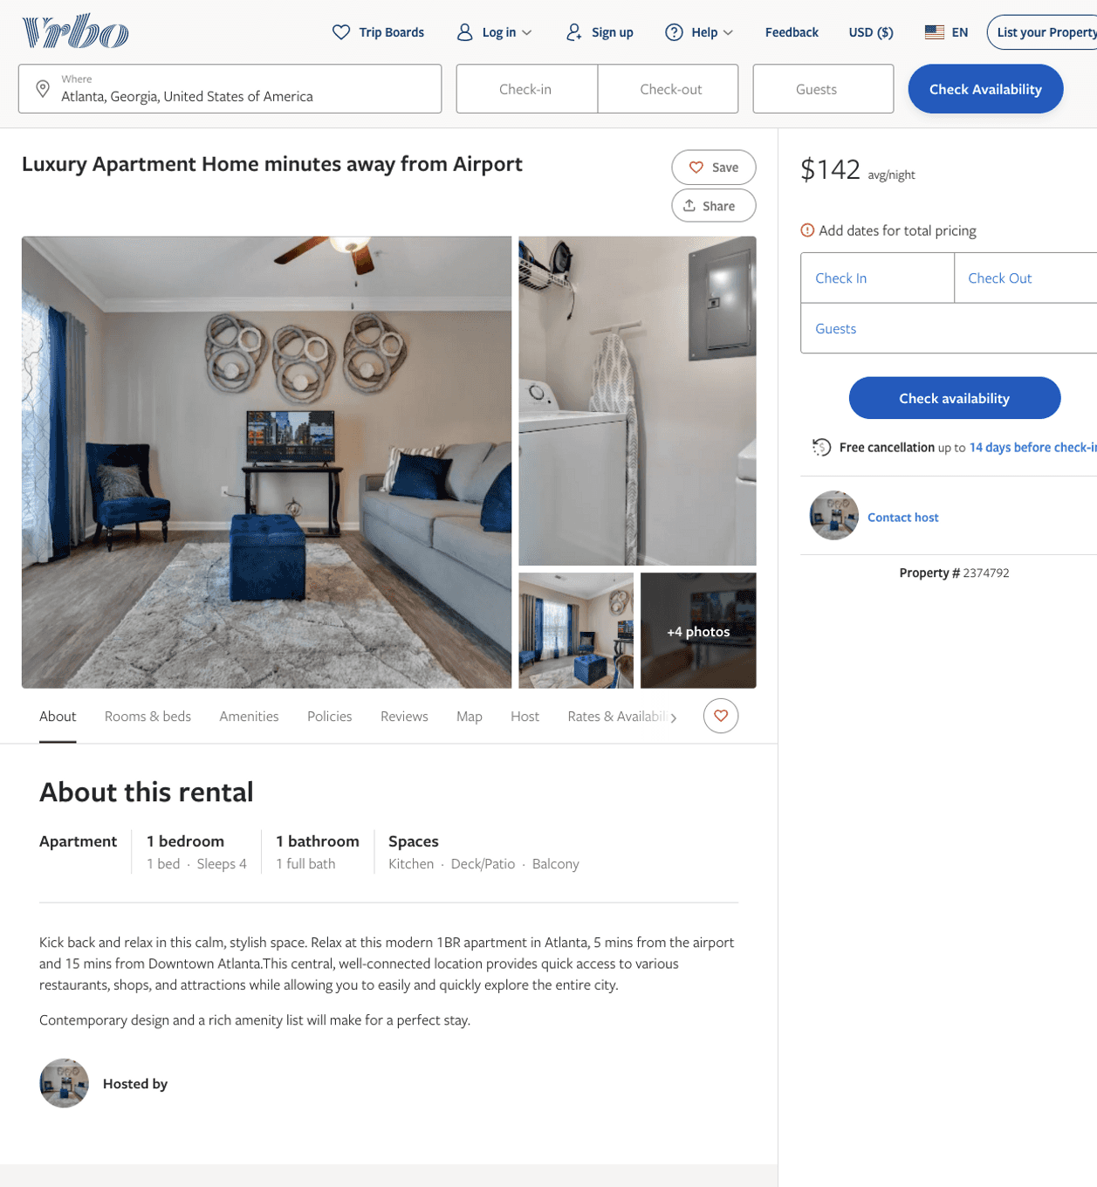
Listing 2374792
1
4
$142 - $161
1
Marquon Pauling
https://www.vrbo.com/2374792
Aug 2022

Slide 5
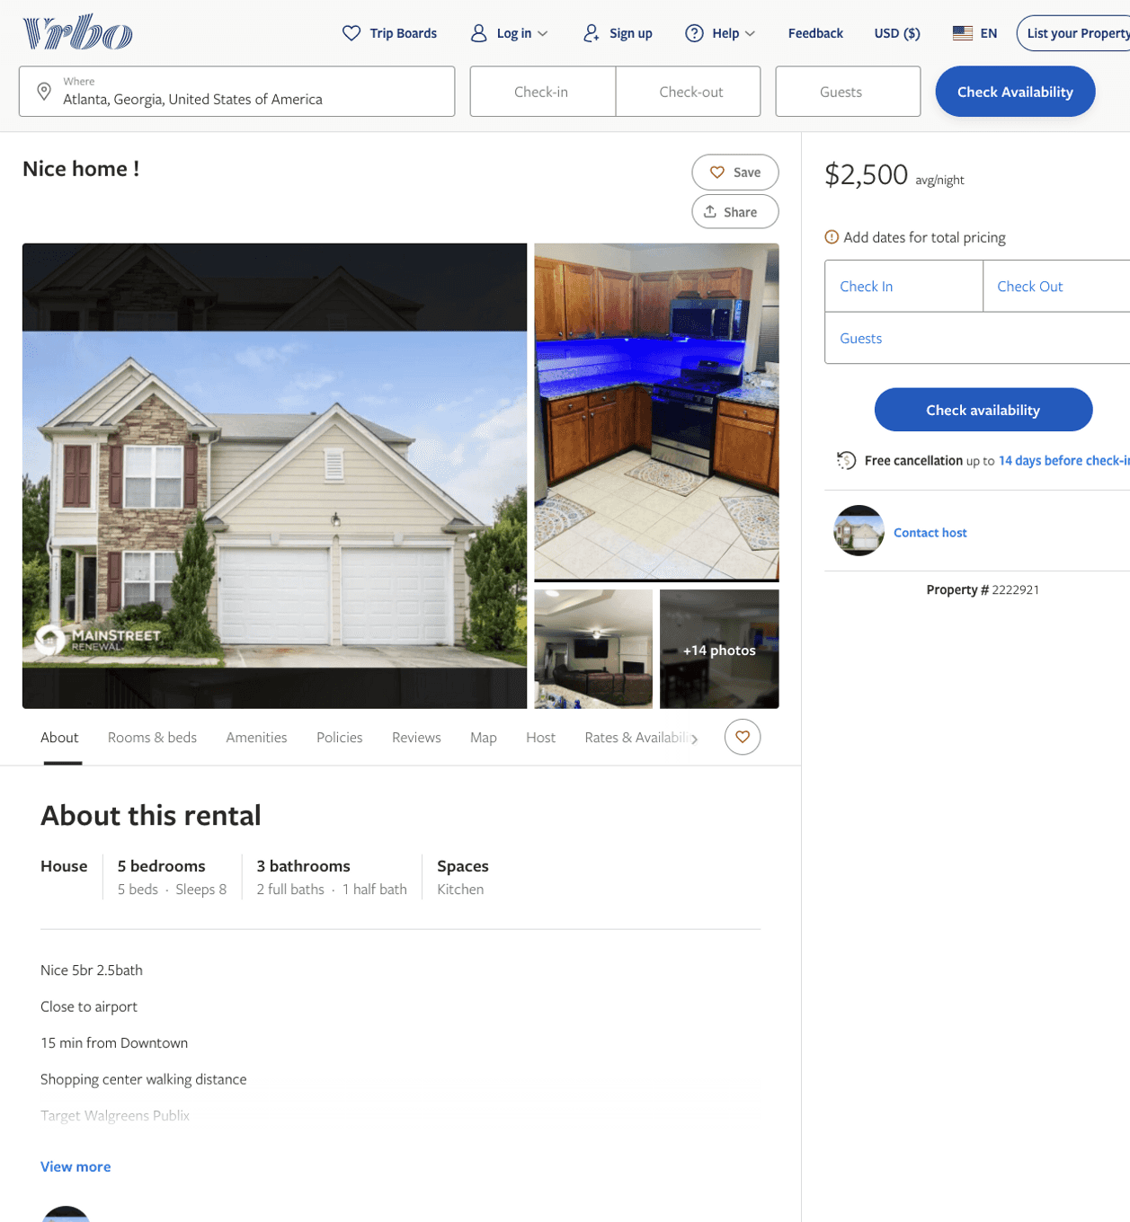
Listing 2222921
5
8
$2,500
2
https://www.vrbo.com/2222921
Aug 2022

Slide 6
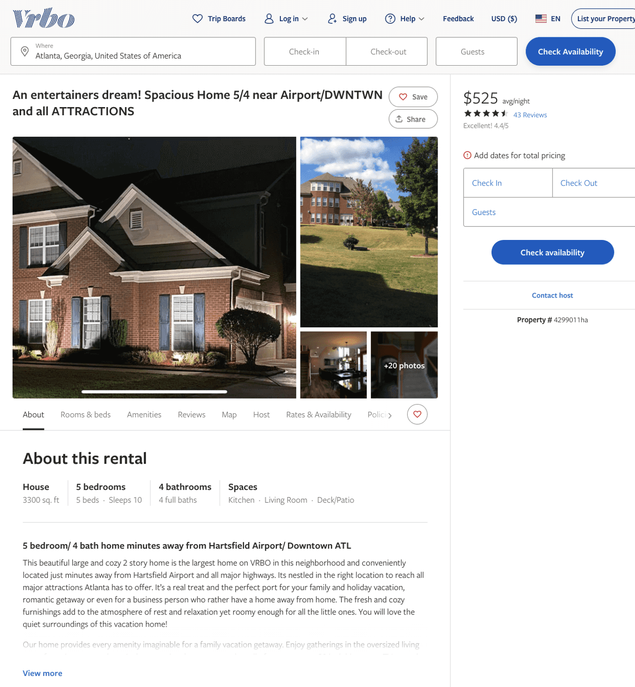
Listing 4299011
5
10
$495 - $553
4.4375
3
Mirna Elie
https://www.vrbo.com/4299011ha
Aug 2022

Slide 7
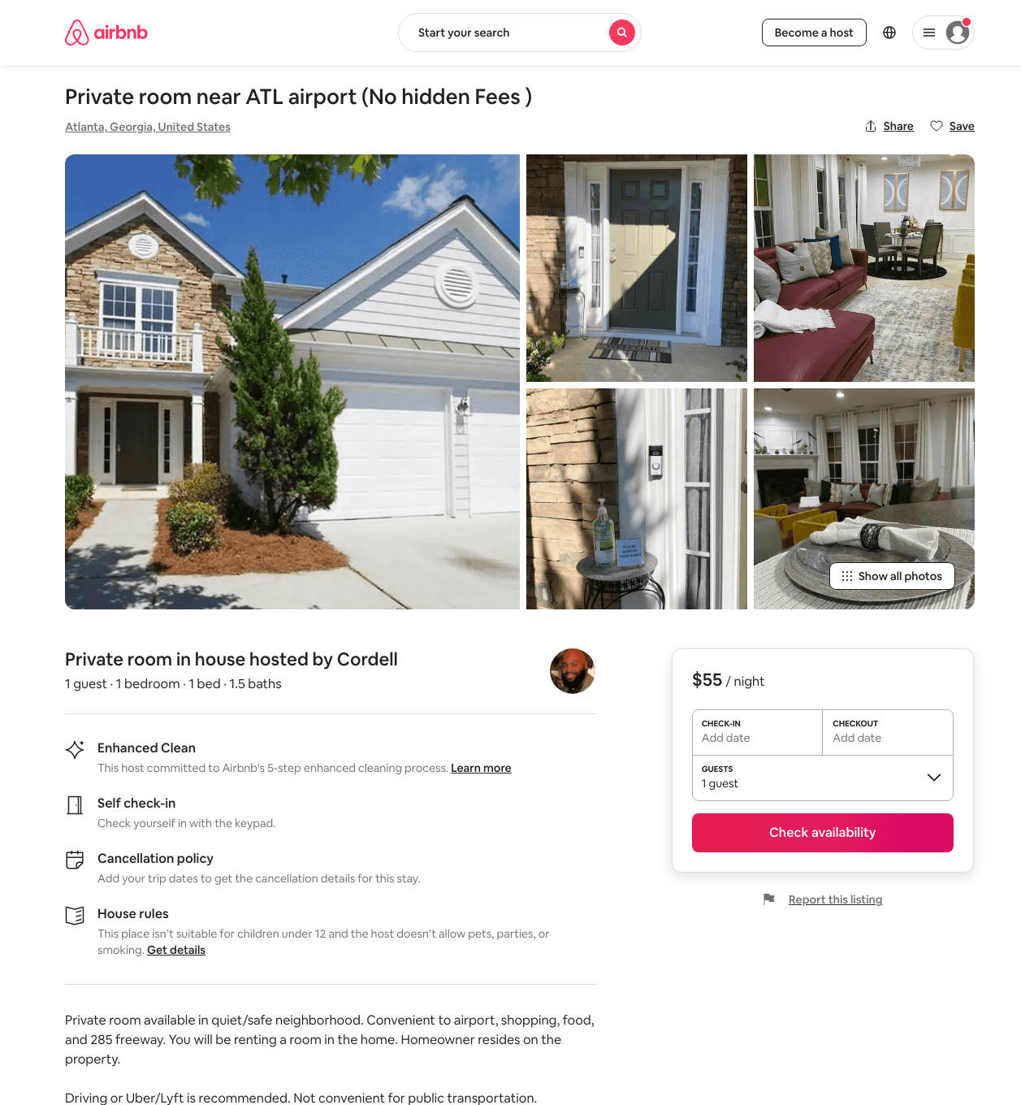
Listing 42996986
1
1
$53 - $55
1
Cordell
40649458
1
https://www.airbnb.com/rooms/42996986
Aug 2022

Slide 8
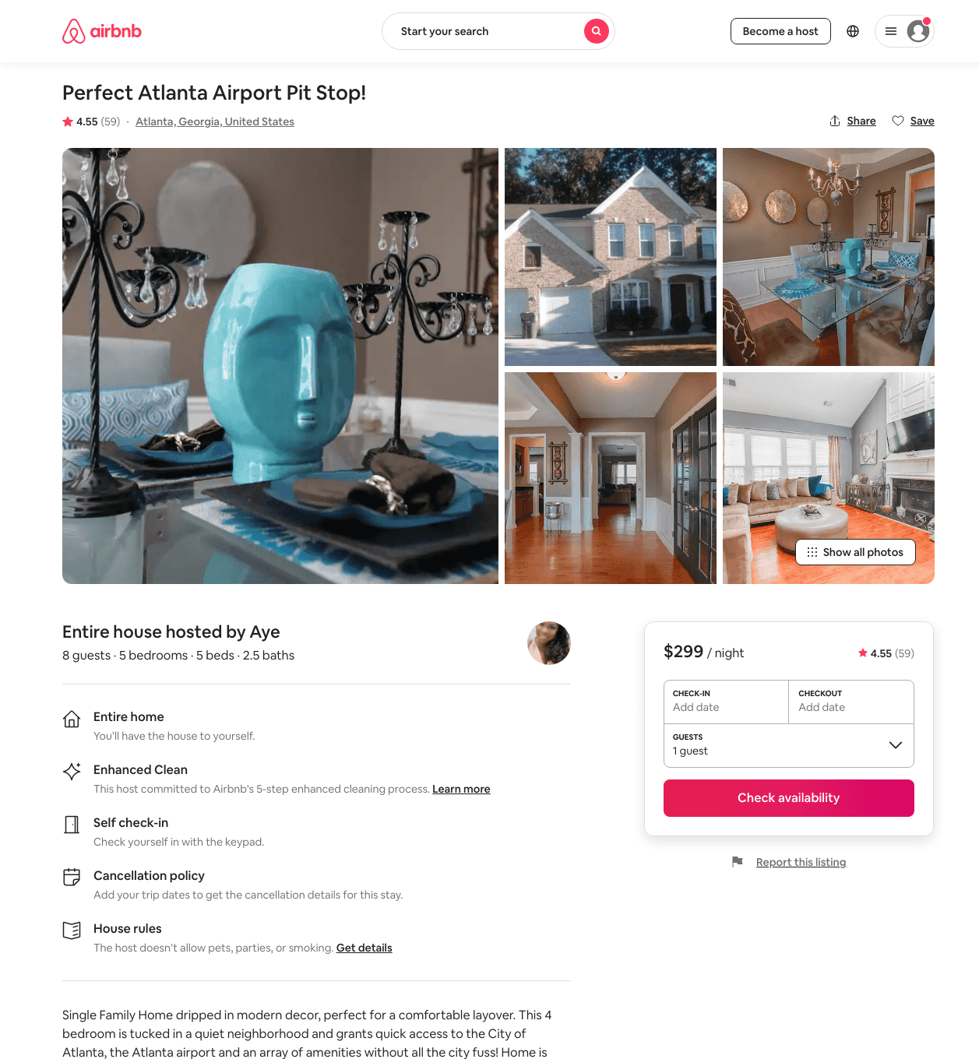
Listing 11826196
5
8
$199 - $314
4.63
3
Aye
62997544
2
https://www.airbnb.com/rooms/11826196
Aug 2022

Slide 9
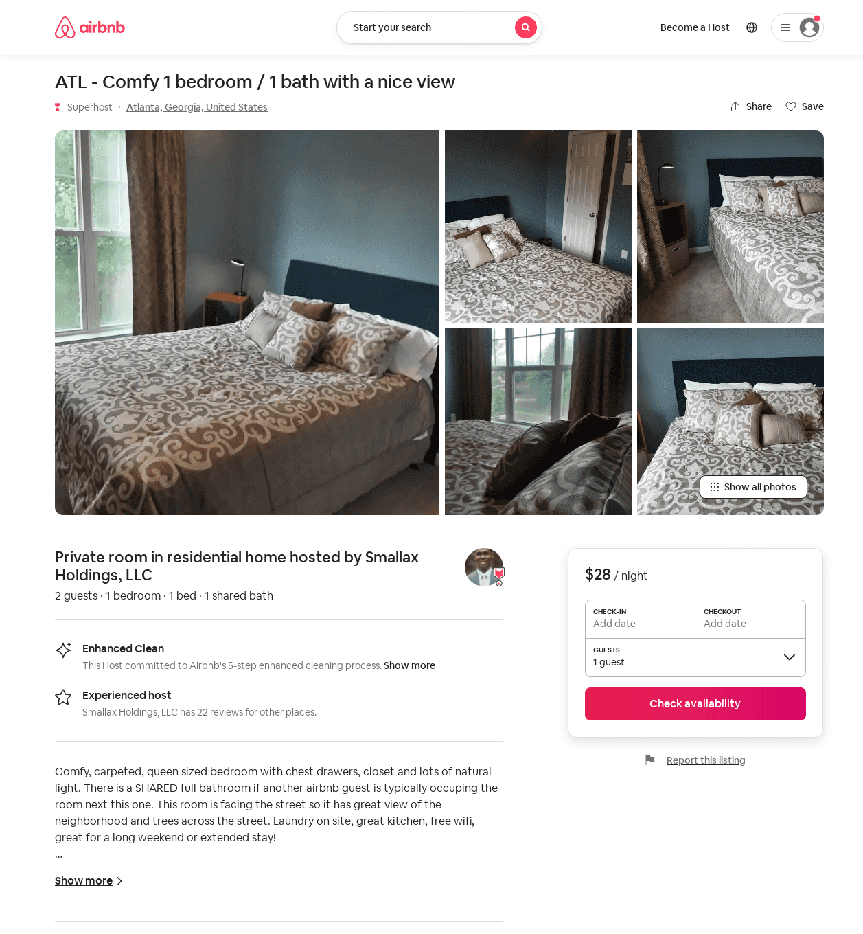
Listing 23358959
1
2
$28 - $35
5
Smallax Holdings, LLC
92483565
2
https://www.airbnb.com/rooms/23358959
Jun 2022

Slide 10
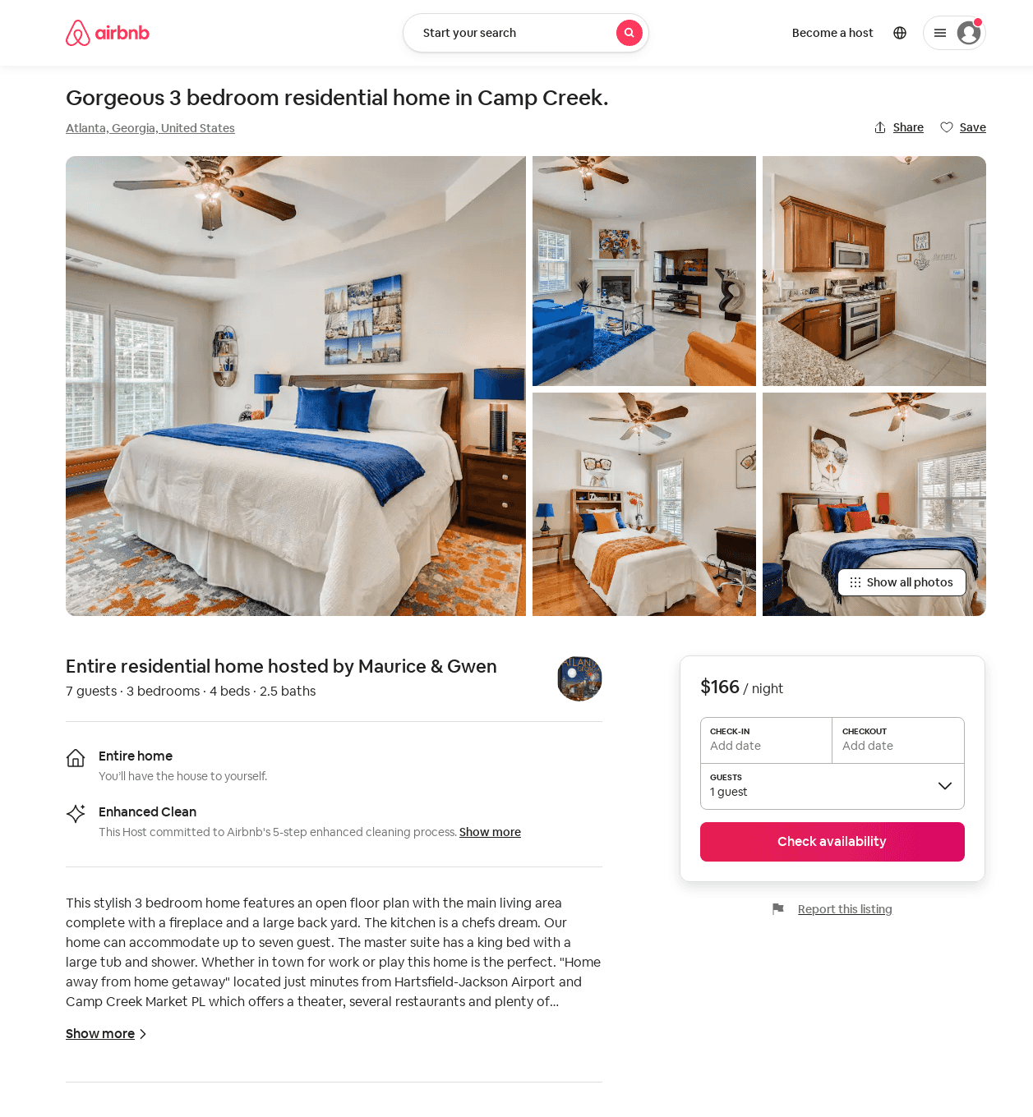
Listing 52572522
3
7
$140 - $300
4.63
2
Maurice & Gwen
425087170
1
https://www.airbnb.com/rooms/52572522
Aug 2022

Slide 11
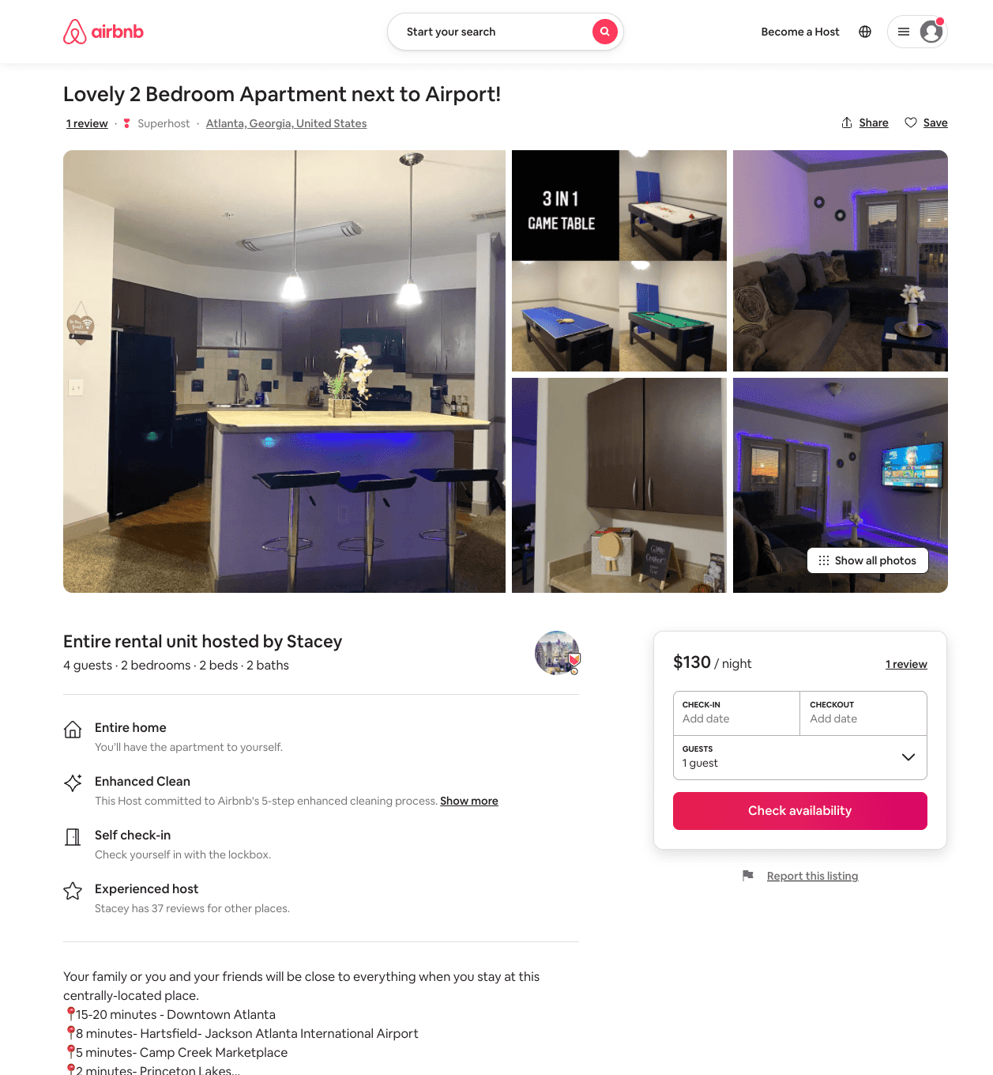
Listing 52517805
2
4
$121 - $150
4.96
2
Stacey
286160617
1
https://www.airbnb.com/rooms/52517805
Jun 2022

Slide 12
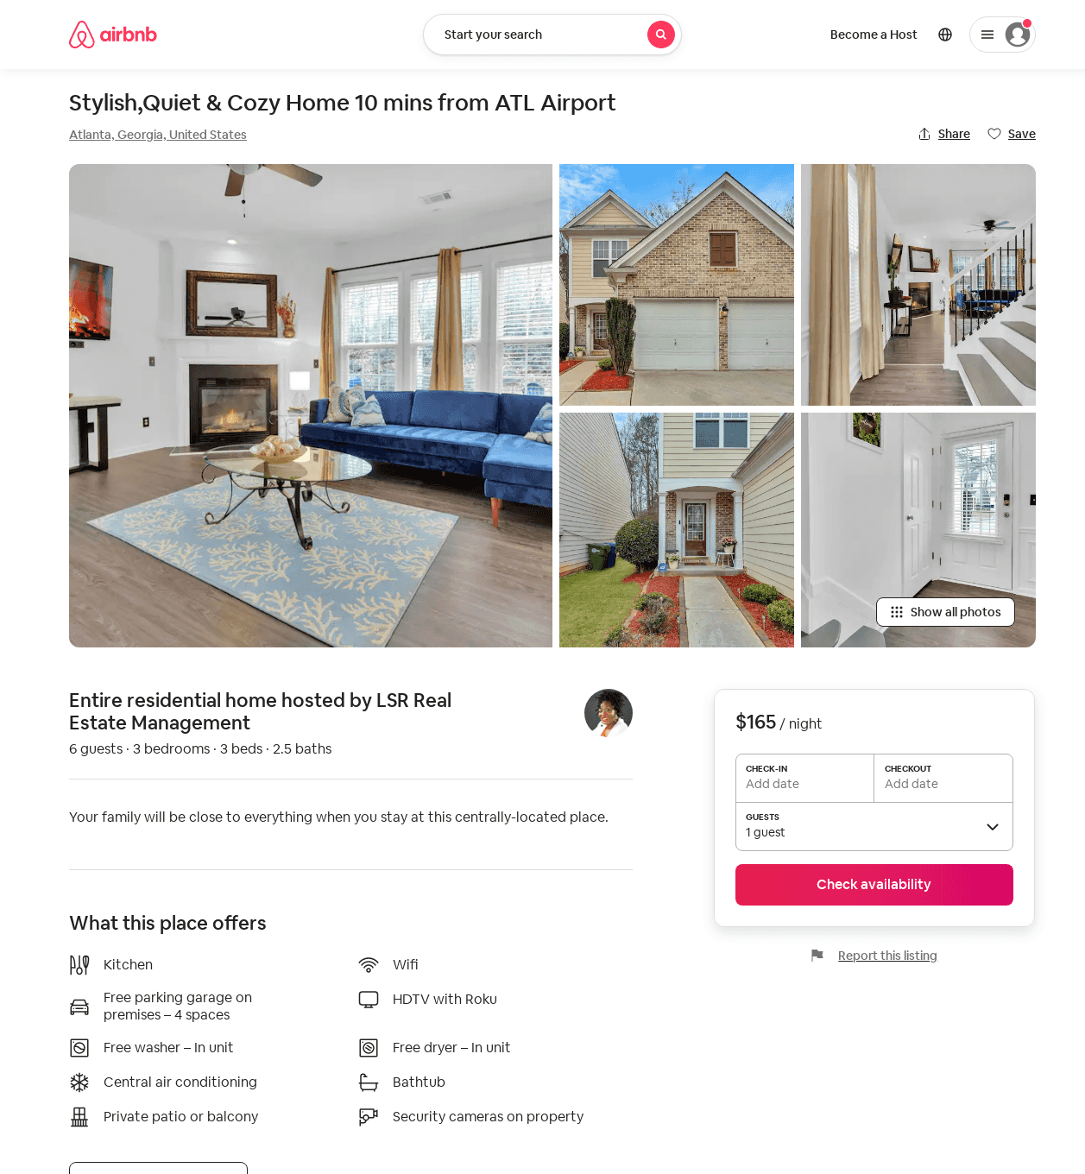
Listing 50897967
3
8
$160 - $210
5.0
1
LSR Real Estate Management
402530746
1
https://www.airbnb.com/rooms/50897967
Aug 2022

Slide 13
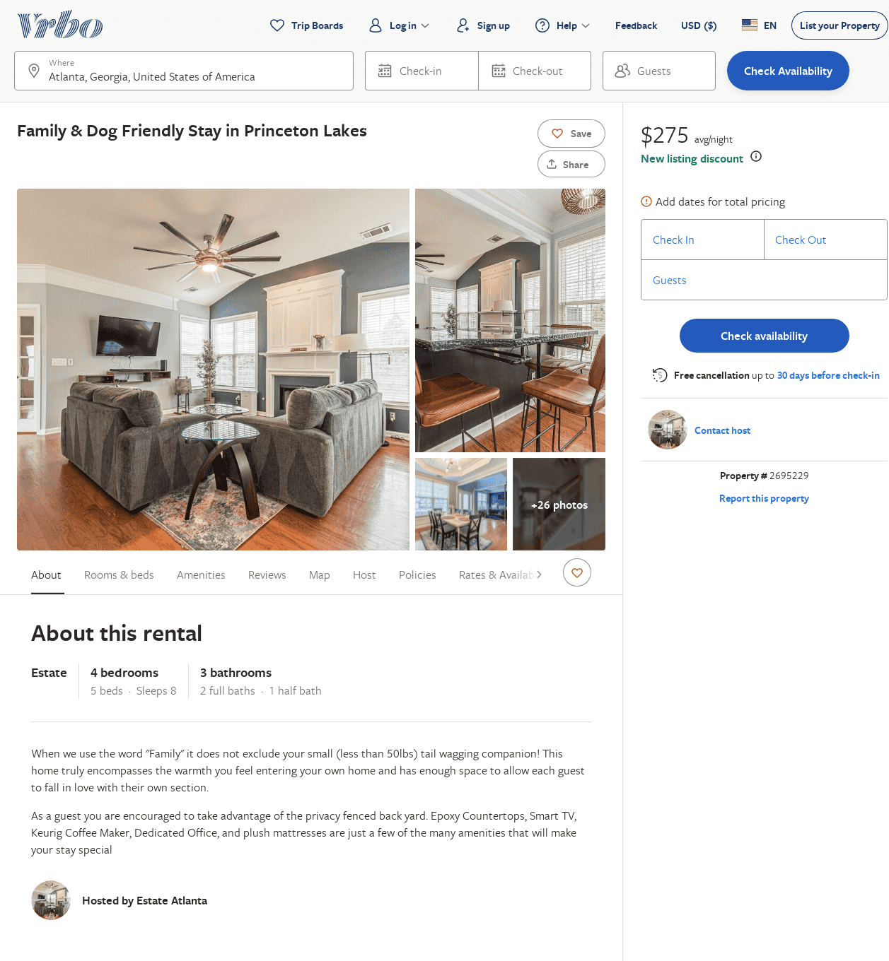
Listing 2695229
4
8
$176
5
2
Niyi
https://www.vrbo.com/2695229
Aug 2022

Slide 14
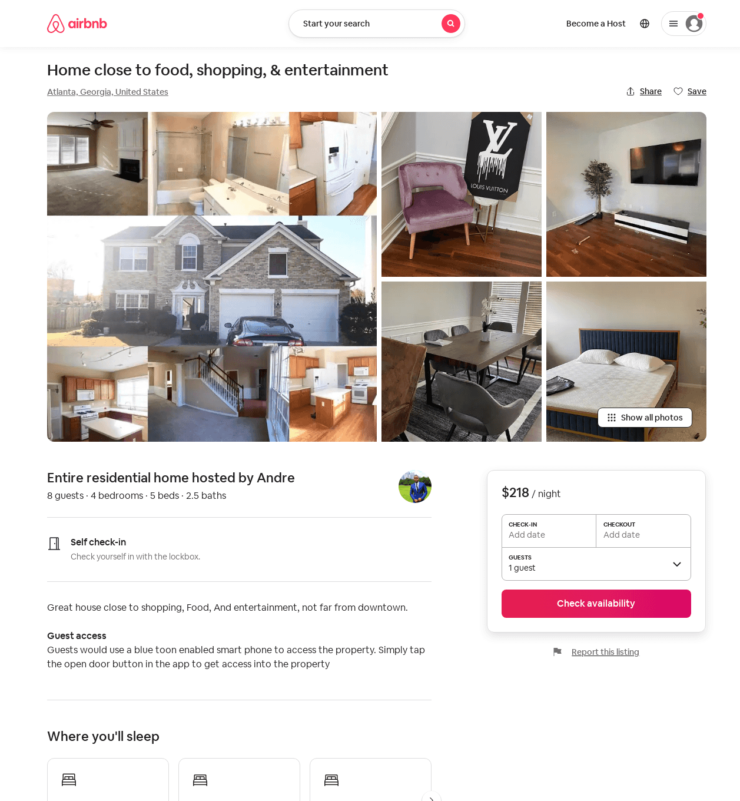
Listing 54209311
4
8
$198 - $350
5.0
2
Andre
15925257
1
https://www.airbnb.com/rooms/54209311
Aug 2022

Slide 15
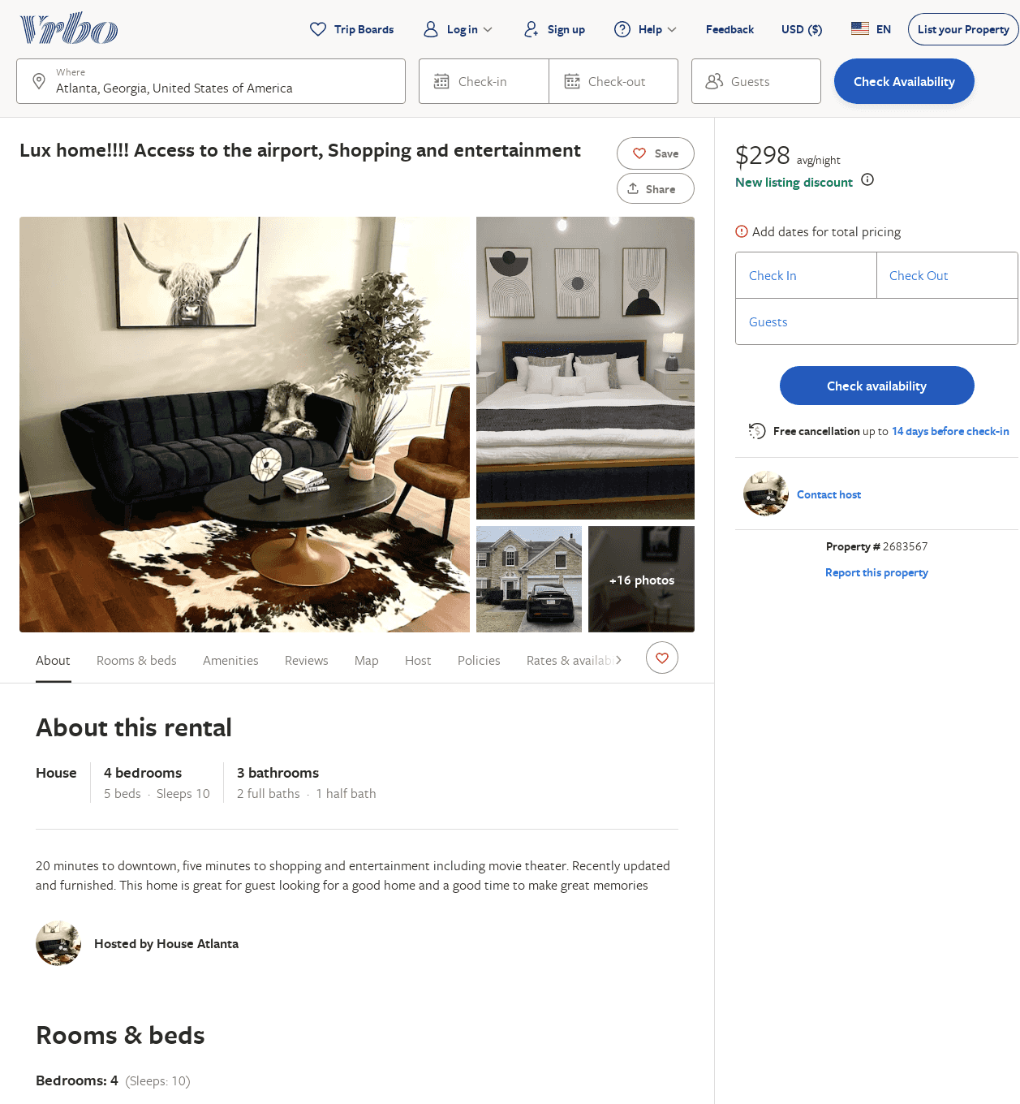
Listing 2683567
4
8
$448
4
3
https://www.vrbo.com/2683567
Aug 2022

Slide 16
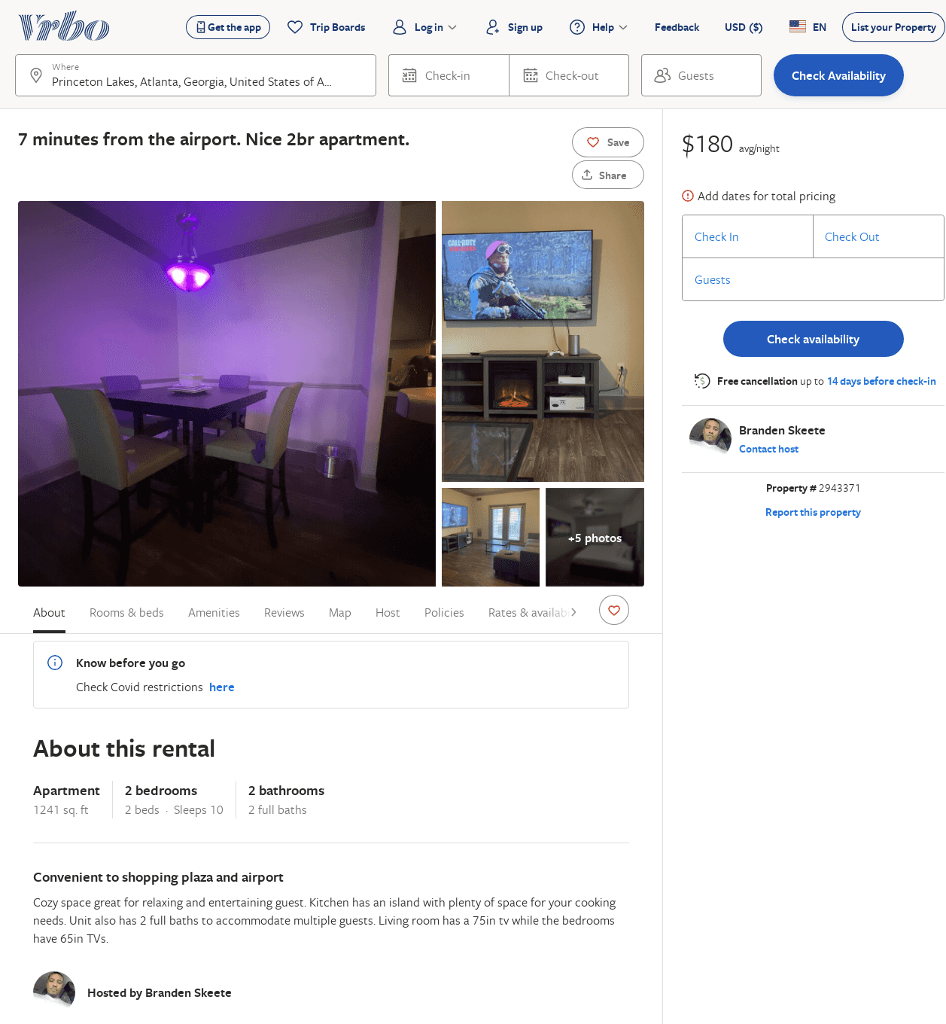
Listing 2943371
2
10
$180
1
Branden Skeete
https://www.vrbo.com/2943371
Aug 2022

