Slide 2
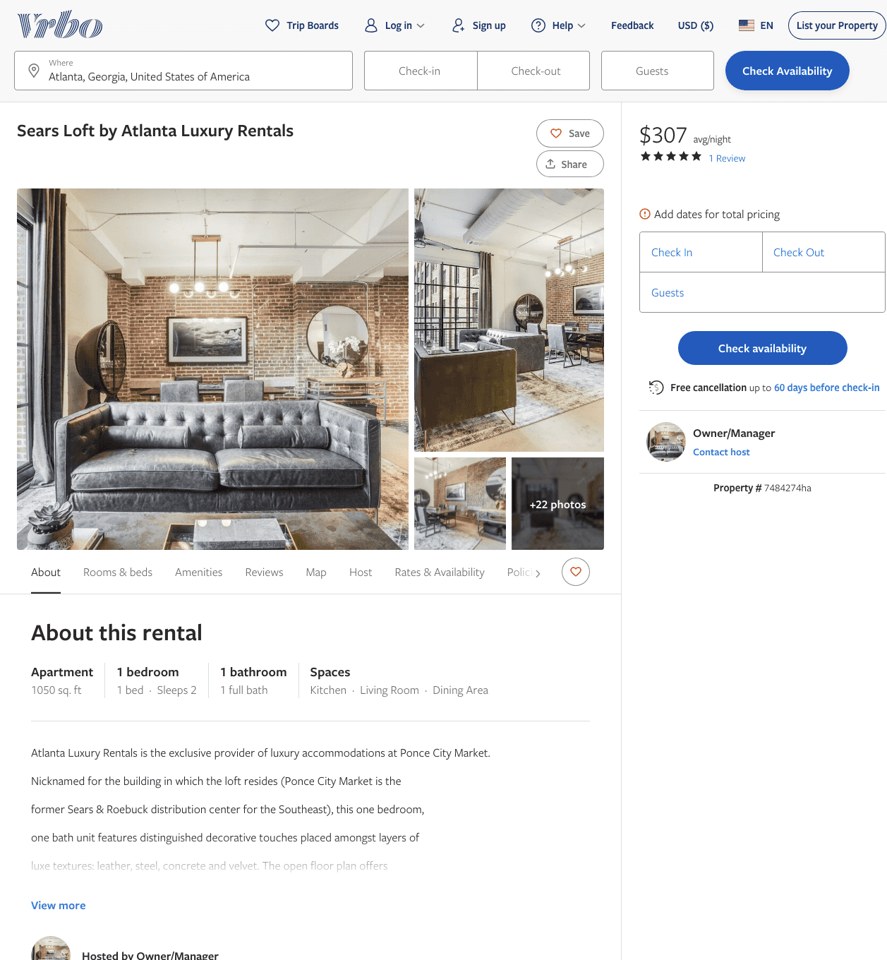
Listing 7484274
1
2
$229 - $354
5
2
Owner/Manager
https://www.vrbo.com/7484274ha
Aug 2022

Slide 3
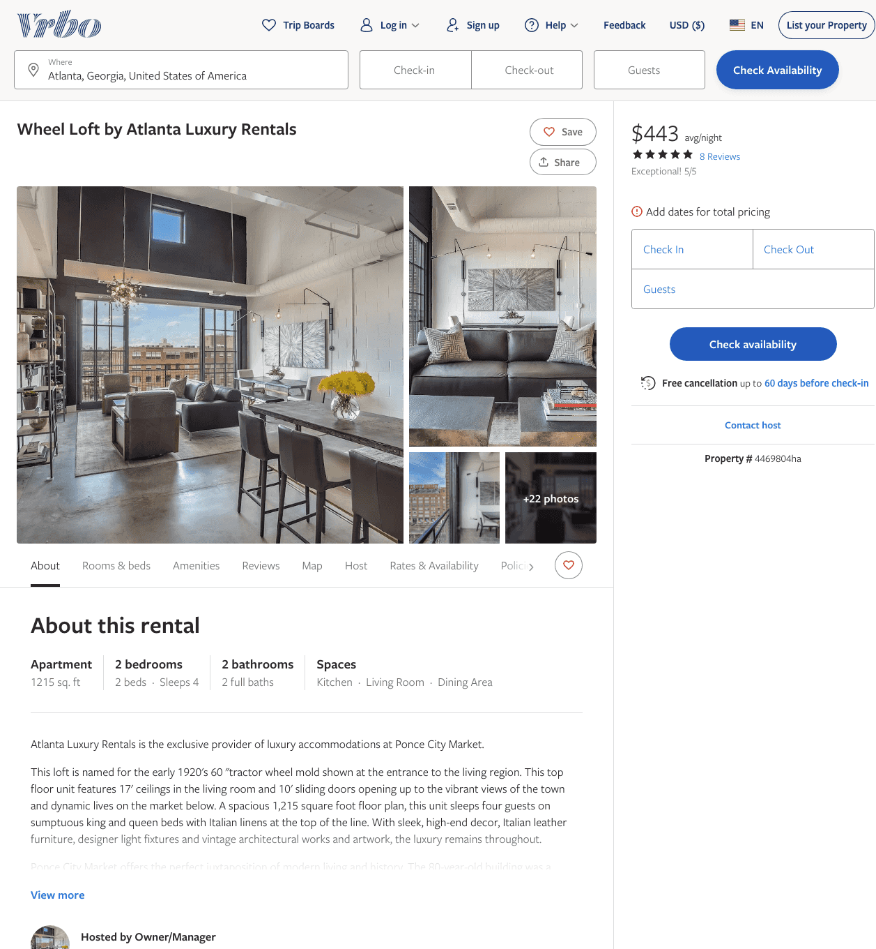
Listing 4469804
2
4
$279 - $411
5
2
Owner/Manager
https://www.vrbo.com/4469804ha
Aug 2022

Slide 4
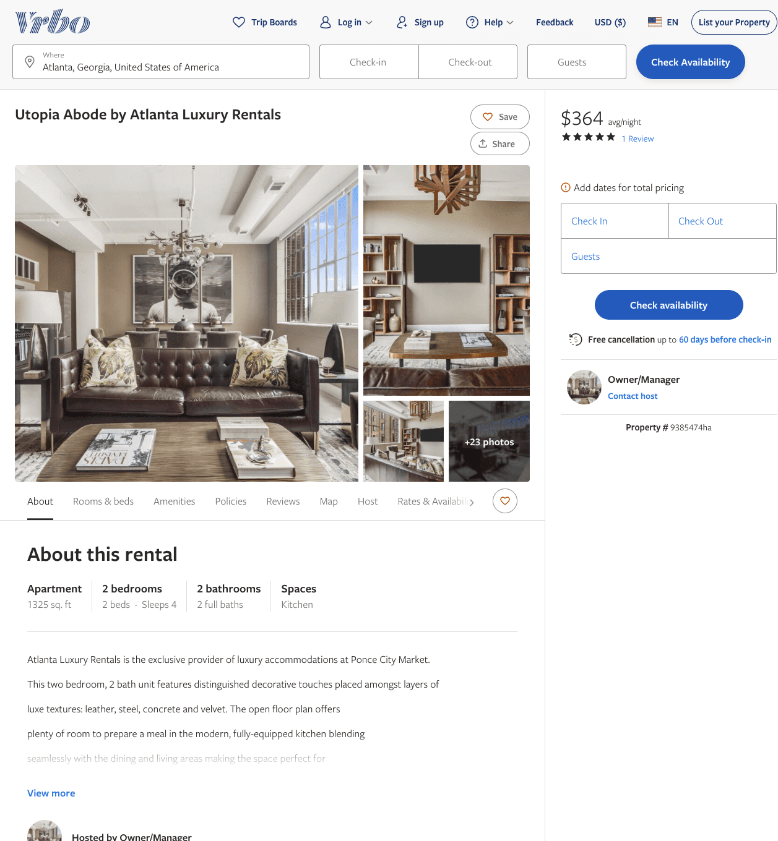
Listing 9385474
2
4
$309 - $410
5
1
Owner/Manager
https://www.vrbo.com/9385474ha
Aug 2022

Slide 5
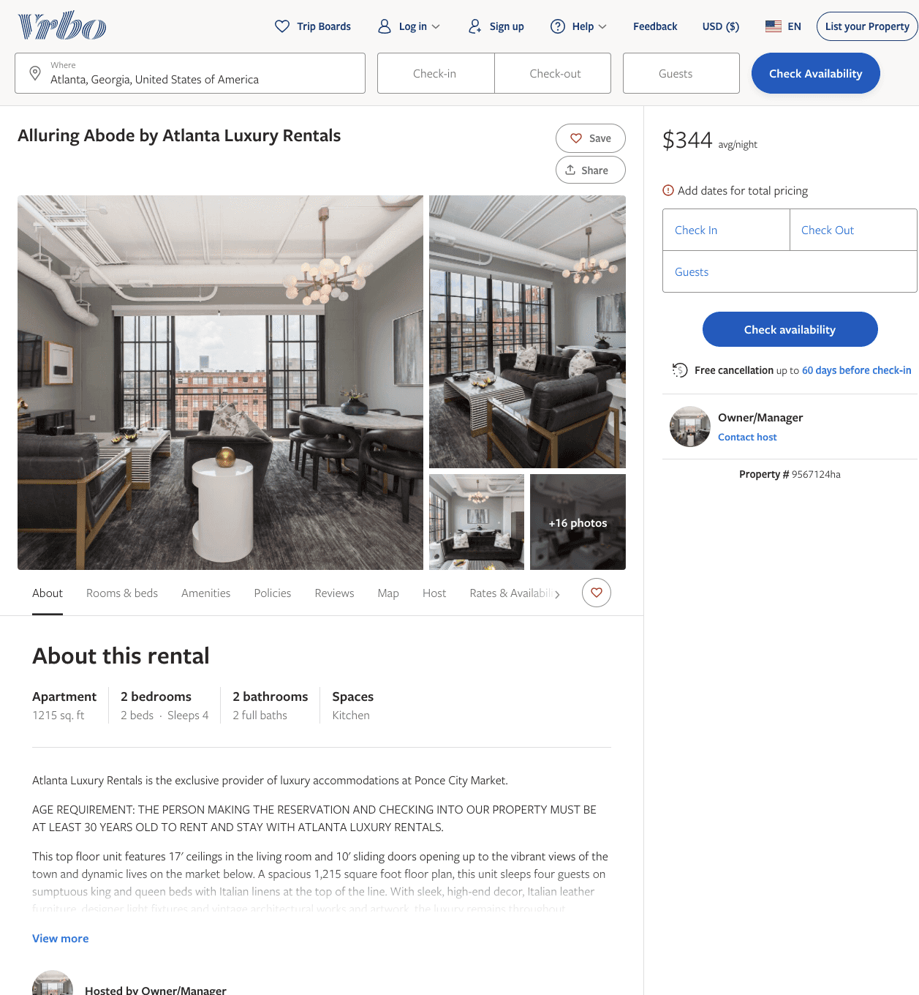
Listing 9567124
2
4
$309 - $680
5
1
Owner/Manager
https://www.vrbo.com/9567124ha
Aug 2022

Slide 6
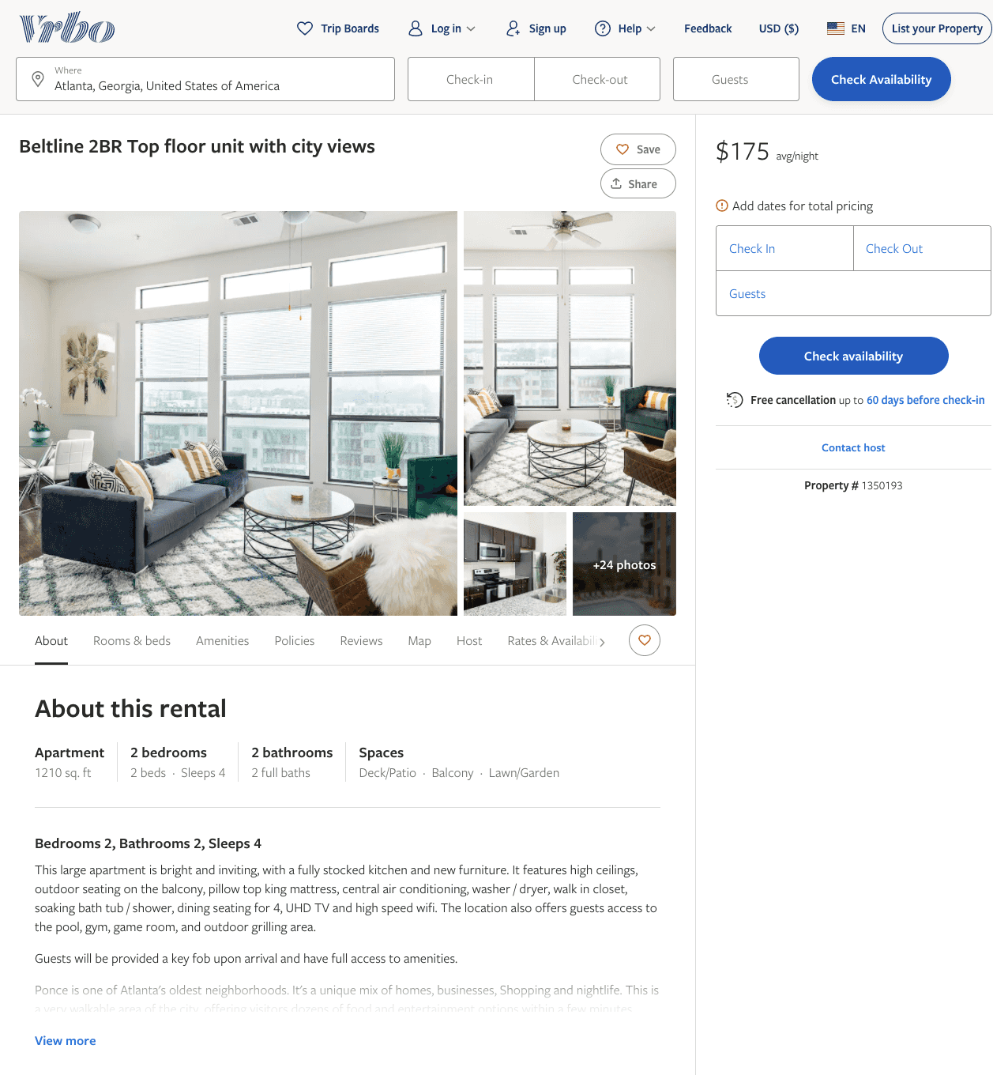
Listing 1350193
2
4
$175 - $216
4
Stewart Wyne
https://www.vrbo.com/1350193
Aug 2022

Slide 7
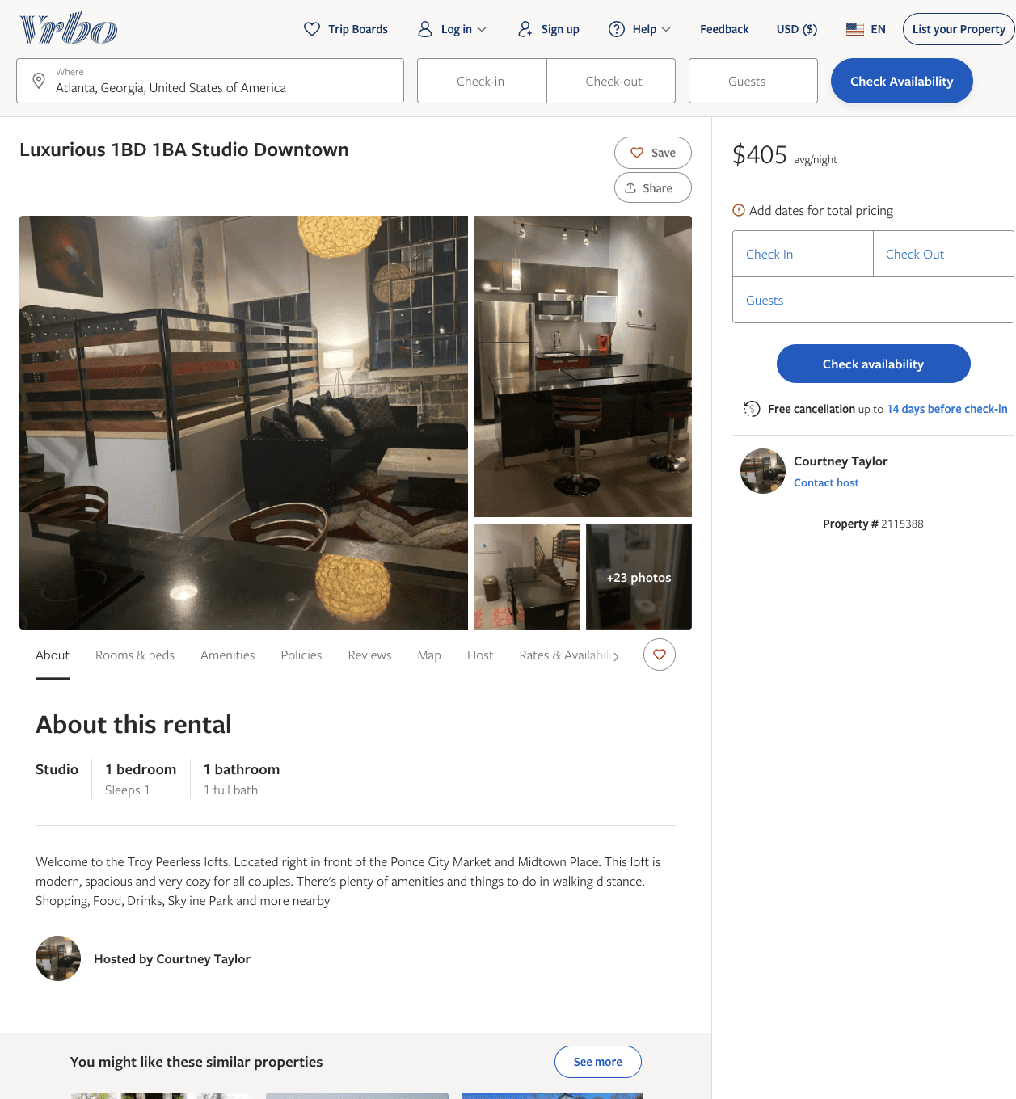
Listing 2115388
1
1
$405
1
Courtney Taylor
https://www.vrbo.com/2115388
Aug 2022

Slide 8
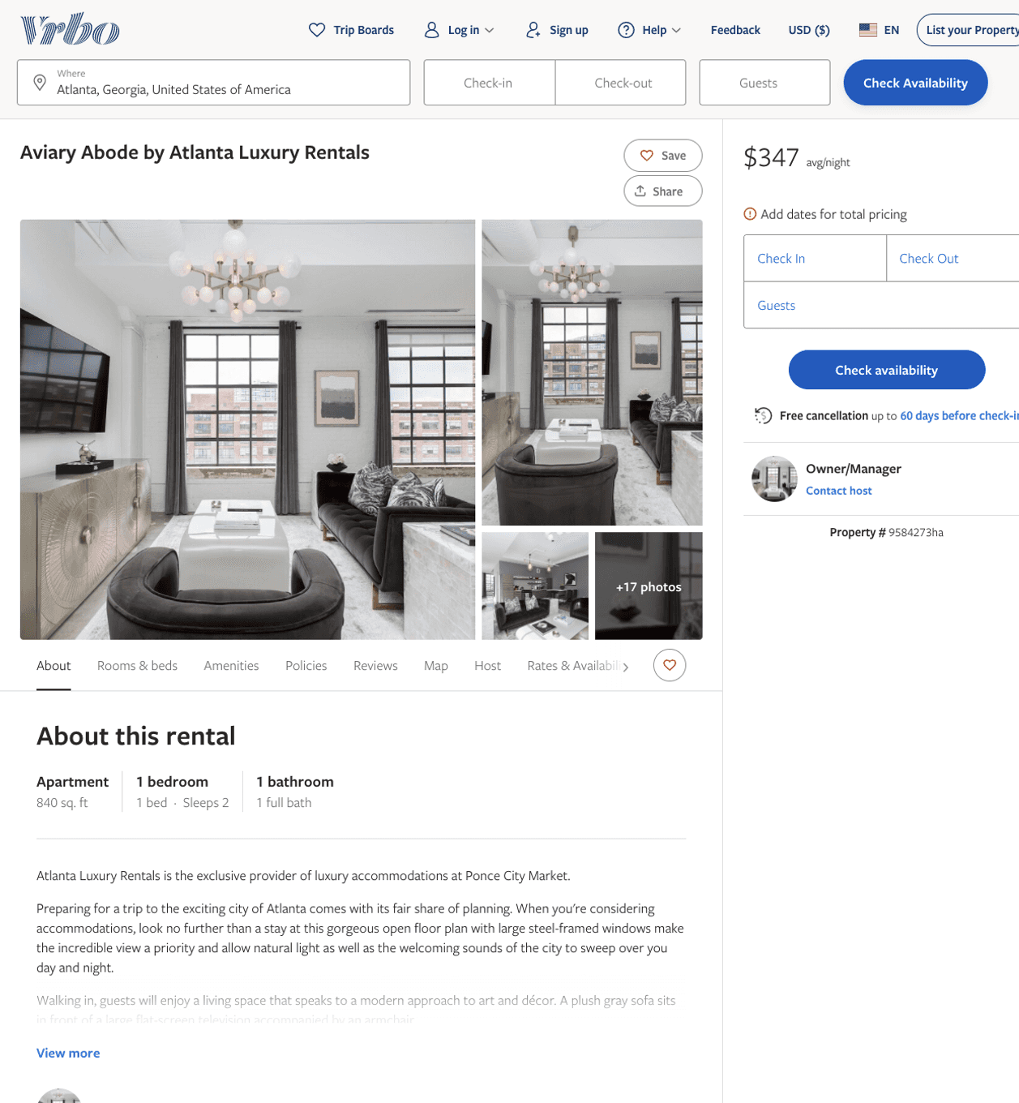
Listing 9584273
1
2
$338 - $473
5
2
Owner/Manager
https://www.vrbo.com/9584273ha
Aug 2022

Slide 9
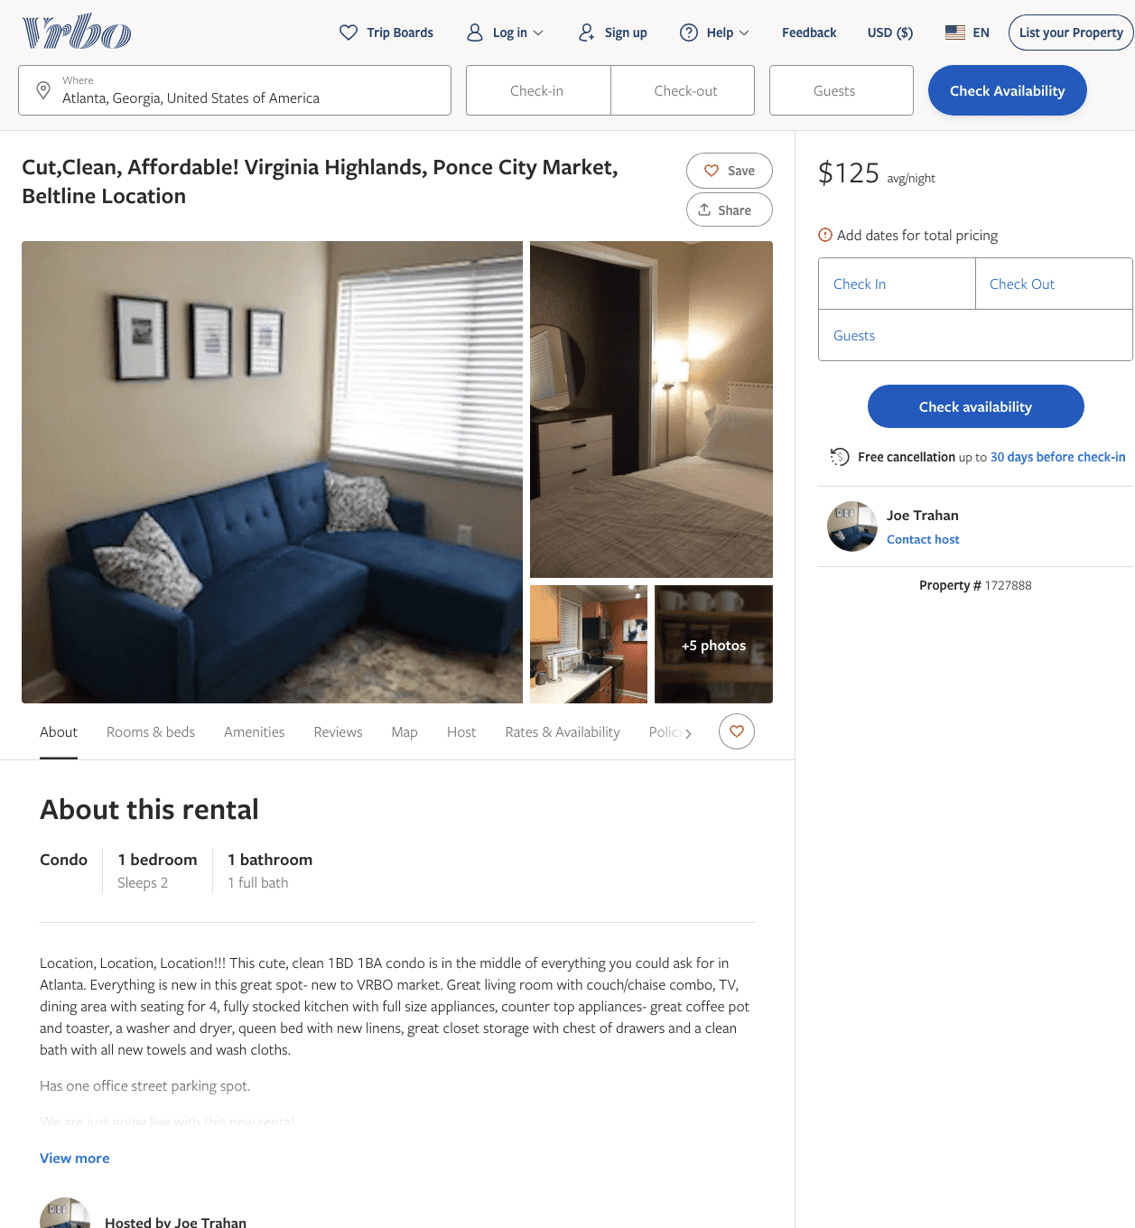
Listing 1727888
1
2
$125 - $140
3
Joe Trahan
https://www.vrbo.com/1727888
Aug 2022

Slide 10
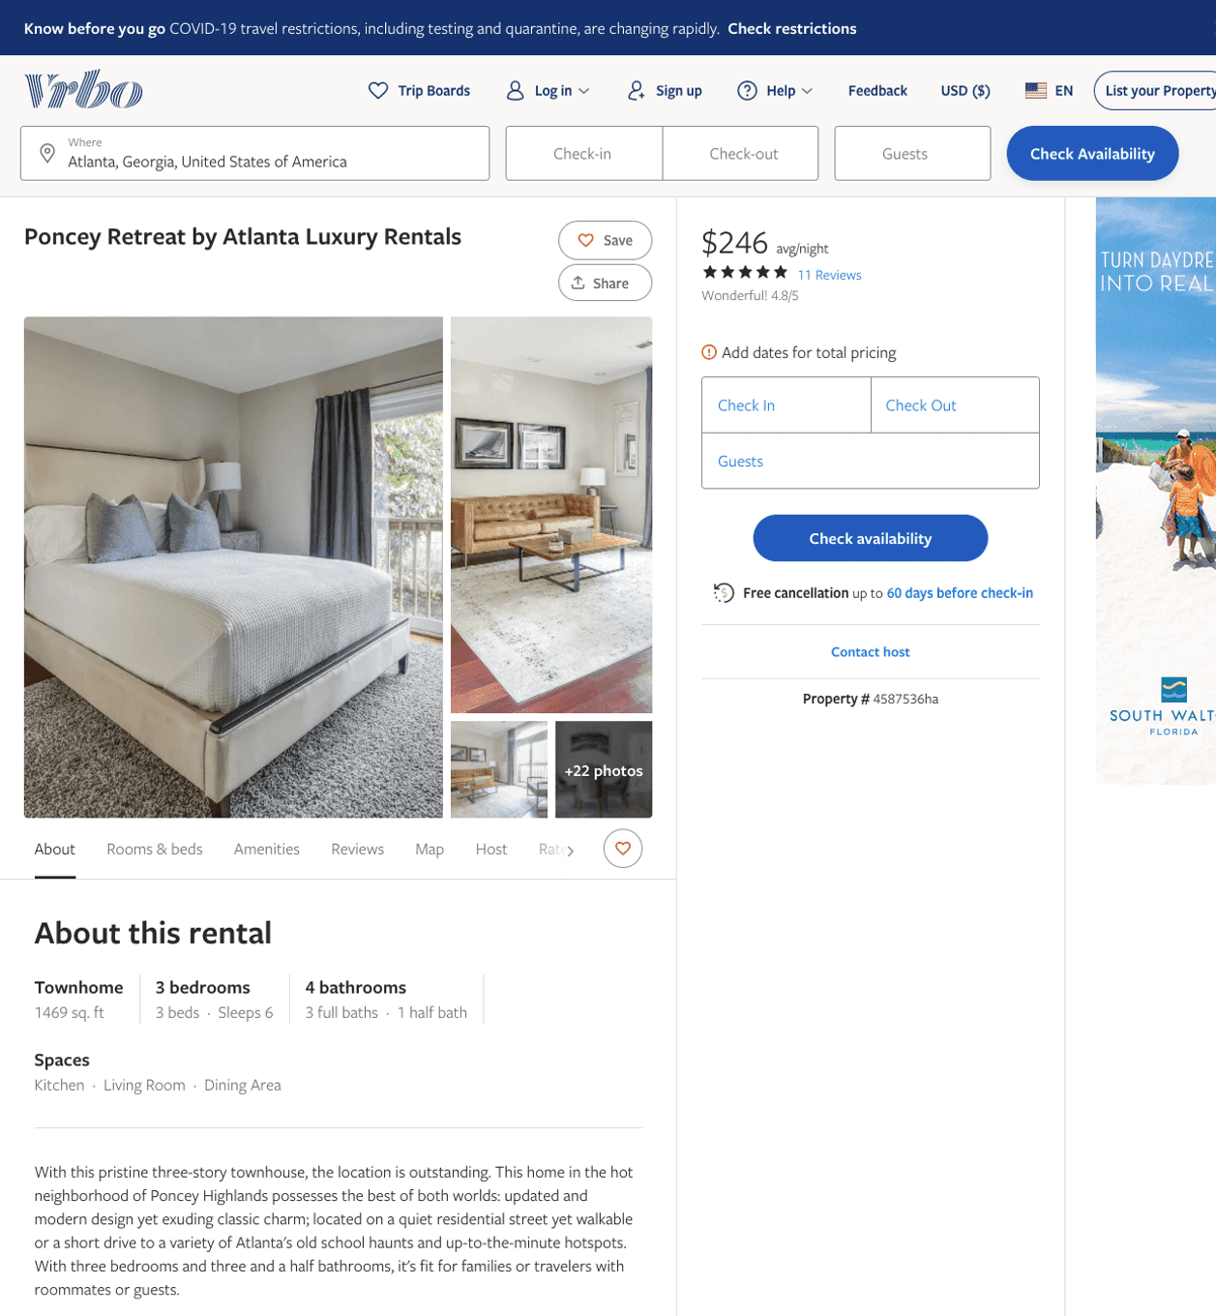
Listing 4587536
3
6
$228 - $312
4.8461537
2
Owner/Manager
https://www.vrbo.com/4587536ha
Aug 2022

Slide 11
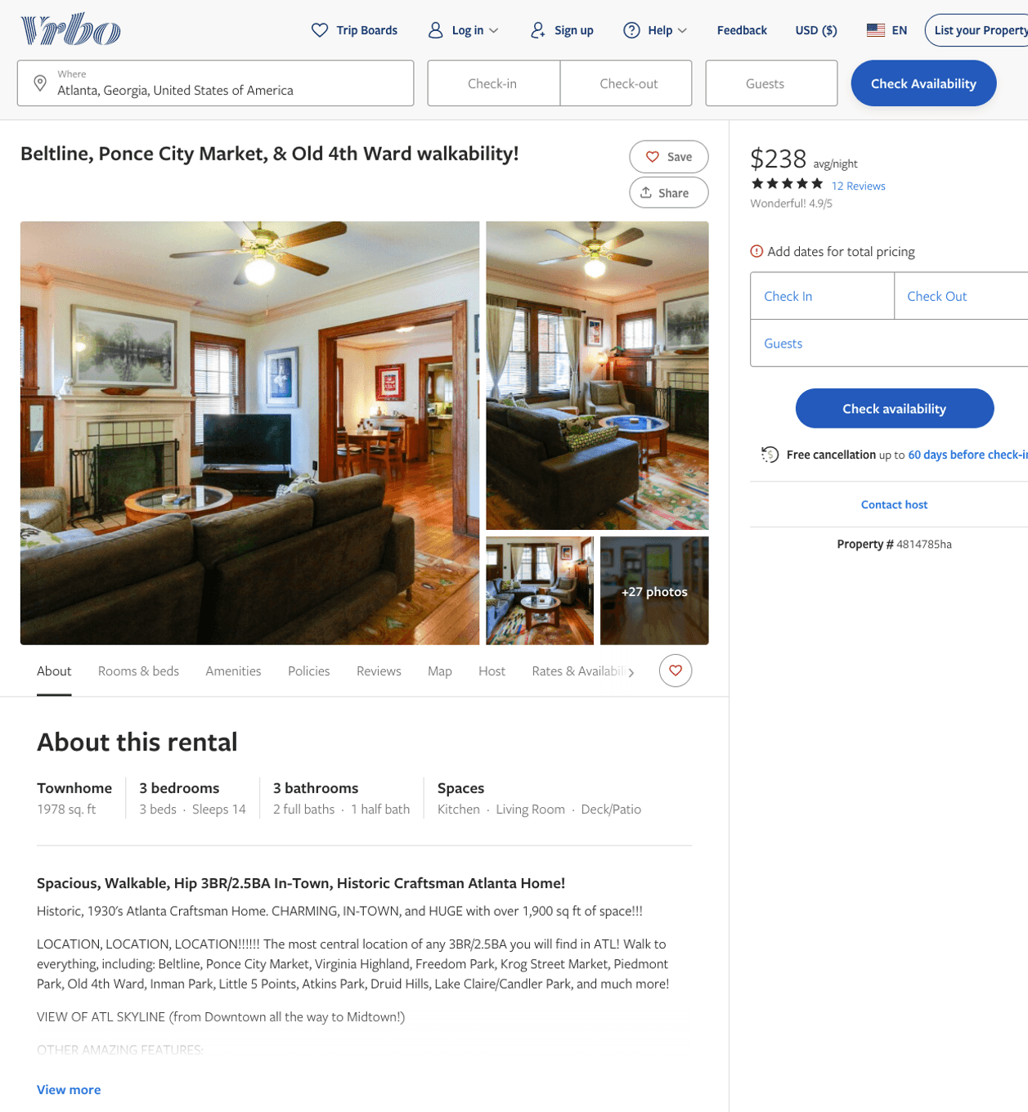
Listing 4814785
3
14
$238
4.9166665
1
Zach Otis-McDonough
https://www.vrbo.com/4814785ha
Aug 2022

Slide 12
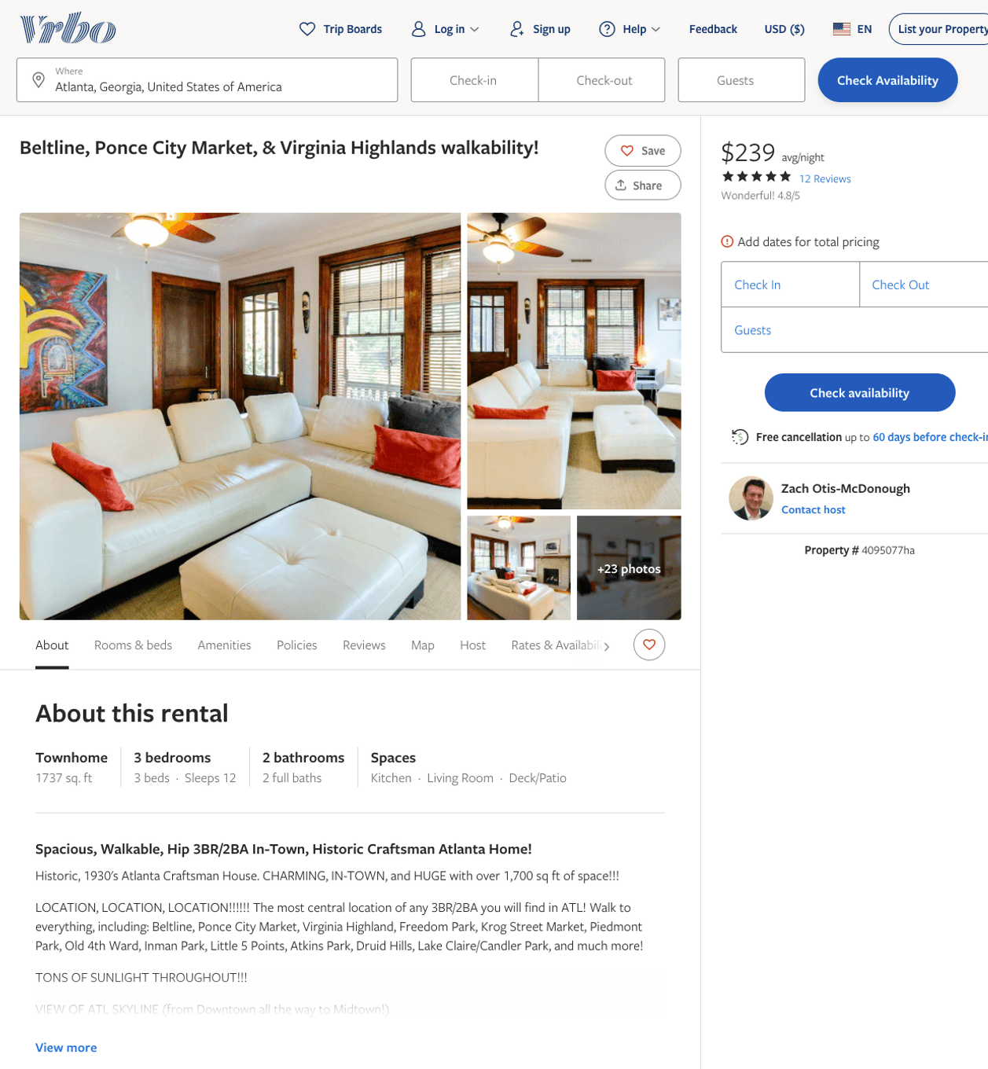
Listing 4095077
3
12
$239
4.8333335
1
Zach Otis-McDonough
https://www.vrbo.com/4095077ha
Aug 2022

Slide 13
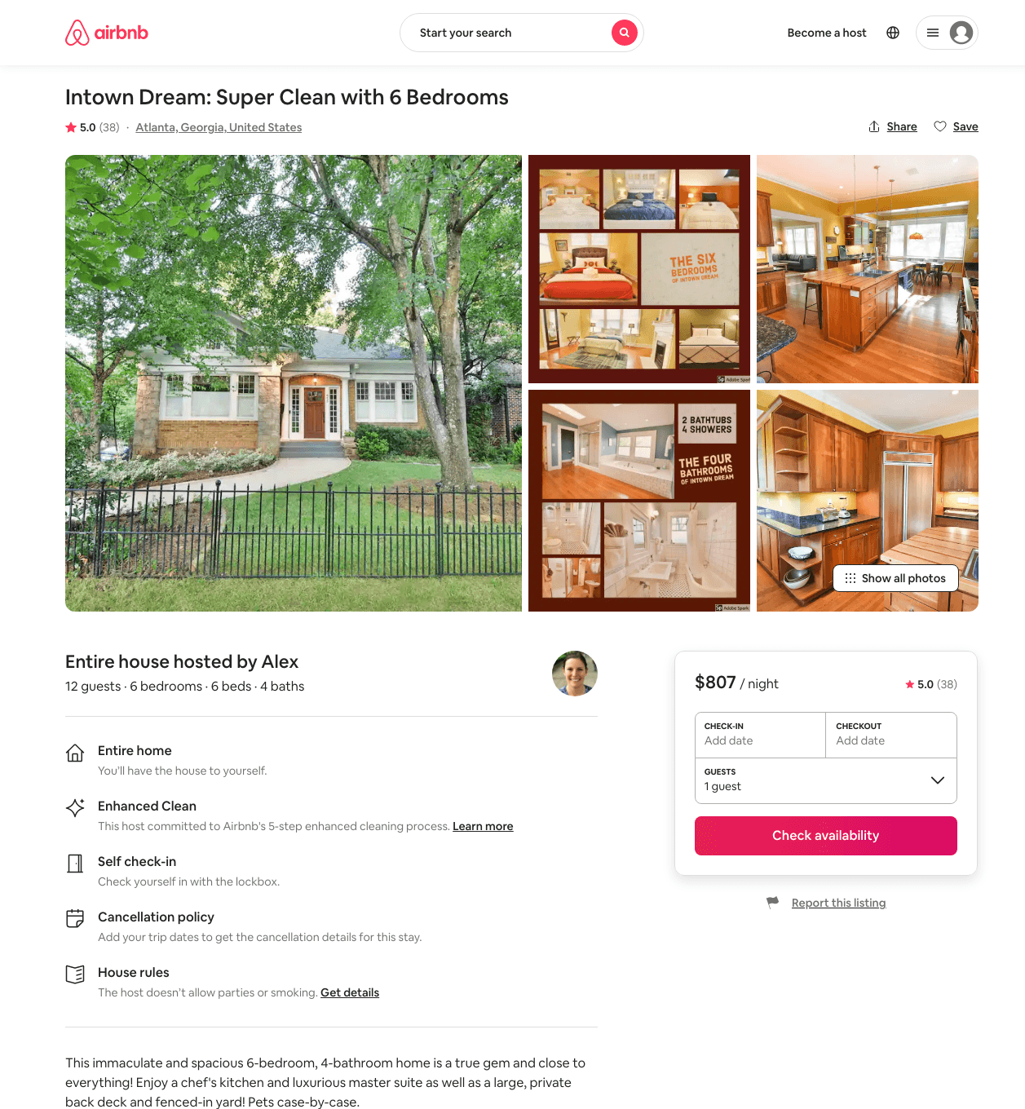
Listing 23546643
6
12
$536 - $979
5.0
2
Alex And Christina
20605441
40
https://www.airbnb.com/rooms/23546643
Aug 2022

Slide 14
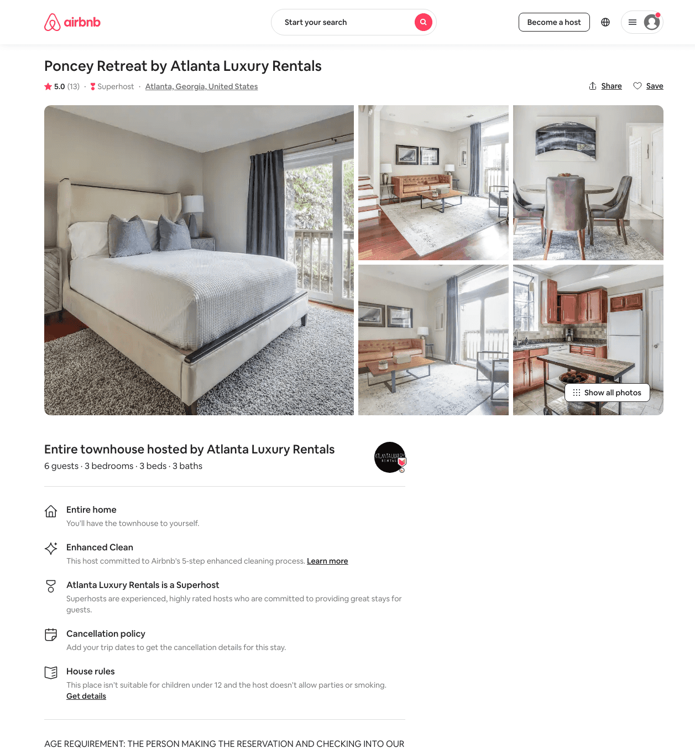
Listing 19068952
3
6
$218 - $326
4.91
3
Atlanta Luxury Rentals
115328988
54
https://www.airbnb.com/rooms/19068952
Aug 2022

Slide 15
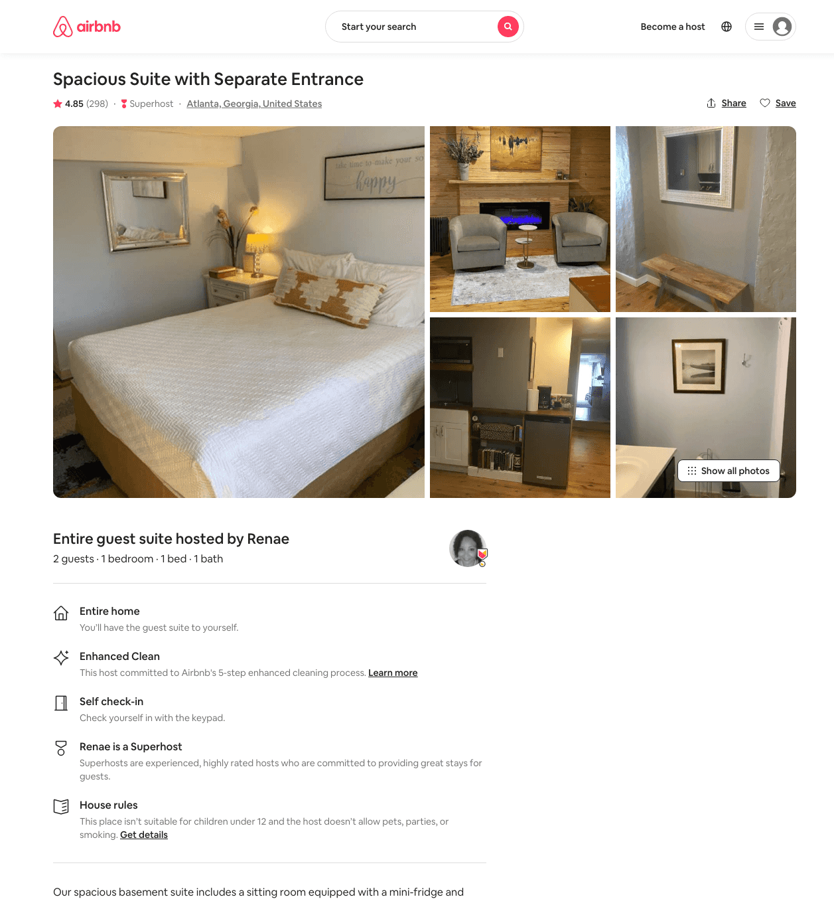
Listing 6860927
1
2
$63 - $97
4.85
1
Renae
23294305
2
https://www.airbnb.com/rooms/6860927
Aug 2022

Slide 16
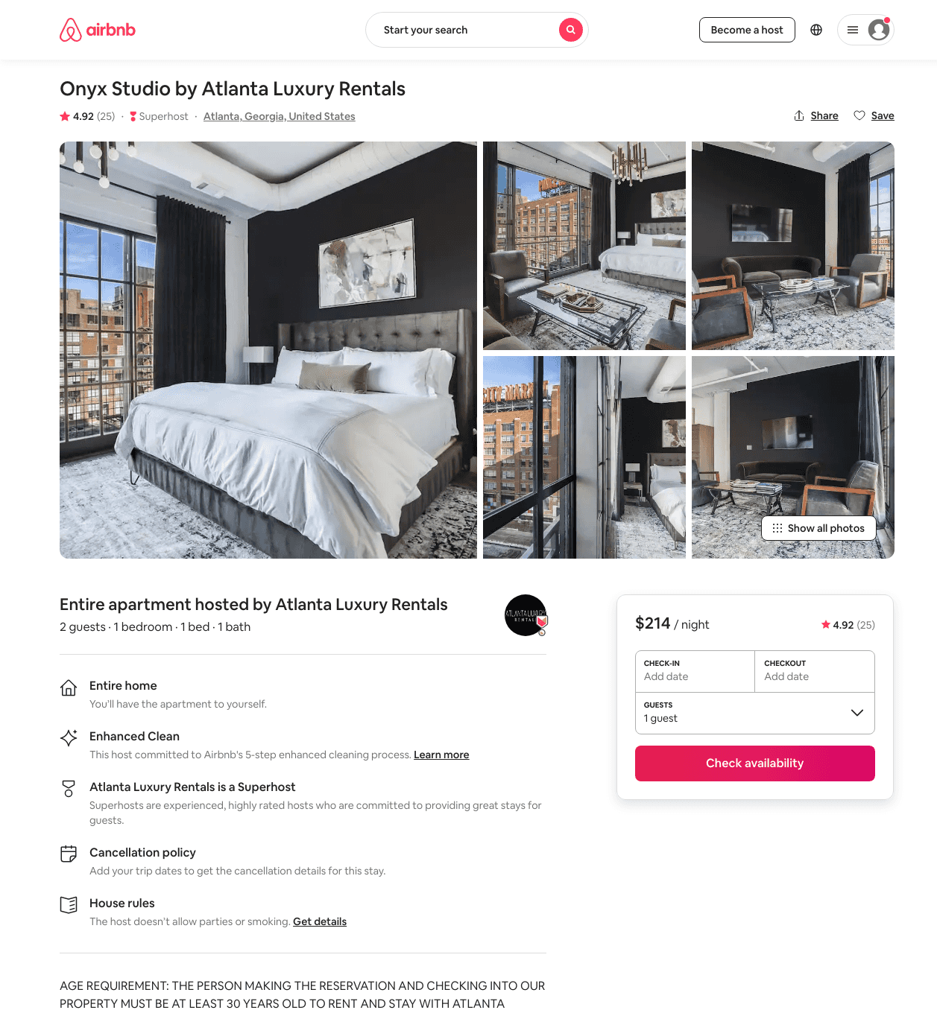
Listing 33191592
1
2
$162 - $751
4.88
1
Atlanta Luxury Rentals
115328988
54
https://www.airbnb.com/rooms/33191592
Aug 2022

Slide 17
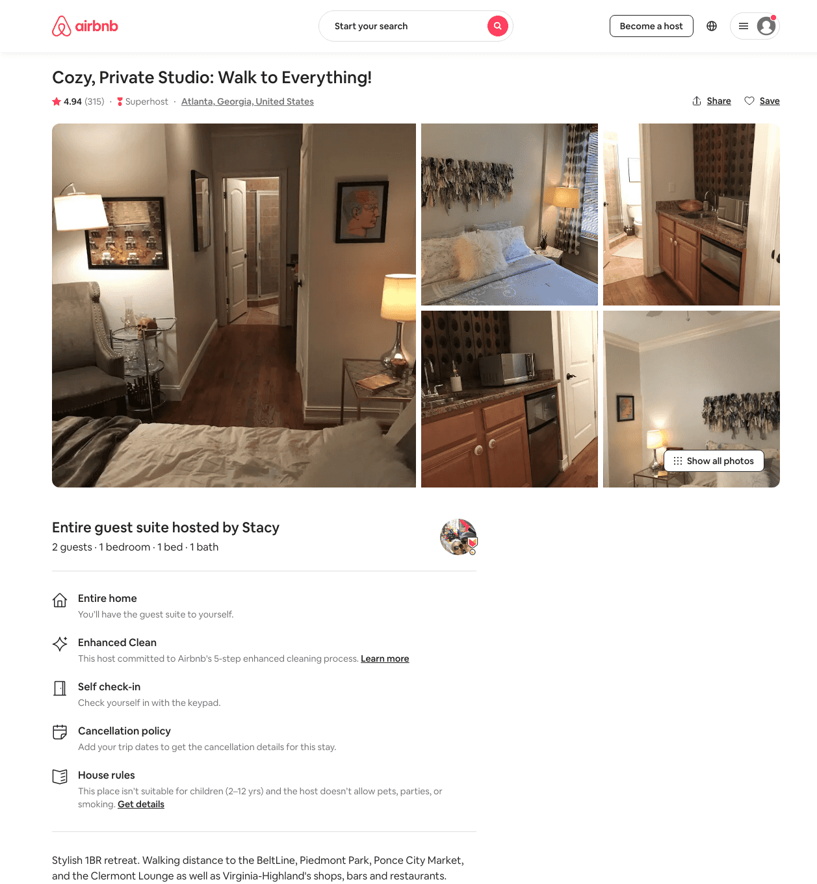
Listing 17341968
1
2
$79 - $119
4.93
1
Stacy
117133929
2
https://www.airbnb.com/rooms/17341968
Aug 2022

Slide 18
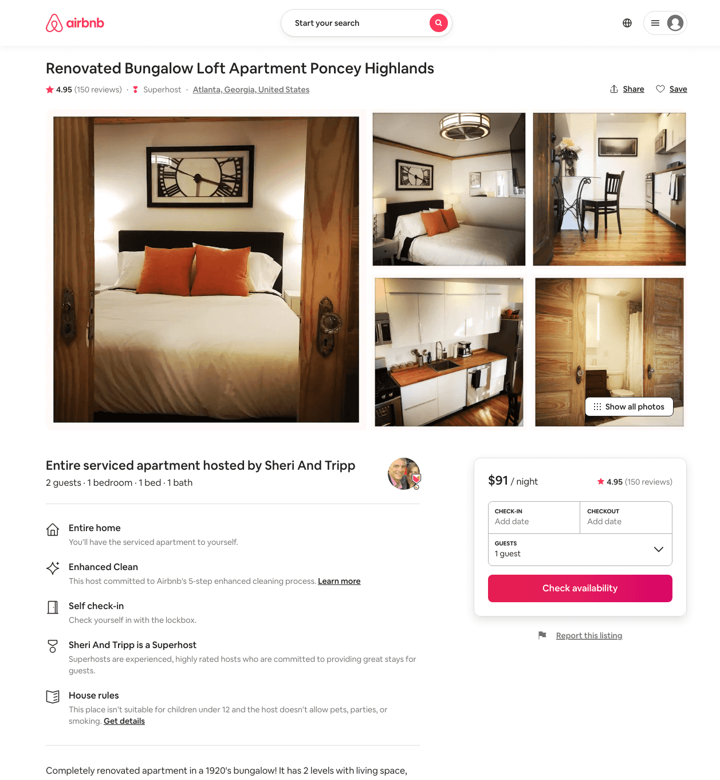
Listing 22427751
1
2
$90 - $103
4.95
2
Sheri And Tripp
164251064
1
https://www.airbnb.com/rooms/22427751
Aug 2022

Slide 19
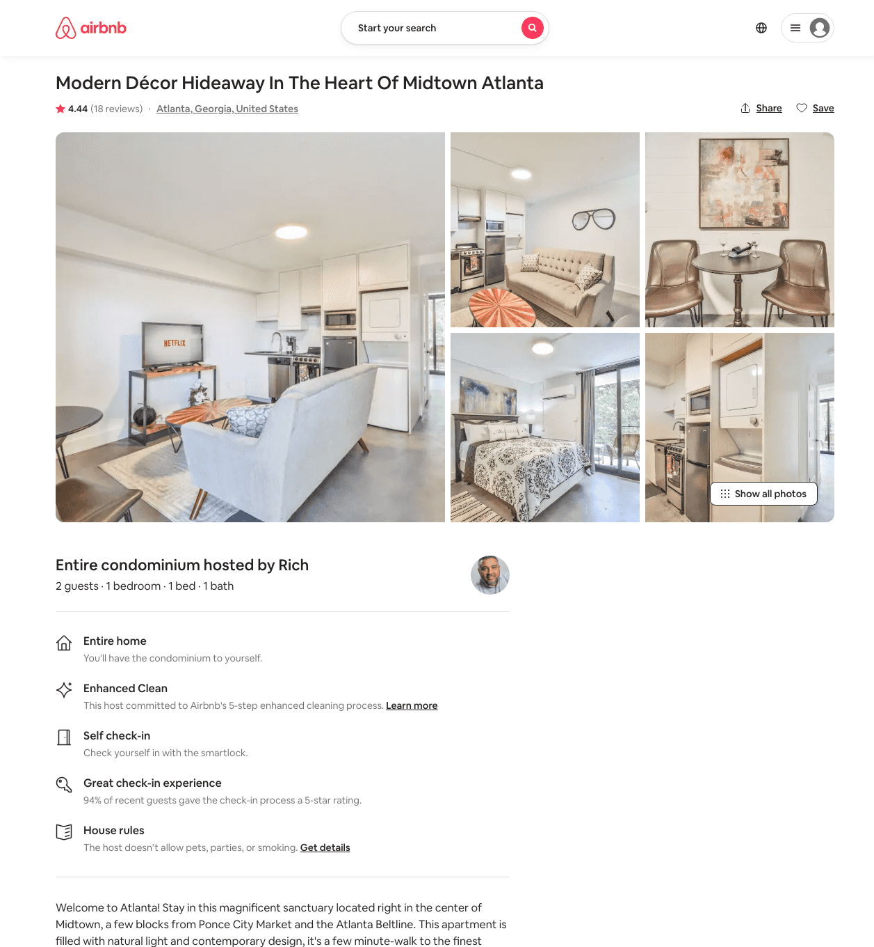
Listing 46024556
1
2
$79 - $130
4.72
2
Rich
31356024
22
https://www.airbnb.com/rooms/46024556
Aug 2022

Slide 20
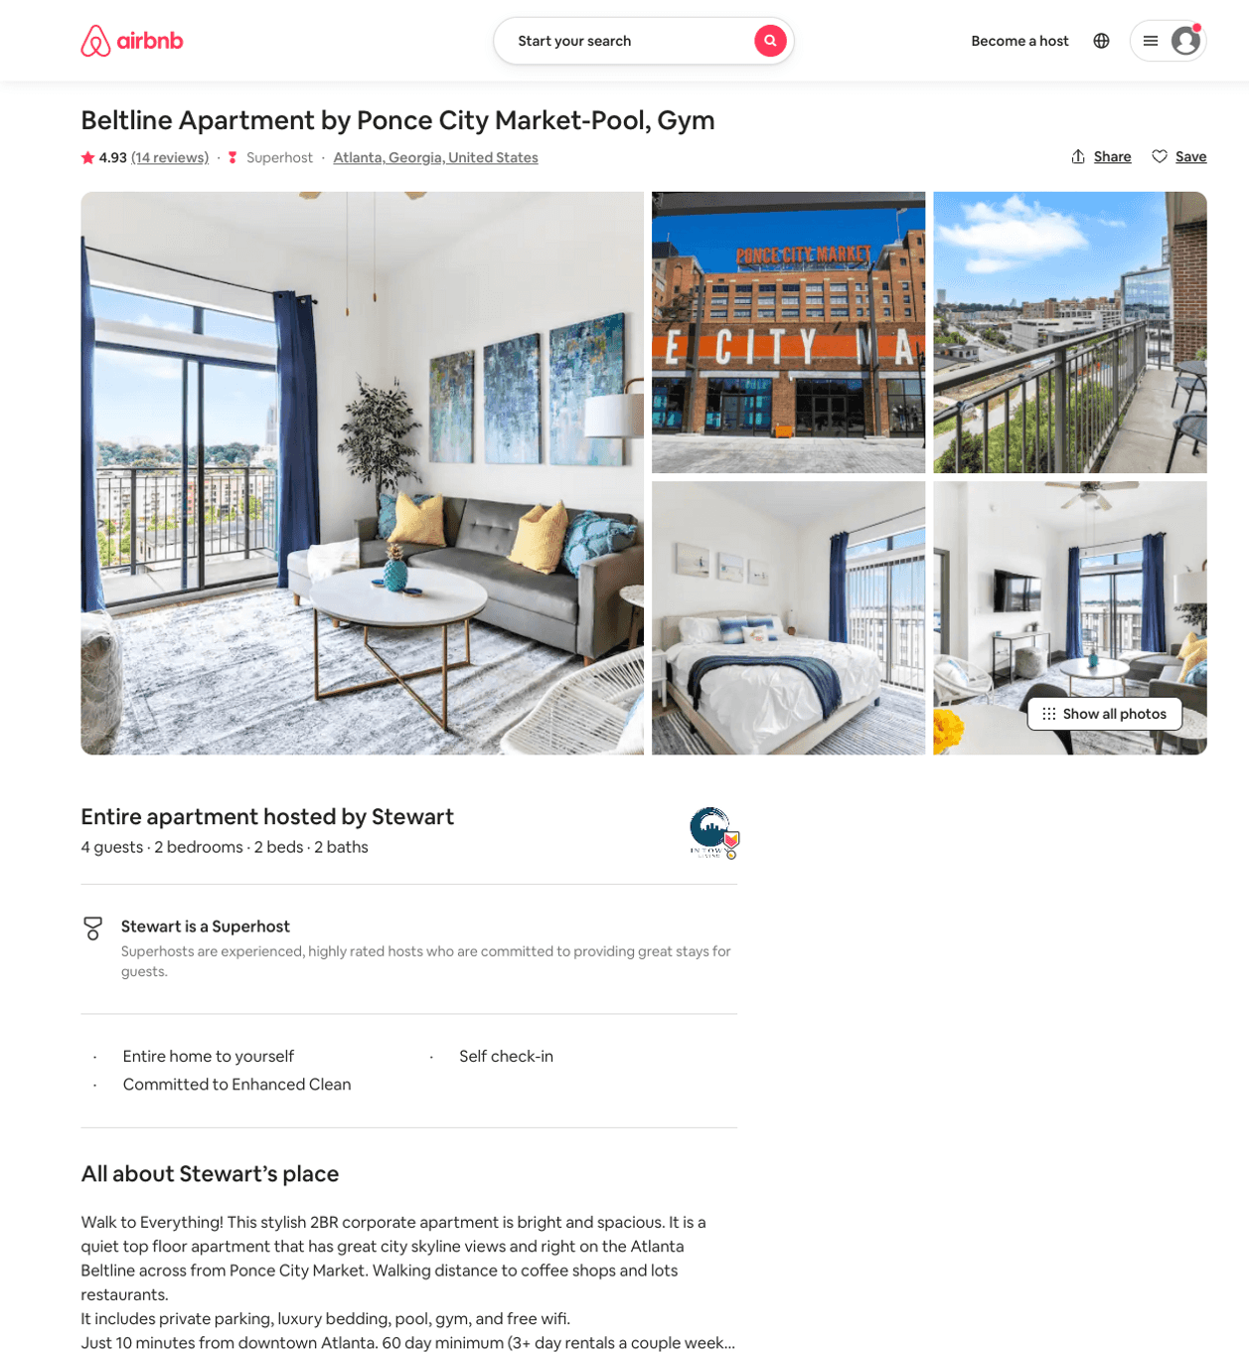
Listing 24331314
2
4
$184 - $277
4.94
58
Stewart
26798403
14
https://www.airbnb.com/rooms/24331314
Aug 2022

Slide 21
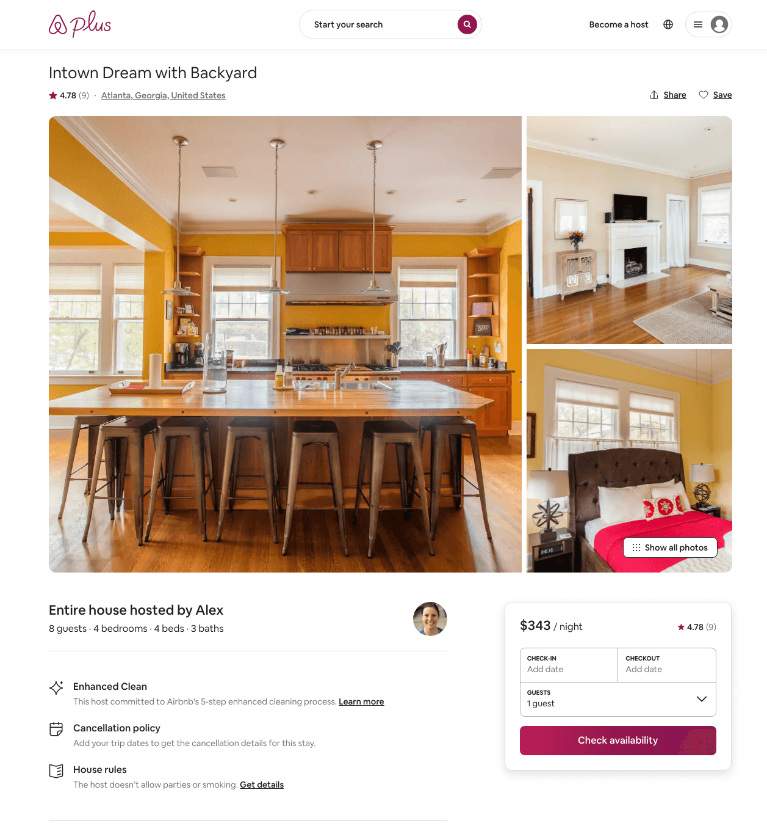
Listing 25480396
4
8
$343 - $879
4.82
2
Alex And Christina
20605441
40
https://www.airbnb.com/rooms/25480396
Aug 2022

Slide 22
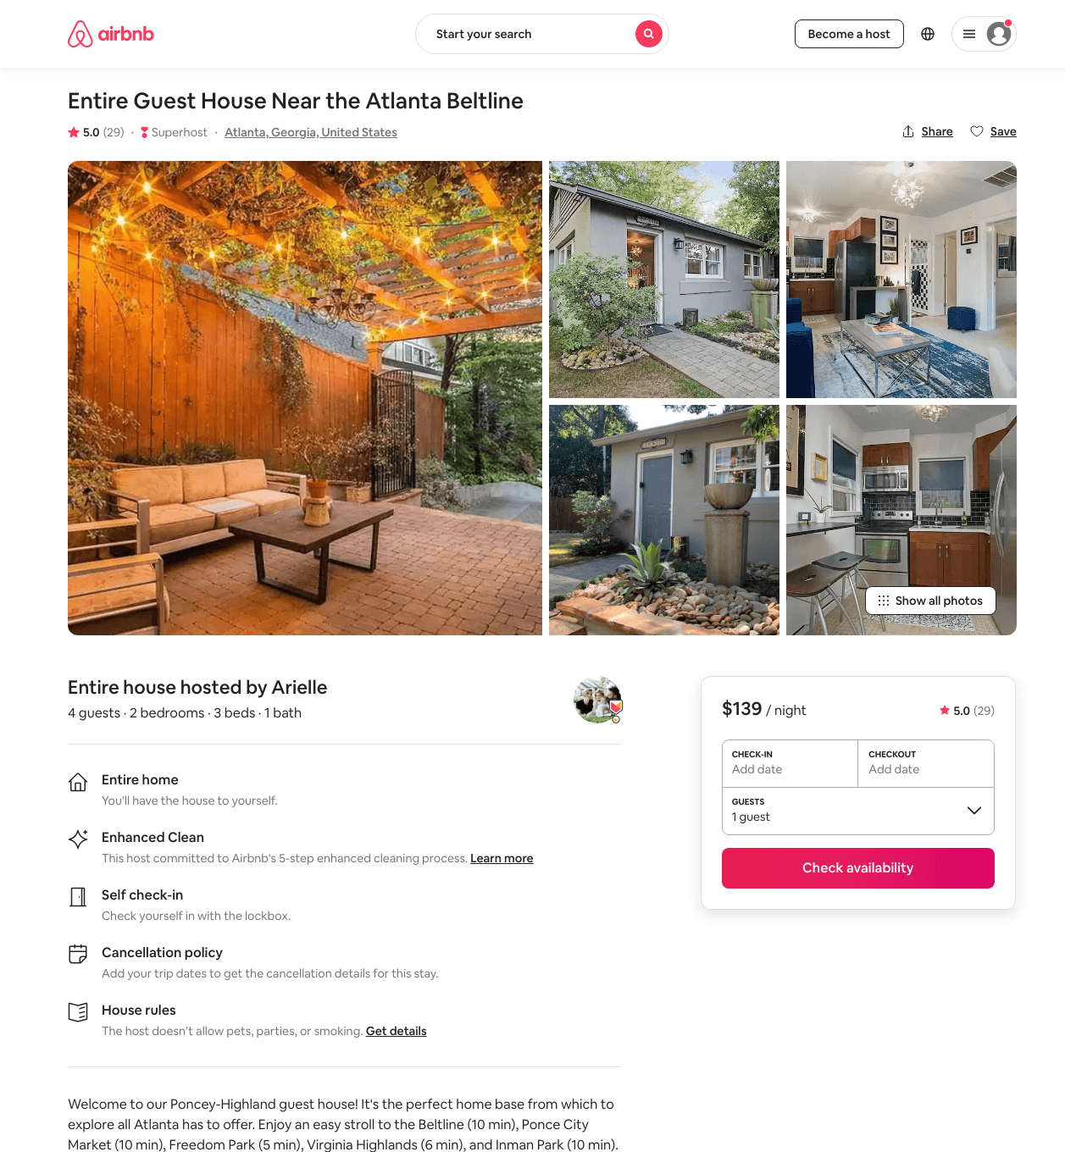
Listing 45290269
2
4
$137 - $153
4.96
1
Arielle
27663550
1
https://www.airbnb.com/rooms/45290269
Aug 2022

Slide 23
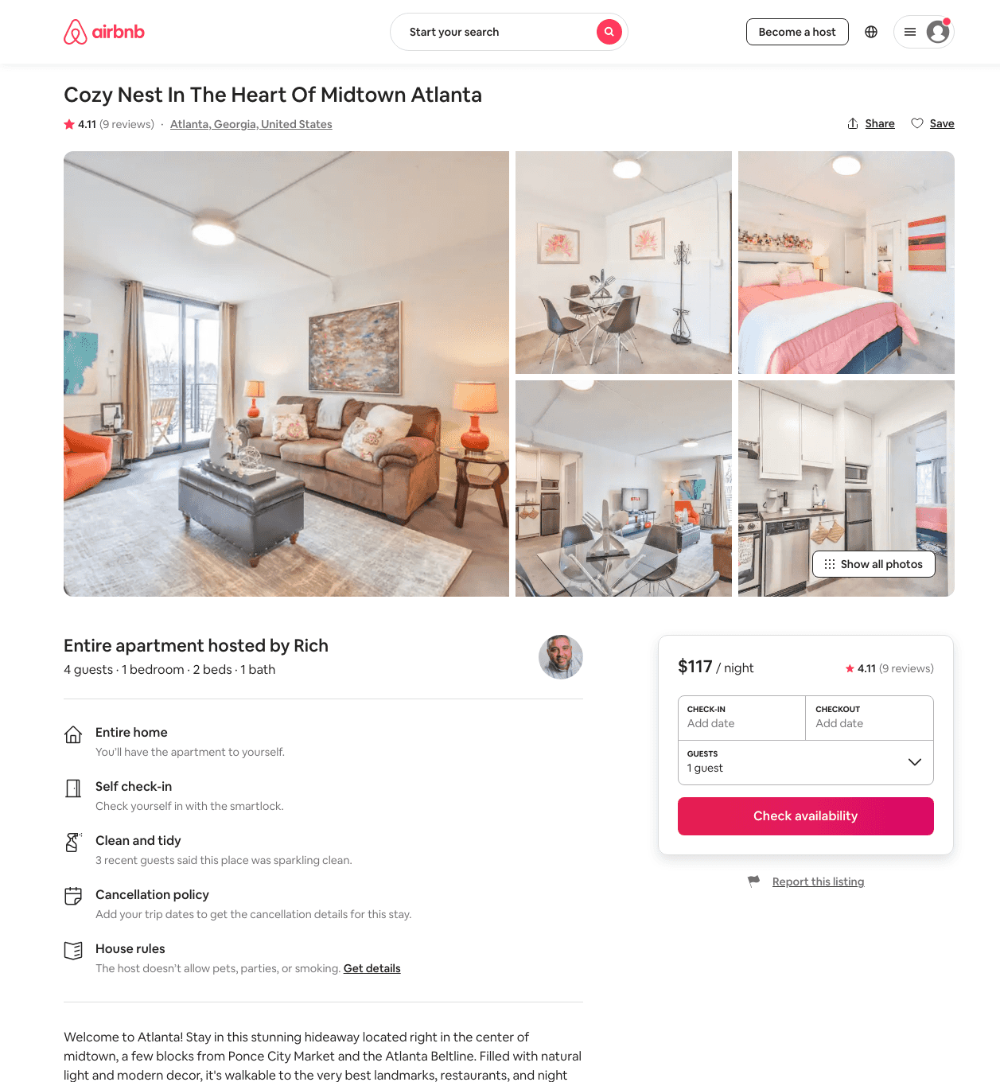
Listing 47534112
1
4
$93 - $148
4.69
2
Rich
31356024
22
https://www.airbnb.com/rooms/47534112
Aug 2022

Slide 24
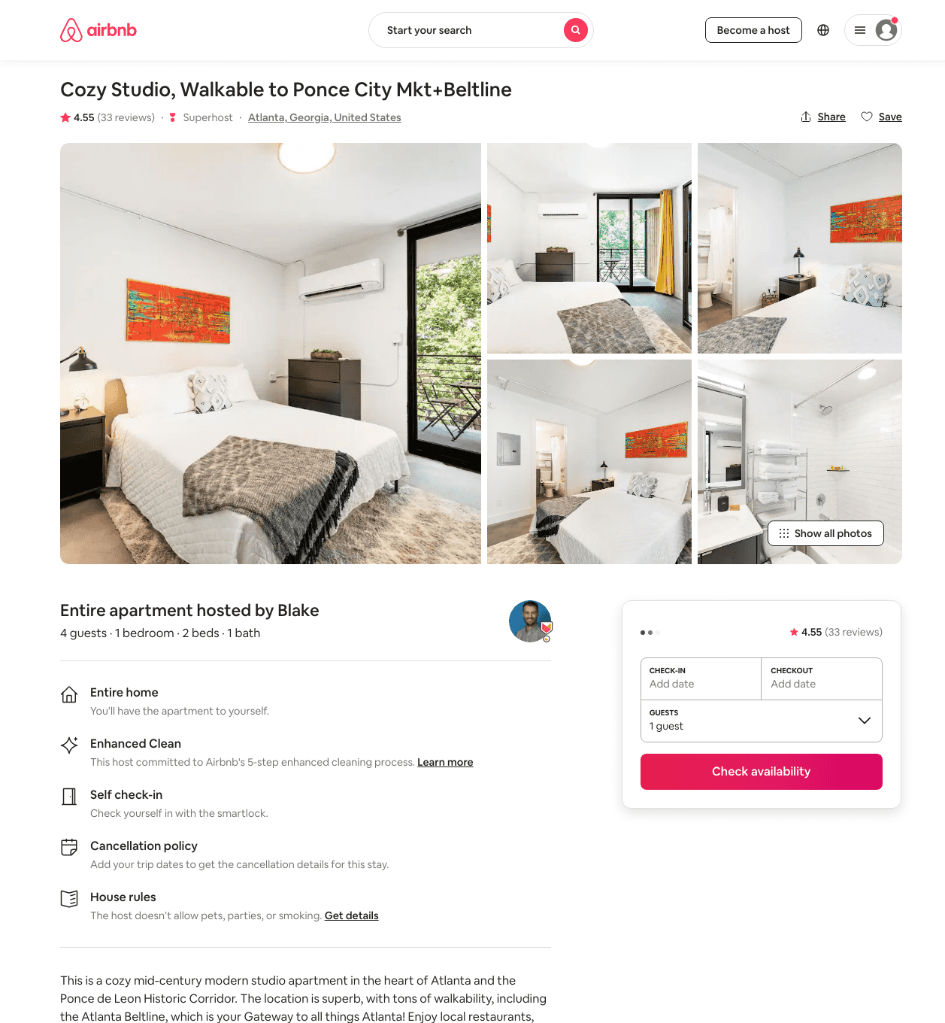
Listing 44611620
1
3
$72 - $167
4.65
2
Blake
81660490
10
https://www.airbnb.com/rooms/44611620
Aug 2022

Slide 25
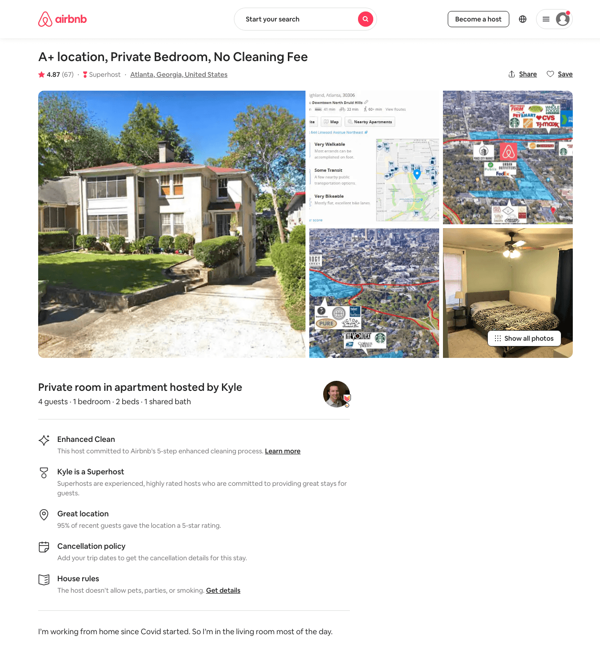
Listing 38581847
1
3
$49 - $737
4.86
1
Kyle
22905143
2
https://www.airbnb.com/rooms/38581847
Jun 2022

Slide 26
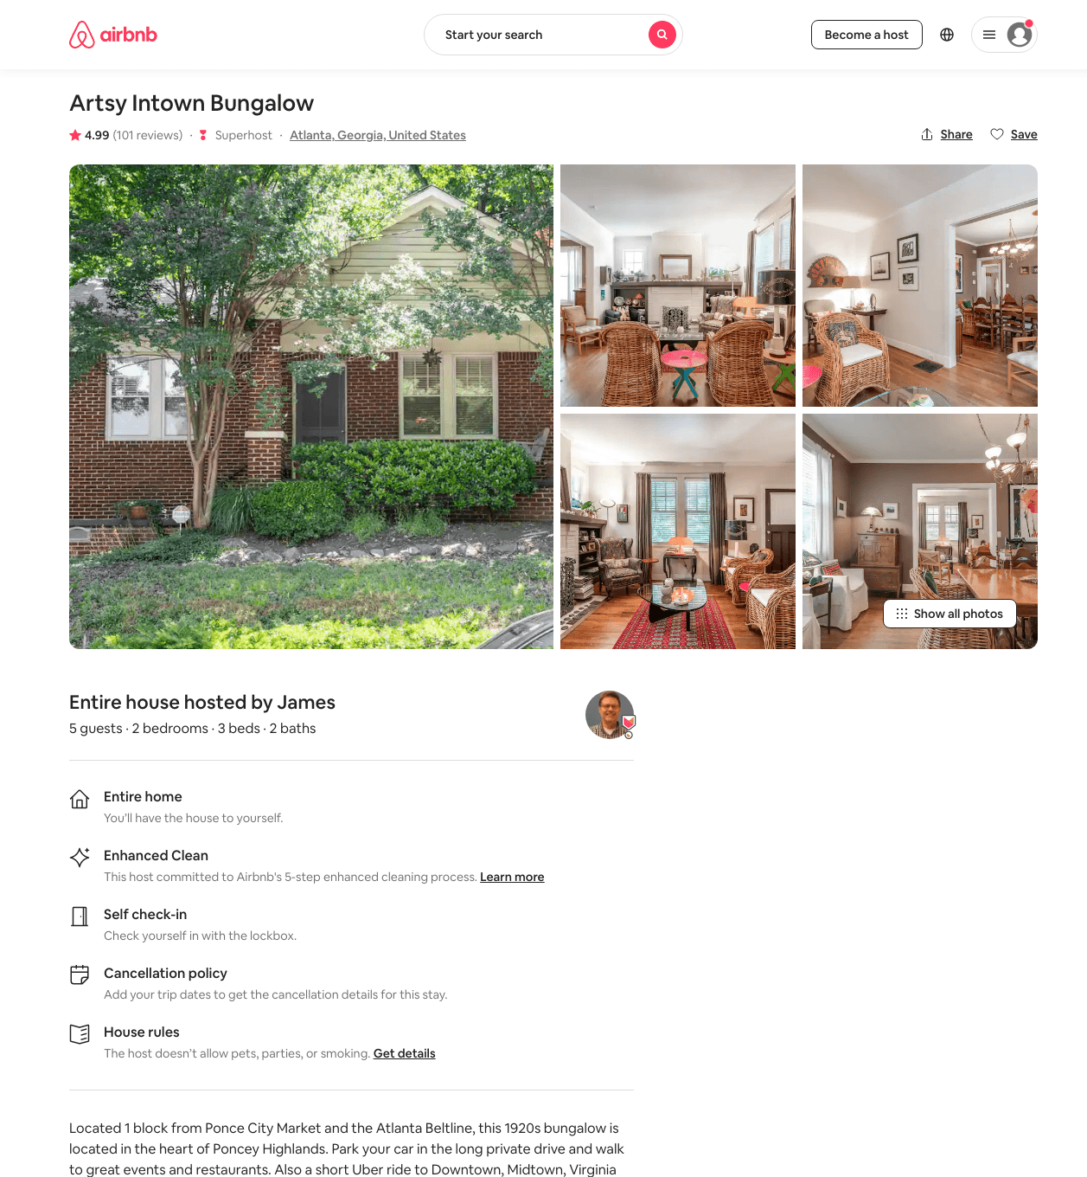
Listing 18649552
2
5
$150 - $200
4.99
4
James
129588259
1
https://www.airbnb.com/rooms/18649552
Aug 2022

Slide 27
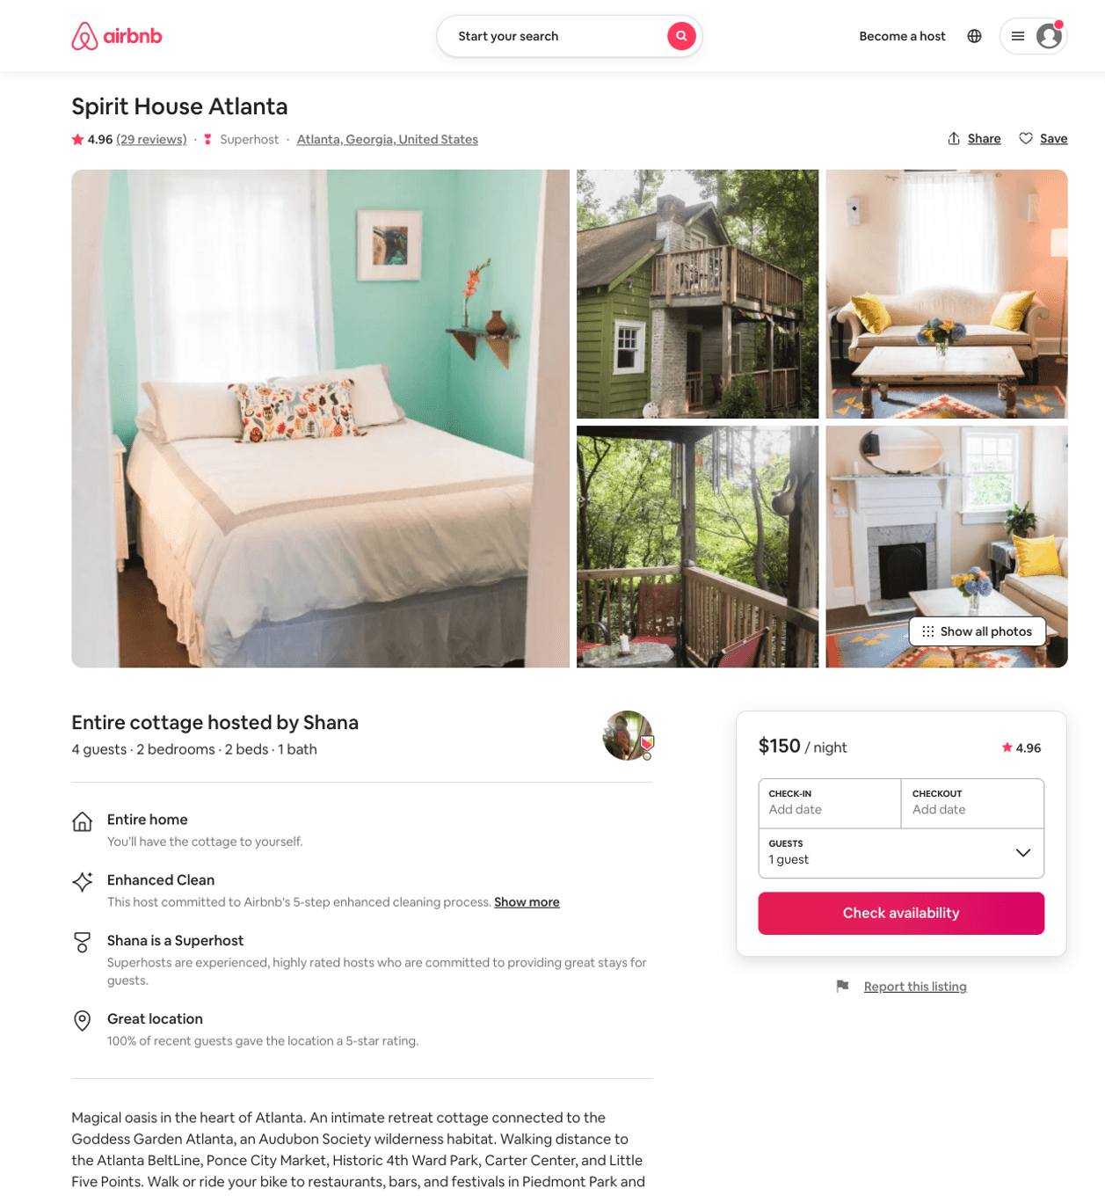
Listing 26712332
2
4
$150 - $200
4.95
1
Shana
4251090
1
https://www.airbnb.com/rooms/26712332
Aug 2022

Slide 28
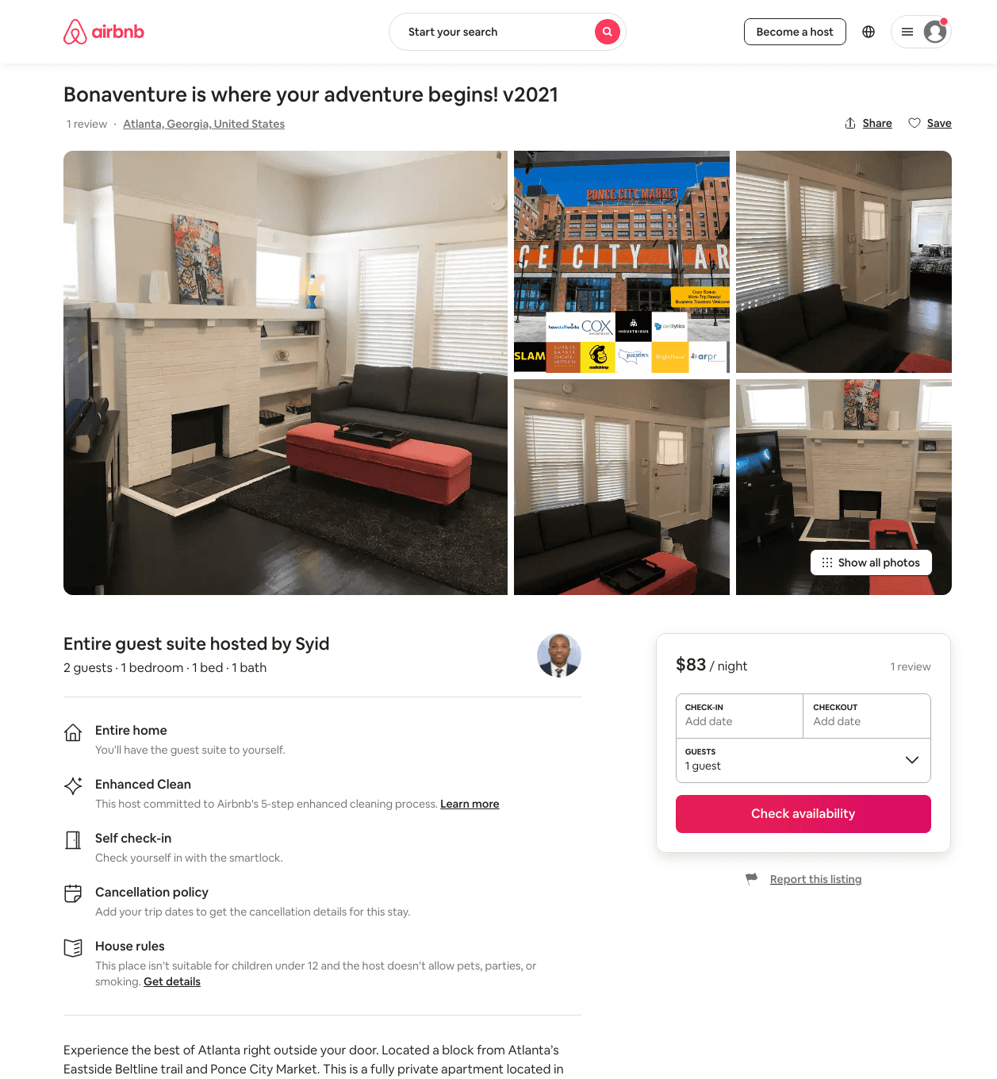
Listing 43961551
1
2
$83 - $140
5.0
31
Syid
189107212
2
https://www.airbnb.com/rooms/43961551
Aug 2022

Slide 29
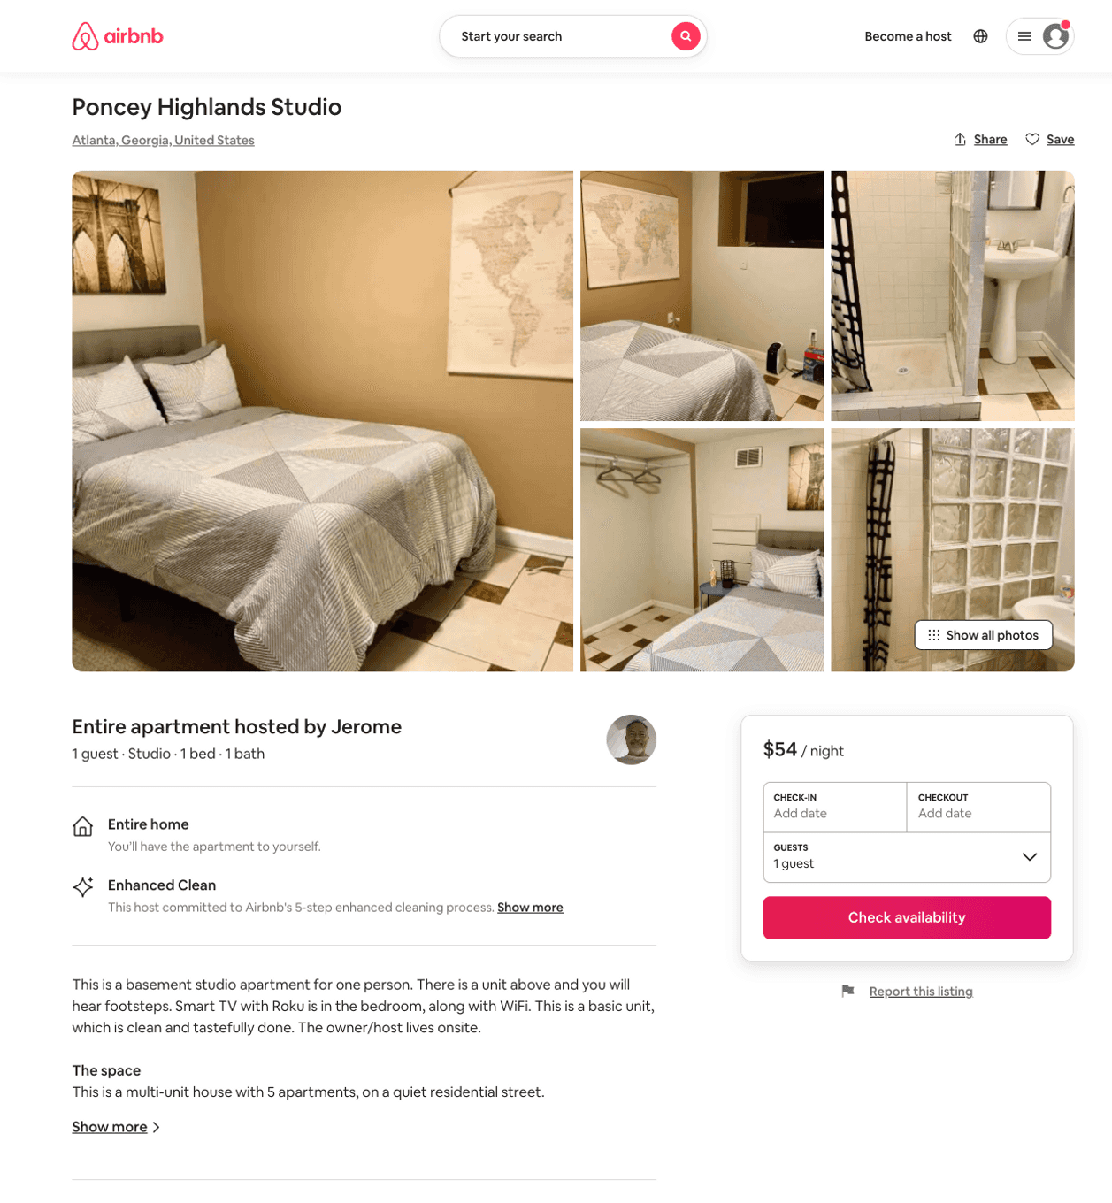
Listing 50891607
1
1
$54 - $65
4.79
1
Jerome
48103075
2
https://www.airbnb.com/rooms/50891607
Aug 2022

Slide 30
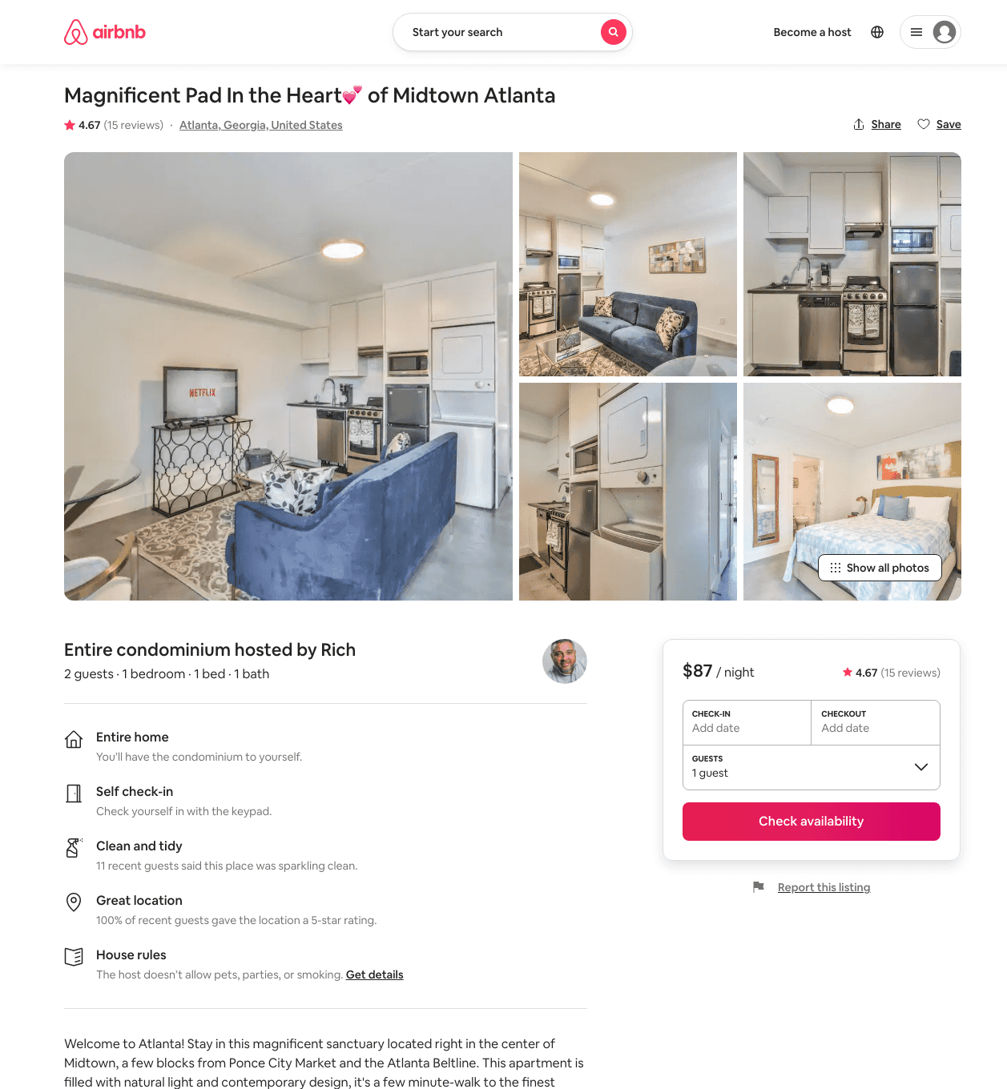
Listing 46024955
1
2
$73 - $130
4.63
2
Rich
31356024
22
https://www.airbnb.com/rooms/46024955
Aug 2022

Slide 31
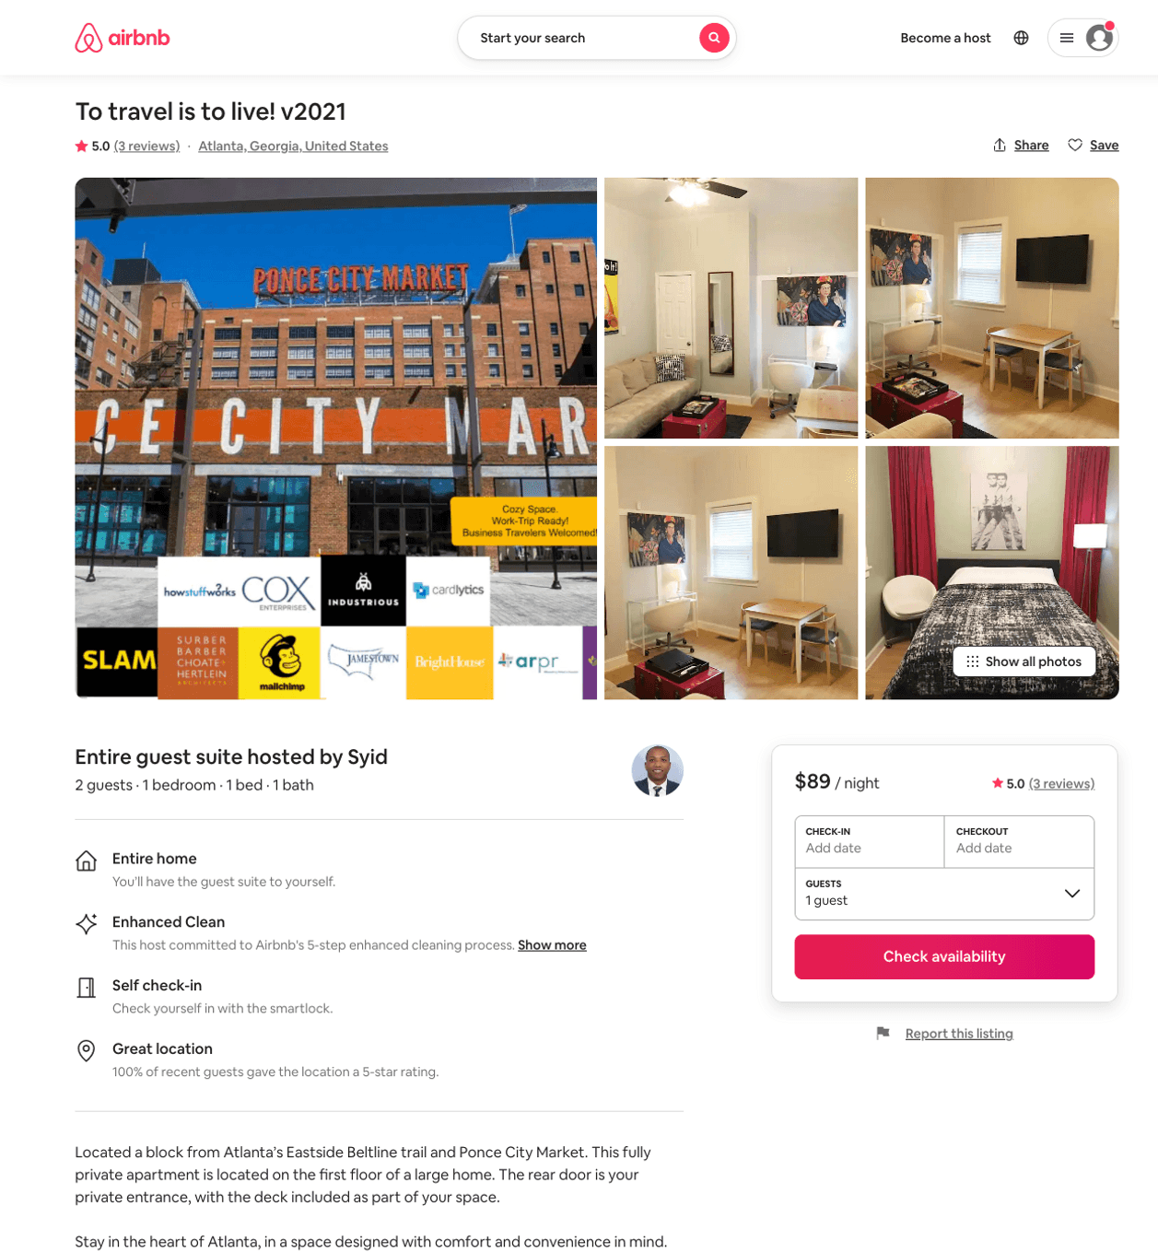
Listing 43961778
1
2
$89 - $114
5.0
31
Syid
189107212
2
https://www.airbnb.com/rooms/43961778
Aug 2022

Slide 32
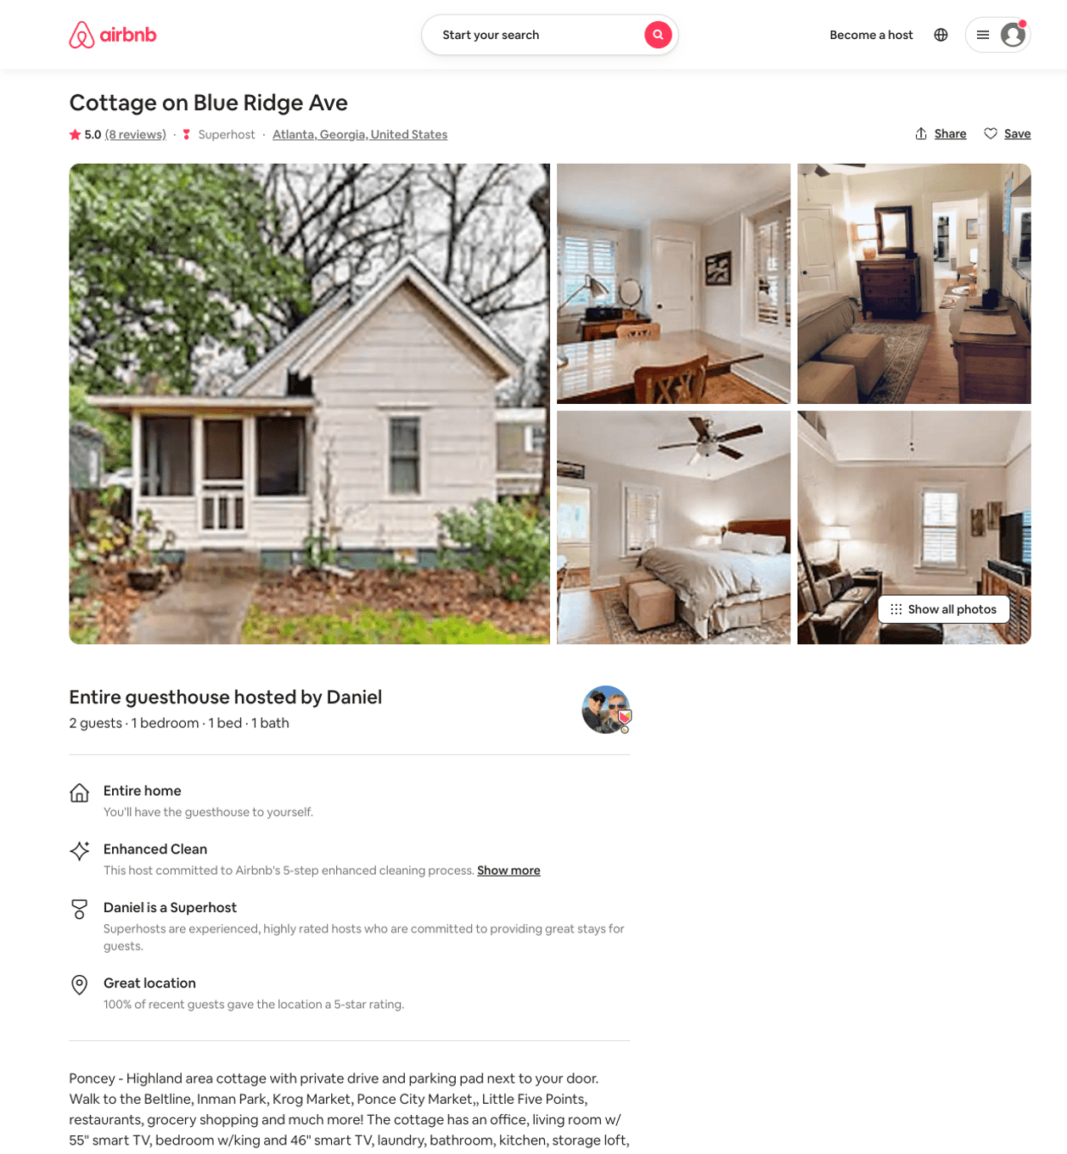
Listing 32099832
1
2
$86 - $90
5.0
31
Daniel
38503484
1
https://www.airbnb.com/rooms/32099832
Aug 2022

Slide 33
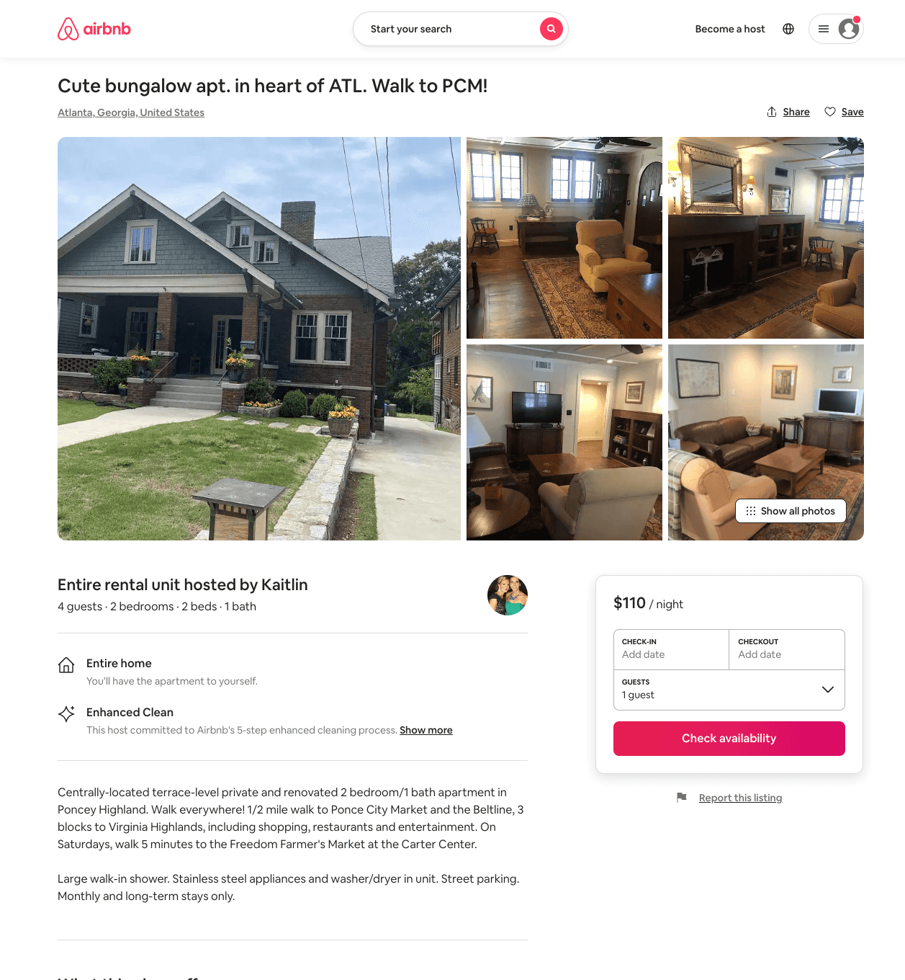
Listing 51143725
2
5
$99 - $181
4.99
2
Kaitlin
25109952
1
https://www.airbnb.com/rooms/51143725
Aug 2022

Slide 34
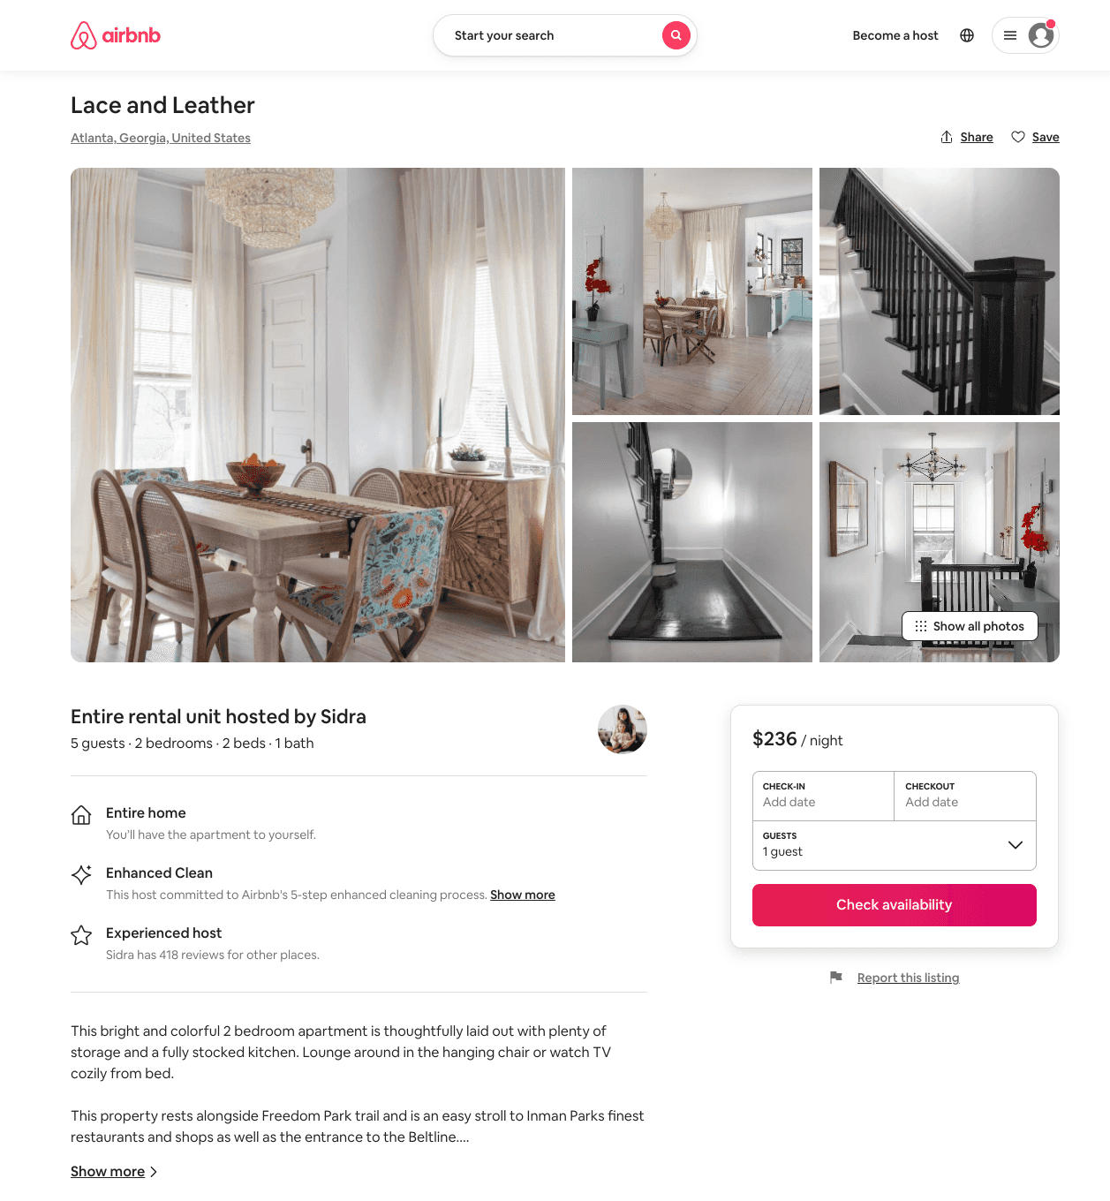
Listing 51283960
2
5
$172 - $267
5.0
2
Minty
3976298
79
https://www.airbnb.com/rooms/51283960
Aug 2022

Slide 35
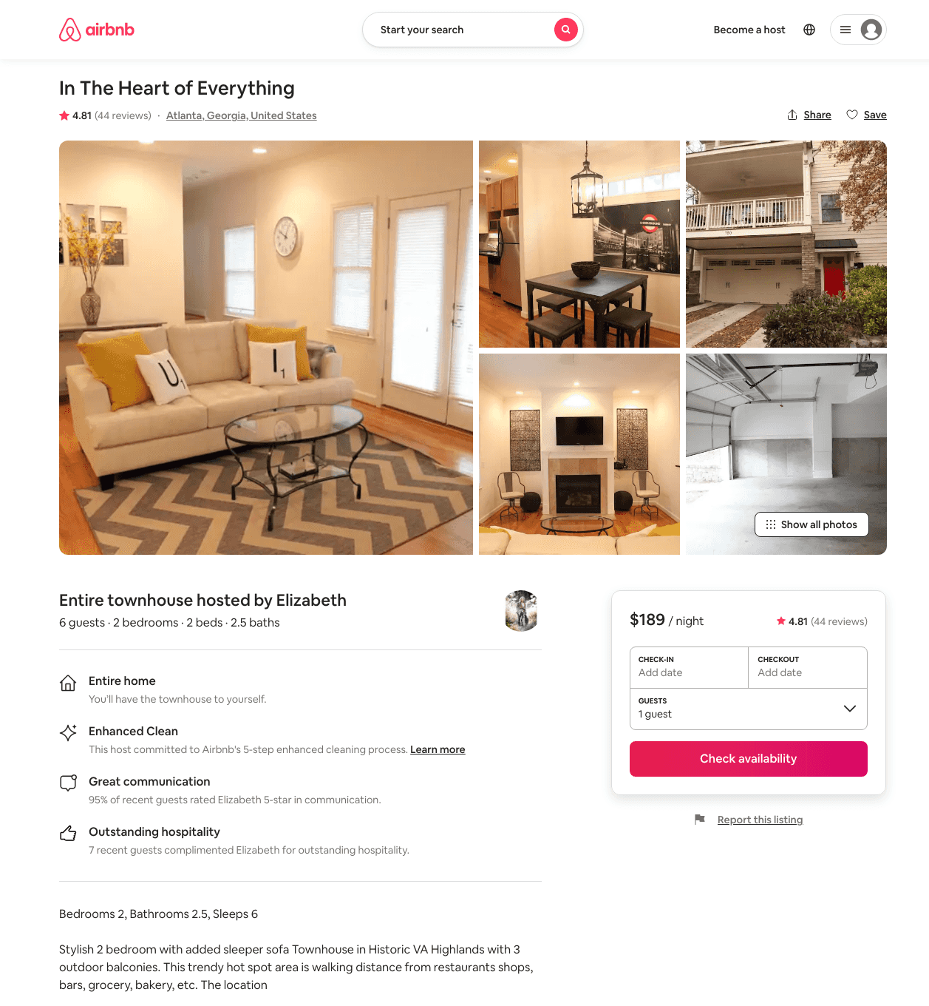
Listing 6901036
2
4
$189 - $219
4.86
2
Elizabeth
36163257
4
https://www.airbnb.com/rooms/6901036
Aug 2022

Slide 36
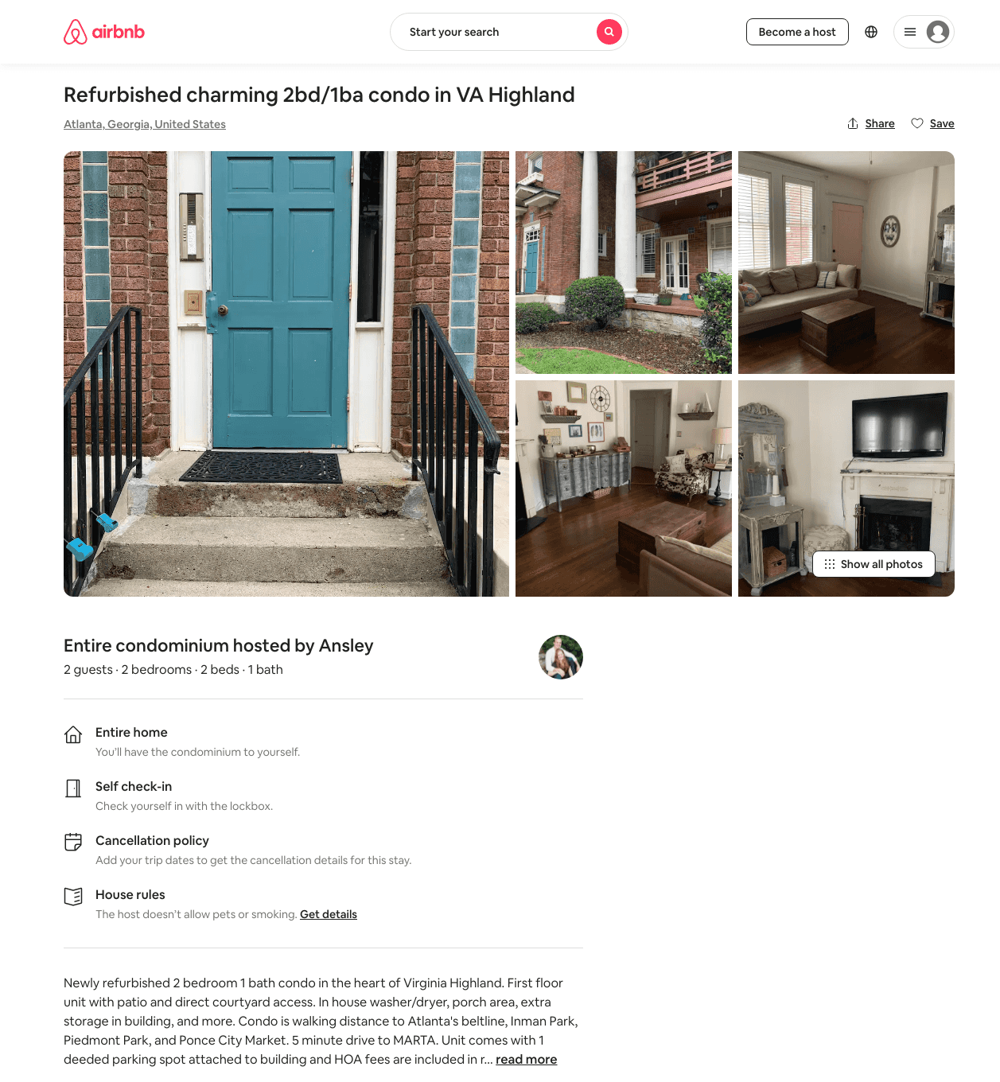
Listing 35085106
2
2
$80
180
Ansley
62091285
1
https://www.airbnb.com/rooms/35085106
Aug 2022

Slide 37
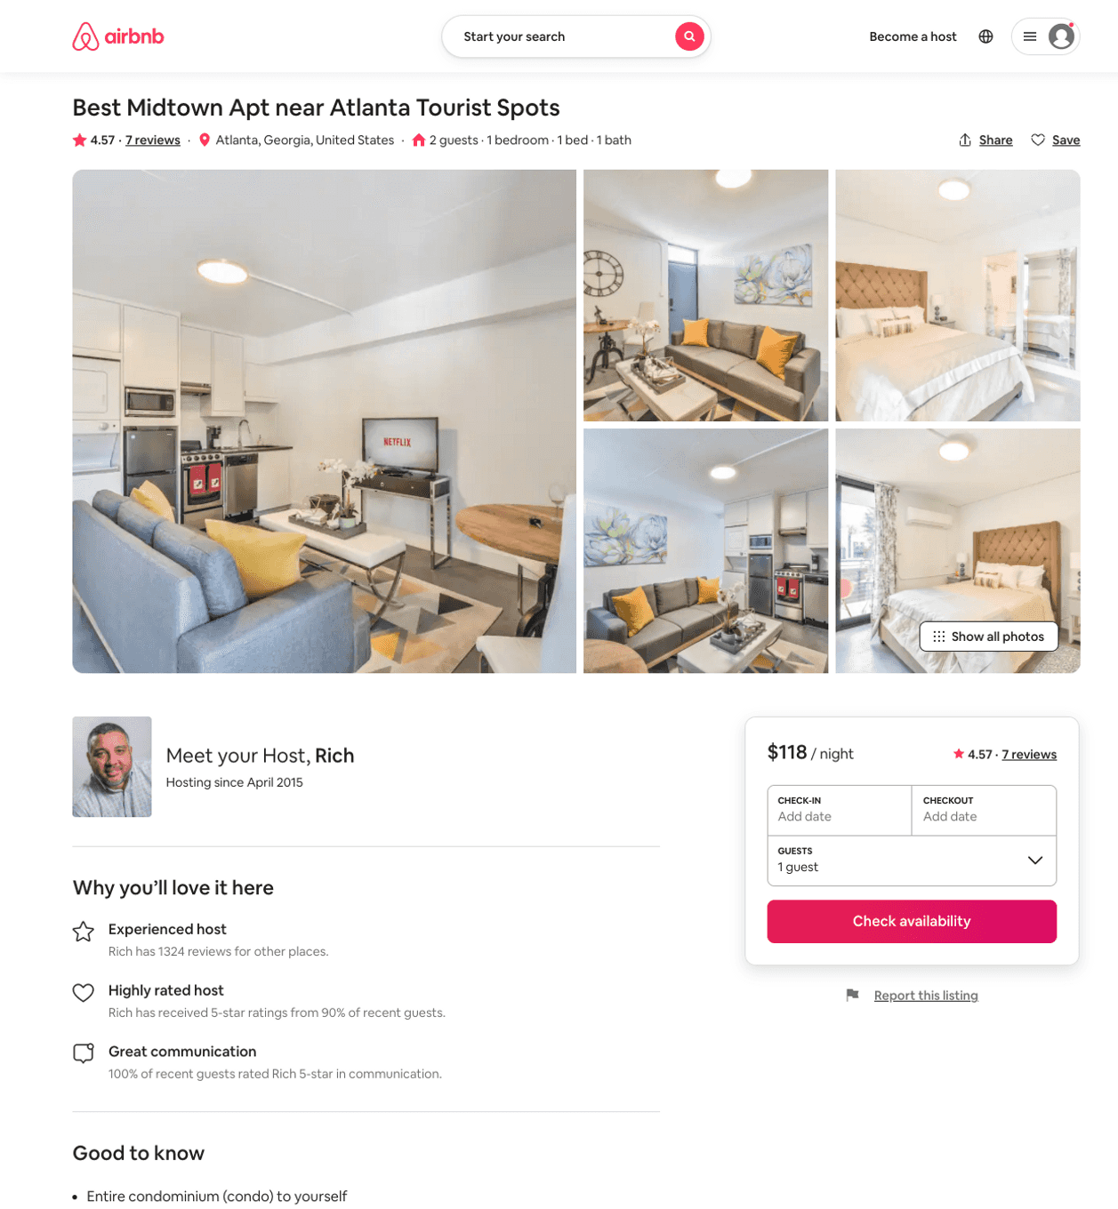
Listing 46024806
1
2
$64 - $130
4.88
2
Rich
31356024
22
https://www.airbnb.com/rooms/46024806
Aug 2022

Slide 38
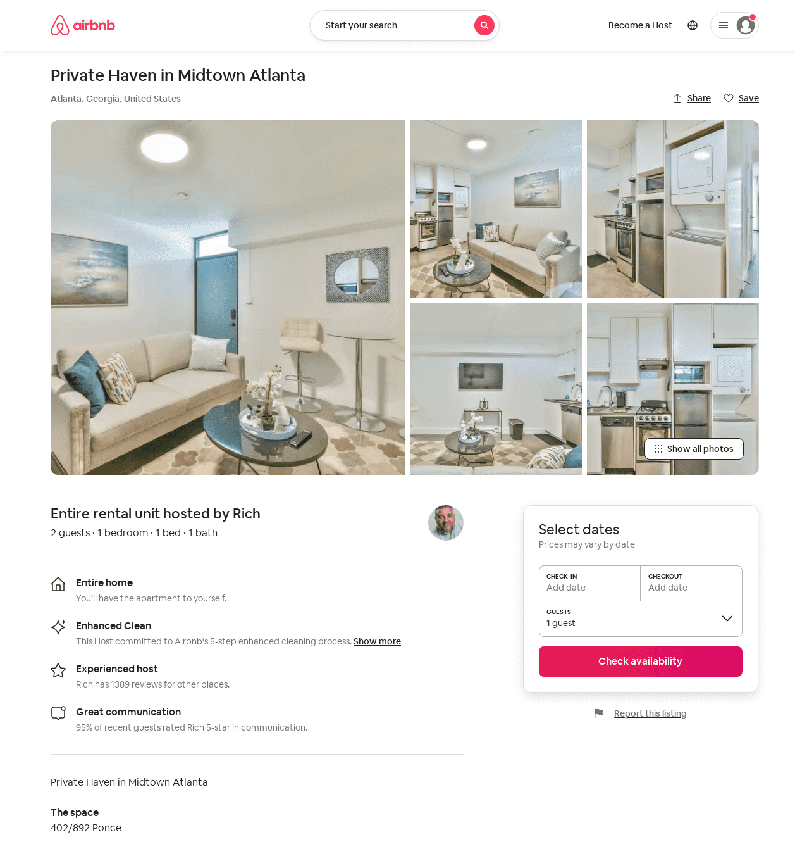
Listing 52569624
1
2
$79 - $101
4.67
2
Rich
31356024
22
https://www.airbnb.com/rooms/52569624
Aug 2022

Slide 39
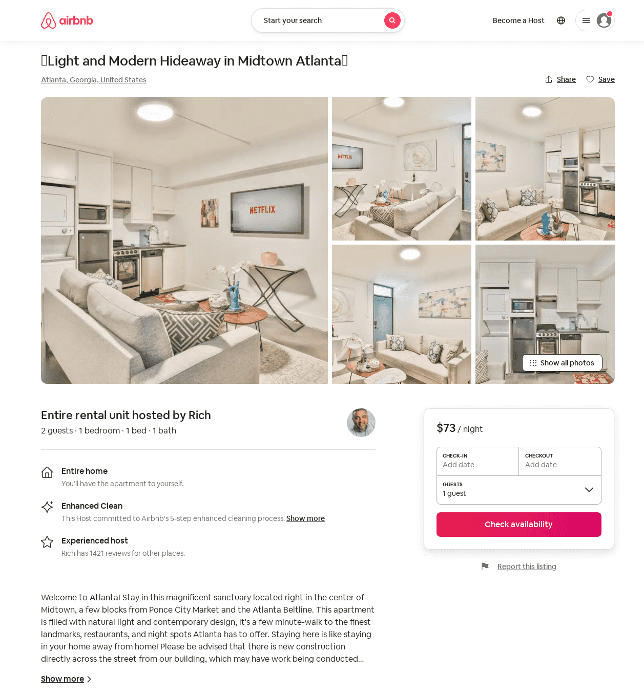
Listing 52923436
1
2
$73 - $104
4.64
2
Rich
31356024
22
https://www.airbnb.com/rooms/52923436
Aug 2022

Slide 40
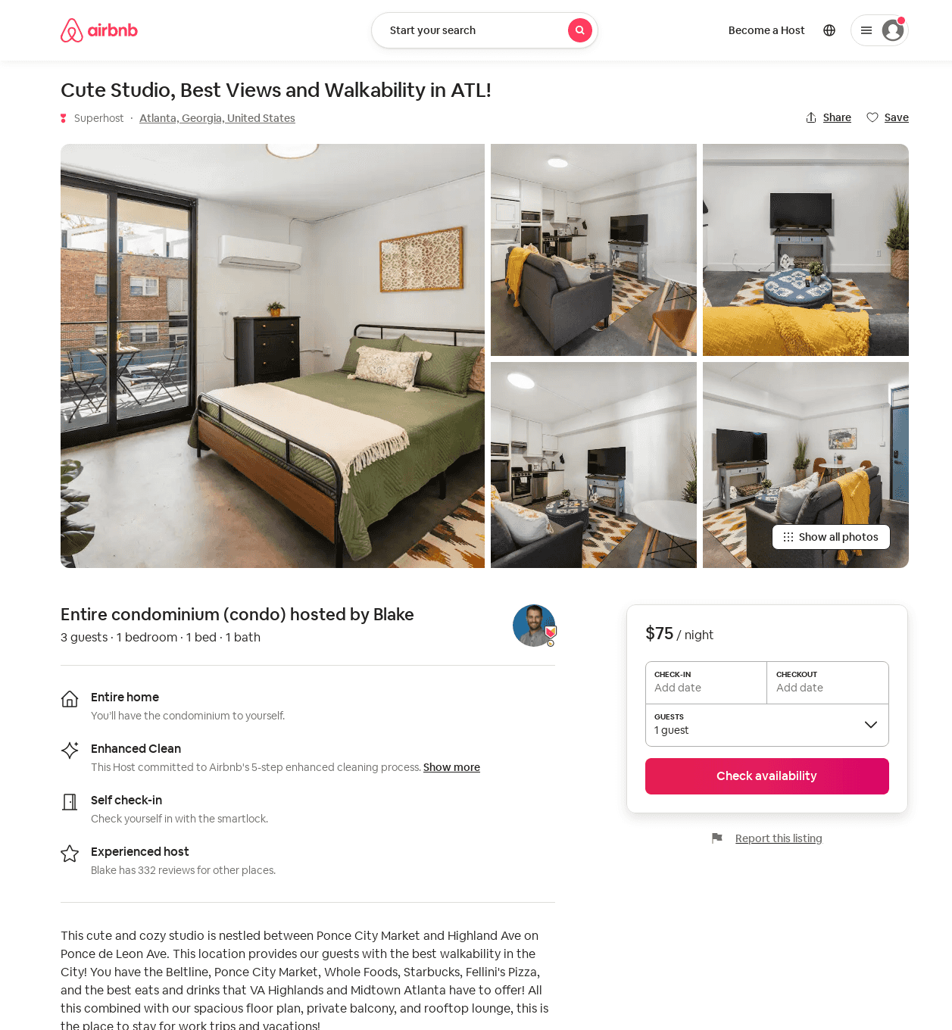
Listing 52971564
1
3
$72 - $94
4.58
2
Blake
81660490
10
https://www.airbnb.com/rooms/52971564
Aug 2022

Slide 41
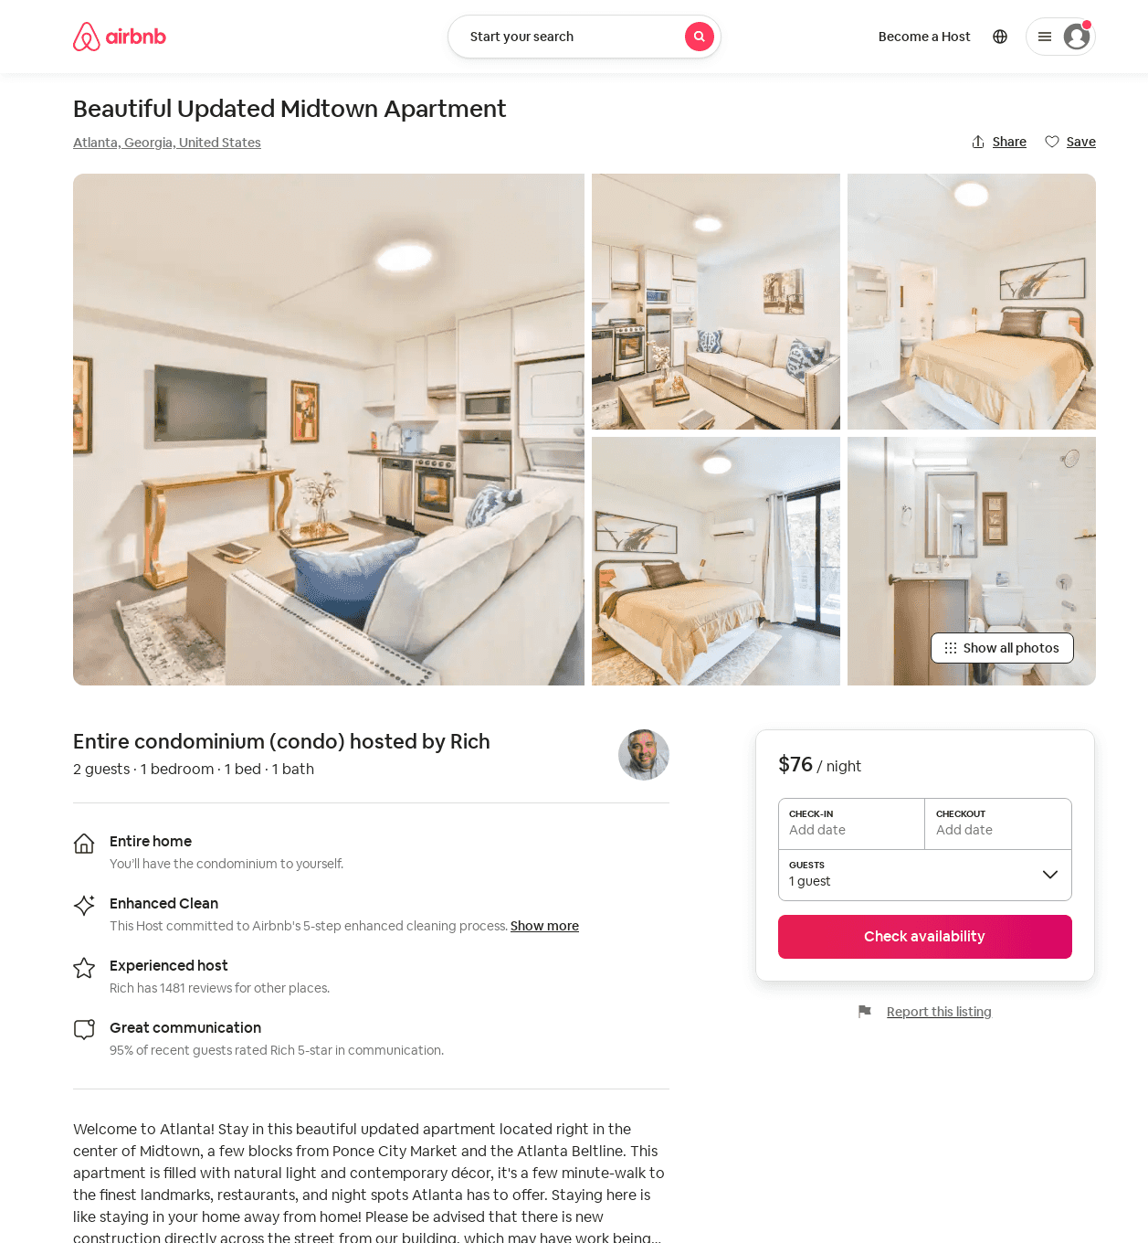
Listing 53416573
1
2
$76 - $110
4.93
2
Rich
31356024
22
https://www.airbnb.com/rooms/53416573
Aug 2022

Slide 42
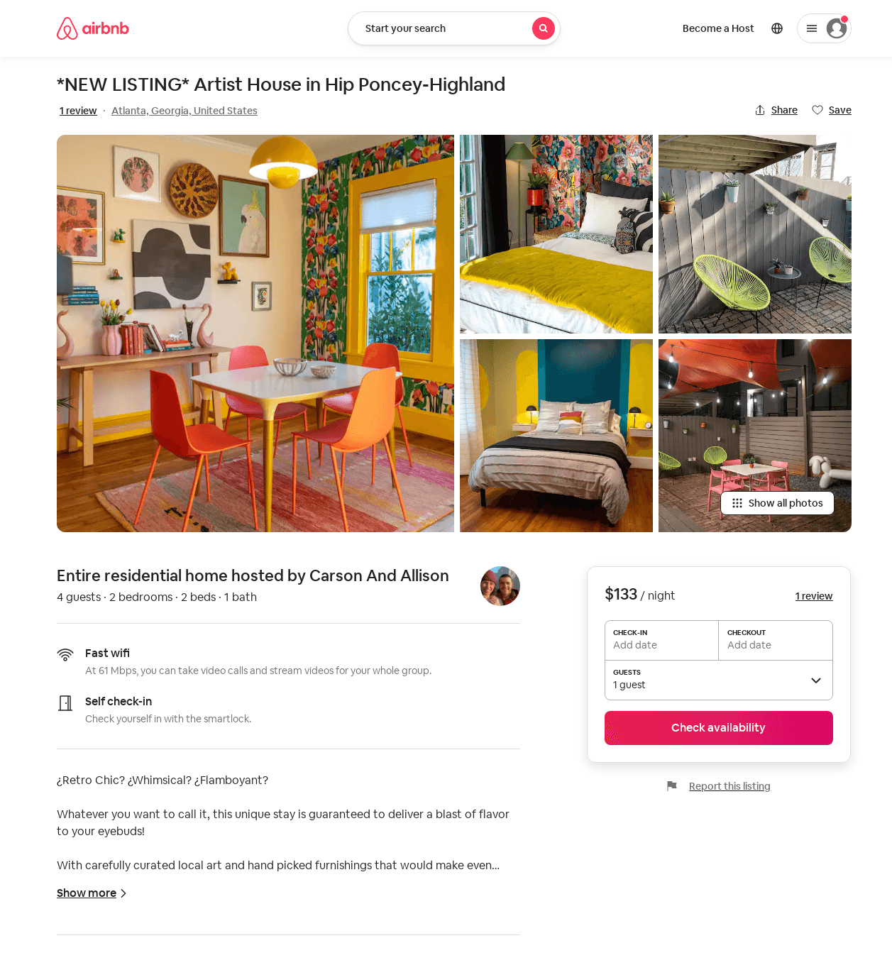
Listing 4742048
2
4
$133 - $156
4.97
2
Carson And Allison
21588987
1
https://www.airbnb.com/rooms/4742048
Aug 2022

Slide 43
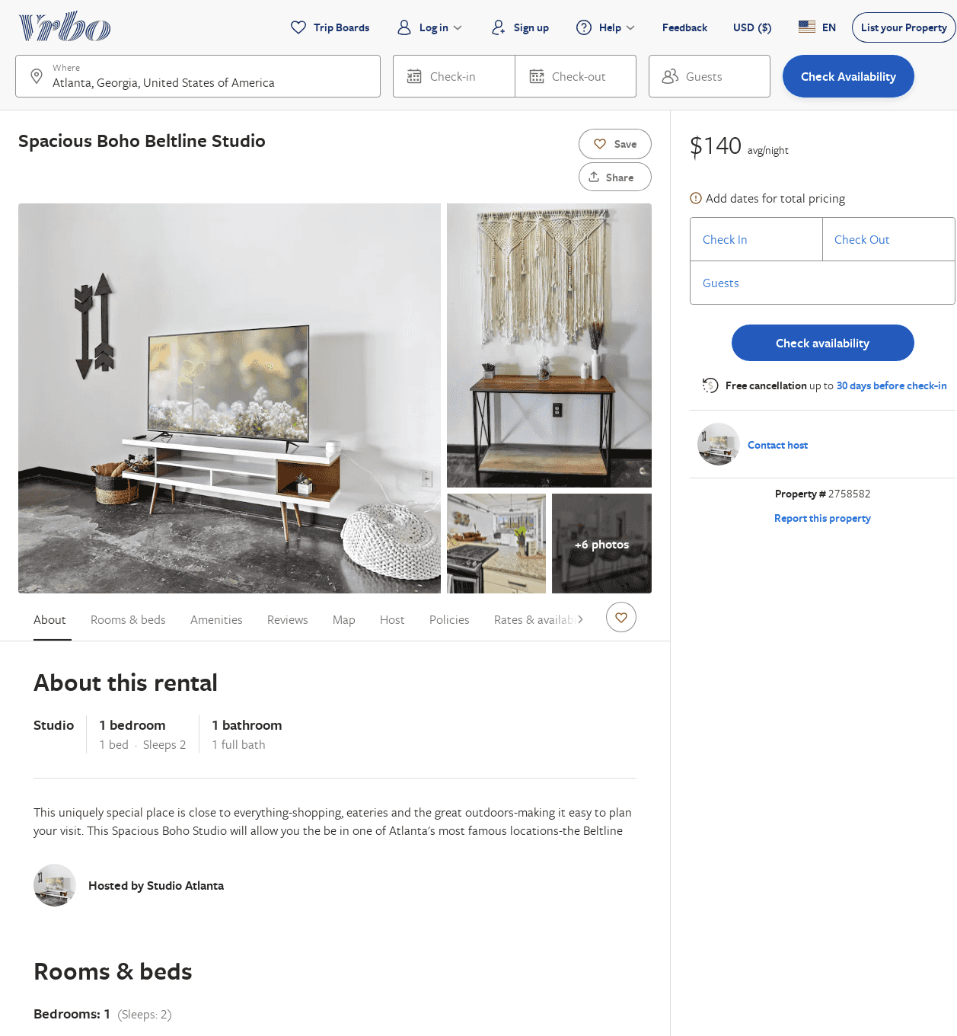
Listing 2758582
1
2
$157
2
https://www.vrbo.com/2758582
Aug 2022

Slide 44
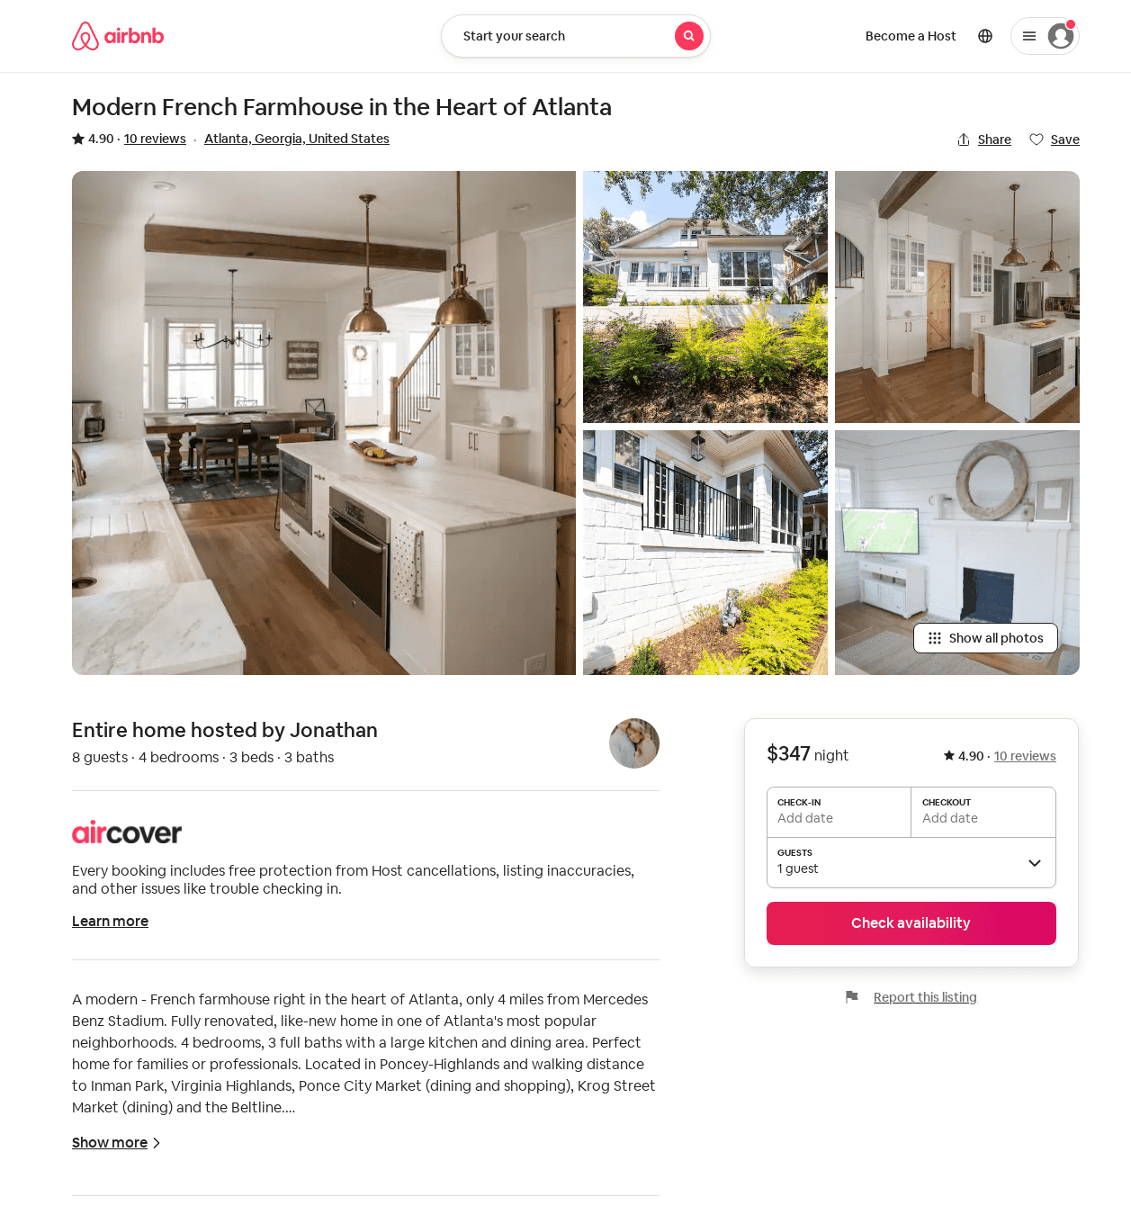
Listing 31623203
4
8
4.73
2
Jonathan
17239181
1
https://www.airbnb.com/rooms/31623203
Jul 2022

Slide 45
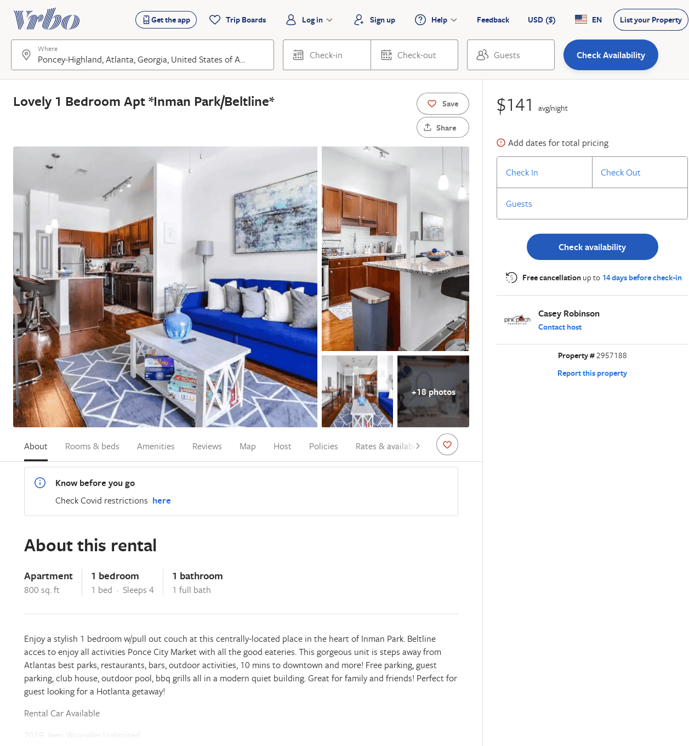
Listing 2957188
1
4
$138
1
Casey Robinson
https://www.vrbo.com/2957188
Aug 2022

Slide 46
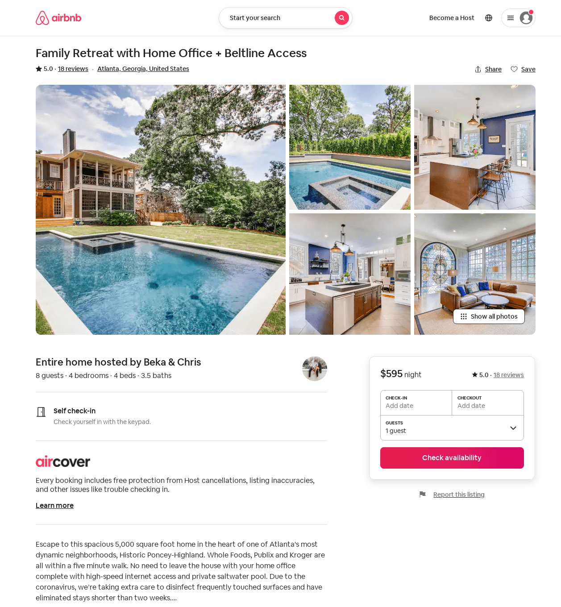
Listing 1796353
4
8
5.0
28
Beka & Chris
9421452
1
https://www.airbnb.com/rooms/1796353
Aug 2022

Slide 47
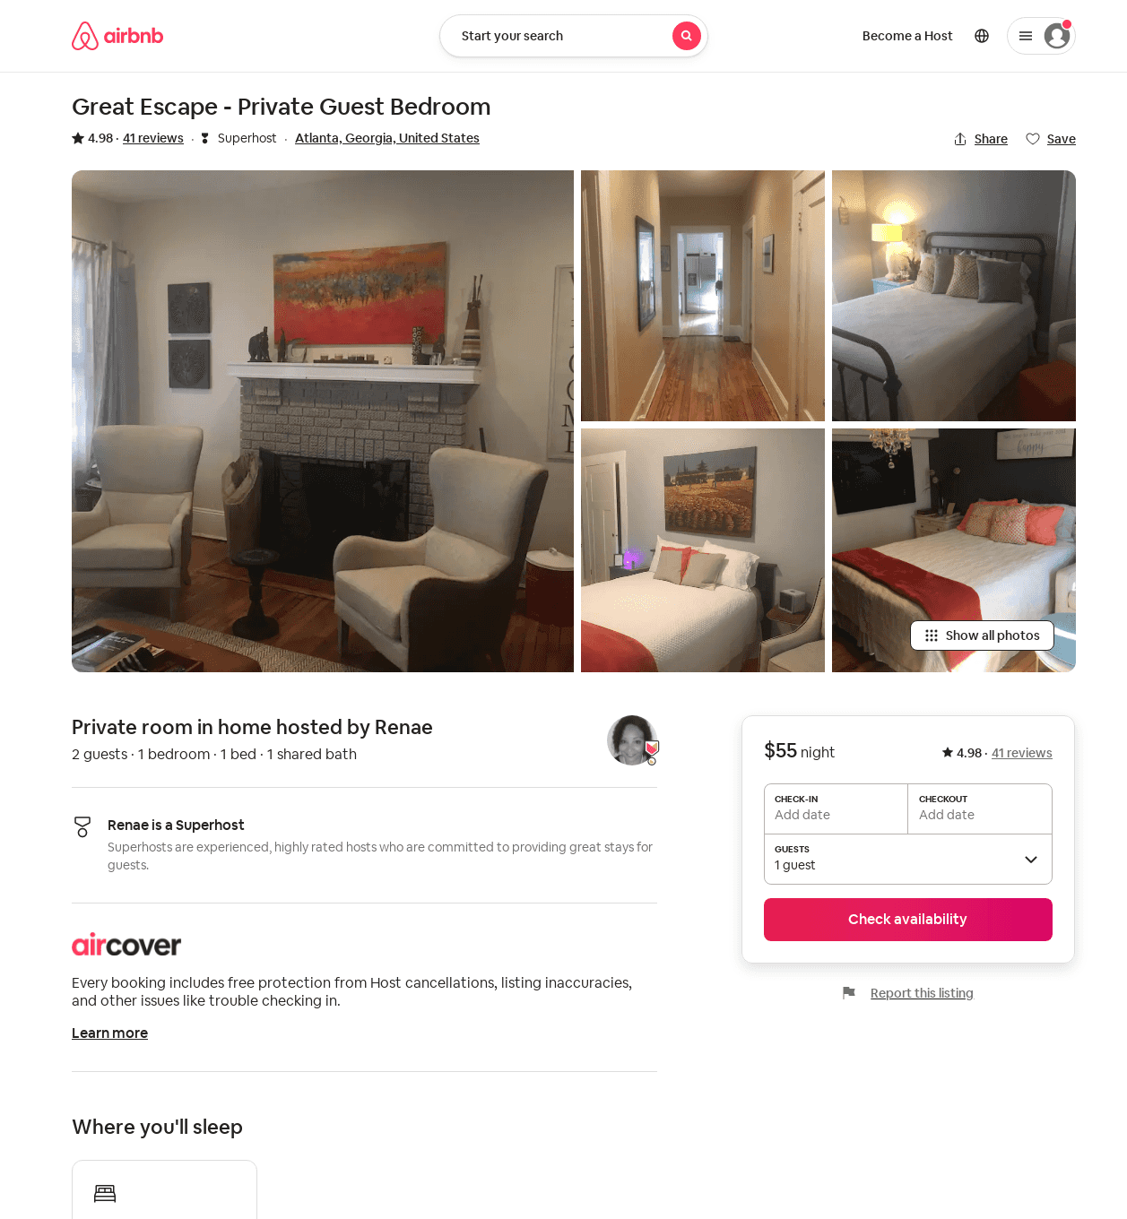
Listing 20834421
1
2
4.98
1
Renae
23294305
2
https://www.airbnb.com/rooms/20834421
Aug 2022

