Slide 2
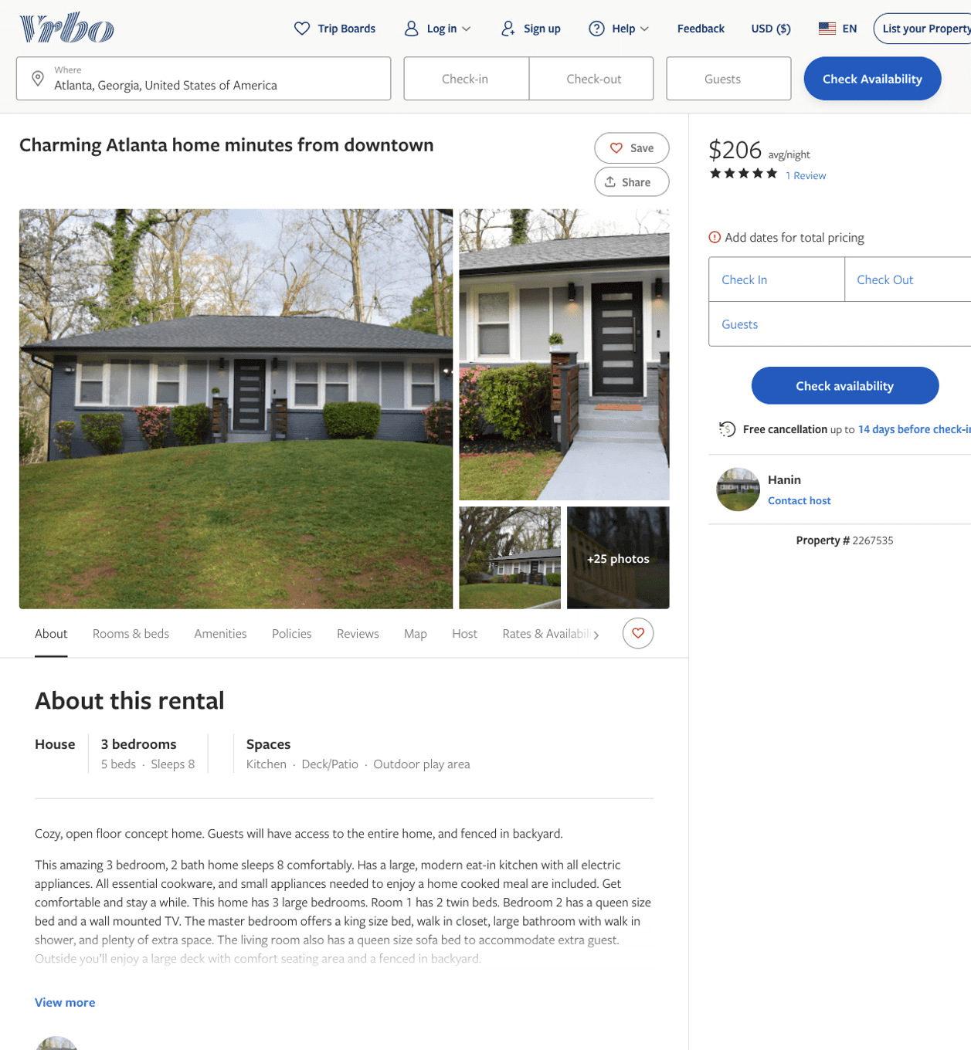
Listing 2267535
3
8
$154 - $206
4.75
3
Hanin
https://www.vrbo.com/2267535
Aug 2022

Slide 3
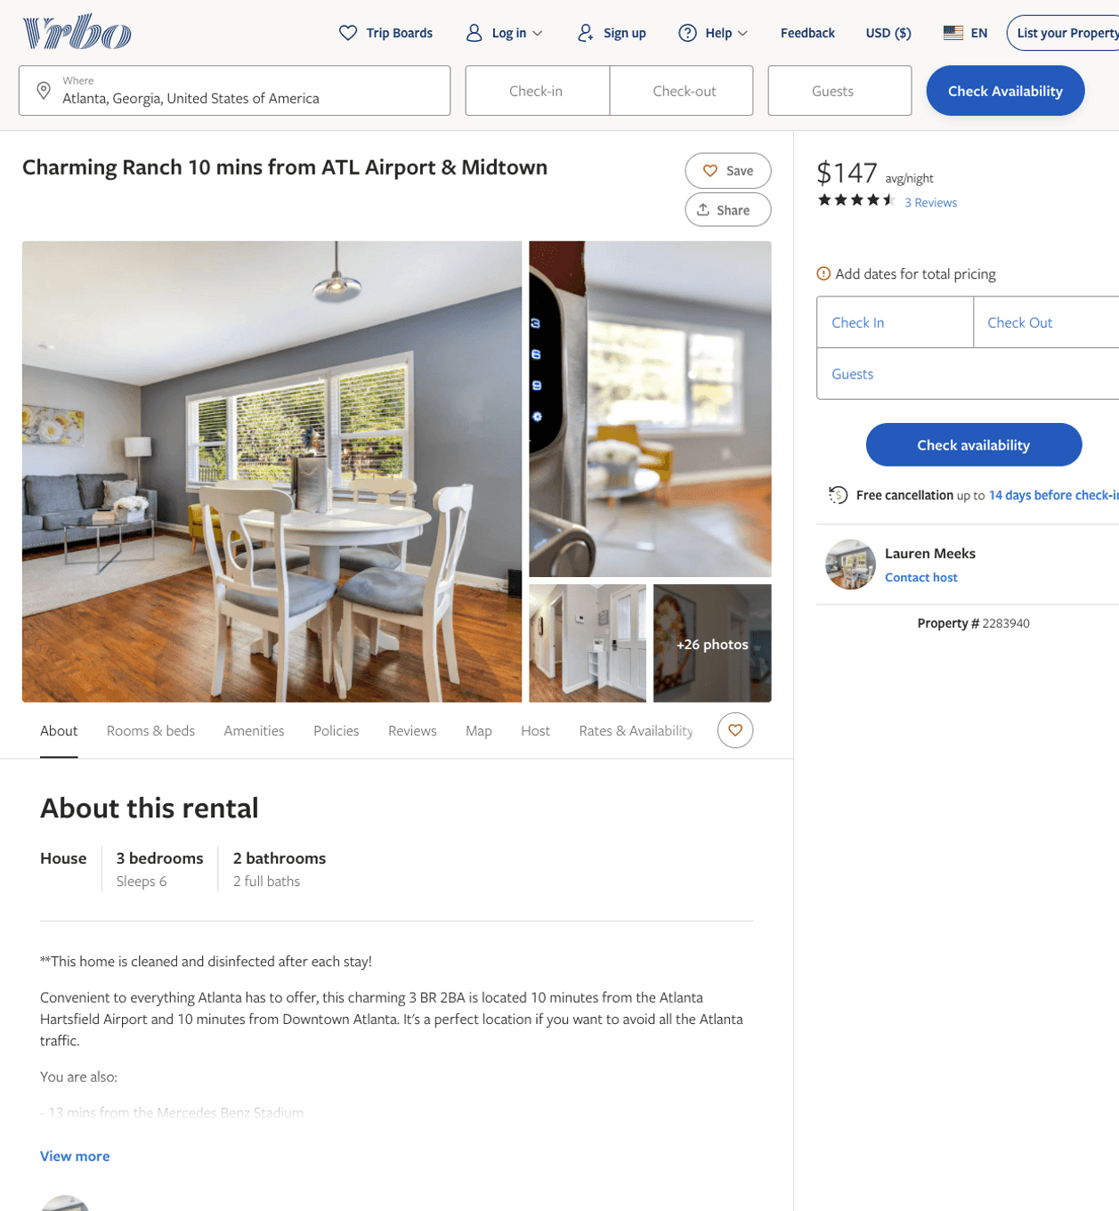
Listing 2283940
3
6
$118 - $185
3.5
1
Lauren Meeks
https://www.vrbo.com/2283940
Aug 2022

Slide 4
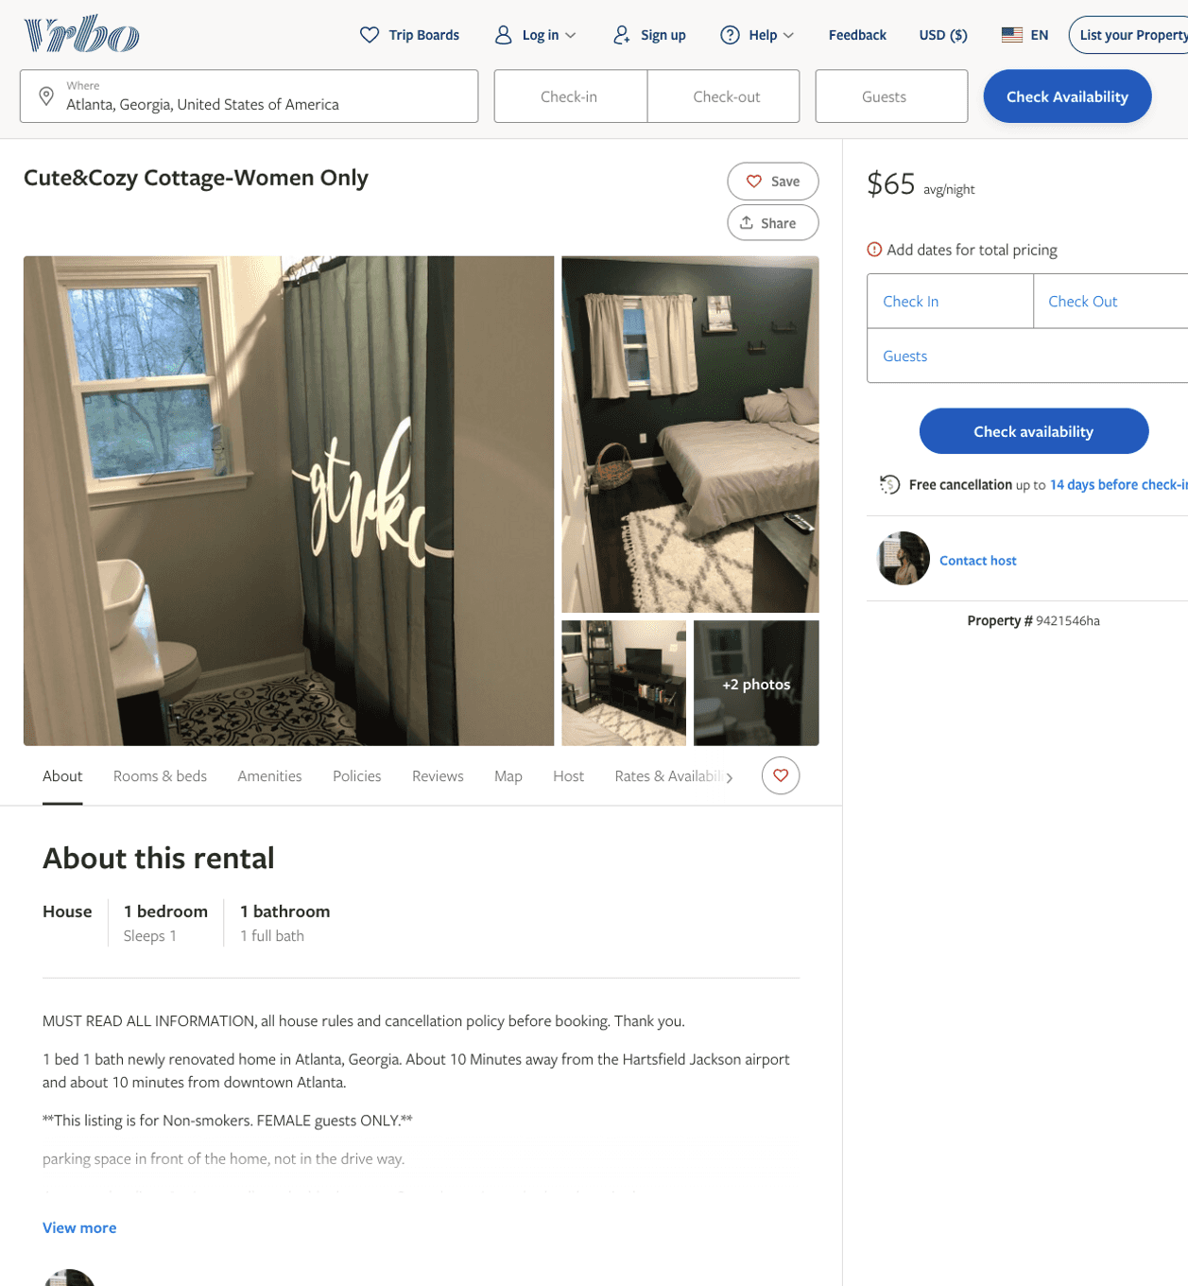
Listing 9421546
1
1
$65
1
https://www.vrbo.com/9421546ha
Aug 2022

Slide 5
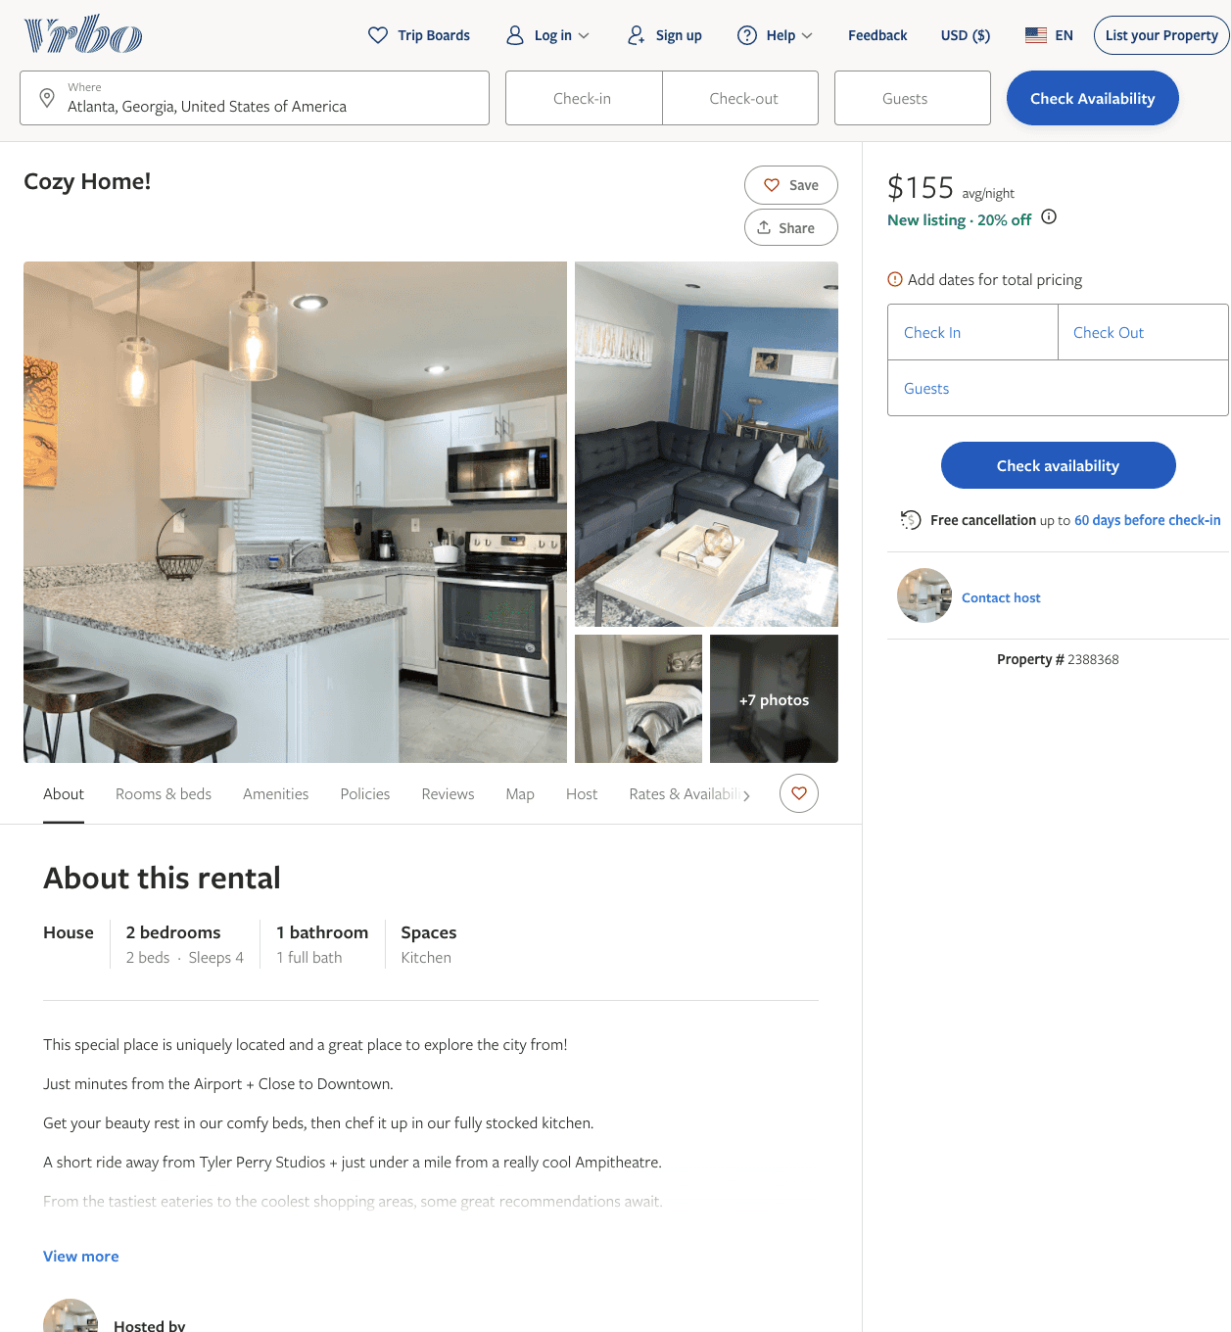
Listing 2388368
2
4
$155
2
https://www.vrbo.com/2388368
Aug 2022

Slide 6
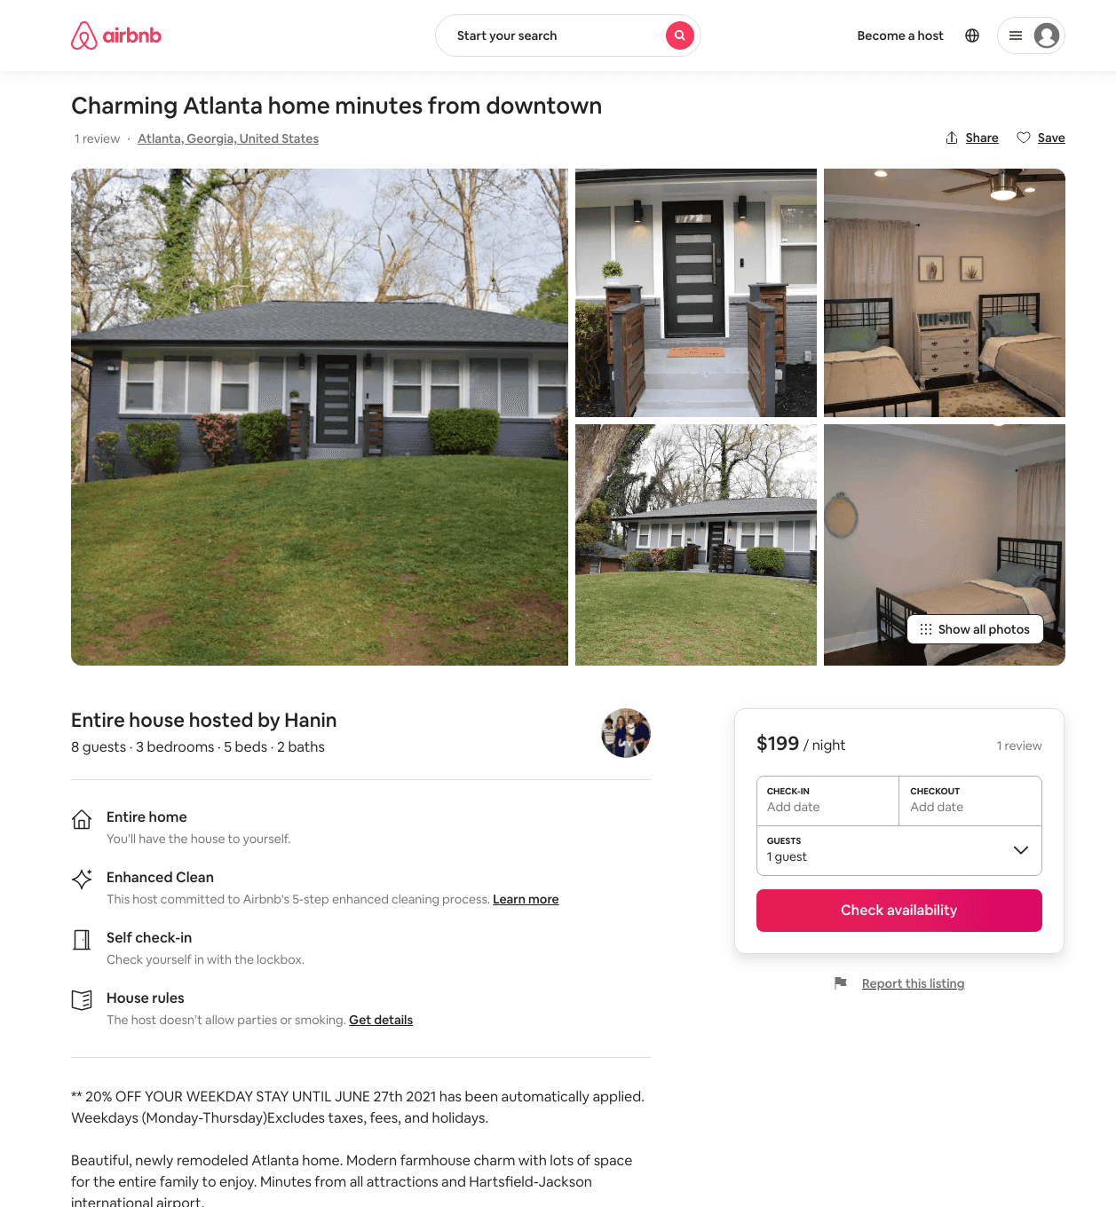
Listing 46452896
3
8
$135 - $221
4.93
3
Hanin
136942043
1
https://www.airbnb.com/rooms/46452896
Aug 2022

Slide 7
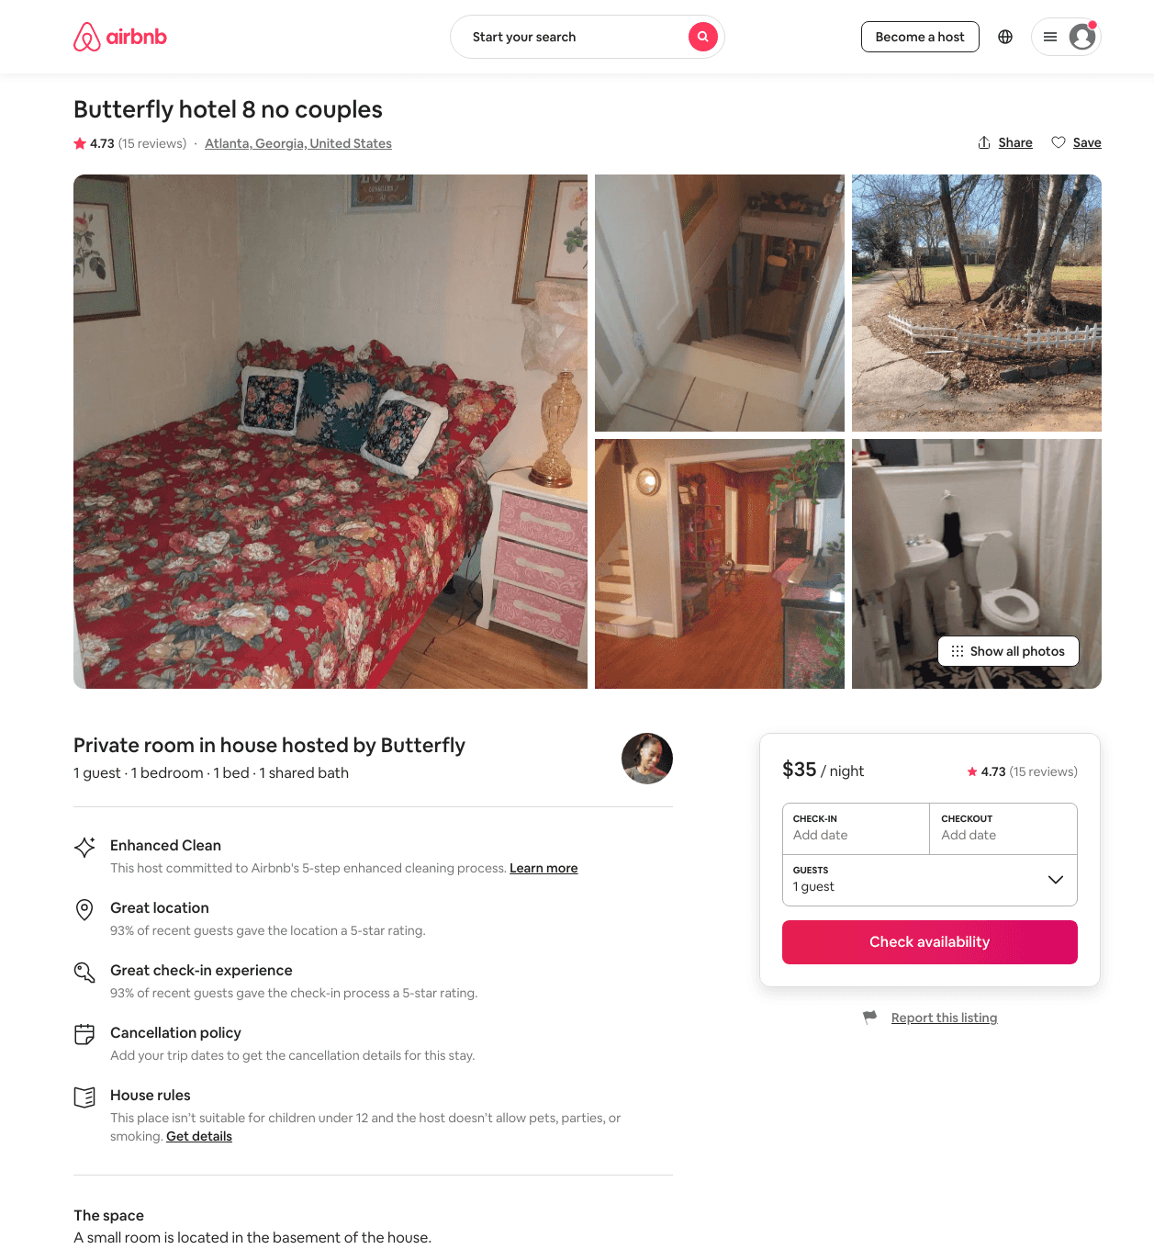
Listing 41020570
1
1
$35
4.75
7
Butterfly
311112935
8
https://www.airbnb.com/rooms/41020570
Jul 2022

Slide 8
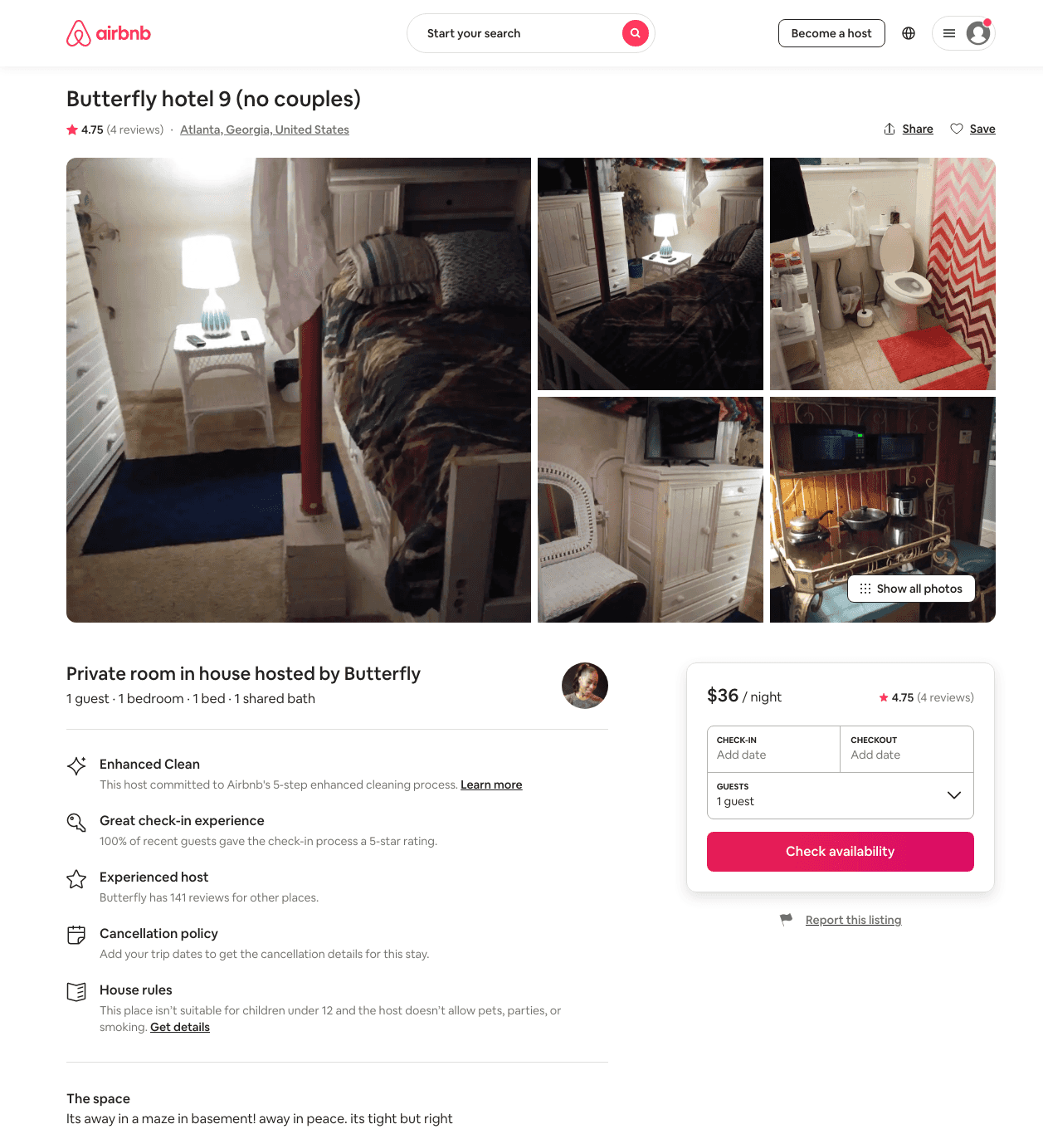
Listing 44071318
1
1
$35 - $36
4.55
7
Butterfly
311112935
8
https://www.airbnb.com/rooms/44071318
Jul 2022

Slide 9
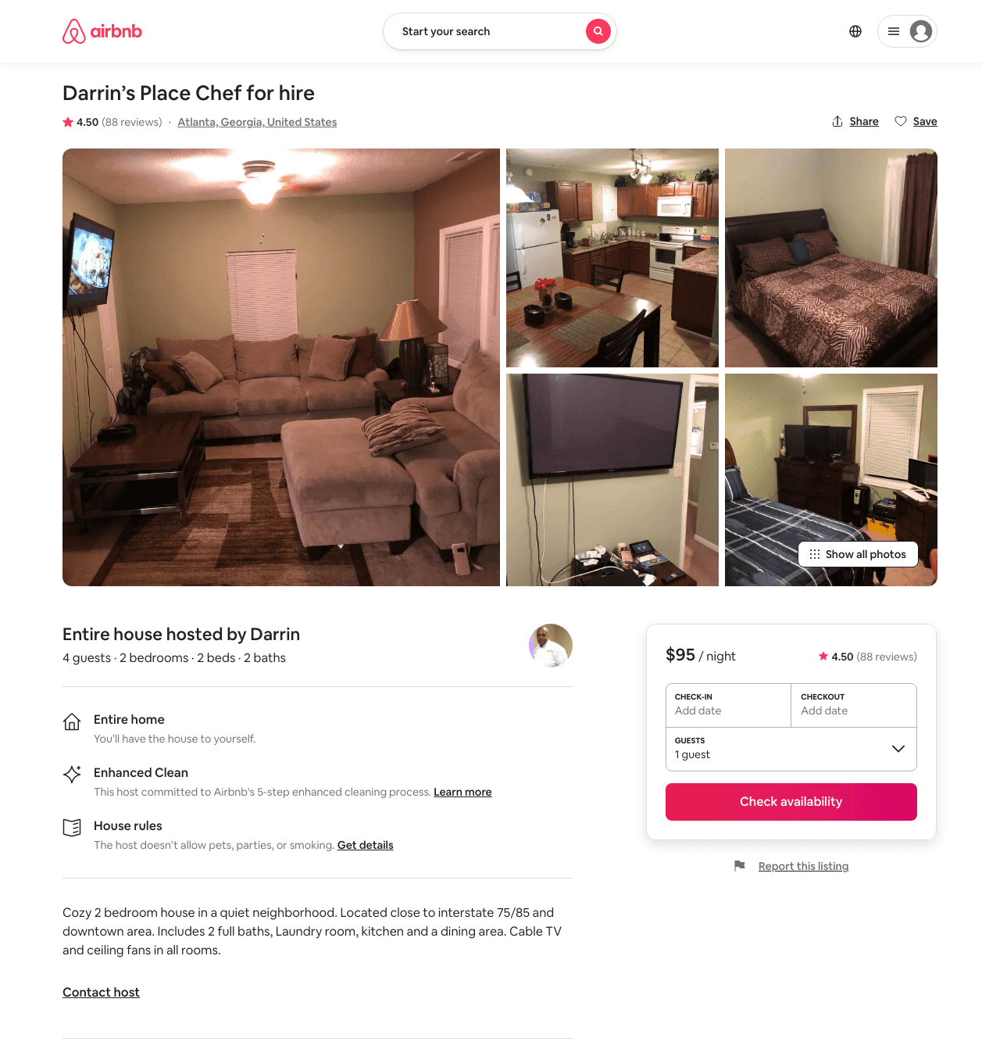
Listing 21427693
2
4
$95
4.50
2
Darrin
116111277
1
https://www.airbnb.com/rooms/21427693
Aug 2022

Slide 10
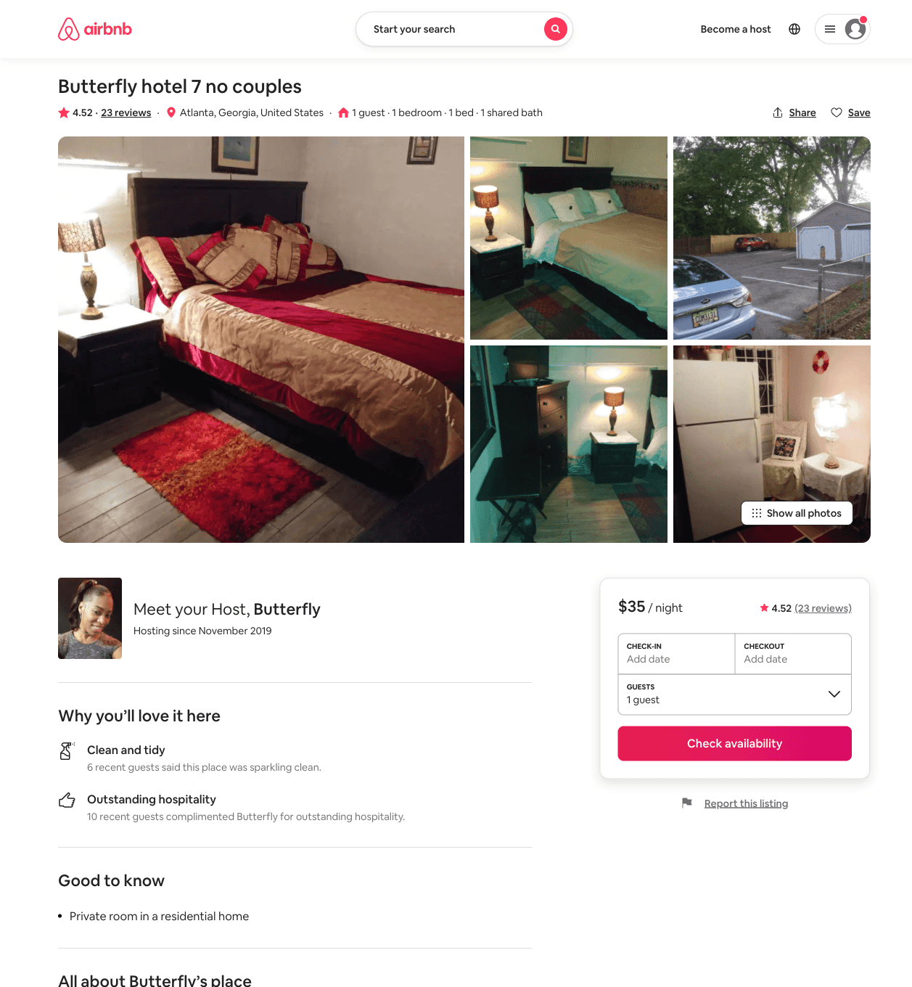
Listing 43327770
1
1
$35 - $40
4.52
30
Butterfly
311112935
8
https://www.airbnb.com/rooms/43327770
Aug 2022

Slide 11
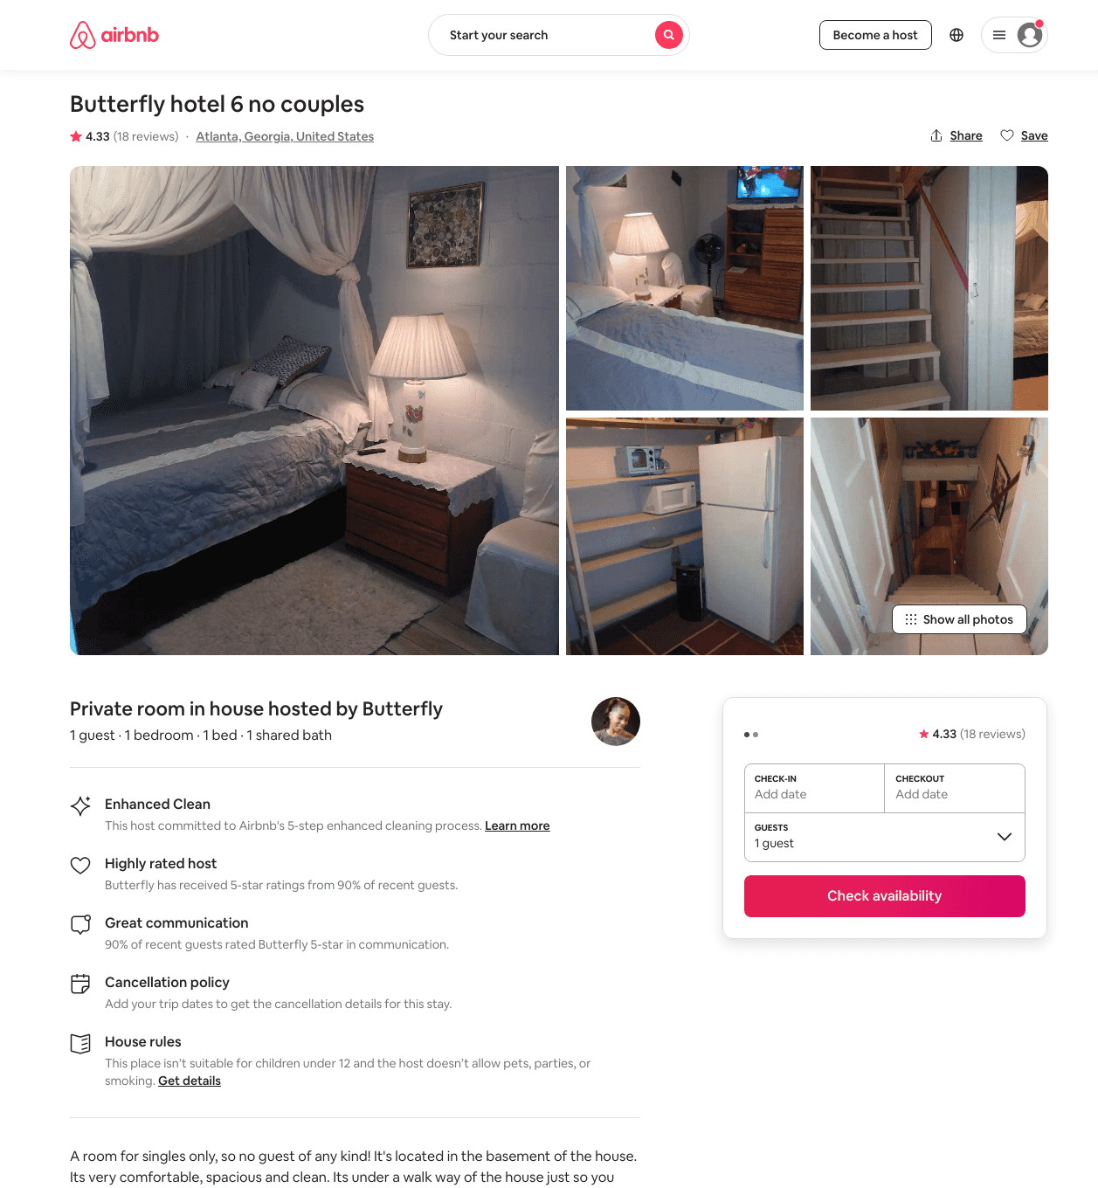
Listing 41192275
1
1
$35
4.43
7
Butterfly
311112935
8
https://www.airbnb.com/rooms/41192275
Jul 2022

Slide 12
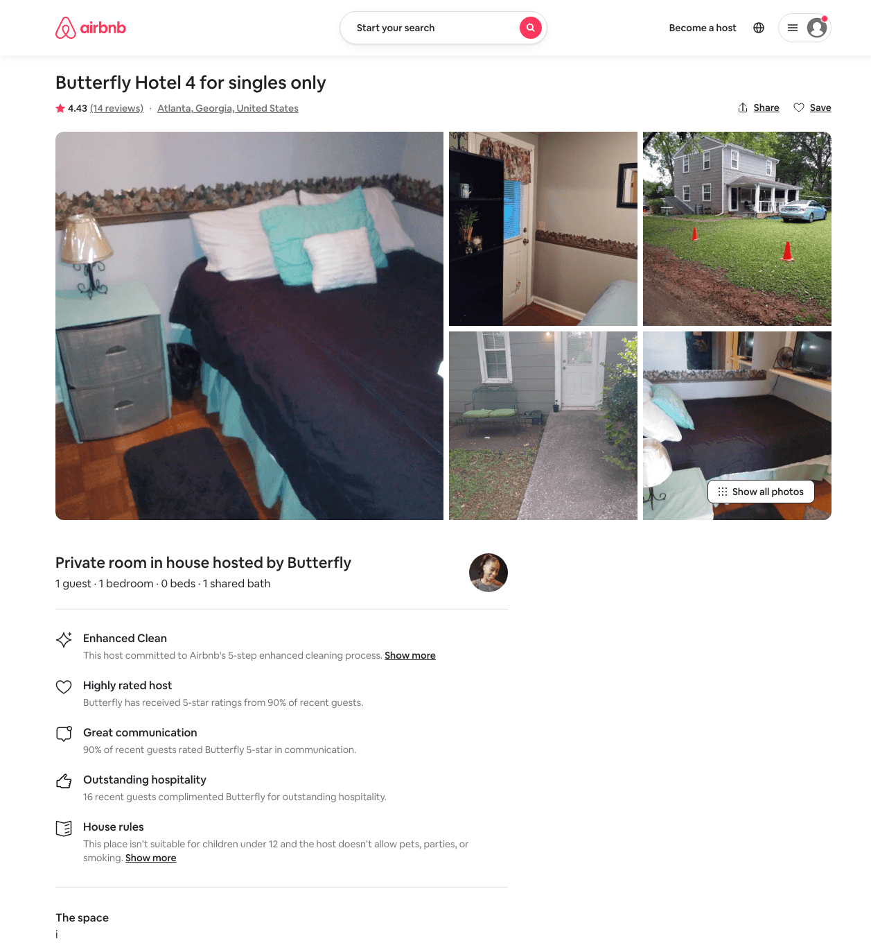
Listing 41020117
1
1
$35 - $55
4.19
3
Butterfly
311112935
8
https://www.airbnb.com/rooms/41020117
Jul 2022

Slide 13
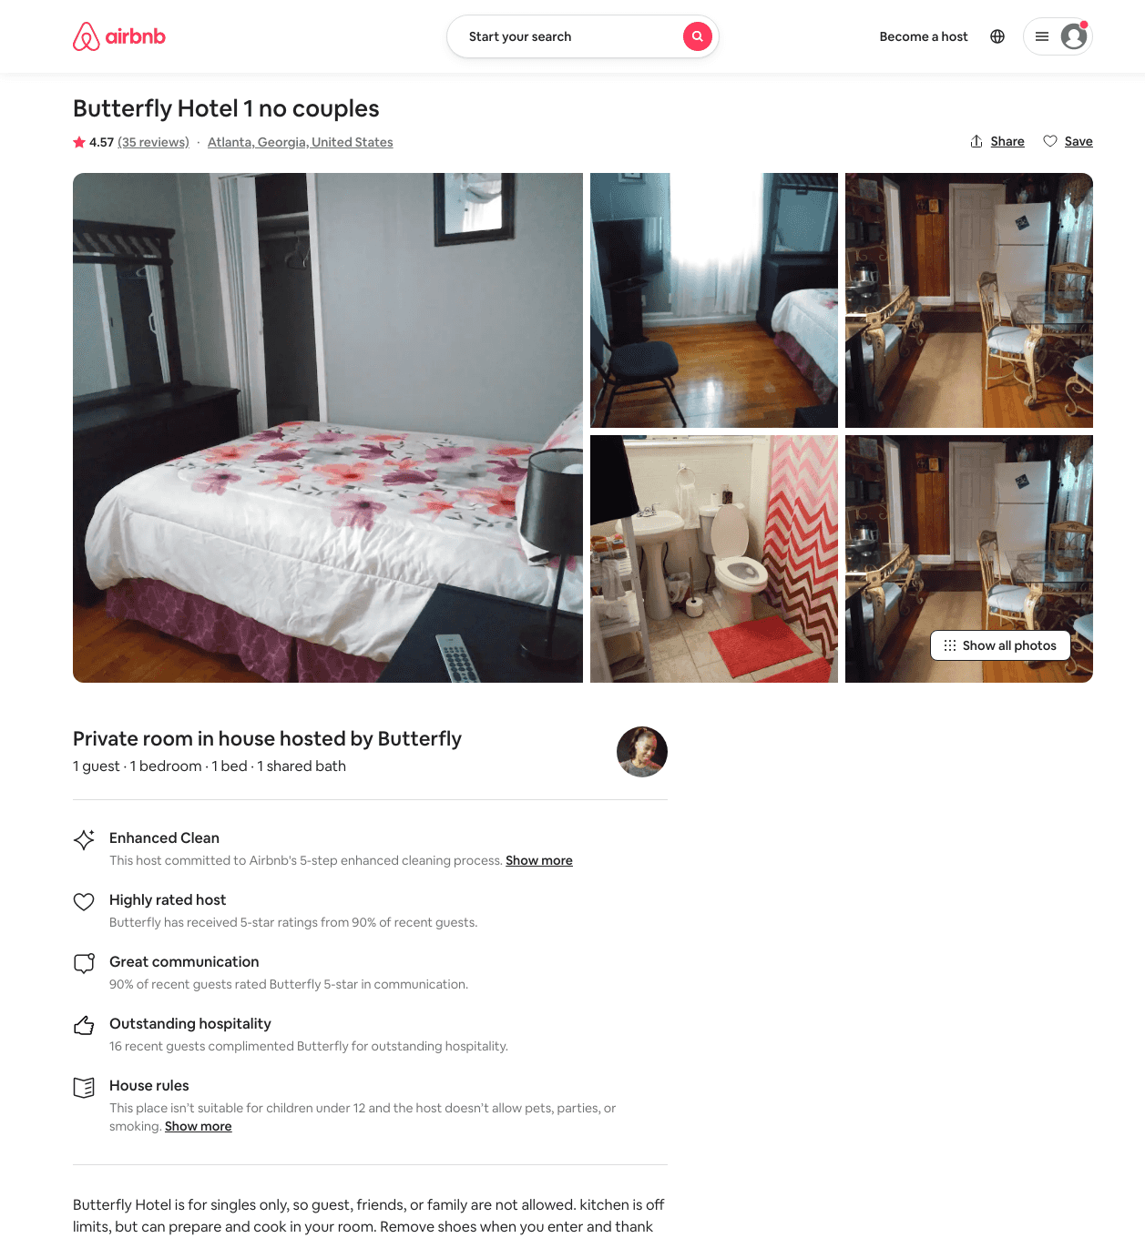
Listing 40276221
1
1
$35 - $40
4.61
7
Butterfly
311112935
8
https://www.airbnb.com/rooms/40276221
Jul 2022

Slide 14
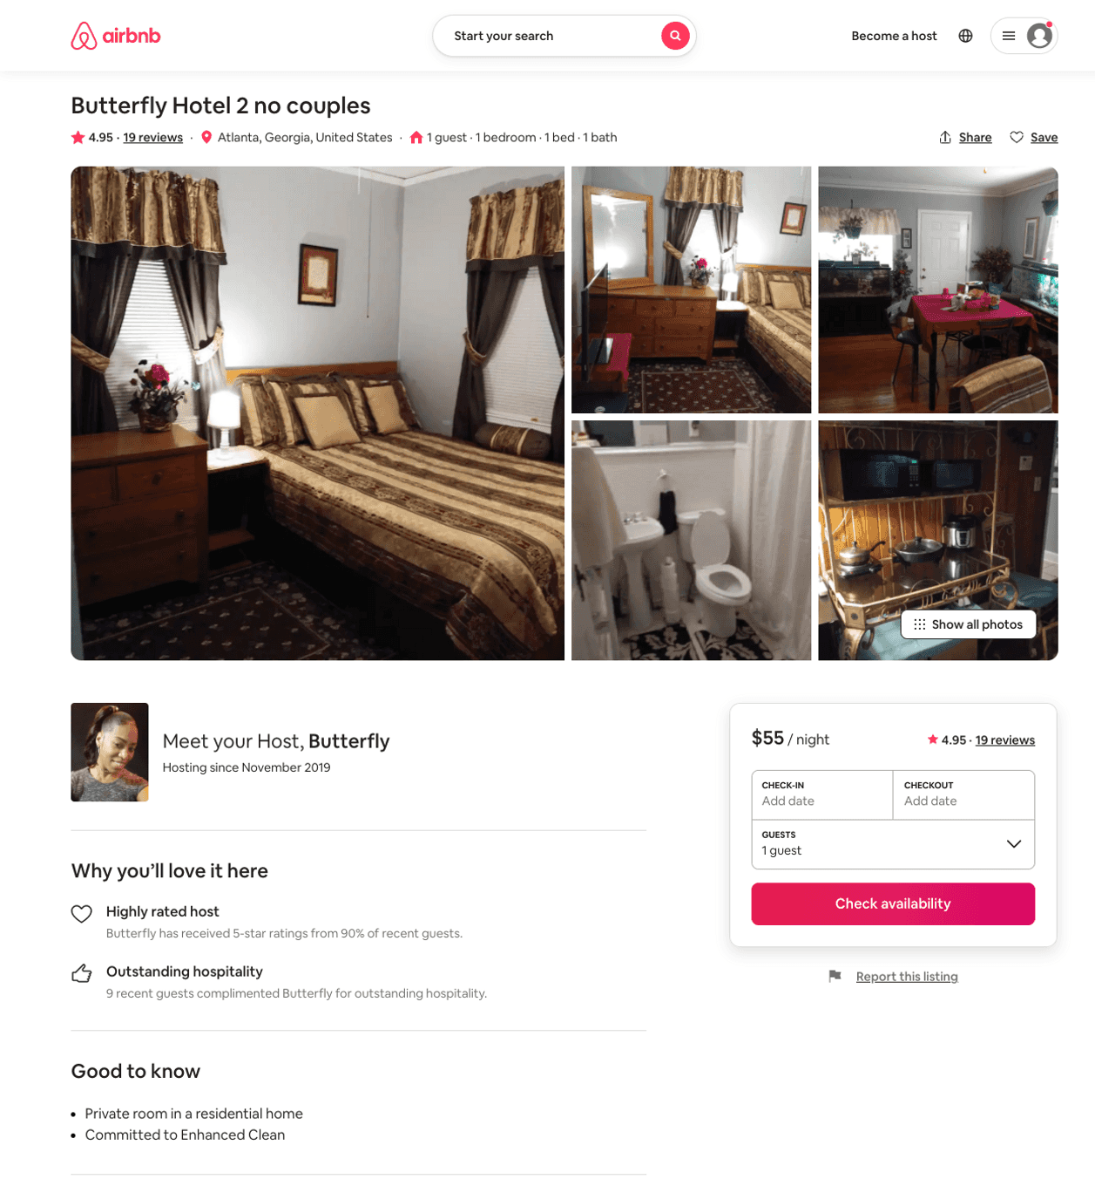
Listing 40274582
1
1
$40 - $55
4.95
3
Butterfly
311112935
8
https://www.airbnb.com/rooms/40274582
Aug 2022

Slide 15
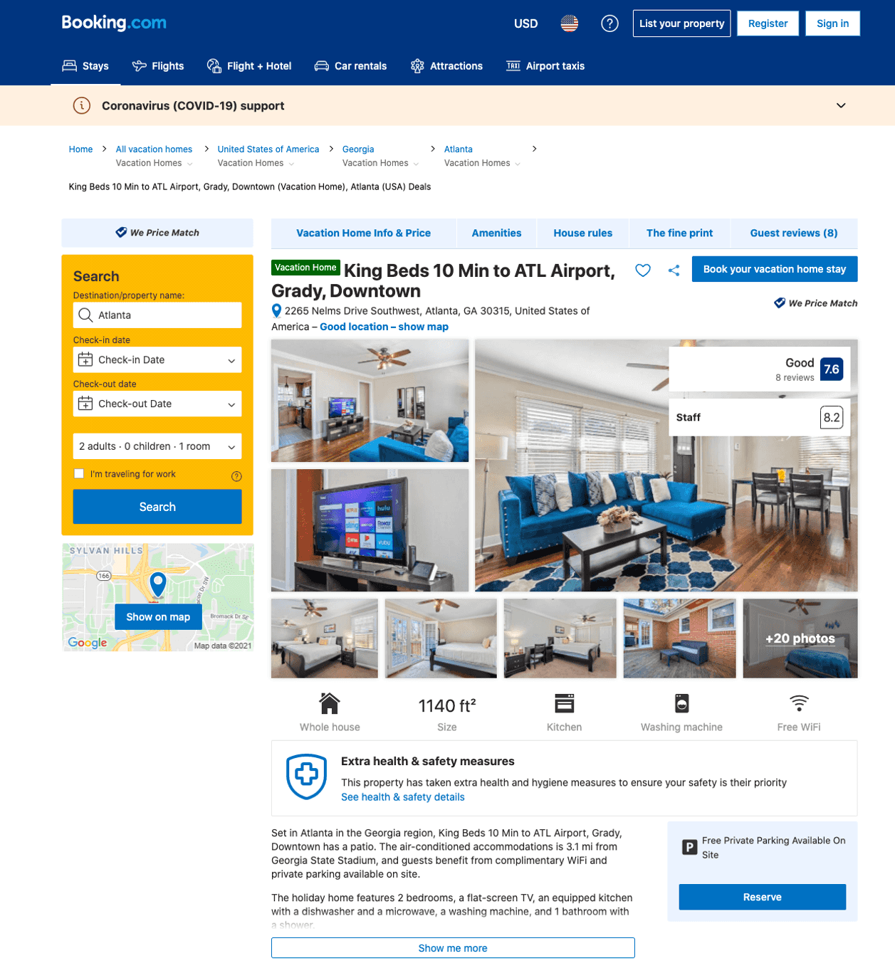
Listing sleeps-6-king-beds-10-min-to-atl-airport
undefined
1
7.9
https://www.booking.com/hotel/us/sleeps-6-king-beds-10-min-to-atl-airport.html
Sep 2022

Slide 16
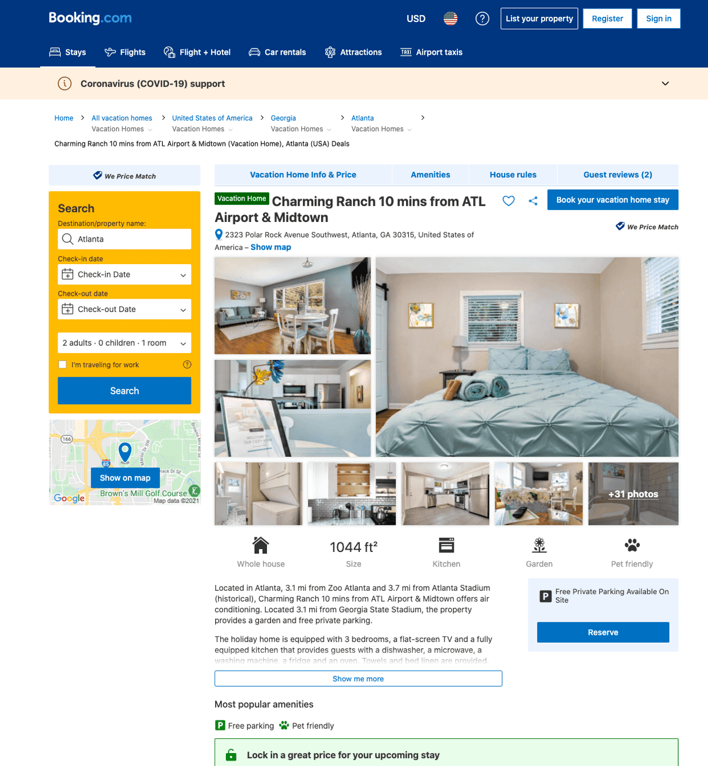
Listing charming-ranch-10-mins-from-atl-airport-amp-midtown
undefined
6
8.2
https://www.booking.com/hotel/us/charming-ranch-10-mins-from-atl-airport-amp-midtown.html
Sep 2022

Slide 17
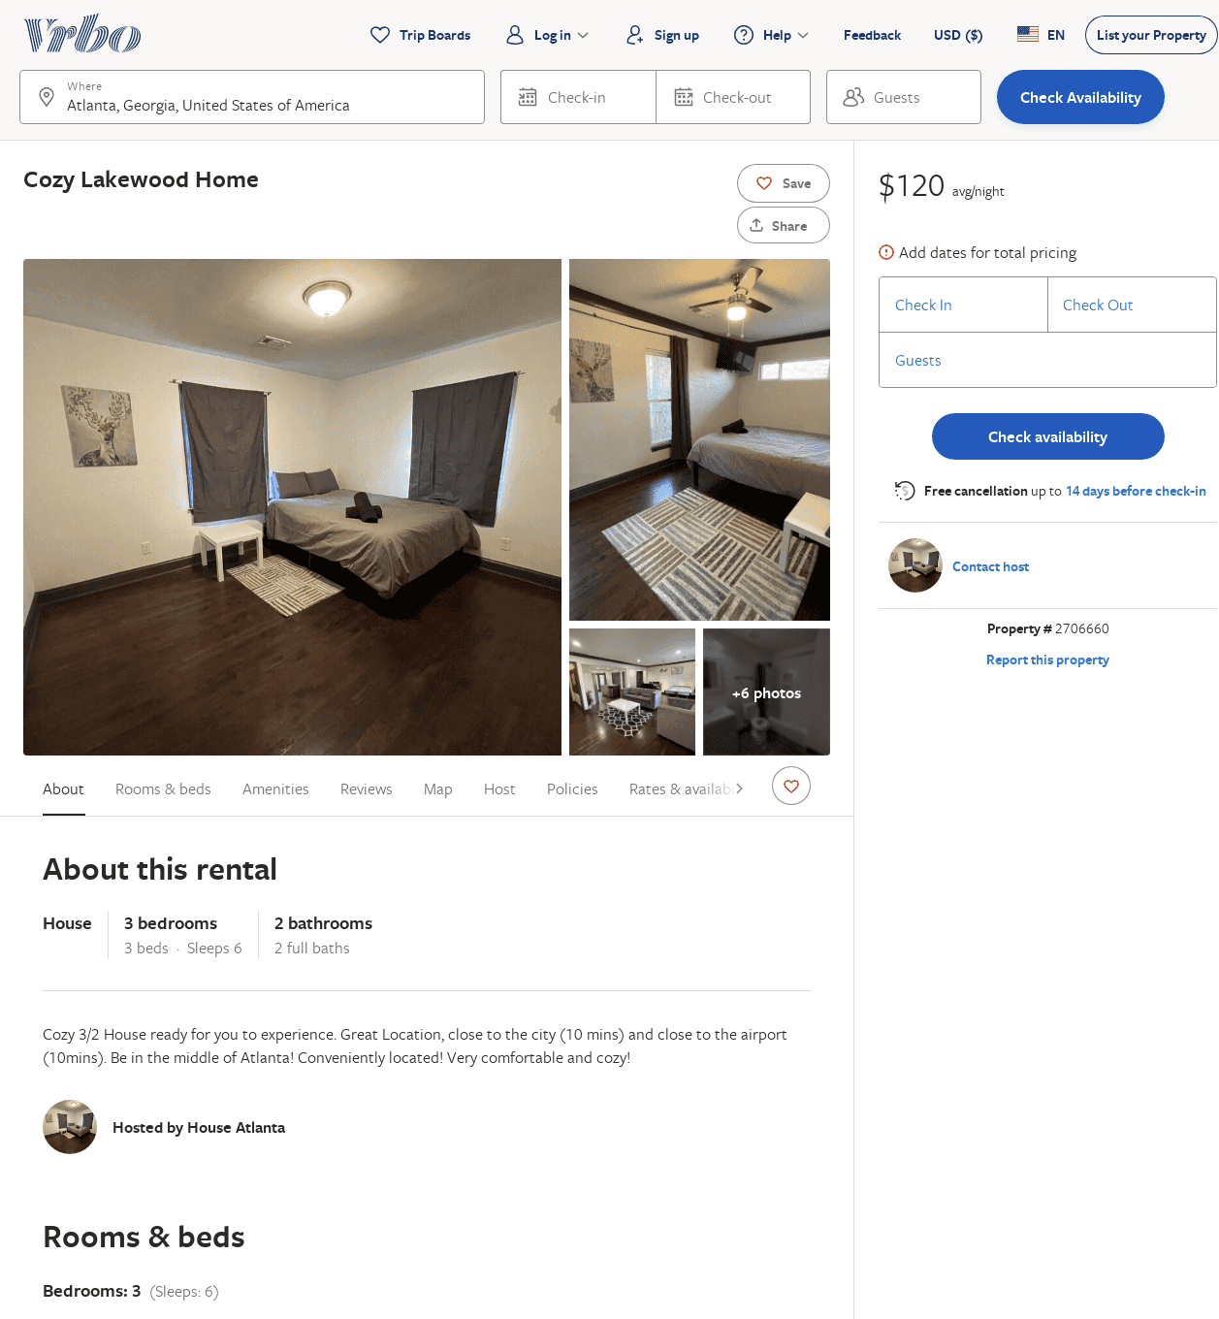
Listing 2706660
3
6
$130
2
https://www.vrbo.com/2706660
Aug 2022

Slide 18
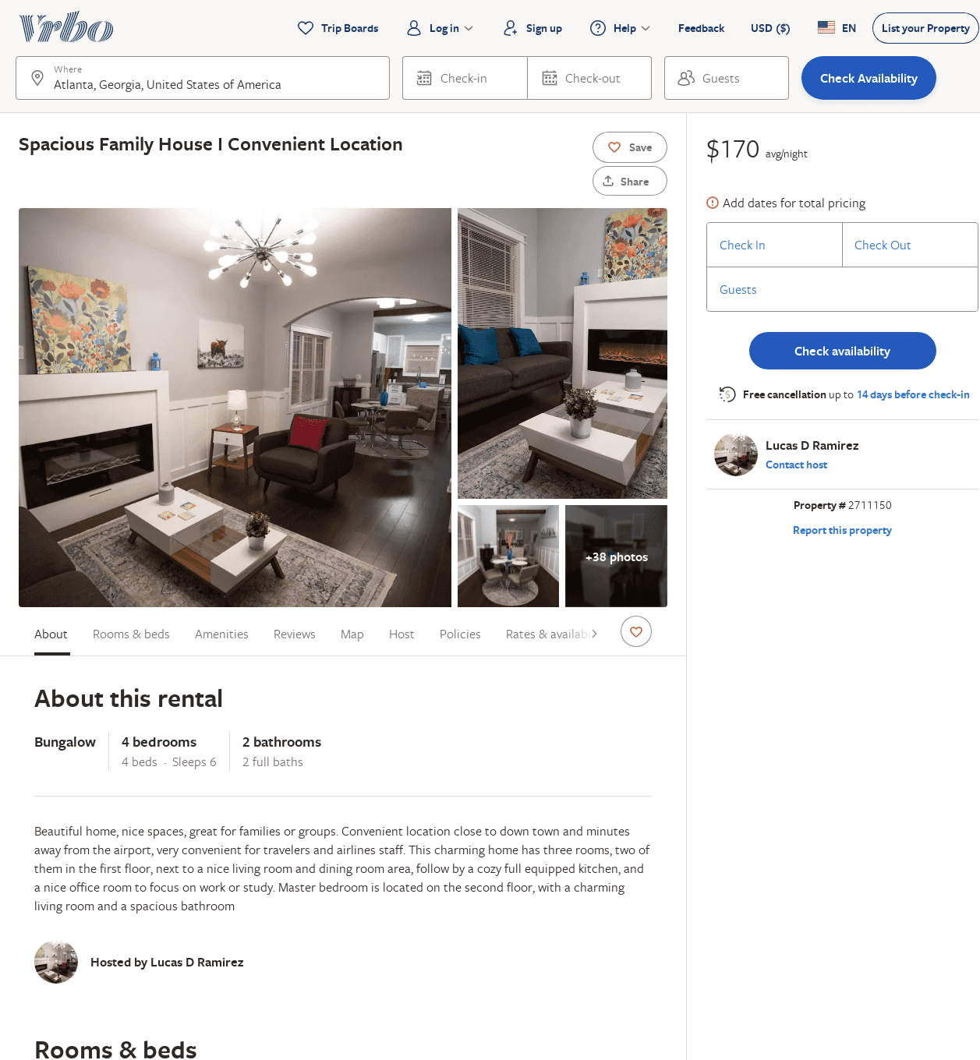
Listing 2711150
4
6
$136
3
Lucas D Ramirez
https://www.vrbo.com/2711150
Aug 2022

Slide 19
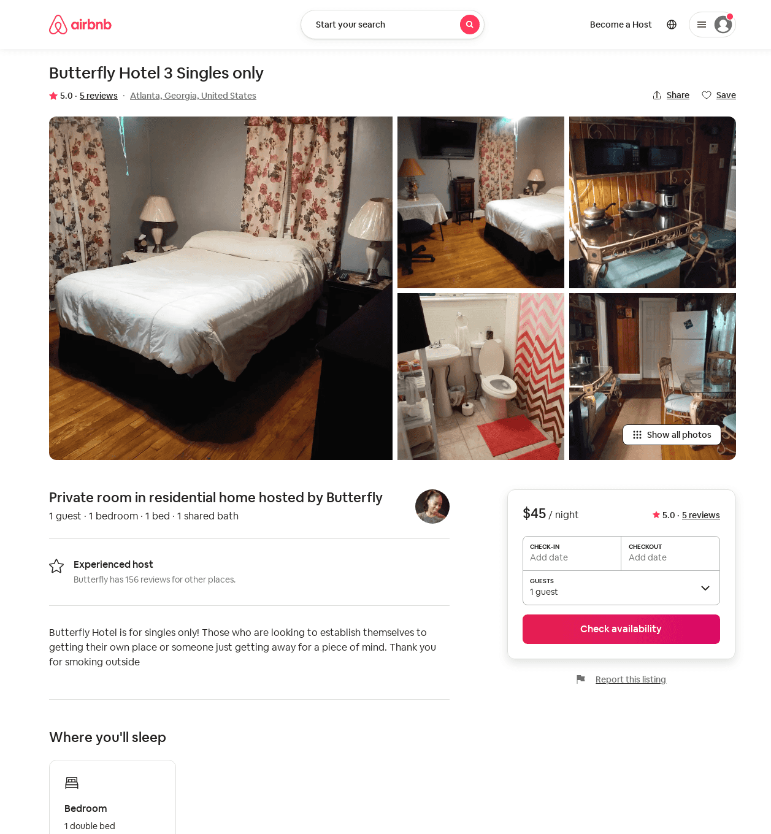
Listing 40277665
1
1
$45
5.0
7
Butterfly
311112935
8
https://www.airbnb.com/rooms/40277665
Aug 2022

Slide 20
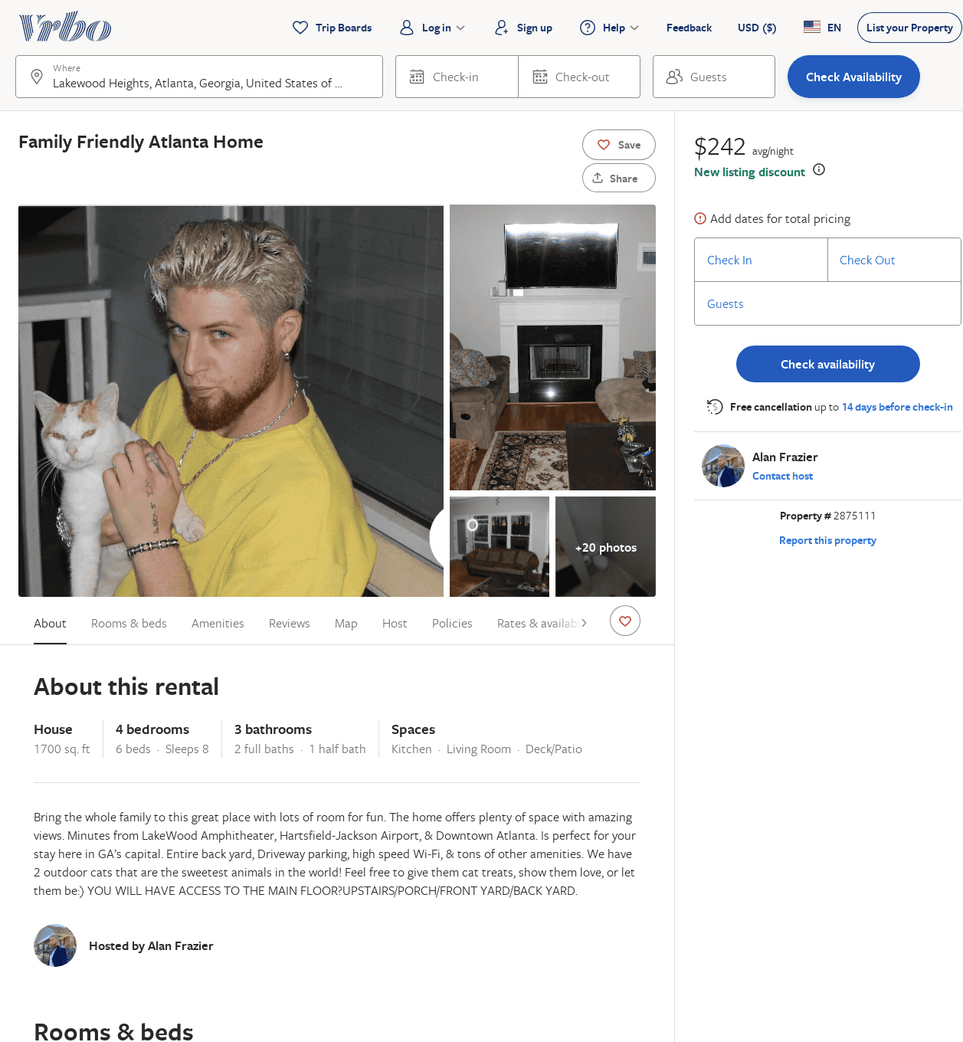
Listing 2875111
4
8
$275
1
Alan Frazier
https://www.vrbo.com/2875111
Aug 2022

Slide 21
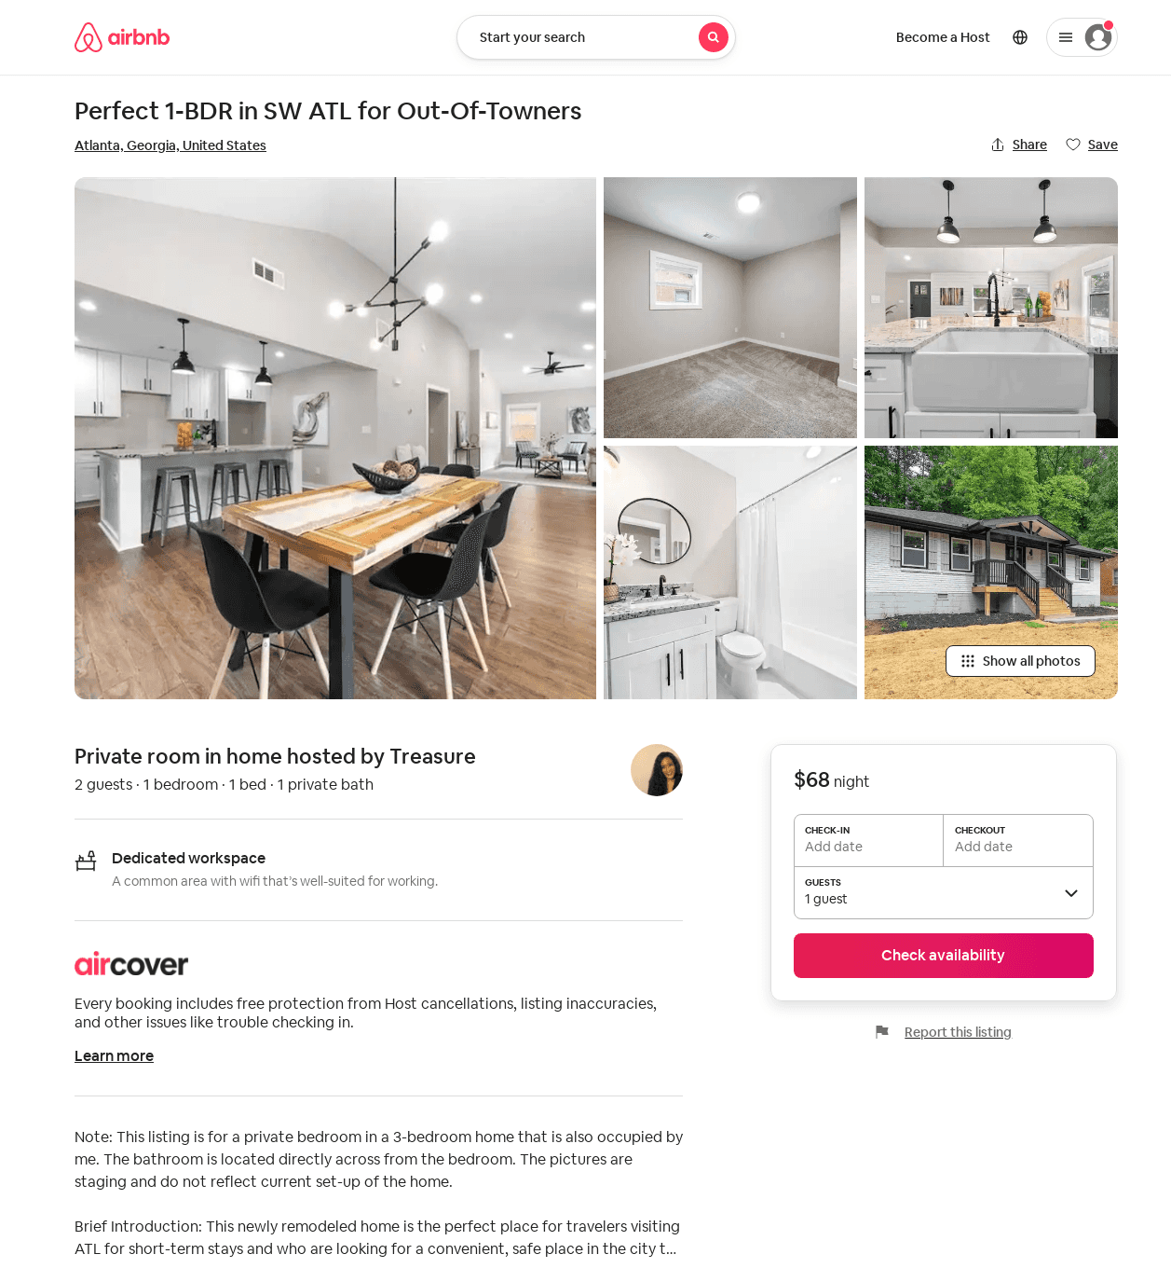
Listing 54076315
1
2
2
Treasure
16746146
1
https://www.airbnb.com/rooms/54076315
Jul 2022

Slide 22
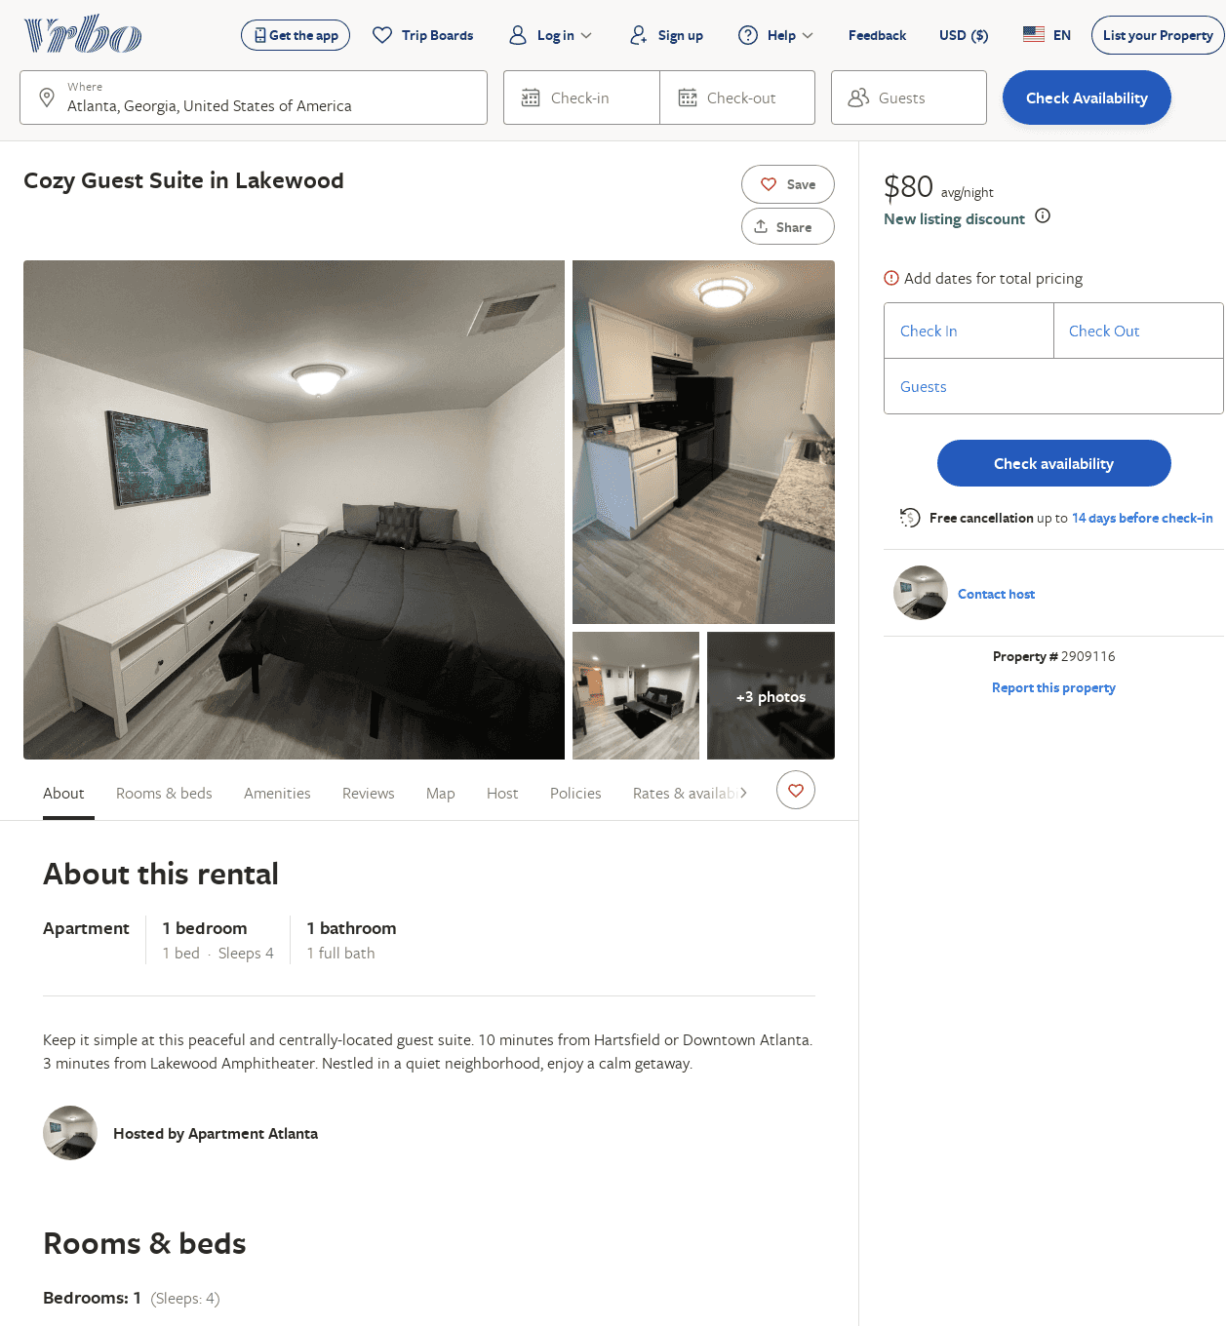
Listing 2909116
1
4
$80
1
https://www.vrbo.com/2909116
Aug 2022

Slide 23
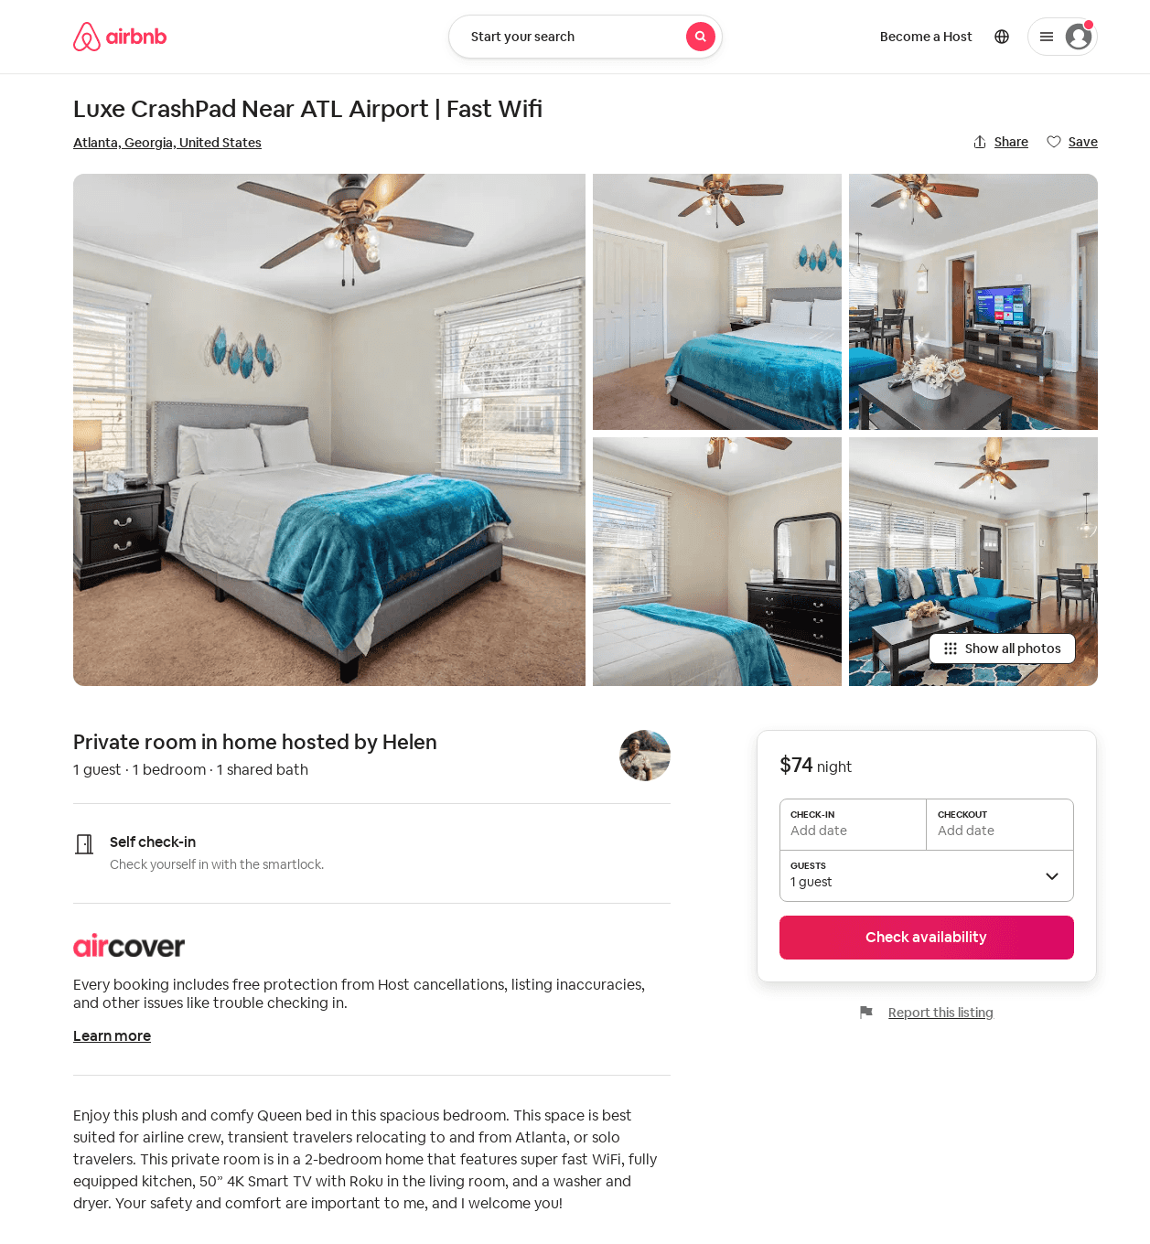
Listing 53271013
1
1
1
Helen
307207253
1
https://www.airbnb.com/rooms/53271013
Aug 2022

