Slide 2
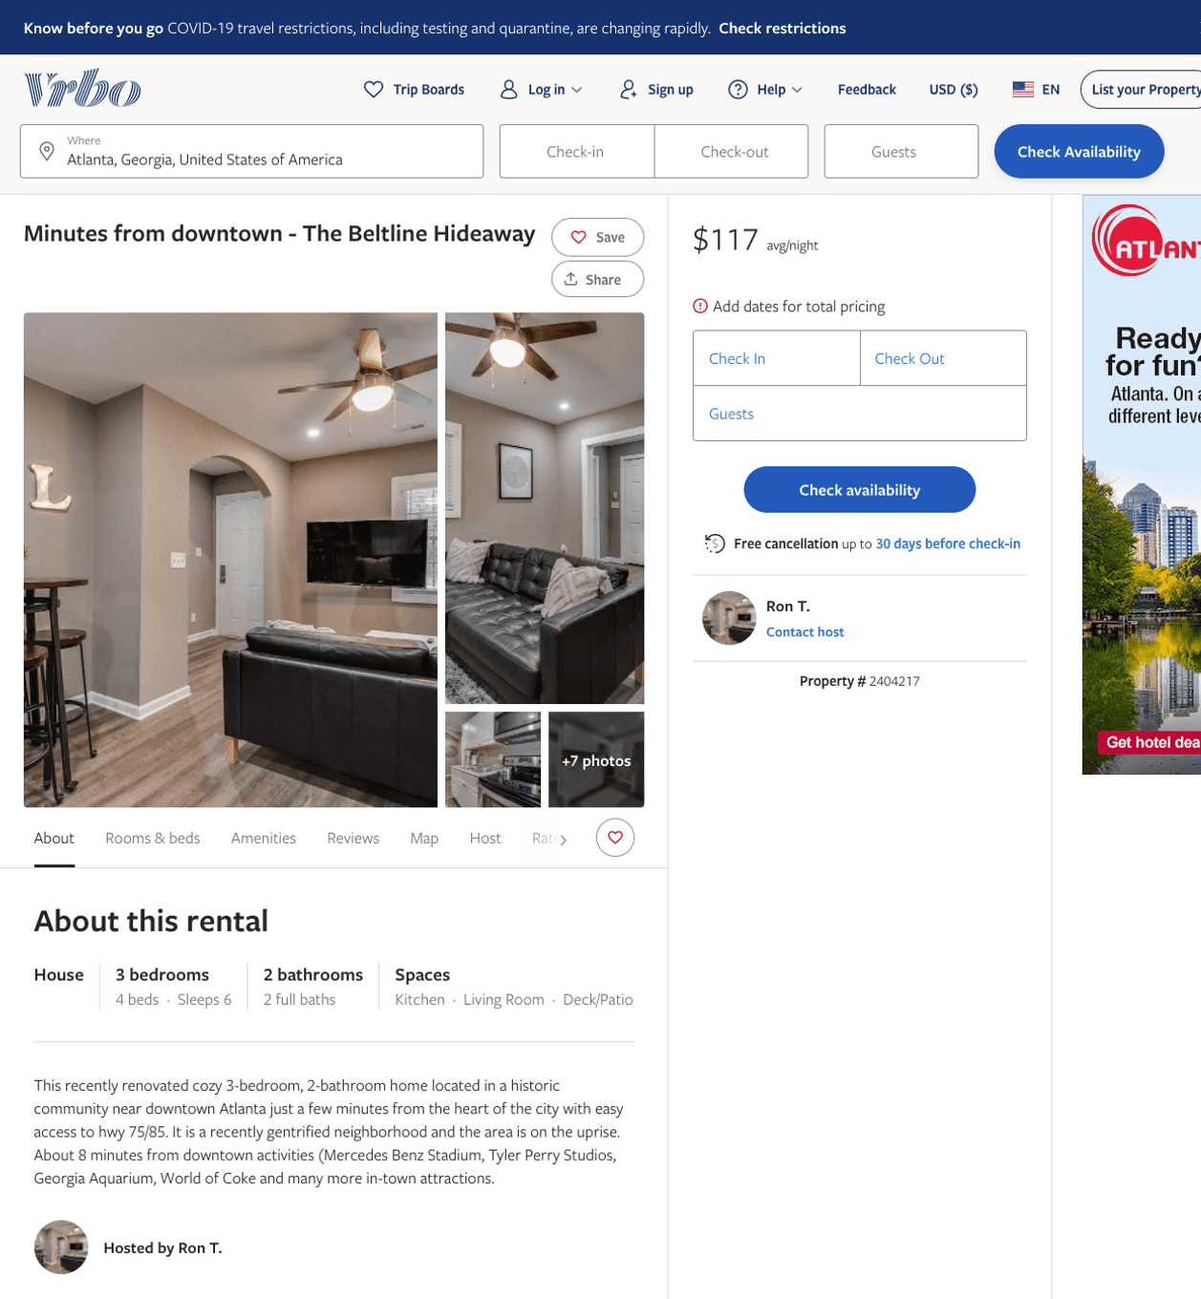
Listing 2404217
3
6
$106 - $168
4.25
3
Ron T.
https://www.vrbo.com/2404217
Aug 2022

Slide 3
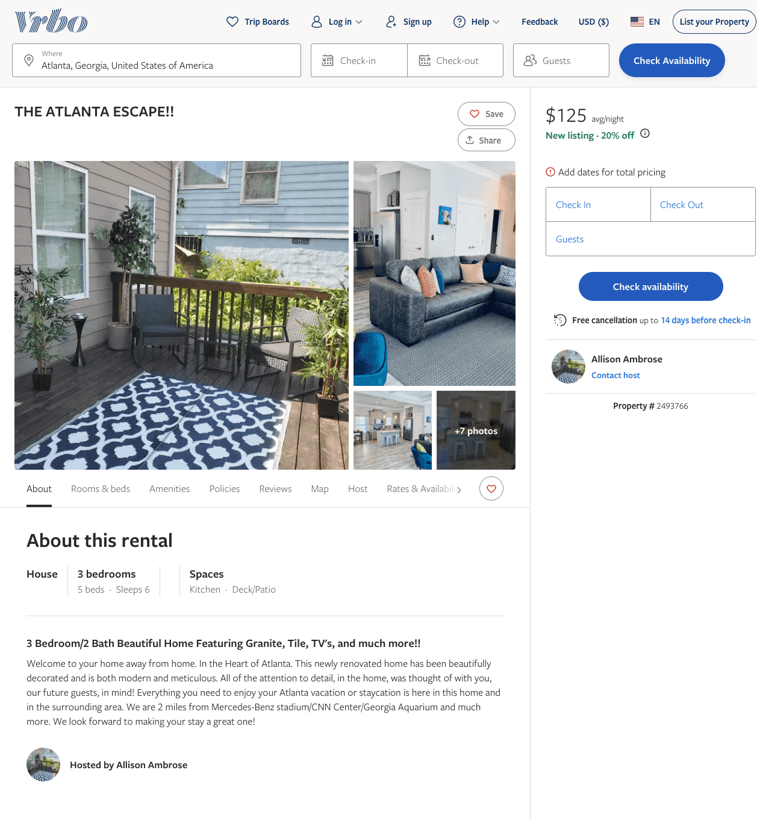
Listing 2493766
3
6
$125 - $159
4.8333335
2
Allison Ambrose
https://www.vrbo.com/2493766
Aug 2022

Slide 4
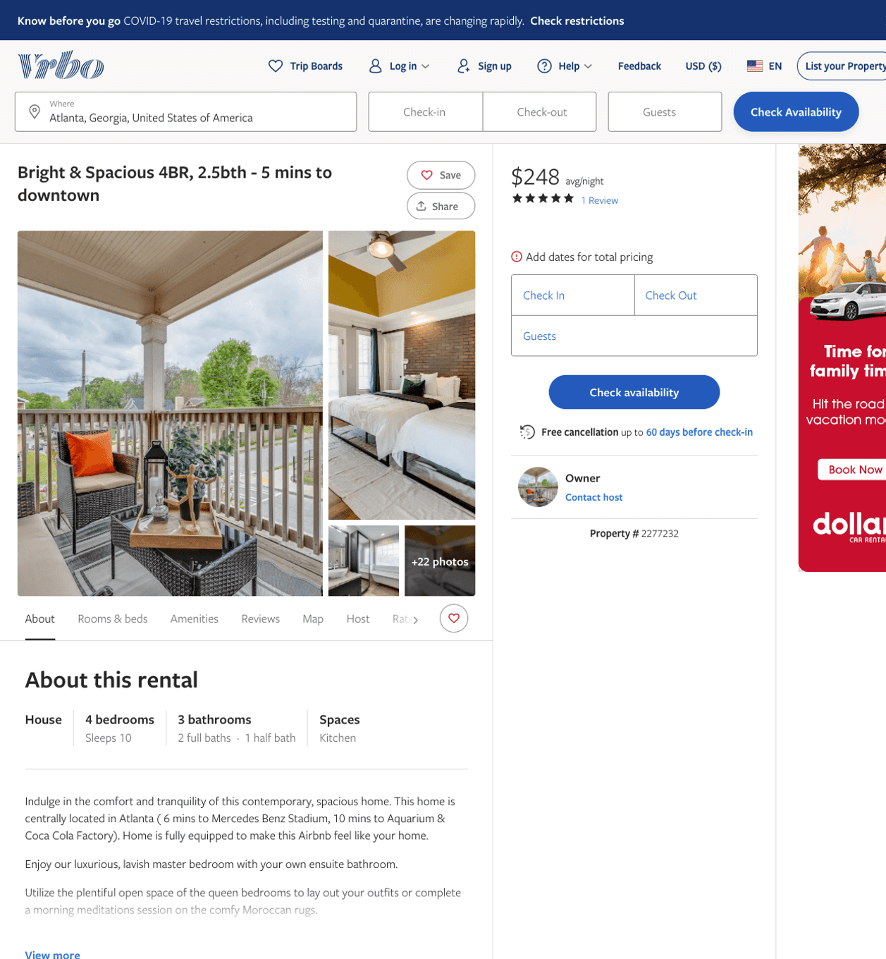
Listing 2277232
4
10
$230 - $327
3.8
2
Owner
https://www.vrbo.com/2277232
Aug 2022

Slide 5
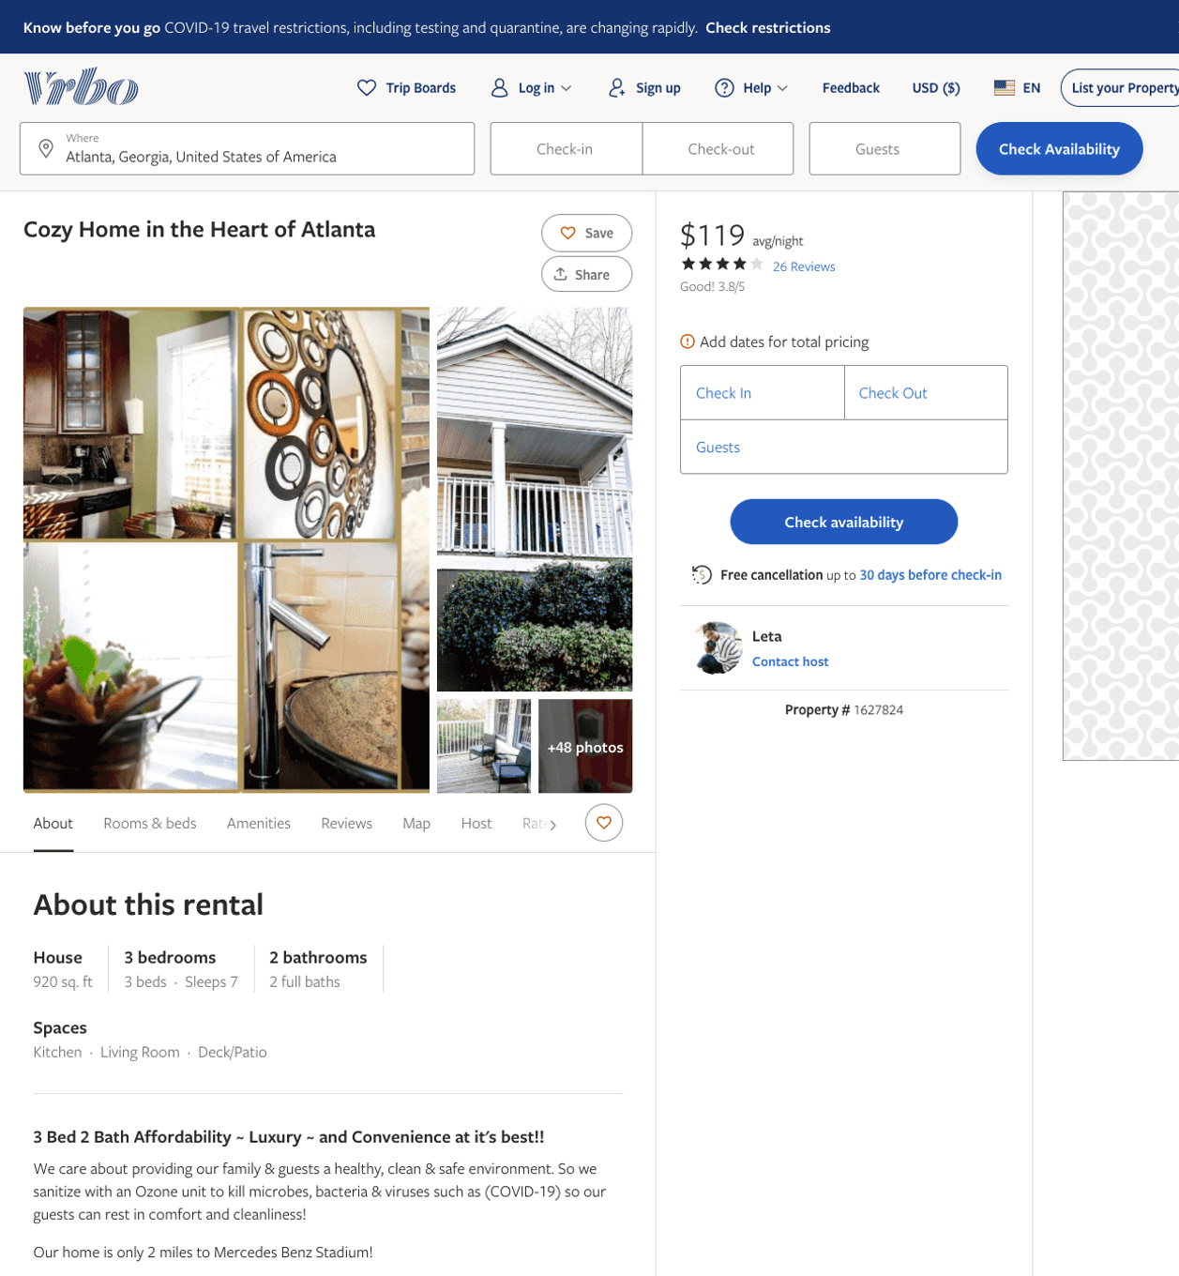
Listing 1627824
3
7
$119 - $121
3.7857144
3
Leta
https://www.vrbo.com/1627824
Aug 2022

Slide 6
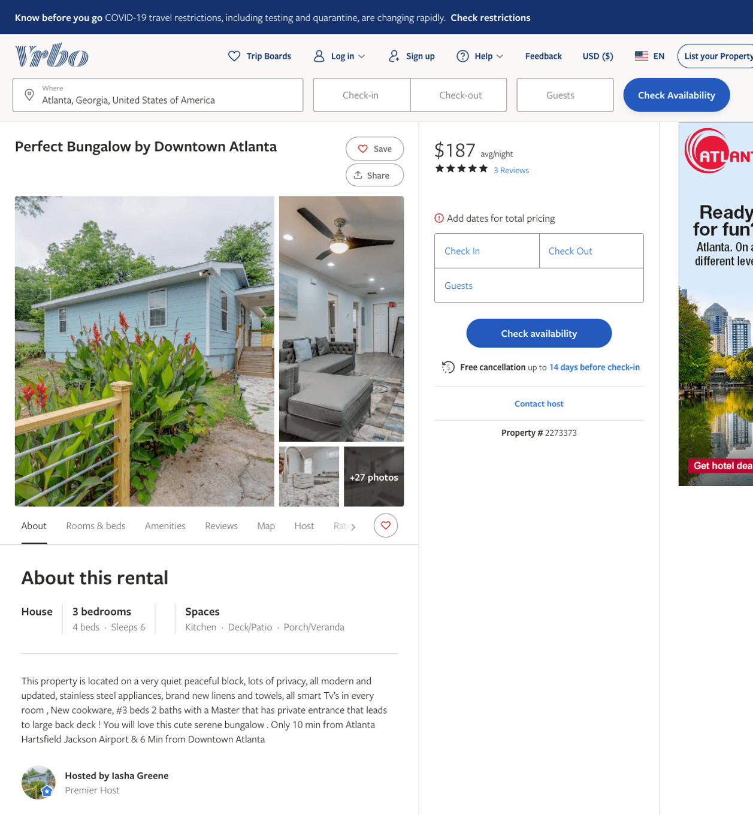
Listing 2273373
3
6
$102 - $204
4.3333335
2
Iasha Greene
https://www.vrbo.com/2273373
Aug 2022

Slide 7
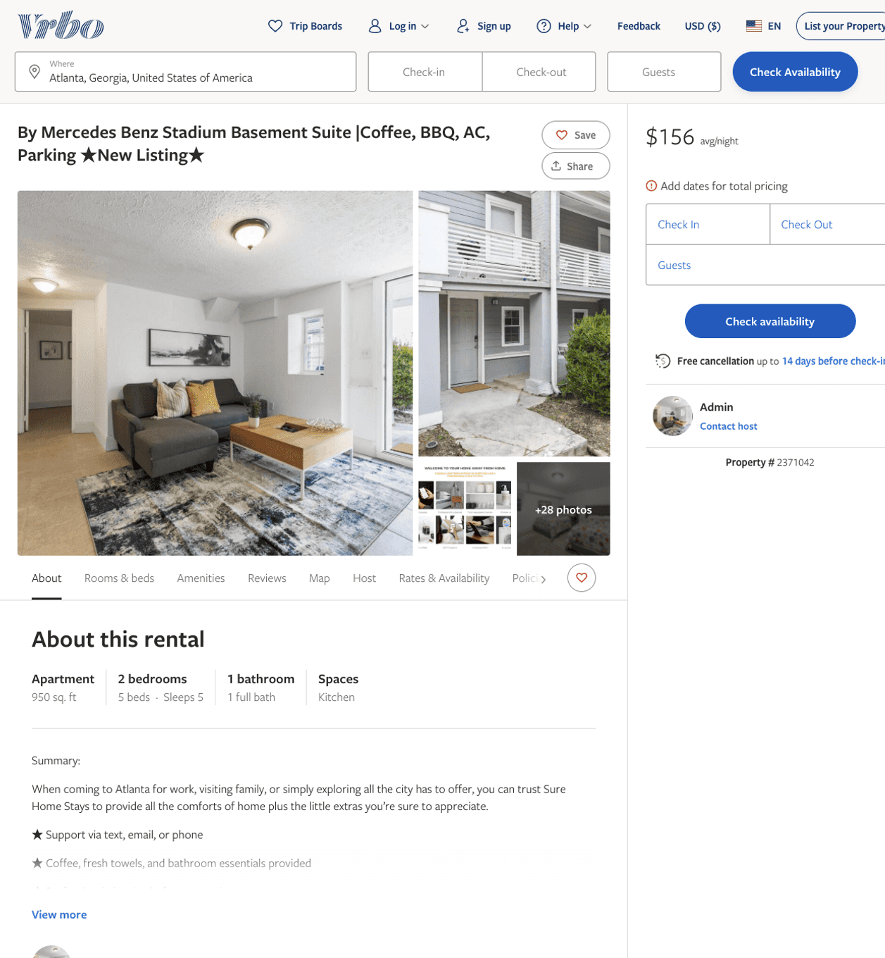
Listing 2371042
2
5
$107 - $86
2
Admin
https://www.vrbo.com/2371042
Aug 2022

Slide 8
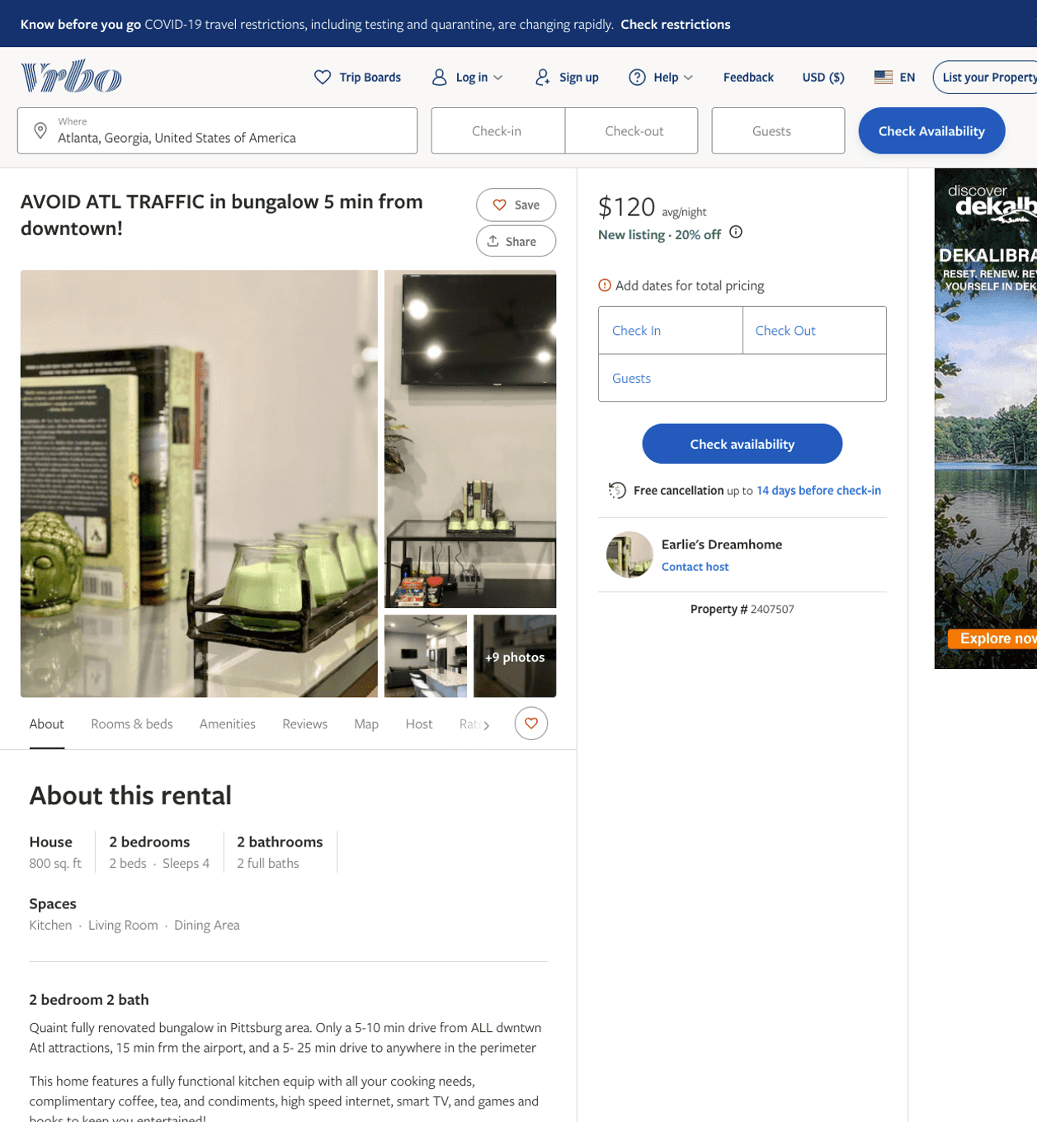
Listing 2407507
2
4
$120 - $130
3
Earlie's Dreamhome
https://www.vrbo.com/2407507
Aug 2022

Slide 9
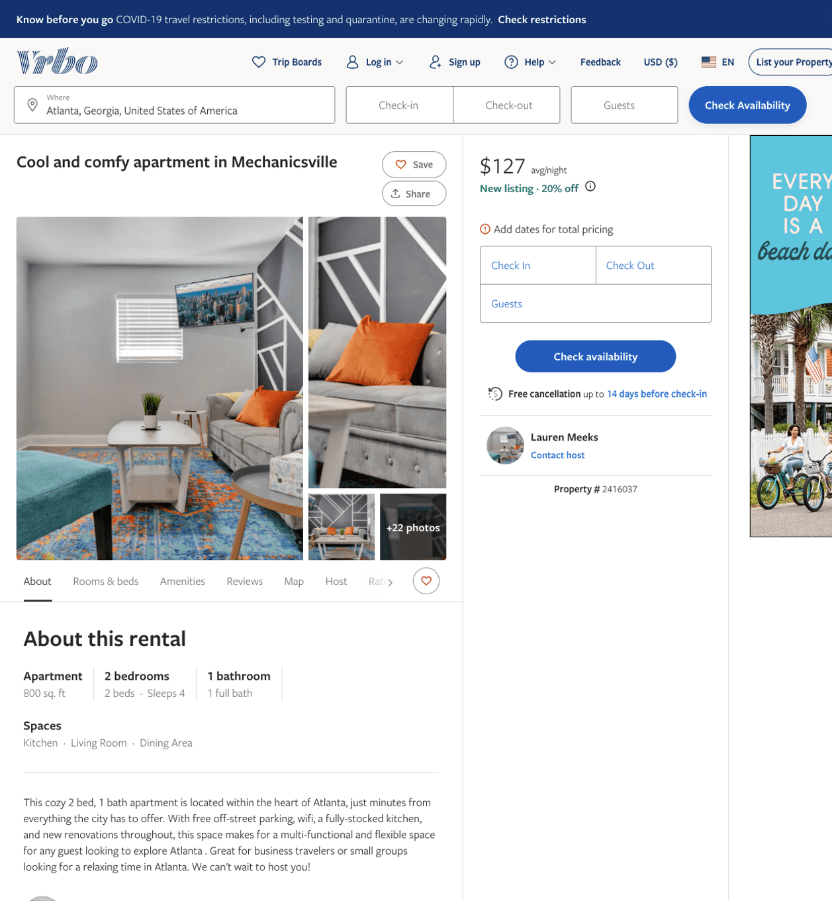
Listing 2416037
2
4
$100 - $97
2
Lauren Meeks
https://www.vrbo.com/2416037
Aug 2022

Slide 10
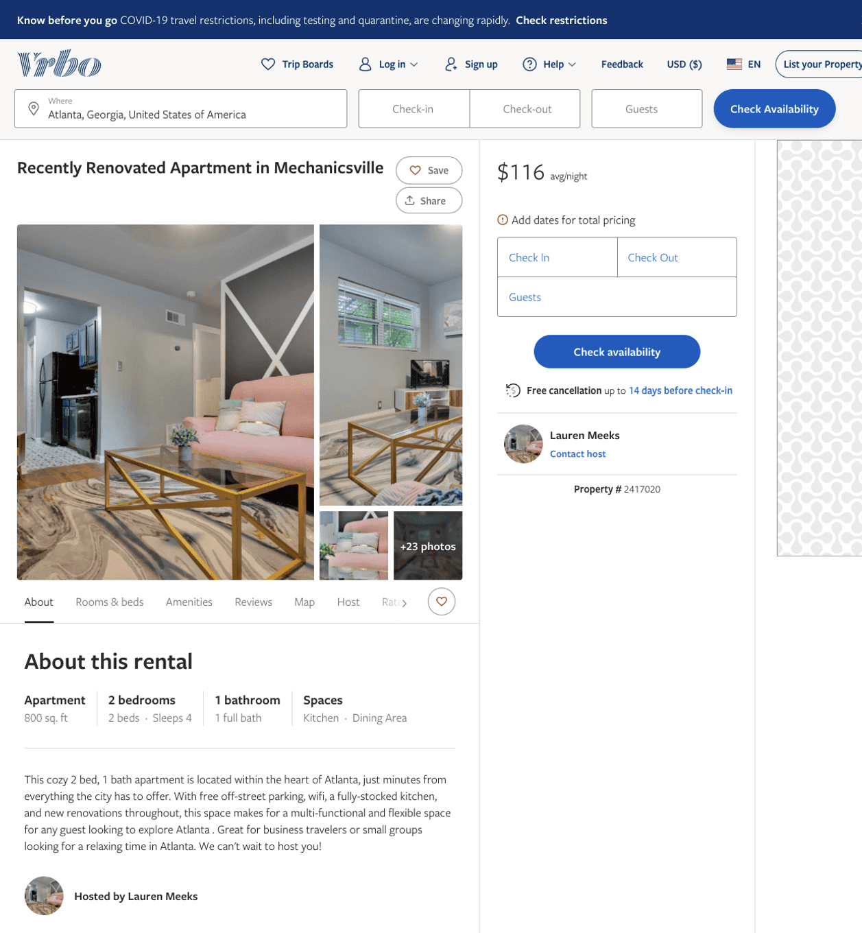
Listing 2417020
2
4
$100 - $99
3.75
2
Lauren Meeks
https://www.vrbo.com/2417020
Aug 2022

Slide 11
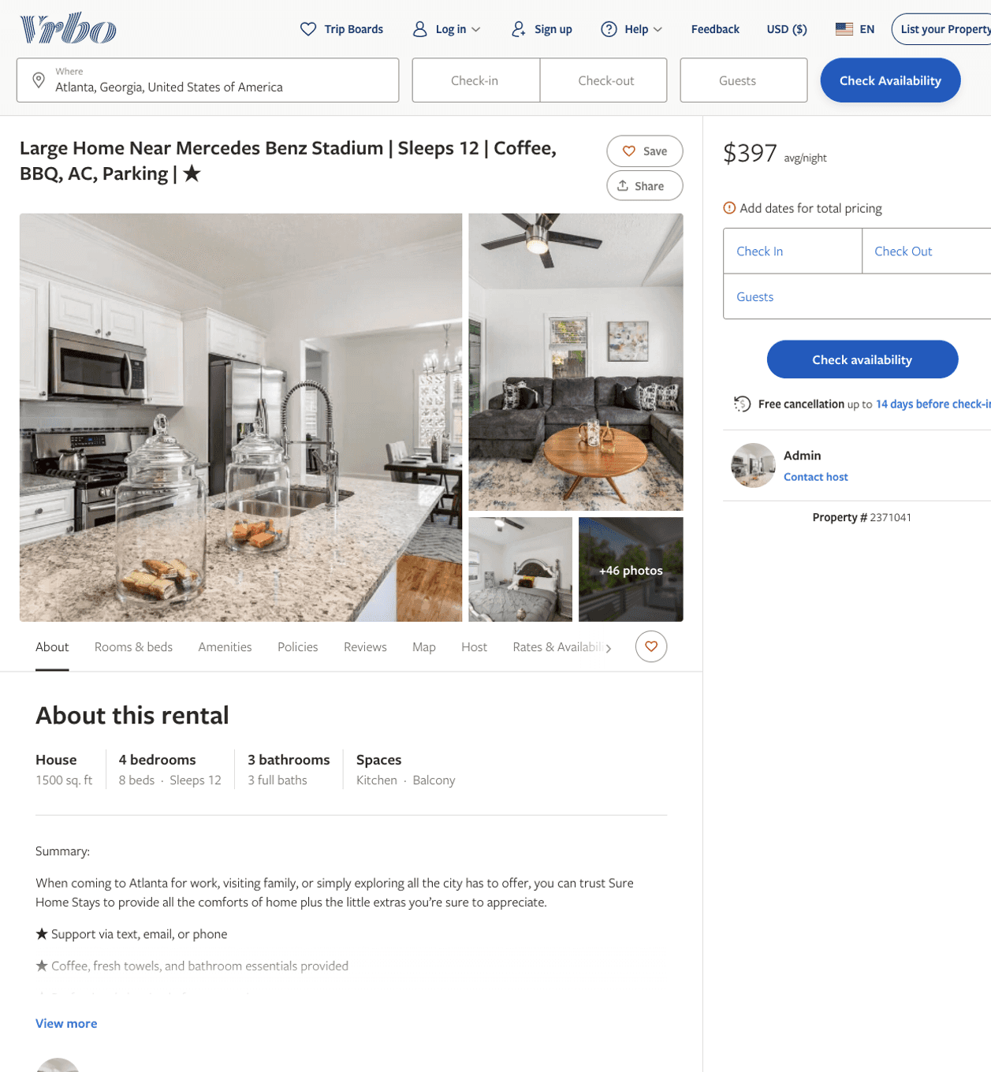
Listing 2371041
4
12
$213 - $473
1
Admin
https://www.vrbo.com/2371041
Aug 2022

Slide 12
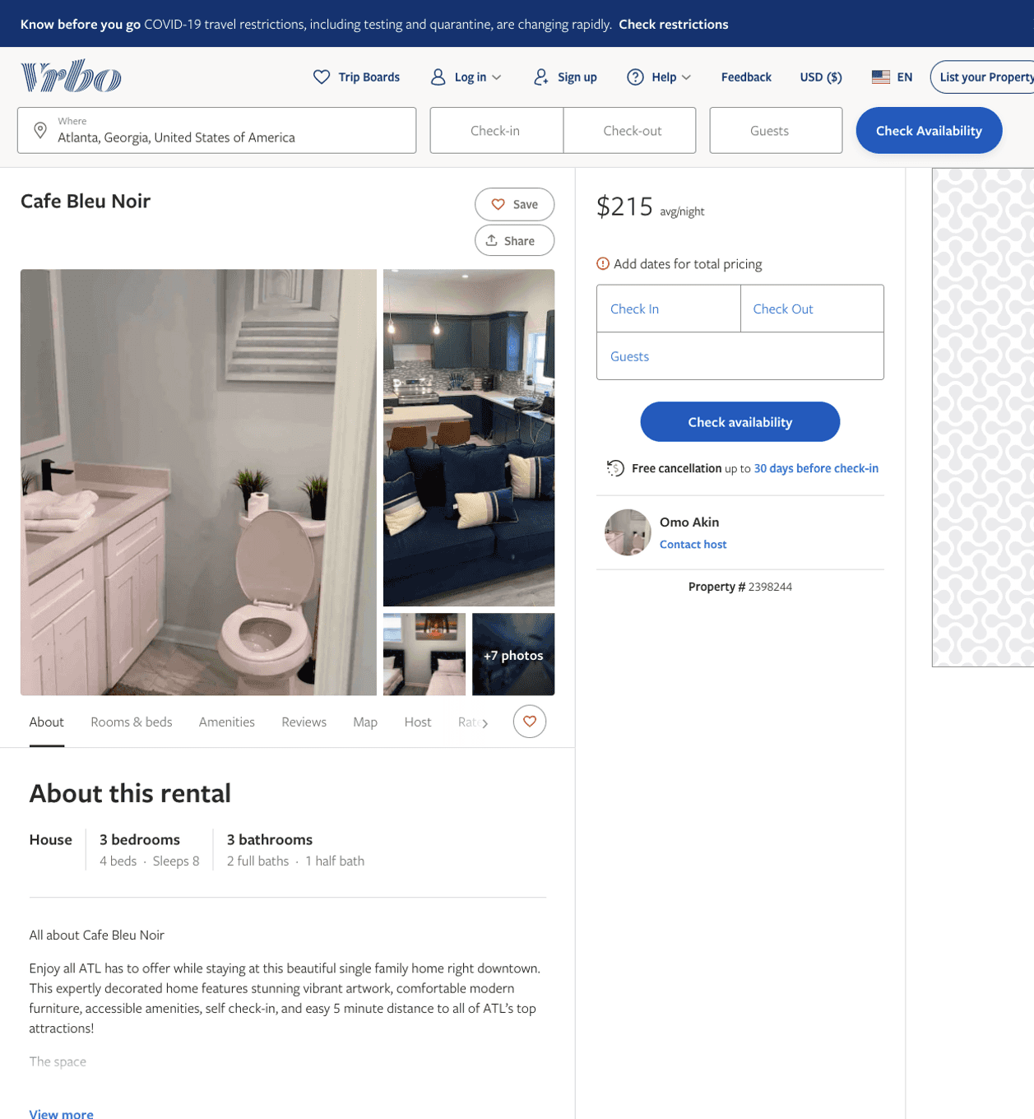
Listing 2398244
3
8
$215
3
Omo Akin
https://www.vrbo.com/2398244
Aug 2022

Slide 13
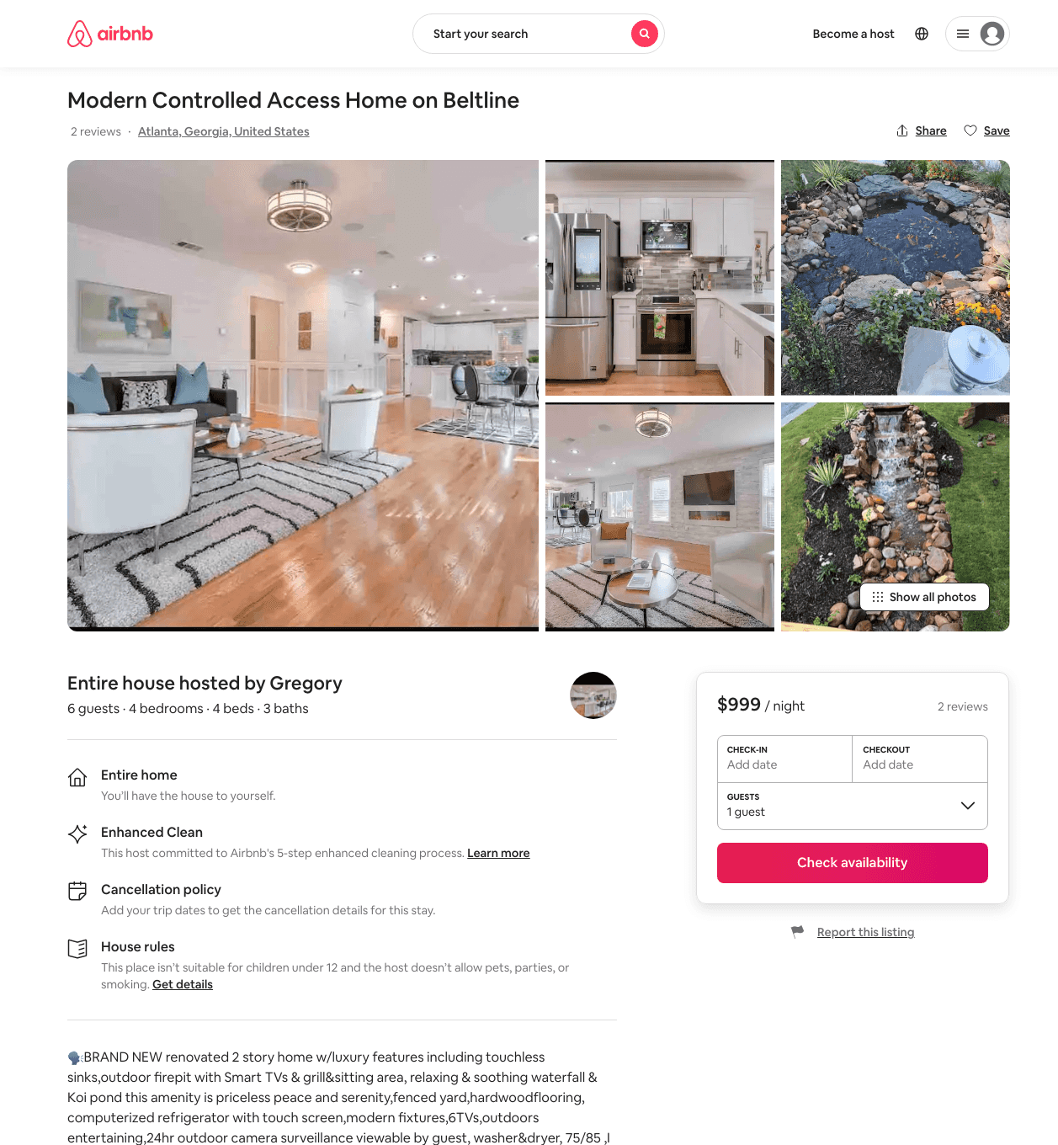
Listing 30293913
4
6
$400 - $1500
5.0
2
Gregory
227522378
2
https://www.airbnb.com/rooms/30293913
Aug 2022

Slide 14
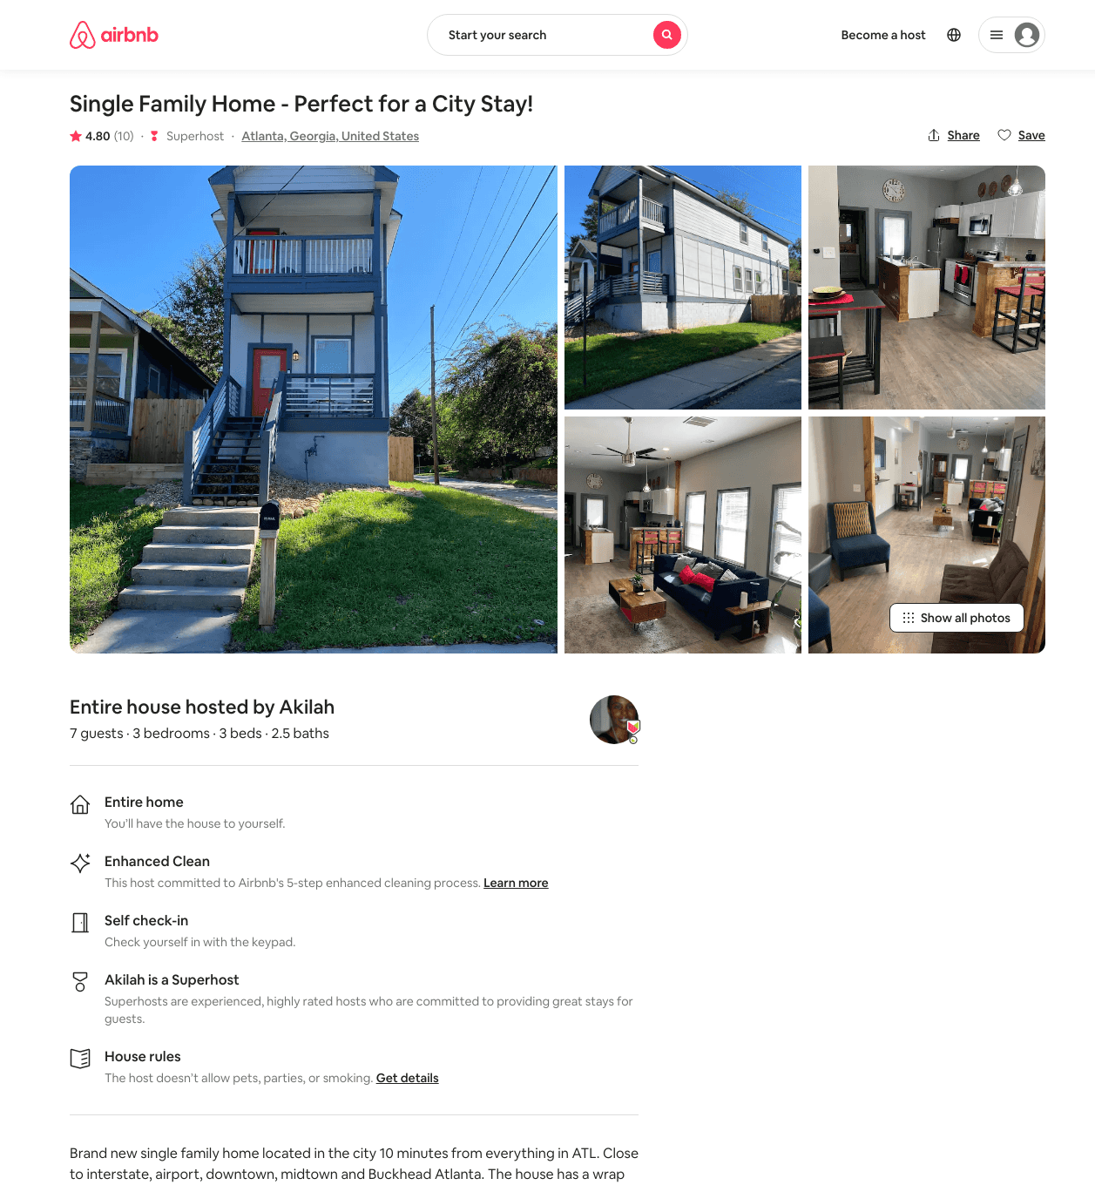
Listing 45769941
3
7
$185 - $382
4.67
2
Akilah
71741525
1
https://www.airbnb.com/rooms/45769941
Aug 2022

Slide 15
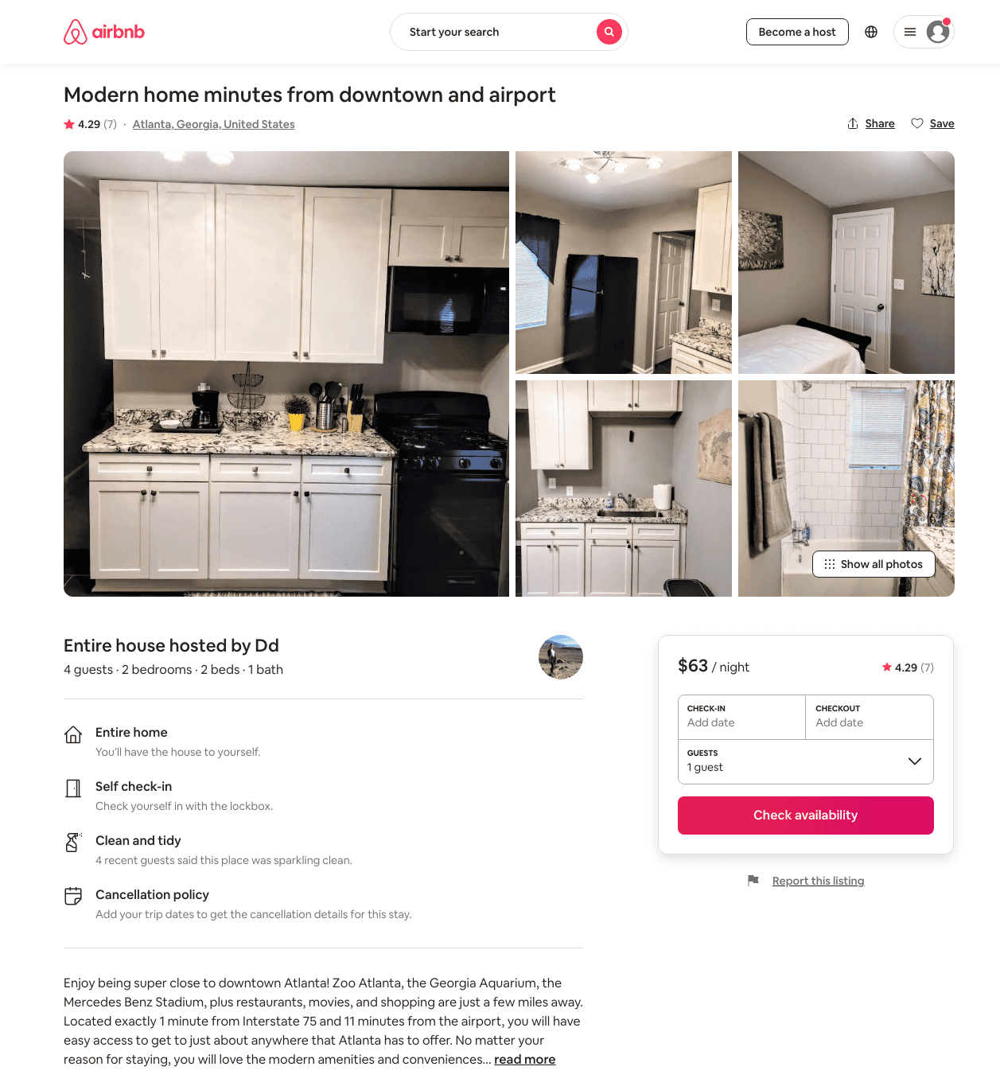
Listing 47756604
2
4
$56 - $76
4.65
2
Dd
189408877
2
https://www.airbnb.com/rooms/47756604
Aug 2022

Slide 16
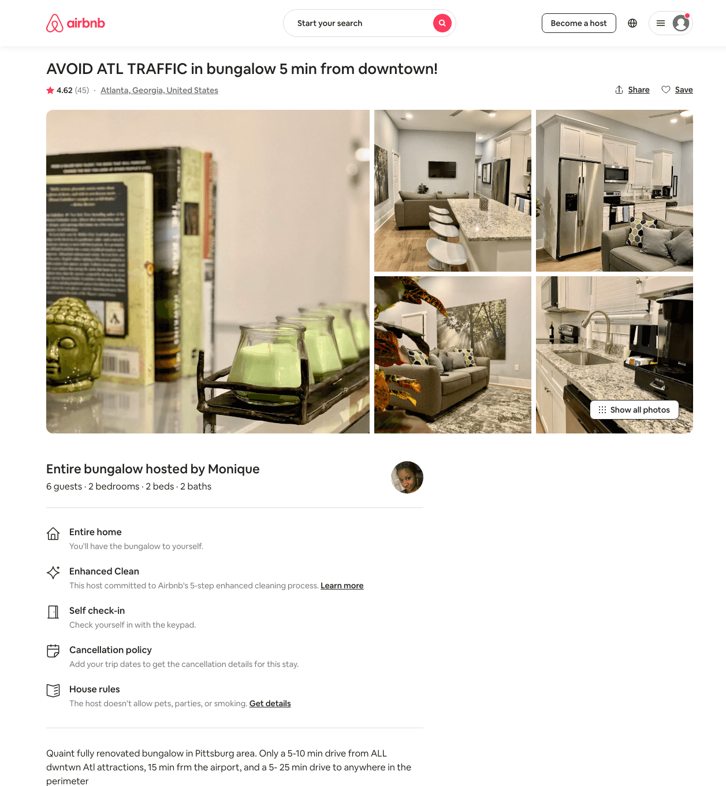
Listing 42894917
2
4
$81 - $158
4.63
14
Monique
95483236
1
https://www.airbnb.com/rooms/42894917
Aug 2022

Slide 17
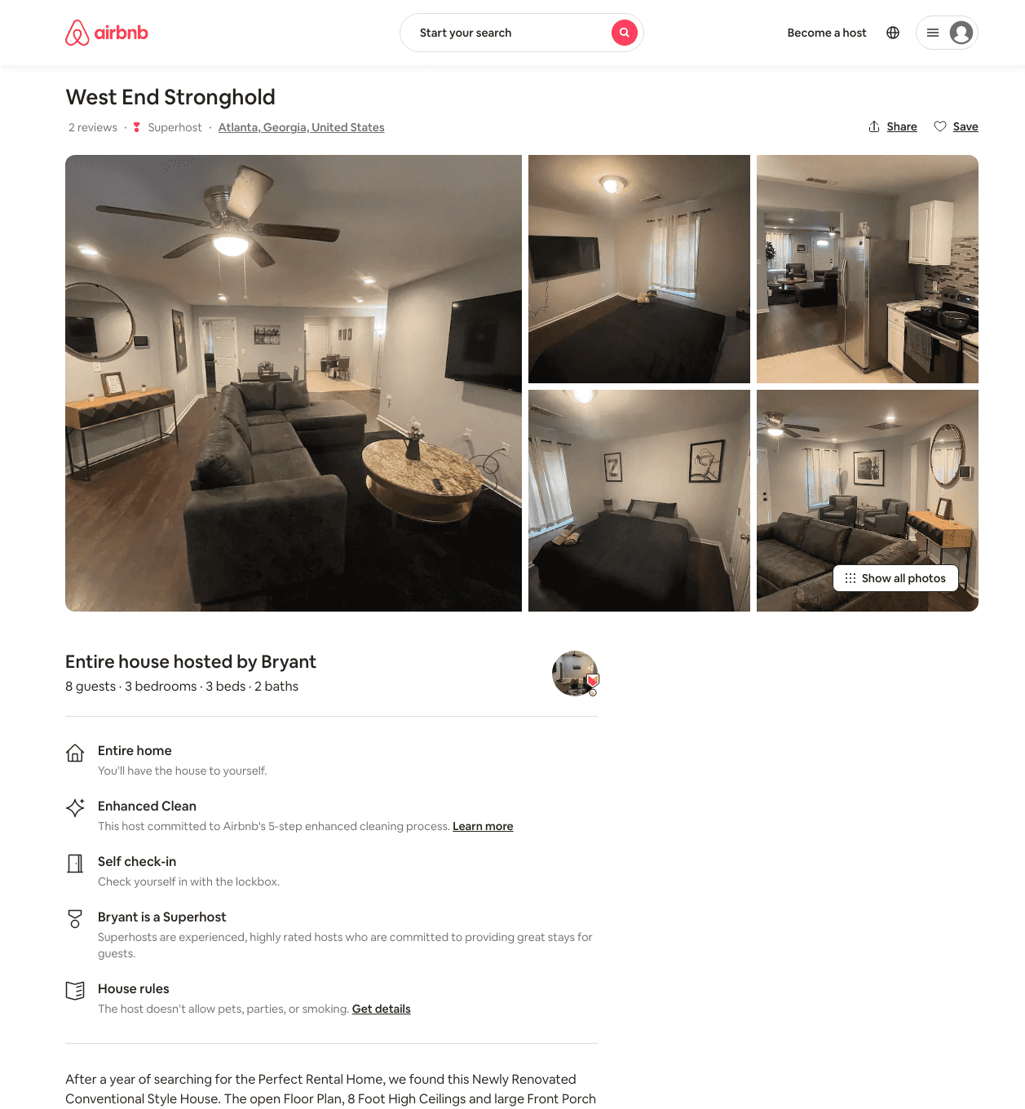
Listing 48845264
1
10
$129 - $234
4.71
2
Bryant
250716419
22
https://www.airbnb.com/rooms/48845264
Aug 2022

Slide 18
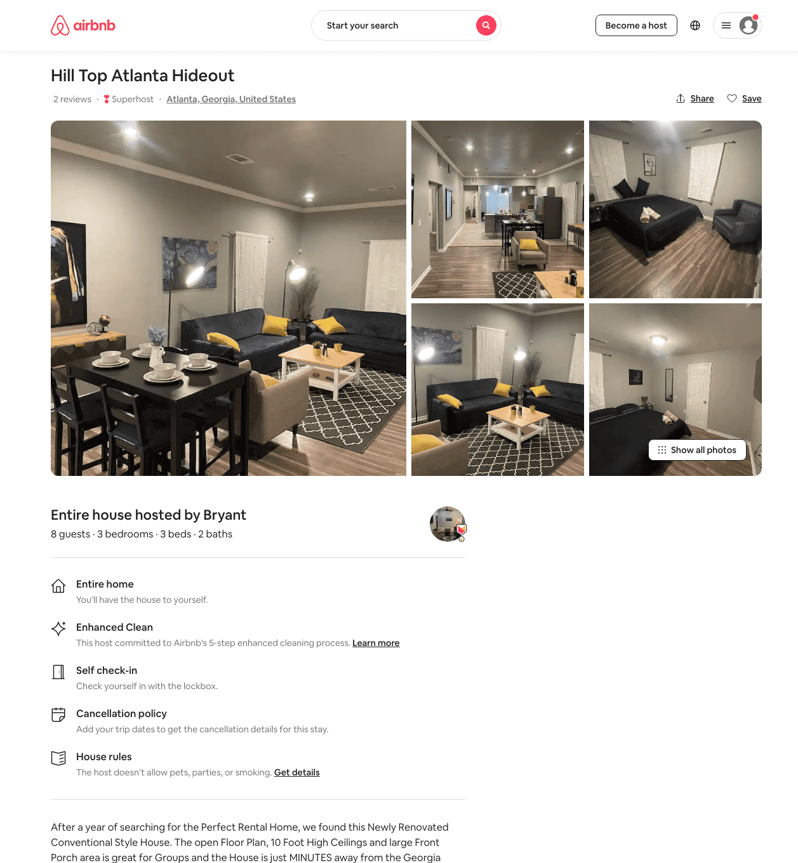
Listing 48469911
3
8
$120 - $257
4.73
2
Bryant
250716419
22
https://www.airbnb.com/rooms/48469911
Aug 2022

Slide 19
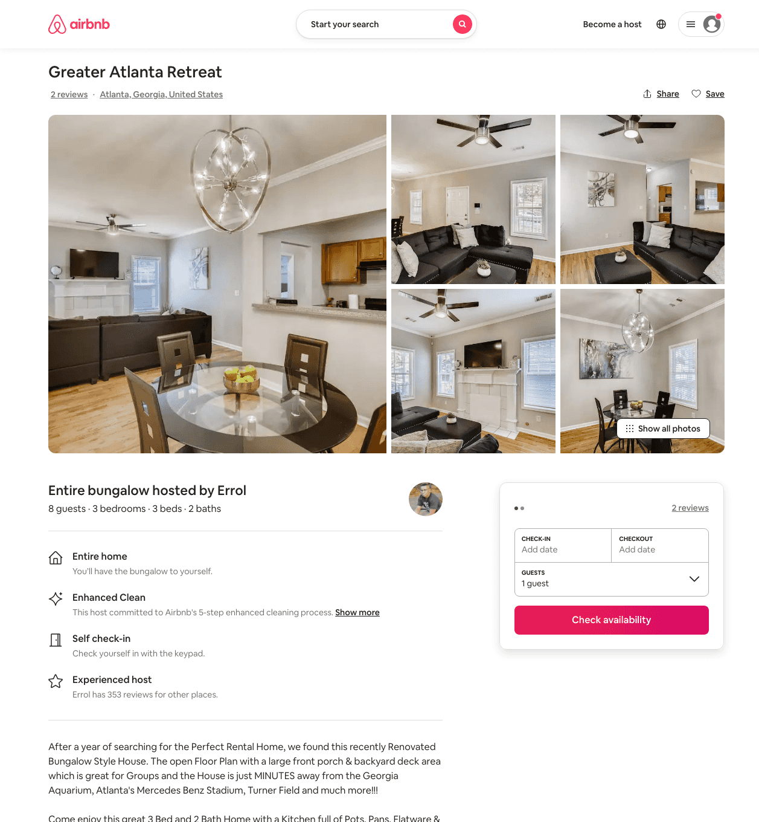
Listing 50069808
3
8
$116 - $192
4.90
2
Errol
97037186
12
https://www.airbnb.com/rooms/50069808
Aug 2022

Slide 20
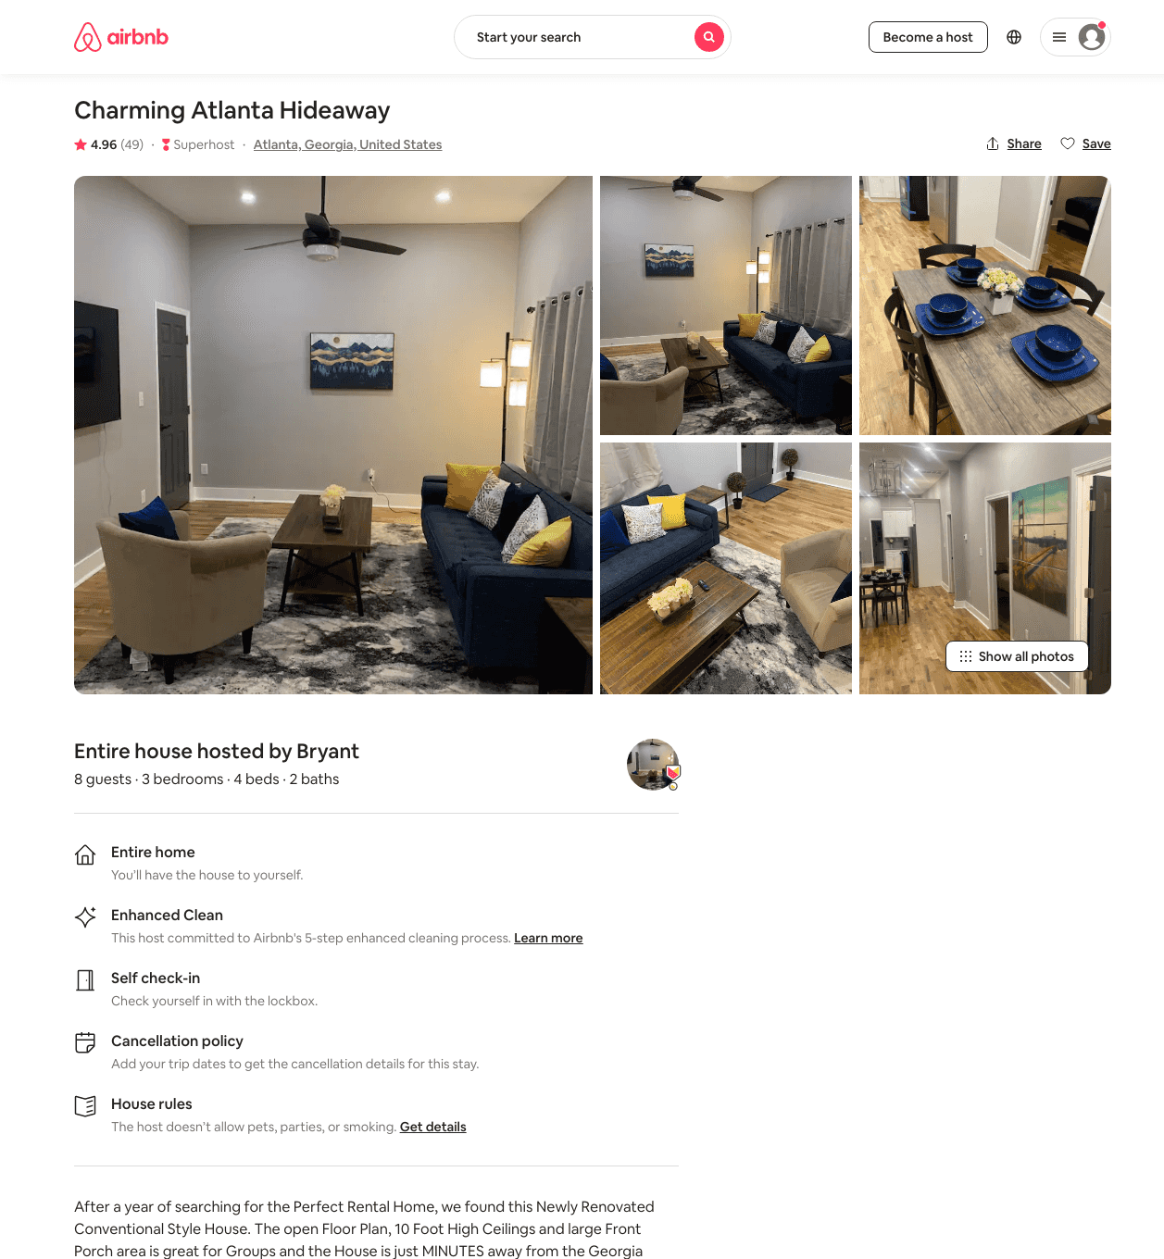
Listing 43580891
3
8
$114 - $250
4.82
2
Bryant
250716419
22
https://www.airbnb.com/rooms/43580891
Jun 2022

Slide 21
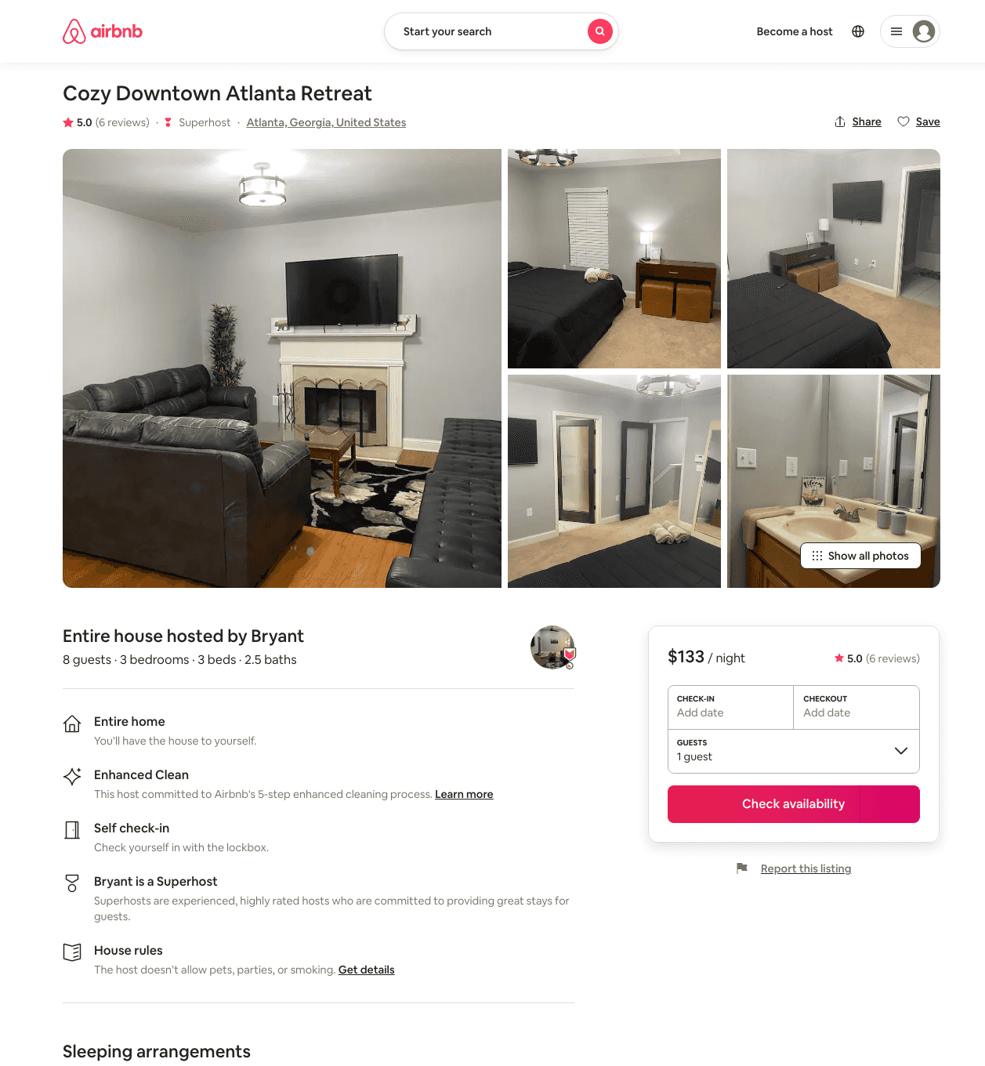
Listing 48470150
3
7
$87 - $250
4.89
1
Bryant
250716419
22
https://www.airbnb.com/rooms/48470150
Aug 2022

Slide 22
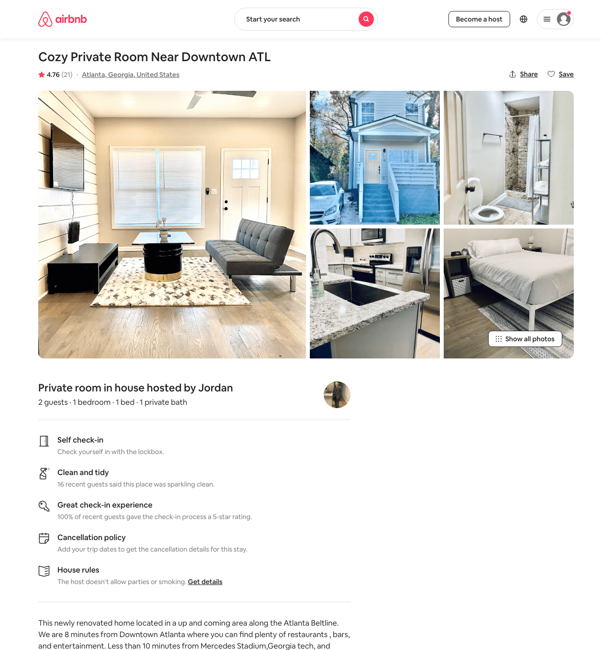
Listing 46376032
1
2
$48 - $67
4.68
1
Jordan
168723090
1
https://www.airbnb.com/rooms/46376032
Aug 2022

Slide 23
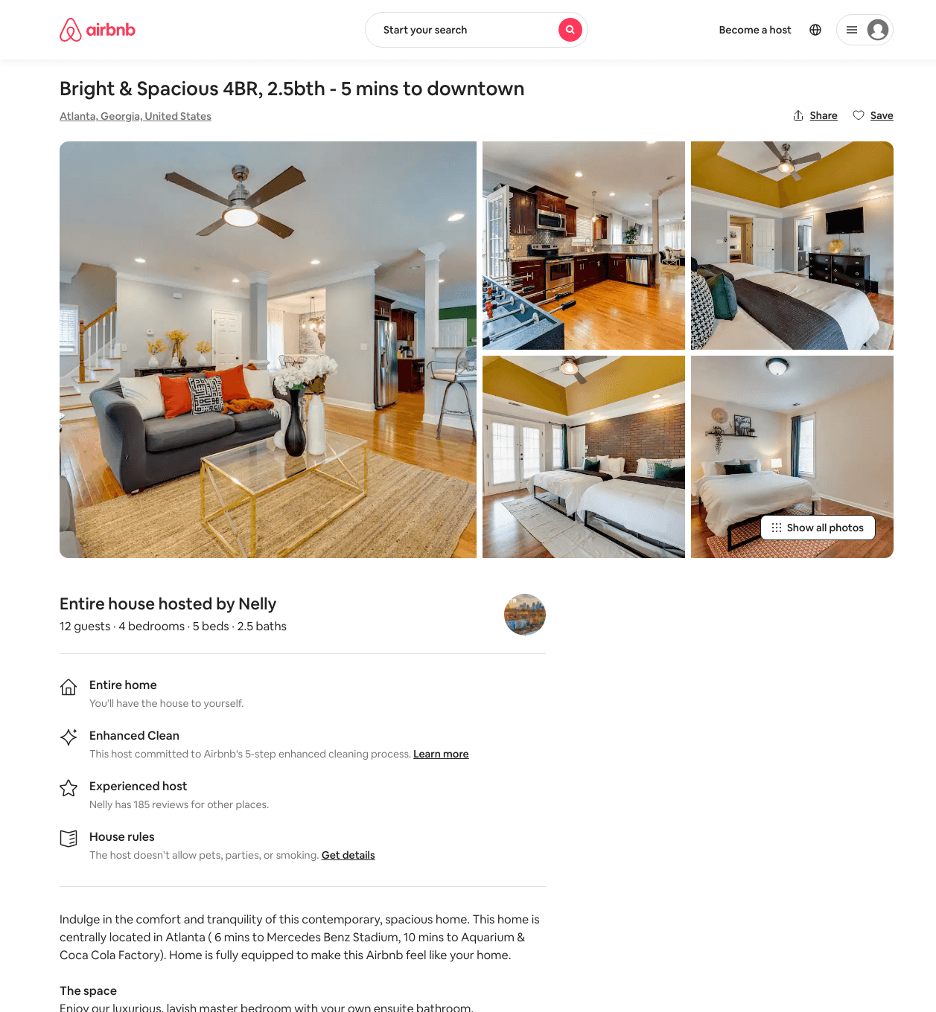
Listing 49141321
4
10
$196 - $386
4.42
28
Nelly
5467335
6
https://www.airbnb.com/rooms/49141321
Aug 2022

Slide 24
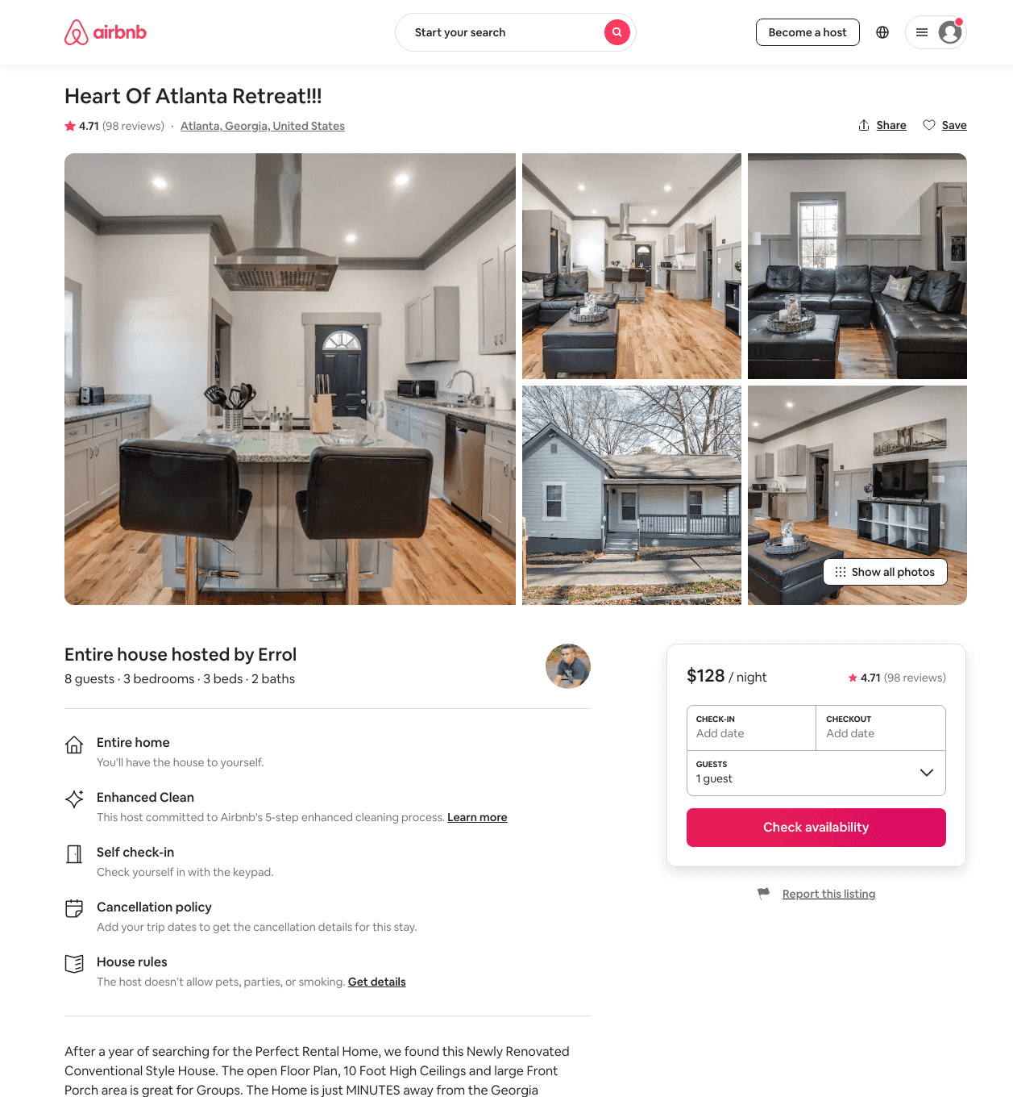
Listing 38174827
3
8
$114 - $189
4.92
2
Errol
97037186
12
https://www.airbnb.com/rooms/38174827
Aug 2022

Slide 25
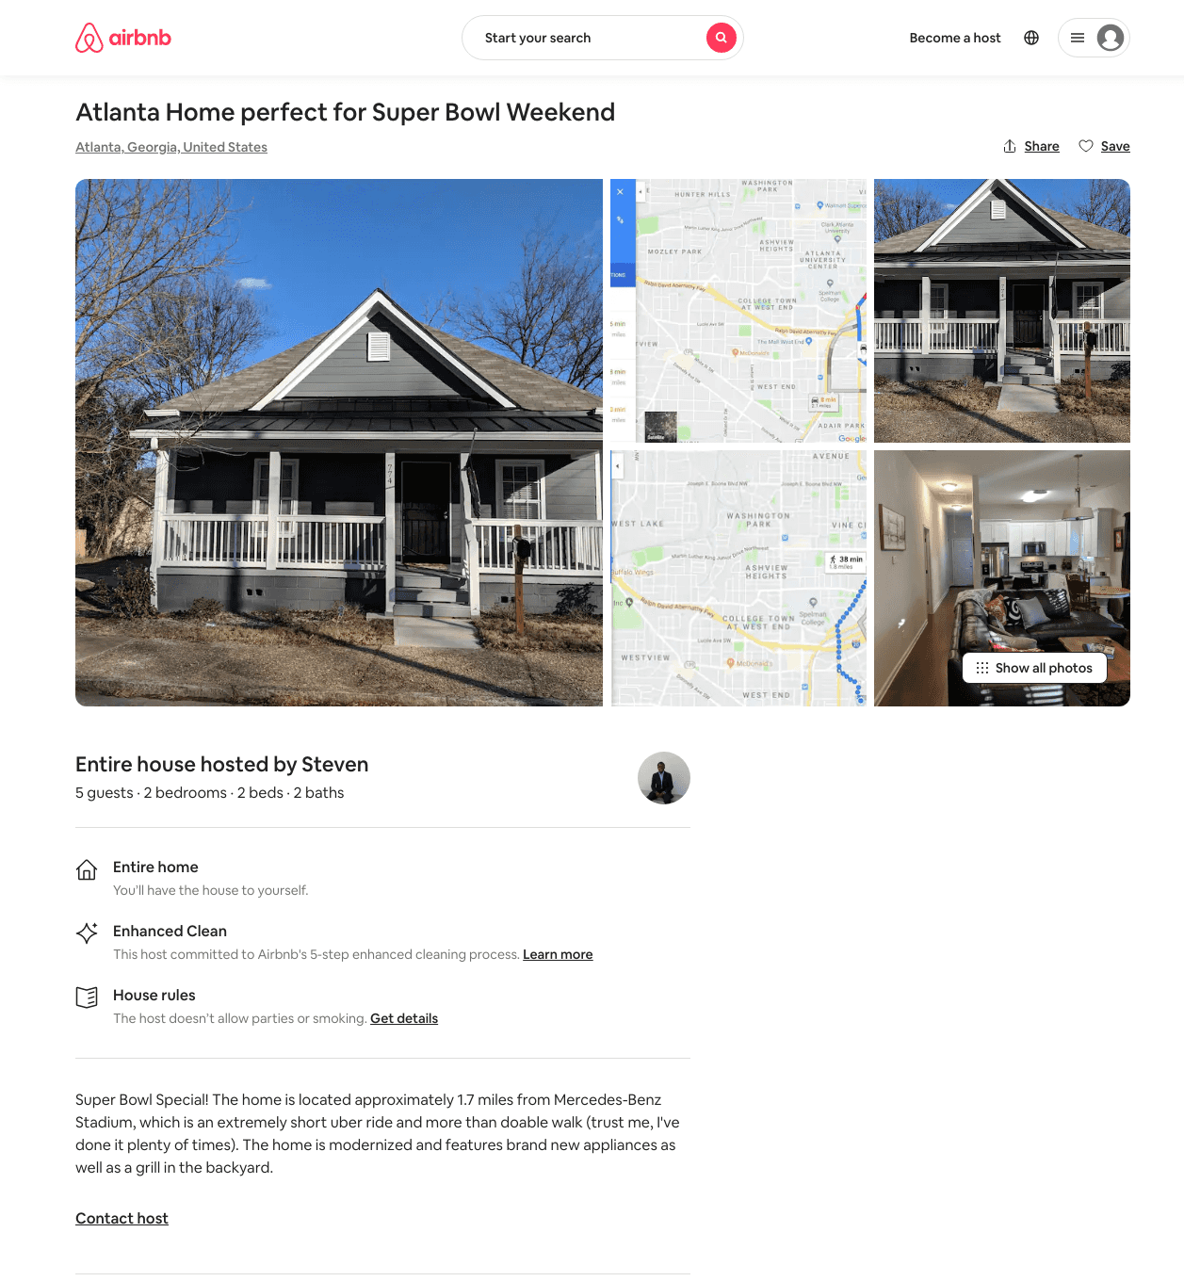
Listing 31469768
2
5
$550
3
Steven
235753531
1
https://www.airbnb.com/rooms/31469768
Aug 2022

Slide 26
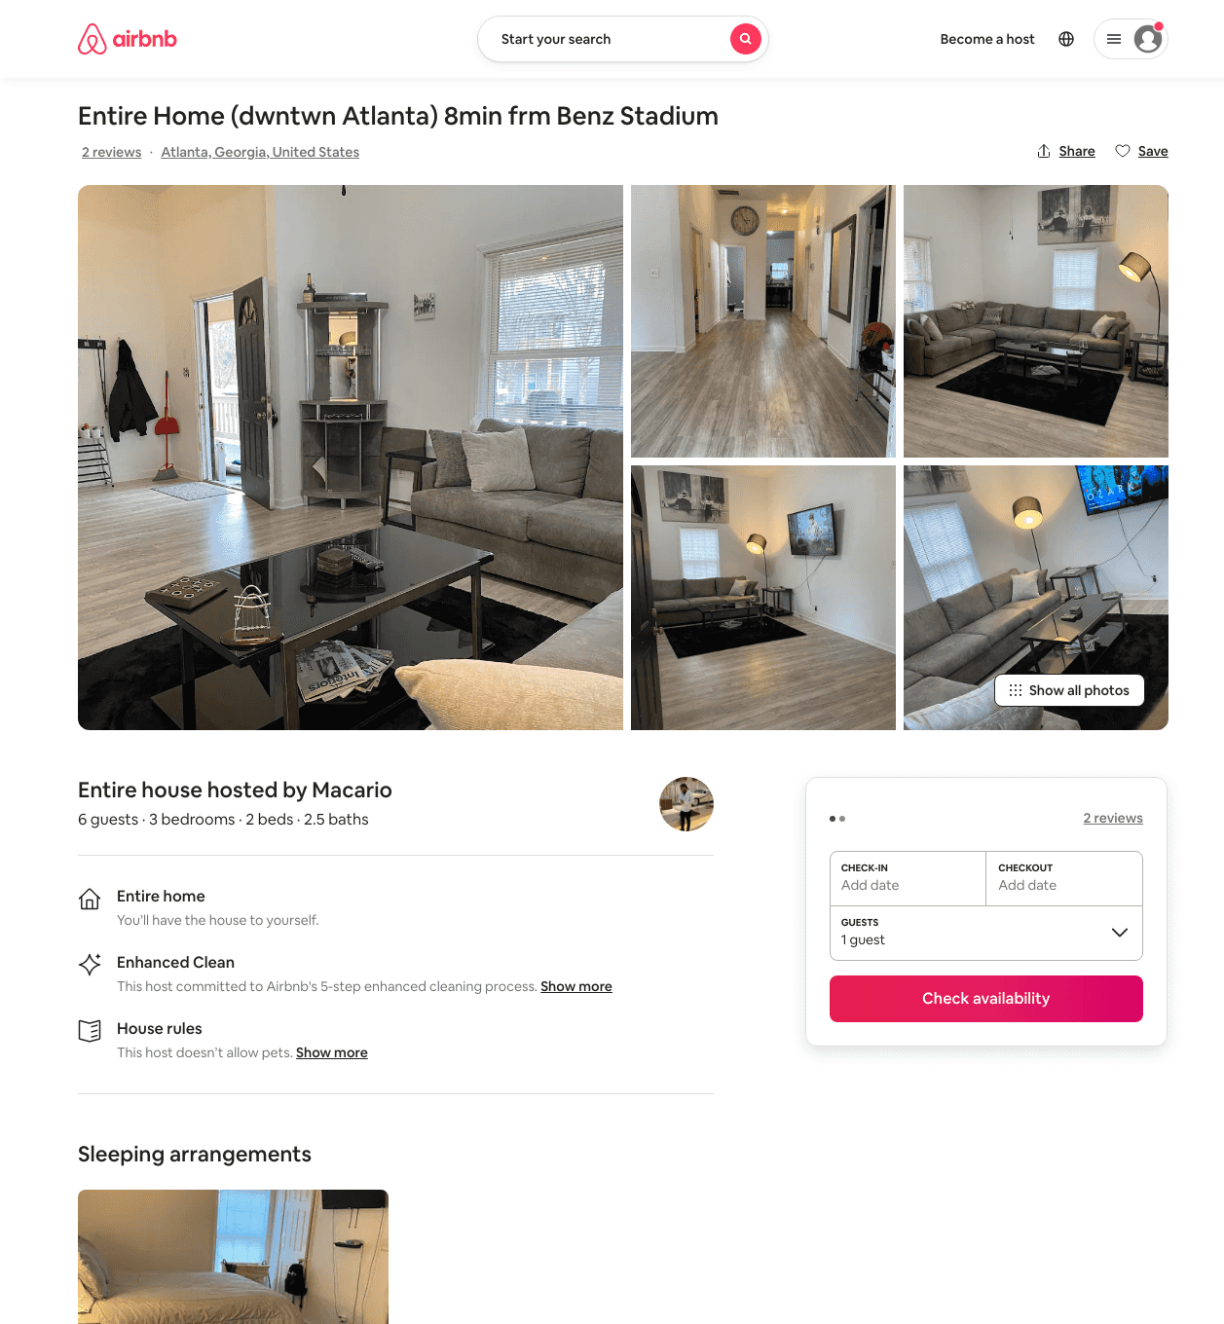
Listing 48421982
3
8
$206
4.57
3
Macario
75673009
1
https://www.airbnb.com/rooms/48421982
Jun 2022

Slide 27
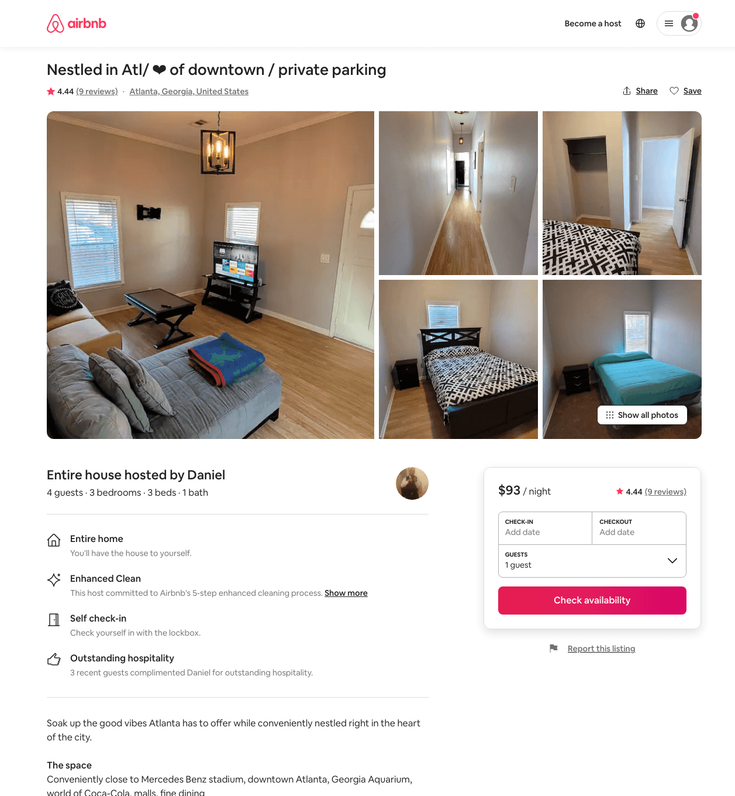
Listing 49336630
3
4
$80 - $108
4.79
2
Daniel
63495602
1
https://www.airbnb.com/rooms/49336630
Aug 2022

Slide 28
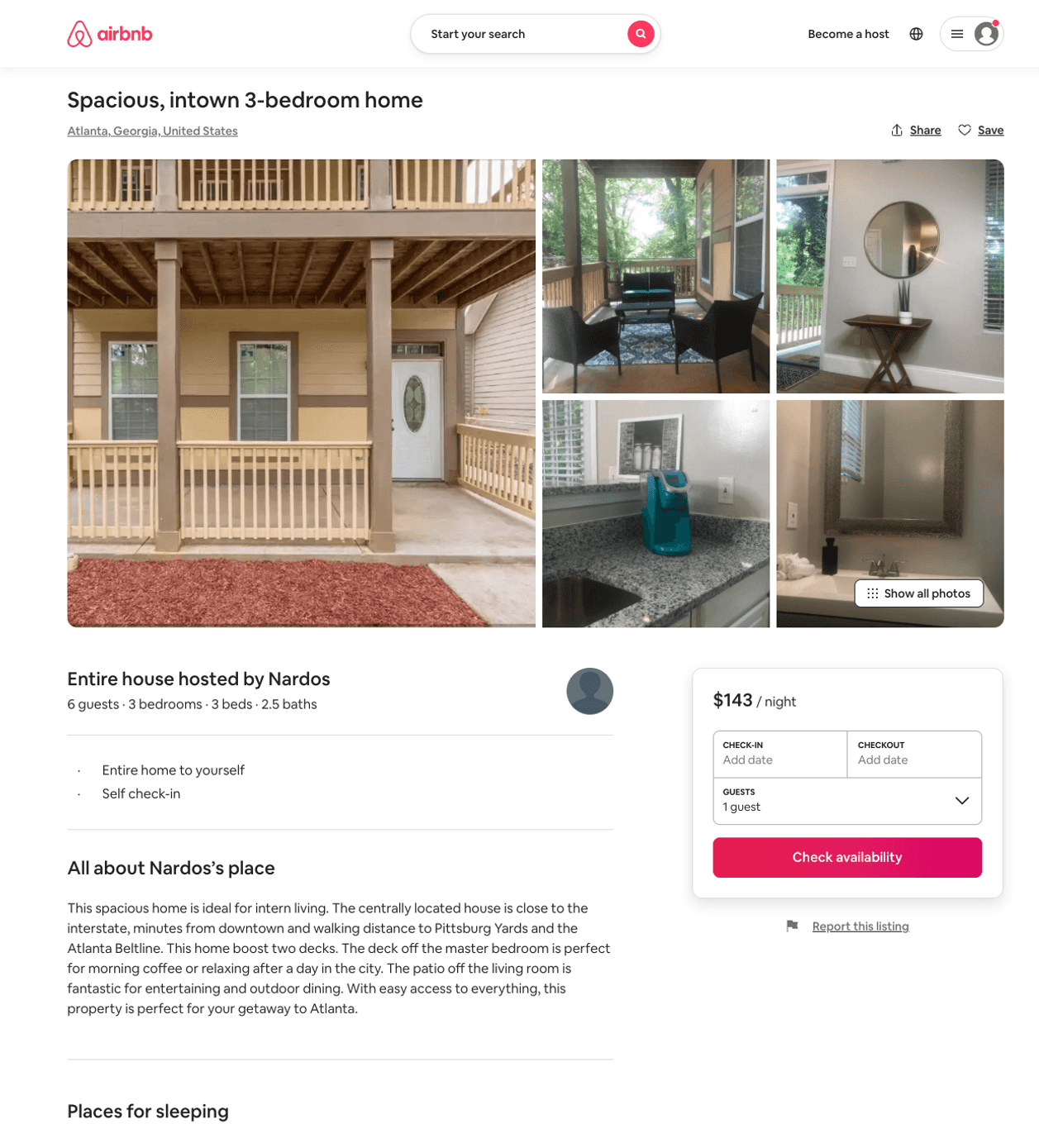
Listing 50507992
3
6
$63 - $143
4.76
3
Nardos
82687513
1
https://www.airbnb.com/rooms/50507992
Aug 2022

Slide 29
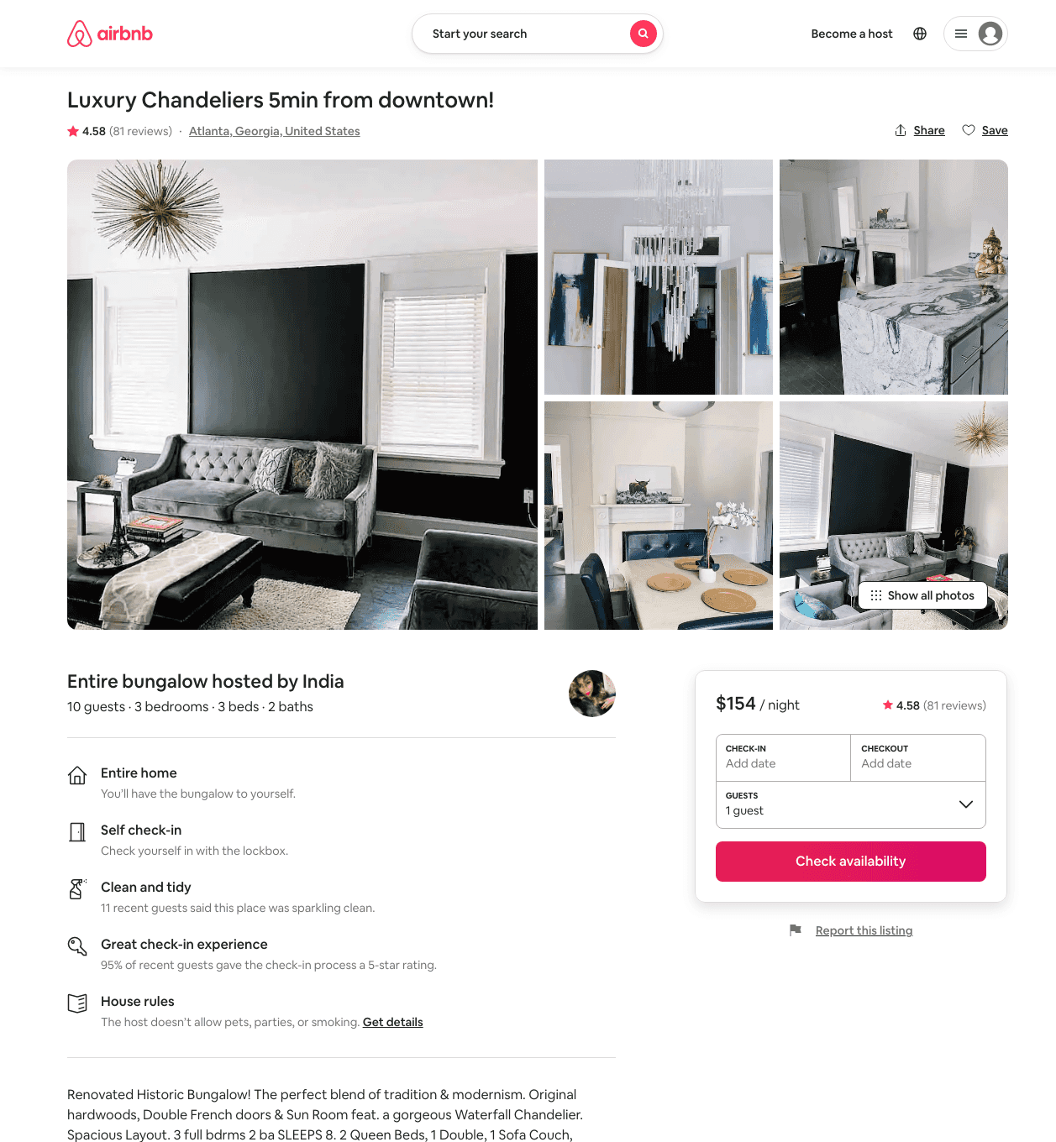
Listing 29736308
3
10
$115 - $163
4.49
1
India
107957688
1
https://www.airbnb.com/rooms/29736308
Aug 2022

Slide 30
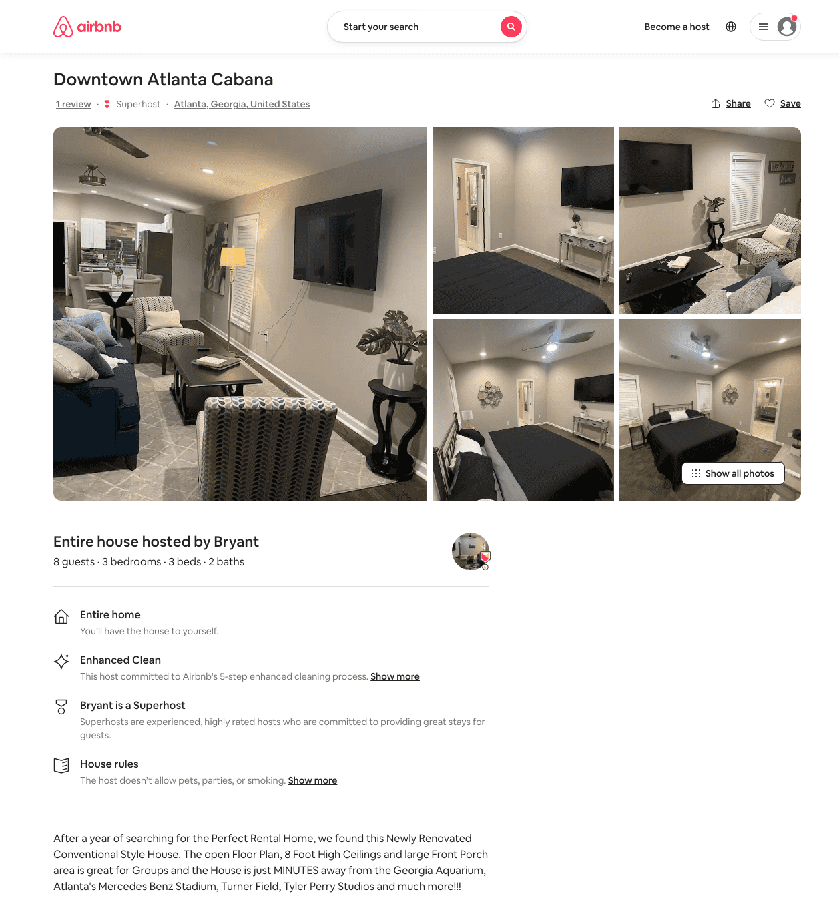
Listing 49450072
3
8
$98 - $292
4.76
1
Bryant
250716419
22
https://www.airbnb.com/rooms/49450072
Aug 2022

Slide 31
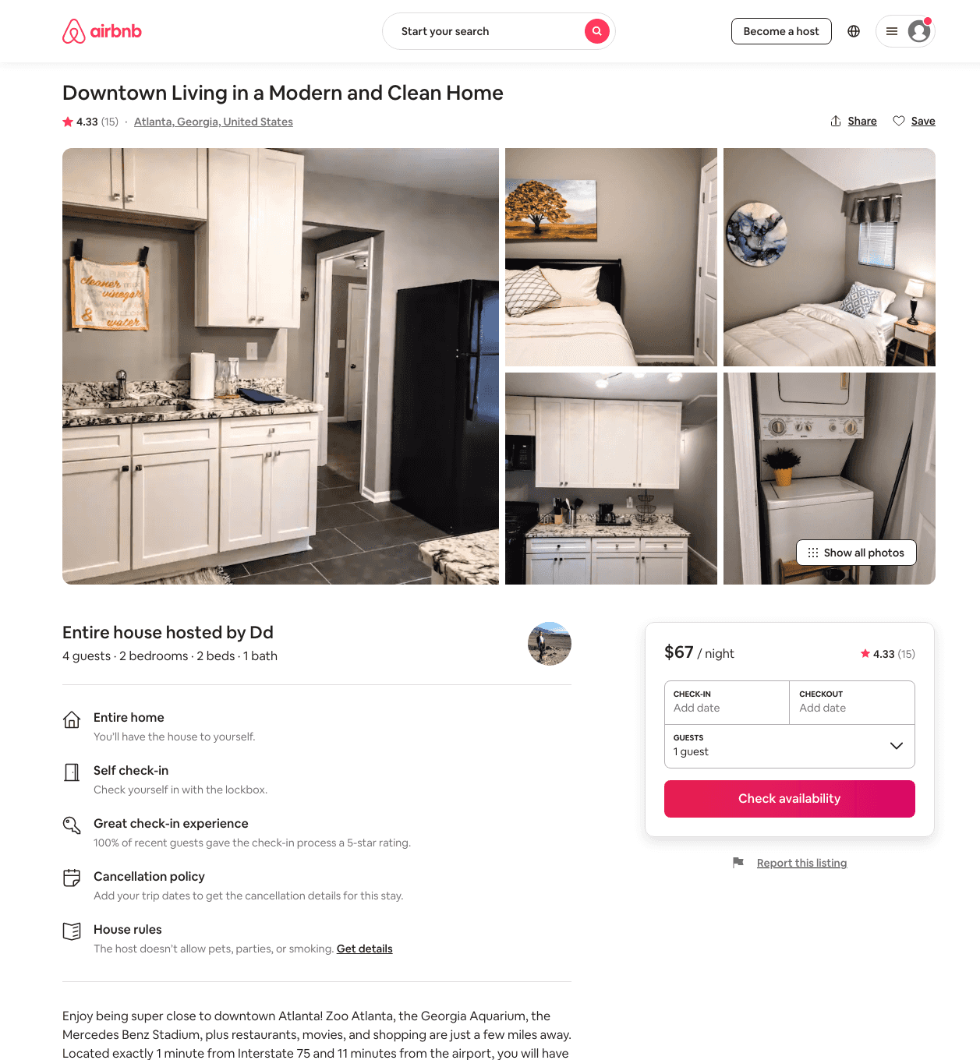
Listing 47528288
2
4
$56 - $74
4.52
2
Dd
189408877
2
https://www.airbnb.com/rooms/47528288
Aug 2022

Slide 32
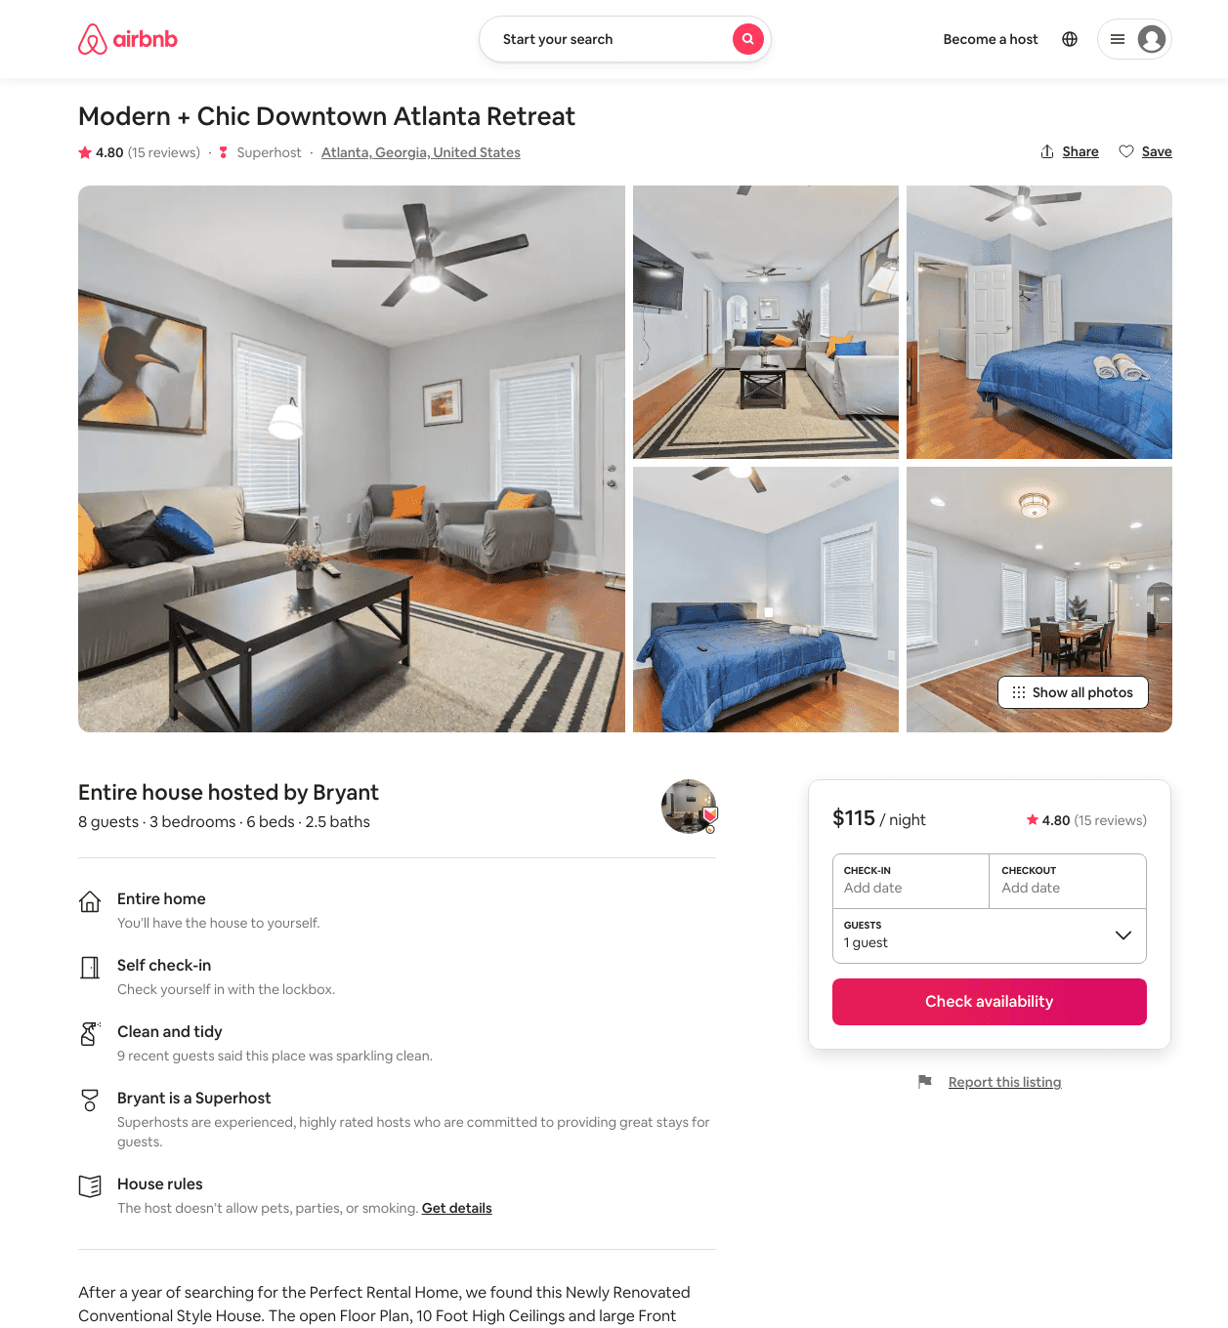
Listing 47114729
3
8
$115 - $250
4.66
2
Bryant
250716419
22
https://www.airbnb.com/rooms/47114729
Aug 2022

Slide 33
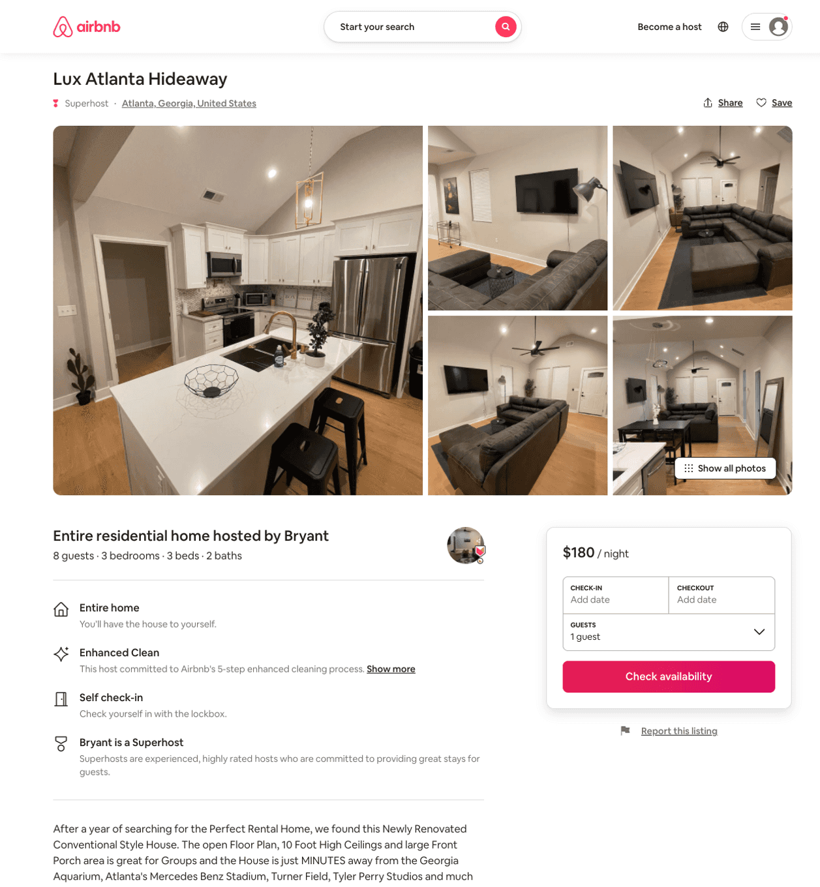
Listing 51352643
3
8
$114 - $300
4.61
1
Bryant
250716419
22
https://www.airbnb.com/rooms/51352643
Aug 2022

Slide 34
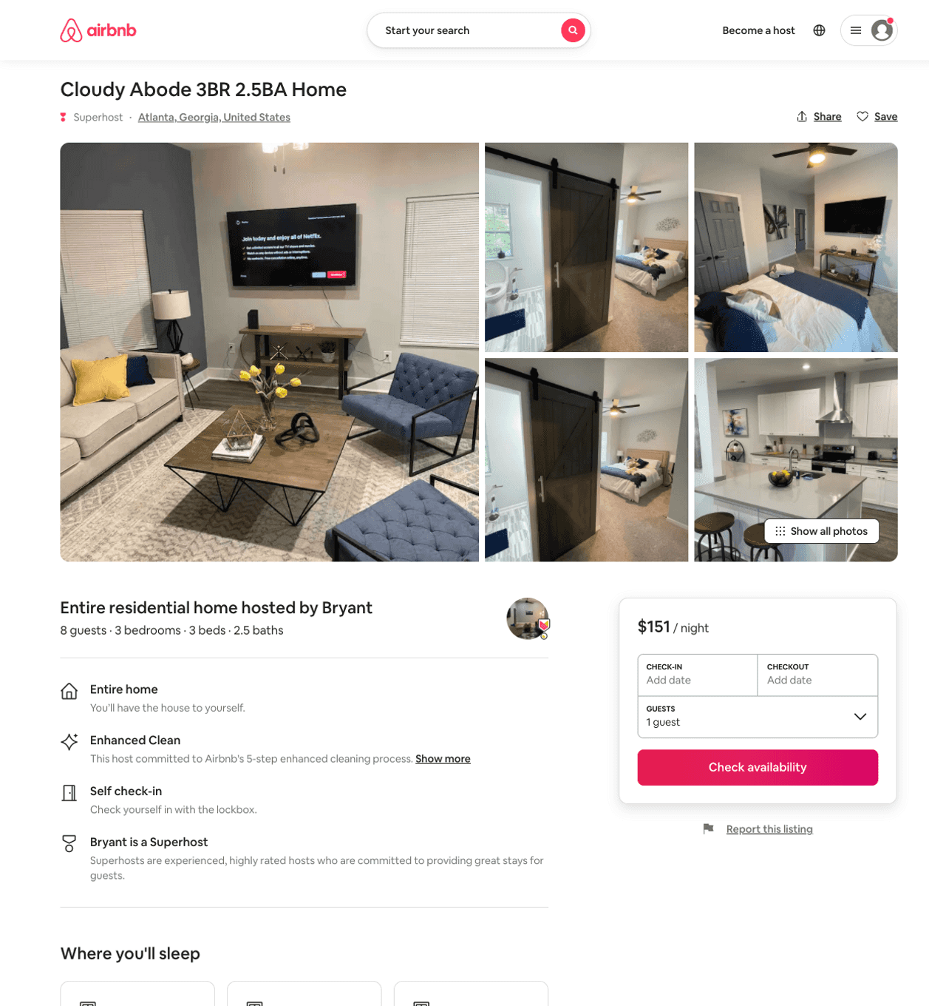
Listing 51384574
3
8
$98 - $156
4.60
1
Bryant
250716419
22
https://www.airbnb.com/rooms/51384574
Aug 2022

Slide 35
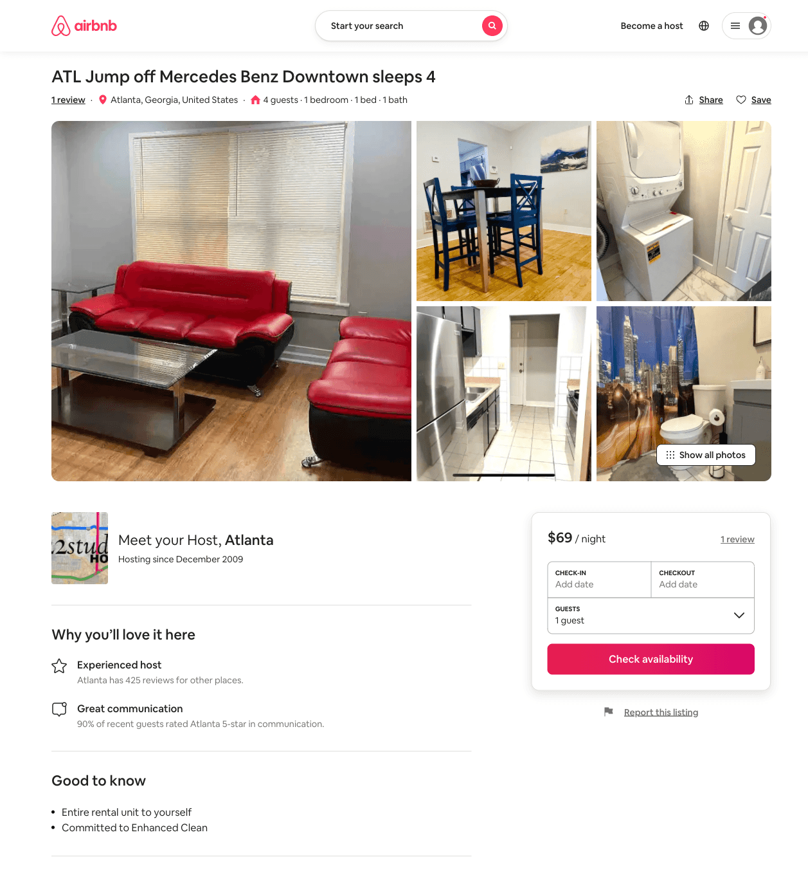
Listing 51592038
1
4
$69 - $95
3
Atlanta
61366
7
https://www.airbnb.com/rooms/51592038
Jun 2022

Slide 36
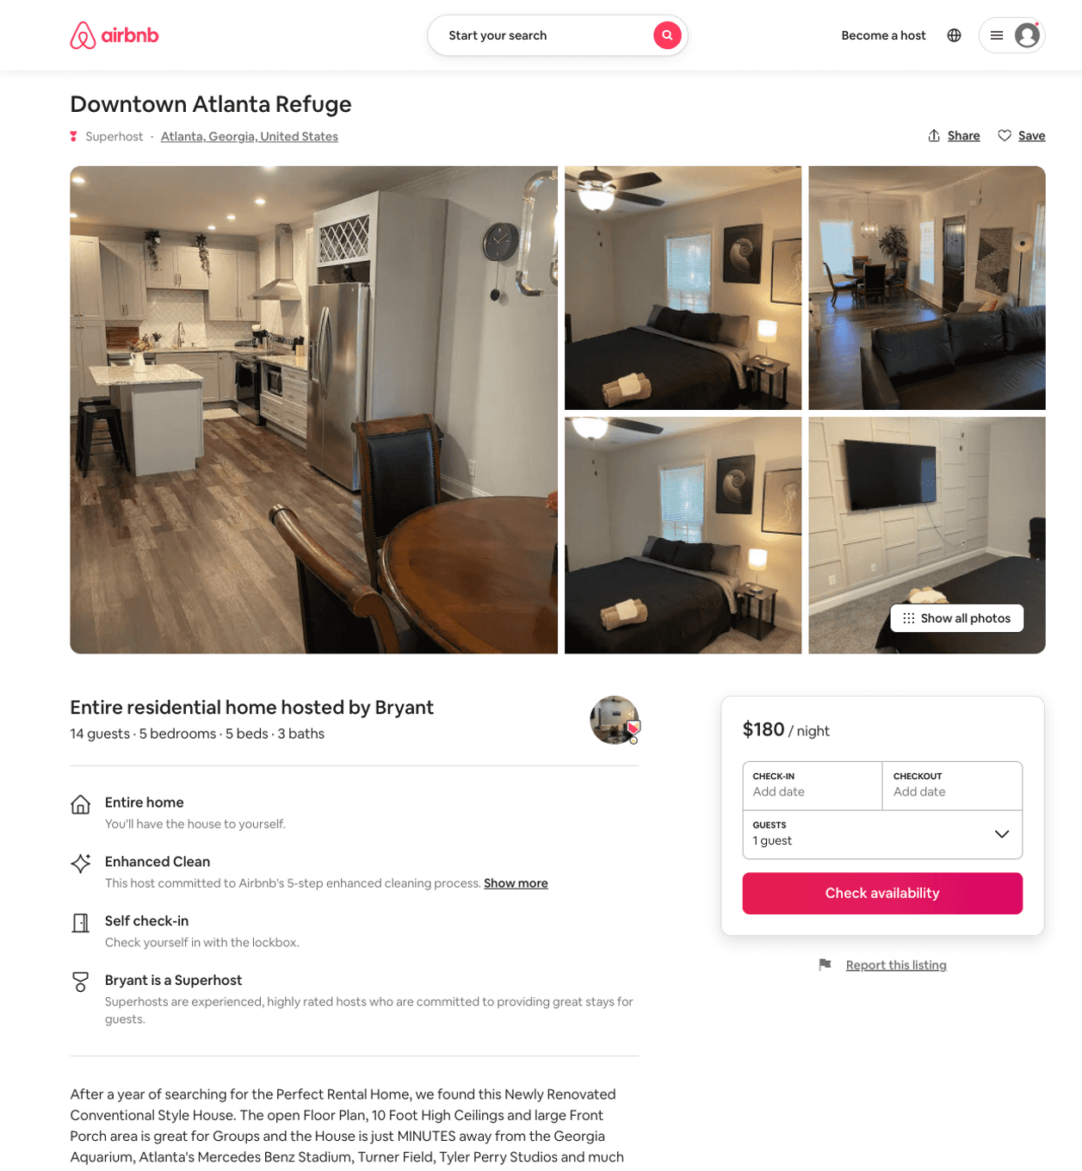
Listing 51688196
5
14
$164 - $256
4.74
1
Bryant
250716419
22
https://www.airbnb.com/rooms/51688196
Aug 2022

Slide 37
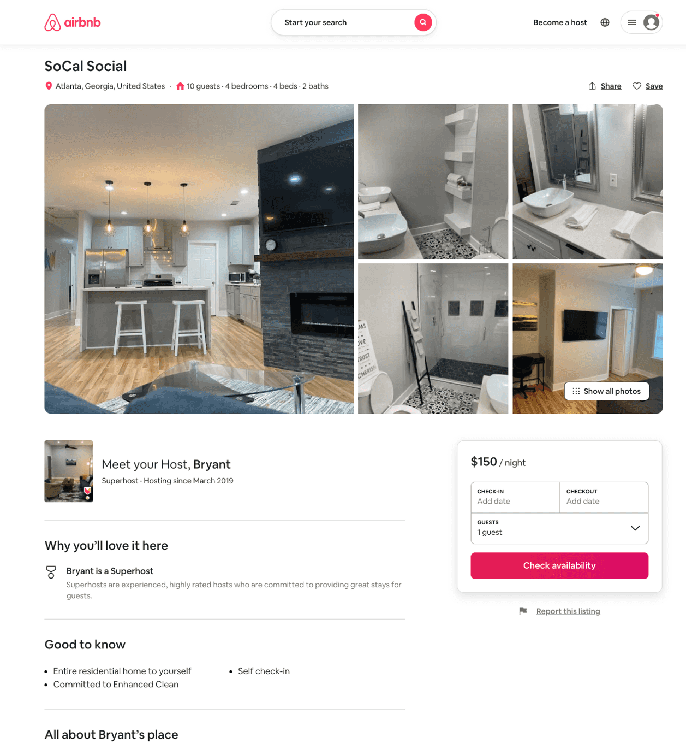
Listing 51688058
4
10
$114 - $307
4.67
1
Bryant
250716419
22
https://www.airbnb.com/rooms/51688058
Aug 2022

Slide 38
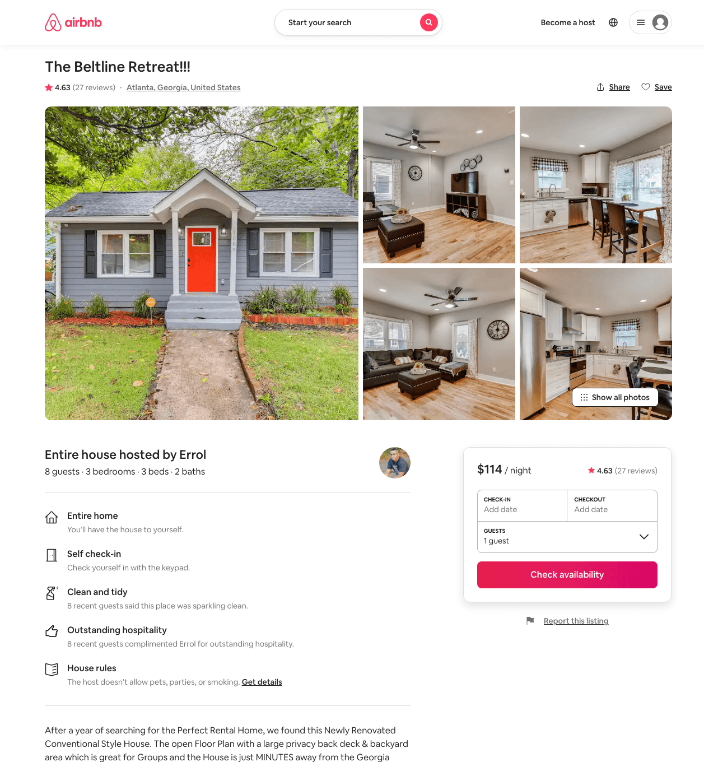
Listing 45496930
3
8
$114 - $189
4.79
2
Errol
97037186
12
https://www.airbnb.com/rooms/45496930
Aug 2022

Slide 39
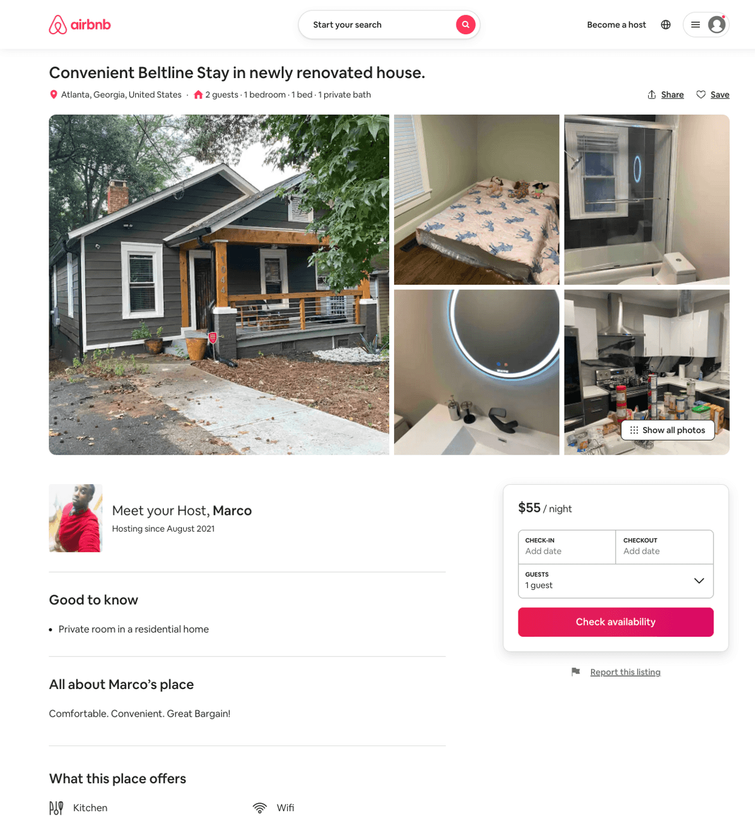
Listing 51910293
1
1
$55
3.67
2
Marco
420455709
1
https://www.airbnb.com/rooms/51910293
Aug 2022

Slide 40
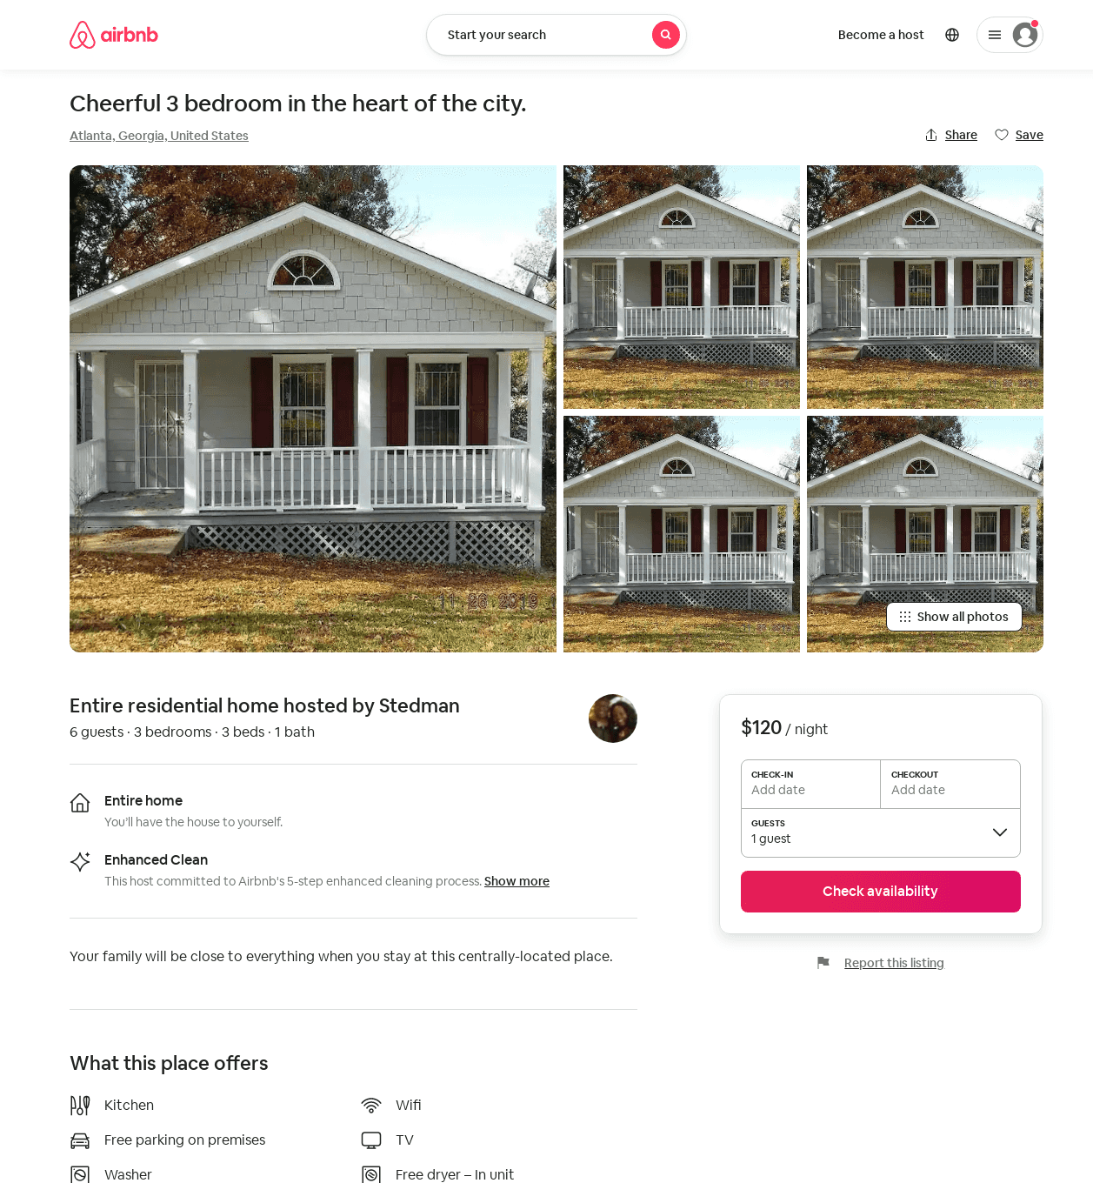
Listing 52224064
3
6
$109 - $150
4.56
2
Stedman
9483765
1
https://www.airbnb.com/rooms/52224064
Jun 2022

Slide 41
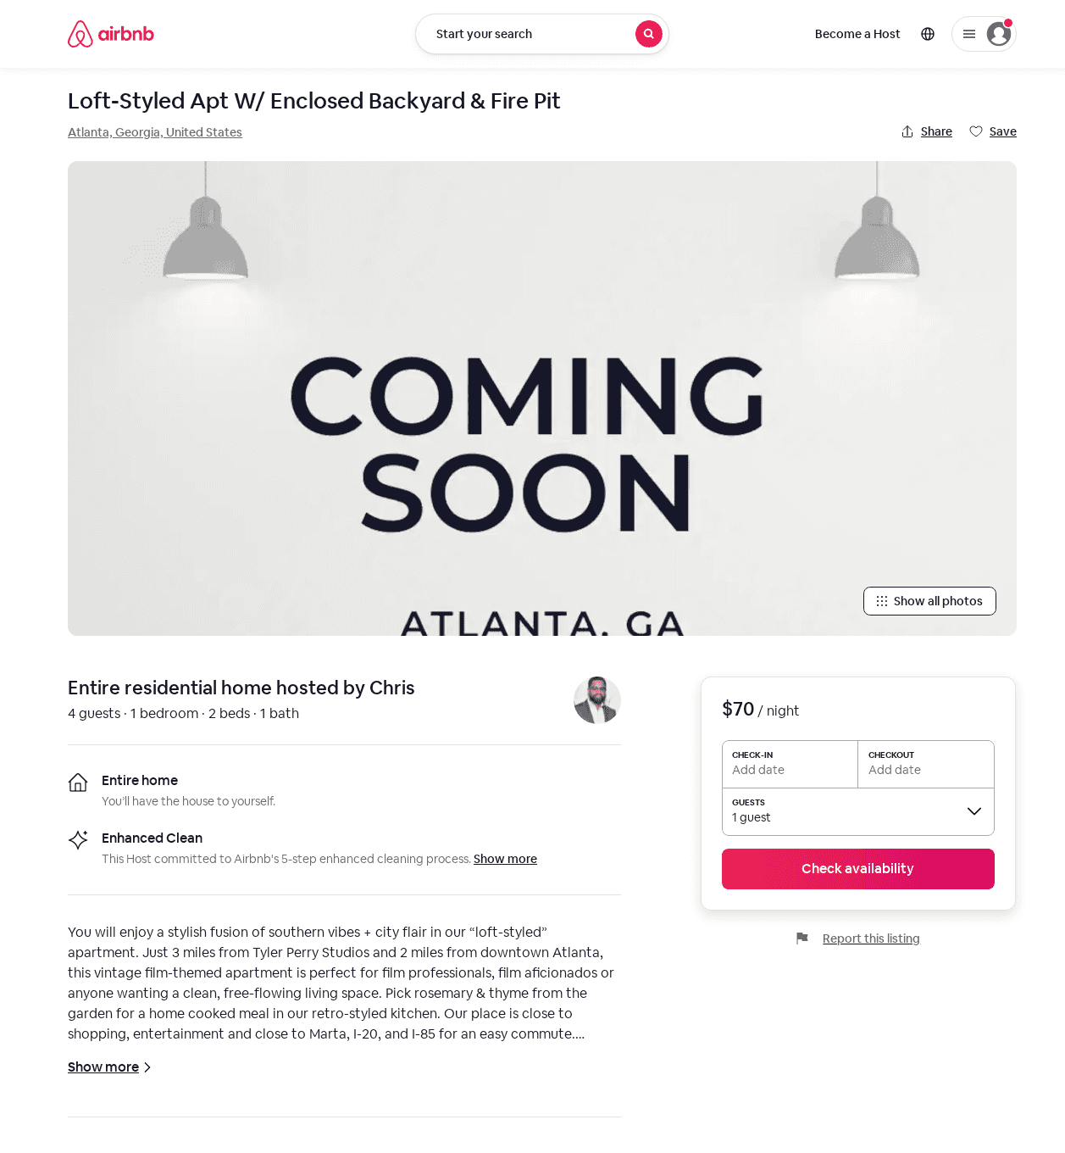
Listing 52658017
1
4
$68 - $113
4.94
2
Chris
42863807
2
https://www.airbnb.com/rooms/52658017
Jul 2022

Slide 42
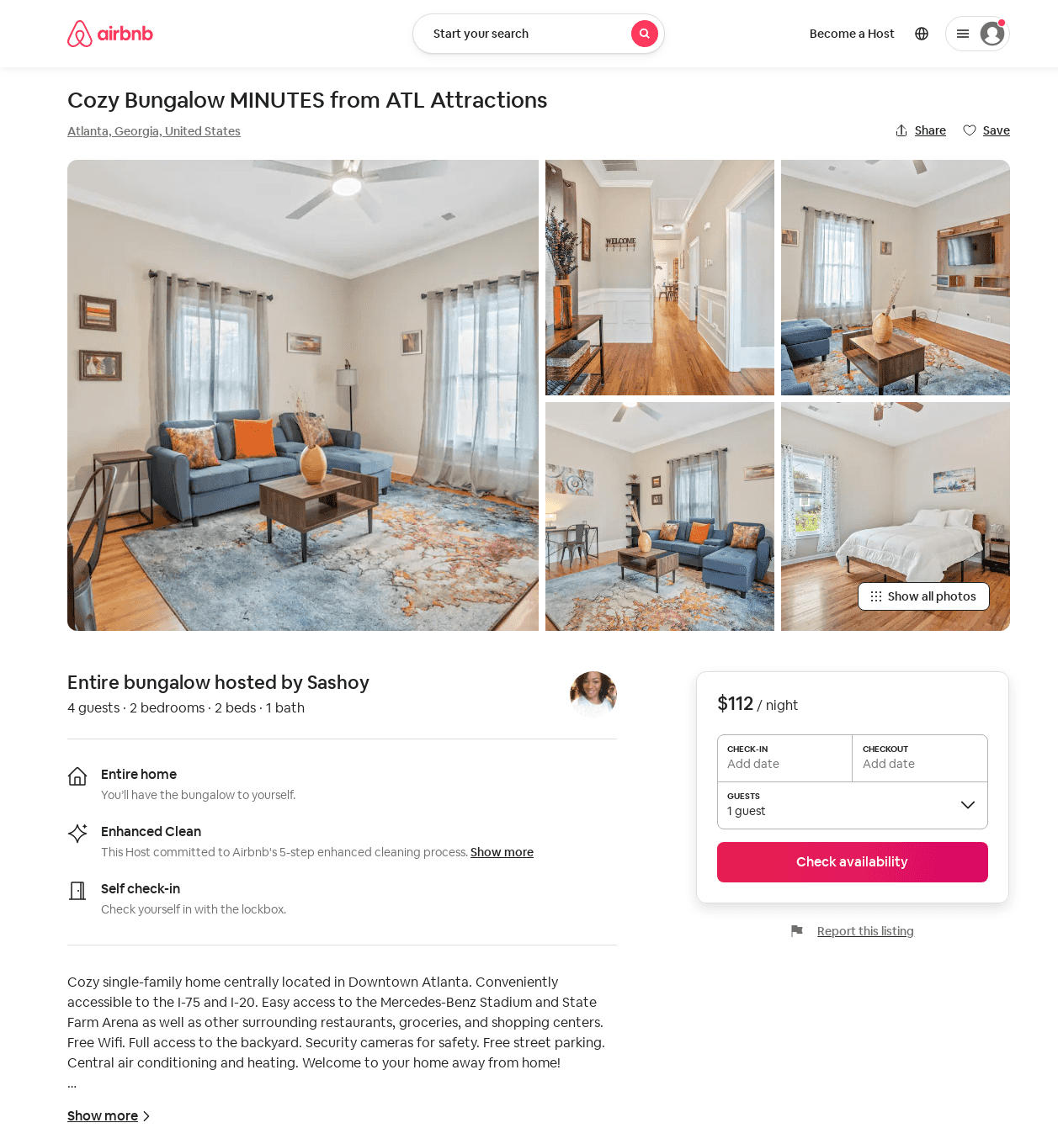
Listing 50164221
2
4
$91 - $112
4.84
2
Imperial
424721722
1
https://www.airbnb.com/rooms/50164221
Aug 2022

Slide 43
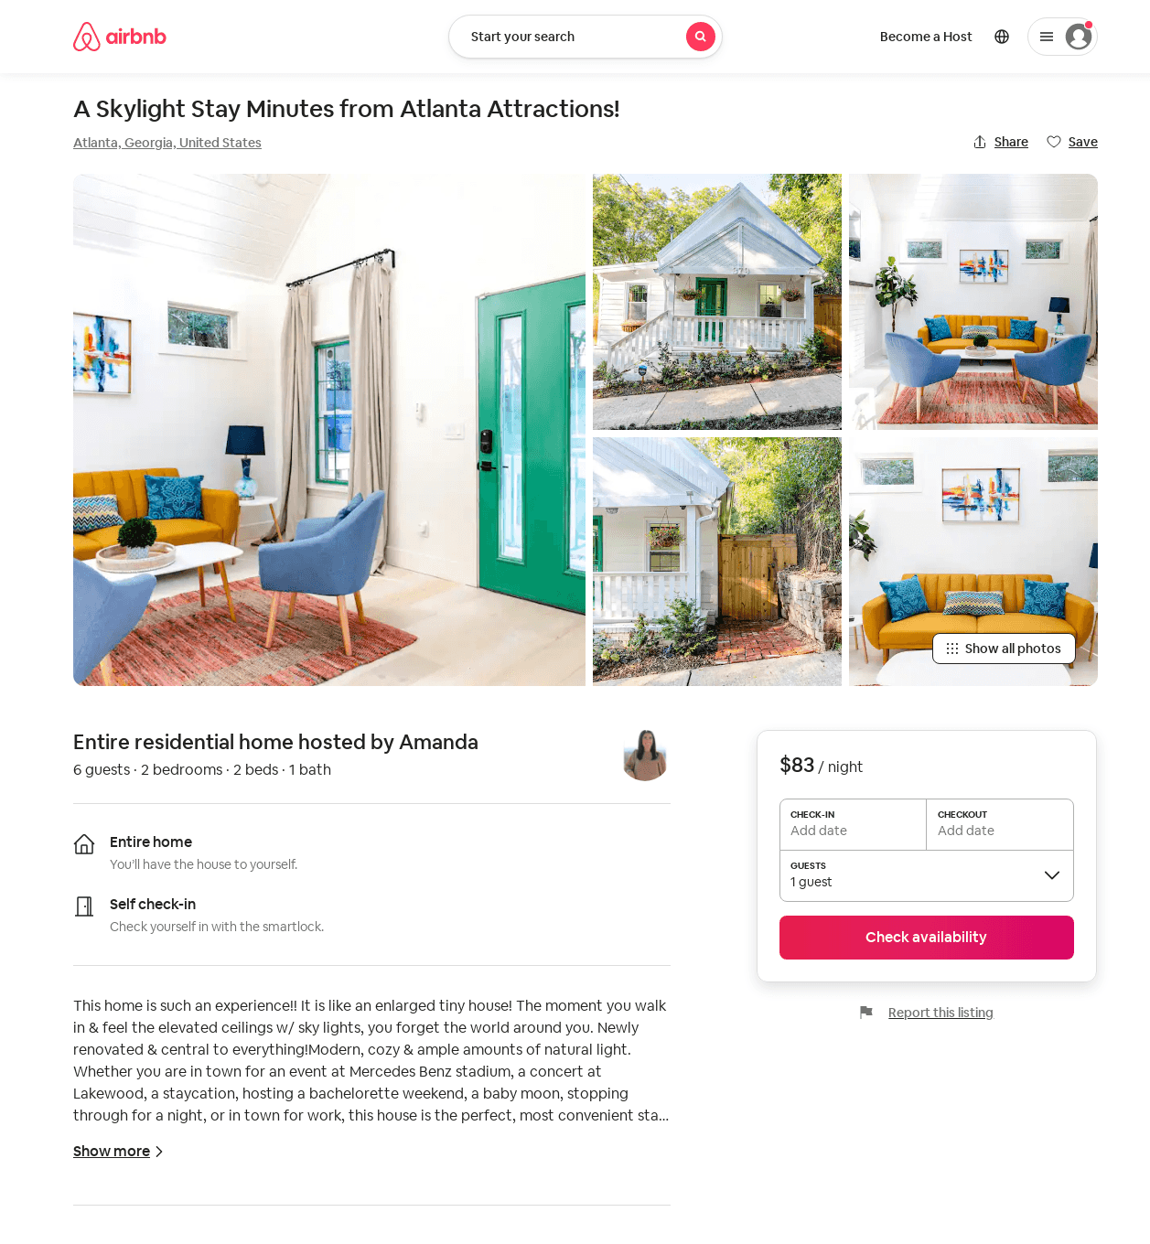
Listing 52841682
2
6
$76 - $141
4.94
1
Amanda
146545322
1
https://www.airbnb.com/rooms/52841682
Aug 2022

Slide 44
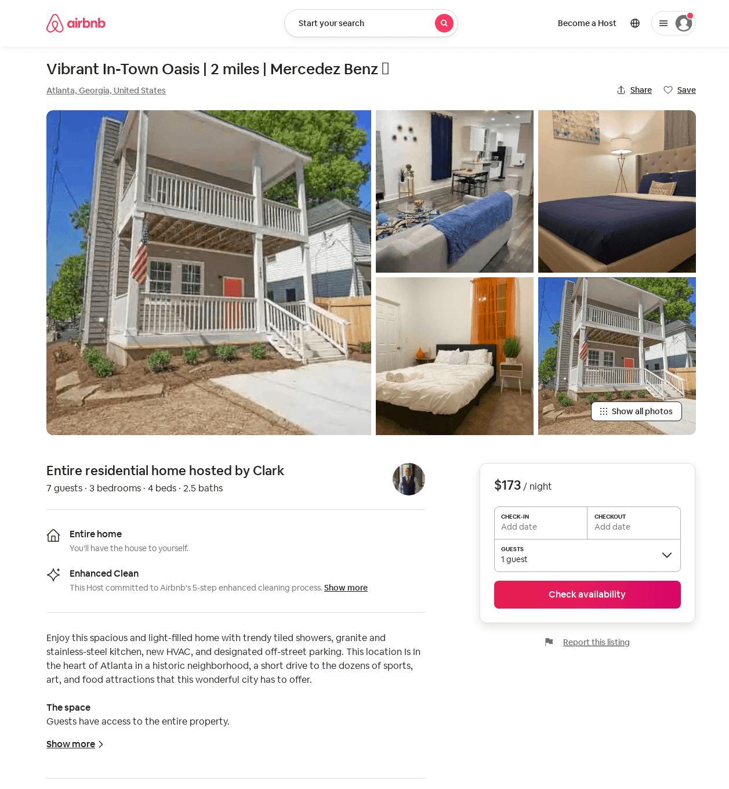
Listing 51707591
3
7
$173
4.80
2
Clark
418899105
1
https://www.airbnb.com/rooms/51707591
Aug 2022

Slide 45
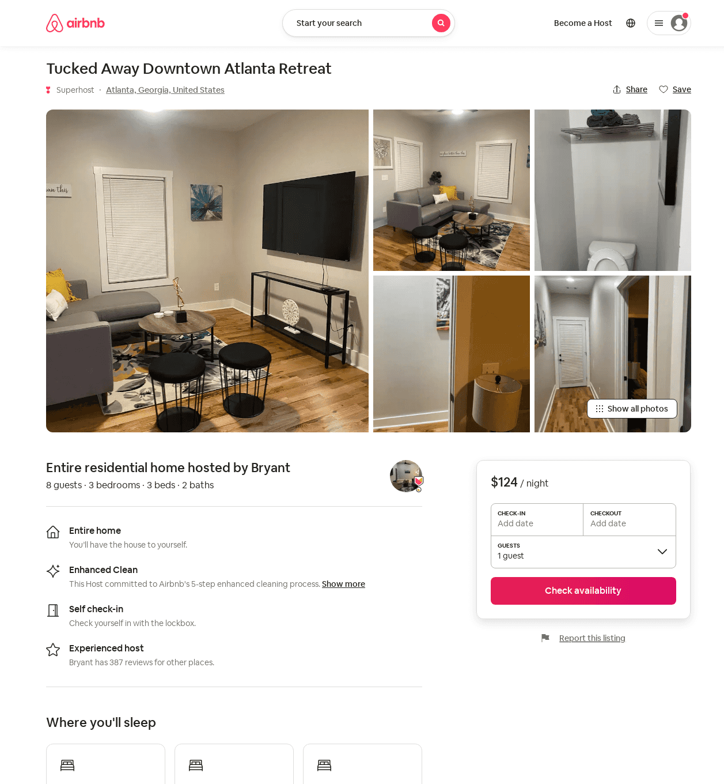
Listing 52919514
3
8
$99 - $173
4.88
2
Bryant
250716419
22
https://www.airbnb.com/rooms/52919514
Jul 2022

Slide 46
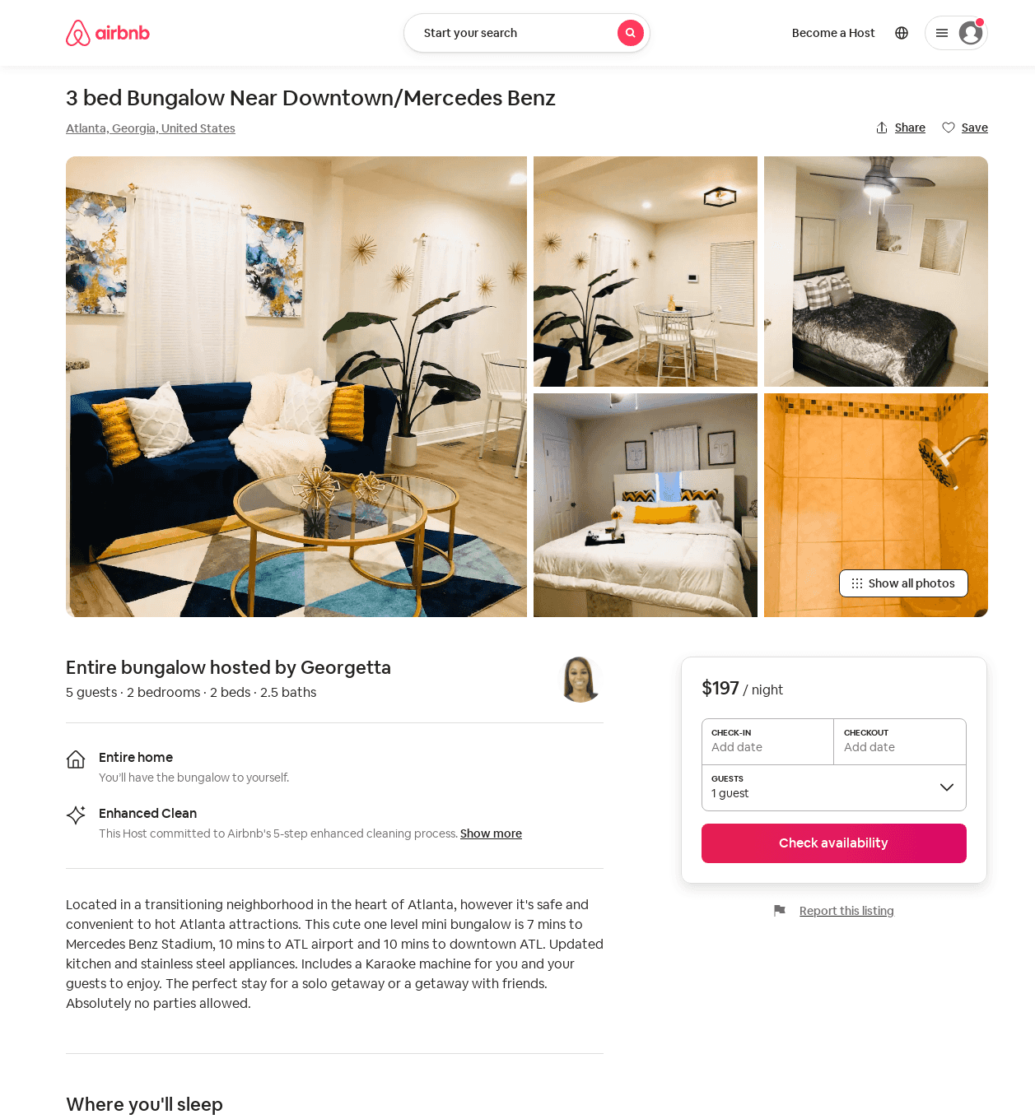
Listing 52873715
2
6
$115 - $197
4.73
2
Otis B
226401517
2
https://www.airbnb.com/rooms/52873715
Aug 2022

Slide 47
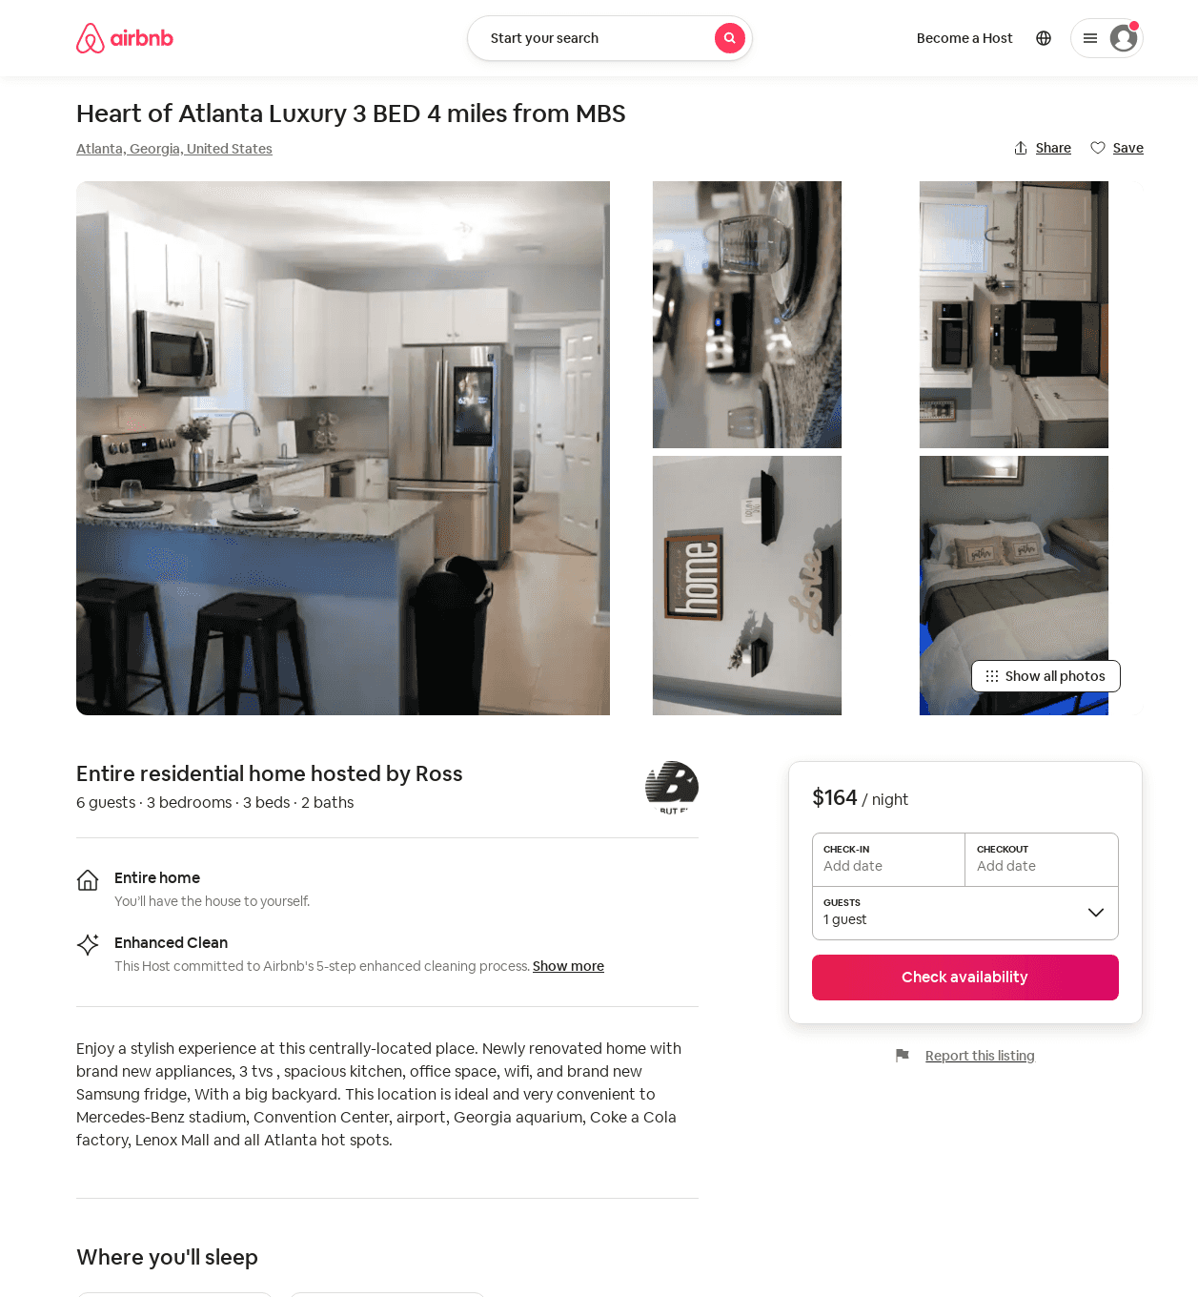
Listing 53052008
3
8
$150 - $164
4.43
1
Ross
270855941
1
https://www.airbnb.com/rooms/53052008
Jun 2022

Slide 48
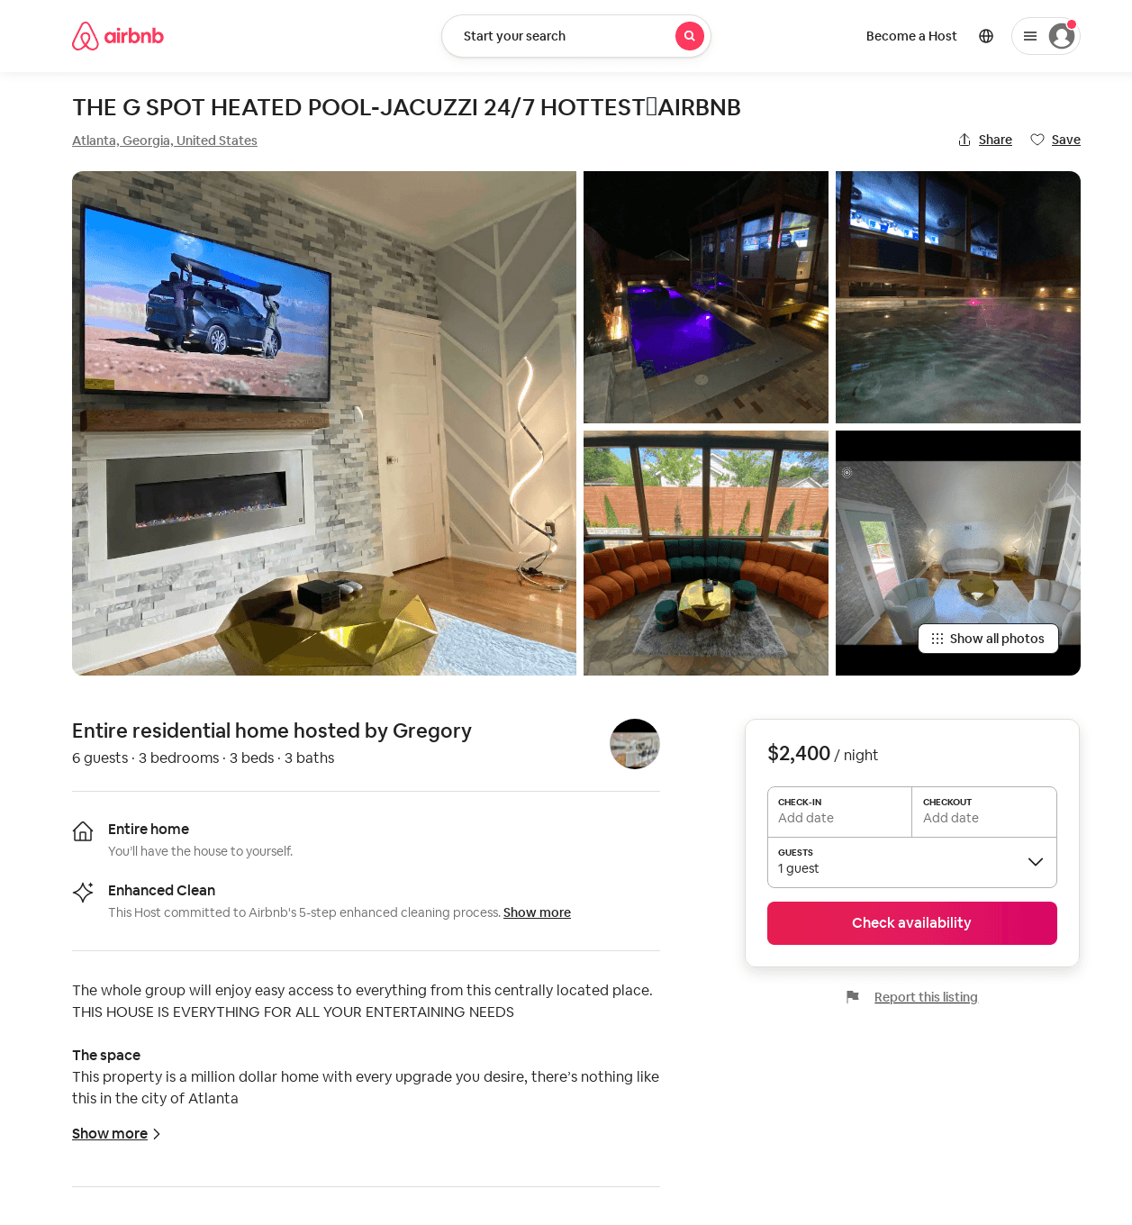
Listing 53608950
3
6
$999 - $2400
5.0
1
Gregory
227522378
2
https://www.airbnb.com/rooms/53608950
Aug 2022

Slide 49
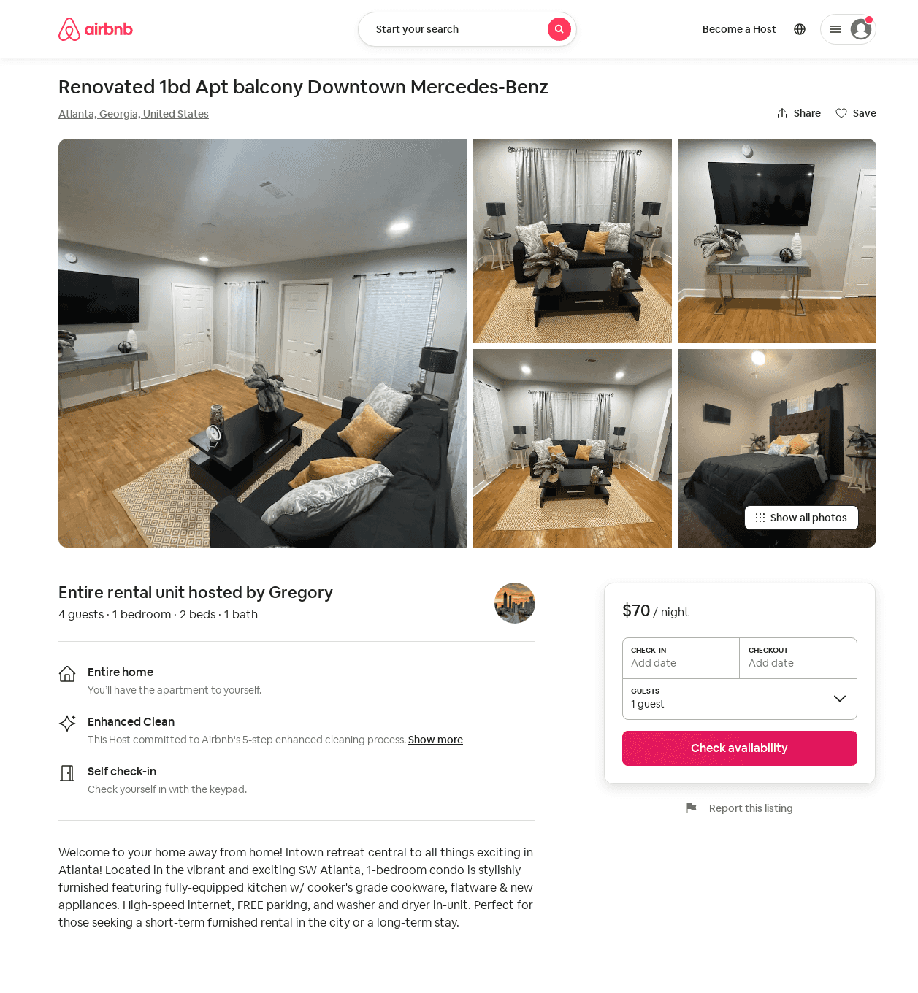
Listing 53645684
1
4
$70 - $75
4.86
6
Gregory
233693121
2
https://www.airbnb.com/rooms/53645684
Aug 2022

Slide 50
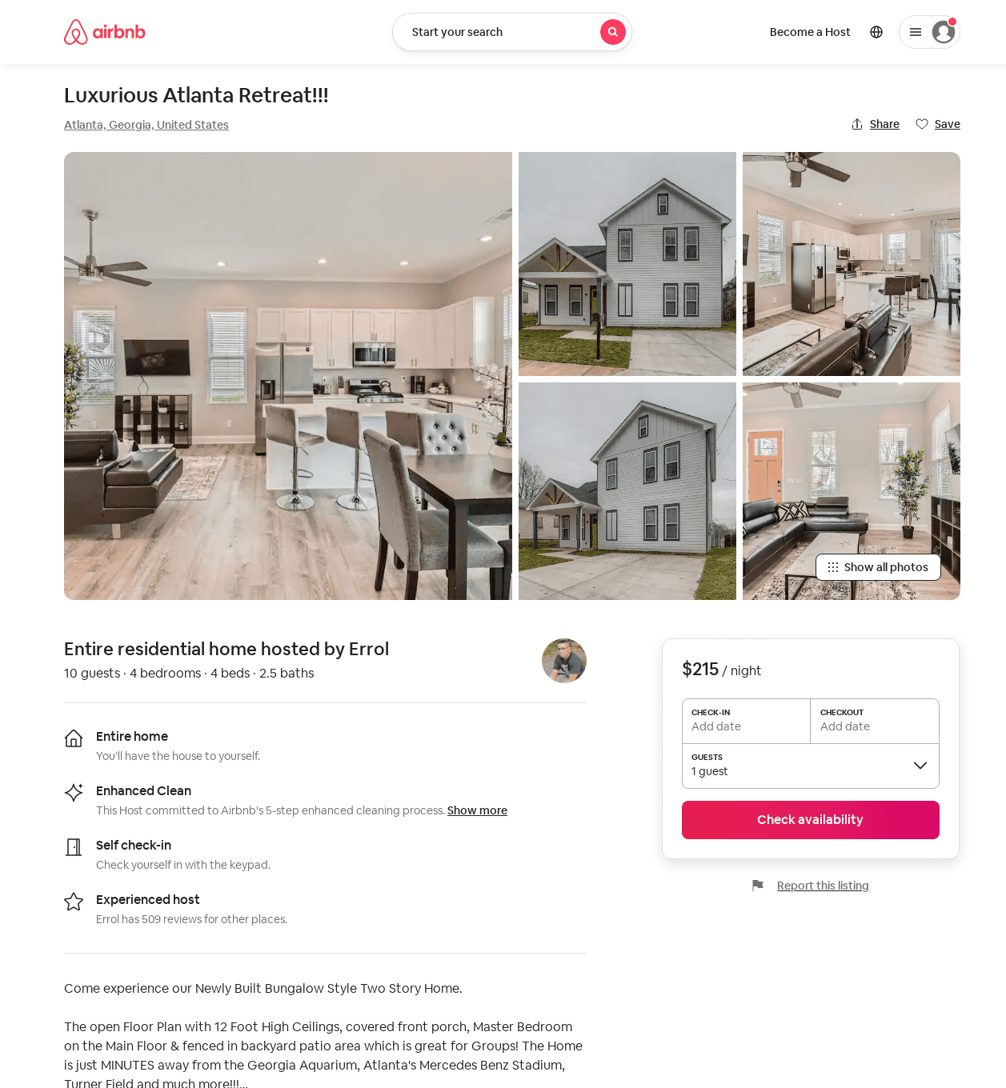
Listing 53972472
4
10
$158 - $215
4.88
2
Errol
97037186
12
https://www.airbnb.com/rooms/53972472
Aug 2022

Slide 51
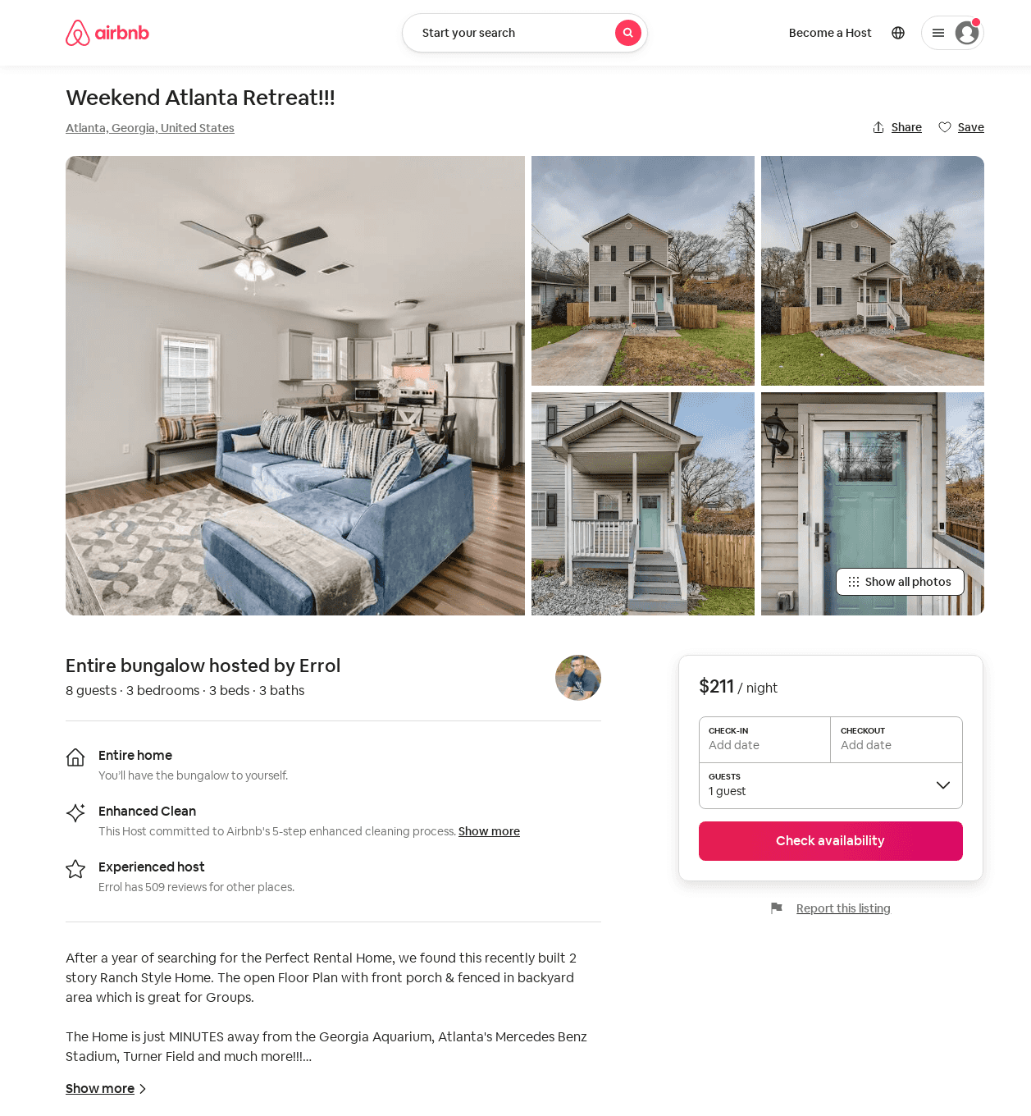
Listing 53888555
3
8
$116 - $211
4.89
2
Errol
97037186
12
https://www.airbnb.com/rooms/53888555
Aug 2022

Slide 52
Listing 53709141
3
6
$86 - $149
4.63
21
Ron
13665735
3
https://www.airbnb.com/rooms/53709141
Aug 2022

Slide 53
Listing 2566806
2
4
$119 - $185
5
1
DC Investment
https://www.vrbo.com/2566806
Aug 2022

Slide 54
Listing 2581713
3
6
$113 - $145
21
Ron T.
https://www.vrbo.com/2581713
Aug 2022

Slide 55
Listing 2206359
4
10
$150 - $176
5
2
Errol J Allen
https://www.vrbo.com/2206359
Aug 2022

Slide 56
Listing 1753531
3
8
$150 - $167
4.5
2
Errol J Allen
https://www.vrbo.com/1753531
Aug 2022

Slide 57
Listing 2592490
4
10
$188 - $231
4.8
1
Maria McNiece
https://www.vrbo.com/2592490
Aug 2022

Slide 58
Listing 51726966
3
5
$146 - $200
4.82
1
Terry
93338832
3
https://www.airbnb.com/rooms/51726966
Jul 2022

Slide 59
Listing 2616680
3
6
$200
5
1
https://www.vrbo.com/2616680
Aug 2022

Slide 60
Listing 54244961
3
8
$111 - $250
4.83
2
O Two
439884276
1
https://www.airbnb.com/rooms/54244961
Jun 2022

Slide 61
Listing 54294454
1
4
$64 - $106
4.92
2
Chris
42863807
2
https://www.airbnb.com/rooms/54294454
Jun 2022

Slide 62
Listing 54327842
3
8
$200 - $309
5.0
2
Logan
440751637
1
https://www.airbnb.com/rooms/54327842
Aug 2022

Slide 63
Listing 2624452
3
6
$386
5
2
https://www.vrbo.com/2624452
Aug 2022

Slide 64
Listing 2626398
3
7
$1,625
3
https://www.vrbo.com/2626398
Aug 2022

Slide 65
Listing 54388495
3
12
$286 - $375
1
Corrina
343308967
2
https://www.airbnb.com/rooms/54388495
Aug 2022

Slide 66
Listing 49477042
3
6
$500 - $750
1
Eddie
211015366
1
https://www.airbnb.com/rooms/49477042
Aug 2022

Slide 67
Listing 54363540
3
12
$113 - $282
4.54
1
Andrew
78939018
2
https://www.airbnb.com/rooms/54363540
Aug 2022

Slide 68
Listing new-listing-large-home-near-mercedes-benz-stadium-sleeps-12-coffee-bbq-ac-parkin
undefined
12
6.3
https://www.booking.com/hotel/us/new-listing-large-home-near-mercedes-benz-stadium-sleeps-12-coffee-bbq-ac-parkin.html
Sep 2022

Slide 69
Listing avoid-atl-traffic-in-bungalow-5-min-from-downtown-atlanta1
undefined
4
7.5
https://www.booking.com/hotel/us/avoid-atl-traffic-in-bungalow-5-min-from-downtown-atlanta1.html
Sep 2022

Slide 70
Listing cozy-home-in-the-heart-of-atlanta
undefined
7
6.4
https://www.booking.com/hotel/us/cozy-home-in-the-heart-of-atlanta.html
Sep 2022

Slide 71
Listing 15617140
1
2
$50
4.77
1
Johndell
96994789
1
https://www.airbnb.com/rooms/15617140
Aug 2022

Slide 72
Listing 2660161
3
8
$167
2
Errol J Allen
https://www.vrbo.com/2660161
Aug 2022

Slide 73
Listing 2661981
3
8
$170
5
2
Errol J Allen
https://www.vrbo.com/2661981
Aug 2022

Slide 74
Listing 2660525
3
8
$150
2
Errol J Allen
https://www.vrbo.com/2660525
Aug 2022

Slide 75
Listing 2661319
3
8
$221
2
Carlton
https://www.vrbo.com/2661319
Aug 2022

Slide 76
Listing 2692784
3
6
$152
4.5
2
Roshad
https://www.vrbo.com/2692784
Aug 2022

Slide 77
Listing 47538135
3
6
$123 - $140
4.81
2
Roshad
383558199
1
https://www.airbnb.com/rooms/47538135
Aug 2022

Slide 78
Listing 2694363
3
8
$250
3
https://www.vrbo.com/2694363
Aug 2022

Slide 79
Listing 50308940
4
10
$128 - $239
4.84
1
Cynthia
406241230
1
https://www.airbnb.com/rooms/50308940
Aug 2022

Slide 80
Listing 2734713
3
6
$250
2
https://www.vrbo.com/2734713
Aug 2022

Slide 81
Listing 29490231
1
2
$55 - $60
4.0
1
Sohna
183389523
1
https://www.airbnb.com/rooms/29490231
Jun 2022

Slide 82
Listing 2515435
3
6
$116
5
2
Nardos Benton
https://www.vrbo.com/2515435
Aug 2022

Slide 83
Listing 2786698
3
7
$125
2
Vacasa of Georgia
https://www.vrbo.com/2786698
Aug 2022

Slide 84
Listing 2845514
3
7
$250
1
https://www.vrbo.com/2845514
Aug 2022

Slide 85
Listing 9697981
3
10
$135
3
Evolve
https://www.vrbo.com/9697981ha
Aug 2022

Slide 86
Listing 2865098
3
12
$131
2
Vacasa of Georgia
https://www.vrbo.com/2865098
Aug 2022

Slide 87
Listing 51386908
4
14
4.57
2
Kru
408613679
13
https://www.airbnb.com/rooms/51386908
Aug 2022

