Slide 2
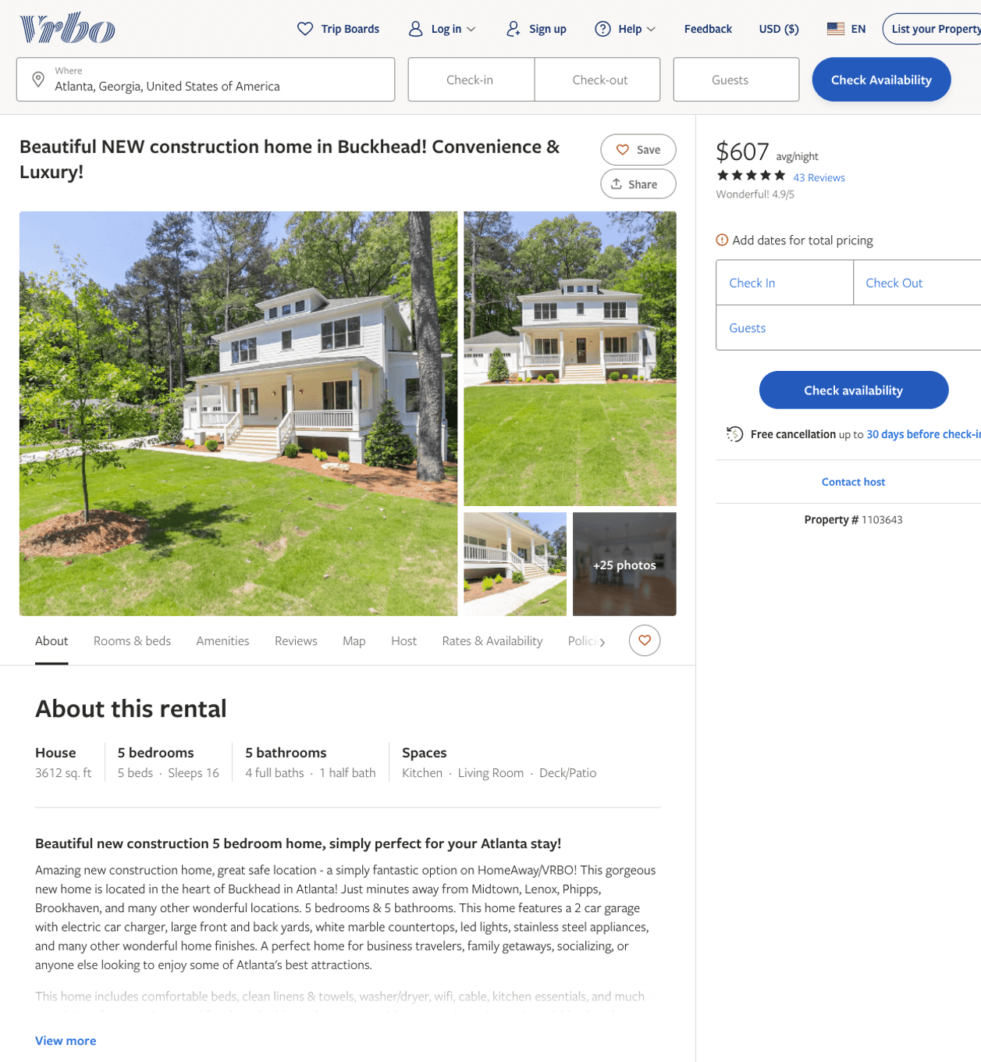
Listing 1103643
5
18
$400 - $607
4.9074073
1
Michael
https://www.vrbo.com/1103643
Aug 2022

Slide 3
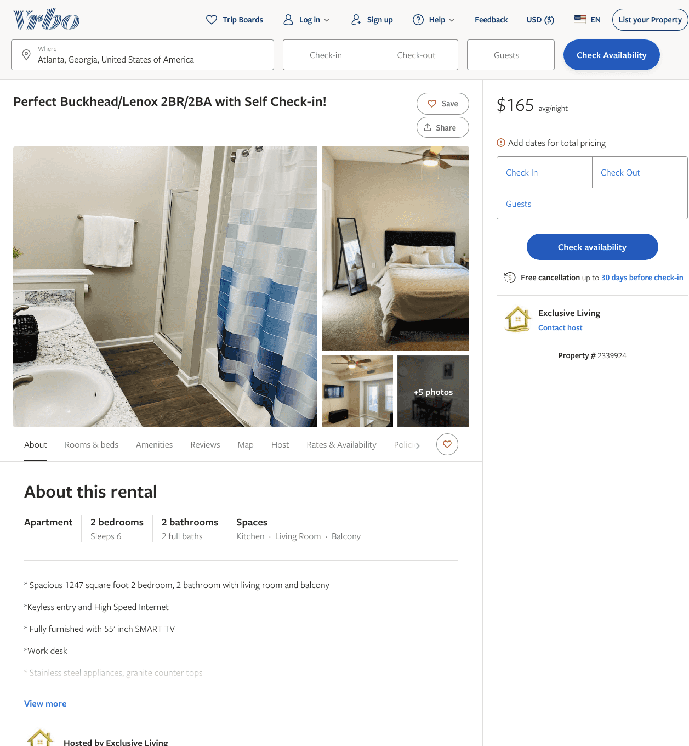
Listing 2339924
2
6
$165
2
Exclusive Living
https://www.vrbo.com/2339924
Aug 2022

Slide 4
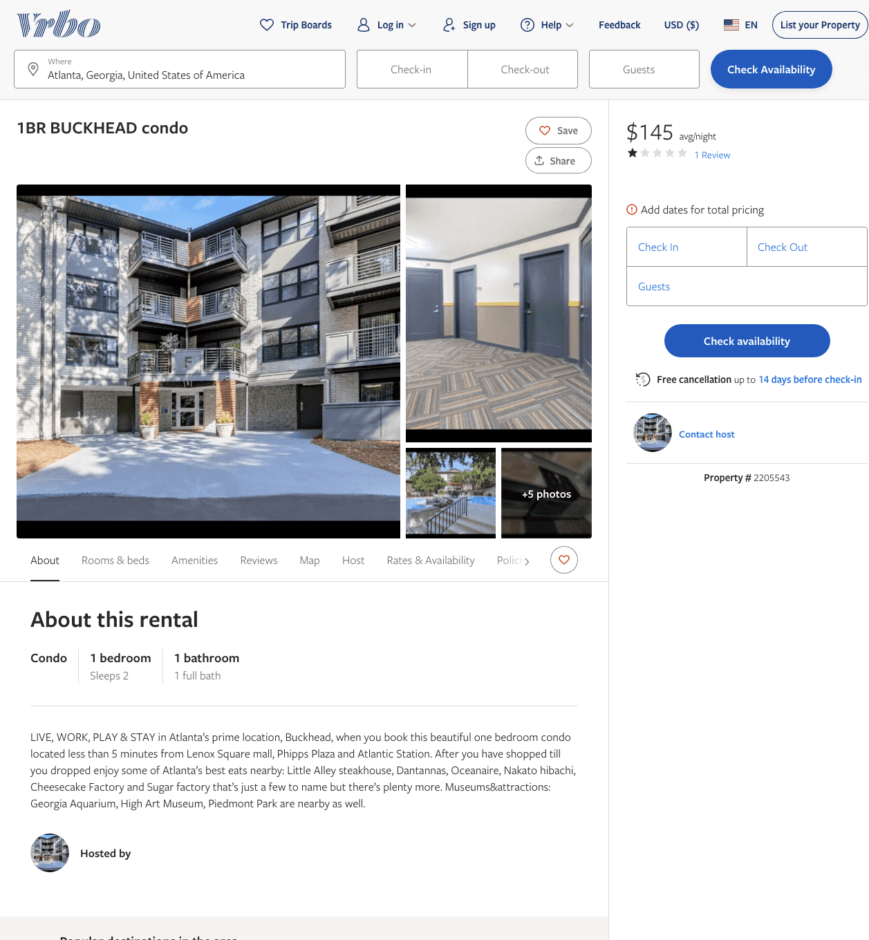
Listing 2205543
1
2
$145
1
2
https://www.vrbo.com/2205543
Aug 2022

Slide 5
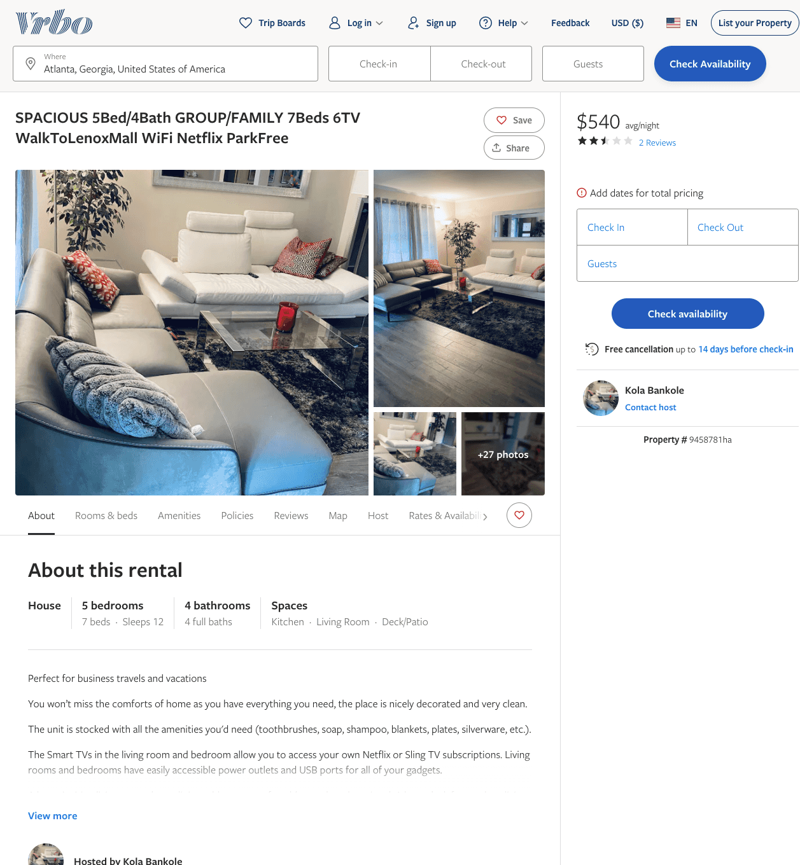
Listing 9458781
5
12
$540
2.5
3
Kola Bankole
https://www.vrbo.com/9458781ha
Aug 2022

Slide 6
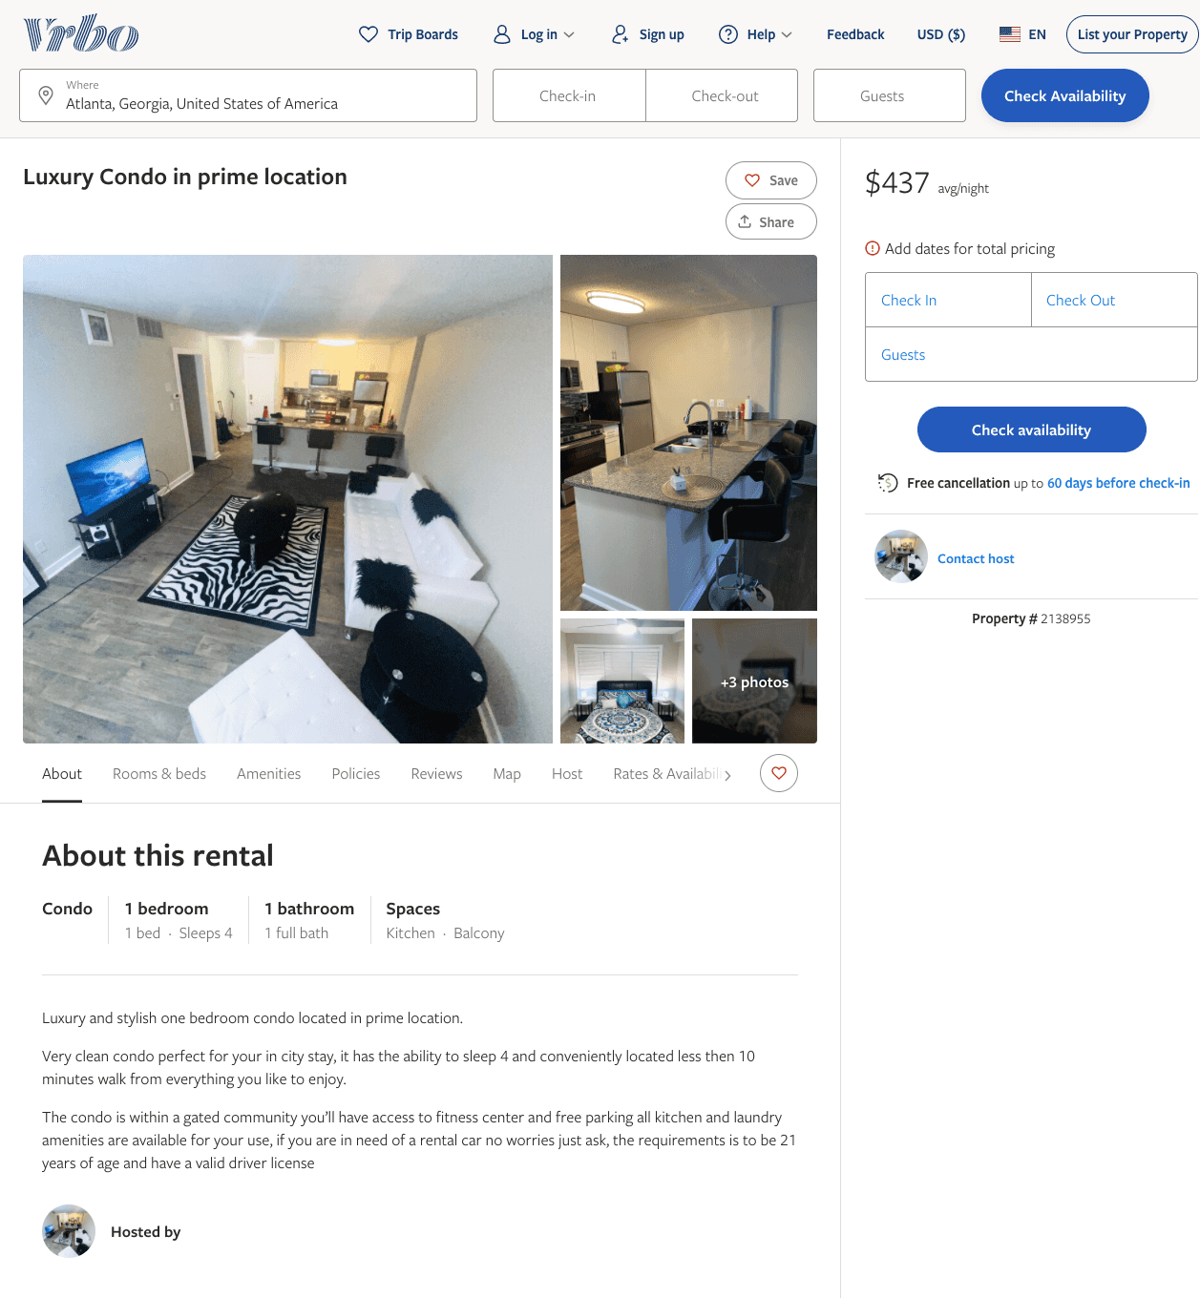
Listing 2138955
1
4
$430 - $437
1
https://www.vrbo.com/2138955
Aug 2022

Slide 7
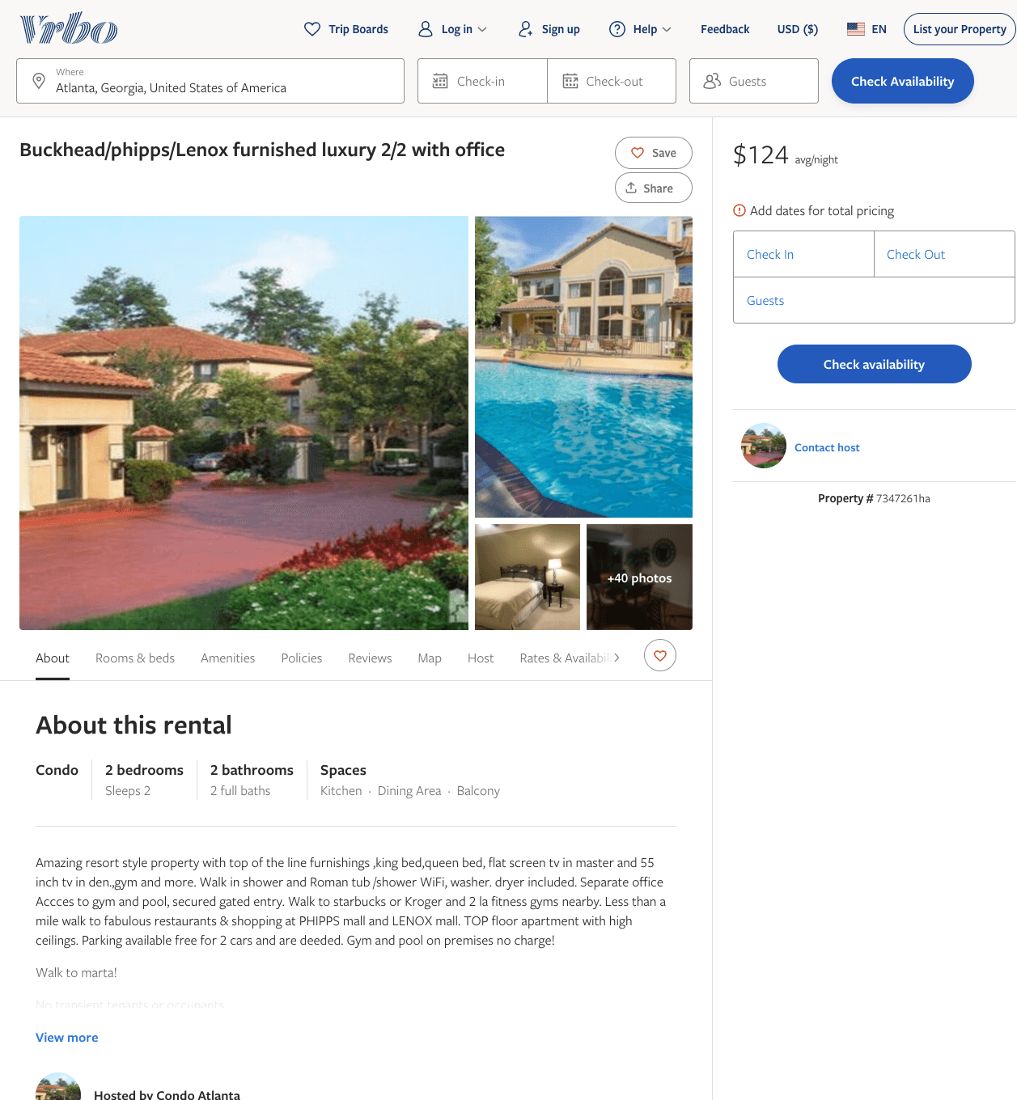
Listing 7347261
2
2
$124
30
https://www.vrbo.com/7347261ha
Aug 2022

Slide 8
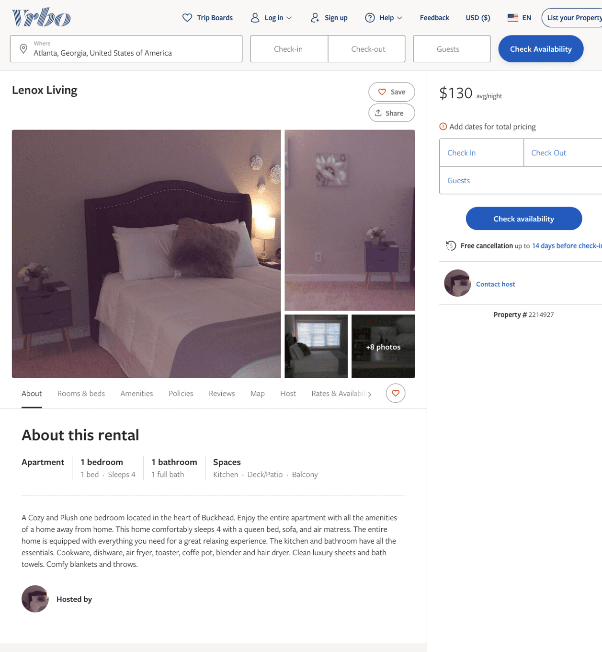
Listing 2214927
1
4
$130
28
https://www.vrbo.com/2214927
Aug 2022

Slide 9
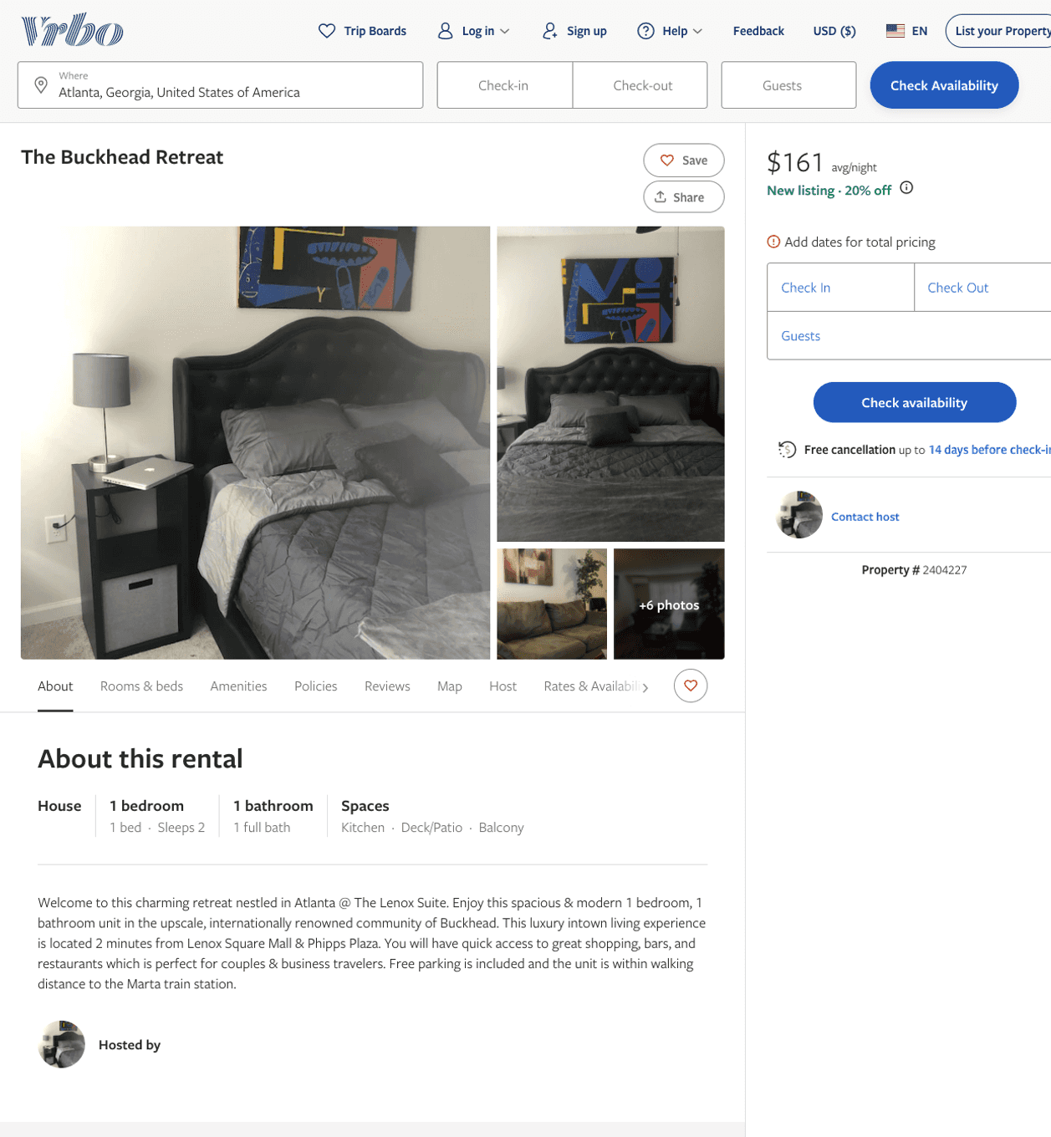
Listing 2404227
1
2
$150 - $161
1
https://www.vrbo.com/2404227
Aug 2022

Slide 10
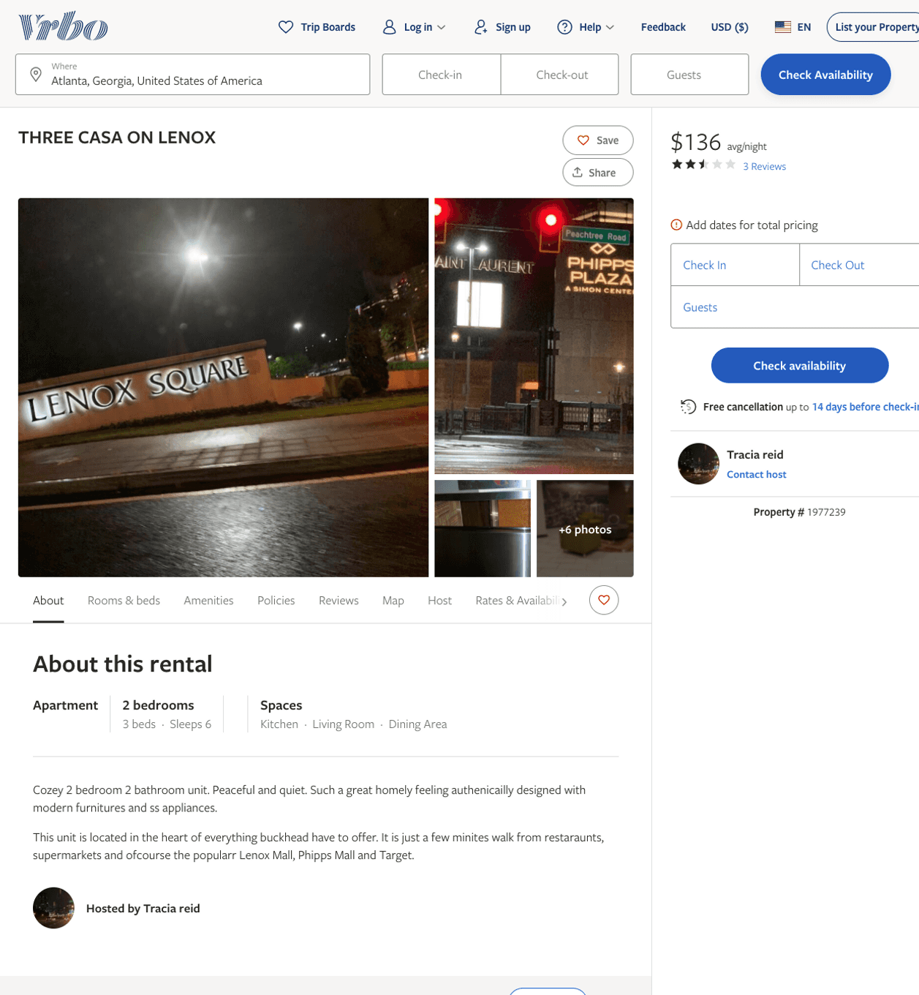
Listing 1977239
2
6
$120 - $185
2.3333333
1
Tracia reid
https://www.vrbo.com/1977239
Aug 2022

Slide 11
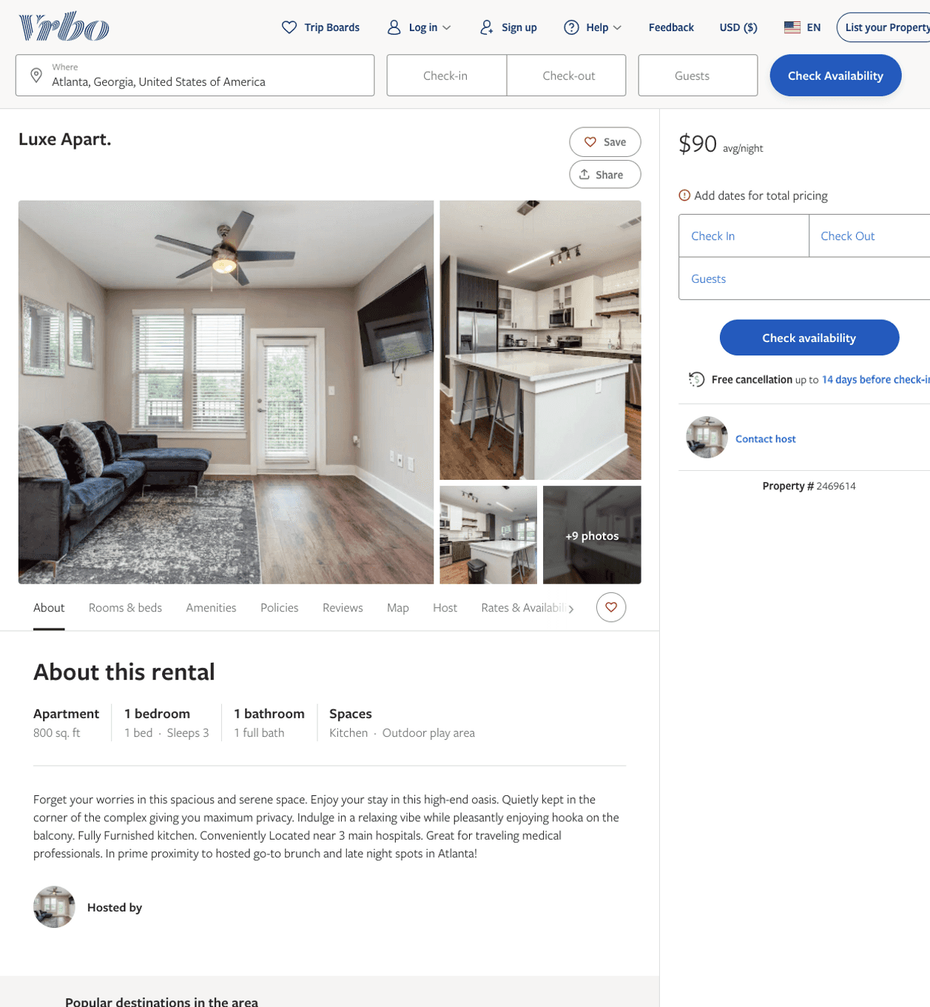
Listing 2469614
1
3
$110 - $90
5
2
https://www.vrbo.com/2469614
Aug 2022

Slide 12
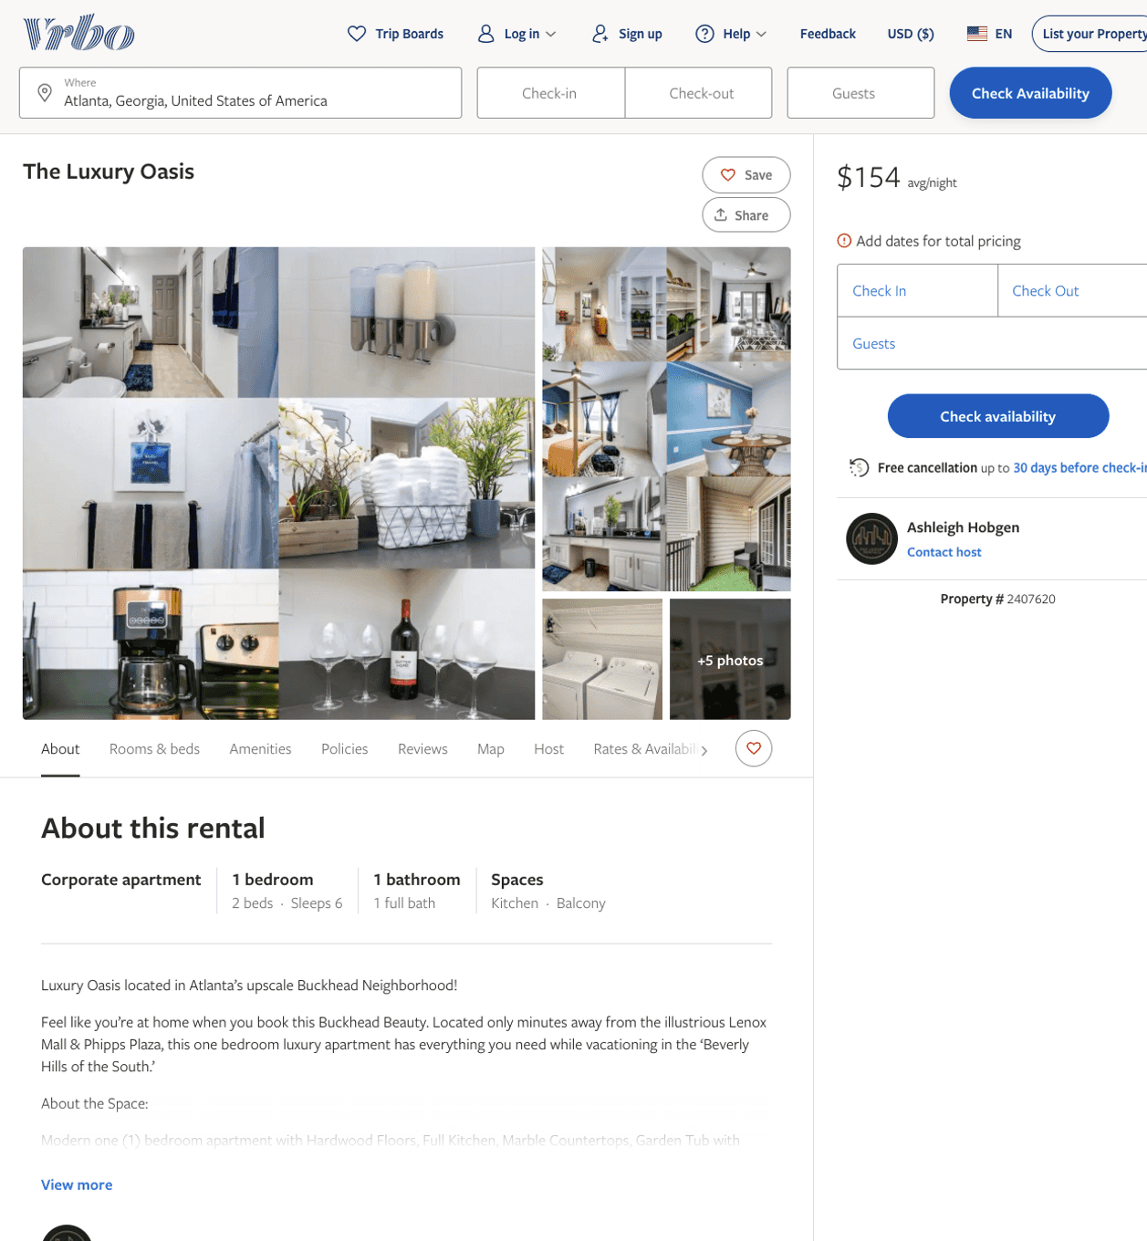
Listing 2407620
1
6
$146 - $154
2
Ashleigh Hobgen
https://www.vrbo.com/2407620
Aug 2022

Slide 13
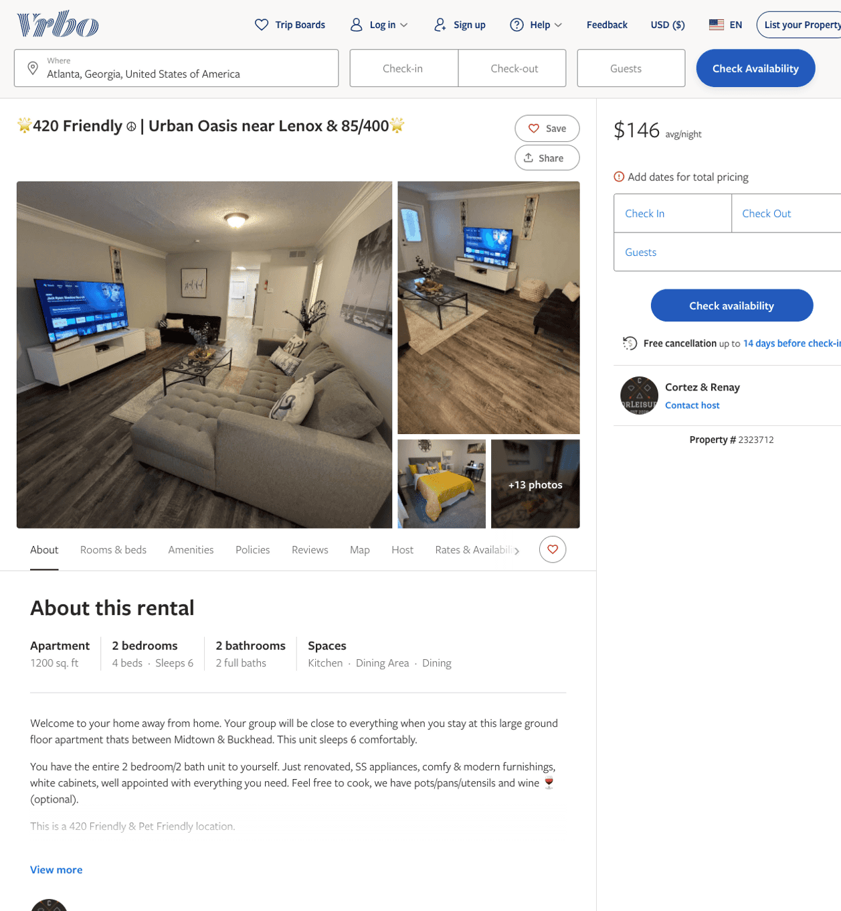
Listing 2323712
2
8
$120 - $146
2
Corleisure Rentals
https://www.vrbo.com/2323712
Aug 2022

Slide 14
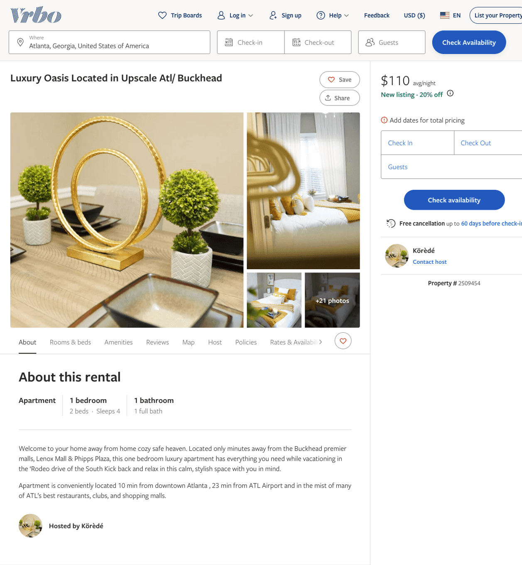
Listing 2509454
1
4
$110 - $130
2
Körèdé
https://www.vrbo.com/2509454
Aug 2022

Slide 15
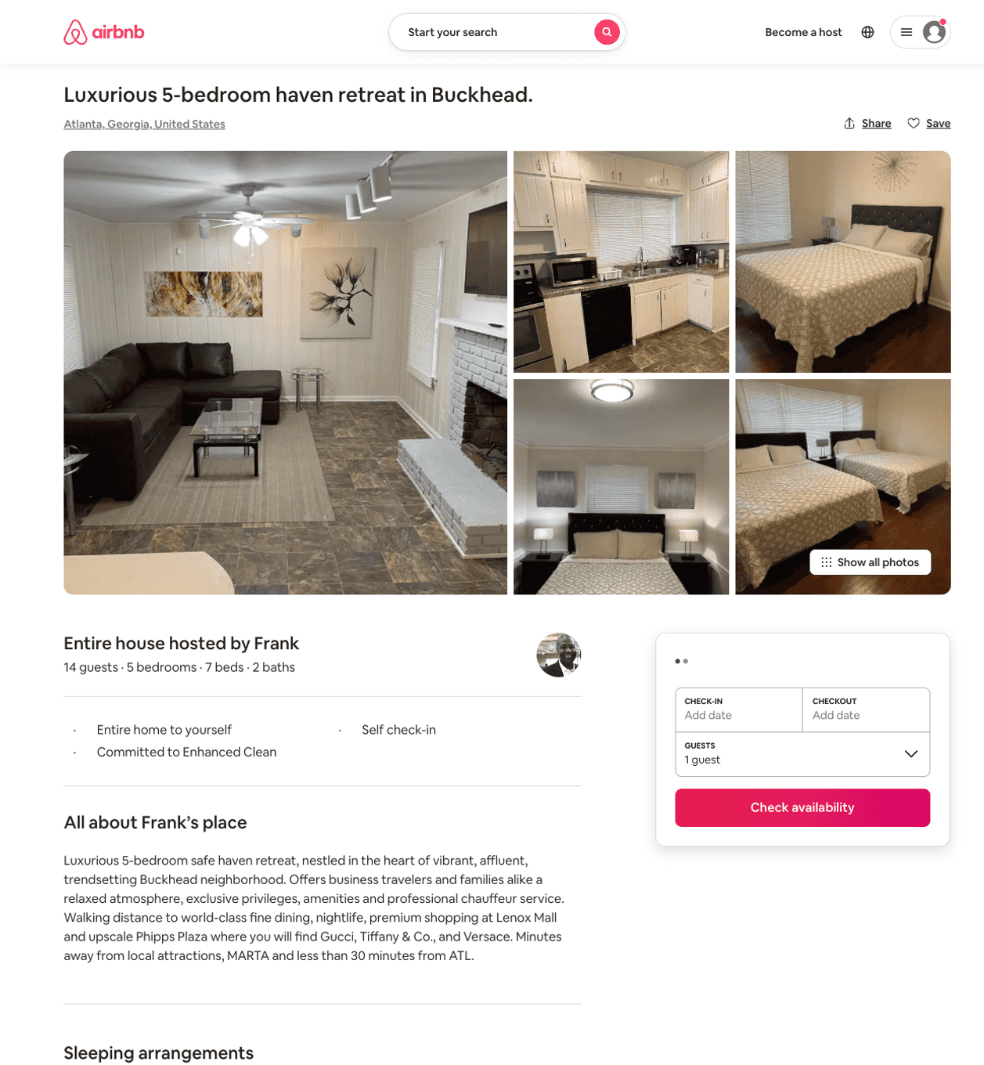
Listing 48741392
5
14
$368 - $600
4.22
2
Frank
20869221
1
https://www.airbnb.com/rooms/48741392
Aug 2022

Slide 16
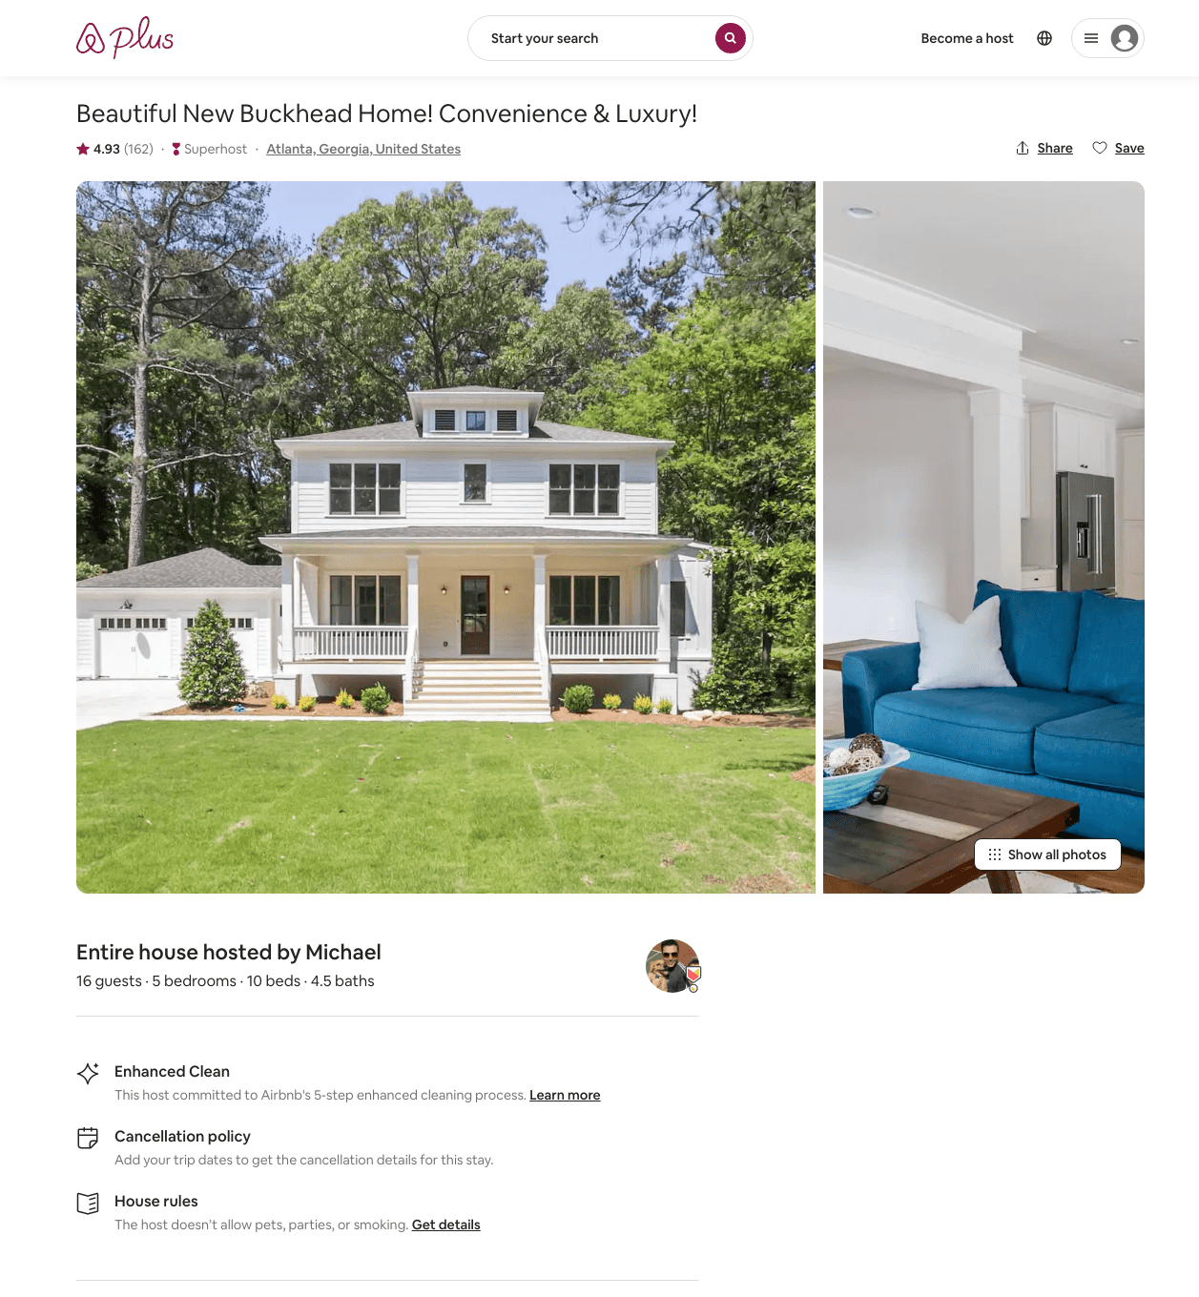
Listing 20131884
5
16
$309 - $478
4.94
1
Michael
143143166
5
https://www.airbnb.com/rooms/20131884
Aug 2022

Slide 17
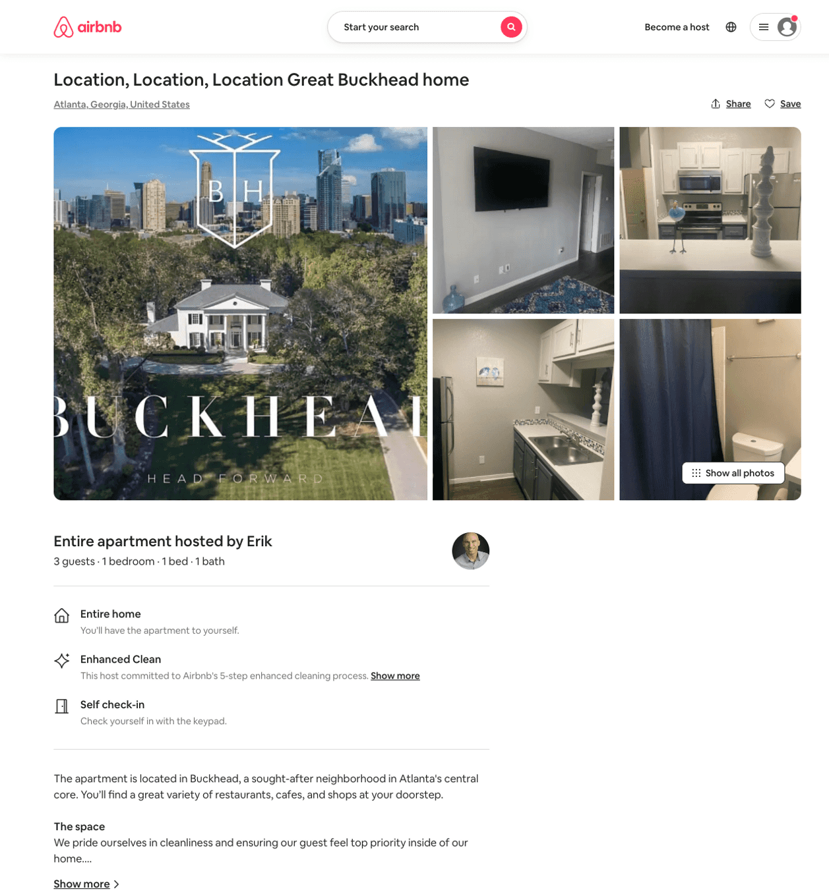
Listing 50324746
1
3
$60 - $86
4.63
1
Erik
406271701
1
https://www.airbnb.com/rooms/50324746
Aug 2022

Slide 18
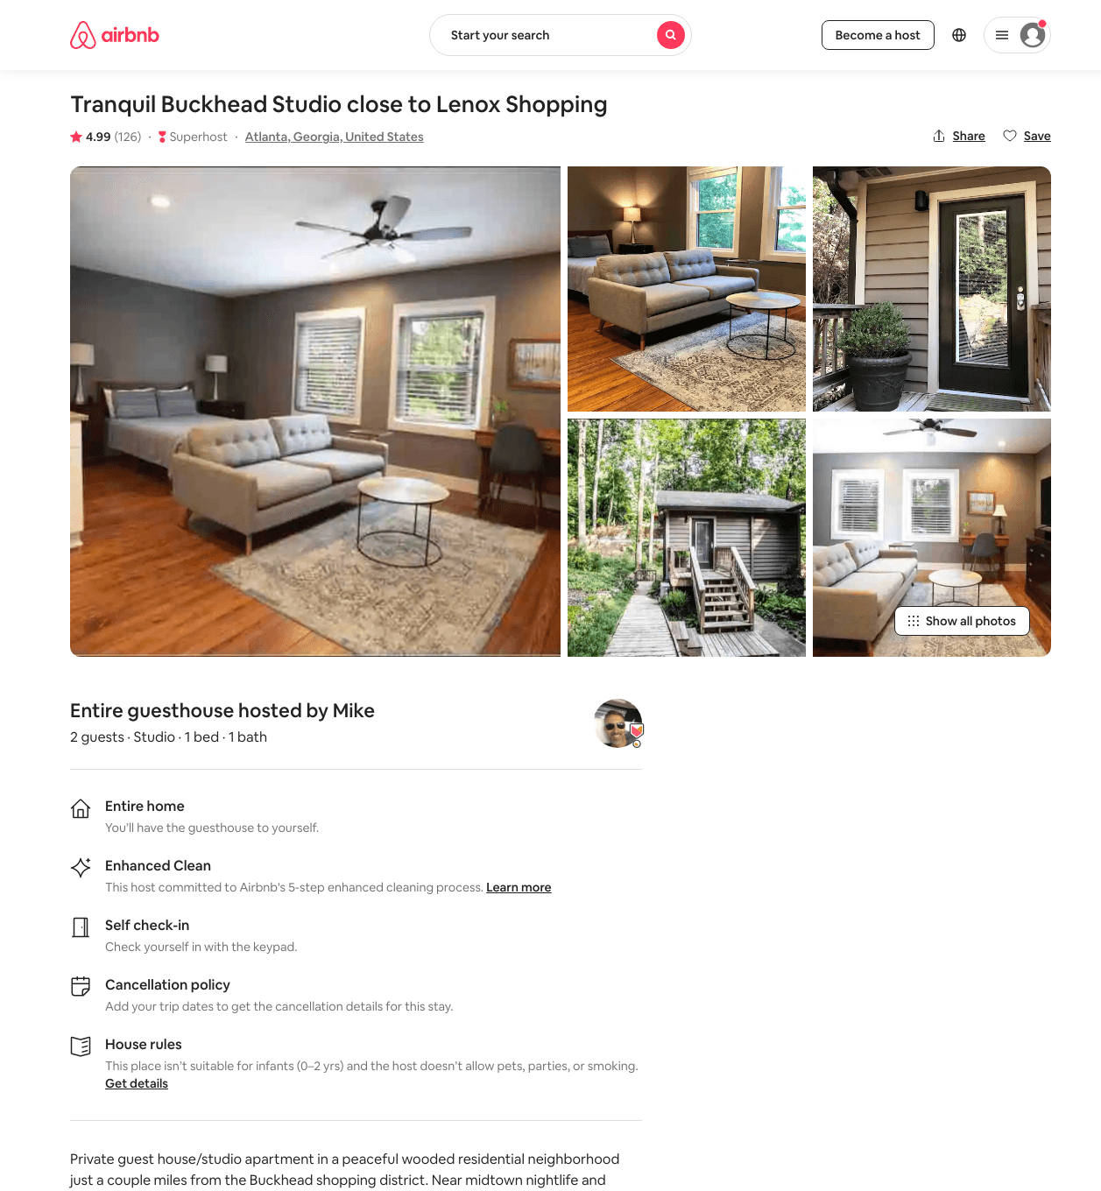
Listing 18637764
Studio
2
$70 - $116
4.99
2
Mike
32871860
1
https://www.airbnb.com/rooms/18637764
Aug 2022

Slide 19
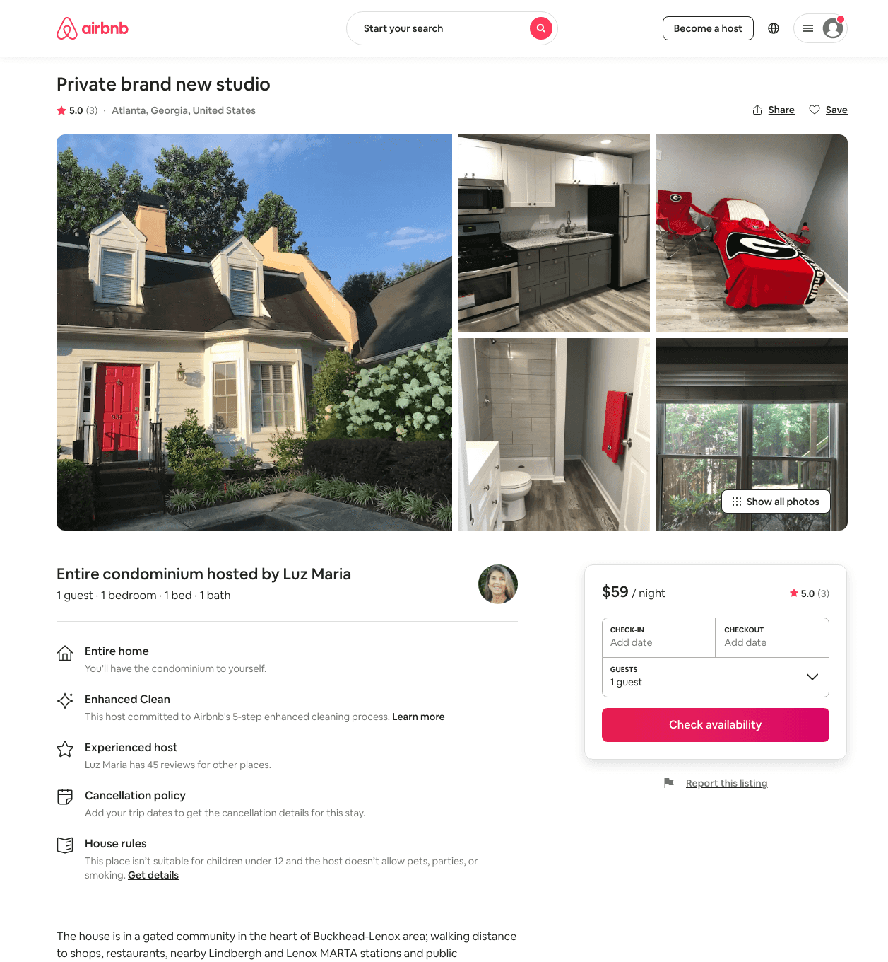
Listing 34864825
Studio
1
$59 - $99
5.0
7
Luz Maria
52709357
2
https://www.airbnb.com/rooms/34864825
Jun 2022

Slide 20
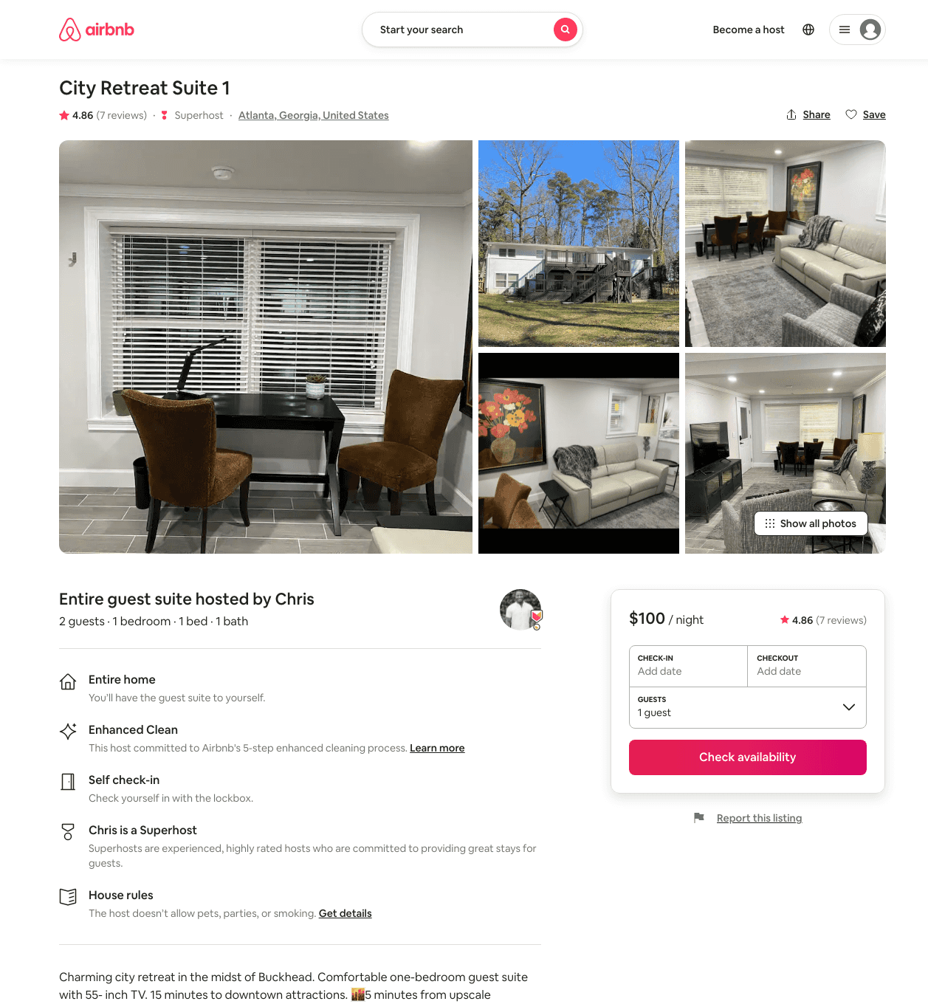
Listing 47385266
1
2
$90 - $125
4.84
3
Chris
106653753
3
https://www.airbnb.com/rooms/47385266
Aug 2022

Slide 21
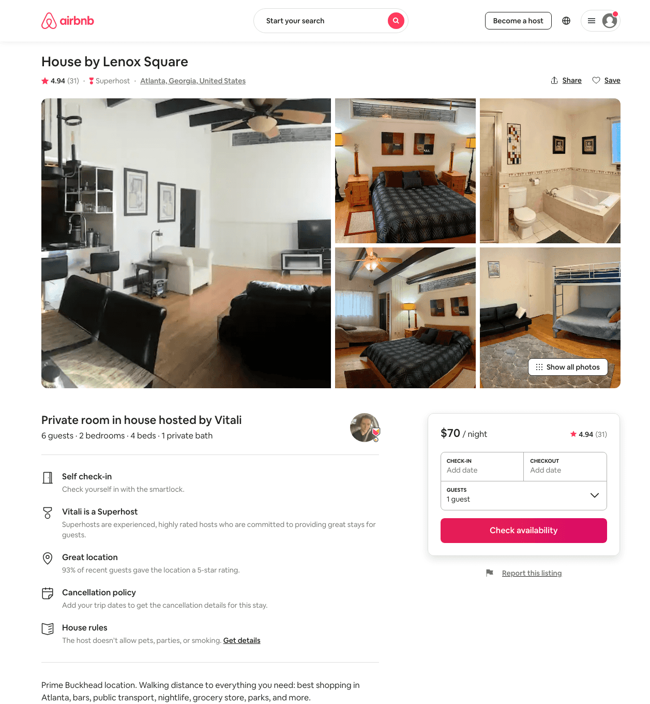
Listing 30570455
2
6
$71 - $74
4.94
1
Vitali
181900675
1
https://www.airbnb.com/rooms/30570455
Aug 2022

Slide 22
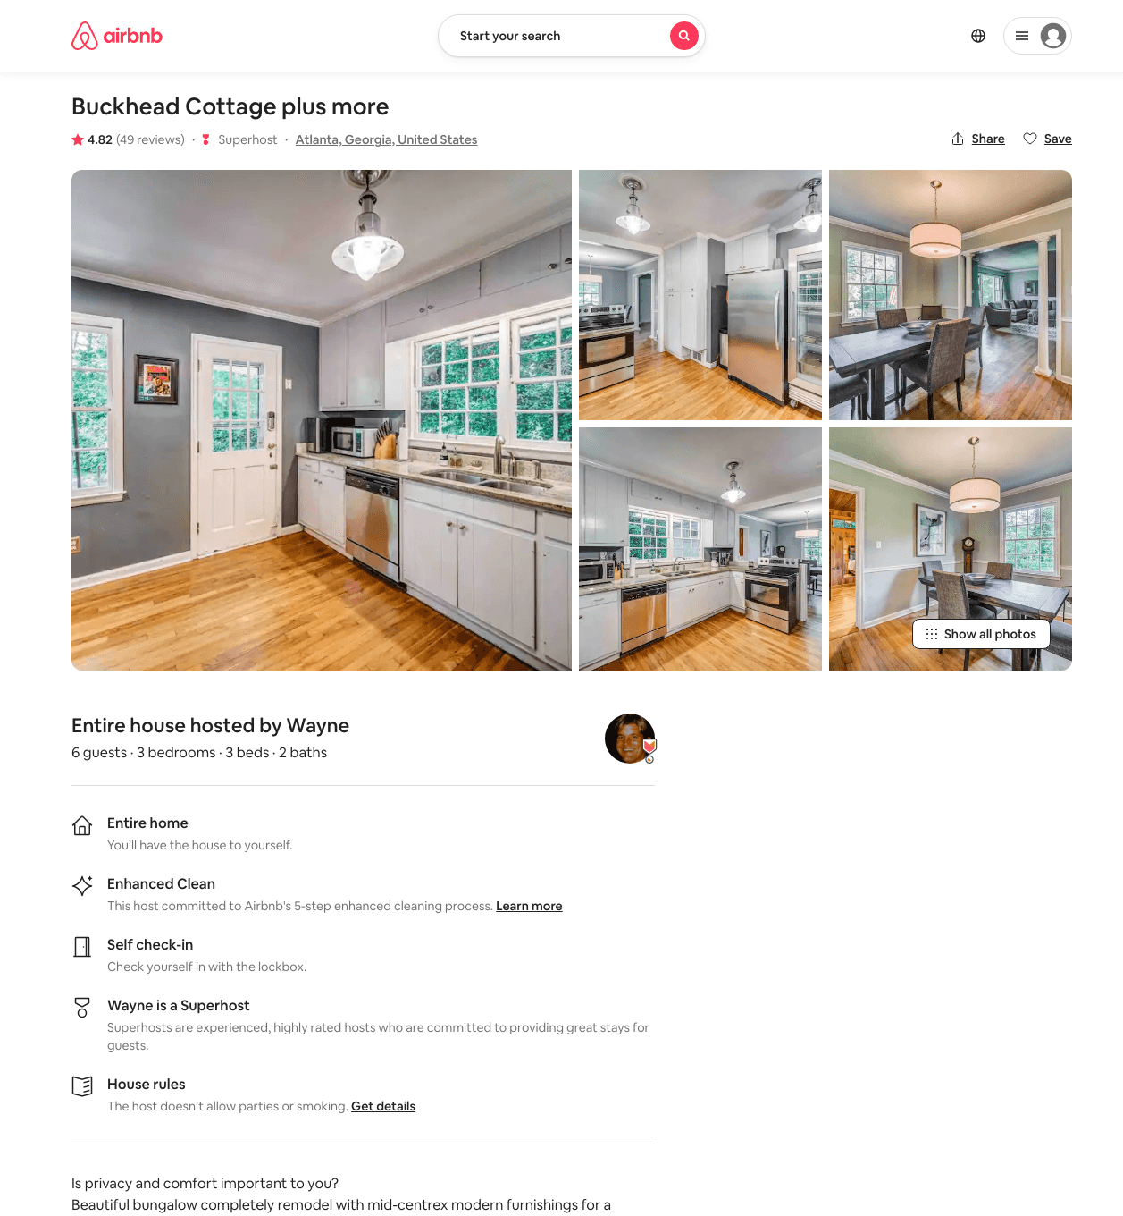
Listing 10432118
3
6
$271 - $391
4.81
3
Wayne
51483572
1
https://www.airbnb.com/rooms/10432118
Aug 2022

Slide 23
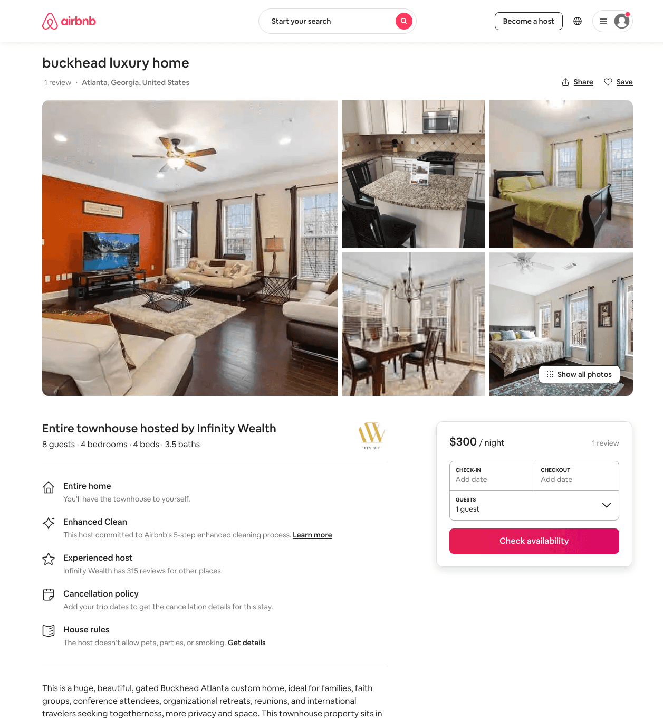
Listing 33151077
4
8
$300 - $450
10
Infinity Wealth
83899049
4
https://www.airbnb.com/rooms/33151077
Aug 2022

Slide 24
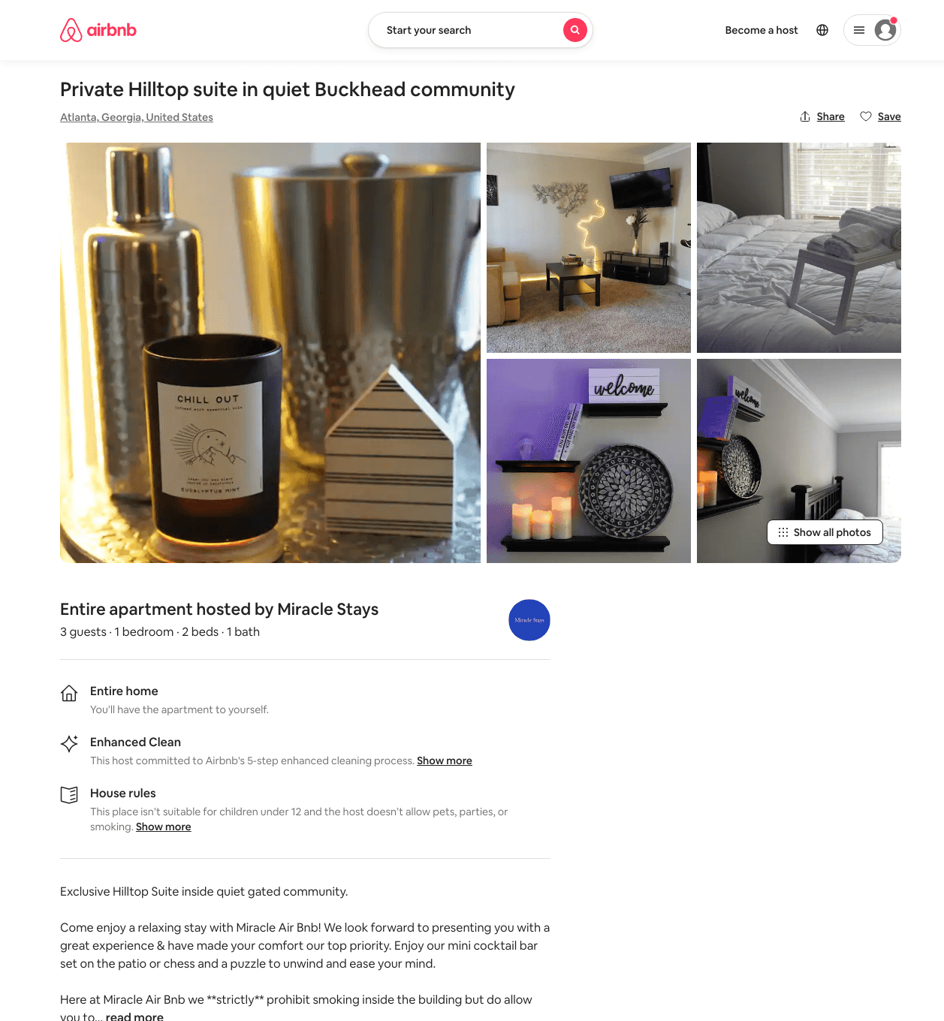
Listing 48742540
1
3
$81 - $85
1
Miracle Stays
154415050
1
https://www.airbnb.com/rooms/48742540
Jul 2022

Slide 25
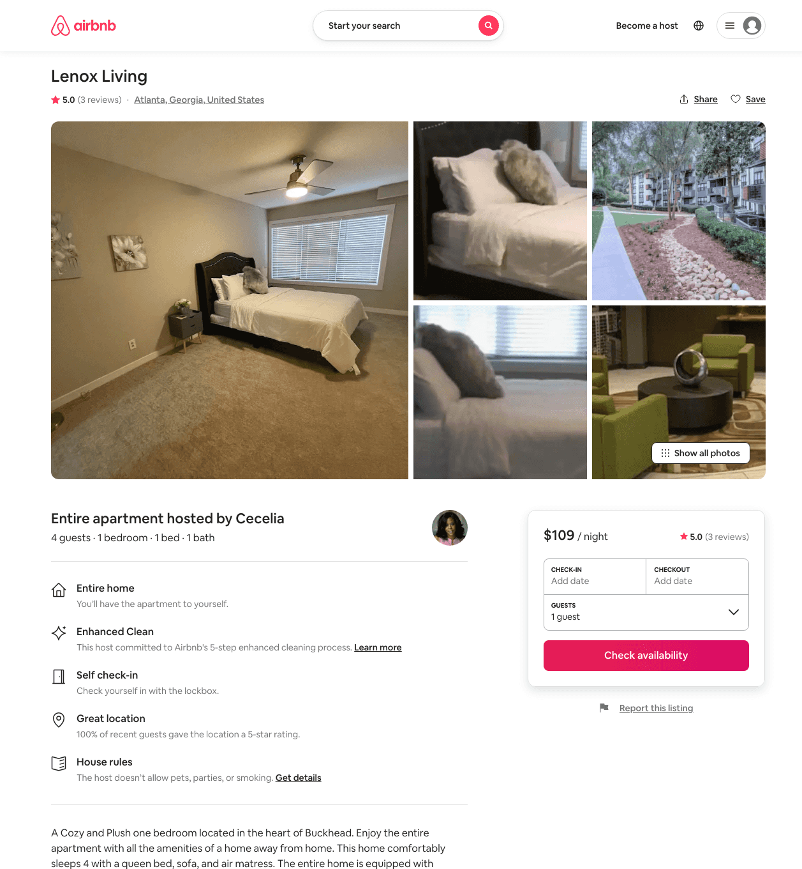
Listing 48032700
1
4
$109 - $110
4.89
1
Cecelia
174814177
1
https://www.airbnb.com/rooms/48032700
Jun 2022

Slide 26
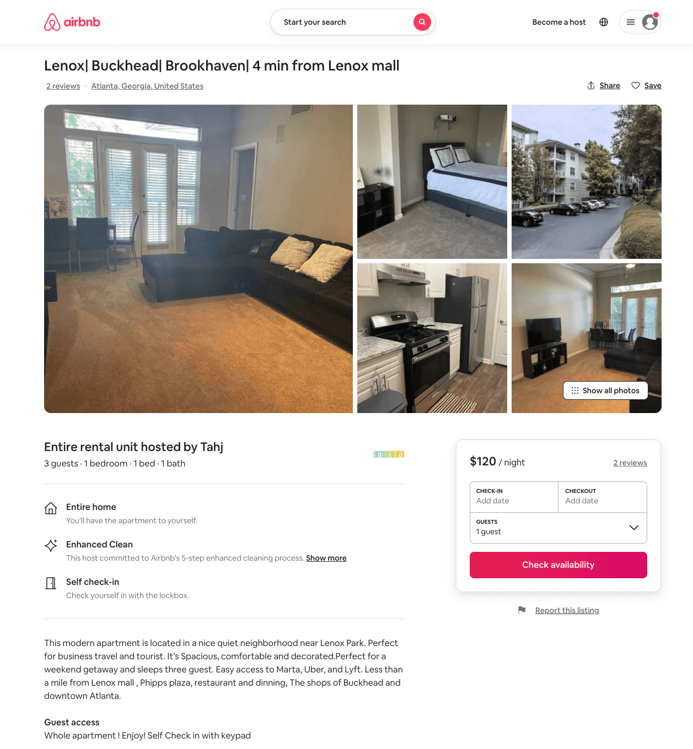
Listing 50457891
1
3
$120 - $129
4.33
1
Tahj
156218609
1
https://www.airbnb.com/rooms/50457891
Aug 2022

Slide 27
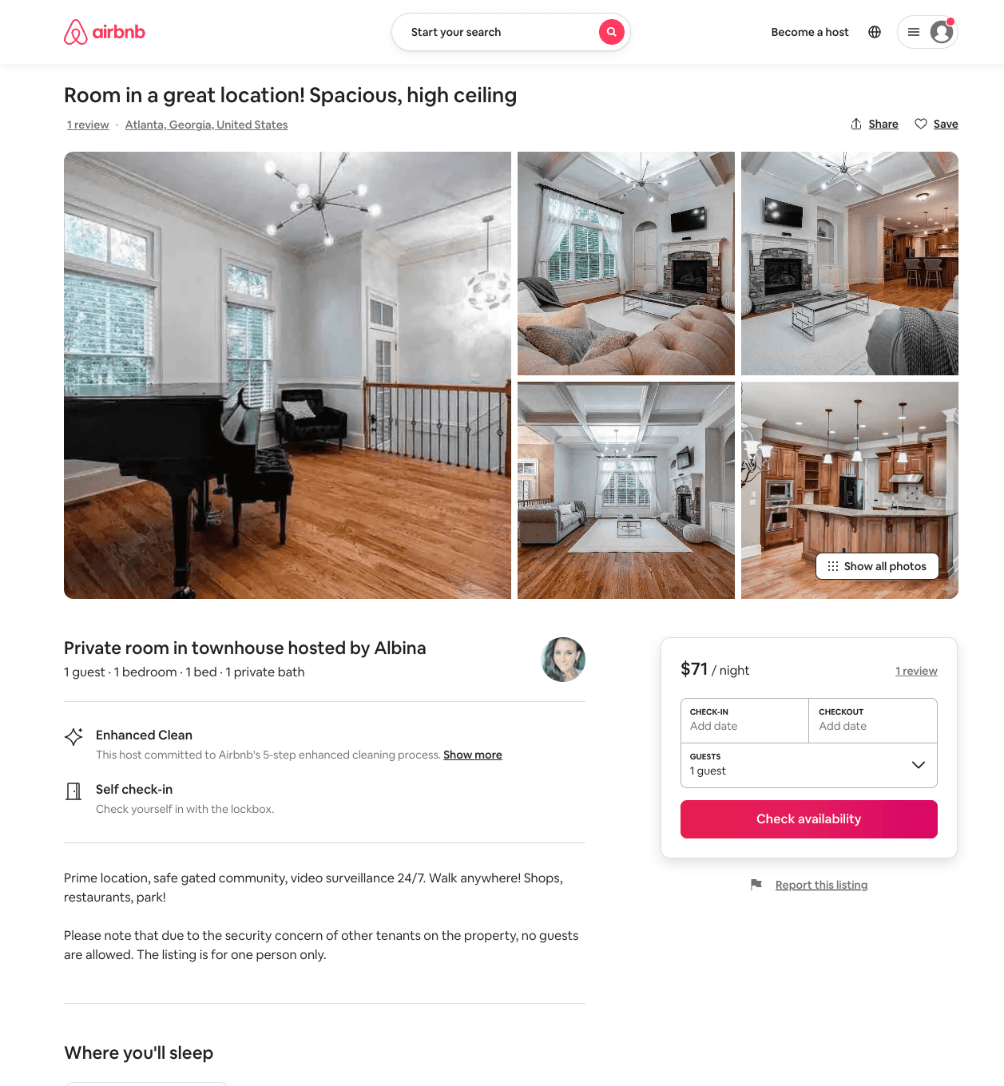
Listing 44646319
1
1
$59 - $71
30
Ally
198740831
3
https://www.airbnb.com/rooms/44646319
Aug 2022

Slide 28
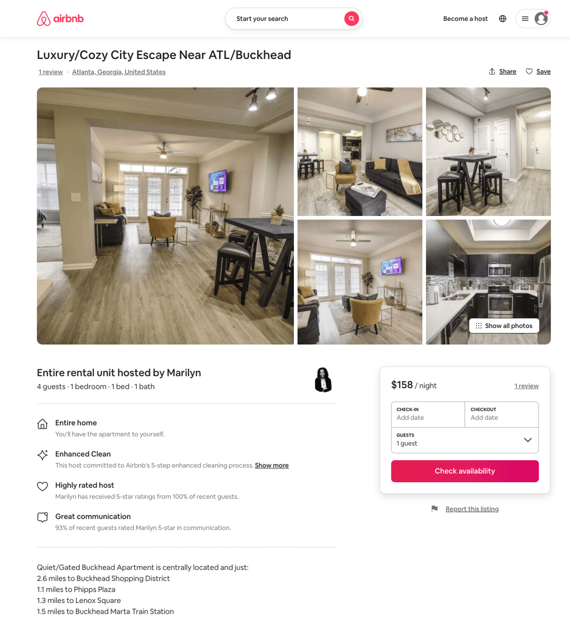
Listing 51353554
1
4
$91 - $158
4.74
2
Marilyn
384105711
3
https://www.airbnb.com/rooms/51353554
Aug 2022

Slide 29
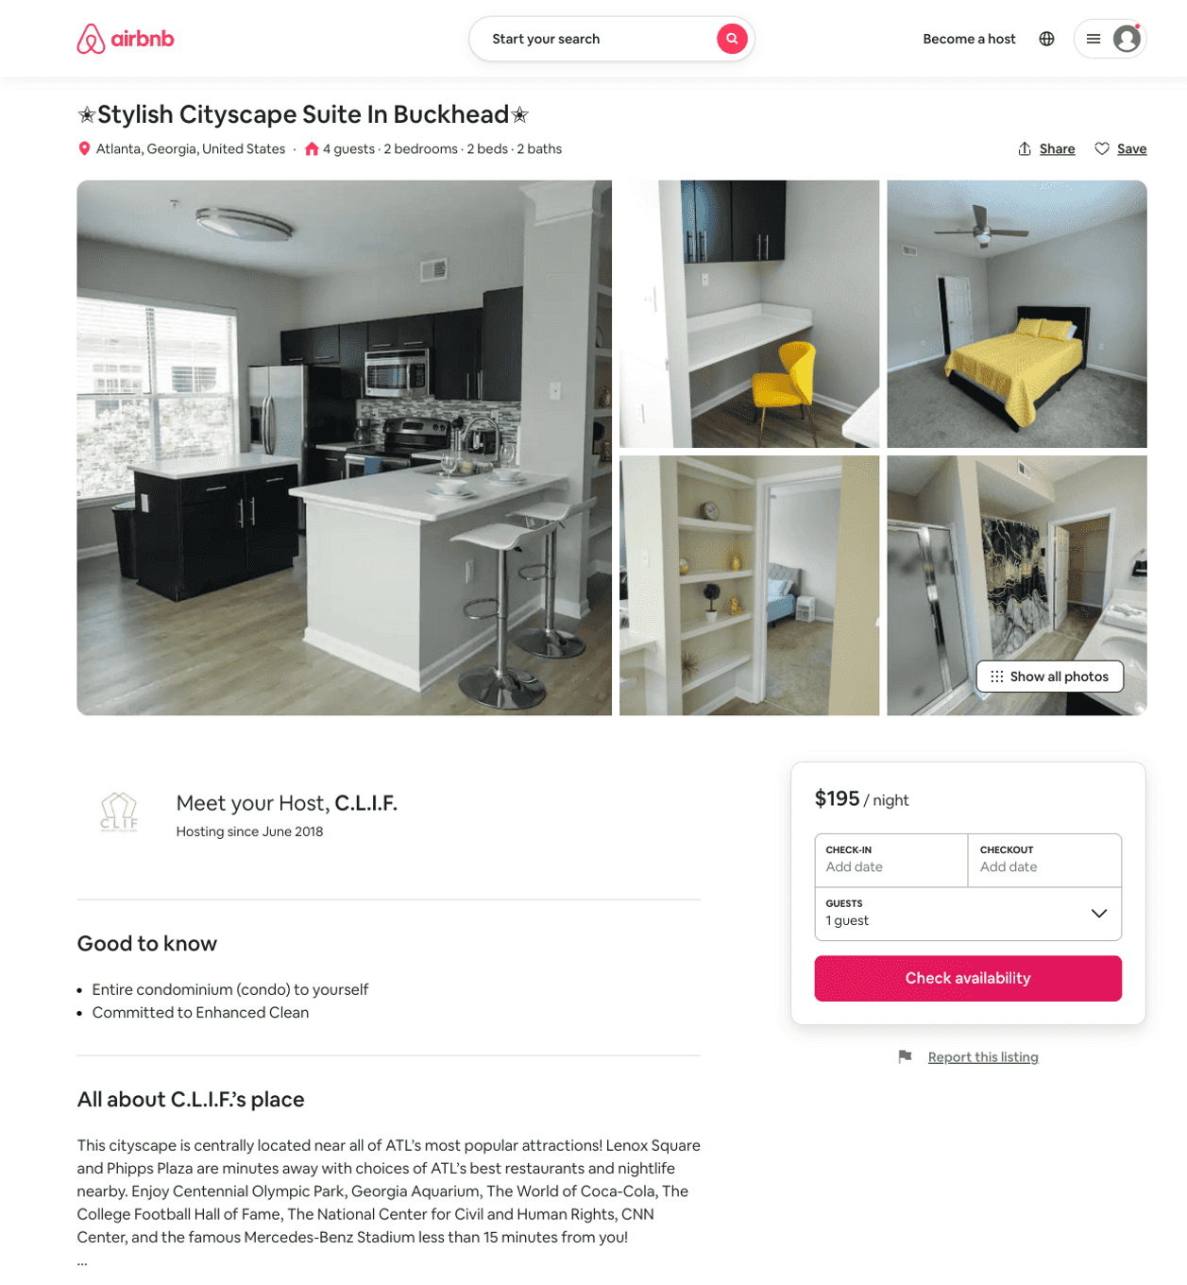
Listing 51537358
2
4
$120 - $195
4.0
1
C.L.I.F.
195831966
2
https://www.airbnb.com/rooms/51537358
Jun 2022

Slide 30
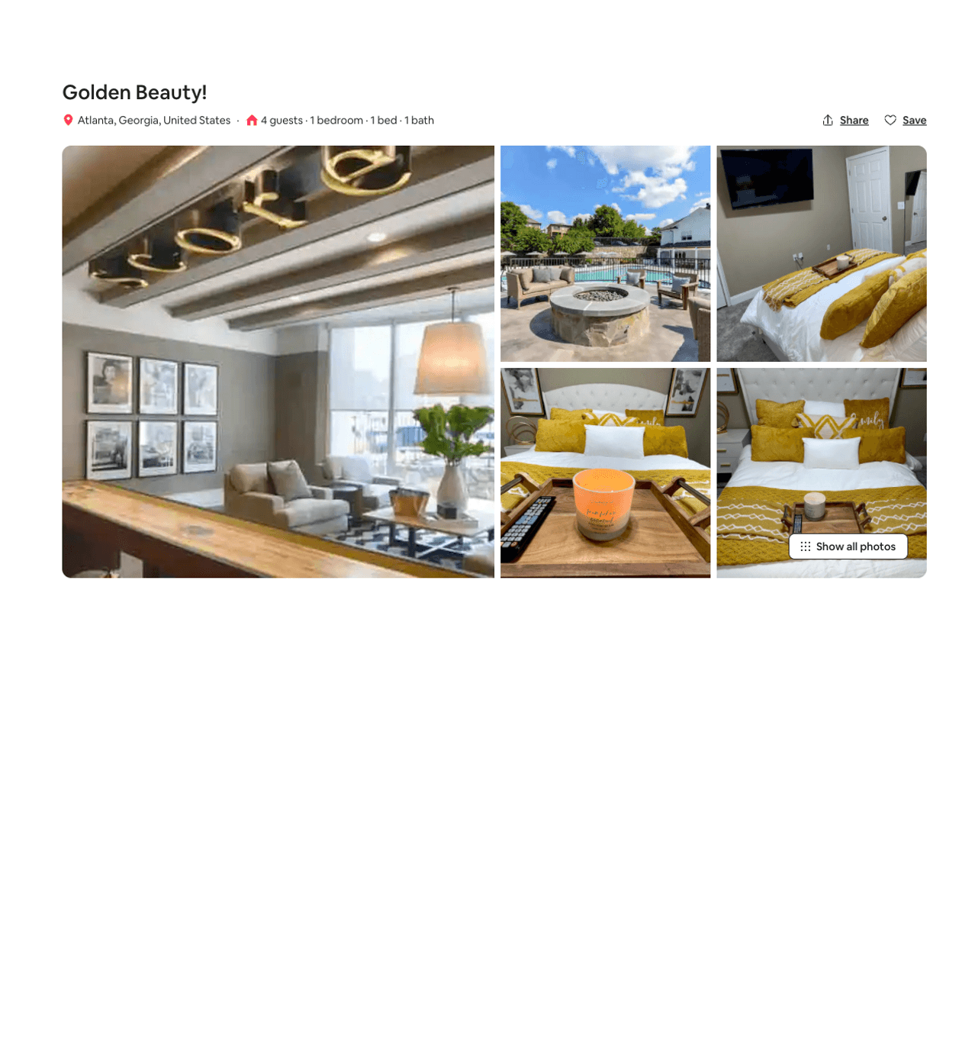
Listing 51701824
1
4
$82 - $165
4.91
2
La Nöir
404964655
1
https://www.airbnb.com/rooms/51701824
Aug 2022

Slide 31
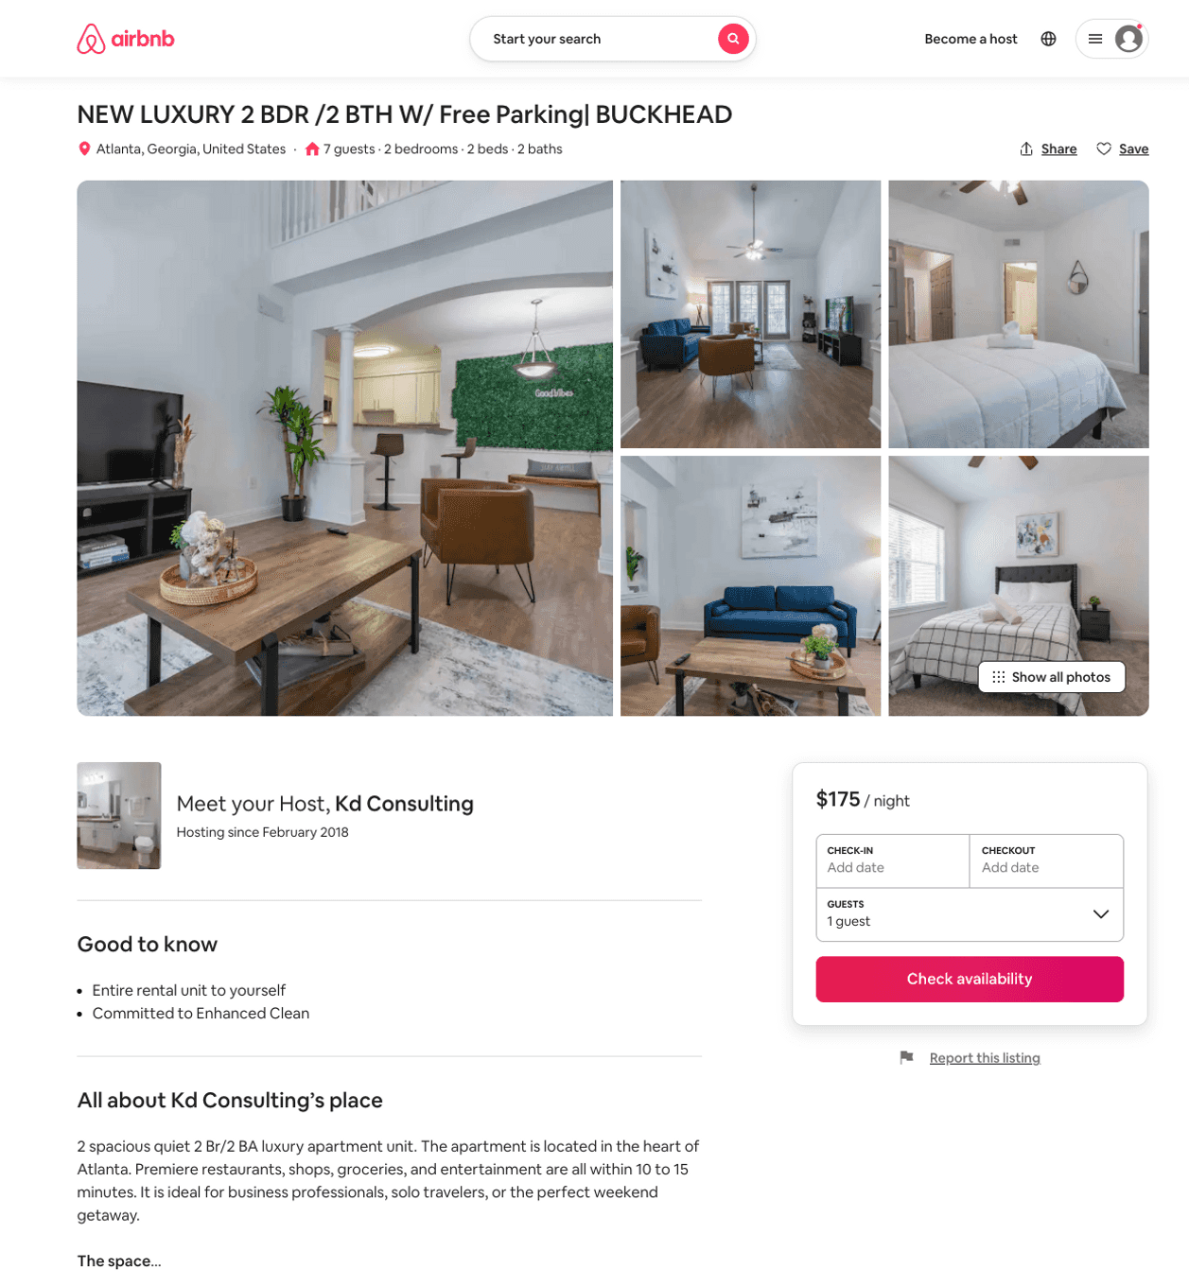
Listing 51652245
2
7
$95 - $204
4.48
2
Kd Consulting
173572972
1
https://www.airbnb.com/rooms/51652245
Jul 2022

Slide 32
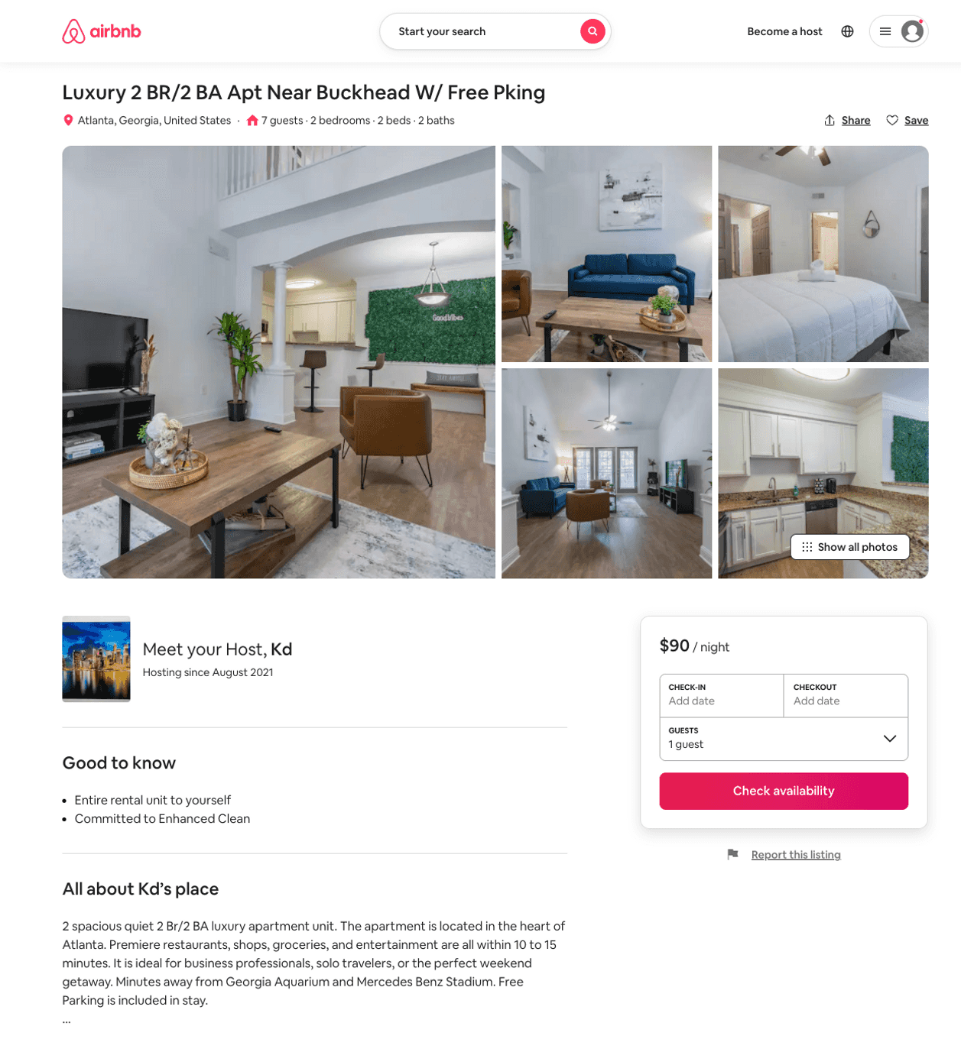
Listing 51715309
2
7
$80 - $225
4.33
2
Kd
418734826
1
https://www.airbnb.com/rooms/51715309
Jun 2022

Slide 33
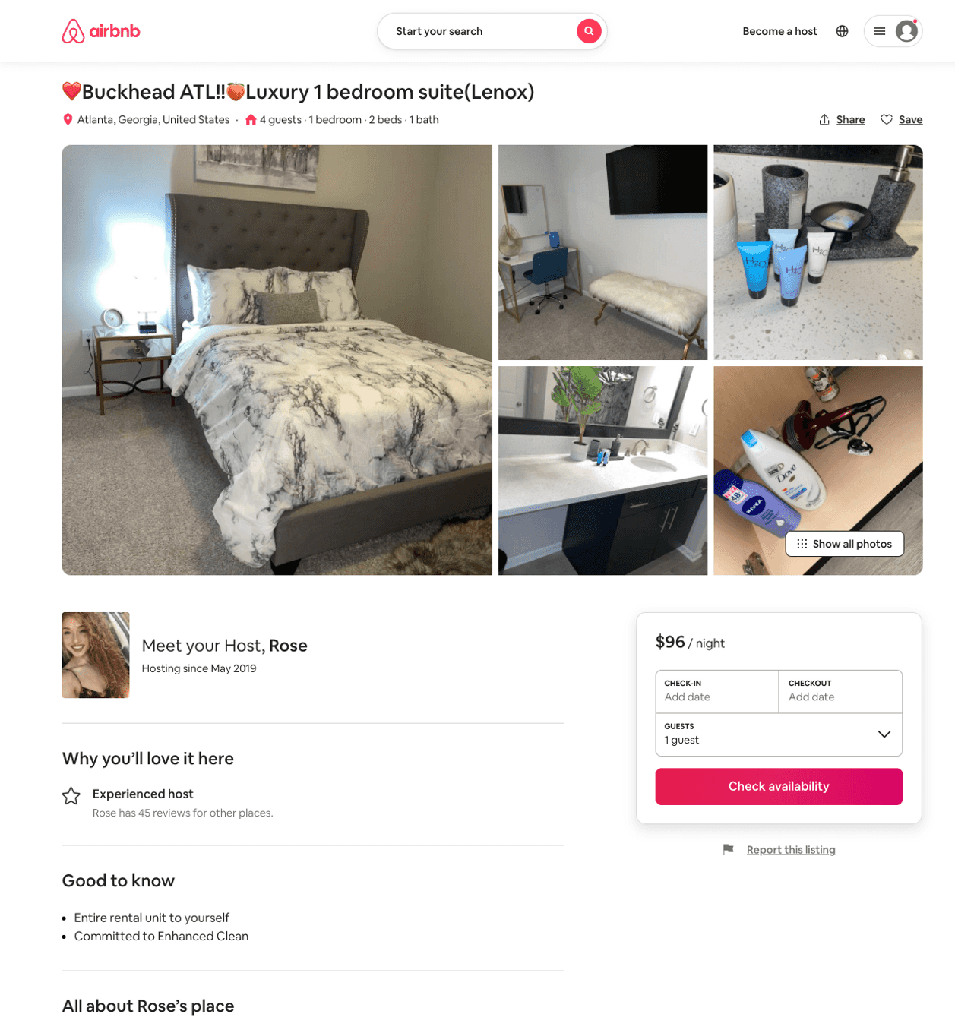
Listing 51310352
1
4
$84 - $120
4.44
1
Rose
263547292
1
https://www.airbnb.com/rooms/51310352
Aug 2022

Slide 34
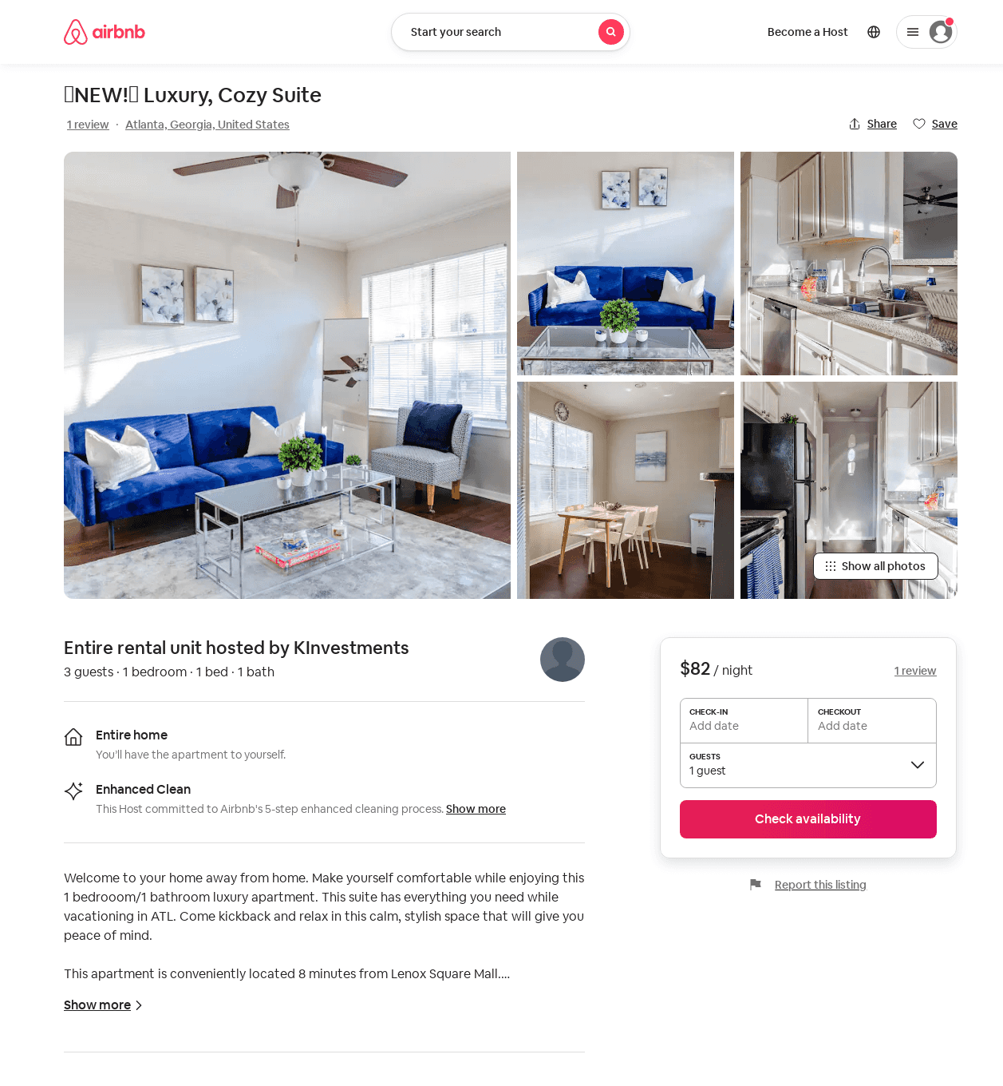
Listing 52705982
1
3
$46 - $117
1
KInvestments
426658823
1
https://www.airbnb.com/rooms/52705982
Jul 2022

Slide 35
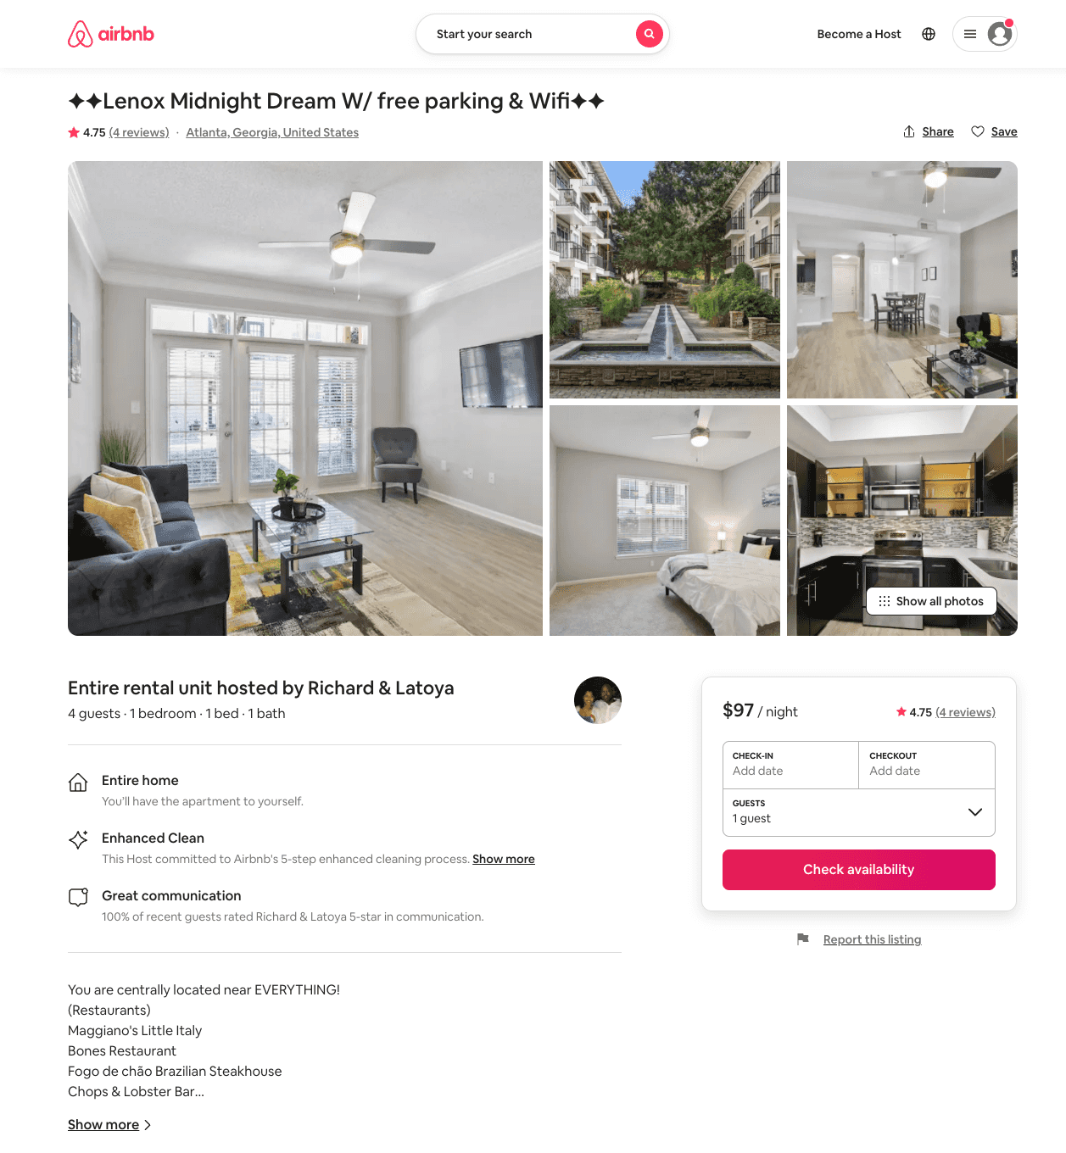
Listing 52925068
1
4
$81 - $118
4.71
1
Luxury Suite
428465020
1
https://www.airbnb.com/rooms/52925068
Aug 2022

Slide 36
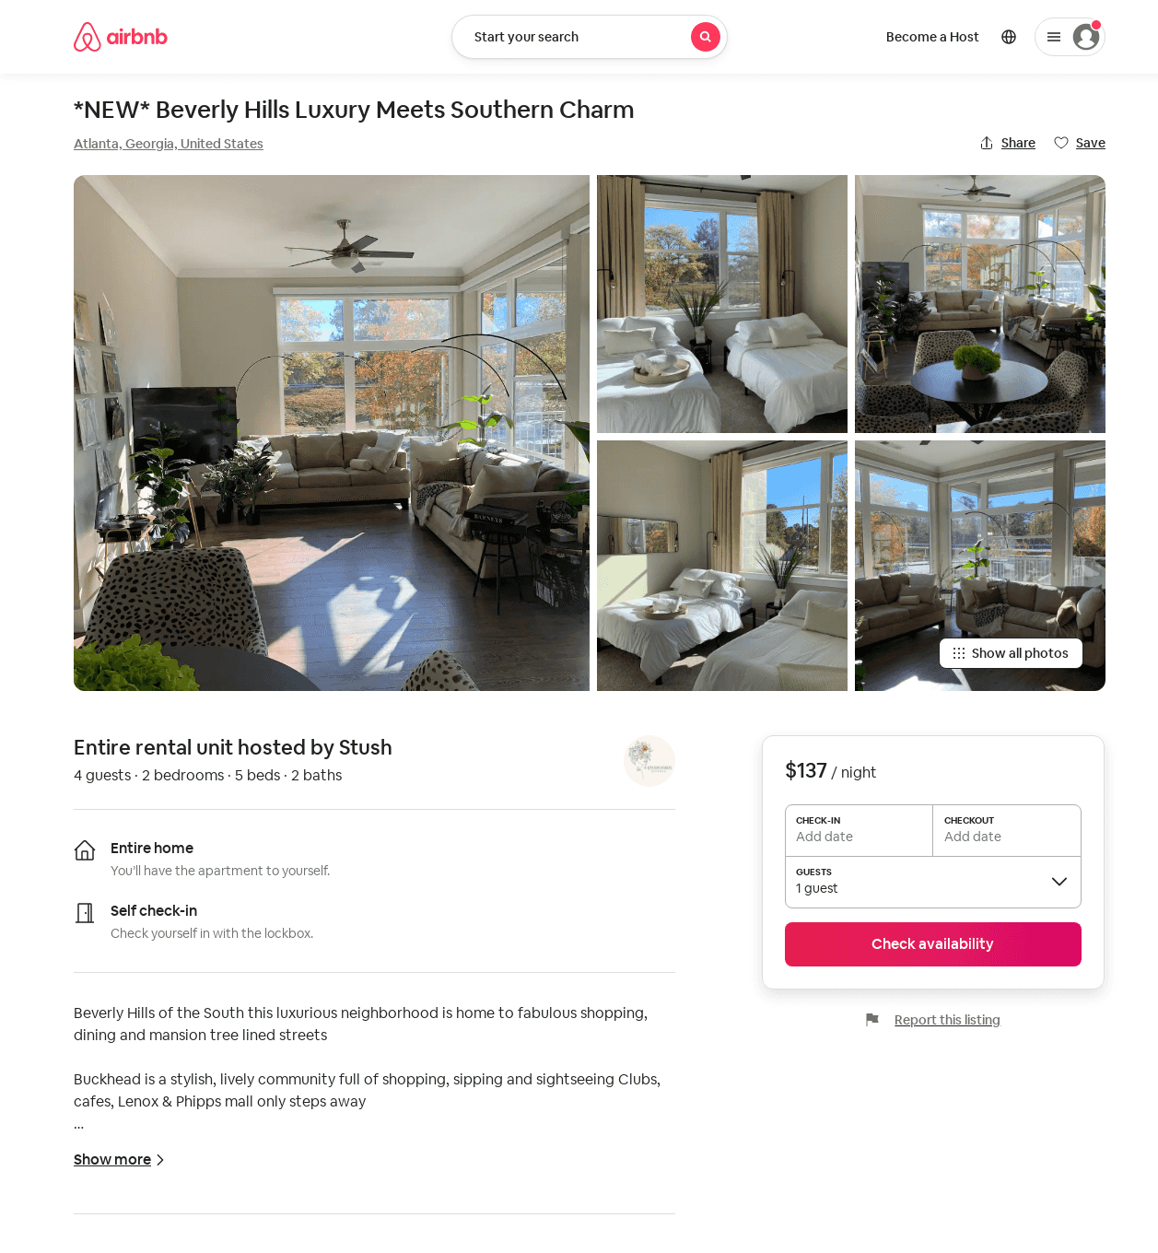
Listing 53068297
2
7
$135 - $239
4.81
2
Lenox
429592153
1
https://www.airbnb.com/rooms/53068297
Aug 2022

Slide 37
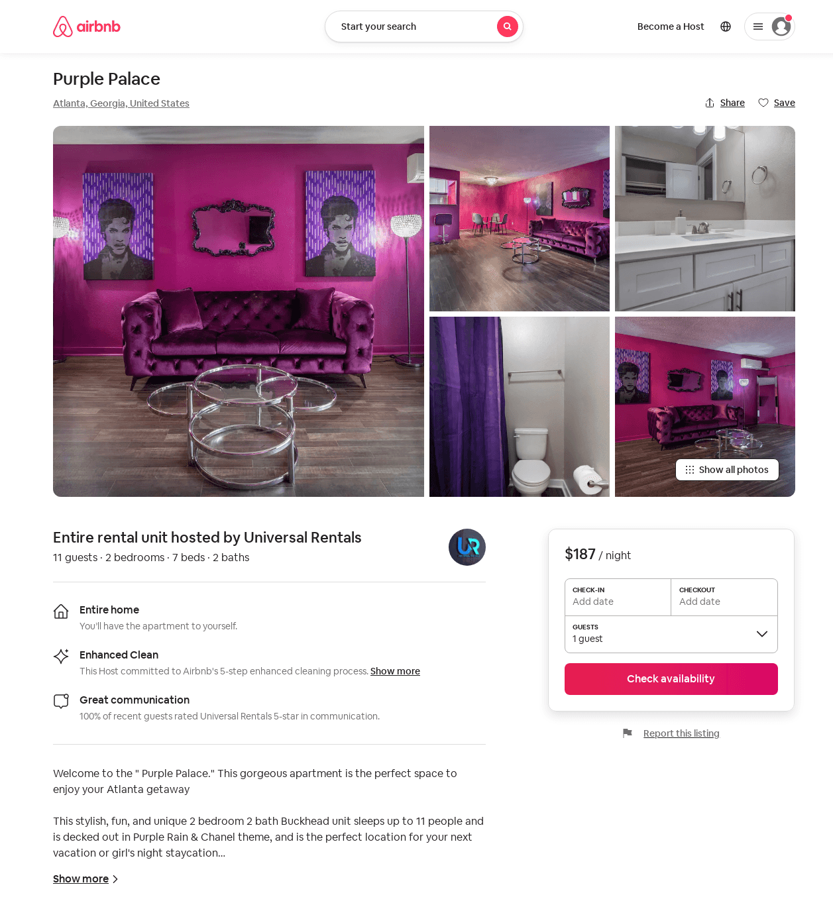
Listing 53881455
2
7
$121 - $187
4.33
1
Universal Rentals
60560861
3
https://www.airbnb.com/rooms/53881455
Jun 2022

Slide 38
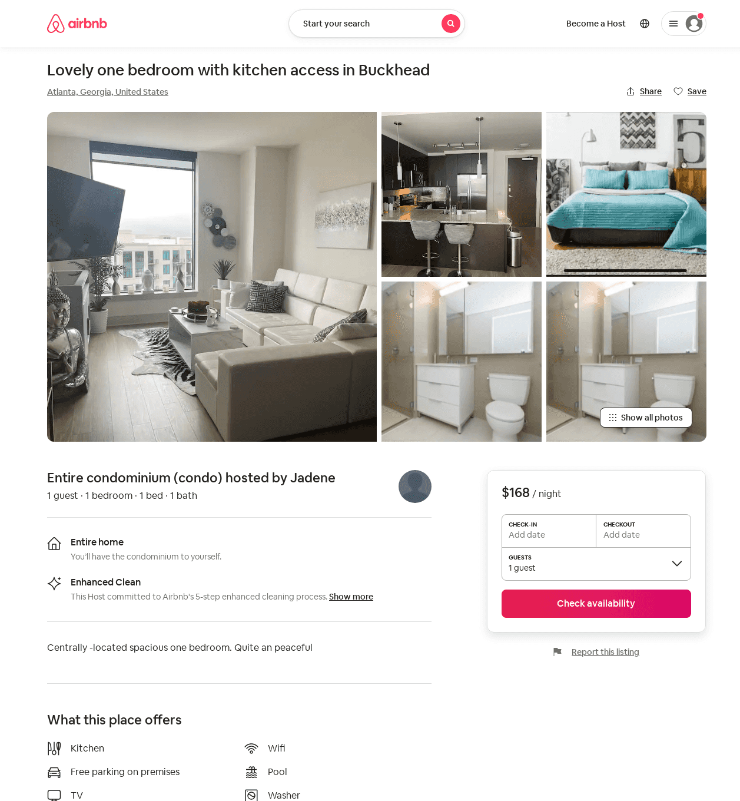
Listing 53737324
2
2
$150 - $250
4.67
2
Jackey
435224783
1
https://www.airbnb.com/rooms/53737324
Aug 2022

Slide 39
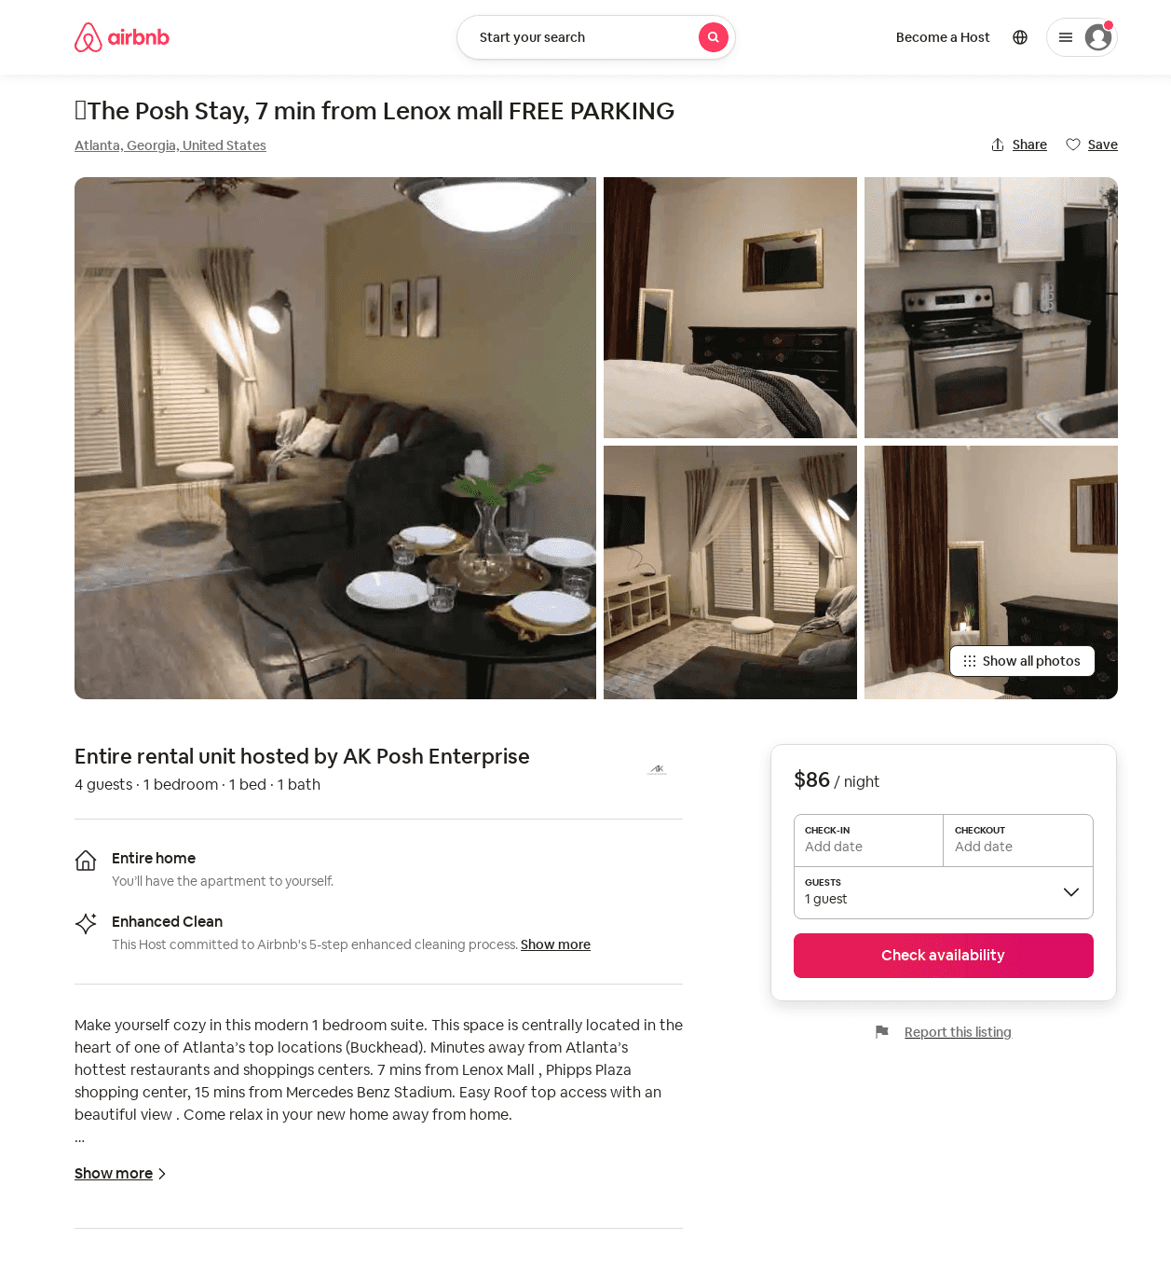
Listing 53867041
1
4
$86 - $124
5.0
28
AK Posh Enterprise
387452261
1
https://www.airbnb.com/rooms/53867041
Aug 2022

Slide 40
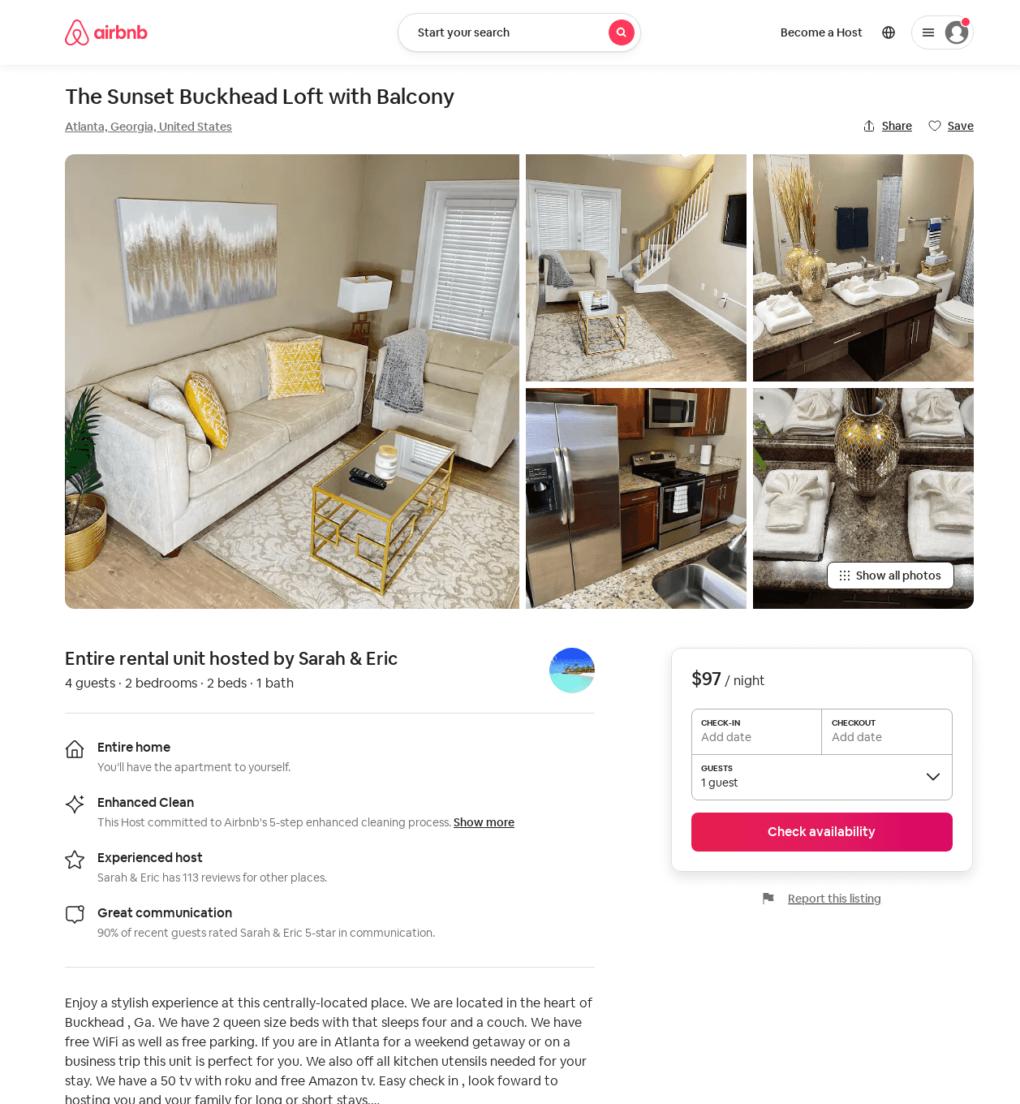
Listing 53921145
2
4
$78 - $102
4.80
1
Brandi
64099311
2
https://www.airbnb.com/rooms/53921145
Jul 2022

Slide 41
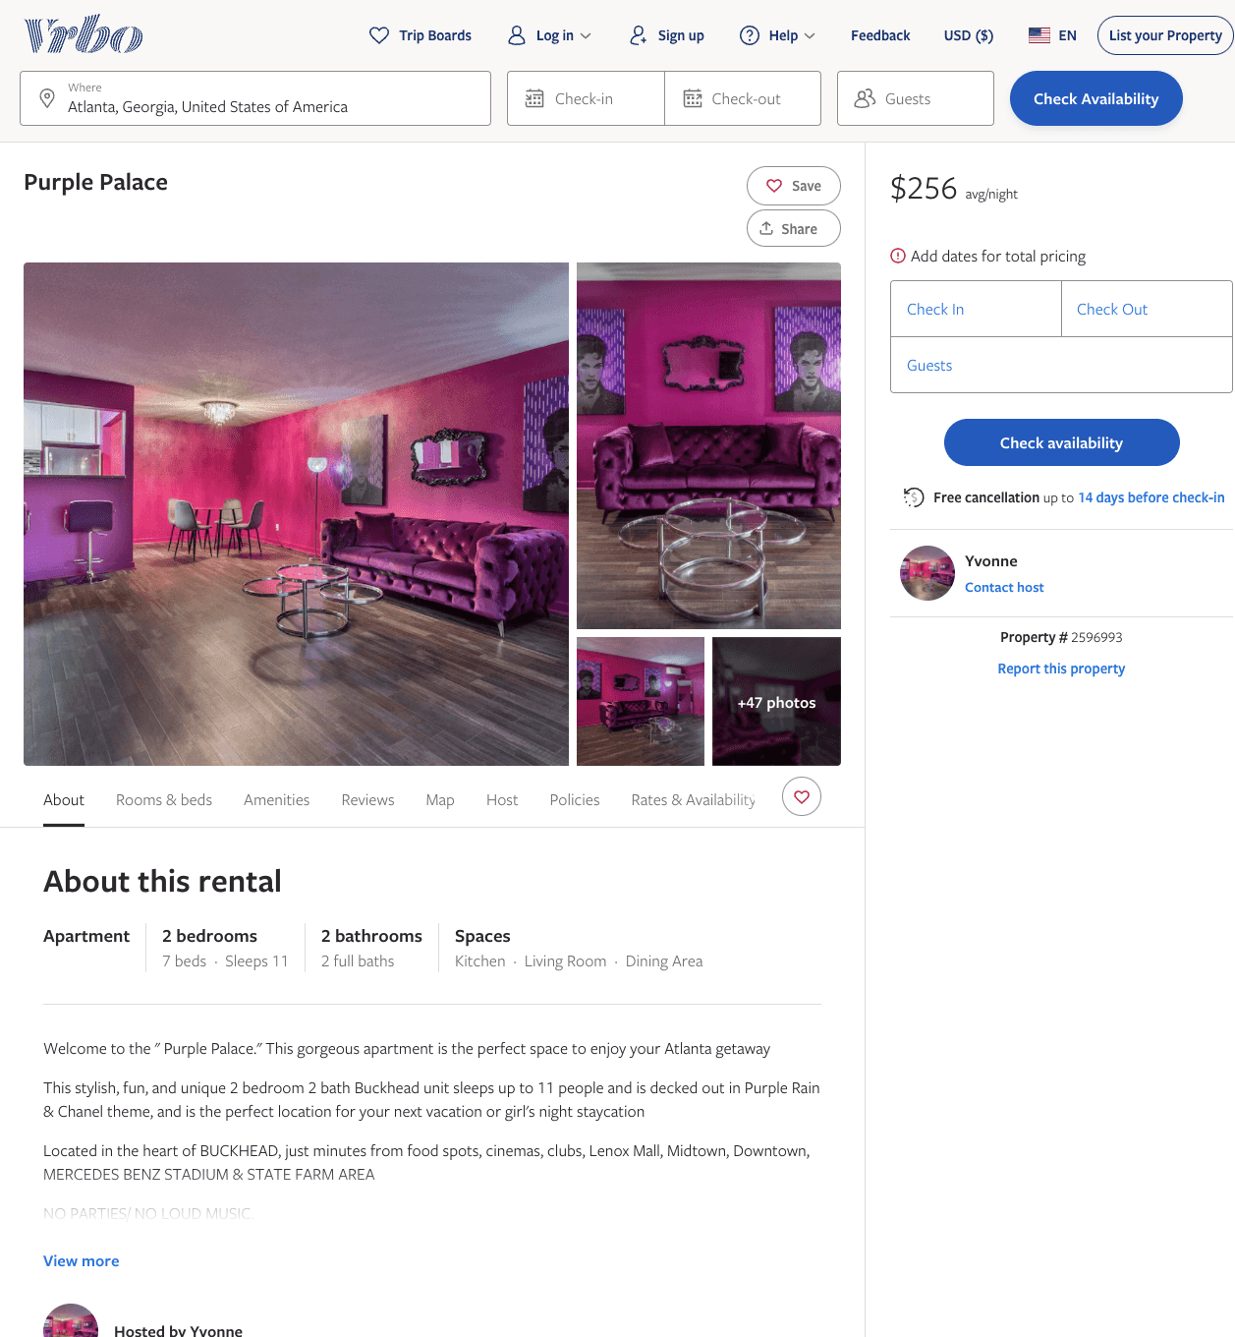
Listing 2596993
2
11
$117 - $256
1
Yvonne
https://www.vrbo.com/2596993
Aug 2022

Slide 42
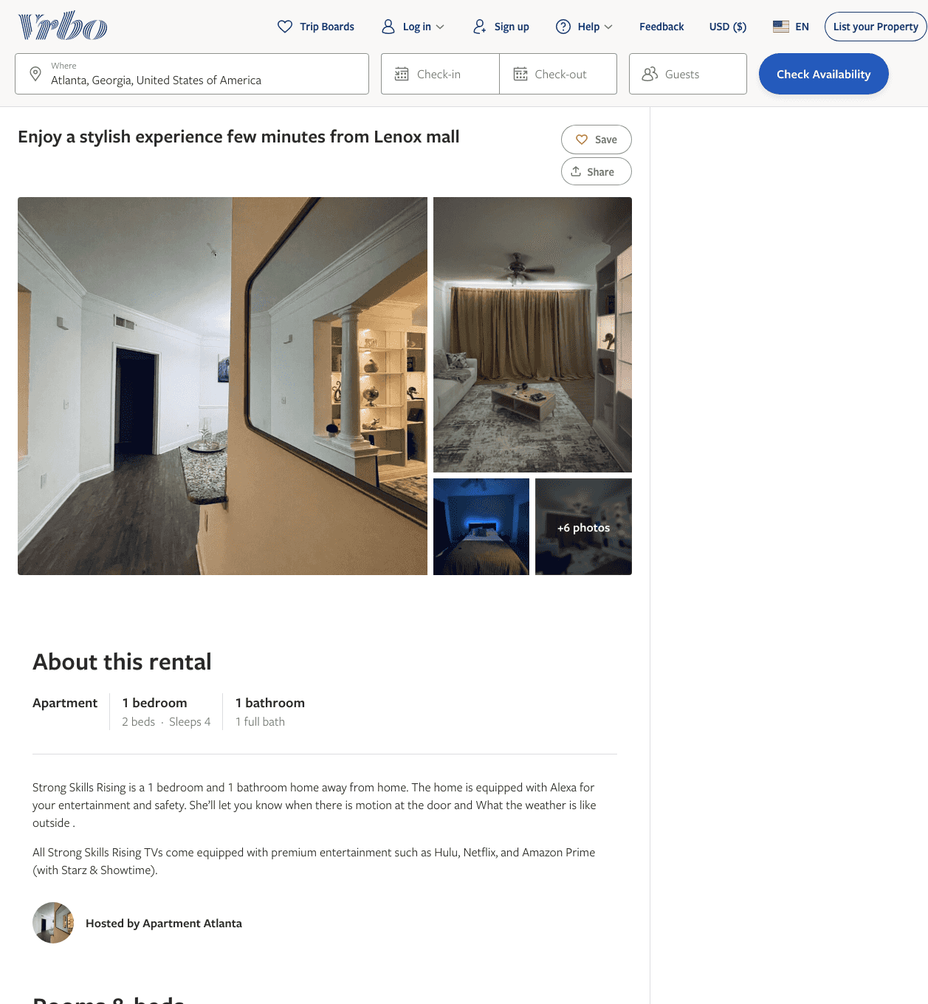
Listing 2602056
1
4
$120 - $149
3
https://www.vrbo.com/2602056
Aug 2022

Slide 43
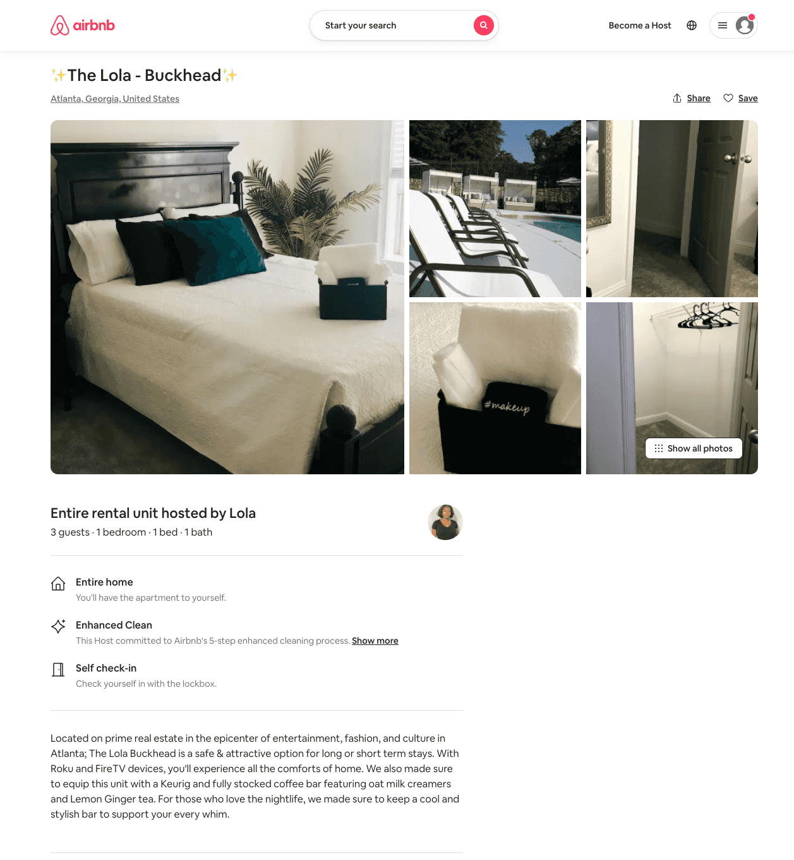
Listing 54005316
1
3
$77 - $83
5.0
1
Lola
2958190
1
https://www.airbnb.com/rooms/54005316
Aug 2022

Slide 44
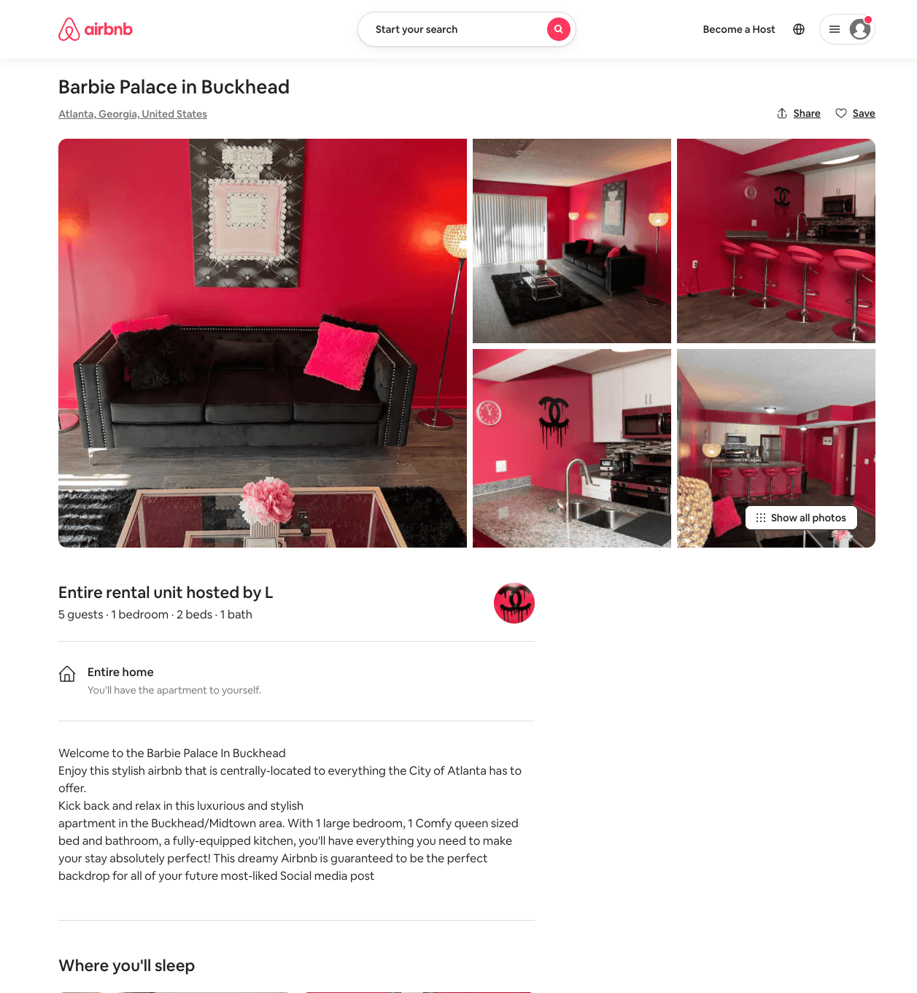
Listing 53918990
1
5
$85 - $108
4.60
1
L
301387975
1
https://www.airbnb.com/rooms/53918990
Aug 2022

Slide 45
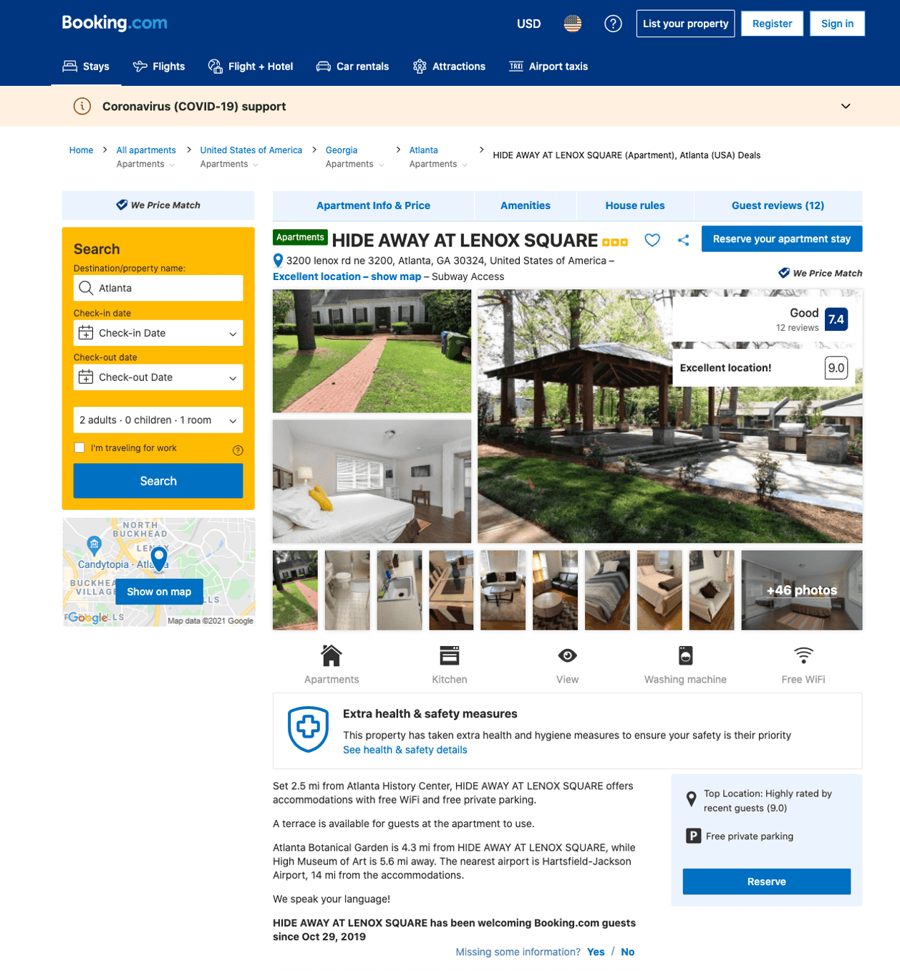
Listing hide-away-at-lenox-square
3200 LENOX RD NE
undefined
1
7.6
https://www.booking.com/hotel/us/hide-away-at-lenox-square.html
Sep 2022

Slide 46
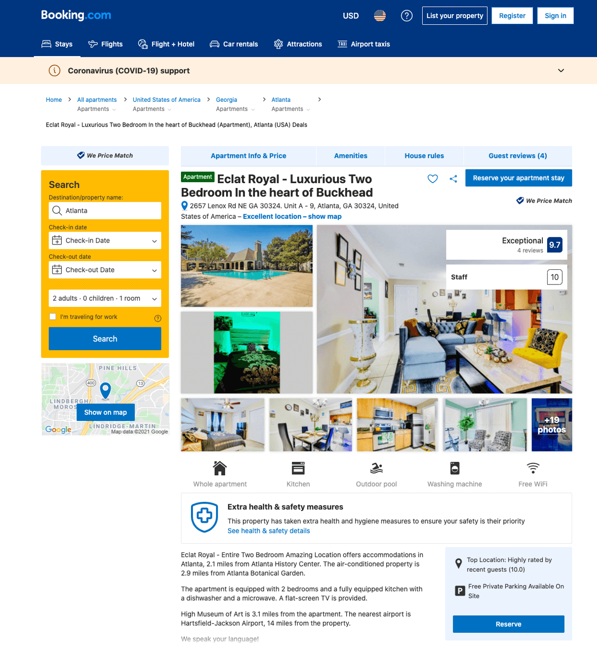
Listing eclat-royal-entire-two-bedroom-amazing-location
undefined
1
8.9
https://www.booking.com/hotel/us/eclat-royal-entire-two-bedroom-amazing-location.html
Sep 2022

Slide 47
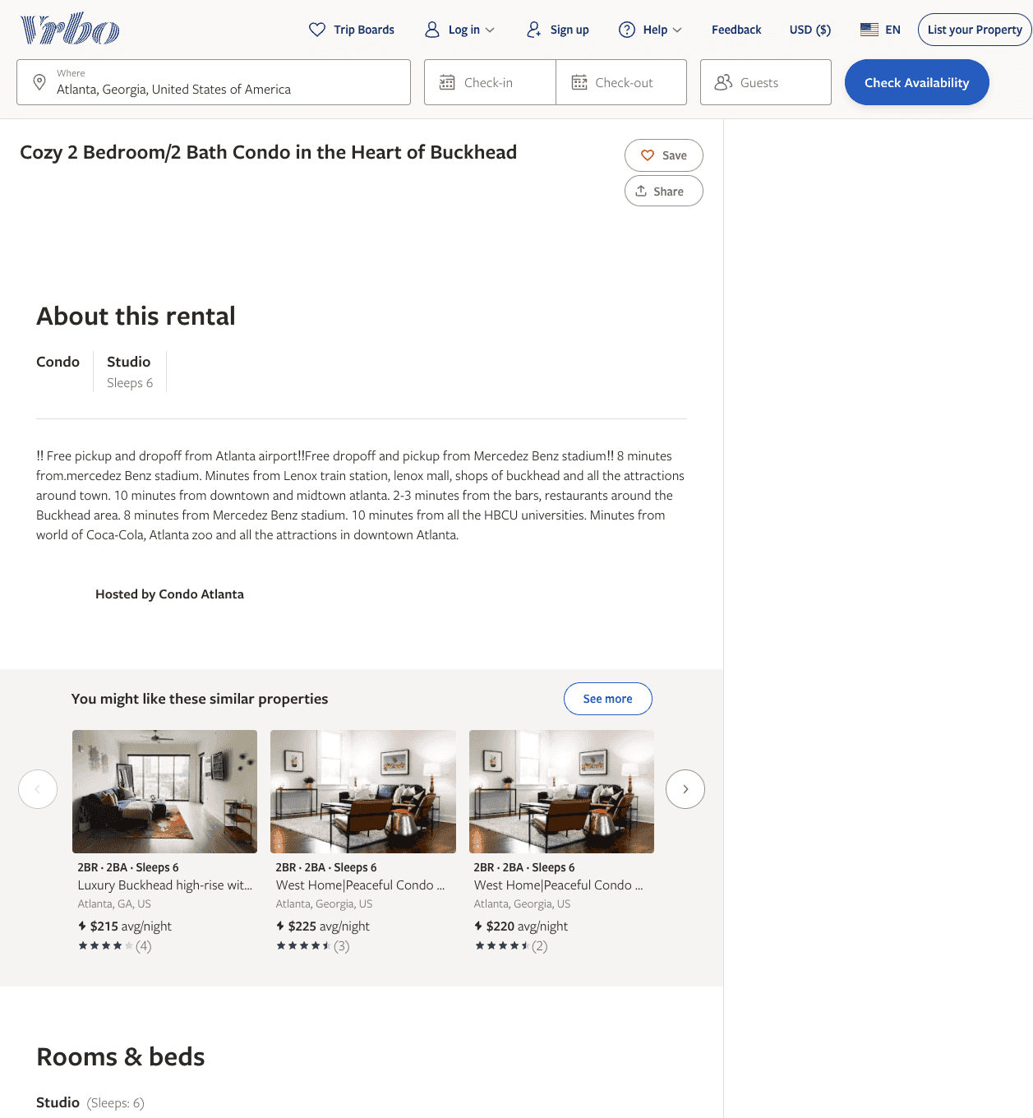
Listing 7564978
2
6
$489
1
1
https://www.vrbo.com/7564978ha
Aug 2022

Slide 48
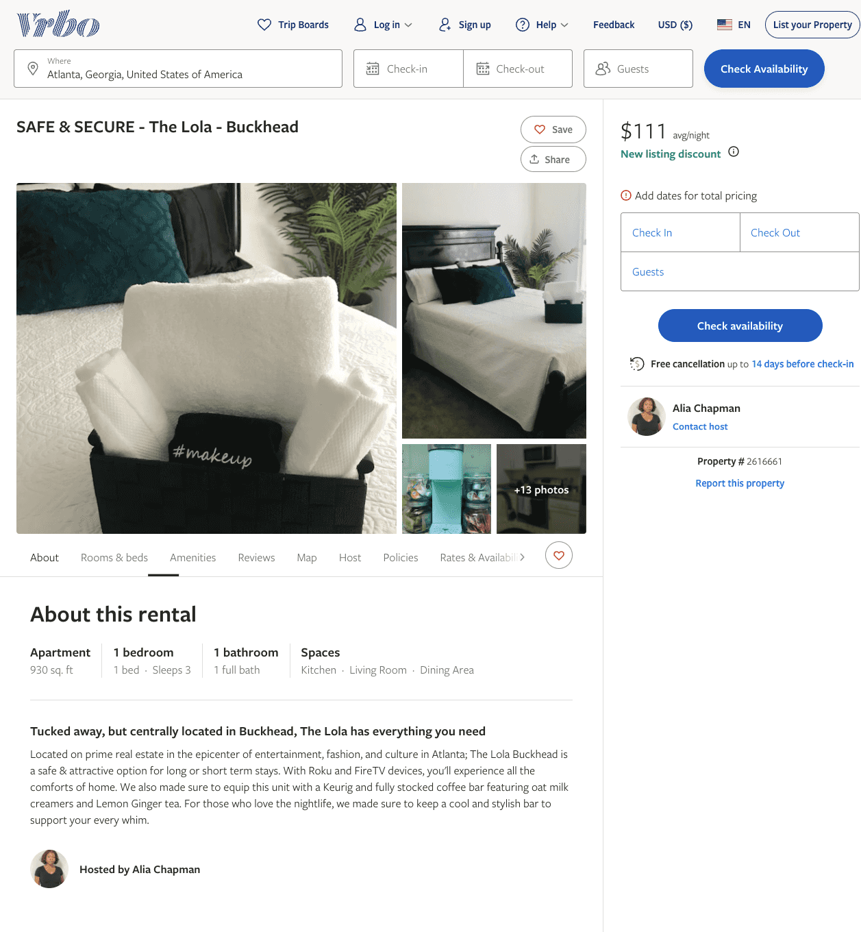
Listing 2616661
1
3
$100
1
Alia Chapman
https://www.vrbo.com/2616661
Aug 2022

Slide 49
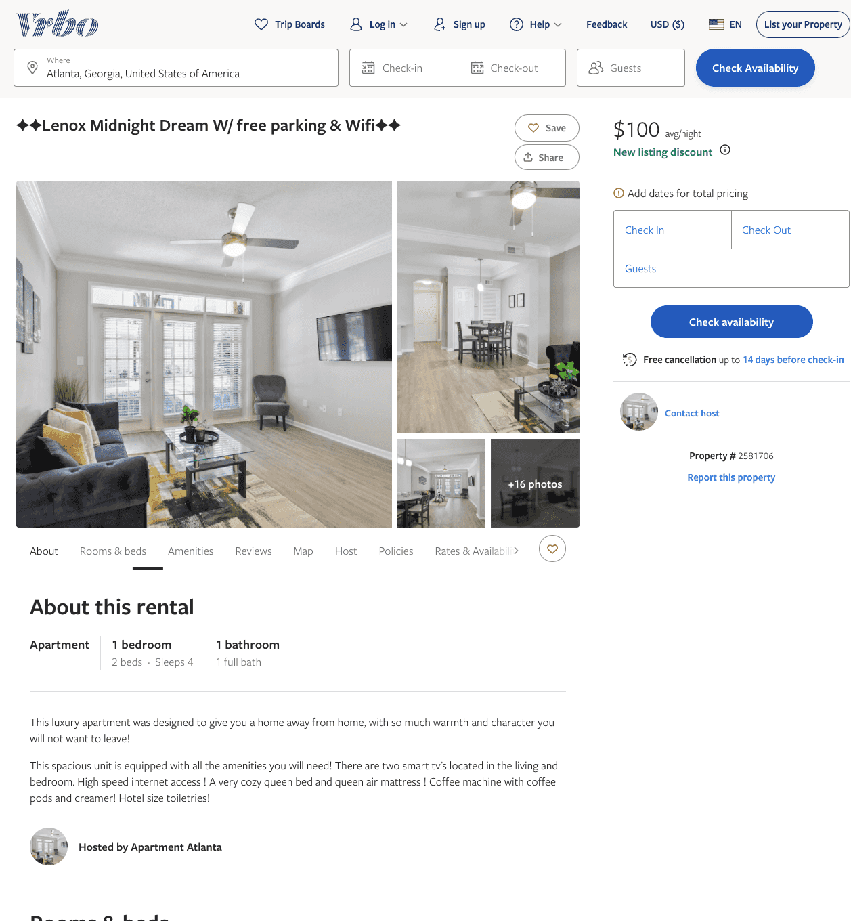
Listing 2581706
1
4
$100
4.3333335
1
https://www.vrbo.com/2581706
Aug 2022

Slide 50
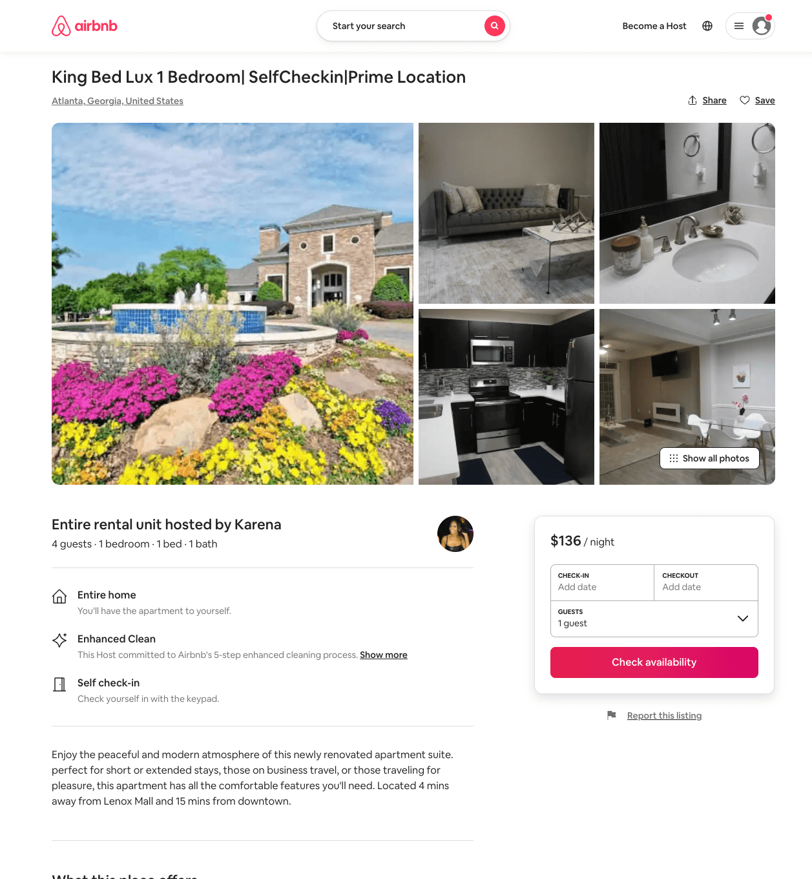
Listing 53387294
1
4
$59 - $146
4.85
2
Karena
178564075
1
https://www.airbnb.com/rooms/53387294
Aug 2022

Slide 51
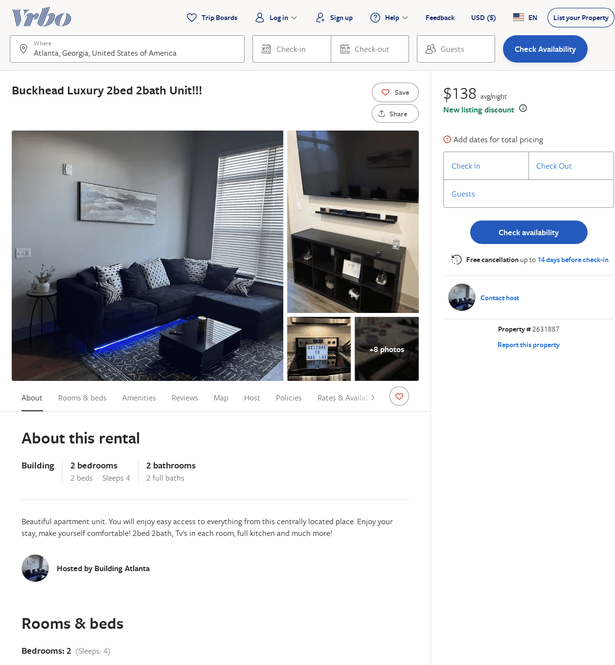
Listing 2631887
2
4
$211
5
1
MAC LUX
https://www.vrbo.com/2631887
Aug 2022

Slide 52
Listing entire-2-br-luxury-apartment-buckhead-47-brookhaven
undefined
4
9.6
https://www.booking.com/hotel/us/entire-2-br-luxury-apartment-buckhead-47-brookhaven.html
Sep 2022

Slide 53
Listing 45370575
1
4
$88 - $120
4.67
1
Jessica
100393795
1
https://www.airbnb.com/rooms/45370575
Aug 2022

Slide 54
Listing 53210268
1
2
$34 - $53
4.96
2
Afua
289748566
1
https://www.airbnb.com/rooms/53210268
Aug 2022

Slide 55
Listing 2681100
1
4
$110
5
2
https://www.vrbo.com/2681100
Aug 2022

Slide 56
Listing 2676690
1
3
$122
5
7
https://www.vrbo.com/2676690
Aug 2022

Slide 57
Listing 2624665
1
2
$250
3
Jade
https://www.vrbo.com/2624665
Aug 2022

Slide 58
Listing 52843065
2
8
$138 - $160
3.67
1
Dannyelle
419130612
1
https://www.airbnb.com/rooms/52843065
Jun 2022

Slide 59
Listing 2723470
2
6
$250
1
https://www.vrbo.com/2723470
Aug 2022

Slide 60
Listing 2726124
1
4
$430
2
LEO and MARIE
https://www.vrbo.com/2726124
Aug 2022

Slide 61
Listing 2727382
1
4
$314
2
LEO and MARIE
https://www.vrbo.com/2727382
Aug 2022

Slide 62
Listing 2749197
2
5
$127
2
https://www.vrbo.com/2749197
Aug 2022

Slide 63
Listing 2812309
3
10
$192
2
https://www.vrbo.com/2812309
Aug 2022

Slide 64
Listing 2820288
2
6
$300
3
Oluwatomiloba A Onadeko
https://www.vrbo.com/2820288
Aug 2022

Slide 65
Listing 2842426
1
2
$125
5
Milla
https://www.vrbo.com/2842426
Aug 2022

Slide 66
Listing 43070743
1
1
$38
30
Ally
198740831
3
https://www.airbnb.com/rooms/43070743
Jul 2022

Slide 67
Listing 31133911
1
4
$93
3
Viviane
194038773
1
https://www.airbnb.com/rooms/31133911
Aug 2022

Slide 68
Listing 2868980
1
4
$115
2
https://www.vrbo.com/2868980
Aug 2022

Slide 69
Listing 655078263859292500
5
16
3
Kolawole
430463503
2
https://www.airbnb.com/rooms/655078263859292500
Aug 2022

Slide 70
Listing 33513640
1
3
3
Melanie
57096545
1
https://www.airbnb.com/rooms/33513640
Aug 2022

Slide 71
Listing 2896687
2
6
$149
1
Jovian
https://www.vrbo.com/2896687
Aug 2022

Slide 72
Listing 2919571
2
4
$158
2
https://www.vrbo.com/2919571
Aug 2022

Slide 73
Listing 53509005
1
4
2
Danielle
273772273
1
https://www.airbnb.com/rooms/53509005
Aug 2022

Slide 74
Listing 52713499
1
4
2
Donald
438190811
1
https://www.airbnb.com/rooms/52713499
Aug 2022

