Slide 2
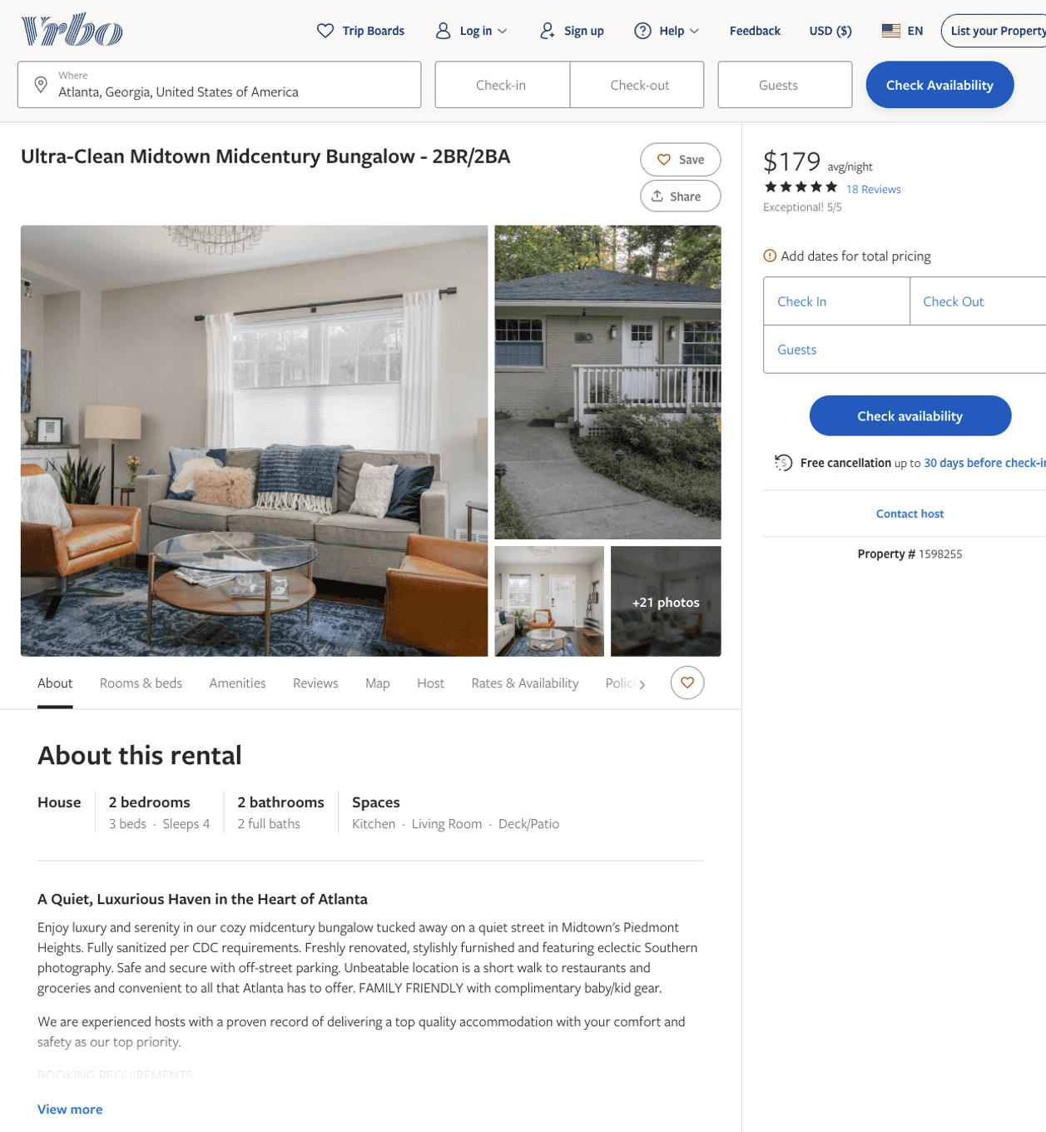
Listing 1598255
2
4
$177 - $193
5
4
Kathie McClure
https://www.vrbo.com/1598255
Aug 2022

Slide 3
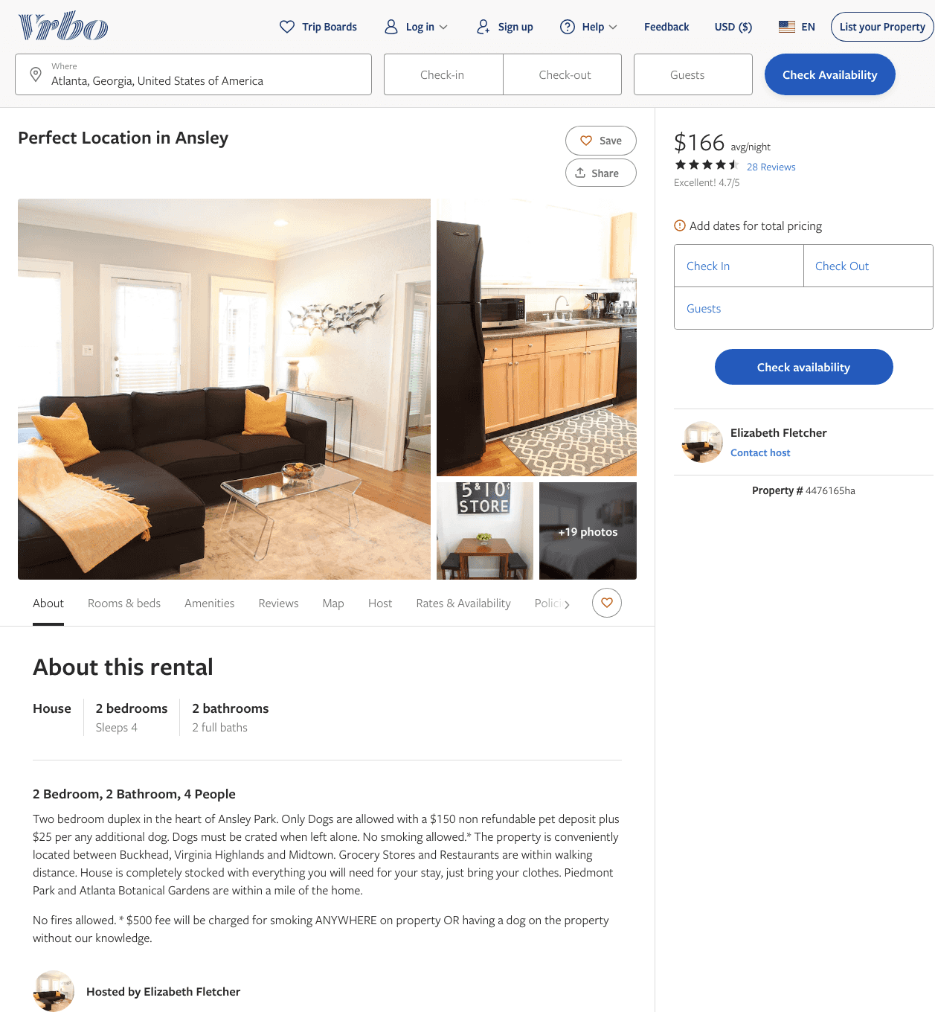
Listing 4476165
2
4
$166 - $185
4.757576
2
Elizabeth Fletcher
https://www.vrbo.com/4476165ha
Aug 2022

Slide 4
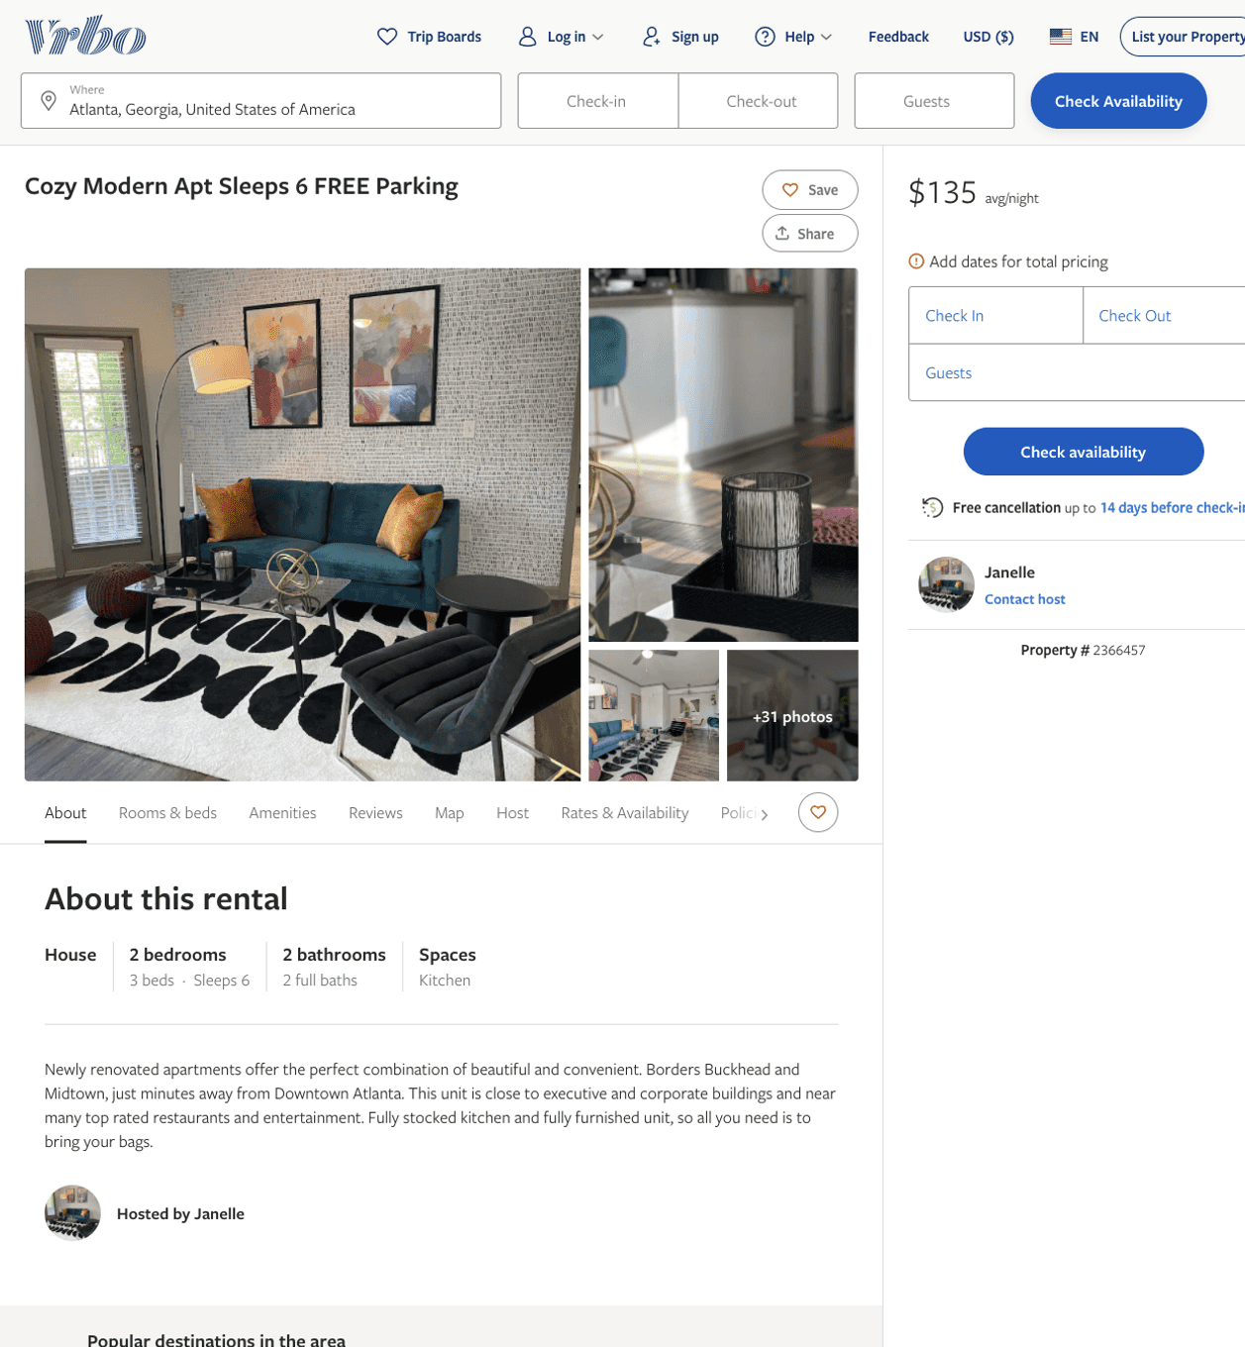
Listing 2366457
2
6
$122 - $158
4.3333335
1
Janelle
https://www.vrbo.com/2366457
Aug 2022

Slide 5
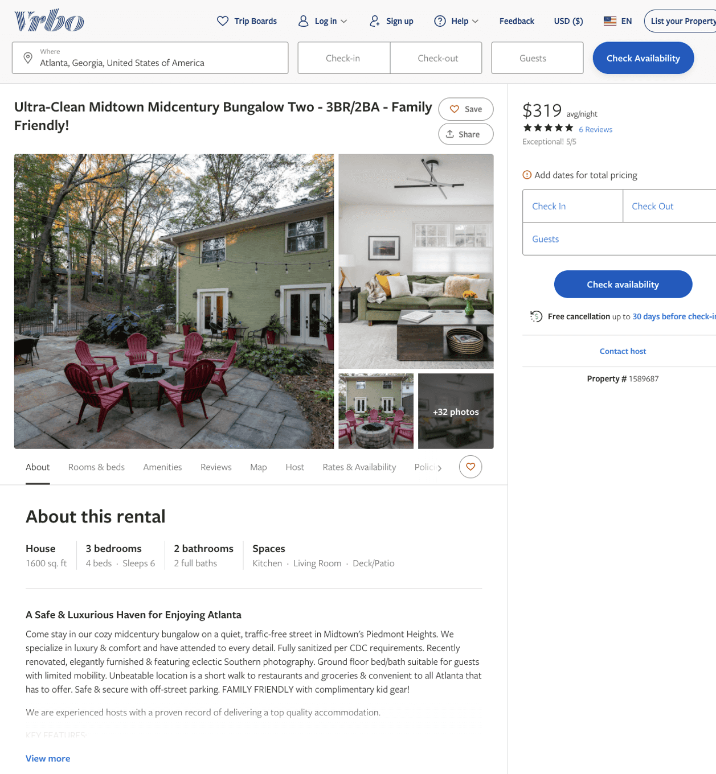
Listing 1589687
3
6
$269 - $346
5
4
Kathie McClure
https://www.vrbo.com/1589687
Aug 2022

Slide 6
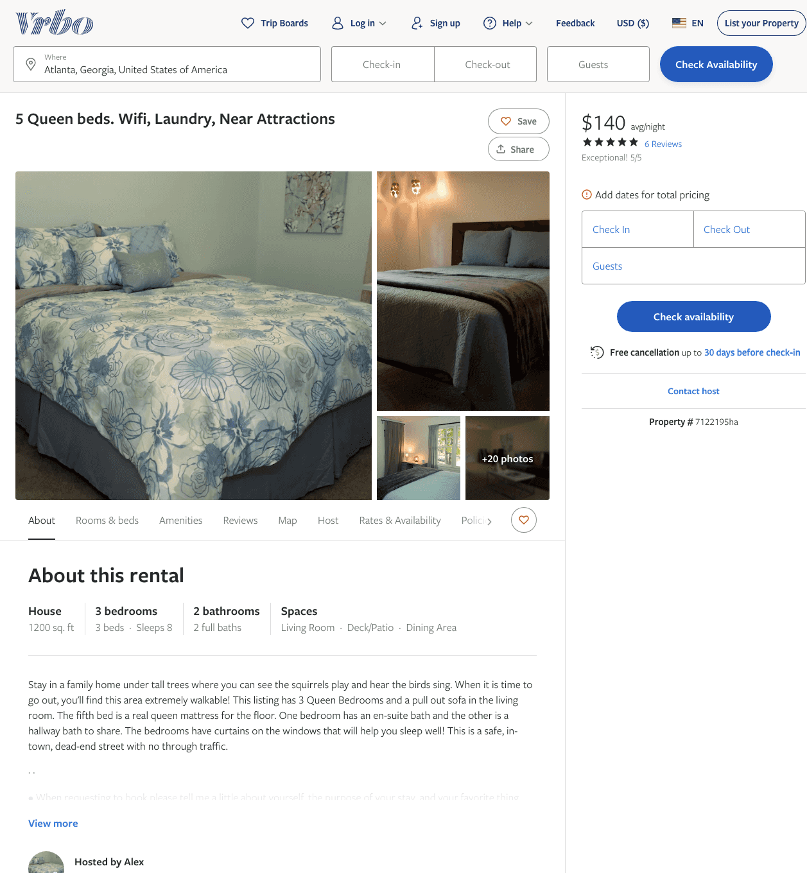
Listing 7122195
3
8
$130 - $167
4.75
4
Alex
https://www.vrbo.com/7122195ha
Aug 2022

Slide 7
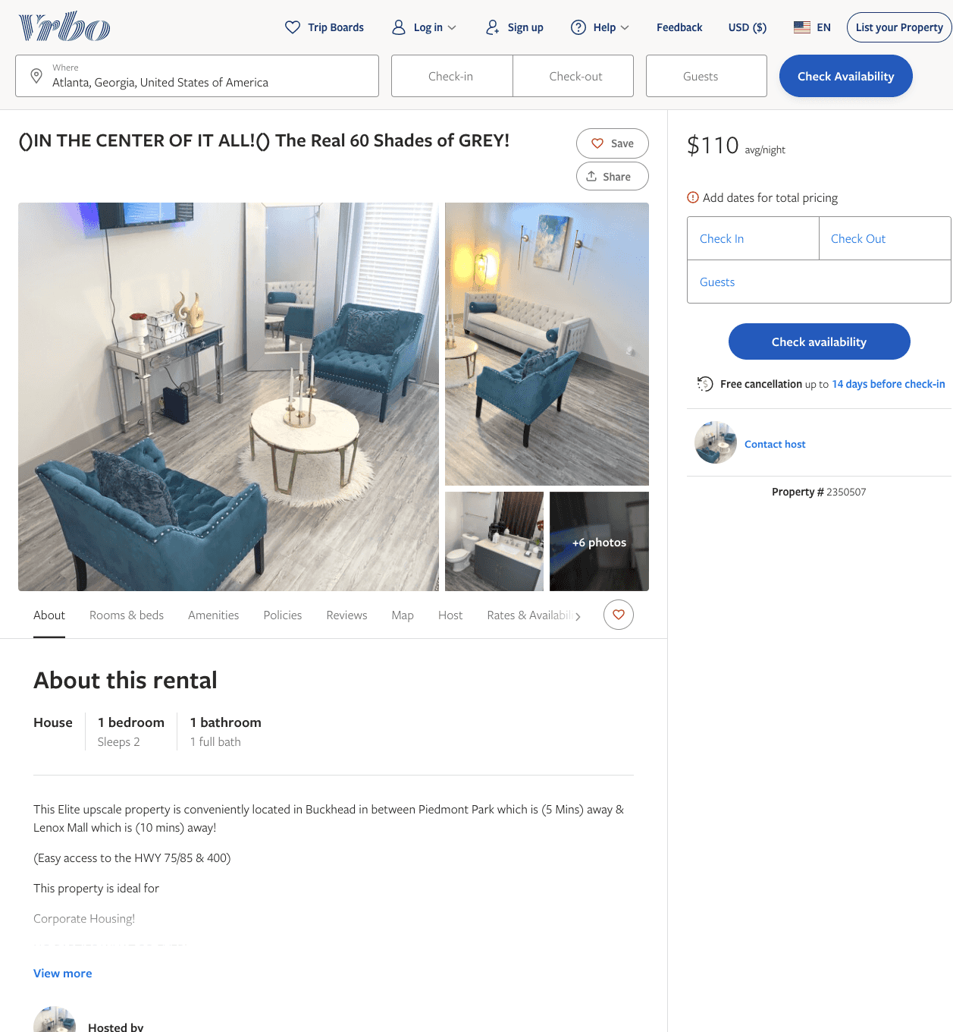
Listing 2350507
1
2
$110
29
https://www.vrbo.com/2350507
Aug 2022

Slide 8
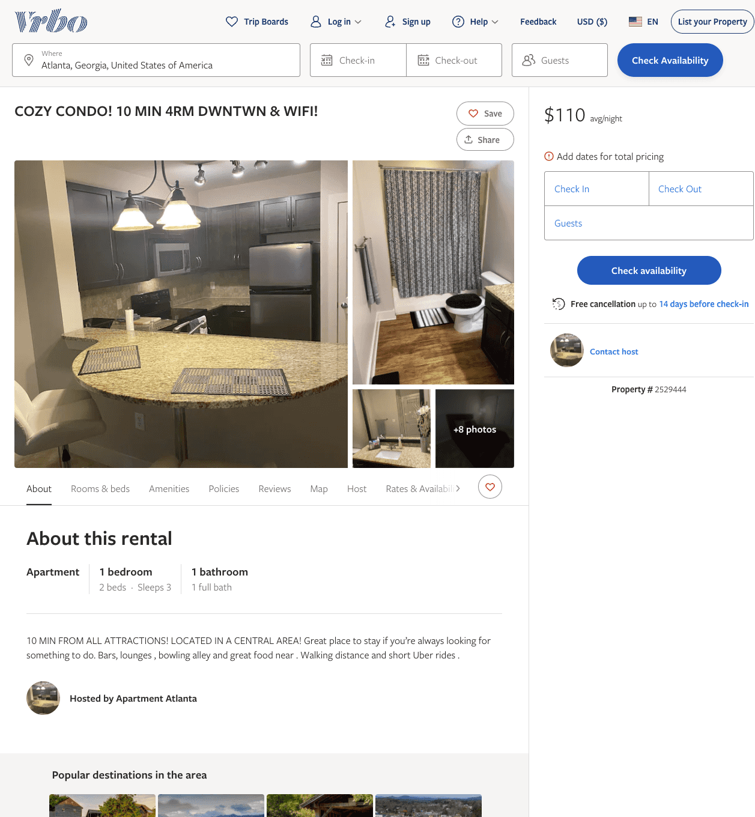
Listing 2529444
1
3
$110
1
1
https://www.vrbo.com/2529444
Aug 2022

Slide 9
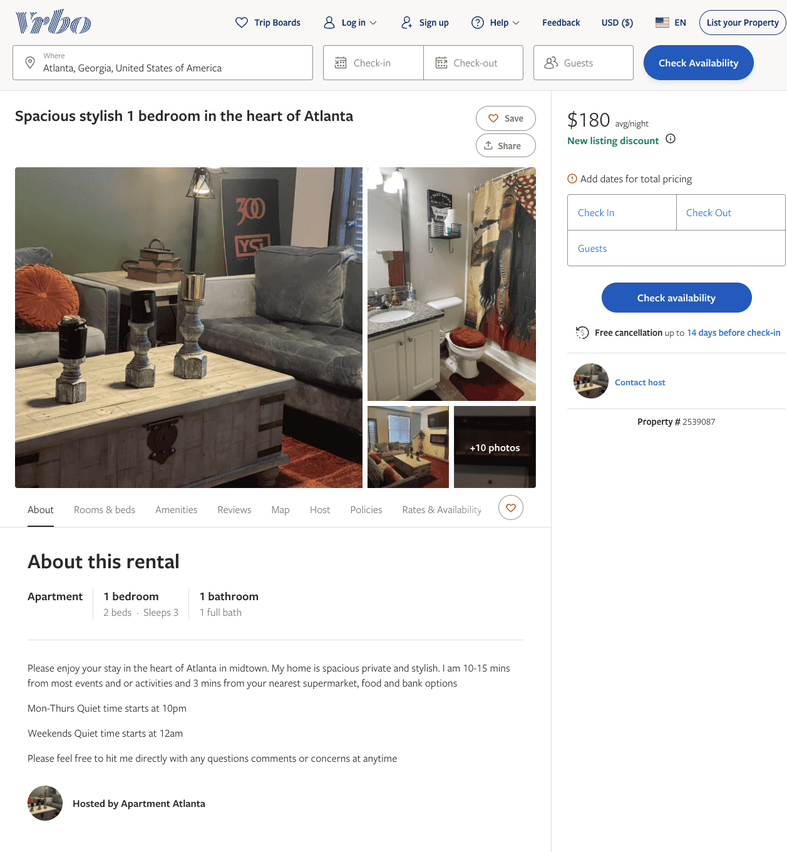
Listing 2539087
1
3
$180
1
https://www.vrbo.com/2539087
Aug 2022

Slide 10
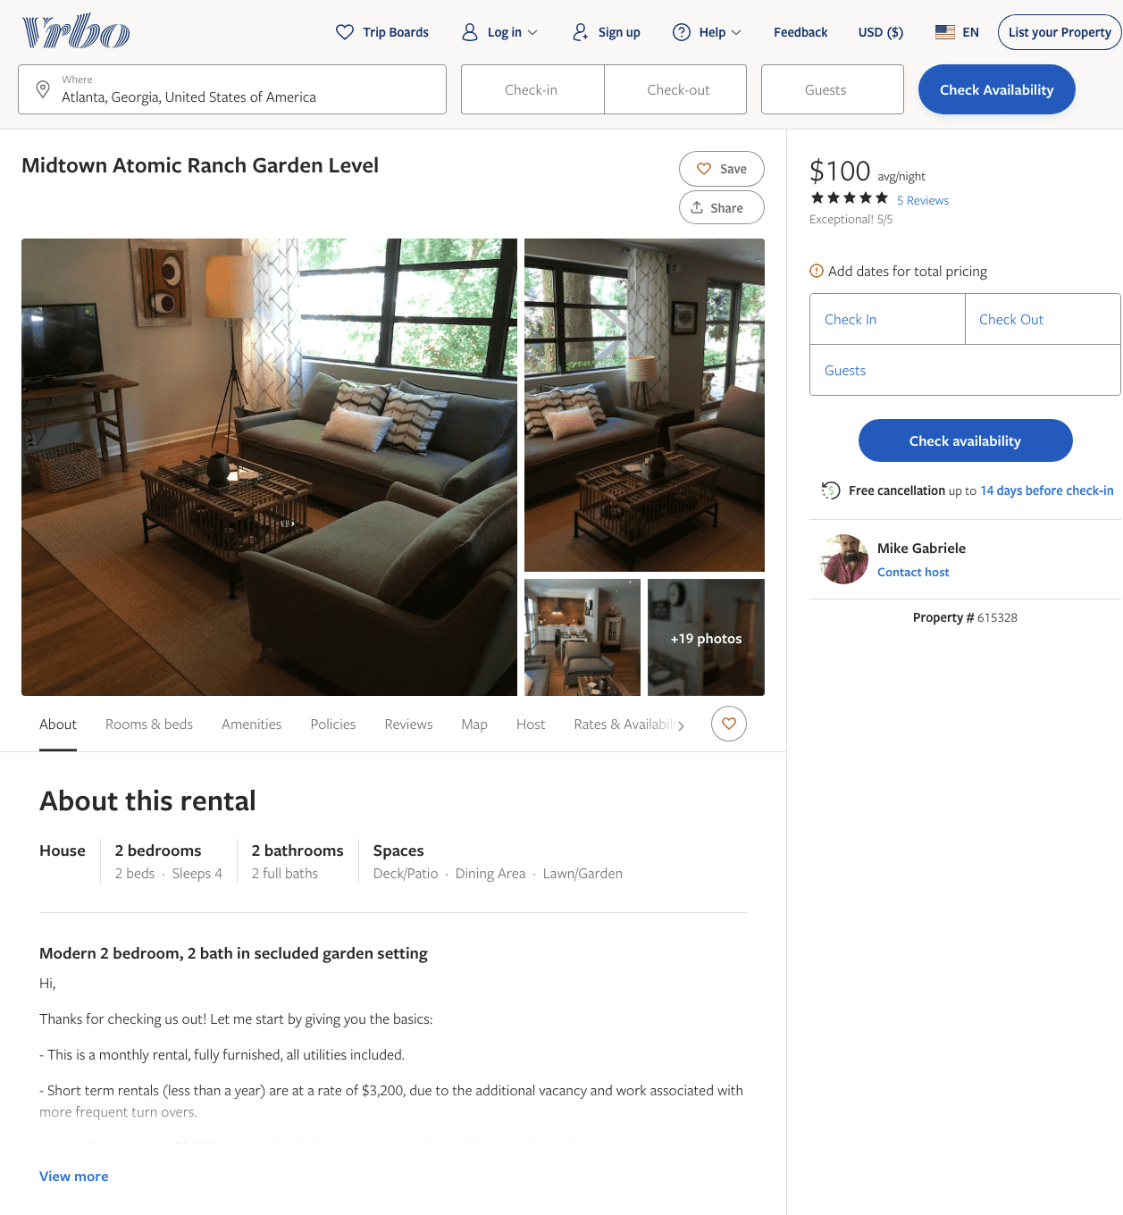
Listing 615328
2
2
$100 - $129
5
30
Mike Gabriele
https://www.vrbo.com/615328
Aug 2022

Slide 11
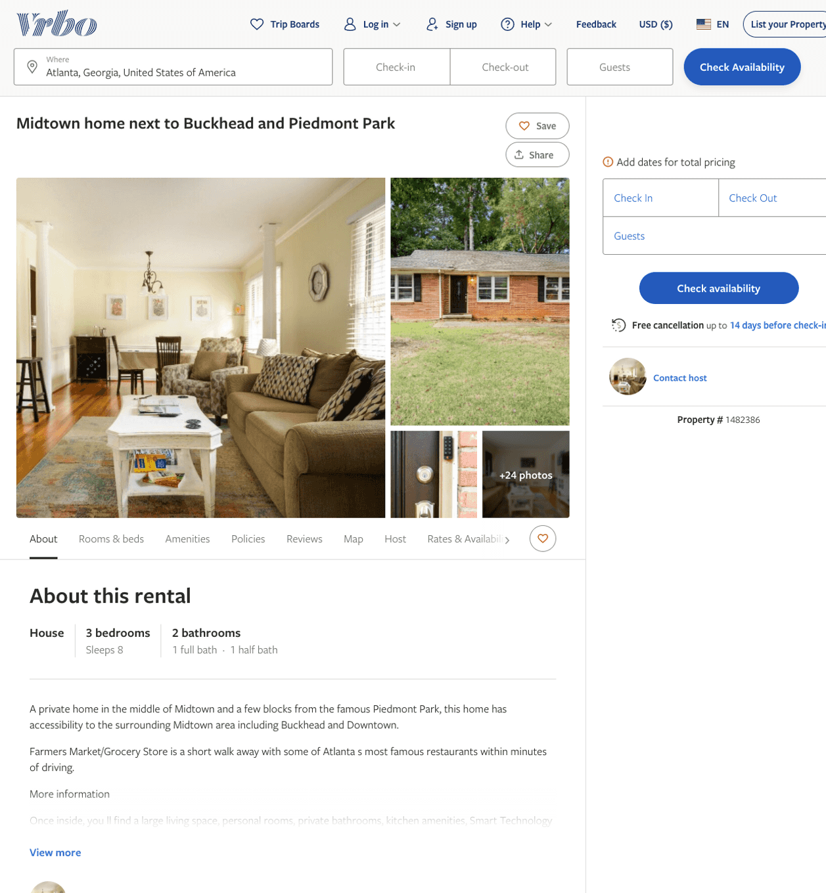
Listing 1482386
3
8
$120
2
https://www.vrbo.com/1482386
Aug 2022

Slide 12
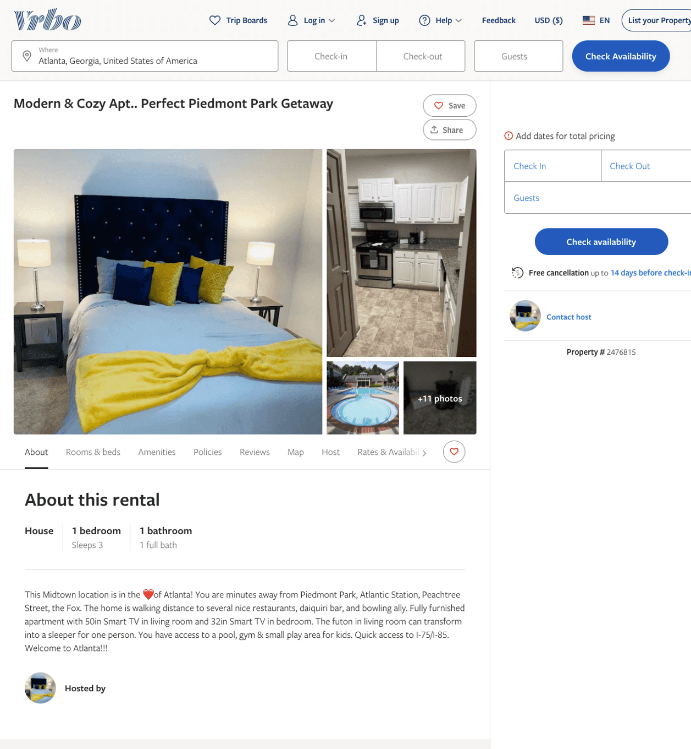
Listing 2476815
1
3
$100 - $99
1
https://www.vrbo.com/2476815
Aug 2022

Slide 13
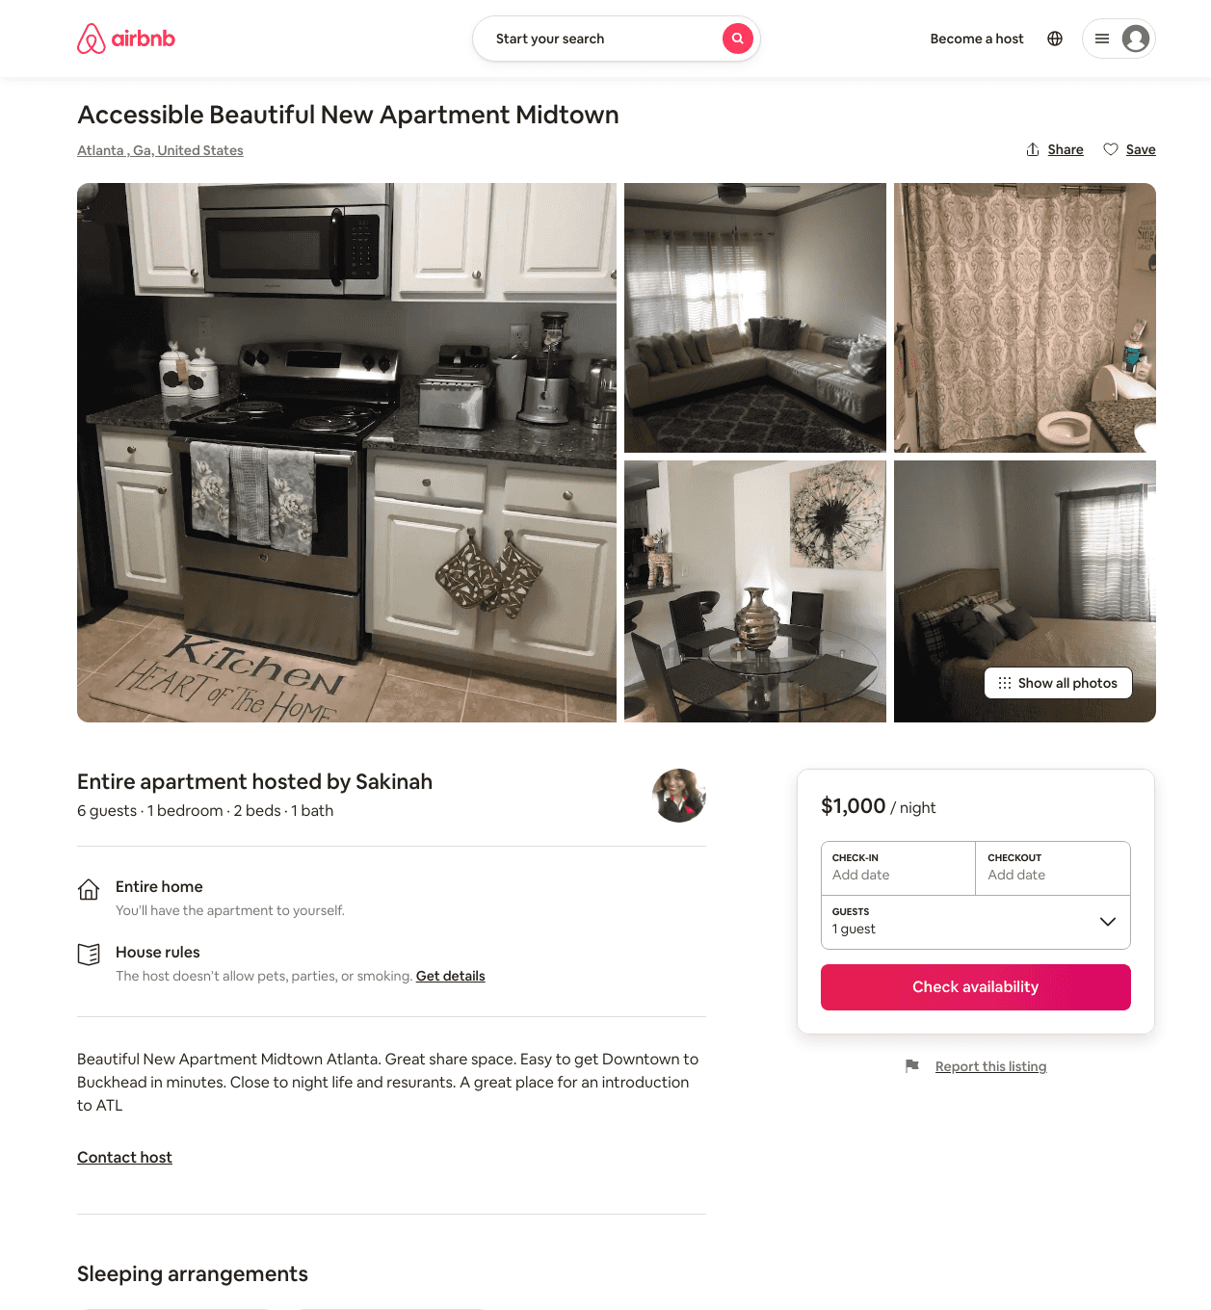
Listing 31896515
1
6
$1000
1
Sakinah
52010954
1
https://www.airbnb.com/rooms/31896515
Jul 2022

Slide 14
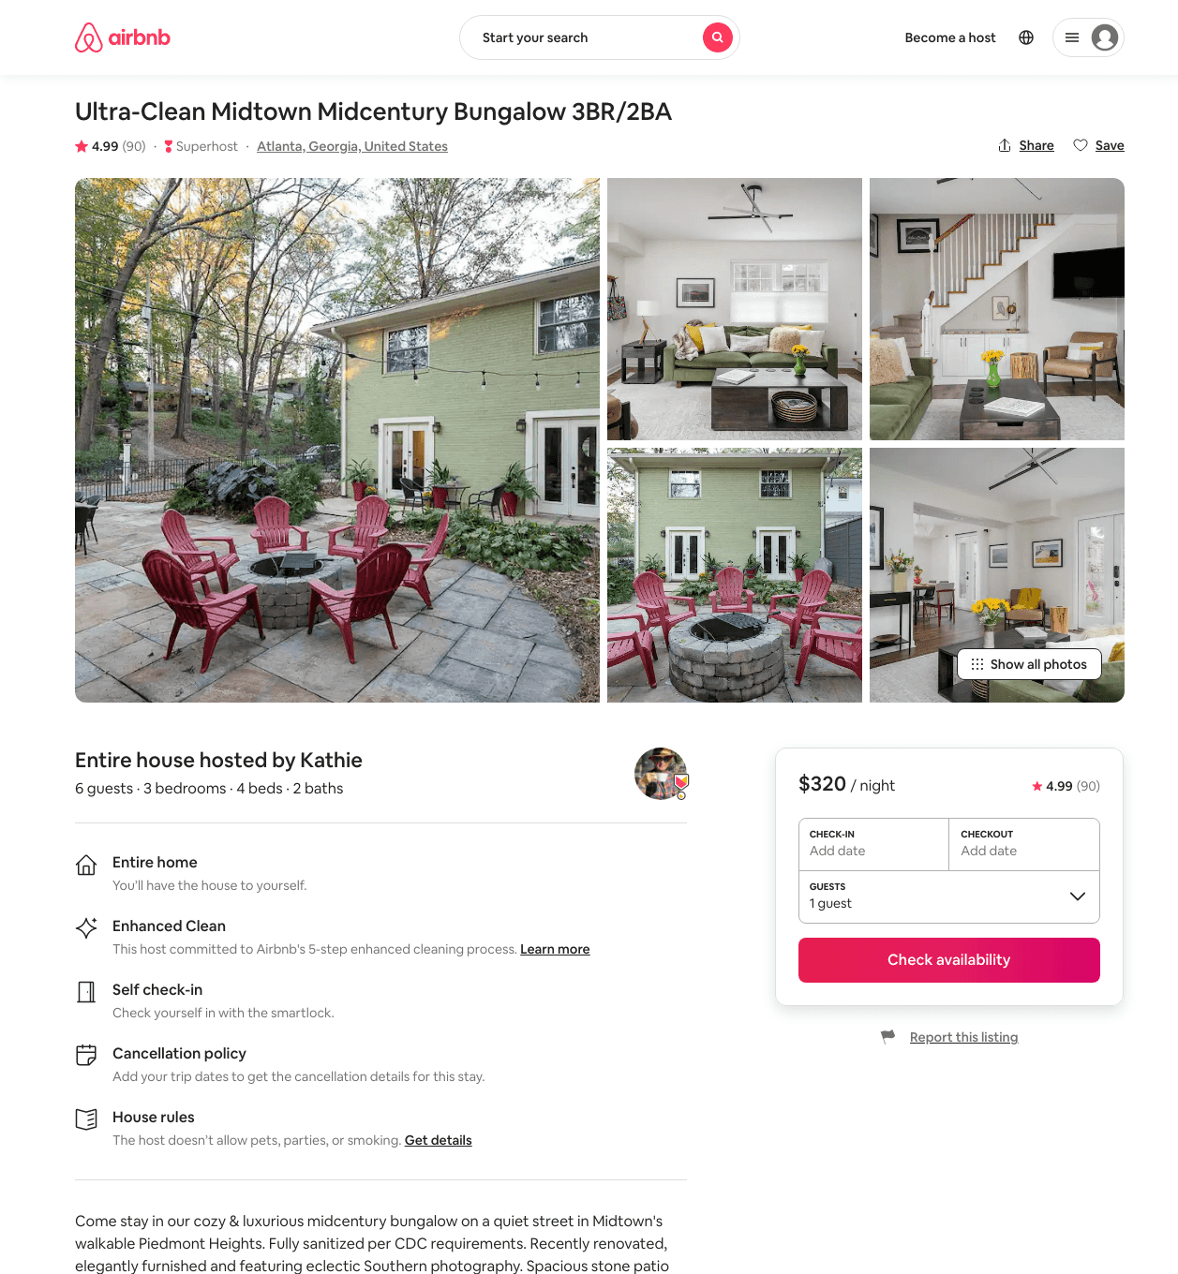
Listing 31066655
1810 WHITE OAK HOLLOW NE
3
6
$306 - $416
4.98
4
Kathie
60044658
2
https://www.airbnb.com/rooms/31066655
Aug 2022

Slide 15
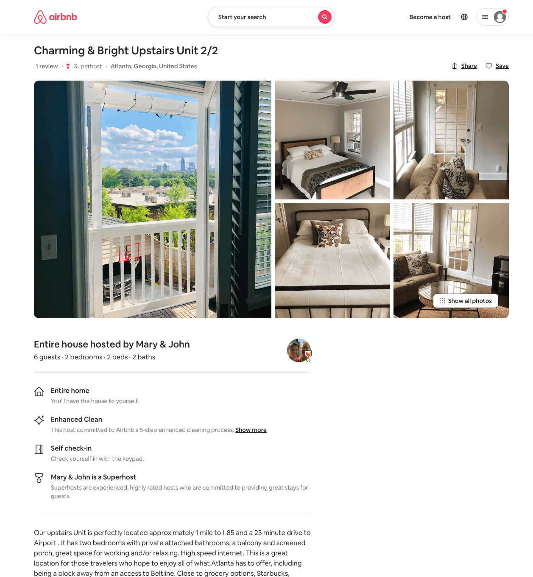
Listing 49854674
2
4
$144 - $252
4.86
1
Mary & John
95291425
1
https://www.airbnb.com/rooms/49854674
Aug 2022

Slide 16
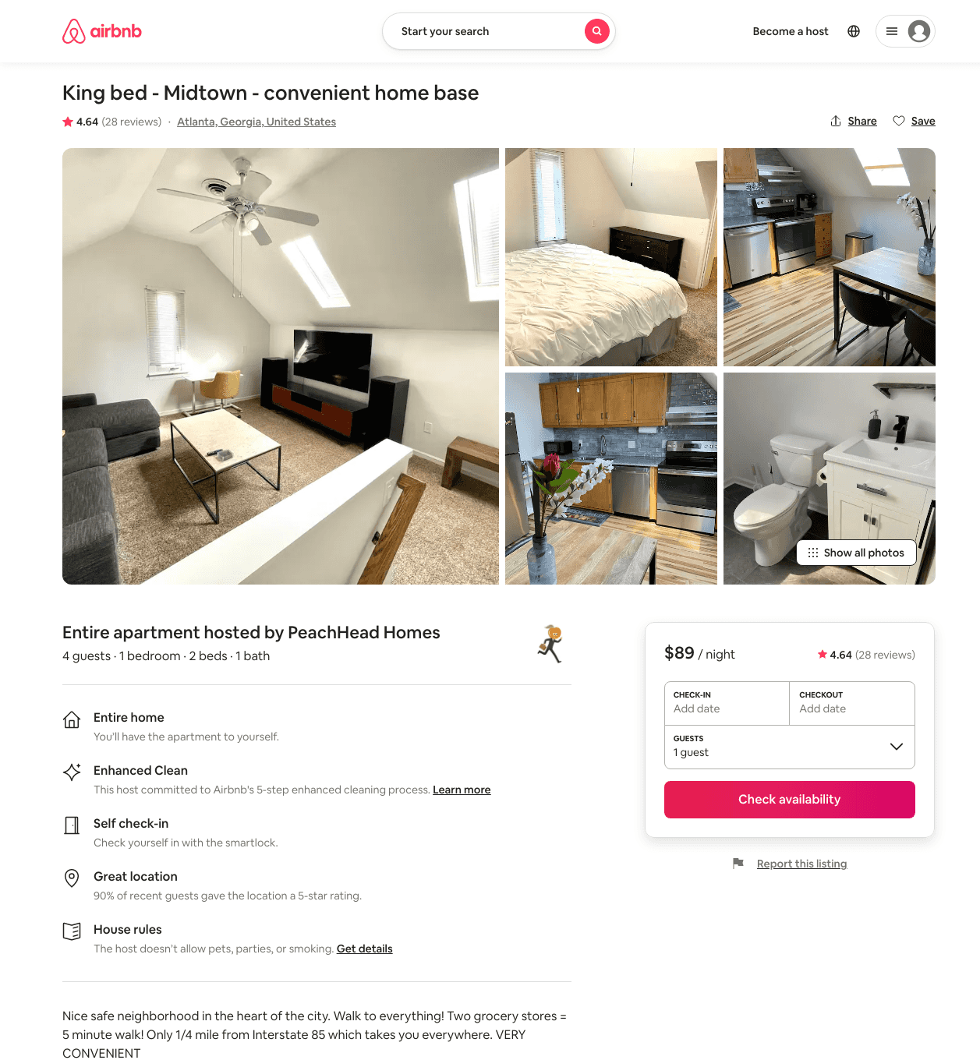
Listing 43555715
1
4
$75 - $104
4.73
1
PeachHead Homes
207768299
3
https://www.airbnb.com/rooms/43555715
Aug 2022

Slide 17
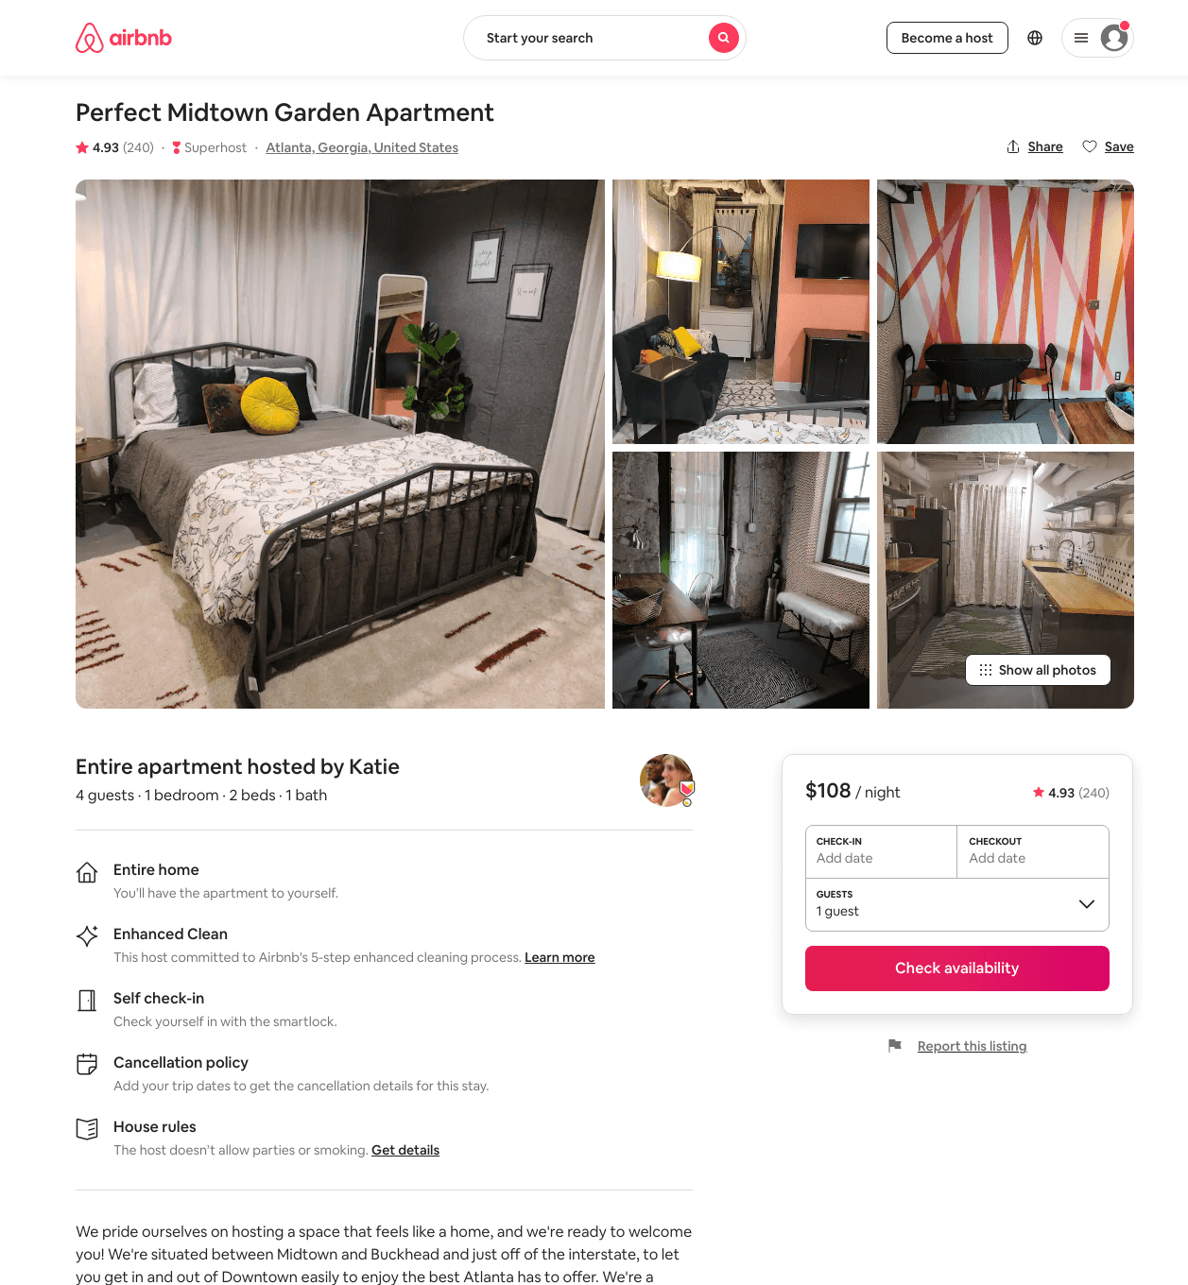
Listing 4455391
1
3
$97 - $125
4.93
1
Katie
1236617
1
https://www.airbnb.com/rooms/4455391
Aug 2022

Slide 18
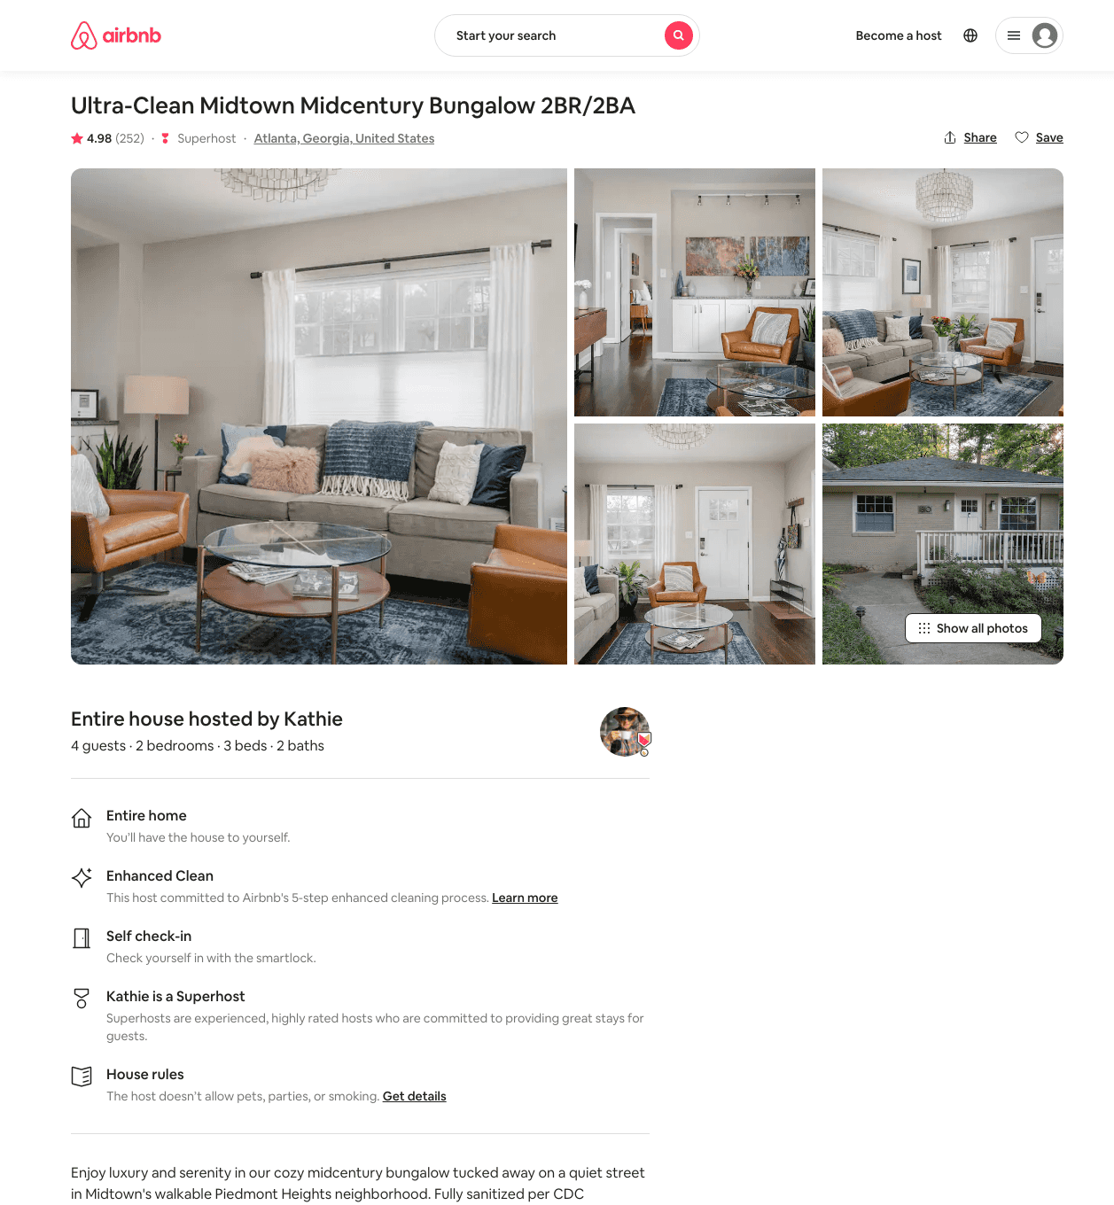
Listing 11430423
1810 WHITE OAK HOLLOW NE
2
4
$161 - $239
4.99
4
Kathie
60044658
2
https://www.airbnb.com/rooms/11430423
Aug 2022

Slide 19
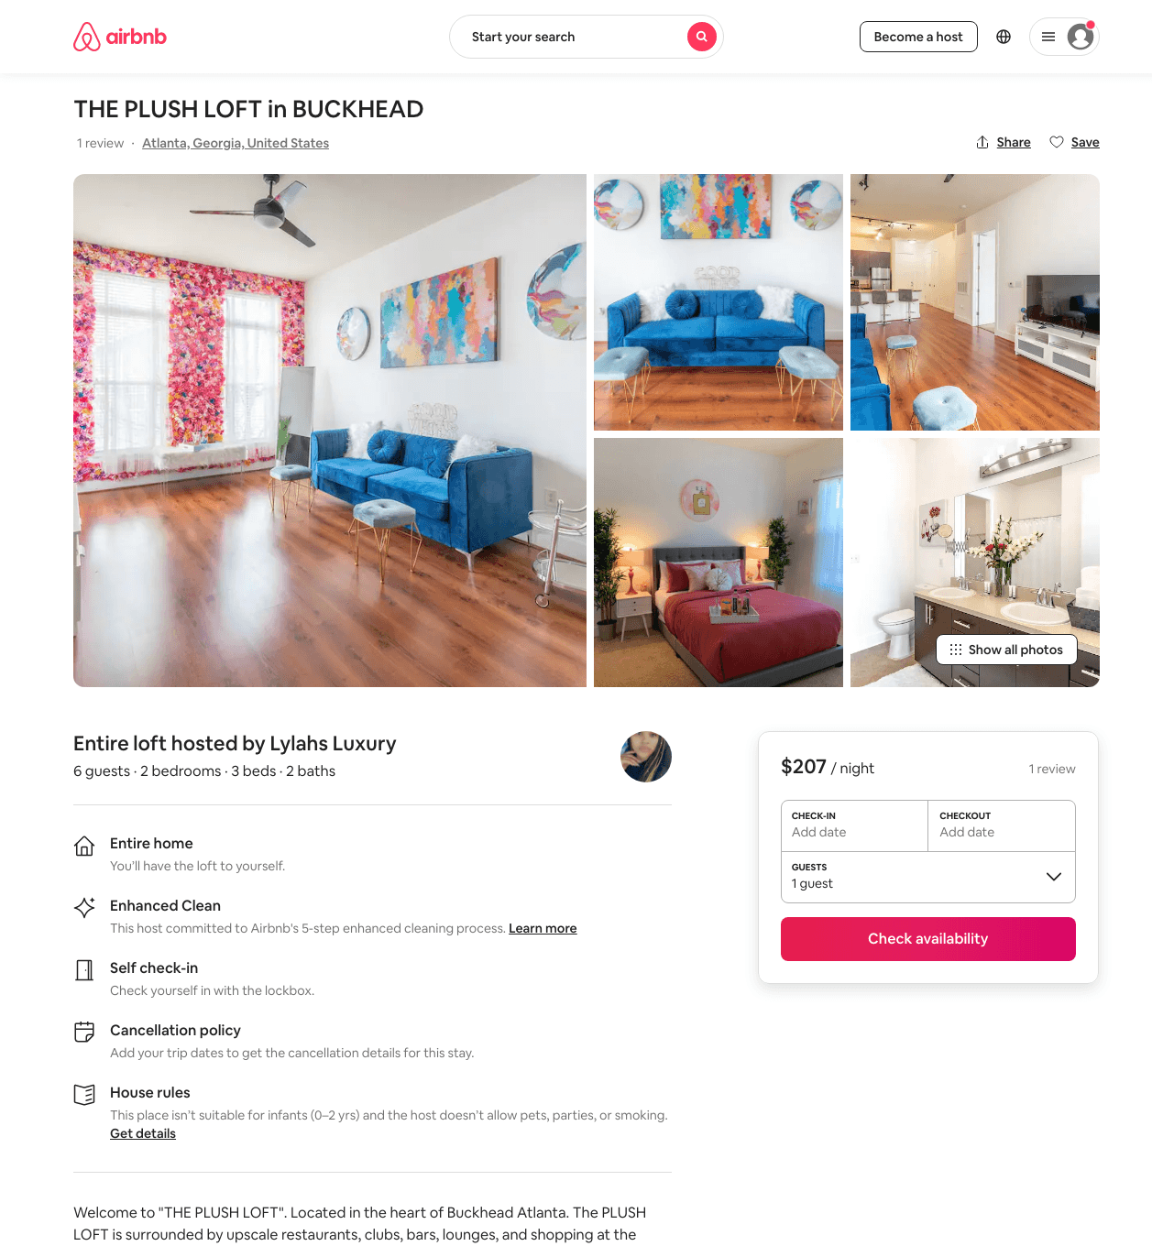
Listing 48429288
2
6
$100 - $233
4.61
2
Lylahs Luxury
390897508
1
https://www.airbnb.com/rooms/48429288
Jun 2022

Slide 20
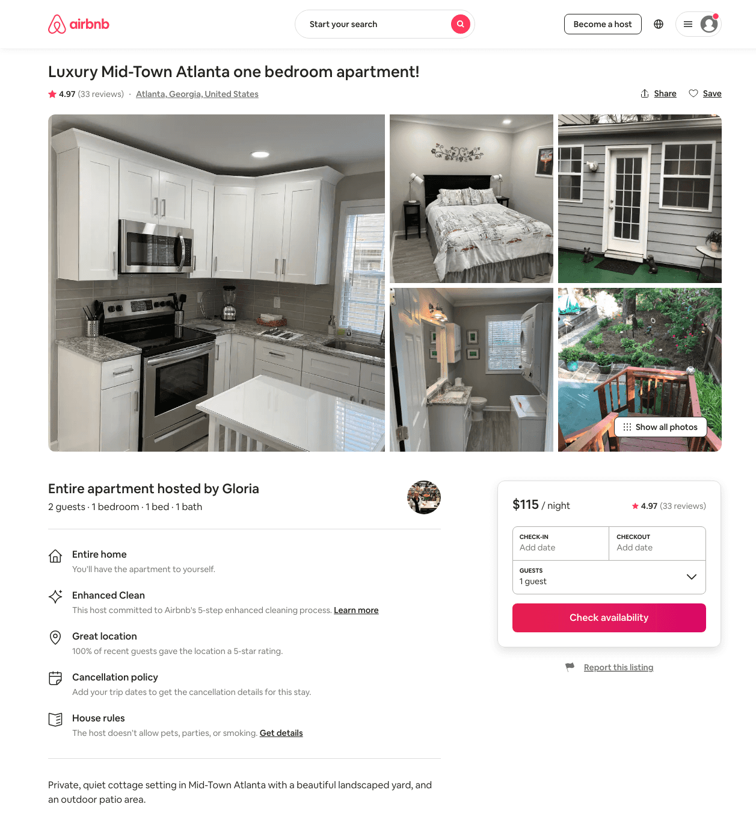
Listing 31864143
1
2
$85 - $119
4.98
2
Gloria
103275794
2
https://www.airbnb.com/rooms/31864143
Aug 2022

Slide 21
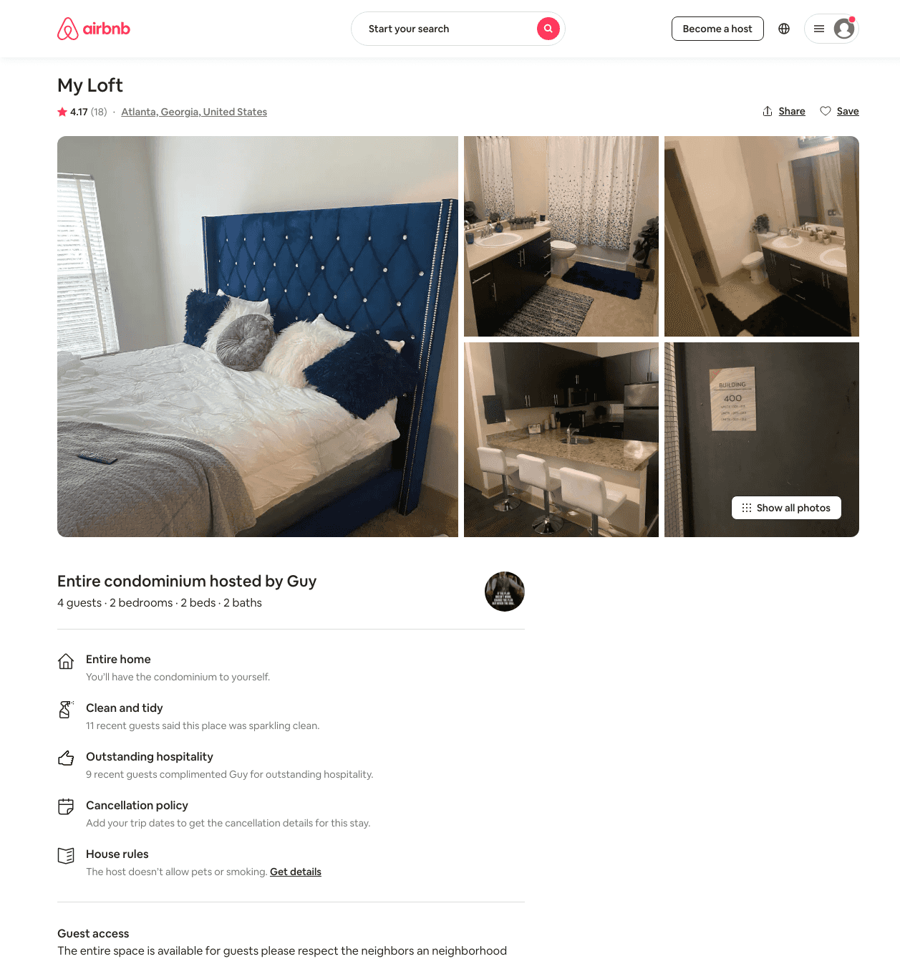
Listing 46158418
2
4
$72 - $173
4.27
2
Gee
307000782
1
https://www.airbnb.com/rooms/46158418
Jun 2022

Slide 22
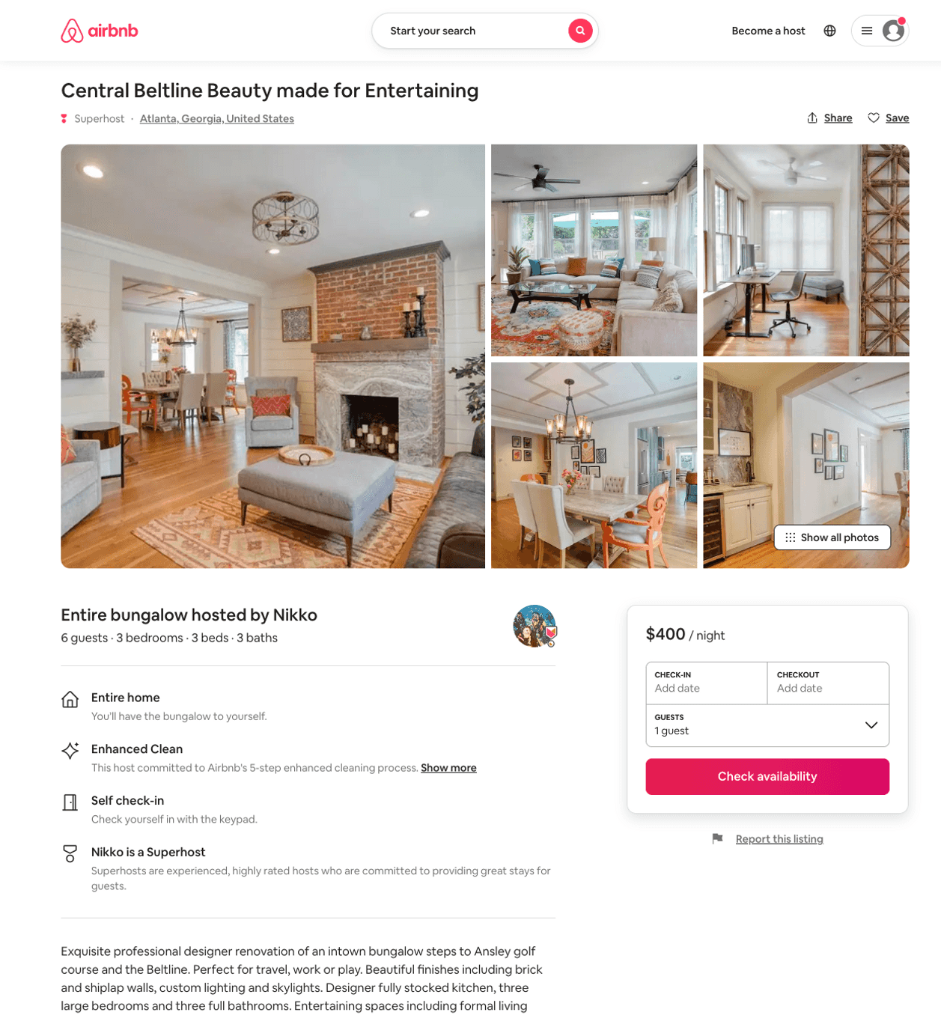
Listing 50073516
3
6
$364 - $557
5.0
5
Nikko
8517251
3
https://www.airbnb.com/rooms/50073516
Aug 2022

Slide 23
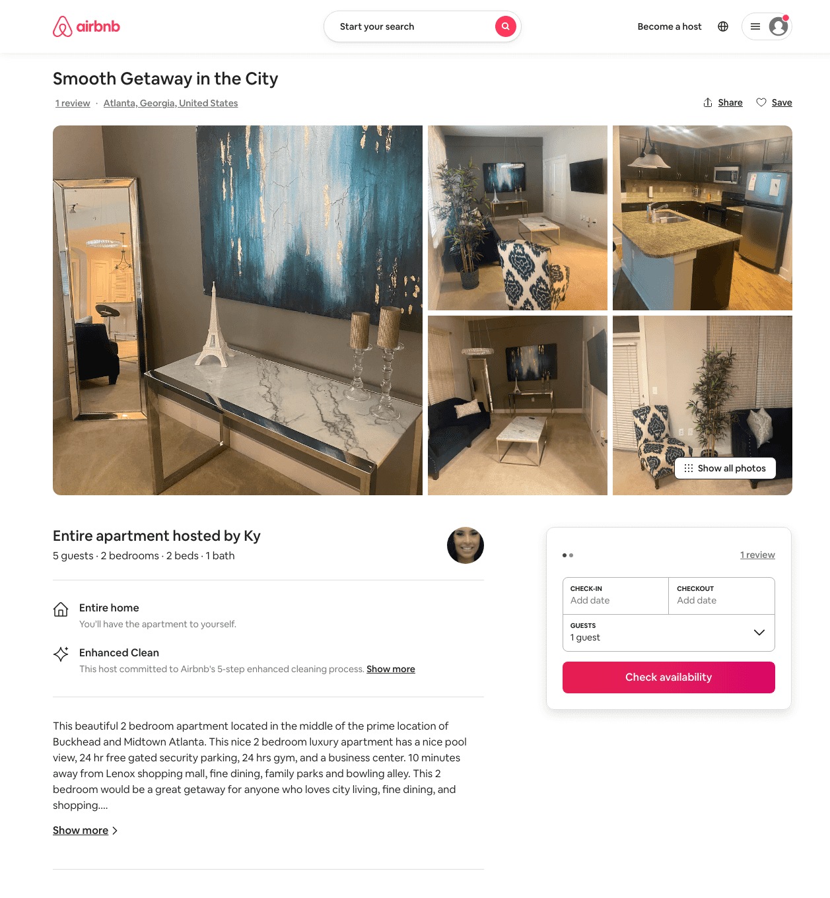
Listing 31236819
2
5
$94 - $178
4.89
2
Ky
233674215
1
https://www.airbnb.com/rooms/31236819
Aug 2022

Slide 24
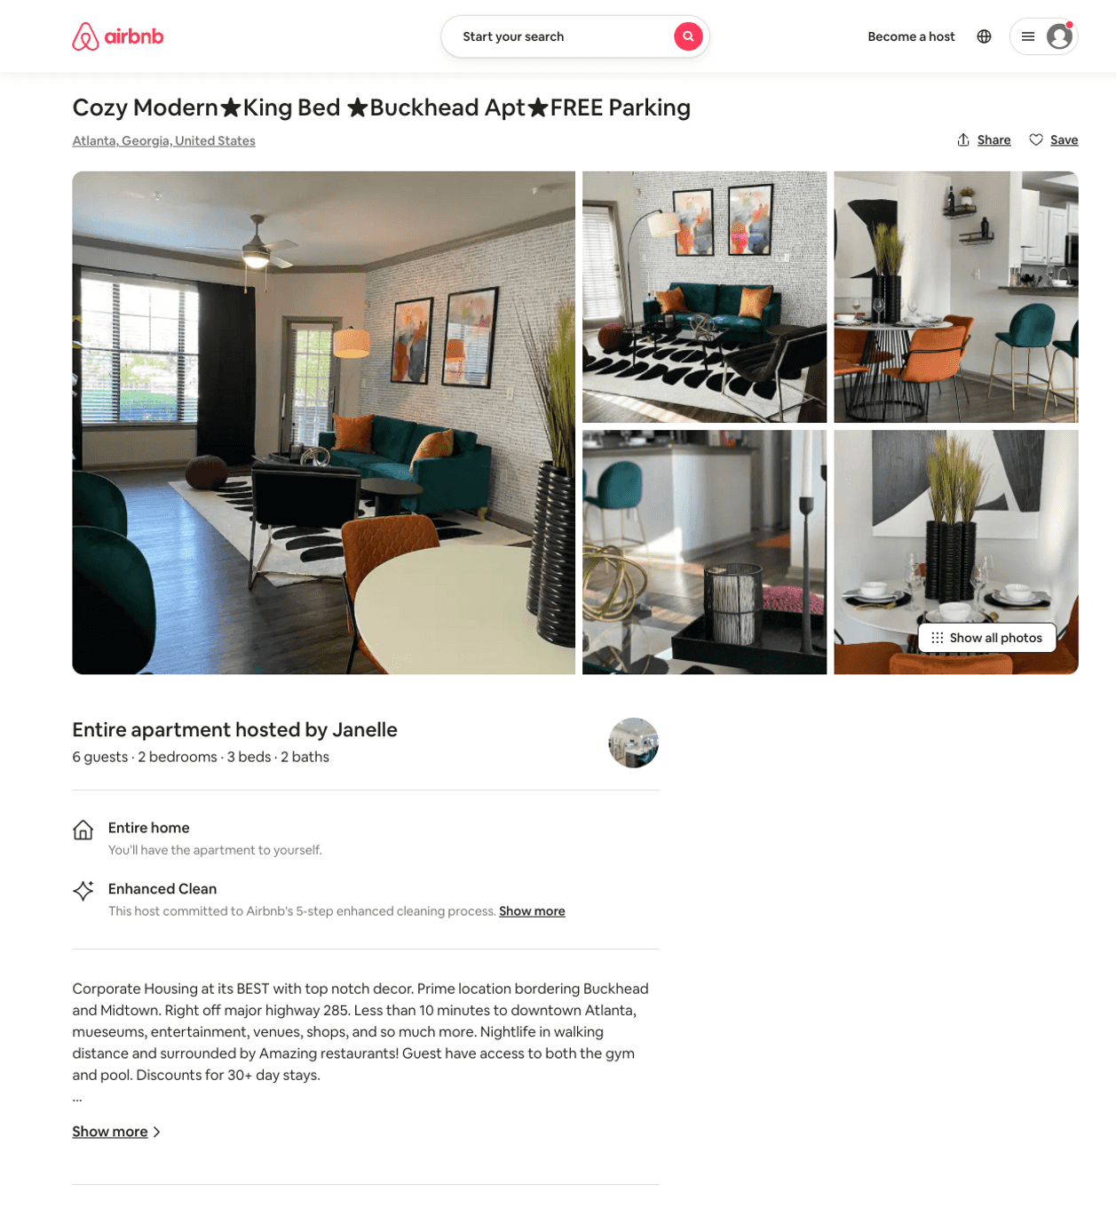
Listing 50468593
2
6
$122 - $152
4.77
1
Janelle
272107356
2
https://www.airbnb.com/rooms/50468593
Jun 2022

Slide 25
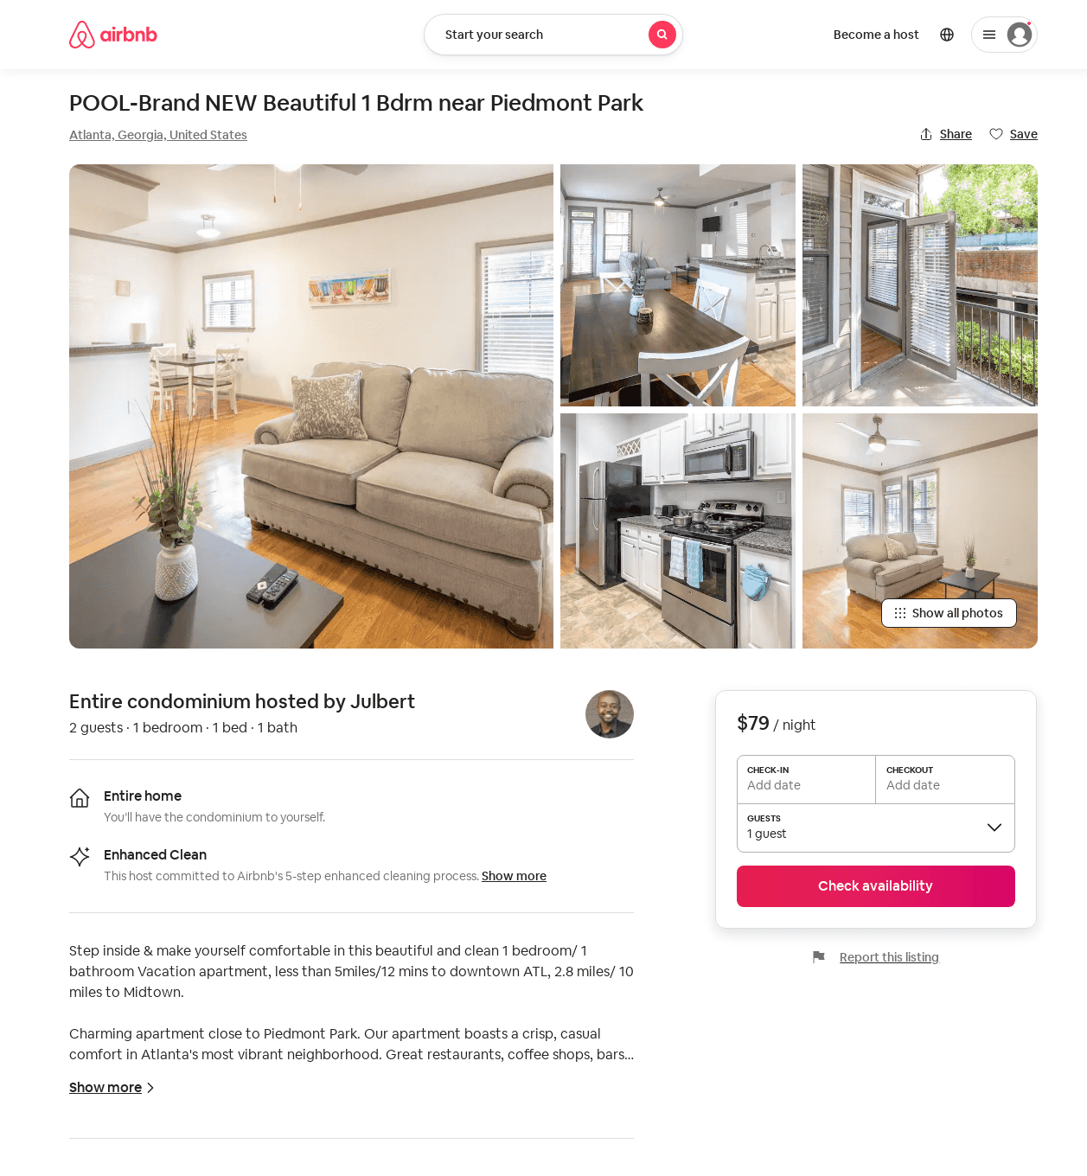
Listing 50032483
1
2
$79 - $99
30
Y And J
71878540
1
https://www.airbnb.com/rooms/50032483
Aug 2022

Slide 26
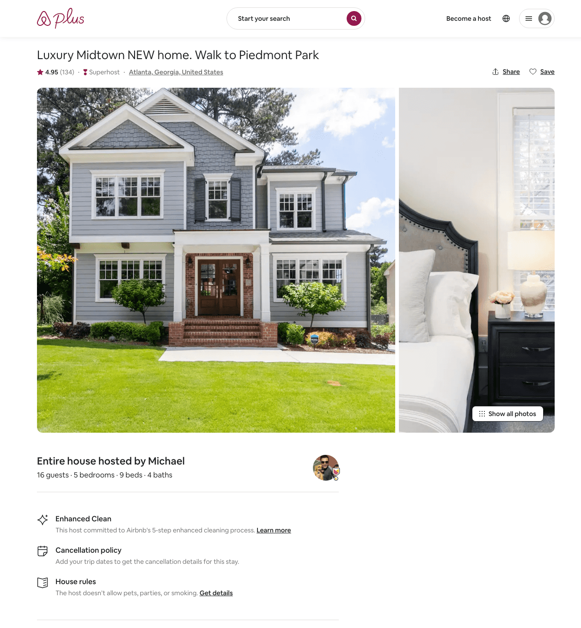
Listing 26217928
5
16
$310 - $448
4.94
1
Michael
143143166
5
https://www.airbnb.com/rooms/26217928
Aug 2022

Slide 27
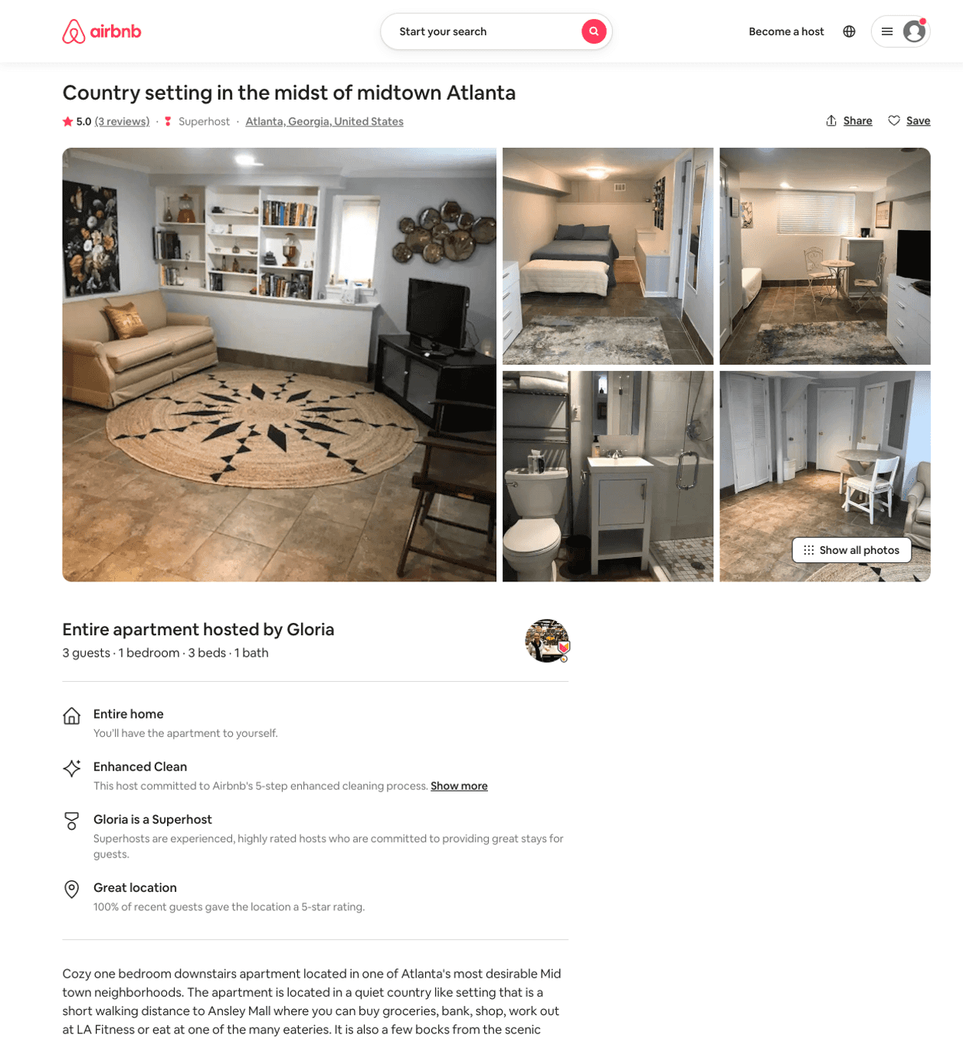
Listing 31863153
1
3
$85 - $95
5.0
2
Gloria
103275794
2
https://www.airbnb.com/rooms/31863153
Aug 2022

Slide 28
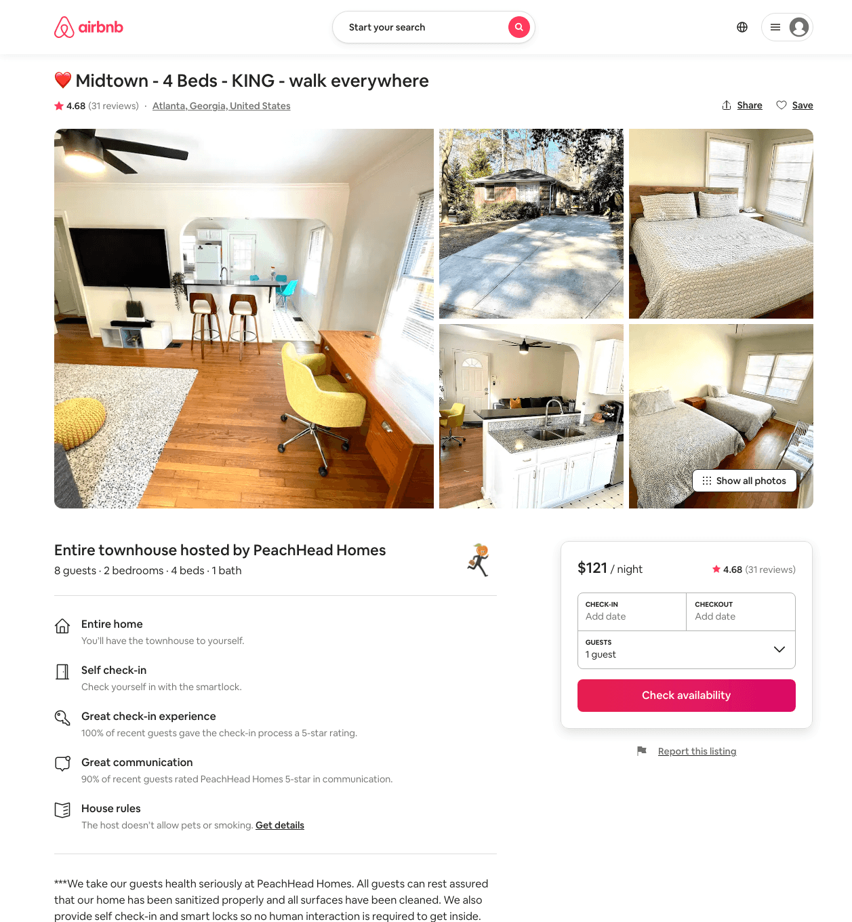
Listing 39969793
2
8
$94 - $130
4.52
1
PeachHead Homes
207768299
3
https://www.airbnb.com/rooms/39969793
Aug 2022

Slide 29
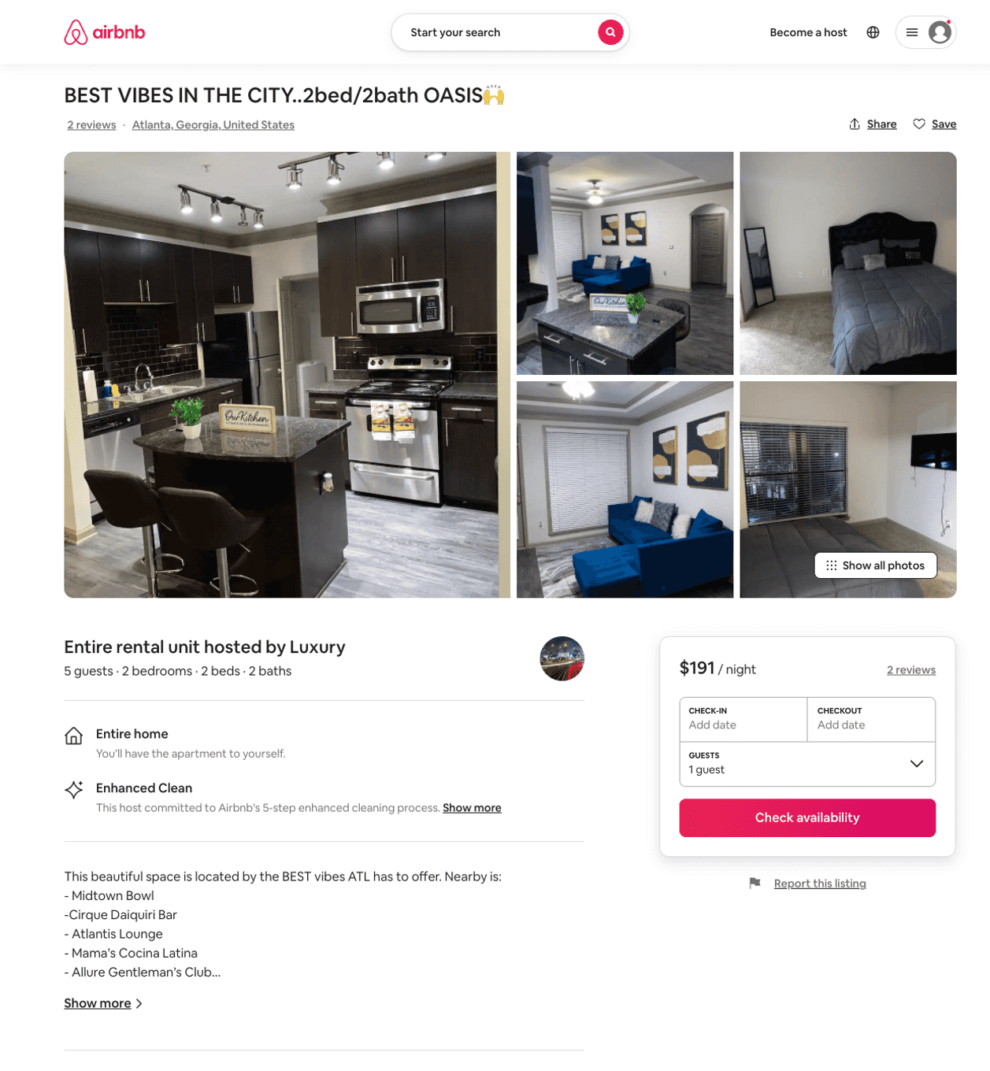
Listing 51028306
2
6
$106 - $196
4.96
1
Luxury
385318860
2
https://www.airbnb.com/rooms/51028306
Aug 2022

Slide 30
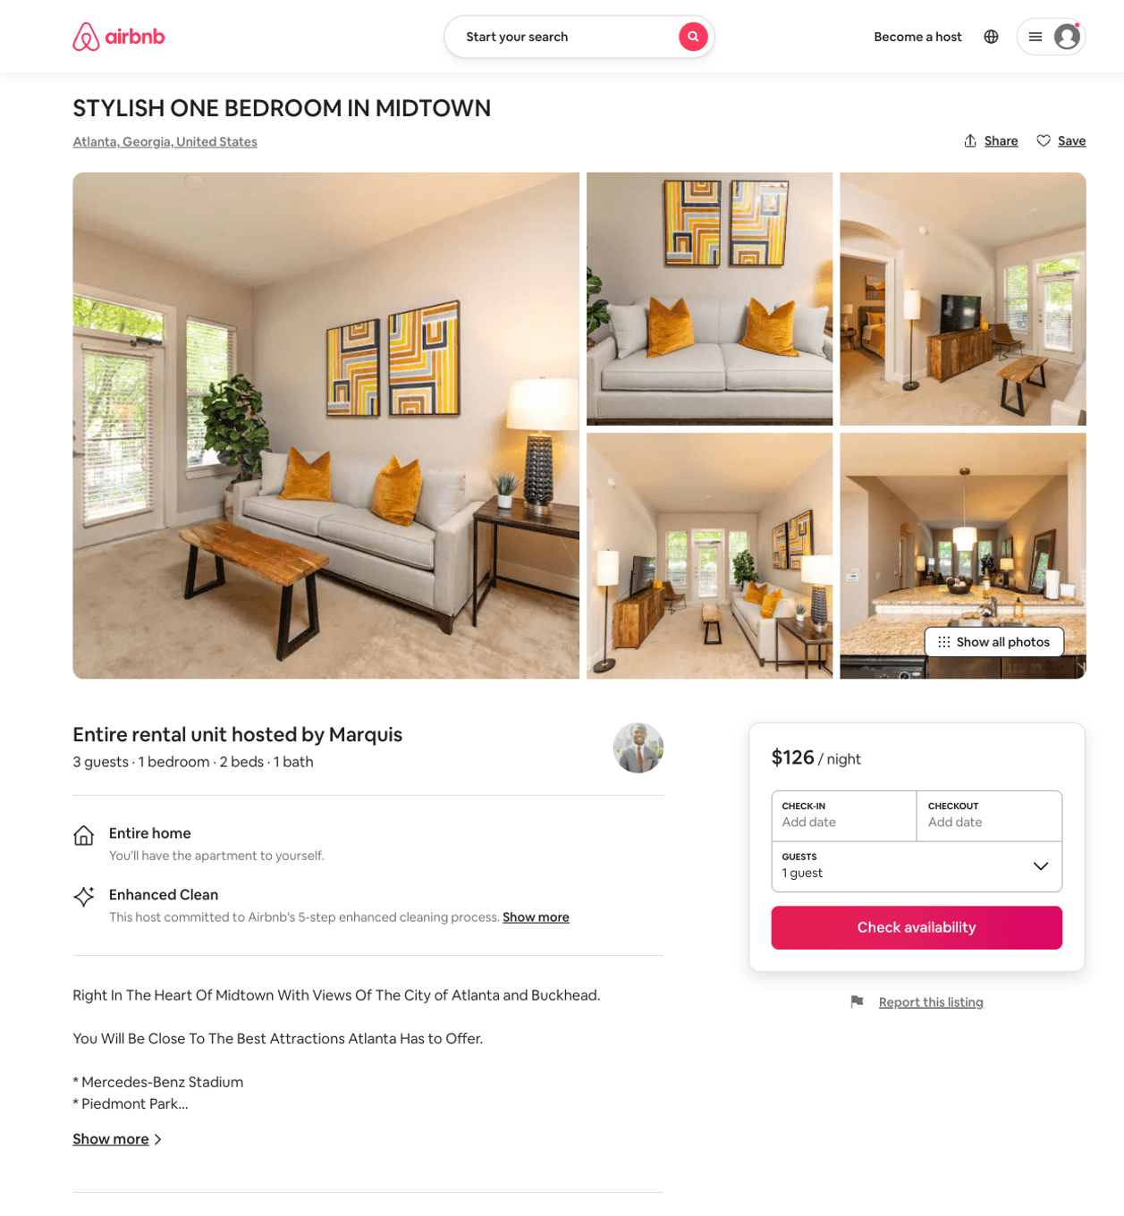
Listing 31626854
1
3
$109 - $126
4.50
2
Marquis
135925172
1
https://www.airbnb.com/rooms/31626854
Jun 2022

Slide 31
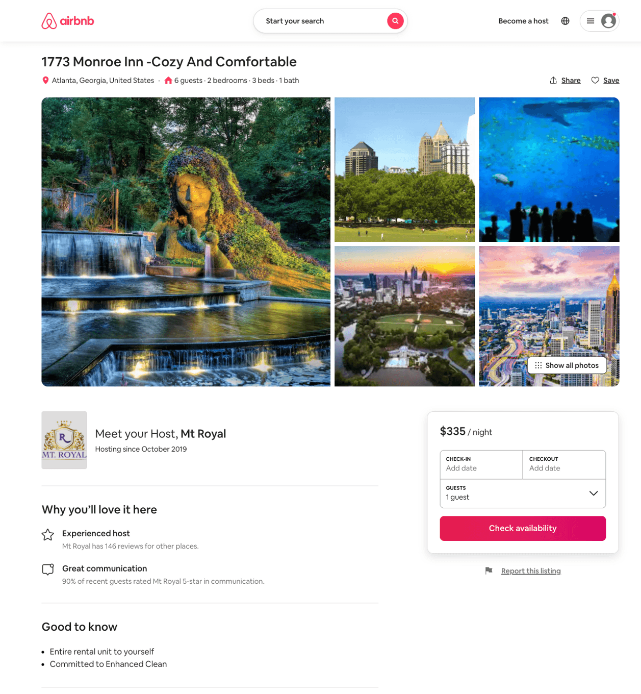
Listing 51911932
2
6
$118 - $399
4.36
1
Mt Royal
305477597
14
https://www.airbnb.com/rooms/51911932
Aug 2022

Slide 32
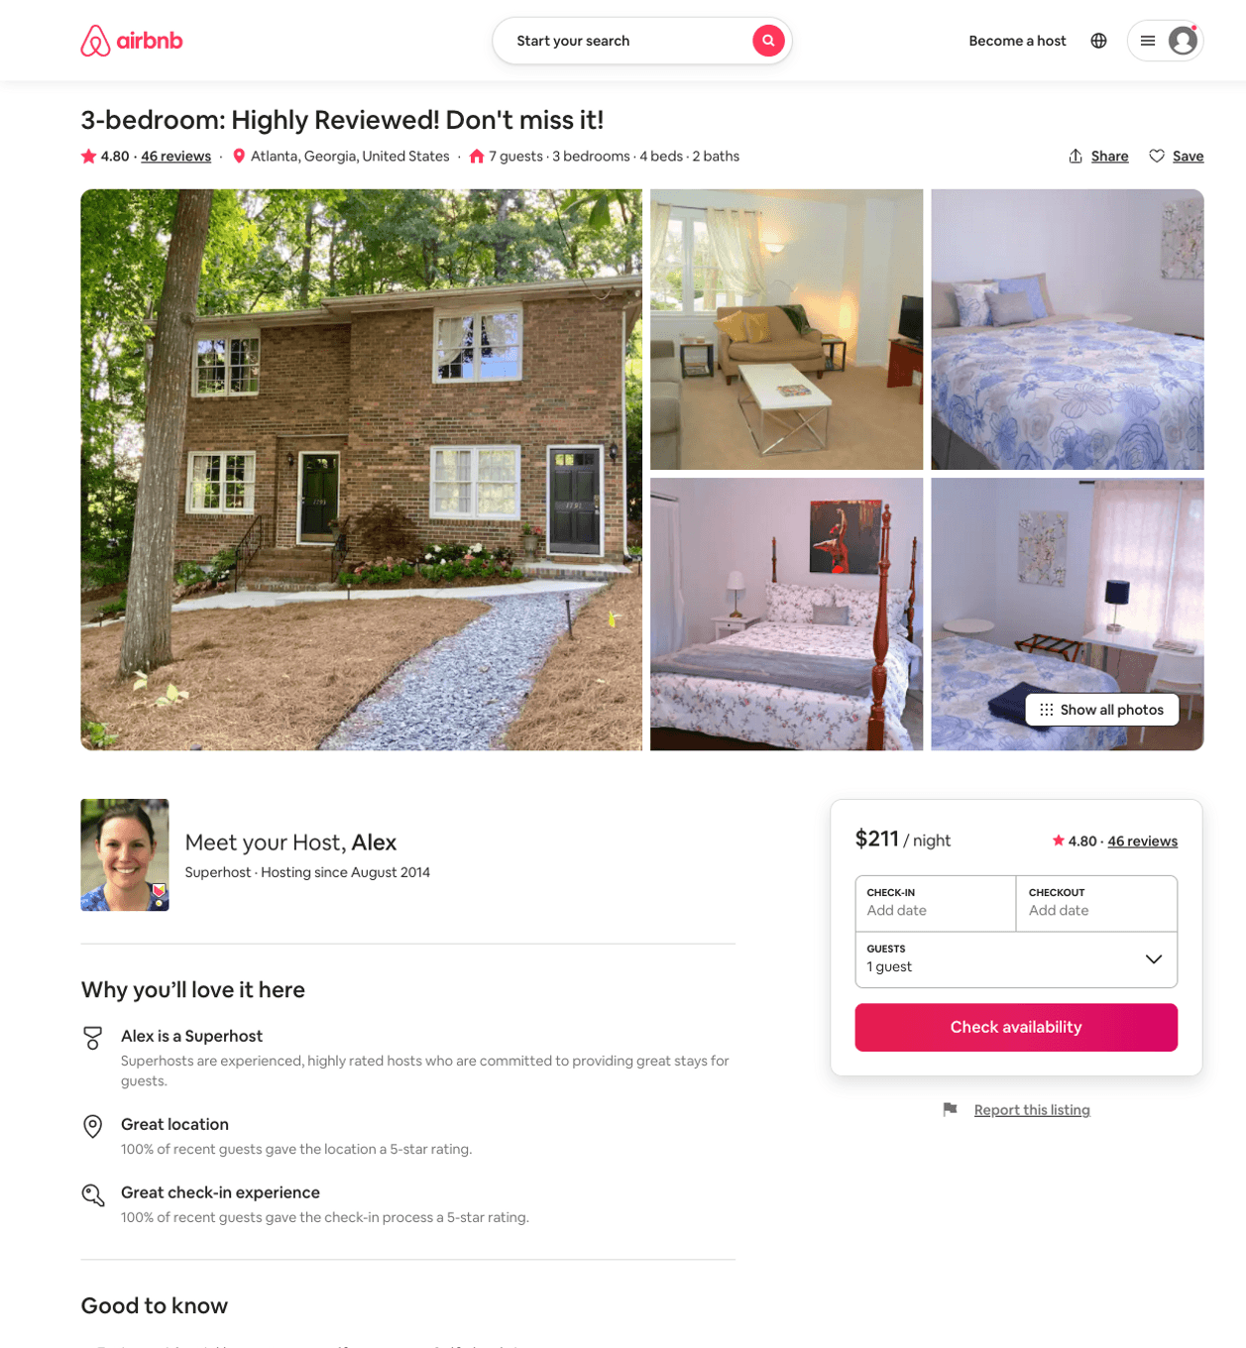
Listing 24368844
3
7
$113 - $221
4.80
2
Alex And Christina
20605441
40
https://www.airbnb.com/rooms/24368844
Jun 2022

Slide 33
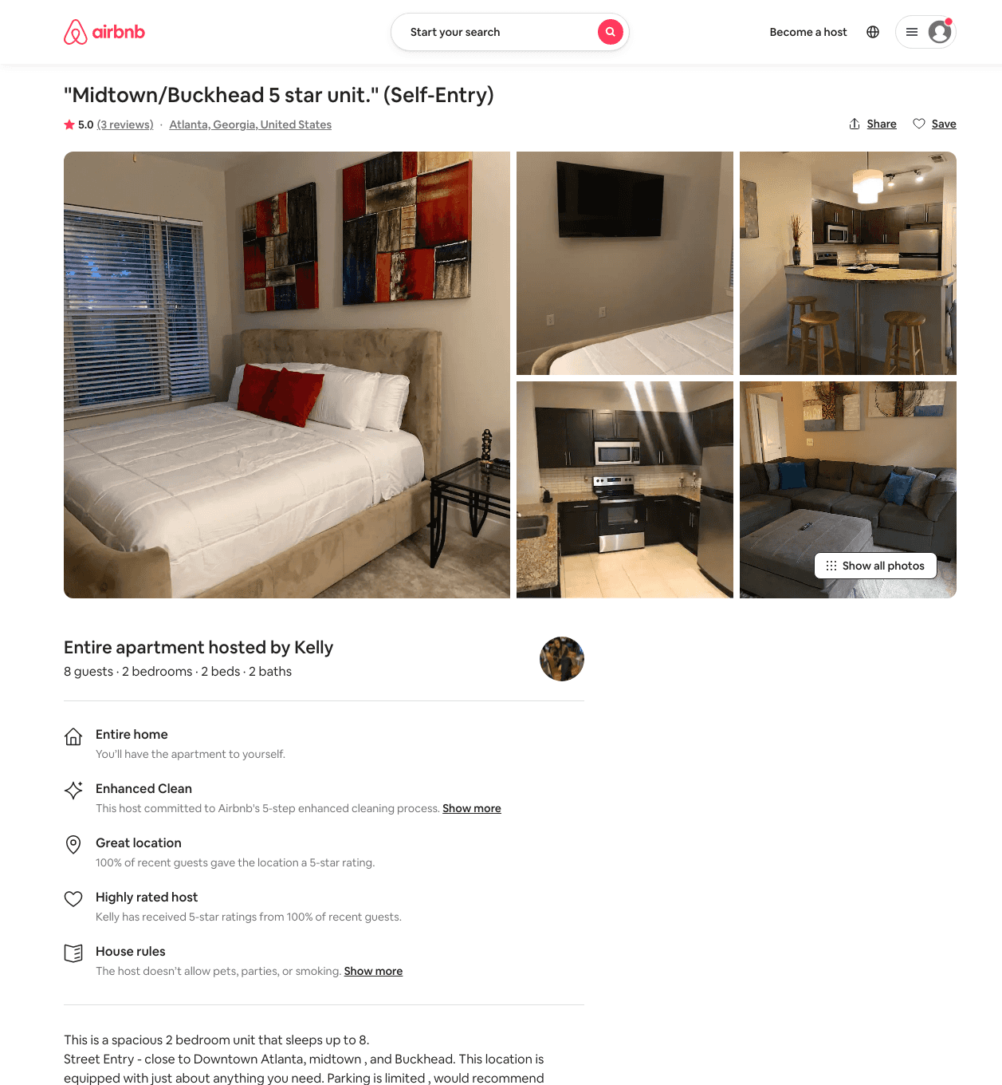
Listing 48182327
1
2
$125 - $142
4.88
2
Kelly
370884278
2
https://www.airbnb.com/rooms/48182327
Jul 2022

Slide 34
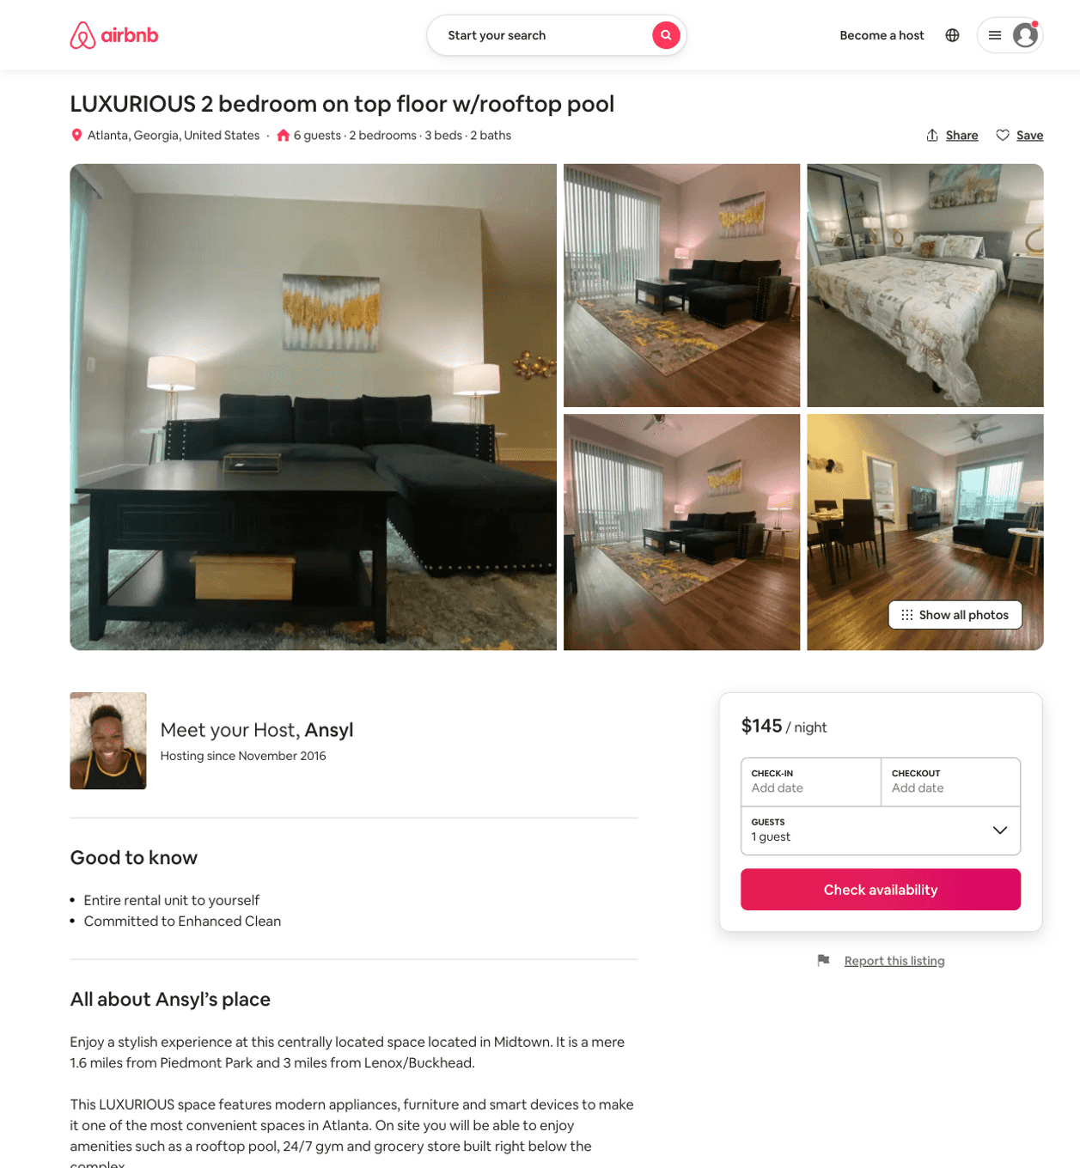
Listing 51967095
2
8
$95 - $191
4.49
1
Justin
103717743
3
https://www.airbnb.com/rooms/51967095
Aug 2022

Slide 35
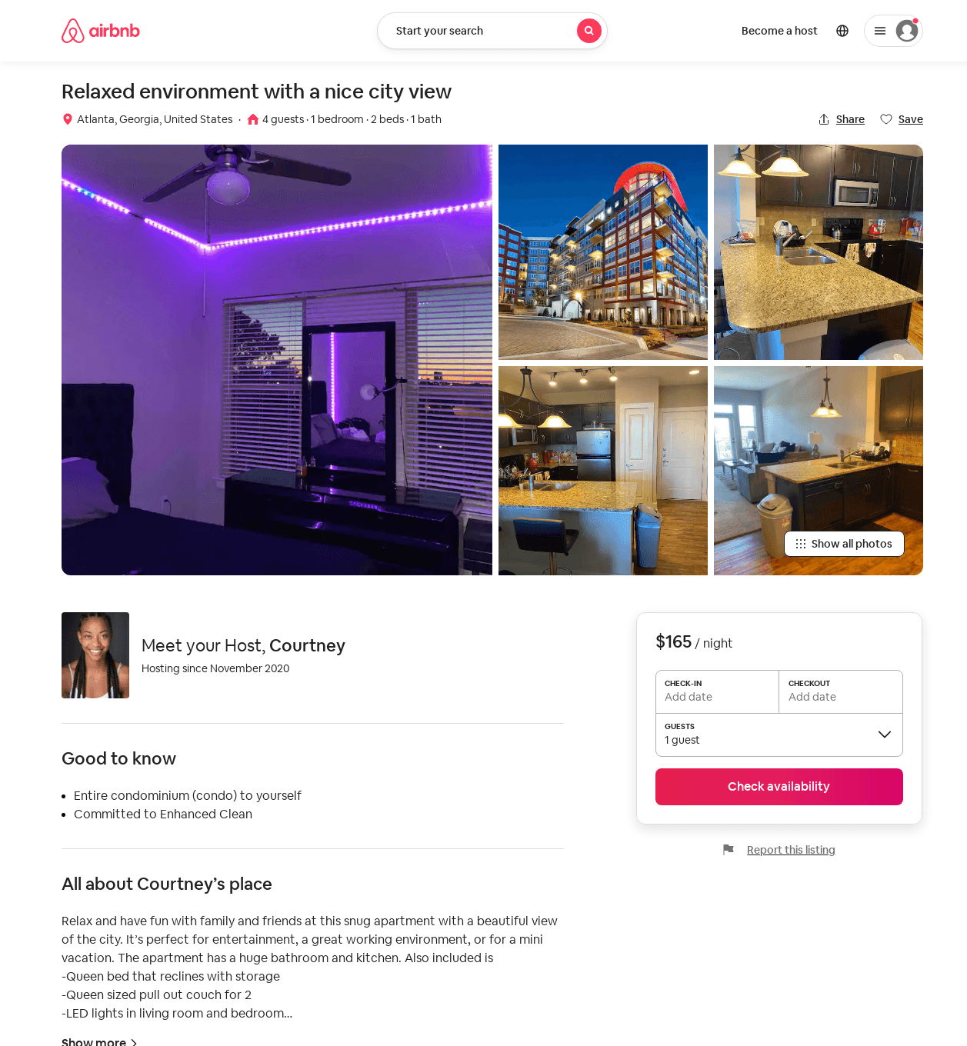
Listing 52125133
1
4
$110 - $200
4.21
2
Courtney
374802742
1
https://www.airbnb.com/rooms/52125133
Aug 2022

Slide 36
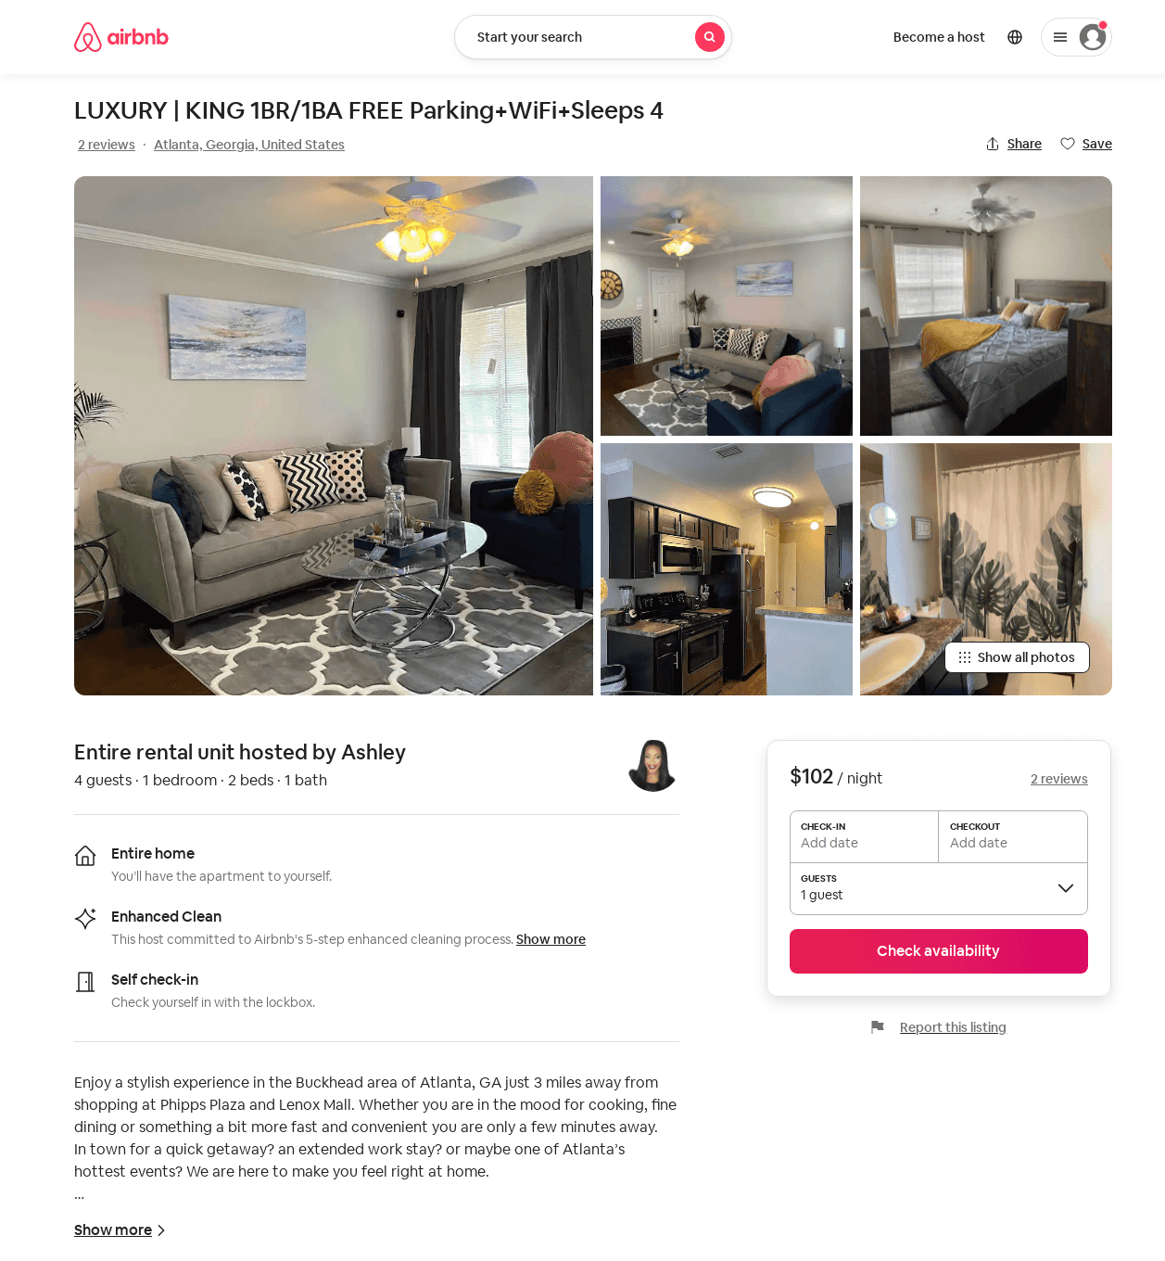
Listing 51544997
1
4
$79 - $129
4.92
1
Priority
194470177
1
https://www.airbnb.com/rooms/51544997
Aug 2022

Slide 37
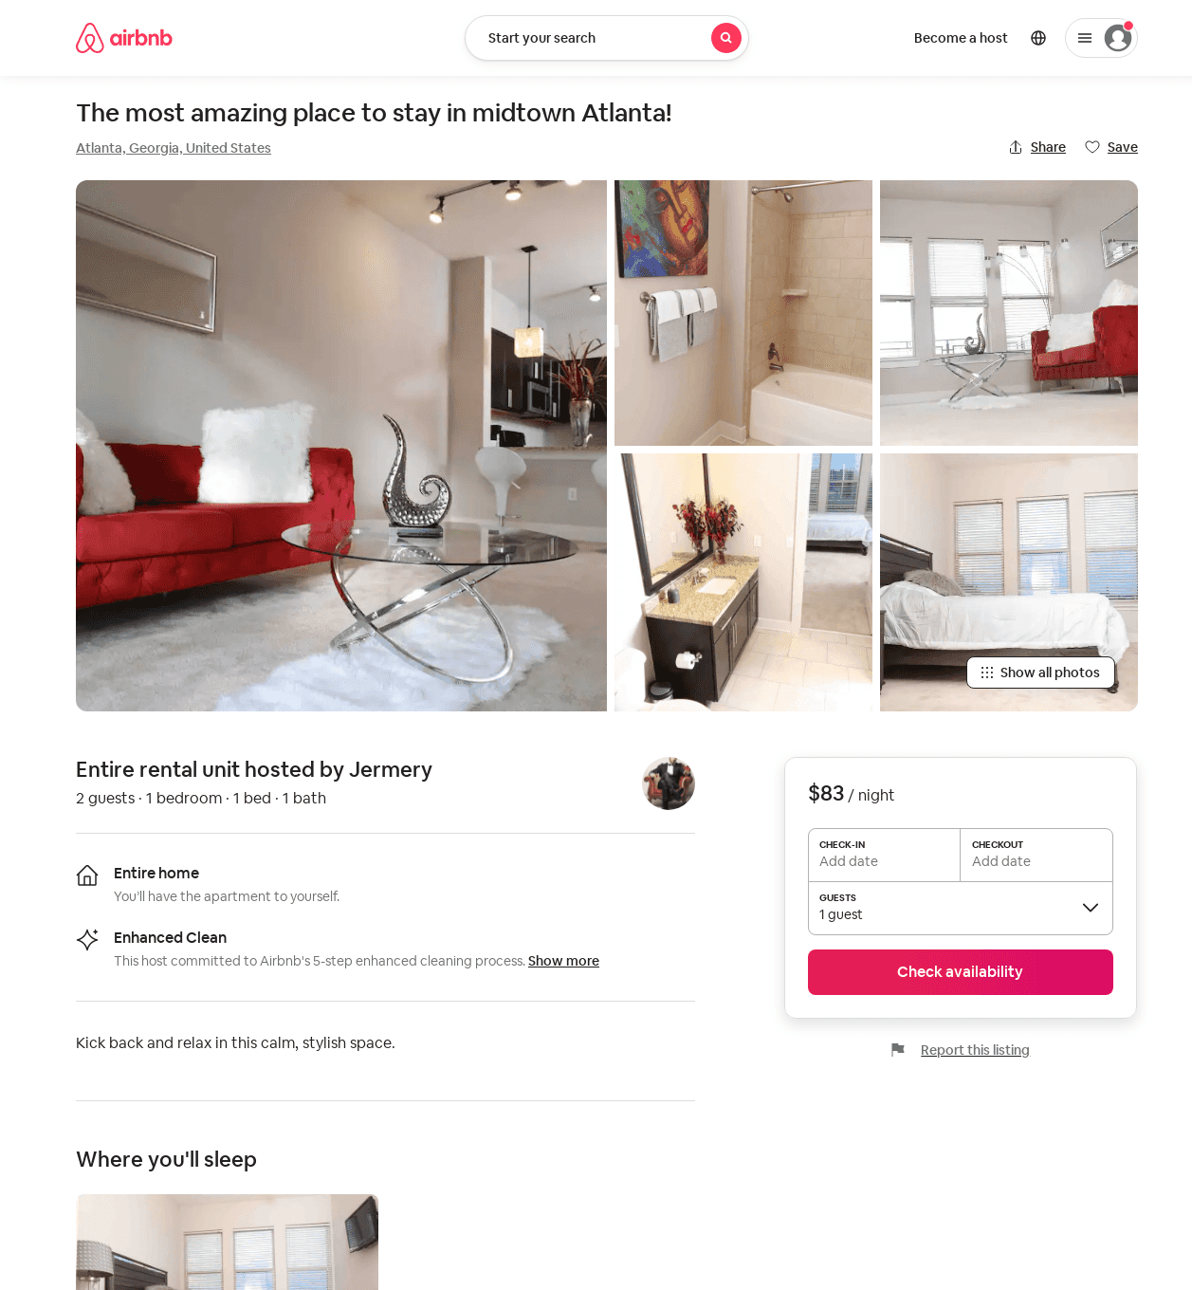
Listing 52335068
1
2
$75 - $132
4.63
1
Jermery
421754593
2
https://www.airbnb.com/rooms/52335068
Jul 2022

Slide 38
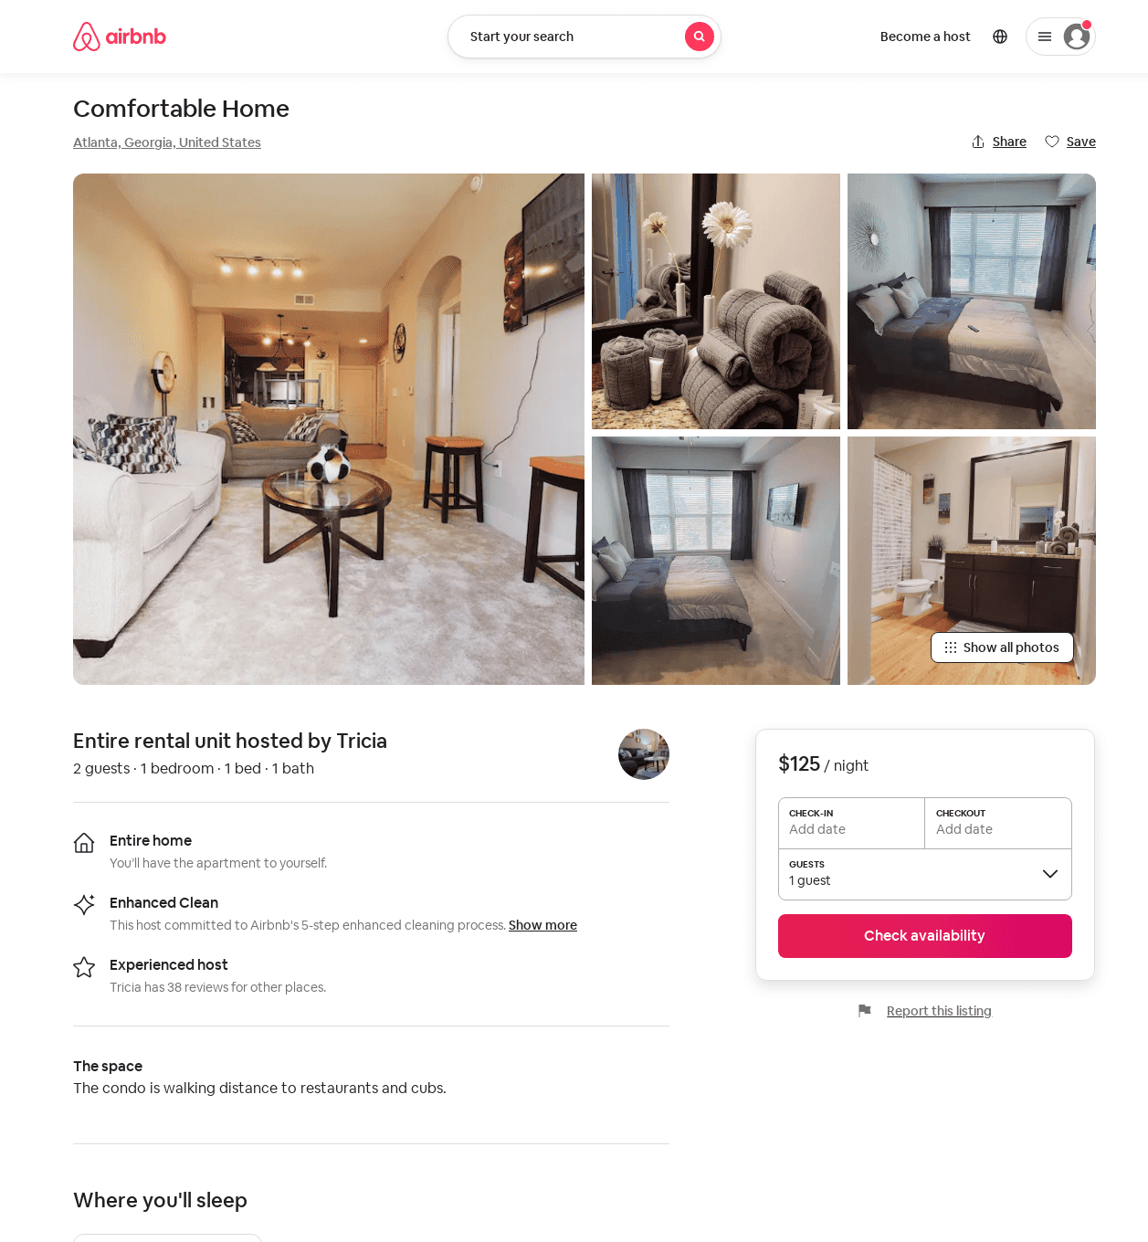
Listing 52470666
1
2
$85 - $125
4.25
2
Tricia
290642214
3
https://www.airbnb.com/rooms/52470666
Aug 2022

Slide 39
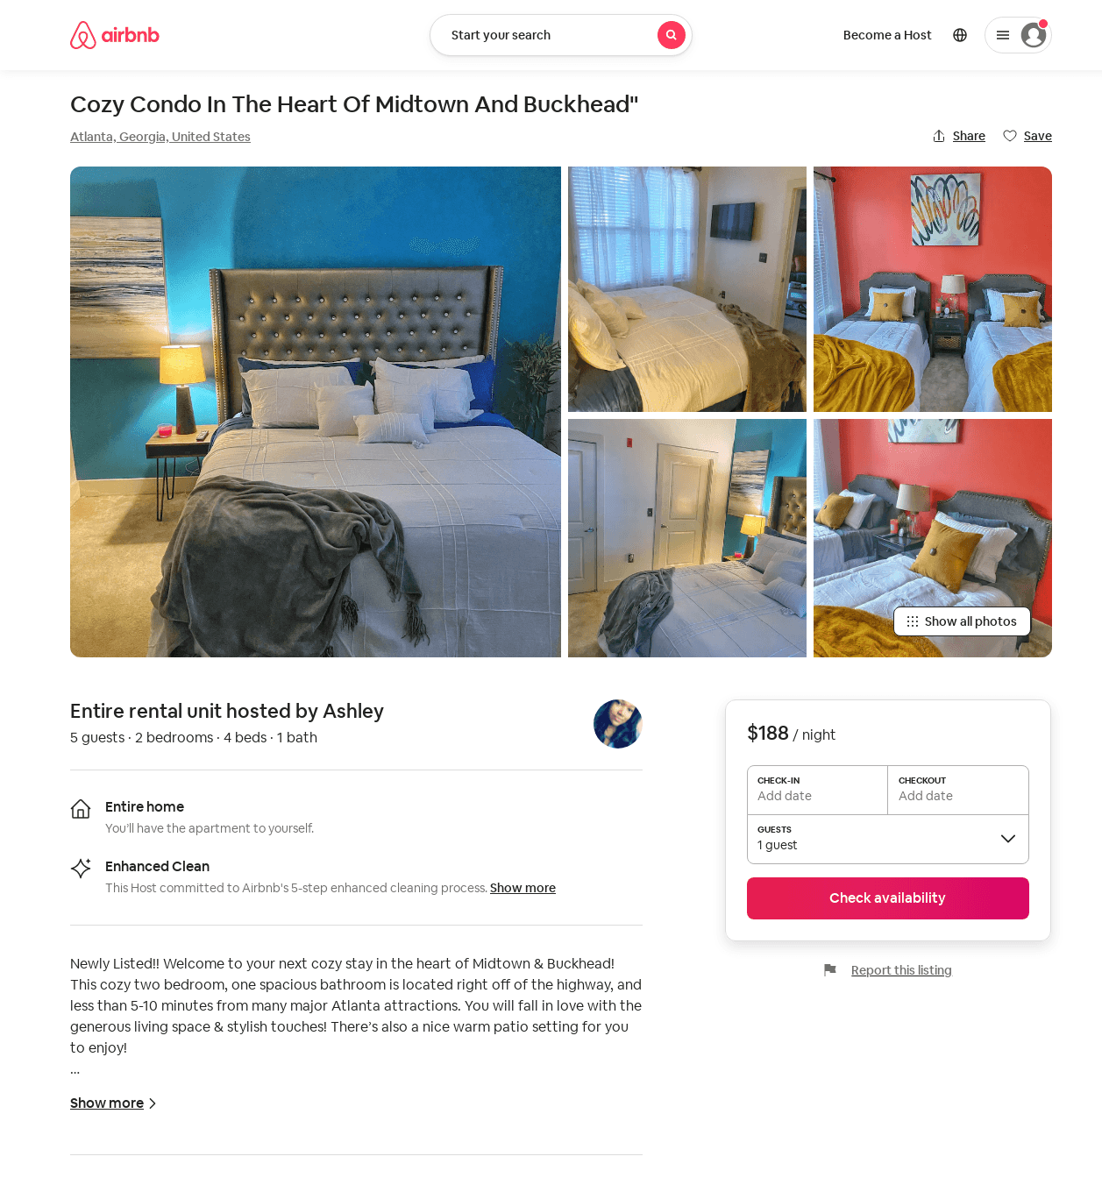
Listing 52912602
2
6
$94 - $188
4.68
1
Stream Investment Properties
62340993
1
https://www.airbnb.com/rooms/52912602
Aug 2022

Slide 40
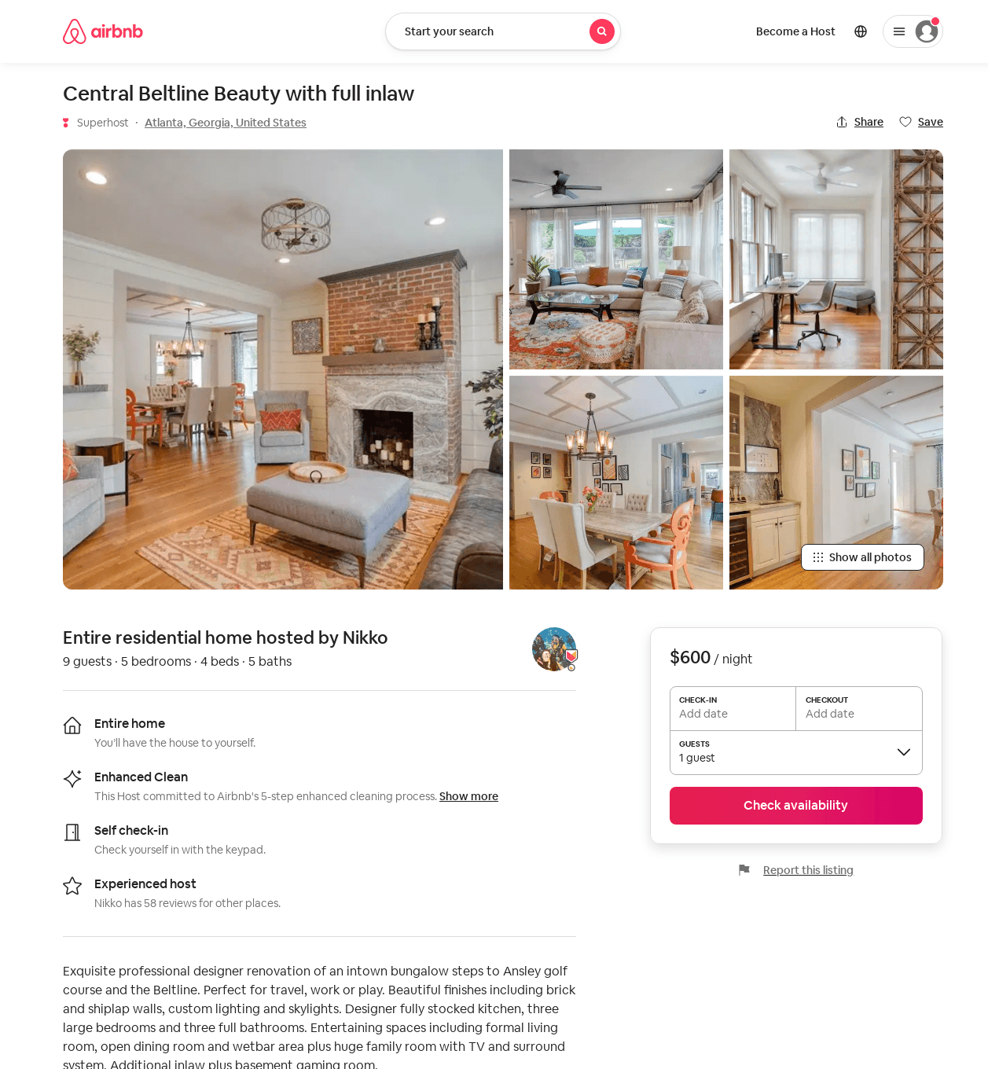
Listing 53113728
5
11
$550 - $678
5.0
1
Nikko
8517251
3
https://www.airbnb.com/rooms/53113728
Aug 2022

Slide 41
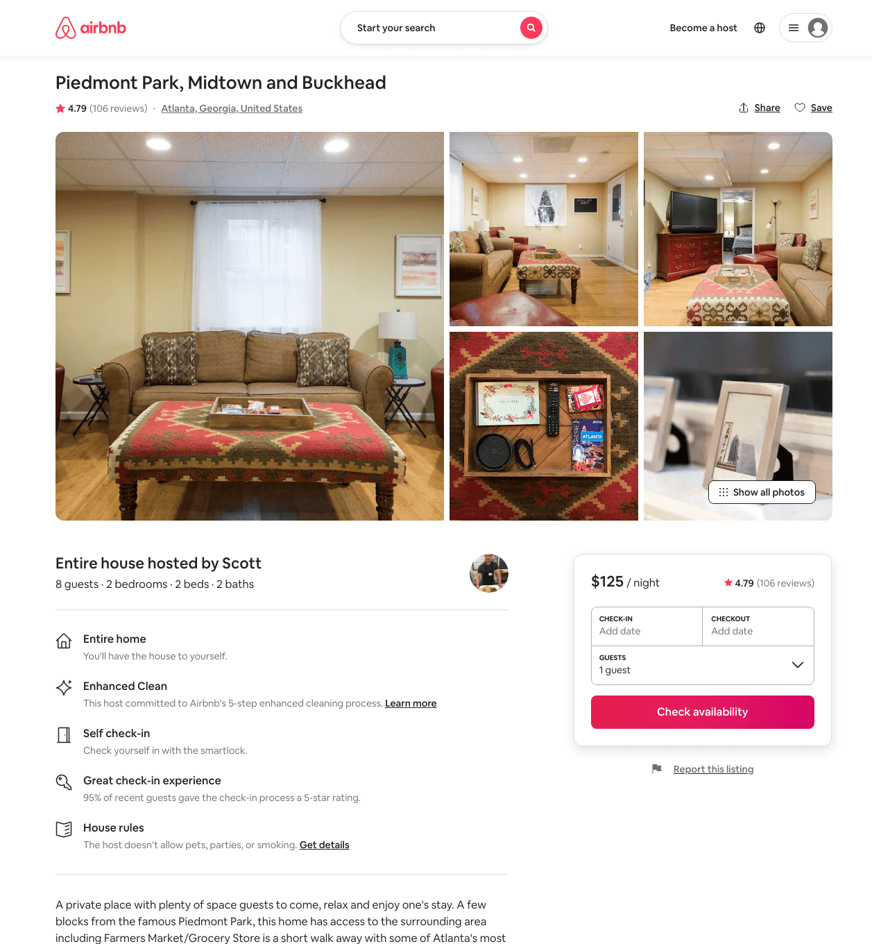
Listing 18915646
2
8
$94 - $800
4.67
2
Scott
117109391
4
https://www.airbnb.com/rooms/18915646
Jun 2022

Slide 42
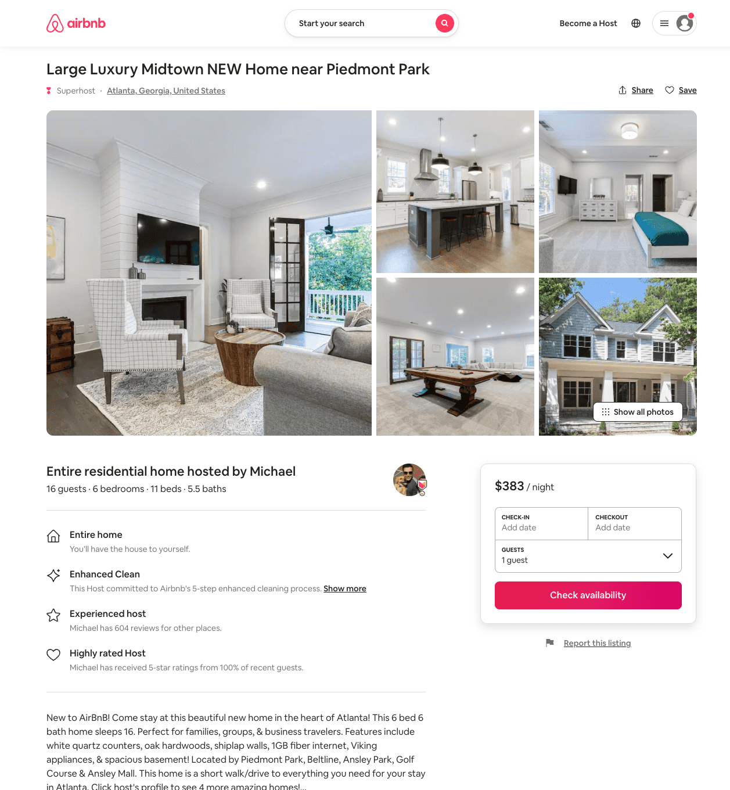
Listing 53429963
6
16
$307 - $469
4.88
1
Michael
143143166
5
https://www.airbnb.com/rooms/53429963
Aug 2022

Slide 43
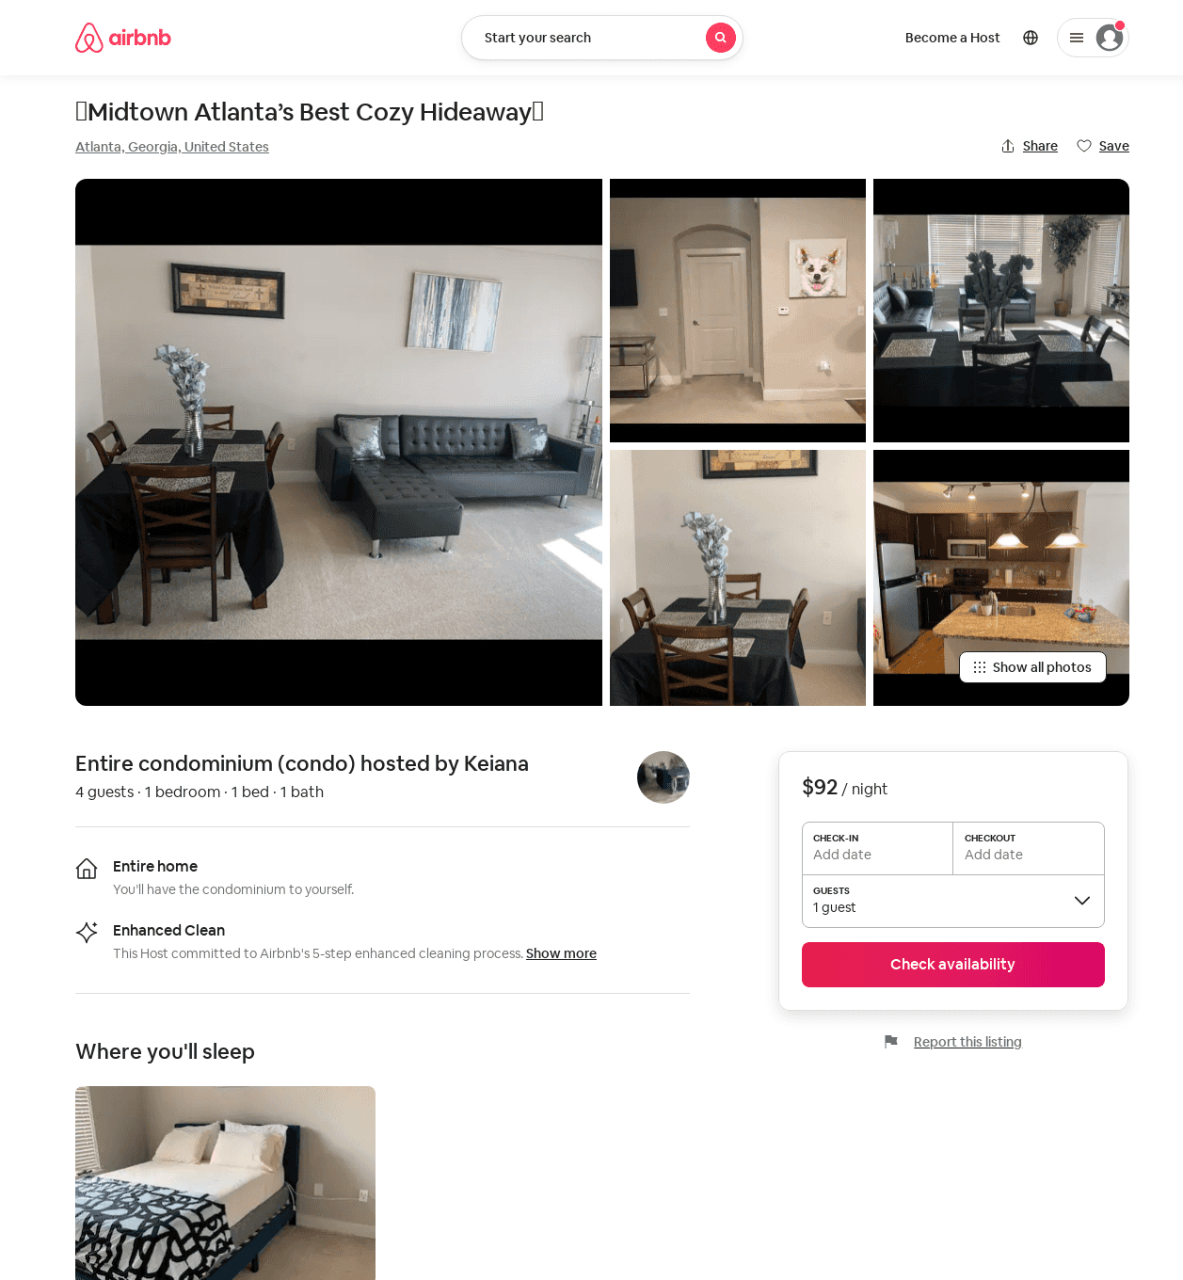
Listing 48295359
1
5
$61 - $86
1
Keiana
389769950
1
https://www.airbnb.com/rooms/48295359
Aug 2022

Slide 44
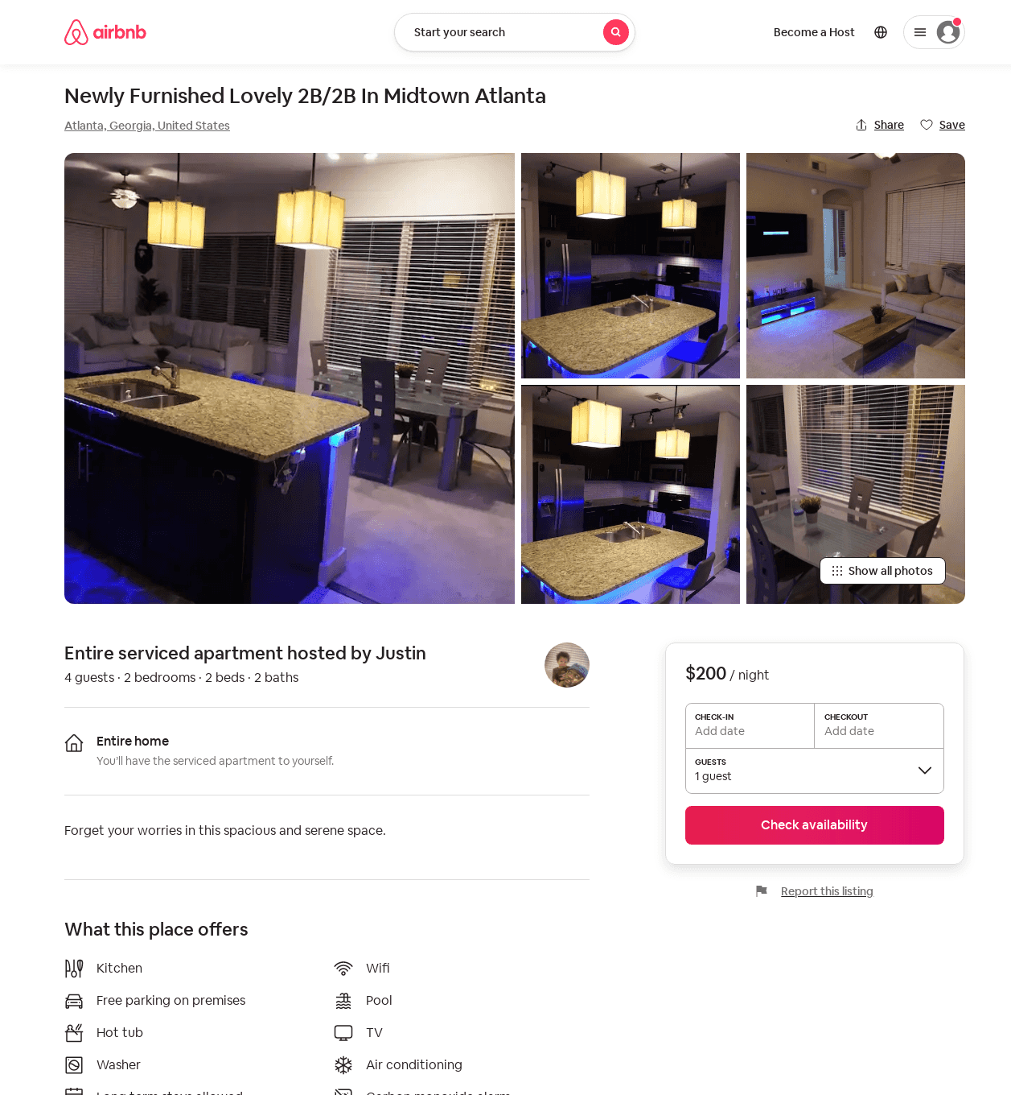
Listing 53510130
2
4
$150 - $200
4.62
1
Forever Homes
57314610
1
https://www.airbnb.com/rooms/53510130
Aug 2022

Slide 45
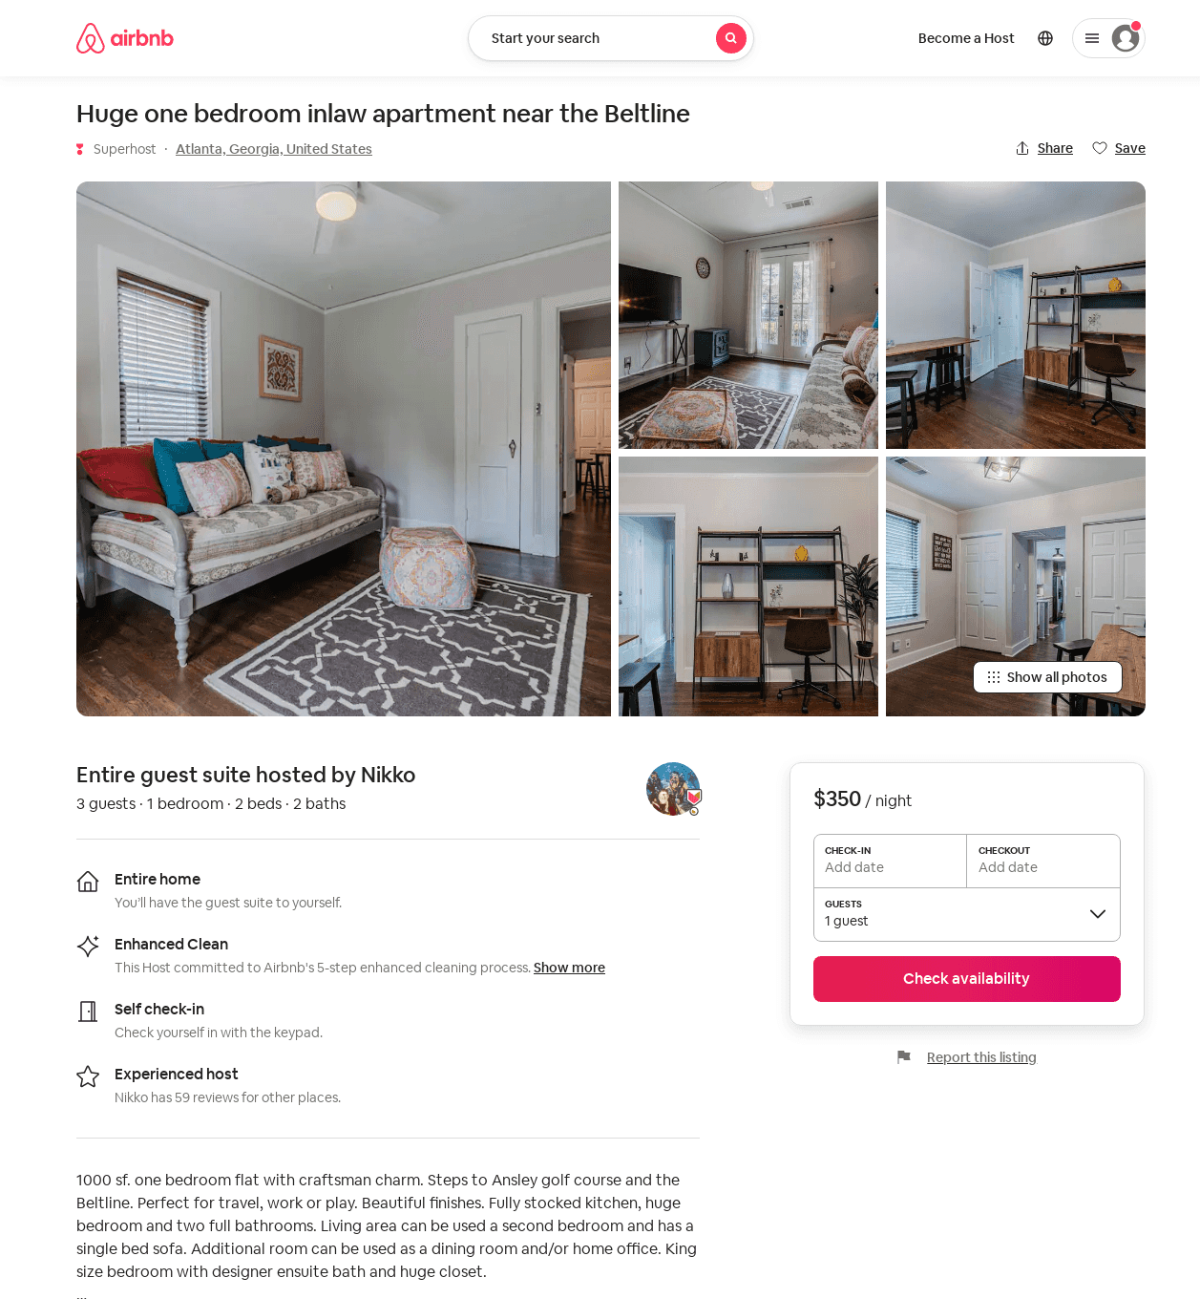
Listing 53114280
1
3
$180 - $350
5.0
3
Nikko
8517251
3
https://www.airbnb.com/rooms/53114280
Aug 2022

Slide 46
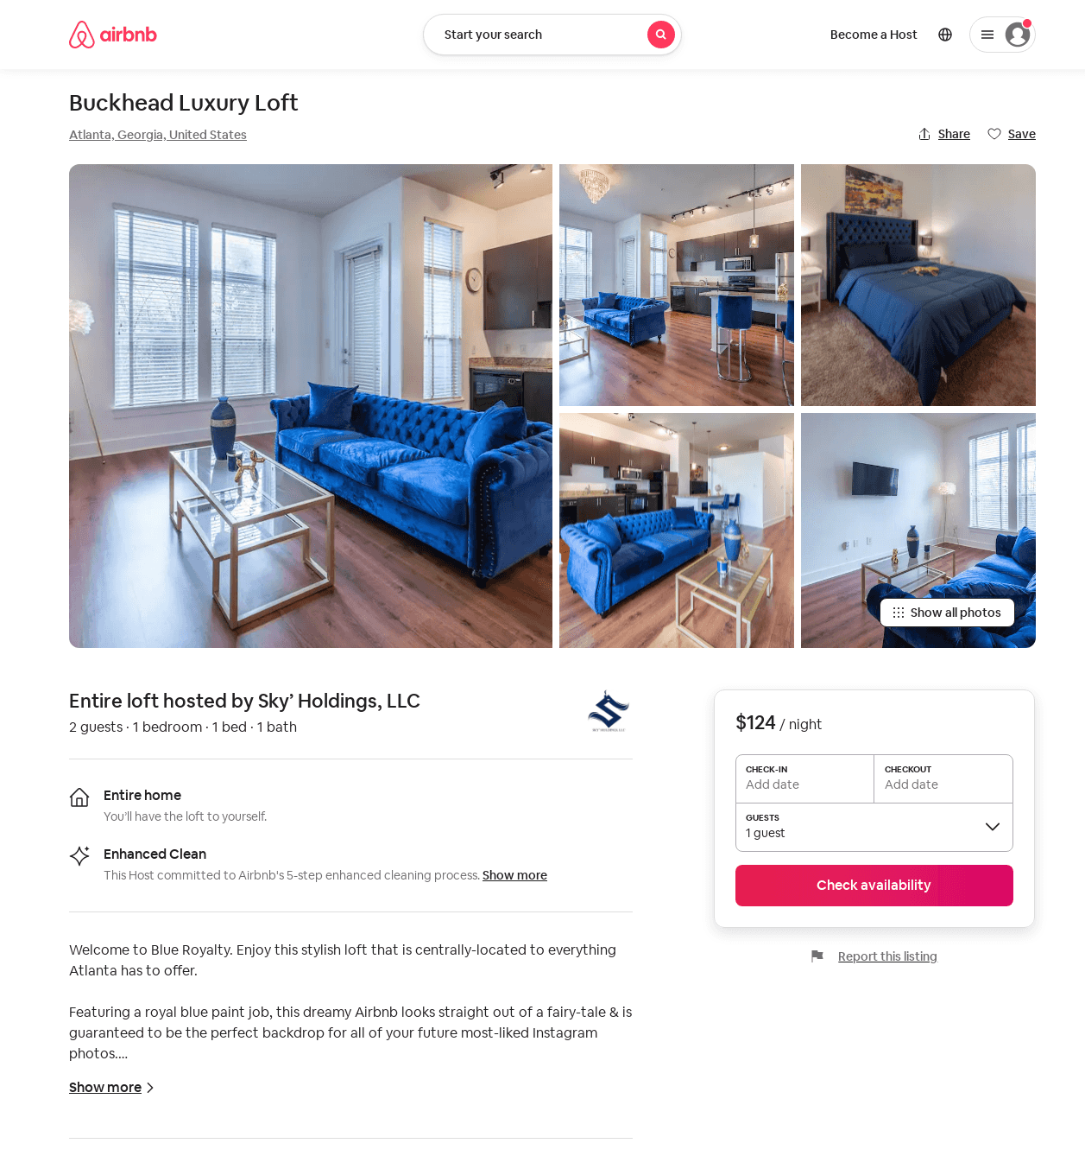
Listing 53958103
1
3
$96 - $182
4.72
1
Sky’ Holdings, LLC
415275863
1
https://www.airbnb.com/rooms/53958103
Aug 2022

Slide 47
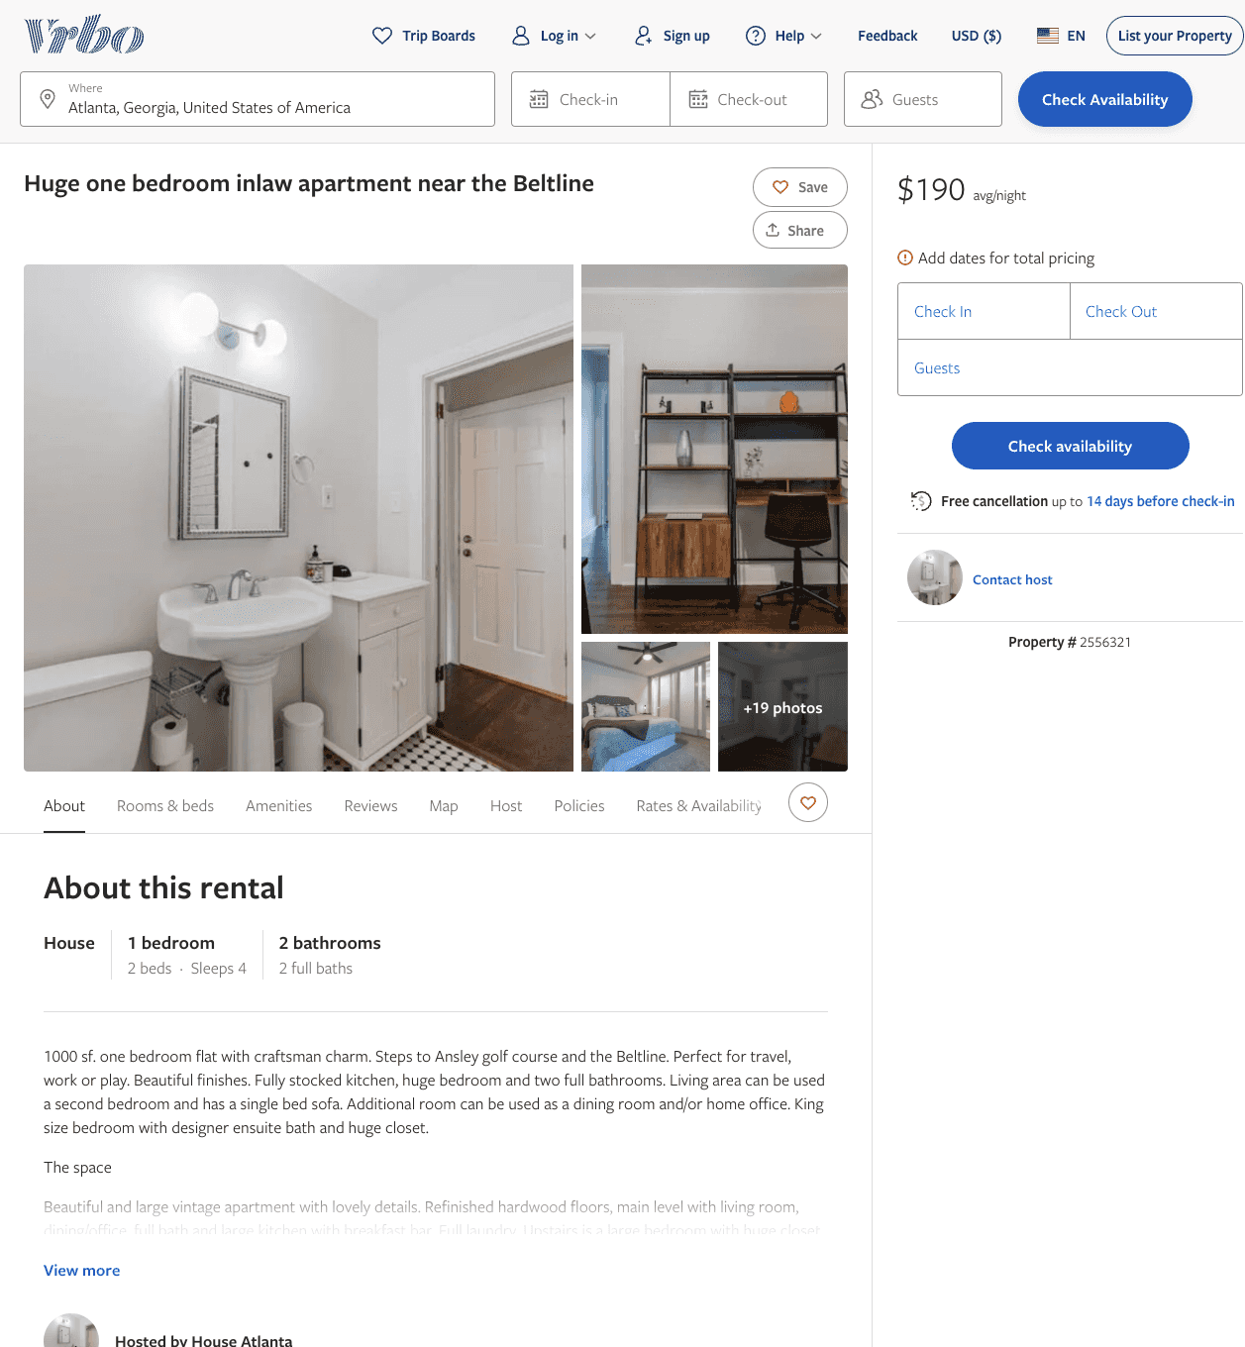
Listing 2556321
1
3
$190 - $212
5
2
https://www.vrbo.com/2556321
Aug 2022

Slide 48
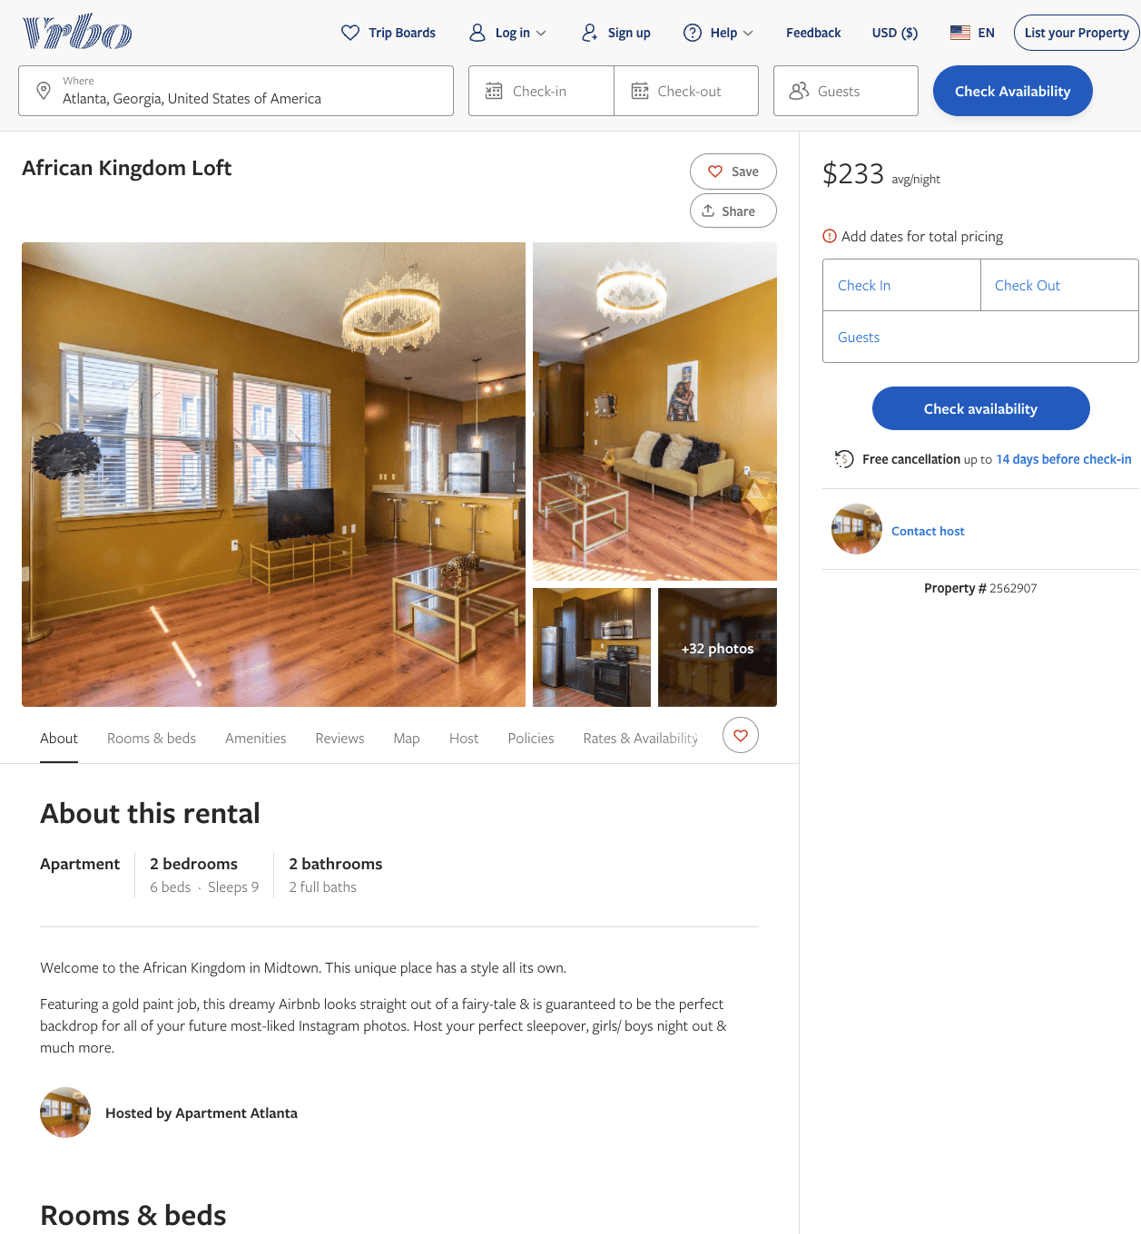
Listing 2562907
2
9
$187 - $233
5
1
Yvonne
https://www.vrbo.com/2562907
Aug 2022

Slide 49
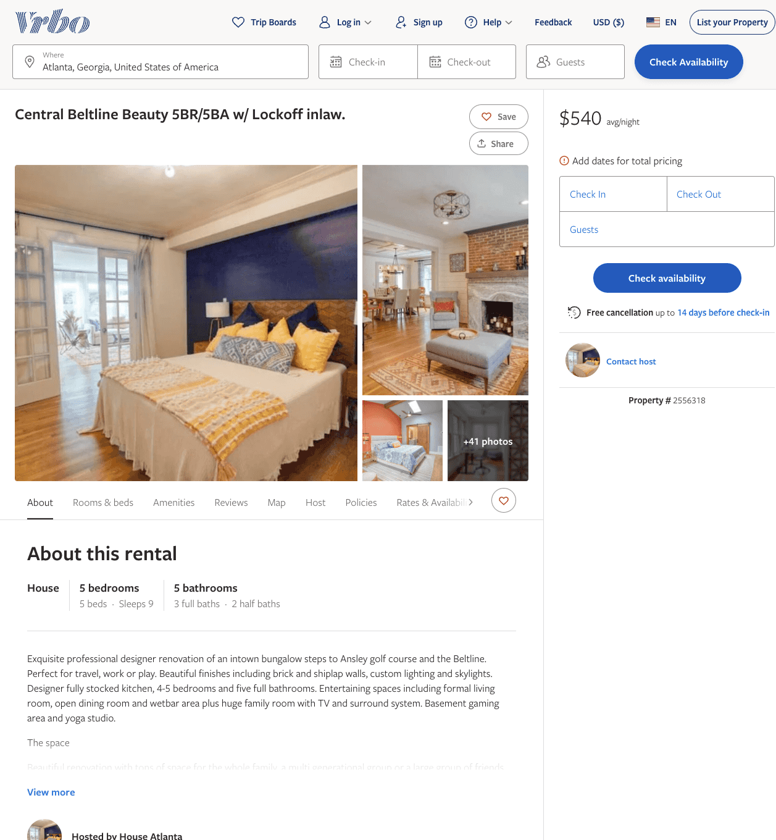
Listing 2556318
5
9
$476 - $600
5
2
https://www.vrbo.com/2556318
Aug 2022

Slide 50
Listing 2556319
3
6
$410 - $450
5
2
https://www.vrbo.com/2556319
Aug 2022

Slide 51
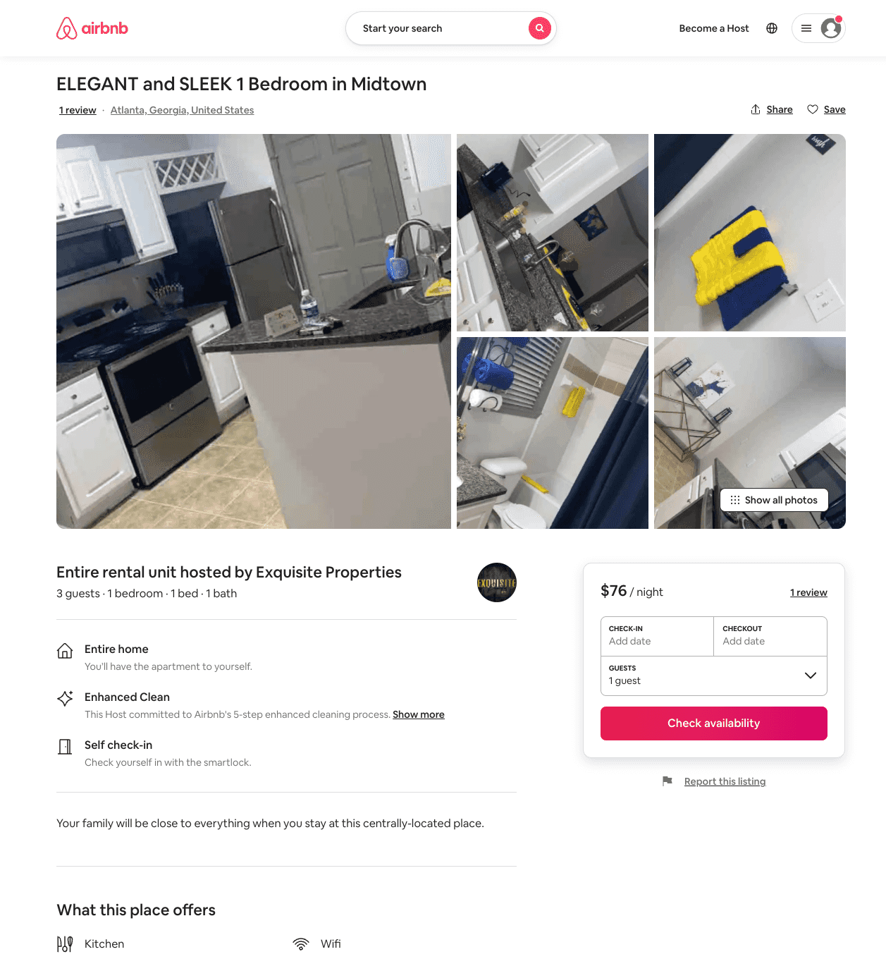
Listing 54184985
1
3
$84 - $110
5.0
1
Exquisite Properties
431319201
2
https://www.airbnb.com/rooms/54184985
Jun 2022

Slide 52
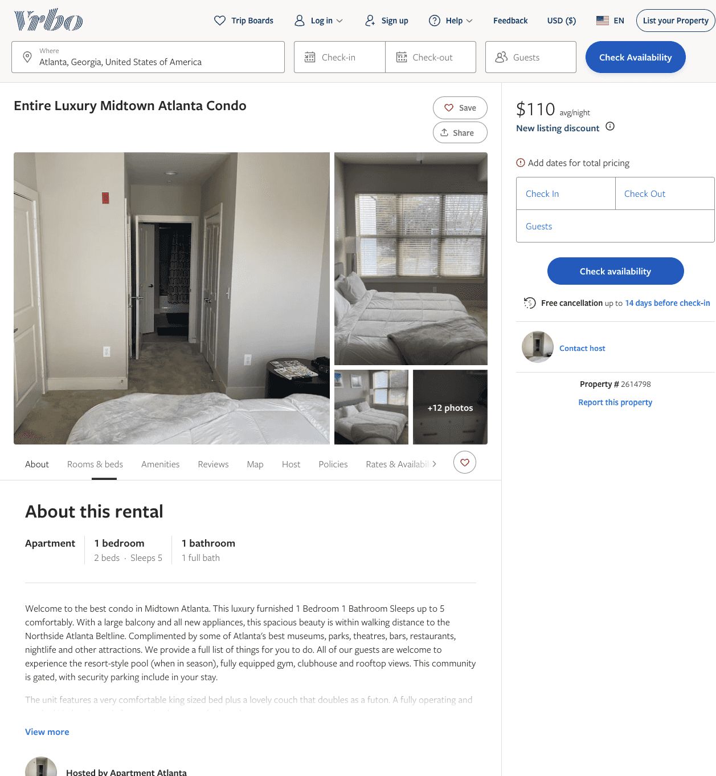
Listing 2614798
1
5
$110
2
https://www.vrbo.com/2614798
Aug 2022

Slide 53
Listing 53665141
1
5
$96 - $120
4.33
2
Jordan
142115230
1
https://www.airbnb.com/rooms/53665141
Aug 2022

Slide 54
Listing 54309779
2
4
$120
4.80
4
Amber
343458668
1
https://www.airbnb.com/rooms/54309779
Aug 2022

Slide 55
Listing 40331957
1
2
$71 - $95
4.80
1
Latasha
311666910
1
https://www.airbnb.com/rooms/40331957
Jun 2022

Slide 56
Listing 53359447
1
2
$102 - $135
4.94
2
Lala
432030536
1
https://www.airbnb.com/rooms/53359447
Aug 2022

Slide 57
Listing 2728993
2
6
$200
1
Justin
https://www.vrbo.com/2728993
Aug 2022

Slide 58
Listing 2749223
1
2
$137
5
3
https://www.vrbo.com/2749223
Aug 2022

Slide 59
Listing 2797498
2
4
$229
3
Alejandro Milrud
https://www.vrbo.com/2797498
Aug 2022

Slide 60
Listing 505765
2
4
$150
5
28
Mike Gabriele
https://www.vrbo.com/505765
Aug 2022

Slide 61
Listing 48957689
3
10
$192
1
Lade'
103015310
1
https://www.airbnb.com/rooms/48957689
Jul 2022

Slide 62
Listing 48446218
1
5
$113 - $114
3.90
2
Londyn
95181505
1
https://www.airbnb.com/rooms/48446218
Aug 2022

Slide 63
Listing 2873071
1
3
$105
2
https://www.vrbo.com/2873071
Aug 2022

Slide 64
Listing 44191157
1
4
1
Teaira
204181599
1
https://www.airbnb.com/rooms/44191157
Jun 2022

Slide 65
Listing 2879983
2
4
$138
5
1
https://www.vrbo.com/2879983
Aug 2022

Slide 66
Listing 2884208
3
4
$233
2
Nkenterprize llc
https://www.vrbo.com/2884208
Aug 2022

Slide 67
Listing 2885321
2
8
$250
2
https://www.vrbo.com/2885321
Aug 2022

