Slide 2
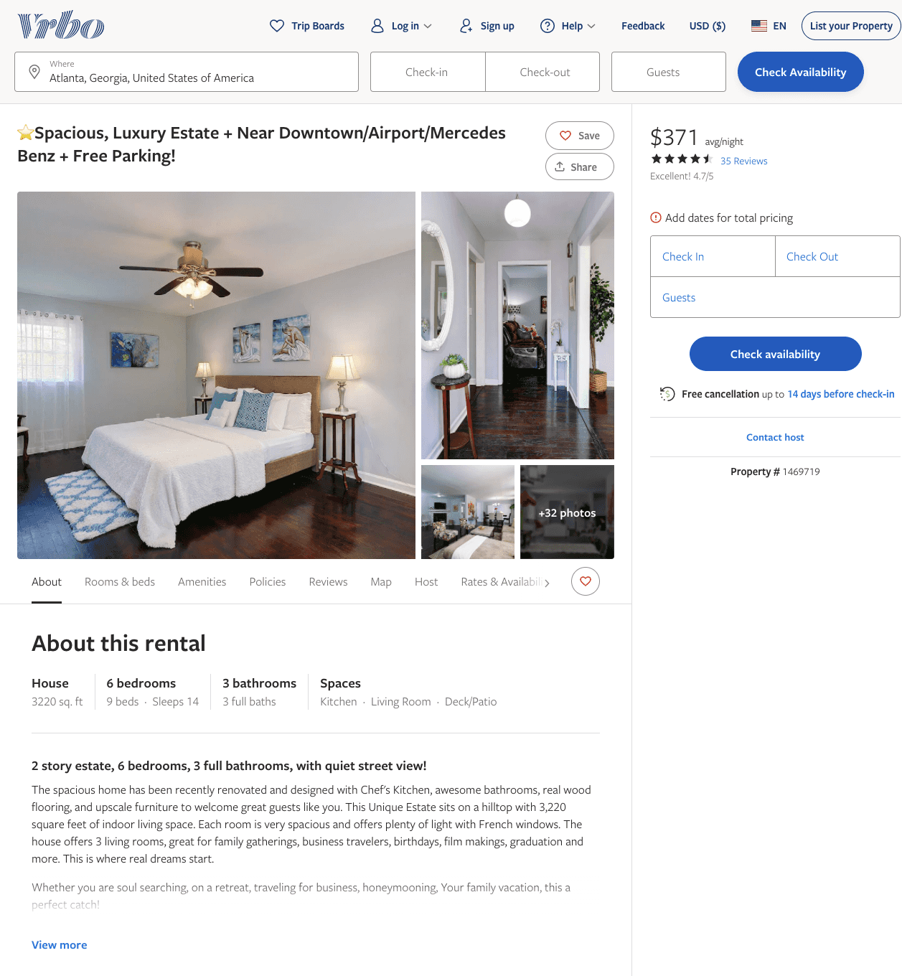
Listing 1469719
6
14
$326 - $389
4.7027025
3
Marie A Sales
https://www.vrbo.com/1469719
Aug 2022

Slide 3
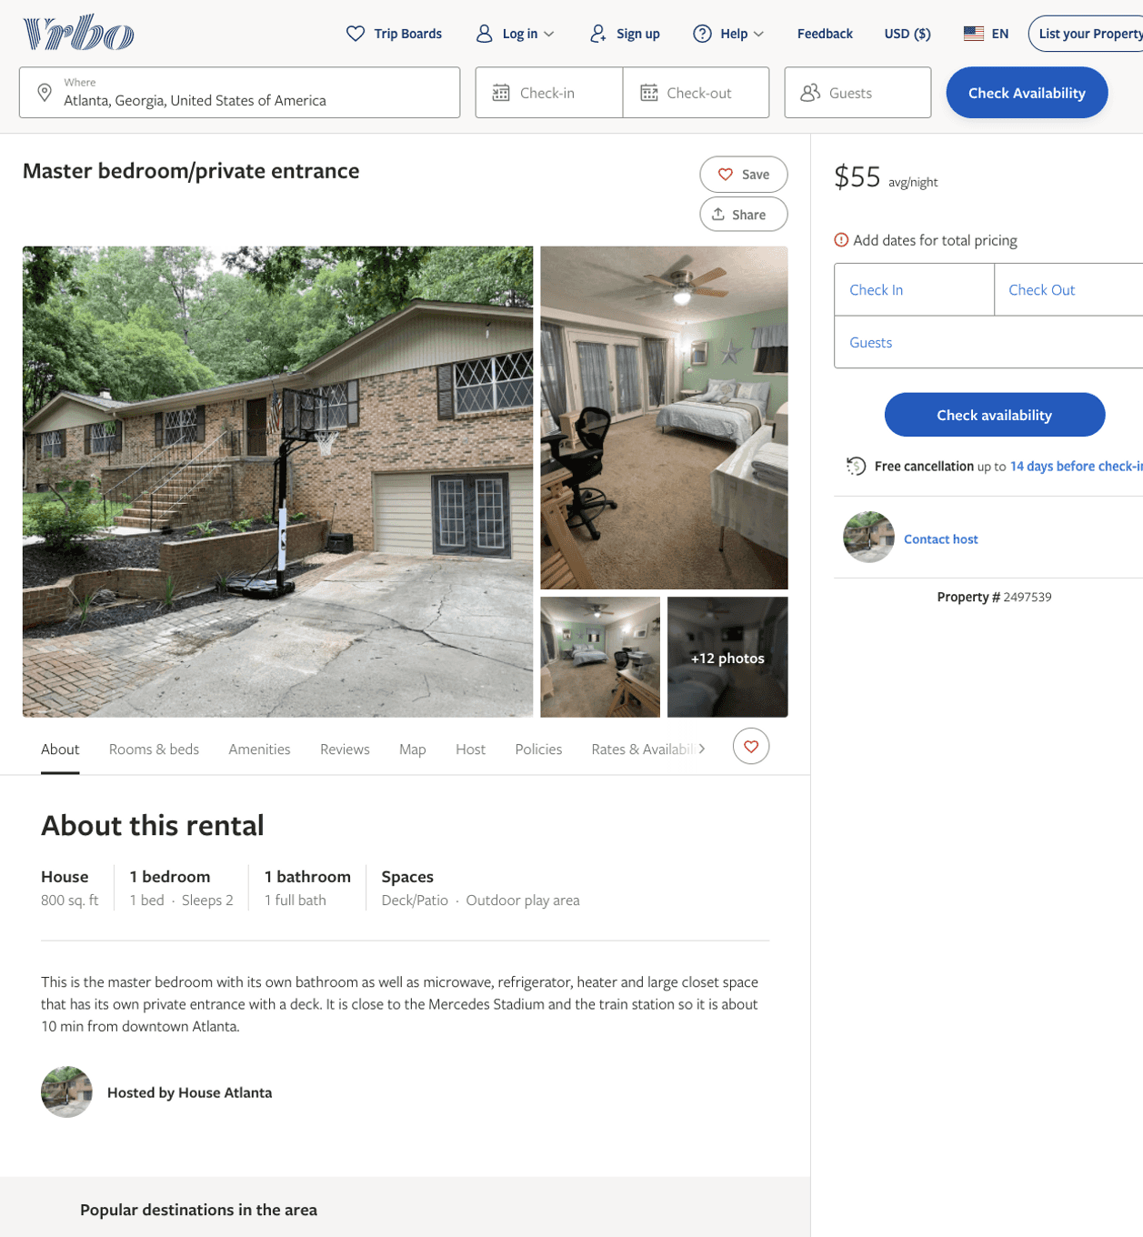
Listing 2497539
1
2
$51 - $57
1
https://www.vrbo.com/2497539
Aug 2022

Slide 4
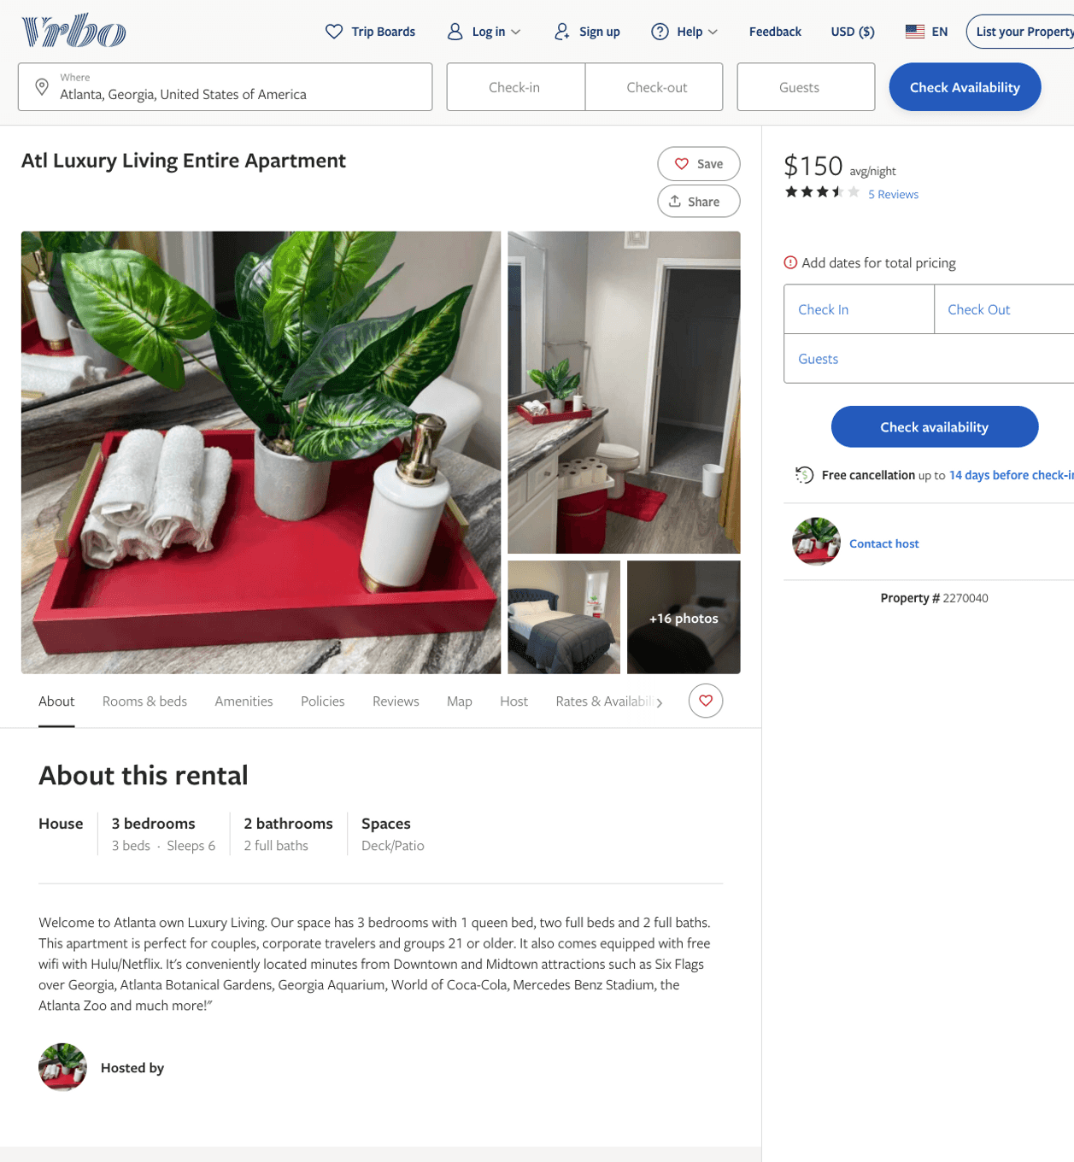
Listing 2270040
3
6
$150
3.6
2
https://www.vrbo.com/2270040
Aug 2022

Slide 5
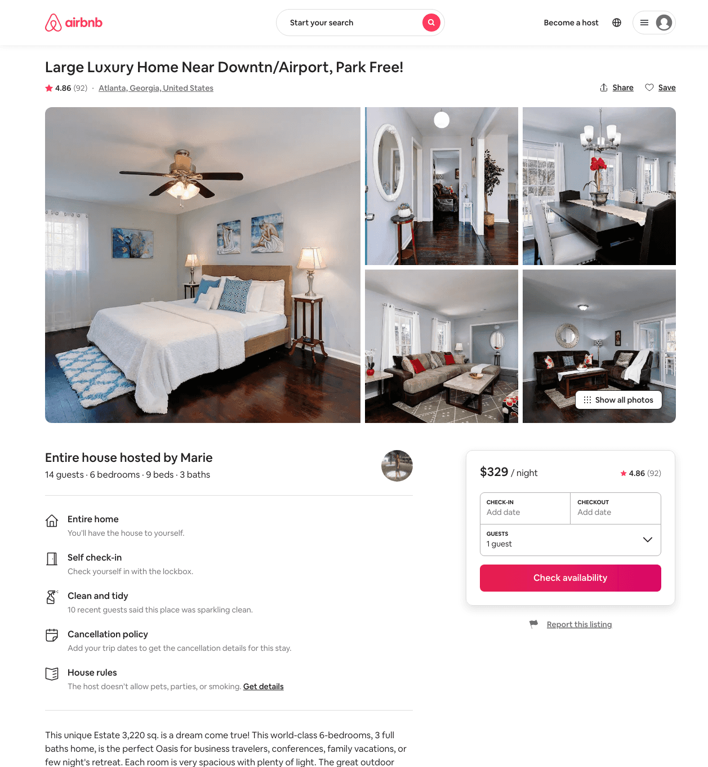
Listing 28762235
6
14
$315 - $466
4.72
2
Marie A
185406737
2
https://www.airbnb.com/rooms/28762235
Aug 2022

Slide 6
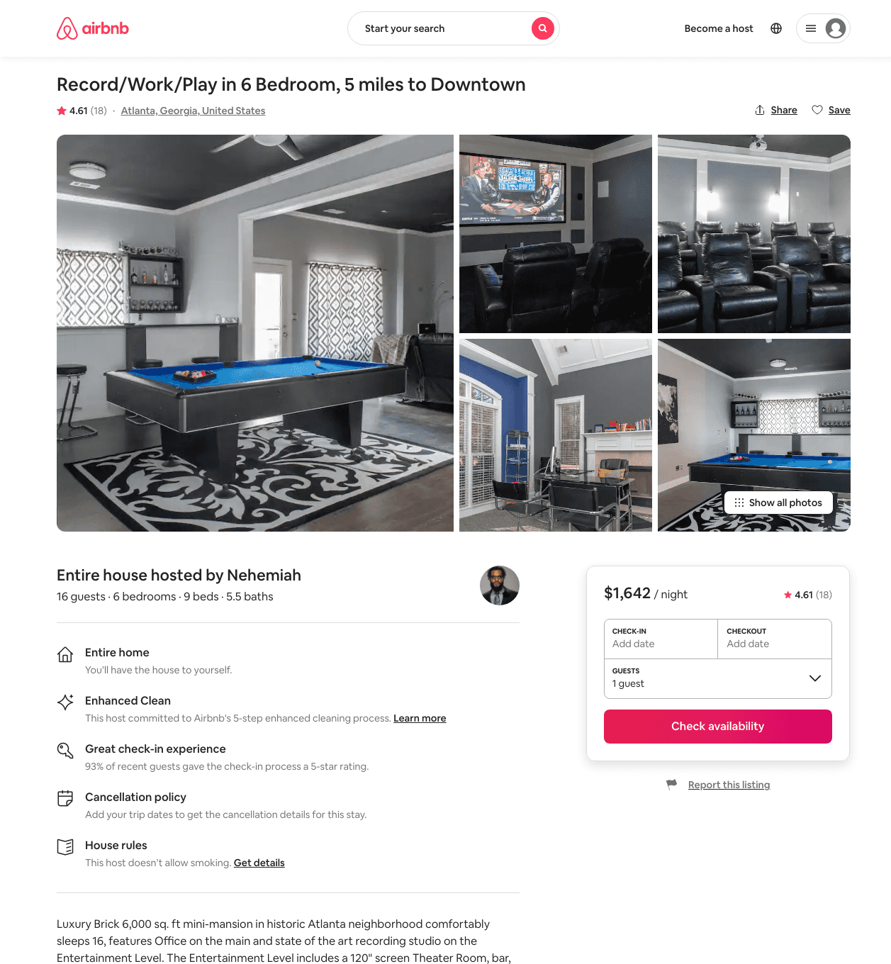
Listing 31473640
6
16
$1500 - $1999
4.52
1
Nehemiah
85135186
1
https://www.airbnb.com/rooms/31473640
Aug 2022

Slide 7
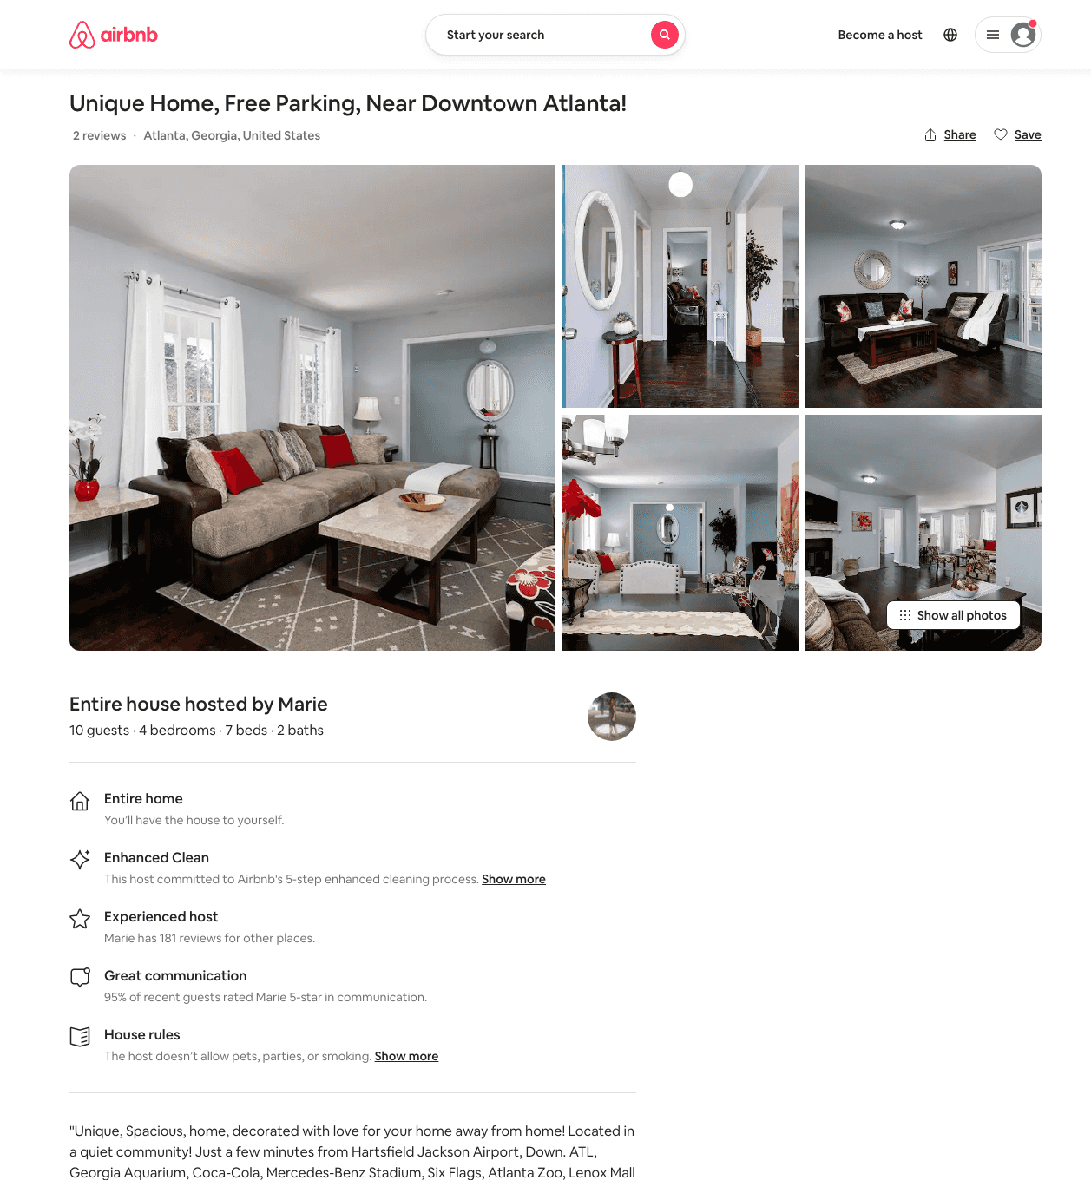
Listing 48251466
4
10
$293 - $523
2
Marie A
185406737
2
https://www.airbnb.com/rooms/48251466
Aug 2022

Slide 8
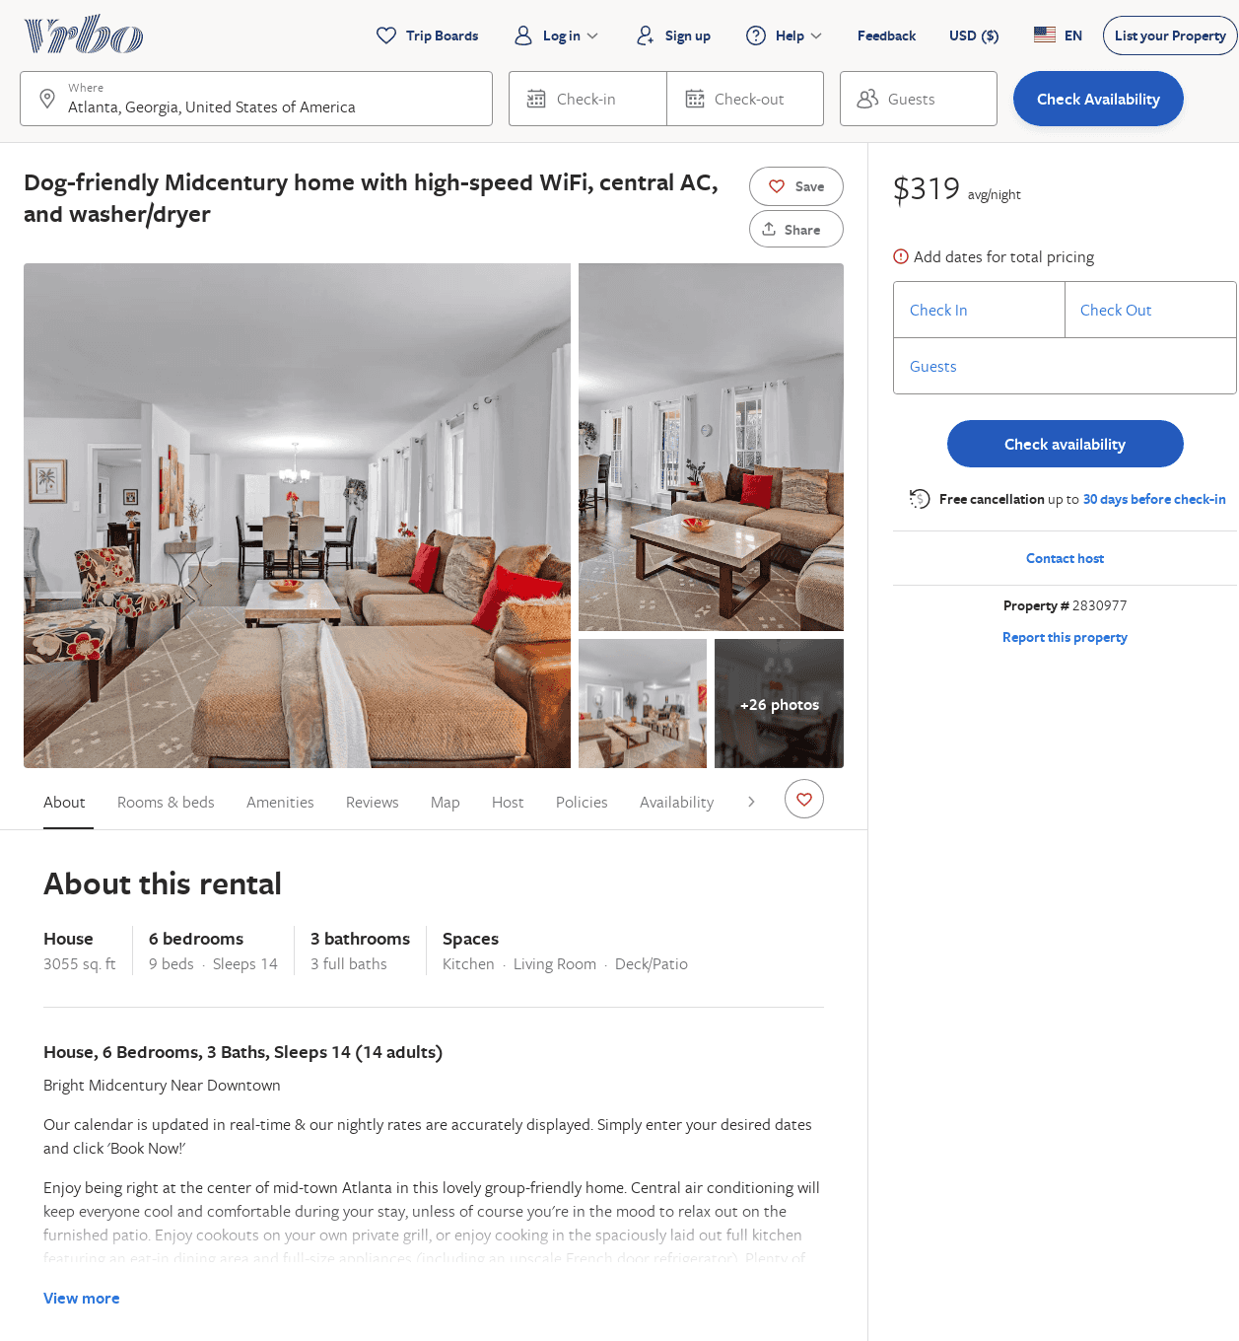
Listing 2830977
6
14
$344
2
Vacasa of Georgia
https://www.vrbo.com/2830977
Aug 2022

Slide 9
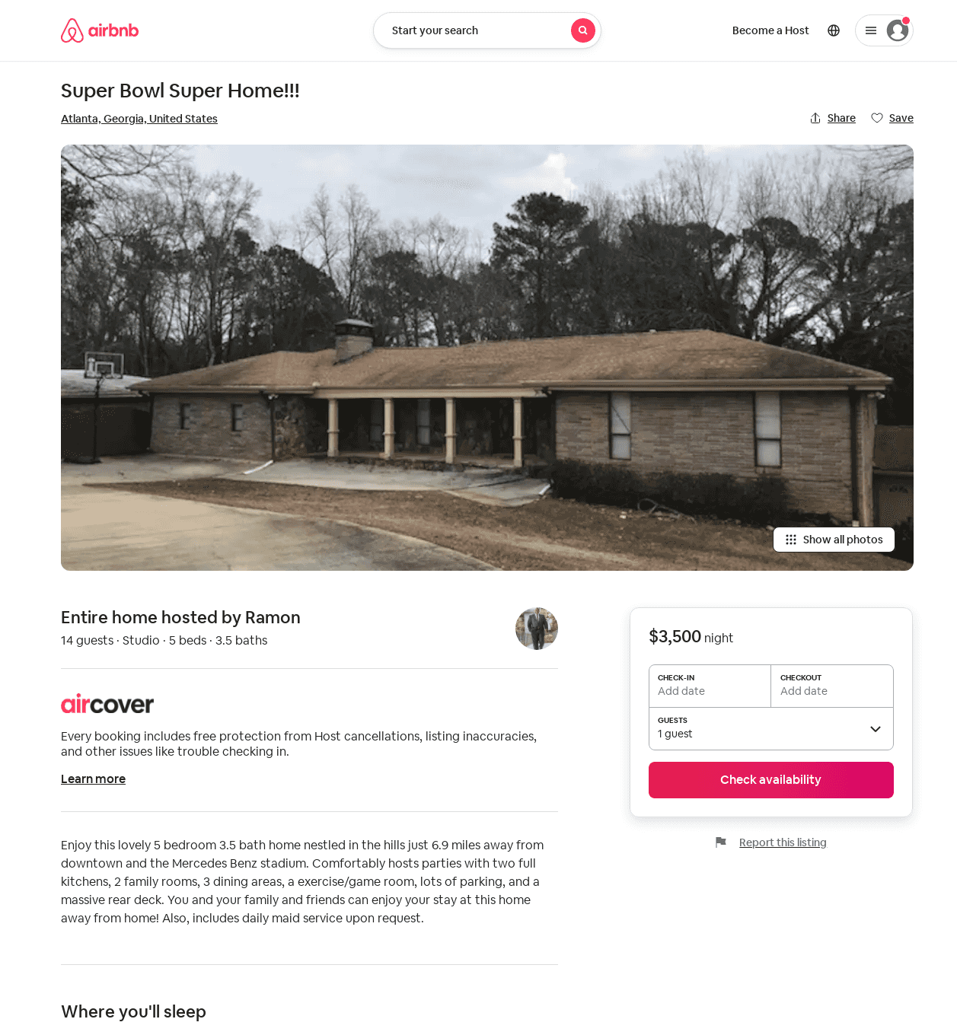
Listing 31806144
Studio
14
$3500
3
Ramon
203426558
1
https://www.airbnb.com/rooms/31806144
Aug 2022

