Slide 2
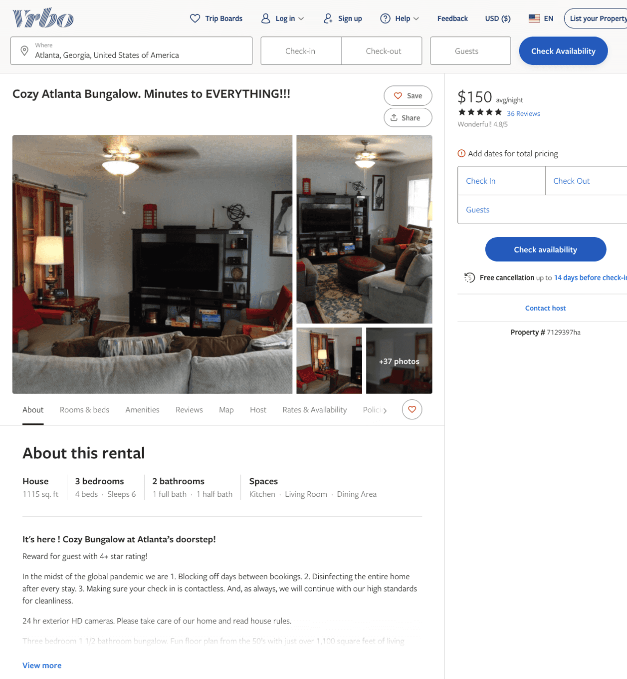
Listing 7129397
3
6
$155 - $215
4.810811
3
Ezelious Adams
https://www.vrbo.com/7129397ha
Aug 2022

Slide 3
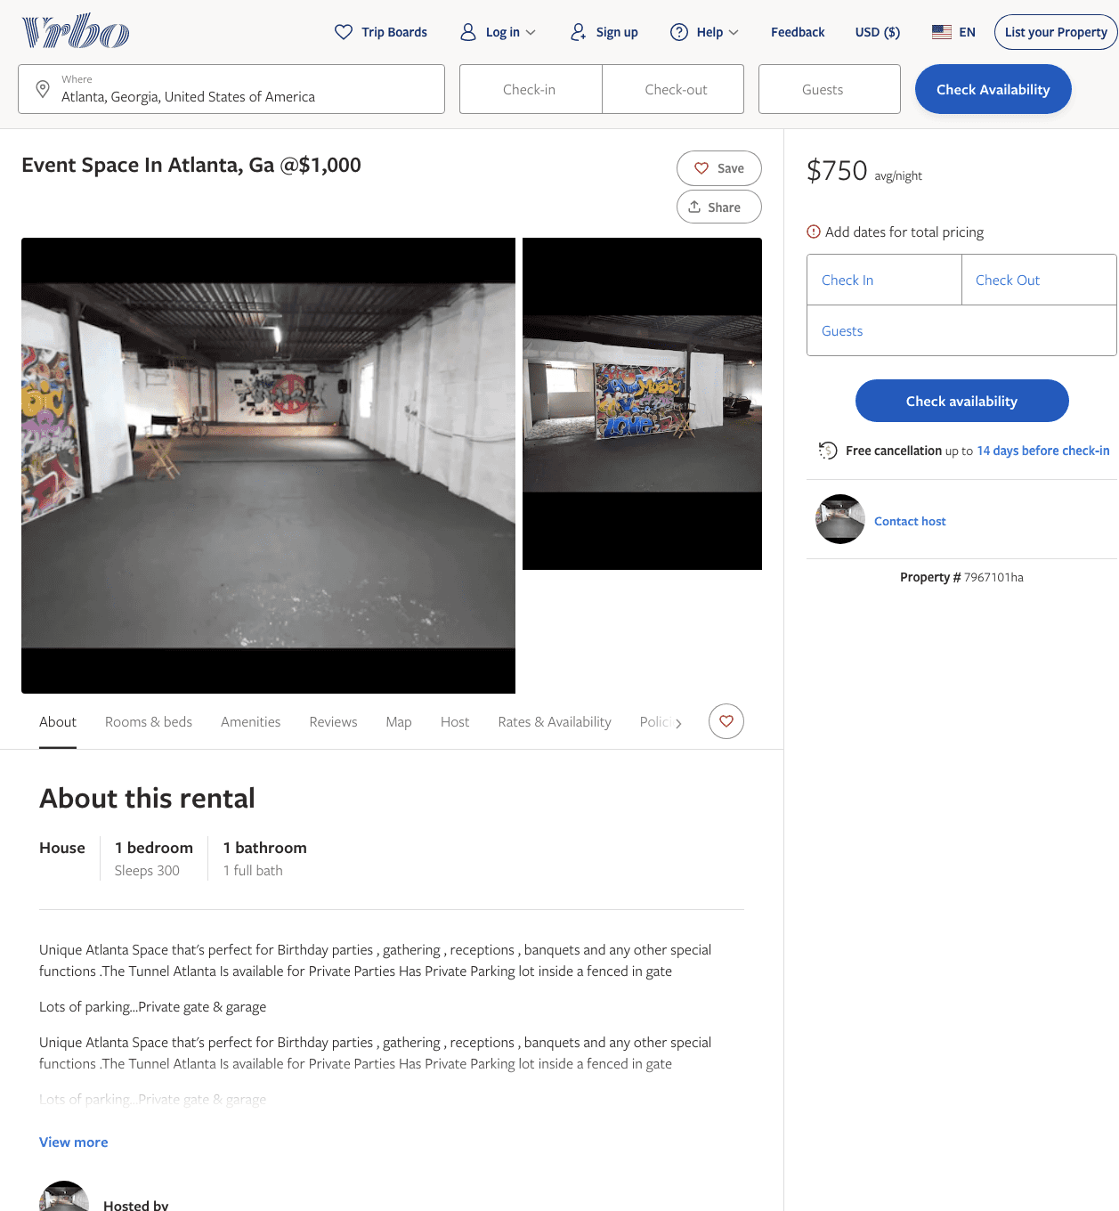
Listing 7967101
1
300
$750
1
https://www.vrbo.com/7967101ha
Aug 2022

Slide 4
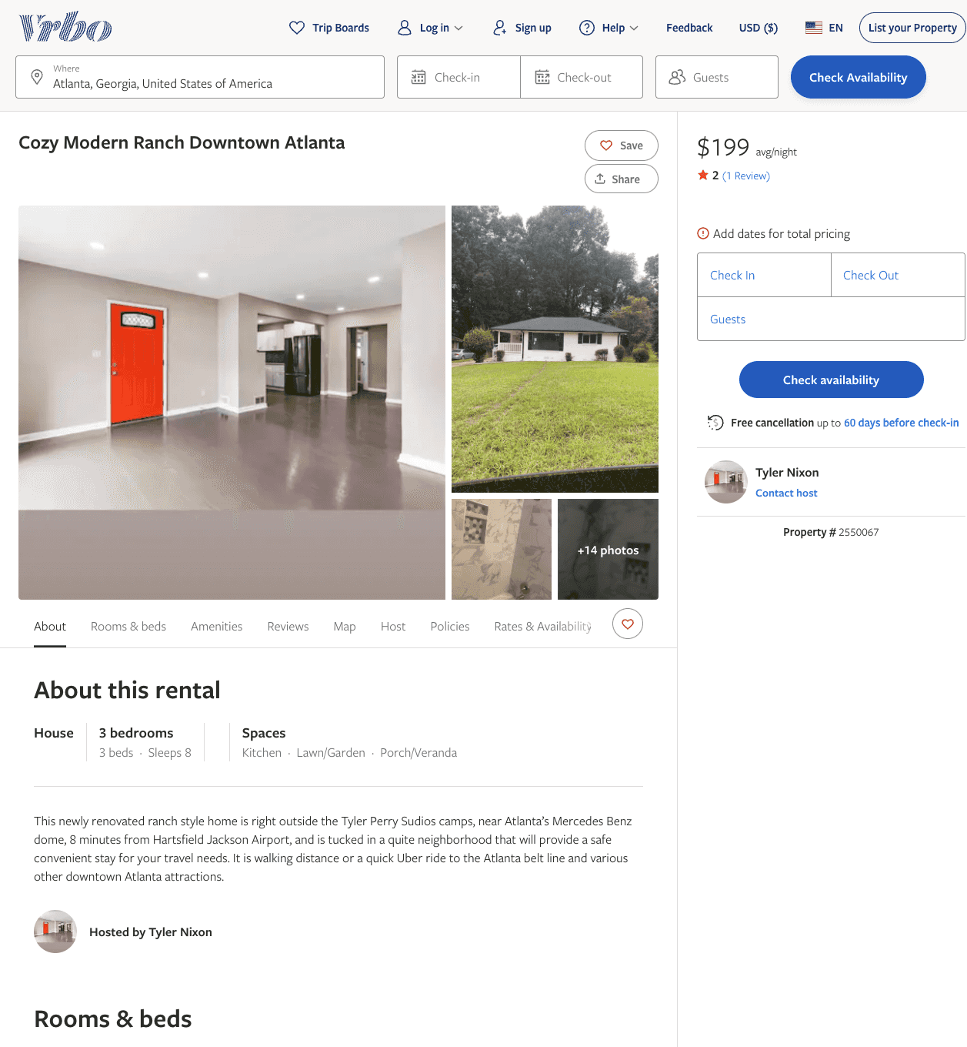
Listing 2550067
3
8
$199
2
2
Tyler Nixon
https://www.vrbo.com/2550067
Aug 2022

Slide 5
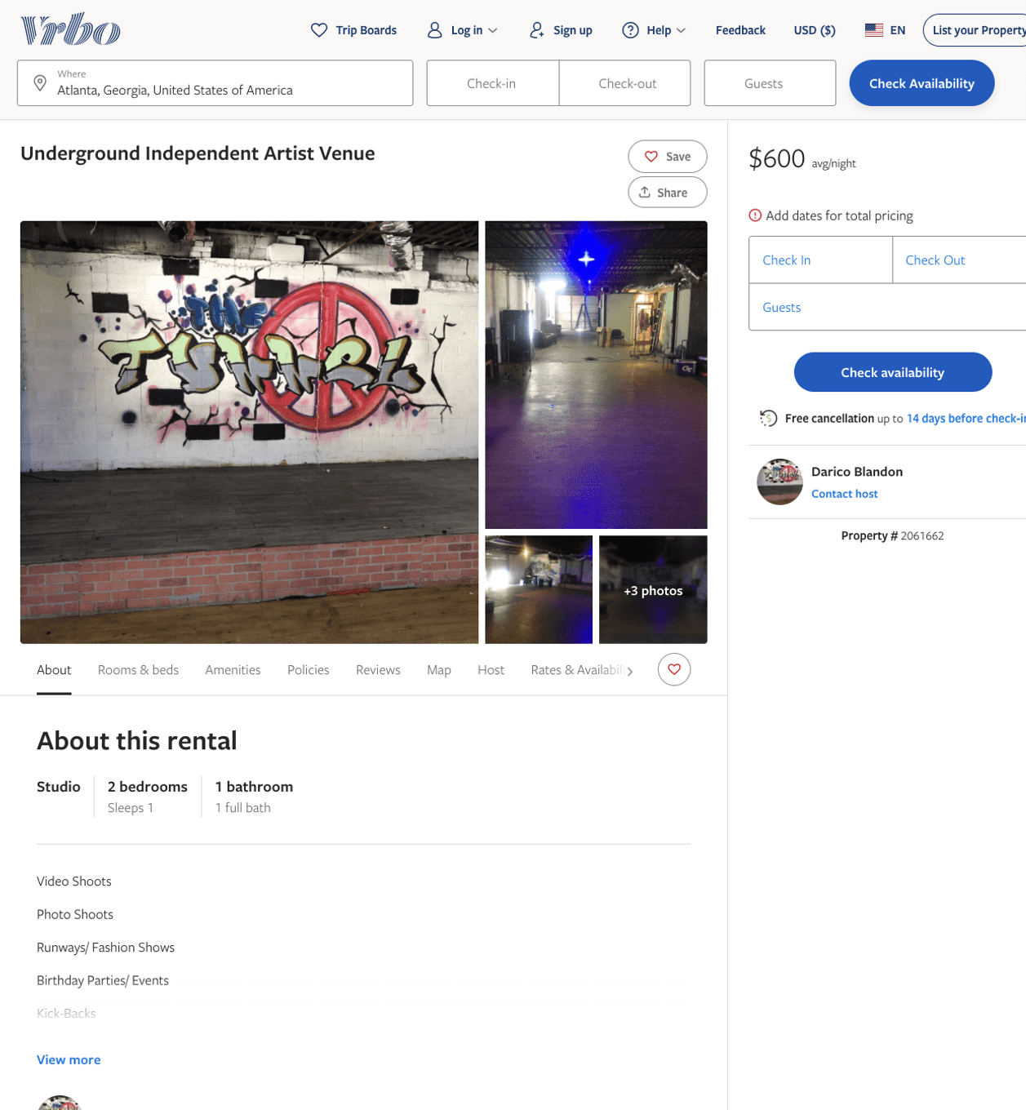
Listing 2061662
2
1
$583 - $600
1
Darico Blandon
https://www.vrbo.com/2061662
Aug 2022

Slide 6
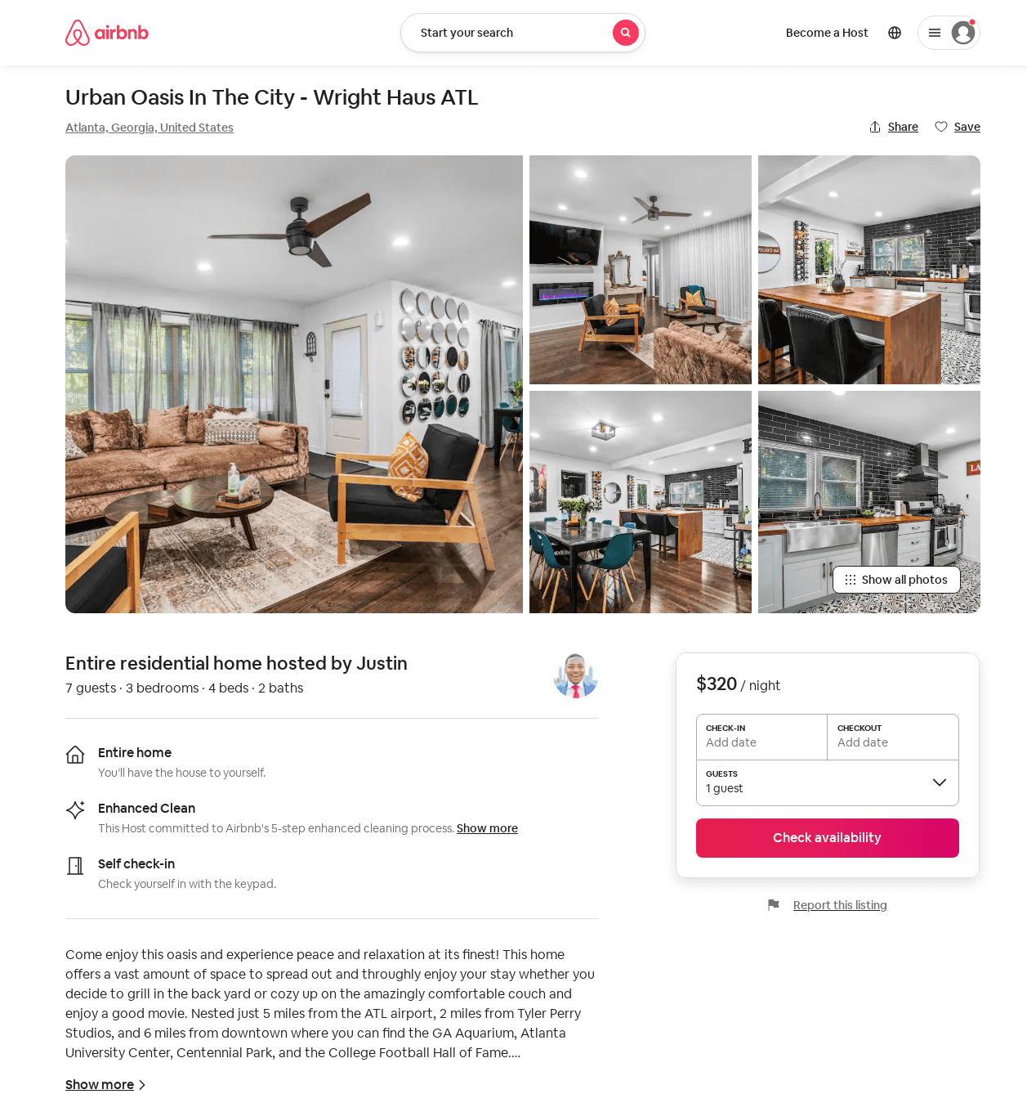
Listing 50230600
3
7
$125 - $400
4.92
2
Justin
235044875
1
https://www.airbnb.com/rooms/50230600
Aug 2022

Slide 7
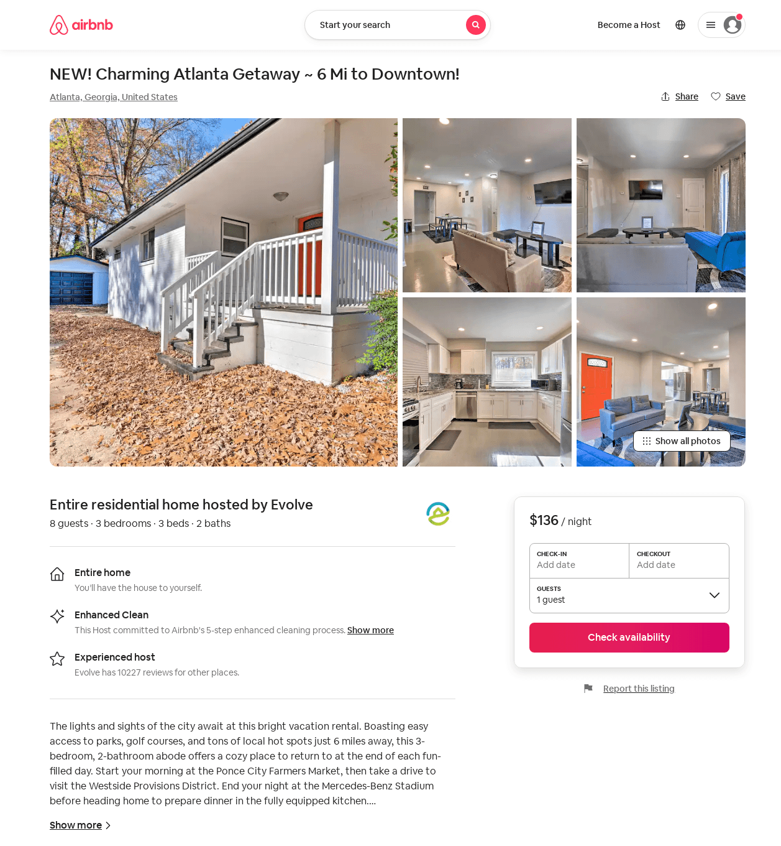
Listing 53773528
3
8
$123 - $139
4.25
2
Evolve
121682456
51
https://www.airbnb.com/rooms/53773528
Aug 2022

Slide 8
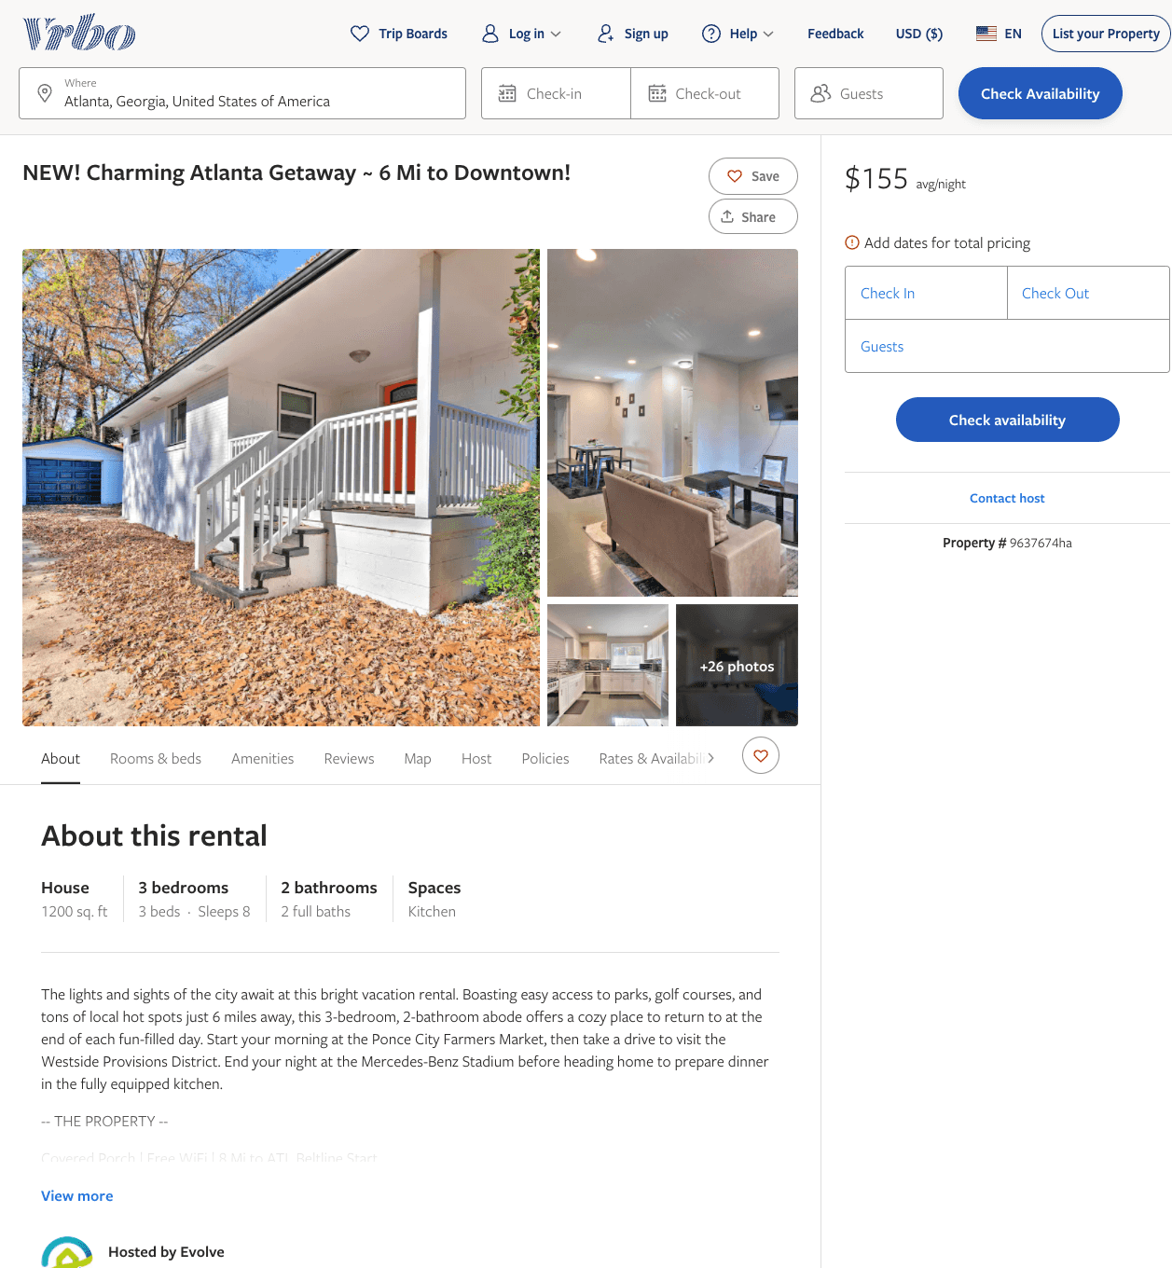
Listing 9637674
3
8
$105 - $169
3
2
Evolve
https://www.vrbo.com/9637674ha
Aug 2022

Slide 9
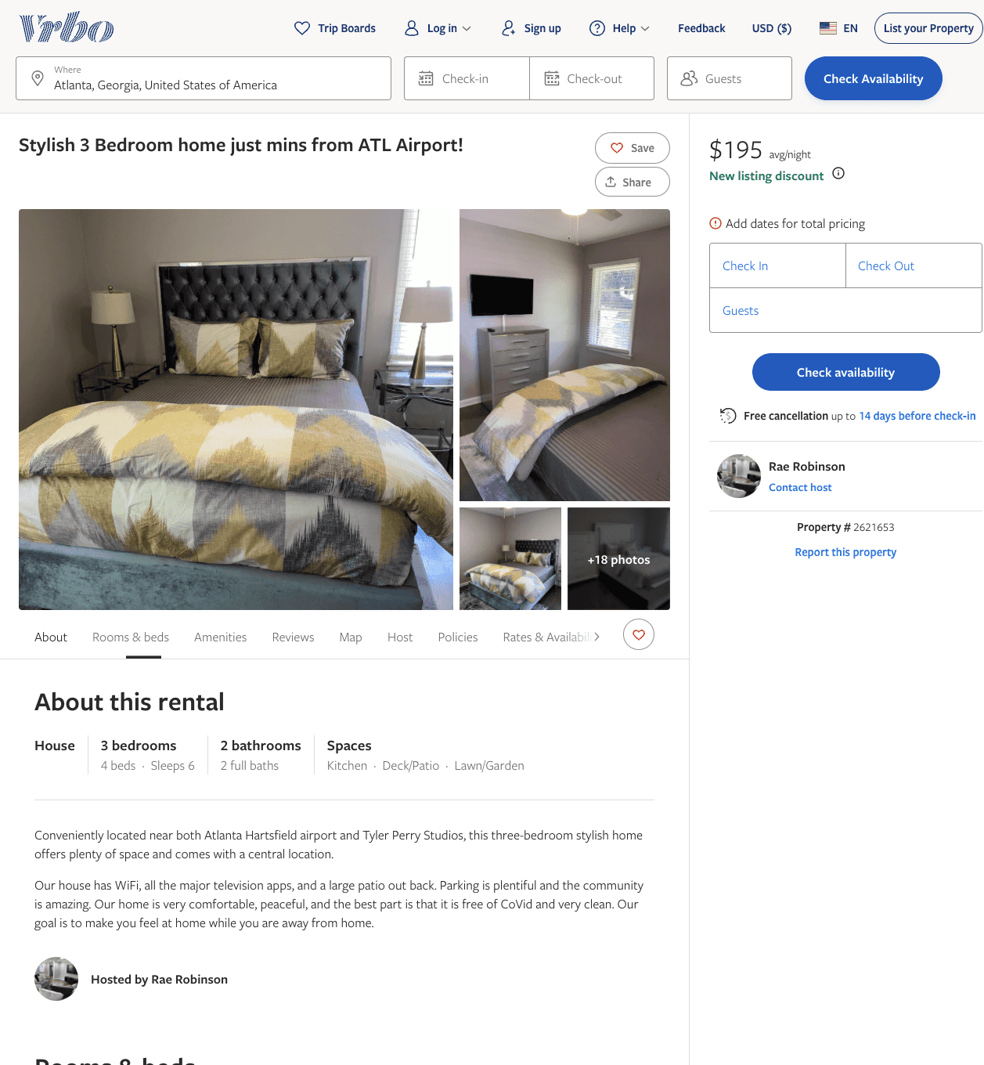
Listing 2621653
3
6
$195
3
Rae Robinson
https://www.vrbo.com/2621653
Aug 2022

Slide 10
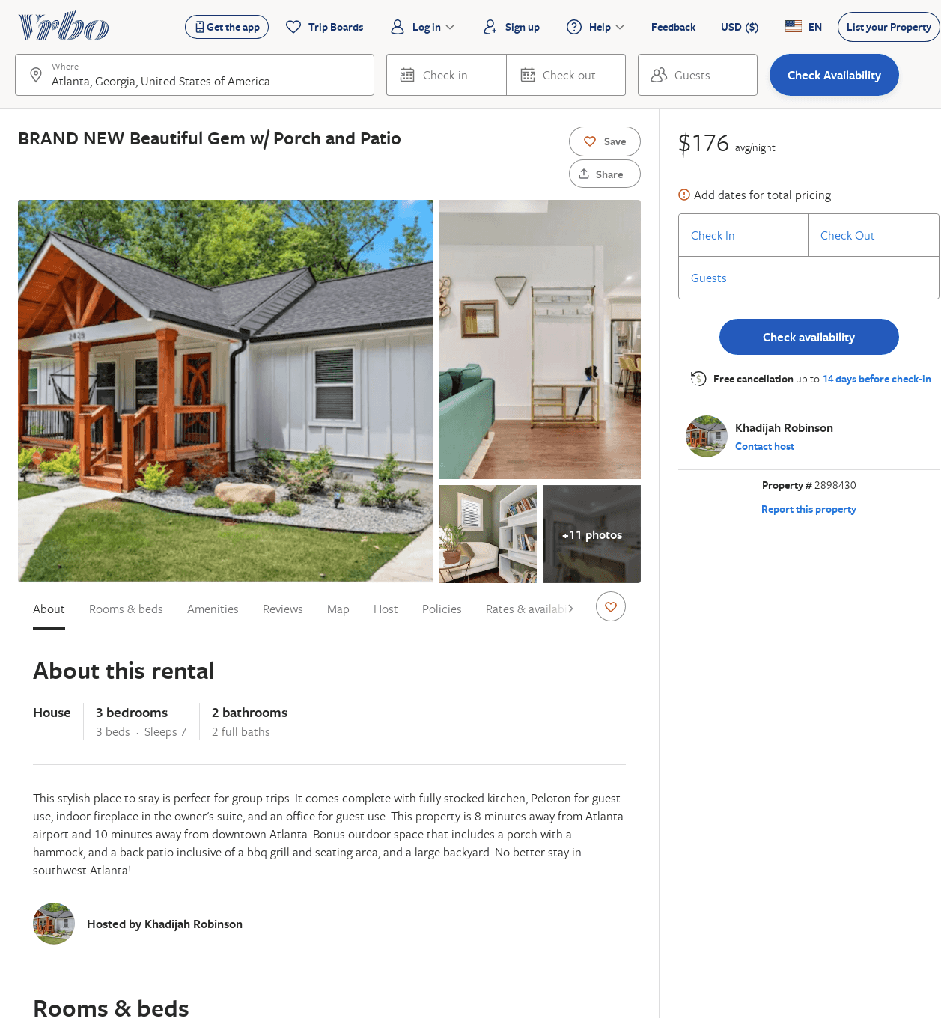
Listing 2898430
3
7
$162
5
3
Khadijah Robinson
https://www.vrbo.com/2898430
Aug 2022

Slide 11
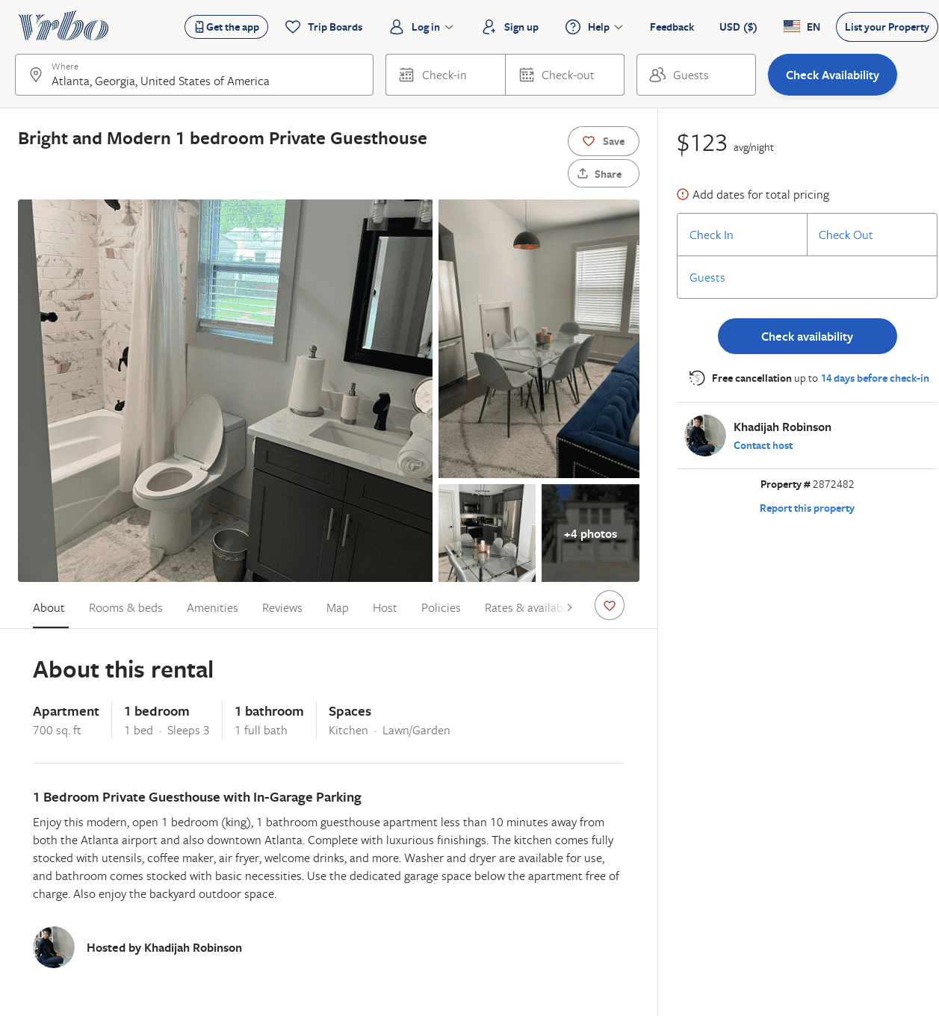
Listing 2872482
1
3
$115
2
Khadijah Robinson
https://www.vrbo.com/2872482
Aug 2022

