Slide 2
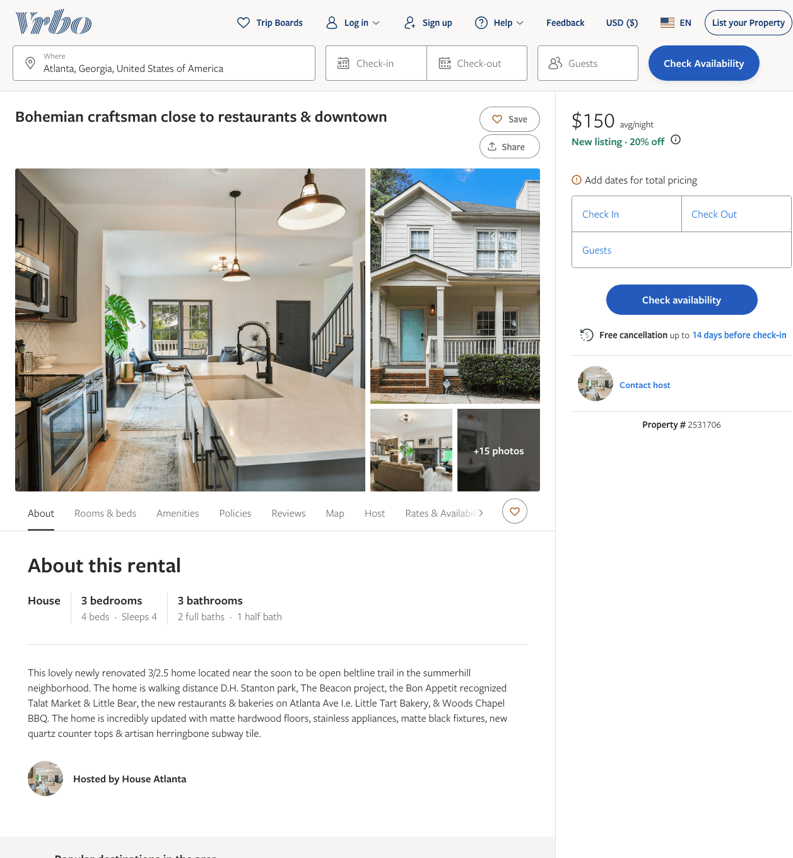
Listing 2531706
3
4
$156 - $240
5
2
https://www.vrbo.com/2531706
Aug 2022

Slide 3
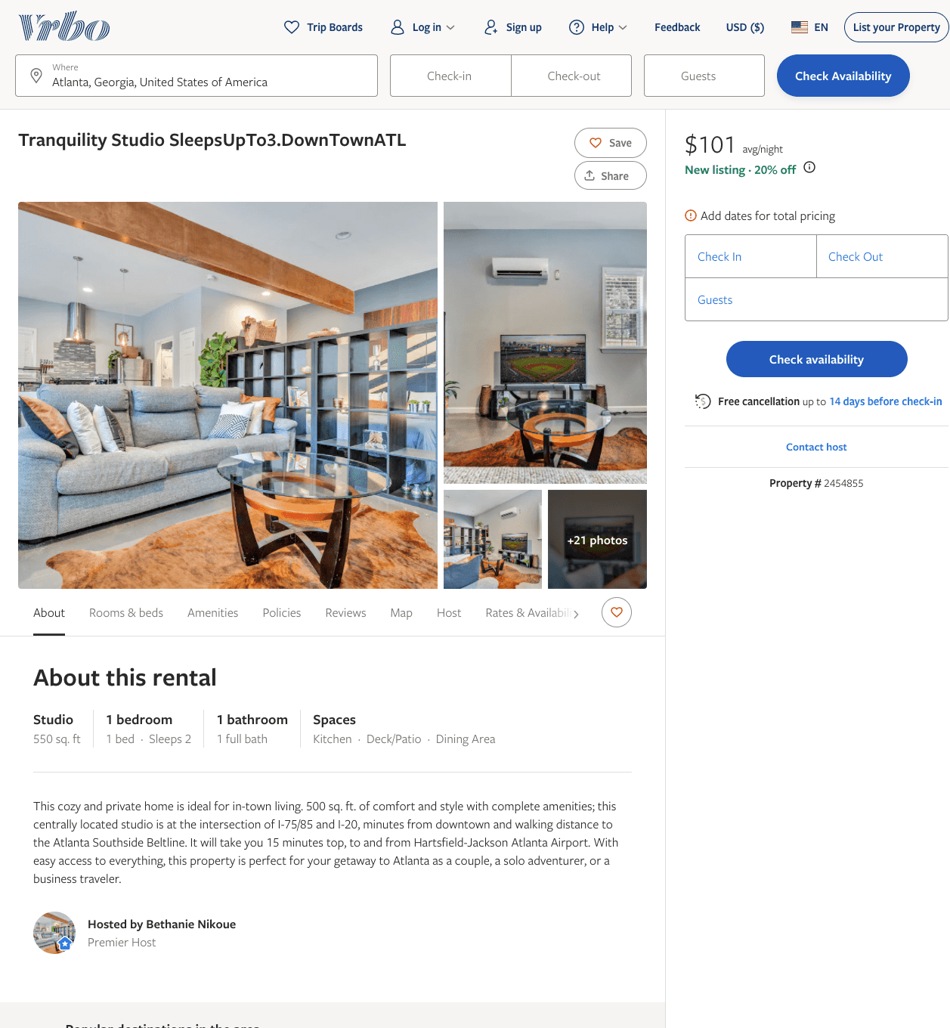
Listing 2454855
1
2
$101 - $98
2
Bethanie Nikoue
https://www.vrbo.com/2454855
Aug 2022

Slide 4
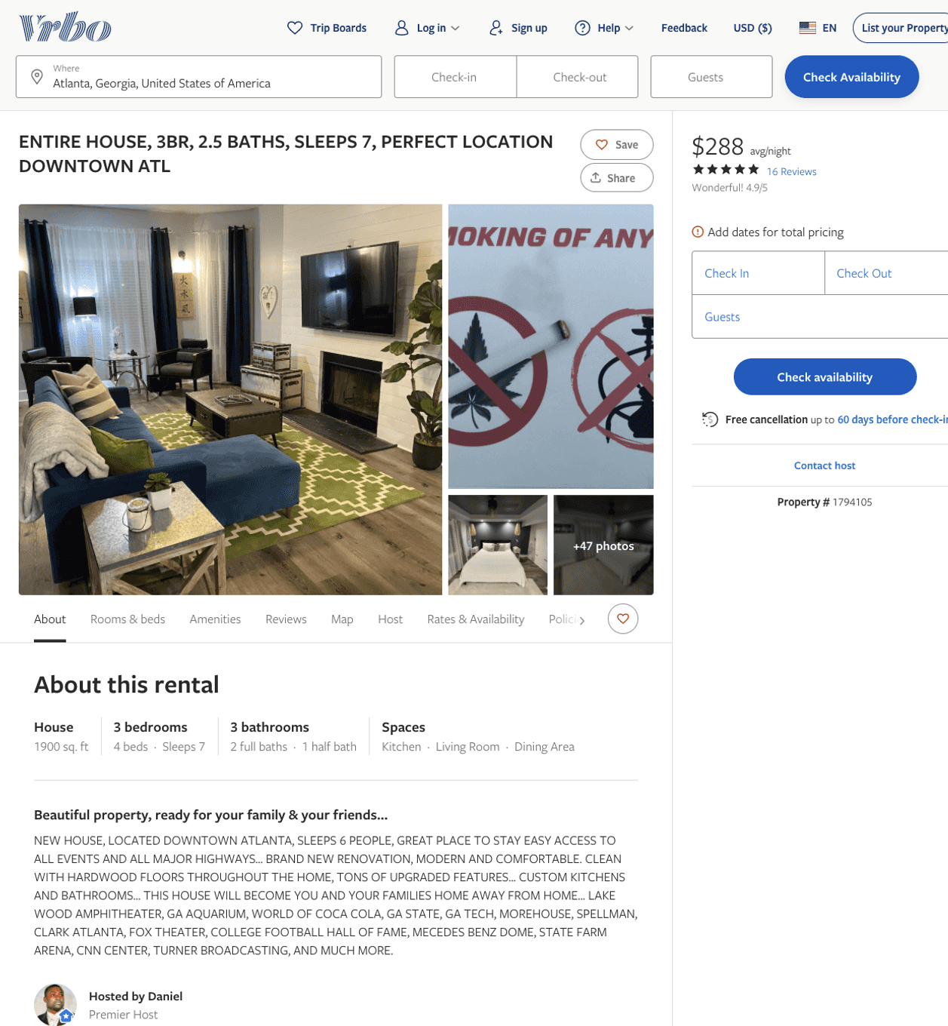
Listing 1794105
3
7
$178 - $288
4.9130435
2
Daniel
https://www.vrbo.com/1794105
Aug 2022

Slide 5
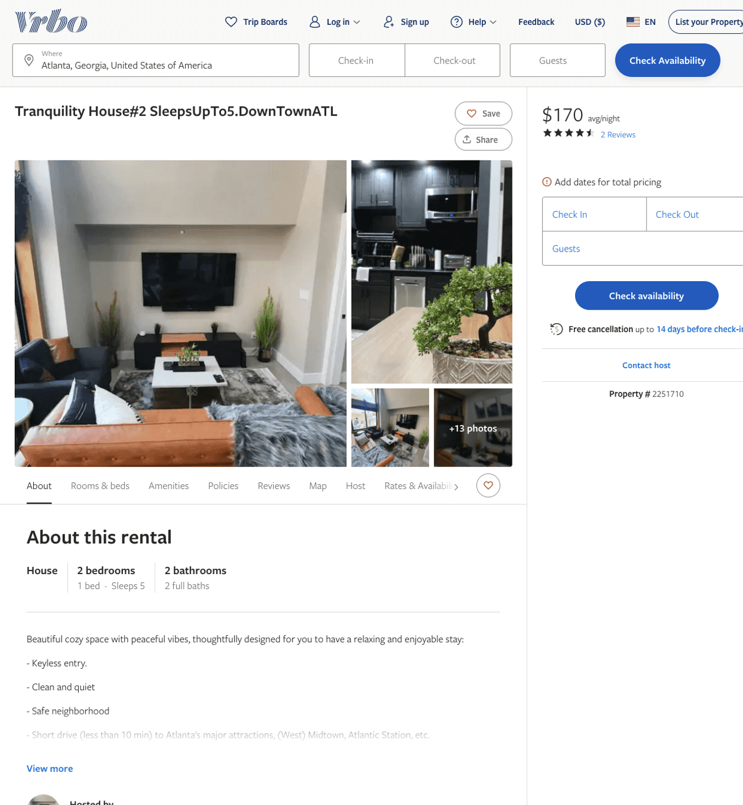
Listing 2251710
2
5
$170 - $205
4.5
2
Bethanie Nikoue
https://www.vrbo.com/2251710
Aug 2022

Slide 6
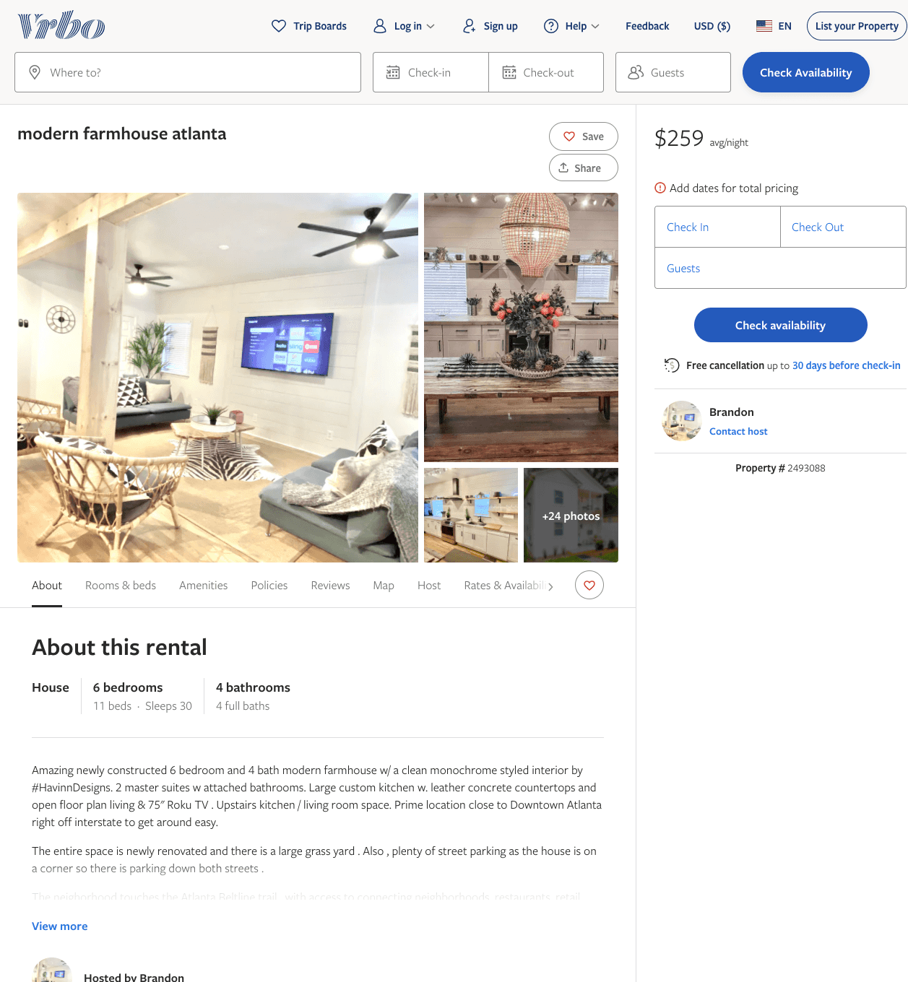
Listing 2493088
6
30
$259 - $437
4.1666665
2
Brandon
https://www.vrbo.com/2493088
Aug 2022

Slide 7
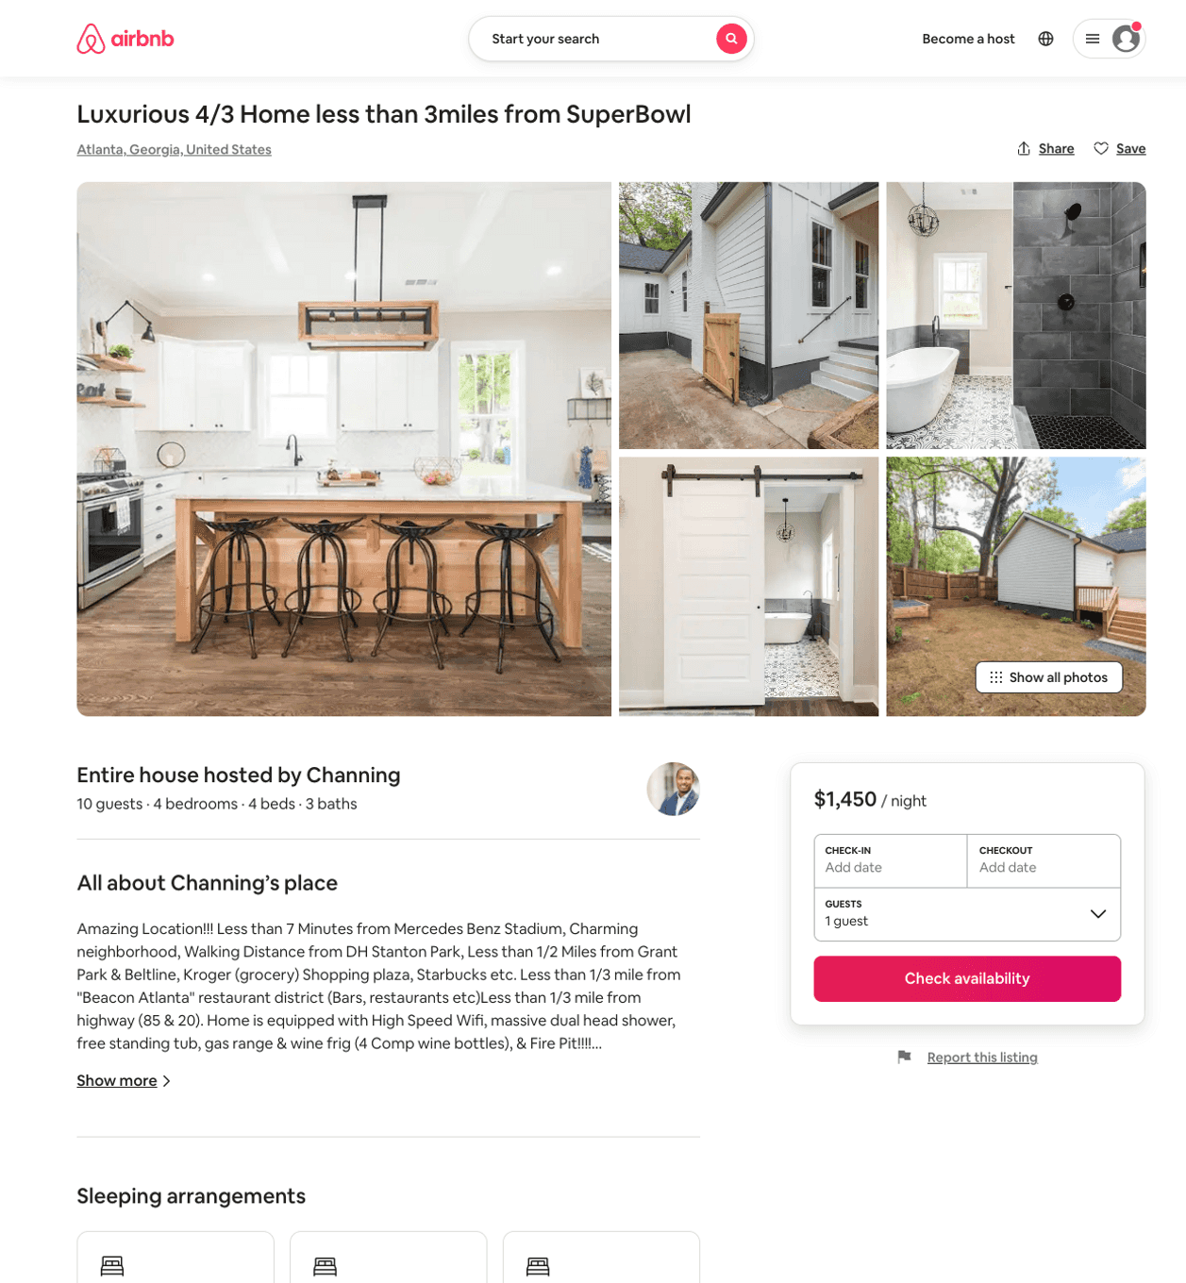
Listing 31312674
4
10
$1450
5
Channing
171759892
1
https://www.airbnb.com/rooms/31312674
Aug 2022

Slide 8
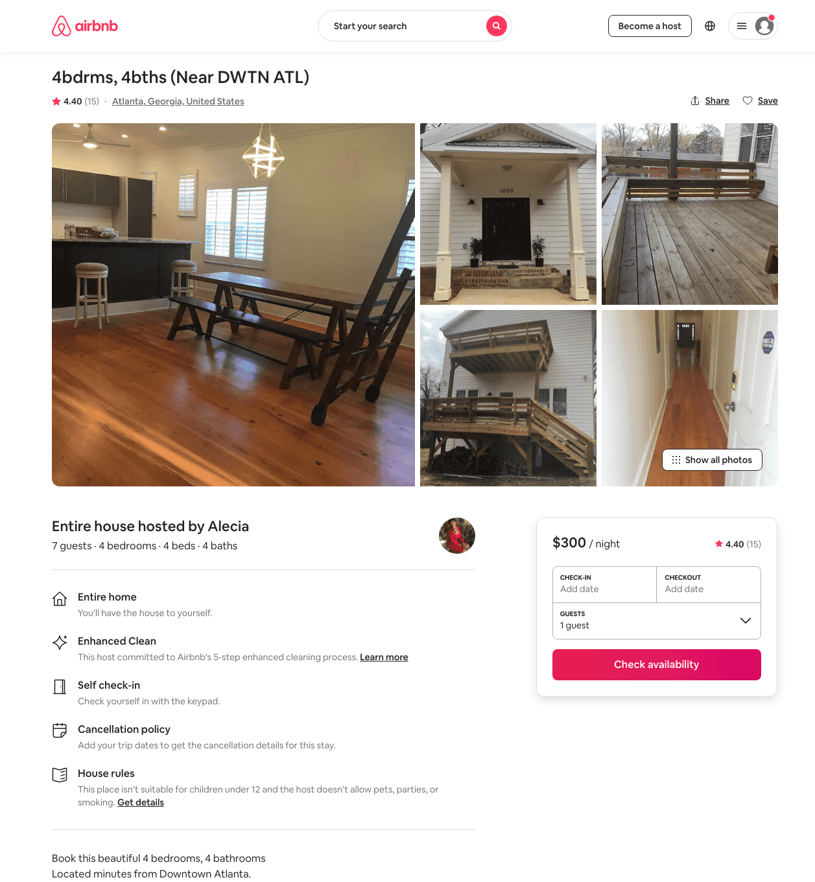
Listing 18440967
4
7
$218 - $2500
4.44
2
Alecia
29342596
2
https://www.airbnb.com/rooms/18440967
Aug 2022

Slide 9
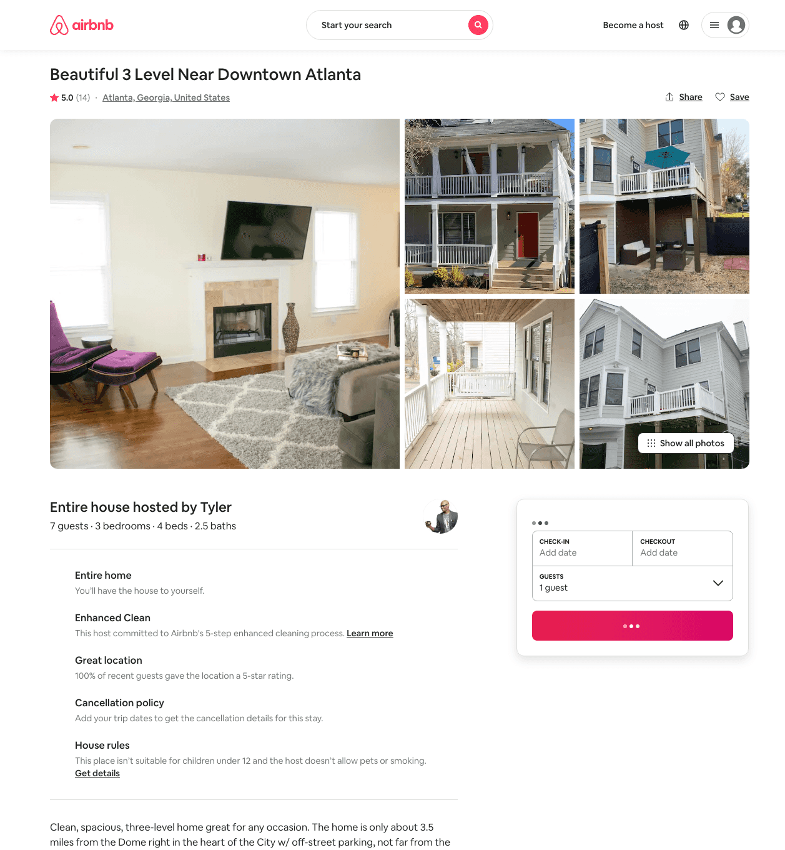
Listing 31803307
3
7
$167 - $1049
4.88
2
Tyler
238338747
2
https://www.airbnb.com/rooms/31803307
Jun 2022

Slide 10
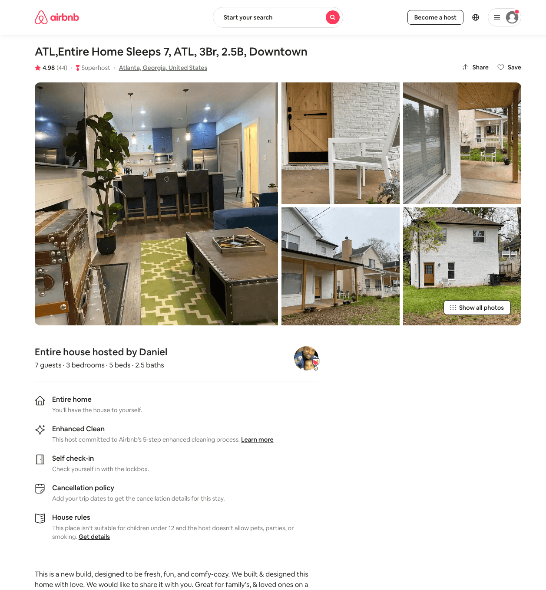
Listing 39089558
3
8
$160 - $400
4.98
2
Daniel
273660683
1
https://www.airbnb.com/rooms/39089558
Aug 2022

Slide 11
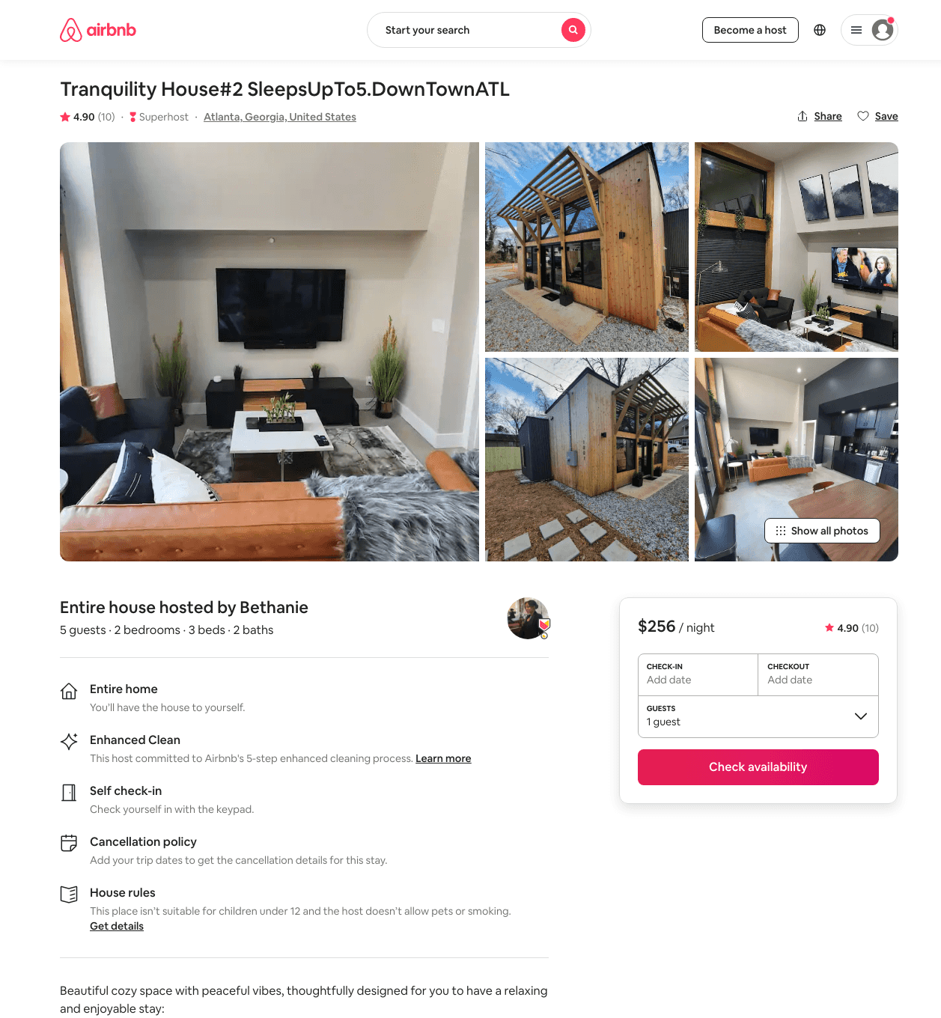
Listing 47310880
2
4
$140 - $256
4.96
2
Bethanie
87997117
6
https://www.airbnb.com/rooms/47310880
Aug 2022

Slide 12
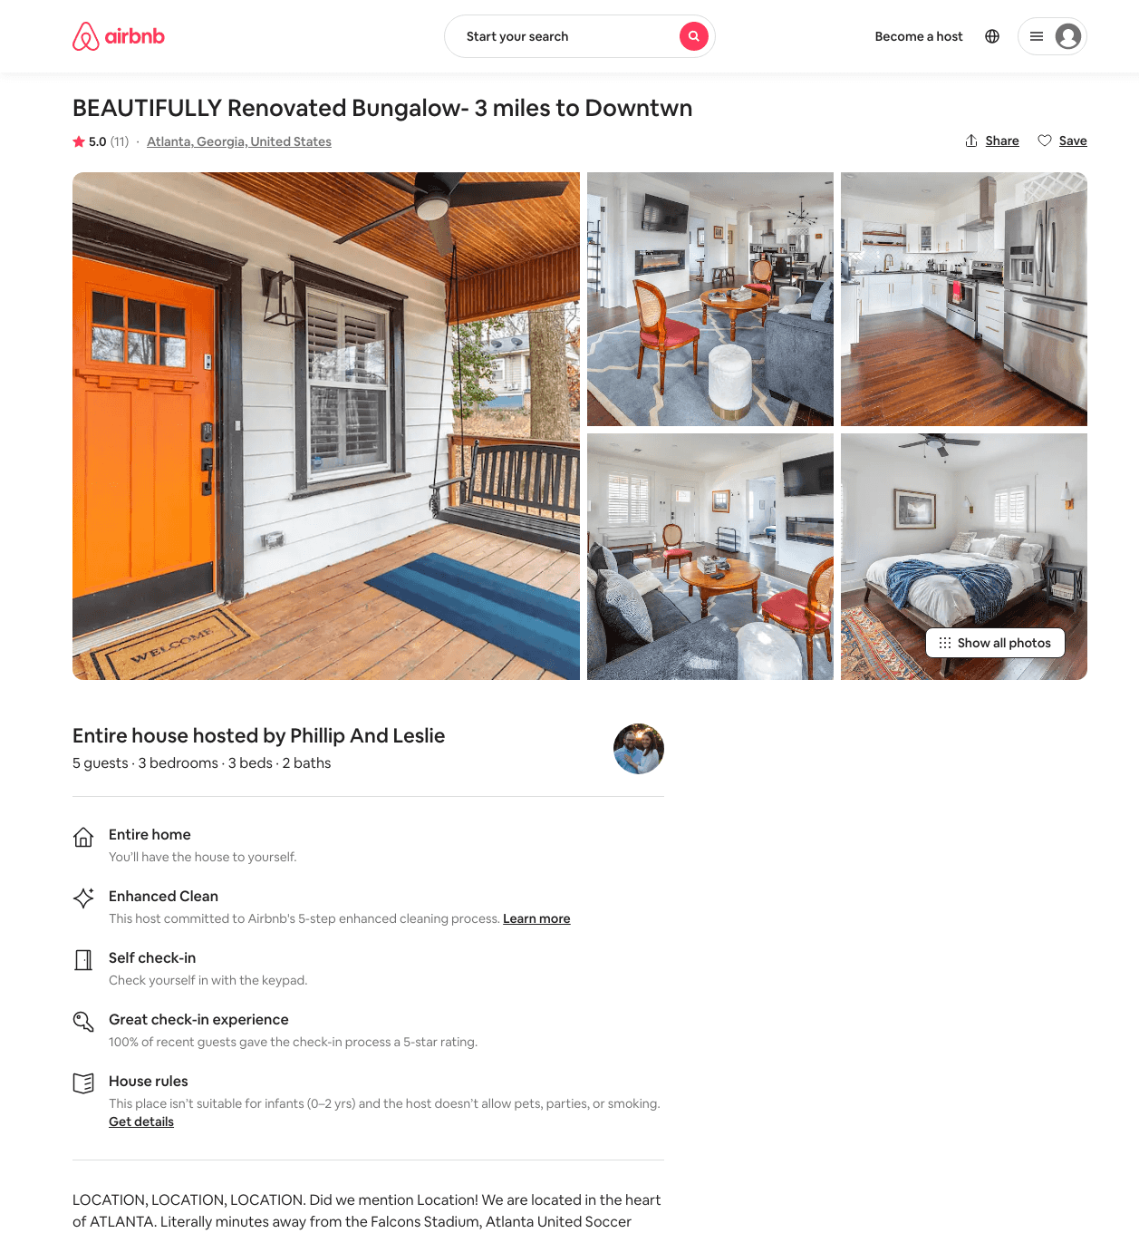
Listing 47493064
3
5
$142 - $257
4.96
4
Phillip And Leslie
42809938
1
https://www.airbnb.com/rooms/47493064
Aug 2022

Slide 13
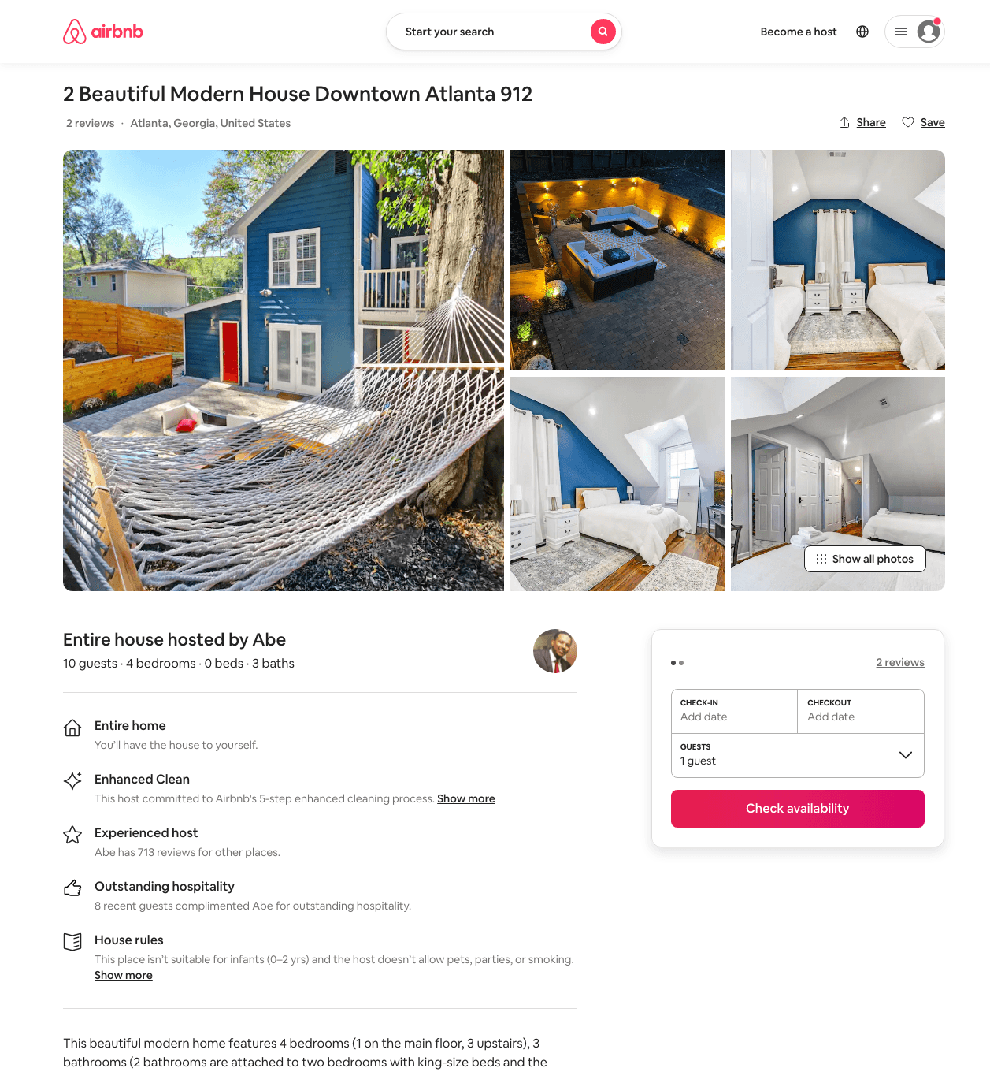
Listing 48505732
4
10
$150 - $328
4.56
1
Abe
12584085
6
https://www.airbnb.com/rooms/48505732
Aug 2022

Slide 14
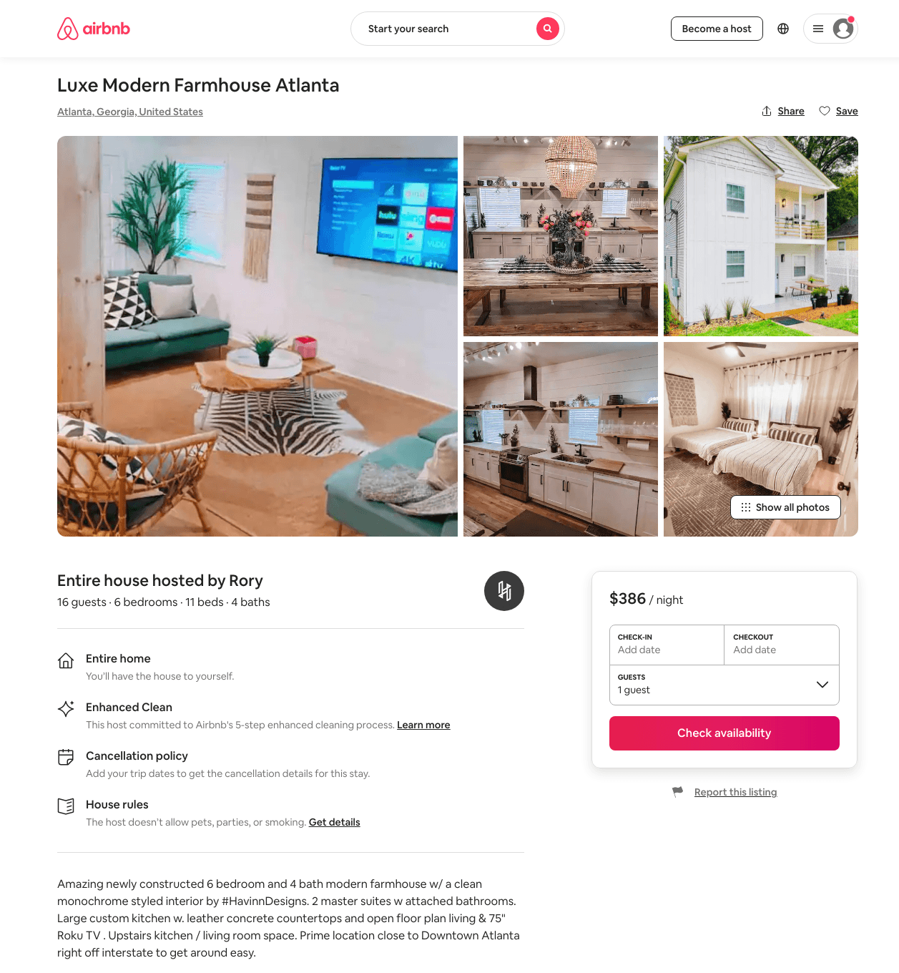
Listing 46581471
6
16
$221 - $561
4.54
3
Rory
350506020
9
https://www.airbnb.com/rooms/46581471
Aug 2022

Slide 15
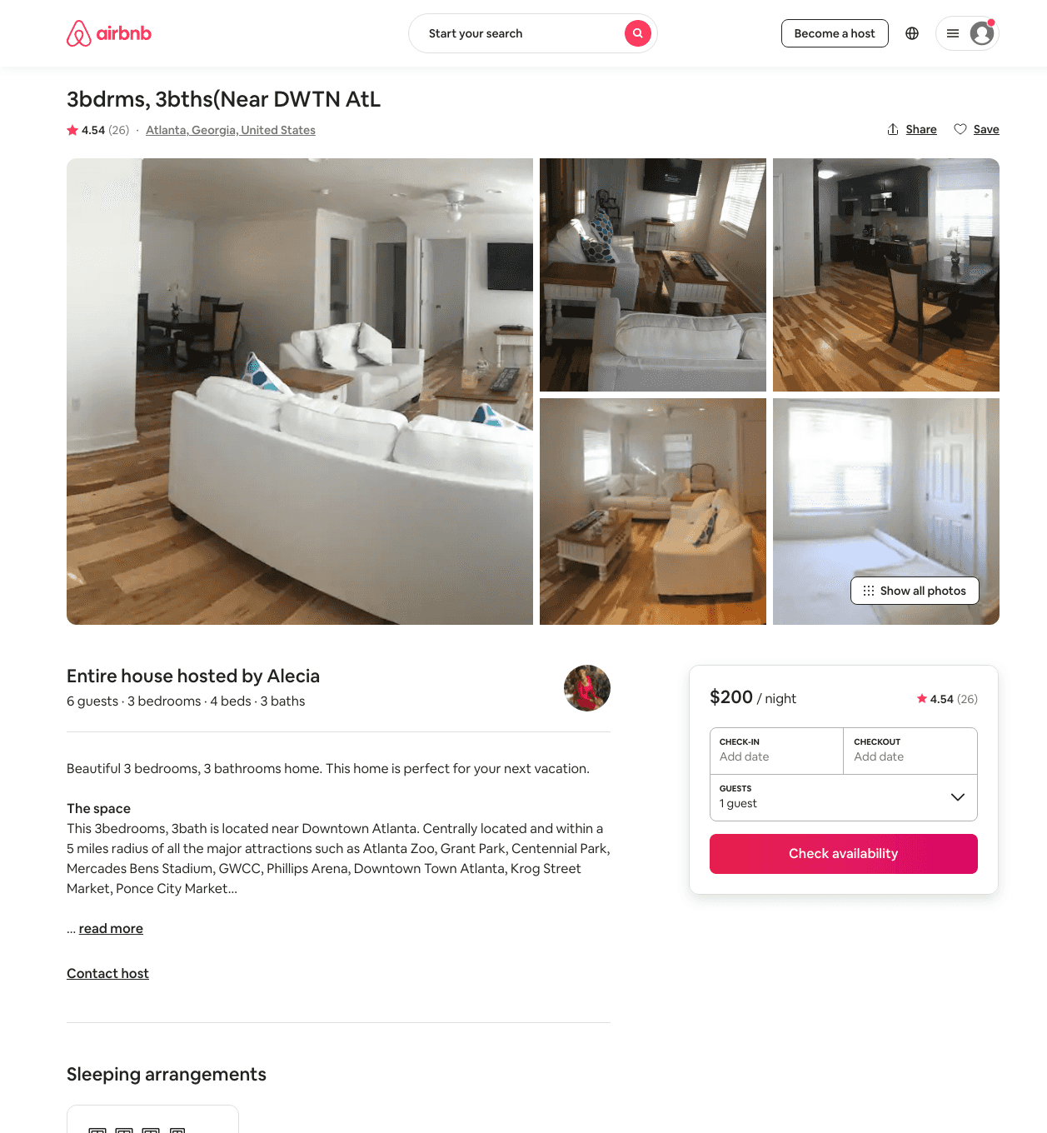
Listing 22602396
3
5
$138 - $516
4.55
2
Alecia
29342596
2
https://www.airbnb.com/rooms/22602396
Aug 2022

Slide 16
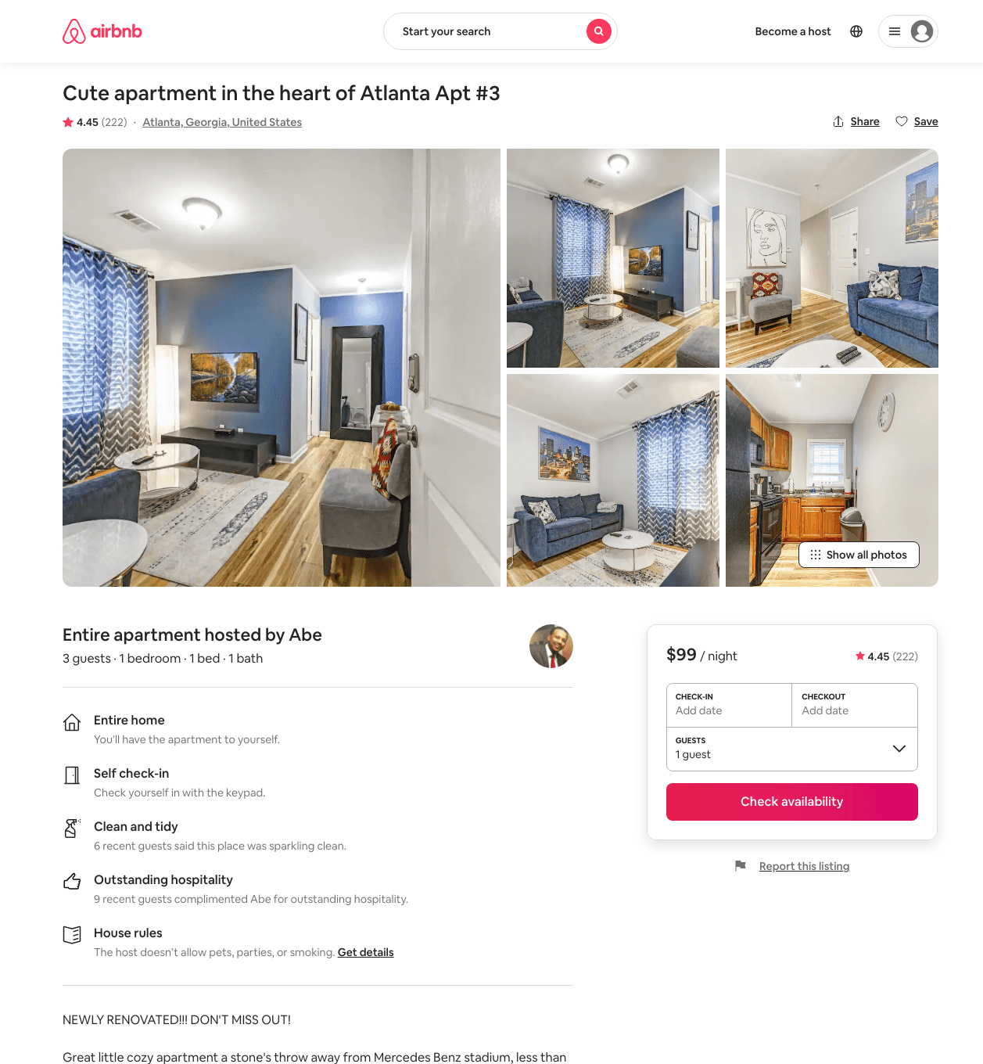
Listing 17303501
1
3
$79 - $119
4.35
2
Abe
12584085
6
https://www.airbnb.com/rooms/17303501
Aug 2022

Slide 17
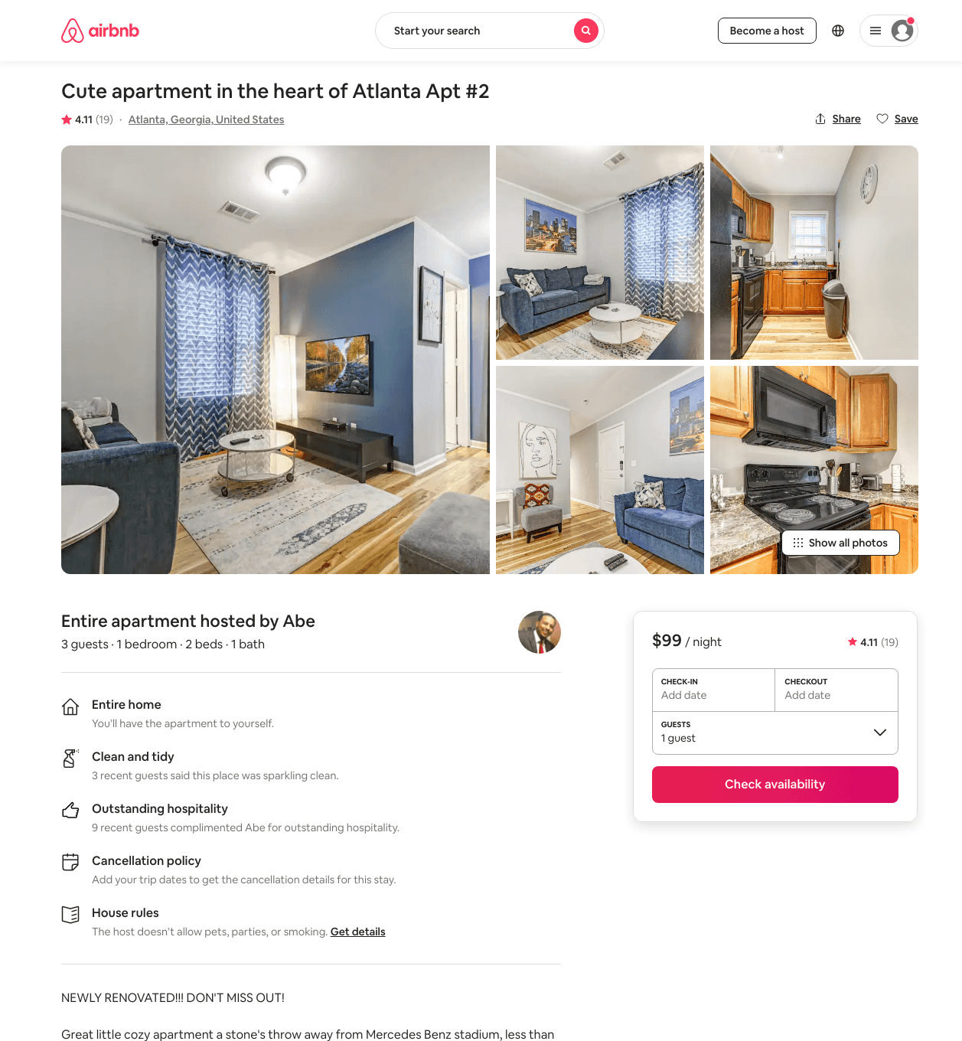
Listing 36515415
1
3
$79 - $129
3.90
2
Abe
12584085
6
https://www.airbnb.com/rooms/36515415
Aug 2022

Slide 18
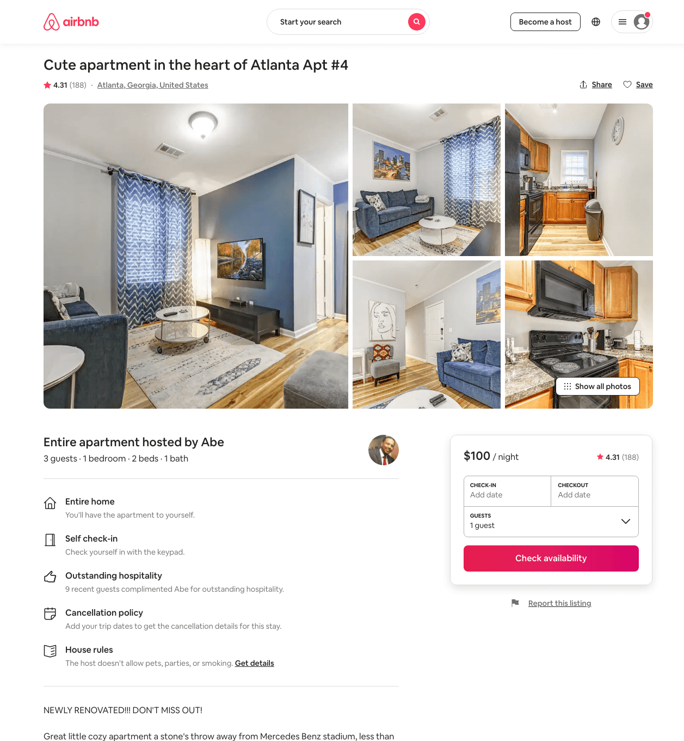
Listing 17681121
1
3
$79 - $112
4.22
2
Abe
12584085
6
https://www.airbnb.com/rooms/17681121
Aug 2022

Slide 19
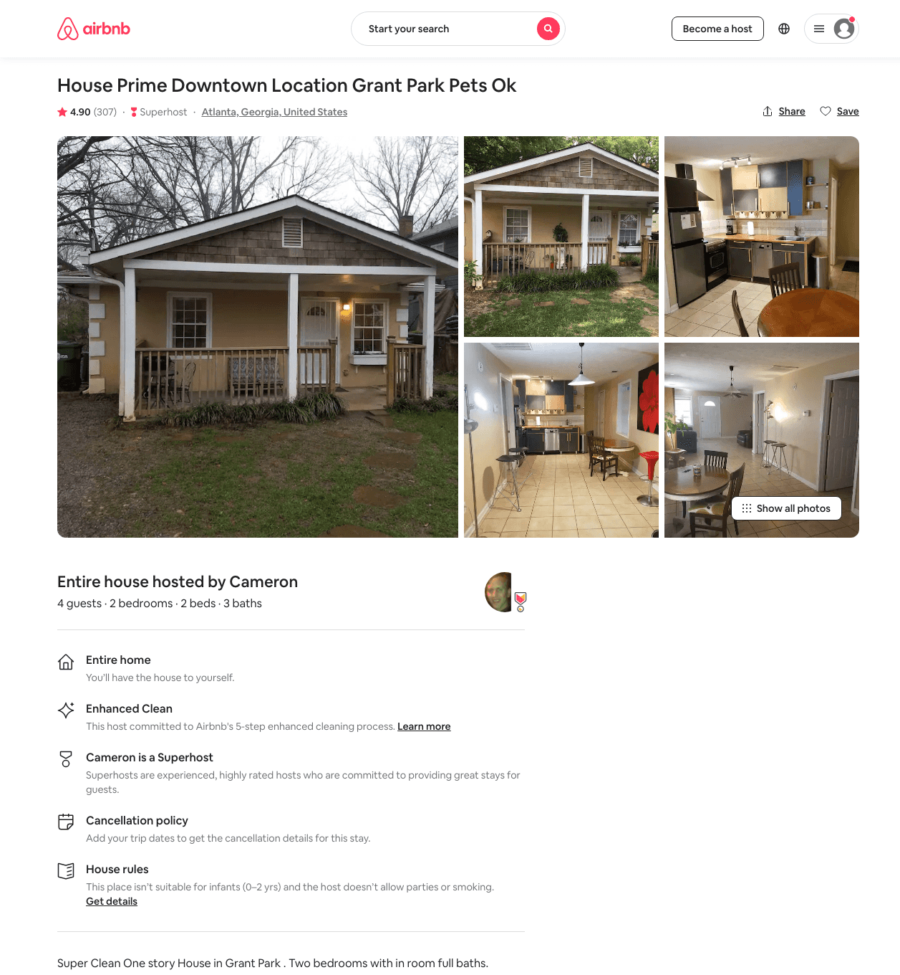
Listing 30594512
2
4
$90 - $107
4.91
1
Cameron
229495463
1
https://www.airbnb.com/rooms/30594512
Aug 2022

Slide 20
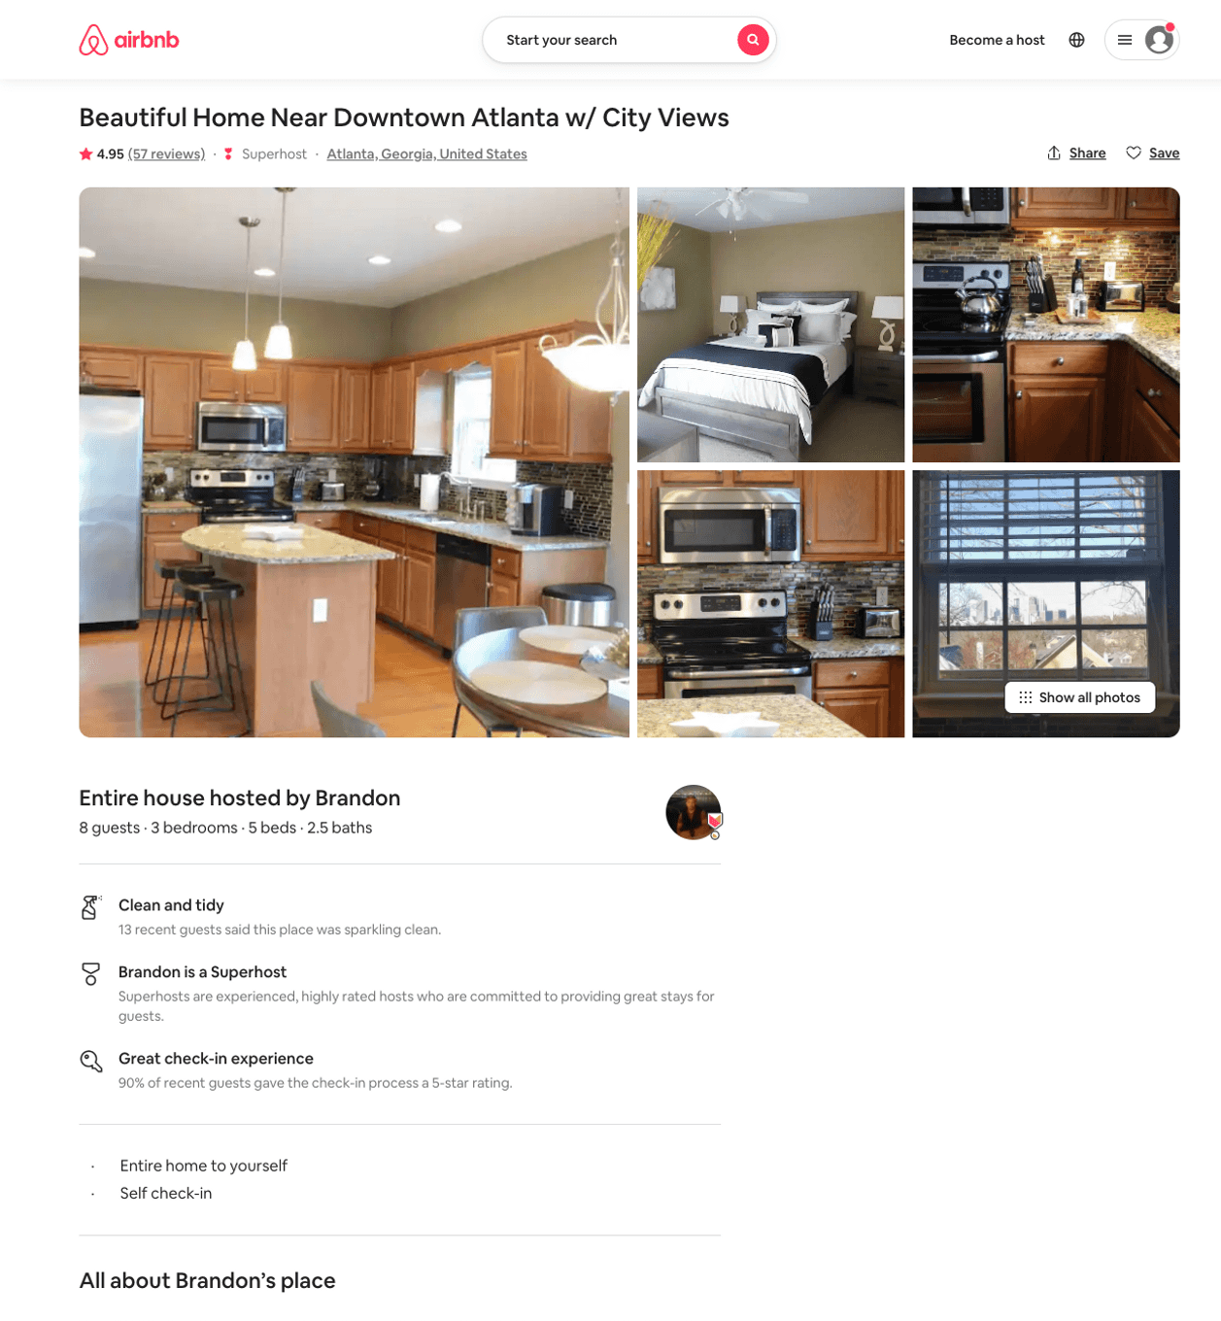
Listing 31817110
3
8
$171 - $318
4.94
2
Brandon
40202785
1
https://www.airbnb.com/rooms/31817110
Aug 2022

Slide 21
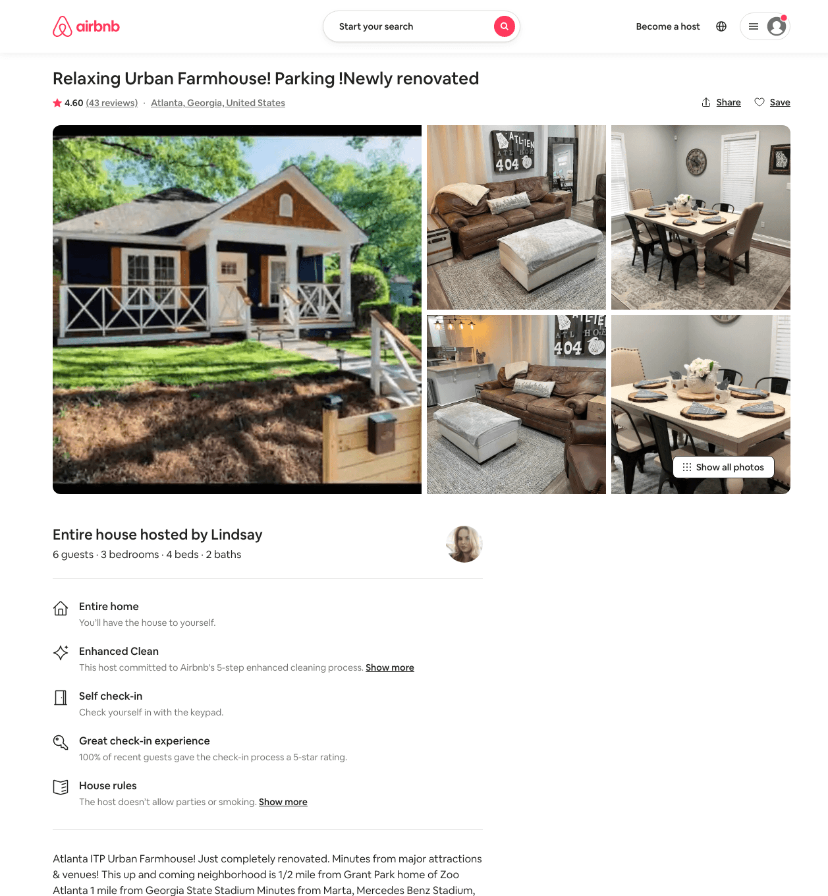
Listing 37557794
3
6
$120 - $179
4.55
1
Lindsay
78856531
1
https://www.airbnb.com/rooms/37557794
Aug 2022

Slide 22
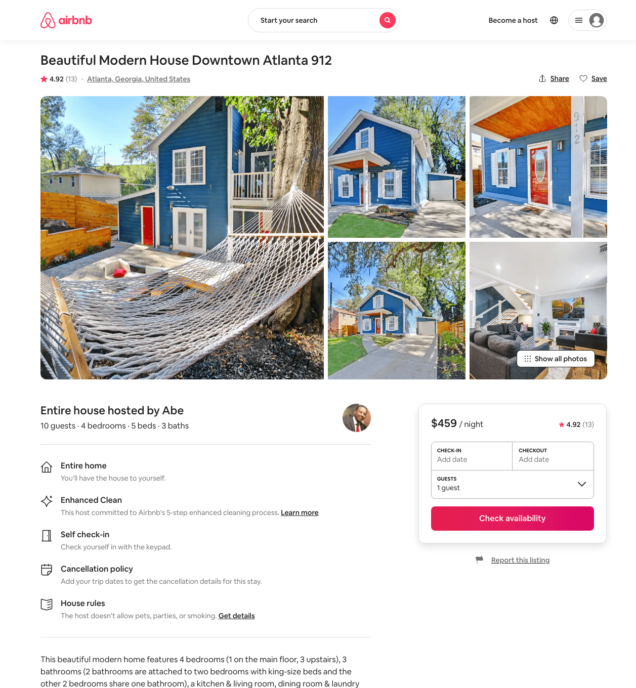
Listing 46336552
4
10
$338 - $599
4.68
3
Abe
12584085
6
https://www.airbnb.com/rooms/46336552
Aug 2022

Slide 23
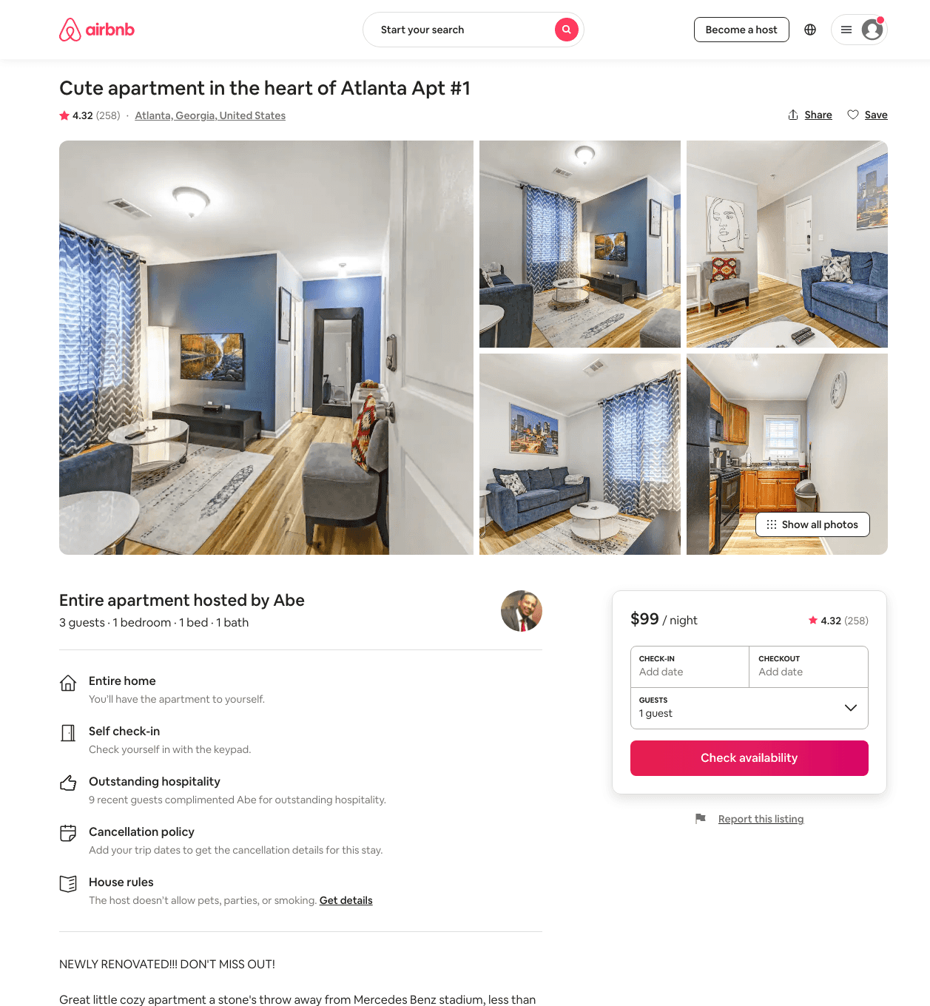
Listing 17287498
1
3
$69 - $119
4.31
2
Abe
12584085
6
https://www.airbnb.com/rooms/17287498
Aug 2022

Slide 24
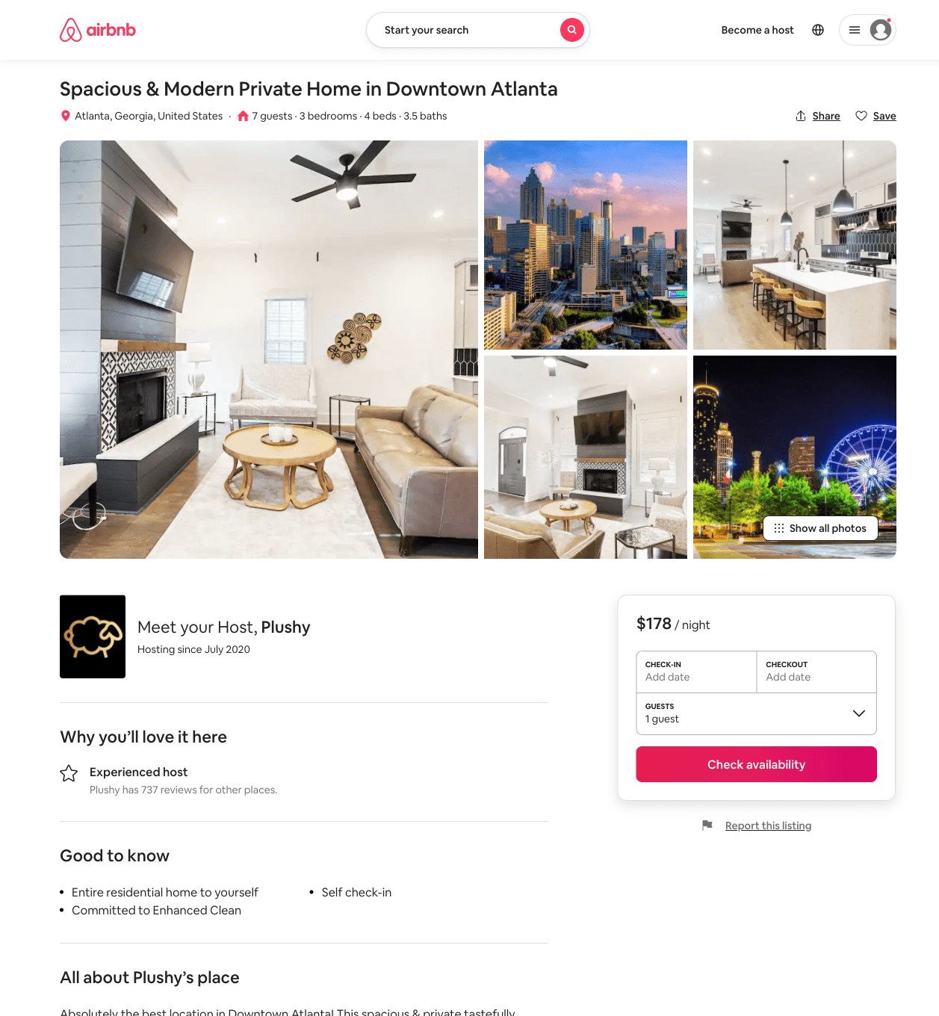
Listing 51624176
3
7
$111 - $286
3.73
2
Plushy
353152177
3
https://www.airbnb.com/rooms/51624176
Aug 2022

Slide 25
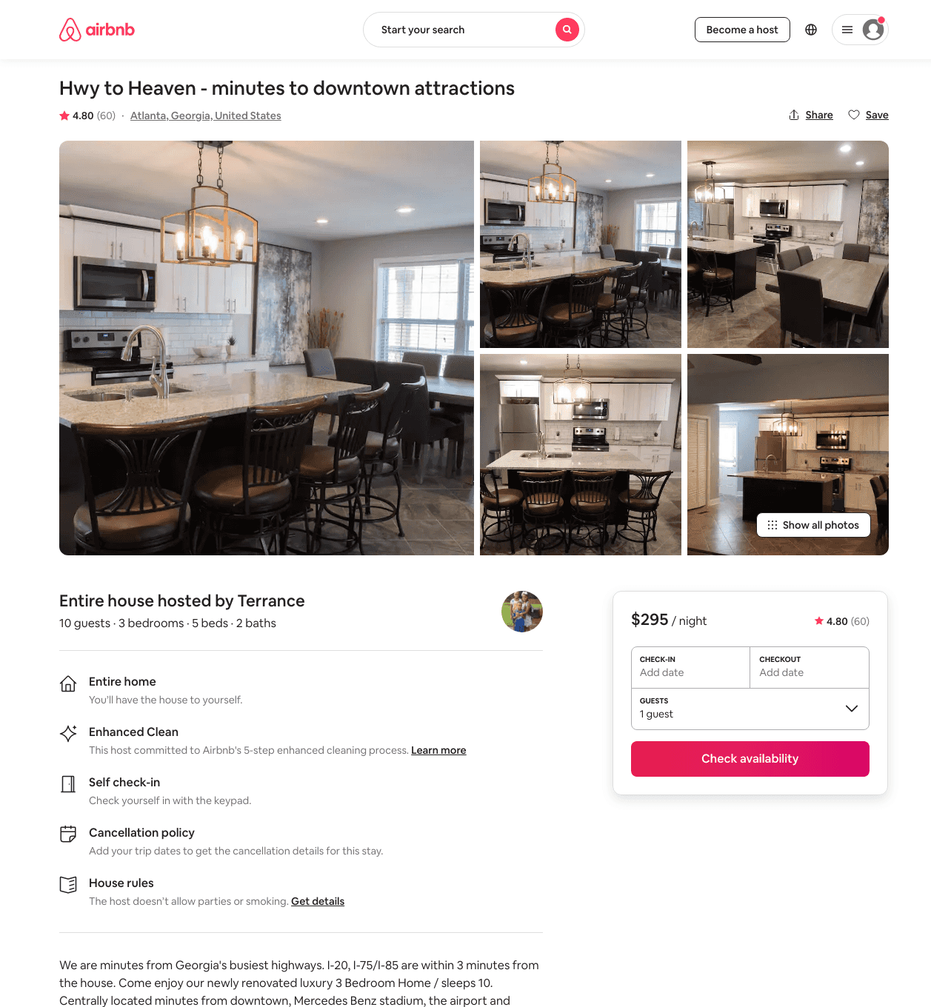
Listing 31361346
3
10
$295 - $343
4.78
2
Terrance
143708849
2
https://www.airbnb.com/rooms/31361346
Aug 2022

Slide 26
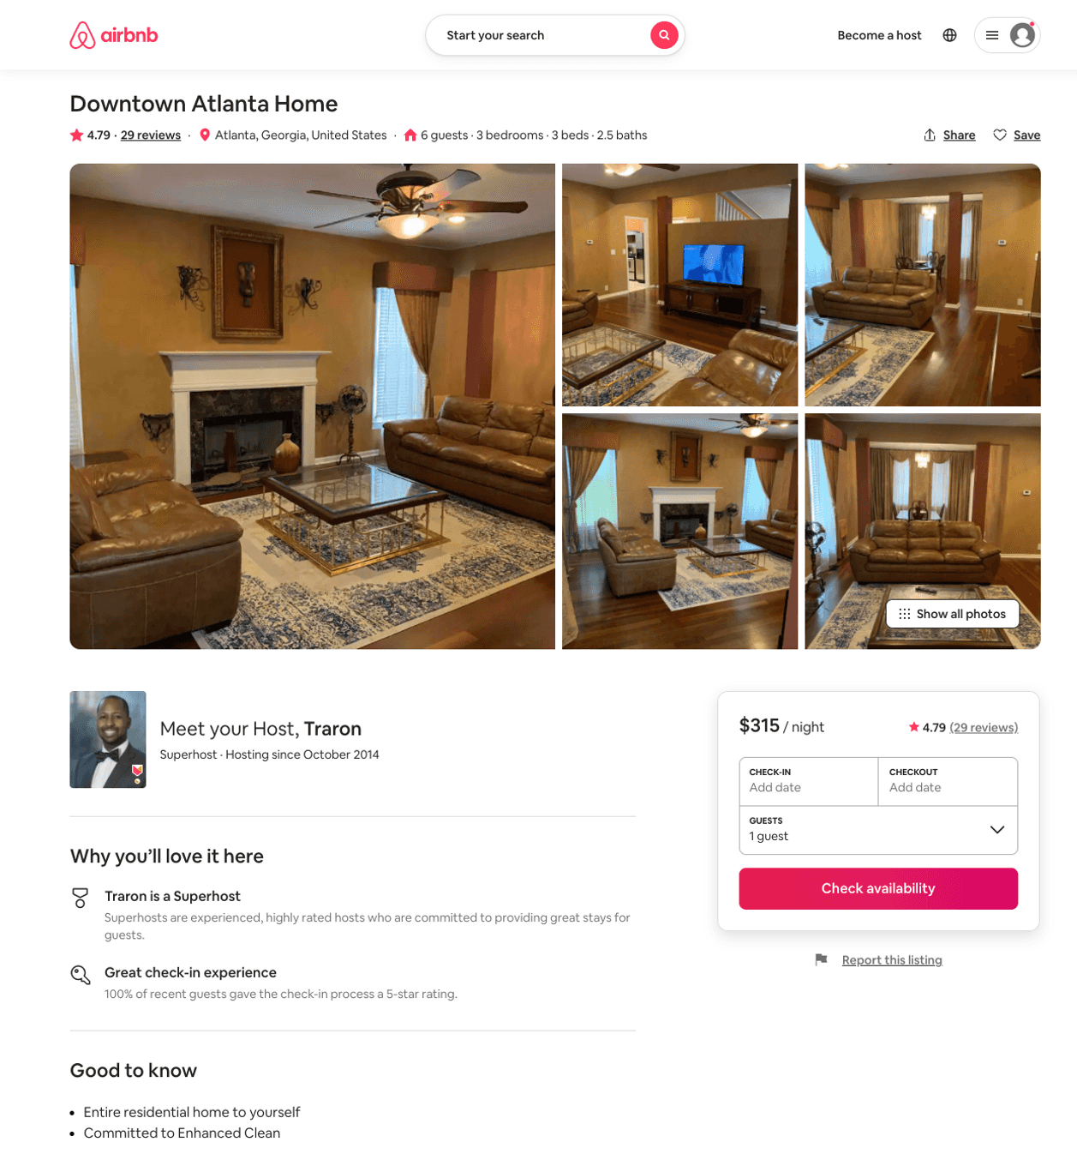
Listing 28347113
3
6
$165 - $362
4.81
1
Traron
22413403
2
https://www.airbnb.com/rooms/28347113
Aug 2022

Slide 27
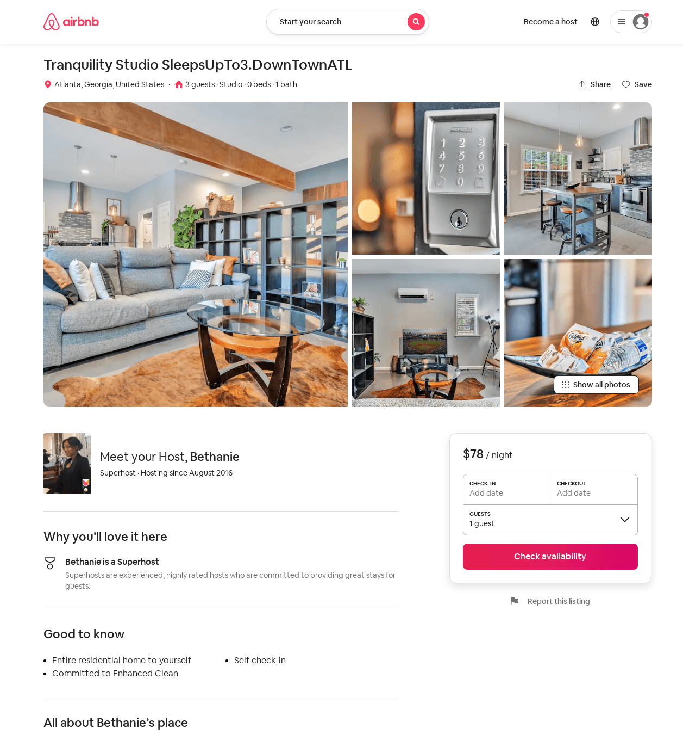
Listing 52074746
Studio
2
$78 - $169
4.88
2
Bethanie
87997117
6
https://www.airbnb.com/rooms/52074746
Aug 2022

Slide 28
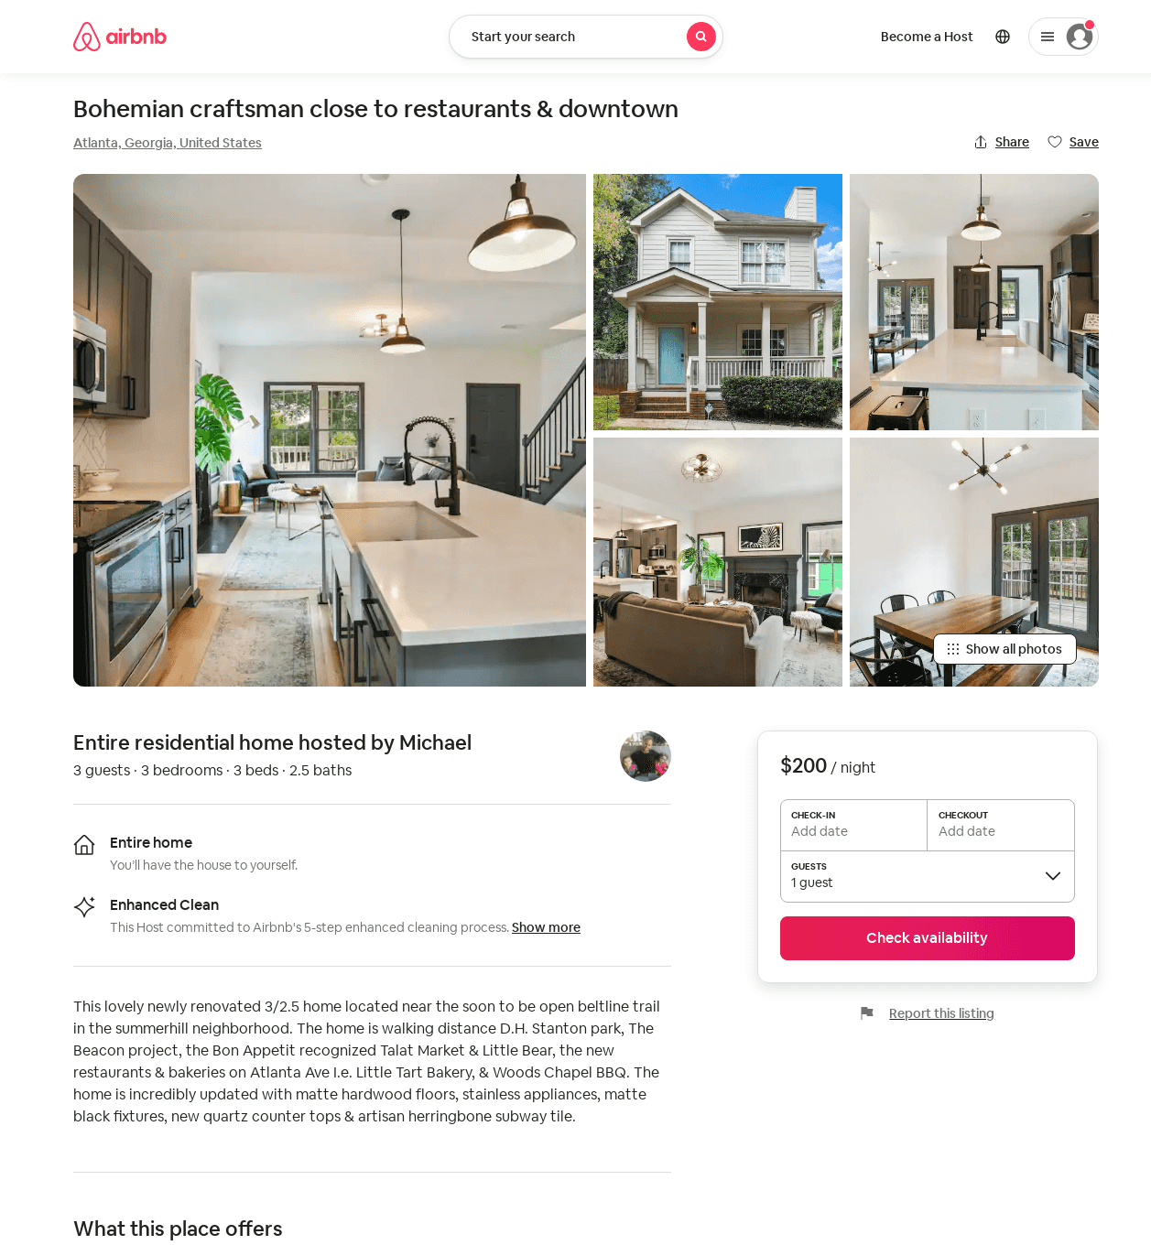
Listing 53027279
3
4
$166 - $207
4.38
2
Michael
2299572
1
https://www.airbnb.com/rooms/53027279
Aug 2022

Slide 29
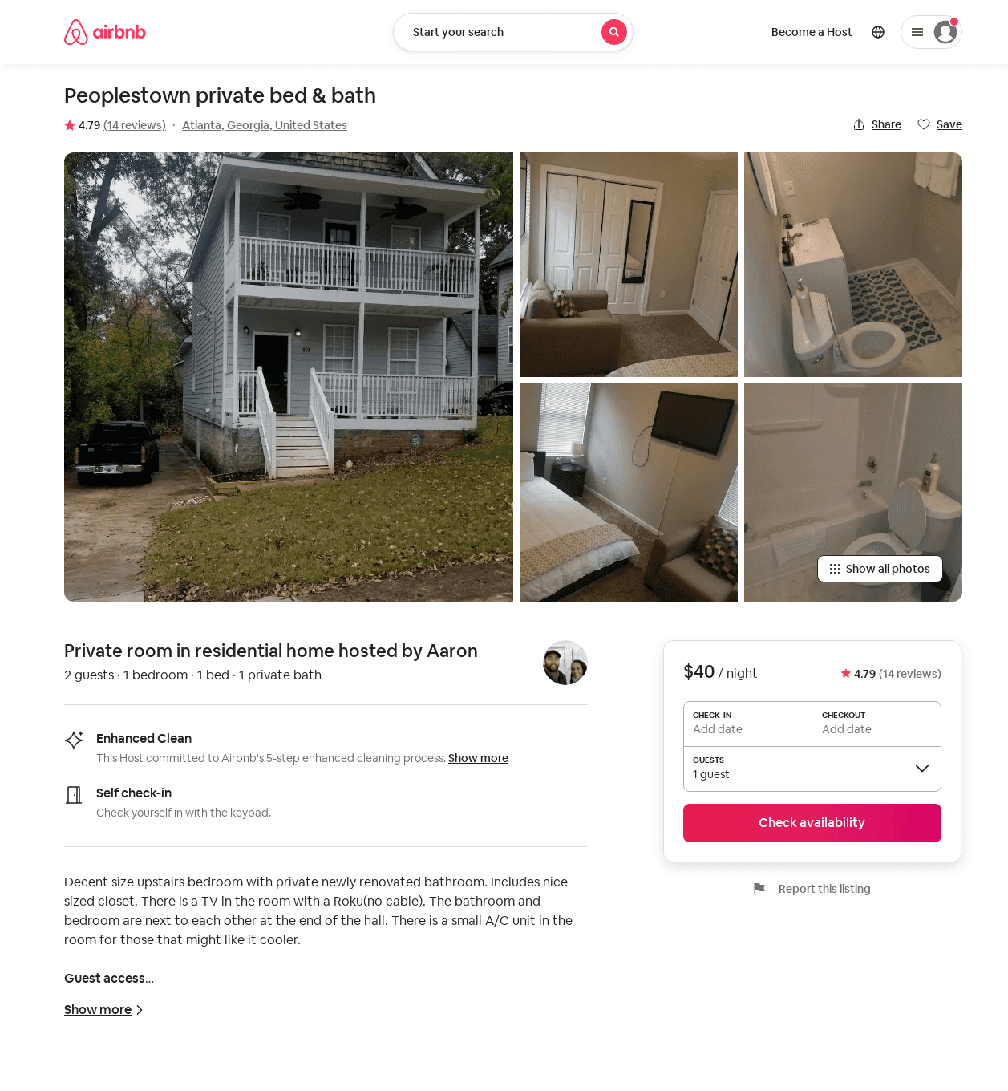
Listing 39646362
1
2
$27 - $68
4.83
1
Aaron
102910942
1
https://www.airbnb.com/rooms/39646362
Aug 2022

Slide 30
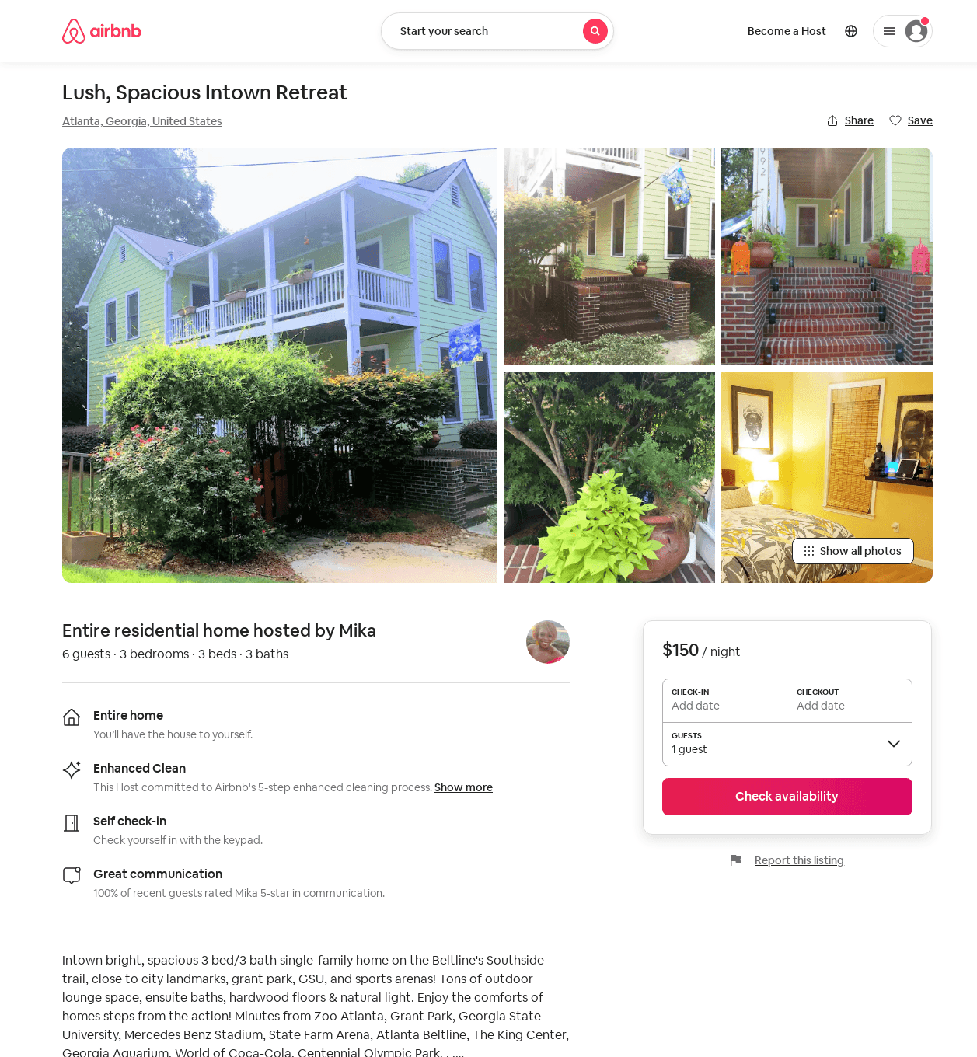
Listing 31073541
3
6
$150
28
Mika
5236653
1
https://www.airbnb.com/rooms/31073541
Jun 2022

Slide 31
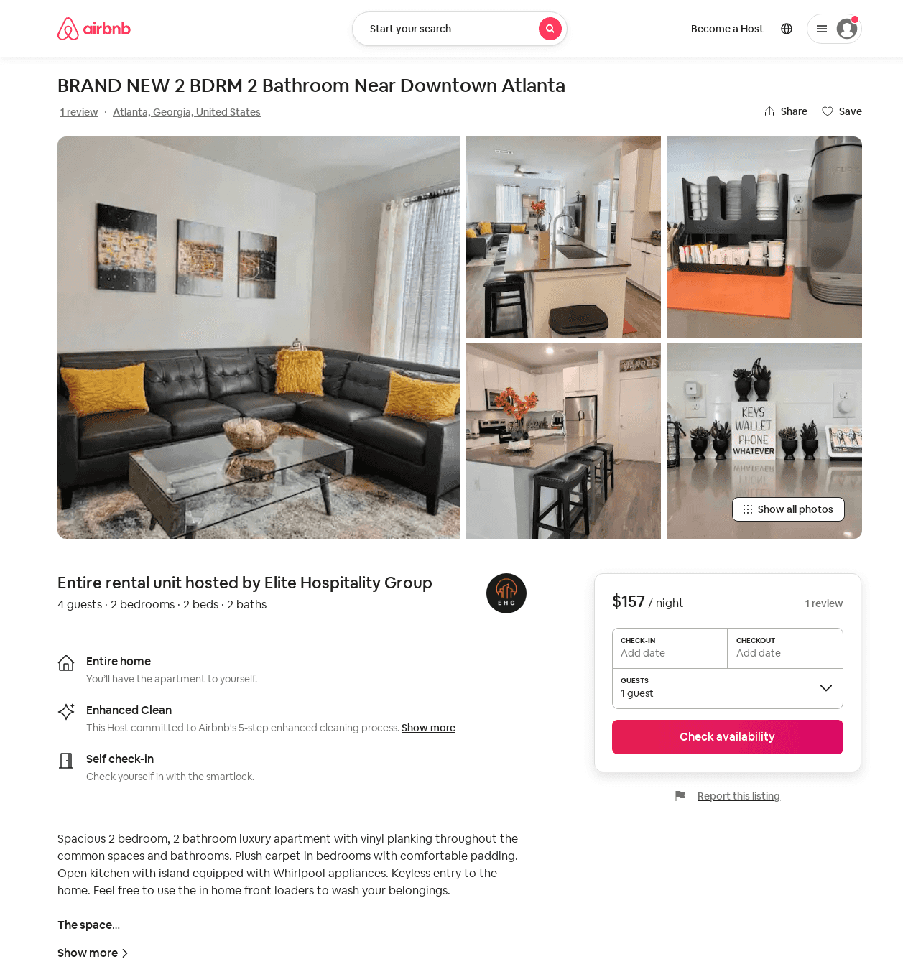
Listing 53436496
2
4
$105 - $185
5.0
1
Elite Hospitality Group
432672446
1
https://www.airbnb.com/rooms/53436496
Aug 2022

Slide 32
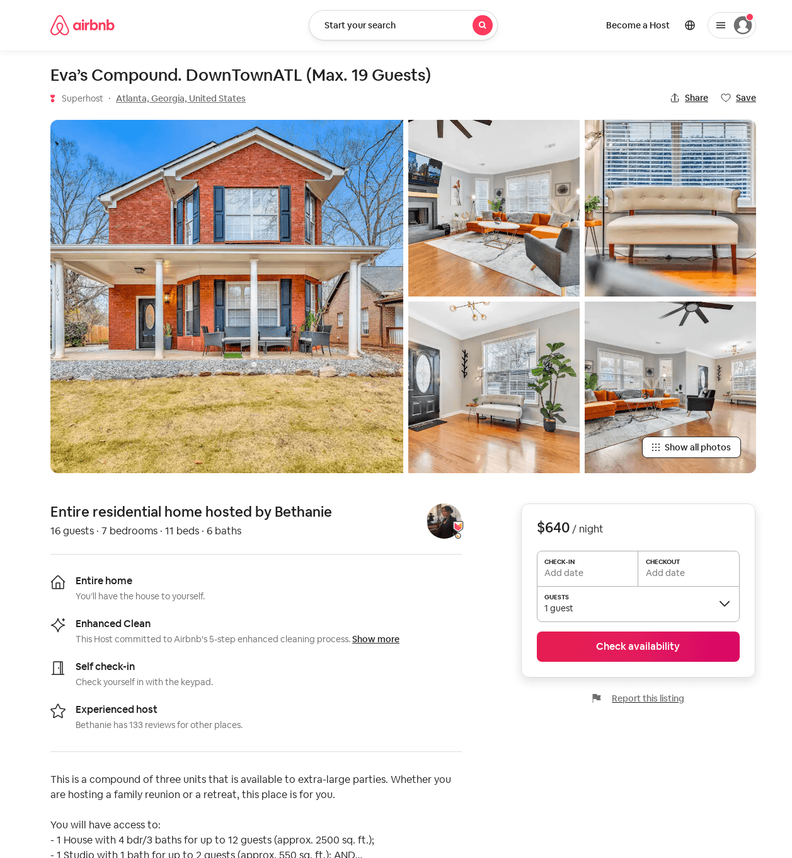
Listing 53900491
7
16
$612 - $993
5.0
2
Bethanie
87997117
6
https://www.airbnb.com/rooms/53900491
Aug 2022

Slide 33
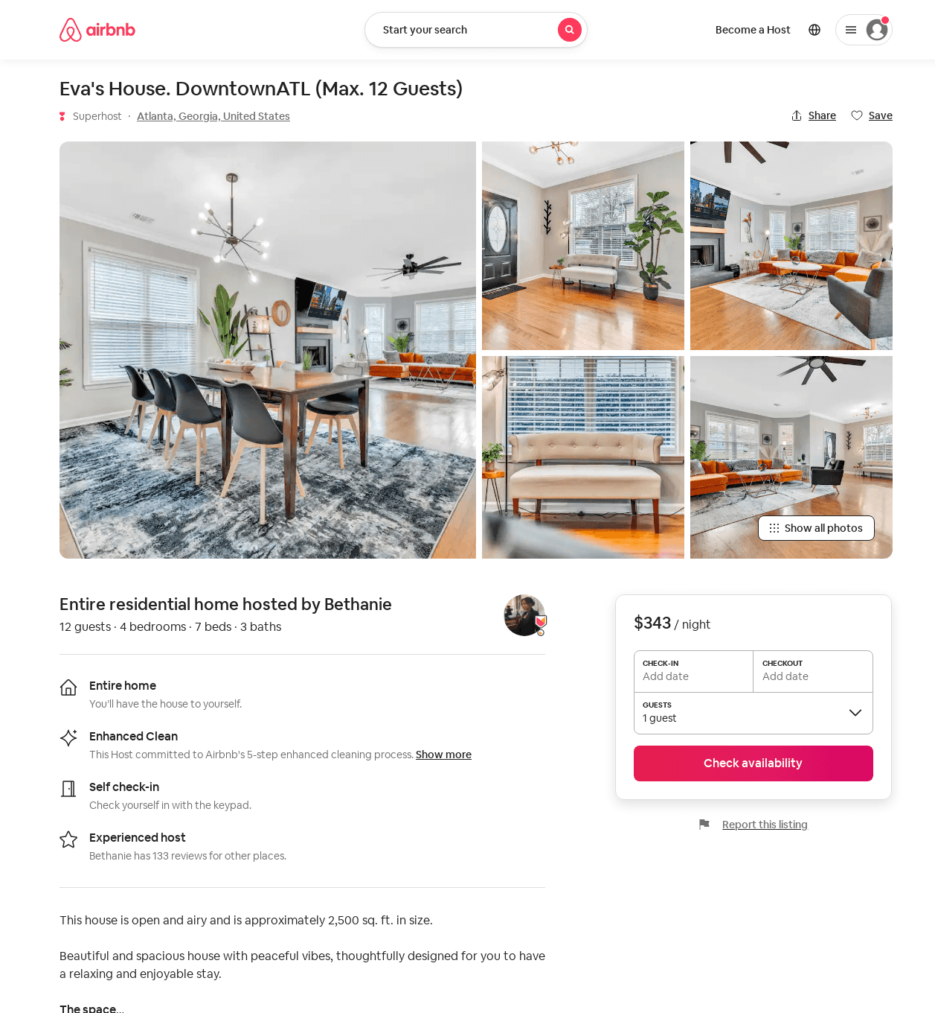
Listing 47389424
4
12
$310 - $395
4.81
2
Bethanie
87997117
6
https://www.airbnb.com/rooms/47389424
Aug 2022

Slide 34
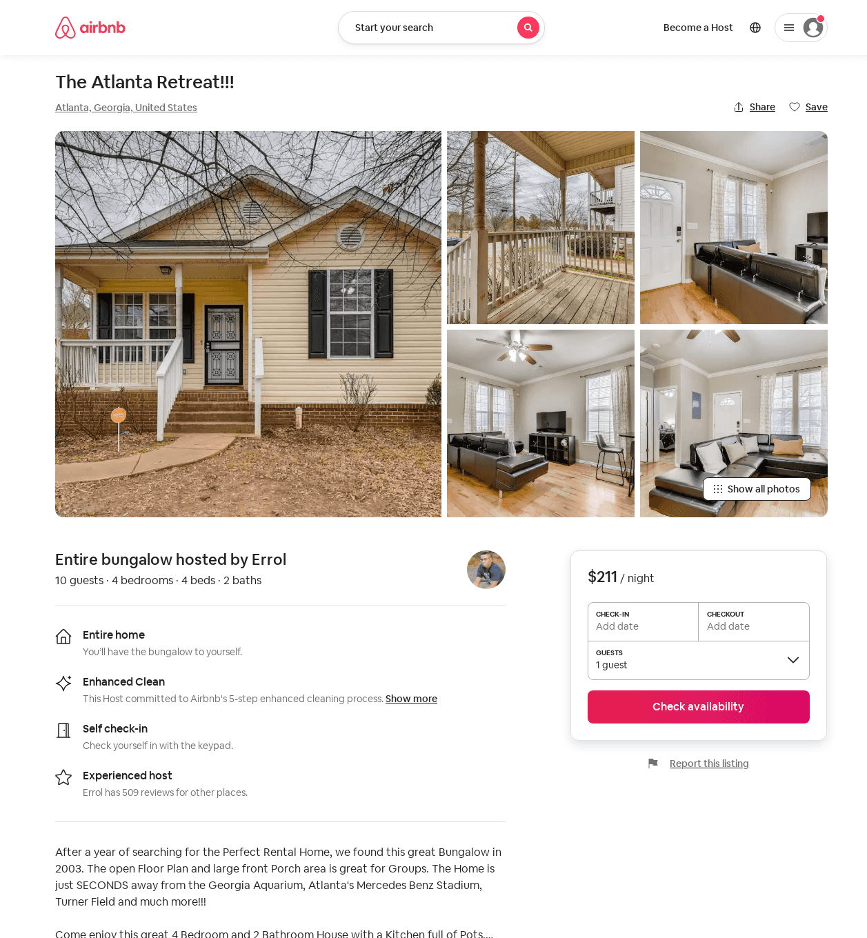
Listing 53970621
4
10
$121 - $211
4.60
2
Errol
97037186
12
https://www.airbnb.com/rooms/53970621
Aug 2022

Slide 35
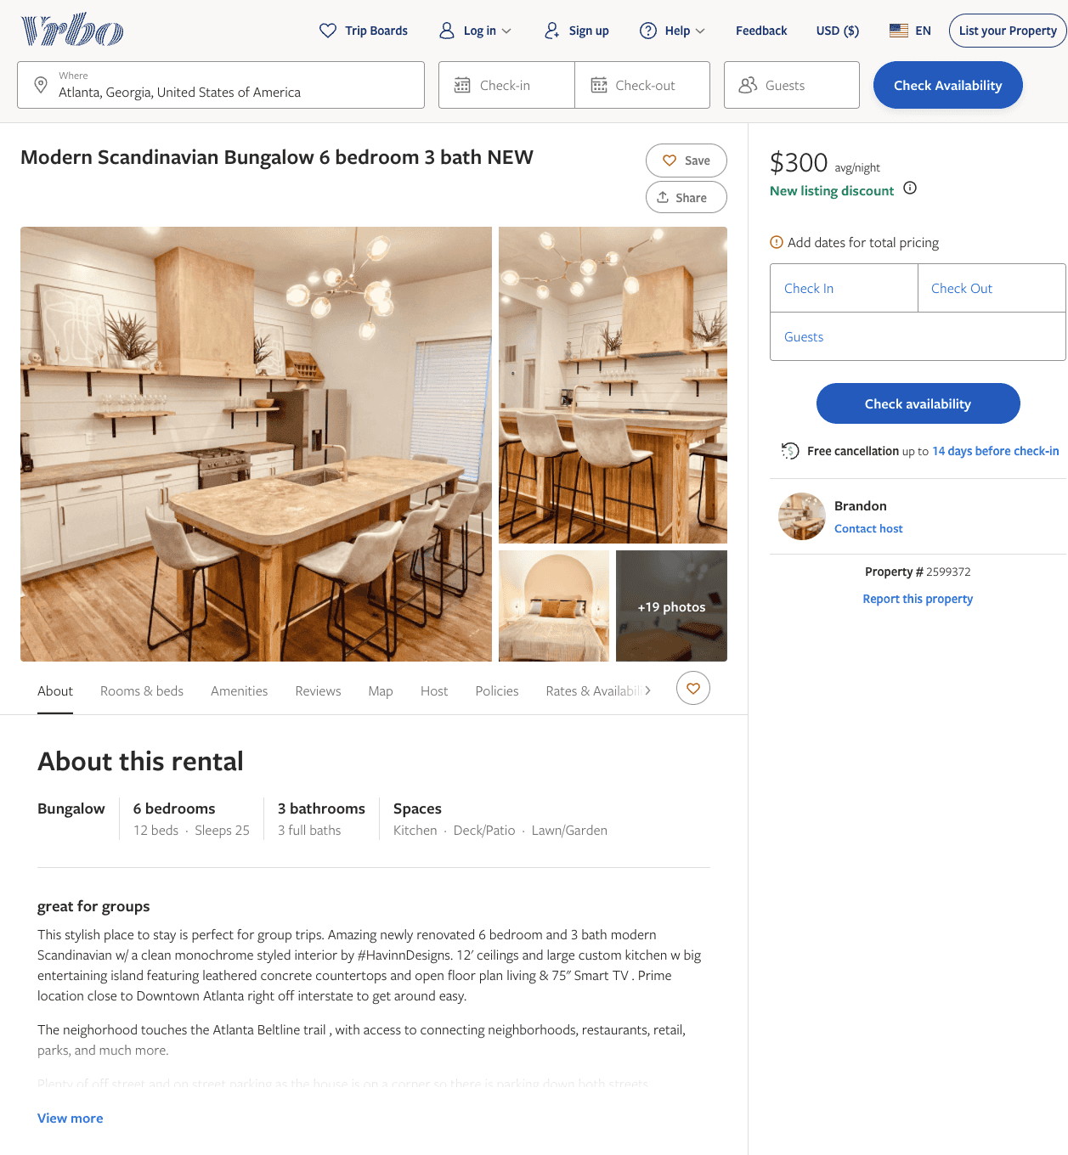
Listing 2599372
6
25
$300 - $470
4.6666665
2
Brandon
https://www.vrbo.com/2599372
Aug 2022

Slide 36
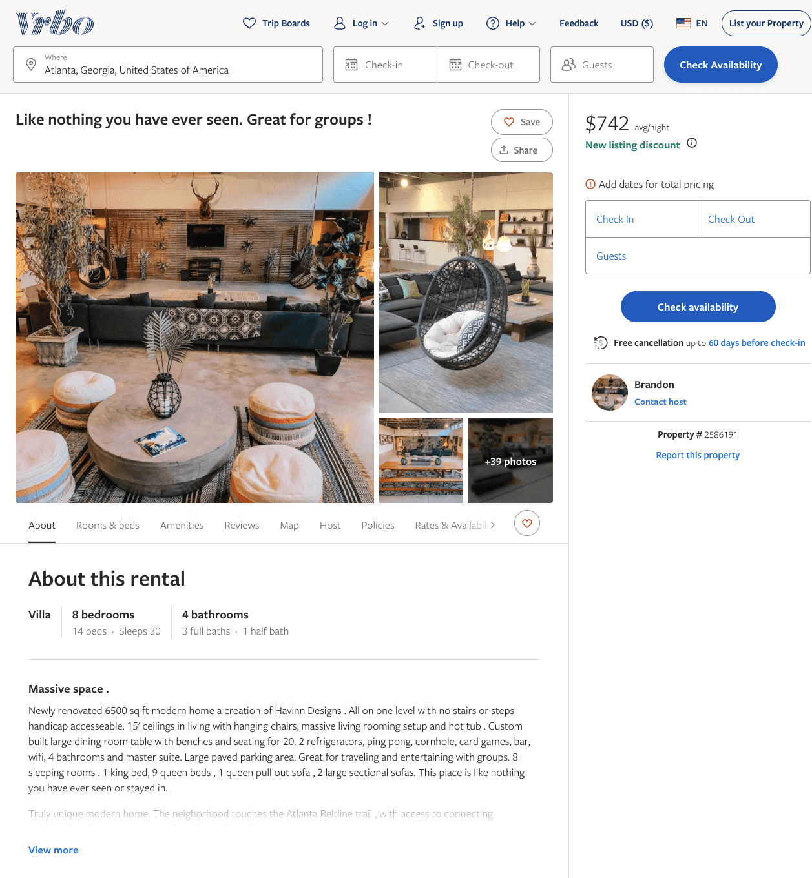
Listing 2586191
8
30
$742 - $890
5
2
Brandon
https://www.vrbo.com/2586191
Aug 2022

Slide 37
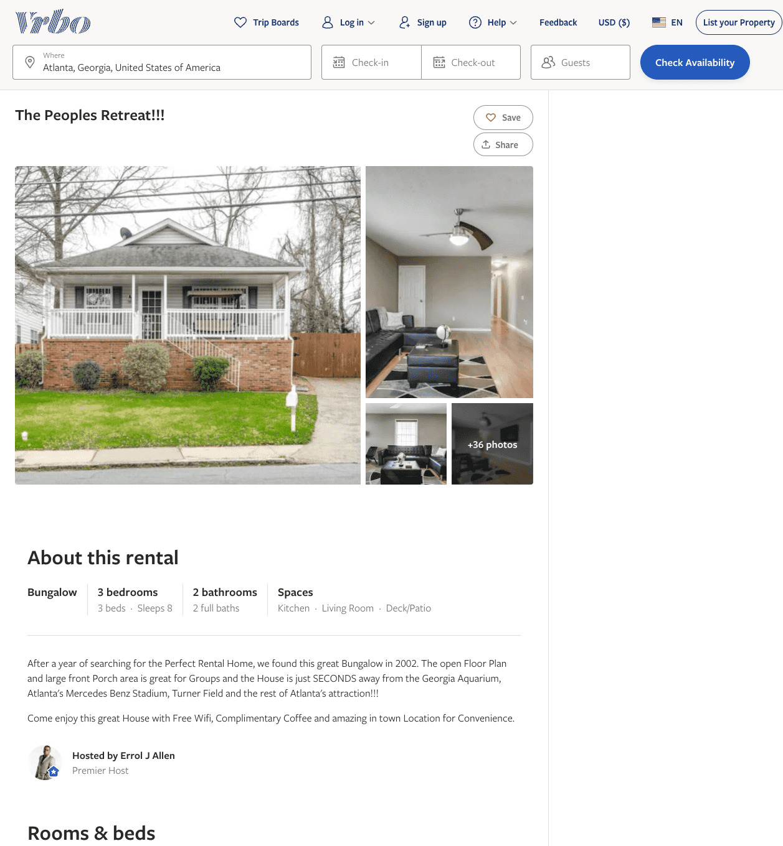
Listing 1920059
3
8
$150
4.6666665
2
Errol J Allen
https://www.vrbo.com/1920059
Aug 2022

Slide 38
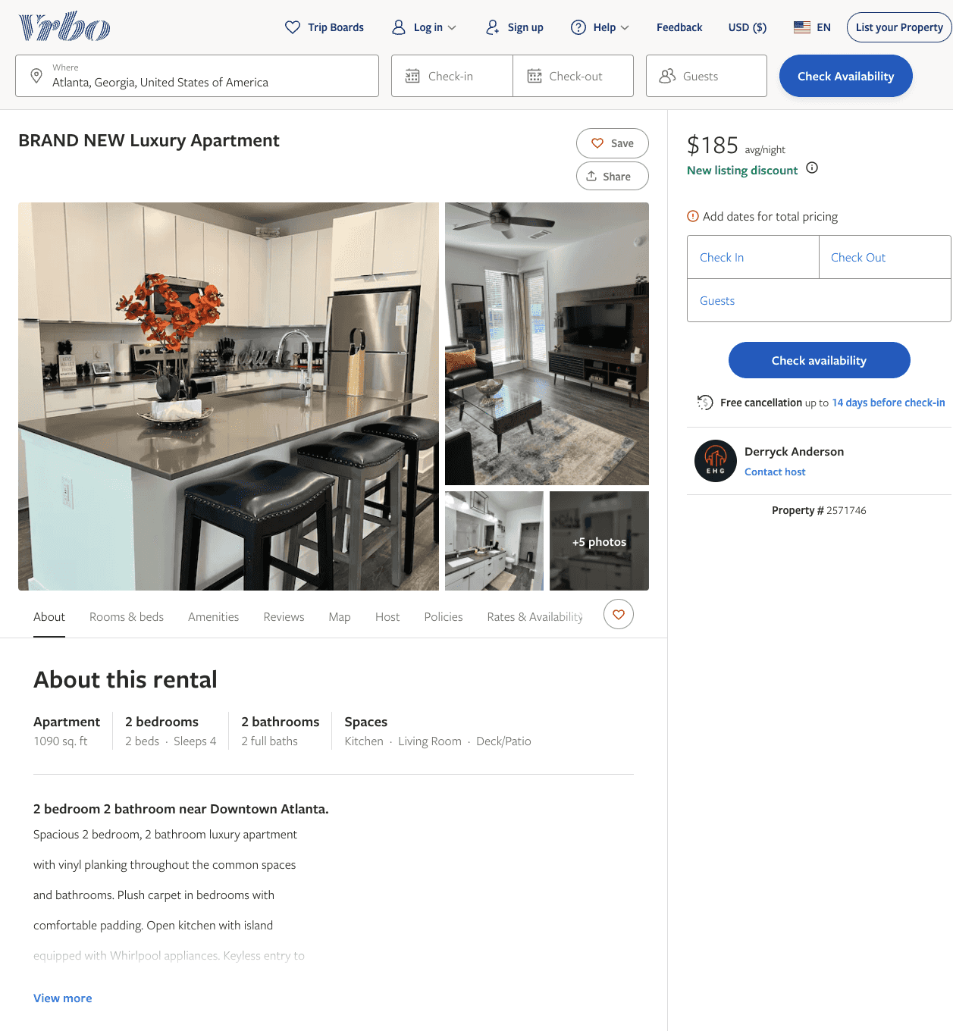
Listing 2571746
2
4
$185
2
Derryck Anderson
https://www.vrbo.com/2571746
Aug 2022

Slide 39
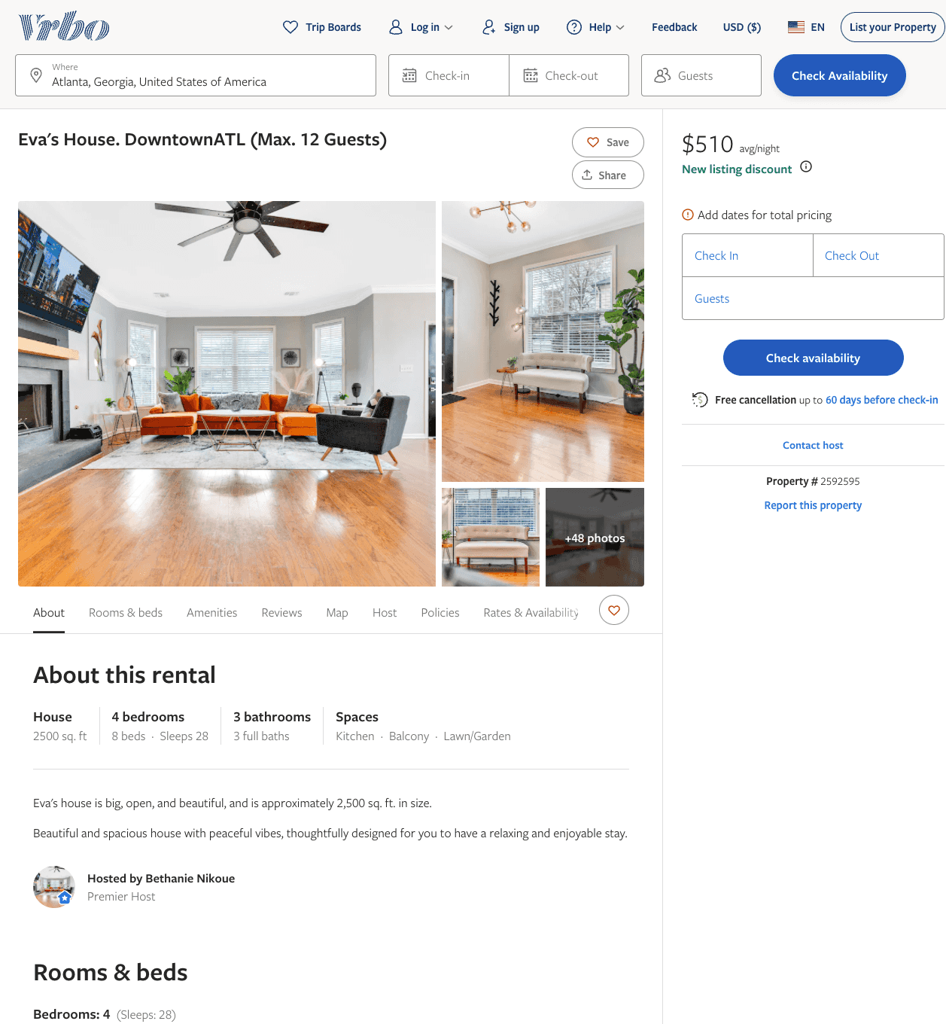
Listing 2592595
4
12
$470 - $510
2
Bethanie Nikoue
https://www.vrbo.com/2592595
Aug 2022

Slide 40
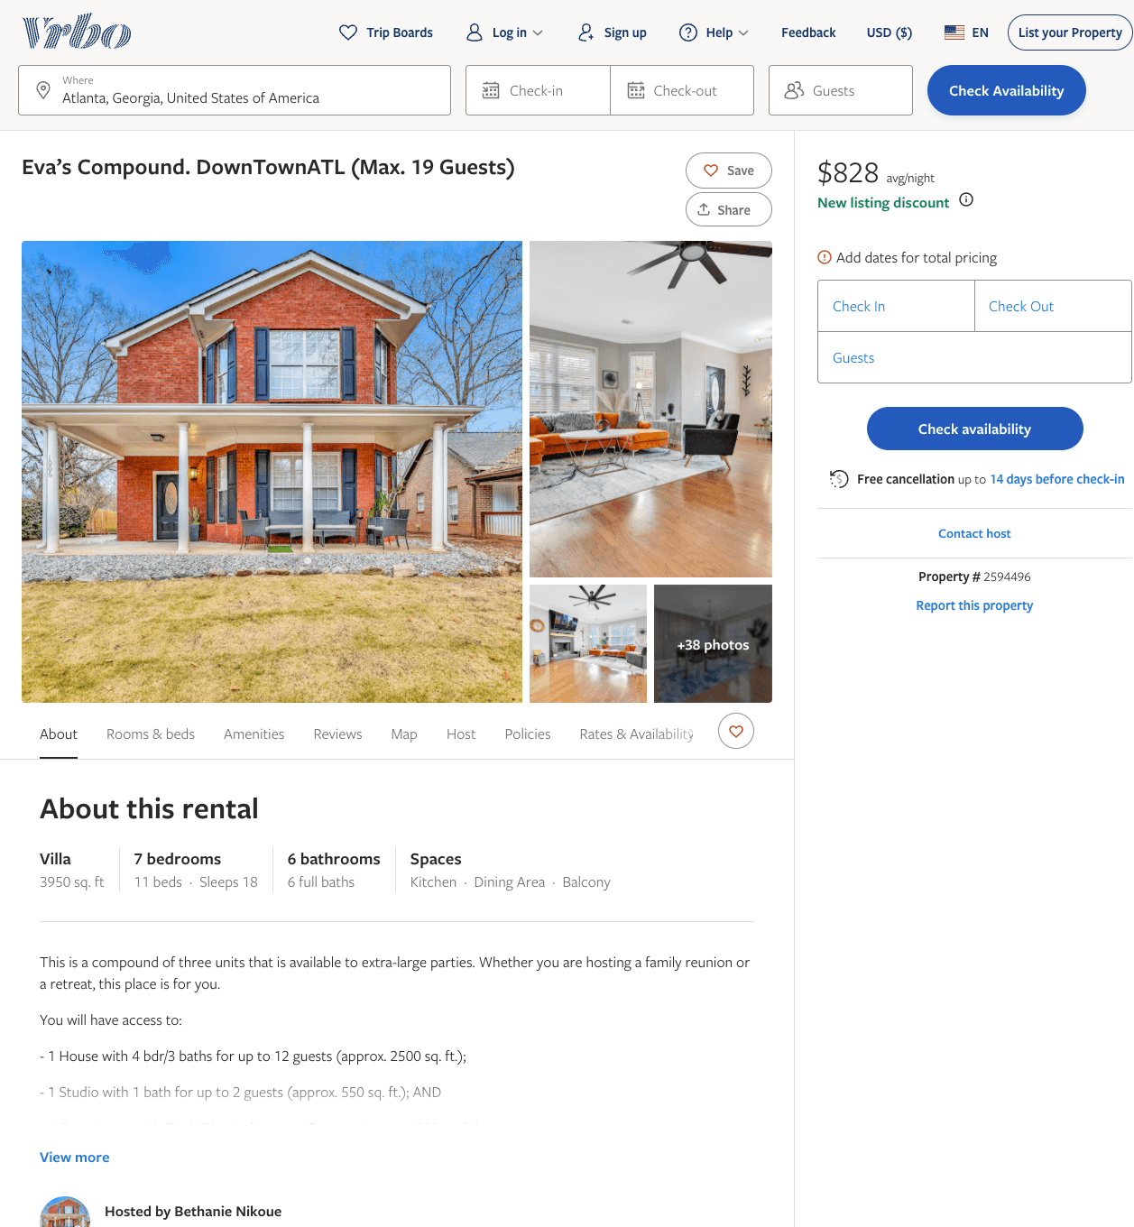
Listing 2594496
7
18
$800 - $868
5
3
Bethanie Nikoue
https://www.vrbo.com/2594496
Aug 2022

Slide 41
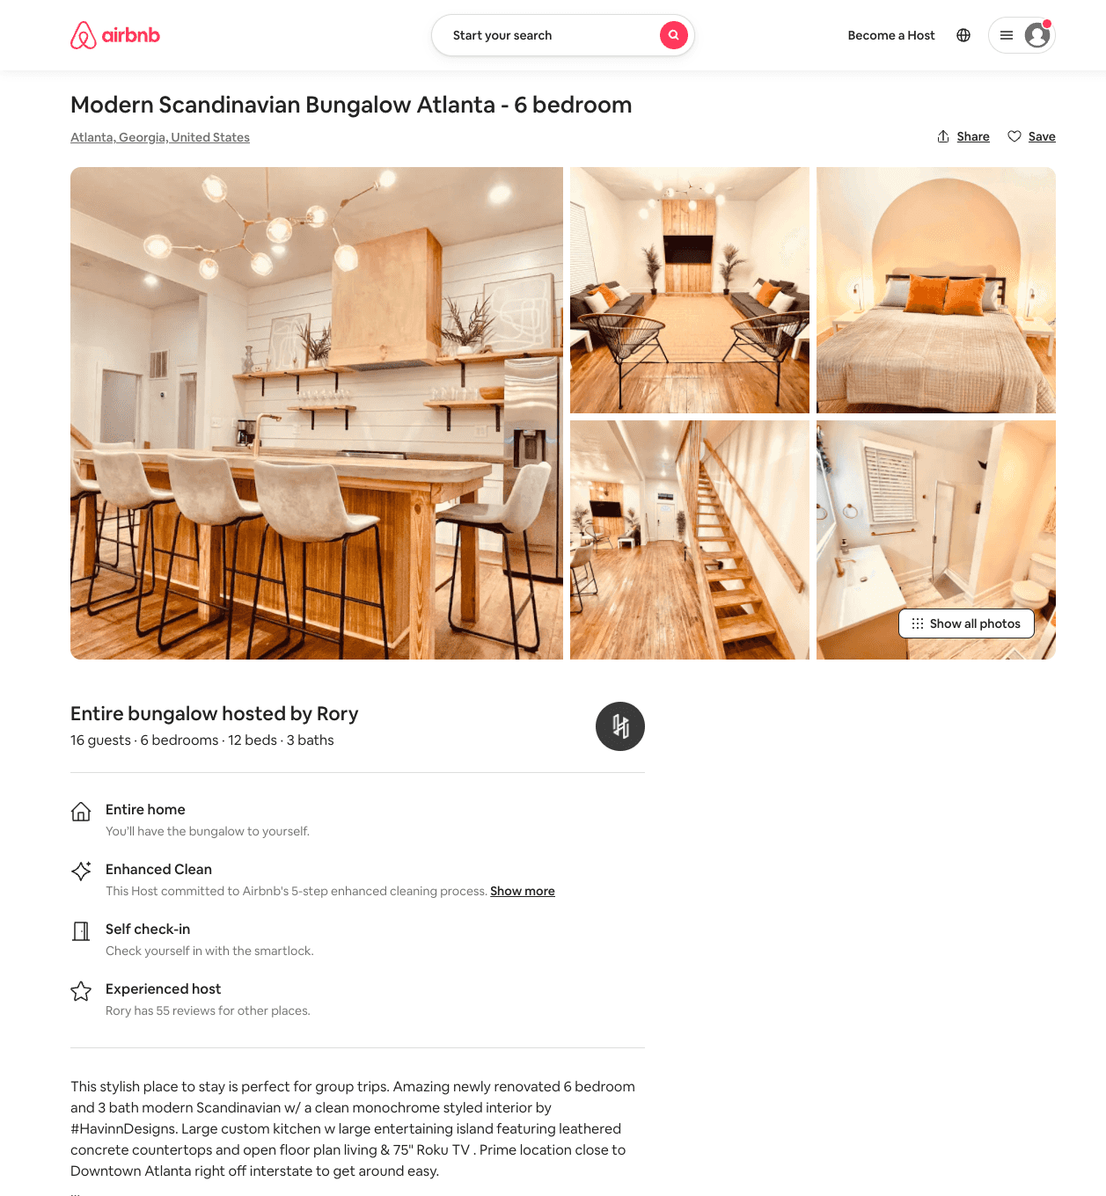
Listing 54040230
6
16
$227 - $394
4.50
3
Rory
350506020
9
https://www.airbnb.com/rooms/54040230
Aug 2022

Slide 42
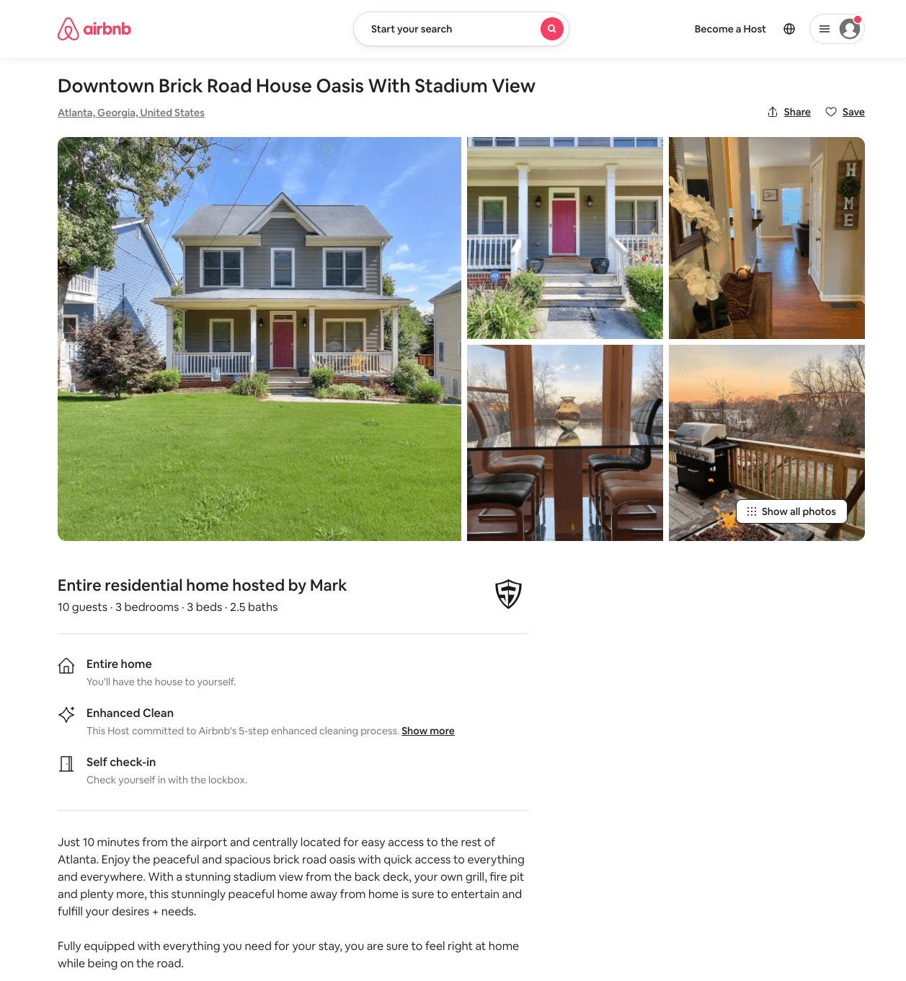
Listing 54070981
3
10
$193 - $295
4.33
1
Mark
436353501
1
https://www.airbnb.com/rooms/54070981
Jul 2022

Slide 43
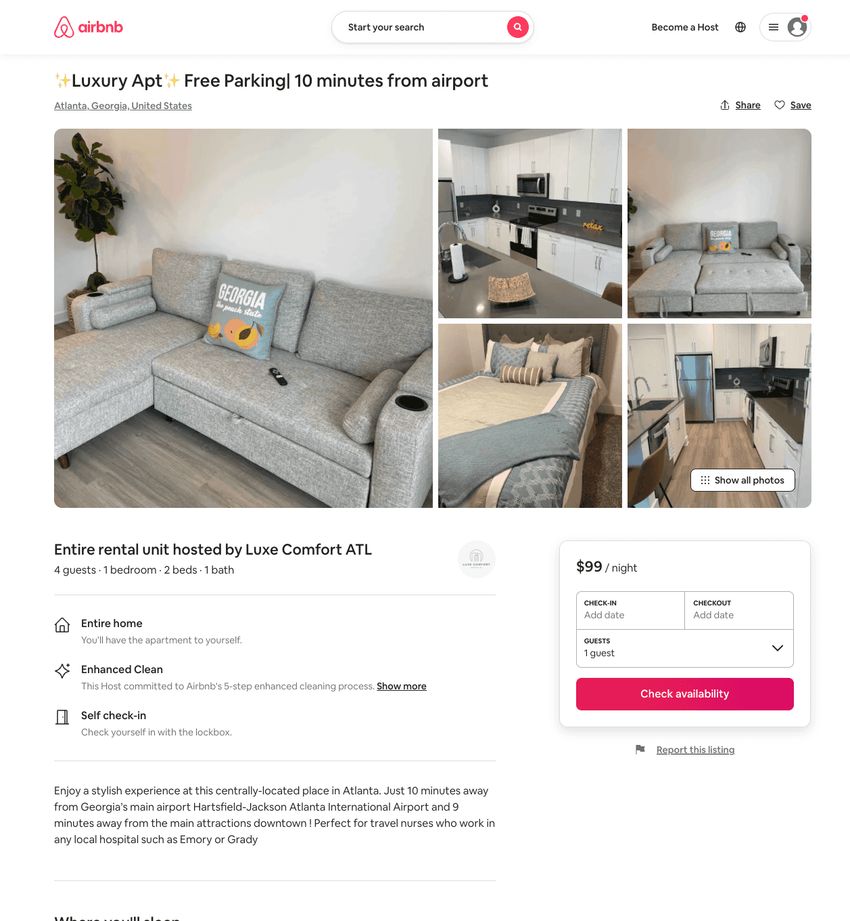
Listing 54193213
1
4
$60 - $106
4.64
1
Luxe Comfort ATL
377790463
1
https://www.airbnb.com/rooms/54193213
Aug 2022

Slide 44
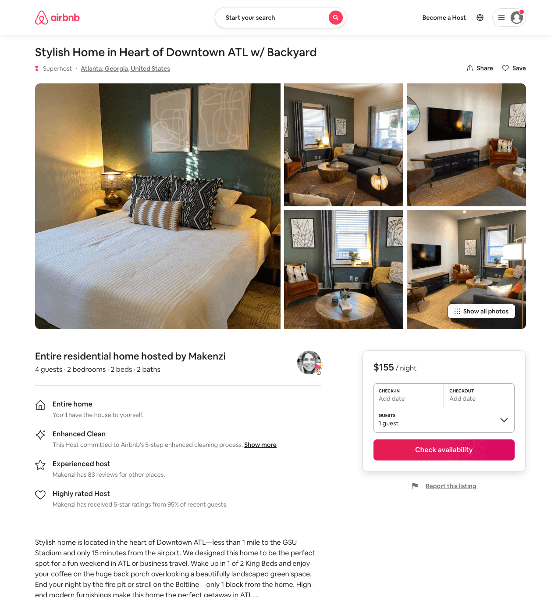
Listing 53790680
2
4
$88 - $176
4.94
2
Makenzi
77371356
1
https://www.airbnb.com/rooms/53790680
Aug 2022

Slide 45
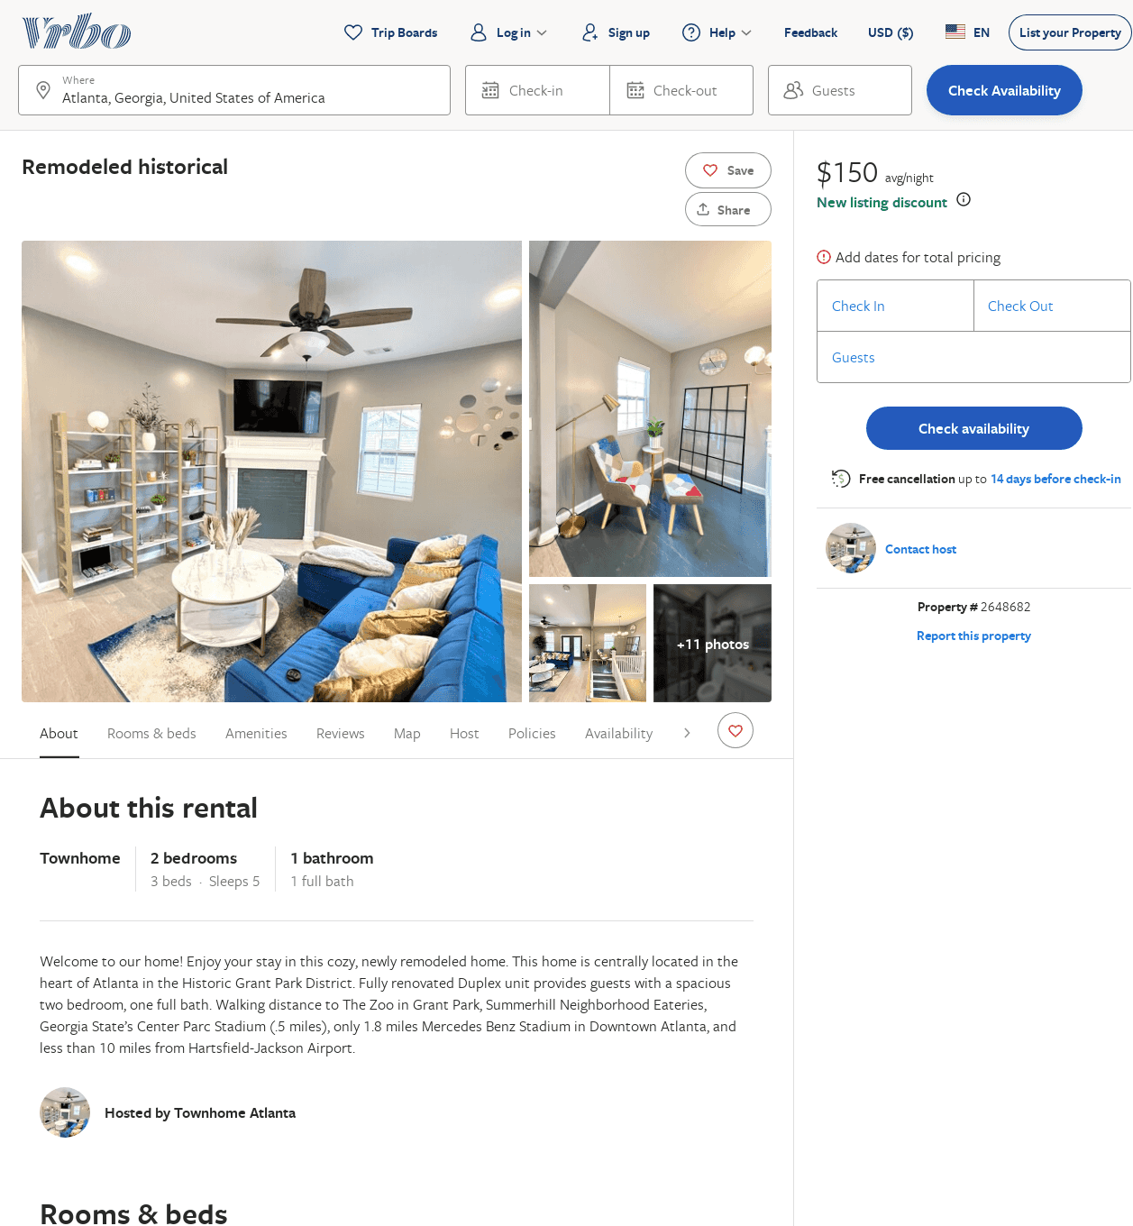
Listing 2648682
2
5
$199
2
https://www.vrbo.com/2648682
Aug 2022

Slide 46
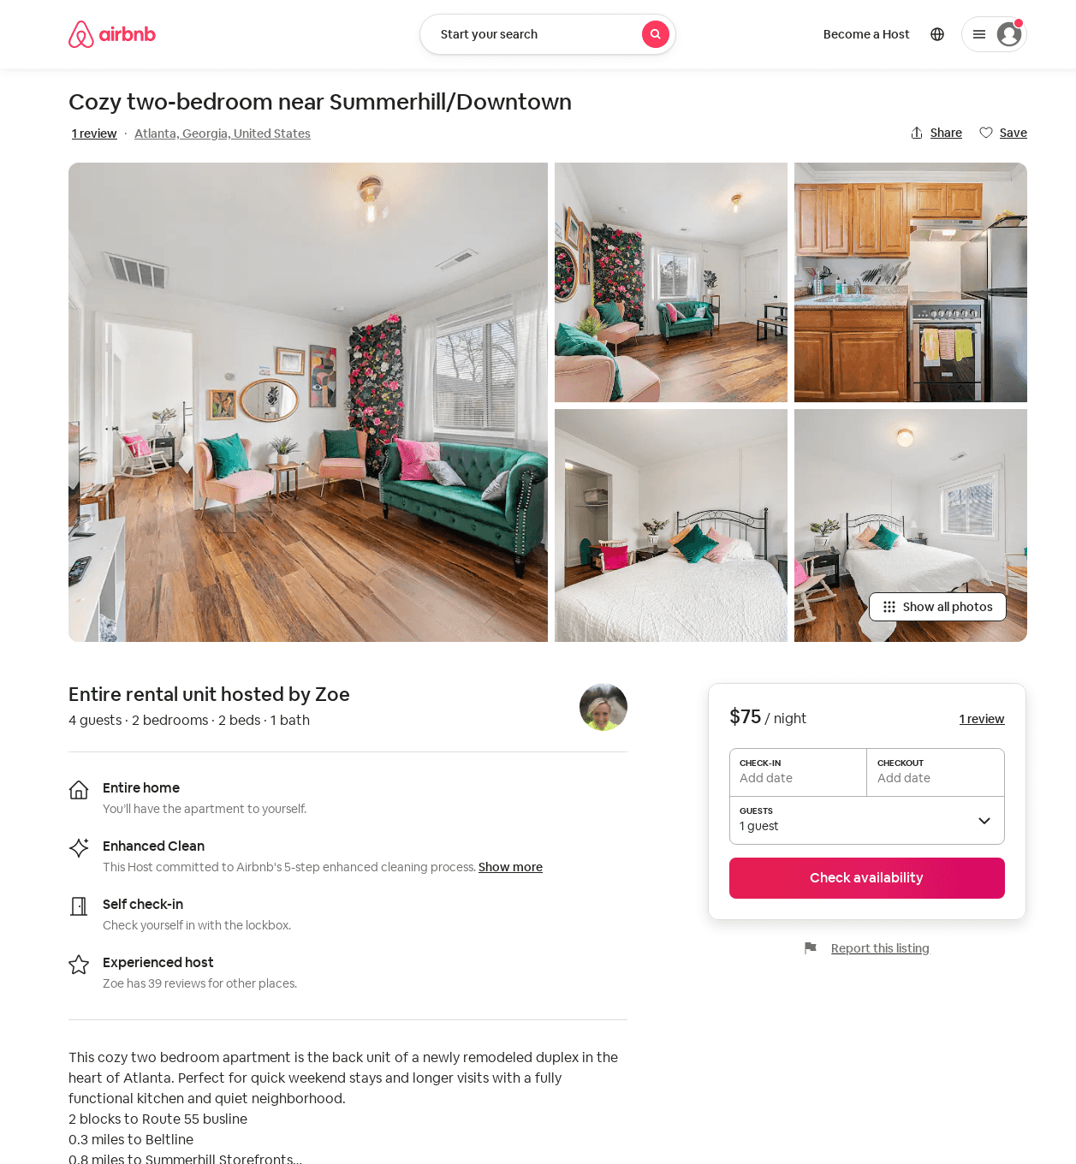
Listing 54172825
2
4
$75 - $80
4.79
1
Zoe
15582862
1
https://www.airbnb.com/rooms/54172825
Aug 2022

Slide 47
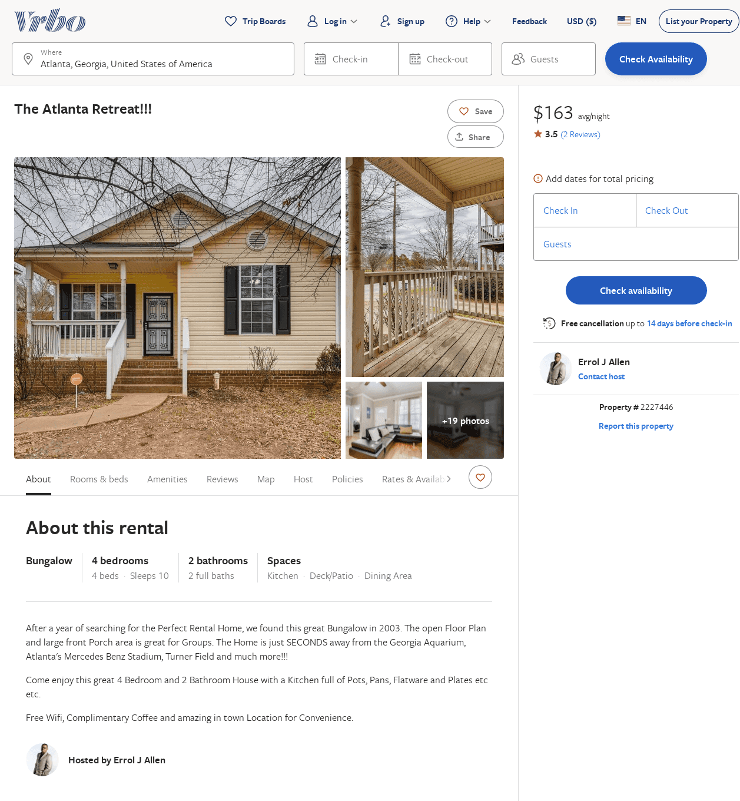
Listing 2227446
4
10
$170
3.5
2
Errol J Allen
https://www.vrbo.com/2227446
Aug 2022

Slide 48
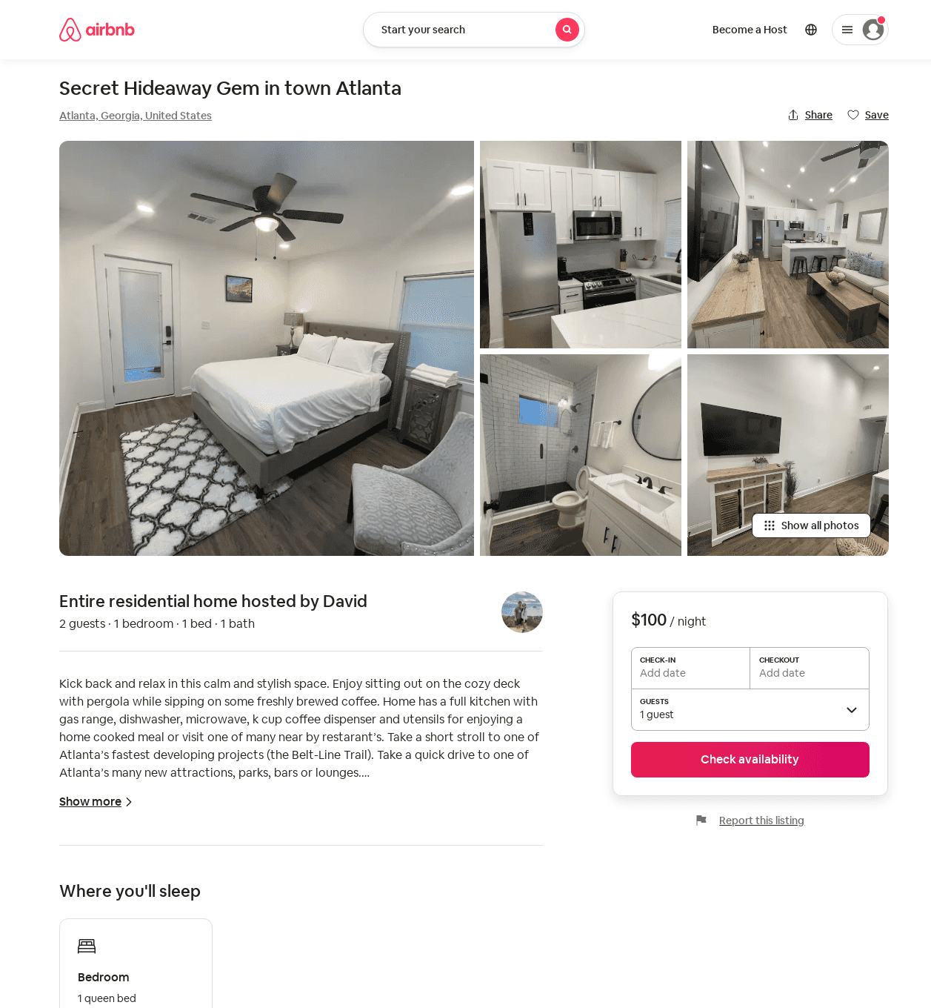
Listing 51104763
1
2
$100 - $125
4.86
2
David
267104026
1
https://www.airbnb.com/rooms/51104763
Aug 2022

Slide 49
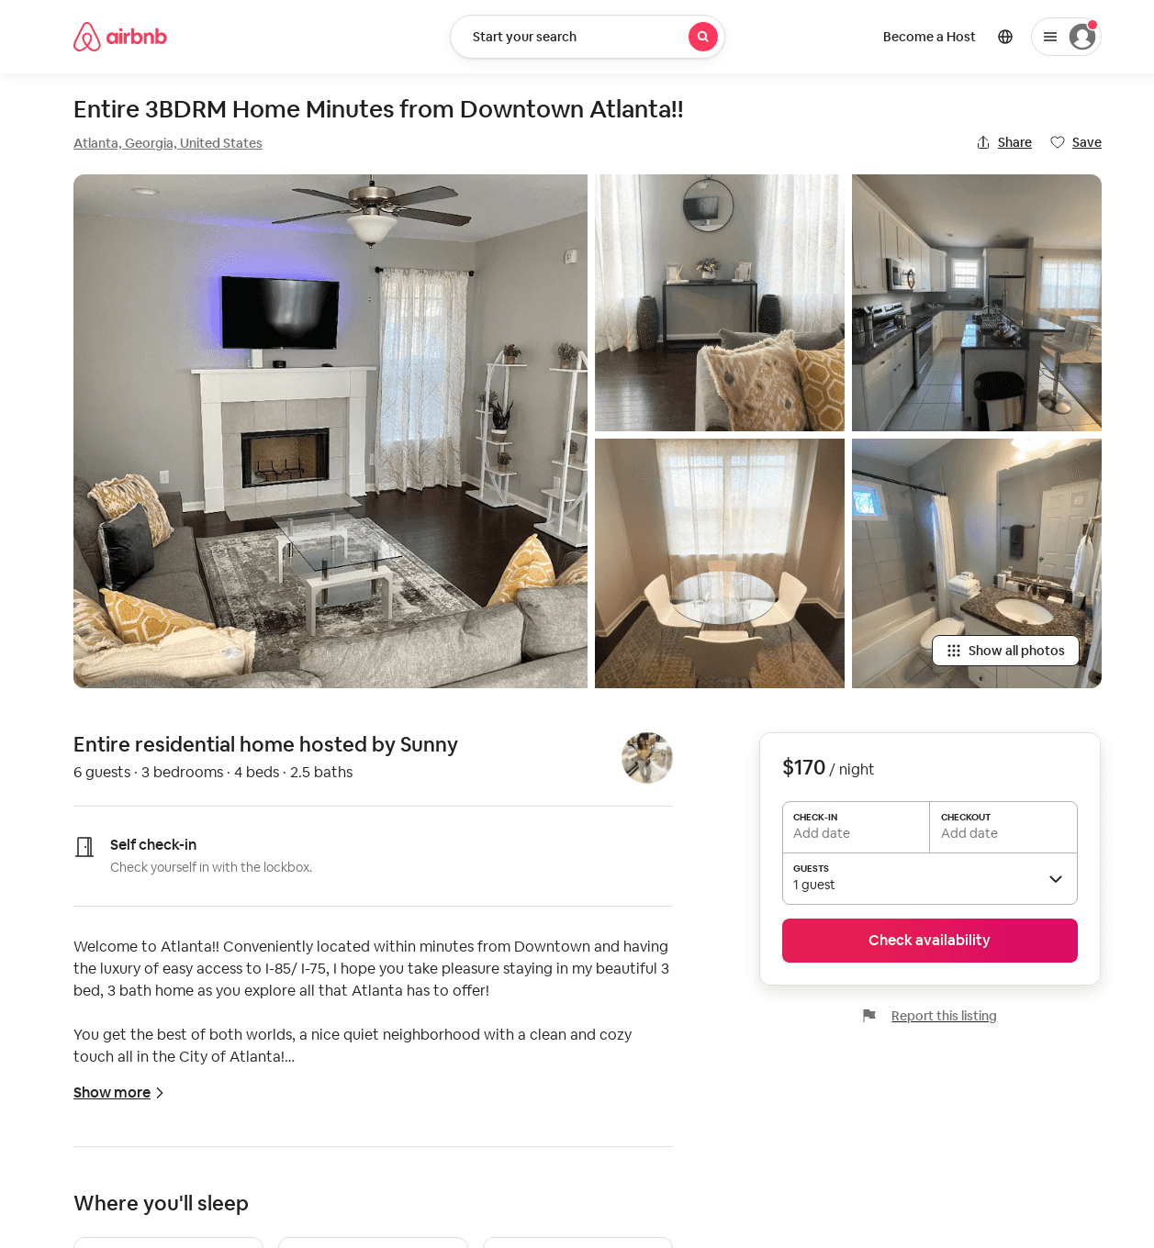
Listing 49989791
3
6
$170
2
Sunny
222166429
1
https://www.airbnb.com/rooms/49989791
Jun 2022

Slide 50
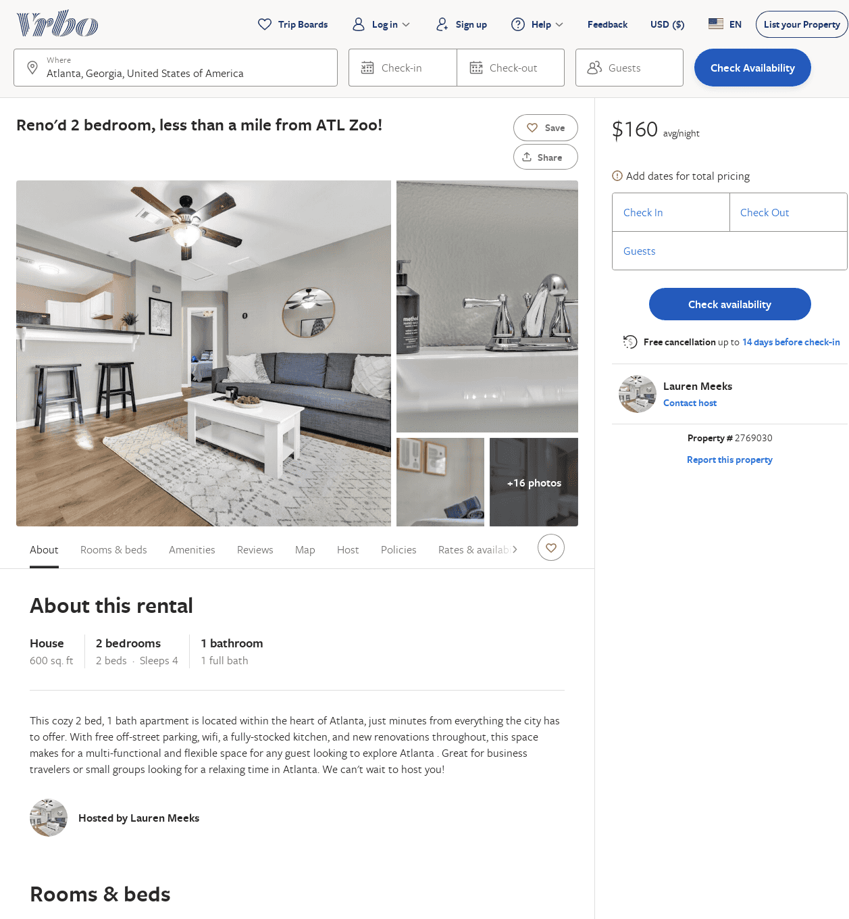
Listing 2769030
2
4
$146
2
Lauren Meeks
https://www.vrbo.com/2769030
Aug 2022

Slide 51
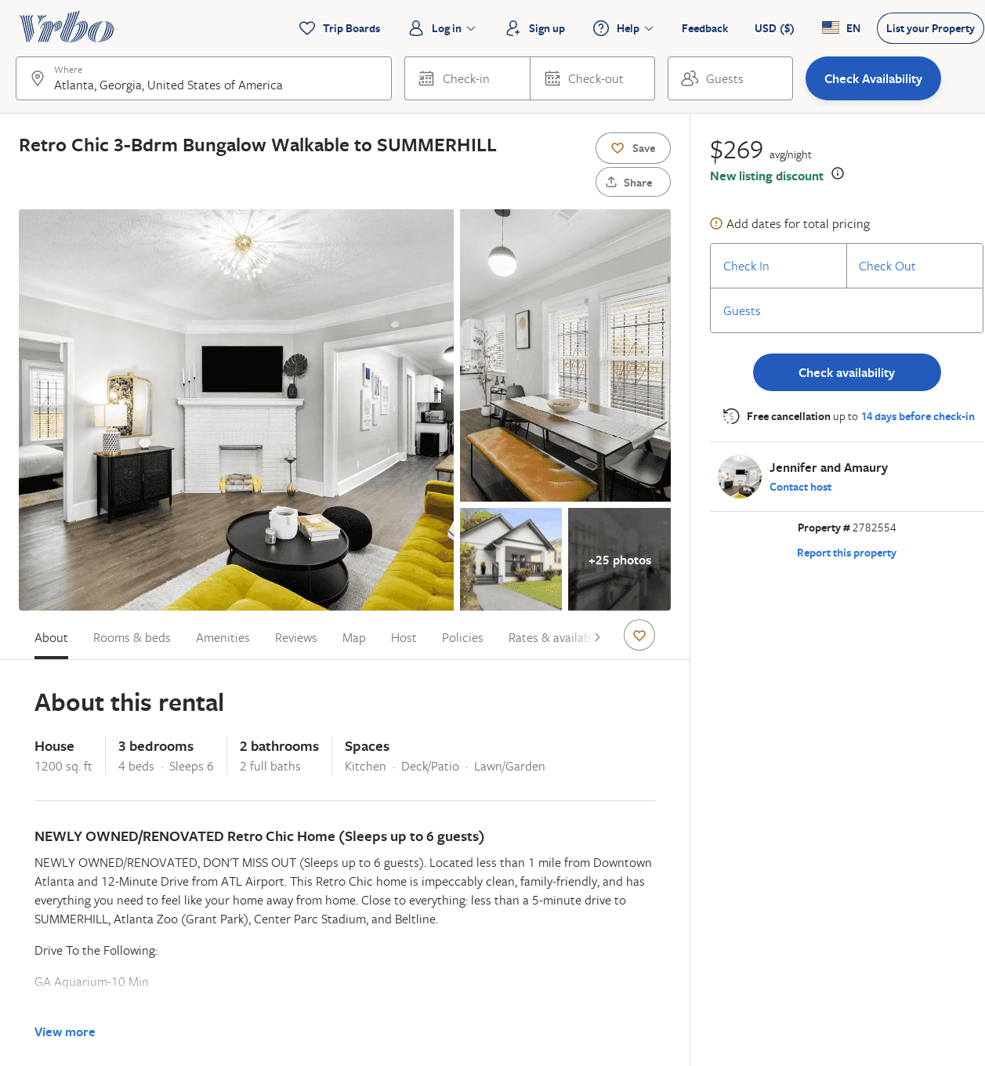
Listing 2782554
3
6
$216
5
2
Jennifer
https://www.vrbo.com/2782554
Aug 2022

Slide 52
Listing 2819184
3
10
$317
2
Kevin
https://www.vrbo.com/2819184
Aug 2022

Slide 53
Listing 2811459
1
4
$100
7
https://www.vrbo.com/2811459
Aug 2022

Slide 54
Listing 2828181
4
10
$358
4
3
Desire Pirkle
https://www.vrbo.com/2828181
Aug 2022

Slide 55
Listing 2870787
6
40
$909
3
Brandon
https://www.vrbo.com/2870787
Aug 2022

Slide 56
Listing 2884834
3
6
$130
1
Rabbu
https://www.vrbo.com/2884834
Aug 2022

Slide 57
Listing 2897808
3
14
$296
2
Brandon
https://www.vrbo.com/2897808
Aug 2022

Slide 58
Listing 2880381
1
2
$170
2
https://www.vrbo.com/2880381
Aug 2022

